Slide 1


Multi-Core Architectures and
Shared Resource Management
Prof. Onur Mutlu
http://www.ece.cmu.edu/~omutlu
onur@cmu.edu
Bogazici University
June 6, 2013

Slide 2
Agenda for Today
Course logistics, info, requirements
  Who am I?
  What will you learn?
  How can you get the best out of these lectures?
Outline of lectures this week and the next
Some readings for next time
Deep dive into the course material

Slide 3
Two Mini Courses
Multi-core Architectures and Shared Resource Management: Fundamentals and Recent Research
  June 6, 7, 10 (1-4pm)
Memory Systems in the Multi-Core Era
  June 13, 14, 17 (1-4pm)

Slide 4
What These Mini Lecture Series is About
Multi-core Architectures and Shared Resource Management: Fundamentals and Recent Research
Memory Systems in the Multi-Core Era
A very “hot” portion of computer architecture research and practice
A very large design space
Many opportunities for innovation and groundbreaking research
We will focus on major aspects of multi-core design
  Fundamentals
  Tradeoffs (advantages and disadvantages)
  Cutting edge research

Slide 5
What These Mini Lecture Series is About
Goal 1:
  Build a strong understanding of the fundamentals of the multi-core architectures and the tradeoffs made in their design.
  Examine how cores and shared resources can be designed.
  The focus will be on fundamentals, tradeoffs in parallel architecture design, and cutting-edge research.
Goal 2:
  Build an understanding of the state-of-the-art research problems in multi-core architectures.
  Get familiar with some important research papers.
  You will be expected to read, critique, and discuss research papers.

Slide 6
Course Info: Who Am I?
Instructor: Prof. Onur Mutlu
  Carnegie Mellon University ECE/CS
  PhD from UT-Austin, worked at Microsoft Research, Intel, AMD
  http://www.ece.cmu.edu/~omutlu
  onur@cmu.edu (Best way to reach me)
  http://users.ece.cmu.edu/~omutlu/projects.htm
Research, Teaching, Consulting Interests
  Computer architecture, hardware/software interaction
  Many-core systems
  Memory systems
  Interconnects
  Hardware/software interaction and co-design (PL, OS, Architecture)
  Predictable and QoS-aware systems
  Hardware fault tolerance and security
  Algorithms and architectures for genome analysis
  …
  Interested in developing efficient, high-performance, and scalable (multi-core, memory) systems; solving difficult architectural problems at low cost & complexity

Slide 7


A Bit More About My Group and CMU

Slide 8

Pittsburgh, Pennsylvania, USA
“America’s Most Livable City” multiple times; #1 in 2010 by Forbes
Rated in the top 10 “Smartest Places to Live” for its low cost of living.
Ranked #1 in the nation and #26 in the world for “Global Livability”
Rated as one of the top 10 “World’s Cleanest Cities”
Top ten in “green” buildings in the nation, including world’s 1st and largest green convention center and Carnegie Mellon’s own LEED-certified residence hall, 1st in USA.
  Sources: Forbes, Places Rated Almanac, Kiplinger’s Personal Finance Magazine, The Economist, MSN Encarta

Slide 9







Carnegie Mellon
Research
$320+ million per year in sponsored research
Award Highlights
17 Nobel Prize Laureates
10 Turing Award Winners
36 National Academy of Engineering Members
10 National Academy of Sciences Members
9 American Academy of Arts & Sciences Members
12 Fulbright Scholars
96 Emmy Award Winners
20 Tony Award Winners
6 Academy Award (Oscar) Winners

Slide 10


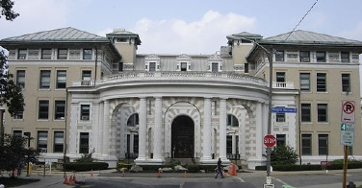

Carnegie Mellon
10,402 undergraduate and graduate students
1,426 faculty members
8:1 student to faculty ratio
72,496 alumni
50 U.S. alumni chapters
20 international alumni chapters
10 degree programs in 12 countries
Notes:
First, SOME FACTS about Carnegie Mellon
Carnegie Mellon is a RELATIVELY SMALL university that was FOUNDED at the turn of the last century
We have APPROXIMATELY 10,000 STUDENTS AND 1400 FACULTY which means our student-to-faculty ratio is about 8; such a small ratio means our students receive a great deal of attention---for example, actually our policy is that only faculty teach courses.
We have ALUMNI CHAPTERS ALL OVER WORLD and DEGREE PROGRAMS IN 12 DIFFERENT COUNTRIES that include, for example, KOREA, GREECE, Portugal, Qatar, and Australia

Slide 11

A Bit More About My Group and CMU
http://www.ece.cmu.edu/~safari/
http://www.ece.cmu.edu/~safari/pubs.html

Slide 12









My Students @ SAFARI
http://www.ece.cmu.edu/~safari/people.html

Slide 13
Who Should Attend This Course?
You should be motivated to learn about and possibly do research in computer architecture
Must know some Computer Architecture basics
  However, ask if you do not know a concept I talk about
Be willing and ready to
  Ask questions
  Think hard
  Read papers
  Focus on tradeoffs
  Discover on your own

Slide 14
What Will I Assume?
Familiarity with basic computer architecture
However, you should ask questions

Slide 15
How Can You Make the Best out of These Lectures?
Ask and answer questions
Take notes
Participate in discussion
Read discussed papers
Explore on your own

Slide 16
Homework 0
Due tonight at midnight Istanbul time
Send me (onur@cmu.edu) an email with
  Your name
  Your picture
  An interesting fact about something personal to you
  Why are you interested in these lectures?
  What do you expect to learn?
  Anything else you would like to share or ask

Slide 17
What Will You Learn?
Tentative, Aggressive Schedule
  Lecture 1: Why multi-core? Basics, alternatives, tradeoffs
  Symmetric versus asymmetric multi-core systems
  Lecture 2: Shared cache design for multi-cores
  (if time permits) Interconnect design for multi-cores
  Lecture 3: Data parallelism and GPUs (if time permits)
  (if time permits) Prefetcher design and management
But, do not believe all of this tentative schedule
  Why?
Systems that perform best are usually dynamically scheduled
  Static vs. Dynamic Scheduling
  Why do you *really* need dynamic scheduling?

Slide 18
Static versus Dynamic Scheduling
Static: Done at compile time or parallel task creation time
  Schedule does not change based on runtime information
Dynamic: Done at run time (e.g., after tasks are created)
  Schedule changes based on runtime information
Example: Parallel Task Assignment

Slide 19
Parallel Task Assignment: Tradeoffs
Problem: N tasks, P processors, N>P. Do we assign tasks to processors statically (fixed) or dynamically (adaptive)?
Static assignment
  + Simpler: No movement of tasks.
  - Inefficient: Underutilizes resources when load is not balanced
  When can load not be balanced?
Dynamic assignment
  + Efficient: Better utilizes processors when load is not balanced
  - More complex: Need to move tasks to balance processor load
  - Higher overhead: Task movement takes time, can disrupt locality

Slide 20
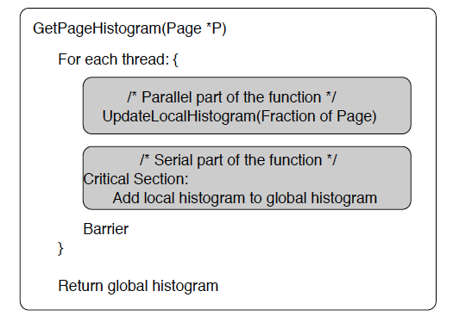
Parallel Task Assignment: Example
Compute histogram of a large set of values
Parallelization:
  Divide the values across T tasks
  Each task computes a local histogram for its value set
  Local histograms merged with global histograms in the end

Slide 21
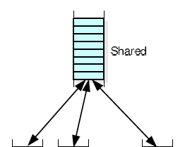
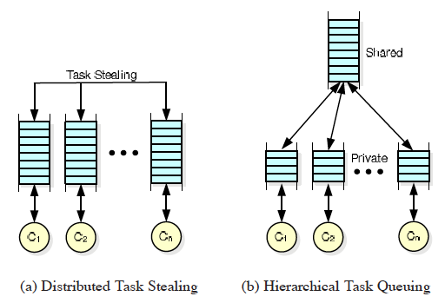

Parallel Task Assignment: Example (II)
How to schedule tasks updating local histograms?
  Static: Assign equal number of tasks to each processor
  Dynamic: Assign tasks to a processor that is available
  When does static work as well as dynamic?
Implementation of Dynamic Assignment with Task Queues

Slide 22
Software Task Queues
What are the advantages and disadvantages of each?
  Centralized
  Distributed
  Hierarchical

Slide 23
Task Stealing
Idea: When a processor’s task queue is empty it steals a task from another processor’s task queue
  Whom to steal from? (Randomized stealing works well)
  How many tasks to steal?
+ Dynamic balancing of computation load
- Additional communication/synchronization overhead between processors
- Need to stop stealing if no tasks to steal

Slide 24
Parallel Task Assignment: Tradeoffs
Who does the assignment? Hardware versus software?
Software
  + Better scope
  - More time overhead
  - Slow to adapt to dynamic events (e.g., a processor becoming idle)
Hardware
  + Low time overhead
  + Can adjust to dynamic events faster
  - Requires hardware changes (area and possibly energy overhead)

Slide 25
How Can the Hardware Help?
Managing task queues in software has overhead
  Especially high when task sizes are small
An idea: Hardware Task Queues
  Each processor has a dedicated task queue
  Software fills the task queues (on demand)
  Hardware manages movement of tasks from queue to queue
  There can be a global task queue as well → hierarchical tasking in hardware
  Kumar et al., “Carbon: Architectural Support for Fine-Grained Parallelism on Chip Multiprocessors,” ISCA 2007.
    Optional reading

Slide 26
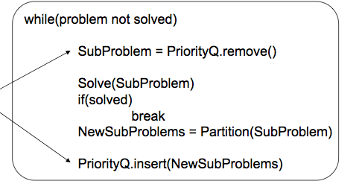
Dynamic Task Generation
Does static task assignment work in this case?
Problem: Searching the exit of a maze

Slide 27
Why Do We Really Want Dynamic Scheduling?
Uncertainty in dynamic events
E.g., Out-of-order execution (dynamic instruction scheduling)
  Really necessary if you do not know the latency of an instruction
  Compiler cannot reorder instructions with unknown latencies

Slide 28
What Will You Learn in Mini Course 1?
Multi-core Architectures and Shared Resource Management: Fundamentals and Recent Research
  June 6, 7, 10 (1-4pm)
Lecture 1: Why multi-core? Basics, alternatives, tradeoffs
Symmetric versus asymmetric multi-core systems
Lecture 2: Shared cache design for multi-cores
(if time permits) Interconnect design for multi-cores
Lecture 3: Data parallelism and GPUs (if time permits)
(if time permits) Prefetcher design and management

Slide 29
What Will You Learn in Mini Course 2?
Memory Systems in the Multi-Core Era
  June 13, 14, 17 (1-4pm)
Lecture 1: Main memory basics, DRAM scaling
Lecture 2: Emerging memory technologies and hybrid memories
Lecture 3: Main memory interference and QoS

Slide 30
Readings for Lecture Today (Lecture 1.1)
Required
  Mutlu et al., “Runahead Execution: An Alternative to Very Large Instruction Windows for Out-of-order Processors,” HPCA 2003, IEEE Micro 2003.
  Suleman et al., “Accelerating Critical Section Execution with Asymmetric Multi-Core Architectures,” ASPLOS 2009, IEEE Micro 2010.
  Suleman et al., “Data Marshaling for Multi-Core Architectures,” ISCA 2010, IEEE Micro 2011.
  Joao et al., “Bottleneck Identification and Scheduling for Multithreaded Applications,” ASPLOS 2012.
  Joao et al., “Utility-Based Acceleration of Multithreaded Applications on Asymmetric CMPs,” ISCA 2013.
Recommended
  Amdahl, “Validity of the single processor approach to achieving large scale computing capabilities,” AFIPS 1967.
  Olukotun et al., “The Case for a Single-Chip Multiprocessor,” ASPLOS 1996.
  Mutlu et al., “Techniques for Efficient Processing in Runahead Execution Engines,” ISCA 2005, IEEE Micro 2006.

Slide 31
Videos for Lecture Today (Lecture 1.1)
Runahead Execution
  http://www.youtube.com/watch?v=z8YpjqXQJIA&list=PL5PHm2jkkXmidJOd59REog9jDnPDTG6IJ&index=28
Multiprocessors
  Basics:http://www.youtube.com/watch?v=7ozCK_Mgxfk&list=PL5PHm2jkkXmidJOd59REog9jDnPDTG6IJ&index=31
  Correctness and Coherence: http://www.youtube.com/watch?v=U-VZKMgItDM&list=PL5PHm2jkkXmidJOd59REog9jDnPDTG6IJ&index=32
  Heterogeneous Multi-Core: http://www.youtube.com/watch?v=r6r2NJxj3kI&list=PL5PHm2jkkXmidJOd59REog9jDnPDTG6IJ&index=34

Slide 32
Readings for Lecture June 7 (Lecture 1.2)
Required
  Qureshi et al., “A Case for MLP-Aware Cache Replacement,” ISCA 2005.
  Seshadri et al., “The Evicted-Address Filter: A Unified Mechanism to Address both Cache Pollution and Thrashing,” PACT 2012.
  Pekhimenko et al., “Base-Delta-Immediate Compression: Practical Data Compression for On-Chip Caches,” PACT 2012.
  Pekhimenko et al., “Linearly Compressed Pages: A Main Memory Compression Framework with Low Complexity and Low Latency,” SAFARI Technical Report 2013.
Recommended
  Qureshi et al., “Utility-Based Cache Partitioning: A Low-Overhead, High-Performance, Runtime Mechanism to Partition Shared Caches,” MICRO 2006.

Slide 33
Videos for Lecture 1.2
Cache basics:
  http://www.youtube.com/watch?v=TpMdBrM1hVc&list=PL5PHm2jkkXmidJOd59REog9jDnPDTG6IJ&index=23
Advanced caches:
  http://www.youtube.com/watch?v=TboaFbjTd-E&list=PL5PHm2jkkXmidJOd59REog9jDnPDTG6IJ&index=24

Slide 34
Readings for Lecture June 10 (Lecture 1.3)
Required
  Moscibroda and Mutlu, “A Case for Bufferless Routing in On-Chip Networks,” ISCA 2009.
  Fallin et al., “CHIPPER: A Low-Complexity Bufferless Deflection Router,” HPCA 2011.
  Fallin et al., “MinBD: Minimally-Buffered Deflection Routing for Energy-Efficient Interconnect,” NOCS 2012.
  Das et al., “Application-Aware Prioritization Mechanisms for On-Chip Networks,” MICRO 2009.
  Das et al., “Aergia: Exploiting Packet Latency Slack in On-Chip Networks,” ISCA 2010, IEEE Micro 2011.
Recommended
  Grot et al. “Preemptive Virtual Clock: A Flexible, Efficient, and Cost-effective QOS Scheme for Networks-on-Chip,” MICRO 2009.
  Grot et al., “Kilo-NOC: A Heterogeneous Network-on-Chip Architecture for Scalability and Service Guarantees,” ISCA 2011, IEEE Micro 2012.

Slide 35
Videos for Lecture 1.3
Interconnects
  http://www.youtube.com/watch?v=6xEpbFVgnf8&list=PL5PHm2jkkXmidJOd59REog9jDnPDTG6IJ&index=33
GPUs and SIMD processing
  Vector/array processing basics: http://www.youtube.com/watch?v=f-XL4BNRoBA&list=PL5PHm2jkkXmidJOd59REog9jDnPDTG6IJ&index=15
  GPUs versus other execution models: http://www.youtube.com/watch?v=vr5hbSkb1Eg&list=PL5PHm2jkkXmidJOd59REog9jDnPDTG6IJ&index=20
  GPUs in more detail: http://www.youtube.com/watch?v=vr5hbSkb1Eg&list=PL5PHm2jkkXmidJOd59REog9jDnPDTG6IJ&index=20

Slide 36
Online Lectures and More Information
Online Computer Architecture Lectures
  http://www.youtube.com/playlist?list=PL5PHm2jkkXmidJOd59REog9jDnPDTG6IJ
Online Computer Architecture Courses
  Intro: http://www.ece.cmu.edu/~ece447/s13/doku.php
  Advanced: http://www.ece.cmu.edu/~ece740/f11/doku.php
  Advanced: http://www.ece.cmu.edu/~ece742/doku.php
Recent Research Papers
  http://users.ece.cmu.edu/~omutlu/projects.htm
  http://scholar.google.com/citations?user=7XyGUGkAAAAJ&hl=en

Slide 37
Parallel Computer Architecture Basics

Slide 38
What is a Parallel Computer?
Definition of a “parallel computer” not really precise
“A ‘parallel computer’ is a “collection of processing elements that communicate and cooperate to solve large problems fast”
  Almasi and Gottlieb, “Highly Parallel Computing,” 1989
Is a superscalar processor a parallel computer?
A processor that gives the illusion of executing a sequential ISA on a single thread at a time is a sequential machine
Almost anything else is a parallel machine
Examples of parallel machines:
  Multiple program counters (PCs)
  Multiple data being operated on simultaneously
  Some combination

Slide 39
Flynn’s Taxonomy of Computers
Mike Flynn, “Very High-Speed Computing Systems,” Proc. of IEEE, 1966
SISD: Single instruction operates on single data element
SIMD: Single instruction operates on multiple data elements
  Array processor
  Vector processor
MISD: Multiple instructions operate on single data element
  Closest form: systolic array processor, streaming processor
MIMD: Multiple instructions operate on multiple data elements (multiple instruction streams)
  Multiprocessor
  Multithreaded processor

Slide 40
Why Parallel Computers?
Parallelism: Doing multiple things at a time
Things: instructions, operations, tasks
Main Goal
  Improve performance (Execution time or task throughput)
    Execution time of a program governed by Amdahl’s Law
Other Goals
  Reduce power consumption
    (4N units at freq F/4) consume less power than (N units at freq F)
    Why?
  Improve cost efficiency and scalability, reduce complexity
    Harder to design a single unit that performs as well as N simpler units
  Improve dependability: Redundant execution in space

Slide 41
Types of Parallelism and How to Exploit Them
Instruction Level Parallelism
  Different instructions within a stream can be executed in parallel
  Pipelining, out-of-order execution, speculative execution, VLIW
  Dataflow
Data Parallelism
  Different pieces of data can be operated on in parallel
  SIMD: Vector processing, array processing
  Systolic arrays, streaming processors
Task Level Parallelism
  Different “tasks/threads” can be executed in parallel
  Multithreading
  Multiprocessing (multi-core)

Slide 42
Task-Level Parallelism: Creating Tasks
Partition a single problem into multiple related tasks (threads)
  Explicitly: Parallel programming
    Easy when tasks are natural in the problem
      Web/database queries
    Difficult when natural task boundaries are unclear
  Transparently/implicitly: Thread level speculation
    Partition a single thread speculatively
Run many independent tasks (processes) together
  Easy when there are many processes
    Batch simulations, different users, cloud computing workloads
  Does not improve the performance of a single task

Slide 43
Caveats of Parallelism
Amdahl’s Law
  p: Parallelizable fraction of a program
  N: Number of processors
  Amdahl, “Validity of the single processor approach to achieving large scale computing capabilities,” AFIPS 1967.
Maximum speedup limited by serial portion: Serial bottleneck
Parallel portion is usually not perfectly parallel
  Synchronization overhead (e.g., updates to shared data)
  Load imbalance overhead (imperfect parallelization)
  Resource sharing overhead (contention among N processors)
1
Speedup =
+
p
1 - p
N

Slide 44
Sequential Bottleneck
Speedup
p (parallel fraction)

Slide 45


Why the Sequential Bottleneck?
Parallel machines have the sequential bottleneck
Main cause: Non-parallelizable operations on data (e.g. non-parallelizable loops)
  for ( i = 0 ; i < N; i++)
  A[i] = (A[i] + A[i-1]) / 2
Single thread prepares data and spawns parallel tasks (usually sequential)

Slide 46
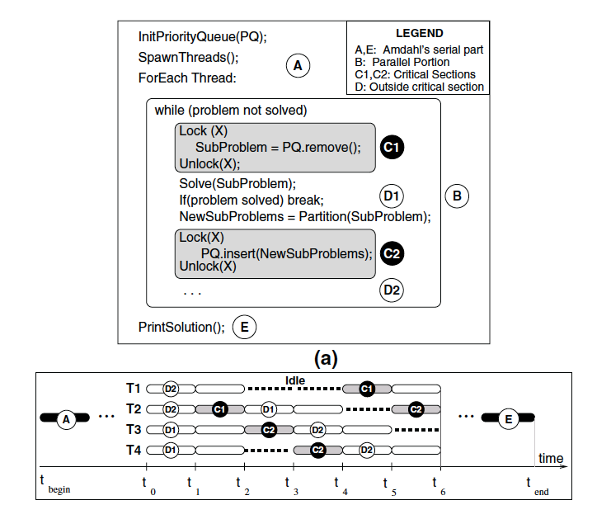
Another Example of Sequential Bottleneck

Slide 47
Bottlenecks in Parallel Portion
Synchronization: Operations manipulating shared data cannot be parallelized
  Locks, mutual exclusion, barrier synchronization
  Communication: Tasks may need values from each other
  - Causes thread serialization when shared data is contended
Load Imbalance: Parallel tasks may have different lengths
  Due to imperfect parallelization or microarchitectural effects
  - Reduces speedup in parallel portion
Resource Contention: Parallel tasks can share hardware resources, delaying each other
  Replicating all resources (e.g., memory) expensive
  - Additional latency not present when each task runs alone

Slide 48
Difficulty in Parallel Programming
Little difficulty if parallelism is natural
  “Embarrassingly parallel” applications
  Multimedia, physical simulation, graphics
  Large web servers, databases?
Difficulty is in
  Getting parallel programs to work correctly
  Optimizing performance in the presence of bottlenecks
Much of parallel computer architecture is about
  Designing machines that overcome the sequential and parallel bottlenecks to achieve higher performance and efficiency
  Making programmer’s job easier in writing correct and high-performance parallel programs

Slide 49
Multiprocessor Types
Loosely coupled multiprocessors
  No shared global memory address space
  Multicomputer network
    Network-based multiprocessors
  Usually programmed via message passing
    Explicit calls (send, receive) for communication
Tightly coupled multiprocessors
  Shared global memory address space
  Traditional multiprocessing: symmetric multiprocessing (SMP)
    Existing multi-core processors, multithreaded processors
  Programming model similar to uniprocessors (i.e., multitasking uniprocessor) except
    Operations on shared data require synchronization

Slide 50
Multi-Core Processors

Slide 51
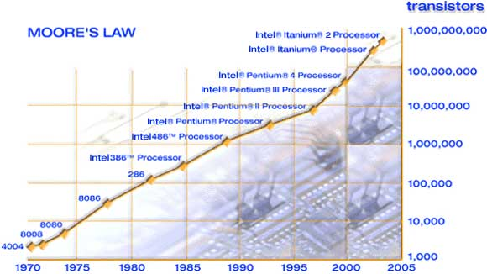
Moore’s Law
Moore, “Cramming more components onto integrated circuits,”
Electronics Magazine, 1968.

Slide 52
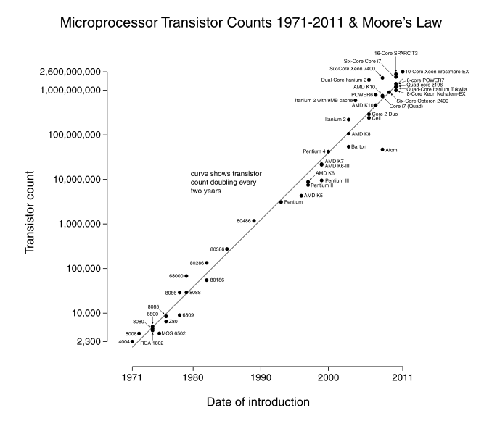

Slide 53
Multi-Core
Idea: Put multiple processors on the same die.
Technology scaling (Moore’s Law) enables more transistors to be placed on the same die area
What else could you do with the die area you dedicate to multiple processors?
  Have a bigger, more powerful core
  Have larger caches in the memory hierarchy
  Simultaneous multithreading
  Integrate platform components on chip (e.g., network interface, memory controllers)

Slide 54
Why Multi-Core?
Alternative: Bigger, more powerful single core
  Larger superscalar issue width, larger instruction window, more execution units, large trace caches, large branch predictors, etc
  + Improves single-thread performance transparently to programmer, compiler
  - Very difficult to design (Scalable algorithms for improving single-thread performance elusive)
  - Power hungry – many out-of-order execution structures consume significant power/area when scaled. Why?
  - Diminishing returns on performance
  - Does not significantly help memory-bound application performance (Scalable algorithms for this elusive)

Slide 55
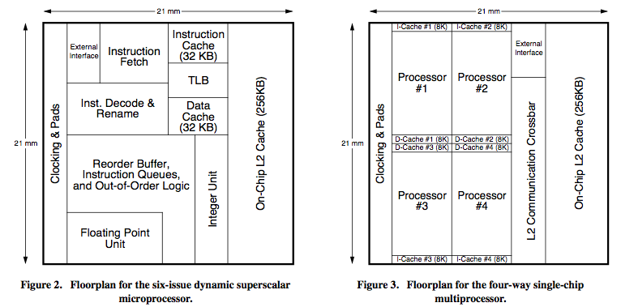
Large Superscalar vs. Multi-Core
Olukotun et al., “The Case for a Single-Chip Multiprocessor,” ASPLOS 1996.

Slide 56
Multi-Core vs. Large Superscalar
Multi-core advantages
  + Simpler cores → more power efficient, lower complexity, easier to design and replicate, higher frequency (shorter wires, smaller structures)
  + Higher system throughput on multiprogrammed workloads → reduced context switches
  + Higher system throughput in parallel applications
Multi-core disadvantages
  - Requires parallel tasks/threads to improve performance (parallel programming)
  - Resource sharing can reduce single-thread performance
  - Shared hardware resources need to be managed
  - Number of pins limits data supply for increased demand

Slide 57
Large Superscalar vs. Multi-Core
Olukotun et al., “The Case for a Single-Chip Multiprocessor,” ASPLOS 1996.
Technology push
  Instruction issue queue size limits the cycle time of the superscalar, OoO processor → diminishing performance
    Quadratic increase in complexity with issue width
  Large, multi-ported register files to support large instruction windows and issue widths → reduced frequency or longer RF access, diminishing performance
Application pull
  Integer applications: little parallelism?
  FP applications: abundant loop-level parallelism
  Others (transaction proc., multiprogramming): CMP better fit

Slide 58
Why Multi-Core?
Alternative: Bigger caches
  + Improves single-thread performance transparently to programmer, compiler
  + Simple to design
  - Diminishing single-thread performance returns from cache size. Why?
  - Multiple levels complicate memory hierarchy

Slide 59
Cache vs. Core

Slide 60
Why Multi-Core?
Alternative: (Simultaneous) Multithreading
  + Exploits thread-level parallelism (just like multi-core)
  + Good single-thread performance with SMT
  + No need to have an entire core for another thread
  + Parallel performance aided by tight sharing of caches
  - Scalability is limited: need bigger register files, larger issue width (and associated costs) to have many threads → complex with many threads
  - Parallel performance limited by shared fetch bandwidth
  - Extensive resource sharing at the pipeline and memory system reduces both single-thread and parallel application performance

Slide 61
Why Multi-Core?
Alternative: Integrate platform components on chip instead
  + Speeds up many system functions (e.g., network interface cards, Ethernet controller, memory controller, I/O controller)
  - Not all applications benefit (e.g., CPU intensive code sections)

Slide 62
Why Multi-Core?
Alternative: More scalable superscalar, out-of-order engines
  Clustered superscalar processors (with multithreading)
  + Simpler to design than superscalar, more scalable than simultaneous multithreading (less resource sharing)
  + Can improve both single-thread and parallel application performance
  - Diminishing performance returns on single thread: Clustering reduces IPC performance compared to monolithic superscalar. Why?
  - Parallel performance limited by shared fetch bandwidth
  - Difficult to design

Slide 63
Clustered Superscalar+OoO Processors
Clustering (e.g., Alpha 21264 integer units)
  Divide the scheduling window (and register file) into multiple clusters
  Instructions steered into clusters (e.g. based on dependence)
  Clusters schedule instructions out-of-order, within cluster scheduling can be in-order
  Inter-cluster communication happens via register files (no full bypass)
  + Smaller scheduling windows, simpler wakeup algorithms
  + Smaller ports into register files
  + Faster within-cluster bypass
  -- Extra delay when instructions require across-cluster communication

Slide 64
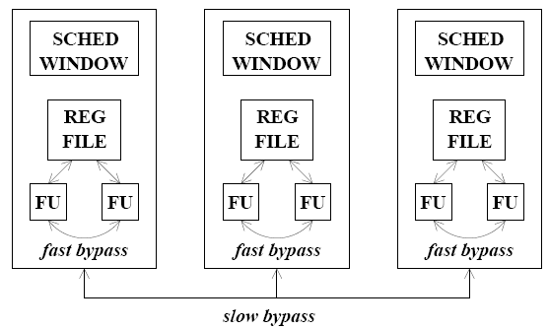
Clustering (I)
Scheduling within each cluster can be out of order

Slide 65
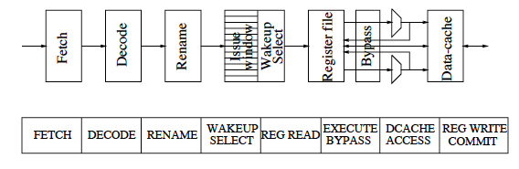
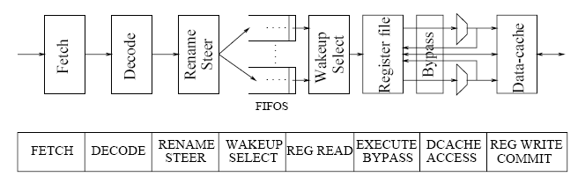
Clustering (II)

Slide 66
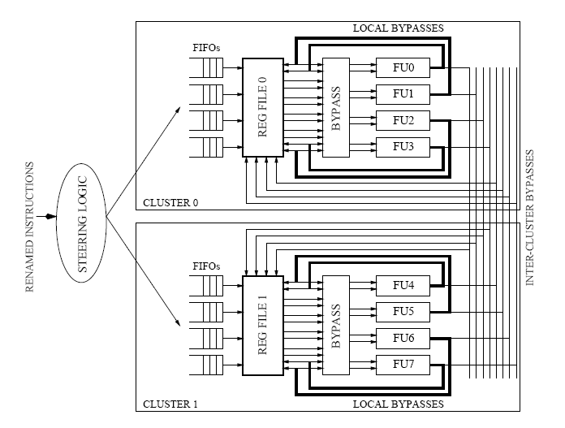
Clustering (III)
Palacharla et al., “Complexity Effective Superscalar Processors,” ISCA 1997.
Each scheduler is a FIFO
+ Simpler
+ Can have N FIFOs
(OoO w.r.t. each other)
+ Reduces scheduling complexity
-- More dispatch stalls
Inter-cluster bypass: Results produced by an FU in Cluster 0 is not individually forwarded to each FU in another cluster.

Slide 67
Why Multi-Core?
Alternative: Traditional symmetric multiprocessors
  + Smaller die size (for the same processing core)
  + More memory bandwidth (no pin bottleneck)
  + Fewer shared resources → less contention between threads
  - Long latencies between cores (need to go off chip) → shared data accesses limit performance → parallel application scalability is limited
  - Worse resource efficiency due to less sharing → worse power/energy efficiency

Slide 68
Why Multi-Core?
Other alternatives?
  Dataflow?
  Vector processors (SIMD)?
  Integrating DRAM on chip?
  Reconfigurable logic? (general purpose?)

Slide 69
Review: Multi-Core Alternatives
Bigger, more powerful single core
Bigger caches
(Simultaneous) multithreading
Integrate platform components on chip instead
More scalable superscalar, out-of-order engines
Traditional symmetric multiprocessors
Dataflow?
Vector processors (SIMD)?
Integrating DRAM on chip?
Reconfigurable logic? (general purpose?)
Other alternatives?
Your solution?

Slide 70
Computer Architecture Today (I)
Today is a very exciting time to study computer architecture
Industry is in a large paradigm shift (to multi-core and beyond) – many different potential system designs possible
Many difficult problems motivating and caused by the shift
  Power/energy constraints
  Complexity of design → multi-core?
  Difficulties in technology scaling → new technologies?
  Memory wall/gap
  Reliability wall/issues
  Programmability wall/problem
No clear, definitive answers to these problems

Slide 71
Computer Architecture Today (II)
These problems affect all parts of the computing stack – if we do not change the way we design systems
No clear, definitive answers to these problems
Problem
Algorithm
Program/Language
User
Runtime System
(VM, OS, MM)
ISA
Microarchitecture
Logic
Circuits
Electrons

Slide 72
Computer Architecture Today (III)
You can revolutionize the way computers are built, if you understand both the hardware and the software (and change each accordingly)
You can invent new paradigms for computation, communication, and storage
Recommended book: Kuhn, “The Structure of Scientific Revolutions” (1962)
  Pre-paradigm science: no clear consensus in the field
  Normal science: dominant theory used to explain things (business as usual); exceptions considered anomalies
  Revolutionary science: underlying assumptions re-examined

Slide 73
… but, first …
Let’s understand the fundamentals…
You can change the world only if you understand it well enough…
  Especially the past and present dominant paradigms
  And, their advantages and shortcomings -- tradeoffs

Slide 74
Multi-Core Design

Slide 75

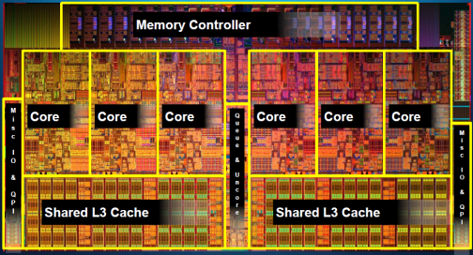
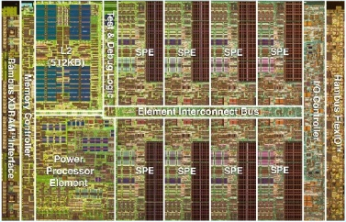
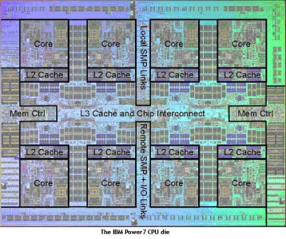
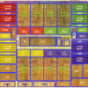
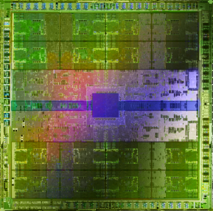
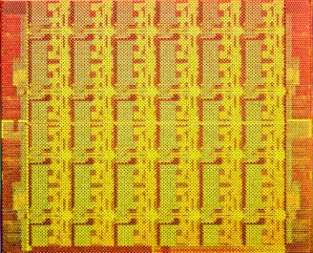
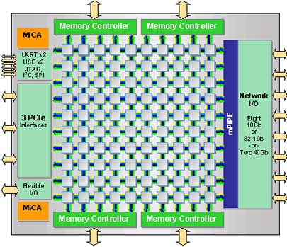
Many Cores on Chip
Simpler and lower power than a single large core
Large scale parallelism on chip
Intel Core i7
8 cores
IBM Cell BE
8+1 cores
IBM POWER7
8 cores
AMD Barcelona
4 cores
Nvidia Fermi
448 “cores”
Intel SCC
48 cores, networked
Tilera TILE Gx
100 cores, networked
Sun Niagara II
8 cores

Slide 76
With Many Cores on Chip
What we want:
  N times the performance with N times the cores when we parallelize an application on N cores
What we get:
  Amdahl’s Law (serial bottleneck)
  Bottlenecks in the parallel portion

Slide 77
Caveats of Parallelism
Amdahl’s Law
  f: Parallelizable fraction of a program
  N: Number of processors
  Amdahl, “Validity of the single processor approach to achieving large scale computing capabilities,” AFIPS 1967.
Maximum speedup limited by serial portion: Serial bottleneck
Parallel portion is usually not perfectly parallel
  Synchronization overhead (e.g., updates to shared data)
  Load imbalance overhead (imperfect parallelization)
  Resource sharing overhead (contention among N processors)
1
Speedup =
1 - f
+
f
N

Slide 78
The Problem: Serialized Code Sections
Many parallel programs cannot be parallelized completely
Causes of serialized code sections
  Sequential portions (Amdahl’s “serial part”)
  Critical sections
  Barriers
  Limiter stages in pipelined programs
Serialized code sections
  Reduce performance
  Limit scalability
  Waste energy

Slide 79
Example from MySQL
Asymmetric
Critical
Section
Access Open Tables Cache
Open database tables
Speedup
Today
Perform the operations
….
Parallel
Chip Area (cores)
Notes:
I show an example from the MySQL database. Each database thread first>>>
opens the database tables it requires, and >>>
then processes the transaction >>>
While independent transactions can proceed in parallel, opening the tables requires accessing a shared data structure called the Open Table Caches. The open tables cache is a 2-dimensional a linked data structure accesses to which are difficult to parallelize. >>>
Thus the accesses are encapsulated in a critical section.>>>

Slide 80
Demands in Different Code Sections
What we want:
In a serialized code section → one powerful “large” core
In a parallel code section → many wimpy “small” cores
These two conflict with each other:
  If you have a single powerful core, you cannot have many cores
  A small core is much more energy and area efficient than a large core

Slide 81
“Large” vs. “Small” Cores
Large
Core
Small
Core
Out-of-order
Wide fetch e.g. 4-wide
Deeper pipeline
Aggressive branch predictor (e.g. hybrid)
Multiple functional units
Trace cache
Memory dependence speculation
In-order
Narrow Fetch e.g. 2-wide
Shallow pipeline
Simple branch predictor (e.g. Gshare)
Few functional units
Large Cores are power inefficient:
e.g., 2x performance for 4x area (power)

Slide 82
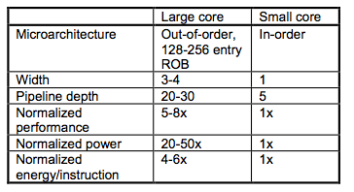
Large vs. Small Cores
Grochowski et al., “Best of both Latency and Throughput,” ICCD 2004.

Slide 83
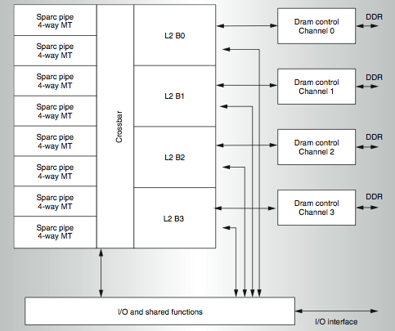
Meet Small: Sun Niagara (UltraSPARC T1)
Kongetira et al., “Niagara: A 32-Way Multithreaded SPARC Processor,” IEEE Micro 2005.

Slide 84
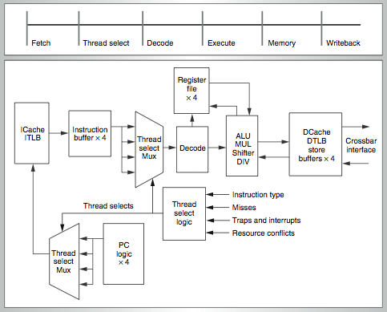
Niagara Core
4-way fine-grain multithreaded, 6-stage, dual-issue in-order
Round robin thread selection (unless cache miss)
Shared FP unit among cores

Slide 85
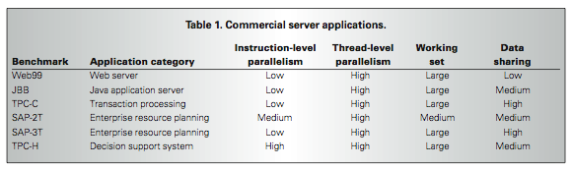
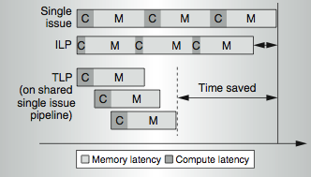
Niagara Design Point
Designed for commercial applications

Slide 86
Meet Small, but Larger: Sun ROCK
Chaudhry et al., “Rock: A High-Performance Sparc CMT Processor,” IEEE Micro, 2009.
Chaudhry et al., “Simultaneous Speculative Threading: A Novel Pipeline Architecture Implemented in Sun's ROCK Processor,” ISCA 2009
Goals:
  Maximize throughput when threads are available
  Boost single-thread performance when threads are not available and on cache misses
Ideas:
  Runahead on a cache miss → ahead thread executes miss-independent instructions, behind thread executes dependent instructions
  Branch prediction (gshare)

Slide 87
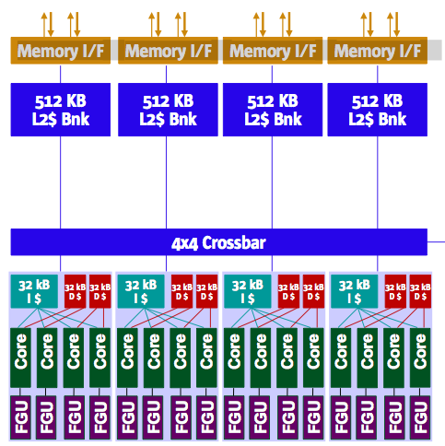
Sun ROCK
16 cores, 2 threads per core (fewer threads than Niagara 2)
4 cores share a 32KB instruction cache
2 cores share a 32KB data cache
2MB L2 cache (smaller than Niagara 2)

Slide 88
Runahead Execution (I)
A simple pre-execution method for prefetching purposes
Mutlu et al., “Runahead Execution: An Alternative to Very Large Instruction Windows for Out-of-order Processors,” HPCA 2003, IEEE Micro 2003.
When the oldest instruction is a long-latency cache miss:
  Checkpoint architectural state and enter runahead mode
In runahead mode:
  Speculatively pre-execute instructions
  The purpose of pre-execution is to generate prefetches
  L2-miss dependent instructions are marked INV and dropped
Runahead mode ends when the original miss returns
  Checkpoint is restored and normal execution resumes

Slide 89
Runahead Execution (II)
Small Window:
Load 1 Miss
Load 2 Miss
Compute
Stall
Compute
Stall
Miss 1
Miss 2
Runahead:
Load 1 Miss
Load 2 Miss
Load 1 Hit
Load 2 Hit
Compute
Runahead
Compute
Saved Cycles
Miss 1
Miss 2

Slide 90
Runahead Execution (III)
Advantages
  + Very accurate prefetches for data/instructions (all cache levels)
  + Follows the program path
  + Simple to implement, most of the hardware is already built in
Disadvantages
  -- Extra executed instructions
Limitations
  -- Limited by branch prediction accuracy
  -- Cannot prefetch dependent cache misses. Solution?
  -- Effectiveness limited by available Memory Level Parallelism
Mutlu et al., “Efficient Runahead Execution: Power-Efficient Memory Latency Tolerance,” IEEE Micro Jan/Feb 2006.
Implemented in IBM POWER6, Sun ROCK

Slide 91
Performance of Runahead Execution

Slide 92
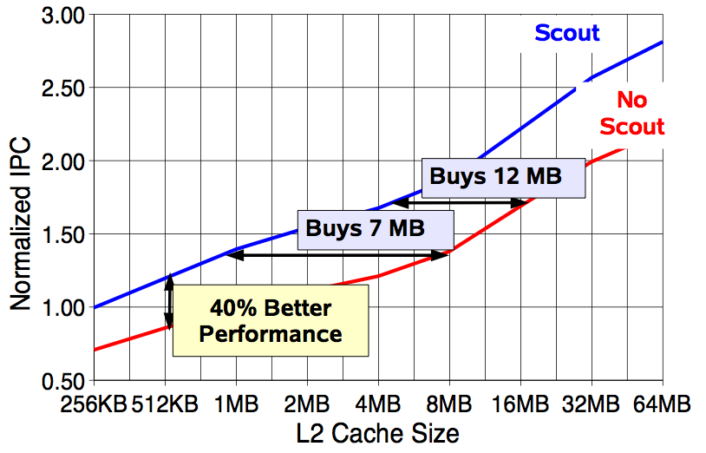
More Powerful Cores in Sun ROCK
Chaudhry talk, Aug 2008.

Slide 93
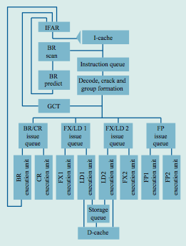
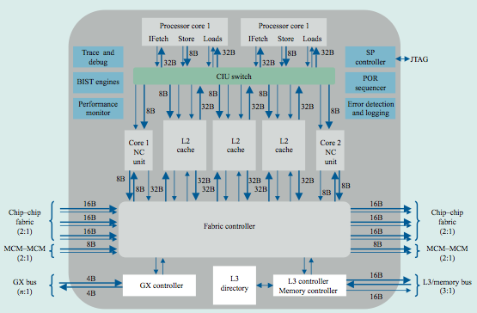
Meet Large: IBM POWER4
Tendler et al., “POWER4 system microarchitecture,” IBM J R&D, 2002.
Another symmetric multi-core chip…
But, fewer and more powerful cores

Slide 94
IBM POWER4
2 cores, out-of-order execution
100-entry instruction window in each core
8-wide instruction fetch, issue, execute
Large, local+global hybrid branch predictor
1.5MB, 8-way L2 cache
Aggressive stream based prefetching

Slide 95
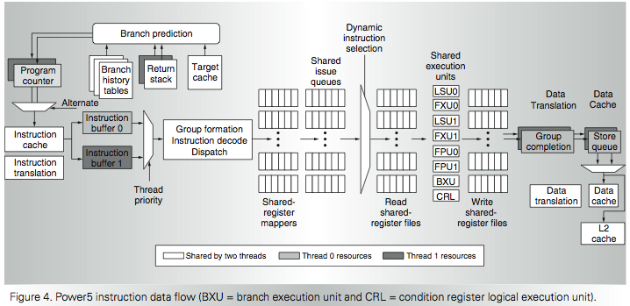
IBM POWER5
  Kalla et al., “IBM Power5 Chip: A Dual-Core Multithreaded Processor,” IEEE Micro 2004.

Slide 96
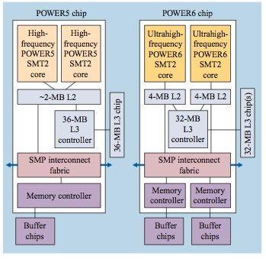
Meet Large, but Smaller: IBM POWER6
Le et al., “IBM POWER6 microarchitecture,” IBM J R&D, 2007.
2 cores, in order, high frequency (4.7 GHz)
8 wide fetch
Simultaneous multithreading in each core
Runahead execution in each core
  Similar to Sun ROCK

Slide 97
Remember the Demands
What we want:
In a serialized code section → one powerful “large” core
In a parallel code section → many wimpy “small” cores
These two conflict with each other:
  If you have a single powerful core, you cannot have many cores
  A small core is much more energy and area efficient than a large core
Can we get the best of both worlds?

Slide 98
Performance vs. Parallelism
Assumptions:
1. Small cores takes an area budget of 1 and has performance of 1
2. Large core takes an area budget of 4 and has performance of 2

Slide 99
Tile-Large Approach
Tile a few large cores
IBM Power 5, AMD Barcelona, Intel Core2Quad, Intel Nehalem
+ High performance on single thread, serial code sections (2 units)
- Low throughput on parallel program portions (8 units)
Large
core
Large
core
Large
core
Large
core
“Tile-Large”

Slide 100
Tile-Small Approach
Tile many small cores
Sun Niagara, Intel Larrabee, Tilera TILE (tile ultra-small)
+ High throughput on the parallel part (16 units)
- Low performance on the serial part, single thread (1 unit)
Small
core
Small
core
Small
core
Small
core
Small
core
Small
core
Small
core
Small
core
Small
core
Small
core
Small
core
Small
core
Small
core
Small
core
Small
core
Small
core
“Tile-Small”

Slide 101
Can we get the best of both worlds?
Tile Large
+ High performance on single thread, serial code sections (2 units)
- Low throughput on parallel program portions (8 units)
Tile Small
+ High throughput on the parallel part (16 units)
- Low performance on the serial part, single thread (1 unit), reduced single-thread performance compared to existing single thread processors
Idea: Have both large and small on the same chip → Performance asymmetry

Slide 102
Asymmetric Multi-Core

Slide 103
Asymmetric Chip Multiprocessor (ACMP)
Provide one large core and many small cores
+ Accelerate serial part using the large core (2 units)
+ Execute parallel part on small cores and large core for high throughput (12+2 units)
Large
core
Large
core
Small
core
Small
core
Small
core
Small
core
Large
core
Small
core
Small
core
Small
core
Small
core
Small
core
Small
core
Small
core
Small
core
Large
core
Large
core
Small
core
Small
core
Small
core
Small
core
Small
core
Small
core
Small
core
Small
core
Small
core
Small
core
Small
core
Small
core
Small
core
Small
core
Small
core
Small
core
“Tile-Large”
“Tile-Small”
ACMP

Slide 104
Accelerating Serial Bottlenecks
Single thread → Large core
Large
core
Small
core
Small
core
Small
core
Small
core
Small
core
Small
core
Small
core
Small
core
Small
core
Small
core
Small
core
Small
core
ACMP Approach

Slide 105
Performance vs. Parallelism
Assumptions:
1. Small cores takes an area budget of 1 and has performance of 1
2. Large core takes an area budget of 4 and has performance of 2

Slide 106
ACMP Performance vs. Parallelism
Area-budget = 16 small cores
Large
core
Large
core
Small
core
Small
core
Small
core
Small
core
Large
core
Small
core
Small
core
Small
core
Small
core
Small
core
Small
core
Small
core
Small
core
Large
core
Large
core
Small
core
Small
core
Small
core
Small
core
Small
core
Small
core
Small
core
Small
core
Small
core
Small
core
Small
core
Small
core
Small
core
Small
core
Small
core
Small
core
“Tile-Large”
“Tile-Small”
ACMP
Large Cores | 4 | 0 | 1
Small Cores | 0 | 16 | 12
Serial Performance | 2 | 1 | 2
Parallel Throughput | 2 x 4 = 8 | 1 x 16 = 16 | 1x2 + 1x12 = 14
106

Slide 107
Caveats of Parallelism, Revisited
Amdahl’s Law
  f: Parallelizable fraction of a program
  N: Number of processors
  Amdahl, “Validity of the single processor approach to achieving large scale computing capabilities,” AFIPS 1967.
Maximum speedup limited by serial portion: Serial bottleneck
Parallel portion is usually not perfectly parallel
  Synchronization overhead (e.g., updates to shared data)
  Load imbalance overhead (imperfect parallelization)
  Resource sharing overhead (contention among N processors)
1
Speedup =
1 - f
+
f
N

Slide 108
Accelerating Parallel Bottlenecks
Serialized or imbalanced execution in the parallel portion can also benefit from a large core
Examples:
  Critical sections that are contended
  Parallel stages that take longer than others to execute
Idea: Dynamically identify these code portions that cause serialization and execute them on a large core

Slide 109
Accelerated Critical Sections
M. Aater Suleman, Onur Mutlu, Moinuddin K. Qureshi, and Yale N. Patt,
"Accelerating Critical Section Execution with Asymmetric Multi-Core Architectures"
Proceedings of the 14th International Conference on Architectural Support for Programming Languages and Operating Systems (ASPLOS)

Slide 110
Contention for Critical Sections
12 iterations, 33% instructions inside the critical section
Critical Section
Parallel
Idle
P = 4
P = 3
P = 2
33% in critical section
P = 1
0
1
2
3
4
5
6
7
8
9
10
11
12
Notes:
For simplicity lets assume that when run as a single thread, each database transaction spends 33% of its time inside the critical section and 75% of its time executing the parallel portion. >>>
I show execution of 16 transactions on a single core. The red represent the critical sections and the grey represent the non-critical section code.>>>
With 2 cores, overall execution time is halved >>>
With 4 cores, the execution time is again halved however note that the critical section is being run at all times. Thus, performance has become critical section limited ..>>>
Further increasing the cores to 8, does not reduce execution time. >>>
Thus critical sections reduce performance and limit scalability.

Slide 111
Contention for Critical Sections
12 iterations, 33% instructions inside the critical section
Critical Section
Parallel
Idle
P = 4
Accelerating critical sections
increases performance and scalability
P = 3
Critical
Section
Accelerated by 2x
P = 2
P = 1
0
1
2
3
4
5
6
7
8
9
10
11
12
Notes:
However, I can accelerate the critical section. When we accelerate the critical section execution by 2x, the time inside the critical section reduces to half. I use blue to show the accelerated critical section. At one core, the overall execution time reduces. >>>
Similarly execution time also reduces at 2, 3, and 4 cores. >>>
Most notably, due to the shorter critical sections, performance no longer saturates at 4 cores. Instead, execution time continues to reduce until 4 cores.

Slide 112
Impact of Critical Sections on Scalability
Contention for critical sections leads to serial execution (serialization) of threads in the parallel program portion
Contention for critical sections increases with the number of threads and limits scalability
Asymmetric
Speedup
Today
MySQL (oltp-1)
Chip Area (cores)

Slide 113
A Case for Asymmetry
Execution time of sequential kernels, critical sections, and limiter stages must be short
It is difficult for the programmer to shorten these
serialized sections
  Insufficient domain-specific knowledge
  Variation in hardware platforms
  Limited resources
Goal: A mechanism to shorten serial bottlenecks without requiring programmer effort
Idea: Accelerate serialized code sections by shipping them to powerful cores in an asymmetric multi-core (ACMP)

Slide 114
An Example: Accelerated Critical Sections
Idea: HW/SW ships critical sections to a large, powerful core in an asymmetric multi-core architecture
Benefit:
  Reduces serialization due to contended locks
  Reduces the performance impact of hard-to-parallelize sections
  Programmer does not need to (heavily) optimize parallel code → fewer bugs, improved productivity
Suleman et al., “Accelerating Critical Section Execution with Asymmetric Multi-Core Architectures,” ASPLOS 2009, IEEE Micro Top Picks 2010.
Suleman et al., “Data Marshaling for Multi-Core Architectures,” ISCA 2010, IEEE Micro Top Picks 2011.
Notes:
SHOW a picture of ACMP and shipping…
Aater’s picture…

Slide 115
Accelerated Critical Sections
EnterCS()
  PriorityQ.insert(…)
LeaveCS()
1. P2 encounters a critical section (CSCALL)
2. P2 sends CSCALL Request to CSRB
3. P1 executes Critical Section
4. P1 sends CSDONE signal
P1
Core executing critical section
P2
P3
P4
Critical Section
Request Buffer (CSRB)
Onchip-Interconnect
Notes:
To accelerate critical sections, the large core is augmented with a critical section request buffer or CSRB. >>>
When a small core encounters a critical section, it ships to the large core. The large core completes the ciritcal section and notifies the requesting core.
For example, When P2 encounters a critical sections,>>>
its sends a request to the large core and becomes idle.>>>
The request is buffered at the CSRB and>>>
is serviced by the large core at the first opportunity.>>>
The large core sends a CSDONE signal when it has completed the critical section. At this point, P2 resumes execution.
115

Slide 116
Accelerated Critical Sections (ACS)
Small Core
Small Core
Large Core
Suleman et al., “Accelerating Critical Section Execution with Asymmetric Multi-Core Architectures,” ASPLOS 2009.
A = compute()
A = compute()
LOCK X
result = CS(A)
UNLOCK X
print result
PUSH A
CSCALL X, Target PC
…
…
…
CSCALL Request
…
…
…
Send X, TPC, STACK_PTR, CORE_ID
Waiting in Critical Section Request Buffer (CSRB)
…
…
…
…
TPC:
Acquire X
POP A
result = CS(A)
PUSH result
Release X
CSRET X
CSDONE Response
POP result
print result

Slide 117
False Serialization
ACS can serialize independent critical sections
Selective Acceleration of Critical Sections (SEL)
  Saturating counters to track false serialization
To large core
4
CSCALL (A)
3
A
2
Critical Section Request Buffer
(CSRB)
4
CSCALL (A)
B
5
CSCALL (B)
From small cores
Notes:
While executing the critical sections on the large core accelerates their execution, ACS can serialize the execution of independent critical sections. Independent critical sections protect disjoint data and can execute concurrently in conventional systems. Since ACS sends all critical sections to the large core, their execution can get serialized. WE call this false serialization. To reduce the effect of false serialization,
we implement a mechanism to selectively disable the acceleration of critical sections which are experiencing false serialization. We call it SEL.
To implement SEL, we add a table of saturating counters to the CSRB which track false serialization. For simplicity, assume there is one counter for every independent critical section. A counter is incremented when the critical section experiences false serialization and decremented otherwise.
For example, consider a system with two critical sections A and B and an empty CSRB.
A CSCALL for critical section A arrives. Since there are no other entries, there is no false serialization, so
the counter corresponding to critical section A is decremented.
While the first call is still in progress, another CSCALL for A arrives. Again, there is NO false serialization since CSCALL for A would have waited for the first instance of critical section A even in the conventional system.
Thus counter for A is again decremented.
Now a CSCALL for B is enters the CSRB. Since B now has to wait for critical section A, which it should NOT. We say that B is experiencing false serialization and
increment its counter.
When a counter reaches its maximum value, acceleration for that critical section is disabled and conventional locking is used for its execution from there on.

Slide 118
ACS Performance Tradeoffs
Pluses
  + Faster critical section execution
  + Shared locks stay in one place: better lock locality
  + Shared data stays in large core’s (large) caches: better shared data locality, less ping-ponging
Minuses
  - Large core dedicated for critical sections: reduced parallel throughput
  - CSCALL and CSDONE control transfer overhead
  - Thread-private data needs to be transferred to large core: worse private data locality

Slide 119
ACS Performance Tradeoffs
Fewer parallel threads vs. accelerated critical sections
  Accelerating critical sections offsets loss in throughput
  As the number of cores (threads) on chip increase:
    Fractional loss in parallel performance decreases
    Increased contention for critical sections
    makes acceleration more beneficial
Overhead of CSCALL/CSDONE vs. better lock locality
  ACS avoids “ping-ponging” of locks among caches by keeping them at the large core
More cache misses for private data vs. fewer misses for shared data
Notes:
ACS dedicates the large core for execution of critical sections which could otherwise be used for executing additional threads. This reduces peak parallel throughput. However, we find that in critical section intensive workloads this is not a problem since the benefit obtained by accelerating of critical sections offsets the loss in peak parallel throughput.
Moreover, we observe that this problem will be further reduce as the number of cores on the chip increase for two reasons.
First, the fraction of throughput lost due to ACS decreases. For example, loosing 4 cores in a 64-core system will be a much smaller loss than loosing 4 cores in a 8-core system.
Second, contention for critical sections increases as the number of concurrent threads increase. When contention is high, accelerating the critical sections not only reduces the critical section execution time BUT also the waiting time for contending threads. Thereby making the acceleration even more beneficial.
ACS also incurs the overhead of sending CSCALL and CSDONE signals.
This overhead is similar to the conventional systems because in conventional systems lock acquire operations often generate a cache miss and the lock variable is brought from another core. In ACS, since all critical sections execute on one LARGE core, the lock variables stay resident in its cache which saves cache misses. Thus, overall, ACS has similar latency.
In ACS the input arguments to the critical section must be transferred from the cache of the small core to the cache of the large core. Let me explain this trade-off with an example.

Slide 120
Cache Misses for Private Data
PriorityHeap.insert(NewSubProblems)
Private Data: NewSubProblems
Shared Data:
The priority heap
Puzzle Benchmark
Notes:
Consider this critical section from the puzzle benchmark. This critical sections protects a priority heap. The input argument is the node to be inserted on the heap.
The priority heap is the Shared data which is data protected by the critical sections and private data is the incoming node to be inserted.
During execution, multiple nodes of the heap are touched to find the right place to insert the incoming private data. In conventional systems, the shared data usually moves from cache-to-cache as different cores modify it inside critical sections. The private data is usually available locally. In ACS, since all critical sections execute on the large core, the shared data stays resident AT the large and does not move from cache to cache. However, private data has to be brought in from the small requesting core to execute the critical section.

Slide 121
ACS Performance Tradeoffs
Fewer parallel threads vs. accelerated critical sections
  Accelerating critical sections offsets loss in throughput
  As the number of cores (threads) on chip increase:
    Fractional loss in parallel performance decreases
    Increased contention for critical sections
    makes acceleration more beneficial
Overhead of CSCALL/CSDONE vs. better lock locality
  ACS avoids “ping-ponging” of locks among caches by keeping them at the large core
More cache misses for private data vs. fewer misses for shared data
  Cache misses reduce if shared data > private data
This problem can be solved

Slide 122
ACS Comparison Points
Small
core
Small
core
Small
core
Small
core
Large
core
Small
core
Small
core
Large
core
Small
core
Small
core
Small
core
Small
core
Small
core
Small
core
Small
core
Small
core
Small
core
Small
core
Small
core
Small
core
Small
core
Small
core
Small
core
Small
core
Small
core
Small
core
Small
core
Small
core
Small
core
Small
core
Small
core
Small
core
Small
core
Small
core
Small
core
Small
core
Small
core
Small
core
Small
core
Small
core
Small
core
Small
core
SCMP
ACMP
ACS
Conventional locking
Conventional locking
Large core executes Amdahl’s serial part
Large core executes Amdahl’s serial part and critical sections
Notes:
In our experiments we simulated three configurations.
First, A symmetric CMP or SCMP with all small cores. The numbers of cores is equal to the chip area and conventional locks are used for critical sections.
Second, an ACMP with one large core and remaining small cores. The large core takes the area of 4 small cores. The large core is used to execute Amdahl’s bottleneck. Critical Sections are executed using conventional locking.
Third, ACS, which is an ACMP with a CSRB and support for accelerating critical sections. In ACS, the Amdahl’s bottleneck as well as the critical sections execute on the large core.
The large core replceas four small cores. When chip area increases, we increase the number of small cores in all three confgiurations. At area 16, the SCMP has 16 small cores and the ACMP and ACS has 1 large core and 12 small cores. At area 32, the SCMP has 32 small cores and ACMP and ACS have 1 large core and 28 small cores.
We use the ACMP as our baseline.

Slide 123
Accelerated Critical Sections: Methodology
Workloads: 12 critical section intensive applications
  Data mining kernels, sorting, database, web, networking
Multi-core x86 simulator
  1 large and 28 small cores
  Aggressive stream prefetcher employed at each core
Details:
  Large core: 2GHz, out-of-order, 128-entry ROB, 4-wide, 12-stage
  Small core: 2GHz, in-order, 2-wide, 5-stage
  Private 32 KB L1, private 256KB L2, 8MB shared L3
  On-chip interconnect: Bi-directional ring, 5-cycle hop latency

Slide 124
ACS Performance
Chip Area = 32 small cores
SCMP = 32 small cores
ACMP = 1 large and 28 small cores
Equal-area comparison
Number of threads = Best threads
269 180 185
Coarse-grain locks
Fine-grain locks

Slide 125
Equal-Area Comparisons
------ SCMP
------ ACMP
------ ACS
Number of threads = No. of cores
(a) ep
(b) is
(c) pagemine
(d) puzzle
(e) qsort
(f) tsp
Speedup over a small core
(g) sqlite
(h) iplookup
(i) oltp-1
(i) oltp-2
(k) specjbb
(l) webcache
Chip Area (small cores)
Notes:
Now we will compare SCMP, ACMP, and ACS as the chip area increases. The X-axis is chip area and the Y-axis shows speedup over a SINGLE small core. The green line shows ACS, the red line shows the ACMP, and blue line shows the SCMP. Here we set the number of threads equal to the number of available cores.
As you can see, critical sections severely limit the scalability of some benchmarks. For example, performance of PageMine saturates at only 8 threads. Notice that the peak speedup of ACS is higher than both ACMP and SCMP and ACS does not saturate until 12 threads.
More importantly, In case of puzzle and oltp-1, while the ACMP and SCMP show poor scalability ACS significantly improves scalability as well as speedup.
In all, ACS improves scalability in 7 out of the 12 workloads.

Slide 126
ACS Summary
Critical sections reduce performance and limit scalability
Accelerate critical sections by executing them on a powerful core
ACS reduces average execution time by:
  34% compared to an equal-area SCMP
  23% compared to an equal-area ACMP
ACS improves scalability of 7 of the 12 workloads
Generalizing the idea: Accelerate all bottlenecks (“critical paths”) by executing them on a powerful core

Slide 127
Bottleneck Identification and Scheduling
Jose A. Joao, M. Aater Suleman, Onur Mutlu, and Yale N. Patt,
"Bottleneck Identification and Scheduling in Multithreaded Applications"
Proceedings of the 17th International Conference on Architectural Support for Programming Languages and Operating Systems (ASPLOS), London, UK, March 2012.

Slide 128
BIS Summary
Problem: Performance and scalability of multithreaded applications
are limited by serializing synchronization bottlenecks
  different types: critical sections, barriers, slow pipeline stages
  importance (criticality) of a bottleneck can change over time
Our Goal: Dynamically identify the most important bottlenecks and
accelerate them
  How to identify the most critical bottlenecks
  How to efficiently accelerate them
Solution: Bottleneck Identification and Scheduling (BIS)
  Software: annotate bottlenecks (BottleneckCall, BottleneckReturn) and implement waiting for bottlenecks with a special instruction (BottleneckWait)
  Hardware: identify bottlenecks that cause the most thread waiting and accelerate those bottlenecks on large cores of an asymmetric multi-core system
Improves multithreaded application performance and scalability, outperforms previous work, and performance improves with more cores

Slide 129
Bottlenecks in Multithreaded Applications
Definition: any code segment for which threads contend (i.e. wait)
Examples:
Amdahl’s serial portions
  Only one thread exists → on the critical path
Critical sections
  Ensure mutual exclusion → likely to be on the critical path if contended
Barriers
  Ensure all threads reach a point before continuing → the latest thread arriving is on the critical path
Pipeline stages
  Different stages of a loop iteration may execute on different threads,
  slowest stage makes other stages wait → on the critical path

Slide 130
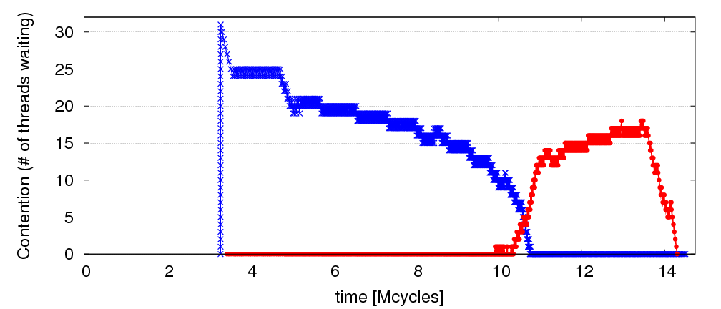
Observation: Limiting Bottlenecks Change Over Time
A=full linked list; B=empty linked list
repeat
Lock A
Traverse list A
Remove X from A
Unlock A
Compute on X
Lock B
Traverse list B
Insert X into B
Unlock B
until A is empty
32 threads
Lock B is limiter
Lock A is limiter

Slide 131
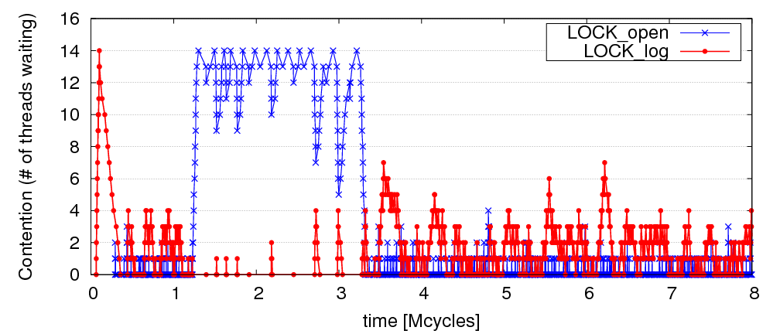
Limiting Bottlenecks Do Change on Real Applications
MySQL running Sysbench queries, 16 threads

Slide 132
Previous Work on Bottleneck Acceleration
Asymmetric CMP (ACMP) proposals [Annavaram+, ISCA’05]
[Morad+, Comp. Arch. Letters’06] [Suleman+, Tech. Report’07]
Accelerated Critical Sections (ACS) [Suleman+, ASPLOS’09, Top Picks’10]
Feedback-Directed Pipelining (FDP) [Suleman+, PACT’10 and PhD thesis’11]
No previous work
→ can accelerate all types of bottlenecks or
→ adapts to fine-grain changes in the importance of bottlenecks
Our goal:
general mechanism to identify and accelerate performance-limiting bottlenecks of any type

Slide 133
Bottleneck Identification and Scheduling (BIS)
Key insight:
  Thread waiting reduces parallelism and
  is likely to reduce performance
  Code causing the most thread waiting → likely critical path
Key idea:
  Dynamically identify bottlenecks that cause
  the most thread waiting
  Accelerate them (using powerful cores in an ACMP)

Slide 134
Bottleneck Identification and Scheduling (BIS)
Compiler/Library/Programmer
Hardware
Annotate
bottleneck code
Implement waiting
for bottlenecks
Measure thread
waiting cycles (TWC)
for each bottleneck
Accelerate bottleneck(s)
with the highest TWC
Binary containing
BIS instructions

Slide 135
Critical Sections: Code Modifications
…
…
…
BottleneckCall bid, targetPC
…
targetPC: while cannot acquire lock
Wait loop for watch_addr
acquire lock
…
release lock
BottleneckReturn bid
while cannot acquire lock
Wait loop for watch_addr
acquire lock
…
release lock
BottleneckWait bid, watch_addr
Used to enable acceleration
Used to keep track of waiting cycles

Slide 136
Barriers: Code Modifications
…
BottleneckCall bid, targetPC
enter barrier
while not all threads in barrier
BottleneckWait bid, watch_addr
exit barrier
…
targetPC: code running for the barrier
…
BottleneckReturn bid

Slide 137
Pipeline Stages: Code Modifications
BottleneckCall bid, targetPC
…
targetPC: while not done
while empty queue
BottleneckWait prev_bid
dequeue work
do the work …
while full queue
BottleneckWait next_bid
enqueue next work
BottleneckReturn bid

Slide 138
Bottleneck Identification and Scheduling (BIS)
Compiler/Library/Programmer
Hardware
Annotate
bottleneck code
Implement waiting
for bottlenecks
Measure thread
waiting cycles (TWC)
for each bottleneck
Accelerate bottleneck(s)
with the highest TWC
Binary containing
BIS instructions

Slide 139
BIS: Hardware Overview
Performance-limiting bottleneck identification and acceleration are independent tasks
Acceleration can be accomplished in multiple ways
  Increasing core frequency/voltage
  Prioritization in shared resources [Ebrahimi+, MICRO’11]
  Migration to faster cores in an Asymmetric CMP
Small
core
Small
core
Large core
Small
core
Small
core
Small
core
Small
core
Small
core
Small
core
Small
core
Small
core
Small
core
Small
core

Slide 140
Bottleneck Identification and Scheduling (BIS)
Compiler/Library/Programmer
Hardware
Annotate
bottleneck code
Implement waiting
for bottlenecks
Measure thread
waiting cycles (TWC)
for each bottleneck
Accelerate bottleneck(s)
with the highest TWC
Binary containing
BIS instructions

Slide 141
Determining Thread Waiting Cycles for Each Bottleneck
Small Core 1
Large Core 0
BottleneckWait x4500
bid=x4500, waiters=0, twc = 11
bid=x4500, waiters=1, twc = 0
bid=x4500, waiters=1, twc = 1
bid=x4500, waiters=2, twc = 7
bid=x4500, waiters=1, twc = 10
bid=x4500, waiters=2, twc = 5
bid=x4500, waiters=1, twc = 9
bid=x4500, waiters=1, twc = 3
bid=x4500, waiters=1, twc = 4
bid=x4500, waiters=1, twc = 5
bid=x4500, waiters=1, twc = 2
bid=x4500, waiters=2, twc = 9
bid=x4500, waiters=1, twc = 11
Small Core 2
Bottleneck
Table (BT)
BottleneckWait x4500
…

Slide 142
Bottleneck Identification and Scheduling (BIS)
Compiler/Library/Programmer
Hardware
Annotate
bottleneck code
Implement waiting
for bottlenecks
Measure thread
waiting cycles (TWC)
for each bottleneck
Accelerate bottleneck(s)
with the highest TWC
Binary containing
BIS instructions

Slide 143
Bottleneck Acceleration
Small Core 1
Large Core 0
BottleneckCall x4700
BottleneckCall x4600
bid=x4700, pc, sp, core1
BottleneckReturn x4700
Execute locally
Execute remotely
Acceleration
Index Table (AIT)
bid=x4700, pc, sp, core1
bid=x4700 , large core 0
Execute remotely
Scheduling Buffer (SB)
Execute locally
bid=x4600, twc=100
← twc < Threshold
Small Core 2
bid=x4700, twc=10000
← twc > Threshold
Bottleneck
Table (BT)
AIT
bid=x4700 , large core 0
…

Slide 144
BIS Mechanisms
Basic mechanisms for BIS:
  Determining Thread Waiting Cycles ✓
  Accelerating Bottlenecks ✓
Mechanisms to improve performance and generality of BIS:
  Dealing with false serialization
  Preemptive acceleration
  Support for multiple large cores

Slide 145
Hardware Cost
Main structures:
  Bottleneck Table (BT): global 32-entry associative cache, minimum-Thread-Waiting-Cycle replacement
  Scheduling Buffers (SB): one table per large core,
  as many entries as small cores
  Acceleration Index Tables (AIT): one 32-entry table
  per small core
Off the critical path
Total storage cost for 56-small-cores, 2-large-cores < 19 KB

Slide 146
BIS Performance Trade-offs
Faster bottleneck execution vs. fewer parallel threads
  Acceleration offsets loss of parallel throughput with large core counts
Better shared data locality vs. worse private data locality
  Shared data stays on large core (good)
  Private data migrates to large core (bad, but latency hidden with Data Marshaling [Suleman+, ISCA’10])
Benefit of acceleration vs. migration latency
  Migration latency usually hidden by waiting (good)
  Unless bottleneck not contended (bad, but likely not on critical path)

Slide 147
Evaluation Methodology
Workloads: 8 critical section intensive, 2 barrier intensive and 2 pipeline-parallel applications
  Data mining kernels, scientific, database, web, networking, specjbb
Cycle-level multi-core x86 simulator
  8 to 64 small-core-equivalent area, 0 to 3 large cores, SMT
  1 large core is area-equivalent to 4 small cores
Details:
  Large core: 4GHz, out-of-order, 128-entry ROB, 4-wide, 12-stage
  Small core: 4GHz, in-order, 2-wide, 5-stage
  Private 32KB L1, private 256KB L2, shared 8MB L3
  On-chip interconnect: Bi-directional ring, 2-cycle hop latency

Slide 148
BIS Comparison Points (Area-Equivalent)
SCMP (Symmetric CMP)
  All small cores
ACMP (Asymmetric CMP)
  Accelerates only Amdahl’s serial portions
  Our baseline
ACS (Accelerated Critical Sections)
  Accelerates only critical sections and Amdahl’s serial portions
  Applicable to multithreaded workloads
  (iplookup, mysql, specjbb, sqlite, tsp, webcache, mg, ft)
FDP (Feedback-Directed Pipelining)
  Accelerates only slowest pipeline stages
  Applicable to pipeline-parallel workloads (rank, pagemine)

Slide 149
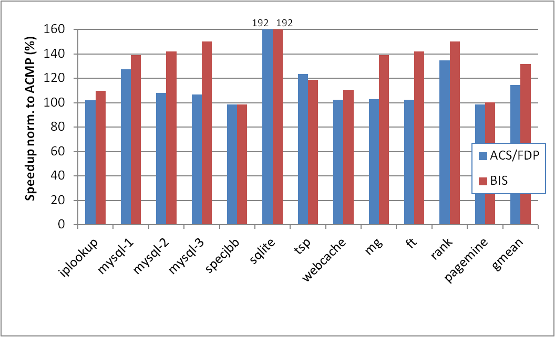
BIS Performance Improvement
Optimal number of threads, 28 small cores, 1 large core
limiting bottlenecks change over time
barriers, which ACS
cannot accelerate
BIS outperforms ACS/FDP by 15% and ACMP by 32%
BIS improves scalability on 4 of the benchmarks
ACS
FDP

Slide 150
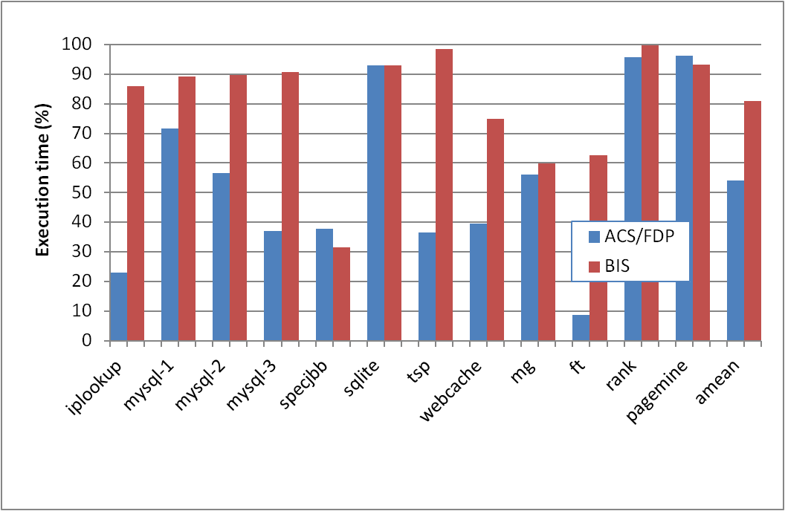
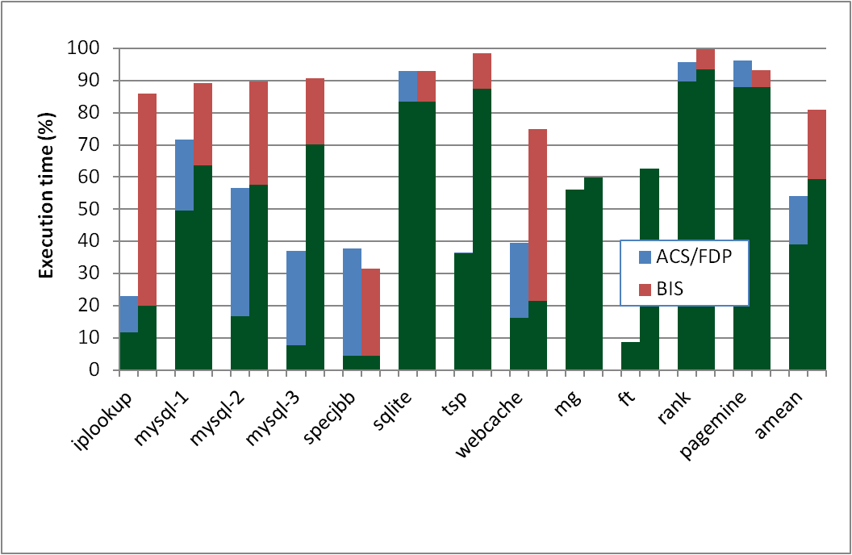
Why Does BIS Work?
Fraction of execution time spent on predicted-important bottlenecks
Actually critical
Coverage: fraction of program critical path that is actually identified as bottlenecks
  39% (ACS/FDP) to 59% (BIS)
Accuracy: identified bottlenecks on the critical path over total identified bottlenecks
  72% (ACS/FDP) to 73.5% (BIS)

Slide 151
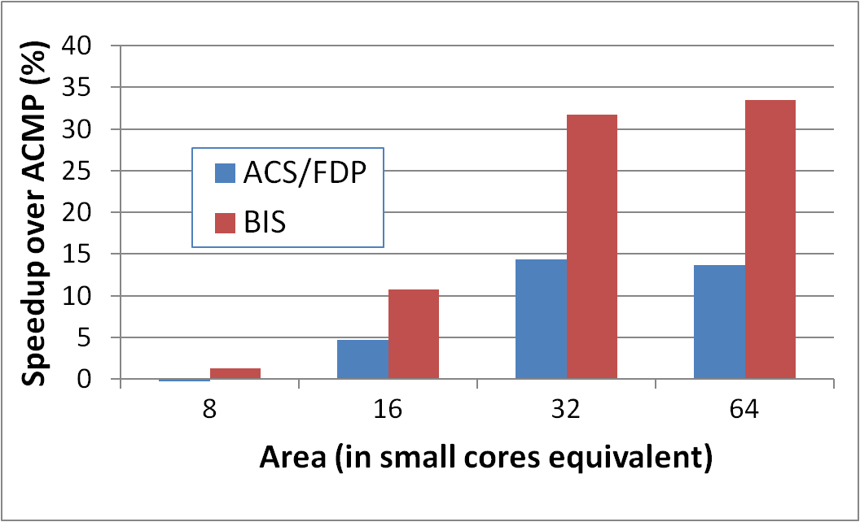
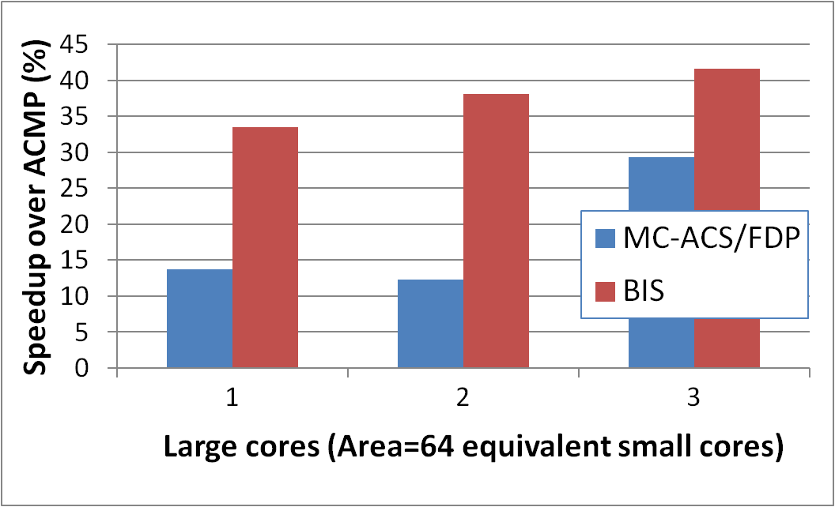
BIS Scaling Results
Performance increases with:
1) More small cores
  Contention due to bottlenecks increases
  Loss of parallel throughput due to large core reduces
2) More large cores
  Can accelerate
  independent bottlenecks
  Without reducing parallel throughput (enough cores)
15%
19%
6.2%
2.4%

Slide 152
BIS Summary
Serializing bottlenecks of different types limit performance of multithreaded applications: Importance changes over time
BIS is a hardware/software cooperative solution:
  Dynamically identifies bottlenecks that cause the most thread waiting and accelerates them on large cores of an ACMP
  Applicable to critical sections, barriers, pipeline stages
BIS improves application performance and scalability:
  Performance benefits increase with more cores
Provides comprehensive fine-grained bottleneck acceleration with no programmer effort

Slide 153
Handling Private Data Locality:
Data Marshaling
M. Aater Suleman, Onur Mutlu, Jose A. Joao, Khubaib, and Yale N. Patt,
"Data Marshaling for Multi-core Architectures"
Proceedings of the 37th International Symposium on Computer Architecture (ISCA), pages 441-450, Saint-Malo, France, June 2010.

Slide 154
Staged Execution Model (I)
Goal: speed up a program by dividing it up into pieces
Idea
  Split program code into segments
  Run each segment on the core best-suited to run it
  Each core assigned a work-queue, storing segments to be run
Benefits
  Accelerates segments/critical-paths using specialized/heterogeneous cores
  Exploits inter-segment parallelism
  Improves locality of within-segment data
Examples
  Accelerated critical sections, Bottleneck identification and scheduling
  Producer-consumer pipeline parallelism
  Task parallelism (Cilk, Intel TBB, Apple Grand Central Dispatch)
  Special-purpose cores and functional units
Notes:
Accelerate critical paths
Ship computation to data (A segmenting approach)

Slide 155
Staged Execution Model (II)
LOAD X
STORE Y
STORE Y
LOAD Y
….
STORE Z
LOAD Z
….
Notes:
Let me demonstrate the staged execution model pictorially. Assume that we have this contiguous chunk of code. I show only loads and stores since they are relevant to our work.

Slide 156
Staged Execution Model (III)
Split code into segments
Segment S0
LOAD X
STORE Y
STORE Y
Segment S1
LOAD Y
….
STORE Z
Segment S2
LOAD Z
….
Notes:
This figure shows the same chunk of code split into three segments, S0, S1, S2.
This split can be done statically and dynamically, and it is not the focus of our paper. However, I will soon show you two paradigms that split the code in different ways.

Slide 157
Staged Execution Model (IV)
Core 0
Core 1
Core 2
Work-queues
Instances
of S0
Instances
of S1
Instances
of S2
Notes:
Once the split is done, each segment is assigned to a different core (this assignment can be done statically or dynamically, and again has been covered in previous work).
The work queue of each core contains the segments to be executed in that core.
In this example, S0 is executed in core 0, S1 executed in core 1, and so on.
*** Usually, to preserve locality and take advantage of customization, a segment is executed in one core.
*** This also preserves the locality of data that is commonly touched by instances of S0, S1, and S2 (intra-segment data, or shared data among instances of the same segment).

Slide 158
Staged Execution Model: Segment Spawning
Core 0
Core 1
Core 2
LOAD X
STORE Y
STORE Y
S0
LOAD Y
….
STORE Z
S1
LOAD Z
….
S2
Notes:
A segment that is executing on one core spawns another segment on another core, which in turn can spawn another segment in another core. These segments may need to communicate with each other because a later segment may need the data produced by a previous segment.
Segment spawning:
OLD:
When these segment runs on three cores P0, P1 and P2, core>>>
P1 incurs a cache miss to fetch Y and >>>
P2 incurs a cache miss to fetch Z
We cnan avoid these misses by shipping the data required by a segment to the core where the segment will run.

Slide 159
Staged Execution Model: Two Examples
Accelerated Critical Sections [Suleman et al., ASPLOS 2009]
  Idea: Ship critical sections to a large core in an asymmetric CMP
    Segment 0: Non-critical section
    Segment 1: Critical section
  Benefit: Faster execution of critical section, reduced serialization, improved lock and shared data locality
Producer-Consumer Pipeline Parallelism
  Idea: Split a loop iteration into multiple “pipeline stages” where one stage consumes data produced by the next stage → each stage runs on a different core
    Segment N: Stage N
  Benefit: Stage-level parallelism, better locality → faster execution
Notes:
Let me give you two concrete examples of staged execution models. I will extensively use these examples to show the benefits of data marshaling.

Slide 160
Problem: Locality of Inter-segment Data
Core 0
Core 1
Core 2
LOAD X
STORE Y
STORE Y
S0
Transfer Y
Cache Miss
LOAD Y
….
STORE Z
S1
Transfer Z
Cache Miss
LOAD Z
….
S2
Notes:
The problem is that when segments execute on different cores, they may need data produced by previous segments.
In this example, when S1 is executing Load to address Y on Core 1, it will incur a cache miss on the cache block containing Y because Core 0 was the last writer to that block.
If there is an inter-segment cache miss, the core that executes the segment will stall (or progress more slowly).
These intra-segment communication misses reduce the performance potential of staged execution.

Slide 161
Problem: Locality of Inter-segment Data
Accelerated Critical Sections [Suleman et al., ASPLOS 2010]
  Idea: Ship critical sections to a large core in an ACMP
  Problem: Critical section incurs a cache miss when it touches data produced in the non-critical section (i.e., thread private data)
Producer-Consumer Pipeline Parallelism
  Idea: Split a loop iteration into multiple “pipeline stages” → each stage runs on a different core
  Problem: A stage incurs a cache miss when it touches data produced by the previous stage
Performance of Staged Execution limited by inter-segment cache misses
Notes:
Let’s quickly take a look at what these misses look like in the two models we have discussed.
Remember in ACS, the critical sections are shipped to a large core. This means that the thread-private data that is produced outside the critical section and consumed inside it needs to be transferred to the large core when the critical section needs this data.
Similarly, in pipeline parallelism, …
…
But what is the effect of such cache misses on overall performance?

Slide 162
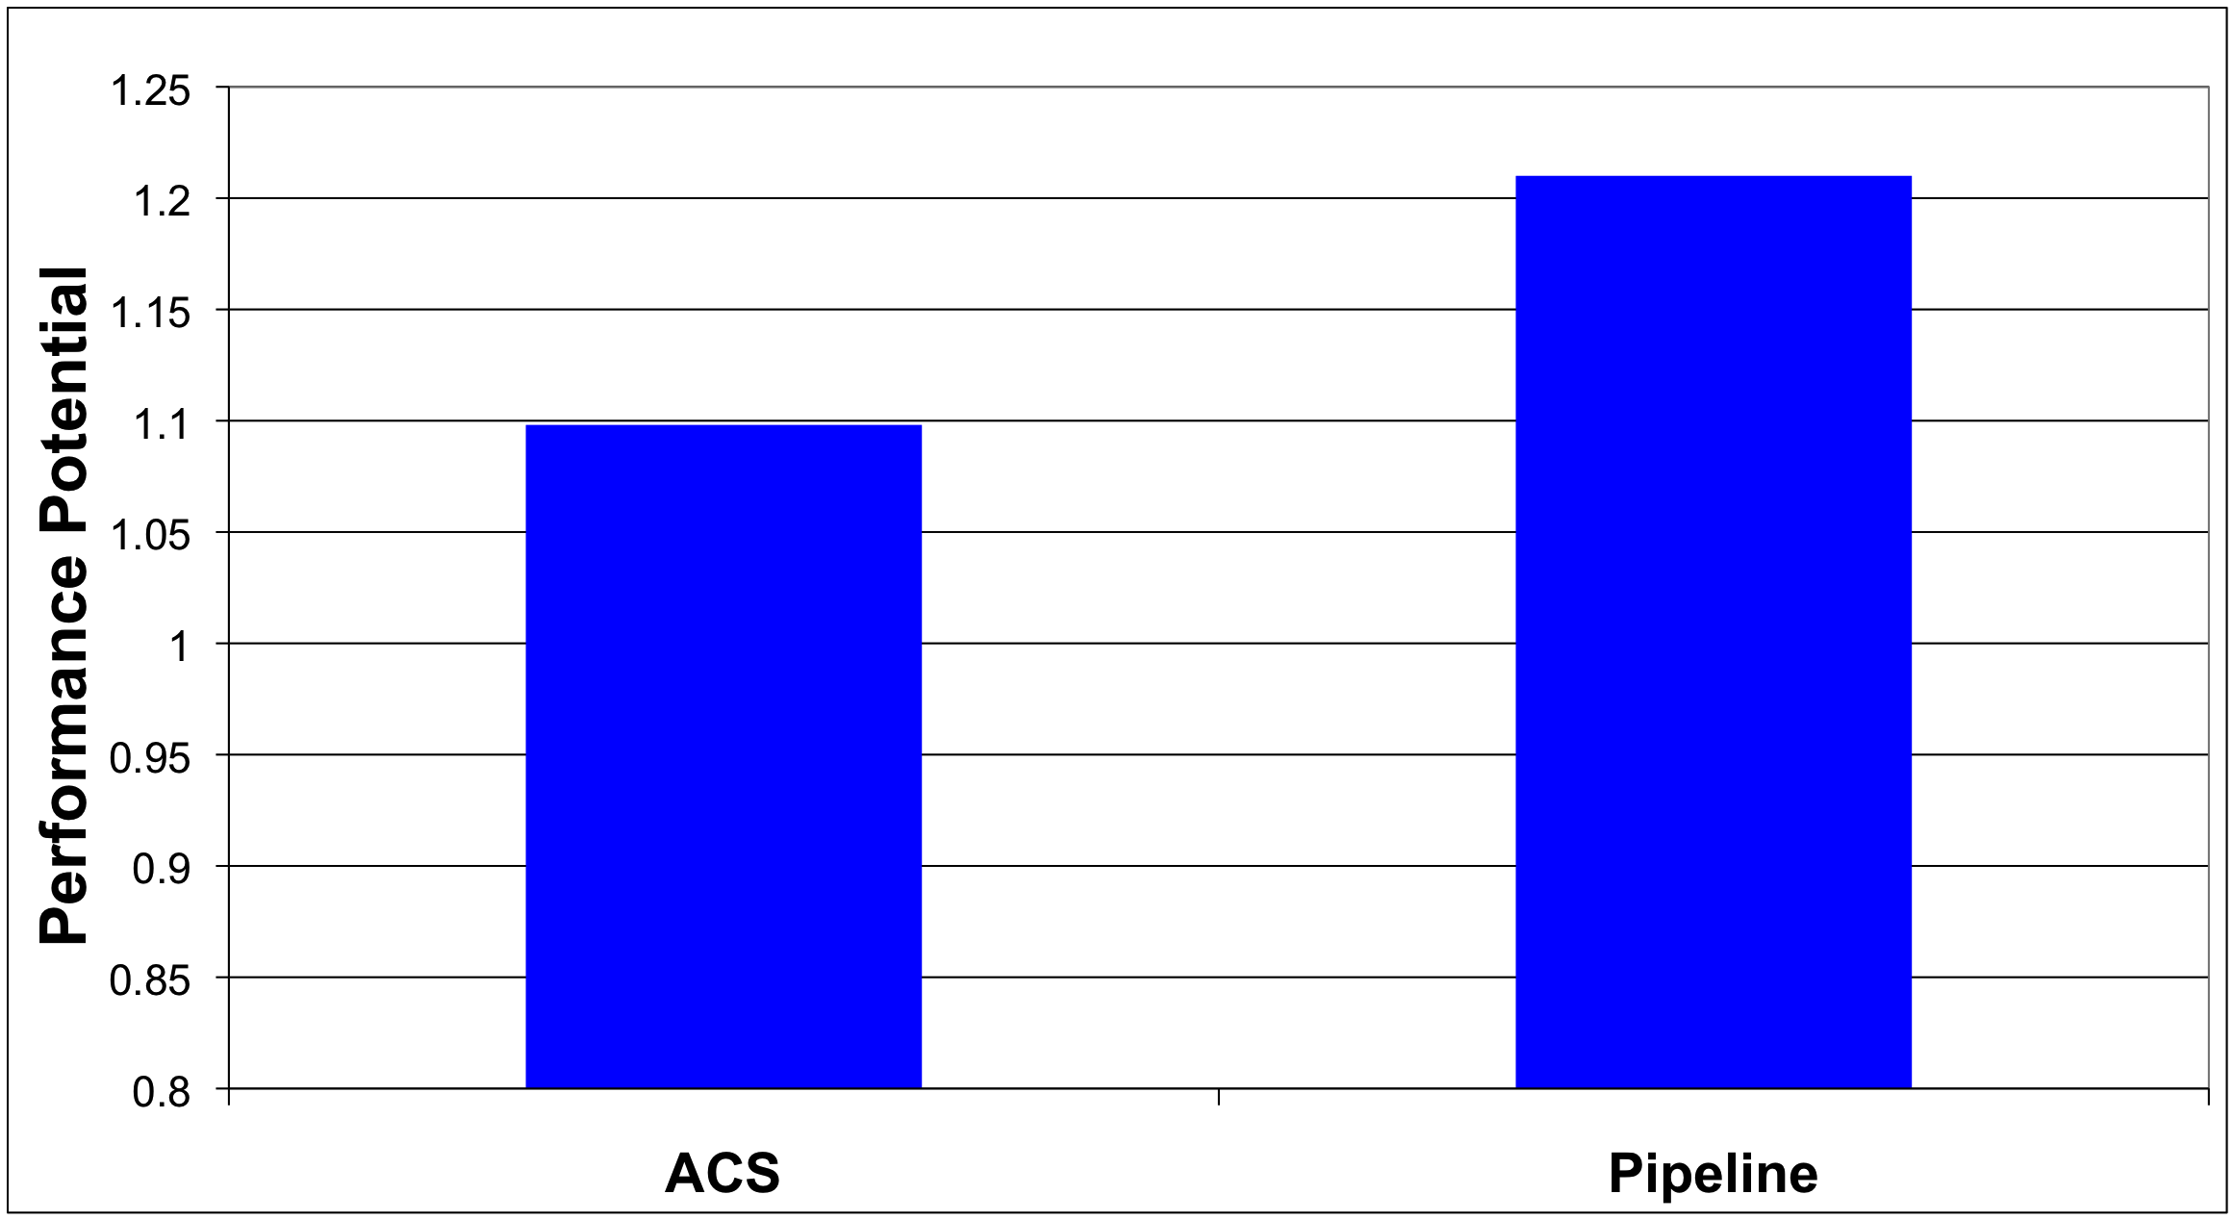
What if We Eliminated All Inter-segment Misses?

Slide 163
Terminology
Core 0
Core 1
Core 2
LOAD X
STORE Y
STORE Y
S0
Inter-segment data: Cache block written by one segment and consumed by the next segment
Transfer Y
LOAD Y
….
STORE Z
S1
Transfer Z
LOAD Z
….
Generator instruction:
The last instruction to write to an inter-segment cache block in a segment
S2
Notes:
Let me first introduce some terminology. >>>
We call the data which is written by one segment and read by the next segment, inter-segment data >>>
In our example, Y and Z are intersegment data. >>>
We call the last instruction to modify intersegment data in a segment a generator. >>>
For example, The instructions which store Y and Z are generator instructions. >>>

Slide 164
Key Observation and Idea
Observation: Set of generator instructions is stable over execution time and across input sets
Idea:
  Identify the generator instructions
  Record cache blocks produced by generator instructions
  Proactively send such cache blocks to the next segment’s core before initiating the next segment
Suleman et al., “Data Marshaling for Multi-Core Architectures,” ISCA 2010, IEEE Micro Top Picks 2011.
Notes:
We made a key observation that lead to the development of data marshaling. We found that across a wide variety of workloads …
Based on this observation, the basic idea is data marshaling is as follows:

Slide 165
Data Marshaling
Compiler/Profiler
Hardware
Identify generator
instructions
Insert marshal
instructions
Record generator-
produced addresses
Marshal recorded
blocks to next core
Binary containing
generator prefixes & marshal Instructions
Notes:
DM consists of two components: Compiler and Hardware.

Slide 166
Data Marshaling
Compiler/Profiler
Hardware
Identify generator
instructions
Insert marshal
instructions
Record generator-
produced addresses
Marshal recorded
blocks to next core
Binary containing
generator prefixes & marshal Instructions
Notes:
The job of the compiler is twofolds.

Slide 167
Profiling Algorithm
Inter-segment data
LOAD X
STORE Y
STORE Y
Mark as Generator Instruction
LOAD Y
….
STORE Z
LOAD Z
….
Notes:
The algorithm runs the program as a single thread and instruments all memory instructions.
Every time an instruction modifies a cache block, the algorithm stores the instruction’s IP as the last-writer of the cache block.
Every time a segment reads a cache block whose last writer is from previous segment, i.e., the data is inter-segment data, the last-writer is added to the generator set.
SPEND LESS TIME

Slide 168
Marshal Instructions
LOAD X
STORE Y
G: STORE Y
MARSHAL C1
When to send (Marshal)
Where to send (C1)
LOAD Y
….
G:STORE Z
MARSHAL C2
0x5: LOAD Z
….
Notes:
In addition to marking the generators, the compiler/library must also insert >>>
a Marshal instruction at the end of every segment.
The instruction informs the hardware that it is time to marshal the lines and the argument to the instruction tells it where the lines should be marshaled to.
(Inserted just before the point where the next segment is initiated)
If segments are not statically scheduled to the cores, the compiler would insert the segment id as argument to the MARSHAL instruction. This segment ID is later bound to a physical core ID via the runtime library or the hardware.
Marshal instructions can come free depending on SE model
SPEND LESS TIME
Binding between segment ID and core ID… accomplished by the runtime library or can be done with hardware dynamically as well if HW scheduling is employed.

Slide 169
DM Support/Cost
Profiler/Compiler: Generators, marshal instructions
ISA: Generator prefix, marshal instructions
Library/Hardware: Bind next segment ID to a physical core
Hardware
  Marshal Buffer
    Stores physical addresses of cache blocks to be marshaled
    16 entries enough for almost all workloads → 96 bytes per core
  Ability to execute generator prefixes and marshal instructions
  Ability to push data to another cache

Slide 170
DM: Advantages, Disadvantages
Advantages
  Timely data transfer: Push data to core before needed
  Can marshal any arbitrary sequence of lines: Identifies generators, not patterns
  Low hardware cost: Profiler marks generators, no need for hardware to find them
Disadvantages
  Requires profiler and ISA support
  Not always accurate (generator set is conservative): Pollution at remote core, wasted bandwidth on interconnect
    Not a large problem as number of inter-segment blocks is small
Notes:
Pollution at remote core

Slide 171
Accelerated Critical Sections with DM
Large Core
LOAD X
STORE Y
G: STORE Y
CSCALL
Small Core 0
Addr Y
LOAD Y
….
G:STORE Z
CSRET
Critical Section
L2
Cache
L2
Cache
Data Y
Marshal
Buffer
Cache Hit!
171
Notes:
171

Slide 172
Accelerated Critical Sections: Methodology
Workloads: 12 critical section intensive applications
  Data mining kernels, sorting, database, web, networking
  Different training and simulation input sets
Multi-core x86 simulator
  1 large and 28 small cores
  Aggressive stream prefetcher employed at each core
Details:
  Large core: 2GHz, out-of-order, 128-entry ROB, 4-wide, 12-stage
  Small core: 2GHz, in-order, 2-wide, 5-stage
  Private 32 KB L1, private 256KB L2, 8MB shared L3
  On-chip interconnect: Bi-directional ring, 5-cycle hop latency

Slide 173
DM on Accelerated Critical Sections: Results
168 170
8.7%
Notes:
I show the speedup of ACMP over SCMP where both of them employ data marshaling. DM improves performance by 8% for critical section-limited workloads and by 16% for pipeline workloads. In both cases, I also show an unrealistic ideal configuration where all misses to private and inter-stage data are artificially converted into hits. Notice that DM gets very close to this unrealistic ideal configuration.

Slide 174
Pipeline Parallelism
Cache Hit!
LOAD X
STORE Y
G: STORE Y
MARSHAL C1
Core 0
Core 1
S0
Addr Y
LOAD Y
….
G:STORE Z
MARSHAL C2
S1
L2
Cache
L2
Cache
Data Y
0x5: LOAD Z
….
Marshal
Buffer
S2
174
Notes:
174
To implement DM, Each core is augmented with a >>>
Marshal Buffer. The marshal buffer stores the addresses of the cache lines to be marshaled. >>>
Every time a core encounters a Generator instruction, it enqueues the address of the cache line being written by the instruction in the marshal buffer. >>>
When a core hits a critical section, it ships al the lines pointed to by the marshal buffer entries to the large core. The large core encounters hits when it needs to access this data.

Slide 175
Pipeline Parallelism: Methodology
Workloads: 9 applications with pipeline parallelism
  Financial, compression, multimedia, encoding/decoding
  Different training and simulation input sets
Multi-core x86 simulator
  32-core CMP: 2GHz, in-order, 2-wide, 5-stage
  Aggressive stream prefetcher employed at each core
  Private 32 KB L1, private 256KB L2, 8MB shared L3
  On-chip interconnect: Bi-directional ring, 5-cycle hop latency

Slide 176
DM on Pipeline Parallelism: Results
16%
Notes:
I show the speedup of ACMP over SCMP where both of them employ data marshaling. DM improves performance by 8% for critical section-limited workloads and by 16% for pipeline workloads. In both cases, I also show an unrealistic ideal configuration where all misses to private and inter-stage data are artificially converted into hits. Notice that DM gets very close to this unrealistic ideal configuration.

Slide 177
DM Coverage, Accuracy, Timeliness
High coverage of inter-segment misses in a timely manner
Medium accuracy does not impact performance
  Only 5.0 and 6.8 cache blocks marshaled for average segment

Slide 178
Scaling Results
DM performance improvement increases with
  More cores
  Higher interconnect latency
  Larger private L2 caches
Why? Inter-segment data misses become a larger bottleneck
  More cores → More communication
  Higher latency → Longer stalls due to communication
  Larger L2 cache → Communication misses remain
Notes:
Relative performance impact of inter-segment data cache misses increases with all three parameters

Slide 179
Other Applications of Data Marshaling
Can be applied to other Staged Execution models
  Task parallelism models
    Cilk, Intel TBB, Apple Grand Central Dispatch
  Special-purpose remote functional units
  Computation spreading [Chakraborty et al., ASPLOS’06]
  Thread motion/migration [e.g., Rangan et al., ISCA’09]
Can be an enabler for more aggressive SE models
  Lowers the cost of data migration
    an important overhead in remote execution of code segments
  Remote execution of finer-grained tasks can become more feasible → finer-grained parallelization in multi-cores

Slide 180
Data Marshaling Summary
Inter-segment data transfers between cores limit the benefit of promising Staged Execution (SE) models
Data Marshaling is a hardware/software cooperative solution: detect inter-segment data generator instructions and push their data to next segment’s core
  Significantly reduces cache misses for inter-segment data
  Low cost, high-coverage, timely for arbitrary address sequences
  Achieves most of the potential of eliminating such misses
Applicable to several existing Staged Execution models
  Accelerated Critical Sections: 9% performance benefit
  Pipeline Parallelism: 16% performance benefit
Can enable new models→ very fine-grained remote execution

Slide 181
A Case for
Asymmetry Everywhere
Onur Mutlu,
"Asymmetry Everywhere (with Automatic Resource Management)"
CRA Workshop on Advancing Computer Architecture Research: Popular Parallel Programming, San Diego, CA, February 2010.
Position paper

Slide 182
The Setting
Hardware resources are shared among many threads/apps in a many-core based system
  Cores, caches, interconnects, memory, disks, power, lifetime, …
Management of these resources is a very difficult task
  When optimizing parallel/multiprogrammed workloads
  Threads interact unpredictably/unfairly in shared resources
Power/energy is arguably the most valuable shared resource
  Main limiter to efficiency and performance

Slide 183
Shield the Programmer from Shared Resources
Writing even sequential software is hard enough
  Optimizing code for a complex shared-resource parallel system will be a nightmare for most programmers
Programmer should not worry about (hardware) resource management
  What should be executed where with what resources
Future cloud computer architectures should be designed to
  Minimize programmer effort to optimize (parallel) programs
  Maximize runtime system’s effectiveness in automatic shared resource management

Slide 184
Shared Resource Management: Goals
Future many-core systems should manage power and performance automatically across threads/applications
Minimize energy/power consumption
While satisfying performance/SLA requirements
  Provide predictability and Quality of Service
Minimize programmer effort
  In creating optimized parallel programs
Asymmetry and configurability in system resources essential to achieve these goals

Slide 185
Asymmetry Enables Customization
Symmetric: One size fits all
  Energy and performance suboptimal for different phase behaviors
Asymmetric: Enables tradeoffs and customization
  Processing requirements vary across applications and phases
  Execute code on best-fit resources (minimal energy, adequate perf.)
C
C
C
C
C1
C2
C
C
C
C
C3
C
C
C
C
C4
C4
C4
C4
C
C
C
C
C5
C5
C5
C5
Symmetric
Asymmetric

Slide 186
Thought Experiment: Asymmetry Everywhere
Design each hardware resource with asymmetric, (re-)configurable, partitionable components
  Different power/performance/reliability characteristics
  To fit different computation/access/communication patterns

Slide 187
Thought Experiment: Asymmetry Everywhere
Design the runtime system (HW & SW) to automatically choose the best-fit components for each workload/phase
  Satisfy performance/SLA with minimal energy
  Dynamically stitch together the “best-fit” chip for each phase

Slide 188
Thought Experiment: Asymmetry Everywhere
Morph software components to match asymmetric HW components
  Multiple versions for different resource characteristics

Slide 189
Many Research and Design Questions
How to design asymmetric components?
  Fixed, partitionable, reconfigurable components?
  What types of asymmetry? Access patterns, technologies?
What monitoring to perform cooperatively in HW/SW?
  Automatically discover phase/task requirements
How to design feedback/control loop between components and runtime system software?
How to design the runtime to automatically manage resources?
  Track task behavior, pick “best-fit” components for the entire workload

Slide 190
Exploiting Asymmetry: Simple Examples
Execute critical/serial sections on high-power, high-performance cores/resources [Suleman+ ASPLOS’09, ISCA’10, Top Picks’10’11, Joao+ ASPLOS’12]
  Programmer can write less optimized, but more likely correct programs

Slide 191
Exploiting Asymmetry: Simple Examples
Execute streaming “memory phases” on streaming-optimized cores and memory hierarchies
  More efficient and higher performance than general purpose hierarchy

Slide 192
Exploiting Asymmetry: Simple Examples
Partition memory controller and on-chip network bandwidth asymmetrically among threads [Kim+ HPCA 2010, MICRO 2010, Top Picks 2011] [Nychis+ HotNets 2010] [Das+ MICRO 2009, ISCA 2010, Top Picks 2011]
  Higher performance and energy-efficiency than symmetric/free-for-all

Slide 193
Exploiting Asymmetry: Simple Examples
Have multiple different memory scheduling policies; apply them to different sets of threads based on thread behavior [Kim+ MICRO 2010, Top Picks 2011] [Ausavarungnirun, ISCA 2012]
  Higher performance and fairness than a homogeneous policy

Slide 194
Exploiting Asymmetry: Simple Examples
CPU
DRAMCtrl
PCM Ctrl
DRAM
Phase Change Memory (or Tech. X)
Fast, durable
Small,
leaky, volatile,
high-cost
Large, non-volatile, low-cost
Slow, wears out, high active energy
Build main memory with different technologies with different characteristics (energy, latency, wear, bandwidth) [Meza+ IEEE CAL’12]
  Map pages/applications to the best-fit memory resource
  Higher performance and energy-efficiency than single-level memory

