Slide 1


Multi-Core Architectures and
Shared Resource Management
Lecture 1.2: Cache Management
Prof. Onur Mutlu
http://www.ece.cmu.edu/~omutlu
onur@cmu.edu
Bogazici University
June 7, 2013

Slide 2
Last Lecture
Parallel Computer Architecture Basics
  Amdahl’s Law
  Bottlenecks in the Parallel Portion (3 fundamental ones)
Why Multi-Core? Alternatives, shortcomings, tradeoffs.
Evolution of Symmetric Multi-Core Systems
  Sun NiagaraX, IBM PowerX, Runahead Execution
Asymmetric Multi-Core Systems
  Accelerated Critical Sections
  Bottleneck Identification and Scheduling

Slide 3
What Will You Learn?
Tentative, Aggressive Schedule
  Lecture 1: Why multi-core? Basics, alternatives, tradeoffs
  Symmetric versus asymmetric multi-core systems
  Lecture 2: Shared cache design for multi-cores
  (if time permits) Interconnect design for multi-cores
  Lecture 3: Data parallelism and GPUs (if time permits)
  (if time permits) Prefetcher design and management

Slide 4
Agenda for Today and Beyond
Wrap up Asymmetric Multi-Core Systems
  Handling Private Data Locality
  Asymmetry Everywhere
Cache design for multi-core systems
Interconnect design for multi-core systems
Prefetcher design for multi-core systems
Data Parallelism and GPUs

Slide 5
Readings for Lecture June 6 (Lecture 1.1)
Required – Symmetric and Asymmetric Multi-Core Systems
  Mutlu et al., “Runahead Execution: An Alternative to Very Large Instruction Windows for Out-of-order Processors,” HPCA 2003, IEEE Micro 2003.
  Suleman et al., “Accelerating Critical Section Execution with Asymmetric Multi-Core Architectures,” ASPLOS 2009, IEEE Micro 2010.
  Suleman et al., “Data Marshaling for Multi-Core Architectures,” ISCA 2010, IEEE Micro 2011.
  Joao et al., “Bottleneck Identification and Scheduling for Multithreaded Applications,” ASPLOS 2012.
  Joao et al., “Utility-Based Acceleration of Multithreaded Applications on Asymmetric CMPs,” ISCA 2013.
Recommended
  Amdahl, “Validity of the single processor approach to achieving large scale computing capabilities,” AFIPS 1967.
  Olukotun et al., “The Case for a Single-Chip Multiprocessor,” ASPLOS 1996.
  Mutlu et al., “Techniques for Efficient Processing in Runahead Execution Engines,” ISCA 2005, IEEE Micro 2006.

Slide 6
Videos for Lecture June 6 (Lecture 1.1)
Runahead Execution
  http://www.youtube.com/watch?v=z8YpjqXQJIA&list=PL5PHm2jkkXmidJOd59REog9jDnPDTG6IJ&index=28
Multiprocessors
  Basics:http://www.youtube.com/watch?v=7ozCK_Mgxfk&list=PL5PHm2jkkXmidJOd59REog9jDnPDTG6IJ&index=31
  Correctness and Coherence: http://www.youtube.com/watch?v=U-VZKMgItDM&list=PL5PHm2jkkXmidJOd59REog9jDnPDTG6IJ&index=32
  Heterogeneous Multi-Core: http://www.youtube.com/watch?v=r6r2NJxj3kI&list=PL5PHm2jkkXmidJOd59REog9jDnPDTG6IJ&index=34

Slide 7
Readings for Lecture June 7 (Lecture 1.2)
Required – Caches in Multi-Core
  Qureshi et al., “A Case for MLP-Aware Cache Replacement,” ISCA 2005.
  Seshadri et al., “The Evicted-Address Filter: A Unified Mechanism to Address both Cache Pollution and Thrashing,” PACT 2012.
  Pekhimenko et al., “Base-Delta-Immediate Compression: Practical Data Compression for On-Chip Caches,” PACT 2012.
  Pekhimenko et al., “Linearly Compressed Pages: A Main Memory Compression Framework with Low Complexity and Low Latency,” SAFARI Technical Report 2013.
Recommended
  Qureshi et al., “Utility-Based Cache Partitioning: A Low-Overhead, High-Performance, Runtime Mechanism to Partition Shared Caches,” MICRO 2006.

Slide 8
Videos for Lecture June7 (Lecture 1.2)
Cache basics:
  http://www.youtube.com/watch?v=TpMdBrM1hVc&list=PL5PHm2jkkXmidJOd59REog9jDnPDTG6IJ&index=23
Advanced caches:
  http://www.youtube.com/watch?v=TboaFbjTd-E&list=PL5PHm2jkkXmidJOd59REog9jDnPDTG6IJ&index=24

Slide 9
Readings for Lecture June 10 (Lecture 1.3)
Required – Interconnects in Multi-Core
  Moscibroda and Mutlu, “A Case for Bufferless Routing in On-Chip Networks,” ISCA 2009.
  Fallin et al., “CHIPPER: A Low-Complexity Bufferless Deflection Router,” HPCA 2011.
  Fallin et al., “MinBD: Minimally-Buffered Deflection Routing for Energy-Efficient Interconnect,” NOCS 2012.
  Das et al., “Application-Aware Prioritization Mechanisms for On-Chip Networks,” MICRO 2009.
  Das et al., “Aergia: Exploiting Packet Latency Slack in On-Chip Networks,” ISCA 2010, IEEE Micro 2011.
Recommended
  Grot et al. “Preemptive Virtual Clock: A Flexible, Efficient, and Cost-effective QOS Scheme for Networks-on-Chip,” MICRO 2009.
  Grot et al., “Kilo-NOC: A Heterogeneous Network-on-Chip Architecture for Scalability and Service Guarantees,” ISCA 2011, IEEE Micro 2012.

Slide 10
Videos for Lecture June 10 (Lecture 1.3)
Interconnects
  http://www.youtube.com/watch?v=6xEpbFVgnf8&list=PL5PHm2jkkXmidJOd59REog9jDnPDTG6IJ&index=33
GPUs and SIMD processing
  Vector/array processing basics: http://www.youtube.com/watch?v=f-XL4BNRoBA&list=PL5PHm2jkkXmidJOd59REog9jDnPDTG6IJ&index=15
  GPUs versus other execution models: http://www.youtube.com/watch?v=dl5TZ4-oao0&list=PL5PHm2jkkXmidJOd59REog9jDnPDTG6IJ&index=19
  GPUs in more detail: http://www.youtube.com/watch?v=vr5hbSkb1Eg&list=PL5PHm2jkkXmidJOd59REog9jDnPDTG6IJ&index=20

Slide 11
Readings for Prefetching
Prefetching
  Srinath et al., “Feedback Directed Prefetching: Improving the Performance and Bandwidth-Efficiency of Hardware Prefetchers,” HPCA 2007.
  Ebrahimi et al., “Coordinated Control of Multiple Prefetchers in Multi-Core Systems,” MICRO 2009.
  Ebrahimi et al., “Techniques for Bandwidth-Efficient Prefetching of Linked Data Structures in Hybrid Prefetching Systems,” HPCA 2009.
  Ebrahimi et al., “Prefetch-Aware Shared Resource Management for Multi-Core Systems,” ISCA 2011.
  Lee et al., “Prefetch-Aware DRAM Controllers,” MICRO 2008.
Recommended
  Lee et al., “Improving Memory Bank-Level Parallelism in the Presence of Prefetching,” MICRO 2009.

Slide 12
Videos for Prefetching
Prefetching
  http://www.youtube.com/watch?v=IIkIwiNNl0c&list=PL5PHm2jkkXmidJOd59REog9jDnPDTG6IJ&index=29
  http://www.youtube.com/watch?v=yapQavK6LUk&list=PL5PHm2jkkXmidJOd59REog9jDnPDTG6IJ&index=30

Slide 13
Readings for GPUs and SIMD
GPUs and SIMD processing
  Narasiman et al., “Improving GPU Performance via Large Warps and Two-Level Warp Scheduling,” MICRO 2011.
  Jog et al., “OWL: Cooperative Thread Array Aware Scheduling Techniques for Improving GPGPU Performance,” ASPLOS 2013.
  Jog et al., “Orchestrated Scheduling and Prefetching for GPGPUs,” ISCA 2013.
  Lindholm et al., “NVIDIA Tesla: A Unified Graphics and Computing Architecture,” IEEE Micro 2008.
  Fung et al., “Dynamic Warp Formation and Scheduling for Efficient GPU Control Flow,” MICRO 2007.

Slide 14
Videos for GPUs and SIMD
GPUs and SIMD processing
  Vector/array processing basics: http://www.youtube.com/watch?v=f-XL4BNRoBA&list=PL5PHm2jkkXmidJOd59REog9jDnPDTG6IJ&index=15
  GPUs versus other execution models: http://www.youtube.com/watch?v=dl5TZ4-oao0&list=PL5PHm2jkkXmidJOd59REog9jDnPDTG6IJ&index=19
  GPUs in more detail: http://www.youtube.com/watch?v=vr5hbSkb1Eg&list=PL5PHm2jkkXmidJOd59REog9jDnPDTG6IJ&index=20

Slide 15
Online Lectures and More Information
Online Computer Architecture Lectures
  http://www.youtube.com/playlist?list=PL5PHm2jkkXmidJOd59REog9jDnPDTG6IJ
Online Computer Architecture Courses
  Intro: http://www.ece.cmu.edu/~ece447/s13/doku.php
  Advanced: http://www.ece.cmu.edu/~ece740/f11/doku.php
  Advanced: http://www.ece.cmu.edu/~ece742/doku.php
Recent Research Papers
  http://users.ece.cmu.edu/~omutlu/projects.htm
  http://scholar.google.com/citations?user=7XyGUGkAAAAJ&hl=en

Slide 16
Asymmetric Multi-Core Systems Continued

Slide 17
Handling Private Data Locality:
Data Marshaling
M. Aater Suleman, Onur Mutlu, Jose A. Joao, Khubaib, and Yale N. Patt,
"Data Marshaling for Multi-core Architectures"
Proceedings of the 37th International Symposium on Computer Architecture (ISCA), pages 441-450, Saint-Malo, France, June 2010.

Slide 18
Staged Execution Model (I)
Goal: speed up a program by dividing it up into pieces
Idea
  Split program code into segments
  Run each segment on the core best-suited to run it
  Each core assigned a work-queue, storing segments to be run
Benefits
  Accelerates segments/critical-paths using specialized/heterogeneous cores
  Exploits inter-segment parallelism
  Improves locality of within-segment data
Examples
  Accelerated critical sections, Bottleneck identification and scheduling
  Producer-consumer pipeline parallelism
  Task parallelism (Cilk, Intel TBB, Apple Grand Central Dispatch)
  Special-purpose cores and functional units
Notes:
Accelerate critical paths
Ship computation to data (A segmenting approach)

Slide 19
Staged Execution Model (II)
LOAD X
STORE Y
STORE Y
LOAD Y
….
STORE Z
LOAD Z
….
Notes:
Let me demonstrate the staged execution model pictorially. Assume that we have this contiguous chunk of code. I show only loads and stores since they are relevant to our work.

Slide 20
Staged Execution Model (III)
Split code into segments
Segment S0
LOAD X
STORE Y
STORE Y
Segment S1
LOAD Y
….
STORE Z
Segment S2
LOAD Z
….
Notes:
This figure shows the same chunk of code split into three segments, S0, S1, S2.
This split can be done statically and dynamically, and it is not the focus of our paper. However, I will soon show you two paradigms that split the code in different ways.

Slide 21
Staged Execution Model (IV)
Core 0
Core 1
Core 2
Work-queues
Instances
of S0
Instances
of S1
Instances
of S2
Notes:
Once the split is done, each segment is assigned to a different core (this assignment can be done statically or dynamically, and again has been covered in previous work).
The work queue of each core contains the segments to be executed in that core.
In this example, S0 is executed in core 0, S1 executed in core 1, and so on.
*** Usually, to preserve locality and take advantage of customization, a segment is executed in one core.
*** This also preserves the locality of data that is commonly touched by instances of S0, S1, and S2 (intra-segment data, or shared data among instances of the same segment).

Slide 22
Staged Execution Model: Segment Spawning
Core 0
Core 1
Core 2
LOAD X
STORE Y
STORE Y
S0
LOAD Y
….
STORE Z
S1
LOAD Z
….
S2
Notes:
A segment that is executing on one core spawns another segment on another core, which in turn can spawn another segment in another core. These segments may need to communicate with each other because a later segment may need the data produced by a previous segment.
Segment spawning:
OLD:
When these segment runs on three cores P0, P1 and P2, core>>>
P1 incurs a cache miss to fetch Y and >>>
P2 incurs a cache miss to fetch Z
We cnan avoid these misses by shipping the data required by a segment to the core where the segment will run.

Slide 23
Staged Execution Model: Two Examples
Accelerated Critical Sections [Suleman et al., ASPLOS 2009]
  Idea: Ship critical sections to a large core in an asymmetric CMP
    Segment 0: Non-critical section
    Segment 1: Critical section
  Benefit: Faster execution of critical section, reduced serialization, improved lock and shared data locality
Producer-Consumer Pipeline Parallelism
  Idea: Split a loop iteration into multiple “pipeline stages” where one stage consumes data produced by the next stage → each stage runs on a different core
    Segment N: Stage N
  Benefit: Stage-level parallelism, better locality → faster execution
Notes:
Let me give you two concrete examples of staged execution models. I will extensively use these examples to show the benefits of data marshaling.

Slide 24
Problem: Locality of Inter-segment Data
Core 0
Core 1
Core 2
LOAD X
STORE Y
STORE Y
S0
Transfer Y
Cache Miss
LOAD Y
….
STORE Z
S1
Transfer Z
Cache Miss
LOAD Z
….
S2
Notes:
The problem is that when segments execute on different cores, they may need data produced by previous segments.
In this example, when S1 is executing Load to address Y on Core 1, it will incur a cache miss on the cache block containing Y because Core 0 was the last writer to that block.
If there is an inter-segment cache miss, the core that executes the segment will stall (or progress more slowly).
These intra-segment communication misses reduce the performance potential of staged execution.

Slide 25
Problem: Locality of Inter-segment Data
Accelerated Critical Sections [Suleman et al., ASPLOS 2010]
  Idea: Ship critical sections to a large core in an ACMP
  Problem: Critical section incurs a cache miss when it touches data produced in the non-critical section (i.e., thread private data)
Producer-Consumer Pipeline Parallelism
  Idea: Split a loop iteration into multiple “pipeline stages” → each stage runs on a different core
  Problem: A stage incurs a cache miss when it touches data produced by the previous stage
Performance of Staged Execution limited by inter-segment cache misses
Notes:
Let’s quickly take a look at what these misses look like in the two models we have discussed.
Remember in ACS, the critical sections are shipped to a large core. This means that the thread-private data that is produced outside the critical section and consumed inside it needs to be transferred to the large core when the critical section needs this data.
Similarly, in pipeline parallelism, …
…
But what is the effect of such cache misses on overall performance?

Slide 26
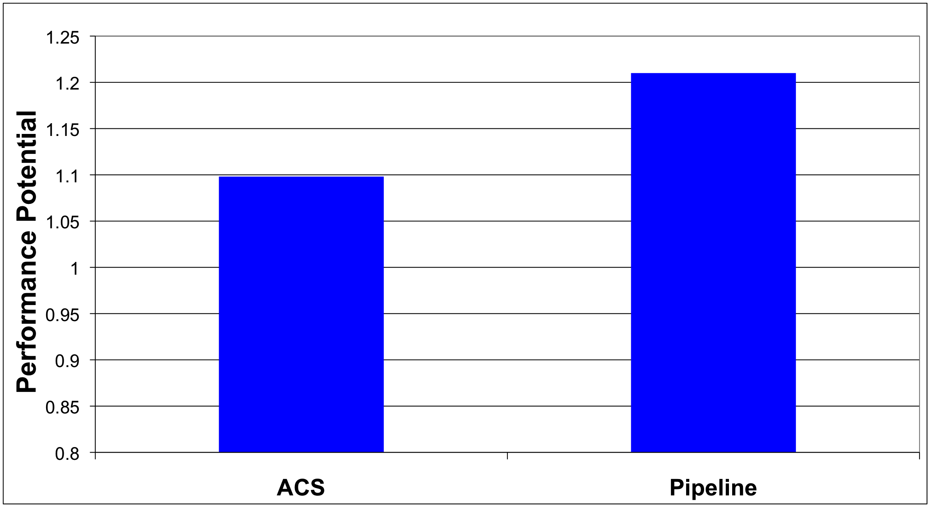
What if We Eliminated All Inter-segment Misses?

Slide 27
Terminology
Core 0
Core 1
Core 2
LOAD X
STORE Y
STORE Y
S0
Inter-segment data: Cache block written by one segment and consumed by the next segment
Transfer Y
LOAD Y
….
STORE Z
S1
Transfer Z
LOAD Z
….
Generator instruction:
The last instruction to write to an inter-segment cache block in a segment
S2
Notes:
Let me first introduce some terminology. >>>
We call the data which is written by one segment and read by the next segment, inter-segment data >>>
In our example, Y and Z are intersegment data. >>>
We call the last instruction to modify intersegment data in a segment a generator. >>>
For example, The instructions which store Y and Z are generator instructions. >>>

Slide 28
Key Observation and Idea
Observation: Set of generator instructions is stable over execution time and across input sets
Idea:
  Identify the generator instructions
  Record cache blocks produced by generator instructions
  Proactively send such cache blocks to the next segment’s core before initiating the next segment
Suleman et al., “Data Marshaling for Multi-Core Architectures,” ISCA 2010, IEEE Micro Top Picks 2011.
Notes:
We made a key observation that lead to the development of data marshaling. We found that across a wide variety of workloads …
Based on this observation, the basic idea is data marshaling is as follows:

Slide 29
Data Marshaling
Compiler/Profiler
Hardware
Identify generator
instructions
Insert marshal
instructions
Record generator-
produced addresses
Marshal recorded
blocks to next core
Binary containing
generator prefixes & marshal Instructions
Notes:
DM consists of two components: Compiler and Hardware.

Slide 30
Data Marshaling
Compiler/Profiler
Hardware
Identify generator
instructions
Insert marshal
instructions
Record generator-
produced addresses
Marshal recorded
blocks to next core
Binary containing
generator prefixes & marshal Instructions
Notes:
The job of the compiler is twofolds.

Slide 31
Profiling Algorithm
Inter-segment data
LOAD X
STORE Y
STORE Y
Mark as Generator Instruction
LOAD Y
….
STORE Z
LOAD Z
….
Notes:
The algorithm runs the program as a single thread and instruments all memory instructions.
Every time an instruction modifies a cache block, the algorithm stores the instruction’s IP as the last-writer of the cache block.
Every time a segment reads a cache block whose last writer is from previous segment, i.e., the data is inter-segment data, the last-writer is added to the generator set.
SPEND LESS TIME

Slide 32
Marshal Instructions
LOAD X
STORE Y
G: STORE Y
MARSHAL C1
When to send (Marshal)
Where to send (C1)
LOAD Y
….
G:STORE Z
MARSHAL C2
0x5: LOAD Z
….
Notes:
In addition to marking the generators, the compiler/library must also insert >>>
a Marshal instruction at the end of every segment.
The instruction informs the hardware that it is time to marshal the lines and the argument to the instruction tells it where the lines should be marshaled to.
(Inserted just before the point where the next segment is initiated)
If segments are not statically scheduled to the cores, the compiler would insert the segment id as argument to the MARSHAL instruction. This segment ID is later bound to a physical core ID via the runtime library or the hardware.
Marshal instructions can come free depending on SE model
SPEND LESS TIME
Binding between segment ID and core ID… accomplished by the runtime library or can be done with hardware dynamically as well if HW scheduling is employed.

Slide 33
DM Support/Cost
Profiler/Compiler: Generators, marshal instructions
ISA: Generator prefix, marshal instructions
Library/Hardware: Bind next segment ID to a physical core
Hardware
  Marshal Buffer
    Stores physical addresses of cache blocks to be marshaled
    16 entries enough for almost all workloads → 96 bytes per core
  Ability to execute generator prefixes and marshal instructions
  Ability to push data to another cache

Slide 34
DM: Advantages, Disadvantages
Advantages
  Timely data transfer: Push data to core before needed
  Can marshal any arbitrary sequence of lines: Identifies generators, not patterns
  Low hardware cost: Profiler marks generators, no need for hardware to find them
Disadvantages
  Requires profiler and ISA support
  Not always accurate (generator set is conservative): Pollution at remote core, wasted bandwidth on interconnect
    Not a large problem as number of inter-segment blocks is small
Notes:
Pollution at remote core

Slide 35
Accelerated Critical Sections with DM
Large Core
LOAD X
STORE Y
G: STORE Y
CSCALL
Small Core 0
Addr Y
LOAD Y
….
G:STORE Z
CSRET
Critical Section
L2
Cache
L2
Cache
Data Y
Marshal
Buffer
Cache Hit!
35
Notes:
35

Slide 36
Accelerated Critical Sections: Methodology
Workloads: 12 critical section intensive applications
  Data mining kernels, sorting, database, web, networking
  Different training and simulation input sets
Multi-core x86 simulator
  1 large and 28 small cores
  Aggressive stream prefetcher employed at each core
Details:
  Large core: 2GHz, out-of-order, 128-entry ROB, 4-wide, 12-stage
  Small core: 2GHz, in-order, 2-wide, 5-stage
  Private 32 KB L1, private 256KB L2, 8MB shared L3
  On-chip interconnect: Bi-directional ring, 5-cycle hop latency

Slide 37
DM on Accelerated Critical Sections: Results
168 170
8.7%
Notes:
I show the speedup of ACMP over SCMP where both of them employ data marshaling. DM improves performance by 8% for critical section-limited workloads and by 16% for pipeline workloads. In both cases, I also show an unrealistic ideal configuration where all misses to private and inter-stage data are artificially converted into hits. Notice that DM gets very close to this unrealistic ideal configuration.

Slide 38
Pipeline Parallelism
Cache Hit!
LOAD X
STORE Y
G: STORE Y
MARSHAL C1
Core 0
Core 1
S0
Addr Y
LOAD Y
….
G:STORE Z
MARSHAL C2
S1
L2
Cache
L2
Cache
Data Y
0x5: LOAD Z
….
Marshal
Buffer
S2
38
Notes:
38
To implement DM, Each core is augmented with a >>>
Marshal Buffer. The marshal buffer stores the addresses of the cache lines to be marshaled. >>>
Every time a core encounters a Generator instruction, it enqueues the address of the cache line being written by the instruction in the marshal buffer. >>>
When a core hits a critical section, it ships al the lines pointed to by the marshal buffer entries to the large core. The large core encounters hits when it needs to access this data.

Slide 39
Pipeline Parallelism: Methodology
Workloads: 9 applications with pipeline parallelism
  Financial, compression, multimedia, encoding/decoding
  Different training and simulation input sets
Multi-core x86 simulator
  32-core CMP: 2GHz, in-order, 2-wide, 5-stage
  Aggressive stream prefetcher employed at each core
  Private 32 KB L1, private 256KB L2, 8MB shared L3
  On-chip interconnect: Bi-directional ring, 5-cycle hop latency

Slide 40
DM on Pipeline Parallelism: Results
16%
Notes:
I show the speedup of ACMP over SCMP where both of them employ data marshaling. DM improves performance by 8% for critical section-limited workloads and by 16% for pipeline workloads. In both cases, I also show an unrealistic ideal configuration where all misses to private and inter-stage data are artificially converted into hits. Notice that DM gets very close to this unrealistic ideal configuration.

Slide 41
DM Coverage, Accuracy, Timeliness
High coverage of inter-segment misses in a timely manner
Medium accuracy does not impact performance
  Only 5.0 and 6.8 cache blocks marshaled for average segment

Slide 42
Scaling Results
DM performance improvement increases with
  More cores
  Higher interconnect latency
  Larger private L2 caches
Why?
  Inter-segment data misses become a larger bottleneck
  More cores → More communication
  Higher latency → Longer stalls due to communication
  Larger L2 cache → Communication misses remain
Notes:
Relative performance impact of inter-segment data cache misses increases with all three parameters

Slide 43
Other Applications of Data Marshaling
Can be applied to other Staged Execution models
  Task parallelism models
    Cilk, Intel TBB, Apple Grand Central Dispatch
  Special-purpose remote functional units
  Computation spreading [Chakraborty et al., ASPLOS’06]
  Thread motion/migration [e.g., Rangan et al., ISCA’09]
Can be an enabler for more aggressive SE models
  Lowers the cost of data migration
    an important overhead in remote execution of code segments
  Remote execution of finer-grained tasks can become more feasible → finer-grained parallelization in multi-cores

Slide 44
Data Marshaling Summary
Inter-segment data transfers between cores limit the benefit of promising Staged Execution (SE) models
Data Marshaling is a hardware/software cooperative solution: detect inter-segment data generator instructions and push their data to next segment’s core
  Significantly reduces cache misses for inter-segment data
  Low cost, high-coverage, timely for arbitrary address sequences
  Achieves most of the potential of eliminating such misses
Applicable to several existing Staged Execution models
  Accelerated Critical Sections: 9% performance benefit
  Pipeline Parallelism: 16% performance benefit
Can enable new models→ very fine-grained remote execution

Slide 45
A Case for
Asymmetry Everywhere
Onur Mutlu,
"Asymmetry Everywhere (with Automatic Resource Management)"
CRA Workshop on Advancing Computer Architecture Research: Popular Parallel Programming, San Diego, CA, February 2010.
Position paper

Slide 46
The Setting
Hardware resources are shared among many threads/apps in a many-core based system
  Cores, caches, interconnects, memory, disks, power, lifetime, …
Management of these resources is a very difficult task
  When optimizing parallel/multiprogrammed workloads
  Threads interact unpredictably/unfairly in shared resources
Power/energy is arguably the most valuable shared resource
  Main limiter to efficiency and performance

Slide 47
Shield the Programmer from Shared Resources
Writing even sequential software is hard enough
  Optimizing code for a complex shared-resource parallel system will be a nightmare for most programmers
Programmer should not worry about (hardware) resource management
  What should be executed where with what resources
Future cloud computer architectures should be designed to
  Minimize programmer effort to optimize (parallel) programs
  Maximize runtime system’s effectiveness in automatic shared resource management

Slide 48
Shared Resource Management: Goals
Future many-core systems should manage power and performance automatically across threads/applications
Minimize energy/power consumption
While satisfying performance/SLA requirements
  Provide predictability and Quality of Service
Minimize programmer effort
  In creating optimized parallel programs
Asymmetry and configurability in system resources essential to achieve these goals

Slide 49
Asymmetry Enables Customization
Symmetric: One size fits all
  Energy and performance suboptimal for different phase behaviors
Asymmetric: Enables tradeoffs and customization
  Processing requirements vary across applications and phases
  Execute code on best-fit resources (minimal energy, adequate perf.)
C
C
C
C
C1
C2
C
C
C
C
C3
C
C
C
C
C4
C4
C4
C4
C
C
C
C
C5
C5
C5
C5
Symmetric
Asymmetric

Slide 50
Thought Experiment: Asymmetry Everywhere
Design each hardware resource with asymmetric, (re-)configurable, partitionable components
  Different power/performance/reliability characteristics
  To fit different computation/access/communication patterns

Slide 51
Thought Experiment: Asymmetry Everywhere
Design the runtime system (HW & SW) to automatically choose the best-fit components for each workload/phase
  Satisfy performance/SLA with minimal energy
  Dynamically stitch together the “best-fit” chip for each phase

Slide 52
Thought Experiment: Asymmetry Everywhere
Morph software components to match asymmetric HW components
  Multiple versions for different resource characteristics

Slide 53
Many Research and Design Questions
How to design asymmetric components?
  Fixed, partitionable, reconfigurable components?
  What types of asymmetry? Access patterns, technologies?
What monitoring to perform cooperatively in HW/SW?
  Automatically discover phase/task requirements
How to design feedback/control loop between components and runtime system software?
How to design the runtime to automatically manage resources?
  Track task behavior, pick “best-fit” components for the entire workload

Slide 54
Exploiting Asymmetry: Simple Examples
Execute critical/serial sections on high-power, high-performance cores/resources [Suleman+ ASPLOS’09, ISCA’10, Top Picks’10’11, Joao+ ASPLOS’12]
  Programmer can write less optimized, but more likely correct programs

Slide 55
Exploiting Asymmetry: Simple Examples
Execute streaming “memory phases” on streaming-optimized cores and memory hierarchies
  More efficient and higher performance than general purpose hierarchy

Slide 56
Exploiting Asymmetry: Simple Examples
Partition memory controller and on-chip network bandwidth asymmetrically among threads [Kim+ HPCA 2010, MICRO 2010, Top Picks 2011] [Nychis+ HotNets 2010] [Das+ MICRO 2009, ISCA 2010, Top Picks 2011]
  Higher performance and energy-efficiency than symmetric/free-for-all

Slide 57
Exploiting Asymmetry: Simple Examples
Have multiple different memory scheduling policies; apply them to different sets of threads based on thread behavior [Kim+ MICRO 2010, Top Picks 2011] [Ausavarungnirun, ISCA 2012]
  Higher performance and fairness than a homogeneous policy

Slide 58
Exploiting Asymmetry: Simple Examples
CPU
DRAMCtrl
PCM Ctrl
DRAM
Phase Change Memory (or Tech. X)
Fast, durable
Small,
leaky, volatile,
high-cost
Large, non-volatile, low-cost
Slow, wears out, high active energy
Build main memory with different technologies with different characteristics (energy, latency, wear, bandwidth) [Meza+ IEEE CAL’12]
  Map pages/applications to the best-fit memory resource
  Higher performance and energy-efficiency than single-level memory

Slide 59
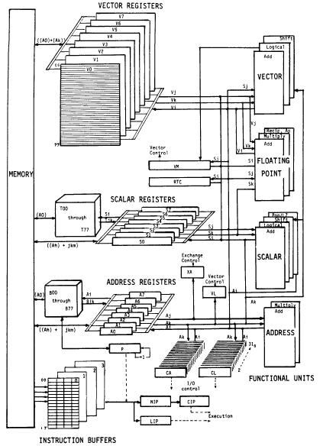
Vector Machine Organization (CRAY-1)
CRAY-1
Russell, “The CRAY-1 computer system,” CACM 1978.
Scalar and vector modes
8 64-element vector registers
64 bits per element
16 memory banks
8 64-bit scalar registers
8 24-bit address registers

Slide 60
Research in Asymmetric Multi-Core
How to Design Asymmetric Cores
  Static
  Dynamic
    Can you fuse in-order cores easily to build an OoO core?
  How to create asymmetry
How to divide the program to best take advantage of asymmetry?
  Explicit vs. transparent
How to match arbitrary program phases to the best-fitting core?
How to minimize code/data migration overhead?
How to satisfy shared resource requirements of different cores?

Slide 61
Related Ongoing/Future Work
Dynamically asymmetric cores
Memory system design for asymmetric cores
Asymmetric memory systems
  Phase Change Memory (or Technology X) + DRAM
  Hierarchies optimized for different access patterns
Asymmetric on-chip interconnects
  Interconnects optimized for different application requirements
Asymmetric resource management algorithms
  E.g., network congestion control
Interaction of multiprogrammed multithreaded workloads

Slide 62
Summary: Asymmetric Design
Applications and phases have varying performance requirements
Designs evaluated on multiple metrics/constraints: energy, performance, reliability, fairness, …
One-size-fits-all design cannot satisfy all requirements and metrics: cannot get the best of all worlds
Asymmetry in design enables tradeoffs: can get the best of all worlds
  Asymmetry in core microarch. → Accelerated Critical Sections, BIS, DM → Good parallel performance + Good serialized performance
  Asymmetry in memory scheduling → Thread Cluster Memory Scheduling → Good throughput + good fairness
  Asymmetry in main memory → Best of multiple technologies
Simple asymmetric designs can be effective and low-cost

Slide 63
Further Reading

Slide 64
Shared Resource Design for Multi-Core Systems

Slide 65
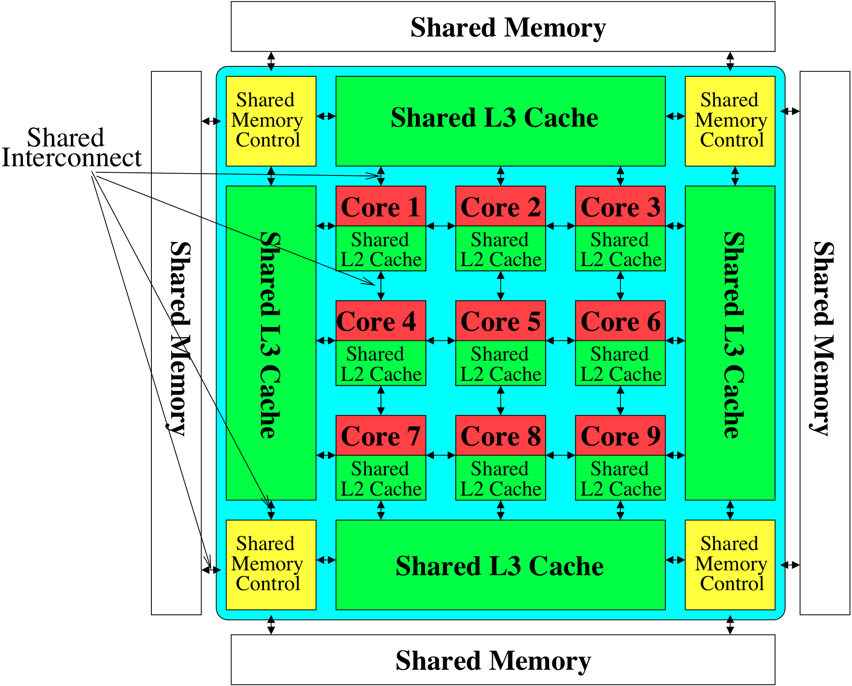

The Multi-Core System: A Shared Resource View
Shared
Storage

Slide 66
Resource Sharing Concept
Idea: Instead of dedicating a hardware resource to a hardware context, allow multiple contexts to use it
  Example resources: functional units, pipeline, caches, buses, memory
Why?
+ Resource sharing improves utilization/efficiency → throughput
  When a resource is left idle by one thread, another thread can use it; no need to replicate shared data
+ Reduces communication latency
  For example, shared data kept in the same cache in SMT processors
+ Compatible with the shared memory model

Slide 67
Resource Sharing Disadvantages
Resource sharing results in contention for resources
  When the resource is not idle, another thread cannot use it
  If space is occupied by one thread, another thread needs to re-occupy it
- Sometimes reduces each or some thread’s performance
- Thread performance can be worse than when it is run alone
- Eliminates performance isolation → inconsistent performance across runs
- Thread performance depends on co-executing threads
- Uncontrolled (free-for-all) sharing degrades QoS
- Causes unfairness, starvation
Need to efficiently and fairly utilize shared resources

Slide 68
Need for QoS and Shared Resource Mgmt.
Why is unpredictable performance (or lack of QoS) bad?
Makes programmer’s life difficult
  An optimized program can get low performance (and performance varies widely depending on co-runners)
Causes discomfort to user
  An important program can starve
  Examples from shared software resources
Makes system management difficult
  How do we enforce a Service Level Agreement when hardware resources are sharing is uncontrollable?

Slide 69
Resource Sharing vs. Partitioning
Sharing improves throughput
  Better utilization of space
Partitioning provides performance isolation (predictable performance)
  Dedicated space
Can we get the benefits of both?
Idea: Design shared resources such that they are efficiently utilized, controllable and partitionable
  No wasted resource + QoS mechanisms for threads

Slide 70
Shared Hardware Resources
Memory subsystem (in both MT and CMP)
  Non-private caches
  Interconnects
  Memory controllers, buses, banks
I/O subsystem (in both MT and CMP)
  I/O, DMA controllers
  Ethernet controllers
Processor (in MT)
  Pipeline resources
  L1 caches

Slide 71
Multi-core Issues in Caching
How does the cache hierarchy change in a multi-core system?
Private cache: Cache belongs to one core (a shared block can be in multiple caches)
Shared cache: Cache is shared by multiple cores
CORE 0
CORE 1
CORE 2
CORE 3
CORE 0
CORE 1
CORE 2
CORE 3
L2
CACHE
L2
CACHE
L2
CACHE
L2
CACHE
L2
CACHE
DRAM MEMORY CONTROLLER
DRAM MEMORY CONTROLLER

Slide 72
Shared Caches Between Cores
Advantages:
  High effective capacity
  Dynamic partitioning of available cache space
    No fragmentation due to static partitioning
  Easier to maintain coherence (a cache block is in a single location)
  Shared data and locks do not ping pong between caches
Disadvantages
  Slower access
  Cores incur conflict misses due to other cores’ accesses
    Misses due to inter-core interference
    Some cores can destroy the hit rate of other cores
  Guaranteeing a minimum level of service (or fairness) to each core is harder (how much space, how much bandwidth?)

Slide 73
Shared Caches: How to Share?
Free-for-all sharing
  Placement/replacement policies are the same as a single core system (usually LRU or pseudo-LRU)
  Not thread/application aware
  An incoming block evicts a block regardless of which threads the blocks belong to
Problems
  Inefficient utilization of cache: LRU is not the best policy
  A cache-unfriendly application can destroy the performance of a cache friendly application
  Not all applications benefit equally from the same amount of cache: free-for-all might prioritize those that do not benefit
  Reduced performance, reduced fairness

Slide 74
Controlled Cache Sharing
Utility based cache partitioning
  Qureshi and Patt, “Utility-Based Cache Partitioning: A Low-Overhead, High-Performance, Runtime Mechanism to Partition Shared Caches,” MICRO 2006.
  Suh et al., “A New Memory Monitoring Scheme for Memory-Aware Scheduling and Partitioning,” HPCA 2002.
Fair cache partitioning
  Kim et al., “Fair Cache Sharing and Partitioning in a Chip Multiprocessor Architecture,” PACT 2004.
Shared/private mixed cache mechanisms
  Qureshi, “Adaptive Spill-Receive for Robust High-Performance Caching in CMPs,” HPCA 2009.
  Hardavellas et al., “Reactive NUCA: Near-Optimal Block Placement and Replication in Distributed Caches,” ISCA 2009.

Slide 75
Efficient Cache Utilization
Qureshi et al., “A Case for MLP-Aware Cache Replacement,” ISCA 2005.
Seshadri et al., “The Evicted-Address Filter: A Unified Mechanism to Address both Cache Pollution and Thrashing,” PACT 2012.
Pekhimenko et al., “Base-Delta-Immediate Compression: Practical Data Compression for On-Chip Caches,” PACT 2012.
Pekhimenko et al., “Linearly Compressed Pages: A Main Memory Compression Framework with Low Complexity and Low Latency,” SAFARI Technical Report 2013.

Slide 76
MLP-Aware Cache Replacement
Moinuddin K. Qureshi, Daniel N. Lynch, Onur Mutlu, and Yale N. Patt,
"A Case for MLP-Aware Cache Replacement"
Proceedings of the 33rd International Symposium on Computer Architecture (ISCA), pages 167-177, Boston, MA, June 2006. Slides (ppt)

Slide 77
Memory Level Parallelism (MLP)
isolated miss
parallel miss
B
A
C
time
Memory Level Parallelism (MLP) means generating and servicing multiple memory accesses in parallel [Glew’98]
Several techniques to improve MLP (e.g., out-of-order execution, runahead execution)
MLP varies. Some misses are isolated and some parallel
How does this affect cache replacement?
Notes:
Processors are fast, Memory is slow. One way to bridge this gap is to service the memory accesses in parallel. If misses are serviced in parallel, the processor incurs only one long latency stall for all the parallel misses. The notion of generating and servicing off-chip accesses in parallel is termed as Memory Level Parallelism or MLP. Out of order processors improve MLP by continuing processing of independent instructions till the instruction window is full. If there is a miss during the processing of independent instructions, the miss is serviced concurrently with the stalling miss. There are several techniques, such as Runahead, CFP, to improve the MLP of out-of-order processors. MLP is not uniform for all cache misses. Some misses, such as pointer chasing loads, are typically serviced with low MLP while other misses, such as array accesses are serviced with high MLP. Current cache management techniques are not aware of this variation in MLP.

Slide 78
Traditional Cache Replacement Policies
Traditional cache replacement policies try to reduce miss count
Implicit assumption: Reducing miss count reduces memory-related stall time
Misses with varying cost/MLP breaks this assumption!
Eliminating an isolated miss helps performance more than eliminating a parallel miss
Eliminating a higher-latency miss could help performance more than eliminating a lower-latency miss

Slide 79
An Example
P4 P3 P2 P1
P1 P2 P3 P4
S1
S2
S3
Misses to blocks P1, P2, P3, P4 can be parallel
Misses to blocks S1, S2, and S3 are isolated
Two replacement algorithms:
  Minimizes miss count (Belady’s OPT)
  Reduces isolated misses (MLP-Aware)
For a fully associative cache containing 4 blocks
Notes:
There are 11 memory access instructions in the loop. The accesses to cache blocks P1, P2, P3, P4 occur in the instruction window at same time. If these accesses result in more than 1 miss, then those misses are serviced in parallel. Conversely, misses to the S blocks are spaced far apart in time to misses to the S blocks are always serviced in isolation. This loop executes many times. I will analyze the cache behavior of this loop for two replacement algorithms. The first minimizes the number of misses. The well known Belady's opt algorithm provides a theoretical lower bound on the number of misses. The other is MLP-aware replacement, which tries to reduce the number of isolated misses.

Slide 80
Fewest Misses = Best Performance
P4
Cache
P4
P3
S1
P2
S2
S3
S3
P4
P1
P3
S1
P2
S2
P1
S3
P4
P4
P3
S1
P4
P2
S2
P3
P1
S3
P2
P4
S1
P3
P2
P4
S2
P3
P2
S3
P4 P3 P2 P1
P1 P2 P3 P4
S1
S2
S3
Hit/Miss
H H H M
H H H H
M
M
M
Misses=4 Stalls=4
Time
stall
Belady’s OPT replacement
Hit/Miss
H M M M
H M M M
H H H
Saved cycles
Misses=6Stalls=2
Time
stall
MLP-Aware replacement
Notes:
Although Belady’s OPT minimizes misses, it is impossible to implement it in a real processor as it requires knowledge of the future. We employ the commonly used LRU policy in our experiments

Slide 81
Motivation
  MLP varies. Some misses more costly than others
  MLP-aware replacement can improve performance by reducing costly misses
Notes:
Thus, misses have different MLP. The performance impact of a miss is dependent on its MLP. If this non-uniformity is made visible to the cache replacement engine, then it can reduce improve performance by reducing the number of costly misses.

Slide 82
Outline
Introduction
MLP-Aware Cache Replacement
  Model for Computing Cost
  Repeatability of Cost
  A Cost-Sensitive Replacement Policy
Practical Hybrid Replacement
  Tournament Selection
  Dynamic Set Sampling
  Sampling Based Adaptive Replacement
Summary
Notes:
We have qualitatively talked about some misses being more costly on others. For making decisions based on cost we need a quantitative definition for MLP-Based cost. As a first step to enable MLP-aware cache replacement, we provide a runtime mechanism to compute MLP-Based Cost.

Slide 83
Computing MLP-Based Cost
Cost of miss is number of cycles the miss stalls the processor
Easy to compute for isolated miss
Divide each stall cycle equally among all parallel misses
1
½
A
½
1
½
B
½
1
C
t0
t1
t2
t3
t4
t5
time
Notes:
The cost of a miss can be approximated by the number of cycles the miss stalls the processor. This is easy to measure for isolated miss: every cycle the processor is stalled, the cost of the miss is incremented by 1. For parallel misses, the stalled cycle is divided equally among all parallel misses. The figure shows three misses A, B, and C. Between time t0 and t1, A incurs a cost of 1 cycle, every cycle … This algorithm can easily be implemented in hardware.

Slide 84
A First-Order Model
Miss Status Holding Register (MSHR) tracks all in flight misses
Add a field mlp-cost to each MSHR entry
Every cycle for each demand entry in MSHR
mlp-cost += (1/N)
N = Number of demand misses in MSHR
Notes:
The Miss Status Holding Register ala the MSHR tracks information about all the misses in-flight. Each MSHR entry is added a field, mlp-cost. When the miss enters MSHR, the mlp-cost associated with the miss is initialized to zero. Let N be the number of demand misses in the MSHR. Every cycle, the mlp-cost of each demand miss in MSHR is incremented by 1 over N.

Slide 85
Machine Configuration
  Processor
    aggressive, out-of-order, 128-entry instruction window
  L2 Cache
    1MB, 16-way, LRU replacement, 32 entry MSHR
  Memory
    400 cycle bank access, 32 banks
  Bus
    Roundtrip delay of 11 bus cycles (44 processor cycles)
Notes:
These are the parameters of the baseline configuration used in our experiments. It contains an aggressive out-of-order processor with 128-entry instruction window. The baseline L2 cache is 1 mega byte 16-way and uses the LRU replacement. Memory is 400 cycles away and the bus delay is 44 cycles for roundtrip. Thus an isolated miss takes 444 cycles to get service.

Slide 86
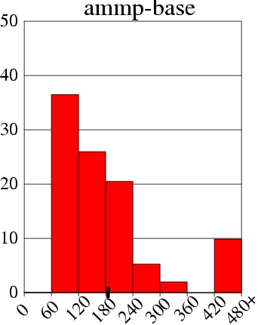
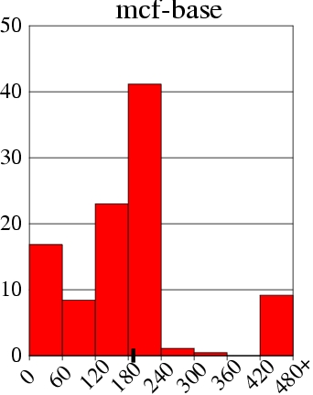
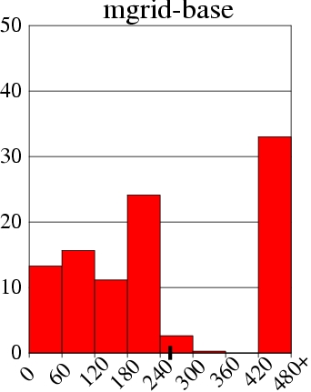
Distribution of MLP-Based Cost
% of All L2 Misses
Cost varies. Does it repeat for a given cache block?
MLP-Based Cost
Notes:
This graph shows the distribution of MLP-based cost for the ammp benchmark. The x axis shows the cost of the miss binned at 60 cycle granularity. The y-axis shows the percentage of all L2 misses. The rightmost bar shows the fraction of misses that have a cost of more than 420 cycles. All isolated misses, and some of the parallel misses serialized because of bank conflicts are accounted for in the right bar. Thus 10% of the misses in ammp are isolated misses. About one third of the misses have a cost between 60 and 120 cycles, denoting an MLP of four. On average, the MLP-based cost of the miss is 185 cycles. (TICK) And such distribution of MLP is true for a wide range of benchmarks. Shown are the distribution of mcf and mgrid. However, to exploit this variation in cost of misses for cost-sensitive replacement, it is important that the cost of the block does not vary significantly between successive misses to the block.

Slide 87
Repeatability of Cost
  An isolated miss can be parallel miss next time
  Can current cost be used to estimate future cost ?
  Let δ = difference in cost for successive miss to a block
    Small δ ➔ cost repeats
    Large δ ➔ cost varies significantly

Slide 88
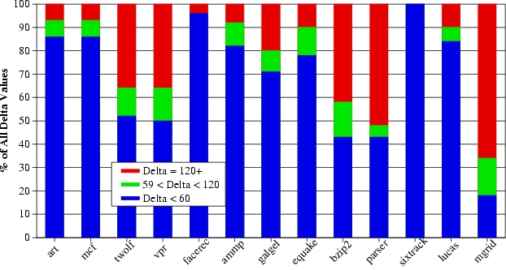
Repeatability of Cost
δ < 60
δ > 120
59 < δ < 120
  In general δ is small ➔ repeatable cost
  When δ is large (e.g. parser, mgrid) ➔ performance loss

Slide 89
The Framework
MEMORY
MSHR
Quantization of Cost
Computed mlp-based cost is quantized to a 3-bit value
Cost Calculation Logic
CCL
C
A
R
E
L2 CACHE
Cost-Aware Repl Engine
ICACHE
DCACHE
PROCESSOR
Notes:
MLP-aware cache replacement has two components. The cost calculation logic computes the mlp-based cost of each miss using a hardware implementation of the algorithm described earlier. This cost is stored in the tag-store entry of the cache block and is used for cost-aware replacement. To reduce storage overhead the mlp-based cost is quantized into a 3-bit value using the following table and this 3-bit quantized cost is used for replacement decisions.

Slide 90
Design of MLP-Aware Replacement policy
  LRU considers only recency and no cost
  Victim-LRU = min { Recency (i) }
  Decisions based only on cost and no recency hurt performance. Cache stores useless high cost blocks
  A Linear (LIN) function that considers recency and cost
  Victim-LIN = min { Recency (i) + S*cost (i) }
  S = significance of cost. Recency(i) = position in LRU stack cost(i) = quantized cost

Slide 91
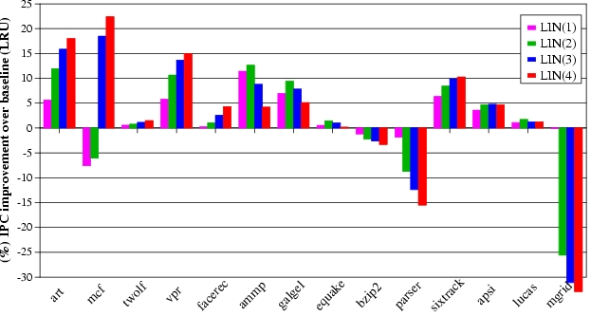
Results for the LIN policy
  Performance loss for parser and mgrid due to large δ
  .

Slide 92
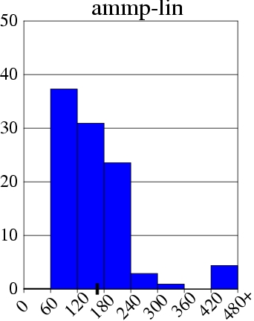
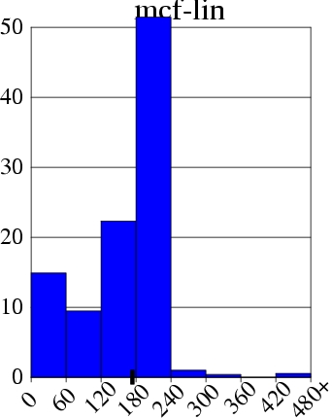
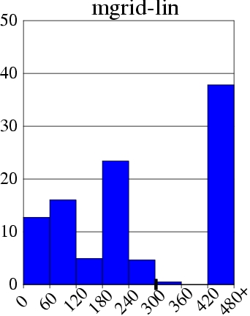
Effect of LIN policy on Cost
Miss += 4%
IPC += 4%
Miss -= 11%
IPC += 22%
Miss += 30%
IPC -= 33%

Slide 93
Outline
Introduction
MLP-Aware Cache Replacement
  Model for Computing Cost
  Repeatability of Cost
  A Cost-Sensitive Replacement Policy
Practical Hybrid Replacement
  Tournament Selection
  Dynamic Set Sampling
  Sampling Based Adaptive Replacement
Summary

Slide 94
Tournament Selection (TSEL) of Replacement Policies for a Single Set
ATD-LIN
SCTR
ATD-LRU
SET A
+
SET A
If MSB of SCTR is 1, MTD uses LIN else MTD use LRU
SET A
MTD
ATD-LIN | ATD-LRU | Saturating Counter (SCTR)
HIT | HIT | Unchanged
MISS | MISS | Unchanged
HIT | MISS | += Cost of Miss in ATD-LRU
MISS | HIT | -= Cost of Miss in ATD-LIN
Notes:
We use the tournament selection algorithm commonly employed in branch predictors. The performance of both LIN and LRU are tracked using separate tag directories, called Auxiliary Tag Directory (ATD). ATD-LIN uses the LIN policy and ATD-LRU uses the LRU policy. Each access for the main tag directory are also send to both the ATD’s. A saturating counter is used to track, which of the two policies is performing better. If there is a hit in ATD-LIN and a miss in ATD-LRU the saturating counter is incremented by a value equal to the cost of the miss in LRU. If miss in ATD-LRU and hit in ATD-LIN then the saturating counter is decremented by a value equal to the cost of the miss in LIN. Thus the high bit of the counter is an indicator of which of the two policies, LIN or LRU, is doing better. If the high bit is 1, MTD uses LRU else it uses LIN.
Implementing tournament selection on a per-set basis is expensive as it requires a counter and two extra tag directories for each set.

Slide 95
Extending TSEL to All Sets
  Implementing TSEL on a per-set basis is expensive
  Counter overhead can be reduced by using a global counter
ATD-LIN
ATD-LRU
Set A
Set A
Set B
Set B
Set C
SCTR
Set C
Set D
+
Set D
Set E
Set E
Set F
Set F
Set G
Set G
Set H
Policy for All
Sets In MTD
Set H
Notes:
The overhead of the counter can be reduced by using a single counter to choose a replacement policy for all the sets in the cache. The figure shows how such a mechanism for a cache that has 8 sets. Although the mechanism requires only one counter it still requires overhead of two extra tag directories.

Slide 96
Dynamic Set Sampling
Not all sets are required to decide the best policy Have the ATD entries only for few sets.
ATD-LIN
ATD-LRU
Set A
Set A
Set B
SCTR
Set B
Set C
Set C
Set D
+
Set D
Set E
Set E
Set F
Set F
Set G
Set G
Set H
Policy for All
Sets In MTD
Set H
Sets that have ATD entries (B, E, G) are called leader sets
Notes:
To reduce the overhead of the tag directories, we introduce the dynamic set sampling technique. The key idea is that not all sets are required to decide the best policy. The mechanism can still choose the best policy with a high probability even if only few sets are sampled. The ATD entries are present only for 3 sets, B, E, and G. These sets decide the replacement policy for all sets in the MTD, hence we call these sets as leader sets.

Slide 97
Dynamic Set Sampling
How many sets are required to choose best performing policy?
Bounds using analytical model and simulation (in paper)
DSS with 32 leader sets performs similar to having all sets
Last-level cache typically contains 1000s of sets, thus ATD entries are required for only 2%-3% of the sets
ATD overhead can further be reduced by using MTD to always simulate one of the policies (say LIN)

Slide 98
Sampling Based Adaptive Replacement (SBAR)
MTD
Set A
Set B
ATD-LRU
Set C
SCTR
Set B
Set D
+
Set E
Set E
Set G
Set F
Set G
Set H
Leader sets
Decide policy only for follower sets
Follower sets
  The storage overhead of SBAR is less than 2KB
  (0.2% of the baseline 1MB cache)

Slide 99
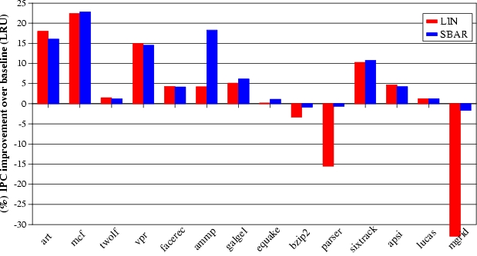
Results for SBAR

Slide 100
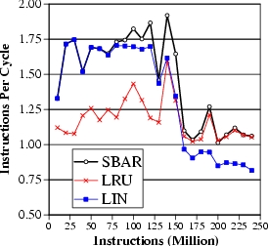
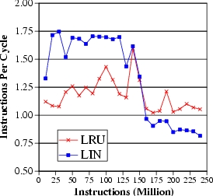
SBAR adaptation to phases
LIN is better
LRU is better
  SBAR selects the best policy for each phase of ammp

Slide 101
Outline
Introduction
MLP-Aware Cache Replacement
  Model for Computing Cost
  Repeatability of Cost
  A Cost-Sensitive Replacement Policy
Practical Hybrid Replacement
  Tournament Selection
  Dynamic Set Sampling
  Sampling Based Adaptive Replacement
Summary

Slide 102
Summary
  MLP varies. Some misses are more costly than others
  MLP-aware cache replacement can reduce costly misses
  Proposed a runtime mechanism to compute MLP-Based cost and the LIN policy for MLP-aware cache replacement
  SBAR allows dynamic selection between LIN and LRU with low hardware overhead
  Dynamic set sampling used in SBAR also enables other cache related optimizations

Slide 103
The Evicted-Address Filter
Vivek Seshadri, Onur Mutlu, Michael A. Kozuch, and Todd C. Mowry,
"The Evicted-Address Filter: A Unified Mechanism to Address Both Cache Pollution and Thrashing"
Proceedings of the 21st ACM International Conference on Parallel Architectures and Compilation Techniques (PACT), Minneapolis, MN, September 2012. Slides (pptx)

Slide 104
Executive Summary
Two problems degrade cache performance
  Pollution and thrashing
  Prior works don’t address both problems concurrently
Goal: A mechanism to address both problems
EAF-Cache
  Keep track of recently evicted block addresses in EAF
  Insert low reuse with low priority to mitigate pollution
  Clear EAF periodically to mitigate thrashing
  Low complexity implementation using Bloom filter
EAF-Cache outperforms five prior approaches that address pollution or thrashing
Notes:
…

Slide 105
Cache Utilization is Important
Large latency
Memory
Core
Core
Core
Last-Level Cache
Core
Core
Increasing contention
Effective cache utilization is important
Notes:
All high-performance processors employ on-chip caches.
In most modern systems, multiple cores share the last-level cache.
With the large latency of main memory access and increasing contention between multiple cores, effective cache utilization is critical for system performance.
For effective cache utilization, the cache should be filled with blocks that are likely to be reused.

Slide 106
Reuse Behavior of Cache Blocks
Different blocks have different reuse behavior
Access Sequence:
A
B
C
A
B
C
S
T
U
V
W
X
Y
Z
A
B
C
High-reuse block
Low-reuse block
Ideal Cache
A
B
C
.
.
.
.
.
Notes:
However, different blocks have different reuse behaviors.
For example, consider the following access sequence.
Blocks A, B and C are accessed repeatedly.
We refer to such blocks as High reuse blocks.
On the other hand, the remaining blocks are not reused. We refer to such blocks as low-reuse blocks.
Ideally, the cache should be filled with high-reuse blocks such as A, B and C.
But traditional cache management policies such as LRU suffer from two problems.

Slide 107
Cache Pollution
Problem: Low-reuse blocks evict high-reuse blocks
Cache
H
S
T
G
H
S
F
G
H
E
F
G
D
E
F
C
D
E
B
C
S
D
T
U
G
F
E
D
C
B
A
A
A
H
B
B
A
LRU Policy
C
MRU
LRU
Prior work: Predict reuse behavior of missed blocks. Insert low-reuse blocks at LRU position.
G
F
E
D
C
B
A
A
S
S
A
T
H
U
A
S
T
MRU
LRU
Notes:
The first problem, referred to as cache pollution, is one where blocks with low-reuse evict blocks with high-reuse from the cache.
Consider the following example of a cache following the LRU policy. Although the cache is filled with high–reuse blocks, the LRU policy inserts even blocks with low-reuse at the MRU position, evicting more useful blocks from the cache. So the future accesses to blocks A, B and C will miss in the cache.
To address this problem, prior work proposed the idea of predicting the reuse behavior of missed cache blocks and inserting low-reuse blocks at the LRU position. This mitigates the impact of pollution as shown in the example.

Slide 108
Cache Thrashing
Problem: High-reuse blocks evict each other
Cache
LRU Policy
H
I
J
B
G
H
I
C
F
G
H
D
E
F
G
E
D
E
F
F
C
D
E
G
B
C
D
H
I
J
A
K
A
I
B
A
J
K
A
B
H
G
F
E
D
C
B
A
C
MRU
LRU
Cache
Prior work: Insert at MRU position with a very low probability (Bimodal insertion policy)
A fraction of working set stays in cache
G
F
E
D
C
B
A
I
J
K
A
A
H
I
I
A
J
MRU
LRU
Notes:
The second problem, referred to as thrashing, occurs when the number of high-reuse blocks is more than what the cache can handle, as shown in the example.
In this case, the LRU policy leads to these high-reuse blocks evicting each other from the cache, leading to zero cache hits.
Prior work proposed to achieve this using the bimodal insertion policy, which inserts blocks at the MRU position with a very low probability.
As a result, majority of the blocks are inserted at the LRU position.
For a thrashing working set, this results in a fraction of the working set to be retained in the cache, leading to cache hits for at least that fraction.

Slide 109
Shortcomings of Prior Works
Prior works do not address both pollution and thrashing concurrently
Prior Work on Cache Pollution
No control on the number of blocks inserted with high priority into the cache
Prior Work on Cache Thrashing
No mechanism to distinguish high-reuse blocks from low-reuse blocks
Our goal: Design a mechanism to address both pollution and thrashing concurrently
Notes:
The motivation behind this work is that prior works do not address both pollution and thrashing concurrently.
Prior works on pollution do not have control over the number of high-reuse blocks. As a result, if there are more high-reuse blocks than what the cache can handle, these approaches can suffer from thrashing.
On the other hand, prior works on cache thrashing have no mechanism to distinguish high-reuse blocks from low-reuse blocks. As a result, when a working set is not thrashing, these approaches can suffer from pollution.
Our goal in this work is to design a mechanism to address both cache pollution and thrashing. In this talk, I will present our mechanism, the Evicted-address filter, that achieves our goal.

Slide 110
Outline
Background and Motivation
Evicted-Address Filter
  Reuse Prediction
  Thrash Resistance
Final Design
Advantages and Disadvantages
Evaluation
Conclusion
Notes:
Our mechanism has two components: a reuse prediction component and a thrash resistance component. I will describe both these components followed by the advantages and disadvantages of our proposed approach. Then, I will present our evaluation results and conclude.

Slide 111
Reuse Prediction
High reuse
Miss
Missed-block
?
Low reuse
Keep track of the reuse behavior of every cache block in the system
Impractical
High storage overhead
Look-up latency
Notes:
The reuse prediction problem asks the following question. On a cache miss, does the missed cache block have high reuse or low reuse?
One possible way to answer this question is to keep track of the reuse behavior of every block in the system.
But such an approach is impractical due to its high storage overhead and look-up latency.
So, how do prior works address this problem?

Slide 112
Prior Work on Reuse Prediction
Use program counter or memory region information.
2. Learn group behavior
1. Group Blocks
3. Predict reuse
PC 1
PC 2
PC 1
PC 2
PC 1
C
C
A
B
S
T
A
B
S
T
PC 2
U
U
Same group → same reuse behavior
No control over number of high-reuse blocks
Notes:
Previous approaches proposed to predict the reuse behavior of missed blocks indirectly using program-counter or memory-region information. At a high level, the program-counter based mechanism operates in three steps.
First, the mechanism groups blocks based on the program counter that caused their cache miss.
Second, the mechanism learns the reuse behavior of each group based on the blocks that were previously accessed by the program counter.
Third, the learned behavior of each group is used to predict the reuse behavior of future blocks accessed by the corresponding program counter.
Such an approach has two shortcomings.
First, blocks belonging to the same program counter may not have the same reuse behavior.
Second, the mechanism has no control over the number of blocks predicted to have high reuse. As a result, this approach can potentially suffer from thrashing.

Slide 113

Our Approach: Per-block Prediction
Use recency of eviction to predict reuse
A
A
Time
Accessed soon after eviction
Time of eviction
Accessed long time after eviction
Time
S
S
Notes:
In this work, we propose a mechanism to predict the reuse behavior of a block based on its own past behavior.
The key idea behind our mechanism is to use the recency of eviction of a block to predict its reuse on its next access.
More specifically, if a block is accessed soon after getting evicted, our mechanism concludes that the block was prematurely evicted and predicts it to have high reuse.
On the other hand, if a block is accessed a long time after eviction, our mechanism concludes that the block is unlikely to be accessed in the near future and predicts it to have low reuse.
The above idea suggests that it is sufficient to keep track of a small number of recently evicted blocks to distinguish between high-reuse blocks and low-reuse blocks.

Slide 114
Evicted-Address Filter (EAF)
Evicted-block address
EAF
(Addresses of recently evicted blocks)
Cache
MRU
LRU
Yes
No
In EAF?
High Reuse
Low Reuse
Miss
Missed-block address
Notes:
Based on this observation, our mechanism augments the cache with a structure called the Evicted-address filter that keeps track of addresses of recently evicted blocks.
When a block is evicted from the cache, our mechanism inserts its address into the EAF.
On a cache miss, if the missed block address is present in the EAF, then the block was evicted recently. Therefore, our mechanism predicts that the block has high reuse and inserts it at the MRU position. It also removes the block address from the EAF to create space for more evicted addresses.
On the other hand, if the missed block address is not present in the EAF, there is one of two possibilities: either the block was accessed before and evicted a long time ago or the block is accessed for the first time. In both cases, our mechanism predicts that the block has low reuse and inserts it at the LRU position.
Although the EAF is a simple mechanism to predict the reuse behavior of missed blocks, one natural question is how to implement it in hardware?

Slide 115
Naïve Implementation: Full Address Tags
Recently evicted address
EAF
?
Need not be 100% accurate
1. Large storage overhead
2. Associative lookups – High energy
Notes:
A naïve implementation of the EAF would be to implement it as a tag store where each tag entry corresponds to the address or a recently evicted block.
However, such an implementation suffers from two problems: 1) it has a large storage overhead and 2) it requires associative lookups which consume high energy.
But notice that the EAF need not be 100% accurate as it is just a prediction structure. This raises the possibility of implementing EAF using a more compact structure which doesn’t have the two shortcomings. So, we consider implementing the EAF using a Bloom filter.

Slide 116
Low-Cost Implementation: Bloom Filter
EAF
?
Need not be 100% accurate
Implement EAF using a Bloom Filter
Low storage overhead + energy
Notes:
A naïve implementation of the EAF would be to implement it as a tag store where each tag entry corresponds to the address or a recently evicted block.
However, such an implementation suffers from two problems: 1) it has a large storage overhead and 2) it requires associative lookups which consume high energy.
But notice that the EAF need not be 100% accurate as it is just a prediction structure. This raises the possibility of implementing EAF using a more compact structure which doesn’t have the two shortcomings. So, we consider implementing the EAF using a Bloom filter.

Slide 117
Bloom Filter
Compact representation of a set
✗
May remove multiple addresses
Insert
✓
Remove
Clear
Test
False positive
1. Bit vector
Y
X
Z
W
2. Set of hash functions
H1
H2
0
0
1
0
0
1
0
0
0
0
0
1
0
0
0
0
0
1
0
0
X
Y
H1
H2
Inserted Elements:
X
Y
Notes:
Let me give you a quick overview of a Bloom filter. A Bloom filter is a compact representation of a set, in this case, a set of addresses.
It consists of a bit vector and a set of hash functions.
All the bits in the bit-vector are initialized to zero.
To insert an address X into the set, the Bloom filter computes the values of the two hash functions and sets the corresponding elements in the filter.
To insert another address Y, the Bloom filter repeats the process.
To test if an address is present in the filter, the Bloom filter computes the values of the hash functions and checks if all the corresponding bits are set. If yes, the Bloom filter concludes that the address is present in the set. This is the case for the address X.
However, even if one of the bits is not set, the Bloom filter concludes that the address is not present in the set.
When we test for the address W, the Bloom filter will conclude that W is present in the set. But W was never inserted. The left bit was set due to the insertion of X and the right bit was set due to the insertion of Y. This situation is referred to as a false positive. The false positive rate of a Bloom filter can be made low by controlling the parameters of the Bloom filter.
Since multiple addresses can map to the same bits, a Bloom filter does not support removing individual addresses from the set.
However, all the addresses can be cleared from the set by simply resetting all the bits in the Bloom filter.
Now, let us look at how we can implement EAF using a Bloom filter.

Slide 118
EAF using a Bloom Filter
EAF
2
Clear
when full
✓
Insert
Bloom Filter
Remove
✗
Evicted-block address
FIFO address
when full
✓
Test
Missed-block address
Remove
✗
1
If present
Bloom-filter EAF: 4x reduction in storage overhead, 1.47% compared to cache size
Notes:
Let us quickly revisit the operations performed on the EAF.
First, on a cache eviction, the evicted block address is inserted into the EAF.
Second, on a cahce miss, our mechanism tests if the missed block address is present in the EAF. If yes, the address is also removed from the EAF.
Finally, when the EAF is full, an address is removed in a FIFO manner to create space for more recently evicted addresses.
A Bloom filter based implementation of EAF will support the insert and the test operations.
However, as we saw in the previous slide, the Bloom filter does not support the remove operations. So we need to somehow eliminate these remove operations. For this purpose, we propose two changes to the EAF design.
First, on a cache miss, if the missed block address is present in the EAF, we choose to retain the block address in the EAF instead of removing it.
Second, when the EAF becomes full, we propose to clear the EAF completely instead of removing an address in a FIFO manner.
With these changes, we can implement the EAF using a Bloom filter.
Doing so can reduce the storage overhead of EAF by 4x, to around 1.47% compared to the cache size.

Slide 119
Outline
Background and Motivation
Evicted-Address Filter
  Reuse Prediction
  Thrash Resistance
Final Design
Advantages and Disadvantages
Evaluation
Conclusion
Notes:
Our mechanism has two components: a reuse prediction component and a thrash resistance component. I will describe both these components followed by the advantages and disadvantages of our proposed approach. Then, I will present our evaluation results and conclude.

Slide 120
Large Working Set: 2 Cases
1
Cache < Working set < Cache + EAF
Cache
EAF
L
K
J
I
H
G
F
E
D
C
B
A
2
Cache + EAF < Working Set
Cache
EAF
S
R
Q
P
O
N
M
L
K
J
I
H
G
F
E
D
C
B
A
Notes:
Thrashing happens when the working set is larger than the cache size. In the context of EAF, there are two cases. In the first case, the working set is larger than the cache but smaller than the blocks tracked by the cache and EAF together. In the second case, the working set is larger than the cache and EAF together. In both cases, the traditional LRU policy will lead to thrashing. I will discuss the operation of EAF in these two cases one by one.

Slide 121
Large Working Set: Case 1
Cache < Working set < Cache + EAF
Cache
EAF
C
D
E
F
C
D
E
F
B
C
D
E
A
B
C
L
D
A
B
K
L
A
B
J
K
L
A
I
J
K
L
H
I
J
K
G
H
I
J
F
G
H
I
H
G
E
F
G
Sequence:
A
B
C
D
A
B
C
D
E
F
G
H
I
J
K
L
A
B
C
EAF Naive:
✗
✗
✗
✗
✗
✗
✗
✗
✗
✗
✗
✗
✗
✗
✗
✗
Notes:
In the first case, the working set is smaller than the cache and EAF put together. Let us first look at how the original FIFO based implementation of EAF works.
Consider the following access sequence that accesses the blocks of the working set in a cyclic manner.
First, the access to block A misses in the cache. However, since the address is present in the EAF, it is inserted with a high priority into the cache.
The same thing happens with block B
and Block C after than.
In fact, every block in the access sequence will miss in the cache. As a result, the FIFO based implementation of EAF performs no better than traditional LRU.

Slide 122
Large Working Set: Case 1
Cache < Working set < Cache + EAF
Cache
EAF
B
D
C
B
F
H
D
E
F
C
D
E
B
C
D
F
A
A
B
C
E
I
A
D
A
L
C
A
A
K
L
A
J
K
L
I
J
K
A
H
I
J
L
G
H
I
K
F
G
H
J
G
I
H
G
G
E
F
E
B
B
B
Not removed
Not present in the EAF
Sequence:
A
B
D
D
A
B
C
D
E
F
G
H
I
J
K
L
A
B
C
EAF Naive:
✗
✗
✗
✗
✗
✗
✗
✗
✗
✗
✗
✗
✗
✗
✗
✗
EAF BF:
✗
✗
✗
✗
✗
✗
✗
✗
✗
✓
✓
✓
✓
✓
✓
✓
Bloom-filter based EAF mitigates thrashing
Notes:
Now lets look at how the Bloom-filter based EAF performs on this access sequence.
When block A is accessed, it misses in the cache but is present in the EAF. It is inserted with a high priority.
But unlike EAF-FIFO, the address is not removed from the EAF.
The same thing happens with Block B.
Moving forward, after the access to block D which also misses in the cache, the EAF becomes full.
At this point, the Bloom-filter based implementation will completely clear the EAF.
As a result, even though the next four accesses to E, F, G and H miss in the cache, their addresses will not be present in the EAF. Therefore, they will be inserted at the LRU position evicting only block I from the cache. As a result, 7 of the next 8 accesses will hit in the cache.
In fact, if the access sequence continues, the bloom-filter based implementation will periodically clear the EAF leading to cache hits to a fraction of the blocks.
So, the Bloom-filter based implementation of EAF mitigates caceh thrashing.

Slide 123
Large Working Set: Case 2
Cache + EAF < Working Set
Cache
EAF
S
R
Q
P
O
N
M
L
K
J
I
H
G
F
E
D
C
B
A
Problem: All blocks are predicted to have low reuse
Allow a fraction of the working set to stay in the cache
Use Bimodal Insertion Policy for low reuse blocks. Insert few of them at the MRU position
Notes:
Now lets move on to the second case of large working sets. In this case, since the working set is larger than both the cache and EAF together, none of the missed addresses will be present in the EAF.
As a result, all blocks will be predicted to have low reuse and inserted with low priority. If the cache is already filled with some other blocks, none of the blocks will get into the cache.
In this case, we would ideally like to allow a fraction of the working set to stay in the cache.
For this purpose, we propose to use the bimodal insertion policy for low reuse blocks. As a result, a few blocks of the working set will be inserted at the MRU position improving the cache utilization.

Slide 124
Outline
Background and Motivation
Evicted-Address Filter
  Reuse Prediction
  Thrash Resistance
Final Design
Advantages and Disadvantages
Evaluation
Conclusion
Notes:
Our mechanism has two components: a reuse prediction component and a thrash resistance component. I will describe both these components followed by the advantages and disadvantages of our proposed approach. Then, I will present our evaluation results and conclude.

Slide 125
EAF-Cache: Final Design
1
Cache eviction
Insert address into filter
Increment counter
Bloom Filter
Cache
Counter
3
Counter reaches max
Clear filter and counter
2
Cache miss
Test if address is present in filter
Yes, insert at MRU. No, insert with BIP
Notes:
Lets take a look at the final design of our mechanism, the EAF-cache.
It augments the cache with a Bloom filter and a counter that keeps track of the number of addresses inserted into the Bloom filter.
On a cache eviction, the evicted address is inserted into the filter and the counter is incremented.
On a cache miss, if the missed block address is present in the Bloom filter, the block is inserted at the MRU position. Otherwise it is inserted with the bimodal insertion policy.
Finally, when the counter reaches a maximum, both the filter and the counter are cleared.

Slide 126
Outline
Background and Motivation
Evicted-Address Filter
  Reuse Prediction
  Thrash Resistance
Final Design
Advantages and Disadvantages
Evaluation
Conclusion
Notes:
Our mechanism has two components: a reuse prediction component and a thrash resistance component. I will describe both these components followed by the advantages and disadvantages of our proposed approach. Then, I will present our evaluation results and conclude.

Slide 127
EAF: Advantages
Cache eviction
Bloom Filter
Cache
Counter
Cache miss
1. Simple to implement
2. Easy to design and verify
3. Works with other techniques (replacement policy)
Notes:
Apart from its ability to mitigate both pollution and thrashing, EAF has three other advantages.
First, it adds only a Bloom filter and a counter. Hardware implementations of the Bloom filter are well studied. So, EAF-cache is simple to implement.
Second, both the Bloom filter and the counter are outside the cache. As a result, our mechanism is easy to design and verify on top of existing cache implementations.
Finally, all operations on the EAF happen on a cache miss. As a result, EAF can work well with other techniques that monitor cache hits to improve performance, for example, the cache replacement policy.

Slide 128
EAF: Disadvantage
Cache
A
A
In EAF?
Miss
A
A
First access
Second access
Problem: For an LRU-friendly application, EAF incurs one additional miss for most blocks
Dueling-EAF: set dueling between EAF and LRU
Notes:
One limitation of the EAF is that when a high-reuse block is accessed for the first time, EAF will falsely predict the block to have low reuse and insert it at the LRU position. So the block will likely get evicted causing the second access to also be a cache miss.
Although this does not affect performance significantly for most applications, for LRU friendly applications, EAF incurs one additional miss for most blocks.
To mitigate this problem, we propose to use a previously proposed technique called set dueling to choose the best between the EAF and the LRU policies. Please read our paper for more details.

Slide 129
Outline
Background and Motivation
Evicted-Address Filter
  Reuse Prediction
  Thrash Resistance
Final Design
Advantages and Disadvantages
Evaluation
Conclusion
Notes:
Our mechanism has two components: a reuse prediction component and a thrash resistance component. I will describe both these components followed by the advantages and disadvantages of our proposed approach. Then, I will present our evaluation results and conclude.

Slide 130
Methodology
Simulated System
  In-order cores, single issue, 4 GHz
  32 KB L1 cache, 256 KB L2 cache (private)
  Shared L3 cache (1MB to 16MB)
  Memory: 150 cycle row hit, 400 cycle row conflict
Benchmarks
  SPEC 2000, SPEC 2006, TPC-C, 3 TPC-H, Apache
Multi-programmed workloads
  Varying memory intensity and cache sensitivity
Metrics
  4 different metrics for performance and fairness
  Present weighted speedup

Slide 131
Comparison with Prior Works
Addressing Cache Pollution
Run-time Bypassing (RTB) – Johnson+ ISCA’97
- Memory region based reuse prediction
Single-usage Block Prediction (SU) – Piquet+ ACSAC’07
Signature-based Hit Prediction (SHIP) – Wu+ MICRO’11
- Program counter based reuse prediction
Miss Classification Table (MCT) – Collins+ MICRO’99
- One most recently evicted block
- No control on number of blocks inserted with high priority ⟹ Thrashing
Notes:
We compare EAF to five previous approaches.
Three of them address the cache pollution problem. Run time cache bypassing learns the reuse behavior of course grain memory regions to predict the reuse of individual cache blocks. Single usage block prediction and signature based hit prediction both use a program counter based reuse prediction mechanism, similar to the memory region approach. The miss classification table keeps track of one most recently evicted block to filter low-reuse blocks. The main drawback of these approaches is that they do not have inherent mechanism to control the number of high reuse blocks. As a result, when the working set is larger than the cache size, they will likely lead to thrashing.
The two other mechanisms we compare to address cache thrashing. They both use set dueling to identify applications with thrashing working sets and use the bimodal insertion policy for such applications. TA-DIP uses the traditional LRU replacement policy as the base policy and TA-DRRIP uses a different replacement policy called RRIP.

Slide 132
Comparison with Prior Works
Addressing Cache Thrashing
TA-DIP – Qureshi+ ISCA’07, Jaleel+ PACT’08
TA-DRRIP – Jaleel+ ISCA’10
- Use set dueling to determine thrashing applications
- No mechanism to filter low-reuse blocks ⟹ Pollution
Notes:
We compare EAF to five previous approaches.
Three of them address the cache pollution problem. Run time cache bypassing learns the reuse behavior of course grain memory regions to predict the reuse of individual cache blocks. Single usage block prediction and signature based hit prediction both use a program counter based reuse prediction mechanism, similar to the memory region approach. The miss classification table keeps track of one most recently evicted block to filter low-reuse blocks. The main drawback of these approaches is that they do not have inherent mechanism to control the number of high reuse blocks. As a result, when the working set is larger than the cache size, they will likely lead to thrashing.
The two other mechanisms we compare to address cache thrashing. They both use set dueling to identify applications with thrashing working sets and use the bimodal insertion policy for such applications. TA-DIP uses the traditional LRU replacement policy as the base policy and TA-DRRIP uses a different replacement policy called RRIP.

Slide 133
Results – Summary
Notes:
This slide presents the summary of our performance results for systems with different number of cores.
As shown, our mechanisms outperform all prior approaches for all the three systems. Also, the multicore results are significantly better than the single core results. This is because, in a multicore system, pollution or thrashing caused by an application will affect useful blocks of other concurrently running applications.
SAY THAT LAST TWO BARS ARE EAF AND D-EAF

Slide 134
4-Core: Performance
Notes:
This figure compares the performance of EAF with the SHIP (BEST PREVIOUS MECHANISM) for all 4-core workloads. Each point on the x-axis corresponds to a 4-core workload and the workloads are sorted based on the performance improvements due to EAF. I would like to draw two conclusions. First, the average improvements of EAF is not due to few workloads. Rather, EAF outperforms SHIP for most workloads.
Second, EAF degrades performance for a few LRU-friendly workloads. However, Dueling-EAF mitigates this degradation while not significantly affecting the performance for other workloads.

Slide 135
Effect of Cache Size
Notes:
This figure shows the effect of varying the cache size on the performance of different schemes. As expected, the gap between different schemes decrease with increasing cache size. With larger cache sizes, the negative impact of pollution and thrashing also reduces.
However, our EAF-based approaches still provide better performance compared to both the LRU baseline and SHIP.

Slide 136
Effect of EAF Size
Notes:
Finally, let’s take a look at the effect of the number of addresses kept track in the EAF on its performance. The x-axis shows the ratio of the number of addresses in the EAF and the number of blocks in the cache.
When the number of addresses in the EAF is low, it falsely predicts many high reuse blocks as low reuse blocks.
On the other extreme, when the number of addresses in the EAF is high, it predicts too many blocks to have high reuse, more than what the cache can handle.
We find that having as many addresses in the EAF as there are blocks in the cache provides the best performance. Our paper describes the intuition behind this behavior.

Slide 137
Other Results in Paper
EAF orthogonal to replacement policies
  LRU, RRIP – Jaleel+ ISCA’10
Performance improvement of EAF increases with increasing memory latency
EAF performs well on four different metrics
  Performance and fairness
Alternative EAF-based designs perform comparably
  Segmented EAF
  Decoupled-clear EAF
Notes:
…

Slide 138
Conclusion
Cache utilization is critical for system performance
  Pollution and thrashing degrade cache performance
  Prior works don’t address both problems concurrently
EAF-Cache
  Keep track of recently evicted block addresses in EAF
  Insert low reuse with low priority to mitigate pollution
  Clear EAF periodically and use BIP to mitigate thrashing
  Low complexity implementation using Bloom filter
EAF-Cache outperforms five prior approaches that address pollution or thrashing
Notes:
…

Slide 139
Base-Delta-Immediate
Cache Compression
Gennady Pekhimenko, Vivek Seshadri, Onur Mutlu, Philip B. Gibbons, Michael A. Kozuch, and Todd C. Mowry,
"Base-Delta-Immediate Compression: Practical Data Compression for On-Chip Caches"
Proceedings of the 21st ACM International Conference on Parallel Architectures and Compilation Techniques (PACT), Minneapolis, MN, September 2012. Slides (pptx)

Slide 140
Executive Summary
Off-chip memory latency is high
  Large caches can help, but at significant cost
Compressing data in cache enables larger cache at low cost
Problem: Decompression is on the execution critical path
Goal: Design a new compression scheme that has
1. low decompression latency, 2. low cost, 3. high compression ratio
Observation: Many cache lines have low dynamic range data
Key Idea: Encode cachelines as a base + multiple differences
Solution: Base-Delta-Immediate compression with low decompression latency and high compression ratio
  Outperforms three state-of-the-art compression mechanisms

Slide 141
Motivation for Cache Compression
Significant redundancy in data:
0x00000000
0x0000000B
0x00000003
0x00000004
…
How can we exploit this redundancy?
  Cache compression helps
  Provides effect of a larger cache without making it physically larger

Slide 142
Background on Cache Compression
Hit
L2 Cache
CPU
L1 Cache
Decompression
Uncompressed
Uncompressed
Compressed
Key requirements:
  Fast (low decompression latency)
  Simple (avoid complex hardware changes)
  Effective (good compression ratio)

Slide 143
Shortcomings of Prior Work
Compression Mechanisms | Decompression Latency | Complexity | Compression Ratio
Zero | ✓ | ✓ | ✗

Slide 144
Shortcomings of Prior Work
Compression Mechanisms | Decompression Latency | Complexity | Compression Ratio
Zero | ✓ | ✓ | ✗
Frequent Value | ✗ | ✗ | ✓

Slide 145
Shortcomings of Prior Work
Compression Mechanisms | Decompression Latency | Complexity | Compression Ratio
Zero | ✓ | ✓ | ✗
Frequent Value | ✗ | ✗ | ✓
Frequent Pattern | ✗ | ✗/✓ | ✓

Slide 146
Shortcomings of Prior Work
Compression Mechanisms | Decompression Latency | Complexity | Compression Ratio
Zero | ✓ | ✓ | ✗
Frequent Value | ✗ | ✗ | ✓
Frequent Pattern | ✗ | ✗/✓ | ✓
Our proposal: BΔI | ✓ | ✓ | ✓

Slide 147
Outline
Motivation & Background
Key Idea & Our Mechanism
Evaluation
Conclusion

Slide 148
Key Data Patterns in Real Applications
  Zero Values: initialization, sparse matrices, NULL pointers
0x00000000
0x00000000
0x00000000
0x00000000
…
  Repeated Values: common initial values, adjacent pixels
0x000000FF
0x000000FF
0x000000FF
0x000000FF
…
  Narrow Values: small values stored in a big data type
0x00000000
0x0000000B
0x00000003
0x00000004
…
  Other Patterns: pointers to the same memory region
0xC04039C0
0xC04039C8
0xC04039D0
0xC04039D8
…

Slide 149
How Common Are These Patterns?
SPEC2006, databases, web workloads, 2MB L2 cache
“Other Patterns” include Narrow Values
  43% of the cache lines belong to key patterns

Slide 150
Key Data Patterns in Real Applications
  Zero Values: initialization, sparse matrices, NULL pointers
  Low Dynamic Range:
  Differences between values are significantly smaller than the values themselves
0x00000000
0x00000000
0x00000000
0x00000000
…
  Repeated Values: common initial values, adjacent pixels
0x000000FF
0x000000FF
0x000000FF
0x000000FF
…
  Narrow Values: small values stored in a big data type
0x00000000
0x0000000B
0x00000003
0x00000004
…
  Other Patterns: pointers to the same memory region
0xC04039C0
0xC04039C8
0xC04039D0
0xC04039D8
…

Slide 151
Key Idea: Base+Delta (B+Δ) Encoding
4 bytes
32-byte Uncompressed Cache Line
0xC04039C0
0xC04039C8
0xC04039D0
…
0xC04039F8
0xC04039C0
Base
12-byte
Compressed Cache Line
0x00
0x08
0x10
…
0x38
1 byte
1 byte
1 byte
  ✓ Fast Decompression: vector addition
  ✓ Simple Hardware:
  arithmetic and comparison
  20 bytes saved
  ✓ Effective: good compression ratio

Slide 152
Can We Do Better?
Uncompressible cache line (with a single base):
Key idea:
Use more bases, e.g., two instead of one
Pro:
  More cache lines can be compressed
Cons:
  Unclear how to find these bases efficiently
  Higher overhead (due to additional bases)
0x00000000
0x09A40178
0x0000000B
0x09A4A838
…

Slide 153
B+Δ with Multiple Arbitrary Bases
  ✓ 2 bases – the best option based on evaluations

Slide 154
How to Find Two Bases Efficiently?
  First base - first element in the cache line
  Second base - implicit base of 0
Advantages over 2 arbitrary bases:
  Better compression ratio
  Simpler compression logic
  ✓ Base+Delta part
  ✓ Immediate part
  Base-Delta-Immediate (BΔI) Compression

Slide 155
B+Δ (with two arbitrary bases) vs. BΔI
  Average compression ratio is close, but BΔI is simpler

Slide 156
BΔI Implementation
Decompressor Design
  Low latency
Compressor Design
  Low cost and complexity
BΔI Cache Organization
  Modest complexity

Slide 157
BΔI Decompressor Design
Compressed Cache Line
B₀
B₀
Δ₀
Δ₀
Δ₁
Δ₁
Δ₂
Δ₂
Δ₃
Δ₃
B₀
B₀
B₀
B₀
+
+
+
+
  Vector addition
V₀
V₁
V₂
V₃
V₀
V₁
V₂
V₃
Uncompressed Cache Line

Slide 158
BΔI Compressor Design
32-byte Uncompressed Cache Line
8-byte B₀
1-byte Δ
CU
8-byte B₀
2-byte Δ
CU
8-byte B₀
4-byte Δ
CU
4-byte B₀
1-byte Δ
CU
4-byte B₀
2-byte Δ
CU
2-byte B₀
1-byte Δ
CU
Zero
CU
Rep.
Values
CU
CFlag &
CCL
CFlag &
CCL
CFlag &
CCL
CFlag &
CCL
CFlag &
CCL
CFlag &
CCL
CFlag &
CCL
CFlag &
CCL
CFlag &
CCL
Compression Selection Logic (based on compr. size)
Compression Flag & Compressed Cache Line
Compressed Cache Line

Slide 159
BΔI Compression Unit: 8-byte B₀ 1-byte Δ
32-byte Uncompressed Cache Line
8 bytes
V₀
V₀
V₀
V₁
V₁
V₂
V₂
V₃
V₃
B₀=
V₀
B₀
B₀
B₀
B₀
-
-
-
-
Δ₀
Δ₁
Δ₂
Δ₃
Within 1-byte range?
Within 1-byte range?
Within 1-byte range?
Within 1-byte range?
Is every element within 1-byte range?
Yes
No
B₀
B₀
Δ₀
Δ₀
Δ₁
Δ₁
Δ₂
Δ₂
Δ₃
Δ₃

Slide 160
BΔI Cache Organization
Tag Storage:
Data Storage:
32 bytes
Conventional 2-way cache with 32-byte cache lines
Set₀
…
…
Set₀
…
…
Set₁
Tag₀
Tag₁
Set₁
Data₀
Data₁
…
…
…
…
Way₀
Way₁
Way₀
Way₁
BΔI: 4-way cache with 8-byte segmented data
Tag Storage:
8 bytes
Set₀
…
…
…
…
Set₀
…
…
…
…
…
…
…
…
Tag₀
Tag₁
Tag₂
Tag₃
S₀
Set₁
Set₁
S₀
S₁
S₂
S₃
S₄
S₅
S₆
S₇
_{C}
✓C - Compr. encoding bits
…
…
…
…
…
…
…
…
…
…
…
…
Way₀
Way₁
Way₂
Way₃
✓Twice as many tags
✓Tags map to multiple adjacent segments
2.3% overhead for 2 MB cache

Slide 161
Qualitative Comparison with Prior Work
Zero-based designs
  ZCA [Dusser+, ICS’09]: zero-content augmented cache
  ZVC [Islam+, PACT’09]: zero-value cancelling
  Limited applicability (only zero values)
FVC [Yang+, MICRO’00]: frequent value compression
  High decompression latency and complexity
Pattern-based compression designs
  FPC [Alameldeen+, ISCA’04]: frequent pattern compression
    High decompression latency (5 cycles) and complexity
  C-pack [Chen+, T-VLSI Systems’10]: practical implementation of FPC-like algorithm
    High decompression latency (8 cycles)

Slide 162
Outline
Motivation & Background
Key Idea & Our Mechanism
Evaluation
Conclusion

Slide 163
Methodology
Simulator
  x86 event-driven simulator based on Simics [Magnusson+, Computer’02]
Workloads
  SPEC2006 benchmarks, TPC, Apache web server
  1 – 4 core simulations for 1 billion representative instructions
System Parameters
  L1/L2/L3 cache latencies from CACTI [Thoziyoor+, ISCA’08]
  4GHz, x86 in-order core, 512kB - 16MB L2, simple memory model (300-cycle latency for row-misses)

Slide 164
Compression Ratio: BΔI vs. Prior Work
SPEC2006, databases, web workloads, 2MB L2
1.53
BΔI achieves the highest compression ratio

Slide 165
Single-Core: IPC and MPKI
3.6%
16%
5.6%
4.9%
24%
5.1%
21%
5.2%
13%
8.1%
19%
14%
BΔI achieves the performance of a 2X-size cache
Performance improves due to the decrease in MPKI

Slide 166
Multi-Core Workloads
Application classification based on
  Compressibility: effective cache size increase
  (Low Compr. (LC) < 1.40, High Compr. (HC) >= 1.40)
  Sensitivity: performance gain with more cache
  (Low Sens. (LS) < 1.10, High Sens. (HS) >= 1.10; 512kB -> 2MB)
Three classes of applications:
  LCLS, HCLS, HCHS, no LCHS applications
For 2-core - random mixes of each possible class pairs (20 each, 120 total workloads)

Slide 167
Multi-Core: Weighted Speedup
If at least one application is sensitive, then the performance improves
BΔI performance improvement is the highest (9.5%)

Slide 168
Other Results in Paper
IPC comparison against upper bounds
  BΔI almost achieves performance of the 2X-size cache
Sensitivity study of having more than 2X tags
  Up to 1.98 average compression ratio
Effect on bandwidth consumption
  2.31X decrease on average
Detailed quantitative comparison with prior work
Cost analysis of the proposed changes
  2.3% L2 cache area increase

Slide 169
Conclusion
A new Base-Delta-Immediate compression mechanism
Key insight: many cache lines can be efficiently represented using base + delta encoding
Key properties:
  Low latency decompression
  Simple hardware implementation
  High compression ratio with high coverage
Improves cache hit ratio and performance of both single-core and multi-core workloads
  Outperforms state-of-the-art cache compression techniques: FVC and FPC

Slide 170
Linearly Compressed Pages
Gennady Pekhimenko, Vivek Seshadri, Yoongu Kim, Hongyi Xin, Onur Mutlu, Michael A. Kozuch, Phillip B. Gibbons, and Todd C. Mowry,
"Linearly Compressed Pages: A Main Memory Compression Framework with Low Complexity and Low Latency"
SAFARI Technical Report, TR-SAFARI-2012-005, Carnegie Mellon University, September 2012.

Slide 171
Executive Summary
Main memory is a limited shared resource
Observation: Significant data redundancy
Idea: Compress data in main memory
Problem: How to avoid latency increase?
Solution: Linearly Compressed Pages (LCP):
fixed-size cache line granularity compression
1. Increases capacity (69% on average)
2. Decreases bandwidth consumption (46%)
3. Improves overall performance (9.5%)

Slide 172
Challenges in Main Memory Compression
Address Computation
Mapping and Fragmentation
Physically Tagged Caches

Slide 173
Address Computation
Cache Line (64B)
Uncompressed Page
L₀
L₁
L₂
. . .
L_{N-1}
Address Offset
0
64
128
(N-1)*64
Compressed Page
L₀
L₁
L₂
. . .
L_{N-1}
Address Offset
0
?
?
?

Slide 174
Mapping and Fragmentation
Virtual Page
(4kB)
Virtual
Address
Physical
Address
Physical Page
(? kB)
Fragmentation

Slide 175
Physically Tagged Caches
Core
Virtual
Address
Critical Path
Address Translation
TLB
Physical Address
tag
data
L2 Cache
Lines
tag
data
tag
data

Slide 176
Shortcomings of Prior Work
Compression Mechanisms | Access Latency | Decompression Latency | Complexity | Compression Ratio
IBM MXT [IBM J.R.D. ’01] | ✗ | ✗ | ✗ | ✓

Slide 177
Shortcomings of Prior Work
Compression Mechanisms | Access Latency | Decompression Latency | Complexity | Compression Ratio
IBM MXT [IBM J.R.D. ’01] | ✗ | ✗ | ✗ | ✓
Robust Main Memory Compression [ISCA’05] | ✗ | ✓ | ✗ | ✓

Slide 178
Shortcomings of Prior Work
Compression Mechanisms | Access Latency | Decompression Latency | Complexity | Compression Ratio
IBM MXT [IBM J.R.D. ’01] | ✗ | ✗ | ✗ | ✓
Robust Main Memory Compression [ISCA’05] | ✗ | ✓ | ✗ | ✓
LCP: Our Proposal | ✓ | ✓ | ✓ | ✓

Slide 179
Linearly Compressed Pages (LCP): Key Idea
Uncompressed Page (4kB: 64*64B)
64B
64B
64B
64B
. . .
64B
4:1 Compression
Exception
Storage
. . .
M
E
Metadata (64B):
? (compressible)
Compressed Data
(1kB)

Slide 180
LCP Overview
Page Table entry extension
  compression type and size
  extended physical base address
Operating System management support
  4 memory pools (512B, 1kB, 2kB, 4kB)
Changes to cache tagging logic
  physical page base address + cache line index
  (within a page)
Handling page overflows
Compression algorithms: BDI [PACT’12] , FPC [ISCA’04]

Slide 181
LCP Optimizations
Metadata cache
  Avoids additional requests to metadata
Memory bandwidth reduction:
Zero pages and zero cache lines
  Handled separately in TLB (1-bit) and in metadata
  (1-bit per cache line)
Integration with cache compression
  BDI and FPC
1 transfer
instead of 4
64B
64B
64B
64B

Slide 182
Methodology
Simulator
  x86 event-driven simulators
    Simics-based [Magnusson+, Computer’02] for CPU
    Multi2Sim [Ubal+, PACT’12] for GPU
Workloads
  SPEC2006 benchmarks, TPC, Apache web server, GPGPU applications
System Parameters
  L1/L2/L3 cache latencies from CACTI [Thoziyoor+, ISCA’08]
  512kB - 16MB L2, simple memory model

Slide 183
Compression Ratio Comparison
SPEC2006, databases, web workloads, 2MB L2 cache
LCP-based frameworks achieve competitive average compression ratios with prior work

Slide 184
Bandwidth Consumption Decrease
SPEC2006, databases, web workloads, 2MB L2 cache
Better
LCP frameworks significantly reduce bandwidth (46%)
Notes:
BPKI – bandwidth per kilo instruction – lower means better.

Slide 185
Performance Improvement
Cores | LCP-BDI | (BDI, LCP-BDI) | (BDI, LCP-BDI+FPC-fixed)
1 | 6.1% | 9.5% | 9.3%
2 | 13.9% | 23.7% | 23.6%
4 | 10.7% | 22.6% | 22.5%
LCP frameworks significantly improve performance

Slide 186
Conclusion
A new main memory compression framework called LCP (Linearly Compressed Pages)
  Key idea: ﬁxed size for compressed cache lines within a page and fixed compression algorithm per page
LCP evaluation:
  Increases capacity (69% on average)
  Decreases bandwidth consumption (46%)
  Improves overall performance (9.5%)
  Decreases energy of the off-chip bus (37%)

Slide 187
Controlled Shared Caching

Slide 188
Controlled Cache Sharing
Utility based cache partitioning
  Qureshi and Patt, “Utility-Based Cache Partitioning: A Low-Overhead, High-Performance, Runtime Mechanism to Partition Shared Caches,” MICRO 2006.
  Suh et al., “A New Memory Monitoring Scheme for Memory-Aware Scheduling and Partitioning,” HPCA 2002.
Fair cache partitioning
  Kim et al., “Fair Cache Sharing and Partitioning in a Chip Multiprocessor Architecture,” PACT 2004.
Shared/private mixed cache mechanisms
  Qureshi, “Adaptive Spill-Receive for Robust High-Performance Caching in CMPs,” HPCA 2009.
  Hardavellas et al., “Reactive NUCA: Near-Optimal Block Placement and Replication in Distributed Caches,” ISCA 2009.

Slide 189
Utility Based Shared Cache Partitioning
Goal: Maximize system throughput
Observation: Not all threads/applications benefit equally from caching → simple LRU replacement not good for system throughput
Idea: Allocate more cache space to applications that obtain the most benefit from more space
The high-level idea can be applied to other shared resources as well.
Qureshi and Patt, “Utility-Based Cache Partitioning: A Low-Overhead, High-Performance, Runtime Mechanism to Partition Shared Caches,” MICRO 2006.
Suh et al., “A New Memory Monitoring Scheme for Memory-Aware Scheduling and Partitioning,” HPCA 2002.

Slide 190
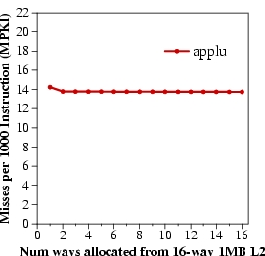
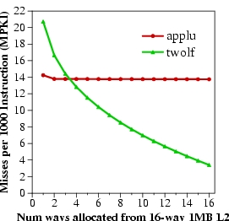
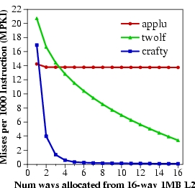
Marginal Utility of a Cache Way
Utility U_{a}^{b} = Misses with a ways – Misses with b ways
Low Utility
Misses per 1000 instructions
High Utility
Saturating Utility
Num ways from 16-way 1MB L2

Slide 191
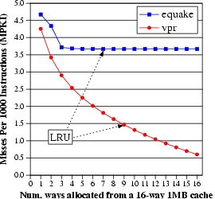
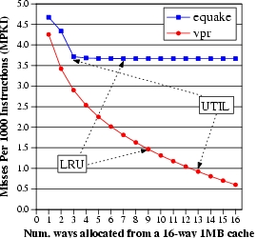
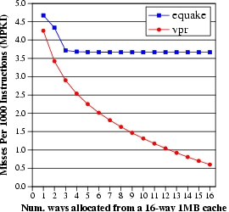
Utility Based Shared Cache Partitioning Motivation
equake
vpr
Improve performance by giving more cache to the application that benefits more from cache
Misses per 1000 instructions (MPKI)
UTIL
LRU
Num ways from 16-way 1MB L2

Slide 192
Utility Based Cache Partitioning (III)
UMON1
PA
UMON2
I$
Shared
L2 cache
I$
Core1
Core2
D$
D$
Main Memory
Three components:
Utility Monitors (UMON) per core
Partitioning Algorithm (PA)
Replacement support to enforce partitions

Slide 193
Utility Monitors
For each core, simulate LRU policy using ATD
Hit counters in ATD to count hits per recency position
LRU is a stack algorithm: hit counts ➔ utility
E.g. hits(2 ways) = H0+H1
(MRU)H0 H1 H2…H15(LRU)
MTD
+
+
+
+
Set A
Set A
Set B
Set B
Set C
ATD
Set C
Set D
Set D
Set E
Set E
Set F
Set F
Set G
Set G
Set H
Set H

Slide 194
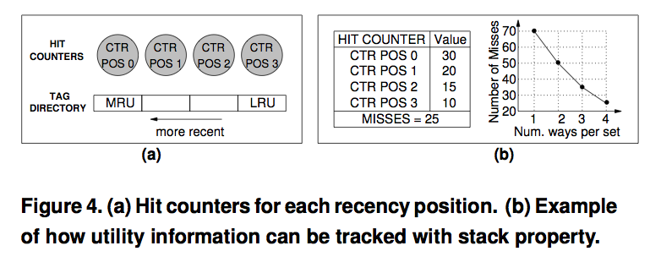
Utility Monitors

Slide 195
Dynamic Set Sampling
Extra tags incur hardware and power overhead
Dynamic Set Sampling reduces overhead [Qureshi, ISCA’06]
32 sets sufficient (analytical bounds)
Storage < 2kB/UMON
(MRU)H0 H1 H2…H15(LRU)
MTD
+
+
+
+
Set A
Set A
Set A
Set B
Set B
ATD
Set B
Set B
Set E
Set C
Set C
Set G
Set C
Set D
Set D
Set D
Set E
Set E
Set E
Set F
Set F
Set F
UMON (DSS)
Set G
Set G
Set G
Set H
Set H
Set H

Slide 196
Partitioning Algorithm
Evaluate all possible partitions and select the best
With a ways to core1 and (16-a) ways to core2:
Hits_{core1} = (H₀ + H₁ + … + H_{a-1}) ---- from UMON1 Hits_{core2} = (H₀ + H₁ + … + H_{16-a-1}) ---- from UMON2
Select a that maximizes (Hits_{core1} + Hits_{core2})
Partitioning done once every 5 million cycles

Slide 197
Way Partitioning
Way partitioning support: [Suh+ HPCA’02, Iyer ICS’04]
  Each line has core-id bits
  On a miss, count ways_occupied in set by miss-causing app
ways_occupied < ways_given
Yes
No
Victim is the LRU line from other app
Victim is the LRU line from miss-causing app

Slide 198
Performance Metrics
Three metrics for performance:
Weighted Speedup (default metric)
➔ perf = IPC₁/SingleIPC₁ + IPC₂/SingleIPC₂
➔ correlates with reduction in execution time
Throughput ➔ perf = IPC₁ + IPC₂ ➔ can be unfair to low-IPC application
Hmean-fairness ➔ perf = hmean(IPC₁/SingleIPC₁, IPC₂/SingleIPC₂) ➔ balances fairness and performance

Slide 199
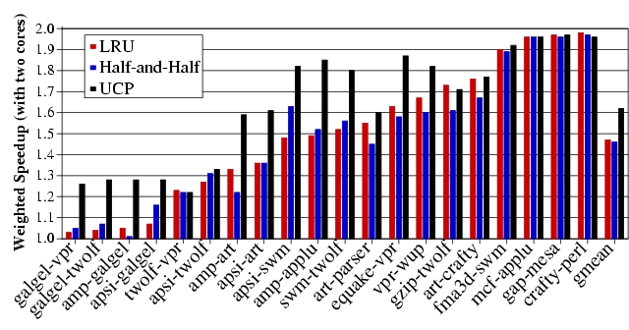
Weighted Speedup Results for UCP

Slide 200
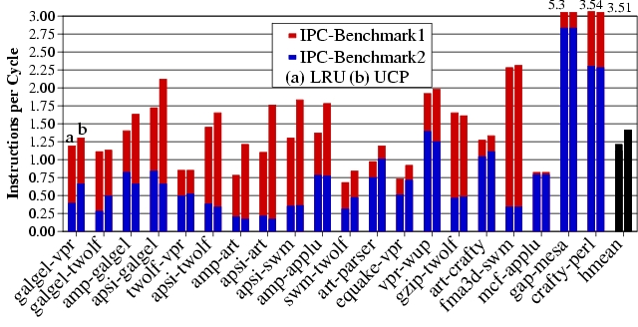
IPC Results for UCP
UCP improves average throughput by 17%

Slide 201
Any Problems with UCP So Far?
- Scalability
- Non-convex curves?
Time complexity of partitioning low for two cores
(number of possible partitions ≈ number of ways)
Possible partitions increase exponentially with cores
For a 32-way cache, possible partitions:
  4 cores → 6545
  8 cores → 15.4 million
Problem NP hard → need scalable partitioning algorithm

Slide 202
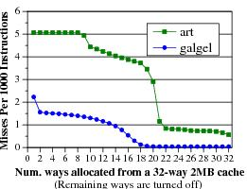
Greedy Algorithm [Stone+ ToC ’92]
GA allocates 1 block to the app that has the max utility for one block. Repeat till all blocks allocated
Optimal partitioning when utility curves are convex
Pathological behavior for non-convex curves

Slide 203
Problem with Greedy Algorithm
Problem: GA considers benefit only from the immediate block. Hence, it fails to exploit large gains from looking ahead
In each iteration, the utility for 1 block:
U(A) = 10 misses U(B) = 0 misses
Misses
All blocks assigned to A, even if B has same miss reduction with fewer blocks
Blocks assigned

Slide 204
Lookahead Algorithm
Marginal Utility (MU) = Utility per cache resource
  MU_{a}^{b} = U_{a}^{b}/(b-a)
GA considers MU for 1 block. LA considers MU for all possible allocations
Select the app that has the max value for MU.
Allocate it as many blocks required to get max MU
Repeat till all blocks assigned

Slide 205
Lookahead Algorithm Example
Iteration 1:
MU(A) = 10/1 block MU(B) = 80/3 blocks
B gets 3 blocks
Misses
Next five iterations:
MU(A) = 10/1 block
MU(B) = 0
A gets 1 block
Blocks assigned
Result: A gets 5 blocks and B gets 3 blocks (Optimal)
  Time complexity ≈ ways²/2 (512 ops for 32-ways)

Slide 206
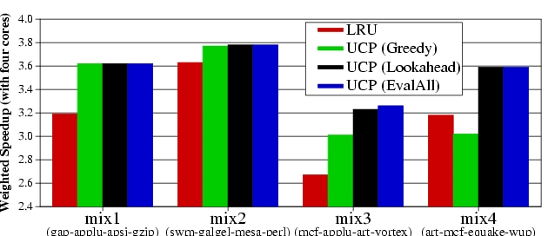
UCP Results
Four cores sharing a 2MB 32-way L2
LRU
UCP(Greedy)
UCP(Lookahead)
UCP(EvalAll)
Mix1
(gap-applu-apsi-gzp)
Mix2
(swm-glg-mesa-prl)
Mix3
(mcf-applu-art-vrtx)
Mix4
(mcf-art-eqk-wupw)
LA performs similar to EvalAll, with low time-complexity

Slide 207
Utility Based Cache Partitioning
Advantages over LRU
  + Improves system throughput
  + Better utilizes the shared cache
Disadvantages
  - Fairness, QoS?
Limitations
  - Scalability: Partitioning limited to ways. What if you have numWays < numApps?
  - Scalability: How is utility computed in a distributed cache?
  - What if past behavior is not a good predictor of utility?

Slide 208
Fair Shared Cache Partitioning
Goal: Equalize the slowdowns of multiple threads sharing the cache
Idea: Dynamically estimate slowdowns due to sharing and assign cache blocks to balance slowdowns
Approximate slowdown with change in miss rate
+ Simple
- Not accurate. Why?
  Kim et al., “Fair Cache Sharing and Partitioning in a Chip Multiprocessor Architecture,” PACT 2004.

Slide 209
Problem with Shared Caches
Processor Core 1
←t1
Processor Core 2
L1 $
L1 $
L2 $
……

Slide 210
Problem with Shared Caches
Processor Core 1
t2→
Processor Core 2
L1 $
L1 $
L2 $
……

Slide 211
Problem with Shared Caches
Processor Core 1
←t1
t2→
Processor Core 2
L1 $
L1 $
L2 $
……
t2’s throughput is significantly reduced due to unfair cache sharing.

Slide 212
Problem with Shared Caches

Slide 213
Fairness Metrics
Uniform slowdown
Minimize:
  Ideally:

Slide 214
Block-Granularity Partitioning
Modified LRU cache replacement policy
  G. Suh, et. al., HPCA 2002
Current Partition
Target Partition
P1: 448B
P1: 384B
P2: 576B
P2: 640B
LRU
LRU
P2 Miss
LRU
LRU

Slide 215
Block-Granularity Partitioning
Modified LRU cache replacement policy
  G. Suh, et. al., HPCA 2002
Current Partition
Target Partition
P1: 448B
P1: 384B
P2: 576B
P2: 640B
LRU
LRU
P2 Miss
LRU
*
LRU
Current Partition
Target Partition
P1: 384B
P1: 384B
P2: 640B
P2: 640B
LRU
LRU
LRU
*
LRU

Slide 216
Dynamic Fair Caching Algorithm
MissRate alone
Ex) Optimizing
M3 metric
P1:
P2:
MissRate shared
P1:
P2:
Repartitioning
interval
Target Partition
P1:
P2:

Slide 217
Dynamic Fair Caching Algorithm
MissRate alone
1st Interval
P1:20%
P2: 5%
MissRate shared
MissRate shared
P1:
P1:20%
P2:
P2:15%
Repartitioning
interval
Target Partition
P1:256KB
P2:256KB
Notes:
At the very beginning, the static profiling obtained miss rate of 20% for P1 and 5% for P2.
Initially, target partitions are equal to P1 and P2.
After the 1st interval, we get shared miss rate by dynamic profiling and it has 20% and 15% miss rate.

Slide 218
Dynamic Fair Caching Algorithm
MissRate alone
Repartition!
P1:20%
P2: 5%
Evaluate M3
P1: 20% / 20%
P2: 15% / 5%
MissRate shared
P1:20%
P2:15%
Repartitioning
interval
Target Partition
Target Partition
Partition granularity: 64KB
P1:256KB
P1:192KB
P2:256KB
P2:320KB
Notes:
At repartitioning, we evaluate M3. It equalize the increase in miss rate. P1 has no increase while P2 has 3 times increase.
In this case, we increase partition size for P2. We used 64KB partition granularity.

Slide 219
Dynamic Fair Caching Algorithm
MissRate alone
2nd Interval
P1:20%
P2: 5%
MissRate shared
MissRate shared
MissRate shared
P1:20%
P1:20%
P1:20%
P2:15%
P2:15%
P2:10%
Repartitioning
interval
Target Partition
P1:192KB
P2:320KB
Notes:
In second interval, new target partition is applied. After the execution, we get new shared miss rate. same 20% and 10%. We have 5% reduction in miss rate.

Slide 220
Dynamic Fair Caching Algorithm
MissRate alone
Repartition!
P1:20%
P2: 5%
Evaluate M3
P1: 20% / 20%
P2: 10% / 5%
MissRate shared
MissRate shared
P1:20%
P1:20%
P2:15%
P2:10%
Repartitioning
interval
Target Partition
Target Partition
P1:192KB
P1:128KB
P2:320KB
P2:384KB
Notes:
When we evaluate M3, again P2 requires more cache space. So we increase it.

Slide 221
Dynamic Fair Caching Algorithm
MissRate alone
3rd Interval
P1:20%
P2: 5%
MissRate shared
MissRate shared
MissRate shared
P1:20%
P1:20%
P1:25%
P2:10%
P2:10%
P2: 9%
Repartitioning
interval
Target Partition
P1:128KB
P2:384KB
Notes:
After third interval, dynamic profiling get the miss rate for P1 25% and 9% for P2.

Slide 222
Dynamic Fair Caching Algorithm
MissRate alone
Repartition!
Do Rollback if:
P2: Δ<T_{rollback}
Δ=MR_{old}-MR_{new}
P1:20%
P2: 5%
MissRate shared
MissRate shared
P1:20%
P1:25%
P2:10%
P2: 9%
Repartitioning
interval
Target Partition
Target Partition
P1:128KB
P1:192KB
P2:384KB
P2:320KB
Notes:
There is a hidden step of rollback phase.
In this step, we check whether P2’s miss rate is reduced more than rollback threshold.
Because we increased cache partition, we expected to see reduction in miss rate.
In our example, P2 only reduced 1% miss rate which is smaller than rollback threshold.
So, we cancel our previous decision and go back to the previous partition.

Slide 223
Dynamic Fair Caching Results
Improves both fairness and throughput

Slide 224
Effect of Partitioning Interval
Fine-grained partitioning is important for both fairness and throughput

Slide 225
Benefits of Fair Caching
Problems of unfair cache sharing
  Sub-optimal throughput
  Thread starvation
  Priority inversion
  Thread-mix dependent performance
Benefits of fair caching
  Better fairness
  Better throughput
  Fair caching likely simplifies OS scheduler design

Slide 226
Advantages/Disadvantages of the Approach
Advantages
  + No (reduced) starvation
  + Better average throughput
Disadvantages
  - Scalable to many cores?
  - Is this the best (or a good) fairness metric?
  - Does this provide performance isolation in cache?
  - Alone miss rate estimation can be incorrect (estimation interval different from enforcement interval)

Slide 227
Software-Based Shared Cache Management
Assume no hardware support (demand based cache sharing, i.e. LRU replacement)
How can the OS best utilize the cache?
Cache sharing aware thread scheduling
  Schedule workloads that “play nicely” together in the cache
    E.g., working sets together fit in the cache
    Requires static/dynamic profiling of application behavior
    Fedorova et al., “Improving Performance Isolation on Chip Multiprocessors via an Operating System Scheduler,” PACT 2007.
Cache sharing aware page coloring
  Dynamically monitor miss rate over an interval and change virtual to physical mapping to minimize miss rate
    Try out different partitions

Slide 228
OS Based Cache Partitioning
Lin et al., “Gaining Insights into Multi-Core Cache Partitioning: Bridging the Gap between Simulation and Real Systems,” HPCA 2008.
Cho and Jin, “Managing Distributed, Shared L2 Caches through OS-Level Page Allocation,” MICRO 2006.
Static cache partitioning
  Predetermines the amount of cache blocks allocated to each program at the beginning of its execution
  Divides shared cache to multiple regions and partitions cache regions through OS page address mapping
Dynamic cache partitioning
  Adjusts cache quota among processes dynamically
  Page re-coloring
  Dynamically changes processes’ cache usage through OS page address re-mapping

Slide 229
Page Coloring
Physical memory divided into colors
Colors map to different cache sets
Cache partitioning
  Ensure two threads are allocated
  pages of different colors
Memory page
Cache
Way-1
…………
Way-n
Thread A
Thread B

Slide 230
Page Coloring
Physically indexed caches are divided into multiple regions (colors).
All cache lines in a physical page are cached in one of those regions (colors).
Physically indexed cache
Virtual address
virtual page number
page offset
OS control
Address translation
… …
Physical address
physical page number
Page offset
OS can control the page color of a virtual page through address mapping
(by selecting a physical page with a specific value in its page color bits).
=
Cache address
Cache tag
Set index
Block offset
page color bits
Notes:
Let me introduce page coloring technique first.
1. A virtual address can be divide into two parts: Virtual page number and page offset
(In our experimental system, the page size is 4KB, so length of page offset bits are 12)
2. The virtual address is converted to physical address by address translation controlled by OS.
Virtual page number is mapped to a physical page number and page offset remain same.
3. The physical address is used in a physically indexed cache. The cache address is divided into tag, set index and block offset.
4. The common bits between physical page number and set index are referred as page color bits.
5. The physically indexed cache is then divided into multiple regions. Each OS page will cached in one of those regions. Indexed by the page color.
In a summary, 1) 2)…

Slide 231
Static Cache Partitioning using Page Coloring
OS address mapping
Physical pages are grouped to page bins
according to their page color
1
Physically indexed cache
2
3
4
…
…
……
i
i+1
i+2
…
…
Shared cache is partitioned between two processes through address mapping.
……
Process 1
...
… …
1
2
Cost: Main memory space needs to be partitioned, too.
3
4
…
…
……
i
i+1
i+2
…
…
……
Process 2
Notes:
1. This slide shows an example how we enhance page coloring to partition shared cache between two processes.
2. Physical pages are grouped into page bins according to their page color. The pages in a same bin will be cached in same cache region or cache color in a physically indexed cache.
3. Suppose there are two processes running on a dual-core processor. Each processor has a set of pages need to be mapped to physical pages.
4. If we limit that pages from one process can only be mapped to a subset of page bins. Then pages from a process will only use part of the cache.
In a summary,
… We call this restriction co-partitioning.

Slide 232
Dynamic Cache Partitioning via Page Re-Coloring
Allocated color
Allocated colors
0
Pages of a process are organized into linked lists by their colors.
Memory allocation guarantees that pages are evenly distributed into all the lists (colors) to avoid hot points.
1
2
3
……
Page re-coloring:
  Allocate page in new color
  Copy memory contents
  Free old page
N - 1
page color table
Notes:
This slides show how we mange the pages and how we design the dynamic cache partitioning.
1. We link all the pages allocated to a process by their page colors. A page links table is added to each working process. And Memory allocation guarantees that pages are evenly distributed into all the cache colors to avoid hot points.
2. Suppose at the beginning of execution, 3 colors was assigned to the process: red, green and yellow. Pages are allocated in a round-robin fashion among those 3 colors.
3. If a policy decide to expand number of colors from 3 to 4, for example, the blue color is allocated to the process
4. one of every 4 pages are selected for migration. And we re-coloring those pages to the new color.
The re-coloring procedure includes three steps:
1. Allocate a physical page in new color
2. Copy memory contents from old page to new page
3. Free old page.
We execute these three steps for all pages that need to be re-colored.

Slide 233
Dynamic Partitioning in Dual Core
Init: Partition the cache as (8:8)
Yes
finished
Exit
No
Run current partition (P₀:P₁) for one epoch
Try one epoch for each of the two neighboring
partitions: (P₀ – 1: P₁+1) and (P₀ + 1: P₁-1)
Choose next partitioning with best policy
metrics measurement (e.g., cache miss rate)
Notes:
Next, I will present a simple dynamic partition policy we used for performance.
1. Initially, half cache capacity is allocated to each program.
2. We then enter the loops of trying to find optimal partitioning regarding a policy metrics M.
3. We first run one period for current partitioning, then try one period for each of the two neighboring partitionings.
4. We choosing best partition for the next epoch based on their policy metrics measurement.
We repeat this loop until the completion of the workload.
This is a simple greedy policy which emulate the policy of a HPCA’02 paper

Slide 234
Experimental Environment
Dell PowerEdge1950
  Two-way SMP, Intel dual-core Xeon 5160
  Shared 4MB L2 cache, 16-way
  8GB Fully Buffered DIMM
Red Hat Enterprise Linux 4.0
  2.6.20.3 kernel
  Performance counter tools from HP (Pfmon)
  Divide L2 cache into 16 colors
Notes:
We conducted our experiment on a two-way SMP machine that has two intel dual-core Xeon processors. Each processor has a 4MB 16-way L2 cache shared by two processor cores. The machine has 4 2GB Fully buffered DIMM as main memory.
We install RHEL 4.0 on the machine and use 2.6 kernel and patched the kernel with hardware Performance counter tools from HP.
And we extend linux kernel to support both static and dynamic cache partitioning. The L2 cache is divided into 16 colors.

Slide 235
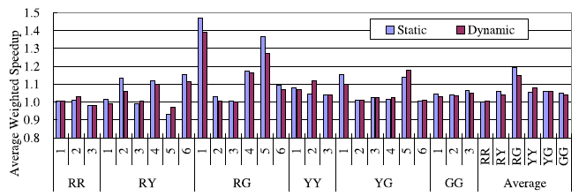
Performance – Static & Dynamic
Aim to minimize combined miss rate
For RG-type, and some RY-type:
  Static partitioning outperforms dynamic partitioning
For RR- and RY-type, and some RY-type
  Dynamic partitioning outperforms static partitioning
Notes:
This figures shows the comparison between the performance of best static partitioning and the performance by the dynamic partitioning policies, using combined miss rates as policy metrics.
It is worth noting that we assume full profiling information is available for the static partitioning. Without such profiling information, the dynamic partitioning perform comparable with static partitioning.
If we look into the workload individually, some workloads perform better by static partitioning
while some other workload performance better by dynamic partitioning.

Slide 236
Software vs. Hardware Cache Management
Software advantages
  + No need to change hardware
  + Easier to upgrade/change algorithm (not burned into hardware)
Disadvantages
  - Less flexible: large granularity (page-based instead of way/block)
  - Limited page colors → reduced performance per application (limited physical memory space!), reduced flexibility
  - Changing partition size has high overhead → page mapping changes
  - Adaptivity is slow: hardware can adapt every cycle (possibly)
  - Not enough information exposed to software (e.g., number of misses due to inter-thread conflict)

Slide 237
Private/Shared Caching
Example: Adaptive spill/receive caching
Goal: Achieve the benefits of private caches (low latency, performance isolation) while sharing cache capacity across cores
Idea: Start with a private cache design (for performance isolation), but dynamically steal space from other cores that do not need all their private caches
  Some caches can spill their data to other cores’ caches dynamically
Qureshi, “Adaptive Spill-Receive for Robust High-Performance Caching in CMPs,” HPCA 2009.

Slide 238
Revisiting Private Caches on CMP
Private caches avoid the need for shared interconnect
++ fast latency, tiled design, performance isolation
CACHE A
CACHE B
CACHE C
CACHE D
Memory
Core A
I$
D$
Core B
I$
D$
Core D
Core C
I$
D$
I$
D$
Problem: When one core needs more cache and other core
has spare cache, private-cache CMPs cannot share capacity

Slide 239
Cache Line Spilling
Spill evicted line from one cache to neighbor cache
- Co-operative caching (CC) [ Chang+ ISCA’06]
Spill
Cache A
Cache B
Cache C
Cache D
Problem with CC:
Performance depends on the parameter (spill probability)
All caches spill as well as receive ➔ Limited improvement
Goal: Robust High-Performance Capacity Sharing with Negligible Overhead

Slide 240
Spill-Receive Architecture
Each Cache is either a Spiller or Receiver but not both
- Lines from spiller cache are spilled to one of the receivers
- Evicted lines from receiver cache are discarded
Spill
Cache A
Cache B
Cache C
Cache D
S/R =1
(Spiller cache)
S/R =0
(Receiver cache)
S/R =1
(Spiller cache)
S/R =0
(Receiver cache)
What is the best N-bit binary string that maximizes the performance of Spill Receive Architecture ➔ Dynamic Spill Receive (DSR)

Slide 241
Dynamic Spill-Receive via “Set Dueling”
    Divide the cache in three:
      Spiller sets
      Receiver sets
      Follower sets (winner of spiller, receiver)
    n-bit PSEL counter
    misses to spiller-sets: PSEL--
    misses to receiver-set: PSEL++
    MSB of PSEL decides policy for Follower sets:
      MSB = 0, Use spill
      MSB = 1, Use receive
Spiller-sets
miss
-
PSEL
Receiver-sets
+
miss
Follower Sets
MSB = 0?
YES
No
Use Recv
Use spill
monitor ➔ choose ➔ apply
(using a single counter)

Slide 242
Dynamic Spill-Receive Architecture
Each cache learns whether it should act as a spiller or receiver
Cache A
Cache B
Cache C
Cache D
Set X
AlwaysSpill
AlwaysRecv
Set Y
Miss in Set X
in any cache
-
PSEL A
PSEL B
PSEL C
PSEL D
Miss in Set Y
in any cache
+
Decides policy for all sets of Cache A (except X and Y)

Slide 243
Experimental Setup
  Baseline Study:
    4-core CMP with in-order cores
    Private Cache Hierarchy: 16KB L1, 1MB L2
    10 cycle latency for local hits, 40 cycles for remote hits
  Benchmarks:
    6 benchmarks that have extra cache: “Givers” (G)
    6 benchmarks that benefit from more cache: “Takers” (T)
    All 4-thread combinations of 12 benchmarks: 495 total
    Five types of workloads:
G4T0
G3T1
G2T2
G1T3
G0T4

Slide 244
Results for Throughput
On average, DSR improves throughput by 18%, co-operative caching by 7%
DSR provides 90% of the benefit of knowing the best decisions a priori
* DSR implemented with 32 dedicated sets and 10 bit PSEL counters

Slide 245
Results for Weighted Speedup
On average, DSR improves weighted speedup by 13%

Slide 246
Results for Hmean Speedup
On average, DSR improves Hmean Fairness from 0.58 to 0.78

Slide 247
DSR vs. Faster Shared Cache
DSR (with 40 cycle extra for remote hits) performs similar to
shared cache with zero latency overhead and crossbar interconnect

Slide 248
Scalability of DSR
DSR improves average throughput by 19% for both systems
(No performance degradation for any of the workloads)

Slide 249
Quality of Service with DSR
For 1 % of the 495x4 =1980 apps, DSR causes IPC loss of > 5%
In some cases, important to ensure that performance does not
degrade compared to dedicated private cache ➔ QoS
DSR can ensure QoS: change PSEL counters by weight of miss:
ΔMiss = MissesWithDSR – MissesWithNoSpill
Weight of Miss = 1 + Max(0, f(ΔMiss))
Calculate weight every 4M cycles. Needs 3 counters per core
Estimated by Spiller Sets
Over time, ΔMiss 0, if DSR is causing more misses.

Slide 250
IPC of QoS-Aware DSR
For Category: G0T4
IPC Normalized To NoSpill
IPC curves for other categories almost overlap for the two schemes.
Avg. throughput improvement across all 495 workloads similar (17.5% vs. 18%)

Slide 251
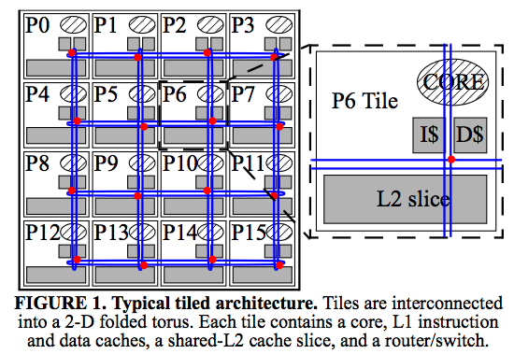
Distributed Caches

Slide 252
Caching for Parallel Applications
core
core
core
core
core
core
core
core
L2
L2
L2
L2
L2
L2
L2
L2
core
core
core
core
core
core
core
core
cache
slice
L2
L2
L2
L2
L2
L2
L2
L2
core
core
core
core
core
core
core
core
L2
L2
L2
L2
L2
L2
L2
L2
core
core
core
core
core
core
core
core
L2
L2
L2
L2
L2
L2
L2
L2
Data placement determines performance
Goal: place data on chip close to where they are used

Slide 253
Shared Cache Management: Research Topics
Scalable partitioning algorithms
  Distributed caches have different tradeoffs
Configurable partitioning algorithms
  Many metrics may need to be optimized at different times or at the same time
  It is not only about overall performance
Ability to have high capacity AND high locality (fast access)
Within vs. across-application prioritization
Holistic design
  How to manage caches, NoC, and memory controllers together?
Cache coherence in shared/private distributed caches

