Slide 1
Processing Data Where It Makes Sense Enabling Practical In- or Near Memory Computation
Onur Mutlu
omutlu@gmail.com
https://people.inf.ethz.ch/omutlu
23 June 2019
CARD Memory Debate (with ISCA)

Slide 2
The Problem
Computing
is Bottlenecked by Data

Slide 3
Data is Key for AI, ML, Genomics, …
Important workloads are all data intensive
They require rapid and efficient processing of large amounts of data
Data is increasing
We can generate more than we can process

Slide 4
Data is Key for Future Workloads
In-memory Databases
[Mao+, EuroSys’12; Clapp+ (Intel), IISWC’15]
Graph/Tree Processing
[Xu+, IISWC’12; Umuroglu+, FPL’15]
In-Memory Data Analytics
[Clapp+ (Intel), IISWC’15;
Awan+, BDCloud’15]
Datacenter Workloads [Kanev+ (Google), ISCA’15]

Slide 5
Data Overwhelms Modern Machines
In-memory Databases
[Mao+, EuroSys’12; Clapp+ (Intel), IISWC’15]
Graph/Tree Processing
[Xu+, IISWC’12; Umuroglu+, FPL’15]
Data → performance & energy bottleneck
In-Memory Data Analytics
[Clapp+ (Intel), IISWC’15;
Awan+, BDCloud’15]
Datacenter Workloads [Kanev+ (Google), ISCA’15]

Slide 6
Data is Key for Future Workloads
Chrome
TensorFlow Mobile
Google’s web browser
Google’s machine learning framework
Video Playback
Video Capture
Google’s video codec
Google’s video codec
Notes:
In this work, we take a look at widely-used google consumer workloads, to figure out the major sources of energy consumption.
We look at Google Chrome web brower. We take a look at Tensorflow, Google’s machine learning framework, and we also take a look at two important video related workloads, video playback and video capture, both rely on Google’s vp9 codec technology.

Slide 7
Data Overwhelms Modern Machines
Chrome
TensorFlow Mobile
Google’s web browser
Google’s machine learning framework
Data → performance & energy bottleneck
Video Playback
Video Capture
Google’s video codec
Google’s video codec
Notes:
In this work, we take a look at widely-used google consumer workloads, to figure out the major sources of energy consumption.
We look at Google Chrome web brower. We take a look at Tensorflow, Google’s machine learning framework, and we also take a look at two important video related workloads, video playback and video capture, both rely on Google’s vp9 codec technology.

Slide 8
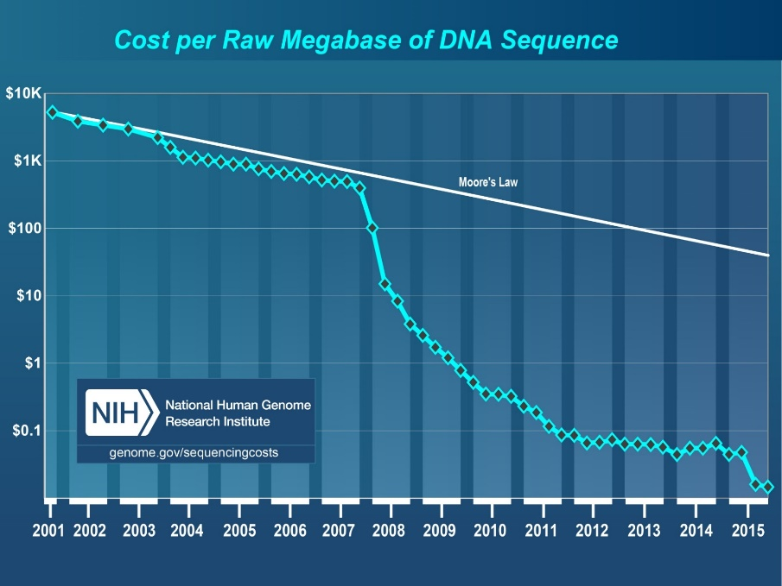
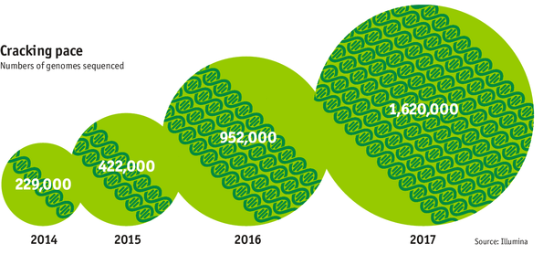
Data is Key for Future Workloads
development of high-throughput sequencing (HTS) technologies
Number of Genomes Sequenced
http://www.economist.com/news/21631808-so-much-genetic-data-so-many-uses-genes-unzipped
Notes:
However, since the development of high throughput sequencing (HTS) technologies, the cost of genome sequencing has fallen off a cliff (<< 1,000$) making it viable for almost everyone's use.

Slide 9
1
Sequencing
Genome Analysis
Read Mapping
2
Data → performance & energy bottleneck
Variant Calling
Scientific Discovery
3
4
Notes:
Genome analysis starts with sequencing random short DNA fragments of copies of the original molecule.
Unfortunately, these reads lack information about their order and which part of genome they are originated from.
Hence the second step is to map these reads to a long reference genome.

Slide 10
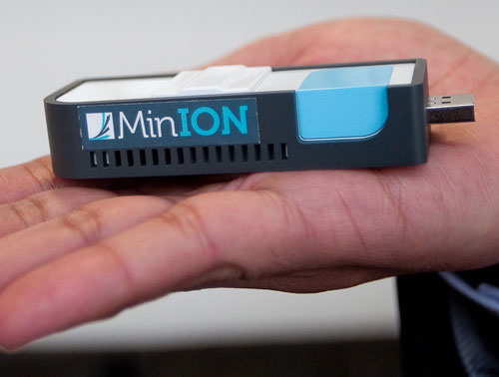
New Genome Sequencing Technologies
Oxford Nanopore MinION
Senol Cali+, “Nanopore Sequencing Technology and Tools for Genome
Assembly: Computational Analysis of the Current State, Bottlenecks
and Future Directions,” Briefings in Bioinformatics, 2018.
[Preliminary arxiv.org version]
Data → performance & energy bottleneck

Slide 11
Data Already Overwhelms Modern Machines
Amirali Boroumand, Saugata Ghose, Youngsok Kim, Rachata Ausavarungnirun, Eric Shiu, Rahul Thakur, Daehyun Kim, Aki Kuusela, Allan Knies, Parthasarathy Ranganathan, and Onur Mutlu, "Google Workloads for Consumer Devices: Mitigating Data Movement Bottlenecks" Proceedings of the 23rd International Conference on Architectural Support for Programming Languages and Operating Systems (ASPLOS), Williamsburg, VA, USA, March 2018.
62.7% of the total system energy
is spent on data movement

Slide 12
Prediction
Future Innovations
Will Be Even More
Bottlenecked by Data

Slide 13
Axiom
An Intelligent Architecture
Handles Data Well

Slide 14
Architectures for Intelligent Machines
Data-centric
Data-driven
Data-aware

Slide 15
Processing Data Where It Makes Sense

Slide 16
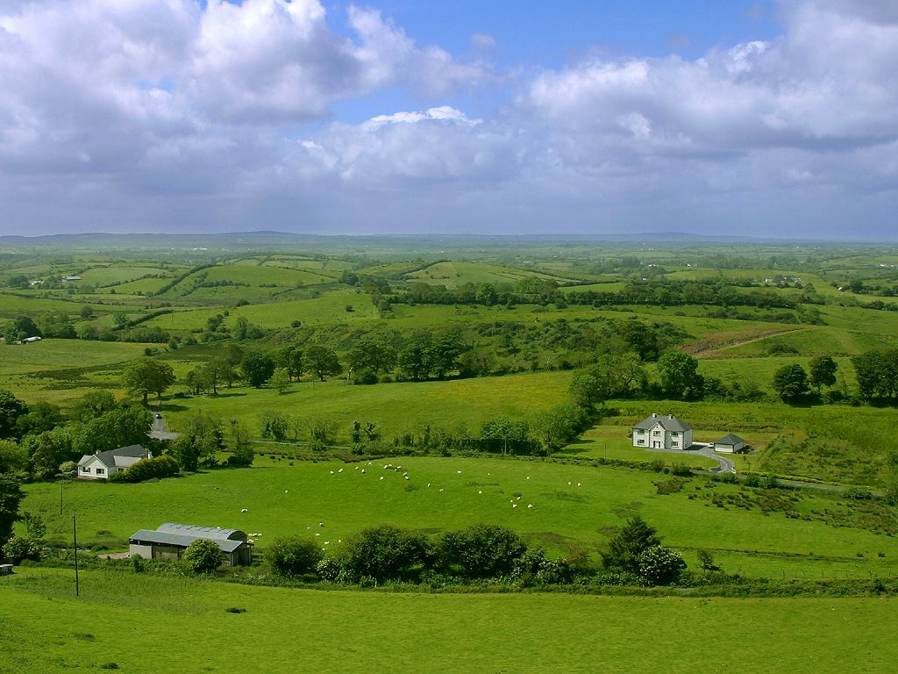
Do We Want This?
Source: V. Milutinovic

Slide 17
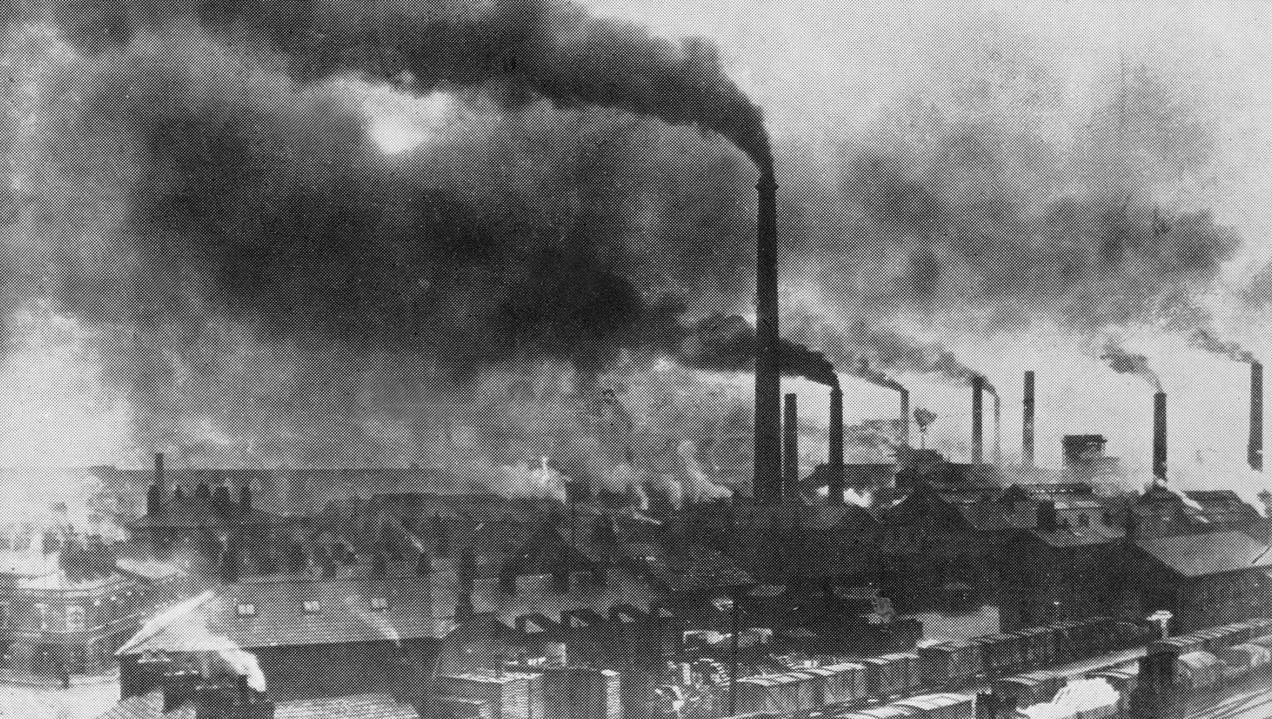
Or This?
Source: V. Milutinovic

Slide 18
Challenge and Opportunity for Future
High Performance,
Energy Efficient,
Sustainable

Slide 19
The Problem
Data access is the major performance and energy bottleneck
Our current
design principles
cause great energy waste
(and great performance loss)

Slide 20
The Problem
Processing of data
is performed
far away from the data

Slide 21
A Computing System
Three key components
Computation
Communication
Storage/memory
Burks, Goldstein, von Neumann, “Preliminary discussion of the
logical design of an electronic computing instrument,” 1946.
Image source: https://lbsitbytes2010.wordpress.com/2013/03/29/john-von-neumann-roll-no-15/

Slide 22
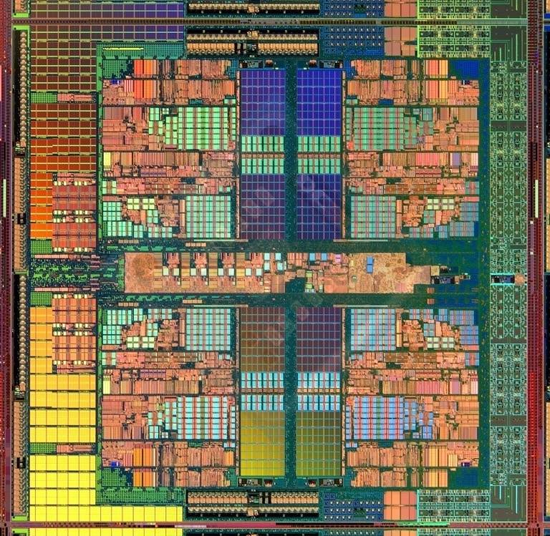
A Computing System
Three key components
Computation
Communication
Storage/memory
Burks, Goldstein, von Neumann, “Preliminary discussion of the
logical design of an electronic computing instrument,” 1946.
Image source: https://lbsitbytes2010.wordpress.com/2013/03/29/john-von-neumann-roll-no-15/

Slide 23
Today’s Computing Systems
Are overwhelmingly processor centric
All data processed in the processor → at great system cost
Processor is heavily optimized and is considered the master
Data storage units are dumb and are largely unoptimized (except for some that are on the processor die)

Slide 24
Yet …
“It’s the Memory, Stupid!” (Richard Sites, MPR, 1996)
Mutlu+, “Runahead Execution: An Alternative to Very Large Instruction Windows for Out-of-Order Processors,” HPCA 2003.

Slide 25
The Performance Perspective
Onur Mutlu, Jared Stark, Chris Wilkerson, and Yale N. Patt, "Runahead Execution: An Alternative to Very Large Instruction Windows for Out-of-order Processors" Proceedings of the 9th International Symposium on High-Performance Computer Architecture (HPCA), pages 129-140, Anaheim, CA, February 2003. Slides (pdf)

Slide 26
The Performance Perspective (Today)
All of Google’s Data Center Workloads (2015):
Kanev+, “Profiling a Warehouse-Scale Computer,” ISCA 2015.

Slide 27
The Performance Perspective (Today)
All of Google’s Data Center Workloads (2015):
Kanev+, “Profiling a Warehouse-Scale Computer,” ISCA 2015.

Slide 28
Perils of Processor-Centric Design
Grossly-imbalanced systems
Processing done only in one place
Everything else just stores and moves data: data moves a lot
→ Energy inefficient
→ Low performance
→ Complex
Overly complex and bloated processor (and accelerators)
To tolerate data access from memory
Complex hierarchies and mechanisms
→ Energy inefficient
→ Low performance
→ Complex

Slide 29
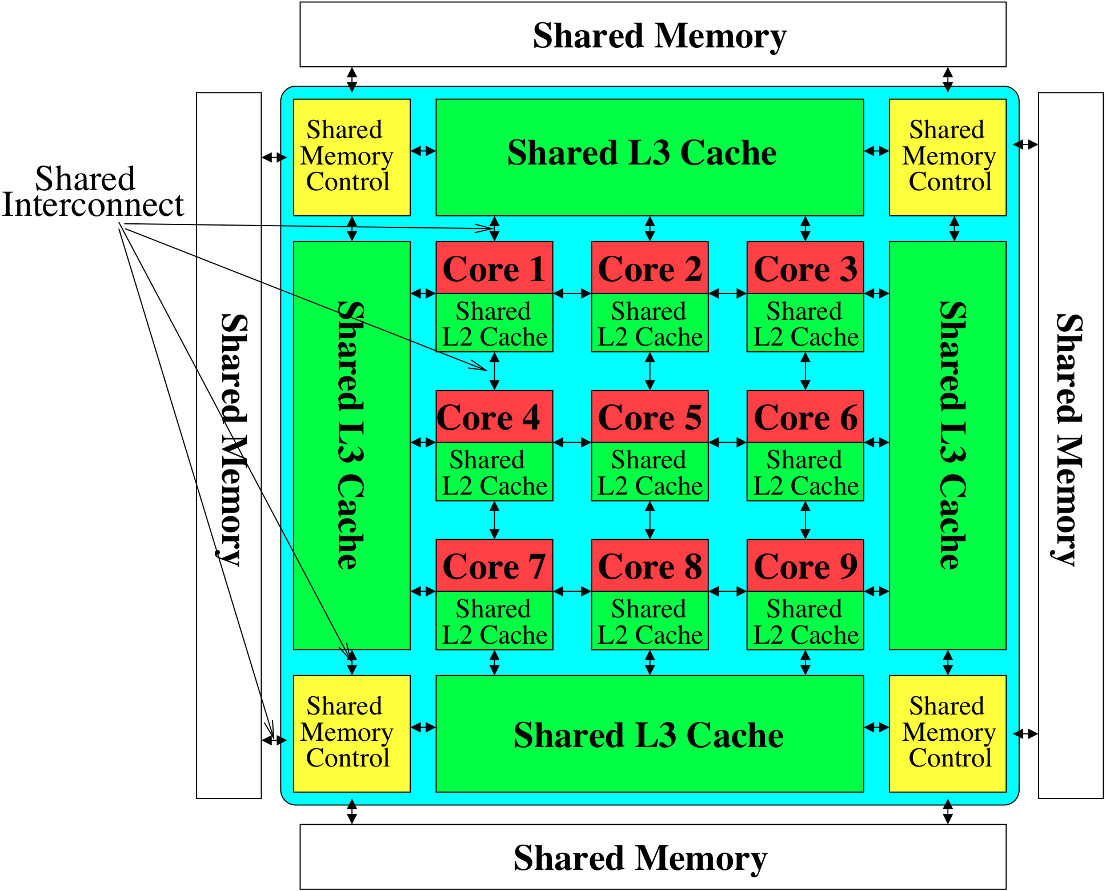
Perils of Processor-Centric Design
Most of the system is dedicated to storing and moving data

Slide 30
The Energy Perspective
Dally, HiPEAC 2015

Slide 31
Data Movement vs. Computation Energy
Dally, HiPEAC 2015
A memory access consumes ~1000X
the energy of a complex addition

Slide 32
Data Movement vs. Computation Energy
Data movement is a major system energy bottleneck
Comprises 41% of mobile system energy during web browsing [2]
Costs ~115 times as much energy as an ADD operation [1, 2]
[1]: Reducing data Movement Energy via Online Data Clustering and Encoding (MICRO’16)
[2]: Quantifying the energy cost of data movement for emerging smart phone workloads on mobile platforms (IISWC’14)

Slide 33
Energy Waste in Mobile Devices
Amirali Boroumand, Saugata Ghose, Youngsok Kim, Rachata Ausavarungnirun, Eric Shiu, Rahul Thakur, Daehyun Kim, Aki Kuusela, Allan Knies, Parthasarathy Ranganathan, and Onur Mutlu, "Google Workloads for Consumer Devices: Mitigating Data Movement Bottlenecks" Proceedings of the 23rd International Conference on Architectural Support for Programming Languages and Operating Systems (ASPLOS), Williamsburg, VA, USA, March 2018.
62.7% of the total system energy
is spent on data movement

Slide 34
We Do Not Want to Move Data!
Dally, HiPEAC 2015
A memory access consumes ~1000X
the energy of a complex addition

Slide 35
We Need A Paradigm Shift To …
Enable computation with minimal data movement
Compute where it makes sense (where data resides)
Make computing architectures more data-centric

Slide 36
Goal: Processing Inside Memory
Many questions … How do we design the:
compute-capable memory & controllers?
processor chip and in-memory units?
software and hardware interfaces?
system software, compilers, languages?
algorithms?
theoretical foundations
Memory
Processor
Core
Database
Graphs
Media
Cache
Query
Interconnect
Problem
Results
Algorithm
Program/Language
System Software
SW/HW Interface
Micro-architecture
Logic
Devices
Electrons

Slide 37
Why In-Memory Computation Today?
Push from Technology
DRAM Scaling at jeopardy
→ Controllers close to DRAM
→ Industry open to new memory architectures

Slide 38
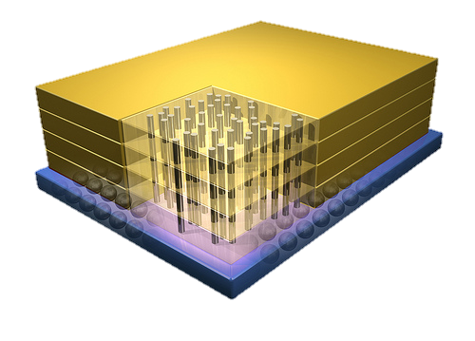
Why In-Memory Computation Today?
Push from Technology
DRAM Scaling at jeopardy
→ Controllers close to DRAM
→ Industry open to new memory architectures

Slide 39
Why In-Memory Computation Today?
Push from Technology
DRAM Scaling at jeopardy
→ Controllers close to DRAM
→ Industry open to new memory architectures
Pull from Systems and Applications
Data access is a major system and application bottleneck
Systems and applications are energy limited
Data movement much more energy-hungry than computation

Slide 40
We Need to Think Differently from the Past Approaches

Slide 41
Processing in Memory: Two Approaches
1. Minimally changing memory chips
2. Exploiting 3D-stacked memory

Slide 42
Starting Simple: Data Copy and Initialization
memmove & memcpy: 5% cycles in Google’s datacenter [Kanev+ ISCA’15]
000000000000000
Zero initialization
(e.g., security)
Forking
Checkpointing
Many more
VM Cloning
Deduplication
Page Migration

Slide 43
Today’s Systems: Bulk Data Copy
1) High latency
Memory
3) Cache pollution
L3
CPU
L2
L1
MC
2) High bandwidth utilization
4) Unwanted data movement
1046ns, 3.6uJ (for 4KB page copy via DMA)

Slide 44
Future Systems: In-Memory Copy
3) No cache pollution
1) Low latency
Memory
L3
CPU
L2
L1
MC
2) Low bandwidth utilization
4) No unwanted data movement
1046ns, 3.6uJ
→ 90ns, 0.04uJ

Slide 45
RowClone: In-DRAM Row Copy
Idea: Two consecutive ACTivates
4 Kbytes
Negligible HW cost
Step 1: Activate row A
Step 2: Activate row B
Transfer row
DRAM subarray
Transfer
row
Row Buffer (4 Kbytes)
8 bits
Data Bus
Notes:
copy

Slide 46
RowClone: Latency and Energy Savings
11.6x
74x
Seshadri et al., “RowClone: Fast and Efficient In-DRAM Copy and Initialization of Bulk Data,” MICRO 2013.

Slide 47
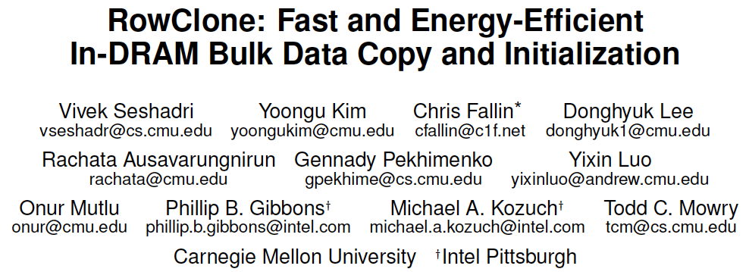
More on RowClone
Vivek Seshadri, Yoongu Kim, Chris Fallin, Donghyuk Lee, Rachata Ausavarungnirun, Gennady Pekhimenko, Yixin Luo, Onur Mutlu, Michael A. Kozuch, Phillip B. Gibbons, and Todd C. Mowry, "RowClone: Fast and Energy-Efficient In-DRAM Bulk Data Copy and Initialization" Proceedings of the 46th International Symposium on Microarchitecture (MICRO), Davis, CA, December 2013. [Slides (pptx) (pdf)] [Lightning Session Slides (pptx) (pdf)] [Poster (pptx) (pdf)]

Slide 48
Memory as an Accelerator
CPU
core
CPU
core
mini-CPU
core
GPU
(throughput)
core
GPU
(throughput)
core
video
core
GPU
(throughput)
core
GPU
(throughput)
core
CPU
core
CPU
core
Memory
imaging
core
LLC
Specialized
compute-capability
in memory
Memory Controller
Memory Bus
Memory similar to a “conventional” accelerator

Slide 49
In-Memory Bulk Bitwise Operations
We can support in-DRAM COPY, ZERO, AND, OR, NOT, MAJ
At low cost
Using analog computation capability of DRAM
Idea: activating multiple rows performs computation
30-60X performance and energy improvement
Seshadri+, “Ambit: In-Memory Accelerator for Bulk Bitwise Operations Using Commodity DRAM Technology,” MICRO 2017.
New memory technologies enable even more opportunities
Memristors, resistive RAM, phase change mem, STT-MRAM, …
Can operate on data with minimal movement

Slide 50
In-DRAM AND/OR: Triple Row Activation
½V_{DD}
½V_{DD}+δ
V_{DD}
A
Final State
AB + BC + AC
B
C
C(A + B) + ~C(AB)
dis
en
0
½V_{DD}
Seshadri+, “Fast Bulk Bitwise AND and OR in DRAM”, IEEE CAL 2015.

Slide 51
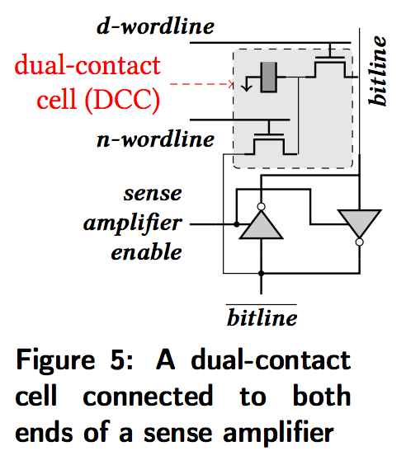
In-DRAM NOT: Dual Contact Cell
Idea:
Feed the
negated value
in the sense amplifier
into a special row
Seshadri+, “Ambit: In-Memory Accelerator for Bulk Bitwise Operations using Commodity DRAM Technology,” MICRO 2017.

Slide 52
Ambit vs. DDR3: Performance and Energy
32X
35X
Seshadri+, “Ambit: In-Memory Accelerator for Bulk Bitwise Operations using Commodity DRAM Technology,” MICRO 2017.

Slide 53
Bulk Bitwise Operations in Workloads
[1] Li and Patel, BitWeaving, SIGMOD 2013
[2] Goodwin+, BitFunnel, SIGIR 2017

Slide 54
Performance: Bitmap Index on Ambit
>5.4-6.6X Performance Improvement
Seshadri+, “Ambit: In-Memory Accelerator for Bulk Bitwise Operations using Commodity DRAM Technology,” MICRO 2017.

Slide 55
Performance: BitWeaving on Ambit
>4-12X Performance Improvement
Seshadri+, “Ambit: In-Memory Accelerator for Bulk Bitwise Operations using Commodity DRAM Technology,” MICRO 2017.

Slide 56
More on Ambit
Vivek Seshadri et al., “Ambit: In-Memory Accelerator for Bulk Bitwise Operations Using Commodity DRAM Technology,” MICRO 2017.

Slide 57
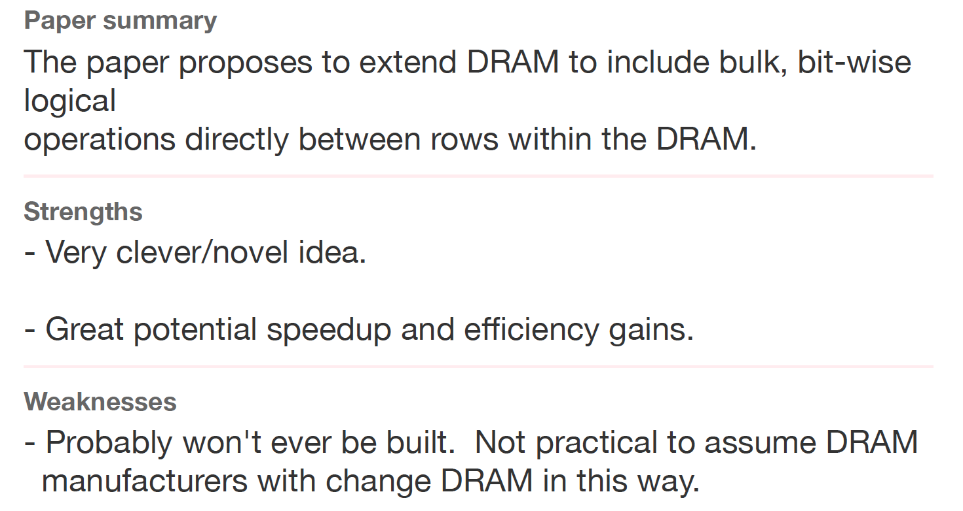
Sounds Good, No?
Review from ISCA 2016

Slide 58
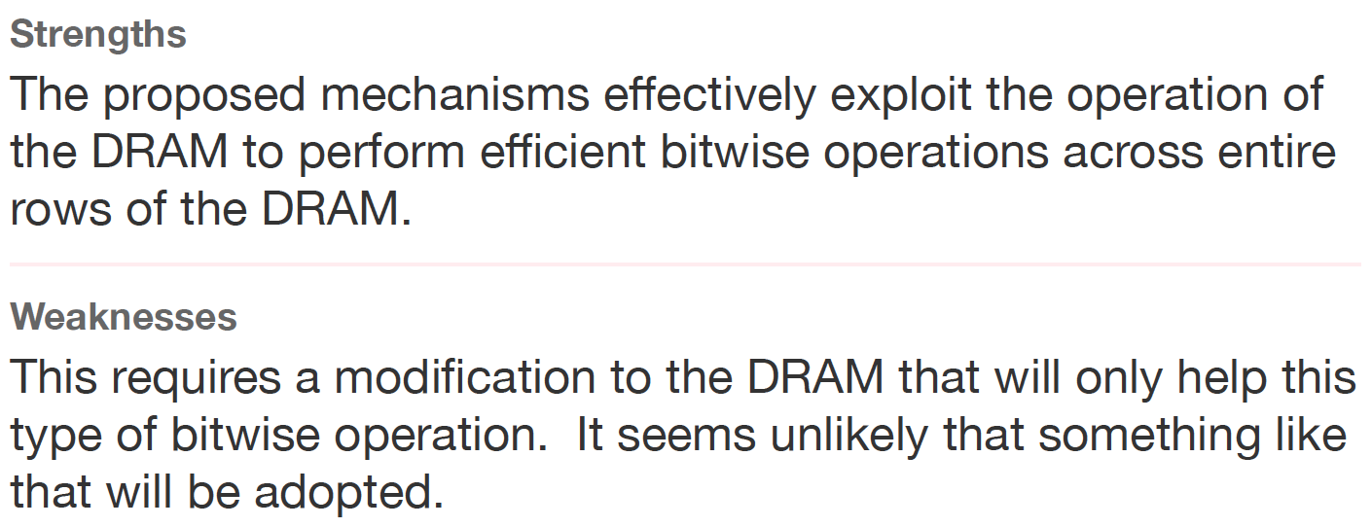
Another Review
Another Review from ISCA 2016

Slide 59
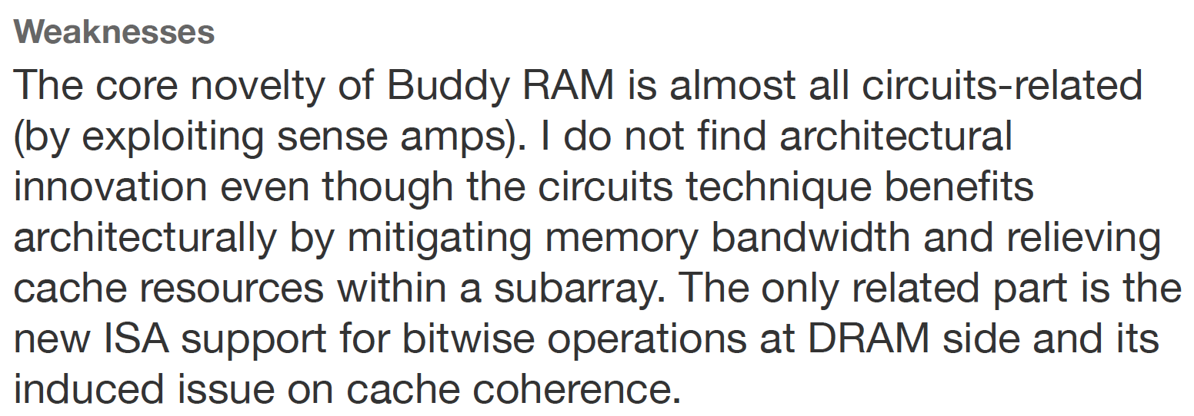
Yet Another Review
Yet Another Review from ISCA 2016

Slide 60
We Have a Mindset Issue…
There are many other similar examples from reviews…
For many other papers…
And, we are not even talking about JEDEC yet…
How do we fix the mindset problem?
By doing more research, education, implementation in alternative processing paradigms
We need to work on enabling the better future…

Slide 61
Aside: A Recommended Book
Raj Jain, “The Art of
Computer Systems
Performance Analysis,”
Wiley, 1991.

Slide 62
Raj Jain, “The Art of
Computer Systems
Performance Analysis,”
Wiley, 1991.

Slide 63
Raj Jain, “The Art of
Computer Systems
Performance Analysis,”
Wiley, 1991.

Slide 64
Processing in Memory: Two Approaches
1. Minimally changing memory chips
2. Exploiting 3D-stacked memory

Slide 65
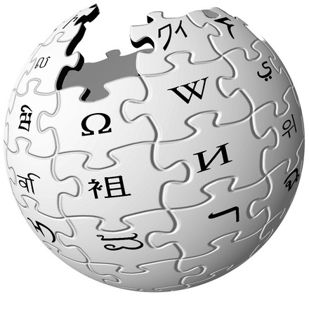
Graph Processing
Large graphs are everywhere (circa 2015)
Scalable large-scale graph processing is challenging
36 Million
Wikipedia Pages
1.4 Billion
Facebook Users
300 Million
Twitter Users
30 Billion
Instagram Photos

Slide 66
Key Bottlenecks in Graph Processing
for (v: graph.vertices) {
for (w: v.successors) {
w.next_rank += weight * v.rank;
}
}
1. Frequent random memory accesses
v
&w
w.rank
w.next_rank
w.edges
weight * v.rank
w
…
2. Little amount of computation

Slide 67
Tesseract System for Graph Processing
Interconnected set of 3D-stacked memory+logic chips with simple cores
Host Processor
Memory
Memory-Mapped
Accelerator Interface
(Noncacheable, Physically Addressed)
Logic
In-Order Core
DRAM Controller
…
…
LP
PF Buffer
Crossbar Network
…
MTP
…
Message Queue
NI
Ahn+, “A Scalable Processing-in-Memory Accelerator for Parallel Graph Processing” ISCA 2015.

Slide 68
Tesseract: Evaluated Systems
DDR3-OoO
HMC-OoO
HMC-MC
Tesseract
32 Tesseract Cores
8 OoO
4GHz
8 OoO
4GHz
8 OoO
4GHz
8 OoO
4GHz
128 In-Order
2GHz
128 In-Order
2GHz
8 OoO
4GHz
8 OoO
4GHz
8 OoO
4GHz
8 OoO
4GHz
128 In-Order
2GHz
128 In-Order
2GHz
102.4GB/s
640GB/s
640GB/s
8TB/s
Ahn+, “A Scalable Processing-in-Memory Accelerator for Parallel Graph Processing” ISCA 2015.

Slide 69
Tesseract Graph Processing Performance
>13X Performance Improvement
On five graph processing algorithms
Ahn+, “A Scalable Processing-in-Memory Accelerator for Parallel Graph Processing” ISCA 2015.

Slide 70
Tesseract Graph Processing System Energy
> 8X Energy Reduction
Ahn+, “A Scalable Processing-in-Memory Accelerator for Parallel Graph Processing” ISCA 2015.

Slide 71
More on Tesseract
Junwhan Ahn, Sungpack Hong, Sungjoo Yoo, Onur Mutlu, and Kiyoung Choi, "A Scalable Processing-in-Memory Accelerator for Parallel Graph Processing" Proceedings of the 42nd International Symposium on Computer Architecture (ISCA), Portland, OR, June 2015. [Slides (pdf)] [Lightning Session Slides (pdf)]

Slide 72
Another Example: PIM on Mobile Devices
Amirali Boroumand, Saugata Ghose, Youngsok Kim, Rachata Ausavarungnirun, Eric Shiu, Rahul Thakur, Daehyun Kim, Aki Kuusela, Allan Knies, Parthasarathy Ranganathan, and Onur Mutlu, "Google Workloads for Consumer Devices: Mitigating Data Movement Bottlenecks" Proceedings of the 23rd International Conference on Architectural Support for Programming Languages and Operating Systems (ASPLOS), Williamsburg, VA, USA, March 2018.

Slide 73
Four Important Workloads
Chrome
TensorFlow Mobile
Google’s web browser
Google’s machine learning framework
Video Playback
Video Capture
Google’s video codec
Google’s video codec
Notes:
In this work, we take a look at widely-used google consumer workloads, to figure out the major sources of energy consumption.
We look at Google Chrome web brower. We take a look at Tensorflow, Google’s machine learning framework, and we also take a look at two important video related workloads, video playback and video capture, both rely on Google’s vp9 codec technology.

Slide 74
Simple PIM on Mobile Workloads
2nd key observation: a significant fraction of the data movement often comes from simple functions
We can design lightweight logic to implement these simple functions in memory
Small embedded low-power core
Small fixed-function accelerators
PIM Core
PIM Accelerator
PIM Accelerator
PIM Accelerator
Offloading to PIM logic reduces energy and
execution time, on average, by 55.4% and 54.2%
Notes:
To figure out if we can use processing in memory, we dig deeper into our analysis and we make another key observation that majority of data movement often comes form simple functions and pritmitives. We find that these simple function can be implemented in memory as either a small embedded core, or group of small fixed function accelerators. Our result shows that offloading these function to PIM logic can significantly reduce data movement for each function and reduce energy on average around 55% and improve perforamcne around 54%.
our PIM core can reduce significant portion of data movement, reduce enregy by 49.1% for each function and improve performance up to 2.2X. While using group of fixed function accelerator reduce energy by 55.4% and improve performance by up to 2.5X.
Or use Saugata’s approach : Reduces total system energy by an average of 55.4%
Reduces execution time by an average of 54.2%
Our result show that both of them can significantly reduce the data movement for each function.
Feedback: talk about result more
Don’t talk about specific detail like MemCopy, MemSet stuff like that
Main take away: data movement come from simple functions that are simple enough to implement in PIM
We find that these functions and primitves can be implemented as PIM logic using either (1) a small low-power general-purpose embedded core or (2) a group of small fixed-function accelerators (PIM accelerators). Our Analysis shows that both are cost-feasible to use in consumer devices. We find that they eliminate a significant fraction of dat amovement, and reduce energy consumption for each of these operation on average by 49 and 55%.

Slide 75
The Results Are Quite Promising…
1-2 orders of magnitude… ~2X in the limited case…
How do we enable them in real life?
By doing more research and education in alternative processing paradigms
By being more cognizant about the adoption issues and solving them…
We need to work on enabling the better future…

Slide 76
Eliminating the Adoption Barriers
How to Enable Adoption of Processing in Memory

Slide 77
Barriers to Adoption of PIM
1. Functionality of and applications & software for PIM
2. Ease of programming (interfaces and compiler/HW support)
3. System support: coherence & virtual memory
4. Runtime and compilation systems for adaptive scheduling, data mapping, access/sharing control
5. Infrastructures to assess benefits and feasibility
All can be solved with change of mindset

Slide 78
We Need to Revisit the Entire Stack
Problem
Algorithm
Program/Language
System Software
SW/HW Interface
Micro-architecture
Logic
Devices
Electrons
We can get there step by step

Slide 79
PIM Review and Open Problems
Onur Mutlu, Saugata Ghose, Juan Gomez-Luna, and Rachata Ausavarungnirun, "Processing Data Where It Makes Sense: Enabling In-Memory Computation" Invited paper in Microprocessors and Microsystems (MICPRO), June 2019. [arXiv version]
https://arxiv.org/pdf/1903.03988.pdf

Slide 80
Concluding Remarks
It is time to design principled system architectures to solve the data handling (i.e., memory/storage) problem
Design complete systems to be truly balanced, high-performance, and energy-efficient → intelligent architectures
Data-centric, data-driven, data-aware
Enable computation capability inside and close to memory
This can
Lead to orders-of-magnitude improvements
Enable new applications & computing platforms
Enable better understanding of nature
…
Notes:
Perhaps we have taken processor-centric system design a bit too far

Slide 81
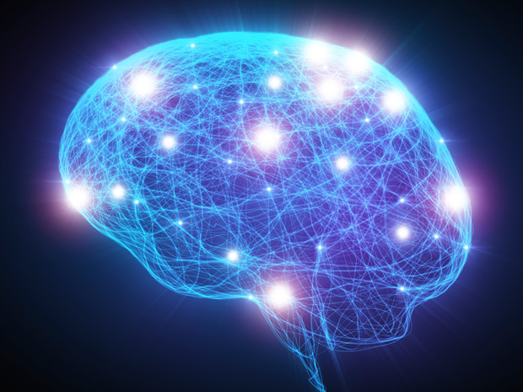
Source: http://spectrum.ieee.org/image/MjYzMzAyMg.jpeg

Slide 82
Challenge and Opportunity for Future
Computing Architectures
with
Minimal Data Movement

Slide 83
Processing Data Where It Makes Sense Enabling Practical In- or Near Memory Computation
Onur Mutlu
omutlu@gmail.com
https://people.inf.ethz.ch/omutlu
23 June 2019
CARD Memory Debate (with ISCA)

Slide 84
Backup Slides

Slide 85
Some PIM Adoption Issues

Slide 86
Two Key Questions in 3D-Stacked PIM
What are the performance and energy benefits of using 3D-stacked memory as a coarse-grained accelerator?
By changing the entire system
By performing simple function offloading
What is the minimal processing-in-memory support we can provide?
With minimal changes to system and programming

Slide 87
PEI: PIM-Enabled Instructions (Ideas)
Goal: Develop mechanisms to get the most out of near-data processing with minimal cost, minimal changes to the system, no changes to the programming model
Key Idea 1: Expose each PIM operation as a cache-coherent, virtually-addressed host processor instruction (called PEI) that operates on only a single cache block
e.g., __pim_add(&w.next_rank, value) → pim.add r1, (r2)
No changes sequential execution/programming model
No changes to virtual memory
Minimal changes to cache coherence
No need for data mapping: Each PEI restricted to a single memory module
Key Idea 2: Dynamically decide where to execute a PEI (i.e., the host processor or PIM accelerator) based on simple locality characteristics and simple hardware predictors
Execute each operation at the location that provides the best performance

Slide 88
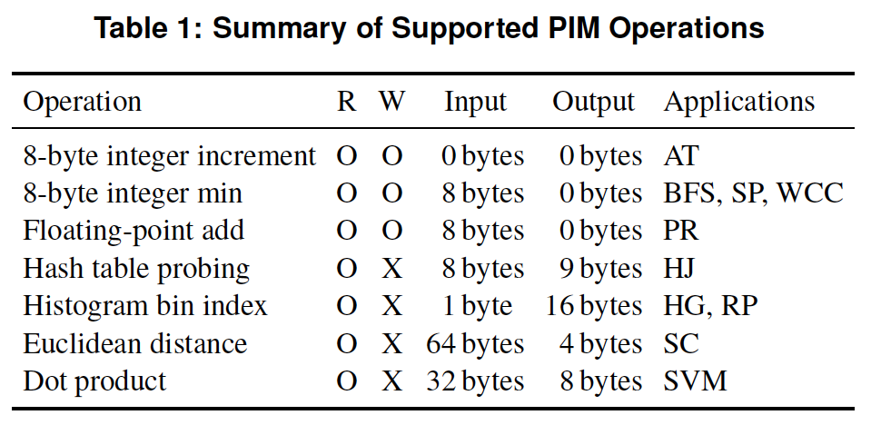
PEI: PIM-Enabled Instructions (Example)
for (v: graph.vertices) {
value = weight * v.rank;
for (w: v.successors) {
__pim_add(&w.next_rank, value);
}
}
pfence();
pim.add r1, (r2)
pfence
Executed either in memory or in the processor: dynamic decision
Low-cost locality monitoring for a single instruction
Cache-coherent, virtually-addressed, single cache block only
Atomic between different PEIs
Not atomic with normal instructions (use pfence for ordering)

Slide 89
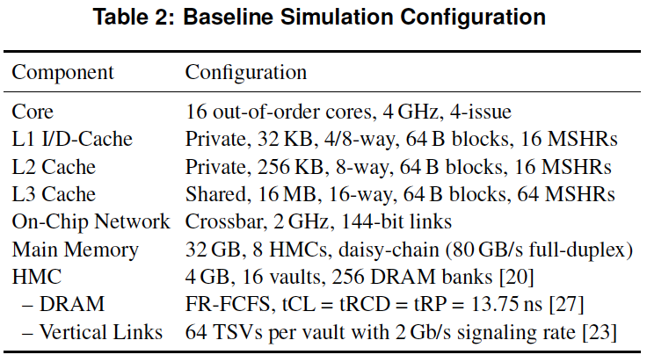
PEI: Initial Evaluation Results
Initial evaluations with 10 emerging data-intensive workloads
Large-scale graph processing
In-memory data analytics
Machine learning and data mining
Three input sets (small, medium, large) for each workload to analyze the impact of data locality
Pin-based cycle-level x86-64 simulation
Performance Improvement and Energy Reduction:
47% average speedup with large input data sets
32% speedup with small input data sets
25% avg. energy reduction in a single node with large input data sets

Slide 90
PEI Performance Delta: Large Data Sets
(Large Inputs, Baseline: Host-Only)
47% Performance
Improvement

Slide 91
PEI Energy Consumption
25% Energy
Reduction
Host-Only
PIM-Only
Locality-Aware

Slide 92
Simpler PIM: PIM-Enabled Instructions
Junwhan Ahn, Sungjoo Yoo, Onur Mutlu, and Kiyoung Choi, "PIM-Enabled Instructions: A Low-Overhead, Locality-Aware Processing-in-Memory Architecture" Proceedings of the 42nd International Symposium on Computer Architecture (ISCA), Portland, OR, June 2015. [Slides (pdf)] [Lightning Session Slides (pdf)]

Slide 93
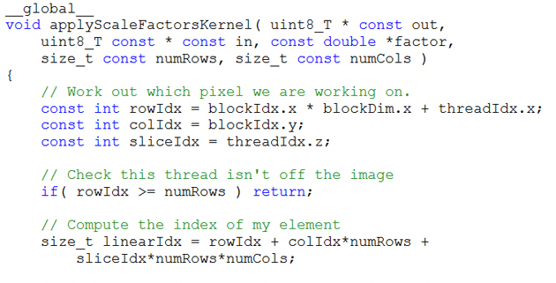
Key Challenge 1: Code Mapping
Challenge 1: Which operations should be executed in memory vs. in CPU?
?
3D-stacked memory
(memory stack)
SM (Streaming Multiprocessor)
?
Logic layer
Logic layer SM
Main GPU
Crossbar switch
Vault Ctrl
….
Vault Ctrl

Slide 94
Key Challenge 2: Data Mapping
Challenge 2: How should data be mapped to different 3D memory stacks?
3D-stacked memory
(memory stack)
SM (Streaming Multiprocessor)
Logic layer
Logic layer SM
Main GPU
Crossbar switch
Vault Ctrl
….
Vault Ctrl

Slide 95
How to Do the Code and Data Mapping?
Kevin Hsieh, Eiman Ebrahimi, Gwangsun Kim, Niladrish Chatterjee, Mike O'Connor, Nandita Vijaykumar, Onur Mutlu, and Stephen W. Keckler, "Transparent Offloading and Mapping (TOM): Enabling Programmer-Transparent Near-Data Processing in GPU Systems" Proceedings of the 43rd International Symposium on Computer Architecture (ISCA), Seoul, South Korea, June 2016. [Slides (pptx) (pdf)] [Lightning Session Slides (pptx) (pdf)]

Slide 96
How to Schedule Code?
Ashutosh Pattnaik, Xulong Tang, Adwait Jog, Onur Kayiran, Asit K. Mishra, Mahmut T. Kandemir, Onur Mutlu, and Chita R. Das, "Scheduling Techniques for GPU Architectures with Processing-In-Memory Capabilities" Proceedings of the 25th International Conference on Parallel Architectures and Compilation Techniques (PACT), Haifa, Israel, September 2016.

Slide 97
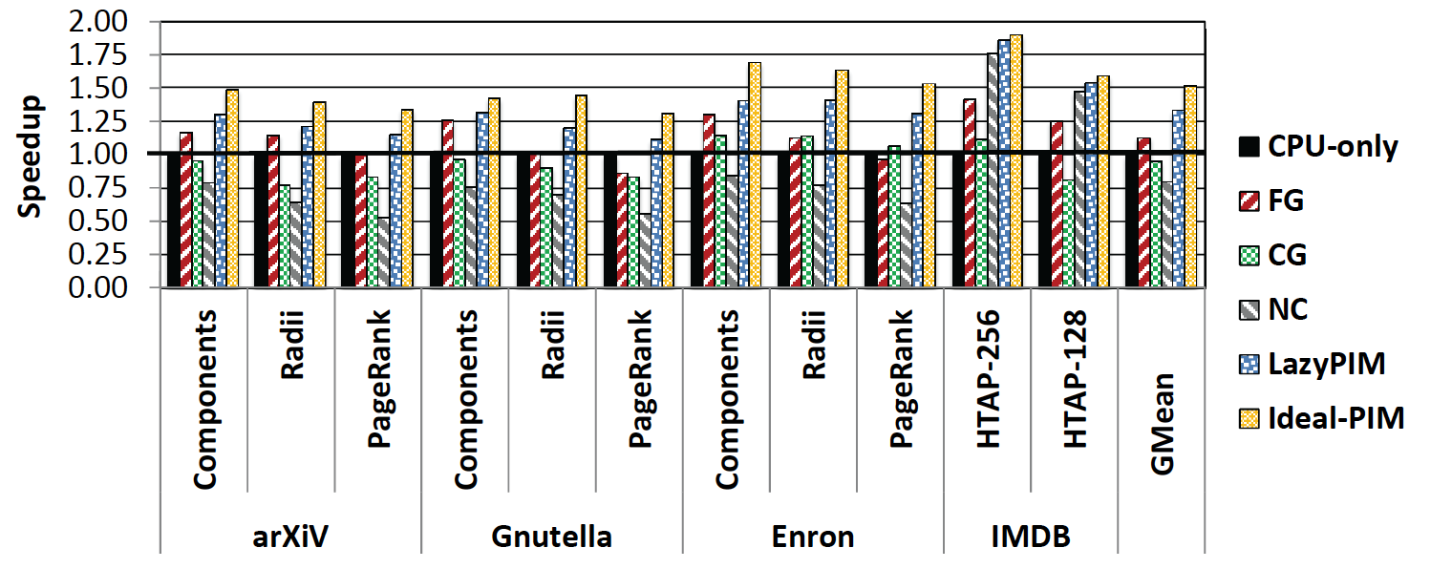
Challenge: Coherence for Hybrid CPU-PIM Apps
Traditional
coherence
No coherence
overhead

Slide 98
How to Maintain Coherence? (I)
Amirali Boroumand, Saugata Ghose, Minesh Patel, Hasan Hassan, Brandon Lucia, Kevin Hsieh, Krishna T. Malladi, Hongzhong Zheng, and Onur Mutlu, "LazyPIM: An Efficient Cache Coherence Mechanism for Processing-in-Memory" IEEE Computer Architecture Letters (CAL), June 2016.

Slide 99
How to Maintain Coherence? (II)
Amirali Boroumand, Saugata Ghose, Minesh Patel, Hasan Hassan, Brandon Lucia, Kevin Hsieh, Krishna T. Malladi, Hongzhong Zheng, and Onur Mutlu, "CoNDA: Efficient Cache Coherence Support for Near-Data Accelerators" Proceedings of the 46th International Symposium on Computer Architecture (ISCA), Phoenix, AZ, USA, June 2019.

Slide 100
How to Support Virtual Memory?
Kevin Hsieh, Samira Khan, Nandita Vijaykumar, Kevin K. Chang, Amirali Boroumand, Saugata Ghose, and Onur Mutlu, "Accelerating Pointer Chasing in 3D-Stacked Memory: Challenges, Mechanisms, Evaluation" Proceedings of the 34th IEEE International Conference on Computer Design (ICCD), Phoenix, AZ, USA, October 2016.

Slide 101
How to Design Data Structures for PIM?
Zhiyu Liu, Irina Calciu, Maurice Herlihy, and Onur Mutlu, "Concurrent Data Structures for Near-Memory Computing" Proceedings of the 29th ACM Symposium on Parallelism in Algorithms and Architectures (SPAA), Washington, DC, USA, July 2017. [Slides (pptx) (pdf)]

Slide 102
Simulation Infrastructures for PIM
Ramulator extended for PIM
Flexible and extensible DRAM simulator
Can model many different memory standards and proposals
Kim+, “Ramulator: A Flexible and Extensible DRAM Simulator”, IEEE CAL 2015.
https://github.com/CMU-SAFARI/ramulator

Slide 103
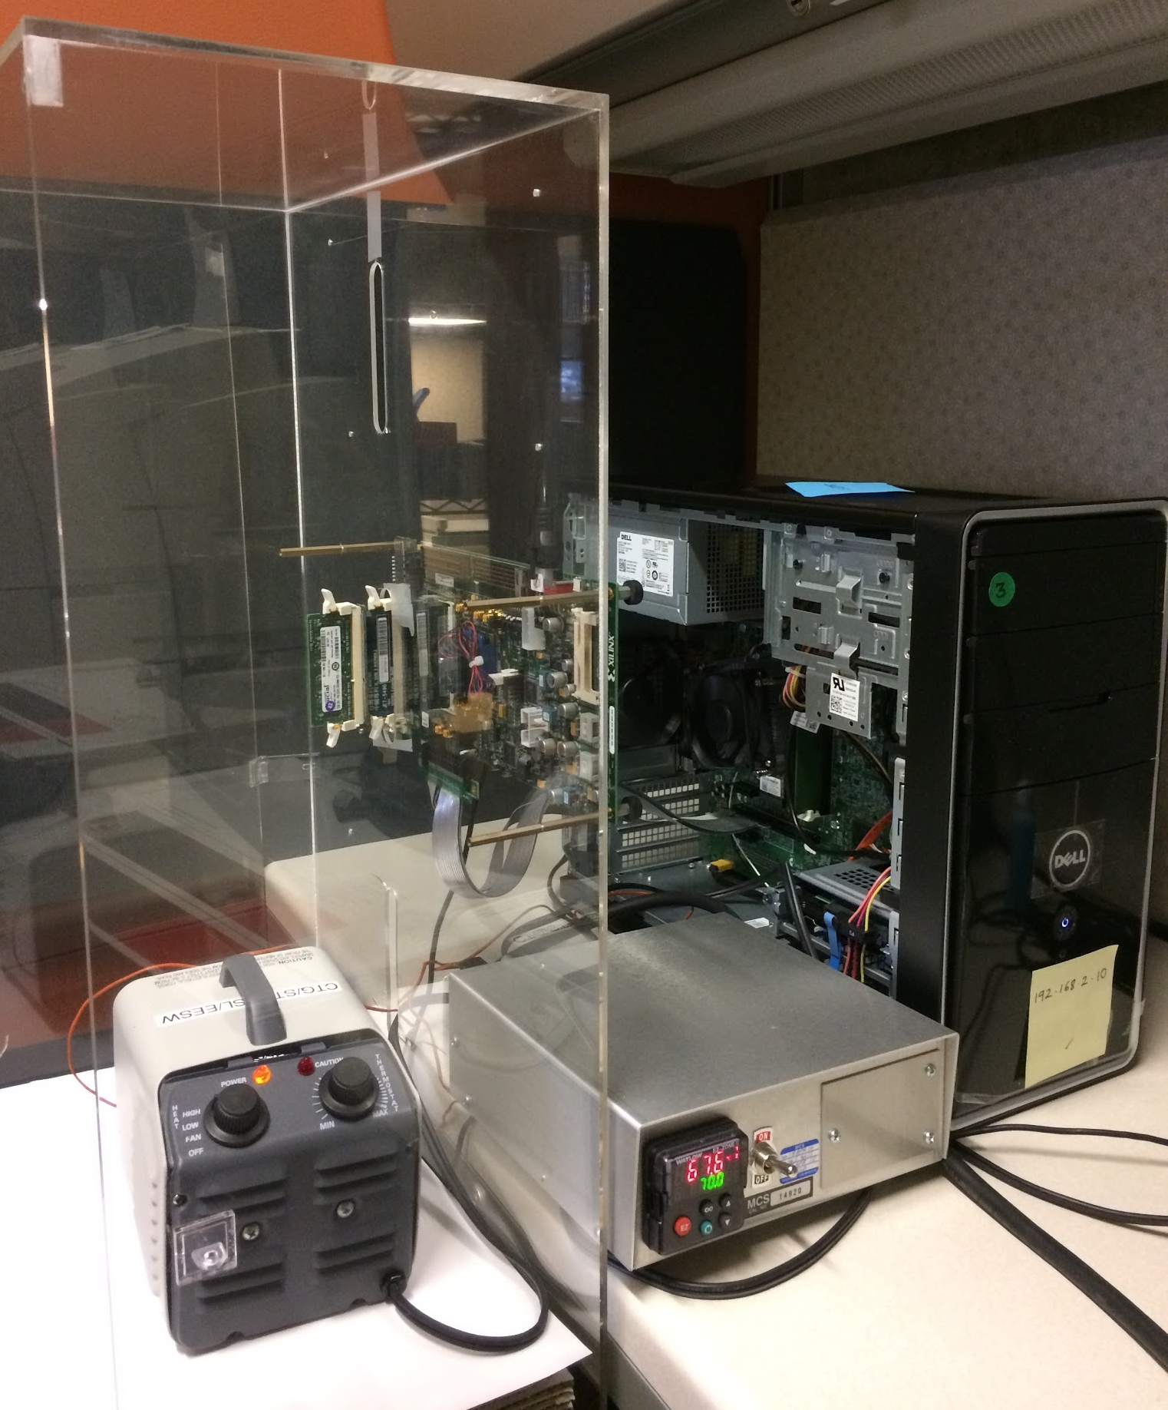
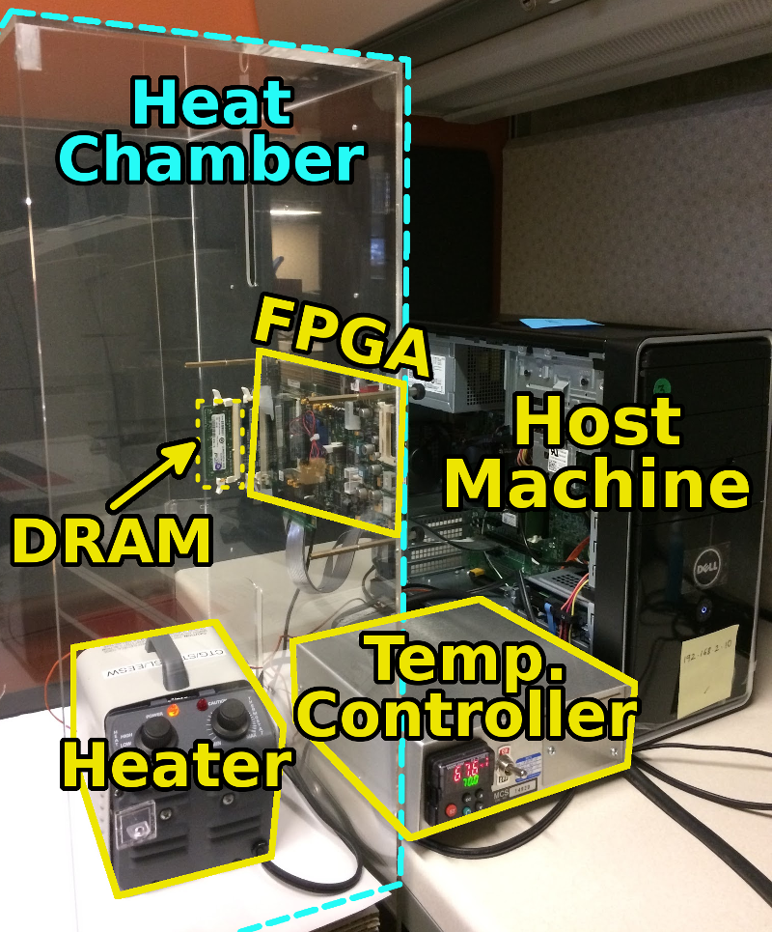
An FPGA-based Test-bed for PIM?
Hasan Hassan et al., SoftMC: A Flexible and Practical Open-Source Infrastructure for Enabling Experimental DRAM Studies HPCA 2017.
Flexible
Easy to Use (C++ API)
Open-source
github.com/CMU-SAFARI/SoftMC

Slide 104
Simulation Infrastructures for PIM (in SSDs)
Arash Tavakkol, Juan Gomez-Luna, Mohammad Sadrosadati, Saugata Ghose, and Onur Mutlu, "MQSim: A Framework for Enabling Realistic Studies of Modern Multi-Queue SSD Devices" Proceedings of the 16th USENIX Conference on File and Storage Technologies (FAST), Oakland, CA, USA, February 2018. [Slides (pptx) (pdf)] [Source Code]

Slide 105
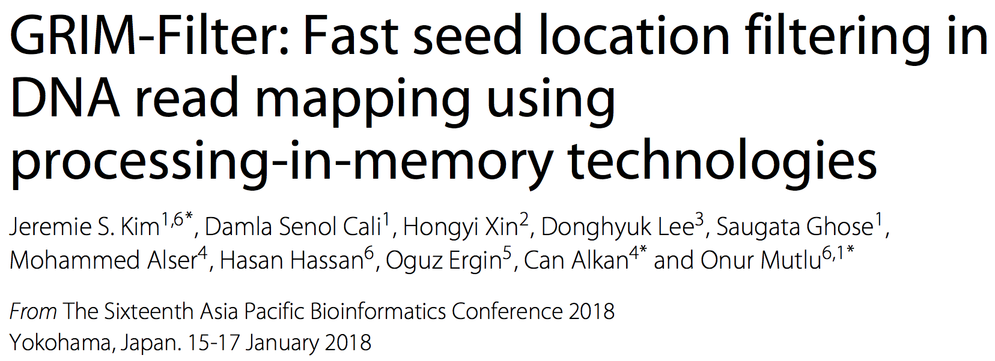
New Applications and Use Cases for PIM
Jeremie S. Kim, Damla Senol Cali, Hongyi Xin, Donghyuk Lee, Saugata Ghose, Mohammed Alser, Hasan Hassan, Oguz Ergin, Can Alkan, and Onur Mutlu, "GRIM-Filter: Fast Seed Location Filtering in DNA Read Mapping Using Processing-in-Memory Technologies" BMC Genomics, 2018. Proceedings of the 16th Asia Pacific Bioinformatics Conference (APBC), Yokohama, Japan, January 2018. arxiv.org Version (pdf)

Slide 106
Readings, Videos, Reference Materials

Slide 107
Accelerated Memory Course (~6.5 hours)
ACACES 2018
Memory Systems and Memory-Centric Computing Systems
Taught by Onur Mutlu July 9-13, 2018
~6.5 hours of lectures
Website for the Course including Videos, Slides, Papers
https://people.inf.ethz.ch/omutlu/acaces2018.html
https://www.youtube.com/playlist?list=PL5Q2soXY2Zi-HXxomthrpDpMJm05P6J9x
All Papers are at:
https://people.inf.ethz.ch/omutlu/projects.htm
Final lecture notes and readings (for all topics)

Slide 108
Reference Overview Paper I
Onur Mutlu, Saugata Ghose, Juan Gomez-Luna, and Rachata Ausavarungnirun, "Processing Data Where It Makes Sense: Enabling In-Memory Computation" Invited paper in Microprocessors and Microsystems (MICPRO), June 2019. [arXiv version]
https://arxiv.org/pdf/1903.03988.pdf

Slide 109
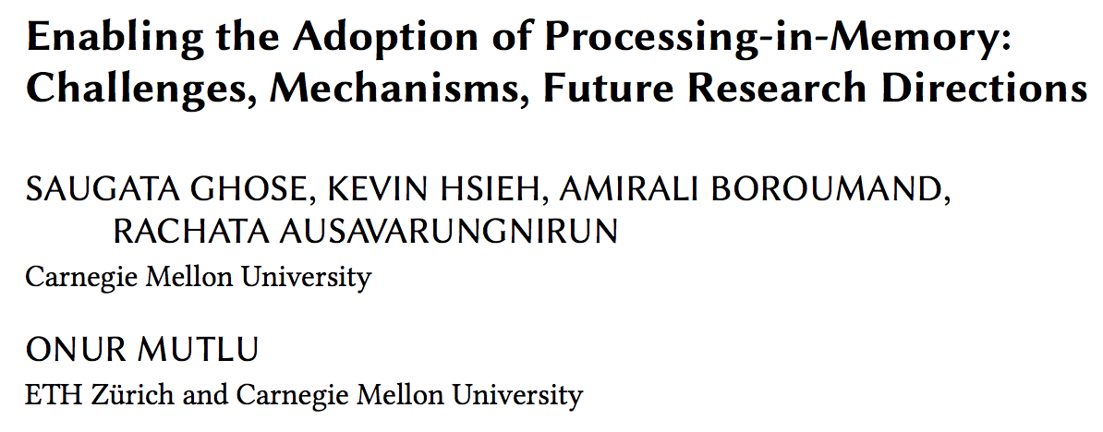
Reference Overview Paper II
Saugata Ghose, Kevin Hsieh, Amirali Boroumand, Rachata Ausavarungnirun, Onur Mutlu, "Enabling the Adoption of Processing-in-Memory: Challenges, Mechanisms, Future Research Directions" Invited Book Chapter, to appear in 2018. [Preliminary arxiv.org version]
https://arxiv.org/pdf/1802.00320.pdf

Slide 110
Reference Overview Paper III
Onur Mutlu and Lavanya Subramanian, "Research Problems and Opportunities in Memory Systems" Invited Article in Supercomputing Frontiers and Innovations (SUPERFRI), 2014/2015.
https://people.inf.ethz.ch/omutlu/pub/memory-systems-research_superfri14.pdf

Slide 111
Reference Overview Paper IV
Onur Mutlu, "The RowHammer Problem and Other Issues We May Face as Memory Becomes Denser" Invited Paper in Proceedings of the Design, Automation, and Test in Europe Conference (DATE), Lausanne, Switzerland, March 2017. [Slides (pptx) (pdf)]
https://people.inf.ethz.ch/omutlu/pub/rowhammer-and-other-memory-issues_date17.pdf

Slide 112
Reference Overview Paper V
Onur Mutlu, "Memory Scaling: A Systems Architecture Perspective" Technical talk at MemCon 2013 (MEMCON), Santa Clara, CA, August 2013. [Slides (pptx) (pdf)] [Video] [Coverage on StorageSearch]
https://people.inf.ethz.ch/omutlu/pub/memory-scaling_memcon13.pdf

Slide 113
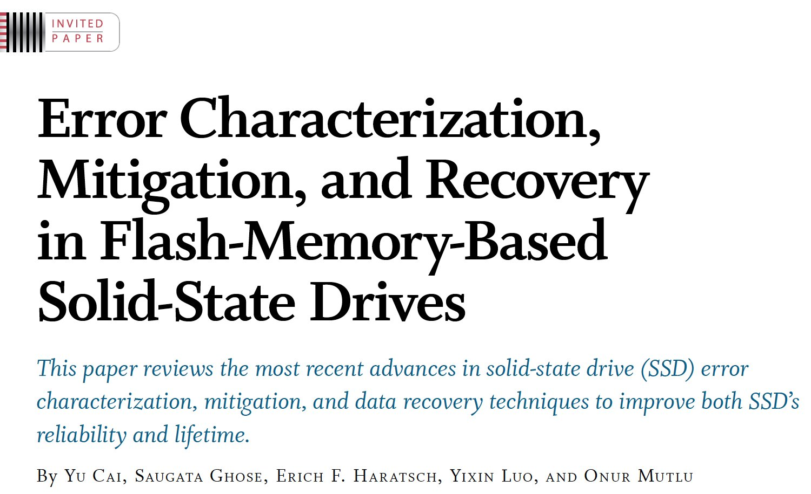
Reference Overview Paper VI
Proceedings of the IEEE, Sept. 2017
https://arxiv.org/pdf/1706.08642

Slide 114
Related Videos and Course Materials (I)
Undergraduate Computer Architecture Course Lecture Videos (2015, 2014, 2013)
Undergraduate Computer Architecture Course Materials (2015, 2014, 2013)
Graduate Computer Architecture Course Lecture Videos (2018, 2017, 2015, 2013)
Graduate Computer Architecture Course Materials (2018, 2017, 2015, 2013)
Parallel Computer Architecture Course Materials (Lecture Videos)

Slide 115
Related Videos and Course Materials (II)
Freshman Digital Circuits and Computer Architecture Course Lecture Videos (2018, 2017)
Freshman Digital Circuits and Computer Architecture Course Materials (2018)
Memory Systems Short Course Materials
(Lecture Video on Main Memory and DRAM Basics)

Slide 116
Some Open Source Tools (I)
Rowhammer – Program to Induce RowHammer Errors
https://github.com/CMU-SAFARI/rowhammer
Ramulator – Fast and Extensible DRAM Simulator
https://github.com/CMU-SAFARI/ramulator
MemSim – Simple Memory Simulator
https://github.com/CMU-SAFARI/memsim
NOCulator – Flexible Network-on-Chip Simulator
https://github.com/CMU-SAFARI/NOCulator
SoftMC – FPGA-Based DRAM Testing Infrastructure
https://github.com/CMU-SAFARI/SoftMC
Other open-source software from my group
https://github.com/CMU-SAFARI/
http://www.ece.cmu.edu/~safari/tools.html

Slide 117
Some Open Source Tools (II)
MQSim – A Fast Modern SSD Simulator
https://github.com/CMU-SAFARI/MQSim
Mosaic – GPU Simulator Supporting Concurrent Applications
https://github.com/CMU-SAFARI/Mosaic
IMPICA – Processing in 3D-Stacked Memory Simulator
https://github.com/CMU-SAFARI/IMPICA
SMLA – Detailed 3D-Stacked Memory Simulator
https://github.com/CMU-SAFARI/SMLA
HWASim – Simulator for Heterogeneous CPU-HWA Systems
https://github.com/CMU-SAFARI/HWASim
Other open-source software from my group
https://github.com/CMU-SAFARI/
http://www.ece.cmu.edu/~safari/tools.html

Slide 118
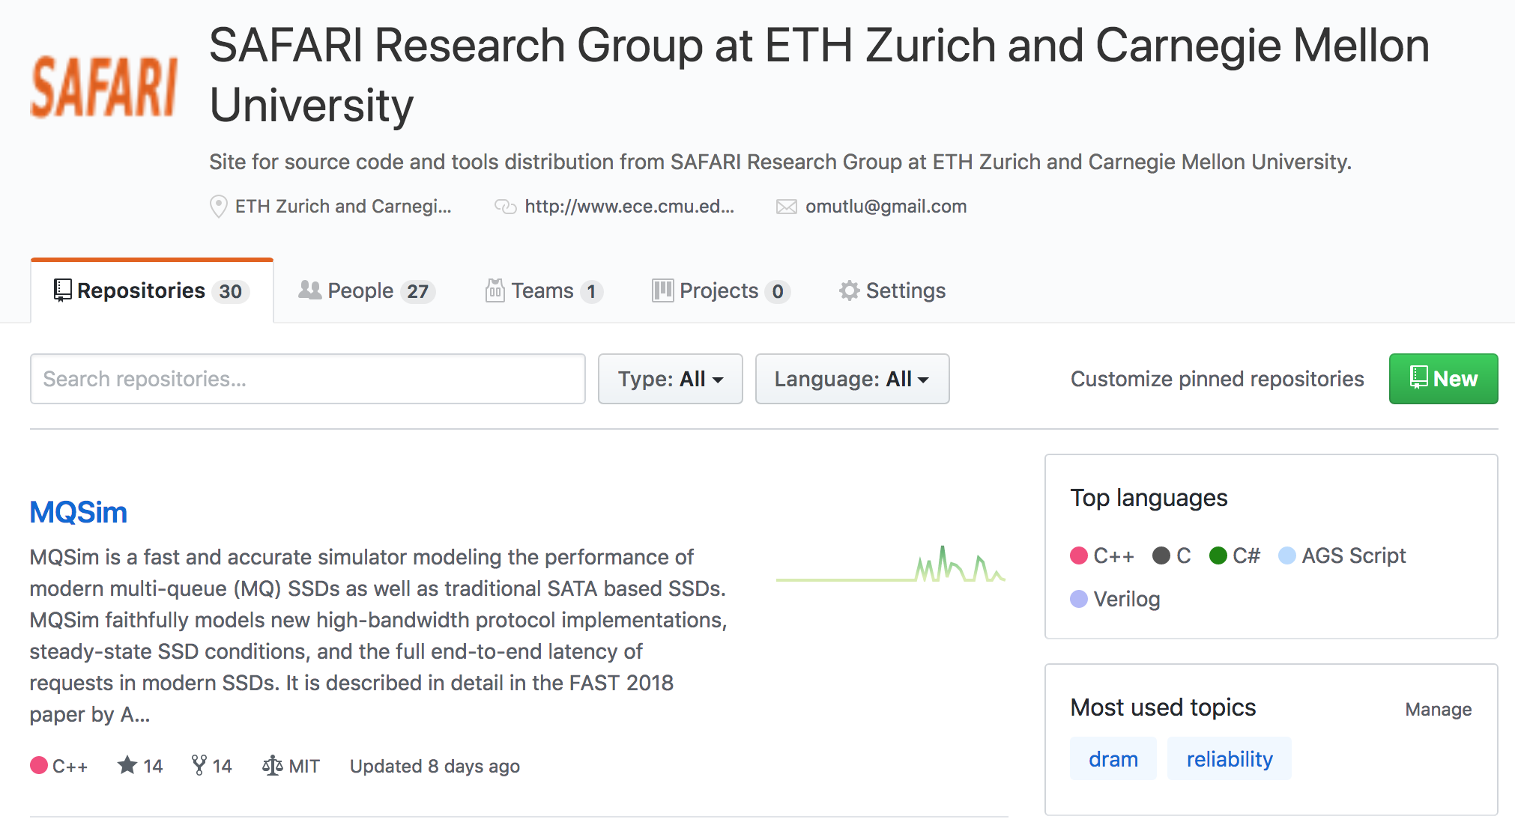
More Open Source Tools (III)
A lot more open-source software from my group
https://github.com/CMU-SAFARI/
http://www.ece.cmu.edu/~safari/tools.html

Slide 119
Referenced Papers
All are available at
https://people.inf.ethz.ch/omutlu/projects.htm
http://scholar.google.com/citations?user=7XyGUGkAAAAJ&hl=en
https://people.inf.ethz.ch/omutlu/acaces2018.html

