Slide 1


Storage-Centric Computing
Enabling
Fundamentally-Efficient Computers
Onur Mutlu
omutlu@gmail.com
https://people.inf.ethz.ch/omutlu
1 December 2024
CCF China Storage Keynote Talk

Slide 2
Problem
Computing
is Bottlenecked by Data

Slide 3
Data is Key for AI, ML, Genomics, …
Important workloads are all data intensive
They require rapid and efficient processing of large amounts of data
Data is increasing
  We can generate more than we can process
  We need to perform more sophisticated analyses on more data

Slide 4
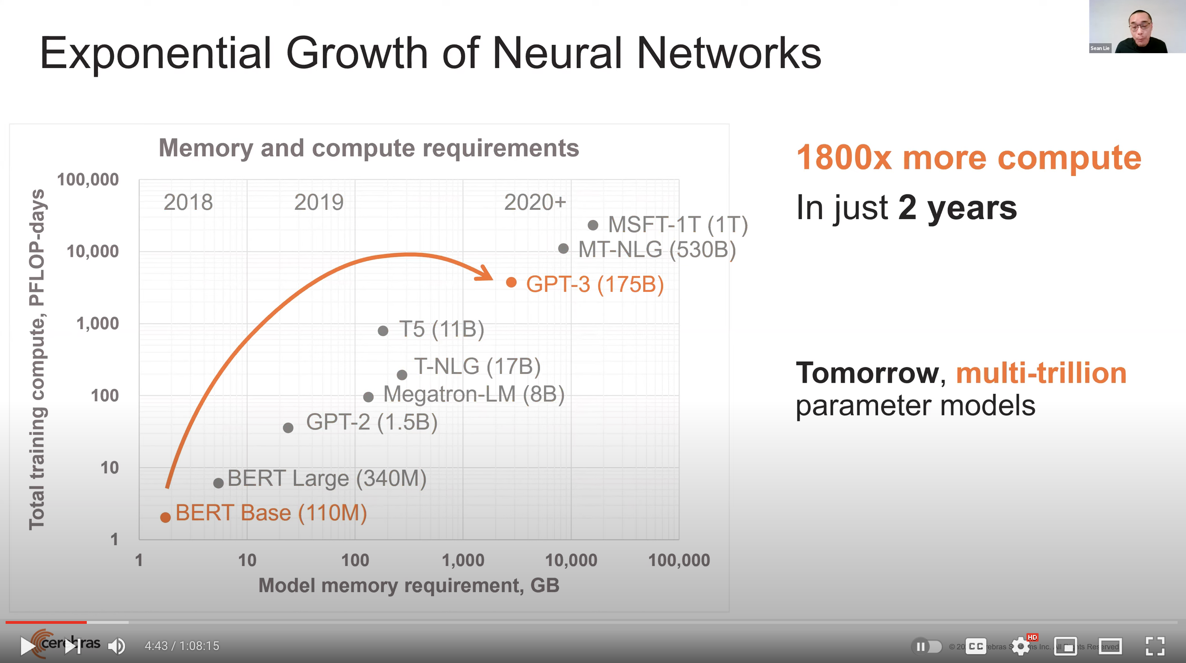
Huge Demand for Performance & Efficiency
~4 orders of magnitude increase in memory requirement in
just a few years!
Source: https://youtu.be/Bh13Idwcb0Q?t=283

Slide 5
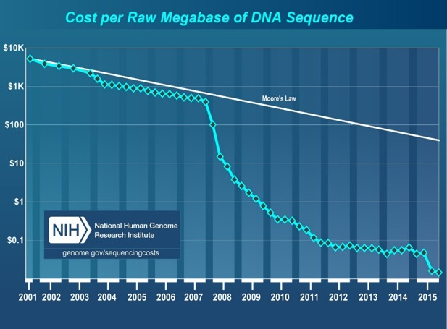
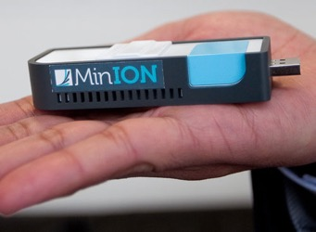
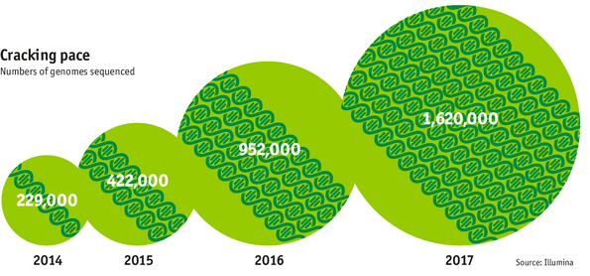

Huge Demand for Performance & Efficiency
development of new
sequencing technologies
Oxford Nanopore MinION
Number of Genomes Sequenced
http://www.economist.com/news/21631808-so-much-genetic-data-so-many-uses-genes-unzipped
Notes:
However, since the development of high throughput sequencing (HTS) technologies, the cost of genome sequencing has fallen off a cliff (<< 1,000$) making it viable for almost everyone's use.

Slide 6
Challenge and Opportunity for Future
High Performance,
Energy Efficient,
Sustainable
(All at the Same Time)

Slide 7
The Problem
Data access is the major performance and energy bottleneck
Our current
design principles
cause great energy waste
(and great performance loss)

Slide 8
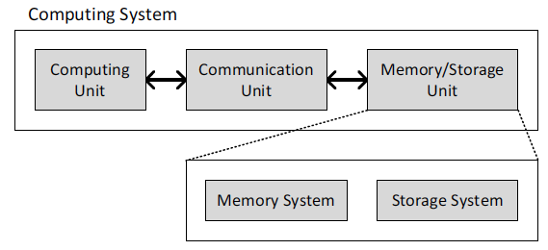
Today’s Computing Systems
Processor centric
All data processed in the processor → at great system cost

Slide 9
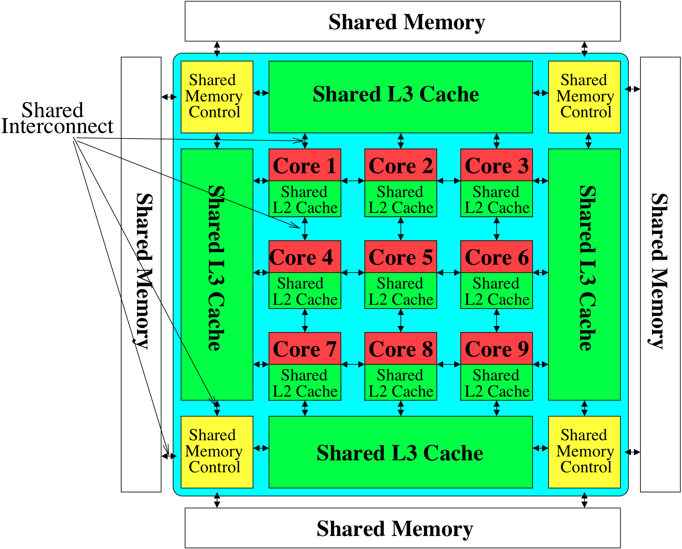

Perils of Processor-Centric Design
Most of the system is dedicated to storing and moving data
Yet, system is still bottlenecked by memory & storage

Slide 10
Processor-Centric System Performance
All of Google’s Data Center Workloads (2015):
Kanev+, “Profiling a Warehouse-Scale Computer,” ISCA 2015.

Slide 11
Data Movement vs. Computation Energy
Han+, “EIE: Efficient Inference Engine on Compressed Deep Neural Network,” ISCA 2016.

Slide 12
Data Movement vs. Computation Energy
6400X
A memory access consumes 6400X
the energy of a simple integer addition
Han+, “EIE: Efficient Inference Engine on Compressed Deep Neural Network,” ISCA 2016.

Slide 13
Energy Waste in Mobile Devices
Amirali Boroumand, Saugata Ghose, Youngsok Kim, Rachata Ausavarungnirun, Eric Shiu, Rahul Thakur, Daehyun Kim, Aki Kuusela, Allan Knies, Parthasarathy Ranganathan, and Onur Mutlu,
"Google Workloads for Consumer Devices: Mitigating Data Movement Bottlenecks"
Proceedings of the 23rd International Conference on Architectural Support for Programming Languages and Operating Systems (ASPLOS), Williamsburg, VA, USA, March 2018.
62.7% of the total system energy
is spent on data movement

Slide 14
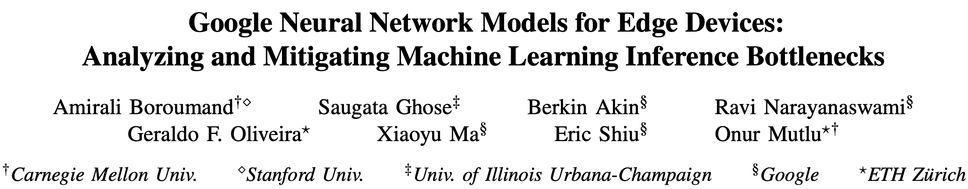
Energy Waste in Accelerators
Amirali Boroumand, Saugata Ghose, Berkin Akin, Ravi Narayanaswami, Geraldo F. Oliveira, Xiaoyu Ma, Eric Shiu, and Onur Mutlu,
"Google Neural Network Models for Edge Devices: Analyzing and Mitigating Machine Learning Inference Bottlenecks"
Proceedings of the 30th International Conference on Parallel Architectures and Compilation Techniques (PACT), Virtual, September 2021.
[Slides (pptx) (pdf)]
[Talk Video (14 minutes)]
> 90% of the total system energy
is spent on memory in large ML models

Slide 15
Example Energy Breakdowns
In LSTMs and Transducers used by Google,
>90% energy spent on off-chip interconnect and DRAM
https://arxiv.org/pdf/2109.14320

Slide 16
Fundamental Problem
Processing of data
is performed
far away from the data

Slide 17
We Need A Paradigm Shift To …
Enable computation with minimal data movement
Compute where it makes sense (where data resides)
Make computing architectures more data-centric

Slide 18
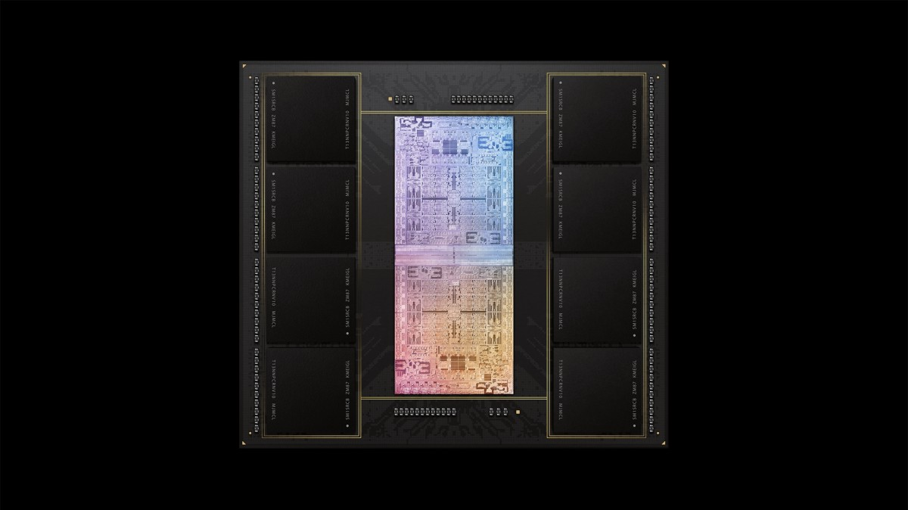
Process Data Where It Makes Sense
Sensors
A lot of
SRAM
Storage
DRAM
DRAM
Storage
Apple M1 Ultra System (2022)
https://www.gsmarena.com/apple_announces_m1_ultra_with_20core_cpu_and_64core_gpu-news-53481.php

Slide 19
Goal: Processing Inside Memory/Storage
Many questions … How do we design the:
  compute-capable memory & controllers?
  processors & communication units?
  software & hardware interfaces?
  system software, compilers, languages?
  algorithms & theoretical foundations?
Database
Graphs
Media
ML model
Memory/Storage
Processor
Core
Cache
Query
Interconnect
Problem
Results
Algorithm
Program/Language
System Software
SW/HW Interface
Micro-architecture
Logic
Devices
Electrons

Slide 20
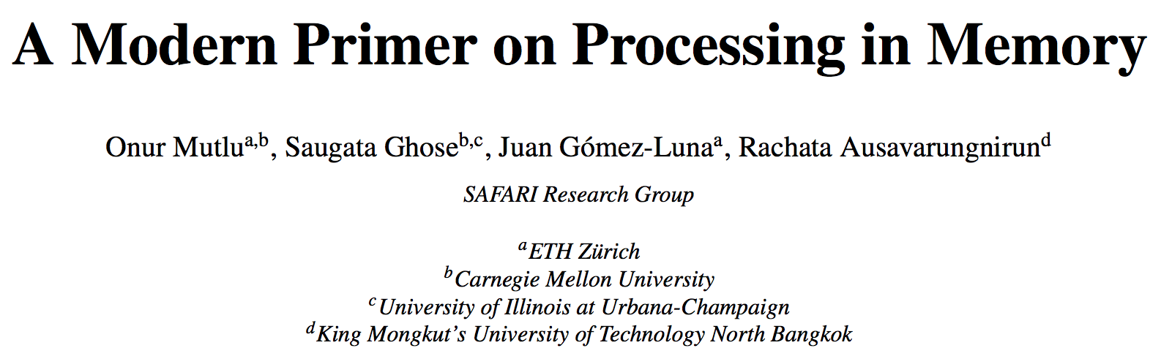
An Overview Paper
Onur Mutlu, Saugata Ghose, Juan Gomez-Luna, and Rachata Ausavarungnirun,
"A Modern Primer on Processing in Memory"
Invited Book Chapter in Emerging Computing: From Devices to Systems - Looking Beyond Moore and Von Neumann, Springer, to be published in 2021.
https://arxiv.org/pdf/2012.03112.pdf

Slide 21
Processing in Storage:
Two Types
1. Processing near Storage Devices
2. Processing using Storage Devices

Slide 22
Processing-in-Memory: Two Types
  Two main approaches for Processing-in-Memory:
1
Processing-Near-Memory: Computation logic is added to the same die as memory or to the logic layer of 3D-stacked memory
2
Processing-Using-Memory: uses the operational principles of
memory cells & circuitry to perform computation
DRAM
(e.g., 3D-Stacked Memory)
DRAM Bank
Vault
Controller
Processing-
Using-DRAM
DRAM Vault
…
PHY
Processing-Near-Vault
…
Processing-Near-Bank
Notes:
Processing-in-Memory architectures alleviate data movement bottlenecks by moving computation to where the data resides. Such architectures can be implemented
[CLICK] by adding logic near the memory arrays, in what is called processing-near-memory or
[CLICK] by using the analog operating principles of the memory cells to perform computation, in what is called processing-using-memory
[NEXT]

Slide 23
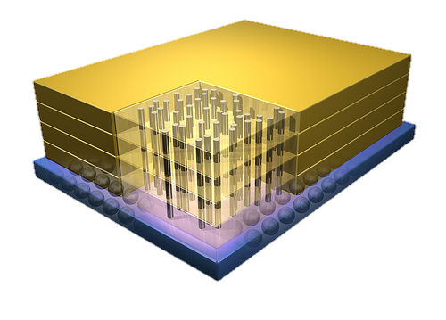


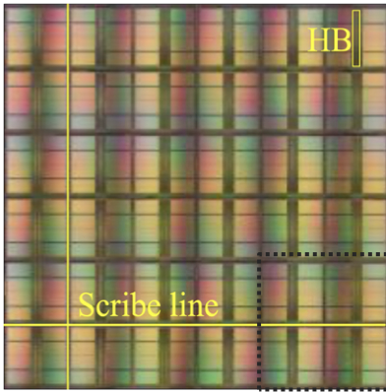
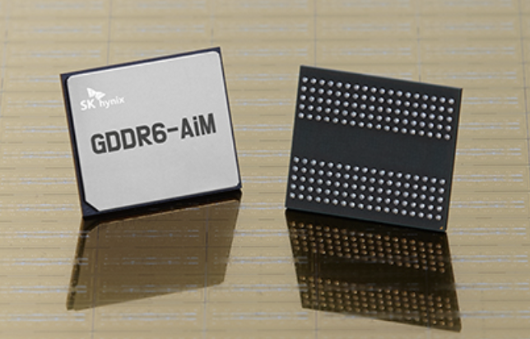
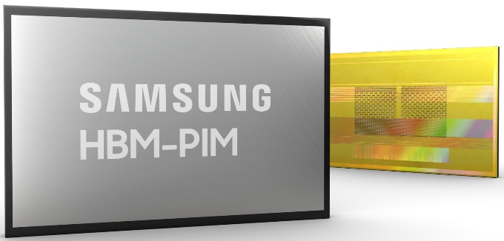
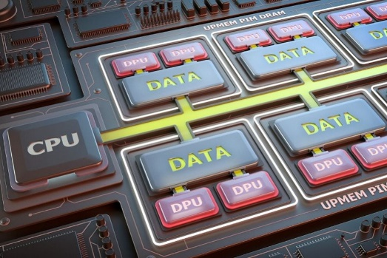
Processing-in-Memory Landscape Today
[Samsung 2021]
[Alibaba 2022]
[SK Hynix 2022]
[Samsung 2021]
[UPMEM 2019]
And, many other experimental chips and startups

Slide 24
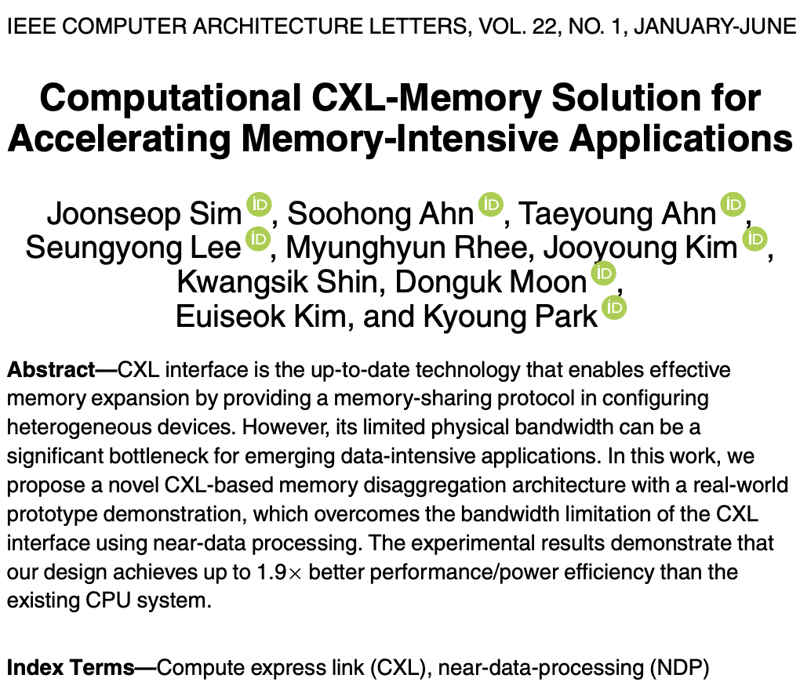
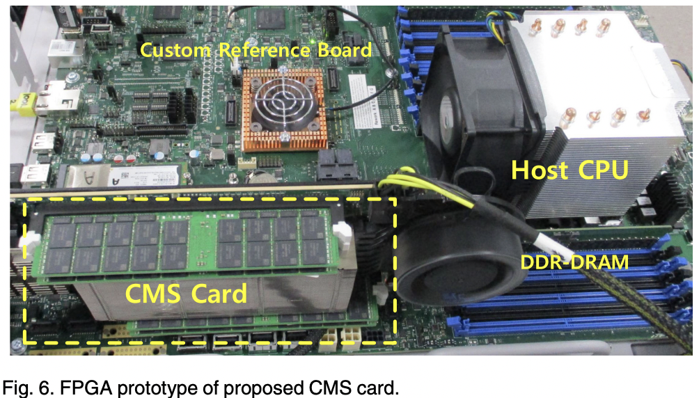
Processing-in-Memory Landscape Today

Slide 25
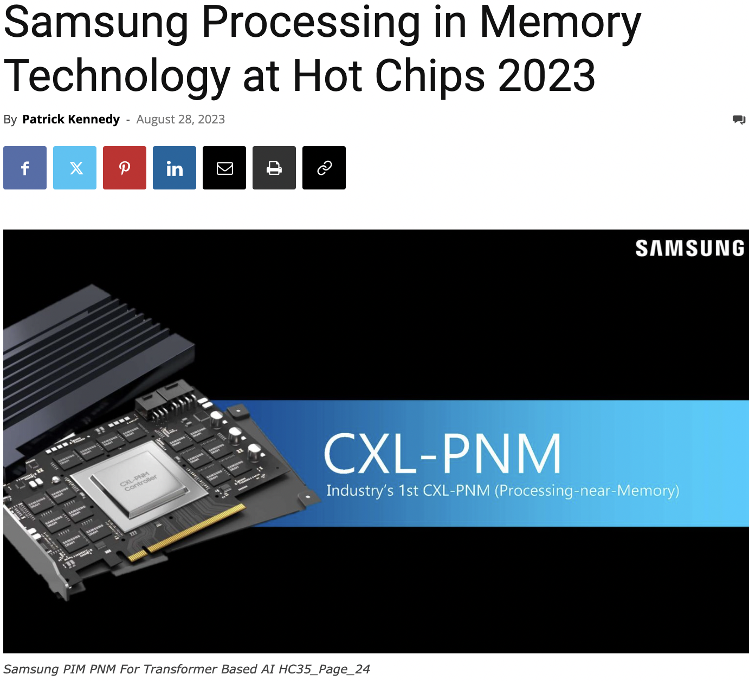
Processing-in-Memory Landscape Today
https://www.servethehome.com/samsung-processing-in-memory-technology-at-hot-chips-2023/

Slide 26
Opportunity: 3D-Stacked Logic+Memory
Memory
Logic
Other “True 3D” technologies
under development

Slide 27
Tesseract System for Graph Processing
Interconnected set of 3D-stacked memory+logic chips with simple cores
Host Processor
Memory
Memory-Mapped
Accelerator Interface
(Noncacheable, Physically Addressed)
Logic
In-Order Core
DRAM Controller
…
…
LP
PF Buffer
Crossbar Network
…
MTP
…
Message Queue
NI
Ahn+, “A Scalable Processing-in-Memory Accelerator for Parallel Graph Processing” ISCA 2015.

Slide 28
Evaluated Systems
DDR3-OoO
HMC-OoO
HMC-MC
Tesseract
32 Tesseract Cores
8 OoO
4GHz
8 OoO
4GHz
8 OoO
4GHz
8 OoO
4GHz
128
In-Order
2GHz
128
In-Order
2GHz
8 OoO
4GHz
8 OoO
4GHz
8 OoO
4GHz
8 OoO
4GHz
128
In-Order
2GHz
128
In-Order
2GHz
102.4GB/s
640GB/s
640GB/s
8TB/s
Ahn+, “A Scalable Processing-in-Memory Accelerator for Parallel Graph Processing” ISCA 2015.

Slide 29
Tesseract Graph Processing Performance
>13X Performance Improvement
On five graph processing algorithms
Ahn+, “A Scalable Processing-in-Memory Accelerator for Parallel Graph Processing” ISCA 2015.

Slide 30
Tesseract Graph Processing System Energy
> 8X Energy Reduction
Ahn+, “A Scalable Processing-in-Memory Accelerator for Parallel Graph Processing” ISCA 2015.

Slide 31
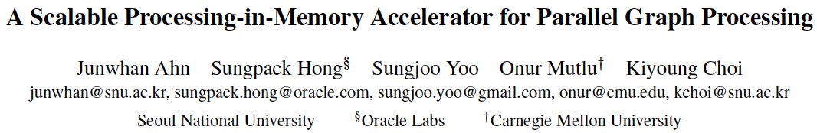
More on Tesseract
Junwhan Ahn, Sungpack Hong, Sungjoo Yoo, Onur Mutlu, and Kiyoung Choi,
"A Scalable Processing-in-Memory Accelerator for Parallel Graph Processing"
Proceedings of the 42nd International Symposium on Computer Architecture (ISCA), Portland, OR, June 2015.
[Slides (pptx) (pdf)] [Lightning Session Slides (pptx) (pdf)]
Top Picks Honorable Mention by IEEE Micro.
Selected to the ISCA-50 25-Year Retrospective Issue covering 1996-2020 in 2023 (Retrospective (pdf) Full Issue).

Slide 32
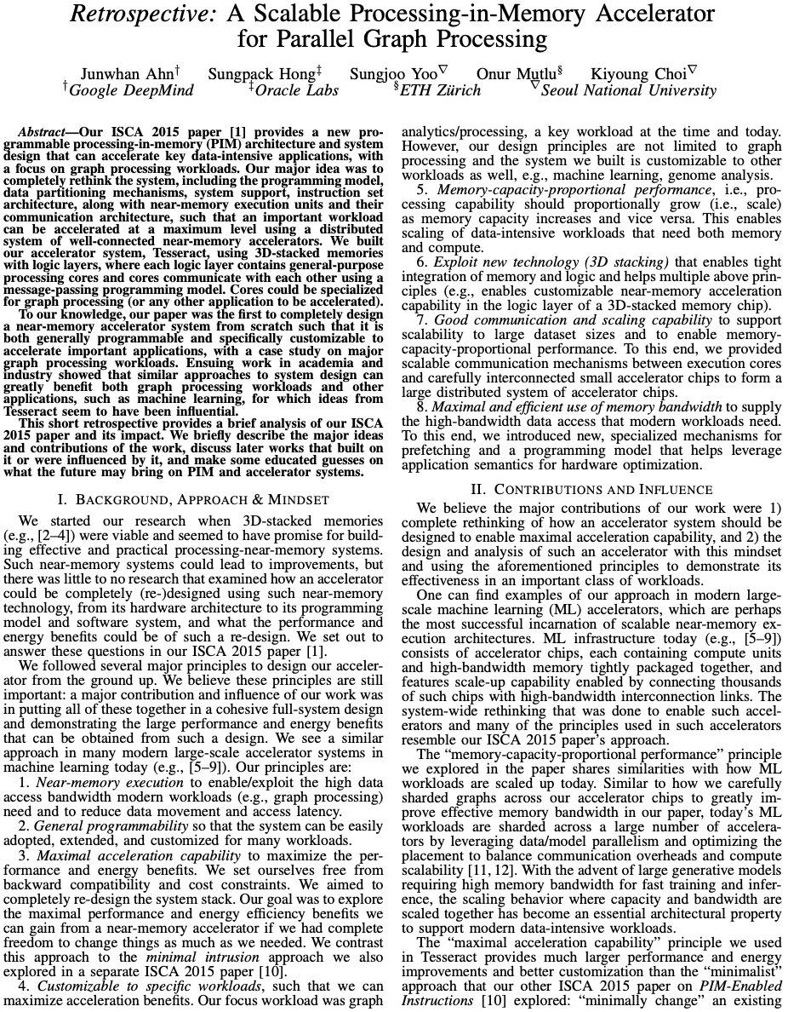
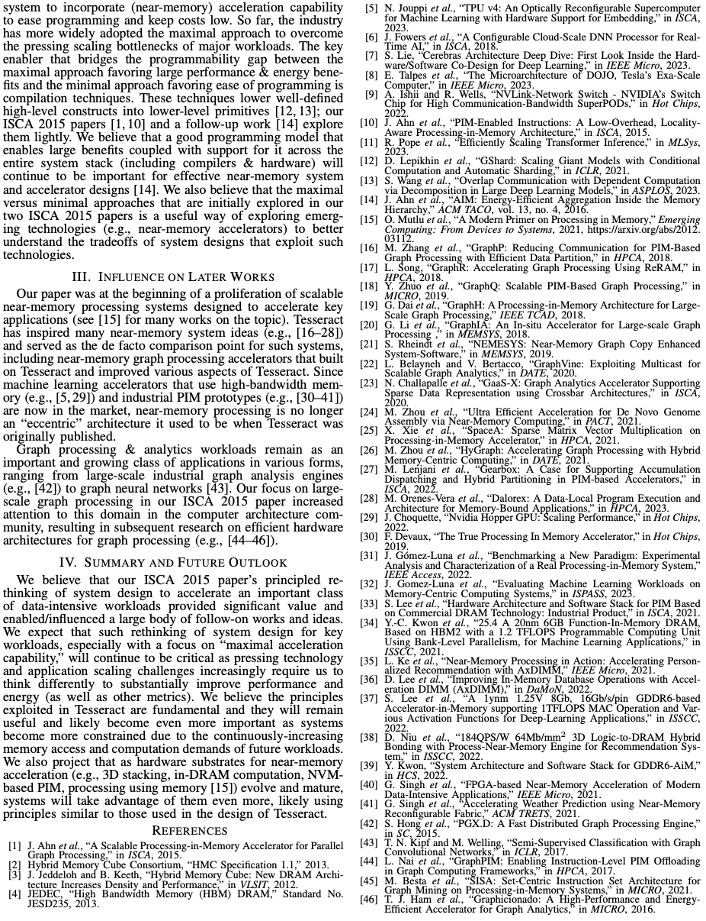
A Short Retrospective @ 50 Years of ISCA
https://arxiv.org/pdf/2306.16093

Slide 33
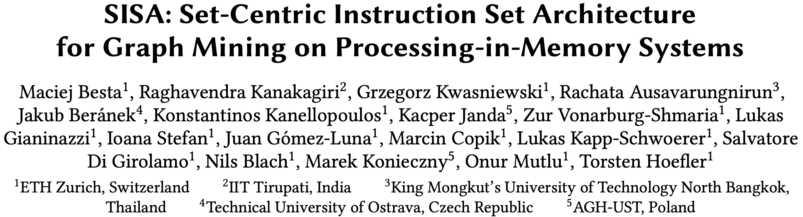
Accelerating Graph Pattern Mining
Maciej Besta, Raghavendra Kanakagiri, Grzegorz Kwasniewski, Rachata Ausavarungnirun, Jakub Beránek, Konstantinos Kanellopoulos, Kacper Janda, Zur Vonarburg-Shmaria, Lukas Gianinazzi, Ioana Stefan, Juan Gómez-Luna, Marcin Copik, Lukas Kapp-Schwoerer, Salvatore Di Girolamo, Nils Blach, Marek Konieczny, Onur Mutlu, and Torsten Hoefler,
"SISA: Set-Centric Instruction Set Architecture for Graph Mining on Processing-in-Memory Systems"
Proceedings of the 54th International Symposium on Microarchitecture (MICRO), Virtual, October 2021.
[Slides (pdf)]
[Talk Video (22 minutes)]
[Lightning Talk Video (1.5 minutes)]
[Full arXiv version]

Slide 34
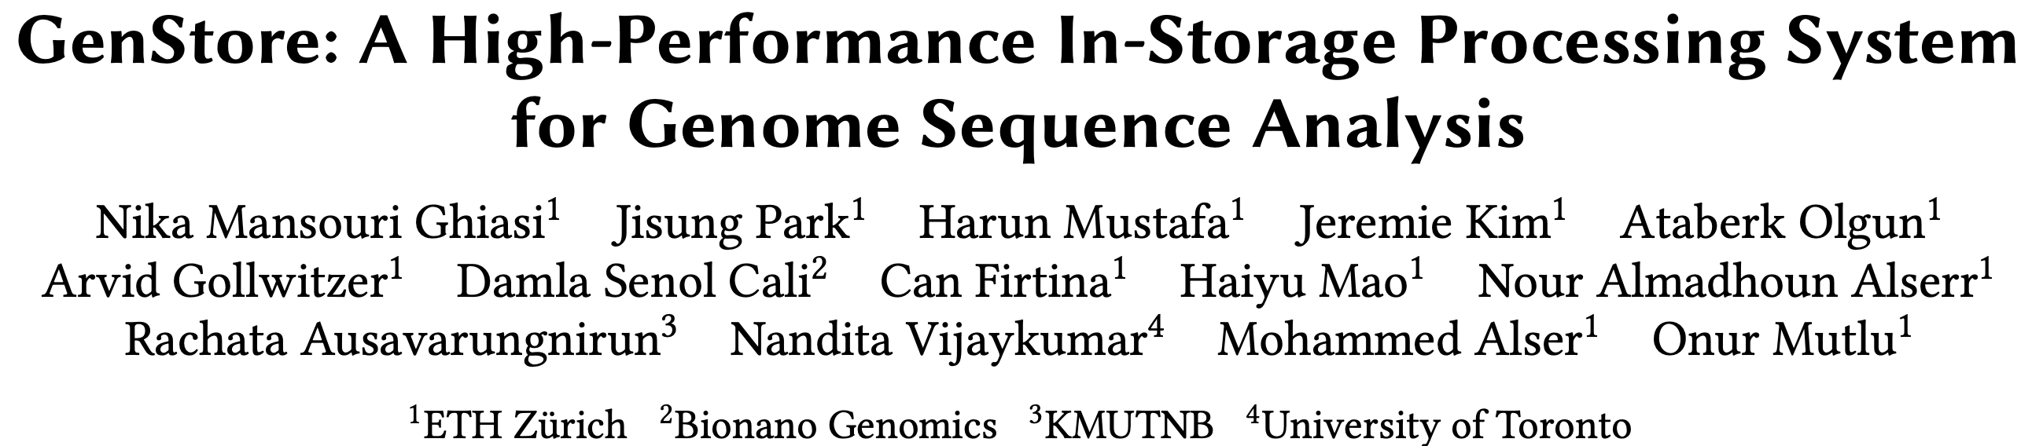
In-Storage Genomic Data Filtering [ASPLOS 2022]
Nika Mansouri Ghiasi, Jisung Park, Harun Mustafa, Jeremie Kim, Ataberk Olgun, Arvid Gollwitzer, Damla Senol Cali, Can Firtina, Haiyu Mao, Nour Almadhoun Alserr, Rachata Ausavarungnirun, Nandita Vijaykumar, Mohammed Alser, and Onur Mutlu,
"GenStore: A High-Performance and Energy-Efficient In-Storage Computing System for Genome Sequence Analysis"
Proceedings of the 27th International Conference on Architectural Support for Programming Languages and Operating Systems (ASPLOS), Virtual, February-March 2022.
[Lightning Talk Slides (pptx) (pdf)]
[Lightning Talk Video (90 seconds)]
https://arxiv.org/abs/2202.10400

Slide 35




We Need Faster & Scalable Genome Analysis
Understanding genetic variations, species, evolution, …
Predicting the presence and relative abundance of microbes in a sample
Rapid surveillance of disease outbreaks
Developing personalized medicine
And, many, many other applications …
Notes:
Knowing what organisms are present in a given environmental sample and how abundant are they

Slide 36
Genome Sequence Analysis
Read mapping: first key step in genome sequence analysis
  Aligns reads to potential matching locations in the reference genome
  For each matching location, the alignment step finds the degree of similarity (alignment score)
Reference Genome
…GCCCATATGGTTAAGCTTCCATGGAAATGGGCTTTCGCTTCCACAATG…
Differences
Differences
GCTTCCAGAATG
Calculating the alignment score requires computationally-expensive approximate string matching (ASM) to account for differences between reads and the reference genome due to:
AAGCTTCCATGG
AAATGGGCTTTC
GCCCAAATGGTT
  Sequencing errors
  Genetic variation
Notes:
Read mapping is the first key step in genome sequence analysis [CLICK]
That Aligns reads to potential matching locations within the reference genome [CLICK]
For each matching location, the alignment step finds the degree of similarity between read and reference by calculating the alignment score
Calculating the alignment score requires computationally-expensive approximate string matching (ASM) to account for differences between reads and the reference genome. [CLICK]

Slide 37

Genome Sequence Analysis
Data Movement from Storage
Alignment
Storage
System
Main
Memory
Cache
Computation
Unit
(CPU or Accelerator)
AAGCTTCCATGG
CGTTCCTTGGCA
GGGCCAGAATG
CCTTTGGGTCCA
AAAATTCCATGG
GAATGGGGCCA
TTTTTTCCAAAA
TCCCCGGGGCCA
GCTTCCAGAATG
Computation overhead
Data movement overhead
Notes:
Read mapping performs alignment on large genomic datasets, containing millions of reads. [CLICK]
Therefore, read mapping is both computationally expensive [CLICK]
And incurs high data movement overhead [CLICK]

Slide 38



Compute-Centric Accelerators
Heuristics
Accelerators
Filters
Storage
System
Main
Memory
Cache
Computation
Unit
(CPU or Accelerator)
AAGCTTCCATGG
CGTTCCTTGGCA
GGGCCAGAATG
CCTTTGGGTCCA
AAAATTCCATGG
GAATGGGGCCA
TTTTTTCCAAAA
TCCCCGGGGCCA
GCTTCCAGAATG
✓
Computation overhead
Data movement overhead
Notes:
There has been significant effort into improving read mapping performance [CLICK]
Through efficient heuristics [CLICK]
hardware accelerators [CLICK]
and various filters that prune reads that do not require expensive computation [CLICK].
While these approaches address the computation overhead in read mapping [CLICK]
[While Reads Move] None of them alleviate the data movement overhead from storage, whose impact becomes even larger when the computation overhead gets alleviated [CLICK]

Slide 39

Key Idea: In-Storage Filtering
Filter reads that do not require alignment
inside the storage system
Storage
System
Main
Memory
Cache
Computation
Unit
(CPU or Accelerator)
AAGCTTCCATGG
CGTTCCTTGGCA
GGGCCAGAATG
CCTTTGGGTCCA
AAAATTCCATGG
GAATGGGGCCA
TTTTTTCCAAAA
TCCCCGGGGCCA
GCTTCCAGAATG
Filtered Reads
Exactly-matching reads
Do not need expensive approximate string matching during alignment
Non-matching reads
Do not have potential matching locations and can skip alignment
Notes:
Our key idea is to filter reads that do not require the expensive alignment computation in the storage system [CLICK] …
[While Reads Move] To fundamentally reduce the data movement overhead of read mapping
Examples of the reads that not require the costlt alignment step
Exactly-matching reads to the reference genome that do not need approximate string matching performed during alignment
Non-matching reads that have no potential matching locations in the reference genome hence skip the alignemt step

Slide 40
GenStore
Key idea: Filter reads that do not require alignment inside the storage system
Challenges
  Different behavior across read mapping workloads
  Limited hardware resources in the SSD
Host System
Reads that need
substantial processing
SSD Controller
In-SSD DRAM
Flash
Ctrl.#1
ACC
GenStore
FTL
FTL
NAND
Die#1
NAND
Die#4
Core
L2P
Mappings
Core
⋯
Core
⋯
Flash
Ctrl.#N
ACC
ACC
GenStore
Metadata
NAND
Die#1
NAND
Die#4
⋯
Notes:
Which is the first in-storage processing system designed for genome sequence analysis
Our key idea is to Filter reads that do not require alignment inside the storage system and send the unfiltered data to the host system for further processing
However, filtering reads in a modern SSD can be challenging [CLICK]
Due to different behavior across read mapping workloads. [CLICK]
And the limited hardware resources in the SSD.

Slide 41
Filtering Opportunities
Sequencing machines produce one of two kinds of reads
  Short reads: highly accurate and short
  Long reads: less accurate and long
Reads that do not require the expensive alignment step:
Exactly-matching reads
Do not need expensive approximate string matching during alignment
Low sequencing error rates (short reads) combined with
Low genetic variation
Non-matching reads
Do not have potential matching locations, so they skip alignment
High sequencing error rates (long reads) or
High genetic variation (short or long reads)
Notes:
Let’s take a look at filtering opportunities based on the input reads.
Sequencing machines produce one of two kinds of reads
Short reads: highly accurate (99.9%) and short (e.g., up to a few hundreds of DNA characters)
Long reads: less accurate (85-90%) and long (e.g., from hundreds to millions of DNA characters)
Based on these, We leverage two filtering opportunities
First, we can filter exactly matching reads, which are reads that match exactly to one or more subsequences of the reference genome and do not require approximate string matching during alignment. Exact matches can frequently occur in short read sets with low sequencing errors and low genetic variations
Second, we can filter non-matching reads. Such reads do not have any potential matching locations in the reference genome can skip the expensive alignment step. Non-matching reads can frequently occur in long read sets with high sequencing errors and short or long read sets with high genetic variations

Slide 42
GenStore
GenStore-EM for Exactly-Matching Reads
GenStore-NM for Non-Matching Reads
Notes:
by thorough analysis of mapping processes of reads with different properties and different degrees of genetic variation, we design two low-cost in-storage filters
[CLICK] 1) GenStore-EM for filtering exactly-matching reads
[CLICK] and 2) GenStore-NM for filtering most of the non-matching reads

Slide 43
GenStore
Filter reads that do not require alignment
inside the storage system
GenStore-Enabled
Storage
System
Main
Memory
Cache
Computation
Unit
(CPU or Accelerator)
✓
Computation overhead
✓
Data movement overhead
  GenStore provides significant speedup (1.4x - 33.6x) and
  energy reduction (3.9x – 29.2x) at low cost
Notes:
We propose GenStore, the first in-storage processing system designed for genome sequence analysis. [CLICK]
To reduce both the computation [CLICK]
And the data movement overhead [CLICK]
GenStore provides high-performance and energy benefits compared to state-of-the-art HW and SW baselines [CLICK]

Slide 44
Performance – GenStore-EM
With the Software Mapper
With the Hardware Mapper
3.3x
2.1x
2.1x
29
2.5x
2.5x
1.5x
Exec. time [sec]
2.1× - 2.5× speedup compared to the software Base
1.5× – 3.3× speedup compared to the hardware Base
On average 3.92× energy reduction
Notes:
We analyze the benefits of GenStore-EM for a 22-GB short read set where 80% of reads exactly match some subsequence in the reference genome and can be filtered.
We show the benefit of GS on software and hardware read mappers.
GS provides 2.1× - 2.5× speedup compared to the software Base
GS provides 1.5× – 3.3× speedup compared to the hardware Base
GS provides on average 3.92× energy reduction

Slide 45
Performance – GenStore-NM
With the Software Mapper
With the Hardware Mapper
Exec. time [sec]
Log scale
22.4
27.9x
19.2x
29x
6.8x
6.8x
22.4× – 27.9× speedup compared to the software Base
6.8× – 19.2× speedup compared to the hardware Base
On average 27.2× energy reduction
Notes:
We analyze the benefits of GenStore-NM for a 12-GB long read set with very high genetic variation compared the the reference genome where 99.7% of reads do not match any subsequence in the reference genome.
We show the benefit of GS on software and hardware read mappers.
GS provides 22.4× – 27.9× speedup compared to the software Base
GS provides 6.8× – 19.2× speedup compared to the hardware Base
GS provides on average 27.2× energy reduction

Slide 46
Area and Power Consumption
Based on Synthesis of GenStore accelerators using the Synopsys Design Compiler @ 65nm technology node
Logic unit | # of instances | Area [mm²] | Power [mW]
Comparator | 1 per SSD | 0.0007 | 0.14
K -mer Window | 2 per channel | 0.0018 | 0.27
Hash Accelerator | 2 per SSD | 0.008 | 1.8
Location Buffer | 1 per channel | 0.00725 | 0.37375
Chaining Buffer | 1 per channel | 0.008 | 0.95
Chaining PE | 1 per channel | 0.004 | 0.98
Control | 1 per SSD | 0.0002 | 0.11
Total for an 8-channel SSD | - | 0.2 | 26.6
Only 0.006% of a 14nm Intel Processor, less than 9.5% of the three ARM processors in a SATA SSD controller
Notes:
We find area and power values of GenStore by synthesizing GenStore-EM and NM using 65nm technology node,
And find that for an 8-channel SSD, the area of GS is 0.2 mm square and the power is 26.6 watts
BY scaling the area to lower technology nodes, we observe that the area overhead of GS is 0.006% of an Intel processor and less than 9.5% of the of the three ARM processors in a SATA SSD controller.

Slide 47
In-Storage Genomic Data Filtering [ASPLOS 2022]
Nika Mansouri Ghiasi, Jisung Park, Harun Mustafa, Jeremie Kim, Ataberk Olgun, Arvid Gollwitzer, Damla Senol Cali, Can Firtina, Haiyu Mao, Nour Almadhoun Alserr, Rachata Ausavarungnirun, Nandita Vijaykumar, Mohammed Alser, and Onur Mutlu,
"GenStore: A High-Performance and Energy-Efficient In-Storage Computing System for Genome Sequence Analysis"
Proceedings of the 27th International Conference on Architectural Support for Programming Languages and Operating Systems (ASPLOS), Virtual, February-March 2022.
[Lightning Talk Slides (pptx) (pdf)]
[Lightning Talk Video (90 seconds)]
https://arxiv.org/abs/2202.10400

Slide 48
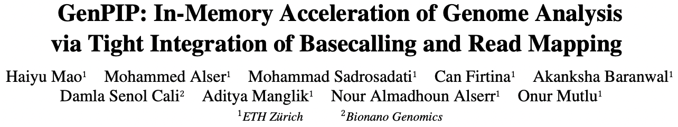
Tight Integration of Genome Analysis Tasks
Haiyu Mao, Mohammed Alser, Mohammad Sadrosadati, Can Firtina, Akanksha Baranwal, Damla Senol Cali, Aditya Manglik, Nour Almadhoun Alserr, and Onur Mutlu,
"GenPIP: In-Memory Acceleration of Genome Analysis via Tight Integration of Basecalling and Read Mapping"
Proceedings of the 55th International Symposium on Microarchitecture (MICRO), Chicago, IL, USA, October 2022.
[Slides (pptx) (pdf)]
[Longer Lecture Slides (pptx) (pdf)]
[Lecture Video (25 minutes)]
[arXiv version]
https://arxiv.org/pdf/2209.08600.pdf

Slide 49
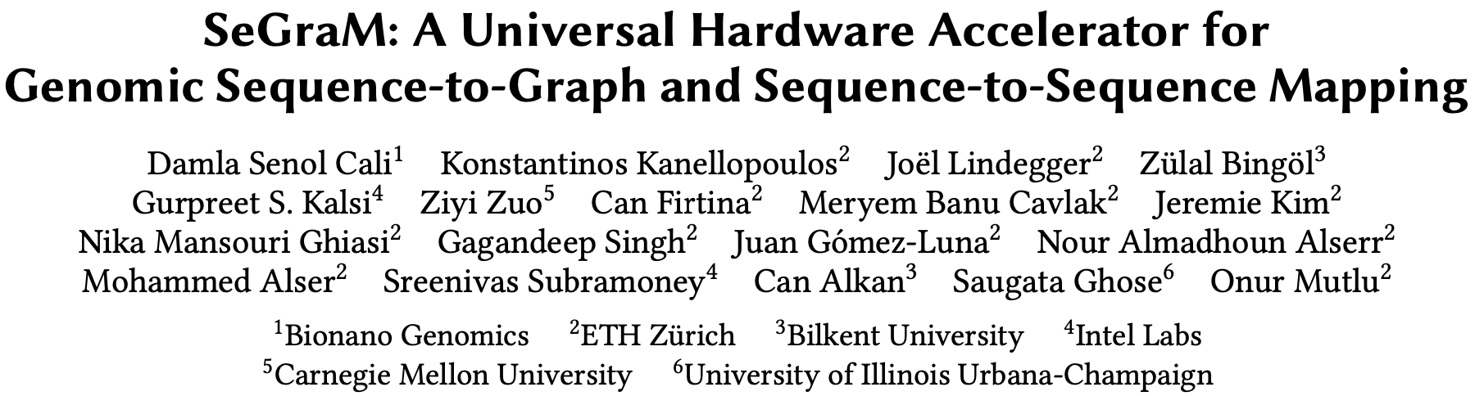
Accelerating Sequence-to-Graph Mapping
Damla Senol Cali, Konstantinos Kanellopoulos, Joel Lindegger, Zulal Bingol, Gurpreet S. Kalsi, Ziyi Zuo, Can Firtina, Meryem Banu Cavlak, Jeremie Kim, Nika MansouriGhiasi, Gagandeep Singh, Juan Gomez-Luna, Nour Almadhoun Alserr, Mohammed Alser, Sreenivas Subramoney, Can Alkan, Saugata Ghose, and Onur Mutlu,
"SeGraM: A Universal Hardware Accelerator for Genomic Sequence-to-Graph and Sequence-to-Sequence Mapping"
Proceedings of the 49th International Symposium on Computer Architecture (ISCA), New York, June 2022.
[arXiv version]
https://arxiv.org/pdf/2205.05883.pdf

Slide 50
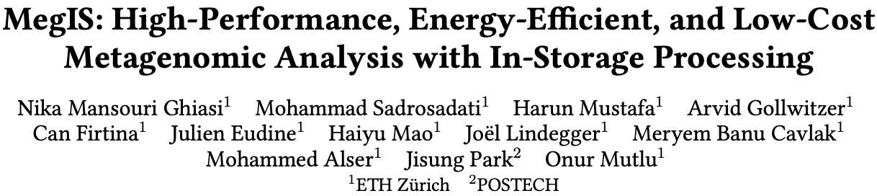
In-Storage Metagenomics [ISCA 2024]
Nika Mansouri Ghiasi, Mohammad Sadrosadati, Harun Mustafa, Arvid Gollwitzer, Can Firtina, Julien Eudine, Haiyu Mao, Joel Lindegger, Meryem Banu Cavlak, Mohammed Alser, Jisung Park, and Onur Mutlu,
"MegIS: High-Performance and Low-Cost Metagenomic Analysis with In-Storage Processing"
Proceedings of the 51st Annual International Symposium on Computer Architecture (ISCA), Buenos Aires, Argentina, July 2024.
[Slides (pptx) (pdf)]
[arXiv version]
https://arxiv.org/pdf/2406.19113

Slide 51

MegIS
High-Performance, Energy-Efficient, and Low-Cost Metagenomic Analysis with In-Storage Processing
Nika Mansouri Ghiasi
Mohammad Sadrosadati Harun Mustafa Arvid Gollwitzer Can Firtina
Julien Eudine Haiyu Mao Joël Lindegger Meryem Banu Cavlak
Mohammed Alser Jisung Park Onur Mutlu
Notes:
Hi everyone, I am Nika, and today, I will talk about
MegIS: High-Performance, Energy-Efficient, and Low-Cost Metagenomic Analysis
with In-Storage Processing

Slide 52




What is Metagenomics?
Metagenomics: Study of genome sequences of diverse organisms
within a shared environment (e.g., blood, ocean, soil)
Overcomes the limitations of traditional genomics
  Bypasses the need for analyzing individual species in isolation
Notes:
Metagenomics: Study of genome sequences of diverse organisms within a shared environment (e.g., blood, ocean, soil)
Metagenomics overcomes the limitations of traditional genomics
Because it bypasses the need for culturing individual species in isolation,
which is not feasible in many important clinical and environmental use cases

Slide 53


What is Metagenomics?
Metagenomics: Study of genome sequences of diverse organisms
within a shared environment (e.g., blood, ocean, soil)
Has led to groundbreaking advances
Precision medicine
Understanding microbial diversity of an environment
Discovering early warnings of communicable diseases
Notes:
Therefore, metagenomics has led to ground-breaking advances
In many fields such as
Precision medicine
Understanding microbial diversity of an environment
Discovering early warnings of communicable diseases

Slide 54






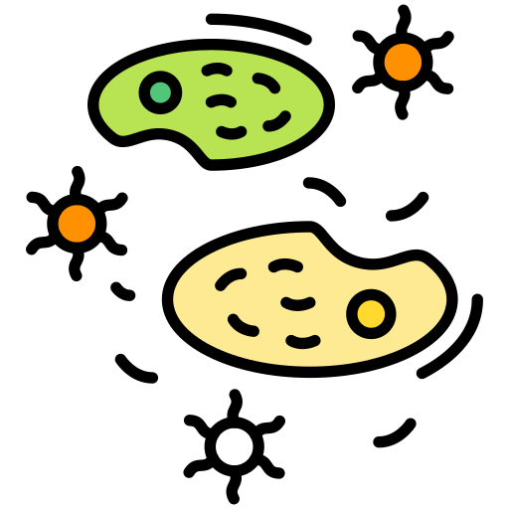




Metagenomic Analysis
GCTCA
Preparation
of Input Queries
Query
K-mers
CTCAT
TCATG
…
Metagenomic sample
with species that
are not known in advance
V. cholerae
Presence/Absence Identification
SARS-CoV-2
E. coli
Abundance
Estimation
A large database
containing information
on many species
(e.g., > 100 TBs in emerging databases)
Notes:
Since the species that are present in a metagenomic sample are not known in advance,
Metagenomic analysis performs tasks to enable an understanding of the sample’s composition.
Here, I am going to start with showing the genomic sequences of the organisms in the metagenomic sample,
To perform metagenomic analysis
First, many tools extract k-mers (i.e., subsequences of length k) from the input queries in a sample
Second, they find species present/absent in the sample by searching the query k-mers against a large metagenomic database containing information on many species’ genomes.
Many databases used for various use cases can be very large, for example, to several TBs or more than a hundred TBs in emerging databases
This step outputs the IDs of the species that are identified to be present in the sample
Finally, some applications perform a third optional step of abundance estimatimation,
which calculates the relative frequencies of the occurrence of different species in the sample

Slide 55


Challenges of In-Storage Processing
No metagenomic analysis tool can run in-storage due to SSD limits
  Long latency of NAND flash chips
  Limited DRAM capacity inside the SSD
  Limited DRAM bandwidth inside the SSD
FTL
SSD
Controller
SSD DRAM
Cores
SSD
Cntrl
Cntrl
⋯
Channel#1
⋯
Channel#N
Notes:
While In-Storage Processing (ISP) can be a promising direction to achieve our goal by processing data directly inside the storage device,
none of the existing approaches can be effectively implemented
as an ISP system due to limited hardware resources in the SSD such as
Long latency of NAND flash chips
Limited DRAM capacity inside the SSD
And its limited bandwidth

Slide 56

MegIS: Metagenomics In-Storage
First in-storage system for end-to-end metagenomic analysis
Idea: Cooperative in-storage processing for metagenomic analysis
  Hardware/software co-design between the storage system and host system
FTL
SSD
Controller
SSD DRAM
Cores
Standard
Metadata
Host System
MegIS-Enabled SSD
Cntrl
Cntrl
⋯
Channel#1
⋯
Channel#N
Notes:
Which is the first in-storage processing system for end-to-end metagenomic analysis
The key idea of megis is Cooperative ISP for metagenomics
Which is enabled by a synergistic hardware/software co-design between the storage system and the host system

Slide 57
MegIS’s Steps
Step 1
GCTCA
Preparation
of Input Queries
Query
K-mers
CTCAT
TCATG
…
Step 2
Metagenomic sample
with species that
are not known in advance
V. cholerae
Presence/Absence Identification
SARS-CoV-2
E. coli
Step 3
Abundance
Estimation
A large database
containing information
on many species

Slide 58
MegIS Hardware-Software Co-Design
FTL
SSD
Controller
SSD DRAM
Cores
Standard
Metadata
Host System
MegIS-Enabled SSD
Cntrl
Cntrl
⋯
Channel#1
⋯
Channel#N
Notes:
To (i) leverage and (ii) orchestrate the capabilities of both systems, megis includes hw/sw co-design in 5 directions

Slide 59

MegIS Hardware-Software Co-Design
Task partitioning and mapping
Each step executes
in its most suitable system
Step 1
Step 2
Step 3
FTL
SSD
Controller
SSD DRAM
Cores
Standard
Metadata
Host System
MegIS-Enabled SSD
Cntrl
Cntrl
⋯
Channel#1
⋯
Channel#N

Slide 60
MegIS Hardware-Software Co-Design
Task partitioning and mapping
Each step executes
in its most suitable system
Data/computation flow coordination
Reduce communication overhead
Reduce #writes to flash chips
Step 1
Step 2
Step 3
FTL
SSD
Controller
SSD DRAM
Cores
Standard
Metadata
Host System
MegIS-Enabled SSD
Cntrl
Cntrl
⋯
Channel#1
⋯
Channel#N

Slide 61
MegIS Hardware-Software Co-Design
Task partitioning and mapping
Each step executes
in its most suitable system
Data/computation flow coordination
Reduce communication overhead
Reduce #writes to flash chips
Step 1
Step 2
Step 3
FTL
SSD
Controller
SSD DRAM
Cores
Standard
Metadata
Host System
MegIS-Enabled SSD
Cntrl
Cntrl
⋯
Channel#1
⋯
Channel#N
Storage-aware algorithms
Enable efficient
access patterns to the SSD

Slide 62
MegIS Hardware-Software Co-Design
Task partitioning and mapping
Each step executes
in its most suitable system
Data/computation flow coordination
Reduce communication overhead
Reduce #writes to flash chips
Step 1
Step 2
Step 3
FTL
SSD
Controller
SSD DRAM
Cores
Standard
Metadata
ACC
ACC
Host System
MegIS-Enabled SSD
Cntrl
Cntrl
⋯
Channel#1
⋯
Channel#N
Storage-aware algorithms
Enable efficient
access patterns to the SSD
Lightweight in-storage accelerators
Minimize SRAM/DRAM buffer spaces needed inside the SSD

Slide 63
MegIS Hardware-Software Co-Design
Task partitioning and mapping
Each step executes
in its most suitable system
Data/computation flow coordination
Reduce communication overhead
Reduce #writes to flash chips
Step 1
Step 2
Step 3
MegIS
FTL
SSD
Controller
SSD DRAM
FTL
Cores
Standard
Metadata
ACC
ACC
Host System
MegIS-Enabled SSD
Cntrl
Cntrl
MegIS
Metadata
⋯
Channel#1
⋯
Channel#N
Storage-aware algorithms
Enable efficient
access patterns to the SSD
Lightweight in-storage accelerators
Minimize SRAM/DRAM buffer spaces needed inside the SSD
Data mapping scheme and Flash Translation Layer (FTL)
Specialize to the characteristics of metagenomic analysis
Leverage the SSD’s full internal bandwidth
Notes:
6 mins until here

Slide 64
Evaluation Methodology Overview
Performance, Energy, and Power Analysis
Hardware Components
Synthesized Verilog model for the in-storage accelerators
MQSim [Tavakkol+, FAST’18] for SSD’s internal operations
Ramulator [Kim+, CAL’15] for SSD’s internal DRAM
Software Components
Measure on a real system:
AMD® EPYC® CPU with 128 physical cores
1-TB DRAM
Baseline Comparison Points
Performance-optimized software, Kraken2 [Genome Biology’19]
Accuracy-optimized software, Metalign [Genome Biology’20]
PIM hardware-accelerated tool (using processing-in-memory), Sieve [ISCA’21]
SSD Configurations
SSD-C: with SATA3 interface (0.5 GB/s sequential read bandwidth)
SSD-P: with PCIe Gen4 interface (7 GB/s sequential read bandwidth)
Notes:
We model performance, energy, and power of the systems based on
the latency and throughput of each hardware-based and software-based component
We valuate the following baselines:
...
We evaluate these tools on systems with cost-optimized and performance-optimized SSD configurations

Slide 65
Speedup over Software (with Cost-Optimized SSD)
Performance-Optimized
Accuracy-Optimized
MegIS
SSD-C
SSD-C
Speedup
5.8x
5.8x
14.9x
14.9x
Sample Genetic Diversity
Sample Genetic Diversity
MegIS provides significant speedup over both
Performance-Optimized and Accuracy-Optimized baselines
Notes:
We analyze the benefits of MegIS for samples with low, medium, and high genetic diversity,
And here I am showing for a cost optimized-SSD
We observe that compared to both P-Opt and A-Opt
MegIS provides significant speedups

Slide 66
Speedup over Software (with Performance-Optimized SSD)
Performance-Optimized
Accuracy-Optimized
MegIS
SSD-P
Speedup
4.0x
12.1x
Sample Genetic Diversity
MegIS provides significant speedup over both
Performance-Optimized and Accuracy-Optimized baselines
MegIS improves performance on both
cost-optimized and performance-optimized SSDs

Slide 67
Speedup over the PIM Hardware Baseline
PIM
MegIS
PIM
MegIS
SSD-C
SSD-P
Speedup
4.9x
1.9x
Sample Genetic Diversity
Sample Genetic Diversity
MegIS provides significant speedup over the PIM baseline
Notes:
Similarly, we evaluate megis compared to the pim baseline
and show that on systems with cost-optimized
and performance-optimized ssds,
MegiS significantly outperforms the PIM baseline

Slide 68
Reduction in Energy Consumption
Same
accuracy
On average across different input sets and SSDs
5.4x
15.2x
1.9x
GeoMean Energy Reduction
(Higher is Better)
MegIS provides significant energy reduction over
the Performance-Optimized, Accuracy-Optimized, and PIM baselines
Notes:
Next, we show megis's energy reduction on average accross different input sets and SSDs and observe that megis provides...

Slide 69
Accuracy, Area, and Power
Accuracy
Same accuracy as the accuracy-optimized baseline
Significantly higher accuracy than the performance-optimized and PIM baselines
  4.6 – 5.2× higher F1 score
  3 – 24% lower L1 norm error
Area and Power
Total for an 8-channel SSD:
Area: 0.04 mm²
Power: 7.658 mW
(Only 1.7% of the area and 4.6% of the power consumption
of three ARM Cortex R4 cores in an SSD controller)
Notes:
MegIS provides all these benefits while achieving high accuracy

Slide 70
System Cost-Efficiency
Cost-optimized system ($): With SSD-C and 64-GB DRAM
Performance-optimized system ($$$): With SSD-P and 1-TB DRAM
GMean Speedup
16.2x
19.9x
2.4x
7.2x
($)
($)
($$$)
($$$)
($)
MegIS outperforms the baselines
even when running on a much less costly system
Notes:
Self-note (copy from arxiv version): For the performance-optimized system, we calculate the cost of 1TB
DRAM to be roughly 7080 USD (8 x 128GB modules [230]) and the cost of
SSD-P to be roughly 875 USD. For the performance-optimized system, we calculate
the cost of 64GB DRAM to be roughly 312 USD (8 x 8GB modules [231],
assuming the same number of memory channels as the performance-optimized
system) and the cost of SSD-C to be roughly 346 USD. Note that the cost of
the total storage system depends not only on the price of each SSD but also on
the available interconnection slots in the systems, as systems typically have
fewer PCIe slots (needed for SSD-P) than SATA slots (needed for SSD-C).

Slide 71
System Cost-Efficiency
Cost-optimized system ($): With SSD-C and 64-GB DRAM
Performance-optimized system ($$$): With SSD-P and 1-TB DRAM
MegIS improves system cost-efficiency
and makes accurate metagenomics more accessible
for wider adoption
GMean Speedup
16.2x
19.9x
2.4x
7.2x
($)
($)
($$$)
($$$)
($)
MegIS outperforms the baselines
even when running on a much less costly system
Notes:
Self-note (copy from arxiv version): For the performance-optimized system, we calculate the cost of 1TB
DRAM to be roughly 7080 USD (8 x 128GB modules [230]) and the cost of
SSD-P to be roughly 875 USD. For the performance-optimized system, we calculate
the cost of 64GB DRAM to be roughly 312 USD (8 x 8GB modules [231],
assuming the same number of memory channels as the performance-optimized
system) and the cost of SSD-C to be roughly 346 USD. Note that the cost of
the total storage system depends not only on the price of each SSD but also on
the available interconnection slots in the systems, as systems typically have
fewer PCIe slots (needed for SSD-P) than SATA slots (needed for SSD-C).

Slide 72
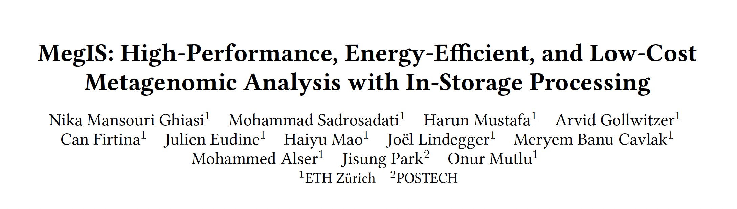

More in the Paper
MegIS’s performance with the cores in the SSD controller
MegIS’s performance outside SSD
Sensitivity analysis with varying
  Database sizes
  Memory capacities
  #SSDs
  #Channels
  #Samples
MegIS’s performance for abundance estimation
https://arxiv.org/abs/2406.19113

Slide 73
More to Come…

Slide 74
Processing in Storage:
Two Types
1. Processing near Storage Devices
2. Processing using Storage Devices

Slide 75
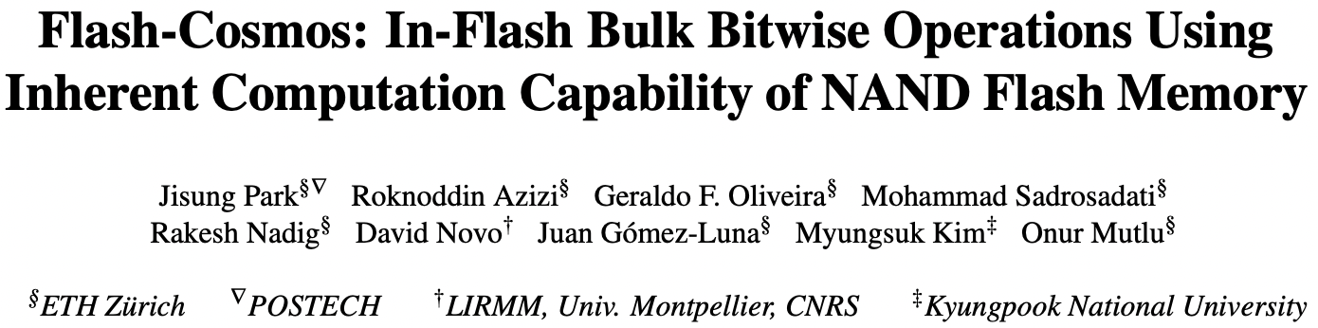
In-Flash Bulk Bitwise Execution
Jisung Park, Roknoddin Azizi, Geraldo F. Oliveira, Mohammad Sadrosadati, Rakesh Nadig, David Novo, Juan Gómez-Luna, Myungsuk Kim, and Onur Mutlu,
"Flash-Cosmos: In-Flash Bulk Bitwise Operations Using Inherent Computation Capability of NAND Flash Memory"
Proceedings of the 55th International Symposium on Microarchitecture (MICRO), Chicago, IL, USA, October 2022.
[Slides (pptx) (pdf)]
[Longer Lecture Slides (pptx) (pdf)]
[Lecture Video (44 minutes)]
[arXiv version]
https://arxiv.org/pdf/2209.05566.pdf

Slide 76
In-Storage Processing (ISP)
Uses in-storage compute units (embedded cores or FPGA) to send only the computation results
Memory bandwidth:
~ 40 GB/s
Storage
(NAND Flash-Based SSD)
CPU/GPU
Main
Memory
(DRAM)
$ (SRAM)
Storage I/O bandwidth:
~ 8 GB/s
Notes:
In-storage processing leverages cute units inside the storage devices, [Clompick] such as …

Slide 77
In-Storage Processing (ISP)
Uses in-storage compute units (embedded cores or FPGA) to send only the computation results
Memory bandwidth:
~ 40 GB/s
Storage
(NAND Flash-Based SSD)
CPU/GPU
Main
Memory
(DRAM)
In-Storage
Compute
Units
NAND
Chip#1
…
NAND
Chip#4
$ (SRAM)
…
In-storage
processing
NAND
Chip#31
…
NAND
Chip#32
Storage I/O bandwidth:
~ 8 GB/s
Notes:
Such as embedded core or FPGA to perform computation inside the storage [Click] and sends …

Slide 78
In-Storage Processing (ISP)
Uses in-storage compute units (embedded cores or FPGA) to send only the computation results
Memory bandwidth:
~ 40 GB/s
Storage
(NAND Flash-Based SSD)
Results only
CPU/GPU
Main
Memory
(DRAM)
In-Storage
Compute
Units
NAND
Chip#1
…
NAND
Chip#4
$ (SRAM)
…
In-storage
processing
NAND
Chip#31
…
NAND
Chip#32
Storage I/O bandwidth:
~ 8 GB/s
ISP can mitigate data movement overhead
by reducing SSD-external data movement
Notes:
Sends only the computation results. [Click]
This way, in-storage processing can significatnly mitigate the data movement by reducing external I/Os between the host and the storage device. [Click]

Slide 79
In-Storage Processing (ISP)
Uses in-storage compute units (embedded cores or FPGA) to send only the computation results
Memory bandwidth:
~ 40 GB/s
Storage
(NAND Flash-Based SSD)
Results only
CPU/GPU
Main
Memory
(DRAM)
In-Storage
Compute
Units
NAND
Chip#1
…
NAND
Chip#4
$ (SRAM)
…
In-storage
processing
NAND
Chip#31
…
NAND
Chip#32
Storage I/O bandwidth:
~ 8 GB/s
SSD-internal bandwidth
becomes the new bottleneck in ISP
SSD internal I/O bandwidth: ~ 10 GB/s
Notes:
However, in-storage processing also needs to read the massive data from underlying NAND flash chips, [Click] and SSD internal bandwidth is not that higher than the external bandwidth even in high-end NAND flash-based SSDs. [Click]
As a result, SSD internal I/Os become the new bottlenck in in-storage processing. [Click]

Slide 80
In-Flash Processing (IFP)
Performs computation inside NAND flash chips
Memory bandwidth:
~ 40 GB/s
Storage
(NAND Flash-Based SSD)
Results only
CPU/GPU
Main
Memory
(DRAM)
In-Storage
Compute
Units
NAND
Chip#1
…
NAND
Chip#4
$ (SRAM)
…
NAND
Chip#31
…
NAND
Chip#32
Storage I/O bandwidth:
~ 8 GB/s
In-flash processing
SSD internal I/O bandwidth: ~ 10 GB/s
Notes:
If we can perform computation inside NAND flash chips, [Click] it can reduce …

Slide 81
In-Flash Processing (IFP)
Performs computation inside NAND flash chips
Memory bandwidth:
~ 40 GB/s
Storage
(NAND Flash-Based SSD)
Results only
Results only
CPU/GPU
Main
Memory
(DRAM)
In-Storage
Compute
Units
NAND
Chip#1
…
NAND
Chip#4
$ (SRAM)
…
NAND
Chip#31
…
NAND
Chip#32
Storage I/O bandwidth:
~ 8 GB/s
In-flash processing
SSD internal I/O bandwidth: ~ 10 GB/s
IFP fundamentally mitigates data movement
Notes:
It can reduce the internal data movement within the SSD by sending only the results to the flash controller and the host, [Click] thereby fundamentally mitigating the data movement from the storage device. [Click]

Slide 82
Our Proposal: Flash-Cosmos
Flash-Cosmos enables
  Computation on multiple operands with a single sensing operation
  Accurate computation results by eliminating raw bit errors in stored data
NAND Flash Chip
Operand O₁
Operand O₁
Operand O₂
Operand O₂
Operand O₃
Operand O₃
…
…
Simultaneous sensing
Operand O₃₂
Operand O₃₂
Bitlines (BLs)
Page Buffer
O₁ & O₂ & O₃ & … & O₃₂
Notes:
At a very high level, Flash-Cosmos enables [Click] computation while sensing multiple operands at once and accurate computation results by zeroing raw bit errors in stored data. [Click]

Slide 83

Key Ideas of Flash-Cosmos
Multi-Wordline Sensing (MWS)
to enable in-flash bulk bitwise operations
via a single sensing operation
Enhanced SLC-Mode Programming (ESP)
to eliminate raw bit errors in stored data
(and thus in computation results)
Notes:
We introduce two techniques, Multi-Wordline Sensing, or MWS in short, that enables in-flash bulk bitwise operations via a single sensing operation, [Click] and Enhanced SLC-Mode Programming, or ESP in short, to achieve zero raw bit errors in stored data and thus no errors in computation results. [Click]

Slide 84
Multi-Wordline Sensing (MWS): Bitwise AND
Intra-Block MWS:
Simultaneously activates multiple WLs in the same block
→ Bitwise AND of the stored data in the WLs
BL₁
BL₂
BL₃
BL₄
WL₁
0
0
1
1
…
WL₂
0
1
0
1
…
WL₃
1
0
1
1
…
WL₄
0
0
1
0
…
…
…
…
…
Block_{i}
Notes:
The key observation is that, if we simultaneously activate multiple wordlines within a block, which we call intra-block MWS, it results in the bitwise AND of stored data in the wordlines. [Click]

Slide 85
Multi-Wordline Sensing (MWS): Bitwise AND
Intra-Block MWS:
Simultaneously activates multiple WLs in the same block
→ Bitwise AND of the stored data in the WLs
BL₁
BL₂
BL₃
BL₄
WL₁
0
0
1
1
…
WL₂
0
1
0
1
…
WL₃
1
0
1
1
…
Non-Target Cells:
Operate
as resistors
0
0
1
0
…
WL₄
…
…
…
…
Block_{i}
Notes:
As explained all the non-target cell would operate as a resistance, [Click] while …

Slide 86
Multi-Wordline Sensing (MWS): Bitwise AND
Intra-Block MWS:
Simultaneously activates multiple WLs in the same block
→ Bitwise AND of the stored data in the WLs
BL₁
BL₂
BL₃
BL₄
Target Cells:
Operate
as resistors (1)
or open switches (0)
WL₁
0
0
1
1
…
WL₂
0
1
0
1
…
WL₃
1
0
1
1
…
Non-Target Cells:
Operate
as resistors
0
0
1
0
…
WL₄
…
…
…
…
Result:
0
0
0
1
Notes:
Target cells operate as either a resistance or an open switch depending the stored data. [Click]
In this example, only Bitline 4 can conduct flow, as the other bitlines have at least one cell that operates as an open switch. [Click]

Slide 87
Multi-Wordline Sensing (MWS): Bitwise AND
Intra-Block MWS:
Simultaneously activates multiple WLs in the same block
→ Bitwise AND of the stored data in the WLs
BL₁
BL₂
BL₃
BL₄
Target Cell:
Operate
as a resistance (1)
or an open switch (0)
WL₁
0
0
1
1
…
A bitline reads as ‘1’ only when all the target cells store ‘1’
→ Equivalent to the bitwise AND of all the target cells
WL₂
0
1
0
1
…
WL₃
1
0
1
1
…
Non-Target Cell:
Operate
as a resistance
0
0
1
0
…
WL₄
…
…
…
…
Result:
0
0
0
1
Notes:
So, the sensing result would be ‘1’ only when all the target cells store bit data ‘1’, which is equivalent to the bitwise AND of all the target cells. [Click]

Slide 88
Multi-Wordline Sensing (MWS): Bitwise AND
Intra-Block MWS:
Simultaneously activates multiple WLs in the same block
→ Bitwise AND of the stored data in the WLs
BL₁
BL₂
BL₃
BL₄
WL₁
0
0
1
1
…
Target Cells:
Operate
as resistors (1)
or open switches (0)
WL₂
0
1
0
1
…
WL₃
1
0
1
1
…
WL₄
0
0
1
0
…
…
…
…
…
Result:
0
0
0
0
Notes:
This property also holds [Click] when we activate more than two wordlines at the same time, [Click], for example, …

Slide 89
Multi-Wordline Sensing (MWS): Bitwise AND
Intra-Block MWS:
Simultaneously activates multiple WLs in the same block
→ Bitwise AND of the stored data in the WLs
BL₁
BL₂
BL₃
BL₄
A bitline reads as ‘1’ only when all the target cells store ‘1’
→ Equivalent to the bitwise AND of all the target cells
WL₁
0
0
1
1
…
Target Cell:
Operate
as a resistance (1)
or an open switch (0)
WL₂
0
1
0
1
…
WL₃
1
0
1
1
…
WL₄
0
0
1
0
…
…
…
…
…
Result:
0
0
0
0
Notes:
The bitline current cannot flow through Bitline 4 any longer, as it has a cell that stores ‘0’ and blocks the bitline current. [Click]

Slide 90
Multi-Wordline Sensing (MWS): Bitwise AND
Intra-Block MWS:
Simultaneously activates multiple WLs in the same block
→ Bitwise AND of the stored data in the WLs
BL₁
BL₂
BL₃
BL₄
Flash-Cosmos (Intra-Block MWS) enables
bitwise AND of multiple pages in the same block
via a single sensing operation
WL₁
0
0
1
1
…
A bitline reads as ‘1’ only when all the target cells store ‘1’
→ Equivalent to the bitwise AND of all the target cells
Target Cell:
Operate
as a resistance (1)
or an open switch (0)
WL₂
0
1
0
1
…
WL₃
1
0
1
1
…
WL₄
0
0
1
1
…
…
…
…
…
Result:
0
0
0
1
Notes:
This way, intra-block MWS enables bitwise AND operation on any pages in the same block via a single sensing operation. [Click]

Slide 91
Multi-Wordline Sensing (MWS): Bitwise OR
Inter-Block MWS:
Simultaneously activates multiple WLs in different blocks
→ Bitwise OR of the stored data in the WLs
BL₁
BL₂
BL₃
BL₄
WL_{x} in Block₁
1
0
1
0
…
…
…
…
…
WL_{y} in Block_{i}
1
1
0
0
…
…
…
…
…
Notes:
Flash-Cosmos also enables bitwise OR operations by simultaneously activating multiple wordlines in different blocks, which we call inter-block MWS. [Click]

Slide 92
Multi-Wordline Sensing (MWS): Bitwise OR
Inter-Block MWS:
Simultaneously activates multiple WLs in different blocks
→ Bitwise OR of the stored data in the WLs
BL₁
BL₂
BL₃
BL₄
WL_{x} in Block₁
1
0
1
0
…
…
…
…
…
WL_{y} in Block_{i}
1
1
0
0
…
…
…
…
…
Result:
1
1
1
0
Notes:
In this example, only Bitline 4 cannot conduct current, as both the target NAND string have a cell that operates as an open switch. [Click]

Slide 93
Multi-Wordline Sensing (MWS): Bitwise OR
Inter-Block MWS:
Simultaneously activates multiple WLs in different blocks
→ Bitwise OR of the stored data in the WLs
BL₁
BL₂
BL₃
BL₄
WL_{x} in Block₁
1
0
1
0
…
A bitline reads as ‘0’ only when all the target cells store ‘0’
→ Equivalent to the bitwise OR of all the target cells
…
…
…
…
WL_{y} in Block_{i}
1
1
0
0
…
…
…
…
…
Result:
1
1
1
0
Notes:
It means that the sensing result would read as ‘0’ only when all the target cells store bit data ‘0’, which is equivalent to the bitwise OR of all the target cells. [Click]

Slide 94
Multi-Wordline Sensing (MWS): Bitwise OR
Inter-Block MWS:
Simultaneously activates multiple WLs in different blocks
→ Bitwise OR of the stored data in the WLs
BL₁
BL₂
BL₃
BL₄
WL_{x} in Block₁
1
0
1
0
…
…
…
…
…
WL_{y} in Block_{i}
1
1
0
0
…
…
…
…
…
WL_{z} in Block_{j}
1
0
0
1
…
Result:
1
1
1
1
Notes:
Like intra-block MWS, [Click] this property holds when we activate more than two wordlines in different blocks at the same time, [Click], as we can see …

Slide 95
Multi-Wordline Sensing (MWS): Bitwise OR
Inter-Block MWS:
Simultaneously activates multiple WLs in different blocks
→ Bitwise OR of the stored data in the WLs
BL₁
BL₂
BL₃
BL₄
A bitline reads as ‘0’ only when all the target cells store ‘0’
→ Equivalent to the bitwise OR of all the target cells
WL_{x} in Block₁
1
0
1
0
…
…
…
…
…
WL_{y} in Block_{i}
1
1
0
0
…
…
…
…
…
WL_{z} in Block_{j}
1
0
0
1
…
Result:
1
1
1
1
Notes:
As we can see the current can flow through Bitline 4 as well, since there is a cell that operates as a resistance. [Click]

Slide 96
Multi-Wordline Sensing (MWS): Bitwise OR
Inter-Block MWS:
Simultaneously activates multiple WLs in different blocks
→ Bitwise OR of the stored data in the WLs
BL₁
BL₂
BL₃
BL₄
1
0
1
0
…
Flash-Cosmos (Inter-Block MWS) enables
bitwise OR of multiple pages in different blocks
via a single sensing operation
WL_{x} in Block₁
…
…
…
…
WL_{y} in Block_{i}
1
1
0
0
…
…
…
…
…
WL_{z} in Block_{j}
1
0
0
1
…
Result:
1
1
1
1
Notes:
This way, inter-block MWS enables bitwise OR operations on any pages in different blocks via only a single sensing operation. [Click]

Slide 97
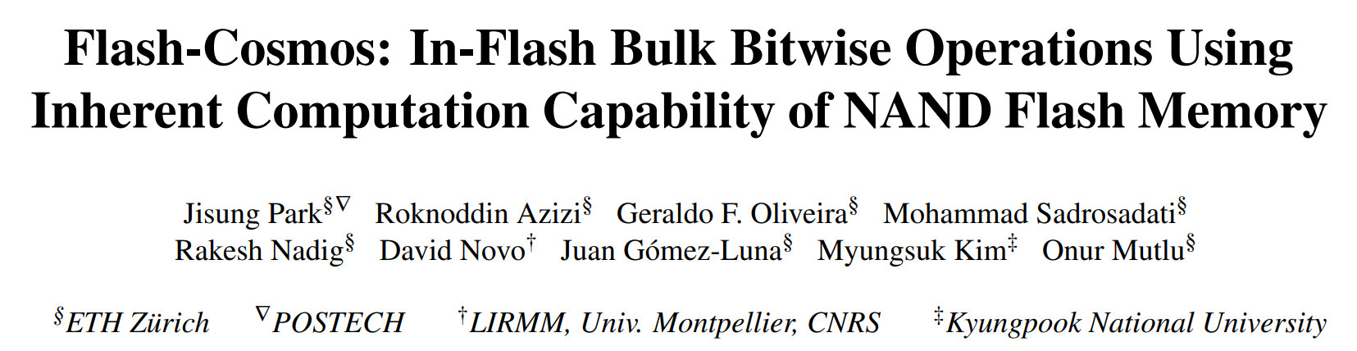

Other Types of Bitwise Operations
Flash-Cosmos also enables
other types of bitwise operations (NOT/NAND/NOR/XOR/XNOR)
leveraging existing features of NAND flash memory
https://arxiv.org/abs/2209.05566.pdf

Slide 98
Key Ideas
Multi-Wordline Sensing (MWS)
to enable in-flash bulk bitwise operations
via a single sensing operation
Enhanced SLC-Mode Programming (ESP)
to eliminate raw bit errors in stored data
(and thus in computation results)
Notes:
Now let’s dive into the key ideas of Enhanced SLC-Mode Programming [Click] that elminiates …

Slide 99
Enhanced SLC-Mode Programming (ESP)
Goal: eliminate raw bit errors in stored data (and computation results)
Key ideas
  Programs only a single bit per cell (SLC-mode programming)
    Trades storage density for reliable computation
  Performs more precise programming of the cells
    Trades programming latency for reliable computaion
Maximizes the reliability margin
between the different states of flash cells
Notes:
Eliminates raw bit errors in stored data. [Click]
The key idea is to program only a single bit per cell for the target data of computation, meaning that ESP trades storage density, [Click] and use more precise program-voltage control, meaning that it also trades program latency, [Click] to maximize the reliability margin between the program and erased states of flash cells. [Click]

Slide 100
Enhanced SLC-Mode Programming (ESP)
To eliminate raw bit errors in stored data (and computation results)
Key ideas
  Programs only a single bit per cell (SLC-mode programming)
    Trades storage density for reliable computation
  More precise program-voltage control
    Trades programming latency for reliable computaion
Flash-Cosmos (ESP) enables
reliable in-flash computation
by trading storage density & programming latency
Storage & latency overheads affect
only data used in in-flash computation
Maximizes the reliability margin
between the different states of flash cells
Notes:
So, ESP enables reliable in-flash computation by trading storage density and program performance, [Click] but the overheads occur only for the target data of computation. [Click]

Slide 101
Evaluation Methodology
Real-device characterization
  To validate the feasibility and reliability of Flash-Cosmos
  Using 160 48-WL-layer 3D Triple-Level Cell NAND flash chips
    3,686,400 tested wordlines
  Under worst-case operating conditions
    Under a 1-year retention time at 10K P/E cycles
    Worst-case data patterns
System-level evaluation
  Using the state-of-the-art SSD simulator (MQSim [Tavakkol+, FAST’18])
  Three real-world applications
    Bitmap Indices (BMI): Bitwise AND of up to ~1,000 operands
    Image Segmentation (IMS): Bitwise AND of 3 operands
    K-clique Star Listing (KCS): Bitwise OR of up to 32 operands
  Baselines
    Outside-Storage Processing (OSP): A multi-core CPU (Intel i7-11700K)
    In-Storage Processing (ISP): An in-storage hardware accelerator
    ParaBit [Gao+, MICRO’21]: State-of-the-art in-flash processing mechanism
Notes:
First, we conducted rigorous real-device characterization to validate the feasibility and reliability of Flash-Cosmos, [Click] using 160 3D NAND flash chips, [Click] considering the worst-case operation conditions. [Click]
We also performed system-level evaluation using the state-of-the-art SSD simulator, [Click] for three real-world applications that perform bulk bitwise operations on different numbers of operands. [Click]
We compared Flash-Cosmos against three baselines, a conventional system that uses a multi-core CPU, an in-storage processing system with an in-storage hardware accelerator, and a system that adopts the state-of-the-art in-flash processing mechanism to perform bulk bitwise operations. [Click]

Slide 102
Results: Real-Device Characterization
No changes to the cell array
of commodity NAND flash chips
Can have many operands
(AND: up to 48, OR: up to 4)
with small increase in sensing latency (< 10%)
ESP significantly improves
the reliability of computation results
(no observed bit error in the tested flash cells)
Notes:
Through our real-device characterization, we demnostrated that both MWS operations are possible without requiring any change ot the cell array of commodity NAND flash chips, [Click] and they can reliably activate multiple wordlines at the same time without significant increase in sensing latency. [Click]
We also observed no errors in the tested cells when we program data using ESP, which shows that Flash-Cosmos enables reliable in-flash bulk bitwise operations. [Click]

Slide 103
Results: Performance & Energy
ISP
ParaBit
Flash-Cosmos
150×
70×
Speedup over OSP
Energy benefit over OSP
14×
2×
25×
3.5×
12×
2×
13.4×
3.3×
1.6×
10×
2.5×
20×
Flash-Cosmos provides significant performance & energy benefits over all the baselines
The larger the number of operands,
the higher the performance & energy benefits
Notes:
As system-level evaluation, [Click] we evaluate the speedup and [Click] energy benefit over the conventional system. [Click]
We observe that Flash-Cosmos provides significant performance and energy benefits over all the baselines, including the state-of-the-art in-flash bulk bitwise operation technique, [Click] and the larger the number of operands for bulk bitwise operations, the higher the performance and energy benefits that Flash-Cosmos can achieve over other computing platforms. [Click]

Slide 104
In-Flash Bulk Bitwise Execution
Jisung Park, Roknoddin Azizi, Geraldo F. Oliveira, Mohammad Sadrosadati, Rakesh Nadig, David Novo, Juan Gómez-Luna, Myungsuk Kim, and Onur Mutlu,
"Flash-Cosmos: In-Flash Bulk Bitwise Operations Using Inherent Computation Capability of NAND Flash Memory"
Proceedings of the 55th International Symposium on Microarchitecture (MICRO), Chicago, IL, USA, October 2022.
[Slides (pptx) (pdf)]
[Longer Lecture Slides (pptx) (pdf)]
[Lecture Video (44 minutes)]
[arXiv version]
https://arxiv.org/pdf/2209.05566.pdf

Slide 105
More to Come…

Slide 106
Concluding Remarks

Slide 107
Challenge and Opportunity for Future
Fundamentally
Energy-Efficient
(Data-Centric)
Computing Architectures

Slide 108
Challenge and Opportunity for Future
Fundamentally
High-Performance
(Data-Centric)
Computing Architectures

Slide 109
Challenge and Opportunity for Future
Computing Architectures
with
Minimal Data Movement

Slide 110
We Need to Revisit the Entire Stack
With a storage-centric mindset
Problem
Algorithm
Program/Language
System Software
SW/HW Interface
Micro-architecture
Logic
Devices
Electrons
We can get there step by step

Slide 111

Source: http://spectrum.ieee.org/image/MjYzMzAyMg.jpeg

Slide 112
An Overview Paper
Onur Mutlu, Saugata Ghose, Juan Gomez-Luna, and Rachata Ausavarungnirun,
"A Modern Primer on Processing in Memory"
Invited Book Chapter in Emerging Computing: From Devices to Systems - Looking Beyond Moore and Von Neumann, Springer, to be published in 2021.
https://arxiv.org/pdf/2012.03112.pdf

Slide 113
Referenced Papers, Talks, Artifacts
All are available at
  https://people.inf.ethz.ch/omutlu/projects.htm
  https://www.youtube.com/onurmutlulectures
  https://github.com/CMU-SAFARI/

Slide 114








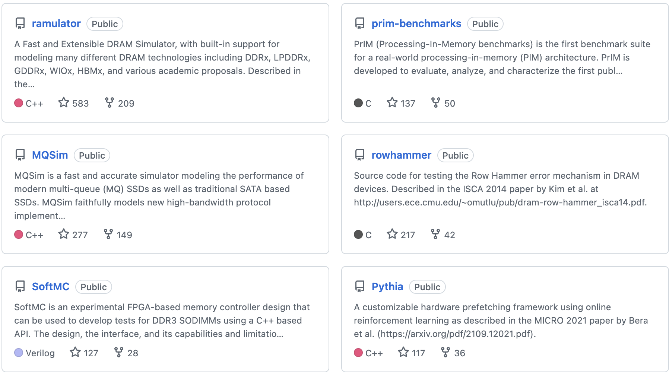
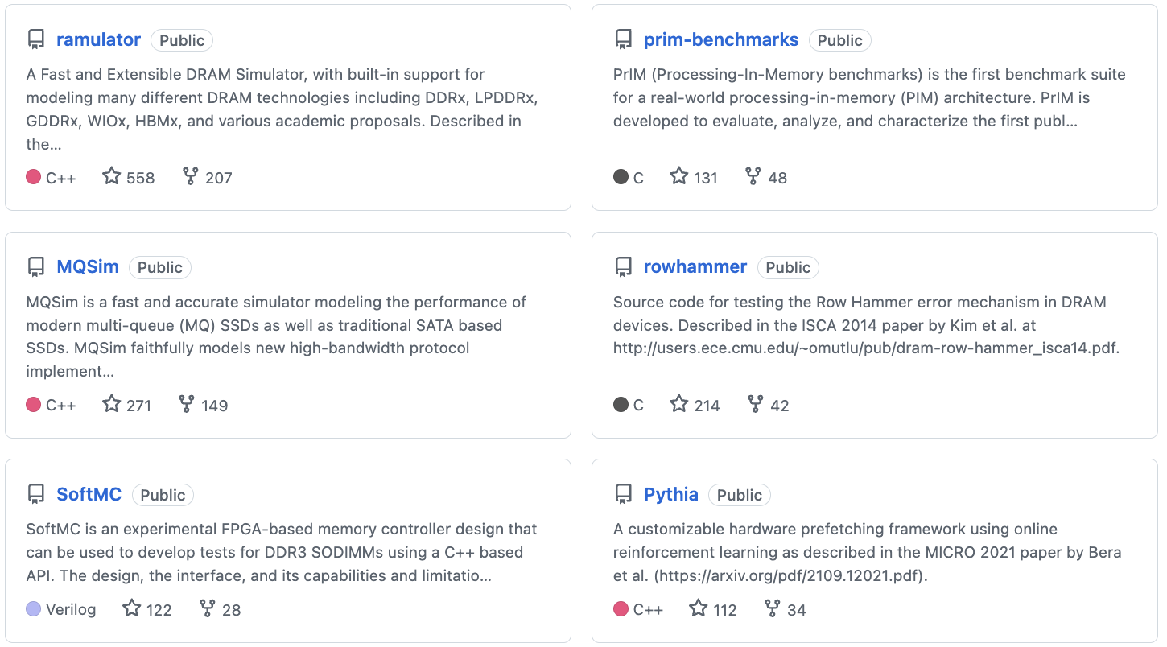
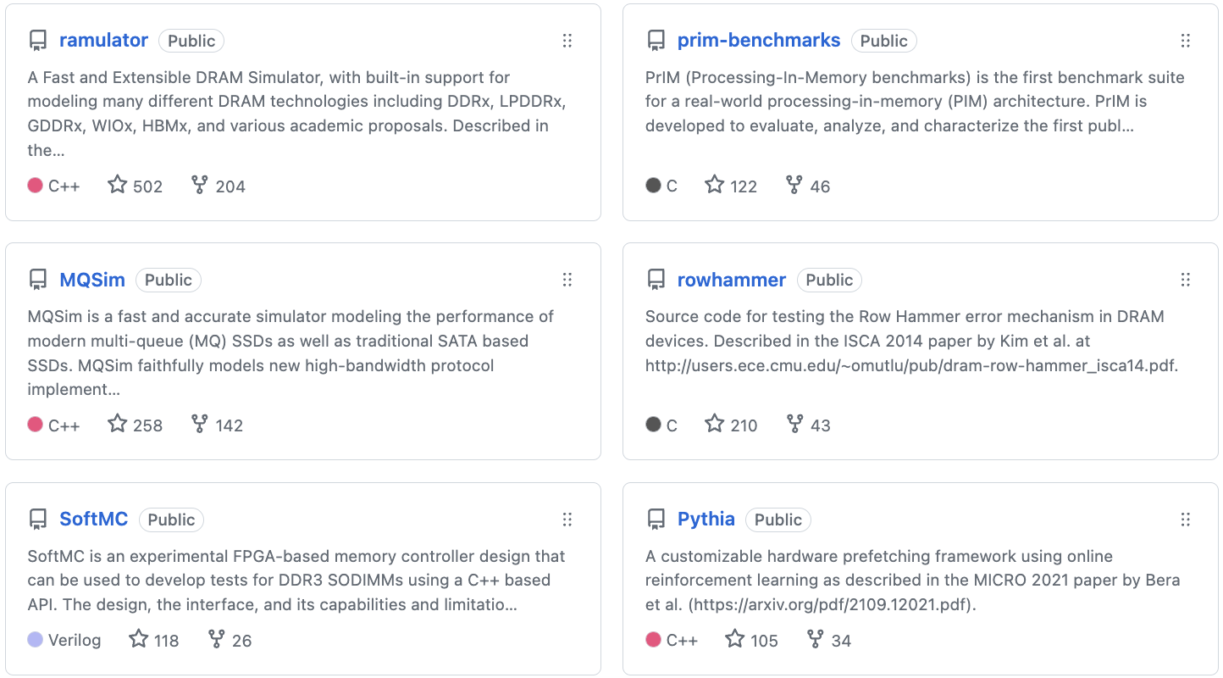
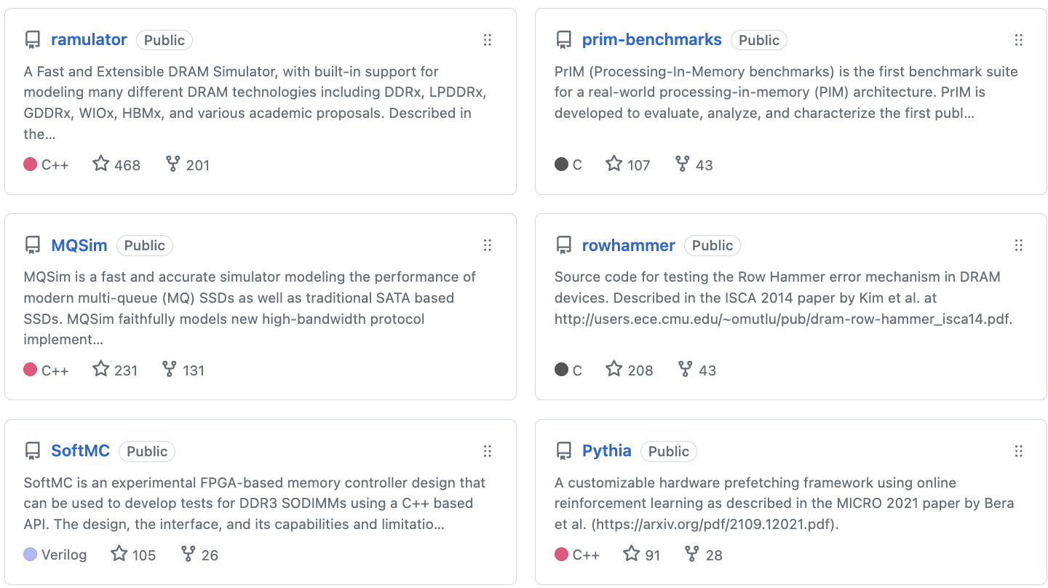
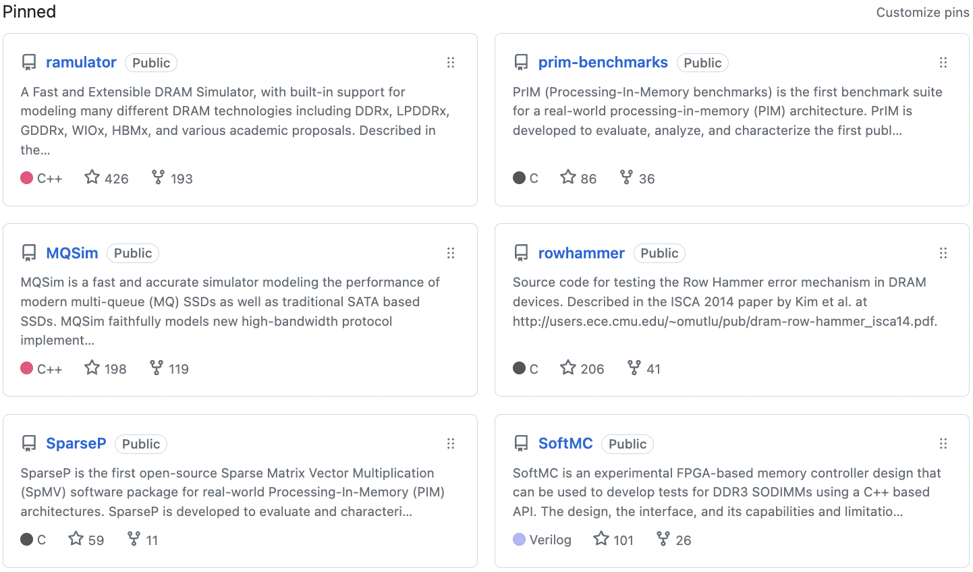
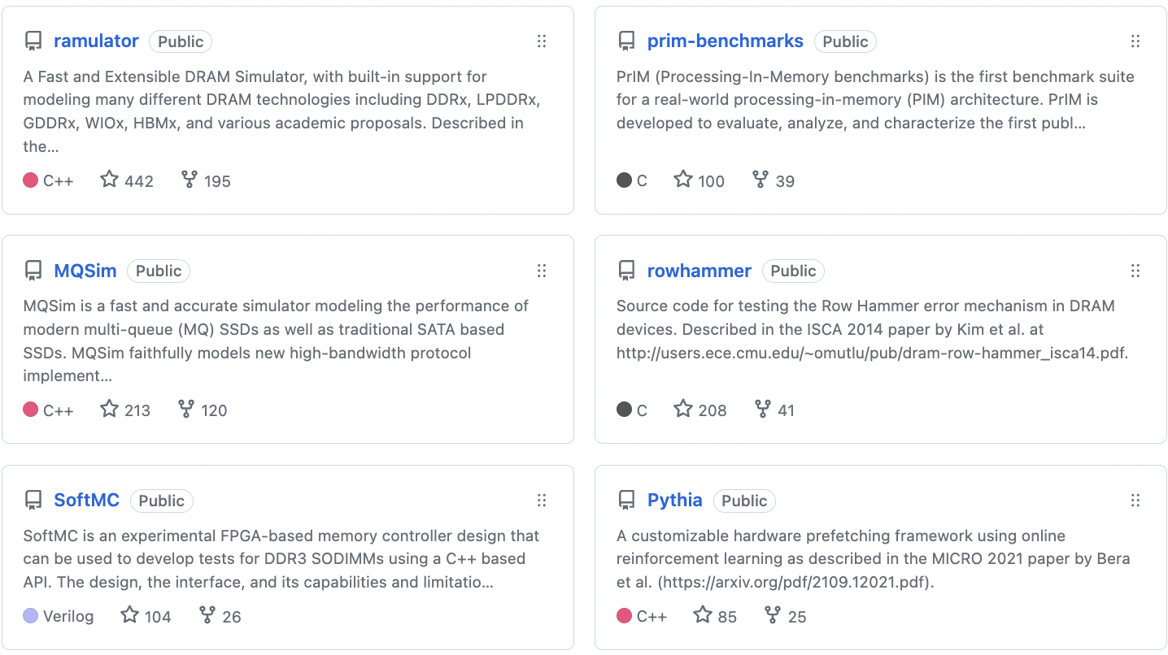
Open Source Tools: SAFARI GitHub
https://github.com/CMU-SAFARI/

Slide 115

Acknowledgments
Think BIG, Aim HIGH!
https://safari.ethz.ch

Slide 116
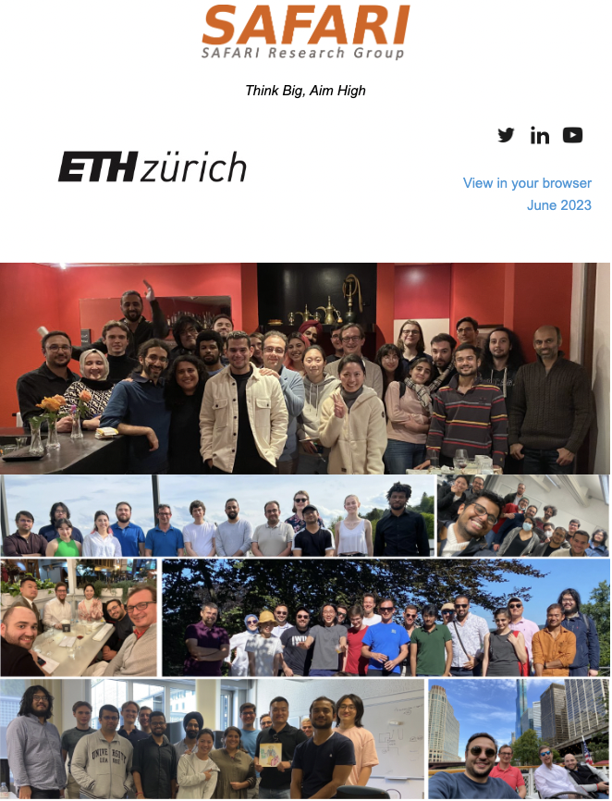
SAFARI Newsletter June 2023 Edition
https://safari.ethz.ch/safari-newsletter-june-2023/

Slide 117
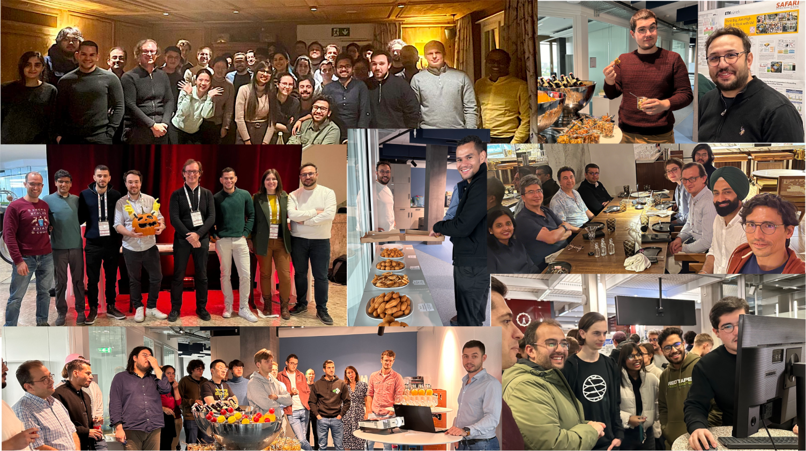
SAFARI Newsletter July 2024 Edition
https://safari.ethz.ch/safari-newsletter-july-2024/

Slide 118
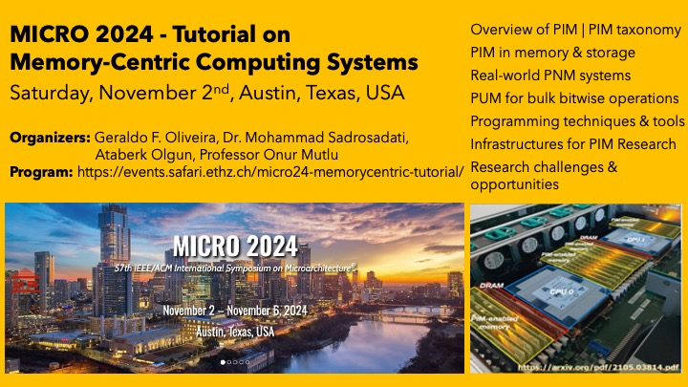
PIM Tutorial November 2024 Edition
https://www.youtube.com/watch?v=KV2MXvcBgb0
https://events.safari.ethz.ch/micro24-memorycentric-tutorial/

Slide 119
Storage-Centric Computing
Enabling
Fundamentally-Efficient Computers
Onur Mutlu
omutlu@gmail.com
https://people.inf.ethz.ch/omutlu
1 December 2024
CCF China Storage Keynote Talk

Slide 120
Backup Slides

Slide 121
Processing in Memory:
Two Types
1. Processing near Memory
2. Processing using Memory

Slide 122
Processing using DRAM
We can support
  Bulk bitwise AND, OR, NOT, MAJ
  Bulk bitwise COPY and INIT/ZERO
  True Random Number Generation; Physical Unclonable Functions
  More complex computation using Lookup Tables
At low cost
Using analog computation capability of DRAM
  Idea: activating (multiple) rows performs computation
    Even in commodity off-the-shelf DRAM chips!
30X-257X performance and energy improvements
Seshadri+“RowClone: Fast and Efficient In-DRAM Copy and Initialization of Bulk Data,” MICRO 2013.
Seshadri+, “Fast Bulk Bitwise AND and OR in DRAM”, IEEE CAL 2015.
Seshadri+, “Ambit: In-Memory Accelerator for Bulk Bitwise Operations Using Commodity DRAM Technology,” MICRO 2017.
Hajinazar+, “SIMDRAM: A Framework for Bit-Serial SIMD Processing using DRAM,” ASPLOS 2021.
Oliveira+, “MIMDRAM: An End-to-End Processing-Using-DRAM System for High-Throughput, Energy-Efficient and Programmer-Transparent Multiple-Instruction Multiple-Data Processing,” HPCA 2024.

Slide 123
In-DRAM Acceleration of Database Queries
>4-12X Performance Improvement
Seshadri+, “Ambit: In-Memory Accelerator for Bulk Bitwise Operations using Commodity DRAM Technology,” MICRO 2017.

Slide 124
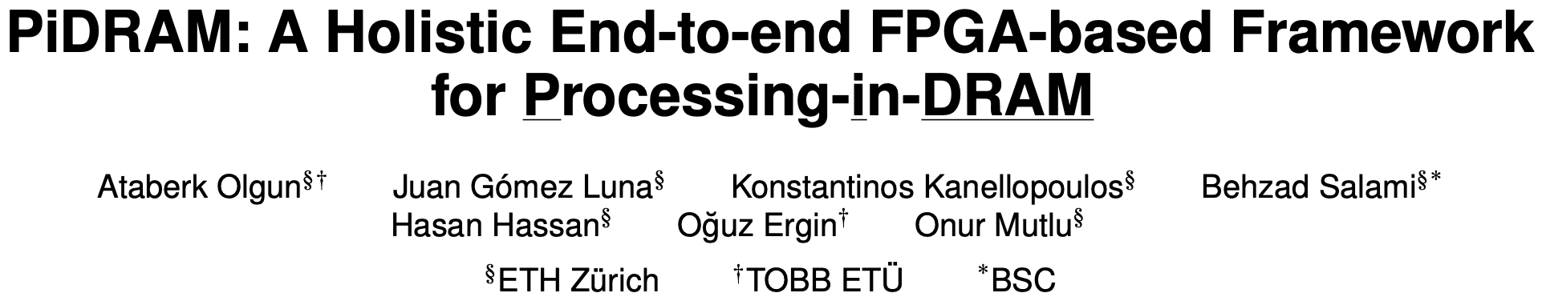
Real Processing Using Memory Prototype
End-to-end RowClone & TRNG using off-the-shelf DRAM chips
Idea: Violate DRAM timing parameters to mimic RowClone
https://arxiv.org/pdf/2111.00082.pdf
https://github.com/cmu-safari/pidram
https://www.youtube.com/watch?v=qeukNs5XI3g&t=4192s

Slide 125
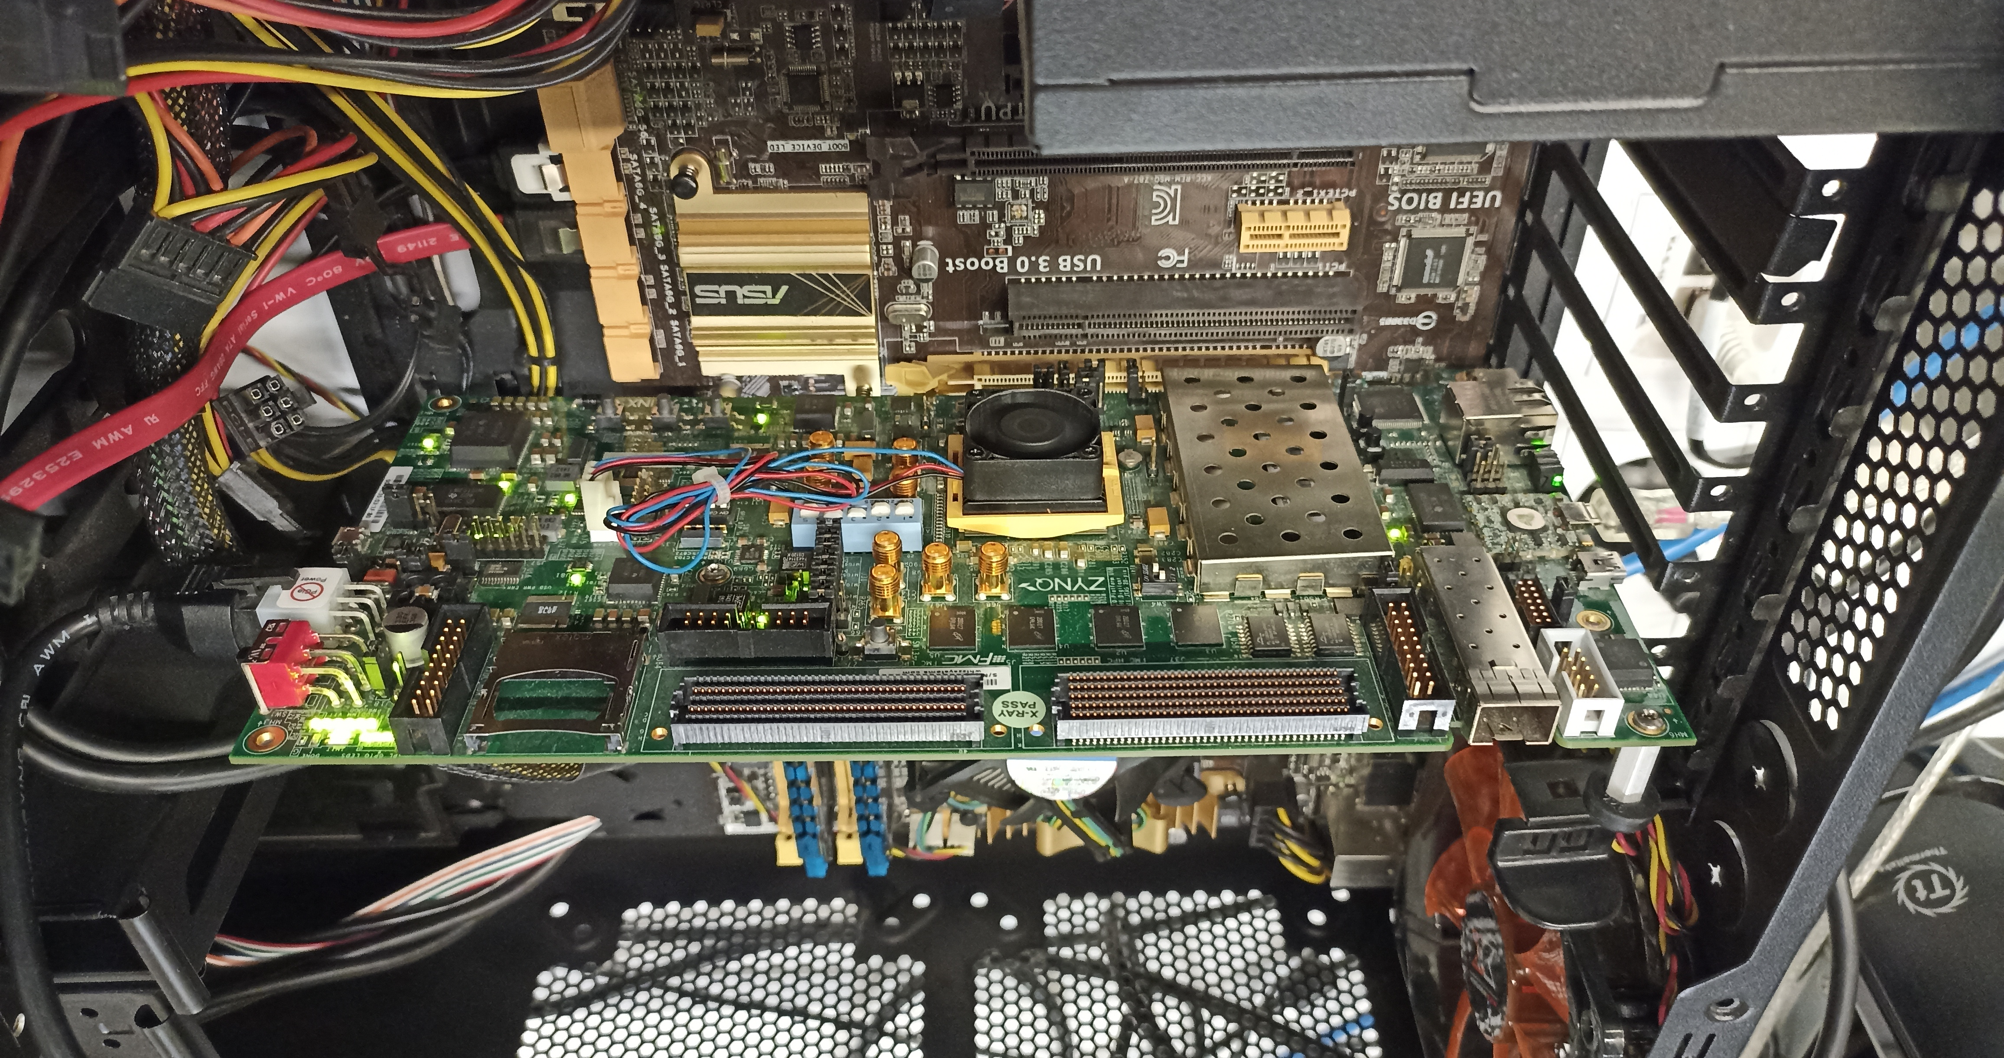
Real Processing-using-Memory Prototype
https://arxiv.org/pdf/2111.00082.pdf
https://github.com/cmu-safari/pidram
https://www.youtube.com/watch?v=qeukNs5XI3g&t=4192s
Host Machine
FPGA Board
RISC-V System
PiM-Enabled DIMM

Slide 126
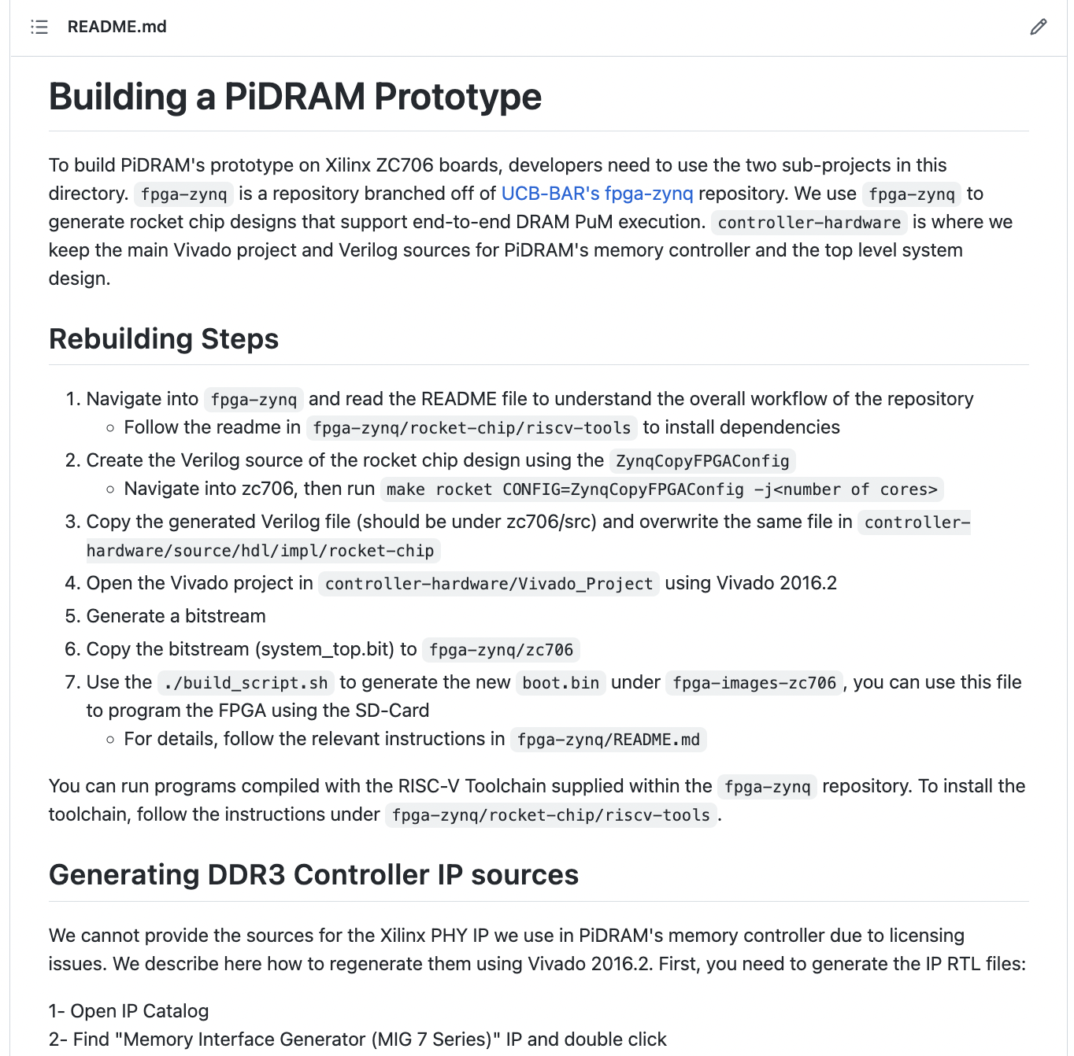
Real Processing-using-Memory Prototype
https://arxiv.org/pdf/2111.00082.pdf
https://github.com/cmu-safari/pidram
https://www.youtube.com/watch?v=qeukNs5XI3g&t=4192s

Slide 127
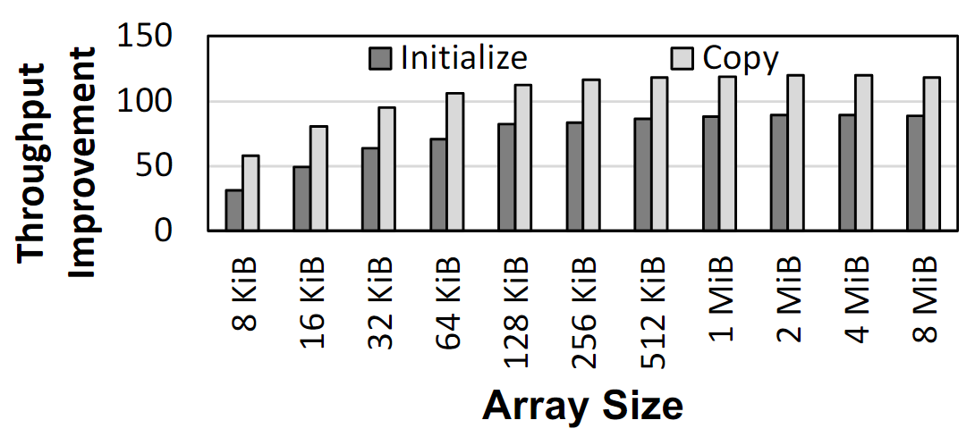
Microbenchmark Copy/Initialization Throughput
In-DRAM Copy and Initialization
improve throughput by 119x and 89x
Notes:
This plot shows the throughput improvement provided by in-DRAM copy operations for bulk data initialization and copy over CPU-based copy and initialization using LOAD and STORE instructions. We do not execute any CLFLUSH instructions and assume that the data is up to date in DRAM and there are no cached copies.
The x-axis shows the size of the arrays that we copy or initialize. The dark gray bar shows the improvement for initialization operations, and the bright gray bar shows the improvement for copy operations.
[CLICK] We observe that in-DRAM copy and initialization operations improve copy and initialization throughput by 119x and 89x including the overheads of system support required for RowClone operations

Slide 128
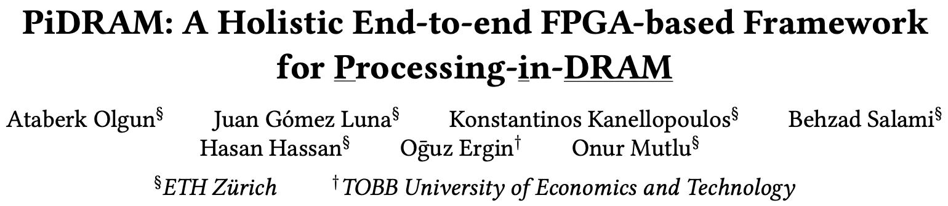
More on PiDRAM
Ataberk Olgun, Juan Gomez Luna, Konstantinos Kanellopoulos, Behzad Salami, Hasan Hassan, Oguz Ergin, and Onur Mutlu,
"PiDRAM: A Holistic End-to-end FPGA-based Framework for Processing-in-DRAM"
ACM Transactions on Architecture and Code Optimization (TACO), March 2023.
[arXiv version]
Presented at the 18th HiPEAC Conference, Toulouse, France, January 2023.
[Slides (pptx) (pdf)]
[Longer Lecture Slides (pptx) (pdf)]
[Lecture Video (40 minutes)]
[PiDRAM Source Code]

Slide 129
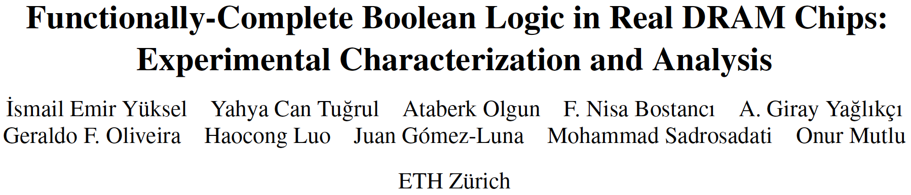
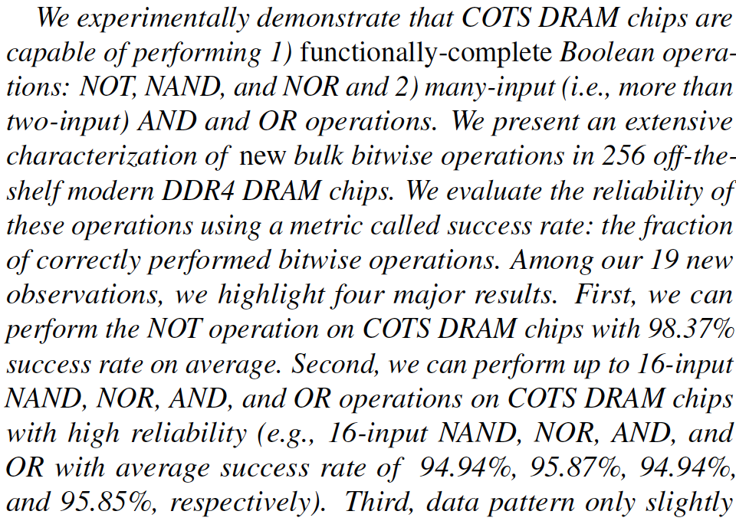
DRAM Chips Are Already (Quite) Capable!
Appears at HPCA 2024
https://arxiv.org/pdf/2402.18736.pdf

Slide 130
The Capability of COTS DRAM Chips
We demonstrate that COTS DRAM chips:
1
Can copy one row into up to 31 other rows
with >99.98% success rate
2
Can perform NOT operation
with up to 32 output operands
3
Can perform up to 16-input
AND, NAND, OR, and NOR operations
130
Notes:
[CLICK]In this study, we experimentally demonstrate that off-the-shelf DRAM chips
[CLICK] Can simultaneously activating up to 48 DRAM rows in two neighboring subarrays
[CLICK] Can performing NOT operation with up to 32 output operands
[CLICK] Can performing up to 16-input AND, NAND, OR, and NOR operations

Slide 131
Eliminating the Adoption Barriers
How to Enable Adoption of Processing in Memory

Slide 132
Potential Barriers to Adoption of PIM
1. Applications & software for PIM
2. Ease of programming (interfaces and compiler/HW support)
3. System and security support: coherence, synchronization, virtual memory, isolation, communication interfaces, …
4. Runtime and compilation systems for adaptive scheduling, data mapping, access/sharing control, …
5. Infrastructures to assess benefits and feasibility
All can be solved with change of mindset

Slide 133
We Need to Revisit the Entire Stack
With a memory-centric mindset
Problem
Algorithm
Program/Language
System Software
SW/HW Interface
Micro-architecture
Logic
Devices
Electrons
We can get there step by step

Slide 134
Concluding Remarks
We must design systems to be balanced, high-performance, energy-efficient (all at the same time) → intelligent systems
  Data-centric, data-driven, data-aware
Enable computation capability inside and close to memory
This can
  Lead to orders-of-magnitude improvements
  Enable new applications & computing platforms
  Enable better understanding of nature
  …
Future of truly memory-centric computing is bright
  We need to do research & design across the computing stack
Notes:
Perhaps we have taken processor-centric system design a bit too far

Slide 135
We Need to Revisit the Entire Stack
With a data-centric mindset
Problem
Algorithm
Program/Language
System Software
SW/HW Interface
Micro-architecture
Logic
Devices
Electrons
We can get there step by step

Slide 136
Funding Acknowledgments
Alibaba, AMD, ASML, Google, Facebook, Hi-Silicon, HP Labs, Huawei, IBM, Intel, Microsoft, Nvidia, Oracle, Qualcomm, Rambus, Samsung, Seagate, VMware, Xilinx
NSF
NIH
GSRC
SRC
CyLab
EFCL
SNSF
ACCESS
Thank you!

