Slide 1



Enabling Computation with
Minimal Data Movement:
Changing the Computing Paradigm
Onur Mutlu
omutlu@gmail.com
https://people.inf.ethz.ch/omutlu
2 June 2019
Design Automation Summer School @ DAC 2019

Slide 2
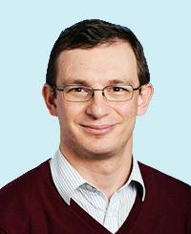
Brief Self Introduction
Onur Mutlu
  Full Professor @ ETH Zurich CS, since September 2015
  Strecker Professor @ Carnegie Mellon University ECE/CS, 2009-2016, 2016-…
  PhD from UT-Austin, worked at Google, VMware, Microsoft Research, Intel, AMD
  https://people.inf.ethz.ch/omutlu/
  omutlu@gmail.com (Best way to reach me)
  https://people.inf.ethz.ch/omutlu/projects.htm
Research and Teaching in:
  Computer architecture, computer systems, hardware security, bioinformatics
  Memory and storage systems
  Hardware security, safety, predictability
  Fault tolerance
  Hardware/software cooperation
  Architectures for bioinformatics, health, medicine
  …

Slide 3
Research & Teaching: Some Overview Talks
https://www.youtube.com/watch?v=kgiZlSOcGFM&list=PL5Q2soXY2Zi8D_5MGV6EnXEJHnV2YFBJl
Future Computing Architectures
  https://www.youtube.com/watch?v=kgiZlSOcGFM&list=PL5Q2soXY2Zi8D_5MGV6EnXEJHnV2YFBJl&index=1
Enabling In-Memory Computation
  https://www.youtube.com/watch?v=oHqsNbxgdzM&list=PL5Q2soXY2Zi8D_5MGV6EnXEJHnV2YFBJl&index=7
Accelerating Genome Analysis
  https://www.youtube.com/watch?v=hPnSmfwu2-A&list=PL5Q2soXY2Zi8D_5MGV6EnXEJHnV2YFBJl&index=9
Rethinking Memory System Design
  https://www.youtube.com/watch?v=F7xZLNMIY1E&list=PL5Q2soXY2Zi8D_5MGV6EnXEJHnV2YFBJl&index=3

Slide 4



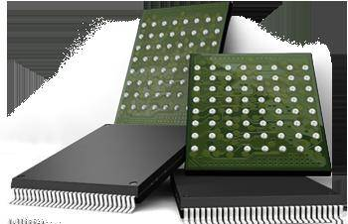

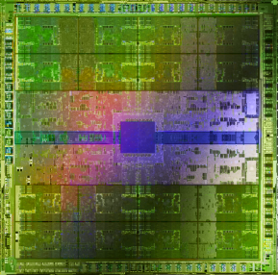
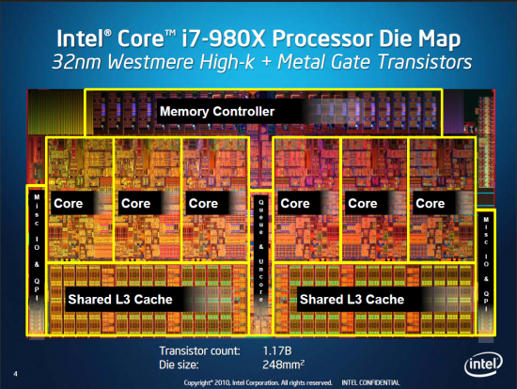
Current Research Focus Areas
Research Focus: Computer architecture, HW/SW, bioinformatics, security
Memory and storage (DRAM, flash, emerging), interconnects
Heterogeneous & parallel systems, GPUs, systems for data analytics
System/architecture interaction, new execution models, new interfaces
Hardware security, energy efficiency, fault tolerance, performance
Genome sequence analysis & assembly algorithms and architectures
Biologically inspired systems & system design for bio/medicine
Hybrid Main Memory
Heterogeneous
Processors and
Accelerators
Persistent Memory/Storage
Broad research
spanning apps, systems, logic
with architecture at the center
Graphics and Vision Processing
Notes:
Professor Mutlu’s research focus is all aspects of computer architecture, HW/SW interaction and bioinformatics.
He is looking for students to perform research in these areas.
He and his group, SAFARI, solve fundamental problems spanning:
Memory, memory, memory, storage, interconnects
Parallel architectures, heterogeneous architectures, GP-GPUs
System/architecture interaction, new execution models
Energy efficiency, fault tolerance, hardware security
Genome sequence analysis and assembly
His group does broad research spanning systems to logic with architecture at center

Slide 5
Four Key Directions
Fundamentally Secure/Reliable/Safe Architectures
Fundamentally Energy-Efficient and Sustainable Architectures
  Memory-centric (Data-centric) Architectures
Fundamentally Low-Latency and Predictable Architectures
Architectures for Genomics, Medicine, Health

Slide 6
A Motivating Detour:
Genome Sequence Analysis

Slide 7
Our Dream (circa 2007)
An embedded device that can perform comprehensive genome analysis in real time (within a minute)
  Which of these DNAs does this DNA segment match with?
  What is the likely genetic disposition of this patient to this drug?
  . . .

Slide 8
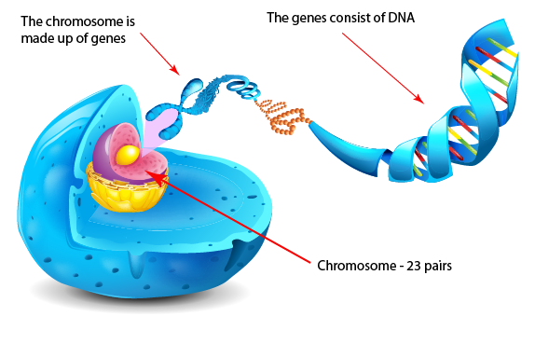
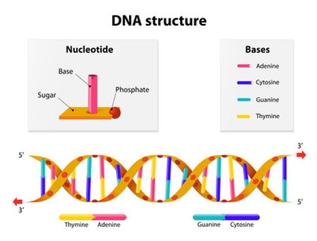
What Is a Genome Made Of?
Cell
Nucleus
The discovery of DNA’s double-helical structure (Watson+, 1953)
Notes:
Unlocking the life’s code requires diving into the nucleus of our body cells, where the double-stranded genome resides. Genome is literally the 'code of life' - it is the set of instructions for making everything from you to zebras, strawberries, and even yeast.
since the discovery of dna’s double-helical structure (watson et al. 1953)

Slide 9
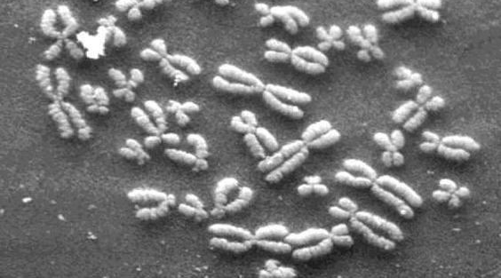
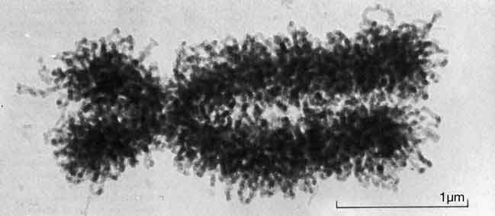
DNA Under Electron Microscope
human chromosome #12
from HeLa’s cell
Notes:
Henrietta Lacks,

Slide 10
DNA Sequencing
Goal:
  Find the complete sequence of A, C, G, T’s in DNA.
Challenge:
  There is no machine that takes long DNA as an input, and gives the complete sequence as output
  All sequencing machines chop DNA into pieces and identify relatively small pieces (but not how they fit together)

Slide 11
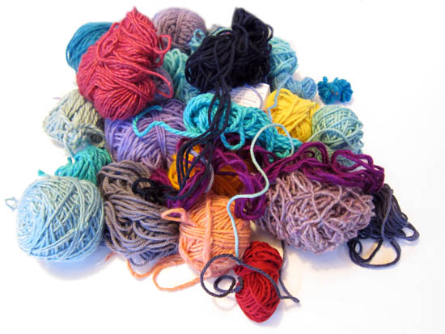
Untangling Yarn Balls & DNA Sequencing
Notes:
untangling yarn ball

Slide 12
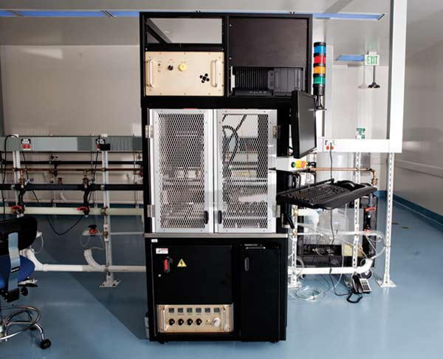
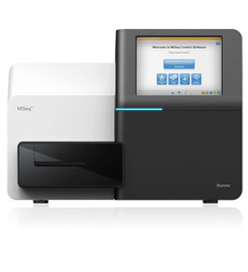
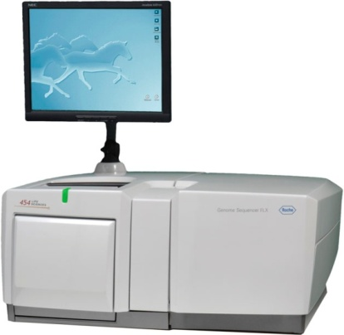
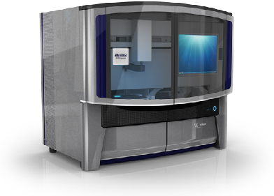
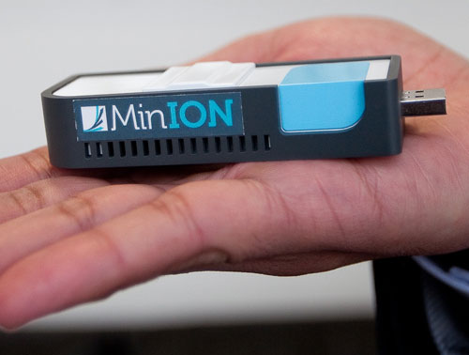
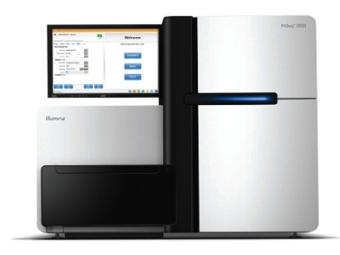
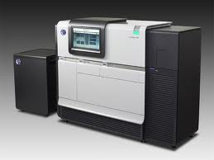
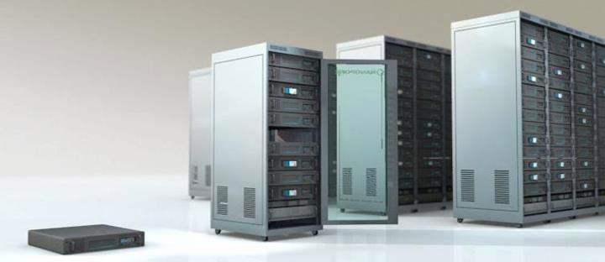
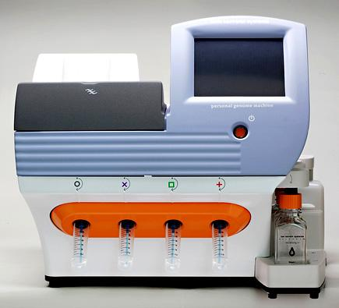
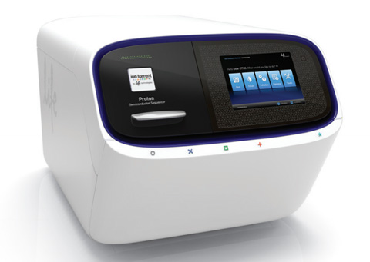
Genome Sequencers
Illumina MiSeq
Complete
Genomics
Roche/454
AB SOLiD
Oxford Nanopore MinION
Illumina
NovaSeq
6000
Illumina HiSeq2000
Pacific Biosciences RS
Oxford Nanopore GridION
Ion Torrent PGM
… and more! All produce data with different properties.
Ion Torrent Proton

Slide 13
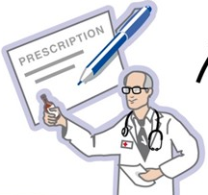
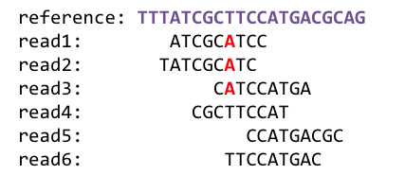
1
Sequencing
Genome Analysis
Read Mapping
2
Variant Calling
Scientific Discovery
3
4
Notes:
Genome analysis starts with sequencing random short DNA fragments of copies of the original molecule.
Unfortunately, these reads lack information about their order and which part of genome they are originated from.
Hence the second step is to map these reads to a long reference genome.

Slide 14
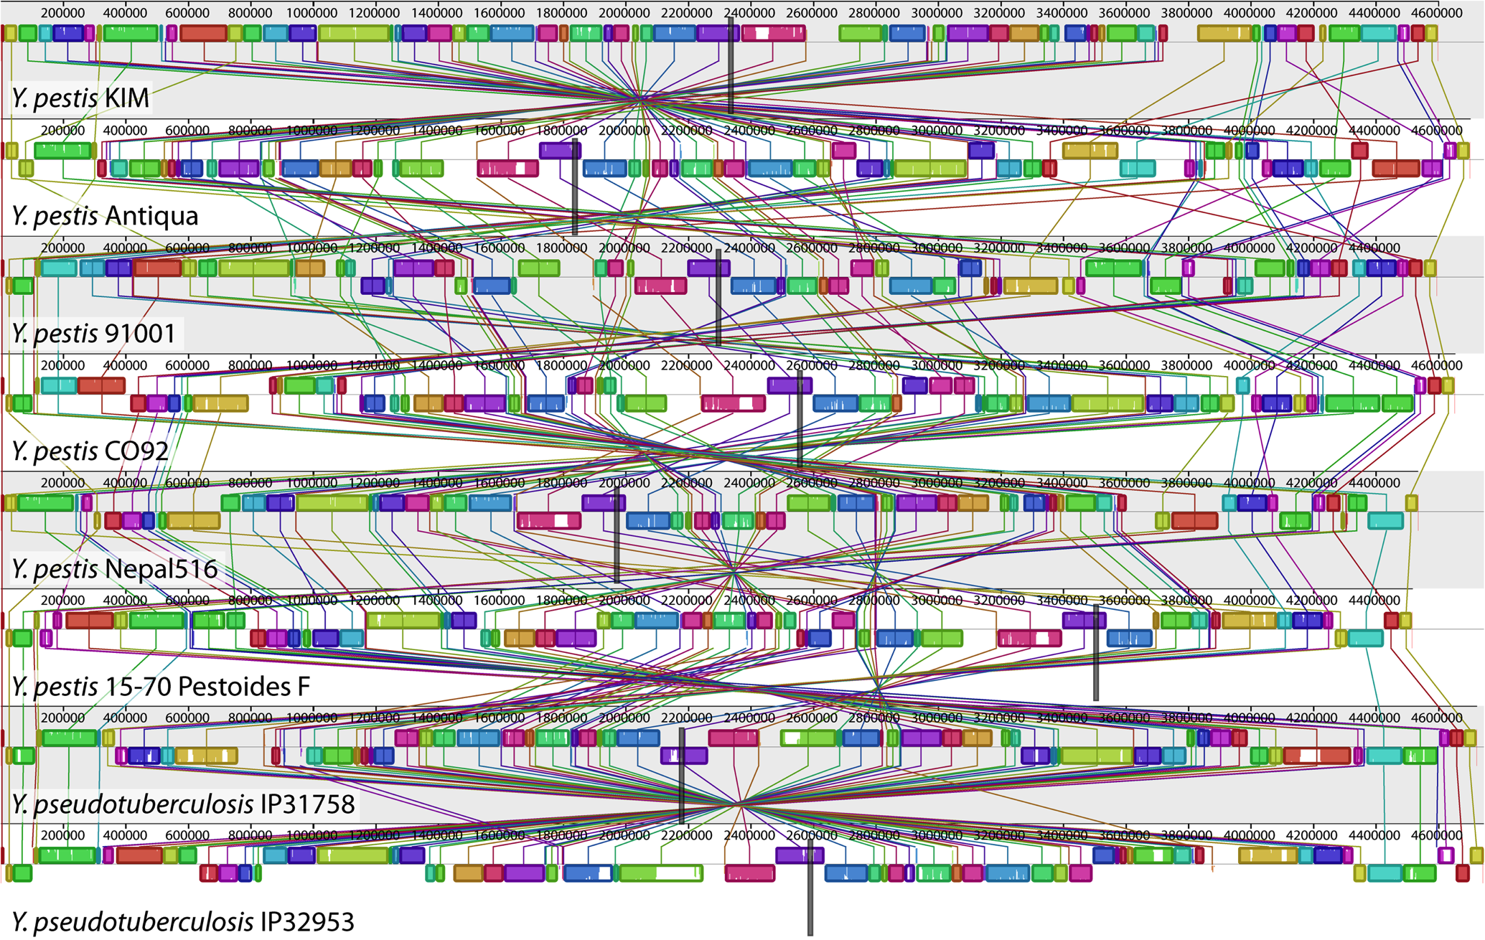
Genome Sequence Alignment: Example
Source: By Aaron E. Darling, István Miklós, Mark A. Ragan - Figure 1 from Darling AE, Miklós I, Ragan MA (2008).
"Dynamics of Genome Rearrangement in Bacterial Populations". PLOS Genetics. DOI:10.1371/journal.pgen.1000128., CC BY 2.5, https://commons.wikimedia.org/w/index.php?curid=30550950

Slide 15
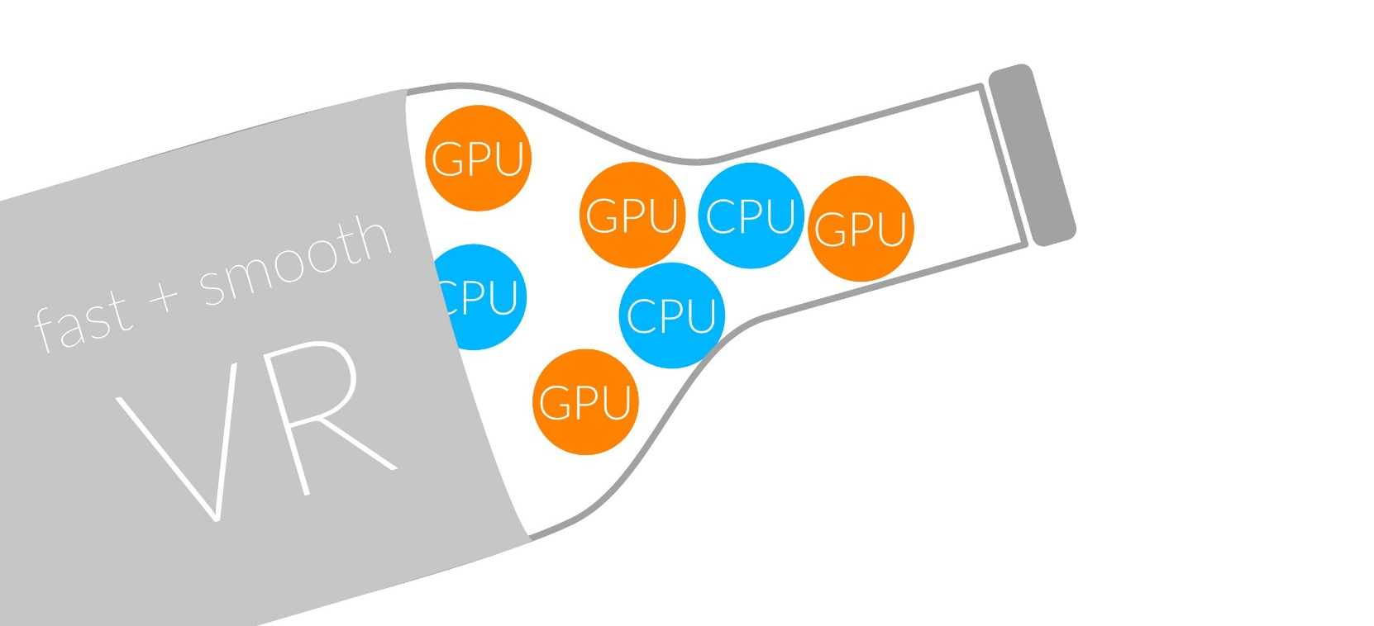
1
Sequencing
Read Mapping
2
Bottlenecked in Mapping!!
Illumina HiSeq4000
on average
GAGTCAGAATTTGAC
2 M
bases/min
300 M
bases/min
GAGTCAGAATTTGAC
GAGTCAGAATTTGAC
GAGTCAGAATTTGAC
GAGTCAGAATTTGAC
GAGTCAGAATTTGAC
GAGTCAGAATTTGAC
GAGTCAGAATTTGAC
GAGTCAGAATTTGAC
GAGTCAGAATTTGAC
GAGTCAGAATTTGAC
GAGTCAGAATTTGAC
GAGTCAGAATTTGAC
GAGTCAGAATTTGAC
GAGTCAGAATTTGAC
(0.6%)
Variant Calling
Scientific Discovery
3
4
Notes:
Typical sequencer machine generates a flood of reads, for example, Illumina HiSeq4000 generates 300 million bases/minute.
However, existing computer alignment algorithms can only process 0.6% of these reads in the same amount of time.
This gap is widening as more advanced sequencers are made available in the market.

Slide 16
Problem
Need to construct
the entire genome
from many reads

Slide 17
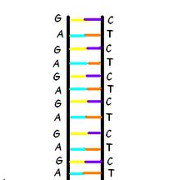
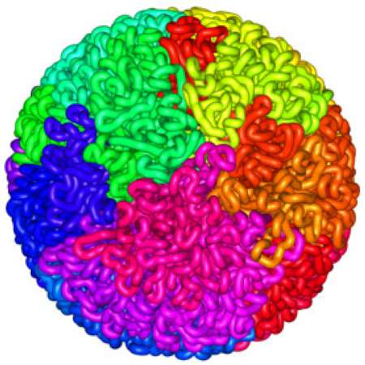
Read Mapping
Map many short DNA fragments (reads) to a known reference genome with some differences allowed
Reference genome
Reads
DNA, physically
DNA, logically
Mapping short reads to reference genome is challenging (billions of 50-300 base pair reads)
Notes:
Read mapping is a post processing procedure after DNA sequencing. It maps the data output from a DNA sequencer, which are many short DNA fragments, to a known reference genome, with some minor differences allowed.
To illustrate the problem better, let us take a closer look at the DNA itself. Logically, the DNA is a double stranded long string. In reality, within a cell they folded into a sphere in the nucleus like a ball of wool. Since it is very hard to disentangle the DNA at molecular level, to extract the information out, a sequencer cuts the mass into many short DNA pieces which are called reads.
A mapper’s job is to find where these DNA short reads are most likely to be originally placed so that later we can assemble them in the correct order to restore the original DNA.
Mapping these short reads, up to billions of them, with each one being 50 to 300 base-pairs long, to the reference genome is challenging.

Slide 18
Read Alignment/Verification
Edit distance is defined as the minimum number of edits (i.e. insertions, deletions, or substitutions) needed to make the read exactly match the reference segment.
NETHERLANDS x SWITZERLAND
N | E | - | T | H | E | R | L | A | N | D | S
S | W | I | T | Z | E | R | L | A | N | D | -
match
deletion
insertion
mismatch
Notes:
http://www.let.rug.nl/kleiweg/lev/

Slide 19
Challenges in Read Mapping
Need to find many mappings of each read
  How can we find all mappings efficiently?
Need to tolerate small variances/errors in each read
  Each individual is different: Subject’s DNA may slightly differ from the reference (Mismatches, insertions, deletions)
  How can we efficiently map each read with up to e errors present?
Need to map each read very fast (i.e., performance is important)
  Human DNA is 3.2 billion base pairs long → Millions to billions of reads (State-of-the-art mappers take weeks to map a human’s DNA)
  How can we design a much higher performance read mapper?
Notes:
There are three main challenges.
First. The mapper needs to find many mappings for each read. Because the read is so short, they can map to multiple locations in the reference genome. How can we efficiently find all mappings of a read?
Second. The mapper needs to tolerate small variance or errors in each read. Since individuals are different, the subject’s DNA might slightly differs from the reference DNA, which can be mismatches, insertions or deletions of base pairs. How can we efficiently map each read with up to a number of e errors present?
Third. The mapper needs to map each read very fast. In another word, performance is important. Because the human DNA is 3.2 billion base-pairs long and each read is only hundreds of base-pairs long, there can be billions of reads subjected to mapping for an individual human. Current state of the art mappers take weeks to map a human’s DNA. So the question is, how can we design a much higher performance read mapper?

Slide 20
Hash Table Based Read Mappers
+ Guaranteed to find all mappings → sensitive
+ Can tolerate up to e errors
http://mrfast.sourceforge.net/
Alkan+, "Personalized copy number and segmental duplication
maps using next-generation sequencing”, Nature Genetics 2009.
Notes:
It turned out the Hash Table based mappers solve the first 2 challenges pretty well. They guarantee to find all mappings with no more than e errors present.

Slide 21
Read Mapping Execution Time Breakdown
Notes:
An overwhelming majority of the read mapper’s execution time is spent in read alignment.

Slide 22
Idea
Filter fast before you align
Minimize costly
“approximate string comparisons”

Slide 23
Our First Filter: Pure Software Approach
Download the source code and try for yourself
  Download link to FastHASH

Slide 24
Shifted Hamming Distance: SIMD Acceleration
https://github.com/CMU-SAFARI/Shifted-Hamming-Distance
Xin+, "Shifted Hamming Distance: A Fast and Accurate SIMD-friendly Filter
to Accelerate Alignment Verification in Read Mapping”, Bioinformatics 2015.

Slide 25
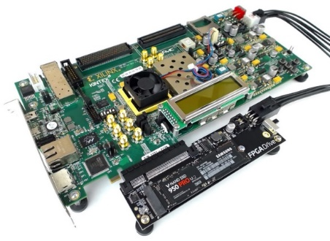
GateKeeper: FPGA-Based Alignment Filtering
1
st
Alignment Filter
FPGA-based Alignment Filter.
Notes:
To bridge the widening gap between the sequencer & the mapper, we propose the concept of pre-alignment filtering. We added a new examination step before the accurate alignment step. The main objective of this step is to detect the incorrect mappings accurately and rapidly. Only the mappings that pass our filter are examined by the alignment step. We also explore exploiting todays’ hardware accelerators to further boost the filtering speed of such filters.

Slide 26
GateKeeper: FPGA-Based Alignment Filtering
Mohammed Alser, Hasan Hassan, Hongyi Xin, Oguz Ergin, Onur Mutlu, and Can Alkan
"GateKeeper: A New Hardware Architecture for Accelerating Pre-Alignment in DNA Short Read Mapping"
Bioinformatics, [published online, May 31], 2017.
[Source Code]
[Online link at Bioinformatics Journal]

Slide 27
MAGNET Accelerator [Alser+, TIR 2017]
Notes:
We implement our algorithm in Verilog and design a hardware accelerator for it. Each processing core is able to examine a single mapping. We integrate many hardware processing cores in the architecture of MAGNET for examining many mappings in a parallel fashion.

Slide 28
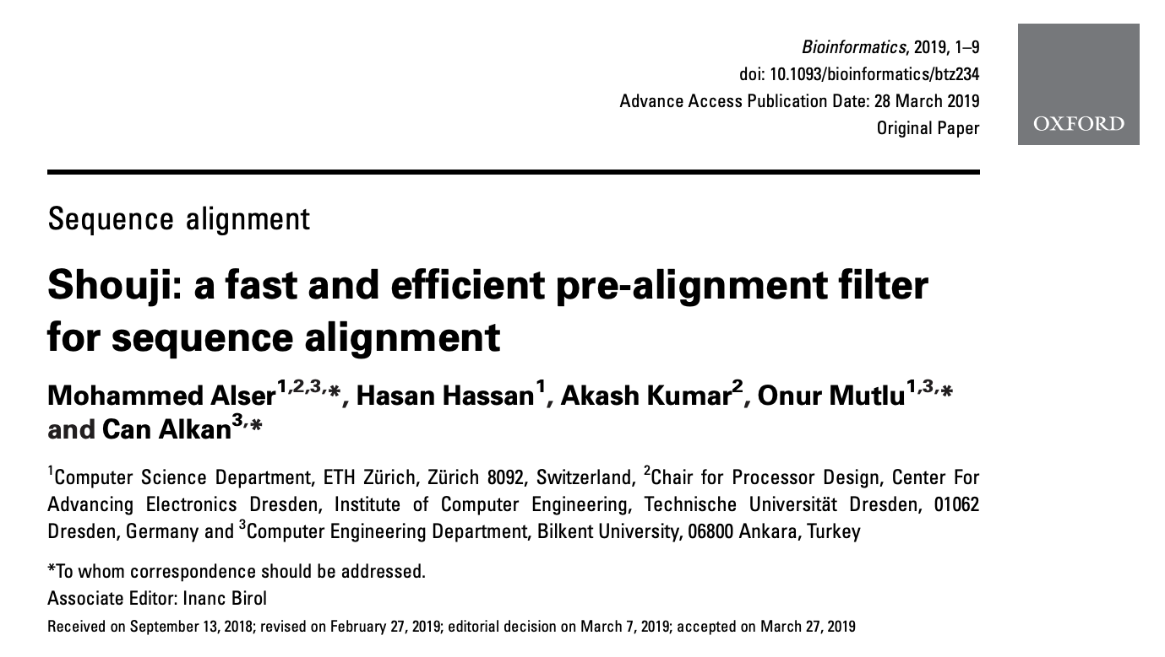
Newest Work: Shouji [Alser+, Bioinformatics 2019]
Mohammed Alser, Hasan Hassan, Akash Kumar, Onur Mutlu, and Can Alkan,
"Shouji: A Fast and Efficient Pre-Alignment Filter for Sequence Alignment"
Bioinformatics, [published online, March 28], 2019.
[Source Code]
[Online link at Bioinformatics Journal]

Slide 29
DNA Read Mapping & Filtering
Problem: Heavily bottlenecked by Data Movement
GateKeeper FPGA performance limited by DRAM bandwidth [Alser+, Bioinformatics 2017]
Ditto for SHD on SIMD [Xin+, Bioinformatics 2015]
Solution: Processing-in-memory can alleviate the bottleneck
However, we need to design mapping & filtering algorithms to fit processing-in-memory

Slide 30
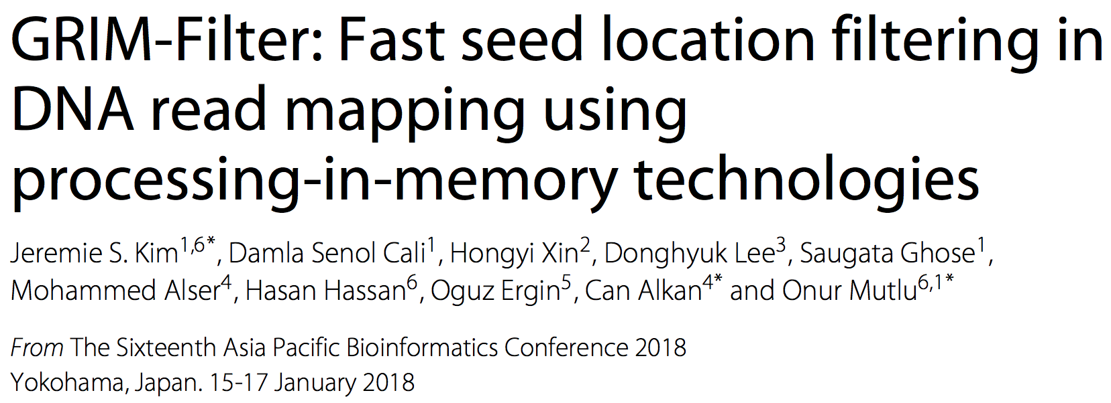
In-Memory DNA Sequence Analysis
Jeremie S. Kim, Damla Senol Cali, Hongyi Xin, Donghyuk Lee, Saugata Ghose, Mohammed Alser, Hasan Hassan, Oguz Ergin, Can Alkan, and Onur Mutlu,
"GRIM-Filter: Fast Seed Location Filtering in DNA Read Mapping Using Processing-in-Memory Technologies"
BMC Genomics, 2018.
Proceedings of the 16th Asia Pacific Bioinformatics Conference (APBC), Yokohama, Japan, January 2018.
arxiv.org Version (pdf)

Slide 31
Quick Note: Key Principles and Results
Two key principles:
  Exploit the structure of the genome to minimize computation
  Morph and exploit the structure of the underlying hardware to maximize performance and efficiency
Algorithm-architecture co-design for DNA read mapping
  Speeds up read mapping by ~300X (sometimes more)
  Improves accuracy of read mapping in the presence of errors
Xin et al., “Accelerating Read Mapping with FastHASH,” BMC Genomics 2013.
Xin et al., “Shifted Hamming Distance: A Fast and Accurate SIMD-friendly Filter to Accelerate
Alignment Verification in Read Mapping,” Bioinformatics 2015.
Alser et al., “GateKeeper: A New Hardware Architecture for Accelerating Pre-Alignment in DNA
Short Read Mapping,” Bioinformatics 2017.
Kim et al., “Genome Read In-Memory (GRIM) Filter,” BMC Genomics 2018.

Slide 32
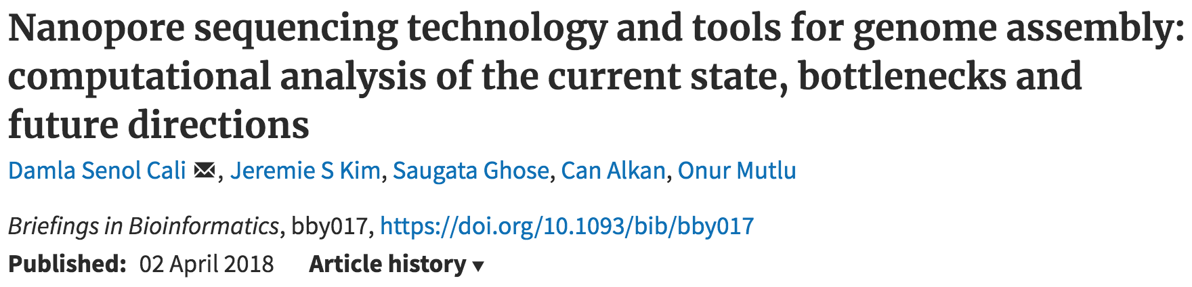
New Genome Sequencing Technologies
Oxford Nanopore MinION
Senol Cali+, “Nanopore Sequencing Technology and Tools for Genome
Assembly: Computational Analysis of the Current State, Bottlenecks
and Future Directions,” Briefings in Bioinformatics, 2018.
[Preliminary arxiv.org version]

Slide 33
Nanopore Genome Assembly Pipeline
Senol Cali+, “Nanopore Sequencing Technology and Tools for Genome
Assembly,” Briefings in Bioinformatics, 2018.

Slide 34
Recall Our Dream
An embedded device that can perform comprehensive genome analysis in real time (within a minute)
Still a long ways to go
  Energy efficiency
  Performance (latency)
  Security
  Huge memory bottleneck

Slide 35

More on Genome Analysis: Another Talk
Onur Mutlu,
"Accelerating Genome Analysis: A Primer on an Ongoing Journey"
Keynote talk at 2nd Workshop on Accelerator Architecture in Computational Biology and Bioinformatics (AACBB), Washington, DC, USA, February 2019.
[Slides (pptx)(pdf)]
[Video]
https://www.youtube.com/watch?v=hPnSmfwu2-A

Slide 36
Four Key Directions
Fundamentally Secure/Reliable/Safe Architectures
Fundamentally Energy-Efficient Architectures
  Memory-centric (Data-centric) Architectures
Fundamentally Low-Latency Architectures
Architectures for Genomics, Medicine, Health

Slide 37
Memory & Storage

Slide 38
The Main Memory System
Main memory is a critical component of all computing systems: server, mobile, embedded, desktop, sensor
Main memory system must scale (in size, technology, efficiency, cost, and management algorithms) to maintain performance growth and technology scaling benefits
Processors
and caches
Main Memory
Storage (SSD/HDD)

Slide 39
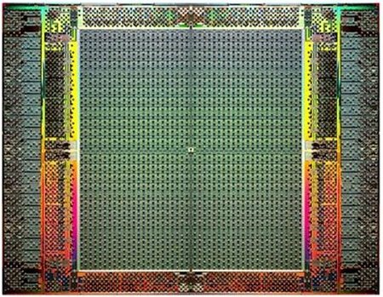
The Main Memory System
Main memory is a critical component of all computing systems: server, mobile, embedded, desktop, sensor
Main memory system must scale (in size, technology, efficiency, cost, and management algorithms) to maintain performance growth and technology scaling benefits
FPGAs
Main Memory
Storage (SSD/HDD)

Slide 40
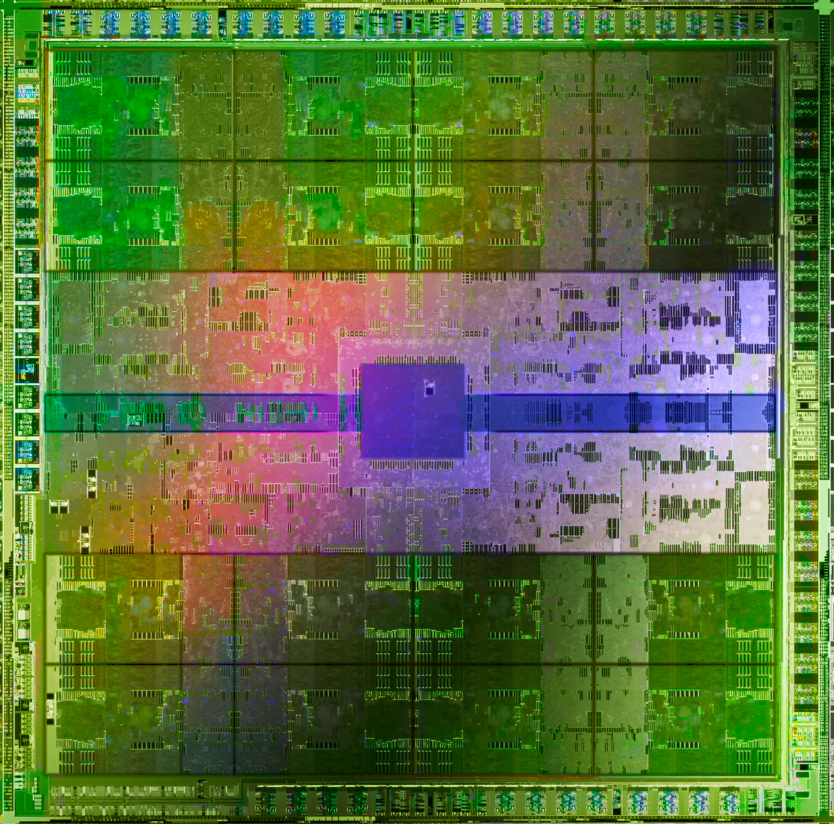
The Main Memory System
Main memory is a critical component of all computing systems: server, mobile, embedded, desktop, sensor
Main memory system must scale (in size, technology, efficiency, cost, and management algorithms) to maintain performance growth and technology scaling benefits
GPUs
Main Memory
Storage (SSD/HDD)

Slide 41
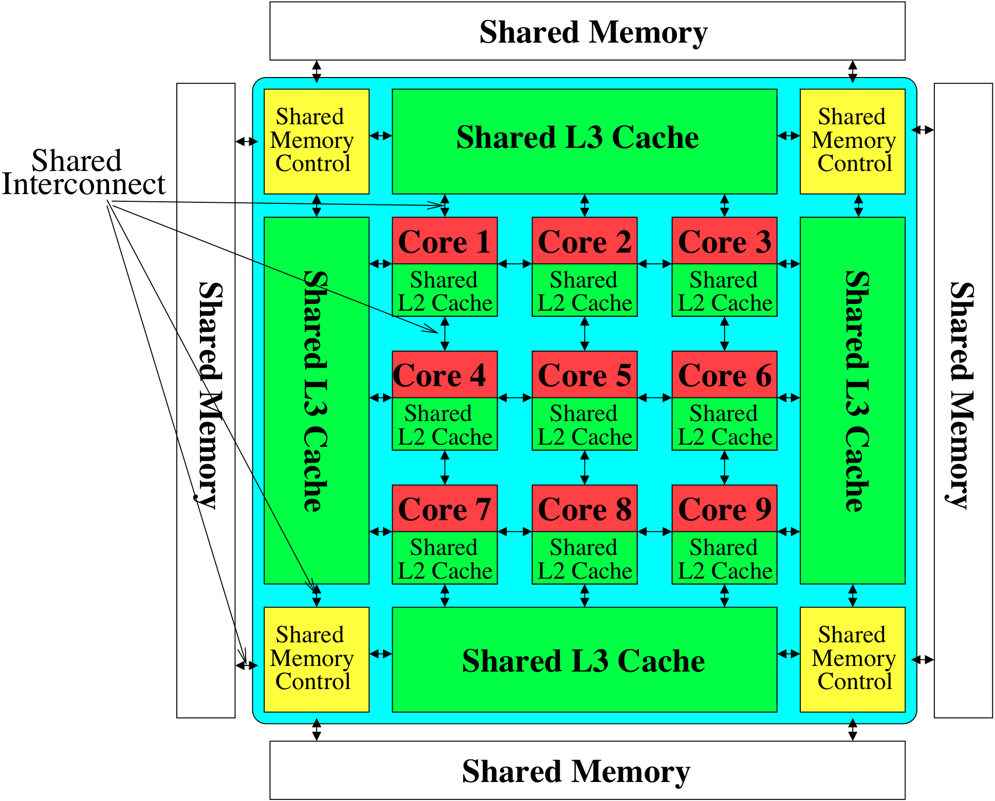
Memory System: A Shared Resource View
Storage
Most of the system is dedicated to storing and moving data

Slide 42
State of the Main Memory System
Recent technology, architecture, and application trends
  lead to new requirements
  exacerbate old requirements
DRAM and memory controllers, as we know them today, are (will be) unlikely to satisfy all requirements
Some emerging non-volatile memory technologies (e.g., PCM) enable new opportunities: memory+storage merging
We need to rethink the main memory system
  to fix DRAM issues and enable emerging technologies
  to satisfy all requirements

Slide 43
Major Trends Affecting Main Memory (I)
Need for main memory capacity, bandwidth, QoS increasing
Main memory energy/power is a key system design concern
DRAM technology scaling is ending

Slide 44
Major Trends Affecting Main Memory (II)
Need for main memory capacity, bandwidth, QoS increasing
  Multi-core: increasing number of cores/agents
  Data-intensive applications: increasing demand/hunger for data
  Consolidation: cloud computing, GPUs, mobile, heterogeneity
Main memory energy/power is a key system design concern
DRAM technology scaling is ending

Slide 45
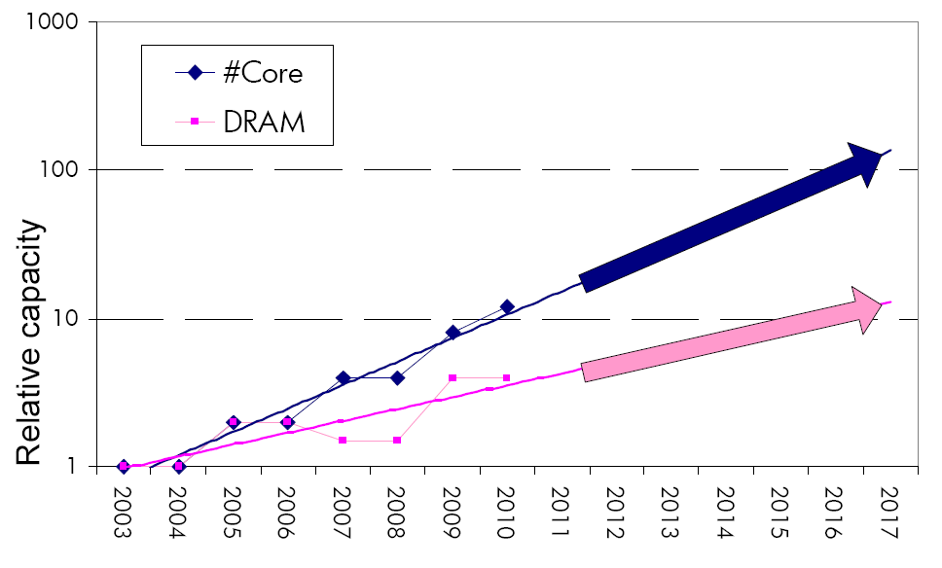
Example: The Memory Capacity Gap
Core count doubling ~ every 2 years
DRAM DIMM capacity doubling ~ every 3 years
Memory capacity per core expected to drop by 30% every two years
Trends worse for memory bandwidth per core!
Lim et al., ISCA 2009

Slide 46
DRAM Capacity, Bandwidth & Latency
128x
20x
1.3x

Slide 47




DRAM Is Critical for Performance
In-memory Databases
[Mao+, EuroSys’12;
Clapp+ (Intel), IISWC’15]
Graph/Tree Processing
[Xu+, IISWC’12; Umuroglu+, FPL’15]
In-Memory Data Analytics
[Clapp+ (Intel), IISWC’15;
Awan+, BDCloud’15]
Datacenter Workloads
[Kanev+ (Google), ISCA’15]

Slide 48
DRAM Is Critical for Performance
In-memory Databases
[Mao+, EuroSys’12;
Clapp+ (Intel), IISWC’15]
Graph/Tree Processing
[Xu+, IISWC’12; Umuroglu+, FPL’15]
Memory → performance bottleneck
In-Memory Data Analytics
[Clapp+ (Intel), IISWC’15;
Awan+, BDCloud’15]
Datacenter Workloads
[Kanev+ (Google), ISCA’15]

Slide 49





DRAM Is Critical for Performance
  Chrome
TensorFlow Mobile
    Google’s web browser
Google’s machine learning framework
  Video Playback
  Video Capture
Google’s video codec
Google’s video codec
Notes:
In this work, we take a look at widely-used google consumer workloads, to figure out the major sources of energy consumption.
We look at Google Chrome web brower. We take a look at Tensorflow, Google’s machine learning framework, and we also take a look at two important video related workloads, video playback and video capture, both rely on Google’s vp9 codec technology.

Slide 50
DRAM Is Critical for Performance
  Chrome
TensorFlow Mobile
    Google’s web browser
Google’s machine learning framework
Memory → performance bottleneck
  Video Playback
  Video Capture
Google’s video codec
Google’s video codec
Notes:
In this work, we take a look at widely-used google consumer workloads, to figure out the major sources of energy consumption.
We look at Google Chrome web brower. We take a look at Tensorflow, Google’s machine learning framework, and we also take a look at two important video related workloads, video playback and video capture, both rely on Google’s vp9 codec technology.

Slide 51
Major Trends Affecting Main Memory (III)
Need for main memory capacity, bandwidth, QoS increasing
Main memory energy/power is a key system design concern
  ~40-50% energy spent in off-chip memory hierarchy [Lefurgy, IEEE Computer’03] >40% power in DRAM [Ware, HPCA’10][Paul,ISCA’15]
  DRAM consumes power even when not used (periodic refresh)
DRAM technology scaling is ending

Slide 52
Energy Waste in Mobile Devices
Amirali Boroumand, Saugata Ghose, Youngsok Kim, Rachata Ausavarungnirun, Eric Shiu, Rahul Thakur, Daehyun Kim, Aki Kuusela, Allan Knies, Parthasarathy Ranganathan, and Onur Mutlu,
"Google Workloads for Consumer Devices: Mitigating Data Movement Bottlenecks"
Proceedings of the 23rd International Conference on Architectural Support for Programming Languages and Operating Systems (ASPLOS), Williamsburg, VA, USA, March 2018.
62.7% of the total system energy
is spent on data movement

Slide 53
Major Trends Affecting Main Memory (IV)
Need for main memory capacity, bandwidth, QoS increasing
Main memory energy/power is a key system design concern
DRAM technology scaling is ending
  ITRS projects DRAM will not scale easily below X nm
  Scaling has provided many benefits:
    higher capacity (density), lower cost, lower energy

Slide 54
Major Trends Affecting Main Memory (V)
DRAM scaling has already become increasingly difficult
  Increasing cell leakage current, reduced cell reliability, increasing manufacturing difficulties [Kim+ ISCA 2014],
  [Liu+ ISCA 2013], [Mutlu IMW 2013], [Mutlu DATE 2017]
  Difficult to significantly improve capacity, energy
Emerging memory technologies are promising
3D-Stacked DRAM | higher bandwidth | smaller capacity
Reduced-Latency DRAM (e.g., RLDRAM, TL-DRAM) | lower latency | higher cost
Low-Power DRAM (e.g., LPDDR3, LPDDR4) | lower power | higher latency higher cost
Non-Volatile Memory (NVM) (e.g., PCM, STTRAM, ReRAM, 3D Xpoint) | larger capacity | higher latency higher dynamic power lower endurance

Slide 55
Major Trends Affecting Main Memory (V)
DRAM scaling has already become increasingly difficult
  Increasing cell leakage current, reduced cell reliability, increasing manufacturing difficulties [Kim+ ISCA 2014],
  [Liu+ ISCA 2013], [Mutlu IMW 2013], [Mutlu DATE 2017]
  Difficult to significantly improve capacity, energy
Emerging memory technologies are promising
3D-Stacked DRAM | higher bandwidth | smaller capacity
Reduced-Latency DRAM (e.g., RL/TL-DRAM, FLY-RAM) | lower latency | higher cost
Low-Power DRAM (e.g., LPDDR3, LPDDR4, Voltron) | lower power | higher latency higher cost
Non-Volatile Memory (NVM) (e.g., PCM, STTRAM, ReRAM, 3D Xpoint) | larger capacity | higher latency higher dynamic power lower endurance

Slide 56
Major Trend: Hybrid Main Memory
CPU
Meza+, “Enabling Efficient and Scalable Hybrid Memories,” IEEE Comp. Arch. Letters, 2012.
Yoon+, “Row Buffer Locality Aware Caching Policies for Hybrid Memories,” ICCD 2012 Best Paper Award.
DRAMCtrl
PCM Ctrl
DRAM
Phase Change Memory (or Tech. X)
Fast, durable
Small,
leaky, volatile,
high-cost
Large, non-volatile, low-cost
Slow, wears out, high active energy
Hardware/software manage data allocation and movement
to achieve the best of multiple technologies

Slide 57
Foreshadowing
Main Memory Needs
Intelligent Controllers

Slide 58
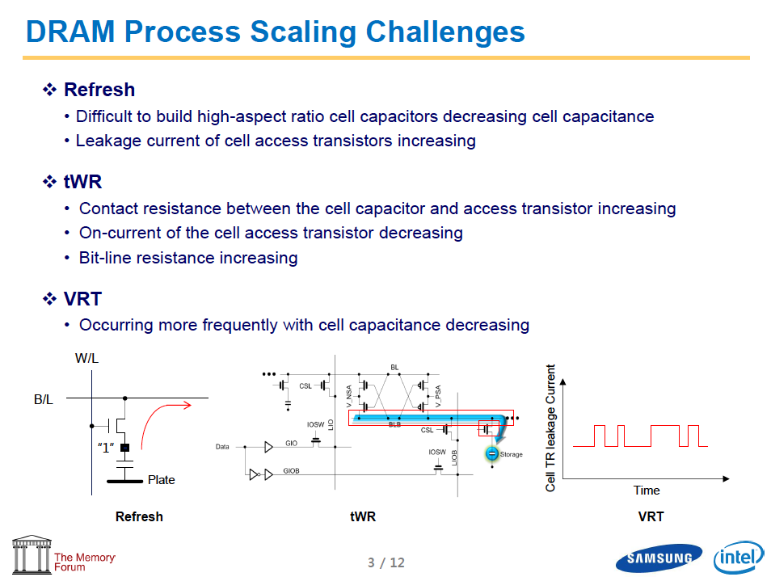
Industry Is Writing Papers About It, Too

Slide 59
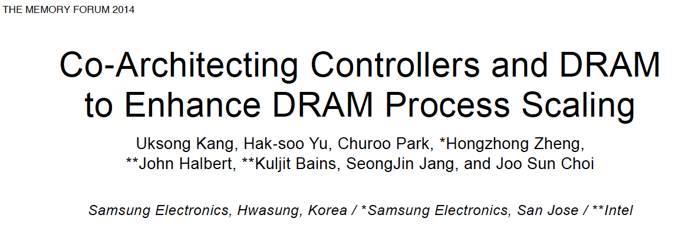
Call for Intelligent Memory Controllers

Slide 60
Agenda
Major Trends Affecting Main Memory
The Need for Intelligent Memory Controllers
  Bottom Up: Push from Circuits and Devices
  Top Down: Pull from Systems and Applications
Processing in Memory: Two Directions
  Minimally Changing Memory Chips
  Exploiting 3D-Stacked Memory
How to Enable Adoption of Processing in Memory
Conclusion

Slide 61
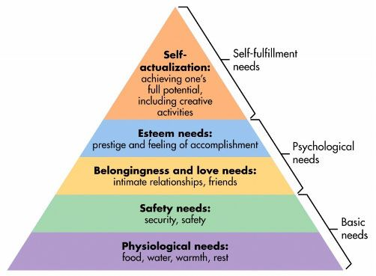
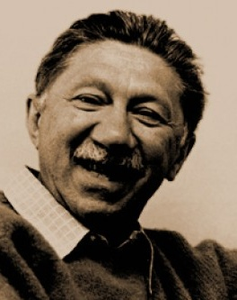
Maslow’s (Human) Hierarchy of Needs
Maslow, “A Theory of Human Motivation,”
Psychological Review, 1943.
Maslow, “A Theory of Human Motivation,”
Psychological Review, 1943.
Maslow, “Motivation and Personality,”
Book, 1954-1970.
We need to start with reliability and security…
Source: https://www.simplypsychology.org/maslow.html
Source: By User:Factoryjoe - Mazlow's Hierarchy of Needs.svg, CC BY-SA 3.0, https://commons.wikimedia.org/w/index.php?curid=7964065

Slide 62
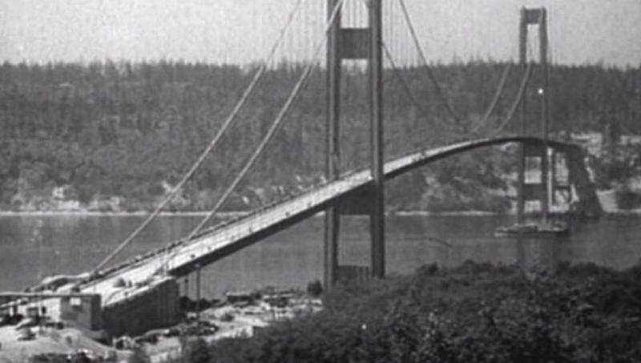
How Reliable/Secure/Safe is This Bridge?
Source: http://www.technologystudent.com/struct1/tacom1.png

Slide 63
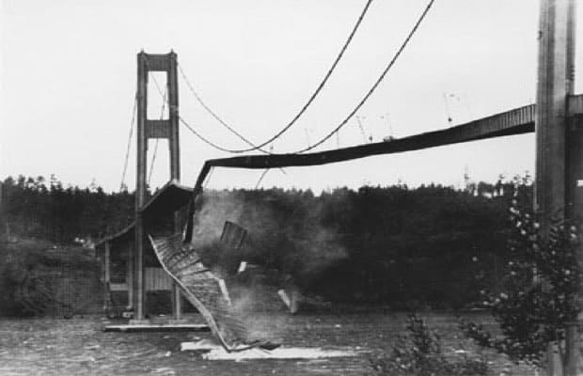
Collapse of the “Galloping Gertie”
Source: AP

Slide 64
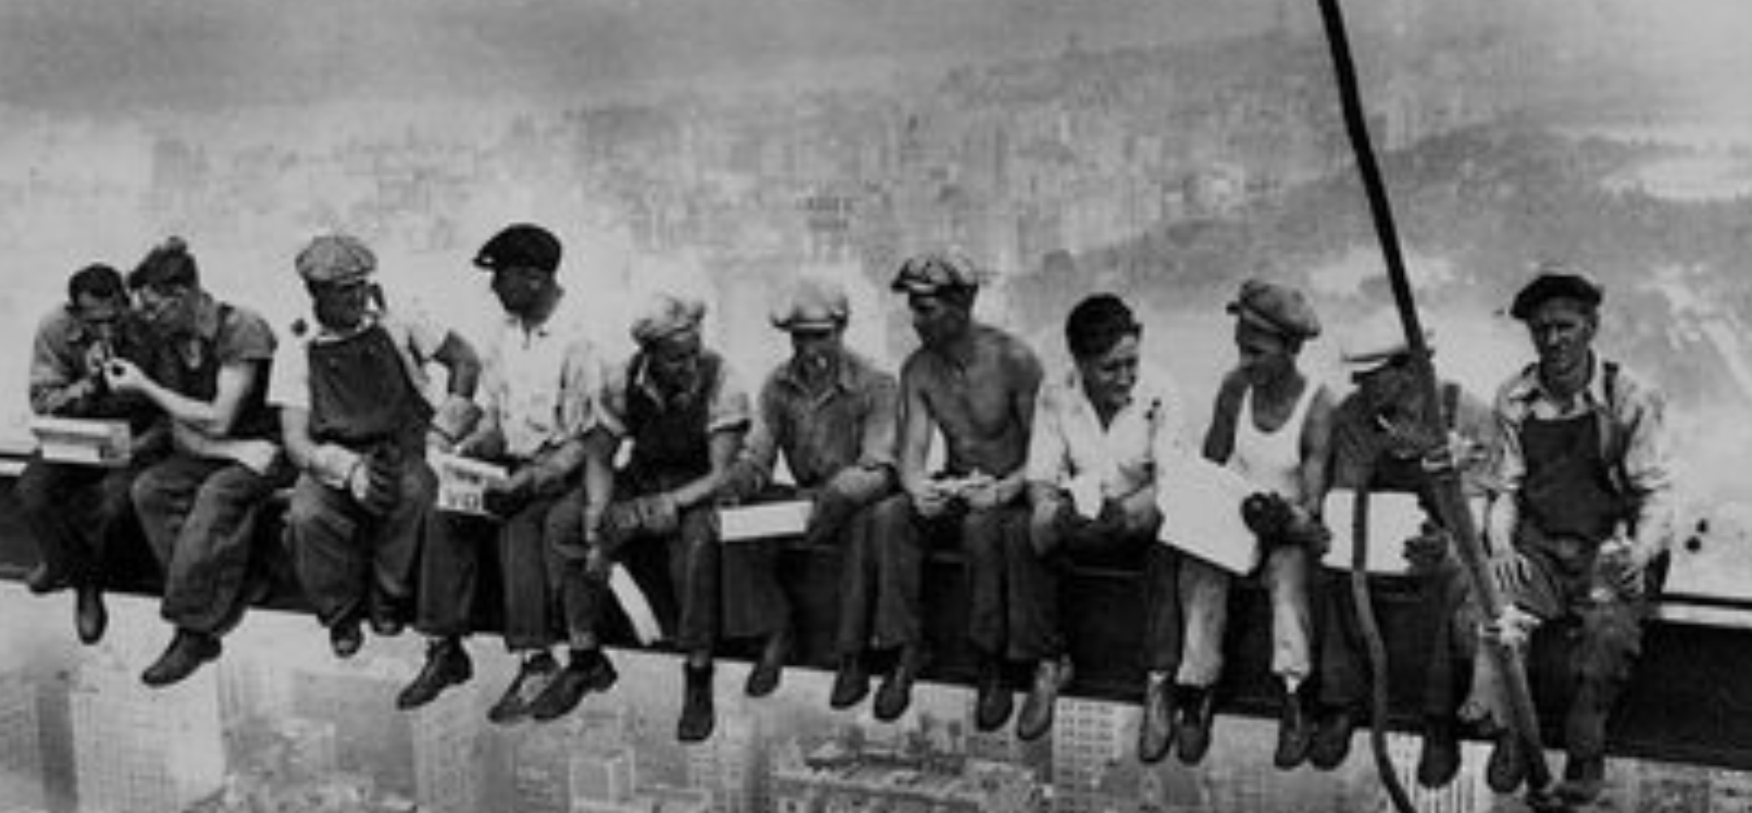
How Secure Are These People?
Security is about preventing unforeseen consequences
Source: https://s-media-cache-ak0.pinimg.com/originals/48/09/54/4809543a9c7700246a0cf8acdae27abf.jpg

Slide 65
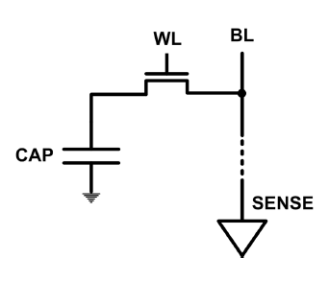
The DRAM Scaling Problem
DRAM stores charge in a capacitor (charge-based memory)
  Capacitor must be large enough for reliable sensing
  Access transistor should be large enough for low leakage and high retention time
  Scaling beyond 40-35nm (2013) is challenging [ITRS, 2009]
DRAM capacity, cost, and energy/power hard to scale

Slide 66
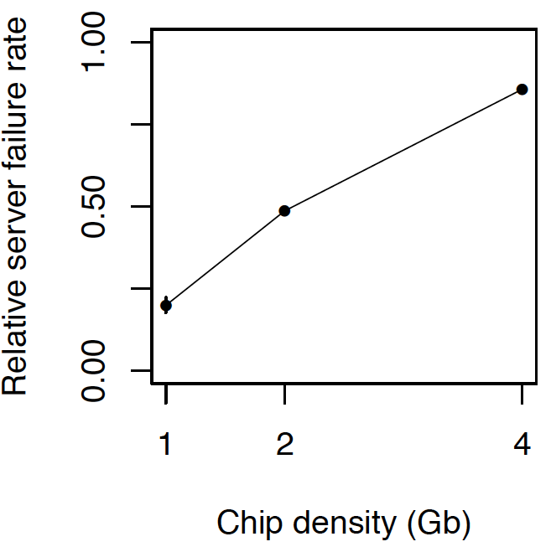
As Memory Scales, It Becomes Unreliable
Data from all of Facebook’s servers worldwide
Meza+, “Revisiting Memory Errors in Large-Scale Production Data Centers,” DSN’15.
Intuition:
quadratic
increase in
capacity

Slide 67
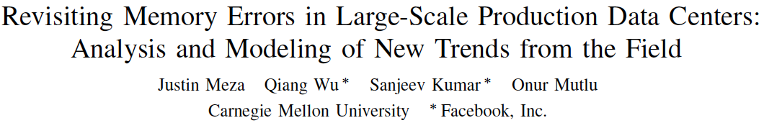
Large-Scale Failure Analysis of DRAM Chips
Analysis and modeling of memory errors found in all of Facebook’s server fleet
Justin Meza, Qiang Wu, Sanjeev Kumar, and Onur Mutlu,
"Revisiting Memory Errors in Large-Scale Production Data Centers: Analysis and Modeling of New Trends from the Field"
Proceedings of the 45th Annual IEEE/IFIP International Conference on Dependable Systems and Networks (DSN), Rio de Janeiro, Brazil, June 2015.
[Slides (pptx) (pdf)] [DRAM Error Model]

Slide 68
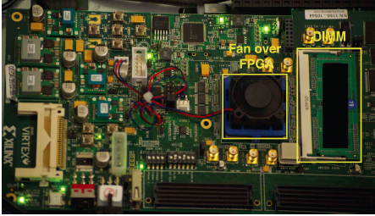
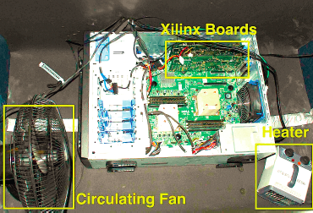
Infrastructures to Understand Such Issues
  An Experimental Study of Data Retention Behavior in Modern DRAM Devices: Implications for Retention Time Profiling Mechanisms (Liu et al., ISCA 2013)
  The Efficacy of Error Mitigation Techniques for DRAM Retention Failures: A Comparative Experimental Study
  (Khan et al., SIGMETRICS 2014)
  Flipping Bits in Memory Without Accessing Them: An Experimental Study of DRAM Disturbance Errors (Kim et al., ISCA 2014)
  Adaptive-Latency DRAM: Optimizing DRAM Timing for the Common-Case (Lee et al., HPCA 2015)
  AVATAR: A Variable-Retention-Time (VRT) Aware Refresh for DRAM Systems (Qureshi et al., DSN 2015)

Slide 69

Infrastructures to Understand Such Issues
Temperature
Controller
FPGAs
Heater
FPGAs
PC
  Kim+, “Flipping Bits in Memory Without Accessing Them: An Experimental Study of DRAM Disturbance Errors,” ISCA 2014.

Slide 70
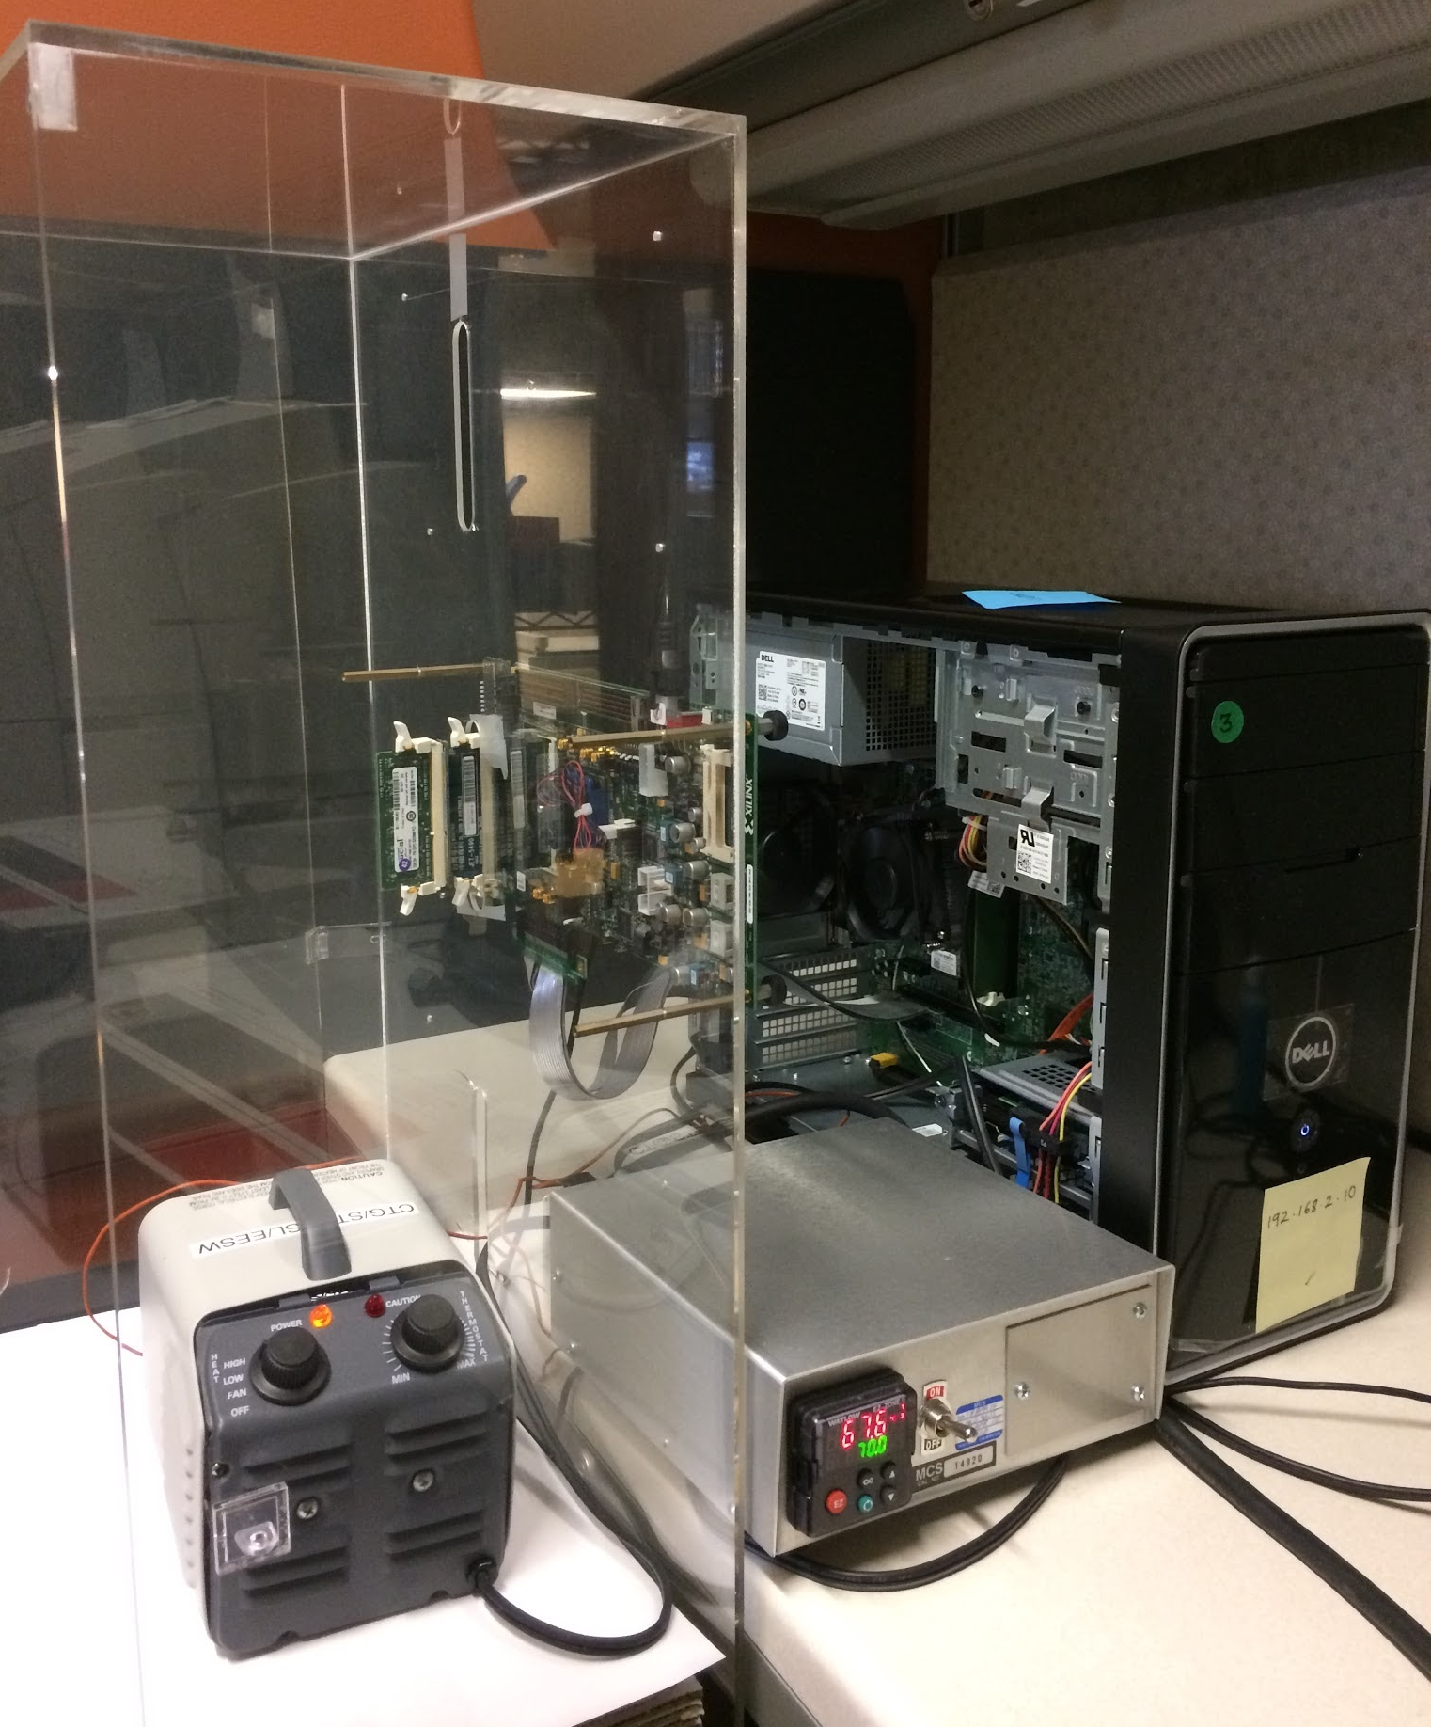
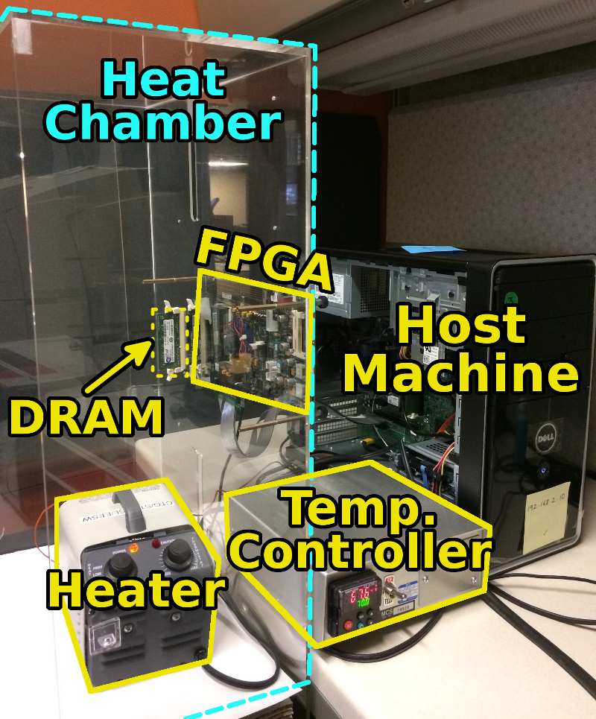
SoftMC: Open Source DRAM Infrastructure
Hasan Hassan et al., “SoftMC: A Flexible and Practical Open-Source Infrastructure for Enabling Experimental DRAM Studies,” HPCA 2017.
Flexible
Easy to Use (C++ API)
Open-source
github.com/CMU-SAFARI/SoftMC

Slide 71
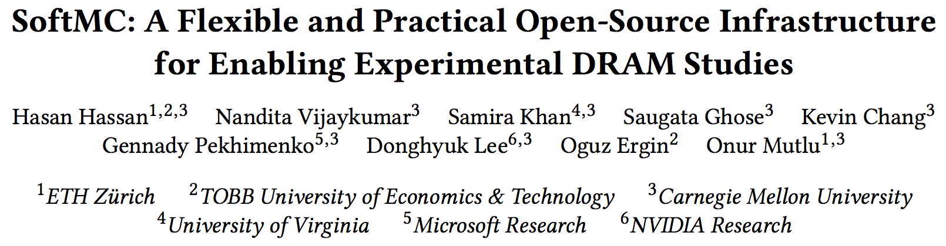
SoftMC
https://github.com/CMU-SAFARI/SoftMC

Slide 72

Data Retention in Memory [Liu et al., ISCA 2013]
Retention Time Profile of DRAM looks like this:
Location dependent
Stored value pattern dependent
Time dependent

Slide 73
Takeaway
Main Memory Needs
Intelligent Controllers

Slide 74
A Curious Discovery [Kim et al., ISCA 2014]
One can
predictably induce errors
in most DRAM memory chips

Slide 75
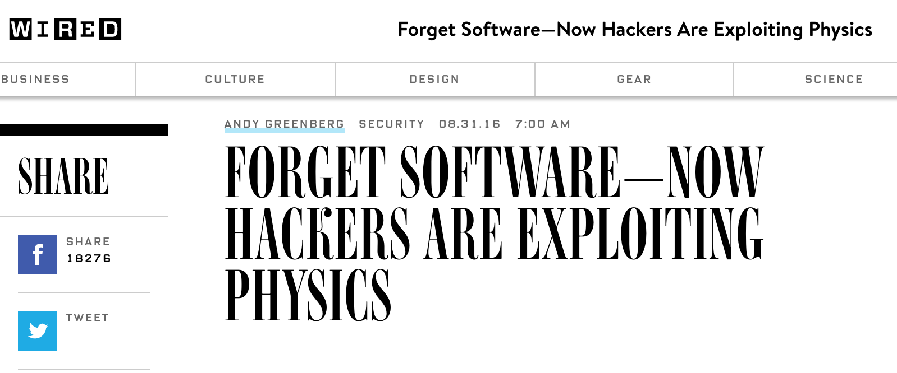
DRAM RowHammer
A simple hardware failure mechanism
can create a widespread
system security vulnerability

Slide 76
Modern DRAM is Prone to Disturbance Errors
Row of Cells
Wordline
Row
Victim Row
Row
Hammered Row
V_{LOW}
Opened
V_{HIGH}
Closed
Row
Victim Row
Row
Repeatedly reading a row enough times (before memory gets refreshed) induces disturbance errors in adjacent rows in most real DRAM chips you can buy today
Flipping Bits in Memory Without Accessing Them: An Experimental Study of DRAM Disturbance Errors, (Kim et al., ISCA 2014)

Slide 77
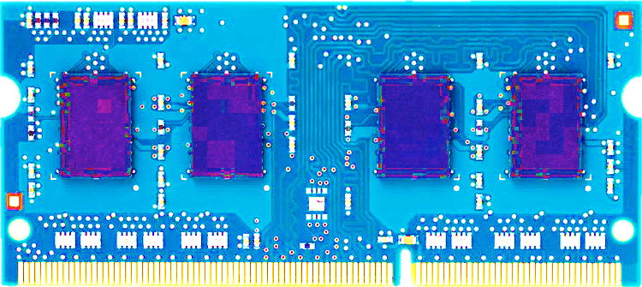
Most DRAM Modules Are Vulnerable
A company
B company
C company
86%
(37/43)
83%
(45/54)
88%
(28/32)
Up to
1.0×10⁷
errors
Up to
2.7×10⁶
errors
Up to
3.3×10⁵
errors
Flipping Bits in Memory Without Accessing Them: An Experimental Study of DRAM Disturbance Errors, (Kim et al., ISCA 2014)

Slide 78


Recent DRAM Is More Vulnerable
Notes:
In this figure, the x-axis is the module manufacture date. And the y-axis is the number of errors in a module, normalized to one billion cells. In 2008 and 2009, there are no errors. But, in 2010, we first start to see errors in C modules. After 2010, the errors start to proliferate. For A and B modules, we first start to see errors in 2011. In particular, all modules from 2012 and 2013 are vulnerable.

Slide 79
Recent DRAM Is More Vulnerable
First
Appearance
Notes:
In this figure, the x-axis is the module manufacture date. And the y-axis is the number of errors in a module, normalized to one billion cells. In 2008 and 2009, there are no errors. But, in 2010, we first start to see errors in C modules. After 2010, the errors start to proliferate. For A and B modules, we first start to see errors in 2011. In particular, all modules from 2012 and 2013 are vulnerable.

Slide 80
Recent DRAM Is More Vulnerable
First
Appearance
All modules from 2012–2013 are vulnerable
Notes:
In this figure, the x-axis is the module manufacture date. And the y-axis is the number of errors in a module, normalized to one billion cells. In 2008 and 2009, there are no errors. But, in 2010, we first start to see errors in C modules. After 2010, the errors start to proliferate. For A and B modules, we first start to see errors in 2011. In particular, all modules from 2012 and 2013 are vulnerable.

Slide 81

A Simple Program Can Induce Many Errors
CPU
DRAM Module
loop:
mov (X), %eax
mov (Y), %ebx
clflush (X)
clflush (Y)
mfence
jmp loop
X
Y
  Download from: https://github.com/CMU-SAFARI/rowhammer
Notes:
We demonstrate the errors on multiple x86 systems. Shown to the bottom-left is a “disturbance kernel”. When executed, it forces two rows to be opened and closed one after the other – over and over again. Consequently, it induces many errors in the module.

Slide 82
A Simple Program Can Induce Many Errors
CPU
DRAM Module
Avoid cache hits
  Flush X from cache
Avoid row hits to X
  Read Y in another row
X
Y
  Download from: https://github.com/CMU-SAFARI/rowhammer
Notes:
We demonstrate the errors on multiple x86 systems. Shown to the bottom-left is a “disturbance kernel”. When executed, it forces two rows to be opened and closed one after the other – over and over again. Consequently, it induces many errors in the module.

Slide 83
A Simple Program Can Induce Many Errors
CPU
DRAM Module
loop:
mov (X), %eax
mov (Y), %ebx
clflush (X)
clflush (Y)
mfence
jmp loop
X
Y
  Download from: https://github.com/CMU-SAFARI/rowhammer
Notes:
We demonstrate the errors on multiple x86 systems. Shown to the bottom-left is a “disturbance kernel”. When executed, it forces two rows to be opened and closed one after the other – over and over again. Consequently, it induces many errors in the module.

Slide 84
A Simple Program Can Induce Many Errors
CPU
DRAM Module
loop:
mov (X), %eax
mov (Y), %ebx
clflush (X)
clflush (Y)
mfence
jmp loop
X
Y
  Download from: https://github.com/CMU-SAFARI/rowhammer
Notes:
We demonstrate the errors on multiple x86 systems. Shown to the bottom-left is a “disturbance kernel”. When executed, it forces two rows to be opened and closed one after the other – over and over again. Consequently, it induces many errors in the module.

Slide 85
A Simple Program Can Induce Many Errors
CPU
DRAM Module
loop:
mov (X), %eax
mov (Y), %ebx
clflush (X)
clflush (Y)
mfence
jmp loop
X
Y
  Download from: https://github.com/CMU-SAFARI/rowhammer
Notes:
We demonstrate the errors on multiple x86 systems. Shown to the bottom-left is a “disturbance kernel”. When executed, it forces two rows to be opened and closed one after the other – over and over again. Consequently, it induces many errors in the module.

Slide 86
Observed Errors in Real Systems
A real reliability & security issue
CPU Architecture | Errors | Access-Rate
Intel Haswell (2013) | 22.9K | 12.3M/sec
Intel Ivy Bridge (2012) | 20.7K | 11.7M/sec
Intel Sandy Bridge (2011) | 16.1K | 11.6M/sec
AMD Piledriver (2012) | 59 | 6.1M/sec
Kim+, “Flipping Bits in Memory Without Accessing Them: An Experimental Study of DRAM Disturbance Errors,” ISCA 2014.
Notes:
When we executed the code on four different processors, all four of them yielded errors. Intel Haswell has the most errors, at 23 thousand, because it has the highest rate of accessing DRAM.
Later on, I’ll show that we can induce as many as ten million disturbance errors in a more controlled environment.
From this, we conclude that disturbance errors are a serious reliability issue.

Slide 87



One Can Take Over an Otherwise-Secure System
Flipping Bits in Memory Without Accessing Them: An Experimental Study of DRAM Disturbance Errors (Kim et al., ISCA 2014)
Exploiting the DRAM rowhammer bug to gain kernel privileges (Seaborn, 2015)

Slide 88
RowHammer Security Attack Example
“Rowhammer” is a problem with some recent DRAM devices in which repeatedly accessing a row of memory can cause bit flips in adjacent rows (Kim et al., ISCA 2014).
  Flipping Bits in Memory Without Accessing Them: An Experimental Study of DRAM Disturbance Errors (Kim et al., ISCA 2014)
We tested a selection of laptops and found that a subset of them exhibited the problem.
We built two working privilege escalation exploits that use this effect.
  Exploiting the DRAM rowhammer bug to gain kernel privileges (Seaborn+, 2015)
One exploit uses rowhammer-induced bit flips to gain kernel privileges on x86-64 Linux when run as an unprivileged userland process.
When run on a machine vulnerable to the rowhammer problem, the process was able to induce bit flips in page table entries (PTEs).
It was able to use this to gain write access to its own page table, and hence gain read-write access to all of physical memory.
Exploiting the DRAM rowhammer bug to gain kernel privileges (Seaborn & Dullien, 2015)

Slide 89


Security Implications
Notes:
Picture from the article:
http://thehackernews.com/2015/03/dram-rowhammer-vulnerability.html

Slide 90

Security Implications
Notes:
Picture from the article:
http://thehackernews.com/2015/03/dram-rowhammer-vulnerability.html

Slide 91

More Security Implications (I)
“We can gain unrestricted access to systems of website visitors.”
Rowhammer.js: A Remote Software-Induced Fault Attack in JavaScript (DIMVA’16)
Source: https://lab.dsst.io/32c3-slides/7197.html

Slide 92

More Security Implications (II)
  “Can gain control of a smart phone deterministically”
Drammer: Deterministic Rowhammer Attacks on Mobile Platforms, CCS’16
Source: https://fossbytes.com/drammer-rowhammer-attack-android-root-devices/

Slide 93


More Security Implications (III)
Using an integrated GPU in a mobile system to remotely escalate privilege via the WebGL interface

Slide 94


More Security Implications (IV)
Rowhammer over RDMA (I)

Slide 95



More Security Implications (V)
Rowhammer over RDMA (II)

Slide 96

More Security Implications?

Slide 97

Apple’s Patch for RowHammer
https://support.apple.com/en-gb/HT204934
HP, Lenovo, and other vendors released similar patches

Slide 98
Our Solution to RowHammer
PARA: Probabilistic Adjacent Row Activation
Key Idea
  After closing a row, we activate (i.e., refresh) one of its neighbors with a low probability: p = 0.005
Reliability Guarantee
  When p=0.005, errors in one year: 9.4×10⁻¹⁴
  By adjusting the value of p, we can vary the strength of protection against errors
Notes:
We provide a more efficient solution, called PARA, which stands for probabilistic adjacent row activation.
The key idea is thus: after closing a row, we activate (i.e., refresh) one of its neighbors with a low probability, for example, p equal to 0.005.
PARA provides a strong reliability guarantee even under the worst-case access patterns to DRAM. When we set p to 0.005, the expected number of errors in one year is 9.4 times 10 to the negative 14. This probability is much lower the failure rate of other hardware components, for example, the hard-disk drive.
And by adjusting the value of p, PARA can provide an arbitrarily strong-degree of protection against errors.

Slide 99
Advantages of PARA
PARA refreshes rows infrequently
  Low power
  Low performance-overhead
    Average slowdown: 0.20% (for 29 benchmarks)
    Maximum slowdown: 0.75%
PARA is stateless
  Low cost
  Low complexity
PARA is an effective and low-overhead solution to prevent disturbance errors
Notes:
PARA has many advantages. Since it refreshes row infrequently, it has low power and low performance-overhead. Simulated across 29 benchmarks, we saw an average of only 0.2% slowdown and a maximum of only 0.75% slowdown.
In addition, due to its stateless nature, PARA has low cost and complexity.
Therefore, PARA is an effective and low-overhead solution to prevent disturbance errors.

Slide 100
Requirements for PARA
If implemented in DRAM chip (done today)
  Enough slack in timing and refresh parameters
  Plenty of slack today:
    Lee et al., “Adaptive-Latency DRAM: Optimizing DRAM Timing for the Common Case,” HPCA 2015.
    Chang et al., “Understanding Latency Variation in Modern DRAM Chips,” SIGMETRICS 2016.
    Lee et al., “Design-Induced Latency Variation in Modern DRAM Chips,” SIGMETRICS 2017.
    Chang et al., “Understanding Reduced-Voltage Operation in Modern DRAM Devices,” SIGMETRICS 2017.
    Ghose et al., “What Your DRAM Power Models Are Not Telling You: Lessons from a Detailed Experimental Study,” SIGMETRICS 2018.
If implemented in memory controller
  Better coordination between memory controller and DRAM
  Memory controller should know which rows are physically adjacent

Slide 101

Probabilistic Activation in Real Life (I)
https://twitter.com/isislovecruft/status/1021939922754723841

Slide 102

Probabilistic Activation in Real Life (II)
https://twitter.com/isislovecruft/status/1021939922754723841

Slide 103

More on RowHammer Analysis
Yoongu Kim, Ross Daly, Jeremie Kim, Chris Fallin, Ji Hye Lee, Donghyuk Lee, Chris Wilkerson, Konrad Lai, and Onur Mutlu,
"Flipping Bits in Memory Without Accessing Them: An Experimental Study of DRAM Disturbance Errors"
Proceedings of the 41st International Symposium on Computer Architecture (ISCA), Minneapolis, MN, June 2014.
[Slides (pptx) (pdf)] [Lightning Session Slides (pptx) (pdf)] [Source Code and Data]

Slide 104

Future of Memory Reliability
Onur Mutlu,
"The RowHammer Problem and Other Issues We May Face as Memory Becomes Denser"
Invited Paper in Proceedings of the Design, Automation, and Test in Europe Conference (DATE), Lausanne, Switzerland, March 2017.
[Slides (pptx) (pdf)]
https://people.inf.ethz.ch/omutlu/pub/rowhammer-and-other-memory-issues_date17.pdf

Slide 105

For More on RowHammer…
Onur Mutlu and Jeremie Kim,
"RowHammer: A Retrospective"
IEEE Transactions on Computer-Aided Design of Integrated Circuits and Systems (TCAD) Special Issue on Top Picks in Hardware and Embedded Security, 2019.

Slide 106
Industry Is Writing Papers About It, Too

Slide 107
Call for Intelligent Memory Controllers

Slide 108

Aside: Intelligent Controller for NAND Flash
USB Daughter Board
USB Jack
HAPS-52 Mother Board
Virtex-II Pro
(USB controller)
1x-nm
NAND Flash
Virtex-V FPGA
(NAND Controller)
[DATE 2012, ICCD 2012, DATE 2013, ITJ 2013, ICCD 2013, SIGMETRICS 2014, HPCA 2015, DSN 2015, MSST 2015, JSAC 2016, HPCA 2017, DFRWS 2017,
PIEEE 2017, HPCA 2018, SIGMETRICS 2018]
NAND Daughter Board
Cai+, “Error Characterization, Mitigation, and Recovery in Flash Memory Based Solid State Drives,” Proc. IEEE 2017.

Slide 109


Aside: Intelligent Controller for NAND Flash
Proceedings of the IEEE, Sept. 2017
https://arxiv.org/pdf/1706.08642

Slide 110
Takeaway
Main Memory Needs
Intelligent Controllers

Slide 111
Agenda
Major Trends Affecting Main Memory
The Need for Intelligent Memory Controllers
  Bottom Up: Push from Circuits and Devices
  Top Down: Pull from Systems and Applications
Processing in Memory: Two Directions
  Minimally Changing Memory Chips
  Exploiting 3D-Stacked Memory
How to Enable Adoption of Processing in Memory
Conclusion

Slide 112
Three Key Systems Trends
1. Data access is a major bottleneck
  Applications are increasingly data hungry
2. Energy consumption is a key limiter
3. Data movement energy dominates compute
  Especially true for off-chip to on-chip movement

Slide 113
The Need for More Memory Performance
In-memory Databases
[Mao+, EuroSys’12;
Clapp+ (Intel), IISWC’15]
Graph/Tree Processing
[Xu+, IISWC’12; Umuroglu+, FPL’15]
In-Memory Data Analytics
[Clapp+ (Intel), IISWC’15;
Awan+, BDCloud’15]
Datacenter Workloads
[Kanev+ (Google), ISCA’15]

Slide 114
The Need for More Memory Performance
  Chrome
TensorFlow Mobile
    Google’s web browser
Google’s machine learning framework
  Video Playback
  Video Capture
Google’s video codec
Google’s video codec
Notes:
In this work, we take a look at widely-used google consumer workloads, to figure out the major sources of energy consumption.
We look at Google Chrome web brower. We take a look at Tensorflow, Google’s machine learning framework, and we also take a look at two important video related workloads, video playback and video capture, both rely on Google’s vp9 codec technology.

Slide 115

Do We Want This?
Source: V. Milutinovic

Slide 116

Or This?
Source: V. Milutinovic

Slide 117
Maslow’s (Human) Hierarchy of Needs, Revisited
Maslow, “A Theory of Human Motivation,”
Psychological Review, 1943.
Maslow, “A Theory of Human Motivation,”
Psychological Review, 1943.
Maslow, “Motivation and Personality,”
Book, 1954-1970.
Everlasting energy
Source: https://www.simplypsychology.org/maslow.html

Slide 118
Challenge and Opportunity for Future
High Performance,
Energy Efficient,
Sustainable

Slide 119
The Problem
Data access is the major performance and energy bottleneck
Our current
design principles
cause great energy waste
(and great performance loss)

Slide 120
The Problem
Processing of data
is performed
far away from the data

Slide 121

A Computing System
Three key components
Computation
Communication
Storage/memory
Burks, Goldstein, von Neumann, “Preliminary discussion of the
logical design of an electronic computing instrument,” 1946.
Image source: https://lbsitbytes2010.wordpress.com/2013/03/29/john-von-neumann-roll-no-15/

Slide 122
A Computing System
Three key components
Computation
Communication
Storage/memory
Burks, Goldstein, von Neumann, “Preliminary discussion of the
logical design of an electronic computing instrument,” 1946.
Image source: https://lbsitbytes2010.wordpress.com/2013/03/29/john-von-neumann-roll-no-15/

Slide 123
Today’s Computing Systems
Are overwhelmingly processor centric
All data processed in the processor → at great system cost
Processor is heavily optimized and is considered the master
Data storage units are dumb and are largely unoptimized (except for some that are on the processor die)

Slide 124

Yet …
“It’s the Memory, Stupid!” (Richard Sites, MPR, 1996)
Mutlu+, “Runahead Execution: An Alternative to Very Large Instruction Windows for Out-of-Order Processors,” HPCA 2003.

Slide 125
The Performance Perspective
Onur Mutlu, Jared Stark, Chris Wilkerson, and Yale N. Patt,
"Runahead Execution: An Alternative to Very Large Instruction Windows for Out-of-order Processors"
Proceedings of the 9th International Symposium on High-Performance Computer Architecture (HPCA), pages 129-140, Anaheim, CA, February 2003. Slides (pdf)

Slide 126
The Performance Perspective (Today)
All of Google’s Data Center Workloads (2015):
Kanev+, “Profiling a Warehouse-Scale Computer,” ISCA 2015.

Slide 127
The Performance Perspective (Today)
All of Google’s Data Center Workloads (2015):
Kanev+, “Profiling a Warehouse-Scale Computer,” ISCA 2015.

Slide 128
Perils of Processor-Centric Design
Grossly-imbalanced systems
  Processing done only in one place
  Everything else just stores and moves data: data moves a lot
  → Energy inefficient
  → Low performance
  → Complex
Overly complex and bloated processor (and accelerators)
  To tolerate data access from memory
  Complex hierarchies and mechanisms
  → Energy inefficient
  → Low performance
  → Complex

Slide 129
Perils of Processor-Centric Design
Most of the system is dedicated to storing and moving data

Slide 130

The Energy Perspective
Dally, HiPEAC 2015

Slide 131
Data Movement vs. Computation Energy
Dally, HiPEAC 2015
A memory access consumes ~1000X
the energy of a complex addition

Slide 132
Data Movement vs. Computation Energy
Data movement is a major system energy bottleneck
  Comprises 41% of mobile system energy during web browsing [2]
  Costs ~115 times as much energy as an ADD operation [1, 2]
[1]: Reducing data Movement Energy via Online Data Clustering and Encoding (MICRO’16)
[2]: Quantifying the energy cost of data movement for emerging smart phone workloads on mobile platforms (IISWC’14)

Slide 133
Energy Waste in Mobile Devices
Amirali Boroumand, Saugata Ghose, Youngsok Kim, Rachata Ausavarungnirun, Eric Shiu, Rahul Thakur, Daehyun Kim, Aki Kuusela, Allan Knies, Parthasarathy Ranganathan, and Onur Mutlu,
"Google Workloads for Consumer Devices: Mitigating Data Movement Bottlenecks"
Proceedings of the 23rd International Conference on Architectural Support for Programming Languages and Operating Systems (ASPLOS), Williamsburg, VA, USA, March 2018.
62.7% of the total system energy
is spent on data movement

Slide 134
We Do Not Want to Move Data!
Dally, HiPEAC 2015
A memory access consumes ~1000X
the energy of a complex addition

Slide 135
We Need A Paradigm Shift To …
Enable computation with minimal data movement
Compute where it makes sense (where data resides)
Make computing architectures more data-centric

Slide 136
Goal: Processing Inside Memory
Many questions … How do we design the:
  compute-capable memory & controllers?
  processor chip and in-memory units?
  software and hardware interfaces?
  system software and languages?
  algorithms?
Memory
Processor
Core
Database
Graphs
Media
Cache
Query
Interconnect
Problem
Results
Algorithm
Program/Language
System Software
SW/HW Interface
Micro-architecture
Logic
Devices
Electrons

Slide 137



Why In-Memory Computation Today?
Dally, HiPEAC 2015
Push from Technology
  DRAM Scaling at jeopardy
  → Controllers close to DRAM
  → Industry open to new memory architectures
Pull from Systems and Applications
  Data access is a major system and application bottleneck
  Systems are energy limited
  Data movement much more energy-hungry than computation

Slide 138
Agenda
Major Trends Affecting Main Memory
The Need for Intelligent Memory Controllers
  Bottom Up: Push from Circuits and Devices
  Top Down: Pull from Systems and Applications
Processing in Memory: Two Directions
  Minimally Changing Memory Chips
  Exploiting 3D-Stacked Memory
How to Enable Adoption of Processing in Memory
Conclusion

Slide 139
Processing in Memory:
Two Approaches
1. Minimally changing memory chips
2. Exploiting 3D-stacked memory

Slide 140
Approach 1: Minimally Changing DRAM
DRAM has great capability to perform bulk data movement and computation internally with small changes
  Can exploit internal connectivity to move data
  Can exploit analog computation capability
  …
Examples: RowClone, In-DRAM AND/OR, Gather/Scatter DRAM
  RowClone: Fast and Efficient In-DRAM Copy and Initialization of Bulk Data (Seshadri et al., MICRO 2013)
  Fast Bulk Bitwise AND and OR in DRAM (Seshadri et al., IEEE CAL 2015)
  Gather-Scatter DRAM: In-DRAM Address Translation to Improve the Spatial Locality of Non-unit Strided Accesses (Seshadri et al., MICRO 2015)
  "Ambit: In-Memory Accelerator for Bulk Bitwise Operations Using Commodity DRAM Technology” (Seshadri et al., MICRO 2017)

Slide 141

Starting Simple: Data Copy and Initialization
  memmove & memcpy: 5% cycles in Google’s datacenter [Kanev+ ISCA’15]
000000000000000
Zero initialization
(e.g., security)
Forking
Checkpointing
Many more
VM Cloning
Deduplication
Page Migration

Slide 142
Today’s Systems: Bulk Data Copy
1) High latency
Memory
3) Cache pollution
L3
CPU
L2
L1
MC
2) High bandwidth utilization
4) Unwanted data movement
1046ns, 3.6uJ (for 4KB page copy via DMA)

Slide 143
Future Systems: In-Memory Copy
3) No cache pollution
1) Low latency
Memory
L3
CPU
L2
L1
MC
2) Low bandwidth utilization
4) No unwanted data movement
1046ns, 3.6uJ
→ 90ns, 0.04uJ

Slide 144
RowClone: In-DRAM Row Copy
Idea: Two consecutive ACTivates
4 Kbytes
Negligible HW cost
Step 1: Activate row A
Step 2: Activate row B
Transfer row
DRAM subarray
Transfer
row
Row Buffer (4 Kbytes)
8 bits
Data Bus
Notes:
copy

Slide 145
RowClone: Latency and Energy Savings
11.6x
74x
Seshadri et al., “RowClone: Fast and Efficient In-DRAM Copy and Initialization of Bulk Data,” MICRO 2013.

Slide 146

More on RowClone
Vivek Seshadri, Yoongu Kim, Chris Fallin, Donghyuk Lee, Rachata Ausavarungnirun, Gennady Pekhimenko, Yixin Luo, Onur Mutlu, Michael A. Kozuch, Phillip B. Gibbons, and Todd C. Mowry,
"RowClone: Fast and Energy-Efficient In-DRAM Bulk Data Copy and Initialization"
Proceedings of the 46th International Symposium on Microarchitecture (MICRO), Davis, CA, December 2013. [Slides (pptx) (pdf)] [Lightning Session Slides (pptx) (pdf)] [Poster (pptx) (pdf)]

Slide 147



Déjà vu From IMW 2013
Onur Mutlu,
"Memory Scaling: A Systems Architecture Perspective"
Proceedings of the 5th International Memory Workshop (IMW), Monterey, CA, May 2013. Slides (pptx) (pdf)
EETimes Reprint

Slide 148
Memory as an Accelerator
CPU
core
CPU
core
mini-CPU
core
GPU
(throughput)
core
GPU
(throughput)
core
video
core
GPU
(throughput)
core
GPU
(throughput)
core
CPU
core
CPU
core
Memory
imaging
core
LLC
Specialized
compute-capability
in memory
Memory Controller
Memory Bus
Memory similar to a “conventional” accelerator

Slide 149
In-Memory Bulk Bitwise Operations
We can support in-DRAM COPY, ZERO, AND, OR, NOT, MAJ
At low cost
Using analog computation capability of DRAM
  Idea: activating multiple rows performs computation
30-60X performance and energy improvement
  Seshadri+, “Ambit: In-Memory Accelerator for Bulk Bitwise Operations Using Commodity DRAM Technology,” MICRO 2017.
New memory technologies enable even more opportunities
  Memristors, resistive RAM, phase change mem, STT-MRAM, …
  Can operate on data with minimal movement

Slide 150
In-DRAM AND/OR: Triple Row Activation
½V_{DD}
½V_{DD}+δ
V_{DD}
A
Final State
AB + BC + AC
B
C
C(A + B) + ~C(AB)
dis
en
0
½V_{DD}
Seshadri+, “Fast Bulk Bitwise AND and OR in DRAM”, IEEE CAL 2015.

Slide 151

In-DRAM NOT: Dual Contact Cell
Idea:
Feed the
negated value
in the sense amplifier
into a special row
Seshadri+, “Ambit: In-Memory Accelerator for Bulk Bitwise Operations using Commodity DRAM Technology,” MICRO 2017.

Slide 152
Performance: In-DRAM Bitwise Operations
Seshadri+, “Ambit: In-Memory Accelerator for Bulk Bitwise Operations using Commodity DRAM Technology,” MICRO 2017.

Slide 153
Energy of In-DRAM Bitwise Operations
Seshadri+, “Ambit: In-Memory Accelerator for Bulk Bitwise Operations using Commodity DRAM Technology,” MICRO 2017.

Slide 154
Ambit vs. DDR3: Performance and Energy
32X
35X
Seshadri+, “Ambit: In-Memory Accelerator for Bulk Bitwise Operations using Commodity DRAM Technology,” MICRO 2017.

Slide 155
Bulk Bitwise Operations in Workloads
[1] Li and Patel, BitWeaving, SIGMOD 2013
[2] Goodwin+, BitFunnel, SIGIR 2017

Slide 156
Example Data Structure: Bitmap Index
Alternative to B-tree and its variants
Efficient for performing range queries and joins
Many bitwise operations to perform a query
age < 18
18 < age < 25
25 < age < 60
age > 60
Bitmap 1
Bitmap 2
Bitmap 3
Bitmap 4

Slide 157
Performance: Bitmap Index on Ambit
Seshadri+, “Ambit: In-Memory Accelerator for Bulk Bitwise Operations using Commodity DRAM Technology,” MICRO 2017.

Slide 158
Performance: BitWeaving on Ambit
Seshadri+, “Ambit: In-Memory Accelerator for Bulk Bitwise Operations using Commodity DRAM Technology,” MICRO 2017.

Slide 159

More on In-DRAM Bulk AND/OR
Vivek Seshadri, Kevin Hsieh, Amirali Boroumand, Donghyuk Lee, Michael A. Kozuch, Onur Mutlu, Phillip B. Gibbons, and Todd C. Mowry,
"Fast Bulk Bitwise AND and OR in DRAM"
IEEE Computer Architecture Letters (CAL), April 2015.

Slide 160
More on Ambit
Vivek Seshadri et al., “Ambit: In-Memory Accelerator for Bulk Bitwise Operations Using Commodity DRAM Technology,” MICRO 2017.

Slide 161
Challenge and Opportunity for Future
Computing Architectures
with
Minimal Data Movement

Slide 162
Challenge: Intelligent Memory Device
Does memory
have to be
dumb?

Slide 163
Agenda
Major Trends Affecting Main Memory
The Need for Intelligent Memory Controllers
  Bottom Up: Push from Circuits and Devices
  Top Down: Pull from Systems and Applications
Processing in Memory: Two Directions
  Minimally Changing Memory Chips
  Exploiting 3D-Stacked Memory
How to Enable Adoption of Processing in Memory
Conclusion

Slide 164
Processing in Memory:
Two Approaches
1. Minimally changing memory chips
2. Exploiting 3D-stacked memory

Slide 165
Opportunity: 3D-Stacked Logic+Memory
Memory
Logic
Other “True 3D” technologies
under development

Slide 166
DRAM Landscape (circa 2015)
  Kim+, “Ramulator: A Flexible and Extensible DRAM Simulator”, IEEE CAL 2015.

Slide 167
Two Key Questions in 3D-Stacked PIM
What are the performance and energy benefits of using 3D-stacked memory as a coarse-grained accelerator?
  By changing the entire system
  By performing simple function offloading
What is the minimal processing-in-memory support we can provide?
  With minimal changes to system and programming

Slide 168




Graph Processing
Large graphs are everywhere (circa 2015)
Scalable large-scale graph processing is challenging
36 Million
Wikipedia Pages
1.4 Billion
Facebook Users
300 Million
Twitter Users
30 Billion
Instagram Photos

Slide 169
Key Bottlenecks in Graph Processing
for (v: graph.vertices) {
for (w: v.successors) {
w.next_rank += weight * v.rank;
}
}
1. Frequent random memory accesses
v
&w
w.rank
w.next_rank
w.edges
weight * v.rank
w
…
2. Little amount of computation

Slide 170
Tesseract System for Graph Processing
Interconnected set of 3D-stacked memory+logic chips with simple cores
Host Processor
Memory
Memory-Mapped
Accelerator Interface
(Noncacheable, Physically Addressed)
Logic
In-Order Core
DRAM Controller
…
…
LP
PF Buffer
Crossbar Network
…
MTP
…
Message Queue
NI
Ahn+, “A Scalable Processing-in-Memory Accelerator for Parallel Graph Processing” ISCA 2015.

Slide 171
Tesseract System for Graph Processing
Host Processor
Memory
Memory-Mapped
Accelerator Interface
(Noncacheable, Physically Addressed)
Logic
In-Order Core
DRAM Controller
…
…
Communications via
Remote Function Calls
LP
PF Buffer
Crossbar Network
…
MTP
…
Message Queue
NI

Slide 172
Communications In Tesseract (I)

Slide 173
Communications In Tesseract (II)

Slide 174
Communications In Tesseract (III)

Slide 175
Remote Function Call (Non-Blocking)

Slide 176
Tesseract System for Graph Processing
Host Processor
Memory
Memory-Mapped
Accelerator Interface
(Noncacheable, Physically Addressed)
Logic
Prefetching
In-Order Core
DRAM Controller
…
…
LP
PF Buffer
Crossbar Network
…
MTP
…
Message Queue
NI

Slide 177
Evaluated Systems
DDR3-OoO
HMC-OoO
HMC-MC
Tesseract
32 Tesseract Cores
8 OoO
4GHz
8 OoO
4GHz
8 OoO
4GHz
8 OoO
4GHz
128
In-Order
2GHz
128
In-Order
2GHz
8 OoO
4GHz
8 OoO
4GHz
8 OoO
4GHz
8 OoO
4GHz
128
In-Order
2GHz
128
In-Order
2GHz
102.4GB/s
640GB/s
640GB/s
8TB/s
Ahn+, “A Scalable Processing-in-Memory Accelerator for Parallel Graph Processing” ISCA 2015.

Slide 178
Tesseract Graph Processing Performance
>13X Performance Improvement
On five graph processing algorithms
Ahn+, “A Scalable Processing-in-Memory Accelerator for Parallel Graph Processing” ISCA 2015.

Slide 179
Tesseract Graph Processing Performance

Slide 180
Tesseract Graph Processing System Energy
> 8X Energy Reduction
Ahn+, “A Scalable Processing-in-Memory Accelerator for Parallel Graph Processing” ISCA 2015.

Slide 181

More on Tesseract
Junwhan Ahn, Sungpack Hong, Sungjoo Yoo, Onur Mutlu, and Kiyoung Choi,
"A Scalable Processing-in-Memory Accelerator for Parallel Graph Processing"
Proceedings of the 42nd International Symposium on Computer Architecture (ISCA), Portland, OR, June 2015.
[Slides (pdf)] [Lightning Session Slides (pdf)]

Slide 182
Two Key Questions in 3D-Stacked PIM
What are the performance and energy benefits of using 3D-stacked memory as a coarse-grained accelerator?
  By changing the entire system
  By performing simple function offloading
What is the minimal processing-in-memory support we can provide?
  With minimal changes to system and programming

Slide 183
PIM on Mobile Devices
Amirali Boroumand, Saugata Ghose, Youngsok Kim, Rachata Ausavarungnirun, Eric Shiu, Rahul Thakur, Daehyun Kim, Aki Kuusela, Allan Knies, Parthasarathy Ranganathan, and Onur Mutlu,
"Google Workloads for Consumer Devices: Mitigating Data Movement Bottlenecks"
Proceedings of the 23rd International Conference on Architectural Support for Programming Languages and Operating Systems (ASPLOS), Williamsburg, VA, USA, March 2018.

Slide 184





Google Workloads for Consumer Devices:
Mitigating Data Movement Bottlenecks
Amirali Boroumand
Saugata Ghose, Youngsok Kim, Rachata Ausavarungnirun,
Eric Shiu, Rahul Thakur, Daehyun Kim, Aki Kuusela,
Allan Knies, Parthasarathy Ranganathan, Onur Mutlu

Slide 185




Consumer Devices
Consumer devices are everywhere!
Energy consumption is
a first-class concern in consumer devices
Notes:
Consumer devices like tablets smartphone and wearable are now everywhere and used by billions of people.
One of the major challenge in these devices is battery limitation which makes the energy consumption a critical concern …

Slide 186
Popular Google Consumer Workloads
  Chrome
TensorFlow Mobile
    Google’s web browser
Google’s machine learning framework
  Video Playback
  Video Capture
Google’s video codec
Google’s video codec
Notes:
In this work, we take a look at widely-used google consumer workloads, to figure out the major sources of energy consumption.
We look at Google Chrome web brower. We take a look at Tensorflow, Google’s machine learning framework, and we also take a look at two important video related workloads, video playback and video capture, both rely on Google’s vp9 codec technology.

Slide 187
Energy Cost of Data Movement
1st key observation: 62.7% of the total system energy is spent on data movement
Data Movement
SoC
DRAM
CPU
L2
CPU
L1
CPU
CPU
Compute Unit
Processing-In-Memory (PIM)
  Potential solution: move computation close to data
  Challenge: limited area and energy budget
Notes:
Throughout our analysis, we make a key observation that out of all sources of energy consumption, data movement is a major contributor to the total system energy. We find that across all of the workloads, on average around 62.7% of total system energy is spent on data movement.
One way to reduce data movement cost is to move computation close to data, or …
One potential solution to address this cost it do move computation close to data, or in other words, do procesing in memory. However, the challenge is that these devices.
One potential solution to mitigate data movement cost and reduce total system energy is to execute data-movement heavy portions of application close to data, or in other words, do processing in memory. However, consumer devices are extermely limited in terms of area and power budget. So the question is can we move part of the data movement heavy portion given the limited area and energy budget. Our

Slide 188
Using PIM to Reduce Data Movement
  2nd key observation: a significant fraction of the
  data movement often comes from simple functions
We can design lightweight logic to implement
these simple functions in memory
Small embedded
low-power core
Small fixed-function accelerators
PIM Core
PIM Accelerator
PIM Accelerator
PIM Accelerator
  Offloading to PIM logic reduces energy and improves performance, on average, by 55.4% and 54.2%
Notes:
To figure out if we can use processing in memory, we dig deeper into our analysis and we make another key observation that majority of data movement often comes form simple functions and pritmitives. We find that these simple function can be implemented in memory as either a small embedded core, or group of small fixed function accelerators. Our result shows that offloading these function to PIM logic can significantly reduce data movement for each function and reduce energy on average around 55% and improve perforamcne around 54%.
our PIM core can reduce significant portion of data movement, reduce enregy by 49.1% for each function and improve performance up to 2.2X. While using group of fixed function accelerator reduce energy by 55.4% and improve performance by up to 2.5X.
Or use Saugata’s approach : Reduces total system energy by an average of 55.4%
Reduces execution time by an average of 54.2%
Our result show that both of them can significantly reduce the data movement for each function.
Feedback: talk about result more
Don’t talk about specific detail like MemCopy, MemSet stuff like that
Main take away: data movement come from simple functions that are simple enough to implement in PIM
We find that these functions and primitves can be implemented as PIM logic using either (1) a small low-power general-purpose embedded core or (2) a group of small fixed-function accelerators (PIM accelerators). Our Analysis shows that both are cost-feasible to use in consumer devices. We find that they eliminate a significant fraction of dat amovement, and reduce energy consumption for each of these operation on average by 49 and 55%.

Slide 189
Workload Analysis
  Chrome
TensorFlow Mobile
    Google’s web browser
Google’s machine learning framework
  Video Playback
  Video Capture
Google’s video codec
Google’s video codec
Notes:
In this work, we take a look at widely-used google consumer workloads, to figure out the major sources of energy consumption.
We look at Google Chrome web brower. We take a look at Tensorflow, Google’s machine learning framework, and we also take a look at two important video related workloads, video playback and video capture, both rely on Google’s vp9 codec technology.

Slide 190

TensorFlow Mobile
Inference
Prediction
57.3% of the inference energy is spent on
data movement
54.4% of the data movement energy comes from
packing/unpacking and quantization

Slide 191
Packing
Matrix
Packing
Packed Matrix
Reorders elements of matrices to minimize
cache misses during matrix multiplication
Up to 40% of the
inference energy and 31% of
inference execution time
Packing’s data movement accounts for up to
35.3% of the inference energy
A simple data reorganization process
that requires simple arithmetic

Slide 192
Quantization
floating point
Quantization
integer
Converts 32-bit floating point to 8-bit integers to improve inference execution time and energy consumption
Up to 16.8% of the inference energy
and 16.1% of
inference execution time
Majority of quantization energy comes from
data movement
A simple data conversion operation that requires shift, addition, and multiplication operations

Slide 193
Quantization
floating point
Quantization
integer
Converts 32-bit floating point to 8-bit integers to improve inference execution time and energy consumption
Based on our analysis, we conclude that:
Both functions are good candidates for PIM execution
It is feasible to implement them in PIM logic
Up to 16.8% of the inference energy
and 16.1% of
inference execution time
Majority of quantization energy comes from
data movement
A simple data conversion operation that requires shift, addition, and multiplication operations

Slide 194
Evaluation Methodology
System Configuration (gem5 Simulator)
  SoC: 4 OoO cores, 8-wide issue, 64 kB L1cache,
  2MB L2 cache
  PIM Core: 1 core per vault, 1-wide issue, 4-wide SIMD,
  32kB L1 cache
  3D-Stacked Memory: 2GB cube, 16 vaults per cube
    Internal Bandwidth: 256GB/S
    Off-Chip Channel Bandwidth: 32 GB/s
  Baseline Memory: LPDDR3, 2GB, FR-FCFS scheduler
We study each target in isolation and emulate each separately and run them in our simulator
Notes:
and then analyzing the benefit of PIM in our simulator

Slide 195
Normalized Energy
TensorFlow Mobile
Video Playback and Capture
77.7% and 82.6% of energy reduction for texture tiling and packing comes from eliminating data movement
Chrome Browser
PIM core and PIM accelerator reduces
energy consumption on average by 49.1% and 55.4%
Notes:
We make another obsrevation that using PIM accelerator provide limited energy reduction over PIM core, for some of these workloads, such as texture tiling. This is becase these kernels are data intensive and have low ocmputational compleity, and as a result, using fixed function accelerator does not provide significant energy reduction over the PIM core.

Slide 196
Normalized Runtime
Chrome Browser
Video Playback and Capture
TensorFlow Mobile
Offloading these kernels to PIM core and PIM accelerator improves performance on average by 44.6% and 54.2%
Notes:
PIM-Core and PIM-Acc significantly outperform CPU-Only across all kernels, improving performance by … This perfomance benefit come from higher bandwidth and lower access latency of 3D-stacked memory, because all of these kernels are data intensive.
Performance improvement of PIM-acc over PIM-core differes across different workloads. In some cases such as Texture Tiling, the performance improvement of PIM-Acc over PIM-Core is limited by the low computational complexity of these two kernels. But there are other cases, such as compression that benefit significantly from using PIM-Acc over PIM-Core in terms of performance, because these kernels are more compute-intensive and less data-intensive compared to texture tiling and.

Slide 197
Google Workloads for Consumer Devices:
Mitigating Data Movement Bottlenecks
Amirali Boroumand
Saugata Ghose, Youngsok Kim, Rachata Ausavarungnirun,
Eric Shiu, Rahul Thakur, Daehyun Kim, Aki Kuusela,
Allan Knies, Parthasarathy Ranganathan, Onur Mutlu
ASPLOS 2018
Notes:
Please drop by our talk during session 1 if you would like to learn more about data movement in Google workloads.

Slide 198
More on PIM for Mobile Devices
Amirali Boroumand, Saugata Ghose, Youngsok Kim, Rachata Ausavarungnirun, Eric Shiu, Rahul Thakur, Daehyun Kim, Aki Kuusela, Allan Knies, Parthasarathy Ranganathan, and Onur Mutlu,
"Google Workloads for Consumer Devices: Mitigating Data Movement Bottlenecks"
Proceedings of the 23rd International Conference on Architectural Support for Programming Languages and Operating Systems (ASPLOS), Williamsburg, VA, USA, March 2018.
62.7% of the total system energy
is spent on data movement

Slide 199

Truly Distributed GPU Processing with PIM?
3D-stacked memory
(memory stack)
SM (Streaming Multiprocessor)
Logic layer
Logic layer SM
Main GPU
Crossbar switch
Vault Ctrl
….
Vault Ctrl

Slide 200

Accelerating GPU Execution with PIM (I)
Kevin Hsieh, Eiman Ebrahimi, Gwangsun Kim, Niladrish Chatterjee, Mike O'Connor, Nandita Vijaykumar, Onur Mutlu, and Stephen W. Keckler,
"Transparent Offloading and Mapping (TOM): Enabling Programmer-Transparent Near-Data Processing in GPU Systems"
Proceedings of the 43rd International Symposium on Computer Architecture (ISCA), Seoul, South Korea, June 2016.
[Slides (pptx) (pdf)]
[Lightning Session Slides (pptx) (pdf)]

Slide 201

Accelerating GPU Execution with PIM (II)
Ashutosh Pattnaik, Xulong Tang, Adwait Jog, Onur Kayiran, Asit K. Mishra, Mahmut T. Kandemir, Onur Mutlu, and Chita R. Das,
"Scheduling Techniques for GPU Architectures with Processing-In-Memory Capabilities"
Proceedings of the 25th International Conference on Parallel Architectures and Compilation Techniques (PACT), Haifa, Israel, September 2016.

Slide 202

Accelerating Linked Data Structures
Kevin Hsieh, Samira Khan, Nandita Vijaykumar, Kevin K. Chang, Amirali Boroumand, Saugata Ghose, and Onur Mutlu,
"Accelerating Pointer Chasing in 3D-Stacked Memory: Challenges, Mechanisms, Evaluation"
Proceedings of the 34th IEEE International Conference on Computer Design (ICCD), Phoenix, AZ, USA, October 2016.

Slide 203

Accelerating Dependent Cache Misses
Milad Hashemi, Khubaib, Eiman Ebrahimi, Onur Mutlu, and Yale N. Patt,
"Accelerating Dependent Cache Misses with an Enhanced Memory Controller"
Proceedings of the 43rd International Symposium on Computer Architecture (ISCA), Seoul, South Korea, June 2016.
[Slides (pptx) (pdf)]
[Lightning Session Slides (pptx) (pdf)]

Slide 204
Two Key Questions in 3D-Stacked PIM
What are the performance and energy benefits of using 3D-stacked memory as a coarse-grained accelerator?
  By changing the entire system
  By performing simple function offloading
What is the minimal processing-in-memory support we can provide?
  With minimal changes to system and programming

Slide 205
PEI: PIM-Enabled Instructions (Ideas)
Goal: Develop mechanisms to get the most out of near-data processing with minimal cost, minimal changes to the system, no changes to the programming model
Key Idea 1: Expose each PIM operation as a cache-coherent, virtually-addressed host processor instruction (called PEI) that operates on only a single cache block
  e.g., __pim_add(&w.next_rank, value) → pim.add r1, (r2)
  No changes sequential execution/programming model
  No changes to virtual memory
  Minimal changes to cache coherence
  No need for data mapping: Each PEI restricted to a single memory module
Key Idea 2: Dynamically decide where to execute a PEI (i.e., the host processor or PIM accelerator) based on simple locality characteristics and simple hardware predictors
  Execute each operation at the location that provides the best performance

Slide 206


Simple PIM Operations as ISA Extensions (II)
for (v: graph.vertices) {
value = weight * v.rank;
for (w: v.successors) {
w.next_rank += value;
}
}
Host Processor
Main Memory
w.next_rank
w.next_rank
w.next_rank
w.next_rank
64 bytes in
64 bytes out
Conventional Architecture

Slide 207
Simple PIM Operations as ISA Extensions (III)
for (v: graph.vertices) {
value = weight * v.rank;
for (w: v.successors) {
__pim_add(&w.next_rank, value);
}
}
pim.add r1, (r2)
Host Processor
Main Memory
value
w.next_rank
w.next_rank
8 bytes in
0 bytes out
In-Memory Addition

Slide 208
Always Executing in Memory? Not A Good Idea
Increased
Memory Bandwidth Consumption
Caching very effective
Reduced Memory Bandwidth
Consumption due to
In-Memory Computation
More Vertices

Slide 209

PEI: PIM-Enabled Instructions (Example)
for (v: graph.vertices) {
value = weight * v.rank;
for (w: v.successors) {
__pim_add(&w.next_rank, value);
}
}
pfence();
pim.add r1, (r2)
pfence
Executed either in memory or in the processor: dynamic decision
  Low-cost locality monitoring for a single instruction
Cache-coherent, virtually-addressed, single cache block only
Atomic between different PEIs
Not atomic with normal instructions (use pfence for ordering)

Slide 210
Example (Abstract) PEI uArchitecture
Host Processor
3D-stacked Memory
Out-Of-Order Core
Last-Level Cache
DRAM Controller
L1 Cache
PCU
L2 Cache
PCU (PEI Computation Unit)
DRAM Controller
PCU
Network
HMC Controller
PMU (PEI
Mgmt Unit)
…
PIM Directory
Locality Monitor
DRAM Controller
PCU
Example PEI uArchitecture

Slide 211

PEI: Initial Evaluation Results
Initial evaluations with 10 emerging data-intensive workloads
  Large-scale graph processing
  In-memory data analytics
  Machine learning and data mining
  Three input sets (small, medium, large) for each workload to analyze the impact of data locality
Pin-based cycle-level x86-64 simulation
  Performance Improvement and Energy Reduction:
    47% average speedup with large input data sets
    32% speedup with small input data sets
    25% avg. energy reduction in a single node with large input data sets

Slide 212
Evaluated Data-Intensive Applications
Ten emerging data-intensive workloads
  Large-scale graph processing
    Average teenage follower, BFS, PageRank, single-source shortest path, weakly connected components
  In-memory data analytics
    Hash join, histogram, radix partitioning
  Machine learning and data mining
    Streamcluster, SVM-RFE
Three input sets (small, medium, large) for each workload to show the impact of data locality

Slide 213
PEI Performance Delta: Large Data Sets
(Large Inputs, Baseline: Host-Only)

Slide 214
PEI Performance: Large Data Sets
(Large Inputs, Baseline: Host-Only)

Slide 215
PEI Energy Consumption
Host-Only
PIM-Only
Locality-Aware

Slide 216

Simpler PIM: PIM-Enabled Instructions
Junwhan Ahn, Sungjoo Yoo, Onur Mutlu, and Kiyoung Choi,
"PIM-Enabled Instructions: A Low-Overhead, Locality-Aware Processing-in-Memory Architecture"
Proceedings of the 42nd International Symposium on Computer Architecture (ISCA), Portland, OR, June 2015.
[Slides (pdf)] [Lightning Session Slides (pdf)]

Slide 217
Automatic Code and Data Mapping
Kevin Hsieh, Eiman Ebrahimi, Gwangsun Kim, Niladrish Chatterjee, Mike O'Connor, Nandita Vijaykumar, Onur Mutlu, and Stephen W. Keckler,
"Transparent Offloading and Mapping (TOM): Enabling Programmer-Transparent Near-Data Processing in GPU Systems"
Proceedings of the 43rd International Symposium on Computer Architecture (ISCA), Seoul, South Korea, June 2016.
[Slides (pptx) (pdf)]
[Lightning Session Slides (pptx) (pdf)]

Slide 218
Automatic Offloading of Critical Code
Milad Hashemi, Khubaib, Eiman Ebrahimi, Onur Mutlu, and Yale N. Patt,
"Accelerating Dependent Cache Misses with an Enhanced Memory Controller"
Proceedings of the 43rd International Symposium on Computer Architecture (ISCA), Seoul, South Korea, June 2016.
[Slides (pptx) (pdf)]
[Lightning Session Slides (pptx) (pdf)]

Slide 219

Automatic Offloading of Prefetch Mechanisms
Milad Hashemi, Onur Mutlu, and Yale N. Patt,
"Continuous Runahead: Transparent Hardware Acceleration for Memory Intensive Workloads"
Proceedings of the 49th International Symposium on Microarchitecture (MICRO), Taipei, Taiwan, October 2016.
[Slides (pptx) (pdf)] [Lightning Session Slides (pdf)] [Poster (pptx) (pdf)]

Slide 220

Efficient Automatic Data Coherence Support
Amirali Boroumand, Saugata Ghose, Minesh Patel, Hasan Hassan, Brandon Lucia, Kevin Hsieh, Krishna T. Malladi, Hongzhong Zheng, and Onur Mutlu,
"LazyPIM: An Efficient Cache Coherence Mechanism for Processing-in-Memory"
IEEE Computer Architecture Letters (CAL), June 2016.

Slide 221
Challenge and Opportunity for Future
Fundamentally
Energy-Efficient
(Data-Centric)
Computing Architectures

Slide 222
Challenge and Opportunity for Future
Fundamentally
High-Performance
(Data-Centric)
Computing Architectures

Slide 223
Challenge and Opportunity for Future
Computing Architectures
with
Minimal Data Movement

Slide 224
Agenda
Major Trends Affecting Main Memory
The Need for Intelligent Memory Controllers
  Bottom Up: Push from Circuits and Devices
  Top Down: Pull from Systems and Applications
Processing in Memory: Two Directions
  Minimally Changing Memory Chips
  Exploiting 3D-Stacked Memory
How to Enable Adoption of Processing in Memory
Conclusion

Slide 225
Eliminating the Adoption Barriers
How to Enable Adoption of Processing in Memory

Slide 226
Barriers to Adoption of PIM
1. Functionality of and applications for PIM
2. Ease of programming (interfaces and compiler/HW support)
3. System support: coherence & virtual memory
4. Runtime systems for adaptive scheduling, data mapping, access/sharing control
5. Infrastructures to assess benefits and feasibility

Slide 227
We Need to Revisit the Entire Stack
Problem
Algorithm
Program/Language
System Software
SW/HW Interface
Micro-architecture
Logic
Devices
Electrons

Slide 228

Open Problems: PIM Adoption
Saugata Ghose, Kevin Hsieh, Amirali Boroumand, Rachata Ausavarungnirun, Onur Mutlu,
"Enabling the Adoption of Processing-in-Memory: Challenges, Mechanisms, Future Research Directions"
Invited Book Chapter, to appear in 2018.
[Preliminary arxiv.org version]
https://arxiv.org/pdf/1802.00320.pdf

Slide 229

Open Problems: PIM Adoption
Onur Mutlu, Saugata Ghose, Juan Gomez-Luna, and Rachata Ausavarungnirun,
"Processing Data Where It Makes Sense: Enabling In-Memory Computation"
Invited paper in Microprocessors and Microsystems (MICPRO), June 2019.
[arXiv version]

Slide 230
Key Challenge 1: Code Mapping
Challenge 1: Which operations should be executed in memory vs. in CPU?
?
3D-stacked memory
(memory stack)
SM (Streaming Multiprocessor)
?
Logic layer
Logic layer SM
Main GPU
Crossbar switch
Vault Ctrl
….
Vault Ctrl

Slide 231
Key Challenge 2: Data Mapping
Challenge 2: How should data be mapped to different 3D memory stacks?
3D-stacked memory
(memory stack)
SM (Streaming Multiprocessor)
Logic layer
Logic layer SM
Main GPU
Crossbar switch
Vault Ctrl
….
Vault Ctrl

Slide 232
How to Do the Code and Data Mapping?
Kevin Hsieh, Eiman Ebrahimi, Gwangsun Kim, Niladrish Chatterjee, Mike O'Connor, Nandita Vijaykumar, Onur Mutlu, and Stephen W. Keckler,
"Transparent Offloading and Mapping (TOM): Enabling Programmer-Transparent Near-Data Processing in GPU Systems"
Proceedings of the 43rd International Symposium on Computer Architecture (ISCA), Seoul, South Korea, June 2016.
[Slides (pptx) (pdf)]
[Lightning Session Slides (pptx) (pdf)]

Slide 233
How to Schedule Code?
Ashutosh Pattnaik, Xulong Tang, Adwait Jog, Onur Kayiran, Asit K. Mishra, Mahmut T. Kandemir, Onur Mutlu, and Chita R. Das,
"Scheduling Techniques for GPU Architectures with Processing-In-Memory Capabilities"
Proceedings of the 25th International Conference on Parallel Architectures and Compilation Techniques (PACT), Haifa, Israel, September 2016.

Slide 234

Challenge: Coherence for Hybrid CPU-PIM Apps
Traditional
coherence
No coherence
overhead

Slide 235
How to Maintain Coherence?
Amirali Boroumand, Saugata Ghose, Minesh Patel, Hasan Hassan, Brandon Lucia, Kevin Hsieh, Krishna T. Malladi, Hongzhong Zheng, and Onur Mutlu,
"LazyPIM: An Efficient Cache Coherence Mechanism for Processing-in-Memory"
IEEE Computer Architecture Letters (CAL), June 2016.

Slide 236
How to Support Virtual Memory?
Kevin Hsieh, Samira Khan, Nandita Vijaykumar, Kevin K. Chang, Amirali Boroumand, Saugata Ghose, and Onur Mutlu,
"Accelerating Pointer Chasing in 3D-Stacked Memory: Challenges, Mechanisms, Evaluation"
Proceedings of the 34th IEEE International Conference on Computer Design (ICCD), Phoenix, AZ, USA, October 2016.

Slide 237
How to Design Data Structures for PIM?
Zhiyu Liu, Irina Calciu, Maurice Herlihy, and Onur Mutlu,
"Concurrent Data Structures for Near-Memory Computing"
Proceedings of the 29th ACM Symposium on Parallelism in Algorithms and Architectures (SPAA), Washington, DC, USA, July 2017.
[Slides (pptx) (pdf)]

Slide 238

Simulation Infrastructures for PIM
Ramulator extended for PIM
  Flexible and extensible DRAM simulator
  Can model many different memory standards and proposals
  Kim+, “Ramulator: A Flexible and Extensible DRAM Simulator”, IEEE CAL 2015.
  https://github.com/CMU-SAFARI/ramulator

Slide 239
An FPGA-based Test-bed for PIM?
Hasan Hassan et al., SoftMC: A Flexible and Practical Open-Source Infrastructure for Enabling Experimental DRAM Studies HPCA 2017.
Flexible
Easy to Use (C++ API)
Open-source
github.com/CMU-SAFARI/SoftMC

Slide 240

Simulation Infrastructures for PIM (in SSDs)
Arash Tavakkol, Juan Gomez-Luna, Mohammad Sadrosadati, Saugata Ghose, and Onur Mutlu,
"MQSim: A Framework for Enabling Realistic Studies of Modern Multi-Queue SSD Devices"
Proceedings of the 16th USENIX Conference on File and Storage Technologies (FAST), Oakland, CA, USA, February 2018.
[Slides (pptx) (pdf)]
[Source Code]

Slide 241
New Applications and Use Cases for PIM
Jeremie S. Kim, Damla Senol Cali, Hongyi Xin, Donghyuk Lee, Saugata Ghose, Mohammed Alser, Hasan Hassan, Oguz Ergin, Can Alkan, and Onur Mutlu,
"GRIM-Filter: Fast Seed Location Filtering in DNA Read Mapping Using Processing-in-Memory Technologies"
BMC Genomics, 2018.
Proceedings of the 16th Asia Pacific Bioinformatics Conference (APBC), Yokohama, Japan, January 2018.
arxiv.org Version (pdf)

Slide 242

Genome Read In-Memory (GRIM) Filter:
Fast Seed Location Filtering in DNA Read Mapping using Processing-in-Memory Technologies
Jeremie Kim,
Damla Senol, Hongyi Xin, Donghyuk Lee,
Saugata Ghose, Mohammed Alser, Hasan Hassan,
Oguz Ergin, Can Alkan, and Onur Mutlu
Notes:
Hello, my name is Jeremie Kim and I will be presenting Genome Read In-Memory Filter which will also be referred to as GRIM-Filter for short.
[CLICK]

Slide 243
Executive Summary
Genome Read Mapping is a very important problem and is the first step in many types of genomic analysis
  Could lead to improved health care, medicine, quality of life
Read mapping is an approximate string matching problem
  Find the best fit of 100 character strings into a 3 billion character dictionary
  Alignment is currently the best method for determining the similarity between two strings, but is very expensive
We propose an in-memory processing algorithm GRIM-Filter for accelerating read mapping, by reducing the number of required alignments
We implement GRIM-Filter using in-memory processing within 3D-stacked memory and show up to 3.7x speedup.

Slide 244
Google Workloads for Consumer Devices:
Mitigating Data Movement Bottlenecks
Amirali Boroumand
Saugata Ghose, Youngsok Kim, Rachata Ausavarungnirun,
Eric Shiu, Rahul Thakur, Daehyun Kim, Aki Kuusela,
Allan Knies, Parthasarathy Ranganathan, Onur Mutlu

Slide 245
Open Problems: PIM Adoption
Saugata Ghose, Kevin Hsieh, Amirali Boroumand, Rachata Ausavarungnirun, Onur Mutlu,
"Enabling the Adoption of Processing-in-Memory: Challenges, Mechanisms, Future Research Directions"
Invited Book Chapter, to appear in 2018.
[Preliminary arxiv.org version]
https://arxiv.org/pdf/1802.00320.pdf

Slide 246
A Closing Detour:
In-Memory Security Primitives

Slide 247
The Shortcoming
Most of the system is dedicated to main memory
Main memory is in all systems
Main memory devices are used to only store and move data
Can we do better?
Can we better take advantage of the main memory devices?

Slide 248
Doing Better with Memory Devices
Make the memory devices more intelligent
→ minimize data movement, exploit parallel processing
  Processing in memory
  See past talks and many works:
    RowClone [MICRO 2013], Ambit [MICRO 2017], Tesseract [ISCA 2015], PEI [ISCA 2015], TOM [ISCA 2016], EMC [ISCA 2016], Google Workloads [ASPLOS 2018], LazyPIM/CoNDA [ISCA 2019], …

Slide 249
Doing Better with Memory Devices
Make the memory devices more intelligent
→ minimize data movement, exploit parallel processing
  Processing in memory
  See past talks and many works:
    RowClone [MICRO 2013], Ambit [MICRO 2017], Tesseract [ISCA 2015], PEI [ISCA 2015], TOM [ISCA 2016], EMC [ISCA 2016], Google Workloads [ASPLOS 2018], LazyPIM/CoNDA [ISCA 2019], …
Use the memory devices to support key functions
  Security primitives
  …

Slide 250
Key Goal
How to Use
Memory Devices
to Support Security

Slide 251
Using Memory for Security
Generating True Random Numbers (using DRAM)
  Kim et al., HPCA 2019
Evaluating Physically Unclonable Functions (using DRAM)
  Kim et al., HPCA 2018
Quickly Destroying In-Memory Data (using DRAM)
  Orosa et al., arxiv 2019

Slide 252

Generating True Random Numbers
Jeremie S. Kim, Minesh Patel, Hasan Hassan, Lois Orosa, and Onur Mutlu,
"D-RaNGe: Using Commodity DRAM Devices to Generate True Random Numbers with Low Latency and High Throughput"
Proceedings of the 25th International Symposium on High-Performance Computer Architecture (HPCA), Washington, DC, USA, February 2019.
[Slides (pptx) (pdf)]
[Full Talk Video (21 minutes)]

Slide 253

Evaluating Physically Unclonable Functions
Jeremie S. Kim, Minesh Patel, Hasan Hassan, and Onur Mutlu,
"The DRAM Latency PUF: Quickly Evaluating Physical Unclonable Functions by Exploiting the Latency-Reliability Tradeoff in Modern DRAM Devices"
Proceedings of the 24th International Symposium on High-Performance Computer Architecture (HPCA), Vienna, Austria, February 2018.
[Lightning Talk Video]
[Slides (pptx) (pdf)] [Lightning Session Slides (pptx) (pdf)]

Slide 254

Quickly Destroying In-Memory Data
Dataplant: In-DRAM Security Mechanisms for Low-Cost Devices
  https://arxiv.org/pdf/1902.07344.pdf

Slide 255
Using Memory for Security
Generating True Random Numbers (using DRAM)
  Kim et al., HPCA 2019
Evaluating Physically Unclonable Functions (using DRAM)
  Kim et al., HPCA 2018
Quickly Destroying In-Memory Data (using DRAM)
  Orosa et al., arxiv 2019

Slide 256



D-RaNGe: Using Commodity DRAM Devices to Generate True Random Numbers with Low Latency and High Throughput
Jeremie S. Kim Minesh Patel
Hasan Hassan Lois Orosa Onur Mutlu
Notes:
20 Minute talk 5 minute questions
Hello, my name is Jeremie Kim and I will be presenting D-RaNGe: a mechanism that uses commodity DRAM devices to generate true random numbers with low latency and high throughput

Slide 257
Executive Summary
  Motivation: High-throughput true random numbers enable system security and various randomized algorithms.
    Many systems (e.g., IoT, mobile, embedded) do not have dedicated True Random Number Generator (TRNG) hardware but have DRAM devices
Problem: Current DRAM-based TRNGs either
do not sample a fundamentally non-deterministic entropy source
are too slow for continuous high-throughput operation
Goal: A novel and effective TRNG that uses existing commodity DRAM to provide random values with 1) high-throughput, 2) low latency and 3) no adverse effect on concurrently running applications
D-RaNGe: Reduce DRAM access latency below reliable values and exploit DRAM cells’ failure probabilities to generate random values
Evaluation:
  Experimentally characterize 282 real LPDDR4 DRAM devices
    D-RaNGe (717.4 Mb/s) has significantly higher throughput (211x)
    D-RaNGe (100ns) has significantly lower latency (180x)
Notes:
To begin, I will give a brief overview. [CLICK] Our motivation is that high throughput true random numbers enable system security, and various randomized algorithms.
[CLICK] Unfortunately, many systems like IoT, mobile, and embedded systems do not have dedicated true random number generator (TRNG) hardware. However, they do have DRAM devices, on which a few recent papers have proposed generating true random numbers on.
[CLICK] The problem is that current DRAM-based TRNGs either [CLICK] do not sample a fundamentally non-deterministic entropy source, which may not result in true random numbers, or [CLICK] they are too slow for continuous high-throughput operation
[CLICK] Our goal is to develop a novel and effective TRNG for existing commodity DRAM devices that can provide continuous high-throughput random values at low latency while minimally affecting concurrently running applications.
[CLICK] We propose D-RaNGe, a high-throughput TRNG that reduces DRAM access latency below reliable values and exploits DRAM cell failure probabilities to quickly generate random values
[CLICK] In our evaluation
[CLICK] we experimentally characterize 282 real LPDDR4 DRAM devices and [CLICK] find that D-RaNGe provides random values at over 700 Mb/s which is orders of magnitude over prior DRAM-based TRNGs [CLICK] In addition, D-RaNGe can provide 64 bits of random data in 100 ns which is 180x faster than prior proposals

Slide 258
D-RaNGe Key Idea
A cell’s latency failure probability is inherently related to random process variation from manufacturing
We can extract random values by observing DRAM cells’ latency failure probabilities
High % chance to fail with reduced t_{RCD}
Low % chance to fail with reduced t_{RCD}
Row Decoder
SA
SA
SA
SA
SA
SA
SA
Notes:
Our key idea is to reduce DRAM read access latency below the reliable datasheet specification values using software-only system calls in order to exploit the resulting error patterns as true random numbers
[CLICK] We find that the probability that a cell will result in a latency failure due to a reduced-tRCD access, is inherently related to random process variation from manufacturing [CLICK] This knowledge enables us to provide random values by observing DRAM cells’ latency failure probabilities.
[CLICK] Here is a cartoon showing the manufacturing variation across a region of DRAM. When accessed with a reduced timing parameter, [CLICK] some cells have a high percentage chance of failing, while others [CLICK] have a low percentage chance of failing.

Slide 259
D-RaNGe Key Idea
A cell’s latency failure probability is inherently related to random process variation from manufacturing
We can extract random values by observing DRAM cells’ latency failure probabilities
The key idea is to extract random values
by sampling DRAM cells that fail
truly randomly
High % chance to fail with reduced t_{RCD}
Low % chance to fail with reduced t_{RCD}
Row Decoder
SA
SA
SA
SA
SA
SA
SA
Notes:
The Key Idea is to extract random values by sampling those DRAM cells that fail truly randomly and using the resulting data as random data.

Slide 260
D-RaNGe Comparison against Prior Work
Compared to Command Scheduling, D-RaNGe:
  samples a truly random entropy source
  211x higher throughput
  180x lower latency
Compared to Retention Time, D-RaNGe:
  >5 orders of magnitude higher throughput
  >9 orders of magnitude lower latency
  >7 orders of magnitude more energy efficient
Compared to Startup Values, D-RaNGe:
  continuously produces random values
  does not require a system restart
Notes:
Compared to all prior work, D-RaNGe performs better in terms of all the identified characteristics of an effective TRNG.
[CLICK] Compared to Command Scheduling, D-RaNGe actually samples a truly random entropy source, and provides random values at significantly higher throughput and lower latency.
[CLICK] compared to retention time, D-RaNGe provides random values at orders of magnitude higher throughput, less energy, and lower latency.
[CLICK] Compared to startup values, D-RaNGe can continuously produce random values, and likely generate random values with much lower latency and higher throughput.

Slide 261
More on D-RaNGe
Jeremie S. Kim, Minesh Patel, Hasan Hassan, Lois Orosa, and Onur Mutlu,
"D-RaNGe: Using Commodity DRAM Devices to Generate True Random Numbers with Low Latency and High Throughput"
Proceedings of the 25th International Symposium on High-Performance Computer Architecture (HPCA), Washington, DC, USA, February 2019.
[Slides (pptx) (pdf)]
[Full Talk Video (21 minutes)]

Slide 262
Using Memory for Security
Generating True Random Numbers (using DRAM)
  Kim et al., HPCA 2019
Evaluating Physically Unclonable Functions (using DRAM)
  Kim et al., HPCA 2018
Quickly Destroying In-Memory Data (using DRAM)
  Orosa et al., arxiv 2019

Slide 263
The DRAM Latency PUF:
Quickly Evaluating Physical Unclonable Functions by Exploiting the Latency-Reliability Tradeoff in Modern Commodity DRAM Devices
Jeremie S. Kim Minesh Patel
Hasan Hassan Onur Mutlu
Notes:
20 Minute talk 5 minute questions
Hello, my name is Jeremie Kim and I will be presenting the DRAM Latency PUF, a mechanism to quickly evaluate physical unclonable functions by exploiting the latency-reliability tradeoff in modern commodity DRAM devices.

Slide 264
Executive Summary
  Motivation:
    We can authenticate a system via unique signatures if we can evaluate a Physical Unclonable Function (PUF) on it
    Signatures (PUF response) reflect inherent properties of a device
    DRAM is a promising substrate for PUFs because it is widely used
Problem: Current DRAM PUFs are 1) very slow, 2) require a DRAM reboot, or 3) require additional custom hardware
Goal: To develop a novel and effective PUF for existing commodity DRAM devices with low-latency evaluation time and low system interference across all operating temperatures
DRAM Latency PUF: Reduce DRAM access latency below reliable values and exploit the resulting error patterns as unique identifiers
Evaluation:
    Experimentally characterize 223 real LPDDR4 DRAM devices
    2. DRAM latency PUF (88.2 ms) achieves a speedup of 102x/860x at 70°C/55°C over prior DRAM PUF evaluation mechanisms
Notes:
To begin, I will give a brief overview. [CLICK] Our motivation is that we can [CLICK] authenticate a system via unique signatures if we can evaluate a Physical Unclonable Function (PUF) on it. [CLICK] These signatures or PUF responses reflect inherent properties of a device making it unique to the DRAM device generating it. [CLICK] DRAM memory technology is widely used today and has significantly many units that can be used in PUF evaluation, which makes it a promising substrate to evaluate PUFs on. A DRAM PUF would enable you to authenticate any system with a DRAM device on it. [CLICK] The main problem is that current DRAM PUFs are either slow, taking on the order of minutes to evaluate, require a DRAM reboot, or require additional custom hardware and cannot be used on commodity DRAM devices. [CLICK] To this end the goal of this work is to develop a novel and effective PUF for commodity DRAM devices that can be evaluated with low latency and low system interference across all operating temperatures. [CLICK] Our key idea is to reduce DRAM read access latency below the reliable datasheet specifications using software-only system calls in order to exploit the resulting error patterns as unique identifiers. We can do this because we observe that we get reliable and consistent error patterns as a result that can be used as a PUF responses [CLICK] We experimentally characterize 223 real LPDDR4 DRAM devices, and show that DRAM latency PUFs satisfy the requirements of an effective PUF [CLICK] We also find that the DRAM latency PUF can be evaluated in 88.2 ms on average regardless of temperature. Since the evaluation time of prior DRAM PUFs depends on temperature, there is a large tradeoff space. However, we determine that we still achieve a speedup orders of magnitude larger than the prior DRAM PUF proposals at common operating temperatures.

Slide 265
Effective PUF Characteristics
1. Repeatability
DRAM
Device 0
PUF Response₀
==
PUF Response₀
Challenge₀
Trusted Device
PUF Response₁
PUF Response_{N}
Notes:
[CLICK] I will explain these characteristics in the context of a model where a trusted device wants to authenticate a DRAM device
[CLICK] The first characteristic is repeatablility, which means that for each particular challenge X, the PUF response must be highly similar every time.
[CLICK] In this example, the trusted device issues challenge0 twice, [CLICK] and this results in the same [CLICK] PUF response each time

Slide 266
Effective PUF Characteristics
1. Repeatability
2. Diffuseness
DRAM
Device 0
PUF Response₀
PUF Response₀
Challenge₀
Trusted Device
Challenge₁
PUF Response₁
...
Challenge_{N}
PUF Response_{N}
Notes:
PUFs must also exhibit diffuseness, which means that each device must have a large challenge-response space [CLICK] For the large input space, the DRAM device should generate unique signatures.

Slide 267
Effective PUF Characteristics
1. Repeatability
2. Diffuseness
Cannot use multiple challenge-response pairs to guess another
3. Uniform Randomness
PUF Response₀
DRAM
Device 0
PUF Response₀
PUF Response₀
Challenge₀
PUF Response₀
Trusted Device
Challenge₁
PUF Response₁
PUF Response₁
...
PUF Response_{N}
Challenge_{N}
PUF Response_{N}
Notes:
[CLICK] PUFs must also exhibit uniform randomness, which means that each device must be able to generate PUF responses that are very different from each other [CLICK]

Slide 268
Effective PUF Characteristics
1. Repeatability
DRAM
Device 1
2. Diffuseness
3. Uniform Randomness
PUF Response_{Z}
4. Uniqueness
Challenge_{Z}
DRAM
Device 0
Trusted Device
Challenge_{Z}
PUF Response_{Z}
Challenge_{Z}
DRAM
Device
2
All PUF responses of different devices are significantly different
PUF Response_{Z}
Notes:
Not going to spend much time on the general characteristics of a PUF. We want to focus on two key features
[CLICK] We identify 5 key characteristics of a PUF. [CLICK] The first characteristic is repeatable, which means that for each challenge, the PUF response must be highly similar every time.. [CLICK] second is uniqueness, which means that each device can be uniquely identified within a large set of devices. [CLICK] PUFs must also exhibit diffuseness, which means that each device must have a large challenge-response space [CLICK] PUFs must also exhibit uniform randomness, which means that each device must be able to generate PUF responses that are very different from each other [CLICK] They must also be rUnclonability, which means that it is practically impossible to construct another device that exhibits the same properties as another.

Slide 269
Effective PUF Characteristics
1. Repeatability
2. Diffuseness
3. Uniform Randomness
4. Uniqueness
5. Unclonability
✘
DRAM
Device 0
DRAM
Device 0
PUF Response₀
PUF Response₀
Trusted Device
PUF Response₁
PUF Response_{N}
Notes:
Not going to spend much time on the general characteristics of a PUF. We want to focus on two key features
[CLICK] We identify 5 key characteristics of a PUF. [CLICK] The first characteristic is repeatable, which means that for each challenge, the PUF response must be highly similar every time.. [CLICK] second is uniqueness, which means that each device can be uniquely identified within a large set of devices. [CLICK] PUFs must also exhibit diffuseness, which means that each device must have a large challenge-response space [CLICK] PUFs must also exhibit uniform randomness, which means that each device must be able to generate PUF responses that are very different from each other [CLICK] They must also be rUnclonability, which means that it is practically impossible to construct another device that exhibits the same properties as another.

Slide 270
Effective PUF Characteristics
1. Repeatability
2. Diffuseness
3. Uniform Randomness
4. Uniqueness
More analysis
of the effective PUF characteristics in the paper
5. Unclonability
DRAM
Device 0
PUF Response₀
PUF Response₀
Trusted Device
PUF Response₁
PUF Response_{N}
Notes:
Not going to spend much time on the general characteristics of a PUF. We want to focus on two key features
[CLICK] We identify 5 key characteristics of a PUF. [CLICK] The first characteristic is repeatable, which means that for each challenge, the PUF response must be highly similar every time.. [CLICK] second is uniqueness, which means that each device can be uniquely identified within a large set of devices. [CLICK] PUFs must also exhibit diffuseness, which means that each device must have a large challenge-response space [CLICK] PUFs must also exhibit uniform randomness, which means that each device must be able to generate PUF responses that are very different from each other [CLICK] They must also be rUnclonability, which means that it is practically impossible to construct another device that exhibits the same properties as another.

Slide 271
Effective PUF Characteristics
Runtime-accessible PUFs must have
Low Latency
  Each device can quickly generate a PUF response
Low System Interference
  PUF evaluation minimally affects performance of concurrently-running applications
Notes:
[CLICK] We identify two key characteristics that a PUF must have in order to be runtime-accessible.
[CLICK] the PUF must be evaluated with low latency, providing a quick PUF response for every challenge input, and [CLICK] the evaluation of the PUF must have low system interference and minimally affect the performance of concurrently running applications.
A runtime-accessible PUF enables frequent authentication of a device, allowing for re-authentication of the system component throughout an application lifetime rather than just at bootup. A fast runtime-accessible PUF enables the protection of a system from attacks that exploit the fact that the time of authentication is different from the time of use.

Slide 272
DRAM Latency PUF Key Idea
A cell’s latency failure probability is inherently related to random process variation from manufacturing
We can provide repeatable and unique device signatures using latency error patterns
High % chance to fail with reduced t_{RCD}
Low % chance to fail with reduced t_{RCD}
Row Decoder
SA
SA
SA
SA
SA
SA
SA
Notes:
Our key idea is to reduce DRAM read access latency below the reliable datasheet specifications using software-only system calls in order to exploit the resulting error patterns as unique identifiers.
[CLICK] We find that the probability that a cell will result in a latency failure due to a reduced-tRCD access, is inherently related to random process variation from manufacturing [CLICK] This knowledge enables us to provide a repeatable and unique device signature with these patterns of latency failures.
[CLICK] Here is a cartoon showing the manufacturing variation across a region of DRAM. When accessed with a reduced timing parameter, [CLICK] some cells have a high percentage chance of failing, while others [CLICK] have a low percentage chance of failing.
The Key Idea is to generate a PUF response using the locations of cells that have a high percentage chance of failing with a tRCD value reduced below manufacturer-recommended values.

Slide 273
DRAM Latency PUF Key Idea
A cell’s latency failure probability is inherently related to random process variation from manufacturing
We can provide repeatable and unique device signatures using latency error patterns
The key idea is to compose a PUF response using the DRAM cells that fail
with high probability
High % chance to fail with reduced t_{RCD}
Low % chance to fail with reduced t_{RCD}
Row Decoder
SA
SA
SA
SA
SA
SA
SA
Notes:
Our key idea is to reduce DRAM read access latency below the reliable datasheet specifications using software-only system calls in order to exploit the resulting error patterns as unique identifiers.
[CLICK] We find that the probability that a cell will result in a latency failure due to a reduced-tRCD access, is inherently related to random process variation from manufacturing [CLICK] This knowledge enables us to provide a repeatable and unique device signature with these patterns of latency failures.
[CLICK] Here is a cartoon showing the manufacturing variation across a region of DRAM. When accessed with a reduced timing parameter, [CLICK] some cells have a high percentage chance of failing, while others [CLICK] have a low percentage chance of failing.
The Key Idea is to generate a PUF response using the locations of cells that have a high percentage chance of failing with a tRCD value reduced below manufacturer-recommended values.

Slide 274
More on the DRAM Latency PUF
Jeremie S. Kim, Minesh Patel, Hasan Hassan, and Onur Mutlu,
"The DRAM Latency PUF: Quickly Evaluating Physical Unclonable Functions by Exploiting the Latency-Reliability Tradeoff in Modern DRAM Devices"
Proceedings of the 24th International Symposium on High-Performance Computer Architecture (HPCA), Vienna, Austria, February 2018.
[Lightning Talk Video]
[Slides (pptx) (pdf)] [Lightning Session Slides (pptx) (pdf)]

Slide 275
Using Memory for Security
Generating True Random Numbers (using DRAM)
  Kim et al., HPCA 2019
Evaluating Physically Unclonable Functions (using DRAM)
  Kim et al., HPCA 2018
Quickly Destroying In-Memory Data (using DRAM)
  Orosa et al., arxiv 2019

Slide 276
Dataplant:
In-DRAM Security Mechanisms for Low-Cost Devices
Lois Orosa, Yaohua Wang, Ivan Puddu, Mohammad Sadrosadati, Kaveh Razavi, Juan Gomez-Luna, Hasan Hassan, Nika Mansouri, Arash Tavakkol, Minesh Patel, Jeremie Kim, Vivek Seshadri, Uksong Kang, Saugata Ghose, Rodolfo Azevedo, Onur Mutlu

Slide 277
Executive Summary
Problem: Cannot quickly destroy data in DRAM
Goal: Low-cost data destruction/randomization primitives in DRAM
Key Idea:
  Generate random values in DRAM by slightly changing internal DRAM timing
  Generate values that depend on process variation
Key applications:
  Physical Unclonable Functions (PUFs)
  Cold Boot Attack Prevention Mechanism

Slide 278

US-Dataplant
Key idea: Assert the SA before asserting the access transistor
Assert the SA
The bitline is biased towards a value that depends on process variation
Assert the access transistor (wordline) - optional
The content of the cell is destroyed - - optional
The generated value depends on process variation
Value generated in the SA (it does not require a cell to generate a value)
1
2
2
3
4
4
3
1

Slide 279

Dataplant Primitive Results
Comparison with state-of-the-art DRAM primitives for cloning data in DRAM
Latency and energy to overwrite a DRAM row:
Dataplant is much faster and energy efficient

Slide 280

PUF Results
Dataplant is more resilient to temperature changes
Dataplant is faster than the state-of-the-art DRAM PUFs
  DRAM Latency PUF evaluation time: 87 ms
  Dataplant PUF evaluation time: 8.7 ms (10X faster)
DRAM Latency PUF: Large changes with temperature
Dataplant PUF: Small changes with temperature

Slide 281
More on Dataplant
Dataplant: In-DRAM Security Mechanisms for Low-Cost Devices
  https://arxiv.org/pdf/1902.07344.pdf

Slide 282
Agenda
Major Trends Affecting Main Memory
The Need for Intelligent Memory Controllers
  Bottom Up: Push from Circuits and Devices
  Top Down: Pull from Systems and Applications
Processing in Memory: Two Directions
  Minimally Changing Memory Chips
  Exploiting 3D-Stacked Memory
How to Enable Adoption of Processing in Memory
Conclusion

Slide 283
Maslow’s Hierarchy of Needs, A Third Time
Maslow, “A Theory of Human Motivation,”
Psychological Review, 1943.
Maslow, “Motivation and Personality,”
Book, 1954-1970.
Speed
Speed
Speed
Speed
Speed
Source: https://www.simplypsychology.org/maslow.html

Slide 284
Challenge and Opportunity for Future
Fundamentally
Energy-Efficient
(Data-Centric)
Computing Architectures

Slide 285
Challenge and Opportunity for Future
Fundamentally
Low-Latency
(Data-Centric)
Computing Architectures

Slide 286
Challenge and Opportunity for Future
Computing Architectures
with
Minimal Data Movement

Slide 287
One Important Takeaway
Main Memory Needs
Intelligent Controllers

Slide 288
Concluding Remarks

Slide 289

A Quote from A Famous Architect
“architecture […] based upon principle, and not upon precedent”

Slide 290

Precedent-Based Design?
“architecture […] based upon principle, and not upon precedent”

Slide 291

Principled Design
“architecture […] based upon principle, and not upon precedent”

Slide 292


Slide 293


The Overarching Principle

Slide 294

Another Example: Precedent-Based Design
Source: http://cookiemagik.deviantart.com/art/Train-station-207266944

Slide 295

Principled Design
Source: By Toni_V, CC BY-SA 2.0, https://commons.wikimedia.org/w/index.php?curid=4087256

Slide 296


Another Principled Design
Source: By Martín Gómez Tagle - Lisbon, Portugal, CC BY-SA 3.0, https://commons.wikimedia.org/w/index.php?curid=13764903
Source: http://www.arcspace.com/exhibitions/unsorted/santiago-calatrava/

Slide 297

Another Principled Design
Source: De Galván - Puente del Alamillo.jpg on Enciclopedia.us.es, GFDL, https://commons.wikimedia.org/w/index.php?curid=15026095

Slide 298

Another Principled Design
Source: https://www.archdaily.com/245628/how-not-to-host-the-olympics-part-iii/6051758999_5df1511bb5_z-4 Photo via CC Flickr User Vaidas M.

Slide 299


Principle Applied to Another Structure
Source: By 準建築人手札網站 Forgemind ArchiMedia - Flickr: IMG_2489.JPG, CC BY 2.0,
https://commons.wikimedia.org/w/index.php?curid=31493356, https://en.wikipedia.org/wiki/Santiago_Calatrava
Source: https://www.dezeen.com/2016/08/29/santiago-calatrava-oculus-world-trade-center-transportation-hub-new-york-photographs-hufton-crow/

Slide 300


The Overarching Principle

Slide 301

Overarching Principle for Computing?
Source: http://spectrum.ieee.org/image/MjYzMzAyMg.jpeg

Slide 302
Concluding Remarks
It is time to design principled system architectures to solve the memory problem
Design complete systems to be balanced, high-performance, and energy-efficient, i.e., data-centric (or memory-centric)
Enable computation capability inside and close to memory
This can
  Lead to orders-of-magnitude improvements
  Enable new applications & computing platforms
  Enable better understanding of nature
  …
Notes:
Perhaps we have taken processor-centric system design a bit too far

Slide 303
The Future of Processing in Memory is Bright
Regardless of challenges
  in underlying technology and overlying problems/requirements
Problem
Can enable:
- Orders of magnitude
improvements
- New applications and
computing systems
Yet, we have to
- Think across the stack
- Design enabling systems
Algorithm
Program/Language
System Software
SW/HW Interface
Micro-architecture
Logic
Devices
Electrons

Slide 304

Déjà vu From IMW 2013
Onur Mutlu,
"Memory Scaling: A Systems Architecture Perspective"
Proceedings of the 5th International Memory Workshop (IMW), Monterey, CA, May 2013. Slides (pptx) (pdf)
EETimes Reprint

Slide 305
If In Doubt, See Other Doubtful Technologies
A very “doubtful” emerging technology
  for at least two decades
Proceedings of the IEEE, Sept. 2017
https://arxiv.org/pdf/1706.08642

Slide 306
For Some Open Problems, See
Saugata Ghose, Kevin Hsieh, Amirali Boroumand, Rachata Ausavarungnirun, Onur Mutlu,
"Enabling the Adoption of Processing-in-Memory: Challenges, Mechanisms, Future Research Directions"
Invited Book Chapter, to appear in 2018.
[Preliminary arxiv.org version]
https://arxiv.org/pdf/1802.00320.pdf

Slide 307
For Some Open Problems, See (II)
Onur Mutlu, Saugata Ghose, Juan Gomez-Luna, and Rachata Ausavarungnirun,
"Processing Data Where It Makes Sense: Enabling In-Memory Computation"
Invited paper in Microprocessors and Microsystems (MICPRO), June 2019.
[arXiv version]

Slide 308
Accelerated Memory Course (~6.5 hours)
ACACES 2018
  Memory Systems and Memory-Centric Computing Systems
  Taught by Onur Mutlu July 9-13, 2018
  ~6.5 hours of lectures
Website for the Course including Videos, Slides, Papers
  https://people.inf.ethz.ch/omutlu/acaces2018.html
  https://www.youtube.com/playlist?list=PL5Q2soXY2Zi-HXxomthrpDpMJm05P6J9x
All Papers are at:
  https://people.inf.ethz.ch/omutlu/projects.htm
  Final lecture notes and readings (for all topics)

Slide 309
Food for Thought: Two Quotes
The reasonable man adapts himself to the world;
The unreasonable one persists in trying adapt the world to himself.
Therefore all progress depends on the unreasonable man.
George Bernard Shaw
Progress is impossible without change,
and those who cannot change their minds
cannot change anything.
Image: By Alvin Langdon Coburn - Illustrated London News, p. 575 (subscription required), PD-US, https://en.wikipedia.org/w/index.php?curid=49887931

Slide 310
Enabling Computation with
Minimal Data Movement:
Changing the Computing Paradigm
Onur Mutlu
omutlu@gmail.com
https://people.inf.ethz.ch/omutlu
2 June 2019
Design Automation Summer School @ DAC 2019

Slide 311
Slides Not Covered
But Could Be Useful

Slide 312
Readings, Videos, Reference Materials

Slide 313
Accelerated Memory Course (~6.5 hours)
ACACES 2018
  Memory Systems and Memory-Centric Computing Systems
  Taught by Onur Mutlu July 9-13, 2018
  ~6.5 hours of lectures
Website for the Course including Videos, Slides, Papers
  https://people.inf.ethz.ch/omutlu/acaces2018.html
  https://www.youtube.com/playlist?list=PL5Q2soXY2Zi-HXxomthrpDpMJm05P6J9x
All Papers are at:
  https://people.inf.ethz.ch/omutlu/projects.htm
  Final lecture notes and readings (for all topics)

Slide 314
Reference Overview Paper
Onur Mutlu, Saugata Ghose, Juan Gomez-Luna, and Rachata Ausavarungnirun,
"Processing Data Where It Makes Sense: Enabling In-Memory Computation"
Invited paper in Microprocessors and Microsystems (MICPRO), June 2019.
[arXiv version]

Slide 315
Reference Overview Paper I
Saugata Ghose, Kevin Hsieh, Amirali Boroumand, Rachata Ausavarungnirun, Onur Mutlu,
"Enabling the Adoption of Processing-in-Memory: Challenges, Mechanisms, Future Research Directions"
Invited Book Chapter, to appear in 2018.
[Preliminary arxiv.org version]
https://arxiv.org/pdf/1802.00320.pdf

Slide 316

Reference Overview Paper II
Onur Mutlu and Lavanya Subramanian,
"Research Problems and Opportunities in Memory Systems"
Invited Article in Supercomputing Frontiers and Innovations (SUPERFRI), 2014/2015.
https://people.inf.ethz.ch/omutlu/pub/memory-systems-research_superfri14.pdf

Slide 317
Reference Overview Paper III
Onur Mutlu,
"The RowHammer Problem and Other Issues We May Face as Memory Becomes Denser"
Invited Paper in Proceedings of the Design, Automation, and Test in Europe Conference (DATE), Lausanne, Switzerland, March 2017.
[Slides (pptx) (pdf)]
https://people.inf.ethz.ch/omutlu/pub/rowhammer-and-other-memory-issues_date17.pdf

Slide 318

Reference Overview Paper IV
Onur Mutlu,
"Memory Scaling: A Systems Architecture Perspective"
Technical talk at MemCon 2013 (MEMCON), Santa Clara, CA, August 2013. [Slides (pptx) (pdf)]
[Video] [Coverage on StorageSearch]
https://people.inf.ethz.ch/omutlu/pub/memory-scaling_memcon13.pdf

Slide 319
Reference Overview Paper V
Proceedings of the IEEE, Sept. 2017
https://arxiv.org/pdf/1706.08642

Slide 320
Related Videos and Course Materials (I)
Undergraduate Computer Architecture Course Lecture Videos (2015, 2014, 2013)
Undergraduate Computer Architecture Course Materials (2015, 2014, 2013)
Graduate Computer Architecture Course Lecture Videos (2017, 2015, 2013)
Graduate Computer Architecture Course Materials (2017, 2015, 2013)
Parallel Computer Architecture Course Materials (Lecture Videos)

Slide 321
Related Videos and Course Materials (II)
Freshman Digital Circuits and Computer Architecture Course Lecture Videos (2018, 2017)
Freshman Digital Circuits and Computer Architecture Course Materials (2018)
Memory Systems Short Course Materials
(Lecture Video on Main Memory and DRAM Basics)

Slide 322
Some Open Source Tools (I)
Rowhammer – Program to Induce RowHammer Errors
  https://github.com/CMU-SAFARI/rowhammer
Ramulator – Fast and Extensible DRAM Simulator
  https://github.com/CMU-SAFARI/ramulator
MemSim – Simple Memory Simulator
  https://github.com/CMU-SAFARI/memsim
NOCulator – Flexible Network-on-Chip Simulator
  https://github.com/CMU-SAFARI/NOCulator
SoftMC – FPGA-Based DRAM Testing Infrastructure
  https://github.com/CMU-SAFARI/SoftMC
Other open-source software from my group
  https://github.com/CMU-SAFARI/
  http://www.ece.cmu.edu/~safari/tools.html

Slide 323
Some Open Source Tools (II)
MQSim – A Fast Modern SSD Simulator
  https://github.com/CMU-SAFARI/MQSim
Mosaic – GPU Simulator Supporting Concurrent Applications
  https://github.com/CMU-SAFARI/Mosaic
IMPICA – Processing in 3D-Stacked Memory Simulator
  https://github.com/CMU-SAFARI/IMPICA
SMLA – Detailed 3D-Stacked Memory Simulator
  https://github.com/CMU-SAFARI/SMLA
HWASim – Simulator for Heterogeneous CPU-HWA Systems
  https://github.com/CMU-SAFARI/HWASim
Other open-source software from my group
  https://github.com/CMU-SAFARI/
  http://www.ece.cmu.edu/~safari/tools.html

Slide 324

More Open Source Tools (III)
A lot more open-source software from my group
  https://github.com/CMU-SAFARI/
  http://www.ece.cmu.edu/~safari/tools.html

Slide 325
Referenced Papers
All are available at
  https://people.inf.ethz.ch/omutlu/projects.htm
  http://scholar.google.com/citations?user=7XyGUGkAAAAJ&hl=en
  https://people.inf.ethz.ch/omutlu/acaces2018.html

Slide 326
Ramulator: A Fast and Extensible DRAM Simulator
[IEEE Comp Arch Letters’15]

Slide 327

Ramulator Motivation
DRAM and Memory Controller landscape is changing
Many new and upcoming standards
Many new controller designs
A fast and easy-to-extend simulator is very much needed

Slide 328

Ramulator
Provides out-of-the box support for many DRAM standards:
  DDR3/4, LPDDR3/4, GDDR5, WIO1/2, HBM, plus new proposals (SALP, AL-DRAM, TLDRAM, RowClone, and SARP)
~2.5X faster than fastest open-source simulator
Modular and extensible to different standards

Slide 329


Case Study: Comparison of DRAM Standards
Across 22 workloads, simple CPU model

Slide 330
Ramulator Paper and Source Code
Yoongu Kim, Weikun Yang, and Onur Mutlu,
"Ramulator: A Fast and Extensible DRAM Simulator"
IEEE Computer Architecture Letters (CAL), March 2015.
[Source Code]
Source code is released under the liberal MIT License
  https://github.com/CMU-SAFARI/ramulator

Slide 331
FPGA-Based Testing Infrastructures for Memory Scaling Issues

Slide 332
Infrastructures to Understand Such Issues
  An Experimental Study of Data Retention Behavior in Modern DRAM Devices: Implications for Retention Time Profiling Mechanisms (Liu et al., ISCA 2013)
  The Efficacy of Error Mitigation Techniques for DRAM Retention Failures: A Comparative Experimental Study
  (Khan et al., SIGMETRICS 2014)
  Flipping Bits in Memory Without Accessing Them: An Experimental Study of DRAM Disturbance Errors (Kim et al., ISCA 2014)
  Adaptive-Latency DRAM: Optimizing DRAM Timing for the Common-Case (Lee et al., HPCA 2015)
  AVATAR: A Variable-Retention-Time (VRT) Aware Refresh for DRAM Systems (Qureshi et al., DSN 2015)

Slide 333
Infrastructures to Understand Such Issues
Temperature
Controller
FPGAs
Heater
FPGAs
PC
  Kim+, “Flipping Bits in Memory Without Accessing Them: An Experimental Study of DRAM Disturbance Errors,” ISCA 2014.

Slide 334
SoftMC: Open Source DRAM Infrastructure
Hasan Hassan et al., “SoftMC: A Flexible and Practical Open-Source Infrastructure for Enabling Experimental DRAM Studies,” HPCA 2017.
Flexible
Easy to Use (C++ API)
Open-source
github.com/CMU-SAFARI/SoftMC

Slide 335
SoftMC
https://github.com/CMU-SAFARI/SoftMC

Slide 336
Tesseract: Extra Slides

Slide 337
Communications In Tesseract (I)

Slide 338
Communications In Tesseract (II)

Slide 339
Communications In Tesseract (III)

Slide 340
Remote Function Call (Non-Blocking)

Slide 341
Effect of Bandwidth & Programming Model
HMC-MC Bandwidth (640GB/s)
Tesseract Bandwidth (8TB/s)
Programming Model
Bandwidth
(No Prefetching)

Slide 342
More on Data Movement in Google Consumer Workloads

Slide 343
Google Workloads for Consumer Devices:
Mitigating Data Movement Bottlenecks
Amirali Boroumand
Saugata Ghose, Youngsok Kim, Rachata Ausavarungnirun,
Eric Shiu, Rahul Thakur, Daehyun Kim, Aki Kuusela,
Allan Knies, Parthasarathy Ranganathan, Onur Mutlu

Slide 344
Consumer Devices
Consumer devices are everywhere!
Energy consumption is
a first-class concern in consumer devices
Notes:
Consumer devices like tablets smartphone and wearable are now everywhere and used by billions of people.
One of the major challenge in these devices is battery limitation which makes the energy consumption a critical concern …

Slide 345
Popular Google Consumer Workloads
  Chrome
TensorFlow Mobile
    Google’s web browser
Google’s machine learning framework
  Video Playback
  Video Capture
Google’s video codec
Google’s video codec
Notes:
In this work, we take a look at widely-used google consumer workloads, to figure out the major sources of energy consumption.
We look at Google Chrome web brower. We take a look at Tensorflow, Google’s machine learning framework, and we also take a look at two important video related workloads, video playback and video capture, both rely on Google’s vp9 codec technology.

Slide 346
Energy Cost of Data Movement
1st key observation: 62.7% of the
total system energy is spent on data movement
Data Movement
SoC
DRAM
CPU
L2
CPU
L1
CPU
CPU
Compute Unit
Processing-in-Memory (PIM)
  Potential solution: move computation close to data
  Challenge: limited area and energy budget
Notes:
Throughout our analysis, we make a key observation that out of all sources of energy consumption, data movement is a major contributor to the total system energy. We find that across all of the workloads, on average around 62.7% of total system energy is spent on data movement.
One way to reduce data movement cost is to move computation close to data, or …
One potential solution to address this cost it do move computation close to data, or in other words, do procesing in memory. However, the challenge is that these devices.
One potential solution to mitigate data movement cost and reduce total system energy is to execute data-movement heavy portions of application close to data, or in other words, do processing in memory. However, consumer devices are extermely limited in terms of area and power budget. So the question is can we move part of the data movement heavy portion given the limited area and energy budget. Our

Slide 347
Using PIM to Reduce Data Movement
  2nd key observation: a significant fraction of
  data movement often comes from simple functions
We can design lightweight logic to
implement these simple functions in memory
Small embedded
low-power core
Small fixed-function accelerators
PIM Core
PIM Accelerator
PIM Accelerator
PIM Accelerator
  Offloading to PIM logic reduces energy by 55.4%
  and improves performance by 54.2% on average
Notes:
To figure out if we can use processing in memory, we dig deeper into our analysis and we make another key observation that majority of data movement often comes form simple functions and pritmitives. We find that these simple function can be implemented in memory as either a small embedded core, or group of small fixed function accelerators. Our result shows that offloading these function to PIM logic can significantly reduce data movement for each function and reduce energy on average around 55% and improve perforamcne around 54%.

Slide 348
Goals
1
Understand the data movement related bottlenecks in modern consumer workloads
2
Analyze opportunities to mitigate data movement by using processing-in-memory (PIM)
3
    Design PIM logic that can maximize energy efficiency given the limited area and energy budget in consumer devices

Slide 349
Outline
  Introduction
  Background
  Analysis Methodology
  Workload Analysis
  Evaluation
  Conclusion
Notes:
Before we jump into our analysis, lets talk about …

Slide 350


Potential Solution to Address Data Movement
Processing-in-Memory (PIM)
  A potential solution to reduce data movement
  Idea: move computation close to data
Enabled by recent advances in 3D-stacked memory
Reduces data movement
Exploits large in-memory bandwidth
Exploits shorter access latency to memory

Slide 351
Outline
  Introduction
  Background
  Analysis Methodology
  Workload Analysis
  Evaluation
  Conclusion

Slide 352
Workload Analysis Methodology
  Workload Characterization
  Chromebook with an
  Intel Celeron SoC and 2GB of DRAM
  Extensively use performance counters within SoC
Energy Model
  Sum of the energy consumption within the CPU,
  all caches, off-chip interconnects, and DRAM
DRAM
L2
L1
CPU
CPU
Notes:
Feedback: no wifi mention
We did our workload characterization on a Chromebook with an Intel SoC. We use performance counter within Soc to do our analysis.
We model energy as sum of the energy consumption that take place in CPU, caches, interconnet and DRAM. We turn off the wifi and use the lowest brightness for the display to ensure that the majority of the total energy is spent on the SoC and the memory system

Slide 353
PIM Logic Implementation
DRAM
Logic Layer
SoC
PIM Core
PIM Accelerator
PIM Accelerator
PIM Accelerator N
  Customized embedded general-purpose core
  Small fixed-function accelerators
    No aggressive ILP techniques
    Multiple copies of customized
    in-memory logic unit
    256-bit SIMD unit
Notes:
During our analysis, for each workload, once we identify a PIM target, we consider two types of PIM logic implementation: (1) a general-purpose PIM core; and (2) a fixed-function PIM accelerator,
For the PIM core, we design a small general purpose core based on the charateristic of PIM candidate we find across the workloads. It’s simple embedded core that doesn’t have any aggressi ILP techniques, and it includes a SIMD unit to benefit from parallelism. For the PIM accelerator, we design a fixed function logic that has an in memory logic unit for each candidates we find. To benefit from paralalliesm, eacch PIM accelerator has multiple. ..
that can run any of the PIM candidates we find. Majortiy of the candidates we find are data instensive and performs simple operations, as a result, our PIM core doesn’t have any aggressive high performance/ILP techniques. It also has a SIMD unit as all of candidates we find benefit from parallelism.
For the PIM accelerator, for each of our PIM targets, we first design a customized in-memory logic unit, To benefit from parallelism, each PIM acceleartor has multiple copies of the in-memory logic unit,

Slide 354
Workload Analysis
  Chrome
TensorFlow
    Google’s web browser
Google’s machine learning framework
  Video Playback
  Video Capture
Google’s video codec
Google’s video Codec
Notes:
Now I’m gonna talk about our workload analysis. I will focus on chrome browser for the most of this talk.

Slide 355
Workload Analysis
  Chrome
TensorFlow
    Google’s web browser
Google’s machine learning framework
  Video Playback
  Video Capture
Google’s video codec
Google’s video codec

Slide 356

How Chrome Renders a Web Page
Loading and Parsing
Painting
HTML
HTML
HTML Parser
HTML Parser
Render Tree
Render Tree
Layout
Layout
Rasteriza-tion
Rasteriza-tion
Composit-ing
Composi-ting
CSS
CSS
CSS Parser
CSS Parser

Slide 357
How Chrome Renders a Web Page
Loading and Parsing
Layouting
Painting
assembles all layers
into a final screen image
HTML
HTML
HTML Parser
HTML Parser
Render Tree
Render Tree
Layout
Layout
Rasteriza-tion
Rasteriza-tion
Composi-ting
Composi-ting
CSS
CSS
CSS Parser
CSS Parser
paints those objects
and generates the bitmaps
  calculates the
  visual elements and position of each object
Notes:
Feedback: the first major part just download the source files and parse them.
I just want to give you a brief high-level overview of how chrome renders a webpage. First the browser downloads the HTML and CSS, it starts parsing them to extract the content of the webpage. Then, based on those, at the next two stages, the browser calculate the visual rep and position of each object at the page. So at the end of layout stage, for each object, it knows the visual elements and the location of each object that needs to be drawn.. Then it goes to rasterization which is basically the process of painiting those object and generating the bitmaps. And at the final stages, compositing gets those bitmaps and composite them to gether and gerenate the final screen.
and calculate the visual represenation and postiion of each object in the page. At the end of the layout section,
Everything starts with downloading the HTML and CSS.
The chrome’s rendering engine, starts by parsing HTML files and store the the contents of a web page a tree of Node objects called the DOM tree. It also extracts style rules by parsing the CSS files. DOM tree and style rules together allows them to creates the render tree. The browser combines the DOM and style rules and generates "render tree,”. This tree is the visual representation of the document. The purpose of this tree is to enable painting the contents in their correct order. Up to this point we've calculated which nodes should be visible and their computed styles, but we have not calculated their exact position and size within the viewport of the device---that's the "layout" stage. Layout computes the exact position and size of each object.
Finally, now that we know which nodes are visible, and their computed styles and geometry, we can pass this information to the final stage, which converts each node in the render tree to actual pixels on the screen. This step is often referred to as "painting" or "rasterizing.” Painting is the process of filling in pixels into bitmaps. It involves drawing out text, colors, images, borders, and shadows, essentially every visual part of the elements. Finally, The rasterized bitmap (also known as a texture) is then sent to the GPU through a process called texture upload, after which the GPU performs compositing.
DOM: the contents of a web page are internally stored as a tree of Node objects called the DOM tree.
DOM: content of the webpage
Style rules: describe the style that need to be applies to the document
Render Tree: This tree is of visual elements in the order in which they will be displayed. It is the visual representation of the document. The purpose of this tree is to enable painting the contents in their correct order.
Layout: The calculation of geometric information (where and what size each element has) for every visible element. It’s normally done for the entire
Paint/rasterize: Painting is the process of filling in pixels. It involves drawing out text, colors, images, borders, and shadows, essentially every visual part of the elements. The drawing is typically done onto multiple surfaces, often called layers.
Compositing: Since the parts of the page were drawn into potentially multiple layers they need to be drawn to the screen in the correct order so that the page renders correctly. This is especially important for elements that overlap another, since a mistake could result in one element appearing over the top of another incorrectly.
https://aerotwist.com/blog/the-anatomy-of-a-frame/
The main subsystems are:
Input handling [technically not related to graphics per se, but nevertheless critical for many interactions]
Parsing, which turns a chunk of HTML into DOM nodes
Style, which resolves CSS onto the DOM
Layout, which figures out where DOM elements end up relative to one another
Paint setup, sometimes referred to as recording, which converts styled DOM elements into a display list (SkPicture) of drawing commands to paint later, on a per-layer basis
Painting, which converts the SkPicture of drawing commands into pixels in a bitmap somewhere (either in system memory or on the GPU if using Ganesh)
Compositing, which assembles all layers into a final screen image
and, less obviously, the presentation infrastructure responsible for actually pushing a new frame to the OS (i.e. the browser UI and its compositor, the GPU process which actually communicates with the GL driver, etc).

Slide 358
Browser Analysis
To satisfy user experience, the browser must provide:
  Fast loading of webpages
  Smooth scrolling of webpages
  Quick switching between browser tabs
We focus on two important user interactions:
1) Page Scrolling
2) Tab Switching
  Both include page loading
Notes:
So what are the important actions that users do with the browswe in the consumer devices?
The user perception of the browser speed is based on three factors: (1) page load time, (2) smooth web page scrolling, and (3) quick switching between browser tabs. In our study, we focus on two user interactions that impact these three factors, and govern a user’s browsing experience: (1) page scrolling and (2) tab switching. Note that each interaction includes page loading.
We emulate all these actions using Google’s temeletry freamework and focus on two actions:
Link it back to telemtery and probably remove the first bullet

Slide 359
Scrolling
Notes:
Now let me give you a little bit background on how prior works deal with the PIM coherence.

Slide 360
What Does Happen During Scrolling?
rasterization uses color blitters
to convert the basic primitives
into bitmaps
    Rasterization generates the bitmap and sends it to GPU for compositing
Color Blitting
HTML
HTML Parser
Render Tree
Layout
Layout
Rasteriza-tion
Rasteriza-tion
Composi-itng
Composi-ting
CSS
CSS Parser
Texture Tiling
to minimize cache misses
during compositing, the graphics driver reorganizes the bitmaps
Notes:
When user scrolls a webpage, it triggers three operations in the browser. It forces the browser to recompute the layout because the position of each object has changed, it forces the browser to do rasterization, because there are some new contents that needs to be rasterized, and the browser need to do compositing because there are new objects that need to be displayed.
In addition to that, I want to briefly talk about two other important functions that play a key role in our analysis. The first one is Texture Tiling, that happens between rasterization and compositing. To minimze cache misses, the graphic drivers invokes texture tiling to reo-rganize the bitmaps before sending them to GPU. Another important function is color blitting. Color blitting is inoked during the rasterization. And it is used to convert the basic primitives like text and line, into bitmaps.

Slide 361
Scrolling Energy Analysis
Google
Docs
Gmail
Google
Calendar
Word-
Press
Twitter
Ani-
mation
AVG
41.9% of page scrolling energy is spent on
texture tiling and color blitting
Notes:
Here I’m showing the energy breakdown for scrolling on different web pages. This figures shows what functions in browser consume the most of the energy when user do the scrolling. Across all of the pages that we test, 41.9% of page scrolling energy is spent on two data-intensive components: (1) texture tiling, where the graphics driver reorganizes the linear bitmap data into a tiled format for the GPU; and (2) color blitting, which is invoked by the Skia library [51] during rasterization.
The rest of the energy is spent on a variety of other libraries and functions, each of which contributes to less than 1% of the total energy consumption
So now the question is, where exactly the energy is spent in the system?

Slide 362
Scrolling a Google Docs Web Page
77% of total energy consumption goes to data movement
A significant portion of
total data movement comes from
texture tiling and color blitting
37.7% of total system energy
Notes:
To answer that question, here I’m showing the energy break down, across different hardware components in the consumer devices. The x axis shows how much energy is spent on each components like DRAM, caches or CPU, and the y axis shows the total energy.
A major observation from this figure is that majority of energy is spent on accessing data from DRAM, or on-chip caches, or moving data over interconnects. Our anlaysis shows that 77% of total energy goes to data movement. Our analysis show that almost half of that data movement comes from texture tiling and color blitting. Here I’m showsing that for each of those functions how much of the energy goes to data movement and computation. We find that these two functions are extermely data intensive and the data movement generate by these
To answer this question, we dig deeper into our energy analysis. This figure shows gives more insight into where energy is spent in the system when we scroll through a Google Docs.
We find that 77% of the total energy consumption is due to data movement. The data movement energy includes the energy consumed by DRAM, the off-chip interconnect, and the on-chip caches.
We then zoom into each of those function and we find out that these functions are both very data intensive and majority of their energy goes to dat amovment. In fact we find that the data movement generated by texture tiling and color blitting alone accounts for 37.7% of the total system energy
OR
In fact, the data movement generated by these two functions account for 37.7 of total system energy.
When you present the question, you would say: we first need to see whats going on during texture tiling.
To answer this question, we need to first figure what each function does. We start by texture tiling.

Slide 363
Scrolling a Google Docs Web Page
77% of total energy consumption goes to data movement
Can we use PIM to mitigate the data movement cost
for texture tiling and color blitting?
A significant portion of
total data movement comes from
texture tiling and color blitting
37.7% of total system energy
Notes:
To answer that question, here I’m showing the energy break down, across different hardware components in the consumer devices. The x axis shows how much energy is spent on each components like DRAM, caches or CPU, and the y axis shows the total energy.
A major observation from this figure is that majority of energy is spent on accessing data from DRAM, or on-chip caches, or moving data over interconnects. Our anlaysis shows that 77% of total energy goes to data movement. Our analysis show that almost half of that data movement comes from texture tiling and color blitting. Here I’m showsing that for each of those functions how much of the energy goes to data movement and computation. We find that these two functions are extermely data intensive and the data movement generate by these
To answer this question, we dig deeper into our energy analysis. This figure shows gives more insight into where energy is spent in the system when we scroll through a Google Docs.
We find that 77% of the total energy consumption is due to data movement. The data movement energy includes the energy consumed by DRAM, the off-chip interconnect, and the on-chip caches.
We then zoom into each of those function and we find out that these functions are both very data intensive and majority of their energy goes to dat amovment. In fact we find that the data movement generated by texture tiling and color blitting alone accounts for 37.7% of the total system energy
OR
In fact, the data movement generated by these two functions account for 37.7 of total system energy.
When you present the question, you would say: we first need to see whats going on during texture tiling.
To answer this question, we need to first figure what each function does. We start by texture tiling.

Slide 364
Can We Use PIM for Texture Tiling?
CPU-Only
time
CPU + PIM
CPU
Memory
CPU
PIM
Rasterization
Rasterization
Linear
Linear
Bitmap
Read Bitmap
Bitmap
idle
Conversion
Texture Tiling
Conversion
Texture
high
Invoke
Tiles
data movement
Compositing
Write Back
Texture
Invoke
Tiles
Compositing
1) Eliminate a significant portion of data movement
Major sources of data movement:
1) poor data locality
2) large rasterized bitmap size (e.g. 4MB)
  Texture tiling is a good candidate for
  PIM execution
2) Free up CPU to perform
Notes:
Feedback: move stuff from CPU-only to CPU+PIM, not fade
So can we use PIM for texture tiling? To answer that, here I’m showing you a bit more detailed of interactions between CPU and memory during texture tiling. As I said the cpu performs rasterization and store the bitmap in memory. It then needs to invoke Compositing process. Texture Tiling happens in between. The graphic driver read the bitmap, convert it to a more cache friendly format for GPU, and write it back to a location that GPU reads from.. It then invoke compositing. That’s where a lot of data movement happens because there is poor data locality during this processn and the bitmap sizes are so large that in some cases they don’t even fit into last level cache. This process is a good candidate for PIM. Here I’m showing what would happen if we move it to PIM. PIM logic access the bitmaps in memory, do the conversion, and write it to the location gpu access that. This way, it eliminates a significant porition of data movement and it also frees up the cpu to do other important task
So whats texture Tiglin. Here I want to walk you through the major steps during Texture tiling.
Texture tiling happens after rasterization and before compositing. Rasterization generates a rasterized bitmap. Then, that bitmap is sent to GPU for compositing. After rasterization, compositing accesses each texture in both the horizontal and vertical directions. To minimize cache misses during compositing, the graphics driver reads the rasterized bitmap ( 2 ) and converts the bitmap into a tiled texture layout
Because of this high amount of data movement, texture tiling is a good candidate for PIM execution. By moving texture tiling to PIM, we can let the PIM logic read the bitmap, performs the tiling operation in the memory, and the write it to a location that GPU will access. This wa,y we can elimnate a significant portion of data movement as it happens close to data and avoid moving the texture back and forth between memory and CPU . we can free up the CPU ( 5 ) to perform other important compute-intensive tasks in Chrome, such as handling user interaction, executing JavaScript code, or rasterizing other render objects.

Slide 365
Can We Implement Texture Tiling in PIM Logic?
Linear Bitmap
Texture Tiling
Tiled Texture
Requires simple primitives: memcopy, bitwise operations, and simple arithmetic operations
PIM Core
PIM Accelerator
9.4% of the area available for PIM logic
7.1% of the area available for PIM logic
  PIM core and PIM accelerator are feasible to implement in-memory Texture Tiling
Notes:
The next question is whether texture tiling is feasible to be implemented using PIM in consumer devices. To answer that, we analyze the texutre tiling in detail and find that
hat texture tiling requires only simple primitives: memcopy, bitwise operations, and simple arithmetic operations (e.g., addition).
These operations can be performed at high performance on our PIM core, and they can easily be implemented as a fixed function PIM accelerator.
Our analysis hsows that each of them takes less than 10% of the area available per vault, and as a result, both are feasible to implement in a consumer device with 3D-stacked memory
As we explained before our PIM core is …
Our PIM accelerator for texture tiling consists of multiple in-memory tiling units.
Each in-memory tiling unit consists of only a simple ALU, and operates on a single 4 kB tile.
We empirically decide to use four in-memory tiling units in each PIM accelerator
We conclude that the area required for texture tiling PIM logic is small, making the PIM logic feasible to implement in a consumer device with 3D-stacked memory

Slide 366
Color Blitting Analysis
Generates a large amount of data movement
  Accounts for 19.1% of the total system energy during scrolling
Color blitting is a good candidate
for PIM execution
Requires low-cost operations:
Memset, simple arithmetic, and shift operations
It is feasible to implement color blitting
in PIM core and PIM accelerator
Notes:
We did the same analysis for Color Blitting. Because of lack of time, I will talk about the key points here.
Majority come from its streaming access pattern and the large sizes of the bitmaps (e.g., 1024x1024 pixels).
The function itself require simple computations

Slide 367
Scrolling Wrap Up
Texture tiling and color blitting account for
a significant portion (41.9%) of energy consumption
37.7% of total system energy goes to
data movement generated by these functions
  Both functions can benefit significantly
  from PIM execution
1
  Both functions are feasible to implement
  as PIM logic
2
Notes:
So here I just want to wrap up our analysis for page scrolling. We found two data intensive functions that account for a significant portion of energy during scrolling. We find that both function can significantly benfti from PIM execution. We also find that both functions are simple enough that can be impelemented at pim logic

Slide 368
Tab Switching
Notes:
Now let me give you a little bit background on how prior works deal with the PIM coherence.

Slide 369


What Happens During Tab Switching?
Chrome employs a multi-process architecture
  Each tab is a separate process
Main operations during tab switching:
  Context switch
  Load the new page
Chrome Process
…
Tab 1
Process
Tab 2
Process
Tab N
Process
Notes:
Chrome uses a multi-process architecture, where each tab has its own application process for rendering the page displayed in the tab to improve reliability and performance.
When a user switches between browser tabs, this triggers two operations: (1) a context switch to the process for the selected tab, and (2) a load operation for the new page.

Slide 370
Memory Consumption
Primary concerns during tab switching:
  How fast a new tab loads and becomes interactive
  Memory consumption
Chrome uses compression to
reduce each tab’s memory footprint
DRAM
CPU
Inactive Tab
Compressed Tab
ZRAM
Decompression
Compression
Notes:
There are two primary concerns during tab switching: (1) how fast a new tab loads and becomes interactive, as this directly affects user satisfaction; and (2) memory consumption.
Memory consumption is a major concern for three reasons. First, the average memory footprint of a web page has increased significantly in recent years because of increased use of images, JavaScript, and video in modern web pages.
Second users tend to open multiple tabs at a time with each tab consuming additional memory.
Third, consumer devices typically have a much lower memory capacity than server or desktop systems, and without careful memory management, Chrome could run out of memory on these systems over time.

Slide 371
Data Movement Study
To study data movement during tab switching,
we emulate a user switching through 50 tabs
We make two key observations:
Compression and decompression
contribute to18.1% of the total system energy
1
19.6 GB of data moves between
CPU and ZRAM
2
Notes:
Moves between CPU and ZRAM
There are two primary concerns during tab switching: (1) how fast a new tab loads and becomes interactive, as this directly affects user satisfaction; and (2) memory consumption.
Memory consumption is a major concern for three reasons. First, the average memory footprint of a web page has increased significantly in recent years because of increased use of images, JavaScript, and video in modern web pages.
Second users tend to open multiple tabs at a time with each tab consuming additional memory.
Third, consumer devices typically have a much lower memory capacity than server or desktop systems, and without careful memory management, Chrome could run out of memory on these systems over time.

Slide 372
Can We Use PIM to Mitigate the Cost?
CPU-Only
time
CPU + PIM
CPU
Memory
CPU
PIM
Swap out N pages
Swap out N pages
Uncompressed
Uncompressed
Pages
Pages
Read N Pages
Other tasks
Compress
Compress
high
compression
No off-chip data movement
data movement
ZRAM
Write back
Other tasks
ZRAM
  PIM core and PIM accelerator are feasible to implement in-memory compression/decompression
Notes:
Now we want to see if we can mitigate data movement cost with PIM. To answer that, lets again take a look at interaction between CPU and memory when CPU wants to swap out N pages. we need to figure out where the data movement happens. Here shows what happens when CPU wants to swap out N inactive pages. it first read the inactive page data, compress the data ( 2 ), and write the compressed data to ZRAM. This incur a lot of overhead. This operation is a good fit for PIM as (1) it cause a large amount of data movement; and (2) compression can be handled in the background, since none of the active tab processes need the data that is being compressed
Our analysis shows that the compression algorithm used by chrome is simple enough that both pim core and …
To wrap up, we found that a lot of data movement happens during tab switching as chrome tries to compress and decompress tabs. We find that both compression and decompression can significantly benefit from PIM execution and are feasible to be implemented at PIM logic
Now on the right what happens when we offload compression to PIM. In this case, the CPU only informs the PIM logic about the pages that need to be swapped out, and the PIM logic operates on the uncompressed page data that is already in memory. This (1) eliminates the off-chip page data movement that took place during CPU-based compression, and (2) frees up the CPU to perform other tasks while PIM performs compression in the background. We observe a similar behavior during decompression.

Slide 373
Tab Switching Wrap Up
A large amount of data movement happens during tab switching as Chrome attempts to compress and decompress tabs
  Both functions can benefit from PIM execution and can be implemented as PIM logic
2
Notes:
To wrap up, we found that a lot of data movement happens during tab switching as chrome tries to compress and decompress tabs. We find that both compression and decompression can significantly benefit from PIM execution and are feasible to be implemented at PIM logic

Slide 374
Workload Analysis
  Chrome
TensorFlow
    Google’s web browser
Google’s machine learning framework
  Video Playback
  Video Capture
Google’s video codec
Google’s video codec

Slide 375
Workload Analysis
  Chrome
TensorFlow
    Google’s web browser
Google’s machine learning framework
  Video Playback
  Video Capture
Google’s video codec
Google’s video codec

Slide 376
TensorFlow Mobile
Inference
Prediction
57.3% of the inference energy is spent on
data movement
54.4% of the data movement energy comes from
packing/unpacking and quantization

Slide 377
Packing
Matrix
Packing
Packed Matrix
Reorders elements of matrices to minimize
cache misses during matrix multiplication
Up to 40% of the
inference energy and 31% of
inference execution time
Packing’s data movement accounts for up to
35.3% of the inference energy
A simple data reorganization process
that requires simple arithmetic

Slide 378
Quantization
floating point
Quantization
integer
Converts 32-bit floating point to 8-bit integers to improve inference execution time and energy consumption
Up to 16.8% of the inference energy
and 16.1% of
inference execution time
Majority of quantization energy comes from
data movement
A simple data conversion operation that requires shift, addition, and multiplication operations

Slide 379
Quantization
floating point
Quantization
integer
Converts 32-bit floating point to 8-bit integers to improve inference execution time and energy consumption
Based on our analysis, we conclude that:
Both functions are good candidates for PIM execution
It is feasible to implement them in PIM logic
Up to 16.8% of the inference energy
and 16.1% of
inference execution time
Majority of quantization energy comes from
data movement
A simple data conversion operation that requires shift, addition, and multiplication operations

Slide 380

Video Playback and Capture
Compressed video
Captured video
Compressed
video
Display
VP9 Decoder
VP9 Encoder
Majority of energy is spent on data movement
Majority of data movement comes from
simple functions in decoding and encoding pipelines
Notes:
We also analyze video play back and video capture. We take a look at energy consumption when vp9 decider is yaed to playback a netflix film, and when vp9 wncoder is used to do real-time encoding of ...
We find that for both of these workloads data movemwnt is a major contributor to the total system enery.
When we dog deeper we find that they are simple functions in decoding and encoding pipeline that generate the majority of dara movement.
Please refer to the paper for more detail.

Slide 381
Outline
  Introduction
  Background
  Analysis Methodology
  Workload Analysis
  Evaluation
  Conclusion

Slide 382
Evaluation Methodology
System Configuration (gem5 Simulator)
  SoC: 4 OoO cores, 8-wide issue, 64 kB L1cache,
  2MB L2 cache
  PIM Core: 1 core per vault, 1-wide issue, 4-wide SIMD,
  32kB L1 cache
  3D-Stacked Memory: 2GB cube, 16 vaults per cube
    Internal Bandwidth: 256GB/S
    Off-Chip Channel Bandwidth: 32 GB/s
  Baseline Memory: LPDDR3, 2GB, FR-FCFS scheduler
We study each target in isolation and emulate each separately and run them in our simulator
Notes:
and then analyzing the benefit of PIM in our simulator

Slide 383
Normalized Energy
TensorFlow Mobile
Video Playback and Capture
77.7% and 82.6% of energy reduction for texture tiling and packing comes from eliminating data movement
Chrome Browser
PIM core and PIM accelerator reduces
energy consumption on average by 49.1% and 55.4%
Notes:
We make another obsrevation that using PIM accelerator provide limited energy reduction over PIM core, for some of these workloads, such as texture tiling. This is becase these kernels are data intensive and have low ocmputational compleity, and as a result, using fixed function accelerator does not provide significant energy reduction over the PIM core.

Slide 384
Normalized Runtime
Chrome Browser
Video Playback and Capture
TensorFlow Mobile
Offloading these kernels to PIM core and PIM accelerator improves performance on average by 44.6% and 54.2%
Notes:
PIM-Core and PIM-Acc significantly outperform CPU-Only across all kernels, improving performance by … This perfomance benefit come from higher bandwidth and lower access latency of 3D-stacked memory, because all of these kernels are data intensive.
Performance improvement of PIM-acc over PIM-core differes across different workloads. In some cases such as Texture Tiling, the performance improvement of PIM-Acc over PIM-Core is limited by the low computational complexity of these two kernels. But there are other cases, such as compression that benefit significantly from using PIM-Acc over PIM-Core in terms of performance, because these kernels are more compute-intensive and less data-intensive compared to texture tiling and.

Slide 385
Conclusion
Energy consumption is a major challenge in consumer devices
We conduct an in-depth analysis of popular Google consumer workloads
  62.7% of the total system energy is spent on data movement
  Most of the data movement comes from simple functions that consist of simple operations
We use PIM to reduce data movement cost
  We design lightweight logic to implement
  simple operations in DRAM
  Reduces total energy by 55.4% on average
  Reduces execution time by 54.2% on average
PIM Core
PIM Accelerator
PIM Accelerator
PIM Accelerator

Slide 386
Google Workloads for Consumer Devices:
Mitigating Data Movement Bottlenecks
Amirali Boroumand
Saugata Ghose, Youngsok Kim, Rachata Ausavarungnirun,
Eric Shiu, Rahul Thakur, Daehyun Kim, Aki Kuusela,
Allan Knies, Parthasarathy Ranganathan, Onur Mutlu

Slide 387
Data Overwhelms Modern Machines …
Storage/memory capability
Communication capability
Computation capability
Greatly impacts robustness, energy, performance, cost

Slide 388
Axiom
An Intelligent Architecture
Handles Data Well

Slide 389
How to Handle Data Well
Ensure data does not overwhelm the components
  via intelligent algorithms
  via intelligent architectures
  via whole system designs: algorithm-architecture-devices
Take advantage of vast amounts of data and metadata
  to improve architectural & system-level decisions
Understand and exploit properties of (different) data
  to improve algorithms & architectures in various metrics

Slide 390
Data-Centric Architectures: Properties
Process data where it resides (where it makes sense)
  Processing in and near memory structures
Low-latency & low-energy data access
  Low latency memory
  Low energy memory
Low-cost data storage & processing
  High capacity memory at low cost: hybrid memory, compression
Intelligent data management
  Intelligent controllers handling robustness, security, cost, scaling

Slide 391
Corollaries: Architectures Today …
Architectures are terrible at dealing with data
  Designed to mainly store and move data vs. to compute
  They are processor-centric as opposed to data-centric
Architectures are terrible at taking advantage of vast amounts of data (and metadata) available to them
  Designed to make simple decisions, ignoring lots of data
  They make human-driven decisions vs. data-driven decisions
Architectures are terrible at knowing and exploiting different properties of application data
  Designed to treat all data as the same
  They make component-aware decisions vs. data-aware

Slide 392
Exploiting Data to Design Intelligent Architectures

Slide 393
System Architecture Design Today
Human-driven
  Humans design the policies (how to do things)
Many (too) simple, short-sighted policies all over the system
No automatic data-driven policy learning
(Almost) no learning: cannot take lessons from past actions
Can we design
fundamentally intelligent architectures?

Slide 394
An Intelligent Architecture
Data-driven
  Machine learns the “best” policies (how to do things)
Sophisticated, workload-driven, changing, far-sighted policies
Automatic data-driven policy learning
All controllers are intelligent data-driven agents
How do we start?

Slide 395
Self-Optimizing
Memory Controllers

Slide 396
Memory Controller
How to schedule requests to maximize system performance?
Resolves memory contention by scheduling requests
Core
Core
Memory Controller
Memory
Core
Core

Slide 397
Why are Memory Controllers Difficult to Design?
Need to obey DRAM timing constraints for correctness
  There are many (50+) timing constraints in DRAM
  tWTR: Minimum number of cycles to wait before issuing a read command after a write command is issued
  tRC: Minimum number of cycles between the issuing of two consecutive activate commands to the same bank
  …
Need to keep track of many resources to prevent conflicts
  Channels, banks, ranks, data bus, address bus, row buffers, …
Need to handle DRAM refresh
Need to manage power consumption
Need to optimize performance & QoS (in the presence of constraints)
  Reordering is not simple
  Fairness and QoS needs complicates the scheduling problem
…

Slide 398

Many Memory Timing Constraints
From Lee et al., “DRAM-Aware Last-Level Cache Writeback: Reducing Write-Caused Interference in Memory Systems,” HPS Technical Report, April 2010.

Slide 399

Many Memory Timing Constraints
Kim et al., “A Case for Exploiting Subarray-Level Parallelism (SALP) in DRAM,” ISCA 2012.
Lee et al., “Tiered-Latency DRAM: A Low Latency and Low Cost DRAM Architecture,” HPCA 2013.

Slide 400
Memory Controller Design Is Becoming More Difficult
CPU
CPU
CPU
CPU
GPU
HWA
HWA
Shared Cache
DRAM and Hybrid Memory Controllers
DRAM and Hybrid Memories
Heterogeneous agents: CPUs, GPUs, and HWAs
Main memory interference between CPUs, GPUs, HWAs
Many timing constraints for various memory types
Many goals at the same time: performance, fairness, QoS, energy efficiency, …

Slide 401
Reality and Dream
Reality: It difficult to design a policy that maximizes performance, QoS, energy-efficiency, …
  Too many things to think about
  Continuously changing workload and system behavior
Dream: Wouldn’t it be nice if the DRAM controller automatically found a good scheduling policy on its own?

Slide 402
Self-Optimizing DRAM Controllers
Problem: DRAM controllers are difficult to design
  It is difficult for human designers to design a policy that can adapt itself very well to different workloads and different system conditions
Idea: A memory controller that adapts its scheduling policy to workload behavior and system conditions using machine learning.
Observation: Reinforcement learning maps nicely to memory control.
Design: Memory controller is a reinforcement learning agent
  It dynamically and continuously learns and employs the best scheduling policy to maximize long-term performance.
Ipek+, “Self Optimizing Memory Controllers: A Reinforcement Learning Approach,” ISCA 2008.

Slide 403

Self-Optimizing DRAM Controllers
Engin Ipek, Onur Mutlu, José F. Martínez, and Rich Caruana,
"Self Optimizing Memory Controllers: A Reinforcement Learning Approach"
Proceedings of the 35th International Symposium on Computer Architecture (ISCA), pages 39-50, Beijing, China, June 2008.
Goal: Learn to choose actions to maximize r₀ + γr₁ + γ²r₂ + … ( 0 ≤ γ < 1)

Slide 404

Self-Optimizing DRAM Controllers
Dynamically adapt the memory scheduling policy via interaction with the system at runtime
  Associate system states and actions (commands) with long term reward values: each action at a given state leads to a learned reward
  Schedule command with highest estimated long-term reward value in each state
  Continuously update reward values for <state, action> pairs based on feedback from system

Slide 405

Self-Optimizing DRAM Controllers
Engin Ipek, Onur Mutlu, José F. Martínez, and Rich Caruana,
"Self Optimizing Memory Controllers: A Reinforcement Learning Approach"
Proceedings of the 35th International Symposium on Computer Architecture (ISCA), pages 39-50, Beijing, China, June 2008.

Slide 406
States, Actions, Rewards
Reward function
  +1 for scheduling Read and Write commands
  0 at all other times
  Goal is to maximize long-term data bus utilization
State attributes
  Number of reads, writes, and load misses in transaction queue
  Number of pending writes and ROB heads waiting for referenced row
  Request’s relative ROB order
Actions
  Activate
  Write
  Read - load miss
  Read - store miss
  Precharge - pending
  Precharge - preemptive
  NOP

Slide 407


Performance Results
Large, robust performance improvements
over many human-designed policies

Slide 408
Self Optimizing DRAM Controllers
+ Continuous learning in the presence of changing environment
+ Reduced designer burden in finding a good scheduling policy. Designer specifies:
1) What system variables might be useful
2) What target to optimize, but not how to optimize it
-- How to specify different objectives? (e.g., fairness, QoS, …)
-- Hardware complexity?
-- Design mindset and flow

Slide 409

More on Self-Optimizing DRAM Controllers
Engin Ipek, Onur Mutlu, José F. Martínez, and Rich Caruana,
"Self Optimizing Memory Controllers: A Reinforcement Learning Approach"
Proceedings of the 35th International Symposium on Computer Architecture (ISCA), pages 39-50, Beijing, China, June 2008.

Slide 410
An Intelligent Architecture
Data-driven
  Machine learns the “best” policies (how to do things)
Sophisticated, workload-driven, changing, far-sighted policies
Automatic data-driven policy learning
All controllers are intelligent data-driven agents
We need to rethink design
(of all controllers)

Slide 411
Challenge and Opportunity for Future
Self-Optimizing
(Data-Driven)
Computing Architectures

Slide 412
Corollaries: Architectures Today …
Architectures are terrible at dealing with data
  Designed to mainly store and move data vs. to compute
  They are processor-centric as opposed to data-centric
Architectures are terrible at taking advantage of vast amounts of data (and metadata) available to them
  Designed to make simple decisions, ignoring lots of data
  They make human-driven decisions vs. data-driven decisions
Architectures are terrible at knowing and exploiting different properties of application data
  Designed to treat all data as the same
  They make component-aware decisions vs. data-aware

Slide 413
Data-Aware Architectures
A data-aware architecture understands what it can do with and to each piece of data
It makes use of different properties of data to improve performance, efficiency and other metrics
  Compressibility
  Approximability
  Locality
  Sparsity
  Criticality for Computation X
  Access Semantics
  …

Slide 414

One Problem: Limited Interfaces

Slide 415

A Solution: More Expressive Interfaces

Slide 416

Expressive (Memory) Interfaces
Nandita Vijaykumar, Abhilasha Jain, Diptesh Majumdar, Kevin Hsieh, Gennady Pekhimenko, Eiman Ebrahimi, Nastaran Hajinazar, Phillip B. Gibbons and Onur Mutlu,
"A Case for Richer Cross-layer Abstractions: Bridging the Semantic Gap with Expressive Memory"
Proceedings of the 45th International Symposium on Computer Architecture (ISCA), Los Angeles, CA, USA, June 2018.
[Slides (pptx) (pdf)] [Lightning Talk Slides (pptx) (pdf)]
[Lightning Talk Video]

Slide 417

Expressive (Memory) Interfaces for GPUs
Nandita Vijaykumar, Eiman Ebrahimi, Kevin Hsieh, Phillip B. Gibbons and Onur Mutlu,
"The Locality Descriptor: A Holistic Cross-Layer Abstraction to Express Data Locality in GPUs"
Proceedings of the 45th International Symposium on Computer Architecture (ISCA), Los Angeles, CA, USA, June 2018.
[Slides (pptx) (pdf)] [Lightning Talk Slides (pptx) (pdf)]
[Lightning Talk Video]

Slide 418
An Example: Hybrid Memory Management
SoC
Meza+, “Enabling Efficient and Scalable Hybrid Memories,” IEEE Comp. Arch. Letters, 2012.
Yoon+, “Row Buffer Locality Aware Caching Policies for Hybrid Memories,” ICCD 2012 Best Paper Award.
DRAMCtrl
PCM Ctrl
DRAM
Phase Change Memory (or Tech. X)
Fast, durable
Small,
leaky, volatile,
high-cost
Large, non-volatile, low-cost
Slow, wears out, high active energy
Hardware/software manage data allocation and movement
to achieve the best of multiple technologies

Slide 419

An Example: Heterogeneous-Reliability Memory
Yixin Luo, Sriram Govindan, Bikash Sharma, Mark Santaniello, Justin Meza, Aman Kansal, Jie Liu, Badriddine Khessib, Kushagra Vaid, and Onur Mutlu,
"Characterizing Application Memory Error Vulnerability to Optimize Data Center Cost via Heterogeneous-Reliability Memory"
Proceedings of the 44th Annual IEEE/IFIP International Conference on Dependable Systems and Networks (DSN), Atlanta, GA, June 2014. [Summary] [Slides (pptx) (pdf)] [Coverage on ZDNet]

Slide 420

Exploiting Memory Error Tolerance with Hybrid Memory Systems
Heterogeneous-Reliability Memory [DSN 2014]
Vulnerable data
Vulnerable data
Tolerant data
Tolerant data
Reliable memory
Low-cost memory
Vulnerable data
  On Microsoft’s Web Search workload
  Reduces server hardware cost by 4.7 %
  Achieves single server availability target of 99.90 %
ECC protected
Well-tested chips
Tolerant data
NoECC or Parity
Less-tested chips
Notes:
As we have shown earlier, either across or within applications, our characterization can identify data that are vulnerable to memory errors and data that are tolerant to memory errors.
To exploit this observation, we would like to map these different data onto different memory modules according to their memory error tolerance.
As an example here, we map vulnerable data to reliable memory to improve reliability, and map tolerant data to low-cost less-reliable memory to exploit its tolerance and lower the cost. We call this mechanism heterogeneous-reliability memory, HRM.
Reliable memory consists of … Low cost memory consists of …
As we will show later, HRM allows us to use weaker error protection in memory, and enables the use of less-tested memory chips to lower the cost of the memory system, while still achieving reasonable single-server reliability target.

Slide 421
Another Example: EDEN
Deep Neural Network evaluation is very DRAM-intensive (especially for large networks)
1. Some data and layers in DNNs are very tolerant to errors
2. We can reduce DRAM latency and voltage on such data and layers (intermediate feature maps and weights)
3. While still achieving a user-specified DNN accuracy target by making training DRAM-error-aware
Data-aware management of DRAM latency and voltage

Slide 422







EDEN Flow
Goal: reduce energy consumption and improve performance of DNNs by reducing voltage and timing parameters in DRAM
Key Ideas:
  Build an error model by profiling the target DRAM module with reduced voltage and timing
  Boost DNN accuracy by introducing the error model in training
  Profile the boosted DNN to understand the network’s error tolerance
  Map DNN components to DRAM partitions and DRAM settings

Slide 423

EDEN Power, Performance, Accuracy
~15-20% power savings, 8% perf improvement, <1% accuracy loss

Slide 424
Challenge and Opportunity for Future
Data-Aware
(Expressive)
Computing Architectures

Slide 425
Recap: Corollaries: Architectures Today …
Architectures are terrible at dealing with data
  Designed to mainly store and move data vs. to compute
  They are processor-centric as opposed to data-centric
Architectures are terrible at taking advantage of vast amounts of data (and metadata) available to them
  Designed to make simple decisions, ignoring lots of data
  They make human-driven decisions vs. data-driven decisions
Architectures are terrible at knowing and exploiting different properties of application data
  Designed to treat all data as the same
  They make component-aware decisions vs. data-aware

Slide 426
Concluding Remarks
It is time to design principled system architectures to solve the data handling (i.e., memory/storage) problem
Design complete systems to be truly balanced, high-performance, and energy-efficient → intelligent architectures
Data-centric, data-driven, data-aware
This can
  Lead to orders-of-magnitude improvements
  Enable new applications & computing platforms
  Enable better understanding of nature
  …
Notes:
Perhaps we have taken processor-centric system design a bit too far

Slide 427
Architectures for Intelligent Machines
Data-centric
Data-driven
Data-aware

Slide 428
Source: http://spectrum.ieee.org/image/MjYzMzAyMg.jpeg

Slide 429
We Need to Revisit the Entire Stack
Problem
Algorithm
Program/Language
System Software
SW/HW Interface
Micro-architecture
Logic
Devices
Electrons

