Slide 1
How to Build an Impactful Research Group
Onur Mutlu
omutlu@gmail.com
https://people.inf.ethz.ch/omutlu
19 July 2020
DAC Early Career Workshop Panel

Slide 2
Intro & Research Group

Slide 3
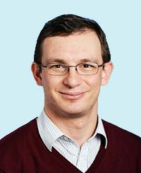
A Bit About Myself
Onur Mutlu
Full Professor @ ETH Zurich, since September 2015
Strecker Professor @ Carnegie Mellon University ECE/CS, 2009-2016, 2016-…
PhD from UT-Austin, worked at Google, VMware, Microsoft Research, Intel, AMD
https://people.inf.ethz.ch/omutlu/
omutlu@gmail.com (Best way to reach me)
https://people.inf.ethz.ch/omutlu/projects.htm
Research and Teaching in:
Computer architecture, computer systems, hardware security, bioinformatics
Memory and storage systems
Hardware security, safety, predictability
Fault tolerance
Hardware/software cooperation
Architectures for bioinformatics, health, medicine
…

Slide 4
The Transformation Hierarchy
Problem
Algorithm
Program/Language
System Software
Computer Architecture (expanded view)
SW/HW Interface
Computer Architecture (narrow view)
Micro-architecture
Logic
Devices
Electrons

Slide 5
Axiom
To achieve the highest energy efficiency and performance:
we must take the expanded view
of computer architecture
Problem
Algorithm
Program/Language
System Software
Co-design across the hierarchy:
Algorithms to devices
SW/HW Interface
Micro-architecture
Logic
Specialize as much as possible
within the design goals
Devices
Electrons

Slide 6
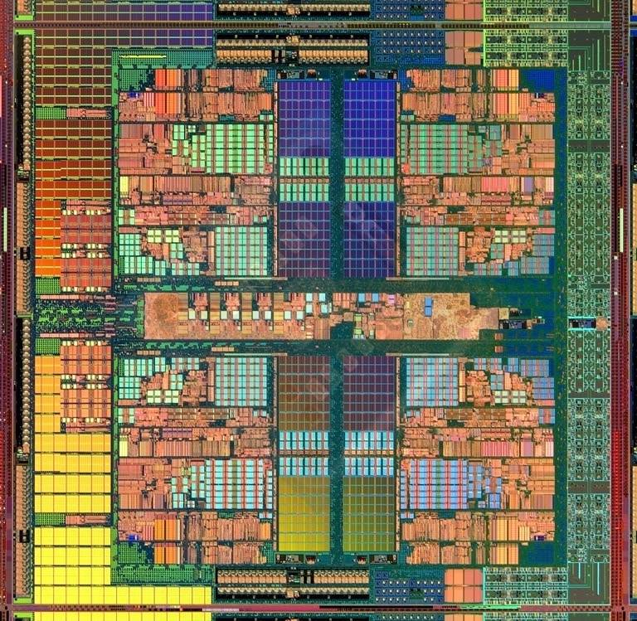
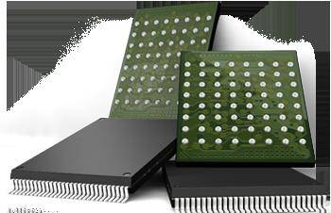
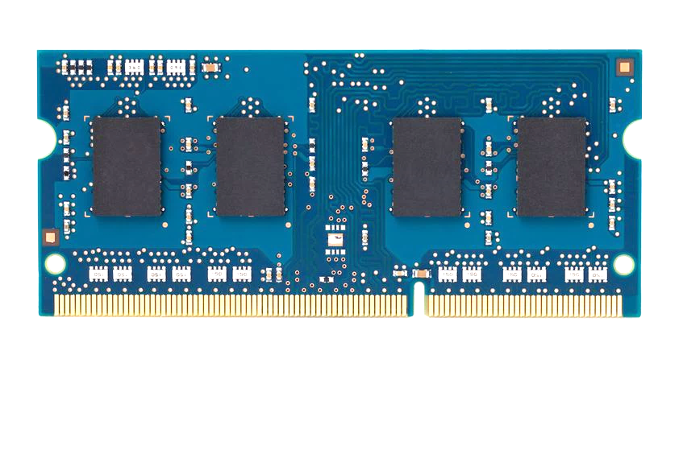
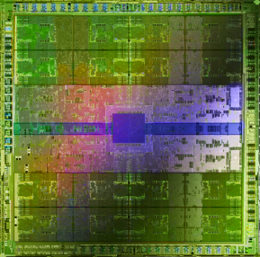
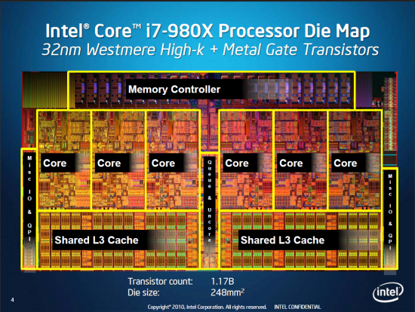
Current Research Mission
Computer architecture, HW/SW, systems, bioinformatics, security
Hybrid Main Memory
Heterogeneous
Processors and
Accelerators
Persistent Memory/Storage
Graphics and Vision Processing
Build fundamentally better architectures
Notes:
Professor Mutlu’s research focus is all aspects of computer architecture, HW/SW interaction and bioinformatics.
He is looking for students to perform research in these areas.
He and his group, SAFARI, solve fundamental problems spanning:
Memory, memory, memory, storage, interconnects
Parallel architectures, heterogeneous architectures, GP-GPUs
System/architecture interaction, new execution models
Energy efficiency, fault tolerance, hardware security
Genome sequence analysis and assembly
His group does broad research spanning systems to logic with architecture at center

Slide 7
Current Research Focus Areas
Research Focus: Computer architecture, HW/SW, bioinformatics, security
Memory and storage (DRAM, flash, emerging), interconnects
Heterogeneous & parallel systems, GPUs, systems for data analytics
System/architecture interaction, new execution models, new interfaces
Hardware security, energy efficiency, fault tolerance, performance
Genome sequence analysis & assembly algorithms and architectures
Biologically inspired systems & system design for bio/medicine
Hybrid Main Memory
Heterogeneous
Processors and
Accelerators
Persistent Memory/Storage
Broad research
spanning apps, systems, logic
with architecture at the center
Graphics and Vision Processing
Notes:
Professor Mutlu’s research focus is all aspects of computer architecture, HW/SW interaction and bioinformatics.
He is looking for students to perform research in these areas.
He and his group, SAFARI, solve fundamental problems spanning:
Memory, memory, memory, storage, interconnects
Parallel architectures, heterogeneous architectures, GP-GPUs
System/architecture interaction, new execution models
Energy efficiency, fault tolerance, hardware security
Genome sequence analysis and assembly
His group does broad research spanning systems to logic with architecture at center

Slide 8
Research & Teaching: Some Overview Talks
https://www.youtube.com/onurmutlulectures
Future Computing Architectures
https://www.youtube.com/watch?v=kgiZlSOcGFM&list=PL5Q2soXY2Zi8D_5MGV6EnXEJHnV2YFBJl&index=1
Enabling In-Memory Computation
https://www.youtube.com/watch?v=njX_14584Jw&list=PL5Q2soXY2Zi8D_5MGV6EnXEJHnV2YFBJl&index=16
Accelerating Genome Analysis
https://www.youtube.com/watch?v=hPnSmfwu2-A&list=PL5Q2soXY2Zi8D_5MGV6EnXEJHnV2YFBJl&index=9
Rethinking Memory System Design
https://www.youtube.com/watch?v=F7xZLNMIY1E&list=PL5Q2soXY2Zi8D_5MGV6EnXEJHnV2YFBJl&index=3
Intelligent Architectures for Intelligent Machines
https://www.youtube.com/watch?v=n8Aj_A0WSg8&list=PL5Q2soXY2Zi8D_5MGV6EnXEJHnV2YFBJl&index=22

Slide 9
Accelerated Memory Course (~6.5 hours)
ACACES 2018
Memory Systems and Memory-Centric Computing Systems
Taught by Onur Mutlu July 9-13, 2018
~6.5 hours of lectures
Website for the Course including Videos, Slides, Papers
https://people.inf.ethz.ch/omutlu/acaces2018.html
https://www.youtube.com/playlist?list=PL5Q2soXY2Zi-HXxomthrpDpMJm05P6J9x
All Papers are at:
https://people.inf.ethz.ch/omutlu/projects.htm
Final lecture notes and readings (for all topics)

Slide 10
An Interview on Research and Education
Computing Research and Education (@ ISCA 2019)
https://www.youtube.com/watch?v=8ffSEKZhmvo&list=PL5Q2soXY2Zi_4oP9LdL3cc8G6NIjD2Ydz
Maurice Wilkes Award Speech (10 minutes)
https://www.youtube.com/watch?v=tcQ3zZ3JpuA&list=PL5Q2soXY2Zi8D_5MGV6EnXEJHnV2YFBJl&index=15

Slide 11
SAFARI Research Group
Think BIG, Aim HIGH!
https://safari.ethz.ch

Slide 12
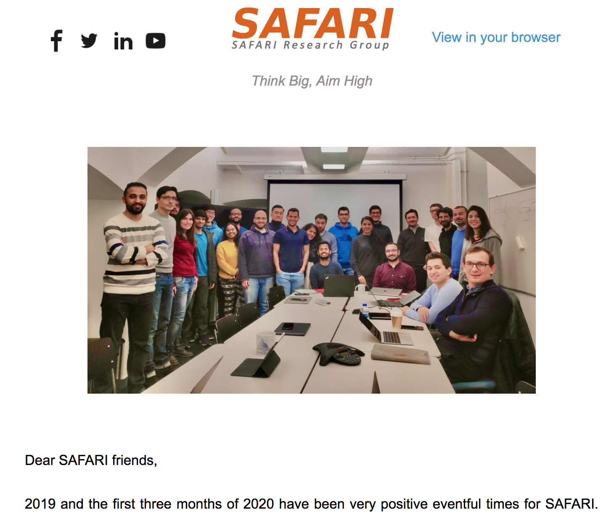
SAFARI Newsletter April 2020 Edition
https://safari.ethz.ch/safari-newsletter-april-2020/

Slide 13
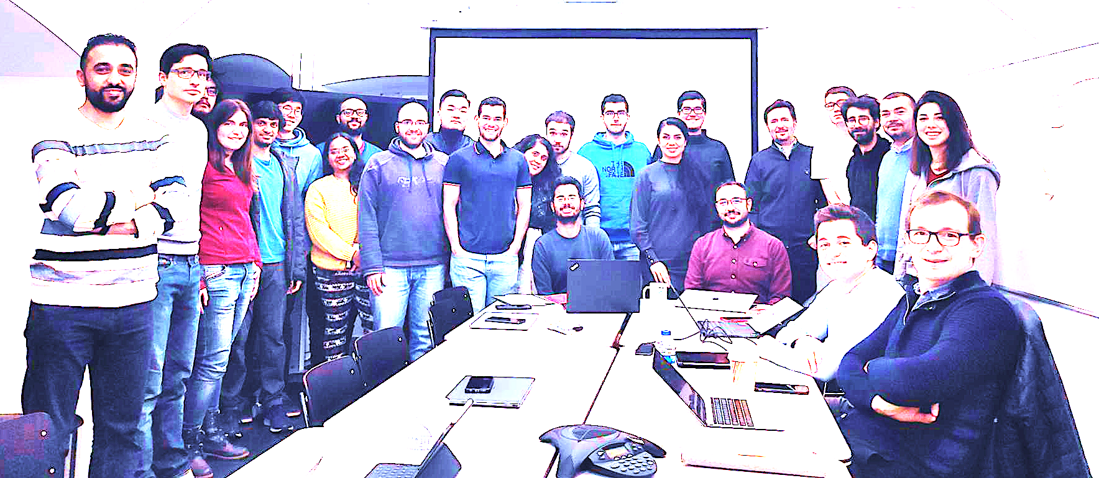
SAFARI Research Group
33 ☺ = 1 Professor, 2 Lecturers & Senior Researchers, 3 Senior Researchers, 12 PhD Students,
5 Masters, 8 PhD/Bachelors Interns, 2 Admins
Think BIG, Aim HIGH!
https://safari.ethz.ch

Slide 14
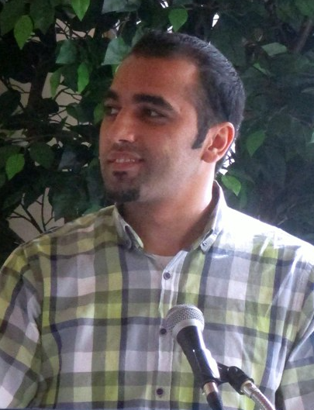
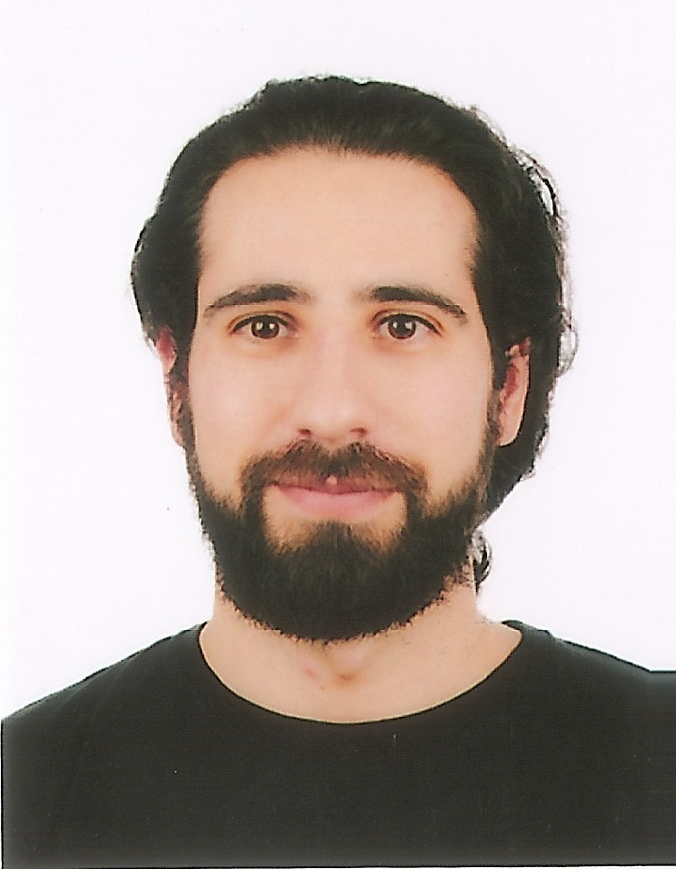
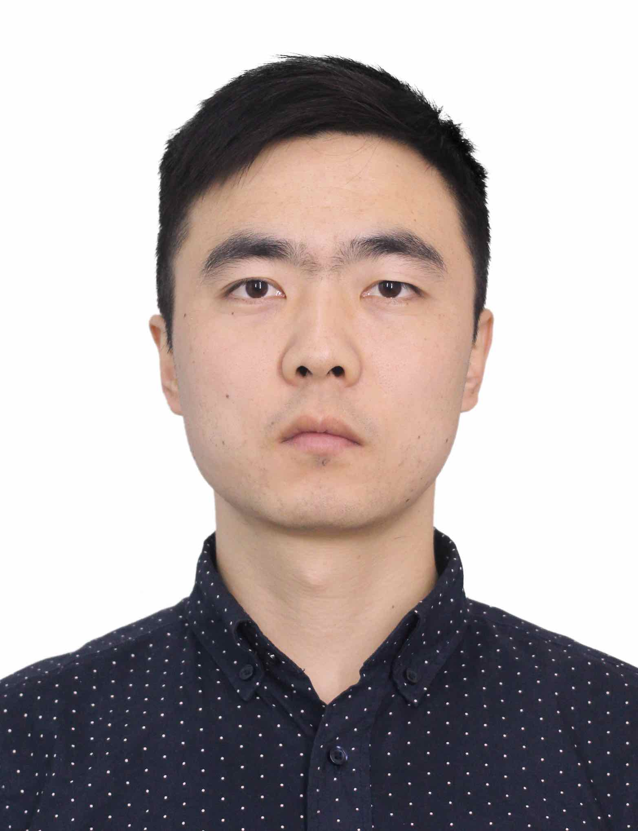
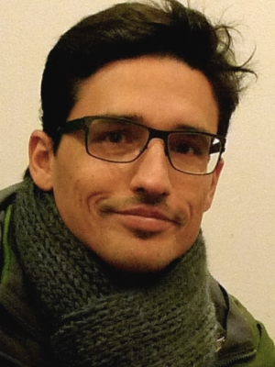
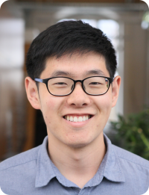
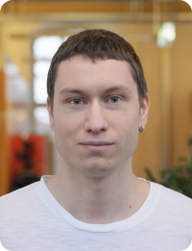
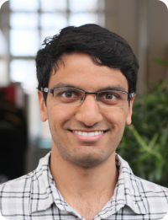
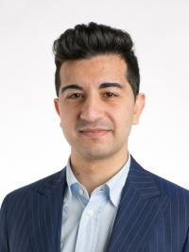
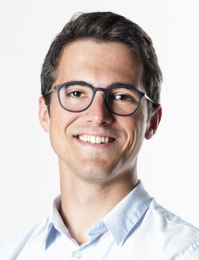
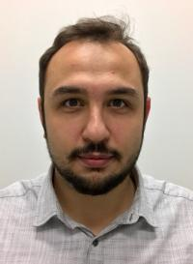
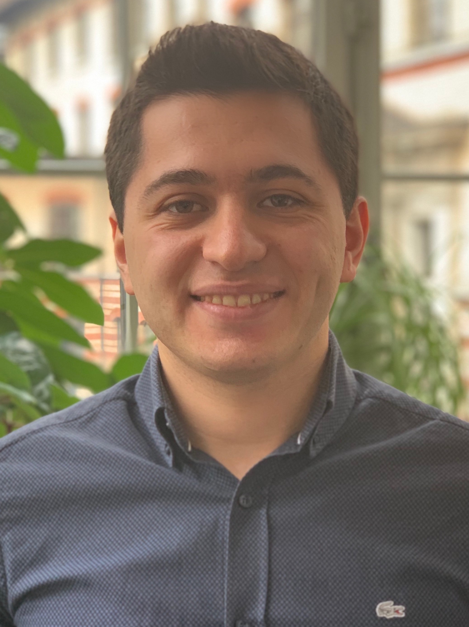
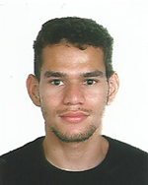
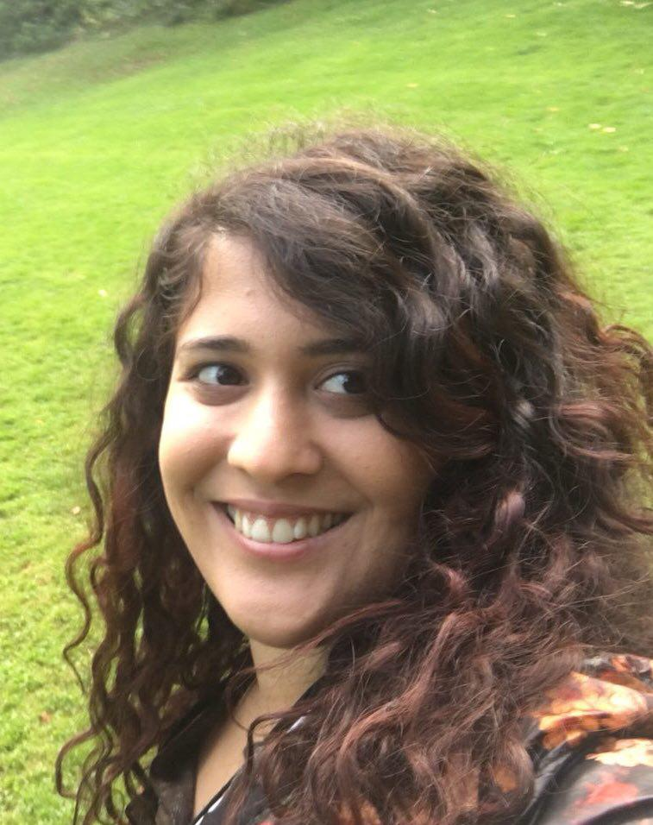
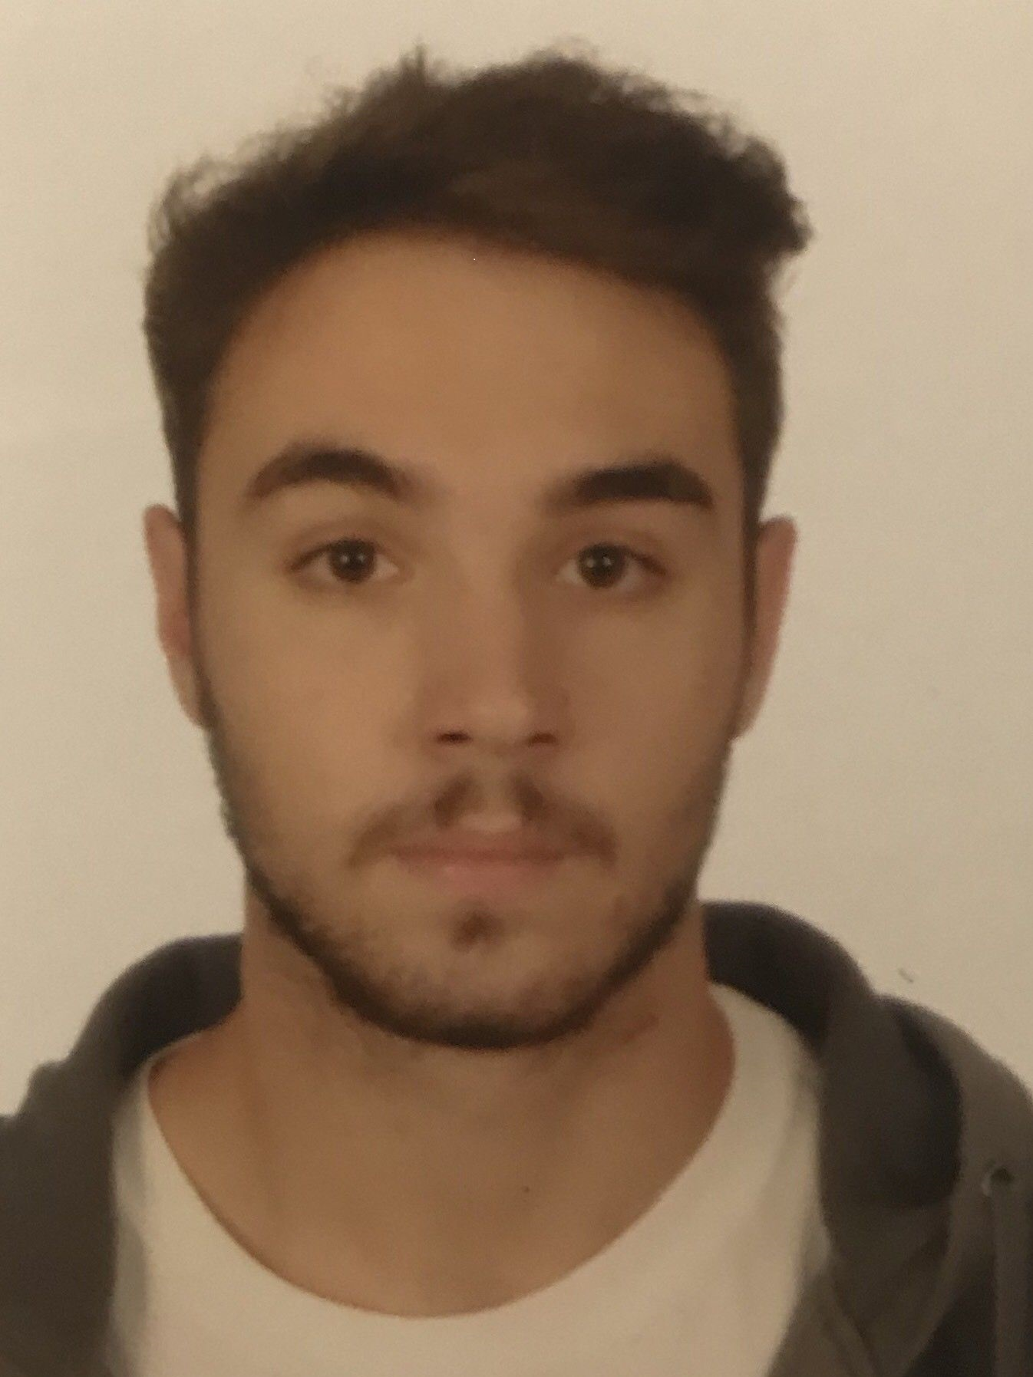
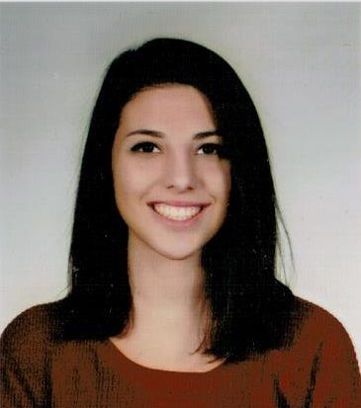
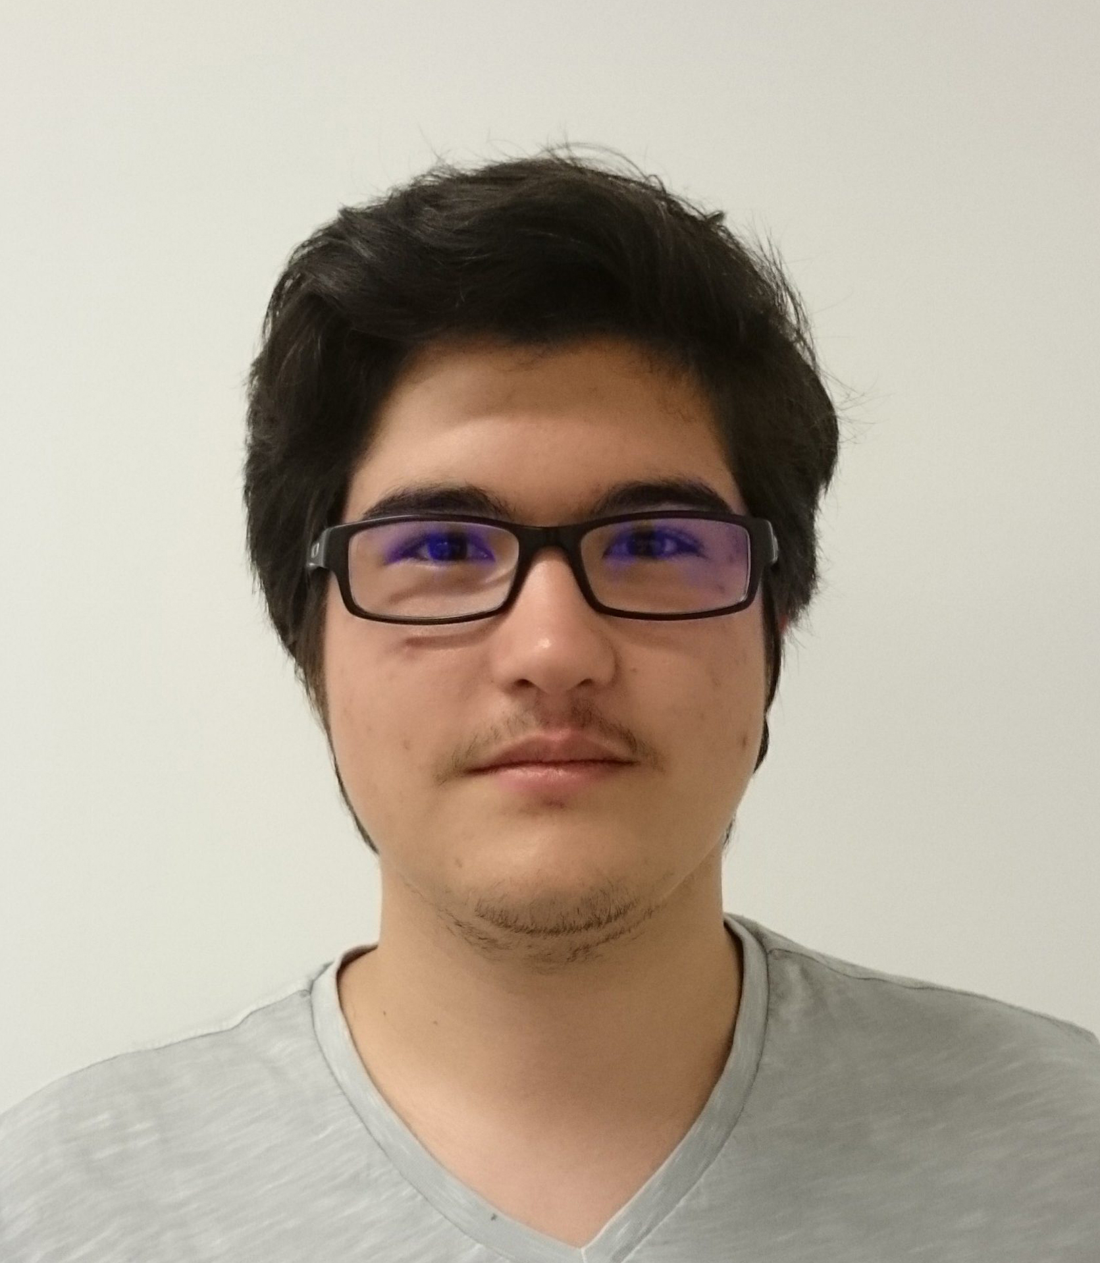
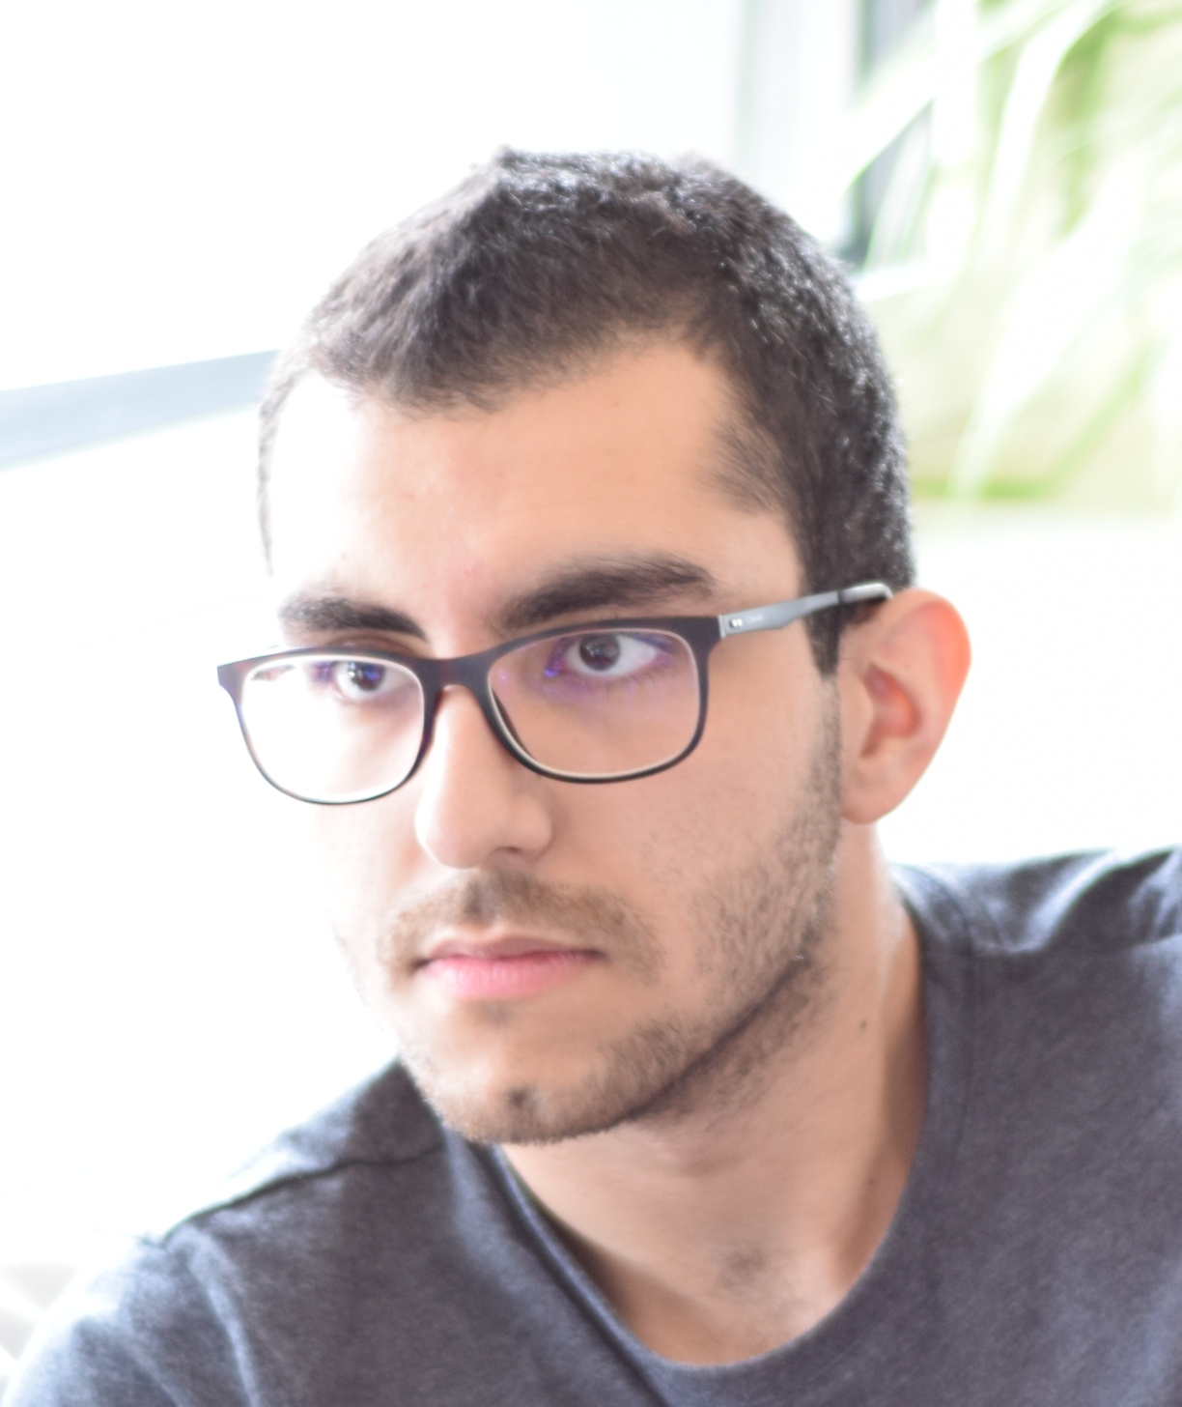
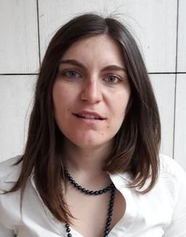
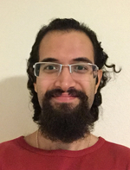
SAFARI Group Members @ ETH Zurich
7 Post-doctoral Researchers
12 PhD Students + 2 at CMU
5 Interns
8 Master’s and Bachelor’s Researchers
Dr. Mohammed Alser
Dr. Lois
Orosa
Dr. Yaohua
Wang
Dr. Juan
Gómez-Luna
Jeremie Kim
Hasan Hassan
Minesh Patel
Ivan Puddu
Lukas Breitwieser
Giray Yaglikci
Can Firtina
Geraldo F.
de Oliveira
Nika Mansouri
Skanda Koppula
Konstantinos
Kanellopoulos
Nisa Bostanci
Ataberk Olgun
Rokneddin Azizi
Christina
Giannoula
Taha
Shahroodi

Slide 15
SAFARI PhD and Post-Doc Alumni
https://safari.ethz.ch/safari-alumni/
Nandita Vijaykumar (Univ. of Toronto, Assistant Professor)
Kevin Hsieh (Microsoft Research)
Justin Meza (Facebook)
Mohammed Alser (ETH Zurich)
Yixin Luo (Google)
Kevin Chang (Facebook)
Rachata Ausavarungnirun (KMUNTB, Assistant Professor)
Gennady Pekhimenko (Univ. of Toronto, Assistant Professor)
Vivek Seshadri (Microsoft Research)
Donghyuk Lee (NVIDIA Research)
Yoongu Kim (Google)
Lavanya Subramanian (Intel Labs → Facebook)
Samira Khan (Univ. of Virginia, Assistant Professor)
Saugata Ghose (Univ. of Illinois, Assistant Professor)

Slide 16
Example Research Topics (I)
Onur Mutlu, Saugata Ghose, Juan Gomez-Luna, and Rachata Ausavarungnirun, "Processing Data Where It Makes Sense: Enabling In-Memory Computation" Invited paper in Microprocessors and Microsystems (MICPRO), June 2019. [arXiv version]

Slide 17
Example Research Topics (I)
Saugata Ghose, Amirali Boroumand, Jeremie S. Kim, Juan Gomez-Luna, and Onur Mutlu, "Processing-in-Memory: A Workload-Driven Perspective" Invited Article in IBM Journal of Research & Development, Special Issue on Hardware for Artificial Intelligence, to appear in November 2019. [Preliminary arXiv version]
https://arxiv.org/pdf/1907.12947.pdf

Slide 18
Example Research Topics (II)
Onur Mutlu, "The RowHammer Problem and Other Issues We May Face as Memory Becomes Denser" Invited Paper in Proceedings of the Design, Automation, and Test in Europe Conference (DATE), Lausanne, Switzerland, March 2017. [Slides (pptx) (pdf)]
https://people.inf.ethz.ch/omutlu/pub/rowhammer-and-other-memory-issues_date17.pdf

Slide 19
Example Research Topics (III)
Onur Mutlu, "Memory Scaling: A Systems Architecture Perspective" Technical talk at MemCon 2013 (MEMCON), Santa Clara, CA, August 2013. [Slides (pptx) (pdf)] [Video] [Coverage on StorageSearch]
https://people.inf.ethz.ch/omutlu/pub/memory-scaling_memcon13.pdf

Slide 20
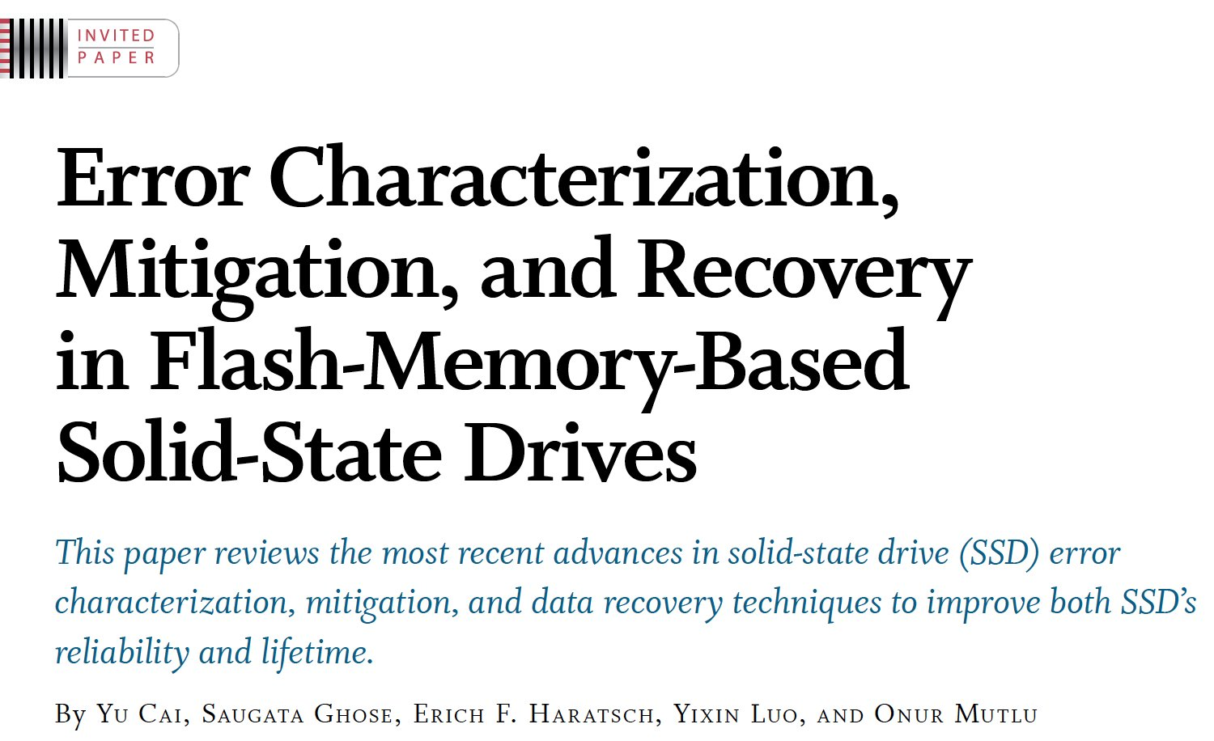
Example Research Topics (IV)
Proceedings of the IEEE, Sept. 2017
https://arxiv.org/pdf/1706.08642

Slide 21
Example Research Topics (V)
Onur Mutlu and Jeremie Kim, "RowHammer: A Retrospective" IEEE Transactions on Computer-Aided Design of Integrated Circuits and Systems (TCAD) Special Issue on Top Picks in Hardware and Embedded Security, 2019. [Preliminary arXiv version]

Slide 22
Teaching: Online Courses and Lectures
Undergraduate Digital Design & Computer Architecture Course Lecture Videos (2020, 2019, 2018, 2017, 2015, 2014, 2013)
Graduate Computer Architecture Course Lecture Videos (2019, 2018, 2017, 2015, 2013)
Seminar in Computer Architecture Course Lecture Videos (Spring 2020, Fall 2019, Spring 2019, 2018)
Parallel Computer Architecture Course Materials (Lecture Videos)
https://people.inf.ethz.ch/omutlu/teaching.html
https://www.youtube.com/onurmutlulectures
https://www.youtube.com/user/cmu18447

Slide 23
Some Open Source Tools (I)
Rowhammer – Program to Induce RowHammer Errors
https://github.com/CMU-SAFARI/rowhammer
Ramulator – Fast and Extensible DRAM Simulator
https://github.com/CMU-SAFARI/ramulator
MemSim – Simple Memory Simulator
https://github.com/CMU-SAFARI/memsim
NOCulator – Flexible Network-on-Chip Simulator
https://github.com/CMU-SAFARI/NOCulator
SoftMC – FPGA-Based DRAM Testing Infrastructure
https://github.com/CMU-SAFARI/SoftMC
Other open-source software from my group
https://github.com/CMU-SAFARI/
http://www.ece.cmu.edu/~safari/tools.html

Slide 24
Some Open Source Tools (II)
MQSim – A Fast Modern SSD Simulator
https://github.com/CMU-SAFARI/MQSim
Mosaic – GPU Simulator Supporting Concurrent Applications
https://github.com/CMU-SAFARI/Mosaic
IMPICA – Processing in 3D-Stacked Memory Simulator
https://github.com/CMU-SAFARI/IMPICA
SMLA – Detailed 3D-Stacked Memory Simulator
https://github.com/CMU-SAFARI/SMLA
HWASim – Simulator for Heterogeneous CPU-HWA Systems
https://github.com/CMU-SAFARI/HWASim
Other open-source software from my group
https://github.com/CMU-SAFARI/
http://www.ece.cmu.edu/~safari/tools.html

Slide 25
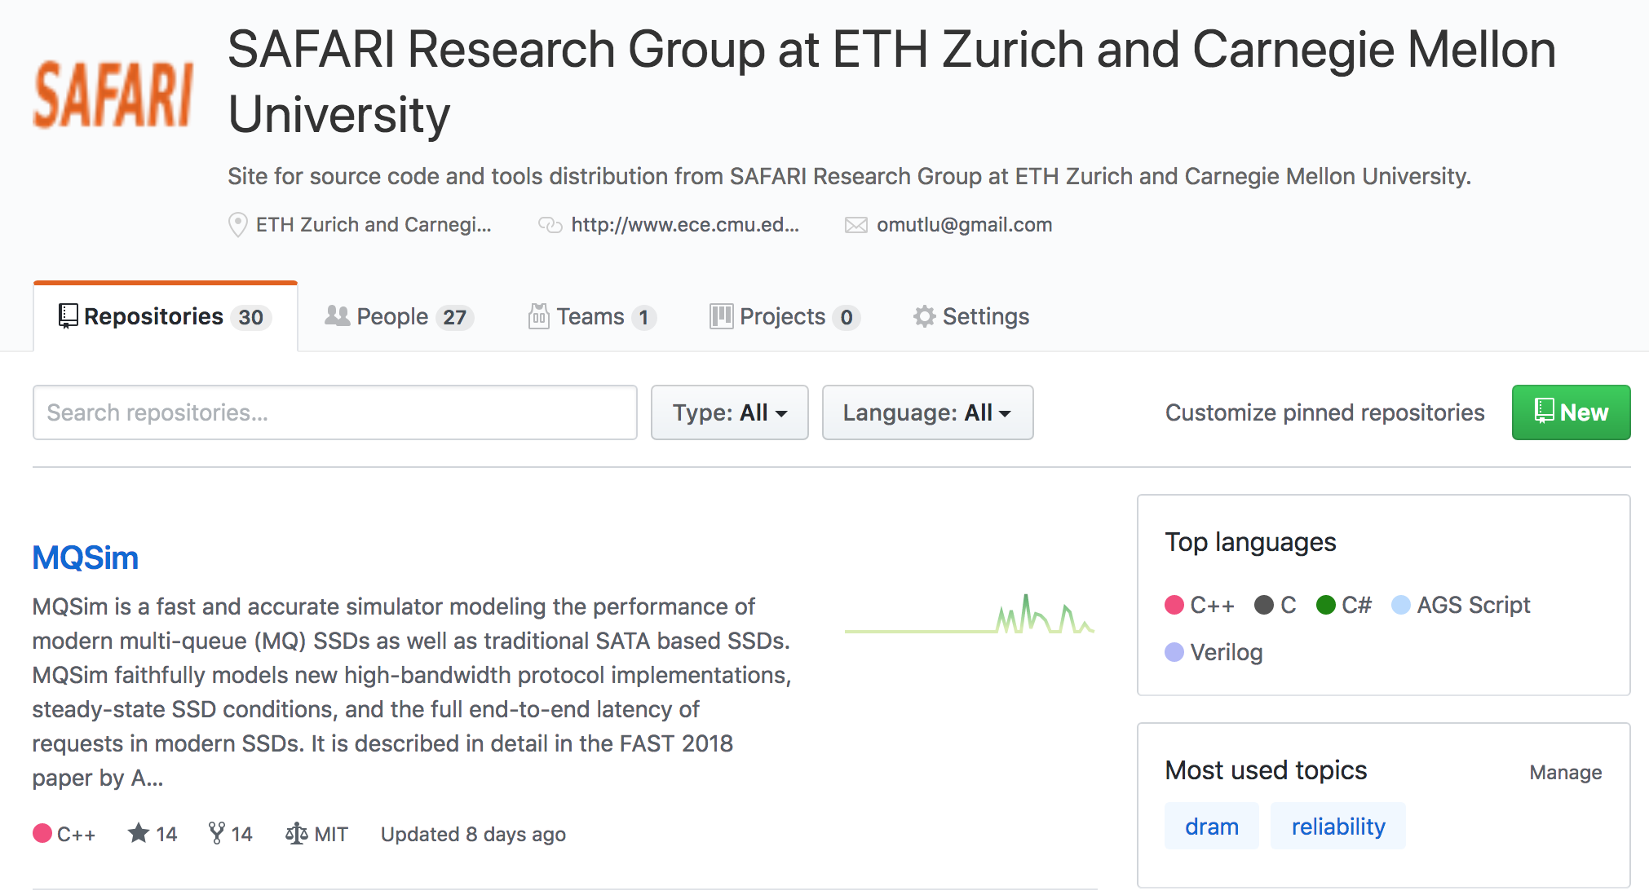
More Open Source Tools (III)
A lot more open-source software from my group
https://github.com/CMU-SAFARI/
http://www.ece.cmu.edu/~safari/tools.html

Slide 26
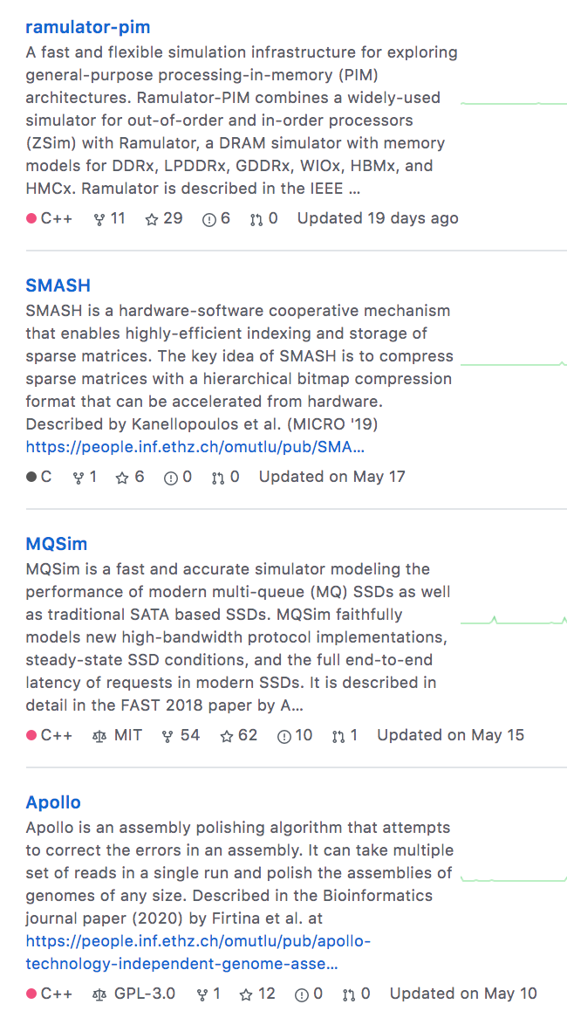
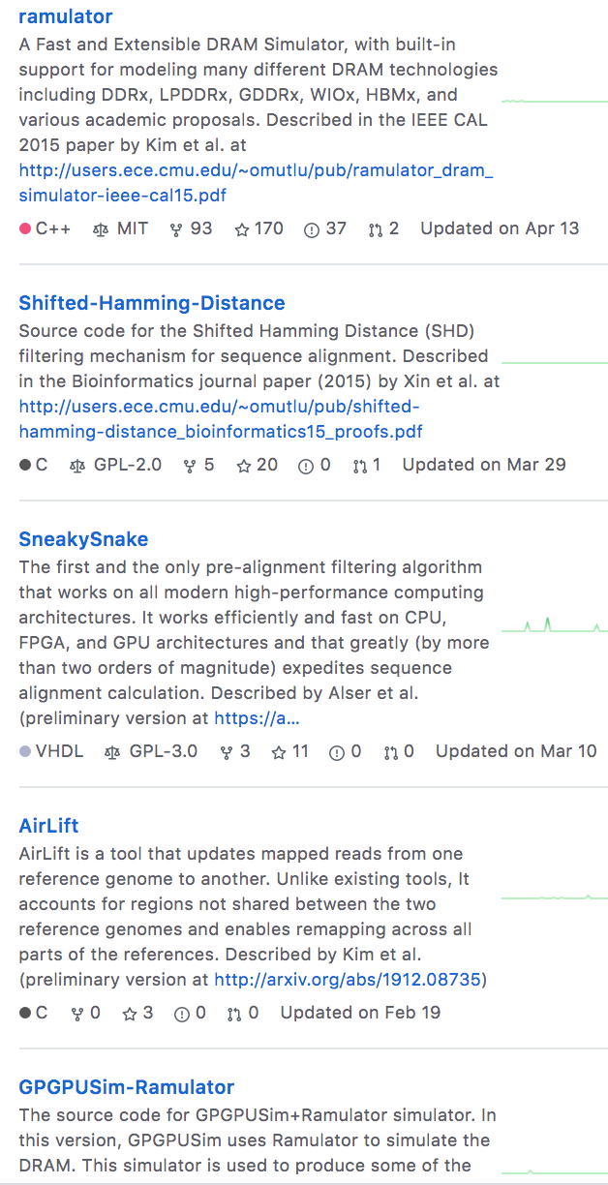

Slide 27
Papers
All are available at
https://people.inf.ethz.ch/omutlu/projects.htm
http://scholar.google.com/citations?user=7XyGUGkAAAAJ&hl=en
https://people.inf.ethz.ch/omutlu/acaces2018.html

Slide 28
Revisiting the Entire Stack
Problem
Algorithm
Program/Language
System Software
SW/HW Interface
Micro-architecture
Logic
Devices
Electrons

Slide 29
Panel Questions

Slide 30
Question 1: Best Practices
Which are the best practices that you would suggest to your peers as the essential one for the success of an academic team?

Slide 31
Before I Start…
There is no single way of having impact.
The following is my way, methods and principles.
There definitely are other ways.
The critical thing is finding the way that works well for you and your goals.
That you can own, cherish and optimize

Slide 32
Principle: Personalized Methods
Find the methods
that work for you

Slide 33
Motivation & Mindset

Slide 34
Principle: Mindset and Motivation
Start out with
the right
motivation and mindset

Slide 35
Motivation Sets The Culture and Goals
Mindset 1: change the world positively, have high influence
Mindset 2: enable students to achieve a potential that they did not even think they could ever achieve
Not papers
Not fame
Not money
…
Motivation correction may be needed at times – be ready

Slide 36
Principle: Team of Excellence
Get motivated students
Build a team of excellence

Slide 37
Principle: Learning and Scholarship
Focus on
learning and scholarship

Slide 38
Some Basics of Research
Slides used in several of my courses:
e.g., https://www.youtube.com/watch?v=M0y_Nvb9rGA

Slide 39
How To Do Research & Advanced Dev.
We will talk a lot about this in this course
Learning by example
Reading and evaluating strong and seminal papers & designs
Learning by doing
Semester-long research/design projects, masters’ projects, PhD thesis
Learning by open, critical discussions
Paper reading groups, frequent brainstorming and discussions
Design sessions
Collaborations
Slides used in several of my courses: e.g., https://www.youtube.com/watch?v=M0y_Nvb9rGA

Slide 40
Principle: Environment of Freedom
Create an environment
that values
free exploration, openness, collaboration, hard work, creativity

Slide 41
What Is The Goal of Research?
To generate new insight
that can enable what previously did not exist
Research is a hunt for insight that can eventually impact the world
Slides used in several of my courses: e.g., https://www.youtube.com/watch?v=M0y_Nvb9rGA

Slide 42
Principle: Insight and Ideas
Focus on Insight
Encourage New Ideas

Slide 43
Some Basic Advice for Good Research
Choose great problems to solve: Have great taste
Difficult
Important
High impact
Read heavily and critically
Think big (out of the box)
Do not restrain yourself to tweaks or constraints of today
Yet, think about adoption issues
Aim high
Write and present extremely well
Slides used in several of my courses: e.g., https://www.youtube.com/watch?v=M0y_Nvb9rGA

Slide 44
Many Principles on the Previous Slide

Slide 45
Principle: Bar
Set the Bar High

Slide 46
Set the Bar High
The goal should be to enable students to achieve a potential that they did not even think they could ever achieve
“Think big, aim high, enable positive change”
Reward good, positive behavior that helps with this culture
Recommended reading:
Hamming, “You and Your Research,” Talk at Bell Labs, 1986.
https://www.cs.virginia.edu/~robins/YouAndYourResearch.html

Slide 47
Principle: Focus on Fundamentals
Fundamentals
and scholarship
are critical
(hypes come and go)

Slide 48
Principle: Focus on Big Problems
Choose Great Problems
and guide your group toward them
(but give them freedom)

Slide 49
Principle: Teaching and Research
…
Teaching drives Research
Research drives Teaching
…

Slide 50
More on Teaching and Research
Care about teaching immensely
Teaching and research are two sides of the same coin → scholarship
Both long-term and short-term is affected by teaching
Research motivates teaching motivates research
I introduce RowHammer, Processing in Memory, Meltdown/Spectre, DRAM Refresh, Various Technology Scaling problems, and research examples in my Freshman course:
https://safari.ethz.ch/digitaltechnik/spring2020/
All courses can have research examples

Slide 51
Principle: Focus on Communication
Emphasize
Clarity and Rigor
in Communication
(critical for high impact)

Slide 52
Do Everything to Have High Impact
Engage with companies
Engage and collaborate with researchers who fit your mindset
Collaborate, not fight
Strive for the highest excellence

Slide 53
Principle: Collaboration
Foster collaboration
(within group)
(across groups)
(with companies)

Slide 54
Principle: Reach Out
Inspire and Reach Out

Slide 55
Principle: Reach Out
Give talks
Educate others on your work and research
Listen to everyone
Especially your students
Teach, educate, collaborate

Slide 56
Principle: Feedback
Receive & Address Feedback
(but do not get derailed)

Slide 57
Principle: Receive & Address Feedback
Address reviewer feedback
Take them positively
They can be helpful
Feedback is not always right
Need to apply corrections to it
Do not let rejection derail you – be ready for it
Remind and encourage your students:
https://www.sciencealert.com/these-8-papers-were-rejected-before-going-on-to-win-the-nobel-prize

Slide 58
Principle: Resilience
Be Resilient

Slide 59
Principle: Passion
Follow Your Passion

Slide 60
Principle: Passion Extended
Follow Your Passion
(Do not get derailed
by naysayers)

Slide 61
Principle: Learning and Scholarship
The quality of your work defines your impact

Slide 62
If In Doubt, See Other Doubtful Technologies
A very “doubtful” emerging technology
for at least two decades
Proceedings of the IEEE, Sept. 2017
https://arxiv.org/pdf/1706.08642

Slide 63
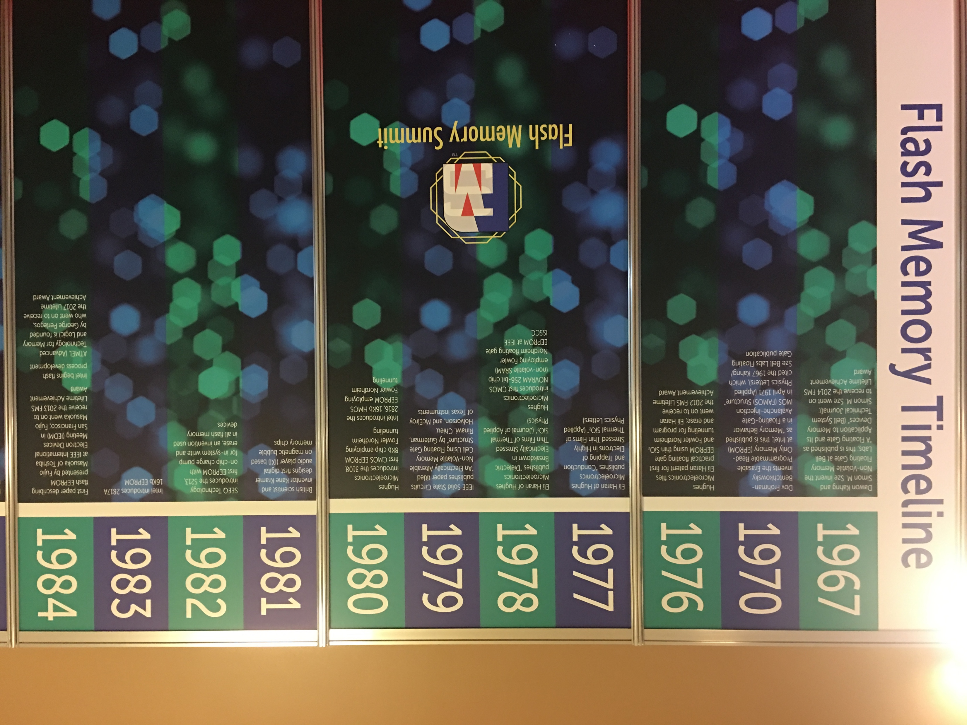
Flash Memory Timeline (1967-2019)

Slide 64
Flash Memory Timeline (1967-2019)

Slide 65
Four Key Current Directions
Fundamentally Secure/Reliable/Safe Architectures
Fundamentally Energy-Efficient Architectures
Memory-centric (Data-centric) Architectures
Fundamentally Low-Latency and Predictable Architectures
Architectures for AI/ML, Genomics, Medicine, Health

Slide 66
Our Dream (circa 2007)
An embedded device that can perform comprehensive genome analysis in real time (within a minute)
Which of these DNAs does this DNA segment match with?
What is the likely genetic disposition of this patient to this drug?
. . .

Slide 67
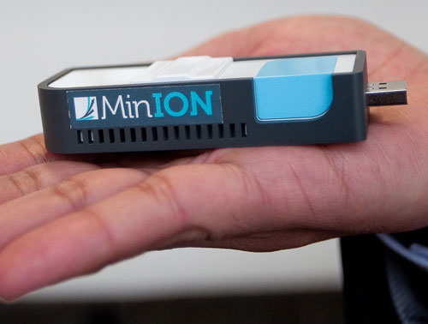
New Genome Sequencing Technologies
Oxford Nanopore MinION
Senol Cali+, “Nanopore Sequencing Technology and Tools for Genome
Assembly: Computational Analysis of the Current State, Bottlenecks
and Future Directions,” Briefings in Bioinformatics, 2018.
[Preliminary arxiv.org version]

Slide 68
Nanopore Genome Assembly Pipeline
Senol Cali+, “Nanopore Sequencing Technology and Tools for Genome
Assembly,” Briefings in Bioinformatics, 2018.

Slide 69
GateKeeper: FPGA-Based Alignment Filtering
Mohammed Alser, Hasan Hassan, Hongyi Xin, Oguz Ergin, Onur Mutlu, and Can Alkan "GateKeeper: A New Hardware Architecture for Accelerating Pre-Alignment in DNA Short Read Mapping" Bioinformatics, [published online, May 31], 2017. [Source Code] [Online link at Bioinformatics Journal]

Slide 70
Current State: Shouji [Alser+, Bioinformatics 2019]
Mohammed Alser, Hasan Hassan, Akash Kumar, Onur Mutlu, and Can Alkan, "Shouji: A Fast and Efficient Pre-Alignment Filter for Sequence Alignment" Bioinformatics, [published online, March 28], 2019. [Source Code] [Online link at Bioinformatics Journal]

Slide 71
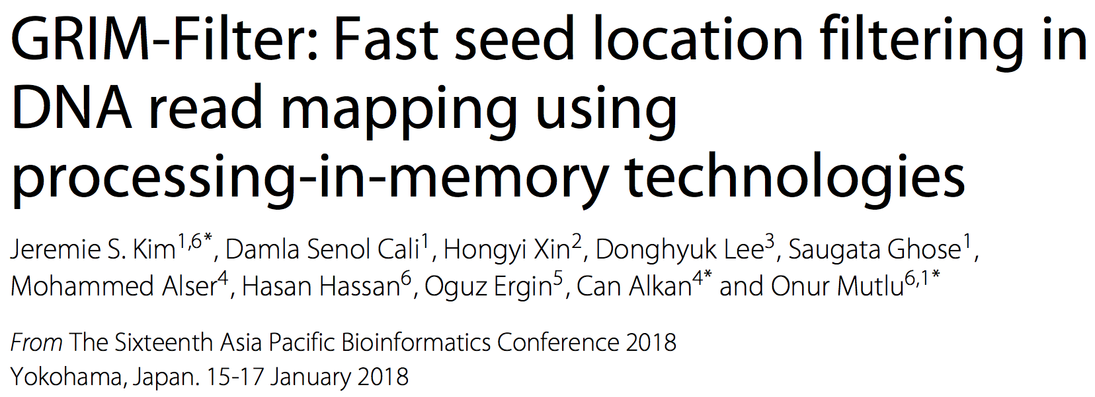
In-Memory DNA Sequence Analysis
Jeremie S. Kim, Damla Senol Cali, Hongyi Xin, Donghyuk Lee, Saugata Ghose, Mohammed Alser, Hasan Hassan, Oguz Ergin, Can Alkan, and Onur Mutlu, "GRIM-Filter: Fast Seed Location Filtering in DNA Read Mapping Using Processing-in-Memory Technologies" BMC Genomics, 2018. Proceedings of the 16th Asia Pacific Bioinformatics Conference (APBC), Yokohama, Japan, January 2018. arxiv.org Version (pdf)

Slide 72
Principle: Passion
Follow Your Passion

Slide 73
Principle: Build Infrastructure
Build Infrastructure to Enable Your Passion
(Big Projects)

Slide 74
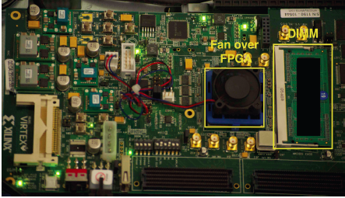
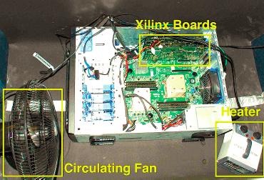
Example: Our DRAM Infrastructure (since 2012)
An Experimental Study of Data Retention Behavior in Modern DRAM Devices: Implications for Retention Time Profiling Mechanisms (Liu et al., ISCA 2013)
The Efficacy of Error Mitigation Techniques for DRAM Retention Failures: A Comparative Experimental Study
(Khan et al., SIGMETRICS 2014)
Flipping Bits in Memory Without Accessing Them: An Experimental Study of DRAM Disturbance Errors (Kim et al., ISCA 2014)
Adaptive-Latency DRAM: Optimizing DRAM Timing for the Common-Case (Lee et al., HPCA 2015)
AVATAR: A Variable-Retention-Time (VRT) Aware Refresh for DRAM Systems (Qureshi et al., DSN 2015)

Slide 75
Example: Our DRAM Infrastructure (since 2012)
Temperature
Controller
FPGAs
Heater
FPGAs
PC
Kim+, “Flipping Bits in Memory Without Accessing Them: An Experimental Study of DRAM Disturbance Errors,” ISCA 2014.

Slide 76
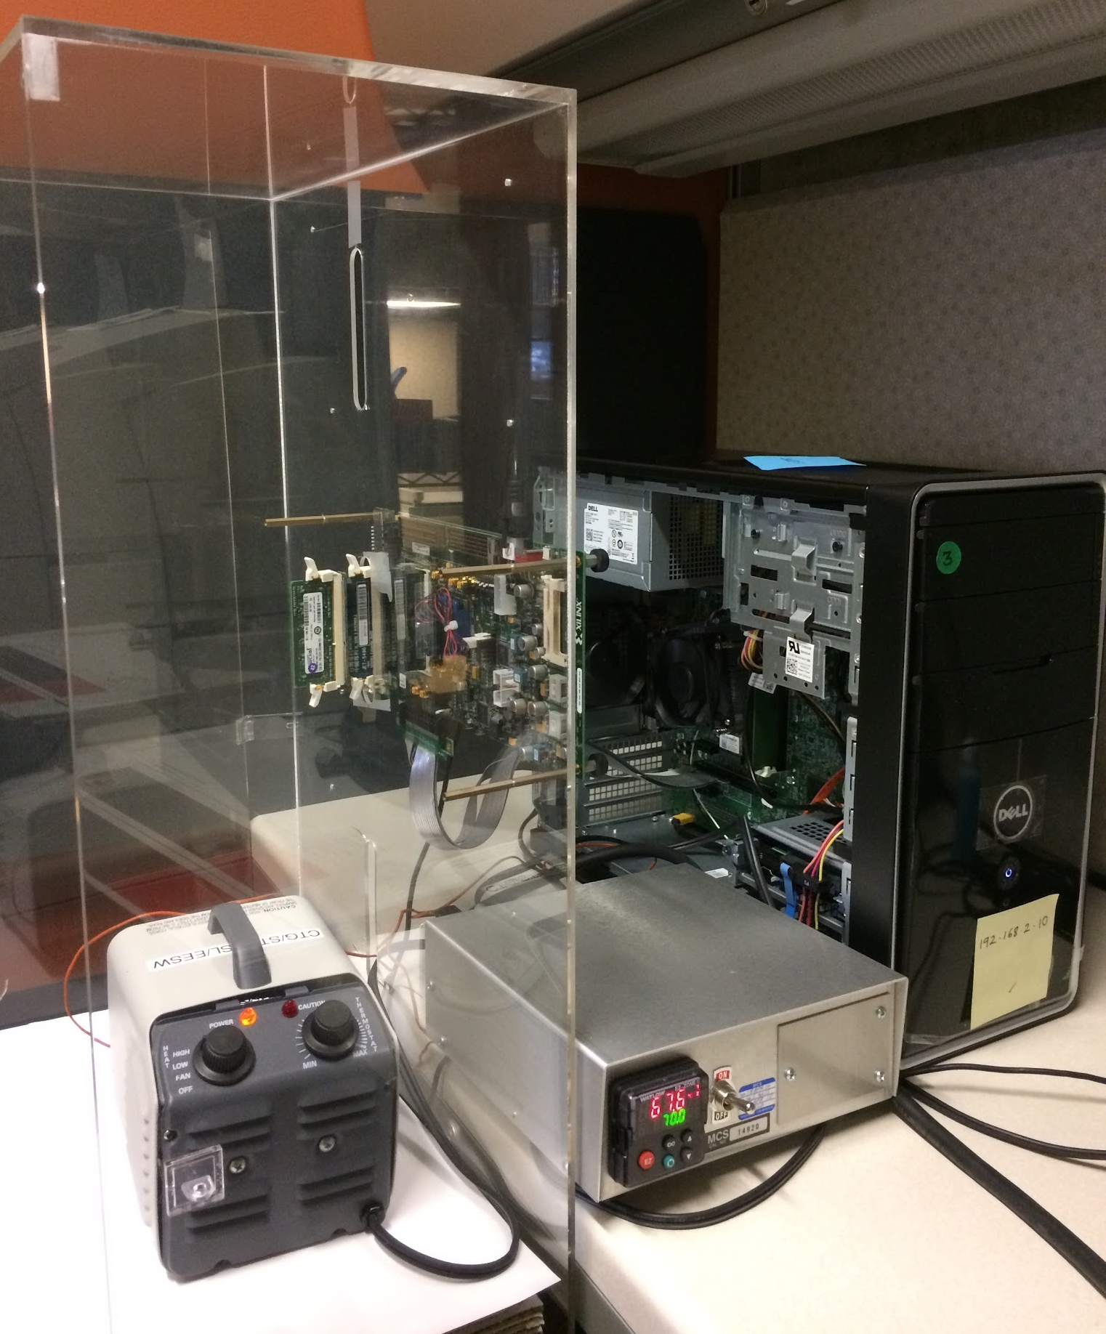
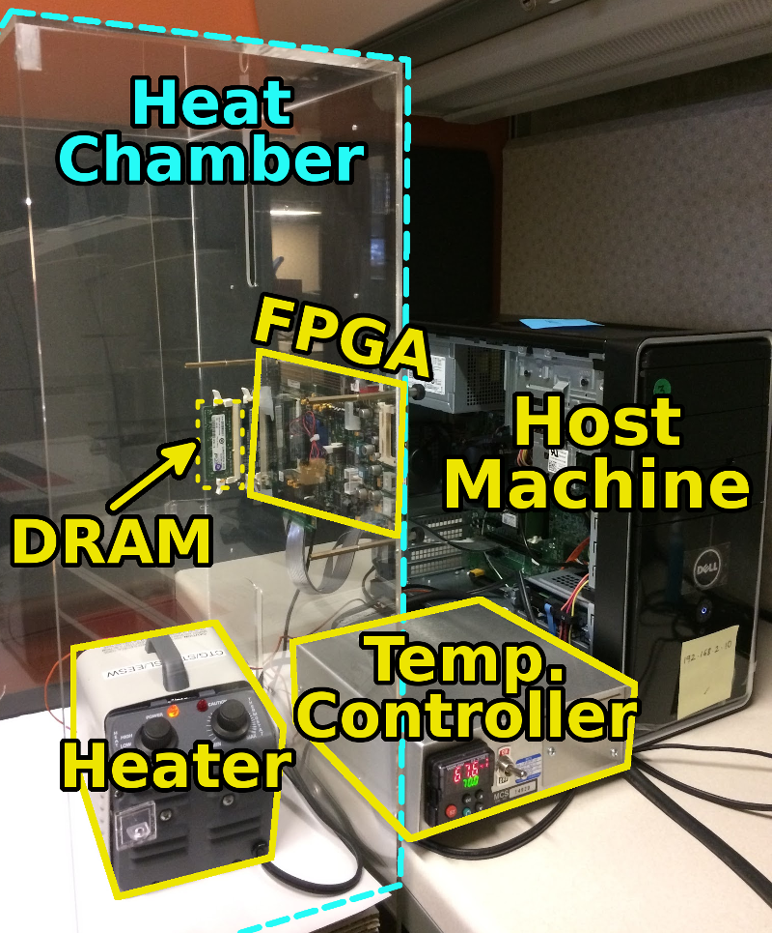
SoftMC: Open Source DRAM Infrastructure
Hasan Hassan et al., “SoftMC: A Flexible and Practical Open-Source Infrastructure for Enabling Experimental DRAM Studies,” HPCA 2017.
Flexible
Easy to Use (C++ API)
Open-source
github.com/CMU-SAFARI/SoftMC

Slide 77
SoftMC [HPCA 2017]
https://github.com/CMU-SAFARI/SoftMC

Slide 78
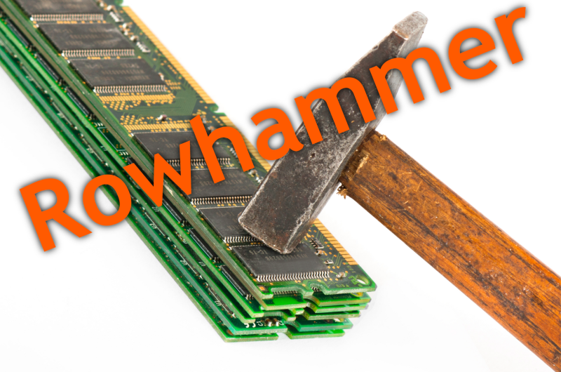
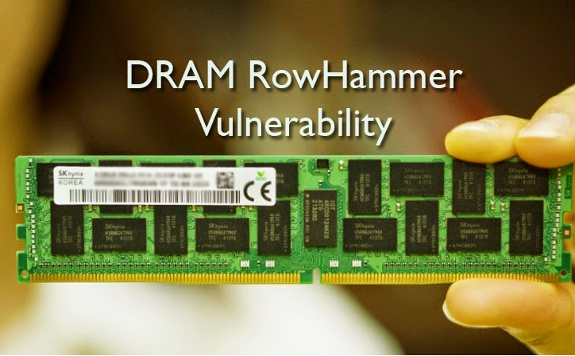
Infrastructure Enabled Research: RowHammer
Notes:
Picture from the article:
http://thehackernews.com/2015/03/dram-rowhammer-vulnerability.html

Slide 79
Infrastructure Enabled Research: RowHammer
Yoongu Kim, Ross Daly, Jeremie Kim, Chris Fallin, Ji Hye Lee, Donghyuk Lee, Chris Wilkerson, Konrad Lai, and Onur Mutlu, "Flipping Bits in Memory Without Accessing Them: An Experimental Study of DRAM Disturbance Errors" Proceedings of the 41st International Symposium on Computer Architecture (ISCA), Minneapolis, MN, June 2014. [Slides (pptx) (pdf)] [Lightning Session Slides (pptx) (pdf)] [Source Code and Data]

Slide 80
Infrastructure Enabled Research: RowHammer
Onur Mutlu and Jeremie Kim, "RowHammer: A Retrospective" IEEE Transactions on Computer-Aided Design of Integrated Circuits and Systems (TCAD) Special Issue on Top Picks in Hardware and Embedded Security, 2019.
[Preliminary arXiv version]

Slide 81
Infrastructure Enabled Research: RowHammer
Jeremie S. Kim, Minesh Patel, A. Giray Yaglikci, Hasan Hassan, Roknoddin Azizi, Lois Orosa, and Onur Mutlu, "Revisiting RowHammer: An Experimental Analysis of Modern Devices and Mitigation Techniques" Proceedings of the 47th International Symposium on Computer Architecture (ISCA), Valencia, Spain, June 2020. [Slides (pptx) (pdf)] [Lightning Talk Slides (pptx) (pdf)] [Talk Video (20 minutes)] [Lightning Talk Video (3 minutes)]

Slide 82
Infrastructure Enabled Research: RowHammer
Pietro Frigo, Emanuele Vannacci, Hasan Hassan, Victor van der Veen, Onur Mutlu, Cristiano Giuffrida, Herbert Bos, and Kaveh Razavi, "TRRespass: Exploiting the Many Sides of Target Row Refresh" Proceedings of the 41st IEEE Symposium on Security and Privacy (S&P), San Francisco, CA, USA, May 2020. [Slides (pptx) (pdf)] [Talk Video (17 minutes)] [Source Code] [Web Article] Best paper award.

Slide 83
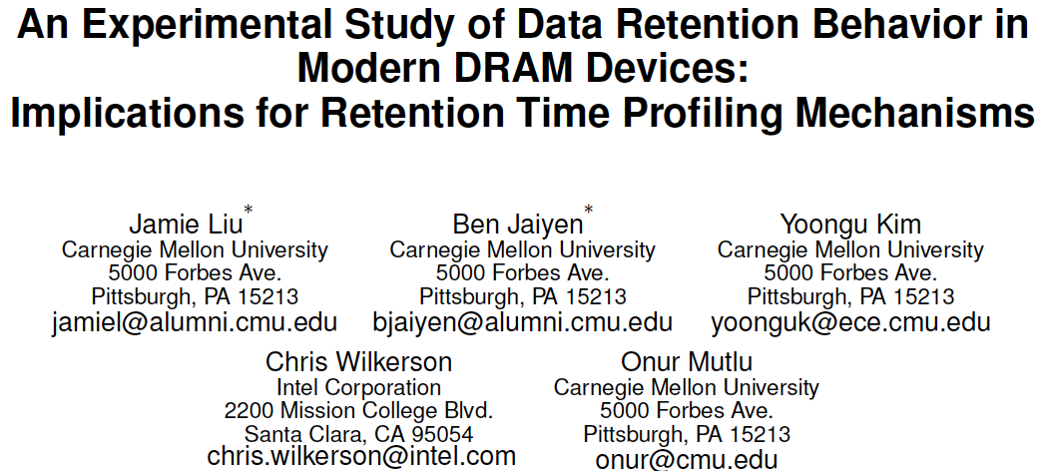
Infrastructure Enabled Research: Refresh
Jamie Liu, Ben Jaiyen, Yoongu Kim, Chris Wilkerson, and Onur Mutlu, "An Experimental Study of Data Retention Behavior in Modern DRAM Devices: Implications for Retention Time Profiling Mechanisms" Proceedings of the 40th International Symposium on Computer Architecture (ISCA), Tel-Aviv, Israel, June 2013. Slides (ppt) Slides (pdf)

Slide 84
Infrastructure Enabled Research: Latency
Donghyuk Lee, Yoongu Kim, Gennady Pekhimenko, Samira Khan, Vivek Seshadri, Kevin Chang, and Onur Mutlu, "Adaptive-Latency DRAM: Optimizing DRAM Timing for the Common-Case" Proceedings of the 21st International Symposium on High-Performance Computer Architecture (HPCA), Bay Area, CA, February 2015. [Slides (pptx) (pdf)] [Full data sets]

Slide 85
Infrastructure Enabled Research: Voltage
Kevin Chang, A. Giray Yaglikci, Saugata Ghose, Aditya Agrawal, Niladrish Chatterjee, Abhijith Kashyap, Donghyuk Lee, Mike O'Connor, Hasan Hassan, and Onur Mutlu, "Understanding Reduced-Voltage Operation in Modern DRAM Devices: Experimental Characterization, Analysis, and Mechanisms" Proceedings of the ACM International Conference on Measurement and Modeling of Computer Systems (SIGMETRICS), Urbana-Champaign, IL, USA, June 2017. [Abstract] [POMACS Journal Version (same content, different format)] [Slides (pptx) (pdf)] [Full Lecture Video (33 minutes)] [Full Data Sets and Circuit Model]

Slide 86
Infrastructure Enabled Research: ECC
Minesh Patel, Jeremie S. Kim, Hasan Hassan, and Onur Mutlu, "Understanding and Modeling On-Die Error Correction in Modern DRAM: An Experimental Study Using Real Devices" Proceedings of the 49th Annual IEEE/IFIP International Conference on Dependable Systems and Networks (DSN), Portland, OR, USA, June 2019. [Slides (pptx) (pdf)] [Talk Video (26 minutes)] [Full Talk Lecture (29 minutes)] [Source Code for EINSim, the Error Inference Simulator] Best paper award.

Slide 87
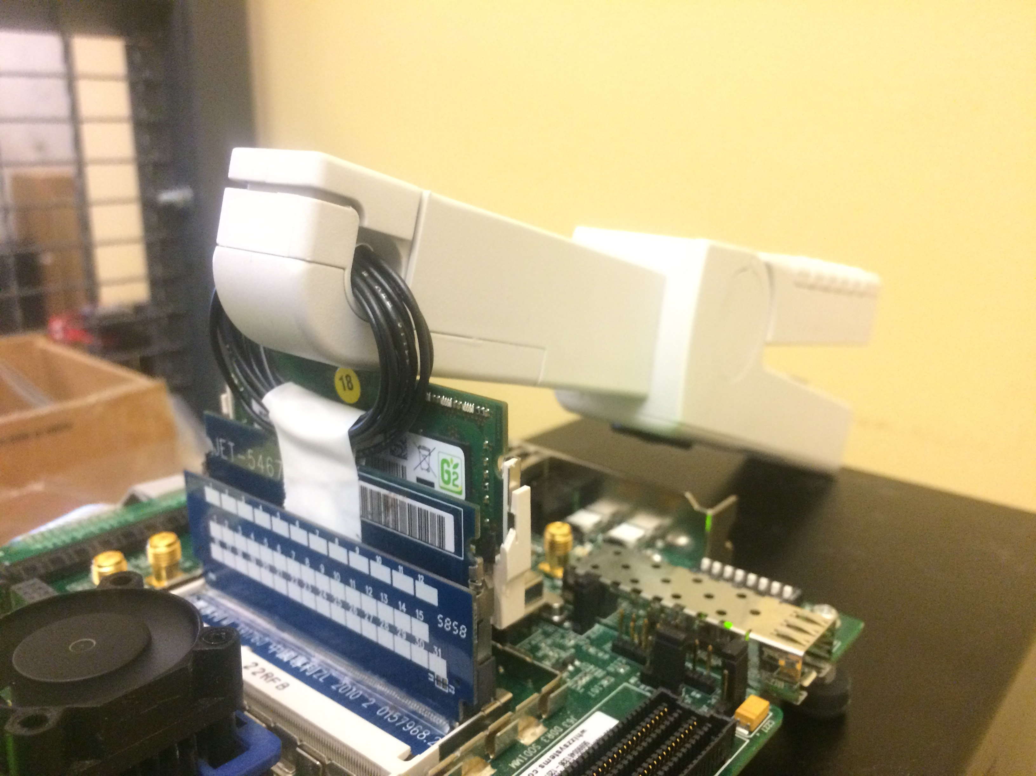
Power Measurement Platform
Keysight 34134A
DC Current Probe
DDR3L SO-DIMM
Virtex 6 FPGA
JET-5467A Riser Board
Notes:
50 SO-DIMMs -> 200 DRAM chips

Slide 88
Infrastructure Enabled Research: Power
Saugata Ghose, A. Giray Yaglikci, Raghav Gupta, Donghyuk Lee, Kais Kudrolli, William X. Liu, Hasan Hassan, Kevin K. Chang, Niladrish Chatterjee, Aditya Agrawal, Mike O'Connor, and Onur Mutlu, "What Your DRAM Power Models Are Not Telling You: Lessons from a Detailed Experimental Study" Proceedings of the ACM International Conference on Measurement and Modeling of Computer Systems (SIGMETRICS), Irvine, CA, USA, June 2018. [Abstract] [POMACS Journal Version (same content, different format)] [Slides (pptx) (pdf)] [VAMPIRE DRAM Power Model]

Slide 89
Infrastructure Enabled Research: PUF
Jeremie S. Kim, Minesh Patel, Hasan Hassan, and Onur Mutlu, "The DRAM Latency PUF: Quickly Evaluating Physical Unclonable Functions by Exploiting the Latency-Reliability Tradeoff in Modern DRAM Devices" Proceedings of the 24th International Symposium on High-Performance Computer Architecture (HPCA), Vienna, Austria, February 2018. [Lightning Talk Video] [Slides (pptx) (pdf)] [Lightning Session Slides (pptx) (pdf)]

Slide 90
Infrastructure Enabled Research: TRNG
Jeremie S. Kim, Minesh Patel, Hasan Hassan, Lois Orosa, and Onur Mutlu, "D-RaNGe: Using Commodity DRAM Devices to Generate True Random Numbers with Low Latency and High Throughput" Proceedings of the 25th International Symposium on High-Performance Computer Architecture (HPCA), Washington, DC, USA, February 2019. [Slides (pptx) (pdf)] [Full Talk Video (21 minutes)] [Full Talk Lecture Video (27 minutes)] Top Picks Honorable Mention by IEEE Micro.

Slide 91
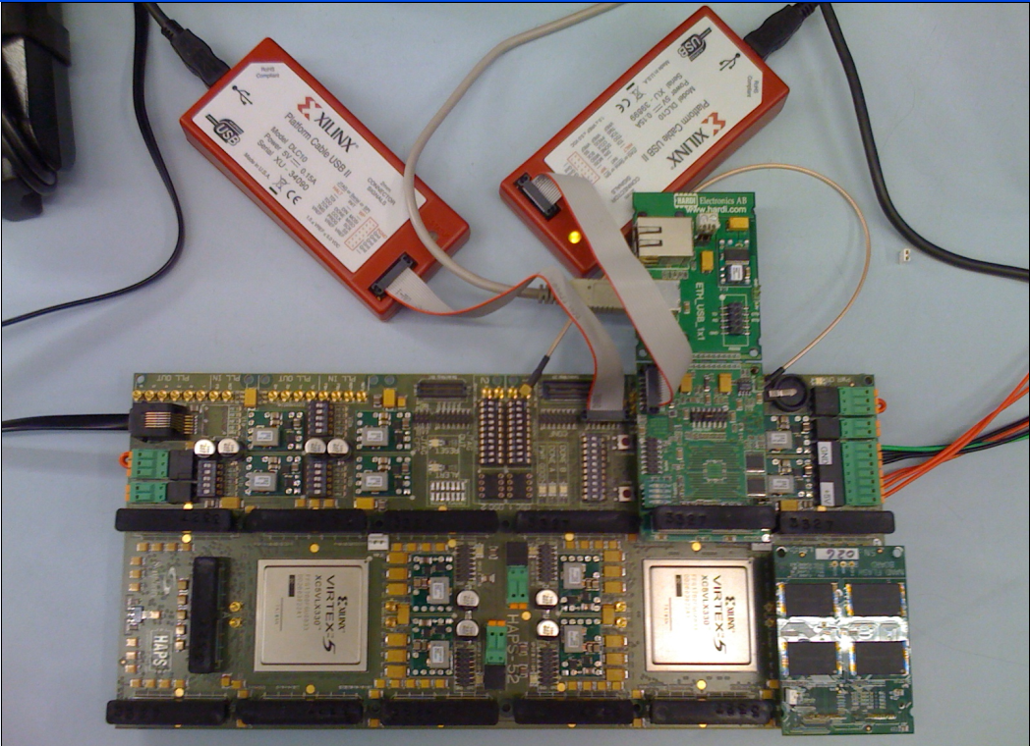
Our NAND Flash Infrastructure
USB Daughter Board
USB Jack
HAPS-52 Mother Board
Virtex-II Pro
(USB controller)
1x-nm
NAND Flash
Virtex-V FPGA
(NAND Controller)
[DATE 2012, ICCD 2012, DATE 2013, ITJ 2013, ICCD 2013, SIGMETRICS 2014, HPCA 2015, DSN 2015, MSST 2015, JSAC 2016, HPCA 2017, DFRWS 2017,
PIEEE 2017, HPCA 2018, SIGMETRICS 2018]
NAND Daughter Board
Cai+, “Error Characterization, Mitigation, and Recovery in Flash Memory Based Solid State Drives,” Proc. IEEE 2017.

Slide 92
Infrastructure Enabled Research: SSD Errors
Proceedings of the IEEE, Sept. 2017
https://arxiv.org/pdf/1706.08642

Slide 93
Ramulator – DRAM Simulation Infrastructure
Kim+, “Ramulator: A Flexible and Extensible DRAM Simulator”, IEEE CAL 2015.

Slide 94
Ramulator Paper and Source Code
Yoongu Kim, Weikun Yang, and Onur Mutlu, "Ramulator: A Fast and Extensible DRAM Simulator" IEEE Computer Architecture Letters (CAL), March 2015. [Source Code]
Source code is released under the liberal MIT License
https://github.com/CMU-SAFARI/ramulator

Slide 95
Ramulator-PIM Paper and Source Code
Gagandeep Singh, Juan Gomez-Luna, Giovanni Mariani, Geraldo F. Oliveira, Stefano Corda, Sander Stujik, Onur Mutlu, and Henk Corporaal, "NAPEL: Near-Memory Computing Application Performance Prediction via Ensemble Learning" Proceedings of the 56th Design Automation Conference (DAC), Las Vegas, NV, USA, June 2019. [Slides (pptx) (pdf)] [Poster (pptx) (pdf)] [Source Code for Ramulator-PIM]
https://github.com/CMU-SAFARI/ramulator-pim

Slide 96
Infrastructure Enabled Research: PIM (I)
Amirali Boroumand, Saugata Ghose, Youngsok Kim, Rachata Ausavarungnirun, Eric Shiu, Rahul Thakur, Daehyun Kim, Aki Kuusela, Allan Knies, Parthasarathy Ranganathan, and Onur Mutlu, "Google Workloads for Consumer Devices: Mitigating Data Movement Bottlenecks" Proceedings of the 23rd International Conference on Architectural Support for Programming Languages and Operating Systems (ASPLOS), Williamsburg, VA, USA, March 2018. [Slides (pptx) (pdf)] [Lightning Session Slides (pptx) (pdf)] [Poster (pptx) (pdf)] [Lightning Talk Video (2 minutes)] [Full Talk Video (21 minutes)]

Slide 97
Infrastructure Enabled Research: PIM (II)
Onur Mutlu, Saugata Ghose, Juan Gomez-Luna, and Rachata Ausavarungnirun, "Processing Data Where It Makes Sense: Enabling In-Memory Computation" Invited paper in Microprocessors and Microsystems (MICPRO), June 2019. [arXiv version]

Slide 98
Infrastructure Enabled Research: PIM (III)
Saugata Ghose, Amirali Boroumand, Jeremie S. Kim, Juan Gomez-Luna, and Onur Mutlu, "Processing-in-Memory: A Workload-Driven Perspective" Invited Article in IBM Journal of Research & Development, Special Issue on Hardware for Artificial Intelligence, to appear in November 2019. [Preliminary arXiv version]
https://arxiv.org/pdf/1907.12947.pdf

Slide 99
Infrastructure Enabled Research: PIM (IV)
Vivek Seshadri and Onur Mutlu, "In-DRAM Bulk Bitwise Execution Engine" Invited Book Chapter in Advances in Computers, to appear in 2020. [Preliminary arXiv version]

Slide 100
Question 2: Heterogeneity & Inclusiveness
How much is important the heterogeneity of the group? What about the inclusion?

Slide 101
Principle: Diversity & Heterogeneity
Diversity is very important
No two people are the same -- everyone brings perspective
Critical to be diverse, accepting, inclusive, heterogeneous
Age
Gender
Experience level
Education level
Geography (maybe natural in our field?)
Critical for open, expressive culture
Set a common goal and common culture

Slide 102
Principle: Environment of Freedom & Inclusion
Create an environment
that values
free exploration, openness, collaboration, hard work, creativity

Slide 103
Question 3: Choosing Students
Which are the main characteristics and skills one should take into account when choosing PhD students and researchers for new and (possibly) impactful research groups?

Slide 104
How to Select PhD Students & Researchers
Motivation and Mindset
Creativity
Resilience
Hard work
Boldness
Perseverance, commitment
Intellectual strength
Openness to feedback
Communicativeness
Ability to execute things until the end
…
A PhD is a long road. It is not for everyone. Commitment & resilience are critical.

Slide 105
How to Select Students
https://safari.ethz.ch/apply/

Slide 106
Question 4 and Answer: Mentoring
Can mentoring young students and managing a group be taught?
Answer: Yes (and, the mentoring process can be managed)
Mentoring is a critical part of a PhD

Slide 107
Question 5 and Answer: Emotional Intelligence
Emotional intelligence is considered today a key skill for managers and entrepreneurs. Do you believe that is it crucial also for research groups leaders?
Answer: Yes, absolutely
Communication, understanding, mindset are all critical
And part of Emotional Intelligence

Slide 108
Question 6 and Answer: Hierarchy
How does the group's internal hierarchy impact work effectiveness? Is a strong hierarchy implying a reduction of diversity and heterogeneity or not?
Answer: Less hierarchy is better. Yet, tasks of different types of students are different (postdoc vs PhD students)
Openness and valuing of every single person and idea, regardless of level or experience
Valuing of mentorship
Inexperienced folks learn from experienced ones
Everyone collaborates
No (artificial) barriers between people

Slide 109
Food for Thought: Three Quotes
The reasonable man adapts himself to the world;
The unreasonable one persists in trying to adapt the world to himself.
Therefore, all progress depends on the unreasonable man.
Progress is impossible without change,
and those who cannot change their minds
cannot change anything.
George Bernard Shaw
My heart is in the work.
Andrew Carnegie
Image: By Alvin Langdon Coburn - Illustrated London News, p. 575 (subscription required), PD-US, https://en.wikipedia.org/w/index.php?curid=49887931

Slide 110
How to Build an Impactful Research Group
Onur Mutlu
omutlu@gmail.com
https://people.inf.ethz.ch/omutlu
19 July 2020
DAC Early Career Workshop Panel

Slide 111
Backup Slides

Slide 112
Some Resilience Examples from Our Research

Slide 113
Enabling DRAM to Compute at Low Cost

Slide 114
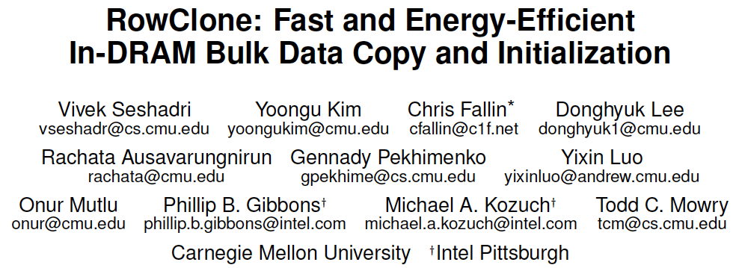
RowClone [MICRO’13]
Vivek Seshadri, Yoongu Kim, Chris Fallin, Donghyuk Lee, Rachata Ausavarungnirun, Gennady Pekhimenko, Yixin Luo, Onur Mutlu, Michael A. Kozuch, Phillip B. Gibbons, and Todd C. Mowry, "RowClone: Fast and Energy-Efficient In-DRAM Bulk Data Copy and Initialization" Proceedings of the 46th International Symposium on Microarchitecture (MICRO), Davis, CA, December 2013. [Slides (pptx) (pdf)] [Lightning Session Slides (pptx) (pdf)] [Poster (pptx) (pdf)]

Slide 115
Ambit [MICRO’17]
Vivek Seshadri et al., “Ambit: In-Memory Accelerator for Bulk Bitwise Operations Using Commodity DRAM Technology,” MICRO 2017.

Slide 116
Ambit
Vivek Seshadri and Onur Mutlu, "In-DRAM Bulk Bitwise Execution Engine" Invited Book Chapter in Advances in Computers, to appear in 2020. [Preliminary arXiv version]

Slide 117
In-Memory Bulk Bitwise Operations
We can support in-DRAM COPY, ZERO, AND, OR, NOT, MAJ
At low cost
Using analog computation capability of DRAM
Idea: activating multiple rows performs computation
30-74X performance and energy improvement
Seshadri+, “Ambit: In-Memory Accelerator for Bulk Bitwise Operations Using Commodity DRAM Technology,” MICRO 2017.
New memory technologies enable even more opportunities

Slide 118
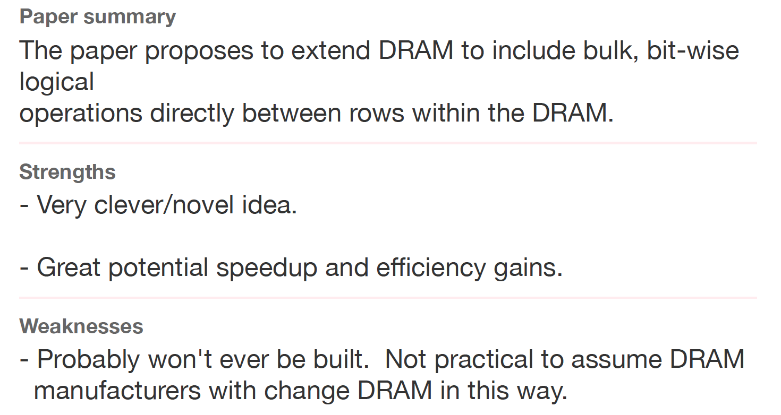
Ambit Sounds Good, No?
Review from ISCA 2016

Slide 119
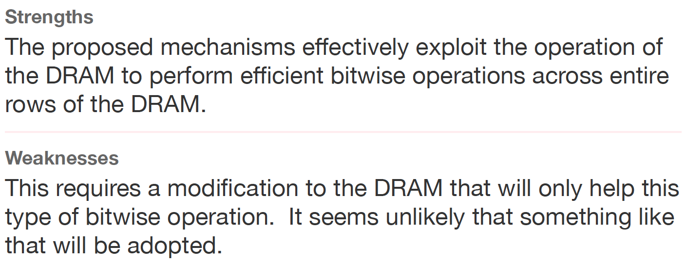
Another Review
Another Review from ISCA 2016

Slide 120
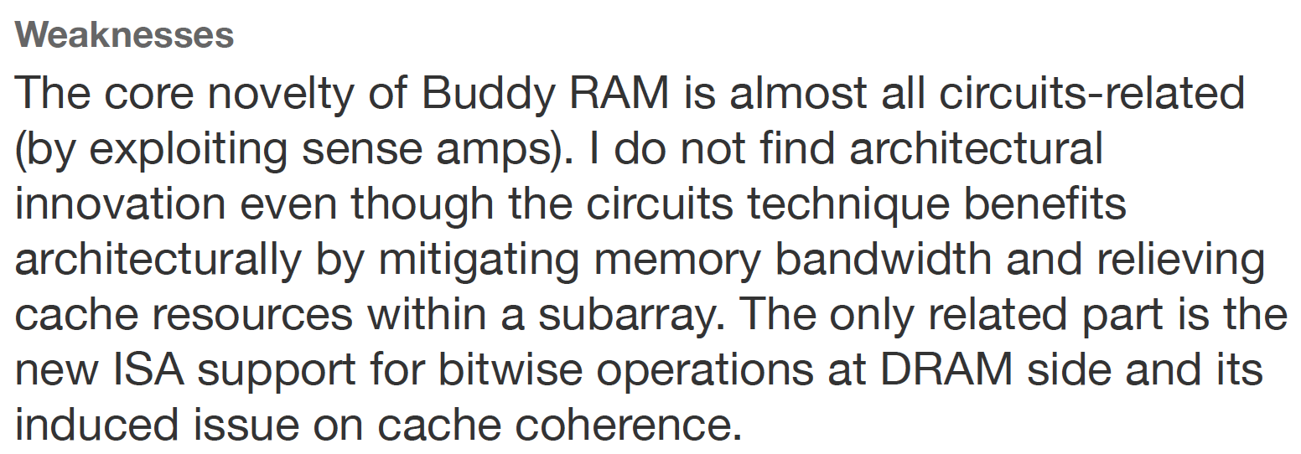
Yet Another Review
Yet Another Review from ISCA 2016

Slide 121
RowClone & Bitwise Ops in Real DRAM Chips
https://parallel.princeton.edu/papers/micro19-gao.pdf

Slide 122
Pinatubo: RowClone and Bitwise Ops in PCM
https://cseweb.ucsd.edu/~jzhao/files/Pinatubo-dac2016.pdf

Slide 123
We Have a Mindset Issue…
There are many other similar examples from reviews…
For many other papers…
And, we are not even talking about JEDEC yet…
How do we fix the mindset problem?
By doing more research, education, implementation in alternative processing paradigms
We need to work on enabling the better future…

Slide 124
Aside: A Recommended Book
Raj Jain, “The Art of
Computer Systems
Performance Analysis,”
Wiley, 1991.

Slide 125
Raj Jain, “The Art of
Computer Systems
Performance Analysis,”
Wiley, 1991.

Slide 126
Raj Jain, “The Art of
Computer Systems
Performance Analysis,”
Wiley, 1991.

Slide 127
Suggestions to Reviewers
Be fair; you do not know it all
Be open-minded; you do not know it all
Be accepting of diverse research methods: there is no single way of doing research
Be constructive, not destructive
Do not have double standards…
Do not block or delay scientific progress for non-reasons

Slide 128
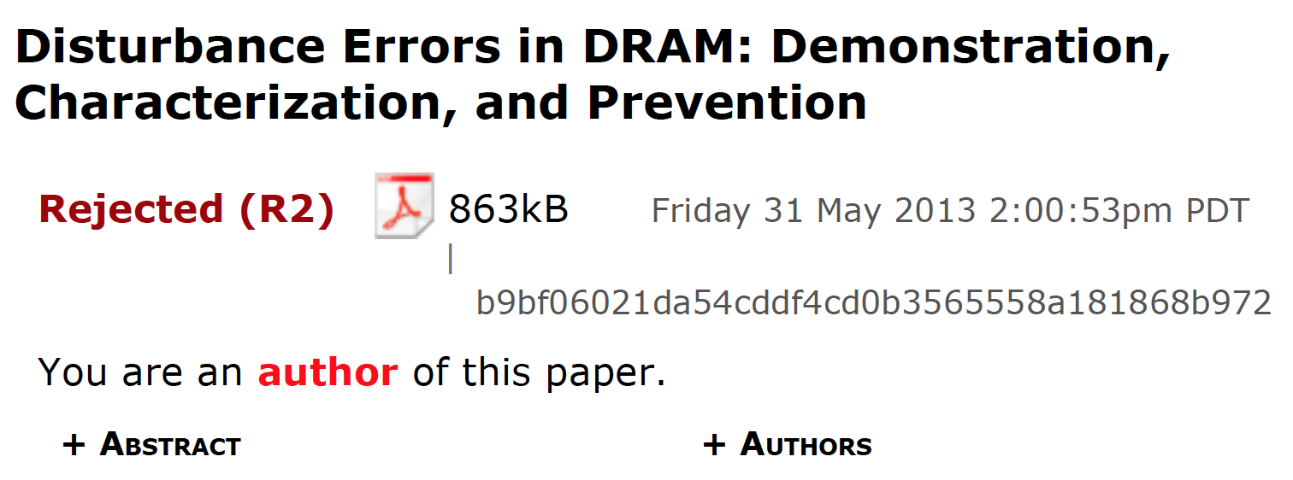
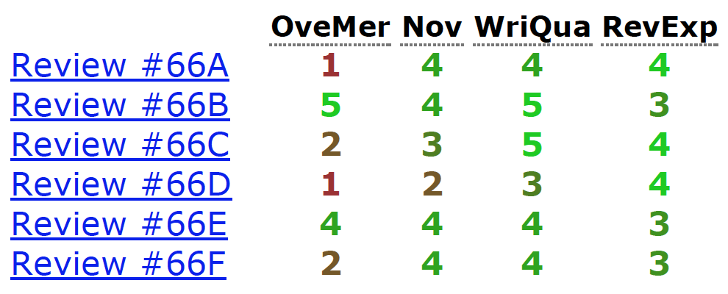
Initial RowHammer Reviews

Slide 129
Missing the Point
Reviews from Micro 2013

Slide 130
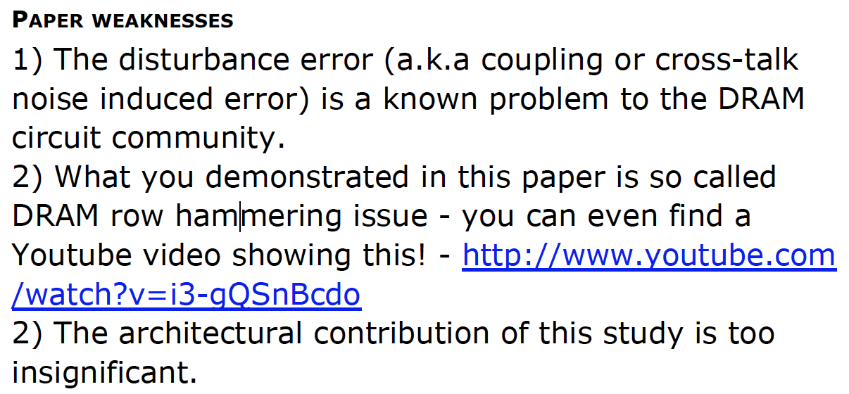
Dismissing Science
Reviews from ISCA 2014

Slide 131
Final RowHammer Reviews

Slide 132
Suggestion to Community
We Need to Fix the Reviewer Accountability Problem

Slide 133
Suggestion to Community
Eliminate
Double Standards

Slide 134
Another Recommended Book

Slide 135
Computer Architecture Today
You can revolutionize the way computers are built, if you understand both the hardware and the software (and change each accordingly)
You can invent new paradigms for computation, communication, and storage
Recommended book: Thomas Kuhn, “The Structure of Scientific Revolutions” (1962)
Pre-paradigm science: no clear consensus in the field
Normal science: dominant theory used to explain/improve things (business as usual); exceptions considered anomalies
Revolutionary science: underlying assumptions re-examined

Slide 136
Suggestion to Researchers: Principle: Passion
Follow Your Passion
(Do not get derailed
by naysayers)

Slide 137
Suggestion to Researchers: Principle: Resilience
Be Resilient

Slide 138
Principle: Learning and Scholarship
Focus on
learning and scholarship

Slide 139
Principle: Learning and Scholarship
The quality of your work defines your impact

Slide 140
More Thoughts and Suggestions
Onur Mutlu, "Some Reflections (on DRAM)" Award Speech for ACM SIGARCH Maurice Wilkes Award, at the ISCA Awards Ceremony, Phoenix, AZ, USA, 25 June 2019. [Slides (pptx) (pdf)] [Video of Award Acceptance Speech (Youtube; 10 minutes) (Youku; 13 minutes)] [Video of Interview after Award Acceptance (Youtube; 1 hour 6 minutes) (Youku; 1 hour 6 minutes)] [News Article on "ACM SIGARCH Maurice Wilkes Award goes to Prof. Onur Mutlu"]
Onur Mutlu, "How to Build an Impactful Research Group" Design Automation Conference Early Career Workshop, Las Vegas, NV, USA, June 2019. [Slides (pptx) (pdf)]

Slide 141
Funding Acknowledgments
Alibaba, AMD, ASML, Google, Facebook, Hi-Silicon, HP Labs, Huawei, IBM, Intel, Microsoft, Nvidia, Oracle, Qualcomm, Rambus, Samsung, Seagate, VMware
NSF
NIH
GSRC
SRC
CyLab

