Slide 1
How to Build an Impactful Research Group
Onur Mutlu
omutlu@gmail.com
https://people.inf.ethz.ch/omutlu
2 June 2019
DAC Early Career Workshop Panel

Slide 2
Intro & Research Group

Slide 3
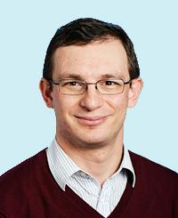
A Bit About Myself
Onur Mutlu
Full Professor @ ETH Zurich, since September 2015
Strecker Professor @ Carnegie Mellon University ECE/CS, 2009-2016, 2016-…
PhD from UT-Austin, worked at Google, VMware, Microsoft Research, Intel, AMD
https://people.inf.ethz.ch/omutlu/
omutlu@gmail.com (Best way to reach me)
https://people.inf.ethz.ch/omutlu/projects.htm
Research and Teaching in:
Computer architecture, computer systems, hardware security, bioinformatics
Memory and storage systems
Hardware security, safety, predictability
Fault tolerance
Hardware/software cooperation
Architectures for bioinformatics, health, medicine
…

Slide 4
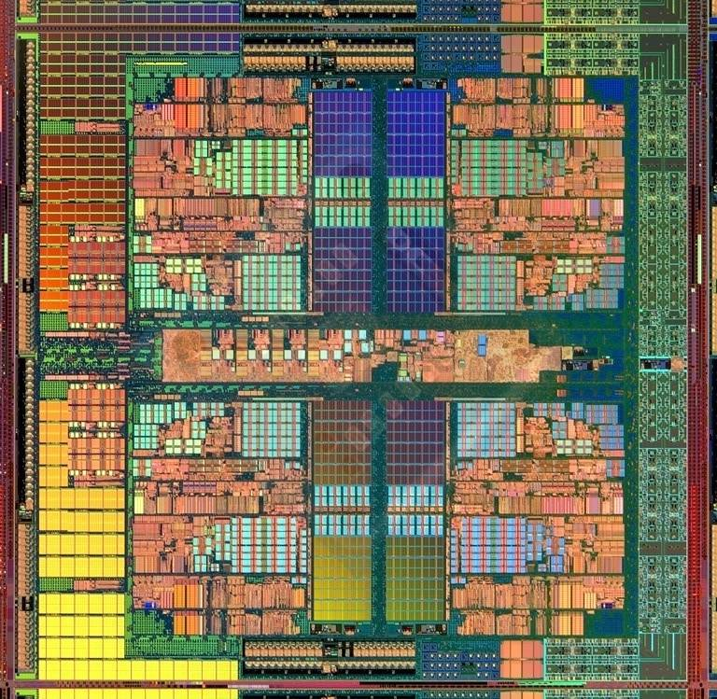
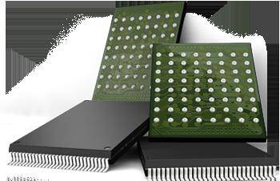
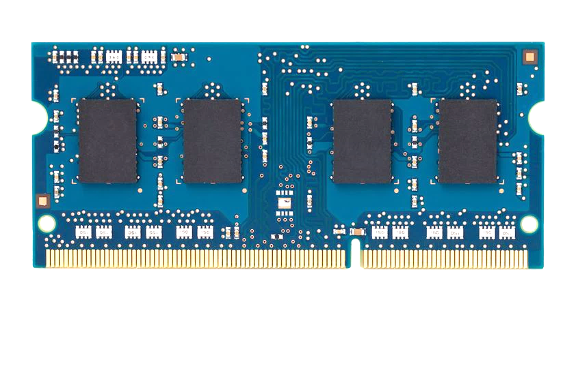
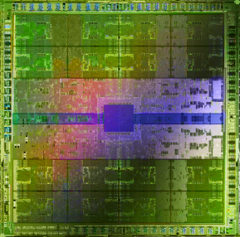
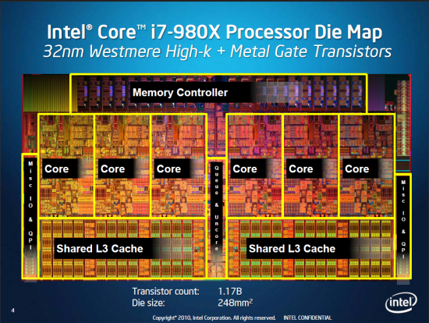
Current Research Focus Areas
Research Focus: Computer architecture, HW/SW, bioinformatics, security
Memory and storage (DRAM, flash, emerging), interconnects
Heterogeneous & parallel systems, GPUs, systems for data analytics
System/architecture interaction, new execution models, new interfaces
Hardware security, energy efficiency, fault tolerance, performance
Genome sequence analysis & assembly algorithms and architectures
Biologically inspired systems & system design for bio/medicine
Hybrid Main Memory
Heterogeneous
Processors and
Accelerators
Persistent Memory/Storage
Broad research
spanning apps, systems, logic
with architecture at the center
Graphics and Vision Processing
Notes:
Professor Mutlu’s research focus is all aspects of computer architecture, HW/SW interaction and bioinformatics.
He is looking for students to perform research in these areas.
He and his group, SAFARI, solve fundamental problems spanning:
Memory, memory, memory, storage, interconnects
Parallel architectures, heterogeneous architectures, GP-GPUs
System/architecture interaction, new execution models
Energy efficiency, fault tolerance, hardware security
Genome sequence analysis and assembly
His group does broad research spanning systems to logic with architecture at center

Slide 5
Research & Teaching: Some Overview Talks
https://www.youtube.com/watch?v=kgiZlSOcGFM&list=PL5Q2soXY2Zi8D_5MGV6EnXEJHnV2YFBJl
Future Computing Architectures
https://www.youtube.com/watch?v=kgiZlSOcGFM&list=PL5Q2soXY2Zi8D_5MGV6EnXEJHnV2YFBJl&index=1
Enabling In-Memory Computation
https://www.youtube.com/watch?v=oHqsNbxgdzM&list=PL5Q2soXY2Zi8D_5MGV6EnXEJHnV2YFBJl&index=7
Accelerating Genome Analysis
https://www.youtube.com/watch?v=hPnSmfwu2-A&list=PL5Q2soXY2Zi8D_5MGV6EnXEJHnV2YFBJl&index=9
Rethinking Memory System Design
https://www.youtube.com/watch?v=F7xZLNMIY1E&list=PL5Q2soXY2Zi8D_5MGV6EnXEJHnV2YFBJl&index=3

Slide 6
Accelerated Memory Course (~6.5 hours)
ACACES 2018
Memory Systems and Memory-Centric Computing Systems
Taught by Onur Mutlu July 9-13, 2018
~6.5 hours of lectures
Website for the Course including Videos, Slides, Papers
https://people.inf.ethz.ch/omutlu/acaces2018.html
https://www.youtube.com/playlist?list=PL5Q2soXY2Zi-HXxomthrpDpMJm05P6J9x
All Papers are at:
https://people.inf.ethz.ch/omutlu/projects.htm
Final lecture notes and readings (for all topics)

Slide 7
SAFARI Research Group
Think BIG, Aim HIGH!
https://safari.ethz.ch

Slide 8
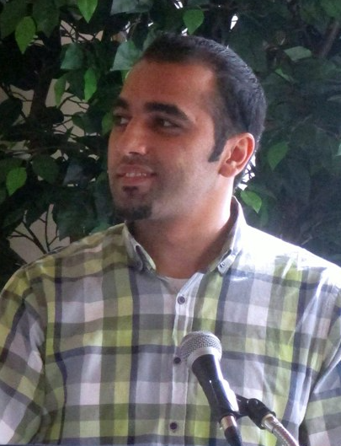
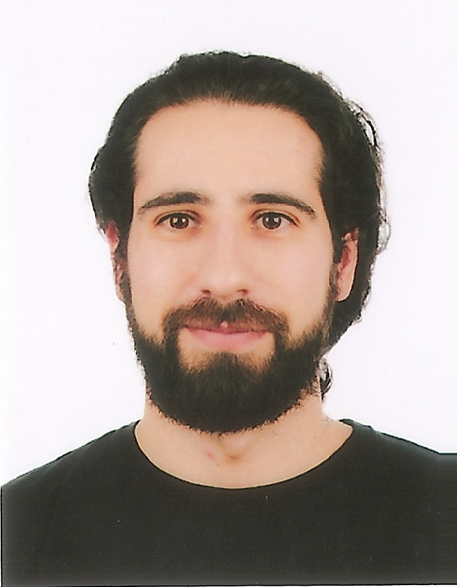
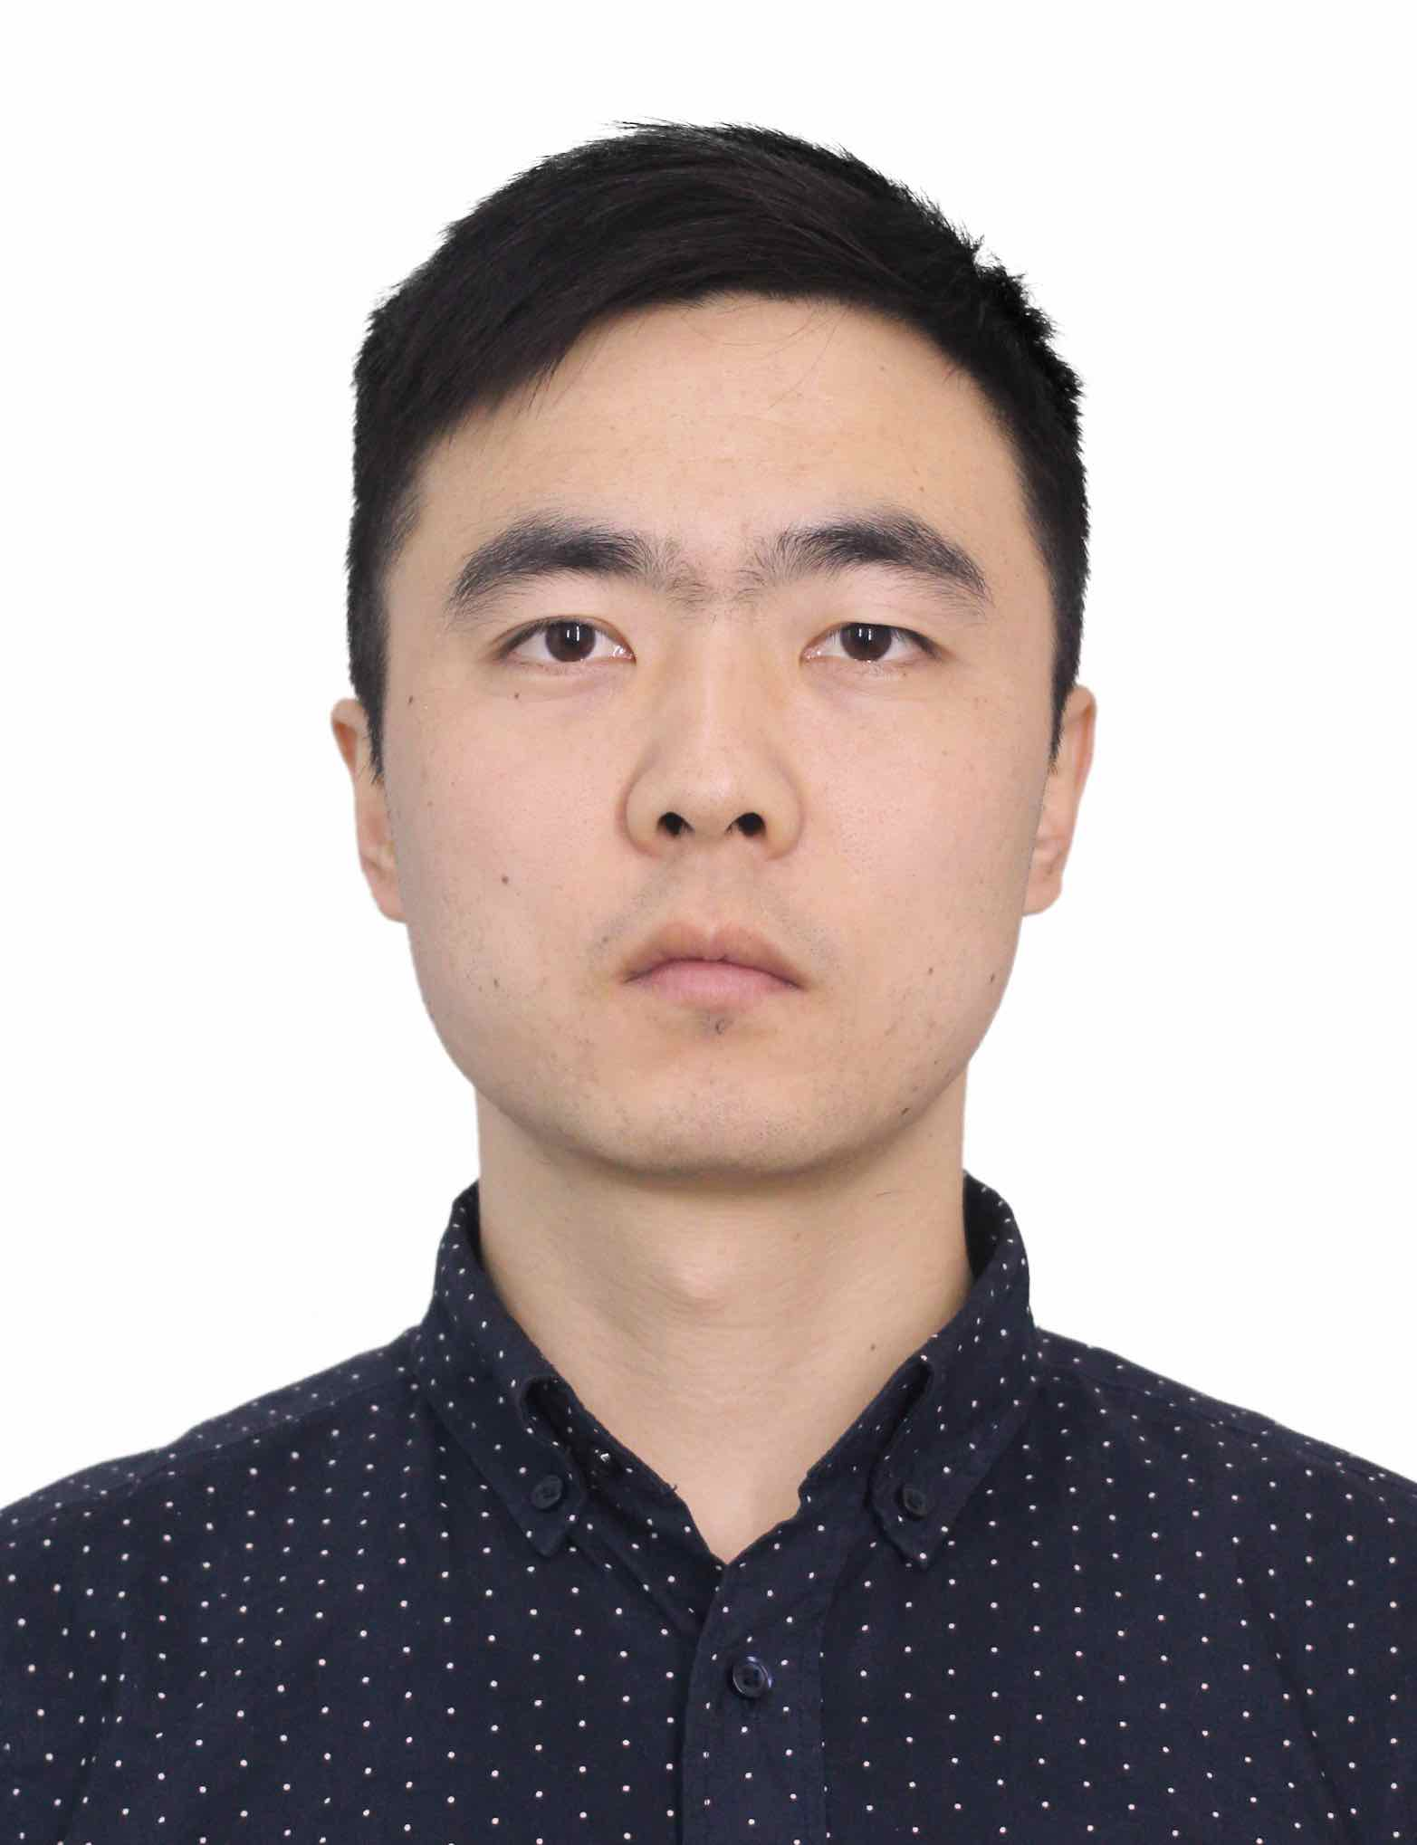
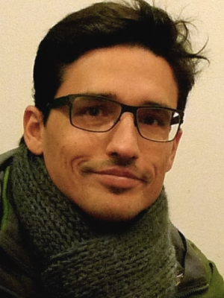
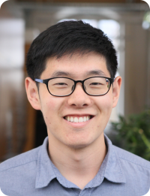
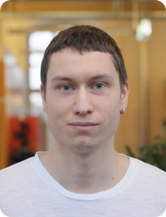
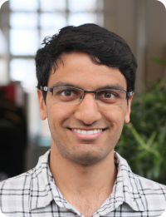
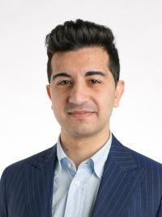
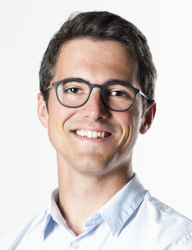
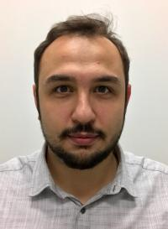
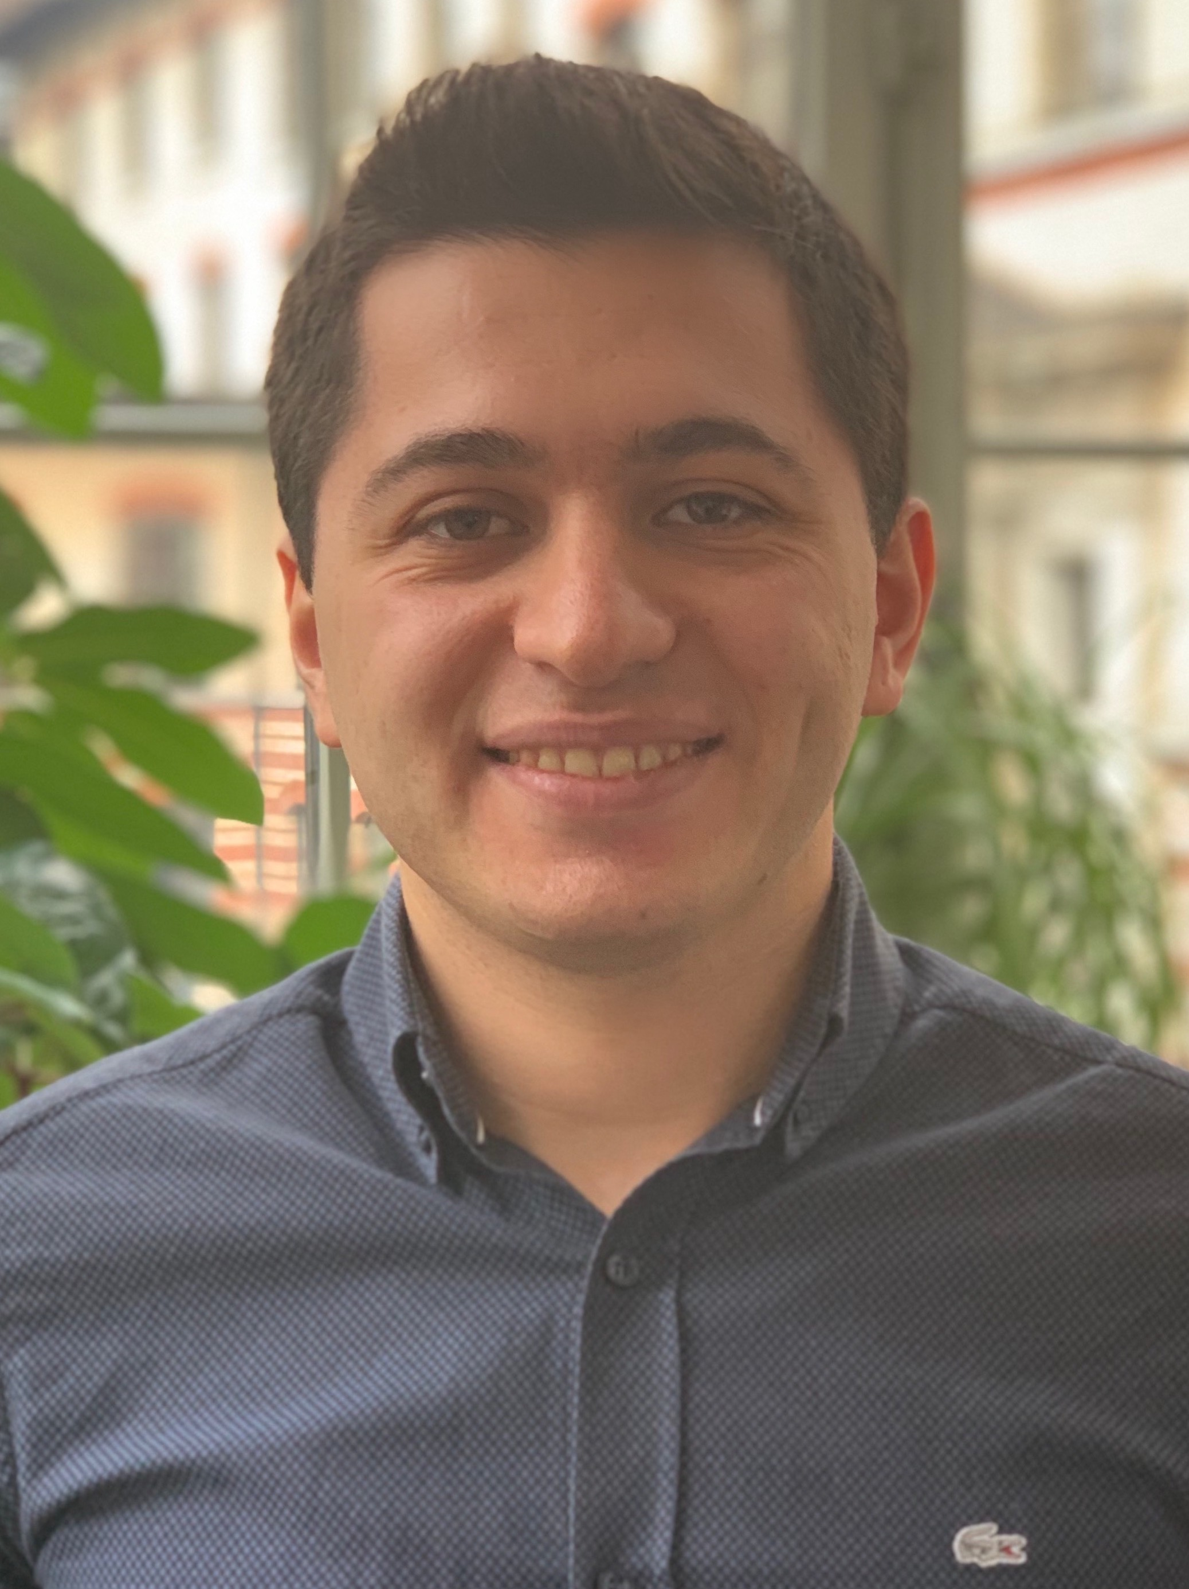
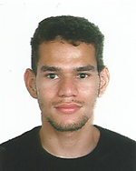
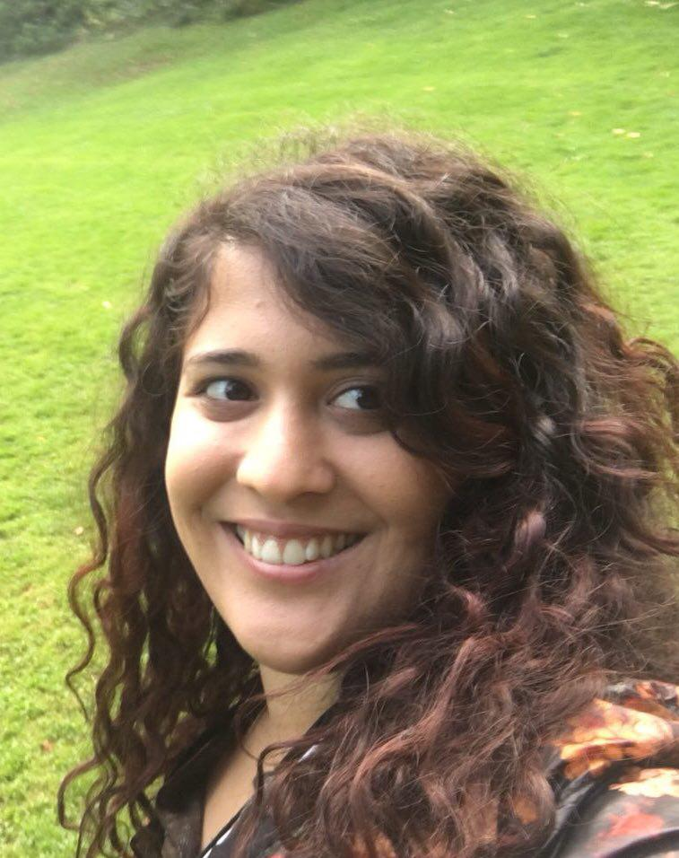
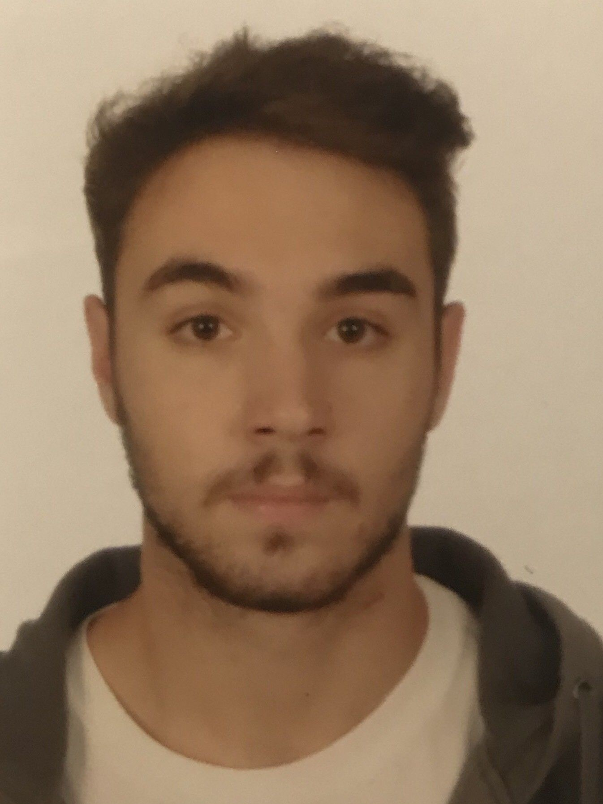
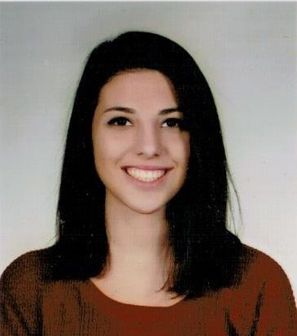
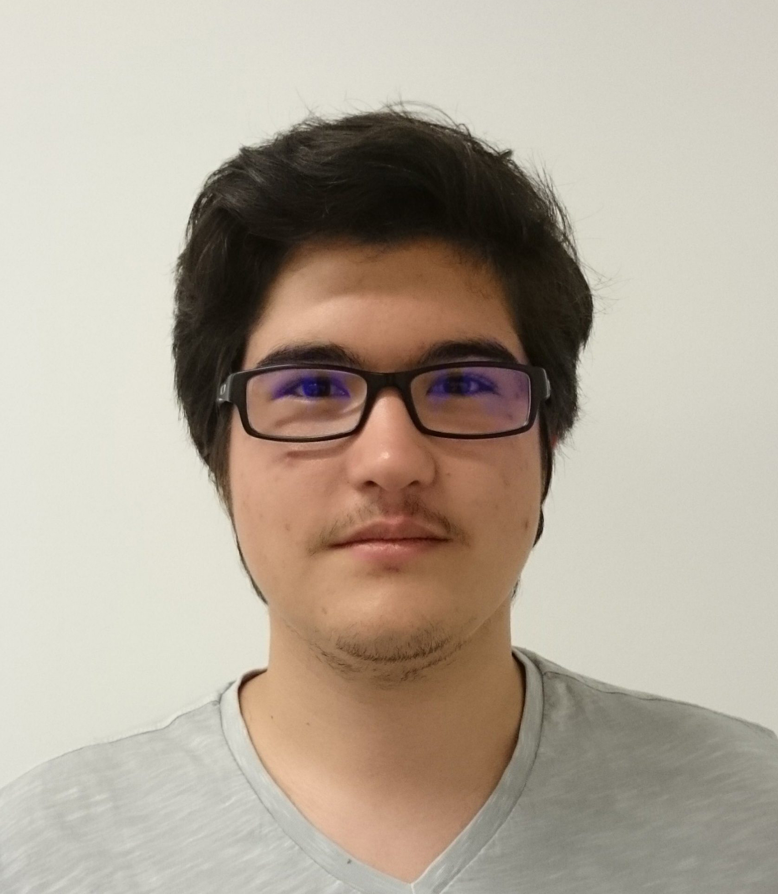
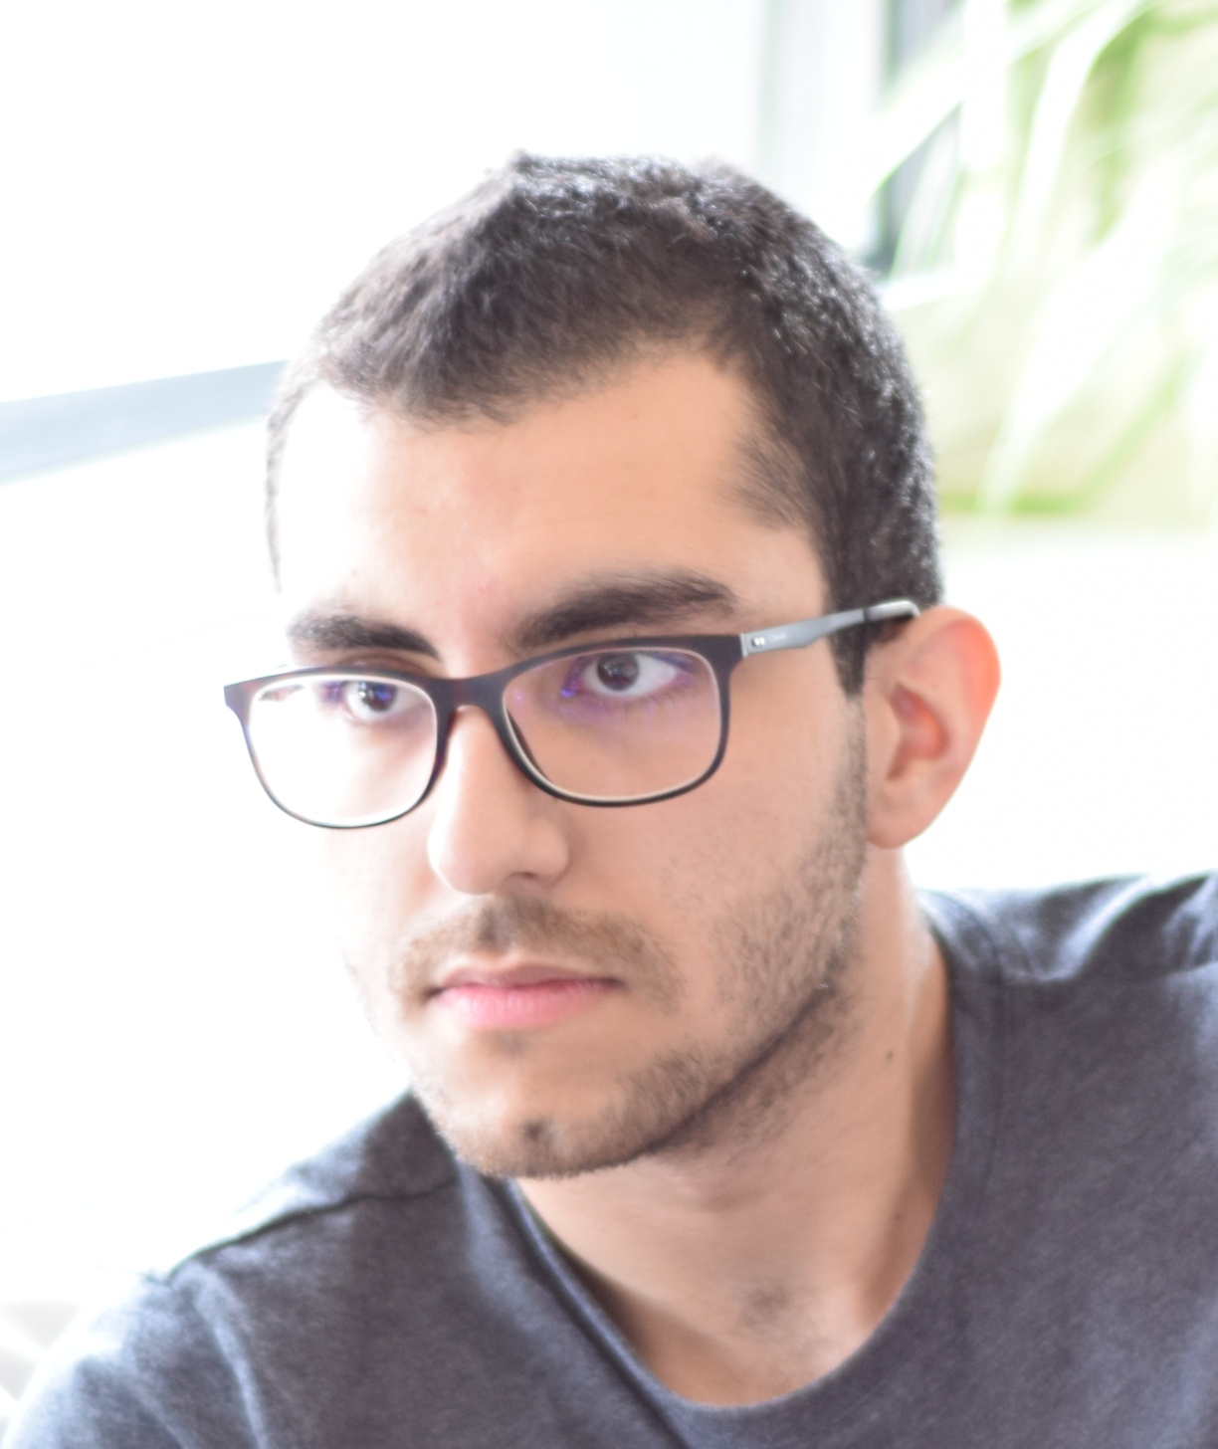
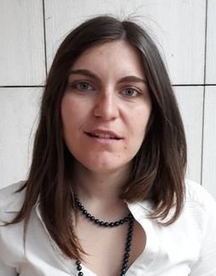
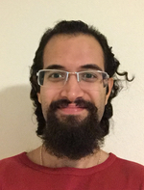
SAFARI Group Members @ ETH Zurich
4 Post-doctoral Researchers
8 PhD Students + 4 at CMU
5 Interns
15 Master’s and Bachelor’s Researchers
Dr. Mohammed Alser
Dr. Lois
Orosa
Dr. Yaohua
Wang
Dr. Juan
Gómez-Luna
Jeremie Kim
Hasan Hassan
Minesh Patel
Ivan Puddu
Lukas Breitwieser
Giray Yaglikci
Can Firtina
Geraldo F.
de Oliveira
Nika Mansouri
Skanda Koppula
Konstantinos
Kanellopoulos
Nisa Bostanci
Ataberk Olgun
Rokneddin Azizi
Christina
Giannoula
Taha
Shahroodi

Slide 9
Example Research Topics (I)
Onur Mutlu, Saugata Ghose, Juan Gomez-Luna, and Rachata Ausavarungnirun, "Processing Data Where It Makes Sense: Enabling In-Memory Computation" Invited paper in Microprocessors and Microsystems (MICPRO), June 2019. [arXiv version]

Slide 10
Example Research Topics (II)
Onur Mutlu, "The RowHammer Problem and Other Issues We May Face as Memory Becomes Denser" Invited Paper in Proceedings of the Design, Automation, and Test in Europe Conference (DATE), Lausanne, Switzerland, March 2017. [Slides (pptx) (pdf)]
https://people.inf.ethz.ch/omutlu/pub/rowhammer-and-other-memory-issues_date17.pdf

Slide 11
Example Research Topics (III)
Onur Mutlu, "Memory Scaling: A Systems Architecture Perspective" Technical talk at MemCon 2013 (MEMCON), Santa Clara, CA, August 2013. [Slides (pptx) (pdf)] [Video] [Coverage on StorageSearch]
https://people.inf.ethz.ch/omutlu/pub/memory-scaling_memcon13.pdf

Slide 12
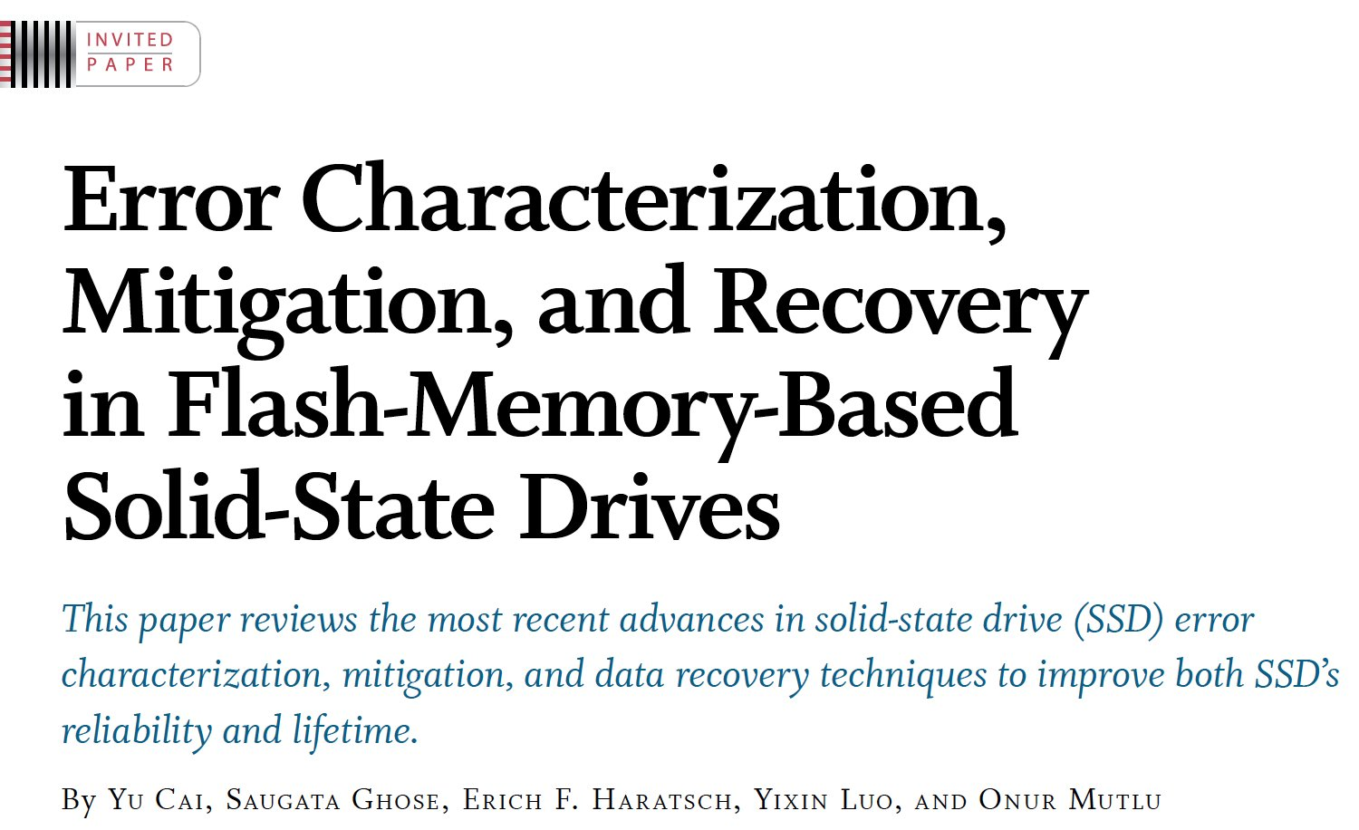
Example Research Topics (IV)
Proceedings of the IEEE, Sept. 2017
https://arxiv.org/pdf/1706.08642

Slide 13
Example Research Topics (V)
Onur Mutlu and Jeremie Kim, "RowHammer: A Retrospective" IEEE Transactions on Computer-Aided Design of Integrated Circuits and Systems (TCAD) Special Issue on Top Picks in Hardware and Embedded Security, 2019. [Preliminary arXiv version]

Slide 14
Teaching: Online Courses and Lectures
Freshman Digital Circuits and Computer Architecture Course Lecture Videos (2018, 2017)
Graduate Computer Architecture Course Lecture Videos (2018, 2017, 2015, 2013)
Undergraduate Computer Architecture Course Lecture Videos (2015, 2014, 2013)
Parallel Computer Architecture Course Materials (Lecture Videos)
https://people.inf.ethz.ch/omutlu/teaching.html
https://www.youtube.com/channel/UCIwQ8uOeRFgOEvBLYc3kc3g
https://www.youtube.com/user/cmu18447

Slide 15
Some Open Source Tools (I)
Rowhammer – Program to Induce RowHammer Errors
https://github.com/CMU-SAFARI/rowhammer
Ramulator – Fast and Extensible DRAM Simulator
https://github.com/CMU-SAFARI/ramulator
MemSim – Simple Memory Simulator
https://github.com/CMU-SAFARI/memsim
NOCulator – Flexible Network-on-Chip Simulator
https://github.com/CMU-SAFARI/NOCulator
SoftMC – FPGA-Based DRAM Testing Infrastructure
https://github.com/CMU-SAFARI/SoftMC
Other open-source software from my group
https://github.com/CMU-SAFARI/
http://www.ece.cmu.edu/~safari/tools.html

Slide 16
Some Open Source Tools (II)
MQSim – A Fast Modern SSD Simulator
https://github.com/CMU-SAFARI/MQSim
Mosaic – GPU Simulator Supporting Concurrent Applications
https://github.com/CMU-SAFARI/Mosaic
IMPICA – Processing in 3D-Stacked Memory Simulator
https://github.com/CMU-SAFARI/IMPICA
SMLA – Detailed 3D-Stacked Memory Simulator
https://github.com/CMU-SAFARI/SMLA
HWASim – Simulator for Heterogeneous CPU-HWA Systems
https://github.com/CMU-SAFARI/HWASim
Other open-source software from my group
https://github.com/CMU-SAFARI/
http://www.ece.cmu.edu/~safari/tools.html

Slide 17
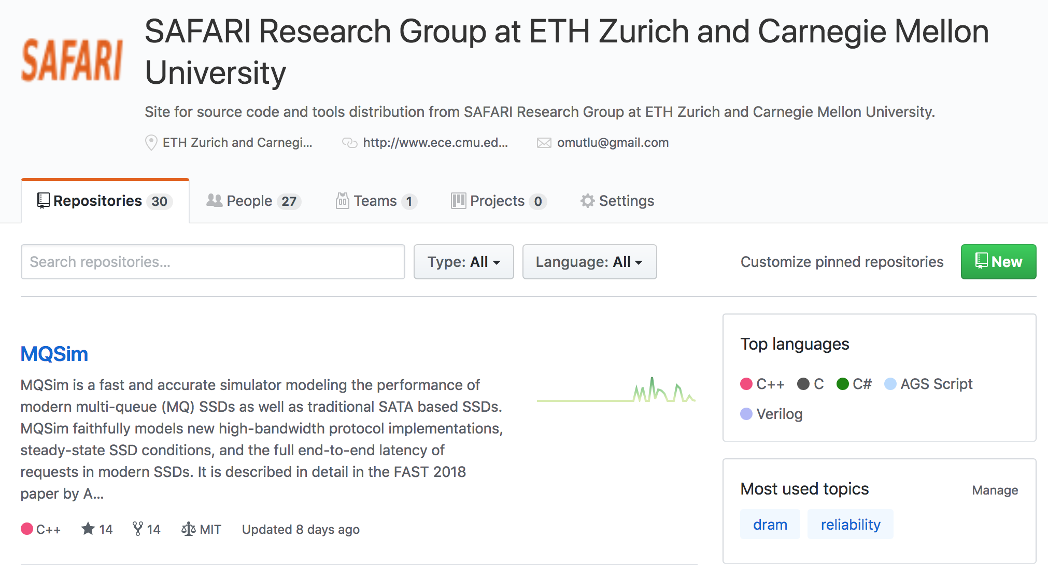
More Open Source Tools (III)
A lot more open-source software from my group
https://github.com/CMU-SAFARI/
http://www.ece.cmu.edu/~safari/tools.html

Slide 18
Papers
All are available at
https://people.inf.ethz.ch/omutlu/projects.htm
http://scholar.google.com/citations?user=7XyGUGkAAAAJ&hl=en
https://people.inf.ethz.ch/omutlu/acaces2018.html

Slide 19
Revisiting the Entire Stack
Problem
Algorithm
Program/Language
System Software
SW/HW Interface
Micro-architecture
Logic
Devices
Electrons

Slide 20
Panel Questions

Slide 21
Question 1
Which are the best practices that you would suggest to your peers as the essential one for the success of an academic team?

Slide 22
Before I Start…
There is no single way of having impact.
The following is my way, methods and principles.
There definitely are other ways.
The critical thing is finding the way that works well for you and your goals.
That you can own, cherish and optimize

Slide 23
Principle: Personalized Methods
Find the methods
that work for you

Slide 24
Motivation & Mindset

Slide 25
Principle: Mindset and Motivation
Start out with
the right
motivation and mindset

Slide 26
Motivation Sets The Culture and Goals
Mindset 1: change the world positively, have high influence
Mindset 2: enable students to achieve a potential that they did not even think they could ever achieve
Not papers
Not fame
Not money
…
Motivation correction may be needed at times – be ready

Slide 27
Principle: Team of Excellence
Get motivated students
Build a team of excellence

Slide 28
Principle: Learning and Scholarship
Focus on
learning and scholarship

Slide 29
Some Basics of Research
Slides used in several of my courses:
e.g., https://www.youtube.com/watch?v=M0y_Nvb9rGA

Slide 30
How To Do Research & Advanced Dev.
We will talk a lot about this in this course
Learning by example
Reading and evaluating strong and seminal papers & designs
Learning by doing
Semester-long research/design projects, masters’ projects, PhD thesis
Learning by open, critical discussions
Paper reading groups, frequent brainstorming and discussions
Design sessions
Collaborations
Slides used in several of my courses: e.g., https://www.youtube.com/watch?v=M0y_Nvb9rGA

Slide 31
Principle: Environment of Freedom
Create an environment
that values
free exploration, openness, collaboration, hard work, creativity

Slide 32
What Is The Goal of Research?
To generate new insight
that can enable what previously did not exist
Research is a hunt for insight that can eventually impact the world
Slides used in several of my courses: e.g., https://www.youtube.com/watch?v=M0y_Nvb9rGA

Slide 33
Principle: Insight and Ideas
Focus on Insight
Encourage New Ideas

Slide 34
Some Basic Advice for Good Research
Choose great problems to solve: Have great taste
Difficult
Important
High impact
Read heavily and critically
Think big (out of the box)
Do not restrain yourself to tweaks or constraints of today
Yet, think about adoption issues
Aim high
Write and present extremely well
Slides used in several of my courses: e.g., https://www.youtube.com/watch?v=M0y_Nvb9rGA

Slide 35
Many Principles on the Previous Slide

Slide 36
Principle: Bar
Set the Bar High

Slide 37
Set the Bar High
The goal should be to enable students to achieve a potential that they did not even think they could ever achieve
“Think big, aim high, enable positive change”
Reward good, positive behavior that helps with this culture
Recommended reading:
Hamming, “You and Your Research,” Talk at Bell Labs, 1986.

Slide 38
Principle: Focus on Fundamentals
Fundamentals
and scholarship
are critical
(hypes come and go)

Slide 39
Principle: Focus on Big Problems
Choose Great Problems
and guide your group toward them
(but give them freedom)

Slide 40
Principle: Teaching and Research
…
Teaching drives Research
Research drives Teaching
…

Slide 41
More on Teaching and Research
Care about teaching immensely
Teaching and research are two sides of the same coin → scholarship
Both long-term and short-term is affected by teaching
Research motivates teaching motivates research
I introduce RowHammer, Processing in Memory, Meltdown/Spectre, DRAM Refresh, Various Technology Scaling problems, and research examples in my Freshman course:
https://safari.ethz.ch/digitaltechnik/spring2019/
All courses can have research examples

Slide 42
Principle: Focus on Communication
Emphasize
Clarity and Rigor
in Communication
(critical for high impact)

Slide 43
Do Everything to Have High Impact
Engage with companies
Engage and collaborate with researchers who fit your mindset
Collaborate, not fight
Strive for the highest excellence

Slide 44
Principle: Collaboration
Foster collaboration
(within group)
(across groups)
(with companies)

Slide 45
Principle: Reach Out
Inspire and Reach Out

Slide 46
Principle: Reach Out
Give talks
Educate others on your work and research
Listen to everyone
Especially your students
Teach, educate, collaborate

Slide 47
Principle: Feedback
Receive & Address Feedback
(but do not get derailed)

Slide 48
Principle: Receive & Address Feedback
Address reviewer feedback
Take them positively
They can be helpful
Feedback is not always right
Need to apply corrections to it
Do not let rejection derail you – be ready for it
Remind and encourage your students:
https://www.sciencealert.com/these-8-papers-were-rejected-before-going-on-to-win-the-nobel-prize

Slide 49
Principle: Resilience
Be Resilient

Slide 50
Principle: Passion
Follow Your Passion

Slide 51
If In Doubt, See Other Doubtful Technologies
A very “doubtful” emerging technology
for at least two decades
Proceedings of the IEEE, Sept. 2017
https://arxiv.org/pdf/1706.08642

Slide 52
Principle: Build Infrastructure
Build Infrastructure to Enable Your Passion
(Big Projects)

Slide 53
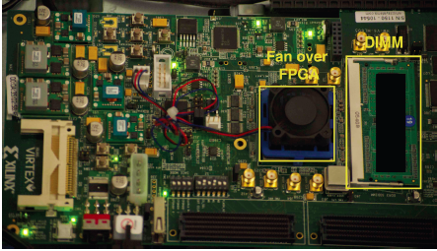
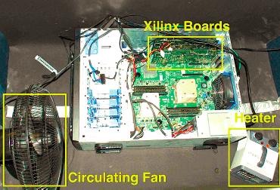
Example: Our DRAM Infrastructure (since 2012)
An Experimental Study of Data Retention Behavior in Modern DRAM Devices: Implications for Retention Time Profiling Mechanisms (Liu et al., ISCA 2013)
The Efficacy of Error Mitigation Techniques for DRAM Retention Failures: A Comparative Experimental Study
(Khan et al., SIGMETRICS 2014)
Flipping Bits in Memory Without Accessing Them: An Experimental Study of DRAM Disturbance Errors (Kim et al., ISCA 2014)
Adaptive-Latency DRAM: Optimizing DRAM Timing for the Common-Case (Lee et al., HPCA 2015)
AVATAR: A Variable-Retention-Time (VRT) Aware Refresh for DRAM Systems (Qureshi et al., DSN 2015)

Slide 54
Example: Our DRAM Infrastructure (since 2012)
Temperature
Controller
FPGAs
Heater
FPGAs
PC
Kim+, “Flipping Bits in Memory Without Accessing Them: An Experimental Study of DRAM Disturbance Errors,” ISCA 2014.

Slide 55
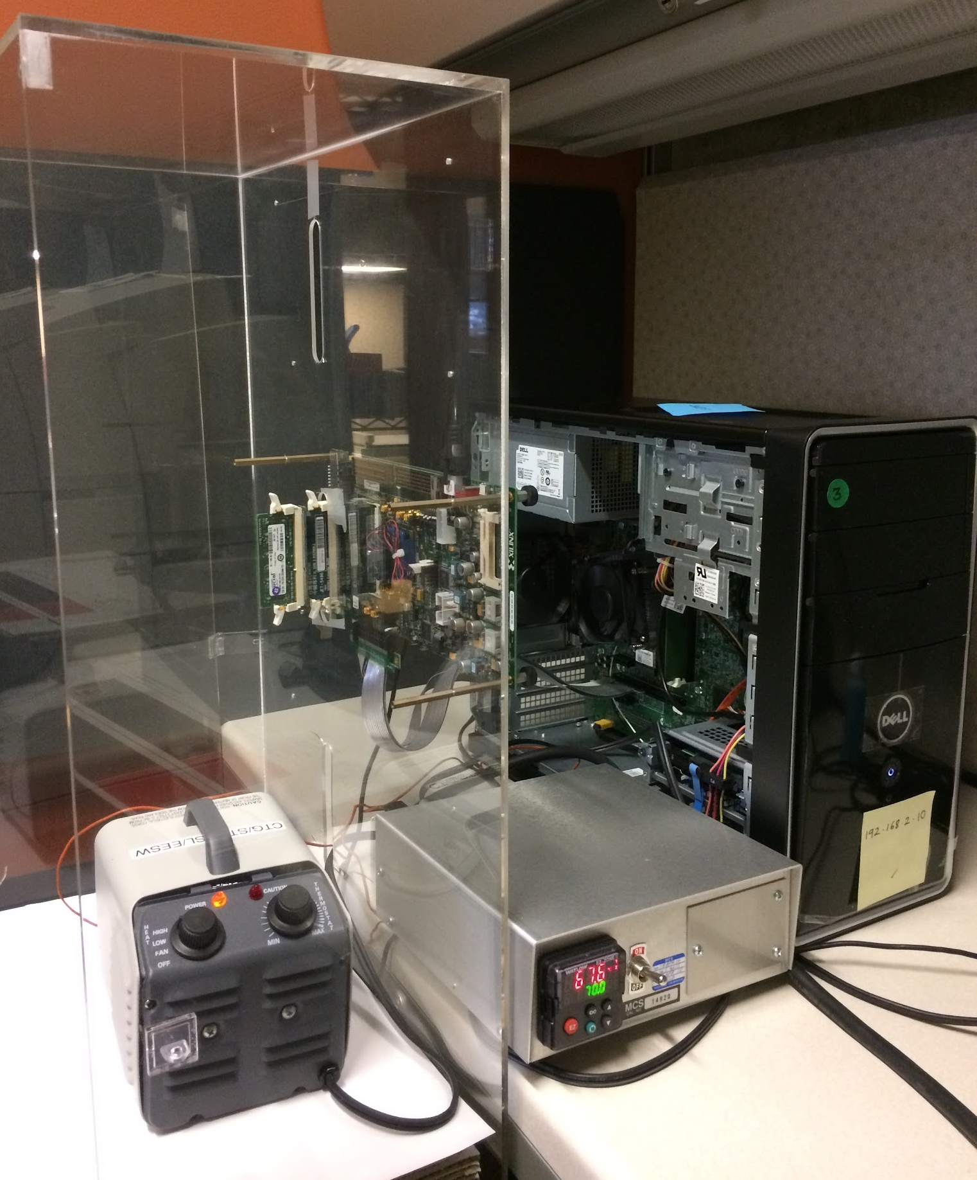
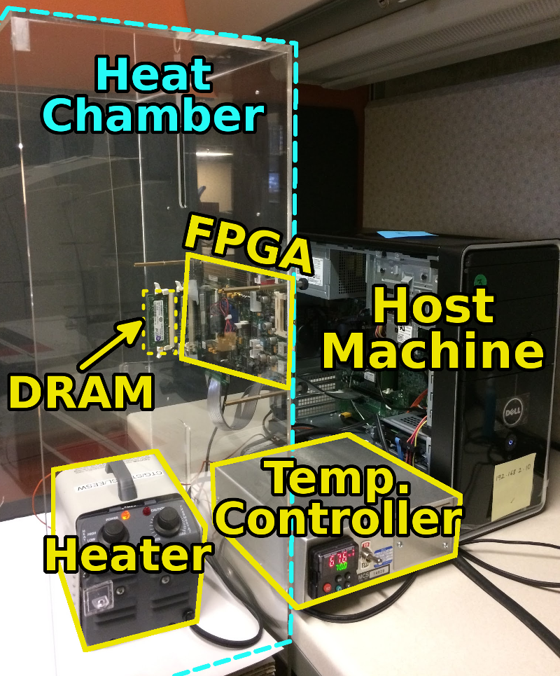
SoftMC: Open Source DRAM Infrastructure
Hasan Hassan et al., “SoftMC: A Flexible and Practical Open-Source Infrastructure for Enabling Experimental DRAM Studies,” HPCA 2017.
Flexible
Easy to Use (C++ API)
Open-source
github.com/CMU-SAFARI/SoftMC

Slide 56
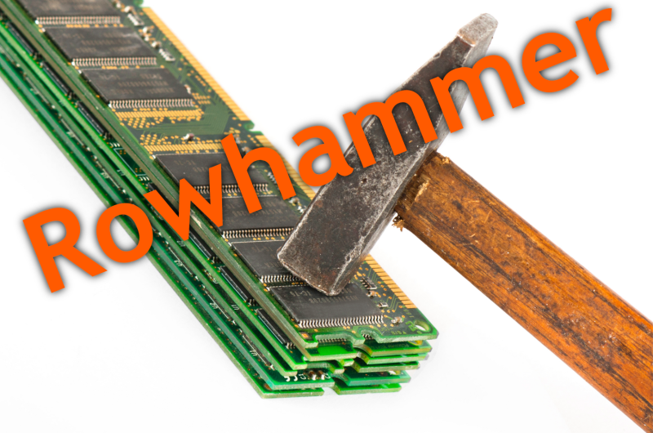
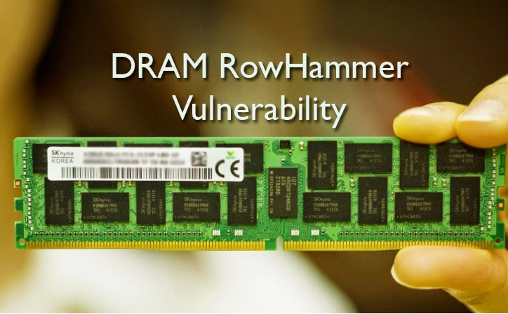
Infrastructure Enabled Research: RowHammer
Notes:
Picture from the article:
http://thehackernews.com/2015/03/dram-rowhammer-vulnerability.html

Slide 57
Infrastructure Enabled Research: RowHammer
Yoongu Kim, Ross Daly, Jeremie Kim, Chris Fallin, Ji Hye Lee, Donghyuk Lee, Chris Wilkerson, Konrad Lai, and Onur Mutlu, "Flipping Bits in Memory Without Accessing Them: An Experimental Study of DRAM Disturbance Errors" Proceedings of the 41st International Symposium on Computer Architecture (ISCA), Minneapolis, MN, June 2014. [Slides (pptx) (pdf)] [Lightning Session Slides (pptx) (pdf)] [Source Code and Data]

Slide 58
Infrastructure Enabled Research: RowHammer
Onur Mutlu and Jeremie Kim, "RowHammer: A Retrospective" IEEE Transactions on Computer-Aided Design of Integrated Circuits and Systems (TCAD) Special Issue on Top Picks in Hardware and Embedded Security, 2019.
[Preliminary arXiv version]

Slide 59
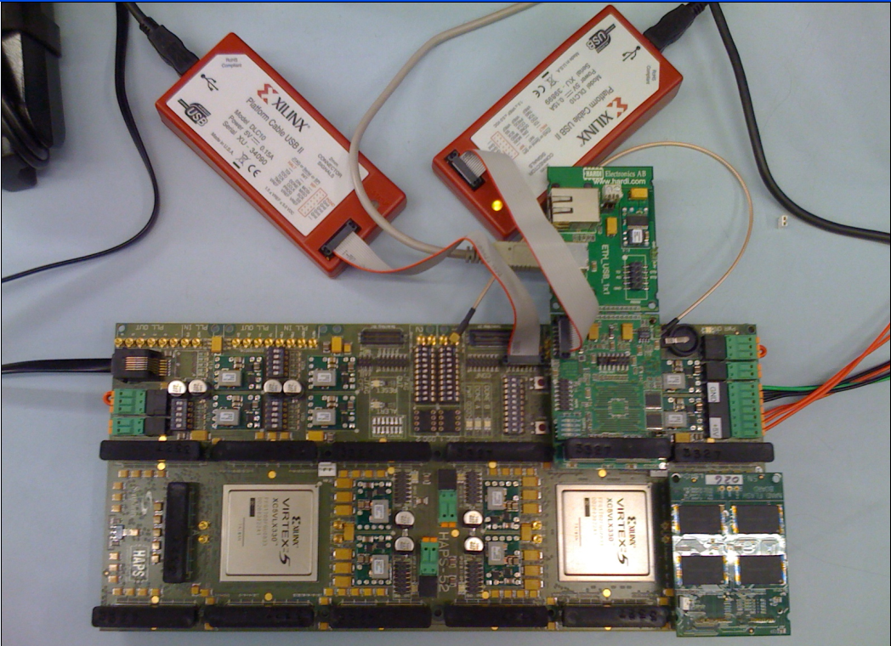
Our NAND Flash Infrastructure
USB Daughter Board
USB Jack
HAPS-52 Mother Board
Virtex-II Pro
(USB controller)
1x-nm
NAND Flash
Virtex-V FPGA
(NAND Controller)
[DATE 2012, ICCD 2012, DATE 2013, ITJ 2013, ICCD 2013, SIGMETRICS 2014, HPCA 2015, DSN 2015, MSST 2015, JSAC 2016, HPCA 2017, DFRWS 2017,
PIEEE 2017, HPCA 2018, SIGMETRICS 2018]
NAND Daughter Board
Cai+, “Error Characterization, Mitigation, and Recovery in Flash Memory Based Solid State Drives,” Proc. IEEE 2017.

Slide 60
Infrastructure Enabled Research: SSD Errors
Proceedings of the IEEE, Sept. 2017
https://arxiv.org/pdf/1706.08642

Slide 61
Ramulator – DRAM Simulation Infrastructure
Kim+, “Ramulator: A Flexible and Extensible DRAM Simulator”, IEEE CAL 2015.

Slide 62
Ramulator Paper and Source Code
Yoongu Kim, Weikun Yang, and Onur Mutlu, "Ramulator: A Fast and Extensible DRAM Simulator" IEEE Computer Architecture Letters (CAL), March 2015. [Source Code]
Source code is released under the liberal MIT License
https://github.com/CMU-SAFARI/ramulator

Slide 63
Infrastructure Enabled Research: PIM (I)
Amirali Boroumand, Saugata Ghose, Youngsok Kim, Rachata Ausavarungnirun, Eric Shiu, Rahul Thakur, Daehyun Kim, Aki Kuusela, Allan Knies, Parthasarathy Ranganathan, and Onur Mutlu, "Google Workloads for Consumer Devices: Mitigating Data Movement Bottlenecks" Proceedings of the 23rd International Conference on Architectural Support for Programming Languages and Operating Systems (ASPLOS), Williamsburg, VA, USA, March 2018. [Slides (pptx) (pdf)] [Lightning Session Slides (pptx) (pdf)] [Poster (pptx) (pdf)] [Lightning Talk Video (2 minutes)] [Full Talk Video (21 minutes)]

Slide 64
Infrastructure Enabled Research: PIM (II)
Onur Mutlu, Saugata Ghose, Juan Gomez-Luna, and Rachata Ausavarungnirun, "Processing Data Where It Makes Sense: Enabling In-Memory Computation" Invited paper in Microprocessors and Microsystems (MICPRO), June 2019. [arXiv version]

Slide 65
Question 2
How much is important the heterogeneity of the group? What about the inclusion?

Slide 66
Principle: Diversity
Diversity is very important
Noone is the same -- everyone brings perspective
Critical to be diverse, accepting, inclusive
Age
Gender
Experience level
Education level
Geography (natural in our field)
Critical for open, expressive culture
Set a common goal and common culture

Slide 67
Principle: Environment of Freedom
Create an environment
that values
free exploration, openness, collaboration, hard work, creativity

Slide 68
Question 3
Which are the main characteristics and skills one should take into account when choosing PhD students and researchers for new and (possibly) impactful research groups?

Slide 69
How to Select PhD Students & Researchers
Motivation and Mindset
Creativity
Resilience
Hard work
Boldness
Perseverance, commitment
Intellectual strength
Openness to feedback
Communicativeness
…

Slide 70
Question 4 and Answer
Can mentoring young students and managing a group be taught?
Answer: Yes
Mentoring is a critical part of a PhD

Slide 71
Question 5 and Answer
Emotional intelligence is considered today a key skill for managers and entrepreneurs. Do you believe that is it crucial also for research groups leaders?
Answer: Yes
Communication, understanding, mindset are all critical
And part of Emotional Intelligence

Slide 72
Question 6 and Answer
How does the group's internal hierarchy impact work effectiveness? Is a strong hierarchy implying a reduction of diversity and heterogeneity or not?
Answer: Flat hierarchy is better.
Openness and valuing of every single person and idea, regardless of level or experience
Valuing of mentorship
Inexperienced folks learn from experienced ones
Everyone collaborates
No artificial barriers between people

Slide 73
Food for Thought: Two Quotes
The reasonable man adapts himself to the world;
The unreasonable one persists in trying adapt the world to himself.
Therefore all progress depends on the unreasonable man.
George Bernard Shaw
Progress is impossible without change,
and those who cannot change their minds
cannot change anything.
Image: By Alvin Langdon Coburn - Illustrated London News, p. 575 (subscription required), PD-US, https://en.wikipedia.org/w/index.php?curid=49887931

Slide 74
How to Build an Impactful Research Group
Onur Mutlu
omutlu@gmail.com
https://people.inf.ethz.ch/omutlu
2 June 2019
DAC Early Career Workshop Panel

