Slide 1
Intelligent Architectures for Intelligent Computing Systems
Onur Mutlu
omutlu@gmail.com
https://people.inf.ethz.ch/omutlu
2 February 2021
DATE Special Session Invited Talk

Slide 2
The Problem
Computing
is Bottlenecked by Data

Slide 3
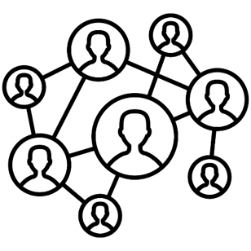
Data is Key for Future Workloads
In-memory Databases
[Mao+, EuroSys’12; Clapp+ (Intel), IISWC’15]
Graph/Tree Processing
[Xu+, IISWC’12; Umuroglu+, FPL’15]
In-Memory Data Analytics
[Clapp+ (Intel), IISWC’15;
Awan+, BDCloud’15]
Datacenter Workloads [Kanev+ (Google), ISCA’15]

Slide 4
Data Overwhelms Modern Machines
In-memory Databases
[Mao+, EuroSys’12; Clapp+ (Intel), IISWC’15]
Graph/Tree Processing
[Xu+, IISWC’12; Umuroglu+, FPL’15]
Data → performance & energy bottleneck
In-Memory Data Analytics
[Clapp+ (Intel), IISWC’15;
Awan+, BDCloud’15]
Datacenter Workloads [Kanev+ (Google), ISCA’15]

Slide 5
Data is Key for Future Workloads
Chrome
TensorFlow Mobile
Google’s web browser
Google’s machine learning framework
Video Playback
Video Capture
Google’s video codec
Google’s video codec
Notes:
In this work, we take a look at widely-used google consumer workloads, to figure out the major sources of energy consumption.
We look at Google Chrome web brower. We take a look at Tensorflow, Google’s machine learning framework, and we also take a look at two important video related workloads, video playback and video capture, both rely on Google’s vp9 codec technology.

Slide 6
Data Overwhelms Modern Machines
Chrome
TensorFlow Mobile
Google’s web browser
Google’s machine learning framework
Data → performance & energy bottleneck
Video Playback
Video Capture
Google’s video codec
Google’s video codec
Notes:
In this work, we take a look at widely-used google consumer workloads, to figure out the major sources of energy consumption.
We look at Google Chrome web brower. We take a look at Tensorflow, Google’s machine learning framework, and we also take a look at two important video related workloads, video playback and video capture, both rely on Google’s vp9 codec technology.

Slide 7
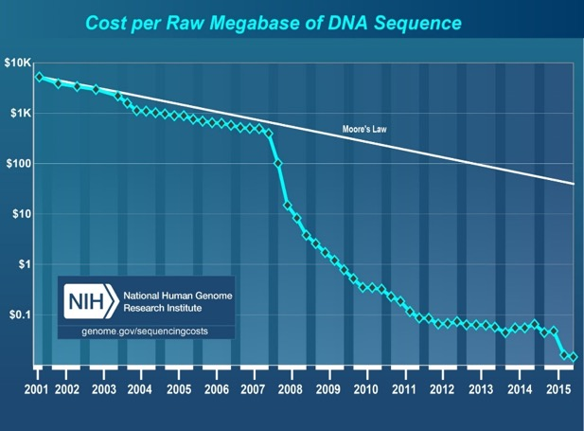
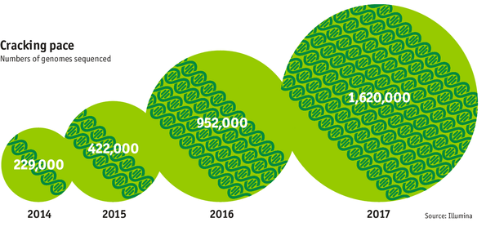
Data is Key for Future Workloads
development of high-throughput sequencing (HTS) technologies
Number of Genomes Sequenced
http://www.economist.com/news/21631808-so-much-genetic-data-so-many-uses-genes-unzipped
Notes:
However, since the development of high throughput sequencing (HTS) technologies, the cost of genome sequencing has fallen off a cliff (<< 1,000$) making it viable for almost everyone's use.

Slide 8
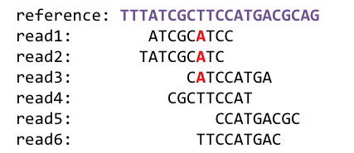
1
Sequencing
Genome Analysis
Read Mapping
2
Data → performance & energy bottleneck
Variant Calling
Scientific Discovery
3
4
Notes:
Genome analysis starts with sequencing random short DNA fragments of copies of the original molecule.
Unfortunately, these reads lack information about their order and which part of genome they are originated from.
Hence the second step is to map these reads to a long reference genome.

Slide 9
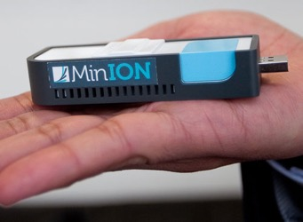
New Genome Sequencing Technologies
Oxford Nanopore MinION
Senol Cali+, “Nanopore Sequencing Technology and Tools for Genome
Assembly: Computational Analysis of the Current State, Bottlenecks
and Future Directions,” Briefings in Bioinformatics, 2018.
[Open arxiv.org version]

Slide 10
New Genome Sequencing Technologies
Oxford Nanopore MinION
Senol Cali+, “Nanopore Sequencing Technology and Tools for Genome
Assembly: Computational Analysis of the Current State, Bottlenecks
and Future Directions,” Briefings in Bioinformatics, 2018.
[Preliminary arxiv.org version]
Data → performance & energy bottleneck

Slide 11
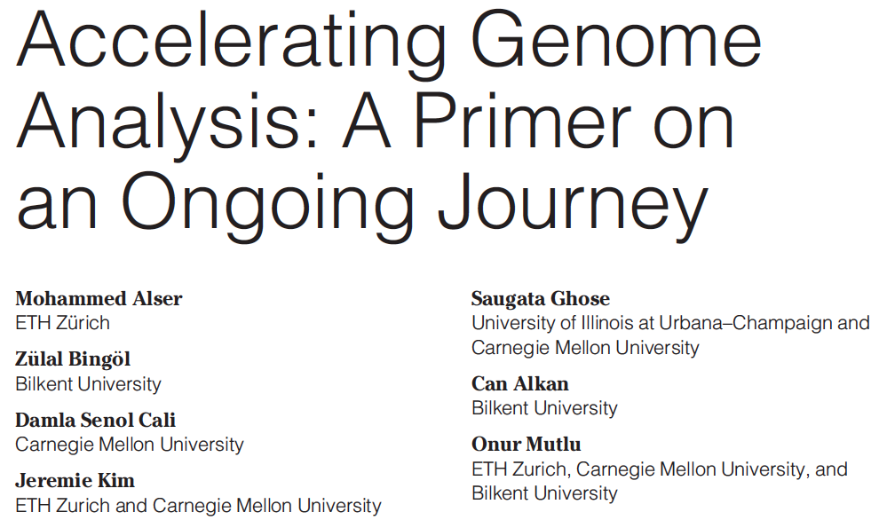
Accelerating Genome Analysis
Mohammed Alser, Zulal Bingol, Damla Senol Cali, Jeremie Kim, Saugata Ghose, Can Alkan, and Onur Mutlu, "Accelerating Genome Analysis: A Primer on an Ongoing Journey" IEEE Micro (IEEE MICRO), Vol. 40, No. 5, pages 65-75, September/October 2020. [Slides (pptx)(pdf)] [Talk Video (1 hour 2 minutes)]

Slide 12
GenASM Framework [MICRO 2020]
Damla Senol Cali, Gurpreet S. Kalsi, Zulal Bingol, Can Firtina, Lavanya Subramanian, Jeremie S. Kim, Rachata Ausavarungnirun, Mohammed Alser, Juan Gomez-Luna, Amirali Boroumand, Anant Nori, Allison Scibisz, Sreenivas Subramoney, Can Alkan, Saugata Ghose, and Onur Mutlu, "GenASM: A High-Performance, Low-Power Approximate String Matching Acceleration Framework for Genome Sequence Analysis" Proceedings of the 53rd International Symposium on Microarchitecture (MICRO), Virtual, October 2020. [Lighting Talk Video (1.5 minutes)] [Lightning Talk Slides (pptx) (pdf)] [Talk Video (18 minutes)] [Slides (pptx) (pdf)]

Slide 13
Data Overwhelms Modern Machines …
Storage/memory capability
Communication capability
Computation capability
Greatly impacts robustness, energy, performance, cost

Slide 14
Data Movement Overwhelms Modern Machines
Amirali Boroumand, Saugata Ghose, Youngsok Kim, Rachata Ausavarungnirun, Eric Shiu, Rahul Thakur, Daehyun Kim, Aki Kuusela, Allan Knies, Parthasarathy Ranganathan, and Onur Mutlu, "Google Workloads for Consumer Devices: Mitigating Data Movement Bottlenecks" Proceedings of the 23rd International Conference on Architectural Support for Programming Languages and Operating Systems (ASPLOS), Williamsburg, VA, USA, March 2018.
62.7% of the total system energy
is spent on data movement

Slide 15
Axiom
An Intelligent Architecture
Handles Data Well

Slide 16
How to Handle Data Well
Ensure data does not overwhelm the components
via intelligent algorithms
via intelligent architectures
via whole system designs: algorithm-architecture-devices
Take advantage of vast amounts of data and metadata
to improve architectural & system-level decisions
Understand and exploit properties of (different) data
to improve algorithms & architectures in various metrics

Slide 17
Corollaries: Architectures Today …
Architectures are terrible at dealing with data
Designed to mainly store and move data vs. to compute
They are processor-centric as opposed to data-centric
Architectures are terrible at taking advantage of vast amounts of data (and metadata) available to them
Designed to make simple decisions, ignoring lots of data
They make human-driven decisions vs. data-driven decisions
Architectures are terrible at knowing and exploiting different properties of application data
Designed to treat all data as the same
They make component-aware decisions vs. data-aware

Slide 18
Architectures for Intelligent Machines
Data-centric
Data-driven
Data-aware

Slide 19
Data-Centric (Memory-Centric) Architectures

Slide 20
Data-Centric Architectures: Properties
Process data where it resides (where it makes sense)
Processing in and near memory structures
Low-latency and low-energy data access
Low latency memory
Low energy memory
Low-cost data storage and processing
High capacity memory at low cost: hybrid memory, compression
Intelligent data management
Intelligent controllers handling robustness, security, cost

Slide 21
Processing Data Where It Makes Sense

Slide 22
Goal: Processing Inside Memory
Many questions … How do we design the:
compute-capable memory & controllers?
processor chip and in-memory units?
software and hardware interfaces?
system software, compilers, languages?
algorithms and theoretical foundations?
Memory
Processor
Core
Database
Graphs
Media
Cache
Query
Interconnect
Problem
Results
Algorithm
Program/Language
System Software
SW/HW Interface
Micro-architecture
Logic
Devices
Electrons

Slide 23
Memory as an Accelerator
CPU
core
CPU
core
mini-CPU
core
GPU
(throughput)
core
GPU
(throughput)
core
video
core
GPU
(throughput)
core
GPU
(throughput)
core
CPU
core
CPU
core
Memory
imaging
core
LLC
Specialized
compute-capability
in memory
Memory Controller
Memory Bus
Memory similar to a “conventional” accelerator

Slide 24
Processing in Memory: Two Approaches
1. Minimally changing memory chips
2. Exploiting 3D-stacked memory

Slide 25
Approach 1: Minimally Changing Memory
DRAM has great capability to perform bulk data movement and computation internally with small changes
Can exploit internal connectivity to move data
Can exploit analog computation capability
…
Examples: RowClone, In-DRAM AND/OR, Gather/Scatter DRAM
RowClone: Fast and Efficient In-DRAM Copy and Initialization of Bulk Data (Seshadri et al., MICRO 2013)
Fast Bulk Bitwise AND and OR in DRAM (Seshadri et al., IEEE CAL 2015)
Gather-Scatter DRAM: In-DRAM Address Translation to Improve the Spatial Locality of Non-unit Strided Accesses (Seshadri et al., MICRO 2015)
"Ambit: In-Memory Accelerator for Bulk Bitwise Operations Using Commodity DRAM Technology” (Seshadri et al., MICRO 2017)

Slide 26
In-Memory Bulk Bitwise Operations
We can support in-DRAM COPY, ZERO, AND, OR, NOT, MAJ
At low cost
Using analog computation capability of DRAM
Idea: activating multiple rows performs computation
30-60X performance and energy improvement
Seshadri+, “Ambit: In-Memory Accelerator for Bulk Bitwise Operations Using Commodity DRAM Technology,” MICRO 2017.
New memory technologies enable even more opportunities
Memristors, resistive RAM, phase change mem, STT-MRAM, …
Can operate on data with minimal movement

Slide 27
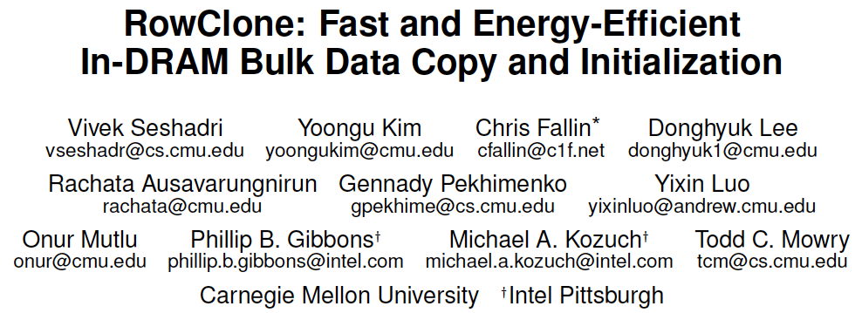
RowClone: In-DRAM Data Copy and Init.
Vivek Seshadri, Yoongu Kim, Chris Fallin, Donghyuk Lee, Rachata Ausavarungnirun, Gennady Pekhimenko, Yixin Luo, Onur Mutlu, Michael A. Kozuch, Phillip B. Gibbons, and Todd C. Mowry, "RowClone: Fast and Energy-Efficient In-DRAM Bulk Data Copy and Initialization" Proceedings of the 46th International Symposium on Microarchitecture (MICRO), Davis, CA, December 2013. [Slides (pptx) (pdf)] [Lightning Session Slides (pptx) (pdf)] [Poster (pptx) (pdf)]

Slide 28
LISA: Increasing Connectivity in DRAM
Kevin K. Chang, Prashant J. Nair, Saugata Ghose, Donghyuk Lee, Moinuddin K. Qureshi, and Onur Mutlu, "Low-Cost Inter-Linked Subarrays (LISA): Enabling Fast Inter-Subarray Data Movement in DRAM" Proceedings of the 22nd International Symposium on High-Performance Computer Architecture (HPCA), Barcelona, Spain, March 2016. [Slides (pptx) (pdf)] [Source Code]

Slide 29
FIGARO: Fine-Grained In-DRAM Copy
Yaohua Wang, Lois Orosa, Xiangjun Peng, Yang Guo, Saugata Ghose, Minesh Patel, Jeremie S. Kim, Juan Gómez Luna, Mohammad Sadrosadati, Nika Mansouri Ghiasi, and Onur Mutlu, "FIGARO: Improving System Performance via Fine-Grained In-DRAM Data Relocation and Caching" Proceedings of the 53rd International Symposium on Microarchitecture (MICRO), Virtual, October 2020.

Slide 30
Network-On-Memory: Fast Inter-Bank Copy
Seyyed Hossein SeyyedAghaei Rezaei, Mehdi Modarressi, Rachata Ausavarungnirun, Mohammad Sadrosadati, Onur Mutlu, and Masoud Daneshtalab, "NoM: Network-on-Memory for Inter-Bank Data Transfer in Highly-Banked Memories" IEEE Computer Architecture Letters (CAL), to appear in 2020.

Slide 31
In-DRAM AND/OR: Triple Row Activation
½V_{DD}
½V_{DD}+δ
V_{DD}
A
Final State
AB + BC + AC
B
C
C(A + B) + ~C(AB)
dis
en
0
½V_{DD}
Seshadri+, “Fast Bulk Bitwise AND and OR in DRAM”, IEEE CAL 2015.

Slide 32
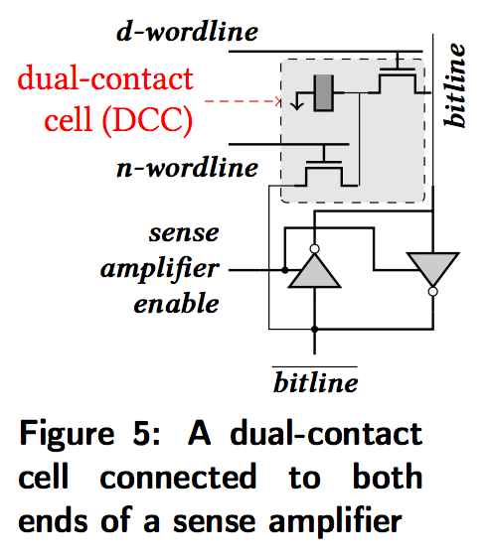
In-DRAM NOT: Dual Contact Cell
Idea:
Feed the
negated value
in the sense amplifier
into a special row
Seshadri+, “Ambit: In-Memory Accelerator for Bulk Bitwise Operations using Commodity DRAM Technology,” MICRO 2017.

Slide 33
Ambit vs. DDR3: Performance and Energy
32X
35X
Seshadri+, “Ambit: In-Memory Accelerator for Bulk Bitwise Operations using Commodity DRAM Technology,” MICRO 2017.

Slide 34
Bulk Bitwise Operations in Workloads
[1] Li and Patel, BitWeaving, SIGMOD 2013
[2] Goodwin+, BitFunnel, SIGIR 2017

Slide 35
Performance: Bitmap Index on Ambit
>5.4-6.6X Performance Improvement
Seshadri+, “Ambit: In-Memory Accelerator for Bulk Bitwise Operations using Commodity DRAM Technology,” MICRO 2017.

Slide 36
Performance: BitWeaving on Ambit
>4-12X Performance Improvement
Seshadri+, “Ambit: In-Memory Accelerator for Bulk Bitwise Operations using Commodity DRAM Technology,” MICRO 2017.

Slide 37
More on In-DRAM Bulk AND/OR
Vivek Seshadri, Kevin Hsieh, Amirali Boroumand, Donghyuk Lee, Michael A. Kozuch, Onur Mutlu, Phillip B. Gibbons, and Todd C. Mowry, "Fast Bulk Bitwise AND and OR in DRAM" IEEE Computer Architecture Letters (CAL), April 2015.

Slide 38
More on Ambit
Vivek Seshadri et al., “Ambit: In-Memory Accelerator for Bulk Bitwise Operations Using Commodity DRAM Technology,” MICRO 2017.

Slide 39
In-DRAM Bulk Bitwise Execution
Vivek Seshadri and Onur Mutlu, "In-DRAM Bulk Bitwise Execution Engine" Invited Book Chapter in Advances in Computers, to appear in 2020. [Preliminary arXiv version]

Slide 40
Coming Up in ASPLOS 2021…
https://arxiv.org/pdf/2012.11890.pdf

Slide 41
RowClone & Bitwise Ops in Real DRAM Chips
https://parallel.princeton.edu/papers/micro19-gao.pdf

Slide 42
Pinatubo: RowClone and Bitwise Ops in PCM
https://cseweb.ucsd.edu/~jzhao/files/Pinatubo-dac2016.pdf

Slide 43
Processing in Memory: Two Approaches
1. Minimally changing memory chips
2. Exploiting 3D-stacked memory

Slide 44
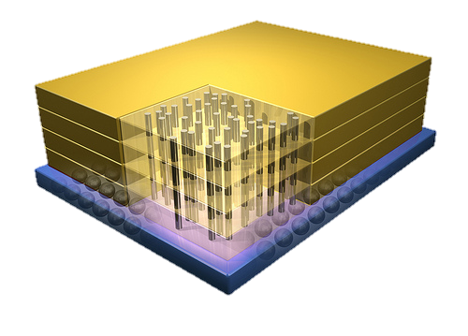
Opportunity: 3D-Stacked Logic+Memory
Memory
Logic
Other “True 3D” technologies
under development

Slide 45
Tesseract System for Graph Processing
Interconnected set of 3D-stacked memory+logic chips with simple cores
Host Processor
Memory
Memory-Mapped
Accelerator Interface
(Noncacheable, Physically Addressed)
Logic
In-Order Core
DRAM Controller
…
…
LP
PF Buffer
Crossbar Network
…
MTP
…
Message Queue
NI
Ahn+, “A Scalable Processing-in-Memory Accelerator for Parallel Graph Processing” ISCA 2015.

Slide 46
Evaluated Systems
DDR3-OoO
HMC-OoO
HMC-MC
Tesseract
32 Tesseract Cores
8 OoO
4GHz
8 OoO
4GHz
8 OoO
4GHz
8 OoO
4GHz
128 In-Order
2GHz
128 In-Order
2GHz
8 OoO
4GHz
8 OoO
4GHz
8 OoO
4GHz
8 OoO
4GHz
128 In-Order
2GHz
128 In-Order
2GHz
102.4GB/s
640GB/s
640GB/s
8TB/s
Ahn+, “A Scalable Processing-in-Memory Accelerator for Parallel Graph Processing” ISCA 2015.

Slide 47
Tesseract Graph Processing Performance
>13X Performance Improvement
On five graph processing algorithms
Ahn+, “A Scalable Processing-in-Memory Accelerator for Parallel Graph Processing” ISCA 2015.

Slide 48
Tesseract Graph Processing System Energy
> 8X Energy Reduction
Ahn+, “A Scalable Processing-in-Memory Accelerator for Parallel Graph Processing” ISCA 2015.

Slide 49
More on Tesseract
Junwhan Ahn, Sungpack Hong, Sungjoo Yoo, Onur Mutlu, and Kiyoung Choi, "A Scalable Processing-in-Memory Accelerator for Parallel Graph Processing" Proceedings of the 42nd International Symposium on Computer Architecture (ISCA), Portland, OR, June 2015. [Slides (pdf)] [Lightning Session Slides (pdf)]

Slide 50
Eliminating the Adoption Barriers
How to Enable Adoption of Processing in Memory

Slide 51
Barriers to Adoption of PIM
1. Functionality of and applications & software for PIM
2. Ease of programming (interfaces and compiler/HW support)
3. System support: coherence & virtual memory
4. Runtime and compilation systems for adaptive scheduling, data mapping, access/sharing control
5. Infrastructures to assess benefits and feasibility
All can be solved with change of mindset

Slide 52
We Need to Revisit the Entire Stack
Problem
Algorithm
Program/Language
System Software
SW/HW Interface
Micro-architecture
Logic
Devices
Electrons
We can get there step by step

Slide 53
PIM Review and Open Problems
Onur Mutlu, Saugata Ghose, Juan Gomez-Luna, and Rachata Ausavarungnirun, "A Modern Primer on Processing in Memory" Invited Book Chapter in Emerging Computing: From Devices to Systems - Looking Beyond Moore and Von Neumann, Springer, to be published in 2021.
https://arxiv.org/pdf/1903.03988.pdf

Slide 54
PIM Review and Open Problems (II)
Saugata Ghose, Amirali Boroumand, Jeremie S. Kim, Juan Gomez-Luna, and Onur Mutlu, "Processing-in-Memory: A Workload-Driven Perspective" Invited Article in IBM Journal of Research & Development, Special Issue on Hardware for Artificial Intelligence, to appear in November 2019. [Preliminary arXiv version]
https://arxiv.org/pdf/1907.12947.pdf

Slide 55
UPMEM Processing-in-DRAM Engine (2019)
Processing in DRAM Engine
Includes standard DIMM modules, with a large number of DPU processors combined with DRAM chips.
Replaces standard DIMMs
DDR4 R-DIMM modules
8GB+128 DPUs (16 PIM chips)
Standard 2x-nm DRAM process
Large amounts of compute & memory bandwidth
https://www.anandtech.com/show/14750/hot-chips-31-analysis-inmemory-processing-by-upmem
https://www.upmem.com/video-upmem-presenting-its-true-processing-in-memory-solution-hot-chips-2019/

Slide 56
Challenge and Opportunity for Future
Computing Architectures
with
Minimal Data Movement

Slide 57
Exploiting Data to Design Intelligent Architectures

Slide 58
System Architecture Design Today
Human-driven
Humans design the policies (how to do things)
Many (too) simple, short-sighted policies all over the system
No automatic data-driven policy learning
(Almost) no learning: cannot take lessons from past actions
Can we design
fundamentally intelligent architectures?

Slide 59
An Intelligent Architecture
Data-driven
Machine learns the “best” policies (how to do things)
Sophisticated, workload-driven, changing, far-sighted policies
Automatic data-driven policy learning
All controllers are intelligent data-driven agents
How do we start?

Slide 60
More on Self-Optimizing DRAM Controllers
Engin Ipek, Onur Mutlu, José F. Martínez, and Rich Caruana, "Self Optimizing Memory Controllers: A Reinforcement Learning Approach" Proceedings of the 35th International Symposium on Computer Architecture (ISCA), pages 39-50, Beijing, China, June 2008.

Slide 61
Challenge and Opportunity for Future
Self-Optimizing
(Data-Driven)
Computing Architectures

Slide 62
Data-Aware Architectures
A data-aware architecture understands what it can do with and to each piece of data
It makes use of different properties of data to improve performance, efficiency and other metrics
Compressibility
Approximability
Locality
Sparsity
Criticality for Computation X
Access Semantics
…

Slide 63
One Problem: Limited Expressiveness

Slide 64
A Solution: More Expressive Interfaces

Slide 65
Expressive (Memory) Interfaces
Nandita Vijaykumar, Abhilasha Jain, Diptesh Majumdar, Kevin Hsieh, Gennady Pekhimenko, Eiman Ebrahimi, Nastaran Hajinazar, Phillip B. Gibbons and Onur Mutlu, "A Case for Richer Cross-layer Abstractions: Bridging the Semantic Gap with Expressive Memory" Proceedings of the 45th International Symposium on Computer Architecture (ISCA), Los Angeles, CA, USA, June 2018. [Slides (pptx) (pdf)] [Lightning Talk Slides (pptx) (pdf)] [Lightning Talk Video]

Slide 66
Expressive (Memory) Interfaces for GPUs
Nandita Vijaykumar, Eiman Ebrahimi, Kevin Hsieh, Phillip B. Gibbons and Onur Mutlu, "The Locality Descriptor: A Holistic Cross-Layer Abstraction to Express Data Locality in GPUs" Proceedings of the 45th International Symposium on Computer Architecture (ISCA), Los Angeles, CA, USA, June 2018. [Slides (pptx) (pdf)] [Lightning Talk Slides (pptx) (pdf)] [Lightning Talk Video]

Slide 67
EDEN: Data-Aware Efficient DNN Inference
Skanda Koppula, Lois Orosa, A. Giray Yaglikci, Roknoddin Azizi, Taha Shahroodi, Konstantinos Kanellopoulos, and Onur Mutlu, "EDEN: Enabling Energy-Efficient, High-Performance Deep Neural Network Inference Using Approximate DRAM" Proceedings of the 52nd International Symposium on Microarchitecture (MICRO), Columbus, OH, USA, October 2019. [Lightning Talk Slides (pptx) (pdf)] [Lightning Talk Video (90 seconds)]

Slide 68
SMASH: SW/HW Indexing Acceleration
Konstantinos Kanellopoulos, Nandita Vijaykumar, Christina Giannoula, Roknoddin Azizi, Skanda Koppula, Nika Mansouri Ghiasi, Taha Shahroodi, Juan Gomez-Luna, and Onur Mutlu, "SMASH: Co-designing Software Compression and Hardware-Accelerated Indexing for Efficient Sparse Matrix Operations" Proceedings of the 52nd International Symposium on Microarchitecture (MICRO), Columbus, OH, USA, October 2019. [Slides (pptx) (pdf)] [Lightning Talk Slides (pptx) (pdf)] [Poster (pptx) (pdf)] [Lightning Talk Video (90 seconds)] [Full Talk Lecture (30 minutes)]

Slide 69
Data-Aware Virtual Memory Framework
Nastaran Hajinazar, Pratyush Patel, Minesh Patel, Konstantinos Kanellopoulos, Saugata Ghose, Rachata Ausavarungnirun, Geraldo Francisco de Oliveira Jr., Jonathan Appavoo, Vivek Seshadri, and Onur Mutlu, "The Virtual Block Interface: A Flexible Alternative to the Conventional Virtual Memory Framework" Proceedings of the 47th International Symposium on Computer Architecture (ISCA), Virtual, June 2020. [Slides (pptx) (pdf)] [Lightning Talk Slides (pptx) (pdf)] [ARM Research Summit Poster (pptx) (pdf)] [Talk Video (26 minutes)] [Lightning Talk Video (3 minutes)] [Lecture Video (43 minutes)]

Slide 70
Challenge and Opportunity for Future
Data-Aware
(Expressive)
Computing Architectures

Slide 71
Architectures for Intelligent Machines
Data-centric
Data-driven
Data-aware

Slide 72
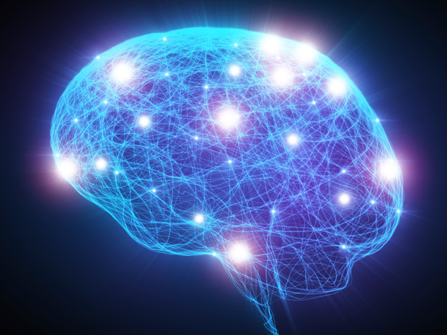
Source: http://spectrum.ieee.org/image/MjYzMzAyMg.jpeg

Slide 73
We Need to Revisit the Entire Stack
Problem
Algorithm
Program/Language
System Software
SW/HW Interface
Micro-architecture
Logic
Devices
Electrons
We can get there step by step

Slide 74
PIM Review and Open Problems
Onur Mutlu, Saugata Ghose, Juan Gomez-Luna, and Rachata Ausavarungnirun, "A Modern Primer on Processing in Memory" Invited Book Chapter in Emerging Computing: From Devices to Systems - Looking Beyond Moore and Von Neumann, Springer, to be published in 2021.
https://arxiv.org/pdf/1903.03988.pdf

Slide 75
PIM Review and Open Problems (II)
Saugata Ghose, Amirali Boroumand, Jeremie S. Kim, Juan Gomez-Luna, and Onur Mutlu, "Processing-in-Memory: A Workload-Driven Perspective" Invited Article in IBM Journal of Research & Development, Special Issue on Hardware for Artificial Intelligence, to appear in November 2019. [Preliminary arXiv version]
https://arxiv.org/pdf/1907.12947.pdf

Slide 76
A Longer Version of This Talk
Onur Mutlu, "Memory-Centric Computing Systems" Invited Tutorial at 66th International Electron Devices Meeting (IEDM), Virtual, 12 December 2020. [Slides (pptx) (pdf)] [Executive Summary Slides (pptx) (pdf)] [Tutorial Video (1 hour 51 minutes)] [Executive Summary Video (2 minutes)] [Abstract and Bio] [Related Keynote Paper from VLSI-DAT 2020] [Related Review Paper on Processing in Memory]
https://www.youtube.com/watch?v=H3sEaINPBOE
https://www.youtube.com/onurmutlulectures

Slide 77
Detailed Lectures on PIM (I)
Computer Architecture, Fall 2020, Lecture 6
Computation in Memory (ETH Zürich, Fall 2020)
https://www.youtube.com/watch?v=oGcZAGwfEUE&list=PL5Q2soXY2Zi9xidyIgBxUz7xRPS-wisBN&index=12
Computer Architecture, Fall 2020, Lecture 7
Near-Data Processing (ETH Zürich, Fall 2020)
https://www.youtube.com/watch?v=j2GIigqn1Qw&list=PL5Q2soXY2Zi9xidyIgBxUz7xRPS-wisBN&index=13
Computer Architecture, Fall 2020, Lecture 11a
Memory Controllers (ETH Zürich, Fall 2020)
https://www.youtube.com/watch?v=TeG773OgiMQ&list=PL5Q2soXY2Zi9xidyIgBxUz7xRPS-wisBN&index=20
Computer Architecture, Fall 2020, Lecture 12d
Real Processing-in-DRAM with UPMEM (ETH Zürich, Fall 2020)
https://www.youtube.com/watch?v=Sscy1Wrr22A&list=PL5Q2soXY2Zi9xidyIgBxUz7xRPS-wisBN&index=25
https://www.youtube.com/onurmutlulectures

Slide 78
Detailed Lectures on PIM (II)
Computer Architecture, Fall 2020, Lecture 15
Emerging Memory Technologies (ETH Zürich, Fall 2020)
https://www.youtube.com/watch?v=AlE1rD9G_YU&list=PL5Q2soXY2Zi9xidyIgBxUz7xRPS-wisBN&index=28
Computer Architecture, Fall 2020, Lecture 16a
Opportunities & Challenges of Emerging Memory Technologies (ETH Zürich, Fall 2020)
https://www.youtube.com/watch?v=pmLszWGmMGQ&list=PL5Q2soXY2Zi9xidyIgBxUz7xRPS-wisBN&index=29
Computer Architecture, Fall 2020, Guest Lecture
In-Memory Computing: Memory Devices & Applications (ETH Zürich, Fall 2020)
https://www.youtube.com/watch?v=wNmqQHiEZNk&list=PL5Q2soXY2Zi9xidyIgBxUz7xRPS-wisBN&index=41
https://www.youtube.com/onurmutlulectures

Slide 79
Funding Acknowledgments
Alibaba, AMD, ASML, Google, Facebook, Hi-Silicon, HP Labs, Huawei, IBM, Intel, Microsoft, Nvidia, Oracle, Qualcomm, Rambus, Samsung, Seagate, VMware
NSF
NIH
GSRC
SRC
CyLab

Slide 80
Acknowledgments
My current and past students and postdocs
Rachata Ausavarungnirun, Abhishek Bhowmick, Amirali Boroumand, Rui Cai, Yu Cai, Kevin Chang, Saugata Ghose, Kevin Hsieh, Tyler Huberty, Ben Jaiyen, Samira Khan, Jeremie Kim, Yoongu Kim, Yang Li, Jamie Liu, Lavanya Subramanian, Donghyuk Lee, Yixin Luo, Justin Meza, Gennady Pekhimenko, Vivek Seshadri, Lavanya Subramanian, Nandita Vijaykumar, HanBin Yoon, Jishen Zhao, …
My collaborators
Can Alkan, Chita Das, Phil Gibbons, Sriram Govindan, Norm Jouppi, Mahmut Kandemir, Mike Kozuch, Konrad Lai, Ken Mai, Todd Mowry, Yale Patt, Moinuddin Qureshi, Partha Ranganathan, Bikash Sharma, Kushagra Vaid, Chris Wilkerson, …

Slide 81
Acknowledgments
Think BIG, Aim HIGH!
https://safari.ethz.ch

Slide 82
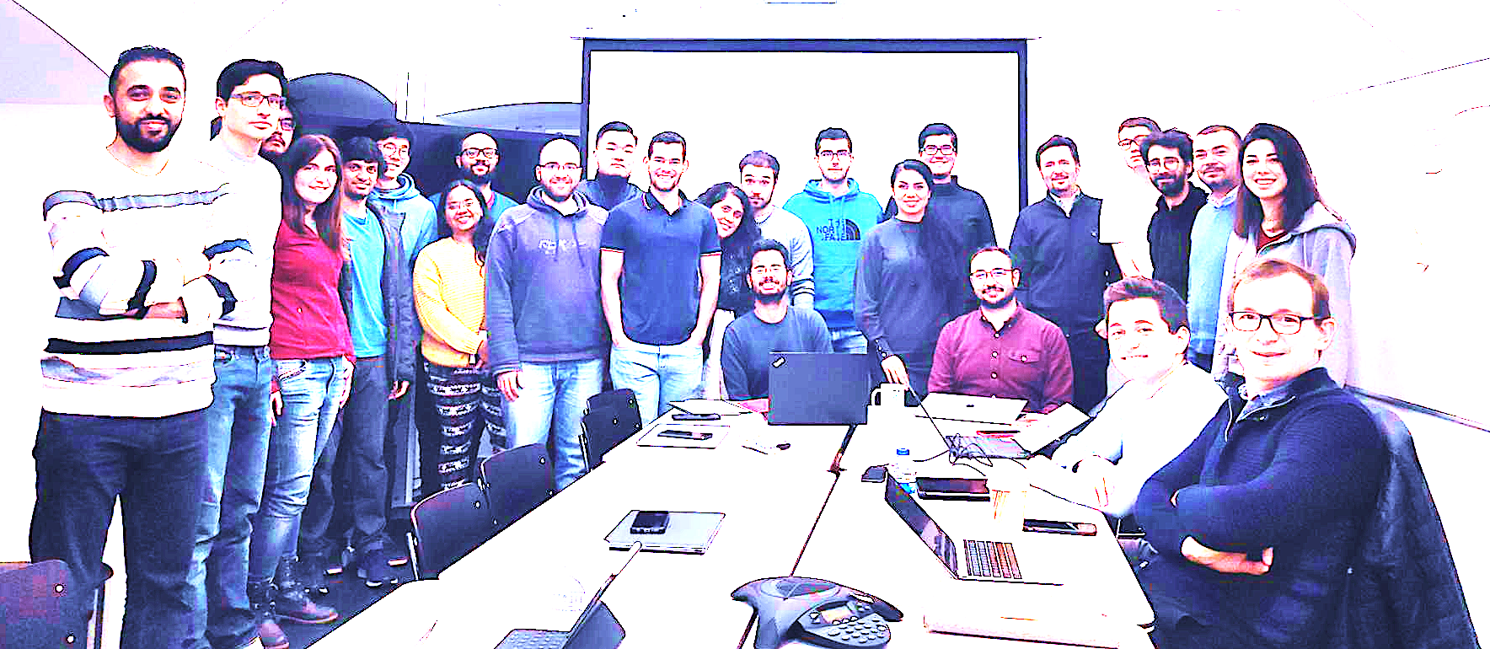
Onur Mutlu’s SAFARI Research Group
Computer architecture, HW/SW, systems, bioinformatics, security, memory
https://safari.ethz.ch/safari-newsletter-january-2021/
38+ Researchers
Think BIG, Aim HIGH!
https://safari.ethz.ch

Slide 83
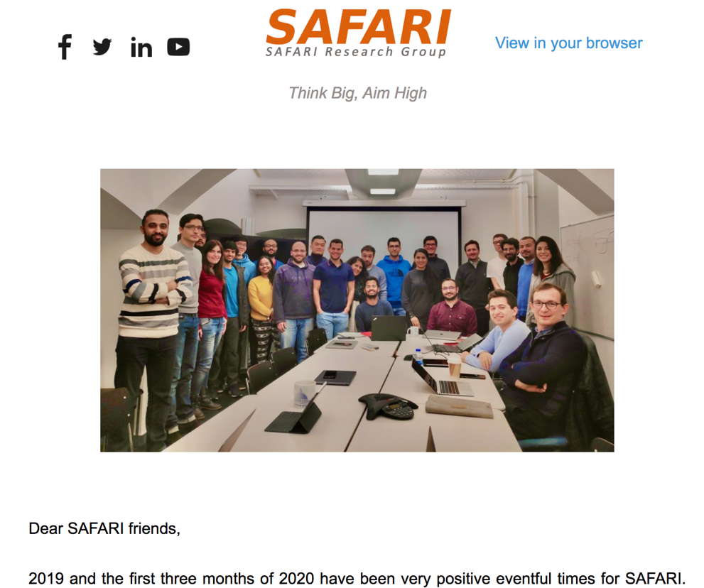
SAFARI Newsletter April 2020 Edition
https://safari.ethz.ch/safari-newsletter-april-2020/

Slide 84
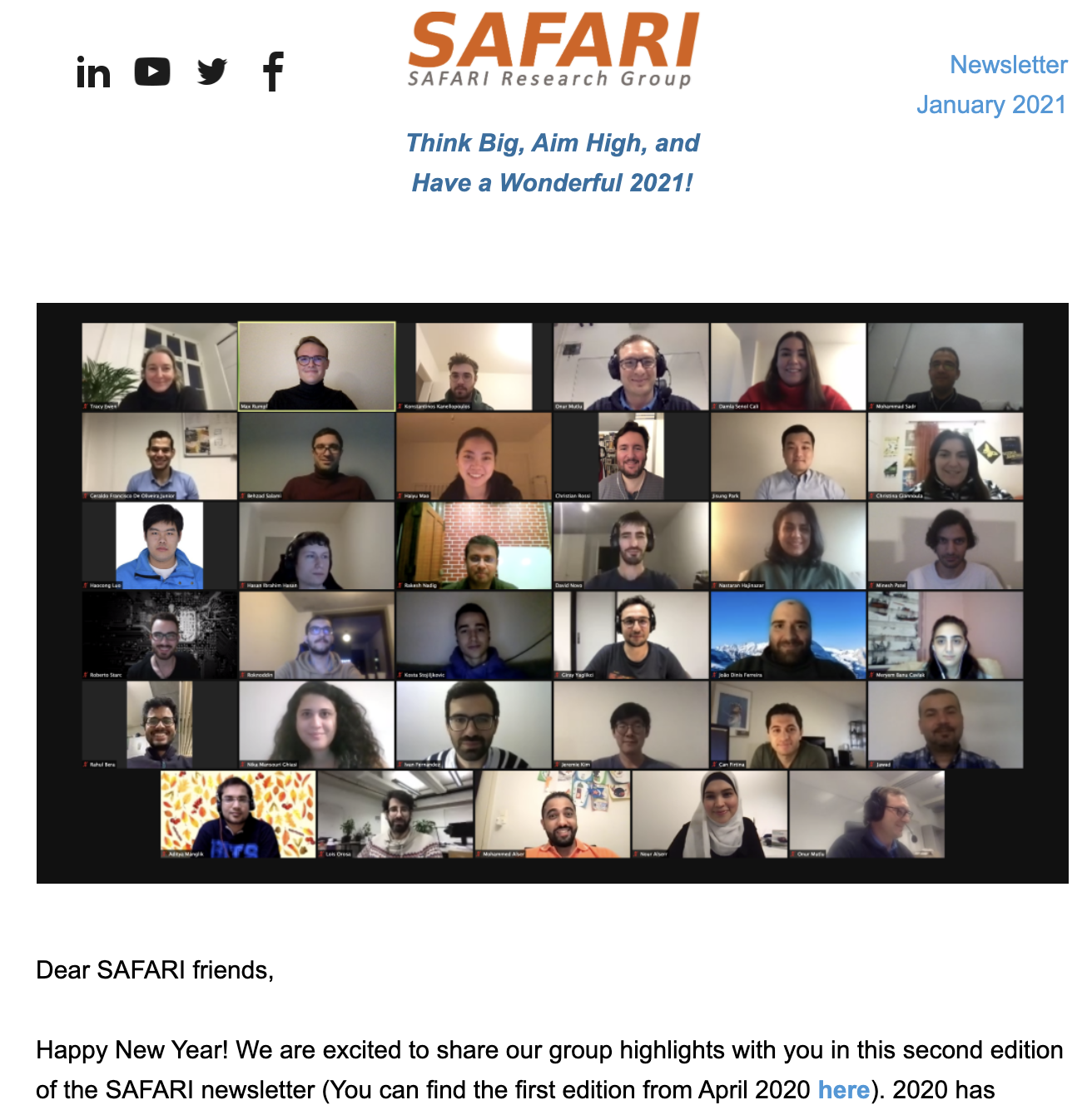
SAFARI Newsletter January 2021 Edition
https://safari.ethz.ch/safari-newsletter-january-2021/

Slide 85
Intelligent Architectures for Intelligent Computing Systems
Onur Mutlu
omutlu@gmail.com
https://people.inf.ethz.ch/omutlu
2 February 2021
DATE Special Session Invited Talk

Slide 86
Backup Slides for Further Info

Slide 87
Referenced Papers and Talks
All are available at
https://people.inf.ethz.ch/omutlu/projects.htm
http://scholar.google.com/citations?user=7XyGUGkAAAAJ&hl=en
https://www.youtube.com/onurmutlulectures

Slide 88
Research & Teaching: Some Overview Talks
https://www.youtube.com/onurmutlulectures
Future Computing Architectures
https://www.youtube.com/watch?v=kgiZlSOcGFM&list=PL5Q2soXY2Zi8D_5MGV6EnXEJHnV2YFBJl&index=1
Enabling In-Memory Computation
https://www.youtube.com/watch?v=njX_14584Jw&list=PL5Q2soXY2Zi8D_5MGV6EnXEJHnV2YFBJl&index=16
Accelerating Genome Analysis
https://www.youtube.com/watch?v=hPnSmfwu2-A&list=PL5Q2soXY2Zi8D_5MGV6EnXEJHnV2YFBJl&index=9
Rethinking Memory System Design
https://www.youtube.com/watch?v=F7xZLNMIY1E&list=PL5Q2soXY2Zi8D_5MGV6EnXEJHnV2YFBJl&index=3
Intelligent Architectures for Intelligent Machines
https://www.youtube.com/watch?v=n8Aj_A0WSg8&list=PL5Q2soXY2Zi8D_5MGV6EnXEJHnV2YFBJl&index=22
Revisiting RowHammer
https://www.youtube.com/watch?v=B58YT9hZM4g&list=PL5Q2soXY2Zi8D_5MGV6EnXEJHnV2YFBJl&index=25

Slide 89
An Interview on Research and Education
Computing Research and Education (@ ISCA 2019)
https://www.youtube.com/watch?v=8ffSEKZhmvo&list=PL5Q2soXY2Zi_4oP9LdL3cc8G6NIjD2Ydz
Maurice Wilkes Award Speech (10 minutes)
https://www.youtube.com/watch?v=tcQ3zZ3JpuA&list=PL5Q2soXY2Zi8D_5MGV6EnXEJHnV2YFBJl&index=15

Slide 90
More Thoughts and Suggestions
Onur Mutlu, "Some Reflections (on DRAM)" Award Speech for ACM SIGARCH Maurice Wilkes Award, at the ISCA Awards Ceremony, Phoenix, AZ, USA, 25 June 2019. [Slides (pptx) (pdf)] [Video of Award Acceptance Speech (Youtube; 10 minutes) (Youku; 13 minutes)] [Video of Interview after Award Acceptance (Youtube; 1 hour 6 minutes) (Youku; 1 hour 6 minutes)] [News Article on "ACM SIGARCH Maurice Wilkes Award goes to Prof. Onur Mutlu"]
Onur Mutlu, "How to Build an Impactful Research Group" 57th Design Automation Conference Early Career Workshop (DAC), Virtual, 19 July 2020. [Slides (pptx) (pdf)]

Slide 91
Reference Overview Paper I
Onur Mutlu, Saugata Ghose, Juan Gomez-Luna, and Rachata Ausavarungnirun, "Processing Data Where It Makes Sense: Enabling In-Memory Computation" Invited paper in Microprocessors and Microsystems (MICPRO), June 2019. [arXiv version]
https://arxiv.org/pdf/1903.03988.pdf

Slide 92
Reference Overview Paper II
Saugata Ghose, Amirali Boroumand, Jeremie S. Kim, Juan Gomez-Luna, and Onur Mutlu, "Processing-in-Memory: A Workload-Driven Perspective" Invited Article in IBM Journal of Research & Development, Special Issue on Hardware for Artificial Intelligence, to appear in November 2019. [Preliminary arXiv version]
https://arxiv.org/pdf/1907.12947.pdf

Slide 93
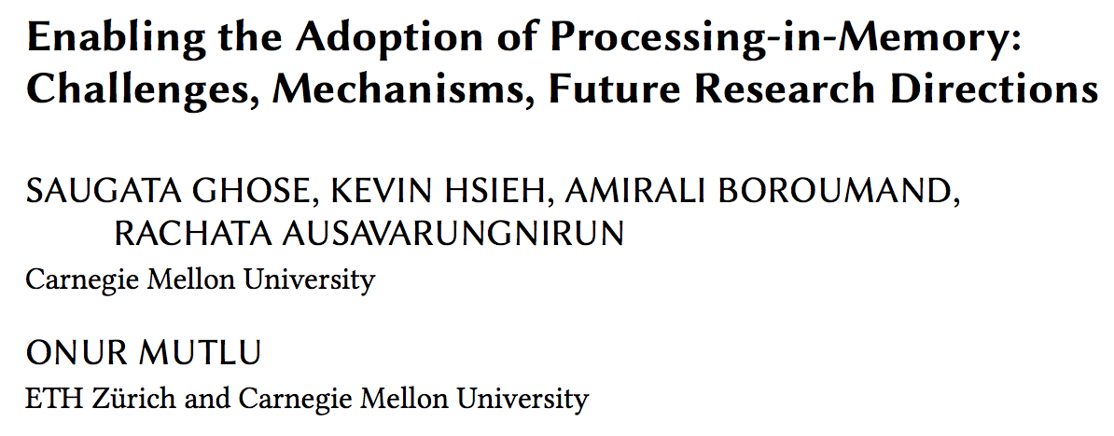
Reference Overview Paper III
Saugata Ghose, Kevin Hsieh, Amirali Boroumand, Rachata Ausavarungnirun, Onur Mutlu, "Enabling the Adoption of Processing-in-Memory: Challenges, Mechanisms, Future Research Directions" Invited Book Chapter, to appear in 2018. [Preliminary arxiv.org version]
https://arxiv.org/pdf/1802.00320.pdf

Slide 94
Reference Overview Paper IV
Onur Mutlu and Lavanya Subramanian, "Research Problems and Opportunities in Memory Systems" Invited Article in Supercomputing Frontiers and Innovations (SUPERFRI), 2014/2015.
https://people.inf.ethz.ch/omutlu/pub/memory-systems-research_superfri14.pdf

Slide 95
Reference Overview Paper V
Onur Mutlu, "The RowHammer Problem and Other Issues We May Face as Memory Becomes Denser" Invited Paper in Proceedings of the Design, Automation, and Test in Europe Conference (DATE), Lausanne, Switzerland, March 2017. [Slides (pptx) (pdf)]
https://people.inf.ethz.ch/omutlu/pub/rowhammer-and-other-memory-issues_date17.pdf

Slide 96
Reference Overview Paper VI
Onur Mutlu, "Memory Scaling: A Systems Architecture Perspective" Technical talk at MemCon 2013 (MEMCON), Santa Clara, CA, August 2013. [Slides (pptx) (pdf)] [Video] [Coverage on StorageSearch]
https://people.inf.ethz.ch/omutlu/pub/memory-scaling_memcon13.pdf

Slide 97
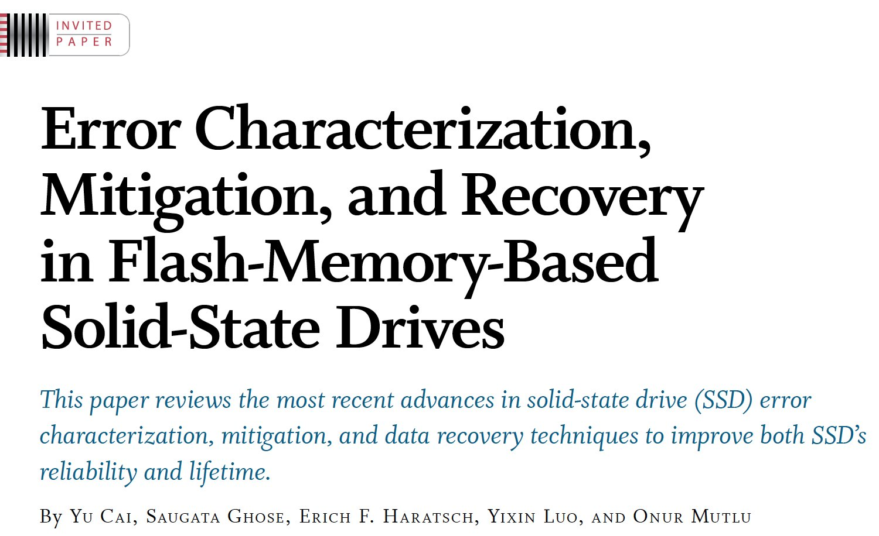
Reference Overview Paper VII
Proceedings of the IEEE, Sept. 2017
https://arxiv.org/pdf/1706.08642

Slide 98
Reference Overview Paper VIII
Onur Mutlu and Jeremie Kim, "RowHammer: A Retrospective" IEEE Transactions on Computer-Aided Design of Integrated Circuits and Systems (TCAD) Special Issue on Top Picks in Hardware and Embedded Security, 2019. [Preliminary arXiv version]

