Slide 1


Processing Data Where It Makes Sense in Modern Computing Systems:
Enabling In-Memory Computation
Onur Mutlu
omutlu@gmail.com
https://people.inf.ethz.ch/omutlu
23 March 2018
DATE Emerging Memory Workshop Keynote Talk

Slide 2



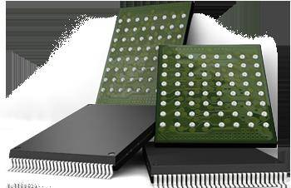

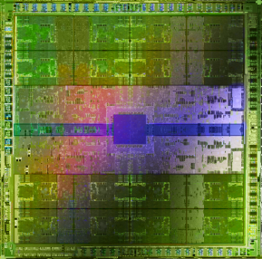
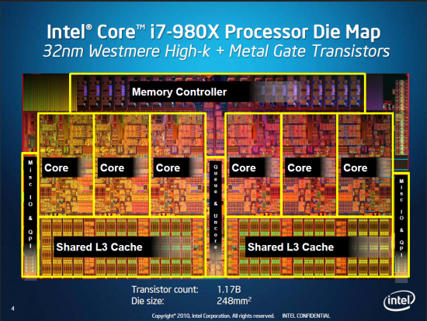
Current Research Focus Areas
Research Focus: Computer architecture, HW/SW, bioinformatics, security
Memory and storage (DRAM, flash, emerging), interconnects
Heterogeneous & parallel systems, GPUs, systems for data analytics
System/architecture interaction, new execution models, new interfaces
Hardware security, energy efficiency, fault tolerance, performance
Genome sequence analysis & assembly algorithms and architectures
Biologically inspired systems & system design for bio/medicine
Hybrid Main Memory
Heterogeneous
Processors and
Accelerators
Persistent Memory/Storage
Broad research
spanning apps, systems, logic
with architecture at the center
Graphics and Vision Processing
Notes:
Professor Mutlu’s research focus is all aspects of computer architecture, HW/SW interaction and bioinformatics.
He is looking for students to perform research in these areas.
He and his group, SAFARI, solve fundamental problems spanning:
Memory, memory, memory, storage, interconnects
Parallel architectures, heterogeneous architectures, GP-GPUs
System/architecture interaction, new execution models
Energy efficiency, fault tolerance, hardware security
Genome sequence analysis and assembly
His group does broad research spanning systems to logic with architecture at center

Slide 3
Four Key Directions
Fundamentally Secure/Reliable/Safe Architectures
Fundamentally Energy-Efficient Architectures
  Memory-centric (Data-centric) Architectures
Fundamentally Low-Latency Architectures
Architectures for Genomics, Medicine, Health

Slide 4
In-Memory DNA Sequence Analysis
Jeremie S. Kim, Damla Senol Cali, Hongyi Xin, Donghyuk Lee, Saugata Ghose, Mohammed Alser, Hasan Hassan, Oguz Ergin, Can Alkan, and Onur Mutlu,
"GRIM-Filter: Fast Seed Location Filtering in DNA Read Mapping Using Processing-in-Memory Technologies"
to appear in BMC Genomics, 2018.
to also appear in Proceedings of the 16th Asia Pacific Bioinformatics Conference (APBC), Yokohama, Japan, January 2018.
arxiv.org Version (pdf)

Slide 5
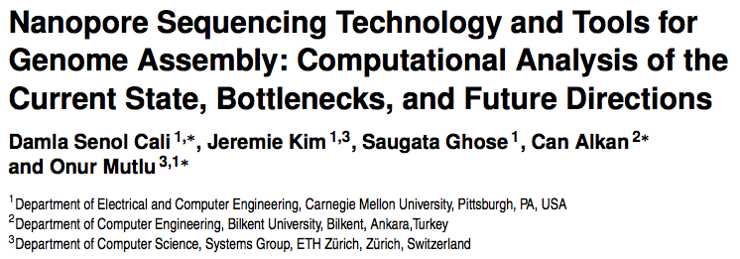
New Genome Sequencing Technologies
Senol Cali+, “Nanopore Sequencing Technology and Tools for Genome
Assembly: Computational Analysis of the Current State, Bottlenecks
and Future Directions,” to appear in Briefings in Bioinformatics, 2018.
[Preliminary arxiv.org version]

Slide 6
Memory & Storage

Slide 7
The Main Memory System
Main memory is a critical component of all computing systems: server, mobile, embedded, desktop, sensor
Main memory system must scale (in size, technology, efficiency, cost, and management algorithms) to maintain performance growth and technology scaling benefits
Processors
and caches
Main Memory
Storage (SSD/HDD)

Slide 8
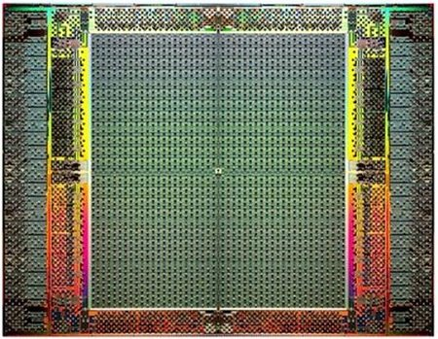
The Main Memory System
Main memory is a critical component of all computing systems: server, mobile, embedded, desktop, sensor
Main memory system must scale (in size, technology, efficiency, cost, and management algorithms) to maintain performance growth and technology scaling benefits
FPGAs
Main Memory
Storage (SSD/HDD)

Slide 9
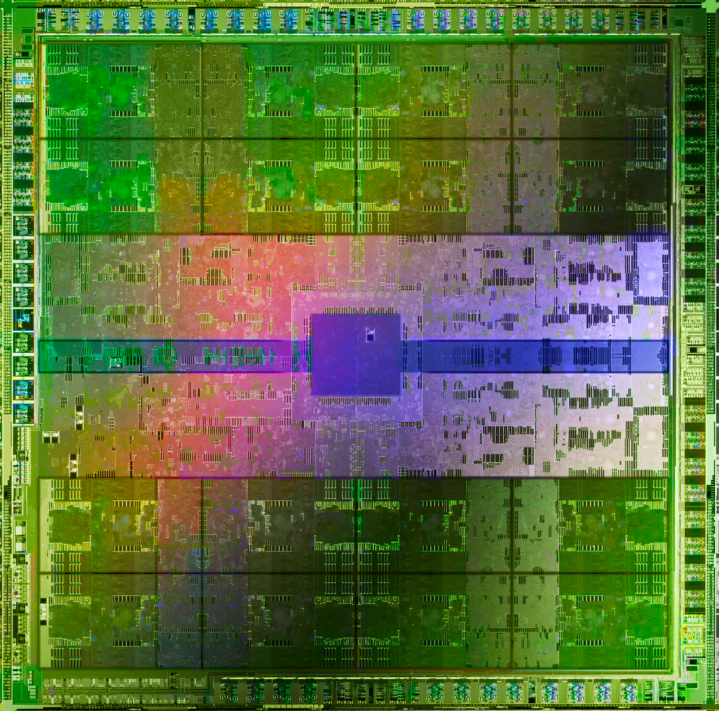
The Main Memory System
Main memory is a critical component of all computing systems: server, mobile, embedded, desktop, sensor
Main memory system must scale (in size, technology, efficiency, cost, and management algorithms) to maintain performance growth and technology scaling benefits
GPUs
Main Memory
Storage (SSD/HDD)

Slide 10
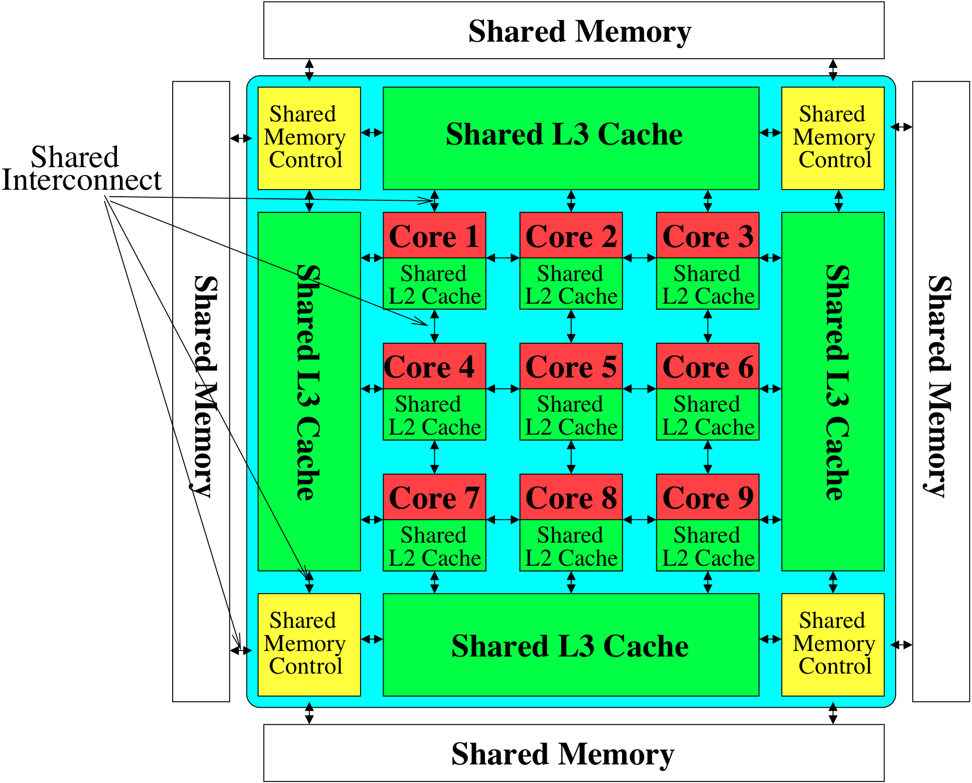
Memory System: A Shared Resource View
Storage
Most of the system is dedicated to storing and moving data

Slide 11
State of the Main Memory System
Recent technology, architecture, and application trends
  lead to new requirements
  exacerbate old requirements
DRAM and memory controllers, as we know them today, are (will be) unlikely to satisfy all requirements
Some emerging non-volatile memory technologies (e.g., PCM) enable new opportunities: memory+storage merging
We need to rethink the main memory system
  to fix DRAM issues and enable emerging technologies
  to satisfy all requirements

Slide 12
Major Trends Affecting Main Memory (I)
Need for main memory capacity, bandwidth, QoS increasing
Main memory energy/power is a key system design concern
DRAM technology scaling is ending

Slide 13
Major Trends Affecting Main Memory (II)
Need for main memory capacity, bandwidth, QoS increasing
  Multi-core: increasing number of cores/agents
  Data-intensive applications: increasing demand/hunger for data
  Consolidation: cloud computing, GPUs, mobile, heterogeneity
Main memory energy/power is a key system design concern
DRAM technology scaling is ending

Slide 14
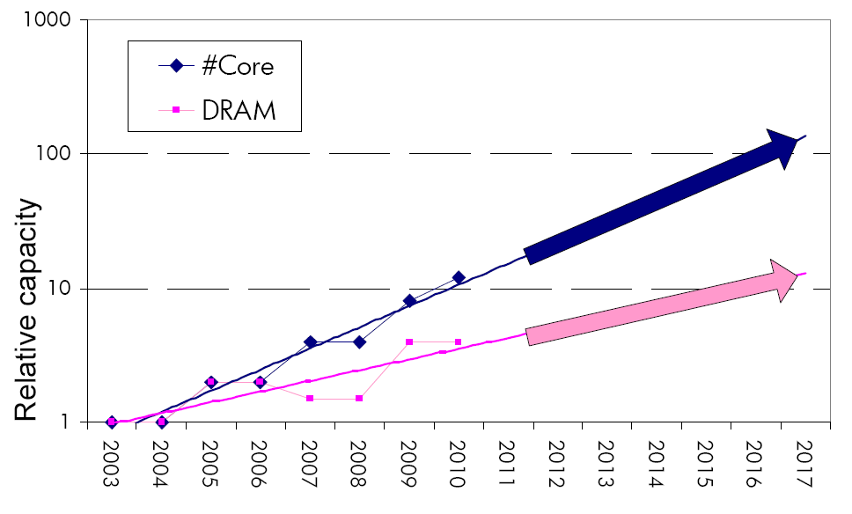
Example: The Memory Capacity Gap
Core count doubling ~ every 2 years
DRAM DIMM capacity doubling ~ every 3 years
Memory capacity per core expected to drop by 30% every two years
Trends worse for memory bandwidth per core!
Lim et al., ISCA 2009

Slide 15
Example: Capacity, Bandwidth & Latency
128x
20x
1.3x
Memory latency remains almost constant

Slide 16
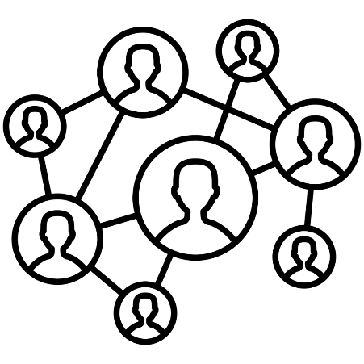

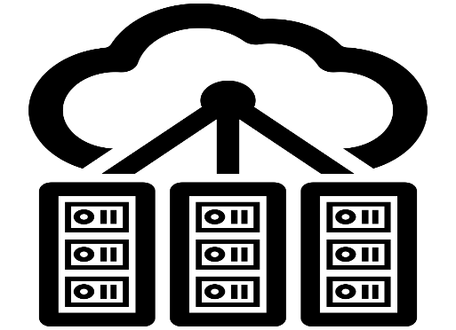

DRAM Latency Is Critical for Performance
In-memory Databases
[Mao+, EuroSys’12;
Clapp+ (Intel), IISWC’15]
Graph/Tree Processing
[Xu+, IISWC’12; Umuroglu+, FPL’15]
In-Memory Data Analytics
[Clapp+ (Intel), IISWC’15;
Awan+, BDCloud’15]
Datacenter Workloads
[Kanev+ (Google), ISCA’15]

Slide 17
DRAM Latency Is Critical for Performance
In-memory Databases
[Mao+, EuroSys’12;
Clapp+ (Intel), IISWC’15]
Graph/Tree Processing
[Xu+, IISWC’12; Umuroglu+, FPL’15]
Long memory latency → performance bottleneck
In-Memory Data Analytics
[Clapp+ (Intel), IISWC’15;
Awan+, BDCloud’15]
Datacenter Workloads
[Kanev+ (Google), ISCA’15]

Slide 18
Major Trends Affecting Main Memory (III)
Need for main memory capacity, bandwidth, QoS increasing
Main memory energy/power is a key system design concern
  ~40-50% energy spent in off-chip memory hierarchy [Lefurgy, IEEE Computer’03] >40% power in DRAM [Ware, HPCA’10][Paul,ISCA’15]
  DRAM consumes power even when not used (periodic refresh)
DRAM technology scaling is ending

Slide 19
Major Trends Affecting Main Memory (IV)
Need for main memory capacity, bandwidth, QoS increasing
Main memory energy/power is a key system design concern
DRAM technology scaling is ending
  ITRS projects DRAM will not scale easily below X nm
  Scaling has provided many benefits:
    higher capacity (density), lower cost, lower energy

Slide 20
Major Trends Affecting Main Memory (V)
DRAM scaling has already become increasingly difficult
  Increasing cell leakage current, reduced cell reliability, increasing manufacturing difficulties [Kim+ ISCA 2014],
  [Liu+ ISCA 2013], [Mutlu IMW 2013], [Mutlu DATE 2017]
  Difficult to significantly improve capacity, energy
Emerging memory technologies are promising
3D-Stacked DRAM | higher bandwidth | smaller capacity
Reduced-Latency DRAM (e.g., RLDRAM, TL-DRAM) | lower latency | higher cost
Low-Power DRAM (e.g., LPDDR3, LPDDR4) | lower power | higher latency higher cost
Non-Volatile Memory (NVM) (e.g., PCM, STTRAM, ReRAM, 3D Xpoint) | larger capacity | higher latency higher dynamic power lower endurance

Slide 21
Major Trends Affecting Main Memory (V)
DRAM scaling has already become increasingly difficult
  Increasing cell leakage current, reduced cell reliability, increasing manufacturing difficulties [Kim+ ISCA 2014],
  [Liu+ ISCA 2013], [Mutlu IMW 2013], [Mutlu DATE 2017]
  Difficult to significantly improve capacity, energy
Emerging memory technologies are promising
3D-Stacked DRAM | higher bandwidth | smaller capacity
Reduced-Latency DRAM (e.g., RL/TL-DRAM, FLY-RAM) | lower latency | higher cost
Low-Power DRAM (e.g., LPDDR3, LPDDR4, Voltron) | lower power | higher latency higher cost
Non-Volatile Memory (NVM) (e.g., PCM, STTRAM, ReRAM, 3D Xpoint) | larger capacity | higher latency higher dynamic power lower endurance

Slide 22
Major Trend: Hybrid Main Memory
CPU
Meza+, “Enabling Efficient and Scalable Hybrid Memories,” IEEE Comp. Arch. Letters, 2012.
Yoon+, “Row Buffer Locality Aware Caching Policies for Hybrid Memories,” ICCD 2012 Best Paper Award.
DRAMCtrl
PCM Ctrl
DRAM
Phase Change Memory (or Tech. X)
Fast, durable
Small,
leaky, volatile,
high-cost
Large, non-volatile, low-cost
Slow, wears out, high active energy
Hardware/software manage data allocation and movement
to achieve the best of multiple technologies

Slide 23
Foreshadowing
Main Memory Needs
Intelligent Controllers

Slide 24
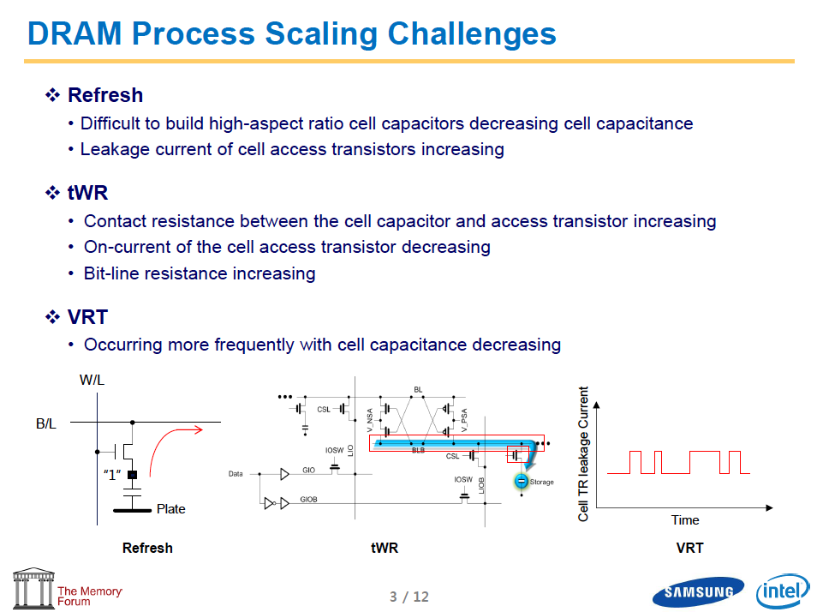
Industry Is Writing Papers About It, Too

Slide 25
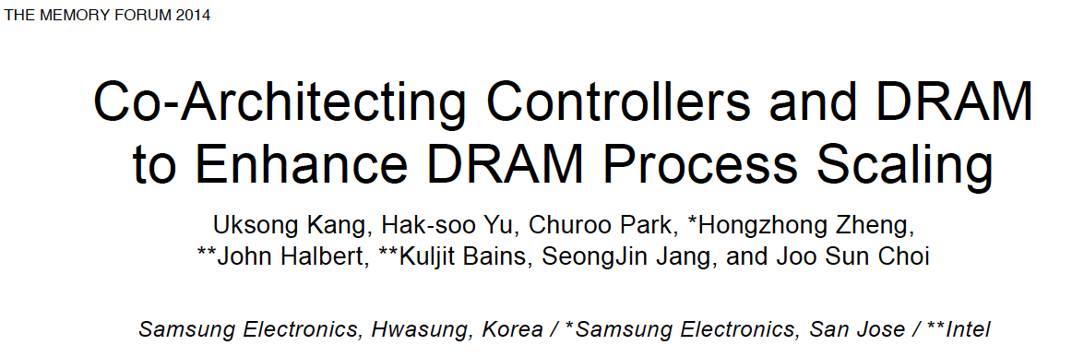
Call for Intelligent Memory Controllers

Slide 26
Agenda
Major Trends Affecting Main Memory
The Need for Intelligent Memory Controllers
  Bottom Up: Push from Circuits and Devices
  Top Down: Pull from Systems and Applications
Processing in Memory: Two Directions
  Minimally Changing Memory Chips
  Exploiting 3D-Stacked Memory
How to Enable Adoption of Processing in Memory
Conclusion

Slide 27
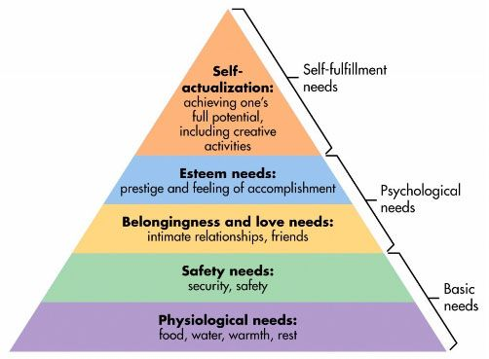
Maslow’s (Human) Hierarchy of Needs
Maslow, “A Theory of Human Motivation,”
Psychological Review, 1943.
Maslow, “A Theory of Human Motivation,”
Psychological Review, 1943.
Maslow, “Motivation and Personality,”
Book, 1954-1970.
We need to start with reliability and security…
Source: https://www.simplypsychology.org/maslow.html

Slide 28
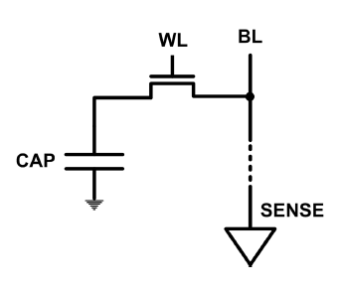
The DRAM Scaling Problem
DRAM stores charge in a capacitor (charge-based memory)
  Capacitor must be large enough for reliable sensing
  Access transistor should be large enough for low leakage and high retention time
  Scaling beyond 40-35nm (2013) is challenging [ITRS, 2009]
DRAM capacity, cost, and energy/power hard to scale

Slide 29
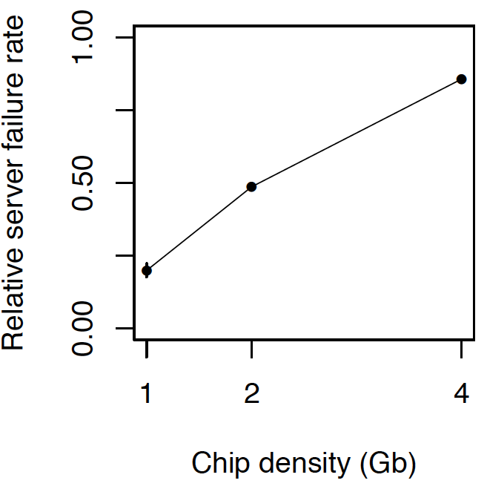
As Memory Scales, It Becomes Unreliable
Data from all of Facebook’s servers worldwide
Meza+, “Revisiting Memory Errors in Large-Scale Production Data Centers,” DSN’15.
Intuition:
quadratic
increase in
capacity

Slide 30
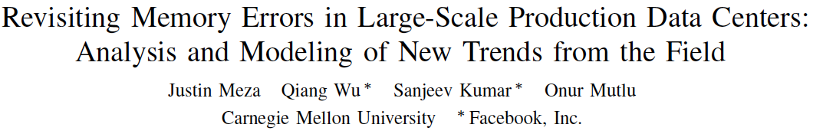
Large-Scale Failure Analysis of DRAM Chips
Analysis and modeling of memory errors found in all of Facebook’s server fleet
Justin Meza, Qiang Wu, Sanjeev Kumar, and Onur Mutlu,
"Revisiting Memory Errors in Large-Scale Production Data Centers: Analysis and Modeling of New Trends from the Field"
Proceedings of the 45th Annual IEEE/IFIP International Conference on Dependable Systems and Networks (DSN), Rio de Janeiro, Brazil, June 2015.
[Slides (pptx) (pdf)] [DRAM Error Model]

Slide 31
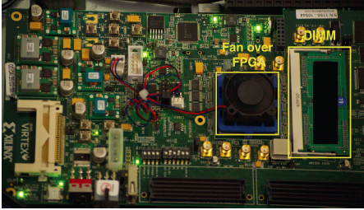
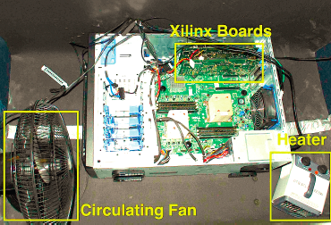
Infrastructures to Understand Such Issues
  An Experimental Study of Data Retention Behavior in Modern DRAM Devices: Implications for Retention Time Profiling Mechanisms (Liu et al., ISCA 2013)
  The Efficacy of Error Mitigation Techniques for DRAM Retention Failures: A Comparative Experimental Study
  (Khan et al., SIGMETRICS 2014)
  Flipping Bits in Memory Without Accessing Them: An Experimental Study of DRAM Disturbance Errors (Kim et al., ISCA 2014)
  Adaptive-Latency DRAM: Optimizing DRAM Timing for the Common-Case (Lee et al., HPCA 2015)
  AVATAR: A Variable-Retention-Time (VRT) Aware Refresh for DRAM Systems (Qureshi et al., DSN 2015)

Slide 32

Infrastructures to Understand Such Issues
Temperature
Controller
FPGAs
Heater
FPGAs
PC
  Kim+, “Flipping Bits in Memory Without Accessing Them: An Experimental Study of DRAM Disturbance Errors,” ISCA 2014.

Slide 33
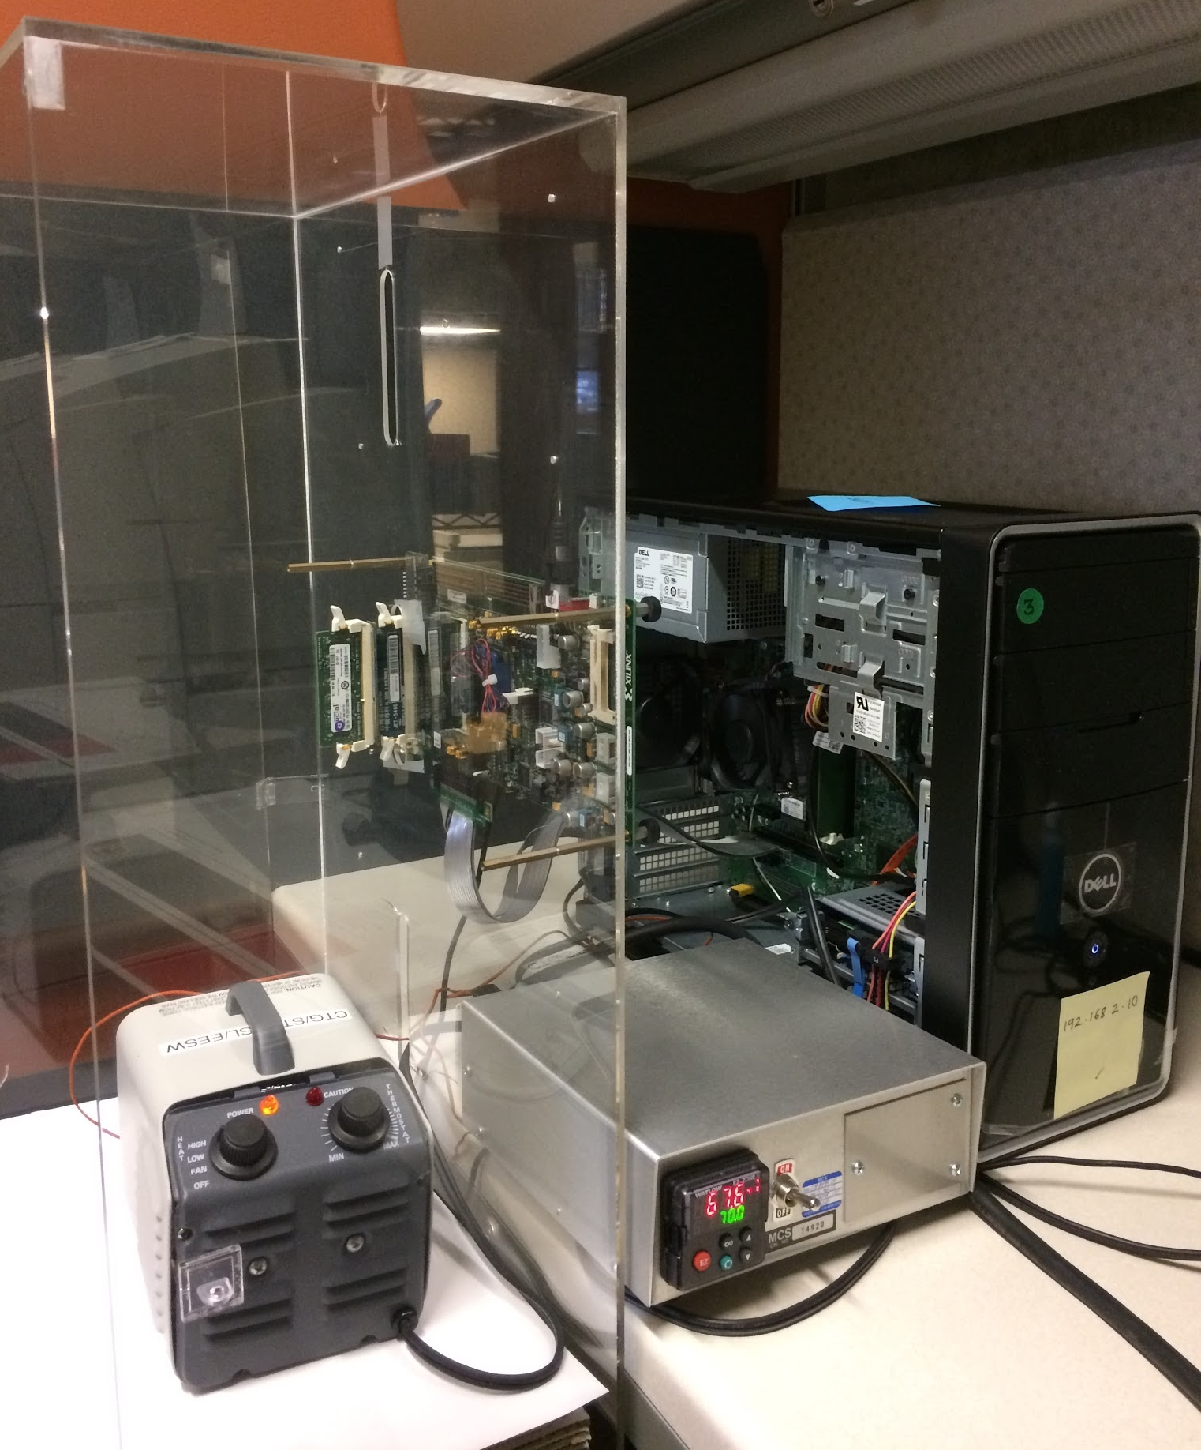
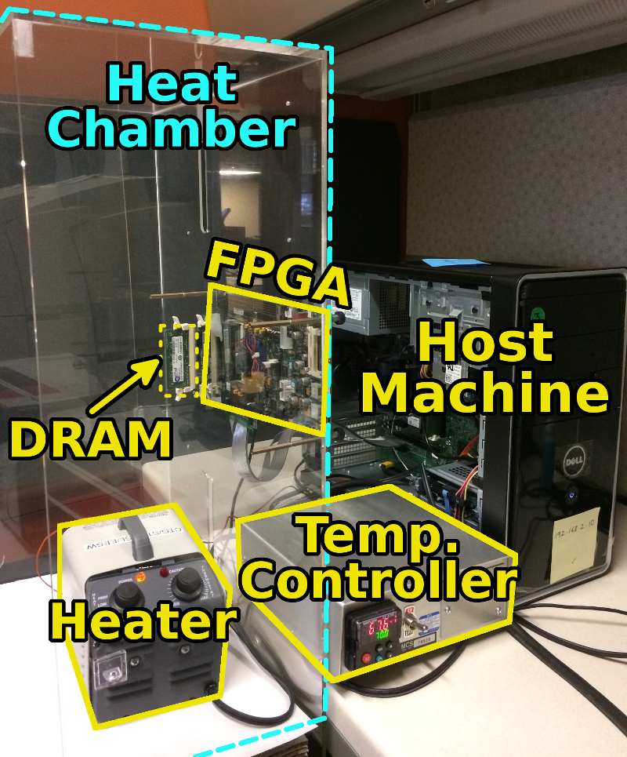
SoftMC: Open Source DRAM Infrastructure
Hasan Hassan et al., “SoftMC: A Flexible and Practical Open-Source Infrastructure for Enabling Experimental DRAM Studies,” HPCA 2017.
Flexible
Easy to Use (C++ API)
Open-source
github.com/CMU-SAFARI/SoftMC

Slide 34
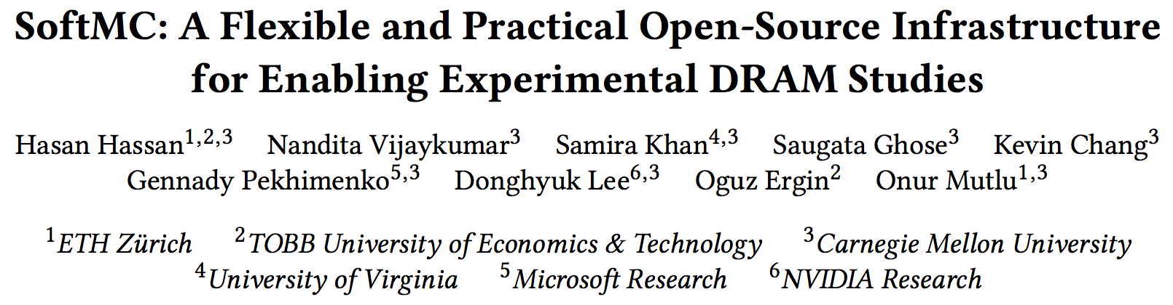
SoftMC
https://github.com/CMU-SAFARI/SoftMC

Slide 35

Data Retention in Memory [Liu et al., ISCA 2013]
Retention Time Profile of DRAM looks like this:
Location dependent
Stored value pattern dependent
Time dependent

Slide 36
A Curious Discovery [Kim et al., ISCA 2014]
One can
predictably induce errors
in most DRAM memory chips

Slide 37
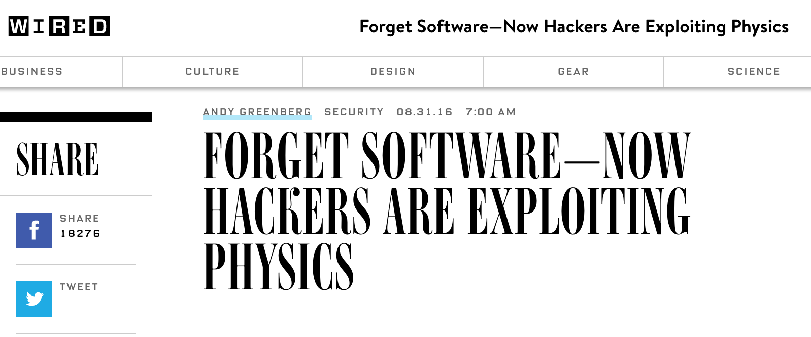
DRAM RowHammer
A simple hardware failure mechanism
can create a widespread
system security vulnerability

Slide 38
Modern DRAM is Prone to Disturbance Errors
Row of Cells
Wordline
Row
Victim Row
Row
Hammered Row
V_{LOW}
Opened
V_{HIGH}
Closed
Row
Victim Row
Row
Repeatedly reading a row enough times (before memory gets refreshed) induces disturbance errors in adjacent rows in most real DRAM chips you can buy today
Flipping Bits in Memory Without Accessing Them: An Experimental Study of DRAM Disturbance Errors, (Kim et al., ISCA 2014)

Slide 39
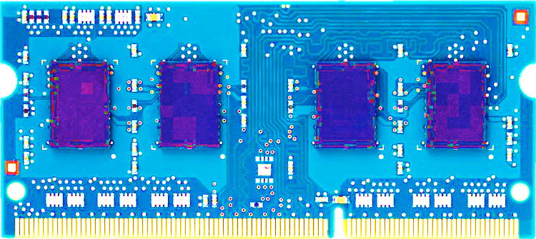
Most DRAM Modules Are Vulnerable
A company
B company
C company
86%
(37/43)
83%
(45/54)
88%
(28/32)
Up to
1.0×10⁷
errors
Up to
2.7×10⁶
errors
Up to
3.3×10⁵
errors
Flipping Bits in Memory Without Accessing Them: An Experimental Study of DRAM Disturbance Errors, (Kim et al., ISCA 2014)

Slide 40
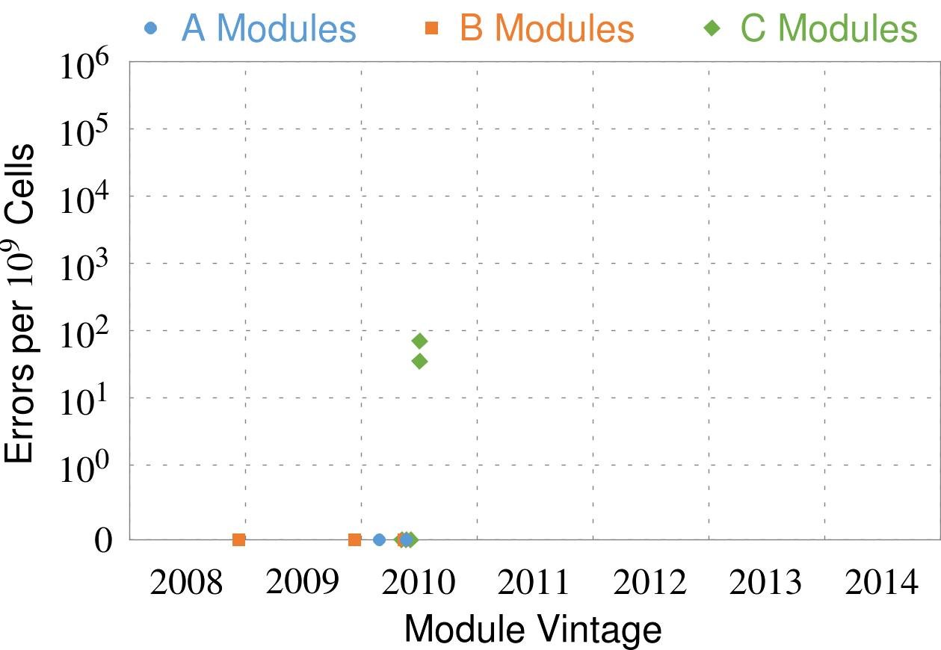
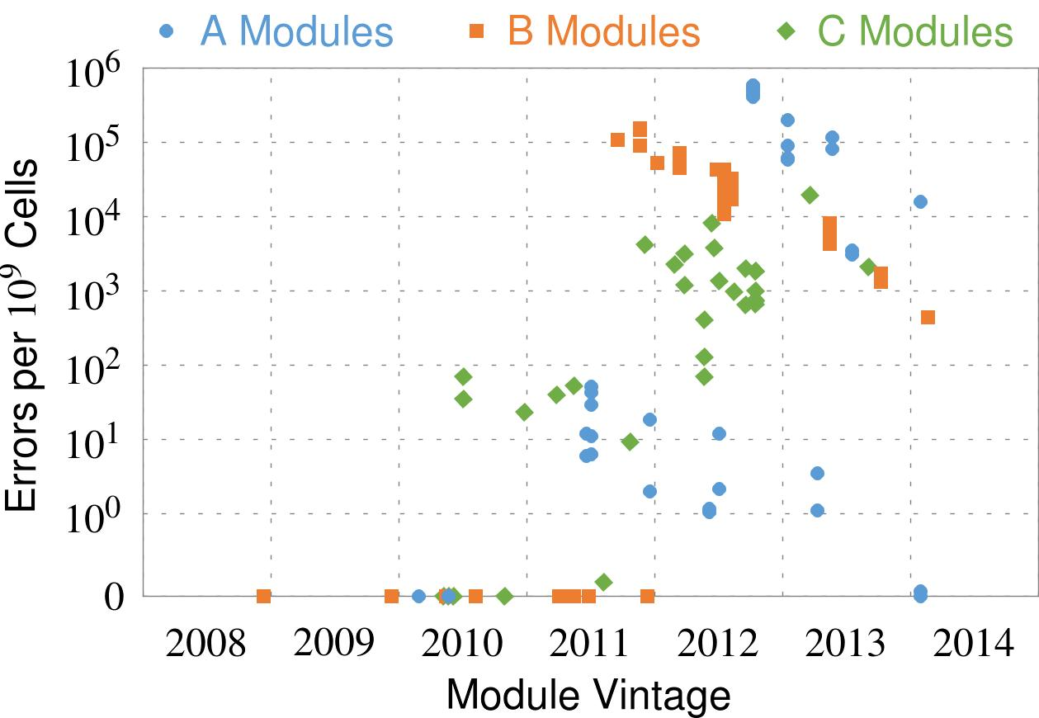
Recent DRAM Is More Vulnerable
Notes:
In this figure, the x-axis is the module manufacture date. And the y-axis is the number of errors in a module, normalized to one billion cells. In 2008 and 2009, there are no errors. But, in 2010, we first start to see errors in C modules. After 2010, the errors start to proliferate. For A and B modules, we first start to see errors in 2011. In particular, all modules from 2012 and 2013 are vulnerable.

Slide 41
Recent DRAM Is More Vulnerable
First
Appearance
Notes:
In this figure, the x-axis is the module manufacture date. And the y-axis is the number of errors in a module, normalized to one billion cells. In 2008 and 2009, there are no errors. But, in 2010, we first start to see errors in C modules. After 2010, the errors start to proliferate. For A and B modules, we first start to see errors in 2011. In particular, all modules from 2012 and 2013 are vulnerable.

Slide 42
Recent DRAM Is More Vulnerable
First
Appearance
All modules from 2012–2013 are vulnerable
Notes:
In this figure, the x-axis is the module manufacture date. And the y-axis is the number of errors in a module, normalized to one billion cells. In 2008 and 2009, there are no errors. But, in 2010, we first start to see errors in C modules. After 2010, the errors start to proliferate. For A and B modules, we first start to see errors in 2011. In particular, all modules from 2012 and 2013 are vulnerable.

Slide 43


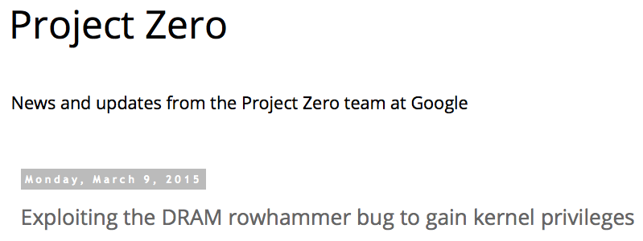
One Can Take Over an Otherwise-Secure System
Flipping Bits in Memory Without Accessing Them: An Experimental Study of DRAM Disturbance Errors (Kim et al., ISCA 2014)
Exploiting the DRAM rowhammer bug to gain kernel privileges (Seaborn, 2015)

Slide 44
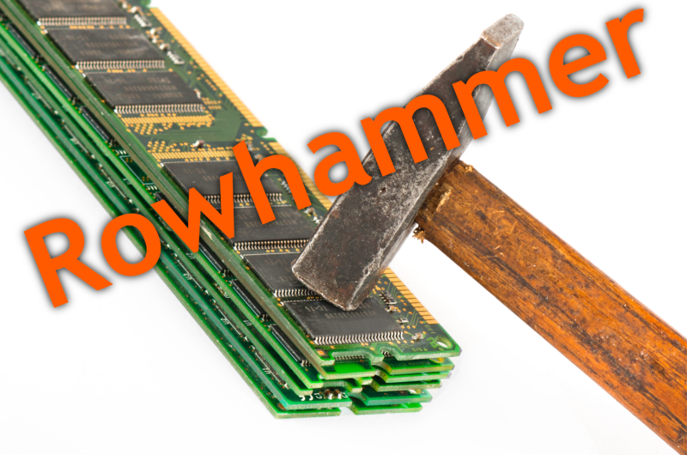

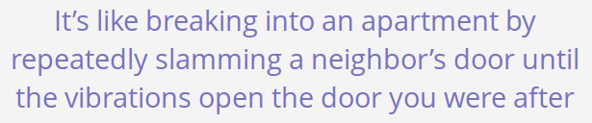
Security Implications
Notes:
Picture from the article:
http://thehackernews.com/2015/03/dram-rowhammer-vulnerability.html

Slide 45
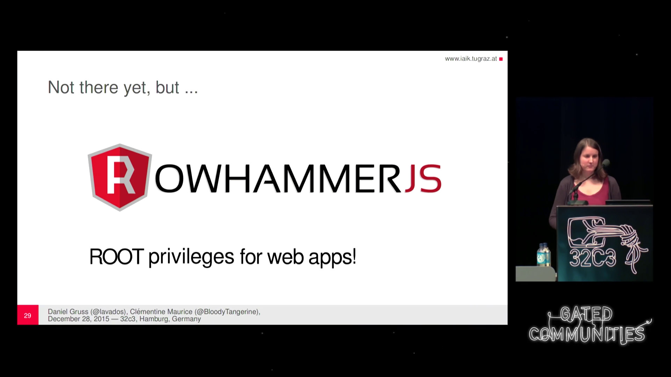
More Security Implications
“We can gain unrestricted access to systems of website visitors.”
Rowhammer.js: A Remote Software-Induced Fault Attack in JavaScript (DIMVA’16)
Source: https://lab.dsst.io/32c3-slides/7197.html

Slide 46

More Security Implications
  “Can gain control of a smart phone deterministically”
Drammer: Deterministic Rowhammer Attacks on Mobile Platforms, CCS’16
Source: https://fossbytes.com/drammer-rowhammer-attack-android-root-devices/

Slide 47
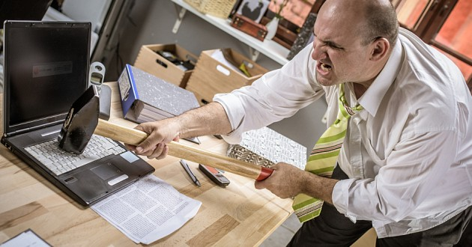
More Security Implications?

Slide 48
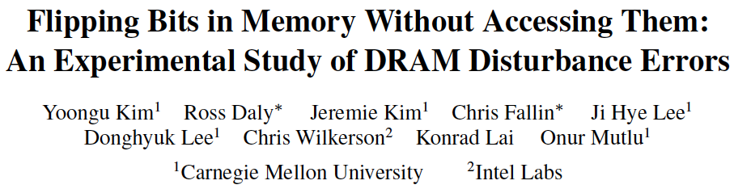
More on RowHammer Analysis
Yoongu Kim, Ross Daly, Jeremie Kim, Chris Fallin, Ji Hye Lee, Donghyuk Lee, Chris Wilkerson, Konrad Lai, and Onur Mutlu,
"Flipping Bits in Memory Without Accessing Them: An Experimental Study of DRAM Disturbance Errors"
Proceedings of the 41st International Symposium on Computer Architecture (ISCA), Minneapolis, MN, June 2014.
[Slides (pptx) (pdf)] [Lightning Session Slides (pptx) (pdf)] [Source Code and Data]

Slide 49
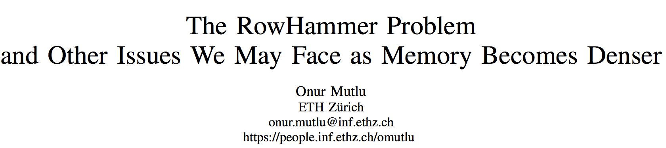
Future of Memory Reliability
Onur Mutlu,
"The RowHammer Problem and Other Issues We May Face as Memory Becomes Denser"
Invited Paper in Proceedings of the Design, Automation, and Test in Europe Conference (DATE), Lausanne, Switzerland, March 2017.
[Slides (pptx) (pdf)]
https://people.inf.ethz.ch/omutlu/pub/rowhammer-and-other-memory-issues_date17.pdf

Slide 50
Call for Intelligent Memory Controllers

Slide 51
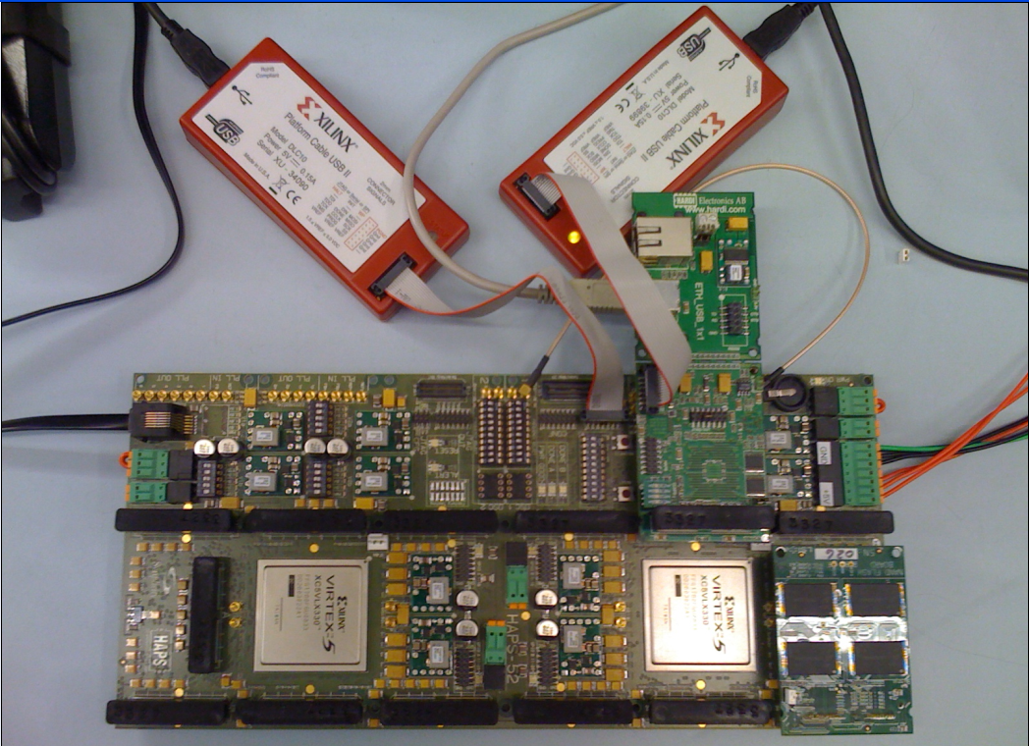
Aside: Intelligent Controller for NAND Flash
USB Daughter Board
USB Jack
HAPS-52 Mother Board
Virtex-II Pro
(USB controller)
1x-nm
NAND Flash
Virtex-V FPGA
(NAND Controller)
[DATE 2012, ICCD 2012, DATE 2013, ITJ 2013, ICCD 2013, SIGMETRICS 2014, HPCA 2015, DSN 2015, MSST 2015, JSAC 2016, HPCA 2017, DFRWS 2017, PIEEE’17]
NAND Daughter Board
Cai+, “Error Characterization, Mitigation, and Recovery in Flash Memory Based Solid State Drives,” Proc. IEEE 2017.

Slide 52
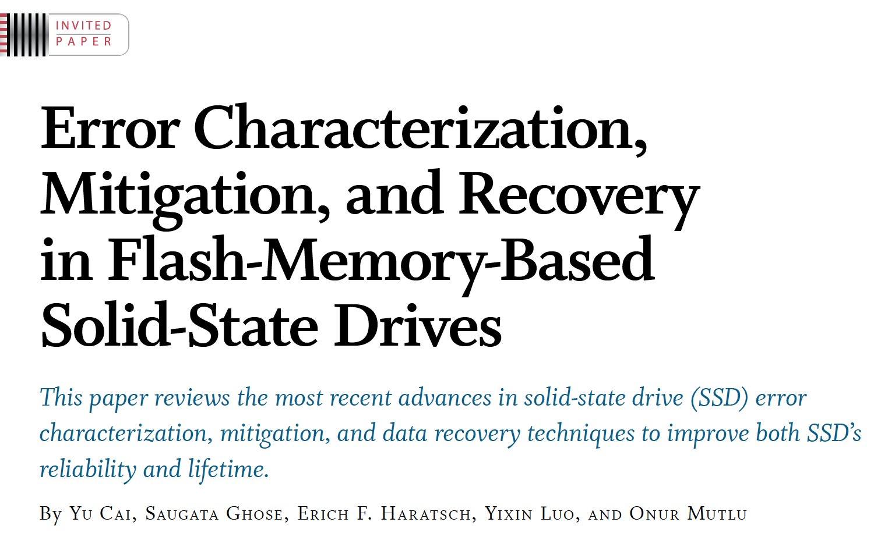

Aside: Intelligent Controller for NAND Flash
Proceedings of the IEEE, Sept. 2017
https://arxiv.org/pdf/1706.08642

Slide 53
Takeaway
Main Memory Needs
Intelligent Controllers

Slide 54
Agenda
Major Trends Affecting Main Memory
The Need for Intelligent Memory Controllers
  Bottom Up: Push from Circuits and Devices
  Top Down: Pull from Systems and Applications
Processing in Memory: Two Directions
  Minimally Changing Memory Chips
  Exploiting 3D-Stacked Memory
How to Enable Adoption of Processing in Memory
Conclusion

Slide 55
Three Key Systems Trends
1. Data access is a major bottleneck
  Applications are increasingly data hungry
2. Energy consumption is a key limiter
3. Data movement energy dominates compute
  Especially true for off-chip to on-chip movement

Slide 56
The Need for More Memory Performance
In-memory Databases
[Mao+, EuroSys’12;
Clapp+ (Intel), IISWC’15]
Graph/Tree Processing
[Xu+, IISWC’12; Umuroglu+, FPL’15]
In-Memory Data Analytics
[Clapp+ (Intel), IISWC’15;
Awan+, BDCloud’15]
Datacenter Workloads
[Kanev+ (Google), ISCA’15]

Slide 57
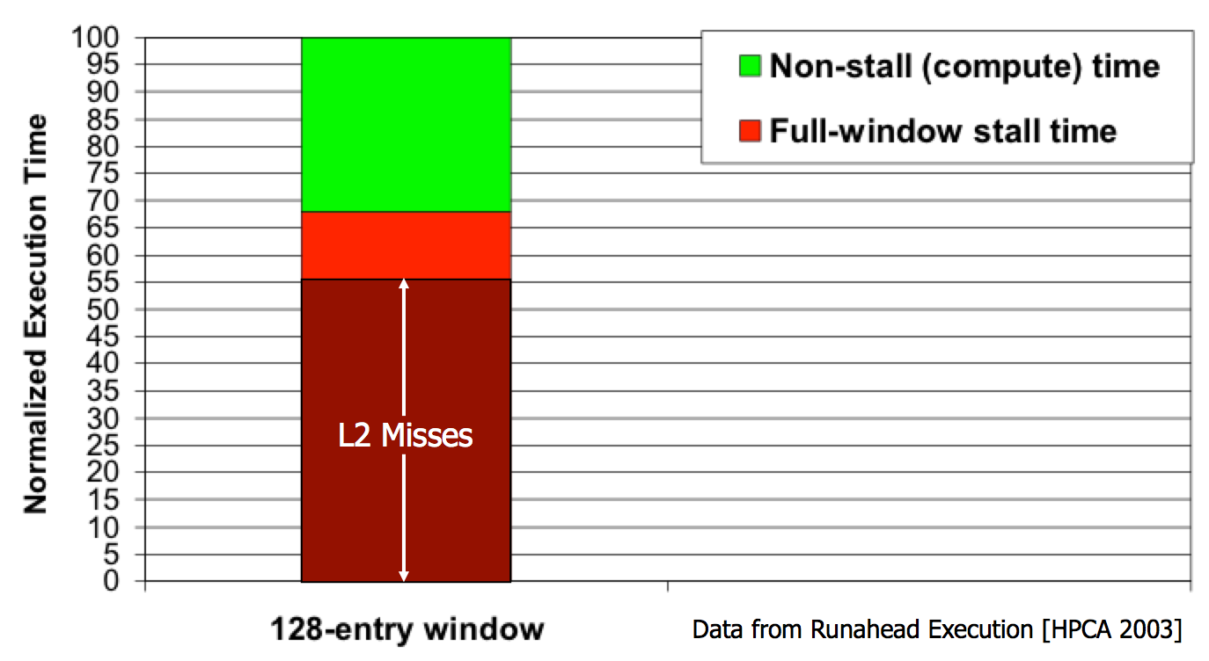
The Performance Perspective (1996-2005)
“It’s the Memory, Stupid!” (Richard Sites, MPR, 1996)
Mutlu+, “Runahead Execution: An Alternative to Very Large Instruction Windows for Out-of-Order Processors,” HPCA 2003.

Slide 58
The Performance Perspective
Onur Mutlu, Jared Stark, Chris Wilkerson, and Yale N. Patt,
"Runahead Execution: An Alternative to Very Large Instruction Windows for Out-of-order Processors"
Proceedings of the 9th International Symposium on High-Performance Computer Architecture (HPCA), pages 129-140, Anaheim, CA, February 2003. Slides (pdf)

Slide 59
The Performance Perspective (Today)
All of Google’s Data Center Workloads (2015):
Kanev+, “Profiling a Warehouse-Scale Computer,” ISCA 2015.

Slide 60
The Performance Perspective (Today)
All of Google’s Data Center Workloads (2015):
Kanev+, “Profiling a Warehouse-Scale Computer,” ISCA 2015.

Slide 61
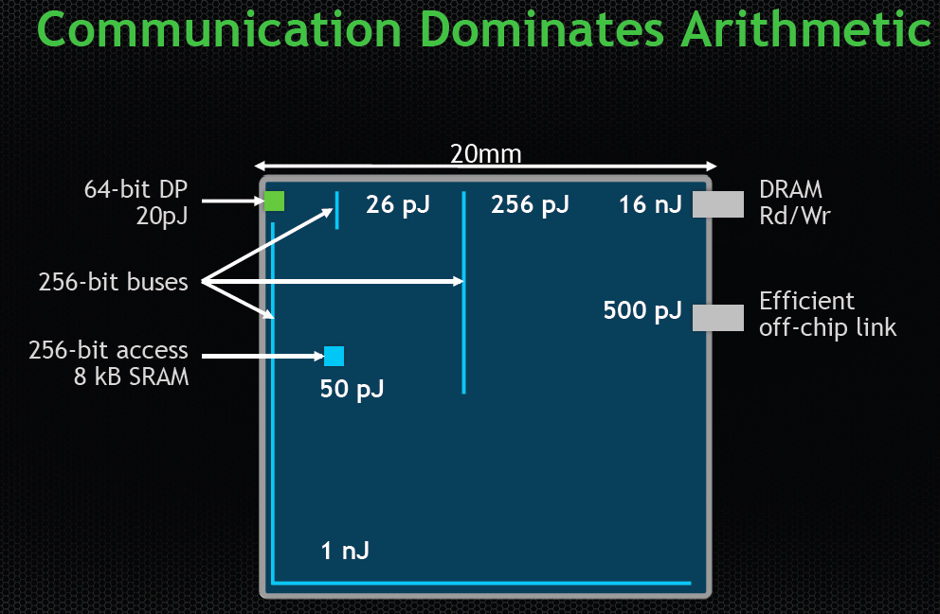
The Energy Perspective
Dally, HiPEAC 2015

Slide 62
Data Movement vs. Computation Energy
Dally, HiPEAC 2015
A memory access consumes ~1000X
the energy of a complex addition

Slide 63
Data Movement vs. Computation Energy
Data movement is a major system energy bottleneck
  Comprises 41% of mobile system energy during web browsing [2]
  Costs ~115 times as much energy as an ADD operation [1, 2]
[1]: Reducing data Movement Energy via Online Data Clustering and Encoding (MICRO’16)
[2]: Quantifying the energy cost of data movement for emerging smart phone workloads on mobile platforms (IISWC’14)

Slide 64
Challenge and Opportunity for Future
High Performance
and
Energy Efficient

Slide 65
Maslow’s (Human) Hierarchy of Needs, Revisited
Maslow, “A Theory of Human Motivation,”
Psychological Review, 1943.
Maslow, “A Theory of Human Motivation,”
Psychological Review, 1943.
Maslow, “Motivation and Personality,”
Book, 1954-1970.
Everlasting energy
Source: https://www.simplypsychology.org/maslow.html

Slide 66
The Problem
Data access is the major performance and energy bottleneck
Our current
design principles
cause great energy waste
(and great performance loss)

Slide 67
The Problem
Processing of data
is performed
far away from the data

Slide 68
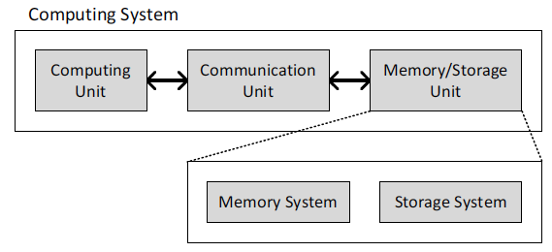
A Computing System
Three key components
Computation
Communication
Storage/memory
Burks, Goldstein, von Neumann, “Preliminary discussion of the
logical design of an electronic computing instrument,” 1946.
Image source: https://lbsitbytes2010.wordpress.com/2013/03/29/john-von-neumann-roll-no-15/

Slide 69
A Computing System
Three key components
Computation
Communication
Storage/memory
Burks, Goldstein, von Neumann, “Preliminary discussion of the
logical design of an electronic computing instrument,” 1946.
Image source: https://lbsitbytes2010.wordpress.com/2013/03/29/john-von-neumann-roll-no-15/

Slide 70
Today’s Computing Systems
Are overwhelmingly processor centric
All data processed in the processor → at great system cost
Processor is heavily optimized and is considered the master
Data storage units are dumb and are largely unoptimized (except for some that are on the processor die)

Slide 71
Yet …
“It’s the Memory, Stupid!” (Richard Sites, MPR, 1996)
Mutlu+, “Runahead Execution: An Alternative to Very Large Instruction Windows for Out-of-Order Processors,” HPCA 2003.

Slide 72
Perils of Processor-Centric Design
Grossly-imbalanced systems
  Processing done only in one place
  Everything else just stores and moves data: data moves a lot
  → Energy inefficient
  → Low performance
  → Complex
Overly complex and bloated processor (and accelerators)
  To tolerate data access from memory
  Complex hierarchies and mechanisms
  → Energy inefficient
  → Low performance
  → Complex

Slide 73
Perils of Processor-Centric Design
Most of the system is dedicated to storing and moving data

Slide 74
We Do Not Want to Move Data!
Dally, HiPEAC 2015
A memory access consumes ~1000X
the energy of a complex addition

Slide 75
Energy Waste in Mobile Devices
Amirali Boroumand, Saugata Ghose, Youngsok Kim, Rachata Ausavarungnirun, Eric Shiu, Rahul Thakur, Daehyun Kim, Aki Kuusela, Allan Knies, Parthasarathy Ranganathan, and Onur Mutlu,
"Google Workloads for Consumer Devices: Mitigating Data Movement Bottlenecks"
Proceedings of the 23rd International Conference on Architectural Support for Programming Languages and Operating Systems (ASPLOS), Williamsburg, VA, USA, March 2018.
62.7% of the total system energy
is spent on data movement

Slide 76
We Need A Paradigm Shift To …
Enable computation with minimal data movement
Compute where it makes sense (where data resides)
Make computing architectures more data-centric

Slide 77
Goal: Processing Inside Memory
Many questions … How do we design the:
  compute-capable memory & controllers?
  processor chip?
  software and hardware interfaces?
  system software and languages?
  algorithms?
Memory
Processor
Core
Database
Graphs
Media
Cache
Query
Interconnect
Problem
Results
Algorithm
Program/Language
System Software
SW/HW Interface
Micro-architecture
Logic
Devices
Electrons

Slide 78
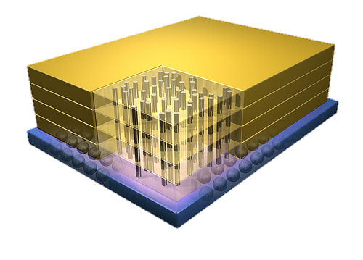


Why In-Memory Computation Today?
Dally, HiPEAC 2015
Push from Technology
  DRAM Scaling at jeopardy
  → Controllers close to DRAM
  → Industry open to new memory architectures
Pull from Systems and Applications
  Data access is a major system and application bottleneck
  Systems are energy limited
  Data movement much more energy-hungry than computation

Slide 79
Agenda
Major Trends Affecting Main Memory
The Need for Intelligent Memory Controllers
  Bottom Up: Push from Circuits and Devices
  Top Down: Pull from Systems and Applications
Processing in Memory: Two Directions
  Minimally Changing Memory Chips
  Exploiting 3D-Stacked Memory
How to Enable Adoption of Processing in Memory
Conclusion

Slide 80
Processing in Memory:
Two Approaches
1. Minimally changing memory chips
2. Exploiting 3D-stacked memory

Slide 81
Approach 1: Minimally Changing DRAM
DRAM has great capability to perform bulk data movement and computation internally with small changes
  Can exploit internal connectivity to move data
  Can exploit analog computation capability
  …
Examples: RowClone, In-DRAM AND/OR, Gather/Scatter DRAM
  RowClone: Fast and Efficient In-DRAM Copy and Initialization of Bulk Data (Seshadri et al., MICRO 2013)
  Fast Bulk Bitwise AND and OR in DRAM (Seshadri et al., IEEE CAL 2015)
  Gather-Scatter DRAM: In-DRAM Address Translation to Improve the Spatial Locality of Non-unit Strided Accesses (Seshadri et al., MICRO 2015)
  "Ambit: In-Memory Accelerator for Bulk Bitwise Operations Using Commodity DRAM Technology” (Seshadri et al., MICRO 2017)

Slide 82

Starting Simple: Data Copy and Initialization
  memmove & memcpy: 5% cycles in Google’s datacenter [Kanev+ ISCA’15]
000000000000000
Zero initialization
(e.g., security)
Forking
Checkpointing
Many more
VM Cloning
Deduplication
Page Migration

Slide 83
Today’s Systems: Bulk Data Copy
1) High latency
Memory
3) Cache pollution
L3
CPU
L2
L1
MC
2) High bandwidth utilization
4) Unwanted data movement
1046ns, 3.6uJ (for 4KB page copy via DMA)

Slide 84
Future Systems: In-Memory Copy
3) No cache pollution
1) Low latency
Memory
L3
CPU
L2
L1
MC
2) Low bandwidth utilization
4) No unwanted data movement
1046ns, 3.6uJ
→ 90ns, 0.04uJ

Slide 85
RowClone: In-DRAM Row Copy
Idea: Two consecutive ACTivates
4 Kbytes
Negligible HW cost
Step 1: Activate row A
Step 2: Activate row B
Transfer row
DRAM subarray
Transfer
row
Row Buffer (4 Kbytes)
8 bits
Data Bus
Notes:
copy

Slide 86
RowClone: Latency and Energy Savings
11.6x
74x
Seshadri et al., “RowClone: Fast and Efficient In-DRAM Copy and Initialization of Bulk Data,” MICRO 2013.

Slide 87
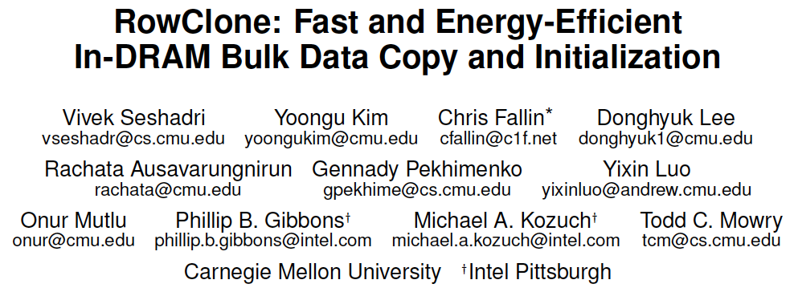
More on RowClone
Vivek Seshadri, Yoongu Kim, Chris Fallin, Donghyuk Lee, Rachata Ausavarungnirun, Gennady Pekhimenko, Yixin Luo, Onur Mutlu, Michael A. Kozuch, Phillip B. Gibbons, and Todd C. Mowry,
"RowClone: Fast and Energy-Efficient In-DRAM Bulk Data Copy and Initialization"
Proceedings of the 46th International Symposium on Microarchitecture (MICRO), Davis, CA, December 2013. [Slides (pptx) (pdf)] [Lightning Session Slides (pptx) (pdf)] [Poster (pptx) (pdf)]

Slide 88
Memory as an Accelerator
CPU
core
CPU
core
mini-CPU
core
GPU
(throughput)
core
GPU
(throughput)
core
video
core
GPU
(throughput)
core
GPU
(throughput)
core
CPU
core
CPU
core
Memory
imaging
core
LLC
Specialized
compute-capability
in memory
Memory Controller
Memory Bus
Memory similar to a “conventional” accelerator

Slide 89
In-Memory Bulk Bitwise Operations
We can support in-DRAM COPY, ZERO, AND, OR, NOT, MAJ
At low cost
Using analog computation capability of DRAM
  Idea: activating multiple rows performs computation
30-60X performance and energy improvement
  Seshadri+, “Ambit: In-Memory Accelerator for Bulk Bitwise Operations Using Commodity DRAM Technology,” MICRO 2017.
New memory technologies enable even more opportunities
  Memristors, resistive RAM, phase change mem, STT-MRAM, …
  Can operate on data with minimal movement

Slide 90
In-DRAM AND/OR: Triple Row Activation
½V_{DD}
½V_{DD}+δ
V_{DD}
A
Final State
AB + BC + AC
B
C
C(A + B) + ~C(AB)
dis
en
0
½V_{DD}
Seshadri+, “Fast Bulk Bitwise AND and OR in DRAM”, IEEE CAL 2015.

Slide 91
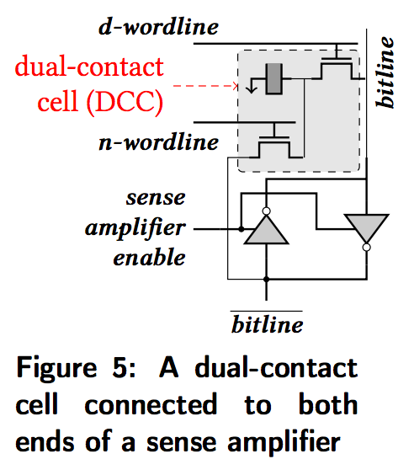
In-DRAM NOT: Dual Contact Cell
Idea:
Feed the
negated value
in the sense amplifier
into a special row
Seshadri+, “Ambit: In-Memory Accelerator for Bulk Bitwise Operations using Commodity DRAM Technology,” MICRO 2017.

Slide 92
Performance: In-DRAM Bitwise Operations
Seshadri+, “Ambit: In-Memory Accelerator for Bulk Bitwise Operations using Commodity DRAM Technology,” MICRO 2017.

Slide 93
Energy of In-DRAM Bitwise Operations
Seshadri+, “Ambit: In-Memory Accelerator for Bulk Bitwise Operations using Commodity DRAM Technology,” MICRO 2017.

Slide 94
Ambit vs. DDR3: Performance and Energy
32X
35X
Seshadri+, “Ambit: In-Memory Accelerator for Bulk Bitwise Operations using Commodity DRAM Technology,” MICRO 2017.

Slide 95
Bulk Bitwise Operations in Workloads
[1] Li and Patel, BitWeaving, SIGMOD 2013
[2] Goodwin+, BitFunnel, SIGIR 2017

Slide 96
Example Data Structure: Bitmap Index
Alternative to B-tree and its variants
Efficient for performing range queries and joins
Many bitwise operations to perform a query
age < 18
18 < age < 25
25 < age < 60
age > 60
Bitmap 1
Bitmap 2
Bitmap 3
Bitmap 4

Slide 97
Performance: Bitmap Index on Ambit
Seshadri+, “Ambit: In-Memory Accelerator for Bulk Bitwise Operations using Commodity DRAM Technology,” MICRO 2017.

Slide 98
Performance: BitWeaving on Ambit
Seshadri+, “Ambit: In-Memory Accelerator for Bulk Bitwise Operations using Commodity DRAM Technology,” MICRO 2017.

Slide 99
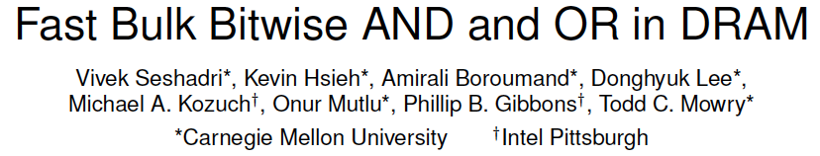
More on In-DRAM Bulk AND/OR
Vivek Seshadri, Kevin Hsieh, Amirali Boroumand, Donghyuk Lee, Michael A. Kozuch, Onur Mutlu, Phillip B. Gibbons, and Todd C. Mowry,
"Fast Bulk Bitwise AND and OR in DRAM"
IEEE Computer Architecture Letters (CAL), April 2015.

Slide 100
More on Ambit
Vivek Seshadri et al., “Ambit: In-Memory Accelerator for Bulk Bitwise Operations Using Commodity DRAM Technology,” MICRO 2017.

Slide 101
Challenge and Opportunity for Future
Computing Architectures
with
Minimal Data Movement

Slide 102
Challenge: Intelligent Memory Device
Does memory
have to be
dumb?

Slide 103
Agenda
Major Trends Affecting Main Memory
The Need for Intelligent Memory Controllers
  Bottom Up: Push from Circuits and Devices
  Top Down: Pull from Systems and Applications
Processing in Memory: Two Directions
  Minimally Changing Memory Chips
  Exploiting 3D-Stacked Memory
How to Enable Adoption of Processing in Memory
Conclusion

Slide 104
Opportunity: 3D-Stacked Logic+Memory
Memory
Logic
Other “True 3D” technologies
under development

Slide 105
DRAM Landscape (circa 2015)
  Kim+, “Ramulator: A Flexible and Extensible DRAM Simulator”, IEEE CAL 2015.

Slide 106
Two Key Questions in 3D-Stacked PIM
How can we accelerate important applications if we use 3D-stacked memory as a coarse-grained accelerator?
  what is the architecture and programming model?
  what are the mechanisms for acceleration?
What is the minimal processing-in-memory support we can provide?
  without changing the system significantly
  while achieving significant benefits

Slide 107
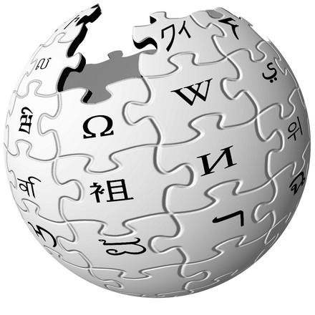



Graph Processing
Large graphs are everywhere (circa 2015)
Scalable large-scale graph processing is challenging
36 Million
Wikipedia Pages
1.4 Billion
Facebook Users
300 Million
Twitter Users
30 Billion
Instagram Photos

Slide 108
Key Bottlenecks in Graph Processing
for (v: graph.vertices) {
for (w: v.successors) {
w.next_rank += weight * v.rank;
}
}
1. Frequent random memory accesses
v
&w
w.rank
w.next_rank
w.edges
weight * v.rank
w
…
2. Little amount of computation

Slide 109
Tesseract System for Graph Processing
Interconnected set of 3D-stacked memory+logic chips with simple cores
Host Processor
Memory
Memory-Mapped
Accelerator Interface
(Noncacheable, Physically Addressed)
Logic
In-Order Core
DRAM Controller
…
…
LP
PF Buffer
Crossbar Network
…
MTP
…
Message Queue
NI
Ahn+, “A Scalable Processing-in-Memory Accelerator for Parallel Graph Processing” ISCA 2015.

Slide 110
Tesseract System for Graph Processing
Host Processor
Memory
Memory-Mapped
Accelerator Interface
(Noncacheable, Physically Addressed)
Logic
In-Order Core
DRAM Controller
…
…
Communications via
Remote Function Calls
LP
PF Buffer
Crossbar Network
…
MTP
…
Message Queue
NI

Slide 111
Tesseract System for Graph Processing
Host Processor
Memory
Memory-Mapped
Accelerator Interface
(Noncacheable, Physically Addressed)
Logic
Prefetching
In-Order Core
DRAM Controller
…
…
LP
PF Buffer
Crossbar Network
…
MTP
…
Message Queue
NI

Slide 112
Evaluated Systems
DDR3-OoO
HMC-OoO
HMC-MC
Tesseract
32 Tesseract Cores
8 OoO
4GHz
8 OoO
4GHz
8 OoO
4GHz
8 OoO
4GHz
128
In-Order
2GHz
128
In-Order
2GHz
8 OoO
4GHz
8 OoO
4GHz
8 OoO
4GHz
8 OoO
4GHz
128
In-Order
2GHz
128
In-Order
2GHz
102.4GB/s
640GB/s
640GB/s
8TB/s
Ahn+, “A Scalable Processing-in-Memory Accelerator for Parallel Graph Processing” ISCA 2015.

Slide 113
Tesseract Graph Processing Performance
>13X Performance Improvement
On five graph processing algorithms
Ahn+, “A Scalable Processing-in-Memory Accelerator for Parallel Graph Processing” ISCA 2015.

Slide 114
Tesseract Graph Processing Performance

Slide 115
Tesseract Graph Processing System Energy
> 8X Energy Reduction
Ahn+, “A Scalable Processing-in-Memory Accelerator for Parallel Graph Processing” ISCA 2015.

Slide 116
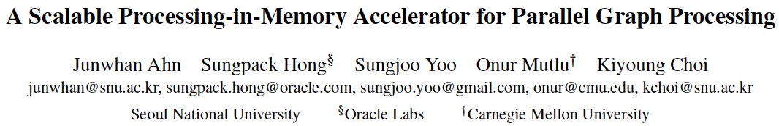
More on Tesseract
Junwhan Ahn, Sungpack Hong, Sungjoo Yoo, Onur Mutlu, and Kiyoung Choi,
"A Scalable Processing-in-Memory Accelerator for Parallel Graph Processing"
Proceedings of the 42nd International Symposium on Computer Architecture (ISCA), Portland, OR, June 2015.
[Slides (pdf)] [Lightning Session Slides (pdf)]

Slide 117
PIM on Mobile Devices
Amirali Boroumand, Saugata Ghose, Youngsok Kim, Rachata Ausavarungnirun, Eric Shiu, Rahul Thakur, Daehyun Kim, Aki Kuusela, Allan Knies, Parthasarathy Ranganathan, and Onur Mutlu,
"Google Workloads for Consumer Devices: Mitigating Data Movement Bottlenecks"
Proceedings of the 23rd International Conference on Architectural Support for Programming Languages and Operating Systems (ASPLOS), Williamsburg, VA, USA, March 2018.

Slide 118
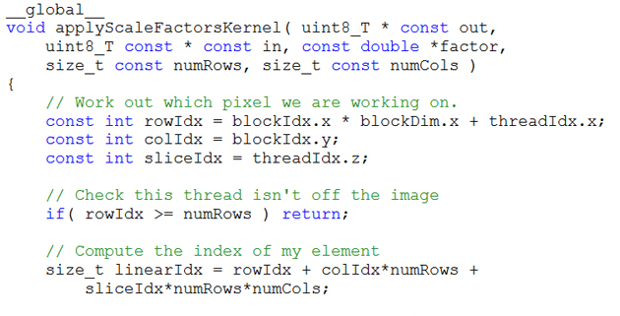
Truly Distributed GPU Processing with PIM?
3D-stacked memory
(memory stack)
SM (Streaming Multiprocessor)
Logic layer
Logic layer SM
Main GPU
Crossbar switch
Vault Ctrl
….
Vault Ctrl

Slide 119
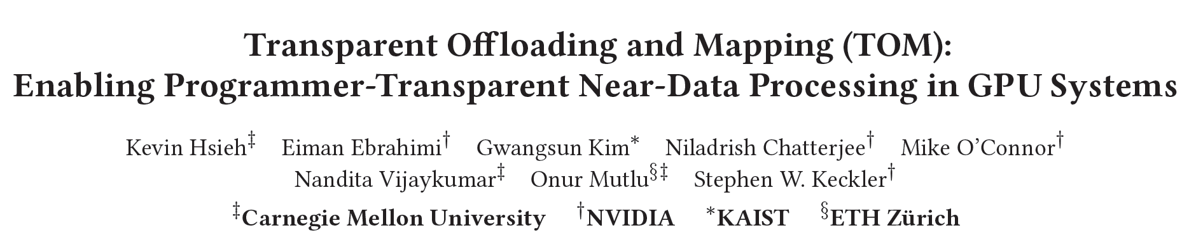
Accelerating GPU Execution with PIM (I)
Kevin Hsieh, Eiman Ebrahimi, Gwangsun Kim, Niladrish Chatterjee, Mike O'Connor, Nandita Vijaykumar, Onur Mutlu, and Stephen W. Keckler,
"Transparent Offloading and Mapping (TOM): Enabling Programmer-Transparent Near-Data Processing in GPU Systems"
Proceedings of the 43rd International Symposium on Computer Architecture (ISCA), Seoul, South Korea, June 2016.
[Slides (pptx) (pdf)]
[Lightning Session Slides (pptx) (pdf)]

Slide 120
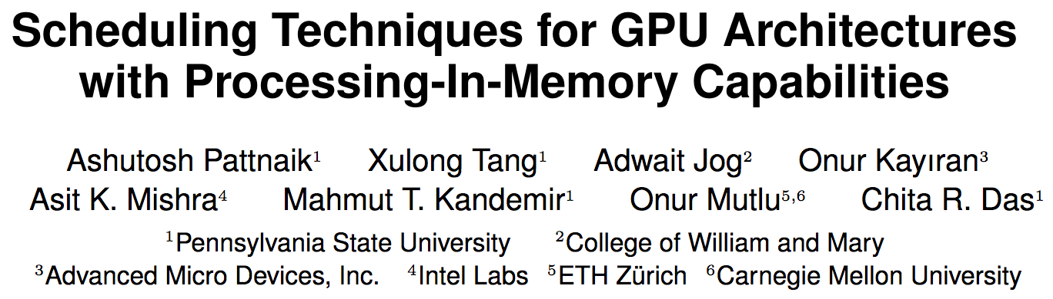
Accelerating GPU Execution with PIM (II)
Ashutosh Pattnaik, Xulong Tang, Adwait Jog, Onur Kayiran, Asit K. Mishra, Mahmut T. Kandemir, Onur Mutlu, and Chita R. Das,
"Scheduling Techniques for GPU Architectures with Processing-In-Memory Capabilities"
Proceedings of the 25th International Conference on Parallel Architectures and Compilation Techniques (PACT), Haifa, Israel, September 2016.

Slide 121
Two Key Questions in 3D-Stacked PIM
How can we accelerate important applications if we use 3D-stacked memory as a coarse-grained accelerator?
  what is the architecture and programming model?
  what are the mechanisms for acceleration?
What is the minimal processing-in-memory support we can provide?
  without changing the system significantly
  while achieving significant benefits

Slide 122
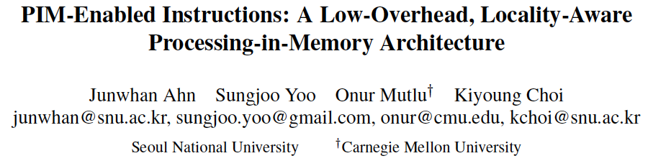
Simpler PIM: PIM-Enabled Instructions
Junwhan Ahn, Sungjoo Yoo, Onur Mutlu, and Kiyoung Choi,
"PIM-Enabled Instructions: A Low-Overhead, Locality-Aware Processing-in-Memory Architecture"
Proceedings of the 42nd International Symposium on Computer Architecture (ISCA), Portland, OR, June 2015.
[Slides (pdf)] [Lightning Session Slides (pdf)]

Slide 123
Automatic Code and Data Mapping
Kevin Hsieh, Eiman Ebrahimi, Gwangsun Kim, Niladrish Chatterjee, Mike O'Connor, Nandita Vijaykumar, Onur Mutlu, and Stephen W. Keckler,
"Transparent Offloading and Mapping (TOM): Enabling Programmer-Transparent Near-Data Processing in GPU Systems"
Proceedings of the 43rd International Symposium on Computer Architecture (ISCA), Seoul, South Korea, June 2016.
[Slides (pptx) (pdf)]
[Lightning Session Slides (pptx) (pdf)]

Slide 124
Challenge and Opportunity for Future
Fundamentally
Energy-Efficient
(Data-Centric)
Computing Architectures

Slide 125
Challenge and Opportunity for Future
Fundamentally
Low-Latency
(Data-Centric)
Computing Architectures

Slide 126
Agenda
Major Trends Affecting Main Memory
The Need for Intelligent Memory Controllers
  Bottom Up: Push from Circuits and Devices
  Top Down: Pull from Systems and Applications
Processing in Memory: Two Directions
  Minimally Changing Memory Chips
  Exploiting 3D-Stacked Memory
How to Enable Adoption of Processing in Memory
Conclusion

Slide 127
Eliminating the Adoption Barriers
How to Enable Adoption of Processing in Memory

Slide 128
Barriers to Adoption of PIM
1. Functionality of and applications for PIM
2. Ease of programming (interfaces and compiler/HW support)
3. System support: coherence & virtual memory
4. Runtime systems for adaptive scheduling, data mapping, access/sharing control
5. Infrastructures to assess benefits and feasibility

Slide 129
We Need to Revisit the Entire Stack
Problem
Algorithm
Program/Language
System Software
SW/HW Interface
Micro-architecture
Logic
Devices
Electrons

Slide 130
Key Challenge 1: Code Mapping
Challenge 1: Which operations should be executed in memory vs. in CPU?
?
3D-stacked memory
(memory stack)
SM (Streaming Multiprocessor)
?
Logic layer
Logic layer SM
Main GPU
Crossbar switch
Vault Ctrl
….
Vault Ctrl

Slide 131
Key Challenge 2: Data Mapping
Challenge 2: How should data be mapped to different 3D memory stacks?
3D-stacked memory
(memory stack)
SM (Streaming Multiprocessor)
Logic layer
Logic layer SM
Main GPU
Crossbar switch
Vault Ctrl
….
Vault Ctrl

Slide 132
How to Do the Code and Data Mapping?
Kevin Hsieh, Eiman Ebrahimi, Gwangsun Kim, Niladrish Chatterjee, Mike O'Connor, Nandita Vijaykumar, Onur Mutlu, and Stephen W. Keckler,
"Transparent Offloading and Mapping (TOM): Enabling Programmer-Transparent Near-Data Processing in GPU Systems"
Proceedings of the 43rd International Symposium on Computer Architecture (ISCA), Seoul, South Korea, June 2016.
[Slides (pptx) (pdf)]
[Lightning Session Slides (pptx) (pdf)]

Slide 133
How to Schedule Code?
Ashutosh Pattnaik, Xulong Tang, Adwait Jog, Onur Kayiran, Asit K. Mishra, Mahmut T. Kandemir, Onur Mutlu, and Chita R. Das,
"Scheduling Techniques for GPU Architectures with Processing-In-Memory Capabilities"
Proceedings of the 25th International Conference on Parallel Architectures and Compilation Techniques (PACT), Haifa, Israel, September 2016.

Slide 134
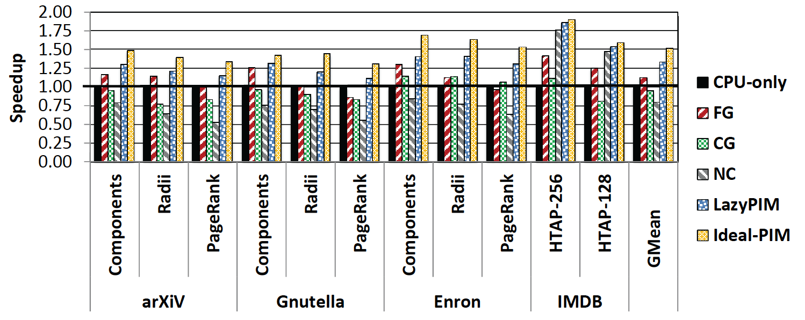
Challenge: Coherence for Hybrid CPU-PIM Apps
Traditional
coherence
No coherence
overhead

Slide 135
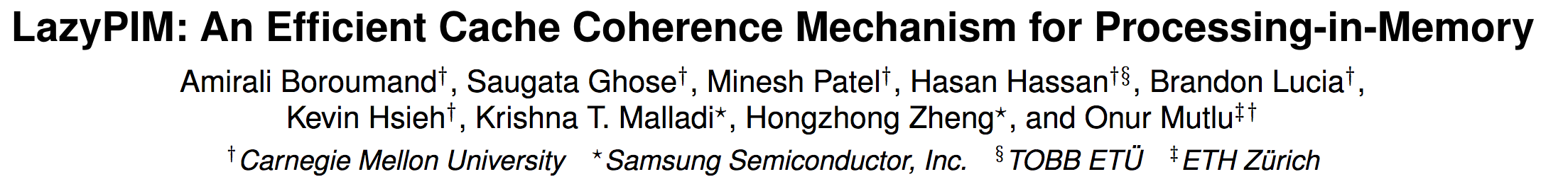
How to Maintain Coherence?
Amirali Boroumand, Saugata Ghose, Minesh Patel, Hasan Hassan, Brandon Lucia, Kevin Hsieh, Krishna T. Malladi, Hongzhong Zheng, and Onur Mutlu,
"LazyPIM: An Efficient Cache Coherence Mechanism for Processing-in-Memory"
IEEE Computer Architecture Letters (CAL), June 2016.

Slide 136
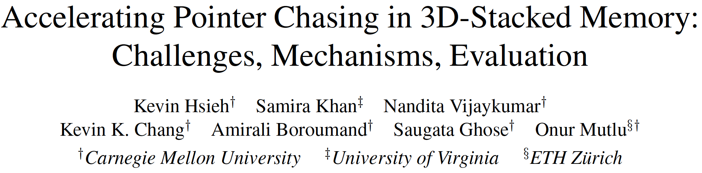
How to Support Virtual Memory?
Kevin Hsieh, Samira Khan, Nandita Vijaykumar, Kevin K. Chang, Amirali Boroumand, Saugata Ghose, and Onur Mutlu,
"Accelerating Pointer Chasing in 3D-Stacked Memory: Challenges, Mechanisms, Evaluation"
Proceedings of the 34th IEEE International Conference on Computer Design (ICCD), Phoenix, AZ, USA, October 2016.

Slide 137
How to Design Data Structures for PIM?
Zhiyu Liu, Irina Calciu, Maurice Herlihy, and Onur Mutlu,
"Concurrent Data Structures for Near-Memory Computing"
Proceedings of the 29th ACM Symposium on Parallelism in Algorithms and Architectures (SPAA), Washington, DC, USA, July 2017.
[Slides (pptx) (pdf)]

Slide 138

Simulation Infrastructures for PIM
Ramulator extended for PIM
  Flexible and extensible DRAM simulator
  Can model many different memory standards and proposals
  Kim+, “Ramulator: A Flexible and Extensible DRAM Simulator”, IEEE CAL 2015.
  https://github.com/CMU-SAFARI/ramulator

Slide 139
An FPGA-based Test-bed for PIM?
Hasan Hassan et al., SoftMC: A Flexible and Practical Open-Source Infrastructure for Enabling Experimental DRAM Studies HPCA 2017.
Flexible
Easy to Use (C++ API)
Open-source
github.com/CMU-SAFARI/SoftMC

Slide 140
Genome Read Mapping in PIM

Slide 141
Goals
Understand the primitives, architectures, and benefits of PIM by carefully examining many important workloads
Develop a common workload suite for PIM research

Slide 142



Genome Read In-Memory (GRIM) Filter:
Fast Location Filtering in DNA Read Mapping with Emerging Memory Technologies
Jeremie Kim,
Damla Senol, Hongyi Xin, Donghyuk Lee,
Saugata Ghose, Mohammed Alser, Hasan Hassan,
Oguz Ergin, Can Alkan, and Onur Mutlu
Notes:
Hello, my name is Jeremie Kim and I will be presenting Genome Read In-Memory Filter which will also be referred to as GRIM-Filter for short.
[CLICK]

Slide 143
Executive Summary
Genome Read Mapping is a very important problem and is the first step in many types of genomic analysis
  Could lead to improved health care, medicine, quality of life
Read mapping is an approximate string matching problem
  Find the best fit of 100 character strings into a 3 billion character dictionary
  Alignment is currently the best method for determining the similarity between two strings, but is very expensive
We propose an in-memory processing algorithm GRIM-Filter for accelerating read mapping, by reducing the number of required alignments
We implement GRIM-Filter using in-memory processing within 3D-stacked memory and show up to 3.7x speedup.

Slide 144
GRIM-Filter in 3D-stacked DRAM
The layout of bit vectors in a bank enables filtering many bins in parallel
Customized logic for accumulation and comparison per genome segment
  Low area overhead, simple implementation
Notes:
[CLICK]
Each DRAM layer is organized as an array of Banks
[CLICK]
and a bank is an array of cells with a row buffer. The row buffer holds one row at a time and uses this structure to transfer data with high bandwidth into the logic layer via TSVs
[CLICK]
We now show the distribution of bit vectors across the DRAM arrays to enable parallel processing of many bins.
[CLICK]
Each row represents a token's occurrence across many sequential bins. and the row of the appropriate token gets queried to find a vector showing the occurrence of the token across many bins.
These are the vectors are brought down into the logic layer to be operated on.
[CLICK]
[END-CLICK]

Slide 145

GRIM-Filter Performance
Time (x1000 seconds)
Benchmarks and their Execution Times
1.8x-3.7x performance benefit across real data sets
Notes:
We ran 10 separate experiments with real read data sets, consisting of approximately 4 million reads each, and got the following results. Compared to the previous best filter, our filter enjoys a 2x average end-to-end read mapper performance gain across the data sets, and a 6x average lower false positive rate. Again, these are the locations that were not discarded by the filter, but were then later discarded after alignment

Slide 146

GRIM-Filter False Positive Rate
False Positive Rate (%)
Benchmarks and their False Positive Rates
5.6x-6.4x False Positive reduction across real data sets
Notes:
We ran 10 separate experiments with real read data sets, consisting of approximately 4 million reads each, and got the following results. Compared to the previous best filter, our filter enjoys a 2x average end-to-end read mapper performance gain across the data sets, and a 6x average lower false positive rate. Again, these are the locations that were not discarded by the filter, but were then later discarded after alignment

Slide 147
Conclusions
We propose an in memory filter algorithm to accelerate end-to-end genome read mapping by reducing the number of required alignments
Compared to the previous best filter
  We observed 1.8x-3.7x speedup
  We observed 5.6x-6.4x fewer false positives
GRIM-Filter is a universal filter that can be applied to any genome read mapper
Notes:
[CLICK]
We propose an in-memory filter to accelerate read mapping
[CLICK]
Compared to the previous best filter we show up to 3.7x end-to-end speedup on the same mapper and
We also observe on average 6x fewer false positives
[CLICK]
GRIM-Filter is a universal filter that can be applied to any read mapper and we hope these results encourage people to use processing in memory to improve other data intensive algorithms
[END-CLICK]

Slide 148
PIM-Based DNA Sequence Analysis
Jeremie Kim, Damla Senol, Hongyi Xin, Donghyuk Lee, Mohammed Alser, Hasan Hassan, Oguz Ergin, Can Alkan, and Onur Mutlu,
"Genome Read In-Memory (GRIM) Filter: Fast Location Filtering in DNA Read Mapping Using Emerging Memory Technologies"
Pacific Symposium on Biocomputing (PSB) Poster Session, Hawaii, January 2017.
[Poster (pdf) (pptx)] [Abstract (pdf)]
To Appear in APBC 2018 and BMC Genomics 2018.

Slide 149
Agenda
Major Trends Affecting Main Memory
The Need for Intelligent Memory Controllers
  Bottom Up: Push from Circuits and Devices
  Top Down: Pull from Systems and Applications
Processing in Memory: Two Directions
  Minimally Changing Memory Chips
  Exploiting 3D-Stacked Memory
How to Enable Adoption of Processing in Memory
Conclusion

Slide 150
Maslow’s Hierarchy of Needs, A Third Time
Maslow, “A Theory of Human Motivation,”
Psychological Review, 1943.
Maslow, “Motivation and Personality,”
Book, 1954-1970.
Speed
Speed
Speed
Speed
Speed
Source: https://www.simplypsychology.org/maslow.html

Slide 151
Challenge and Opportunity for Future
Fundamentally
Energy-Efficient
(Data-Centric)
Computing Architectures

Slide 152
Challenge and Opportunity for Future
Fundamentally
Low-Latency
(Data-Centric)
Computing Architectures

Slide 153
Concluding Remarks

Slide 154

A Quote from A Famous Architect
“architecture […] based upon principle, and not upon precedent”

Slide 155

Precedent-Based Design?
“architecture […] based upon principle, and not upon precedent”

Slide 156

Principled Design
“architecture […] based upon principle, and not upon precedent”

Slide 157


Slide 158


The Overarching Principle

Slide 159

Another Example: Precedent-Based Design
Source: http://cookiemagik.deviantart.com/art/Train-station-207266944

Slide 160

Principled Design
Source: By Toni_V, CC BY-SA 2.0, https://commons.wikimedia.org/w/index.php?curid=4087256

Slide 161


Another Principled Design
Source: By Martín Gómez Tagle - Lisbon, Portugal, CC BY-SA 3.0, https://commons.wikimedia.org/w/index.php?curid=13764903
Source: http://www.arcspace.com/exhibitions/unsorted/santiago-calatrava/

Slide 162


Principle Applied to Another Structure
Source: By 準建築人手札網站 Forgemind ArchiMedia - Flickr: IMG_2489.JPG, CC BY 2.0,
https://commons.wikimedia.org/w/index.php?curid=31493356, https://en.wikipedia.org/wiki/Santiago_Calatrava
Source: https://www.dezeen.com/2016/08/29/santiago-calatrava-oculus-world-trade-center-transportation-hub-new-york-photographs-hufton-crow/

Slide 163


The Overarching Principle

Slide 164

Overarching Principle for Computing?
Source: http://spectrum.ieee.org/image/MjYzMzAyMg.jpeg

Slide 165
Concluding Remarks
It is time to design principled system architectures to solve the memory problem
Design complete systems to be balanced, high-performance, and energy-efficient, i.e., data-centric (or memory-centric)
Enable computation capability inside and close to memory
This can
  Lead to orders-of-magnitude improvements
  Enable new applications & computing platforms
  Enable better understanding of nature
  …
Notes:
Perhaps we have taken processor-centric system design a bit too far

Slide 166
The Future of Processing in Memory is Bright
Regardless of challenges
  in underlying technology and overlying problems/requirements
Problem
Can enable:
- Orders of magnitude
improvements
- New applications and
computing systems
Yet, we have to
- Think across the stack
- Design enabling systems
Algorithm
Program/Language
System Software
SW/HW Interface
Micro-architecture
Logic
Devices
Electrons

Slide 167
If In Doubt, See Other Doubtful Technologies
A very “doubtful” emerging technology
  for at least two decades
Proceedings of the IEEE, Sept. 2017
https://arxiv.org/pdf/1706.08642

Slide 168
Processing Data Where It Makes Sense in Modern Computing Systems:
Enabling In-Memory Computation
Onur Mutlu
omutlu@gmail.com
https://people.inf.ethz.ch/omutlu
23 March 2018
DATE Emerging Memory Workshop Keynote Talk

Slide 169
Acknowledgments
My current and past students and postdocs
  Rachata Ausavarungnirun, Abhishek Bhowmick, Amirali Boroumand, Rui Cai, Yu Cai, Kevin Chang, Saugata Ghose, Kevin Hsieh, Tyler Huberty, Ben Jaiyen, Samira Khan, Jeremie Kim, Yoongu Kim, Yang Li, Jamie Liu, Lavanya Subramanian, Donghyuk Lee, Yixin Luo, Justin Meza, Gennady Pekhimenko, Vivek Seshadri, Lavanya Subramanian, Nandita Vijaykumar, HanBin Yoon, Jishen Zhao, …
My collaborators
  Can Alkan, Chita Das, Phil Gibbons, Sriram Govindan, Norm Jouppi, Mahmut Kandemir, Mike Kozuch, Konrad Lai, Ken Mai, Todd Mowry, Yale Patt, Moinuddin Qureshi, Partha Ranganathan, Bikash Sharma, Kushagra Vaid, Chris Wilkerson, …

Slide 170
Funding Acknowledgments
NSF
GSRC
SRC
CyLab
AMD, Google, Facebook, HP Labs, Huawei, IBM, Intel, Microsoft, Nvidia, Oracle, Qualcomm, Rambus, Samsung, Seagate, VMware

Slide 171
Some Open Source Tools
Rowhammer
  https://github.com/CMU-SAFARI/rowhammer
Ramulator – Fast and Extensible DRAM Simulator
  https://github.com/CMU-SAFARI/ramulator
MemSim
  https://github.com/CMU-SAFARI/memsim
NOCulator
  https://github.com/CMU-SAFARI/NOCulator
DRAM Error Model
  http://www.ece.cmu.edu/~safari/tools/memerr/index.html
Other open-source software from my group
  https://github.com/CMU-SAFARI/
  http://www.ece.cmu.edu/~safari/tools.html

Slide 172
Tesseract: Extra Slides

Slide 173
Communications In Tesseract (I)

Slide 174
Communications In Tesseract (II)

Slide 175
Communications In Tesseract (III)

Slide 176
Remote Function Call (Non-Blocking)

Slide 177
Effect of Bandwidth & Programming Model
HMC-MC Bandwidth (640GB/s)
Tesseract Bandwidth (8TB/s)
Programming Model
Bandwidth
(No Prefetching)

Slide 178
Reducing Memory Latency

Slide 179
Main Memory Latency Lags Behind
128x
20x
1.3x
Memory latency remains almost constant

Slide 180

A Closer Look …
Chang+, “Understanding Latency Variation in Modern DRAM Chips: Experimental
Characterization, Analysis, and Optimization",” SIGMETRICS 2016.

Slide 181
DRAM Latency Is Critical for Performance
In-memory Databases
[Mao+, EuroSys’12;
Clapp+ (Intel), IISWC’15]
Graph/Tree Processing
[Xu+, IISWC’12; Umuroglu+, FPL’15]
In-Memory Data Analytics
[Clapp+ (Intel), IISWC’15;
Awan+, BDCloud’15]
Datacenter Workloads
[Kanev+ (Google), ISCA’15]

Slide 182
DRAM Latency Is Critical for Performance
In-memory Databases
[Mao+, EuroSys’12;
Clapp+ (Intel), IISWC’15]
Graph/Tree Processing
[Xu+, IISWC’12; Umuroglu+, FPL’15]
Long memory latency → performance bottleneck
In-Memory Data Analytics
[Clapp+ (Intel), IISWC’15;
Awan+, BDCloud’15]
Datacenter Workloads
[Kanev+ (Google), ISCA’15]

Slide 183
Why the Long Latency?
Design of DRAM uArchitecture
  Goal: Maximize capacity/area, not minimize latency
“One size fits all” approach to latency specification
  Same latency parameters for all temperatures
  Same latency parameters for all DRAM chips (e.g., rows)
  Same latency parameters for all parts of a DRAM chip
  Same latency parameters for all supply voltage levels
  Same latency parameters for all application data
  …

Slide 184

Latency Variation in Memory Chips
Heterogeneous manufacturing & operating conditions →
latency variation in timing parameters
DRAM A
DRAM B
DRAM C
Slow cells
Low
High
DRAM Latency

Slide 185
DRAM Characterization Infrastructure
Temperature
Controller
FPGAs
Heater
FPGAs
PC
  Kim+, “Flipping Bits in Memory Without Accessing Them: An Experimental Study of DRAM Disturbance Errors,” ISCA 2014.

Slide 186
DRAM Characterization Infrastructure
Hasan Hassan et al., SoftMC: A Flexible and Practical Open-Source Infrastructure for Enabling Experimental DRAM Studies, HPCA 2017.
Flexible
Easy to Use (C++ API)
Open-source
github.com/CMU-SAFARI/SoftMC

Slide 187
SoftMC: Open Source DRAM Infrastructure
https://github.com/CMU-SAFARI/SoftMC

Slide 188
Tackling the Fixed Latency Mindset
Reliable operation latency is actually very heterogeneous
  Across temperatures, chips, parts of a chip, voltage levels, …
Idea: Dynamically find out and use the lowest latency one can reliably access a memory location with
  Adaptive-Latency DRAM [HPCA 2015]
  Flexible-Latency DRAM [SIGMETRICS 2016]
  Design-Induced Variation-Aware DRAM [SIGMETRICS 2017]
  Voltron [SIGMETRICS 2017]
  ...
We would like to find sources of latency heterogeneity and exploit them to minimize latency

Slide 189
Adaptive-Latency DRAM
Key idea
  Optimize DRAM timing parameters online
Two components
  DRAM manufacturer provides multiple sets of reliable DRAM timing parameters at different temperatures for each DIMM
  System monitors DRAM temperature & uses appropriate DRAM timing parameters
reliable DRAM timing parameters
DRAM temperature
Lee+, “Adaptive-Latency DRAM: Optimizing DRAM Timing for the Common-Case,” HPCA 2015.

Slide 190
Latency Reduction Summary of 115 DIMMs
Latency reduction for read & write (55°C)
  Read Latency: 32.7%
  Write Latency: 55.1%
Latency reduction for each timing parameter (55°C)
  Sensing: 17.3%
  Restore: 37.3% (read), 54.8% (write)
  Precharge: 35.2%
Lee+, “Adaptive-Latency DRAM: Optimizing DRAM Timing for the Common-Case,” HPCA 2015.

Slide 191


AL-DRAM: Real System Evaluation
System
  CPU: AMD 4386 ( 8 Cores, 3.1GHz, 8MB LLC)
  DRAM: 4GByte DDR3-1600 (800Mhz Clock)
  OS: Linux
  Storage: 128GByte SSD
Workload
  35 applications from SPEC, STREAM, Parsec, Memcached, Apache, GUPS

Slide 192
AL-DRAM: Single-Core Evaluation
Average
Improvement
6.7%
Performance Improvement
5.0%
1.4%
all-35-workload
AL-DRAM improves single-core performance
on a real system

Slide 193
AL-DRAM: Multi-Core Evaluation
Average
Improvement
14.0%
10.4%
Performance Improvement
2.9%
all-35-workload
AL-DRAM provides higher performance on
multi-programmed & multi-threaded workloads

Slide 194
Reducing Latency Also Reduces Energy
AL-DRAM reduces DRAM power consumption by 5.8%
Major reason: reduction in row activation time

Slide 195

More on Adaptive-Latency DRAM
Donghyuk Lee, Yoongu Kim, Gennady Pekhimenko, Samira Khan, Vivek Seshadri, Kevin Chang, and Onur Mutlu,
"Adaptive-Latency DRAM: Optimizing DRAM Timing for the Common-Case"
Proceedings of the 21st International Symposium on High-Performance Computer Architecture (HPCA), Bay Area, CA, February 2015.
[Slides (pptx) (pdf)] [Full data sets]

Slide 196
Heterogeneous Latency within A Chip
19.7%
19.5%
17.6%
13.3%
Chang+, “Understanding Latency Variation in Modern DRAM Chips: Experimental
Characterization, Analysis, and Optimization",” SIGMETRICS 2016.

Slide 197

Analysis of Latency Variation in DRAM Chips
Kevin Chang, Abhijith Kashyap, Hasan Hassan, Samira Khan, Kevin Hsieh, Donghyuk Lee, Saugata Ghose, Gennady Pekhimenko, Tianshi Li, and Onur Mutlu,
"Understanding Latency Variation in Modern DRAM Chips: Experimental Characterization, Analysis, and Optimization"
Proceedings of the ACM International Conference on Measurement and Modeling of Computer Systems (SIGMETRICS), Antibes Juan-Les-Pins, France, June 2016.
[Slides (pptx) (pdf)]
[Source Code]

Slide 198
What Is Design-Induced Variation?
fast
slow
across column
inherently slow
distance from wordline driver
slow
across row
wordline drivers
distance from sense amplifier
fast
Inherently fast
sense amplifiers
Systematic variation in cell access times
caused by the physical organization of DRAM
Notes:
As we described, cells in a mat have different distances from peripheral logic.
Cells in different rows have different distance from the sense amplifiers.
Cells in different columns have different distance from the wordline drivers.
Therefore, some regions are inherently faster than other regions,
and some regions are inherently slower than other regions.
We call this architectural variation.

Slide 199
DIVA Online Profiling
Design-Induced-Variation-Aware
inherently slow
wordline driver
sense amplifier
Profile only slow regions to determine min. latency
→ Dynamic & low cost latency optimization
Notes:
We propoe AVA Online profiling.
The key idea is profiling only slow regions to determine latency, leading to low cost online DRAM test.

Slide 200
DIVA Online Profiling
Design-Induced-Variation-Aware
slow cells
inherently slow
process
variation
design-induced
variation
wordline driver
random error
localized error
error-correcting code
online profiling
sense amplifier
Combine error-correcting codes & online profiling
→ Reliably reduce DRAM latency
Notes:
However, due to the process variation, some cells are more vulnerable than other cells, as the figure show.
These cells are randomly distributed while cells in the slow regions cause localized error.
To address both type of cells,
We integrate conventional ECC to correct the process variation induced errors.
Therefore, combining ECC and online profiling leads to reliably reducing DRAM latency.

Slide 201
DIVA-DRAM Reduces Latency
Read
Write
Latency Reduction
DIVA
DIVA
DIVA
DIVA
DIVA-DRAM reduces latency more aggressively
and uses ECC to correct random slow cells
Notes:
The figure compares latency reduction by using AL-DRAM, AVA Profiling, and both AVA Profiling and Shuffling.
As we can, using AVA profiling and shuffling enables more latency reduction compared to AL-DRAM.
This is mainly because ECC corrects the worst cells in a DRAM module, reducing more latency.
Therefore, we conclude that AVA-DRAM reduces latency significantly.

Slide 202

Design-Induced Latency Variation in DRAM
Donghyuk Lee, Samira Khan, Lavanya Subramanian, Saugata Ghose, Rachata Ausavarungnirun, Gennady Pekhimenko, Vivek Seshadri, and Onur Mutlu,
"Design-Induced Latency Variation in Modern DRAM Chips: Characterization, Analysis, and Latency Reduction Mechanisms"
Proceedings of the ACM International Conference on Measurement and Modeling of Computer Systems (SIGMETRICS), Urbana-Champaign, IL, USA, June 2017.

Slide 203
Voltron: Exploiting the
Voltage-Latency-Reliability Relationship

Slide 204
Executive Summary
DRAM (memory) power is significant in today’s systems
  Existing low-voltage DRAM reduces voltage conservatively
Goal: Understand and exploit the reliability and latency behavior of real DRAM chips under aggressive reduced-voltage operation
Key experimental observations:
  Huge voltage margin -- Errors occur beyond some voltage
  Errors exhibit spatial locality
  Higher operation latency mitigates voltage-induced errors
Voltron: A new DRAM energy reduction mechanism
  Reduce DRAM voltage without introducing errors
  Use a regression model to select voltage that does not degrade performance beyond a chosen target → 7.3% system energy reduction

Slide 205

Analysis of Latency-Voltage in DRAM Chips
Kevin Chang, A. Giray Yaglikci, Saugata Ghose, Aditya Agrawal, Niladrish Chatterjee, Abhijith Kashyap, Donghyuk Lee, Mike O'Connor, Hasan Hassan, and Onur Mutlu,
"Understanding Reduced-Voltage Operation in Modern DRAM Devices: Experimental Characterization, Analysis, and Mechanisms"
Proceedings of the ACM International Conference on Measurement and Modeling of Computer Systems (SIGMETRICS), Urbana-Champaign, IL, USA, June 2017.

Slide 206
And, What If …
… we can sacrifice reliability of some data to access it with even lower latency?

Slide 207
Tiered Latency DRAM

Slide 208
What Causes the Long Latency?
DRAM Chip
DRAM Chip
cell array
subarray
Subarray
I/O
I/O
I/O
channel
channel
DRAM Latency = Subarray Latency + I/O Latency
DRAM Latency = Subarray Latency + I/O Latency
Dominant
Notes:
To understand what causes the long latency, let me take a look at the DRAM organization.
DRAM consists of two components, the cell array and the I/O circuitry. The cell array consists of multiple subarrays.
To read from a DRAM chip, the data is first accessed from the subarray and then the data is transferred over the channel by the I/O circuitry.
So, the DRAM latency is the sum of the subarray latency and the I/O latency.
We observed that the subarray latency is much higher than the I/O latency.
As a result, subarray is the dominant source of the DRAM latency as we explained in the paper.

Slide 209
Why is the Subarray So Slow?
Subarray
Cell
cell
wordline
bitline: 512 cells
access
row decoder
row decoder
transistor
capacitor
sense amplifier
bitline
sense amplifier
large sense amplifier
Long bitline
  Amortizes sense amplifier cost → Small area
  Large bitline capacitance → High latency & power
Notes:
The cell’s capacitor is small and can store only a small amount of charge.
That is why a subarray also has sense-amplifiers, which are specialized circuits that can detect the small amount of charge.
Unfortunately, a sense-amplifier size is about *100* times the cell size.
So, to amortize the area of the sense-amplifiers,
hundreds of cells share the same sense-amplifier through a long bitline.
However, a long bitline has a large capacitance that increases latency and power consumption.
Therefore, the long bitline is one of the dominant sources of high latency and high power consumption.
To understand why the subarray is so slow,
let me take a look at the subarray organization.

Slide 210
Trade-Off: Area (Die Size) vs. Latency
Long Bitline
Short Bitline
Faster
Smaller
Trade-Off: Area vs. Latency
Notes:
A naïve way to reduce the DRAM latency is to have short bitlines that have lower latency.
Unfortunately, short bitlines significantly increase the DRAM area.
Therefore, the bitline length exposes an important trade-off between area and latency.

Slide 211
Trade-Off: Area (Die Size) vs. Latency
32
Fancy DRAM
Short Bitline
Commodity DRAM
Long Bitline
64
Cheaper
128
256
512 cells/bitline
GOAL
Faster
Notes:
This figure shows the trade-off between DRAM area and latency as we change the bitline length.
Y-axis is the normalized DRAM area compared to a DRAM using 512 cells/bitline. A lower value is cheaper.
X-axis shows the latency in terms of tRC, an important DRAM timing constraint. A lower value is faster.
Commodity DRAM chips use long bitlines to minimize area cost. On the other hand, shorter bitlines achieve lower latency at higher cost.
Our goal is to achieve the best of both worlds: low latency and low area cost.

Slide 212
Approximating the Best of Both Worlds
Long Bitline
Long Bitline
Our Proposal
Short Bitline
Short Bitline
Small Area
Large Area
Small Area
High Latency
Low Latency
Low Latency
Need Isolation
Add Isolation Transistors
Short Bitline ➔ Fast
Notes:
To sum up, both long and short bitline do not achieve small area and low latency.
Long bitline has small area but has high latency while short bitline has low latency but has large area.
To achieve the best of both worlds, we first start from long bitline, which has small area.
After that, to achieve the low latency of short bitline, we divide the long bitline into two smaller segments.
The bitline length of the segment nearby the sense-amplifier is same as the length of short bitline.
Therefore, the latency of the segment is as low as the latency of the short bitline.
To isolate this fast segment from the other segment, we add isolation transistors that selectively connect the two segments.

Slide 213
Approximating the Best of Both Worlds
Long Bitline
Tiered-Latency DRAM
Our Proposal
Short Bitline
Long Bitline
Short Bitline
Small Area
Small Area
Large Area
High Latency
Low Latency
Low Latency
Small area using long bitline
Low Latency
Notes:
This way, our proposed approach achieves small area and low latency.
We call this new DRAM architecture as Tiered-Latency DRAM

Slide 214
Commodity DRAM vs. TL-DRAM [HPCA 2013]
DRAM Latency (tRC)
DRAM Power
  +49%
  +23%
  (52.5ns)
Latency
Power
  –56%
  –51%
  Near Far
  Near Far
  Commodity DRAM
  Commodity DRAM
  TL-DRAM
  TL-DRAM
DRAM Area Overhead
  ~3%: mainly due to the isolation transistors
Notes:
This figure compares the latency.
Y-axis is normalized latency.
Compared to commodity DRAM, TL-DRAM’s near segment has 56% lower latency, while the far segment has 23% higher latency.
The right figure compares the power.
Y-axis is normalized power.
Compared to commodity DRAM, TL-DRAM’s near segment has 51% lower power consumption and the far segment has 49% higher power consumption.
Lastly, mainly due to the isolation transistor, Tiered-latency DRAM increases the die-size by about 3%.

Slide 215
Trade-Off: Area (Die-Area) vs. Latency
32
64
Cheaper
128
256
512 cells/bitline
Near Segment
Far Segment
GOAL
Faster
Notes:
Again, the figure shows the trade-off between area and latency in existing DRAM.
Unlike existing DRAM, TL-DRAM achieves low latency using the near segment while increasing the area by only 3%.
Although the far segment has higher latency than commodity DRAM, we show that efficient use of the near segment enables TL-DRAM to achieve high system performance.

Slide 216
Leveraging Tiered-Latency DRAM
TL-DRAM is a substrate that can be leveraged by the hardware and/or software
Many potential uses
  Use near segment as hardware-managed inclusive cache to far segment
  Use near segment as hardware-managed exclusive cache to far segment
  Profile-based page mapping by operating system
  Simply replace DRAM with TL-DRAM
Lee+, “Tiered-Latency DRAM: A Low Latency and Low Cost DRAM Architecture,” HPCA 2013.
Notes:
There are multiple ways to leverage the TL-DRAM substrate by hardware or software.
In this slide, I describe many such ways.
First, the near segment can be used as a hardware-managed inclusive cache to the far segment.
Second, the near segment can be used as a hardware-managed exclusive cache to the far segment.
Third, the operating system can intelligently allocate frequently-accessed pages to the near segment.
Forth mechanism is to simple replace DRAM with TL-DRAM without any near segment handling
While our paper provides detailed explanations and evaluations of first three mechanism,
in this talk, we will focus on the first approach, which is to use the near segment as a hardware managed cache for the far segment.

Slide 217
Performance & Power Consumption
12.4%
11.5%
10.7%
–23%
–24%
–26%
Normalized Performance
Normalized Power
Core-Count (Channel)
Core-Count (Channel)
Using near segment as a cache improves performance and reduces power consumption
Lee+, “Tiered-Latency DRAM: A Low Latency and Low Cost DRAM Architecture,” HPCA 2013.
Notes:
This figure shows the IPC improvement of our three caching mechanisms over commodity DRAM.
All of them improve performance and benefit-based caching shows maximum performance improvement by 12.7%.
The right figure shows the normalized power reduction of our three caching mechanisms over commodity DRAM.
All of them reduce power consumption and benefit-based caching shows maximum power reduction by 23%.
Therefore, using near segment as a cache improves performance and reduces power consumption at the cost of 3% area overhead.

Slide 218
Challenge and Opportunity for Future
Fundamentally
Low Latency
Computing Architectures

Slide 219
Ramulator: A Fast and Extensible DRAM Simulator
[IEEE Comp Arch Letters’15]

Slide 220

Ramulator Motivation
DRAM and Memory Controller landscape is changing
Many new and upcoming standards
Many new controller designs
A fast and easy-to-extend simulator is very much needed

Slide 221

Ramulator
Provides out-of-the box support for many DRAM standards:
  DDR3/4, LPDDR3/4, GDDR5, WIO1/2, HBM, plus new proposals (SALP, AL-DRAM, TLDRAM, RowClone, and SARP)
~2.5X faster than fastest open-source simulator
Modular and extensible to different standards

Slide 222


Case Study: Comparison of DRAM Standards
Across 22 workloads, simple CPU model

Slide 223
Ramulator Paper and Source Code
Yoongu Kim, Weikun Yang, and Onur Mutlu,
"Ramulator: A Fast and Extensible DRAM Simulator"
IEEE Computer Architecture Letters (CAL), March 2015.
[Source Code]
Source code is released under the liberal MIT License
  https://github.com/CMU-SAFARI/ramulator

Slide 224
End of Backup Slides

Slide 225

Brief Self Introduction
Onur Mutlu
  Full Professor @ ETH Zurich CS, since September 2015 (officially May 2016)
  Strecker Professor @ Carnegie Mellon University ECE/CS, 2009-2016, 2016-…
  PhD from UT-Austin, worked at Google, VMware, Microsoft Research, Intel, AMD
  https://people.inf.ethz.ch/omutlu/
  omutlu@gmail.com (Best way to reach me)
  https://people.inf.ethz.ch/omutlu/projects.htm
Research and Teaching in:
  Computer architecture, computer systems, security, bioinformatics
  Memory and storage systems
  Hardware security
  Fault tolerance
  Hardware/software cooperation
  …

