Slide 1


Security of PIM Systems
Onur Mutlu
omutlu@gmail.com
https://people.inf.ethz.ch/omutlu
30 November 2023
Dagstuhl MAD (Microarchitectural Attacks & Defenses)

Slide 2
Problem
Computing
is Bottlenecked by Data

Slide 3
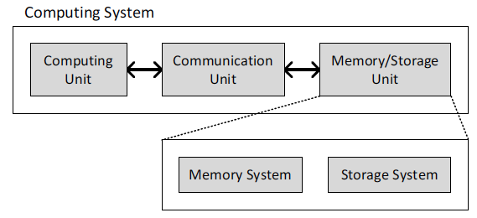
Today’s Computing Systems
Processor centric
All data processed in the processor → at great system cost

Slide 4
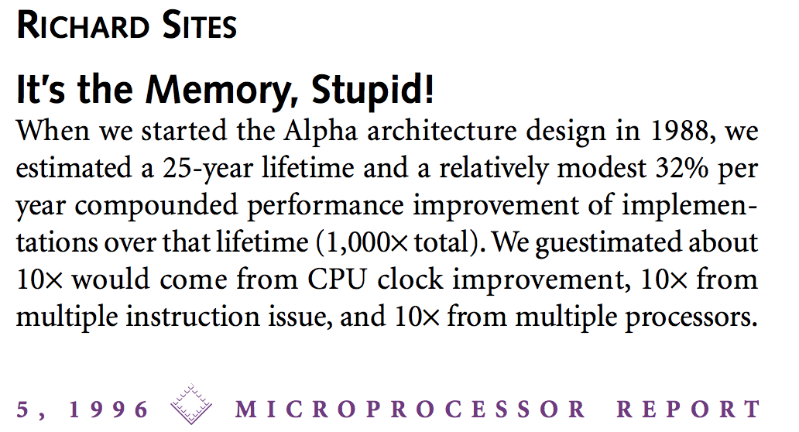
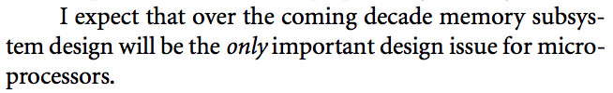
It’s the Memory, Stupid!
“It’s the Memory, Stupid!” (Richard Sites, MPR, 1996)
http://cva.stanford.edu/classes/cs99s/papers/architects_look_to_future.pdf

Slide 5
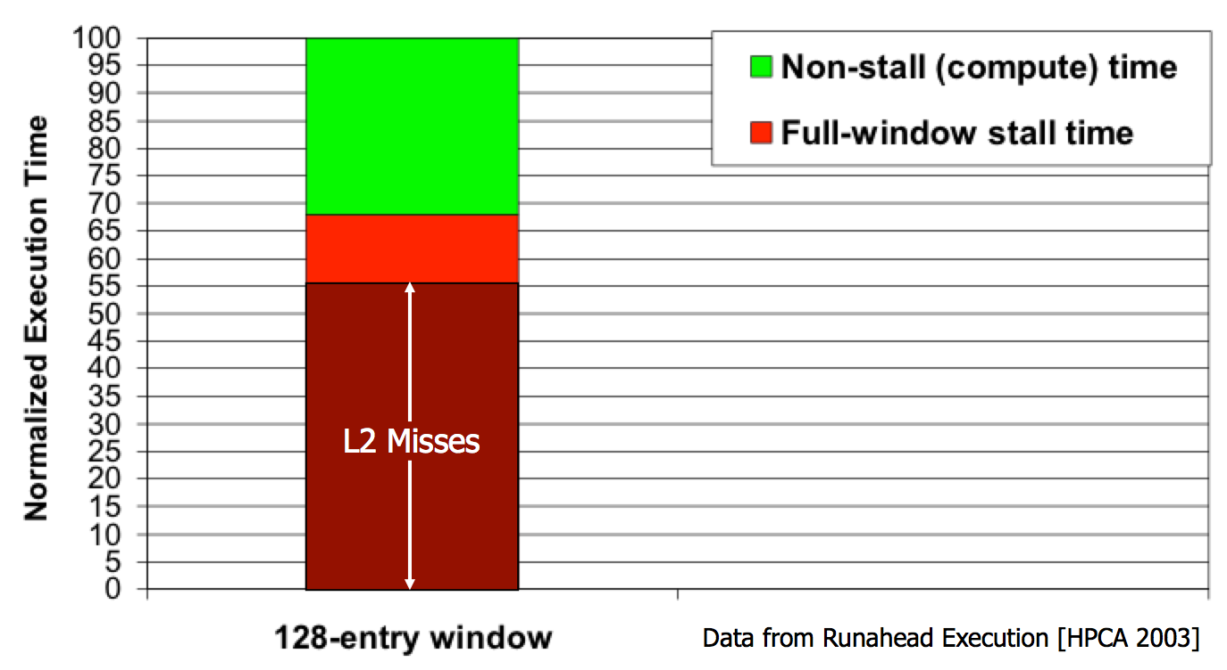
Processor-Centric System Performance
Mutlu+, “Runahead Execution: An Alternative to Very Large Instruction Windows for Out-of-Order Processors,” HPCA 2003.

Slide 6
Processor-Centric System Performance
All of Google’s Data Center Workloads (2015):
Kanev+, “Profiling a Warehouse-Scale Computer,” ISCA 2015.

Slide 7
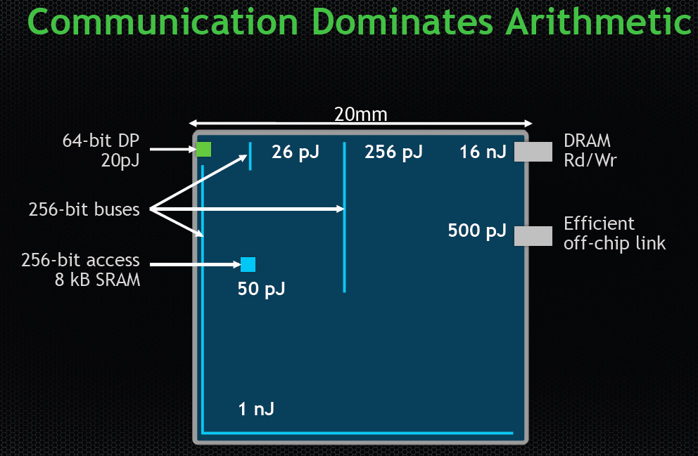
Data Movement vs. Computation Energy
Dally, HiPEAC 2015
A memory access consumes ~100-1000X
the energy of a complex addition

Slide 8
Data Movement vs. Computation Energy
Han+, “EIE: Efficient Inference Engine on Compressed Deep Neural Network,” ISCA 2016.

Slide 9
Data Movement vs. Computation Energy
6400X
A memory access consumes 6400X
the energy of a simple integer addition
Han+, “EIE: Efficient Inference Engine on Compressed Deep Neural Network,” ISCA 2016.

Slide 10
Energy Waste in Mobile Devices
Amirali Boroumand, Saugata Ghose, Youngsok Kim, Rachata Ausavarungnirun, Eric Shiu, Rahul Thakur, Daehyun Kim, Aki Kuusela, Allan Knies, Parthasarathy Ranganathan, and Onur Mutlu,
"Google Workloads for Consumer Devices: Mitigating Data Movement Bottlenecks"
Proceedings of the 23rd International Conference on Architectural Support for Programming Languages and Operating Systems (ASPLOS), Williamsburg, VA, USA, March 2018.
62.7% of the total system energy
is spent on data movement

Slide 11
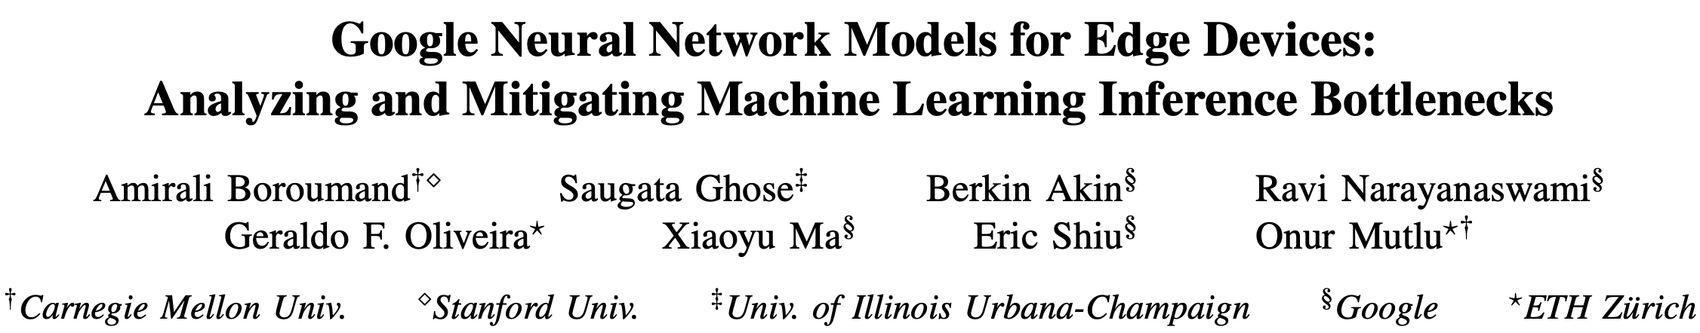
Energy Waste in Accelerators
Amirali Boroumand, Saugata Ghose, Berkin Akin, Ravi Narayanaswami, Geraldo F. Oliveira, Xiaoyu Ma, Eric Shiu, and Onur Mutlu,
"Google Neural Network Models for Edge Devices: Analyzing and Mitigating Machine Learning Inference Bottlenecks"
Proceedings of the 30th International Conference on Parallel Architectures and Compilation Techniques (PACT), Virtual, September 2021.
[Slides (pptx) (pdf)]
[Talk Video (14 minutes)]
> 90% of the total system energy
is spent on memory in large ML models

Slide 12
Fundamental Problem
Processing of data
is performed
far away from the data

Slide 13
We Need A Paradigm Shift To …
Enable computation with minimal data movement
Compute where it makes sense (where data resides)
Make computing architectures more data-centric

Slide 14
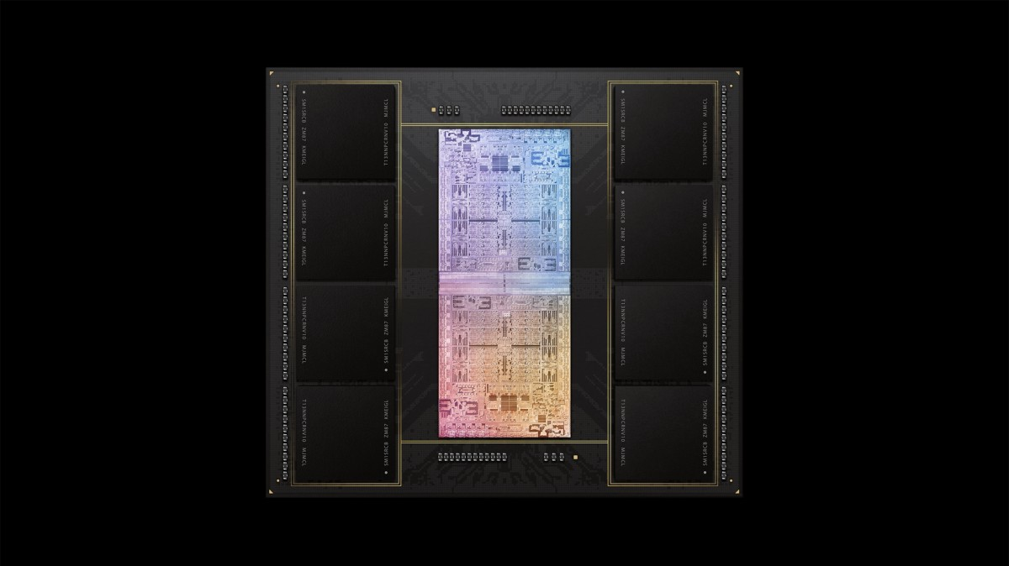
Process Data Where It Makes Sense
Sensors
A lot of
SRAM
Storage
DRAM
DRAM
Storage
Apple M1 Ultra System (2022)
https://www.gsmarena.com/apple_announces_m1_ultra_with_20core_cpu_and_64core_gpu-news-53481.php

Slide 15
Memory as an Accelerator
CPU
core
CPU
core
mini-CPU
core
GPU
(throughput)
core
GPU
(throughput)
core
video
core
GPU
(throughput)
core
GPU
(throughput)
core
CPU
core
CPU
core
Memory
imaging
core
LLC
Specialized
compute-capability
in memory
Memory Controller
Memory Bus
Memory similar to a “conventional” accelerator

Slide 16
Goal: Processing Inside Memory/Storage
Many questions … How do we design the:
  compute-capable memory & controllers?
  processors & communication units?
  software & hardware interfaces?
  system software, compilers, languages?
  algorithms & theoretical foundations?
Memory/Storage
Database
Graphs
Media
Processor
Core
Cache
Query
Interconnect
Problem
Results
Algorithm
Program/Language
System Software
SW/HW Interface
Micro-architecture
Logic
Devices
Electrons

Slide 17
Processing in Memory:
Two Types
1. Processing near Memory
2. Processing using Memory

Slide 18
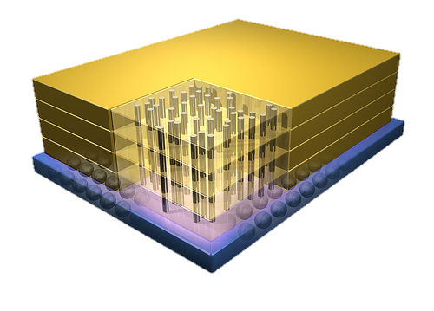


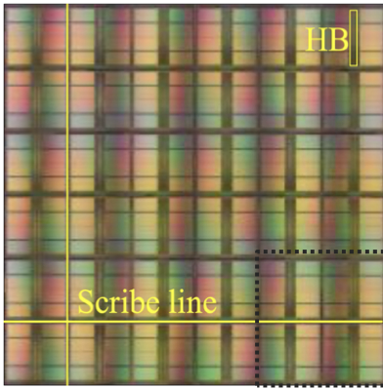
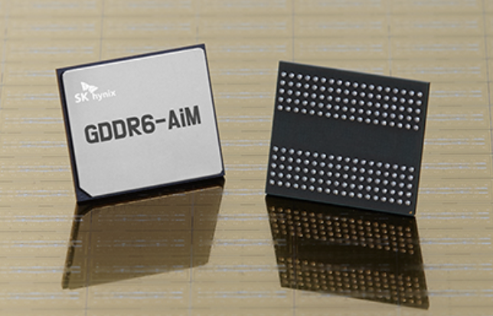
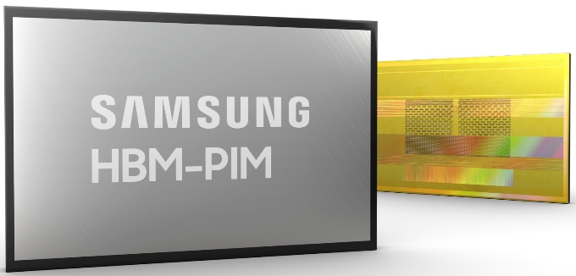
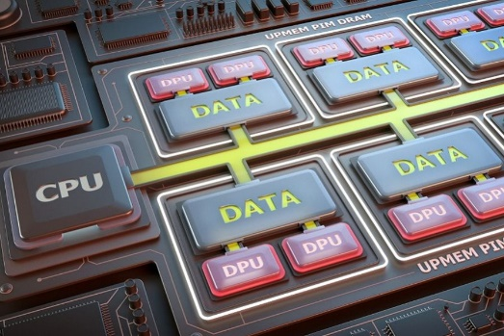
Processing-in-Memory Landscape Today
[Samsung 2021]
[Alibaba 2022]
[SK Hynix 2022]
[Samsung 2021]
[UPMEM 2019]
And, many other experimental chips and startups

Slide 19
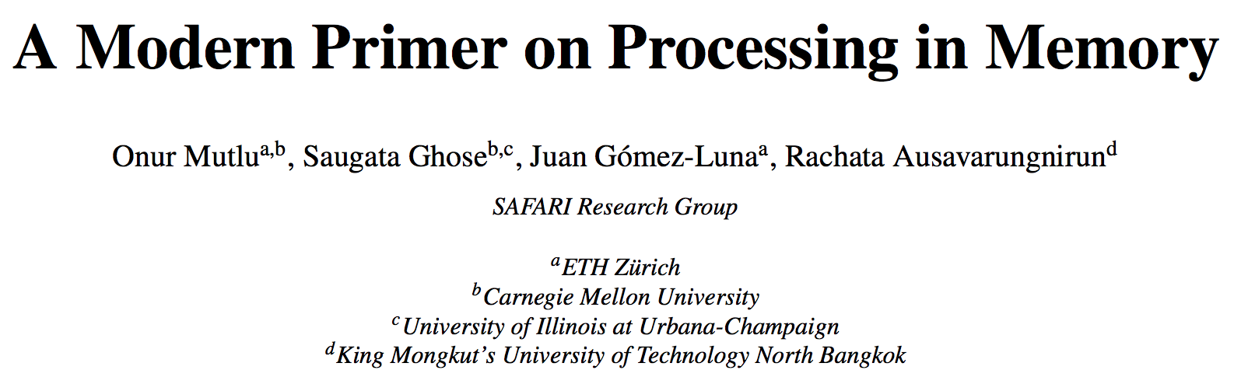
PIM Review and Open Problems
Onur Mutlu, Saugata Ghose, Juan Gomez-Luna, and Rachata Ausavarungnirun,
"A Modern Primer on Processing in Memory"
Invited Book Chapter in Emerging Computing: From Devices to Systems - Looking Beyond Moore and Von Neumann, Springer, to be published in 2021.
https://arxiv.org/pdf/2012.03112.pdf

Slide 20
Potential Security Issues & Benefits (I)
Can PIM worsen security?
  Worsened or easier-to-induce physical issues (e.g., RowHammer)?
  Worsened or new side channels?
  Hardware bugs?
  New threat models?
  …
Can PIM enhance security?
  Less exposure of data (& keys?)
  In-memory encryption & cryptographic hashing
  Execution of security functions; trusted execution in memory
  Support for security primitives (TRNGs, PUFs, encryption, …)
  More or better isolation?
  …

Slide 21
Potential Security Issues & Benefits (II)
Security analysis of PIM Systems
  Different types of PIM: PnM vs. PuM
  Different locations: cache, MC, DRAM, NVM, storage, remote, …
  General-purpose vs. special-purpose PIM?
  Multi tenancy vs. single workload?
  Concurrent host and PIM access?
  Memory bus protection; memory wire(s) protection?
  Robustness issues like RowHammer, RowPress, …
  …
Can PIM support (more) secure execution of workloads?
  What is needed to do so?
  Secure PIM enclaves?
  …

Slide 22
Processing in Memory:
Evaluation Methods

Slide 23
Simulators (Open Source)
Ramulator 2.0 & Ramulator-PIM
DAMOVSim
UPMEMSim (UPMEM)
AiMSim (SK Hynix)
…

Slide 24

Ramulator + Gem5
Haocong Luo, Yahya Can Tugrul, F. Nisa Bostanci, Ataberk Olgun, A. Giray Yaglikci, and Onur Mutlu,
"Ramulator 2.0: A Modern, Modular, and Extensible DRAM Simulator"
Preprint on arxiv, August 2023.
[arXiv version]
[Ramulator 2.0 Source Code]
https://arxiv.org/pdf/2308.11030.pdf
https://github.com/CMU-SAFARI/ramulator2

Slide 25
Opportunity: 3D-Stacked Logic+Memory
Memory
Logic
Other “True 3D” technologies
under development

Slide 26
Tesseract System for Graph Processing
Interconnected set of 3D-stacked memory+logic chips with simple cores
Host Processor
Memory
Memory-Mapped
Accelerator Interface
(Noncacheable, Physically Addressed)
Logic
In-Order Core
DRAM Controller
…
…
LP
PF Buffer
Crossbar Network
…
MTP
…
Message Queue
NI
Ahn+, “A Scalable Processing-in-Memory Accelerator for Parallel Graph Processing” ISCA 2015.

Slide 27
Tesseract System for Graph Processing
Host Processor
Memory
Memory-Mapped
Accelerator Interface
(Noncacheable, Physically Addressed)
Logic
In-Order Core
DRAM Controller
…
…
Communications via
Remote Function Calls
LP
PF Buffer
Crossbar Network
…
MTP
…
Message Queue
NI

Slide 28
Tesseract System for Graph Processing
Host Processor
Memory
Memory-Mapped
Accelerator Interface
(Noncacheable, Physically Addressed)
Logic
Prefetching
In-Order Core
DRAM Controller
…
…
LP
PF Buffer
Crossbar Network
…
MTP
…
Message Queue
NI

Slide 29
Simulated Systems
DDR3-OoO
HMC-OoO
HMC-MC
Tesseract
32 Tesseract Cores
8 OoO
4GHz
8 OoO
4GHz
8 OoO
4GHz
8 OoO
4GHz
128
In-Order
2GHz
128
In-Order
2GHz
8 OoO
4GHz
8 OoO
4GHz
8 OoO
4GHz
8 OoO
4GHz
128
In-Order
2GHz
128
In-Order
2GHz
102.4GB/s
640GB/s
640GB/s
8TB/s
Ahn+, “A Scalable Processing-in-Memory Accelerator for Parallel Graph Processing” ISCA 2015.

Slide 30
Tesseract Graph Processing Performance
>13X Performance Improvement
On five graph processing algorithms
Ahn+, “A Scalable Processing-in-Memory Accelerator for Parallel Graph Processing” ISCA 2015.

Slide 31
Tesseract Graph Processing System Energy
> 8X Energy Reduction
Ahn+, “A Scalable Processing-in-Memory Accelerator for Parallel Graph Processing” ISCA 2015.

Slide 32
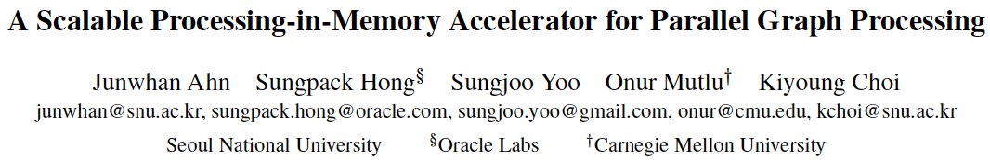
More on Tesseract
Junwhan Ahn, Sungpack Hong, Sungjoo Yoo, Onur Mutlu, and Kiyoung Choi,
"A Scalable Processing-in-Memory Accelerator for Parallel Graph Processing"
Proceedings of the 42nd International Symposium on Computer Architecture (ISCA), Portland, OR, June 2015.
[Slides (pptx) (pdf)] [Lightning Session Slides (pptx) (pdf)]
Top Picks Honorable Mention by IEEE Micro.
Selected to the ISCA-50 25-Year Retrospective Issue covering 1996-2020 in 2023 (Retrospective (pdf) Full Issue).

Slide 33
PIM Prototypes
Processing-in-Memory
in the Real World

Slide 34
Processing-in-Memory Landscape Today
[Samsung 2021]
[Alibaba 2022]
[SK Hynix 2022]
[Samsung 2021]
[UPMEM 2019]
And, many other experimental chips and startups

Slide 35
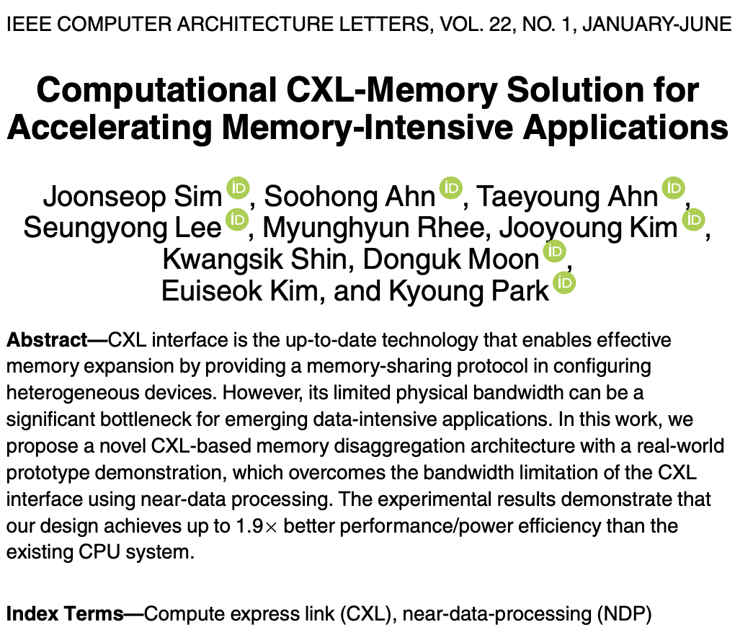
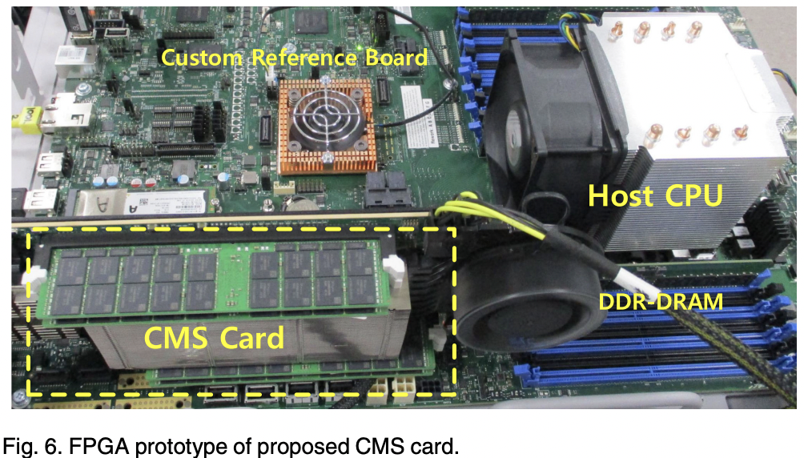
Processing-in-Memory Landscape Today

Slide 36
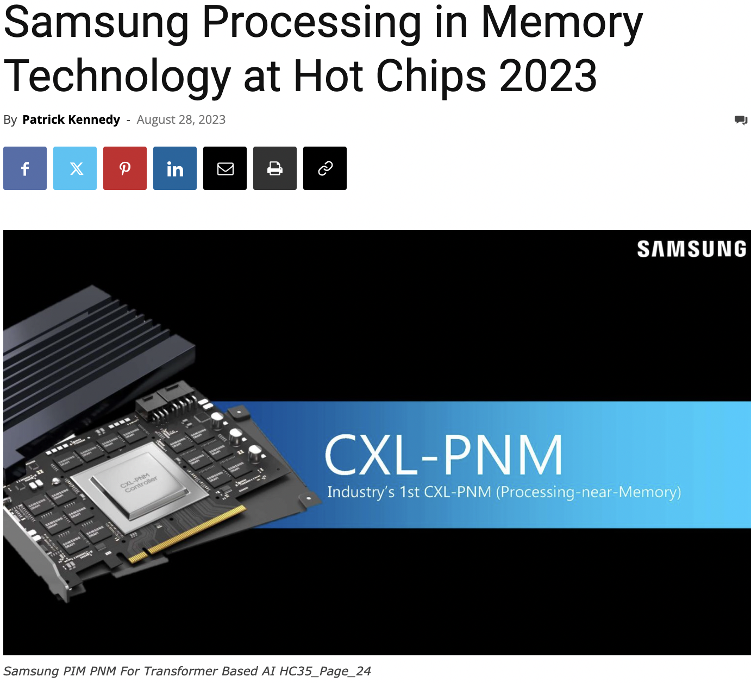
Processing-in-Memory Landscape Today
https://www.servethehome.com/samsung-processing-in-memory-technology-at-hot-chips-2023/

Slide 37
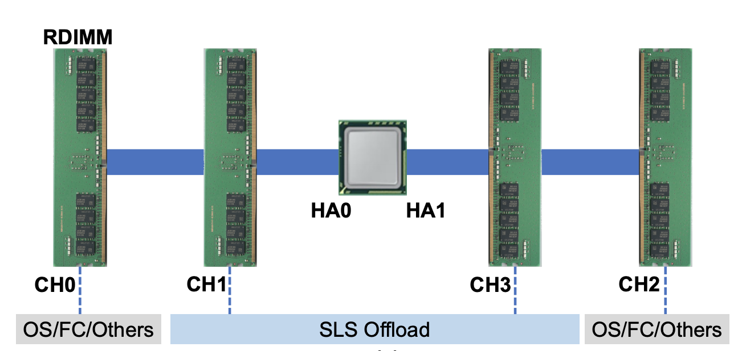
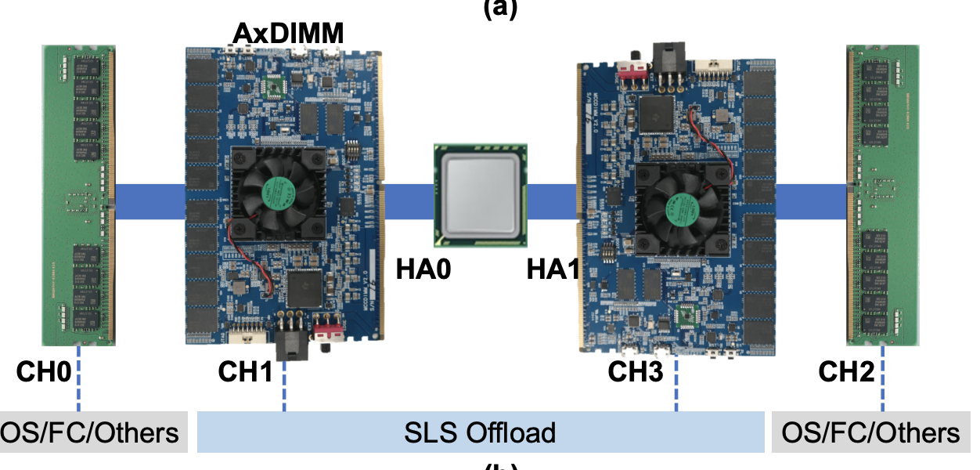
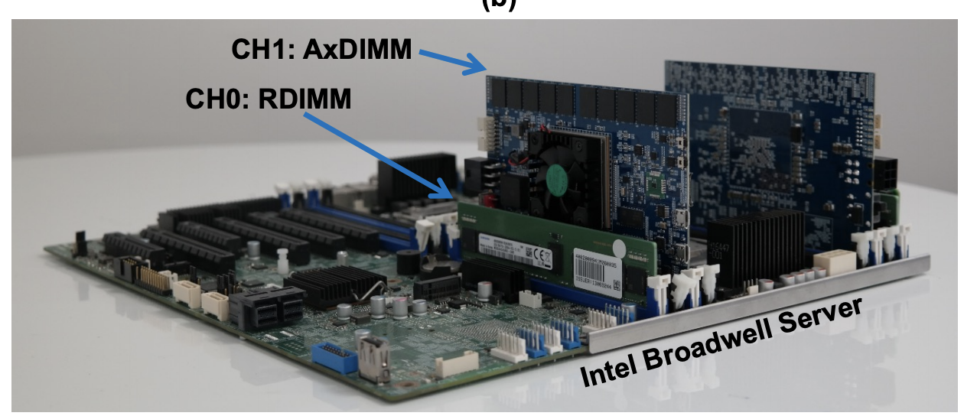
Samsung AxDIMM (2021)
Baseline System
DDRx-PIM
  DLRM recommendation system
AxDIMM System
Ke et al. "Near-Memory Processing in Action: Accelerating Personalized Recommendation with AxDIMM", IEEE Micro (2021)

Slide 38
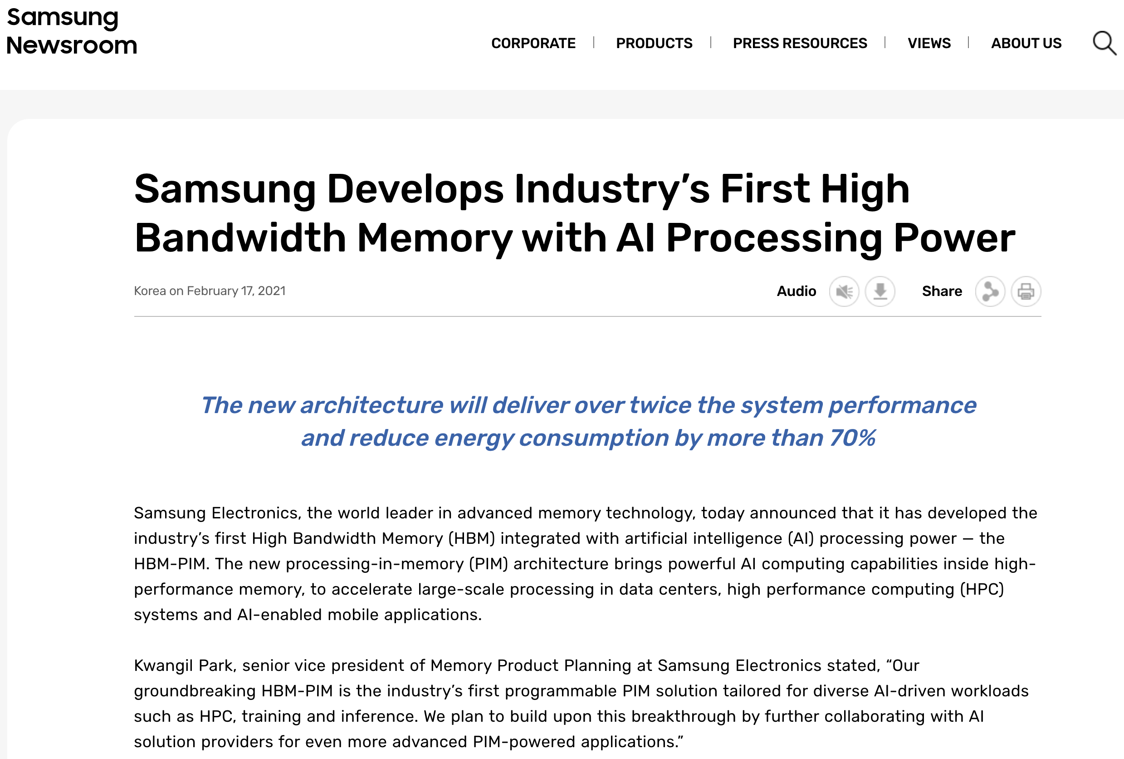
Samsung Function-in-Memory DRAM (2021)
https://news.samsung.com/global/samsung-develops-industrys-first-high-bandwidth-memory-with-ai-processing-power

Slide 39
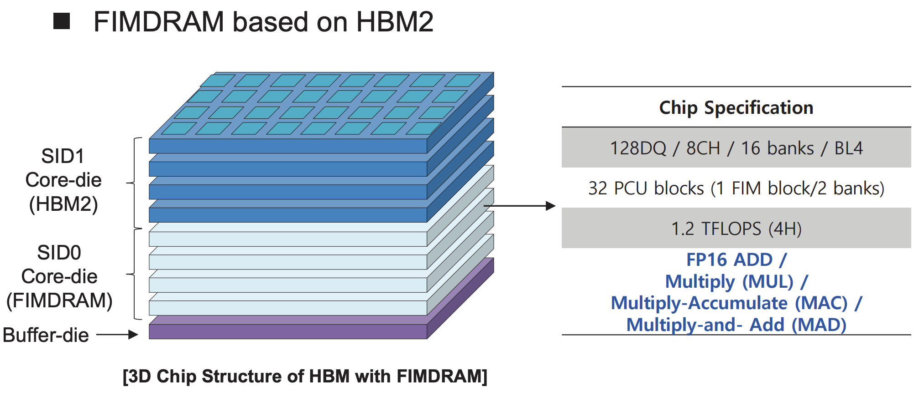
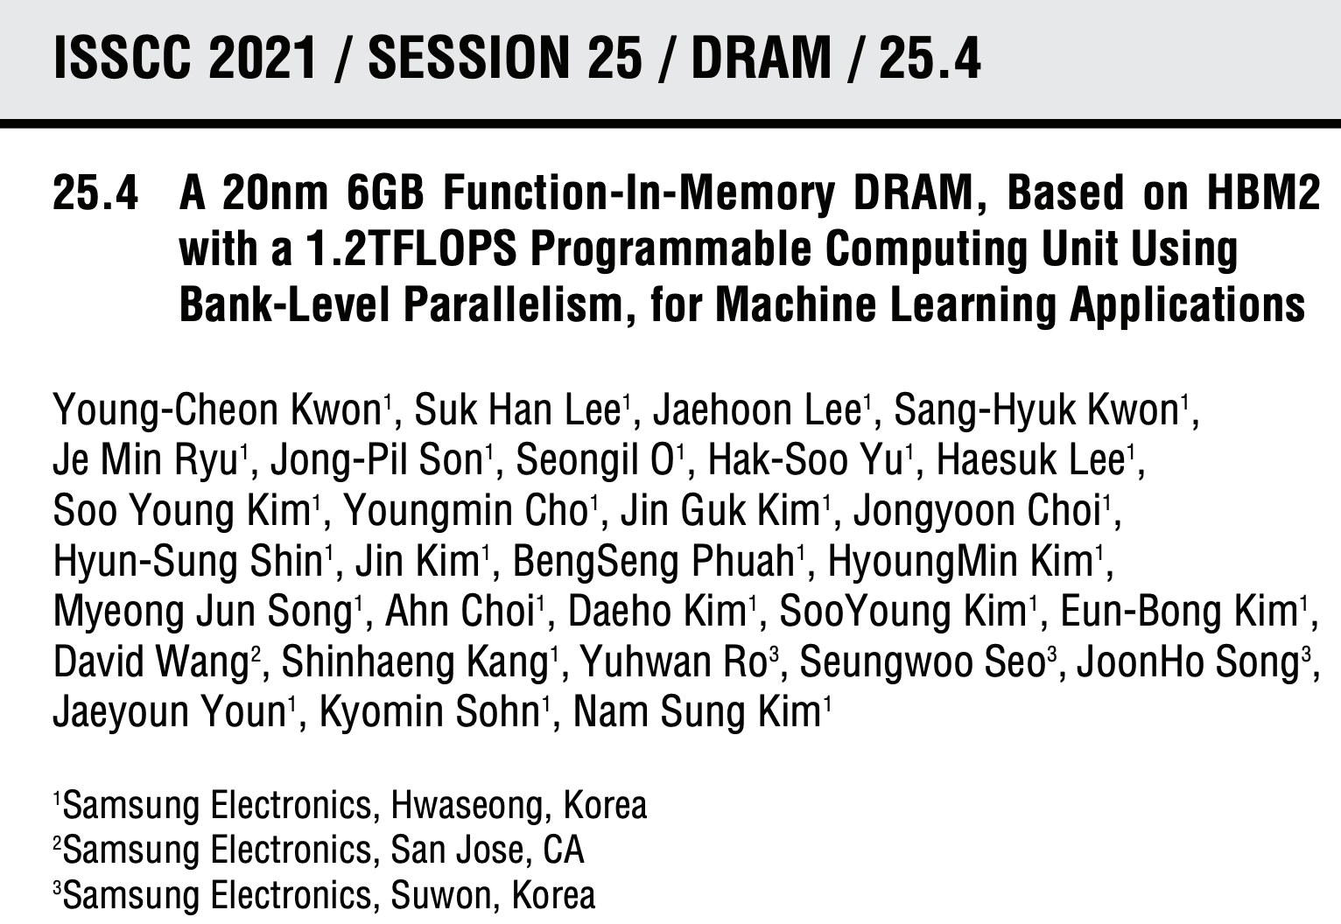
Samsung Function-in-Memory DRAM (2021)

Slide 40
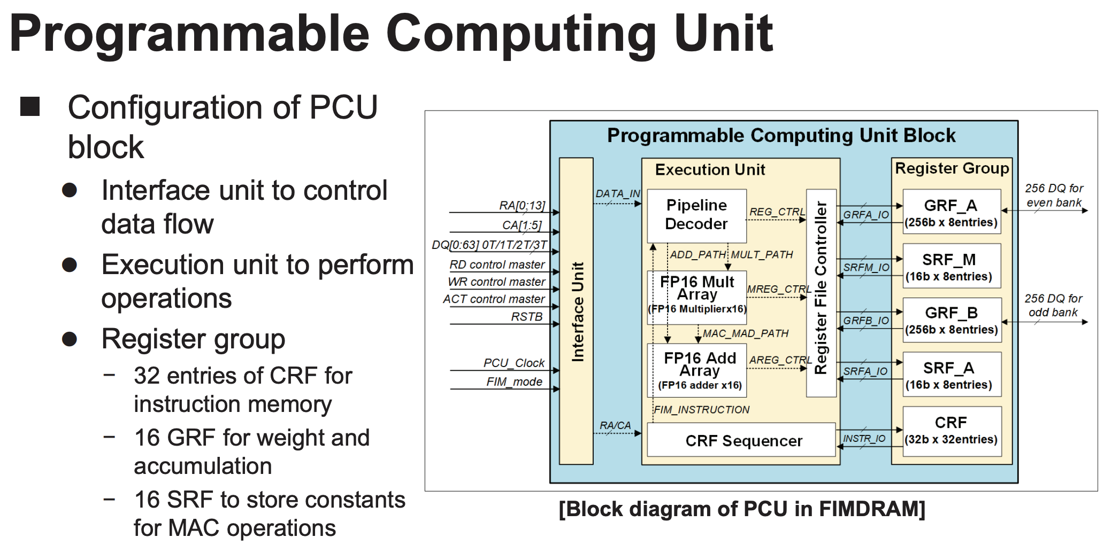
Samsung Function-in-Memory DRAM (2021)

Slide 41
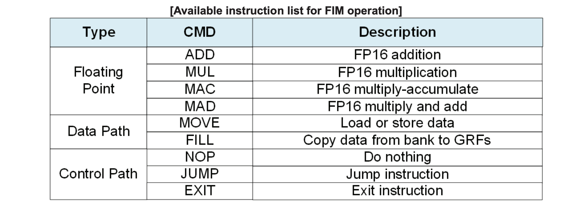
Samsung Function-in-Memory DRAM (2021)

Slide 42
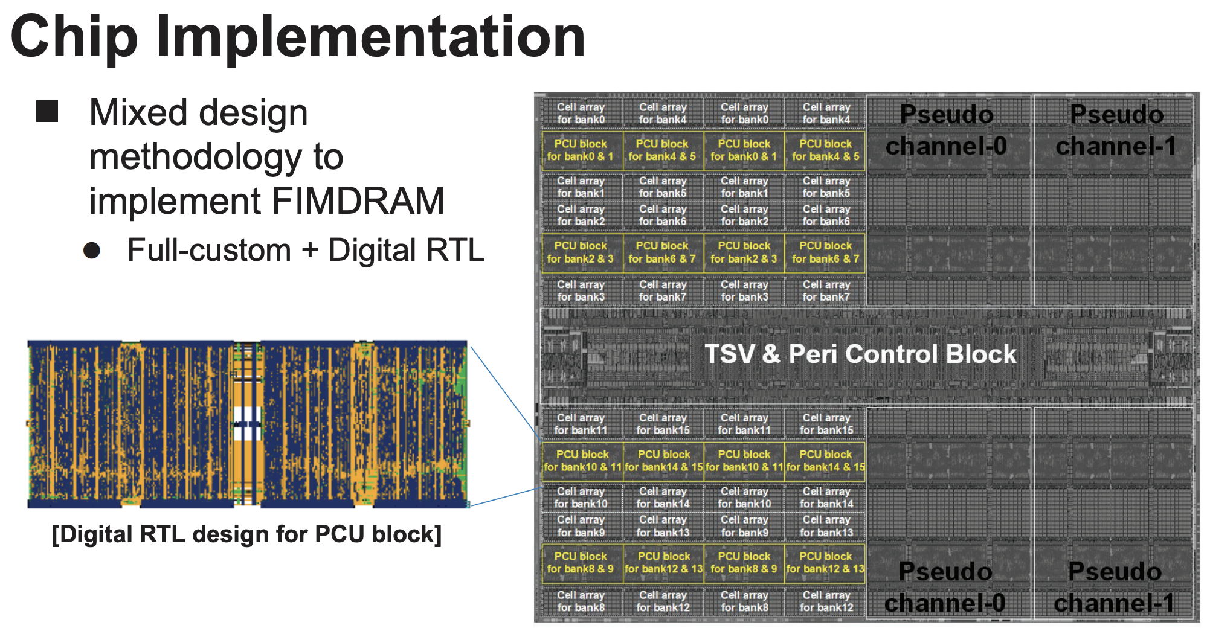
Samsung Function-in-Memory DRAM (2021)

Slide 43
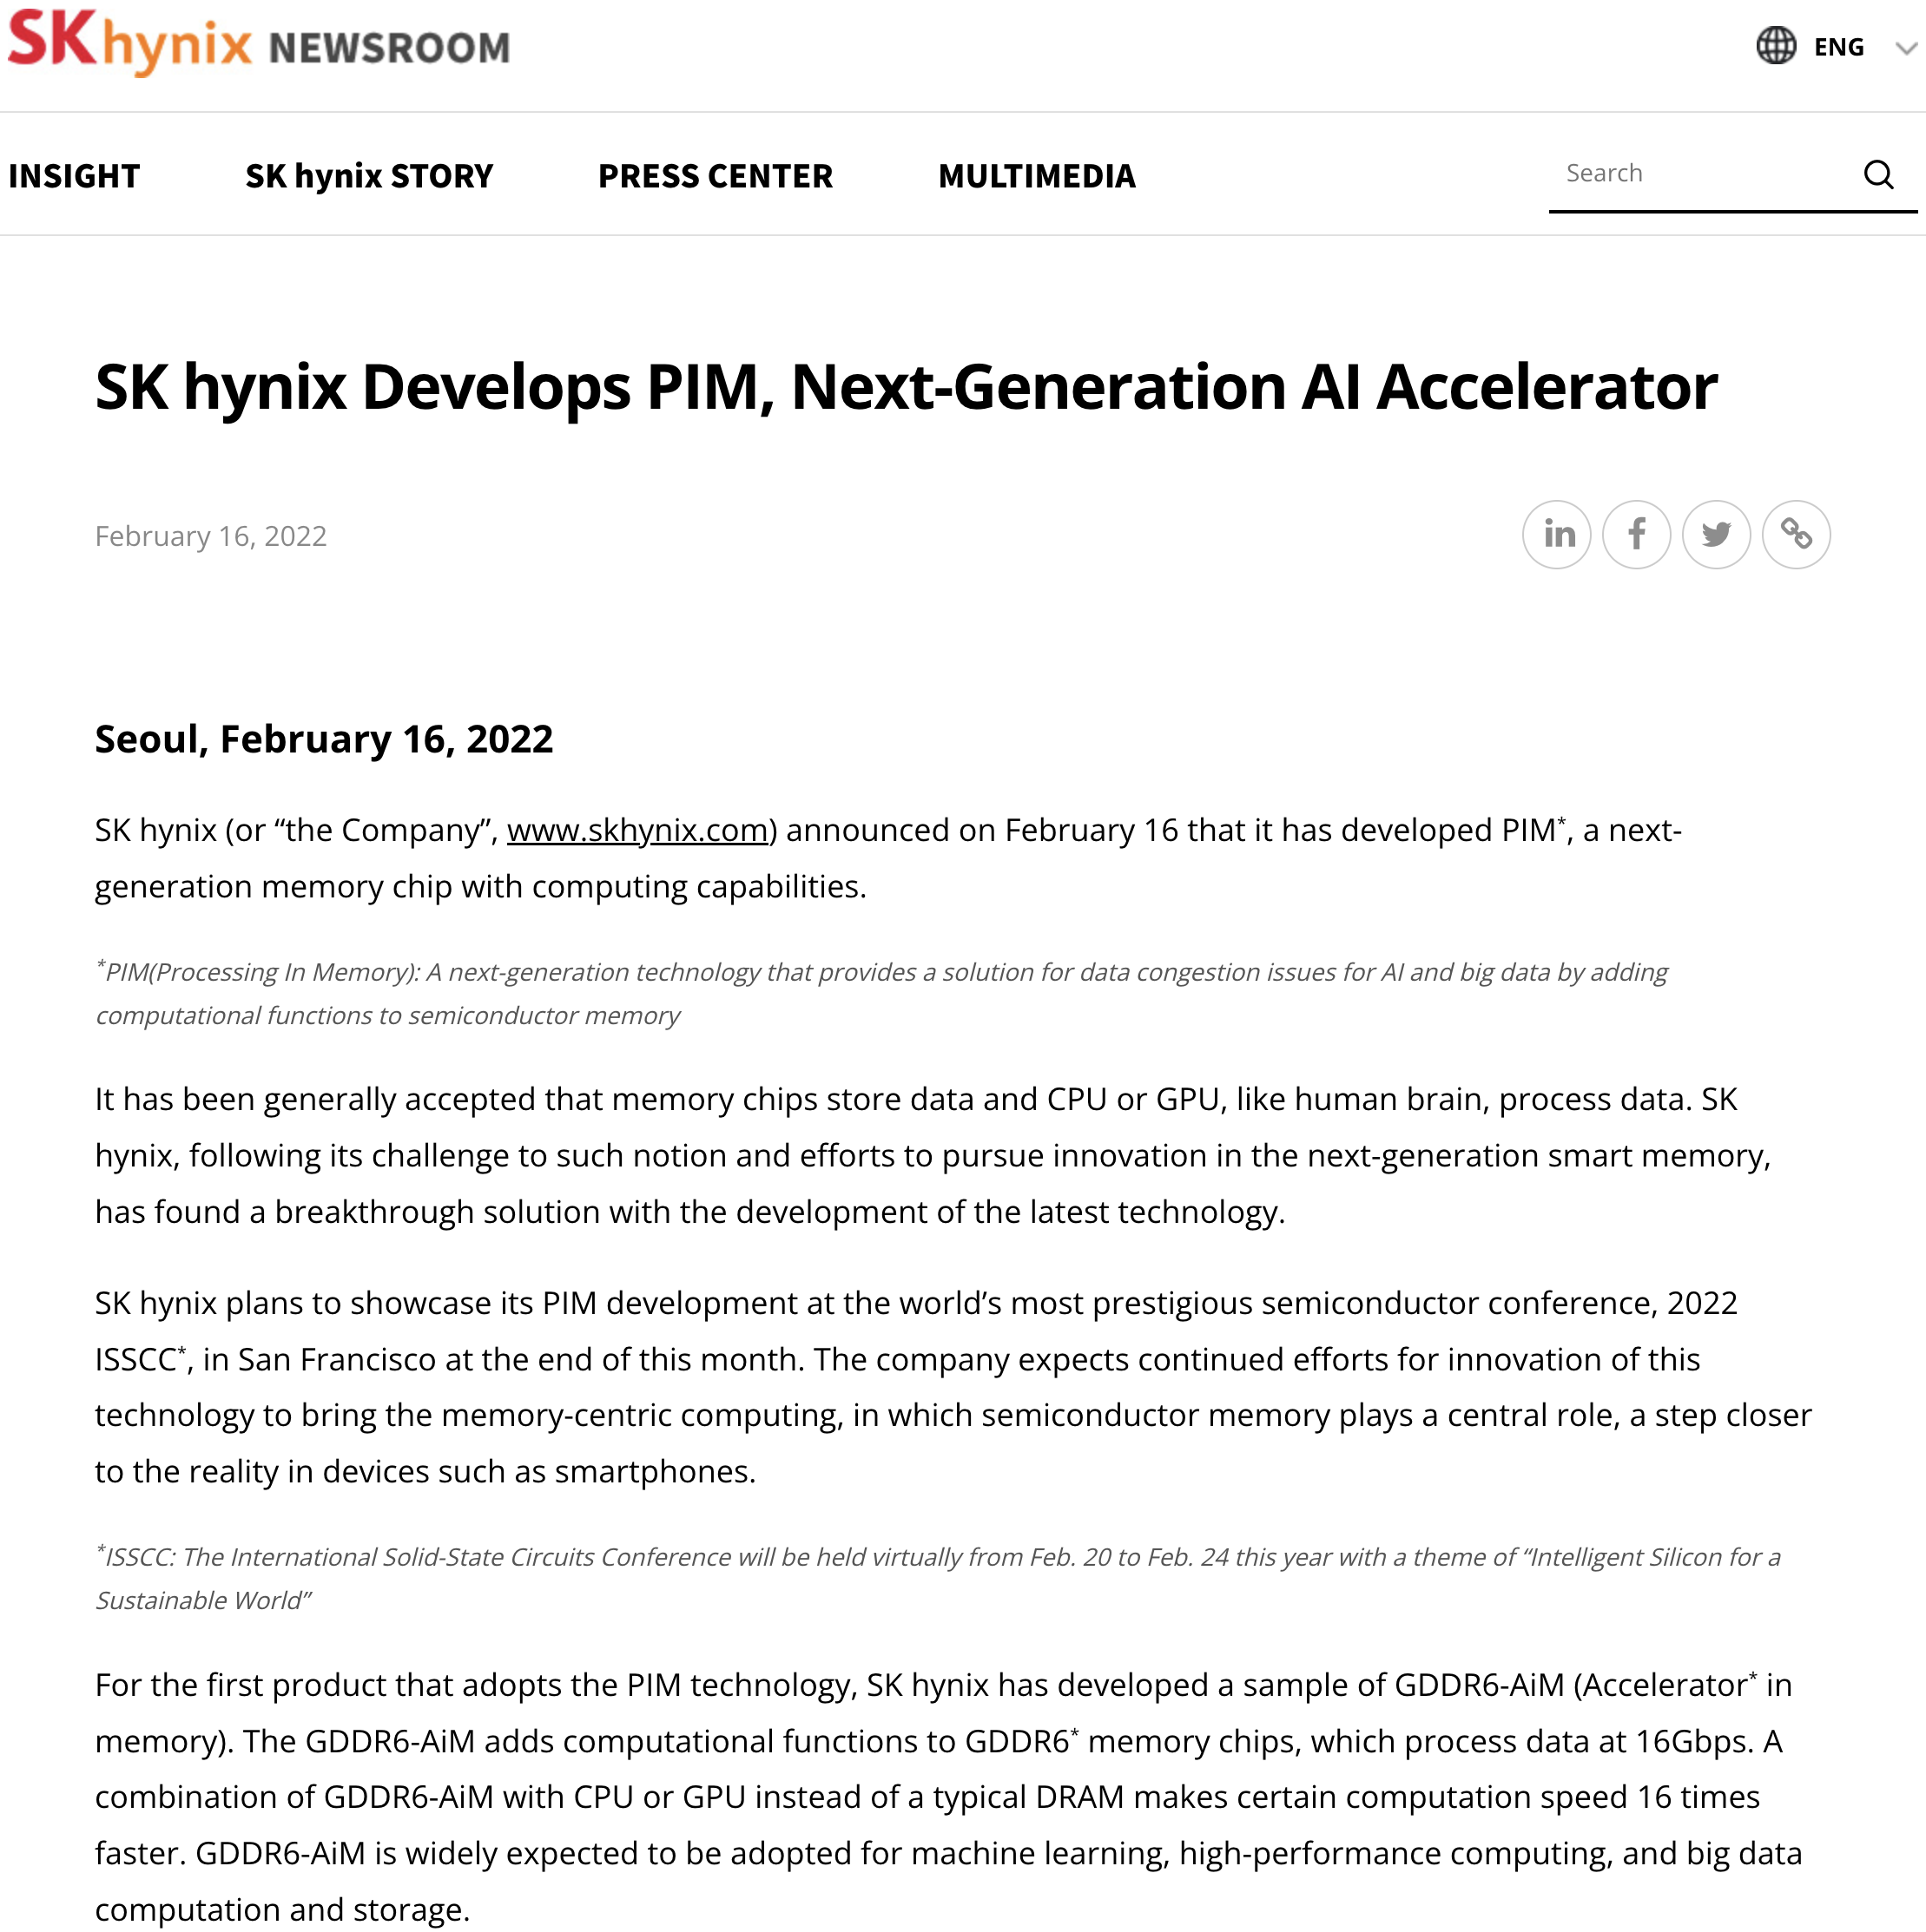
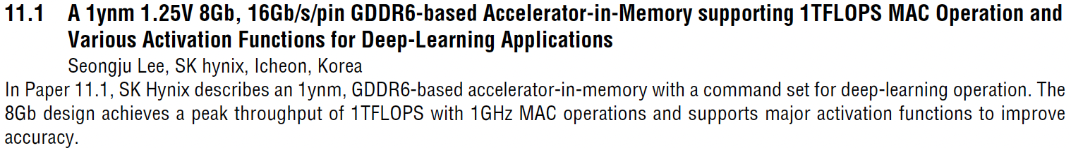
SK Hynix Accelerator-in-Memory (2022)
https://news.skhynix.com/sk-hynix-develops-pim-next-generation-ai-accelerator/

Slide 44
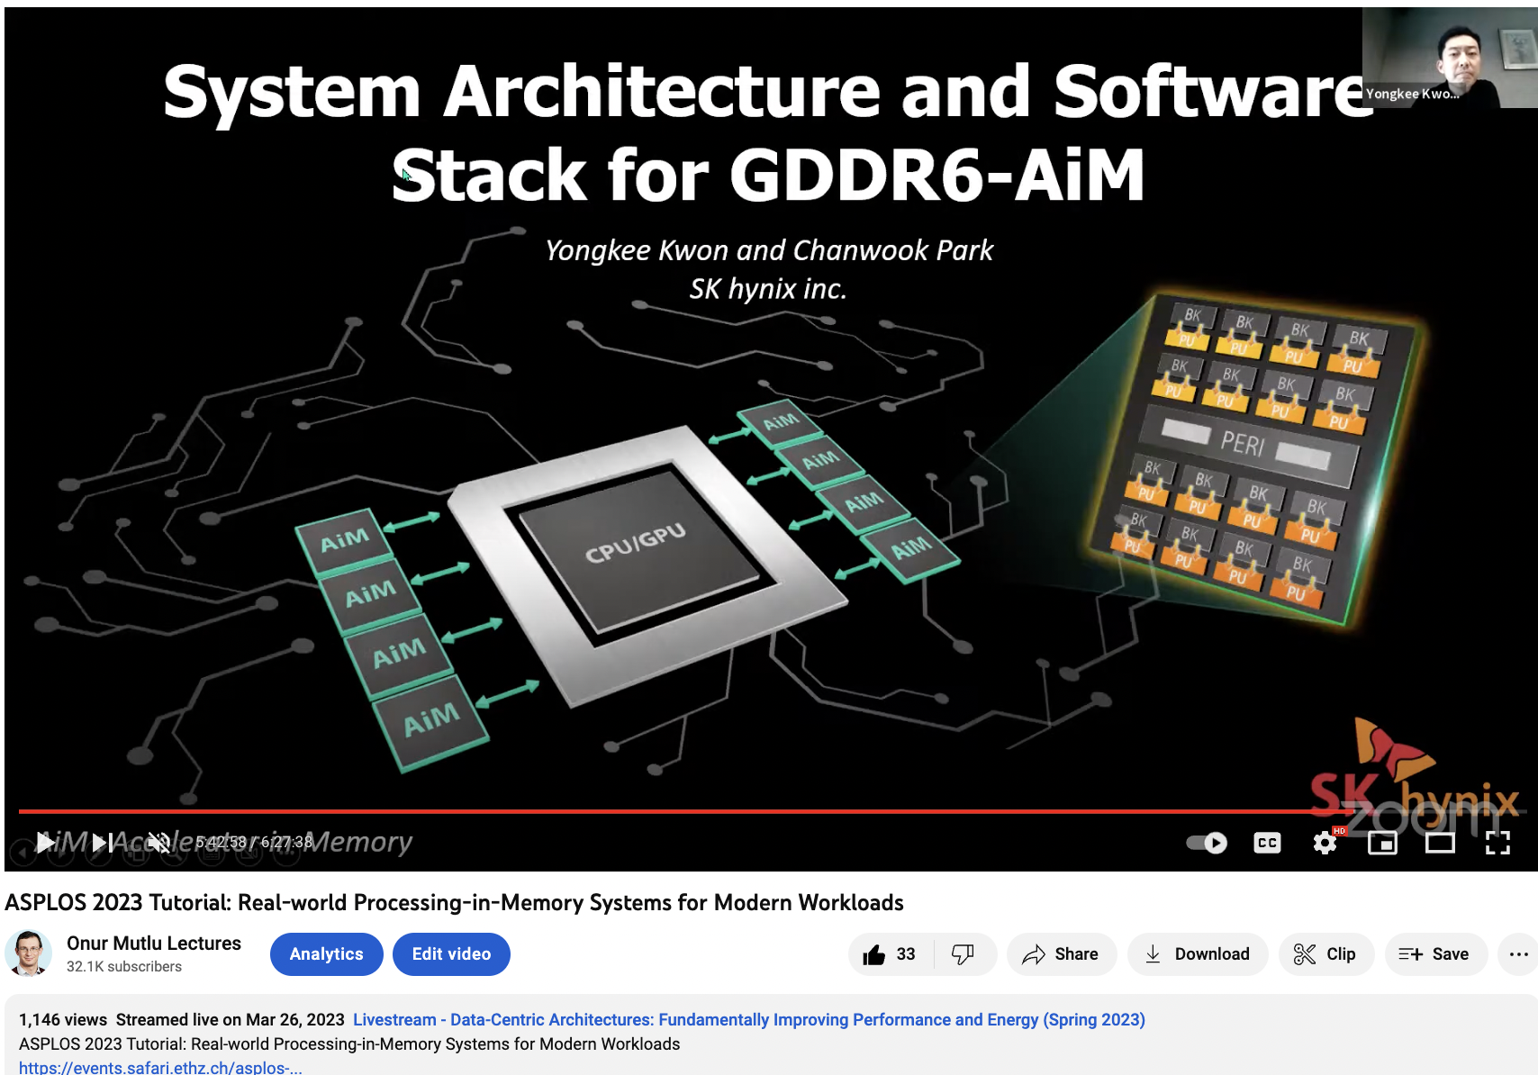
SK Hynix Accelerator-in-Memory (2022)
https://www.youtube.com/watch?v=oYCaLcT0Kmo

Slide 45
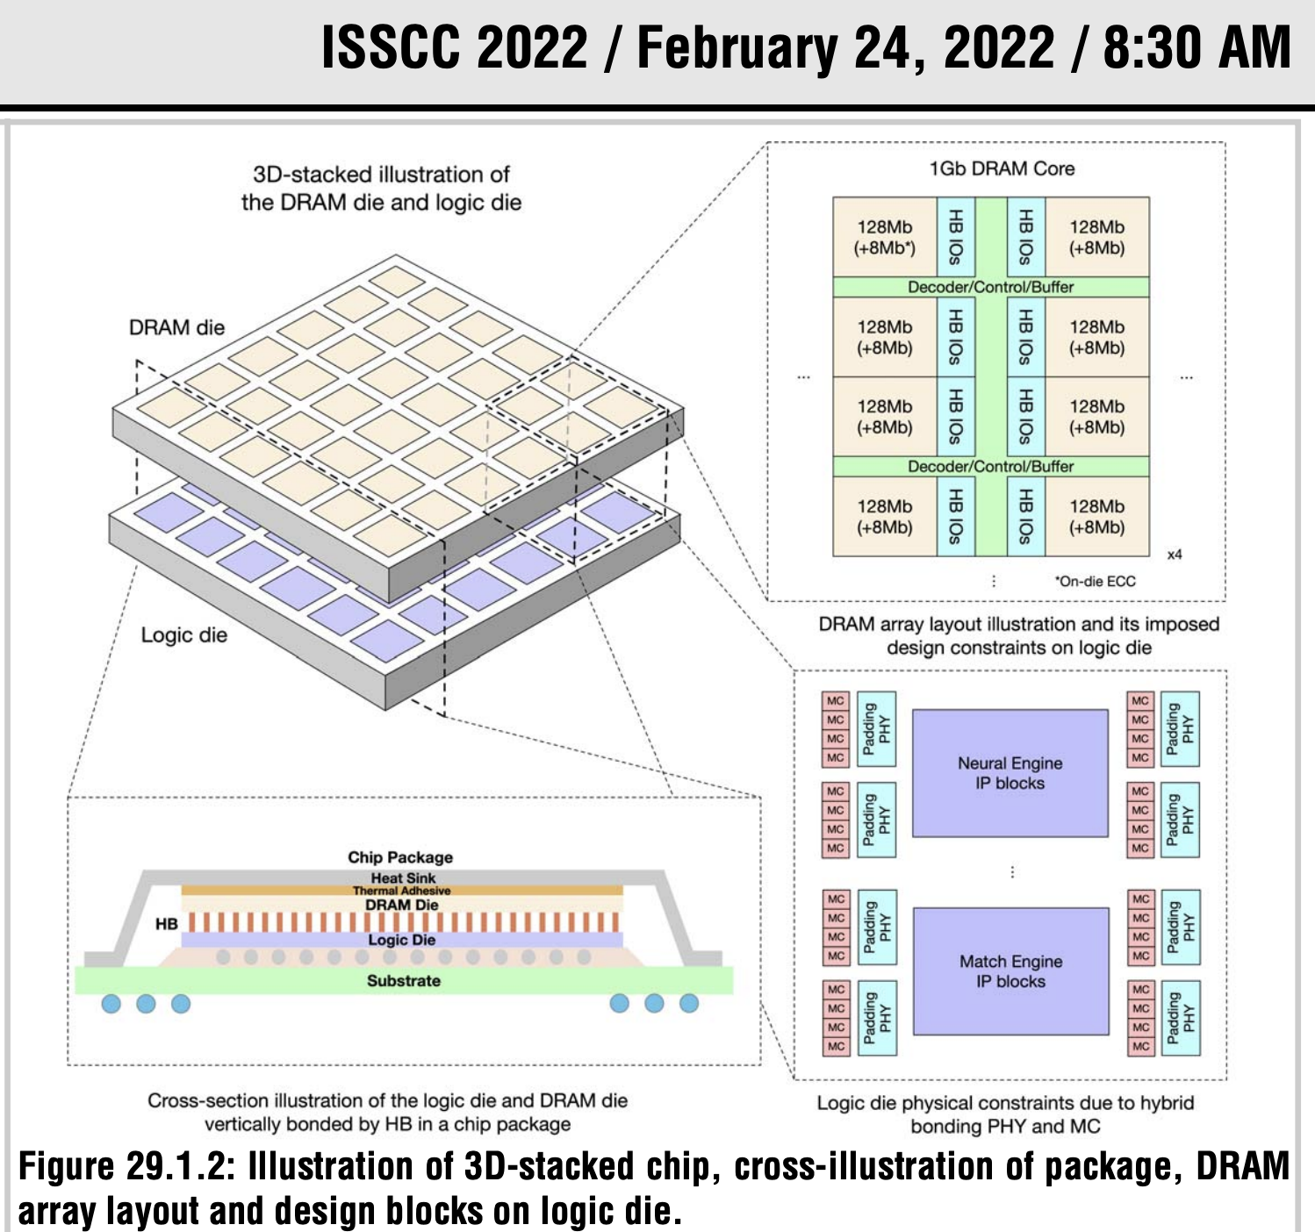
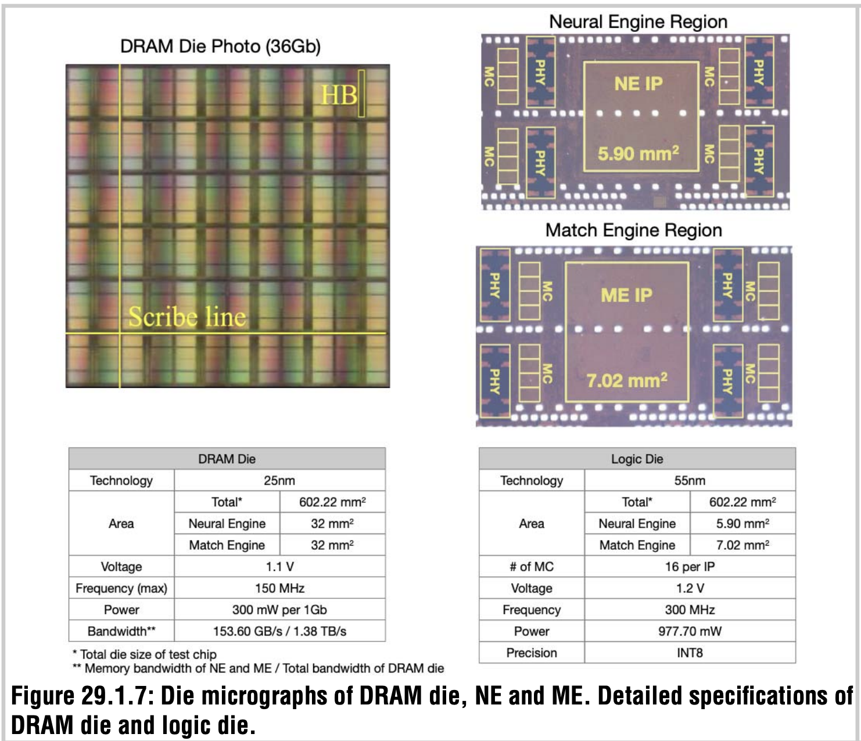
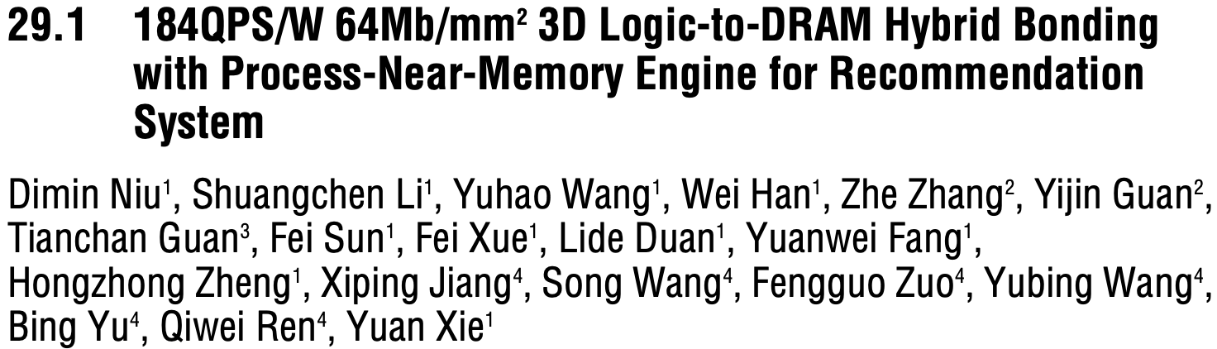
AliBaba PIM Recommendation System (2022)

Slide 46
UPMEM Processing-in-DRAM Engine (2019)
Processing in DRAM Engine
Includes standard DIMM modules, with a large number of DPU processors combined with DRAM chips.
Replaces standard DIMMs
  DDR4 R-DIMM modules
    8GB+128 DPUs (16 PIM chips)
    Standard 2x-nm DRAM process
  Large amounts of compute & memory bandwidth
https://www.anandtech.com/show/14750/hot-chips-31-analysis-inmemory-processing-by-upmem
https://www.upmem.com/video-upmem-presenting-its-true-processing-in-memory-solution-hot-chips-2019/

Slide 47
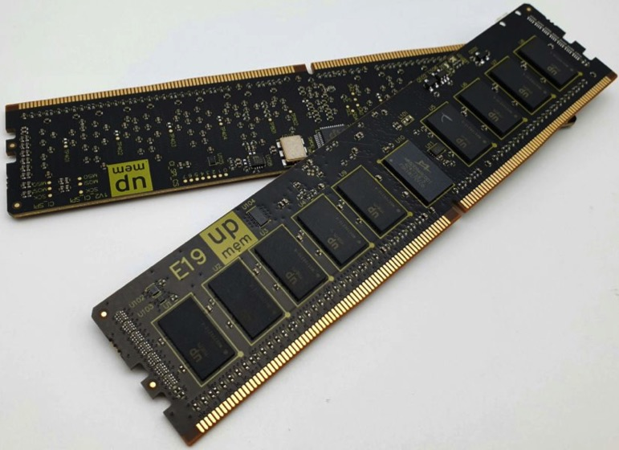
UPMEM Memory Modules
E19: 8 chips DIMM (1 rank). DPUs @ 267 MHz
P21: 16 chips DIMM (2 ranks). DPUs @ 350 MHz
www.upmem.com

Slide 48
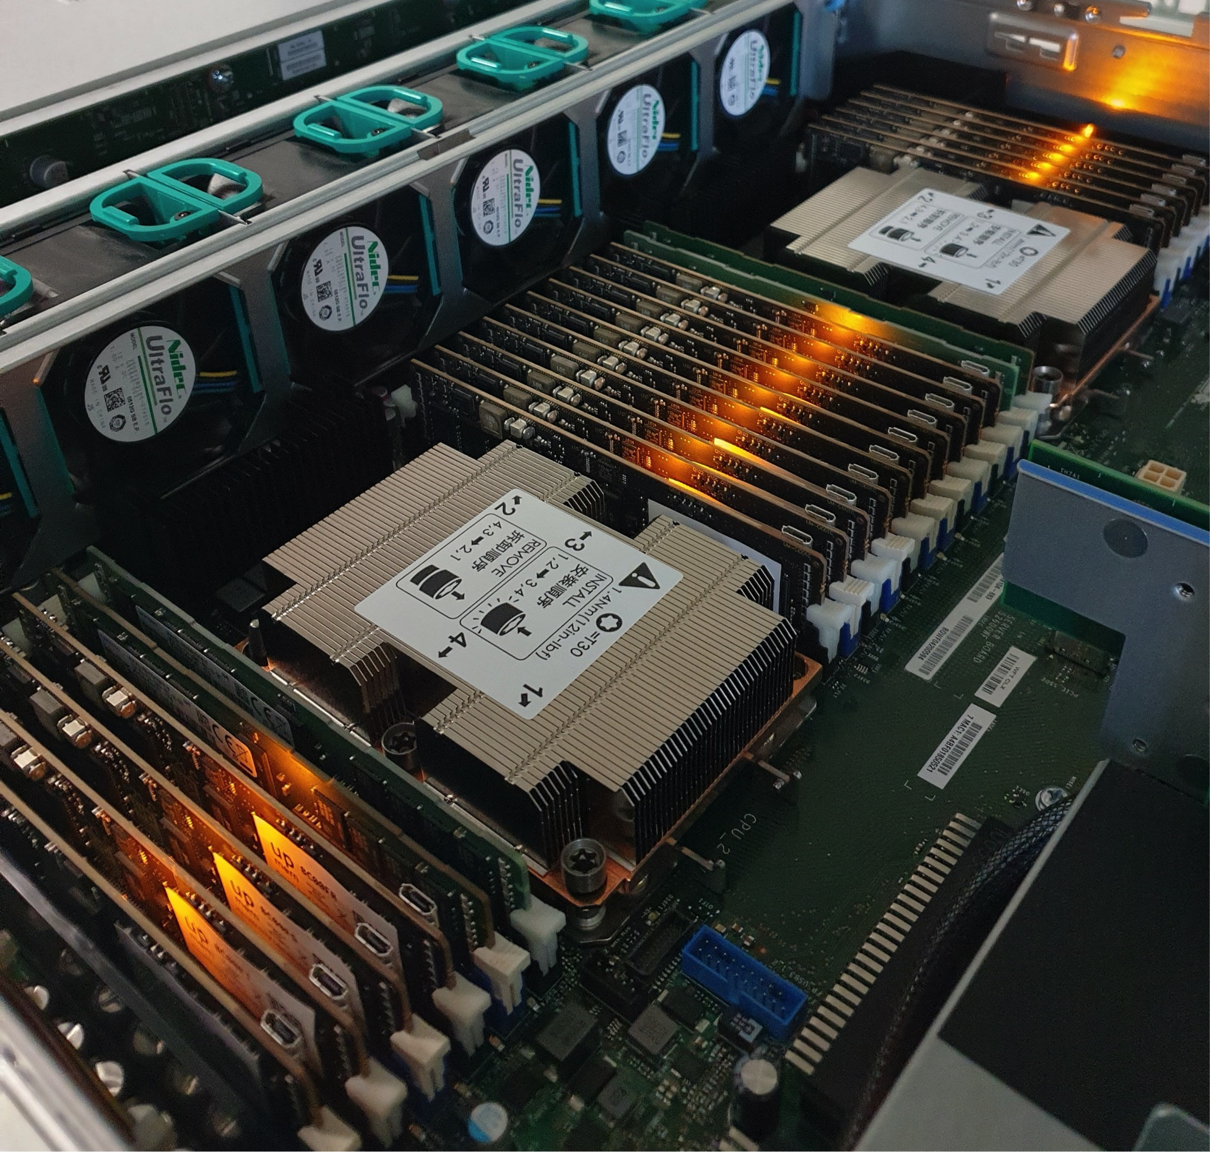
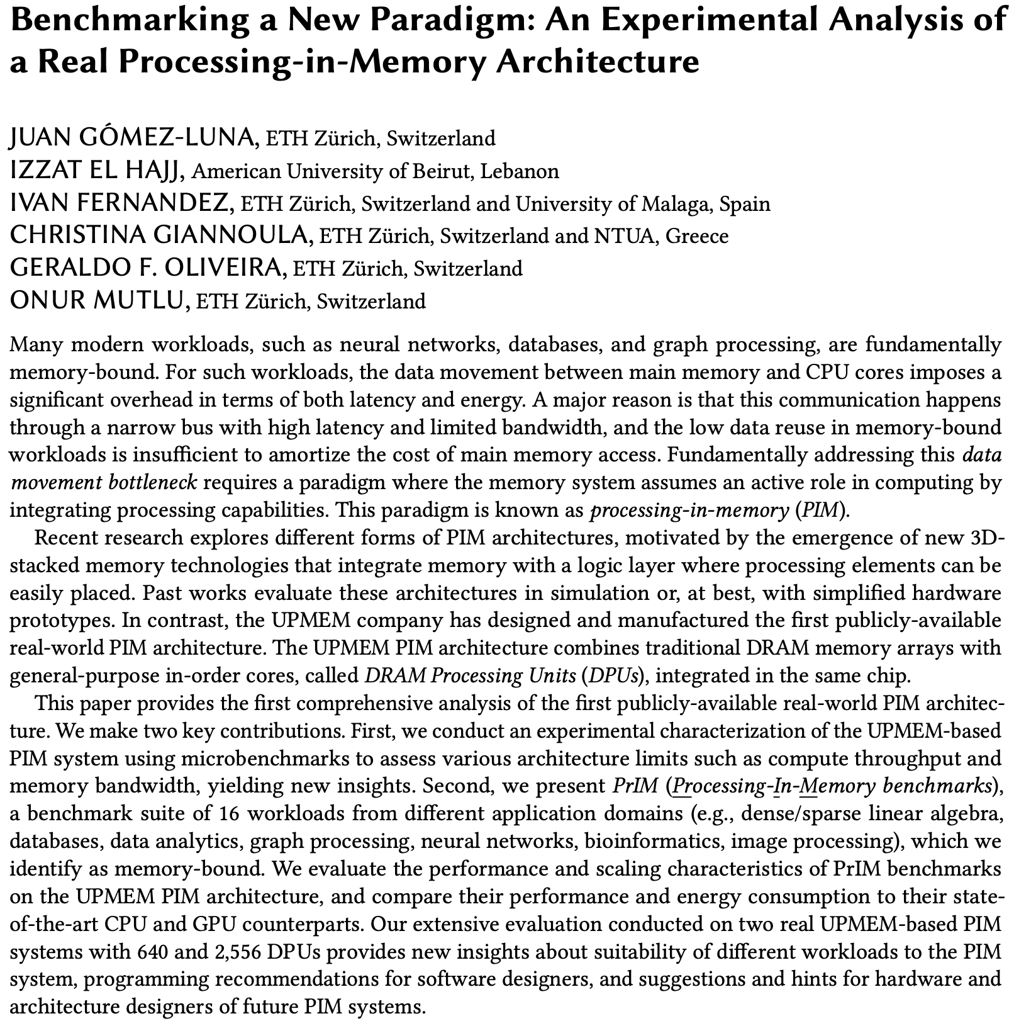
2,560-DPU Processing-in-Memory System
https://arxiv.org/pdf/2105.03814.pdf

Slide 49
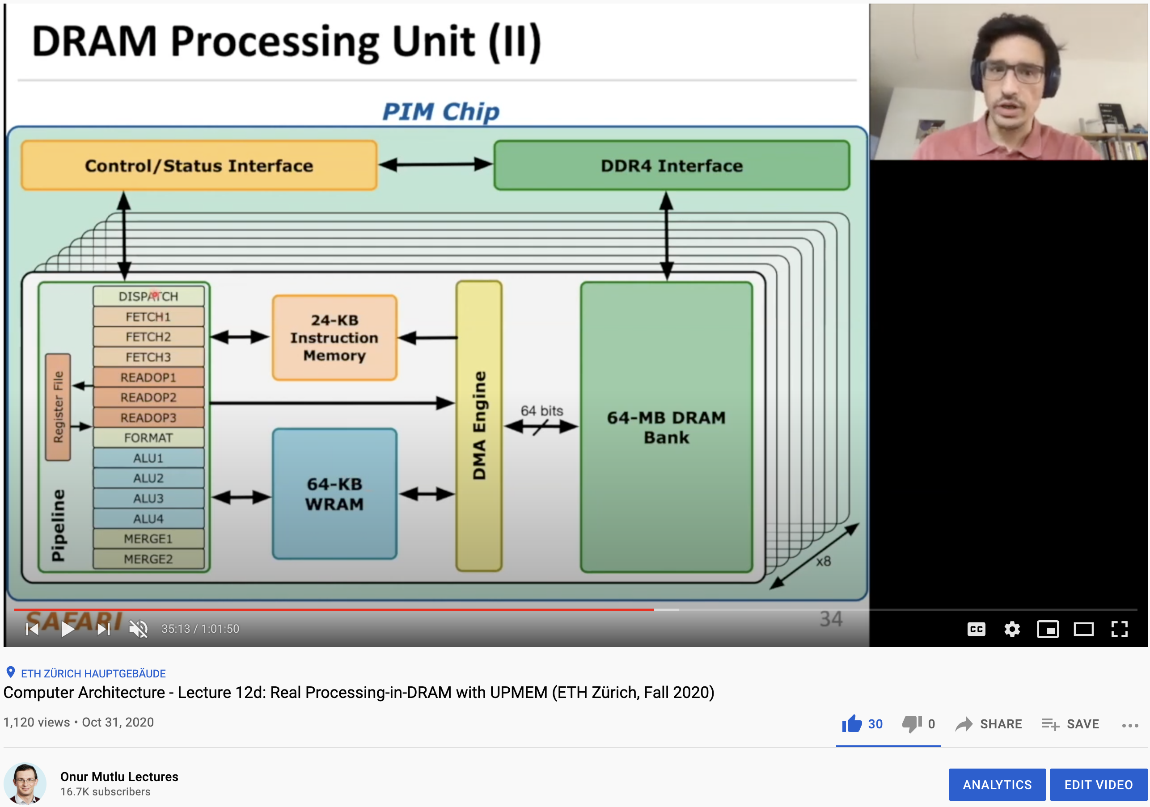
More on the UPMEM PIM System
https://www.youtube.com/watch?v=Sscy1Wrr22A&list=PL5Q2soXY2Zi9xidyIgBxUz7xRPS-wisBN&index=26

Slide 50
Experimental Analysis of the UPMEM PIM Engine
https://arxiv.org/pdf/2105.03814.pdf

Slide 51
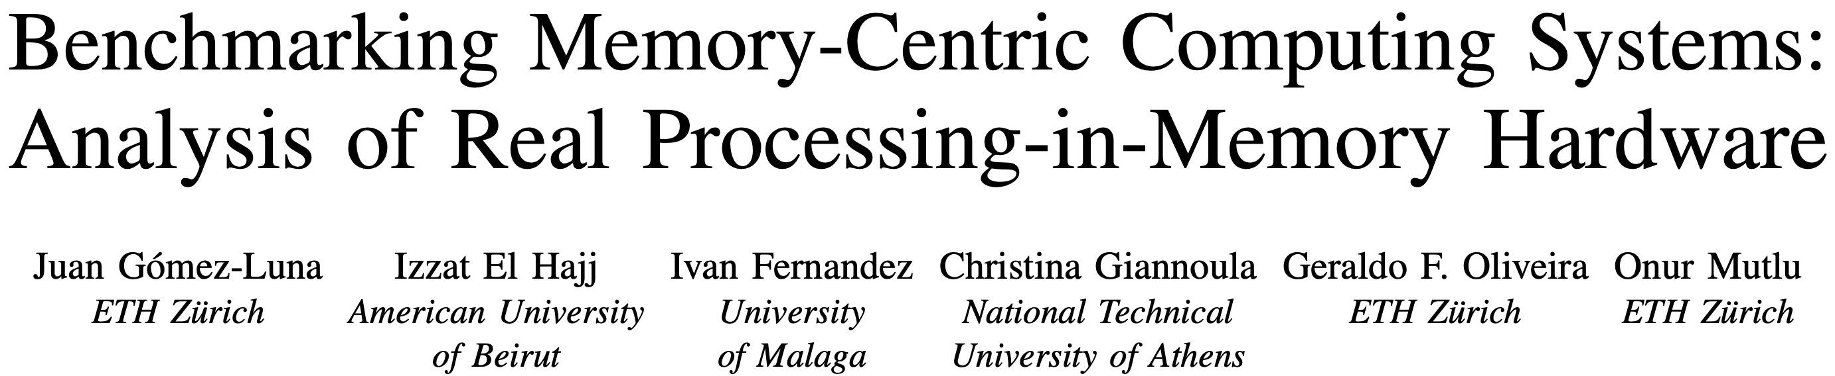
UPMEM PIM System Summary & Analysis
Juan Gomez-Luna, Izzat El Hajj, Ivan Fernandez, Christina Giannoula, Geraldo F. Oliveira, and Onur Mutlu,
"Benchmarking Memory-Centric Computing Systems: Analysis of Real Processing-in-Memory Hardware"
Invited Paper at Workshop on Computing with Unconventional Technologies (CUT), Virtual, October 2021.
[arXiv version]
[PrIM Benchmarks Source Code]
[Slides (pptx) (pdf)]
[Talk Video (37 minutes)]
[Lightning Talk Video (3 minutes)]

Slide 52
PrIM Benchmarks: Application Domains
Domain | Benchmark | Short name
Dense linear algebra | Vector Addition | VA
 | Matrix-Vector Multiply | GEMV
Sparse linear algebra | Sparse Matrix-Vector Multiply | SpMV
Databases | Select | SEL
 | Unique | UNI
Data analytics | Binary Search | BS
 | Time Series Analysis | TS
Graph processing | Breadth-First Search | BFS
Neural networks | Multilayer Perceptron | MLP
Bioinformatics | Needleman-Wunsch | NW
Image processing | Image histogram (short) | HST-S
 | Image histogram (large) | HST-L
Parallel primitives | Reduction | RED
 | Prefix sum (scan-scan-add) | SCAN-SSA
 | Prefix sum (reduce-scan-scan) | SCAN-RSS
 | Matrix transposition | TRNS

Slide 53
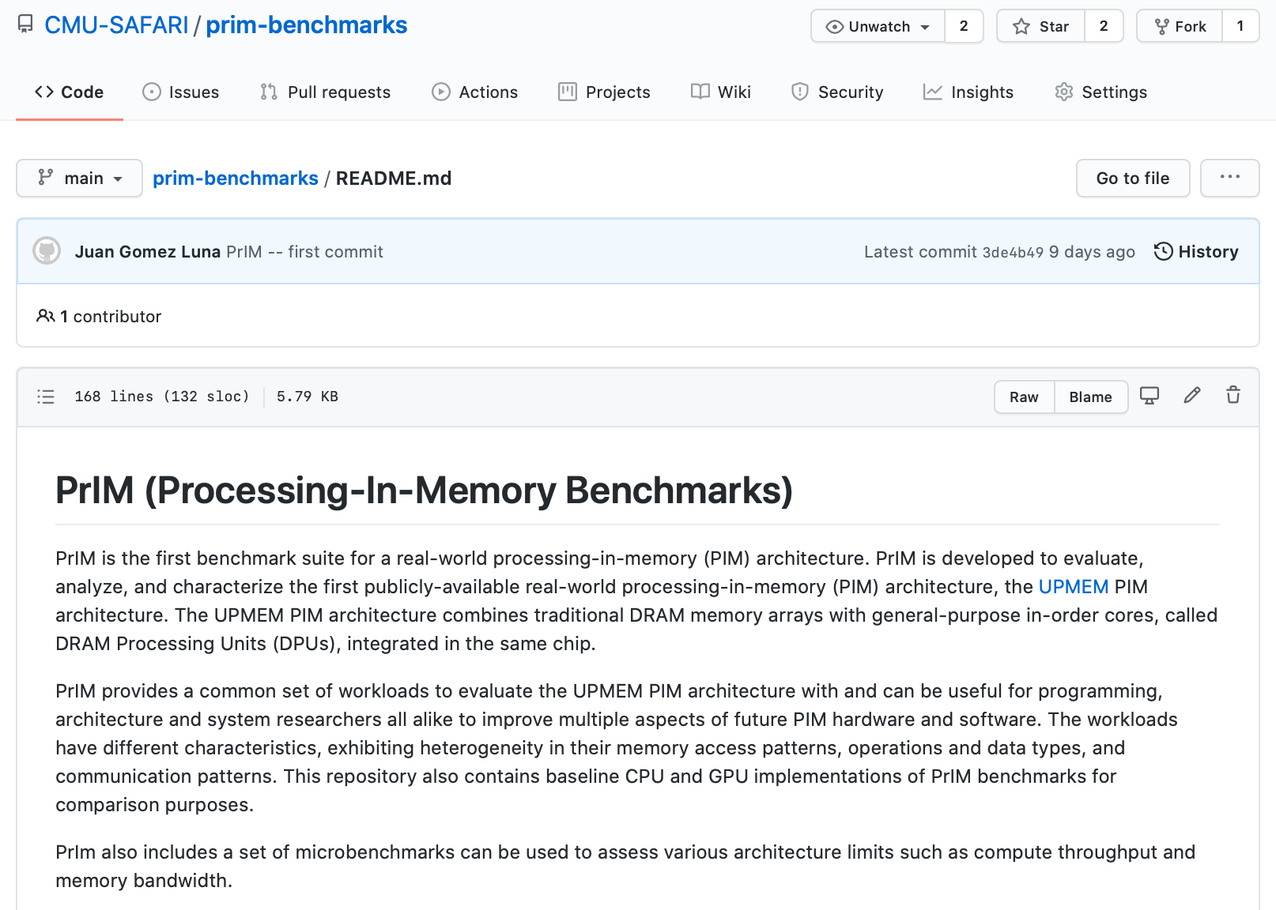
PrIM Benchmarks are Open Source
All microbenchmarks, benchmarks, and scripts
https://github.com/CMU-SAFARI/prim-benchmarks

Slide 54
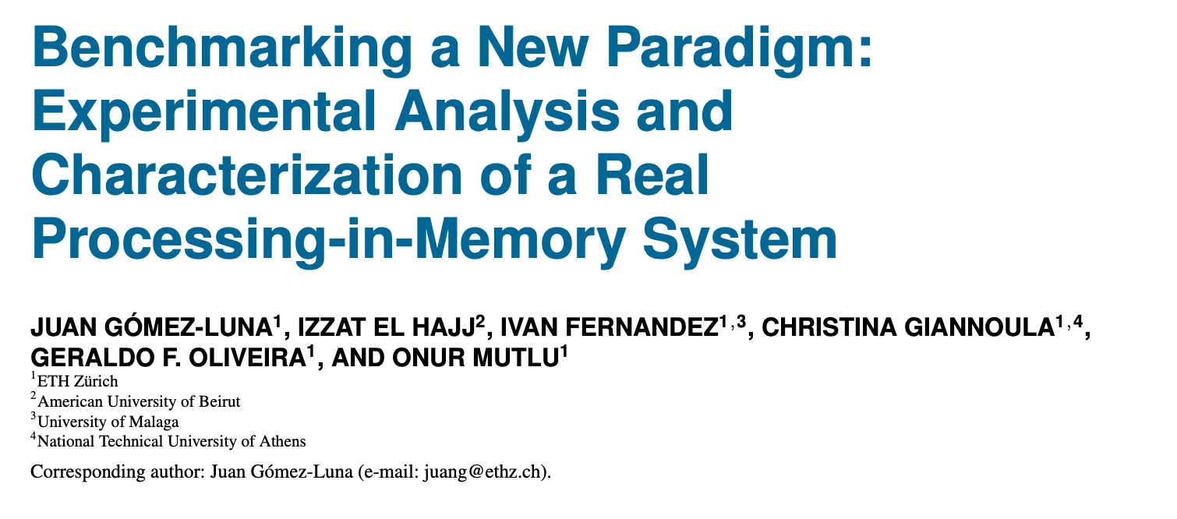
Understanding a Modern PIM Architecture
https://arxiv.org/pdf/2105.03814.pdf
https://github.com/CMU-SAFARI/prim-benchmarks

Slide 55
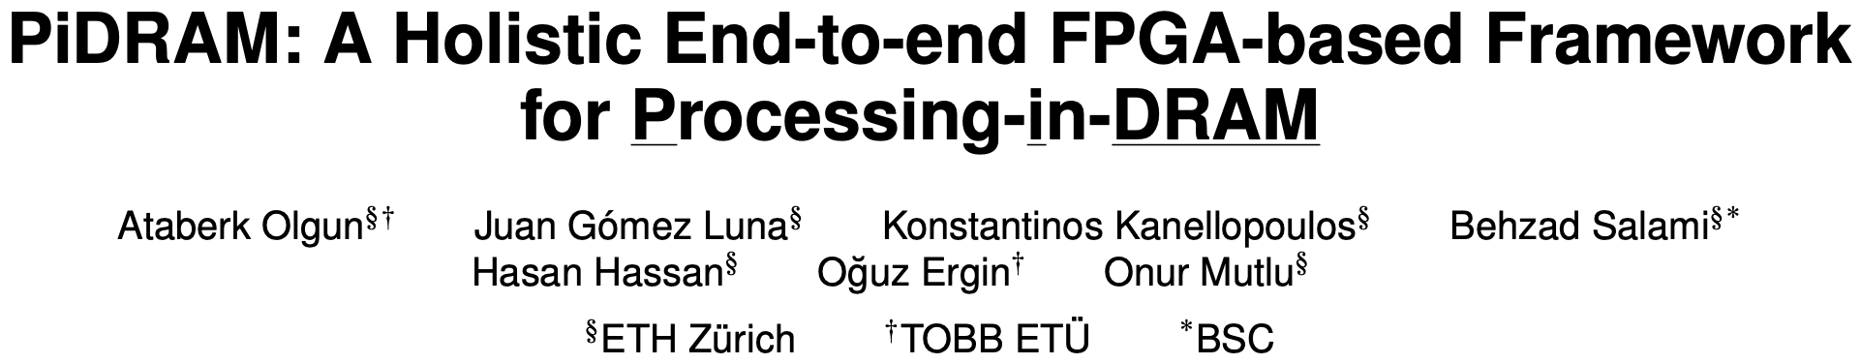
Real Processing Using Memory Prototype
End-to-end RowClone & TRNG using off-the-shelf DRAM chips
Idea: Violate DRAM timing parameters to mimic RowClone
https://arxiv.org/pdf/2111.00082.pdf
https://github.com/cmu-safari/pidram
https://www.youtube.com/watch?v=qeukNs5XI3g&t=4192s

Slide 56
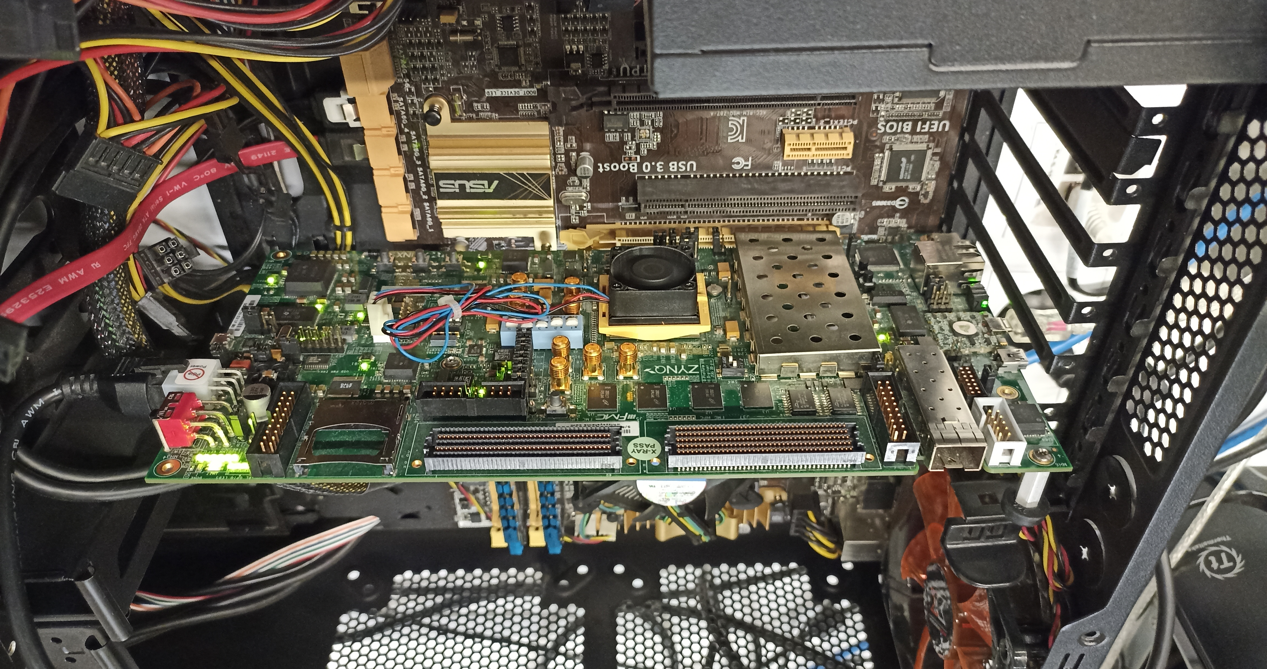
Real Processing Using Memory Prototype
https://arxiv.org/pdf/2111.00082.pdf
https://github.com/cmu-safari/pidram
https://www.youtube.com/watch?v=qeukNs5XI3g&t=4192s
Host Machine
FPGA Board
RISC-V System
PiM-Enabled DIMM

Slide 57
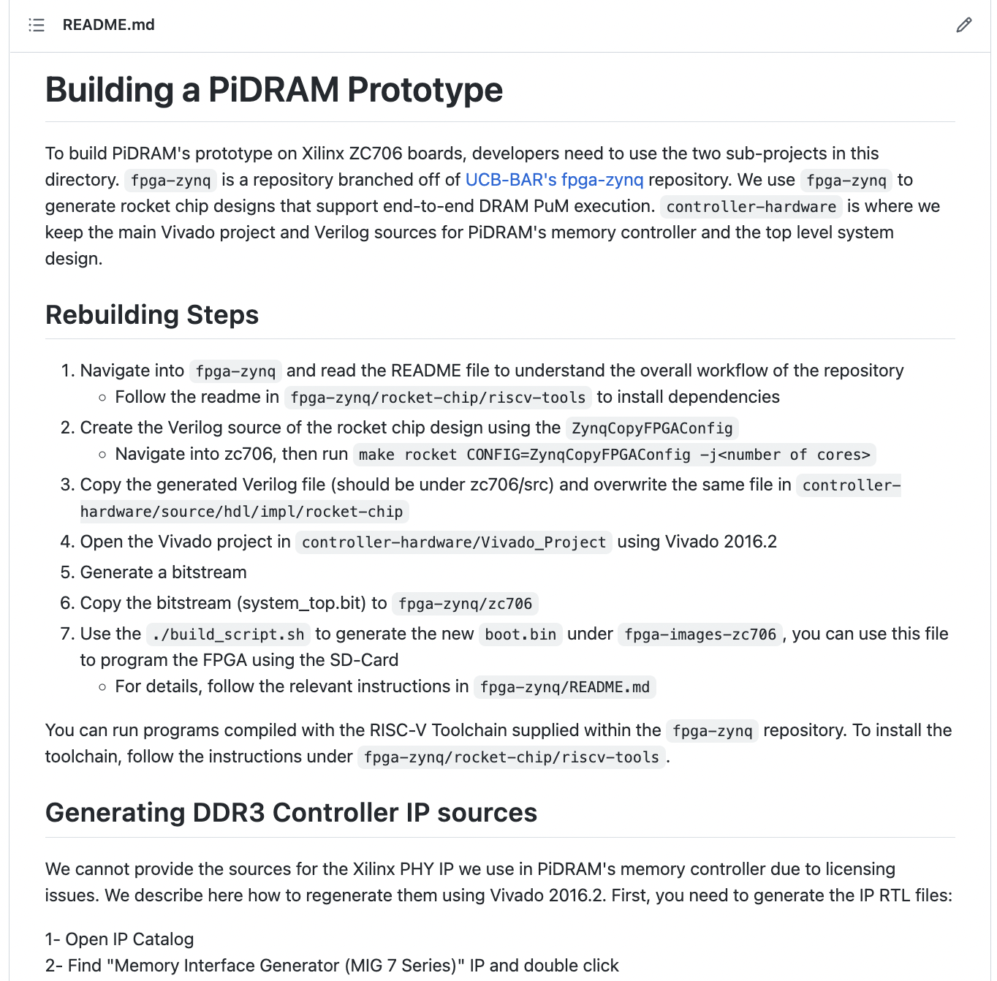
Real Processing Using Memory Prototype
https://arxiv.org/pdf/2111.00082.pdf
https://github.com/cmu-safari/pidram
https://www.youtube.com/watch?v=qeukNs5XI3g&t=4192s

Slide 58
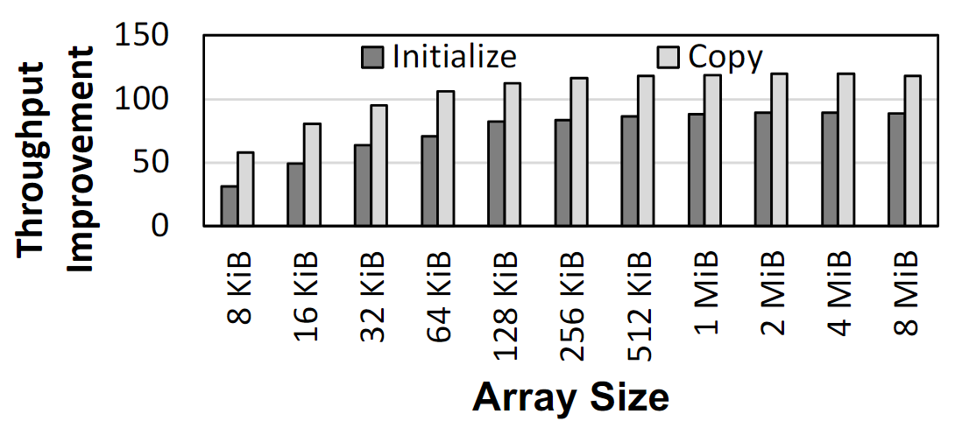
Microbenchmark Copy/Initialization Throughput
In-DRAM Copy and Initialization
improve throughput by 119x and 89x
Notes:
This plot shows the throughput improvement provided by in-DRAM copy operations for bulk data initialization and copy over CPU-based copy and initialization using LOAD and STORE instructions. We do not execute any CLFLUSH instructions and assume that the data is up to date in DRAM and there are no cached copies.
The x-axis shows the size of the arrays that we copy or initialize. The dark gray bar shows the improvement for initialization operations, and the bright gray bar shows the improvement for copy operations.
[CLICK] We observe that in-DRAM copy and initialization operations improve copy and initialization throughput by 119x and 89x including the overheads of system support required for RowClone operations

Slide 59
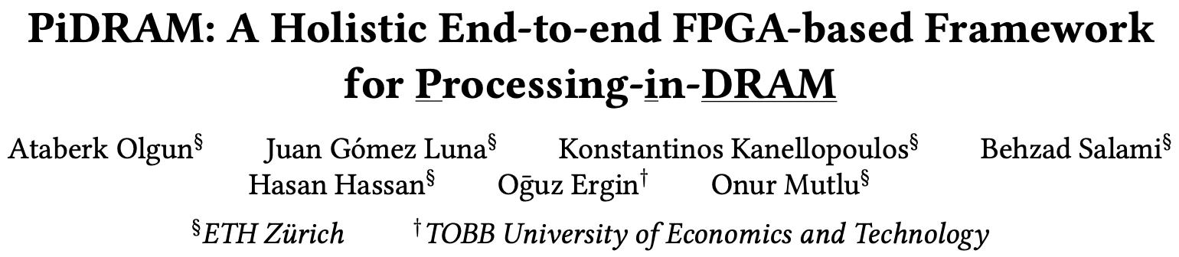
More on PiDRAM
Ataberk Olgun, Juan Gomez Luna, Konstantinos Kanellopoulos, Behzad Salami, Hasan Hassan, Oguz Ergin, and Onur Mutlu,
"PiDRAM: A Holistic End-to-end FPGA-based Framework for Processing-in-DRAM"
ACM Transactions on Architecture and Code Optimization (TACO), March 2023.
[arXiv version]
Presented at the 18th HiPEAC Conference, Toulouse, France, January 2023.
[Slides (pptx) (pdf)]
[Longer Lecture Slides (pptx) (pdf)]
[Lecture Video (40 minutes)]
[PiDRAM Source Code]

Slide 60
Eliminating the Adoption Barriers
How to Enable Adoption of Processing in Memory

Slide 61
Potential Barriers to Adoption of PIM
1. Applications & software for PIM
2. Ease of programming (interfaces and compiler/HW support)
3. System and security support: coherence, synchronization, virtual memory, isolation, communication interfaces, …
4. Runtime and compilation systems for adaptive scheduling, data mapping, access/sharing control, …
5. Infrastructures to assess benefits and feasibility
All can be solved with change of mindset

Slide 62
Potential Security Issues & Benefits (I)
Can PIM worsen security?
  Worsened or easier-to-induce physical issues (e.g., RowHammer)?
  Worsened or new side channels?
  Hardware bugs?
  …
Can PIM enhance security?
  Less exposure of data (& keys?)
  In-memory encryption & cryptographic hashing
  Execution of security functions; trusted execution in memory
  Support for security primitives (TRNGs, PUFs, encryption, …)
  …

Slide 63
Potential Security Issues & Benefits (II)
Security evaluation of PIM Systems
  Different types of PIM: PnM vs. PuM
  Different locations: cache, MC, DRAM, NVM, storage, remote, …
  General-purpose vs. special-purpose PIM?
  Multi tenancy vs. single workload?
  Concurrent host and PIM access?
  Memory bus protection; memory wire(s) protection?
  Robustness issues like RowHammer, RowPress, …
  …
Can PIM support (more) secure execution of workloads?
  What is needed to do so?
  Secure PIM enclaves?
  …

Slide 64
Security of PIM Systems
Onur Mutlu
omutlu@gmail.com
https://people.inf.ethz.ch/omutlu
30 November 2023
Dagstuhl MAD (Microarchitectural Attacks & Defenses)

Slide 65
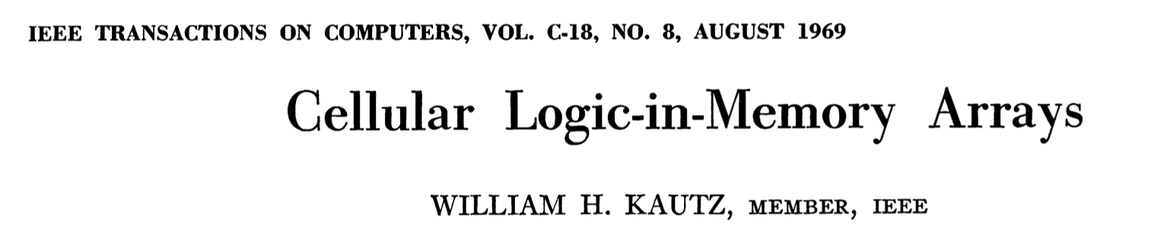
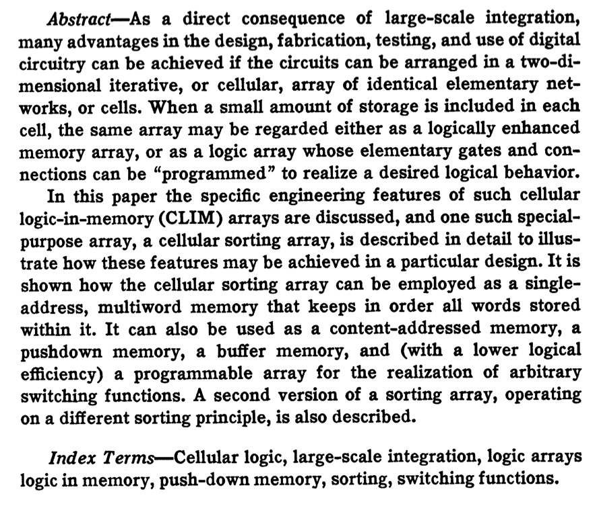
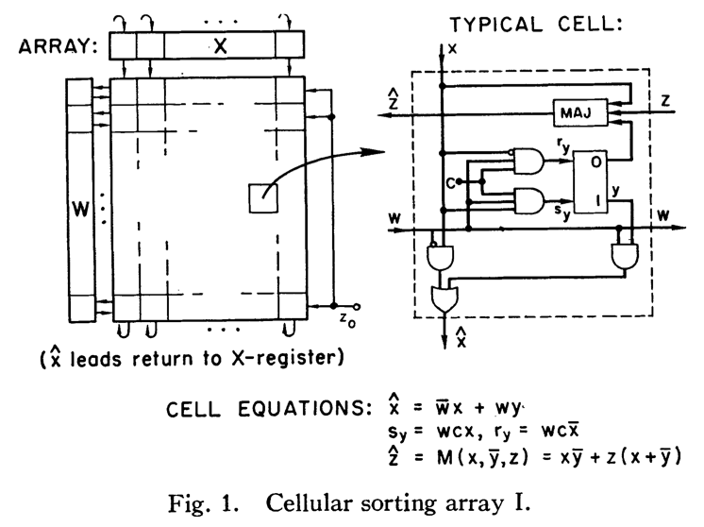
Processing in/near Memory: An Old Idea
Kautz, “Cellular Logic-in-Memory Arrays”, IEEE TC 1969.
https://doi.org/10.1109/T-C.1969.222754

Slide 66
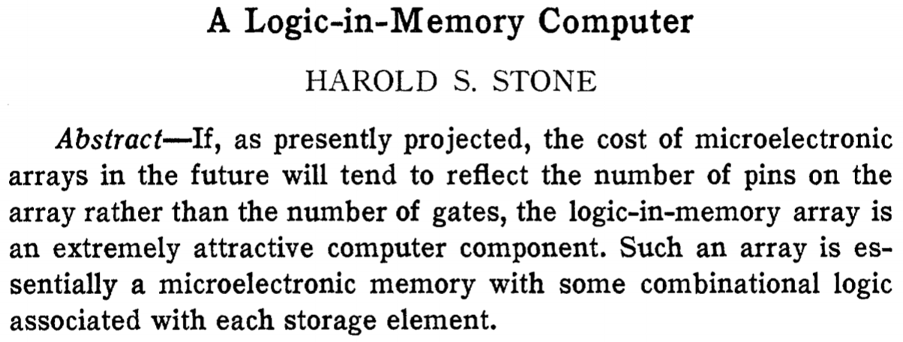
Processing in/near Memory: An Old Idea
Stone, “A Logic-in-Memory Computer,” IEEE TC 1970.
https://safari.ethz.ch/architecture/fall2020/lib/exe/fetch.php?media=stone_logic_in_memory_1970.pdf

Slide 67
Eliminating the Adoption Barriers
Processing-near-Memory
Systems

Slide 68
Opportunity: 3D-Stacked Logic+Memory
Memory
Logic
Other “True 3D” technologies
under development

Slide 69
Tesseract System for Graph Processing
Interconnected set of 3D-stacked memory+logic chips with simple cores
Host Processor
Memory
Memory-Mapped
Accelerator Interface
(Noncacheable, Physically Addressed)
Logic
In-Order Core
DRAM Controller
…
…
LP
PF Buffer
Crossbar Network
…
MTP
…
Message Queue
NI
Ahn+, “A Scalable Processing-in-Memory Accelerator for Parallel Graph Processing” ISCA 2015.

Slide 70
Tesseract System for Graph Processing
Host Processor
Memory
Memory-Mapped
Accelerator Interface
(Noncacheable, Physically Addressed)
Logic
In-Order Core
DRAM Controller
…
…
Communications via
Remote Function Calls
LP
PF Buffer
Crossbar Network
…
MTP
…
Message Queue
NI

Slide 71
Tesseract System for Graph Processing
Host Processor
Memory
Memory-Mapped
Accelerator Interface
(Noncacheable, Physically Addressed)
Logic
Prefetching
In-Order Core
DRAM Controller
…
…
LP
PF Buffer
Crossbar Network
…
MTP
…
Message Queue
NI

Slide 72
Evaluated Systems
DDR3-OoO
HMC-OoO
HMC-MC
Tesseract
32 Tesseract Cores
8 OoO
4GHz
8 OoO
4GHz
8 OoO
4GHz
8 OoO
4GHz
128
In-Order
2GHz
128
In-Order
2GHz
8 OoO
4GHz
8 OoO
4GHz
8 OoO
4GHz
8 OoO
4GHz
128
In-Order
2GHz
128
In-Order
2GHz
102.4GB/s
640GB/s
640GB/s
8TB/s
Ahn+, “A Scalable Processing-in-Memory Accelerator for Parallel Graph Processing” ISCA 2015.

Slide 73
Tesseract Graph Processing Performance
>13X Performance Improvement
On five graph processing algorithms
Ahn+, “A Scalable Processing-in-Memory Accelerator for Parallel Graph Processing” ISCA 2015.

Slide 74
Tesseract Graph Processing System Energy
> 8X Energy Reduction
Ahn+, “A Scalable Processing-in-Memory Accelerator for Parallel Graph Processing” ISCA 2015.

Slide 75
More on Tesseract
Junwhan Ahn, Sungpack Hong, Sungjoo Yoo, Onur Mutlu, and Kiyoung Choi,
"A Scalable Processing-in-Memory Accelerator for Parallel Graph Processing"
Proceedings of the 42nd International Symposium on Computer Architecture (ISCA), Portland, OR, June 2015.
[Slides (pptx) (pdf)] [Lightning Session Slides (pptx) (pdf)]
Top Picks Honorable Mention by IEEE Micro.
Selected to the ISCA-50 25-Year Retrospective Issue covering 1996-2020 in 2023 (Retrospective (pdf) Full Issue).

Slide 76
Eliminating the Adoption Barriers
Processing-using-Memory
Systems

Slide 77
Processing using DRAM
We can support
  Bulk bitwise AND, OR, NOT, MAJ
  Bulk bitwise COPY and INIT/ZERO
  True Random Number Generation; Physical Unclonable Functions
  Lookup Table based more complex computation
At low cost
Using analog computation capability of DRAM
  Idea: activating (multiple) rows performs computation
30-77X performance and energy improvement
  Seshadri+, “Ambit: In-Memory Accelerator for Bulk Bitwise Operations Using Commodity DRAM Technology,” MICRO 2017.
  Seshadri+“RowClone: Fast and Efficient In-DRAM Copy and Initialization of Bulk Data,” MICRO 2013.

Slide 78

Starting Simple: Data Copy and Initialization
  memmove & memcpy: 5% cycles in Google’s datacenter [Kanev+ ISCA’15]
000000000000000
Zero initialization
(e.g., security)
Forking
Checkpointing
Many more
VM Cloning
Deduplication
Page Migration

Slide 79
Future Systems: In-Memory Copy
3) No cache pollution
1) Low latency
Memory
L3
CPU
L2
L1
MC
2) Low bandwidth utilization
4) No unwanted data movement
1046ns, 3.6uJ
→ 90ns, 0.04uJ

Slide 80
RowClone: In-DRAM Row Copy
Idea: Two consecutive ACTivates
4 Kbytes
Negligible HW cost
Step 1: Activate row A
Step 2: Activate row B
Transfer row
DRAM subarray
Transfer
row
Row Buffer (4 Kbytes)
8 bits
Data Bus
Notes:
copy

Slide 81
RowClone: Latency and Energy Savings
11.6x
74x
Seshadri et al., “RowClone: Fast and Efficient In-DRAM Copy and Initialization of Bulk Data,” MICRO 2013.

Slide 82
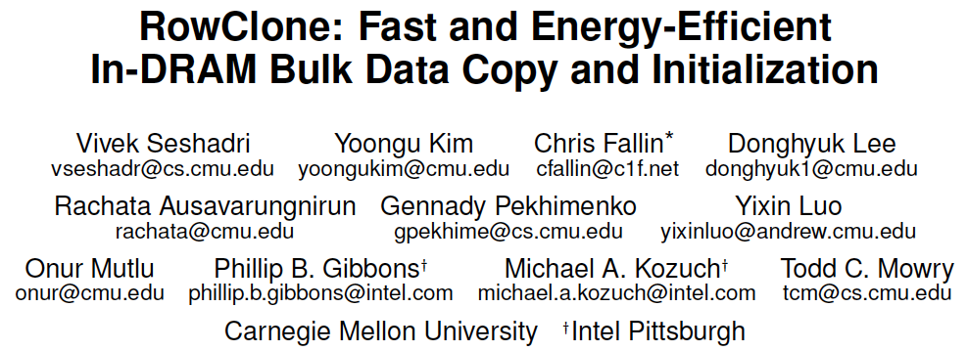
More on RowClone
Vivek Seshadri, Yoongu Kim, Chris Fallin, Donghyuk Lee, Rachata Ausavarungnirun, Gennady Pekhimenko, Yixin Luo, Onur Mutlu, Michael A. Kozuch, Phillip B. Gibbons, and Todd C. Mowry,
"RowClone: Fast and Energy-Efficient In-DRAM Bulk Data Copy and Initialization"
Proceedings of the 46th International Symposium on Microarchitecture (MICRO), Davis, CA, December 2013. [Slides (pptx) (pdf)] [Lightning Session Slides (pptx) (pdf)] [Poster (pptx) (pdf)]

Slide 83
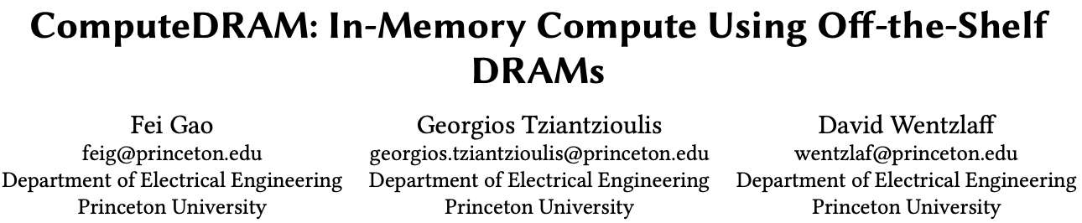
RowClone in Off-the-Shelf DRAM Chips
Idea: Violate DRAM timing parameters to mimic RowClone
https://parallel.princeton.edu/papers/micro19-gao.pdf

Slide 84
Real Processing Using Memory Prototype
End-to-end RowClone & TRNG using off-the-shelf DRAM chips
Idea: Violate DRAM timing parameters to mimic RowClone
https://arxiv.org/pdf/2111.00082.pdf
https://github.com/cmu-safari/pidram
https://www.youtube.com/watch?v=qeukNs5XI3g&t=4192s

Slide 85
Real Processing-using-Memory Prototype
https://arxiv.org/pdf/2111.00082.pdf
https://github.com/cmu-safari/pidram
https://www.youtube.com/watch?v=qeukNs5XI3g&t=4192s
Host Machine
FPGA Board
RISC-V System
PiM-Enabled DIMM

Slide 86
Real Processing-using-Memory Prototype
https://arxiv.org/pdf/2111.00082.pdf
https://github.com/cmu-safari/pidram
https://www.youtube.com/watch?v=qeukNs5XI3g&t=4192s

Slide 87
Microbenchmark Copy/Initialization Throughput
In-DRAM Copy and Initialization
improve throughput by 119x and 89x
Notes:
This plot shows the throughput improvement provided by in-DRAM copy operations for bulk data initialization and copy over CPU-based copy and initialization using LOAD and STORE instructions. We do not execute any CLFLUSH instructions and assume that the data is up to date in DRAM and there are no cached copies.
The x-axis shows the size of the arrays that we copy or initialize. The dark gray bar shows the improvement for initialization operations, and the bright gray bar shows the improvement for copy operations.
[CLICK] We observe that in-DRAM copy and initialization operations improve copy and initialization throughput by 119x and 89x including the overheads of system support required for RowClone operations

Slide 88
More on PiDRAM
Ataberk Olgun, Juan Gomez Luna, Konstantinos Kanellopoulos, Behzad Salami, Hasan Hassan, Oguz Ergin, and Onur Mutlu,
"PiDRAM: A Holistic End-to-end FPGA-based Framework for Processing-in-DRAM"
ACM Transactions on Architecture and Code Optimization (TACO), March 2023.
[arXiv version]
Presented at the 18th HiPEAC Conference, Toulouse, France, January 2023.
[Slides (pptx) (pdf)]
[Longer Lecture Slides (pptx) (pdf)]
[Lecture Video (40 minutes)]
[PiDRAM Source Code]

Slide 89

Lecture on RowClone & Processing using DRAM
https://www.youtube.com/watch?v=n6Pwg1qax_E&list=PL5Q2soXY2Zi_7UBNmC9B8Yr5JSwTG9yH4&index=4

Slide 90
(Truly) In-Memory Computation
We can support in-DRAM AND, OR, NOT, MAJ
At low cost
Using analog computation capability of DRAM
  Idea: activating multiple rows performs computation
30-60X performance and energy improvement
  Seshadri+, “Ambit: In-Memory Accelerator for Bulk Bitwise Operations Using Commodity DRAM Technology,” MICRO 2017.
New memory technologies enable even more opportunities
  Memristors, resistive RAM, phase change mem, STT-MRAM, …
  Can operate on data with minimal movement

Slide 91
In-DRAM AND/OR: Triple Row Activation
½V_{DD}
½V_{DD}+δ
V_{DD}
A
Final State
AB + BC + AC
B
C
C(A + B) + ~C(AB)
dis
en
0
½V_{DD}
Seshadri+, “Fast Bulk Bitwise AND and OR in DRAM”, IEEE CAL 2015.

Slide 92
Bulk Bitwise Operations in Workloads
[1] Li and Patel, BitWeaving, SIGMOD 2013
[2] Goodwin+, BitFunnel, SIGIR 2017

Slide 93
In-DRAM Acceleration of Database Queries
>4-12X Performance Improvement
Seshadri+, “Ambit: In-Memory Accelerator for Bulk Bitwise Operations using Commodity DRAM Technology,” MICRO 2017.

Slide 94
More on Ambit
Vivek Seshadri, Donghyuk Lee, Thomas Mullins, Hasan Hassan, Amirali Boroumand, Jeremie Kim, Michael A. Kozuch, Onur Mutlu, Phillip B. Gibbons, and Todd C. Mowry,
"Ambit: In-Memory Accelerator for Bulk Bitwise Operations Using Commodity DRAM Technology"
Proceedings of the 50th International Symposium on Microarchitecture (MICRO), Boston, MA, USA, October 2017.
[Slides (pptx) (pdf)] [Lightning Session Slides (pptx) (pdf)] [Poster (pptx) (pdf)]

Slide 95

In-DRAM Bulk Bitwise Execution
Vivek Seshadri and Onur Mutlu,
"In-DRAM Bulk Bitwise Execution Engine"
Invited Book Chapter in Advances in Computers, to appear in 2020.
[Preliminary arXiv version]

Slide 96

SIMDRAM Framework
Nastaran Hajinazar, Geraldo F. Oliveira, Sven Gregorio, Joao Dinis Ferreira, Nika Mansouri Ghiasi, Minesh Patel, Mohammed Alser, Saugata Ghose, Juan Gomez-Luna, and Onur Mutlu,
"SIMDRAM: An End-to-End Framework for Bit-Serial SIMD Computing in DRAM"
Proceedings of the 26th International Conference on Architectural Support for Programming Languages and Operating Systems (ASPLOS), Virtual, March-April 2021.
[2-page Extended Abstract]
[Short Talk Slides (pptx) (pdf)]
[Talk Slides (pptx) (pdf)]
[Short Talk Video (5 mins)]
[Full Talk Video (27 mins)]

