Slide 1



SAFARI Research Group
Introduction & Research
Onur Mutlu
omutlu@gmail.com
https://people.inf.ethz.ch/omutlu
6 July 2021
EFCL Welcome Workshop

Slide 2
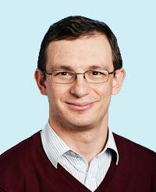
Brief Self Introduction
Onur Mutlu
  Full Professor @ ETH Zurich ITET (INFK), since September 2015
  Strecker Professor @ Carnegie Mellon University ECE/CS, 2009-2016, 2016-…
  PhD from UT-Austin, worked at Google, VMware, Microsoft Research, Intel, AMD
  https://people.inf.ethz.ch/omutlu/
  omutlu@gmail.com (Best way to reach me)
  https://people.inf.ethz.ch/omutlu/projects.htm
Research and Teaching in:
  Computer architecture, computer systems, hardware security, bioinformatics
  Memory and storage systems
  Hardware security, safety, predictability
  Fault tolerance
  Hardware/software cooperation
  Architectures for bioinformatics, health, medicine
  …

Slide 3



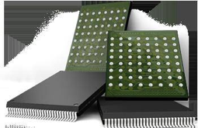

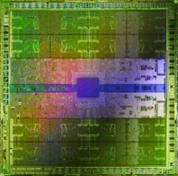
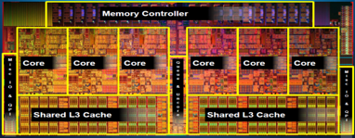
Current Research Mission
Computer architecture, HW/SW, systems, bioinformatics, security
Hybrid Main Memory
Heterogeneous
Processors and
Accelerators
Persistent Memory/Storage
Graphics and Vision Processing
Build fundamentally better architectures
Notes:
Professor Mutlu’s research focus is all aspects of computer architecture, HW/SW interaction and bioinformatics.
He is looking for students to perform research in these areas.
He and his group, SAFARI, solve fundamental problems spanning:
Memory, memory, memory, storage, interconnects
Parallel architectures, heterogeneous architectures, GP-GPUs
System/architecture interaction, new execution models
Energy efficiency, fault tolerance, hardware security
Genome sequence analysis and assembly
His group does broad research spanning systems to logic with architecture at center

Slide 4
Four Key Current Directions
Fundamentally Secure/Reliable/Safe Architectures
Fundamentally Energy-Efficient Architectures
  Memory-centric (Data-centric) Architectures
Fundamentally Low-Latency and Predictable Architectures
Architectures for AI/ML, Genomics, Medicine, Health, …

Slide 5
The Transformation Hierarchy
Problem
Algorithm
Program/Language
System Software
Computer Architecture (expanded view)
SW/HW Interface
Computer Architecture (narrow view)
Micro-architecture
Logic
Devices
Electrons

Slide 6
Axiom
To achieve the highest energy efficiency and performance:
we must take the expanded view
of computer architecture
Problem
Algorithm
Program/Language
System Software
Co-design across the hierarchy:
Algorithms to devices
SW/HW Interface
Micro-architecture
Logic
Specialize as much as possible
within the design goals
Devices
Electrons

Slide 7
Current Research Mission & Major Topics
Build fundamentally better architectures
Data-centric arch. for low energy & high perf.
  Proc. in Mem/DRAM, NVM, unified mem/storage
Low-latency & predictable architectures
  Low-latency, low-energy yet low-cost memory
  QoS-aware and predictable memory systems
Fundamentally secure/reliable/safe arch.
  Tolerating all bit flips; patchable HW; secure mem
Architectures for ML/AI/Genomics/Health/Med
  Algorithm/arch./logic co-design; full heterogeneity
Data-driven and data-aware architectures
  ML/AI-driven architectural controllers and design
  Expressive memory and expressive systems
Problem
Algorithm
Program/Language
System Software
SW/HW Interface
Micro-architecture
Logic
Devices
Electrons
Broad research
spanning apps, systems, logic
with architecture at the center

Slide 8

SAFARI Research Group
Think BIG, Aim HIGH!
https://safari.ethz.ch

Slide 9
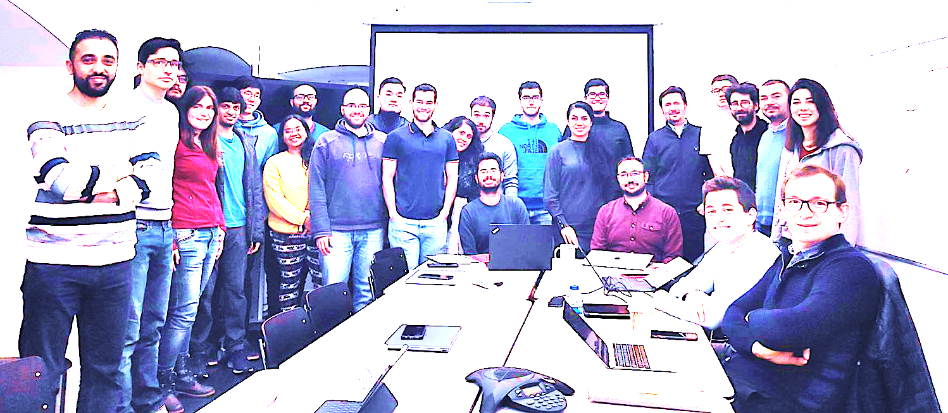

Onur Mutlu’s SAFARI Research Group
Computer architecture, HW/SW, systems, bioinformatics, security, memory
https://safari.ethz.ch/safari-newsletter-april-2020/
40+ Researchers
Think BIG, Aim HIGH!
https://safari.ethz.ch

Slide 10
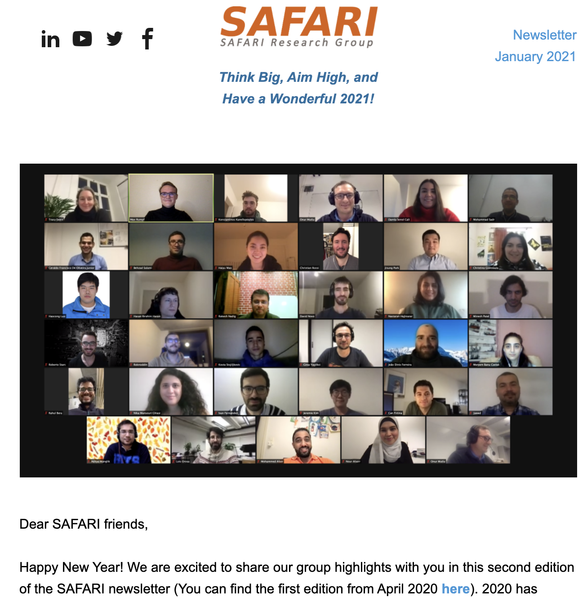
SAFARI Newsletter January 2021 Edition
https://safari.ethz.ch/safari-newsletter-january-2021/

Slide 11
SAFARI PhD and Post-Doc Alumni
https://safari.ethz.ch/safari-alumni/
Nastaran Hajinazar (ETH Zurich)
Gagandeep Singh (ETH Zurich)
Amirali Boroumand (Stanford Univ)
Jeremie Kim (ETH Zurich)
Nandita Vijaykumar (Univ. of Toronto, Assistant Professor)
Kevin Hsieh (Microsoft Research, Senior Researcher)
Justin Meza (Facebook)
Mohammed Alser (ETH Zurich)
Yixin Luo (Google)
Kevin Chang (Facebook)
Rachata Ausavarungnirun (KMUNTB, Assistant Professor)
Gennady Pekhimenko (Univ. of Toronto, Assistant Professor)
Vivek Seshadri (Microsoft Research)
Donghyuk Lee (NVIDIA Research, Senior Researcher)
Yoongu Kim (Google)
Lavanya Subramanian (Intel Labs → Facebook)
Samira Khan (Univ. of Virginia, Assistant Professor)
Saugata Ghose (Univ. of Illinois, Assistant Professor)

Slide 12
Principle: Teaching and Research
…
Teaching drives Research
Research drives Teaching
…

Slide 13
Research & Teaching: Some Overview Talks
https://www.youtube.com/onurmutlulectures
Future Computing Architectures
  https://www.youtube.com/watch?v=kgiZlSOcGFM&list=PL5Q2soXY2Zi8D_5MGV6EnXEJHnV2YFBJl&index=1
Enabling In-Memory Computation
  https://www.youtube.com/watch?v=njX_14584Jw&list=PL5Q2soXY2Zi8D_5MGV6EnXEJHnV2YFBJl&index=16
Accelerating Genome Analysis
  https://www.youtube.com/watch?v=r7sn41lH-4A&list=PL5Q2soXY2Zi8D_5MGV6EnXEJHnV2YFBJl&index=41
Rethinking Memory System Design
  https://www.youtube.com/watch?v=F7xZLNMIY1E&list=PL5Q2soXY2Zi8D_5MGV6EnXEJHnV2YFBJl&index=3
Intelligent Architectures for Intelligent Machines
  https://www.youtube.com/watch?v=c6_LgzuNdkw&list=PL5Q2soXY2Zi8D_5MGV6EnXEJHnV2YFBJl&index=25
The Story of RowHammer
  https://www.youtube.com/watch?v=sgd7PHQQ1AI&list=PL5Q2soXY2Zi8D_5MGV6EnXEJHnV2YFBJl&index=39

Slide 14
Online Courses & Lectures
First Computer Architecture & Digital Design Course
  Digital Design and Computer Architecture
  Spring 2021 Livestream Edition: https://www.youtube.com/watch?v=LbC0EZY8yw4&list=PL5Q2soXY2Zi_uej3aY39YB5pfW4SJ7LlN
Advanced Computer Architecture Course
  Computer Architecture
  Falll 2020 Edition: https://www.youtube.com/watch?v=c3mPdZA-Fmc&list=PL5Q2soXY2Zi9xidyIgBxUz7xRPS-wisBN
https://www.youtube.com/onurmutlulectures

Slide 15
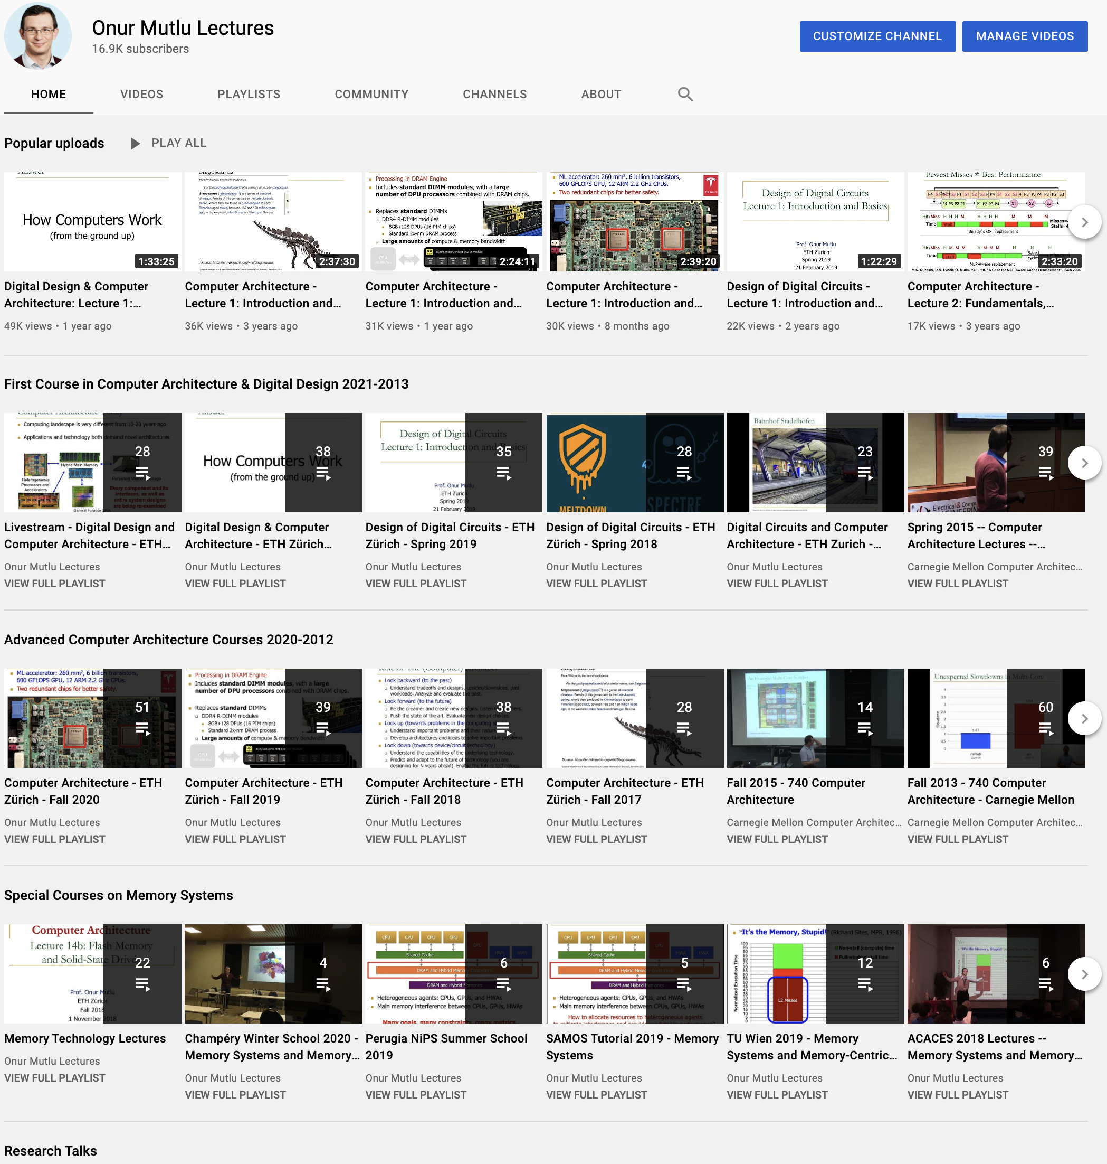
https://www.youtube.com/onurmutlulectures

Slide 16
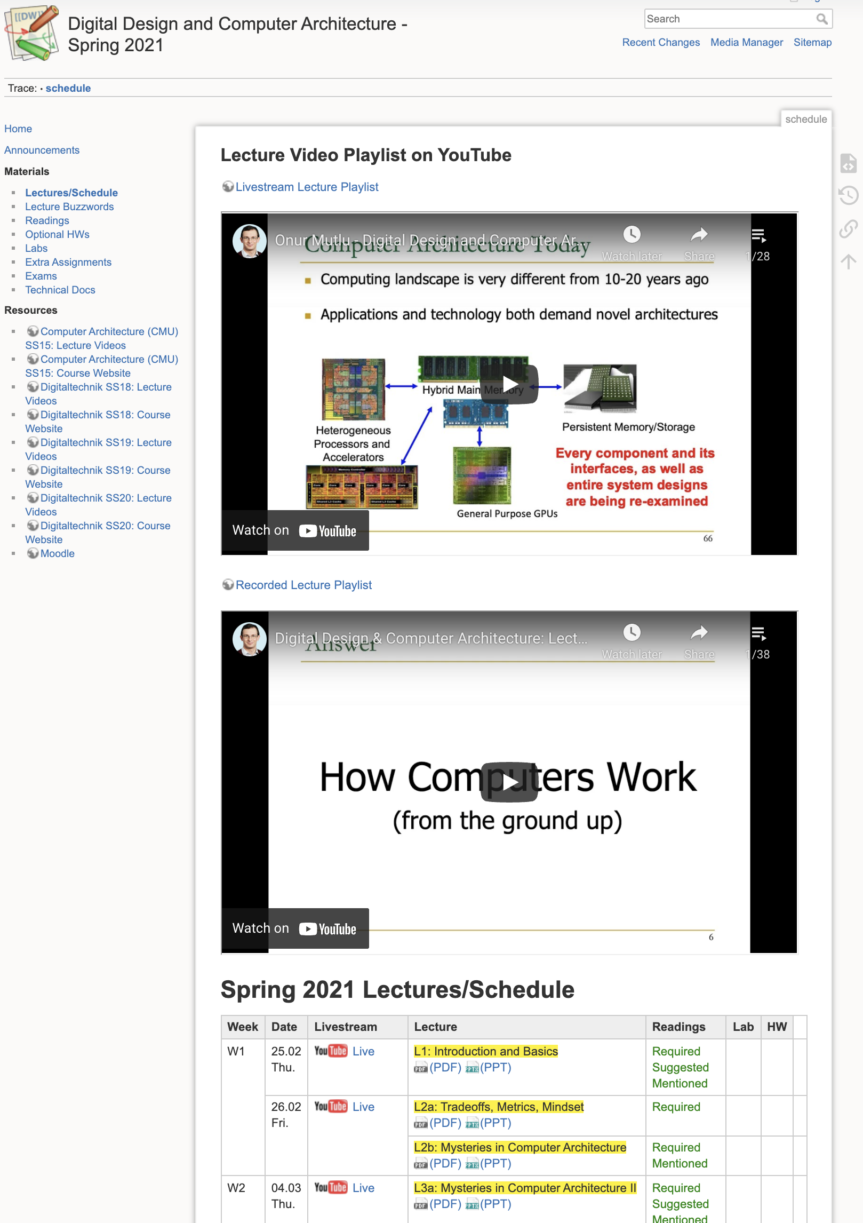
DDCA (Spring 2021)
https://safari.ethz.ch/digitaltechnik/spring2021/doku.php?id=schedule
https://www.youtube.com/watch?v=LbC0EZY8yw4&list=PL5Q2soXY2Zi_uej3aY39YB5pfW4SJ7LlN
Bachelor’s course
  2nd semester at ETH Zurich
  Rigorous introduction into “How Computers Work”
  Digital Design/Logic
  Computer Architecture
  10 FPGA Lab Assignments

Slide 17
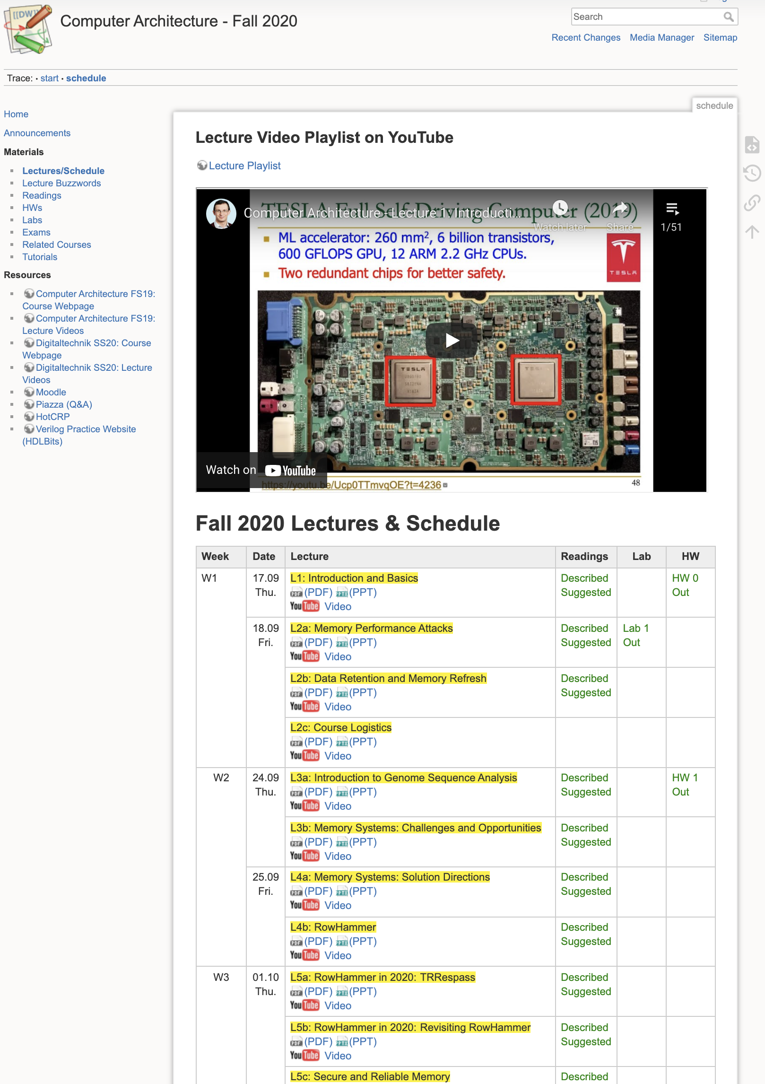
Comp Arch (Fall 2020)
https://safari.ethz.ch/architecture/fall2020/doku.php?id=schedule
https://www.youtube.com/watch?v=c3mPdZA-Fmc&list=PL5Q2soXY2Zi9xidyIgBxUz7xRPS-wisBN
Master’s level course
  Taken by Bachelor’s/Masters/PhD students
  Cutting-edge research topics + fundamentals in Computer Architecture
  5 Simulator-based Lab Assignments
  Potential research exploration
  Many research readings

Slide 18
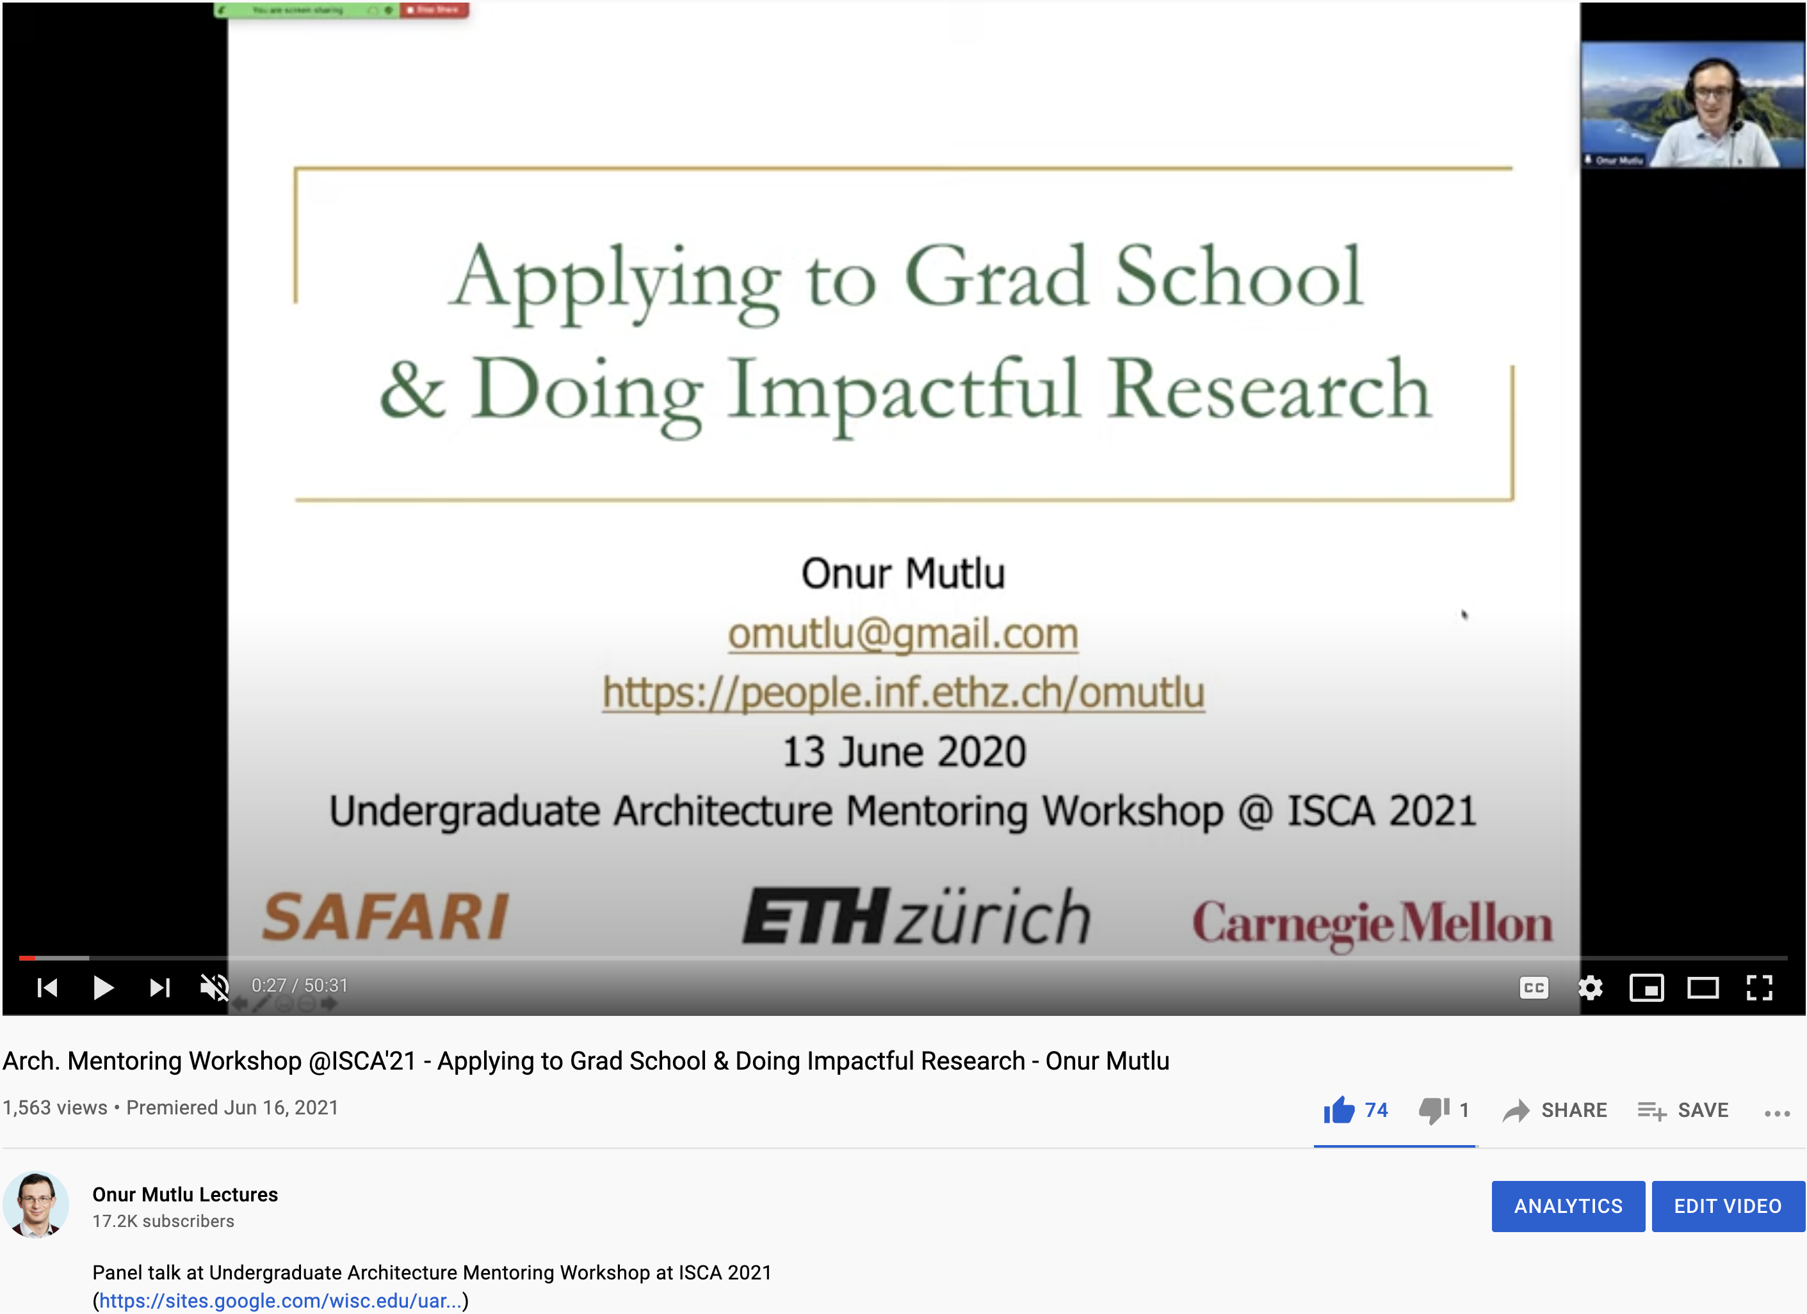
A Talk on Impactful Research & Teaching
https://www.youtube.com/watch?v=83tlorht7Mc&list=PL5Q2soXY2Zi8D_5MGV6EnXEJHnV2YFBJl&index=54

Slide 19
Open-Source Artifacts
https://github.com/CMU-SAFARI

Slide 20
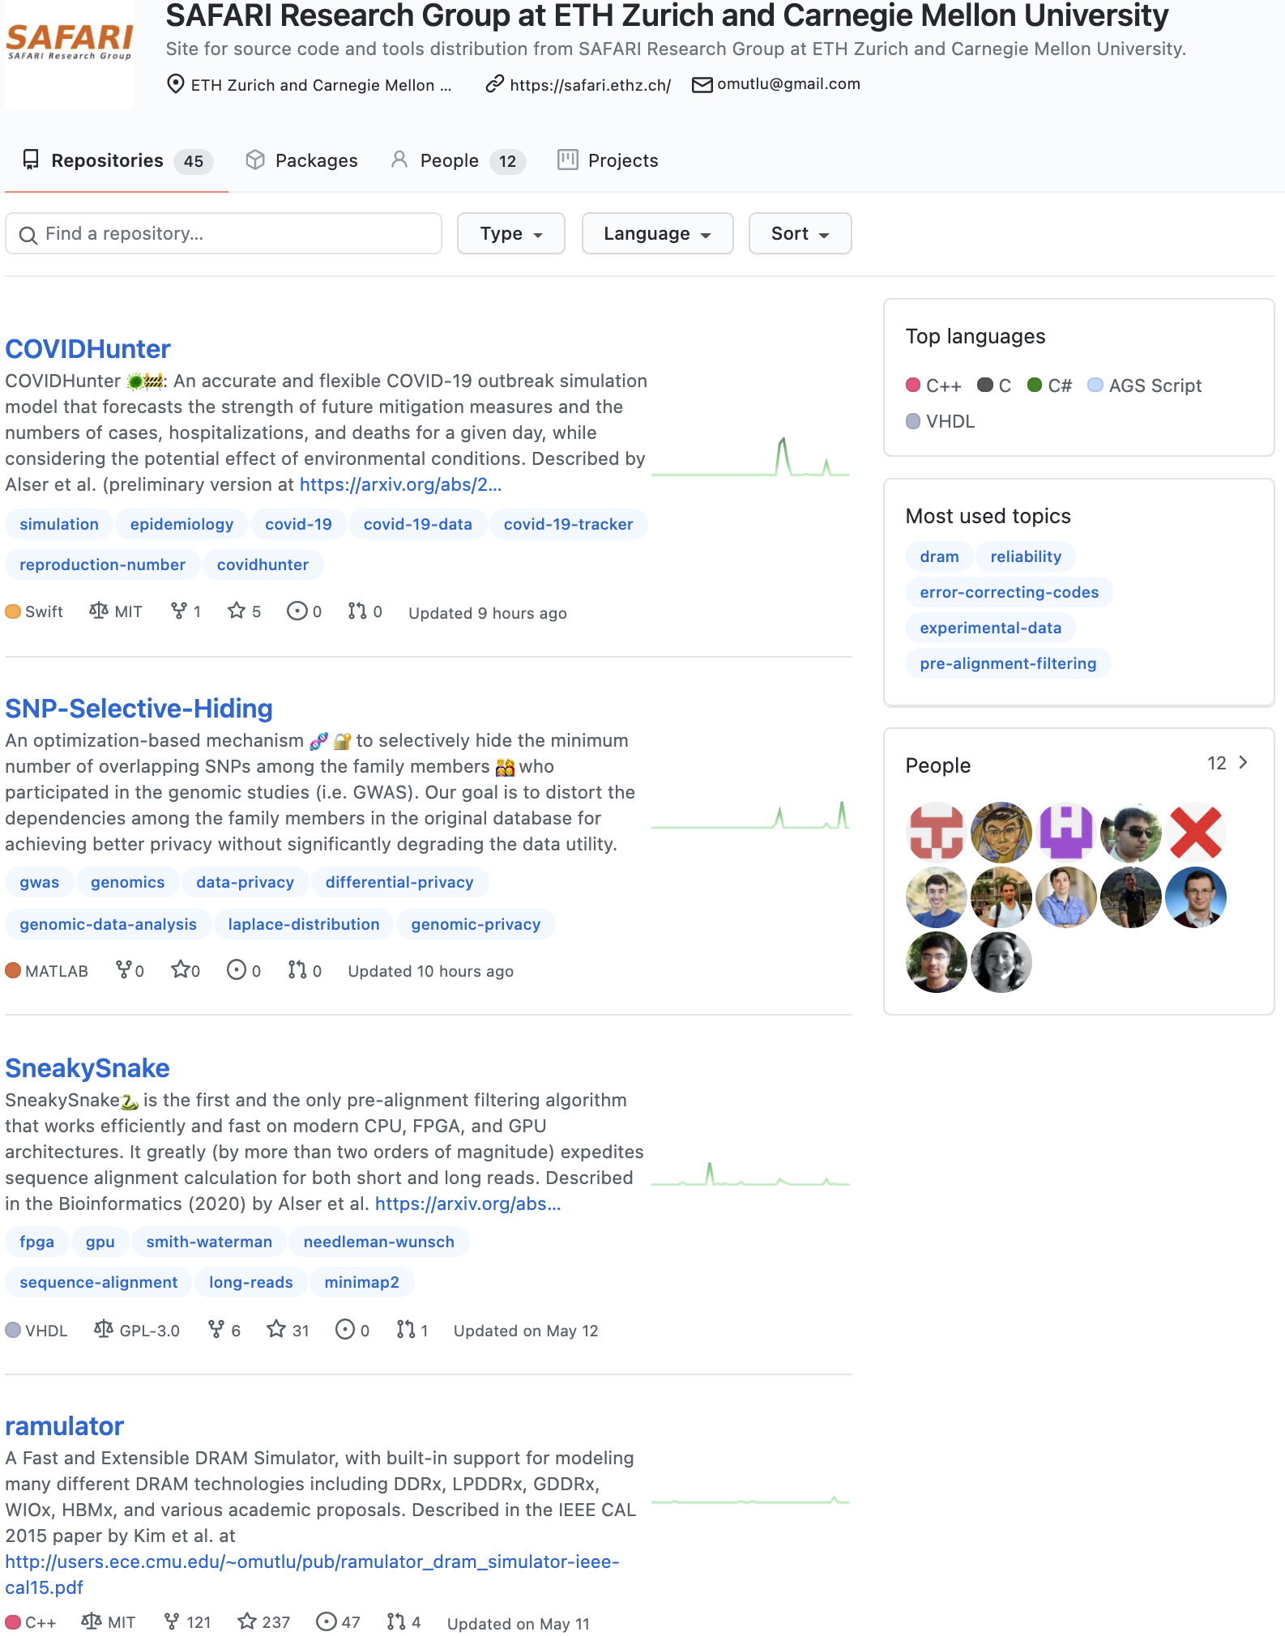
https://github.com/CMU-SAFARI

Slide 21
Papers, Talks, Videos, Artifacts
All are available at
  https://people.inf.ethz.ch/omutlu/projects.htm
  https://www.youtube.com/onurmutlulectures
  https://github.com/CMU-SAFARI/

Slide 22
Funding Acknowledgments
Alibaba, AMD, ASML, Google, Facebook, Hi-Silicon, HP Labs, Huawei, IBM, Intel, Microsoft, Nvidia, Oracle, Qualcomm, Rambus, Samsung, Seagate, VMware
NSF
NIH
GSRC
SRC
CyLab

Slide 23
Example Research Topics:
Quick Overview

Slide 24
Current Research Mission
Computer architecture, HW/SW, systems, bioinformatics, security
Hybrid Main Memory
Heterogeneous
Processors and
Accelerators
Persistent Memory/Storage
Graphics and Vision Processing
Build fundamentally better architectures
Notes:
Professor Mutlu’s research focus is all aspects of computer architecture, HW/SW interaction and bioinformatics.
He is looking for students to perform research in these areas.
He and his group, SAFARI, solve fundamental problems spanning:
Memory, memory, memory, storage, interconnects
Parallel architectures, heterogeneous architectures, GP-GPUs
System/architecture interaction, new execution models
Energy efficiency, fault tolerance, hardware security
Genome sequence analysis and assembly
His group does broad research spanning systems to logic with architecture at center

Slide 25
Four Key Issues in Future Platforms
Fundamentally Secure/Reliable/Safe Architectures
Fundamentally Energy-Efficient Architectures
  Memory-centric (Data-centric) Architectures
Fundamentally Low-Latency and Predictable Architectures
Architectures for AI/ML, Genomics, Medicine, Health

Slide 26
Architectures for Intelligent Machines
Data-centric
Data-driven
Data-aware

Slide 27
Current EFCL Projects
“A New Methodology and Open-Source Benchmark Suite for Evaluating Data Movement Bottlenecks: A Processing-in-Memory Case Study”
  Data-centric
“Machine-Learning-Assisted Intelligent Microarchitectures to Reduce Memory Access Latency”
  Data-driven
“Cross-layer Hardware/Software Techniques to Enable Powerful Computation and Memory Optimizations”
  Data-aware

Slide 28
The Problem
Computing
is Bottlenecked by Data

Slide 29
Data is Key for AI, ML, Genomics, …
Important workloads are all data intensive
They require rapid and efficient processing of large amounts of data
Data is increasing
  We can generate more than we can process

Slide 30
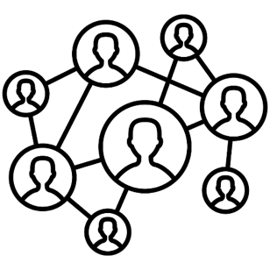



Data is Key for Future Workloads
In-memory Databases
[Mao+, EuroSys’12;
Clapp+ (Intel), IISWC’15]
Graph/Tree Processing
[Xu+, IISWC’12; Umuroglu+, FPL’15]
In-Memory Data Analytics
[Clapp+ (Intel), IISWC’15;
Awan+, BDCloud’15]
Datacenter Workloads
[Kanev+ (Google), ISCA’15]

Slide 31
Data Overwhelms Modern Machines
In-memory Databases
[Mao+, EuroSys’12;
Clapp+ (Intel), IISWC’15]
Graph/Tree Processing
[Xu+, IISWC’12; Umuroglu+, FPL’15]
Data → performance & energy bottleneck
In-Memory Data Analytics
[Clapp+ (Intel), IISWC’15;
Awan+, BDCloud’15]
Datacenter Workloads
[Kanev+ (Google), ISCA’15]

Slide 32








Data is Key for Future Workloads
  Chrome
TensorFlow Mobile
    Google’s web browser
Google’s machine learning framework
  Video Playback
  Video Capture
Google’s video codec
Google’s video codec
Notes:
In this work, we take a look at widely-used google consumer workloads, to figure out the major sources of energy consumption.
We look at Google Chrome web brower. We take a look at Tensorflow, Google’s machine learning framework, and we also take a look at two important video related workloads, video playback and video capture, both rely on Google’s vp9 codec technology.

Slide 33
Data Overwhelms Modern Machines
  Chrome
TensorFlow Mobile
    Google’s web browser
Google’s machine learning framework
Data → performance & energy bottleneck
  Video Playback
  Video Capture
Google’s video codec
Google’s video codec
Notes:
In this work, we take a look at widely-used google consumer workloads, to figure out the major sources of energy consumption.
We look at Google Chrome web brower. We take a look at Tensorflow, Google’s machine learning framework, and we also take a look at two important video related workloads, video playback and video capture, both rely on Google’s vp9 codec technology.

Slide 34
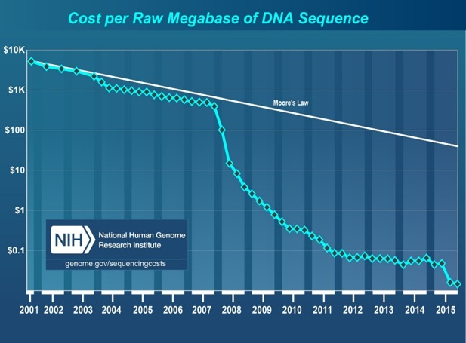
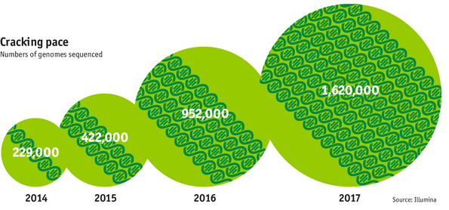

Data is Key for Future Workloads
development of high-throughput sequencing (HTS) technologies
Number of Genomes Sequenced
http://www.economist.com/news/21631808-so-much-genetic-data-so-many-uses-genes-unzipped
Notes:
However, since the development of high throughput sequencing (HTS) technologies, the cost of genome sequencing has fallen off a cliff (<< 1,000$) making it viable for almost everyone's use.

Slide 35

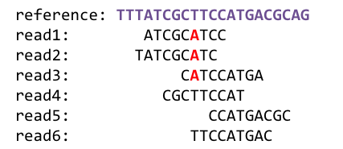
1
Sequencing
Genome Analysis
Read Mapping
2
Data → performance & energy bottleneck
Variant Calling
Scientific Discovery
3
4
Notes:
Genome analysis starts with sequencing random short DNA fragments of copies of the original molecule.
Unfortunately, these reads lack information about their order and which part of genome they are originated from.
Hence the second step is to map these reads to a long reference genome.

Slide 36
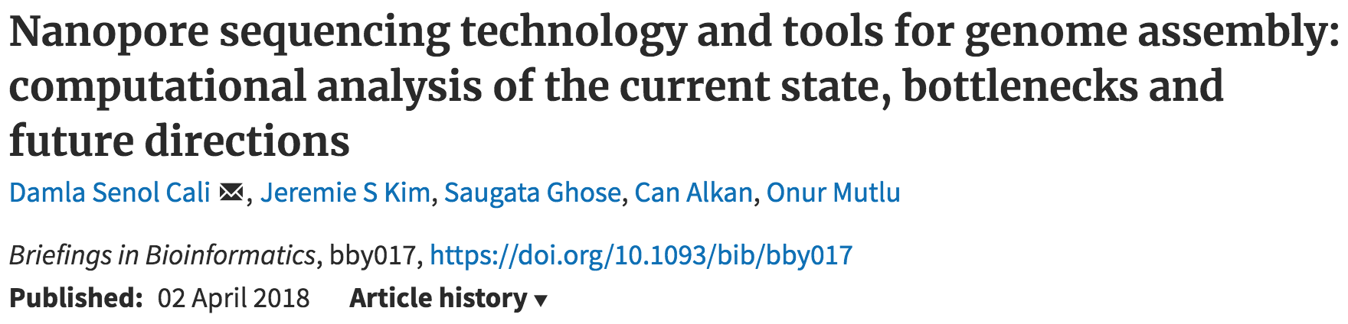
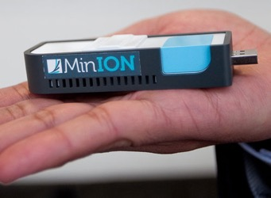
New Genome Sequencing Technologies
Oxford Nanopore MinION
Senol Cali+, “Nanopore Sequencing Technology and Tools for Genome
Assembly: Computational Analysis of the Current State, Bottlenecks
and Future Directions,” Briefings in Bioinformatics, 2018.
[Open arxiv.org version]

Slide 37
New Genome Sequencing Technologies
Oxford Nanopore MinION
Senol Cali+, “Nanopore Sequencing Technology and Tools for Genome
Assembly: Computational Analysis of the Current State, Bottlenecks
and Future Directions,” Briefings in Bioinformatics, 2018.
[Preliminary arxiv.org version]
Data → performance & energy bottleneck

Slide 38
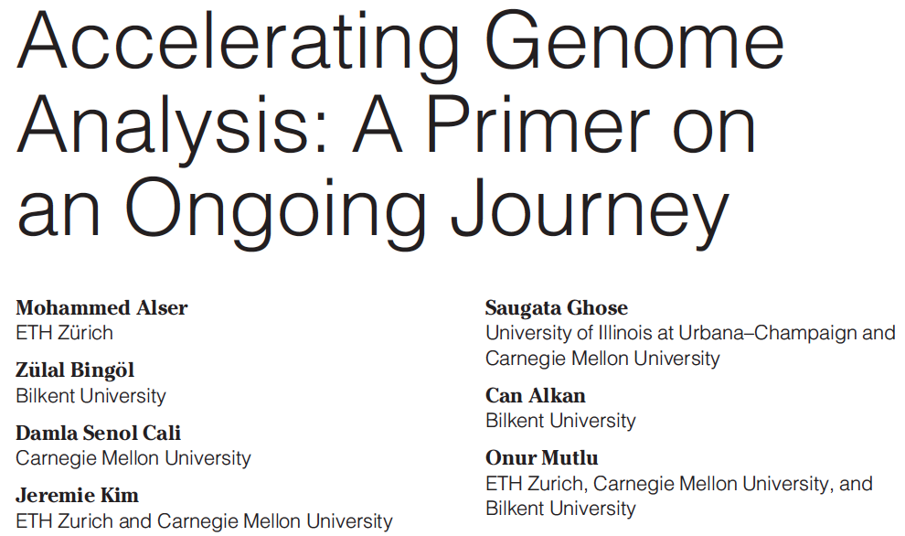
Accelerating Genome Analysis [IEEE MICRO 2020]
Mohammed Alser, Zulal Bingol, Damla Senol Cali, Jeremie Kim, Saugata Ghose, Can Alkan, and Onur Mutlu,
"Accelerating Genome Analysis: A Primer on an Ongoing Journey"
IEEE Micro (IEEE MICRO), Vol. 40, No. 5, pages 65-75, September/October 2020.
[Slides (pptx)(pdf)]
[Talk Video (1 hour 2 minutes)]

Slide 39
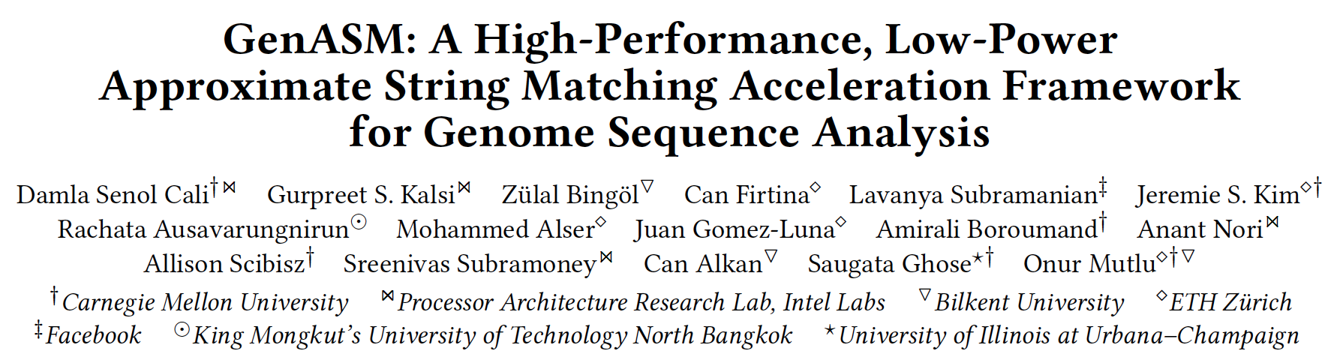
GenASM Framework [MICRO 2020]
Damla Senol Cali, Gurpreet S. Kalsi, Zulal Bingol, Can Firtina, Lavanya Subramanian, Jeremie S. Kim, Rachata Ausavarungnirun, Mohammed Alser, Juan Gomez-Luna, Amirali Boroumand, Anant Nori, Allison Scibisz, Sreenivas Subramoney, Can Alkan, Saugata Ghose, and Onur Mutlu,
"GenASM: A High-Performance, Low-Power Approximate String Matching Acceleration Framework for Genome Sequence Analysis"
Proceedings of the 53rd International Symposium on Microarchitecture (MICRO), Virtual, October 2020.
[Lighting Talk Video (1.5 minutes)]
[Lightning Talk Slides (pptx) (pdf)]
[Talk Video (18 minutes)]
[Slides (pptx) (pdf)]

Slide 40
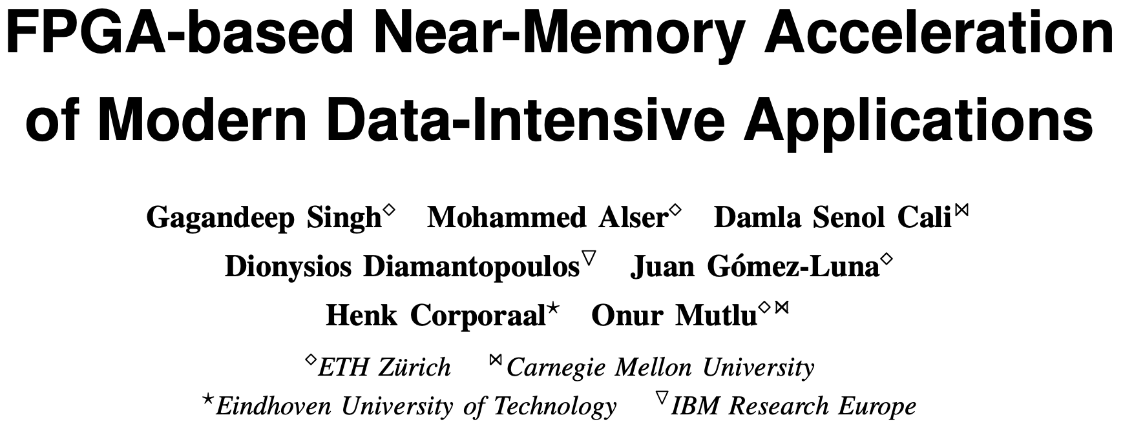
FPGA-based Processing Near Memory
Gagandeep Singh, Mohammed Alser, Damla Senol Cali, Dionysios Diamantopoulos, Juan Gómez-Luna, Henk Corporaal, and Onur Mutlu,
"FPGA-based Near-Memory Acceleration of Modern Data-Intensive Applications"
IEEE Micro (IEEE MICRO), to appear, 2021.

Slide 41
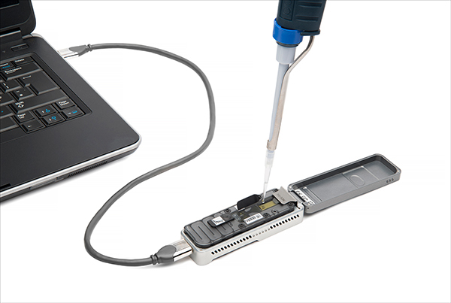
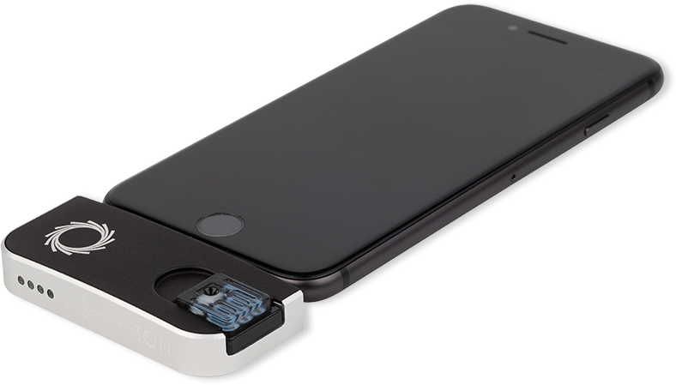
Future of Genome Sequencing & Analysis
MinION from ONT
SmidgION from ONT
Alser+, "Accelerating Genome Analysis: A Primer on an Ongoing Journey”, IEEE Micro 2020.

Slide 42
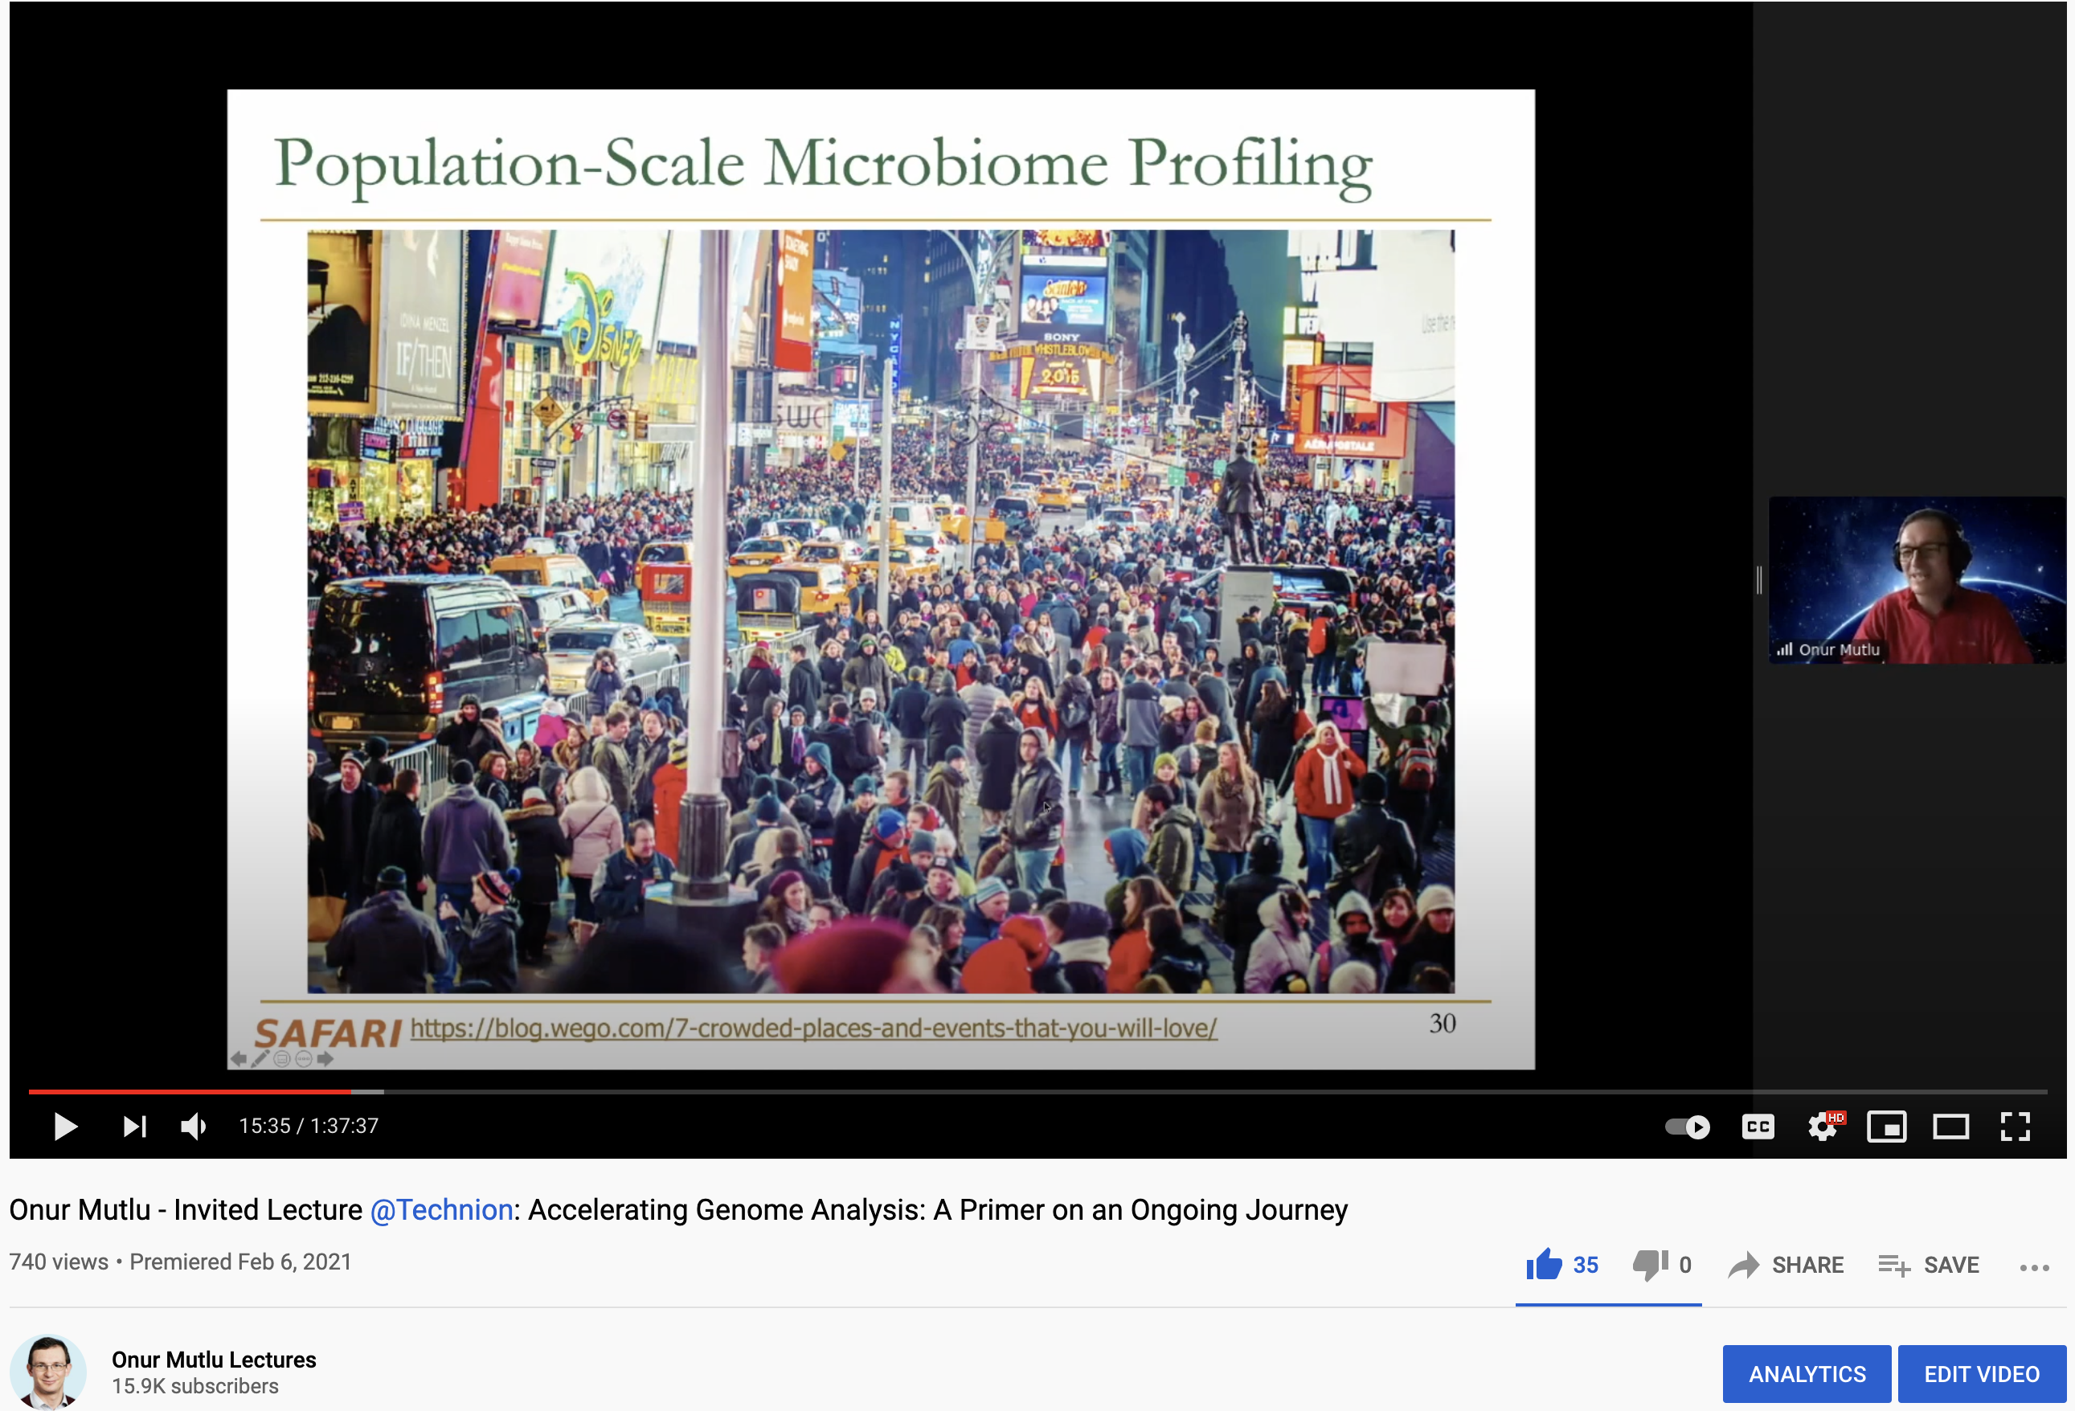
More on Fast & Efficient Genome Analysis …
Onur Mutlu,
"Accelerating Genome Analysis: A Primer on an Ongoing Journey"
Invited Lecture at Technion, Virtual, 26 January 2021.
[Slides (pptx) (pdf)]
[Talk Video (1 hour 37 minutes, including Q&A)]
[Related Invited Paper (at IEEE Micro, 2020)]

Slide 43
Detailed Lectures on Genome Analysis
Computer Architecture, Fall 2020, Lecture 3a
  Introduction to Genome Sequence Analysis (ETH Zürich, Fall 2020)
  https://www.youtube.com/watch?v=CrRb32v7SJc&list=PL5Q2soXY2Zi9xidyIgBxUz7xRPS-wisBN&index=5
Computer Architecture, Fall 2020, Lecture 8
  Intelligent Genome Analysis (ETH Zürich, Fall 2020)
  https://www.youtube.com/watch?v=ygmQpdDTL7o&list=PL5Q2soXY2Zi9xidyIgBxUz7xRPS-wisBN&index=14
Computer Architecture, Fall 2020, Lecture 9a
  GenASM: Approx. String Matching Accelerator (ETH Zürich, Fall 2020)
  https://www.youtube.com/watch?v=XoLpzmN-Pas&list=PL5Q2soXY2Zi9xidyIgBxUz7xRPS-wisBN&index=15
Accelerating Genomics Project Course, Fall 2020, Lecture 1
  Accelerating Genomics (ETH Zürich, Fall 2020)
  https://www.youtube.com/watch?v=rgjl8ZyLsAg&list=PL5Q2soXY2Zi9E2bBVAgCqLgwiDRQDTyId
https://www.youtube.com/onurmutlulectures

Slide 44
Data Overwhelms Modern Machines …
Storage/memory capability
Communication capability
Computation capability
Greatly impacts robustness, energy, performance, cost

Slide 45
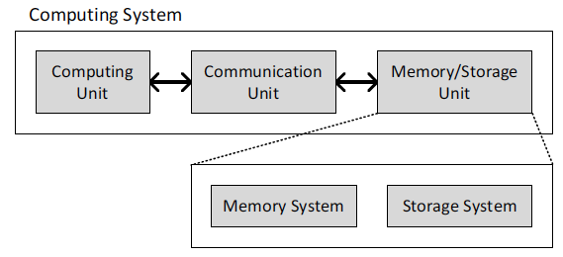
A Computing System
Three key components
Computation
Communication
Storage/memory
Burks, Goldstein, von Neumann, “Preliminary discussion of the
logical design of an electronic computing instrument,” 1946.
Image source: https://lbsitbytes2010.wordpress.com/2013/03/29/john-von-neumann-roll-no-15/

Slide 46
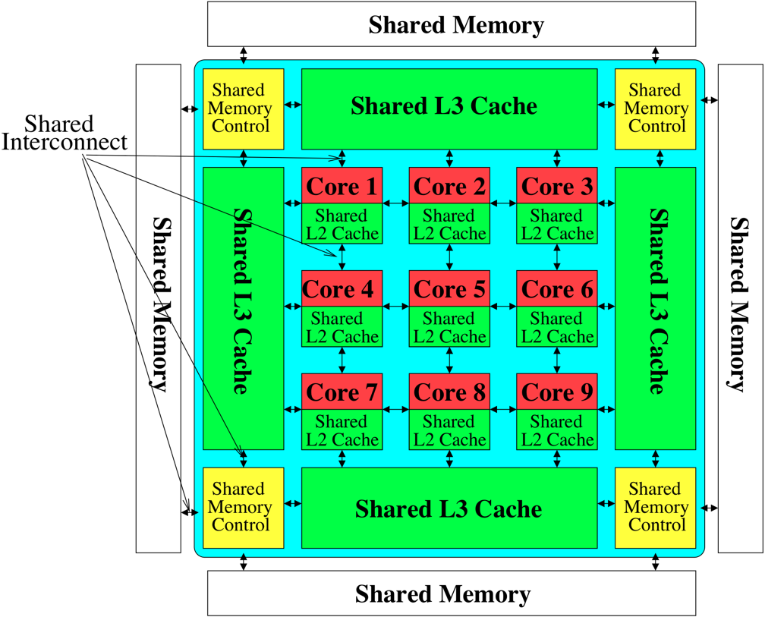

Perils of Processor-Centric Design
Most of the system is dedicated to storing and moving data

Slide 47
Data Overwhelms Modern Machines
  Chrome
TensorFlow Mobile
    Google’s web browser
Google’s machine learning framework
Data → performance & energy bottleneck
  Video Playback
  Video Capture
Google’s video codec
Google’s video codec
Notes:
In this work, we take a look at widely-used google consumer workloads, to figure out the major sources of energy consumption.
We look at Google Chrome web brower. We take a look at Tensorflow, Google’s machine learning framework, and we also take a look at two important video related workloads, video playback and video capture, both rely on Google’s vp9 codec technology.

Slide 48
Data Movement Overwhelms Modern Machines
Amirali Boroumand, Saugata Ghose, Youngsok Kim, Rachata Ausavarungnirun, Eric Shiu, Rahul Thakur, Daehyun Kim, Aki Kuusela, Allan Knies, Parthasarathy Ranganathan, and Onur Mutlu,
"Google Workloads for Consumer Devices: Mitigating Data Movement Bottlenecks"
Proceedings of the 23rd International Conference on Architectural Support for Programming Languages and Operating Systems (ASPLOS), Williamsburg, VA, USA, March 2018.
62.7% of the total system energy
is spent on data movement

Slide 49
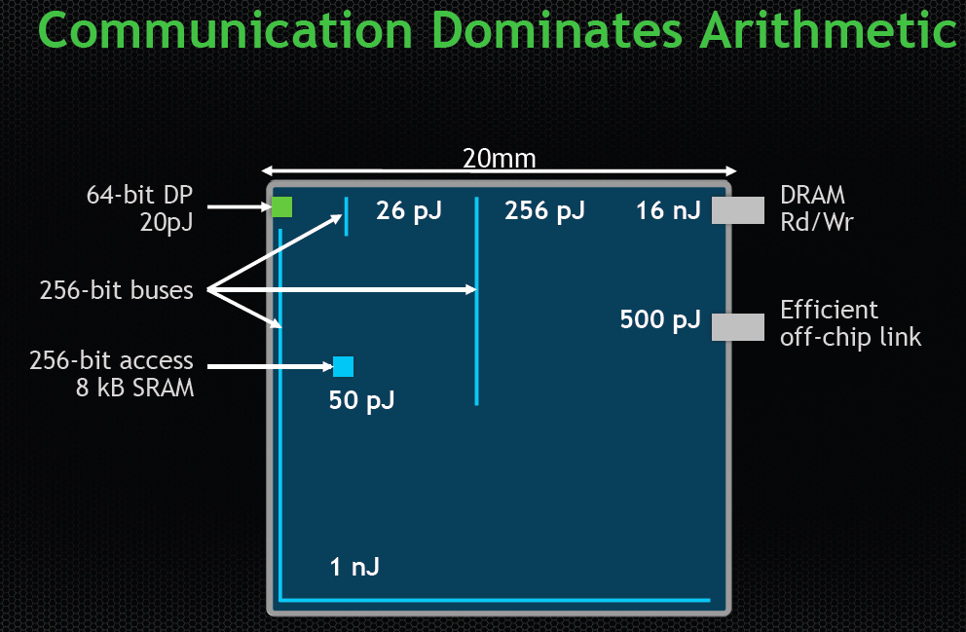
Data Movement vs. Computation Energy
Dally, HiPEAC 2015
A memory access consumes ~100-1000X
the energy of a complex addition

Slide 50
Axiom
An Intelligent Architecture
Handles Data Well

Slide 51
How to Handle Data Well
Ensure data does not overwhelm the components
  via intelligent algorithms
  via intelligent architectures
  via whole system designs: algorithm-architecture-devices
Take advantage of vast amounts of data and metadata
  to improve architectural & system-level decisions
Understand and exploit properties of (different) data
  to improve algorithms & architectures in various metrics

Slide 52
Corollaries: Architectures Today …
Architectures are terrible at dealing with data
  Designed to mainly store and move data vs. to compute
  They are processor-centric as opposed to data-centric
Architectures are terrible at taking advantage of vast amounts of data (and metadata) available to them
  Designed to make simple decisions, ignoring lots of data
  They make human-driven decisions vs. data-driven
Architectures are terrible at knowing and exploiting different properties of application data
  Designed to treat all data as the same
  They make component-aware decisions vs. data-aware

Slide 53
Data-Centric (Memory-Centric) Architectures

Slide 54
Data-Centric Architectures: Properties
Process data where it resides (where it makes sense)
  Processing in and near memory structures
Low-latency and low-energy data access
  Low latency memory
  Low energy memory
Low-cost data storage and processing
  High capacity memory at low cost: hybrid memory, compression
Intelligent data management
  Intelligent controllers handling robustness, security, cost

Slide 55
Processing Data
Where It Makes Sense

Slide 56
The Problem
Data access is the major performance and energy bottleneck
Our current
design principles
cause great energy waste
(and great performance loss)

Slide 57
The Problem
Processing of data
is performed
far away from the data

Slide 58
We Need A Paradigm Shift To …
Enable computation with minimal data movement
Compute where it makes sense (where data resides)
Make computing architectures more data-centric

Slide 59
Challenge and Opportunity for Future
Computing Architectures
with
Minimal Data Movement

Slide 60
Challenge and Opportunity for Future
Fundamentally
Energy-Efficient
(Data-Centric)
Computing Architectures

Slide 61
Challenge and Opportunity for Future
Fundamentally
High-Performance
(Data-Centric)
Computing Architectures

Slide 62
Goal: Processing Inside Memory
Many questions … How do we design the:
  compute-capable memory & controllers?
  processor chip and in-memory units?
  software and hardware interfaces?
  system software, compilers, languages?
  algorithms and theoretical foundations?
Memory
Processor
Core
Database
Graphs
Media
Cache
Query
Interconnect
Problem
Results
Algorithm
Program/Language
System Software
SW/HW Interface
Micro-architecture
Logic
Devices
Electrons

Slide 63
Memory as an Accelerator
CPU
core
CPU
core
mini-CPU
core
GPU
(throughput)
core
GPU
(throughput)
core
video
core
GPU
(throughput)
core
GPU
(throughput)
core
CPU
core
CPU
core
Memory
imaging
core
LLC
Specialized
compute-capability
in memory
Memory Controller
Memory Bus
Memory similar to a “conventional” accelerator

Slide 64
Processing in Memory:
Two Approaches
1. Processing using Memory
2. Processing near Memory

Slide 65
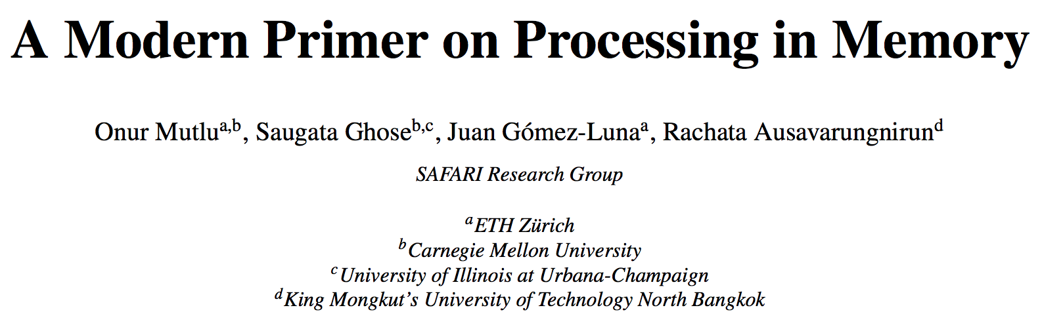
PIM Review and Open Problems
Onur Mutlu, Saugata Ghose, Juan Gomez-Luna, and Rachata Ausavarungnirun,
"A Modern Primer on Processing in Memory"
Invited Book Chapter in Emerging Computing: From Devices to Systems - Looking Beyond Moore and Von Neumann, Springer, to be published in 2021.
https://arxiv.org/pdf/1903.03988.pdf

Slide 66
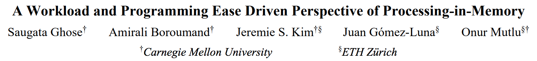
PIM Review and Open Problems (II)
Saugata Ghose, Amirali Boroumand, Jeremie S. Kim, Juan Gomez-Luna, and Onur Mutlu,
"Processing-in-Memory: A Workload-Driven Perspective"
Invited Article in IBM Journal of Research & Development, Special Issue on Hardware for Artificial Intelligence, to appear in November 2019.
[Preliminary arXiv version]
https://arxiv.org/pdf/1907.12947.pdf

Slide 67
UPMEM Processing-in-DRAM Engine (2019)
Processing in DRAM Engine
Includes standard DIMM modules, with a large number of DPU processors combined with DRAM chips.
Replaces standard DIMMs
  DDR4 R-DIMM modules
    8GB+128 DPUs (16 PIM chips)
    Standard 2x-nm DRAM process
  Large amounts of compute & memory bandwidth
https://www.anandtech.com/show/14750/hot-chips-31-analysis-inmemory-processing-by-upmem
https://www.upmem.com/video-upmem-presenting-its-true-processing-in-memory-solution-hot-chips-2019/

Slide 68
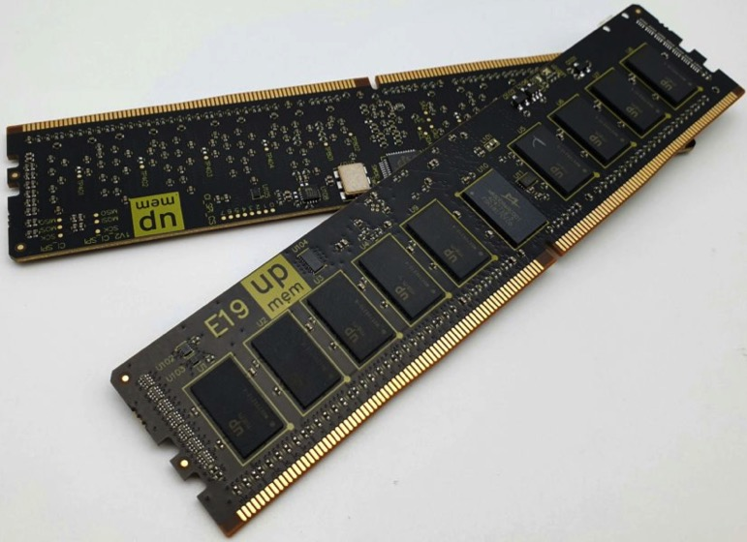
UPMEM Memory Modules
E19: 8 chips DIMM (1 rank). DPUs @ 267 MHz
P21: 16 chips DIMM (2 ranks). DPUs @ 350 MHz
www.upmem.com

Slide 69
PIM System Organization
UPMEM-based PIM system with 20 UPMEM memory modules of 16 chips each (40 ranks) → 2560 DPUs

Slide 70
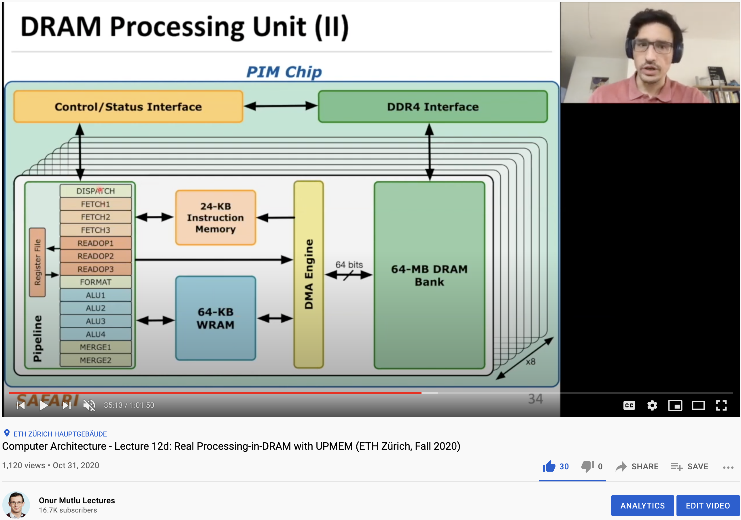
More on the UPMEM PIM System
https://www.youtube.com/watch?v=Sscy1Wrr22A&list=PL5Q2soXY2Zi9xidyIgBxUz7xRPS-wisBN&index=26

Slide 71
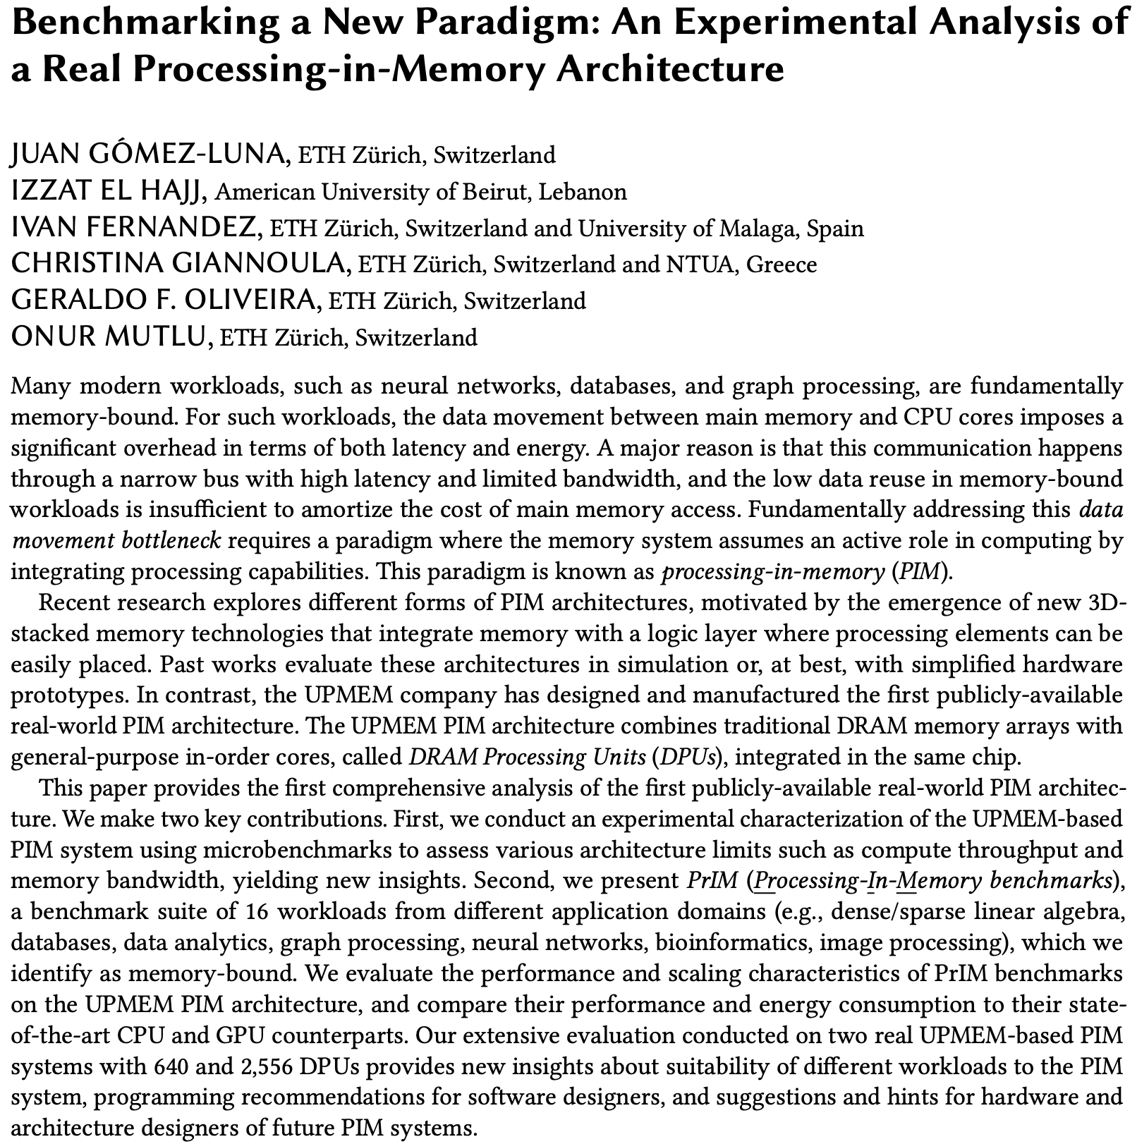
Experimental Analysis of the UPMEM PIM Engine
https://arxiv.org/pdf/2105.03814.pdf

Slide 72
FPGA-based Processing Near Memory
Gagandeep Singh, Mohammed Alser, Damla Senol Cali, Dionysios Diamantopoulos, Juan Gómez-Luna, Henk Corporaal, and Onur Mutlu,
"FPGA-based Near-Memory Acceleration of Modern Data-Intensive Applications"
IEEE Micro (IEEE MICRO), to appear, 2021.

Slide 73
Eliminating the Adoption Barriers
How to Enable Adoption of Processing in Memory

Slide 74
We Need to Revisit the Entire Stack
Problem
Algorithm
Program/Language
System Software
SW/HW Interface
Micro-architecture
Logic
Devices
Electrons
We can get there step by step

Slide 75
Challenge and Opportunity for Future
Data-Driven
(Self-Optimizing)
Computing Architectures

Slide 76
Challenge and Opportunity for Future
Data-Aware
(Expressive)
Computing Architectures

Slide 77
More Info in This Tutorial…
Onur Mutlu,
"Memory-Centric Computing Systems"
Invited Tutorial at 66th International Electron Devices Meeting (IEDM), Virtual, 12 December 2020.
[Slides (pptx) (pdf)]
[Executive Summary Slides (pptx) (pdf)]
[Tutorial Video (1 hour 51 minutes)]
[Executive Summary Video (2 minutes)]
[Abstract and Bio]
[Related Keynote Paper from VLSI-DAT 2020]
[Related Review Paper on Processing in Memory]
https://www.youtube.com/watch?v=H3sEaINPBOE
https://www.youtube.com/onurmutlulectures

Slide 78
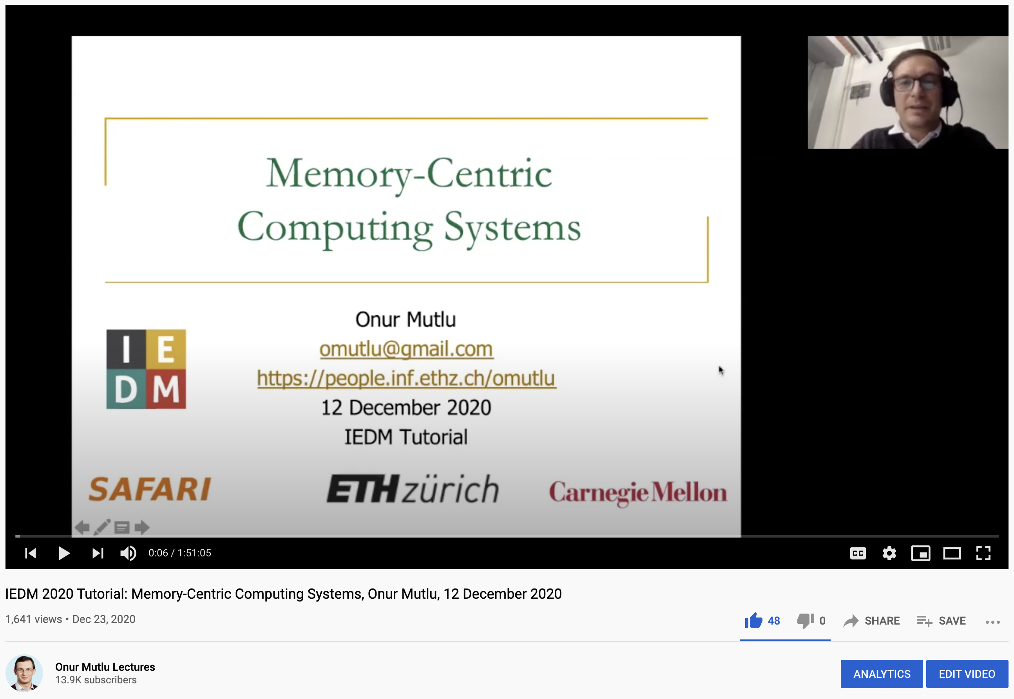
A Tutorial on PIM
Onur Mutlu,
"Memory-Centric Computing Systems"
Invited Tutorial at 66th International Electron Devices Meeting (IEDM), Virtual, 12 December 2020.
[Slides (pptx) (pdf)]
[Executive Summary Slides (pptx) (pdf)]
[Tutorial Video (1 hour 51 minutes)]
[Executive Summary Video (2 minutes)]
[Abstract and Bio]
[Related Keynote Paper from VLSI-DAT 2020]
[Related Review Paper on Processing in Memory]
https://www.youtube.com/watch?v=H3sEaINPBOE
https://www.youtube.com/onurmutlulectures

Slide 79
Architectures for Intelligent Machines
Data-centric
Data-driven
Data-aware

Slide 80
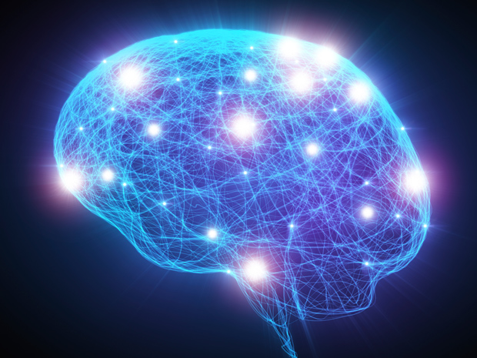
Source: http://spectrum.ieee.org/image/MjYzMzAyMg.jpeg

Slide 81
SAFARI Research Group
Introduction & Research
Onur Mutlu
omutlu@gmail.com
https://people.inf.ethz.ch/omutlu
6 July 2021
EFCL Welcome Workshop

Slide 82
More Detailed
Research Overview

Slide 83
Slides from ISCA 2021 Mentoring Workshop Panel
Onur Mutlu,
"Applying to Graduate School & Doing Impactful Research"
Invited Panel Talk at the 3rd Undergraduate Mentoring Workshop, held with the 48th International Symposium on Computer Architecture (ISCA), Virtual, 18 June 2021.
[Slides (pptx) (pdf)]
[Talk Video (50 minutes)]

Slide 84
A Talk on Impactful Research & Teaching
https://www.youtube.com/watch?v=83tlorht7Mc&list=PL5Q2soXY2Zi8D_5MGV6EnXEJHnV2YFBJl&index=54

Slide 85
Example Research Topics:
Quick Overview

Slide 86
Challenge and Opportunity for Future
High Performance
(to solve
the toughest & all problems)

Slide 87
Challenge and Opportunity for Future
Personalized and Private
(in every aspect of life:
health, medicine,
spaces, devices, robotics, …)

Slide 88
Accelerating Genome Analysis
Mohammed Alser, Zulal Bingol, Damla Senol Cali, Jeremie Kim, Saugata Ghose, Can Alkan, and Onur Mutlu,
"Accelerating Genome Analysis: A Primer on an Ongoing Journey"
IEEE Micro (IEEE MICRO), Vol. 40, No. 5, pages 65-75, September/October 2020.
[Slides (pptx)(pdf)]
[Talk Video (1 hour 2 minutes)]

Slide 89
GenASM Framework [MICRO 2020]
Damla Senol Cali, Gurpreet S. Kalsi, Zulal Bingol, Can Firtina, Lavanya Subramanian, Jeremie S. Kim, Rachata Ausavarungnirun, Mohammed Alser, Juan Gomez-Luna, Amirali Boroumand, Anant Nori, Allison Scibisz, Sreenivas Subramoney, Can Alkan, Saugata Ghose, and Onur Mutlu,
"GenASM: A High-Performance, Low-Power Approximate String Matching Acceleration Framework for Genome Sequence Analysis"
Proceedings of the 53rd International Symposium on Microarchitecture (MICRO), Virtual, October 2020.
[Lighting Talk Video (1.5 minutes)]
[Lightning Talk Slides (pptx) (pdf)]
[Talk Video (18 minutes)]
[Slides (pptx) (pdf)]

Slide 90

New Genome Sequencing Technologies
Oxford Nanopore MinION
Senol Cali+, “Nanopore Sequencing Technology and Tools for Genome
Assembly: Computational Analysis of the Current State, Bottlenecks
and Future Directions,” Briefings in Bioinformatics, 2018.
[Preliminary arxiv.org version]

Slide 91
Future of Genome Sequencing & Analysis
MinION from ONT
SmidgION from ONT
Alser+, "Accelerating Genome Analysis: A Primer on an Ongoing Journey”, IEEE Micro 2020.

Slide 92
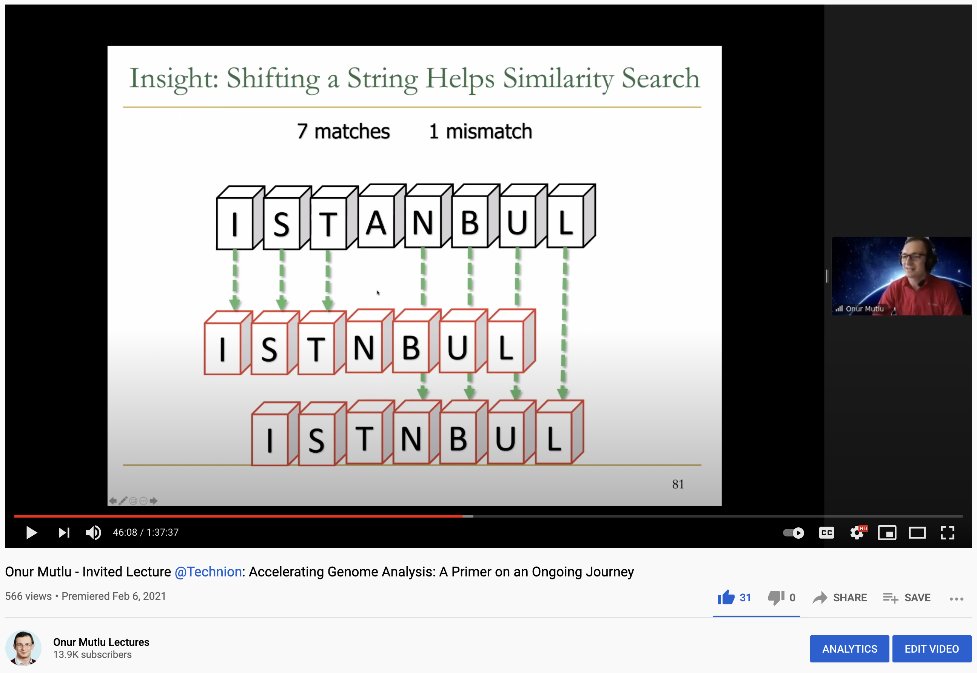
More on Fast & Efficient Genome Analysis
Onur Mutlu,
"Accelerating Genome Analysis: A Primer on an Ongoing Journey"
Invited Lecture at Technion, Virtual, 26 January 2021.
[Slides (pptx) (pdf)]
[Talk Video (1 hour 37 minutes, including Q&A)]
[Related Invited Paper (at IEEE Micro, 2020)]

Slide 93
Detailed Lectures on Genome Analysis
Computer Architecture, Fall 2020, Lecture 3a
  Introduction to Genome Sequence Analysis (ETH Zürich, Fall 2020)
  https://www.youtube.com/watch?v=CrRb32v7SJc&list=PL5Q2soXY2Zi9xidyIgBxUz7xRPS-wisBN&index=5
Computer Architecture, Fall 2020, Lecture 8
  Intelligent Genome Analysis (ETH Zürich, Fall 2020)
  https://www.youtube.com/watch?v=ygmQpdDTL7o&list=PL5Q2soXY2Zi9xidyIgBxUz7xRPS-wisBN&index=14
Computer Architecture, Fall 2020, Lecture 9a
  GenASM: Approx. String Matching Accelerator (ETH Zürich, Fall 2020)
  https://www.youtube.com/watch?v=XoLpzmN-Pas&list=PL5Q2soXY2Zi9xidyIgBxUz7xRPS-wisBN&index=15
Accelerating Genomics Project Course, Fall 2020, Lecture 1
  Accelerating Genomics (ETH Zürich, Fall 2020)
  https://www.youtube.com/watch?v=rgjl8ZyLsAg&list=PL5Q2soXY2Zi9E2bBVAgCqLgwiDRQDTyId
https://www.youtube.com/onurmutlulectures

Slide 94
The Problem
Computing
is Bottlenecked by Data

Slide 95
Realization
Modern Systems are Bottlenecked by
Data Storage
and Movement

Slide 96
Realization Reworded
Modern Systems are Bottlenecked by
Memory

Slide 97
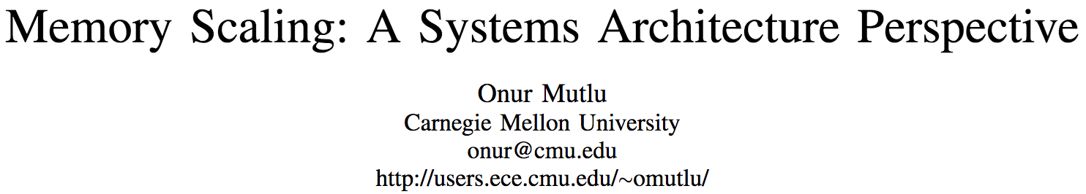
An “Early” Overview Paper…
Onur Mutlu,
"Memory Scaling: A Systems Architecture Perspective"
Proceedings of the 5th International Memory Workshop (IMW), Monterey, CA, May 2013. Slides (pptx) (pdf)
EETimes Reprint
https://people.inf.ethz.ch/omutlu/pub/memory-scaling_memcon13.pdf

Slide 98
Challenge and Opportunity for Future
Fundamentally
Secure, Reliable, Safe
Computing Architectures

Slide 99
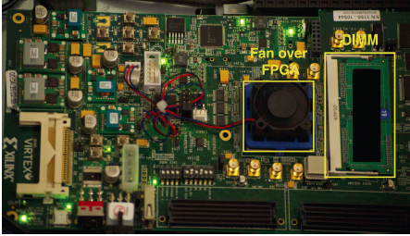
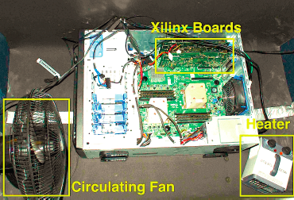
Infrastructures to Understand Such Issues
  An Experimental Study of Data Retention Behavior in Modern DRAM Devices: Implications for Retention Time Profiling Mechanisms (Liu et al., ISCA 2013)
  The Efficacy of Error Mitigation Techniques for DRAM Retention Failures: A Comparative Experimental Study
  (Khan et al., SIGMETRICS 2014)
  Flipping Bits in Memory Without Accessing Them: An Experimental Study of DRAM Disturbance Errors (Kim et al., ISCA 2014)
  Adaptive-Latency DRAM: Optimizing DRAM Timing for the Common-Case (Lee et al., HPCA 2015)
  AVATAR: A Variable-Retention-Time (VRT) Aware Refresh for DRAM Systems (Qureshi et al., DSN 2015)

Slide 100

Infrastructures to Understand Such Issues
Temperature
Controller
FPGAs
Heater
FPGAs
PC
  Kim+, “Flipping Bits in Memory Without Accessing Them: An Experimental Study of DRAM Disturbance Errors,” ISCA 2014.

Slide 101
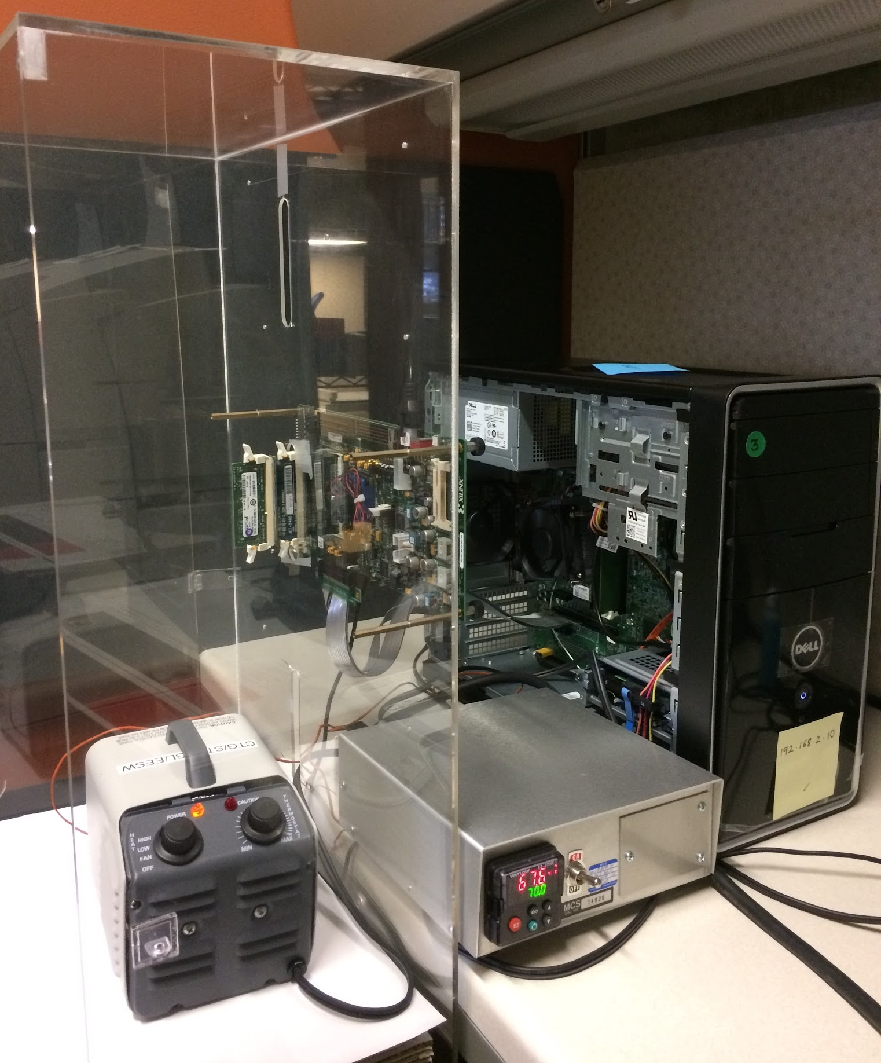
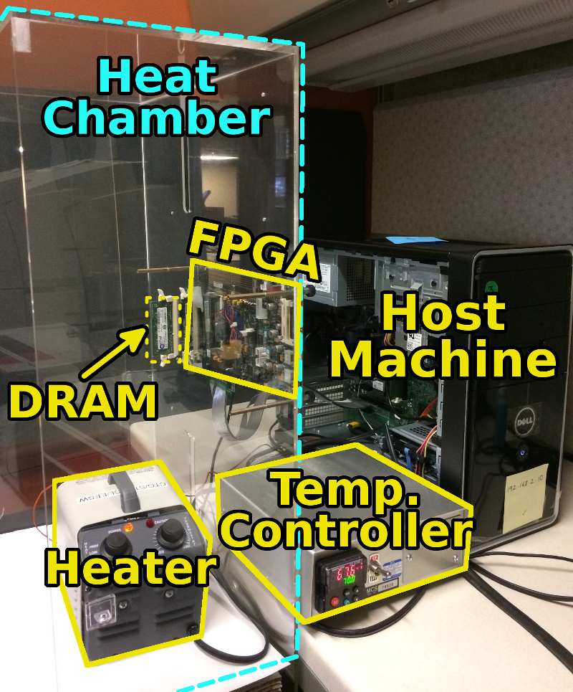
SoftMC: Open Source DRAM Infrastructure
Hasan Hassan et al., “SoftMC: A Flexible and Practical Open-Source Infrastructure for Enabling Experimental DRAM Studies,” HPCA 2017.
Flexible
Easy to Use (C++ API)
Open-source
github.com/CMU-SAFARI/SoftMC

Slide 102
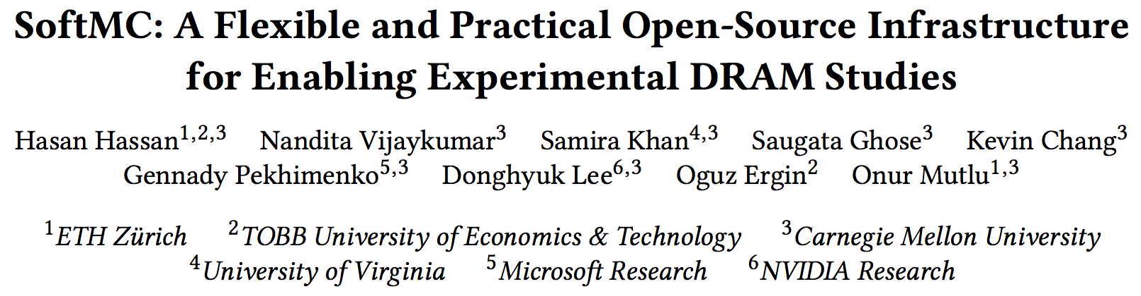
SoftMC
https://github.com/CMU-SAFARI/SoftMC

Slide 103
A Curious Discovery [Kim et al., ISCA 2014]
One can
predictably induce errors
in most DRAM memory chips

Slide 104
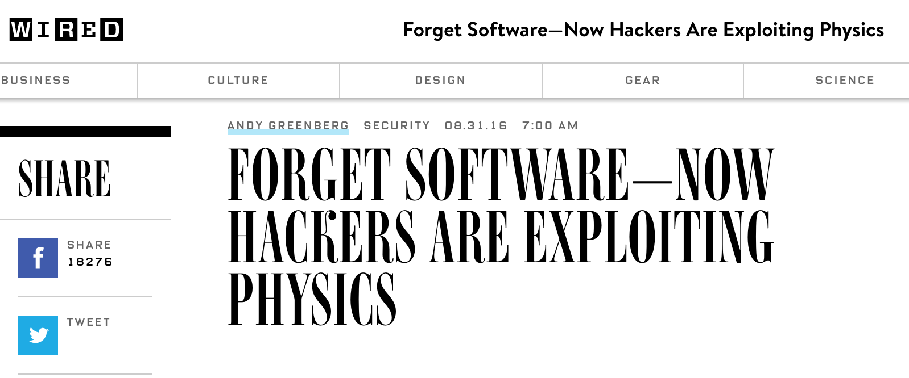
DRAM RowHammer
A simple hardware failure mechanism
can create a widespread
system security vulnerability

Slide 105


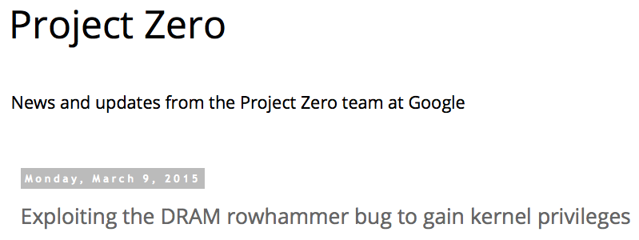
One Can Take Over an Otherwise-Secure System
Flipping Bits in Memory Without Accessing Them: An Experimental Study of DRAM Disturbance Errors (Kim et al., ISCA 2014)
Exploiting the DRAM rowhammer bug to gain kernel privileges (Seaborn+, 2015)

Slide 106
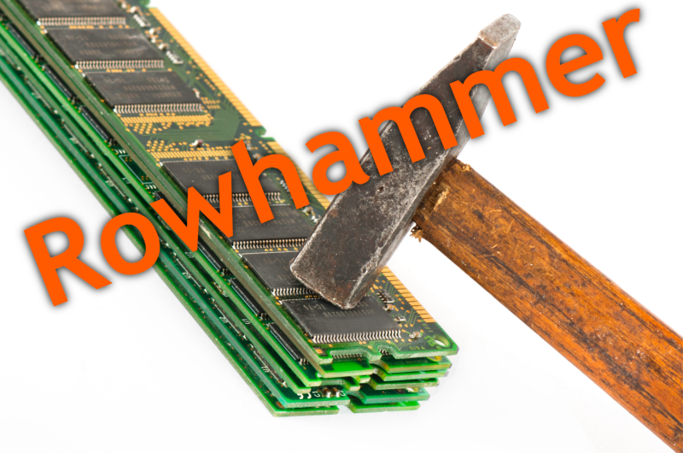
Notes:
Picture from the article:
http://thehackernews.com/2015/03/dram-rowhammer-vulnerability.html

Slide 107
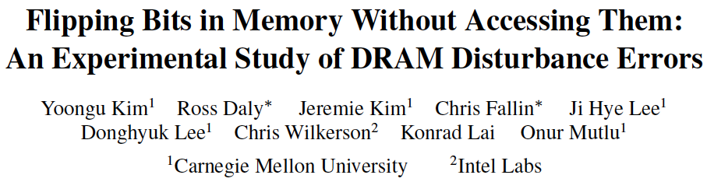
First RowHammer Analysis
Yoongu Kim, Ross Daly, Jeremie Kim, Chris Fallin, Ji Hye Lee, Donghyuk Lee, Chris Wilkerson, Konrad Lai, and Onur Mutlu,
"Flipping Bits in Memory Without Accessing Them: An Experimental Study of DRAM Disturbance Errors"
Proceedings of the 41st International Symposium on Computer Architecture (ISCA), Minneapolis, MN, June 2014.
[Slides (pptx) (pdf)] [Lightning Session Slides (pptx) (pdf)] [Source Code and Data]

Slide 108
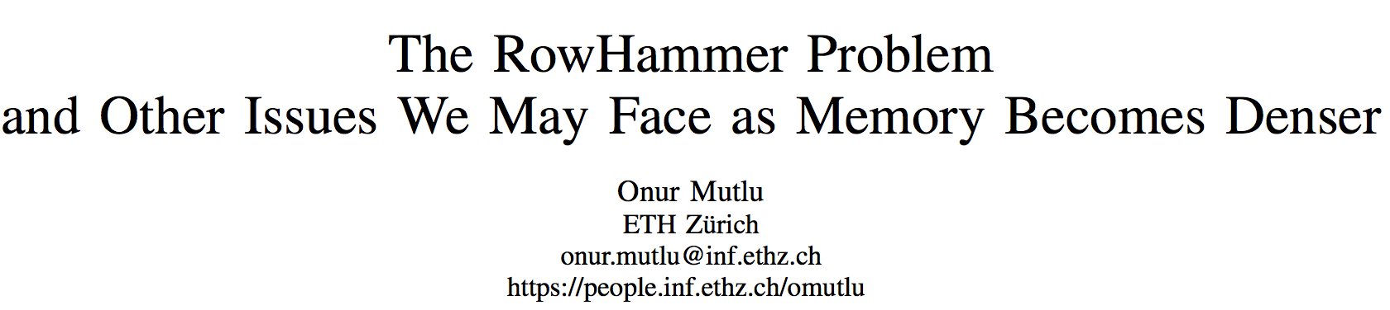
Future of Memory Reliability/Security
Onur Mutlu,
"The RowHammer Problem and Other Issues We May Face as Memory Becomes Denser"
Invited Paper in Proceedings of the Design, Automation, and Test in Europe Conference (DATE), Lausanne, Switzerland, March 2017.
[Slides (pptx) (pdf)]
https://people.inf.ethz.ch/omutlu/pub/rowhammer-and-other-memory-issues_date17.pdf

Slide 109
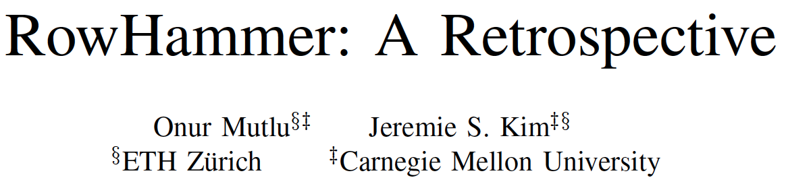
A More Recent RowHammer Retrospective
Onur Mutlu and Jeremie Kim,
"RowHammer: A Retrospective"
IEEE Transactions on Computer-Aided Design of Integrated Circuits and Systems (TCAD) Special Issue on Top Picks in Hardware and Embedded Security, 2019.
[Preliminary arXiv version]
[Slides from COSADE 2019 (pptx)]
[Slides from VLSI-SOC 2020 (pptx) (pdf)]
[Talk Video (30 minutes)]

Slide 110
RowHammer in 2020

Slide 111
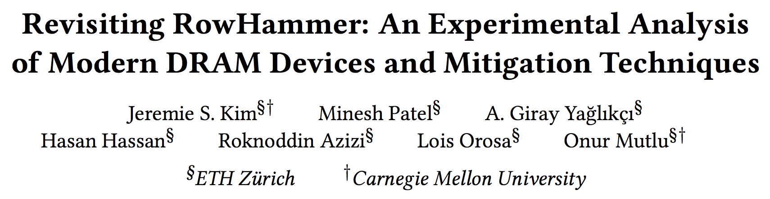
RowHammer in 2020 (I)
Jeremie S. Kim, Minesh Patel, A. Giray Yaglikci, Hasan Hassan, Roknoddin Azizi, Lois Orosa, and Onur Mutlu,
"Revisiting RowHammer: An Experimental Analysis of Modern Devices and Mitigation Techniques"
Proceedings of the 47th International Symposium on Computer Architecture (ISCA), Valencia, Spain, June 2020.
[Slides (pptx) (pdf)]
[Lightning Talk Slides (pptx) (pdf)]
[Talk Video (20 minutes)]
[Lightning Talk Video (3 minutes)]

Slide 112
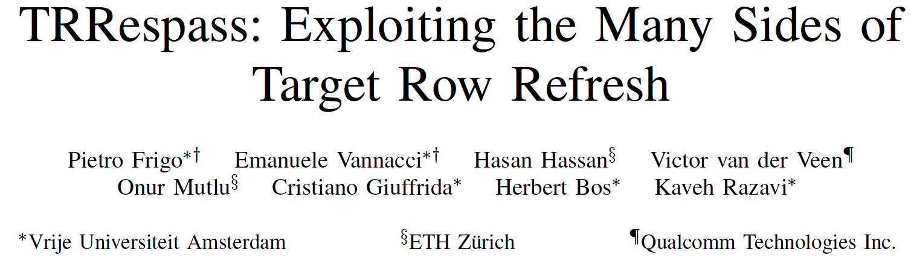
RowHammer in 2020 (II)
Pietro Frigo, Emanuele Vannacci, Hasan Hassan, Victor van der Veen, Onur Mutlu, Cristiano Giuffrida, Herbert Bos, and Kaveh Razavi,
"TRRespass: Exploiting the Many Sides of Target Row Refresh"
Proceedings of the 41st IEEE Symposium on Security and Privacy (S&P), San Francisco, CA, USA, May 2020.
[Slides (pptx) (pdf)]
[Lecture Slides (pptx) (pdf)]
[Talk Video (17 minutes)]
[Lecture Video (59 minutes)]
[Source Code]
[Web Article]
Best paper award.
Pwnie Award 2020 for Most Innovative Research. Pwnie Awards 2020

Slide 113
TRRespass Key Takeaways
RowHammer is still
an open problem
Security by obscurity
is likely not a good solution

Slide 114
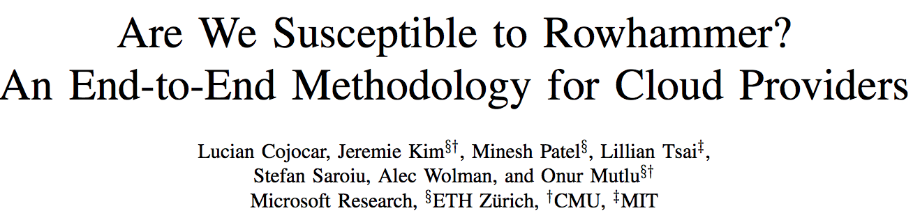
RowHammer in 2020 (III)
Lucian Cojocar, Jeremie Kim, Minesh Patel, Lillian Tsai, Stefan Saroiu, Alec Wolman, and Onur Mutlu,
"Are We Susceptible to Rowhammer? An End-to-End Methodology for Cloud Providers"
Proceedings of the 41st IEEE Symposium on Security and Privacy (S&P), San Francisco, CA, USA, May 2020.
[Slides (pptx) (pdf)]
[Talk Video (17 minutes)]

Slide 115
BlockHammer Solution in 2021
A. Giray Yaglikci, Minesh Patel, Jeremie S. Kim, Roknoddin Azizi, Ataberk Olgun, Lois Orosa, Hasan Hassan, Jisung Park, Konstantinos Kanellopoulos, Taha Shahroodi, Saugata Ghose, and Onur Mutlu,
"BlockHammer: Preventing RowHammer at Low Cost by Blacklisting Rapidly-Accessed DRAM Rows"
Proceedings of the 27th International Symposium on High-Performance Computer Architecture (HPCA), Virtual, February-March 2021.
[Slides (pptx) (pdf)]
[Short Talk Slides (pptx) (pdf)]
[Talk Video (22 minutes)]
[Short Talk Video (7 minutes)]

Slide 116
Detailed Lectures on RowHammer
Computer Architecture, Fall 2020, Lecture 4b
  RowHammer (ETH Zürich, Fall 2020)
  https://www.youtube.com/watch?v=KDy632z23UE&list=PL5Q2soXY2Zi9xidyIgBxUz7xRPS-wisBN&index=8
Computer Architecture, Fall 2020, Lecture 5a
  RowHammer in 2020: TRRespass (ETH Zürich, Fall 2020)
  https://www.youtube.com/watch?v=pwRw7QqK_qA&list=PL5Q2soXY2Zi9xidyIgBxUz7xRPS-wisBN&index=9
Computer Architecture, Fall 2020, Lecture 5b
  RowHammer in 2020: Revisiting RowHammer (ETH Zürich, Fall 2020)
  https://www.youtube.com/watch?v=gR7XR-Eepcg&list=PL5Q2soXY2Zi9xidyIgBxUz7xRPS-wisBN&index=10
Computer Architecture, Fall 2020, Lecture 5c
  Secure and Reliable Memory (ETH Zürich, Fall 2020)
  https://www.youtube.com/watch?v=HvswnsfG3oQ&list=PL5Q2soXY2Zi9xidyIgBxUz7xRPS-wisBN&index=11
https://www.youtube.com/onurmutlulectures

Slide 117
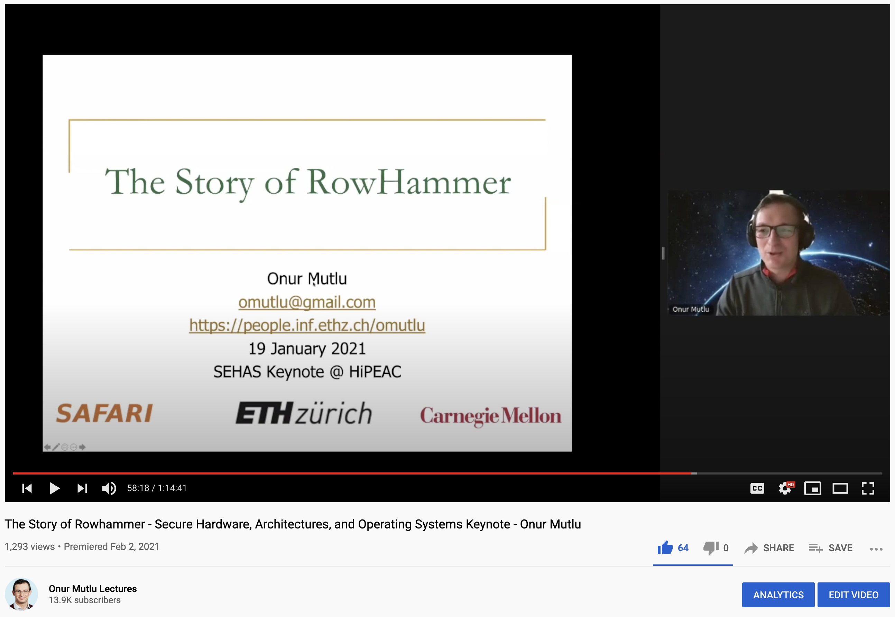
The Story of RowHammer Lecture …
Onur Mutlu,
"The Story of RowHammer"
Keynote Talk at Secure Hardware, Architectures, and Operating Systems Workshop (SeHAS), held with HiPEAC 2021 Conference, Virtual, 19 January 2021.
[Slides (pptx) (pdf)]
[Talk Video (1 hr 15 minutes, with Q&A)]

Slide 118

Understanding Flash Memory & SSD Reliability
Proceedings of the IEEE, Sept. 2017
https://arxiv.org/pdf/1706.08642

Slide 119

Understand and Model with Experiments (Flash)
USB Daughter Board
USB Jack
HAPS-52 Mother Board
Virtex-II Pro
(USB controller)
1x-nm
NAND Flash
Virtex-V FPGA
(NAND Controller)
[DATE 2012, ICCD 2012, DATE 2013, ITJ 2013, ICCD 2013, SIGMETRICS 2014, HPCA 2015, DSN 2015, MSST 2015, JSAC 2016, HPCA 2017, DFRWS 2017,
PIEEE 2017, HPCA 2018, SIGMETRICS 2018]
NAND Daughter Board
Cai+, “Error Characterization, Mitigation, and Recovery in Flash Memory Based Solid State Drives,” Proc. IEEE 2017.

Slide 120
One Important Takeaway
Main Memory Needs
Intelligent Controllers

Slide 121
Another Challenge and Opportunity
High Performance,
Energy Efficient,
Sustainable

Slide 122
The Problem
Processing of data
is performed
far away from the data

Slide 123
Energy Waste in Mobile Devices
Amirali Boroumand, Saugata Ghose, Youngsok Kim, Rachata Ausavarungnirun, Eric Shiu, Rahul Thakur, Daehyun Kim, Aki Kuusela, Allan Knies, Parthasarathy Ranganathan, and Onur Mutlu,
"Google Workloads for Consumer Devices: Mitigating Data Movement Bottlenecks"
Proceedings of the 23rd International Conference on Architectural Support for Programming Languages and Operating Systems (ASPLOS), Williamsburg, VA, USA, March 2018.
62.7% of the total system energy
is spent on data movement

Slide 124
The Problem
Data access is the major performance and energy bottleneck
Our current
design principles
cause great energy waste
(and great performance loss)

Slide 125
We Need A Paradigm Shift To …
Enable computation with minimal data movement
Compute where it makes sense (where data resides)
Make computing architectures more data-centric

Slide 126
Challenge and Opportunity for Future
Computing Architectures
with
Minimal Data Movement

Slide 127
Challenge and Opportunity for Future
Fundamentally
Energy-Efficient
(Data-Centric)
Computing Architectures

Slide 128
Challenge and Opportunity for Future
Fundamentally
High-Performance
(Data-Centric)
Computing Architectures

Slide 129
Goal: Processing Inside Memory
Many questions … How do we design the:
  compute-capable memory & controllers?
  processor chip and in-memory units?
  software and hardware interfaces?
  system software, compilers, languages?
  algorithms and theoretical foundations?
Memory
Processor
Core
Database
Graphs
Media
Cache
Query
Interconnect
Problem
Results
Algorithm
Program/Language
System Software
SW/HW Interface
Micro-architecture
Logic
Devices
Electrons

Slide 130
Memory as an Accelerator
CPU
core
CPU
core
mini-CPU
core
GPU
(throughput)
core
GPU
(throughput)
core
video
core
GPU
(throughput)
core
GPU
(throughput)
core
CPU
core
CPU
core
Memory
imaging
core
LLC
Specialized
compute-capability
in memory
Memory Controller
Memory Bus
Memory similar to a “conventional” accelerator

Slide 131
Processing in Memory:
Two Approaches
1. Processing using Memory
2. Processing near Memory

Slide 132
PIM Review and Open Problems
Onur Mutlu, Saugata Ghose, Juan Gomez-Luna, and Rachata Ausavarungnirun,
"A Modern Primer on Processing in Memory"
Invited Book Chapter in Emerging Computing: From Devices to Systems - Looking Beyond Moore and Von Neumann, Springer, to be published in 2021.
https://arxiv.org/pdf/1903.03988.pdf

Slide 133
PIM Review and Open Problems (II)
Saugata Ghose, Amirali Boroumand, Jeremie S. Kim, Juan Gomez-Luna, and Onur Mutlu,
"Processing-in-Memory: A Workload-Driven Perspective"
Invited Article in IBM Journal of Research & Development, Special Issue on Hardware for Artificial Intelligence, to appear in November 2019.
[Preliminary arXiv version]
https://arxiv.org/pdf/1907.12947.pdf

Slide 134
More on Processing in Memory
Vivek Seshadri et al., “Ambit: In-Memory Accelerator for Bulk Bitwise Operations Using Commodity DRAM Technology,” MICRO 2017.

Slide 135

More on Processing in Memory
Vivek Seshadri and Onur Mutlu,
"In-DRAM Bulk Bitwise Execution Engine"
Invited Book Chapter in Advances in Computers, to appear in 2020.
[Preliminary arXiv version]

Slide 136

More on Processing in Memory (II)
Nastaran Hajinazar, Geraldo F. Oliveira, Sven Gregorio, Joao Dinis Ferreira, Nika Mansouri Ghiasi, Minesh Patel, Mohammed Alser, Saugata Ghose, Juan Gomez-Luna, and Onur Mutlu,
"SIMDRAM: An End-to-End Framework for Bit-Serial SIMD Computing in DRAM"
Proceedings of the 26th International Conference on Architectural Support for Programming Languages and Operating Systems (ASPLOS), Virtual, March-April 2021.
[2-page Extended Abstract]
[Short Talk Slides (pptx) (pdf)]
[Talk Slides (pptx) (pdf)]
[Short Talk Video (5 mins)]
[Full Talk Video (27 mins)]

Slide 137

More on Processing in Memory (III)
Junwhan Ahn, Sungpack Hong, Sungjoo Yoo, Onur Mutlu, and Kiyoung Choi,
"A Scalable Processing-in-Memory Accelerator for Parallel Graph Processing"
Proceedings of the 42nd International Symposium on Computer Architecture (ISCA), Portland, OR, June 2015.
[Slides (pdf)] [Lightning Session Slides (pdf)]

Slide 138
More on Processing in Memory (IV)
Amirali Boroumand, Saugata Ghose, Youngsok Kim, Rachata Ausavarungnirun, Eric Shiu, Rahul Thakur, Daehyun Kim, Aki Kuusela, Allan Knies, Parthasarathy Ranganathan, and Onur Mutlu,
"Google Workloads for Consumer Devices: Mitigating Data Movement Bottlenecks"
Proceedings of the 23rd International Conference on Architectural Support for Programming Languages and Operating Systems (ASPLOS), Williamsburg, VA, USA, March 2018.

Slide 139

More on Processing in Memory (V)
Junwhan Ahn, Sungjoo Yoo, Onur Mutlu, and Kiyoung Choi,
"PIM-Enabled Instructions: A Low-Overhead, Locality-Aware Processing-in-Memory Architecture"
Proceedings of the 42nd International Symposium on Computer Architecture (ISCA), Portland, OR, June 2015.
[Slides (pdf)] [Lightning Session Slides (pdf)]

Slide 140

In-DRAM Physical Unclonable Functions
Jeremie S. Kim, Minesh Patel, Hasan Hassan, and Onur Mutlu,
"The DRAM Latency PUF: Quickly Evaluating Physical Unclonable Functions by Exploiting the Latency-Reliability Tradeoff in Modern DRAM Devices"
Proceedings of the 24th International Symposium on High-Performance Computer Architecture (HPCA), Vienna, Austria, February 2018.
[Lightning Talk Video]
[Slides (pptx) (pdf)] [Lightning Session Slides (pptx) (pdf)]
[Full Talk Lecture Video (28 minutes)]

Slide 141

In-DRAM True Random Number Generation
Jeremie S. Kim, Minesh Patel, Hasan Hassan, Lois Orosa, and Onur Mutlu,
"D-RaNGe: Using Commodity DRAM Devices to Generate True Random Numbers with Low Latency and High Throughput"
Proceedings of the 25th International Symposium on High-Performance Computer Architecture (HPCA), Washington, DC, USA, February 2019.
[Slides (pptx) (pdf)]
[Full Talk Video (21 minutes)]
[Full Talk Lecture Video (27 minutes)]
Top Picks Honorable Mention by IEEE Micro.

Slide 142
Eliminating the Adoption Barriers
How to Enable Adoption of Processing in Memory

Slide 143
We Need to Revisit the Entire Stack
Problem
Algorithm
Program/Language
System Software
SW/HW Interface
Micro-architecture
Logic
Devices
Electrons
We can get there step by step

Slide 144
UPMEM Processing-in-DRAM Engine (2019)
Processing in DRAM Engine
Includes standard DIMM modules, with a large number of DPU processors combined with DRAM chips.
Replaces standard DIMMs
  DDR4 R-DIMM modules
    8GB+128 DPUs (16 PIM chips)
    Standard 2x-nm DRAM process
  Large amounts of compute & memory bandwidth
CPU
(x86, ARM, RV…)
DDR
Data bus
https://www.anandtech.com/show/14750/hot-chips-31-analysis-inmemory-processing-by-upmem
https://www.upmem.com/video-upmem-presenting-its-true-processing-in-memory-solution-hot-chips-2019/

Slide 145
UPMEM Memory Modules
E19: 8 chips DIMM (1 rank). DPUs @ 267 MHz
P21: 16 chips DIMM (2 ranks). DPUs @ 350 MHz
www.upmem.com

Slide 146
PIM System Organization
UPMEM-based PIM system with 20 UPMEM memory modules of 16 chips each (40 ranks) → 2560 DPUs

Slide 147
More on the UPMEM PIM System
https://www.youtube.com/watch?v=Sscy1Wrr22A&list=PL5Q2soXY2Zi9xidyIgBxUz7xRPS-wisBN&index=26

Slide 148
Experimental Analysis of the UPMEM PIM Engine
https://arxiv.org/pdf/2105.03814.pdf

Slide 149

DAMOV Methodology & Workloads
https://arxiv.org/pdf/2105.03725.pdf

Slide 150
Detailed Lectures on PIM (I)
Computer Architecture, Fall 2020, Lecture 6
  Computation in Memory (ETH Zürich, Fall 2020)
  https://www.youtube.com/watch?v=oGcZAGwfEUE&list=PL5Q2soXY2Zi9xidyIgBxUz7xRPS-wisBN&index=12
Computer Architecture, Fall 2020, Lecture 7
  Near-Data Processing (ETH Zürich, Fall 2020)
  https://www.youtube.com/watch?v=j2GIigqn1Qw&list=PL5Q2soXY2Zi9xidyIgBxUz7xRPS-wisBN&index=13
Computer Architecture, Fall 2020, Lecture 11a
  Memory Controllers (ETH Zürich, Fall 2020)
  https://www.youtube.com/watch?v=TeG773OgiMQ&list=PL5Q2soXY2Zi9xidyIgBxUz7xRPS-wisBN&index=20
Computer Architecture, Fall 2020, Lecture 12d
  Real Processing-in-DRAM with UPMEM (ETH Zürich, Fall 2020)
  https://www.youtube.com/watch?v=Sscy1Wrr22A&list=PL5Q2soXY2Zi9xidyIgBxUz7xRPS-wisBN&index=25
https://www.youtube.com/onurmutlulectures

Slide 151
Detailed Lectures on PIM (II)
Computer Architecture, Fall 2020, Lecture 15
  Emerging Memory Technologies (ETH Zürich, Fall 2020)
  https://www.youtube.com/watch?v=AlE1rD9G_YU&list=PL5Q2soXY2Zi9xidyIgBxUz7xRPS-wisBN&index=28
Computer Architecture, Fall 2020, Lecture 16a
  Opportunities & Challenges of Emerging Memory Technologies (ETH Zürich, Fall 2020)
  https://www.youtube.com/watch?v=pmLszWGmMGQ&list=PL5Q2soXY2Zi9xidyIgBxUz7xRPS-wisBN&index=29
Computer Architecture, Fall 2020, Guest Lecture
  In-Memory Computing: Memory Devices & Applications (ETH Zürich, Fall 2020)
  https://www.youtube.com/watch?v=wNmqQHiEZNk&list=PL5Q2soXY2Zi9xidyIgBxUz7xRPS-wisBN&index=41
https://www.youtube.com/onurmutlulectures

Slide 152
A Tutorial on PIM
Onur Mutlu,
"Memory-Centric Computing Systems"
Invited Tutorial at 66th International Electron Devices Meeting (IEDM), Virtual, 12 December 2020.
[Slides (pptx) (pdf)]
[Executive Summary Slides (pptx) (pdf)]
[Tutorial Video (1 hour 51 minutes)]
[Executive Summary Video (2 minutes)]
[Abstract and Bio]
[Related Keynote Paper from VLSI-DAT 2020]
[Related Review Paper on Processing in Memory]
https://www.youtube.com/watch?v=H3sEaINPBOE
https://www.youtube.com/onurmutlulectures

Slide 153
A Tutorial on PIM
Onur Mutlu,
"Memory-Centric Computing Systems"
Invited Tutorial at 66th International Electron Devices Meeting (IEDM), Virtual, 12 December 2020.
[Slides (pptx) (pdf)]
[Executive Summary Slides (pptx) (pdf)]
[Tutorial Video (1 hour 51 minutes)]
[Executive Summary Video (2 minutes)]
[Abstract and Bio]
[Related Keynote Paper from VLSI-DAT 2020]
[Related Review Paper on Processing in Memory]
https://www.youtube.com/watch?v=H3sEaINPBOE
https://www.youtube.com/onurmutlulectures

Slide 154
PIM Can Enable New Medical Platforms
Oxford Nanopore MinION
Senol Cali+, “Nanopore Sequencing Technology and Tools for Genome
Assembly: Computational Analysis of the Current State, Bottlenecks
and Future Directions,” Briefings in Bioinformatics, 2018.
[Preliminary arxiv.org version]

Slide 155
Future of Genome Sequencing & Analysis
MinION from ONT
SmidgION from ONT

Slide 156
Accelerating Genome Analysis: Overview
Mohammed Alser, Zulal Bingol, Damla Senol Cali, Jeremie Kim, Saugata Ghose, Can Alkan, and Onur Mutlu,
"Accelerating Genome Analysis: A Primer on an Ongoing Journey"
IEEE Micro (IEEE MICRO), Vol. 40, No. 5, pages 65-75, September/October 2020.
[Slides (pptx)(pdf)]
[Talk Video (1 hour 2 minutes)]

Slide 157
More on Fast Genome Analysis …
Onur Mutlu,
"Accelerating Genome Analysis: A Primer on an Ongoing Journey"
Invited Lecture at Technion, Virtual, 26 January 2021.
[Slides (pptx) (pdf)]
[Talk Video (1 hour 37 minutes, including Q&A)]
[Related Invited Paper (at IEEE Micro, 2020)]

Slide 158
Detailed Lectures on Genome Analysis
Computer Architecture, Fall 2020, Lecture 3a
  Introduction to Genome Sequence Analysis (ETH Zürich, Fall 2020)
  https://www.youtube.com/watch?v=CrRb32v7SJc&list=PL5Q2soXY2Zi9xidyIgBxUz7xRPS-wisBN&index=5
Computer Architecture, Fall 2020, Lecture 8
  Intelligent Genome Analysis (ETH Zürich, Fall 2020)
  https://www.youtube.com/watch?v=ygmQpdDTL7o&list=PL5Q2soXY2Zi9xidyIgBxUz7xRPS-wisBN&index=14
Computer Architecture, Fall 2020, Lecture 9a
  GenASM: Approx. String Matching Accelerator (ETH Zürich, Fall 2020)
  https://www.youtube.com/watch?v=XoLpzmN-Pas&list=PL5Q2soXY2Zi9xidyIgBxUz7xRPS-wisBN&index=15
Accelerating Genomics Project Course, Fall 2020, Lecture 1
  Accelerating Genomics (ETH Zürich, Fall 2020)
  https://www.youtube.com/watch?v=rgjl8ZyLsAg&list=PL5Q2soXY2Zi9E2bBVAgCqLgwiDRQDTyId
https://www.youtube.com/onurmutlulectures

Slide 159
Challenge and Opportunity for Future
Fundamentally
Low-Latency
Computing Architectures

Slide 160
Truly Reducing Memory Latency

Slide 161

Tiered-Latency DRAM
Donghyuk Lee, Yoongu Kim, Vivek Seshadri, Jamie Liu, Lavanya Subramanian, and Onur Mutlu,
"Tiered-Latency DRAM: A Low Latency and Low Cost DRAM Architecture"
Proceedings of the 19th International Symposium on High-Performance Computer Architecture (HPCA), Shenzhen, China, February 2013. Slides (pptx)

Slide 162

Adaptive-Latency DRAM
Donghyuk Lee, Yoongu Kim, Gennady Pekhimenko, Samira Khan, Vivek Seshadri, Kevin Chang, and Onur Mutlu,
"Adaptive-Latency DRAM: Optimizing DRAM Timing for the Common-Case"
Proceedings of the 21st International Symposium on High-Performance Computer Architecture (HPCA), Bay Area, CA, February 2015.
[Slides (pptx) (pdf)] [Full data sets]

Slide 163

Analysis of Latency Variation in DRAM Chips
Kevin Chang, Abhijith Kashyap, Hasan Hassan, Samira Khan, Kevin Hsieh, Donghyuk Lee, Saugata Ghose, Gennady Pekhimenko, Tianshi Li, and Onur Mutlu,
"Understanding Latency Variation in Modern DRAM Chips: Experimental Characterization, Analysis, and Optimization"
Proceedings of the ACM International Conference on Measurement and Modeling of Computer Systems (SIGMETRICS), Antibes Juan-Les-Pins, France, June 2016.
[Slides (pptx) (pdf)]
[Source Code]

Slide 164

Design-Induced Latency Variation in DRAM
Donghyuk Lee, Samira Khan, Lavanya Subramanian, Saugata Ghose, Rachata Ausavarungnirun, Gennady Pekhimenko, Vivek Seshadri, and Onur Mutlu,
"Design-Induced Latency Variation in Modern DRAM Chips: Characterization, Analysis, and Latency Reduction Mechanisms"
Proceedings of the ACM International Conference on Measurement and Modeling of Computer Systems (SIGMETRICS), Urbana-Champaign, IL, USA, June 2017.

Slide 165

Solar-DRAM: Putting It Together
Jeremie S. Kim, Minesh Patel, Hasan Hassan, and Onur Mutlu,
"Solar-DRAM: Reducing DRAM Access Latency by Exploiting the Variation in Local Bitlines"
Proceedings of the 36th IEEE International Conference on Computer Design (ICCD), Orlando, FL, USA, October 2018.
[Slides (pptx) (pdf)]
[Talk Video (16 minutes)]

Slide 166

CLR-DRAM: Capacity-Latency Reconfigurability
Haocong Luo, Taha Shahroodi, Hasan Hassan, Minesh Patel, A. Giray Yaglikci, Lois Orosa, Jisung Park, and Onur Mutlu,
"CLR-DRAM: A Low-Cost DRAM Architecture Enabling Dynamic Capacity-Latency Trade-Off"
Proceedings of the 47th International Symposium on Computer Architecture (ISCA), Valencia, Spain, June 2020.
[Slides (pptx) (pdf)]
[Lightning Talk Slides (pptx) (pdf)]
[Talk Video (20 minutes)]
[Lightning Talk Video (3 minutes)]

Slide 167

Low-Latency Solid-State Drives (SSDs)
Jisung Park, Myungsuk Kim, Myoungjun Chun, Lois Orosa, Jihong Kim, and Onur Mutlu,
"Reducing Solid-State Drive Read Latency by Optimizing Read-Retry"
Proceedings of the 26th International Conference on Architectural Support for Programming Languages and Operating Systems (ASPLOS), Virtual, March-April 2021.
[2-page Extended Abstract]
[Short Talk Slides (pptx) (pdf)]
[Full Talk Slides (pptx) (pdf)]
[Short Talk Video (5 mins)]
[Full Talk Video (19 mins)]

Slide 168
Lectures on Low-Latency Memory
Computer Architecture, Fall 2020, Lecture 10
  Low-Latency Memory (ETH Zürich, Fall 2020)
  https://www.youtube.com/watch?v=vQd1YgOH1Mw&list=PL5Q2soXY2Zi9xidyIgBxUz7xRPS-wisBN&index=19
Computer Architecture, Fall 2020, Lecture 12b
  Capacity-Latency Reconfigurable DRAM (ETH Zürich, Fall 2020)
  https://www.youtube.com/watch?v=DUtPFW3jxq4&list=PL5Q2soXY2Zi9xidyIgBxUz7xRPS-wisBN&index=23
Computer Architecture, Fall 2019, Lecture 11a
  DRAM Latency PUF (ETH Zürich, Fall 2019)
  https://www.youtube.com/watch?v=7gqnrTZpjxE&list=PL5Q2soXY2Zi-DyoI3HbqcdtUm9YWRR_z-&index=15
Computer Architecture, Fall 2019, Lecture 11b
  DRAM True Random Number Generator (ETH Zürich, Fall 2020)
  https://www.youtube.com/watch?v=Y3hPv1I5f8Y&list=PL5Q2soXY2Zi-DyoI3HbqcdtUm9YWRR_z-&index=16
https://www.youtube.com/onurmutlulectures

Slide 169

A Tutorial on Low-Latency Memory
https://www.youtube.com/onurmutlulectures

Slide 170
We Need to Revisit the Entire Stack
Problem
Algorithm
Program/Language
System Software
SW/HW Interface
Micro-architecture
Logic
Devices
Electrons
We can get there step by step

Slide 171
Open-Source Artifacts
https://github.com/CMU-SAFARI

Slide 172
https://github.com/CMU-SAFARI

Slide 173
Some Open Source Tools (I)
Rowhammer – Program to Induce RowHammer Errors
  https://github.com/CMU-SAFARI/rowhammer
Ramulator – Fast and Extensible DRAM Simulator
  https://github.com/CMU-SAFARI/ramulator
MemSim – Simple Memory Simulator
  https://github.com/CMU-SAFARI/memsim
NOCulator – Flexible Network-on-Chip Simulator
  https://github.com/CMU-SAFARI/NOCulator
SoftMC – FPGA-Based DRAM Testing Infrastructure
  https://github.com/CMU-SAFARI/SoftMC
Other open-source software from my group
  https://github.com/CMU-SAFARI/
  http://www.ece.cmu.edu/~safari/tools.html

Slide 174
Some Open Source Tools (II)
MQSim – A Fast Modern SSD Simulator
  https://github.com/CMU-SAFARI/MQSim
Mosaic – GPU Simulator Supporting Concurrent Applications
  https://github.com/CMU-SAFARI/Mosaic
IMPICA – Processing in 3D-Stacked Memory Simulator
  https://github.com/CMU-SAFARI/IMPICA
SMLA – Detailed 3D-Stacked Memory Simulator
  https://github.com/CMU-SAFARI/SMLA
HWASim – Simulator for Heterogeneous CPU-HWA Systems
  https://github.com/CMU-SAFARI/HWASim
Other open-source software from my group
  https://github.com/CMU-SAFARI/
  http://www.ece.cmu.edu/~safari/tools.html

Slide 175

More Open Source Tools (III)
A lot more open-source software from my group
  https://github.com/CMU-SAFARI/

Slide 176



Slide 177
End of Slides on More Detailed
Research Overview

