Slide 1


SAFARI EFCL Research Projects:
Recent Results and Future Outlook
Onur Mutlu
omutlu@gmail.com
https://people.inf.ethz.ch/omutlu
23 May 2022
EFCL Mini-Conference

Slide 2



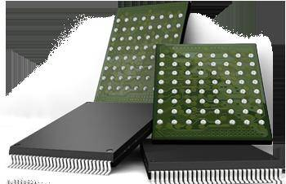

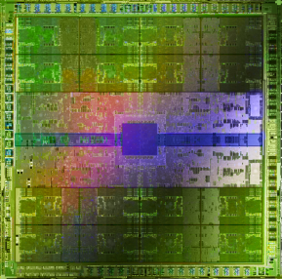
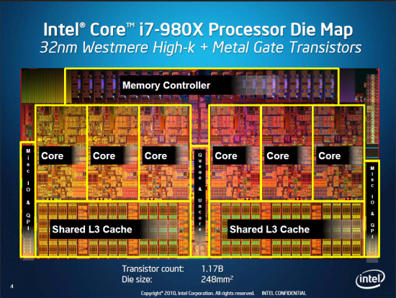
Current Research Mission
Computer architecture, HW/SW, systems, bioinformatics, security
Hybrid Main Memory
Heterogeneous
Processors and
Accelerators
Persistent Memory/Storage
Graphics and Vision Processing
Build fundamentally better architectures
Notes:
Professor Mutlu’s research focus is all aspects of computer architecture, HW/SW interaction and bioinformatics.
He is looking for students to perform research in these areas.
He and his group, SAFARI, solve fundamental problems spanning:
Memory, memory, memory, storage, interconnects
Parallel architectures, heterogeneous architectures, GP-GPUs
System/architecture interaction, new execution models
Energy efficiency, fault tolerance, hardware security
Genome sequence analysis and assembly
His group does broad research spanning systems to logic with architecture at center

Slide 3
Four Key Current Directions
Fundamentally Secure/Reliable/Safe Architectures
Fundamentally Energy-Efficient Architectures
  Memory-centric (Data-centric) Architectures
Fundamentally Low-Latency and Predictable Architectures
Architectures for AI/ML, Genomics, Medicine, Health, …

Slide 4
Fundamentally Better Architectures
Data-centric
Data-driven
Data-aware

Slide 5
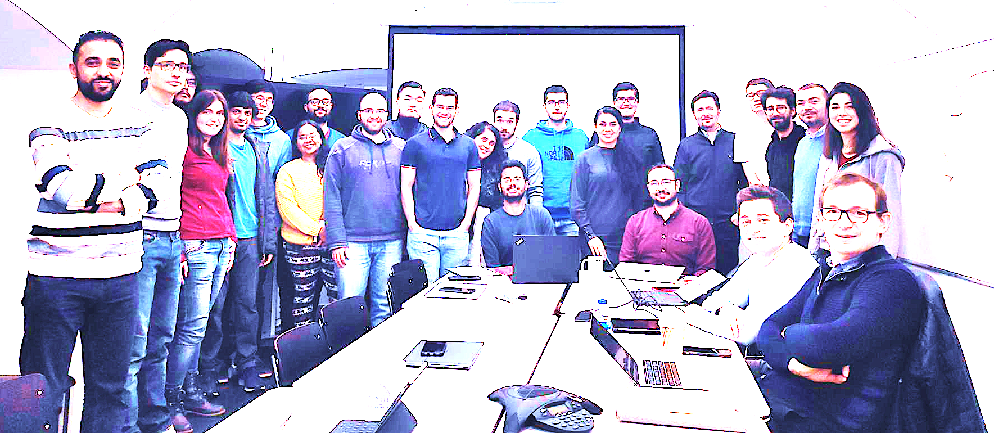

Onur Mutlu’s SAFARI Research Group
Computer architecture, HW/SW, systems, bioinformatics, security, memory
https://safari.ethz.ch/safari-newsletter-january-2021/
40+ Researchers
Think BIG, Aim HIGH!
https://safari.ethz.ch
5

Slide 6
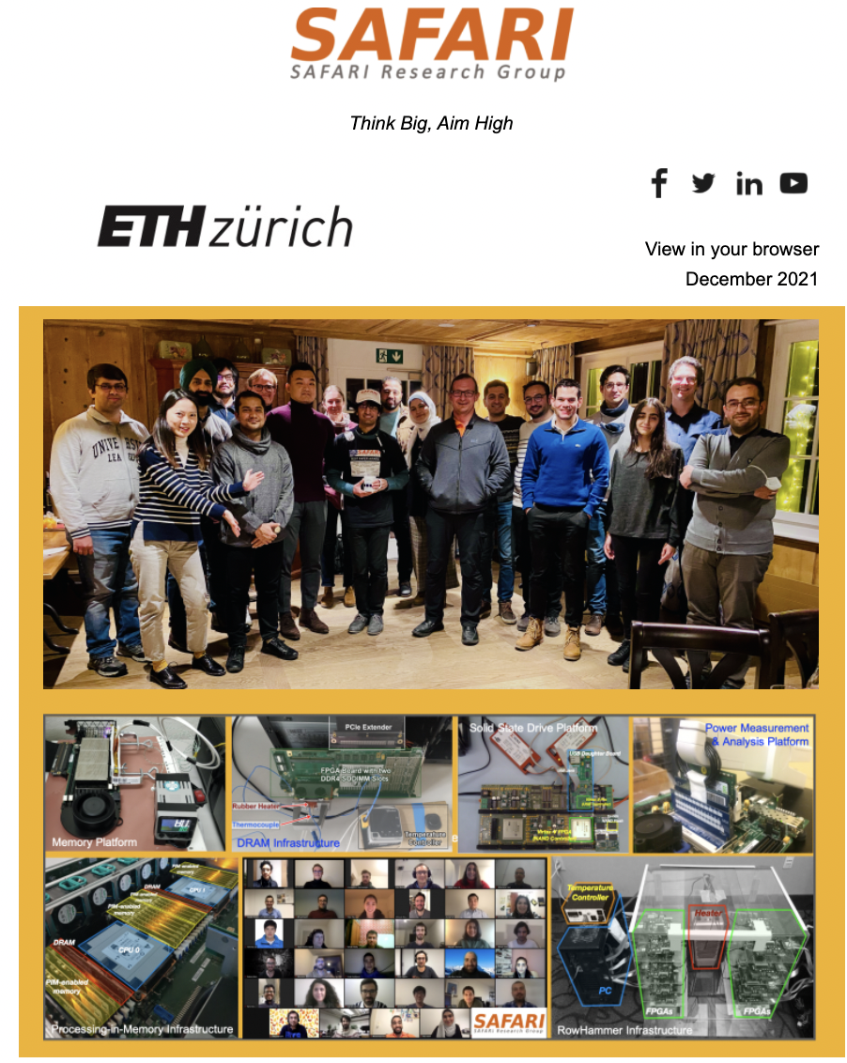
SAFARI Newsletter December 2021 Edition
https://safari.ethz.ch/safari-newsletter-december-2021/

Slide 7
Referenced Papers, Talks, Artifacts
All are available at
  https://people.inf.ethz.ch/omutlu/projects.htm
  https://www.youtube.com/onurmutlulectures
  https://github.com/CMU-SAFARI/

Slide 8
Open-Source Artifacts
https://github.com/CMU-SAFARI

Slide 9

Open Source Tools: SAFARI GitHub
https://github.com/CMU-SAFARI/

Slide 10

Onur Mutlu’s SAFARI Research Group
Think BIG, Aim HIGH!
https://safari.ethz.ch

Slide 11
SAFARI Overview at EFCL Huawei Day
Onur Mutlu,
"SAFARI Research Group: Introduction & Research"
Invited Talk at the ETH Future Computing Laboratory Huawei Day, Virtual, 19 October 2021.
[Slides (pptx) (pdf)]
[Talk Video (15 minutes)]

Slide 12
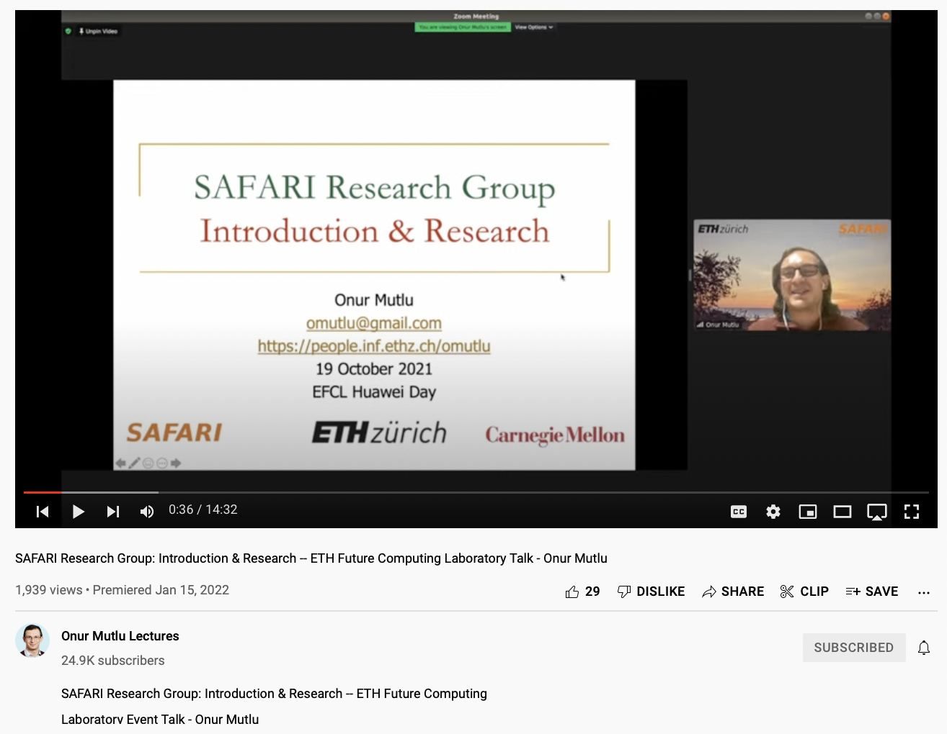
SAFARI Overview at EFCL Huawei Day
https://youtu.be/mSr1QQmYuX0

Slide 13
Fundamentally Better Architectures
Data-centric
Data-driven
Data-aware

Slide 14
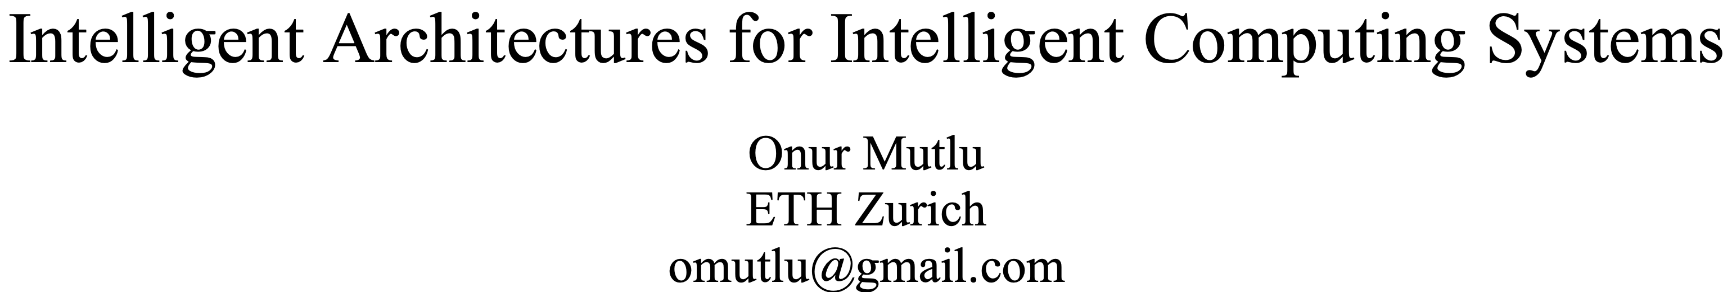
A Blueprint for Fundamentally Better Architectures
Onur Mutlu,
"Intelligent Architectures for Intelligent Computing Systems"
Invited Paper in Proceedings of the Design, Automation, and Test in Europe Conference (DATE), Virtual, February 2021.
[Slides (pptx) (pdf)]
[IEDM Tutorial Slides (pptx) (pdf)]
[Short DATE Talk Video (11 minutes)]
[Longer IEDM Tutorial Video (1 hr 51 minutes)]

Slide 15
Current EFCL Projects
“A New Methodology and Open-Source Benchmark Suite for Evaluating Data Movement Bottlenecks: A Processing-in-Memory Case Study”
  Data-centric
“Machine-Learning-Assisted Intelligent Microarchitectures to Reduce Memory Access Latency”
  Data-driven
“Cross-layer Hardware/Software Techniques to Enable Powerful Computation and Memory Optimizations”
  Data-aware

Slide 16
A New Methodology and
Open-Source Benchmark Suite for Evaluating Data Movement Bottlenecks:
A Processing-in-Memory Case Study
Juan Gómez Luna, Geraldo F. Oliveira,
Mohammad Sadr, Lois Orosa
Onur Mutlu

Slide 17
Goal: Processing Inside Memory
Many questions … How do we design the:
  compute-capable memory & controllers?
  processors & communication units?
  software & hardware interfaces?
  system software, compilers, languages?
  algorithms & theoretical foundations?
Memory
Processor
Core
Database
Graphs
Media
Cache
Query
Interconnect
Problem
Results
Algorithm
Program/Language
System Software
SW/HW Interface
Micro-architecture
Logic
Devices
Electrons

Slide 18
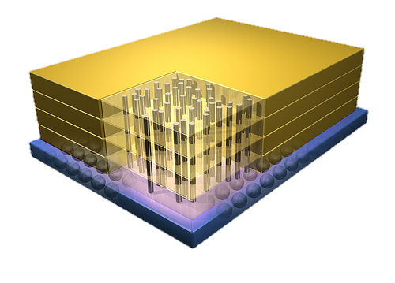


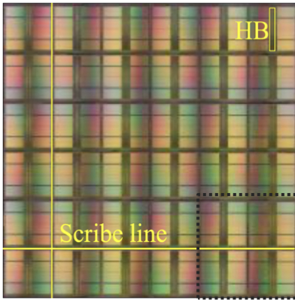
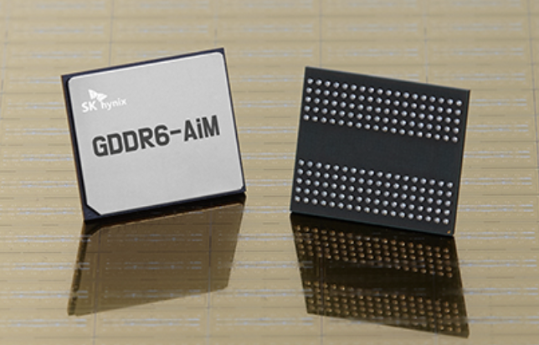

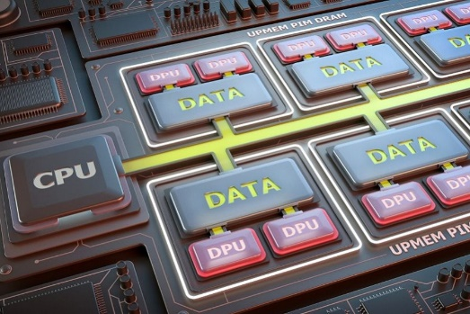
Processing-in-Memory Landscape Today
[Samsung 2021]
[Alibaba 2022]
[SK Hynix 2022]
[Samsung 2021]
[UPMEM 2019]
This does not include many experimental chips and startups

Slide 19
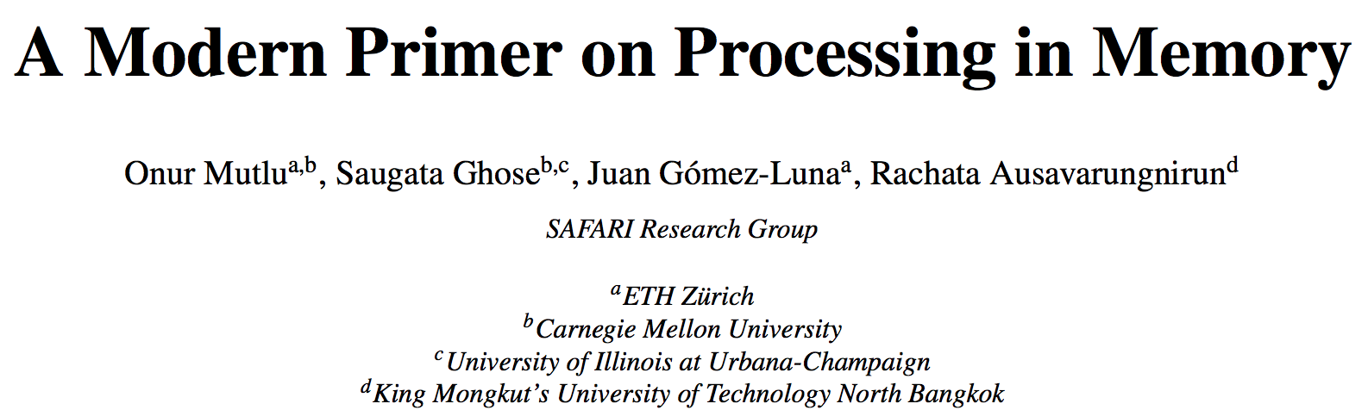
PIM Review and Open Problems
Onur Mutlu, Saugata Ghose, Juan Gomez-Luna, and Rachata Ausavarungnirun,
"A Modern Primer on Processing in Memory"
Invited Book Chapter in Emerging Computing: From Devices to Systems - Looking Beyond Moore and Von Neumann, Springer, to be published in 2021.
https://arxiv.org/pdf/1903.03988.pdf

Slide 20
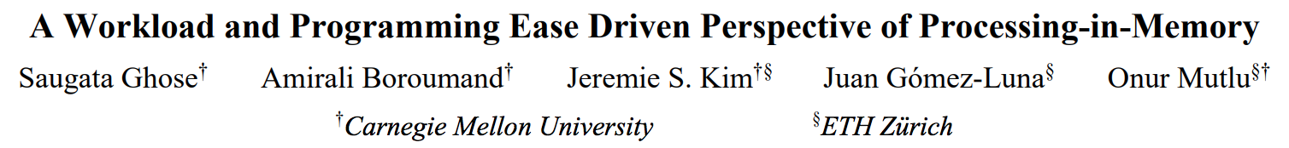
PIM Review and Open Problems (II)
Saugata Ghose, Amirali Boroumand, Jeremie S. Kim, Juan Gomez-Luna, and Onur Mutlu,
"Processing-in-Memory: A Workload-Driven Perspective"
Invited Article in IBM Journal of Research & Development, Special Issue on Hardware for Artificial Intelligence, to appear in November 2019.
[Preliminary arXiv version]
https://arxiv.org/pdf/1907.12947.pdf

Slide 21
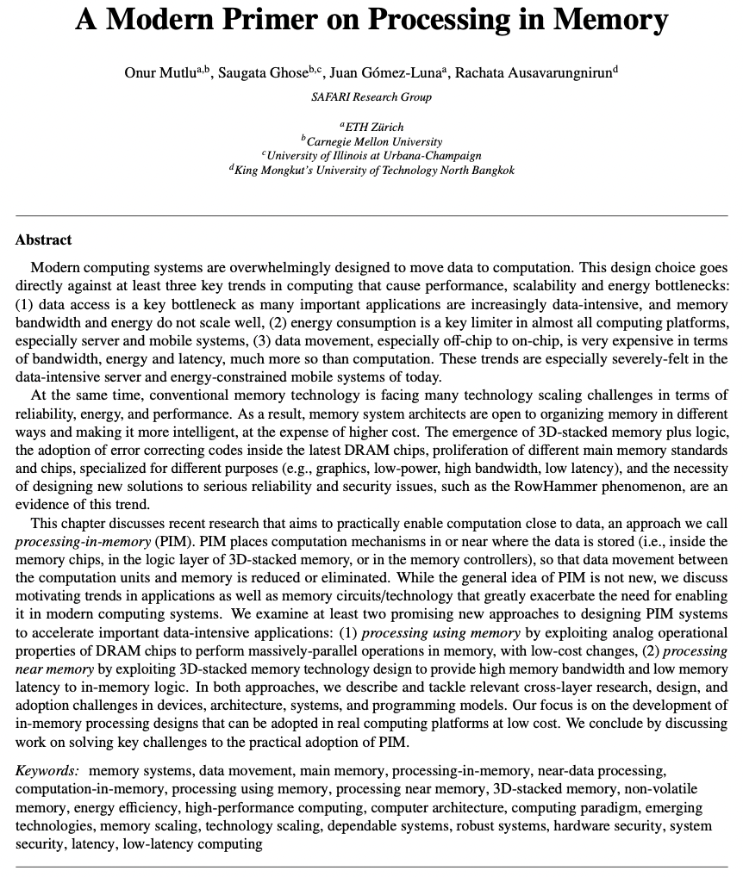

Slide 22
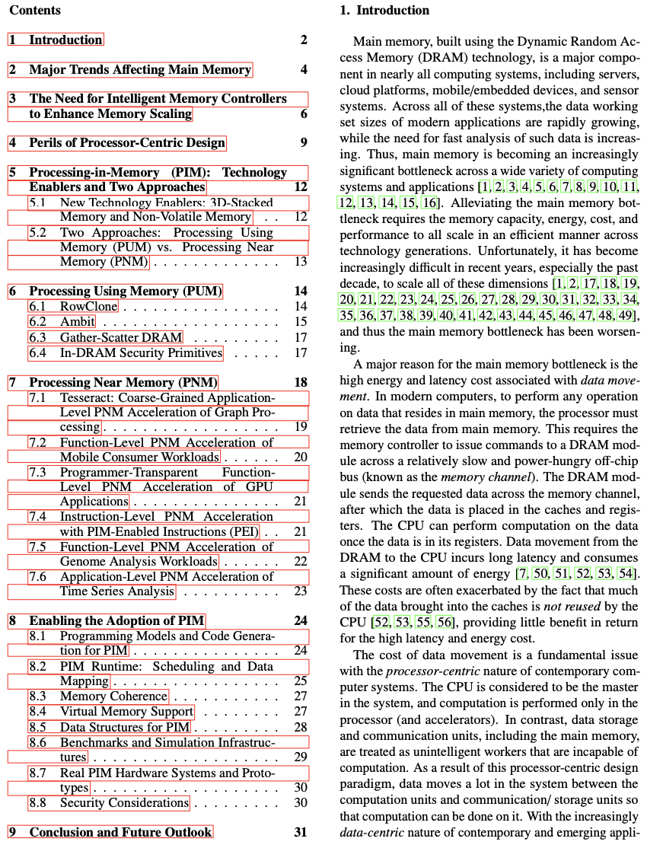

Slide 23
Eliminating the Adoption Barriers
How to Enable Adoption of Processing in Memory

Slide 24
Potential Barriers to Adoption of PIM
1. Applications & software for PIM
2. Ease of programming (interfaces and compiler/HW support)
3. System and security support: coherence, synchronization, virtual memory, isolation, communication interfaces, …
4. Runtime and compilation systems for adaptive scheduling, data mapping, access/sharing control, …
5. Infrastructures to assess benefits and feasibility
All can be solved with change of mindset

Slide 25
Our Goal
To enable adoption of Processing-in-Memory (PIM) systems by solving various key challenges
  Identifying workloads and functions suitable for PIM
    Fundamental (architecture-independent) characterization
    Architecture-specific suitability
  Overcoming the problem of lack of useful tools
    Profiling tools
    Analytical performance and energy models (or ML-based models)
    Simulation tools
The project is organized in two phases
  Phase 1: Methodology and open-source benchmark suite(s)
  Phase 2: Follow-up project to enable PIM adoption

Slide 26
Results So Far (2021-2022)
DAMOV: A New Methodology and Benchmark Suite for Evaluating Data Movement Bottlenecks [IEEE Access 2021]
Benchmarking a New Paradigm: Experimental Analysis and Characterization of a Real Processing-in-Memory System [IEEE Access 2022]
Google Neural Network Models for Edge Devices: Analyzing and Mitigating Machine Learning Inference Bottlenecks [PACT 2021]
Enabling High-Performance and Energy-Efficient Hybrid Transactional/Analytical Databases with Hardware/Software Cooperation [ICDE 2022]
FPGA-based Near-Memory Acceleration of Modern Data-Intensive Applications [IEEE Micro 2021]

Slide 27





DAMOV: A New Methodology and Benchmark Suite for Evaluating
Data Movement Bottlenecks
Geraldo F. Oliveira
Juan Gómez-Luna Lois Orosa Saugata Ghose
Nandita Vijaykumar Ivan Fernandez Mohammad Sadrosadati
Onur Mutlu
Notes:
Hi, I’m Geraldo, a PhD Student under the supervision of professor Multu at ETH Zurich and I’ll be talking about our work DAMOV: A New Methodology and Benchmark Suite for Evaluating Data Movement Bottlenecks.
[NEXT]

Slide 28
Executive Summary
Problem: Data movement is a major bottleneck is modern systems.
However, it is unclear how to identify:
− different sources of data movement bottlenecks
  − the most suitable mitigation technique (e.g., caching, prefetching, near-data processing) for a given data movement bottleneck
Goals:
1. Design a methodology to identify sources of data movement bottlenecks
2. Compare compute- and memory-centric data movement mitigation techniques
Key Approach: Perform a large-scale application characterization to identify key metrics that reveal the sources to data movement bottlenecks
Key Contributions:
− Experimental characterization of 77K functions across 345 applications
− A methodology to characterize applications based on data movement bottlenecks and their relation with different data movement mitigation techniques
− DAMOV: a benchmark suite with 144 functions for data movement studies
− Four case-studies to highlight DAMOV’s applicability to open research problems
DAMOV: https://github.com/CMU-SAFARI/DAMOV
Notes:
First, I will give a glance of what this talk is about.
[CLICK] It is known that data movement is a major bottleneck in modern systems. However, it is unclear how we can identify
[CLICK] the different sources that lead to a data movement bottleneck
[CLICK] and the most suitable data movement mitigation technique, as for example, traditional compute-centric techniques as data caching and prefetching, and memory-centric techniques as near-data processing, for a given data movement bottleneck
[CLICK] Therefore, the goal of our work is twofold
[CLICK] First, we aim to design a methodology that can systematically identify different sources of data movement bottlenecks in a system and
[CLICK] Second, we aim to compare the suitability of compute-centric and memory-centric data movement mitigation techniques for different data movement bottlenecks
[CLICK] To do so, we perform a large-scale application characterization in order to identify key metrics that can reveal a particular source of data movement bottleneck
[CLICK] From such characterization, we draw four key contributions
[CLICK] Our first contribution is our large-scale experimental workload characterization of 77K functions from across 345 different applications from varying domains
[CLICK] Second, we develop and validate a systematic methodology that cluster workloads into six different classes of data movement bottlenecks using four key metrics.
We also analyze how each one of the six classes of data movement bottlenecks correlates with three different data movement mitigation techniques, including near-data processing architectures
[CLICK] Third, by applying our new methodology over a wide-range of workloads, we develop DAMOV, a open-source benchmark suite with 144 application functions that target the study of data movement related topics.
[CLICK] Fourth, we showcase how DAMOV can aid the study of open research problems with four case studies.
[CLICK] We public release and open-source DAMOV in our github, with the hope it can enables further studies and research on hardware and software solutions for data movement bottlenecks
[NEXT]

Slide 29
Near-Data Processing
UPMEM (2019)
Samsung FIMDRAM (2021)
Near-DRAM-banks processing
for general-purpose computing
0.9 TOPS compute throughput¹
Near-DRAM-banks processing
for neural networks
1.2 TFLOPS compute throughput²
  The goal of Near-Data Processing (NDP) is
  to mitigate data movement
[1] Devaux, "The True Processing In Memory Accelerator,” HCS, 2019
[2] Kwon+, “A 20nm 6GB Function-In-Memory DRAM, Based on HBM2 with a 1.2TFLOPS Programmable Computing Unit Using Bank-Level Parallelism, for Machine Learning Applications," ISSCC, 2021
Notes:
Near-data processing in not a new idea. In fact, the idea of near-data processing architectures has been around for at least five decades. However, only recently industry has introduced the first NDP architectures
[CLICK] For example, the UPMEM architecture designed by the company of same name.
[CLICK] integrates a large number of simple CPUs nearby DRAM chips, targeting general-purpose computing
[CLICK] The UPMEM architecture can provide a compute throughput of around 0.9 TOPS
[CLICK] Another example, Samsung recently introduced the FIMDRAM architecture
[CLICK] which integrates processing elements nearby DRAM banks, which aims to accelerate neural networks.
[CLICK] The FIMDRAM architecture can provide up to 1.2 TFLOPS of compute throughput.
[NEXT]

Slide 30
When to Employ Near-Data Processing?
Mobile consumer workloads
(GoogleWL²)
Graph processing
(Tesseract¹)
Neural networks
(GoogleWL²)
Near-Data
Processing
Databases
(Polynesia⁵)
DNA
sequence mapping
(GenASM³; GRIM-Filter⁴)
Time series analysis
(NATSA⁶)
...
[1] Ahn+, “A Scalable Processing-in-Memory Accelerator for Parallel Graph Processing," ISCA, 2015
[2] Boroumand+, "Google Workloads for Consumer Devices: Mitigating Data Movement Bottlenecks,” ASPLOS, 2018
[3] Cali+, "GenASM: A High-Performance, Low-Power Approximate String Matching Acceleration Framework for Genome Sequence Analysis,” MICRO, 2020
[4] Kim+, "GRIM-Filter: Fast Seed Location Filtering in DNA Read Mapping Using Processing-in-Memory Technologies,” BMC Genomics, 2018
[5] Boroumand+, "Polynesia: Enabling Effective Hybrid Transactional/Analytical Databases with Specialized Hardware/Software Co-Design,” arXiv:2103.00798 [cs.AR], 2021
[6] Fernandez+, “NATSA: A Near-Data Processing Accelerator for Time Series Analysis,” ICCD, 2020
Notes:
[CLICK] Many recent works explore how NDP can benefit various application domains like
[CLICK] Graph processing,
[CLICK] mobile consumer workloads
[CLICK] neural networks
[CLICK] DNA sequence mapping
[CLICK] Databases
[CLICK] Time series analysis
[CLICK] and more
[NEXT]

Slide 31
Key Approach
New workload characterization methodology to analyze:
  data movement bottlenecks
  suitability of different data movement mitigation mechanisms
Two main profiling strategies:
Architecture-independent profiling:
  characterizes the memory behavior independently of the underlying hardware
Architecture-dependent profiling:
  evaluates the impact of the system configuration on the memory behavior
Notes:
[CLICK] We develop a new workload characterization methodology to analyze
[CLICK] data movement bottlenecks and
[CLICK] the suitability of different data movement mitigation mechanisms for these bottlenecks
[CLICK] We use two main profiling strategies to gather key metrics from applications
[CLICK] an architecture-independent profiling that provides metrics that characterize the application memory behavior independently of the underlying hardware.
[CLICK] And an architecture-dependent profiling that evaluates the impact of the system configuration (e.g., cache hierarchy) on the memory behavior.
[NEXT]

Slide 32

Methodology Overview
User Input
Step 1
Application Profiling
DAMOV-SIM Simulator
Target Application
roi_begin
ld 0xFF
st 0xAF
ld 0xFF
st 0xAF
ld 0xFF
Source Code
Memory Traces
# Cores
roi_end
Profiler
Scalability Analysis
DRAM Bandwidth
Methodology Output
Step 2
Locality-based Clustering
DRAM Latency
L1/L2 Cache Capacity
High
Temporal Locality
LFMR
L3 Cache Contention
High
Spatial Locality
Temp. Locality
L1 Cache Capacity
…
Step 3
Memory Bottleneck Class.
Memory Bottleneck Classes
LFMR
Compute-Bound
Low
Arithmetic Intensity
Low
LLC MPKI
Last-to-First
Miss Ratio (LFMR)
Notes:
Our methodology has three steps.
[CLICK] It takes as input an application’s source code and its input datasets.
[CLICK] In Step 1, we use a hardware profiling tool to identify memory-bound functions across many applications. This step allows for a quick first-level identification of many applications that suffer from memory bottlenecks and functions that cause these bottlenecks.
[CLICK] We utilize a new simulator, called DAMOV-SIM to collect key metrics and execute performance analysis of the functions identified in Step 1.
[CLICK] In Step 2, we use the architecture-independent profiling tool to collect metrics that provide insights about the memory access behavior of the memory-bottlenecked functions.
[CLICK] In Step 3, we collect architecture-dependent metrics and analyze the performance and energy of each function in an application when each of our three candidate data movement mitigation mechanisms is applied to the system.
[CLICK] By combining the data obtained from all three steps, we can systematically classify the leading causes of data movement bottlenecks in an application or function into different bottleneck classes
[NEXT]

Slide 33
Step 1: Application Profiling
We analyze 345 applications from distinct domains:
Graph Processing
Deep Neural Networks
Physics
High-Performance Computing
Genomics
Machine Learning
Databases
Data Reorganization
Image Processing
Map-Reduce
Benchmarking
Linear Algebra
…
Signal processing
Machine learning
Data mining
Data analytics
Genomics
Deep Neural Networks
Security
Linear algebra
Image processing
Data reorganization
Graph processing
Database
Physics
Notes:
In this work, we analyzed 345 applications from distinct domains, from
[CLICK] GRAPH Processing [CLICK] Neural Networks
[CLICK] Physics [CLICK] High-performance computing
[CLICK]Genomics [CLICK] And more
[NEXT]

Slide 34
Step 3: Memory Bottleneck Analysis
Memory Bottleneck Class
High
Low
1a: DRAM Bandwidth
High
AI
MPKI
Low
1b: DRAM Latency
AI
Low
Low
  Six classes of
  data movement bottlenecks:
  each class ↔ data movement
  mitigation mechanism
LFMR
Low
Low
1c: L1/L2
Cache Capacity
Decreasing
MPKI
AI
Temporal Locality
Increasing
Low
Low
2a: L3 Cache Contention
MPKI
AI
LFMR
Low
2b: L1 Cache Capacity
High
MPKI
AI
Low
Low
2c: Compute-Bound
High
Notes:
[CLICK] With such classification, we analyze how the functions in each class correlates with different data movement mitigation mechanisms in terms of performance and energy using our scalability analysis.
[NEXT]

Slide 35
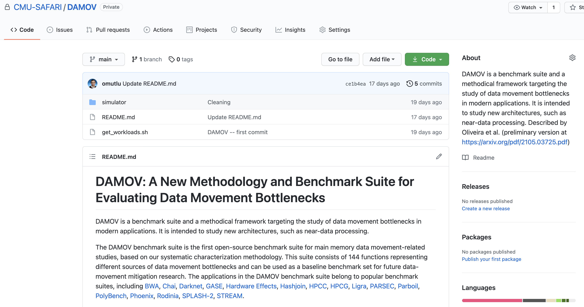
DAMOV is Open Source
We open-source our benchmark suite and our toolchain
DAMOV-SIM
DAMOV
Benchmarks
Notes:
We open source DAMOV to facilitate further research in mitigating data movement bottlenecks, including in near data processing.
[CLICK] In our DAMOV repository, we provide
[CLICK] The complete set of 144 application functions that compose our benchmark suite
[CLICK] And our DAMOV-SIM simulator
[NEXT]

Slide 36
DAMOV is Open Source
We open-source our benchmark suite and our toolchain
Get DAMOV at:
https://github.com/CMU-SAFARI/DAMOV
DAMOV-SIM
DAMOV
Benchmarks
Notes:
We open source DAMOV to facilitate further research in mitigating data movement bottlenecks, including in near data processing.
[CLICK] In our DAMOV repository, we provide
[CLICK] The complete set of 144 application functions that compose our benchmark suite
[CLICK] And our DAMOV-SIM simulator
[NEXT]

Slide 37
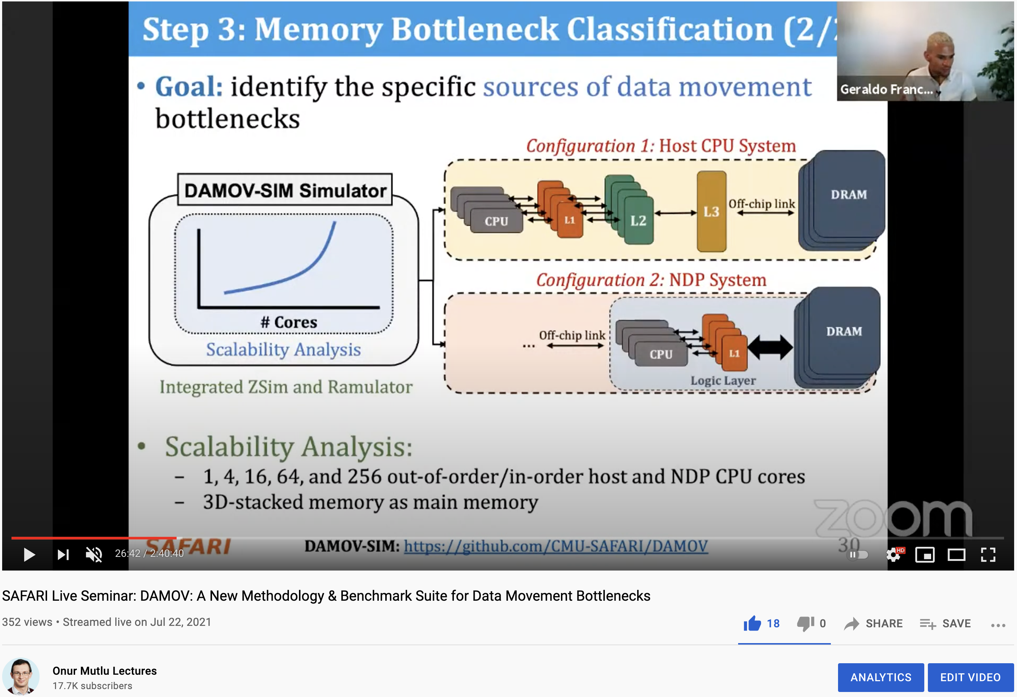
More on DAMOV Analysis Methodology & Workloads
https://www.youtube.com/watch?v=GWideVyo0nM&list=PL5Q2soXY2Zi_tOTAYm--dYByNPL7JhwR9&index=3

Slide 38
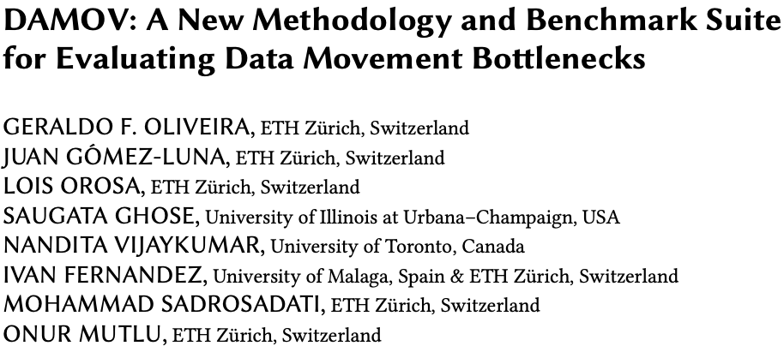
More on DAMOV Methods & Benchmarks
Geraldo F. Oliveira, Juan Gomez-Luna, Lois Orosa, Saugata Ghose, Nandita Vijaykumar, Ivan fernandez, Mohammad Sadrosadati, and Onur Mutlu,
"DAMOV: A New Methodology and Benchmark Suite for Evaluating Data Movement Bottlenecks"
IEEE Access, 8 September 2021.
Preprint in arXiv, 8 May 2021.
[arXiv preprint]
[IEEE Access version]
[DAMOV Suite and Simulator Source Code]
[SAFARI Live Seminar Video (2 hrs 40 mins)]
[Short Talk Video (21 minutes)]

Slide 39
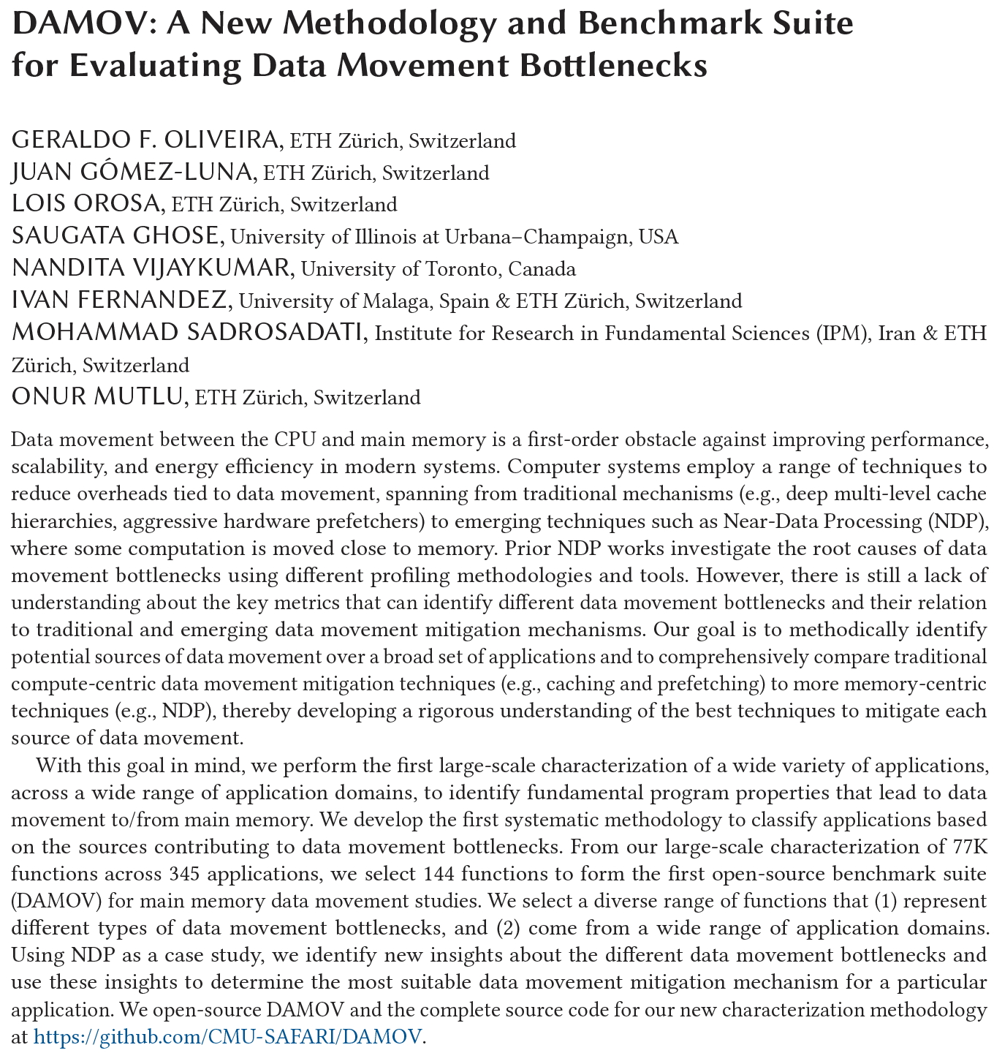
DAMOV Analysis Methodology & Workloads
https://arxiv.org/pdf/2105.03725.pdf

Slide 40
Results So Far (2021-2022)
DAMOV: A New Methodology and Benchmark Suite for Evaluating Data Movement Bottlenecks [IEEE Access 2021]
Benchmarking a New Paradigm: Experimental Analysis and Characterization of a Real Processing-in-Memory System [IEEE Access 2022]
Google Neural Network Models for Edge Devices: Analyzing and Mitigating Machine Learning Inference Bottlenecks [PACT 2021]
Enabling High-Performance and Energy-Efficient Hybrid Transactional/Analytical Databases with Hardware/Software Cooperation [ICDE 2022]
FPGA-based Near-Memory Acceleration of Modern Data-Intensive Applications [IEEE Micro 2021]

Slide 41
Eliminating the Adoption Barriers
Processing-in-Memory
in the Real World

Slide 42
UPMEM Processing-in-DRAM Engine (2019)
Processing in DRAM Engine
Includes standard DIMM modules, with a large number of DPU processors combined with DRAM chips.
Replaces standard DIMMs
  DDR4 R-DIMM modules
    8GB+128 DPUs (16 PIM chips)
    Standard 2x-nm DRAM process
  Large amounts of compute & memory bandwidth
https://www.anandtech.com/show/14750/hot-chips-31-analysis-inmemory-processing-by-upmem
https://www.upmem.com/video-upmem-presenting-its-true-processing-in-memory-solution-hot-chips-2019/

Slide 43
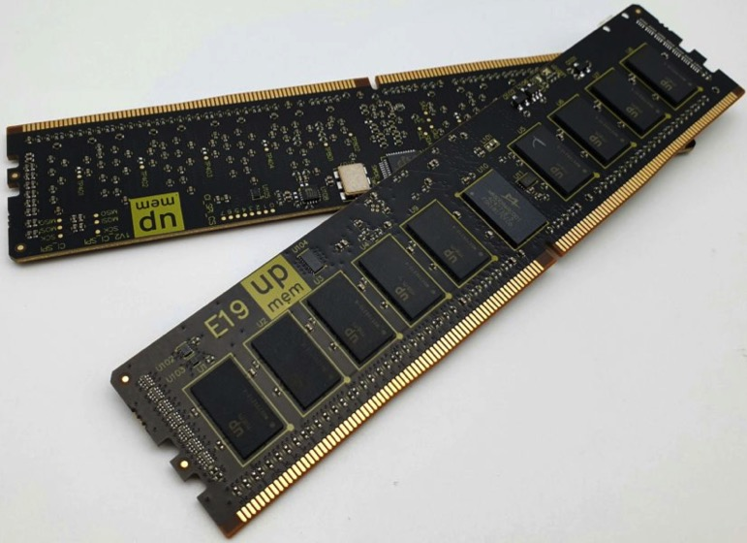
UPMEM Memory Modules
E19: 8 chips DIMM (1 rank). DPUs @ 267 MHz
P21: 16 chips DIMM (2 ranks). DPUs @ 350 MHz
www.upmem.com

Slide 44
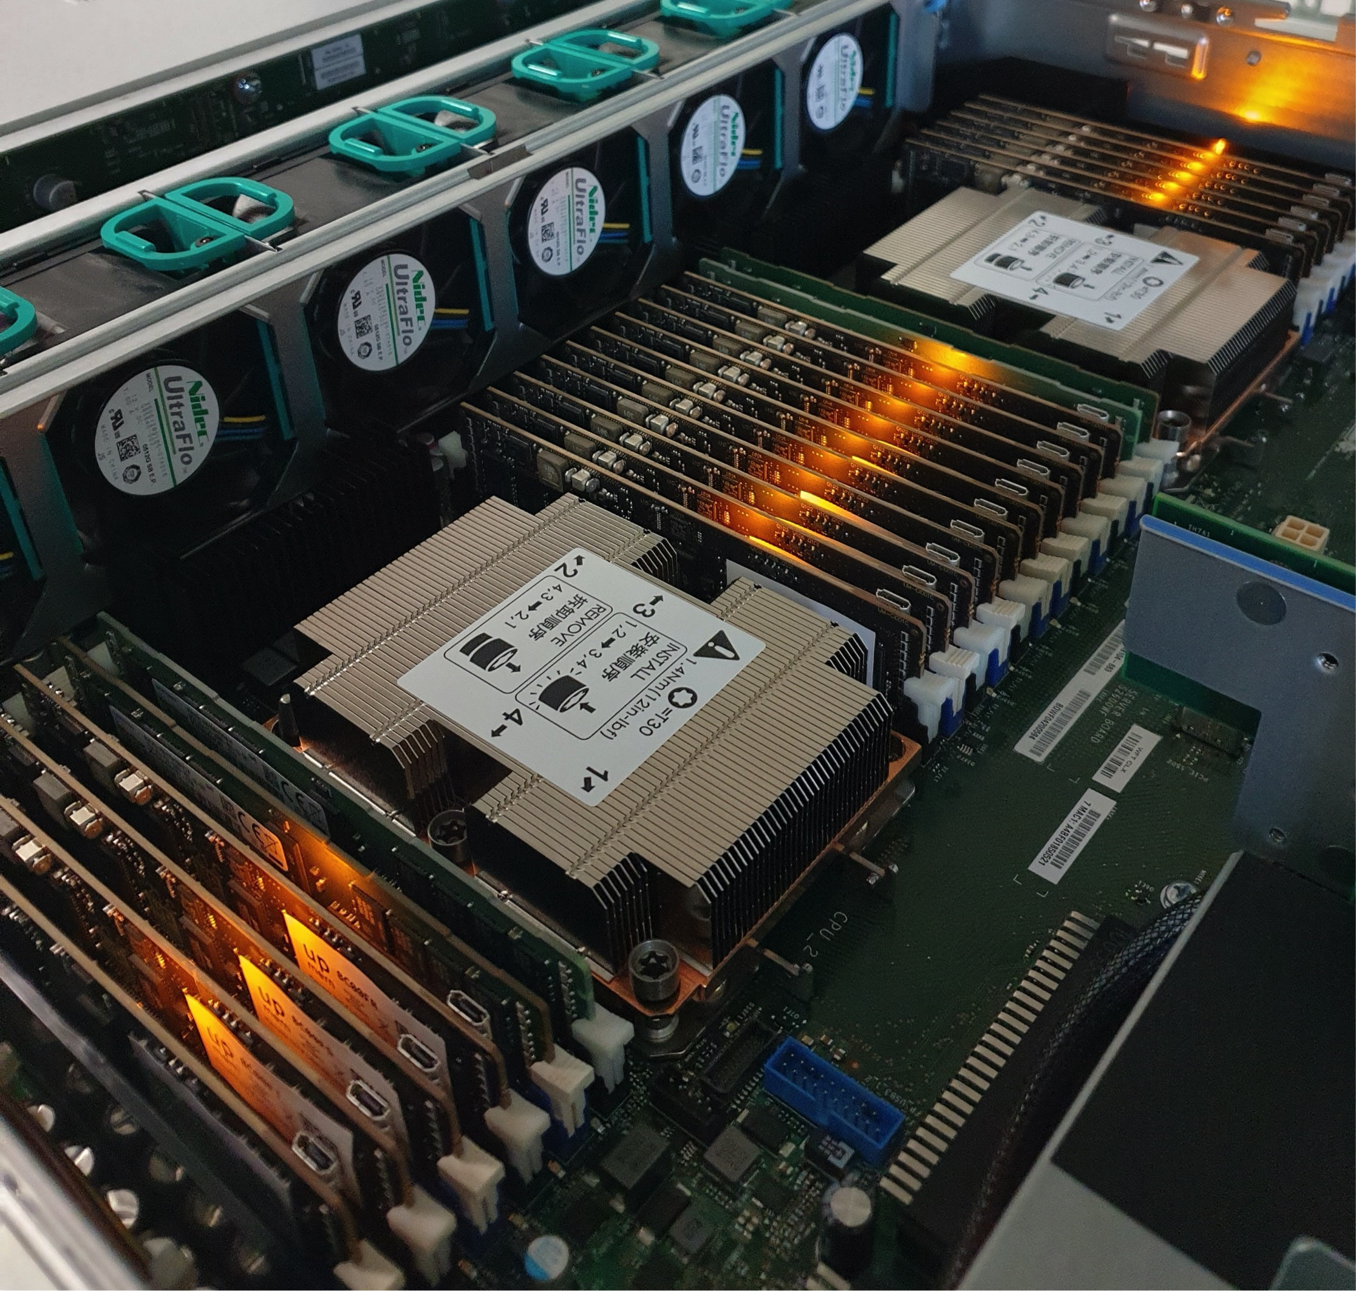
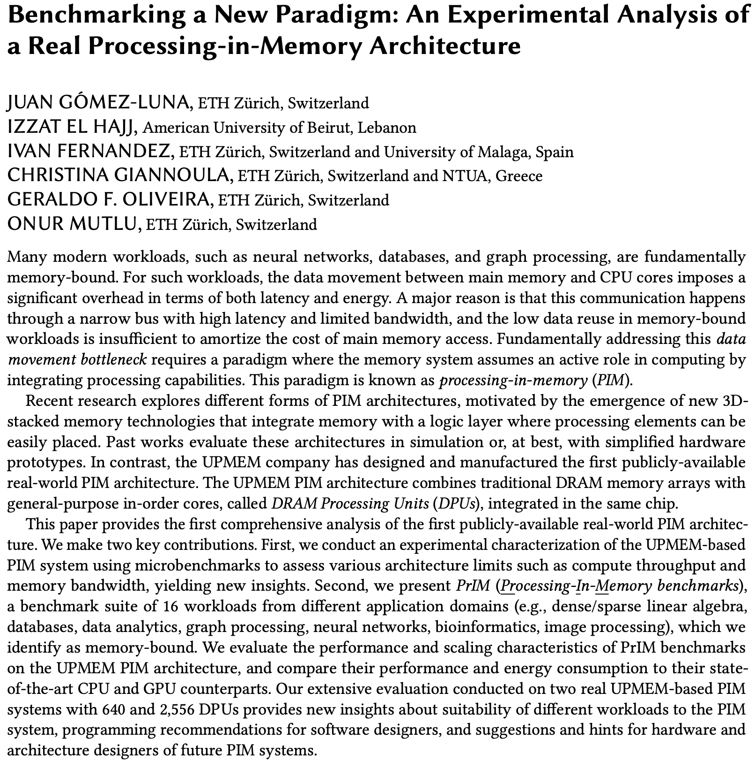
2,560-DPU Processing-in-Memory System
https://arxiv.org/pdf/2105.03814.pdf

Slide 45
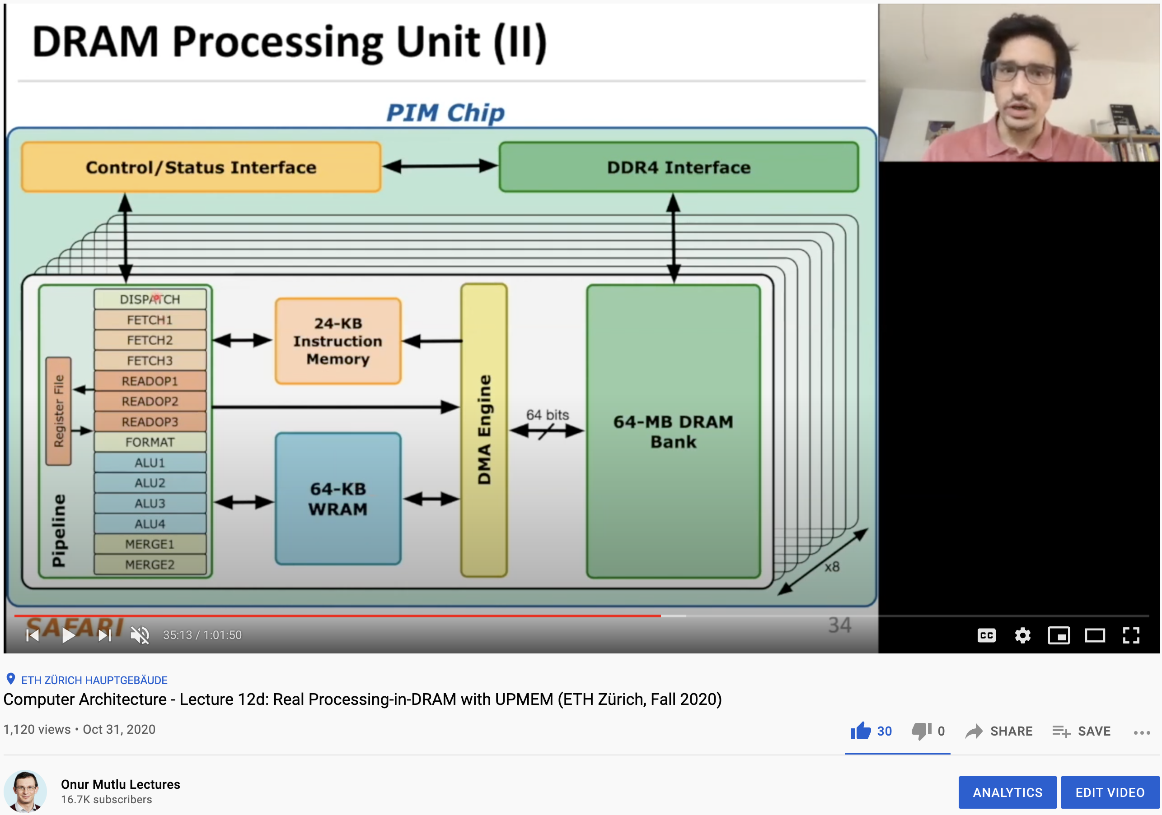
More on the UPMEM PIM System
https://www.youtube.com/watch?v=Sscy1Wrr22A&list=PL5Q2soXY2Zi9xidyIgBxUz7xRPS-wisBN&index=26

Slide 46
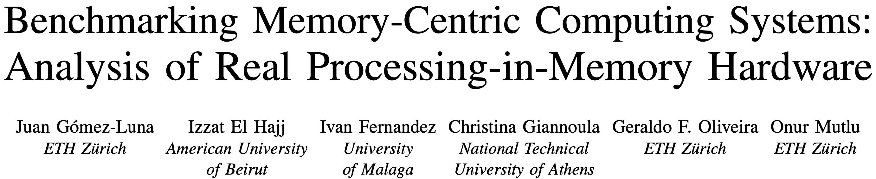
UPMEM PIM System Summary & Analysis
Juan Gomez-Luna, Izzat El Hajj, Ivan Fernandez, Christina Giannoula, Geraldo F. Oliveira, and Onur Mutlu,
"Benchmarking Memory-Centric Computing Systems: Analysis of Real Processing-in-Memory Hardware"
Invited Paper at Workshop on Computing with Unconventional Technologies (CUT), Virtual, October 2021.
[arXiv version]
[PrIM Benchmarks Source Code]
[Slides (pptx) (pdf)]
[Talk Video (37 minutes)]
[Lightning Talk Video (3 minutes)]

Slide 47
Understanding a Modern Processing-in-Memory Architecture:
Benchmarking and Experimental Characterization
Juan Gómez Luna, Izzat El Hajj,
Ivan Fernandez, Christina Giannoula,
Geraldo F. Oliveira, Onur Mutlu
https://arxiv.org/pdf/2105.03814.pdf
https://github.com/CMU-SAFARI/prim-benchmarks

Slide 48
Executive Summary
Data movement between memory/storage units and compute units is a major contributor to execution time and energy consumption
Processing-in-Memory (PIM) is a paradigm that can tackle the data movement bottleneck
  Though explored for +50 years, technology challenges prevented the successful materialization
UPMEM has designed and fabricated the first publicly-available real-world PIM architecture
  DDR4 chips embedding in-order multithreaded DRAM Processing Units (DPUs)
Our work:
  Introduction to UPMEM programming model and PIM architecture
  Microbenchmark-based characterization of the DPU
  Benchmarking and workload suitability study
Main contributions:
  Comprehensive characterization and analysis of the first commercially-available PIM architecture
  PrIM (Processing-In-Memory) benchmarks:
    16 workloads that are memory-bound in conventional processor-centric systems
    Strong and weak scaling characteristics
  Comparison to state-of-the-art CPU and GPU
Takeaways:
  Workload characteristics for PIM suitability
  Programming recommendations
  Suggestions and hints for hardware and architecture designers of future PIM systems
  PrIM: (a) programming samples, (b) evaluation and comparison of current and future PIM systems

Slide 49
PrIM Benchmarks: Application Domains
Domain | Benchmark | Short name
Dense linear algebra | Vector Addition | VA
 | Matrix-Vector Multiply | GEMV
Sparse linear algebra | Sparse Matrix-Vector Multiply | SpMV
Databases | Select | SEL
 | Unique | UNI
Data analytics | Binary Search | BS
 | Time Series Analysis | TS
Graph processing | Breadth-First Search | BFS
Neural networks | Multilayer Perceptron | MLP
Bioinformatics | Needleman-Wunsch | NW
Image processing | Image histogram (short) | HST-S
 | Image histogram (large) | HST-L
Parallel primitives | Reduction | RED
 | Prefix sum (scan-scan-add) | SCAN-SSA
 | Prefix sum (reduce-scan-scan) | SCAN-RSS
 | Matrix transposition | TRNS

Slide 50
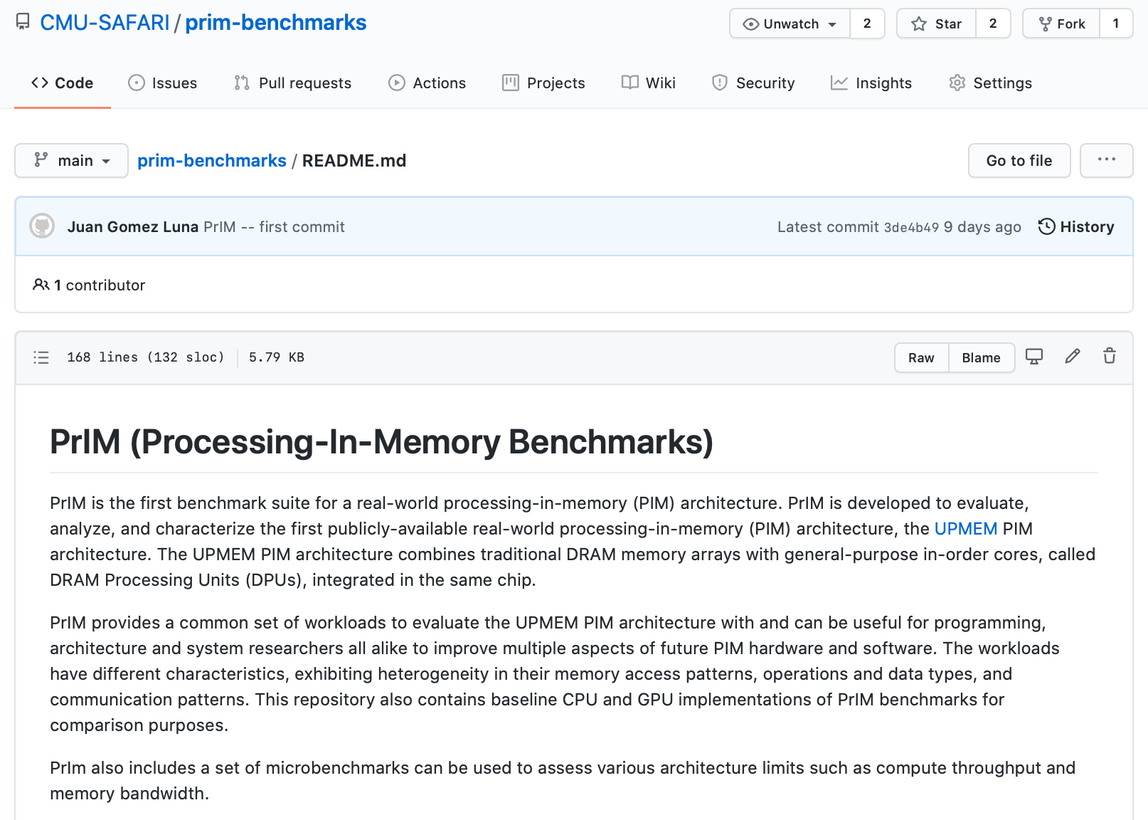
PrIM Benchmarks are Open Source
All microbenchmarks, benchmarks, and scripts
https://github.com/CMU-SAFARI/prim-benchmarks

Slide 51
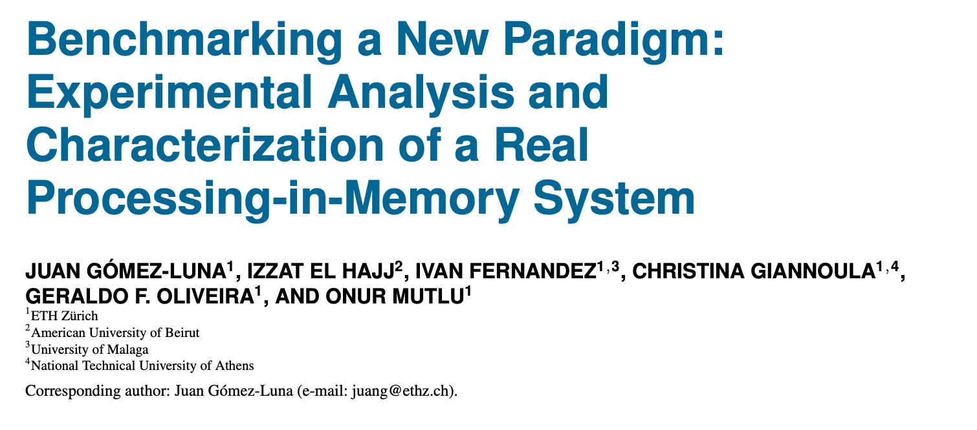
Understanding a Modern PIM Architecture
https://doi.org/10.1109/ACCESS.2022.3174101
https://github.com/CMU-SAFARI/prim-benchmarks

Slide 52
Observations, Recommendations, Takeaways
GENERAL PROGRAMMING RECOMMENDATIONS
Execute on the DRAM Processing Units (DPUs) portions of parallel code that are as long as possible.
Split the workload into independent data blocks, which the DPUs operate on independently.
Use as many working DPUs in the system as possible.
Launch at least 11 tasklets (i.e., software threads) per DPU.
PROGRAMMING RECOMMENDATION 1
For data movement between the DPU’s MRAM bank and the WRAM, use large DMA transfer sizes when all the accessed data is going to be used.
KEY OBSERVATION 7
Larger CPU-DPU and DPU-CPU transfers between the host main memory and the DRAM Processing Unit’s Main memory (MRAM) banks result in higher sustained bandwidth.
KEY TAKEAWAY 1
The UPMEM PIM architecture is fundamentally compute bound. As a result, the most suitable work- loads are memory-bound.

Slide 53
Outline
Introduction
  Accelerator Model
  UPMEM-based PIM System Overview
UPMEM PIM Programming
  Vector Addition
  CPU-DPU Data Transfers
  Inter-DPU Communication
  CPU-DPU/DPU-CPU Transfer Bandwidth
DRAM Processing Unit
  Arithmetic Throughput
  WRAM and MRAM Bandwidth
PrIM Benchmarks
  Roofline Model
  Benchmark Diversity
Evaluation
  Strong and Weak Scaling
  Comparison to CPU and GPU
Key Takeaways

Slide 54
Key Takeaway 1
The throughput saturation point is as low as ¼ OP/B,
i.e., 1 integer addition per every 32-bit element fetched
Memory-bound region
Compute-bound region
KEY TAKEAWAY 1
The UPMEM PIM architecture is fundamentally compute bound.
As a result, the most suitable workloads are memory-bound.

Slide 55
Key Takeaway 2
KEY TAKEAWAY 2
The most well-suited workloads for the UPMEM PIM architecture use no arithmetic operations or use only simple operations (e.g., bitwise operations and integer addition/subtraction).

Slide 56
Key Takeaway 3
KEY TAKEAWAY 3
The most well-suited workloads for the UPMEM PIM architecture require little or no communication across DPUs (inter-DPU communication).

Slide 57
Key Takeaway 4
KEY TAKEAWAY 4
• UPMEM-based PIM systems outperform state-of-the-art CPUs in terms of performance and energy efficiency on most of PrIM benchmarks.
• UPMEM-based PIM systems outperform state-of-the-art GPUs on a majority of PrIM benchmarks, and the outlook is even more positive for future PIM systems.
• UPMEM-based PIM systems are more energy-efficient than state-of-the-art CPUs and GPUs on workloads that they provide performance improvements over the CPUs and the GPUs.

Slide 58
Understanding a Modern PIM Architecture
https://doi.org/10.1109/ACCESS.2022.3174101
https://github.com/CMU-SAFARI/prim-benchmarks

Slide 59
Understanding a Modern Processing-in-Memory Architecture:
Benchmarking and Experimental Characterization
Juan Gómez Luna, Izzat El Hajj,
Ivan Fernandez, Christina Giannoula,
Geraldo F. Oliveira, Onur Mutlu
el1goluj@gmail.com
https://arxiv.org/pdf/2105.03814.pdf
https://github.com/CMU-SAFARI/prim-benchmarks

Slide 60
Experimental Analysis of the UPMEM PIM Engine
https://arxiv.org/pdf/2105.03814.pdf

Slide 61
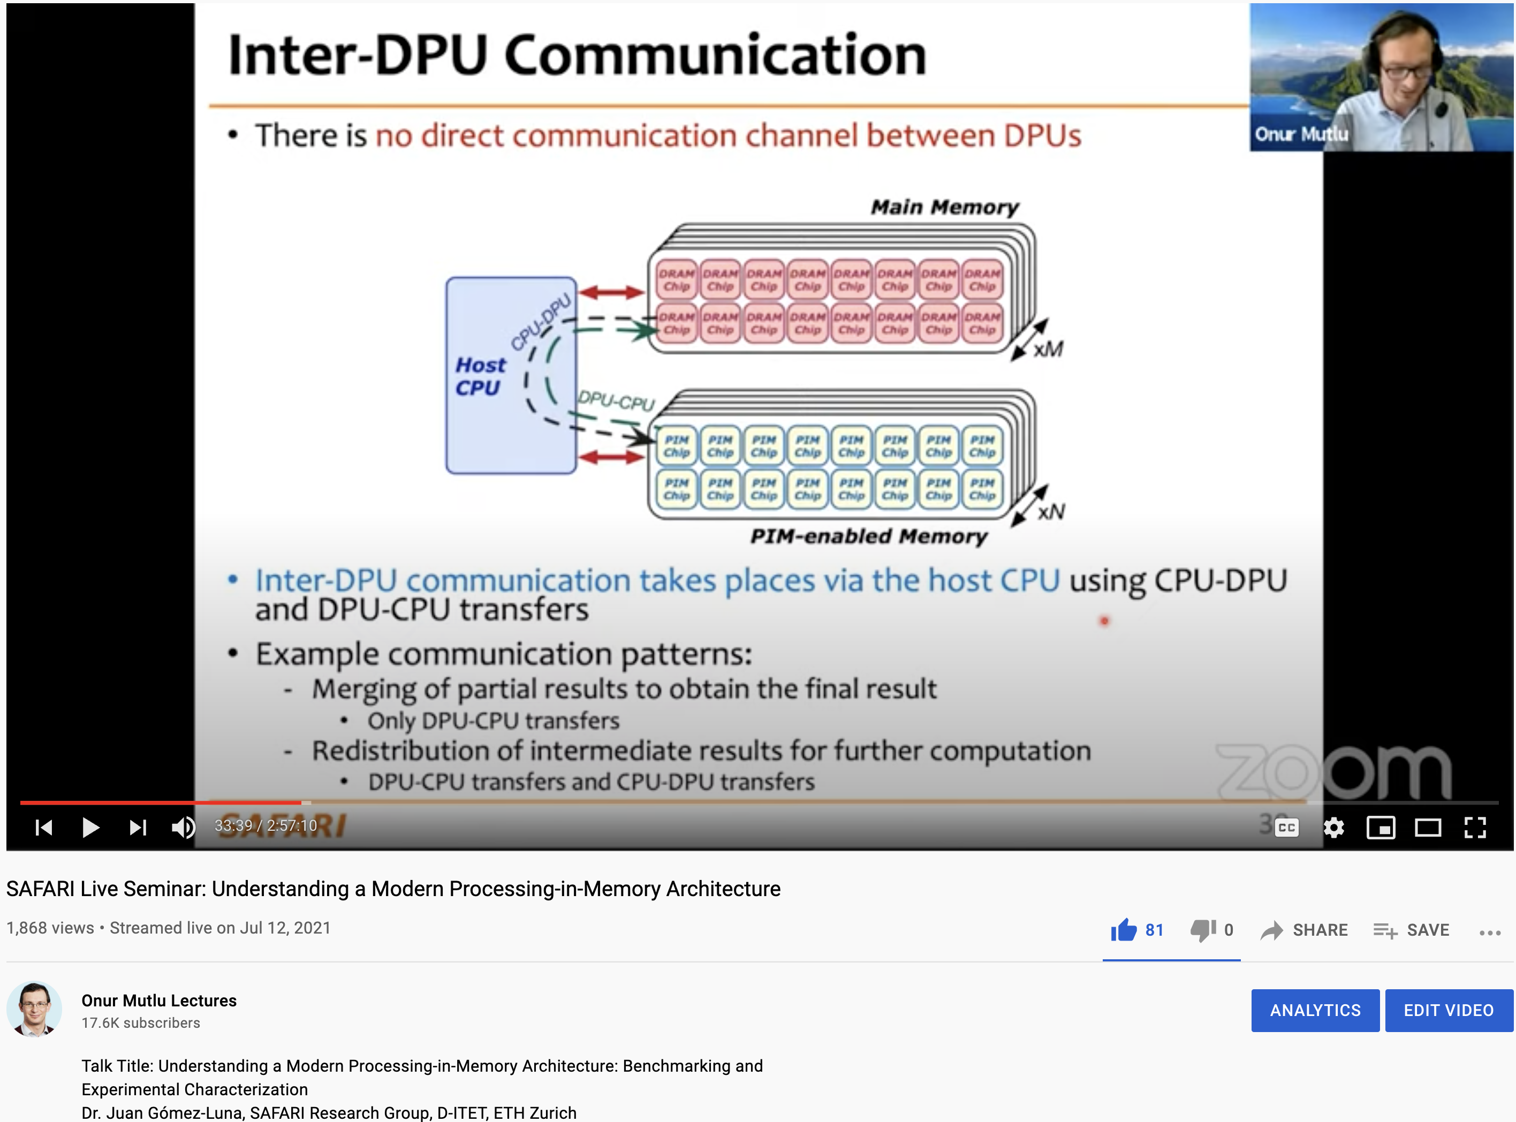
More on Analysis of the UPMEM PIM Engine
https://www.youtube.com/watch?v=D8Hjy2iU9l4&list=PL5Q2soXY2Zi_tOTAYm--dYByNPL7JhwR9

Slide 62
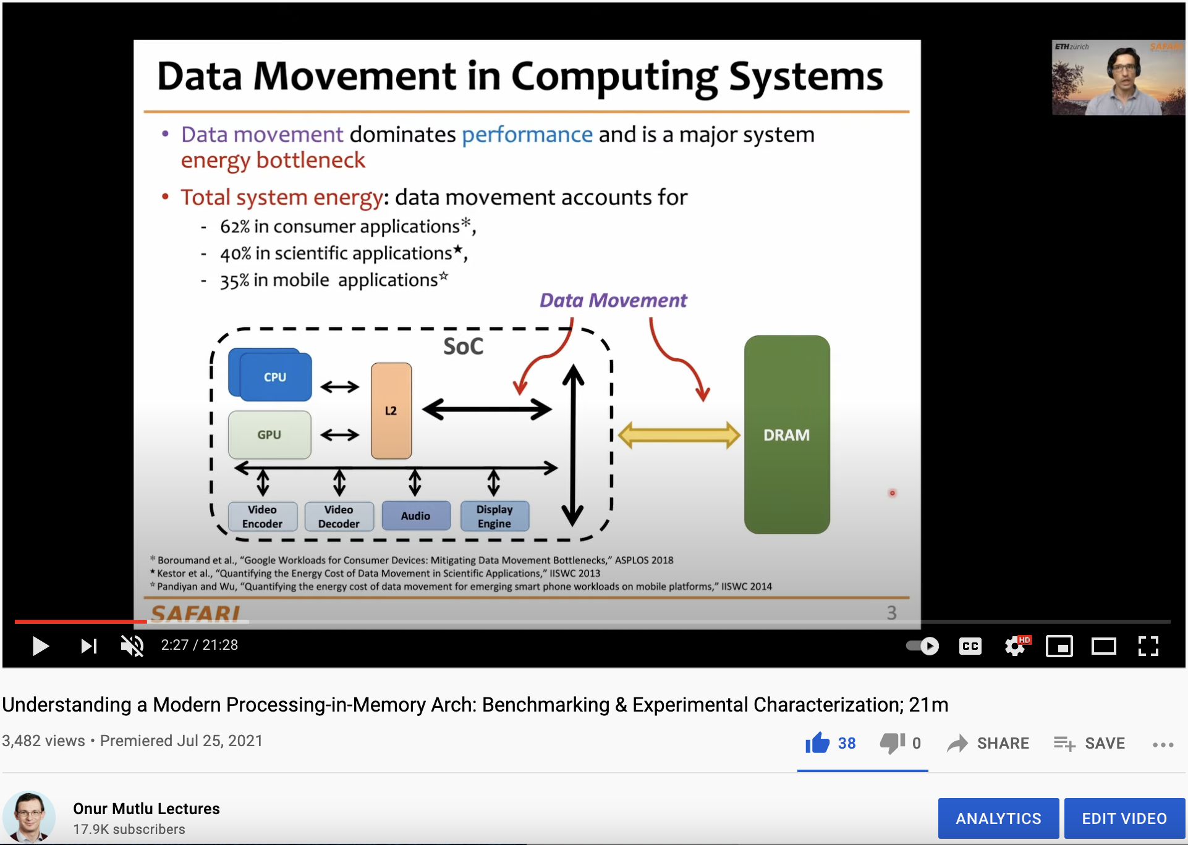
More on Analysis of the UPMEM PIM Engine
https://www.youtube.com/watch?v=Pp9jSU2b9oM&list=PL5Q2soXY2Zi8_VVChACnON4sfh2bJ5IrD&index=159

Slide 63
More on PRIM Benchmarks
Juan Gomez-Luna, Izzat El Hajj, Ivan Fernandez, Christina Giannoula, Geraldo F. Oliveira, and Onur Mutlu,
"Benchmarking a New Paradigm: An Experimental Analysis of a Real Processing-in-Memory Architecture"
Preprint in arXiv, 9 May 2021.
[arXiv preprint]
[PrIM Benchmarks Source Code]
[Slides (pptx) (pdf)]
[Long Talk Slides (pptx) (pdf)]
[Short Talk Slides (pptx) (pdf)]
[SAFARI Live Seminar Slides (pptx) (pdf)]
[SAFARI Live Seminar Video (2 hrs 57 mins)]
[Lightning Talk Video (3 minutes)]

Slide 64
UPMEM PIM System Summary & Analysis
Juan Gomez-Luna, Izzat El Hajj, Ivan Fernandez, Christina Giannoula, Geraldo F. Oliveira, and Onur Mutlu,
"Benchmarking Memory-Centric Computing Systems: Analysis of Real Processing-in-Memory Hardware"
Invited Paper at Workshop on Computing with Unconventional Technologies (CUT), Virtual, October 2021.
[arXiv version]
[PrIM Benchmarks Source Code]
[Slides (pptx) (pdf)]
[Talk Video (37 minutes)]
[Lightning Talk Video (3 minutes)]

Slide 65
Results So Far (2021-2022)
DAMOV: A New Methodology and Benchmark Suite for Evaluating Data Movement Bottlenecks [IEEE Access 2021]
Benchmarking a New Paradigm: Experimental Analysis and Characterization of a Real Processing-in-Memory System [IEEE Access 2022]
Google Neural Network Models for Edge Devices: Analyzing and Mitigating Machine Learning Inference Bottlenecks [PACT 2021]
Enabling High-Performance and Energy-Efficient Hybrid Transactional/Analytical Databases with Hardware/Software Cooperation [ICDE 2022]
FPGA-based Near-Memory Acceleration of Modern Data-Intensive Applications [IEEE Micro 2021]

Slide 66
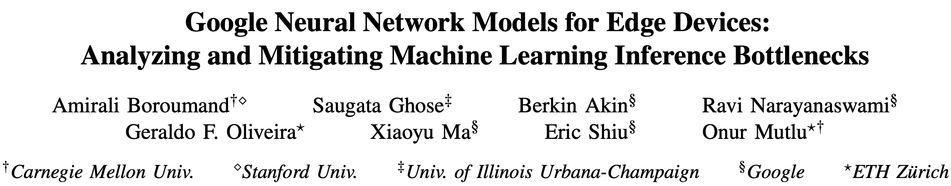
Data-Centric Neural Network Inference
Amirali Boroumand, Saugata Ghose, Berkin Akin, Ravi Narayanaswami, Geraldo F. Oliveira, Xiaoyu Ma, Eric Shiu, and Onur Mutlu,
"Google Neural Network Models for Edge Devices: Analyzing and Mitigating Machine Learning Inference Bottlenecks"
Proceedings of the 30th International Conference on Parallel Architectures and Compilation Techniques (PACT), Virtual, September 2021.
[Slides (pptx) (pdf)]
[Talk Video (14 minutes)]

Slide 67



Google Neural Network Models for Edge Devices:
Analyzing and Mitigating
Machine Learning Inference Bottlenecks
Amirali Boroumand Saugata Ghose Berkin Akin
Ravi Narayanaswami Geraldo F. Oliveira Xiaoyu Ma
Eric Shiu Onur Mutlu
PACT 2021
Notes:
Hi, I’m Geraldo, a PhD Student at ETH Zurich.
Today I will present our work “Google Neural Network Models for Edge Devices: Analyzing and Mitigating Machine Learning Inference Bottlenecks”
This work was lead by Amirali Boroumand during his internship at Google.

Slide 68
Executive Summary
Context: We extensively analyze a state-of-the-art edge ML accelerator (Google Edge TPU) using 24 Google edge models
  Wide range of models (CNNs, LSTMs, Transducers, RCNNs)
Problem: The Edge TPU accelerator suffers from three challenges:
  It operates significantly below its peak throughput
  It operates significantly below its theoretical energy efficiency
  It inefficiently handles memory accesses
  Key Insight: These shortcomings arise from the monolithic design of the Edge TPU accelerator
  The Edge TPU accelerator design does not account for layer heterogeneity
  Key Mechanism: A new framework called Mensa
  Mensa consists of heterogeneous accelerators whose dataflow and hardware are specialized for specific families of layers
  Key Results: We design a version of Mensa for Google edge ML models
  Mensa improves performance and energy by 3.0X and 3.1X
  Mensa reduces cost and improves area efficiency
Notes:
First, I will give an overview of this work.
[CLICK] In this work, we extensively analyze 24 edge NN models from Google while running inference on the Google Edge TPU accelerator for various types of NN models
[CLICK] We identify that while running NN inference, the accelerator suffers from three main challenges
[CLICK] it operates significantly below its peak throughput
[CLICK] it operates significantly below its theorical peak energy efficiency
[CLICK] and its memory system is not efficient
[CLICK] Our analysis leads to the key insight that these challenges arrive due to the monolithic one-size-fit-all design of the accelerators, which does not account for heterogeneity across different NN layers
[CLICK] To solve this issue, we propose Mensa, a framework that maps the execution of a particular NN layer to its most appropriate hardware accelerator
[CLICK] We extensively evaluate Mensa for Google NN models and we observe that it improves performance and energy efficiency by 3.0x and 3.1x compared to the baseline Edge TPU accelerator while reducing area and cost across 24 edge ML models
[NEXT]

Slide 69


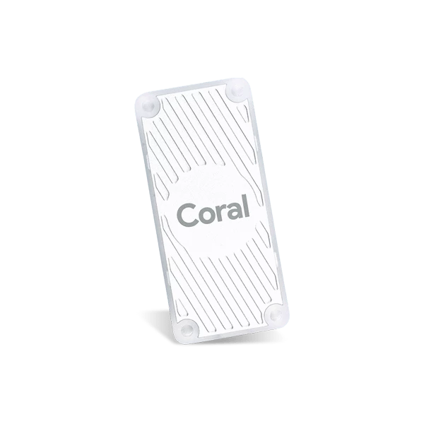


Google Edge NN Models
  We analyze inference execution using 24 edge NN models
6 RNN
Transducers
2 LSTMs
Speech Recognition
Language Translation
13 CNN
3 RCNN
Google Edge TPU
Face Detection
Image Captioning
Notes:
[CLICK] We analyze inference execution on the accelerator using 24 edge NN models that serve as internal benchmarks for the Google Edge TPU, including
[CLICK] 6 RNN Transducers, used for applications such as automatic speech recognition.
[CLICK] 13 convolutional neural networks (CNNs), typically used for applications such as image classification and object detection
[CLICK] 2 long short-term memories (LSTMs), used for applications such as language translation and and handwriting recognition, and
[CLICK] 3 recurrent convolutional neural networks (RCNNs), used for applications such as image captioning
[NEXT]

Slide 70
Diversity Across the Models
Insight 1: there is significant variation in terms of
layer characteristics across the models
Layers from
CNNs and RCNNs
Layers from
LSTMs and Transducers
Notes:
We draw key two insights from our model analysis
[CLICK] First, we observe a large variation in terms of layer characteristics across different models.
[CLICK] To illustrate, the figure shows the total parameter footprint vs. the FLOP/B ratio (or reuse) across the layers of representative CNNs, LSTMs, and Transducers
[CLICK] We observe from the figure that that layers from LSTMs and Transducers have larger parameter footprints and lower reuse than layers from CNNs.
[NEXT]

Slide 71
Diversity Within the Models
Insight 2: even within each model, layers exhibit
significant variation in terms of layer characteristics
For example, our analysis of edge CNN models shows:
1
2
Variation in MAC intensity: up to 200x across layers
Variation in FLOP/Byte: up to 244x across layers
Notes:
[CLICK] Second, even within a single model, layers show variation in terms of layer characteristics
[CLICK] For example, we observe that layers in a single CNN models show
[CLICK] a varying MAC intensity of up to 200x across different layers
and
[CLICK] a varying flop/byte ratio of up to 244x across different layers
[NEXT]

Slide 72
Root Cause of Accelerator Challenges
The key components of Google Edge TPU are completely
oblivious to layer heterogeneity
Dataflow
DRAM
PE Array
Buffer
Off-chip
bandwidth
Edge accelerators typically take a monolithic approach:
equip the accelerator with an over-provisioned PE array and
on-chip buffer, a rigid dataflow, and fixed off-chip bandwidth
  While this approach might work for a specific group of layers, it fails to efficiently execute inference across a wide variety of edge models
Notes:
[CLICK] The main conclusion of our analysis is that the key components of the Edge TPU are oblivious to the layer heterogeneity of different NN models and even within a single NN model
[CLICK] The monolithic design approach of the edge TPU leads to inefficiency and resources under-utilization, since the accelerator design over-provised the size of the PE array and on-chip buffer, while assuming a rigid dataflow and fixed off-chip memory bandwidth
[CLICK] leading to the three accelerator challenges related to performance, energy and memory we identified in our analysis
[NEXT]

Slide 73
Mensa Framework
  Goal: design an edge accelerator that can efficiently run
  inference across a wide range of different models and layers
  Instead of running the entire NN model on
  a monolithic accelerator:
1
  Mensa: a new acceleration framework for edge NN inference
2
Notes:
[CLICK] Based on our analysis and insights, the goal of our work is to design an edge NN accelerator that can efficiently run inference across a varying number of different models and layers.
[CLICK] To this end, instead of designing a one-size-fit-all monolithic accelerator
[CLICK] We propose Mensa, a new acceleration framework for NN inference
[NEXT]

Slide 74
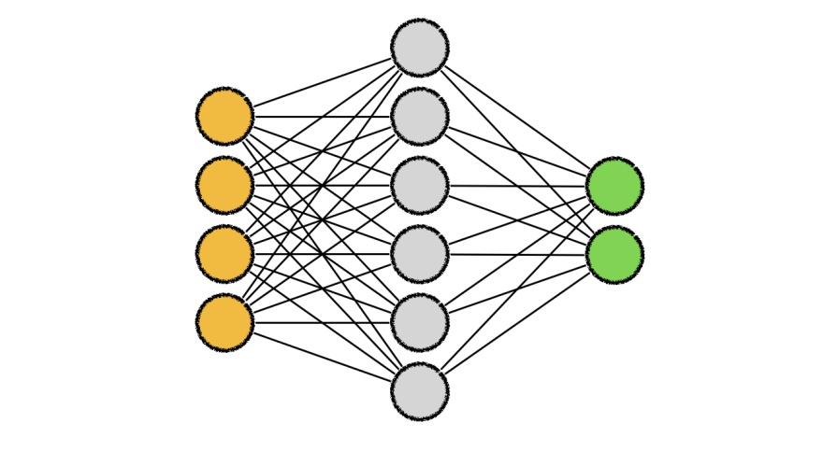
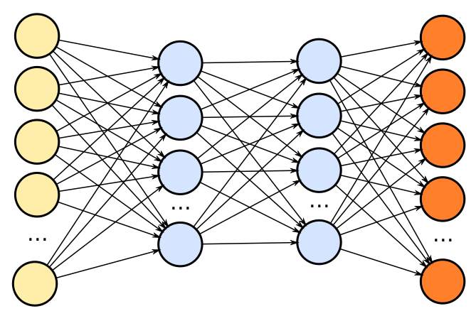
Mensa High-Level Overview
Edge TPU Accelerator
Mensa
Model A
Model B
Model C
Model A
Model B
Model C
Runtime
Family 1
Family 2
Family 3
PE
PE
PE
PE
PE
PE
PE
PE
PE
PE
PE
PE
PE
PE
PE
PE
Buffer
PE
PE
PE
PE
PE
PE
PE
PE
NoC
PE
PE
PE
PE
PE
PE
PE
PE
PE
PE
PE
PE
PE
PE
PE
PE
PE
PE
PE
PE
PE
PE
PE
PE
PE
PE
PE
PE
PE
PE
PE
PE
Buffer
PE
PE
PE
PE
PE
PE
PE
PE
Buffer
PE
PE
PE
PE
PE
PE
PE
PE
Buffer
PE
PE
PE
PE
PE
PE
PE
PE
PE
PE
PE
PE
PE
PE
PE
PE
PE
PE
PE
PE
PE
PE
PE
PE
PE
PE
PE
PE
PE
PE
PE
PE
PE
PE
PE
PE
PE
PE
PE
PE
NoC
NoC
NoC
PE
PE
PE
PE
PE
PE
PE
PE
PE
PE
PE
PE
PE
PE
PE
PE
PE
PE
PE
PE
PE
PE
PE
PE
PE
PE
PE
PE
PE
PE
PE
PE
PE
PE
PE
PE
PE
PE
PE
PE
PE
PE
PE
PE
PE
PE
PE
PE
Monolithic Accelerator
PE
PE
PE
PE
PE
PE
PE
PE
PE
PE
PE
PE
PE
PE
PE
PE
PE
PE
PE
PE
PE
PE
PE
PE
PE
PE
PE
PE
PE
PE
PE
PE
PE
PE
PE
PE
PE
PE
PE
PE
PE
PE
PE
PE
PE
PE
PE
PE
PE
PE
PE
PE
PE
PE
PE
PE
PE
PE
PE
PE
PE
PE
PE
PE
PE
PE
PE
PE
PE
PE
PE
PE
PE
PE
PE
PE
PE
PE
PE
PE
PE
PE
PE
PE
PE
PE
PE
PE
PE
PE
PE
PE
PE
PE
PE
PE
Acc. 1
Acc. 2
Acc. 3
Notes:
[CLICK ] In a baseline system, different machine learning models are execute in a single, monolithic edge accelerator, which leads to performance and energy issues.
[CLICK] On the other hand, Mensa distributes the layers from an NN model using a runtime scheduler across a collection of smaller hardware accelerators that are catered the properties of different layer types. By specializing each accelerator to a subset of layers, Mensa avoids the shortcomings of current monolithic edge ML accelerators, resulting in a highly-efficient and high-performance accelerator with a much smaller area.
Next I will give an brief overview of Mensa’s ruy
[NEXT]

Slide 75

Mensa Runtime Scheduler
  The goal of Mensa’s software runtime scheduler is to identify which accelerator each layer in an NN model should run on
Generated once
during initial setup
of a system
NN model
Accelerator characteristics
Scheduler
Layer
Mapping
Layer
characteristics
Each of the accelerators
caters to
a specific family of layers
Layers tend to group
together into a small
number of families
Notes:
[CLICK] The goal of Mensa’s software runtime scheduler is to identify which accelerator each layer in an NN model should run on. It works as follows
[CLICK] The scheduler gets a NN model as an input.
[CLICK] It also has two other pieces of information: (1) the characteristics of each layer; and (2) the key characteristics of the available hardware accelerators.
[CLICK] As I will show next, different layers tend to group into a smaller set of layer families with sharing key properties
[CLICK] In this way we can have a small pool of edge accelerators where each accelerator caters to a specific family of layers
[CLICK] We collect the characteristics of the accelerators and layers once prior to inference execution
[CLICK] With all this information, the scheduler generates a per-layer mapping between layers and accelerators by utilizing a mapping heuristic.
[NEXT].

Slide 76
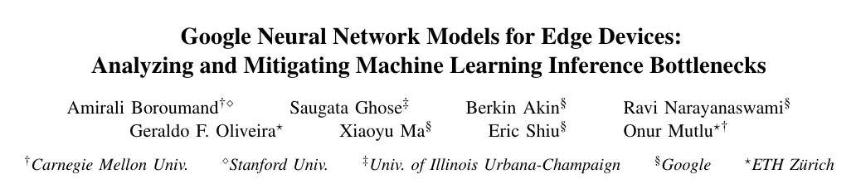
Mensa Runtime Scheduler
  The goal of Mensa’s software runtime scheduler is to identify which accelerator each layer in an NN model should run on
Generated once
during initial setup
of a system
NN model
Accelerator characteristics
Scheduler
Layer
Mapping
Layer
characteristics
Each of the accelerators
caters to
a specific family of layers
Layers tend to group
together into a small
number of families
Notes:
[We invite you to check our paper for more details about our scheduling heuristics.
[NEXT].

Slide 77
Mensa: Highly-Efficient ML Inference
Amirali Boroumand, Saugata Ghose, Berkin Akin, Ravi Narayanaswami, Geraldo F. Oliveira, Xiaoyu Ma, Eric Shiu, and Onur Mutlu,
"Google Neural Network Models for Edge Devices: Analyzing and Mitigating Machine Learning Inference Bottlenecks"
Proceedings of the 30th International Conference on Parallel Architectures and Compilation Techniques (PACT), Virtual, September 2021.
[Slides (pptx) (pdf)]
[Talk Video (14 minutes)]

Slide 78
Results So Far (2021-2022)
DAMOV: A New Methodology and Benchmark Suite for Evaluating Data Movement Bottlenecks [IEEE Access 2021]
Benchmarking a New Paradigm: Experimental Analysis and Characterization of a Real Processing-in-Memory System [IEEE Access 2022]
Google Neural Network Models for Edge Devices: Analyzing and Mitigating Machine Learning Inference Bottlenecks [PACT 2021]
Enabling High-Performance and Energy-Efficient Hybrid Transactional/Analytical Databases with Hardware/Software Cooperation [ICDE 2022]
FPGA-based Near-Memory Acceleration of Modern Data-Intensive Applications [IEEE Micro 2021]

Slide 79
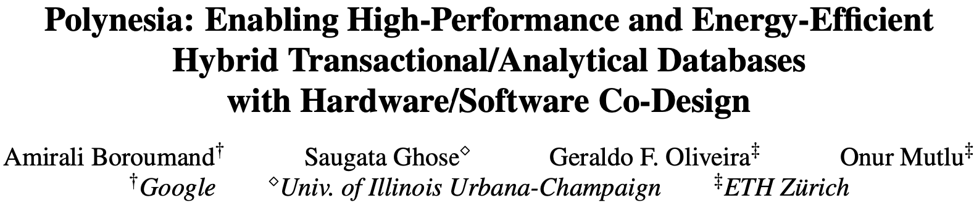
Accelerating HTAP Database Systems
Appears in ICDE 2022
https://arxiv.org/pdf/2204.11275.pdf

Slide 80
Results So Far (2021-2022)
DAMOV: A New Methodology and Benchmark Suite for Evaluating Data Movement Bottlenecks [IEEE Access 2021]
Benchmarking a New Paradigm: Experimental Analysis and Characterization of a Real Processing-in-Memory System [IEEE Access 2022]
Google Neural Network Models for Edge Devices: Analyzing and Mitigating Machine Learning Inference Bottlenecks [PACT 2021]
Enabling High-Performance and Energy-Efficient Hybrid Transactional/Analytical Databases with Hardware/Software Cooperation [ICDE 2022]
FPGA-based Near-Memory Acceleration of Modern Data-Intensive Applications [IEEE Micro 2021]

Slide 81
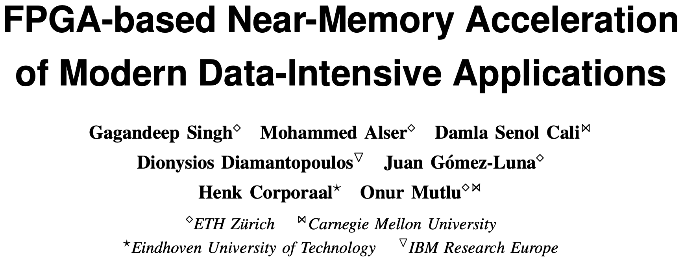
FPGA-based Processing Near Memory
Gagandeep Singh, Mohammed Alser, Damla Senol Cali, Dionysios Diamantopoulos, Juan Gómez-Luna, Henk Corporaal, and Onur Mutlu,
"FPGA-based Near-Memory Acceleration of Modern Data-Intensive Applications"
IEEE Micro (IEEE MICRO), 2021.

Slide 82
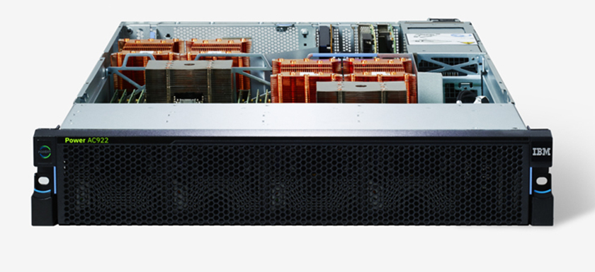
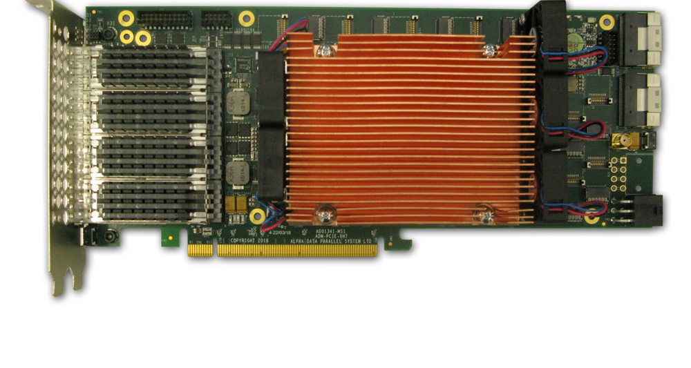
Near-Memory Acceleration Using FPGAs
OCAPI
Source: IBM
Source: AlphaData
IBM POWER9 CPU
HBM-based FPGA board
Near-HBM FPGA-based accelerator
Two communication technologies: CAPI2 and OCAPI
Two memory technologies: DDR4 and HBM
Two workloads: Weather Modeling and Genome Analysis
Notes:
To this end we build a [CLICK] near-HBM FPGA based accelerator which is connected to a server-grade IBM POWER9-based CPU system

Slide 83
Performance & Energy Greatly Improve
5-27× performance vs. a 16-core (64-thread) IBM POWER9 CPU
12-133× energy efficiency vs. a 16-core (64-thread) IBM POWER9 CPU
HBM alleviates memory bandwidth contention vs. DDR4
Notes:
[CLICK]

Slide 84
We Need to Revisit the Entire Stack
Problem
Algorithm
Program/Language
System Software
SW/HW Interface
Micro-architecture
Logic
Devices
Electrons
We can get there step by step

Slide 85
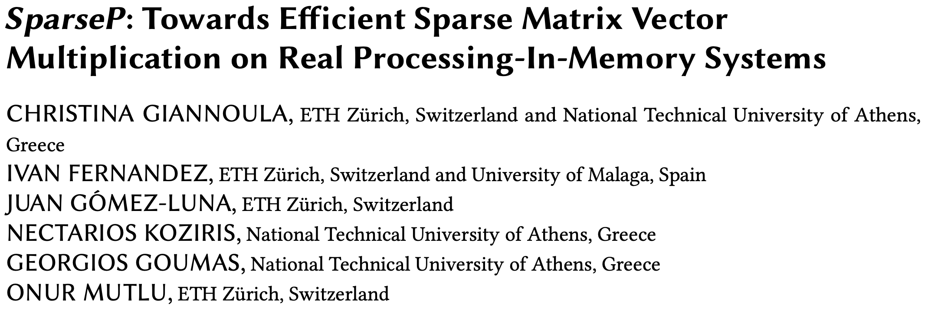
Coming Up: SpMV on Real PIM Systems
To appear in SIGMETRICS 2022
https://arxiv.org/pdf/2201.05072.pdf
https://github.com/CMU-SAFARI/SparseP

Slide 86
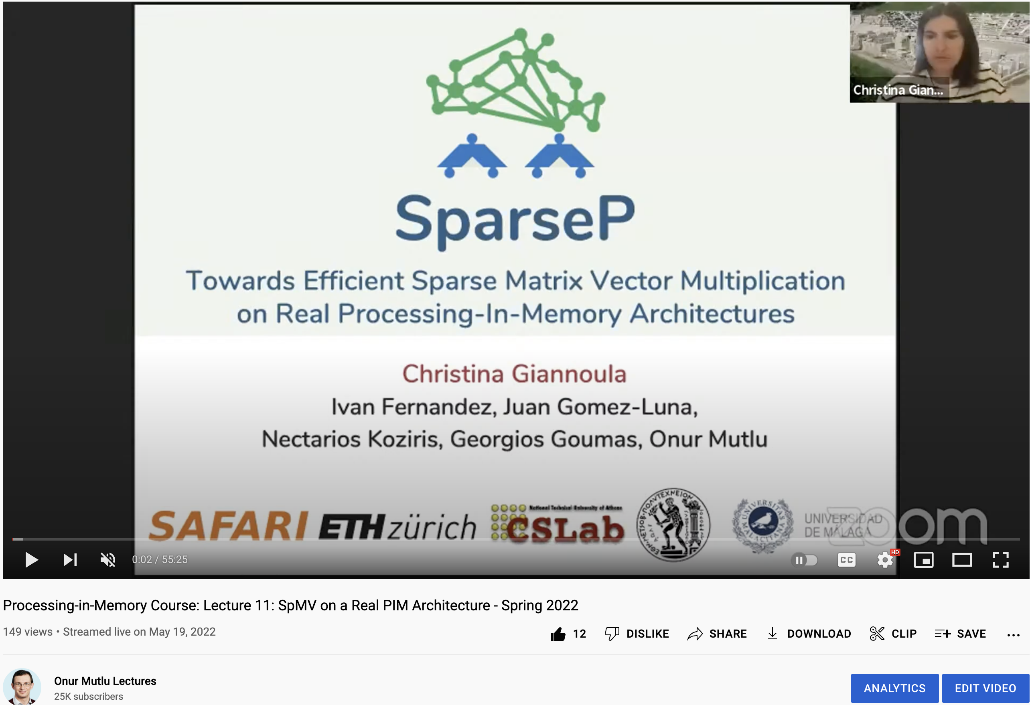
Coming Up: SpMV on Real PIM Systems
https://www.youtube.com/watch?v=5kaOsJKlGrE

Slide 87
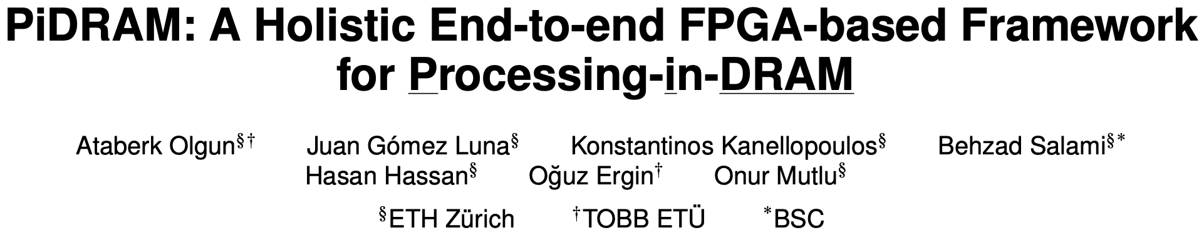
Coming Up: FPGA Framework for PuM
https://arxiv.org/pdf/2111.00082.pdf
https://github.com/cmu-safari/pidram

Slide 88
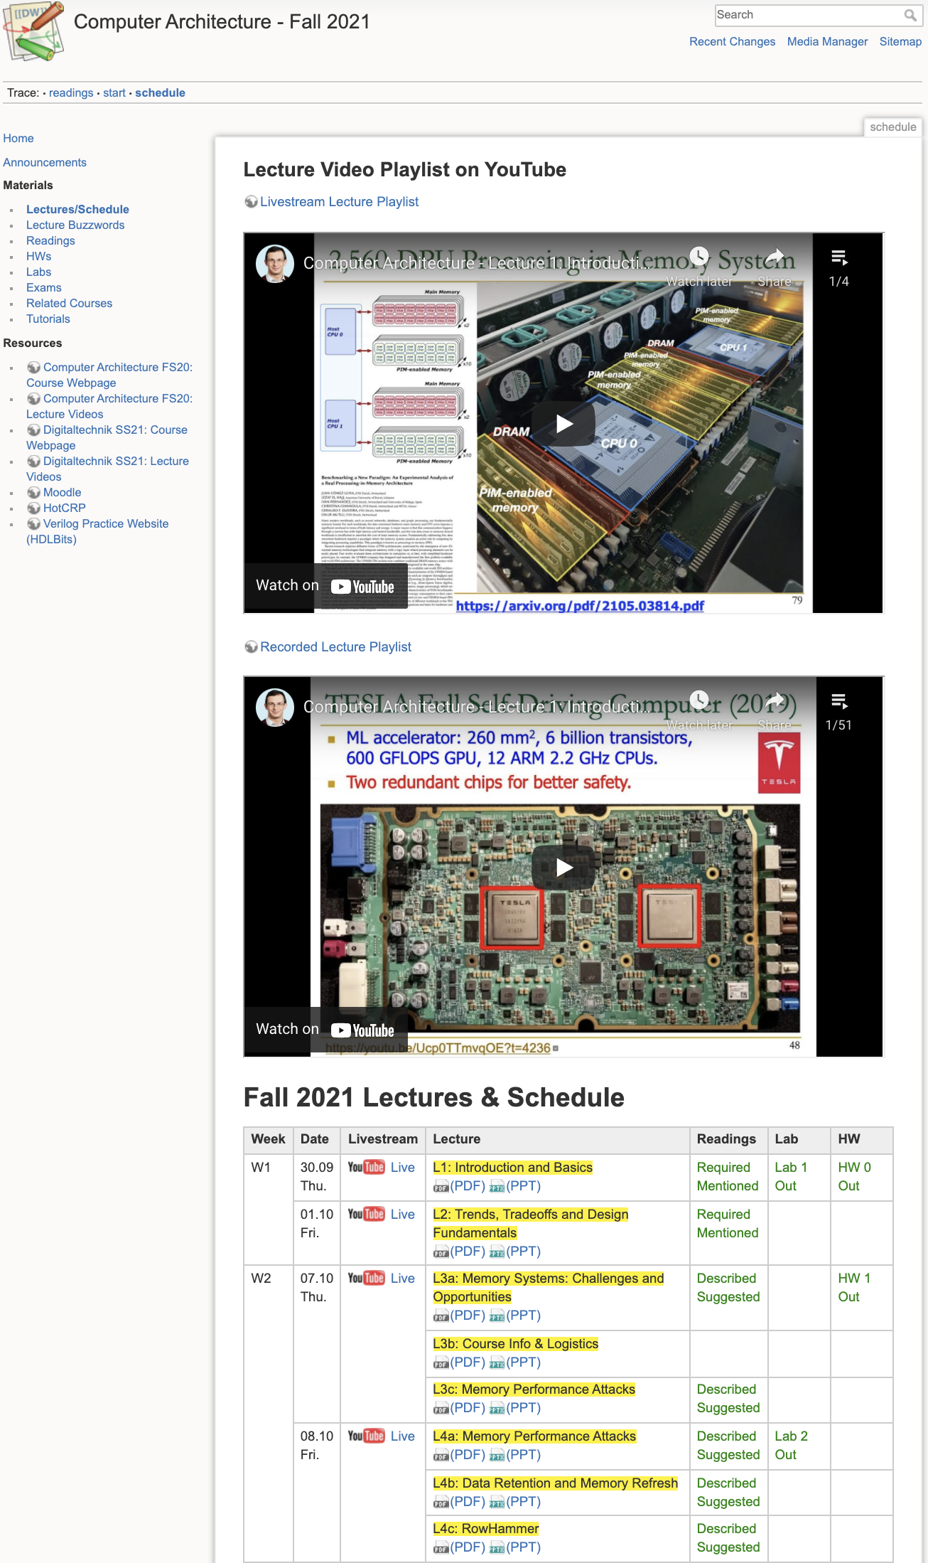
Comp Arch (Fall’21)
Fall 2021 Edition:
  https://safari.ethz.ch/architecture/fall2021/doku.php?id=schedule
Fall 2020 Edition:
  https://safari.ethz.ch/architecture/fall2020/doku.php?id=schedule
Youtube Livestream (2021):
  https://www.youtube.com/watch?v=4yfkM_5EFgo&list=PL5Q2soXY2Zi-Mnk1PxjEIG32HAGILkTOF
Youtube Livestream (2020):
  https://www.youtube.com/watch?v=c3mPdZA-Fmc&list=PL5Q2soXY2Zi9xidyIgBxUz7xRPS-wisBN
Master’s level course
  Taken by Bachelor’s/Masters/PhD students
  Cutting-edge research topics + fundamentals in Computer Architecture
  5 Simulator-based Lab Assignments
  Potential research exploration
  Many research readings
https://www.youtube.com/onurmutlulectures

Slide 89
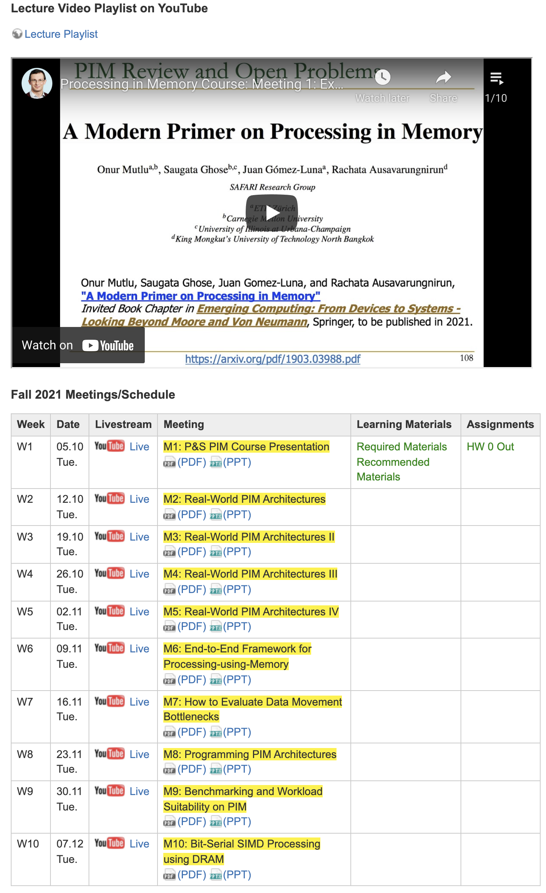
PIM Course (Fall’21)
Fall 2021 Edition:
  https://safari.ethz.ch/projects_and_seminars/fall2021/doku.php?id=processing_in_memory
Youtube Livestream:
  https://www.youtube.com/watch?v=9e4Chnwdovo&list=PL5Q2soXY2Zi-841fUYYUK9EsXKhQKRPyX
Project course
  Taken by Bachelor’s/Master’s students
  Processing-in-Memory lectures
  Hands-on research exploration
  Many research readings

Slide 90
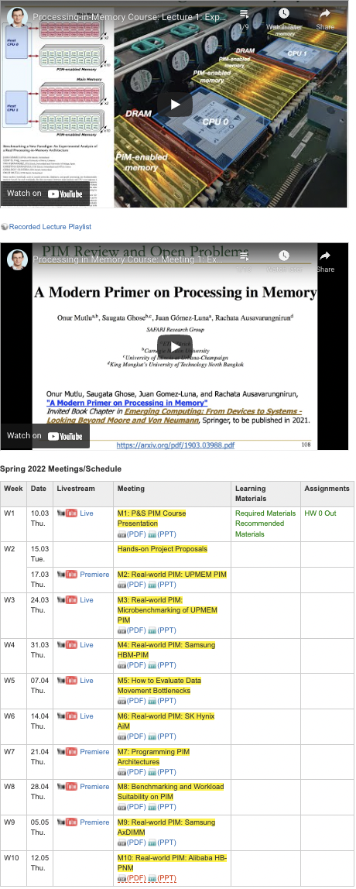
PIM Course (Current)
Spring 2022 Edition:
  https://safari.ethz.ch/projects_and_seminars/spring2022/doku.php?id=processing_in_memory
Youtube Livestream:
  https://www.youtube.com/watch?v=9e4Chnwdovo&list=PL5Q2soXY2Zi-841fUYYUK9EsXKhQKRPyX
Project course
  Taken by Bachelor’s/Master’s students
  Processing-in-Memory lectures
  Hands-on research exploration
  Many research readings

Slide 91
Current EFCL Projects
“A New Methodology and Open-Source Benchmark Suite for Evaluating Data Movement Bottlenecks: A Processing-in-Memory Case Study”
  Data-centric
“Machine-Learning-Assisted Intelligent Microarchitectures to Reduce Memory Access Latency”
  Data-driven
“Cross-layer Hardware/Software Techniques to Enable Powerful Computation and Memory Optimizations”
  Data-aware

Slide 92
Machine-Learning-Assisted
Intelligent Microarchitectures to Reduce Memory Access Latency
Rahul Bera, Gagandeep Singh,
Rakesh Nadig, Konstantinos Kanellopoulos,
Onur Mutlu

Slide 93
System Architecture Design Today
Human-driven
  Humans design the policies (how to do things)
Many (too) simple, short-sighted policies all over the system
No automatic data-driven policy learning
(Almost) no learning: cannot take lessons from past actions
Can we design
fundamentally intelligent architectures?

Slide 94
An Intelligent Architecture
Data-driven
  Machine learns the “best” policies (how to do things)
Sophisticated, workload-driven, changing, far-sighted policies
Automatic data-driven policy learning
All controllers are intelligent data-driven agents
How do we start?

Slide 95
Challenge and Opportunity for Future
Data-Driven
(Self-Optimizing)
Computing Architectures

Slide 96
Results So Far (2021-2022)
Pythia: A Customizable Hardware Prefetching Framework Using Online Reinforcement Learning [MICRO 2021]
Sibyl: Adaptive and Extensible Data Placement in Hybrid Storage Systems Using Online Reinforcement Learning [ISCA 2022]

Slide 97
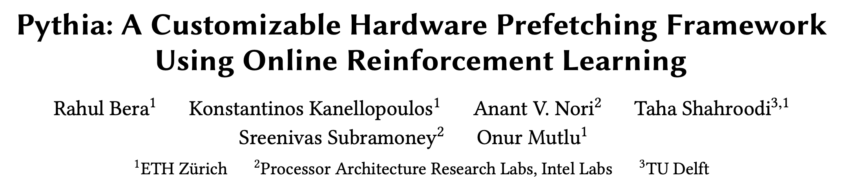
Self-Optimizing Memory Prefetchers
Rahul Bera, Konstantinos Kanellopoulos, Anant Nori, Taha Shahroodi, Sreenivas Subramoney, and Onur Mutlu,
"Pythia: A Customizable Hardware Prefetching Framework Using Online Reinforcement Learning"
Proceedings of the 54th International Symposium on Microarchitecture (MICRO), Virtual, October 2021.
[Slides (pptx) (pdf)]
[Short Talk Slides (pptx) (pdf)]
[Lightning Talk Slides (pptx) (pdf)]
[Talk Video (20 minutes)]
[Lightning Talk Video (1.5 minutes)]
[Pythia Source Code (Officially Artifact Evaluated with All Badges)]
[arXiv version]
https://arxiv.org/pdf/2109.12021.pdf

Slide 98






Pythia
A Customizable Hardware Prefetching Framework Using Online Reinforcement Learning
Rahul Bera, Konstantinos Kanellopoulos, Anant V. Nori,
Taha Shahroodi, Sreenivas Subramoney, Onur Mutlu
https://github.com/CMU-SAFARI/Pythia
Notes:
Hi I am Rahul. Today, I’m going to present our work “…”
This work is done by researchers from SAFARI research group at ETH Zurich, in collaboration with Intel Labs and TU Delft.

Slide 99
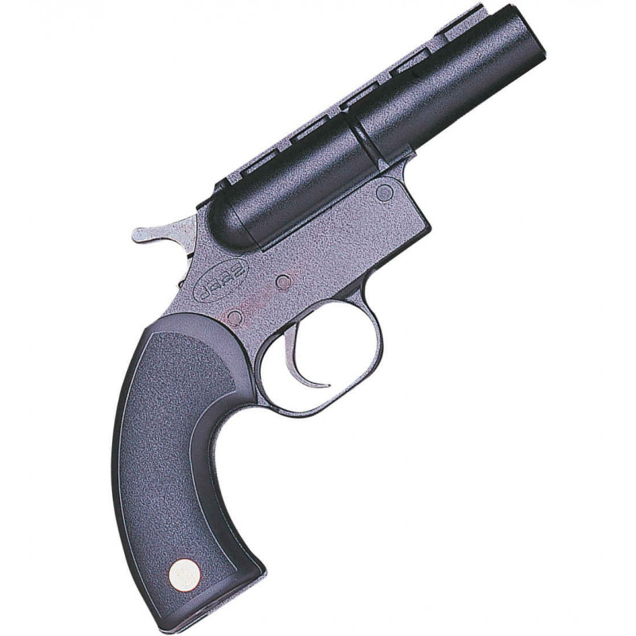

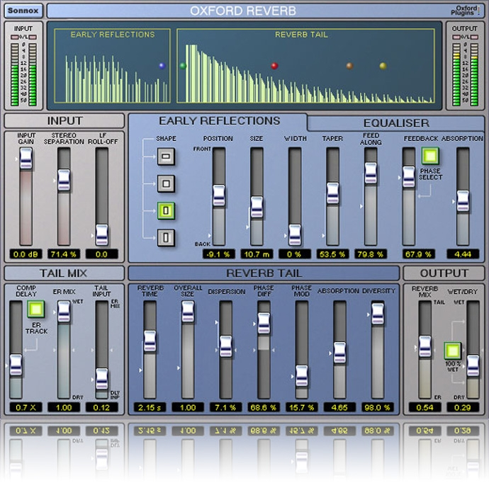
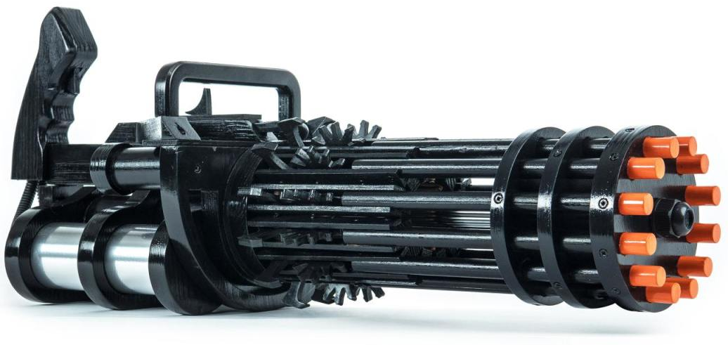

1
2
3
Mainly use one program context info. for prediction
Lack system awareness
Lack in-silicon customizability
Why prefetchers do not perform well?
Notes:
We analyze many prior prefetchers and observe three key shortcomings that significantly limits their performance.
[CLICK] First, they use mainly a single program context for prefetch prediction
[CLICK] Second, they lack system awareness
[CLICK] Third, they lack in-silicon customizability

Slide 100



Pythia
Autonomously learns to prefetch using multiple program context information
and system-level feedback
In-silicon customizable to change program context information or prefetching objective on the fly
Notes:
To alleviate these challenges, we introduce Pythia that:
[CLICK] autonomously learns to prefetch using multiple program context information and system-level feedback
[CLICK] and can be customizable in silicon to alter the program context information or the objective of the prefetcher

Slide 101
Basics of Reinforcement Learning (RL)
Algorithmic approach to learn to take an action in a given situation to maximize a numerical reward
Agent stores Q-values for every state-action pair
  Expected return for taking an action in a state
  Given a state, selects action that provides highest Q-value
Notes:
First, let me briefly describe the basics of reinforcement learning.
Reinforcement learning, in its simplest form, is the ...
A RL system contains two components: [CLICK] the agent and the environment.
The agent observes the state of the environment in every timestep [CLICK], takes an action based on the state [CLICK], and receives a reward for that action [CLICK].
[CLICK] The agent stores …
Given a state, the agent …

Slide 102
Brief Overview of Pythia
Pythia formulates prefetching as a reinforcement learning problem
Notes:
Pythia formulates prefetching as a reinforcement learning problem where,
[CLICK] the prefetcher acts as the agent, ….

Slide 103
Basic Pythia Configuration
Derived from automatic design-space exploration
State: 2 features
  PC+Delta
  Sequence of last-4 deltas
Actions: 16 prefetch offsets
  Ranging between -6 to +32. Including 0.
Rewards:
  R_{AT} = +20; R_{AL} = +12; R_{NP}-H=-2; R_{NP}-L=-4;
  R_{IN}-H=-14; R_{IN}-L=-8; R_{CL}=-12

Slide 104
More Detailed Pythia Overview
Q-Value Store: Records Q-values for all state-action pairs
Evaluation Queue: A FIFO queue of recently-taken actions
Find the Action with max Q-Value
A1
A2
A3
4
2
Look up
QVStore
Generate
prefetch
Demand Request
State
Vector
Memory
Hierarchy
S1
3
S2
Max
S3
S4
Q-Value Store
(QVStore)
6
Evict EQ entry and update QVStore
5
Evaluation Queue (EQ)
Insert prefetch action &
State-Action pair in EQ
1
7
Set filled bit
Assign reward to
corresponding EQ entry
Prefetch Fill
Notes:
Pythia consists of two key components:
[CLICK] Q-value store, which is responsible for …
[CLICK] Evaluation queue, which is a first-in-first-out queue that stores the recently taken action.
As Pythia cannot always immediately assign a reward to a taken action
because the usefulness of the corresponding prefetch request is known, Pythia stores the action
in evaluation queue to properly assign rewards to them.
[CLICK] For every demand request, Pythia first checks EQ with deamdned address. If a matching entry is found in EQ, it means the corresponding action in EQ entry has generated a useful prefetch, and Pythia assigns a reward accordingly.
[CLICK] Then Pythia extracts features from the attributes of the demand request to create the state-vector and uses the state-vector to lookup QVStore [CLICK]
[CLICK] For the given state-vector, Pythia finds the action that has the highest Q-value and generates prefetch request accordingly to the memory hierarchy [CLICK]
[CLICK] Next, Pythia inserts the action in the EQ along with the state-action pair.
[CLICK] Pythia uses the reward stored in the evicted EQ entry to update the QVStore.

Slide 105
Rigorous Evaluation Methodology
Champsim [3] trace-driven simulator
150 single-core memory-intensive workload traces
  SPEC CPU2006 and CPU2017
  PARSEC 2.1
  Ligra
  Cloudsuite
Homogeneous and heterogeneous multi-core mixes
Five state-of-the-art prefetchers
  SPP [Kim+, MICRO’16]
  Bingo [Bakhshalipour+, HPCA’19]
  MLOP [Shakerinava+, 3rd Prefetching Championship, 2019 ]
  SPP+DSPatch [Bera+, MICRO’19]
  SPP+PPF [Bhatia+, ISCA’20]
[3] https://github.com/ChampSim/ChampSim

Slide 106
1
We evaluate Pythia using a wide-range of workloads
Pythia improves performance by
3.4% and 3.8% in single-core
7.7% and 9.6% in twelve-core
16.9% and 20.2% in memory bandwidth-constrained core
over state-of-the-art MLOP and Bingo prefetchers
2
We gain 7.8% more performance on top of basic Pythia configuration by simply customizing reward values for graph workloads
3
Realistic, practical implementation
No complex structures, only simple tables.
Only 1.03% area and 0.4% power of a desktop-class processor
Notes:
[CLICK] We extensively evaluate Pythia over a wide range of workloads and show that Pythia outperforms many state-of-the-art prefetcher over a wide range of system configuration.
[CLICK] We also show that by simple customization via configuration registers, Pythia can provide higher performance benefits for target workloads, without any changes to the underlying hardware.
[CLICK] Finally, Pythia proposes a realistic implementation of its RL algorithm that incurs a modest area and power overhead on top of a traditional processor.

Slide 107
Performance with Varying Core Count
Pythia
3.4%
7.7%
SPP
MLOP
Bingo

Slide 108
Performance with Varying Core Count
1. Pythia consistently provides the highest performance in all core configurations
Pythia
7.7%
3.4%
SPP
2. Pythia’s gain increases with core count
MLOP
Bingo

Slide 109
Performance with Varying DRAM Bandwidth
3%
Pythia
Bingo
MLOP
Baseline
SPP
~Intel Xeon 6258R
~AMD EPYC Rome 7702P
17%
~AMD Threadripper 3990x

Slide 110
Performance with Varying DRAM Bandwidth
3%
Pythia
Bingo
MLOP
Baseline
SPP
~Intel Xeon 6258R
Pythia outperforms prior best prefetchers for
a wide range of DRAM bandwidth configurations
~AMD EPYC Rome 7702P
17%
~AMD Threadripper 3990x

Slide 111
A Lot More in the Paper
Performance comparison with unseen traces
  Pythia provides equally high performance benefits
Comparison against multi-level prefetchers
  Pythia outperforms prior best multi-level prefetchers
Understanding Pythia’s learning with a case study
  We reason towards the correctness of Pythia’s decision
Performance sensitivity towards different features and hyperparameter values
Detailed single-core and four-core performance
https://arxiv.org/pdf/2109.12021.pdf
Notes:
We have many more exciting results including, ….
We encourage everyone to read it.

Slide 112
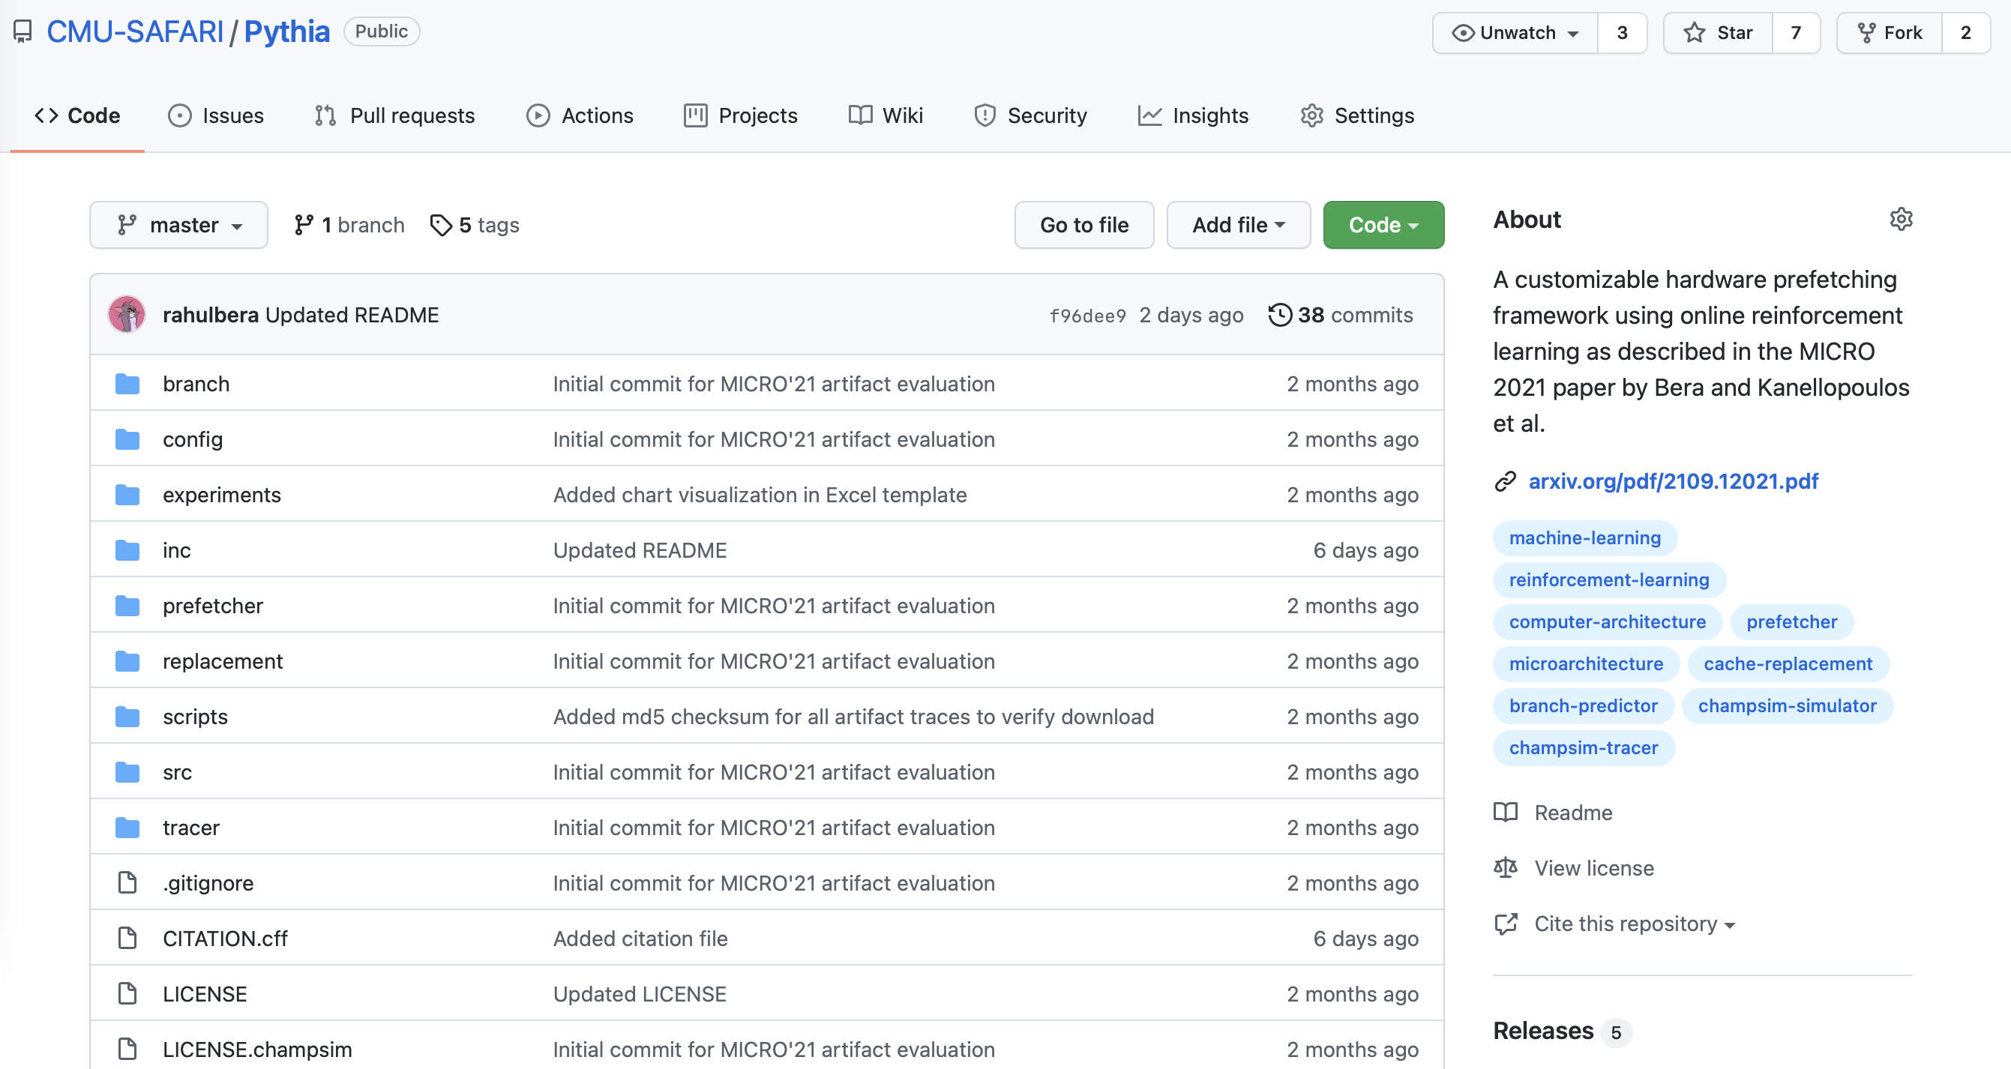
Pythia is Open Source
https://github.com/CMU-SAFARI/Pythia
MICRO’21 artifact evaluated
Champsim source code + Chisel modeling code
All traces used for evaluation

Slide 113
Pythia
A Customizable Hardware Prefetching Framework Using Online Reinforcement Learning
Rahul Bera, Konstantinos Kanellopoulos, Anant V. Nori,
Taha Shahroodi, Sreenivas Subramoney, Onur Mutlu
https://github.com/CMU-SAFARI/Pythia
Notes:
Hi I am Rahul. Today, I’m going to present our work “…”
This work is done by researchers from SAFARI research group at ETH Zurich, in collaboration with Intel Labs and TU Delft.

Slide 114
An Intelligent Architecture
Data-driven
  Machine learns the “best” policies (how to do things)
Sophisticated, workload-driven, changing, far-sighted policies
Automatic data-driven policy learning
All controllers are intelligent data-driven agents
We need to rethink design
(of all controllers)

Slide 115
Results So Far (2021-2022)
Pythia: A Customizable Hardware Prefetching Framework Using Online Reinforcement Learning [MICRO 2021]
Sibyl: Adaptive and Extensible Data Placement in Hybrid Storage Systems Using Online Reinforcement Learning [ISCA 2022]

Slide 116
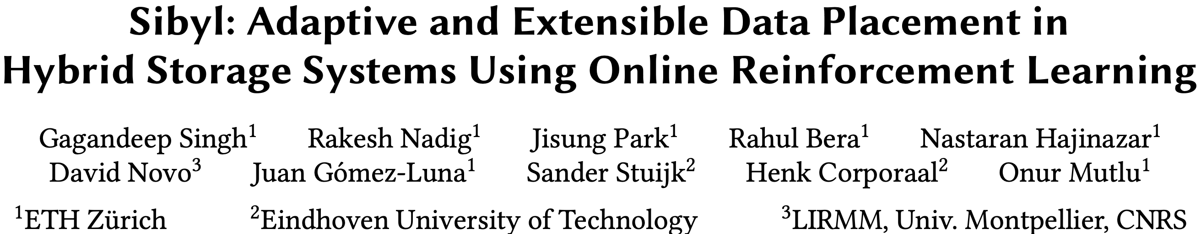
Self-Optimizing Hybrid Storage Systems
To appear in ISCA 2022
https://arxiv.org/pdf/2205.07394.pdf

Slide 117


Sibyl:
Adaptive and Extensible Data Placement in Hybrid Storage Systems Using Online Reinforcement Learning
Gagandeep Singh, Rakesh Nadig, Jisung Park, Rahul Bera, Nastaran Hajinazar, David Novo, Juan Gómez-Luna, Onur Mutlu

Slide 118
Executive Summary
Background: Hybrid storage systems (HSSs) complement different storage technologies to extend the overall capacity and reduce the system cost with minimal effect on the application performance
Problem: Accurately identify the performance-critical data of an application and placing it in the “best-fit” storage device. Three key shortcomings of prior data placement policies (heuristic-based and supervised learning-based) of hybrid storage systems:
Lack of adaptability
Lack of device awareness (e.g., read/write latencies of each device)
Lack of extensibility
Goal: Develop a new, efficient, and high performance data-placement mechanism for hybrid storage systems that can:
Dynamically derive an adaptive data-placement strategy by continuously learning and adapting to the application and underlying device characteristics
Easily extensible to incorporate a wide range of hybrid storage configurations.
Key Idea: Sibyl, an online reinforcement learning-based self-optimizing mechanism for data placement that:
Dynamically learns from past experiences and continuously adapts its policy to improve long-term performance by interacting with the hybrid storage system
Learns the asymmetry in the read/write latencies present in modern hybrid storage devices while taking into account the inherent characteristics of an application
Key Results: Sibyl is evaluated on a real system with multiple device configurations
Evaluated using a wide range of workloads from MSR Cambridge and Filebench
In a performance (cost) optimized hybrid storage configuration, Sibyl provides up to 21.6% (19.9%) performance improvement compared to prior data placement policies
On a tri-hybrid storage system, Sibyl outperforms a heuristics-based policy by 23.9% -48.2%
Sibyl achieves 80% performance of an oracle policy with storage overhead of 124.4 KiB

Slide 119
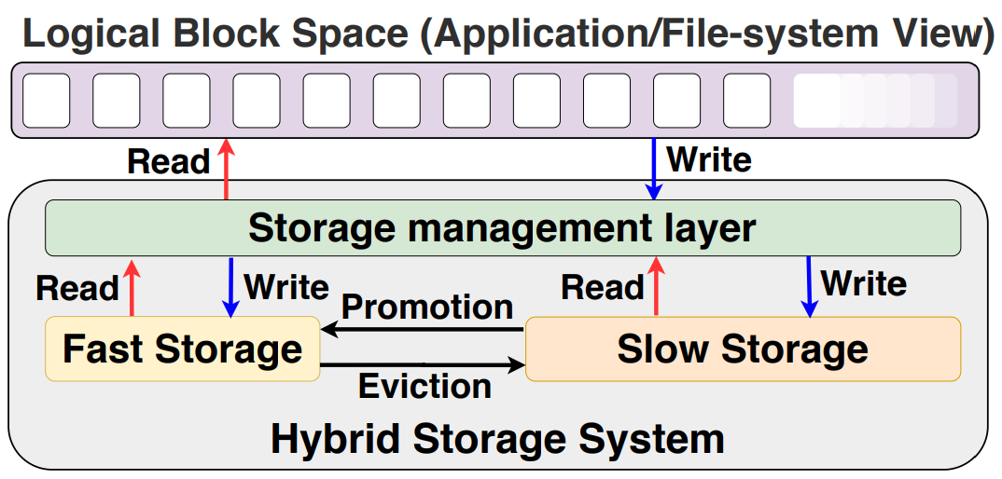
Hybrid Storage Systems

Slide 120
Key Shortcomings of Prior Data Placement Techniques
We observe three key shortcomings that significantly limit performance benefits of data-placement techniques
Lack of adaptability
Lack of device awareness
Lack of extensibility

Slide 121
Lack of Adaptability (1/2)
Prior heuristic-based techniques consider only a few characteristics (e.g., access frequency) to perform data placement
Statically tuned characteristics (based on fixed thresholds) are ineffective when used on a wide range of applications and system configurations
Supervised learning techniques need labeled data and frequent retraining to adapt to varying workloads and system conditions
Prior techniques offer 41.1% lower performance compared to an Oracle policy
Notes:
In contrast, traditional heuristics usually describe a request by recency, frequency, and/or size and use these features in isolation or combination to make rigid data placement decisions without system-level feedback.

Slide 122

Lack of Adaptability (2/2)
(a) Performance-optimized (H&M)
(b) Cost-optimized
(H&L)
CDE shows an average performance gap of 41.1% (32.6%) to Oracle for H&M (H&L)
HPS shows an average performance gap of 37.2% (55.5%) to Oracle for H&M (H&L)
Notes:
Cost-optimized (H&L)

Slide 123
Lack of Device Awareness
Prior data placement techniques:
do not adapt well to changes in underlying device characteristics (e.g., storage read latency)
do not consider the data migration cost between storage devices while making a data placement decision
are highly inefficient in hybrid storage systems that have devices with significantly different read/write latencies

Slide 124
Lack of Extensibility
Prior data placement techniques are typically designed for a hybrid storage system with only two storage devices
Significant effort is required to extend the data placement policies for more than two devices
Compared to a RL-based solution, a heuristic-based policy provides 48.2% lower performance when extended from two to three devices
Notes:
we evaluate the effectiveness of a state-of-the-art heuristic-based policy [77], which extends CDE [49] policy to a tri-hybrid storage system. This policy divides pages into hot, cold, and frozen data and allocates these pages to H, M, and L devices, respectively.

Slide 125
Our Goal
A data-placement mechanism that can
dynamically derive an adaptive data-placement strategy by continuously learning and adapting to the application and underlying device characteristics
be easily extended to incorporate a wide range of hybrid storage configurations

Slide 126

Basics of Reinforcement Learning
RL is a framework for decision making
  An autonomous agent observes the current state of the environment
  It interacts with the environment by taking actions
  Agent is rewarded or penalized based on the consequences of its actions
  Agent tries to maximize the cumulative reward
Notes:
Agent tries to maximize the reward function
Aims to calculate the optimal action-value function Q. Q-value represents the expected cumulative reward by taking an action A in a given state
State is a representation of the environment

Slide 127
Applying RL to Data Placement
Key factors in applying RL for data placement in a hybrid storage system
RL agent needs to be aware of:
  asymmetry in read/write latencies of a storage device
  differences in latencies across hybrid storage devices
  application access patterns
Data placement module should decide which actions to reward and penalize (credit assignment)
Low implementation overhead

Slide 128

RL State
Feature selection is performed to select only the most correlated features that affect data placement
Divide the states into a small number of bins to reduce the state space
Notes:
Second, we empirically observe that our RL agent is more sensitive to the reward structure than to the amount of features in the state
Specifically, using the request latency as a reward provides indirect feedback on the internal timing attributes and the current state of the hybrid storage system.

Slide 129

Reward
For every action at time-step t, Sibyl gets a reward from the environment at time-step t + 1
Reward acts as a feedback to the agent’s past action
Request latency faithfully captures the status of the hybrid storage system
Penalty value is chosen to prevent the agent from aggressively servicing all the requests from the faster device
L_{t} = latency of the request
R_{p} = eviction penalty
Notes:
We need the penalty at the correct scale so that it is large enough to penalize the agent and small enough not to deviate the learned policy too much on a wrong decision.
We use a half-precision floating-point representation datatype for our reward.

Slide 130

Overview of Sibyl
The two threads run asynchronously to prevent training delay from affecting the inference time

Slide 131

Hyper-parameter Tuning
Different hyper-parameter configurations were chosen using the design of experiments (DoE) technique
Notes:
we vary the discount factor (γ), which balances the immediate reward and the future reward. γ = 0, the agent gives more importance to the immediate reward than the long-term reward
Learning rate asserts the speed of learning for an agent. Higher alpha makes the agent consider only recently calculated Q-value
Epsilon factor determines the exploration vs exploitation. Epsilon decays over time from 1 to 0.1 and then settles down on a fixed exploration rate. In the beginning, the system makes completely random moves to explore the state maximally
ReLU is a piecewise linear function that will output the input directly if it is positive, otherwise, it will output 0
Swish is a smooth, non-monotonic function f(x) = x * sigmoid(X). It is a smoothing function which nonlinearly interpolates between linear and ReLU
For hyper-parameter tuning, we perform cross-validation [116] using different hyper-parameter values. During cross-validation, we randomly select one workload for hyper-parameter tuning and leave other workloads for validation.

Slide 132
Evaluation Methodology
Evaluated on a real system with different hybrid storage configurations
Hybrid storage system constitutes one contiguous logical block address space
A custom block driver was implemented to manage the I/O requests to the storage devices
We evaluate three different hybrid storage configurations
  Performance-optimized (H&M)
  Cost-optimized (H&L)
  Tri-hybrid storage system

Slide 133

Evaluation Methodology

Slide 134
Evaluation Methodology
18 different workloads from MSR Cambridge and FileBench suites
Sibyl is compared against four baselines
  Heuristic-based policies
    Cold data eviction (CDE) [Matsui et. al., “Design of Hybrid SSDs With Storage Class Memory and NAND Flash Memory,” IEEE 2017]
    History Page Scheduler (HPS) [Meswani et.al., “Heterogeneous Memory Architectures: A HW/SW Approach for Mixing Die-stacked and Off-package Memories,” HPCA, 2015]
  Supervised learning-based policies
    Recurrent neural network (RNN)-based technique adapted from Kleio [Doudali et.al., “Kleio: A Hybrid Memory Page Scheduler with Machine Intelligence,” HPDC, 2019]
    Neural network-based classifier based on Archivist [Ren et.al., “Archivist: A Machine Learning Assisted Data Placement Mechanism for Hybrid Storage Systems,” ICCD, 2019 ]
Notes:
Kleio - selects top pages based on misplacements by HPS and access frequency from the previous epoch. Trains RNNs for those top pages and RNNs predict the access frequency of those pages in the upcoming epoch
Archivist trains nn classifier to classify the pages to be placed in one of the devices. It uses access frequency to train the classifier. Does not take into account the capacity for the training.
Classifier considers all pages present in the mapping table

Slide 135

Latency Improvement
(a) Performance-optimized (H&M)
(b) Cost-optimized
(H&L)
Configuration | CDE | HPS | Archivist | RNN-HSS
H&M | 28.1% | 23.2% | 36.1% | 21.6%
H&L | 19.9% | 45.9% | 68.8% | 34.1%

Slide 136
Throughput Improvement
(a) Performance-optimized (H&M)
(b) Cost-optimized
(H&L)
Configuration | CDE | HPS | Archivist | RNN-HSS
H&M | 32.6% | 21.9% | 54.2% | 22.7%
H&L | 22.8% | 49.1% | 86.9% | 41.9%

Slide 137

Latency in Tri-Hybrid System
Sibyl outperforms the heuristic-based data placement policy for tri-hybrid system by 48.2% on average across all workloads
Notes:
To extend Sibyl for the three devices, we had to only: (1) add a new action in Sibyl’s action space, and (2) add remaining capacity in the middle device as a state feature. This reduces system architects burden in designing sophisticated data-placement mechanisms.

Slide 138

Latency for Unseen Workloads
In H&M (H&L) configurations, Sibyl outperforms RNN-HSS and Archivist by 46.1% (54.6%) and 8.5% (44.1%) respectively

Slide 139

Sensitivity to Fast Storage Capacity

Slide 140

Sensitivity to Fast Storage Capacity
Sibyl consistently provides highest performance by dynamically adapting its data-placement policy

Slide 141
Overhead Analysis
Performance Overhead
  ~10ns for every inference on the evaluated system; this is several orders of magnitude less than I/O latency of high-end SSD
Implementation Overhead
  124.4 KiB of implementation overhead
Metadata overhead
  0.1% of the total storage capacity when using a 4 KiB data placement granularity
  40-bit metadata overhead per data placement unit
Notes:
Therefore, to store a single experience tuple ⟨State, Action, Reward, NextState⟩, we would need 40-bit+1-bit+16-bit+40-bit. Therefore, for 1k experiences the replay buffer would require a total of 94.7 KiB.

Slide 142
For More on Sybil
To appear in ISCA 2022
https://arxiv.org/pdf/2205.07394.pdf

Slide 143
Current EFCL Projects
“A New Methodology and Open-Source Benchmark Suite for Evaluating Data Movement Bottlenecks: A Processing-in-Memory Case Study”
  Data-centric
“Machine-Learning-Assisted Intelligent Microarchitectures to Reduce Memory Access Latency”
  Data-driven
“Cross-layer Hardware/Software Techniques to Enable Powerful Computation and Memory Optimizations”
  Data-aware

Slide 144
Cross-layer Hardware/Software Techniques to Enable Powerful
Computation and Memory Optimizations
Ataberk Olgun, Konstantinos Kanellopoulos, Nisa Bostanci
Onur Mutlu

Slide 145
Data-Aware Architectures
A data-aware architecture understands what it can do with and to each piece of data
It makes use of different properties of data to improve performance, efficiency and other metrics
  Compressibility
  Approximability
  Locality
  Sparsity
  Criticality for Computation X
  Access Semantics
  …

Slide 146

One Problem: Limited Expressiveness

Slide 147

A Solution: More Expressive Interfaces

Slide 148
Challenge and Opportunity for Future
Data-Aware
(Expressive)
Computing Architectures

Slide 149
Results So Far (2021-2022)
MetaSys: A Practical Open-Source Metadata Management System to Implement and Evaluate Cross-Layer Optimizations [ACM TACO 2022]

Slide 150

MetaSys Open Source Framework
Appears in ACM TACO 2022
https://arxiv.org/pdf/2105.08123.pdf

Slide 151


MetaSys
A Practical Open-Source Metadata Management System to Implement and Evaluate
Cross-Layer Optimizations
Nandita Vijaykumar
Ataberk Olgun, Konstantinos Kanellopoulos, F. Nisa Bostanci
Hasan Hassan, Mehrshad Lotfi, Phillip B. Gibbons, Onur Mutlu

Slide 152
Executive Summary
Problem
Cross-layer techniques are challenging to implement because they require full-stack changes
Existing open-source infrastructures for implementing cross-layer techniques are not designed to provide key features
Key Idea – Provide:
Rich dynamic HW/SW interfaces
Low-overhead metadata management
Interfaces to key hardware components (e.g., prefetcher, caches)
Our goal is twofold:
Develop an efficient and flexible framework to enable rapid implementation of new cross-layer techniques
Perform a detailed limit study to quantify the overheads associated with general metadata systems
Notes:
HW-SW cooperative, cross-layer techniques can greatly improve performance, QoS and security of general purpose processors.
[CLICK] These techniques are hard to implement because they require changes across the whole stack,
[CLICK] and existing open-source infrastructure for implementing these techniques are not designed to facilitate the implementation of new techniques
[CLICK] MetaSys’s key idea is to provide a rich dynamic cross-layer interface to enable a large variety of cross-layer optimizations,
a low-overhead metadata management subsystem to efficiently support cross-layer optimizations,
and standardized interfaces to important hardware components to enable quick integration of cross-layer optimizations
[CLICK] Our goal in MetaSys is two-fold:
First, we want to develop a new efficient and flexible framework enable quick implementation of new cross-layer techniques
Second, using this infrastructure we want to perform a detailed characterization study to quantify the overheads of general metadata systems

Slide 153

The Atom Abstraction
An abstraction to express data semantics
Unique Atom ID
Data Value Properties:
  INT, FLOAT, CHAR,…
  COMPRESSIBLE
Access Properties:
  Read-Write Characteristics
  Access Pattern
  Access Intensity
Data Locality:
Working Set
Reuse
…
Atom: X
Program
Attributes
Mapping
State
Atom
Valid/invalid at current execution point
Notes:
We use [CLICK] ATOMs to represent metadata in main memory.
[CLICK] An ATOM is mapped to a region in memory that typically [CLICK] contains a data structure
[CLICK] It encapsulates higher-level program information in its program attributes
[CLICK] And it maintains a simple state that indicates whether it is valid at a point in time
[CLICK] ATOMs are identified by unique ids

Slide 154
The Software Interface
Three Atom operators
Atom
1. CREATE
Atom
2. MAP/UNMAP
Create ID, Metadata
Program
Attributes
Mapping
Map ID, Start Addr., Size
Map2D ID, …
State
3. ACTIVATE/DEACTIVATE
Activate ID
Deactivate ID
Notes:
MetaSys exposes operations to manipulate an atom
[CLICK] Using the CREATE operation, programmers can modify program attributes
[CLICK] Using MAP/UNMAP operations, programmers can map atoms to data structures
And [CLICK] Using ACTIVATE/DEACTIVATE operations, programmers can validate or invalidate an ATOM
[CLICKx3] We expose these three classes of operations as instructions in MetaSys

Slide 155
MetaSys Key Structures
Metadata Mapping Table
Metadata Mapping Cache
Memory Address | Atom ID
TLB
Atom ID
Attribute Table
Resides in Main Memory
Attributes
Metadata Lookup Unit
Virtual Address
Optimization
Client
Metadata Mapping Cache
Notes:
In this slide I will describe the key structures in MetaSys, and how a hardware module (or an optimization client) can retrieve program attributes to ultimately perform some optimization.
[CLICK] The optimization client is the hardware module that wants to retrieve some metadata to perform an optimization
[CLICK] It accesses the metadata (or atom) lookup unit using a virtual address, which looks up the metadata mapping cache that stores mappings between addresses and atom IDs
[CLICK] The Metadata lookup unit will translate the virtual address by accessing the TLB and then
[CLICK] access the metadata mapping table that resides in main memory.
[CLICK] The lookup unit will retrieve a valid mapping from the mapping table and place it in the metadata mapping cache
[CLICK] Finally, it will access the attribute table which stores metadata or attributes and [CLICK] convey it to the optimization client
Example optimization client: Dcache deciding on which cache block to replace

Slide 156


FPGA Prototype
Prototype on Xilinx Zedboard
within a real RISC-V system (Rocket Chip)
Zedboard
Rocket Chip
Notes:
We developed a prototype of MetaSys on the Zedboard FPGA that is integrated into the RISC-V rocket chip system
The figure on the right depicts a typical configuration of the rocket chip system. The system is pretty simple, in-order rocket cores execute RISC-V programs, small L1 caches and an accelerator that is tightly integrated with the l1 subsystem. It connects to a DRAM device over the AXI interface.

Slide 157
MetaSys in Rocket Chip
Implement two main components:
Atom Controller
  Manages the attribute table (CREATE – (DE)ACTIVATE)
  Performs atom mapping (MAP/UNMAP)
    Physical address → Atom ID
Metadata Lookup Unit
  Responds to clients:
    Provides atom attributes
  Contains the metadata mapping cache
Notes:
We make two modifications to rocket chip
[CLICK] We implement the atom controller which executes all MetaSys instructions
[CLICK] and the metadata lookup unit performs metadata lookups by accessing the metadata table in main memory

Slide 158

MetaSys is Open Source
https://github.com/CMU-SAFARI/MetaSys
Notes:
We fully open sourced our implementation on Github and you can access it using the link in this slide.

Slide 159

Performance Overhead
Metadata lookups occur low performance overheads
2.7% on average
Notes:
X-axis: Workloads
Y-axis: Execution time normalized to baseline without general metadata support (no lookups)
Bars: represent the execution time when we perform a lookup per L1 miss, and per memory access

Slide 160

Impact of Tagging Granularity on TLB misses
Fine tagging granularities increase TLB misses

Slide 161
MetaSys
A Practical Open-Source Metadata Management System to Implement and Evaluate
Cross-Layer Optimizations
Nandita Vijaykumar
Ataberk Olgun, Konstantinos Kanellopoulos, F. Nisa Bostanci
Hasan Hassan, Mehrshad Lotfi, Phillip B. Gibbons, Onur Mutlu

Slide 162
Results So Far (2021-2022)
Many Educational and Outreach Efforts
  11 Different Courses (livestreamed & recorded)
  Tutorials
  Keynote Talks
  Invited Talks
  Conference & Workshop Talks
  …
All are freely available on our YouTube Channel
  https://www.youtube.com/onurmutlulectures

Slide 163
A Detailed Tutorial
Onur Mutlu,
"Memory-Centric Computing"
Education Class at Embedded Systems Week (ESWEEK), Virtual, 9 October 2021.
[Slides (pptx) (pdf)]
[Abstract (pdf)]
[Talk Video (2 hours, including Q&A)]
[Invited Paper at DATE 2021]
["A Modern Primer on Processing in Memory" paper]
https://www.youtube.com/watch?v=N1Ac1ov1JOM
https://www.youtube.com/onurmutlulectures

Slide 164

Latest Longer & Detailed Tutorial on PIM
Onur Mutlu,
"Memory-Centric Computing"
Education Class at Embedded Systems Week (ESWEEK), Virtual, 9 October 2021.
[Slides (pptx) (pdf)]
[Abstract (pdf)]
[Talk Video (2 hours, including Q&A)]
[Invited Paper at DATE 2021]
["A Modern Primer on Processing in Memory" paper]
https://www.youtube.com/watch?v=N1Ac1ov1JOM&list=PL5Q2soXY2Zi8D_5MGV6EnXEJHnV2YFBJl&index=65
https://www.youtube.com/watch?v=N1Ac1ov1JOM
https://www.youtube.com/onurmutlulectures

Slide 165
Online Courses & Lectures
First Computer Architecture & Digital Design Course
  Digital Design and Computer Architecture
  Spring 2022 Livestream Edition: https://www.youtube.com/watch?v=cpXdE3HwvK0&list=PL5Q2soXY2Zi97Ya5DEUpMpO2bbAoaG7c6
  Spring 2021 Livestream Edition: https://www.youtube.com/watch?v=LbC0EZY8yw4&list=PL5Q2soXY2Zi_uej3aY39YB5pfW4SJ7LlN
Advanced Computer Architecture Course
  Computer Architecture
  Fall 2021 Livestream Edition: https://www.youtube.com/watch?v=4yfkM_5EFgo&list=PL5Q2soXY2Zi-Mnk1PxjEIG32HAGILkTOF
  Fall 2020 Edition: https://www.youtube.com/watch?v=c3mPdZA-Fmc&list=PL5Q2soXY2Zi9xidyIgBxUz7xRPS-wisBN
https://www.youtube.com/onurmutlulectures

Slide 166
Comp Arch (Fall’21)
Fall 2021 Edition:
  https://safari.ethz.ch/architecture/fall2021/doku.php?id=schedule
Fall 2020 Edition:
  https://safari.ethz.ch/architecture/fall2020/doku.php?id=schedule
Youtube Livestream (2021):
  https://www.youtube.com/watch?v=4yfkM_5EFgo&list=PL5Q2soXY2Zi-Mnk1PxjEIG32HAGILkTOF
Youtube Livestream (2020):
  https://www.youtube.com/watch?v=c3mPdZA-Fmc&list=PL5Q2soXY2Zi9xidyIgBxUz7xRPS-wisBN
Master’s level course
  Taken by Bachelor’s/Masters/PhD students
  Cutting-edge research topics + fundamentals in Computer Architecture
  5 Simulator-based Lab Assignments
  Potential research exploration
  Many research readings
https://www.youtube.com/onurmutlulectures

Slide 167
PIM Course (Current)
Spring 2022 Edition:
  https://safari.ethz.ch/projects_and_seminars/spring2022/doku.php?id=processing_in_memory
Youtube Livestream:
  https://www.youtube.com/watch?v=9e4Chnwdovo&list=PL5Q2soXY2Zi-841fUYYUK9EsXKhQKRPyX
Project course
  Taken by Bachelor’s/Master’s students
  Processing-in-Memory lectures
  Hands-on research exploration
  Many research readings

Slide 168
PIM Course (Fall’21)
Fall 2021 Edition:
  https://safari.ethz.ch/projects_and_seminars/fall2021/doku.php?id=processing_in_memory
Youtube Livestream:
  https://www.youtube.com/watch?v=9e4Chnwdovo&list=PL5Q2soXY2Zi-841fUYYUK9EsXKhQKRPyX
Project course
  Taken by Bachelor’s/Master’s students
  Processing-in-Memory lectures
  Hands-on research exploration
  Many research readings

Slide 169

Hetero. Systems (Fall’21)
Fall 2021 Edition:
  https://safari.ethz.ch/projects_and_seminars/fall2021/doku.php?id=heterogeneous_systems
Youtube Livestream:
  https://www.youtube.com/watch?v=QY_bjwzsfMM&list=PL5Q2soXY2Zi_OwkTgEyA6tk3UsoPBH737
Project course
  Taken by Bachelor’s/Master’s students
  GPU and Parallelism lectures
  Hands-on research exploration
  Many research readings

Slide 170

Genomics (Fall 2021)
Fall 2021 Edition:
  https://safari.ethz.ch/projects_and_seminars/fall2021/doku.php?id=bioinformatics
Youtube Livestream:
  https://www.youtube.com/watch?v=MnogTeMjY8k&list=PL5Q2soXY2Zi8sngH-TrNZnDhDkPq55J9J
Project course
  Taken by Bachelor’s/Master’s students
  Genomics lectures
  Hands-on research exploration
  Many research readings

Slide 171


HW/SW Co-Design (Spring 2022)
Spring 2022 Edition:
  https://safari.ethz.ch/projects_and_seminars/spring2022/doku.php?id=hw_sw_codesign
Youtube Livestream:
  https://youtube.com/playlist?list=PL5Q2soXY2Zi8nH7un3ghD2nutKWWDk-NK
Project course
  Taken by Bachelor’s/Master’s students
  HW/SW co-design lectures
  Hands-on research exploration
  Many research readings

Slide 172


SSD Course (Spring 2022)
Spring 2022 Edition:
  https://safari.ethz.ch/projects_and_seminars/spring2022/doku.php?id=modern_ssds
Youtube Livestream:
  https://www.youtube.com/watch?v=_q4rm71DsY4&list=PL5Q2soXY2Zi8vabcse1kL22DEcgMl2RAq
Project course
  Taken by Bachelor’s/Master’s students
  SSD Basics and Advanced Topics
  Hands-on research exploration
  Many research readings

Slide 173

Hands-On Projects & Seminars Courses
https://safari.ethz.ch/projects_and_seminars

Slide 174

https://www.youtube.com/onurmutlulectures

Slide 175
SAFARI EFCL Research Projects:
Recent Results and Future Outlook
Onur Mutlu
omutlu@gmail.com
https://people.inf.ethz.ch/omutlu
23 May 2022
EFCL Mini-Conference

Slide 176
Backup Slides
(for More Detail)

Slide 177

Brief Self Introduction
Onur Mutlu
  Full Professor @ ETH Zurich ITET (INFK), since Sept 2015
  Strecker Professor @ Carnegie Mellon University ECE (CS), 2009-2016, 2016-…
  Started the Comp Arch Research Group @ Microsoft Research, 2006-2009
  Worked @ Google, VMware, Microsoft Research, Intel, AMD
  PhD in Computer Engineering from University of Texas at Austin in 2006
  BS in Computer Engineering & Psychology from University of Michigan in 2000
  https://people.inf.ethz.ch/omutlu/ omutlu@gmail.com
Research and Teaching in:
  Computer architecture, systems, hardware security, bioinformatics
  Memory and storage systems
  Robust & dependable hardware systems: security, safety, predictability, reliability
  Hardware/software cooperation
  New computing paradigms; architectures with emerging technologies/devices
  Architectures for bioinformatics, genomics, health, medicine, AI/ML
  …

Slide 178
A New Methodology and
Open-Source Benchmark Suite for Evaluating Data Movement Bottlenecks:
A Processing-in-Memory Case Study
Backup Slides

Slide 179
Executive Summary
Data movement between memory units and compute units is a major system bottleneck
Many workloads suffer from the data movement bottleneck
  Machine learning, computational biology, graph processing, databases, video analytics, real-time data analytics…
The traditional processor-centric design should evolve to a more data-centric design where processing elements are closer to where the data resides
  Near-data processing (NDP), processing-in-memory (PIM)
  Processing-immersed-with-memory (monolithic 3D integration)
Some main challenges for adoption
  Identifying suitable workloads and functions
  Lack of profiling tools, analytical models, simulators…

Slide 180
Data Movement in Computing Systems
Data movement dominates performance and is a major system energy bottleneck
Total system energy: data movement accounts for
  62% in consumer applications✻,
  40% in scientific applications★,
  35% in mobile applications☆
Data Movement
SoC
DRAM
CPU
CPU
L2
GPU
Video Encoder
Video Decoder
Audio
Display Engine
✻ Boroumand et al., “Google Workloads for Consumer Devices: Mitigating Data Movement Bottlenecks,” ASPLOS 2018
★ Kestor et al., “Quantifying the Energy Cost of Data Movement in Scientific Applications,” IISWC 2013
☆ Pandiyan and Wu, “Quantifying the energy cost of data movement for emerging smart phone workloads on mobile platforms,” IISWC 2014

Slide 181
Our Goal
To enable adoptable PIM systems by solving various key challenges
  Identifying workloads and functions that are suitable for processing near/inside where the data resides
    Fundamental (architecture-independent) characterization
    Architecture-specific suitability
  Lack of tools
    Profiling tools
    Analytical performance and energy models (or ML-based models)
    Simulation tools
The project is organized in two phases
  Phase 1: Methodology and benchmark suite
  Phase 2: Follow-up project to enable PIM adoption

Slide 182
Phase 1: Methodology and Benchmark Suite
We aim to develop understanding into modern workloads with the key goal of identifying workload characteristics and portions that would be beneficial to offload to a PIM engine
We intend to develop:
  New profiling tools
  Analytical and simulation models
  Benchmark suites
Three anticipated steps:
  1. Application profiling on modern processors
  2. Application characterization
  3. Performance analysis and validation

Slide 183
Phase 1: Three Anticipated Steps (I)
Step 1: Application profiling on modern processors
  We will use
    Profiling tools: VTune, perf, nvprof
    Relevant metrics (e.g., cache misses, DRAM accesses, data locality)
  Outcomes
    Motivate the need for PIM and type of PIM
    Strong empirical understanding about workload characteristics and suitable portions

Slide 184
Phase 1: Three Anticipated Steps (II)
Step 2: Application characterization
  Analysis of metrics
    Architecture-independent and architecture-dependent metrics
    Identification of key metrics
  Huge design space
    Types of cores, accelerators, functional units
    Processing models on host and PIM side

Slide 185
Phase 1: Three Anticipated Steps (III)
Step 3: Performance analysis and validation
  Rigorous analysis and validation
  Commonalities between functions
  Development and evaluation of general-purpose and special-purpose PIM

Slide 186
Phase 1: Target Applications
We will apply our methodology to more than 500 applications
  Benchmark suites, frameworks
  Custom open-source version
Major domains
  Machine learning
  Graph processing
  Data analytics
  Databases
  Bioinformatics
  Image/video processing
  Physics simulation
  Etc.

Slide 187
Phase 1: Types of PIM
Where?
  Processing in logic layer of 3D stacked memories
  Processing in memory controllers on die
  In-DRAM processing ala Ambit
  In-DRAM processing ala UPMEM
  In-cache processing
What?
  General-purpose and special-purpose PIM
  Host: CPU, GPU, FPGA, accelerators

Slide 188
Phase 1: Tools
Profiling tools
  VTune
  Perf
  Pin
Simulation tools
  Ramulator
  Gem5
  GPGPU-Sim
  Ramulator-PIM

Slide 189
DAMOV Analysis Methodology & Workloads
https://arxiv.org/pdf/2105.03725.pdf

Slide 190
Step 1: Application Profiling
We analyze 345 applications from distinct domains:
Graph Processing
Deep Neural Networks
Physics
High-Performance Computing
Genomics
Machine Learning
Databases
Data Reorganization
Image Processing
Map-Reduce
Benchmarking
Linear Algebra
…
Signal processing
Machine learning
Data mining
Data analytics
Genomics
Deep Neural Networks
Security
Linear algebra
Image processing
Data reorganization
Graph processing
Database
Physics
190
Notes:
In this work, we analyzed 345 applications from distinct domains, from
[CLICK] GRAPH Processing [CLICK] Neural Networks
[CLICK] Physics [CLICK] High-performance computing
[CLICK]Genomics [CLICK] And more
[NEXT]

Slide 191
Methodology Overview
User Input
Step 1
Application Profiling
DAMOV-SIM Simulator
Target Application
roi_begin
ld 0xFF
st 0xAF
ld 0xFF
st 0xAF
ld 0xFF
Source Code
Memory Traces
# Cores
roi_end
Profiler
Scalability Analysis
DRAM Bandwidth
Methodology Output
Step 2
Locality-based Clustering
DRAM Latency
L1/L2 Cache Capacity
High
Temporal Locality
LFMR
L3 Cache Contention
High
Spatial Locality
Temp. Locality
L1 Cache Capacity
…
Step 3
Memory Bottleneck Class.
Memory Bottleneck Classes
LFMR
Compute-Bound
Low
Arithmetic Intensity
Low
LLC MPKI
Last-to-First
Miss Ratio (LFMR)
191
Notes:
Our methodology has three steps.
[CLICK] It takes as input an application’s source code and its input datasets.
[CLICK] In Step 1, we use a hardware profiling tool to identify memory-bound functions across many applications. This step allows for a quick first-level identification of many applications that suffer from memory bottlenecks and functions that cause these bottlenecks.
[CLICK] We utilize a new simulator, called DAMOV-SIM to collect key metrics and execute performance analysis of the functions identified in Step 1.
[CLICK] In Step 2, we use the architecture-independent profiling tool to collect metrics that provide insights about the memory access behavior of the memory-bottlenecked functions.
[CLICK] In Step 3, we collect architecture-dependent metrics and analyze the performance and energy of each function in an application when each of our three candidate data movement mitigation mechanisms is applied to the system.
[CLICK] By combining the data obtained from all three steps, we can systematically classify the leading causes of data movement bottlenecks in an application or function into different bottleneck classes
[NEXT]

Slide 192
DAMOV is Open Source
We open-source our benchmark suite and our toolchain
DAMOV-SIM
DAMOV
Benchmarks
Get DAMOV at:
https://github.com/CMU-SAFARI/DAMOV
192
Notes:
We open source DAMOV to facilitate further research in mitigating data movement bottlenecks, including in near data processing.
[CLICK] In our DAMOV repository, we provide
[CLICK] The complete set of 144 application functions that compose our benchmark suite
[CLICK] And our DAMOV-SIM simulator
[NEXT]

Slide 193
More on DAMOV Analysis Methodology & Workloads
https://www.youtube.com/watch?v=GWideVyo0nM&list=PL5Q2soXY2Zi_tOTAYm--dYByNPL7JhwR9&index=3

Slide 194
Experimental Analysis of the UPMEM PIM Engine
https://arxiv.org/pdf/2105.03814.pdf

Slide 195
2,560-DPU Processing-in-Memory System
https://arxiv.org/pdf/2105.03814.pdf

Slide 196
PrIM Benchmarks: Application Domains
Domain | Benchmark | Short name
Dense linear algebra | Vector Addition | VA
 | Matrix-Vector Multiply | GEMV
Sparse linear algebra | Sparse Matrix-Vector Multiply | SpMV
Databases | Select | SEL
 | Unique | UNI
Data analytics | Binary Search | BS
 | Time Series Analysis | TS
Graph processing | Breadth-First Search | BFS
Neural networks | Multilayer Perceptron | MLP
Bioinformatics | Needleman-Wunsch | NW
Image processing | Image histogram (short) | HST-S
 | Image histogram (large) | HST-L
Parallel primitives | Reduction | RED
 | Prefix sum (scan-scan-add) | SCAN-SSA
 | Prefix sum (reduce-scan-scan) | SCAN-RSS
 | Matrix transposition | TRNS

Slide 197
PrIM Benchmarks are Open Source
All microbenchmarks, benchmarks, and scripts
https://github.com/CMU-SAFARI/prim-benchmarks

Slide 198

Understanding a Modern PIM Architecture
https://www.youtube.com/watch?v=D8Hjy2iU9l4&list=PL5Q2soXY2Zi_tOTAYm--dYByNPL7JhwR9

Slide 199
Phase 2: Projects to Enable PIM Adoption (I)
Learnings and artifacts (e.g., benchmark suites) from Phase 1 will allow us to start the exploration of the following lines of research
1. Design space exploration for PIM hardware accelerators
  Understand hardware requirements of a vast range of dataflow-based PIM accelerators
  Near-memory hardware accelerators for PIM-friendly workloads
  Pre-RTL power-performance accelerator simulator
  PIM hardware library to instantiate by workloads

Slide 200
Phase 2: Projects to Enable PIM Adoption (II)
2. Runtime scheduling
  Runtime schedulers that can automatically identify when to offload a code segment to a PIM core
  Considerations:
    Data movement
    Memory coherence
    Memory interference between applications and PIM cores
    Offloading to different levels of the memory hierarchy

Slide 201
Phase 2: Projects to Enable PIM Adoption (III)
3. PIM API
  Search for common computation patterns
  PIM API can facilitate PIM programmability
  Techniques to maximize performance, bandwidth utilization, to reduce communication

Slide 202
Phase 2: Projects to Enable PIM Adoption (IV)
4. Extending our methodology to other levels of the memory/storage hierarchy
  Computation offloading to other parts of the memory hierarchy
    Near-cache computing
    Near-storage computing
  Memory technologies other than DRAM

Slide 203

Term / Timeline
The project plan spans 3 years

Slide 204
Expected Outcomes
At the completion of Phase 1 of this project
  1. Tools for identification of PIM suitability
  2. Models for understanding and evaluating PIM architectures
  3. PIM benchmark suites
At the completion of Phase 2 of this project
  1. Design space exploration of PIM accelerators
  2. Runtime schedulers
  3. Tools for PIM programming
  4. Tools for PIM suitability across other levels of memory/storage

Slide 205
Machine-Learning-Assisted
Intelligent Microarchitectures to Reduce Memory Access Latency
Backup Slides

Slide 206
Pythia
A Customizable Hardware Prefetching Framework Using Online Reinforcement Learning
Rahul Bera, Konstantinos Kanellopoulos, Anant V. Nori,
Taha Shahroodi, Sreenivas Subramoney, Onur Mutlu
https://github.com/CMU-SAFARI/Pythia
Notes:
Hi I am Rahul. Today, I’m going to present our work “…”
This work is done by researchers from SAFARI research group at ETH Zurich, in collaboration with Intel Labs and TU Delft.

Slide 207
Executive Summary
Background: Prefetchers predict addresses of future memory requests by associating memory access patterns with program context (called feature)
Problem: Three key shortcomings of prior prefetchers:
  Predict mainly using a single program feature
  Lack inherent system awareness (e.g., memory bandwidth usage)
  Lack in-silicon customizability
Goal: Design a prefetching framework that:
  Learns from multiple features and inherent system-level feedback
  Can be customized in silicon to use different features and/or prefetching objectives
Contribution: Pythia, which formulates prefetching as reinforcement learning problem
  Takes adaptive prefetch decisions using multiple features and system-level feedback
  Can be customized in silicon for target workloads via simple configuration registers
  Proposes a realistic and practical implementation of RL algorithm in hardware
Key Results:
  Evaluated using a wide range of workloads from SPEC CPU, PARSEC, Ligra, Cloudsuite
  Outperforms best prefetcher (in 1-core config.) by 3.4%, 7.7% and 17% in 1/4/bw-constrained cores
  Up to 7.8% more performance over basic Pythia across Ligra workloads via simple customization
https://github.com/CMU-SAFARI/Pythia
Notes:
First, I am going to start with an executive summary.
[CLICK] Prefetching is a speculative technique that predicts address of future memory requests by associating patterns in memory addresses with some program context. We call this context a feature.
[CLICK] We observe three key shortcomings in prior prefetchers:
First, they mainly use a single program feature for prediction.
Second, they lack inherent system awareness
Third, they also lack any customizability in silicon
[CLICK] Our goal in this work is to design a prefetching framework that
– can learn from multiple program features and inherent system-level feedback
-- and can be customized in silicon to change the features or the objective of the prefetcher
[CLICK] Towards this we propose Pythia, that formulates …
Pythia makes adaptive and autonomous …
Pythia also proposes a realistic and practical …
[CLICK] We extensively evaluate Pythia using …
We show that Pythia outperforms prior state-of-the-art …
Pythia is freely available in our GitHub repository.

Slide 208
Key Shortcomings in Prior Prefetchers
We observe three key shortcomings that significantly limit performance benefits of prior prefetchers
Predict mainly using a single program feature
1
Lack inherent system awareness
2
Lack in-silicon customizability
3
Notes:
We observe three key shortcomings in prior prefetchers that significantly limits their performance improvement
[CLICK] First, they predict mainly …
[CLICK] Second, they lack any inherent …
[CLICK] Third, the also lack any online in-silicon customizability
Let’s take a closer look at each of these shortcomings.
[NEXT]

Slide 209
Our Goal
A prefetching framework that can:
Learn to prefetch using multiple features and inherent system-level feedback information
Be easily customized in silicon to use different features and/or change prefetcher’s objectives
Notes:
So our goal in this work is to … that
[CLICK] …
[CLICK] …

Slide 210

Our Proposal
Pythia
Formulates prefetching as a reinforcement learning problem
Pythia is named after the oracle of Delphi, who is known for her accurate prophecies
https://en.wikipedia.org/wiki/Pythia

Slide 211
Basics of Reinforcement Learning (RL)
Algorithmic approach to learn to take an action in a given situation to maximize a numerical reward
Agent stores Q-values for every state-action pair
  Expected return for taking an action in a state
  Given a state, selects action that provides highest Q-value
Notes:
First, let me briefly describe the basics of reinforcement learning.
Reinforcement learning, in its simplest form, is the ...
A RL system contains two components: [CLICK] the agent and the environment.
The agent observes the state of the environment in every timestep [CLICK], takes an action based on the state [CLICK], and receives a reward for that action [CLICK].
[CLICK] The agent stores …
Given a state, the agent …

Slide 212
Formulating Prefetching as RL
Notes:
In Pythia, we formulate prefetching as a reinforcement learning problem.
[CLICK] The prefetcher acts as the agent, while [CLICK] the processor and memory subsystem acts as the environment.
[CLICK] Pythia extracts the program features from every demand request and use it as a state information to take a prefetch action [CLICK]
[CLICK] For every prefetch action, Pythia receives a numerical reward that evaluates the usefulness of the prefetch request, while considering various system-level feedbacks.
Not let’s concretely define the state, action, and the reward for Pythia.

Slide 213
Pythia Overview
Q-Value Store: Records Q-values for all state-action pairs
Evaluation Queue: A FIFO queue of recently-taken actions
Find the Action with max Q-Value
A1
A2
A3
4
2
Look up
QVStore
Generate
prefetch
Demand Request
State
Vector
Memory
Hierarchy
S1
3
S2
Max
S3
S4
Q-Value Store
(QVStore)
6
Evict EQ entry and update QVStore
5
Evaluation Queue (EQ)
Insert prefetch action &
State-Action pair in EQ
1
7
Set filled bit
Assign reward to
corresponding EQ entry
Prefetch Fill
Notes:
Pythia consists of two key components:
[CLICK] Q-value store, which is responsible for …
[CLICK] Evaluation queue, which is a first-in-first-out queue that stores the recently taken action.
As Pythia cannot always immediately assign a reward to a taken action
because the usefulness of the corresponding prefetch request is known, Pythia stores the action
in evaluation queue to properly assign rewards to them.
[CLICK] For every demand request, Pythia first checks EQ with deamdned address. If a matching entry is found in EQ, it means the corresponding action in EQ entry has generated a useful prefetch, and Pythia assigns a reward accordingly.
[CLICK] Then Pythia extracts features from the attributes of the demand request to create the state-vector and uses the state-vector to lookup QVStore [CLICK]
[CLICK] For the given state-vector, Pythia finds the action that has the highest Q-value and generates prefetch request accordingly to the memory hierarchy [CLICK]
[CLICK] Next, Pythia inserts the action in the EQ along with the state-action pair.
[CLICK] Pythia uses the reward stored in the evicted EQ entry to update the QVStore.

Slide 214
Simulation Methodology
Champsim [3] trace-driven simulator
150 single-core memory-intensive workload traces
  SPEC CPU2006 and CPU2017
  PARSEC 2.1
  Ligra
  Cloudsuite
Homogeneous and heterogeneous multi-core mixes
Five state-of-the-art prefetchers
  SPP [Kim+, MICRO’16]
  Bingo [Bakhshalipour+, HPCA’19]
  MLOP [Shakerinava+, 3rd Prefetching Championship, 2019 ]
  SPP+DSPatch [Bera+, MICRO’19]
  SPP+PPF [Bhatia+, ISCA’20]
[3] https://github.com/ChampSim/ChampSim

Slide 215
Basic Pythia Configuration
Derived from automatic design-space exploration
State: 2 features
  PC+Delta
  Sequence of last-4 deltas
Actions: 16 prefetch offsets
  Ranging between -6 to +32. Including 0.
Rewards:
  R_{AT} = +20; R_{AL} = +12; R_{NP}-H=-2; R_{NP}-L=-4;
  R_{IN}-H=-14; R_{IN}-L=-8; R_{CL}=-12

Slide 216
Performance with Varying Core Count
Pythia
3.4%
7.7%
SPP
MLOP
Bingo

Slide 217
Performance with Varying Core Count
1. Pythia consistently provides the highest performance in all core configurations
Pythia
7.7%
3.4%
SPP
2. Pythia’s gain increases with core count
MLOP
Bingo

Slide 218
Performance with Varying DRAM Bandwidth
3%
Pythia
Bingo
MLOP
Baseline
SPP
~Intel Xeon 6258R
~AMD EPYC Rome 7702P
17%
~AMD Threadripper 3990x

Slide 219
Performance with Varying DRAM Bandwidth
3%
Pythia
Bingo
MLOP
Baseline
SPP
~Intel Xeon 6258R
Pythia outperforms prior best prefetchers for
a wide range of DRAM bandwidth configurations
~AMD EPYC Rome 7702P
17%
~AMD Threadripper 3990x

Slide 220

Pythia’s Overhead
25.5 KB of total metadata storage per core
  Only simple tables
We also model functionally-accurate Pythia with full complexity in Chisel [4] HDL
1.03% area overhead
0.4% power overhead
Satisfies prediction latency
of a desktop-class 4-core Skylake processor (Xeon D2132IT, 60W)
[4] https://www.chisel-lang.org
Notes:
All of Pythia’s performance benefits comes at a modest cost of 25.5KB of metadata storge, which is invested only in simple storage, without any need to complex structures.
[CLICK] We also model a fully-functionally-accurate Pythia with its full complexity in Chisel and show that, Pythia incurs
[CLICK] a modest area overhead of 1.03%
[CLICK] a power overhead of half-a-percent
[CLICK] while simultaneously satisfying the prediction latency at L2 cache frequency
Of a desktop-class …

Slide 221
More in the Paper
Performance comparison with unseen traces
  Pythia provides equally high performance benefits
Comparison against multi-level prefetchers
  Pythia outperforms prior best multi-level prefetchers
Understanding Pythia’s learning with a case study
  We reason towards the correctness of Pythia’s decision
Performance sensitivity towards different features and hyperparameter values
Detailed single-core and four-core performance
https://arxiv.org/pdf/2109.12021.pdf
Notes:
We have many more exciting results including, ….
We encourage everyone to read it.

Slide 222
Pythia is Open Source
https://github.com/CMU-SAFARI/Pythia
MICRO’21 artifact evaluated
Champsim source code + Chisel modeling code
All traces used for evaluation

Slide 223
Pythia
A Customizable Hardware Prefetching Framework Using Online Reinforcement Learning
Rahul Bera, Konstantinos Kanellopoulos, Anant V. Nori,
Taha Shahroodi, Sreenivas Subramoney, Onur Mutlu
https://github.com/CMU-SAFARI/Pythia
Notes:
Hi I am Rahul. Today, I’m going to present our work “…”
This work is done by researchers from SAFARI research group at ETH Zurich, in collaboration with Intel Labs and TU Delft.

Slide 224
Self-Optimizing Memory Prefetchers
Rahul Bera, Konstantinos Kanellopoulos, Anant Nori, Taha Shahroodi, Sreenivas Subramoney, and Onur Mutlu,
"Pythia: A Customizable Hardware Prefetching Framework Using Online Reinforcement Learning"
Proceedings of the 54th International Symposium on Microarchitecture (MICRO), Virtual, October 2021.
[Slides (pptx) (pdf)]
[Short Talk Slides (pptx) (pdf)]
[Lightning Talk Slides (pptx) (pdf)]
[Talk Video (20 minutes)]
[Lightning Talk Video (1.5 minutes)]
[Pythia Source Code (Officially Artifact Evaluated with All Badges)]
[arXiv version]
https://arxiv.org/pdf/2109.12021.pdf

Slide 225
An Intelligent Architecture
Data-driven
  Machine learns the “best” policies (how to do things)
Sophisticated, workload-driven, changing, far-sighted policies
Automatic data-driven policy learning
All controllers are intelligent data-driven agents
We need to rethink design
(of all controllers)

Slide 226
Self-Optimizing Hybrid Storage Systems
To appear in ISCA 2022
https://arxiv.org/pdf/2205.07394.pdf

Slide 227
Sibyl:
Adaptive and Extensible Data Placement in Hybrid Storage Systems Using Online Reinforcement Learning
Gagandeep Singh, Rakesh Nadig, Jisung Park, Rahul Bera, Nastaran Hajinazar, David Novo, Juan Gómez-Luna, Onur Mutlu

Slide 228
Executive Summary
Background: Hybrid storage systems (HSSs) complement different storage technologies to extend the overall capacity and reduce the system cost with minimal effect on the application performance
Problem: Accurately identify the performance-critical data of an application and placing it in the “best-fit” storage device. Three key shortcomings of prior data placement policies (heuristic-based and supervised learning-based) of hybrid storage systems:
Lack of adaptability
Lack of device awareness (e.g., read/write latencies of each device)
Lack of extensibility
Goal: Develop a new, efficient, and high performance data-placement mechanism for hybrid storage systems that can:
Dynamically derive an adaptive data-placement strategy by continuously learning and adapting to the application and underlying device characteristics
Easily extensible to incorporate a wide range of hybrid storage configurations.
Key Idea: Sibyl, an online reinforcement learning-based self-adaptable mechanism for data placement that:
Dynamically learns from past experiences and continuously adapts its policy to improve long-term performance by interacting with the hybrid storage system
Learns the asymmetry in the read/write latencies present in modern hybrid storage devices while taking into account the inherent characteristics of an application
Key Results: Sibyl is evaluated on a real system with multiple device configurations
Evaluated using a wide range of workloads from MSR Cambridge and Filebench
In a performance (cost) optimized hybrid storage configuration, Sibyl provides up to 21.6% (19.9%) performance improvement compared to prior data placement policies
On a tri-hybrid storage system, Sibyl outperforms a heuristics-based policy by 23.9% -48.2%
Sibyl achieves 80% performance of an oracle policy with storage overhead of 124.4 KiB

Slide 229
Outline
Background
Formulating Data Placement as RL problem
Sibyl: Overview
Evaluation and Key Results
Conclusion

Slide 230
Hybrid Storage Systems

Slide 231
Key Shortcomings of Prior Data Placement Techniques
We observe three key shortcomings that significantly limit performance benefits of data-placement techniques
Lack of adaptability
Lack of device awareness
Lack of extensibility

Slide 232
Lack of Adaptability (1/2)
Prior heuristic-based techniques consider only a few characteristics (e.g., access frequency) to perform data placement
Statically tuned characteristics (based on fixed thresholds) are ineffective when used on a wide range of applications and system configurations
Supervised learning techniques need labeled data and frequent retraining to adapt to varying workloads and system conditions
Prior techniques offer 41.1% lower performance compared to an Oracle policy
Notes:
In contrast, traditional heuristics usually describe a request by recency, frequency, and/or size and use these features in isolation or combination to make rigid data placement decisions without system-level feedback.

Slide 233
Lack of Adaptability (2/2)
(a) Performance-optimized (H&M)
(b) Cost-optimized
(H&L)
CDE shows an average performance gap of 41.1% (32.6%) to Oracle for H&M (H&L)
HPS shows an average performance gap of 37.2% (55.5%) to Oracle for H&M (H&L)
Notes:
Cost-optimized (H&L)

Slide 234
Lack of Device Awareness
Prior data placement techniques:
do not adapt well to changes in underlying device characteristics (e.g., storage read latency)
do not consider the data migration cost between storage devices while making a data placement decision
are highly inefficient in hybrid storage systems that have devices with significantly different read/write latencies

Slide 235
Lack of Extensibility
Prior data placement techniques are typically designed for a hybrid storage system with only two storage devices
Significant effort is required to extend the data placement policies for more than two devices
Compared to a RL-based solution, a heuristic-based policy provides 48.2% lower performance when extended from two to three devices
Notes:
we evaluate the effectiveness of a state-of-the-art heuristic-based policy [77], which extends CDE [49] policy to a tri-hybrid storage system. This policy divides pages into hot, cold, and frozen data and allocates these pages to H, M, and L devices, respectively.

Slide 236
Our Goal
A data-placement mechanism that can
dynamically derive an adaptive data-placement strategy by continuously learning and adapting to the application and underlying device characteristics
be easily extended to incorporate a wide range of hybrid storage configurations

Slide 237
Outline
Background
Formulating Data Placement as RL problem
Sibyl: Overview
Evaluation and Key Results
Conclusion

Slide 238
Basics of Reinforcement Learning
RL is a framework for decision making
  An autonomous agent observes the current state of the environment
  It interacts with the environment by taking actions
  Agent is rewarded or penalized based on the consequences of its actions
  Agent tries to maximize the cumulative reward
Notes:
Agent tries to maximize the reward function
Aims to calculate the optimal action-value function Q. Q-value represents the expected cumulative reward by taking an action A in a given state
State is a representation of the environment

Slide 239
Applying RL to Data Placement
Key factors in applying RL for data placement in a hybrid storage system
RL agent needs to be aware of:
  asymmetry in read/write latencies of a storage device
  differences in latencies across hybrid storage devices
  application access patterns
Data placement module should decide which actions to reward and penalize (credit assignment)
Low implementation overhead

Slide 240
RL Formulation
Sibyl observes multiple application/device features for every storage request to make a data placement decision
Possible actions - Placing data in fast or slow device
For every action, Sibyl receives a reward that takes into account the data placement decision and state of the environment
Sibyl finds an optimal data placement policy that increases the overall performance for any workload and system configuration

Slide 241
RL State
Feature selection is performed to select only the most correlated features that affect data placement
Divide the states into a small number of bins to reduce the state space
Notes:
Second, we empirically observe that our RL agent is more sensitive to the reward structure than to the amount of features in the state
Specifically, using the request latency as a reward provides indirect feedback on the internal timing attributes and the current state of the hybrid storage system.

Slide 242
Reward
For every action at time-step t, Sibyl gets a reward from the environment at time-step t + 1
Reward acts as a feedback to the agent’s past action
Request latency faithfully captures the status of the hybrid storage system
Penalty value is chosen to prevent the agent from aggressively servicing all the requests from the faster device
L_{t} = latency of the request
R_{p} = eviction penalty
Notes:
We need the penalty at the correct scale so that it is large enough to penalize the agent and small enough not to deviate the learned policy too much on a wrong decision.
We use a half-precision floating-point representation datatype for our reward.

Slide 243
Outline
Background
Formulating Data Placement as RL problem
Sibyl: Overview
Evaluation and Key Results
Conclusion

Slide 244
Overview of Sibyl
The two threads run asynchronously to prevent training delay from affecting the inference time

Slide 245
Overview of Sibyl
In the RL training thread, Sibyl uses explored experiences to autonomously update its decision-making policy

Slide 246
Hyper-parameter Tuning
Different hyper-parameter configurations were chosen using the design of experiments (DoE) technique
Notes:
we vary the discount factor (γ), which balances the immediate reward and the future reward. γ = 0, the agent gives more importance to the immediate reward than the long-term reward
Learning rate asserts the speed of learning for an agent. Higher alpha makes the agent consider only recently calculated Q-value
Epsilon factor determines the exploration vs exploitation. Epsilon decays over time from 1 to 0.1 and then settles down on a fixed exploration rate. In the beginning, the system makes completely random moves to explore the state maximally
ReLU is a piecewise linear function that will output the input directly if it is positive, otherwise, it will output 0
Swish is a smooth, non-monotonic function f(x) = x * sigmoid(X). It is a smoothing function which nonlinearly interpolates between linear and ReLU
For hyper-parameter tuning, we perform cross-validation [116] using different hyper-parameter values. During cross-validation, we randomly select one workload for hyper-parameter tuning and leave other workloads for validation.

Slide 247
Outline
Background
Formulating Data Placement as RL problem
Sibyl: Overview
Evaluation and Key Results
Conclusion

Slide 248
Evaluation Methodology
Evaluated on a real system with different hybrid storage configurations
Hybrid storage system constitutes one contiguous logical block address space
A custom block driver was implemented to manage the I/O requests to the storage devices
We evaluate three different hybrid storage configurations
  Performance-optimized (H&M)
  Cost-optimized (H&L)
  Tri-hybrid storage system

Slide 249
Evaluation Methodology

Slide 250
Evaluation Methodology
18 different workloads from MSR Cambridge and FileBench suites
Sibyl is compared against four baselines
  Heuristic-based policies
    Cold data eviction (CDE) [Matsui et. al., “Design of Hybrid SSDs With Storage Class Memory and NAND Flash Memory,” IEEE 2017]
    History Page Scheduler (HPS) [Meswani et.al., “Heterogeneous Memory Architectures: A HW/SW Approach for Mixing Die-stacked and Off-package Memories,” HPCA, 2015]
  Supervised learning-based policies
    Recurrent neural network (RNN)-based technique adapted from Kleio [Doudali et.al., “Kleio: A Hybrid Memory Page Scheduler with Machine Intelligence,” HPDC, 2019]
    Neural network-based classifier based on Archivist [Ren et.al., “Archivist: A Machine Learning Assisted Data Placement Mechanism for Hybrid Storage Systems,” ICCD, 2019 ]
Notes:
Kleio - selects top pages based on misplacements by HPS and access frequency from the previous epoch. Trains RNNs for those top pages and RNNs predict the access frequency of those pages in the upcoming epoch
Archivist trains nn classifier to classify the pages to be placed in one of the devices. It uses access frequency to train the classifier. Does not take into account the capacity for the training.
Classifier considers all pages present in the mapping table

Slide 251
Latency for HSS Configurations
(a) Performance-optimized (H&M)
(b) Cost-optimized
(H&L)
Configuration | CDE | HPS | Archivist | RNN-HSS
H&M | 28.1% | 23.2% | 36.1% | 21.6%
H&L | 19.9% | 45.9% | 68.8% | 34.1%

Slide 252
Throughput for HSS Configurations
(a) Performance-optimized (H&M)
(b) Cost-optimized
(H&L)
Configuration | CDE | HPS | Archivist | RNN-HSS
H&M | 32.6% | 21.9% | 54.2% | 22.7%
H&L | 22.8% | 49.1% | 86.9% | 41.9%

Slide 253
Latency in Tri-Hybrid System
Sibyl outperforms the heuristic-based data placement policy for tri-hybrid system by 48.2% on average across all workloads
Notes:
To extend Sibyl for the three devices, we had to only: (1) add a new action in Sibyl’s action space, and (2) add remaining capacity in the middle device as a state feature. This reduces system architects burden in designing sophisticated data-placement mechanisms.

Slide 254
Latency for Unseen Workloads
In H&M (H&L) configurations, Sibyl outperforms RNN-HSS and Archivist by 46.1% (54.6%) and 8.5% (44.1%) respectively

Slide 255
Sensitivity to Fast Storage Capacity

Slide 256
Sensitivity to Fast Storage Capacity
Sibyl consistently provides highest performance by dynamically adapting its data-placement policy

Slide 257
Overhead Analysis
Performance Overhead
  ~10ns for every inference on the evaluated system; this is several orders of magnitude less than I/O latency of high-end SSD
Implementation Overhead
  124.4 KiB of implementation overhead
Metadata overhead
  0.1% of the total storage capacity when using a 4 KiB data placement granularity
  40-bit metadata overhead per data placement unit
Notes:
Therefore, to store a single experience tuple ⟨State, Action, Reward, NextState⟩, we would need 40-bit+1-bit+16-bit+40-bit. Therefore, for 1k experiences the replay buffer would require a total of 94.7 KiB.

Slide 258
For More on Sybil
To appear in ISCA 2022
https://arxiv.org/pdf/2205.07394.pdf

Slide 259
Cross-layer Hardware/Software Techniques to Enable Powerful
Computation and Memory Optimizations
Backup Slides

Slide 260
MetaSys
A Practical Open-Source Metadata Management System to Implement and Evaluate
Cross-Layer Optimizations
Nandita Vijaykumar
Ataberk Olgun, Konstantinos Kanellopoulos, F. Nisa Bostanci
Hasan Hassan, Mehrshad Lotfi, Phillip B. Gibbons, Onur Mutlu

Slide 261
Executive Summary
Problem
Cross-layer techniques are challenging to implement because they require full-stack changes
Existing open-source infrastructures for implementing cross-layer techniques are not designed to provide key features
Key Idea – Provide:
Rich dynamic HW/SW interfaces
Low-overhead metadata management
Interfaces to key hardware components (e.g., prefetcher)
Our goal is twofold:
Develop an efficient and flexible framework to enable rapid implementation of new cross-layer techniques
Perform a detailed limit study to quantify the overheads associated with general metadata systems
Notes:
HW-SW cooperative, cross-layer techniques can greatly improve performance, QoS and security of general purpose processors.
[CLICK] These techniques are hard to implement because they require changes across the whole stack,
[CLICK] and existing open-source infrastructure for implementing these techniques are not designed to facilitate the implementation of new techniques
[CLICK] MetaSys’s key idea is to provide a rich dynamic cross-layer interface to enable a large variety of cross-layer optimizations,
a low-overhead metadata management subsystem to efficiently support cross-layer optimizations,
and standardized interfaces to important hardware components to enable quick integration of cross-layer optimizations
[CLICK] Our goal in MetaSys is two-fold:
First, we want to develop a new efficient and flexible framework enable quick implementation of new cross-layer techniques
Second, using this infrastructure we want to perform a detailed characterization study to quantify the overheads of general metadata systems

Slide 262
Outline
Background on Expressive Memory
MetaSys
  Software Interface
  Key Structures
FPGA Implementation
Evaluation
Notes:
Here is the outline of this talk
I will briefly describe the idea behind expressive memory, which is an important prior work that implements the first general cross-layer interface.

Slide 263






Higher-level information is not visible to HW
Code Optimizations
Data Structures
Access Patterns
Float
Integer
Char
Data Type
Software
Hardware
100011111…
101010011…
Instructions
Memory Addresses
Notes:
[CLICK] Higher-level information or metadata that is commonly available to the software or the developer typically is squeezed through
[CLICK] a restrictive interface
[CLICK] and converted into a combination of instructions and data residing in memory in current general purpose computing systems.
Because of this, the hardware is unaware of the higher-level information and cannot perform optimizations that could improve its performance, QoS or security.

Slide 264
With a richer abstraction:
SW can provide program information can significantly help hardware
Float
Integer
Data Type/Layout
Char
Data Structures
Access Patterns
Software
Hardware
Data Placement
Prefetcher
Data Compression
Notes:
Given a richer abstraction instead of a restrictive interface between software and hardware,
[CLICK] we can convey high-level information about programs or data residing in memory which can enable the hardware to perform optimizations.
[CLICK] Specifically, by accessing metadata on data structures and access patterns, the hardware can make better placement decisions, or
[CLICK] improve prefetcher performance.
[CLICK] Similarly by accessing metadata on data types, for example the compressibility characteristics of a data type, the hardware can perform better data compression.

Slide 265
Outline
Background on Expressive Memory
MetaSys
  Software Interface
  Key Structures
FPGA Implementation
Evaluation
Notes:
Now I will describe MetaSys that provides a rich cross-layer interface to enable such optimizations.

Slide 266

Metadata: Data Semantics
Data Value Properties:
  INT, FLOAT, CHAR,…
  COMPRESSIBLE
Access Properties:
  Read-Write Characteristics
  Access Pattern
  Access Intensity (“Hotness”)
Data Locality:
Working Set
Reuse
…
0xFFFFFF
OS
Memory
Controller
Prefetcher
Caches
Data
0x000000
Program information
Memory address space
Notes:
In a typical general purpose system, [CLICK] main memory stores program information and [CLICK] data
[CLICK] MetaSys, at a high-level, extends the information residing in main memory by additionally storing metadata or high-level program information, such as data types and characteristics associated with data types, access patterns used in accessing data, and locality of data structures.
[CLICK] This way, the higher-level program information is made available to a variety of components in the system such as the OS, memory controllers, prefetcher and caches via access to main memory.

Slide 267
The ATOM
An abstraction to express data semantics
Unique Atom ID
Data Value Properties:
  INT, FLOAT, CHAR,…
  COMPRESSIBLE
Access Properties:
  Read-Write Characteristics
  Access Pattern
  Access Intensity
Data Locality:
Working Set
Reuse
…
Atom: X
Program
Attributes
Mapping
State
Atom
Valid/invalid at current execution point
Notes:
We use [CLICK] ATOMs to represent metadata in main memory.
[CLICK] An ATOM is mapped to a region in memory that typically [CLICK] contains a data structure
[CLICK] It encapsulates higher-level program information in its program attributes
[CLICK] And it maintains a simple state that indicates whether it is valid at a point in time
[CLICK] ATOMs are identified by unique ids

Slide 268
The Software Interface
Three Atom operators
Atom
1. CREATE
Atom
2. MAP/UNMAP
Create ID, Metadata
Program
Attributes
Mapping
Map ID, Start Addr., Size
Map2D ID, …
State
3. ACTIVATE/DEACTIVATE
Activate ID
Deactivate ID
Notes:
MetaSys exposes operations to manipulate an atom
[CLICK] Using the CREATE operation, programmers can modify program attributes
[CLICK] Using MAP/UNMAP operations, programmers can map atoms to data structures
And [CLICK] Using ACTIVATE/DEACTIVATE operations, programmers can validate or invalidate an ATOM
[CLICKx3] We expose these three classes of operations as instructions in MetaSys

Slide 269
MetaSys Key Structures
Metadata Mapping Table
Metadata Mapping Cache
Memory Address | Atom ID
TLB
Atom ID
Attribute Table
Resides in Main Memory
Attributes
Metadata Lookup Unit
Virtual Address
Optimization
Client
Metadata Mapping Cache
Notes:
In this slide I will describe the key structures in MetaSys, and how a hardware module (or an optimization client) can retrieve program attributes to ultimately perform some optimization.
[CLICK] The optimization client is the hardware module that wants to retrieve some metadata to perform an optimization
[CLICK] It accesses the metadata (or atom) lookup unit using a virtual address, which looks up the metadata mapping cache that stores mappings between addresses and atom IDs
[CLICK] The Metadata lookup unit will translate the virtual address by accessing the TLB and then
[CLICK] access the metadata mapping table that resides in main memory.
[CLICK] The lookup unit will retrieve a valid mapping from the mapping table and place it in the metadata mapping cache
[CLICK] Finally, it will access the attribute table which stores metadata or attributes and [CLICK] convey it to the optimization client
Example optimization client: Dcache deciding on which cache block to replace

Slide 270
Outline
Background on Expressive Memory
MetaSys
  Software Interface
  Key Structures
FPGA Implementation
Evaluation
Notes:
I will quickly describe our prototype of MetaSys

Slide 271
FPGA Prototype
Prototype on Xilinx Zedboard
within a real RISC-V system (Rocket Chip)
Zedboard
Rocket Chip
Notes:
We developed a prototype of MetaSys on the Zedboard FPGA that is integrated into the RISC-V rocket chip system
The figure on the right depicts a typical configuration of the rocket chip system. The system is pretty simple, in-order rocket cores execute RISC-V programs, small L1 caches and an accelerator that is tightly integrated with the l1 subsystem. It connects to a DRAM device over the AXI interface.

Slide 272
MetaSys in Rocket Chip
Implement two main components:
Atom Controller
  Manages the attribute table (CREATE – (DE)ACTIVATE)
  Performs atom mapping (MAP/UNMAP)
    Physical address → Atom ID
Metadata Lookup Unit
  Responds to clients:
    Provides atom attributes
  Contains the metadata mapping cache
Notes:
We make two modifications to rocket chip
[CLICK] We implement the atom controller which executes all MetaSys instructions
[CLICK] and the metadata lookup unit performs metadata lookups by accessing the metadata table in main memory

Slide 273



Changes in Rocket Chip
Instructions
User Program
Optimization
Client
Lookup IO
I: Address
O: Attributes
Notes:
[CLICK] We implement both components within the co-processor because it is tightly integrated with the core and can easily fetch instructions from the program
[CLICK] The user program interfaces with the atom controller to modify the attribute table using [CLICK] metasys instructions
[CLICK] and the optimization client communicates with the metadata lookup unit over what we call a Lookup IO which can convey attributes and addresses

Slide 274
Source on Github
https://github.com/CMU-SAFARI/MetaSys
Notes:
We fully open sourced our implementation on Github and you can access it using the link in this slide.

Slide 275
Outline
Background on Expressive Memory
MetaSys
  Software Interface
  Key Structures
FPGA Implementation
Evaluation

Slide 276
Characterizing Metadata Management
Our goal is twofold:
…
Perform a detailed limit study to quantify the overheads associated with general metadata systems
Quantify the overheads of
performing lookups in MetaSys
Notes:
In line with our second goal, we perform a limit study using our FPGA prototype to quantify the overheads of performing lookups
[Pls check the paper for the full set of results and our analyses]

Slide 277

Evaluation Methodology
Run workloads on MetaSys prototype (Zedboard):
Microbenchmarks: Represent a variety of memory access patterns
Polybench: Scientific computation kernels
Ligra: Graph workloads
Notes:
We run a set of workloads on our prototype to test MetaSys under a diverse set of programs with different levels of computation/memory intensity
The table lists the configuration of components that we use in our system, we configure the metadata cache to have 128 entries and the metadata table to contain 256 entries.

Slide 278
Performance Overhead
Metadata lookups occur low performance overheads
2.7% on average
Notes:
X-axis: Workloads
Y-axis: Execution time normalized to baseline without general metadata support (no lookups)
Bars: represent the execution time when we perform a lookup per L1 miss, and per memory access

Slide 279

MMC hit rate
MMC can cover ~81% of all memory requests on average
MMC hit rate correlates with locality of application requests
Notes:
Y-axis: metadata mapping cache hit rate
Bars: similar to previous figure, black is when we lookup L1-misses only and gray is for all memory accesses

Slide 280

Impact of MMC size
Workloads with low temporal and spatial locality
are not sensitive to MMC size
Notes:
Y-axis: Normalized execution time (baseline: no lookups)
Bars: Each bar shows the normalized execution time for an MMC size depicted on the legend

Slide 281

Impact of Tagging Granularity
Performance impact increases with finer granularity
Notes:
Y-axis: Normalized to

Slide 282
Impact of Tagging Granularity on TLB misses
Fine tagging granularities increase TLB misses

Slide 283

Effect of Contention
One Client: All memory requests originating from rocket core
Two Clients: One client + all memory requests originating from the page table walker
Multiple clients do not significantly affect performance
(0.3% overhead on average)

Slide 284
Executive Summary
Problem
Cross-layer techniques are challenging to implement because they require full-stack changes
Existing open-source infrastructures for implementing cross-layer techniques are not designed to provide key features:
Key Idea – Provide:
Rich dynamic HW/SW interfaces
Low-overhead metadata management
Interfaces to key hardware components (e.g., prefetcher)
Our goal is twofold:
Develop an efficient and flexible framework to enable rapid implementation of new cross-layer techniques
Perform a detailed limit study to quantify the overheads associated with general metadata systems
Notes:
HW-SW cooperative, cross-layer techniques can greatly improve performance, QoS and security of general purpose processors.
[CLICK] These techniques are hard to implement because they require changes across the whole stack,
[CLICK] and existing open-source infrastructure for implementing these techniques are not designed to facilitate the implementation of new techniques
[CLICK] MetaSys’s key idea is to provide a rich dynamic cross-layer interface to enable a large variety of cross-layer optimizations,
a low-overhead metadata management subsystem to efficiently support cross-layer optimizations,
and standardized interfaces to important hardware components to enable quick integration of cross-layer optimizations
[CLICK] Our goal in MetaSys is two-fold:
First, we want to develop a new efficient and flexible framework enable quick implementation of new cross-layer techniques
Second, using this infrastructure we want to perform a detailed characterization study to quantify the overheads of general metadata systems

Slide 285
MetaSys
A Practical Open-Source Metadata Management System to Implement and Evaluate
Cross-Layer Optimizations
Nandita Vijaykumar
Ataberk Olgun, Konstantinos Kanellopoulos, F. Nisa Bostanci
Hasan Hassan, Mehrshad Lotfi, Phillip B. Gibbons, Onur Mutlu

