Slide 1
Intelligent Architectures for Intelligent Machines
Onur Mutlu
omutlu@gmail.com
https://people.inf.ethz.ch/omutlu
29 April 2021
FICC Keynote Talk

Slide 2
The Problem
Computing
is Bottlenecked by Data

Slide 3
Data is Key for AI, ML, Genomics, …
Important workloads are all data intensive
They require rapid and efficient processing of large amounts of data
Data is increasing
We can generate more than we can process

Slide 4
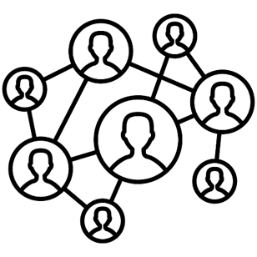
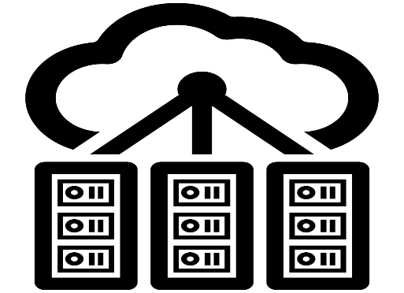
Data is Key for Future Workloads
In-memory Databases
[Mao+, EuroSys’12; Clapp+ (Intel), IISWC’15]
Graph/Tree Processing
[Xu+, IISWC’12; Umuroglu+, FPL’15]
In-Memory Data Analytics
[Clapp+ (Intel), IISWC’15;
Awan+, BDCloud’15]
Datacenter Workloads [Kanev+ (Google), ISCA’15]

Slide 5
Data Overwhelms Modern Machines
In-memory Databases
[Mao+, EuroSys’12; Clapp+ (Intel), IISWC’15]
Graph/Tree Processing
[Xu+, IISWC’12; Umuroglu+, FPL’15]
Data → performance & energy bottleneck
In-Memory Data Analytics
[Clapp+ (Intel), IISWC’15;
Awan+, BDCloud’15]
Datacenter Workloads [Kanev+ (Google), ISCA’15]

Slide 6
Data is Key for Future Workloads
Chrome
TensorFlow Mobile
Google’s web browser
Google’s machine learning framework
Video Playback
Video Capture
Google’s video codec
Google’s video codec
Notes:
In this work, we take a look at widely-used google consumer workloads, to figure out the major sources of energy consumption.
We look at Google Chrome web brower. We take a look at Tensorflow, Google’s machine learning framework, and we also take a look at two important video related workloads, video playback and video capture, both rely on Google’s vp9 codec technology.

Slide 7
Data Overwhelms Modern Machines
Chrome
TensorFlow Mobile
Google’s web browser
Google’s machine learning framework
Data → performance & energy bottleneck
Video Playback
Video Capture
Google’s video codec
Google’s video codec
Notes:
In this work, we take a look at widely-used google consumer workloads, to figure out the major sources of energy consumption.
We look at Google Chrome web brower. We take a look at Tensorflow, Google’s machine learning framework, and we also take a look at two important video related workloads, video playback and video capture, both rely on Google’s vp9 codec technology.

Slide 8
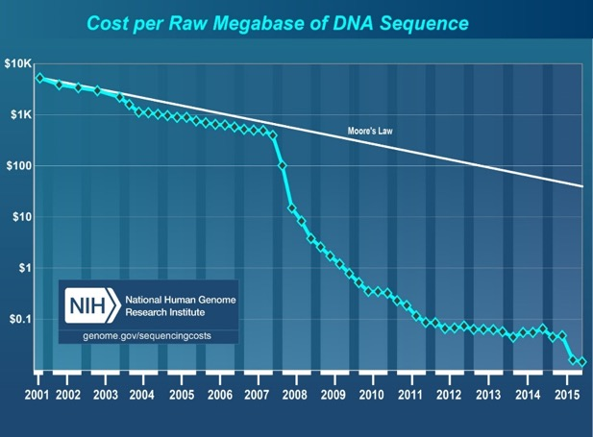
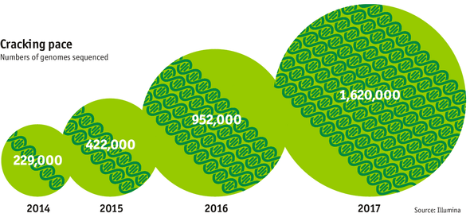
Data is Key for Future Workloads
development of high-throughput sequencing (HTS) technologies
Number of Genomes Sequenced
http://www.economist.com/news/21631808-so-much-genetic-data-so-many-uses-genes-unzipped
Notes:
However, since the development of high throughput sequencing (HTS) technologies, the cost of genome sequencing has fallen off a cliff (<< 1,000$) making it viable for almost everyone's use.

Slide 9
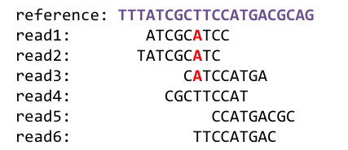
1
Sequencing
Genome Analysis
Read Mapping
2
Data → performance & energy bottleneck
Variant Calling
Scientific Discovery
3
4
Notes:
Genome analysis starts with sequencing random short DNA fragments of copies of the original molecule.
Unfortunately, these reads lack information about their order and which part of genome they are originated from.
Hence the second step is to map these reads to a long reference genome.

Slide 10
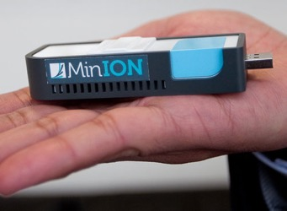
New Genome Sequencing Technologies
Oxford Nanopore MinION
Senol Cali+, “Nanopore Sequencing Technology and Tools for Genome
Assembly: Computational Analysis of the Current State, Bottlenecks
and Future Directions,” Briefings in Bioinformatics, 2018.
[Open arxiv.org version]

Slide 11
New Genome Sequencing Technologies
Oxford Nanopore MinION
Senol Cali+, “Nanopore Sequencing Technology and Tools for Genome
Assembly: Computational Analysis of the Current State, Bottlenecks
and Future Directions,” Briefings in Bioinformatics, 2018.
[Preliminary arxiv.org version]
Data → performance & energy bottleneck

Slide 12
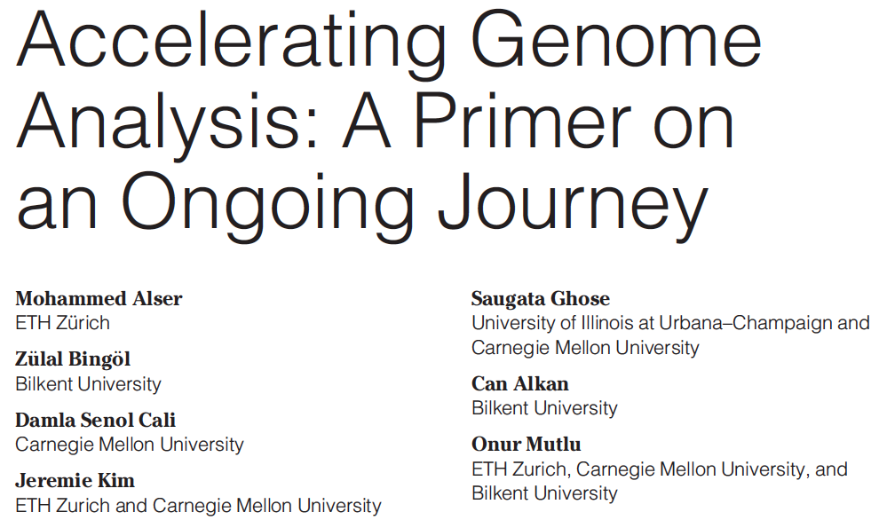
Accelerating Genome Analysis [IEEE MICRO 2020]
Mohammed Alser, Zulal Bingol, Damla Senol Cali, Jeremie Kim, Saugata Ghose, Can Alkan, and Onur Mutlu, "Accelerating Genome Analysis: A Primer on an Ongoing Journey" IEEE Micro (IEEE MICRO), Vol. 40, No. 5, pages 65-75, September/October 2020. [Slides (pptx)(pdf)] [Talk Video (1 hour 2 minutes)]

Slide 13
GenASM Framework [MICRO 2020]
Damla Senol Cali, Gurpreet S. Kalsi, Zulal Bingol, Can Firtina, Lavanya Subramanian, Jeremie S. Kim, Rachata Ausavarungnirun, Mohammed Alser, Juan Gomez-Luna, Amirali Boroumand, Anant Nori, Allison Scibisz, Sreenivas Subramoney, Can Alkan, Saugata Ghose, and Onur Mutlu, "GenASM: A High-Performance, Low-Power Approximate String Matching Acceleration Framework for Genome Sequence Analysis" Proceedings of the 53rd International Symposium on Microarchitecture (MICRO), Virtual, October 2020. [Lighting Talk Video (1.5 minutes)] [Lightning Talk Slides (pptx) (pdf)] [Talk Video (18 minutes)] [Slides (pptx) (pdf)]

Slide 14
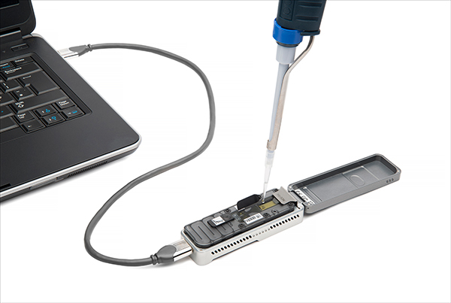
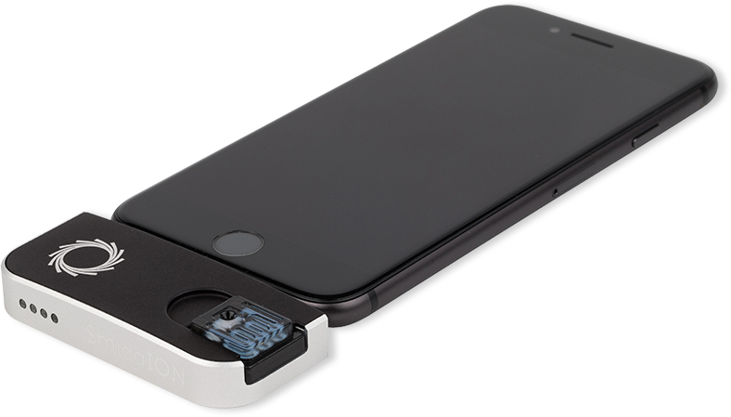
Future of Genome Sequencing & Analysis
MinION from ONT
SmidgION from ONT
Alser+, "Accelerating Genome Analysis: A Primer on an Ongoing Journey”, IEEE Micro 2020.

Slide 15
More on Fast & Efficient Genome Analysis …
Onur Mutlu, "Accelerating Genome Analysis: A Primer on an Ongoing Journey" Invited Lecture at Technion, Virtual, 26 January 2021. [Slides (pptx) (pdf)] [Talk Video (1 hour 37 minutes, including Q&A)] [Related Invited Paper (at IEEE Micro, 2020)]

Slide 16
Detailed Lectures on Genome Analysis
Computer Architecture, Fall 2020, Lecture 3a
Introduction to Genome Sequence Analysis (ETH Zürich, Fall 2020)
https://www.youtube.com/watch?v=CrRb32v7SJc&list=PL5Q2soXY2Zi9xidyIgBxUz7xRPS-wisBN&index=5
Computer Architecture, Fall 2020, Lecture 8
Intelligent Genome Analysis (ETH Zürich, Fall 2020)
https://www.youtube.com/watch?v=ygmQpdDTL7o&list=PL5Q2soXY2Zi9xidyIgBxUz7xRPS-wisBN&index=14
Computer Architecture, Fall 2020, Lecture 9a
GenASM: Approx. String Matching Accelerator (ETH Zürich, Fall 2020)
https://www.youtube.com/watch?v=XoLpzmN-Pas&list=PL5Q2soXY2Zi9xidyIgBxUz7xRPS-wisBN&index=15
Accelerating Genomics Project Course, Fall 2020, Lecture 1
Accelerating Genomics (ETH Zürich, Fall 2020)
https://www.youtube.com/watch?v=rgjl8ZyLsAg&list=PL5Q2soXY2Zi9E2bBVAgCqLgwiDRQDTyId
https://www.youtube.com/onurmutlulectures

Slide 17
Data Overwhelms Modern Machines …
Storage/memory capability
Communication capability
Computation capability
Greatly impacts robustness, energy, performance, cost

Slide 18
A Computing System
Three key components
Computation
Communication
Storage/memory
Burks, Goldstein, von Neumann, “Preliminary discussion of the
logical design of an electronic computing instrument,” 1946.
Image source: https://lbsitbytes2010.wordpress.com/2013/03/29/john-von-neumann-roll-no-15/

Slide 19
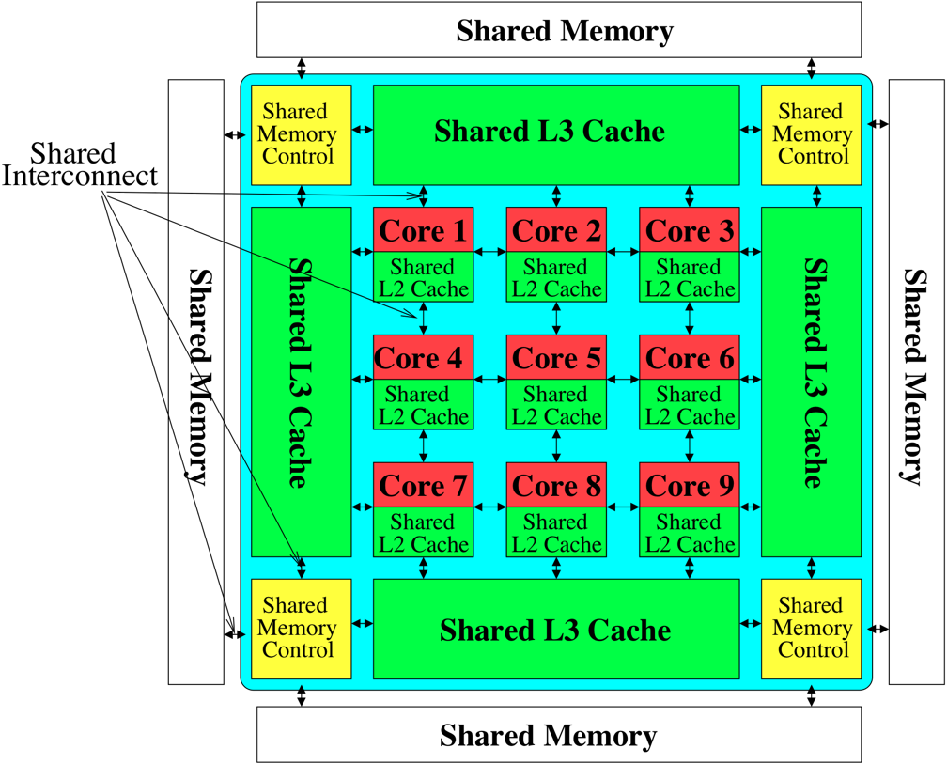
Perils of Processor-Centric Design
Most of the system is dedicated to storing and moving data

Slide 20
Data Overwhelms Modern Machines
Chrome
TensorFlow Mobile
Google’s web browser
Google’s machine learning framework
Data → performance & energy bottleneck
Video Playback
Video Capture
Google’s video codec
Google’s video codec
Notes:
In this work, we take a look at widely-used google consumer workloads, to figure out the major sources of energy consumption.
We look at Google Chrome web brower. We take a look at Tensorflow, Google’s machine learning framework, and we also take a look at two important video related workloads, video playback and video capture, both rely on Google’s vp9 codec technology.

Slide 21
Data Movement Overwhelms Modern Machines
Amirali Boroumand, Saugata Ghose, Youngsok Kim, Rachata Ausavarungnirun, Eric Shiu, Rahul Thakur, Daehyun Kim, Aki Kuusela, Allan Knies, Parthasarathy Ranganathan, and Onur Mutlu, "Google Workloads for Consumer Devices: Mitigating Data Movement Bottlenecks" Proceedings of the 23rd International Conference on Architectural Support for Programming Languages and Operating Systems (ASPLOS), Williamsburg, VA, USA, March 2018.
62.7% of the total system energy
is spent on data movement

Slide 22
Axiom
An Intelligent Architecture
Handles Data Well

Slide 23
How to Handle Data Well
Ensure data does not overwhelm the components
via intelligent algorithms
via intelligent architectures
via whole system designs: algorithm-architecture-devices
Take advantage of vast amounts of data and metadata
to improve architectural & system-level decisions
Understand and exploit properties of (different) data
to improve algorithms & architectures in various metrics

Slide 24
Corollaries: Architectures Today …
Architectures are terrible at dealing with data
Designed to mainly store and move data vs. to compute
They are processor-centric as opposed to data-centric
Architectures are terrible at taking advantage of vast amounts of data (and metadata) available to them
Designed to make simple decisions, ignoring lots of data
They make human-driven decisions vs. data-driven
Architectures are terrible at knowing and exploiting different properties of application data
Designed to treat all data as the same
They make component-aware decisions vs. data-aware

Slide 25
Data-Centric (Memory-Centric) Architectures

Slide 26
Data-Centric Architectures: Properties
Process data where it resides (where it makes sense)
Processing in and near memory structures
Low-latency and low-energy data access
Low latency memory
Low energy memory
Low-cost data storage and processing
High capacity memory at low cost: hybrid memory, compression
Intelligent data management
Intelligent controllers handling robustness, security, cost

Slide 27
Processing Data Where It Makes Sense

Slide 28
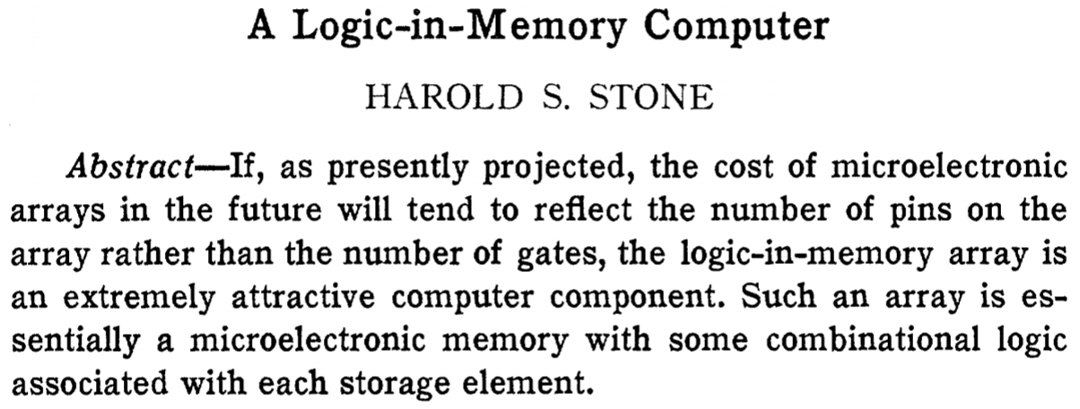
Processing in/near Memory: An Old Idea
Stone, “A Logic-in-Memory Computer,” IEEE TC 1970.

Slide 29
Why In-Memory Computation Today?
Push from Technology
DRAM Scaling at jeopardy
→ Controllers close to DRAM
→ Industry open to new memory architectures

Slide 30
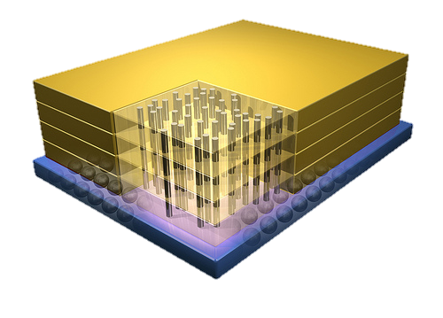
Why In-Memory Computation Today?
Push from Technology
DRAM Scaling at jeopardy
→ Controllers close to DRAM
→ Industry open to new memory architectures

Slide 31
Memory Scaling Issues Were Real
Onur Mutlu, "Memory Scaling: A Systems Architecture Perspective" Proceedings of the 5th International Memory Workshop (IMW), Monterey, CA, May 2013. Slides (pptx) (pdf) EETimes Reprint
https://people.inf.ethz.ch/omutlu/pub/memory-scaling_memcon13.pdf

Slide 32
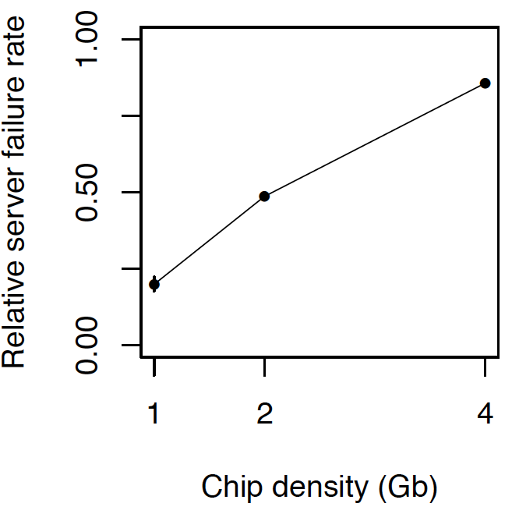
As Memory Scales, It Becomes Unreliable
Data from all of Facebook’s servers worldwide
Meza+, “Revisiting Memory Errors in Large-Scale Production Data Centers,” DSN’15.
Intuition: quadratic increase in capacity

Slide 33
Large-Scale Failure Analysis of DRAM Chips
Analysis and modeling of memory errors found in all of Facebook’s server fleet
Justin Meza, Qiang Wu, Sanjeev Kumar, and Onur Mutlu, "Revisiting Memory Errors in Large-Scale Production Data Centers: Analysis and Modeling of New Trends from the Field" Proceedings of the 45th Annual IEEE/IFIP International Conference on Dependable Systems and Networks (DSN), Rio de Janeiro, Brazil, June 2015. [Slides (pptx) (pdf)] [DRAM Error Model]

Slide 34
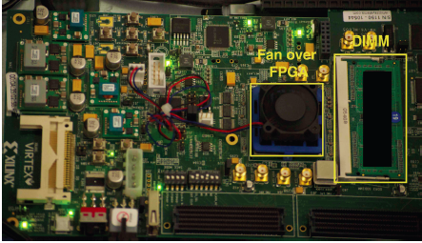
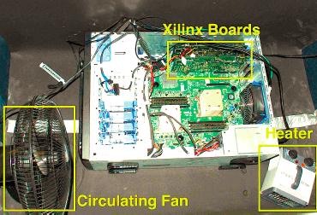
Infrastructures to Understand Such Issues
An Experimental Study of Data Retention Behavior in Modern DRAM Devices: Implications for Retention Time Profiling Mechanisms (Liu et al., ISCA 2013)
The Efficacy of Error Mitigation Techniques for DRAM Retention Failures: A Comparative Experimental Study
(Khan et al., SIGMETRICS 2014)
Flipping Bits in Memory Without Accessing Them: An Experimental Study of DRAM Disturbance Errors (Kim et al., ISCA 2014)
Adaptive-Latency DRAM: Optimizing DRAM Timing for the Common-Case (Lee et al., HPCA 2015)
AVATAR: A Variable-Retention-Time (VRT) Aware Refresh for DRAM Systems (Qureshi et al., DSN 2015)

Slide 35
Infrastructures to Understand Such Issues
Temperature
Controller
FPGAs
Heater
FPGAs
PC
Kim+, “Flipping Bits in Memory Without Accessing Them: An Experimental Study of DRAM Disturbance Errors,” ISCA 2014.

Slide 36
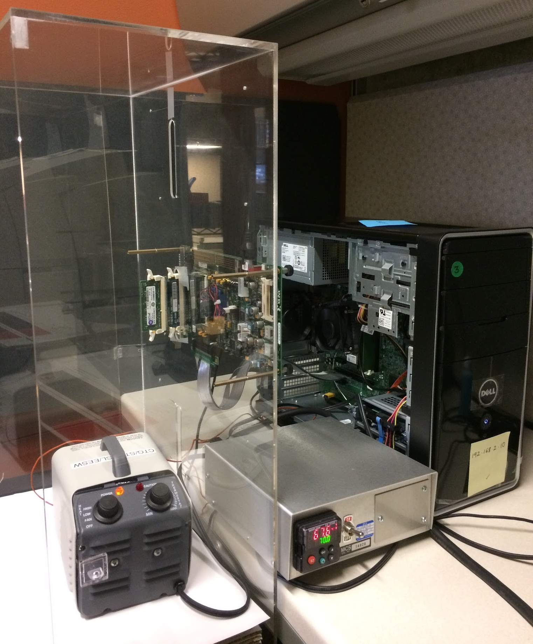
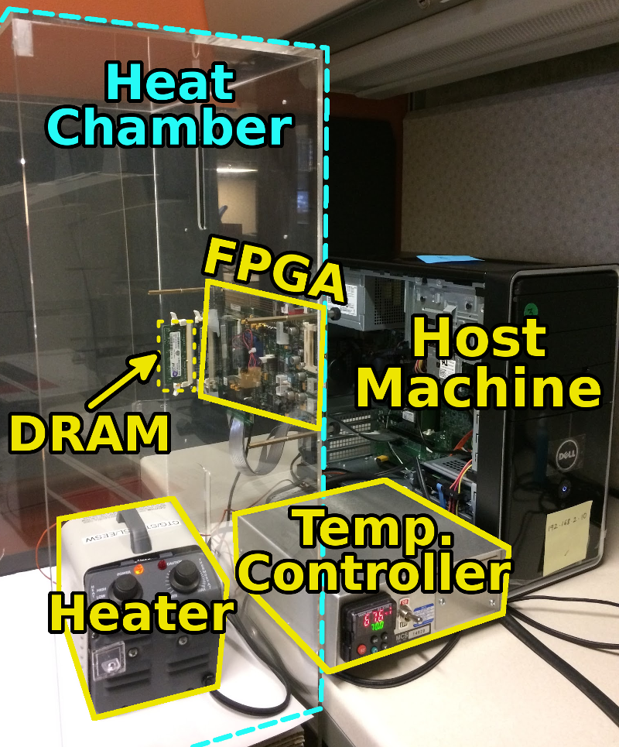
SoftMC: Open Source DRAM Infrastructure
Hasan Hassan et al., “SoftMC: A Flexible and Practical Open-Source Infrastructure for Enabling Experimental DRAM Studies,” HPCA 2017.
Flexible
Easy to Use (C++ API)
Open-source
github.com/CMU-SAFARI/SoftMC

Slide 37
SoftMC
https://github.com/CMU-SAFARI/SoftMC

Slide 38
A Curious Discovery [Kim et al., ISCA 2014]
One can
predictably induce errors
in most DRAM memory chips

Slide 39
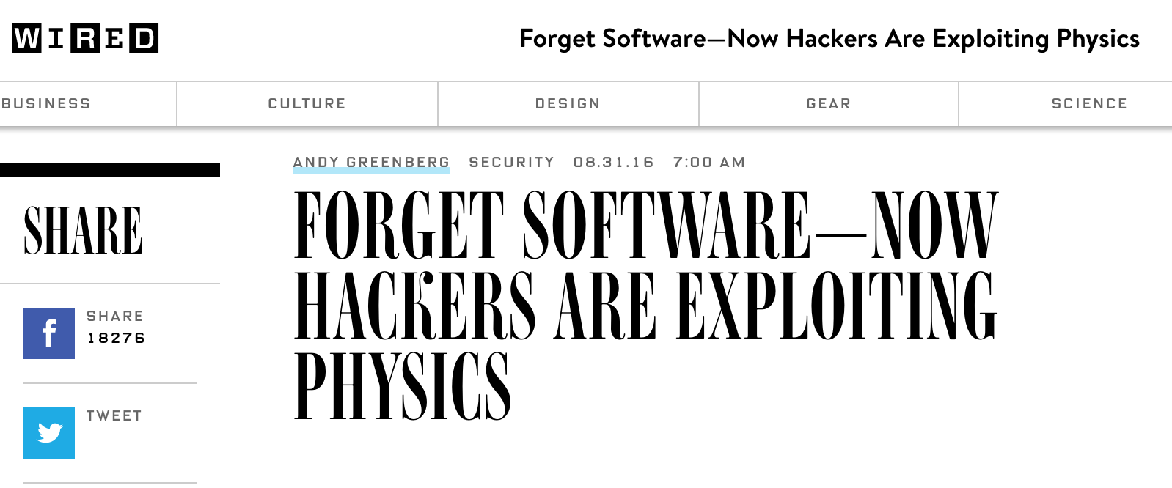
The Story of RowHammer
One can predictably induce bit flips in commodity DRAM chips
>80% of the tested DRAM chips are vulnerable
First example of how a simple hardware failure mechanism can create a widespread system security vulnerability

Slide 40
Modern DRAM is Prone to Disturbance Errors
Row of Cells
Wordline
Row
Victim Row
Row
Hammered Row
V_{LOW}
Opened
V_{HIGH}
Closed
Row
Victim Row
Row
Repeatedly reading a row enough times (before memory gets refreshed) induces disturbance errors in adjacent rows in most real DRAM chips you can buy today
Flipping Bits in Memory Without Accessing Them: An Experimental Study of DRAM Disturbance Errors, (Kim et al., ISCA 2014)

Slide 41
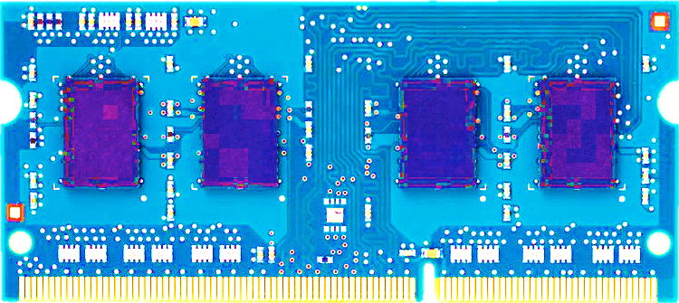
Most DRAM Modules Are Vulnerable
A company
B company
C company
86%
(37/43)
83%
(45/54)
88%
(28/32)
Up to
1.0×10⁷ errors
Up to
2.7×10⁶ errors
Up to
3.3×10⁵ errors
Flipping Bits in Memory Without Accessing Them: An Experimental Study of DRAM Disturbance Errors, (Kim et al., ISCA 2014)

Slide 42
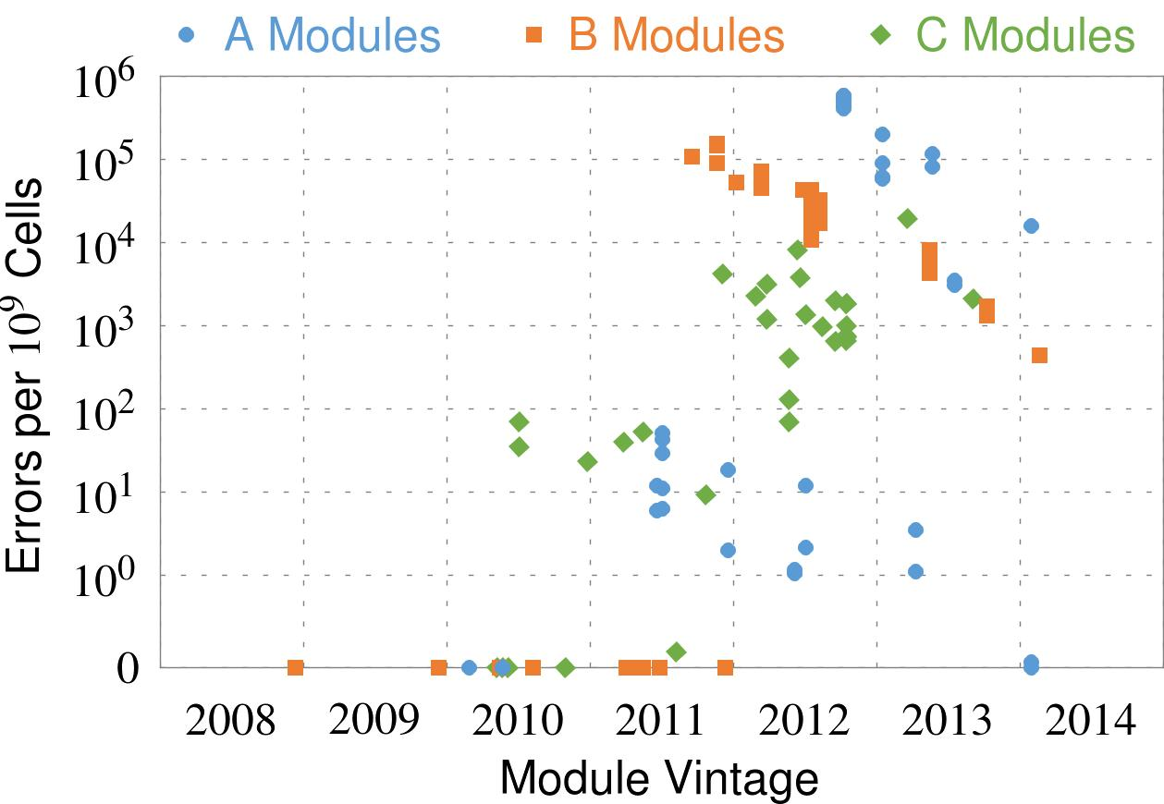
Recent DRAM Is More Vulnerable
First
Appearance
All modules from 2012–2013 are vulnerable
Notes:
In this figure, the x-axis is the module manufacture date. And the y-axis is the number of errors in a module, normalized to one billion cells. In 2008 and 2009, there are no errors. But, in 2010, we first start to see errors in C modules. After 2010, the errors start to proliferate. For A and B modules, we first start to see errors in 2011. In particular, all modules from 2012 and 2013 are vulnerable.

Slide 43
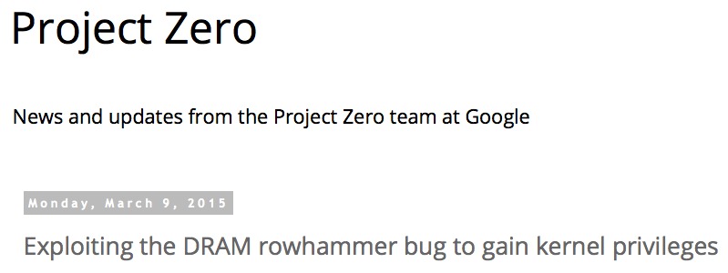
One Can Take Over an Otherwise-Secure System
Flipping Bits in Memory Without Accessing Them: An Experimental Study of DRAM Disturbance Errors (Kim et al., ISCA 2014)
Exploiting the DRAM rowhammer bug to gain kernel privileges (Seaborn, 2015)

Slide 44
More Security Implications (I)
“We can gain unrestricted access to systems of website visitors.”
Rowhammer.js: A Remote Software-Induced Fault Attack in JavaScript (DIMVA’16)
Source: https://lab.dsst.io/32c3-slides/7197.html

Slide 45
More Security Implications (II)
“Can gain control of a smart phone deterministically”
Drammer: Deterministic Rowhammer Attacks on Mobile Platforms, CCS’16
Source: https://fossbytes.com/drammer-rowhammer-attack-android-root-devices/

Slide 46
More Security Implications (VII)
USENIX Security 2019

Slide 47
More Security Implications (VIII)
USENIX Security 2020

Slide 48
Memory Scaling Issues Are Real
Yoongu Kim, Ross Daly, Jeremie Kim, Chris Fallin, Ji Hye Lee, Donghyuk Lee, Chris Wilkerson, Konrad Lai, and Onur Mutlu, "Flipping Bits in Memory Without Accessing Them: An Experimental Study of DRAM Disturbance Errors" Proceedings of the 41st International Symposium on Computer Architecture (ISCA), Minneapolis, MN, June 2014. [Slides (pptx) (pdf)] [Lightning Session Slides (pptx) (pdf)] [Source Code and Data]

Slide 49
A Review of the RowHammer Vulnerability
Onur Mutlu and Jeremie Kim, "RowHammer: A Retrospective" IEEE Transactions on Computer-Aided Design of Integrated Circuits and Systems (TCAD) Special Issue on Top Picks in Hardware and Embedded Security, 2019. [Preliminary arXiv version]

Slide 50
The Push from Circuits and Devices
Main Memory Needs
Intelligent Controllers

Slide 51
RowHammer in 2020 (I)
Jeremie S. Kim, Minesh Patel, A. Giray Yaglikci, Hasan Hassan, Roknoddin Azizi, Lois Orosa, and Onur Mutlu, "Revisiting RowHammer: An Experimental Analysis of Modern Devices and Mitigation Techniques" Proceedings of the 47th International Symposium on Computer Architecture (ISCA), Valencia, Spain, June 2020. [Slides (pptx) (pdf)] [Lightning Talk Slides (pptx) (pdf)] [Talk Video (20 minutes)] [Lightning Talk Video (3 minutes)]

Slide 52
Key Takeaways from 1580 Chips
Newer DRAM chips are more vulnerable to RowHammer
There are chips today whose weakest cells fail after only 4800 hammers
Chips of newer DRAM technology nodes can exhibit RowHammer bit flips 1) in more rows and 2) farther away from the victim row.
Existing mitigation mechanisms are NOT effective
Notes:
To reiterate our three key takeaways from our experimental characterization, we find that
[CLICK] First, chips of newer DRAM technology nodes are more vulnerable to RowHammer
[CLICK] Second, there are chips today whose weakest cells fail after only 4800 hammers
[CLICK] Third, chips of newer DRAM technology nodes can exhibit RowHammer bit flips in more rows and farther away from the victim row
================

Slide 53
RowHammer in 2020 (II)
Pietro Frigo, Emanuele Vannacci, Hasan Hassan, Victor van der Veen, Onur Mutlu, Cristiano Giuffrida, Herbert Bos, and Kaveh Razavi, "TRRespass: Exploiting the Many Sides of Target Row Refresh" Proceedings of the 41st IEEE Symposium on Security and Privacy (S&P), San Francisco, CA, USA, May 2020. [Slides (pptx) (pdf)] [Talk Video (17 minutes)] [Source Code] [Web Article] Best paper award.

Slide 54
RowHammer in 2020 (III)
Lucian Cojocar, Jeremie Kim, Minesh Patel, Lillian Tsai, Stefan Saroiu, Alec Wolman, and Onur Mutlu, "Are We Susceptible to Rowhammer? An End-to-End Methodology for Cloud Providers" Proceedings of the 41st IEEE Symposium on Security and Privacy (S&P), San Francisco, CA, USA, May 2020. [Slides (pptx) (pdf)] [Talk Video (17 minutes)]

Slide 55
BlockHammer Solution in 2021
A. Giray Yaglikci, Minesh Patel, Jeremie S. Kim, Roknoddin Azizi, Ataberk Olgun, Lois Orosa, Hasan Hassan, Jisung Park, Konstantinos Kanellopoulos, Taha Shahroodi, Saugata Ghose, and Onur Mutlu, "BlockHammer: Preventing RowHammer at Low Cost by Blacklisting Rapidly-Accessed DRAM Rows" Proceedings of the 27th International Symposium on High-Performance Computer Architecture (HPCA), Virtual, February-March 2021. [Slides (pptx) (pdf)] [Short Talk Slides (pptx) (pdf)] [Talk Video (22 minutes)] [Short Talk Video (7 minutes)]

Slide 56
Detailed Lectures on RowHammer
Computer Architecture, Fall 2020, Lecture 4b
RowHammer (ETH Zürich, Fall 2020)
https://www.youtube.com/watch?v=KDy632z23UE&list=PL5Q2soXY2Zi9xidyIgBxUz7xRPS-wisBN&index=8
Computer Architecture, Fall 2020, Lecture 5a
RowHammer in 2020: TRRespass (ETH Zürich, Fall 2020)
https://www.youtube.com/watch?v=pwRw7QqK_qA&list=PL5Q2soXY2Zi9xidyIgBxUz7xRPS-wisBN&index=9
Computer Architecture, Fall 2020, Lecture 5b
RowHammer in 2020: Revisiting RowHammer (ETH Zürich, Fall 2020)
https://www.youtube.com/watch?v=gR7XR-Eepcg&list=PL5Q2soXY2Zi9xidyIgBxUz7xRPS-wisBN&index=10
Computer Architecture, Fall 2020, Lecture 5c
Secure and Reliable Memory (ETH Zürich, Fall 2020)
https://www.youtube.com/watch?v=HvswnsfG3oQ&list=PL5Q2soXY2Zi9xidyIgBxUz7xRPS-wisBN&index=11
https://www.youtube.com/onurmutlulectures

Slide 57
The Story of RowHammer Lecture …
Onur Mutlu, "The Story of RowHammer" Keynote Talk at Secure Hardware, Architectures, and Operating Systems Workshop (SeHAS), held with HiPEAC 2021 Conference, Virtual, 19 January 2021. [Slides (pptx) (pdf)] [Talk Video (1 hr 15 minutes, with Q&A)]

Slide 58
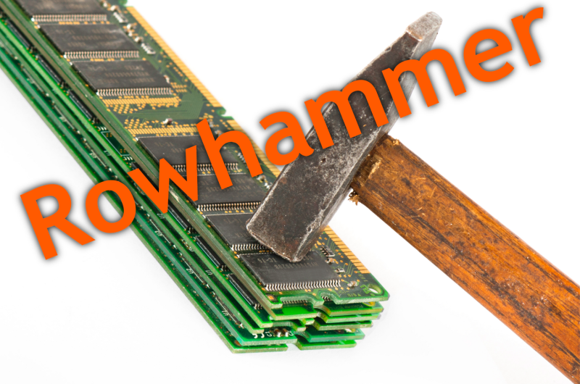
Notes:
Picture from the article:
http://thehackernews.com/2015/03/dram-rowhammer-vulnerability.html

Slide 59
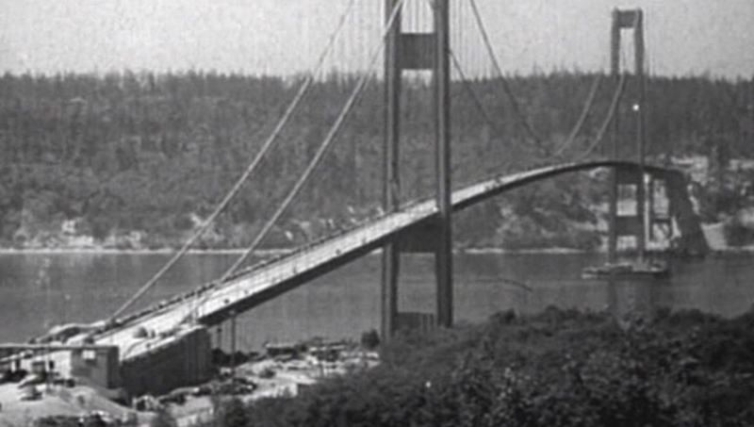
How Reliable/Secure/Safe is This Bridge?
Source: http://www.technologystudent.com/struct1/tacom1.png

Slide 60
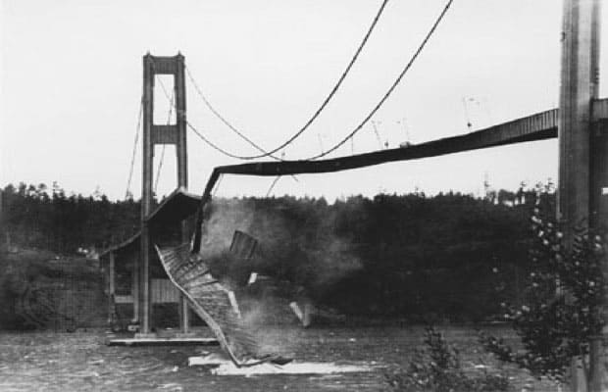
Collapse of the “Galloping Gertie” (1940)
Source: AP
http://www.wsdot.wa.gov/tnbhistory/connections/connections3.htm

Slide 61
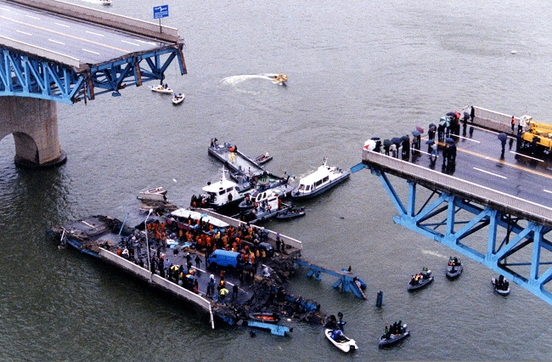
Another Example (1994)
Source: By 최광모 - Own work, CC BY-SA 4.0, https://commons.wikimedia.org/w/index.php?curid=35197984

Slide 62
Yet Another Example (2007)
Source: Morry Gash/AP,
https://www.npr.org/2017/08/01/540669701/10-years-after-bridge-collapse-america-is-still-crumbling?t=1535427165809

Slide 63
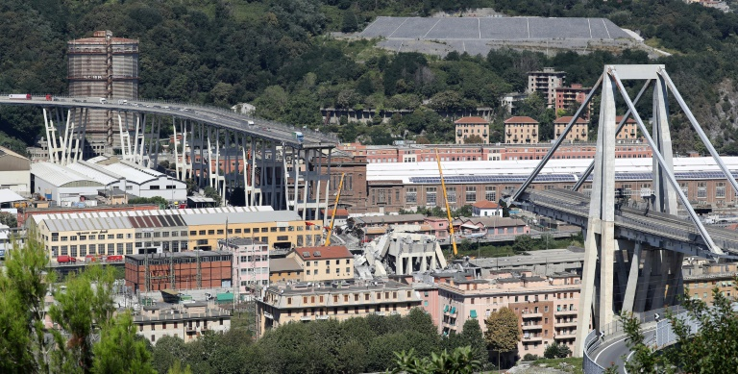
A More Recent Example (2018)
Source: AFP / Valery HACHE, https://www.capitalfm.co.ke/news/2018/08/genoa-bridge-collapse-what-we-know/

Slide 64
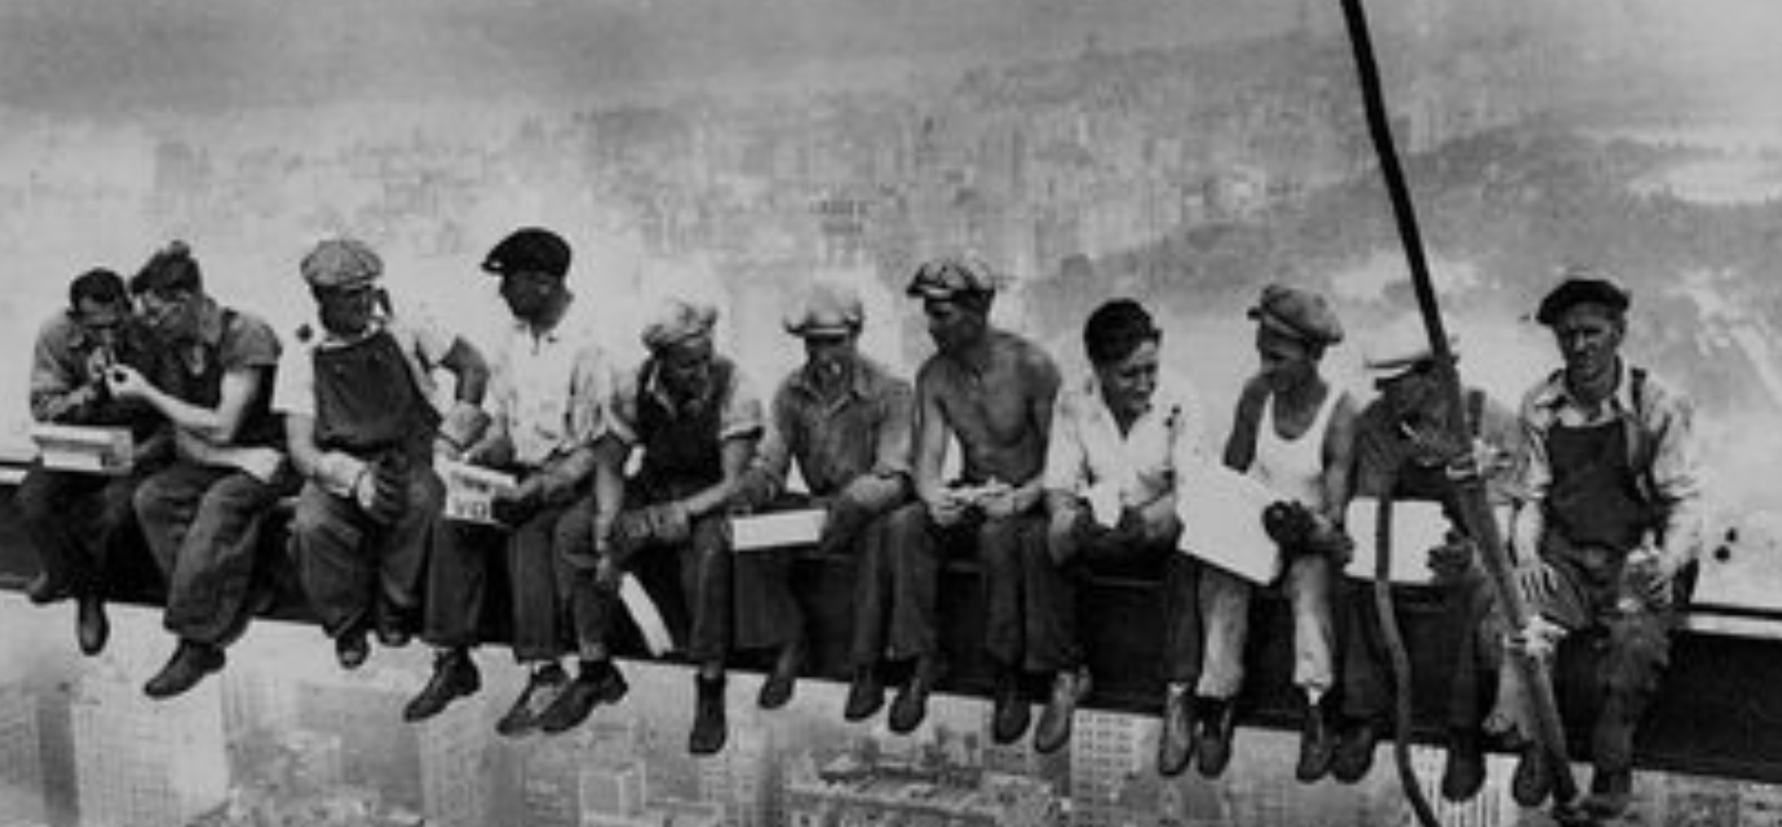
How Safe & Secure Is This Platform?
Security is about preventing unforeseen consequences
Source: https://s-media-cache-ak0.pinimg.com/originals/48/09/54/4809543a9c7700246a0cf8acdae27abf.jpg

Slide 65
How Safe & Secure Is This Platform?
Source: https://taxistartup.com/wp-content/uploads/2015/03/UK-Self-Driving-Cars.jpg

Slide 66
Challenge and Opportunity for Future
Fundamentally
Secure, Reliable, Safe
Computing Architectures

Slide 67
Solution Direction: Principled Designs
Design fundamentally secure
computing architectures
Predict and prevent
safety & security issues

Slide 68
The Push from Circuits and Devices
Computing Systems Need
Intelligent Memories

Slide 69
The Takeaway, Again
In-Field Patch-ability
(Intelligent Memory)
Can Avoid Many Failures

Slide 70
Why In-Memory Computation Today?
Push from Technology
DRAM Scaling at jeopardy
→ Controllers close to DRAM
→ Industry open to new memory architectures
Pull from Systems and Applications
Data access is a major system and application bottleneck
Systems are energy limited
Data movement much more energy-hungry than computation

Slide 71
Three Key Systems & Application Trends
1. Data access is a major bottleneck
Applications are increasingly data hungry
2. Energy consumption is a key limiter
3. Data movement energy dominates compute
Especially true for off-chip to on-chip movement

Slide 72
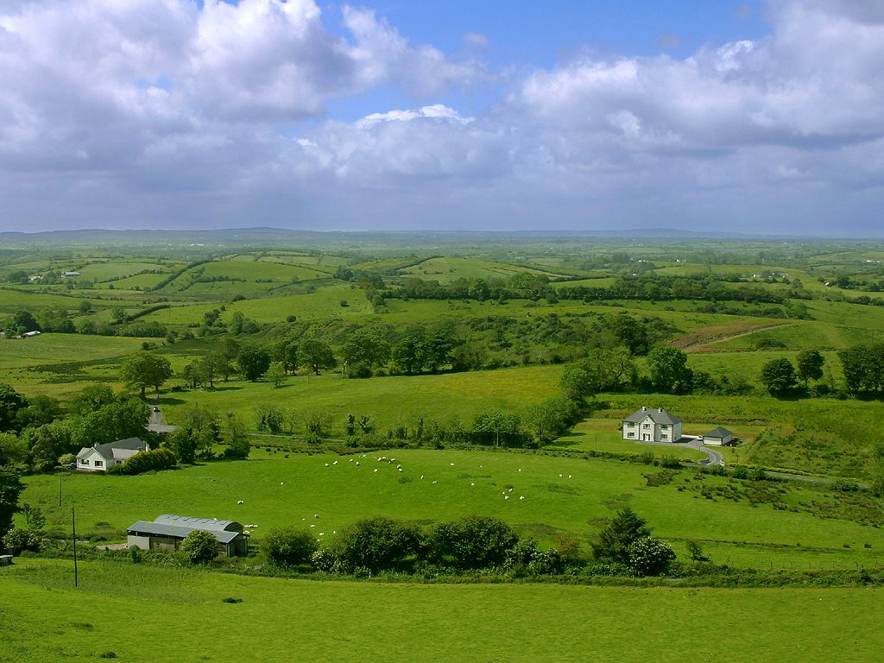
Do We Want This?
Source: V. Milutinovic

Slide 73
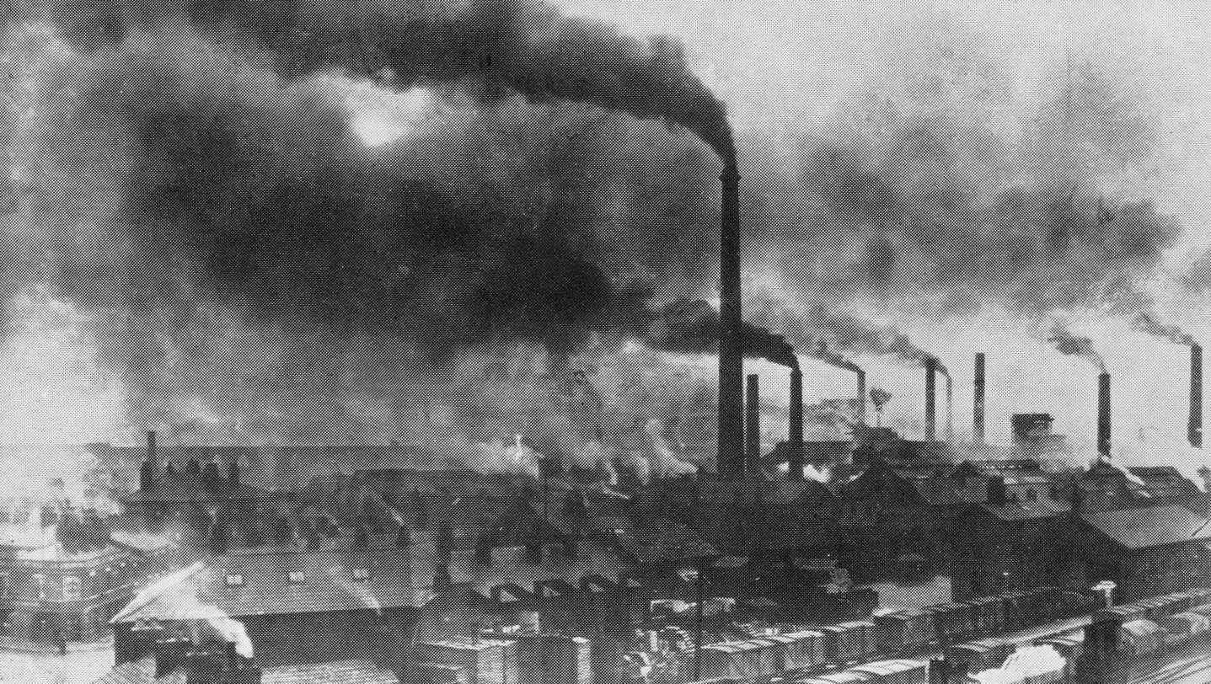
Or This?
Source: V. Milutinovic

Slide 74
Challenge and Opportunity for Future
High Performance,
Energy Efficient,
Sustainable

Slide 75
The Problem
Data access is the major performance and energy bottleneck
Our current
design principles
cause great energy waste
(and great performance loss)

Slide 76
The Problem
Processing of data
is performed
far away from the data

Slide 77
A Computing System
Three key components
Computation
Communication
Storage/memory
Burks, Goldstein, von Neumann, “Preliminary discussion of the
logical design of an electronic computing instrument,” 1946.
Image source: https://lbsitbytes2010.wordpress.com/2013/03/29/john-von-neumann-roll-no-15/

Slide 78
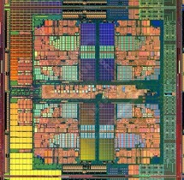
A Computing System
Three key components
Computation
Communication
Storage/memory
Burks, Goldstein, von Neumann, “Preliminary discussion of the
logical design of an electronic computing instrument,” 1946.
Image source: https://lbsitbytes2010.wordpress.com/2013/03/29/john-von-neumann-roll-no-15/

Slide 79
Today’s Computing Systems
Are overwhelmingly processor centric
All data processed in the processor → at great system cost
Processor is heavily optimized and is considered the master
Data storage units are dumb and are largely unoptimized (except for some that are on the processor die)

Slide 80
Yet …
“It’s the Memory, Stupid!” (Richard Sites, MPR, 1996)
Mutlu+, “Runahead Execution: An Alternative to Very Large Instruction Windows for Out-of-Order Processors,” HPCA 2003.

Slide 81
The Performance Perspective
Onur Mutlu, Jared Stark, Chris Wilkerson, and Yale N. Patt, "Runahead Execution: An Alternative to Very Large Instruction Windows for Out-of-order Processors" Proceedings of the 9th International Symposium on High-Performance Computer Architecture (HPCA), pages 129-140, Anaheim, CA, February 2003. Slides (pdf)

Slide 82
The Performance Perspective (Today)
All of Google’s Data Center Workloads (2015):
Kanev+, “Profiling a Warehouse-Scale Computer,” ISCA 2015.

Slide 83
The Performance Perspective (Today)
All of Google’s Data Center Workloads (2015):
Kanev+, “Profiling a Warehouse-Scale Computer,” ISCA 2015.

Slide 84
Perils of Processor-Centric Design
Grossly-imbalanced systems
Processing done only in one place
Everything else just stores and moves data: data moves a lot
→ Energy inefficient
→ Low performance
→ Complex
Overly complex and bloated processor (and accelerators)
To tolerate data access from memory
Complex hierarchies and mechanisms
→ Energy inefficient
→ Low performance
→ Complex

Slide 85
Perils of Processor-Centric Design
Most of the system is dedicated to storing and moving data

Slide 86
The Energy Perspective
Dally, HiPEAC 2015

Slide 87
Data Movement vs. Computation Energy
Dally, HiPEAC 2015
A memory access consumes ~100-1000X
the energy of a complex addition

Slide 88
Data Movement vs. Computation Energy
Data movement is a major system energy bottleneck
Comprises 41% of mobile system energy during web browsing [2]
Costs ~115 times as much energy as an ADD operation [1, 2]
[1]: Reducing data Movement Energy via Online Data Clustering and Encoding (MICRO’16)
[2]: Quantifying the energy cost of data movement for emerging smart phone workloads on mobile platforms (IISWC’14)

Slide 89
Energy Waste in Mobile Devices
Amirali Boroumand, Saugata Ghose, Youngsok Kim, Rachata Ausavarungnirun, Eric Shiu, Rahul Thakur, Daehyun Kim, Aki Kuusela, Allan Knies, Parthasarathy Ranganathan, and Onur Mutlu, "Google Workloads for Consumer Devices: Mitigating Data Movement Bottlenecks" Proceedings of the 23rd International Conference on Architectural Support for Programming Languages and Operating Systems (ASPLOS), Williamsburg, VA, USA, March 2018.
62.7% of the total system energy
is spent on data movement

Slide 90
We Do Not Want to Move Data!
Dally, HiPEAC 2015
A memory access consumes ~100-1000X
the energy of a complex addition

Slide 91
We Need A Paradigm Shift To …
Enable computation with minimal data movement
Compute where it makes sense (where data resides)
Make computing architectures more data-centric

Slide 92
Goal: Processing Inside Memory
Many questions … How do we design the:
compute-capable memory & controllers?
processor chip and in-memory units?
software and hardware interfaces?
system software, compilers, languages?
algorithms and theoretical foundations?
Memory
Processor
Core
Database
Graphs
Media
Cache
Query
Interconnect
Problem
Results
Algorithm
Program/Language
System Software
SW/HW Interface
Micro-architecture
Logic
Devices
Electrons

Slide 93
Processing in Memory: Two Approaches
1. Minimally changing memory chips
2. Exploiting 3D-stacked memory

Slide 94
Starting Simple: Data Copy and Initialization
memmove & memcpy: 5% cycles in Google’s datacenter [Kanev+ ISCA’15]
000000000000000
Zero initialization
(e.g., security)
Forking
Checkpointing
Many more
VM Cloning
Deduplication
Page Migration

Slide 95
Today’s Systems: Bulk Data Copy
1) High latency
Memory
3) Cache pollution
L3
CPU
L2
L1
MC
2) High bandwidth utilization
4) Unwanted data movement
1046ns, 3.6uJ (for 4KB page copy via DMA)

Slide 96
Future Systems: In-Memory Copy
3) No cache pollution
1) Low latency
Memory
L3
CPU
L2
L1
MC
2) Low bandwidth utilization
4) No unwanted data movement
1046ns, 3.6uJ
→ 90ns, 0.04uJ

Slide 97
RowClone: In-DRAM Row Copy
Idea: Two consecutive ACTivates
4 Kbytes
Negligible HW cost
Step 1: Activate row A
Step 2: Activate row B
Transfer row
DRAM subarray
Transfer
row
Row Buffer (4 Kbytes)
8 bits
Data Bus
Notes:
copy

Slide 98
RowClone: Latency and Energy Savings
11.6x
74x
Seshadri et al., “RowClone: Fast and Efficient In-DRAM Copy and Initialization of Bulk Data,” MICRO 2013.

Slide 99
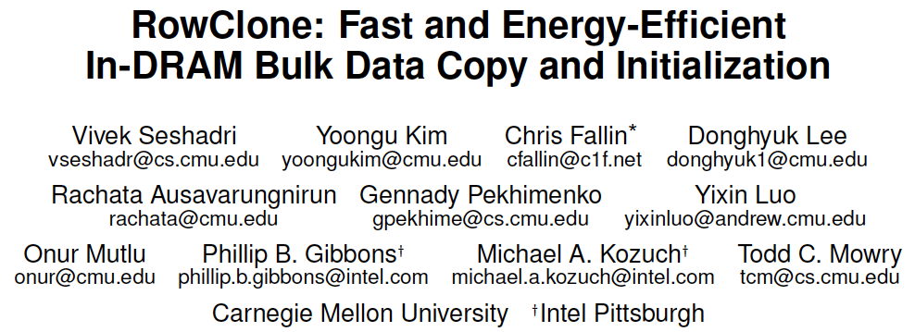
More on RowClone
Vivek Seshadri, Yoongu Kim, Chris Fallin, Donghyuk Lee, Rachata Ausavarungnirun, Gennady Pekhimenko, Yixin Luo, Onur Mutlu, Michael A. Kozuch, Phillip B. Gibbons, and Todd C. Mowry, "RowClone: Fast and Energy-Efficient In-DRAM Bulk Data Copy and Initialization" Proceedings of the 46th International Symposium on Microarchitecture (MICRO), Davis, CA, December 2013. [Slides (pptx) (pdf)] [Lightning Session Slides (pptx) (pdf)] [Poster (pptx) (pdf)]

Slide 100
Memory as an Accelerator
CPU
core
CPU
core
mini-CPU
core
GPU
(throughput)
core
GPU
(throughput)
core
video
core
GPU
(throughput)
core
GPU
(throughput)
core
CPU
core
CPU
core
Memory
imaging
core
LLC
Specialized
compute-capability
in memory
Memory Controller
Memory Bus
Memory similar to a “conventional” accelerator

Slide 101
(Truly) In-Memory Computation
We can support in-DRAM AND, OR, NOT, MAJ
At low cost
Using analog computation capability of DRAM
Idea: activating multiple rows performs computation
30-60X performance and energy improvement
Seshadri+, “Ambit: In-Memory Accelerator for Bulk Bitwise Operations Using Commodity DRAM Technology,” MICRO 2017.
New memory technologies enable even more opportunities
Memristors, resistive RAM, phase change mem, STT-MRAM, …
Can operate on data with minimal movement

Slide 102
In-DRAM Acceleration of Database Queries
>4-12X Performance Improvement
Seshadri+, “Ambit: In-Memory Accelerator for Bulk Bitwise Operations using Commodity DRAM Technology,” MICRO 2017.

Slide 103
More on Ambit
Vivek Seshadri, Donghyuk Lee, Thomas Mullins, Hasan Hassan, Amirali Boroumand, Jeremie Kim, Michael A. Kozuch, Onur Mutlu, Phillip B. Gibbons, and Todd C. Mowry, "Ambit: In-Memory Accelerator for Bulk Bitwise Operations Using Commodity DRAM Technology" Proceedings of the 50th International Symposium on Microarchitecture (MICRO), Boston, MA, USA, October 2017. [Slides (pptx) (pdf)] [Lightning Session Slides (pptx) (pdf)] [Poster (pptx) (pdf)]

Slide 104
In-DRAM Bulk Bitwise Execution
Vivek Seshadri and Onur Mutlu, "In-DRAM Bulk Bitwise Execution Engine" Invited Book Chapter in Advances in Computers, to appear in 2020. [Preliminary arXiv version]

Slide 105
SIMDRAM
Nastaran Hajinazar, Geraldo F. Oliveira, Sven Gregorio, Joao Dinis Ferreira, Nika Mansouri Ghiasi, Minesh Patel, Mohammed Alser, Saugata Ghose, Juan Gomez-Luna, and Onur Mutlu, "SIMDRAM: An End-to-End Framework for Bit-Serial SIMD Computing in DRAM" Proceedings of the 26th International Conference on Architectural Support for Programming Languages and Operating Systems (ASPLOS), Virtual, March-April 2021. [2-page Extended Abstract] [Short Talk Slides (pptx) (pdf)] [Talk Slides (pptx) (pdf)] [Short Talk Video (5 mins)] [Full Talk Video (27 mins)]

Slide 106
Processing in Memory: Two Approaches
1. Minimally changing memory chips
2. Exploiting 3D-stacked memory

Slide 107
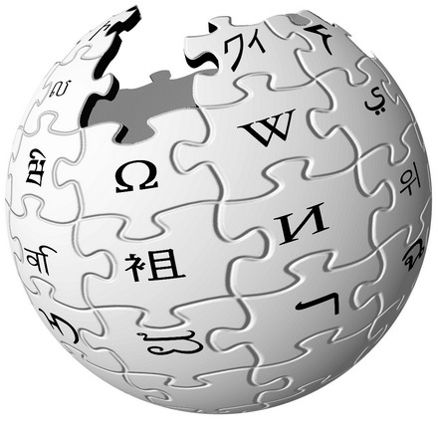
Another Example: In-Memory Graph Processing
Large graphs are everywhere (circa 2015)
Scalable large-scale graph processing is challenging
36 Million
Wikipedia Pages
1.4 Billion
Facebook Users
300 Million
Twitter Users
30 Billion
Instagram Photos

Slide 108
Key Bottlenecks in Graph Processing
for (v: graph.vertices) {
for (w: v.successors) {
w.next_rank += weight * v.rank;
}
}
1. Frequent random memory accesses
v
&w
w.rank
w.next_rank
w.edges
weight * v.rank
w
…
2. Little amount of computation

Slide 109
Opportunity: 3D-Stacked Logic+Memory
Memory
Logic
Other “True 3D” technologies
under development

Slide 110
Tesseract System for Graph Processing
Interconnected set of 3D-stacked memory+logic chips with simple cores
Host Processor
Memory
Memory-Mapped
Accelerator Interface
(Noncacheable, Physically Addressed)
Logic
In-Order Core
DRAM Controller
…
…
LP
PF Buffer
Crossbar Network
…
MTP
…
Message Queue
NI
Ahn+, “A Scalable Processing-in-Memory Accelerator for Parallel Graph Processing” ISCA 2015.

Slide 111
Tesseract System for Graph Processing
Host Processor
Memory
Memory-Mapped
Accelerator Interface
(Noncacheable, Physically Addressed)
Logic
In-Order Core
DRAM Controller
…
…
Communications via Remote Function Calls
LP
PF Buffer
Crossbar Network
…
MTP
…
Message Queue
NI

Slide 112
Tesseract System for Graph Processing
Host Processor
Memory
Memory-Mapped
Accelerator Interface
(Noncacheable, Physically Addressed)
Logic
Prefetching
In-Order Core
DRAM Controller
…
…
LP
PF Buffer
Crossbar Network
…
MTP
…
Message Queue
NI

Slide 113
Evaluated Systems
DDR3-OoO
HMC-OoO
HMC-MC
Tesseract
32 Tesseract Cores
8 OoO
4GHz
8 OoO
4GHz
8 OoO
4GHz
8 OoO
4GHz
128 In-Order
2GHz
128 In-Order
2GHz
8 OoO
4GHz
8 OoO
4GHz
8 OoO
4GHz
8 OoO
4GHz
128 In-Order
2GHz
128 In-Order
2GHz
102.4GB/s
640GB/s
640GB/s
8TB/s
Ahn+, “A Scalable Processing-in-Memory Accelerator for Parallel Graph Processing” ISCA 2015.

Slide 114
Tesseract Graph Processing Performance
>13X Performance Improvement
On five graph processing algorithms
Ahn+, “A Scalable Processing-in-Memory Accelerator for Parallel Graph Processing” ISCA 2015.

Slide 115
Tesseract Graph Processing Performance

Slide 116
Tesseract Graph Processing System Energy
> 8X Energy Reduction
Ahn+, “A Scalable Processing-in-Memory Accelerator for Parallel Graph Processing” ISCA 2015.

Slide 117
More on Tesseract
Junwhan Ahn, Sungpack Hong, Sungjoo Yoo, Onur Mutlu, and Kiyoung Choi, "A Scalable Processing-in-Memory Accelerator for Parallel Graph Processing" Proceedings of the 42nd International Symposium on Computer Architecture (ISCA), Portland, OR, June 2015. [Slides (pdf)] [Lightning Session Slides (pdf)]

Slide 118
Google Workloads for Consumer Devices: Mitigating Data Movement Bottlenecks
Amirali Boroumand
Saugata Ghose, Youngsok Kim, Rachata Ausavarungnirun,
Eric Shiu, Rahul Thakur, Daehyun Kim, Aki Kuusela, Allan Knies, Parthasarathy Ranganathan, Onur Mutlu

Slide 119
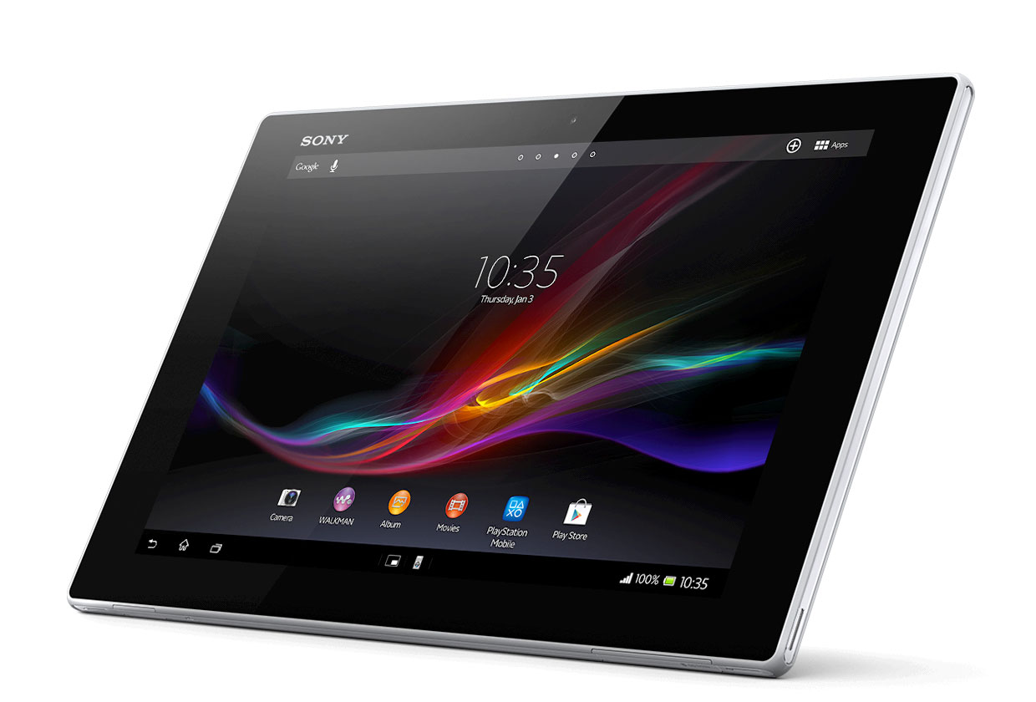
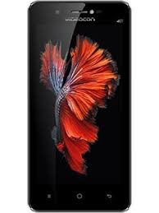
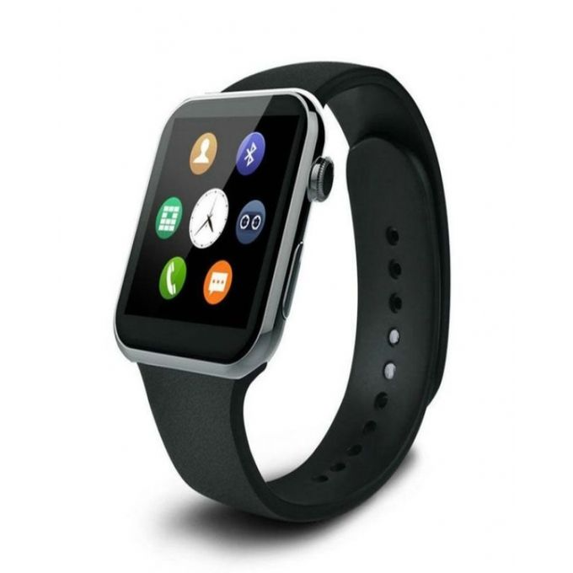
Consumer Devices
Consumer devices are everywhere!
Energy consumption is a first-class concern in consumer devices
Notes:
Consumer devices like tablets smartphone and wearable are now everywhere and used by billions of people.
One of the major challenge in these devices is battery limitation which makes the energy consumption a critical concern …

Slide 120
Popular Consumer Workloads
Chrome
TensorFlow Mobile
Google’s web browser
Google’s machine learning framework
Video Playback
Video Capture
Google’s video codec
Google’s video codec
Notes:
In this work, we take a look at widely-used google consumer workloads, to figure out the major sources of energy consumption.
We look at Google Chrome web brower. We take a look at Tensorflow, Google’s machine learning framework, and we also take a look at two important video related workloads, video playback and video capture, both rely on Google’s vp9 codec technology.

Slide 121
Energy Cost of Data Movement
1st key observation: 62.7% of the total system energy is spent on data movement
Data Movement
SoC
DRAM
CPU
L2
CPU
L1
CPU
CPU
Compute Unit
Processing-In-Memory (PIM)
Potential solution: move computation close to data
Challenge: limited area and energy budget
Notes:
Throughout our analysis, we make a key observation that out of all sources of energy consumption, data movement is a major contributor to the total system energy. We find that across all of the workloads, on average around 62.7% of total system energy is spent on data movement.
One way to reduce data movement cost is to move computation close to data, or …
One potential solution to address this cost it do move computation close to data, or in other words, do procesing in memory. However, the challenge is that these devices.
One potential solution to mitigate data movement cost and reduce total system energy is to execute data-movement heavy portions of application close to data, or in other words, do processing in memory. However, consumer devices are extermely limited in terms of area and power budget. So the question is can we move part of the data movement heavy portion given the limited area and energy budget. Our

Slide 122
Using PIM to Reduce Data Movement
2nd key observation: a significant fraction of the data movement often comes from simple functions
We can design lightweight logic to implement these simple functions in memory
Small embedded low-power core
Small fixed-function accelerators
PIM Core
PIM Accelerator
PIM Accelerator
PIM Accelerator
Offloading to PIM logic reduces energy and improves performance, on average, by 2.3X and 2.2X
Notes:
To figure out if we can use processing in memory, we dig deeper into our analysis and we make another key observation that majority of data movement often comes form simple functions and pritmitives. We find that these simple function can be implemented in memory as either a small embedded core, or group of small fixed function accelerators. Our result shows that offloading these function to PIM logic can significantly reduce data movement for each function and reduce energy on average around 55% and improve perforamcne around 54%.
our PIM core can reduce significant portion of data movement, reduce enregy by 49.1% for each function and improve performance up to 2.2X. While using group of fixed function accelerator reduce energy by 55.4% and improve performance by up to 2.5X.
Or use Saugata’s approach : Reduces total system energy by an average of 55.4%
Reduces execution time by an average of 54.2%
Our result show that both of them can significantly reduce the data movement for each function.
Feedback: talk about result more
Don’t talk about specific detail like MemCopy, MemSet stuff like that
Main take away: data movement come from simple functions that are simple enough to implement in PIM
We find that these functions and primitves can be implemented as PIM logic using either (1) a small low-power general-purpose embedded core or (2) a group of small fixed-function accelerators (PIM accelerators). Our Analysis shows that both are cost-feasible to use in consumer devices. We find that they eliminate a significant fraction of dat amovement, and reduce energy consumption for each of these operation on average by 49 and 55%.

Slide 123
Workload Analysis
Chrome
TensorFlow Mobile
Google’s web browser
Google’s machine learning framework
Video Playback
Video Capture
Google’s video codec
Google’s video codec
Notes:
In this work, we take a look at widely-used google consumer workloads, to figure out the major sources of energy consumption.
We look at Google Chrome web brower. We take a look at Tensorflow, Google’s machine learning framework, and we also take a look at two important video related workloads, video playback and video capture, both rely on Google’s vp9 codec technology.

Slide 124
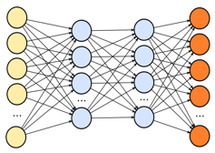
TensorFlow Mobile
Inference
Prediction
57.3% of the inference energy is spent on data movement
54.4% of the data movement energy comes from packing/unpacking and quantization

Slide 125
More on PIM for Mobile Devices
Amirali Boroumand, Saugata Ghose, Youngsok Kim, Rachata Ausavarungnirun, Eric Shiu, Rahul Thakur, Daehyun Kim, Aki Kuusela, Allan Knies, Parthasarathy Ranganathan, and Onur Mutlu, "Google Workloads for Consumer Devices: Mitigating Data Movement Bottlenecks" Proceedings of the 23rd International Conference on Architectural Support for Programming Languages and Operating Systems (ASPLOS), Williamsburg, VA, USA, March 2018. [Slides (pptx) (pdf)] [Lightning Session Slides (pptx) (pdf)] [Poster (pptx) (pdf)] [Lightning Talk Video (2 minutes)] [Full Talk Video (21 minutes)]

Slide 126
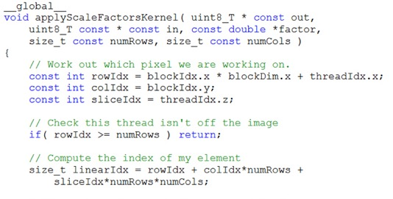
Truly Distributed GPU Processing with PIM
3D-stacked memory
(memory stack)
SM (Streaming Multiprocessor)
Logic layer
Logic layer SM
Main GPU
Crossbar switch
Vault Ctrl
….
Vault Ctrl

Slide 127
Accelerating GPU Execution with PIM (I)
Kevin Hsieh, Eiman Ebrahimi, Gwangsun Kim, Niladrish Chatterjee, Mike O'Connor, Nandita Vijaykumar, Onur Mutlu, and Stephen W. Keckler, "Transparent Offloading and Mapping (TOM): Enabling Programmer-Transparent Near-Data Processing in GPU Systems" Proceedings of the 43rd International Symposium on Computer Architecture (ISCA), Seoul, South Korea, June 2016. [Slides (pptx) (pdf)] [Lightning Session Slides (pptx) (pdf)]

Slide 128
Accelerating GPU Execution with PIM (II)
Ashutosh Pattnaik, Xulong Tang, Adwait Jog, Onur Kayiran, Asit K. Mishra, Mahmut T. Kandemir, Onur Mutlu, and Chita R. Das, "Scheduling Techniques for GPU Architectures with Processing-In-Memory Capabilities" Proceedings of the 25th International Conference on Parallel Architectures and Compilation Techniques (PACT), Haifa, Israel, September 2016.

Slide 129
Accelerating Linked Data Structures
Kevin Hsieh, Samira Khan, Nandita Vijaykumar, Kevin K. Chang, Amirali Boroumand, Saugata Ghose, and Onur Mutlu, "Accelerating Pointer Chasing in 3D-Stacked Memory: Challenges, Mechanisms, Evaluation" Proceedings of the 34th IEEE International Conference on Computer Design (ICCD), Phoenix, AZ, USA, October 2016.

Slide 130
Accelerating Climate Modeling
Gagandeep Singh, Dionysios Diamantopoulos, Christoph Hagleitner, Juan Gómez-Luna, Sander Stuijk, Onur Mutlu, and Henk Corporaal, "NERO: A Near High-Bandwidth Memory Stencil Accelerator for Weather Prediction Modeling" Proceedings of the 30th International Conference on Field-Programmable Logic and Applications (FPL), Gothenburg, Sweden, September 2020. [Slides (pptx) (pdf)] [Lightning Talk Slides (pptx) (pdf)] [Talk Video (23 minutes)] Nominated for the Stamatis Vassiliadis Memorial Award.

Slide 131
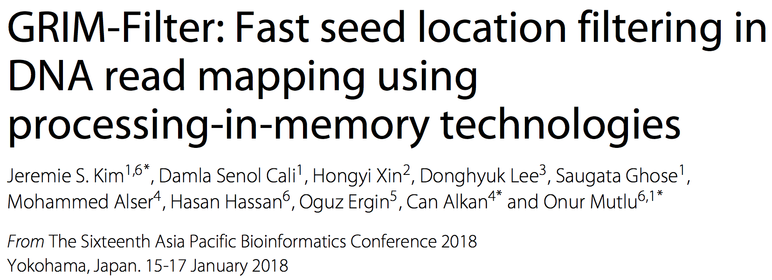
Accelerating Genome Sequence Analysis
Jeremie S. Kim, Damla Senol Cali, Hongyi Xin, Donghyuk Lee, Saugata Ghose, Mohammed Alser, Hasan Hassan, Oguz Ergin, Can Alkan, and Onur Mutlu, "GRIM-Filter: Fast Seed Location Filtering in DNA Read Mapping Using Processing-in-Memory Technologies" BMC Genomics, 2018. Proceedings of the 16th Asia Pacific Bioinformatics Conference (APBC), Yokohama, Japan, January 2018. [Slides (pptx) (pdf)] [Source Code] [arxiv.org Version (pdf)] [Talk Video at AACBB 2019]

Slide 132
Accelerating Approximate String Matching
Damla Senol Cali, Gurpreet S. Kalsi, Zulal Bingol, Can Firtina, Lavanya Subramanian, Jeremie S. Kim, Rachata Ausavarungnirun, Mohammed Alser, Juan Gomez-Luna, Amirali Boroumand, Anant Nori, Allison Scibisz, Sreenivas Subramoney, Can Alkan, Saugata Ghose, and Onur Mutlu, "GenASM: A High-Performance, Low-Power Approximate String Matching Acceleration Framework for Genome Sequence Analysis" Proceedings of the 53rd International Symposium on Microarchitecture (MICRO), Virtual, October 2020. [Lighting Talk Video (1.5 minutes)] [Lightning Talk Slides (pptx) (pdf)] [Talk Video (18 minutes)] [Slides (pptx) (pdf)]

Slide 133
Accelerating Time Series Analysis
Ivan Fernandez, Ricardo Quislant, Christina Giannoula, Mohammed Alser, Juan Gómez-Luna, Eladio Gutiérrez, Oscar Plata, and Onur Mutlu, "NATSA: A Near-Data Processing Accelerator for Time Series Analysis" Proceedings of the 38th IEEE International Conference on Computer Design (ICCD), Virtual, October 2020. [Slides (pptx) (pdf)] [Talk Video (10 minutes)]

Slide 134
We Need to Revisit the Entire Stack
Problem
Algorithm
Program/Language
System Software
SW/HW Interface
Micro-architecture
Logic
Devices
Electrons
We can get there step by step

Slide 135
PIM Review and Open Problems
Onur Mutlu, Saugata Ghose, Juan Gomez-Luna, and Rachata Ausavarungnirun, "A Modern Primer on Processing in Memory" Invited Book Chapter in Emerging Computing: From Devices to Systems - Looking Beyond Moore and Von Neumann, Springer, to be published in 2021.
https://arxiv.org/pdf/1903.03988.pdf

Slide 136
PIM Review and Open Problems (II)
Saugata Ghose, Amirali Boroumand, Jeremie S. Kim, Juan Gomez-Luna, and Onur Mutlu, "Processing-in-Memory: A Workload-Driven Perspective" Invited Article in IBM Journal of Research & Development, Special Issue on Hardware for Artificial Intelligence, to appear in November 2019. [Preliminary arXiv version]
https://arxiv.org/pdf/1907.12947.pdf

Slide 137
UPMEM Processing-in-DRAM Engine (2019)
Processing in DRAM Engine
Includes standard DIMM modules, with a large number of DPU processors combined with DRAM chips.
Replaces standard DIMMs
DDR4 R-DIMM modules
8GB+128 DPUs (16 PIM chips)
Standard 2x-nm DRAM process
Large amounts of compute & memory bandwidth
https://www.anandtech.com/show/14750/hot-chips-31-analysis-inmemory-processing-by-upmem
https://www.upmem.com/video-upmem-presenting-its-true-processing-in-memory-solution-hot-chips-2019/

Slide 138
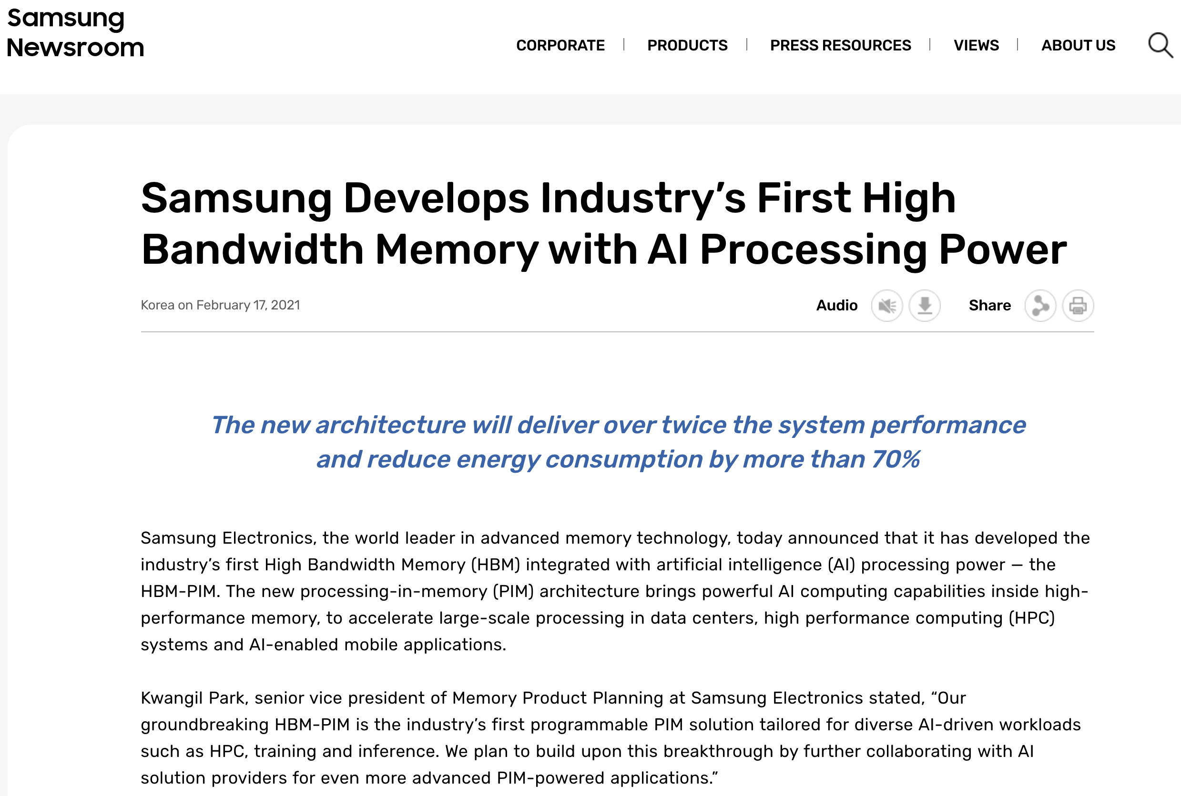
Samsung Function-in-Memory DRAM (2021)
https://news.samsung.com/global/samsung-develops-industrys-first-high-bandwidth-memory-with-ai-processing-power

Slide 139
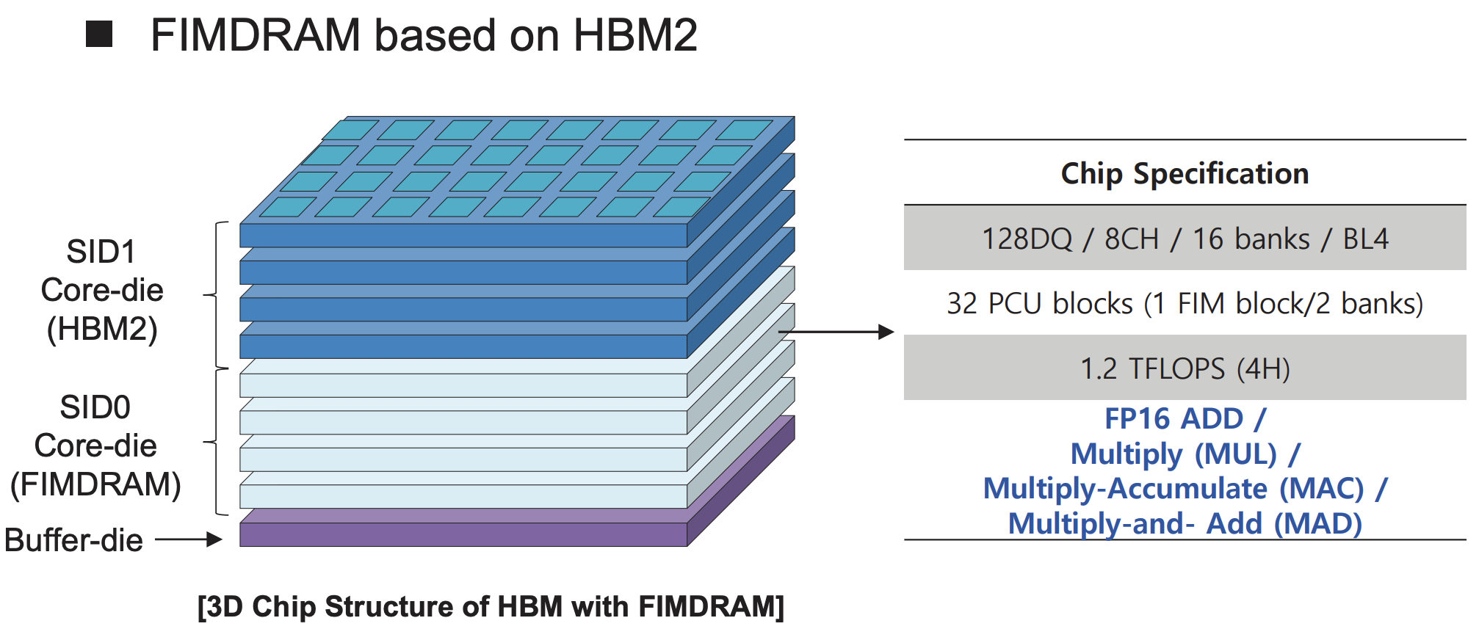
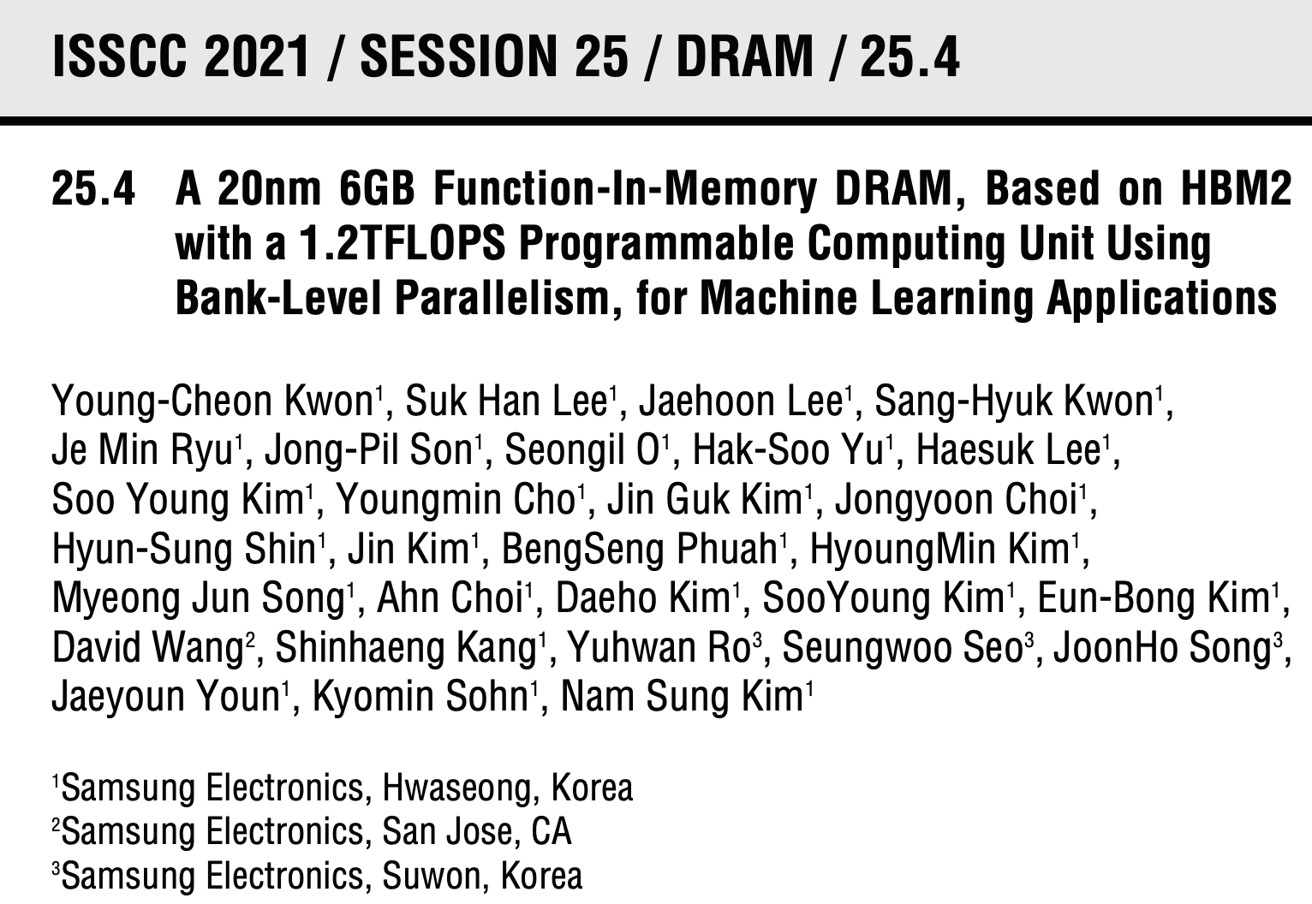
Samsung Function-in-Memory DRAM (2021)

Slide 140
Samsung Function-in-Memory DRAM (2021)

Slide 141
Detailed Lectures on PIM (I)
Computer Architecture, Fall 2020, Lecture 6
Computation in Memory (ETH Zürich, Fall 2020)
https://www.youtube.com/watch?v=oGcZAGwfEUE&list=PL5Q2soXY2Zi9xidyIgBxUz7xRPS-wisBN&index=12
Computer Architecture, Fall 2020, Lecture 7
Near-Data Processing (ETH Zürich, Fall 2020)
https://www.youtube.com/watch?v=j2GIigqn1Qw&list=PL5Q2soXY2Zi9xidyIgBxUz7xRPS-wisBN&index=13
Computer Architecture, Fall 2020, Lecture 11a
Memory Controllers (ETH Zürich, Fall 2020)
https://www.youtube.com/watch?v=TeG773OgiMQ&list=PL5Q2soXY2Zi9xidyIgBxUz7xRPS-wisBN&index=20
Computer Architecture, Fall 2020, Lecture 12d
Real Processing-in-DRAM with UPMEM (ETH Zürich, Fall 2020)
https://www.youtube.com/watch?v=Sscy1Wrr22A&list=PL5Q2soXY2Zi9xidyIgBxUz7xRPS-wisBN&index=25
https://www.youtube.com/onurmutlulectures

Slide 142
Detailed Lectures on PIM (II)
Computer Architecture, Fall 2020, Lecture 15
Emerging Memory Technologies (ETH Zürich, Fall 2020)
https://www.youtube.com/watch?v=AlE1rD9G_YU&list=PL5Q2soXY2Zi9xidyIgBxUz7xRPS-wisBN&index=28
Computer Architecture, Fall 2020, Lecture 16a
Opportunities & Challenges of Emerging Memory Technologies (ETH Zürich, Fall 2020)
https://www.youtube.com/watch?v=pmLszWGmMGQ&list=PL5Q2soXY2Zi9xidyIgBxUz7xRPS-wisBN&index=29
Computer Architecture, Fall 2020, Guest Lecture
In-Memory Computing: Memory Devices & Applications (ETH Zürich, Fall 2020)
https://www.youtube.com/watch?v=wNmqQHiEZNk&list=PL5Q2soXY2Zi9xidyIgBxUz7xRPS-wisBN&index=41
https://www.youtube.com/onurmutlulectures

Slide 143
A Tutorial on PIM
Onur Mutlu, "Memory-Centric Computing Systems" Invited Tutorial at 66th International Electron Devices Meeting (IEDM), Virtual, 12 December 2020. [Slides (pptx) (pdf)] [Executive Summary Slides (pptx) (pdf)] [Tutorial Video (1 hour 51 minutes)] [Executive Summary Video (2 minutes)] [Abstract and Bio] [Related Keynote Paper from VLSI-DAT 2020] [Related Review Paper on Processing in Memory]
https://www.youtube.com/watch?v=H3sEaINPBOE
https://www.youtube.com/onurmutlulectures

Slide 144
A Tutorial on PIM
Onur Mutlu, "Memory-Centric Computing Systems" Invited Tutorial at 66th International Electron Devices Meeting (IEDM), Virtual, 12 December 2020. [Slides (pptx) (pdf)] [Executive Summary Slides (pptx) (pdf)] [Tutorial Video (1 hour 51 minutes)] [Executive Summary Video (2 minutes)] [Abstract and Bio] [Related Keynote Paper from VLSI-DAT 2020] [Related Review Paper on Processing in Memory]
https://www.youtube.com/watch?v=H3sEaINPBOE
https://www.youtube.com/onurmutlulectures

Slide 145
Challenge and Opportunity for Future
Fundamentally
Energy-Efficient
(Data-Centric)
Computing Architectures

Slide 146
Challenge and Opportunity for Future
Fundamentally
High-Performance
(Data-Centric)
Computing Architectures

Slide 147
Challenge and Opportunity for Future
Computing Architectures
with
Minimal Data Movement

Slide 148
Eliminating the Adoption Barriers
How to Enable Adoption of Processing in Memory

Slide 149
Barriers to Adoption of PIM
1. Functionality of and applications & software for PIM
2. Ease of programming (interfaces and compiler/HW support)
3. System support: coherence & virtual memory
4. Runtime and compilation systems for adaptive scheduling, data mapping, access/sharing control
5. Infrastructures to assess benefits and feasibility
All can be solved with change of mindset

Slide 150
We Need to Revisit the Entire Stack
Problem
Algorithm
Program/Language
System Software
SW/HW Interface
Micro-architecture
Logic
Devices
Electrons
We can get there step by step

Slide 151
Challenge and Opportunity for Future
Data-Driven
(Self-Optimizing)
Computing Architectures

Slide 152
Challenge and Opportunity for Future
Data-Aware
(Expressive)
Computing Architectures

Slide 153
Concluding Remarks

Slide 154
Recap: Corollaries: Architectures Today …
Architectures are terrible at dealing with data
Designed to mainly store and move data vs. to compute
They are processor-centric as opposed to data-centric
Architectures are terrible at taking advantage of vast amounts of data (and metadata) available to them
Designed to make simple decisions, ignoring lots of data
They make human-driven decisions vs. data-driven
Architectures are terrible at knowing and exploiting different properties of application data
Designed to treat all data as the same
They make component-aware decisions vs. data-aware

Slide 155
Concluding Remarks
It is time to design principled system architectures to solve the data handling (i.e., memory/storage) problem
Design complete systems to be truly balanced, high-performance, and energy-efficient → intelligent architectures
Data-centric, data-driven, data-aware
Enable computation capability inside and close to memory
This can
Lead to orders-of-magnitude improvements
Enable new applications & computing platforms
Enable better understanding of nature
…
Notes:
Perhaps we have taken processor-centric system design a bit too far

Slide 156
Architectures for Intelligent Machines
Data-centric
Data-driven
Data-aware

Slide 157
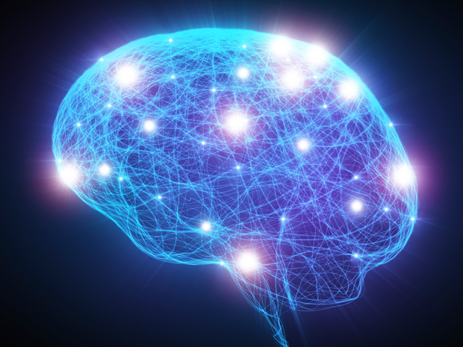
Source: http://spectrum.ieee.org/image/MjYzMzAyMg.jpeg

Slide 158
We Need to Revisit the Entire Stack
Problem
Algorithm
Program/Language
System Software
SW/HW Interface
Micro-architecture
Logic
Devices
Electrons
We can get there step by step

Slide 159
We Need to Exploit Good Principles
Data-centric system design
All components intelligent
Better cross-layer communication, better interfaces
Better-than-worst-case design
Heterogeneity
Flexibility, adaptability
Open minds

Slide 160
PIM Review and Open Problems
Onur Mutlu, Saugata Ghose, Juan Gomez-Luna, and Rachata Ausavarungnirun, "A Modern Primer on Processing in Memory" Invited Book Chapter in Emerging Computing: From Devices to Systems - Looking Beyond Moore and Von Neumann, Springer, to be published in 2021.
https://arxiv.org/pdf/1903.03988.pdf

Slide 161
PIM Review and Open Problems (II)
Saugata Ghose, Amirali Boroumand, Jeremie S. Kim, Juan Gomez-Luna, and Onur Mutlu, "Processing-in-Memory: A Workload-Driven Perspective" Invited Article in IBM Journal of Research & Development, Special Issue on Hardware for Artificial Intelligence, to appear in November 2019. [Preliminary arXiv version]
https://arxiv.org/pdf/1907.12947.pdf

Slide 162
A Longer Version of This Talk
Onur Mutlu, "Memory-Centric Computing Systems" Invited Tutorial at 66th International Electron Devices Meeting (IEDM), Virtual, 12 December 2020. [Slides (pptx) (pdf)] [Executive Summary Slides (pptx) (pdf)] [Tutorial Video (1 hour 51 minutes)] [Executive Summary Video (2 minutes)] [Abstract and Bio] [Related Keynote Paper from VLSI-DAT 2020] [Related Review Paper on Processing in Memory]
https://www.youtube.com/watch?v=H3sEaINPBOE
https://www.youtube.com/onurmutlulectures

Slide 163
A Tutorial on PIM
Onur Mutlu, "Memory-Centric Computing Systems" Invited Tutorial at 66th International Electron Devices Meeting (IEDM), Virtual, 12 December 2020. [Slides (pptx) (pdf)] [Executive Summary Slides (pptx) (pdf)] [Tutorial Video (1 hour 51 minutes)] [Executive Summary Video (2 minutes)] [Abstract and Bio] [Related Keynote Paper from VLSI-DAT 2020] [Related Review Paper on Processing in Memory]
https://www.youtube.com/watch?v=H3sEaINPBOE
https://www.youtube.com/onurmutlulectures

Slide 164
Funding Acknowledgments
Alibaba, AMD, ASML, Google, Facebook, Hi-Silicon, HP Labs, Huawei, IBM, Intel, Microsoft, Nvidia, Oracle, Qualcomm, Rambus, Samsung, Seagate, VMware
NSF
NIH
GSRC
SRC
CyLab

Slide 165
Acknowledgments
Think BIG, Aim HIGH!
https://safari.ethz.ch

Slide 166
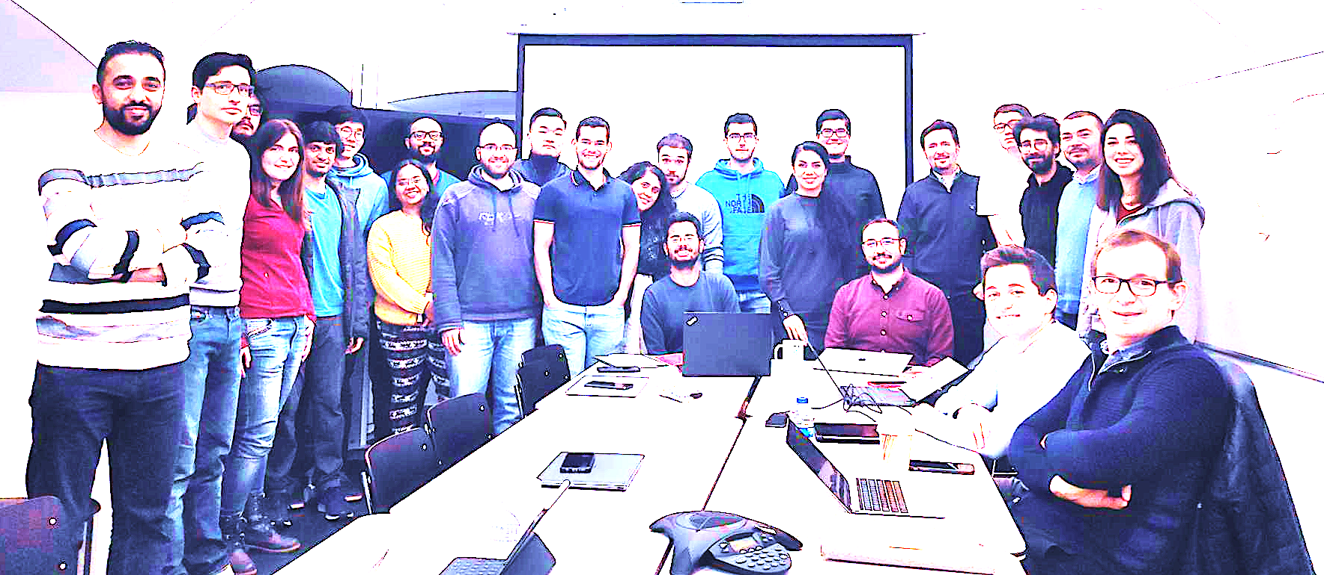
Onur Mutlu’s SAFARI Research Group
Computer architecture, HW/SW, systems, bioinformatics, security, memory
https://safari.ethz.ch/safari-newsletter-january-2021/
38+ Researchers
Think BIG, Aim HIGH!
https://safari.ethz.ch

Slide 167
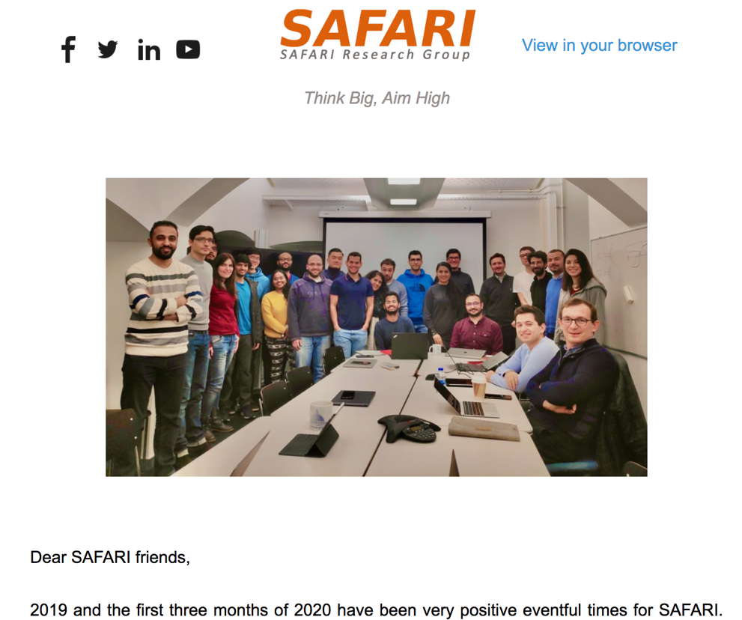
SAFARI Newsletter April 2020 Edition
https://safari.ethz.ch/safari-newsletter-april-2020/

Slide 168
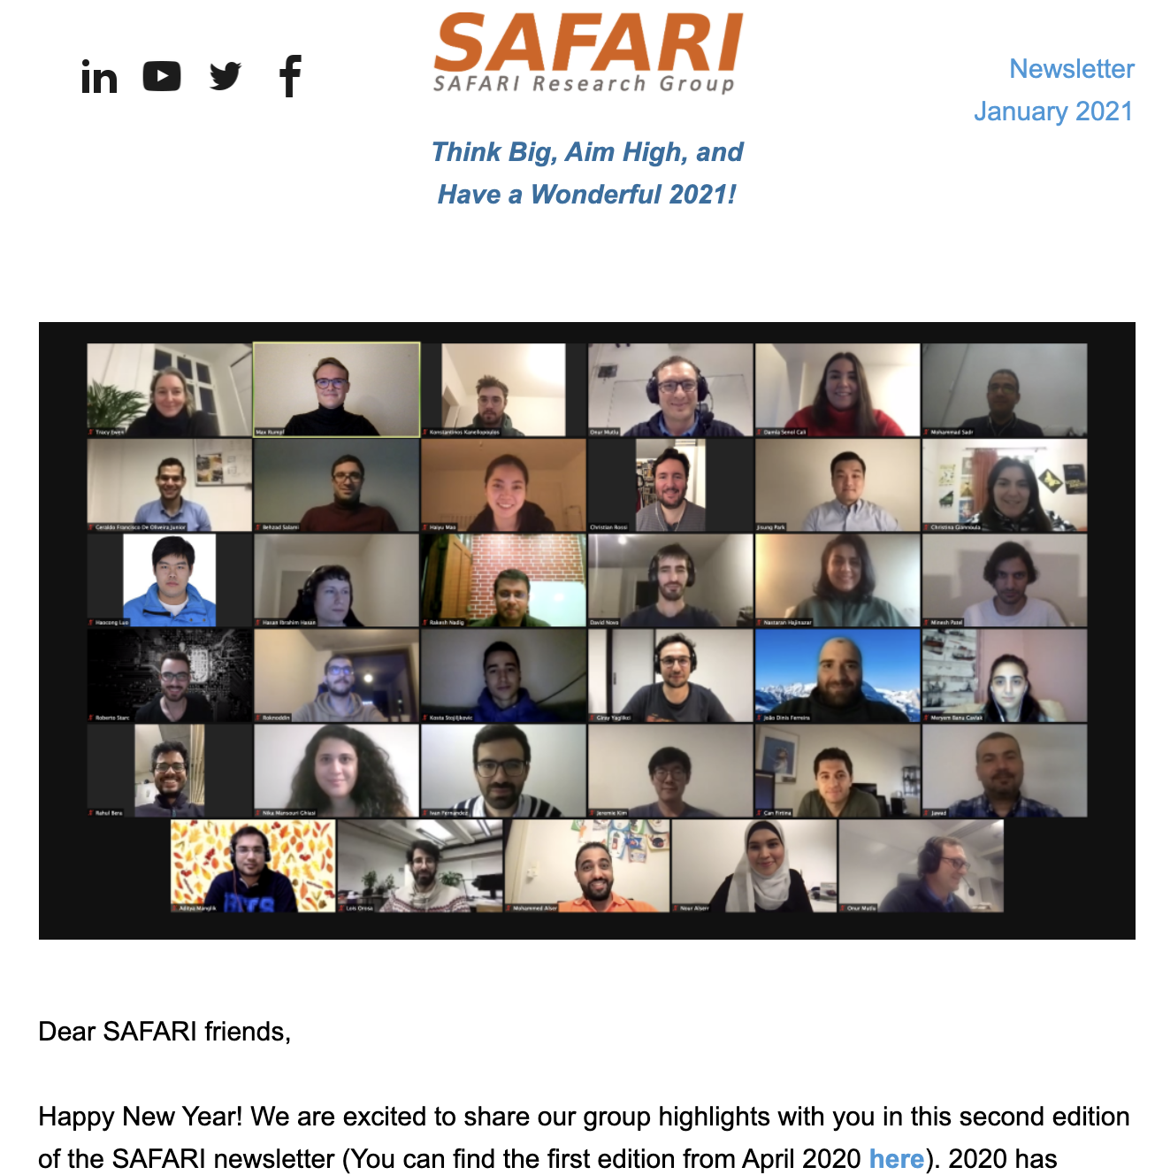
SAFARI Newsletter January 2021 Edition
https://safari.ethz.ch/safari-newsletter-january-2021/

Slide 169
Referenced Papers, Talks, Artifacts
All are available at
https://people.inf.ethz.ch/omutlu/projects.htm
http://scholar.google.com/citations?user=7XyGUGkAAAAJ&hl=en
https://www.youtube.com/onurmutlulectures
https://github.com/CMU-SAFARI/

Slide 170
Intelligent Architectures for Intelligent Machines
Onur Mutlu
omutlu@gmail.com
https://people.inf.ethz.ch/omutlu
29 April 2021
FICC Keynote Talk

Slide 171
Backup Slides

Slide 172
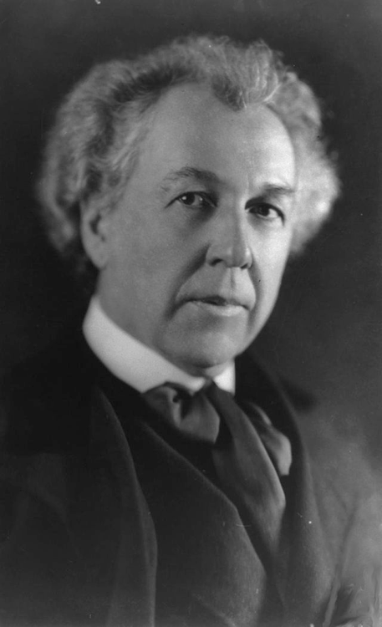
A Quote from A Famous Architect
“architecture […] based upon principle, and not upon precedent”

Slide 173
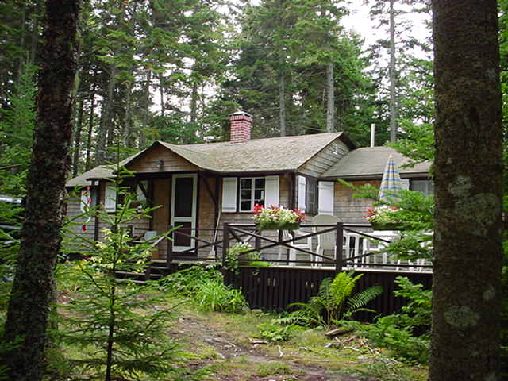
Precedent-Based Design?
“architecture […] based upon principle, and not upon precedent”

Slide 174
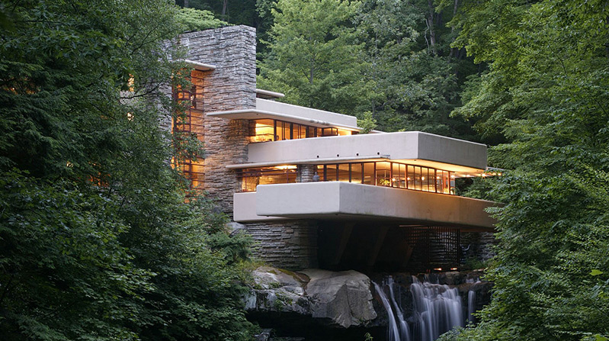
Principled Design
“architecture […] based upon principle, and not upon precedent”

Slide 175
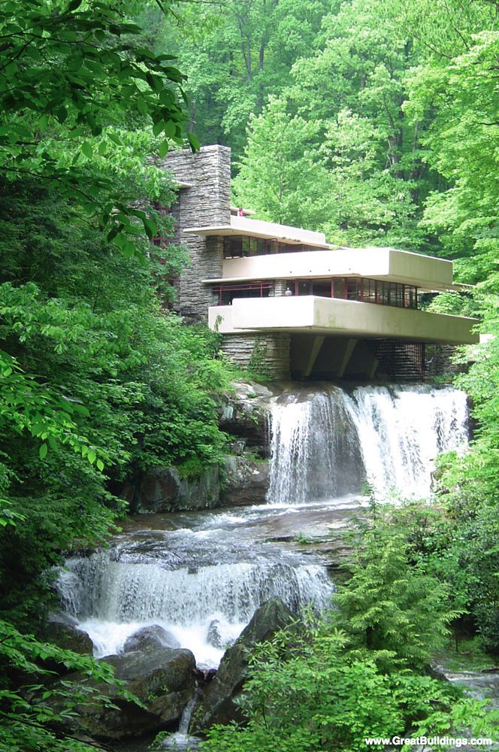

Slide 176
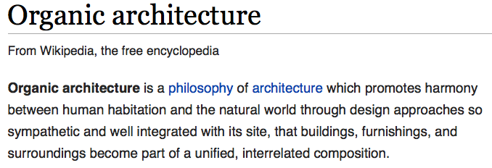
The Overarching Principle

Slide 177
Another Example: Precedent-Based Design
Source: http://cookiemagik.deviantart.com/art/Train-station-207266944

Slide 178
Principled Design
Source: By Toni_V, CC BY-SA 2.0, https://commons.wikimedia.org/w/index.php?curid=4087256

Slide 179
Another Principled Design
Source: By Martín Gómez Tagle - Lisbon, Portugal, CC BY-SA 3.0, https://commons.wikimedia.org/w/index.php?curid=13764903
Source: http://www.arcspace.com/exhibitions/unsorted/santiago-calatrava/

Slide 180
Another Principled Design
Source: CC BY-SA 3.0, https://commons.wikimedia.org/w/index.php?curid=172107

Slide 181
Principle Applied to Another Structure
Source: By 準建築人手札網站 Forgemind ArchiMedia - Flickr: IMG_2489.JPG, CC BY 2.0,
https://commons.wikimedia.org/w/index.php?curid=31493356, https://en.wikipedia.org/wiki/Santiago_Calatrava
Source: https://www.dezeen.com/2016/08/29/santiago-calatrava-oculus-world-trade-center-transportation-hub-new-york-photographs-hufton-crow/

Slide 182
The Overarching Principle

Slide 183
Overarching Principles for Computing?
Source: http://spectrum.ieee.org/image/MjYzMzAyMg.jpeg

Slide 184
Readings, Videos, Reference Materials

Slide 185
More on My Research & Teaching

Slide 186
Brief Self Introduction
Onur Mutlu
Full Professor @ ETH Zurich ITET (INFK), since September 2015
Strecker Professor @ Carnegie Mellon University ECE/CS, 2009-2016, 2016-…
PhD from UT-Austin, worked at Google, VMware, Microsoft Research, Intel, AMD
https://people.inf.ethz.ch/omutlu/
omutlu@gmail.com (Best way to reach me)
https://people.inf.ethz.ch/omutlu/projects.htm
Research and Teaching in:
Computer architecture, computer systems, hardware security, bioinformatics
Memory and storage systems
Hardware security, safety, predictability
Fault tolerance
Hardware/software cooperation
Architectures for bioinformatics, health, medicine
…

Slide 187
Current Research Mission
Computer architecture, HW/SW, systems, bioinformatics, security
Hybrid Main Memory
Heterogeneous
Processors and
Accelerators
Persistent Memory/Storage
Graphics and Vision Processing
Build fundamentally better architectures
Notes:
Professor Mutlu’s research focus is all aspects of computer architecture, HW/SW interaction and bioinformatics.
He is looking for students to perform research in these areas.
He and his group, SAFARI, solve fundamental problems spanning:
Memory, memory, memory, storage, interconnects
Parallel architectures, heterogeneous architectures, GP-GPUs
System/architecture interaction, new execution models
Energy efficiency, fault tolerance, hardware security
Genome sequence analysis and assembly
His group does broad research spanning systems to logic with architecture at center

Slide 188
Four Key Current Directions
Fundamentally Secure/Reliable/Safe Architectures
Fundamentally Energy-Efficient Architectures
Memory-centric (Data-centric) Architectures
Fundamentally Low-Latency and Predictable Architectures
Architectures for AI/ML, Genomics, Medicine, Health

Slide 189
The Transformation Hierarchy
Problem
Algorithm
Program/Language
System Software
Computer Architecture (expanded view)
SW/HW Interface
Computer Architecture (narrow view)
Micro-architecture
Logic
Devices
Electrons

Slide 190
Axiom
To achieve the highest energy efficiency and performance:
we must take the expanded view
of computer architecture
Problem
Algorithm
Program/Language
System Software
Co-design across the hierarchy:
Algorithms to devices
SW/HW Interface
Micro-architecture
Logic
Specialize as much as possible
within the design goals
Devices
Electrons

Slide 191
Current Research Mission & Major Topics
Build fundamentally better architectures
Data-centric arch. for low energy & high perf.
Proc. in Mem/DRAM, NVM, unified mem/storage
Low-latency & predictable architectures
Low-latency, low-energy yet low-cost memory
QoS-aware and predictable memory systems
Fundamentally secure/reliable/safe arch.
Tolerating all bit flips; patchable HW; secure mem
Architectures for ML/AI/Genomics/Health/Med
Algorithm/arch./logic co-design; full heterogeneity
Data-driven and data-aware architectures
ML/AI-driven architectural controllers and design
Expressive memory and expressive systems
Problem
Algorithm
Program/Language
System Software
SW/HW Interface
Micro-architecture
Logic
Devices
Electrons
Broad research
spanning apps, systems, logic
with architecture at the center

Slide 192
Onur Mutlu’s SAFARI Research Group
Computer architecture, HW/SW, systems, bioinformatics, security, memory
https://safari.ethz.ch/safari-newsletter-april-2020/
38+ Researchers
Think BIG, Aim HIGH!
https://safari.ethz.ch

Slide 193
SAFARI Newsletter January 2021 Edition
https://safari.ethz.ch/safari-newsletter-january-2021/

Slide 194
Principle: Teaching and Research
…
Teaching drives Research
Research drives Teaching
…

Slide 195
Principle: Insight and Ideas
Focus on Insight
Encourage New Ideas

Slide 196
Research & Teaching: Some Overview Talks
https://www.youtube.com/onurmutlulectures
Future Computing Architectures
https://www.youtube.com/watch?v=kgiZlSOcGFM&list=PL5Q2soXY2Zi8D_5MGV6EnXEJHnV2YFBJl&index=1
Enabling In-Memory Computation
https://www.youtube.com/watch?v=njX_14584Jw&list=PL5Q2soXY2Zi8D_5MGV6EnXEJHnV2YFBJl&index=16
Accelerating Genome Analysis
https://www.youtube.com/watch?v=r7sn41lH-4A&list=PL5Q2soXY2Zi8D_5MGV6EnXEJHnV2YFBJl&index=41
Rethinking Memory System Design
https://www.youtube.com/watch?v=F7xZLNMIY1E&list=PL5Q2soXY2Zi8D_5MGV6EnXEJHnV2YFBJl&index=3
Intelligent Architectures for Intelligent Machines
https://www.youtube.com/watch?v=c6_LgzuNdkw&list=PL5Q2soXY2Zi8D_5MGV6EnXEJHnV2YFBJl&index=25
The Story of RowHammer
https://www.youtube.com/watch?v=sgd7PHQQ1AI&list=PL5Q2soXY2Zi8D_5MGV6EnXEJHnV2YFBJl&index=39

Slide 197
An Interview on Research and Education
Computing Research and Education (@ ISCA 2019)
https://www.youtube.com/watch?v=8ffSEKZhmvo&list=PL5Q2soXY2Zi_4oP9LdL3cc8G6NIjD2Ydz
Maurice Wilkes Award Speech (10 minutes)
https://www.youtube.com/watch?v=tcQ3zZ3JpuA&list=PL5Q2soXY2Zi8D_5MGV6EnXEJHnV2YFBJl&index=15

Slide 198
More Thoughts and Suggestions
Onur Mutlu, "Some Reflections (on DRAM)" Award Speech for ACM SIGARCH Maurice Wilkes Award, at the ISCA Awards Ceremony, Phoenix, AZ, USA, 25 June 2019. [Slides (pptx) (pdf)] [Video of Award Acceptance Speech (Youtube; 10 minutes) (Youku; 13 minutes)] [Video of Interview after Award Acceptance (Youtube; 1 hour 6 minutes) (Youku; 1 hour 6 minutes)] [News Article on "ACM SIGARCH Maurice Wilkes Award goes to Prof. Onur Mutlu"]
Onur Mutlu, "How to Build an Impactful Research Group" 57th Design Automation Conference Early Career Workshop (DAC), Virtual, 19 July 2020. [Slides (pptx) (pdf)]

Slide 199
Referenced Papers, Talks, Artifacts
All are available at
https://people.inf.ethz.ch/omutlu/projects.htm
http://scholar.google.com/citations?user=7XyGUGkAAAAJ&hl=en
https://www.youtube.com/onurmutlulectures
https://github.com/CMU-SAFARI/

Slide 200
End of Backup Slides

