Slide 1

Memory-Centric Computing
Onur Mutlu
ETH Zurich

Slide 2


Memory-Centric
Computing
Onur Mutlu
omutlu@gmail.com
https://people.inf.ethz.ch/omutlu
2 November 2024
Future of Science Prize Week Keynote Talk

Slide 3
Problem
Computing
is Bottlenecked by Data

Slide 4
Data is Key for AI, ML, Genomics, …
Important workloads are all data intensive
They require rapid and efficient processing of large amounts of data
Data is increasing
  We can generate more than we can process
  We need to perform more sophisticated analyses on more data

Slide 5
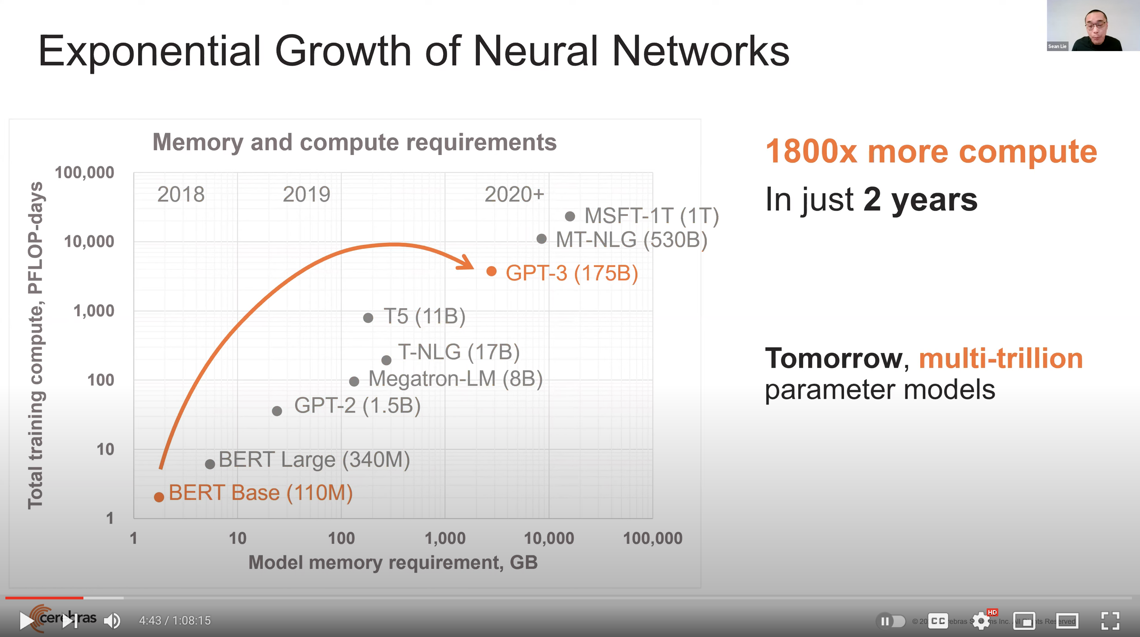
Huge Demand for Performance & Efficiency
Source: https://youtu.be/Bh13Idwcb0Q?t=283

Slide 6
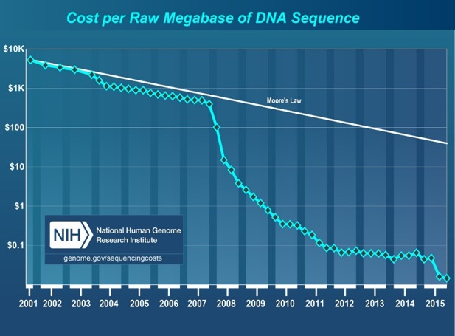
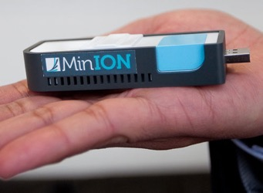
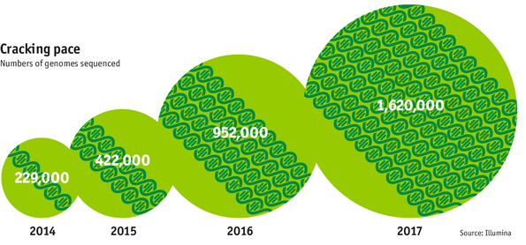

Huge Demand for Performance & Efficiency
development of new
sequencing technologies
Oxford Nanopore MinION
Number of Genomes Sequenced
http://www.economist.com/news/21631808-so-much-genetic-data-so-many-uses-genes-unzipped
Notes:
However, since the development of high throughput sequencing (HTS) technologies, the cost of genome sequencing has fallen off a cliff (<< 1,000$) making it viable for almost everyone's use.

Slide 7
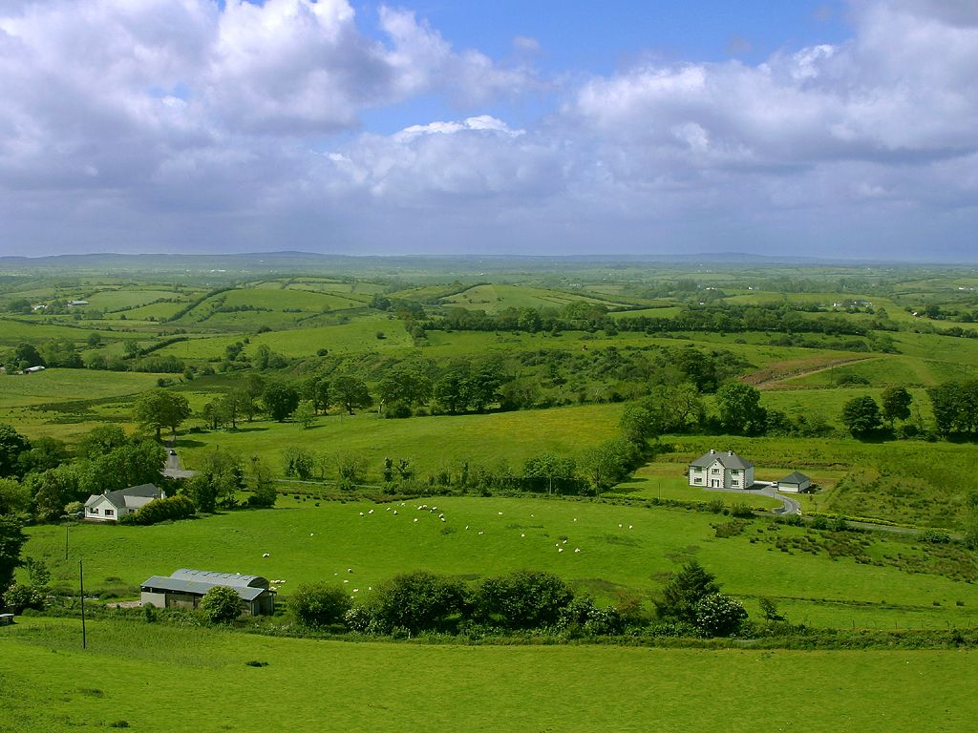
Do We Want This?
Source: V. Milutinovic

Slide 8
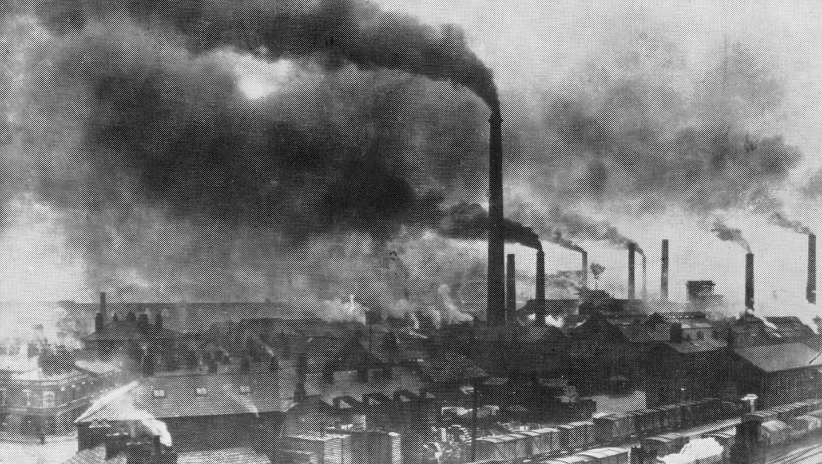
Or This?
Source: V. Milutinovic

Slide 9
Challenge and Opportunity for Future
High Performance,
Energy Efficient,
Sustainable
(All at the Same Time)

Slide 10
The Problem
Data access is the major performance and energy bottleneck
Our current
design principles
cause great energy waste
(and great performance loss)

Slide 11
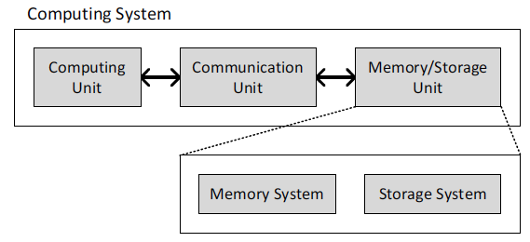
Today’s Computing Systems
Processor centric
All data processed in the processor → at great system cost

Slide 12
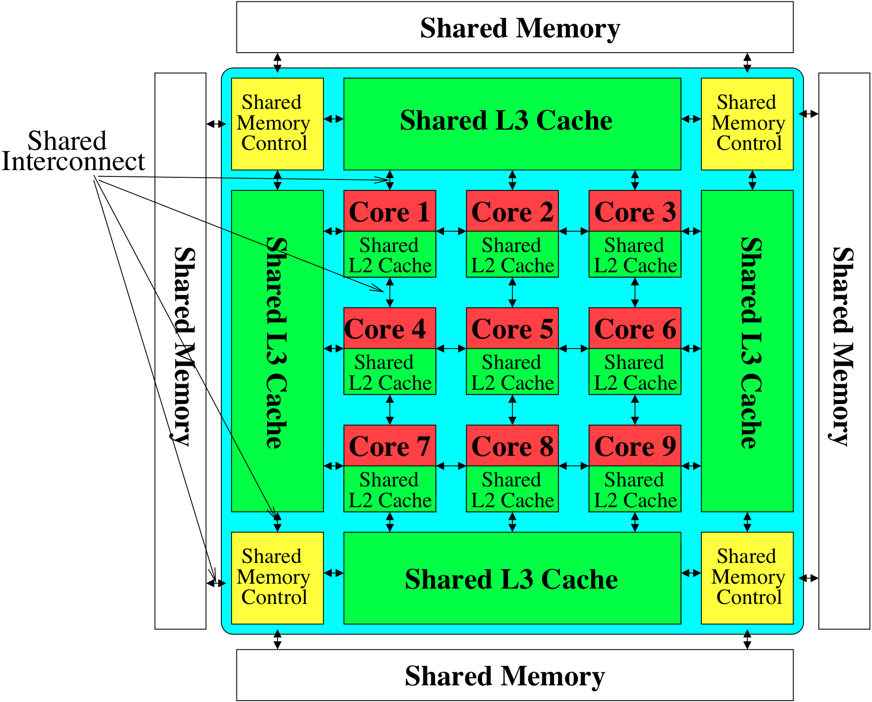

Perils of Processor-Centric Design
Most of the system is dedicated to storing and moving data
Yet, system is still bottlenecked by memory

Slide 13
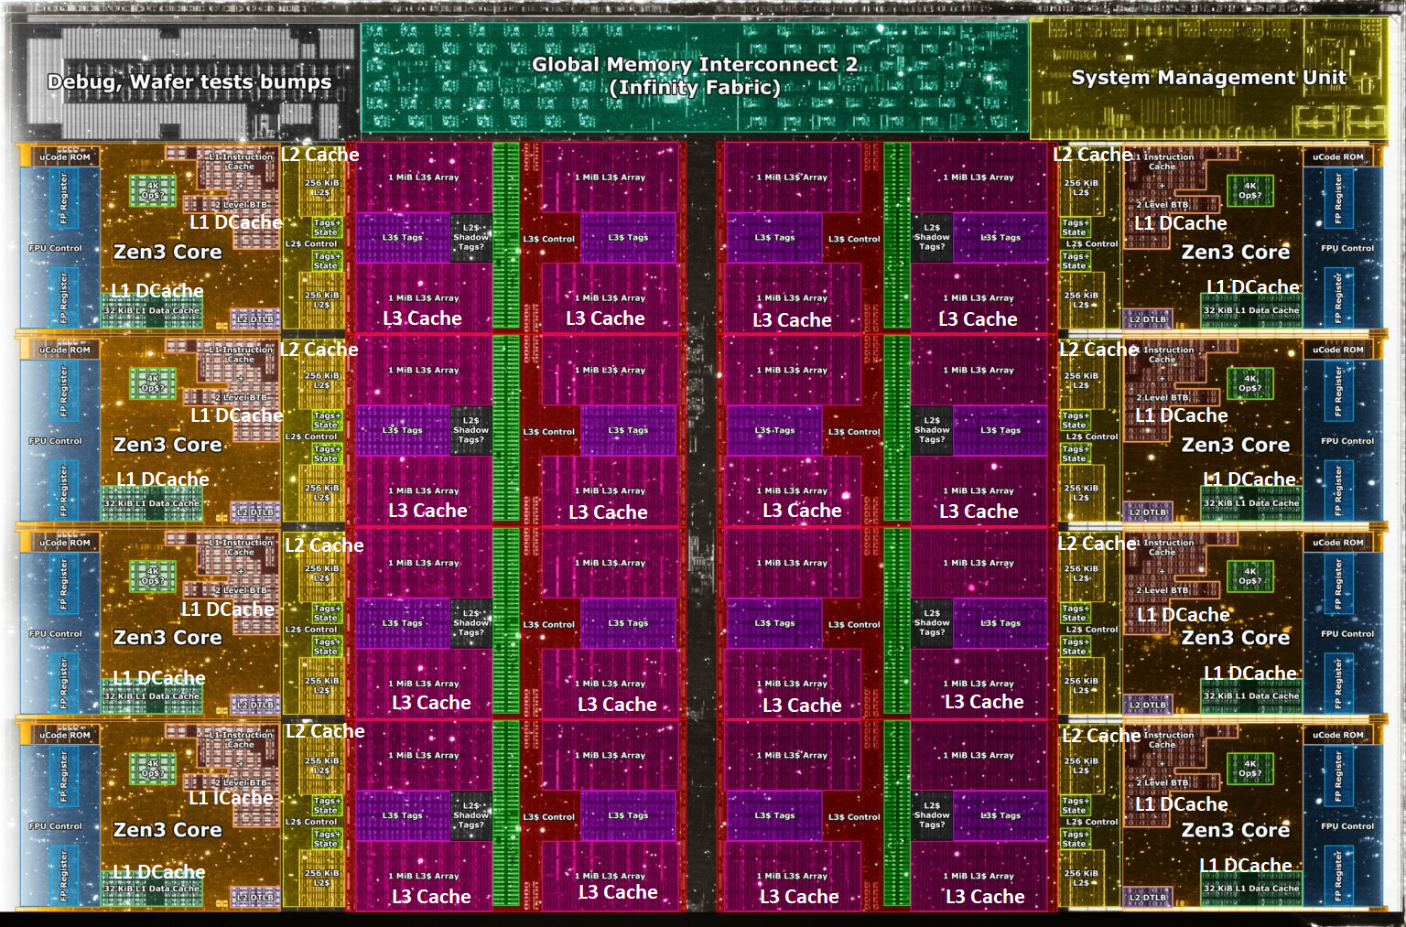
Deeper and Larger Memory Hierarchies
Core Count:
8 cores/16 threads
L1 Caches:
32 KB per core
L2 Caches:
512 KB per core
L3 Cache:
32 MB shared
AMD Ryzen 5000, 2020
https://wccftech.com/amd-ryzen-5000-zen-3-vermeer-undressed-high-res-die-shots-close-ups-pictured-detailed/

Slide 14
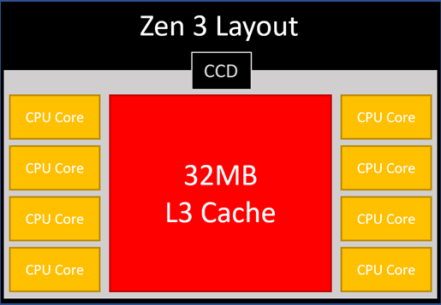
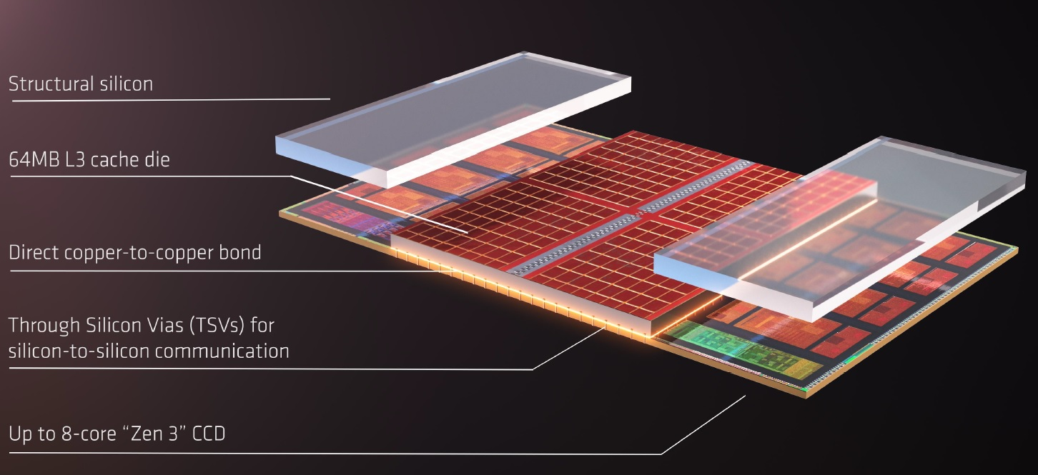
AMD’s 3D Last Level Cache (2021)
AMD increases the L3 size of their 8-core Zen 3 processors from 32 MB to 96 MB
Additional 64 MB L3 cache die stacked on top of the processor die
- Connected using Through Silicon Vias (TSVs)
- Total of 96 MB L3 cache
https://community.microcenter.com/discussion/5134/comparing-zen-3-to-zen-2
https://youtu.be/gqAYMx34euU
https://www.tech-critter.com/amd-keynote-computex-2021/
Notes:
CCD = Core Chiplet Die
Structural silicon is used to equalize the height and facilitate heat dissipation from the cores.

Slide 15
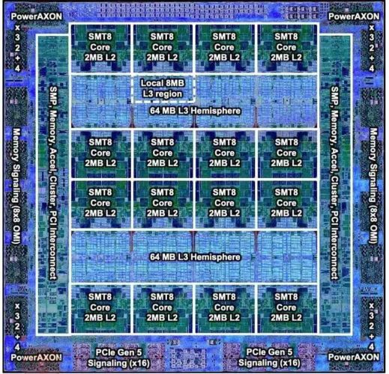
Deeper and Larger Memory Hierarchies
IBM POWER10,
2020
Cores:
15-16 cores,
8 threads/core
L2 Caches:
2 MB per core
L3 Cache:
120 MB shared
https://www.it-techblog.de/ibm-power10-prozessor-mehr-speicher-mehr-tempo-mehr-sicherheit/09/2020/

Slide 16
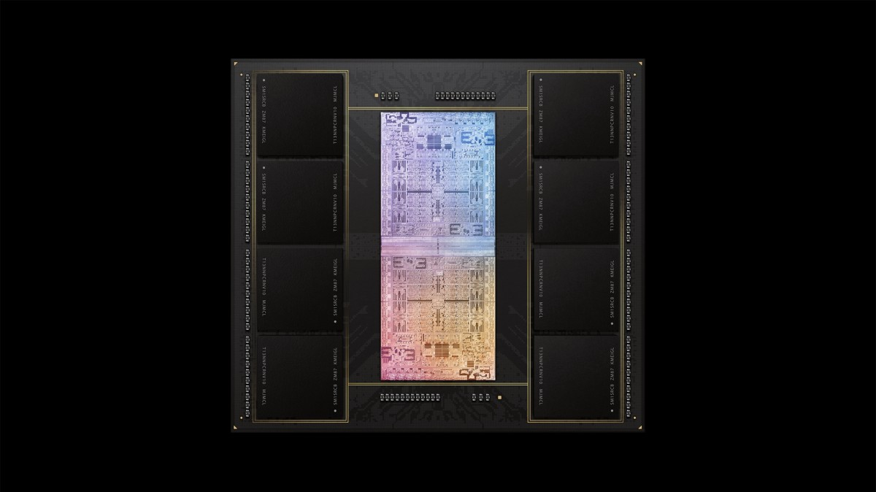
Deeper and Larger Memory Hierarchies
A lot of
SRAM
Storage
DRAM
DRAM
Storage
Apple M1 Ultra System (2022)
https://www.gsmarena.com/apple_announces_m1_ultra_with_20core_cpu_and_64core_gpu-news-53481.php

Slide 17
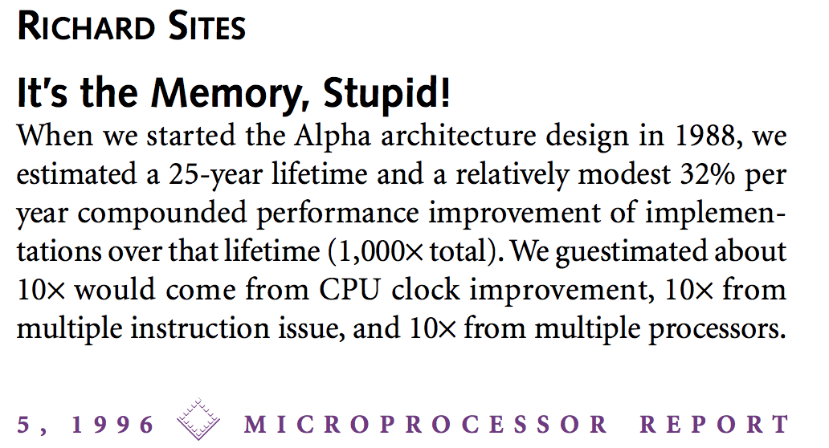
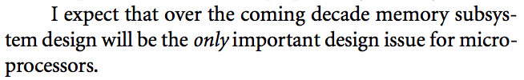
It’s the Memory, Stupid!
“It’s the Memory, Stupid!” (Richard Sites, MPR, 1996)
http://cva.stanford.edu/classes/cs99s/papers/architects_look_to_future.pdf

Slide 18
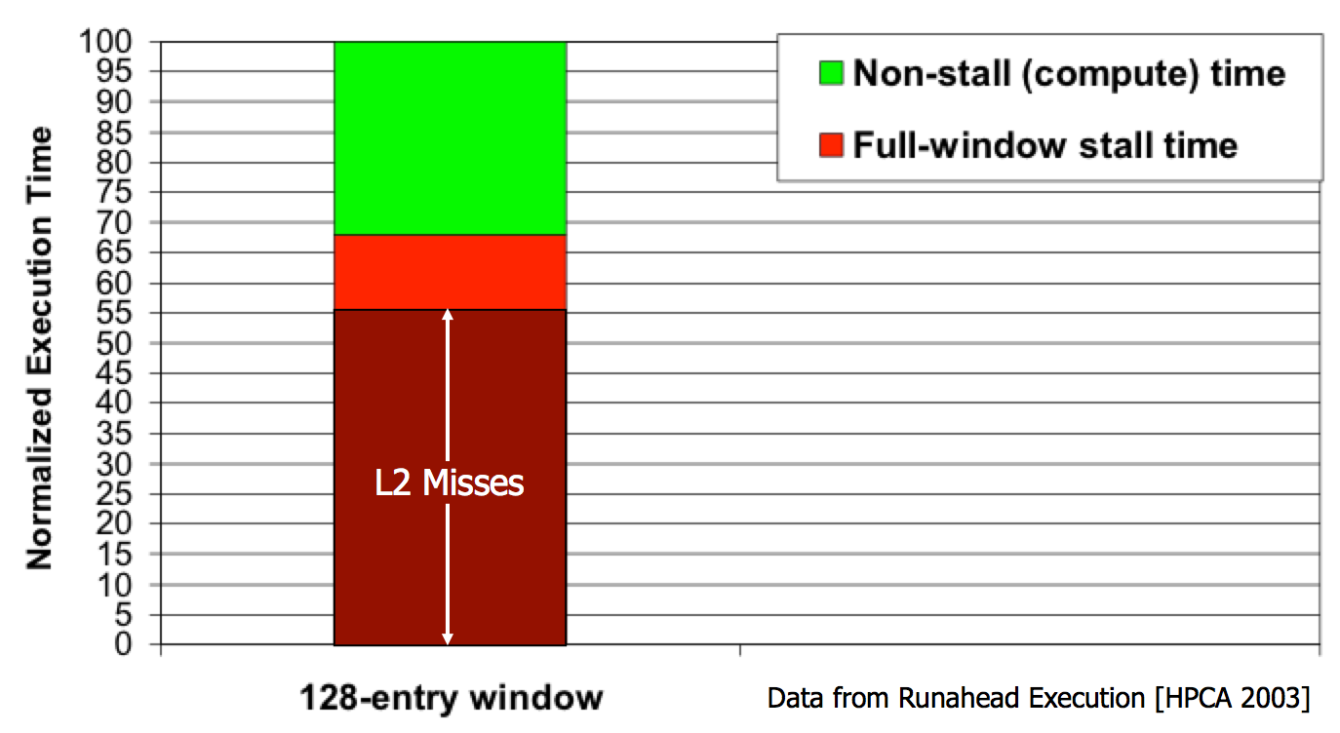
Processor-Centric System Performance
Mutlu+, “Runahead Execution: An Alternative to Very Large Instruction Windows for Out-of-Order Processors,” HPCA 2003.

Slide 19
Processor-Centric System Performance
All of Google’s Data Center Workloads (2015):
Kanev+, “Profiling a Warehouse-Scale Computer,” ISCA 2015.

Slide 20
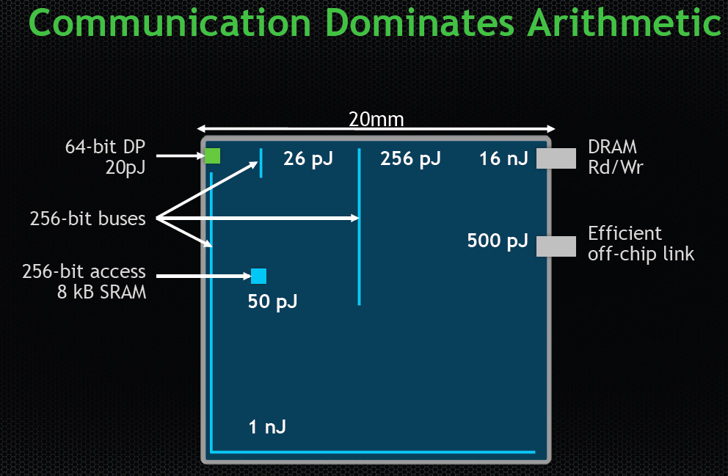
Data Movement vs. Computation Energy
Dally, HiPEAC 2015
A memory access consumes ~100-1000X
the energy of a complex addition

Slide 21
Data Movement vs. Computation Energy
Han+, “EIE: Efficient Inference Engine on Compressed Deep Neural Network,” ISCA 2016.

Slide 22
Data Movement vs. Computation Energy
6400X
A memory access consumes 6400X
the energy of a simple integer addition
Han+, “EIE: Efficient Inference Engine on Compressed Deep Neural Network,” ISCA 2016.

Slide 23
Energy Waste in Mobile Devices
Amirali Boroumand, Saugata Ghose, Youngsok Kim, Rachata Ausavarungnirun, Eric Shiu, Rahul Thakur, Daehyun Kim, Aki Kuusela, Allan Knies, Parthasarathy Ranganathan, and Onur Mutlu,
"Google Workloads for Consumer Devices: Mitigating Data Movement Bottlenecks"
Proceedings of the 23rd International Conference on Architectural Support for Programming Languages and Operating Systems (ASPLOS), Williamsburg, VA, USA, March 2018.
62.7% of the total system energy
is spent on data movement

Slide 24
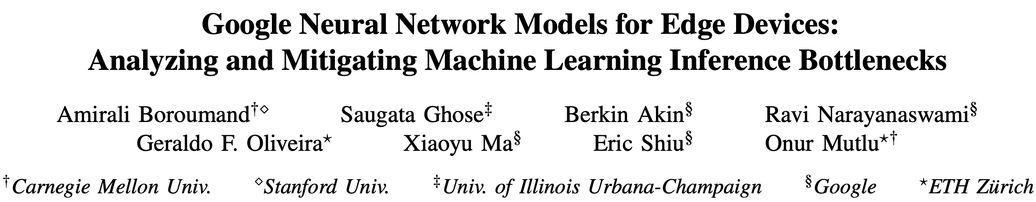
Energy Waste in Accelerators
Amirali Boroumand, Saugata Ghose, Berkin Akin, Ravi Narayanaswami, Geraldo F. Oliveira, Xiaoyu Ma, Eric Shiu, and Onur Mutlu,
"Google Neural Network Models for Edge Devices: Analyzing and Mitigating Machine Learning Inference Bottlenecks"
Proceedings of the 30th International Conference on Parallel Architectures and Compilation Techniques (PACT), Virtual, September 2021.
[Slides (pptx) (pdf)]
[Talk Video (14 minutes)]
> 90% of the total system energy
is spent on memory in large ML models

Slide 25
Example Energy Breakdowns
In LSTMs and Transducers used by Google,
>90% energy spent on off-chip interconnect and DRAM
https://arxiv.org/pdf/2109.14320
Notes:
[CLICK] Fist, Mensa-G placement of accelerators and careful dataflow design enables to reduce the energy consumed by on-chip and off-chip parameter traffic by 15.3x on average compared to the baseline.
[CLICK] Second, Mensa-G reduces the dynamic energy of on-chip buffers and Noc by almost 50x compared to the Baseline system with high bw memory.
[CLICK] We conclude that Mensa-G reduces energy by 66% and improves inference energy efficiency by 3.0x compared to the baseline edge TPU.
[NEXT]

Slide 26
Fundamental Problem
Processing of data
is performed
far away from the data

Slide 27
We Need A Paradigm Shift To …
Enable computation with minimal data movement
Compute where it makes sense (where data resides)
Make computing architectures more data-centric

Slide 28
Process Data Where It Makes Sense
Sensors
A lot of
SRAM
Storage
DRAM
DRAM
Storage
Apple M1 Ultra System (2022)
https://www.gsmarena.com/apple_announces_m1_ultra_with_20core_cpu_and_64core_gpu-news-53481.php

Slide 29
Memory as an Accelerator
CPU
core
CPU
core
mini-CPU
core
GPU
(throughput)
core
GPU
(throughput)
core
video
core
GPU
(throughput)
core
GPU
(throughput)
core
CPU
core
CPU
core
Memory
imaging
core
LLC
Specialized
compute-capability
in memory
Memory Controller
Memory Bus
Memory similar to a “conventional” accelerator

Slide 30
Goal: Processing Inside Memory/Storage
Many questions … How do we design the:
  compute-capable memory & controllers?
  processors & communication units?
  software & hardware interfaces?
  system software, compilers, languages?
  algorithms & theoretical foundations?
Memory/Storage
Database
Graphs
Media
Processor
Core
Cache
Query
Interconnect
Problem
Results
Algorithm
Program/Language
System Software
SW/HW Interface
Micro-architecture
Logic
Devices
Electrons

Slide 31
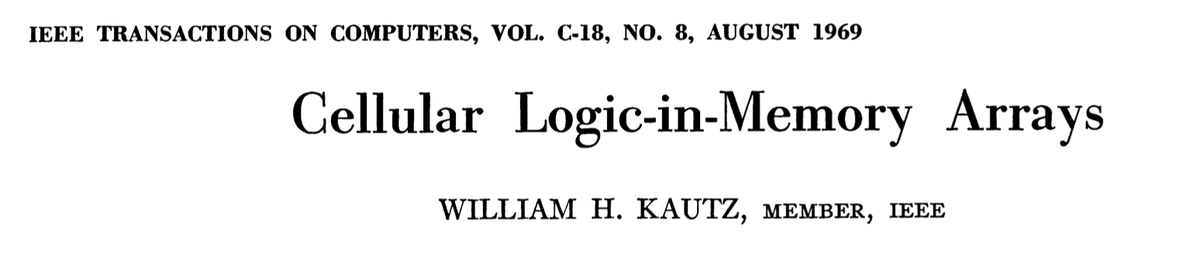
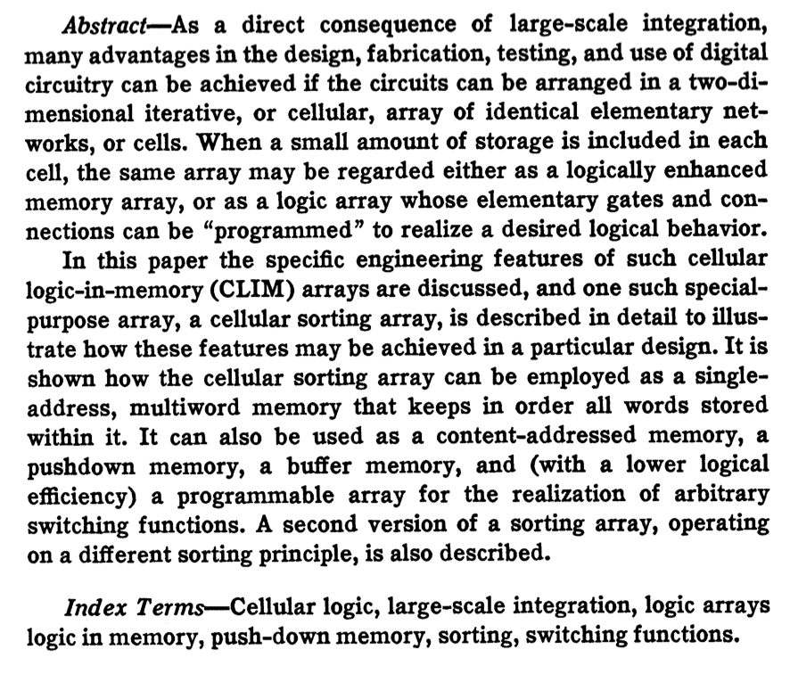
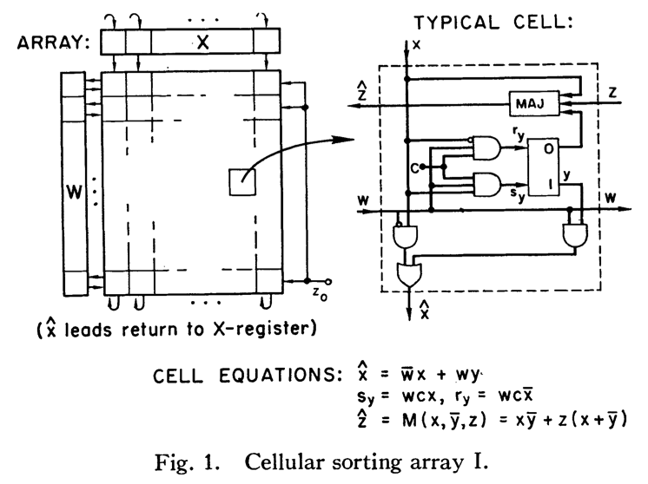
Processing in/near Memory: An Old Idea
Kautz, “Cellular Logic-in-Memory Arrays”, IEEE TC 1969.
https://doi.org/10.1109/T-C.1969.222754

Slide 32
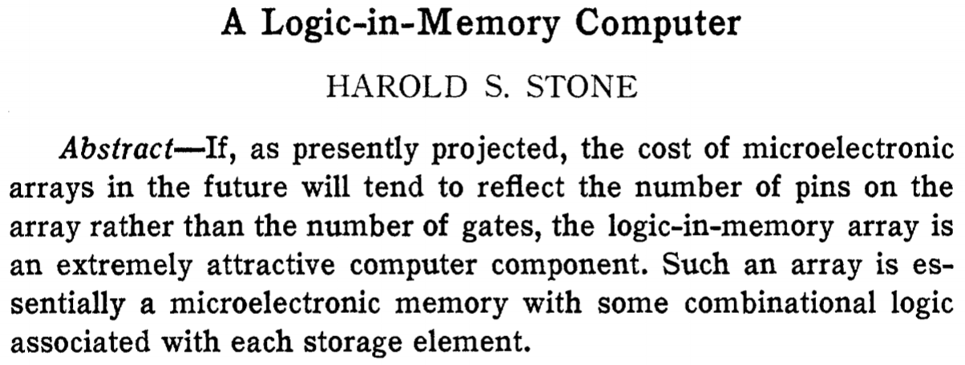
Processing in/near Memory: An Old Idea
Stone, “A Logic-in-Memory Computer,” IEEE TC 1970.
https://safari.ethz.ch/architecture/fall2020/lib/exe/fetch.php?media=stone_logic_in_memory_1970.pdf

Slide 33
Why In-Memory Computation Today?
Huge problems with Memory Technology
  Memory technology scaling is not going well (e.g., RowHammer)
  Many scaling issues demand intelligence in memory
Huge demand from Applications & Systems
  Data access bottleneck
  Energy & power bottlenecks
  Data movement energy dominates computation energy
  Need all at the same time: performance, energy, sustainability
  We can improve all metrics by minimizing data movement
Designs are squeezed in the middle

Slide 34
Processing in Memory:
Two Types
1. Processing near Memory
2. Processing using Memory

Slide 35
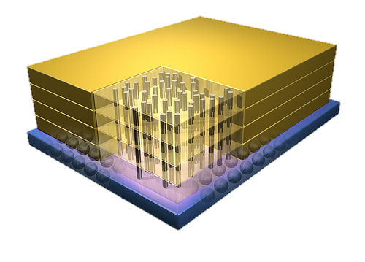


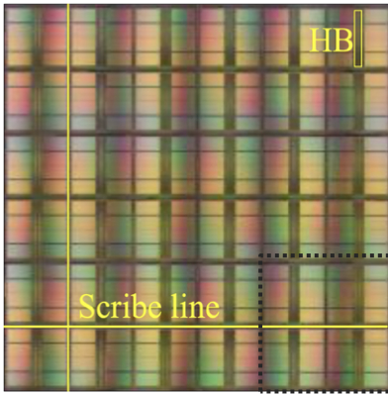
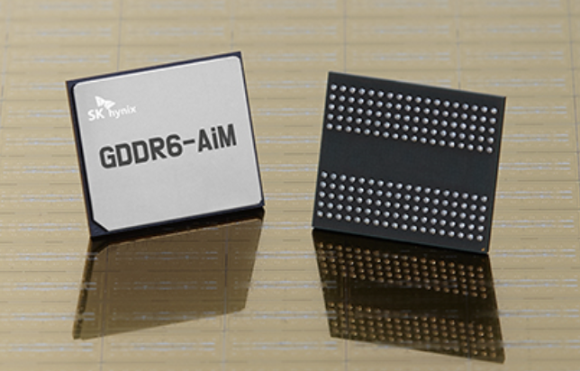
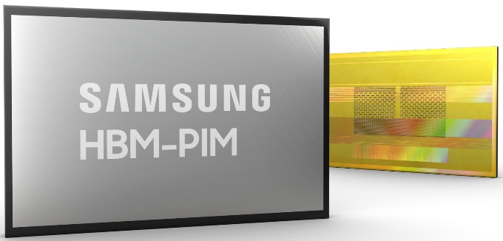
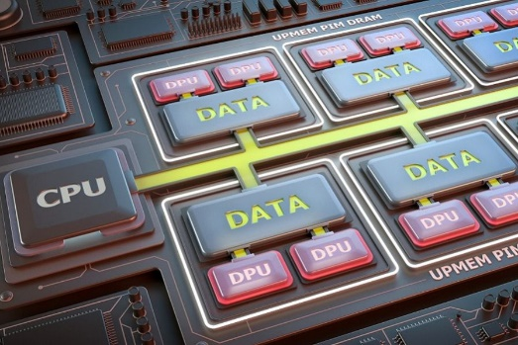
Processing-in-Memory Landscape Today
[Samsung 2021]
[Alibaba 2022]
[SK Hynix 2022]
[Samsung 2021]
[UPMEM 2019]
And, many other experimental chips and startups

Slide 36
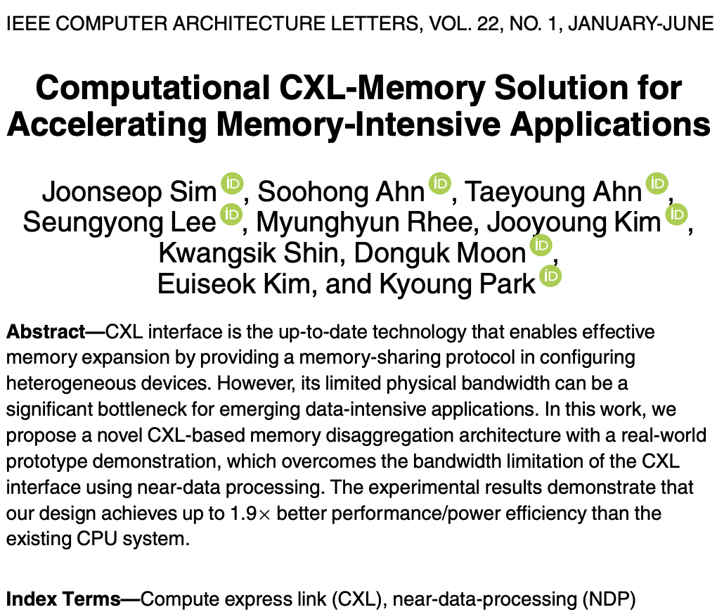
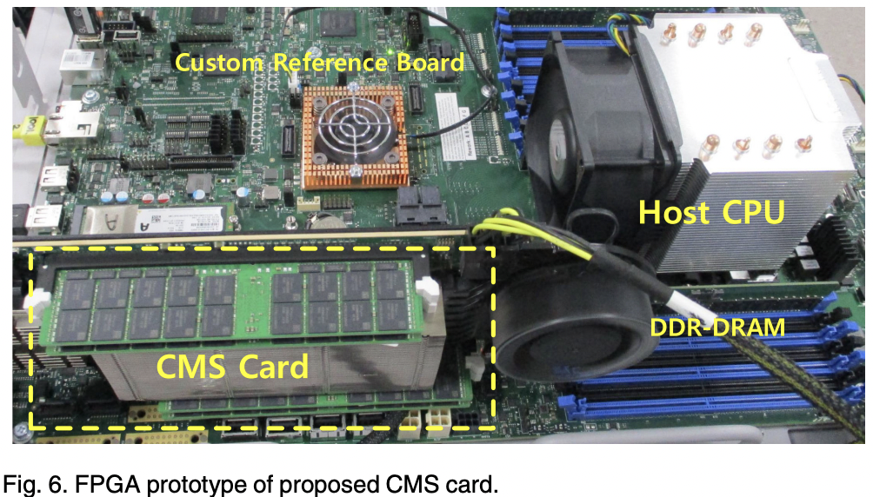
Processing-in-Memory Landscape Today

Slide 37
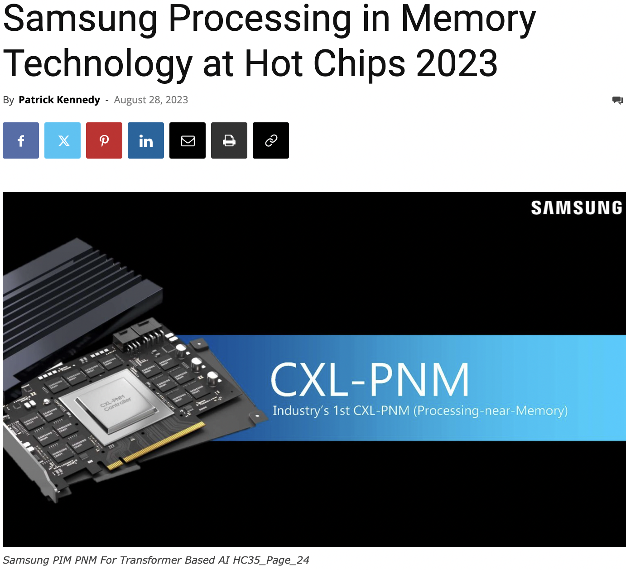
Processing-in-Memory Landscape Today
https://www.servethehome.com/samsung-processing-in-memory-technology-at-hot-chips-2023/

Slide 38
Opportunity: 3D-Stacked Logic+Memory
Memory
Logic
Other “True 3D” technologies
under development

Slide 39
Tesseract System for Graph Processing
Interconnected set of 3D-stacked memory+logic chips with simple cores
Host Processor
Memory
Memory-Mapped
Accelerator Interface
(Noncacheable, Physically Addressed)
Logic
In-Order Core
DRAM Controller
…
…
LP
PF Buffer
Crossbar Network
…
MTP
…
Message Queue
NI
Ahn+, “A Scalable Processing-in-Memory Accelerator for Parallel Graph Processing” ISCA 2015.

Slide 40
Tesseract Graph Processing Performance
>13X Performance Improvement
On five graph processing algorithms
Ahn+, “A Scalable Processing-in-Memory Accelerator for Parallel Graph Processing” ISCA 2015.

Slide 41
Tesseract Graph Processing System Energy
> 8X Energy Reduction
Ahn+, “A Scalable Processing-in-Memory Accelerator for Parallel Graph Processing” ISCA 2015.

Slide 42
Processing in Memory:
Two Types
1. Processing near Memory
2. Processing using Memory

Slide 43
Processing using DRAM
We can support
  Bulk bitwise AND, OR, NOT, MAJ
  Bulk bitwise COPY and INIT/ZERO
  True Random Number Generation; Physical Unclonable Functions
  More complex computation using Lookup Tables
At low cost
Using analog computation capability of DRAM
  Idea: activating (multiple) rows performs computation
    Even in commodity off-the-shelf DRAM chips!
30X-257X performance and energy improvements
Seshadri+“RowClone: Fast and Efficient In-DRAM Copy and Initialization of Bulk Data,” MICRO 2013.
Seshadri+, “Fast Bulk Bitwise AND and OR in DRAM”, IEEE CAL 2015.
Seshadri+, “Ambit: In-Memory Accelerator for Bulk Bitwise Operations Using Commodity DRAM Technology,” MICRO 2017.
Hajinazar+, “SIMDRAM: A Framework for Bit-Serial SIMD Processing using DRAM,” ASPLOS 2021.
Oliveira+, “MIMDRAM: An End-to-End Processing-Using-DRAM System for High-Throughput, Energy-Efficient and Programmer-Transparent Multiple-Instruction Multiple-Data Processing,” HPCA 2024.

Slide 44
Future Systems: In-Memory Copy
3) No cache pollution
1) Low latency
Memory
L3
CPU
L2
L1
MC
2) Low bandwidth utilization
4) No unwanted data movement
1046ns, 3.6uJ
→ 90ns, 0.04uJ

Slide 45
RowClone: In-DRAM Row Copy
Idea: Two consecutive ACTivates
4 Kbytes
Negligible HW cost
Step 1: Activate row A
Step 2: Activate row B
Transfer row
DRAM subarray
Transfer
row
Row Buffer (4 Kbytes)
8 bits
Data Bus
Notes:
copy

Slide 46
RowClone: Latency and Energy Savings
11.6x
74x
Seshadri et al., “RowClone: Fast and Efficient In-DRAM Copy and Initialization of Bulk Data,” MICRO 2013.

Slide 47
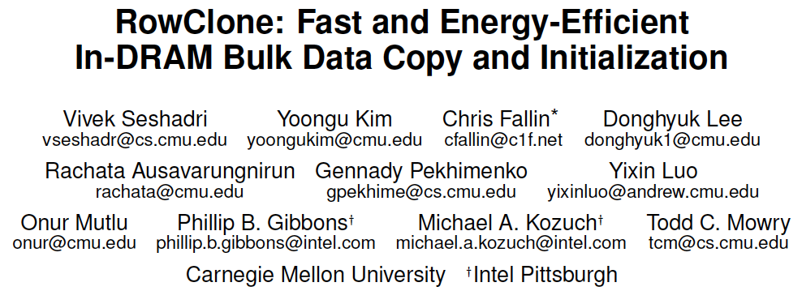
More on RowClone
Vivek Seshadri, Yoongu Kim, Chris Fallin, Donghyuk Lee, Rachata Ausavarungnirun, Gennady Pekhimenko, Yixin Luo, Onur Mutlu, Michael A. Kozuch, Phillip B. Gibbons, and Todd C. Mowry,
"RowClone: Fast and Energy-Efficient In-DRAM Bulk Data Copy and Initialization"
Proceedings of the 46th International Symposium on Microarchitecture (MICRO), Davis, CA, December 2013. [Slides (pptx) (pdf)] [Lightning Session Slides (pptx) (pdf)] [Poster (pptx) (pdf)]

Slide 48
In-DRAM AND/OR: Triple Row Activation
½V_{DD}
½V_{DD}+δ
V_{DD}
A
Final State
AB + BC + AC
B
C
C(A + B) + ~C(AB)
dis
en
0
½V_{DD}
Seshadri+, “Fast Bulk Bitwise AND and OR in DRAM”, IEEE CAL 2015.

Slide 49
Bulk Bitwise Operations in Workloads
[1] Li and Patel, BitWeaving, SIGMOD 2013
[2] Goodwin+, BitFunnel, SIGIR 2017

Slide 50
In-DRAM Acceleration of Database Queries
>4-12X Performance Improvement
Seshadri+, “Ambit: In-Memory Accelerator for Bulk Bitwise Operations using Commodity DRAM Technology,” MICRO 2017.

Slide 51
More on Ambit
Vivek Seshadri, Donghyuk Lee, Thomas Mullins, Hasan Hassan, Amirali Boroumand, Jeremie Kim, Michael A. Kozuch, Onur Mutlu, Phillip B. Gibbons, and Todd C. Mowry,
"Ambit: In-Memory Accelerator for Bulk Bitwise Operations Using Commodity DRAM Technology"
Proceedings of the 50th International Symposium on Microarchitecture (MICRO), Boston, MA, USA, October 2017.
[Slides (pptx) (pdf)] [Lightning Session Slides (pptx) (pdf)] [Poster (pptx) (pdf)]

Slide 52
Capabilities of Off-The-Shelf Memory
Existing DRAM Chips
Are Already Quite Capable

Slide 53
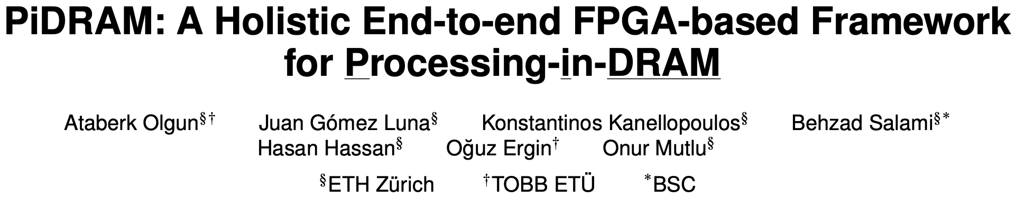
Real Processing Using Memory Prototype
End-to-end RowClone & TRNG using off-the-shelf DRAM chips
Idea: Violate DRAM timing parameters to mimic RowClone
https://arxiv.org/pdf/2111.00082.pdf
https://github.com/cmu-safari/pidram
https://www.youtube.com/watch?v=qeukNs5XI3g&t=4192s

Slide 54
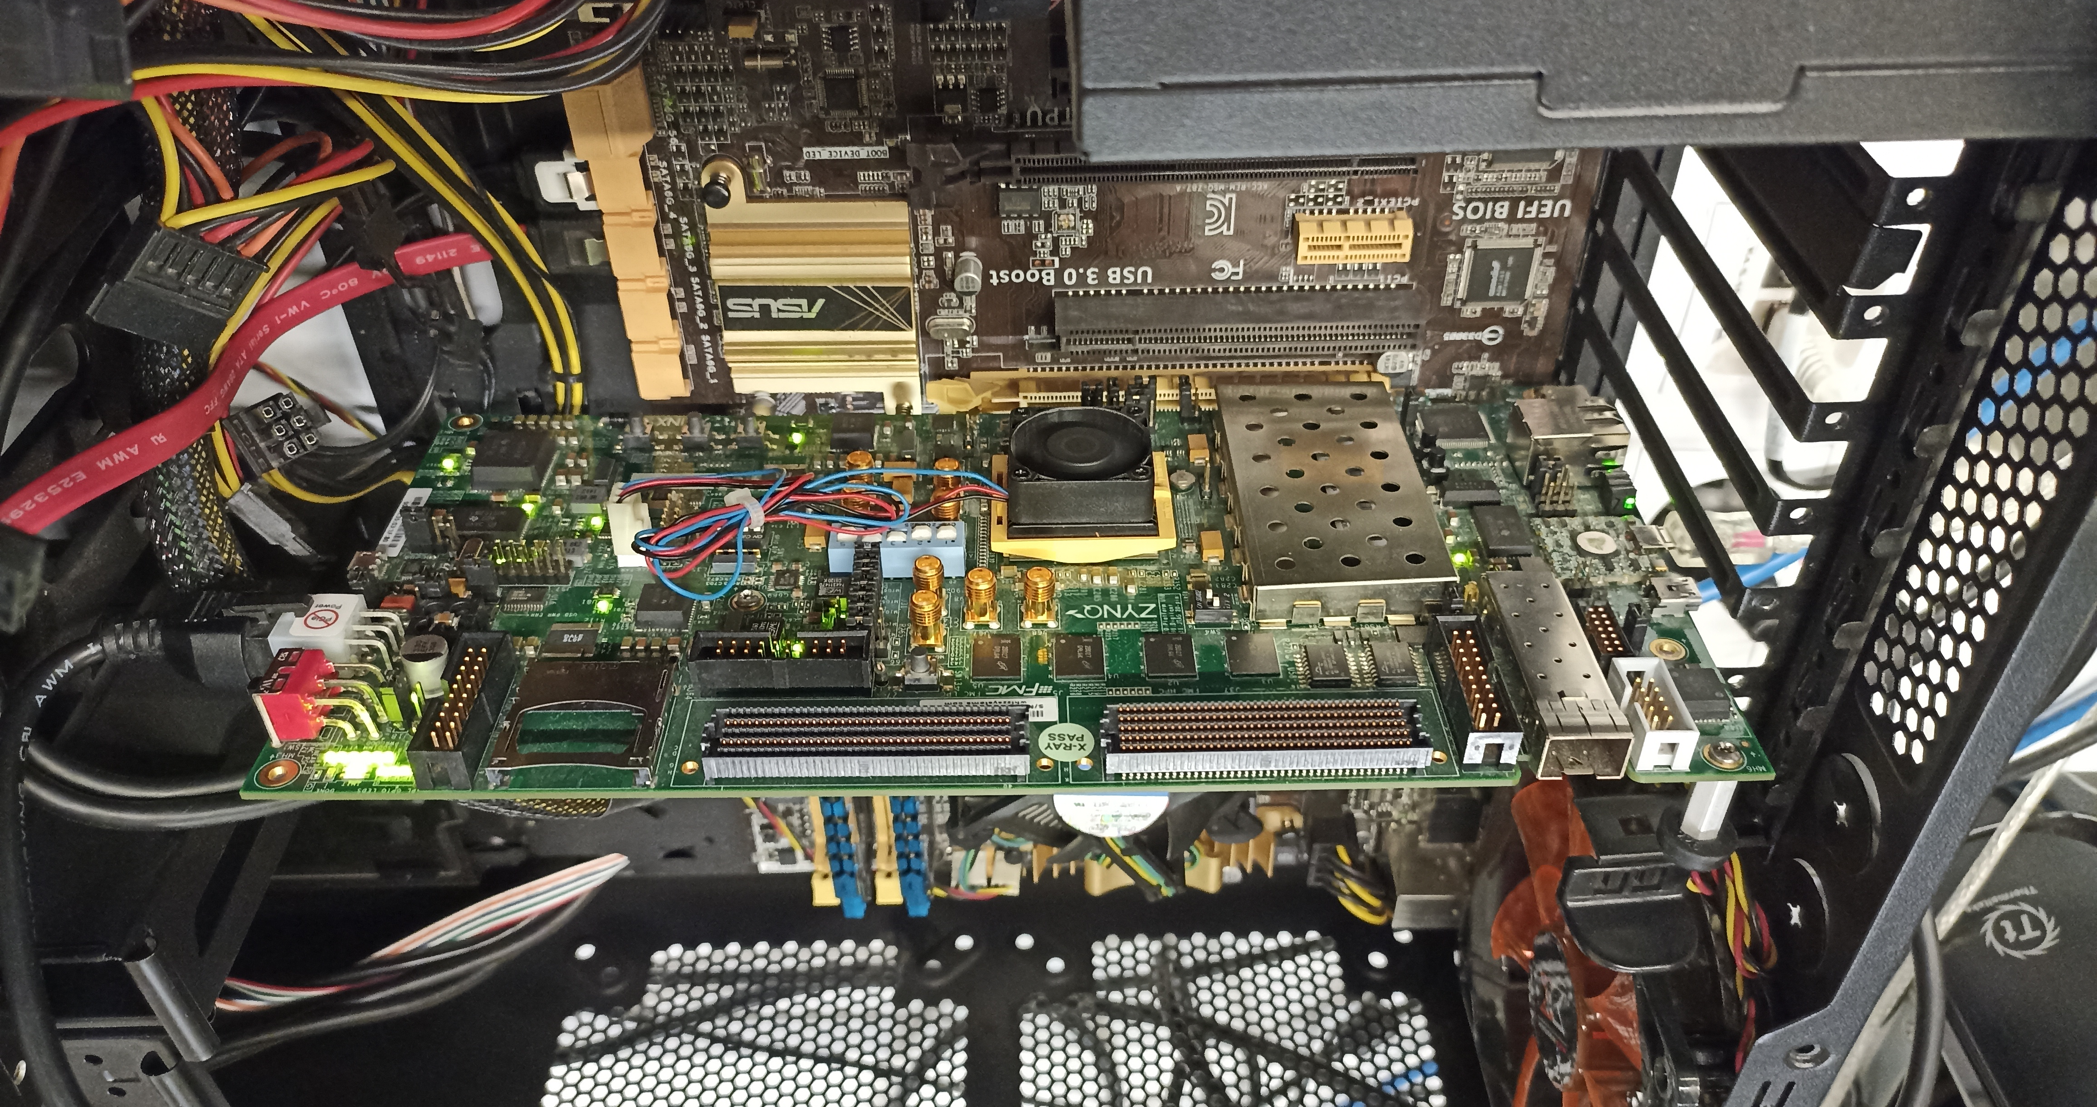
Real Processing-using-Memory Prototype
https://arxiv.org/pdf/2111.00082.pdf
https://github.com/cmu-safari/pidram
https://www.youtube.com/watch?v=qeukNs5XI3g&t=4192s
Host Machine
FPGA Board
RISC-V System
PiM-Enabled DIMM

Slide 55
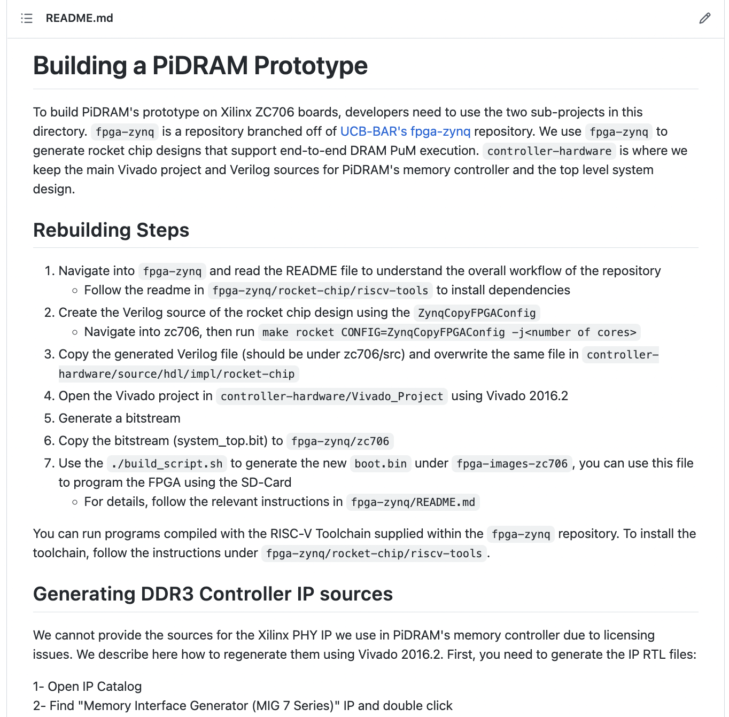
Real Processing-using-Memory Prototype
https://arxiv.org/pdf/2111.00082.pdf
https://github.com/cmu-safari/pidram
https://www.youtube.com/watch?v=qeukNs5XI3g&t=4192s

Slide 56
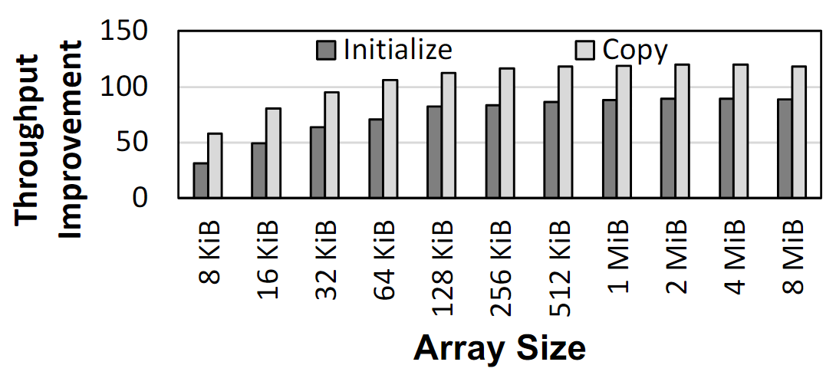
Microbenchmark Copy/Initialization Throughput
In-DRAM Copy and Initialization
improve throughput by 119x and 89x
Notes:
This plot shows the throughput improvement provided by in-DRAM copy operations for bulk data initialization and copy over CPU-based copy and initialization using LOAD and STORE instructions. We do not execute any CLFLUSH instructions and assume that the data is up to date in DRAM and there are no cached copies.
The x-axis shows the size of the arrays that we copy or initialize. The dark gray bar shows the improvement for initialization operations, and the bright gray bar shows the improvement for copy operations.
[CLICK] We observe that in-DRAM copy and initialization operations improve copy and initialization throughput by 119x and 89x including the overheads of system support required for RowClone operations

Slide 57
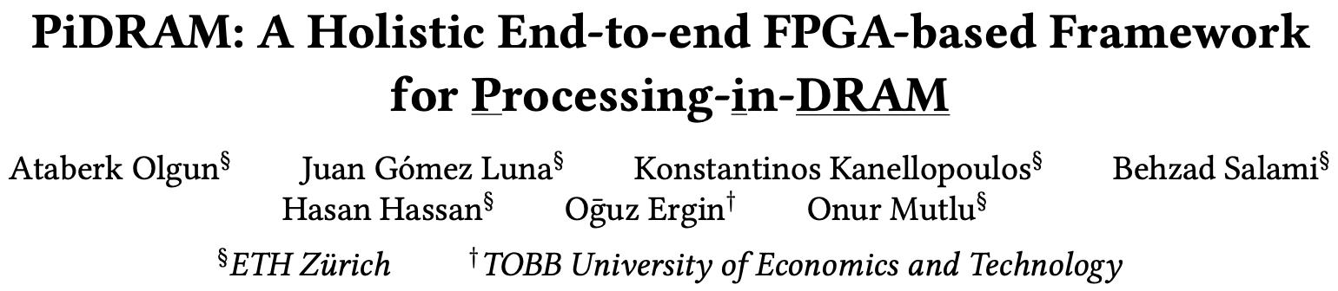
More on PiDRAM
Ataberk Olgun, Juan Gomez Luna, Konstantinos Kanellopoulos, Behzad Salami, Hasan Hassan, Oguz Ergin, and Onur Mutlu,
"PiDRAM: A Holistic End-to-end FPGA-based Framework for Processing-in-DRAM"
ACM Transactions on Architecture and Code Optimization (TACO), March 2023.
[arXiv version]
Presented at the 18th HiPEAC Conference, Toulouse, France, January 2023.
[Slides (pptx) (pdf)]
[Longer Lecture Slides (pptx) (pdf)]
[Lecture Video (40 minutes)]
[PiDRAM Source Code]

Slide 58
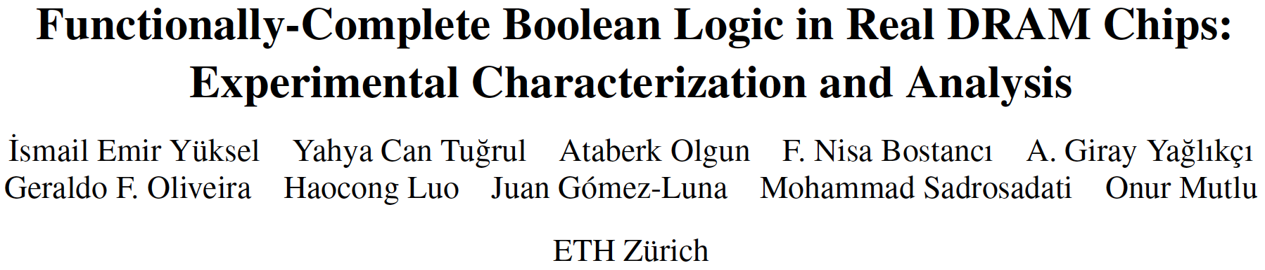
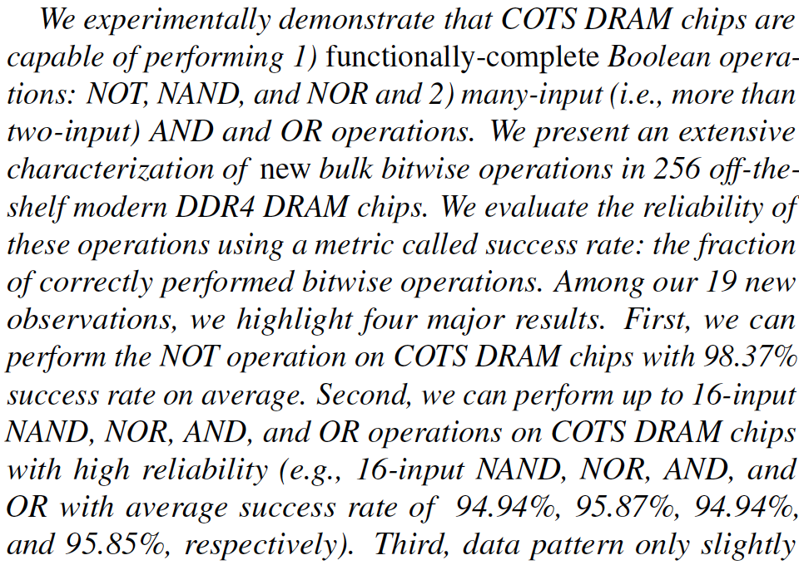
DRAM Chips Are Already (Quite) Capable!
Appears at HPCA 2024
https://arxiv.org/pdf/2402.18736.pdf

Slide 59
The Capability of COTS DRAM Chips
We demonstrate that COTS DRAM chips:
1
Can copy one row into up to 31 other rows
with >99.98% success rate
2
Can perform NOT operation
with up to 32 output operands
3
Can perform up to 16-input
AND, NAND, OR, and NOR operations
59
Notes:
[CLICK]In this study, we experimentally demonstrate that off-the-shelf DRAM chips
[CLICK] Can simultaneously activating up to 48 DRAM rows in two neighboring subarrays
[CLICK] Can performing NOT operation with up to 32 output operands
[CLICK] Can performing up to 16-input AND, NAND, OR, and NOR operations

Slide 60
Key Idea: NOT Operation
Connect rows in neighboring subarrays
through a NOT gate by simultaneously activating rows
src
src
src
NOT gate
A
A
A
SA
SA
SA
ACT src
ACT dst
~A
dst
dst
dst
60
Notes:
Our key idea is to leverage the connection between neighboring subarrays,
[CLICK] the NOT gate in the sense amplifier.
[CLICK] By simultaneously activating rows in neighboring subarrays, we can connect these rows through a NOT gate
[CLICK] As an example, source and destination in neighboring subarrays and if we first activate src
[CLICK] and then activate destination, this result in sense amplifier to drive the negated src value to the dst

Slide 61
Key Idea: NAND, NOR, AND, OR
Manipulate the bitline voltage to express
a wide variety of functions using
multiple-row activation in neighboring subarrays
V_{REF}
V_{(A,B)}
A
A
B
B
SA
Multiple Row ACT
SA
sense amp.
compares
V_{(A,B)} and V_{(X,Y)}
X
X
Y
Y
V_{REF}
V_{(X,Y)}
61
Notes:
[CLICK] Let me give the key idea by showing four cells: X,Y,A, and B, two from each neighboring subarrays.
[CLICK] Now if we activate these four cells simultaneously,
[CLICK] the bitline at the bottom subarray becomes the function of voltages in X and Y and the bitline at the top subarray becomes the function of voltages in A and B
[CLICK] Sense amplifier will compare voltage at the bottom bitline to the voltage at the top bitline and figure out which one is higher

Slide 62
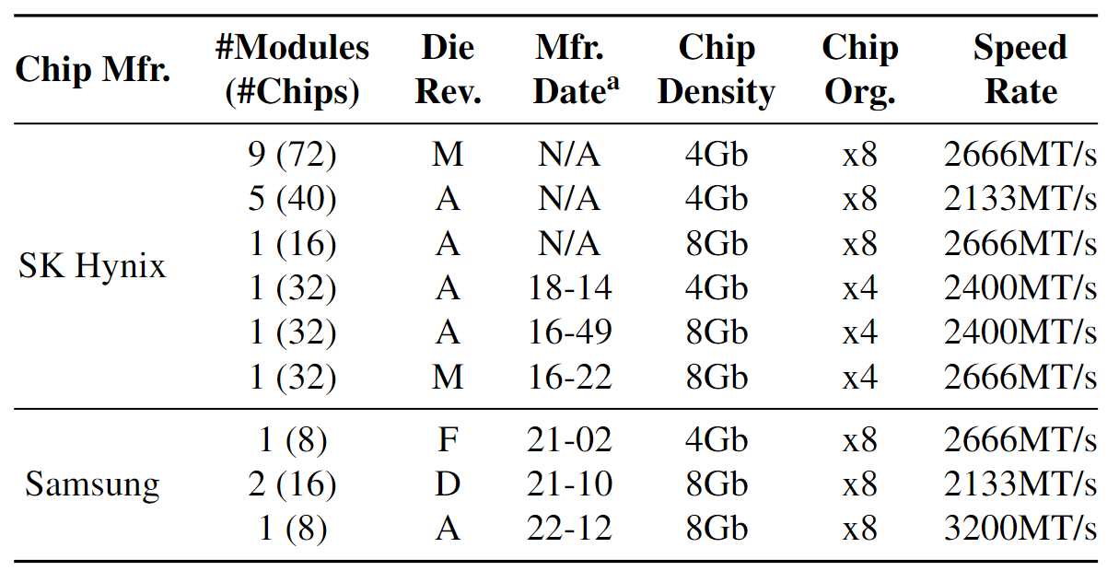
DRAM Chips Tested
256 DDR4 chips from two major DRAM manufacturers
Covers different die revisions and chip densities
62
Notes:
[CLICK]We test 256 DDR4 chips from two major DRAM manufacturers,
[CLICK] covering different die densities and revisions

Slide 63
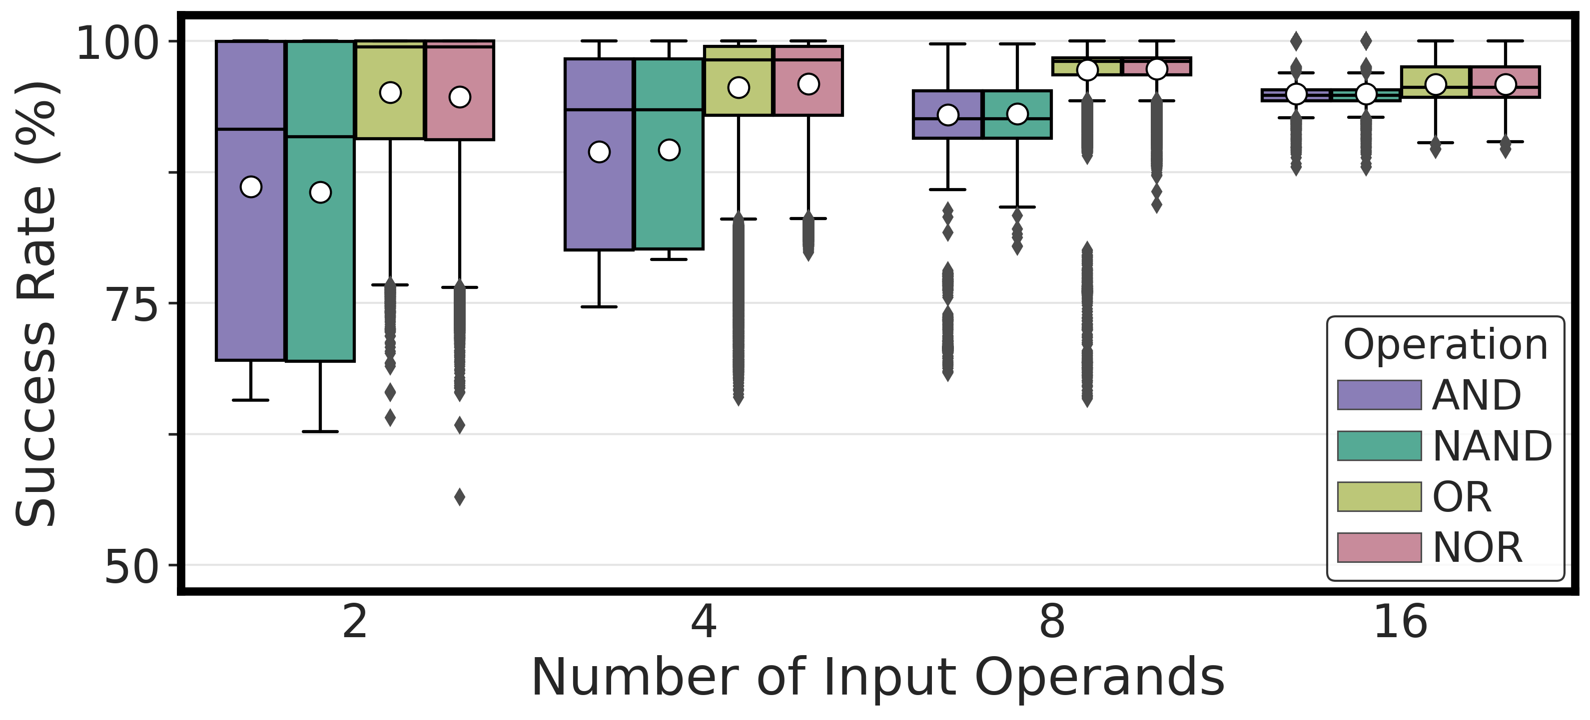
Performing AND, NAND, OR, and NOR
COTS DRAM chips can perform
{2, 4, 8, 16}-input AND, NAND, OR, and NOR operations
63
Notes:
Let’s see our first results
[CLICK] Here is the plot, in the x-axis we have the number of input operands and y-axis shows the success rate distribution across dram cells and the hue shows the type of operation
[CLICK] Our key takeaway from this experiment is off-the-shelf DRAM chips can perform 2, 4, 8, 16 input AND, NAND, OR, and NOR operations

Slide 64
Performing AND, NAND, OR, and NOR
COTS DRAM chips can perform
16-input AND, NAND, OR, and NOR operations
with very high success rate (>94%)
64
Notes:
Let’s see our first results
[CLICK] Here is the plot, in the x-axis we have the number of input operands and y-axis shows the success rate distribution across dram cells and the hue shows the type of operation
[CLICK] Our key takeaway from this experiment is off-the-shelf DRAM chips can perform 2, 4, 8, 16 input AND, NAND, OR, and NOR operations

Slide 65
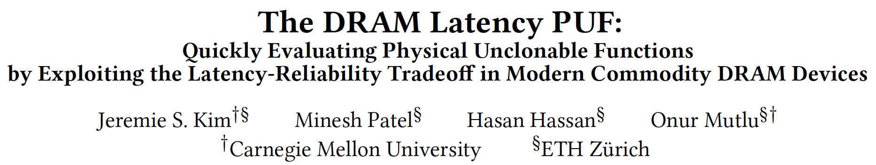
In-DRAM Physical Unclonable Functions
Jeremie S. Kim, Minesh Patel, Hasan Hassan, and Onur Mutlu,
"The DRAM Latency PUF: Quickly Evaluating Physical Unclonable Functions by Exploiting the Latency-Reliability Tradeoff in Modern DRAM Devices"
Proceedings of the 24th International Symposium on High-Performance Computer Architecture (HPCA), Vienna, Austria, February 2018.
[Lightning Talk Video]
[Slides (pptx) (pdf)] [Lightning Session Slides (pptx) (pdf)]
[Full Talk Lecture Video (28 minutes)]

Slide 66
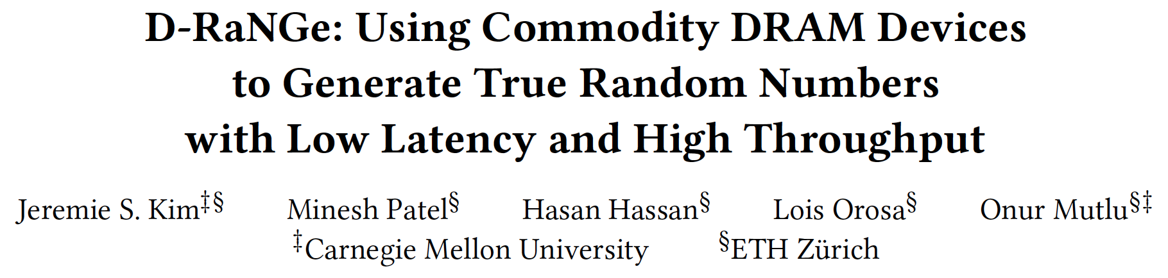
In-DRAM True Random Number Generation
Jeremie S. Kim, Minesh Patel, Hasan Hassan, Lois Orosa, and Onur Mutlu,
"D-RaNGe: Using Commodity DRAM Devices to Generate True Random Numbers with Low Latency and High Throughput"
Proceedings of the 25th International Symposium on High-Performance Computer Architecture (HPCA), Washington, DC, USA, February 2019.
[Slides (pptx) (pdf)]
[Full Talk Video (21 minutes)]
[Full Talk Lecture Video (27 minutes)]
Top Picks Honorable Mention by IEEE Micro.

Slide 67
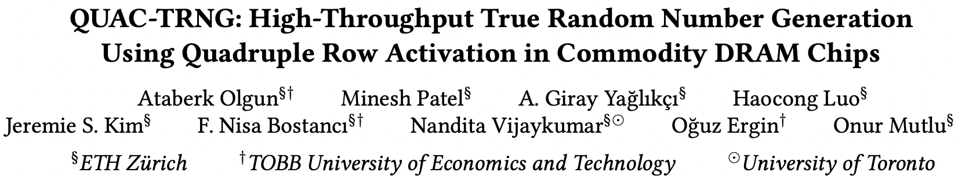
In-DRAM True Random Number Generation
Ataberk Olgun, Minesh Patel, A. Giray Yaglikci, Haocong Luo, Jeremie S. Kim, F. Nisa Bostanci, Nandita Vijaykumar, Oguz Ergin, and Onur Mutlu,
"QUAC-TRNG: High-Throughput True Random Number Generation Using Quadruple Row Activation in Commodity DRAM Chips"
Proceedings of the 48th International Symposium on Computer Architecture (ISCA), Virtual, June 2021.
[Slides (pptx) (pdf)]
[Short Talk Slides (pptx) (pdf)]
[Talk Video (25 minutes)]
[SAFARI Live Seminar Video (1 hr 26 mins)]

Slide 68
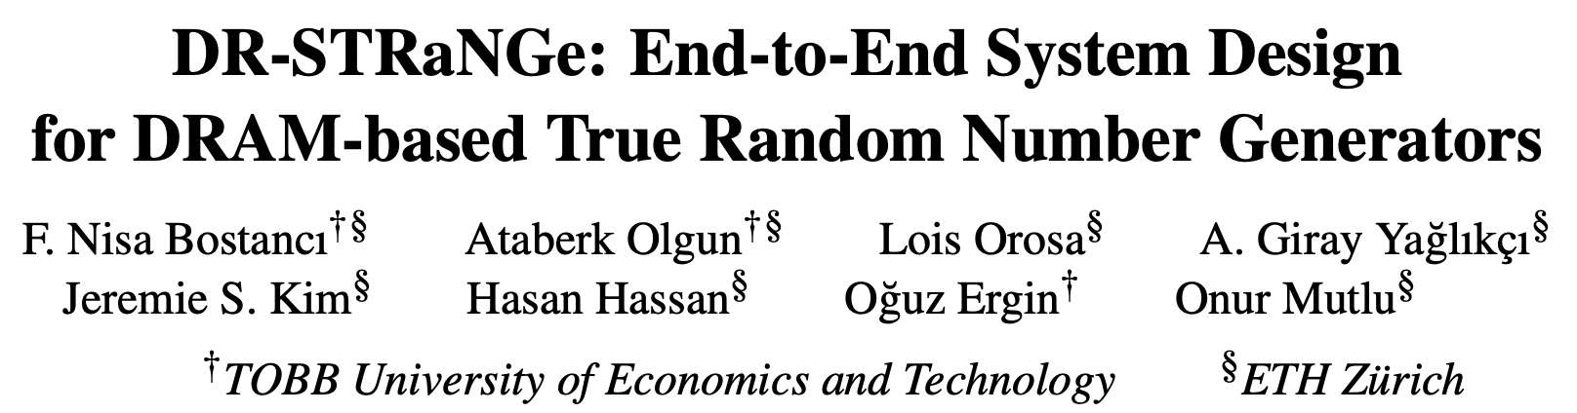
In-DRAM True Random Number Generation
F. Nisa Bostanci, Ataberk Olgun, Lois Orosa, A. Giray Yaglikci, Jeremie S. Kim, Hasan Hassan, Oguz Ergin, and Onur Mutlu,
"DR-STRaNGe: End-to-End System Design for DRAM-based True Random Number Generators"
Proceedings of the 28th International Symposium on High-Performance Computer Architecture (HPCA), Virtual, April 2022.
[Slides (pptx) (pdf)]
[Short Talk Slides (pptx) (pdf)]
https://arxiv.org/pdf/2201.01385.pdf

Slide 69
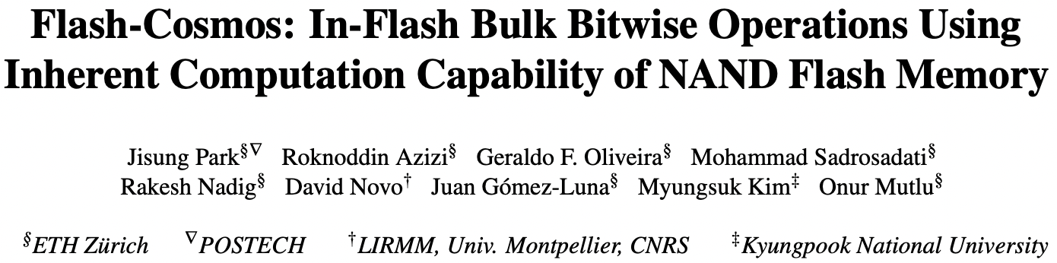
In-Flash Bulk Bitwise Execution
Jisung Park, Roknoddin Azizi, Geraldo F. Oliveira, Mohammad Sadrosadati, Rakesh Nadig, David Novo, Juan Gómez-Luna, Myungsuk Kim, and Onur Mutlu,
"Flash-Cosmos: In-Flash Bulk Bitwise Operations Using Inherent Computation Capability of NAND Flash Memory"
Proceedings of the 55th International Symposium on Microarchitecture (MICRO), Chicago, IL, USA, October 2022.
[Slides (pptx) (pdf)]
[Longer Lecture Slides (pptx) (pdf)]
[Lecture Video (44 minutes)]
[arXiv version]
https://arxiv.org/pdf/2209.05566.pdf

Slide 70
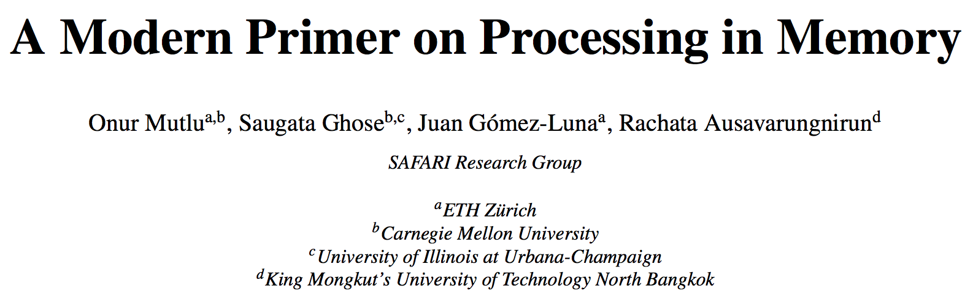
PIM Review and Open Problems
Onur Mutlu, Saugata Ghose, Juan Gomez-Luna, and Rachata Ausavarungnirun,
"A Modern Primer on Processing in Memory"
Invited Book Chapter in Emerging Computing: From Devices to Systems - Looking Beyond Moore and Von Neumann, Springer, to be published in 2021.
https://arxiv.org/pdf/2012.03112.pdf

Slide 71
Eliminating the Adoption Barriers
How to Enable Adoption of Processing in Memory

Slide 72
Potential Barriers to Adoption of PIM
1. Applications & software for PIM
2. Ease of programming (interfaces and compiler/HW support)
3. System and security support: coherence, synchronization, virtual memory, isolation, communication interfaces, …
4. Runtime and compilation systems for adaptive scheduling, data mapping, access/sharing control, …
5. Infrastructures to assess benefits and feasibility
All can be solved with change of mindset

Slide 73
We Need to Revisit the Entire Stack
With a memory-centric mindset
Problem
Algorithm
Program/Language
System Software
SW/HW Interface
Micro-architecture
Logic
Devices
Electrons
We can get there step by step

Slide 74
Concluding Remarks

Slide 75
Challenge and Opportunity for Future
Fundamentally
Energy-Efficient
(Data-Centric)
Computing Architectures

Slide 76
Challenge and Opportunity for Future
Fundamentally
High-Performance
(Data-Centric)
Computing Architectures

Slide 77
Challenge and Opportunity for Future
Computing Architectures
with
Minimal Data Movement

Slide 78
Concluding Remarks
We must design systems to be balanced, high-performance, energy-efficient (all at the same time) → intelligent systems
  Data-centric, data-driven, data-aware
Enable computation capability inside and close to memory
This can
  Lead to orders-of-magnitude improvements
  Enable new applications & computing platforms
  Enable better understanding of nature
  …
Future of truly memory-centric computing is bright
  We need to do research & design across the computing stack
Notes:
Perhaps we have taken processor-centric system design a bit too far

Slide 79
Fundamentally Better Architectures
Data-centric
Data-driven
Data-aware

Slide 80
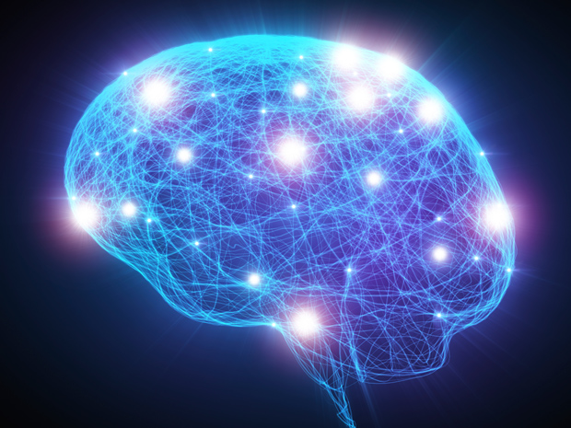
Source: http://spectrum.ieee.org/image/MjYzMzAyMg.jpeg

Slide 81
We Need to Revisit the Entire Stack
With a data-centric mindset
Problem
Algorithm
Program/Language
System Software
SW/HW Interface
Micro-architecture
Logic
Devices
Electrons
We can get there step by step

Slide 82
PIM Review and Open Problems
Onur Mutlu, Saugata Ghose, Juan Gomez-Luna, and Rachata Ausavarungnirun,
"A Modern Primer on Processing in Memory"
Invited Book Chapter in Emerging Computing: From Devices to Systems - Looking Beyond Moore and Von Neumann, Springer, to be published in 2021.
https://arxiv.org/pdf/2012.03112.pdf

Slide 83
Referenced Papers, Talks, Artifacts
All are available at
  https://people.inf.ethz.ch/omutlu/projects.htm
  https://www.youtube.com/onurmutlulectures
  https://github.com/CMU-SAFARI/

Slide 84








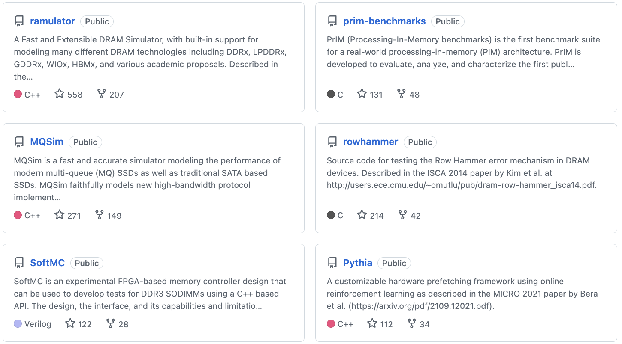
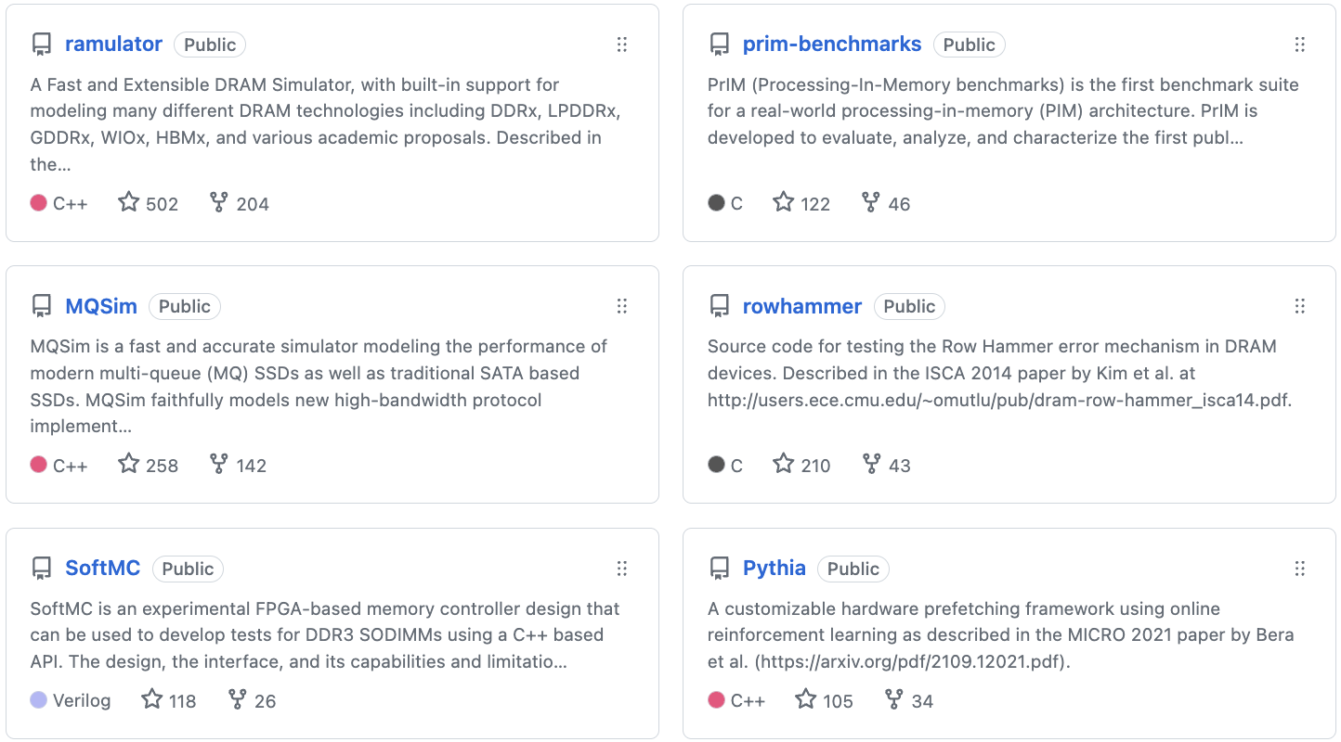
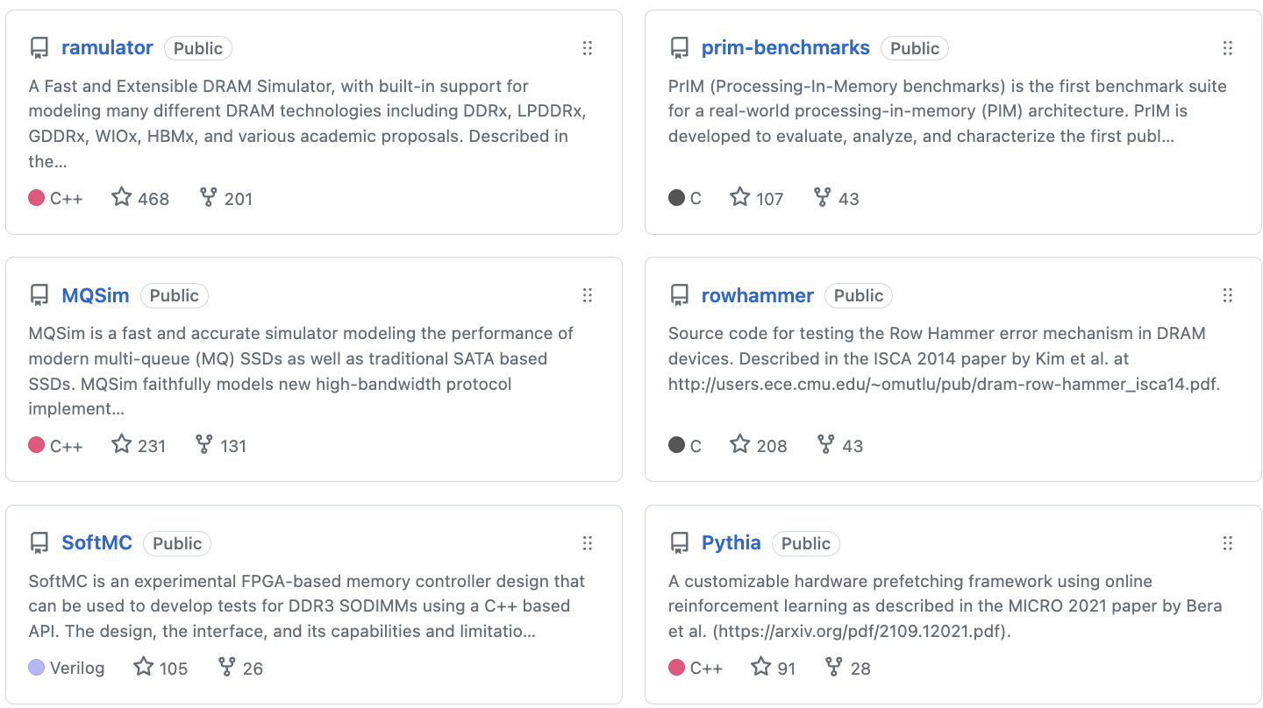


Open Source Tools: SAFARI GitHub
https://github.com/CMU-SAFARI/

Slide 85
Funding Acknowledgments
Alibaba, AMD, ASML, Google, Facebook, Hi-Silicon, HP Labs, Huawei, IBM, Intel, Microsoft, Nvidia, Oracle, Qualcomm, Rambus, Samsung, Seagate, VMware, Xilinx
NSF
NIH
GSRC
SRC
CyLab
EFCL
SNSF
ACCESS
Thank you!

Slide 86

Acknowledgments
Think BIG, Aim HIGH!
https://safari.ethz.ch

Slide 87

SAFARI Newsletter June 2023 Edition
https://safari.ethz.ch/safari-newsletter-june-2023/

Slide 88

SAFARI Newsletter July 2024 Edition
https://safari.ethz.ch/safari-newsletter-july-2024/

Slide 89
Memory-Centric
Computing
Onur Mutlu
omutlu@gmail.com
https://people.inf.ethz.ch/omutlu
2 November 2024
Future of Science Prize Week Keynote Talk

Slide 90
Memory-Centric Computing
Onur Mutlu
ETH Zurich

