Slide 1
Future Computing Architectures Challenges and Opportunities
Onur Mutlu
omutlu@gmail.com
https://people.inf.ethz.ch/omutlu
30 January 2019
UT Austin ECE Colloquium

Slide 2
Why Do We Do Computing?

Slide 3
Answer
To Solve Problems

Slide 4
Answer Reworded
To Gain Insight
Hamming, “Numerical Methods for Scientists and Engineers,” 1962.

Slide 5
Answer Extended
To Enable
a Better Life & Future

Slide 6
How Does a Computer Solve Problems?

Slide 7
Answer
Orchestrating Electrons
In today’s dominant technologies

Slide 8
How Do Problems Get Solved by Electrons?

Slide 9
The Transformation Hierarchy
Problem
Algorithm
Program/Language
System Software
Computer Architecture (expanded view)
SW/HW Interface
Computer Architecture (narrow view)
Micro-architecture
Logic
Devices
Electrons

Slide 10
Computer Architecture
is the science and art of designing computing platforms (hardware, interface, system SW, and programming model)
to achieve a set of design goals
E.g., highest performance on earth on workloads X, Y, Z
E.g., longest battery life at a form factor that fits in your pocket with cost < $$$ CHF
E.g., best average performance across all known workloads at the best performance/cost ratio
…
Designing a supercomputer is different from designing a smartphone → But, many fundamental principles are similar

Slide 11
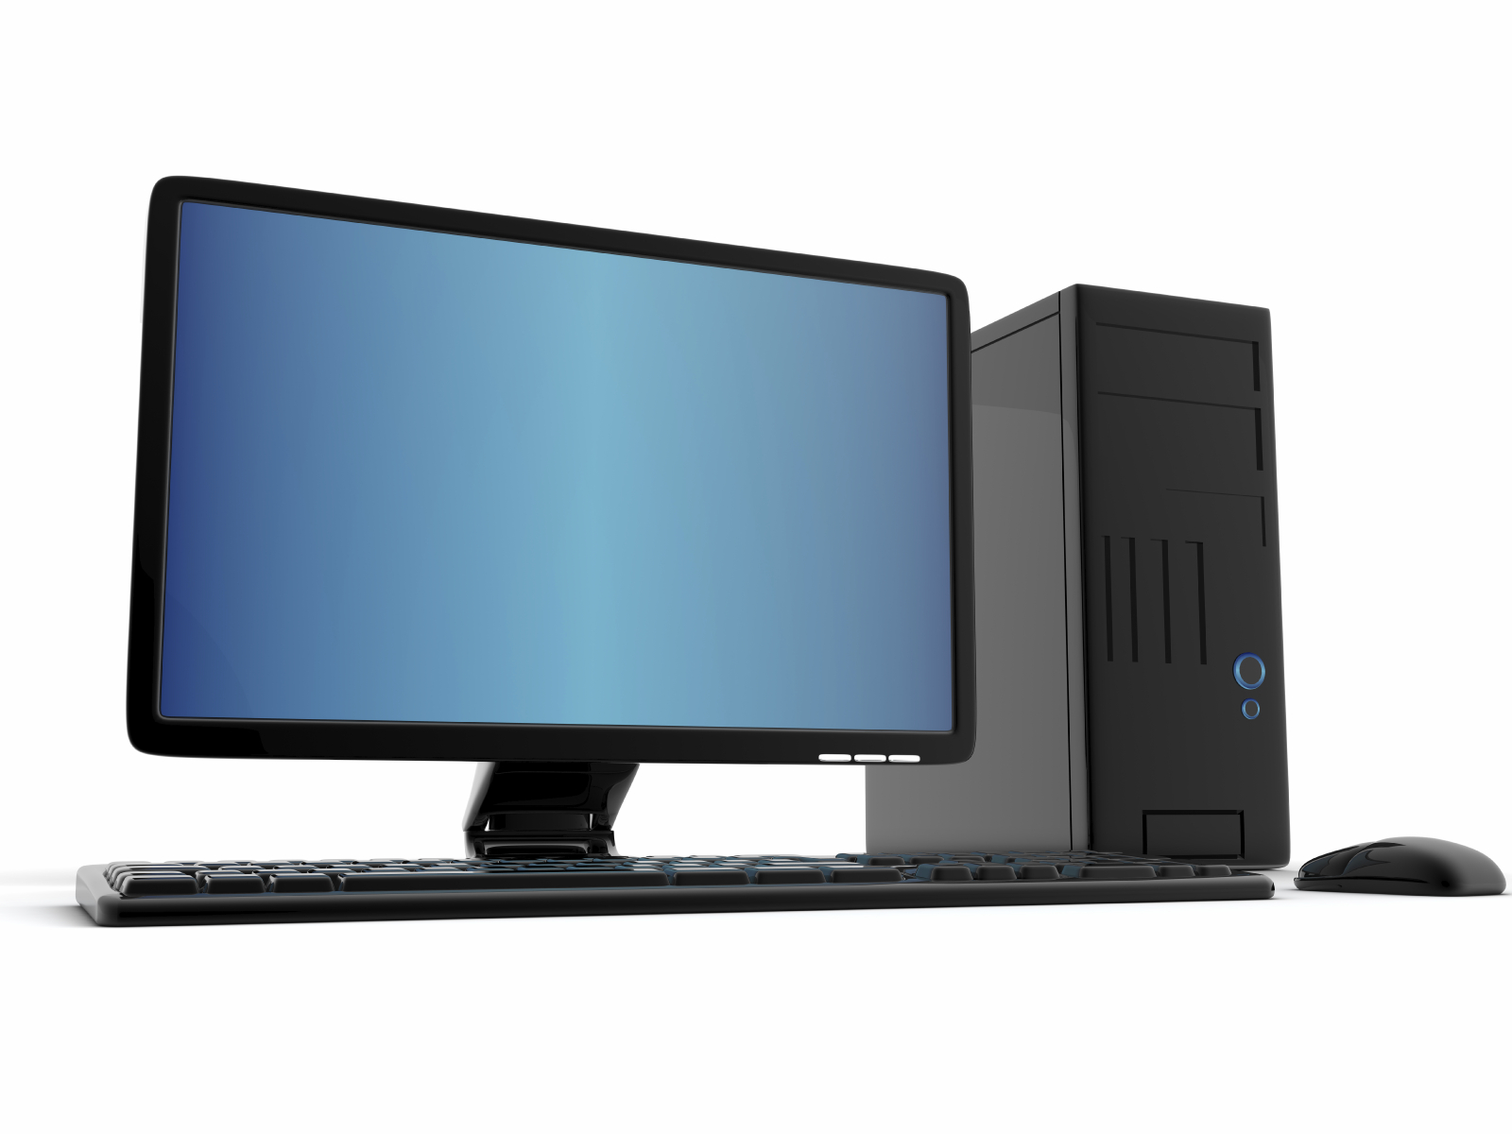
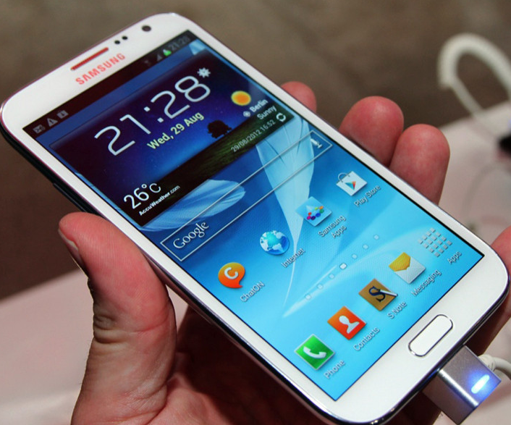
Different Platforms, Different Goals
Source: http://www.sia-online.org (semiconductor industry association)

Slide 12
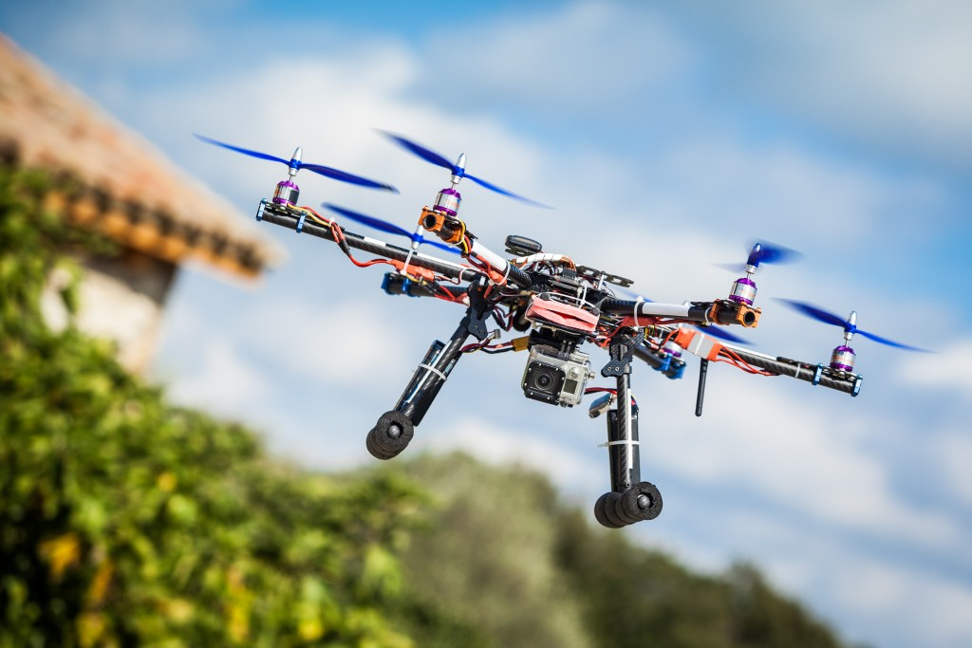
Different Platforms, Different Goals
Source: https://iq.intel.com/5-awesome-uses-for-drone-technology/

Slide 13
Different Platforms, Different Goals
Source: https://taxistartup.com/wp-content/uploads/2015/03/UK-Self-Driving-Cars.jpg

Slide 14
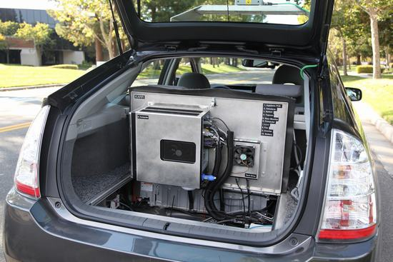
Different Platforms, Different Goals
Source: http://sm.pcmag.com/pcmag_uk/photo/g/google-self-driving-car-the-guts/google-self-driving-car-the-guts_dwx8.jpg

Slide 15
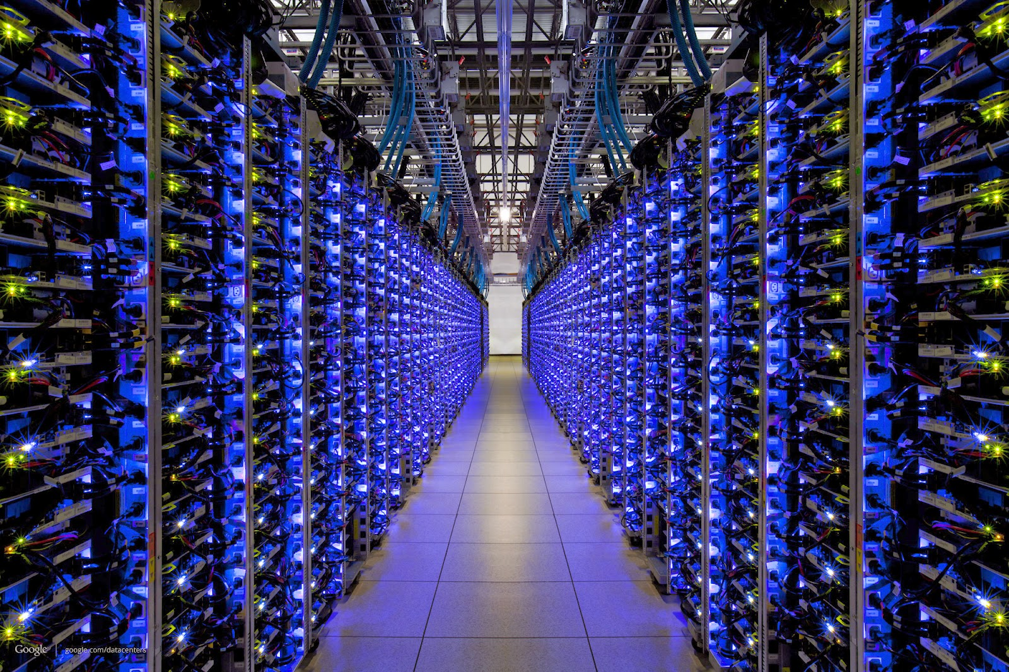
Different Platforms, Different Goals
Source: http://datacentervoice.com/wp-content/uploads/2015/10/data-center.jpg

Slide 16
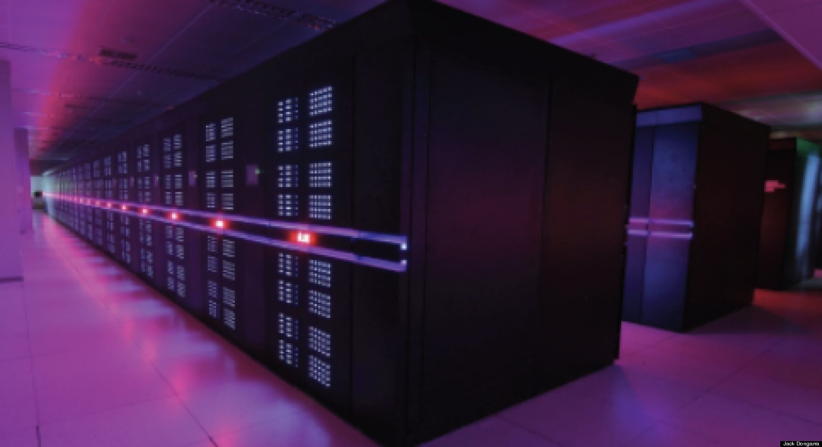
Different Platforms, Different Goals
Source: https://fossbytes.com/wp-content/uploads/2015/06/Supercomputer-TIANHE2-china.jpg

Slide 17
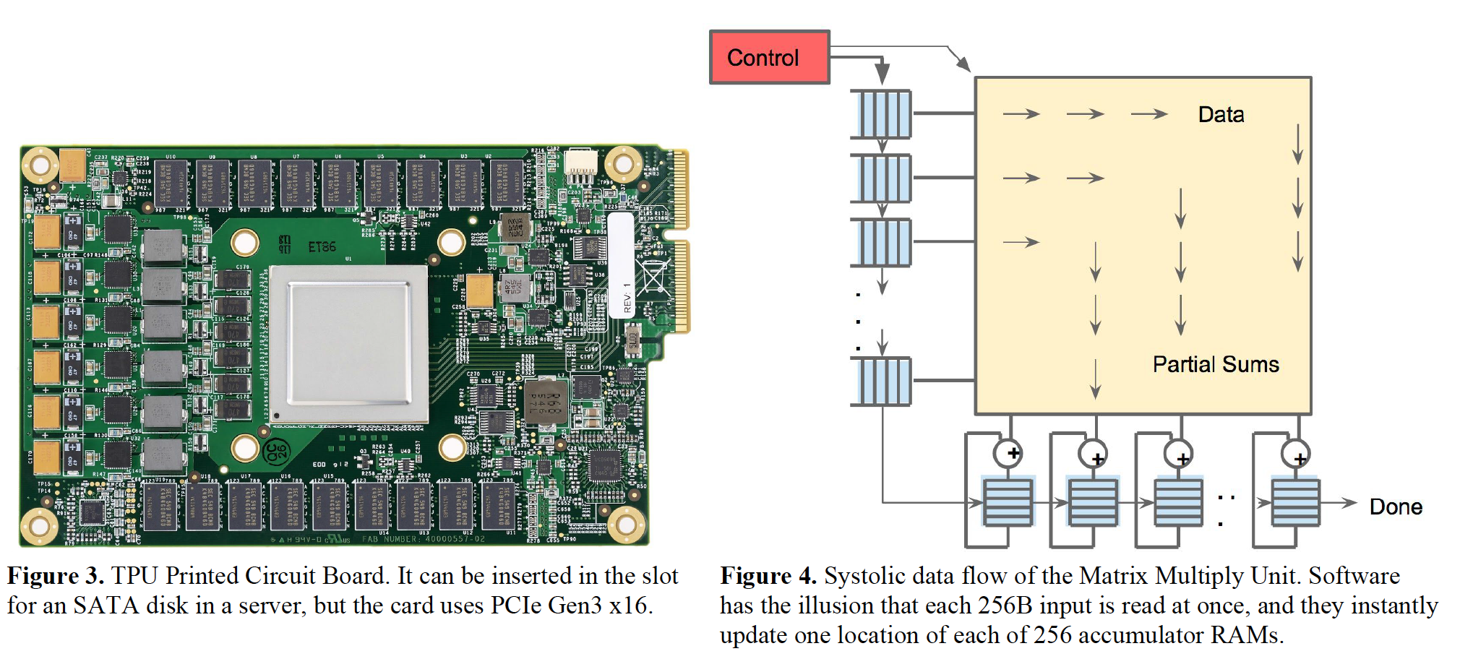
Different Platforms, Different Goals
Jouppi et al., “In-Datacenter Performance Analysis of a Tensor Processing Unit”, ISCA 2017.

Slide 18
Axiom
To achieve the highest energy efficiency and performance:
we must take the expanded view
of computer architecture
Problem
Algorithm
Program/Language
System Software
Co-design across the hierarchy:
Algorithms to devices
SW/HW Interface
Micro-architecture
Logic
Specialize as much as possible
within the design goals
Devices
Electrons

Slide 19
What Kind of a Future Do We Want?

Slide 20
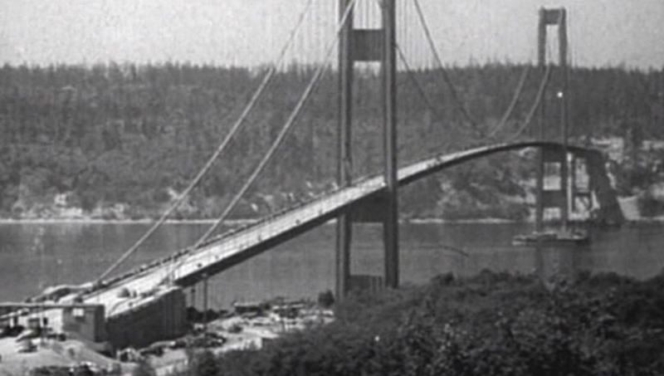
How Reliable/Secure/Safe is This Bridge?
Source: http://www.technologystudent.com/struct1/tacom1.png

Slide 21
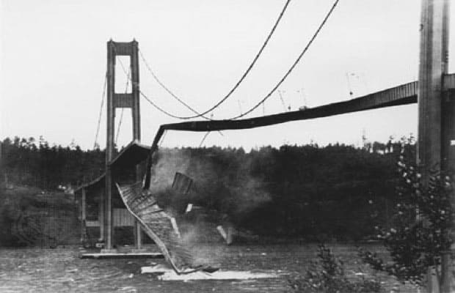
Collapse of the “Galloping Gertie”
Source: AP
http://www.wsdot.wa.gov/tnbhistory/connections/connections3.htm

Slide 22
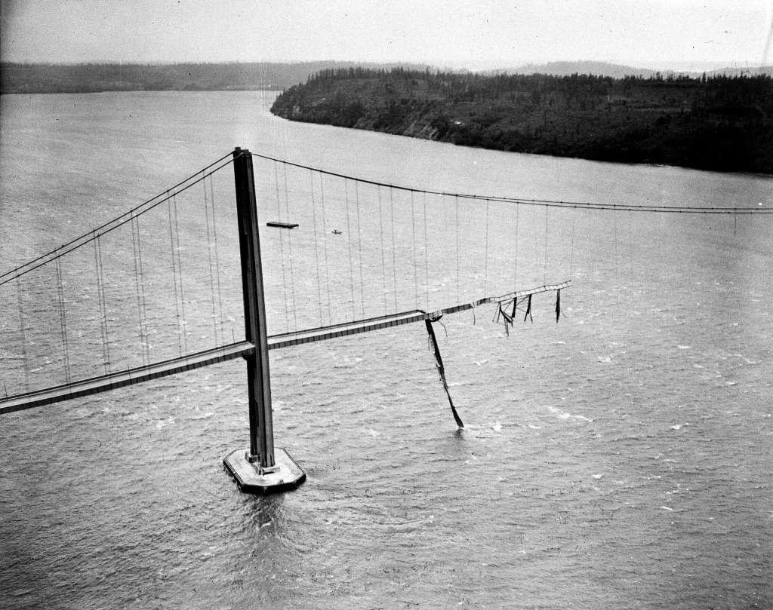
Another View
Source: AP
Source: http://www.seattlepi.com/science/article/A-Tacoma-Narrows-Galloping-Gertie-bridge-6617030.php

Slide 23
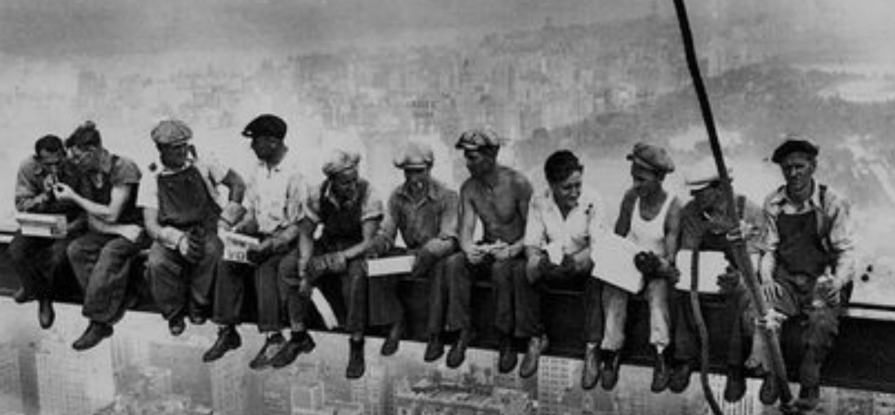
How Secure Are These People?
Security is about preventing unforeseen consequences
Source: https://s-media-cache-ak0.pinimg.com/originals/48/09/54/4809543a9c7700246a0cf8acdae27abf.jpg

Slide 24
Challenge and Opportunity for Future
Reliable, Secure, Safe

Slide 25
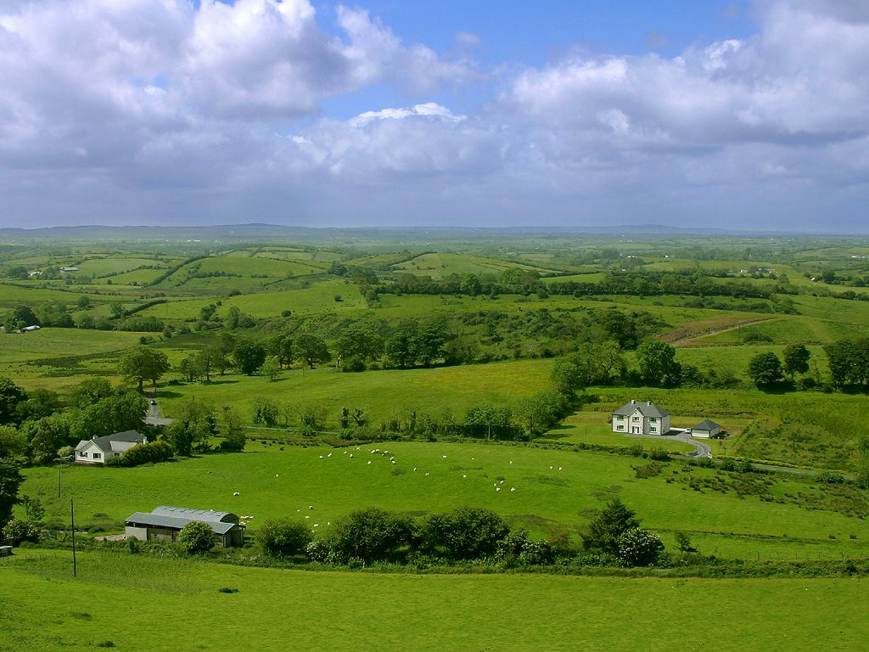
Do We Want This?
Source: V. Milutinovic

Slide 26
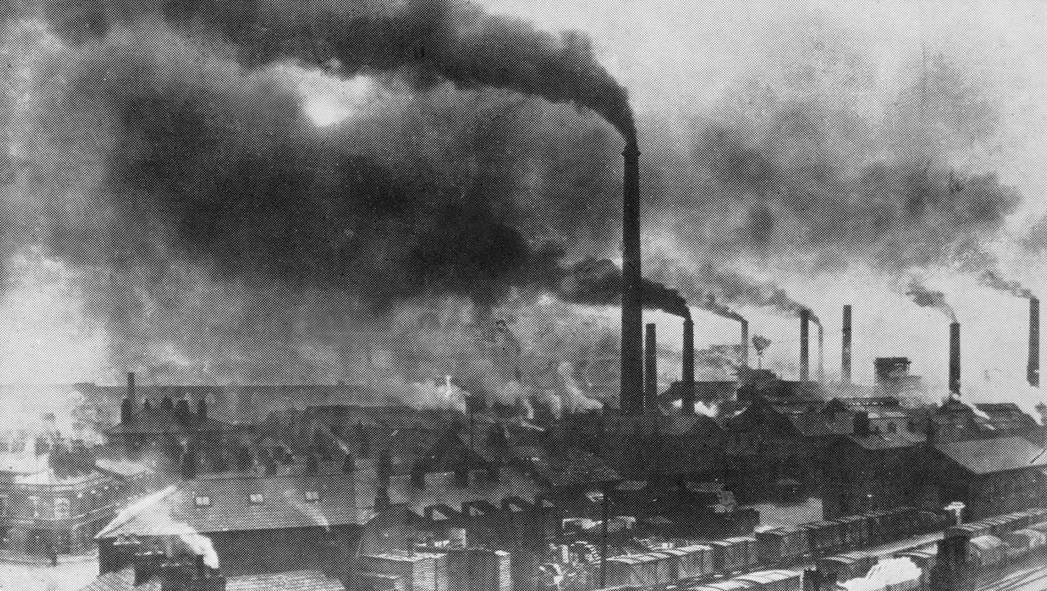
Or This?
Source: V. Milutinovic

Slide 27
Challenge and Opportunity for Future
Sustainable
and
Energy Efficient

Slide 28
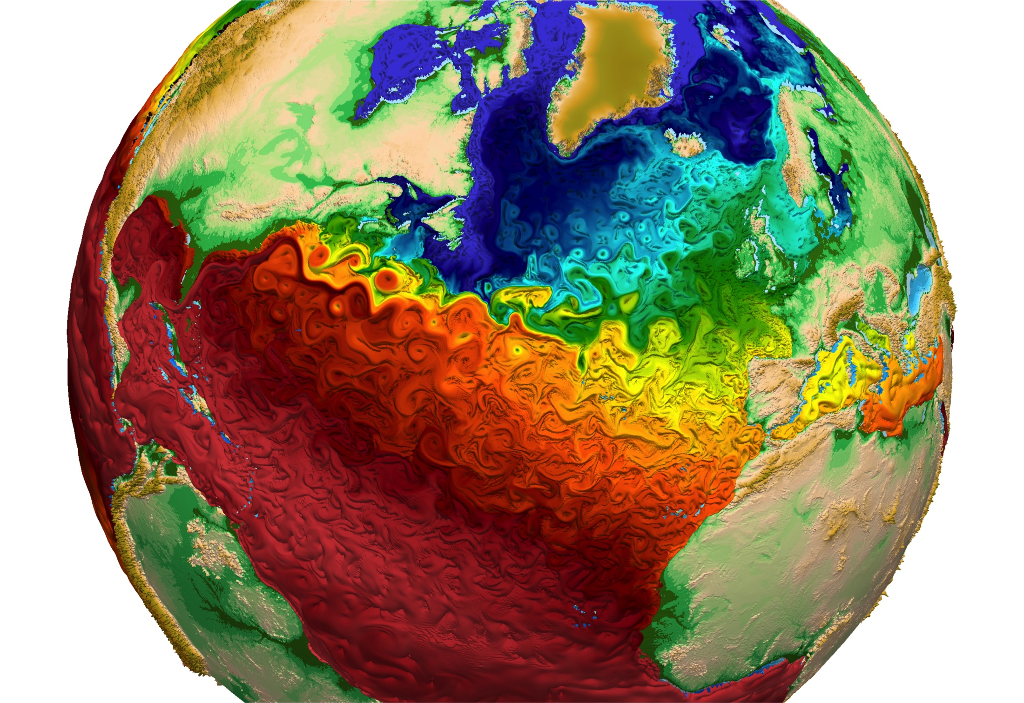
Many Difficult Problems: Climate
Source: https://farm9.staticflickr.com/8571/16376102935_8628150df8_o.jpg

Slide 29
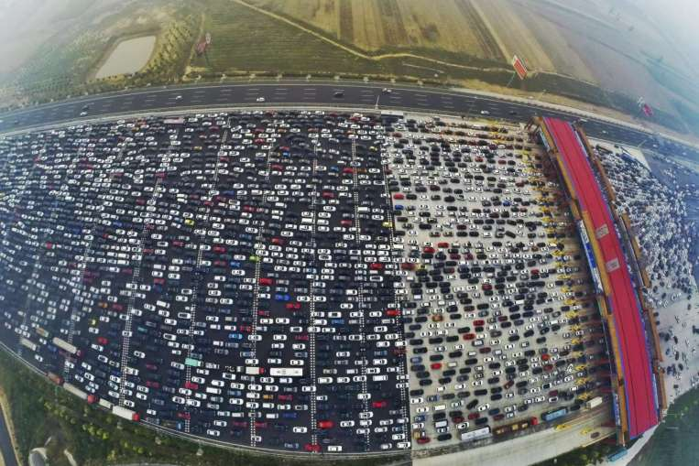
Many Difficult Problems: Congestion
Source: https://blogs-images.forbes.com/jimgorzelany/files/2015/10/China-G4-backup-this-oct-reuters.jpg

Slide 30
Many Difficult Problems: Nature
Source: http://spectrum.ieee.org/image/MjYzMzAyMg.jpeg

Slide 31
Challenge and Opportunity for Future
High Performance
(to solve
the toughest & all problems)

Slide 32
Personalized Medicine
Source: Jane Ades, NHGRI

Slide 33
Comparative Genomics
Source: By Aaron E. Darling, István Miklós, Mark A. Ragan - Figure 1 from Darling AE, Miklós I, Ragan MA (2008).
"Dynamics of Genome Rearrangement in Bacterial Populations". PLOS Genetics. DOI:10.1371/journal.pgen.1000128., CC BY 2.5, https://commons.wikimedia.org/w/index.php?curid=30550950

Slide 34
Challenge and Opportunity for Future
Personalized and Private
(in every aspect of life:
health, medicine,
spaces, devices, robotics, …)

Slide 35
This Lecture is About …
Questioning what limits us in designing the best computing architectures for the future
Providing directions for fundamentally better designs
Advocating principled approaches

Slide 36
Increasingly Demanding Applications
Dream
and, they will come
As applications push boundaries, computing platforms will become increasingly strained.

Slide 37
Key Realization

Slide 38
Realization
Modern Systems are Bottlenecked by
Data Storage
and Movement

Slide 39
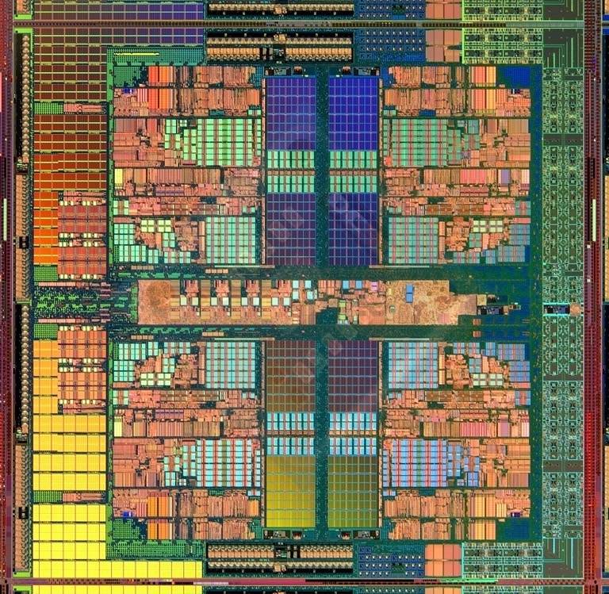
Focus is on Data Storage Systems (Memory)
Main memory is a critical component of all computing systems: server, mobile, embedded, desktop, sensor
Main memory system must scale (in size, technology, efficiency, cost, and management algorithms) to maintain performance growth and technology scaling benefits
Processors
and caches
Main Memory
Storage (SSD/HDD)

Slide 40
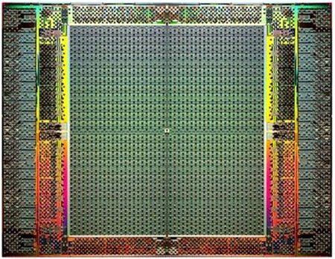
Focus is on Data Storage Systems (Memory)
Main memory is a critical component of all computing systems: server, mobile, embedded, desktop, sensor
Main memory system must scale (in size, technology, efficiency, cost, and management algorithms) to maintain performance growth and technology scaling benefits
FPGAs
Main Memory
Storage (SSD/HDD)

Slide 41
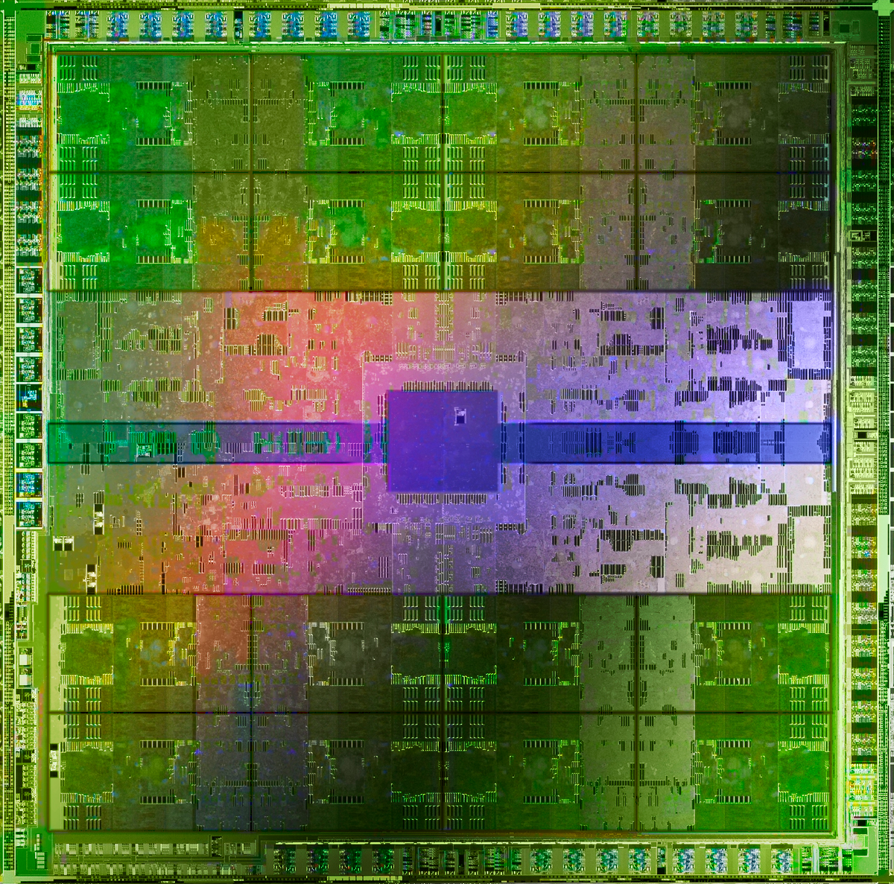
Focus is on Data Storage Systems (Memory)
Main memory is a critical component of all computing systems: server, mobile, embedded, desktop, sensor
Main memory system must scale (in size, technology, efficiency, cost, and management algorithms) to maintain performance growth and technology scaling benefits
GPUs
Main Memory
Storage (SSD/HDD)

Slide 42
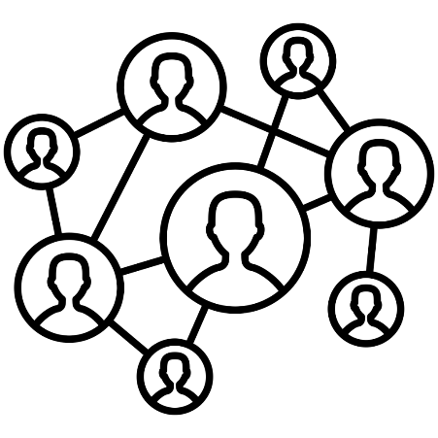
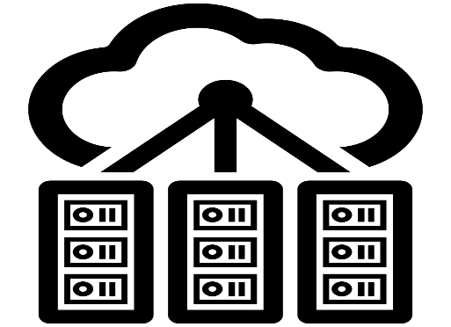
Memory Is Critical for Performance (I)
In-memory Databases
[Mao+, EuroSys’12; Clapp+ (Intel), IISWC’15]
Graph/Tree Processing
[Xu+, IISWC’12; Umuroglu+, FPL’15]
In-Memory Data Analytics
[Clapp+ (Intel), IISWC’15;
Awan+, BDCloud’15]
Datacenter Workloads [Kanev+ (Google), ISCA’15]

Slide 43
Memory Is Critical for Performance (I)
In-memory Databases
[Mao+, EuroSys’12; Clapp+ (Intel), IISWC’15]
Graph/Tree Processing
[Xu+, IISWC’12; Umuroglu+, FPL’15]
Memory → bottleneck
In-Memory Data Analytics
[Clapp+ (Intel), IISWC’15;
Awan+, BDCloud’15]
Datacenter Workloads [Kanev+ (Google), ISCA’15]

Slide 44
Memory Is Critical for Performance (II)
Chrome
TensorFlow Mobile
Google’s web browser
Google’s machine learning framework
Video Playback
Video Capture
Google’s video codec
Google’s video codec
Notes:
In this work, we take a look at widely-used google consumer workloads, to figure out the major sources of energy consumption.
We look at Google Chrome web brower. We take a look at Tensorflow, Google’s machine learning framework, and we also take a look at two important video related workloads, video playback and video capture, both rely on Google’s vp9 codec technology.

Slide 45
Memory Is Critical for Performance (II)
Chrome
TensorFlow Mobile
Google’s web browser
Google’s machine learning framework
Memory → bottleneck
Video Playback
Video Capture
Google’s video codec
Google’s video codec
Notes:
In this work, we take a look at widely-used google consumer workloads, to figure out the major sources of energy consumption.
We look at Google Chrome web brower. We take a look at Tensorflow, Google’s machine learning framework, and we also take a look at two important video related workloads, video playback and video capture, both rely on Google’s vp9 codec technology.

Slide 46
Memory is Critical for Energy
Amirali Boroumand, Saugata Ghose, Youngsok Kim, Rachata Ausavarungnirun, Eric Shiu, Rahul Thakur, Daehyun Kim, Aki Kuusela, Allan Knies, Parthasarathy Ranganathan, and Onur Mutlu, "Google Workloads for Consumer Devices: Mitigating Data Movement Bottlenecks" Proceedings of the 23rd International Conference on Architectural Support for Programming Languages and Operating Systems (ASPLOS), Williamsburg, VA, USA, March 2018.
62.7% of the total system energy
is spent on data movement

Slide 47
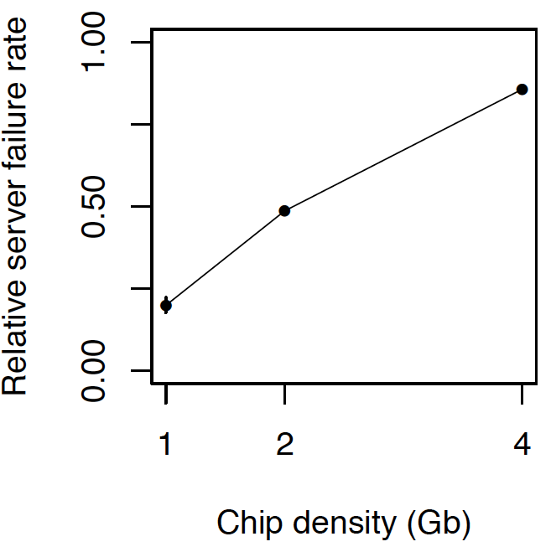
Memory is Critical for Reliability
Data from all of Facebook’s servers worldwide
Meza+, “Revisiting Memory Errors in Large-Scale Production Data Centers,” DSN’15.
As memory
capacity increases, system reliability reduces

Slide 48
Realization Reworded
Modern Systems are Bottlenecked by
Memory

Slide 49
Four Key Issues in Future Platforms
Fundamentally Secure/Reliable/Safe Architectures
Fundamentally Energy-Efficient Architectures
Memory-centric (Data-centric) Architectures
Fundamentally Low-Latency Architectures
Architectures for Genomics, Medicine, Health

Slide 50
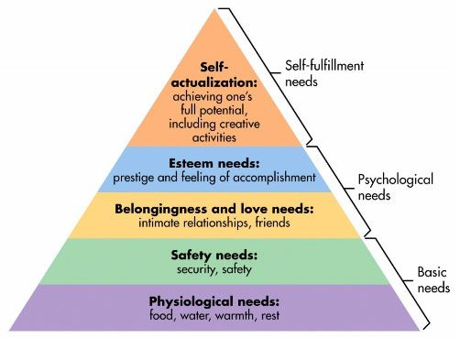
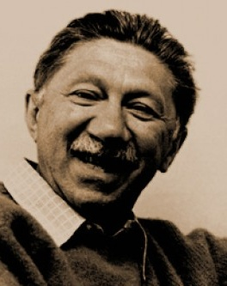
Maslow’s (Human) Hierarchy of Needs
Maslow, “A Theory of Human Motivation,”
Psychological Review, 1943.
Maslow, “A Theory of Human Motivation,”
Psychological Review, 1943.
Maslow, “Motivation and Personality,”
Book, 1954-1970.
We need to start with reliability and security…
Source: https://www.simplypsychology.org/maslow.html
Source: By User:Factoryjoe - Mazlow's Hierarchy of Needs.svg, CC BY-SA 3.0, https://commons.wikimedia.org/w/index.php?curid=7964065

Slide 51
How Reliable/Secure/Safe is This Bridge?
Source: http://www.technologystudent.com/struct1/tacom1.png

Slide 52
Collapse of the “Galloping Gertie”
Source: AP
http://www.wsdot.wa.gov/tnbhistory/connections/connections3.htm

Slide 53
How Secure Are These People?
Security is about preventing unforeseen consequences
Source: https://s-media-cache-ak0.pinimg.com/originals/48/09/54/4809543a9c7700246a0cf8acdae27abf.jpg

Slide 54
The Problem
We do not seem to have
design principles for
(guaranteeing)
reliability and security

Slide 55
As Memory Scales, It Becomes Unreliable
Data from all of Facebook’s servers worldwide
Meza+, “Revisiting Memory Errors in Large-Scale Production Data Centers,” DSN’15.
Intuition: quadratic increase in capacity

Slide 56
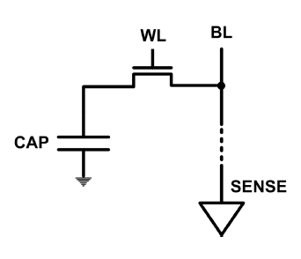
The DRAM Scaling Problem
DRAM stores charge in a capacitor (charge-based memory)
Capacitor must be large enough for reliable sensing
Access transistor must be large enough for long data retention time
As DRAM cell becomes smaller, it becomes more vulnerable

Slide 57
Infrastructures to Understand Such Issues
Temperature
Controller
FPGAs
Heater
FPGAs
PC
Kim+, “Flipping Bits in Memory Without Accessing Them: An Experimental Study of DRAM Disturbance Errors,” ISCA 2014.

Slide 58
A Curious Discovery [Kim et al., ISCA 2014]
One can
predictably induce errors
in most DRAM memory chips

Slide 59
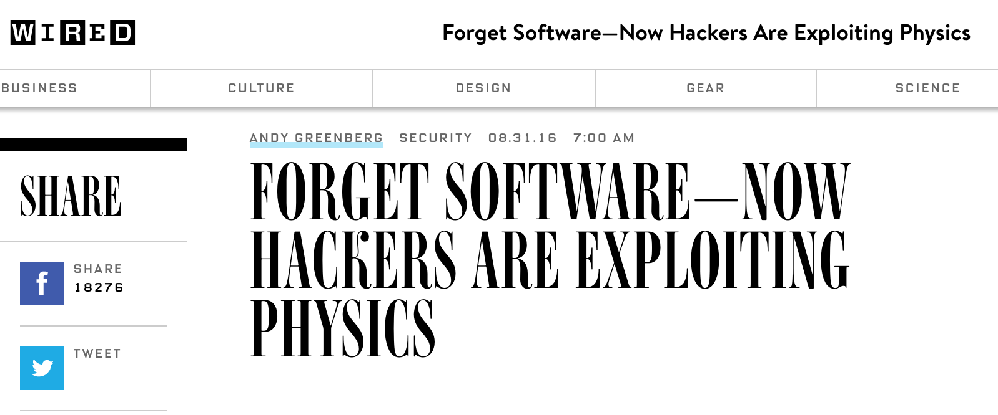
DRAM RowHammer
A simple hardware failure mechanism
can create a widespread
system security vulnerability

Slide 60
Modern DRAM is Prone to Disturbance Errors
Row of Cells
Wordline
Row
Victim Row
Row
Hammered Row
V_{LOW}
Opened
V_{HIGH}
Closed
Row
Victim Row
Row
Repeatedly reading a row enough times (before memory gets refreshed) induces disturbance errors in adjacent rows in most real DRAM chips you can buy today
Flipping Bits in Memory Without Accessing Them: An Experimental Study of DRAM Disturbance Errors, (Kim et al., ISCA 2014)

Slide 61
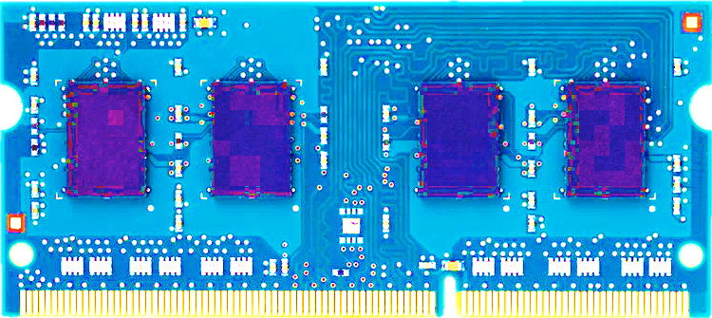
Most DRAM Modules Are Vulnerable
A company
B company
C company
86%
(37/43)
83%
(45/54)
88%
(28/32)
Up to
1.0×10⁷ errors
Up to
2.7×10⁶ errors
Up to
3.3×10⁵ errors
Flipping Bits in Memory Without Accessing Them: An Experimental Study of DRAM Disturbance Errors, (Kim et al., ISCA 2014)

Slide 62
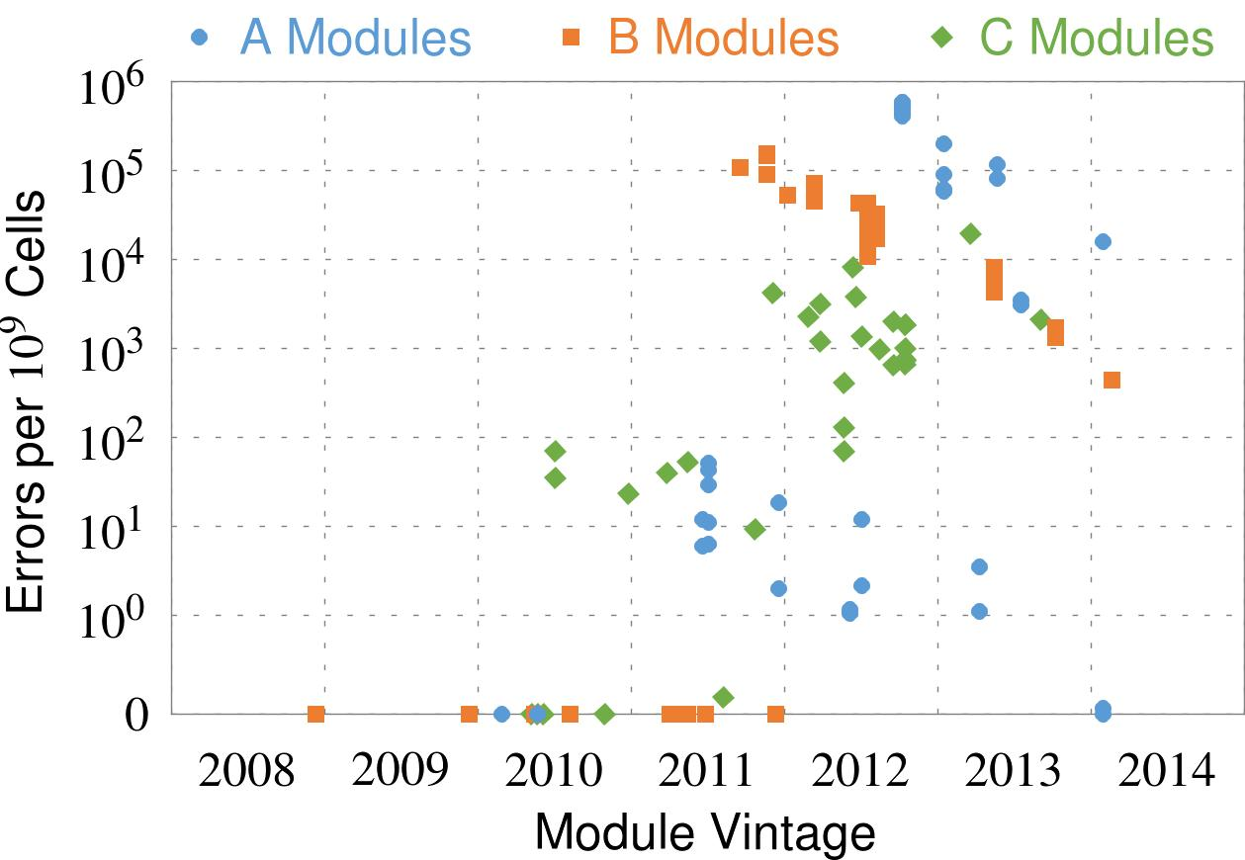
Recent DRAM Is More Vulnerable
Notes:
In this figure, the x-axis is the module manufacture date. And the y-axis is the number of errors in a module, normalized to one billion cells. In 2008 and 2009, there are no errors. But, in 2010, we first start to see errors in C modules. After 2010, the errors start to proliferate. For A and B modules, we first start to see errors in 2011. In particular, all modules from 2012 and 2013 are vulnerable.

Slide 63
Recent DRAM Is More Vulnerable
First
Appearance
Notes:
In this figure, the x-axis is the module manufacture date. And the y-axis is the number of errors in a module, normalized to one billion cells. In 2008 and 2009, there are no errors. But, in 2010, we first start to see errors in C modules. After 2010, the errors start to proliferate. For A and B modules, we first start to see errors in 2011. In particular, all modules from 2012 and 2013 are vulnerable.

Slide 64
Recent DRAM Is More Vulnerable
First
Appearance
All modules from 2012–2013 are vulnerable
Notes:
In this figure, the x-axis is the module manufacture date. And the y-axis is the number of errors in a module, normalized to one billion cells. In 2008 and 2009, there are no errors. But, in 2010, we first start to see errors in C modules. After 2010, the errors start to proliferate. For A and B modules, we first start to see errors in 2011. In particular, all modules from 2012 and 2013 are vulnerable.

Slide 65
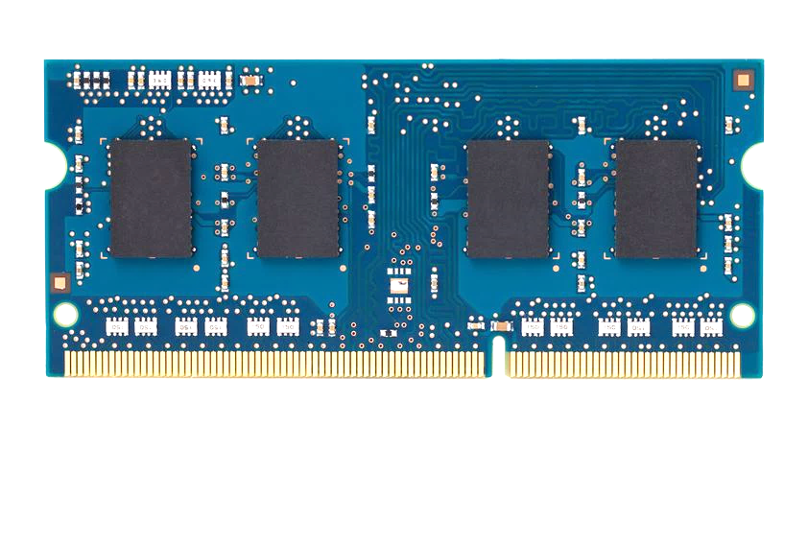
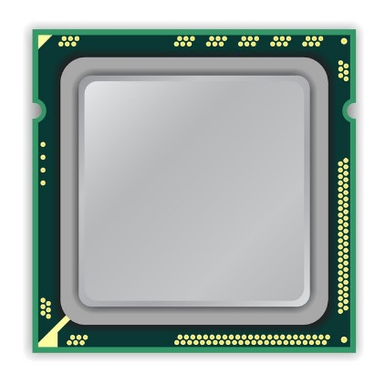
A Simple Program Can Induce Many Errors
CPU
DRAM Module
loop:
mov (X), %eax
mov (Y), %ebx
clflush (X)
clflush (Y)
mfence
jmp loop
X
Y
Download from: https://github.com/CMU-SAFARI/rowhammer
Notes:
We demonstrate the errors on multiple x86 systems. Shown to the bottom-left is a “disturbance kernel”. When executed, it forces two rows to be opened and closed one after the other – over and over again. Consequently, it induces many errors in the module.

Slide 66
A Simple Program Can Induce Many Errors
CPU
DRAM Module
loop:
mov (X), %eax
mov (Y), %ebx
clflush (X)
clflush (Y)
mfence
jmp loop
X
Y
Download from: https://github.com/CMU-SAFARI/rowhammer
Notes:
We demonstrate the errors on multiple x86 systems. Shown to the bottom-left is a “disturbance kernel”. When executed, it forces two rows to be opened and closed one after the other – over and over again. Consequently, it induces many errors in the module.

Slide 67
A Simple Program Can Induce Many Errors
CPU
DRAM Module
loop:
mov (X), %eax
mov (Y), %ebx
clflush (X)
clflush (Y)
mfence
jmp loop
X
Y
Download from: https://github.com/CMU-SAFARI/rowhammer
Notes:
We demonstrate the errors on multiple x86 systems. Shown to the bottom-left is a “disturbance kernel”. When executed, it forces two rows to be opened and closed one after the other – over and over again. Consequently, it induces many errors in the module.

Slide 68
A Simple Program Can Induce Many Errors
CPU
DRAM Module
loop:
mov (X), %eax
mov (Y), %ebx
clflush (X)
clflush (Y)
mfence
jmp loop
X
Y
Download from: https://github.com/CMU-SAFARI/rowhammer
Notes:
We demonstrate the errors on multiple x86 systems. Shown to the bottom-left is a “disturbance kernel”. When executed, it forces two rows to be opened and closed one after the other – over and over again. Consequently, it induces many errors in the module.

Slide 69
Observed Errors in Real Systems
A real reliability & security issue
CPU Architecture | Errors | Access-Rate
Intel Haswell (2013) | 22.9K | 12.3M/sec
Intel Ivy Bridge (2012) | 20.7K | 11.7M/sec
Intel Sandy Bridge (2011) | 16.1K | 11.6M/sec
AMD Piledriver (2012) | 59 | 6.1M/sec
Kim+, “Flipping Bits in Memory Without Accessing Them: An Experimental Study of DRAM Disturbance Errors,” ISCA 2014.
Notes:
When we executed the code on four different processors, all four of them yielded errors. Intel Haswell has the most errors, at 23 thousand, because it has the highest rate of accessing DRAM.
Later on, I’ll show that we can induce as many as ten million disturbance errors in a more controlled environment.
From this, we conclude that disturbance errors are a serious reliability issue.

Slide 70
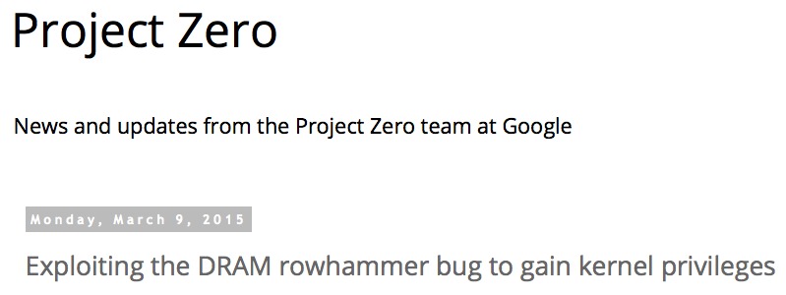
One Can Take Over an Otherwise-Secure System
Flipping Bits in Memory Without Accessing Them: An Experimental Study of DRAM Disturbance Errors (Kim et al., ISCA 2014)
Exploiting the DRAM rowhammer bug to gain kernel privileges (Seaborn+, 2015)

Slide 71
RowHammer Security Attack Example
“Rowhammer” is a problem with some recent DRAM devices in which repeatedly accessing a row of memory can cause bit flips in adjacent rows (Kim et al., ISCA 2014).
Flipping Bits in Memory Without Accessing Them: An Experimental Study of DRAM Disturbance Errors (Kim et al., ISCA 2014)
We tested a selection of laptops and found that a subset of them exhibited the problem.
We built two working privilege escalation exploits that use this effect.
Exploiting the DRAM rowhammer bug to gain kernel privileges (Seaborn+, 2015)
One exploit uses rowhammer-induced bit flips to gain kernel privileges on x86-64 Linux when run as an unprivileged userland process.
When run on a machine vulnerable to the rowhammer problem, the process was able to induce bit flips in page table entries (PTEs).
It was able to use this to gain write access to its own page table, and hence gain read-write access to all of physical memory.
Exploiting the DRAM rowhammer bug to gain kernel privileges (Seaborn & Dullien, 2015)

Slide 72
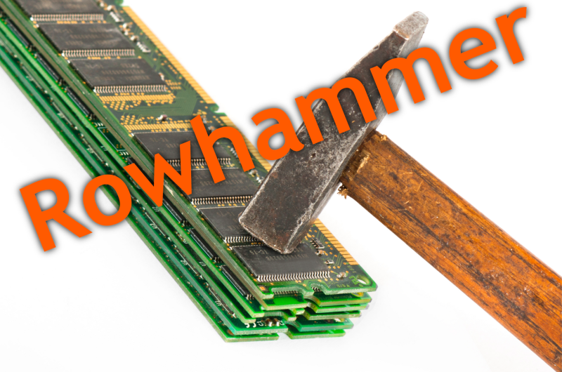
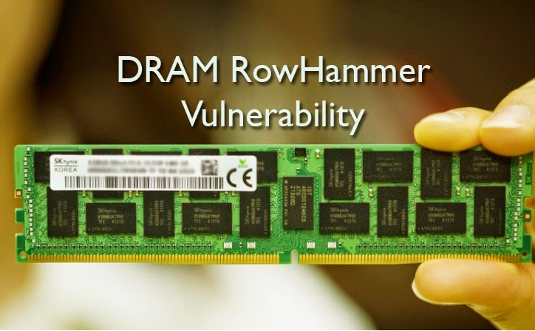
Security Implications
Notes:
Picture from the article:
http://thehackernews.com/2015/03/dram-rowhammer-vulnerability.html

Slide 73
Security Implications
Notes:
Picture from the article:
http://thehackernews.com/2015/03/dram-rowhammer-vulnerability.html

Slide 74
More Security Implications
“We can gain unrestricted access to systems of website visitors.”
Rowhammer.js: A Remote Software-Induced Fault Attack in JavaScript (DIMVA’16)
Source: https://lab.dsst.io/32c3-slides/7197.html

Slide 75
More Security Implications
“Can gain control of a smart phone deterministically”
Drammer: Deterministic Rowhammer Attacks on Mobile Platforms, CCS’16
Source: https://fossbytes.com/drammer-rowhammer-attack-android-root-devices/

Slide 76
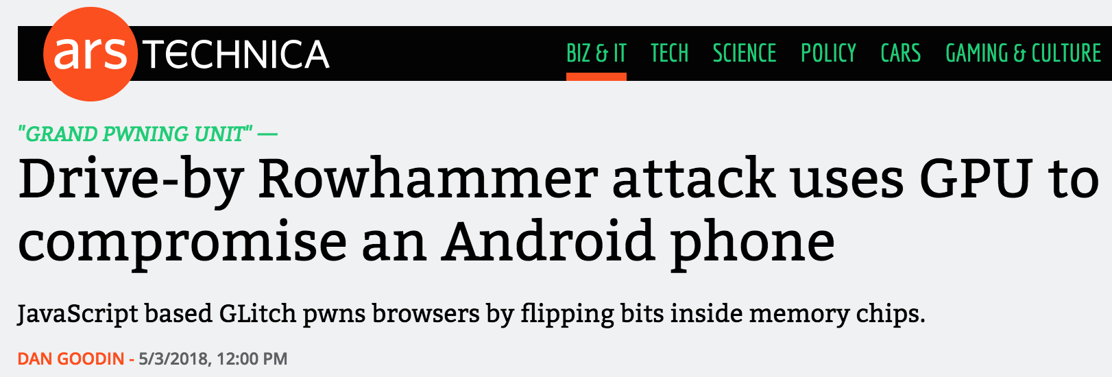
More Security Implications (III)
Using an integrated GPU in a mobile system to remotely escalate privilege via the WebGL interface

Slide 77
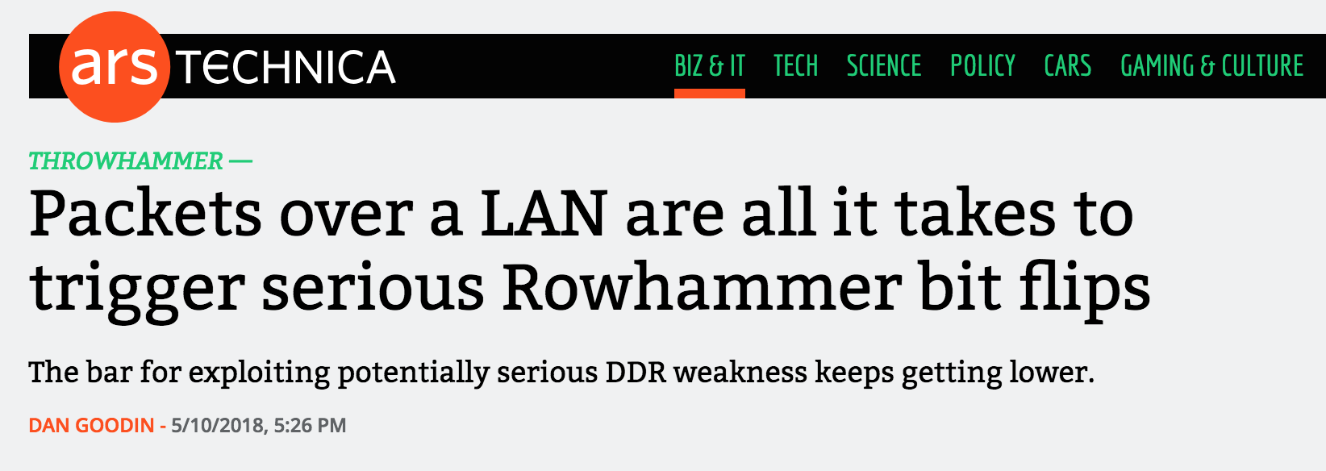
More Security Implications (IV)
Rowhammer over RDMA (I)

Slide 78
More Security Implications (V)
Rowhammer over RDMA (II)

Slide 79
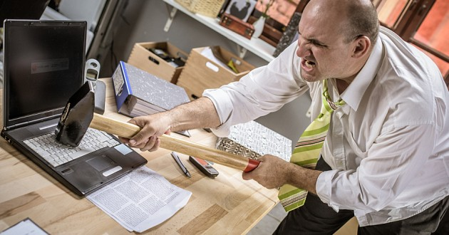
More Security Implications?

Slide 80
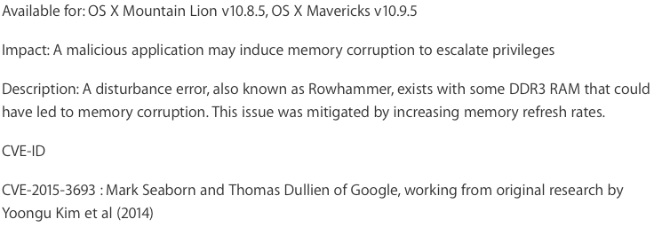
Apple’s Patch for RowHammer
https://support.apple.com/en-gb/HT204934
HP, Lenovo, and other vendors released similar patches

Slide 81
Solution Direction: Principled Designs
Design fundamentally secure
computing architectures
Predict and prevent
such safety issues

Slide 82
Our Solution to RowHammer
PARA: Probabilistic Adjacent Row Activation
Key Idea
After closing a row, we activate (i.e., refresh) one of its neighbors with a low probability: p = 0.005
Reliability Guarantee
When p=0.005, errors in one year: 9.4×10⁻¹⁴
By adjusting the value of p, we can vary the strength of protection against errors
Notes:
We provide a more efficient solution, called PARA, which stands for probabilistic adjacent row activation.
The key idea is thus: after closing a row, we activate (i.e., refresh) one of its neighbors with a low probability, for example, p equal to 0.005.
PARA provides a strong reliability guarantee even under the worst-case access patterns to DRAM. When we set p to 0.005, the expected number of errors in one year is 9.4 times 10 to the negative 14. This probability is much lower the failure rate of other hardware components, for example, the hard-disk drive.
And by adjusting the value of p, PARA can provide an arbitrarily strong-degree of protection against errors.

Slide 83
Advantages of PARA
PARA refreshes rows infrequently
Low power
Low performance-overhead
Average slowdown: 0.20% (for 29 benchmarks)
Maximum slowdown: 0.75%
PARA is stateless
Low cost
Low complexity
PARA is an effective and low-overhead solution to prevent disturbance errors
Notes:
PARA has many advantages. Since it refreshes row infrequently, it has low power and low performance-overhead. Simulated across 29 benchmarks, we saw an average of only 0.2% slowdown and a maximum of only 0.75% slowdown.
In addition, due to its stateless nature, PARA has low cost and complexity.
Therefore, PARA is an effective and low-overhead solution to prevent disturbance errors.

Slide 84
Requirements for PARA
If implemented in DRAM chip (done today)
Enough slack in timing parameters
Plenty of slack today:
Lee et al., “Adaptive-Latency DRAM: Optimizing DRAM Timing for the Common Case,” HPCA 2015.
Chang et al., “Understanding Latency Variation in Modern DRAM Chips,” SIGMETRICS 2016.
Lee et al., “Design-Induced Latency Variation in Modern DRAM Chips,” SIGMETRICS 2017.
Chang et al., “Understanding Reduced-Voltage Operation in Modern DRAM Devices,” SIGMETRICS 2017.
Ghose et al., “What Your DRAM Power Models Are Not Telling You: Lessons from a Detailed Experimental Study,” SIGMETRICS 2018.
If implemented in memory controller
Better coordination between memory controller and DRAM
Memory controller should know which rows are physically adjacent

Slide 85
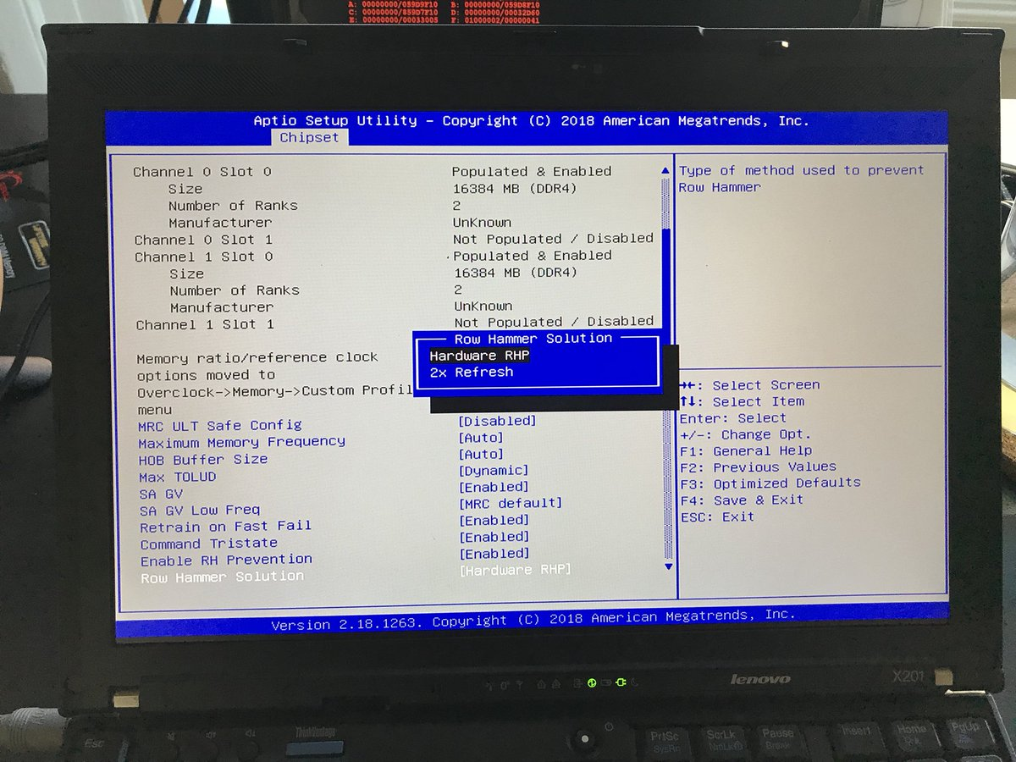
Probabilistic Activation in Real Life (I)
https://twitter.com/isislovecruft/status/1021939922754723841

Slide 86
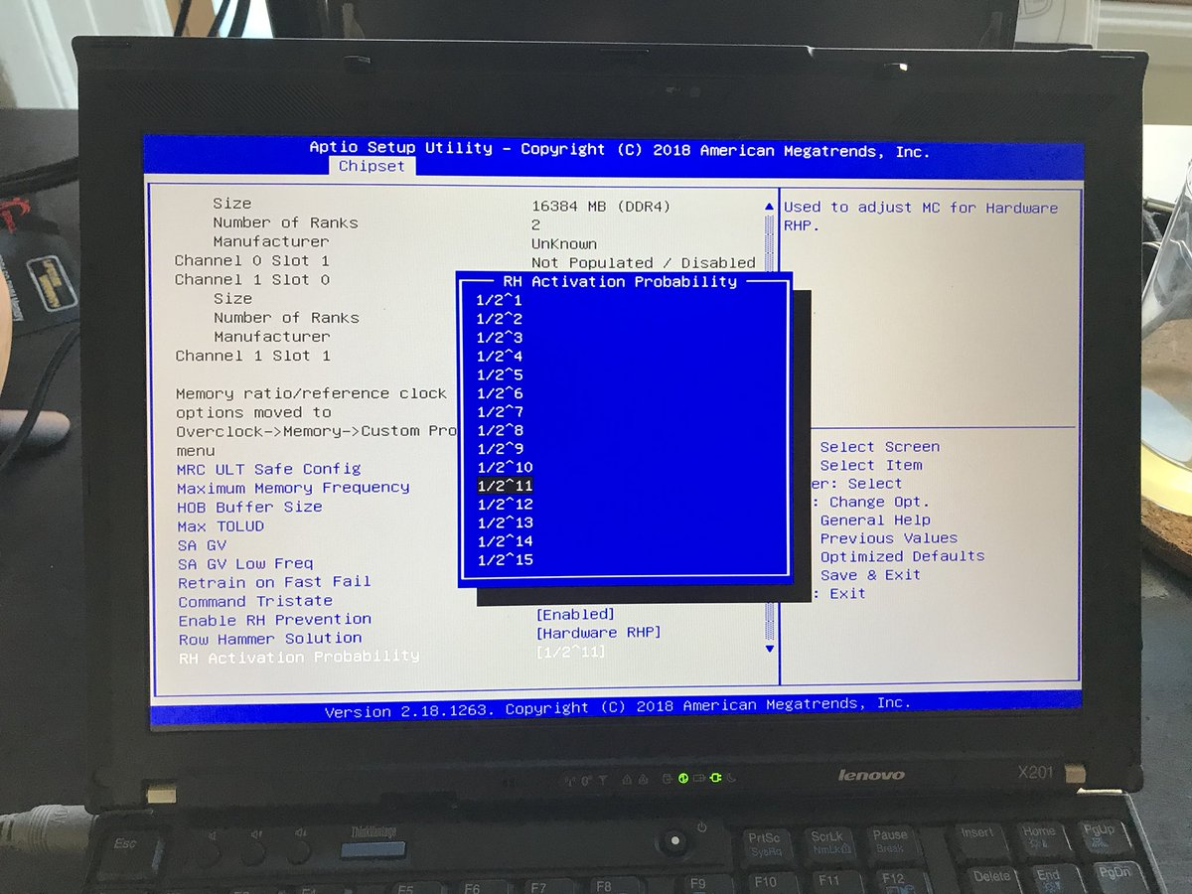
Probabilistic Activation in Real Life (II)
https://twitter.com/isislovecruft/status/1021939922754723841

Slide 87
More on RowHammer Analysis
Yoongu Kim, Ross Daly, Jeremie Kim, Chris Fallin, Ji Hye Lee, Donghyuk Lee, Chris Wilkerson, Konrad Lai, and Onur Mutlu, "Flipping Bits in Memory Without Accessing Them: An Experimental Study of DRAM Disturbance Errors" Proceedings of the 41st International Symposium on Computer Architecture (ISCA), Minneapolis, MN, June 2014. [Slides (pptx) (pdf)] [Lightning Session Slides (pptx) (pdf)] [Source Code and Data]

Slide 88
Future of Memory Reliability/Security
Onur Mutlu, "The RowHammer Problem and Other Issues We May Face as Memory Becomes Denser" Invited Paper in Proceedings of the Design, Automation, and Test in Europe Conference (DATE), Lausanne, Switzerland, March 2017. [Slides (pptx) (pdf)]
https://people.inf.ethz.ch/omutlu/pub/rowhammer-and-other-memory-issues_date17.pdf

Slide 89
Future of Main Memory
DRAM is becoming less reliable → more vulnerable
Due to difficulties in DRAM scaling, other problems may also appear (or they may be going unnoticed)
Some errors may already be slipping into the field
Read disturb errors (Rowhammer)
Retention errors
Read errors, write errors
…
These errors can also pose security vulnerabilities

Slide 90
All Memory Technologies are Vulnerable
DRAM
Flash memory
Emerging Technologies
Phase Change Memory
STT-MRAM
RRAM, memristors
…

Slide 91
How Do We Keep Memory Secure?
Understand: Methodologies for failure modeling and discovery
Modeling and prediction based on real (device) data
Architect: Principled co-architecting of system and memory
Good partitioning of duties across the stack
Design & Test: Principled design, automation, testing
High coverage and good interaction with system reliability methods

Slide 92
Understand and Model with Experiments (DRAM)
Temperature
Controller
FPGAs
Heater
FPGAs
PC
Kim+, “Flipping Bits in Memory Without Accessing Them: An Experimental Study of DRAM Disturbance Errors,” ISCA 2014.

Slide 93
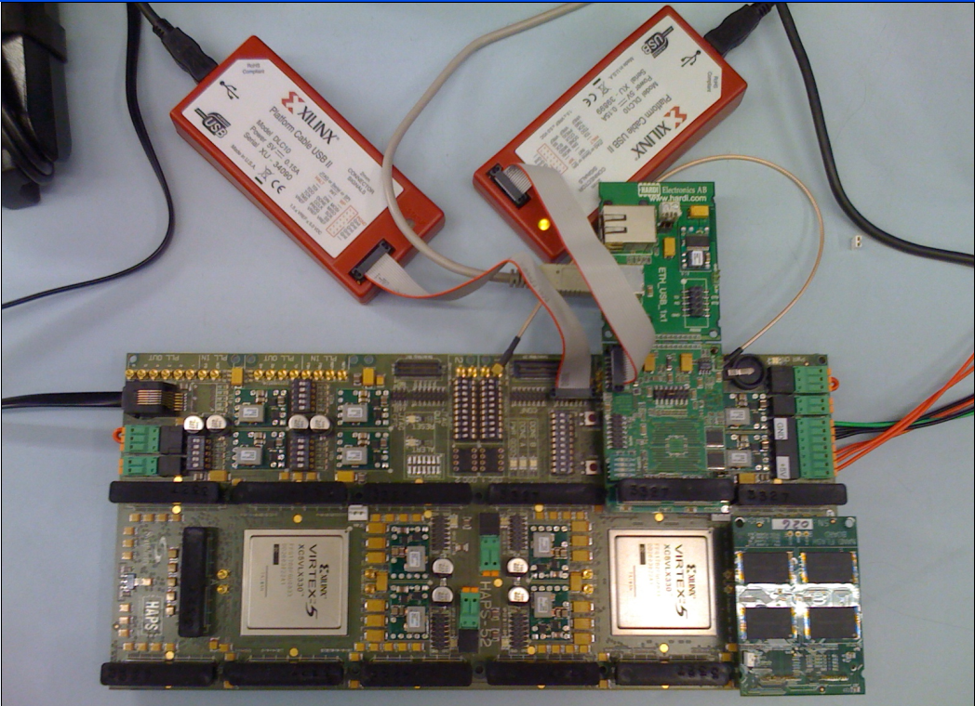
Understand and Model with Experiments (Flash)
USB Daughter Board
USB Jack
HAPS-52 Mother Board
Virtex-II Pro
(USB controller)
1x-nm
NAND Flash
Virtex-V FPGA
(NAND Controller)
[DATE 2012, ICCD 2012, DATE 2013, ITJ 2013, ICCD 2013, SIGMETRICS 2014, HPCA 2015, DSN 2015, MSST 2015, JSAC 2016, HPCA 2017, DFRWS 2017,
PIEEE 2017, HPCA 2018, SIGMETRICS 2018]
NAND Daughter Board
Cai+, “Error Characterization, Mitigation, and Recovery in Flash Memory Based Solid State Drives,” Proc. IEEE 2017.

Slide 94
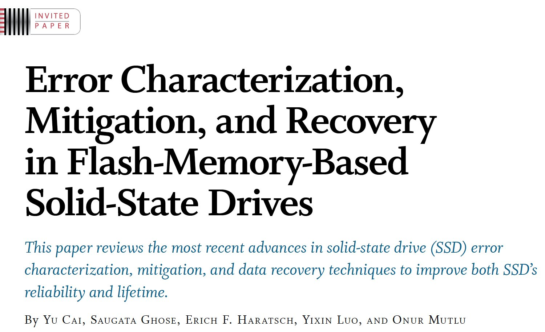
Understanding Flash Memory Reliability
Proceedings of the IEEE, Sept. 2017
https://arxiv.org/pdf/1706.08642

Slide 95
There are Two Other Solution Directions
New Technologies: Replace or (more likely) augment DRAM with a different technology
Non-volatile memories
Embracing Un-reliability:
Design memories with different reliability
and store data intelligently across them
[Luo+ DSN 2014]
…
Problem
Algorithm
Program/Language
System Software
SW/HW Interface
Micro-architecture
Logic
Devices
Electrons
Fundamental solutions to security require co-design across the hierarchy

Slide 96
Challenge and Opportunity for Future
Fundamentally
Secure, Reliable, Safe
Computing Architectures

Slide 97
One Important Takeaway
Main Memory Needs
Intelligent Controllers

Slide 98
Four Key Issues in Future Platforms
Fundamentally Secure/Reliable/Safe Architectures
Fundamentally Energy-Efficient Architectures
Memory-centric (Data-centric) Architectures
Fundamentally Low-Latency Architectures
Architectures for Genomics, Medicine, Health

Slide 99
Maslow’s (Human) Hierarchy of Needs, Revisited
Maslow, “A Theory of Human Motivation,”
Psychological Review, 1943.
Maslow, “A Theory of Human Motivation,”
Psychological Review, 1943.
Maslow, “Motivation and Personality,”
Book, 1954-1970.
Everlasting energy
Source: https://www.simplypsychology.org/maslow.html

Slide 100
Do We Want This?
Source: V. Milutinovic

Slide 101
Or This?
Source: V. Milutinovic

Slide 102
Challenge and Opportunity for Future
High Performance,
Energy Efficient,
Sustainable

Slide 103
The Problem
Data access is the major performance and energy bottleneck
Our current
design principles
cause great energy waste
(and great performance loss)

Slide 104
The Problem
Processing of data
is performed
far away from the data

Slide 105
A Computing System
Three key components
Computation
Communication
Storage/memory
Burks, Goldstein, von Neumann, “Preliminary discussion of the
logical design of an electronic computing instrument,” 1946.
Image source: https://lbsitbytes2010.wordpress.com/2013/03/29/john-von-neumann-roll-no-15/

Slide 106
A Computing System
Three key components
Computation
Communication
Storage/memory
Burks, Goldstein, von Neumann, “Preliminary discussion of the
logical design of an electronic computing instrument,” 1946.
Image source: https://lbsitbytes2010.wordpress.com/2013/03/29/john-von-neumann-roll-no-15/

Slide 107
Today’s Computing Systems
Are overwhelmingly processor centric
All data processed in the processor → at great system cost
Processor is heavily optimized and is considered the master
Data storage units are dumb and are largely unoptimized (except for some that are on the processor die)

Slide 108
Yet …
“It’s the Memory, Stupid!” (Richard Sites, MPR, 1996)
Mutlu+, “Runahead Execution: An Alternative to Very Large Instruction Windows for Out-of-Order Processors,” HPCA 2003.

Slide 109
The Performance Perspective
Onur Mutlu, Jared Stark, Chris Wilkerson, and Yale N. Patt, "Runahead Execution: An Alternative to Very Large Instruction Windows for Out-of-order Processors" Proceedings of the 9th International Symposium on High-Performance Computer Architecture (HPCA), pages 129-140, Anaheim, CA, February 2003. Slides (pdf)

Slide 110
The Performance Perspective (2015)
All of Google’s Data Center Workloads (2015):
Kanev+, “Profiling a Warehouse-Scale Computer,” ISCA 2015.

Slide 111
Perils of Processor-Centric Design
Grossly-imbalanced systems
Processing done only in one place
Everything else just stores and moves data: data moves a lot
→ Energy inefficient
→ Low performance
→ Complex
Overly complex and bloated processor (and accelerators)
To tolerate data access from memory
Complex hierarchies and mechanisms
→ Energy inefficient
→ Low performance
→ Complex

Slide 112
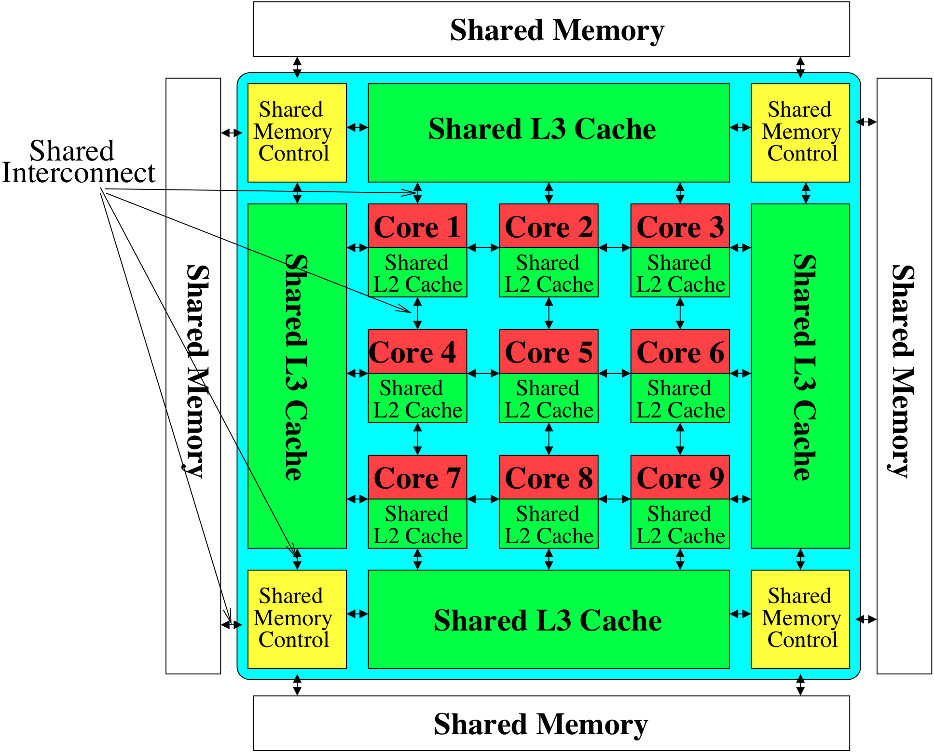
Perils of Processor-Centric Design
Most of the system is dedicated to storing and moving data

Slide 113
Three Key Systems Trends
1. Data access is a major bottleneck
Applications are increasingly data hungry
2. Energy consumption is a key limiter
3. Data movement energy dominates compute
Especially true for off-chip to on-chip movement

Slide 114
Data Movement vs. Computation Energy
Dally, HiPEAC 2015

Slide 115
Data Movement vs. Computation Energy
Dally, HiPEAC 2015
A memory access consumes ~1000X
the energy of a complex addition

Slide 116
Data Movement vs. Computation Energy
Data movement is a major system energy bottleneck
Comprises 41% of mobile system energy during web browsing [2]
Costs ~115 times as much energy as an ADD operation [1, 2]
[1]: Reducing data Movement Energy via Online Data Clustering and Encoding (MICRO’16)
[2]: Quantifying the energy cost of data movement for emerging smart phone workloads on mobile platforms (IISWC’14)

Slide 117
Energy Waste in Mobile Devices
Amirali Boroumand, Saugata Ghose, Youngsok Kim, Rachata Ausavarungnirun, Eric Shiu, Rahul Thakur, Daehyun Kim, Aki Kuusela, Allan Knies, Parthasarathy Ranganathan, and Onur Mutlu, "Google Workloads for Consumer Devices: Mitigating Data Movement Bottlenecks" Proceedings of the 23rd International Conference on Architectural Support for Programming Languages and Operating Systems (ASPLOS), Williamsburg, VA, USA, March 2018.
62.7% of the total system energy
is spent on data movement

Slide 118
We Do Not Want to Move Data!
Dally, HiPEAC 2015
A memory access consumes ~1000X
the energy of a complex addition

Slide 119
We Need A Paradigm Shift To …
Enable computation with minimal data movement
Compute where it makes sense (where data resides)
Make computing architectures more data-centric

Slide 120
Goal: Processing Inside Memory
Many questions … How do we design the:
compute-capable memory & controllers?
processor chip and in-memory units?
software and hardware interfaces?
system software and languages?
algorithms?
Memory
Processor
Core
Database
Graphs
Media
Cache
Query
Interconnect
Problem
Results
Algorithm
Program/Language
System Software
SW/HW Interface
Micro-architecture
Logic
Devices
Electrons

Slide 121
Starting Simple: Data Copy and Initialization
memmove & memcpy: 5% cycles in Google’s datacenter [Kanev+ ISCA’15]
000000000000000
Zero initialization
(e.g., security)
Forking
Checkpointing
Many more
VM Cloning
Deduplication
Page Migration

Slide 122
Today’s Systems: Bulk Data Copy
1) High latency
Memory
3) Cache pollution
L3
CPU
L2
L1
MC
2) High bandwidth utilization
4) Unwanted data movement
1046ns, 3.6uJ (for 4KB page copy via DMA)

Slide 123
Future Systems: In-Memory Copy
3) No cache pollution
1) Low latency
Memory
L3
CPU
L2
L1
MC
2) Low bandwidth utilization
4) No unwanted data movement
1046ns, 3.6uJ
→ 90ns, 0.04uJ

Slide 124
RowClone: In-DRAM Row Copy
Idea: Two consecutive ACTivates
4 Kbytes
Negligible HW cost
Step 1: Activate row A
Step 2: Activate row B
Transfer row
DRAM subarray
Transfer
row
Row Buffer (4 Kbytes)
8 bits
Data Bus
Notes:
copy

Slide 125
RowClone: Latency and Energy Savings
11.6x
74x
Seshadri et al., “RowClone: Fast and Efficient In-DRAM Copy and Initialization of Bulk Data,” MICRO 2013.

Slide 126
(Truly) In-Memory Computation
We can support in-DRAM AND, OR, NOT
At low cost
Using analog computation capability of DRAM
Idea: activating multiple rows performs computation
30-60X performance and energy improvement
Seshadri+, “Ambit: In-Memory Accelerator for Bulk Bitwise Operations Using Commodity DRAM Technology,” MICRO 2017.
New memory technologies enable even more opportunities
Memristors, resistive RAM, phase change mem, STT-MRAM, …
Can operate on data with minimal movement

Slide 127
In-DRAM Acceleration of Database Queries
>4-12X Performance Improvement
Seshadri+, “Ambit: In-Memory Accelerator for Bulk Bitwise Operations using Commodity DRAM Technology,” MICRO 2017.

Slide 128
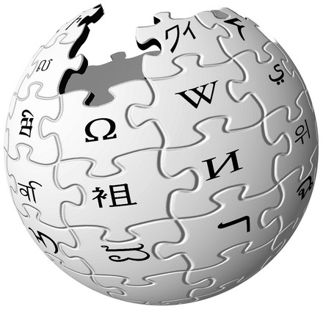
Another Example: In-Memory Graph Processing
Large graphs are everywhere (circa 2015)
Scalable large-scale graph processing is challenging
36 Million
Wikipedia Pages
1.4 Billion
Facebook Users
300 Million
Twitter Users
30 Billion
Instagram Photos

Slide 129
Key Bottlenecks in Graph Processing
for (v: graph.vertices) {
for (w: v.successors) {
w.next_rank += weight * v.rank;
}
}
1. Frequent random memory accesses
v
&w
w.rank
w.next_rank
w.edges
weight * v.rank
w
…
2. Little amount of computation

Slide 130
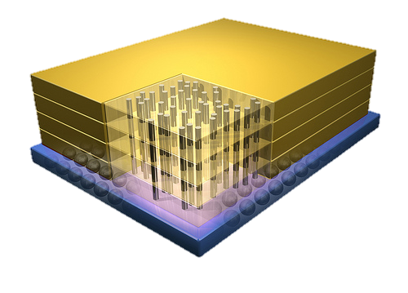
Tesseract System for Graph Processing
Interconnected set of 3D-stacked memory+logic chips with simple cores
Host Processor
Memory
Memory-Mapped
Accelerator Interface
(Noncacheable, Physically Addressed)
Logic
In-Order Core
DRAM Controller
…
…
LP
PF Buffer
Crossbar Network
…
MTP
…
Message Queue
NI

Slide 131
Tesseract System for Graph Processing
Host Processor
Memory
Memory-Mapped
Accelerator Interface
(Noncacheable, Physically Addressed)
Logic
In-Order Core
DRAM Controller
…
…
Communications via Remote Function Calls
LP
PF Buffer
Crossbar Network
…
MTP
…
Message Queue
NI

Slide 132
Tesseract System for Graph Processing
Host Processor
Memory
Memory-Mapped
Accelerator Interface
(Noncacheable, Physically Addressed)
Logic
Prefetching
In-Order Core
DRAM Controller
…
…
LP
PF Buffer
Crossbar Network
…
MTP
…
Message Queue
NI

Slide 133
Evaluated Systems
DDR3-OoO
HMC-OoO
HMC-MC
Tesseract
32 Tesseract Cores
8 OoO
4GHz
8 OoO
4GHz
8 OoO
4GHz
8 OoO
4GHz
128 In-Order
2GHz
128 In-Order
2GHz
8 OoO
4GHz
8 OoO
4GHz
8 OoO
4GHz
8 OoO
4GHz
128 In-Order
2GHz
128 In-Order
2GHz
102.4GB/s
640GB/s
640GB/s
8TB/s
Ahn+, “A Scalable Processing-in-Memory Accelerator for Parallel Graph Processing” ISCA 2015.

Slide 134
Tesseract Graph Processing Performance
>13X Performance Improvement
On five graph processing algorithms
Ahn+, “A Scalable Processing-in-Memory Accelerator for Parallel Graph Processing” ISCA 2015.

Slide 135
Tesseract Graph Processing Performance

Slide 136
Tesseract Graph Processing Energy
> 8X Energy Reduction
Ahn+, “A Scalable Processing-in-Memory Accelerator for Parallel Graph Processing” ISCA 2015.

Slide 137
Google Workloads for Consumer Devices: Mitigating Data Movement Bottlenecks
Amirali Boroumand
Saugata Ghose, Youngsok Kim, Rachata Ausavarungnirun,
Eric Shiu, Rahul Thakur, Daehyun Kim, Aki Kuusela, Allan Knies, Parthasarathy Ranganathan, Onur Mutlu

Slide 138
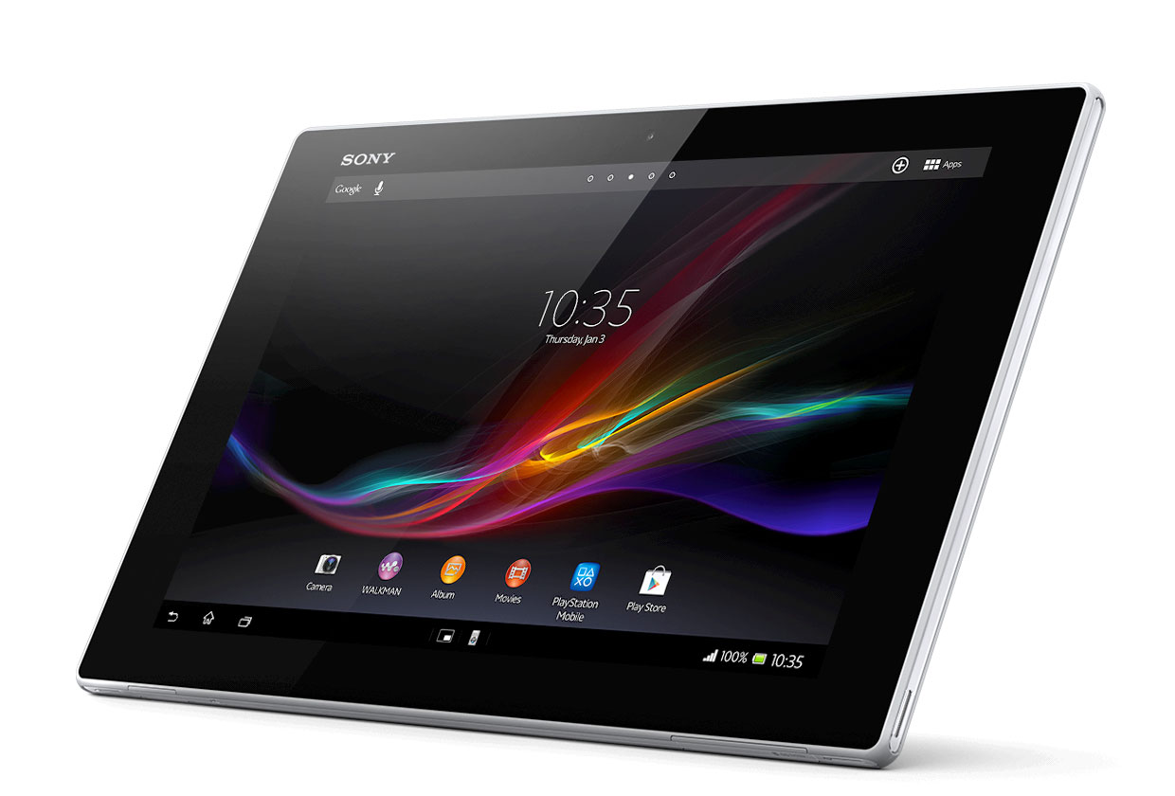
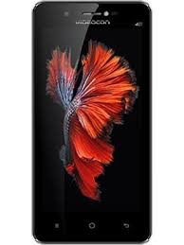
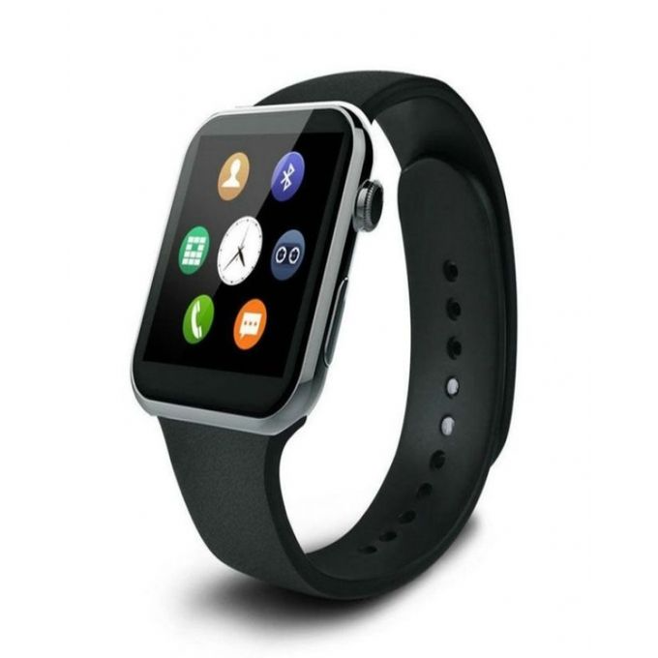
Consumer Devices
Consumer devices are everywhere!
Energy consumption is a first-class concern in consumer devices
Notes:
Consumer devices like tablets smartphone and wearable are now everywhere and used by billions of people.
One of the major challenge in these devices is battery limitation which makes the energy consumption a critical concern …

Slide 139
Popular Google Consumer Workloads
Chrome
TensorFlow Mobile
Google’s web browser
Google’s machine learning framework
Video Playback
Video Capture
Google’s video codec
Google’s video codec
Notes:
In this work, we take a look at widely-used google consumer workloads, to figure out the major sources of energy consumption.
We look at Google Chrome web brower. We take a look at Tensorflow, Google’s machine learning framework, and we also take a look at two important video related workloads, video playback and video capture, both rely on Google’s vp9 codec technology.

Slide 140
Energy Cost of Data Movement
1st key observation: 62.7% of the total system energy is spent on data movement
Data Movement
SoC
DRAM
CPU
L2
CPU
L1
CPU
CPU
Compute Unit
Processing-In-Memory (PIM)
Potential solution: move computation close to data
Challenge: limited area and energy budget
Notes:
Throughout our analysis, we make a key observation that out of all sources of energy consumption, data movement is a major contributor to the total system energy. We find that across all of the workloads, on average around 62.7% of total system energy is spent on data movement.
One way to reduce data movement cost is to move computation close to data, or …
One potential solution to address this cost it do move computation close to data, or in other words, do procesing in memory. However, the challenge is that these devices.
One potential solution to mitigate data movement cost and reduce total system energy is to execute data-movement heavy portions of application close to data, or in other words, do processing in memory. However, consumer devices are extermely limited in terms of area and power budget. So the question is can we move part of the data movement heavy portion given the limited area and energy budget. Our

Slide 141
Using PIM to Reduce Data Movement
2nd key observation: a significant fraction of the data movement often comes from simple functions
We can design lightweight logic to implement these simple functions in memory
Small embedded low-power core
Small fixed-function accelerators
PIM Core
PIM Accelerator
PIM Accelerator
PIM Accelerator
Offloading to PIM logic reduces energy and improves performance, on average, by 55.4% and 54.2%
Notes:
To figure out if we can use processing in memory, we dig deeper into our analysis and we make another key observation that majority of data movement often comes form simple functions and pritmitives. We find that these simple function can be implemented in memory as either a small embedded core, or group of small fixed function accelerators. Our result shows that offloading these function to PIM logic can significantly reduce data movement for each function and reduce energy on average around 55% and improve perforamcne around 54%.
our PIM core can reduce significant portion of data movement, reduce enregy by 49.1% for each function and improve performance up to 2.2X. While using group of fixed function accelerator reduce energy by 55.4% and improve performance by up to 2.5X.
Or use Saugata’s approach : Reduces total system energy by an average of 55.4%
Reduces execution time by an average of 54.2%
Our result show that both of them can significantly reduce the data movement for each function.
Feedback: talk about result more
Don’t talk about specific detail like MemCopy, MemSet stuff like that
Main take away: data movement come from simple functions that are simple enough to implement in PIM
We find that these functions and primitves can be implemented as PIM logic using either (1) a small low-power general-purpose embedded core or (2) a group of small fixed-function accelerators (PIM accelerators). Our Analysis shows that both are cost-feasible to use in consumer devices. We find that they eliminate a significant fraction of dat amovement, and reduce energy consumption for each of these operation on average by 49 and 55%.

Slide 142
Challenge and Opportunity for Future
Fundamentally
Energy-Efficient
(Data-Centric)
Computing Architectures

Slide 143
Four Key Issues in Future Platforms
Fundamentally Secure/Reliable/Safe Architectures
Fundamentally Energy-Efficient Architectures
Memory-centric (Data-centric) Architectures
Fundamentally Low-Latency Architectures
Architectures for Genomics, Medicine, Health

Slide 144
Low Latency Communication is Critical
Source: http://spectrum.ieee.org/image/MjYzMzAyMg.jpeg

Slide 145
Maslow’s Hierarchy of Needs, A Third Time
Maslow, “A Theory of Human Motivation,”
Psychological Review, 1943.
Maslow, “Motivation and Personality,”
Book, 1954-1970.
Speed
Speed
Speed
Speed
Speed
Source: https://www.simplypsychology.org/maslow.html

Slide 146
Challenge and Opportunity for Future
Fundamentally
Low-Latency
Computing Architectures

Slide 147
Main Memory Latency Lags Behind
128x
20x
1.3x
Memory latency remains almost constant

Slide 148
The Memory Latency Problem
High memory latency is a significant limiter of system performance and energy-efficiency
It is becoming increasingly so with higher memory contention in multi-core and heterogeneous architectures
Exacerbating the bandwidth need
Exacerbating the QoS problem
It increases processor design complexity due to the mechanisms incorporated to tolerate memory latency

Slide 149
Retrospective: Conventional Latency Tolerance Techniques
Caching [initially by Wilkes, 1965]
Widely used, simple, effective, but inefficient, passive
Not all applications/phases exhibit temporal or spatial locality
Prefetching [initially in IBM 360/91, 1967]
Works well for regular memory access patterns
Prefetching irregular access patterns is difficult, inaccurate, and hardware-intensive
Multithreading [initially in CDC 6600, 1964]
Works well if there are multiple threads
Improving single thread performance using multithreading hardware is an ongoing research effort
Out-of-order execution [initially by Tomasulo, 1967]
Tolerates cache misses that cannot be prefetched
Requires extensive hardware resources for tolerating long latencies
None of These
Fundamentally Reduce
Memory Latency

Slide 150
Truly Reducing Memory Latency

Slide 151
Why the Long Memory Latency?
Reason 1: Design of DRAM Micro-architecture
Goal: Maximize capacity/area, not minimize latency
Reason 2: “One size fits all” approach to latency specification
Same latency parameters for all temperatures
Same latency parameters for all DRAM chips
Same latency parameters for all parts of a DRAM chip
Same latency parameters for all supply voltage levels
Same latency parameters for all application data
…

Slide 152
Tackling the Fixed Latency Mindset
Reliable operation latency is actually very heterogeneous
Across temperatures, chips, parts of a chip, voltage levels, …
Idea: Dynamically find out and use the lowest latency one can reliably access a memory location with
Adaptive-Latency DRAM [HPCA 2015]
Flexible-Latency DRAM [SIGMETRICS 2016]
Design-Induced Variation-Aware DRAM [SIGMETRICS 2017]
Voltron [SIGMETRICS 2017]
DRAM Latency PUF [HPCA 2018]
DRAM Latency True Random Number Generator [HPCA 2019]
...
We would like to find sources of latency heterogeneity and exploit them to minimize latency

Slide 153
Latency Variation in Memory Chips
Heterogeneous manufacturing & operating conditions → latency variation in timing parameters
DRAM A
DRAM B
DRAM C
Slow cells
Low
High
DRAM Latency

Slide 154
Why is Latency High?
DRAM latency: Delay as specified in DRAM standards
Doesn’t reflect true DRAM device latency
Imperfect manufacturing process → latency variation
High standard latency chosen to increase yield
DRAM A
DRAM B
DRAM C
Standard
Latency
Manufacturing Variation
Low
High
DRAM Latency
Notes:
To understand the latency problem, we need to go into what defines latency.
DRAM latency is the total amnt of time that the underlying hw operations need <> to retrieve data.
The DRAM standards define a single fixed time for how long these ops should take in every DRAM chip.
However, this defined delay doesn’t actually reflect the latency of the individual DRAMs.
<Timeline illustration>
Because the manufacturing process is imperfect, it introduces variation in the production chips, resulting in latency variation across different chips.
This simple illustartion shows the difference b/w the average latency across 3 different dram chips, to convey the point of latency variation.
It’s important to note that not only does latency variation exists <across> chips, but also <inside> each dram chip itself.
<Blue standard>
Since we don’t want to throw away the chips with high variation, we tolerate them.
The simple way is to <slow> down the acceptable latency so that the majority of chips can all work reliably under this high standard latency.
as we can see, the high standard latency is a result of a trade-off made for higher DRAM production yield.
---
<> Operative word

Slide 155
What Causes the Long Memory Latency?
Conservative timing margins!
DRAM timing parameters are set to cover the worst case
Worst-case temperatures
85 degrees vs. common-case
to enable a wide range of operating conditions
Worst-case devices
DRAM cell with smallest charge across any acceptable device
to tolerate process variation at acceptable yield
This leads to large timing margins for the common case

Slide 156
Understanding and Exploiting Variation in DRAM Latency

Slide 157
DRAM Characterization Infrastructure
Temperature
Controller
FPGAs
Heater
FPGAs
PC
Kim+, “Flipping Bits in Memory Without Accessing Them: An Experimental Study of DRAM Disturbance Errors,” ISCA 2014.

Slide 158
Adaptive-Latency DRAM
Key idea
Optimize DRAM timing parameters online
Two components
DRAM manufacturer provides multiple sets of reliable DRAM timing parameters at different temperatures for each DIMM
System monitors DRAM temperature & uses appropriate DRAM timing parameters
reliable DRAM timing parameters
DRAM temperature
Lee+, “Adaptive-Latency DRAM: Optimizing DRAM Timing for the Common-Case,” HPCA 2015.

Slide 159
Latency Reduction Summary of 115 DIMMs
Latency reduction for read & write (55°C)
Read Latency: 32.7%
Write Latency: 55.1%
Latency reduction for each timing parameter (55°C)
Sensing: 17.3%
Restore: 37.3% (read), 54.8% (write)
Precharge: 35.2%
Lee+, “Adaptive-Latency DRAM: Optimizing DRAM Timing for the Common-Case,” HPCA 2015.

Slide 160
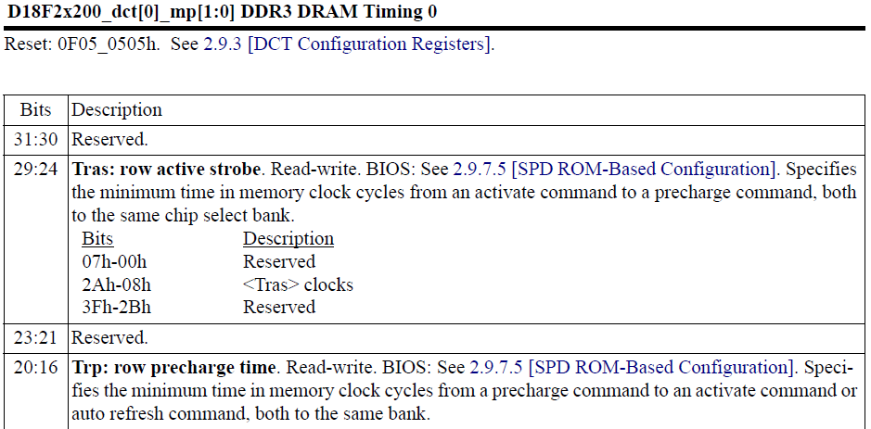
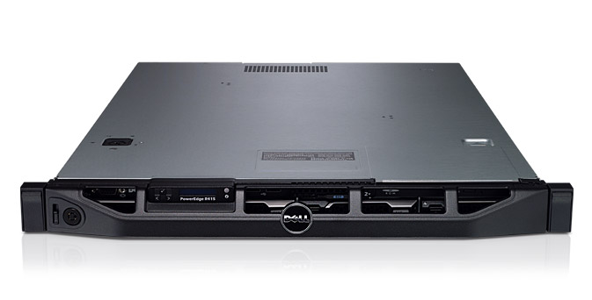
AL-DRAM: Real System Evaluation
System
CPU: AMD 4386 ( 8 Cores, 3.1GHz, 8MB LLC)
DRAM: 4GByte DDR3-1600 (800Mhz Clock)
OS: Linux
Storage: 128GByte SSD
Workload
35 applications from SPEC, STREAM, Parsec, Memcached, Apache, GUPS

Slide 161
AL-DRAM: Single-Core Evaluation
Average
Improvement
6.7%
Performance Improvement
5.0%
1.4%
all-35-workload
AL-DRAM improves single-core performance
on a real system

Slide 162
AL-DRAM: Multi-Core Evaluation
Average
Improvement
14.0%
10.4%
Performance Improvement
2.9%
all-35-workload
AL-DRAM provides higher performance on
multi-programmed & multi-threaded workloads

Slide 163
Reducing Latency Also Reduces Energy
AL-DRAM reduces DRAM power consumption by 5.8%
Major reason: reduction in row activation time

Slide 164
Challenge and Opportunity for Future
Fundamentally
Low-Latency
Computing Architectures

Slide 165
D-RaNGe: Using Commodity DRAM Devices to Generate True Random Numbers with Low Latency and High Throughput
Jeremie S. Kim Minesh Patel
Hasan Hassan Lois Orosa Onur Mutlu

Slide 166
DRAM Latency Characterization of 282 LPDDR4 DRAM Devices
Latency failures come from accessing DRAM with reduced timing parameters.
Key Observations:
A cell’s latency failure probability is determined by random process variation
Some cells fail randomly
Notes:
In this work, we show results from a detailed experimental characterization of 282 state-of-the-art LPDDR4 DRAM devices. [CLICK] We characterize DRAM latency by observing the effects of accessing DRAM with DRAM timing parameters reduced below manufacturer-recommended values.
[CLICK] We make two key observations. [CLICK] first, a cell’s probability to fail, when accessed with reduced timing parameters, is directly correlated with random variations that arise from process manufacturing. [CLICK] secondly, We note that some cells fail randomly when accessed with a reduced tRCD.

Slide 167
D-RaNGe Key Idea
Low % chance to fail with reduced t_{RCD}
High % chance to fail with reduced t_{RCD}
Row Decoder
SA
SA
SA
SA
SA
SA
SA
Fails randomly
with reduced t_{RCD}
Notes:
Here is a cartoon showing the manufacturing variation across a region of DRAM. When accessed with a reduced timing parameter, [CLICK] some cells have a high percentage chance of failing, while others [CLICK] have a low percentage chance of failing. [CLICK} Some cells fail randomly when accessed with a reduced tRCD.

Slide 168
D-RaNGe Key Idea
Low % chance to fail with reduced t_{RCD}
High % chance to fail with reduced t_{RCD}
We refer to cells that fail randomly
when accessed with a reduced t_{RCD}
as RNG cells
Row Decoder
SA
SA
SA
SA
SA
SA
SA
Fails randomly
with reduced t_{RCD}
Notes:
We refer to cells that fail randomly when accessed with a reduced tRCD as RNG cells

Slide 169
Our D-RaNGe Evaluation
We generate random values by repeatedly accessing RNG cells and aggregating the data read
The random data satisfies the NIST statistical test suite for randomness
The D-RaNGE generates random numbers
Throughput: 717.4 Mb/s
Latency: 64 bits in <1us
Power: 4.4 nJ/bit

Slide 170
DRAM Latency True Random Number Generator
Jeremie S. Kim, Minesh Patel, Hasan Hassan, Lois Orosa, and Onur Mutlu, "D-RaNGe: Using Commodity DRAM Devices to Generate True Random Numbers with Low Latency and High Throughput" Proceedings of the 25th International Symposium on High-Performance Computer Architecture (HPCA), Washington, DC, USA, February 2019.

Slide 171
Four Key Issues in Future Platforms
Fundamentally Secure/Reliable/Safe Architectures
Fundamentally Energy-Efficient Architectures
Memory-centric (Data-centric) Architectures
Fundamentally Low-Latency Architectures
Architectures for Genomics, Medicine, Health

Slide 172
Our Dream
An embedded device that can perform comprehensive genome analysis in real time (within a minute)
Which of these DNAs does this DNA segment match with?
What is the likely genetic disposition of this patient to this drug?
. . .

Slide 173
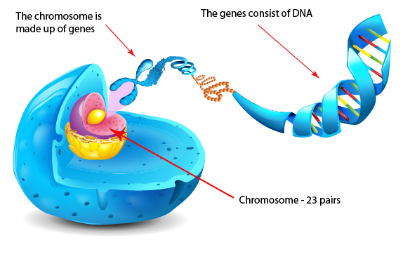
What Is a Genome Made Of?
Cell
Nucleus
The discovery of DNA’s double-helical structure (Watson+, 1953)
Notes:
Unlocking the life’s code requires diving into the nucleus of our body cells, where the double-stranded genome resides. Genome is literally the 'code of life' - it is the set of instructions for making everything from you to zebras, strawberries, and even yeast.
since the discovery of dna’s double-helical structure (watson et al. 1953)

Slide 174
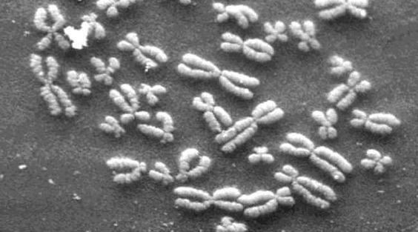
DNA Under Electron Microscope
human chromosome #12
from HeLa’s cell
Notes:
Henrietta Lacks,

Slide 175
DNA Sequencing
Goal:
Find the complete sequence of A, C, G, T’s in DNA.
Challenge:
There is no machine that takes long DNA as an input, and gives the complete sequence as output
All sequencing machines chop DNA into pieces and identify relatively small pieces (but not how they fit together)

Slide 176
Untangling Yarn Balls & DNA Sequencing
Notes:
untangling yarn ball

Slide 177
Genome Sequencers
Illumina MiSeq
Complete
Genomics
Roche/454
AB SOLiD
Oxford Nanopore MinION
Illumina
NovaSeq
6000
Illumina HiSeq2000
Pacific Biosciences RS
Oxford Nanopore GridION
Ion Torrent PGM
… and more! All produce data with different properties.
Ion Torrent Proton

Slide 178
1
Sequencing
Genome Analysis
Read Mapping
2
Variant Calling
Scientific Discovery
3
4
Notes:
Genome analysis starts with sequencing random short DNA fragments of copies of the original molecule.
Unfortunately, these reads lack information about their order and which part of genome they are originated from.
Hence the second step is to map these reads to a long reference genome.

Slide 179
Genome Sequence Alignment: Example
Source: By Aaron E. Darling, István Miklós, Mark A. Ragan - Figure 1 from Darling AE, Miklós I, Ragan MA (2008).
"Dynamics of Genome Rearrangement in Bacterial Populations". PLOS Genetics. DOI:10.1371/journal.pgen.1000128., CC BY 2.5, https://commons.wikimedia.org/w/index.php?curid=30550950

Slide 180
1
Sequencing
Read Mapping
2
Bottlenecked in Mapping!!
Illumina HiSeq4000
on average
GAGTCAGAATTTGAC
2 M
bases/min
300 M
bases/min
GAGTCAGAATTTGAC
GAGTCAGAATTTGAC
GAGTCAGAATTTGAC
GAGTCAGAATTTGAC
GAGTCAGAATTTGAC
GAGTCAGAATTTGAC
GAGTCAGAATTTGAC
GAGTCAGAATTTGAC
GAGTCAGAATTTGAC
GAGTCAGAATTTGAC
GAGTCAGAATTTGAC
GAGTCAGAATTTGAC
GAGTCAGAATTTGAC
GAGTCAGAATTTGAC
(0.6%)
Variant Calling
Scientific Discovery
3
4
Notes:
Typical sequencer machine generates a flood of reads, for example, Illumina HiSeq4000 generates 300 million bases/minute.
However, existing computer alignment algorithms can only process 0.6% of these reads in the same amount of time.
This gap is widening as more advanced sequencers are made available in the market.

Slide 181
Hash Table Based Read Mappers
+ Guaranteed to find all mappings → sensitive
+ Can tolerate up to e errors
http://mrfast.sourceforge.net/
Alkan+, "Personalized copy number and segmental duplication
maps using next-generation sequencing”, Nature Genetics 2009.
Notes:
It turned out the Hash Table based mappers solve the first 2 challenges pretty well. They guarantee to find all mappings with no more than e errors present.

Slide 182
Read Mapping Execution Time Breakdown
Notes:
An overwhelming majority of the read mapper’s execution time is spent in read alignment.

Slide 183
Idea
Filter fast before you align
Minimize costly
“approximate string comparisons”

Slide 184
Our First Filter: Pure Software Approach
Download the source code and try for yourself
Download link to FastHASH

Slide 185
Shifted Hamming Distance: SIMD Acceleration
https://github.com/CMU-SAFARI/Shifted-Hamming-Distance
Xin+, "Shifted Hamming Distance: A Fast and Accurate SIMD-friendly Filter
to Accelerate Alignment Verification in Read Mapping”, Bioinformatics 2015.

Slide 186
GateKeeper: FPGA-Based Alignment Filtering
1
st
Alignment Filter
FPGA-based Alignment Filter.
Notes:
To bridge the widening gap between the sequencer & the mapper, we propose the concept of pre-alignment filtering. We added a new examination step before the accurate alignment step. The main objective of this step is to detect the incorrect mappings accurately and rapidly. Only the mappings that pass our filter are examined by the alignment step. We also explore exploiting todays’ hardware accelerators to further boost the filtering speed of such filters.

Slide 187
GateKeeper: FPGA-Based Alignment Filtering
Mohammed Alser, Hasan Hassan, Hongyi Xin, Oguz Ergin, Onur Mutlu, and Can Alkan "GateKeeper: A New Hardware Architecture for Accelerating Pre-Alignment in DNA Short Read Mapping" Bioinformatics, [published online, May 31], 2017. [Source Code] [Online link at Bioinformatics Journal]

Slide 188
DNA Read Mapping & Filtering
Problem: Heavily bottlenecked by Data Movement
GateKeeper FPGA performance limited by DRAM bandwidth [Alser+, Bioinformatics 2017]
Ditto for SHD on SIMD [Xin+, Bioinformatics 2015]
Solution: Processing-in-memory can alleviate the bottleneck
However, we need to design mapping & filtering algorithms to fit processing-in-memory

Slide 189
In-Memory DNA Sequence Analysis
Jeremie S. Kim, Damla Senol Cali, Hongyi Xin, Donghyuk Lee, Saugata Ghose, Mohammed Alser, Hasan Hassan, Oguz Ergin, Can Alkan, and Onur Mutlu, "GRIM-Filter: Fast Seed Location Filtering in DNA Read Mapping Using Processing-in-Memory Technologies" BMC Genomics, 2018. Proceedings of the 16th Asia Pacific Bioinformatics Conference (APBC), Yokohama, Japan, January 2018. arxiv.org Version (pdf)

Slide 190
Quick Note: Key Principles and Results
Two key principles:
Exploit the structure of the genome to minimize computation
Morph and exploit the structure of the underlying hardware to maximize performance and efficiency
Algorithm-architecture co-design for DNA read mapping
Speeds up read mapping by ~200X (sometimes more)
Improves accuracy of read mapping in the presence of errors
Xin et al., “Accelerating Read Mapping with FastHASH,” BMC Genomics 2013.
Xin et al., “Shifted Hamming Distance: A Fast and Accurate SIMD-friendly Filter to Accelerate
Alignment Verification in Read Mapping,” Bioinformatics 2015.
Alser et al., “GateKeeper: A New Hardware Architecture for Accelerating Pre-Alignment in DNA
Short Read Mapping,” Bioinformatics 2017.
Kim et al., “Genome Read In-Memory (GRIM) Filter,” BMC Genomics 2018.

Slide 191
New Genome Sequencing Technologies
Oxford Nanopore MinION
Senol Cali+, “Nanopore Sequencing Technology and Tools for Genome
Assembly: Computational Analysis of the Current State, Bottlenecks
and Future Directions,” Briefings in Bioinformatics, 2018.
[Preliminary arxiv.org version]

Slide 192
Nanopore Genome Assembly Pipeline
Senol Cali+, “Nanopore Sequencing Technology and Tools for Genome
Assembly,” Briefings in Bioinformatics, 2018.

Slide 193
More on Genome Analysis: Another Talk

Slide 194
Recall Our Dream
An embedded device that can perform comprehensive genome analysis in real time (within a minute)
Still a long ways to go
Energy efficiency
Performance (latency)
Security
Huge memory bottleneck

Slide 195
Concluding Remarks

Slide 196
A Quote from A Famous Architect
“architecture […] based upon principle, and not upon precedent”

Slide 197
Precedent-Based Design
“architecture […] based upon principle, and not upon precedent”

Slide 198
Principled Design
“architecture […] based upon principle, and not upon precedent”

Slide 200
Another Example: Precedent-Based Design
Source: http://cookiemagik.deviantart.com/art/Train-station-207266944

Slide 201
Principled Design
Source: By Toni_V, CC BY-SA 2.0, https://commons.wikimedia.org/w/index.php?curid=4087256

Slide 202
Another Principled Design
Source: By Martín Gómez Tagle - Lisbon, Portugal, CC BY-SA 3.0, https://commons.wikimedia.org/w/index.php?curid=13764903
Source: http://www.arcspace.com/exhibitions/unsorted/santiago-calatrava/

Slide 203
Another Principled Design
Source: CC BY-SA 3.0, https://commons.wikimedia.org/w/index.php?curid=172107

Slide 204
Principle Applied to Another Structure
Source: By 準建築人手札網站 Forgemind ArchiMedia - Flickr: IMG_2489.JPG, CC BY 2.0,
https://commons.wikimedia.org/w/index.php?curid=31493356, https://en.wikipedia.org/wiki/Santiago_Calatrava
Source: https://www.dezeen.com/2016/08/29/santiago-calatrava-oculus-world-trade-center-transportation-hub-new-york-photographs-hufton-crow/

Slide 205
Overarching Principles for Computing?
Source: http://spectrum.ieee.org/image/MjYzMzAyMg.jpeg

Slide 206
Some Solution Principles (So Far)
Data-centric system design & intelligence spread around
Do not center everything around traditional computation units
Better cooperation across layers of the system
Careful co-design of components and layers: system/arch/device
Better, richer, more expressive and flexible interfaces
Better-than-worst-case design
Do not optimize for the worst case
Worst case should not determine the common case
Heterogeneity in design (specialization, asymmetry)
Enables a more efficient design (No one size fits all)

Slide 207
Some Solution Principles (More Compact)
Data-centric design
All components intelligent
Good cross-layer communication, expressive interfaces
Better-than-worst-case design
Heterogeneity
Flexibility, adaptability

Slide 208
Concluding Remarks
It is time to design principled computing architectures to achieve the highest security, performance, and efficiency
Discover design principles for fundamentally secure and reliable computer architectures
Design complete systems to be balanced and energy-efficient, i.e., data-centric (or memory-centric) and low-latency
Enable new platforms for genomics, medicine, health
This can
Lead to orders-of-magnitude improvements
Enable new applications & computing platforms
Enable better understanding of nature
…
Notes:
Perhaps we have taken processor-centric system design a bit too far

Slide 209
The Future is Very Bright
Regardless of challenges
in underlying technology and overlying problems/requirements
Problem
Algorithm
Program/Language
System Software
SW/HW Interface
Micro-architecture
Logic
Devices
Electrons

Slide 210
We Need to Think and Act Across the Stack
Problem
Algorithm
Program/Language
System Software
SW/HW Interface
Micro-architecture
Logic
Devices
Electrons

Slide 211
Future Computing Architectures Challenges and Opportunities
Onur Mutlu
omutlu@gmail.com
https://people.inf.ethz.ch/omutlu
30 January 2019
UT Austin ECE Colloquium

Slide 212
Acknowledgments
My current and past students and postdocs
Rachata Ausavarungnirun, Abhishek Bhowmick, Amirali Boroumand, Rui Cai, Yu Cai, Kevin Chang, Saugata Ghose, Kevin Hsieh, Tyler Huberty, Ben Jaiyen, Samira Khan, Jeremie Kim, Yoongu Kim, Yang Li, Jamie Liu, Lavanya Subramanian, Donghyuk Lee, Yixin Luo, Justin Meza, Gennady Pekhimenko, Vivek Seshadri, Lavanya Subramanian, Nandita Vijaykumar, HanBin Yoon, Jishen Zhao, …
My collaborators
Can Alkan, Chita Das, Phil Gibbons, Sriram Govindan, Norm Jouppi, Mahmut Kandemir, Mike Kozuch, Konrad Lai, Ken Mai, Todd Mowry, Yale Patt, Moinuddin Qureshi, Partha Ranganathan, Bikash Sharma, Kushagra Vaid, Chris Wilkerson, …

Slide 213
Funding Acknowledgments
NSF
GSRC
SRC
CyLab
Alibaba, AMD, Google, Facebook, HP Labs, Huawei, IBM, Intel, Microsoft, Nvidia, Oracle, Qualcomm, Rambus, Samsung, Seagate, VMware

Slide 214
Readings, Videos, Reference Materials

Slide 215
Accelerated Memory Course (~6.5 hours)
ACACES 2018
Memory Systems and Memory-Centric Computing Systems
Taught by Onur Mutlu July 9-13, 2018
~6.5 hours of lectures
Website for the Course including Videos, Slides, Papers
https://people.inf.ethz.ch/omutlu/acaces2018.html
https://www.youtube.com/playlist?list=PL5Q2soXY2Zi-HXxomthrpDpMJm05P6J9x
All Papers are at:
https://people.inf.ethz.ch/omutlu/projects.htm
Final lecture notes and readings (for all topics)

Slide 216
Reference Overview Paper I
Saugata Ghose, Kevin Hsieh, Amirali Boroumand, Rachata Ausavarungnirun, Onur Mutlu, "Enabling the Adoption of Processing-in-Memory: Challenges, Mechanisms, Future Research Directions" Invited Book Chapter, to appear in 2018. [Preliminary arxiv.org version]
https://arxiv.org/pdf/1802.00320.pdf

Slide 217
Reference Overview Paper II
Onur Mutlu and Lavanya Subramanian, "Research Problems and Opportunities in Memory Systems" Invited Article in Supercomputing Frontiers and Innovations (SUPERFRI), 2014/2015.
https://people.inf.ethz.ch/omutlu/pub/memory-systems-research_superfri14.pdf

Slide 218
Reference Overview Paper III
Onur Mutlu, "The RowHammer Problem and Other Issues We May Face as Memory Becomes Denser" Invited Paper in Proceedings of the Design, Automation, and Test in Europe Conference (DATE), Lausanne, Switzerland, March 2017. [Slides (pptx) (pdf)]
https://people.inf.ethz.ch/omutlu/pub/rowhammer-and-other-memory-issues_date17.pdf

Slide 219
Reference Overview Paper IV
Onur Mutlu, "Memory Scaling: A Systems Architecture Perspective" Technical talk at MemCon 2013 (MEMCON), Santa Clara, CA, August 2013. [Slides (pptx) (pdf)] [Video] [Coverage on StorageSearch]
https://people.inf.ethz.ch/omutlu/pub/memory-scaling_memcon13.pdf

Slide 220
Reference Overview Paper V
Proceedings of the IEEE, Sept. 2017
https://arxiv.org/pdf/1706.08642

Slide 221
Some Open Source Tools (I)
Rowhammer – Program to Induce RowHammer Errors
https://github.com/CMU-SAFARI/rowhammer
Ramulator – Fast and Extensible DRAM Simulator
https://github.com/CMU-SAFARI/ramulator
MemSim – Simple Memory Simulator
https://github.com/CMU-SAFARI/memsim
NOCulator – Flexible Network-on-Chip Simulator
https://github.com/CMU-SAFARI/NOCulator
SoftMC – FPGA-Based DRAM Testing Infrastructure
https://github.com/CMU-SAFARI/SoftMC
Other open-source software from my group
https://github.com/CMU-SAFARI/
http://www.ece.cmu.edu/~safari/tools.html

Slide 222
Some Open Source Tools (II)
MQSim – A Fast Modern SSD Simulator
https://github.com/CMU-SAFARI/MQSim
Mosaic – GPU Simulator Supporting Concurrent Applications
https://github.com/CMU-SAFARI/Mosaic
IMPICA – Processing in 3D-Stacked Memory Simulator
https://github.com/CMU-SAFARI/IMPICA
SMLA – Detailed 3D-Stacked Memory Simulator
https://github.com/CMU-SAFARI/SMLA
HWASim – Simulator for Heterogeneous CPU-HWA Systems
https://github.com/CMU-SAFARI/HWASim
Other open-source software from my group
https://github.com/CMU-SAFARI/
http://www.ece.cmu.edu/~safari/tools.html

Slide 223
More Open Source Tools (III)
A lot more open-source software from my group
https://github.com/CMU-SAFARI/
http://www.ece.cmu.edu/~safari/tools.html

Slide 224
Referenced Papers and Lectures
All are available at
https://people.inf.ethz.ch/omutlu/projects.htm
http://scholar.google.com/citations?user=7XyGUGkAAAAJ&hl=en
https://people.inf.ethz.ch/omutlu/acaces2018.html
https://people.inf.ethz.ch/omutlu/teaching.html

Slide 225
Ramulator: A Fast and Extensible DRAM Simulator [IEEE Comp Arch Letters’15]

Slide 226
Ramulator Motivation
DRAM and Memory Controller landscape is changing
Many new and upcoming standards
Many new controller designs
A fast and easy-to-extend simulator is very much needed

Slide 227
Ramulator
Provides out-of-the box support for many DRAM standards:
DDR3/4, LPDDR3/4, GDDR5, WIO1/2, HBM, plus new proposals (SALP, AL-DRAM, TLDRAM, RowClone, and SARP)
~2.5X faster than fastest open-source simulator
Modular and extensible to different standards

Slide 228
Case Study: Comparison of DRAM Standards
Across 22 workloads, simple CPU model

Slide 229
Ramulator Paper and Source Code
Yoongu Kim, Weikun Yang, and Onur Mutlu, "Ramulator: A Fast and Extensible DRAM Simulator" IEEE Computer Architecture Letters (CAL), March 2015. [Source Code]
Source code is released under the liberal MIT License
https://github.com/CMU-SAFARI/ramulator

Slide 230
SoftMC: DRAM Testing Infrastructure [HPCA 2017]

Slide 231
Infrastructures to Understand DRAM Issues
An Experimental Study of Data Retention Behavior in Modern DRAM Devices: Implications for Retention Time Profiling Mechanisms (Liu et al., ISCA 2013)
The Efficacy of Error Mitigation Techniques for DRAM Retention Failures: A Comparative Experimental Study
(Khan et al., SIGMETRICS 2014)
Flipping Bits in Memory Without Accessing Them: An Experimental Study of DRAM Disturbance Errors (Kim et al., ISCA 2014)
Adaptive-Latency DRAM: Optimizing DRAM Timing for the Common-Case (Lee et al., HPCA 2015)
AVATAR: A Variable-Retention-Time (VRT) Aware Refresh for DRAM Systems (Qureshi et al., DSN 2015)

Slide 232
Where RowHammer was Discovered
Temperature
Controller
FPGAs
Heater
FPGAs
PC
Kim+, “Flipping Bits in Memory Without Accessing Them: An Experimental Study of DRAM Disturbance Errors,” ISCA 2014.

Slide 233
SoftMC: Open Source DRAM Infrastructure
Hasan Hassan et al., “SoftMC: A Flexible and Practical Open-Source Infrastructure for Enabling Experimental DRAM Studies,” HPCA 2017.
Flexible
Easy to Use (C++ API)
Open-source
github.com/CMU-SAFARI/SoftMC

Slide 234
SoftMC
https://github.com/CMU-SAFARI/SoftMC

Slide 235
End of Backup Slides

