Slide 1



Using Commodity Memory Devices to Support Fundamental Security Primitives
Onur Mutlu
omutlu@gmail.com
https://people.inf.ethz.ch/omutlu
10 May 2019
HOST ESSA Workshop Visionary Talk

Slide 2



The Main Memory System
Main memory is a critical component of all computing systems: server, mobile, embedded, desktop, sensor
Devices that make up main memory are ubiquitous in all systems
Processors
and caches
Main Memory
Storage (SSD/HDD)

Slide 3
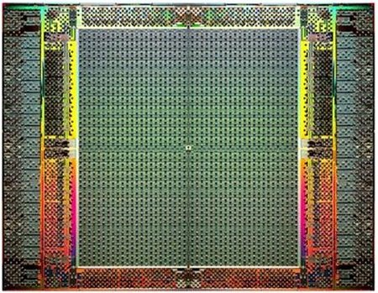
The Main Memory System
Main memory is a critical component of all computing systems: server, mobile, embedded, desktop, sensor
Devices that make up main memory are ubiquitous in all systems
FPGAs
Main Memory
Storage (SSD/HDD)

Slide 4
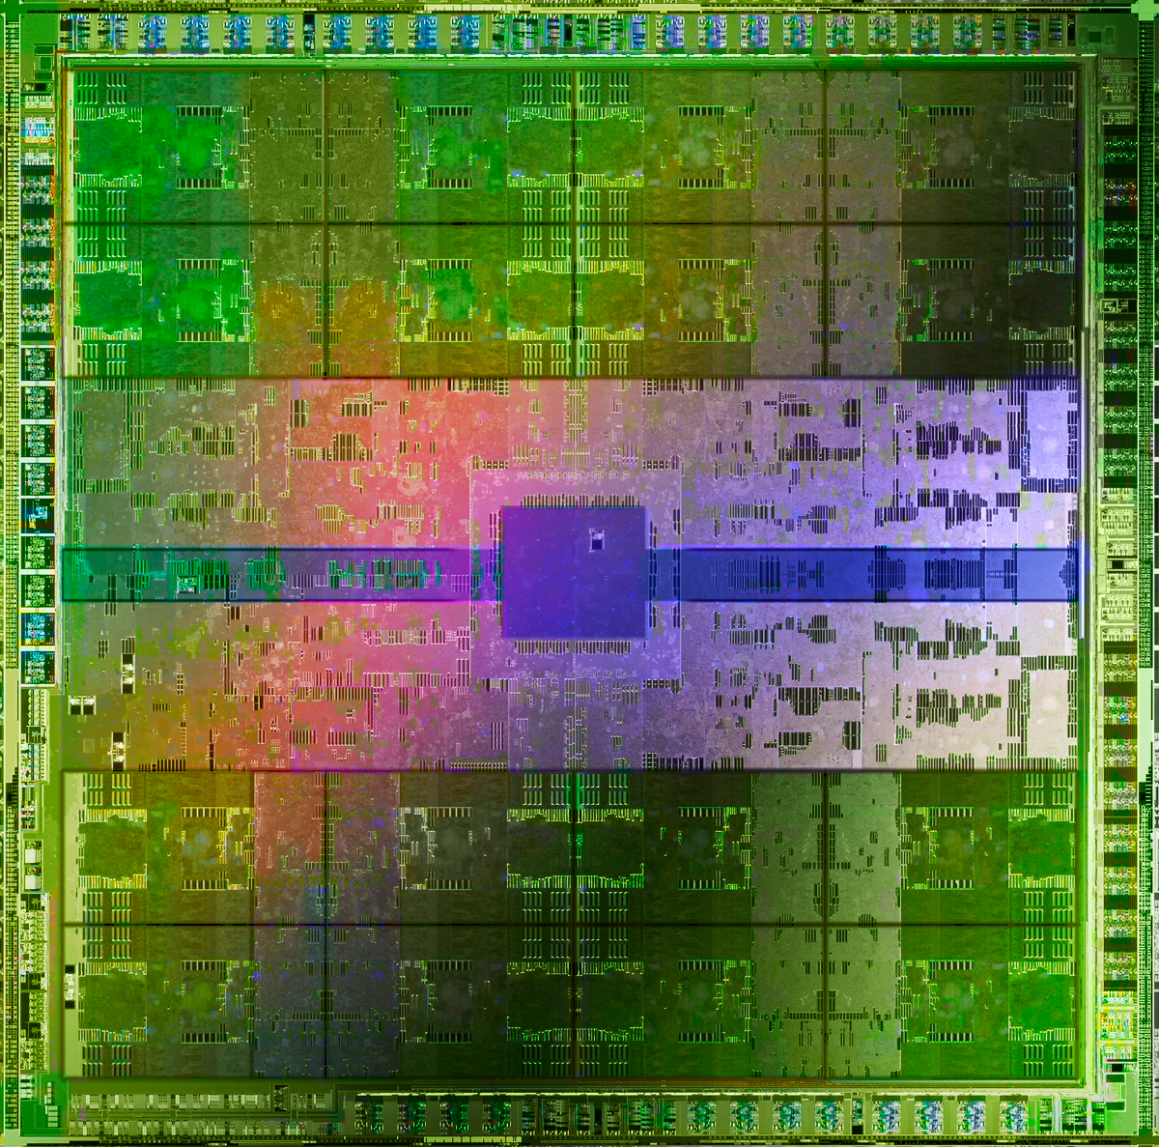
The Main Memory System
Main memory is a critical component of all computing systems: server, mobile, embedded, desktop, sensor
Devices that make up main memory are ubiquitous in all systems
GPUs
Main Memory
Storage (SSD/HDD)

Slide 5
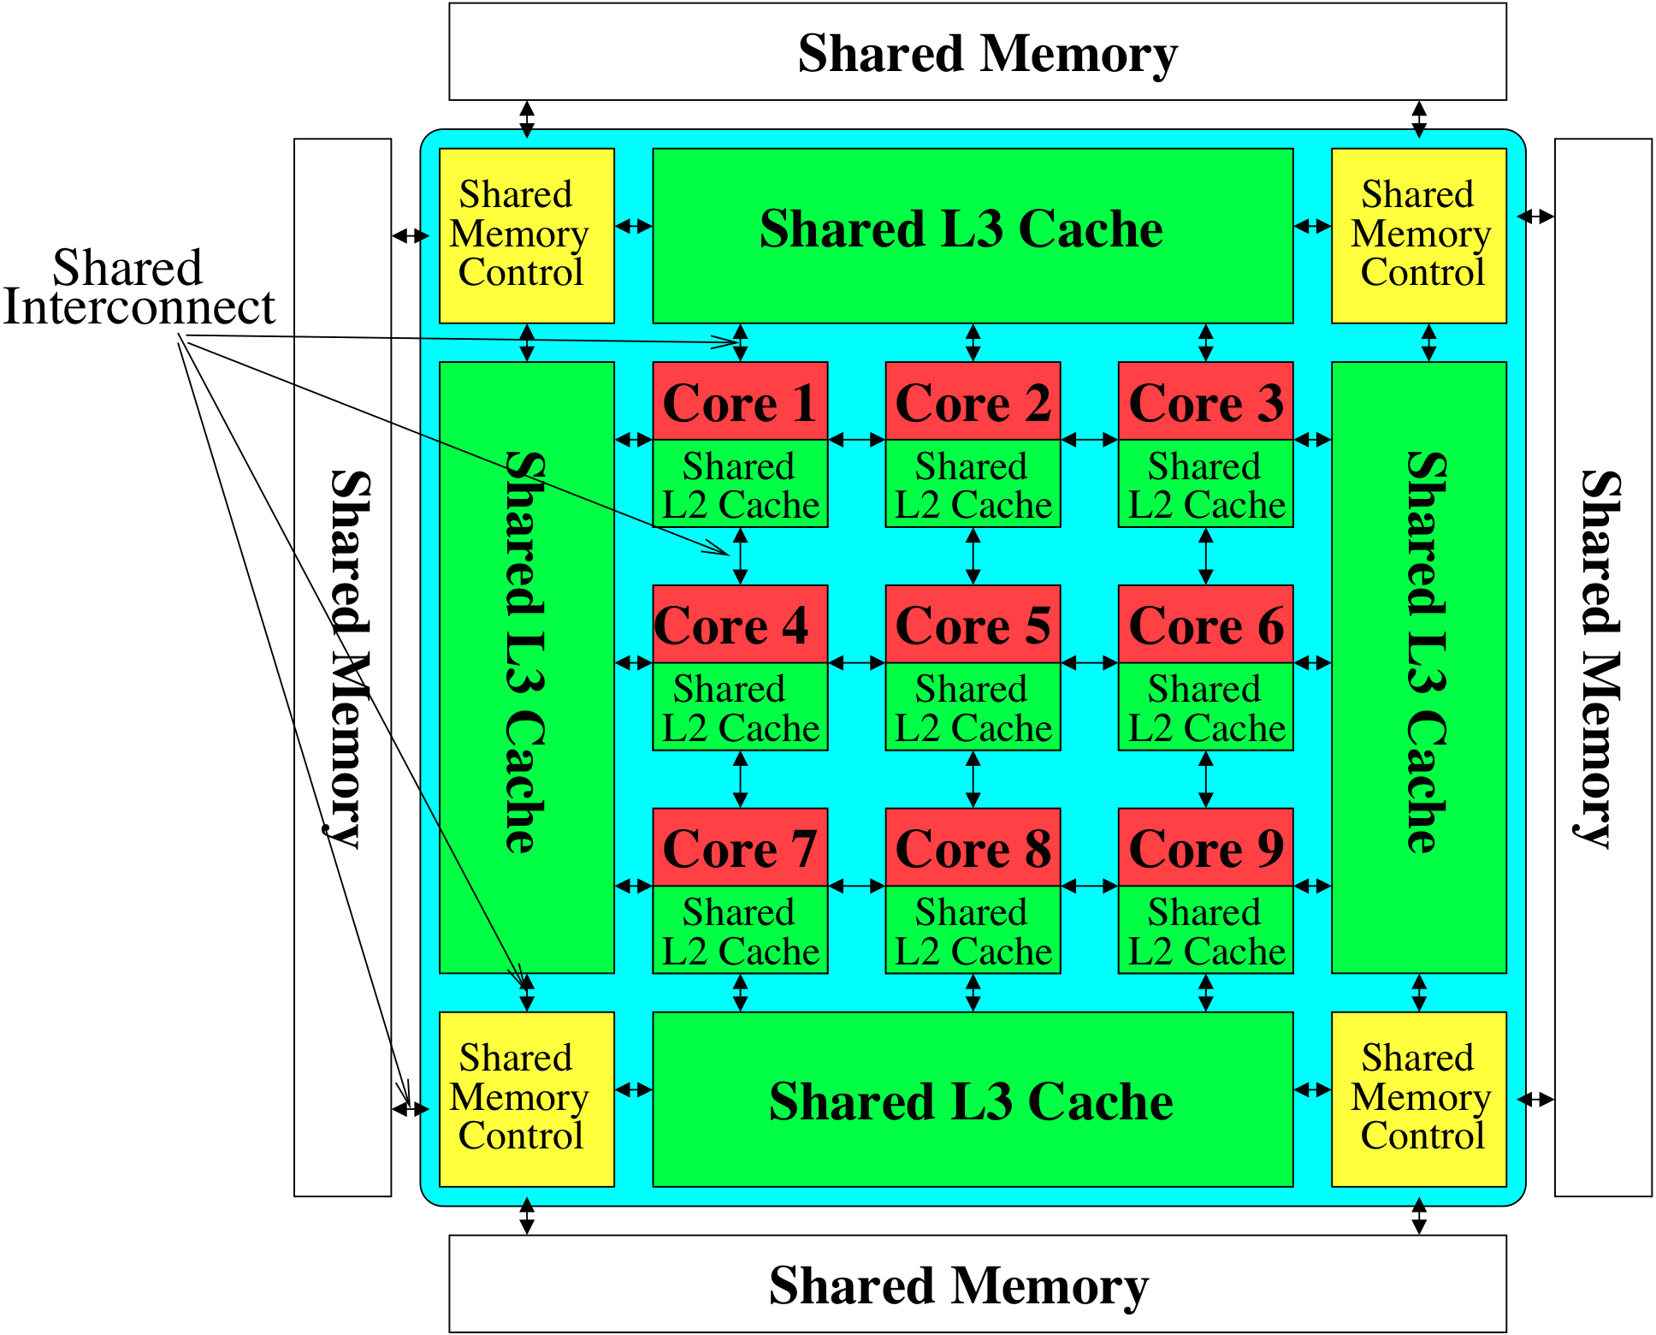
The Main Memory System
Storage
Most of the system is dedicated to storing and moving data

Slide 6
The Shortcoming
Most of the system is dedicated to main memory
Main memory is in all systems
Main memory devices are used to only store and move data
Can we do better?
Can we better take advantage of the main memory devices?

Slide 7
Doing Better with Memory Devices
Make the memory devices more intelligent
→ minimize data movement, exploit parallel processing
  Processing in memory
  See past talks and many works:
    RowClone [MICRO 2013], Ambit [MICRO 2017], Tesseract [ISCA 2015], PEI [ISCA 2015], TOM [ISCA 2016], EMC [ISCA 2016], Google Workloads [ASPLOS 2018], LazyPIM/CoNDA [ISCA 2019], …

Slide 8
Processing in Memory (I)
Amirali Boroumand, Saugata Ghose, Youngsok Kim, Rachata Ausavarungnirun, Eric Shiu, Rahul Thakur, Daehyun Kim, Aki Kuusela, Allan Knies, Parthasarathy Ranganathan, and Onur Mutlu,
"Google Workloads for Consumer Devices: Mitigating Data Movement Bottlenecks"
Proceedings of the 23rd International Conference on Architectural Support for Programming Languages and Operating Systems (ASPLOS), Williamsburg, VA, USA, March 2018.
62.7% of the total system energy
is spent on data movement

Slide 9





Google Workloads for Consumer Devices:
Mitigating Data Movement Bottlenecks
Amirali Boroumand
Saugata Ghose, Youngsok Kim, Rachata Ausavarungnirun,
Eric Shiu, Rahul Thakur, Daehyun Kim, Aki Kuusela,
Allan Knies, Parthasarathy Ranganathan, Onur Mutlu

Slide 10
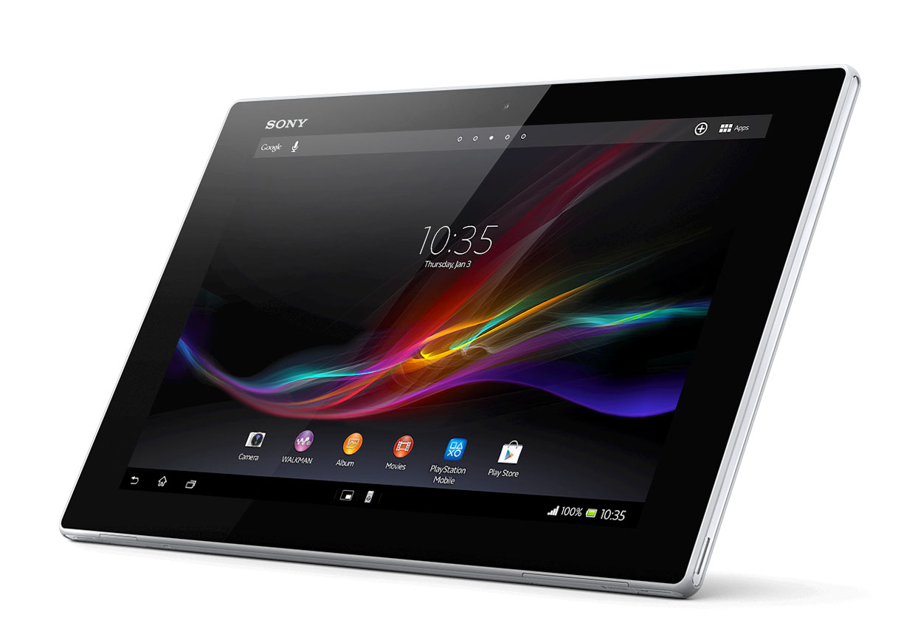
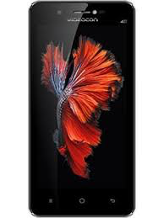
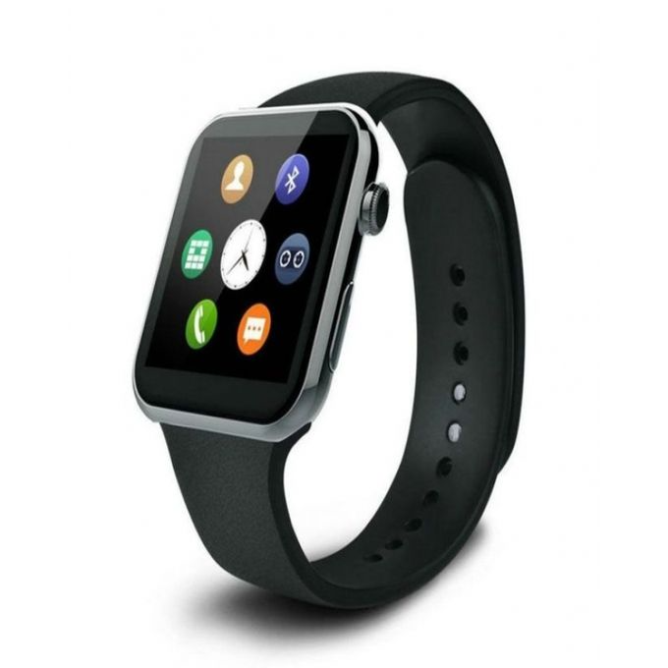

Consumer Devices
Consumer devices are everywhere!
Energy consumption is
a first-class concern in consumer devices
Notes:
Consumer devices like tablets smartphone and wearable are now everywhere and used by billions of people.
One of the major challenge in these devices is battery limitation which makes the energy consumption a critical concern …

Slide 11





Popular Google Consumer Workloads
  Chrome
TensorFlow Mobile
    Google’s web browser
Google’s machine learning framework
  Video Playback
  Video Capture
Google’s video codec
Google’s video codec
Notes:
In this work, we take a look at widely-used google consumer workloads, to figure out the major sources of energy consumption.
We look at Google Chrome web brower. We take a look at Tensorflow, Google’s machine learning framework, and we also take a look at two important video related workloads, video playback and video capture, both rely on Google’s vp9 codec technology.

Slide 12
Energy Cost of Data Movement
1st key observation: 62.7% of the total system energy is spent on data movement
Data Movement
SoC
DRAM
CPU
L2
CPU
L1
CPU
CPU
Compute Unit
Processing-In-Memory (PIM)
  Potential solution: move computation close to data
  Challenge: limited area and energy budget
Notes:
Throughout our analysis, we make a key observation that out of all sources of energy consumption, data movement is a major contributor to the total system energy. We find that across all of the workloads, on average around 62.7% of total system energy is spent on data movement.
One way to reduce data movement cost is to move computation close to data, or …
One potential solution to address this cost it do move computation close to data, or in other words, do procesing in memory. However, the challenge is that these devices.
One potential solution to mitigate data movement cost and reduce total system energy is to execute data-movement heavy portions of application close to data, or in other words, do processing in memory. However, consumer devices are extermely limited in terms of area and power budget. So the question is can we move part of the data movement heavy portion given the limited area and energy budget. Our

Slide 13
Using PIM to Reduce Data Movement
  2nd key observation: a significant fraction of the
  data movement often comes from simple functions
We can design lightweight logic to implement
these simple functions in memory
Small embedded
low-power core
Small fixed-function accelerators
PIM Core
PIM Accelerator
PIM Accelerator
PIM Accelerator
  Offloading to PIM logic reduces energy and improves performance, on average, by 55.4% and 54.2%
Notes:
To figure out if we can use processing in memory, we dig deeper into our analysis and we make another key observation that majority of data movement often comes form simple functions and pritmitives. We find that these simple function can be implemented in memory as either a small embedded core, or group of small fixed function accelerators. Our result shows that offloading these function to PIM logic can significantly reduce data movement for each function and reduce energy on average around 55% and improve perforamcne around 54%.
our PIM core can reduce significant portion of data movement, reduce enregy by 49.1% for each function and improve performance up to 2.2X. While using group of fixed function accelerator reduce energy by 55.4% and improve performance by up to 2.5X.
Or use Saugata’s approach : Reduces total system energy by an average of 55.4%
Reduces execution time by an average of 54.2%
Our result show that both of them can significantly reduce the data movement for each function.
Feedback: talk about result more
Don’t talk about specific detail like MemCopy, MemSet stuff like that
Main take away: data movement come from simple functions that are simple enough to implement in PIM
We find that these functions and primitves can be implemented as PIM logic using either (1) a small low-power general-purpose embedded core or (2) a group of small fixed-function accelerators (PIM accelerators). Our Analysis shows that both are cost-feasible to use in consumer devices. We find that they eliminate a significant fraction of dat amovement, and reduce energy consumption for each of these operation on average by 49 and 55%.

Slide 14
Normalized Energy
Chrome Browser
TensorFlow Mobile
Video Playback and Capture
PIM core and PIM accelerator reduces
energy consumption on average by 49.1% and 55.4%
Notes:
We make another obsrevation that using PIM accelerator provide limited energy reduction over PIM core, for some of these workloads, such as texture tiling. This is becase these kernels are data intensive and have low ocmputational compleity, and as a result, using fixed function accelerator does not provide significant energy reduction over the PIM core.

Slide 15
Normalized Runtime
Chrome Browser
Video Playback and Capture
TensorFlow Mobile
Offloading these kernels to PIM core and PIM accelerator improves performance on average by 44.6% and 54.2%
Notes:
PIM-Core and PIM-Acc significantly outperform CPU-Only across all kernels, improving performance by … This perfomance benefit come from higher bandwidth and lower access latency of 3D-stacked memory, because all of these kernels are data intensive.
Performance improvement of PIM-acc over PIM-core differes across different workloads. In some cases such as Texture Tiling, the performance improvement of PIM-Acc over PIM-Core is limited by the low computational complexity of these two kernels. But there are other cases, such as compression that benefit significantly from using PIM-Acc over PIM-Core in terms of performance, because these kernels are more compute-intensive and less data-intensive compared to texture tiling and.

Slide 16
Google Workloads for Consumer Devices:
Mitigating Data Movement Bottlenecks
Amirali Boroumand
Saugata Ghose, Youngsok Kim, Rachata Ausavarungnirun,
Eric Shiu, Rahul Thakur, Daehyun Kim, Aki Kuusela,
Allan Knies, Parthasarathy Ranganathan, Onur Mutlu
ASPLOS 2018
Notes:
Please drop by our talk during session 1 if you would like to learn more about data movement in Google workloads.

Slide 17
More on PIM for Mobile Devices
Amirali Boroumand, Saugata Ghose, Youngsok Kim, Rachata Ausavarungnirun, Eric Shiu, Rahul Thakur, Daehyun Kim, Aki Kuusela, Allan Knies, Parthasarathy Ranganathan, and Onur Mutlu,
"Google Workloads for Consumer Devices: Mitigating Data Movement Bottlenecks"
Proceedings of the 23rd International Conference on Architectural Support for Programming Languages and Operating Systems (ASPLOS), Williamsburg, VA, USA, March 2018.
[Slides (pptx) (pdf)] [Lightning Session Slides (pptx) (pdf)] [Poster (pptx) (pdf)]
[Lightning Talk Video (2 minutes)]
[Full Talk Video (21 minutes)]

Slide 18
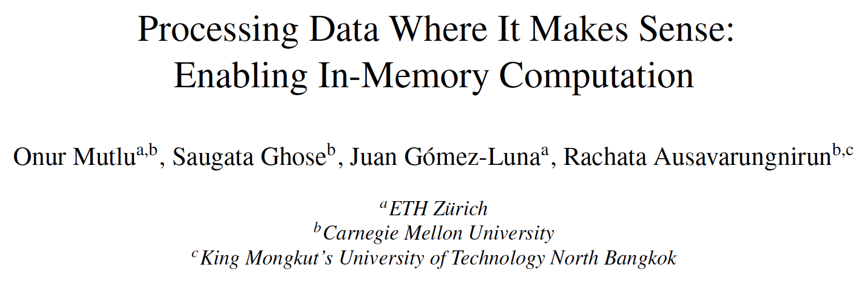
Processing in Memory: Overview Paper
Onur Mutlu, Saugata Ghose, Juan Gomez-Luna, and Rachata Ausavarungnirun,
"Processing Data Where It Makes Sense: Enabling In-Memory Computation"
Invited paper in Microprocessors and Microsystems (MICPRO), June 2019.
[arXiv version]

Slide 19

Processing in Memory: Overview Video
Onur Mutlu,
"Processing Data Where It Makes Sense in Modern Computing Systems: Enabling In-Memory Computation"
Distinguished Lecture at George Washington University, Washington, DC, USA, February 2019.
[Slides (pptx)]
[Abstract]
[Video]
https://people.inf.ethz.ch/omutlu/talks.htm
https://www.youtube.com/channel/UCIwQ8uOeRFgOEvBLYc3kc3g

Slide 20
Doing Better with Memory Devices
Make the memory devices more intelligent
→ minimize data movement, exploit parallel processing
  Processing in memory
  See past talks and many works:
    RowClone [MICRO 2013], Ambit [MICRO 2017], Tesseract [ISCA 2015], PEI [ISCA 2015], TOM [ISCA 2016], EMC [ISCA 2016], Google Workloads [ASPLOS 2018], LazyPIM/CoNDA [ISCA 2019], …
Use the memory devices to support key functions
  Security primitives
  …

Slide 21
Key Goal
How to Use
Memory Devices
to Support Security

Slide 22
Using Memory for Security
Generating True Random Numbers (using DRAM)
  Kim et al., HPCA 2019
Evaluating Physically Unclonable Functions (using DRAM)
  Kim et al., HPCA 2018
Quickly Destroying In-Memory Data (using DRAM)
  Orosa et al., arxiv 2019

Slide 23
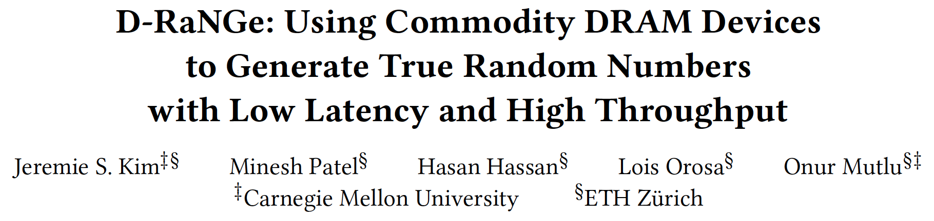
Generating True Random Numbers
Jeremie S. Kim, Minesh Patel, Hasan Hassan, Lois Orosa, and Onur Mutlu,
"D-RaNGe: Using Commodity DRAM Devices to Generate True Random Numbers with Low Latency and High Throughput"
Proceedings of the 25th International Symposium on High-Performance Computer Architecture (HPCA), Washington, DC, USA, February 2019.
[Slides (pptx) (pdf)]
[Full Talk Video (21 minutes)]

Slide 24
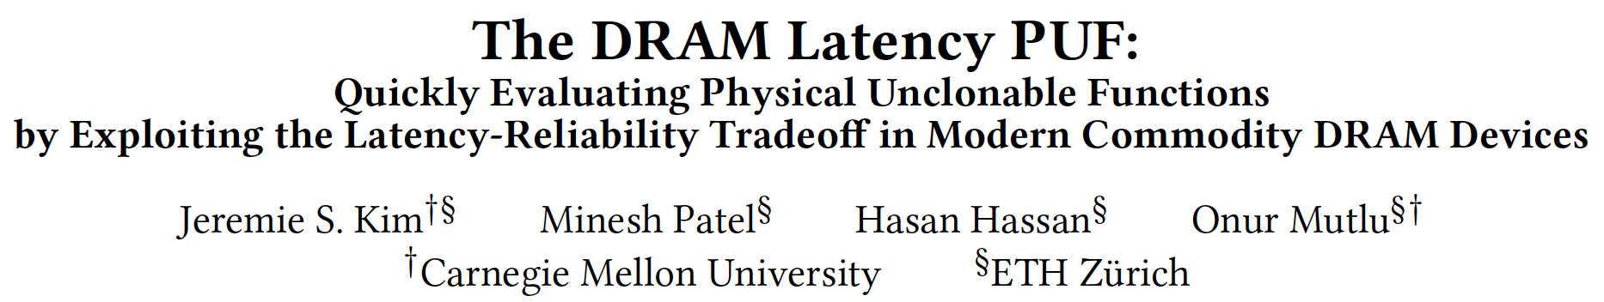
Evaluating Physically Unclonable Functions
Jeremie S. Kim, Minesh Patel, Hasan Hassan, and Onur Mutlu,
"The DRAM Latency PUF: Quickly Evaluating Physical Unclonable Functions by Exploiting the Latency-Reliability Tradeoff in Modern DRAM Devices"
Proceedings of the 24th International Symposium on High-Performance Computer Architecture (HPCA), Vienna, Austria, February 2018.
[Lightning Talk Video]
[Slides (pptx) (pdf)] [Lightning Session Slides (pptx) (pdf)]

Slide 25
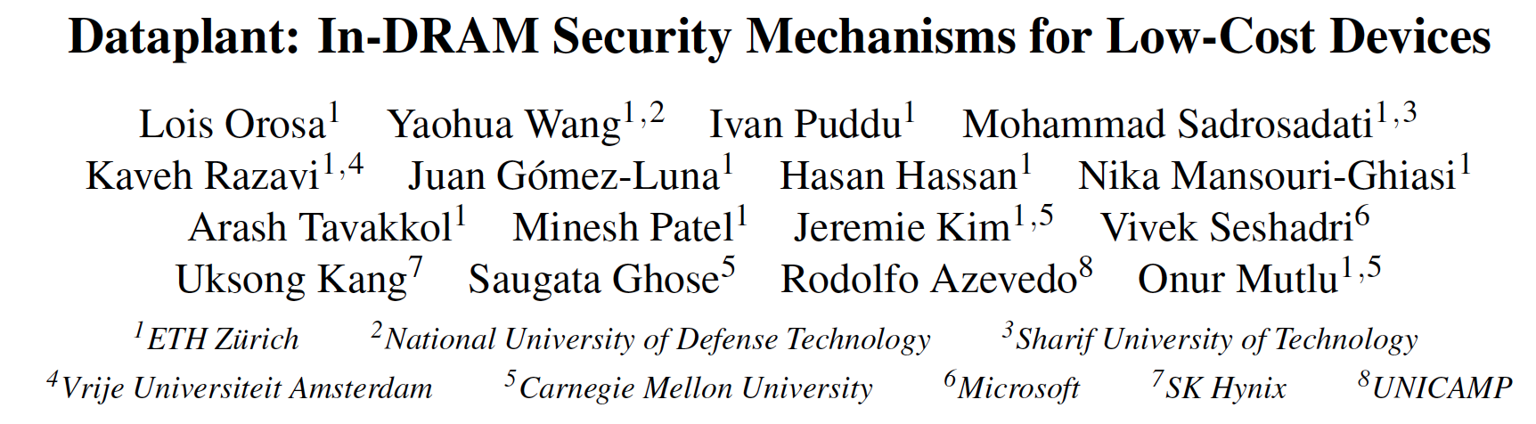
Quickly Destroying In-Memory Data
Dataplant: In-DRAM Security Mechanisms for Low-Cost Devices
  https://arxiv.org/pdf/1902.07344.pdf

Slide 26
Using Memory for Security
Generating True Random Numbers (using DRAM)
  Kim et al., HPCA 2019
Evaluating Physically Unclonable Functions (using DRAM)
  Kim et al., HPCA 2018
Quickly Destroying In-Memory Data (using DRAM)
  Orosa et al., arxiv 2019

Slide 27



D-RaNGe: Using Commodity DRAM Devices to Generate True Random Numbers with Low Latency and High Throughput
Jeremie S. Kim Minesh Patel
Hasan Hassan Lois Orosa Onur Mutlu
Notes:
20 Minute talk 5 minute questions
Hello, my name is Jeremie Kim and I will be presenting D-RaNGe: a mechanism that uses commodity DRAM devices to generate true random numbers with low latency and high throughput

Slide 28
Executive Summary
  Motivation: High-throughput true random numbers enable system security and various randomized algorithms.
    Many systems (e.g., IoT, mobile, embedded) do not have dedicated True Random Number Generator (TRNG) hardware but have DRAM devices
Problem: Current DRAM-based TRNGs either
do not sample a fundamentally non-deterministic entropy source
are too slow for continuous high-throughput operation
Goal: A novel and effective TRNG that uses existing commodity DRAM to provide random values with 1) high-throughput, 2) low latency and 3) no adverse effect on concurrently running applications
D-RaNGe: Reduce DRAM access latency below reliable values and exploit DRAM cells’ failure probabilities to generate random values
Evaluation:
  Experimentally characterize 282 real LPDDR4 DRAM devices
    D-RaNGe (717.4 Mb/s) has significantly higher throughput (211x)
    D-RaNGe (100ns) has significantly lower latency (180x)
Notes:
To begin, I will give a brief overview. [CLICK] Our motivation is that high throughput true random numbers enable system security, and various randomized algorithms.
[CLICK] Unfortunately, many systems like IoT, mobile, and embedded systems do not have dedicated true random number generator (TRNG) hardware. However, they do have DRAM devices, on which a few recent papers have proposed generating true random numbers on.
[CLICK] The problem is that current DRAM-based TRNGs either [CLICK] do not sample a fundamentally non-deterministic entropy source, which may not result in true random numbers, or [CLICK] they are too slow for continuous high-throughput operation
[CLICK] Our goal is to develop a novel and effective TRNG for existing commodity DRAM devices that can provide continuous high-throughput random values at low latency while minimally affecting concurrently running applications.
[CLICK] We propose D-RaNGe, a high-throughput TRNG that reduces DRAM access latency below reliable values and exploits DRAM cell failure probabilities to quickly generate random values
[CLICK] In our evaluation
[CLICK] we experimentally characterize 282 real LPDDR4 DRAM devices and [CLICK] find that D-RaNGe provides random values at over 700 Mb/s which is orders of magnitude over prior DRAM-based TRNGs [CLICK] In addition, D-RaNGe can provide 64 bits of random data in 100 ns which is 180x faster than prior proposals

Slide 29
D-RaNGe Outline
Motivation
Effective True Random Number Generators
D-RaNGe
  DRAM Operation
  Key Idea
Methodology
Results
Prior work on DRAM-based TRNGs
  Command scheduling
  Cell charge retention
  Start-up values
Summary
Notes:
Here is the outline for the talk today

Slide 30
D-RaNGe Outline
Motivation
Effective True Random Number Generators
D-RaNGe
  DRAM Operation
  Key Idea
Methodology
Results
Prior work on DRAM-based TRNGs
  Command scheduling
  Cell charge retention
  Start-up values
Summary
Notes:
I will first discuss the Motivation of the work

Slide 31
Motivation and Goal
High throughput True Random Numbers are required for many real-world applications
  Importantly cryptography for securely encrypting file systems, network packets, data in standard protocols (TLS/SSL/RSA…)
  Others include randomized algorithms, scientific simulation, statistical sampling, recreational entertainment
True random numbers can only be generated via physical processes
  e.g., radioactive decay, thermal noise, shot noise
  Systems rely on dedicated TRNG Hardware that samples non-deterministic various physical phenomena
Notes:
[CLICK] high throughput True random numbers are required for many real world applications
[CLICK] These applications include cryptography for securely encrypting file systems, network packets, data in standard protocols such as TLS, SSL, RSA, etc.
[CLICK] others include randomized algorithms, scientific simulation, statistical sampling, industrial testing, recreational entertainment, etc.
[CLICK] True random numbers can only be generated from physical processes [CLICK] such as shot noise, electrical noise, thermal noise, radioactive decay, Brownian motion, etc.
[CLICK] For this reason, systems generally rely on dedicated TRNG Hardware that samples non-deterministic random variables that are inherent in various physical phenomena

Slide 32
Motivation and Goal
Smaller devices (e.g., IoT, mobile, embedded) require, but often lack, a high throughput True Random Number Generator (TRNG)
DRAM devices are available on most systems
Mechanism that generates TRN using DRAM enables:
  applications that require true random numbers to now run on most systems
  other use-cases, e.g., processing-in-memory applications to generate true random numbers within memory itself
Our Goal: to provide a TRNG using DRAM devices that satisfies the characteristics of an effective TRNG
Notes:
[CLICK] Unfortunately, smaller devices such as IoT, mobile or embedded devices that may not have the provisions for dedicated True random number generator or TRNG hardware, require a high-throughput TRNG to enable the previously mentioned applications
[CLICK] However, DRAM devices are available on most systems
[CLICK] A TRNG that generates true random numbers using DRAM, would enable
[CLICK] applications that require true random numbers to now run on most systems and
[CLICK] other applications and use cases. One example would be PIM applications generating true random numbers within memory itself
[CLICK] Our goal is to therefore provide a TRNG that uses DRAM devices and satisfies the characteristics of an effective TRNG.

Slide 33
D-RaNGe Outline
Motivation
Effective True Random Number Generators
D-RaNGe
  DRAM Operation
  Key Idea
Methodology
Results
Prior work on DRAM-based TRNGs
  Command scheduling
  Cell charge retention
  Start-up values
Summary
Notes:
I will discuss these characteritstics next.

Slide 34
Effective TRNG Characteristics
Low implementation cost
Fully non-deterministic
    impossible to predict the next output given complete information about how the mechanism operates
Provide a continuous stream of true random numbers with high throughput
Provide true random numbers with low latency
Exhibit low system interference
    not significantly slow down concurrently-running applications
Generate random values with low energy overhead
Notes:
We identify 6 effective TRNG characteristics that we want our proposal to satisfy.
[CLICK] it should have a Low implementation cost. A mechanism that requires little or no changes to current systems and minimal additional area overhead.
[CLICK] it should be Fully non-deterministic which can be guaranteed by sampling a truly random physical phenomena, so it is impossible to predict the next output given complete information about how the mechanism operates.
[CLICK] It should provide a continuous stream of true random numbers with high throughput
[CLICK] it should provide true random numbers with low latency such that applications do not have to stall when requesting random values.
[CLICK] it should exhibit low system interference, which means that it should not significantly slow down concurrently-running applications
Finally, [CLICK] it should generate random values with low energy overhead

Slide 35
D-RaNGe Outline
Motivation
Effective True Random Number Generators
D-RaNGe
  DRAM Operation
  Key Idea
Methodology
Results
Prior work on DRAM-based TRNGs
  Command scheduling
  Cell charge retention
  Start-up values
Summary
Notes:
I will now discuss our mechanism D-RaNGe, after providing the necessary background on DRAM

Slide 36
DRAM Organization
A DRAM bank is hierarchically organized into subarrays
local
bitline
DRAM cell
wordline
DRAM Bank
DRAM row
Columns of cells in subarrays share a local bitline
Rows of cells in a subarray share a wordline
Notes:
[CLICK] Each DRAM bank is hierarchically organized into subarrays. [CLICK] Each circle in the cartoon represents a single DRAM cell. [CLICK] columns of DRAM cells in a subarray are connected with a wire referred to as a local bitline. [CLICK] and rows of DRAM cells are connected with a wire referred to as a wordline, and [CLICK] a row of DRAM cells is called a DRAM row. [CLICK] at the peripherals of the core cell arrays are a local row decoder, which selects the row to read and write to, and a local row-buffer which amplifies the data that is stored in the cell to an I/O readable value. [CLICK] DRAM is comprised of many subarrays which are often composed of 512 to 1024 rows. Further peripherals exist containing groups of subarrays called [CLICK] a bank. The global row decoder selects the local row decoder that will drive the wordline, and global row buffer aids in the transfer of data to and from the CPU. A DRAM device is comprised of several banks, and each bank can be accessed independently [CLICK]

Slide 37
DRAM Operation
Cache line
…
Row Decoder
…
…
…
…
…
Local Row Buffer
Local Row Buffer
Local Row Buffer
READ
READ
READ
READ
READ
READ
ACT R0
RD
RD
RD
PRE R0
ACT R1
RD
RD
RD
Notes:
Let’s take a look at how DRAM operates in the scope of a single subarray. [CLICK] Because memory controllers typically access DRAM at the granularity of a cache line, we combine consecutive, aligned DRAM cells as cache lines in our diagram. [CLICK] First, we activate the first row, which [CLICK] copies the entire rows' data into the row buffer. At this point, we can [CLICK] read our data at the granularity [CLICK] of cache lines within the [CLICK] activated or opened row. When we want to access data on another row, we must precharge [CLICK] the currently opened row, which prepares the row buffer for copying data from another row. We can now [CLICK] activate the second row, before reading data from it [CLICK][CLICK][CLICK]

Slide 38
DRAM Accesses and Failures
wordline
Guardband
Strong
V_{dd}
access
transistor
V_{min}
Weak
Ready to Access
Voltage Level
Process variation during manufacturing results in cells having unique behavior
bitline
Bitline Voltage
Bitline Charge Sharing
capacitor
Sense Amplifier
0.5 V_{dd}
Time
ACTIVATE
SA Enable
READ
t_{RCD}
Notes:
Now Lets take a deeper look at the circuitry to understand access latency failures.
[CLICK] A DRAM cell holds its data as charge in a capacitor and and the access transistor gates reads and writes to the cell data. The data gets read out by the sense amplifier via the bitline when the access transistor is enabled. [CLICK][CLICK] Initially the bitline is kept at Vdd/2. [CLICK] When the wordline is driven high or activated, [CLICK] the capacitor begins to share charge with the bitline. The sense amplifier is then enabled and [CLICK] the voltage differential on the bitline is amplified to an I/O readable value. [CLICK] In order to ensure correctness of operation, the memory controller can only read data tRCD time after the activation. [CLICK] We could read this data earlier, when it reaches a readable voltage threshold (Vmin), [CLICK] but we want to make sure that there is enough guardband such that other cells that may be [CLICK] weaker due to process variation will not fail when accessed tRCD time after activation. [CLICK] We highlight and refer to varying degrees of strengths of cells in terms of how early they reach the readable voltage threshold.

Slide 39
DRAM Accesses and Failures
wordline
Strong
V_{dd}
access
transistor
V_{min}
Weak
Ready to Access
Voltage Level
bitline
Weaker cells have
a higher probability
to fail
Bitline Voltage
capacitor
SA
0.5 V_{dd}
Time
ACTIVATE
SA Enable
READ
t_{RCD}
Notes:
If we are to read with a [CLICK] tRCD reduced below manufacturer-recommended values, we begin to induce latency failures in the weaker cell. Cells that are read when their bitline’s voltage is lower than Vmin, have a probability of failure. And this probability increases as you read further below the voltage threshold.

Slide 40
D-RaNGe Outline
Motivation
Effective True Random Number Generators
D-RaNGe
  DRAM Operation
  Key Idea
Methodology
Results
Prior work on DRAM-based TRNGs
  Command scheduling
  Cell charge retention
  Start-up values
Summary
Notes:
This leads to our key idea.

Slide 41
D-RaNGe Key Idea
A cell’s latency failure probability is inherently related to random process variation from manufacturing
We can extract random values by observing DRAM cells’ latency failure probabilities
High % chance to fail with reduced t_{RCD}
Low % chance to fail with reduced t_{RCD}
Row Decoder
SA
SA
SA
SA
SA
SA
SA
Notes:
Our key idea is to reduce DRAM read access latency below the reliable datasheet specification values using software-only system calls in order to exploit the resulting error patterns as true random numbers
[CLICK] We find that the probability that a cell will result in a latency failure due to a reduced-tRCD access, is inherently related to random process variation from manufacturing [CLICK] This knowledge enables us to provide random values by observing DRAM cells’ latency failure probabilities.
[CLICK] Here is a cartoon showing the manufacturing variation across a region of DRAM. When accessed with a reduced timing parameter, [CLICK] some cells have a high percentage chance of failing, while others [CLICK] have a low percentage chance of failing.

Slide 42
D-RaNGe Key Idea
A cell’s latency failure probability is inherently related to random process variation from manufacturing
We can extract random values by observing DRAM cells’ latency failure probabilities
The key idea is to extract random values
by sampling DRAM cells that fail
truly randomly
High % chance to fail with reduced t_{RCD}
Low % chance to fail with reduced t_{RCD}
Row Decoder
SA
SA
SA
SA
SA
SA
SA
Notes:
The Key Idea is to extract random values by sampling those DRAM cells that fail truly randomly and using the resulting data as random data.

Slide 43
D-RaNGe: Extracting Random Values
Identify all DRAM cells that fail randomly when accessed with a reduced t_{RCD} (RNG Cell)
When accessing an RNG Cell with a reduced t_{RCD}, the values read will be truly random values
RNG Cell
1
Random values when accessed with t_{RCD} reduced by 45%
1 0010110100110011101000110101
SA
1 0 1 0 1 0 0 1 0 0
Notes:
[CLICK] we first identify all DRAM cells that fail randomly when accessed with a reduced tRCD, and we refer to these as RNG cells. [CLICK]
[CLICK] When accessing an RNG cell with a reduced tRCD, the values read will be truly random values and we can directly use the output as such

Slide 44
D-RaNGe: Identifying RNG Cells
To identify RNG Cells, extract 1M values (bitstream) from each DRAM cell
An RNG Cell is a DRAM cell whose output passes the NIST statistical test suite for randomness
NIST tests [Rukhin+, Tech report, 2001] include tests for:
  Unbiased output of 1’s and 0’s across entire bitstream
  Unbiased output within smaller segments of the bitstream
  Limited number of uninterrupted sequence of identical bits
  Peak heights in the discrete fourier transform of bitstream
  Even distribution of short sequences within bitstream
  Cumulative sum always stays close to zero
  …
Minimum Shannon entropy across RNG cells: 0.9507
1 0 1 0 1 0 0 1 0 0
Notes:
[CLICK] to identify RNG cells, we first extract one million values that we will refer to as a bitstream from each DRAM cell.
[CLICK] We then classify each DRAM cell whose output passes the NIST statistical test suite for randomness as RNG cells
[CLICK] the NIST test suite includes tests for:
[CLICK] unbiased output of 1’s and 0’s across the entire bitstream
[CLICK] unbiased output within smaller segments of the bitstream
[CLICK] a limited number of uninterrupted sequences of identical bits
[CLICK] etc. [CLICK][CLICK][CLICK]

Slide 45
D-RaNGe: Access Pattern
To maximize the bits that are accessed immediately following activation, we alternate accesses to distinct rows in each bank
  quickly generate tRCD failures within cache lines in two rows
  maximizes tRCD failures when using reduced tRCD
Cache line
…
Row Decoder
…
…
…
…
…
Local Row Buffer
Local Row Buffer
Local Row Buffer
READ
READ
READ
READ
Notes:
[CLICK] To maximize the bits that are accessed immediately following an activation, we alternate accesses to distinct rows in a bank.
[CLICK] This access pattern quickly generates tRCD failures within cache lines in two rows
[CLICK] this maximizes tRCD failures when accessing with a reduced tRCD
[CLICK]
[CLICK] we activate the first wordline
[CLICK] and immediately read the cache line from the first row
[CLICK]
[CLICK] we then activate the second wordline
[CLICK]
[CLICK] we then immediately read the cacheline from the second row
[CLICK] [CLICK].... We keep alternating accesses to different rows

Slide 46
D-RaNGe: Access Pattern
To maximize the bits that are accessed immediately following activation, we alternate accesses to distinct rows in each bank
  quickly generate tRCD failures within cache lines in two rows
  maximizes tRCD failures when using reduced tRCD
Accessing cache lines containing
more RNG cells will result
in more random values
Cache line
…
Row Decoder
…
…
…
…
…
Local Row Buffer
Local Row Buffer
Local Row Buffer
READ
READ
READ
READ
Notes:
[CLICK] Because only cache lines immediately read after activation result in failures, Cache lines containing more RNG cells provide more random bits of data per access

Slide 47
D-RaNGe: Exclusive Access
To minimize system interference, D-RaNGe has exclusive access to RNG cells
In a bank, find the two cache lines in distinct rows with the most number of RNG cells
Cache line
…
Row Decoder
…
…
…
…
Local Row Buffer
Notes:
To minimize the system interference of D-RaNGe, we give D-RaNGe exclusive access to RNG cells, such that data must not be migrated before starting to generate random values.
[CLICK] here we show a DRAM array of cache lines
[CLICK] We highlight the two cache lines in distinct rows with the most number of RNG cells in this bank.

Slide 48
D-RaNGe: Exclusive Access
Reserve rows containing selected cache lines
exclusively for D-RaNGe accesses
to minimize interference
Cache lines containing more RNG cells provide more random bits of data per access
In a bank, find the two cache lines in distinct rows with the most number of RNG cells
Cache line
…
Row Decoder
…
…
…
…
Local Row Buffer
Notes:
In order to minimize interference, we reserve these rows such that D-RaNGe can exclusively access the cache lines containing the most RNG cells.

Slide 49
D-RaNGe: Exclusive Access
Cache lines containing more RNG cells provide more random bits of data per access
In a bank, find the two cache lines in distinct rows with the most number of RNG cells
Reserve neighboring rows to minimize
DRAM data pattern/read interference
Cache line
…
Row Decoder
…
…
…
…
Local Row Buffer
Notes:
we also reserve the surrounding rows such that DRAM data pattern or read/write interference does not occur.
[CLICK]

Slide 50
D-RaNGe: Exclusive Access
Cache lines containing more RNG cells provide more random bits of data per access
In a bank, find the two cache lines in distinct rows with the most number of RNG cells
We can parallelize accesses
across all available DRAM banks
for higher throughput of random values
Cache line
…
Row Decoder
…
…
…
…
Local Row Buffer
Notes:
We can parallelize accesses across all available DRAM banks for higher throughput of random values. [CLICK]

Slide 51
D-RaNGe: Example Implementation
Memory controller reserves rows containing selected RNG cells and neighboring rows
When system not accessing a bank, memory controller runs D-RaNGe firmware to generate random values in the bank
Memory controller has buffer of random data
Stores random values in memory controller buffer
Expose API for returning random values from the buffer when requested by the user
Notes:
[CLICK] one such example implementation of D-RaNGe is that:
[CLICK] The memory controller reserves rows containing the selected RNG cells and neighboring rows in each bank to avoid DRAM read/write interference
[CLICK] When the system is not accessing memory , the memory controller runs firmware that generates random values using the D-RaNGe methodology
[CLICK] the memory controller maintains a buffer of random data.
[CLICK] and D-RaNGe stores the random numbers in the memory buffer at the memory controller
[CLICK] We then expose an API for returning random values from the buffer whenever requested by the user

Slide 52
D-RaNGe Outline
Motivation
Effective True Random Number Generators
D-RaNGe
  DRAM Operation
  Key Idea
Methodology
Results
Prior work on DRAM-based TRNGs
  Command scheduling
  Cell charge retention
  Start-up values
Summary
Notes:
I will next discuss the methodology for testing DRAM and evaluating our mechanism

Slide 53
Methodology
282 2y-nm LPDDR4 DRAM devices
  2GB device size from 3 major DRAM manufacturers
Thermally controlled testing chamber
  Ambient temperature range: {40°C – 55°C} ± 0.25°C
  DRAM temperature is held at 15°C above ambient
Control over DRAM commands/timing parameters
  Test reduced latency effects by reducing t_{RCD} parameter
Cycle-level simulator: Ramulator [Kim+, CAL’15]
https://github.com/CMU-SAFARI/ramulator
  SPEC CPU2006 workloads, 4-core
DRAM Energy: DRAMPower [Chandrasekar+, ‘12] http://www.es.ele.tue.nl/drampower/
  Using output from Ramulator
Notes:
[CLICK] The infrastructure we developed can test 282 state-of-the-art LPDDR4 DRAM chips.
Each device is [CLICK] 2 gigabytes in size, and we have chips from across three major DRAM manufacturers.
[CLICK] We test within a thermally controlled chamber with an [CLICK] ambient temperature range of 40 to 55 degrees C with a tolerance of 0.25 degrees.
[CLICK] DRAM temperature is always held at 15 degrees C above ambient using a local heat source
[CLICK] We had precise control over DRAM commands and timing parameters
[CLICK] we test reduced latency effects by reducing the tRCD parameter
[CLICK] We use a cycle-level simulator called Ramulator using SPEC CPU2006 workloads simulating a 4-core system to evaluate the throughput, latency, and system interference of D-RaNGe
[CLICK] We also use DRAMPower to estimate the DRAM energy consumption of D-RaNGe using the output from Ramulator
[CLICK]

Slide 54
D-RaNGe Outline
Motivation
Effective True Random Number Generators
D-RaNGe
  DRAM Operation
  Key Idea
Methodology
Results
Prior work on DRAM-based TRNGs
  Command scheduling
  Cell charge retention
  Start-up values
Summary
Notes:
I will now go into our results

Slide 55
Results – NIST Randomness Tests
How do we know whether D-RaNGe is truly random?
[Rukhin+, Tech report, 2001]
Passes all tests in NIST test suite for randomness!
More details in our HPCA 2019 paper
Notes:
How do we know whether D-RaNGe provides truly random values?
We test many bitstreams with the NIST Statistical Test Suite for Randomness and show that the RNG cells that we sample pass the test
[CLICK] There are more details in the paper.

Slide 56
Results – 64-bit TRN Latency
Latency is related to density of available RNG cells per cache line
Outlier
Whisker
Q3: 75% point
Median: 50%
Q1: 25% point
Whisker
Across our devices, we analyze availability of RNG cells per cache line in a bank. Each point is the number of occurrences in a bank.
We plot the distribution across many banks as box-and-whisker plot
Notes:
I will now discuss our latency results
[CLICK] Latency is related to the density of available RNG cells per cache lines
[CLICK] This plot shows the number of cache lines that we find in each bank containing a certain number of RNG cells which is on the x-axis. The most we ever observe is 4 RNG cells per cache line.
[CLICK] Each point here is represents the number of cachelines containing x RNG cells in a single bank. Note that the y-axis has a logarithmic scale.
[CLICK] We plot the distribution of points for each x value across many banks as a box-and-whisker plot. The median is the red line inside the box and represents the 50 percentile point. The box is bounded by Quartile 3 or the 75 percentile point and Quartile 1 or the 25 percentile point. The outliers are shown with x's.

Slide 57
Results – 64-bit TRN Latency
Latency is related to density of available RNG cells per cache line
Maximum latency: 960 ns
assuming 1 RNG cell / cache line from a single bank
Minimum empirical latency: 100 ns
assuming 4 RNG cell / cache line in all 32 banks in 4-channels
Notes:
We plot the latency distributions for each of the three DRAM manufacturers that we test. The manufacturers are labeled A, B, and C.
We use these distributions to determine the latency of generating 64 bits of random data.
[CLICK] As a maximum latency, we assume that we are accessing cache lines containing only one single RNG cell and also using only using cache lines within a single bank. We find the maximum latency to be 960 ns.
[CLICK] To find the minimum empirical latency, we assume that we are accessing cache lines that contain 4 RNG cells and that we parallelize accesses across all available banks. We find the minimum empirical latency to be 100 ns.

Slide 58
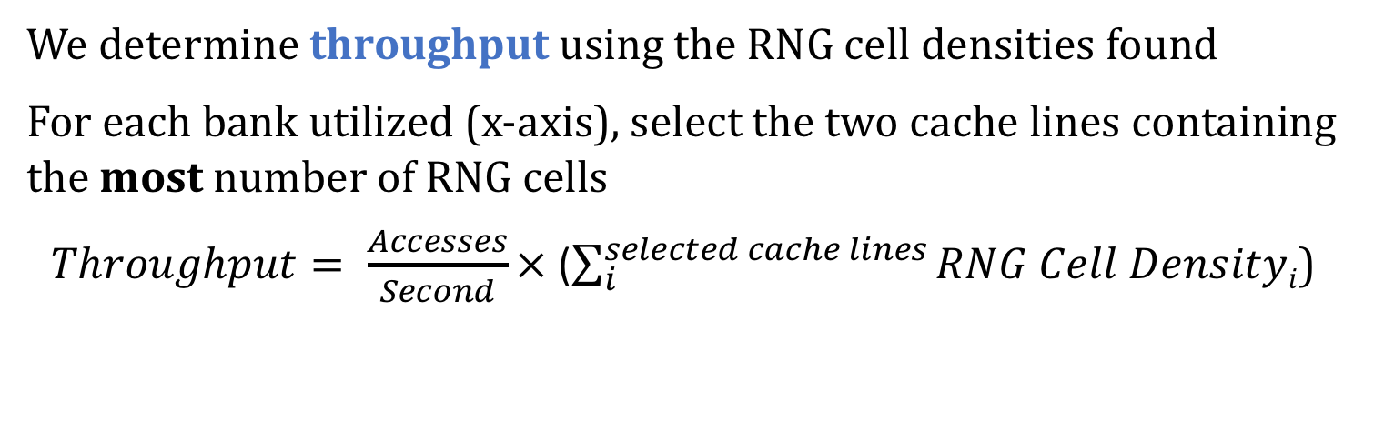
Results – Single Channel Throughput
We determine throughput using the RNG cell densities found
For each bank utilized (x-axis), select the two cache lines containing the most number of RNG cells
$Throughput= \frac{Accesses}{Second}×$ ($\sum_{i}^{selected cache lines}{RNG Cell Densityi}$)
Notes:
I will now present the single channel TRNG throughput evaluation results.
[CLICK] we plot a box and whisker plot again for the throughput. The x-axis sweeps the number of banks that we parallelize D-RaNGe accesses on, and the y-axis plots the TRNG throughput in terms of Mb/s.
[CLICK] we determine the throughput using the RNG cell densities found.
[CLICK] for each bank that we use, we select the two cache lines containing the most number of RNG cells
[CLICK] The throughput is calculated by taking the number of accesses we can make per second to a cache line when generating random numbers and multiplying that value, by the sum of all RNG cells in our selected cache lines.

Slide 59
Results – Single Channel Throughput
Since there are only between 1 and 4 RNG cells per cache line, there are a limited number of possible throughputs
At least 40 Mb/s when using all 8 banks in a single channel
Maximum throughput for A/B/C: 179.4/179.4/134.5 Mb/s
4-channel max (avg) throughput: 717.4 Mb/s (435.7 Mb/s)
Notes:
We plot the distributions for all three DRAM manufacturers
[CLICK] Because we have only observed between 1 and 4 RNG cells per cache line, there are a limited number of possible throughputs.
[CLICK] We find that we can generate true random numbers at at least 40 Mb/s when parallelizing D-RaNGe access across all banks.
[CLICK] We find that the maximum throughputs for manufacturers A,B, and C, are around 180, 180, and 130 Mb/s
[CLICK] When we parallelize across 4 Channels of DRAM which is often available on systems, D-RaNGe can produce random numbers at a maximum of 717 Mb/s and an average of 435 Mb/s
[CLICK]

Slide 60
Results
System Interference
  Capacity overhead: 6 DRAM rows per DRAM bank (~0.018%)
  D-RaNGe is flexible and can adjust its level of interference
  D-RaNGe throughput with SPEC CPU2006 workloads in the pessimistic case where D-RaNGe only issues accesses to a DRAM bank when it is idle (no interference)
    Average throughput of 83.1 Mb/s
Energy Consumption
  4.4 nJ/bit
  Determined by Ramulator + DRAMPower
    https://github.com/CMU-SAFARI/ramulator
    http://www.es.ele.tue.nl/drampower/
Notes:
Let’s now look at the system interference results.
[CLICK] We find that the capacity overhead of D-RaNGe is the 6 DRAM rows per DRAM bank that we must reserve. This includes the 2 rows containing the selected cachelines and the 4 rows surrounding each side of the two rows. This is an insignificant capacity overhead of less than 0.1%
[CLICK] D-RaNGe is inherently a flexible mechanism and can adjust its level of interference in a number of ways. One way would be to change the priority at which D-RaNGe accesses are issued compared to regular application DRAM accesses.
[CLICK] In trying to show the flexibility of D-RaNGe, we study the SPEC CPU2006 workloads in the pessimistic case where D-RaNGe only issues accesses to a DRAM bank when it is idle such that D-RaNGe has no interference with concurrently running applications. We find that in this case, D-RaNGe can still provide on average 83.1 Mb/s of random data.
[CLICK] Next we will look into the energy consumption of D-RaNGe
[CLICK] We find that D-RaNGe can provide random data at the rate of 4.4 nJ per bit, and [CLICK] this was determined by Ramulator and DRAMPower.

Slide 61
Other Results in the Paper
LPDDR4 DRAM Activation Failure Characterization
  Spatial distribution, data pattern dependence, temperature effects, variation over time
A detailed analysis on:
  Devices of the three major DRAM manufacturers
  D-RaNGe energy consumption, 64-bit latency, throughput
Further discussion on:
  Algorithm for D-RaNGe to effectively generate random values
  Design considerations for D-RaNGe
  D-RaNGe overhead analysis
  Analysis of NIST statistical test suite results
  Detailed comparison against prior work
Notes:
Let me briefly talk about othlller results that are included in the paper before presenting our comparison of D-RaNGe against prior work. These include the following:
[CLICK] LPDDR4 DRAM Activation failure characterization, including [CLICK] the spatial distribution, data pattern dependence, temperature effects, and variation over time
[CLICK] How D-RaNGe meets the basic requirements for an effective TRNG
[CLICK] a detailed analysis on [CLICK] devices of the three major DRAM manufacturers and [CLICK] D-RaNGe energy consumption, 64 bit latency, and throughput
[CLICK] Further discussion on [CLICK] the algorithm for D-RaNGe to effectively generate random values,
[CLICK] design considerations for D-RaNGe
[CLICK] D-RaNGe overhead analysis
[CLICK] detailed comparison against prior work
[CLICK] analysis of NIST statistical test suite results

Slide 62
D-RaNGe Outline
Motivation
Effective True Random Number Generators
D-RaNGe
  DRAM Operation
  Key Idea
Methodology
Results
Prior work on DRAM-based TRNGs
  Command scheduling
  Cell charge retention
  Start-up values
Summary
Notes:
I will now discuss the three classes of existing prior work on DRAM-based TRNGs. The first class is DRAM command-scheduling based, the second is DRAM cell charge retention based, and the third is DRAM start-up value based. I will start by comparing against the command-scheduling based TRNG.

Slide 63
Prior Work: Command Scheduling
[Pyo+, IET, 2009]
Randomness source: time it takes to run a code segment of many DRAM accesses
  Since time to access DRAM is unpredictable due to memory conflicts, refresh operations, calibration, etc.
  Lower bits of the cycle timer used as random values
Can produce random numbers at 3.4 Mb/s
D-RaNGe can produce TRNs at >700Mb/s (211x higher)
Downsides of DRAM Command Scheduling based TRNGs
  Randomness source is not truly random: depends on memory controller implementation and concurrently running applications
  Much lower TRN throughput than D-RaNGe
Notes:
[CLICK] In DRAM Command-scheduling based TRNGs, the randomness source is the time it takes to run a code segment containing many DRAM accesses.
[CLICK] The authors claim the time to complete this code segment is random because the time to access DRAM is unpredictable due to memory conflicts, refresh operations, calibration, etc.
[CLICK] The time to complete this code segment is measured and the lower bits of the timer are extracted as random values,
[CLICK] The authors show that this proposal can generate random numbers at 3.4 Mb/s
[CLICK] On the other hand, D-RaNGe produces true random numbers at over 700 Mb/s which is orders of magnitude higher
[CLICK] Unfortunately, we claim that the randomness source is not truly random as it does not rely on a physical non-deterministic phenomena
[CLICK] In fact, it heavily depends on the memory controller implementation as we ll as concurrently running applications.
[CLICK] it also can only provide a very small throughput of True random numbers compared to D-RaNGe

Slide 64
D-RaNGe Outline
Motivation
Effective True Random Number Generators
D-RaNGe
  DRAM Operation
  Key Idea
Methodology
Results
Prior work on DRAM-based TRNGs
  Command scheduling
  Cell charge retention
  Start-up values
Summary
Notes:
The next prior work I will discuss is the DRAM cell charge retention based TRNGs along with some background information

Slide 65
DRAM Cell Leakage
DRAM encodes information in leaky capacitors
wordline
access
transistor
charge
leakage
paths
capacitor
bitline
Stored data is corrupted if too much charge leaks (i.e., the capacitor voltage degrades too much)
[Patel et al., REAPER, ISCA’17]
Notes:
DRAM encodes data in fundamentally leaky capacitors [CLICK] Here is a simplified diagram of a DRAM cell.
[CLICK]
There are a number of leakage paths by which charge can enter or exit the capacitor.
[CLICK]
The important thing to note is that stored data can be corrupted if too much charge leaks
Which is the same as saying if the capacitor voltage degrades too much
[END]

Slide 66
DRAM Cell Retention
100%
Retention Success
Vmin
Retention Failure
Capacitor voltage (Vdd)
0%
Retention time
time
Retention failure – when leakage corrupts stored data
Retention time – how long a cell holds its value
[Patel et al., REAPER, ISCA’17]
Notes:
Here, we have a simplified diagram of the capacitor voltage over time
We see that the voltage decreases over time in an exponential decay.
[CLICK]
Again we have our voltage, Vmin, under which we can no longer guarantee that we will correctly read the data that was originally stored in the cell.
[CLICK]
As long as a cell’s voltage remains above this line, we consider this a retention success.
[CLICK]
However, as soon as the voltage drops below Vmin, we consider this a retention failure
[CLICK]
We define the length of time that must elapse before a cell experiences a retention failure as the ‘retention time’ of a cell.
[END]

Slide 67
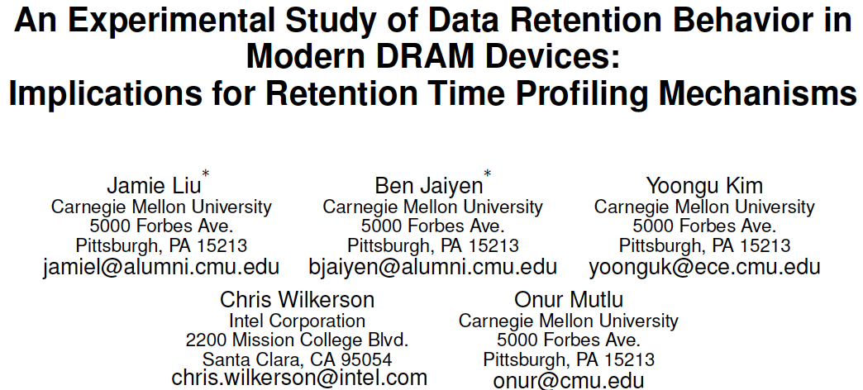
Data Retention in DRAM Cells [ISCA 2013]
Jamie Liu, Ben Jaiyen, Yoongu Kim, Chris Wilkerson, and Onur Mutlu,
"An Experimental Study of Data Retention Behavior in Modern DRAM Devices: Implications for Retention Time Profiling Mechanisms"
Proceedings of the 40th International Symposium on Computer Architecture (ISCA), Tel-Aviv, Israel, June 2013. Slides (ppt) Slides (pdf)

Slide 68
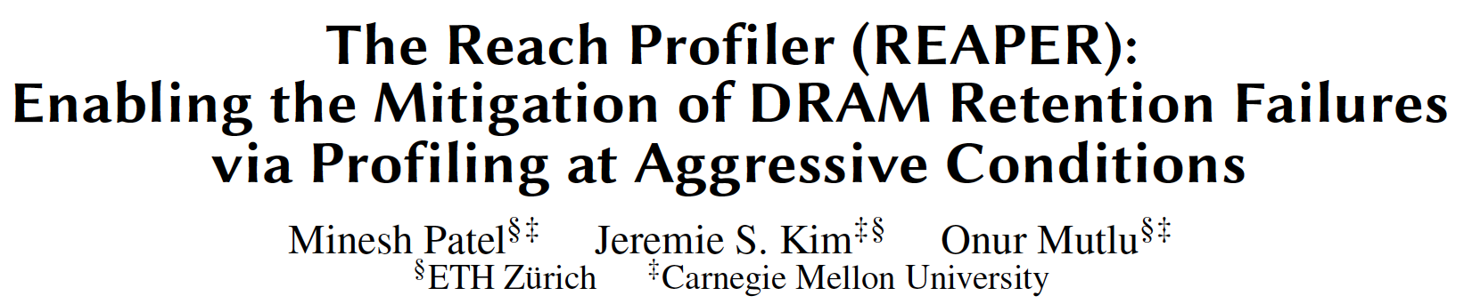
Data Retention in DRAM Cells [ISCA 2017]
Minesh Patel, Jeremie S. Kim, and Onur Mutlu,
"The Reach Profiler (REAPER): Enabling the Mitigation of DRAM Retention Failures via Profiling at Aggressive Conditions"
Proceedings of the 44th International Symposium on Computer Architecture (ISCA), Toronto, Canada, June 2017.
[Slides (pptx) (pdf)]
[Lightning Session Slides (pptx) (pdf)]
First experimental analysis of (mobile) LPDDR4 chips
Analyzes the complex tradeoff space of retention time profiling
Idea: enable fast and robust profiling at higher refresh intervals & temperatures

Slide 69
Retention-based TRNGs
[Keller+, ISCAS, 2014] [Hashemian, DATE, 2015] [Sutar+, TECS, 2018]
Generate random values using data from cells that fail randomly with a refresh interval N
Can handle a longer refresh interval
Row Decoder
Fails with refresh interval N
SA
SA
SA
SA
SA
SA
SA
SA
SA
SA
After time N, some cells leak close to Vmin.
These RNG cells fail randomly
Notes:
[CLICK] Retention-based TRNGs generate random values using data from cells that fail randomly with a refresh interval N. We induce retention failures by disabling refresh for a time longer than the standard 64ms.
[CLICK] Here is a cartoon showing the variation of cell retention times in different colors.
[CLICK] When we disable refresh for a time interval N, we see that the charge in different cells leak over time.
[CLICK] some cells leak charge below Vmin which results in retention failures, but
[CLICK] other cells can handle a longer refresh interval without failing.
[CLICK] After time N, some cells leak close to Vmin and it is these cells that fail randomly. We refer to these as RNG cells in this context.

Slide 70
Retention-based TRNGs
[Keller+, ISCAS, 2014] [Hashemian, DATE, 2015] [Sutar+, TECS, 2018]
Generate random values using data from cells that fail randomly with a refresh interval N
The key idea is to extract random values
by aggregating values from RNG cells after every increased refresh interval N
Can handle a longer refresh interval
Row Decoder
Fails with refresh interval N
SA
SA
SA
SA
SA
SA
SA
SA
SA
SA
After time N, some cells leak close to Vmin.
These RNG cells fail randomly
Notes:
[CLICK] Retention-based TRNGs generate random values using data from cells that fail randomly with a refresh interval N. We induce retention failures by disabling refresh for a time longer than the standard 64ms.
[CLICK] Here is a cartoon showing the variation of cell retention times in different colors.
[CLICK] When we disable refresh for a time interval N, we see that the charge in different cells leak over time.
[CLICK] some cells leak charge below Vmin which results in retention failures, but
[CLICK] other cells can handle a longer refresh interval without failing.
[CLICK] After time N, some cells leak close to Vmin and it is these cells that fail randomly. We refer to these as RNG cells in this context.

Slide 71
DRAM Retention TRNG Weaknesses
High latency
Prior work shows that 40 sec refresh interval results in 256 random bits of data per 4MiB DRAM block
D-RaNGe’s latency is 100ns (>9 orders of magnitude faster)
Low Throughput / High DRAM capacity overhead
Requires more capacity for higher throughput
  Fully reserving a 32GB DRAM device results in 0.05 Mb/s
D-RaNGe has 14,000x higher throughput with a fixed capacity overhead (384 KB)
High energy consumption
6.8mJ/bit mainly due to long idle periods
D-RaNGe: 4.4 nJ/bit (>7 orders of magnitude lower)
Notes:
Unfortunately, DRAM retention-baed TRNGs have weaknesses
[CLICK] They generate random values with a low throughput and high latency
[CLICK] Prior work shows that 40 second refresh intervals result in 256 random bits of data per 4MB DRAM blocks. This means that fully using a 32GB DRAM device would result in 0.05 Mb/s. This is significantly lower than D-RaNGe and [CLICK] has a much higher capacity overhead. [CLICK] Requiring reserving large region of DRAM during random number generation, since a whole 4MB DRAM block only produces 256 bits.
[CLICK] They have high energy consumption.
[CLICK] They consume 6.8milliJ per bit since they have a very long idle time for waiting for retention failure to occur.

Slide 72
D-RaNGe Outline
Motivation
Effective True Random Number Generators
D-RaNGe
  DRAM Operation
  Key Idea
Methodology
Results
Prior work on DRAM-based TRNGs
  Command scheduling
  Cell charge retention
  Start-up values
Summary
Notes:
Lastly, I will discuss the third class of DRAM-based TRNGs: DRAM start-up value based TRNGs.

Slide 73
Start-up Values as Random Numbers
[Tehranipoor, HOST, 2016]
When a device is powered up, some DRAM cells have random values due to interaction between
  precharge logic
  row decoder logic
  column select lines
Prior works propose power cycling DRAM to extract the random data resident in those cells
Downsides of DRAM Start-up value based TRNGs
  Must power cycle DRAM to generate random values:
    High latency: based on power cycle time and data migration
    High storage cost: all data must be migrated or will be lost
Notes:
[CLICK] Prior work exploit the interaction of precharge and row decoder logic, and column select lines when a device is powered up to produce random values in some DRAM cells.
[CLICK] Prior works propose power cycling DRAM to extract the random data resident in those cells.
[CLICK] unfortunately, these TRNGs come with their own constraints as well.
[CLICK] The latency of generating random values depends on a long DRAM power cycle time. While the authors do not evaluate this, there is oftentime a high latency in power cycling DRAM due to all the initialization and calibration required for reading and writing from DRAM.
[CLICK] this mechanism also has a high storage cost since all data will be lost during the power cycle,

Slide 74
D-RaNGe Comparison against Prior Work
Compared to Command Scheduling, D-RaNGe:
  samples a truly random entropy source
  211x higher throughput
  180x lower latency
Compared to Retention Time, D-RaNGe:
  >5 orders of magnitude higher throughput
  >9 orders of magnitude lower latency
  >7 orders of magnitude more energy efficient
Compared to Startup Values, D-RaNGe:
  continuously produces random values
  does not require a system restart
Notes:
Compared to all prior work, D-RaNGe performs better in terms of all the identified characteristics of an effective TRNG.
[CLICK] Compared to Command Scheduling, D-RaNGe actually samples a truly random entropy source, and provides random values at significantly higher throughput and lower latency.
[CLICK] compared to retention time, D-RaNGe provides random values at orders of magnitude higher throughput, less energy, and lower latency.
[CLICK] Compared to startup values, D-RaNGe can continuously produce random values, and likely generate random values with much lower latency and higher throughput.

Slide 75
D-RaNGe Outline
Motivation
Effective True Random Number Generators
D-RaNGe
  DRAM Operation
  Key Idea
Methodology
Results
Prior work on DRAM-based TRNGs
  Command scheduling
  Cell charge retention
  Start-up values
Summary
Notes:
now let me conclude by giving the summary

Slide 76
Summary and Conclusion
  Motivation: High-throughput true random numbers enable system security and various randomized algorithms.
    Many systems (e.g., IoT, mobile, embedded) do not have dedicated True Random Number Generator (TRNG) hardware but have DRAM devices
Problem: Current DRAM-based TRNGs either
do not sample a fundamentally non-deterministic entropy source
are too slow for continuous high-throughput operation
Goal: A novel and effective TRNG that uses existing commodity DRAM to provide random values with 1) high-throughput, 2) low latency and 3) no adverse effect on concurrently running applications
D-RaNGe: Reduce DRAM access latency below reliable values and exploit DRAM cells’ failure probabilities to generate random values
Evaluation:
  Experimentally characterize 282 real LPDDR4 DRAM devices
    D-RaNGe (717.4 Mb/s) has significantly higher throughput (211x)
    D-RaNGe (100ns) has significantly lower latency (180x)
Notes:
To begin, I will give a brief overview. [CLICK] Our motivation is that high throughput true random numbers enable system security, and various randomized algorithms.
[CLICK] Unfortunately, many systems like IoT, mobile, and embedded systems do not have dedicated true random number generator (TRNG) hardware. However, they do have DRAM devices, on which a few recent papers have proposed generating true random numbers on.
[CLICK] The problem is that current DRAM-based TRNGs either [CLICK] do not sample a fundamentally non-deterministic entropy source, which may not result in true random numbers, or [CLICK] they are too slow for continuous high-throughput operation
[CLICK] Our goal is to develop a novel and effective TRNG for existing commodity DRAM devices that can provide continuous high-throughput random values at low latency while minimally affecting concurrently running applications.
[CLICK] We propose D-RaNGe, a high-throughput TRNG that reduces DRAM access latency below reliable values and exploits DRAM cell failure probabilities to quickly generate random values
[CLICK] In our evaluation
[CLICK] we experimentally characterize 282 real LPDDR4 DRAM devices and [CLICK] find that D-RaNGe provides random values at over 700 Mb/s which is orders of magnitude over prior DRAM-based TRNGs [CLICK] In addition, D-RaNGe can provide 64 bits of random data in 100 ns which is 180x faster than prior proposals

Slide 77
D-RaNGe: Using Commodity DRAM Devices to Generate True Random Numbers with Low Latency and High Throughput
Jeremie S. Kim Minesh Patel
Hasan Hassan Lois Orosa Onur Mutlu
Notes:
20 Minute talk 5 minute questions
Hello, my name is Jeremie Kim and I will be presenting D-RaNGe: a mechanism that uses commodity DRAM devices to generate true random numbers with low latency and high throughput

Slide 78
More on D-RaNGe
Jeremie S. Kim, Minesh Patel, Hasan Hassan, Lois Orosa, and Onur Mutlu,
"D-RaNGe: Using Commodity DRAM Devices to Generate True Random Numbers with Low Latency and High Throughput"
Proceedings of the 25th International Symposium on High-Performance Computer Architecture (HPCA), Washington, DC, USA, February 2019.
[Slides (pptx) (pdf)]
[Full Talk Video (21 minutes)]

Slide 79
Using Memory for Security
Generating True Random Numbers (using DRAM)
  Kim et al., HPCA 2019
Evaluating Physically Unclonable Functions (using DRAM)
  Kim et al., HPCA 2018
Quickly Destroying In-Memory Data (using DRAM)
  Orosa et al., arxiv 2019

Slide 80
The DRAM Latency PUF:
Quickly Evaluating Physical Unclonable Functions by Exploiting the Latency-Reliability Tradeoff in Modern Commodity DRAM Devices
Jeremie S. Kim Minesh Patel
Hasan Hassan Onur Mutlu
Notes:
20 Minute talk 5 minute questions
Hello, my name is Jeremie Kim and I will be presenting the DRAM Latency PUF, a mechanism to quickly evaluate physical unclonable functions by exploiting the latency-reliability tradeoff in modern commodity DRAM devices.

Slide 81
Executive Summary
  Motivation:
    We can authenticate a system via unique signatures if we can evaluate a Physical Unclonable Function (PUF) on it
    Signatures (PUF response) reflect inherent properties of a device
    DRAM is a promising substrate for PUFs because it is widely used
Problem: Current DRAM PUFs are 1) very slow, 2) require a DRAM reboot, or 3) require additional custom hardware
Goal: To develop a novel and effective PUF for existing commodity DRAM devices with low-latency evaluation time and low system interference across all operating temperatures
DRAM Latency PUF: Reduce DRAM access latency below reliable values and exploit the resulting error patterns as unique identifiers
Evaluation:
    Experimentally characterize 223 real LPDDR4 DRAM devices
    2. DRAM latency PUF (88.2 ms) achieves a speedup of 102x/860x at 70°C/55°C over prior DRAM PUF evaluation mechanisms
Notes:
To begin, I will give a brief overview. [CLICK] Our motivation is that we can [CLICK] authenticate a system via unique signatures if we can evaluate a Physical Unclonable Function (PUF) on it. [CLICK] These signatures or PUF responses reflect inherent properties of a device making it unique to the DRAM device generating it. [CLICK] DRAM memory technology is widely used today and has significantly many units that can be used in PUF evaluation, which makes it a promising substrate to evaluate PUFs on. A DRAM PUF would enable you to authenticate any system with a DRAM device on it. [CLICK] The main problem is that current DRAM PUFs are either slow, taking on the order of minutes to evaluate, require a DRAM reboot, or require additional custom hardware and cannot be used on commodity DRAM devices. [CLICK] To this end the goal of this work is to develop a novel and effective PUF for commodity DRAM devices that can be evaluated with low latency and low system interference across all operating temperatures. [CLICK] Our key idea is to reduce DRAM read access latency below the reliable datasheet specifications using software-only system calls in order to exploit the resulting error patterns as unique identifiers. We can do this because we observe that we get reliable and consistent error patterns as a result that can be used as a PUF responses [CLICK] We experimentally characterize 223 real LPDDR4 DRAM devices, and show that DRAM latency PUFs satisfy the requirements of an effective PUF [CLICK] We also find that the DRAM latency PUF can be evaluated in 88.2 ms on average regardless of temperature. Since the evaluation time of prior DRAM PUFs depends on temperature, there is a large tradeoff space. However, we determine that we still achieve a speedup orders of magnitude larger than the prior DRAM PUF proposals at common operating temperatures.

Slide 82
The DRAM Latency PUF Outline
Motivation
Effective PUF Characteristics
DRAM Latency PUF
  DRAM Operation
  Key Idea
Prior Best DRAM PUF: DRAM Retention PUF
  DRAM Cell Retention
  Key Idea
  Weaknesses
Methodology
Results
Summary
Notes:
Here is the outline for the talk today

Slide 83
The DRAM Latency PUF Outline
Motivation
Effective PUF Characteristics
DRAM Latency PUF
  DRAM Operation
  Key Idea
Prior Best DRAM PUF: DRAM Retention PUF
  DRAM Cell Retention
  Key Idea
  Weaknesses
Methodology
Results
Summary
Notes:
I will first expand upon the motivation of our work

Slide 84
Motivation
We want a way to ensure that a system’s components are not compromised
Physical Unclonable Function (PUF): a function we evaluate on a device to generate a signature unique to the device
We refer to the unique signature as a PUF response
Often used in a Challenge-Response Protocol (CRP)
Input:
Challenge_{X}
Trusted Device
Device
Authenticated
✔
Checking
PUF response
Evaluating
PUF
.
.
Output:
PUF Response_{X}
.
.
.
.
TODO: nice PUF input/output animation showing how a CRP works. Define evaluate, define input, and output (PUF response)
Notes:
[CLICK] We want a way to ensure that a system’s components are not compromised. One example would be if an attacker maliciously swaps a healthy component with a faulty one at runtime in order to steal information. [CLICK] A method for detecting this change in the system would be the use of a physical unclonable function or a PUF. A PUF is a function that we evaluate on a device to generate a signature that is unique to a device. [CLICK] We refer to this unique signature as a PUF response and it reflects the properties inherent In the device, making it unique to the device that generated it. [CLICK] PUFs are often used in a challenge-response protocol (CRP) for device authentication, which works as follows: [CLICK] a trusted device issues an [CLICK] input or a challenge X to the device [CLICK] The device then evaluates the physical unclonable function with the given challenge X, and [CLICK] returns the PUF response X to the trusted device. [CLICK] The trusted server then checks the PUF response, and if it matches the expected response for the given input challenge X, the device will be authenticated and can now be trusted to perform privileged tasks. [CLICK]
====================
[CLICK] A PUF is a function that generates a signature that is unique to a given device. [CLICK] PUFs are often used in a challenge response protocol, which we refer to as a CRP, for authentication. [CLICK] A trusted server, which stores a database of challenges and expected PUF responses, issues a challenge to a device in the form of inputs, or conditions in which the PUF response must be generated. If the device returns the correct PUF response, then the device is authenticated. [CLICK] We need a reliable and fast PUF for systems that use RDMA or perform functions on remote devices or [CLICK] systems with interchangeable system components such as SSD drives

Slide 85
Motivation
We want a runtime-accessible PUF
  Should be evaluated quickly with minimal impact on concurrent applications
  Can protect against attacks that swap system components with malicious parts
2. DRAM is a promising substrate for evaluating PUFs because it is ubiquitous in modern systems
  Unfortunately, current DRAM PUFs are slow and get exponentially slower at lower temperatures
Notes:
[CLICK] First, we want a PUF that is runtime-accessible, which means that the PUF can be evaluated quickly with minimal performance impact on concurrently running applications. [CLICK] The faster you can evaluate a PUF, the earlier you can detect whether a system component has been compromised, and the better you can protect against a wide array of attacks. [CLICK] Secondly, we want to provide a runtime-accessible PUF that can be evaluated on DRAM since it is a ubiquitous memory technology in modern systems today. [CLICK] The problem with current DRAM PUFs, is that they are slow and get exponentially slower at lower temperatures. This is because the speed of their method of generating a unique identifier is inversely affected by temperature.

Slide 86
The DRAM Latency PUF Outline
Motivation
Effective PUF Characteristics
DRAM Latency PUF
  DRAM Operation
  Key Idea
Prior Best DRAM PUF: DRAM Retention PUF
  DRAM Cell Retention
  Key Idea
  Weaknesses
Methodology
Results
Summary
Notes:
Now let me briefly tell you the characteristics we want in an effective DRAM PUF.

Slide 87
Effective PUF Characteristics
1. Repeatability
DRAM
Device 0
PUF Response₀
==
PUF Response₀
Challenge₀
Trusted Device
PUF Response₁
PUF Response_{N}
Notes:
[CLICK] I will explain these characteristics in the context of a model where a trusted device wants to authenticate a DRAM device
[CLICK] The first characteristic is repeatablility, which means that for each particular challenge X, the PUF response must be highly similar every time.
[CLICK] In this example, the trusted device issues challenge0 twice, [CLICK] and this results in the same [CLICK] PUF response each time

Slide 88
Effective PUF Characteristics
1. Repeatability
2. Diffuseness
DRAM
Device 0
PUF Response₀
PUF Response₀
Challenge₀
Trusted Device
Challenge₁
PUF Response₁
...
Challenge_{N}
PUF Response_{N}
Notes:
PUFs must also exhibit diffuseness, which means that each device must have a large challenge-response space [CLICK] For the large input space, the DRAM device should generate unique signatures.

Slide 89
Effective PUF Characteristics
1. Repeatability
2. Diffuseness
Cannot use multiple challenge-response pairs to guess another
3. Uniform Randomness
PUF Response₀
DRAM
Device 0
PUF Response₀
PUF Response₀
Challenge₀
PUF Response₀
Trusted Device
Challenge₁
PUF Response₁
PUF Response₁
...
PUF Response_{N}
Challenge_{N}
PUF Response_{N}
Notes:
[CLICK] PUFs must also exhibit uniform randomness, which means that each device must be able to generate PUF responses that are very different from each other [CLICK]

Slide 90
Effective PUF Characteristics
1. Repeatability
DRAM
Device 1
2. Diffuseness
3. Uniform Randomness
PUF Response_{Z}
4. Uniqueness
Challenge_{Z}
DRAM
Device 0
Trusted Device
Challenge_{Z}
PUF Response_{Z}
Challenge_{Z}
DRAM
Device
2
All PUF responses of different devices are significantly different
PUF Response_{Z}
Notes:
Not going to spend much time on the general characteristics of a PUF. We want to focus on two key features
[CLICK] We identify 5 key characteristics of a PUF. [CLICK] The first characteristic is repeatable, which means that for each challenge, the PUF response must be highly similar every time.. [CLICK] second is uniqueness, which means that each device can be uniquely identified within a large set of devices. [CLICK] PUFs must also exhibit diffuseness, which means that each device must have a large challenge-response space [CLICK] PUFs must also exhibit uniform randomness, which means that each device must be able to generate PUF responses that are very different from each other [CLICK] They must also be rUnclonability, which means that it is practically impossible to construct another device that exhibits the same properties as another.

Slide 91
Effective PUF Characteristics
1. Repeatability
2. Diffuseness
3. Uniform Randomness
4. Uniqueness
5. Unclonability
✘
DRAM
Device 0
DRAM
Device 0
PUF Response₀
PUF Response₀
Trusted Device
PUF Response₁
PUF Response_{N}
Notes:
Not going to spend much time on the general characteristics of a PUF. We want to focus on two key features
[CLICK] We identify 5 key characteristics of a PUF. [CLICK] The first characteristic is repeatable, which means that for each challenge, the PUF response must be highly similar every time.. [CLICK] second is uniqueness, which means that each device can be uniquely identified within a large set of devices. [CLICK] PUFs must also exhibit diffuseness, which means that each device must have a large challenge-response space [CLICK] PUFs must also exhibit uniform randomness, which means that each device must be able to generate PUF responses that are very different from each other [CLICK] They must also be rUnclonability, which means that it is practically impossible to construct another device that exhibits the same properties as another.

Slide 92
Effective PUF Characteristics
1. Repeatability
2. Diffuseness
3. Uniform Randomness
4. Uniqueness
More analysis
of the effective PUF characteristics in the paper
5. Unclonability
DRAM
Device 0
PUF Response₀
PUF Response₀
Trusted Device
PUF Response₁
PUF Response_{N}
Notes:
Not going to spend much time on the general characteristics of a PUF. We want to focus on two key features
[CLICK] We identify 5 key characteristics of a PUF. [CLICK] The first characteristic is repeatable, which means that for each challenge, the PUF response must be highly similar every time.. [CLICK] second is uniqueness, which means that each device can be uniquely identified within a large set of devices. [CLICK] PUFs must also exhibit diffuseness, which means that each device must have a large challenge-response space [CLICK] PUFs must also exhibit uniform randomness, which means that each device must be able to generate PUF responses that are very different from each other [CLICK] They must also be rUnclonability, which means that it is practically impossible to construct another device that exhibits the same properties as another.

Slide 93
Effective PUF Characteristics
Runtime-accessible PUFs must have
Low Latency
  Each device can quickly generate a PUF response
Low System Interference
  PUF evaluation minimally affects performance of concurrently-running applications
Notes:
[CLICK] We identify two key characteristics that a PUF must have in order to be runtime-accessible.
[CLICK] the PUF must be evaluated with low latency, providing a quick PUF response for every challenge input, and [CLICK] the evaluation of the PUF must have low system interference and minimally affect the performance of concurrently running applications.
A runtime-accessible PUF enables frequent authentication of a device, allowing for re-authentication of the system component throughout an application lifetime rather than just at bootup. A fast runtime-accessible PUF enables the protection of a system from attacks that exploit the fact that the time of authentication is different from the time of use.

Slide 94
The DRAM Latency PUF Outline
Motivation
Effective PUF Characteristics
DRAM Latency PUF
  DRAM Operation
  Key Idea
Prior Best DRAM PUF: DRAM Retention PUF
  DRAM Cell Retention
  Key Idea
  Weaknesses
Methodology
Results
Summary
Notes:
I will now discuss our proposal: The DRAM latency PUF, but before I do, I will first explain the required basics of DRAM operation.

Slide 95
DRAM Accesses and Failures
wordline
Guardband
Strong
V_{dd}
access
transistor
V_{min}
Weak
Ready to Access
Voltage Level
Process variation during manufacturing results in cells having unique behavior
bitline
Bitline Voltage
Bitline Charge Sharing
capacitor
Sense Amplifier
0.5 V_{dd}
Time
ACTIVATE
SA Enable
READ
t_{RCD}
Notes:
[CLICK] A DRAM cell holds its charge in a capacitor and gets read out by the sense amplifier via the bitline. [CLICK][CLICK] Initially the bitline is kept at Vdd/2. [CLICK] When the wordline is driven high or activated, [CLICK] the capacitor begins to share charge with the bitline. The sense amplifier is then enabled and [CLICK] the voltage differential on the bitline is amplified to an I/O readable value. [CLICK] In order to ensure correctness of operation, the memory controller can only read data tRCD time after the activation. [CLICK] We could read this data earlier, when it reaches a readable voltage threshold (Vmin), [CLICK] but we want to make sure that there is enough guardband such that other cells that may be [CLICK] weaker due to process variation will not fail when accessed tRCD time after activation. [CLICK] We highlight and refer to varying degrees of strengths of cells in terms of how early they reach the readable voltage threshold.

Slide 96
DRAM Accesses and Failures
wordline
Strong
V_{dd}
access
transistor
V_{min}
Weak
Ready to Access
Voltage Level
bitline
Weaker cells have
a higher probability
to fail
Bitline Voltage
capacitor
SA
0.5 V_{dd}
Time
ACTIVATE
SA Enable
READ
t_{RCD}
Notes:
If we are to read with a [CLICK] tRCD reduced below manufacturer-recommended values, we begin to induce latency failures in the weaker cell. Cells that are read when their bitline’s voltage is lower than Vmin, have a probability of failure. And this probability increases as you read further below the voltage threshold.

Slide 97
The DRAM Latency PUF Outline
Motivation
Effective PUF Characteristics
DRAM Latency PUF
  DRAM Operation
  Key Idea
Prior Best DRAM PUF: DRAM Retention PUF
  DRAM Cell Retention
  Key Idea
  Weaknesses
Methodology
Results
Summary
Notes:
I will now present the key idea of the DRAM latency PUF

Slide 98
DRAM Latency PUF Key Idea
A cell’s latency failure probability is inherently related to random process variation from manufacturing
We can provide repeatable and unique device signatures using latency error patterns
High % chance to fail with reduced t_{RCD}
Low % chance to fail with reduced t_{RCD}
Row Decoder
SA
SA
SA
SA
SA
SA
SA
Notes:
Our key idea is to reduce DRAM read access latency below the reliable datasheet specifications using software-only system calls in order to exploit the resulting error patterns as unique identifiers.
[CLICK] We find that the probability that a cell will result in a latency failure due to a reduced-tRCD access, is inherently related to random process variation from manufacturing [CLICK] This knowledge enables us to provide a repeatable and unique device signature with these patterns of latency failures.
[CLICK] Here is a cartoon showing the manufacturing variation across a region of DRAM. When accessed with a reduced timing parameter, [CLICK] some cells have a high percentage chance of failing, while others [CLICK] have a low percentage chance of failing.
The Key Idea is to generate a PUF response using the locations of cells that have a high percentage chance of failing with a tRCD value reduced below manufacturer-recommended values.

Slide 99
DRAM Latency PUF Key Idea
A cell’s latency failure probability is inherently related to random process variation from manufacturing
We can provide repeatable and unique device signatures using latency error patterns
The key idea is to compose a PUF response using the DRAM cells that fail
with high probability
High % chance to fail with reduced t_{RCD}
Low % chance to fail with reduced t_{RCD}
Row Decoder
SA
SA
SA
SA
SA
SA
SA
Notes:
Our key idea is to reduce DRAM read access latency below the reliable datasheet specifications using software-only system calls in order to exploit the resulting error patterns as unique identifiers.
[CLICK] We find that the probability that a cell will result in a latency failure due to a reduced-tRCD access, is inherently related to random process variation from manufacturing [CLICK] This knowledge enables us to provide a repeatable and unique device signature with these patterns of latency failures.
[CLICK] Here is a cartoon showing the manufacturing variation across a region of DRAM. When accessed with a reduced timing parameter, [CLICK] some cells have a high percentage chance of failing, while others [CLICK] have a low percentage chance of failing.
The Key Idea is to generate a PUF response using the locations of cells that have a high percentage chance of failing with a tRCD value reduced below manufacturer-recommended values.

Slide 100
Evaluating a DRAM Latency PUF
Determine whether a single cell’s location should be included in a DRAM latency PUF response
- Include if the cell fails with a probability greater than a chosen threshold when accessed with a reduced t_{RCD}
Chosen Threshold: 50%
This Cell’s Failure Rate: 60%
Failure rate is greater than the chosen threshold, so the cell’s location should be included
1
1 0 1 0 1 0 0 1 0 0
SA
✘ ✘ ✘✘ ✘✘
1 0 1 0 1 0 0 1 0 0
Notes:
[CLICK] We start by showing how to determine whether a single cell’s location should be included in a DRAM latency PUF response or not.
[CLICK] We do this by choosing a failure probability threshold and sampling the cell multiple times with a reduced tRCD access to see if it will fail with a greater probability than the chosen threshold.
[CLICK] For this example, we choose a threshold of 50%
[CLICK] We sample the cell 10 times with a reduced tRCD, and
[CLICK] determine the failure rate as a fraction of the number of samples taken. In this cell, we find a failure rate of 60%.
[CLICK] we find that the failure rate is greater than the chosen threshold, and so we include this cell in the PUF response.
We find that this filtering stage is useful in removing cells that have a very low percentage chance of failing from the evaluations that happen to find them.

Slide 101
Evaluating a DRAM Latency PUF
We induce latency failures 100 times and use a threshold of 10% (i.e., use cells that fail > 10 times)
We do this for every cell in a continuous 8KiB memory region, that we refer to as a PUF memory segment
Example 21-bit PUF memory segment
PUF Response
Row Decoder
0 0 0 1 0 0 1
1 0 0 1 1 0 0
0 0 1 1 0 0 0
SA
SA
SA
SA
SA
SA
SA
Notes:
[CLICK] We induce latency failures 100 times and use a threshold of 10%. In other words we include cells that fail greater than 10 times across our 100.
[CLICK] We do this for every cell in a continuous 8KiB memory region that we refer to as a PUF memory segment
[CLICK] in this example, we have a 21 bit PUF memory segment and varying cell strengths in this PUF memory segment are reflected with different colors and cell sizes.
[CLICK] We use this memory segment to induce latency failures and return a PUF response
=============================
In order to show how we generate our PUF responses so fast, we expand on a few key features our mechanism.
[CLICK] Every DRAM access induces errors at a DRAM cacheline granularity which is 32 Bytes
[CLICK] Because we are inducing tRCD related failures, we must activate a new row each time we want to access data on that row with a reduced tRCD. Otherwise, the data will already be stored in the sense amplifiers and no sense amplification step necessary.
[CLICK] In order to increase the determinism of the memory controller, we issue a memory barrier after every access such that the memory access is the only one in the memory controller at a given time.
[CLICK] Finally, in order to estimate every cells’ failure probability, we utilize a counter buffer in a separate DRAM channel which after each iteration of inducing latency failures across a memory segment, we increment every counter associated with the bits that were observed to fail. We can then recreate the PUF response utilizing only the cells that we find to fail more than 10 times.
[CLICK] Here I will show a quick animation of how accesses occur in this example PUF memory segment of 4 cachelines and their counters
[CLICK] We induce errors in a column-order access scheme [CLICK] and update the counter buffers associated with the cacheline immediately after observing the errors.

Slide 102
Evaluating a DRAM Latency PUF
We induce latency failures 100 times and use a threshold of 10% (i.e., use cells that fail > 10 times)
We do this for every cell in a continuous 8KiB memory region, that we refer to as a PUF memory segment
We can evaluate
the DRAM latency PUF
in only 88.2ms on average
regardless of temperature!
PUF Response
0 0 0 1 0 0 1
1 0 0 1 1 0 0
0 0 1 1 0 0 0

Slide 103
The DRAM Latency PUF Outline
Motivation
Effective PUF Characteristics
DRAM Latency PUF
  DRAM Operation
  Key Idea
Prior Best DRAM PUF: DRAM Retention PUF
  DRAM Cell Retention
  Key Idea
  Weaknesses
Methodology
Results
Summary
Notes:
I will now discuss the prior best DRAM PUF: the DRAM retention PUF.

Slide 104
DRAM Cell Leakage
DRAM encodes information in leaky capacitors
wordline
access
transistor
charge
leakage
paths
capacitor
bitline
Stored data is corrupted if too much charge leaks (i.e., the capacitor voltage degrades too much)
[Patel et al., REAPER, ISCA’17]
Notes:
DRAM encodes data in fundamentally leaky capacitors [CLICK] Here is a simplified diagram of a DRAM cell.
Data is encoded in the capacitor as either charged or uncharged, and the access transistor is used to read from or write to the cell.
[CLICK]
There are a number of leakage paths by which charge can enter or exit the capacitor.
[CLICK]
The important thing to note is that stored data can be corrupted if too much charge leaks
Which is the same as saying if the capacitor voltage degrades too much
[END]

Slide 105
DRAM Cell Retention
100%
Retention Success
Vmin
Retention Failure
Capacitor voltage (Vdd)
0%
Retention time
time
Retention failure – when leakage corrupts stored data
Retention time – how long a cell holds its value
[Patel et al., REAPER, ISCA’17]
Notes:
Here, we have a simplified diagram of the capacitor voltage over time
We see that the voltage decreases over time in an exponential decay.
[CLICK]
Again we have our voltage, Vmin, under which we can no longer guarantee that we will correctly read the data that was originally stored in the cell.
[CLICK]
As long as a cell’s voltage remains above this line, we consider this a retention success.
[CLICK]
However, as soon as the voltage drops below Vmin, we consider this a retention failure
[CLICK]
We define the length of time that must elapse before a cell experiences a retention failure as the ‘retention time’ of a cell.
[END]

Slide 106
Each Cell has a Different Retention Time
Row Decoder
wordline
access
transistor
capacitor
Row Buffer
bitline
8GB DRAM = 6.4e10 cells
[Patel et al., REAPER, ISCA’17]
Notes:
DRAM is comprised of [CLICK] many of these small cells to have a large capacity. [CLICK] For an example 8GB DRAM device, there are 64 billion of these cells.
In correct operation, every one of these cells are restored every 64 ms, so there are no retention failures during program execution.
However, prior work has shown that cells of a given retention time are uniform randomly distributed across the DRAM array

Slide 107
The DRAM Latency PUF Outline
Motivation
Effective PUF Characteristics
DRAM Latency PUF
  DRAM Operation
  Key Idea
Prior Best DRAM PUF: DRAM Retention PUF
  DRAM Cell Retention
  Key Idea
  Weaknesses
Methodology
Results
Summary
Notes:
I will now discuss the key idea of the DRAM retention PUF

Slide 108
Evaluating a DRAM Retention PUF
Generate a PUF response with locations of cells in a PUF memory segment that fail with a refresh interval N
Can handle a longer refresh interval
Row Decoder
Fails with refresh interval N
SA
SA
SA
SA
SA
SA
SA
SA
SA
SA
The pattern of retention failures across a segment of DRAM is unique to the device
Notes:
[CLICK] The key idea behind evaluating a DRAM retention PUF is to change the refresh interval and record the corresponding error pattern within a PUF memory segment. We induce retention failures by disabling refresh for a time longer than the standard 64ms. [CLICK] Here is a cartoon showing the variation of cell retention times in different colors. [CLICK] When we disable refresh for a time interval N, we see that the charge in different cells leak over time. [CLICK] some cells leak charge below Vmin which results in retention failures, but [CLICK] other cells can handle a longer refresh interval without failing. [CLICK] Prior work finds that the pattern of retention failures is unique to the device that generated it.

Slide 109
Evaluating a DRAM Retention PUF
Generate a PUF response with locations of cells in a PUF memory segment that fail with a refresh interval N
Can handle a longer refresh interval
We use the best methods
from prior work
and optimize the retention PUF
for our devices
Row Decoder
Fails with refresh interval X
SA
SA
SA
SA
SA
SA
SA
SA
SA
SA
The pattern of retention failures across a segment of DRAM is unique to the device
Notes:
====================================================
Similar to prior work, we determine that we need to find 512 bits of identification to uniquely identify a single device within a set of significantly many devices. For the retention PUF, we need to wait a long enough period of time with refresh disabled so that 512 bits result in retention failure within the PUF memory segment.

Slide 110
The DRAM Latency PUF Outline
Motivation
Effective PUF Characteristics
DRAM Latency PUF
  DRAM Operation
  Key Idea
Prior Best DRAM PUF: DRAM Retention PUF
  DRAM Cell Retention
  Key Idea
  Weaknesses
Methodology
Results
Summary
Notes:
Here is the outline for the talk today

Slide 111
DRAM Retention PUF Weaknesses
DRAM Retention PUF evaluation time is very long and leads to high system interference
Long evaluation time:
  Most DRAM cells are strong → need to wait for long time to drain charge from capacitors
  Especially at low temperatures
High system interference:
  DRAM refresh can only be disabled at a channel granularity (512MB – 2GB)
  Must issue manual refreshes to maintain data correctness in the rest of the channel during entire evaluation time
  Manually refreshing DRAM consumes significant bandwidth on the DRAM bus
Notes:
=============================================
First of all, there is a large tradeoff space in DRAM retention PUFs. This is because its [CLICK] evaluation time is inversely correlated with both temperature and PUF segment size. [CLICK] However, we find that even with reasonably high temperatures and large PUF memory segment sizes, retention PUFs still exhibit relatively long evaluation times. [CLICK] In this figure, we show retention PUF evaluation times on the y-axis for the three major DRAM manufacturers. This figure presents a sweep of temperatures in which a DRAM device evaluates a retention PUF, and a sweep of PUF memory segment sizes that the PUF is evaluated on. The different manufacturers are represented with different colors. The temperatures are indicated on the x-axis. And, the different memory segment sizes used are indicated by the labels on the figure. As you can see, an 8KiB PUF memory segment size results in long evaluation times and the evaluation times decrease as the memory segment size increases. Also note that the y-axis is a log scale. [CLICK] We note that when using an 8KiB memory segment size at 55C, chips of certain manufacturers on average evaluate a retention PUF in 3 hours! [CLICK] Even when we increase the memory segment size to 64MiB, we find that some chips still take 8 seconds to evaluate a retention PUF.
[CLICK] It is possible to reduce the evaluation time of retention PUFs with a larger PUF memory segment or higher temperature, but there is high system overhead with larger memory segment sizes, and it is very difficult to control temperature on these devices in the field.
Long evaluation time! Big. second slide. we an do these things.

Slide 112
DRAM Retention PUF Weaknesses
Long evaluation time could be ameliorated in 2 ways:
Increase temperature – higher rate of charge leakage
→ Observe failures faster
Unfortunately:
1. Difficult to control DRAM temperature in the field
2. Operating at high temperatures is undesirable
Increase PUF memory segment size – more cells with low retention time in PUF memory segment
→ Observe more failures faster
Unfortunately:
    Large PUF memory segment
→ high DRAM capacity overhead

Slide 113
The DRAM Latency PUF Outline
Motivation
Effective PUF Characteristics
DRAM Latency PUF
  DRAM Operation
  Key Idea
Prior Best DRAM PUF: DRAM Retention PUF
  DRAM Cell Retention
  Key Idea
  Weaknesses
Methodology
Results
Summary
Notes:
Now I will discuss the methodology we used to experimentally characterize our DRAM devices

Slide 114
Methodology
223 2y-nm LPDDR4 DRAM devices
  2GB device size
  From 3 major DRAM manufacturers
Thermally controlled testing chamber
  Ambient temperature range: {40°C – 55°C} ± 0.25°C
  DRAM temperature is held at 15°C above ambient
Precise control over DRAM commands and timing parameters
  Test retention time effects by disabling refresh
  Test reduced latency effects by reducing t_{RCD} parameter
Notes:
The infrastructure we developed can test 223 state-of-the-art LPDDR4 DRAM chips.
Each device is [CLICK] 2 gigabytes in size, and we have chips from across [CLICK] three major DRAM vendors.
[CLICK] We test within a thermally controlled chamber with an [CLICK] ambient temperature range of 40 to 55 degrees C with a tolerance of 0.25 degrees.
[CLICK] DRAM temperature is always held at 15 degrees C above ambient using a local heat source
[CLICK] We had precise control over DRAM commands and timing parameters
[CLICK] We experimentally characterized DRAM retention PUFs by disabling refresh for various periods of time and sweeping temperatures to see the individual effects
[CLICK] We analyzed DRAM latency PUFs by testing with reduced tRCD access latencies and analyzing the resulting failures.
[END]

Slide 115
The DRAM Latency PUF Outline
Motivation
Effective PUF Characteristics
DRAM Latency PUF
  DRAM Operation
  Key Idea
Prior Best DRAM PUF: DRAM Retention PUF
  DRAM Cell Retention
  Key Idea
  Weaknesses
Methodology
Results
Summary
Notes:
Now I will talk about the results that we gathered using our methodology

Slide 116
Results – PUF Evaluation Latency
8KiB memory segment
33,806.6x
318.3x
8KiB memory segment
DRAM latency PUF is
1. Fast and constant latency (88.2ms)
Can evaluate a DRAM Latency PUF (88ms) orders of magnitudes faster (152x/1426x at 55°C/70°C) than the prior best DRAM PUF with the same memory segment size
Notes:
[CLICK] We next show the same retention PUF evaluation time figure as before, but now we overlay the execution time of our DRAM latency PUF proposal. Remember that the y axis is a log scale. Our PUF memory segment has significantly lower overhead in terms of evaluation time and system interference compared to the DRAM retention PUF. The DRAM latency PUF can be evaluated in an average of 88ms regardless of the temperature. This is because, unlike the DRAM retention PUF, the speed of inducing latency failures is NOT dependent on temperature.
[CLICK] We find that we can evaluate a DRAM latency PUF on DRAM orders of magnitudes faster than the prior best DRAM PUF with the same memory segment size. We achieve a speedup of 152x at 55C and 1426x at 70C.
TODO: draw first banner at the bottom after the first line of DRAM latency PUF .
OK lets look at DRAM retention PUF with the same overhead 8KB memory segment. annotate figure showing the 1426x, and show the 70C speedup.
annotate the figure showing the speedup for manufacturer A. Even with 64MiB, we still have this speeedup. remove the numbers after showing all manufactuers. This is similar across all manufacturer. across all manufactures here is average with same storeage overhead.
8KiB
55 -> 33806.6x
70 -> 318.3x
64KiB
55 -> 869.8x
70 -> 108.93x
64MiB
55 -> 17.31x
70 -> 11.487x

Slide 117
Results – PUF Evaluation Latency
8KiB memory segment
64KiB memory segment
869.8x
108.9x
8KiB memory segment
DRAM latency PUF is
1. Fast and constant latency (88.2ms)
Can evaluate a DRAM Latency PUF (88ms) orders of magnitudes faster (152x/1426x at 55°C/70°C) than the prior best DRAM PUF with the same memory segment size
Notes:
[CLICK] We next show the same retention PUF evaluation time figure as before, but now we overlay the execution time of our DRAM latency PUF proposal. Remember that the y axis is a log scale. Our PUF memory segment has significantly lower overhead in terms of evaluation time and system interference compared to the DRAM retention PUF. The DRAM latency PUF can be evaluated in an average of 88ms regardless of the temperature. This is because, unlike the DRAM retention PUF, the speed of inducing latency failures is NOT dependent on temperature.
[CLICK] We find that we can evaluate a DRAM latency PUF on DRAM orders of magnitudes faster than the prior best DRAM PUF with the same memory segment size. We achieve a speedup of 152x at 55C and 1426x at 70C.
TODO: draw first banner at the bottom after the first line of DRAM latency PUF .
OK lets look at DRAM retention PUF with the same overhead 8KB memory segment. annotate figure showing the 1426x, and show the 70C speedup.
annotate the figure showing the speedup for manufacturer A. Even with 64MiB, we still have this speeedup. remove the numbers after showing all manufactuers. This is similar across all manufacturer. across all manufactures here is average with same storeage overhead.
8KiB
55 -> 33806.6x
70 -> 318.3x
64KiB
55 -> 869.8x
70 -> 108.93x
64MiB
55 -> 17.31x
70 -> 11.487x

Slide 118
Results – PUF Evaluation Latency
8KiB memory segment
64KiB memory segment
64MiB memory segment
17.3x
11.5x
8KiB memory segment
DRAM latency PUF is
1. Fast and constant latency (88.2ms)
Can evaluate a DRAM Latency PUF (88ms) orders of magnitudes faster (152x/1426x at 55°C/70°C) than the prior best DRAM PUF with the same memory segment size
Notes:
[CLICK] We next show the same retention PUF evaluation time figure as before, but now we overlay the execution time of our DRAM latency PUF proposal. Remember that the y axis is a log scale. Our PUF memory segment has significantly lower overhead in terms of evaluation time and system interference compared to the DRAM retention PUF. The DRAM latency PUF can be evaluated in an average of 88ms regardless of the temperature. This is because, unlike the DRAM retention PUF, the speed of inducing latency failures is NOT dependent on temperature.
[CLICK] We find that we can evaluate a DRAM latency PUF on DRAM orders of magnitudes faster than the prior best DRAM PUF with the same memory segment size. We achieve a speedup of 152x at 55C and 1426x at 70C.
TODO: draw first banner at the bottom after the first line of DRAM latency PUF .
OK lets look at DRAM retention PUF with the same overhead 8KB memory segment. annotate figure showing the 1426x, and show the 70C speedup.
annotate the figure showing the speedup for manufacturer A. Even with 64MiB, we still have this speeedup. remove the numbers after showing all manufactuers. This is similar across all manufacturer. across all manufactures here is average with same storeage overhead.
8KiB
55 -> 33806.6x
70 -> 318.3x
64KiB
55 -> 869.8x
70 -> 108.93x
64MiB
55 -> 17.31x
70 -> 11.487x

Slide 119
Results – PUF Evaluation Latency
8KiB memory segment
64KiB memory segment
64MiB memory segment
8KiB memory segment
DRAM latency PUF is
1. Fast and constant latency (88.2ms)
2. On average, 102x/860x faster than the previous
DRAM PUF with the same DRAM capacity overhead (64KiB)
Can evaluate a DRAM Latency PUF (88ms) orders of magnitudes faster (152x/1426x at 55°C/70°C) than the prior best DRAM PUF with the same memory segment size
Notes:
[CLICK] We next show the same retention PUF evaluation time figure as before, but now we overlay the execution time of our DRAM latency PUF proposal. Remember that the y axis is a log scale. Our PUF memory segment has significantly lower overhead in terms of evaluation time and system interference compared to the DRAM retention PUF. The DRAM latency PUF can be evaluated in an average of 88ms regardless of the temperature. This is because, unlike the DRAM retention PUF, the speed of inducing latency failures is NOT dependent on temperature.
[CLICK] We find that we can evaluate a DRAM latency PUF on DRAM orders of magnitudes faster than the prior best DRAM PUF with the same memory segment size. We achieve a speedup of 152x at 55C and 1426x at 70C.
TODO: draw first banner at the bottom after the first line of DRAM latency PUF .
OK lets look at DRAM retention PUF with the same overhead 8KB memory segment. annotate figure showing the 1426x, and show the 70C speedup.
annotate the figure showing the speedup for manufacturer A. Even with 64MiB, we still have this speeedup. remove the numbers after showing all manufactuers. This is similar across all manufacturer. across all manufactures here is average with same storeage overhead.
8KiB
55 -> 33806.6x
70 -> 318.3x
64KiB
55 -> 869.8x
70 -> 108.93x
64MiB
55 -> 17.31x
70 -> 11.487x

Slide 120
Results – System Interference
During PUF evaluation on commodity devices:
The DRAM Retention PUF
  Disables refresh at channel granularity (~512MB – 2GB)
    Issue manual refresh operations to rows in channel but not in PUF memory segment to prevent data corruption
  Has long evaluation time at low temperatures
The DRAM Latency PUF
  Does not require disabling refresh
  Has short evaluation time at any operating temperature
Notes:
Ive shown latency, now lets look at t he intereference resulting from different types of PUFs. DRAM retention PUF we have to disable refresh at the channel granularity. We can use retention puf that leads to high interference, there is stall when accessing a huge channel.
Discuss the high refresh overhead. Disable refresh at the channel granularity. Since it has to evaluate over a long period of time, there is high interference.
In contrast, DRAM latency PUF has low system interference because first you don't have to disable refresh, and can access the channel.
- > TODO: here we just remove the refresh overhead from retention PUF. DRAM LAtency puf gets rid of both of these overheads. Short evaluation time, and we don't have to issue manual refresh operations not present at all. Some ovperations need to be ruced latency, but those can be done.
one implementation is this. Others have high overhead.
TODO:
know how the refresh operation works.

Slide 121
Other Results in the Paper
How the DRAM latency PUF meets the basic requirements for an effective PUF
A detailed analysis on:
  Devices of the three major DRAM manufacturers
  The evaluation time of a PUF
Further discussion on:
  Optimizing retention PUFs
  System interference of DRAM retention and latency PUFs
  Algorithm to quickly and reliably evaluate DRAM latency PUF
  Design considerations for a DRAM latency PUF
  The DRAM Latency PUF overhead analysis
Notes:
Othlller results that are included in the paper include the following:
[CLICK] An analysis on how the DRAM latency PUF meets the basic requirements for an effective PUF.
[CLICK] A detailed analysis on
[CLICK] devices from the three major DRAM manufacturers
[CLICK] the evaluation time of a DRAM latency PUF
[CLICK] A further discussion on
[CLICK] how one could optimize a DRAM retention PUF
[CLICK] the system interference of both DRAM retention and latency PUFs
[CLICK] an algorithm for quickly and reliably evaluating DRAM latency PUFs
[CLICK] design considerations for a DRAM latency PUF

Slide 122
The DRAM Latency PUF Outline
Motivation
Effective PUF Characteristics
DRAM Latency PUF
  DRAM Operation
  Key Idea
Prior Best DRAM PUF: DRAM Retention PUF
  DRAM Cell Retention
  Key Idea
  Weaknesses
Methodology
Results
Summary
Notes:
To conclude, I will go over a brief summary of our work

Slide 123
Executive Summary
  Motivation:
    We can authenticate a system via unique signatures if we can evaluate a Physical Unclonable Function (PUF) on it
    Signatures (PUF response) reflect inherent properties of a device
    DRAM is a promising substrate for PUFs because it is widely used
Problem: Current DRAM PUFs are 1) very slow, 2) require a DRAM reboot, or 3) require additional custom hardware
Goal: To develop a novel and effective PUF for existing commodity DRAM devices with low-latency evaluation time and low system interference across all operating temperatures
DRAM Latency PUF: Reduce DRAM access latency below reliable values and exploit the resulting error patterns as unique identifiers
Evaluation:
    Experimentally characterize 223 real LPDDR4 DRAM devices
    2. DRAM latency PUF (88.2 ms) achieves a speedup of 102x/860x at 70°C/55°C over prior DRAM PUF evaluation mechanisms
Notes:
To begin, I will give a brief overview. [CLICK] Our motivation is that we can [CLICK] authenticate a system via unique signatures if we can evaluate a Physical Unclonable Function (PUF) on it. [CLICK] These signatures or PUF responses reflect inherent properties of a device making it unique to the DRAM device generating it. [CLICK] DRAM memory technology is widely used today and has significantly many units that can be used in PUF evaluation, which makes it a promising substrate to evaluate PUFs on. A DRAM PUF would enable you to authenticate any system with a DRAM device on it. [CLICK] The main problem is that current DRAM PUFs are either slow, taking on the order of minutes to evaluate, require a DRAM reboot, or require additional custom hardware and cannot be used on commodity DRAM devices. [CLICK] To this end the goal of this work is to develop a novel and effective PUF for commodity DRAM devices that can be evaluated with low latency and low system interference across all operating temperatures. [CLICK] Our key idea is to reduce DRAM read access latency below the reliable datasheet specifications using software-only system calls in order to exploit the resulting error patterns as unique identifiers. We can do this because we observe that we get reliable and consistent error patterns as a result that can be used as a PUF responses [CLICK] We experimentally characterize 223 real LPDDR4 DRAM devices, and show that DRAM latency PUFs satisfy the requirements of an effective PUF [CLICK] We also find that the DRAM latency PUF can be evaluated in 88.2 ms on average regardless of temperature. Since the evaluation time of prior DRAM PUFs depends on temperature, there is a large tradeoff space. However, we determine that we still achieve a speedup orders of magnitude larger than the prior DRAM PUF proposals at common operating temperatures.

Slide 124
The DRAM Latency PUF:
Quickly Evaluating Physical Unclonable Functions by Exploiting the Latency-Reliability Tradeoff in Modern Commodity DRAM Devices
Jeremie S. Kim Minesh Patel
Hasan Hassan Onur Mutlu
Notes:
20 Minute talk 5 minute questions
Hello, my name is Jeremie Kim and I will be presenting the DRAM Latency PUF, a mechanism to quickly evaluate physical unclonable functions by exploiting the latency-reliability tradeoff in modern commodity DRAM devices.

Slide 125
More on the DRAM Latency PUF
Jeremie S. Kim, Minesh Patel, Hasan Hassan, and Onur Mutlu,
"The DRAM Latency PUF: Quickly Evaluating Physical Unclonable Functions by Exploiting the Latency-Reliability Tradeoff in Modern DRAM Devices"
Proceedings of the 24th International Symposium on High-Performance Computer Architecture (HPCA), Vienna, Austria, February 2018.
[Lightning Talk Video]
[Slides (pptx) (pdf)] [Lightning Session Slides (pptx) (pdf)]

Slide 126
Using Memory for Security
Generating True Random Numbers (using DRAM)
  Kim et al., HPCA 2019
Evaluating Physically Unclonable Functions (using DRAM)
  Kim et al., HPCA 2018
Quickly Destroying In-Memory Data (using DRAM)
  Orosa et al., arxiv 2019

Slide 127
Dataplant:
In-DRAM Security Mechanisms for Low-Cost Devices
Lois Orosa, Yaohua Wang, Ivan Puddu, Mohammad Sadrosadati, Kaveh Razavi, Juan Gomez-Luna, Hasan Hassan, Nika Mansouri, Arash Tavakkol, Minesh Patel, Jeremie Kim, Vivek Seshadri, Uksong Kang, Saugata Ghose, Rodolfo Azevedo, Onur Mutlu

Slide 128
Executive Summary
Problem: Cannot quickly destroy data in DRAM
Goal: Low-cost data destruction/randomization primitives in DRAM
Key Idea:
  Generate random values in DRAM by slightly changing internal DRAM timing
  Generate values that depend on process variation
Key applications:
  Physical Unclonable Functions (PUFs)
  Cold Boot Attack Prevention Mechanism

Slide 129
Motivation
Security Primitives in-DRAM:
  DRAM has no security support at all
  Encryption and other primitives cannot be easily implemented in DRAM and undesirable in low-cost devices
Application 1: DRAM PUFs
  Existing DRAM PUFs:
    are slow
    destroy memory content
    are very sensitive to temperature
Application 2 : Cold Boot Attack Prevention
  State-of-the-art mechanisms are based on encryption
    They have energy, area and performance overheads
    They might be overkill for low-cost devices

Slide 130
[ Overview ]
Notes:
Here is the outline for the talk today

Slide 131
Dataplant Key Idea
Modify DRAM internal timing parameters to generate values that depend on process variation
Similar to a regular DRAM activation
Values are random but repeatable
  A region of memory generates always the same random numbers
We propose two different implementations:
  US-Dataplant: Generates values in the DRAM Sense Amplifiers
    It does not destroy the memory content (optional)
  UC-Dataplant: Generates values in the DRAM Cells
Generate values in-place (no data movement)
  High performance
  Low energy

Slide 132
Dataplant Applications
PUFs
  The generated values are based on process variation: they can be used for PUFs
  Reduced evaluation time compared to the state-of-the-art DRAM PUFs
Cold Boot Attack Prevention Mechanism
  New Mechanism: automatically delete all DRAM content at power up
  Dataplant is integrated in a DRAM self-refresh cycle
  No runtime performance and energy overhead

Slide 133
[ DRAM Background ]
Notes:
Here is the outline for the talk today

Slide 134
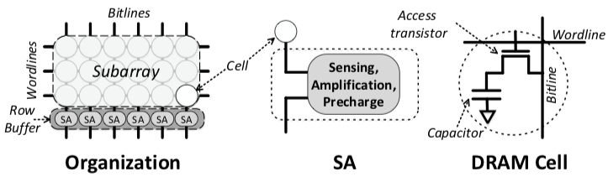
DRAM Organization
DRAM design has being optimized for capacity and bandwidth for years
Manufacturers are reluctant to make large changes in DRAM
Small changes can add a lot of value

Slide 135
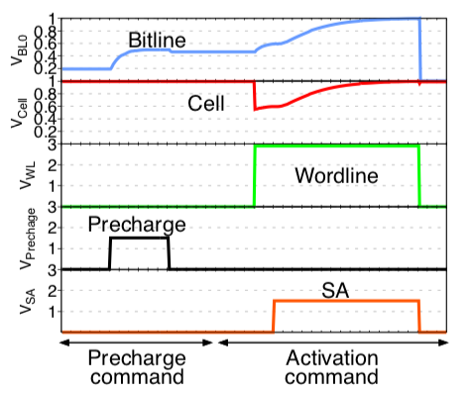
DRAM Precharge
Goal: Prepare the bitline for the next access
Precharge logic is asserted
The bitline gets precharged to Vdd/2 = 0.5V
Notice that:
  Content of the cell does not change (0 value in the figure)
  The wordline is not asserted
  The SA is not asserted
2
1
2
1

Slide 136
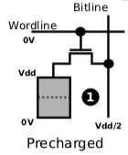
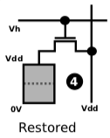
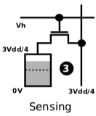
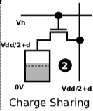
DRAM Activation
Goal: Sense and Amplify the content of a DRAM cell
Initial state (precharged bitline)
Charge Sharing: the access transistor (wordline) is asserted
Sensing phase
The SA is asserted and the content of the cell is restored
3
2
1
0
0
2
1
1
2
3
3

Slide 137
[ Dataplant Implementations]
Notes:
Here is the outline for the talk today

Slide 138
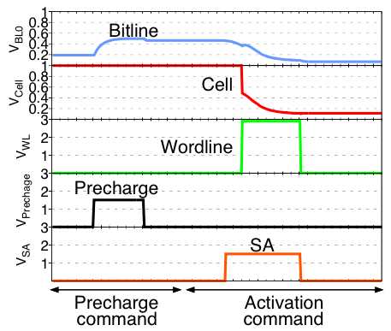
US-Dataplant
Key idea: Assert the SA before asserting the access transistor
Assert the SA
The bitline is biased towards a value that depends on process variation
Assert the access transistor (wordline) - optional
The content of the cell is destroyed - - optional
The generated value depends on process variation
Value generated in the SA (it does not require a cell to generate a value)
1
2
2
3
4
4
3
1

Slide 139
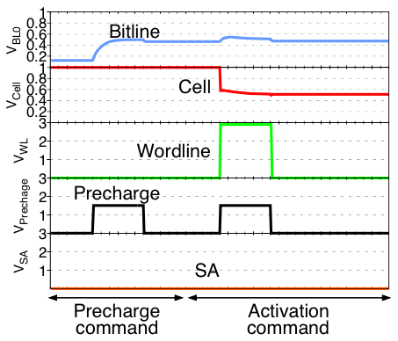
UC-Dataplant
Key Idea: discharge the DRAM cells by asserting the precharge logic while asserting the access transistor
Assert the access transistor (wordline)
Assert the precharge logic
The cell is driven to Vdd/2
The value is generated in the next regular activation
The cell will restore towards a value that depends on process variation
1
3
2
3
1
2

Slide 140
UC-Dataplant vs. US-Dataplant
Both:
  Quick evaluation (same as a regular activation)
  Tolerate temperature changes
US-Dataplant
  Random values are generated in the DRAM Sense Amplifiers
  Content of the cell is not necessarily destroyed (decided under the user’s control)
UC-Dataplant
  Random values are generated in the DRAM cells
  Content of the cell is destroyed

Slide 141
[ Results ]
Notes:
Here is the outline for the talk today

Slide 142
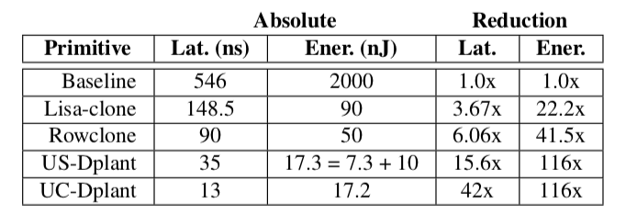
Dataplant Primitive Results
Comparison with state-of-the-art DRAM primitives for cloning data in DRAM
Latency and energy to overwrite a DRAM row:
Dataplant is much faster and energy efficient

Slide 143
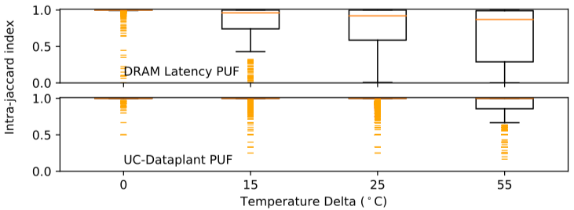
PUF Results
Dataplant is more resilient to temperature changes
Dataplant is faster than the state-of-the-art DRAM PUFs
  DRAM Latency PUF evaluation time: 87 ms
  Dataplant PUF evaluation time: 8.7 ms (10X faster)
DRAM Latency PUF: Large changes with temperature
Dataplant PUF: Small changes with temperature

Slide 144
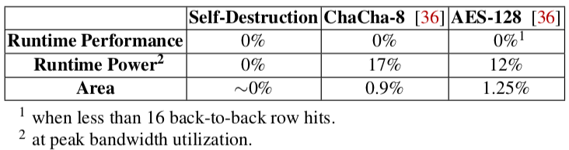
Cold Boot Attack Results
Zero Runtime performance overhead
Zero Runtime power overhead
Negligible area overhead
Dataplant
[36] S. F. Yitbarek, et al. “Cold boot attacks are still hot: Security analysis of memory scramblers in modern processors,” in HPCA, 2017

Slide 145
Dataplant:
In-DRAM Security Mechanisms for Low-Cost Devices
Lois Orosa, Yaohua Wang, Ivan Puddu, Mohammad Sadrosadati, Kaveh Razavi, Juan Gomez-Luna, Hasan Hassan, Nika Mansouri, Arash Tavakkol, Minesh Patel, Jeremie Kim, Vivek Seshadri, Uksong Kang, Saugata Ghose, Rodolfo Azevedo, Onur Mutlu

Slide 146
More on Dataplant
Dataplant: In-DRAM Security Mechanisms for Low-Cost Devices
  https://arxiv.org/pdf/1902.07344.pdf

Slide 147
Using Memory for Security
Generating True Random Numbers (using DRAM)
  Kim et al., HPCA 2019
Evaluating Physically Unclonable Functions (using DRAM)
  Kim et al., HPCA 2018
Quickly Destroying In-Memory Data (using DRAM)
  Orosa et al., arxiv 2019

Slide 148
Conclusion
Memory devices have inherent capability to support key security primitives
  True Random Number Generation
  Physically Unclonable Functions
  Fast Destruction/Randomization of Data
  …
It is time for us to treat memory as an intelligent device
  that does more than simply storing and supplying data…
  Producing security primitives is one example
We can reinvent computing
  with a memory-centric design perspective

Slide 149

Nature is (Likely) Memory-Centric
Source: http://spectrum.ieee.org/image/MjYzMzAyMg.jpeg

Slide 150
Accelerated Memory Course (~6.5 hours)
ACACES 2018
  Memory Systems and Memory-Centric Computing Systems
  Taught by Onur Mutlu July 9-13, 2018
  ~6.5 hours of lectures
Website for the Course including Videos, Slides, Papers
  https://people.inf.ethz.ch/omutlu/acaces2018.html
  https://www.youtube.com/playlist?list=PL5Q2soXY2Zi-HXxomthrpDpMJm05P6J9x
All Papers are at:
  https://people.inf.ethz.ch/omutlu/projects.htm
  Final lecture notes and readings (for all topics)

Slide 151
Using Commodity Memory Devices to Support Fundamental Security Primitives
Onur Mutlu
omutlu@gmail.com
https://people.inf.ethz.ch/omutlu
10 May 2019
HOST ESSA Workshop Visionary Talk

Slide 152
Readings, Videos, Reference Materials

Slide 153
Accelerated Memory Course (~6.5 hours)
ACACES 2018
  Memory Systems and Memory-Centric Computing Systems
  Taught by Onur Mutlu July 9-13, 2018
  ~6.5 hours of lectures
Website for the Course including Videos, Slides, Papers
  https://people.inf.ethz.ch/omutlu/acaces2018.html
  https://www.youtube.com/playlist?list=PL5Q2soXY2Zi-HXxomthrpDpMJm05P6J9x
All Papers are at:
  https://people.inf.ethz.ch/omutlu/projects.htm
  Final lecture notes and readings (for all topics)

Slide 154
Reference Overview Paper
Onur Mutlu, Saugata Ghose, Juan Gomez-Luna, and Rachata Ausavarungnirun,
"Processing Data Where It Makes Sense: Enabling In-Memory Computation"
Invited paper in Microprocessors and Microsystems (MICPRO), June 2019.
[arXiv version]

Slide 155
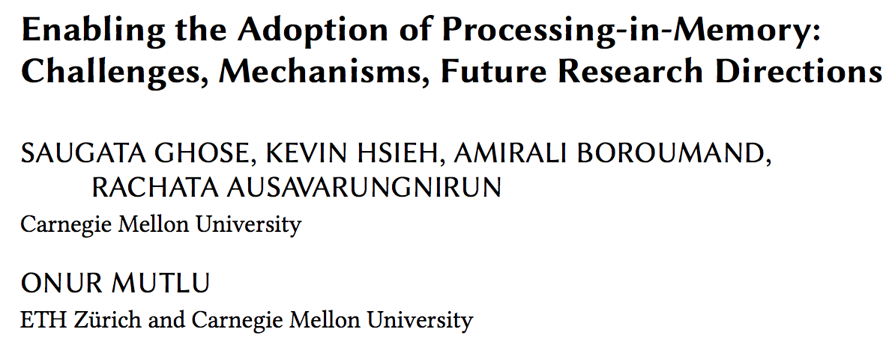
Reference Overview Paper I
Saugata Ghose, Kevin Hsieh, Amirali Boroumand, Rachata Ausavarungnirun, Onur Mutlu,
"Enabling the Adoption of Processing-in-Memory: Challenges, Mechanisms, Future Research Directions"
Invited Book Chapter, to appear in 2018.
[Preliminary arxiv.org version]
https://arxiv.org/pdf/1802.00320.pdf

Slide 156
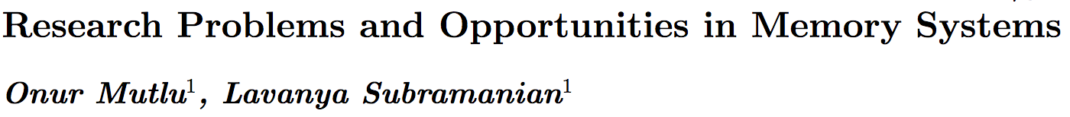
Reference Overview Paper II
Onur Mutlu and Lavanya Subramanian,
"Research Problems and Opportunities in Memory Systems"
Invited Article in Supercomputing Frontiers and Innovations (SUPERFRI), 2014/2015.
https://people.inf.ethz.ch/omutlu/pub/memory-systems-research_superfri14.pdf

Slide 157
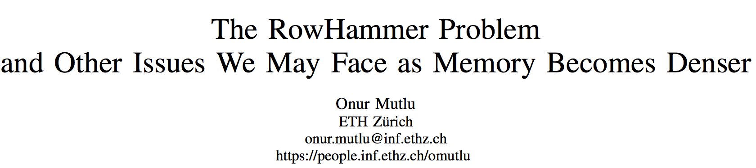
Reference Overview Paper III
Onur Mutlu,
"The RowHammer Problem and Other Issues We May Face as Memory Becomes Denser"
Invited Paper in Proceedings of the Design, Automation, and Test in Europe Conference (DATE), Lausanne, Switzerland, March 2017.
[Slides (pptx) (pdf)]
https://people.inf.ethz.ch/omutlu/pub/rowhammer-and-other-memory-issues_date17.pdf

Slide 158
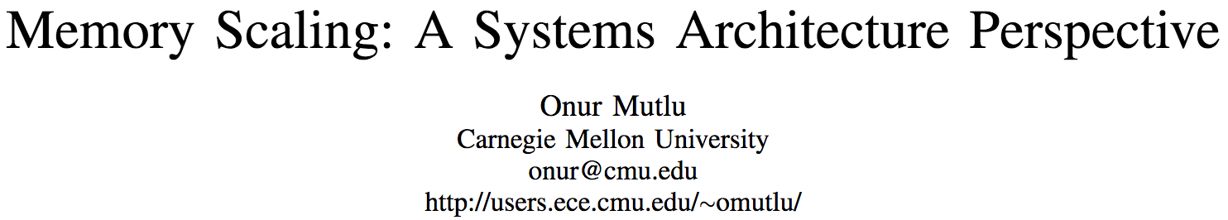
Reference Overview Paper IV
Onur Mutlu,
"Memory Scaling: A Systems Architecture Perspective"
Technical talk at MemCon 2013 (MEMCON), Santa Clara, CA, August 2013. [Slides (pptx) (pdf)]
[Video] [Coverage on StorageSearch]
https://people.inf.ethz.ch/omutlu/pub/memory-scaling_memcon13.pdf

Slide 159
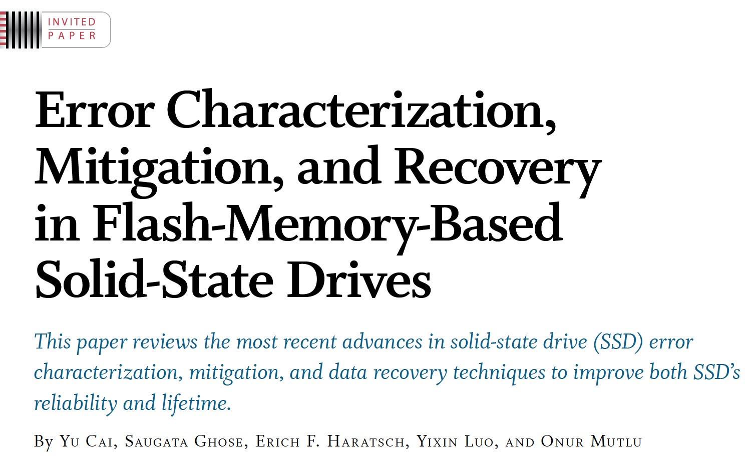
Reference Overview Paper V
Proceedings of the IEEE, Sept. 2017
https://arxiv.org/pdf/1706.08642

Slide 160
Related Videos and Course Materials (I)
Undergraduate Computer Architecture Course Lecture Videos (2015, 2014, 2013)
Undergraduate Computer Architecture Course Materials (2015, 2014, 2013)
Graduate Computer Architecture Course Lecture Videos (2017, 2015, 2013)
Graduate Computer Architecture Course Materials (2017, 2015, 2013)
Parallel Computer Architecture Course Materials (Lecture Videos)

Slide 161
Related Videos and Course Materials (II)
Freshman Digital Circuits and Computer Architecture Course Lecture Videos (2018, 2017)
Freshman Digital Circuits and Computer Architecture Course Materials (2018)
Memory Systems Short Course Materials
(Lecture Video on Main Memory and DRAM Basics)

Slide 162
Some Open Source Tools (I)
Rowhammer – Program to Induce RowHammer Errors
  https://github.com/CMU-SAFARI/rowhammer
Ramulator – Fast and Extensible DRAM Simulator
  https://github.com/CMU-SAFARI/ramulator
MemSim – Simple Memory Simulator
  https://github.com/CMU-SAFARI/memsim
NOCulator – Flexible Network-on-Chip Simulator
  https://github.com/CMU-SAFARI/NOCulator
SoftMC – FPGA-Based DRAM Testing Infrastructure
  https://github.com/CMU-SAFARI/SoftMC
Other open-source software from my group
  https://github.com/CMU-SAFARI/
  http://www.ece.cmu.edu/~safari/tools.html

Slide 163
Some Open Source Tools (II)
MQSim – A Fast Modern SSD Simulator
  https://github.com/CMU-SAFARI/MQSim
Mosaic – GPU Simulator Supporting Concurrent Applications
  https://github.com/CMU-SAFARI/Mosaic
IMPICA – Processing in 3D-Stacked Memory Simulator
  https://github.com/CMU-SAFARI/IMPICA
SMLA – Detailed 3D-Stacked Memory Simulator
  https://github.com/CMU-SAFARI/SMLA
HWASim – Simulator for Heterogeneous CPU-HWA Systems
  https://github.com/CMU-SAFARI/HWASim
Other open-source software from my group
  https://github.com/CMU-SAFARI/
  http://www.ece.cmu.edu/~safari/tools.html

Slide 164

More Open Source Tools (III)
A lot more open-source software from my group
  https://github.com/CMU-SAFARI/
  http://www.ece.cmu.edu/~safari/tools.html

Slide 165
Referenced Papers
All are available at
  https://people.inf.ethz.ch/omutlu/projects.htm
  http://scholar.google.com/citations?user=7XyGUGkAAAAJ&hl=en
  https://people.inf.ethz.ch/omutlu/acaces2018.html

Slide 166
FPGA-Based Testing Infrastructures for Memory Scaling Issues

Slide 167
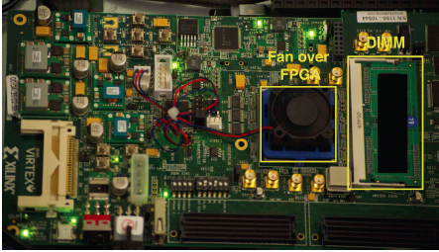
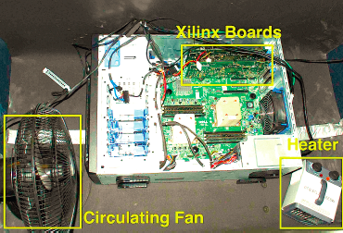
Infrastructures to Understand Such Issues
  An Experimental Study of Data Retention Behavior in Modern DRAM Devices: Implications for Retention Time Profiling Mechanisms (Liu et al., ISCA 2013)
  The Efficacy of Error Mitigation Techniques for DRAM Retention Failures: A Comparative Experimental Study
  (Khan et al., SIGMETRICS 2014)
  Flipping Bits in Memory Without Accessing Them: An Experimental Study of DRAM Disturbance Errors (Kim et al., ISCA 2014)
  Adaptive-Latency DRAM: Optimizing DRAM Timing for the Common-Case (Lee et al., HPCA 2015)
  AVATAR: A Variable-Retention-Time (VRT) Aware Refresh for DRAM Systems (Qureshi et al., DSN 2015)

Slide 168

Infrastructures to Understand Such Issues
Temperature
Controller
FPGAs
Heater
FPGAs
PC
  Kim+, “Flipping Bits in Memory Without Accessing Them: An Experimental Study of DRAM Disturbance Errors,” ISCA 2014.

Slide 169
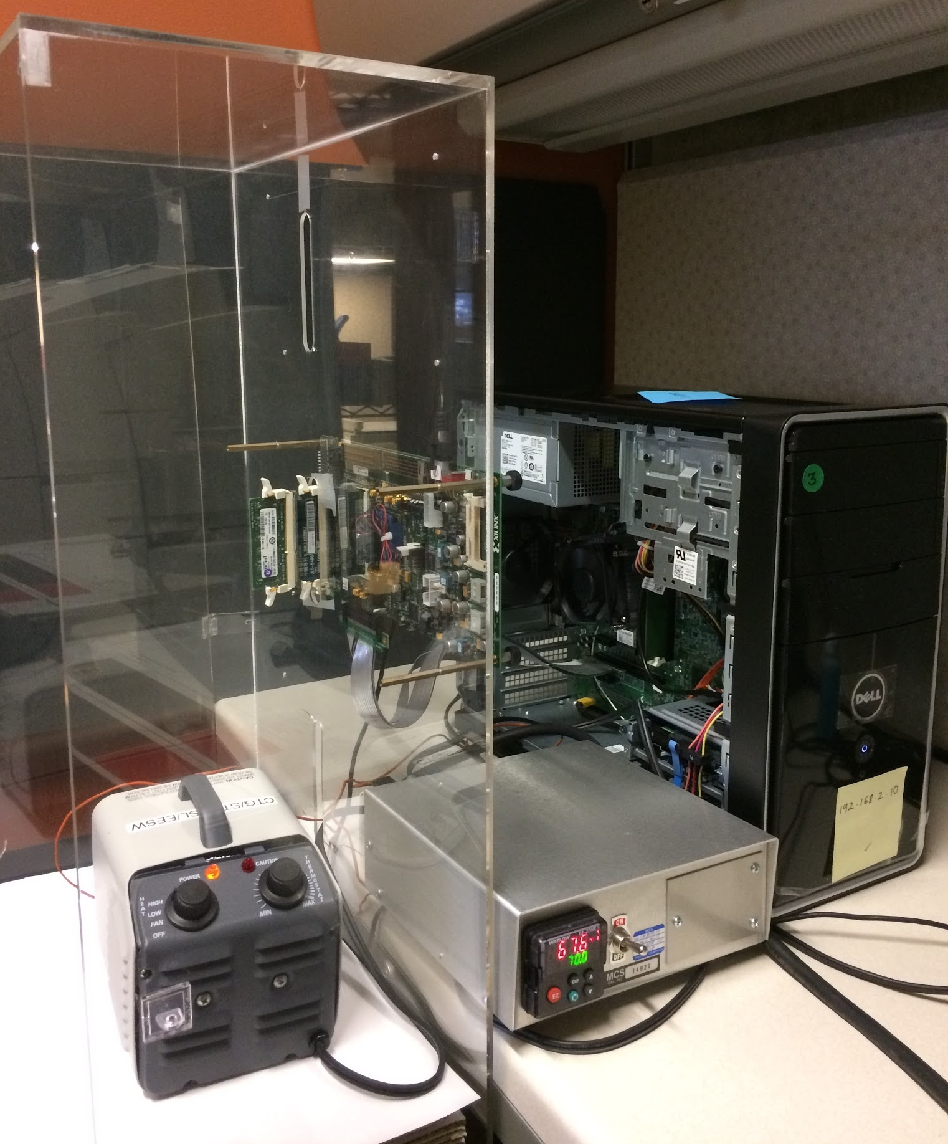
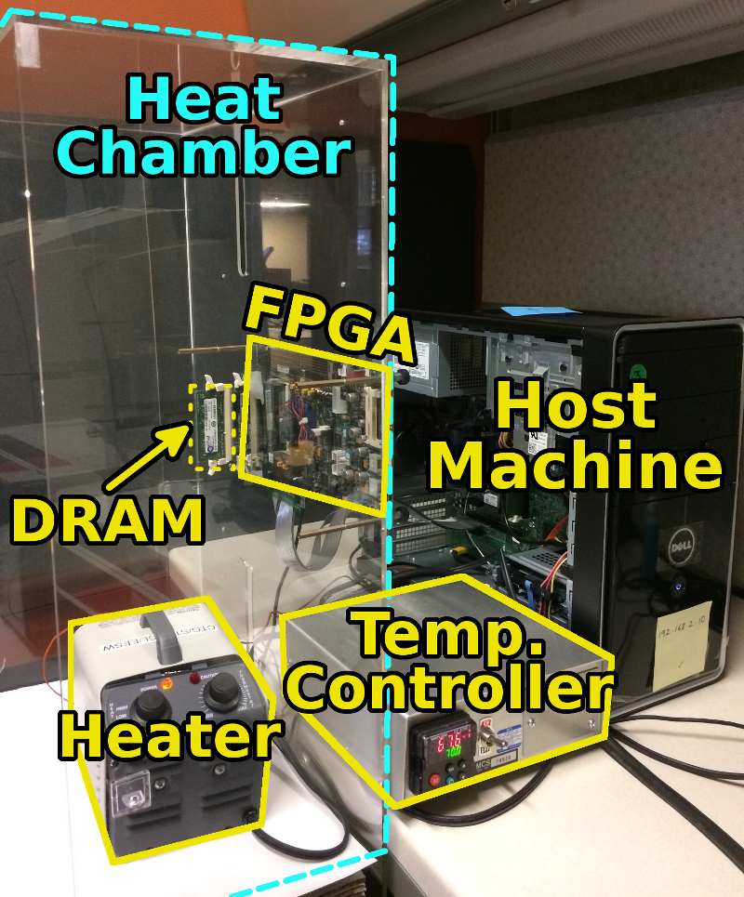
SoftMC: Open Source DRAM Infrastructure
Hasan Hassan et al., “SoftMC: A Flexible and Practical Open-Source Infrastructure for Enabling Experimental DRAM Studies,” HPCA 2017.
Flexible
Easy to Use (C++ API)
Open-source
github.com/CMU-SAFARI/SoftMC

Slide 170
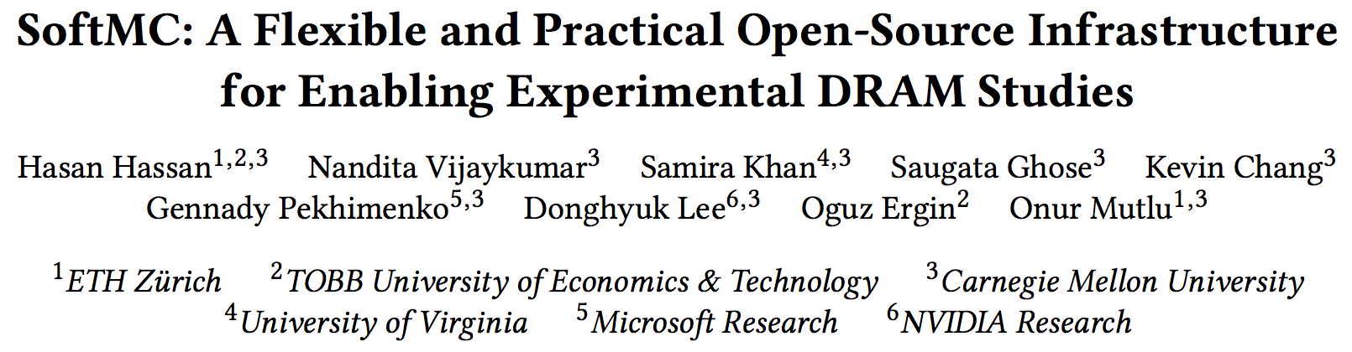
SoftMC
https://github.com/CMU-SAFARI/SoftMC

Slide 171
DRaNGe Backup Slides

Slide 172
DRAM Organization + Operation

Slide 173
DRAM Activation Failure Testing

Slide 174
Activation Failure Spatial Distribution

Slide 175
Activation Failure Temperature Dependence

Slide 176
Full D-RaNGe Algorithm

Slide 177
Summary Comparison Table

Slide 178
DRAM Data Pattern Dependence

Slide 179
Each Cell has a Different Retention Time
Row Decoder
wordline
access
transistor
capacitor
Row Buffer
bitline
8GB DRAM = 6.4e10 cells
[Patel et al., REAPER, ISCA’17]
Notes:
DRAM is comprised of [CLICK] many of these small cells to have a large capacity. [CLICK] For an example 8GB DRAM device, there are 64 billion of these cells.
In correct operation, every one of these cells are restored every 64 ms, so there are no retention failures during program execution.
However, prior work has shown that cells of a given retention time are uniform randomly distributed across the DRAM array

Slide 180
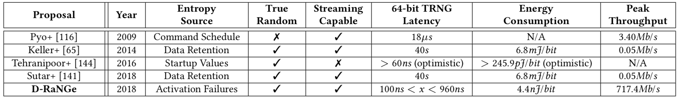
D-RaNGe Compared to Prior Work
Proposal | Pyo+ | Keller+ | Tehranipoor+ | Sutar+ | D-RaNGe
Year | 2009 | 2014 | 2016 | 2018 | 2019
Entropy Source | Command Schedule | Data Retention | Startup Values | Data Retention | Activation Failures
True Random
Streaming Capable
64-bit TRNG Latency | 18us | 40s | >60ns (optimistic) | 40s | 100ns < x < 960ns
Energy Consumption | N/A | 6.8mJ/bit | 245.9pJ/bit (optimistic) | 6.8mJ/bit | 4.4nJ/bit
Peak Throughput | 3.4Mb/s | 0.05Mb/s | N/A | 0.05Mb/s | 717.4Mb/s

Slide 181
DRAM Architecture Background

Slide 182
Sources of Retention Time Variation
Process/voltage/temperature
Data pattern dependence (DPD)
  Retention times change with data in cells/neighbors
  e.g., all 1’s vs. all 0’s
Variable retention time (VRT)
  Retention time changes randomly (unpredictably)
  Due to a combination of various circuit effects
Notes:
Let’s take a look at some of the sources of this variation.
[CLICK]
First, cell retention times depend on process variation and vary dynamically with changes in voltage and temeperature.
[CLICK]
Second, data pattern dependence effects mean that the retention time of a cell depends on the value programmed into the cell and its neighbors.
For example, a DRAM containing all 1’s would have a different set of failures than if it contained all 0’s
[CLICK]
Third, variable retention time effects mean that the retention times of cells change randomly, and more importantly, unpredictably, over time
This is due to a combination of various circuit level effects
And prior work has shown that VRT effects make ECC necessary to operate at a longer refresh interval.
[END]

Slide 183
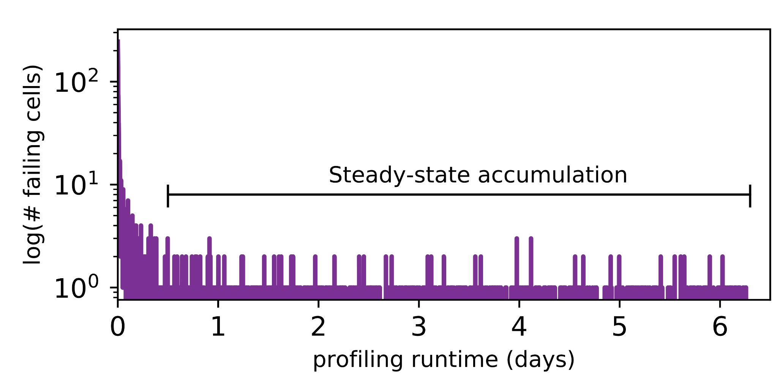
Long-term Continuous Profiling
Representative chip from Vendor B, 2048ms, 45°C
# New Failing Cells
Error correction codes (ECC)
and online profiling are necessary
to manage new failing cells
Time (days)
New failing cells continue to appear over time
  Attributed to variable retention time (VRT)
The set of failing cells changes over time
Notes:
Here is some data we collected from a representative chip at a fixed refresh interval of 2048ms.
We show the number of new failing cells discovered by continuously profiling over 6 days.
[CLICK]
We see that new failing cells continue to appear over time.
We attribute these to variable retention time effects, which mean that cells can randomly change retention times at any point.
[CLICK]
This shows that the set of failing cells we find at 2048ms changes over time
[CLICK]
This means that error correction codes and online profiling are necessary to manage new failing cells that continue to appear
[END]

Slide 184
Single-cell Failure Probability (Cartoon)
idealized cell
(retention time = 3s)
actual cell
N(μ, σ) | μ = 3s
Notes:
In another study, we analyzed the failure probability of individual cells.
Here we show the probability of read failure for a single cell over different refresh intervals
We show an idealized cell, with never fails below 3.5 seconds, but always fails above 3.5s
We can say that this cell has a retention time of 3.5s.
[CLICK]
However, we find that real cells look more like the blue cartoon, which follows a normal distribution with a mean at 3.5s.
Note that even below 3.5s, there is a nonzero probability of the cell failing.
[END]

Slide 185
Single-cell Failure Probability (Real)
operate here
profile here
easy
Any cell is more likely to fail
at a longer refresh interval
OR a higher temperature
to find
failed 9 times out of 16 trials
hard
false
to find
positives
Notes:
TEMPERATURE TEMPERATURE TEMPERATURE TEMPERATURE TEMPERATURE TEMPERATURE TEMPERATURE
Here we show real data from a real chip, [CLICK] which we collected by testing how often the cell failed out of 16 trials for different refresh intervals.
[CLICK]
We now show 8 different cells from the same chip.
[CLICK]
Suppose we are interested in operating at a refresh interval of 1.7 seconds.
[CLICK]
We will find 6 cells with a non-negligible probability of failing
[CLICK]
However, the bottom two cells will be hard to find since they have a low probability of failure at this refresh interval
[CLICK]
Instead, if we profile at an increased refresh interval, [CLICK] the same cells will be much easier to find since they will have a high probability of failure.
[CLICK]
However, we will also identify some additional cells as failing, which can end up being false positives.
[CLICK]
We repeat the same analysis for temperature variation and find that cells behave similarly. We show details of this analysis in the paper.
[CLICK]
The takeaway here is that any given cell is more likely to fail at a longer refresh interval or a higher temperature.
[END]

Slide 186
Temperature Relationship
Well-fitting exponential relationship:
E.g., 10°C ~ 10x more failures

Slide 187
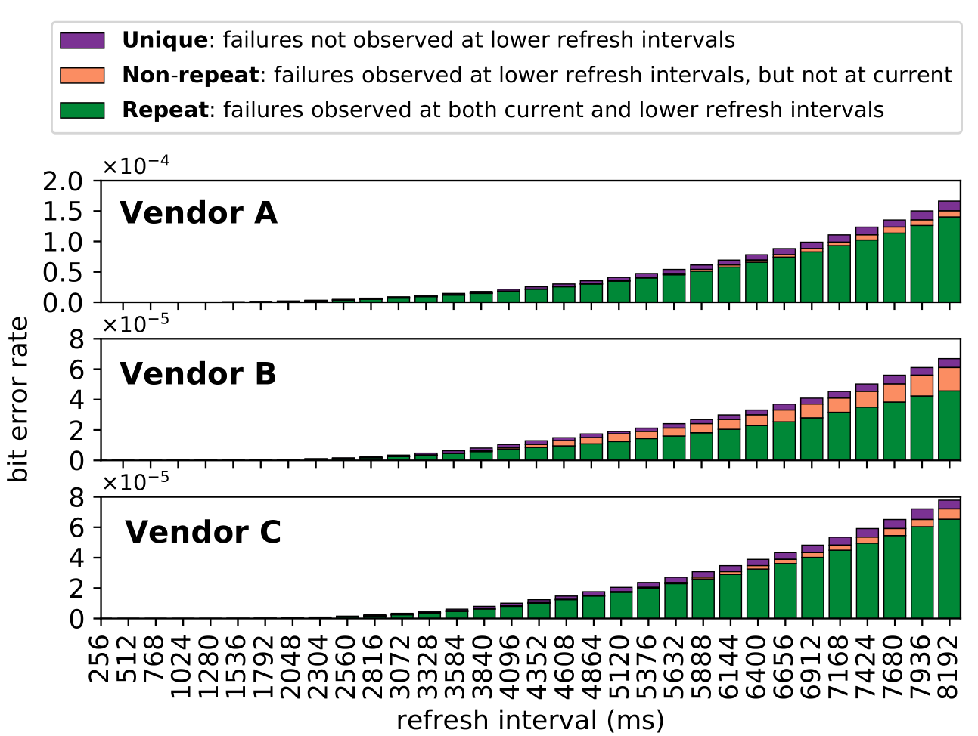
Retention Failures @ 45°C

Slide 188
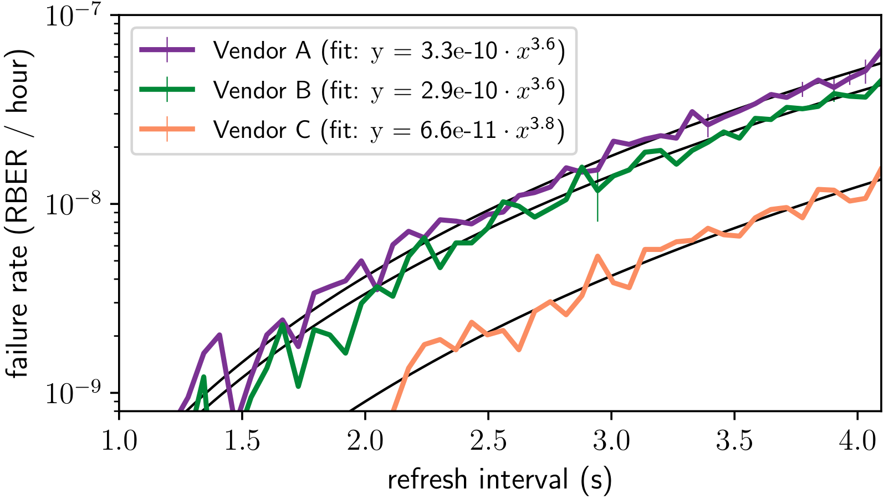
VRT Failure Accumulation Rate
Notes:
BACKUP!!!

Slide 189
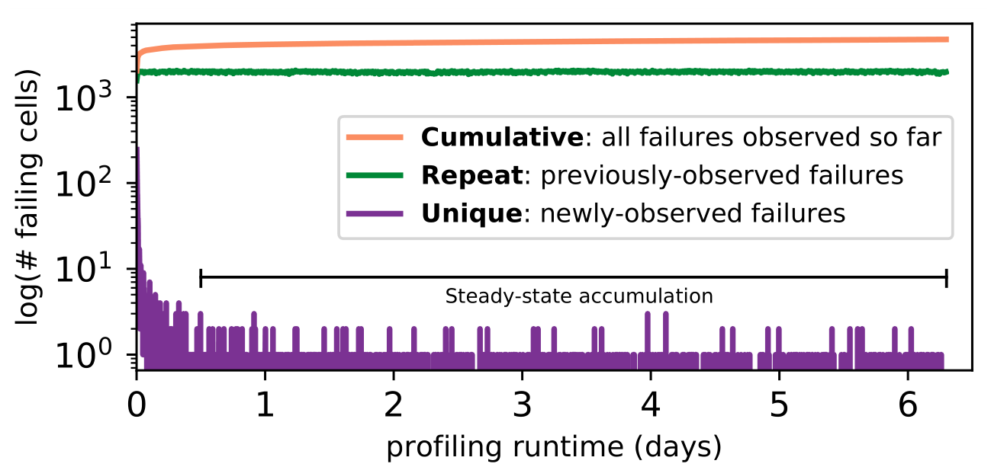
800 Rounds of Profiling @ 2048ms, 45°C

Slide 190
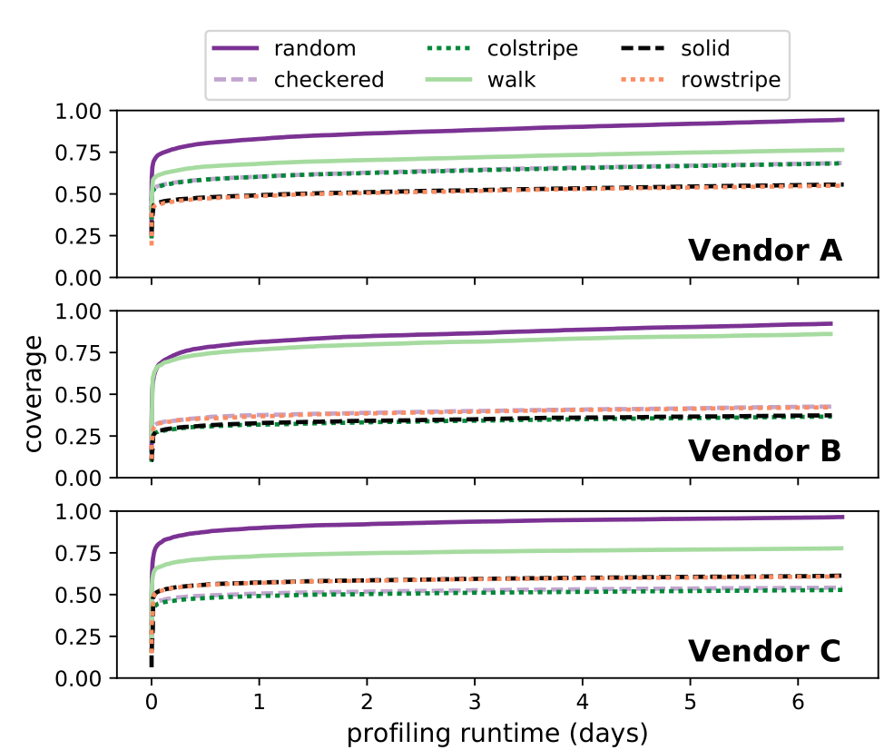
800 Rounds of Profiling @ 2048ms, 45°C

Slide 191
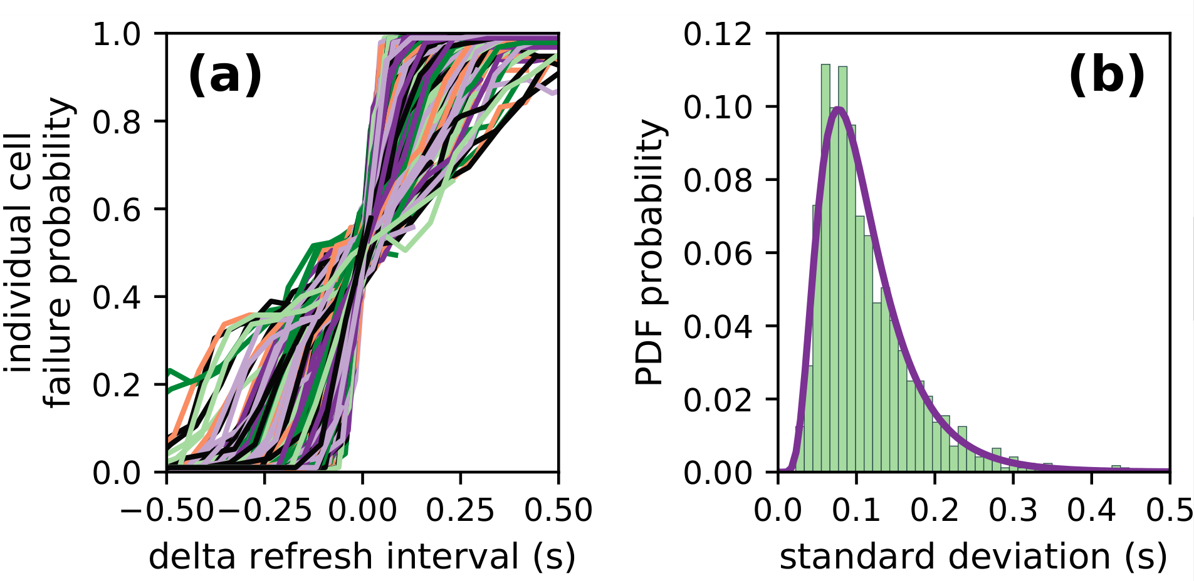
Individual Cell Failure Probabilities
Single representative chip of Vendor B at 40° C
Refresh intervals ranging from 64ms to 4096ms

Slide 192
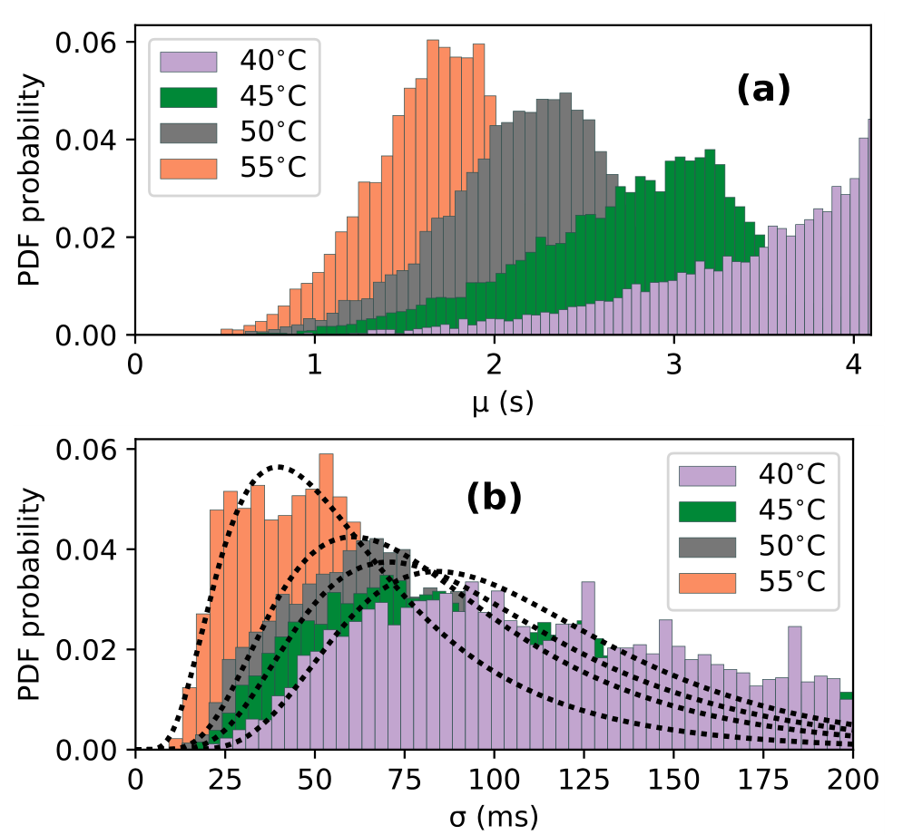
Individual Cell Failure Distributions

Slide 193
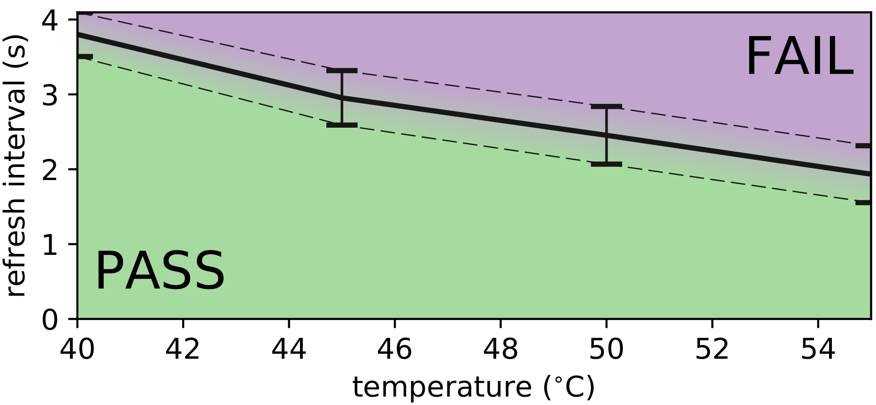
Single-cell Failures With Temperature
Single representative chip of Vendor B
{mean, std} for cells between 64ms and 4096ms

Slide 194
DRAM Latency PUF
Backup Slides

Slide 195
DRAM Architecture Background

Slide 196
Evaluating DRAM Retention PUFs

Slide 201
Temperature Effects

Slide 202
Evaluating a DRAM Latency PUF

Slide 205
DRAM Characterization

Slide 206
Sources of Retention Time Variation
Process/voltage/temperature
Data pattern dependence (DPD)
  Retention times change with data in cells/neighbors
  e.g., all 1’s vs. all 0’s
Variable retention time (VRT)
  Retention time changes randomly (unpredictably)
  Due to a combination of various circuit effects
Notes:
Let’s take a look at some of the sources of this variation.
[CLICK]
First, cell retention times depend on process variation and vary dynamically with changes in voltage and temeperature.
[CLICK]
Second, data pattern dependence effects mean that the retention time of a cell depends on the value programmed into the cell and its neighbors.
For example, a DRAM containing all 1’s would have a different set of failures than if it contained all 0’s
[CLICK]
Third, variable retention time effects mean that the retention times of cells change randomly, and more importantly, unpredictably, over time
This is due to a combination of various circuit level effects
And prior work has shown that VRT effects make ECC necessary to operate at a longer refresh interval.
[END]

Slide 207
Long-term Continuous Profiling
Representative chip from Vendor B, 2048ms, 45°C
# New Failing Cells
Error correction codes (ECC)
and online profiling are necessary
to manage new failing cells
Time (days)
New failing cells continue to appear over time
  Attributed to variable retention time (VRT)
The set of failing cells changes over time
Notes:
Here is some data we collected from a representative chip at a fixed refresh interval of 2048ms.
We show the number of new failing cells discovered by continuously profiling over 6 days.
[CLICK]
We see that new failing cells continue to appear over time.
We attribute these to variable retention time effects, which mean that cells can randomly change retention times at any point.
[CLICK]
This shows that the set of failing cells we find at 2048ms changes over time
[CLICK]
This means that error correction codes and online profiling are necessary to manage new failing cells that continue to appear
[END]

Slide 208
Single-cell Failure Probability (Cartoon)
idealized cell
(retention time = 3s)
actual cell
N(μ, σ) | μ = 3s
Notes:
In another study, we analyzed the failure probability of individual cells.
Here we show the probability of read failure for a single cell over different refresh intervals
We show an idealized cell, with never fails below 3.5 seconds, but always fails above 3.5s
We can say that this cell has a retention time of 3.5s.
[CLICK]
However, we find that real cells look more like the blue cartoon, which follows a normal distribution with a mean at 3.5s.
Note that even below 3.5s, there is a nonzero probability of the cell failing.
[END]

Slide 209
Single-cell Failure Probability (Real)
operate here
profile here
easy
Any cell is more likely to fail
at a longer refresh interval
OR a higher temperature
to find
failed 9 times out of 16 trials
hard
false
to find
positives
Notes:
TEMPERATURE TEMPERATURE TEMPERATURE TEMPERATURE TEMPERATURE TEMPERATURE TEMPERATURE
Here we show real data from a real chip, [CLICK] which we collected by testing how often the cell failed out of 16 trials for different refresh intervals.
[CLICK]
We now show 8 different cells from the same chip.
[CLICK]
Suppose we are interested in operating at a refresh interval of 1.7 seconds.
[CLICK]
We will find 6 cells with a non-negligible probability of failing
[CLICK]
However, the bottom two cells will be hard to find since they have a low probability of failure at this refresh interval
[CLICK]
Instead, if we profile at an increased refresh interval, [CLICK] the same cells will be much easier to find since they will have a high probability of failure.
[CLICK]
However, we will also identify some additional cells as failing, which can end up being false positives.
[CLICK]
We repeat the same analysis for temperature variation and find that cells behave similarly. We show details of this analysis in the paper.
[CLICK]
The takeaway here is that any given cell is more likely to fail at a longer refresh interval or a higher temperature.
[END]

Slide 210
Temperature Relationship
Well-fitting exponential relationship:
E.g., 10°C ~ 10x more failures

Slide 211
Retention Failures @ 45°C

Slide 212
VRT Failure Accumulation Rate
Notes:
BACKUP!!!

Slide 213
800 Rounds of Profiling @ 2048ms, 45°C

Slide 214
800 Rounds of Profiling @ 2048ms, 45°C

Slide 215
Individual Cell Failure Probabilities
Single representative chip of Vendor B at 40° C
Refresh intervals ranging from 64ms to 4096ms

Slide 216
Individual Cell Failure Distributions

Slide 217
Single-cell Failures With Temperature
Single representative chip of Vendor B
{mean, std} for cells between 64ms and 4096ms

