Slide 1
Intelligent Architectures for Intelligent Machines
Onur Mutlu
omutlu@gmail.com
https://people.inf.ethz.ch/omutlu
28 October 2019
HiPEAC CSW Autumn 2019 Keynote

Slide 2
The Problem
Computing
is Bottlenecked by Data

Slide 3
Data is Key for AI, ML, Genomics, …
Important workloads are all data intensive
They require rapid and efficient processing of large amounts of data
Data is increasing
We can generate more than we can process

Slide 4
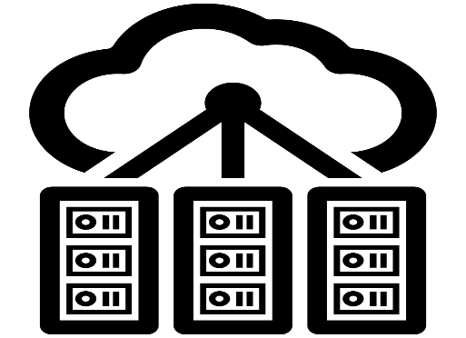
Data is Key for Future Workloads
In-memory Databases
[Mao+, EuroSys’12; Clapp+ (Intel), IISWC’15]
Graph/Tree Processing
[Xu+, IISWC’12; Umuroglu+, FPL’15]
In-Memory Data Analytics
[Clapp+ (Intel), IISWC’15;
Awan+, BDCloud’15]
Datacenter Workloads [Kanev+ (Google), ISCA’15]

Slide 5
Data Overwhelms Modern Machines
In-memory Databases
[Mao+, EuroSys’12; Clapp+ (Intel), IISWC’15]
Graph/Tree Processing
[Xu+, IISWC’12; Umuroglu+, FPL’15]
Data → performance & energy bottleneck
In-Memory Data Analytics
[Clapp+ (Intel), IISWC’15;
Awan+, BDCloud’15]
Datacenter Workloads [Kanev+ (Google), ISCA’15]

Slide 6
Data is Key for Future Workloads
Chrome
TensorFlow Mobile
Google’s web browser
Google’s machine learning framework
Video Playback
Video Capture
Google’s video codec
Google’s video codec
Notes:
In this work, we take a look at widely-used google consumer workloads, to figure out the major sources of energy consumption.
We look at Google Chrome web brower. We take a look at Tensorflow, Google’s machine learning framework, and we also take a look at two important video related workloads, video playback and video capture, both rely on Google’s vp9 codec technology.

Slide 7
Data Overwhelms Modern Machines
Chrome
TensorFlow Mobile
Google’s web browser
Google’s machine learning framework
Data → performance & energy bottleneck
Video Playback
Video Capture
Google’s video codec
Google’s video codec
Notes:
In this work, we take a look at widely-used google consumer workloads, to figure out the major sources of energy consumption.
We look at Google Chrome web brower. We take a look at Tensorflow, Google’s machine learning framework, and we also take a look at two important video related workloads, video playback and video capture, both rely on Google’s vp9 codec technology.

Slide 8
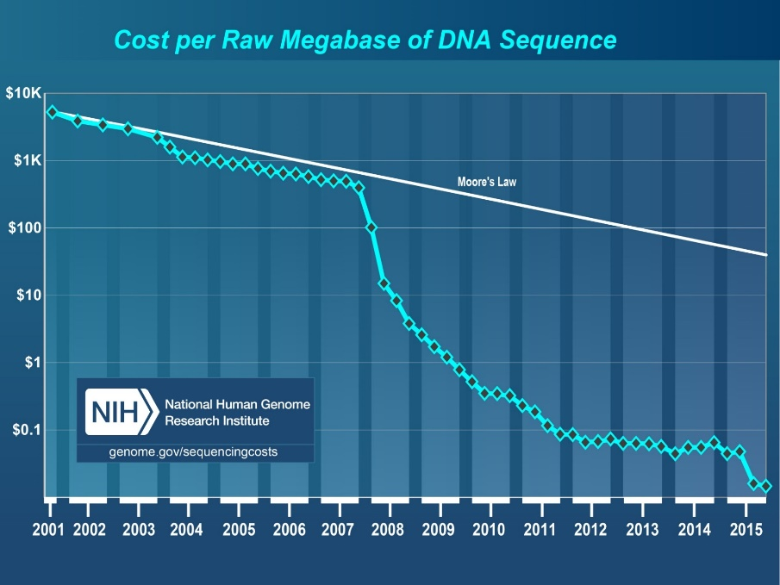
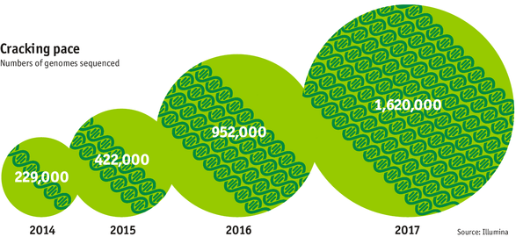
Data is Key for Future Workloads
development of high-throughput sequencing (HTS) technologies
Number of Genomes Sequenced
http://www.economist.com/news/21631808-so-much-genetic-data-so-many-uses-genes-unzipped
Notes:
However, since the development of high throughput sequencing (HTS) technologies, the cost of genome sequencing has fallen off a cliff (<< 1,000$) making it viable for almost everyone's use.

Slide 9
1
Sequencing
Genome Analysis
Read Mapping
2
Data → performance & energy bottleneck
Variant Calling
Scientific Discovery
3
4
Notes:
Genome analysis starts with sequencing random short DNA fragments of copies of the original molecule.
Unfortunately, these reads lack information about their order and which part of genome they are originated from.
Hence the second step is to map these reads to a long reference genome.

Slide 10
New Genome Sequencing Technologies
Oxford Nanopore MinION
Senol Cali+, “Nanopore Sequencing Technology and Tools for Genome
Assembly: Computational Analysis of the Current State, Bottlenecks
and Future Directions,” Briefings in Bioinformatics, 2018.
[Preliminary arxiv.org version]
Data → performance & energy bottleneck

Slide 11
Data Overwhelms Modern Machines …
Storage/memory capability
Communication capability
Computation capability
Greatly impacts robustness, energy, performance, cost

Slide 12
A Computing System
Three key components
Computation
Communication
Storage/memory
Burks, Goldstein, von Neumann, “Preliminary discussion of the
logical design of an electronic computing instrument,” 1946.
Image source: https://lbsitbytes2010.wordpress.com/2013/03/29/john-von-neumann-roll-no-15/

Slide 13
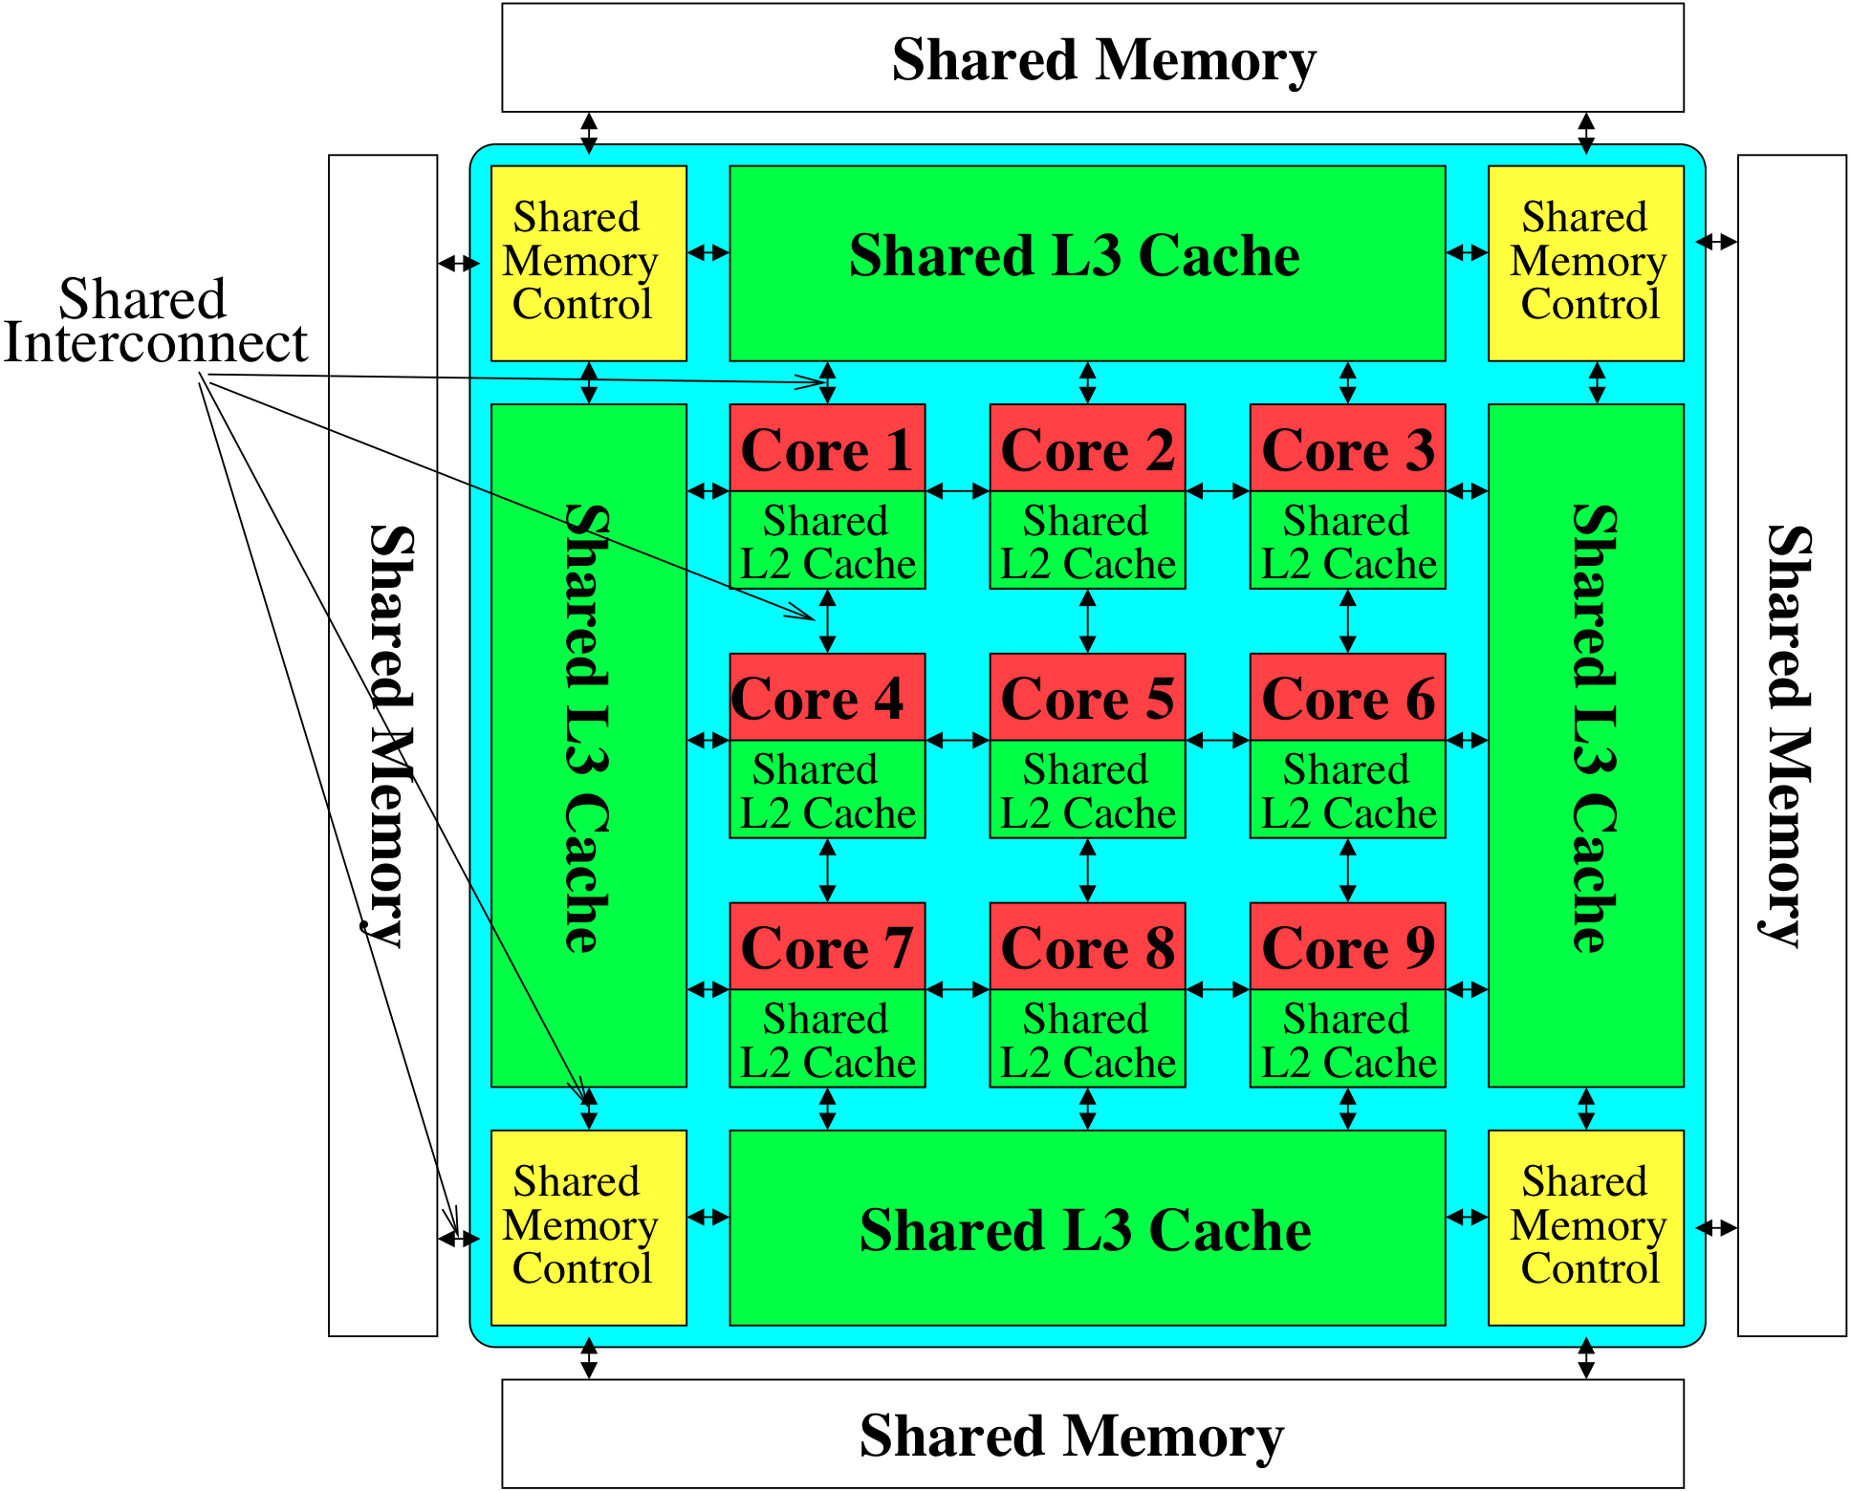
Perils of Processor-Centric Design
Most of the system is dedicated to storing and moving data

Slide 14
Data Overwhelms Modern Machines
Chrome
TensorFlow Mobile
Google’s web browser
Google’s machine learning framework
Data → performance & energy bottleneck
Video Playback
Video Capture
Google’s video codec
Google’s video codec
Notes:
In this work, we take a look at widely-used google consumer workloads, to figure out the major sources of energy consumption.
We look at Google Chrome web brower. We take a look at Tensorflow, Google’s machine learning framework, and we also take a look at two important video related workloads, video playback and video capture, both rely on Google’s vp9 codec technology.

Slide 15
Data Movement Overwhelms Modern Machines
Amirali Boroumand, Saugata Ghose, Youngsok Kim, Rachata Ausavarungnirun, Eric Shiu, Rahul Thakur, Daehyun Kim, Aki Kuusela, Allan Knies, Parthasarathy Ranganathan, and Onur Mutlu, "Google Workloads for Consumer Devices: Mitigating Data Movement Bottlenecks" Proceedings of the 23rd International Conference on Architectural Support for Programming Languages and Operating Systems (ASPLOS), Williamsburg, VA, USA, March 2018.
62.7% of the total system energy
is spent on data movement

Slide 16
Axiom
An Intelligent Architecture
Handles Data Well

Slide 17
How to Handle Data Well
Ensure data does not overwhelm the components
via intelligent algorithms
via intelligent architectures
via whole system designs: algorithm-architecture-devices
Take advantage of vast amounts of data and metadata
to improve architectural & system-level decisions
Understand and exploit properties of (different) data
to improve algorithms & architectures in various metrics

Slide 18
Corollaries: Architectures Today …
Architectures are terrible at dealing with data
Designed to mainly store and move data vs. to compute
They are processor-centric as opposed to data-centric
Architectures are terrible at taking advantage of vast amounts of data (and metadata) available to them
Designed to make simple decisions, ignoring lots of data
They make human-driven decisions vs. data-driven decisions
Architectures are terrible at knowing and exploiting different properties of application data
Designed to treat all data as the same
They make component-aware decisions vs. data-aware

Slide 19
Data-Centric (Memory-Centric) Architectures

Slide 20
Data-Centric Architectures: Properties
Process data where it resides (where it makes sense)
Processing in and near memory structures
Low-latency and low-energy data access
Low latency memory
Low energy memory
Low-cost data storage and processing
High capacity memory at low cost: hybrid memory, compression
Intelligent data management
Intelligent controllers handling robustness, security, cost

Slide 21
Processing Data Where It Makes Sense

Slide 22
Why In-Memory Computation Today?
Push from Technology
DRAM Scaling at jeopardy
→ Controllers close to DRAM
→ Industry open to new memory architectures

Slide 23
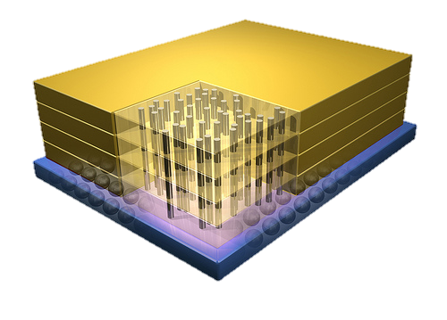
Why In-Memory Computation Today?
Push from Technology
DRAM Scaling at jeopardy
→ Controllers close to DRAM
→ Industry open to new memory architectures

Slide 24
Memory Scaling Issues Were Real
Onur Mutlu, "Memory Scaling: A Systems Architecture Perspective" Proceedings of the 5th International Memory Workshop (IMW), Monterey, CA, May 2013. Slides (pptx) (pdf) EETimes Reprint
https://people.inf.ethz.ch/omutlu/pub/memory-scaling_memcon13.pdf

Slide 25
Memory Scaling Issues Are Real
Onur Mutlu and Jeremie Kim, "RowHammer: A Retrospective" IEEE Transactions on Computer-Aided Design of Integrated Circuits and Systems (TCAD) Special Issue on Top Picks in Hardware and Embedded Security, 2019. [Preliminary arXiv version]

Slide 26
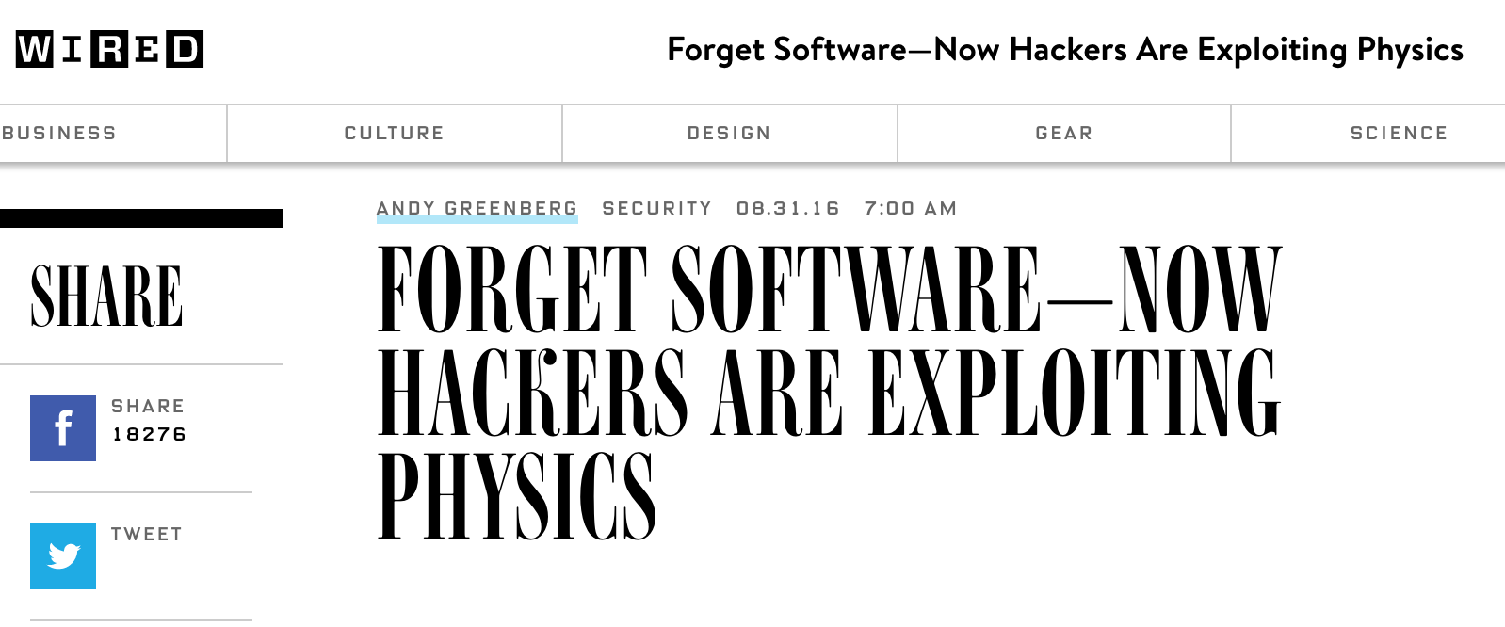
The Story of RowHammer
One can predictably induce bit flips in commodity DRAM chips
>80% of the tested DRAM chips are vulnerable
First example of how a simple hardware failure mechanism can create a widespread system security vulnerability

Slide 27
The Push from Circuits and Devices
Main Memory Needs
Intelligent Controllers

Slide 28
Why In-Memory Computation Today?
Push from Technology
DRAM Scaling at jeopardy
→ Controllers close to DRAM
→ Industry open to new memory architectures
Pull from Systems and Applications
Data access is a major system and application bottleneck
Systems are energy limited
Data movement much more energy-hungry than computation

Slide 29
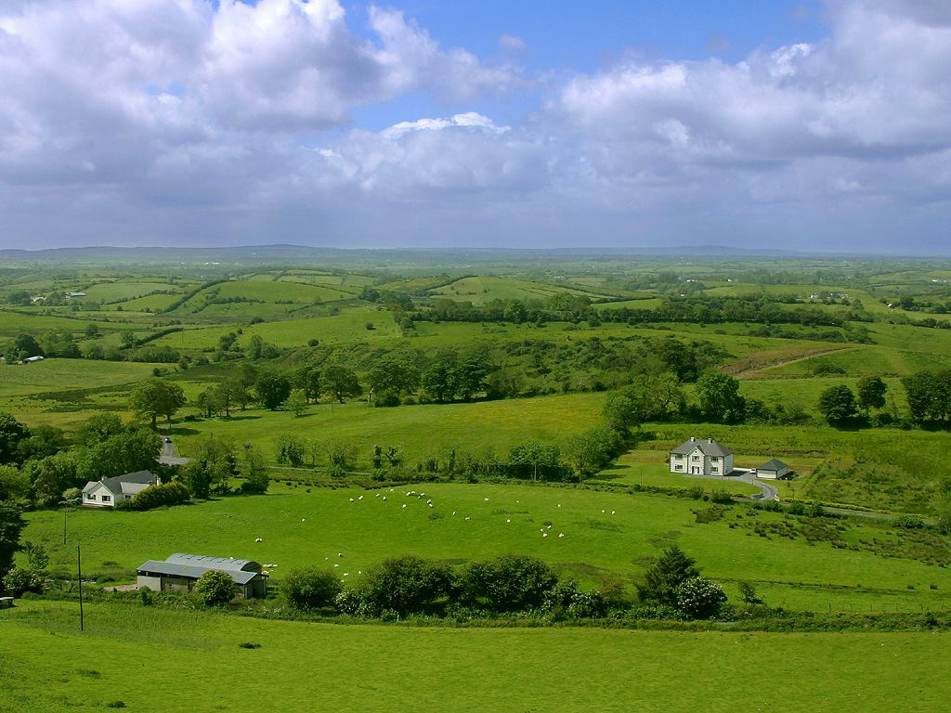
Do We Want This?
Source: V. Milutinovic

Slide 30
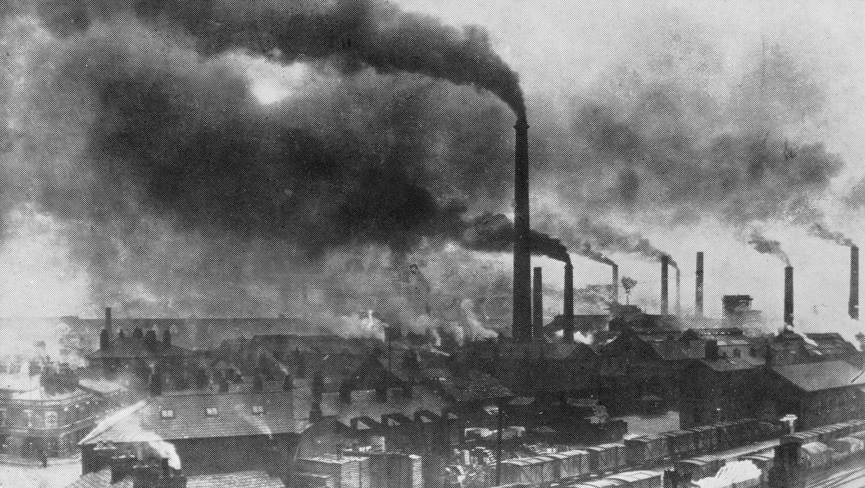
Or This?
Source: V. Milutinovic

Slide 31
Challenge and Opportunity for Future
High Performance,
Energy Efficient,
Sustainable

Slide 32
The Problem
Data access is the major performance and energy bottleneck
Our current
design principles
cause great energy waste
(and great performance loss)

Slide 33
The Problem
Processing of data
is performed
far away from the data

Slide 34
A Computing System
Three key components
Computation
Communication
Storage/memory
Burks, Goldstein, von Neumann, “Preliminary discussion of the
logical design of an electronic computing instrument,” 1946.
Image source: https://lbsitbytes2010.wordpress.com/2013/03/29/john-von-neumann-roll-no-15/

Slide 35
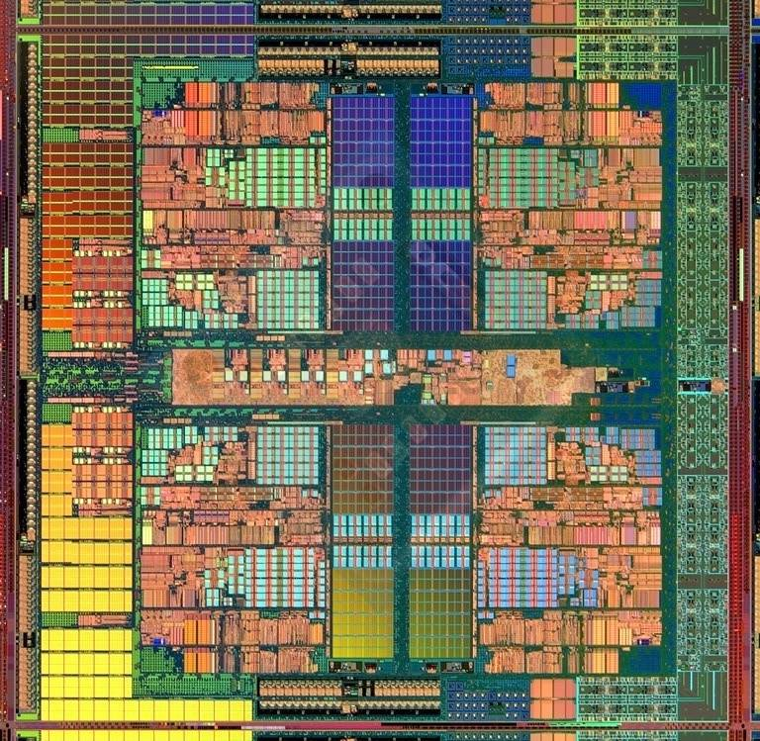
A Computing System
Three key components
Computation
Communication
Storage/memory
Burks, Goldstein, von Neumann, “Preliminary discussion of the
logical design of an electronic computing instrument,” 1946.
Image source: https://lbsitbytes2010.wordpress.com/2013/03/29/john-von-neumann-roll-no-15/

Slide 36
Today’s Computing Systems
Are overwhelmingly processor centric
All data processed in the processor → at great system cost
Processor is heavily optimized and is considered the master
Data storage units are dumb and are largely unoptimized (except for some that are on the processor die)

Slide 37
Yet …
“It’s the Memory, Stupid!” (Richard Sites, MPR, 1996)
Mutlu+, “Runahead Execution: An Alternative to Very Large Instruction Windows for Out-of-Order Processors,” HPCA 2003.

Slide 38
The Performance Perspective
Onur Mutlu, Jared Stark, Chris Wilkerson, and Yale N. Patt, "Runahead Execution: An Alternative to Very Large Instruction Windows for Out-of-order Processors" Proceedings of the 9th International Symposium on High-Performance Computer Architecture (HPCA), pages 129-140, Anaheim, CA, February 2003. Slides (pdf)

Slide 39
The Performance Perspective (Today)
All of Google’s Data Center Workloads (2015):
Kanev+, “Profiling a Warehouse-Scale Computer,” ISCA 2015.

Slide 40
The Performance Perspective (Today)
All of Google’s Data Center Workloads (2015):
Kanev+, “Profiling a Warehouse-Scale Computer,” ISCA 2015.

Slide 41
Perils of Processor-Centric Design
Grossly-imbalanced systems
Processing done only in one place
Everything else just stores and moves data: data moves a lot
→ Energy inefficient
→ Low performance
→ Complex
Overly complex and bloated processor (and accelerators)
To tolerate data access from memory
Complex hierarchies and mechanisms
→ Energy inefficient
→ Low performance
→ Complex

Slide 42
Perils of Processor-Centric Design
Most of the system is dedicated to storing and moving data

Slide 43
The Energy Perspective
Dally, HiPEAC 2015

Slide 44
Data Movement vs. Computation Energy
Dally, HiPEAC 2015
A memory access consumes ~100-1000X
the energy of a complex addition

Slide 45
Data Movement vs. Computation Energy
Data movement is a major system energy bottleneck
Comprises 41% of mobile system energy during web browsing [2]
Costs ~115 times as much energy as an ADD operation [1, 2]
[1]: Reducing data Movement Energy via Online Data Clustering and Encoding (MICRO’16)
[2]: Quantifying the energy cost of data movement for emerging smart phone workloads on mobile platforms (IISWC’14)

Slide 46
Energy Waste in Mobile Devices
Amirali Boroumand, Saugata Ghose, Youngsok Kim, Rachata Ausavarungnirun, Eric Shiu, Rahul Thakur, Daehyun Kim, Aki Kuusela, Allan Knies, Parthasarathy Ranganathan, and Onur Mutlu, "Google Workloads for Consumer Devices: Mitigating Data Movement Bottlenecks" Proceedings of the 23rd International Conference on Architectural Support for Programming Languages and Operating Systems (ASPLOS), Williamsburg, VA, USA, March 2018.
62.7% of the total system energy
is spent on data movement

Slide 47
We Do Not Want to Move Data!
Dally, HiPEAC 2015
A memory access consumes ~100-1000X
the energy of a complex addition

Slide 48
We Need A Paradigm Shift To …
Enable computation with minimal data movement
Compute where it makes sense (where data resides)
Make computing architectures more data-centric

Slide 49
Goal: Processing Inside Memory
Many questions … How do we design the:
compute-capable memory & controllers?
processor chip and in-memory units?
software and hardware interfaces?
system software, compilers, languages?
algorithms and theoretical foundations?
Memory
Processor
Core
Database
Graphs
Media
Cache
Query
Interconnect
Problem
Results
Algorithm
Program/Language
System Software
SW/HW Interface
Micro-architecture
Logic
Devices
Electrons

Slide 50
Processing in Memory: Two Approaches
1. Minimally changing memory chips
2. Exploiting 3D-stacked memory

Slide 51
Approach 1: Minimally Changing Memory
DRAM has great capability to perform bulk data movement and computation internally with small changes
Can exploit internal connectivity to move data
Can exploit analog computation capability
…
Examples: RowClone, In-DRAM AND/OR, Gather/Scatter DRAM
RowClone: Fast and Efficient In-DRAM Copy and Initialization of Bulk Data (Seshadri et al., MICRO 2013)
Fast Bulk Bitwise AND and OR in DRAM (Seshadri et al., IEEE CAL 2015)
Gather-Scatter DRAM: In-DRAM Address Translation to Improve the Spatial Locality of Non-unit Strided Accesses (Seshadri et al., MICRO 2015)
"Ambit: In-Memory Accelerator for Bulk Bitwise Operations Using Commodity DRAM Technology” (Seshadri et al., MICRO 2017)

Slide 52
Starting Simple: Data Copy and Initialization
memmove & memcpy: 5% cycles in Google’s datacenter [Kanev+ ISCA’15]
000000000000000
Zero initialization
(e.g., security)
Forking
Checkpointing
Many more
VM Cloning
Deduplication
Page Migration

Slide 53
Today’s Systems: Bulk Data Copy
1) High latency
Memory
3) Cache pollution
L3
CPU
L2
L1
MC
2) High bandwidth utilization
4) Unwanted data movement
1046ns, 3.6uJ (for 4KB page copy via DMA)

Slide 54
Future Systems: In-Memory Copy
3) No cache pollution
1) Low latency
Memory
L3
CPU
L2
L1
MC
2) Low bandwidth utilization
4) No unwanted data movement
1046ns, 3.6uJ
→ 90ns, 0.04uJ

Slide 55
RowClone: In-DRAM Row Copy
Idea: Two consecutive ACTivates
4 Kbytes
Negligible HW cost
Step 1: Activate row A
Step 2: Activate row B
Transfer row
DRAM subarray
Transfer
row
Row Buffer (4 Kbytes)
8 bits
Data Bus
Notes:
copy

Slide 56
RowClone: Latency and Energy Savings
11.6x
74x
Seshadri et al., “RowClone: Fast and Efficient In-DRAM Copy and Initialization of Bulk Data,” MICRO 2013.

Slide 57
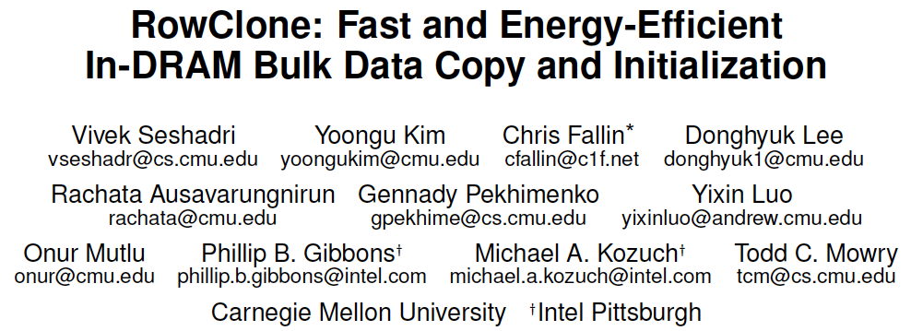
More on RowClone
Vivek Seshadri, Yoongu Kim, Chris Fallin, Donghyuk Lee, Rachata Ausavarungnirun, Gennady Pekhimenko, Yixin Luo, Onur Mutlu, Michael A. Kozuch, Phillip B. Gibbons, and Todd C. Mowry, "RowClone: Fast and Energy-Efficient In-DRAM Bulk Data Copy and Initialization" Proceedings of the 46th International Symposium on Microarchitecture (MICRO), Davis, CA, December 2013. [Slides (pptx) (pdf)] [Lightning Session Slides (pptx) (pdf)] [Poster (pptx) (pdf)]

Slide 58
Memory as an Accelerator
CPU
core
CPU
core
mini-CPU
core
GPU
(throughput)
core
GPU
(throughput)
core
video
core
GPU
(throughput)
core
GPU
(throughput)
core
CPU
core
CPU
core
Memory
imaging
core
LLC
Specialized
compute-capability
in memory
Memory Controller
Memory Bus
Memory similar to a “conventional” accelerator

Slide 59
In-Memory Bulk Bitwise Operations
We can support in-DRAM COPY, ZERO, AND, OR, NOT, MAJ
At low cost
Using analog computation capability of DRAM
Idea: activating multiple rows performs computation
30-60X performance and energy improvement
Seshadri+, “Ambit: In-Memory Accelerator for Bulk Bitwise Operations Using Commodity DRAM Technology,” MICRO 2017.
New memory technologies enable even more opportunities
Memristors, resistive RAM, phase change mem, STT-MRAM, …
Can operate on data with minimal movement

Slide 60
In-DRAM AND/OR: Triple Row Activation
½V_{DD}
½V_{DD}+δ
V_{DD}
A
Final State
AB + BC + AC
B
C
C(A + B) + ~C(AB)
dis
en
0
½V_{DD}
Seshadri+, “Fast Bulk Bitwise AND and OR in DRAM”, IEEE CAL 2015.

Slide 61
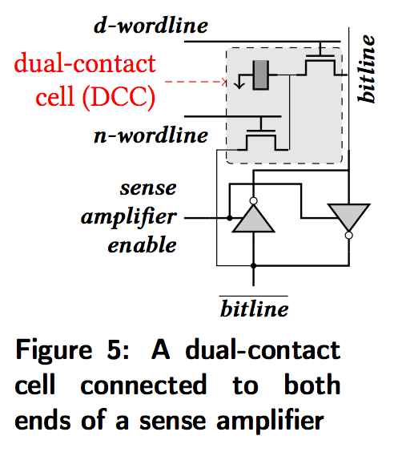
In-DRAM NOT: Dual Contact Cell
Idea:
Feed the
negated value
in the sense amplifier
into a special row
Seshadri+, “Ambit: In-Memory Accelerator for Bulk Bitwise Operations using Commodity DRAM Technology,” MICRO 2017.

Slide 62
Ambit vs. DDR3: Performance and Energy
32X
35X
Seshadri+, “Ambit: In-Memory Accelerator for Bulk Bitwise Operations using Commodity DRAM Technology,” MICRO 2017.

Slide 63
Bulk Bitwise Operations in Workloads
[1] Li and Patel, BitWeaving, SIGMOD 2013
[2] Goodwin+, BitFunnel, SIGIR 2017

Slide 64
Performance: Bitmap Index on Ambit
>5.4-6.6X Performance Improvement
Seshadri+, “Ambit: In-Memory Accelerator for Bulk Bitwise Operations using Commodity DRAM Technology,” MICRO 2017.

Slide 65
Performance: BitWeaving on Ambit
>4-12X Performance Improvement
Seshadri+, “Ambit: In-Memory Accelerator for Bulk Bitwise Operations using Commodity DRAM Technology,” MICRO 2017.

Slide 66
More on Ambit
Vivek Seshadri et al., “Ambit: In-Memory Accelerator for Bulk Bitwise Operations Using Commodity DRAM Technology,” MICRO 2017.

Slide 67
In-DRAM Bulk Bitwise Execution
Vivek Seshadri and Onur Mutlu, "In-DRAM Bulk Bitwise Execution Engine" Invited Book Chapter in Advances in Computers, to appear in 2020. [Preliminary arXiv version]

Slide 68
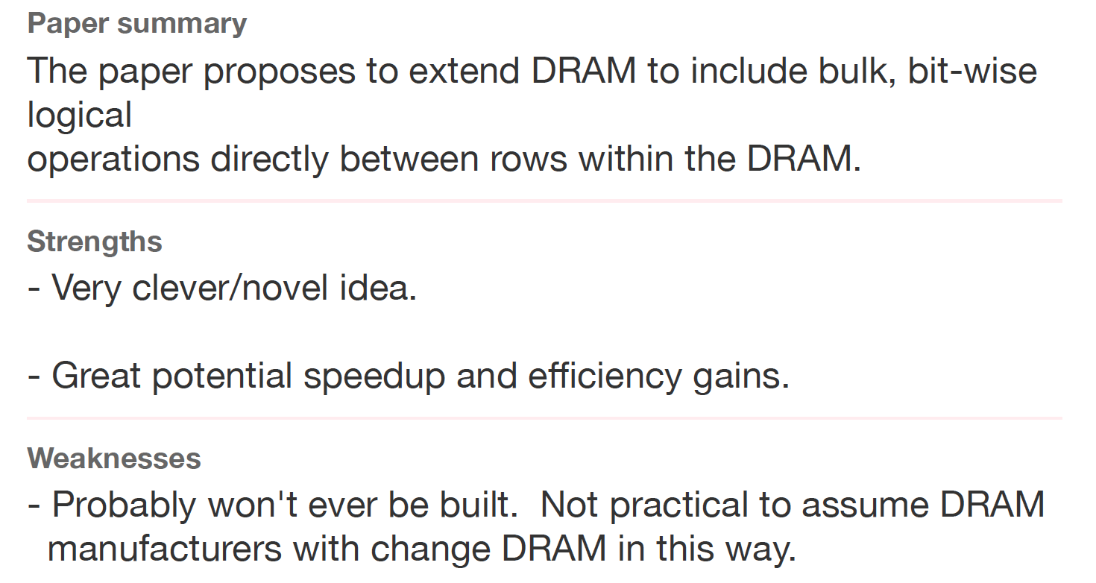
Sounds Good, No?
Review from ISCA 2016

Slide 69
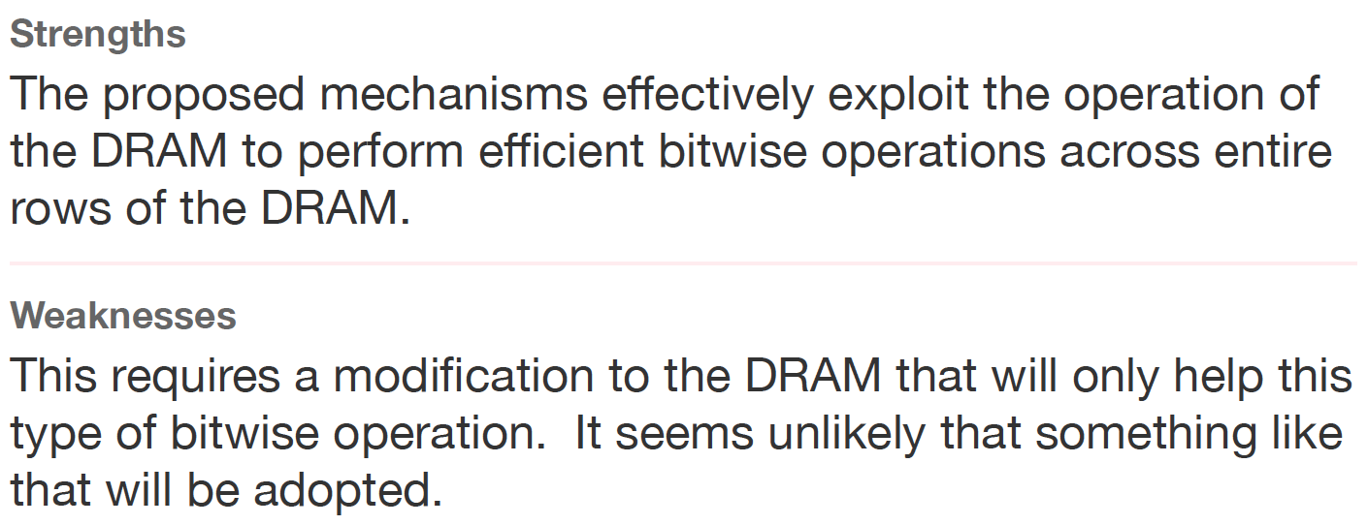
Another Review
Another Review from ISCA 2016

Slide 70
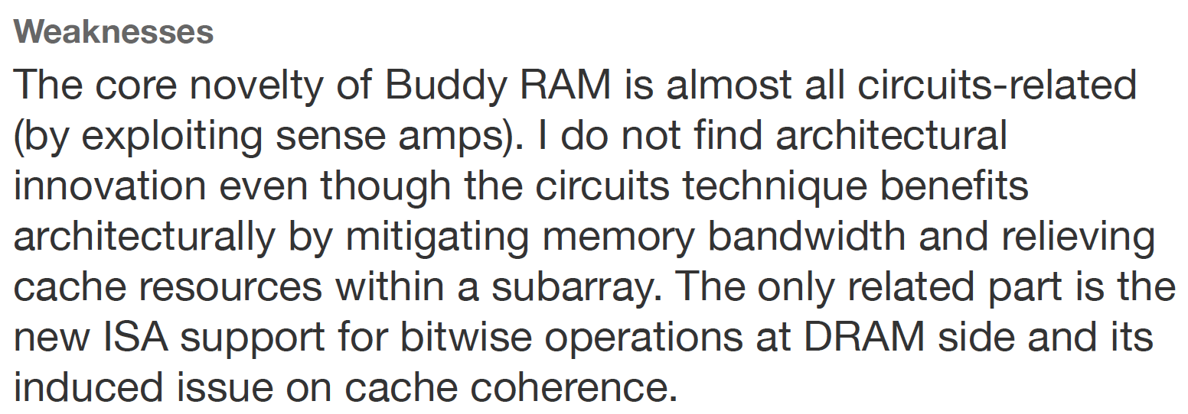
Yet Another Review
Yet Another Review from ISCA 2016

Slide 71
The Reviewer Accountability Problem

Slide 72
We Have a Mindset Issue…
There are many other similar examples from reviews…
For many other papers…
And, we are not even talking about JEDEC yet…
How do we fix the mindset problem?
By doing more research, education, implementation in alternative processing paradigms
We need to work on enabling the better future…

Slide 73
Suggestion to Community
We Need to Fix the Reviewer Accountability Problem

Slide 74
Takeaway
Main Memory Needs
Intelligent Controllers

Slide 75
Takeaway
Our Community Needs
Accountable Reviewers

Slide 76
RowClone & Bitwise Ops in Real DRAM Chips
https://parallel.princeton.edu/papers/micro19-gao.pdf

Slide 77
Pinatubo: RowClone and Bitwise Ops in PCM
https://cseweb.ucsd.edu/~jzhao/files/Pinatubo-dac2016.pdf

Slide 78
Aside: A Recommended Book
Raj Jain, “The Art of
Computer Systems
Performance Analysis,”
Wiley, 1991.

Slide 79
Raj Jain, “The Art of
Computer Systems
Performance Analysis,”
Wiley, 1991.

Slide 80
Raj Jain, “The Art of
Computer Systems
Performance Analysis,”
Wiley, 1991.

Slide 81
Processing in Memory: Two Approaches
1. Minimally changing memory chips
2. Exploiting 3D-stacked memory

Slide 82
Opportunity: 3D-Stacked Logic+Memory
Memory
Logic
Other “True 3D” technologies
under development

Slide 83
DRAM Landscape (circa 2015)
Kim+, “Ramulator: A Flexible and Extensible DRAM Simulator”, IEEE CAL 2015.

Slide 84
Two Key Questions in 3D-Stacked PIM
What are the performance and energy benefits of using 3D-stacked memory as a coarse-grained accelerator?
By changing the entire system
By performing simple function offloading
What is the minimal processing-in-memory support we can provide?
With minimal changes to system and programming

Slide 85
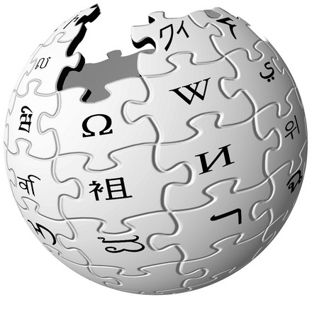
Graph Processing
Large graphs are everywhere (circa 2015)
Scalable large-scale graph processing is challenging
36 Million
Wikipedia Pages
1.4 Billion
Facebook Users
300 Million
Twitter Users
30 Billion
Instagram Photos

Slide 86
Key Bottlenecks in Graph Processing
for (v: graph.vertices) {
for (w: v.successors) {
w.next_rank += weight * v.rank;
}
}
1. Frequent random memory accesses
v
&w
w.rank
w.next_rank
w.edges
weight * v.rank
w
…
2. Little amount of computation

Slide 87
Tesseract System for Graph Processing
Interconnected set of 3D-stacked memory+logic chips with simple cores
Host Processor
Memory
Memory-Mapped
Accelerator Interface
(Noncacheable, Physically Addressed)
Logic
In-Order Core
DRAM Controller
…
…
LP
PF Buffer
Crossbar Network
…
MTP
…
Message Queue
NI
Ahn+, “A Scalable Processing-in-Memory Accelerator for Parallel Graph Processing” ISCA 2015.

Slide 88
Tesseract System for Graph Processing
Host Processor
Memory
Memory-Mapped
Accelerator Interface
(Noncacheable, Physically Addressed)
Logic
In-Order Core
DRAM Controller
…
…
Communications via Remote Function Calls
LP
PF Buffer
Crossbar Network
…
MTP
…
Message Queue
NI

Slide 89
Tesseract System for Graph Processing
Host Processor
Memory
Memory-Mapped
Accelerator Interface
(Noncacheable, Physically Addressed)
Logic
Prefetching
In-Order Core
DRAM Controller
…
…
LP
PF Buffer
Crossbar Network
…
MTP
…
Message Queue
NI

Slide 90
Evaluated Systems
DDR3-OoO
HMC-OoO
HMC-MC
Tesseract
32 Tesseract Cores
8 OoO
4GHz
8 OoO
4GHz
8 OoO
4GHz
8 OoO
4GHz
128 In-Order
2GHz
128 In-Order
2GHz
8 OoO
4GHz
8 OoO
4GHz
8 OoO
4GHz
8 OoO
4GHz
128 In-Order
2GHz
128 In-Order
2GHz
102.4GB/s
640GB/s
640GB/s
8TB/s
Ahn+, “A Scalable Processing-in-Memory Accelerator for Parallel Graph Processing” ISCA 2015.

Slide 91
Tesseract Graph Processing Performance
>13X Performance Improvement
On five graph processing algorithms
Ahn+, “A Scalable Processing-in-Memory Accelerator for Parallel Graph Processing” ISCA 2015.

Slide 92
Tesseract Graph Processing Performance

Slide 93
Tesseract Graph Processing System Energy
> 8X Energy Reduction
Ahn+, “A Scalable Processing-in-Memory Accelerator for Parallel Graph Processing” ISCA 2015.

Slide 94
More on Tesseract
Junwhan Ahn, Sungpack Hong, Sungjoo Yoo, Onur Mutlu, and Kiyoung Choi, "A Scalable Processing-in-Memory Accelerator for Parallel Graph Processing" Proceedings of the 42nd International Symposium on Computer Architecture (ISCA), Portland, OR, June 2015. [Slides (pdf)] [Lightning Session Slides (pdf)]

Slide 95
Two Key Questions in 3D-Stacked PIM
What are the performance and energy benefits of using 3D-stacked memory as a coarse-grained accelerator?
By changing the entire system
By performing simple function offloading
What is the minimal processing-in-memory support we can provide?
With minimal changes to system and programming

Slide 96
Another Example: PIM on Mobile Devices
Amirali Boroumand, Saugata Ghose, Youngsok Kim, Rachata Ausavarungnirun, Eric Shiu, Rahul Thakur, Daehyun Kim, Aki Kuusela, Allan Knies, Parthasarathy Ranganathan, and Onur Mutlu, "Google Workloads for Consumer Devices: Mitigating Data Movement Bottlenecks" Proceedings of the 23rd International Conference on Architectural Support for Programming Languages and Operating Systems (ASPLOS), Williamsburg, VA, USA, March 2018.

Slide 97
Four Important Workloads
Chrome
TensorFlow Mobile
Google’s web browser
Google’s machine learning framework
Video Playback
Video Capture
Google’s video codec
Google’s video codec
Notes:
In this work, we take a look at widely-used google consumer workloads, to figure out the major sources of energy consumption.
We look at Google Chrome web brower. We take a look at Tensorflow, Google’s machine learning framework, and we also take a look at two important video related workloads, video playback and video capture, both rely on Google’s vp9 codec technology.

Slide 98
Energy Cost of Data Movement
1st key observation: 62.7% of the total system energy is spent on data movement
Data Movement
SoC
DRAM
CPU
L2
CPU
L1
CPU
CPU
Compute Unit
Processing-In-Memory (PIM)
Potential solution: move computation close to data
Challenge: limited area and energy budget
Notes:
Throughout our analysis, we make a key observation that out of all sources of energy consumption, data movement is a major contributor to the total system energy. We find that across all of the workloads, on average around 62.7% of total system energy is spent on data movement.
One way to reduce data movement cost is to move computation close to data, or …
One potential solution to address this cost it do move computation close to data, or in other words, do procesing in memory. However, the challenge is that these devices.
One potential solution to mitigate data movement cost and reduce total system energy is to execute data-movement heavy portions of application close to data, or in other words, do processing in memory. However, consumer devices are extermely limited in terms of area and power budget. So the question is can we move part of the data movement heavy portion given the limited area and energy budget. Our

Slide 99
Simple PIM on Mobile Workloads
2nd key observation: a significant fraction of the data movement often comes from simple functions
We can design lightweight logic to implement these simple functions in memory
Small embedded low-power core
Small fixed-function accelerators
PIM Core
PIM Accelerator
PIM Accelerator
PIM Accelerator
Offloading to PIM logic reduces energy and
execution time, on average, by 55.4% and 54.2%
Notes:
To figure out if we can use processing in memory, we dig deeper into our analysis and we make another key observation that majority of data movement often comes form simple functions and pritmitives. We find that these simple function can be implemented in memory as either a small embedded core, or group of small fixed function accelerators. Our result shows that offloading these function to PIM logic can significantly reduce data movement for each function and reduce energy on average around 55% and improve perforamcne around 54%.
our PIM core can reduce significant portion of data movement, reduce enregy by 49.1% for each function and improve performance up to 2.2X. While using group of fixed function accelerator reduce energy by 55.4% and improve performance by up to 2.5X.
Or use Saugata’s approach : Reduces total system energy by an average of 55.4%
Reduces execution time by an average of 54.2%
Our result show that both of them can significantly reduce the data movement for each function.
Feedback: talk about result more
Don’t talk about specific detail like MemCopy, MemSet stuff like that
Main take away: data movement come from simple functions that are simple enough to implement in PIM
We find that these functions and primitves can be implemented as PIM logic using either (1) a small low-power general-purpose embedded core or (2) a group of small fixed-function accelerators (PIM accelerators). Our Analysis shows that both are cost-feasible to use in consumer devices. We find that they eliminate a significant fraction of dat amovement, and reduce energy consumption for each of these operation on average by 49 and 55%.

Slide 100
Normalized Energy
Chrome Browser
TensorFlow Mobile
Video Playback and Capture
PIM core and PIM accelerator reduce energy consumption on average by 49.1% and 55.4%
Notes:
We make another obsrevation that using PIM accelerator provide limited energy reduction over PIM core, for some of these workloads, such as texture tiling. This is becase these kernels are data intensive and have low ocmputational compleity, and as a result, using fixed function accelerator does not provide significant energy reduction over the PIM core.

Slide 101
Normalized Runtime
Chrome Browser
Video Playback and Capture
TensorFlow Mobile
Offloading these kernels to PIM core and PIM accelerator reduces program runtime on average by 44.6% and 54.2%
Notes:
PIM-Core and PIM-Acc significantly outperform CPU-Only across all kernels, improving performance by … This perfomance benefit come from higher bandwidth and lower access latency of 3D-stacked memory, because all of these kernels are data intensive.
Performance improvement of PIM-acc over PIM-core differes across different workloads. In some cases such as Texture Tiling, the performance improvement of PIM-Acc over PIM-Core is limited by the low computational complexity of these two kernels. But there are other cases, such as compression that benefit significantly from using PIM-Acc over PIM-Core in terms of performance, because these kernels are more compute-intensive and less data-intensive compared to texture tiling and.

Slide 102
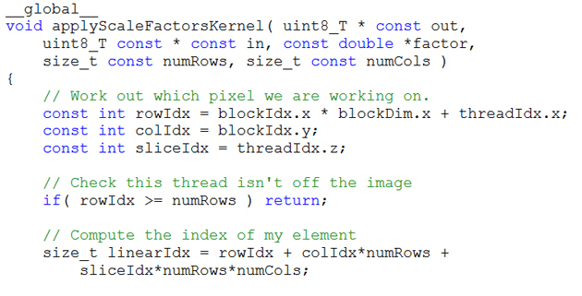
Truly Distributed GPU Processing with PIM?
3D-stacked memory
(memory stack)
SM (Streaming Multiprocessor)
Logic layer
Logic layer SM
Main GPU
Crossbar switch
Vault Ctrl
….
Vault Ctrl

Slide 103
Accelerating GPU Execution with PIM (I)
Kevin Hsieh, Eiman Ebrahimi, Gwangsun Kim, Niladrish Chatterjee, Mike O'Connor, Nandita Vijaykumar, Onur Mutlu, and Stephen W. Keckler, "Transparent Offloading and Mapping (TOM): Enabling Programmer-Transparent Near-Data Processing in GPU Systems" Proceedings of the 43rd International Symposium on Computer Architecture (ISCA), Seoul, South Korea, June 2016. [Slides (pptx) (pdf)] [Lightning Session Slides (pptx) (pdf)]

Slide 104
Accelerating GPU Execution with PIM (II)
Ashutosh Pattnaik, Xulong Tang, Adwait Jog, Onur Kayiran, Asit K. Mishra, Mahmut T. Kandemir, Onur Mutlu, and Chita R. Das, "Scheduling Techniques for GPU Architectures with Processing-In-Memory Capabilities" Proceedings of the 25th International Conference on Parallel Architectures and Compilation Techniques (PACT), Haifa, Israel, September 2016.

Slide 105
Eliminating the Adoption Barriers
How to Enable Adoption of Processing in Memory

Slide 106
Barriers to Adoption of PIM
1. Functionality of and applications & software for PIM
2. Ease of programming (interfaces and compiler/HW support)
3. System support: coherence & virtual memory
4. Runtime and compilation systems for adaptive scheduling, data mapping, access/sharing control
5. Infrastructures to assess benefits and feasibility
All can be solved with change of mindset

Slide 107
We Need to Revisit the Entire Stack
Problem
Algorithm
Program/Language
System Software
SW/HW Interface
Micro-architecture
Logic
Devices
Electrons
We can get there step by step

Slide 108
PIM Review and Open Problems
Onur Mutlu, Saugata Ghose, Juan Gomez-Luna, and Rachata Ausavarungnirun, "Processing Data Where It Makes Sense: Enabling In-Memory Computation" Invited paper in Microprocessors and Microsystems (MICPRO), June 2019. [arXiv version]
https://arxiv.org/pdf/1903.03988.pdf

Slide 109
PIM Review and Open Problems (II)
Saugata Ghose, Amirali Boroumand, Jeremie S. Kim, Juan Gomez-Luna, and Onur Mutlu, "Processing-in-Memory: A Workload-Driven Perspective" Invited Article in IBM Journal of Research & Development, Special Issue on Hardware for Artificial Intelligence, to appear in November 2019. [Preliminary arXiv version]
https://arxiv.org/pdf/1907.12947.pdf

Slide 110
Challenge and Opportunity for Future
Computing Architectures
with
Minimal Data Movement

Slide 111
Corollaries: Architectures Today …
Architectures are terrible at dealing with data
Designed to mainly store and move data vs. to compute
They are processor-centric as opposed to data-centric
Architectures are terrible at taking advantage of vast amounts of data (and metadata) available to them
Designed to make simple decisions, ignoring lots of data
They make human-driven decisions vs. data-driven decisions
Architectures are terrible at knowing and exploiting different properties of application data
Designed to treat all data as the same
They make component-aware decisions vs. data-aware

Slide 112
Exploiting Data to Design Intelligent Architectures

Slide 113
System Architecture Design Today
Human-driven
Humans design the policies (how to do things)
Many (too) simple, short-sighted policies all over the system
No automatic data-driven policy learning
(Almost) no learning: cannot take lessons from past actions
Can we design
fundamentally intelligent architectures?

Slide 114
An Intelligent Architecture
Data-driven
Machine learns the “best” policies (how to do things)
Sophisticated, workload-driven, changing, far-sighted policies
Automatic data-driven policy learning
All controllers are intelligent data-driven agents
How do we start?

Slide 115
Self-Optimizing Memory Controllers

Slide 116
Memory Controller
How to schedule requests to maximize system performance?
Resolves memory contention by scheduling requests
Core
Core
Memory Controller
Memory
Core
Core

Slide 117
Why are Memory Controllers Difficult to Design?
Need to obey DRAM timing constraints for correctness
There are many (50+) timing constraints in DRAM
tWTR: Minimum number of cycles to wait before issuing a read command after a write command is issued
tRC: Minimum number of cycles between the issuing of two consecutive activate commands to the same bank
…
Need to keep track of many resources to prevent conflicts
Channels, banks, ranks, data bus, address bus, row buffers, …
Need to handle DRAM refresh
Need to manage power consumption
Need to optimize performance & QoS (in the presence of constraints)
Reordering is not simple
Fairness and QoS needs complicates the scheduling problem
…

Slide 118
Many Memory Timing Constraints
From Lee et al., “DRAM-Aware Last-Level Cache Writeback: Reducing Write-Caused Interference in Memory Systems,” HPS Technical Report, April 2010.

Slide 119
Many Memory Timing Constraints
Kim et al., “A Case for Exploiting Subarray-Level Parallelism (SALP) in DRAM,” ISCA 2012.
Lee et al., “Tiered-Latency DRAM: A Low Latency and Low Cost DRAM Architecture,” HPCA 2013.

Slide 120
Memory Controller Design Is Becoming More Difficult
CPU
CPU
CPU
CPU
GPU
HWA
HWA
Shared Cache
DRAM and Hybrid Memory Controllers
DRAM and Hybrid Memories
Heterogeneous agents: CPUs, GPUs, and HWAs
Main memory interference between CPUs, GPUs, HWAs
Many timing constraints for various memory types
Many goals at the same time: performance, fairness, QoS, energy efficiency, …

Slide 121
Reality and Dream
Reality: It difficult to design a policy that maximizes performance, QoS, energy-efficiency, …
Too many things to think about
Continuously changing workload and system behavior
Dream: Wouldn’t it be nice if the DRAM controller automatically found a good scheduling policy on its own?

Slide 122
Self-Optimizing DRAM Controllers
Problem: DRAM controllers are difficult to design
It is difficult for human designers to design a policy that can adapt itself very well to different workloads and different system conditions
Idea: A memory controller that adapts its scheduling policy to workload behavior and system conditions using machine learning.
Observation: Reinforcement learning maps nicely to memory control.
Design: Memory controller is a reinforcement learning agent
It dynamically and continuously learns and employs the best scheduling policy to maximize long-term performance.
Ipek+, “Self Optimizing Memory Controllers: A Reinforcement Learning Approach,” ISCA 2008.

Slide 123
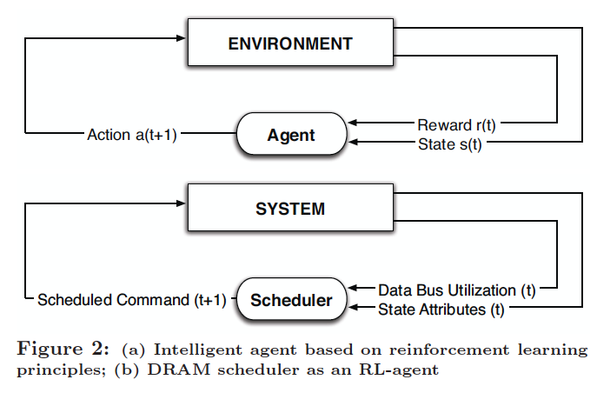
Self-Optimizing DRAM Controllers
Engin Ipek, Onur Mutlu, José F. Martínez, and Rich Caruana, "Self Optimizing Memory Controllers: A Reinforcement Learning Approach" Proceedings of the 35th International Symposium on Computer Architecture (ISCA), pages 39-50, Beijing, China, June 2008.
Goal: Learn to choose actions to maximize r₀ + γr₁ + γ²r₂ + … ( 0 ≤ γ < 1)

Slide 124
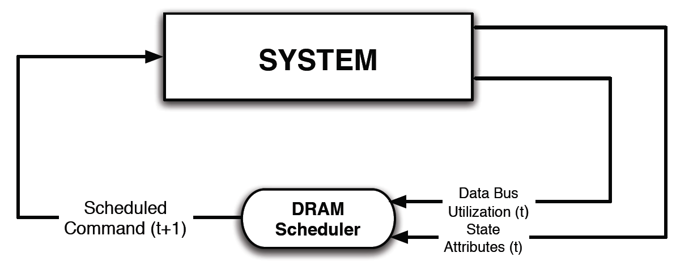
Self-Optimizing DRAM Controllers
Dynamically adapt the memory scheduling policy via interaction with the system at runtime
Associate system states and actions (commands) with long term reward values: each action at a given state leads to a learned reward
Schedule command with highest estimated long-term reward value in each state
Continuously update reward values for <state, action> pairs based on feedback from system

Slide 125
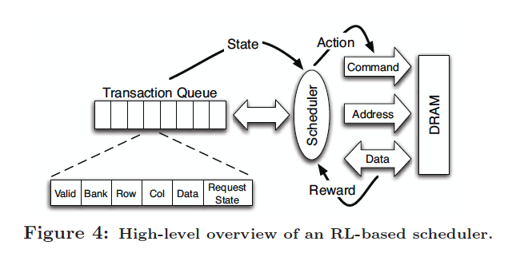
Self-Optimizing DRAM Controllers
Engin Ipek, Onur Mutlu, José F. Martínez, and Rich Caruana, "Self Optimizing Memory Controllers: A Reinforcement Learning Approach" Proceedings of the 35th International Symposium on Computer Architecture (ISCA), pages 39-50, Beijing, China, June 2008.

Slide 126
States, Actions, Rewards
Reward function
+1 for scheduling Read and Write commands
0 at all other times
Goal is to maximize long-term data bus utilization
State attributes
Number of reads, writes, and load misses in transaction queue
Number of pending writes and ROB heads waiting for referenced row
Request’s relative ROB order
Actions
Activate
Write
Read - load miss
Read - store miss
Precharge - pending
Precharge - preemptive
NOP

Slide 127
Performance Results
Large, robust performance improvements over many human-designed policies

Slide 128
Self Optimizing DRAM Controllers
+ Continuous learning in the presence of changing environment
+ Reduced designer burden in finding a good scheduling policy. Designer specifies:
1) What system variables might be useful
2) What target to optimize, but not how to optimize it
-- How to specify different objectives? (e.g., fairness, QoS, …)
-- Hardware complexity?
-- Design mindset and flow

Slide 129
More on Self-Optimizing DRAM Controllers
Engin Ipek, Onur Mutlu, José F. Martínez, and Rich Caruana, "Self Optimizing Memory Controllers: A Reinforcement Learning Approach" Proceedings of the 35th International Symposium on Computer Architecture (ISCA), pages 39-50, Beijing, China, June 2008.

Slide 130
An Intelligent Architecture
Data-driven
Machine learns the “best” policies (how to do things)
Sophisticated, workload-driven, changing, far-sighted policies
Automatic data-driven policy learning
All controllers are intelligent data-driven agents
We need to rethink design
(of all controllers)

Slide 131
Challenge and Opportunity for Future
Self-Optimizing
(Data-Driven)
Computing Architectures

Slide 132
Corollaries: Architectures Today …
Architectures are terrible at dealing with data
Designed to mainly store and move data vs. to compute
They are processor-centric as opposed to data-centric
Architectures are terrible at taking advantage of vast amounts of data (and metadata) available to them
Designed to make simple decisions, ignoring lots of data
They make human-driven decisions vs. data-driven decisions
Architectures are terrible at knowing and exploiting different properties of application data
Designed to treat all data as the same
They make component-aware decisions vs. data-aware

Slide 133
Data-Aware Architectures
A data-aware architecture understands what it can do with and to each piece of data
It makes use of different properties of data to improve performance, efficiency and other metrics
Compressibility
Approximability
Locality
Sparsity
Criticality for Computation X
Access Semantics
…

Slide 134
One Problem: Limited Interfaces

Slide 135
A Solution: More Expressive Interfaces

Slide 136
Expressive (Memory) Interfaces
Nandita Vijaykumar, Abhilasha Jain, Diptesh Majumdar, Kevin Hsieh, Gennady Pekhimenko, Eiman Ebrahimi, Nastaran Hajinazar, Phillip B. Gibbons and Onur Mutlu, "A Case for Richer Cross-layer Abstractions: Bridging the Semantic Gap with Expressive Memory" Proceedings of the 45th International Symposium on Computer Architecture (ISCA), Los Angeles, CA, USA, June 2018. [Slides (pptx) (pdf)] [Lightning Talk Slides (pptx) (pdf)] [Lightning Talk Video]

Slide 137
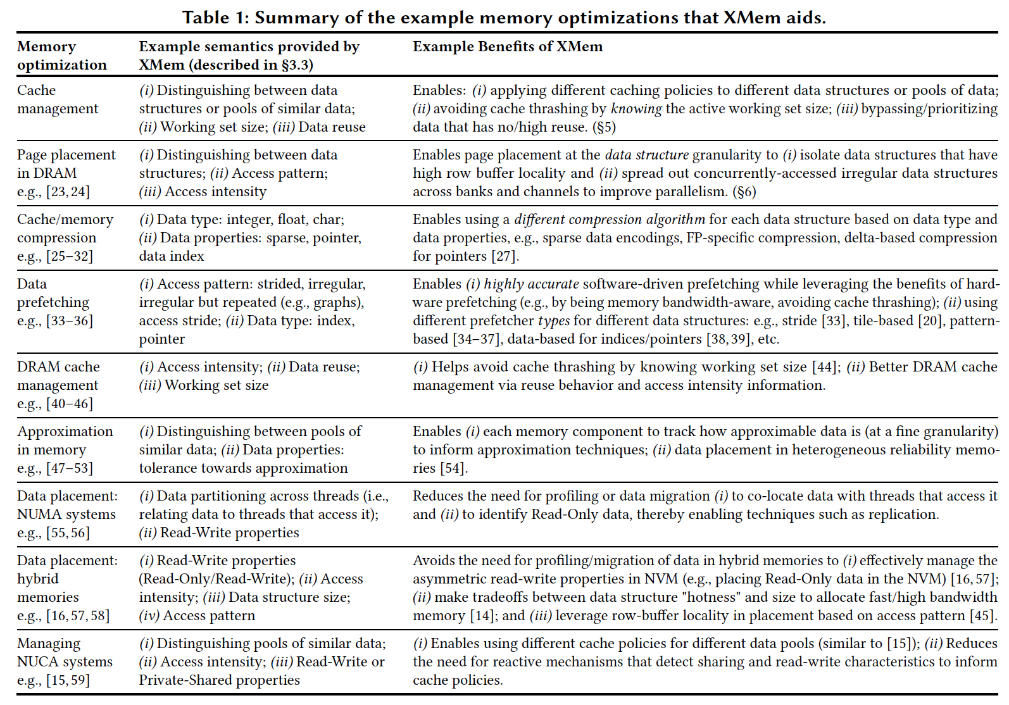
X-MeM Aids Many Optimizations

Slide 138
Expressive (Memory) Interfaces for GPUs
Nandita Vijaykumar, Eiman Ebrahimi, Kevin Hsieh, Phillip B. Gibbons and Onur Mutlu, "The Locality Descriptor: A Holistic Cross-Layer Abstraction to Express Data Locality in GPUs" Proceedings of the 45th International Symposium on Computer Architecture (ISCA), Los Angeles, CA, USA, June 2018. [Slides (pptx) (pdf)] [Lightning Talk Slides (pptx) (pdf)] [Lightning Talk Video]

Slide 139
An Example: Hybrid Memory Management
SoC
Meza+, “Enabling Efficient and Scalable Hybrid Memories,” IEEE Comp. Arch. Letters, 2012.
Yoon+, “Row Buffer Locality Aware Caching Policies for Hybrid Memories,” ICCD 2012 Best Paper Award.
DRAMCtrl
PCM Ctrl
DRAM
Phase Change Memory (or Tech. X)
Fast, durable
Small,
leaky, volatile,
high-cost
Large, non-volatile, low-cost
Slow, wears out, high active energy
Hardware/software manage data allocation and movement
to achieve the best of multiple technologies

Slide 140
An Example: Heterogeneous-Reliability Memory
Yixin Luo, Sriram Govindan, Bikash Sharma, Mark Santaniello, Justin Meza, Aman Kansal, Jie Liu, Badriddine Khessib, Kushagra Vaid, and Onur Mutlu, "Characterizing Application Memory Error Vulnerability to Optimize Data Center Cost via Heterogeneous-Reliability Memory" Proceedings of the 44th Annual IEEE/IFIP International Conference on Dependable Systems and Networks (DSN), Atlanta, GA, June 2014. [Summary] [Slides (pptx) (pdf)] [Coverage on ZDNet]

Slide 141
Exploiting Memory Error Tolerance with Hybrid Memory Systems
Heterogeneous-Reliability Memory [DSN 2014]
Vulnerable data
Vulnerable data
Tolerant data
Tolerant data
Reliable memory
Low-cost memory
Vulnerable data
On Microsoft’s Web Search workload
Reduces server hardware cost by 4.7 %
Achieves single server availability target of 99.90 %
ECC protected
Well-tested chips
Tolerant data
NoECC or Parity
Less-tested chips
Notes:
As we have shown earlier, either across or within applications, our characterization can identify data that are vulnerable to memory errors and data that are tolerant to memory errors.
To exploit this observation, we would like to map these different data onto different memory modules according to their memory error tolerance.
As an example here, we map vulnerable data to reliable memory to improve reliability, and map tolerant data to low-cost less-reliable memory to exploit its tolerance and lower the cost. We call this mechanism heterogeneous-reliability memory, HRM.
Reliable memory consists of … Low cost memory consists of …
As we will show later, HRM allows us to use weaker error protection in memory, and enables the use of less-tested memory chips to lower the cost of the memory system, while still achieving reasonable single-server reliability target.

Slide 142
Another Example: EDEN for DNNs
Deep Neural Network evaluation is very DRAM-intensive (especially for large networks)
1. Some data and layers in DNNs are very tolerant to errors
2. Reduce DRAM latency and voltage on such data and layers
3. While still achieving a user-specified DNN accuracy target by making training DRAM-error-aware
Data-aware management of DRAM latency and voltage for Deep Neural Network Inference

Slide 143
Example DNN Data Type to DRAM Mapping
Mapping example of ResNet-50:
<8% BER
<5% BER
<6% BER
4
2
3
<2% BER
1
Map more error-tolerant DNN layers
to DRAM partitions with lower voltage/latency
4 DRAM partitions with different error rates
Notes:
In contrast, using a DRAM chip partitioned into four voltage domains can use a many-to-four DNN to DRAM mapping, using four different voltage values with error rates indicated by the yellow, red, green, and blue lines

Slide 144
EDEN: Data-Aware Efficient DNN Inference
Skanda Koppula, Lois Orosa, A. Giray Yaglikci, Roknoddin Azizi, Taha Shahroodi, Konstantinos Kanellopoulos, and Onur Mutlu, "EDEN: Enabling Energy-Efficient, High-Performance Deep Neural Network Inference Using Approximate DRAM" Proceedings of the 52nd International Symposium on Microarchitecture (MICRO), Columbus, OH, USA, October 2019. [Lightning Talk Slides (pptx) (pdf)] [Lightning Talk Video (90 seconds)]

Slide 145
Challenge and Opportunity for Future
Data-Aware
(Expressive)
Computing Architectures

Slide 146
Concluding Remarks

Slide 147
Recap: Corollaries: Architectures Today …
Architectures are terrible at dealing with data
Designed to mainly store and move data vs. to compute
They are processor-centric as opposed to data-centric
Architectures are terrible at taking advantage of vast amounts of data (and metadata) available to them
Designed to make simple decisions, ignoring lots of data
They make human-driven decisions vs. data-driven decisions
Architectures are terrible at knowing and exploiting different properties of application data
Designed to treat all data as the same
They make component-aware decisions vs. data-aware

Slide 148
Concluding Remarks
It is time to design principled system architectures to solve the data handling (i.e., memory/storage) problem
Design complete systems to be truly balanced, high-performance, and energy-efficient → intelligent architectures
Data-centric, data-driven, data-aware
This can
Lead to orders-of-magnitude improvements
Enable new applications & computing platforms
Enable better understanding of nature
…
Notes:
Perhaps we have taken processor-centric system design a bit too far

Slide 149
Architectures for Intelligent Machines
Data-centric
Data-driven
Data-aware

Slide 150
Source: http://spectrum.ieee.org/image/MjYzMzAyMg.jpeg

Slide 151
We Need to Think Across the Entire Stack
Problem
Algorithm
Program/Language
System Software
SW/HW Interface
Micro-architecture
Logic
Devices
Electrons
We can get there step by step

Slide 152
We Need to Exploit Good Principles
Data-centric system design
All components intelligent
Better cross-layer communication, better interfaces
Better-than-worst-case design
Heterogeneity
Flexibility, adaptability
Open minds

Slide 153
PIM Review and Open Problems
Onur Mutlu, Saugata Ghose, Juan Gomez-Luna, and Rachata Ausavarungnirun, "Processing Data Where It Makes Sense: Enabling In-Memory Computation" Invited paper in Microprocessors and Microsystems (MICPRO), June 2019. [arXiv version]
https://arxiv.org/pdf/1903.03988.pdf

Slide 154
PIM Review and Open Problems (II)
Saugata Ghose, Amirali Boroumand, Jeremie S. Kim, Juan Gomez-Luna, and Onur Mutlu, "Processing-in-Memory: A Workload-Driven Perspective" Invited Article in IBM Journal of Research & Development, Special Issue on Hardware for Artificial Intelligence, to appear in November 2019. [Preliminary arXiv version]
https://arxiv.org/pdf/1907.12947.pdf

Slide 155
Acknowledgments
My current and past students and postdocs
Rachata Ausavarungnirun, Abhishek Bhowmick, Amirali Boroumand, Rui Cai, Yu Cai, Kevin Chang, Saugata Ghose, Kevin Hsieh, Tyler Huberty, Ben Jaiyen, Samira Khan, Jeremie Kim, Yoongu Kim, Yang Li, Jamie Liu, Lavanya Subramanian, Donghyuk Lee, Yixin Luo, Justin Meza, Gennady Pekhimenko, Vivek Seshadri, Lavanya Subramanian, Nandita Vijaykumar, HanBin Yoon, Jishen Zhao, …
My collaborators
Can Alkan, Chita Das, Phil Gibbons, Sriram Govindan, Norm Jouppi, Mahmut Kandemir, Mike Kozuch, Konrad Lai, Ken Mai, Todd Mowry, Yale Patt, Moinuddin Qureshi, Partha Ranganathan, Bikash Sharma, Kushagra Vaid, Chris Wilkerson, …

Slide 156
Funding Acknowledgments
Alibaba, AMD, Google, Facebook, HP Labs, Huawei, IBM, Intel, Microsoft, Nvidia, Oracle, Qualcomm, Rambus, Samsung, Seagate, VMware
NSF
NIH
GSRC
SRC
CyLab

Slide 157
Acknowledgments
Think BIG, Aim HIGH!
https://safari.ethz.ch

Slide 158
Intelligent Architectures for Intelligent Machines
Onur Mutlu
omutlu@gmail.com
https://people.inf.ethz.ch/omutlu
28 October 2019
HiPEAC CSW Autumn 2019 Keynote

Slide 159
Backup Slides

Slide 160
Readings, Videos, Reference Materials

Slide 161
Accelerated Memory Course (~6.5 hours)
ACACES 2018
Memory Systems and Memory-Centric Computing Systems
Taught by Onur Mutlu July 9-13, 2018
~6.5 hours of lectures
Website for the Course including Videos, Slides, Papers
https://safari.ethz.ch/memory_systems/ACACES2018/
https://www.youtube.com/playlist?list=PL5Q2soXY2Zi-HXxomthrpDpMJm05P6J9x
All Papers are at:
https://people.inf.ethz.ch/omutlu/projects.htm
Final lecture notes and readings (for all topics)

Slide 162
Longer Memory Course (~18 hours)
Tu Wien 2019
Memory Systems and Memory-Centric Computing Systems
Taught by Onur Mutlu June 12-19, 2019
~18 hours of lectures
Website for the Course including Videos, Slides, Papers
https://safari.ethz.ch/memory_systems/TUWien2019
https://www.youtube.com/playlist?list=PL5Q2soXY2Zi_gntM55VoMlKlw7YrXOhbl
All Papers are at:
https://people.inf.ethz.ch/omutlu/projects.htm
Final lecture notes and readings (for all topics)

Slide 163
Some Overview Talks
https://www.youtube.com/watch?v=kgiZlSOcGFM&list=PL5Q2soXY2Zi8D_5MGV6EnXEJHnV2YFBJl
Future Computing Architectures
https://www.youtube.com/watch?v=kgiZlSOcGFM&list=PL5Q2soXY2Zi8D_5MGV6EnXEJHnV2YFBJl&index=1
Enabling In-Memory Computation
https://www.youtube.com/watch?v=oHqsNbxgdzM&list=PL5Q2soXY2Zi8D_5MGV6EnXEJHnV2YFBJl&index=7
Accelerating Genome Analysis
https://www.youtube.com/watch?v=hPnSmfwu2-A&list=PL5Q2soXY2Zi8D_5MGV6EnXEJHnV2YFBJl&index=9
Rethinking Memory System Design
https://www.youtube.com/watch?v=F7xZLNMIY1E&list=PL5Q2soXY2Zi8D_5MGV6EnXEJHnV2YFBJl&index=3

Slide 164
Reference Overview Paper I
Onur Mutlu, Saugata Ghose, Juan Gomez-Luna, and Rachata Ausavarungnirun, "Processing Data Where It Makes Sense: Enabling In-Memory Computation" Invited paper in Microprocessors and Microsystems (MICPRO), June 2019. [arXiv version]
https://arxiv.org/pdf/1903.03988.pdf

Slide 165
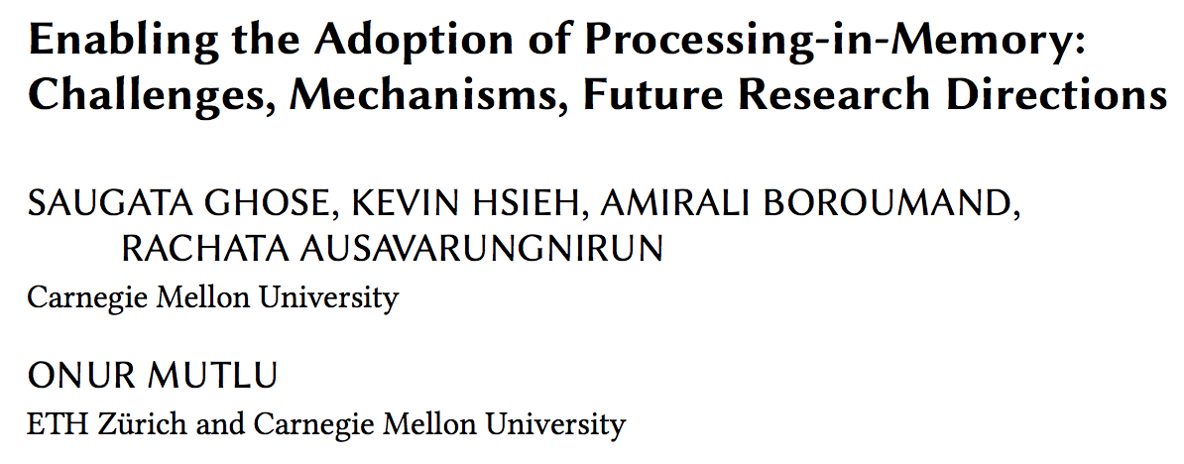
Reference Overview Paper II
Saugata Ghose, Kevin Hsieh, Amirali Boroumand, Rachata Ausavarungnirun, Onur Mutlu, "Enabling the Adoption of Processing-in-Memory: Challenges, Mechanisms, Future Research Directions" Invited Book Chapter, to appear in 2018. [Preliminary arxiv.org version]
https://arxiv.org/pdf/1802.00320.pdf

Slide 166
Reference Overview Paper III
Onur Mutlu and Lavanya Subramanian, "Research Problems and Opportunities in Memory Systems" Invited Article in Supercomputing Frontiers and Innovations (SUPERFRI), 2014/2015.
https://people.inf.ethz.ch/omutlu/pub/memory-systems-research_superfri14.pdf

Slide 167
Reference Overview Paper IV
Onur Mutlu, "The RowHammer Problem and Other Issues We May Face as Memory Becomes Denser" Invited Paper in Proceedings of the Design, Automation, and Test in Europe Conference (DATE), Lausanne, Switzerland, March 2017. [Slides (pptx) (pdf)]
https://people.inf.ethz.ch/omutlu/pub/rowhammer-and-other-memory-issues_date17.pdf

Slide 168
Reference Overview Paper V
Onur Mutlu, "Memory Scaling: A Systems Architecture Perspective" Technical talk at MemCon 2013 (MEMCON), Santa Clara, CA, August 2013. [Slides (pptx) (pdf)] [Video] [Coverage on StorageSearch]
https://people.inf.ethz.ch/omutlu/pub/memory-scaling_memcon13.pdf

Slide 169
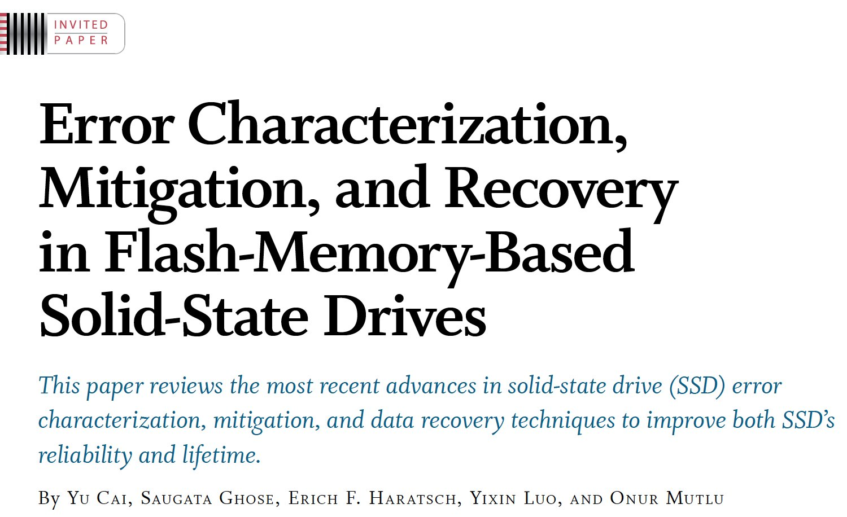
Reference Overview Paper VI
Proceedings of the IEEE, Sept. 2017
https://arxiv.org/pdf/1706.08642

Slide 170
Reference Overview Paper VII
Onur Mutlu and Jeremie Kim, "RowHammer: A Retrospective" IEEE Transactions on Computer-Aided Design of Integrated Circuits and Systems (TCAD) Special Issue on Top Picks in Hardware and Embedded Security, 2019. [Preliminary arXiv version]

Slide 171
Related Videos and Course Materials (I)
Undergraduate Computer Architecture Course Lecture Videos (2015, 2014, 2013)
Undergraduate Computer Architecture Course Materials (2015, 2014, 2013)
Graduate Computer Architecture Course Lecture Videos (2018, 2017, 2015, 2013)
Graduate Computer Architecture Course Materials (2018, 2017, 2015, 2013)
Parallel Computer Architecture Course Materials (Lecture Videos)

Slide 172
Related Videos and Course Materials (II)
Freshman Digital Circuits and Computer Architecture Course Lecture Videos (2018, 2017)
Freshman Digital Circuits and Computer Architecture Course Materials (2018)
Memory Systems Short Course Materials
(Lecture Video on Main Memory and DRAM Basics)

Slide 173
Some Open Source Tools (I)
Rowhammer – Program to Induce RowHammer Errors
https://github.com/CMU-SAFARI/rowhammer
Ramulator – Fast and Extensible DRAM Simulator
https://github.com/CMU-SAFARI/ramulator
MemSim – Simple Memory Simulator
https://github.com/CMU-SAFARI/memsim
NOCulator – Flexible Network-on-Chip Simulator
https://github.com/CMU-SAFARI/NOCulator
SoftMC – FPGA-Based DRAM Testing Infrastructure
https://github.com/CMU-SAFARI/SoftMC
Other open-source software from my group
https://github.com/CMU-SAFARI/
http://www.ece.cmu.edu/~safari/tools.html

Slide 174
Some Open Source Tools (II)
MQSim – A Fast Modern SSD Simulator
https://github.com/CMU-SAFARI/MQSim
Mosaic – GPU Simulator Supporting Concurrent Applications
https://github.com/CMU-SAFARI/Mosaic
IMPICA – Processing in 3D-Stacked Memory Simulator
https://github.com/CMU-SAFARI/IMPICA
SMLA – Detailed 3D-Stacked Memory Simulator
https://github.com/CMU-SAFARI/SMLA
HWASim – Simulator for Heterogeneous CPU-HWA Systems
https://github.com/CMU-SAFARI/HWASim
Other open-source software from my group
https://github.com/CMU-SAFARI/
http://www.ece.cmu.edu/~safari/tools.html

Slide 175
More Open Source Tools (III)
A lot more open-source software from my group
https://github.com/CMU-SAFARI/
http://www.ece.cmu.edu/~safari/tools.html

Slide 176
Referenced Papers
All are available at
https://people.inf.ethz.ch/omutlu/projects.htm
http://scholar.google.com/citations?user=7XyGUGkAAAAJ&hl=en
https://people.inf.ethz.ch/omutlu/acaces2018.html

Slide 177
Some Solution Principles (So Far)
Data-centric system design & intelligence spread around
Do not center everything around traditional computation units
Better cooperation across layers of the system
Careful co-design of components and layers: system/arch/device
Better, richer, more expressive and flexible interfaces
Better-than-worst-case design
Do not optimize for the worst case
Worst case should not determine the common case
Heterogeneity in design (specialization, asymmetry)
Enables a more efficient design (No one size fits all)

Slide 178
Low Latency Data Access

Slide 179
Data-Centric Architectures: Properties
Process data where it resides (where it makes sense)
Processing in and near memory structures
Low-latency & low-energy data access
Low latency memory
Low energy memory
Low-cost data storage & processing
High capacity memory at low cost: hybrid memory, compression
Intelligent data management
Intelligent controllers handling robustness, security, cost, scaling

Slide 180
Low-Latency & Low-Energy Data Access

Slide 181
Main Memory Latency Lags Behind
128x
20x
1.3x
Memory latency remains almost constant

Slide 182
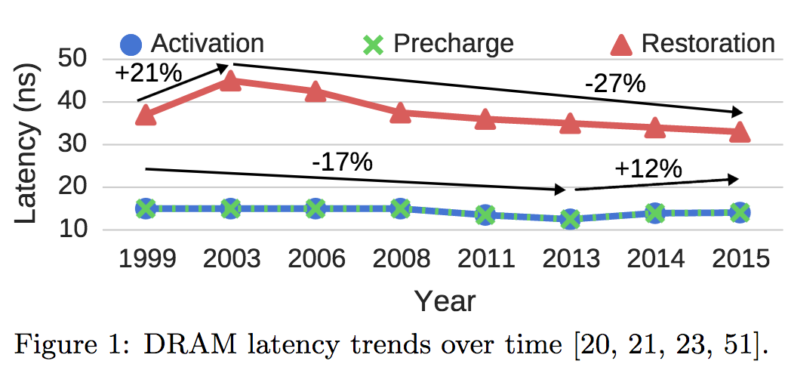
A Closer Look …
Chang+, “Understanding Latency Variation in Modern DRAM Chips: Experimental
Characterization, Analysis, and Optimization",” SIGMETRICS 2016.

Slide 183
DRAM Latency Is Critical for Performance
In-memory Databases
[Mao+, EuroSys’12; Clapp+ (Intel), IISWC’15]
Graph/Tree Processing
[Xu+, IISWC’12; Umuroglu+, FPL’15]
In-Memory Data Analytics
[Clapp+ (Intel), IISWC’15;
Awan+, BDCloud’15]
Datacenter Workloads [Kanev+ (Google), ISCA’15]

Slide 184
DRAM Latency Is Critical for Performance
In-memory Databases
[Mao+, EuroSys’12; Clapp+ (Intel), IISWC’15]
Graph/Tree Processing
[Xu+, IISWC’12; Umuroglu+, FPL’15]
Long memory latency → performance bottleneck
In-Memory Data Analytics
[Clapp+ (Intel), IISWC’15;
Awan+, BDCloud’15]
Datacenter Workloads [Kanev+ (Google), ISCA’15]

Slide 185
New DRAM Types Increase Latency!
Saugata Ghose, Tianshi Li, Nastaran Hajinazar, Damla Senol Cali, and Onur Mutlu, "Demystifying Workload–DRAM Interactions: An Experimental Study" Proceedings of the ACM International Conference on Measurement and Modeling of Computer Systems (SIGMETRICS), Phoenix, AZ, USA, June 2019. [Preliminary arXiv Version] [Abstract] [Slides (pptx) (pdf)]

Slide 186
The Memory Latency Problem
High memory latency is a significant limiter of system performance and energy-efficiency
It is becoming increasingly so with higher memory contention in multi-core and heterogeneous architectures
Exacerbating the bandwidth need
Exacerbating the QoS problem
It increases processor design complexity due to the mechanisms incorporated to tolerate memory latency

Slide 187
Retrospective: Conventional Latency Tolerance Techniques
Caching [initially by Wilkes, 1965]
Widely used, simple, effective, but inefficient, passive
Not all applications/phases exhibit temporal or spatial locality
Prefetching [initially in IBM 360/91, 1967]
Works well for regular memory access patterns
Prefetching irregular access patterns is difficult, inaccurate, and hardware-intensive
Multithreading [initially in CDC 6600, 1964]
Works well if there are multiple threads
Improving single thread performance using multithreading hardware is an ongoing research effort
Out-of-order execution [initially by Tomasulo, 1967]
Tolerates cache misses that cannot be prefetched
Requires extensive hardware resources for tolerating long latencies
None of These
Fundamentally Reduce
Memory Latency

Slide 188
Two Major Sources of Latency Inefficiency
Modern DRAM is not designed for low latency
Main focus is cost-per-bit (capacity)
Modern DRAM latency is determined by worst case conditions and worst case devices
Much of memory latency is unnecessary
Our Goal: Reduce Memory Latency at the Source of the Problem

Slide 189
Why is Memory Latency High?
DRAM latency: Delay as specified in DRAM standards
Doesn’t reflect true DRAM device latency
Imperfect manufacturing process → latency variation
High standard latency chosen to increase yield
DRAM A
DRAM B
DRAM C
Standard
Latency
Manufacturing Variation
Low
High
DRAM Latency
Notes:
To understand the latency problem, we need to go into what defines latency.
DRAM latency is the total amnt of time that the underlying hw operations need <> to retrieve data.
The DRAM standards define a single fixed time for how long these ops should take in every DRAM chip.
However, this defined delay doesn’t actually reflect the latency of the individual DRAMs.
<Timeline illustration>
Because the manufacturing process is imperfect, it introduces variation in the production chips, resulting in latency variation across different chips.
This simple illustartion shows the difference b/w the average latency across 3 different dram chips, to convey the point of latency variation.
It’s important to note that not only does latency variation exists <across> chips, but also <inside> each dram chip itself.
<Blue standard>
Since we don’t want to throw away the chips with high variation, we tolerate them.
The simple way is to <slow> down the acceptable latency so that the majority of chips can all work reliably under this high standard latency.
as we can see, the high standard latency is a result of a trade-off made for higher DRAM production yield.
---
<> Operative word

Slide 190
Adaptive-Latency DRAM
Key idea
Optimize DRAM timing parameters online
Two components
DRAM manufacturer provides multiple sets of reliable DRAM timing parameters at different temperatures for each DIMM
System monitors DRAM temperature & uses appropriate DRAM timing parameters
reliable DRAM timing parameters
DRAM temperature
Lee+, “Adaptive-Latency DRAM: Optimizing DRAM Timing for the Common-Case,” HPCA 2015.

Slide 191
Infrastructures to Understand Such Issues
Temperature
Controller
FPGAs
Heater
FPGAs
PC
Kim+, “Flipping Bits in Memory Without Accessing Them: An Experimental Study of DRAM Disturbance Errors,” ISCA 2014.

Slide 192
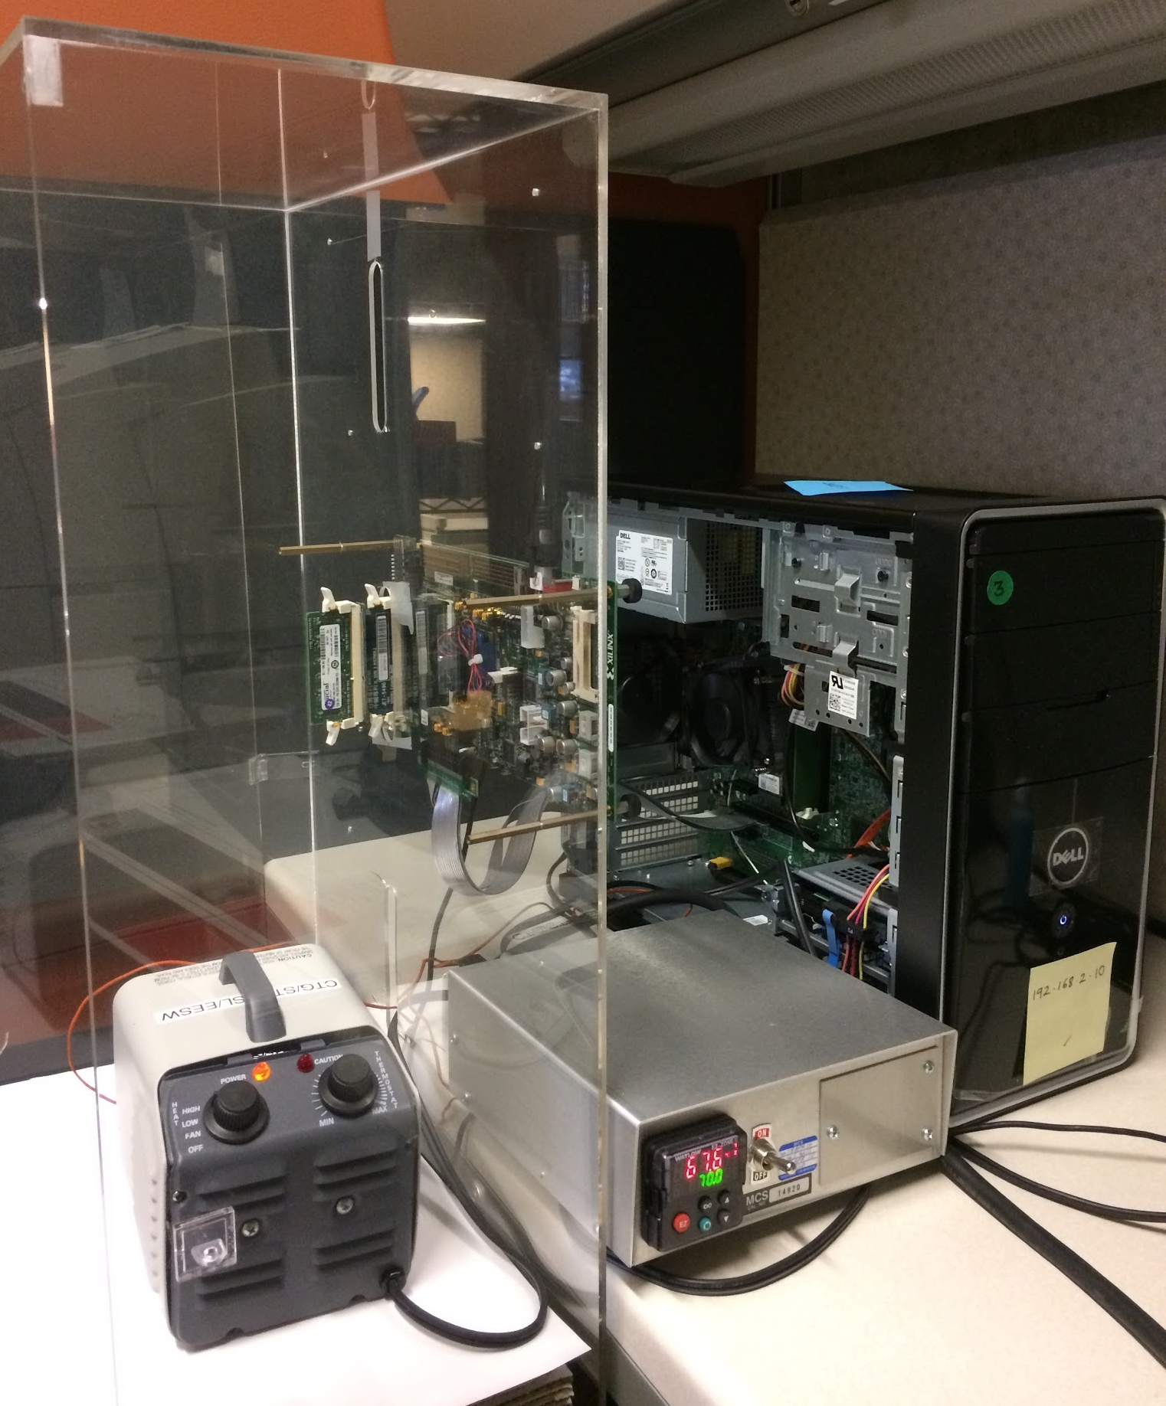
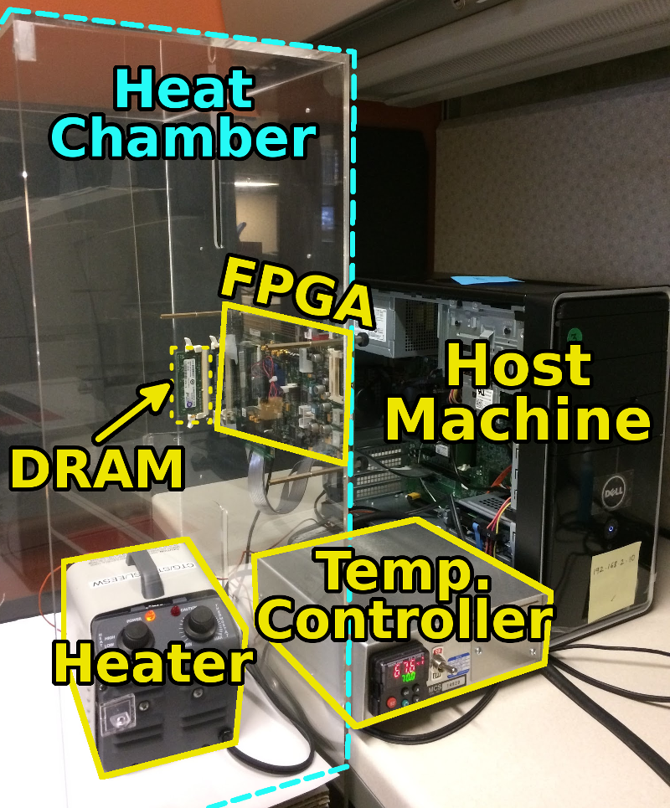
SoftMC: Open Source DRAM Infrastructure
Hasan Hassan et al., “SoftMC: A Flexible and Practical Open-Source Infrastructure for Enabling Experimental DRAM Studies,” HPCA 2017.
Flexible
Easy to Use (C++ API)
Open-source
github.com/CMU-SAFARI/SoftMC

Slide 193
SoftMC
https://github.com/CMU-SAFARI/SoftMC

Slide 194
Latency Reduction Summary of 115 DIMMs
Latency reduction for read & write (55°C)
Read Latency: 32.7%
Write Latency: 55.1%
Latency reduction for each timing parameter (55°C)
Sensing: 17.3%
Restore: 37.3% (read), 54.8% (write)
Precharge: 35.2%
Lee+, “Adaptive-Latency DRAM: Optimizing DRAM Timing for the Common-Case,” HPCA 2015.

Slide 195
AL-DRAM: Real-System Performance
Average
Improvement
14.0%
10.4%
Performance Improvement
2.9%
all-35-workload
AL-DRAM provides high performance on
memory-intensive workloads

Slide 196
Reducing Latency Also Reduces Energy
AL-DRAM reduces DRAM power consumption
Major reason: reduction in row activation time

Slide 197
More on Adaptive-Latency DRAM
Donghyuk Lee, Yoongu Kim, Gennady Pekhimenko, Samira Khan, Vivek Seshadri, Kevin Chang, and Onur Mutlu, "Adaptive-Latency DRAM: Optimizing DRAM Timing for the Common-Case" Proceedings of the 21st International Symposium on High-Performance Computer Architecture (HPCA), Bay Area, CA, February 2015. [Slides (pptx) (pdf)] [Full data sets]

Slide 198
Tackling the Fixed Latency Mindset
Reliable operation latency is actually very heterogeneous
Across temperatures, chips, parts of a chip, voltage levels, …
Idea: Dynamically find out and use the lowest latency one can reliably access a memory location with
Adaptive-Latency DRAM [HPCA 2015]
Flexible-Latency DRAM [SIGMETRICS 2016]
Design-Induced Variation-Aware DRAM [SIGMETRICS 2017]
Voltron [SIGMETRICS 2017]
DRAM Latency PUF [HPCA 2018]
DRAM Latency True Random Number Generator [HPCA 2019]
...
We would like to find sources of latency heterogeneity and exploit them to minimize latency (or create other benefits)

Slide 199
Analysis of Latency Variation in DRAM Chips
Kevin Chang, Abhijith Kashyap, Hasan Hassan, Samira Khan, Kevin Hsieh, Donghyuk Lee, Saugata Ghose, Gennady Pekhimenko, Tianshi Li, and Onur Mutlu, "Understanding Latency Variation in Modern DRAM Chips: Experimental Characterization, Analysis, and Optimization" Proceedings of the ACM International Conference on Measurement and Modeling of Computer Systems (SIGMETRICS), Antibes Juan-Les-Pins, France, June 2016. [Slides (pptx) (pdf)] [Source Code]

Slide 200
Design-Induced Latency Variation in DRAM
Donghyuk Lee, Samira Khan, Lavanya Subramanian, Saugata Ghose, Rachata Ausavarungnirun, Gennady Pekhimenko, Vivek Seshadri, and Onur Mutlu, "Design-Induced Latency Variation in Modern DRAM Chips: Characterization, Analysis, and Latency Reduction Mechanisms" Proceedings of the ACM International Conference on Measurement and Modeling of Computer Systems (SIGMETRICS), Urbana-Champaign, IL, USA, June 2017.

Slide 201
Solar-DRAM: Exploiting Spatial Variation
Jeremie S. Kim, Minesh Patel, Hasan Hassan, and Onur Mutlu, "Solar-DRAM: Reducing DRAM Access Latency by Exploiting the Variation in Local Bitlines" Proceedings of the 36th IEEE International Conference on Computer Design (ICCD), Orlando, FL, USA, October 2018.

Slide 202
DRAM Latency PUFs
Jeremie S. Kim, Minesh Patel, Hasan Hassan, and Onur Mutlu, "The DRAM Latency PUF: Quickly Evaluating Physical Unclonable Functions by Exploiting the Latency-Reliability Tradeoff in Modern DRAM Devices" Proceedings of the 24th International Symposium on High-Performance Computer Architecture (HPCA), Vienna, Austria, February 2018. [Lightning Talk Video] [Slides (pptx) (pdf)] [Lightning Session Slides (pptx) (pdf)]

Slide 203
DRAM Latency True Random Number Generator
Jeremie S. Kim, Minesh Patel, Hasan Hassan, Lois Orosa, and Onur Mutlu, "D-RaNGe: Using Commodity DRAM Devices to Generate True Random Numbers with Low Latency and High Throughput" Proceedings of the 25th International Symposium on High-Performance Computer Architecture (HPCA), Washington, DC, USA, February 2019.

Slide 204
ChargeCache: Exploiting Access Patterns
Hasan Hassan, Gennady Pekhimenko, Nandita Vijaykumar, Vivek Seshadri, Donghyuk Lee, Oguz Ergin, and Onur Mutlu, "ChargeCache: Reducing DRAM Latency by Exploiting Row Access Locality" Proceedings of the 22nd International Symposium on High-Performance Computer Architecture (HPCA), Barcelona, Spain, March 2016. [Slides (pptx) (pdf)] [Source Code]

Slide 205
Exploiting Subarray Level Parallelism
Yoongu Kim, Vivek Seshadri, Donghyuk Lee, Jamie Liu, and Onur Mutlu, "A Case for Exploiting Subarray-Level Parallelism (SALP) in DRAM" Proceedings of the 39th International Symposium on Computer Architecture (ISCA), Portland, OR, June 2012. Slides (pptx)

Slide 206
Tiered-Latency DRAM
Donghyuk Lee, Yoongu Kim, Vivek Seshadri, Jamie Liu, Lavanya Subramanian, and Onur Mutlu, "Tiered-Latency DRAM: A Low Latency and Low Cost DRAM Architecture" Proceedings of the 19th International Symposium on High-Performance Computer Architecture (HPCA), Shenzhen, China, February 2013. Slides (pptx)

Slide 207
LISA: Low-cost Inter-linked Subarrays
Kevin K. Chang, Prashant J. Nair, Saugata Ghose, Donghyuk Lee, Moinuddin K. Qureshi, and Onur Mutlu, "Low-Cost Inter-Linked Subarrays (LISA): Enabling Fast Inter-Subarray Data Movement in DRAM" Proceedings of the 22nd International Symposium on High-Performance Computer Architecture (HPCA), Barcelona, Spain, March 2016. [Slides (pptx) (pdf)] [Source Code]

Slide 208
The CROW Substrate for DRAM
Hasan Hassan, Minesh Patel, Jeremie S. Kim, A. Giray Yaglikci, Nandita Vijaykumar, Nika Mansourighiasi, Saugata Ghose, and Onur Mutlu, "CROW: A Low-Cost Substrate for Improving DRAM Performance, Energy Efficiency, and Reliability" Proceedings of the 46th International Symposium on Computer Architecture (ISCA), Phoenix, AZ, USA, June 2019.

Slide 209
Reducing Refresh Latency
Anup Das, Hasan Hassan, and Onur Mutlu, "VRL-DRAM: Improving DRAM Performance via Variable Refresh Latency" Proceedings of the 55th Design Automation Conference (DAC), San Francisco, CA, USA, June 2018.

Slide 210
Parallelizing Refreshes and Accesses
Kevin Chang, Donghyuk Lee, Zeshan Chishti, Alaa Alameldeen, Chris Wilkerson, Yoongu Kim, and Onur Mutlu, "Improving DRAM Performance by Parallelizing Refreshes with Accesses" Proceedings of the 20th International Symposium on High-Performance Computer Architecture (HPCA), Orlando, FL, February 2014. [Summary] [Slides (pptx) (pdf)]

Slide 211
Eliminating Refreshes
Jamie Liu, Ben Jaiyen, Richard Veras, and Onur Mutlu, "RAIDR: Retention-Aware Intelligent DRAM Refresh" Proceedings of the 39th International Symposium on Computer Architecture (ISCA), Portland, OR, June 2012. Slides (pdf)

Slide 212
Analysis of Latency-Voltage in DRAM Chips
Kevin Chang, A. Giray Yaglikci, Saugata Ghose, Aditya Agrawal, Niladrish Chatterjee, Abhijith Kashyap, Donghyuk Lee, Mike O'Connor, Hasan Hassan, and Onur Mutlu, "Understanding Reduced-Voltage Operation in Modern DRAM Devices: Experimental Characterization, Analysis, and Mechanisms" Proceedings of the ACM International Conference on Measurement and Modeling of Computer Systems (SIGMETRICS), Urbana-Champaign, IL, USA, June 2017.

Slide 213
VAMPIRE DRAM Power Model
Saugata Ghose, A. Giray Yaglikci, Raghav Gupta, Donghyuk Lee, Kais Kudrolli, William X. Liu, Hasan Hassan, Kevin K. Chang, Niladrish Chatterjee, Aditya Agrawal, Mike O'Connor, and Onur Mutlu, "What Your DRAM Power Models Are Not Telling You: Lessons from a Detailed Experimental Study" Proceedings of the ACM International Conference on Measurement and Modeling of Computer Systems (SIGMETRICS), Irvine, CA, USA, June 2018. [Abstract]

Slide 214
Takeaway I
We Can Reduce
Memory Latency
with Change of Mindset

Slide 215
Takeaway II
Main Memory Needs
Intelligent Controllers
to Reduce Latency

