Slide 1


Storage-Centric Computing for Modern Data-Intensive Workloads
Onur Mutlu
omutlu@gmail.com
https://people.inf.ethz.ch/omutlu
23 May 2024
Huawei

Slide 2
Problem
Computing
is Bottlenecked by Data

Slide 3
Data is Key for AI, ML, Genomics, …
Important workloads are all data intensive
They require rapid and efficient processing of large amounts of data
Data is increasing
  We can generate more than we can process
  We need to perform more sophisticated analyses on more data

Slide 4
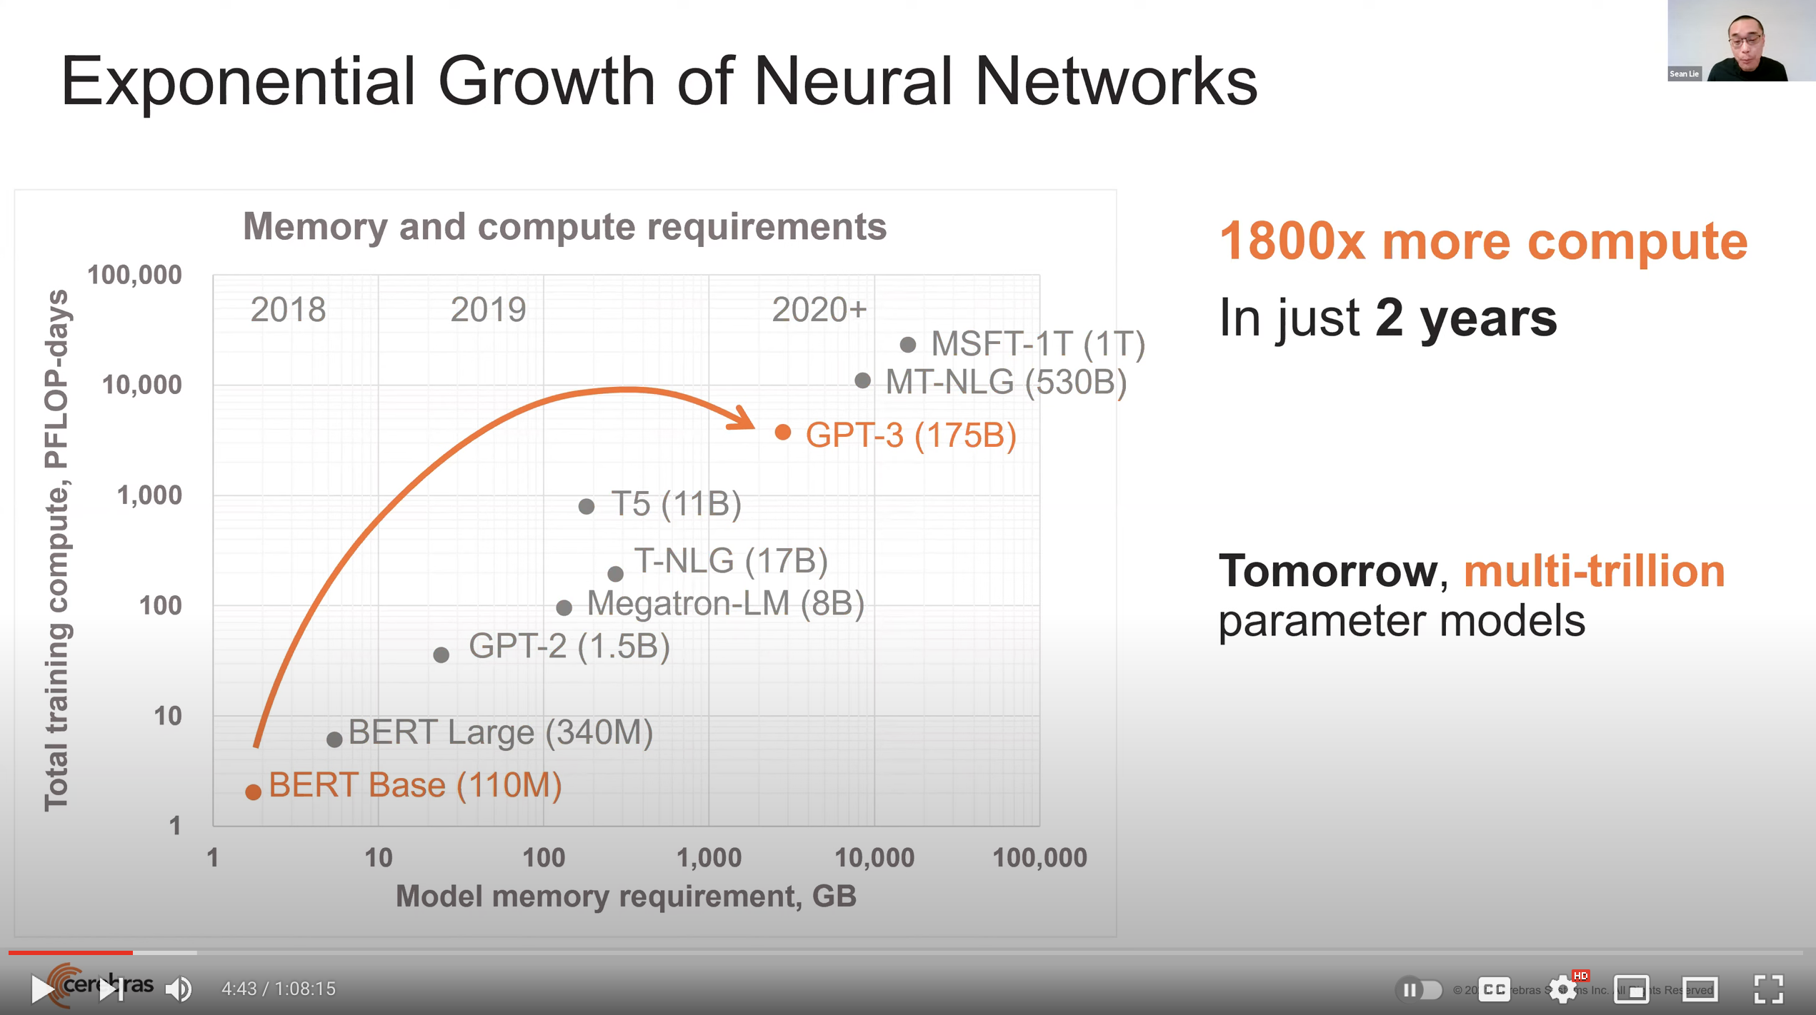
Huge Demand for Performance & Efficiency
Source: https://youtu.be/Bh13Idwcb0Q?t=283

Slide 5
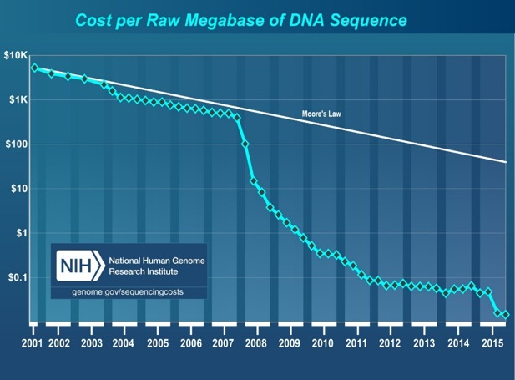

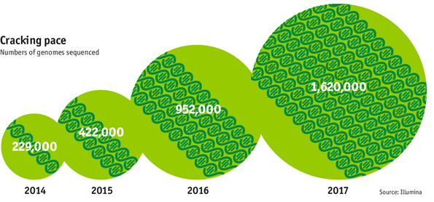

Huge Demand for Performance & Efficiency
development of new
sequencing technologies
Oxford Nanopore MinION
Number of Genomes Sequenced
http://www.economist.com/news/21631808-so-much-genetic-data-so-many-uses-genes-unzipped
Notes:
However, since the development of high throughput sequencing (HTS) technologies, the cost of genome sequencing has fallen off a cliff (<< 1,000$) making it viable for almost everyone's use.

Slide 6

Do We Want This?
Source: V. Milutinovic

Slide 7

Or This?
Source: V. Milutinovic

Slide 8
Challenge and Opportunity for Future
High Performance,
Energy Efficient,
Sustainable
(All at the Same Time)

Slide 9
The Problem
Data access is the major performance and energy bottleneck
Our current
design principles
cause great energy waste
(and great performance loss)

Slide 10
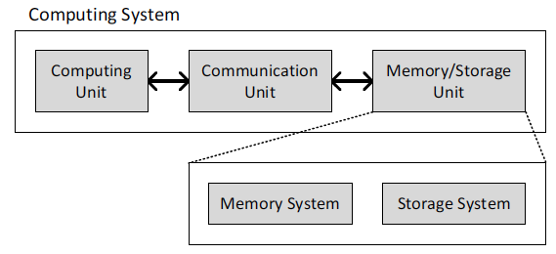
Today’s Computing Systems
Processor centric
All data processed in the processor → at great system cost

Slide 11
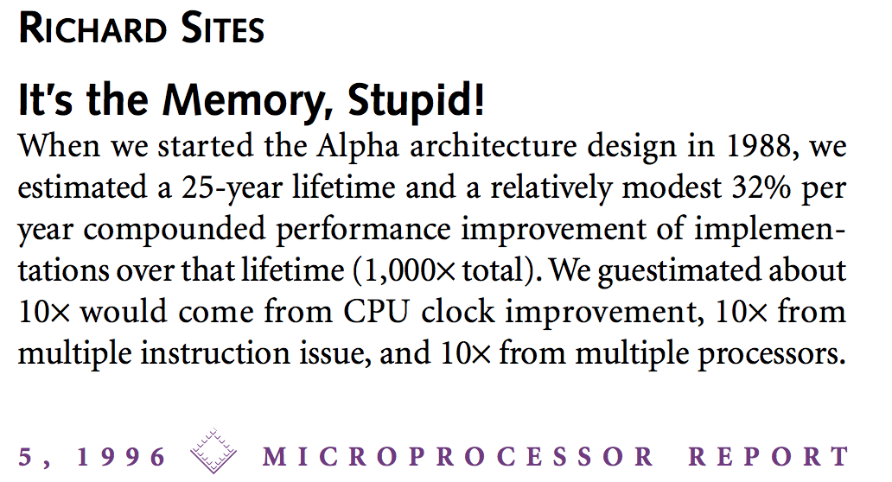
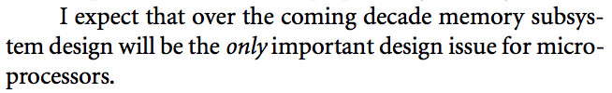
It’s the Memory, Stupid!
“It’s the Memory, Stupid!” (Richard Sites, MPR, 1996)
http://cva.stanford.edu/classes/cs99s/papers/architects_look_to_future.pdf

Slide 12
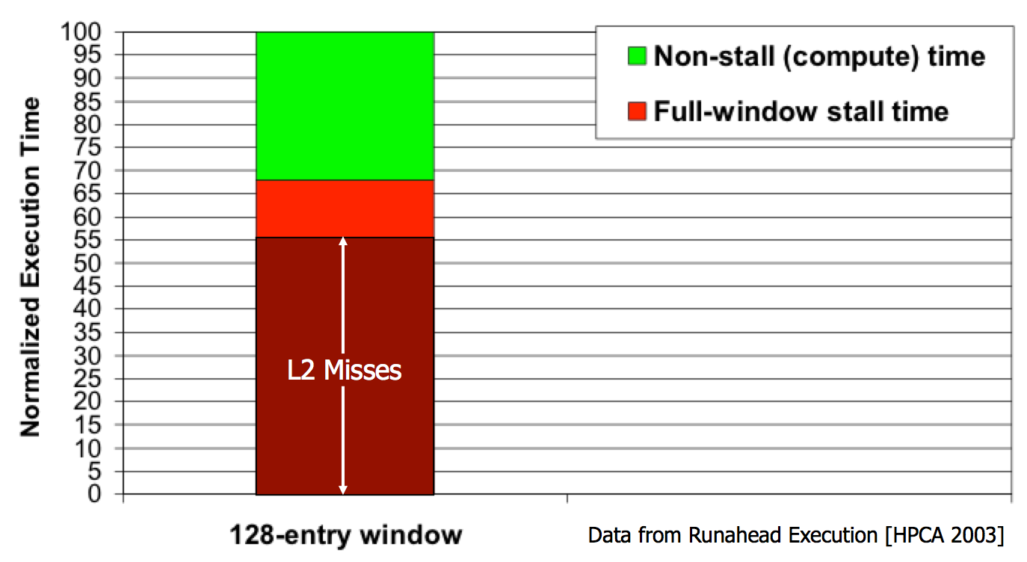
Processor-Centric System Performance
Mutlu+, “Runahead Execution: An Alternative to Very Large Instruction Windows for Out-of-Order Processors,” HPCA 2003.

Slide 13
Processor-Centric System Performance
All of Google’s Data Center Workloads (2015):
Kanev+, “Profiling a Warehouse-Scale Computer,” ISCA 2015.

Slide 14
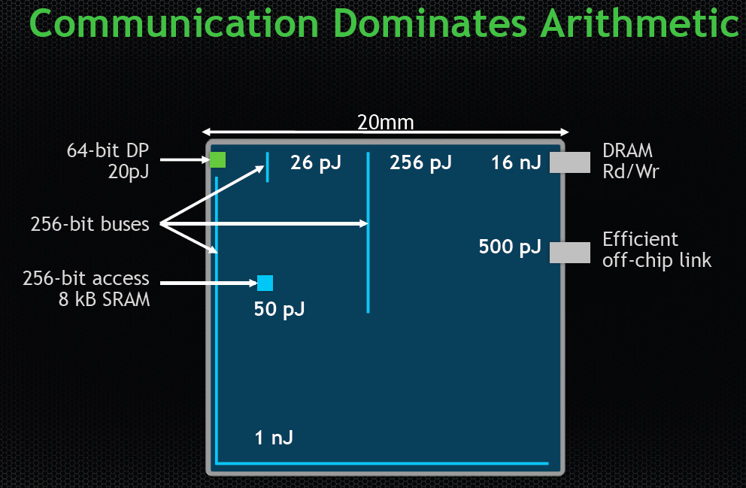
Data Movement vs. Computation Energy
Dally, HiPEAC 2015
A memory access consumes ~100-1000X
the energy of a complex addition

Slide 15
Data Movement vs. Computation Energy
Han+, “EIE: Efficient Inference Engine on Compressed Deep Neural Network,” ISCA 2016.

Slide 16
Data Movement vs. Computation Energy
6400X
A memory access consumes 6400X
the energy of a simple integer addition
Han+, “EIE: Efficient Inference Engine on Compressed Deep Neural Network,” ISCA 2016.

Slide 17
Energy Waste in Mobile Devices
Amirali Boroumand, Saugata Ghose, Youngsok Kim, Rachata Ausavarungnirun, Eric Shiu, Rahul Thakur, Daehyun Kim, Aki Kuusela, Allan Knies, Parthasarathy Ranganathan, and Onur Mutlu,
"Google Workloads for Consumer Devices: Mitigating Data Movement Bottlenecks"
Proceedings of the 23rd International Conference on Architectural Support for Programming Languages and Operating Systems (ASPLOS), Williamsburg, VA, USA, March 2018.
62.7% of the total system energy
is spent on data movement

Slide 18
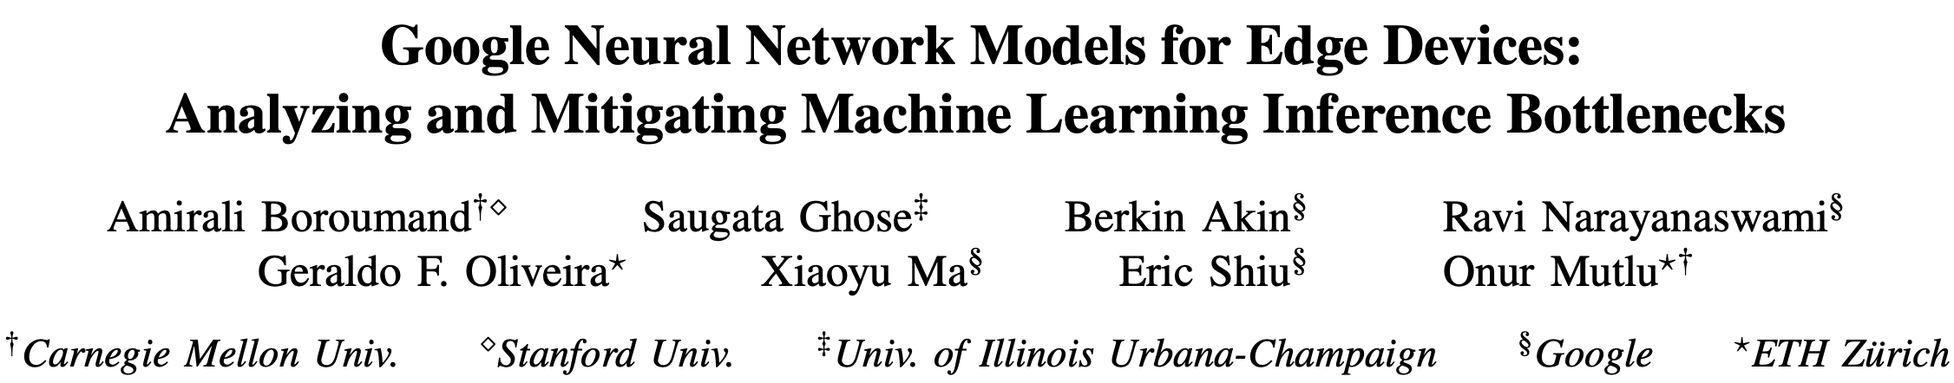
Energy Waste in Accelerators
Amirali Boroumand, Saugata Ghose, Berkin Akin, Ravi Narayanaswami, Geraldo F. Oliveira, Xiaoyu Ma, Eric Shiu, and Onur Mutlu,
"Google Neural Network Models for Edge Devices: Analyzing and Mitigating Machine Learning Inference Bottlenecks"
Proceedings of the 30th International Conference on Parallel Architectures and Compilation Techniques (PACT), Virtual, September 2021.
[Slides (pptx) (pdf)]
[Talk Video (14 minutes)]
> 90% of the total system energy
is spent on memory in large ML models

Slide 19
Fundamental Problem
Processing of data
is performed
far away from the data

Slide 20
We Need A Paradigm Shift To …
Enable computation with minimal data movement
Compute where it makes sense (where data resides)
Make computing architectures more data-centric

Slide 21
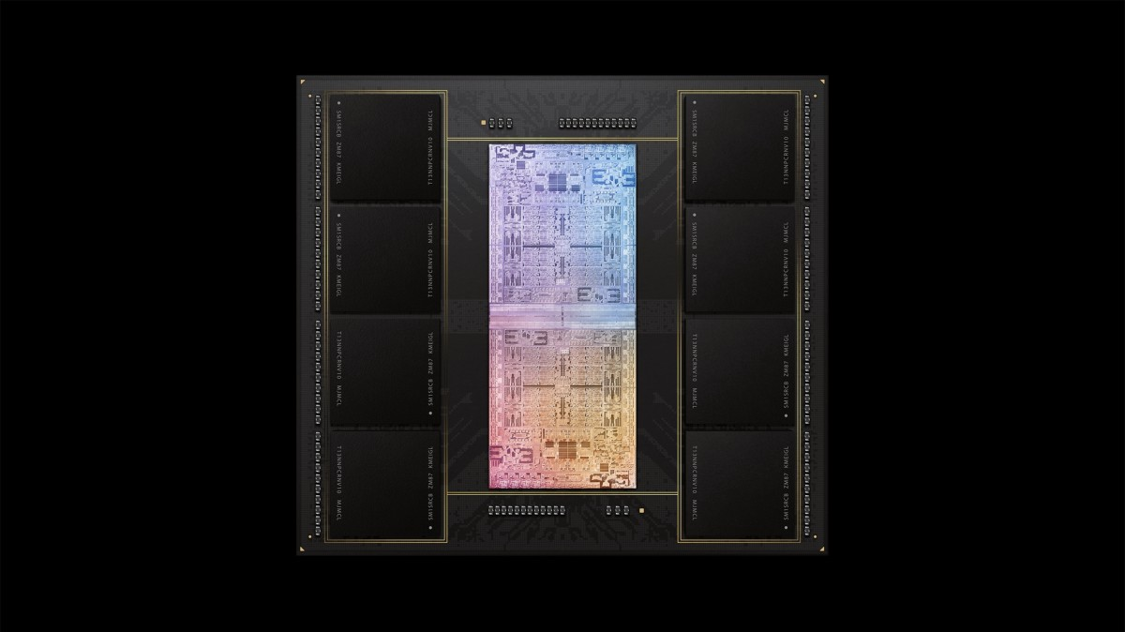
Process Data Where It Makes Sense
Sensors
A lot of
SRAM
Storage
DRAM
DRAM
Storage
Apple M1 Ultra System (2022)
https://www.gsmarena.com/apple_announces_m1_ultra_with_20core_cpu_and_64core_gpu-news-53481.php

Slide 22
Memory/Storage as an Accelerator
CPU
core
CPU
core
mini-CPU
core
GPU
(throughput)
core
GPU
(throughput)
core
video
core
GPU
(throughput)
core
GPU
(throughput)
core
CPU
core
CPU
core
Memory
imaging
core
LLC
Specialized
compute-capability
in memory
Memory Controller
Memory Bus
Memory similar to a “conventional” accelerator

Slide 23
Goal: Processing Inside Memory/Storage
Many questions … How do we design the:
  compute-capable memory & controllers?
  processors & communication units?
  software & hardware interfaces?
  system software, compilers, languages?
  algorithms & theoretical foundations?
Memory/Storage
Database
Graphs
Media
Processor
Core
Cache
Query
Interconnect
Problem
Results
Algorithm
Program/Language
System Software
SW/HW Interface
Micro-architecture
Logic
Devices
Electrons

Slide 24
Broader Vision
An Intelligent Architecture
Handles Data Well

Slide 25
Computing Systems Today …
Are processor-centric vs. data-centric
Make designer-dictated decisions vs. data-driven
Make component-based myopic decisions vs. data-aware

Slide 26
Fundamentally Better Architectures
Data-centric
Data-driven
Data-aware

Slide 27
Vision: Storage-Centric Computing (I)
Storage system is a heterogeneous computing device with hybrid memory
Storage system enables data-centric design of systems & workloads
Application-driven customization enables a powerful data-centric engine
Cai+, “Error Characterization, Mitigation, and Recovery in Flash Memory Based Solid State Drives,” Proc. IEEE 2017.
https://arxiv.org/pdf/1711.11427.pdf

Slide 28






Vision: Storage-Centric Computing (II)
Workload-customized storage-centric computing

Slide 29
Workload-Customized Storage-Centric Computing
Software and hardware customized for major workloads
  Genomics
  Video analytics
  Data & graph analytics
  Machine learning
  …
Data-centric (processing capability in all memories)
Data-driven (design & decision making)
Data-aware (optimization & design)
Unified interfaces for efficient & fast communication

Slide 30
Processing in Storage:
Two Approaches
1. Processing using Storage
2. Processing near Storage

Slide 31
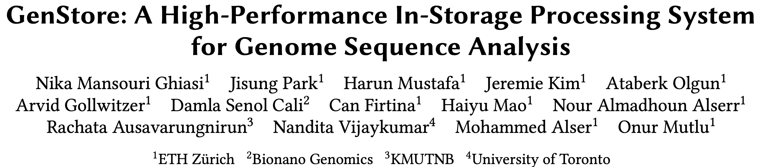
In-Storage Genomic Data Filtering [ASPLOS 2022]
Nika Mansouri Ghiasi, Jisung Park, Harun Mustafa, Jeremie Kim, Ataberk Olgun, Arvid Gollwitzer, Damla Senol Cali, Can Firtina, Haiyu Mao, Nour Almadhoun Alserr, Rachata Ausavarungnirun, Nandita Vijaykumar, Mohammed Alser, and Onur Mutlu,
"GenStore: A High-Performance and Energy-Efficient In-Storage Computing System for Genome Sequence Analysis"
Proceedings of the 27th International Conference on Architectural Support for Programming Languages and Operating Systems (ASPLOS), Virtual, February-March 2022.
[Lightning Talk Slides (pptx) (pdf)]
[Lightning Talk Video (90 seconds)]

Slide 32
Genome Sequence Analysis
Read mapping: first key step in genome sequence analysis
  Aligns reads to potential matching locations in the reference genome
  For each matching location, the alignment step finds the degree of similarity (alignment score)
Reference Genome
…GCCCATATGGTTAAGCTTCCATGGAAATGGGCTTTCGCTTCCACAATG…
Differences
Differences
GCTTCCAGAATG
Calculating the alignment score requires computationally-expensive approximate string matching (ASM) to account for differences between reads and the reference genome due to:
AAGCTTCCATGG
AAATGGGCTTTC
GCCCAAATGGTT
  Sequencing errors
  Genetic variation
Notes:
Read mapping is the first key step in genome sequence analysis [CLICK]
That Aligns reads to potential matching locations within the reference genome [CLICK]
For each matching location, the alignment step finds the degree of similarity between read and reference by calculating the alignment score
Calculating the alignment score requires computationally-expensive approximate string matching (ASM) to account for differences between reads and the reference genome. [CLICK]

Slide 33

Genome Sequence Analysis
Data Movement from Storage
Alignment
Storage
System
Main
Memory
Cache
Computation
Unit
(CPU or Accelerator)
AAGCTTCCATGG
CGTTCCTTGGCA
GGGCCAGAATG
CCTTTGGGTCCA
AAAATTCCATGG
GAATGGGGCCA
TTTTTTCCAAAA
TCCCCGGGGCCA
GCTTCCAGAATG
Computation overhead
Data movement overhead
Notes:
Read mapping performs alignment on large genomic datasets, containing millions of reads. [CLICK]
Therefore, read mapping is both computationally expensive [CLICK]
And incurs high data movement overhead [CLICK]

Slide 34



Compute-Centric Accelerators
Heuristics
Accelerators
Filters
Storage
System
Main
Memory
Cache
Computation
Unit
(CPU or Accelerator)
AAGCTTCCATGG
CGTTCCTTGGCA
GGGCCAGAATG
CCTTTGGGTCCA
AAAATTCCATGG
GAATGGGGCCA
TTTTTTCCAAAA
TCCCCGGGGCCA
GCTTCCAGAATG
✓
Computation overhead
Data movement overhead
Notes:
There has been significant effort into improving read mapping performance [CLICK]
Through efficient heuristics [CLICK]
hardware accelerators [CLICK]
and various filters that prune reads that do not require expensive computation [CLICK].
While these approaches address the computation overhead in read mapping [CLICK]
[While Reads Move] None of them alleviate the data movement overhead from storage, whose impact becomes even larger when the computation overhead gets alleviated [CLICK]

Slide 35

Key Idea: In-Storage Filtering
Filter reads that do not require alignment
inside the storage system
Storage
System
Main
Memory
Cache
Computation
Unit
(CPU or Accelerator)
AAGCTTCCATGG
CGTTCCTTGGCA
GGGCCAGAATG
CCTTTGGGTCCA
AAAATTCCATGG
GAATGGGGCCA
TTTTTTCCAAAA
TCCCCGGGGCCA
GCTTCCAGAATG
Filtered Reads
Exactly-matching reads
Do not need expensive approximate string matching during alignment
Non-matching reads
Do not have potential matching locations and can skip alignment
Notes:
Our key idea is to filter reads that do not require the expensive alignment computation in the storage system [CLICK] …
[While Reads Move] To fundamentally reduce the data movement overhead of read mapping
Examples of the reads that not require the costlt alignment step
Exactly-matching reads to the reference genome that do not need approximate string matching performed during alignment
Non-matching reads that have no potential matching locations in the reference genome hence skip the alignemt step

Slide 36
GenStore
Key idea: Filter reads that do not require alignment inside the storage system
Challenges
  Different behavior across read mapping workloads
  Limited hardware resources in the SSD
Host System
Reads that need
substantial processing
SSD Controller
In-SSD DRAM
Flash
Ctrl.#1
ACC
GenStore
FTL
FTL
NAND
Die#1
NAND
Die#4
Core
L2P
Mappings
Core
⋯
Core
⋯
Flash
Ctrl.#N
ACC
ACC
GenStore
Metadata
NAND
Die#1
NAND
Die#4
⋯
Notes:
Which is the first in-storage processing system designed for genome sequence analysis
Our key idea is to Filter reads that do not require alignment inside the storage system and send the unfiltered data to the host system for further processing
However, filtering reads in a modern SSD can be challenging [CLICK]
Due to different behavior across read mapping workloads. [CLICK]
And the limited hardware resources in the SSD.

Slide 37
Filtering Opportunities
Sequencing machines produce one of two kinds of reads
  Short reads: highly accurate and short
  Long reads: less accurate and long
Reads that do not require the expensive alignment step:
Exactly-matching reads
Do not need expensive approximate string matching during alignment
Low sequencing error rates (short reads) combined with
Low genetic variation
Non-matching reads
Do not have potential matching locations, so they skip alignment
High sequencing error rates (long reads) or
High genetic variation (short or long reads)
Notes:
Let’s take a look at filtering opportunities based on the input reads.
Sequencing machines produce one of two kinds of reads
Short reads: highly accurate (99.9%) and short (e.g., up to a few hundreds of DNA characters)
Long reads: less accurate (85-90%) and long (e.g., from hundreds to millions of DNA characters)
Based on these, We leverage two filtering opportunities
First, we can filter exactly matching reads, which are reads that match exactly to one or more subsequences of the reference genome and do not require approximate string matching during alignment. Exact matches can frequently occur in short read sets with low sequencing errors and low genetic variations
Second, we can filter non-matching reads. Such reads do not have any potential matching locations in the reference genome can skip the expensive alignment step. Non-matching reads can frequently occur in long read sets with high sequencing errors and short or long read sets with high genetic variations

Slide 38
GenStore
GenStore-EM for Exactly-Matching Reads
GenStore-NM for Non-Matching Reads
Notes:
by thorough analysis of mapping processes of reads with different properties and different degrees of genetic variation, we design two low-cost in-storage filters
[CLICK] 1) GenStore-EM for filtering exactly-matching reads
[CLICK] and 2) GenStore-NM for filtering most of the non-matching reads

Slide 39
GenStore
Filter reads that do not require alignment
inside the storage system
GenStore-Enabled
Storage
System
Main
Memory
Cache
Computation
Unit
(CPU or Accelerator)
✓
Computation overhead
✓
Data movement overhead
  GenStore provides significant speedup (1.4x - 33.6x) and
  energy reduction (3.9x – 29.2x) at low cost
Notes:
We propose GenStore, the first in-storage processing system designed for genome sequence analysis. [CLICK]
To reduce both the computation [CLICK]
And the data movement overhead [CLICK]
GenStore provides high-performance and energy benefits compared to state-of-the-art HW and SW baselines [CLICK]

Slide 40
Performance – GenStore-EM
With the Software Mapper
With the Hardware Mapper
3.3x
2.1x
2.1x
29
2.5x
2.5x
1.5x
Exec. time [sec]
2.1× - 2.5× speedup compared to the software Base
1.5× – 3.3× speedup compared to the hardware Base
On average 3.92× energy reduction
Notes:
We analyze the benefits of GenStore-EM for a 22-GB short read set where 80% of reads exactly match some subsequence in the reference genome and can be filtered.
We show the benefit of GS on software and hardware read mappers.
GS provides 2.1× - 2.5× speedup compared to the software Base
GS provides 1.5× – 3.3× speedup compared to the hardware Base
GS provides on average 3.92× energy reduction

Slide 41
Performance – GenStore-NM
With the Software Mapper
With the Hardware Mapper
Exec. time [sec]
Log scale
22.4
27.9x
19.2x
29x
6.8x
6.8x
22.4× – 27.9× speedup compared to the software Base
6.8× – 19.2× speedup compared to the hardware Base
On average 27.2× energy reduction
Notes:
We analyze the benefits of GenStore-NM for a 12-GB long read set with very high genetic variation compared the the reference genome where 99.7% of reads do not match any subsequence in the reference genome.
We show the benefit of GS on software and hardware read mappers.
GS provides 22.4× – 27.9× speedup compared to the software Base
GS provides 6.8× – 19.2× speedup compared to the hardware Base
GS provides on average 27.2× energy reduction

Slide 42
Area and Power Consumption
Based on Synthesis of GenStore accelerators using the Synopsys Design Compiler @ 65nm technology node
Logic unit | # of instances | Area [mm²] | Power [mW]
Comparator | 1 per SSD | 0.0007 | 0.14
K -mer Window | 2 per channel | 0.0018 | 0.27
Hash Accelerator | 2 per SSD | 0.008 | 1.8
Location Buffer | 1 per channel | 0.00725 | 0.37375
Chaining Buffer | 1 per channel | 0.008 | 0.95
Chaining PE | 1 per channel | 0.004 | 0.98
Control | 1 per SSD | 0.0002 | 0.11
Total for an 8-channel SSD | - | 0.2 | 26.6
Only 0.006% of a 14nm Intel Processor, less than 9.5% of the three ARM processors in a SATA SSD controller
Notes:
We find area and power values of GenStore by synthesizing GenStore-EM and NM using 65nm technology node,
And find that for an 8-channel SSD, the area of GS is 0.2 mm square and the power is 26.6 watts
BY scaling the area to lower technology nodes, we observe that the area overhead of GS is 0.006% of an Intel processor and less than 9.5% of the of the three ARM processors in a SATA SSD controller.

Slide 43
In-Storage Genomic Data Filtering [ASPLOS 2022]
Nika Mansouri Ghiasi, Jisung Park, Harun Mustafa, Jeremie Kim, Ataberk Olgun, Arvid Gollwitzer, Damla Senol Cali, Can Firtina, Haiyu Mao, Nour Almadhoun Alserr, Rachata Ausavarungnirun, Nandita Vijaykumar, Mohammed Alser, and Onur Mutlu,
"GenStore: A High-Performance and Energy-Efficient In-Storage Computing System for Genome Sequence Analysis"
Proceedings of the 27th International Conference on Architectural Support for Programming Languages and Operating Systems (ASPLOS), Virtual, February-March 2022.
[Lightning Talk Slides (pptx) (pdf)]
[Lightning Talk Video (90 seconds)]

Slide 44
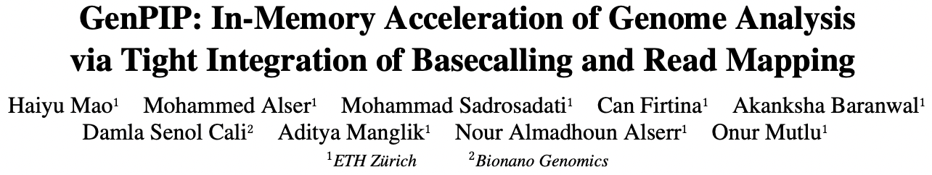
Tight Integration of Genome Analysis Tasks
Haiyu Mao, Mohammed Alser, Mohammad Sadrosadati, Can Firtina, Akanksha Baranwal, Damla Senol Cali, Aditya Manglik, Nour Almadhoun Alserr, and Onur Mutlu,
"GenPIP: In-Memory Acceleration of Genome Analysis via Tight Integration of Basecalling and Read Mapping"
Proceedings of the 55th International Symposium on Microarchitecture (MICRO), Chicago, IL, USA, October 2022.
[Slides (pptx) (pdf)]
[Longer Lecture Slides (pptx) (pdf)]
[Lecture Video (25 minutes)]
[arXiv version]
https://arxiv.org/pdf/2209.08600.pdf

Slide 45

MegIS:
High-Performance and Low-Cost Metagenomic Analysis with In-Storage Processing
Nika Mansouri Ghiasi, Mohammad Sadrosadati, Harun Mustafa, Arvid Gollwitzer,
Can Firtina, Julien Eudine, Haiyu Mao, Joël Lindegger, Meryem Banu Cavlak,
Mohammed Alser, Jisung Park, Onur Mutlu

Slide 46
What is Metagenomics?
Metagenomics: Analysis of genome sequences of diverse organisms within a shared environment (e.g., blood, soil, oceans)
Overcomes the limitations of traditional genomics
  Bypasses the need for isolating and culturing individual species
  Addresses clinical/environmental challenges where culturing is impractical
Has led to ground-breaking advancements
  Precision medicine
  Understanding microbial diversity of an environment
  Discovering early warnings of communicable diseases

Slide 47
Key Steps of the Metagenomic Workflow
Sequencing
Extracts the genomic information of all organisms in a sample into digital data
A sequencing machine generates randomly sampled, inexact fragments of genomic information, called reads
Basecalling
Converts the raw sequencer data into sequences of characters (A, C, G, and T)
Analysis
Determines the species present/absent in the sample
Determines their relative abundances

Slide 48
Why Accelerating the Analysis Step?
Metagenomic analysis is typically performed
much more frequently compared to the other two steps
Even for one round of analysis,
the analysis step bottlenecks
the end-to-end performance and energy efficiency
Due to rapid advancements in sequencing technologies,
the gap between sequencing and analysis is widening

Slide 49
Executive Summary
Problem: Metagenomic analysis suffers from significant storage I/O data movement overhead due to accessing large amounts of low-reuse data
Goal: Improve the performance of metagenomic analysis by reducing data movement overhead right from the storage system, in a cost-effective manner
Challenge: While in-storage processing can be a promising direction, none of the existing approaches can be effectively implemented inside the storage system due to the limited resources available in storage devices
Idea: Enable cooperative ISP for metagenomics, where we do not merely focus on the storage system and, instead, capitalize on the strengths of processing both inside and outside the storage system via a synergistic design
MegIS: The first in-storage processing system tailored for metagenomic analysis
  Leverages and orchestrates processing inside and outside the storage system
  1) Task partitioning, 2) Data/computation flow coordination, 3) Storage-aware algorithms, 4) Lightweight in-storage accelerators, and 5) Data mapping
Results: Significant speedup (1.5x – 100.2x) and energy reduction (1.9x – 25.7x) with high accuracy and at low cost

Slide 50
MegIS
The first ISP system for end-to-end metagenomic analysis
  Cooperative ISP
  Enables an efficient pipeline between the host and the storage
  Maximally leverage and orchestrate their capabilities
SSD
Cntrl
Host
MegIS
FTL
DRAM
❶ Start
Cores
Standard
Metadata
❺ Finding
Species
❹ Send
Processed
Queries
ACC
ACC
MegIS-Enabled SSD
❷ Prepare
❸ Prepare
Input Queries
Cntrl
Cntrl
❻ Abundance
Estimation
MegIS
Metadata
❼ Transfer
Channel#1
⋯
Channel#N

Slide 51
Evaluation Methodology
Metagenomic Analysis Tools
Performance-Optimized SW: Kraken2 [Genome Biology’19]
Accuracy-Optimized SW: Metalign [Genome Biology’20]
PIM HW: Sieve [ISCA’21]
SSD Configurations
SSD-C: with SATA3 interface (0.5 GB/s sequential read bandwidth)
SSD-P: with PCIe Gen4 interface (7 GB/s sequential read bandwidth)

Slide 52
Performance
With inputs with Low, Medium, and High genetic diversity
P-Opt
A-Opt
A-Opt+KSS
MS
SSD-C
SSD-P
Speedup
2.66x – 6.38x speedup compared to P-Opt
6.93x – 20.39x speedup compared to A-Opt
5.36x average energy reduction compared to P-Opt
15.16x average energy reduction compared to A-Opt

Slide 53
Performance Compared to PIM
With inputs with Low, Medium, and High genetic diversity
SSD-C
SSD-P
Base
MS
Speedup
1.46x – 5.06x speedup compared to the PIM baseline
1.88× (3.49×) average (max) energy reduction
compared to the PIM baseline

Slide 54
System Cost Efficiency
MegIS on a cost-optimized system
  With SSD-C and 64-GB DRAM
Baselines on a performance-optimized system
  With SSD-P and 1-TB DRAM
P-Opt_P
A-Opt_P
MS_C
Speedup
2.37x average speedup compared to P-Opt
7.20x average speedup compared to A-Opt

Slide 55
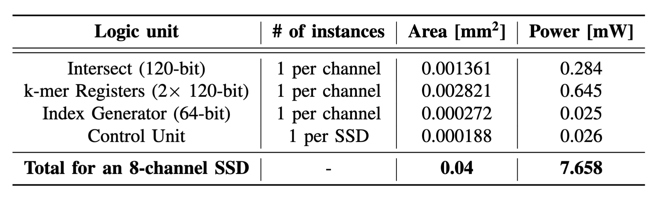
Area and Power
Based on Synthesis of MegIS accelerators using the Synopsys Design Compiler @ 65nm technology node
Only 1.7% of the area of three 28-nm ARM Cortex R4 cores
in a SATA SSD controller

Slide 56
Other Results in the Paper
MegIS’s performance with the SSD cores
MegIS’s performance outside SSD
Performance with varying
  Database sizes
  Memory capacities
  #SSDs
  #Channels
  #Samples
MegIS’s performance for abundance estimation

Slide 57
Processing in Storage:
Two Approaches
1. Processing using Storage
2. Processing near Storage

Slide 58
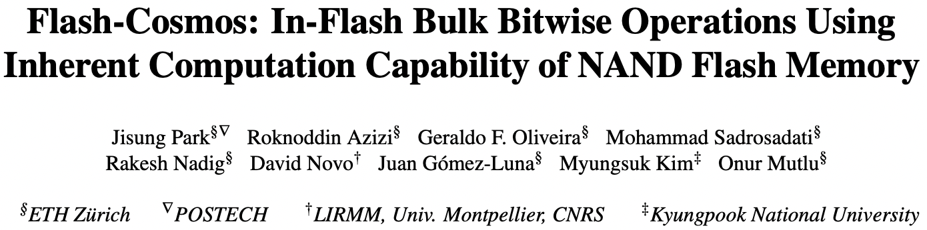
In-Flash Bulk Bitwise Execution
Jisung Park, Roknoddin Azizi, Geraldo F. Oliveira, Mohammad Sadrosadati, Rakesh Nadig, David Novo, Juan Gómez-Luna, Myungsuk Kim, and Onur Mutlu,
"Flash-Cosmos: In-Flash Bulk Bitwise Operations Using Inherent Computation Capability of NAND Flash Memory"
Proceedings of the 55th International Symposium on Microarchitecture (MICRO), Chicago, IL, USA, October 2022.
[Slides (pptx) (pdf)]
[Longer Lecture Slides (pptx) (pdf)]
[Lecture Video (44 minutes)]
[arXiv version]
https://arxiv.org/pdf/2209.05566.pdf

Slide 59
Data-Movement Bottleneck
Conventional systems: Outside-storage processing (OSP) that must move the entire data to CPUs/GPUs through the memory hierarchy
Memory bandwidth:
~ 40 GB/s
Storage
(NAND Flash-Based SSD)
CPU/GPU
Main
Memory
(DRAM)
$ (SRAM)
Storage I/O bandwidth:
~ 8 GB/s
External I/O bandwidth of storage systems
is the main bottleneck in conventional systems (OSP)
Notes:
This is a very high-level overview of computing systems that consist of three main components, compute units, main memory, and storage devices. [Click]
To perform just simple bitwise operations, conventional systems must first read the massive entire data to the compute units throughout the memory hierarch. [Click]
If the target data resides in the storgage device, [Click] the relatively slow storage bandwidth becomes the main bottleneck in conventional systems. [Click]

Slide 60
In-Storage Processing (ISP)
Uses in-storage compute units (embedded cores or FPGA) to send only the computation results
Memory bandwidth:
~ 40 GB/s
Storage
(NAND Flash-Based SSD)
CPU/GPU
Main
Memory
(DRAM)
$ (SRAM)
Storage I/O bandwidth:
~ 8 GB/s
Notes:
In-storage processing leverages cute units inside the storage devices, [Clompick] such as …

Slide 61
In-Storage Processing (ISP)
Uses in-storage compute units (embedded cores or FPGA) to send only the computation results
Memory bandwidth:
~ 40 GB/s
Storage
(NAND Flash-Based SSD)
CPU/GPU
Main
Memory
(DRAM)
In-Storage
Compute
Units
NAND
Chip#1
…
NAND
Chip#4
$ (SRAM)
…
In-storage
processing
NAND
Chip#31
…
NAND
Chip#32
Storage I/O bandwidth:
~ 8 GB/s
Notes:
Such as embedded core or FPGA to perform computation inside the storage [Click] and sends …

Slide 62
In-Storage Processing (ISP)
Uses in-storage compute units (embedded cores or FPGA) to send only the computation results
Memory bandwidth:
~ 40 GB/s
Storage
(NAND Flash-Based SSD)
Results only
CPU/GPU
Main
Memory
(DRAM)
In-Storage
Compute
Units
NAND
Chip#1
…
NAND
Chip#4
$ (SRAM)
…
In-storage
processing
NAND
Chip#31
…
NAND
Chip#32
Storage I/O bandwidth:
~ 8 GB/s
ISP can mitigate data movement overhead
by reducing SSD-external data movement
Notes:
Sends only the computation results. [Click]
This way, in-storage processing can significatnly mitigate the data movement by reducing external I/Os between the host and the storage device. [Click]

Slide 63
In-Storage Processing (ISP)
Uses in-storage compute units (embedded cores or FPGA) to send only the computation results
Memory bandwidth:
~ 40 GB/s
Storage
(NAND Flash-Based SSD)
Results only
CPU/GPU
Main
Memory
(DRAM)
In-Storage
Compute
Units
NAND
Chip#1
…
NAND
Chip#4
$ (SRAM)
…
In-storage
processing
NAND
Chip#31
…
NAND
Chip#32
Storage I/O bandwidth:
~ 8 GB/s
SSD-internal bandwidth
becomes the new bottleneck in ISP
SSD internal I/O bandwidth: ~ 10 GB/s
Notes:
However, in-storage processing also needs to read the massive data from underlying NAND flash chips, [Click] and SSD internal bandwidth is not that higher than the external bandwidth even in high-end NAND flash-based SSDs. [Click]
As a result, SSD internal I/Os become the new bottlenck in in-storage processing. [Click]

Slide 64
In-Flash Processing (IFP)
Performs computation inside NAND flash chips
Memory bandwidth:
~ 40 GB/s
Storage
(NAND Flash-Based SSD)
Results only
CPU/GPU
Main
Memory
(DRAM)
In-Storage
Compute
Units
NAND
Chip#1
…
NAND
Chip#4
$ (SRAM)
…
NAND
Chip#31
…
NAND
Chip#32
Storage I/O bandwidth:
~ 8 GB/s
In-flash processing
SSD internal I/O bandwidth: ~ 10 GB/s
Notes:
If we can perform computation inside NAND flash chips, [Click] it can reduce …

Slide 65
In-Flash Processing (IFP)
Performs computation inside NAND flash chips
Memory bandwidth:
~ 40 GB/s
Storage
(NAND Flash-Based SSD)
Results only
Results only
CPU/GPU
Main
Memory
(DRAM)
In-Storage
Compute
Units
NAND
Chip#1
…
NAND
Chip#4
$ (SRAM)
…
NAND
Chip#31
…
NAND
Chip#32
Storage I/O bandwidth:
~ 8 GB/s
In-flash processing
SSD internal I/O bandwidth: ~ 10 GB/s
IFP fundamentally mitigates data movement
Notes:
It can reduce the internal data movement within the SSD by sending only the results to the flash controller and the host, [Click] thereby fundamentally mitigating the data movement from the storage device. [Click]

Slide 66
Our Proposal: Flash-Cosmos
Flash-Cosmos enables
  Computation on multiple operands with a single sensing operation
  Accurate computation results by eliminating raw bit errors in stored data
NAND Flash Chip
Operand O₁
Operand O₁
Operand O₂
Operand O₂
Operand O₃
Operand O₃
…
…
Simultaneous sensing
Operand O₃₂
Operand O₃₂
Bitlines (BLs)
Page Buffer
O₁ & O₂ & O₃ & … & O₃₂
Notes:
At a very high level, Flash-Cosmos enables [Click] computation while sensing multiple operands at once and accurate computation results by zeroing raw bit errors in stored data. [Click]

Slide 67
Multi-Wordline Sensing (MWS): Bitwise AND
Intra-Block MWS:
Simultaneously activates multiple WLs in the same block
→ Bitwise AND of the stored data in the WLs
BL₁
BL₂
BL₃
BL₄
A bitline reads as ‘1’ only when all the target cells store ‘1’
→ Equivalent to the bitwise AND of all the target cells
WL₁
0
0
1
1
…
Target Cell:
Operate
as a resistance (1)
or an open switch (0)
WL₂
0
1
0
1
…
WL₃
1
0
1
1
…
WL₄
0
0
1
0
…
…
…
…
…
Result:
0
0
0
0
Notes:
The bitline current cannot flow through Bitline 4 any longer, as it has a cell that stores ‘0’ and blocks the bitline current. [Click]

Slide 68
Multi-Wordline Sensing (MWS): Bitwise AND
Intra-Block MWS:
Simultaneously activates multiple WLs in the same block
→ Bitwise AND of the stored data in the WLs
BL₁
BL₂
BL₃
BL₄
Flash-Cosmos (Intra-Block MWS) enables
bitwise AND of multiple pages in the same block
via a single sensing operation
WL₁
0
0
1
1
…
A bitline reads as ‘1’ only when all the target cells store ‘1’
→ Equivalent to the bitwise AND of all the target cells
Target Cell:
Operate
as a resistance (1)
or an open switch (0)
WL₂
0
1
0
1
…
WL₃
1
0
1
1
…
WL₄
0
0
1
1
…
…
…
…
…
Result:
0
0
0
1
Notes:
This way, intra-block MWS enables bitwise AND operation on any pages in the same block via a single sensing operation. [Click]

Slide 69
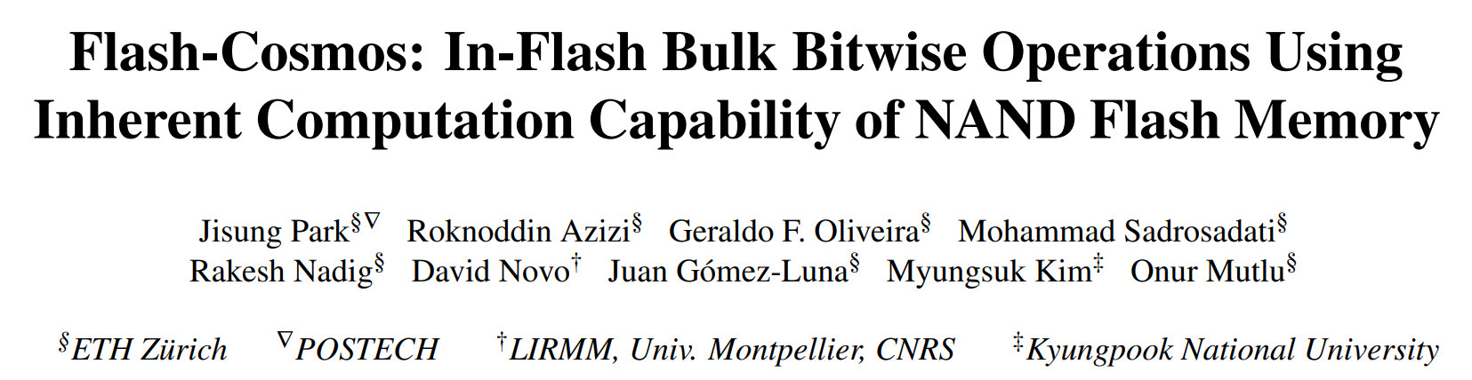

Other Types of Bitwise Operations
Flash-Cosmos also enables
other types of bitwise operations (NOT/NAND/NOR/XOR/XNOR)
leveraging existing features of NAND flash memory
https://arxiv.org/abs/2209.05566.pdf

Slide 70

Key Ideas
Multi-Wordline Sensing (MWS)
to enable in-flash bulk bitwise operations
via a single sensing operation
Enhanced SLC-Mode Programming (ESP)
to eliminate raw bit errors in stored data
(and thus in computation results)
Notes:
Now let’s dive into the key ideas of Enhanced SLC-Mode Programming [Click] that elminiates …

Slide 71
Enhanced SLC-Mode Programming (ESP)
Goal: eliminate raw bit errors in stored data (and computation results)
Key ideas
  Programs only a single bit per cell (SLC-mode programming)
    Trades storage density for reliable computation
  Performs more precise programming of the cells
    Trades programming latency for reliable computaion
Maximizes the reliability margin
between the different states of flash cells
Notes:
Eliminates raw bit errors in stored data. [Click]
The key idea is to program only a single bit per cell for the target data of computation, meaning that ESP trades storage density, [Click] and use more precise program-voltage control, meaning that it also trades program latency, [Click] to maximize the reliability margin between the program and erased states of flash cells. [Click]

Slide 72
Enhanced SLC-Mode Programming (ESP)
To eliminate raw bit errors in stored data (and computation results)
Key ideas
  Programs only a single bit per cell (SLC-mode programming)
    Trades storage density for reliable computation
  More precise program-voltage control
    Trades programming latency for reliable computaion
Flash-Cosmos (ESP) enables
reliable in-flash computation
by trading storage density & programming latency
Storage & latency overheads affect
only data used in in-flash computation
Maximizes the reliability margin
between the different states of flash cells
Notes:
So, ESP enables reliable in-flash computation by trading storage density and program performance, [Click] but the overheads occur only for the target data of computation. [Click]

Slide 73
Evaluation Methodology
Real-device characterization
  To validate the feasibility and reliability of Flash-Cosmos
  Using 160 48-WL-layer 3D Triple-Level Cell NAND flash chips
    3,686,400 tested wordlines
  Under worst-case operating conditions
    Under a 1-year retention time at 10K P/E cycles
    Worst-case data patterns
System-level evaluation
  Using the state-of-the-art SSD simulator (MQSim [Tavakkol+, FAST’18])
  Three real-world applications
    Bitmap Indices (BMI): Bitwise AND of up to ~1,000 operands
    Image Segmentation (IMS): Bitwise AND of 3 operands
    K-clique Star Listing (KCS): Bitwise OR of up to 32 operands
  Baselines
    Outside-Storage Processing (OSP): A multi-core CPU (Intel i7-11700K)
    In-Storage Processing (ISP): An in-storage hardware accelerator
    ParaBit [Gao+, MICRO’21]: State-of-the-art in-flash processing mechanism
Notes:
First, we conducted rigorous real-device characterization to validate the feasibility and reliability of Flash-Cosmos, [Click] using 160 3D NAND flash chips, [Click] considering the worst-case operation conditions. [Click]
We also performed system-level evaluation using the state-of-the-art SSD simulator, [Click] for three real-world applications that perform bulk bitwise operations on different numbers of operands. [Click]
We compared Flash-Cosmos against three baselines, a conventional system that uses a multi-core CPU, an in-storage processing system with an in-storage hardware accelerator, and a system that adopts the state-of-the-art in-flash processing mechanism to perform bulk bitwise operations. [Click]

Slide 74
Results: Real-Device Characterization
No changes to the cell array
of commodity NAND flash chips
Can have many operands
(AND: up to 48, OR: up to 4)
with small increase in sensing latency (< 10%)
ESP significantly improves
the reliability of computation results
(no observed bit error in the tested flash cells)
Notes:
Through our real-device characterization, we demnostrated that both MWS operations are possible without requiring any change ot the cell array of commodity NAND flash chips, [Click] and they can reliably activate multiple wordlines at the same time without significant increase in sensing latency. [Click]
We also observed no errors in the tested cells when we program data using ESP, which shows that Flash-Cosmos enables reliable in-flash bulk bitwise operations. [Click]

Slide 75
Results: Performance & Energy
ISP
ParaBit
Flash-Cosmos
150×
70×
Speedup over OSP
Energy benefit over OSP
14×
2×
25×
3.5×
12×
2×
13.4×
3.3×
1.6×
10×
2.5×
20×
Flash-Cosmos provides significant performance & energy benefits over all the baselines
The larger the number of operands,
the higher the performance & energy benefits
Notes:
As system-level evaluation, [Click] we evaluate the speedup and [Click] energy benefit over the conventional system. [Click]
We observe that Flash-Cosmos provides significant performance and energy benefits over all the baselines, including the state-of-the-art in-flash bulk bitwise operation technique, [Click] and the larger the number of operands for bulk bitwise operations, the higher the performance and energy benefits that Flash-Cosmos can achieve over other computing platforms. [Click]

Slide 76
In-Flash Bulk Bitwise Execution
Jisung Park, Roknoddin Azizi, Geraldo F. Oliveira, Mohammad Sadrosadati, Rakesh Nadig, David Novo, Juan Gómez-Luna, Myungsuk Kim, and Onur Mutlu,
"Flash-Cosmos: In-Flash Bulk Bitwise Operations Using Inherent Computation Capability of NAND Flash Memory"
Proceedings of the 55th International Symposium on Microarchitecture (MICRO), Chicago, IL, USA, October 2022.
[Slides (pptx) (pdf)]
[Longer Lecture Slides (pptx) (pdf)]
[Lecture Video (44 minutes)]
[arXiv version]
https://arxiv.org/pdf/2209.05566.pdf

Slide 77
Complex In-Flash Arithmetic: Summary
Motivation:
  Prior IFP techniques do not accelerate complex arithmetic operations
  Arithmetic operations require handling of intermediate results
  Storing intermediate results reduces flash cell lifespan and increases latency overhead
Key Goal: Implement in-flash arithmetic operations with minimal effect on the flash cell lifespan
Key Ideas:
  Combine prior IFP approaches (e.g., Flash-Cosmos, ParaBit) to implement arithmetic operations
  Logic unrolling to avoid storing the intermediate results
  Algebraic/disjunctive normal form (DNF) hybrid representation of output bits
  Exploit Latch Dump operation to store intermediate results in data latches
Key Results: We use an analytical model to evaluate IFP performance
  Speedup of up to 19.7x over naïve IFP arithmetic
  Speedup of up to 12.3x over read/write bound CPU
  No programming needed to perform addition and multiplication

Slide 78
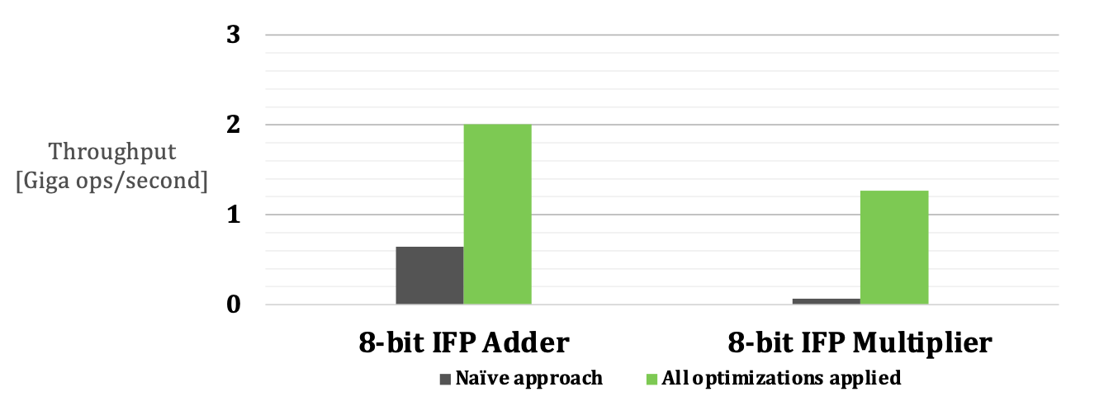
Comparison Against Naïve Implementation
Optimized approach outperforms pure Flash-Cosmos by 3.1x for addition and 19.7x for multiplication
Number of ESP commands goes from 14 for addition and 154 for multiplication to zero

Slide 79
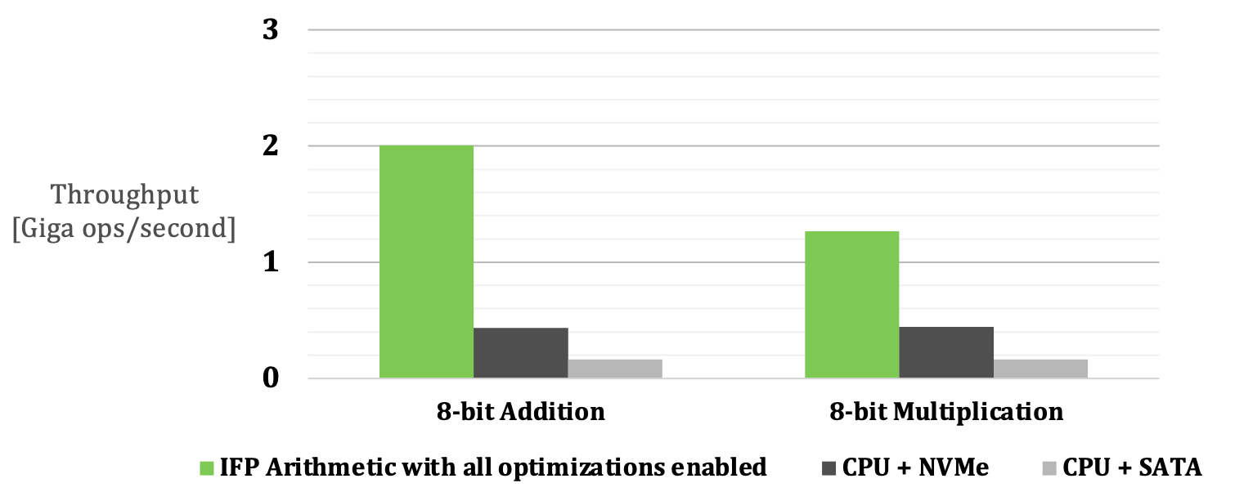
Comparison Against CPU
Comparison against CPU bound by read/write bandwidth of NVMe/SATA SSD
IFP with all optimizations enabled outperforms CPU by 4.6x/12.3x for addition and 2.8x/7.7x for multiplication

Slide 80
Processing in Storage:
Adoption Challenges
1. Processing using Storage
2. Processing near Storage

Slide 81
Eliminating the Adoption Barriers
How to Enable Adoption of Processing in Storage

Slide 82
Potential Barriers to Adoption of PIM
1. Applications & software for PIM
2. Ease of programming (interfaces and compiler/HW support)
3. System and security support: coherence, synchronization, virtual memory, isolation, communication interfaces, …
4. Runtime and compilation systems for adaptive scheduling, data mapping, access/sharing control, …
5. Infrastructures to assess benefits and feasibility
All can be solved with change of mindset

Slide 83
We Need to Revisit the Entire Stack
Problem
Algorithm
Program/Language
System Software
SW/HW Interface
Micro-architecture
Logic
Devices
Electrons
We can get there step by step

Slide 84


Automated Framework for Near-Data Processing in Storage Systems
Ongoing Work
Vamanan Arulchelvan & Rakesh Nadig
21 May 2024

Slide 85
Ongoing Work: Summary
Background: Storage devices (SSDs) enable three key types of near-data processing (NDP): (1) in-storage processing, (2) in-flash processing, and
(3) processing in on-chip DRAM
Problem: Applications offload functions or code blocks for NDP in SSDs in a static manner. There is no automated approach to identify (1) what to offload, and (2) where the computation should be performed, within the storage system.
Goal:
  Perform profiling of the workload and extract accesses to SSD
  Automate identification and offloading of function blocks to different
  compute units within the SSD in a manner that is transparent to the application.
Key Idea: We propose an automated end-to-end NDP framework for SSDs that
  To perform profiling of the workload and extract accesses (a) from application to DRAM (e.g., memory loads and stores), (b) DRAM to SSD (via page faults and mmap), and (c) applications to SSD (via Direct I/O and file accesses)
  Identify instructions which can be offloaded to different compute units within the SSD based on (a) the computation to be performed and (b) where the data resides

Slide 86


RawGAINS
A Heterogeneous Storage-Centric Processing System for Raw Signal Genome Analysis
Melina Soysal
Master Thesis Presentation
14.12.2023
Supervisor: Prof. Onur Mutlu, ETH Zürich
Advisor: Dr. Mohammad Sadrosadati, ETH Zürich
Examiner: Prof. Ulf Schlichtmann, TU München
Notes:
Electrical Engineering and Information Technology student at TU Munich
Master Thesis with the SAFARI Research Group led by Prof. Onur Mutlu at ETH Zurich
The work I’ll present today is RawGAINS which stands for Raw Signal Genome Analysis In- and Near Storage. RawGAINS is a heterogeneous storage-centric processing system for Raw Signal Genome Analysis

Slide 87
Executive Summary
Motivation
Raw signal genome analysis (RSGA) operates on large datasets and is exposed to large data movement overhead, especially from storage to host limiting end-to-end performance
Goal
Design a compact, end-to-end In-Storage Processing system to improve the performance and energy efficiency of the state-of-the-art RSGA algorithm scalable to larger genomes
Key Contributions
RawGAINS, the first HW-Algorithm Co-Design for RSGA scalable to large genomes by orchestrating multiple data-centric compute primitives in a NAND flash-based SSD
Key Results
RawGAINS improves the performance compared to the state-of-the-art RSGA algorithm on a server-class CPU by 14.9x and improves energy consumption by 170.3x across five real-world genomic datasets
Notes:
I’ll start by giving a short summary of the project before concluding
We identified that RSGA operates…
Therefore we formulated the goal to design..

Slide 88
Challenge and Opportunity for Future
Fundamentally
Energy-Efficient
(Data-Centric)
Computing Architectures

Slide 89
Challenge and Opportunity for Future
Fundamentally
High-Performance
(Data-Centric)
Computing Architectures

Slide 90
Challenge and Opportunity for Future
Computing Architectures
with
Minimal Data Movement

Slide 91
Data-Driven (Self-Optimizing) Memory/Storage Architectures

Slide 92
System Architecture Design Today
Human-driven
  Humans design the policies (how to do things)
Many (too) simple, short-sighted policies all over the system
No automatic data-driven policy learning
(Almost) no learning: cannot take lessons from past actions
Can we design
fundamentally intelligent architectures?

Slide 93
An Intelligent Architecture
Data-driven
  Machine learns the “best” policies (how to do things)
Sophisticated, workload-driven, changing, far-sighted policies
Automatic data-driven policy learning
All controllers are intelligent data-driven agents
We need to rethink design
(of all controllers)

Slide 94
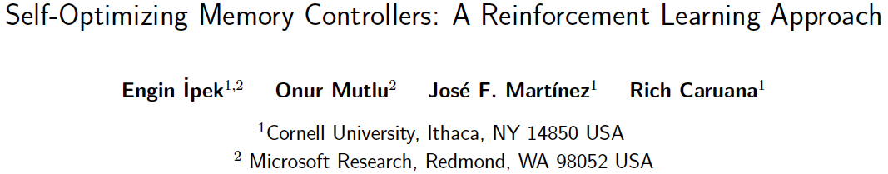
Self-Optimizing Memory Controllers
Engin Ipek, Onur Mutlu, José F. Martínez, and Rich Caruana,
"Self Optimizing Memory Controllers: A Reinforcement Learning Approach"
Proceedings of the 35th International Symposium on Computer Architecture (ISCA), pages 39-50, Beijing, China, June 2008.

Slide 95
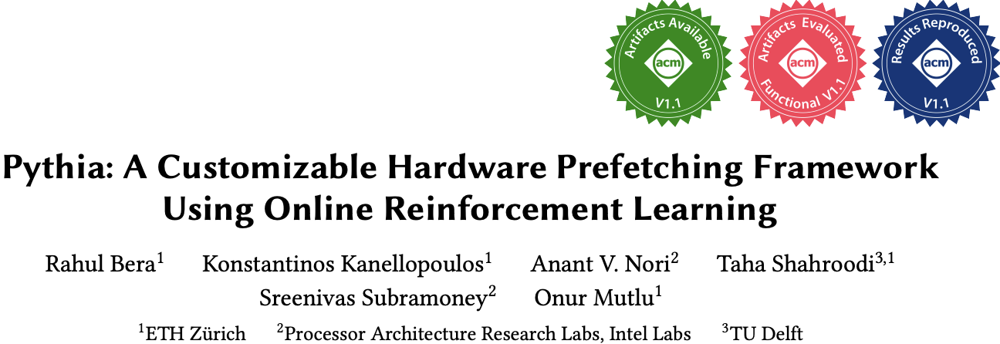
Self-Optimizing Memory Prefetchers
Rahul Bera, Konstantinos Kanellopoulos, Anant Nori, Taha Shahroodi, Sreenivas Subramoney, and Onur Mutlu,
"Pythia: A Customizable Hardware Prefetching Framework Using Online Reinforcement Learning"
Proceedings of the 54th International Symposium on Microarchitecture (MICRO), Virtual, October 2021.
[Slides (pptx) (pdf)]
[Short Talk Slides (pptx) (pdf)]
[Lightning Talk Slides (pptx) (pdf)]
[Talk Video (20 minutes)]
[Lightning Talk Video (1.5 minutes)]
[Pythia Source Code (Officially Artifact Evaluated with All Badges)]
[arXiv version]
Officially artifact evaluated as available, reusable and reproducible.
https://arxiv.org/pdf/2109.12021.pdf

Slide 96
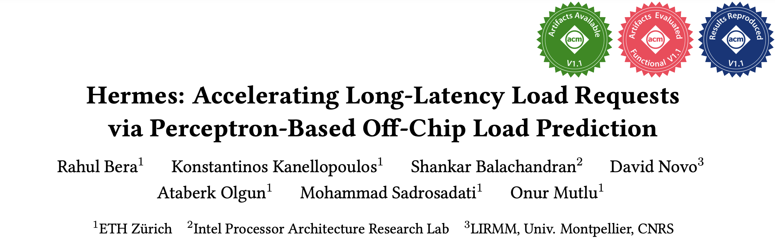
Learning-Based Off-Chip Load Predictors
Rahul Bera, Konstantinos Kanellopoulos, Shankar Balachandran, David Novo, Ataberk Olgun, Mohammad Sadrosadati, and Onur Mutlu,
"Hermes: Accelerating Long-Latency Load Requests via Perceptron-Based Off-Chip Load Prediction"
Proceedings of the 55th International Symposium on Microarchitecture (MICRO), Chicago, IL, USA, October 2022.
[Slides (pptx) (pdf)]
[Longer Lecture Slides (pptx) (pdf)]
[Talk Video (12 minutes)]
[Lecture Video (25 minutes)]
[arXiv version]
[Source Code (Officially Artifact Evaluated with All Badges)]
Officially artifact evaluated as available, reusable and reproducible.
Best paper award at MICRO 2022.
https://arxiv.org/pdf/2209.00188.pdf

Slide 97
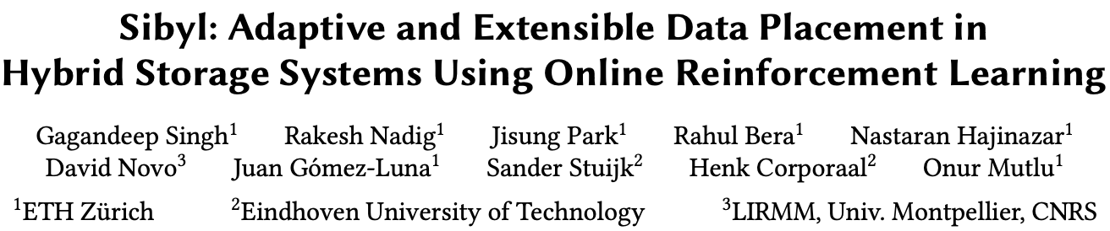
Self-Optimizing Storage Controllers
Gagandeep Singh, Rakesh Nadig, Jisung Park, Rahul Bera, Nastaran Hajinazar, David Novo, Juan Gomez-Luna, Sander Stuijk, Henk Corporaal, and Onur Mutlu,
"Sibyl: Adaptive and Extensible Data Placement in Hybrid Storage Systems Using Online Reinforcement Learning"
Proceedings of the 49th International Symposium on Computer Architecture (ISCA), New York, June 2022.
[Slides (pptx) (pdf)]
[arXiv version]
[Sibyl Source Code]
[Talk Video (16 minutes)]
https://arxiv.org/pdf/2205.07394.pdf

Slide 98

Sibyl:
Adaptive and Extensible Data Placement in Hybrid Storage Systems
Using Online Reinforcement Learning
Gagandeep Singh, Rakesh Nadig, Jisung Park,
Rahul Bera, Nastaran Hajinazar, David Novo,
Juan Gómez Luna, Sander Stuijk, Henk Corporaal,
Onur Mutlu
Notes:
Hi First of all. Thank you very much for staying until this long.
I’m going to present our work “…”

Slide 99
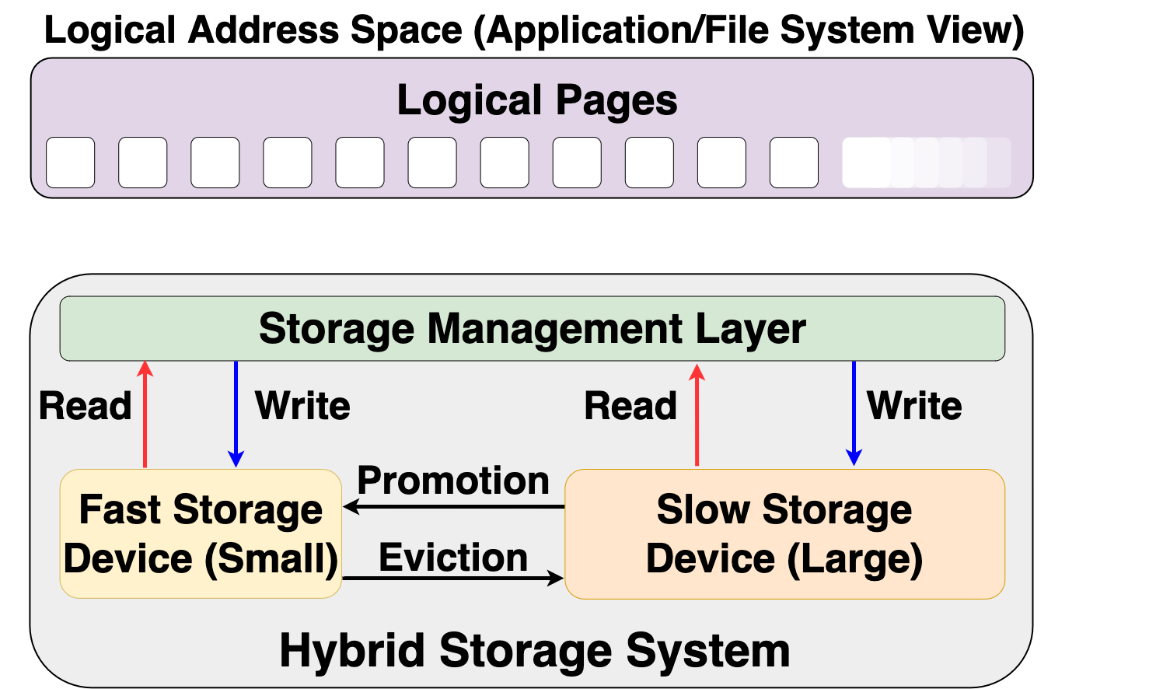
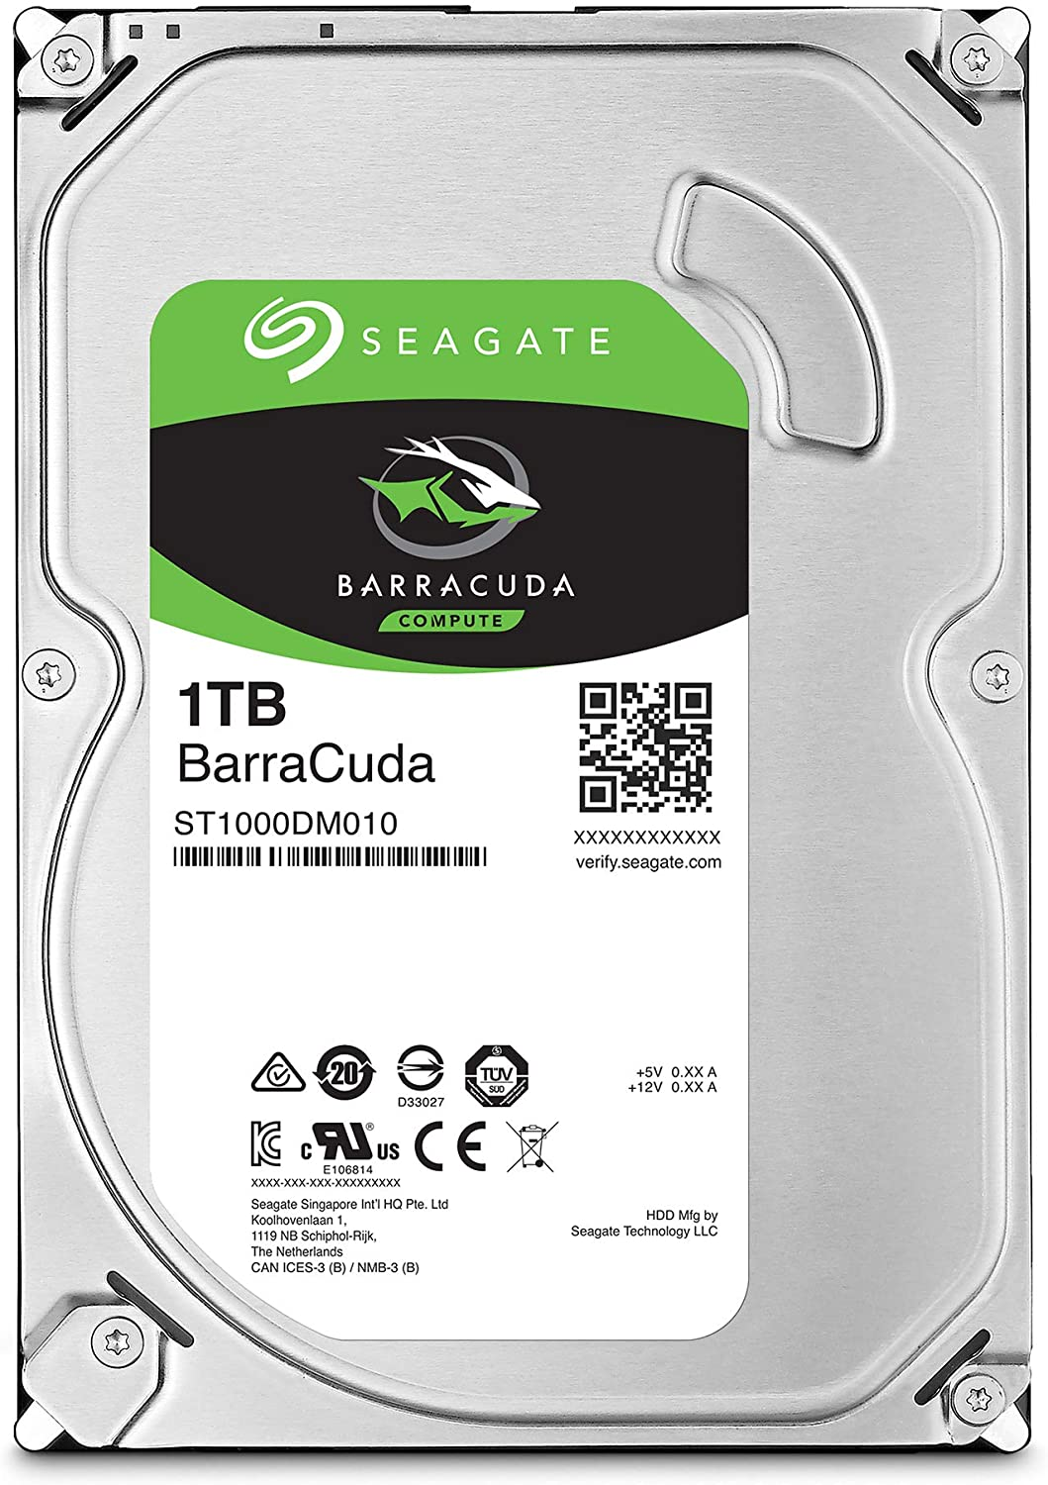
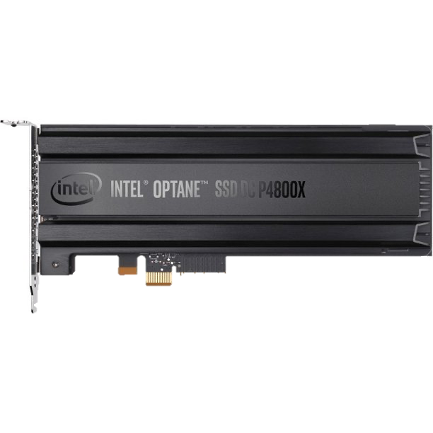
Hybrid Storage System Basics
Address Space (Application/File System View)
Read
Write
Storage Management Layer
Read
Write
Read
Write
Promotion
Eviction
Fast Device
Slow Device
Hybrid Storage System
Notes:
Let's look at some basics on hybrid storage systems. [CLICK] OVER here we show a typical HSS consisting of a fast-yet-small storage device and a slow-yet-large storage device
[CLICK]The address space is divided into a number of logical pages (e.g. 4kib), which are assigned to an application.
[CLICK] The storage management layer in the OS orchestrates host I/O requests across heterogeneous devices,
[CLICK] the storage management layer also manages data migration between the storage devices in an Hybrid storage systems . Eviction usually moves infrequently access data fom the fast storage to the slow storage or when the fast storage device is full.
When data currently stored in the slow storage device is moved to the fast storage device, it is called promotion. Promotion is usually performed when a page in the slow storage device is accessed frequently.
[CLICK] A desirable policy has to effectively utilize the low latency characteristics of the fast device while making optimal use of its small capacity and should provide easy extensibility to a wide range of workloads and Hybrid storage systems configurations

Slide 100
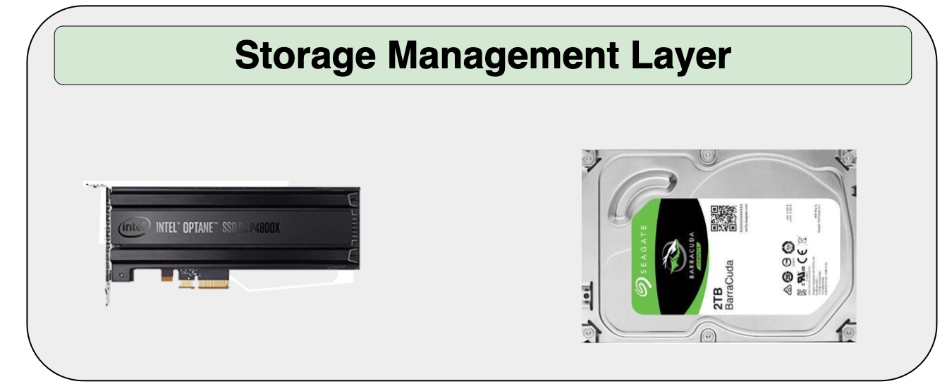
Hybrid Storage System Basics
Read
Write
Performance of a hybrid storage system
highly depends on the ability of the
storage management layer
Read
Write
Read
Write
Promotion
Eviction
Hybrid Storage System
Notes:
[CLICK] Therefore the performance of a hybrid storage system highly depends on the ability of the storage management layer to effectively manage diverse deviaces and workloads

Slide 101
Key Shortcomings in Prior Techniques
We observe two key shortcomings that significantly limit the performance benefits of prior techniques
Lack of adaptivity to:
  Workload changes
  Changes in device types and configuration
Lack of extensibility to more devices
Notes:
We observe two key shortcomings in prior data placement techniques that significantly limits their performance improvement
[CLICK] First, lack of adaptivity to both workload changes and
CLICK] changes in device types and configurations
[CLICK] Second, Lack of extensibility: to more devices
Let’s take a closer look at each of these shortcomings.
[NEXT]

Slide 102
Our Goal
A data-placement mechanism
that can provide:
Adaptivity, by continuously learning and adapting to the application and underlying device characteristics
Easy extensibility to incorporate a wide range of hybrid storage configurations
Notes:
So our goal in this work is to design a data-placement mechanism that can provide
[CLICK]
Adaptivity, by continuously learning and adapting to the application and underlying device characteristics
[CLICK]
Easy extensibility to incorporate a wide range of hybrid storage configurations.

Slide 103

Our Proposal
Sibyl
Formulates data placement in hybrid storage systems as a reinforcement learning problem
Sybil is an oracle that makes accurate prophecies
https://en.wikipedia.org/wiki/Sibyl
Notes:
To this end, we propose Sibyl
Which formulates data placement in hybrid…

Slide 104
Basics of Reinforcement Learning (RL)
Agent learns to take an action in a given state
to maximize a numerical reward
Notes:
First, let me briefly describe the basics of reinforcement learning.
A RL system contains two components: [CLICK] the agent and the environment.
The agent observes the state of the environment in every timestep [CLICK], takes an action based on the state [CLICK], and receives a reward for that action [CLICK].
[CLICK] Agent’s goal is to find a policy where agent’s action in a given state leads to maximum reward

Slide 105
Formulating Data Placement as RL
Agent
State (S_{t})
Reward (R_{t+1})
Action (A_{t})
Environment
Sibyl
Features of the current request and system
Request latency
(of last served request)
Select storage device to place the current page
Hybrid Storage System
Notes:
In Sibyl, we formulate data-placement as a reinforcement learning problem.
[CLICK] Sibyl acts as the agent, while [CLICK] the hybrid storage subsystem acts as the environment.
[CLICK] Sibyl observes workload and system features from every storage request and use it as a state information to take a data placement action [CLICK]
[CLICK] For every data placement action, Sibyl receives a numerical reward that evaluates the effectiveness of the data placement decision
Now we will concretely define the state, action, and the reward for Sibyl.

Slide 106
Sibyl Execution
RL Training Thread
Asynchronous
Execution
State, Reward, and Action Information
Periodic Policy
Weight Update
Storage
Request
(from OS)
RL Decision Thread
Data Placement Decision
Sibyl
Notes:
FIRST we discuss the execution model for Sibyl. We implement sibyl in the the host OS. [CLICK] Where for every storage request Sibyl uses an RL decision thread to make [CLICK] data placemnet decisions.
Sibyl uses another thread, [CLICK] called the RL training thread that works in the background. It keeps collecting information about Sibyl's state, action and reward, which uses this information to train a data placement policy. [CLICK] periodically we replace the RL decision thread policy with RL training thread policy.
[CLICK] Our two-threaded implementation runs ASYNCHROUNOUS AND avoids that the training in RL training thread interrupts or delays data placement decisions for incoming requests.

Slide 107
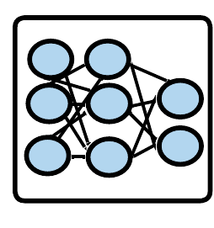
Sibyl Design: Overview
RL Training Thread
Training
Network
Training Dataset
Batch
Periodic Policy
Weight Update
Periodic Weights update
10
RL Decision Thread
Experience Buffer (in host DRAM)
State
Max
Action
Storage
Request
(from OS)
Inference
Network
Sibyl Policy
Observation
Vector
HSS
Reward
Collect
Experiences
State
Notes:
Now we will go into the implementation of each thread

Slide 108
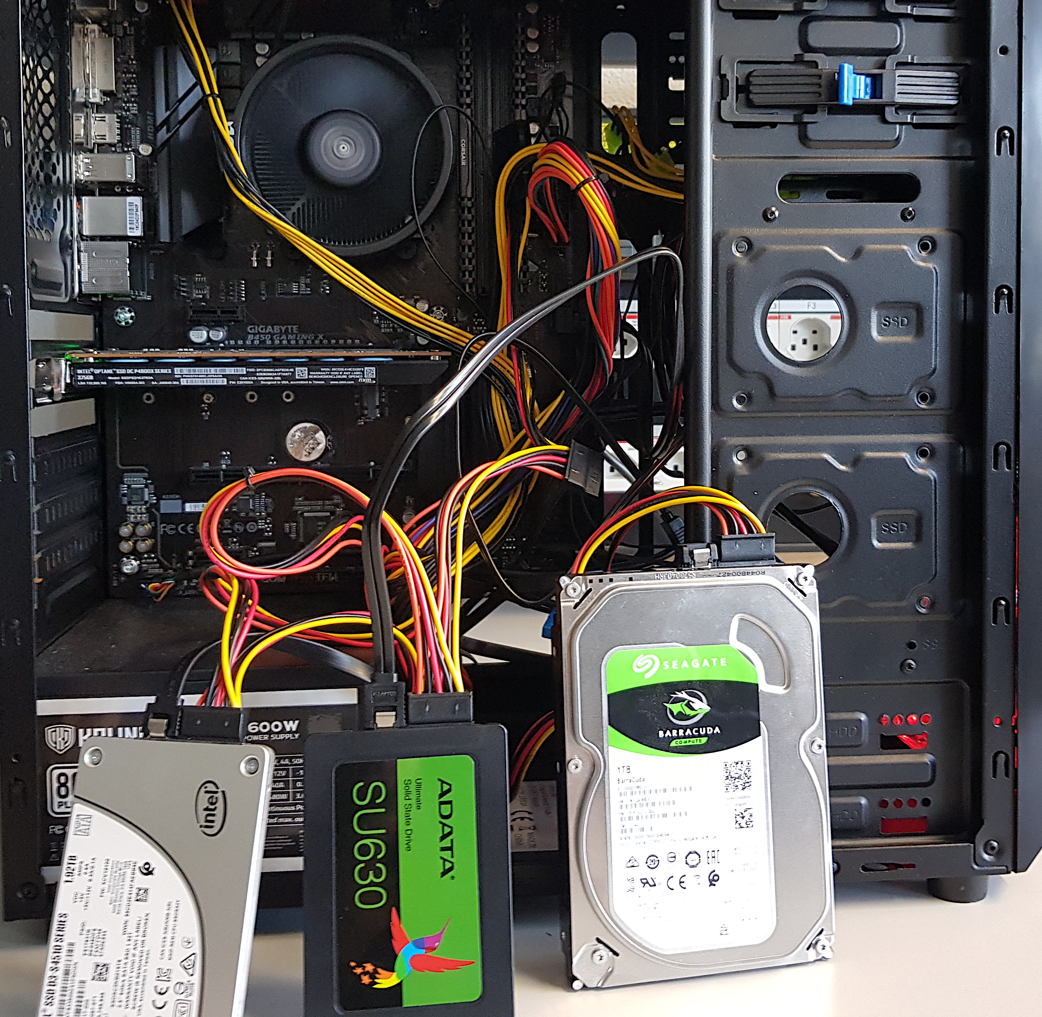
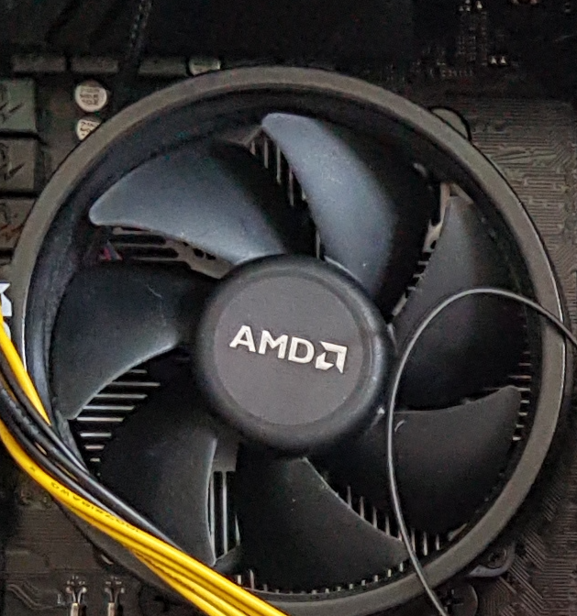
Evaluation Methodology (1/3)
Real system with various HSS configurations
  Dual-hybrid and tri-hybrid systems
AMD Ryzen7 2700G CPU
Intel Optane SSD P4800X
Seagate HDD
ST1000DM010
Intel SSD D3-S4510
ADATA
SU630 SSD
Notes:
[CLICK] We perfrom real system evaluation for both dual-hybrid and tri-hybrid systems
[CLICK] over here we show our evaluation setup that consists of multi different devices
[CLICK] We implement sibyl in the storage management layer of AMD Ryzen 7 2700G CPU

Slide 109
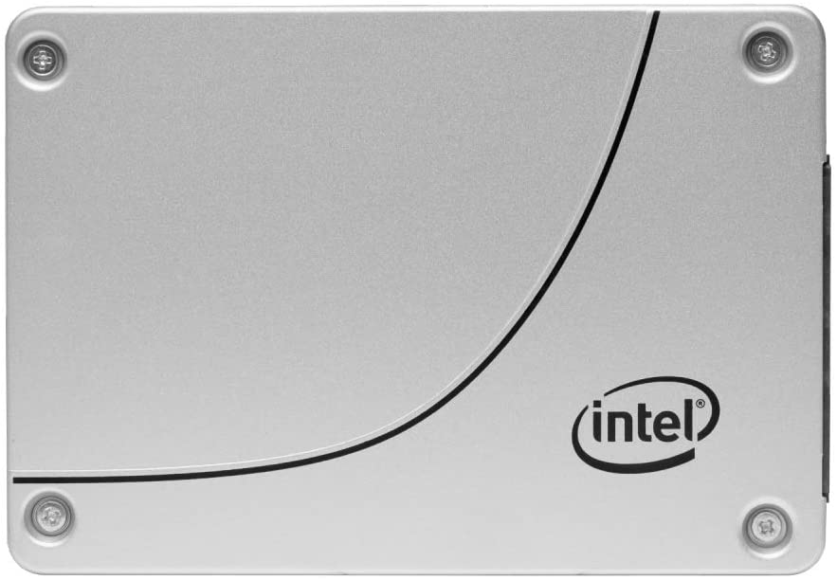
Evaluation Methodology (2/3)
Cost-Oriented HSS Configuration
High-end SSD
Low-end HDD
Performance-Oriented HSS Configuration
High-end SSD
Middle-end SSD
Notes:
First we evalutate a cost-oriented hybrid storage configuration in which we use
[CLICK]a high end ssd with a low-end hard disk drive where the latency difference between the two devices is quite large
[CLICK] Performance oriented hybrid storage configuration we
[CLICK]use a high end ssd with a middle end ssd
where two devices have similar latencies

Slide 110
Evaluation Methodology (3/3)
18 different workloads from:
  MSR Cambridge and Filebench Suites
Four state-of-the-art data placement baselines:
  CDE [Matsui+, Proc. IEEE’17]
  HPS [Meswani+, HPCA’15]
  Archivist [Ren+, ICCD’19]
  RNN-HSS [Doudali+, HPDC’19]
Heuristic-based
Learning-based
Notes:
[CLICK] We use 18 different workloads from MSR CAMBRIDGE and Filebench Suite
[CLICK] and compare Sibyl against four state of heuristic and supervised—learning based data placmenet policies

Slide 111
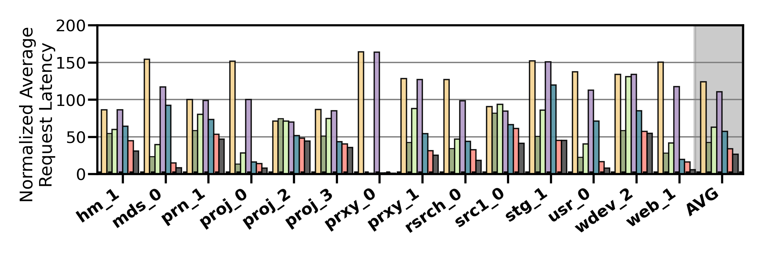
Performance Analysis
High-end SSD
Low-end HDD
Cost-Oriented HSS Configuration
Slow-Only
CDE
HPS
Archivist
RNN-HSS
Sibyl
Oracle
Notes:
[CLICK]Over here we show the performance results in terms of average request latency for MSR CAMBRIDGE workloads for all the workloads and policies

Slide 112
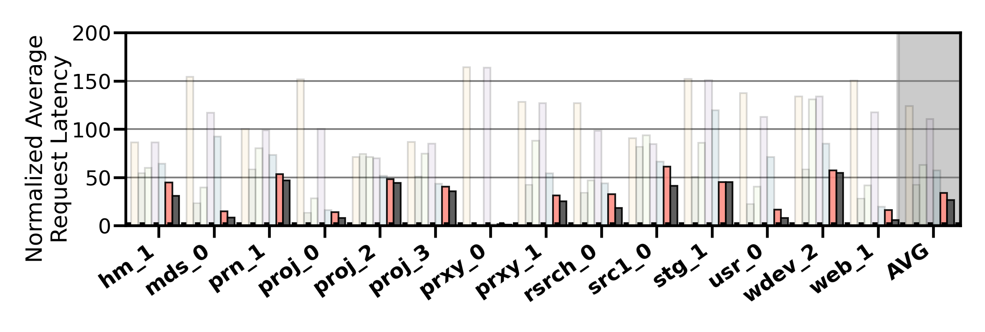
Performance Analysis
High-end SSD
Low-end HDD
Cost-Oriented HSS Configuration
Slow-Only
CDE
HPS
Archivist
RNN-HSS
Sibyl
Oracle
Sibyl consistently outperforms all the baselines
for all the workloads
Notes:
We observe that Sibyl consistently outperforms all the baselines for all the workloads

Slide 113
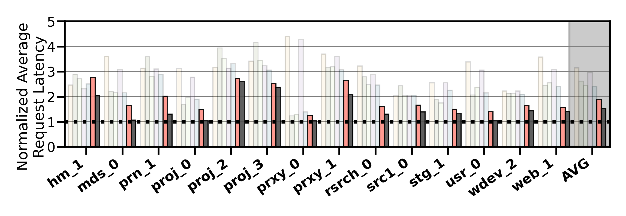
Performance Analysis
High-end SSD
Mid-end SSD
Performance-Oriented HSS Configuration
Slow-Only
CDE
HPS
Archivist
RNN-HSS
Sibyl
Oracle
Sibyl achieves 80% of the performance
of an oracle policy that has
complete knowledge of future access patterns
Notes:
on average Sibyl achieves 80% performance of an oracle policy that has complete knowledge of
future access patterns

Slide 114
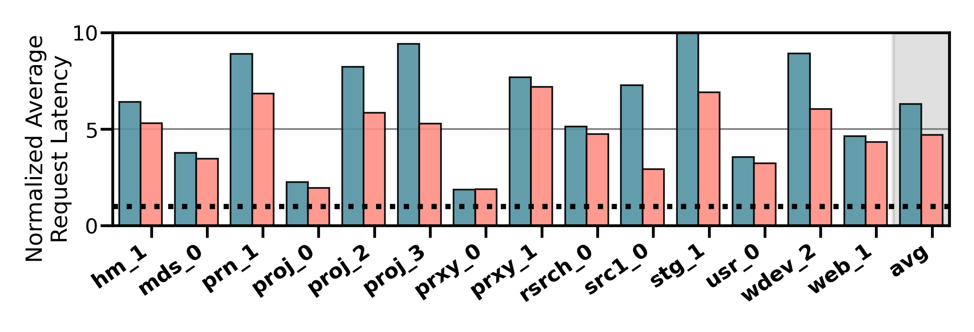
Performance on Tri-HSS
High-end SSD
Mid-end SSD
Low-end HDD
Extending Sibyl for more devices:
  Add a new action
  Add the remaining capacity of the new device as a state feature
Sibyl outperforms the state-of-the-art
data placement policy by
48.2% in a real tri-hybrid system
Heuristic_{Tri-hybrid}
Sibyl_{Tri-hybrid}
Sibyl reduces the system architect's burden
by providing ease of extensibility
Notes:
Sibyl outperforms the state-of-the-art-policy policy by upto 48.2%
[click]
We conclude that Sibyl provides ease of extensibility to new storage system configurations, which reduces the system architect’s burden in designing sophisticated data placement mechanisms.

Slide 115
Sibyl: Summary
We introduced Sibyl, the first reinforcement learning-based data placement technique in hybrid storage systems that provides
  Adaptivity
  Easily extensibility
  Ease of design and implementation
We evaluated Sibyl on real systems using many different workloads
  In a tri-HSS configuration, Sibyl outperforms the state-of-the-art-data placement policy by 48.2%
  Sibyl achieves 80% of the performance of an oracle policy with a storage overhead of only 124.4 KiB
https://github.com/CMU-SAFARI/Sibyl
Notes:
We introduced Sibyl, the first reinforcement learning-based data placement in HSS that provides
Adaptivity
Easily extensibility
Ease of design and implementation
We evaluated Sibyl on real systems using many different workloads
Sibyl improves performance by 21.6% compared to the best previous data placement technique in dual-HSS configuration
In a tri-HSS configuration, Sibyl outperforms the state-of-the-art-policy policy by 48.2%
Sibyl achieves 80% performance of an oracle policy with storage overhead of only 124.4 KiB

Slide 116
Challenge and Opportunity for Future
Data-Driven
(Self-Optimizing)
Computing Architectures

Slide 117
Sibyl Paper, Slides, Videos [ISCA 2022]
Gagandeep Singh, Rakesh Nadig, Jisung Park, Rahul Bera, Nastaran Hajinazar, David Novo, Juan Gomez-Luna, Sander Stuijk, Henk Corporaal, and Onur Mutlu,
"Sibyl: Adaptive and Extensible Data Placement in Hybrid Storage Systems Using Online Reinforcement Learning"
Proceedings of the 49th International Symposium on Computer Architecture (ISCA), New York, June 2022.
[Slides (pptx) (pdf)]
[arXiv version]
[Sibyl Source Code]
[Talk Video (16 minutes)]
https://arxiv.org/pdf/2205.07394.pdf

Slide 118


Janus
Coordinated Data Placement and Data Migration
in Hybrid Storage Systems Using
Multi-Agent Online Reinforcement Learning
Ongoing Work
Notes:
Hi First of all. Thank you very much for staying until this long.
I’m going to present our work “…”

Slide 119




Janus: Summary
First work to use multi-agent online reinforcement learning to optimize data management in HSS
Improves performance
by 26%/23% over the best-performing prior work
on performance-optimized/cost-optimized HSS
Achieves 64%/62% of an Oracle’s performance
on a performance-optimized/cost-optimized HSS
Low inference latency and storage overheads
33

Slide 120
Executive Summary
Background: A hybrid storage system (HSS) uses multiple different storage devices to provide high and scalable storage capacity at high performance
Problem: Prior data placement and data migration policies (1) lack a holistic data management policy, (2) Lack adaptivity to: (i) workload changes, and (ii) changes in device types and configurations, and (iii) Lack of extensibility to more devices
Goal: Design a holistic data management technique that provides:
  Combined optimization of both data placement and data migration policies
  Coordination between data placement and data migration
  Adaptivity, by continuously learning and adapting to the application and
  underlying device characteristics
  Easy extensibility to incorporate a wide range of hybrid storage configurations
Contribution: Janus, the first multi-agent online reinforcement learning-based data management technique in HSS that:
  Performs combined optimization of both data placement and data migration policies
  Coordinates between data placement and data migration
  Provides adaptivity to changing workload demands and underlying device characteristics
  Can easily extend to any number of storage devices
Key Results: Evaluate on real systems using fifteen data-intensive workloads
  Janus improves performance by 26%/22% compared to the best previous data placement technique in performance-optimized/cost-optimized dual-HSS configuration
  In a tri-HSS configuration, Janus outperforms the state-of-the-art policy by 31%
  Janus achieves 64%/62% of an Oracle’s performance on a performance-optimized/cost-optimized HSS with a storage overhead of only 151.2 KiB
Notes:
First, I am going to start with an executive summary.
[CLICK] Hybrid storage systems use multiple different storage devices to provide high and scalable storage capacity at high performance
[CLICK] We observe two key shortcomings in prior data placement techniques:
First, lack of adaptivity to workload changes and changes in device types and configurations
Second, they also lack extensibility to to more devices.
[CLICK] Our goal in this work is to design a data placement technique that provides
Adaptivity, by continuously learning and adapting to the application and underlying device characteristics
Easy extensibility to incorporate a wide range of hybrid storage configurations
[CLICK] to this end we propose Sibyl, an online reinforcement learning-based data placement in Hybrid storage systems that:
Provides both adaptivity
and easy extensiblity
and also Provides ease of design and implementation that requires only a small computation overhead
[CLICK] We extensively evaluate Sibyl on real systems using a wide range of workloads
We show that Sibyl outperforms prior state-of-the-art data placement policeis by 21.6% in dual-hybrid storage system and upto 48.2% on trihybrid system
Sibyl achieves 80% of the performance of an oracle policy that has a complete knowledge of future access patterns while incurring a very modest storage overhead of only 124.4 KiB
The code will be opensourced on our GitHub repository.
https://github.com/CMU-SAFARI/Sibyl

Slide 121
Hybrid Storage System Basics
Application/FileSystem
Read
Write
Unified Logical Address Space
Read
Write
Data Placement
Data Migration
Hybrid Storage System Management Layer
Read
Write
Read
Write
Read
Write
High-End Device
Middle-End
Device
Low-End
Device
Data Migration
Hybrid Storage System
Notes:
Let's look at some basics on hybrid storage systems. [CLICK] OVER here we show a typical HSS consisting of a fast-yet-small storage device and a slow-yet-large storage device
[CLICK]The address space is divided into a number of logical pages (e.g. 4kib), which are assigned to an application.
[CLICK] The storage management layer in the OS orchestrates host I/O requests across heterogeneous devices,
[CLICK] the storage management layer also manages data migration between the storage devices in an Hybrid storage systems . Eviction usually moves infrequently access data fom the fast storage to the slow storage or when the fast storage device is full.
When data currently stored in the slow storage device is moved to the fast storage device, it is called promotion. Promotion is usually performed when a page in the slow storage device is accessed frequently.
[CLICK] A desirable policy has to effectively utilize the low latency characteristics of the fast device while making optimal use of its small capacity and should provide easy extensibility to a wide range of workloads and Hybrid storage systems configurations

Slide 122
Our Goal
A holistic data management mechanism that can provide:
Combined optimization of both data placement and data migration policies
Coordination between data placement and
data migration
Adaptivity, by continuously learning and adapting to the application and underlying device characteristics
Easy extensibility to incorporate a wide range of hybrid storage configurations
Notes:
So our goal in this work is to design a data-placement mechanism that can provide
[CLICK]
Adaptivity, by continuously learning and adapting to the application and underlying device characteristics
[CLICK]
Easy extensibility to incorporate a wide range of hybrid storage configurations.

Slide 123
Need for a Multi-Agent RL Technique
An RL-based technique can adapt to changes in workload and HSS configurations
A single RL agent based technique cannot optimize multiple policies (e.g., data placement and data migration) concurrently because the goals of these policies are different
-28%
Average Request Latency
(a) Performance-Optimized HSS
-12%
(b) Cost-Optimized HSS
Notes:
The lower the request latency the better
We observe that all baselines provide reasonable performance under specific workloads [CLICK] while for other they show way lower performance than oracle. [CLICK]
[CLICK] on avg we observe a performance loss for some policies by 41.1% compared to oracle
We conclude, considering only a limited number of workload characteristics leads to
a significant performance gap

Slide 124

Our Proposal
Janus
A holistic data management technique that uses
multi-agent online reinforcement learning
Janus is the god of beginnings, transitions and endings
https://en.wikipedia.org/wiki/Janus
Notes:
To this end, we propose Sibyl
Which formulates data placement in hybrid…

Slide 125
Formulating Data Management as RL
State (s_{t})
Agent
Environment
Action (a_{t})
Reward (r_{t+1})
State
State
Data Placement Agent
Environment
Data Migration Agent
Action
Action
Reward (Immediate)
Reward (Delayed)
Notes:
In Sibyl, we formulate data-placement as a reinforcement learning problem.
[CLICK] Sibyl acts as the agent, while [CLICK] the hybrid storage subsystem acts as the environment.
[CLICK] Sibyl observes workload and system features from every storage request and use it as a state information to take a data placement action [CLICK]
[CLICK] For every data placement action, Sibyl receives a numerical reward that evaluates the effectiveness of the data placement decision
Now we will concretely define the state, action, and the reward for Sibyl.

Slide 126
Janus: Design
Data Placement Agent
Janus
Training Thread
I/O Request from Application
Placement in
Fast or Slow Device in HSS
Inference Thread
Hybrid Storage System
Fast
Device
Slow
Device
Coordination between the agents
(implicit)
Perform background migration during idle time
Migration Thread
Data previously stored in HSS
Data Migration Agent
Training Thread
Migration Queue
Inference Thread
Candidate pages to migrate

Slide 127

Janus: RL Agent Design
Training Thread
Training Dataset
Experience Replay
Training Network
Inference Thread
Periodic
Policy Weight Update
Experience Buffer
(stored in DRAM)
Experience
Policy
State
Max
Action
Inference
Network
Input
Features
Reward
Observation Vector
Collect Experiences
HSS
State
RL Agent in Janus

Slide 128


Performance Analysis (1/2)
High-end SSD
Mid-end SSD
Performance-Optimized HSS
26%
Average Request Latency
Janus achieves 64% of an Oracle’s performance
on average across different workloads
Notes:
In a performance oriented Hybrid storage systems configuration, where two devices have similar latencies [CLICK]
[CLICK]

Slide 129

Performance Analysis (2/2)
High-end SSD
Low-end HDD
Cost-Optimized HSS
23%
Average Request Latency
Janus achieves 62% of an Oracle’s performance
on average across all workloads
Notes:
We observe that Sibyl consistently outperforms all the baselines for all the workloads

Slide 130



Performance on Tri-HSS
High-end SSD
Mid-end SSD
Low-end HDD
Extending Janus for more devices:
  Add a new action in each agent
  Add the remaining capacity of the new device as a state feature for each agent
31%
Average Request Latency
Notes:
and compare to sibyl for trihybrid system

Slide 131
Multi-Programmed Workloads (1/2)
Performance-Optimized HSS
High-end SSD
Mid-end SSD
30%
Average Request Latency
Janus achieves 73% of Oracle’s performance on average across different workloads
Notes:
In a performance oriented Hybrid storage systems configuration, where two devices have similar latencies [CLICK]
[CLICK]

Slide 132
Multi-Programmed Workloads (2/2)
Cost-Optimized HSS
High-end SSD
Low-end HDD
Average Request Latency
28%
Janus achieves 46% of Oracle’s performance on average across different workloads
Notes:
In a performance oriented Hybrid storage systems configuration, where two devices have similar latencies [CLICK]
[CLICK]

Slide 133
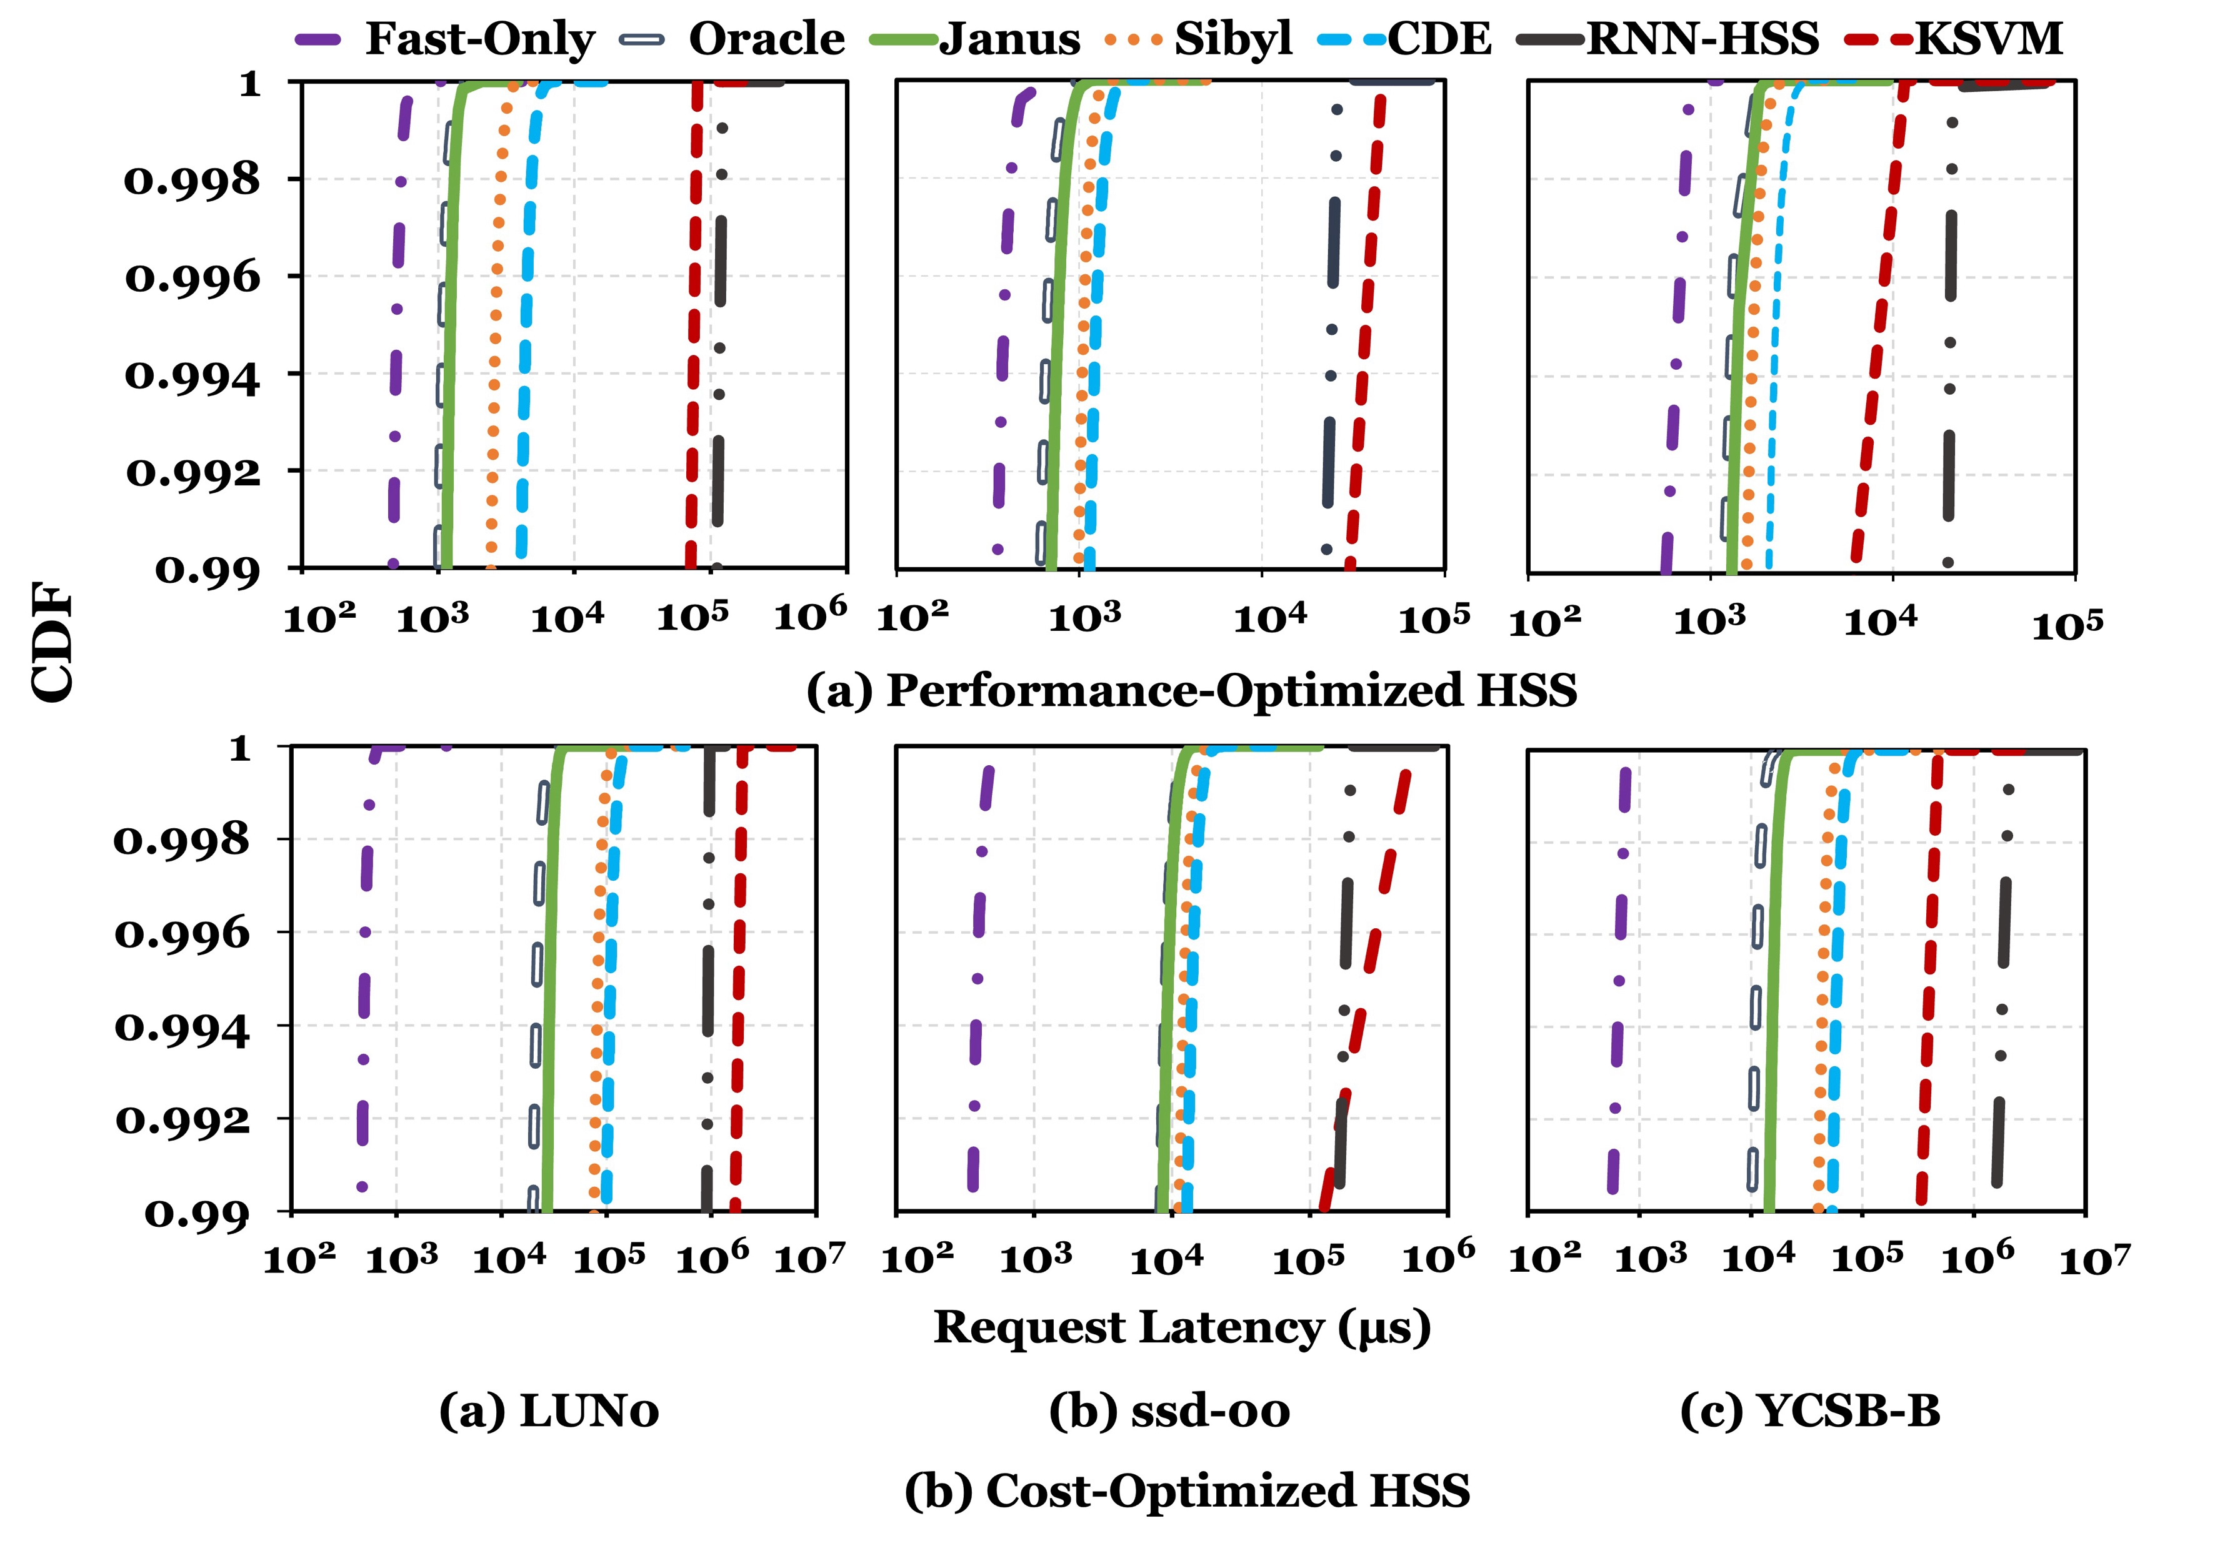
Tail Latency

Slide 134
Impact on Device Lifetimes
Write Amplification
(a) Performance-Optimized HSS
(b) Cost-Optimized HSS

Slide 135
Impact on Device Lifetimes
To improve performance, Janus migrates more data in read-intensive workloads, which causes
higher write amplification
Write Amplification
(a) Performance-Optimized HSS
Janus migrates less data in
write-intensive workloads as data is moved during updates from host , which causes
lower write amplification
(b) Cost-Optimized HSS

Slide 136


Janus: Overhead Analysis
151.2 KiB of total storage cost
  Experience buffer, inference and training network
48-bit metadata overhead per page for state features
Inference Latency ~10ns
Training Latency ~2µs per training step
Small storage overhead
Small inference overhead
Notes:
All of Sibyl performance benefits comes at a modest cost of 124.4KB storage cost to implement experience buffer, inference and training network
[CLICK] and 40-bit metadata overhead per page
[CLICK] We have inference latency of 10nanos, which are orders of magnitude smaller than the I/O read latency of a even a high end SSD (around 3micro seconds for Samsung ZNAND SSD)
[CLICK] with training latency of 2mico sec
So sibyl provides:
[CLICK]small area and
[CLICK]inference overhead [CLICK] which satisfied the prediction latency for making a data placement decision

Slide 137
Janus: Summary
First work to use multi-agent online reinforcement learning to optimize data management in HSS
Improves performance
by 26%/23% over the best-performing prior work
on performance-optimized/cost-optimized HSS
Achieves 64%/62% of an Oracle’s performance
on a performance-optimized/cost-optimized HSS
Low inference latency and storage overheads
33

Slide 138
Future Work
Adding more agents to optimize other policies such as data prefetching across storage devices.
Applicability of these techniques to other memory/storage systems (e.g., distributed storage, hybrid memory)
Look at the other objectives
  endurance, fairness, inter-application interference, QoS, tail latency.

Slide 139
Concluding Remarks

Slide 140
Concluding Remarks
We must design systems to be balanced, high-performance, energy-efficient (all at the same time) → intelligent systems
  Data-centric, data-driven, data-aware
Enable computation capability inside and close to storage
This can
  Lead to orders-of-magnitude improvements
  Enable new applications & computing platforms
  Enable better understanding of nature
  …
Future of truly storage-centric computing is bright
  We need to do research & design across the computing stack
Notes:
Perhaps we have taken processor-centric system design a bit too far

Slide 141
Fundamentally Better Architectures
Data-centric
Data-driven
Data-aware

Slide 142
Source: http://spectrum.ieee.org/image/MjYzMzAyMg.jpeg

Slide 143
We Need to Revisit the Entire Stack
Problem
Algorithm
Program/Language
System Software
SW/HW Interface
Micro-architecture
Logic
Devices
Electrons
We can get there step by step

Slide 144
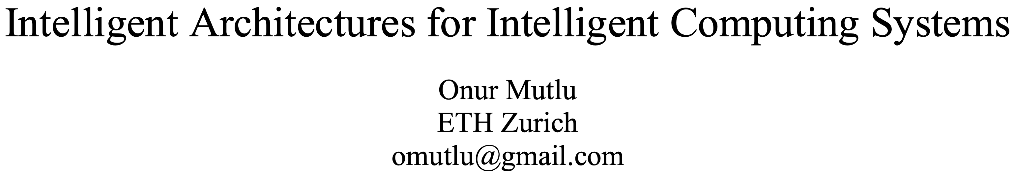
A Blueprint for Fundamentally Better Architectures
Onur Mutlu,
"Intelligent Architectures for Intelligent Computing Systems"
Invited Paper in Proceedings of the Design, Automation, and Test in Europe Conference (DATE), Virtual, February 2021.
[Slides (pptx) (pdf)]
[IEDM Tutorial Slides (pptx) (pdf)]
[Short DATE Talk Video (11 minutes)]
[Longer IEDM Tutorial Video (1 hr 51 minutes)]

Slide 145

Acknowledgments
Think BIG, Aim HIGH!
https://safari.ethz.ch

Slide 146
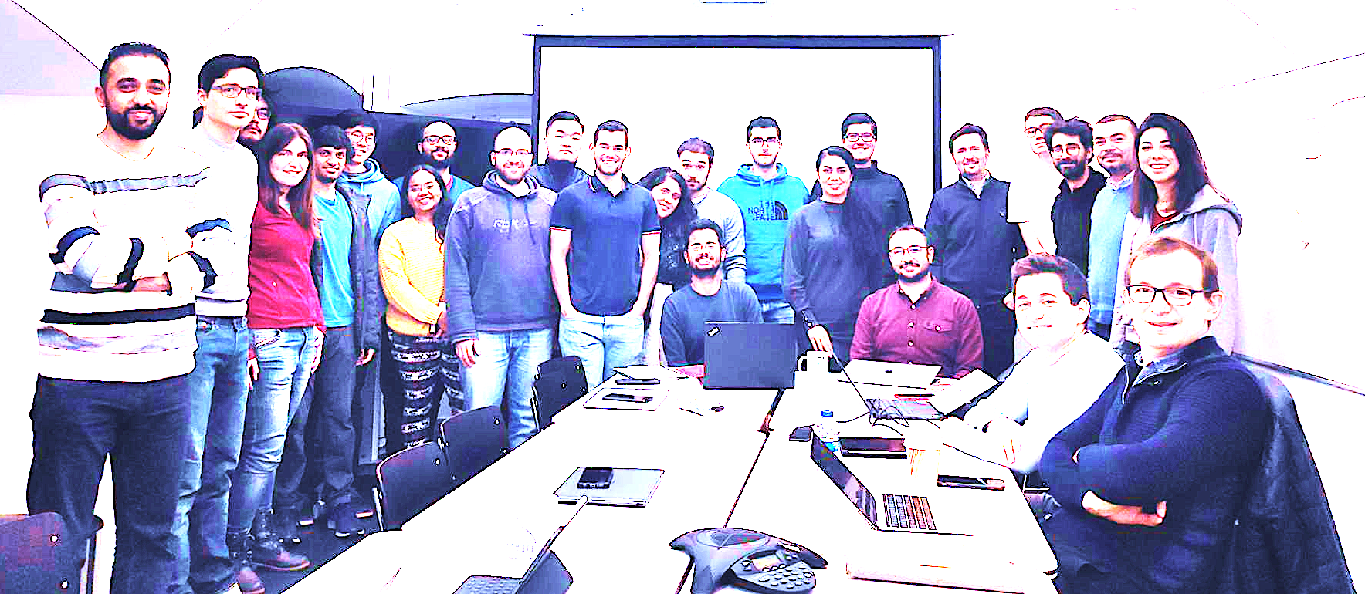

Onur Mutlu’s SAFARI Research Group
Computer architecture, HW/SW, systems, bioinformatics, security, memory
https://safari.ethz.ch/safari-newsletter-january-2021/
40+ Researchers
Think BIG, Aim HIGH!
https://safari.ethz.ch

Slide 147
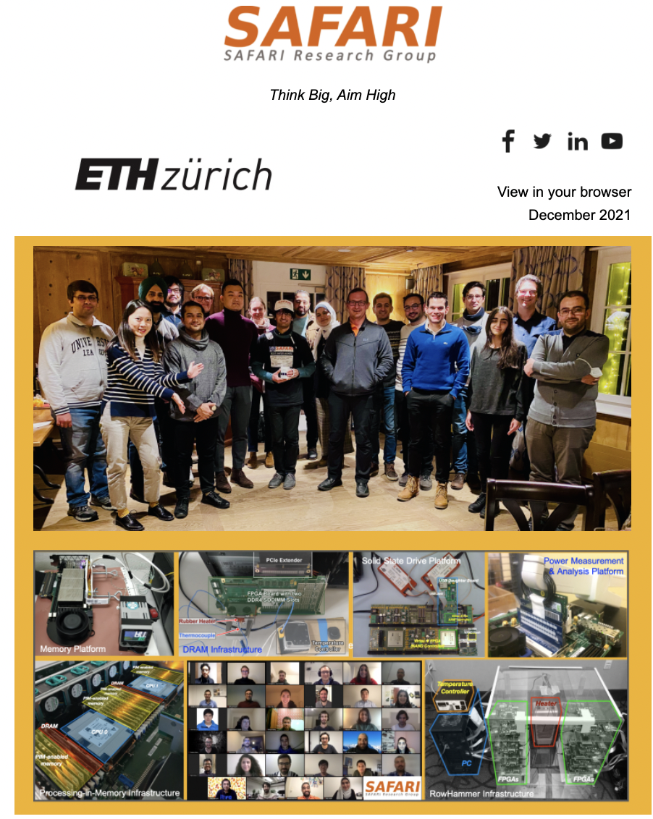
SAFARI Newsletter December 2021 Edition
https://safari.ethz.ch/safari-newsletter-december-2021/

Slide 148
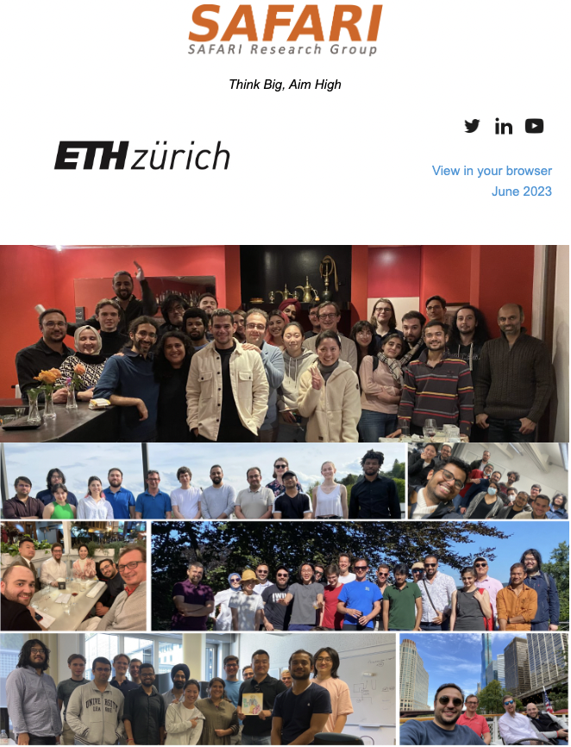
SAFARI Newsletter June 2023 Edition
https://safari.ethz.ch/safari-newsletter-june-2023/

Slide 149

SAFARI Introduction & Research
Computer architecture, HW/SW, systems, bioinformatics, security, memory
Think BIG, Aim HIGH!
https://www.youtube.com/watch?v=mV2OuB2djEs

Slide 150
Referenced Papers, Talks, Artifacts
All are available at
  https://people.inf.ethz.ch/omutlu/projects.htm
  https://www.youtube.com/onurmutlulectures
  https://github.com/CMU-SAFARI/

Slide 151








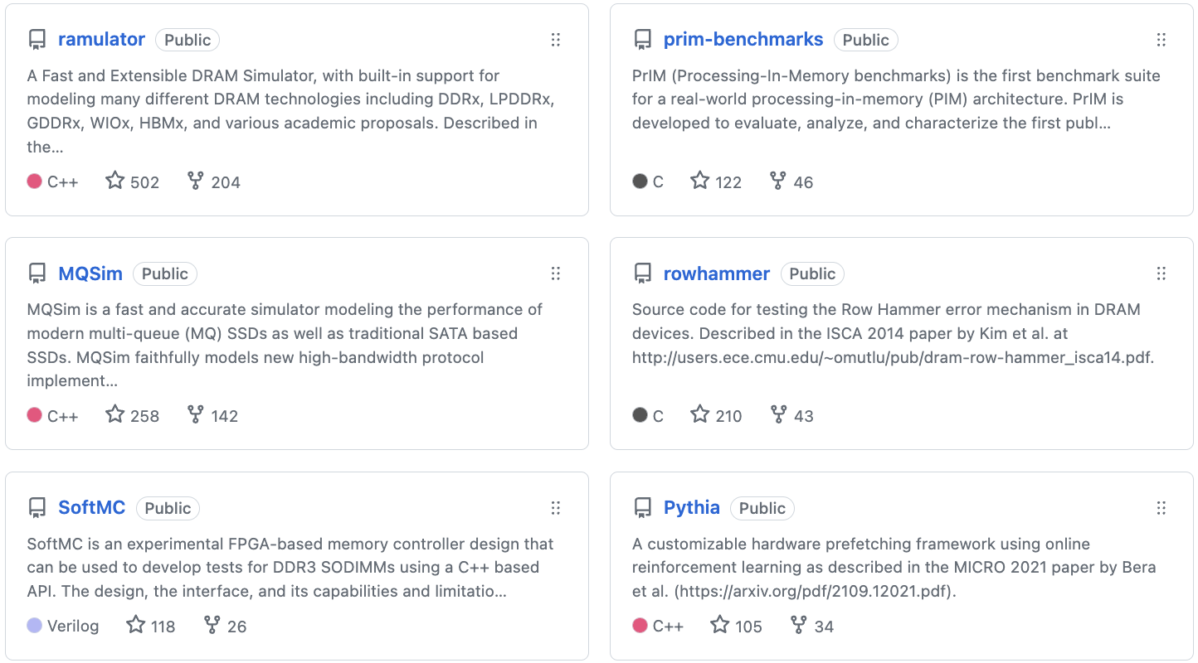
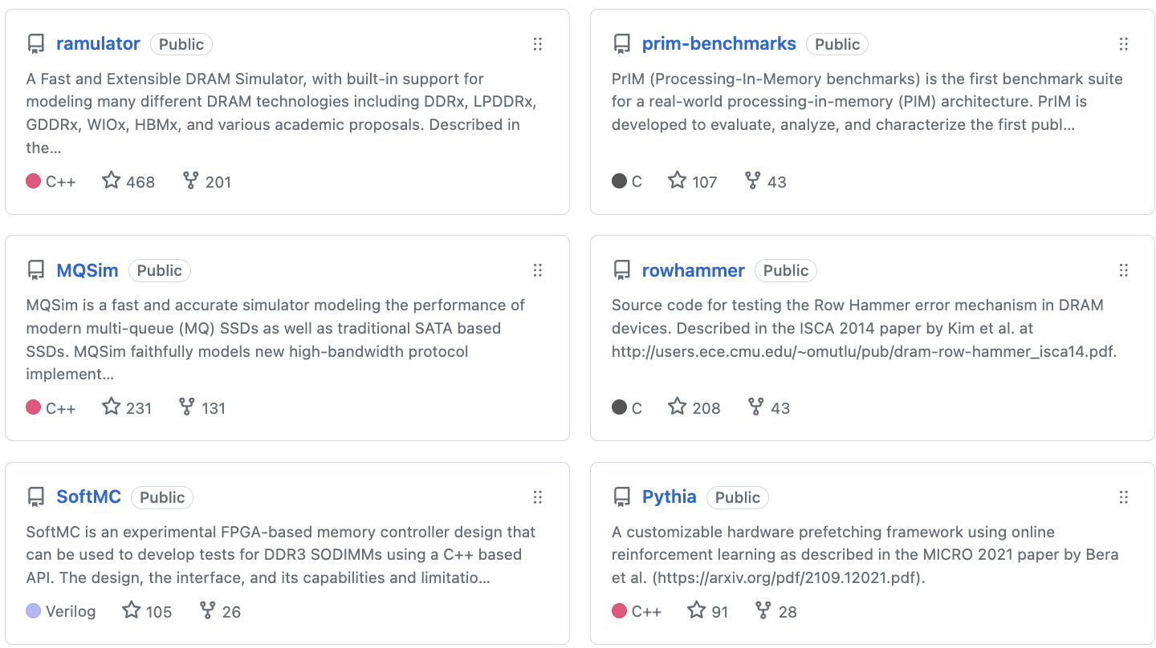
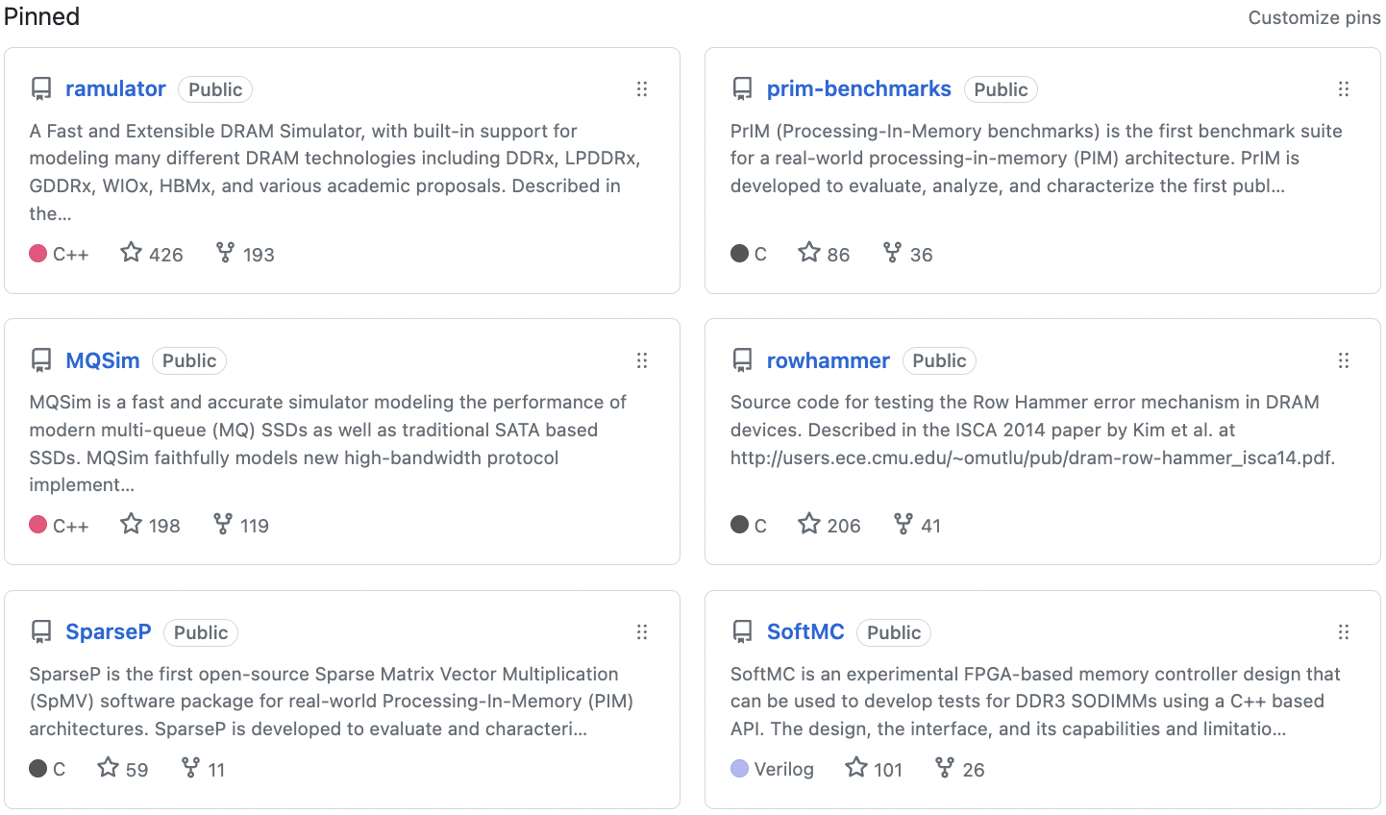
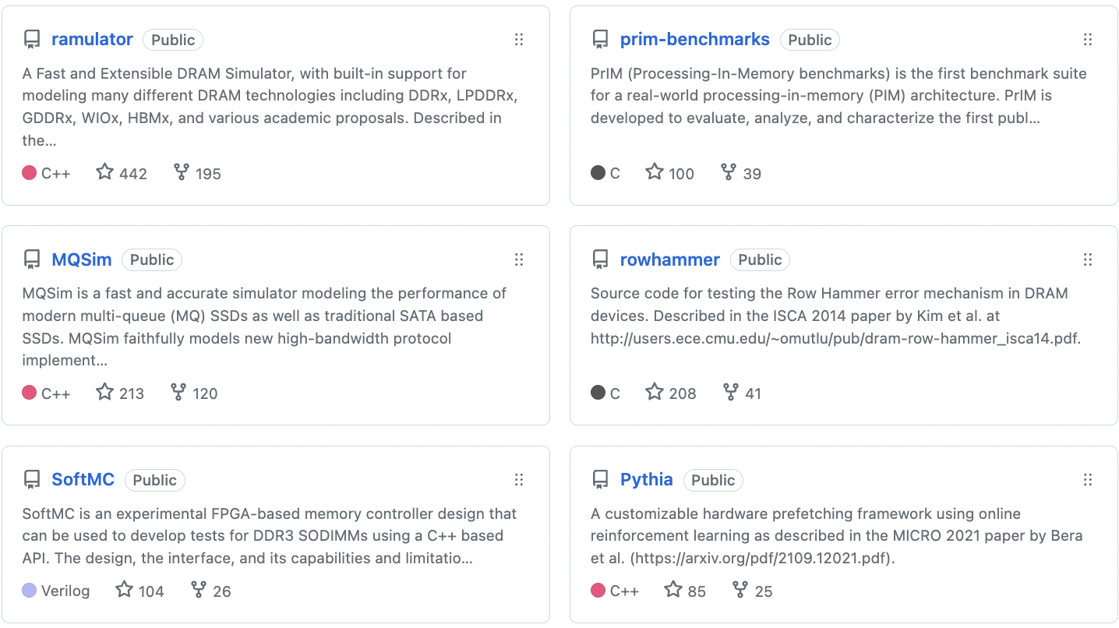
Open Source Tools: SAFARI GitHub
https://github.com/CMU-SAFARI/

Slide 152
Storage-Centric Computing for Modern Data-Intensive Workloads
Onur Mutlu
omutlu@gmail.com
https://people.inf.ethz.ch/omutlu
23 May 2024
Huawei

