Slide 1



Machine Learning Driven
Memory and Storage Systems
Onur Mutlu
omutlu@gmail.com
https://people.inf.ethz.ch/omutlu
19 December 2023
IBM Research

Slide 2
The Problem
Computing
is Bottlenecked by Data

Slide 3
Data is Key for AI, ML, Genomics, …
Important workloads are all data intensive
They require rapid and efficient processing of large amounts of data
Data is increasing
  We can generate more than we can process
  We need to perform more sophisticated analyses on more data

Slide 4




Data is Key for Modern Workloads
In-memory Databases
[Mao+, EuroSys’12;
Clapp+ (Intel), IISWC’15]
Graph/Tree Processing
[Xu+, IISWC’12; Umuroglu+, FPL’15]
In-Memory Data Analytics
[Clapp+ (Intel), IISWC’15;
Awan+, BDCloud’15]
Datacenter Workloads
[Kanev+ (Google), ISCA’15]

Slide 5
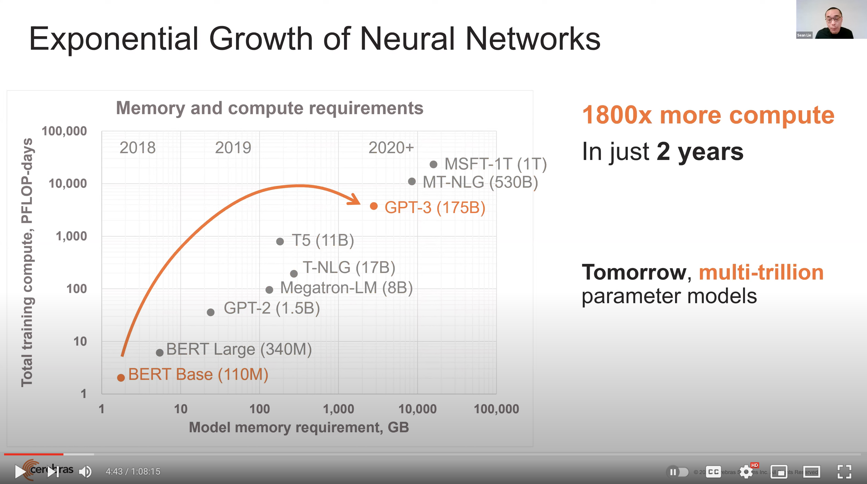
Huge Demand for Performance & Efficiency
Source: https://youtu.be/Bh13Idwcb0Q?t=283

Slide 6
Data Overwhelms Modern Machines
In-memory Databases
[Mao+, EuroSys’12;
Clapp+ (Intel), IISWC’15]
Graph/Tree Processing
[Xu+, IISWC’12; Umuroglu+, FPL’15]
Data → performance & energy bottleneck
In-Memory Data Analytics
[Clapp+ (Intel), IISWC’15;
Awan+, BDCloud’15]
Datacenter Workloads
[Kanev+ (Google), ISCA’15]

Slide 7








Data is Key for Modern Workloads
  Chrome
TensorFlow Mobile
    Google’s web browser
Google’s machine learning framework
  Video Playback
  Video Capture
Google’s video codec
Google’s video codec
Notes:
In this work, we take a look at widely-used google consumer workloads, to figure out the major sources of energy consumption.
We look at Google Chrome web brower. We take a look at Tensorflow, Google’s machine learning framework, and we also take a look at two important video related workloads, video playback and video capture, both rely on Google’s vp9 codec technology.

Slide 8
Data Overwhelms Modern Machines
  Chrome
TensorFlow Mobile
    Google’s web browser
Google’s machine learning framework
Data → performance & energy bottleneck
  Video Playback
  Video Capture
Google’s video codec
Google’s video codec
Notes:
In this work, we take a look at widely-used google consumer workloads, to figure out the major sources of energy consumption.
We look at Google Chrome web brower. We take a look at Tensorflow, Google’s machine learning framework, and we also take a look at two important video related workloads, video playback and video capture, both rely on Google’s vp9 codec technology.

Slide 9
Data Movement Overwhelms Modern Machines
Amirali Boroumand, Saugata Ghose, Youngsok Kim, Rachata Ausavarungnirun, Eric Shiu, Rahul Thakur, Daehyun Kim, Aki Kuusela, Allan Knies, Parthasarathy Ranganathan, and Onur Mutlu,
"Google Workloads for Consumer Devices: Mitigating Data Movement Bottlenecks"
Proceedings of the 23rd International Conference on Architectural Support for Programming Languages and Operating Systems (ASPLOS), Williamsburg, VA, USA, March 2018.
62.7% of the total system energy
is spent on data movement

Slide 10
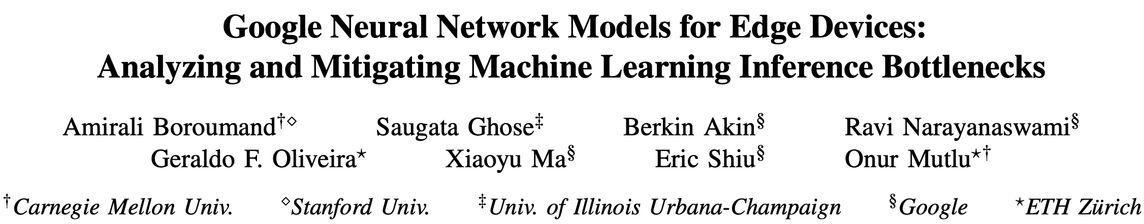
Data Movement Overwhelms Accelerators
Amirali Boroumand, Saugata Ghose, Berkin Akin, Ravi Narayanaswami, Geraldo F. Oliveira, Xiaoyu Ma, Eric Shiu, and Onur Mutlu,
"Google Neural Network Models for Edge Devices: Analyzing and Mitigating Machine Learning Inference Bottlenecks"
Proceedings of the 30th International Conference on Parallel Architectures and Compilation Techniques (PACT), Virtual, September 2021.
[Slides (pptx) (pdf)]
[Talk Video (14 minutes)]
> 90% of the total system energy
is spent on memory in large ML models

Slide 11
Axiom
An Intelligent Architecture
Handles Data Well

Slide 12
How to Handle Data Well
Ensure data does not overwhelm the components
  via intelligent algorithms, architectures & system designs: algorithm-architecture-devices
Take advantage of vast amounts of data and metadata
  to improve architectural & system-level decisions
Understand and exploit properties of (different) data
  to improve algorithms & architectures in various metrics

Slide 13
Corollaries: Computing Systems Today …
Are processor-centric vs. data-centric
Make designer-dictated decisions vs. data-driven
Make component-based myopic decisions vs. data-aware

Slide 14
Fundamentally Better Architectures
Data-centric
Data-driven
Data-aware

Slide 15
We Need to Revisit the Entire Stack
Problem
Algorithm
Program/Language
System Software
SW/HW Interface
Micro-architecture
Logic
Devices
Electrons
We can get there step by step

Slide 16
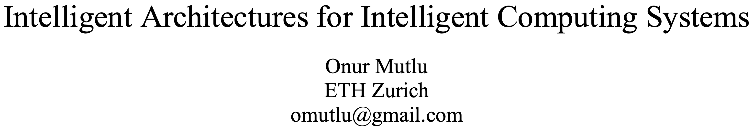
A Blueprint for Fundamentally Better Architectures
Onur Mutlu,
"Intelligent Architectures for Intelligent Computing Systems"
Invited Paper in Proceedings of the Design, Automation, and Test in Europe Conference (DATE), Virtual, February 2021.
[Slides (pptx) (pdf)]
[IEDM Tutorial Slides (pptx) (pdf)]
[Short DATE Talk Video (11 minutes)]
[Longer IEDM Tutorial Video (1 hr 51 minutes)]

Slide 17
Data-Driven (Self-Optimizing) Architectures

Slide 18
System Architecture Design Today
Human-driven
  Humans design the policies (how to do things)
Many (too) simple, short-sighted policies all over the system
No automatic data-driven policy learning
(Almost) no learning: cannot take lessons from past actions
Can we design
fundamentally intelligent architectures?

Slide 19
An Intelligent Architecture
Data-driven
  Machine learns the “best” policies (how to do things)
Sophisticated, workload-driven, changing, far-sighted policies
Automatic data-driven policy learning
All controllers are intelligent data-driven agents
We need to rethink design
(of all controllers)

Slide 20
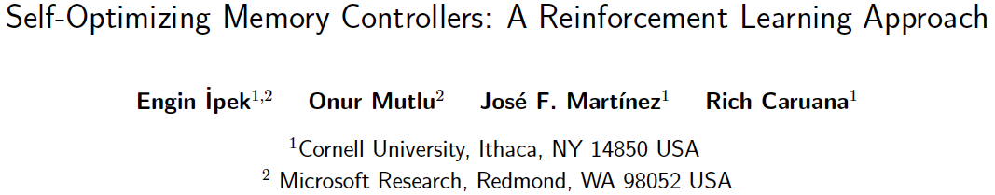
Self-Optimizing Memory Controllers
Engin Ipek, Onur Mutlu, José F. Martínez, and Rich Caruana,
"Self Optimizing Memory Controllers: A Reinforcement Learning Approach"
Proceedings of the 35th International Symposium on Computer Architecture (ISCA), pages 39-50, Beijing, China, June 2008. Selected to the ISCA-50 25-Year Retrospective Issue covering 1996-2020 in 2023 (Retrospective (pdf) Full Issue).

Slide 21
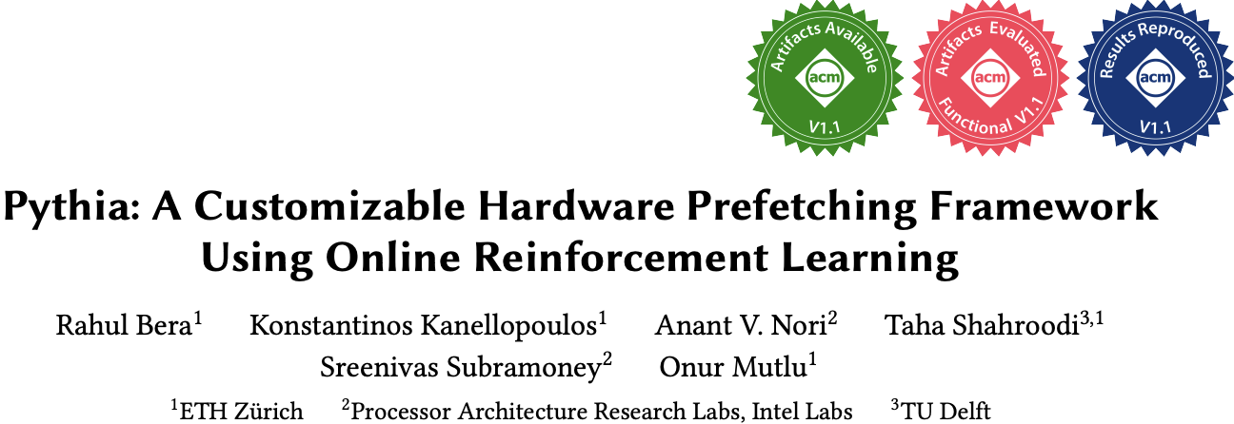
Self-Optimizing Memory Prefetchers
Rahul Bera, Konstantinos Kanellopoulos, Anant Nori, Taha Shahroodi, Sreenivas Subramoney, and Onur Mutlu,
"Pythia: A Customizable Hardware Prefetching Framework Using Online Reinforcement Learning"
Proceedings of the 54th International Symposium on Microarchitecture (MICRO), Virtual, October 2021.
[Slides (pptx) (pdf)]
[Short Talk Slides (pptx) (pdf)]
[Lightning Talk Slides (pptx) (pdf)]
[Talk Video (20 minutes)]
[Lightning Talk Video (1.5 minutes)]
[Pythia Source Code (Officially Artifact Evaluated with All Badges)]
[arXiv version]
Officially artifact evaluated as available, reusable and reproducible.
https://arxiv.org/pdf/2109.12021.pdf

Slide 22
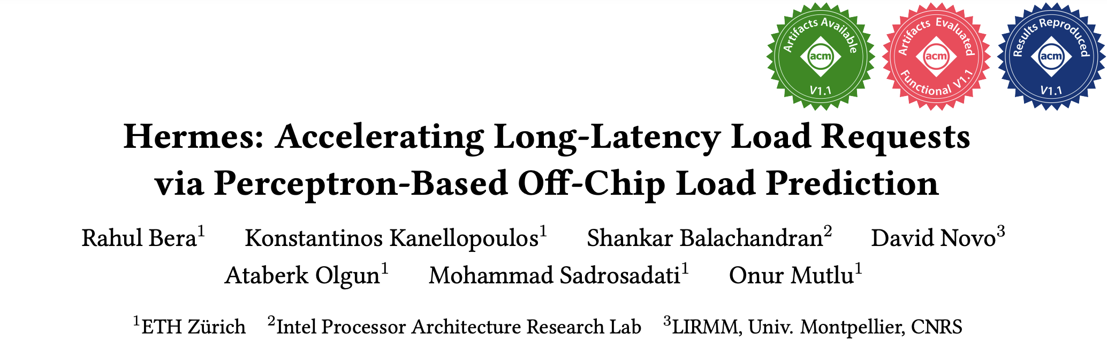
Learning-Based Off-Chip Load Predictors
Rahul Bera, Konstantinos Kanellopoulos, Shankar Balachandran, David Novo, Ataberk Olgun, Mohammad Sadrosadati, and Onur Mutlu,
"Hermes: Accelerating Long-Latency Load Requests via Perceptron-Based Off-Chip Load Prediction"
Proceedings of the 55th International Symposium on Microarchitecture (MICRO), Chicago, IL, USA, October 2022.
[Slides (pptx) (pdf)]
[Longer Lecture Slides (pptx) (pdf)]
[Talk Video (12 minutes)]
[Lecture Video (25 minutes)]
[arXiv version]
[Source Code (Officially Artifact Evaluated with All Badges)]
Officially artifact evaluated as available, reusable and reproducible.
Best paper award at MICRO 2022.
https://arxiv.org/pdf/2209.00188.pdf

Slide 23
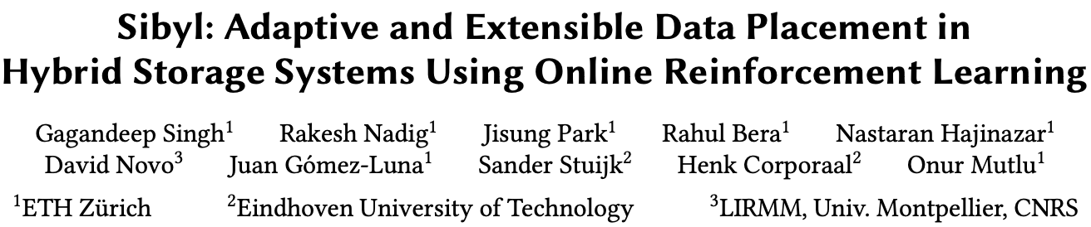
Self-Optimizing Hybrid SSD Controllers
Gagandeep Singh, Rakesh Nadig, Jisung Park, Rahul Bera, Nastaran Hajinazar, David Novo, Juan Gomez-Luna, Sander Stuijk, Henk Corporaal, and Onur Mutlu,
"Sibyl: Adaptive and Extensible Data Placement in Hybrid Storage Systems Using Online Reinforcement Learning"
Proceedings of the 49th International Symposium on Computer Architecture (ISCA), New York, June 2022.
[Slides (pptx) (pdf)]
[arXiv version]
[Sibyl Source Code]
[Talk Video (16 minutes)]
https://arxiv.org/pdf/2205.07394.pdf

Slide 24
Self Optimizing
Memory Controllers

Slide 25
Self-Optimizing Memory Controllers
Engin Ipek, Onur Mutlu, José F. Martínez, and Rich Caruana,
"Self Optimizing Memory Controllers: A Reinforcement Learning Approach"
Proceedings of the 35th International Symposium on Computer Architecture (ISCA), pages 39-50, Beijing, China, June 2008. Selected to the ISCA-50 25-Year Retrospective Issue covering 1996-2020 in 2023 (Retrospective (pdf) Full Issue).

Slide 26
DRAM Controllers Difficult to Design
Need to obey DRAM timing constraints for correctness
  There are many (50+) timing constraints in DRAM
  tWTR: Minimum number of cycles to wait before issuing a read command after a write command is issued
  tRC: Minimum number of cycles between the issuing of two consecutive activate commands to the same bank
  …
Need to keep track of many resources to prevent conflicts
  Channels, banks, ranks, data bus, address bus, row buffers
Need to handle DRAM refresh
Need to manage power consumption
Need to optimize performance & QoS (in the presence of constraints)
  Reordering is not simple
  Fairness and QoS needs complicates the scheduling problem

Slide 27
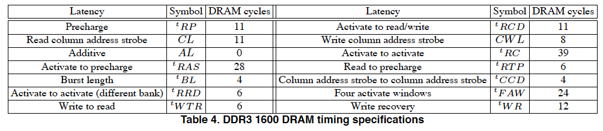
Many DRAM Timing Constraints
From Lee et al., “DRAM-Aware Last-Level Cache Writeback: Reducing Write-Caused Interference in Memory Systems,” HPS Technical Report, April 2010.

Slide 28
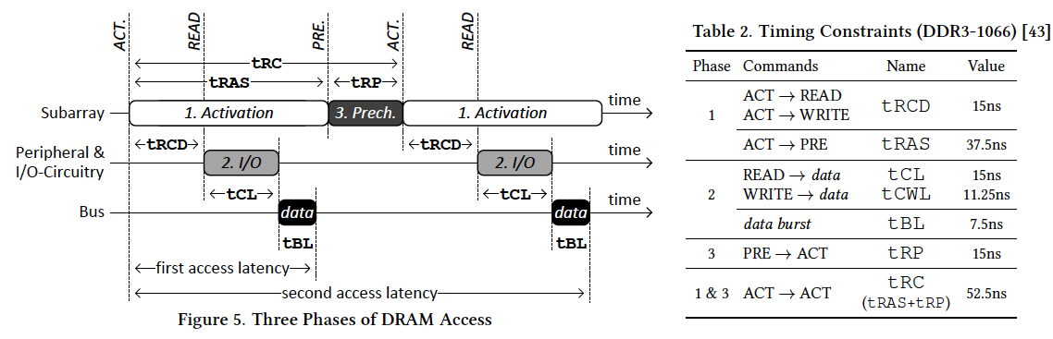
More on DRAM Operation
Kim et al., “A Case for Exploiting Subarray-Level Parallelism (SALP) in DRAM,” ISCA 2012.
Lee et al., “Tiered-Latency DRAM: A Low Latency and Low Cost DRAM Architecture,” HPCA 2013.

Slide 29
Why So Many Timing Constraints? (I)
Kim et al., “A Case for Exploiting Subarray-Level Parallelism (SALP) in DRAM,” ISCA 2012.

Slide 30
Why So Many Timing Constraints? (II)
Lee et al., “Tiered-Latency DRAM: A Low Latency and Low Cost DRAM Architecture,” HPCA 2013.

Slide 31
DRAM Controller Design Is Becoming More Difficult
CPU
CPU
CPU
CPU
GPU
HWA
HWA
Shared Cache
DRAM and Hybrid Memory Controllers
DRAM and Hybrid Memories
Heterogeneous agents: CPUs, GPUs, and HWAs
Main memory interference between CPUs, GPUs, HWAs
Many timing constraints for various memory types
Many goals at the same time: performance, fairness, QoS, energy efficiency, …

Slide 32
Reality and Dream
Reality: It is difficult to design a policy that maximizes performance, QoS, energy-efficiency, …
  Too many things to think about
  Continuously changing workload and system behavior
Dream: Wouldn’t it be nice if the DRAM controller automatically found a good scheduling policy on its own?

Slide 33
Memory Controller: Performance Function
How to schedule requests to maximize system performance?
Resolves memory contention by scheduling requests
Core
Core
Memory Controller
Memory
Core
Core

Slide 34
Self-Optimizing DRAM Controllers
Problem: DRAM controllers are difficult to design
  It is difficult for human designers to design a policy that can adapt itself very well to different workloads and different system conditions
Idea: A memory controller that adapts its scheduling policy to workload behavior and system conditions using machine learning.
Observation: Reinforcement learning maps nicely to memory control.
Design: Memory controller is a reinforcement learning agent
  It dynamically and continuously learns and employs the best scheduling policy to maximize long-term performance.
Ipek+, “Self Optimizing Memory Controllers: A Reinforcement Learning Approach,” ISCA 2008.

Slide 35
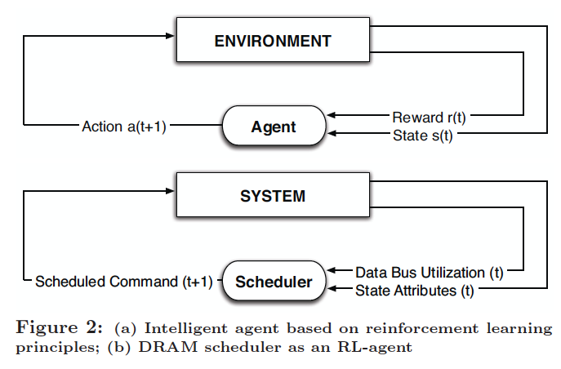
Self-Optimizing DRAM Controllers
Engin Ipek, Onur Mutlu, José F. Martínez, and Rich Caruana,
"Self Optimizing Memory Controllers: A Reinforcement Learning Approach"
Proceedings of the 35th International Symposium on Computer Architecture (ISCA), pages 39-50, Beijing, China, June 2008.
Goal: Learn to choose actions to maximize r₀ + γr₁ + γ²r₂ + … ( 0 ≤ γ < 1)

Slide 36
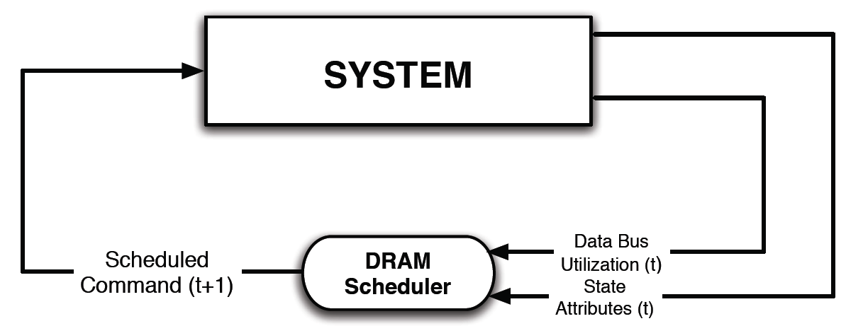
Self-Optimizing DRAM Controllers
Dynamically adapt the memory scheduling policy via interaction with the system at runtime
  Associate system states and actions (commands) with long term reward values: each action at a given state leads to a learned reward
  Schedule command with highest estimated long-term reward value in each state
  Continuously update reward values for <state, action> pairs based on feedback from system

Slide 37
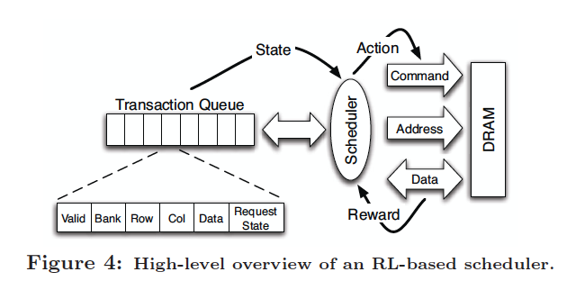
Self-Optimizing DRAM Controllers
Engin Ipek, Onur Mutlu, José F. Martínez, and Rich Caruana,
"Self Optimizing Memory Controllers: A Reinforcement Learning Approach"
Proceedings of the 35th International Symposium on Computer Architecture (ISCA), pages 39-50, Beijing, China, June 2008.

Slide 38
States, Actions, Rewards
Reward function
  +1 for scheduling Read and Write commands
  0 at all other times
  Goal is to maximize long-term data bus utilization
State attributes
  Number of reads, writes, and load misses in transaction queue
  Number of pending writes and ROB heads waiting for referenced row
  Request’s relative ROB order
Actions
  Activate
  Write
  Read - load miss
  Read - store miss
  Precharge - pending
  Precharge - preemptive
  NOP

Slide 39
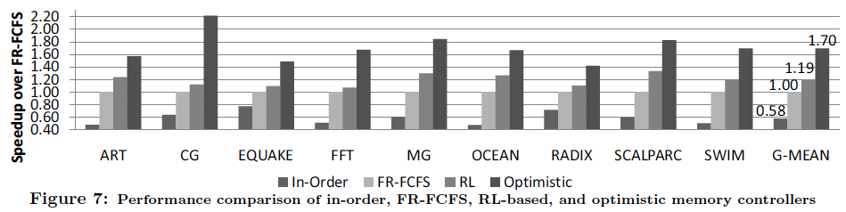
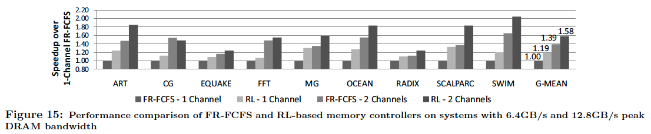
Performance Results
Large, robust performance improvements
over many human-designed policies

Slide 40
Self Optimizing DRAM Controllers
+ Continuous learning in the presence of changing environment
+ Reduced designer burden in finding a good scheduling policy. Designer specifies:
1) What system variables might be useful
2) What target to optimize, but not how to optimize it
-- How to specify different objectives? (e.g., fairness, QoS, …)
-- Hardware complexity?
-- Design mindset and flow

Slide 41
Self-Optimizing Memory Controllers
Engin Ipek, Onur Mutlu, José F. Martínez, and Rich Caruana,
"Self Optimizing Memory Controllers: A Reinforcement Learning Approach"
Proceedings of the 35th International Symposium on Computer Architecture (ISCA), pages 39-50, Beijing, China, June 2008. Selected to the ISCA-50 25-Year Retrospective Issue covering 1996-2020 in 2023 (Retrospective (pdf) Full Issue).

Slide 42
Pythia: Prefetching using
Reinforcement Learning

Slide 43
Self-Optimizing Memory Prefetchers
Rahul Bera, Konstantinos Kanellopoulos, Anant Nori, Taha Shahroodi, Sreenivas Subramoney, and Onur Mutlu,
"Pythia: A Customizable Hardware Prefetching Framework Using Online Reinforcement Learning"
Proceedings of the 54th International Symposium on Microarchitecture (MICRO), Virtual, October 2021.
[Slides (pptx) (pdf)]
[Short Talk Slides (pptx) (pdf)]
[Lightning Talk Slides (pptx) (pdf)]
[Talk Video (20 minutes)]
[Lightning Talk Video (1.5 minutes)]
[Pythia Source Code (Officially Artifact Evaluated with All Badges)]
[arXiv version]
Officially artifact evaluated as available, reusable and reproducible.
https://arxiv.org/pdf/2109.12021.pdf

Slide 44






Pythia
A Customizable Hardware Prefetching Framework Using Online Reinforcement Learning
Rahul Bera, Konstantinos Kanellopoulos, Anant V. Nori,
Taha Shahroodi, Sreenivas Subramoney, Onur Mutlu
https://github.com/CMU-SAFARI/Pythia
https://arxiv.org/pdf/2109.12021.pdf
Notes:
Hi I am Rahul. Today, I’m going to present our work “…”
This work is done by researchers from SAFARI research group at ETH Zurich, in collaboration with Intel Labs and TU Delft.

Slide 45
Executive Summary
Background: Prefetchers predict addresses of future memory requests by associating memory access patterns with pieces of program and system information (called feature)
Problem: Three key shortcomings of prior prefetchers:
  Predict mainly using a single program feature
  Lack inherent system awareness (e.g., memory bandwidth usage)
  Lack in-silicon customizability
Goal: Design a prefetching framework that:
  Learns from multiple features and inherent system-level feedback
  Can be customized in silicon to use different features and/or prefetching objectives
Contribution: Pythia, which formulates prefetching as reinforcement learning problem
  Takes adaptive prefetch decisions using multiple features and system-level feedback
  Can be customized in silicon for target workloads via simple configuration registers
  Proposes a realistic and practical implementation of RL algorithm in hardware
Key Results:
  Evaluated using a wide range of workloads from SPEC CPU, PARSEC, Ligra, Cloudsuite
  Outperforms best prefetcher by 3.4%, 7.7% and 17% in 1/4/bw-constrained cores
  Customizing Pythia leads to up to 7.8% more performance over basic Pythia across Ligra workloads
https://github.com/CMU-SAFARI/Pythia
Notes:
First, I am going to start with an executive summary.
[CLICK] Prefetching is a speculative technique that predicts address of future memory requests by associating patterns in memory addresses with some program context. We call this context a feature.
[CLICK] We observe three key shortcomings in prior prefetchers:
First, they mainly use a single program feature for prediction.
Second, they lack inherent system awareness
Third, they also lack any customizability in silicon
[CLICK] Our goal in this work is to design a prefetching framework that
– can learn from multiple program features and inherent system-level feedback
-- and can be customized in silicon to change the features or the objective of the prefetcher
[CLICK] Towards this we propose Pythia, that formulates …
Pythia makes adaptive and autonomous …
Pythia also proposes a realistic and practical …
[CLICK] We extensively evaluate Pythia using …
We show that Pythia outperforms prior state-of-the-art …
Pythia is freely available in our GitHub repository.

Slide 46
Talk Outline
Key Shortcomings of Prior Prefetchers
Formulating Prefetching as Reinforcement Learning
Pythia: Overview
Evaluation of Pythia and Key Results
Conclusion
Notes:
This is the outline of my talk.
First, I am going to start by discussing key shortcomings of prior prefetchers.

Slide 47
Prefetching Basics
Predicts addresses of long-latency memory requests and fetches data before the program demands it
Associates access patterns from past memory requests with program context or system information
Example program features
  Program counter (PC)
  Page number
  Page offset
  Cacheline delta
  …
  Or a combination of these attributes
Program Feature
Program context → Access Pattern
Notes:
Prefetching is a speculative technique that predicts …
[CLICK] To predict addresses, a prefetcher typically associates …
[CLICK] We call these context information as program feature.
[CLICK] Some examples of program features are … or any combination of these information

Slide 48
Key Shortcomings in Prior Prefetchers
We observe three key shortcomings that significantly limit performance benefits of prior prefetchers
Predict mainly using a single program feature
1
Lack inherent system awareness
2
Lack in-silicon customizability
3
Notes:
We observe three key shortcomings in prior prefetchers that significantly limits their performance improvement
[CLICK] First, they predict mainly …
[CLICK] Second, they lack any inherent …
[CLICK] Third, the also lack any online in-silicon customizability
Let’s take a closer look at each of these shortcomings.
[NEXT]

Slide 49
(1) Single-Feature Prefetch Prediction
Provides good performance gains mainly on workloads where the feature-to-pattern correlation exists
15.4%
4.6%
5.5%
3.5%
Bingo [1] performs better
SPP [2] performs better
[1] Bakshalipour et al., HPCA’19
[2] Kim et al., MICRO’16
Notes:
Due to the use of a single program feature for prefetch prediction, a prefetcher typically provides performance benefits …
In other types of workloads, the same prefetcher fails to provide performance gains.
To illustrate this [CLICK], we show the coverage, overprediction, and performance improvement of two prior prefetchers SPP and Bingo for six sample workloads.
The top figure shows …
The bottom figure shows …
As we can see, for workloads like [CLICK], … Bingo performs better than SPP, as the program feature exploited by Bingo has stronger correlation with the access pattern than SPP.
On the other hand, for workloads like … [CLICK], SPP’s program feature provides better correlation, and thus performs better than Bingo.

Slide 50
(1) Single-Feature Prefetch Prediction
Provides good performance gains mainly on workloads where the feature-to-pattern correlation exists
Relying on a single feature for prediction leaves significant performance improvement on table
15.4%
4.6%
5.5%
3.5%
Bingo [1] performs better
SPP [2] performs better
[1] Bakshalipour et al., HPCA’19
[2] Kim et al., MICRO’16
Notes:
Due to the use of a single program feature for prefetch prediction, a prefetcher typically provides performance benefits …
In other types of workloads, the same prefetcher fails to provide performance gains.
To illustrate this [CLICK], we show the coverage, overprediction, and performance improvement of two prior prefetchers SPP and Bingo for six sample workloads.
The top figure shows …
The bottom figure shows …
As we can see, for workloads like [CLICK], … Bingo performs better than SPP, as the program feature exploited by Bingo has stronger correlation with the access pattern than SPP.
On the other hand, for workloads like … [CLICK], SPP’s program feature provides better correlation, and thus performs better than Bingo.

Slide 51
(2) Lack of Inherent System Awareness
Little understanding of undesirable effects (e.g., memory bandwidth usage, cache pollution, …)
  Performance loss in resource-constrained configurations
368%
574%
Similar coverage
Lower overpredictions
Yet, lower performance
Notes:
The second shortcoming is that, all prior prefetchers have …, which often leads to …
To illustrate this, let revisit the previous figure and focus on Bingo’s performance in PARSEC-Canneal and Ligra-CC.
Bingo in Ligra-CC has similar coverage to PARSEC-Canneal with significantly …
The reason is that, in baseline without prefetching, Ligra-CC consumes much higher main memory …
As a result, even a smaller amount of overprediction hurts more performance in Ligra-CC than in PARSEC-Canneal.
This is only happening as Bingo does not take its undesirable effects into account while prefetching.
Thus the key takeaway is that, [CLICK] …

Slide 52
(2) Lack of Inherent System Awareness
Little understanding of undesirable effects (e.g., memory bandwidth usage, cache pollution, …)
  Performance loss in resource-constrained configurations
368%
574%
Prefetchers often lose performance due to lack of inherent system awareness
Similar coverage
Lower overpredictions
Yet, lower performance
Notes:
The second shortcoming is that, all prior prefetchers have …, which often leads to …
To illustrate this, let revisit the previous figure and focus on Bingo’s performance in PARSEC-Canneal and Ligra-CC.
Bingo in Ligra-CC has similar coverage to PARSEC-Canneal with significantly …
The reason is that, in baseline without prefetching, Ligra-CC consumes much higher main memory …
As a result, even a smaller amount of overprediction hurts more performance in Ligra-CC than in PARSEC-Canneal.
This is only happening as Bingo does not take its undesirable effects into account while prefetching.
Thus the key takeaway is that, [CLICK] …

Slide 53



(3) Lack of In-silicon Customizability
Feature statically selected at design time
  Rigid hardware designed specifically to exploit that feature
No way to change program feature and/or change prefetcher’s objective in silicon
  Cannot adapt to a wide range of workload demands
Design from scratch
Verify
Fabricate
Notes:
The third key shortcoming is that, all prior prefetcher lack in-silicon customizability.
These prefetchers statically selects the feature to exploit at design time and design a rigid hardware to specifically …
[CLICK] There is no way …
In order to exploit a new program feature, architects need to design a prefetcher from scratch …
[CLICK] and this cycle goes on for every new prefetcher. This wastes precious design time and human resource.

Slide 54
Our Goal
A prefetching framework that can:
Learn to prefetch using multiple features and inherent system-level feedback information
Be easily customized in silicon to use different features and/or change prefetcher’s objectives
Notes:
So our goal in this work is to … that
[CLICK] …
[CLICK] …

Slide 55

Our Proposal
Pythia
Formulates prefetching as a reinforcement learning problem
Pythia is named after the oracle of Delphi, who is known for her accurate prophecies
https://en.wikipedia.org/wiki/Pythia

Slide 56
Talk Outline
Key Shortcomings of Prior Prefetchers
Formulating Prefetching as Reinforcement Learning
Pythia: Overview
Evaluation of Pythia and Key Results
Conclusion
Notes:
To this end, we propose Pythia, which formulates …

Slide 57
Basics of Reinforcement Learning (RL)
Algorithmic approach to learn to take an action in a given situation to maximize a numerical reward
Agent stores Q-values for every state-action pair
  Expected return for taking an action in a state
  Given a state, selects action that provides highest Q-value
Notes:
First, let me briefly describe the basics of reinforcement learning.
Reinforcement learning, in its simplest form, is the ...
A RL system contains two components: [CLICK] the agent and the environment.
The agent observes the state of the environment in every timestep [CLICK], takes an action based on the state [CLICK], and receives a reward for that action [CLICK].
[CLICK] The agent stores …
Given a state, the agent …

Slide 58
Formulating Prefetching as RL
Notes:
In Pythia, we formulate prefetching as a reinforcement learning problem.
[CLICK] The prefetcher acts as the agent, while [CLICK] the processor and memory subsystem acts as the environment.
[CLICK] Pythia extracts the program features from every demand request and use it as a state information to take a prefetch action [CLICK]
[CLICK] For every prefetch action, Pythia receives a numerical reward that evaluates the usefulness of the prefetch request, while considering various system-level feedbacks.
Not let’s concretely define the state, action, and the reward for Pythia.

Slide 59

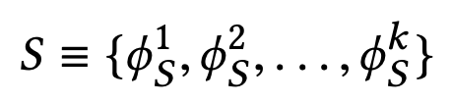
What is State?
k-dimensional vector of features
Feature = control-flow + data-flow
Control-flow examples
  PC
  Branch PC
  Last-3 PCs, …
Data-flow examples
  Cacheline address
  Physical page number
  Delta between two cacheline addresses
  Last 4 deltas, …
Notes:
We define the state as a k-dimensional vector of program features.
[CLICK] Each feature is composed of …
[CLICK] Some examples of control-flow information are …
[CLICK] Some examples of data-flow information are …
Though Pythia can theoretically learn from any number of such program features, we limit the size k as per storage budget.

Slide 60
What is State?
Example of a state information
S = {PC+Delta, Sequence of last-4 deltas}
Feature-1 (ɸ₁)
Feature-2 (ɸ₂)
PC
(Control-flow info.)
Cacheline Delta
(Data-flow info.)
Seq. of last-4 deltas
(Data-flow info.)
Notes:
We define the state as a k-dimensional vector of program features.
[CLICK] Each feature is composed of …
[CLICK] Some examples of control-flow information are …
[CLICK] Some examples of data-flow information are …
Though Pythia can theoretically learn from any number of such program features, we limit the size k as per storage budget.

Slide 61
What is Action?
Given a demand access to address A
the action is to select prefetch offset “O”
Action-space: 127 actions in the range [-63, +63]
  For a machine with 4KB page and 64B cacheline
Upper and lower limits ensure prefetches do not cross physical page boundary
A zero offset means no prefetch is generated
We further prune action-space by design-space exploration
Notes:
We define the action as the selection of a prefetch offset. Pythia adds this offset to the demanded cacheline to get the prefetched cacheline address.
[CLICK] Note that a zero offset is also a valid action for Pythia, which means no prefetch is generated.
[CLICK] As every post-L1 prefetcher …, the list of actions are limited to the range from -63 to +63 for a traditionally-sized …
[CLICK] However, we can prune the action list by automatic design-space exploration, as we show in the paper.

Slide 62
What is Reward?
Defines the objective of Pythia
Encapsulates two metrics:
  Prefetch usefulness (e.g., accurate, late, out-of-page, …)
  System-level feedback (e.g., mem. b/w usage, cache pollution, energy, …)
We demonstrate Pythia with memory bandwidth usage as the system-level feedback in the paper
Notes:
The reward defines the objective of Pythia
[CLICK] A reward encapsulates two metrics: …
[CLICK] Though Pythia can learn from any …, in this paper we demonstrate Pythia using a major system-level feedback: mem b/w usage

Slide 63
What is Reward?
Seven distinct reward levels
  Accurate and timely (R_{AT})
  Accurate but late (R_{AL})
  Loss of coverage (R_{CL})
  Inaccurate
    With low memory b/w usage (R_{IN}-L)
    With high memory b/w usage (R_{IN}-H)
  No-prefetch
    With low memory b/w usage (R_{NP}-L)
    With high memory b/w usage(R_{NP}-H)
Values are set at design time via automatic design-space exploration
  Can be customized further in silicon for higher performance
Notes:
We define reward in five distinct levels mentioned as follows [CLICK].
Each reward level corresponds to various usefulness of a prefetch request. The inaccurate and no-prefetch reward levels are further categorized based on the system memory bandwidth usage.
[CLICK] The values of each of these reward levels are set at design time via automatic design-space exploration.
[CLICK] However, one can customize the rewards in silicon via simple configuration registers to specify a dfferent objective for Pythia for extracting higher performance benefits in target workload suites.

Slide 64
Steering Pythia’s Objective via Reward Values
Example reward configuration for
  Generating accurate prefetches
  Making bandwidth-aware prefetch decisions
-14
-8
-4
-2
+12
+20
R_{IN}-H
R_{IN}-L
R_{NP}-L
R_{NP}-H
R_{AL}
R_{AT}
AT = Accurate & timely; AL = Accurate & late; NP = No-prefetching; IN = Inaccurate;
H = High mem. b/w; L = Low mem. b/w
1
Highly prefers to generate accurate prefetches
2
Prefers not to prefetch if memory bandwidth usage is low
3
Strongly prefers not to prefetch if memory bandwidth usage is high
Notes:
Now, let’s take a concrete example of reward values and how they specify the objectives for Pythia.
[CLICK] These are the reward level values in basic Pythia configuration.
Pythia sets three key objectives for prefetching by this reward configuration.
[CLICK] First, we provide much higher perks to Pythia for prefetching accurately, either timely or untimely. Thus, Pythia prefers to generate accurate prefetches.
[CLICK] Second, in case of low memory bandwidth usage, Pythia has higher perks in no prefetching, rather that prefetching inaccurately.
Thus, if the memory bandwidth usage is low, Pythia prefers not to prefetch, rather than prefetching inaccurately.
[CLICK] Third, in case of high memory bandwidth usage, Pythia has much higher perks in no prefetching than prefetching accurately.
Thus, if the memory bandwidth usage is low, Pythia strongly prefers not to prefetch, rather than prefetching inaccurately.
[] Let’s take a look at a reward values to steer Pythia to generate accurate prefetches and make fine-tuned decisions based on b/w usage.

Slide 65
Steering Pythia’s Objective via Reward Values
Customizing reward values to make Pythia conservative towards prefetching
-22
-20
+1
+2
+12
+20
R_{IN}-H
R_{IN}-L
R_{NP}-L
R_{NP}-H
R_{AL}
R_{AT}
AT = Accurate & timely; AL = Accurate & late; NP = No-prefetching; IN = Inaccurate;
H = High mem. b/w; L = Low mem. b/w
1
Highly prefers to generate accurate prefetches
2
Otherwise prefers not to prefetch
Notes:
Now, if we increase the reward for no prefetching while significantly decreasing the rewards for inaccurate prefetching, we set a different prefetching objective for Pythia.
[CLICK] We still provide much higher perks for prefetching accurately. Thus Pythia strives to generate accurate prefetches.
[CLICK] Otherwise, we provide much higher perks for no prefetching as compared to inaccurate prefetching, irrespective of the memory bandwidth usage. Thus, Pythia becomes conservative and simply do not prefetch at all.
This is particularly useful if we are repurposing Pythia for server-class processors which have modest per-core memory bandwidth
or workloads like Ligra whose performance improvement is sensitive to memory bandwidth usage.

Slide 66

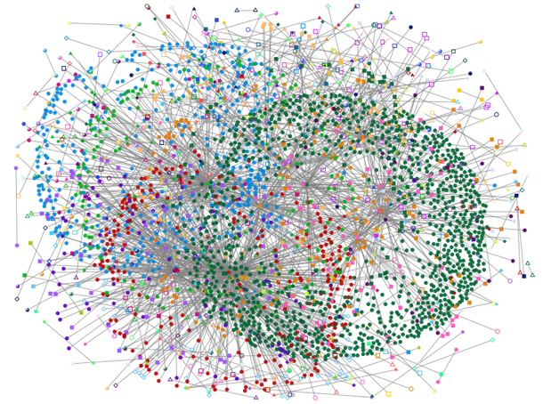
Steering Pythia’s Objective via Reward Values
Customizing reward values to make Pythia conservative towards prefetching
Strict Pythia configuration
-22
-20
+2
+4
+12
+20
R_{IN}-H
R_{IN}-L
R_{NP}-L
R_{NP}-H
R_{AL}
R_{AT}
AT = Accurate & timely; AL = Accurate & late; NP = No-prefetching; IN = Inaccurate;
H = High mem. b/w; L = Low mem. b/w
1
Highly prefers to generate accurate prefetches
2
Bandwidth-sensitive workloads
Otherwise prefers not to prefetch
Server-class processors
Notes:
Now, if we increase the reward for no prefetching while significantly decreasing the rewards for inaccurate prefetching, we set a different prefetching objective for Pythia.
[CLICK] We still provide much higher perks for prefetching accurately. Thus Pythia strives to generate accurate prefetches.
[CLICK] Otherwise, we provide much higher perks for no prefetching as compared to inaccurate prefetching, irrespective of the memory bandwidth usage. Thus, Pythia becomes conservative and simply do not prefetch at all.
This is particularly useful if we are repurposing Pythia for server-class processors which have modest per-core memory bandwidth
or workloads like Ligra whose performance improvement is sensitive to memory bandwidth usage.

Slide 67
Talk Outline
Key Shortcomings of Prior Prefetchers
Formulating Prefetching as Reinforcement Learning
Pythia: Overview
Evaluation of Pythia and Key Results
Conclusion
Notes:
We now provide a brief overview and design of Pythia.

Slide 68
Pythia Overview
Q-Value Store: Records Q-values for all state-action pairs
Evaluation Queue: A FIFO queue of recently-taken actions
Find the Action with max Q-Value
A1
A2
A3
4
2
Look up
QVStore
Generate
prefetch
Demand Request
State
Vector
Memory
Hierarchy
S1
3
S2
Max
S3
S4
Q-Value Store
(QVStore)
6
Evict EQ entry and update QVStore
5
Evaluation Queue (EQ)
Insert prefetch action &
State-Action pair in EQ
1
7
Set filled bit
Assign reward to
corresponding EQ entry
Prefetch Fill
Notes:
Pythia consists of two key components:
[CLICK] Q-value store, which is responsible for …
[CLICK] Evaluation queue, which is a first-in-first-out queue that stores the recently taken action.
As Pythia cannot always immediately assign a reward to a taken action
because the usefulness of the corresponding prefetch request is known, Pythia stores the action
in evaluation queue to properly assign rewards to them.
[CLICK] For every demand request, Pythia first checks EQ with deamdned address. If a matching entry is found in EQ, it means the corresponding action in EQ entry has generated a useful prefetch, and Pythia assigns a reward accordingly.
[CLICK] Then Pythia extracts features from the attributes of the demand request to create the state-vector and uses the state-vector to lookup QVStore [CLICK]
[CLICK] For the given state-vector, Pythia finds the action that has the highest Q-value and generates prefetch request accordingly to the memory hierarchy [CLICK]
[CLICK] Next, Pythia inserts the action in the EQ along with the state-action pair.
[CLICK] Pythia uses the reward stored in the evicted EQ entry to update the QVStore.

Slide 69
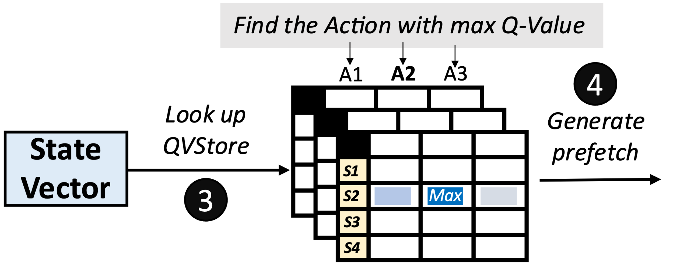
Architecting QVStore
+1
+2
+3
…
S = {PC+Delta,
Sequence of last-4 deltas}
Q-Value Store
(QVStore)
Notes:
Now let’s take a closer look at how Pythia makes a prefetch prediction.
For every prefetch prediction, Pythia has to look up the QVStore using the state vector, [CLICK] for example, a vector of features: PC+Delta, and seq. of last-4 deltas.
For the given state-vector, Pythia has to retrieve the Q-value for each prefetch action, e.g., [CLICK] prefetch offsets +1, +2, +3 and so on, to find the action that has the maximum Q-value.
Thus, it is necessary to store all state-action Q-values in an efficient way for a fast Q-value retrieval.

Slide 70
Architecting the QVStore
Fast prefetch prediction
+1
+2
+3
…
Fast retrieval of Q-values from QVStore
S = {PC+Delta,
Sequence of last-4 deltas}
Q-Value Store
(QVStore)
Efficient storage organization of Q-values in QVStore
Notes:
Now let’s see an example of how QVStore works.
For every prefetch decision, Pythia looks up the QVStore using the state vector, which in this case …
For the state-vector, Pythia retrieves the Q-value for each prefetch action, e.g., +1, +2, +3 ... to find the action that has the maximum Q-value.
Thus, it is necessary to store all state-action Q-values in an efficient way for a fast Q-value retrieval.

Slide 71

Organization of QVStore
A monolithic two-dimensional table?
  Indexed by state and action values
State-space increases exponentially with #bits
S = {PC+Delta, Sequence of last-4 deltas}
32b
+
7b
+
4x7b
= 67 bits
127 actions
 | A1 | A2 | A3 | A4 | A5 | A6 | A7 | A8 | A9
S1
S2
S3
S4
S5
S6
S7
2⁶⁷ states
Design complexity
Access latency
Notes:
[CLICK] Now, a naïve choice for designing the QVStore is to organize as a monolithic two-dimensional table, which is indexed by the state and the action values
[CLICK] However, the state-space increases exponentially with the number of bits used to represent the state.
[CLICK] As you can see, the state information considered in our example requires 67 bits to represent
[CLICK] Which requires an impractically-sized monolithic table to store Q-values for every state-action pairs.
[CLICK] but also significantly increases the access latency.

Slide 72
Organization of QVStore
We partition QVStore into k vaults [k = number of features in state]
  Each vault corresponds to one feature and stores the Q-values of feature-action pairs
To retrieve Q(S,A) for each action
Query each vault in parallel with feature and action
Retrieve feature-action Q-value from each vault
Compute MAX of all feature-action Q-values
MAX ensures the Q(S,A) is driven by the constituent feature that has highest Q(ɸ,A)
Notes:
[CLICK] Thus, we partition the QVStore into k vaults, where k is the number of features in a state information
[CLICK] Each vault corresponds to …
[CLICK] To retrieve the Q-value of a state-action pair …
[CLICK] We do this…
[CLICK] Then we do this …
[CLICK] Then we do this …
[CLICK] The maximum operation ensures that …

Slide 73
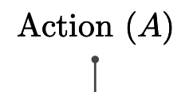
Organization of QVStore
We further partition each vault into multiple planes
  Each plane stores a partial Q-value of a feature-action pair
To retrieve Q(ɸ,A) for each action
Query each plane in parallel with hashed feature and action
Retrieve partial feature-action Q-value from each plane
Compute SUM of all partial feature-action Q-values
Notes:
[CLICK] We further partition …
[CLICK] Where each plane stores …
[CLICK] To retrieve the feature-action Q-value,
[CLICK] We query each plane …
[CLICK] We retrieve the partial Q-value from each plane
[CLICK] and finally compute a sum …

Slide 74
Organization of QVStore
We further partition each vault into multiple planes
  Each plane stores a partial Q-value of a feature-action pair
To retrieve Q(ɸ,A) for each action
1. Enables sharing of partial Q-values between similar feature values, shortens prefetcher training time
Query each plane in parallel with hashed feature and action
Retrieve partial feature-action Q-value from each plane
Compute SUM of all parital feature-action Q-values
2. Reduces chances of sharing partial Q-values
across widely different feature values
Notes:
[CLICK] We further partition …
[CLICK] Where each plane stores …
[CLICK] To retrieve the feature-action Q-value,
[CLICK] We query each plane …
[CLICK] We retrieve the partial Q-value from each plane
[CLICK] and finally compute a sum …

Slide 75
More in the Paper
Pipelined search operation for QVStore
Reward assignment and QVStore update
Automatic design-space exploration
  Feature types
  Actions
  Reward and Hyperparameter values
Notes:
We have much more detailed description of Pythia’s design in our paper including …

Slide 76
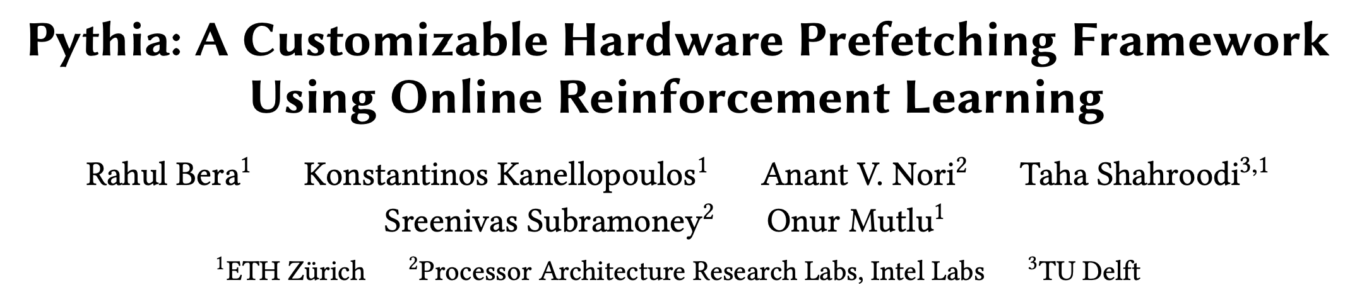
More in the Paper
Pipelined search operation for QVStore
Reward assignment and QVStore update
Automatic design-space exploration
  Feature types
  Action
  Reward and Hyperparameter values
https://arxiv.org/pdf/2109.12021.pdf
Notes:
We have much more detailed description of Pythia’s design in our paper including …

Slide 77
Talk Outline
Key Shortcomings of Prior Prefetchers
Formulating Prefetching as Reinforcement Learning
Pythia: Overview
Evaluation of Pythia and Key Results
Conclusion

Slide 78
Simulation Methodology
Champsim [3] trace-driven simulator
150 single-core memory-intensive workload traces
  SPEC CPU2006 and CPU2017
  PARSEC 2.1
  Ligra
  Cloudsuite
Homogeneous and heterogeneous multi-core mixes
Five state-of-the-art prefetchers
  SPP [Kim+, MICRO’16]
  Bingo [Bakhshalipour+, HPCA’19]
  MLOP [Shakerinava+, 3rd Prefetching Championship, 2019]
  SPP+DSPatch [Bera+, MICRO’19]
  SPP+PPF [Bhatia+, ISCA’20]
[3] https://github.com/ChampSim/ChampSim

Slide 79
Basic Pythia Configuration
Derived from automatic design-space exploration
State: 2 features
  PC+Delta
  Sequence of last-4 deltas
Actions: 16 prefetch offsets
  Ranging between -6 to +32. Including 0.
Rewards:
  R_{AT} = +20; R_{AL} = +12; R_{NP}-H=-2; R_{NP}-L=-4;
  R_{IN}-H=-14; R_{IN}-L=-8; R_{CL}=-12
Notes:
This is the basic Pythia configuration that we are going to evaluate, which is derived from the automatic design-space exploration.

Slide 80
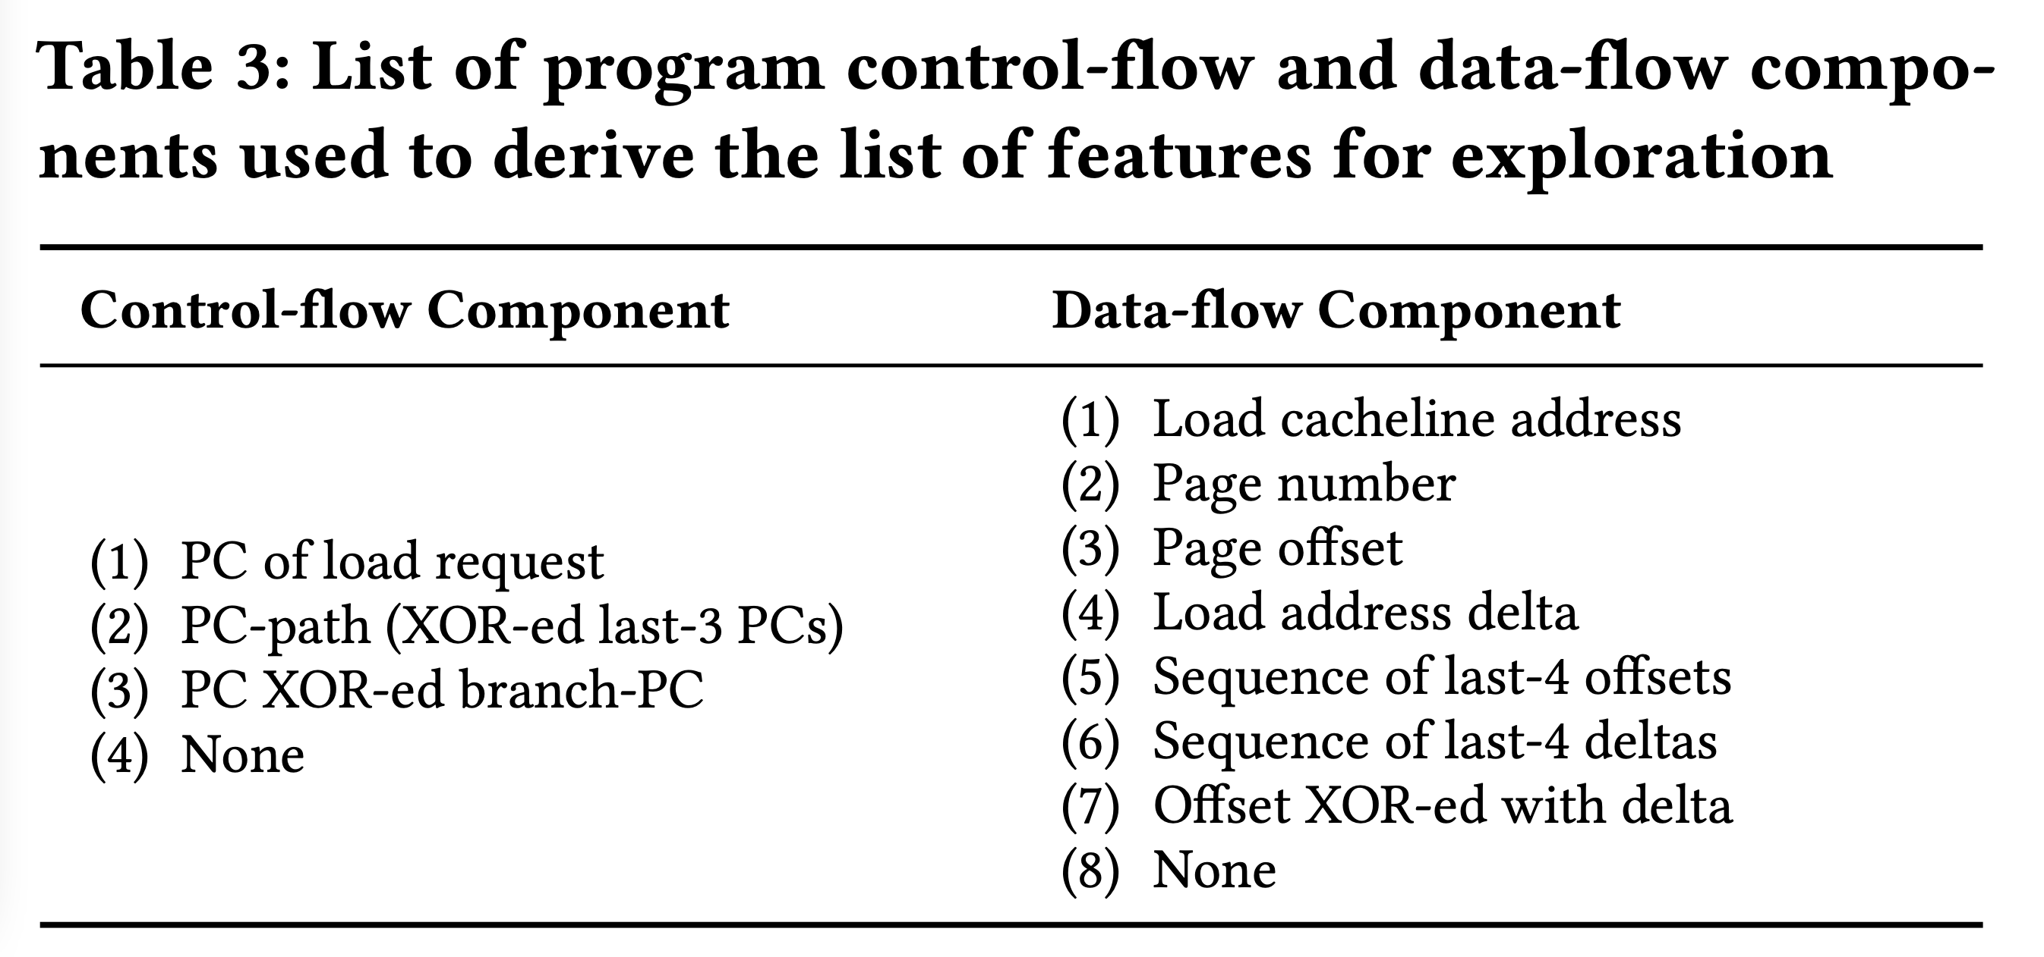

List of Evaluated Features

Slide 81
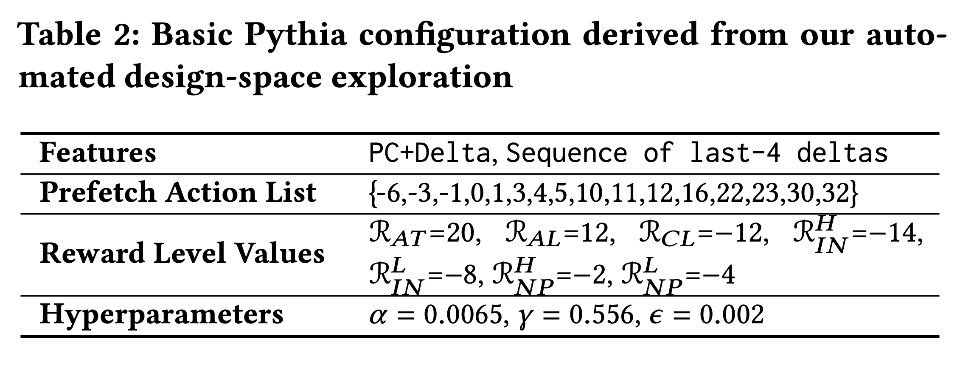
Basic Pythia Configuration

Slide 82
Performance with Varying Core Count
Pythia
3.4%
7.7%
SPP
MLOP
Bingo

Slide 83
Performance with Varying Core Count
1. Pythia consistently provides the highest performance in all core configurations
Pythia
7.7%
3.4%
SPP
2. Pythia’s gain increases with core count
MLOP
Bingo

Slide 84
Performance with Varying DRAM Bandwidth
3%
Pythia
Bingo
MLOP
Baseline
SPP
~Intel Xeon 6258R
~AMD EPYC Rome 7702P
17%
~AMD Threadripper 3990x

Slide 85
Performance with Varying DRAM Bandwidth
3%
Pythia
Bingo
MLOP
Baseline
SPP
~Intel Xeon 6258R
Pythia outperforms prior best prefetchers for
a wide range of DRAM bandwidth configurations
~AMD EPYC Rome 7702P
17%
~AMD Threadripper 3990x

Slide 86
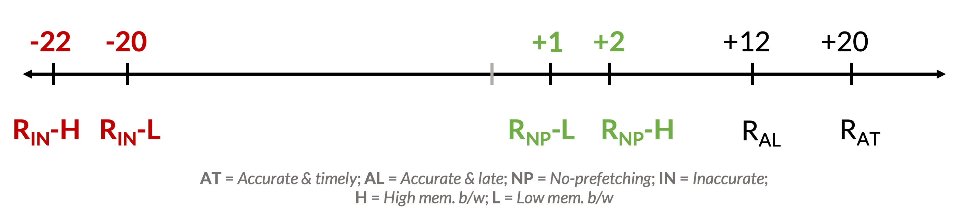
Performance Improvement via Customization
Reward value customization
Strict Pythia configuration
  Increase the rewards for no prefetching
  Decrease the rewards for inaccurate prefetching
Strict Pythia is more conservative in generating prefetch requests than the basic Pythia
Evaluate on all Ligra graph processing workloads
Notes:
Next, we analyze performance improvement of Pythia via customization.
[CLICK] We show an example of reward value customization, where,
[CLICK] We devise a strict Pythia configuration by increasing the reward level values for no prefetching, while decreasing the rewards values for inaccurate prefetching.
In short, strict Pythia is more conservative than the basic Pythia and strongly prefers not to prefetch, rather than prefetching inaccurately.
We evaluate both basic Pythia and strict Pythia on Ligra workload suite.

Slide 87
Performance Improvement via Customization
5.2%
7.8%
2%
2.8%
3.4%
3.1%
Notes:
[CLICK] As you can see, strict Pythia outperforms the basic Pythia configuration as much as 7.8% and
[CLICK] 2% on average over the entire Ligra workload suite.

Slide 88
Performance Improvement via Customization
5.2%
7.8%
Pythia can extract even higher performance via customization without changing hardware
2%
2.8%
3.4%
3.1%
Notes:
[CLICK] As you can see, strict Pythia outperforms the basic Pythia configuration as much as 7.8% and
[CLICK] 2% on average over the entire Ligra workload suite.

Slide 89

Pythia’s Overhead
25.5 KB of total metadata storage per core
  Only simple tables
We also model functionally-accurate Pythia with full complexity in Chisel [4] HDL
1.03% area overhead
0.4% power overhead
Satisfies prediction latency
of a desktop-class 4-core Skylake processor (Xeon D2132IT, 60W)
[4] https://www.chisel-lang.org
Notes:
All of Pythia’s performance benefits comes at a modest cost of 25.5KB of metadata storge, which is invested only in simple storage, without any need to complex structures.
[CLICK] We also model a fully-functionally-accurate Pythia with its full complexity in Chisel and show that, Pythia incurs
[CLICK] a modest area overhead of 1.03%
[CLICK] a power overhead of half-a-percent
[CLICK] while simultaneously satisfying the prediction latency at L2 cache frequency
Of a desktop-class …

Slide 90
More in the Paper
Performance comparison with unseen traces
  Pythia provides equally high performance benefits
Comparison against multi-level prefetchers
  Pythia outperforms prior best multi-level prefetchers
Understanding Pythia’s learning with a case study
  We reason towards the correctness of Pythia’s decision
Performance sensitivity towards different features and hyperparameter values
Detailed single-core and four-core performance
Notes:
We have many more exciting results including, ….
We encourage everyone to read it.

Slide 91
Performance on Previously-Unseen Workloads
Evaluated with 500 traces from value prediction championship
  No prefetcher has been trained on these traces
Pythia outperforms MLOP and Bingo by
8.3% and 3.5% in single-core
And 9.7% and 5.4% in four-core

Slide 92
More in the Paper
Performance comparison with unseen traces
  Pythia provides equally high performance benefits
Comparison against multi-level prefetchers
  Pythia outperforms prior best multi-level prefetchers
Understanding Pythia’s learning with a case study
  We reason towards the correctness of Pythia’s decision
Performance sensitivity towards different features and hyperparameter values
Detailed single-core and four-core performance
https://arxiv.org/pdf/2109.12021.pdf
Notes:
We have many more exciting results including, ….
We encourage everyone to read it.

Slide 93

Pythia is Open Source
https://github.com/CMU-SAFARI/Pythia
MICRO’21 artifact evaluated
Champsim source code + Chisel modeling code
All traces used for evaluation

Slide 94
Talk Outline
Key Shortcomings of Prior Prefetchers
Formulating Prefetching as Reinforcement Learning
Pythia: Overview
Evaluation of Pythia and Key Results
Conclusion

Slide 95
Executive Summary
Background: Prefetchers predict addresses of future memory requests by associating memory access patterns with pieces of program and system information (called feature)
Problem: Three key shortcomings of prior prefetchers:
  Predict mainly using a single program feature
  Lack inherent system awareness (e.g., memory bandwidth usage)
  Lack in-silicon customizability
Goal: Design a prefetching framework that:
  Learns from multiple features and inherent system-level feedback
  Can be customized in silicon to use different features and/or prefetching objectives
Contribution: Pythia, which formulates prefetching as reinforcement learning problem
  Takes adaptive prefetch decisions using multiple features and system-level feedback
  Can be customized in silicon for target workloads via simple configuration registers
  Proposes a realistic and practical implementation of RL algorithm in hardware
Key Results:
  Evaluated using a wide range of workloads from SPEC CPU, PARSEC, Ligra, Cloudsuite
  Outperforms best prefetcher by 3.4%, 7.7% and 17% in 1/4/bw-constrained cores
  Customizing Pythia leads to up to 7.8% more performance over basic Pythia across Ligra workloads
https://github.com/CMU-SAFARI/Pythia
Notes:
First, I am going to start with an executive summary.
[CLICK] Prefetching is a speculative technique that predicts address of future memory requests by associating patterns in memory addresses with some program context. We call this context a feature.
[CLICK] We observe three key shortcomings in prior prefetchers:
First, they mainly use a single program feature for prediction.
Second, they lack inherent system awareness
Third, they also lack any customizability in silicon
[CLICK] Our goal in this work is to design a prefetching framework that
– can learn from multiple program features and inherent system-level feedback
-- and can be customized in silicon to change the features or the objective of the prefetcher
[CLICK] Towards this we propose Pythia, that formulates …
Pythia makes adaptive and autonomous …
Pythia also proposes a realistic and practical …
[CLICK] We extensively evaluate Pythia using …
We show that Pythia outperforms prior state-of-the-art …
Pythia is freely available in our GitHub repository.

Slide 96
Pythia
A Customizable Hardware Prefetching Framework Using Online Reinforcement Learning
Rahul Bera, Konstantinos Kanellopoulos, Anant V. Nori,
Taha Shahroodi, Sreenivas Subramoney, Onur Mutlu
https://github.com/CMU-SAFARI/Pythia
https://arxiv.org/pdf/2109.12021.pdf
Notes:
Hi I am Rahul. Today, I’m going to present our work “…”
This work is done by researchers from SAFARI research group at ETH Zurich, in collaboration with Intel Labs and TU Delft.

Slide 97
Pythia Discussion
FAQs
  Why RL?
  What about large page?
  What’s the prefetch degree?
  Can customization happen during workload execution?
  Can runtime mixing create problem?
Simulation and Methodology
  Basic Pythia configuration
  System parameters
  Configuration of prefetchers
  Evaluated workloads
  Feature selection
Detailed Design
  Reward structure
  Design overview
  QVStore Organization
More Results
  Comparison against other adaptive prefetchers
  Comparison against Context prefetcher
  Feature combination sensitivity
  Hyperparameter sensitivity
  Comparison with multi-level prefetchers
  Performance in unseen workloads
  Single-core s-curve
  Four-core s-curve
  Detailed performance analysis
  Benefit of bandwidth awareness
  Case study
  Customizing rewards
  Customizing features

Slide 98
Self-Optimizing Memory Prefetchers
Rahul Bera, Konstantinos Kanellopoulos, Anant Nori, Taha Shahroodi, Sreenivas Subramoney, and Onur Mutlu,
"Pythia: A Customizable Hardware Prefetching Framework Using Online Reinforcement Learning"
Proceedings of the 54th International Symposium on Microarchitecture (MICRO), Virtual, October 2021.
[Slides (pptx) (pdf)]
[Short Talk Slides (pptx) (pdf)]
[Lightning Talk Slides (pptx) (pdf)]
[Talk Video (20 minutes)]
[Lightning Talk Video (1.5 minutes)]
[Pythia Source Code (Officially Artifact Evaluated with All Badges)]
[arXiv version]
Officially artifact evaluated as available, reusable and reproducible.
https://arxiv.org/pdf/2109.12021.pdf

Slide 99
Hermes: Perceptron-Based
Off-Chip Load Prediction

Slide 100
Learning-Based Off-Chip Load Predictors
Rahul Bera, Konstantinos Kanellopoulos, Shankar Balachandran, David Novo, Ataberk Olgun, Mohammad Sadrosadati, and Onur Mutlu,
"Hermes: Accelerating Long-Latency Load Requests via Perceptron-Based Off-Chip Load Prediction"
Proceedings of the 55th International Symposium on Microarchitecture (MICRO), Chicago, IL, USA, October 2022.
[Slides (pptx) (pdf)]
[Longer Lecture Slides (pptx) (pdf)]
[Talk Video (12 minutes)]
[Lecture Video (25 minutes)]
[arXiv version]
[Source Code (Officially Artifact Evaluated with All Badges)]
Officially artifact evaluated as available, reusable and reproducible.
Best paper award at MICRO 2022.
https://arxiv.org/pdf/2209.00188.pdf

Slide 101
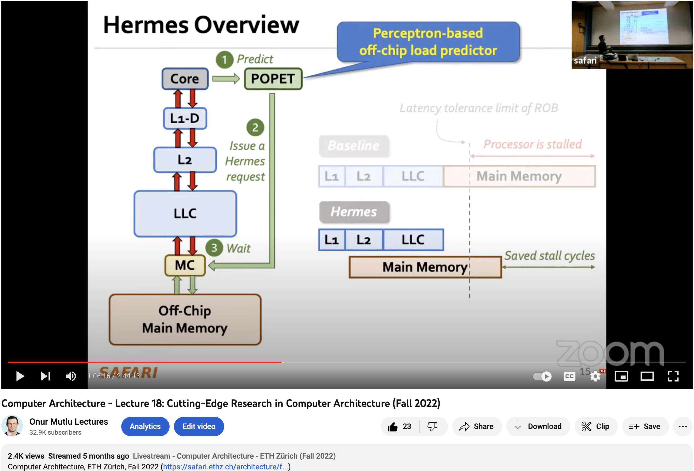
Hermes Talk Video
https://www.youtube.com/watch?v=PWWBtrL60dQ&t=3609s

Slide 102


Accelerating Long-Latency Load Requests
via Perceptron-Based Off-Chip Load Prediction
Rahul Bera, Konstantinos Kanellopoulos, Shankar Balachandran,
David Novo, Ataberk Olgun, Mohammad Sadrosadati, Onur Mutlu
https://github.com/CMU-SAFARI/Hermes
https://arxiv.org/pdf/2209.00188.pdf

Slide 103
The Key Problem
Long-latency off-chip load requests
Often stall processor by
blocking instruction retirement from
Reorder Buffer (ROB)
Limit performance
Notes:
The key problem that we are trying to address in this work is stemming from Off-chip load request
[CLICK] As we know, these off-chip load requests often stall…,
[CLICK] which severely limits the performance of a core.

Slide 104

Traditional Solutions
1
Employ sophisticated prefetchers
2
Increase size of on-chip caches
Notes:
Architects have primarily relied on two key techniques to reduce latency of such loads:
[CLICK] By employing sophisticated data prefetchers
[CLICK] And Increasing size of the on-chip cache hierarchy

Slide 105
Key Observation 1
Many loads still go off-chip
50%
still go off-chip even with
a state-of-the-art prefetcher
50%
successfully prefetched
70% of the off-chip loads
block the ROB
# off-chip loads without any prefetcher
Notes:
In this work, we show that prior prefetchers successfully prefetch a significant fraction of the off-chip load requests.
[CLICK] However, nearly 50% of the off-chip loads in a system without any prefetcher are still going off-chip even in presence of a state-of-the-art prefetcher
[CLICK] And 70% of these off-chip loads even block the ROB.

Slide 106
Key Observation 2
50% still go off-chip
On-chip cache access latency
significantly contributes to off-chip load latency
L1
L2
LLC
Main Memory
L1
L2
LLC
Main Memory
Saved cycles
40% of the stalls can be eliminated by removing
on-chip cache access latency from critical path
Notes:
Now, if we focus on the off-chip loads that are still going to the main memory even in presence of a state-of-the-art prefetcher,
We observe that the on-chip cache access latency…
[CLICK] We show that nearly 40% of …

Slide 107
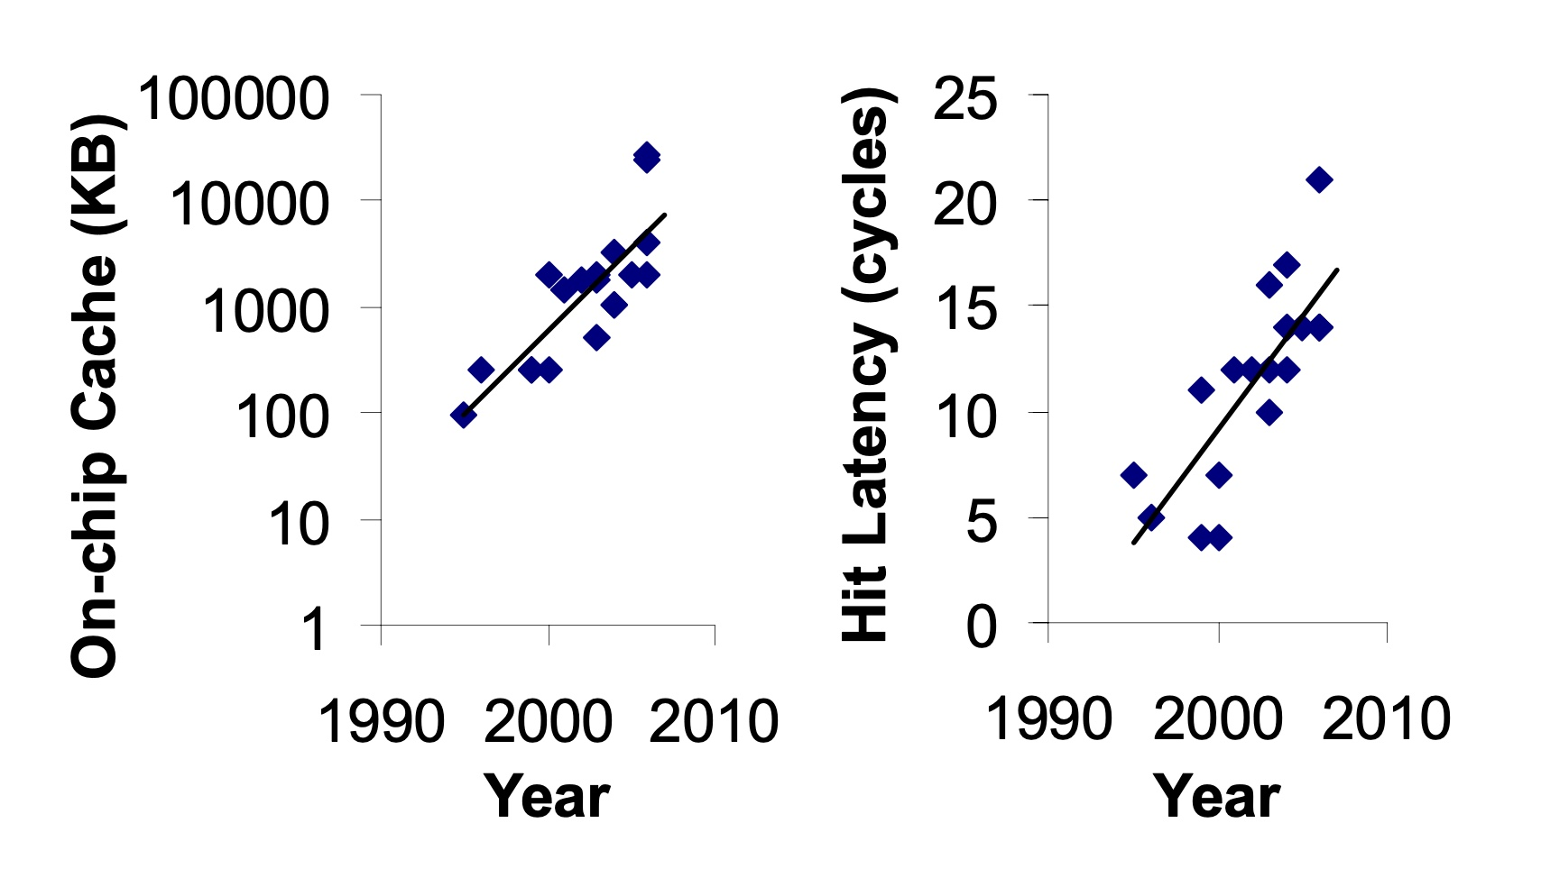
Caches are Getting Bigger and Slower…
On-chip Cache Size (KB)
Hardavellas+, “Database Servers on Chip Multiprocessors: Limitations and Opportunities”, CIDR, 2007
Notes:
As the cache hierarchy continue to grow in size and complexity, as noted by previous works,
As well as a trend that we see in recent processors,
This problem is only going to get exacerbated even more in future generation processors

Slide 108
Our Goal
Improve processor performance
by removing on-chip cache access latency
from the critical path of off-chip loads
Notes:
Thus to alleviate this problem, the goal of our work is to improve…

Slide 109

Predicts which load requests
are likely to go off-chip
Starts fetching data directly from main memory while concurrently accessing the cache hierarchy
Notes:
Towards this we propose Hermes, which is based on two key ideas.
[CLICK] Hermes predicts which…
[CLICK] Hermes starts fetching …

Slide 110




Key Contribution
Hermes employs the first
perceptron-based off-chip load predictor
That predicts which loads are likely to go off-chip
By learning from
multiple program context information
Notes:
To enable accurate off-chip prediction,
Hermes employs the first perceptron-based off-chip load predictor
[CLICK] that identifies loads …
[CLICK] by only learning from multiple…

Slide 111
Hermes Overview
Core
Latency tolerance limit of ROB
L1-D
Baseline
Processor is stalled
L2
L1
L2
LLC
Main Memory
LLC
MC
Off-Chip
Main Memory
Notes:
Now let me give you a brief overview of Hermes.
This is how a traditional cache hierarchy looks like in today’s processor.
[CLICK] And this is how the memory latency timeline looks like for an off-chip load in the baseline system
[CLICK] If the ROB has a latency tolerance limit up till here, the processor stalls for the remaining cycles

Slide 112




Hermes Overview
Perceptron-based
off-chip load predictor
Predict
Core
POPET
Train
Latency tolerance limit of ROB
L1-D
Issue a Hermes request
Baseline
Processor is stalled
L2
L1
L2
LLC
Main Memory
LLC
Hermes
L1
L2
LLC
Wait
Saved stall cycles
MC
Main Memory
Off-Chip
Main Memory
Notes:
Now Hermes employs an off-chip predictor named POPET.
[CLICK] For every load generated in the core, Hermes consults POPET to predict whether this load would go off-chip or not
[CLICK] If the load is predicted to go off-chip, Hermes waits for the address translation to finish, which happens in parallel with L1 cache access
[CLICK] And then issues a speculative memory request, which we call a Hermes request,
directly to the main memory controller to start fetching the data from the main memory,
While also concurrently accessing the cache hierarchy for such a load.
[CLICK] If the off-chip prediction is correct, the load would eventually miss the LLC and arrive at the memory controller
Where it will simply wait for the ongoing Hermes request to finish, thus hiding the entire cache access latency from its critical path.
Once the data returns from the main memory, Hermes returns the data to the core [CLICK],
Thus, saving the precious stall cycles induced by the off-chip load [CLICK], which in turn provides performance benefit.
[CLICK] Hermes trains POPET when the data finally returns to the core, closing the feedback loop.

Slide 113

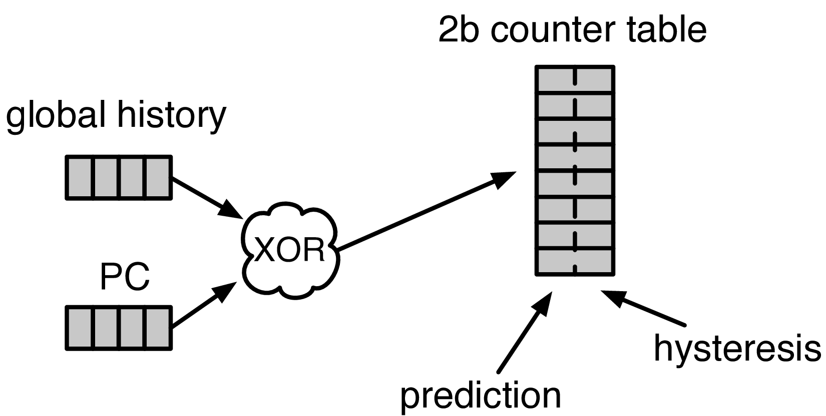


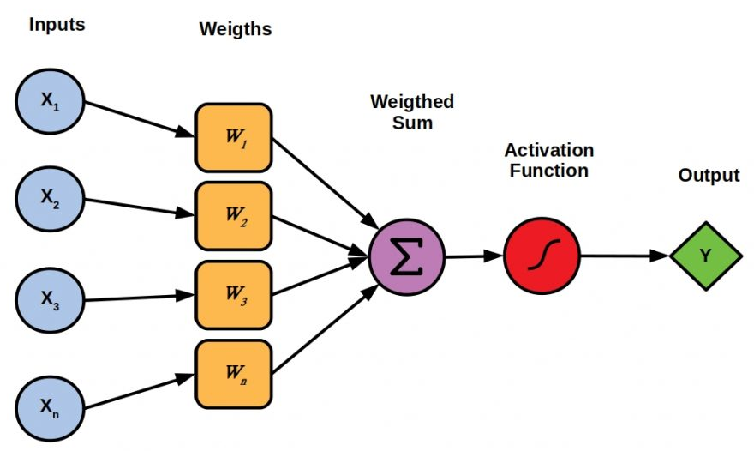

Designing the Off-Chip Load Predictor
History-based prediction
HMP [Yoaz+, ISCA’99] for the L1-D cache
Using branch-predictor-like hybrid predictor:
Global, Gshare, and GSkew
POPET provides
both higher accuracy and higher performance
than predictors inspired from these previous works
Tracking cache contents
MissMap [Loh+, MICRO’11] for the DRAM cache,
D2D [Sembrant+, ISCA’14], D2M [Sembrant+, HPCA’17], LP [Jalili+, HPCA’22] for the cache hierarchy
  Large metadata
  Metadata size increases with cache hierarchy size
  May need to track all cache operations
  Gets complex depending on the cache hierarchy configuration (e.g., inclusivity, bypassing,…)
Learning from program behavior
  Correlate different program features with off-chip loads
Low storage overhead
Low design complexity
Notes:
Now let’s discuss how to design this off-chip predictor.
So, there are multiple prior works that can be used either directly or with small modifications for off-chip load prediction.
These works can be broadly categorized into two classes.
[CLICK] History-based predictor introduced by HMP, uses a branch-predictor like hybrid predictor design
to identify which requests are going to miss L1 cache.
We can easily extend HMP’s design to predict loads that are going to miss the entire cache hierarchy.
[CLICK] Tracking-based methods, on the other hand, explicitly track cache contents
to predict which load requests are going to miss the cache hierarchy.
[CLICK] These tracking-based methods poses two key challenges…
[CLICK] First,…
[CLICK] Second,…
[CLICK] POPET takes a completely different approach to predict off-chip load requests by learning from program behavior.
[CLICK] It aims to correlate multiple different types of program features with off-chip load requests
to provide accurate predictions with much lower storage overhead and design complexity.
[CLICK] In our paper, we compare POPET against predictors inspired from these prior works and show that
[CLICK] POPET provides both higher accuracy and performance than them.

Slide 114
POPET: Perceptron-Based Off-Chip Predictor
Multi-feature hashed perceptron model ^{[1]}
  Each feature has its own weight table
    Stores correlation between feature value and off-chip prediction
[1] D. Tarjan and K. Skadron, “Merging Path and Gshare Indexing in Perceptron Branch Prediction,” TACO, 2005
Notes:
Now let’s deep dive into our off-chip predictor design.
Our predictor, named as POPET, is designed using hashed-perceptron model.
[CLICK] where each feature has its own weight table
That stores the correlation between feature value and the off-chip prediction

Slide 115

Predicting using POPET
Uses simple table lookups, addition, and comparison
42
-4
0x7ffe0+12
3
3 >= -2
Predict that the load would go off-chip
Extract features from the load request
12
-5
Notes:
Hermes predicts using POPET using simple operations like table lookup, addition, and comparison.
Let me give you an example on how POPET’s prediction works.
POPET’s prediction works in three stages.
[CLICK] In the first stage, POPET extracts the features from the load request
[CLICK] In the second stage, each feature value is hashed and used as an index to retrieve the weights from each individual weight tables
[CLICK] In the third stage, the retrieved weights are accumulated and the cumulative weight is used to compute the activation function.
[CLICK] If the cumulative weight is higher than the activation threshold, POPET predicts that the load would go off-chip.

Slide 116
Training POPET
Uses simple increment or decrement of feature weights
42
-1
-4
0x7ffe0+12
3
3 >= -2
Predict that the load would go off-chip
-1
12
Shouldn’t be activated
-5
Cumulative weight < 𝜏_{act}
-1
Notes:
Now let’s understand how to train POPET.
For this let’s assume the previous example where the load is predicted to go off-chip.
[CLICK] But in reality, the load didn’t go off-chip
[CLICK] this means the activation which have triggered before, shouldn’t have triggered
Which means, the cumulative weight should be lower than the activation threshold
[CLICK] Now to adjust the feature weights, POPET again indexes each weight table using the hashed feature values
[CLICK] And simply decrement each weight from the individual weight tables.
Thus, by using simple increment and decrement operations, POPET continuously learns from program behavior to accurately predict off-chip loads.

Slide 117
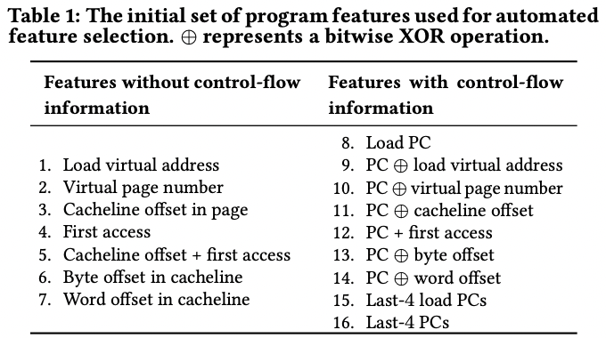
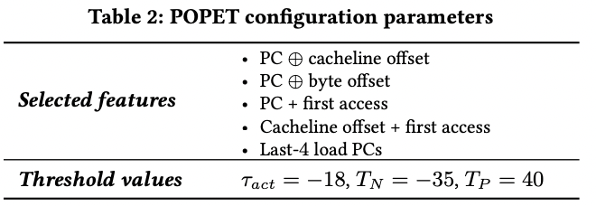
Features Used in Hermes

Slide 118
Evaluation
Notes:
Now let’s evaluate Hermes.

Slide 119
Simulation Methodology
ChampSim trace driven simulator
110 single-core memory-intensive traces
  SPEC CPU 2006 and 2017
  PARSEC 2.1
  Ligra
  Real-world applications
220 eight-core memory-intensive trace mixes
LLC Prefetchers
Off-Chip Predictors
Pythia [Bera+, MICRO’21]
Bingo [Bakshalipour+, HPCA’19]
MLOP [Shakerinava+, 3rd Prefetching Championship’19]
SPP + Perceptron filter [Bhatia+, ISCA’20]
SMS [Somogyi+, ISCA’06]
History-based: HMP [Yoaz+, ISCA’99]
Tracking-based: Address Tag-Tracking based Predictor (TTP)
Ideal Off-chip Predictor
Notes:
We evaluate Hermes using ChampSim simulator,
[CLICK] using a wide range of memory-intensive traces spanning across SPEC CPU, PARSEC, Ligra, and real-world applications
[CLICK] We compare Hermes with five LLC prefetchers
[CLICK] and two off-chip predictors extended from prior works

Slide 120

Latency Configuration
Cache round-trip latency
  L1-D: 5 cycles
  L2: 15 cycles
  LLC: 55 cycles
Hermes request issue latency (incurred after address translation)
Depends on
  Interconnect between POPET and MC
0 cycles
24 cycles
6 cycles
Notes:
For our evaluation, we consider
[CLICK] a 5 cycle L1-D
[CLICK] 15 cycle L2
[CLICK] and 55 cycle LLC round-trip latency.
[CLICK] The latency for Hermes to issue a request directly to the main memory controller (after the address translation) depends on …
[CLICK] For this reason we sweep this latency from 0-cycles to 24-cycles in our paper.
[CLICK] But in this presentation, I am going to show you results considering a 6-cycle latency.

Slide 121
Single-Core Performance Improvement
5.4%
20.3%
11.5%
Hermes alone provides nearly
50% performance benefits of Pythia
with only 1/5th storage overhead
Hermes provides nearly 90% performance benefit of Ideal Hermes that has an ideal off-chip load predictor
Hermes on top of Pythia
outperforms Pythia alone in every workload category
Notes:
Let’s first analyze the single-core performance improvement.
[CLICK] This is how Hermes and a state-of-the-art prefetcher Pythia improves performance on top of a no-prefetching system.
[CLICK] The first takeaway is that Hermes alone provides nearly 50%...
[CLICK] Now if we combine Hermes with Pythia, that provides an additional 5.4% performance improvement on top of a strong baseline that has Pythia.
[CLICK] And finally, if we compare Hermes’s performance benefit with the Ideal Hermes that has an ideal off-chip predictor,
We see that Hermes provides nearly 90% performance benefit of the Ideal Hermes

Slide 122
Increase in Main Memory Requests
20.3%
5.4%
11.5%
For every 1% performance benefit,
increase in main memory requests
Pythia
2%
5.9%
Hermes on top of Pythia
1%
38.5%
Hermes alone
0.5%
5.5%
Hermes is more bandwidth-efficient
than even an efficient prefetcher like Pythia
Notes:
This performance improvement comes at a cost of increase in main memory requests.
This graph shows the increase in the main memory request over the no-prefetching system provided by the three configurations.
[CLICK] As we can see, Hermes increases the main memory requests by 5.5% on average on top of the no-prefetching system..
Whereas Pythia increases …
If we combine two together, then it increases the main memory request by an additional 5.9%.
[CLICK] Now, if we compare this increase in the main memory request with the performance improvement each of these configurations are providing,
We see that
[CLICK] For every 1% performance benefit, Pythia …
[CLICK] This basically shows that Hermes is much more bandwidth efficient than a traditional data prefetcher like Pythia.
And for this reason [NEXT]

Slide 123
Performance with Varying Memory Bandwidth
Pythia+Hermes
Pythia
Hermes
Baseline
~Intel Xeon 6258R
(Cascade Lake, 28C/6ch, 2020)
~AMD EPYC Rome 7702P (Zen 2, 64C/8ch, 2019)
~AMD Threadripper 3990x (Zen 2, 64C/4ch, 2020)
In bandwidth-constrained configurations,
Hermes alone outperforms Pythia
Hermes+Pythia outperforms Pythia
across all bandwidth configurations
Notes:
If we evaluate Pythia and Hermes over a wide range of memory bandwidth configurations, we see that,
[CLICK] In these extremely-bandwidth constrained configurations, which are in fact roughly modeling per-core main memory bandwidth of commercial processors,
Hermes even outperforms Pythia.
[CLICK] And if we combine both of them, the combination of Hermes and Pythia outperforms Pythia in every bandwidth configurations.

Slide 124
Performance with Varying Baseline Prefetcher
5.4%
6.2%
7.6%
5.1%
Hermes consistently improves performance
on top of a wide range of baseline prefetchers
7.7%
Notes:
And these observations are not only true for Pythia.
We evaluate Hermes combined with multiple prior baseline state-of-the-art prefetchers and find that
Hermes consistently improves performance on top of a wide range of baseline prefetchers.

Slide 125
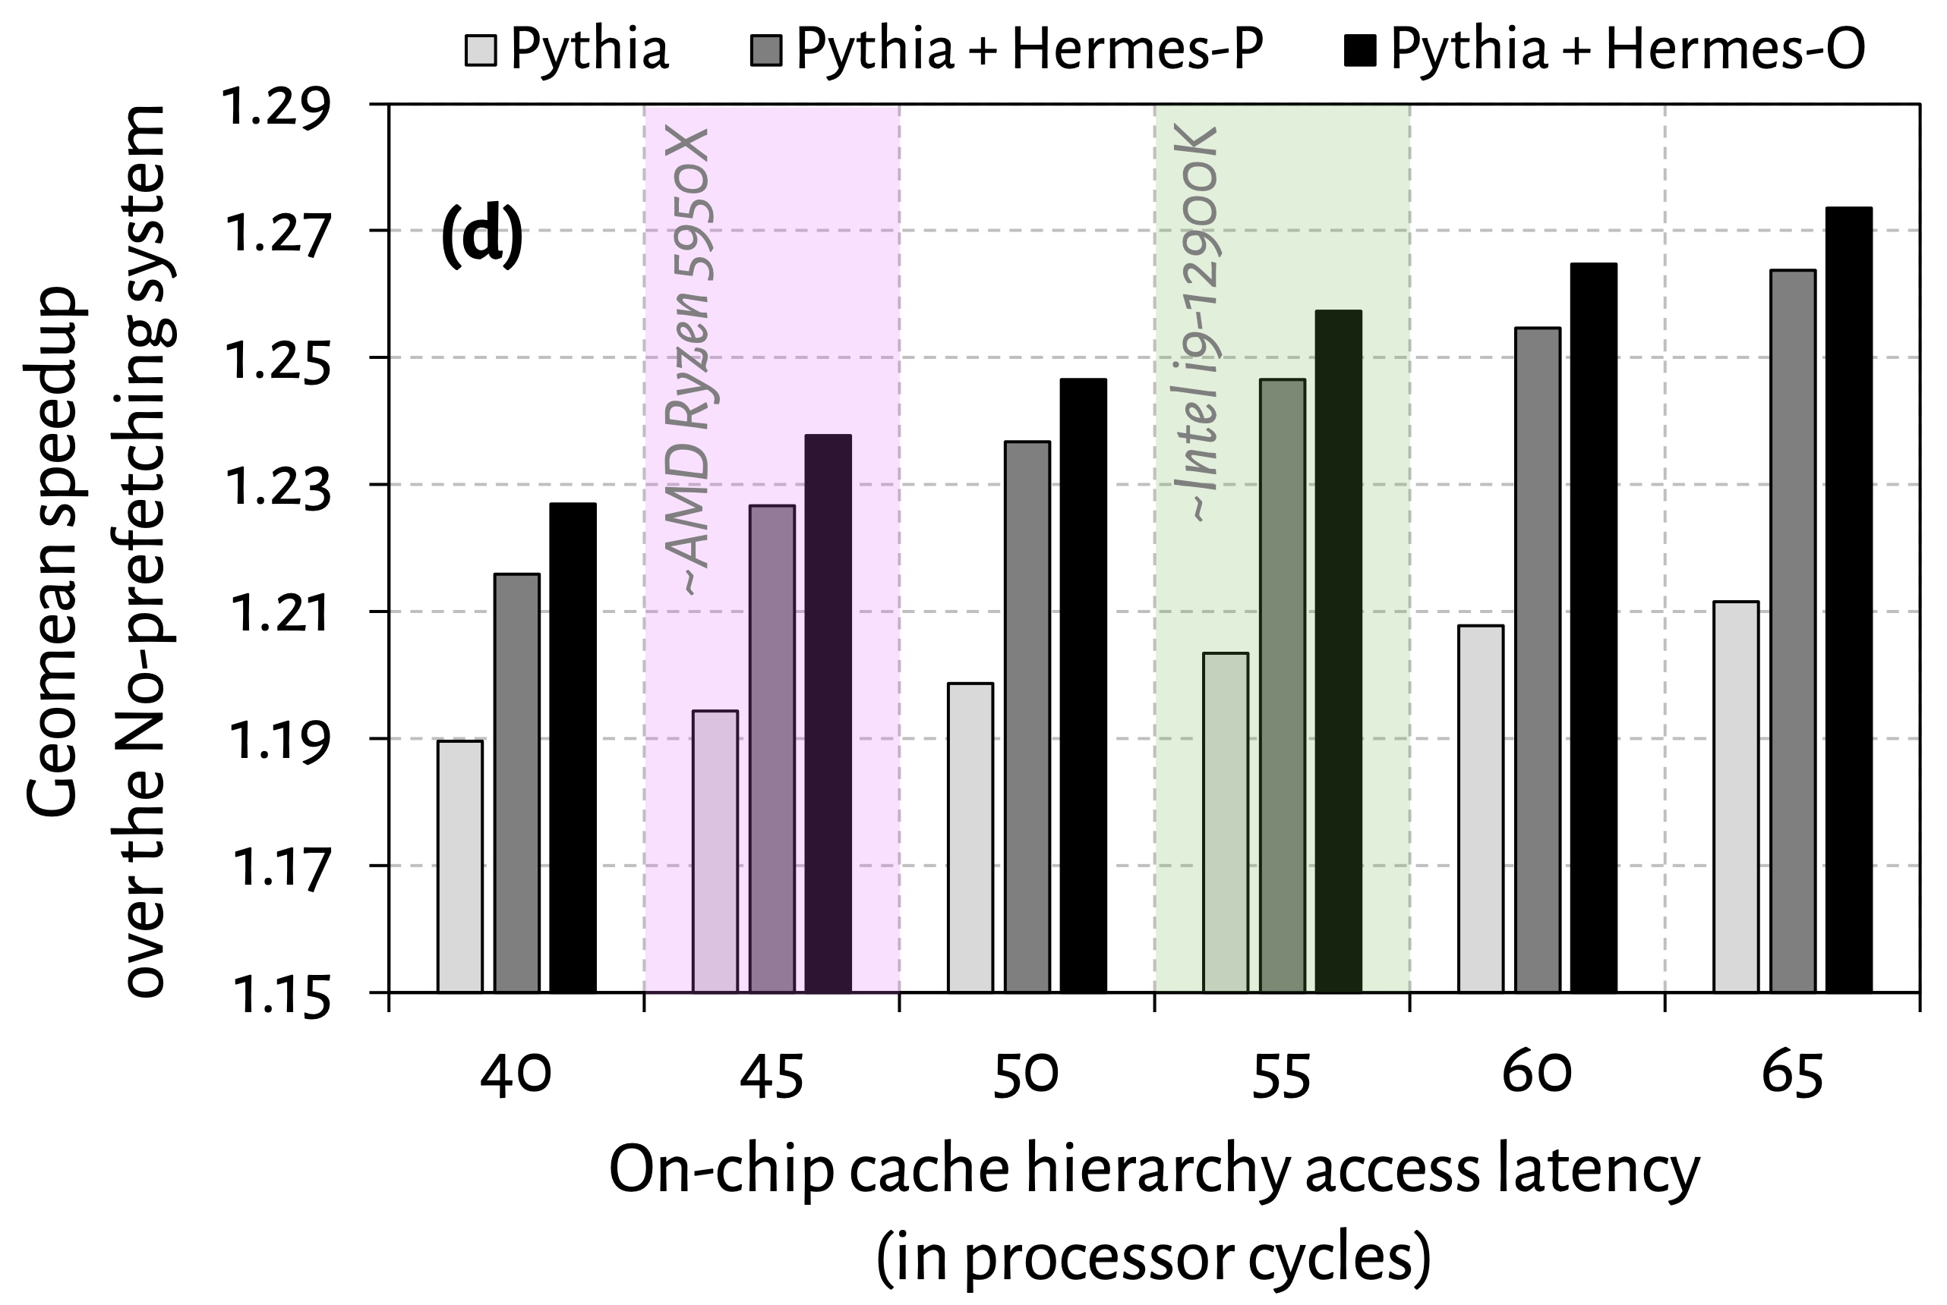
Effect of Cache Hierarchy Access Latency
6.2%
3.6%
Hermes can provide even higher performance benefit in
future processors with bigger and slower on-chip caches

Slide 126
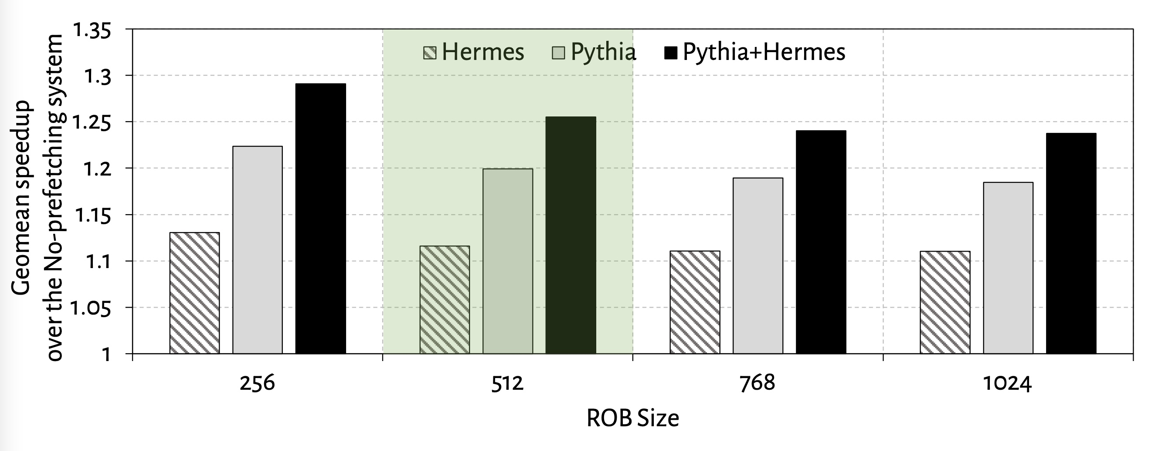
Effect of ROB Size
6.7%
5.3%

Slide 127
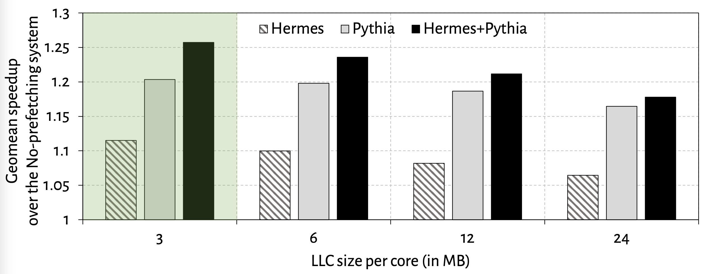
Effect of LLC Size
2.5%
1.3%

Slide 128
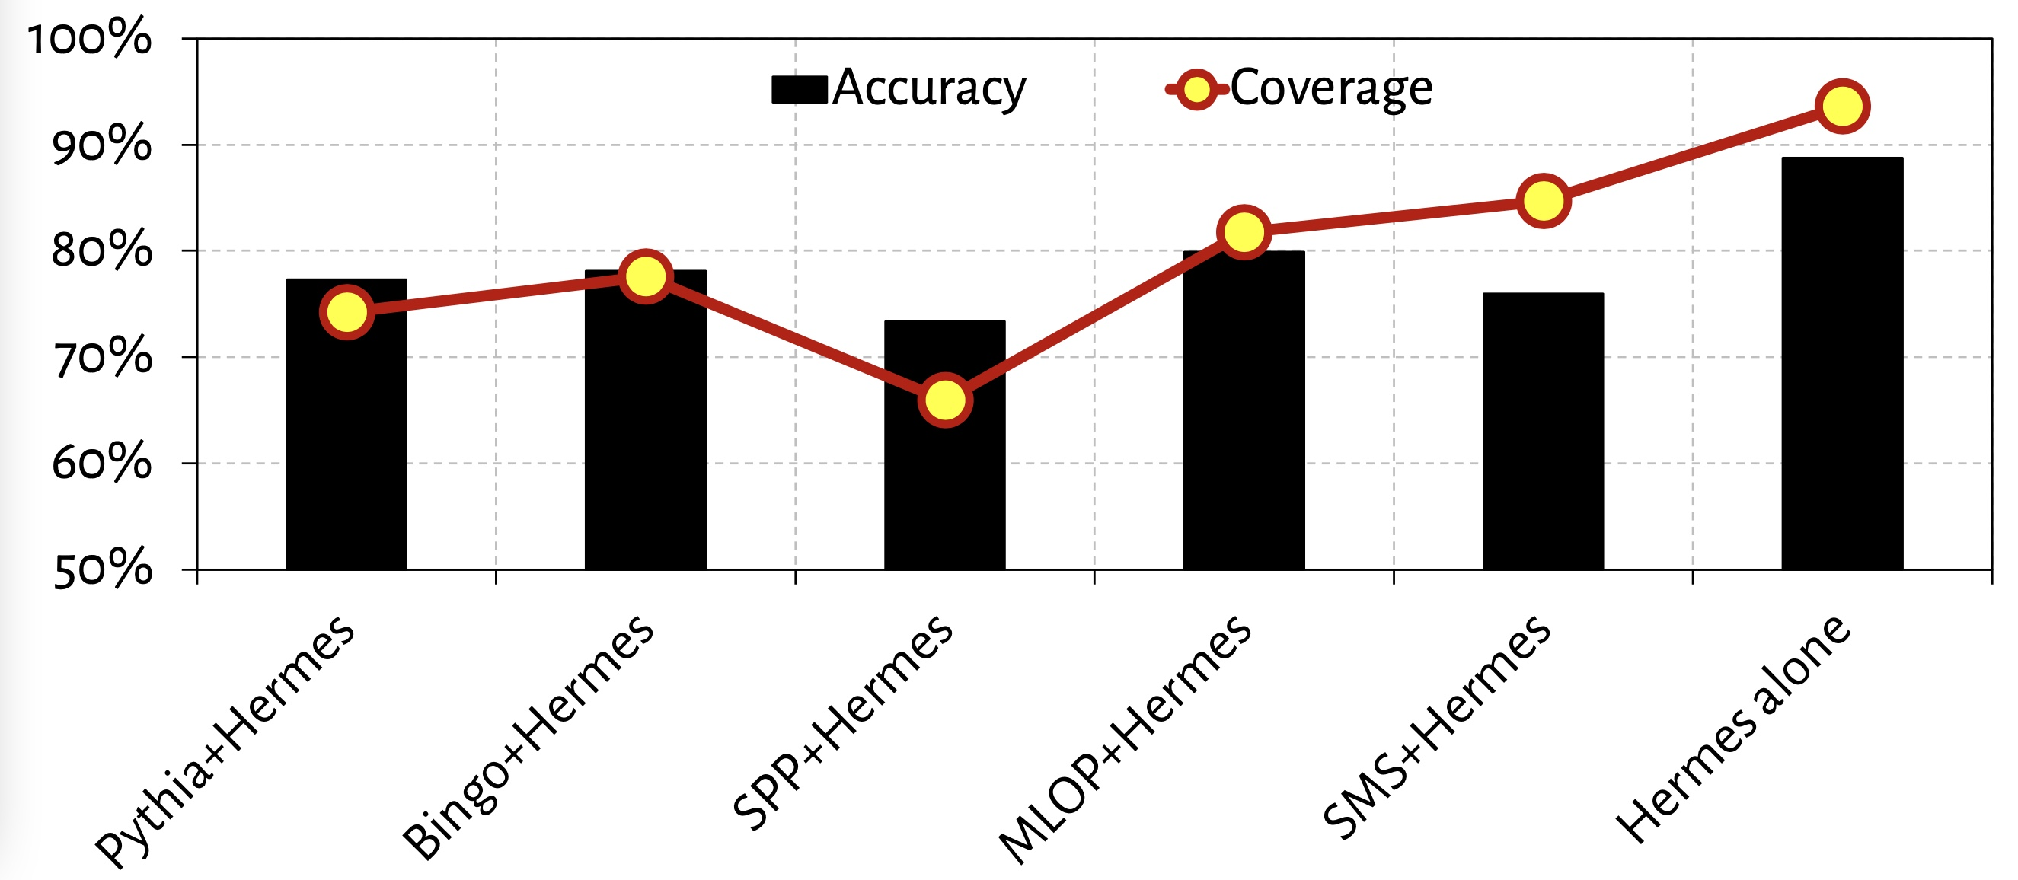
Accuracy and Coverage with Different Prefetchers
POPET’s accuracy and coverage increases significantly
in absence of a data prefetcher

Slide 129
Overhead of Hermes
4 KB storage overhead
1.5% power overhead*
*On top of an Intel Alder Lake-like performance-core ^{[2]} configuration
[2] https://www.anandtech.com/show/16881/a-deep-dive-into-intels-alder-lake-microarchitectures/3
Notes:
All of these performance benefit comes at a
[CLICK] modest 4KB storage overhead per core and
[CLICK] 1.5% power overhead on top an Intel Alder Lake-like performance-core configuration

Slide 130
More in the Paper
Performance sensitivity to:
  Cache hierarchy access latency
  Hermes request issue latency
  Activation threshold
  ROB size (in extended version on arXiv)
  LLC size (in extended version on arXiv)
Accuracy, coverage, and performance analysis against HMP and TTP
Understanding usefulness of each program feature
Effect on stall cycle reduction
Performance analysis on an eight-core system
Notes:
We have many more evaluation results:
For example, a wide range of performance sensitivity study by varying…in the paper.

Slide 131
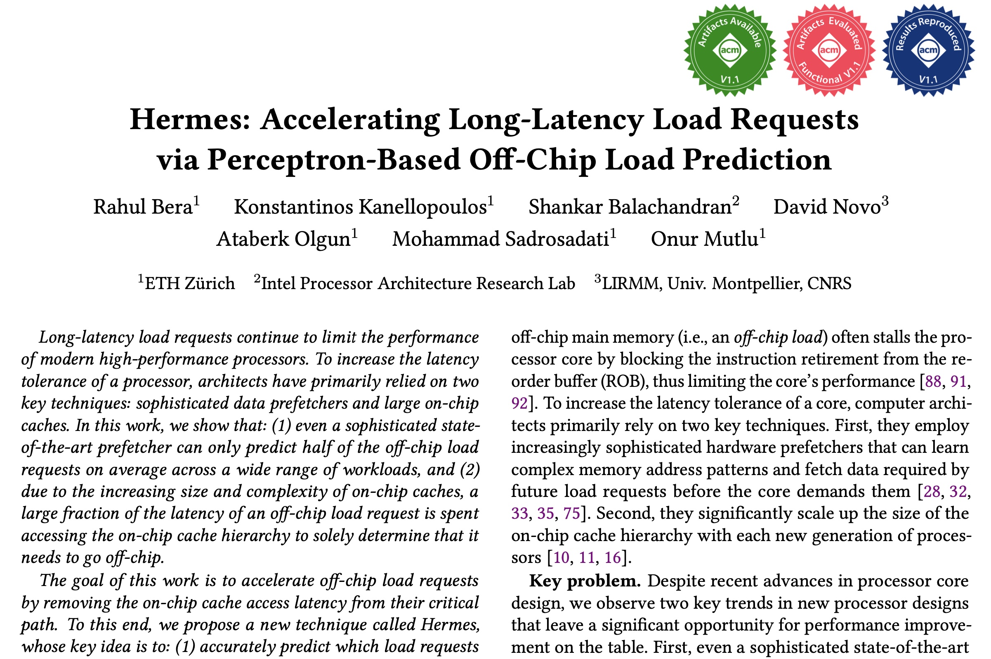
More in the Paper
Performance sensitivity to:
  Cache hierarchy access latency
  Hermes request issue latency
  Activation threshold
  ROB size (in extended version at arXiv)
  LLC size (in extended version at arXiv)
Accuracy, coverage, and performance analysis against HMP and TTP
Understanding usefulness of each program feature
Effect on stall cycle reduction
Performance analysis in eight-core system
https://arxiv.org/pdf/2209.00188.pdf
Notes:
We have many more evaluation results:
For example, a wide range of performance sensitivity study by varying…in the paper.

Slide 132
To Summarize…
Notes:
Thus to summarize…

Slide 133
Summary
Hermes enables off-chip load prediction,
a different form of speculation than
load address prediction employed by prefetchers
Off-chip load prediction can be applied by itself
or combined with load address prediction
to provide performance improvement
Notes:
Hermes advocates …
[CLICK] We show that off-chip load prediction…

Slide 134





Summary
Hermes employs the first
perceptron-based off-chip load predictor
High accuracy
(77%)
High coverage
(74%)
Low storage overhead
(4KB/core)
High performance improvement over best prior baseline
(5.4%)
High performance
per bandwidth

Slide 135
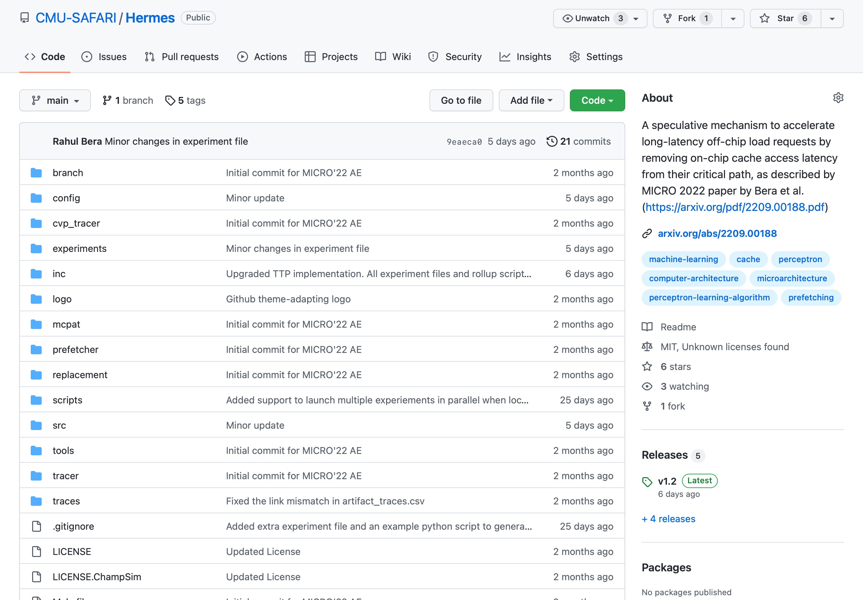
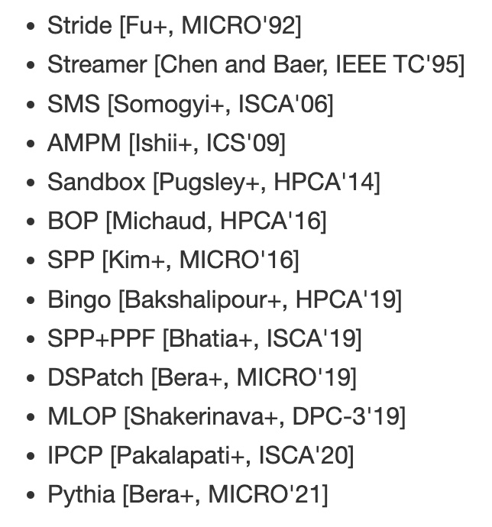
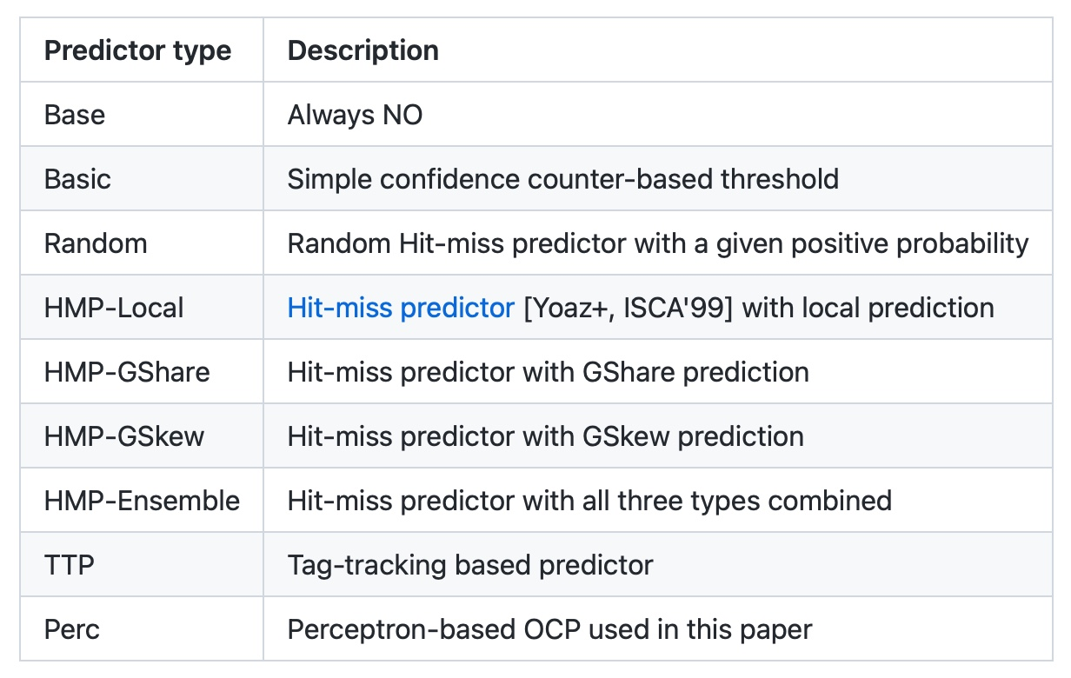
Hermes is Open Sourced
All workload traces
13 prefetchers
9 off-chip predictors
https://github.com/CMU-SAFARI/Hermes
Notes:
That’s why we open-source our artifact.
It can be freely downloaded from our GitHub repository.
In this artifact, [CLICK] you will get all the workload traces we have used to evaluate Hermes,
[CLICK] 13 types of data prefetchers proposed in the past and
[CLICK] 9 types of off-chip predictors out of the box

Slide 136
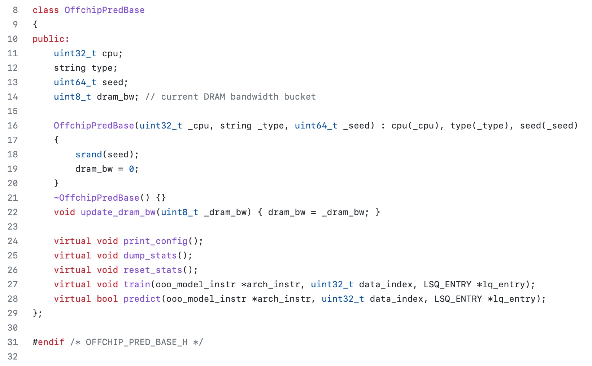
Easy To Define Your Own Off-Chip Predictor
Just extend the OffchipPredBase class
Notes:
But if you want to impalement your own off-chip predictor, that’s also very easy.
All you have to do is to extend the OffchipPred base class…

Slide 137
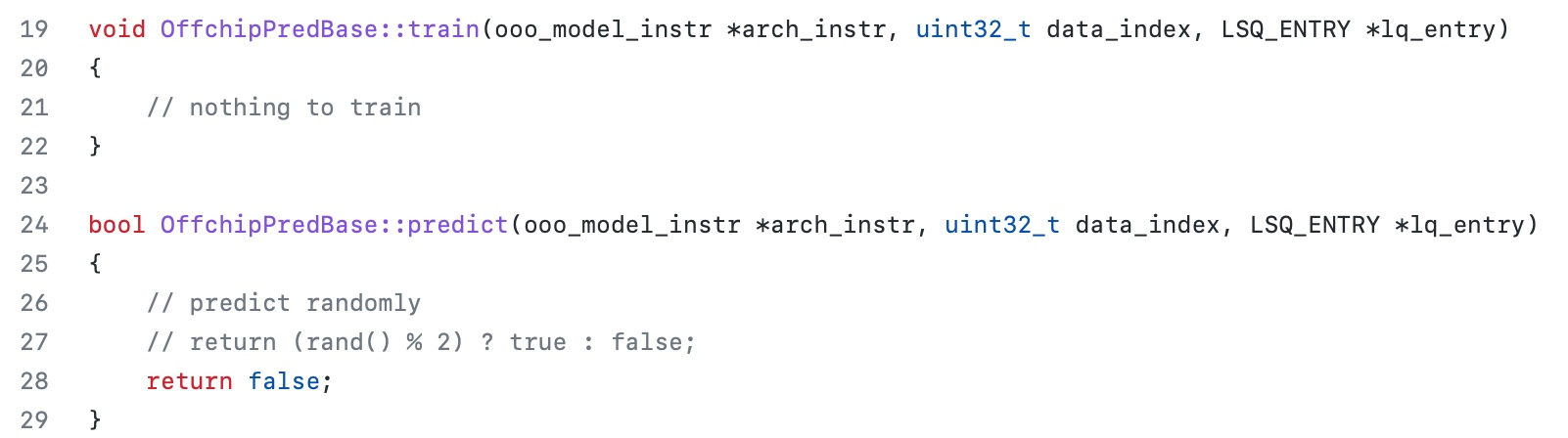
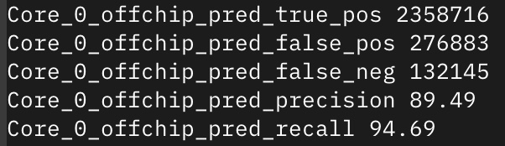
Easy To Define Your Own Off-Chip Predictor
Define your own train() and predict() functions
Get statistics like accuracy (stat name precision) and coverage (stat name recall) out of the box
Notes:
And define your own train() and predict() functions
[CLICK] the infrastructure will automatically provide statistics like precision and recall out of the box

Slide 138
Off-Chip Prediction Can Further Enable…
Prioritizing loads that are likely go off-chip
in cache queues and on-chip network routing
Better instruction scheduling
of data-dependent instructions
Other ideas to improve performance and fairness in multi-core system design...
Notes:
We hope that high-accuracy off-chip prediction can further enable a multitude of optimization possibilities, for example:
[CLICK] prioritizing loads … to improve performance and fairness in extreme core processors
[CLICK] better instruction scheduling for data dependent loads
[CLICK] and many more…

Slide 139
Accelerating Long-Latency Load Requests
via Perceptron-Based Off-Chip Load Prediction
Rahul Bera, Konstantinos Kanellopoulos, Shankar Balachandran,
David Novo, Ataberk Olgun, Mohammad Sadrosadati, Onur Mutlu
https://github.com/CMU-SAFARI/Hermes
https://arxiv.org/pdf/2209.00188.pdf
Notes:
With that hope, I will conclude my talk.
I will be very happy to take any question from the audience.

Slide 140
Hermes Discussion
FAQs
  What are the selected set of program features?
  Can you provide some intuition on why these features work?
  What happens in case of a misprediction?
  What’s the performance headroom for off-chip prediction?
  Do you see a variance of different features in final prediction accuracy?
Simulation Methodology
  System parameters
  Evaluated workloads
More Results
  Percentage of off-chip requests
  Reduction in stall cycles by reducing the critical path
  Fraction of off-chip load requests
  Accuracy and coverage of POPET
  Effect of different features
  Are all features required?
  1C performance
  1C performance line graph
  1C performance against prior predictors
  Effect on stall cycles
  8C performance
  Sensitivity:
    Hermes request issue latency
    Cache hierarchy access latency
    Activation threshold
    ROB size
    LLC size
  Power overhead
  Accuracy without prefetcher
  Main memory request overhead with different prefetchers

Slide 141
Hermes Paper [MICRO 2022]
Rahul Bera, Konstantinos Kanellopoulos, Shankar Balachandran, David Novo, Ataberk Olgun, Mohammad Sadrosadati, and Onur Mutlu,
"Hermes: Accelerating Long-Latency Load Requests via Perceptron-Based Off-Chip Load Prediction"
Proceedings of the 55th International Symposium on Microarchitecture (MICRO), Chicago, IL, USA, October 2022.
[Slides (pptx) (pdf)]
[Longer Lecture Slides (pptx) (pdf)]
[Talk Video (12 minutes)]
[Lecture Video (25 minutes)]
[arXiv version]
[Source Code (Officially Artifact Evaluated with All Badges)]
Officially artifact evaluated as available, reusable and reproducible.
Best paper award at MICRO 2022.
https://arxiv.org/pdf/2209.00188.pdf

Slide 142
Sibyl: Reinforcement Learning based
Data Placement in Hybrid SSDs

Slide 143
Self-Optimizing Hybrid SSD Controllers
Gagandeep Singh, Rakesh Nadig, Jisung Park, Rahul Bera, Nastaran Hajinazar, David Novo, Juan Gomez-Luna, Sander Stuijk, Henk Corporaal, and Onur Mutlu,
"Sibyl: Adaptive and Extensible Data Placement in Hybrid Storage Systems Using Online Reinforcement Learning"
Proceedings of the 49th International Symposium on Computer Architecture (ISCA), New York, June 2022.
[Slides (pptx) (pdf)]
[arXiv version]
[Sibyl Source Code]
[Talk Video (16 minutes)]
https://arxiv.org/pdf/2205.07394.pdf

Slide 144

Sibyl
Adaptive and Extensible Data Placement in Hybrid Storage Systems
Using Online Reinforcement Learning
Gagandeep Singh, Rakesh Nadig, Jisung Park,
Rahul Bera, Nastaran Hajinazar, David Novo,
Juan Gómez Luna, Sander Stuijk, Henk Corporaal,
Onur Mutlu
144
Notes:
Hi First of all. Thank you very much for staying until this long.
I’m going to present our work “…”

Slide 145
Executive Summary
Background: A hybrid storage system (HSS) uses multiple different storage devices to provide high and scalable storage capacity at high performance
Problem: Two key shortcomings of prior data placement policies:
  Lack of adaptivity to:
    Workload changes
    Changes in device types and configurations
  Lack of extensibility to more devices
Goal: Design a data placement technique that provides:
  Adaptivity, by continuously learning and adapting to the application and underlying device characteristics
  Easy extensibility to incorporate a wide range of hybrid storage configurations
Contribution: Sibyl, the first reinforcement learning-based data placement technique in hybrid storage systems that:
  Provides adaptivity to changing workload demands and underlying device characteristics
  Can easily extend to any number of storage devices
  Provides ease of design and implementation that requires only a small computation overhead
Key Results: Evaluate on real systems using a wide range of workloads
  Sibyl improves performance by 21.6% compared to the best previous data placement technique in dual-HSS configuration
  In a tri-HSS configuration, Sibyl outperforms the state-of-the-art-policy policy by 48.2%
  Sibyl achieves 80% of the performance of an oracle policy with storage overhead of only 124.4 KiB
https://github.com/CMU-SAFARI/Sibyl
Notes:
First, I am going to start with an executive summary.
[CLICK] Hybrid storage systems use multiple different storage devices to provide high and scalable storage capacity at high performance
[CLICK] We observe two key shortcomings in prior data placement techniques:
First, lack of adaptivity to workload changes and changes in device types and configurations
Second, they also lack extensibility to to more devices.
[CLICK] Our goal in this work is to design a data placement technique that provides
Adaptivity, by continuously learning and adapting to the application and underlying device characteristics
Easy extensibility to incorporate a wide range of hybrid storage configurations
[CLICK] to this end we propose Sibyl, an online reinforcement learning-based data placement in Hybrid storage systems that:
Provides both adaptivity
and easy extensiblity
and also Provides ease of design and implementation that requires only a small computation overhead
[CLICK] We extensively evaluate Sibyl on real systems using a wide range of workloads
We show that Sibyl outperforms prior state-of-the-art data placement policeis by 21.6% in dual-hybrid storage system and upto 48.2% on trihybrid system
Sibyl achieves 80% of the performance of an oracle policy that has a complete knowledge of future access patterns while incurring a very modest storage overhead of only 124.4 KiB
The code will be opensourced on our GitHub repository.
https://github.com/CMU-SAFARI/Sibyl

Slide 146
Talk Outline
Key Shortcomings of Prior Data Placement Techniques
Formulating Data Placement as Reinforcement Learning
Sibyl: Overview
Evaluation of Sibyl and Key Results
Conclusion
Notes:
This is the outline of my talk.
First, I am going to start by discussing key shortcomings of prior data placement techniques.

Slide 147
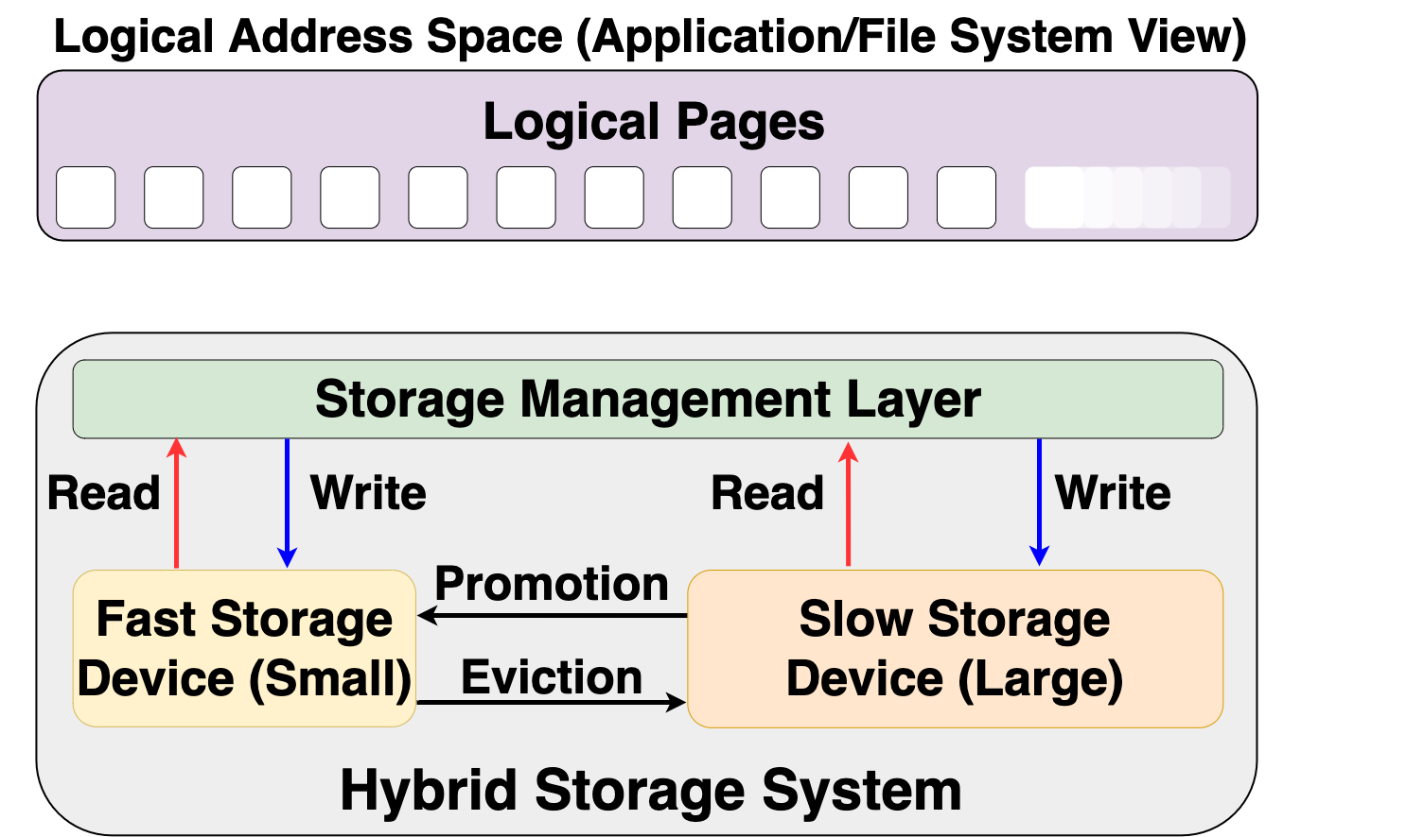


Hybrid Storage System Basics
Address Space (Application/File System View)
Read
Write
Storage Management Layer
Read
Write
Read
Write
Promotion
Eviction
Fast Device
Slow Device
Hybrid Storage System
Notes:
Let's look at some basics on hybrid storage systems. [CLICK] OVER here we show a typical HSS consisting of a fast-yet-small storage device and a slow-yet-large storage device
[CLICK]The address space is divided into a number of logical pages (e.g. 4kib), which are assigned to an application.
[CLICK] The storage management layer in the OS orchestrates host I/O requests across heterogeneous devices,
[CLICK] the storage management layer also manages data migration between the storage devices in an Hybrid storage systems . Eviction usually moves infrequently access data fom the fast storage to the slow storage or when the fast storage device is full.
When data currently stored in the slow storage device is moved to the fast storage device, it is called promotion. Promotion is usually performed when a page in the slow storage device is accessed frequently.
[CLICK] A desirable policy has to effectively utilize the low latency characteristics of the fast device while making optimal use of its small capacity and should provide easy extensibility to a wide range of workloads and Hybrid storage systems configurations

Slide 148
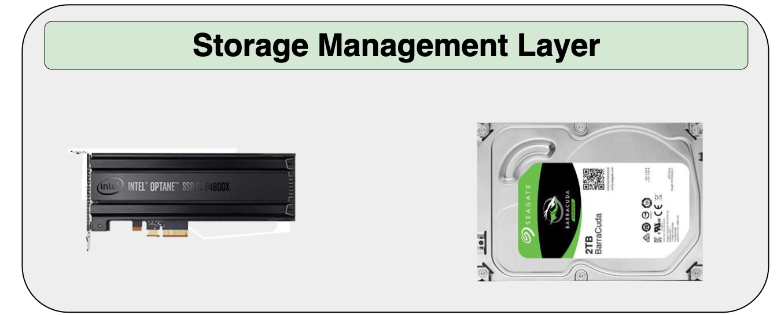
Hybrid Storage System Basics
Read
Write
Performance of a hybrid storage system
highly depends on the ability of the
storage management layer
Read
Write
Read
Write
Promotion
Eviction
Hybrid Storage System
Notes:
[CLICK] Therefore the performance of a hybrid storage system highly depends on the ability of the storage management layer to effectively manage diverse deviaces and workloads

Slide 149
Key Shortcomings in Prior Techniques
We observe two key shortcomings that significantly limit the performance benefits of prior techniques
Lack of adaptivity to:
  Workload changes
  Changes in device types and configuration
Lack of extensibility to more devices
Notes:
We observe two key shortcomings in prior data placement techniques that significantly limits their performance improvement
[CLICK] First, lack of adaptivity to both workload changes and
CLICK] changes in device types and configurations
[CLICK] Second, Lack of extensibility: to more devices
Let’s take a closer look at each of these shortcomings.
[NEXT]

Slide 150
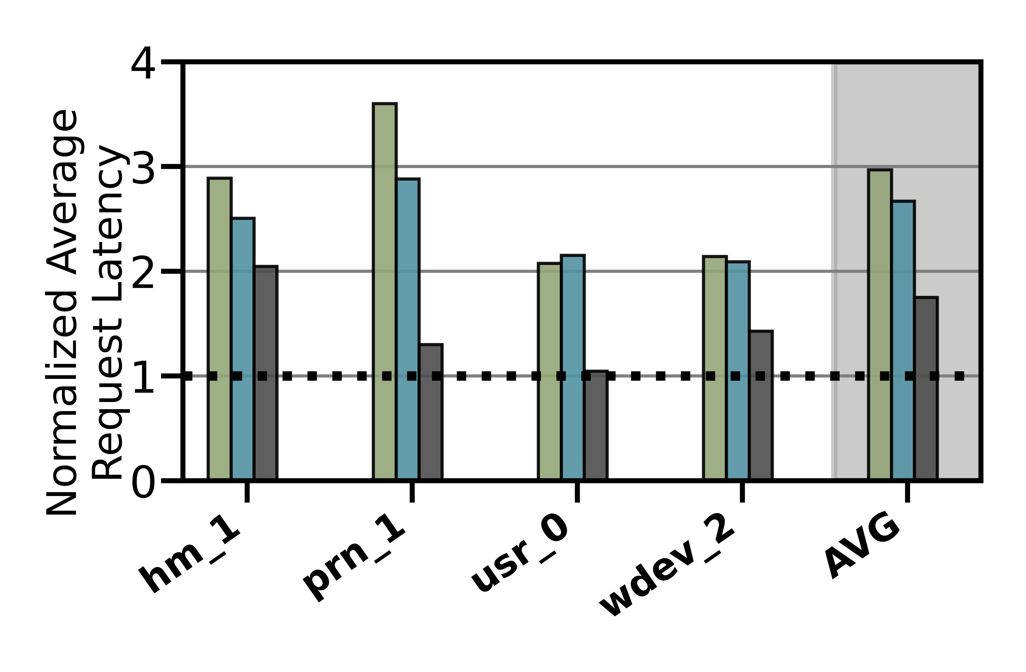
Lack of Adaptivity (1/2)
Workload Changes
Prior data placement techniques consider only a few workload characteristics that are statically tuned
CDE
RNN-HSS
Oracle
41.1%
Notes:
The lower the request latency the better
We observe that all baselines provide reasonable performance under specific workloads [CLICK] while for other they show way lower performance than oracle. [CLICK]
[CLICK] on avg we observe a performance loss for some policies by 41.1% compared to oracle
We conclude, considering only a limited number of workload characteristics leads to
a significant performance gap

Slide 151
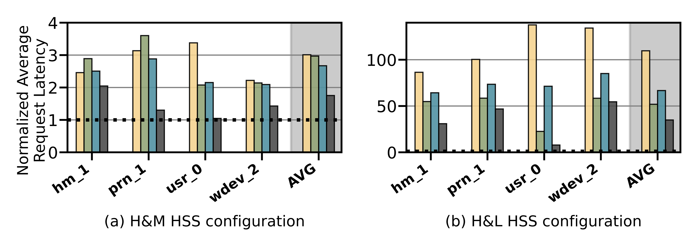
Lack of Adaptivity (2/2)
Changes in Device Types and Configurations
Do not consider underlying storage device characteristics (e.g., changes in the level asymmetry in read/write latencies, garbage collection)
Slow-Only
CDE
RNN-HSS
Oracle
Slow-Only
CDE
RNN-HSS
Oracle
HSS Configuration 1
HSS Configuration 2
Notes:
We obseve that performance of some workloads is even worse than slow-only policy that places everything in the slow storage [CLICK] while in another hybrid storage configuration these workloads perform better than slow only[CLICK] [CLICK]
Therefore, we conclude that the high diversity in device characteristics makes it very difficult for a system architect to design a generic data-placement technique that is suitable for all Hybrid storage systems configurations

Slide 152

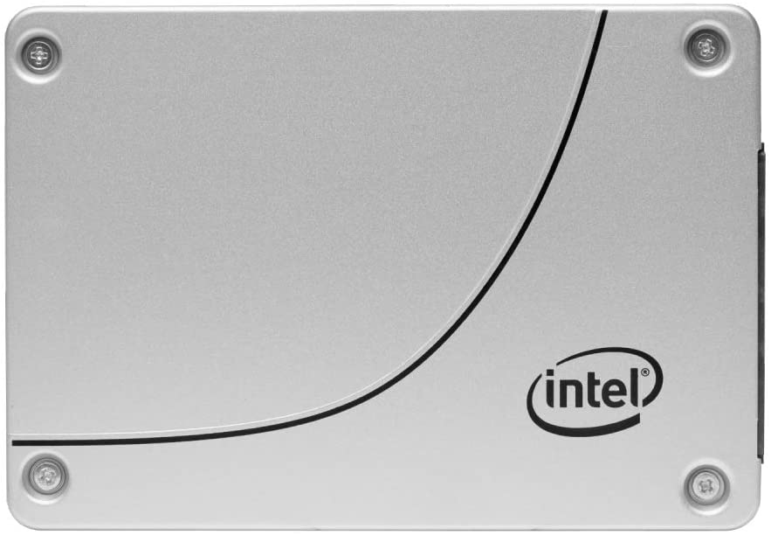
Lack of Extensibility (1/2)
Rigid techniques that require significant effort to accommodate more than two devices
Change in storage configuration
Dual-HSS
Notes:
The second key shortcoming is that, most of the prior techniques are
[CLICK] rigid that require significant effort to accommodate more than two devices
if we extend from dual hybrid stroage configuration from dual hyrbid to a tri-hybrid configuration

Slide 153

Lack of Extensibility (2/2)
Rigid techniques that require significant effort to accommodate more than two devices
Change in storage configuration
Design a new policy
Tri-HSS
Notes:
[click] design a new data policy to exploit the new device to eviction and promotino from the new storage and update heuristic values as wel. [CLICK]
Therefore system architects need to put significant effort into extending prior data placement techniques to accommodate more than two devices [CLICK] This wastes precious design time and human resource.

Slide 154
Our Goal
A data-placement mechanism
that can provide:
Adaptivity, by continuously learning and adapting to the application and underlying device characteristics
Easy extensibility to incorporate a wide range of hybrid storage configurations
Notes:
So our goal in this work is to design a data-placement mechanism that can provide
[CLICK]
Adaptivity, by continuously learning and adapting to the application and underlying device characteristics
[CLICK]
Easy extensibility to incorporate a wide range of hybrid storage configurations.

Slide 155

Our Proposal
Sibyl
Formulates data placement in hybrid storage systems as a reinforcement learning problem
Sibyl is an oracle that makes accurate prophecies
https://en.wikipedia.org/wiki/Sibyl
Notes:
To this end, we propose Sibyl
Which formulates data placement in hybrid…

Slide 156
Talk Outline
Key Shortcomings of Prior Data Placement Techniques
Formulating Data Placement as Reinforcement Learning
Sibyl: Overview
Evaluation of Sibyl and Key Results
Conclusion
Notes:
Lets go into the formulation of dataplacement as a reinforcement learning problem

Slide 157
Basics of Reinforcement Learning (RL)
Agent learns to take an action in a given state
to maximize a numerical reward
Notes:
First, let me briefly describe the basics of reinforcement learning.
A RL system contains two components: [CLICK] the agent and the environment.
The agent observes the state of the environment in every timestep [CLICK], takes an action based on the state [CLICK], and receives a reward for that action [CLICK].
[CLICK] Agent’s goal is to find a policy where agent’s action in a given state leads to maximum reward

Slide 158
Formulating Data Placement as RL
Agent
State (S_{t})
Reward (R_{t+1})
Action (A_{t})
Environment
Sibyl
Features of the current request and system
Request latency
(of last served request)
Select storage device to place the current page
Hybrid Storage System
Notes:
In Sibyl, we formulate data-placement as a reinforcement learning problem.
[CLICK] Sibyl acts as the agent, while [CLICK] the hybrid storage subsystem acts as the environment.
[CLICK] Sibyl observes workload and system features from every storage request and use it as a state information to take a data placement action [CLICK]
[CLICK] For every data placement action, Sibyl receives a numerical reward that evaluates the effectiveness of the data placement decision
Now we will concretely define the state, action, and the reward for Sibyl.

Slide 159
What is State?
Sibyl
Features of the current request and system
Request latency
(of last served request)
Select storage device to place
the current page
Limited number of state features:
  Reduce the implementation overhead
  RL agent is more sensitive to reward
6-dimensional vector of state features
We quantize the state representation into bins to reduce storage overhead
Hybrid Storage System
Notes:
[CLICK] For the state, we use limited number of state features after performing feature selection to:
reduce implementation overhead
[CLICK] and we observe RL agent's perfromance is more sensitive to the reward than state features. So adding many feature does not help
[CLICK] We define the state as a 6-dimensional vector of program features.
[CLICK] Some examples are the size of the incoming request the type of request etc
[click] we also quantize the state representation into bins to reduce the storage overhead

Slide 160
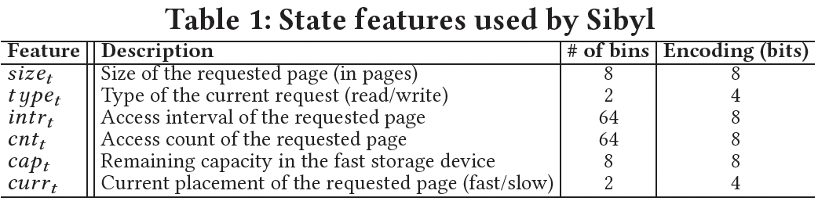
Selected State Attributes

Slide 161
What is Reward?
Sibyl
Features of the current request and system
Request latency
(of last served request)
Select storage device to place
the current page
Defines the objective of Sibyl
We formulate the reward as a function of the request latency
Encapsulates three key aspects:
  Internal state of the device (e.g., read/write latencies, the latency of garbage collection, queuing delays, …)
  Throughput
  Evictions
More details in the paper
Hybrid Storage System
Notes:
The reward defines the objective of Sibyl
[CLICK] Though Sibyl can learn from any …, in this paper we formulate the reward as a function of the request latency
[CLICK] A reward encapsulates three metrics: …

Slide 162
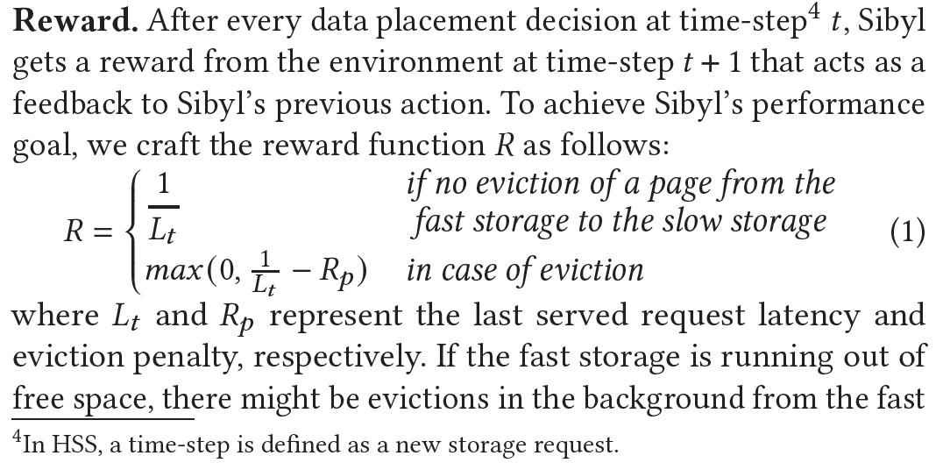
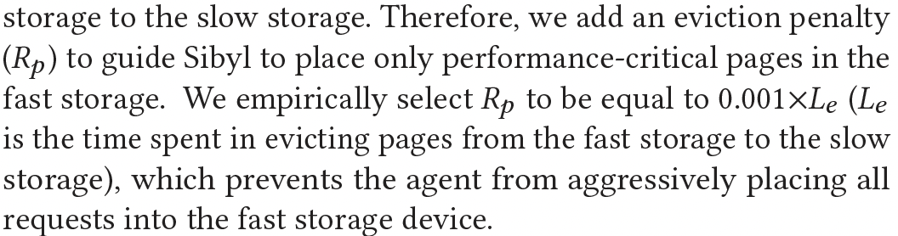
Reward Function

Slide 163
What is Action?
Sibyl
Features of the current request and system
Request latency
(of last served request)
Select storage device to place
the current page
At every new page request, the action is to select a storage device
Action can be easily extended to any number of storage devices
Sibyl learns to proactively evict or promote a page
Hybrid Storage System
Notes:
We define the action as the selection of a storage device to place the current page.
[CLICK] Such an action allows easy extensiblity to any number of storage devices
[CLICK] it makes SIbyl learn to proactively evit or promote a page from the storage device

Slide 164
Talk Outline
Key Shortcomings of Prior Data Placement Techniques
Formulating Data Placement as Reinforcement Learning
Sibyl: Overview
Evaluation of Sibyl and Key Results
Conclusion
Notes:
We now provide a brief overview and design of Sibyl.

Slide 165
Sibyl Execution
RL Training Thread
Asynchronous
Execution
State, Reward, and Action Information
Periodic Policy
Weight Update
Storage
Request
(from OS)
RL Decision Thread
Data Placement Decision
Sibyl
Notes:
FIRST we discuss the execution model for Sibyl. We implement sibyl in the the host OS. [CLICK] Where for every storage request Sibyl uses an RL decision thread to make [CLICK] data placemnet decisions.
Sibyl uses another thread, [CLICK] called the RL training thread that works in the background. It keeps collecting information about Sibyl's state, action and reward, which uses this information to train a data placement policy. [CLICK] periodically we replace the RL decision thread policy with RL training thread policy.
[CLICK] Our two-threaded implementation runs ASYNCHROUNOUS AND avoids that the training in RL training thread interrupts or delays data placement decisions for incoming requests.

Slide 166
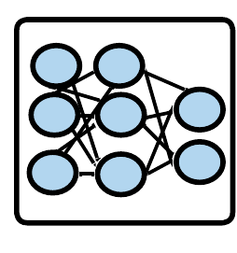
Sibyl Design: Overview
RL Training Thread
Training
Network
Training Dataset
Batch
Periodic Policy
Weight Update
Periodic Weights update
10
RL Decision Thread
Experience Buffer (in host DRAM)
State
Max
Action
Storage
Request
(from OS)
Inference
Network
Sibyl Policy
Observation
Vector
HSS
Reward
Collect
Experiences
State
Notes:
Now we will go into the implementation of each thread

Slide 167
RL Decision Thread
RL Training Thread
Training
Network
Training Dataset
Batch
Periodic Policy
Weight Update
RL Decision Thread
Experience Buffer (in host DRAM)
State
Max
Action
Storage
Request
(from OS)
Inference
Network
Sibyl Policy
Observation
Vector
HSS
Reward
Collect
Experiences
State
Notes:
First we discuss the RL decision thread, where Sibyl decides the data placement of the current storage request while collecting information about its decisions

Slide 168
RL Decision Thread
RL Training Thread
Training
Network
Training Dataset
Batch
Periodic Policy
Weight Update
RL Decision Thread
Experience Buffer (in host DRAM)
State
Max
Action
Storage
Request
(from OS)
Inference
Network
Sibyl Policy
Observation
Vector
HSS
Reward
Collect
Experiences
State
Notes:
For every new storage request to the Hybrid storage systems , Sibyl uses the state information to make a data placement action.

Slide 169
RL Decision Thread
RL Training Thread
Training
Network
Training Dataset
Batch
Periodic Policy
Weight Update
RL Decision Thread
Experience Buffer (in host DRAM)
State
Max
Action
Storage
Request
(from OS)
Inference
Network
Sibyl Policy
Observation
Vector
HSS
Reward
Collect
Experiences
State
Notes:
The inference network predicts the expected benefits of each action for a given state.
Sibyl policy selects the action with the highest expected benefit
or, a random action for exploration of the Hybrid storage systems

Slide 170
RL Decision Thread
RL Training Thread
Training
Network
Training Dataset
Batch
Periodic Policy
Weight Update
RL Decision Thread
Experience Buffer (in host DRAM)
State
Max
Action
Storage
Request
(from OS)
Inference
Network
Sibyl Policy
Observation
Vector
HSS
Reward
Collect
Experiences
State
Notes:
While making data placement decision, Sibyl collects information about the state, action, and reward

Slide 171
RL Decision Thread
RL Training Thread
Training
Network
Training Dataset
Batch
Periodic Policy
Weight Update
RL Decision Thread
Experience Buffer (in host DRAM)
State
Max
Action
Storage
Request
(from OS)
Inference
Network
Sibyl Policy
Observation
Vector
HSS
Reward
Collect
Experiences
State
Notes:
in an experience buffer, which in used in RL Training thread

Slide 172
RL Training Thread
RL Training Thread
Training
Network
Training Dataset
Batch
Periodic Policy
Weight Update
Periodic Weights update
10
RL Decision Thread
Experience Buffer (in host DRAM)
State
Max
Action
Storage
Request
(from OS)
Inference
Network
Sibyl Policy
Observation
Vector
HSS
Reward
Collect
Experiences
State
Notes:
In the RL training thread, Sibyl uses the collected experiences to update its decision making policy online by training a neural network.
Sibyl continuously learns from its past decisions and their impact.

Slide 173
Periodic Weight Transfer
RL Training Thread
Training
Network
Training Dataset
Batch
Periodic Policy
Weight Update
Periodic Weights update
10
RL Decision Thread
Experience Buffer (in host DRAM)
State
Max
Action
Storage
Request
(from OS)
Inference
Network
Sibyl Policy
Observation
Vector
HSS
Reward
Collect
Experiences
State
Notes:
To enable the parallel execution of the two threads, we duplicate the neural network that is used to make data placement decisions, so the inference network does not have a separate training steps and only uses the weights of the training network, which we periodically update.

Slide 174
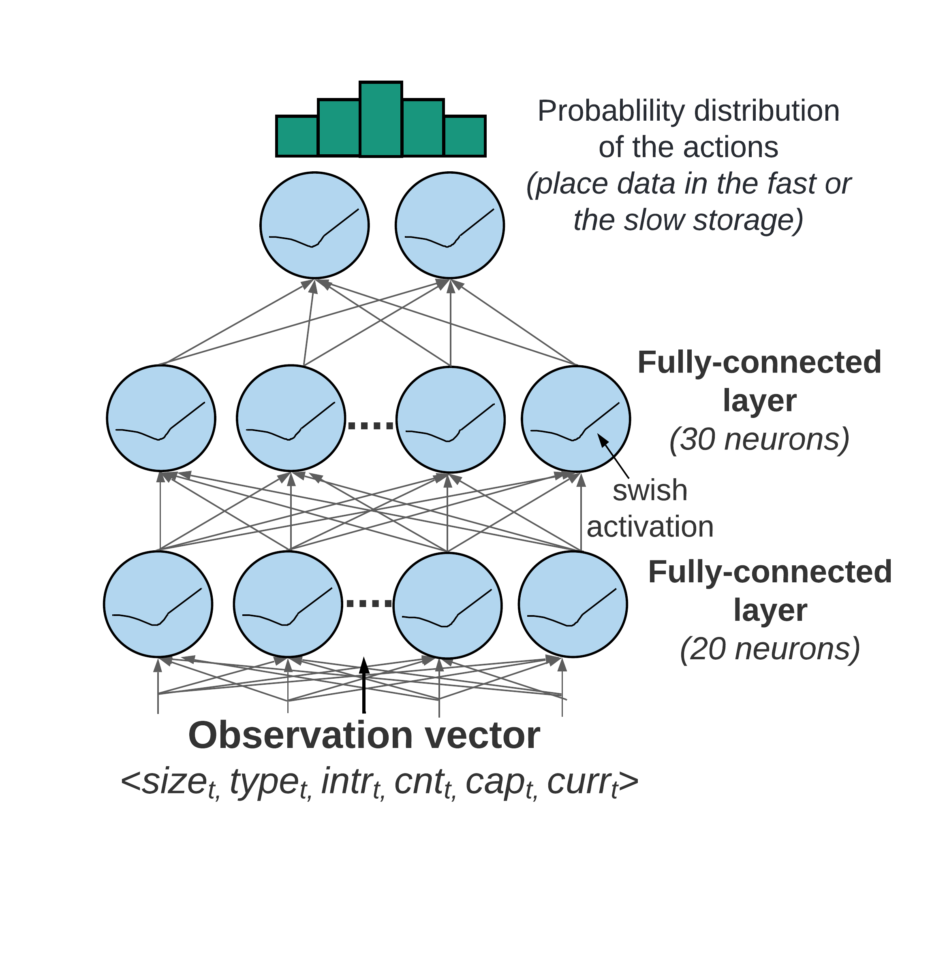
Training and Inference Networks
Training and inference networks allow parallel execution
Observation vector as the input
Produces probability distribution of Q-values
Notes:
A deep neural network can be prohibitive due to the long time it requires for training and convergence, preventing Sibyl to adapt to new state-action pairs in a timely manner.
Based on experiments, we find that a simple feed-forward network [135] with only two hidden layers [136] provides good performance for Sibyl’s data placement task.
The network takes the observation vector 𝑂𝑡 as its input and produces a probability distribution of Q-values as its output

Slide 175
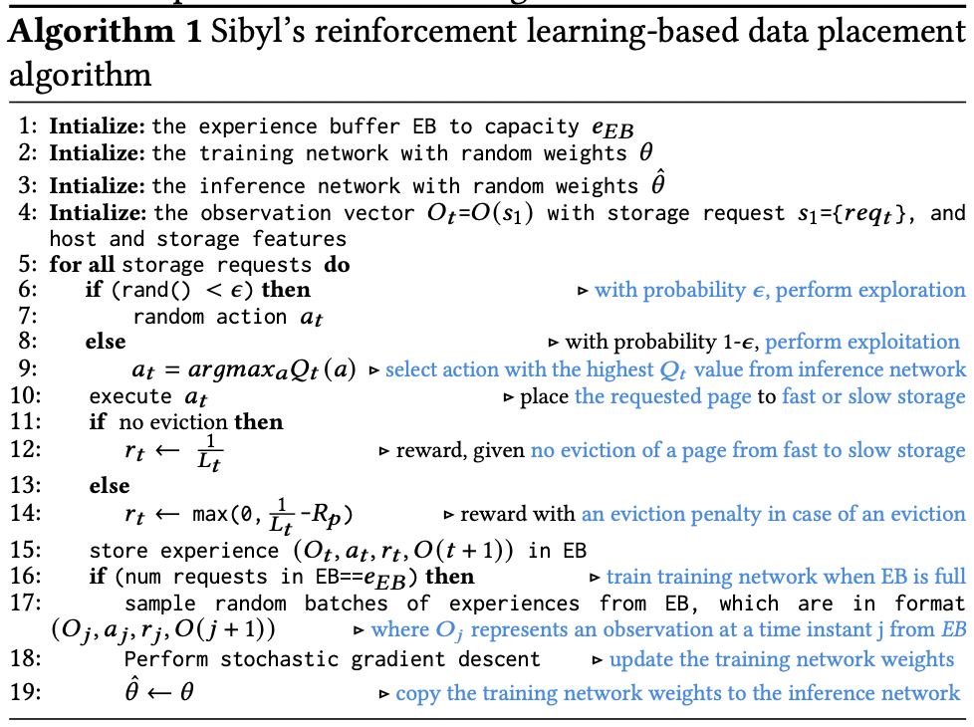
RL-Based Data Placement Algorithm

Slide 176


Hyperparameter Tuning

Slide 177
Talk Outline
Key Shortcomings of Prior Data Placement Techniques
Formulating Data Placement as Reinforcement Learning
Sibyl: Overview
Evaluation of Sibyl and Key Results
Conclusion
Notes:
We now present our key results

Slide 178


Evaluation Methodology (1/3)
Real system with various HSS configurations
  Dual-hybrid and tri-hybrid systems
AMD Ryzen7 2700G CPU
Intel Optane SSD P4800X
Seagate HDD
ST1000DM010
Intel SSD D3-S4510
ADATA
SU630 SSD
Notes:
[CLICK] We perfrom real system evaluation for both dual-hybrid and tri-hybrid systems
[CLICK] over here we show our evaluation setup that consists of multi different devices
[CLICK] We implement sibyl in the storage management layer of AMD Ryzen 7 2700G CPU

Slide 179
Evaluation Methodology (2/3)
Cost-Oriented HSS Configuration
High-end SSD
Low-end HDD
Performance-Oriented HSS Configuration
High-end SSD
Middle-end SSD
Notes:
First we evalutate a cost-oriented hybrid storage configuration in which we use
[CLICK]a high end ssd with a low-end hard disk drive where the latency difference between the two devices is quite large
[CLICK] Performance oriented hybrid storage configuration we
[CLICK]use a high end ssd with a middle end ssd
where two devices have similar latencies

Slide 180
Evaluation Methodology (3/3)
18 different workloads from:
  MSR Cambridge and Filebench Suites
Four state-of-the-art data placement baselines:
  CDE [Matsui+, Proc. IEEE’17]
  HPS [Meswani+, HPCA’15]
  Archivist [Ren+, ICCD’19]
  RNN-HSS [Doudali+, HPDC’19]
Heuristic-based
Learning-based
Notes:
[CLICK] We use 18 different workloads from MSR CAMBRIDGE and Filebench Suite
[CLICK] and compare Sibyl against four state of heuristic and supervised—learning based data placmenet policies

Slide 181

Performance Analysis
High-end SSD
Low-end HDD
Cost-Oriented HSS Configuration
Slow-Only
CDE
HPS
Archivist
RNN-HSS
Sibyl
Oracle
Notes:
[CLICK]Over here we show the performance results in terms of average request latency for MSR CAMBRIDGE workloads for all the workloads and policies

Slide 182

Performance Analysis
High-end SSD
Low-end HDD
Cost-Oriented HSS Configuration
Slow-Only
CDE
HPS
Archivist
RNN-HSS
Sibyl
Oracle
Sibyl consistently outperforms all the baselines
for all the workloads
Notes:
We observe that Sibyl consistently outperforms all the baselines for all the workloads

Slide 183

Performance Analysis
High-end SSD
Mid-end SSD
Performance-Oriented HSS Configuration
Slow-Only
CDE
HPS
Archivist
RNN-HSS
Sibyl
Oracle
Notes:
In a performance oriented Hybrid storage systems configuration, where two devices have similar latencies [CLICK]
[CLICK]

Slide 184

Performance Analysis
High-end SSD
Mid-end SSD
Performance-Oriented HSS Configuration
Slow-Only
CDE
HPS
Archivist
RNN-HSS
Sibyl
Oracle
Sibyl provides 21.6% performance improvement by dynamically adapting its data placement policy
Notes:
Sibyl provides 21.6% performance improvement by dynamically adapting its data placement policy

Slide 185

Performance Analysis
High-end SSD
Mid-end SSD
Performance-Oriented HSS Configuration
Slow-Only
CDE
HPS
Archivist
RNN-HSS
Sibyl
Oracle
Notes:
Sibyl provides slightly lower performance than other baselines in only two workloads for this configuration.
We observe that such workloads are write-intensive and have many random requests (in terms of both access pattern and request size).
Therefore, in the paper we show that for such workloads we need to perform frequent retraining

Slide 186
Performance Analysis
High-end SSD
Mid-end SSD
Performance-Oriented HSS Configuration
Slow-Only
CDE
HPS
Archivist
RNN-HSS
Sibyl
Oracle
Sibyl achieves 80% of the performance
of an oracle policy that has
complete knowledge of future access patterns
Notes:
on average Sibyl achieves 80% performance of an oracle policy that has complete knowledge of
future access patterns

Slide 187

Performance on Tri-HSS
High-end SSD
Mid-end SSD
Low-end HDD
Extending Sibyl for more devices:
Extending Sibyl for more devices:
  Add a new action
  Add the remaining capacity of the new device as a state feature
Heuristic_{Tri-hybrid}
Sibyl_{Tri-hybrid}
Notes:
We also evaluate the EXTENSIBILITY of sibyl to more devices
To extend sibyl for more storage devices we have to only:
1. Add a new action in sibyl’s action space
2. Add the remaining capacity of the new device as a state feature
and sibyl automatically figures out the best policy
Here we show the performanc results for a state of the art heuristic based policy. This heuristic policy is an extended version of CDE policy which requires significant implementation effort for handling all the dataplacement cases because of the new device like eviction and promotion from the new device and where to send that data, set threshold values etc.

Slide 188

Performance on Tri-HSS
High-end SSD
Mid-end SSD
Low-end HDD
Extending Sibyl for more devices:
  Add a new action
  Add the remaining capacity of the new device as a state feature
Heuristic_{Tri-hybrid}
Sibyl_{Tri-hybrid}
Notes:
and compare to sibyl for trihybrid system

Slide 189
Performance on Tri-HSS
High-end SSD
Mid-end SSD
Low-end HDD
Extending Sibyl for more devices:
  Add a new action
  Add the remaining capacity of the new device as a state feature
Sibyl outperforms the state-of-the-art
data placement policy by
48.2% in a real tri-hybrid system
Heuristic_{Tri-hybrid}
Sibyl_{Tri-hybrid}
Sibyl reduces the system architect's burden
by providing ease of extensibility
Notes:
Sibyl outperforms the state-of-the-art-policy policy by upto 48.2%
[click]
We conclude that Sibyl provides ease of extensibility to new storage system configurations, which reduces the system architect’s burden in designing sophisticated data placement mechanisms.

Slide 190
Sibyl’s Overhead
124.4 KiB of total storage cost
  Experience buffer, inference and training network
40-bit metadata overhead per page for state features
Inference latency of ~10ns
Training latency of ~2us
Small area overhead
Small inference overhead
Satisfies prediction latency
Notes:
All of Sibyl performance benefits comes at a modest cost of 124.4KB storage cost to implement experience buffer, inference and training network
[CLICK] and 40-bit metadata overhead per page
[CLICK] We have inference latency of 10nanos, which are orders of magnitude smaller than the I/O read latency of a even a high end SSD (around 3micro seconds for Samsung ZNAND SSD)
[CLICK] with training latency of 2mico sec
So sibyl provides:
[CLICK]small area and
[CLICK]inference overhead [CLICK] which satisfied the prediction latency for making a data placement decision

Slide 191
More in the Paper (1/3)
Throughput (IOPS) evaluation
  Sibyl provides high IOPS compared to baseline policies because it indirectly captures throughput (size/latency)
Evaluation on unseen workloads
  Sibyl can effectively adapt its policy to highly dynamic workloads
Evaluation on mixed workloads
  Sibyl provides equally-high performance benefits as in single workloads
Notes:
We have many more exciting results in the paper including throughput comparison, evaluation on unseen workloads and mixed workloads

Slide 192
More in the Paper (2/3)
Evaluation using different features
  Sibyl autonomously decides which features are important to maximize the performance
Evaluation with different hyperparameter values
Sensitivity to fast storage capacity
  Sibyl provides scalability by dynamically adapting its policy to available storage size
Explainability analysis of Sibyl's decision making
  Explain Sibyl’s actions for different workload characteristics and device configurations
Notes:
And many more.
For more details we encourage you to read our paper

Slide 193

More in the Paper (3/3)
https://arxiv.org/pdf/2205.07394.pdf
https://github.com/CMU-SAFARI/Sibyl

Slide 194
Talk Outline
Key Shortcomings of Prior Data Placement Techniques
Formulating Data Placement as Reinforcement Learning
Sibyl: Overview
Evaluation of Sibyl and Key Results
Conclusion
Notes:
Now I will conclude my talk

Slide 195
Conclusion
We introduced Sibyl, the first reinforcement learning-based data placement technique in hybrid storage systems that provides
  Adaptivity
  Easily extensibility
  Ease of design and implementation
We evaluated Sibyl on real systems using many different workloads
  Sibyl improves performance by 21.6% compared to the best prior data placement policy in a dual-HSS configuration
  In a tri-HSS configuration, Sibyl outperforms the state-of-the-art-data placement policy by 48.2%
  Sibyl achieves 80% of the performance of an oracle policy with a storage overhead of only 124.4 KiB
https://github.com/CMU-SAFARI/Sibyl
Notes:
We introduced Sibyl, the first reinforcement learning-based data placement in HSS that provides
Adaptivity
Easily extensibility
Ease of design and implementation
We evaluated Sibyl on real systems using many different workloads
Sibyl improves performance by 21.6% compared to the best previous data placement technique in dual-HSS configuration
In a tri-HSS configuration, Sibyl outperforms the state-of-the-art-policy policy by 48.2%
Sibyl achieves 80% performance of an oracle policy with storage overhead of only 124.4 KiB

Slide 196
Sibyl
Adaptive and Extensible Data Placement in Hybrid Storage Systems
Using Online Reinforcement Learning
Gagandeep Singh, Rakesh Nadig, Jisung Park,
Rahul Bera, Nastaran Hajinazar, David Novo,
Juan Gómez Luna, Sander Stuijk, Henk Corporaal,
Onur Mutlu
196
Notes:
Hi First of all. Thank you very much for staying until this long.
I’m going to present our work “…”

Slide 197
ISCA 2022 Paper, Slides, Videos
Gagandeep Singh, Rakesh Nadig, Jisung Park, Rahul Bera, Nastaran Hajinazar, David Novo, Juan Gomez-Luna, Sander Stuijk, Henk Corporaal, and Onur Mutlu,
"Sibyl: Adaptive and Extensible Data Placement in Hybrid Storage Systems Using Online Reinforcement Learning"
Proceedings of the 49th International Symposium on Computer Architecture (ISCA), New York, June 2022.
[Slides (pptx) (pdf)]
[arXiv version]
[Sibyl Source Code]
[Talk Video (16 minutes)]
https://arxiv.org/pdf/2205.07394.pdf

Slide 198

SSD Course (Spring 2023)
Spring 2023 Edition:
  https://safari.ethz.ch/projects_and_seminars/spring2023/doku.php?id=modern_ssds
Fall 2022 Edition:
  https://safari.ethz.ch/projects_and_seminars/fall2022/doku.php?id=modern_ssds
Youtube Livestream (Spring 2023):
  https://www.youtube.com/watch?v=4VTwOMmsnJY&list=PL5Q2soXY2Zi_8qOM5Icpp8hB2SHtm4z57&pp=iAQB
Youtube Livestream (Fall 2022):
  https://www.youtube.com/watch?v=hqLrd-Uj0aU&list=PL5Q2soXY2Zi9BJhenUq4JI5bwhAMpAp13&pp=iAQB
Project course
  Taken by Bachelor’s/Master’s students
  SSD Basics and Advanced Topics
  Hands-on research exploration
  Many research readings
https://www.youtube.com/onurmutlulectures

Slide 199

Comp Arch (Fall 2021)
Fall 2021 Edition:
  https://safari.ethz.ch/architecture/fall2021/doku.php?id=schedule
Fall 2020 Edition:
  https://safari.ethz.ch/architecture/fall2020/doku.php?id=schedule
Youtube Livestream (2021):
  https://www.youtube.com/watch?v=4yfkM_5EFgo&list=PL5Q2soXY2Zi-Mnk1PxjEIG32HAGILkTOF
Youtube Livestream (2020):
  https://www.youtube.com/watch?v=c3mPdZA-Fmc&list=PL5Q2soXY2Zi9xidyIgBxUz7xRPS-wisBN
Master’s level course
  Taken by Bachelor’s/Masters/PhD students
  Cutting-edge research topics + fundamentals in Computer Architecture
  5 Simulator-based Lab Assignments
  Potential research exploration
  Many research readings
https://www.youtube.com/onurmutlulectures

Slide 200
Machine Learning Driven
Memory and Storage Systems
Onur Mutlu
omutlu@gmail.com
https://people.inf.ethz.ch/omutlu
19 December 2023
IBM Research

Slide 201
PYTHIA BACKUP

Slide 202
Reward Assignment to EQ Entry
Every action gets inserted into EQ
Reward is assigned to each EQ entry before or during the eviction
During EQ insertion: for actions
  Not to prefetch
  Out-of-page prefetch

Slide 203
Reward Assignment to EQ Entry
Every action gets inserted into EQ
Reward is assigned to each EQ entry before or during the eviction
During EQ insertion: for actions
  Not to prefetch
  Out-of-page prefetch
During EQ residency:
  In case address of a demand matches with address in EQ (signifies accurate prefetch)

Slide 204
Reward Assignment to EQ Entry
Every action gets inserted into EQ
Reward is assigned to each EQ entry before or during the eviction
During EQ insertion: for actions
  Not to prefetch
  Out-of-page prefetch
During EQ residency:
  In case address of a demand matches with address in EQ (signifies accurate prefetch)
During EQ eviction:
  In case no reward is assigned till eviction (signifies inaccurate prefetch)

Slide 205
Performance S-curve: Single-core
603.bwaves_s-2931B
462.libquantum
streamcluster
fluidanimate-9500M
623.xalancbmk_s-592B
BFSCC-22B
pagerank-51B
429.mcf

Slide 206
Performance S-curve: Four-core
437.leslie3d-271B
462.libquantum-1343B
raytrace-23.75B
429.mcf-184B
Mix-59
pagerank
Mix-240

Slide 207
FAQs

Slide 208
Pythia Discussion
FAQs
  Why RL?
  What about large page?
  What’s the prefetch degree?
  Can customization happen during workload execution?
  Can runtime mixing create problem?
Simulation and Methodology
  Basic Pythia configuration
  System parameters
  Configuration of prefetchers
  Evaluated workloads
  Feature selection
Detailed Design
  Reward structure
  Design overview
  QVStore Organization
More Results
  Comparison against other adaptive prefetchers
  Comparison against Context prefetcher
  Feature combination sensitivity
  Hyperparameter sensitivity
  Comparison with multi-level prefetchers
  Performance in unseen workloads
  Single-core s-curve
  Four-core s-curve
  Detailed performance analysis
  Benefit of bandwidth awareness
  Case study
  Customizing rewards
  Customizing features

Slide 209
Why RL? Why Not Supervised Learning?
Determining the benefits of prefetching (i.e., whether a decision was good for performance or not) is not easy
  Depends on a complex set of metrics
    Coverage, accuracy, timeliness
    Effects on system: b/w usage, pollution, cross-application interference, …
  Dynamically-changing environmental conditions change the benefit
  Delayed feedback due to long latency (might not receive feedback at all for inaccurate prefetches!)
Differs from classification tasks (e.g., branch prediction)
  Performance strongly correlates mainly to accuracy
  Does not depend on environment
  Bounded feedback delay

Slide 210
What About Large Pages?
Pythia’s framework can be easily extended to incorporate additional prefetch actions (i.e., possible prefetch offsets for the page size)
To decrease the storage overhead
  Prune action space via automatic design-space exploration
  Hash action values to retrieve Q-values

Slide 211
What is the Prefetch Degree? Is It Managed by the RL Agent?
Pythia employs a simple degree selector, separate from the RL agent
  If the agent has selected the same prefetch action (O) multiple times in a row, Pythia increases the degree (A+2O, A+3O, …)
  At most degree 4
Future works on managing degree by the RL agent

Slide 212
Can the Customization Be Done While the Workload is Running?
Certainly.
Pythia, being an online learning technique, will autonomously adapt (and optimize) its policy to use the new program features or the modified reward values

Slide 213
Can Runtime Workload Mix Create an Issue?
We implement the bandwidth usage feedback using a counter in the memory controller. Thus Pythia already has a global view of the memory bandwidth usage that incorporates all workloads running on a multi-core system
We evaluate a diverse set (300 of each category) of four-core, eight-core, twelve-core random workload mixes
Based on our evaluation, we observe that Pythia dynamically adapts itself to varying workload demands

Slide 214
How does Pythia Compare Against Other Adaptive Prefetching Solutions?
We compare Pythia against IBM POWER7[5] prefetcher
  Adaptively selects prefetcher degree/configuration by monitoring program IPC
4.5%
(a) single-core
6.4%
(b) four-core
[5] Jimenez et al., TOPC’14

Slide 215
How Does Pythia Compare Against the Context Prefetcher?
Pythia widely differs from the Context Prefetcher (CP)[6] in all three aspects: state, action, and reward. The key differences are:
  CP does not consider system-level feedback
  CP models the agent as a contextual bandit which takes myopic prefetch decisions as compared to Pythia
  CP requires compiler support to extract software-level features
Pythia outperforms CP-HW by 5.3% in single-core and 7.6% in four-core system
[6] Leeor et al., ISCA’15

Slide 216
How Pythia’s Performance Changes With Various State Definitions You Have Swept?
In total we evaluate state defined as any-one, any-two, and any-three combinations of 32 features
Performance gain ranges from 20.7% to 22.4%
Coverage ranges from 66.2% to 71.5%
Overprediction ranges from 26.7% to 32.2%

Slide 217
Is Pythia Sensitive to Hyperparameters?
Not setting hyperparameters can significantly impact the overall performance improvement
Changing 𝜀 from 0.002 to 1.0 drops perf. by 16%
Changing 𝛼 from 0.0065 to 1.0 drops perf. by 5.4%

Slide 218
How Does Pythia Compare Against Commercial Multi-level Prefetchers?
Pythia outperforms IPCP [7] by 14.2% on average in 150-MTPS
[6] Prakalapati et al., ISCA’20

Slide 219
Does Pythia Perform Equally Well for Unseen Workloads?
Evaluated with 500 traces from value prediction championship
  No prefetcher has been trained on these traces
Pythia outperforms MLOP and Bingo by
8.3% and 3.5% in single-core
And 9.7% and 5.4% in four-core

Slide 220
Basic Pythia Configuration

Slide 221

System Parameters

Slide 222

Configuration of Prefetchers

Slide 223

Evaluated Workloads

Slide 224
List of Evaluated Features

Slide 225
MORE RESULTS

Slide 226
Performance S-curve: Single-core
603.bwaves_s-2931B
462.libquantum
streamcluster
fluidanimate-9500M
623.xalancbmk_s-592B
BFSCC-22B
pagerank-51B
429.mcf

Slide 227
Performance S-curve: Four-core
437.leslie3d-271B
462.libquantum-1343B
raytrace-23.75B
429.mcf-184B
Mix-59
pagerank
Mix-240

Slide 228
Single-core Coverage & Overprediction

Slide 229
Detailed Performance

Slide 230
Benefit of Bandwidth Awareness

Slide 231

Case Study

Slide 232

Customizing Rewards

Slide 233

Customizing Features

Slide 234
Hermes Discussion
FAQs
  What are the selected set of program features?
  Can you provide some intuition on why these features work?
  What happens in case of a misprediction?
  What’s the performance headroom for off-chip prediction?
  Do you see a variance of different features in final prediction accuracy?
Simulation Methodology
  System parameters
  Evaluated workloads
More Results
  Percentage of off-chip requests
  Reduction in stall cycles by reducing the critical path
  Fraction of off-chip load requests
  Accuracy and coverage of POPET
  Effect of different features
  Are all features required?
  1C performance
  1C performance line graph
  1C performance against prior predictors
  Effect on stall cycles
  8C performance
  Sensitivity:
    Hermes request issue latency
    Cache hierarchy access latency
    Activation threshold
    ROB size
    LLC size
  Power overhead
  Accuracy without prefetcher
  Main memory request overhead with different prefetchers

Slide 235
HERMES BACKUP

Slide 236

Initial Set of Program Features

Slide 237

Selected Set of Program Features
A binary hint that represents whether or not a cacheblock has been recently touched
Five features

Slide 238
When A Feature Works/Does Not Work?
Trace: 462.libquantum-1343B
PC: 0x401442
…
Cacheline #42
Cacheline #43
…
Without prefetcher
With a simple stride prefetcher
PC + first access
Cacheline offset + first access
Cacheline offset + first access

Slide 239
What Happens in case of a Misprediction?
Two cases of mispredictions:
Predicted on-chip but actually goes off-chip
  Loss of performance improvement opportunity
Predicted off-chip but actually is on-chip
  Memory controller forwards the data to LLC if and only if a load to the same address have already missed LLC and arrived at the memory controller
No need for misprediction detection and recovery
No need for misprediction detection and recovery

Slide 240

Performance Headroom of Off-Chip Prediction

Slide 241

System Parameters

Slide 242

Evaluated Workloads

Slide 243
Observation: Not All Off-Chip Loads are Prefetched
50%
1
Nearly 50% of the loads are still not prefetched

Slide 244
Observation: Not All Off-Chip Loads are Prefetched
2
70% of these off-chip loads blocks ROB

Slide 245
Observation: With Large Cache Comes Longer Latency
On-chip cache access latency significantly contributes to the latency of an off-chip load
On-chip cache hierarchy access latency
58

Slide 246
Observation: With Large Cache Comes Longer Latency
On-chip cache access latency significantly contributes to the latency of an off-chip load
On-chip cache hierarchy access latency
40% of stall cycles caused by an off-chip load can be eliminated
by removing on-chip cache access latency from its critical path
58

Slide 247

What Fraction of Load Requests Goes Off-Chip?

Slide 248
Off-Chip Prediction Quality: Defining Metrics
Accuracy
Coverage
Predicted off-chip
Actual off-chip
Predicted and actual off-chip

Slide 249
Off-Chip Prediction Quality: Analysis
Accuracy
77%
47%
16%
Coverage
95%
74%
22%

Slide 250
Off-Chip Prediction Quality: Analysis
Accuracy
77%
47%
16%
POPET provides off-chip predictions with high-accuracy and high-coverage
Coverage
95%
74%
22%

Slide 251

Effect of Different Features
Combination of features provides both higher accuracy and higher coverage than any individual feature

Slide 252

Are All Features Required? (1)
No single feature individually provides
highest prediction accuracy across all workloads

Slide 253

Are All Features Required? (2)
No single feature individually provides
highest prediction coverage across all workloads

Slide 254

Single-Core Performance
Hermes in combination with Pythia
outperforms Pythia alone in every workload category

Slide 255

Single-Core Performance Line Graph

Slide 256

Single-Core Performance Against Prior Predictors
POPET provides higher performance benefit
than prior predictors
Hermes with POPET achieves nearly 90% performance improvement of the Ideal Hermes

Slide 257

Effect on Stall Cycles
Hermes reduces off-chip load induced stall cycles
on average by 16.2% (up-to 51.8%)

Slide 258

Eight-Core Performance
Hermes in combination with Pythia
outperforms Pythia alone by 5.1% on average

Slide 259


Effect of Hermes Request Issue Latency
3.6%
5.7%
Hermes in combination with Pythia outperforms Pythia alone even with a 24-cycle Hermes request issue latency

Slide 260
Effect of Cache Hierarchy Access Latency
6.2%
3.6%
Hermes can provide even higher performance benefit in
future processors with bigger and slower on-chip caches

Slide 261

Effect of Activation Threshold
With increase in activation threshold
Accuracy increases
Coverage decreases

Slide 262

Power Overhead

Slide 263
Effect of ROB Size
6.7%
5.3%

Slide 264
Effect of LLC Size
2.5%
1.3%

Slide 265
Accuracy and Coverage with Different Prefetchers
POPET’s accuracy and coverage increases significantly
in absence of a data prefetcher

Slide 266

Increase in Main Memory Requests

Slide 267
SIBYL BACKUP
267

Slide 268

Performance on Unseen Workloads
H&M (H&L) HSS configuration, Sibyl outperforms RNN-HSS and Archivist by 46.1% (54.6%) and 8.5% (44.1%), respectively

Slide 269
Performance Analysis
Performance-Oriented HSS Configuration
Slow-Only
CDE
HPS
Archivist
RNN-HSS
Sibyl
Oracle
Baseline policies are ineffective for many workloads even when compared to Slow-Only
Notes:
For workloads like prn_1, proj_2, etch baseline policies are ineffeciteve even when compared to slow only policy does places everything in the slow storage

Slide 270

Performance on Mixed Workloads
Slow-Only
CDE
HPS
Archivist
RNN-HSS
Sibyl_{Def}
Sibyl_{Opt}
Oracle
Performance-Oriented
Cost-Oriented
Notes:
We evaluate mixing two or more workloads at the same time while randomly varying their relative start times.
Such a scenario
leads to unpredictable execution where requests arrive at dif- ferent, unpredictable timesteps,
mimics distributed workloads,
(3) further tests the ability of Sibyl to dynamically adapt its decision-making policy.
shows average request latency for mixed workloads in two different storage configuration.[click] We use two different settings for Sibyl: (a) Sibyl𝐷𝑒 𝑓 , where we use our default hyper-parameters and (b) Sibyl𝑂𝑝𝑡, where we optimize the hyper-parameters for these mixed workloads

Slide 271

Performance on Mixed Workloads
Slow-Only
CDE
HPS
Archivist
RNN-HSS
Sibyl_{Def}
Sibyl_{Opt}
Oracle
Performance-Oriented
Cost-Oriented
Sibyl_{Def} outperforms baseline data placement techniques by up to 27.9%
Notes:
Sibyl𝐷𝑒 𝑓 provides upto 27.9% higher performance than baseline policies

Slide 272

Performance on Mixed Workloads
Slow-Only
CDE
HPS
Archivist
RNN-HSS
Sibyl_{Def}
Sibyl_{Opt}
Oracle
Performance-Oriented
Cost-Oriented
Sibyl_{Def} outperforms baseline data placement techniques by up to 27.9%
Sibyl_{Opt} provides 7.2% higher average performance than Sibyl_{Def}
Notes:
With optimized hyper-parameters, Sibyl𝑂𝑝𝑡 provides 5.2% (9.3%) higher average performance for H&M (H&L) HSS configuration than Sibyl𝐷𝑒 𝑓 .
We conclude that Sibyl can effectively adapt its data placement policy online to highly dynamic workloads.

Slide 273

Performance With Different Features
Sibyl autonomously decides which features are important to maximize the performance of the running workload

Slide 274

Sensitivity to Fast Storage Capacity

Slide 275

Explainability Analysis

Slide 276
Training and Inference Network
Training and inference networks allow parallel execution
Observation vector as the input
Produces probability distribution of Q-values
Notes:
A deep neural network can be prohibitive due to the long time it requires for training and convergence, preventing Sibyl to adapt to new state-action pairs in a timely manner.
Based on experiments, we find that a simple feed-forward network [135] with only two hidden layers [136] provides good performance for Sibyl’s data placement task.
The network takes the observation vector 𝑂𝑡 as its input and produces a probability distribution of Q-values as its output

