Slide 1
Processing Data Where It Makes Sense in Modern Computing Systems: Enabling In-Memory Computation
Onur Mutlu
omutlu@gmail.com
https://people.inf.ethz.ch/omutlu
19 November 2019
ICCD Keynote

Slide 2
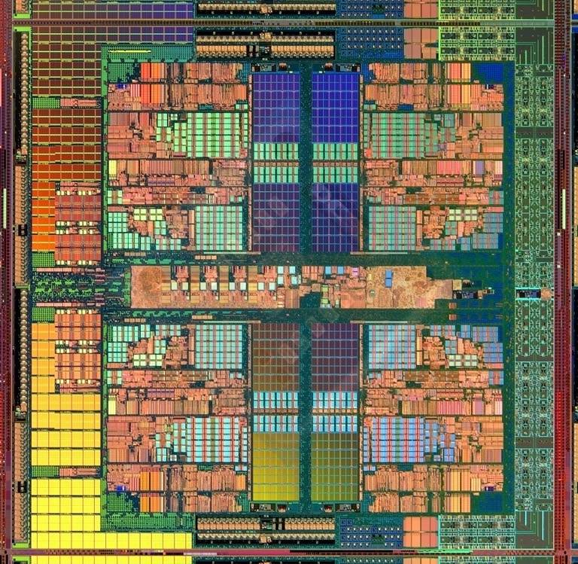
The Main Memory System
Main memory is a critical component of all computing systems: server, mobile, embedded, desktop, sensor
Main memory system must scale (in size, technology, efficiency, cost, and management algorithms) to maintain performance growth and technology scaling benefits
Processors
and caches
Main Memory
Storage (SSD/HDD)

Slide 3
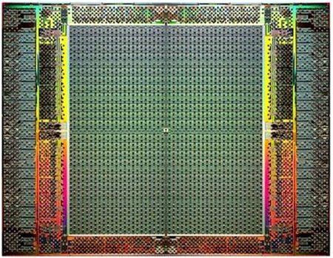
The Main Memory System
Main memory is a critical component of all computing systems: server, mobile, embedded, desktop, sensor
Main memory system must scale (in size, technology, efficiency, cost, and management algorithms) to maintain performance growth and technology scaling benefits
FPGAs
Main Memory
Storage (SSD/HDD)

Slide 4
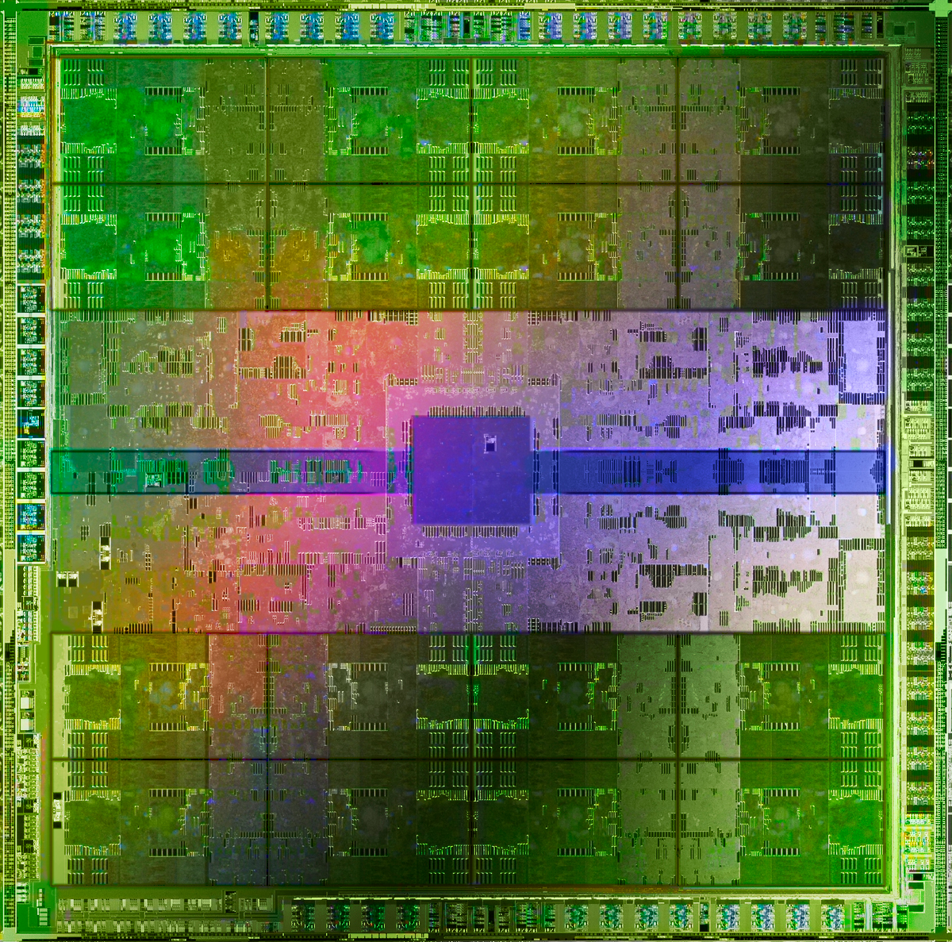
The Main Memory System
Main memory is a critical component of all computing systems: server, mobile, embedded, desktop, sensor
Main memory system must scale (in size, technology, efficiency, cost, and management algorithms) to maintain performance growth and technology scaling benefits
GPUs
Main Memory
Storage (SSD/HDD)

Slide 5
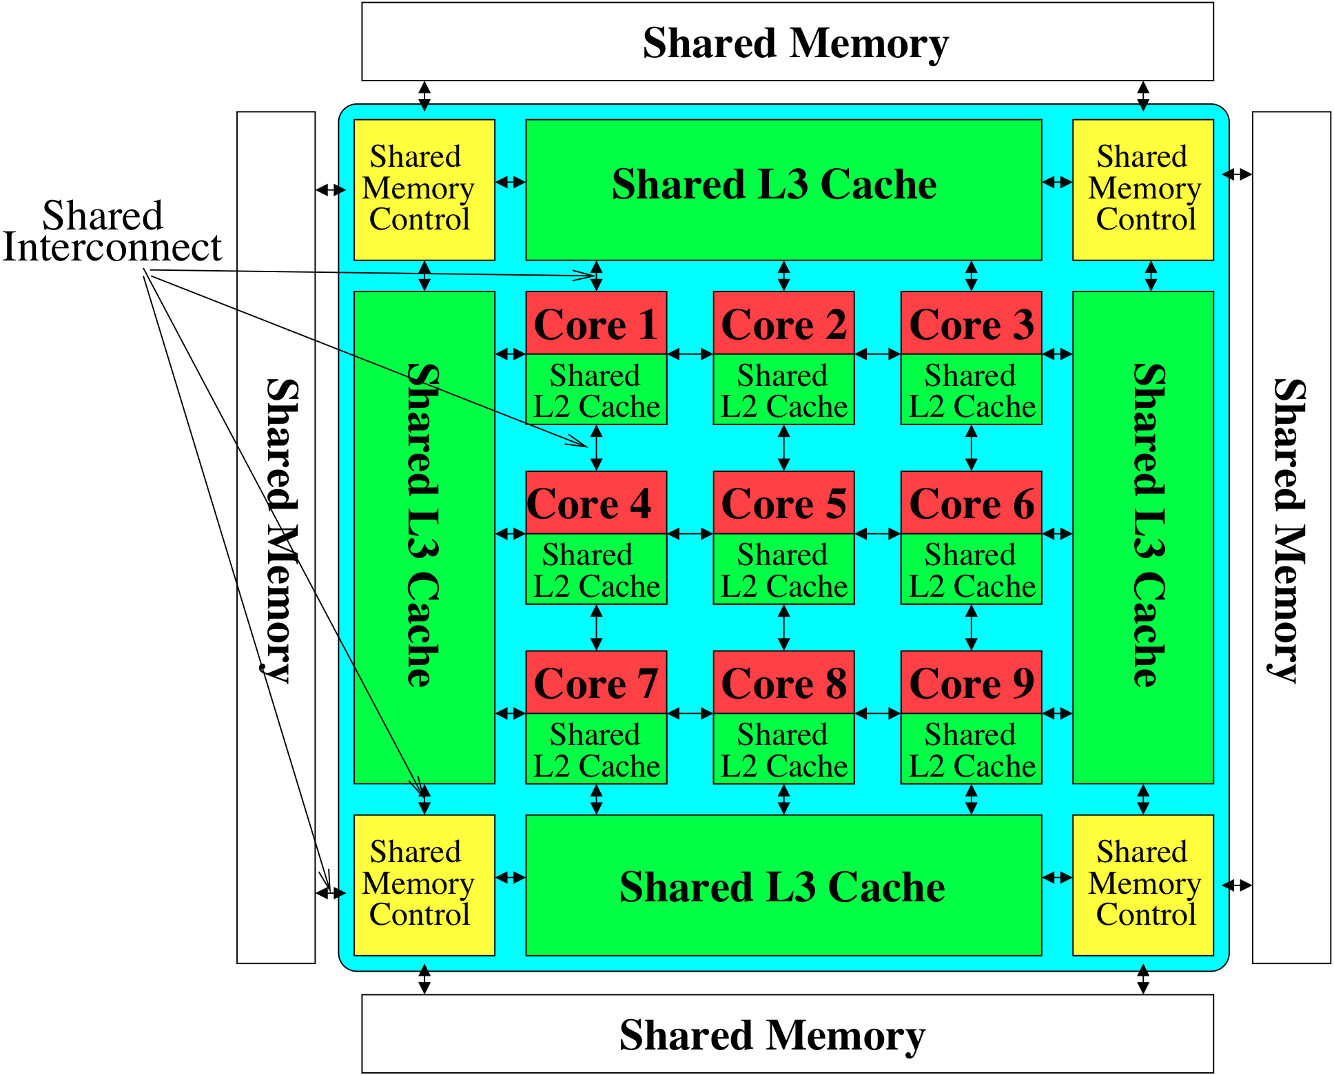
Memory System: A Shared Resource View
Storage
Most of the system is dedicated to storing and moving data

Slide 6
State of the Main Memory System
Recent technology, architecture, and application trends
lead to new requirements
exacerbate old requirements
DRAM and memory controllers, as we know them today, are (will be) unlikely to satisfy all requirements
Some emerging non-volatile memory technologies (e.g., PCM) enable new opportunities: memory+storage merging
We need to rethink the main memory system
to fix DRAM issues and enable emerging technologies
to satisfy all requirements

Slide 7
Major Trends Affecting Main Memory (I)
Need for main memory capacity, bandwidth, QoS increasing
Main memory energy/power is a key system design concern
DRAM technology scaling is ending

Slide 8
Major Trends Affecting Main Memory (II)
Need for main memory capacity, bandwidth, QoS increasing
Multi-core: increasing number of cores/agents
Data-intensive applications: increasing demand/hunger for data
Consolidation: cloud computing, GPUs, mobile, heterogeneity
Main memory energy/power is a key system design concern
DRAM technology scaling is ending

Slide 9
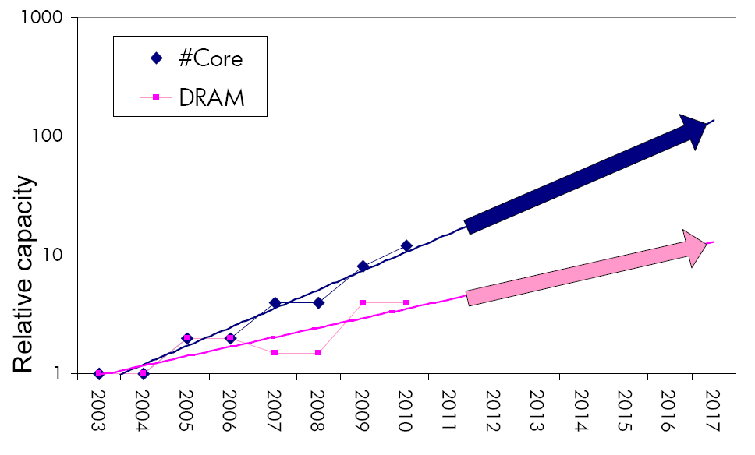
Example: The Memory Capacity Gap
Core count doubling ~ every 2 years
DRAM DIMM capacity doubling ~ every 3 years
Memory capacity per core expected to drop by 30% every two years
Trends worse for memory bandwidth per core!
Lim et al., ISCA 2009

Slide 10
DRAM Capacity, Bandwidth & Latency
128x
20x
1.3x

Slide 11
DRAM Is Critical for Performance
In-memory Databases
[Mao+, EuroSys’12; Clapp+ (Intel), IISWC’15]
Graph/Tree Processing
[Xu+, IISWC’12; Umuroglu+, FPL’15]
In-Memory Data Analytics
[Clapp+ (Intel), IISWC’15;
Awan+, BDCloud’15]
Datacenter Workloads [Kanev+ (Google), ISCA’15]

Slide 12
DRAM Is Critical for Performance
In-memory Databases
[Mao+, EuroSys’12; Clapp+ (Intel), IISWC’15]
Graph/Tree Processing
[Xu+, IISWC’12; Umuroglu+, FPL’15]
Memory → performance bottleneck
In-Memory Data Analytics
[Clapp+ (Intel), IISWC’15;
Awan+, BDCloud’15]
Datacenter Workloads [Kanev+ (Google), ISCA’15]

Slide 13
DRAM Is Critical for Performance
Chrome
TensorFlow Mobile
Google’s web browser
Google’s machine learning framework
Video Playback
Video Capture
Google’s video codec
Google’s video codec
Notes:
In this work, we take a look at widely-used google consumer workloads, to figure out the major sources of energy consumption.
We look at Google Chrome web brower. We take a look at Tensorflow, Google’s machine learning framework, and we also take a look at two important video related workloads, video playback and video capture, both rely on Google’s vp9 codec technology.

Slide 14
DRAM Is Critical for Performance
Chrome
TensorFlow Mobile
Google’s web browser
Google’s machine learning framework
Memory → performance bottleneck
Video Playback
Video Capture
Google’s video codec
Google’s video codec
Notes:
In this work, we take a look at widely-used google consumer workloads, to figure out the major sources of energy consumption.
We look at Google Chrome web brower. We take a look at Tensorflow, Google’s machine learning framework, and we also take a look at two important video related workloads, video playback and video capture, both rely on Google’s vp9 codec technology.

Slide 15
Major Trends Affecting Main Memory (III)
Need for main memory capacity, bandwidth, QoS increasing
Main memory energy/power is a key system design concern
~40-50% energy spent in off-chip memory hierarchy [Lefurgy, IEEE Computer’03] >40% power in DRAM [Ware, HPCA’10][Paul,ISCA’15]
DRAM consumes power even when not used (periodic refresh)
DRAM technology scaling is ending

Slide 16
Energy Waste in Mobile Devices
Amirali Boroumand, Saugata Ghose, Youngsok Kim, Rachata Ausavarungnirun, Eric Shiu, Rahul Thakur, Daehyun Kim, Aki Kuusela, Allan Knies, Parthasarathy Ranganathan, and Onur Mutlu, "Google Workloads for Consumer Devices: Mitigating Data Movement Bottlenecks" Proceedings of the 23rd International Conference on Architectural Support for Programming Languages and Operating Systems (ASPLOS), Williamsburg, VA, USA, March 2018.
62.7% of the total system energy
is spent on data movement

Slide 17
Major Trends Affecting Main Memory (IV)
Need for main memory capacity, bandwidth, QoS increasing
Main memory energy/power is a key system design concern
DRAM technology scaling is ending
ITRS projects DRAM will not scale easily below X nm
Scaling has provided many benefits:
higher capacity (density), lower cost, lower energy

Slide 18
Major Trends Affecting Main Memory (V)
DRAM scaling has already become increasingly difficult
Increasing cell leakage current, reduced cell reliability, increasing manufacturing difficulties [Kim+ ISCA 2014], [Liu+ ISCA 2013], [Mutlu IMW 2013], [Mutlu DATE 2017]
Difficult to significantly improve capacity, energy
Emerging memory technologies are promising
3D-Stacked DRAM | higher bandwidth | smaller capacity
Reduced-Latency DRAM (e.g., RLDRAM, TL-DRAM) | lower latency | higher cost
Low-Power DRAM (e.g., LPDDR3, LPDDR4) | lower power | higher latency higher cost
Non-Volatile Memory (NVM) (e.g., PCM, STTRAM, ReRAM, 3D Xpoint) | larger capacity | higher latency higher dynamic power lower endurance

Slide 19
Major Trends Affecting Main Memory (V)
DRAM scaling has already become increasingly difficult
Increasing cell leakage current, reduced cell reliability, increasing manufacturing difficulties [Kim+ ISCA 2014], [Liu+ ISCA 2013], [Mutlu IMW 2013], [Mutlu DATE 2017]
Difficult to significantly improve capacity, energy
Emerging memory technologies are promising
3D-Stacked DRAM | higher bandwidth | smaller capacity
Reduced-Latency DRAM (e.g., RL/TL-DRAM, FLY-RAM) | lower latency | higher cost
Low-Power DRAM (e.g., LPDDR3, LPDDR4, Voltron) | lower power | higher latency higher cost
Non-Volatile Memory (NVM) (e.g., PCM, STTRAM, ReRAM, 3D Xpoint) | larger capacity | higher latency higher dynamic power lower endurance

Slide 20
Major Trend: Hybrid Main Memory
CPU
Meza+, “Enabling Efficient and Scalable Hybrid Memories,” IEEE Comp. Arch. Letters, 2012.
Yoon+, “Row Buffer Locality Aware Caching Policies for Hybrid Memories,” ICCD 2012 Best Paper Award.
DRAMCtrl
PCM Ctrl
DRAM
Phase Change Memory (or Tech. X)
Fast, durable
Small,
leaky, volatile,
high-cost
Large, non-volatile, low-cost
Slow, wears out, high active energy
Hardware/software manage data allocation and movement
to achieve the best of multiple technologies

Slide 21
Foreshadowing
Main Memory Needs
Intelligent Controllers

Slide 22
Industry Is Writing Papers About It, Too

Slide 23
Call for Intelligent Memory Controllers

Slide 24
Agenda
Major Trends Affecting Main Memory
The Need for Intelligent Memory Controllers
Bottom Up: Push from Circuits and Devices
Top Down: Pull from Systems and Applications
Processing in Memory: Two Directions
Minimally Changing Memory Chips
Exploiting 3D-Stacked Memory
How to Enable Adoption of Processing in Memory
Conclusion

Slide 25
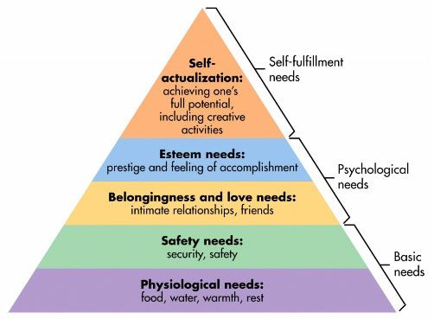
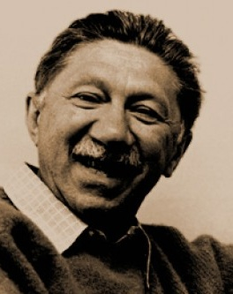
Maslow’s (Human) Hierarchy of Needs
Maslow, “A Theory of Human Motivation,”
Psychological Review, 1943.
Maslow, “A Theory of Human Motivation,”
Psychological Review, 1943.
Maslow, “Motivation and Personality,”
Book, 1954-1970.
We need to start with reliability and security…
Source: https://www.simplypsychology.org/maslow.html
Source: By User:Factoryjoe - Mazlow's Hierarchy of Needs.svg, CC BY-SA 3.0, https://commons.wikimedia.org/w/index.php?curid=7964065

Slide 26
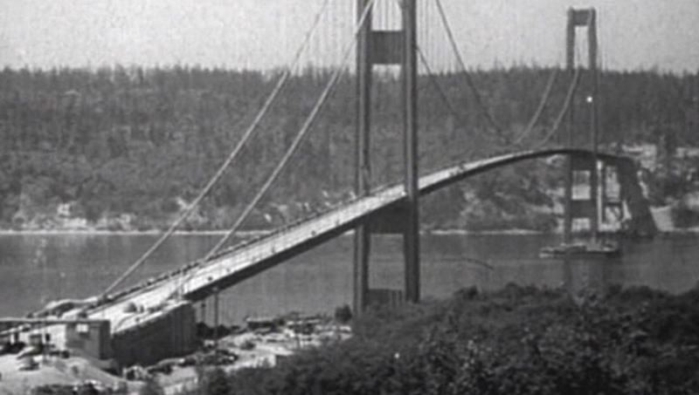
How Reliable/Secure/Safe is This Bridge?
Source: http://www.technologystudent.com/struct1/tacom1.png

Slide 27
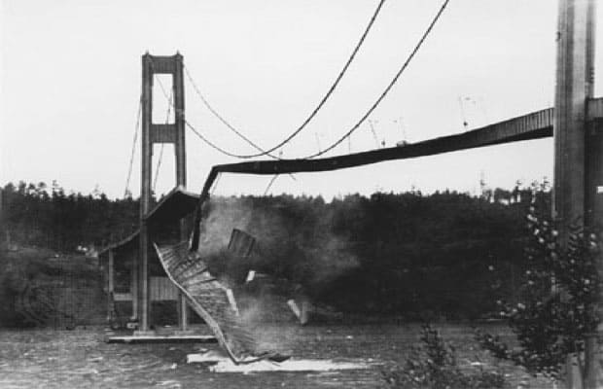
Collapse of the “Galloping Gertie”
Source: AP

Slide 28
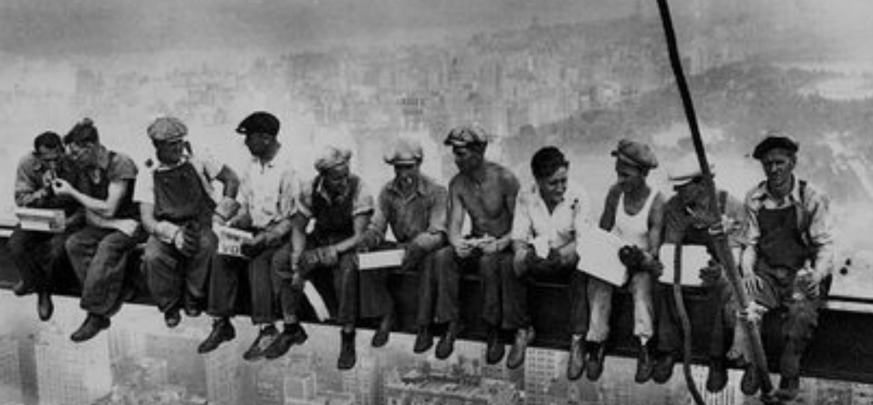
How Secure Are These People?
Security is about preventing unforeseen consequences
Source: https://s-media-cache-ak0.pinimg.com/originals/48/09/54/4809543a9c7700246a0cf8acdae27abf.jpg

Slide 29
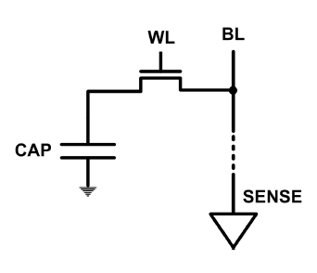
The DRAM Scaling Problem
DRAM stores charge in a capacitor (charge-based memory)
Capacitor must be large enough for reliable sensing
Access transistor should be large enough for low leakage and high retention time
Scaling beyond 40-35nm (2013) is challenging [ITRS, 2009]
DRAM capacity, cost, and energy/power hard to scale

Slide 30
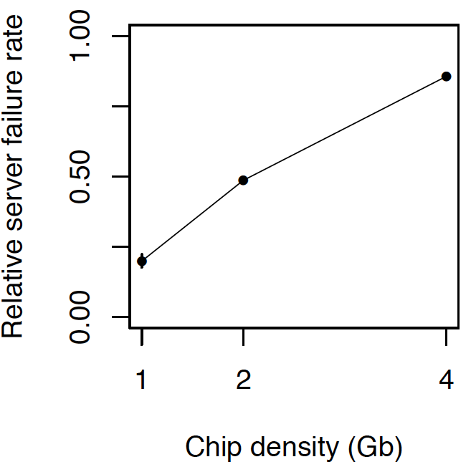
As Memory Scales, It Becomes Unreliable
Data from all of Facebook’s servers worldwide
Meza+, “Revisiting Memory Errors in Large-Scale Production Data Centers,” DSN’15.
Intuition: quadratic increase in capacity

Slide 31
Large-Scale Failure Analysis of DRAM Chips
Analysis and modeling of memory errors found in all of Facebook’s server fleet
Justin Meza, Qiang Wu, Sanjeev Kumar, and Onur Mutlu, "Revisiting Memory Errors in Large-Scale Production Data Centers: Analysis and Modeling of New Trends from the Field" Proceedings of the 45th Annual IEEE/IFIP International Conference on Dependable Systems and Networks (DSN), Rio de Janeiro, Brazil, June 2015. [Slides (pptx) (pdf)] [DRAM Error Model]

Slide 32
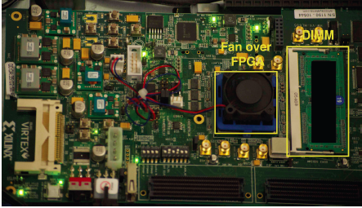
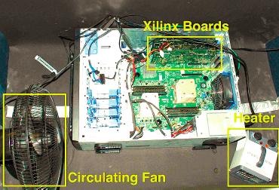
Infrastructures to Understand Such Issues
An Experimental Study of Data Retention Behavior in Modern DRAM Devices: Implications for Retention Time Profiling Mechanisms (Liu et al., ISCA 2013)
The Efficacy of Error Mitigation Techniques for DRAM Retention Failures: A Comparative Experimental Study
(Khan et al., SIGMETRICS 2014)
Flipping Bits in Memory Without Accessing Them: An Experimental Study of DRAM Disturbance Errors (Kim et al., ISCA 2014)
Adaptive-Latency DRAM: Optimizing DRAM Timing for the Common-Case (Lee et al., HPCA 2015)
AVATAR: A Variable-Retention-Time (VRT) Aware Refresh for DRAM Systems (Qureshi et al., DSN 2015)

Slide 33
Infrastructures to Understand Such Issues
Temperature
Controller
FPGAs
Heater
FPGAs
PC
Kim+, “Flipping Bits in Memory Without Accessing Them: An Experimental Study of DRAM Disturbance Errors,” ISCA 2014.

Slide 34
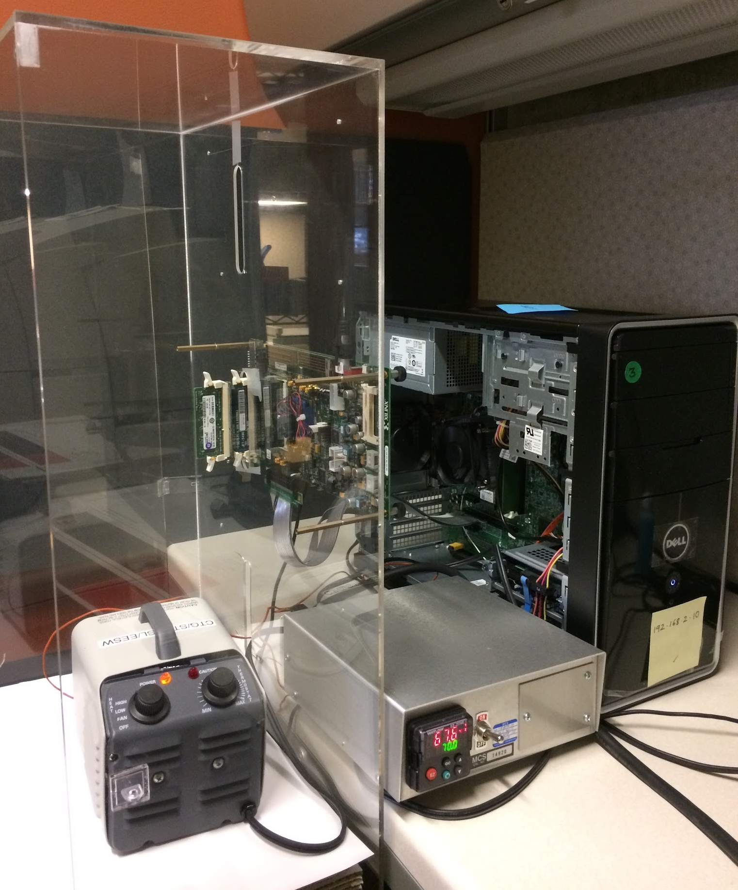
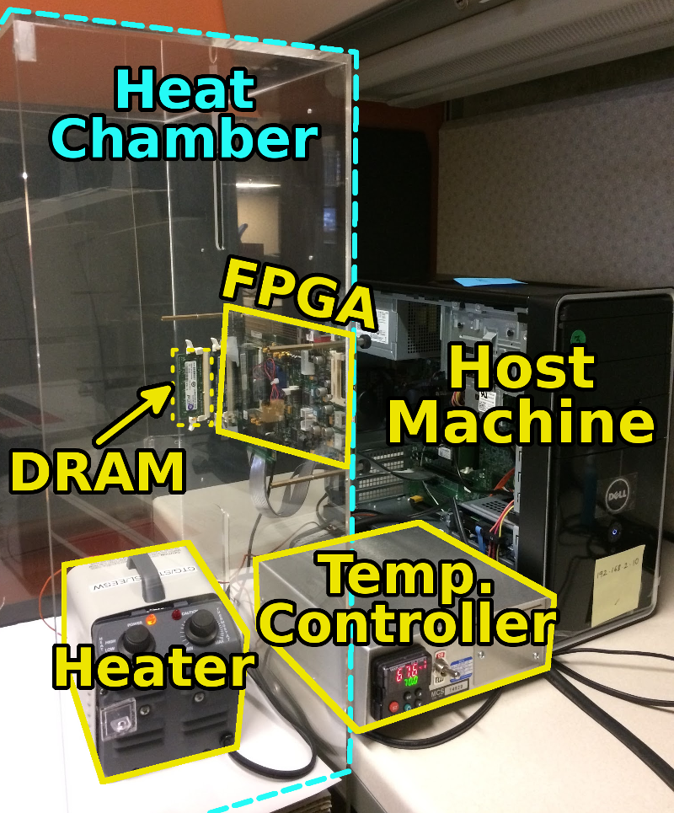
SoftMC: Open Source DRAM Infrastructure
Hasan Hassan et al., “SoftMC: A Flexible and Practical Open-Source Infrastructure for Enabling Experimental DRAM Studies,” HPCA 2017.
Flexible
Easy to Use (C++ API)
Open-source
github.com/CMU-SAFARI/SoftMC

Slide 35
SoftMC
https://github.com/CMU-SAFARI/SoftMC

Slide 36
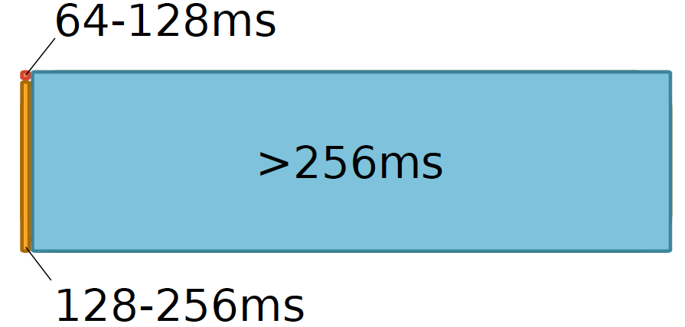
Data Retention in Memory [Liu et al., ISCA 2013]
Retention Time Profile of DRAM looks like this:
Location dependent
Stored value pattern dependent
Time dependent

Slide 37
Takeaway
Main Memory Needs
Intelligent Controllers

Slide 38
More on DRAM Refresh (I)
Jamie Liu, Ben Jaiyen, Richard Veras, and Onur Mutlu, "RAIDR: Retention-Aware Intelligent DRAM Refresh" Proceedings of the 39th International Symposium on Computer Architecture (ISCA), Portland, OR, June 2012. Slides (pdf)

Slide 39
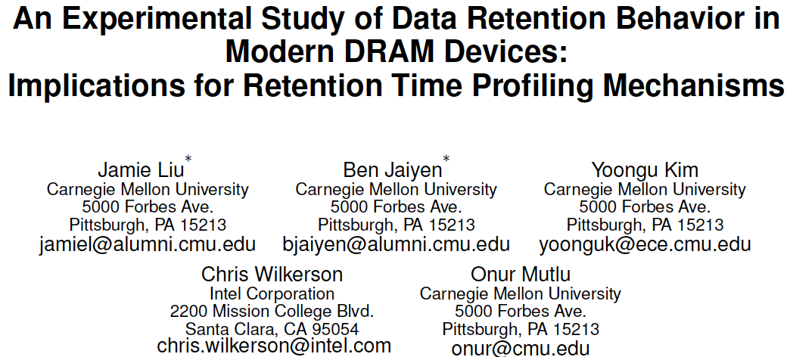
More on DRAM Refresh (II)
Jamie Liu, Ben Jaiyen, Yoongu Kim, Chris Wilkerson, and Onur Mutlu, "An Experimental Study of Data Retention Behavior in Modern DRAM Devices: Implications for Retention Time Profiling Mechanisms" Proceedings of the 40th International Symposium on Computer Architecture (ISCA), Tel-Aviv, Israel, June 2013. Slides (ppt) Slides (pdf)

Slide 40
More on DRAM Refresh (III)
Minesh Patel, Jeremie S. Kim, and Onur Mutlu, "The Reach Profiler (REAPER): Enabling the Mitigation of DRAM Retention Failures via Profiling at Aggressive Conditions" Proceedings of the 44th International Symposium on Computer Architecture (ISCA), Toronto, Canada, June 2017. [Slides (pptx) (pdf)] [Lightning Session Slides (pptx) (pdf)]
First experimental analysis of (mobile) LPDDR4 chips
Analyzes the complex tradeoff space of retention time profiling
Idea: enable fast and robust profiling at higher refresh intervals & temperatures

Slide 41
A Curious Discovery [Kim et al., ISCA 2014]
One can
predictably induce errors
in most DRAM memory chips

Slide 42
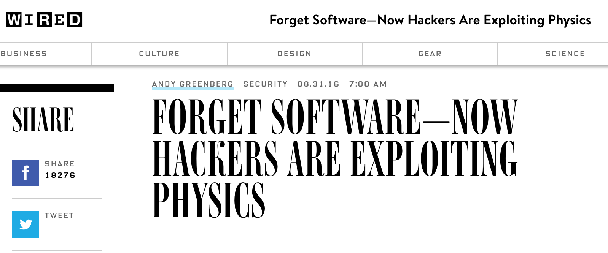
DRAM RowHammer
A simple hardware failure mechanism
can create a widespread
system security vulnerability

Slide 43
Modern DRAM is Prone to Disturbance Errors
Row of Cells
Wordline
Row
Victim Row
Row
Hammered Row
V_{LOW}
Opened
V_{HIGH}
Closed
Row
Victim Row
Row
Repeatedly reading a row enough times (before memory gets refreshed) induces disturbance errors in adjacent rows in most real DRAM chips you can buy today
Flipping Bits in Memory Without Accessing Them: An Experimental Study of DRAM Disturbance Errors, (Kim et al., ISCA 2014)

Slide 44
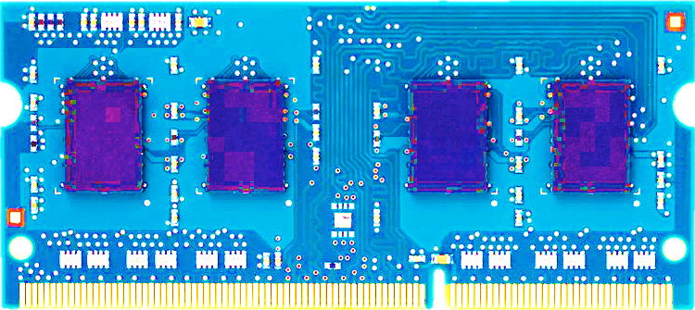
Most DRAM Modules Are Vulnerable
A company
B company
C company
86%
(37/43)
83%
(45/54)
88%
(28/32)
Up to
1.0×10⁷ errors
Up to
2.7×10⁶ errors
Up to
3.3×10⁵ errors
Flipping Bits in Memory Without Accessing Them: An Experimental Study of DRAM Disturbance Errors, (Kim et al., ISCA 2014)

Slide 45
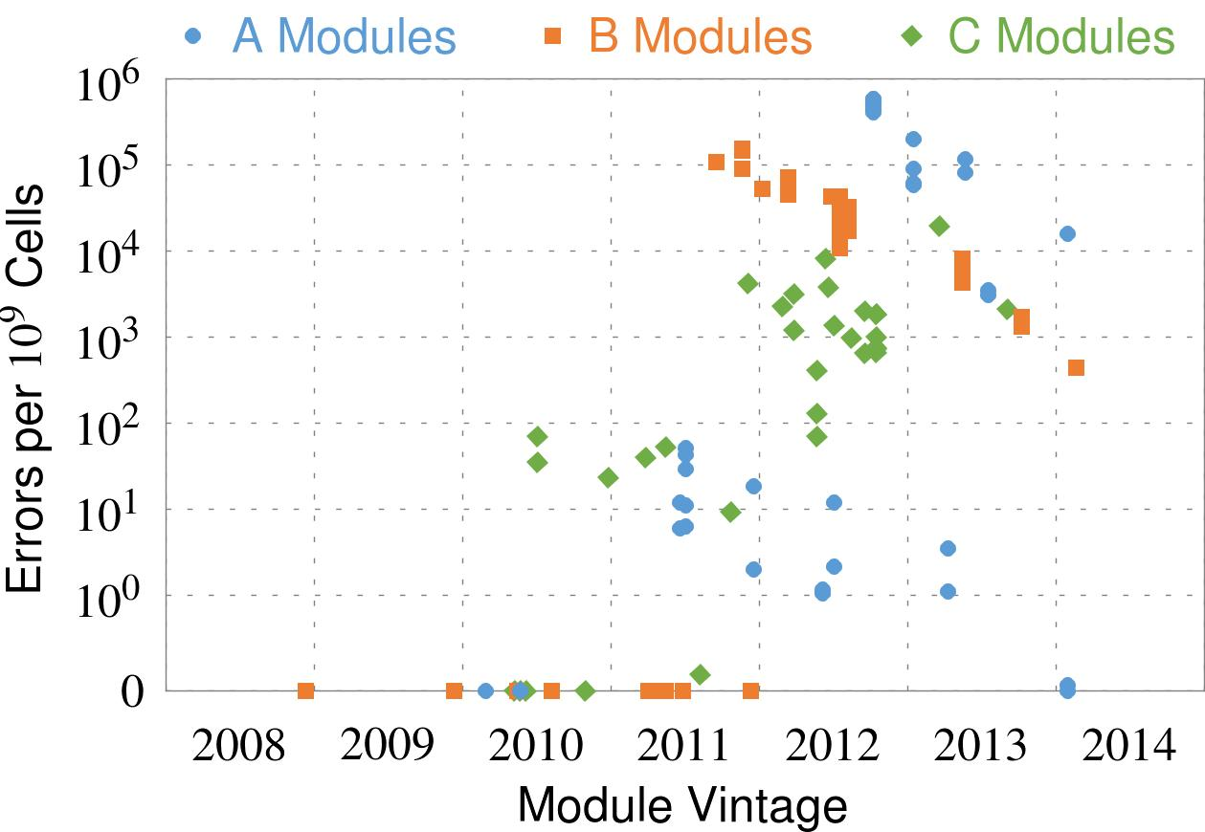
Recent DRAM Is More Vulnerable
Notes:
In this figure, the x-axis is the module manufacture date. And the y-axis is the number of errors in a module, normalized to one billion cells. In 2008 and 2009, there are no errors. But, in 2010, we first start to see errors in C modules. After 2010, the errors start to proliferate. For A and B modules, we first start to see errors in 2011. In particular, all modules from 2012 and 2013 are vulnerable.

Slide 46
Recent DRAM Is More Vulnerable
First
Appearance
Notes:
In this figure, the x-axis is the module manufacture date. And the y-axis is the number of errors in a module, normalized to one billion cells. In 2008 and 2009, there are no errors. But, in 2010, we first start to see errors in C modules. After 2010, the errors start to proliferate. For A and B modules, we first start to see errors in 2011. In particular, all modules from 2012 and 2013 are vulnerable.

Slide 47
Recent DRAM Is More Vulnerable
First
Appearance
All modules from 2012–2013 are vulnerable
Notes:
In this figure, the x-axis is the module manufacture date. And the y-axis is the number of errors in a module, normalized to one billion cells. In 2008 and 2009, there are no errors. But, in 2010, we first start to see errors in C modules. After 2010, the errors start to proliferate. For A and B modules, we first start to see errors in 2011. In particular, all modules from 2012 and 2013 are vulnerable.

Slide 48
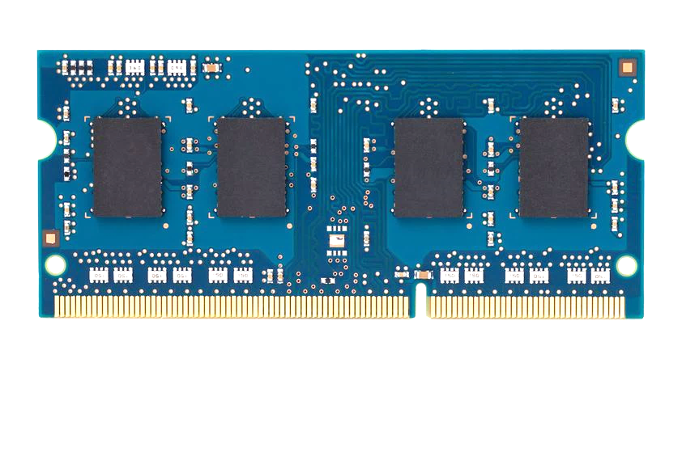
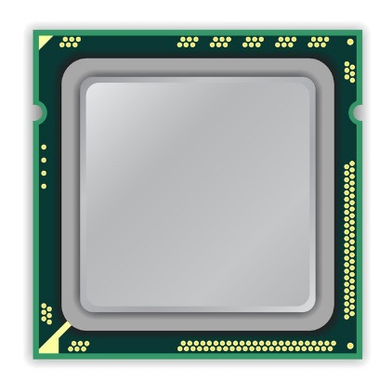
A Simple Program Can Induce Many Errors
CPU
DRAM Module
loop:
mov (X), %eax
mov (Y), %ebx
clflush (X)
clflush (Y)
mfence
jmp loop
X
Y
Download from: https://github.com/CMU-SAFARI/rowhammer
Notes:
We demonstrate the errors on multiple x86 systems. Shown to the bottom-left is a “disturbance kernel”. When executed, it forces two rows to be opened and closed one after the other – over and over again. Consequently, it induces many errors in the module.

Slide 49
A Simple Program Can Induce Many Errors
CPU
DRAM Module
Avoid cache hits
Flush X from cache
Avoid row hits to X
Read Y in another row
X
Y
Download from: https://github.com/CMU-SAFARI/rowhammer
Notes:
We demonstrate the errors on multiple x86 systems. Shown to the bottom-left is a “disturbance kernel”. When executed, it forces two rows to be opened and closed one after the other – over and over again. Consequently, it induces many errors in the module.

Slide 50
A Simple Program Can Induce Many Errors
CPU
DRAM Module
loop:
mov (X), %eax
mov (Y), %ebx
clflush (X)
clflush (Y)
mfence
jmp loop
X
Y
Download from: https://github.com/CMU-SAFARI/rowhammer
Notes:
We demonstrate the errors on multiple x86 systems. Shown to the bottom-left is a “disturbance kernel”. When executed, it forces two rows to be opened and closed one after the other – over and over again. Consequently, it induces many errors in the module.

Slide 51
A Simple Program Can Induce Many Errors
CPU
DRAM Module
loop:
mov (X), %eax
mov (Y), %ebx
clflush (X)
clflush (Y)
mfence
jmp loop
X
Y
Download from: https://github.com/CMU-SAFARI/rowhammer
Notes:
We demonstrate the errors on multiple x86 systems. Shown to the bottom-left is a “disturbance kernel”. When executed, it forces two rows to be opened and closed one after the other – over and over again. Consequently, it induces many errors in the module.

Slide 52
A Simple Program Can Induce Many Errors
CPU
DRAM Module
loop:
mov (X), %eax
mov (Y), %ebx
clflush (X)
clflush (Y)
mfence
jmp loop
X
Y
Download from: https://github.com/CMU-SAFARI/rowhammer
Notes:
We demonstrate the errors on multiple x86 systems. Shown to the bottom-left is a “disturbance kernel”. When executed, it forces two rows to be opened and closed one after the other – over and over again. Consequently, it induces many errors in the module.

Slide 53
Observed Errors in Real Systems
A real reliability & security issue
CPU Architecture | Errors | Access-Rate
Intel Haswell (2013) | 22.9K | 12.3M/sec
Intel Ivy Bridge (2012) | 20.7K | 11.7M/sec
Intel Sandy Bridge (2011) | 16.1K | 11.6M/sec
AMD Piledriver (2012) | 59 | 6.1M/sec
Kim+, “Flipping Bits in Memory Without Accessing Them: An Experimental Study of DRAM Disturbance Errors,” ISCA 2014.
Notes:
When we executed the code on four different processors, all four of them yielded errors. Intel Haswell has the most errors, at 23 thousand, because it has the highest rate of accessing DRAM.
Later on, I’ll show that we can induce as many as ten million disturbance errors in a more controlled environment.
From this, we conclude that disturbance errors are a serious reliability issue.

Slide 54
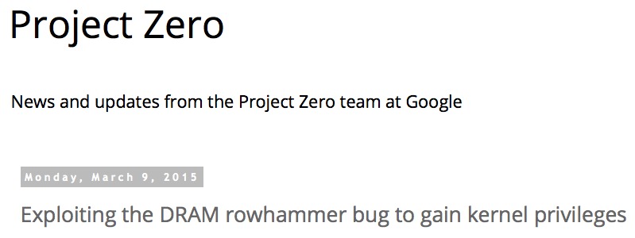
One Can Take Over an Otherwise-Secure System
Flipping Bits in Memory Without Accessing Them: An Experimental Study of DRAM Disturbance Errors (Kim et al., ISCA 2014)
Exploiting the DRAM rowhammer bug to gain kernel privileges (Seaborn, 2015)

Slide 55
RowHammer Security Attack Example
“Rowhammer” is a problem with some recent DRAM devices in which repeatedly accessing a row of memory can cause bit flips in adjacent rows (Kim et al., ISCA 2014).
Flipping Bits in Memory Without Accessing Them: An Experimental Study of DRAM Disturbance Errors (Kim et al., ISCA 2014)
We tested a selection of laptops and found that a subset of them exhibited the problem.
We built two working privilege escalation exploits that use this effect.
Exploiting the DRAM rowhammer bug to gain kernel privileges (Seaborn+, 2015)
One exploit uses rowhammer-induced bit flips to gain kernel privileges on x86-64 Linux when run as an unprivileged userland process.
When run on a machine vulnerable to the rowhammer problem, the process was able to induce bit flips in page table entries (PTEs).
It was able to use this to gain write access to its own page table, and hence gain read-write access to all of physical memory.
Exploiting the DRAM rowhammer bug to gain kernel privileges (Seaborn & Dullien, 2015)

Slide 56
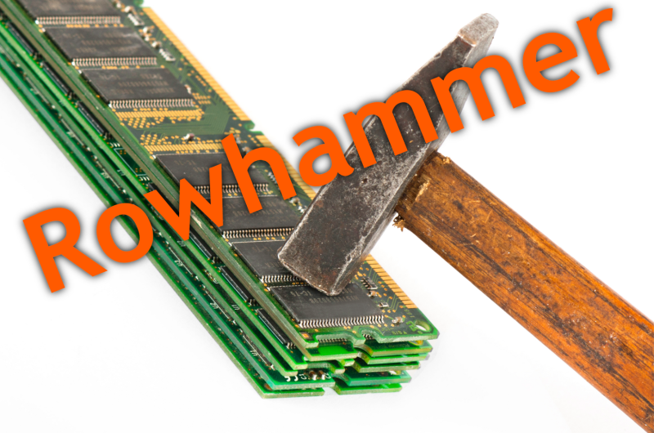
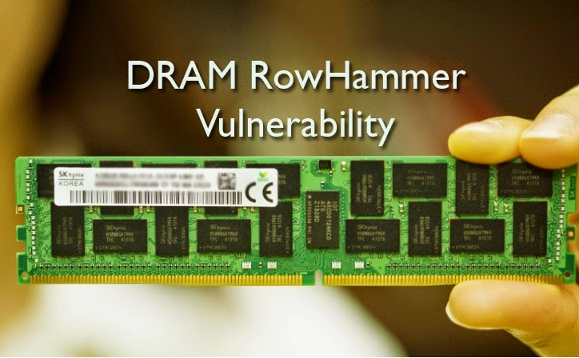
Security Implications
Notes:
Picture from the article:
http://thehackernews.com/2015/03/dram-rowhammer-vulnerability.html

Slide 57
Security Implications
Notes:
Picture from the article:
http://thehackernews.com/2015/03/dram-rowhammer-vulnerability.html

Slide 58
More Security Implications (I)
“We can gain unrestricted access to systems of website visitors.”
Rowhammer.js: A Remote Software-Induced Fault Attack in JavaScript (DIMVA’16)
Source: https://lab.dsst.io/32c3-slides/7197.html

Slide 59
More Security Implications (II)
“Can gain control of a smart phone deterministically”
Drammer: Deterministic Rowhammer Attacks on Mobile Platforms, CCS’16
Source: https://fossbytes.com/drammer-rowhammer-attack-android-root-devices/

Slide 60
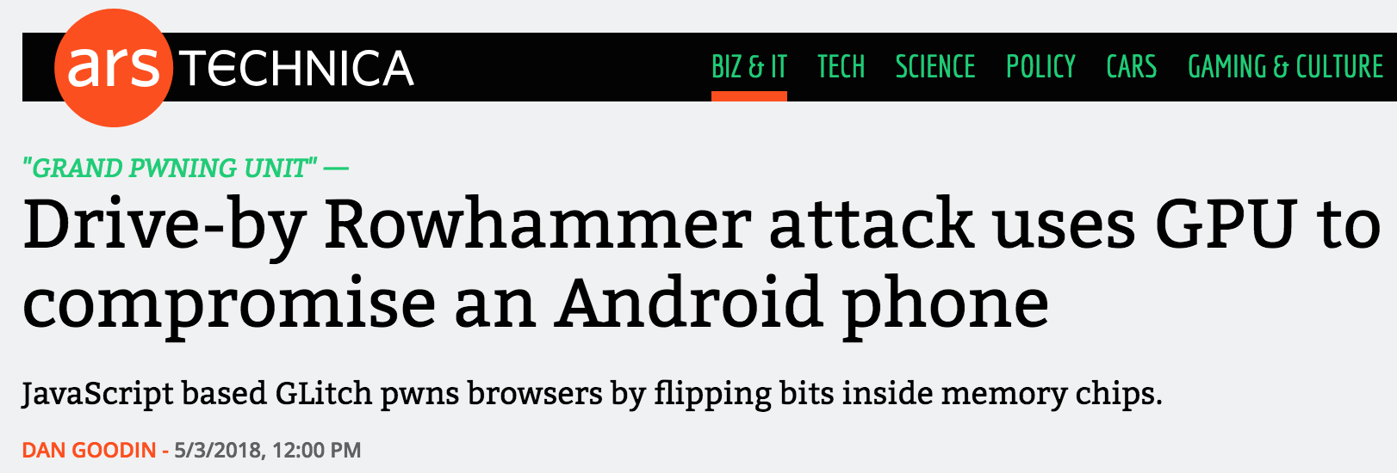
More Security Implications (III)
Using an integrated GPU in a mobile system to remotely escalate privilege via the WebGL interface

Slide 61
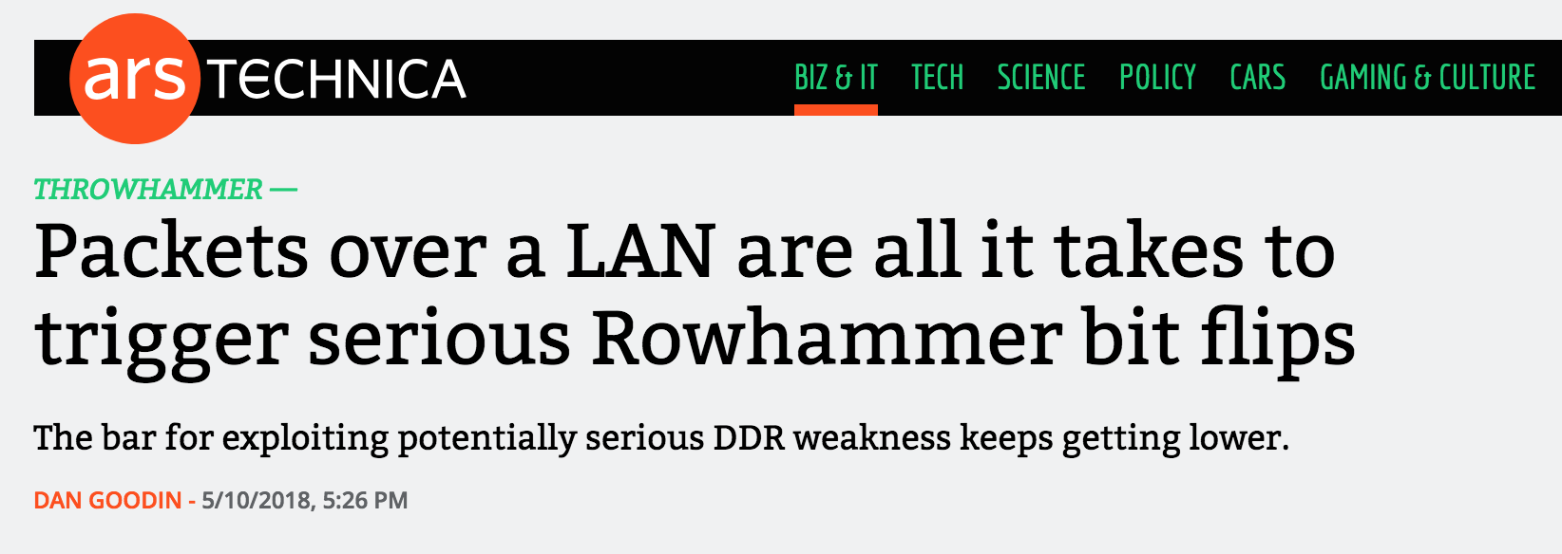
More Security Implications (IV)
Rowhammer over RDMA (I)

Slide 62
More Security Implications (V)
Rowhammer over RDMA (II)

Slide 63
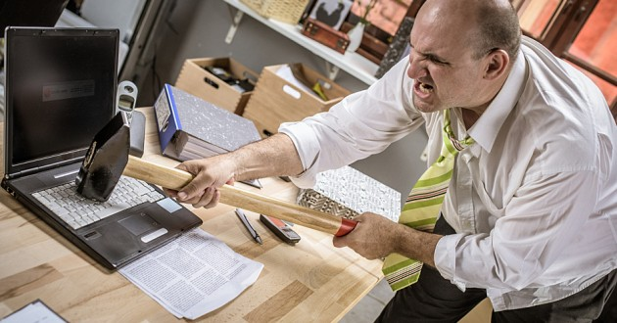
More Security Implications?

Slide 64
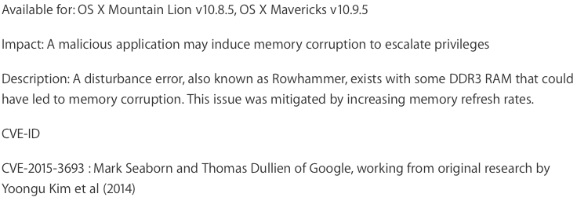
Apple’s Patch for RowHammer
https://support.apple.com/en-gb/HT204934
HP, Lenovo, and other vendors released similar patches

Slide 65
Our Solution to RowHammer
PARA: Probabilistic Adjacent Row Activation
Key Idea
After closing a row, we activate (i.e., refresh) one of its neighbors with a low probability: p = 0.005
Reliability Guarantee
When p=0.005, errors in one year: 9.4×10⁻¹⁴
By adjusting the value of p, we can vary the strength of protection against errors
Notes:
We provide a more efficient solution, called PARA, which stands for probabilistic adjacent row activation.
The key idea is thus: after closing a row, we activate (i.e., refresh) one of its neighbors with a low probability, for example, p equal to 0.005.
PARA provides a strong reliability guarantee even under the worst-case access patterns to DRAM. When we set p to 0.005, the expected number of errors in one year is 9.4 times 10 to the negative 14. This probability is much lower the failure rate of other hardware components, for example, the hard-disk drive.
And by adjusting the value of p, PARA can provide an arbitrarily strong-degree of protection against errors.

Slide 66
Advantages of PARA
PARA refreshes rows infrequently
Low power
Low performance-overhead
Average slowdown: 0.20% (for 29 benchmarks)
Maximum slowdown: 0.75%
PARA is stateless
Low cost
Low complexity
PARA is an effective and low-overhead solution to prevent disturbance errors
Notes:
PARA has many advantages. Since it refreshes row infrequently, it has low power and low performance-overhead. Simulated across 29 benchmarks, we saw an average of only 0.2% slowdown and a maximum of only 0.75% slowdown.
In addition, due to its stateless nature, PARA has low cost and complexity.
Therefore, PARA is an effective and low-overhead solution to prevent disturbance errors.

Slide 67
Requirements for PARA
If implemented in DRAM chip (done today)
Enough slack in timing and refresh parameters
Plenty of slack today:
Lee et al., “Adaptive-Latency DRAM: Optimizing DRAM Timing for the Common Case,” HPCA 2015.
Chang et al., “Understanding Latency Variation in Modern DRAM Chips,” SIGMETRICS 2016.
Lee et al., “Design-Induced Latency Variation in Modern DRAM Chips,” SIGMETRICS 2017.
Chang et al., “Understanding Reduced-Voltage Operation in Modern DRAM Devices,” SIGMETRICS 2017.
Ghose et al., “What Your DRAM Power Models Are Not Telling You: Lessons from a Detailed Experimental Study,” SIGMETRICS 2018.
If implemented in memory controller
Better coordination between memory controller and DRAM
Memory controller should know which rows are physically adjacent

Slide 68
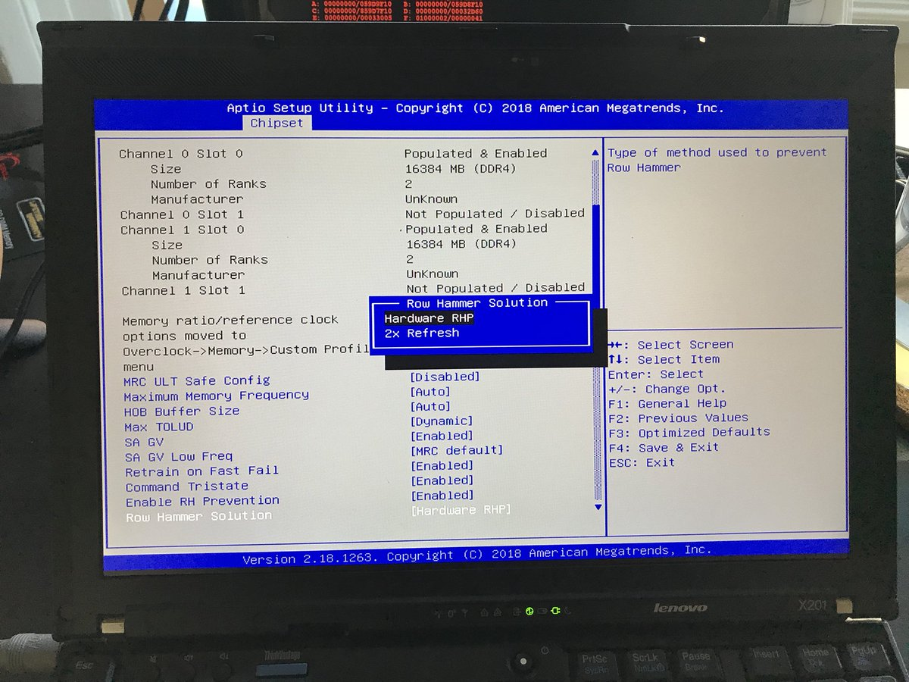
Probabilistic Activation in Real Life (I)
https://twitter.com/isislovecruft/status/1021939922754723841

Slide 69
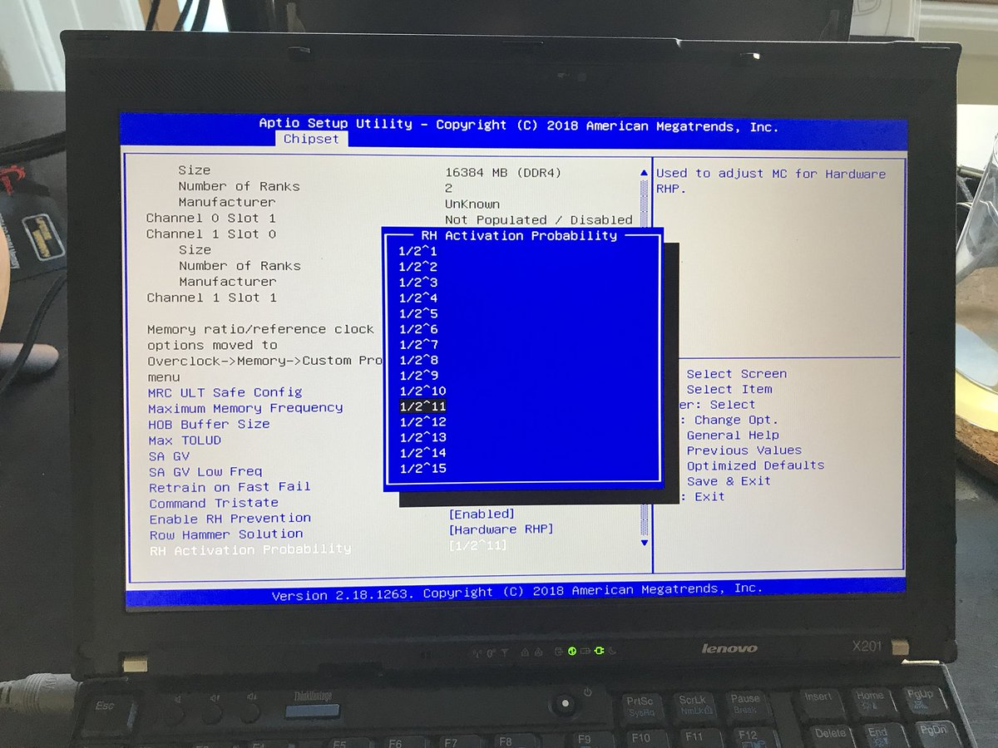
Probabilistic Activation in Real Life (II)
https://twitter.com/isislovecruft/status/1021939922754723841

Slide 70
More on RowHammer Analysis
Yoongu Kim, Ross Daly, Jeremie Kim, Chris Fallin, Ji Hye Lee, Donghyuk Lee, Chris Wilkerson, Konrad Lai, and Onur Mutlu, "Flipping Bits in Memory Without Accessing Them: An Experimental Study of DRAM Disturbance Errors" Proceedings of the 41st International Symposium on Computer Architecture (ISCA), Minneapolis, MN, June 2014. [Slides (pptx) (pdf)] [Lightning Session Slides (pptx) (pdf)] [Source Code and Data]

Slide 71
Future of Memory Reliability
Onur Mutlu, "The RowHammer Problem and Other Issues We May Face as Memory Becomes Denser" Invited Paper in Proceedings of the Design, Automation, and Test in Europe Conference (DATE), Lausanne, Switzerland, March 2017. [Slides (pptx) (pdf)]
https://people.inf.ethz.ch/omutlu/pub/rowhammer-and-other-memory-issues_date17.pdf

Slide 72
A RowHammer Retrospective
Onur Mutlu and Jeremie Kim, "RowHammer: A Retrospective" IEEE Transactions on Computer-Aided Design of Integrated Circuits and Systems (TCAD) Special Issue on Top Picks in Hardware and Embedded Security, 2019. [Preliminary arXiv version]

Slide 73
Takeaway
Main Memory Needs
Intelligent Controllers

Slide 74
Industry Is Writing Papers About It, Too

Slide 75
Call for Intelligent Memory Controllers

Slide 76
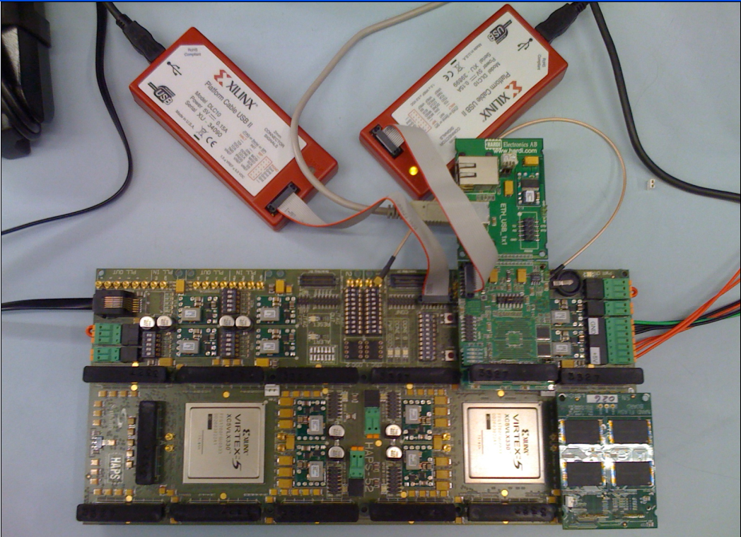
Aside: Intelligent Controller for NAND Flash
USB Daughter Board
USB Jack
HAPS-52 Mother Board
Virtex-II Pro
(USB controller)
1x-nm
NAND Flash
Virtex-V FPGA
(NAND Controller)
[DATE 2012, ICCD 2012, DATE 2013, ITJ 2013, ICCD 2013, SIGMETRICS 2014, HPCA 2015, DSN 2015, MSST 2015, JSAC 2016, HPCA 2017, DFRWS 2017,
PIEEE 2017, HPCA 2018, SIGMETRICS 2018]
NAND Daughter Board
Cai+, “Error Characterization, Mitigation, and Recovery in Flash Memory Based Solid State Drives,” Proc. IEEE 2017.

Slide 77
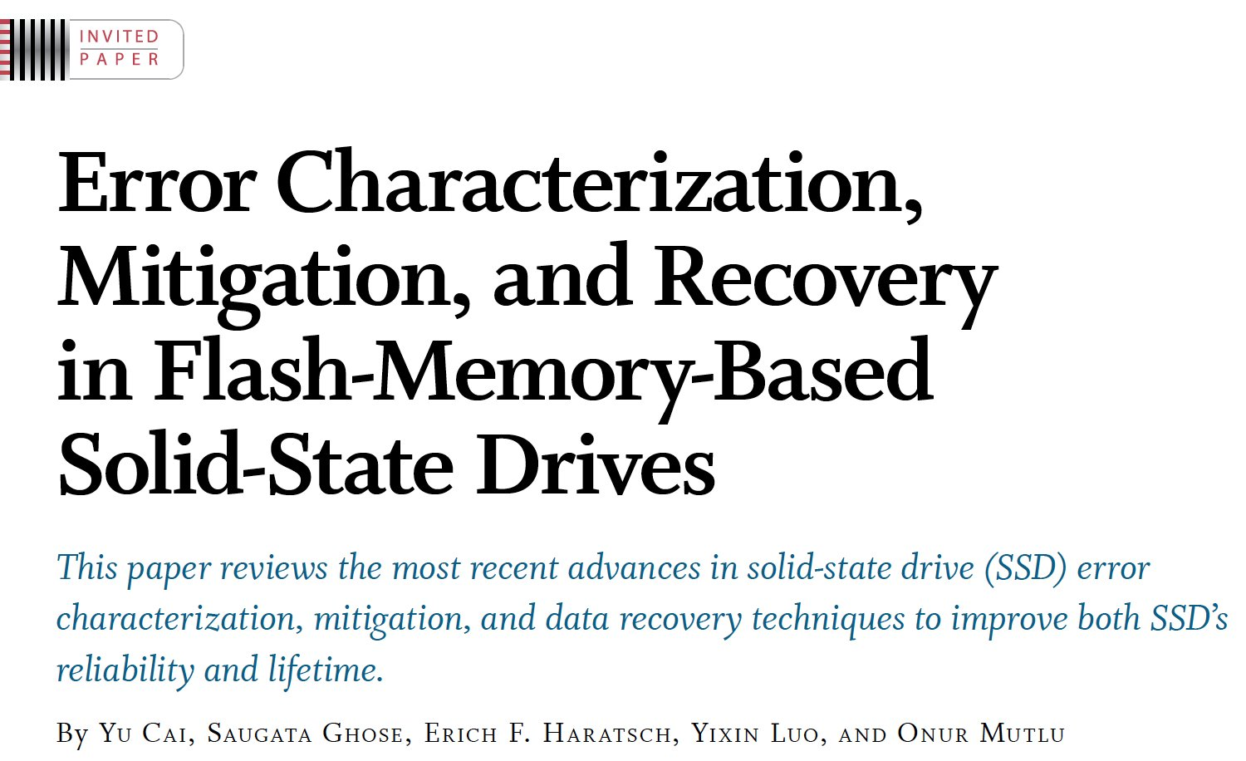
Aside: Intelligent Controller for NAND Flash
Proceedings of the IEEE, Sept. 2017
https://arxiv.org/pdf/1706.08642

Slide 78
Agenda
Major Trends Affecting Main Memory
The Need for Intelligent Memory Controllers
Bottom Up: Push from Circuits and Devices
Top Down: Pull from Systems and Applications
Processing in Memory: Two Directions
Minimally Changing Memory Chips
Exploiting 3D-Stacked Memory
How to Enable Adoption of Processing in Memory
Conclusion

Slide 79
Three Key Systems Trends
1. Data access is a major bottleneck
Applications are increasingly data hungry
2. Energy consumption is a key limiter
3. Data movement energy dominates compute
Especially true for off-chip to on-chip movement

Slide 80
The Need for More Memory Performance
In-memory Databases
[Mao+, EuroSys’12; Clapp+ (Intel), IISWC’15]
Graph/Tree Processing
[Xu+, IISWC’12; Umuroglu+, FPL’15]
In-Memory Data Analytics
[Clapp+ (Intel), IISWC’15;
Awan+, BDCloud’15]
Datacenter Workloads [Kanev+ (Google), ISCA’15]

Slide 81
The Need for More Memory Performance
Chrome
TensorFlow Mobile
Google’s web browser
Google’s machine learning framework
Video Playback
Video Capture
Google’s video codec
Google’s video codec
Notes:
In this work, we take a look at widely-used google consumer workloads, to figure out the major sources of energy consumption.
We look at Google Chrome web brower. We take a look at Tensorflow, Google’s machine learning framework, and we also take a look at two important video related workloads, video playback and video capture, both rely on Google’s vp9 codec technology.

Slide 82
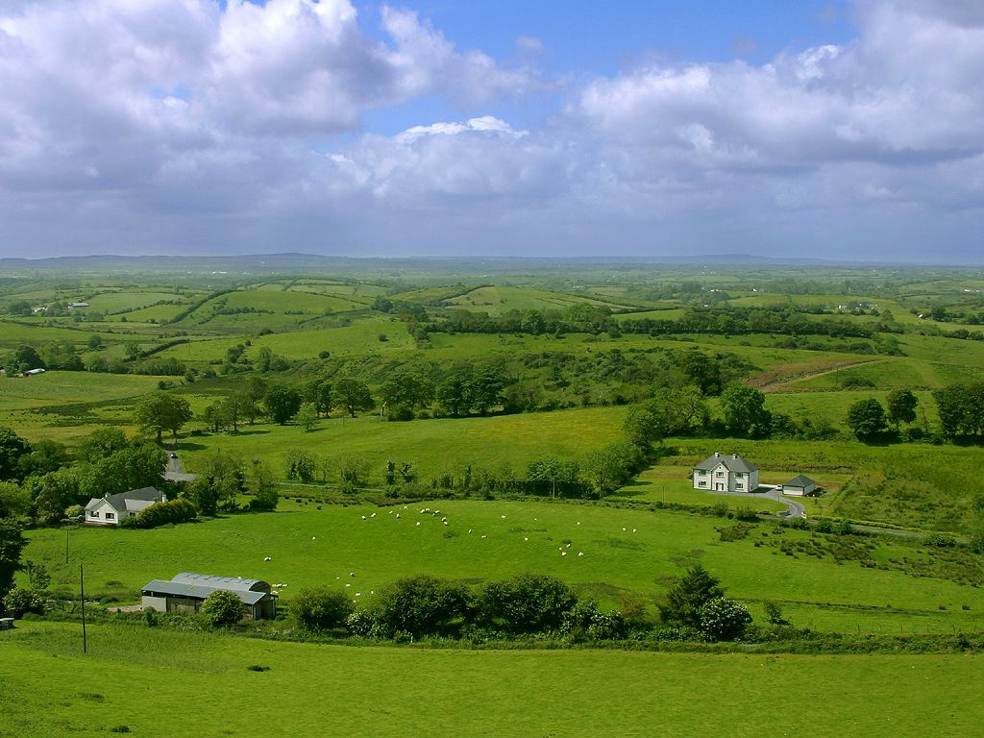
Do We Want This?
Source: V. Milutinovic

Slide 83
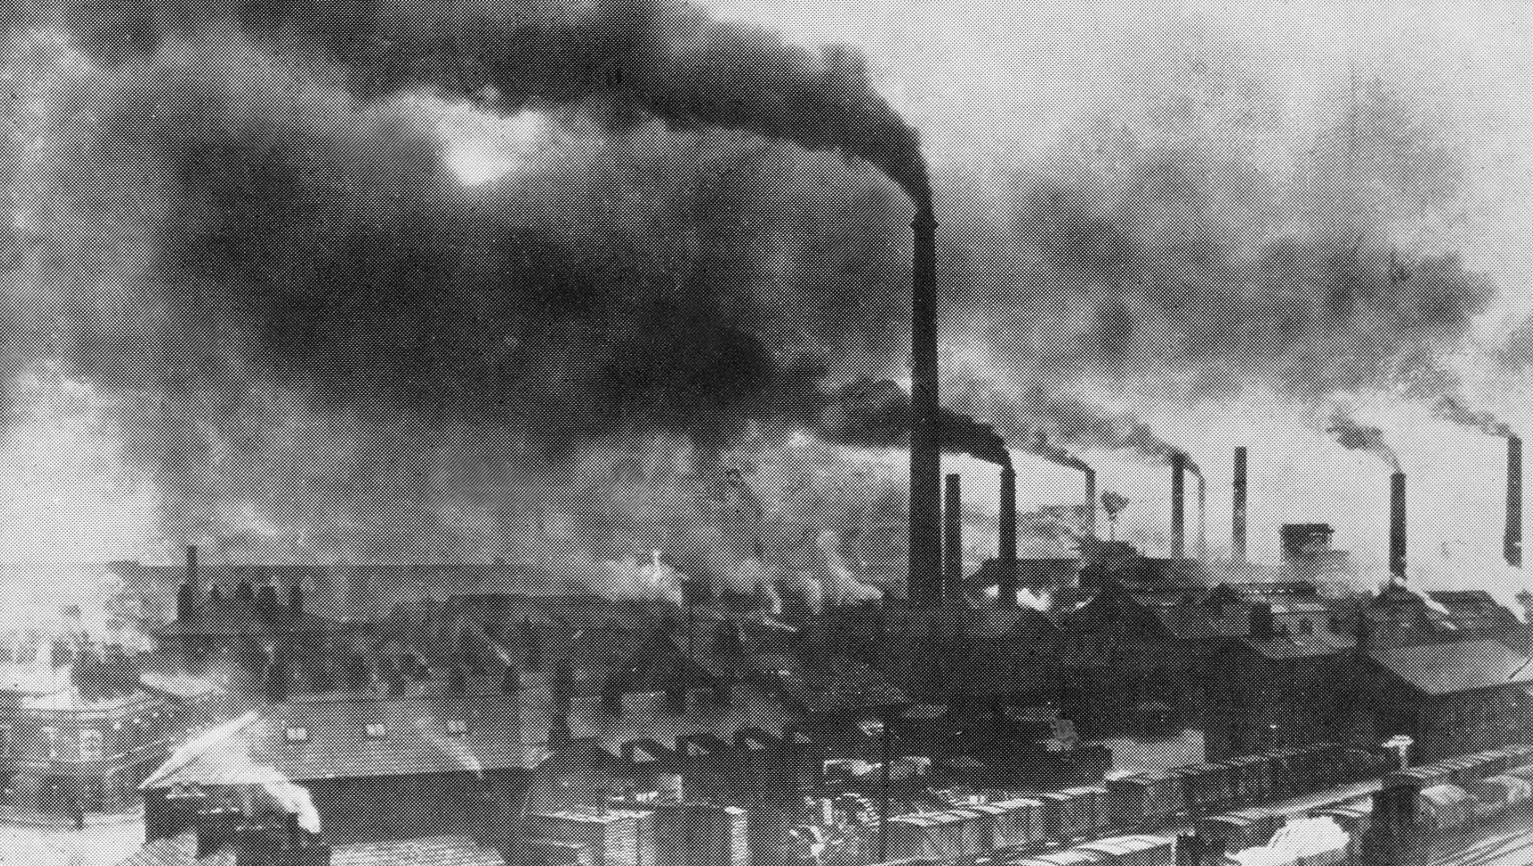
Or This?
Source: V. Milutinovic

Slide 84
Maslow’s (Human) Hierarchy of Needs, Revisited
Maslow, “A Theory of Human Motivation,”
Psychological Review, 1943.
Maslow, “A Theory of Human Motivation,”
Psychological Review, 1943.
Maslow, “Motivation and Personality,”
Book, 1954-1970.
Everlasting energy
Source: https://www.simplypsychology.org/maslow.html

Slide 85
Challenge and Opportunity for Future
High Performance,
Energy Efficient,
Sustainable

Slide 86
The Problem
Data access is the major performance and energy bottleneck
Our current
design principles
cause great energy waste
(and great performance loss)

Slide 87
The Problem
Processing of data
is performed
far away from the data

Slide 88
A Computing System
Three key components
Computation
Communication
Storage/memory
Burks, Goldstein, von Neumann, “Preliminary discussion of the
logical design of an electronic computing instrument,” 1946.
Image source: https://lbsitbytes2010.wordpress.com/2013/03/29/john-von-neumann-roll-no-15/

Slide 89
A Computing System
Three key components
Computation
Communication
Storage/memory
Burks, Goldstein, von Neumann, “Preliminary discussion of the
logical design of an electronic computing instrument,” 1946.
Image source: https://lbsitbytes2010.wordpress.com/2013/03/29/john-von-neumann-roll-no-15/

Slide 90
Today’s Computing Systems
Are overwhelmingly processor centric
All data processed in the processor → at great system cost
Processor is heavily optimized and is considered the master
Data storage units are dumb and are largely unoptimized (except for some that are on the processor die)

Slide 91
Yet …
“It’s the Memory, Stupid!” (Richard Sites, MPR, 1996)
Mutlu+, “Runahead Execution: An Alternative to Very Large Instruction Windows for Out-of-Order Processors,” HPCA 2003.

Slide 92
The Performance Perspective
Onur Mutlu, Jared Stark, Chris Wilkerson, and Yale N. Patt, "Runahead Execution: An Alternative to Very Large Instruction Windows for Out-of-order Processors" Proceedings of the 9th International Symposium on High-Performance Computer Architecture (HPCA), pages 129-140, Anaheim, CA, February 2003. Slides (pdf)

Slide 93
The Performance Perspective (Today)
All of Google’s Data Center Workloads (2015):
Kanev+, “Profiling a Warehouse-Scale Computer,” ISCA 2015.

Slide 94
The Performance Perspective (Today)
All of Google’s Data Center Workloads (2015):
Kanev+, “Profiling a Warehouse-Scale Computer,” ISCA 2015.

Slide 95
Perils of Processor-Centric Design
Grossly-imbalanced systems
Processing done only in one place
Everything else just stores and moves data: data moves a lot
→ Energy inefficient
→ Low performance
→ Complex
Overly complex and bloated processor (and accelerators)
To tolerate data access from memory
Complex hierarchies and mechanisms
→ Energy inefficient
→ Low performance
→ Complex

Slide 96
Perils of Processor-Centric Design
Most of the system is dedicated to storing and moving data

Slide 97
The Energy Perspective
Dally, HiPEAC 2015

Slide 98
Data Movement vs. Computation Energy
Dally, HiPEAC 2015
A memory access consumes ~1000X
the energy of a complex addition

Slide 99
Data Movement vs. Computation Energy
Data movement is a major system energy bottleneck
Comprises 41% of mobile system energy during web browsing [2]
Costs ~115 times as much energy as an ADD operation [1, 2]
[1]: Reducing data Movement Energy via Online Data Clustering and Encoding (MICRO’16)
[2]: Quantifying the energy cost of data movement for emerging smart phone workloads on mobile platforms (IISWC’14)

Slide 100
Energy Waste in Mobile Devices
Amirali Boroumand, Saugata Ghose, Youngsok Kim, Rachata Ausavarungnirun, Eric Shiu, Rahul Thakur, Daehyun Kim, Aki Kuusela, Allan Knies, Parthasarathy Ranganathan, and Onur Mutlu, "Google Workloads for Consumer Devices: Mitigating Data Movement Bottlenecks" Proceedings of the 23rd International Conference on Architectural Support for Programming Languages and Operating Systems (ASPLOS), Williamsburg, VA, USA, March 2018.
62.7% of the total system energy
is spent on data movement

Slide 101
We Do Not Want to Move Data!
Dally, HiPEAC 2015
A memory access consumes ~1000X
the energy of a complex addition

Slide 102
We Need A Paradigm Shift To …
Enable computation with minimal data movement
Compute where it makes sense (where data resides)
Make computing architectures more data-centric

Slide 103
Goal: Processing Inside Memory
Many questions … How do we design the:
compute-capable memory & controllers?
processor chip and in-memory units?
software and hardware interfaces?
system software, compilers, languages?
algorithms and theoretical foundations?
Memory
Processor
Core
Database
Graphs
Media
Cache
Query
Interconnect
Problem
Results
Algorithm
Program/Language
System Software
SW/HW Interface
Micro-architecture
Logic
Devices
Electrons

Slide 104
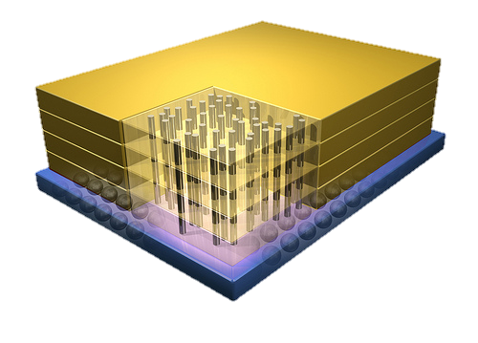
Why In-Memory Computation Today?
Dally, HiPEAC 2015
Push from Technology
DRAM Scaling at jeopardy
→ Controllers close to DRAM
→ Industry open to new memory architectures
Pull from Systems and Applications
Data access is a major system and application bottleneck
Systems are energy limited
Data movement much more energy-hungry than computation

Slide 105
Agenda
Major Trends Affecting Main Memory
The Need for Intelligent Memory Controllers
Bottom Up: Push from Circuits and Devices
Top Down: Pull from Systems and Applications
Processing in Memory: Two Directions
Minimally Changing Memory Chips
Exploiting 3D-Stacked Memory
How to Enable Adoption of Processing in Memory
Conclusion

Slide 106
Processing in Memory: Two Approaches
1. Minimally changing memory chips
2. Exploiting 3D-stacked memory

Slide 107
Approach 1: Minimally Changing DRAM
DRAM has great capability to perform bulk data movement and computation internally with small changes
Can exploit internal connectivity to move data
Can exploit analog computation capability
…
Examples: RowClone, In-DRAM AND/OR, Gather/Scatter DRAM
RowClone: Fast and Efficient In-DRAM Copy and Initialization of Bulk Data (Seshadri et al., MICRO 2013)
Fast Bulk Bitwise AND and OR in DRAM (Seshadri et al., IEEE CAL 2015)
Gather-Scatter DRAM: In-DRAM Address Translation to Improve the Spatial Locality of Non-unit Strided Accesses (Seshadri et al., MICRO 2015)
"Ambit: In-Memory Accelerator for Bulk Bitwise Operations Using Commodity DRAM Technology” (Seshadri et al., MICRO 2017)

Slide 108
Starting Simple: Data Copy and Initialization
memmove & memcpy: 5% cycles in Google’s datacenter [Kanev+ ISCA’15]
000000000000000
Zero initialization
(e.g., security)
Forking
Checkpointing
Many more
VM Cloning
Deduplication
Page Migration

Slide 109
Today’s Systems: Bulk Data Copy
1) High latency
Memory
3) Cache pollution
L3
CPU
L2
L1
MC
2) High bandwidth utilization
4) Unwanted data movement
1046ns, 3.6uJ (for 4KB page copy via DMA)

Slide 110
Future Systems: In-Memory Copy
3) No cache pollution
1) Low latency
Memory
L3
CPU
L2
L1
MC
2) Low bandwidth utilization
4) No unwanted data movement
1046ns, 3.6uJ
→ 90ns, 0.04uJ

Slide 111
RowClone: In-DRAM Row Copy
Idea: Two consecutive ACTivates
4 Kbytes
Negligible HW cost
Step 1: Activate row A
Step 2: Activate row B
Transfer row
DRAM subarray
Transfer
row
Row Buffer (4 Kbytes)
8 bits
Data Bus
Notes:
copy

Slide 112
RowClone: Latency and Energy Savings
11.6x
74x
Seshadri et al., “RowClone: Fast and Efficient In-DRAM Copy and Initialization of Bulk Data,” MICRO 2013.

Slide 113
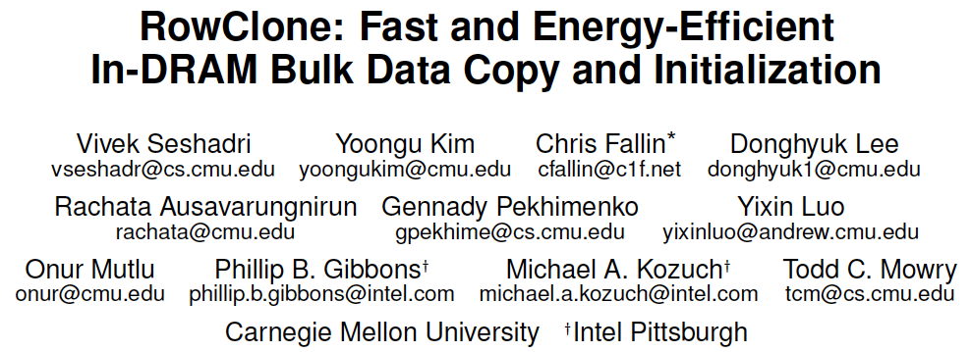
More on RowClone
Vivek Seshadri, Yoongu Kim, Chris Fallin, Donghyuk Lee, Rachata Ausavarungnirun, Gennady Pekhimenko, Yixin Luo, Onur Mutlu, Michael A. Kozuch, Phillip B. Gibbons, and Todd C. Mowry, "RowClone: Fast and Energy-Efficient In-DRAM Bulk Data Copy and Initialization" Proceedings of the 46th International Symposium on Microarchitecture (MICRO), Davis, CA, December 2013. [Slides (pptx) (pdf)] [Lightning Session Slides (pptx) (pdf)] [Poster (pptx) (pdf)]

Slide 114
Memory as an Accelerator
CPU
core
CPU
core
mini-CPU
core
GPU
(throughput)
core
GPU
(throughput)
core
video
core
GPU
(throughput)
core
GPU
(throughput)
core
CPU
core
CPU
core
Memory
imaging
core
LLC
Specialized
compute-capability
in memory
Memory Controller
Memory Bus
Memory similar to a “conventional” accelerator

Slide 115
In-Memory Bulk Bitwise Operations
We can support in-DRAM COPY, ZERO, AND, OR, NOT, MAJ
At low cost
Using analog computation capability of DRAM
Idea: activating multiple rows performs computation
30-60X performance and energy improvement
Seshadri+, “Ambit: In-Memory Accelerator for Bulk Bitwise Operations Using Commodity DRAM Technology,” MICRO 2017.
New memory technologies enable even more opportunities
Memristors, resistive RAM, phase change mem, STT-MRAM, …
Can operate on data with minimal movement

Slide 116
In-DRAM AND/OR: Triple Row Activation
½V_{DD}
½V_{DD}+δ
V_{DD}
A
Final State
AB + BC + AC
B
C
C(A + B) + ~C(AB)
dis
en
0
½V_{DD}
Seshadri+, “Fast Bulk Bitwise AND and OR in DRAM”, IEEE CAL 2015.

Slide 117
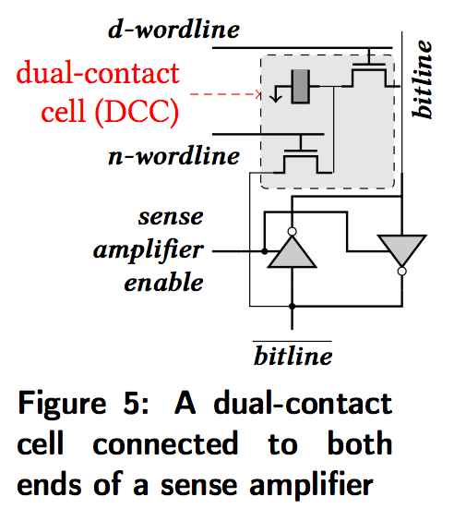
In-DRAM NOT: Dual Contact Cell
Idea:
Feed the
negated value
in the sense amplifier
into a special row
Seshadri+, “Ambit: In-Memory Accelerator for Bulk Bitwise Operations using Commodity DRAM Technology,” MICRO 2017.

Slide 118
Performance: In-DRAM Bitwise Operations
Seshadri+, “Ambit: In-Memory Accelerator for Bulk Bitwise Operations using Commodity DRAM Technology,” MICRO 2017.

Slide 119
Energy of In-DRAM Bitwise Operations
Seshadri+, “Ambit: In-Memory Accelerator for Bulk Bitwise Operations using Commodity DRAM Technology,” MICRO 2017.

Slide 120
Ambit vs. DDR3: Performance and Energy
32X
35X
Seshadri+, “Ambit: In-Memory Accelerator for Bulk Bitwise Operations using Commodity DRAM Technology,” MICRO 2017.

Slide 121
Bulk Bitwise Operations in Workloads
[1] Li and Patel, BitWeaving, SIGMOD 2013
[2] Goodwin+, BitFunnel, SIGIR 2017

Slide 122
Example Data Structure: Bitmap Index
Alternative to B-tree and its variants
Efficient for performing range queries and joins
Many bitwise operations to perform a query
age < 18
18 < age < 25
25 < age < 60
age > 60
Bitmap 1
Bitmap 2
Bitmap 3
Bitmap 4

Slide 123
Performance: Bitmap Index on Ambit
>5.4-6.6X Performance Improvement
Seshadri+, “Ambit: In-Memory Accelerator for Bulk Bitwise Operations using Commodity DRAM Technology,” MICRO 2017.

Slide 124
Performance: BitWeaving on Ambit
>4-12X Performance Improvement
Seshadri+, “Ambit: In-Memory Accelerator for Bulk Bitwise Operations using Commodity DRAM Technology,” MICRO 2017.

Slide 125
More on In-DRAM Bulk AND/OR
Vivek Seshadri, Kevin Hsieh, Amirali Boroumand, Donghyuk Lee, Michael A. Kozuch, Onur Mutlu, Phillip B. Gibbons, and Todd C. Mowry, "Fast Bulk Bitwise AND and OR in DRAM" IEEE Computer Architecture Letters (CAL), April 2015.

Slide 126
More on Ambit
Vivek Seshadri et al., “Ambit: In-Memory Accelerator for Bulk Bitwise Operations Using Commodity DRAM Technology,” MICRO 2017.

Slide 127
More on In-DRAM Bulk Bitwise Execution
Vivek Seshadri and Onur Mutlu, "In-DRAM Bulk Bitwise Execution Engine" Invited Book Chapter in Advances in Computers, to appear in 2020. [Preliminary arXiv version]

Slide 128
Challenge and Opportunity for Future
Computing Architectures
with
Minimal Data Movement

Slide 129
Challenge: Intelligent Memory Device
Does memory
have to be
dumb?

Slide 130
Agenda
Major Trends Affecting Main Memory
The Need for Intelligent Memory Controllers
Bottom Up: Push from Circuits and Devices
Top Down: Pull from Systems and Applications
Processing in Memory: Two Directions
Minimally Changing Memory Chips
Exploiting 3D-Stacked Memory
How to Enable Adoption of Processing in Memory
Conclusion

Slide 131
Processing in Memory: Two Approaches
1. Minimally changing memory chips
2. Exploiting 3D-stacked memory

Slide 132
Opportunity: 3D-Stacked Logic+Memory
Memory
Logic
Other “True 3D” technologies
under development

Slide 133
DRAM Landscape (circa 2015)
Kim+, “Ramulator: A Flexible and Extensible DRAM Simulator”, IEEE CAL 2015.

Slide 134
Two Key Questions in 3D-Stacked PIM
What are the performance and energy benefits of using 3D-stacked memory as a coarse-grained accelerator?
By changing the entire system
By performing simple function offloading
What is the minimal processing-in-memory support we can provide?
With minimal changes to system and programming

Slide 135
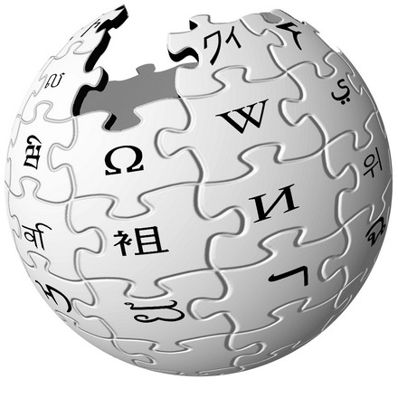
Graph Processing
Large graphs are everywhere (circa 2015)
Scalable large-scale graph processing is challenging
36 Million
Wikipedia Pages
1.4 Billion
Facebook Users
300 Million
Twitter Users
30 Billion
Instagram Photos

Slide 136
Key Bottlenecks in Graph Processing
for (v: graph.vertices) {
for (w: v.successors) {
w.next_rank += weight * v.rank;
}
}
1. Frequent random memory accesses
v
&w
w.rank
w.next_rank
w.edges
weight * v.rank
w
…
2. Little amount of computation

Slide 137
Tesseract System for Graph Processing
Interconnected set of 3D-stacked memory+logic chips with simple cores
Host Processor
Memory
Memory-Mapped
Accelerator Interface
(Noncacheable, Physically Addressed)
Logic
In-Order Core
DRAM Controller
…
…
LP
PF Buffer
Crossbar Network
…
MTP
…
Message Queue
NI
Ahn+, “A Scalable Processing-in-Memory Accelerator for Parallel Graph Processing” ISCA 2015.

Slide 138
Tesseract System for Graph Processing
Host Processor
Memory
Memory-Mapped
Accelerator Interface
(Noncacheable, Physically Addressed)
Logic
In-Order Core
DRAM Controller
…
…
Communications via Remote Function Calls
LP
PF Buffer
Crossbar Network
…
MTP
…
Message Queue
NI

Slide 139
Tesseract System for Graph Processing
Host Processor
Memory
Memory-Mapped
Accelerator Interface
(Noncacheable, Physically Addressed)
Logic
Prefetching
In-Order Core
DRAM Controller
…
…
LP
PF Buffer
Crossbar Network
…
MTP
…
Message Queue
NI

Slide 140
Evaluated Systems
DDR3-OoO
HMC-OoO
HMC-MC
Tesseract
32 Tesseract Cores
8 OoO
4GHz
8 OoO
4GHz
8 OoO
4GHz
8 OoO
4GHz
128 In-Order
2GHz
128 In-Order
2GHz
8 OoO
4GHz
8 OoO
4GHz
8 OoO
4GHz
8 OoO
4GHz
128 In-Order
2GHz
128 In-Order
2GHz
102.4GB/s
640GB/s
640GB/s
8TB/s
Ahn+, “A Scalable Processing-in-Memory Accelerator for Parallel Graph Processing” ISCA 2015.

Slide 141
Tesseract Graph Processing Performance
>13X Performance Improvement
On five graph processing algorithms
Ahn+, “A Scalable Processing-in-Memory Accelerator for Parallel Graph Processing” ISCA 2015.

Slide 142
Tesseract Graph Processing Performance

Slide 143
Tesseract Graph Processing System Energy
> 8X Energy Reduction
Ahn+, “A Scalable Processing-in-Memory Accelerator for Parallel Graph Processing” ISCA 2015.

Slide 144
More on Tesseract
Junwhan Ahn, Sungpack Hong, Sungjoo Yoo, Onur Mutlu, and Kiyoung Choi, "A Scalable Processing-in-Memory Accelerator for Parallel Graph Processing" Proceedings of the 42nd International Symposium on Computer Architecture (ISCA), Portland, OR, June 2015. [Slides (pdf)] [Lightning Session Slides (pdf)]

Slide 145
Two Key Questions in 3D-Stacked PIM
What are the performance and energy benefits of using 3D-stacked memory as a coarse-grained accelerator?
By changing the entire system
By performing simple function offloading
What is the minimal processing-in-memory support we can provide?
With minimal changes to system and programming

Slide 146
PIM on Mobile Devices
Amirali Boroumand, Saugata Ghose, Youngsok Kim, Rachata Ausavarungnirun, Eric Shiu, Rahul Thakur, Daehyun Kim, Aki Kuusela, Allan Knies, Parthasarathy Ranganathan, and Onur Mutlu, "Google Workloads for Consumer Devices: Mitigating Data Movement Bottlenecks" Proceedings of the 23rd International Conference on Architectural Support for Programming Languages and Operating Systems (ASPLOS), Williamsburg, VA, USA, March 2018.

Slide 147
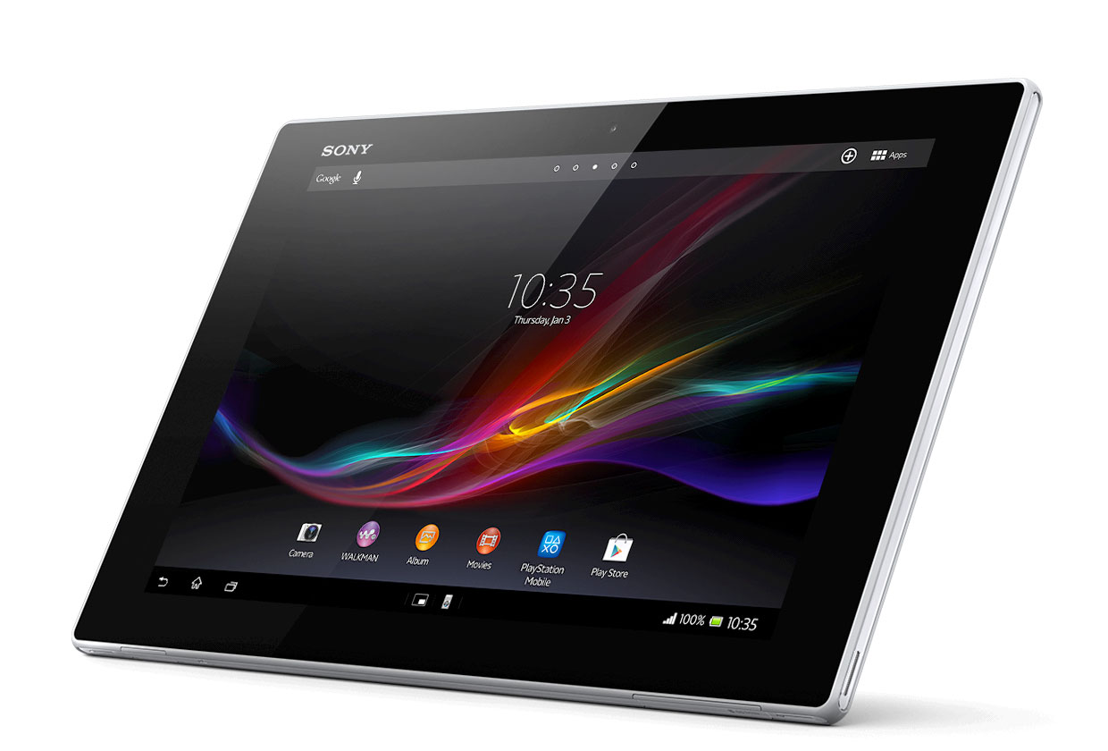
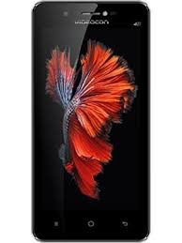
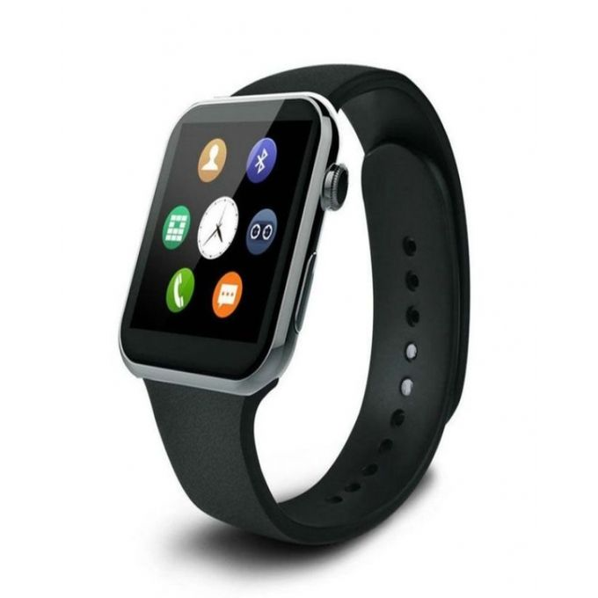
Consumer Devices
Consumer devices are everywhere!
Energy consumption is a first-class concern in consumer devices
Notes:
Consumer devices like tablets smartphone and wearable are now everywhere and used by billions of people.
One of the major challenge in these devices is battery limitation which makes the energy consumption a critical concern …

Slide 148
Four Important Workloads
Chrome
TensorFlow Mobile
Google’s web browser
Google’s machine learning framework
Video Playback
Video Capture
Google’s video codec
Google’s video codec
Notes:
In this work, we take a look at widely-used google consumer workloads, to figure out the major sources of energy consumption.
We look at Google Chrome web brower. We take a look at Tensorflow, Google’s machine learning framework, and we also take a look at two important video related workloads, video playback and video capture, both rely on Google’s vp9 codec technology.

Slide 149
Energy Cost of Data Movement
1st key observation: 62.7% of the total system energy is spent on data movement
Data Movement
SoC
DRAM
CPU
L2
CPU
L1
CPU
CPU
Compute Unit
Processing-In-Memory (PIM)
Potential solution: move computation close to data
Challenge: limited area and energy budget
Notes:
Throughout our analysis, we make a key observation that out of all sources of energy consumption, data movement is a major contributor to the total system energy. We find that across all of the workloads, on average around 62.7% of total system energy is spent on data movement.
One way to reduce data movement cost is to move computation close to data, or …
One potential solution to address this cost it do move computation close to data, or in other words, do procesing in memory. However, the challenge is that these devices.
One potential solution to mitigate data movement cost and reduce total system energy is to execute data-movement heavy portions of application close to data, or in other words, do processing in memory. However, consumer devices are extermely limited in terms of area and power budget. So the question is can we move part of the data movement heavy portion given the limited area and energy budget. Our

Slide 150
Using PIM to Reduce Data Movement
2nd key observation: a significant fraction of the data movement often comes from simple functions
We can design lightweight logic to implement these simple functions in memory
Small embedded low-power core
Small fixed-function accelerators
PIM Core
PIM Accelerator
PIM Accelerator
PIM Accelerator
Offloading to PIM logic reduces energy and improves performance, on average, by 55.4% and 54.2%
Notes:
To figure out if we can use processing in memory, we dig deeper into our analysis and we make another key observation that majority of data movement often comes form simple functions and pritmitives. We find that these simple function can be implemented in memory as either a small embedded core, or group of small fixed function accelerators. Our result shows that offloading these function to PIM logic can significantly reduce data movement for each function and reduce energy on average around 55% and improve perforamcne around 54%.
our PIM core can reduce significant portion of data movement, reduce enregy by 49.1% for each function and improve performance up to 2.2X. While using group of fixed function accelerator reduce energy by 55.4% and improve performance by up to 2.5X.
Or use Saugata’s approach : Reduces total system energy by an average of 55.4%
Reduces execution time by an average of 54.2%
Our result show that both of them can significantly reduce the data movement for each function.
Feedback: talk about result more
Don’t talk about specific detail like MemCopy, MemSet stuff like that
Main take away: data movement come from simple functions that are simple enough to implement in PIM
We find that these functions and primitves can be implemented as PIM logic using either (1) a small low-power general-purpose embedded core or (2) a group of small fixed-function accelerators (PIM accelerators). Our Analysis shows that both are cost-feasible to use in consumer devices. We find that they eliminate a significant fraction of dat amovement, and reduce energy consumption for each of these operation on average by 49 and 55%.

Slide 151
Workload Analysis
Chrome
TensorFlow Mobile
Google’s web browser
Google’s machine learning framework
Video Playback
Video Capture
Google’s video codec
Google’s video codec
Notes:
In this work, we take a look at widely-used google consumer workloads, to figure out the major sources of energy consumption.
We look at Google Chrome web brower. We take a look at Tensorflow, Google’s machine learning framework, and we also take a look at two important video related workloads, video playback and video capture, both rely on Google’s vp9 codec technology.

Slide 152
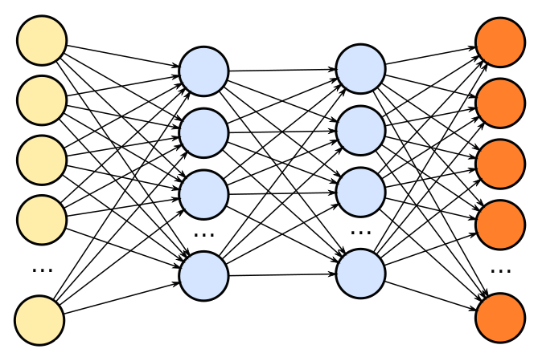
TensorFlow Mobile
Inference
Prediction
57.3% of the inference energy is spent on data movement
54.4% of the data movement energy comes from packing/unpacking and quantization

Slide 153
Packing
Matrix
Packing
Packed Matrix
Reorders elements of matrices to minimize cache misses during matrix multiplication
Up to 40% of the inference energy and 31% of inference execution time
Packing’s data movement accounts for up to 35.3% of the inference energy
A simple data reorganization process that requires simple arithmetic

Slide 154
Quantization
floating point
Quantization
integer
Converts 32-bit floating point to 8-bit integers to improve inference execution time and energy consumption
Up to 16.8% of the inference energy and 16.1% of inference execution time
Majority of quantization energy comes from data movement
A simple data conversion operation that requires shift, addition, and multiplication operations

Slide 155
Normalized Energy
Chrome Browser
TensorFlow Mobile
Video Playback and Capture
PIM core and PIM accelerator reduce energy consumption on average by 49.1% and 55.4%
Notes:
We make another obsrevation that using PIM accelerator provide limited energy reduction over PIM core, for some of these workloads, such as texture tiling. This is becase these kernels are data intensive and have low ocmputational compleity, and as a result, using fixed function accelerator does not provide significant energy reduction over the PIM core.

Slide 156
Normalized Runtime
Chrome Browser
Video Playback and Capture
TensorFlow Mobile
Offloading these kernels to PIM core and PIM accelerator improves performance on average by 44.6% and 54.2%
Notes:
PIM-Core and PIM-Acc significantly outperform CPU-Only across all kernels, improving performance by … This perfomance benefit come from higher bandwidth and lower access latency of 3D-stacked memory, because all of these kernels are data intensive.
Performance improvement of PIM-acc over PIM-core differes across different workloads. In some cases such as Texture Tiling, the performance improvement of PIM-Acc over PIM-Core is limited by the low computational complexity of these two kernels. But there are other cases, such as compression that benefit significantly from using PIM-Acc over PIM-Core in terms of performance, because these kernels are more compute-intensive and less data-intensive compared to texture tiling and.

Slide 157
More on PIM for Mobile Devices
Amirali Boroumand, Saugata Ghose, Youngsok Kim, Rachata Ausavarungnirun, Eric Shiu, Rahul Thakur, Daehyun Kim, Aki Kuusela, Allan Knies, Parthasarathy Ranganathan, and Onur Mutlu, "Google Workloads for Consumer Devices: Mitigating Data Movement Bottlenecks" Proceedings of the 23rd International Conference on Architectural Support for Programming Languages and Operating Systems (ASPLOS), Williamsburg, VA, USA, March 2018.
62.7% of the total system energy
is spent on data movement

Slide 158
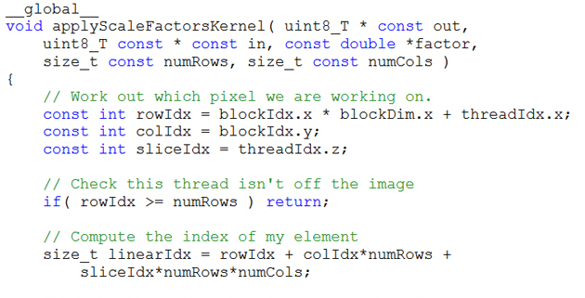
Truly Distributed GPU Processing with PIM?
3D-stacked memory
(memory stack)
SM (Streaming Multiprocessor)
Logic layer
Logic layer SM
Main GPU
Crossbar switch
Vault Ctrl
….
Vault Ctrl

Slide 159
Accelerating GPU Execution with PIM (I)
Kevin Hsieh, Eiman Ebrahimi, Gwangsun Kim, Niladrish Chatterjee, Mike O'Connor, Nandita Vijaykumar, Onur Mutlu, and Stephen W. Keckler, "Transparent Offloading and Mapping (TOM): Enabling Programmer-Transparent Near-Data Processing in GPU Systems" Proceedings of the 43rd International Symposium on Computer Architecture (ISCA), Seoul, South Korea, June 2016. [Slides (pptx) (pdf)] [Lightning Session Slides (pptx) (pdf)]

Slide 160
Accelerating GPU Execution with PIM (II)
Ashutosh Pattnaik, Xulong Tang, Adwait Jog, Onur Kayiran, Asit K. Mishra, Mahmut T. Kandemir, Onur Mutlu, and Chita R. Das, "Scheduling Techniques for GPU Architectures with Processing-In-Memory Capabilities" Proceedings of the 25th International Conference on Parallel Architectures and Compilation Techniques (PACT), Haifa, Israel, September 2016.

Slide 161
Accelerating Linked Data Structures
Kevin Hsieh, Samira Khan, Nandita Vijaykumar, Kevin K. Chang, Amirali Boroumand, Saugata Ghose, and Onur Mutlu, "Accelerating Pointer Chasing in 3D-Stacked Memory: Challenges, Mechanisms, Evaluation" Proceedings of the 34th IEEE International Conference on Computer Design (ICCD), Phoenix, AZ, USA, October 2016.

Slide 162
Accelerating Dependent Cache Misses
Milad Hashemi, Khubaib, Eiman Ebrahimi, Onur Mutlu, and Yale N. Patt, "Accelerating Dependent Cache Misses with an Enhanced Memory Controller" Proceedings of the 43rd International Symposium on Computer Architecture (ISCA), Seoul, South Korea, June 2016. [Slides (pptx) (pdf)] [Lightning Session Slides (pptx) (pdf)]

Slide 163
Two Key Questions in 3D-Stacked PIM
What are the performance and energy benefits of using 3D-stacked memory as a coarse-grained accelerator?
By changing the entire system
By performing simple function offloading
What is the minimal processing-in-memory support we can provide?
With minimal changes to system and programming

Slide 164
PEI: PIM-Enabled Instructions (Ideas)
Goal: Develop mechanisms to get the most out of near-data processing with minimal cost, minimal changes to the system, no changes to the programming model
Key Idea 1: Expose each PIM operation as a cache-coherent, virtually-addressed host processor instruction (called PEI) that operates on only a single cache block
e.g., __pim_add(&w.next_rank, value) → pim.add r1, (r2)
No changes sequential execution/programming model
No changes to virtual memory
Minimal changes to cache coherence
No need for data mapping: Each PEI restricted to a single memory module
Key Idea 2: Dynamically decide where to execute a PEI (i.e., the host processor or PIM accelerator) based on simple locality characteristics and simple hardware predictors
Execute each operation at the location that provides the best performance

Slide 165
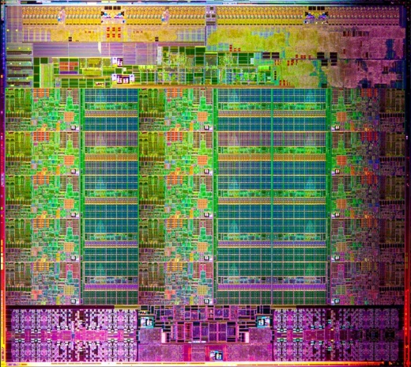
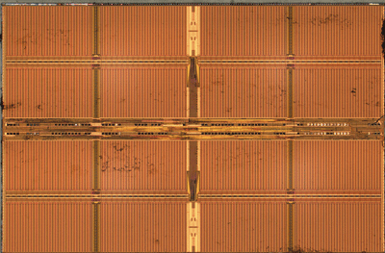
Simple PIM Operations as ISA Extensions (II)
for (v: graph.vertices) {
value = weight * v.rank;
for (w: v.successors) {
w.next_rank += value;
}
}
Host Processor
Main Memory
w.next_rank
w.next_rank
w.next_rank
w.next_rank
64 bytes in
64 bytes out
Conventional Architecture

Slide 166
Simple PIM Operations as ISA Extensions (III)
for (v: graph.vertices) {
value = weight * v.rank;
for (w: v.successors) {
__pim_add(&w.next_rank, value);
}
}
pim.add r1, (r2)
Host Processor
Main Memory
value
w.next_rank
w.next_rank
8 bytes in
0 bytes out
In-Memory Addition

Slide 167
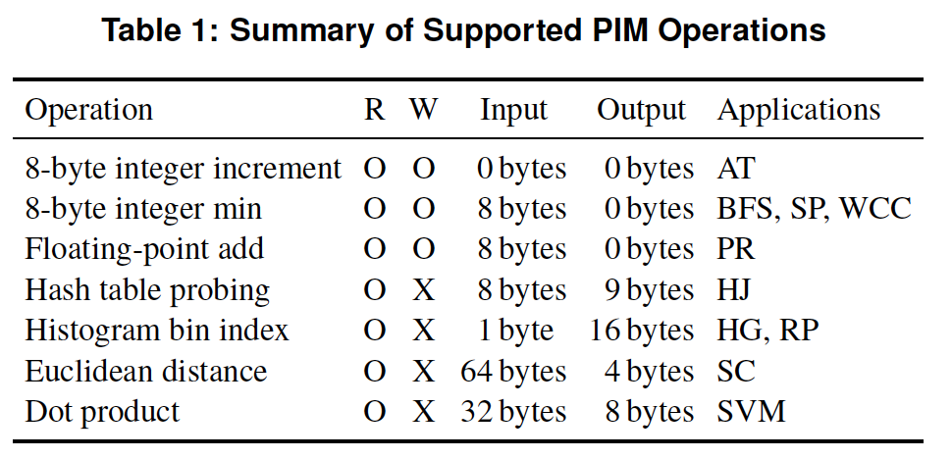
PEI: PIM-Enabled Instructions (Example)
for (v: graph.vertices) {
value = weight * v.rank;
for (w: v.successors) {
__pim_add(&w.next_rank, value);
}
}
pfence();
pim.add r1, (r2)
pfence
Executed either in memory or in the processor: dynamic decision
Low-cost locality monitoring for a single instruction
Cache-coherent, virtually-addressed, single cache block only
Atomic between different PEIs
Not atomic with normal instructions (use pfence for ordering)

Slide 168
Example (Abstract) PEI uArchitecture
Host Processor
3D-stacked Memory
Out-Of-Order Core
Last-Level Cache
DRAM Controller
L1 Cache
PCU
L2 Cache
PCU (PEI Computation Unit)
DRAM Controller
PCU
Network
HMC Controller
PMU (PEI
Mgmt Unit)
…
PIM Directory
Locality Monitor
DRAM Controller
PCU
Example PEI uArchitecture

Slide 169
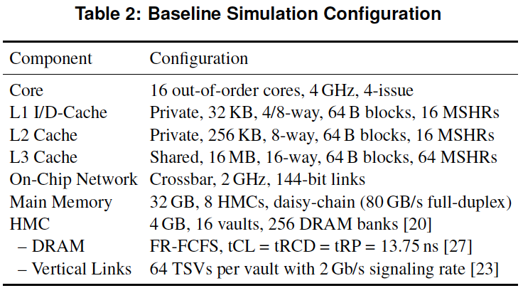
PEI: Initial Evaluation Results
Initial evaluations with 10 emerging data-intensive workloads
Large-scale graph processing
In-memory data analytics
Machine learning and data mining
Three input sets (small, medium, large) for each workload to analyze the impact of data locality
Pin-based cycle-level x86-64 simulation
Performance Improvement and Energy Reduction:
47% average speedup with large input data sets
32% speedup with small input data sets
25% avg. energy reduction in a single node with large input data sets

Slide 170
PEI Performance Delta: Large Data Sets
(Large Inputs, Baseline: Host-Only)
47% Performance
Improvement

Slide 171
PEI Energy Consumption
25% Energy
Reduction
Host-Only
PIM-Only
Locality-Aware

Slide 172
Simpler PIM: PIM-Enabled Instructions
Junwhan Ahn, Sungjoo Yoo, Onur Mutlu, and Kiyoung Choi, "PIM-Enabled Instructions: A Low-Overhead, Locality-Aware Processing-in-Memory Architecture" Proceedings of the 42nd International Symposium on Computer Architecture (ISCA), Portland, OR, June 2015. [Slides (pdf)] [Lightning Session Slides (pdf)]

Slide 173
Automatic Code and Data Mapping
Kevin Hsieh, Eiman Ebrahimi, Gwangsun Kim, Niladrish Chatterjee, Mike O'Connor, Nandita Vijaykumar, Onur Mutlu, and Stephen W. Keckler, "Transparent Offloading and Mapping (TOM): Enabling Programmer-Transparent Near-Data Processing in GPU Systems" Proceedings of the 43rd International Symposium on Computer Architecture (ISCA), Seoul, South Korea, June 2016. [Slides (pptx) (pdf)] [Lightning Session Slides (pptx) (pdf)]

Slide 174
Automatic Offloading of Critical Code
Milad Hashemi, Khubaib, Eiman Ebrahimi, Onur Mutlu, and Yale N. Patt, "Accelerating Dependent Cache Misses with an Enhanced Memory Controller" Proceedings of the 43rd International Symposium on Computer Architecture (ISCA), Seoul, South Korea, June 2016. [Slides (pptx) (pdf)] [Lightning Session Slides (pptx) (pdf)]

Slide 175
Automatic Offloading of Prefetch Mechanisms
Milad Hashemi, Onur Mutlu, and Yale N. Patt, "Continuous Runahead: Transparent Hardware Acceleration for Memory Intensive Workloads" Proceedings of the 49th International Symposium on Microarchitecture (MICRO), Taipei, Taiwan, October 2016. [Slides (pptx) (pdf)] [Lightning Session Slides (pdf)] [Poster (pptx) (pdf)]

Slide 176
Efficient Automatic Data Coherence Support
Amirali Boroumand, Saugata Ghose, Minesh Patel, Hasan Hassan, Brandon Lucia, Kevin Hsieh, Krishna T. Malladi, Hongzhong Zheng, and Onur Mutlu, "LazyPIM: An Efficient Cache Coherence Mechanism for Processing-in-Memory" IEEE Computer Architecture Letters (CAL), June 2016.

Slide 177
Efficient Automatic Data Coherence Support
Amirali Boroumand, Saugata Ghose, Minesh Patel, Hasan Hassan, Brandon Lucia, Kevin Hsieh, Krishna T. Malladi, Hongzhong Zheng, and Onur Mutlu, "CoNDA: Efficient Cache Coherence Support for Near-Data Accelerators" Proceedings of the 46th International Symposium on Computer Architecture (ISCA), Phoenix, AZ, USA, June 2019.

Slide 178
Challenge and Opportunity for Future
Computing Architectures
with
Minimal Data Movement

Slide 179
Agenda
Major Trends Affecting Main Memory
The Need for Intelligent Memory Controllers
Bottom Up: Push from Circuits and Devices
Top Down: Pull from Systems and Applications
Processing in Memory: Two Directions
Minimally Changing Memory Chips
Exploiting 3D-Stacked Memory
How to Enable Adoption of Processing in Memory
Conclusion

Slide 180
Eliminating the Adoption Barriers
How to Enable Adoption of Processing in Memory

Slide 181
Barriers to Adoption of PIM
1. Functionality of and applications & software for PIM
2. Ease of programming (interfaces and compiler/HW support)
3. System support: coherence & virtual memory
4. Runtime and compilation systems for adaptive scheduling, data mapping, access/sharing control
5. Infrastructures and models to assess benefits and feasibility
All can be solved with change of mindset

Slide 182
We Need to Revisit the Entire Stack
Problem
Algorithm
Program/Language
System Software
SW/HW Interface
Micro-architecture
Logic
Devices
Electrons
We can get there step by step

Slide 183
PIM Review and Open Problems
Onur Mutlu, Saugata Ghose, Juan Gomez-Luna, and Rachata Ausavarungnirun, "Processing Data Where It Makes Sense: Enabling In-Memory Computation" Invited paper in Microprocessors and Microsystems (MICPRO), June 2019. [arXiv version]
https://arxiv.org/pdf/1903.03988.pdf

Slide 184
PIM Review and Open Problems (II)
Saugata Ghose, Amirali Boroumand, Jeremie S. Kim, Juan Gomez-Luna, and Onur Mutlu, "Processing-in-Memory: A Workload-Driven Perspective" Invited Article in IBM Journal of Research & Development, Special Issue on Hardware for Artificial Intelligence, to appear in November 2019. [Preliminary arXiv version]
https://arxiv.org/pdf/1907.12947.pdf

Slide 185
Key Challenge 1: Code Mapping
Challenge 1: Which operations should be executed in memory vs. in CPU?
?
3D-stacked memory
(memory stack)
SM (Streaming Multiprocessor)
?
Logic layer
Logic layer SM
Main GPU
Crossbar switch
Vault Ctrl
….
Vault Ctrl

Slide 186
Key Challenge 2: Data Mapping
Challenge 2: How should data be mapped to different 3D memory stacks?
3D-stacked memory
(memory stack)
SM (Streaming Multiprocessor)
Logic layer
Logic layer SM
Main GPU
Crossbar switch
Vault Ctrl
….
Vault Ctrl

Slide 187
How to Do the Code and Data Mapping?
Kevin Hsieh, Eiman Ebrahimi, Gwangsun Kim, Niladrish Chatterjee, Mike O'Connor, Nandita Vijaykumar, Onur Mutlu, and Stephen W. Keckler, "Transparent Offloading and Mapping (TOM): Enabling Programmer-Transparent Near-Data Processing in GPU Systems" Proceedings of the 43rd International Symposium on Computer Architecture (ISCA), Seoul, South Korea, June 2016. [Slides (pptx) (pdf)] [Lightning Session Slides (pptx) (pdf)]

Slide 188
How to Schedule Code?
Ashutosh Pattnaik, Xulong Tang, Adwait Jog, Onur Kayiran, Asit K. Mishra, Mahmut T. Kandemir, Onur Mutlu, and Chita R. Das, "Scheduling Techniques for GPU Architectures with Processing-In-Memory Capabilities" Proceedings of the 25th International Conference on Parallel Architectures and Compilation Techniques (PACT), Haifa, Israel, September 2016.

Slide 189
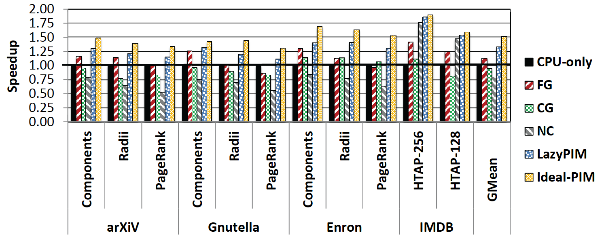
Challenge: Coherence for Hybrid CPU-PIM Apps
Traditional
coherence
No coherence
overhead

Slide 190
How to Maintain Coherence?
Amirali Boroumand, Saugata Ghose, Minesh Patel, Hasan Hassan, Brandon Lucia, Kevin Hsieh, Krishna T. Malladi, Hongzhong Zheng, and Onur Mutlu, "LazyPIM: An Efficient Cache Coherence Mechanism for Processing-in-Memory" IEEE Computer Architecture Letters (CAL), June 2016.

Slide 191
How to Support Virtual Memory?
Kevin Hsieh, Samira Khan, Nandita Vijaykumar, Kevin K. Chang, Amirali Boroumand, Saugata Ghose, and Onur Mutlu, "Accelerating Pointer Chasing in 3D-Stacked Memory: Challenges, Mechanisms, Evaluation" Proceedings of the 34th IEEE International Conference on Computer Design (ICCD), Phoenix, AZ, USA, October 2016.

Slide 192
How to Design Data Structures for PIM?
Zhiyu Liu, Irina Calciu, Maurice Herlihy, and Onur Mutlu, "Concurrent Data Structures for Near-Memory Computing" Proceedings of the 29th ACM Symposium on Parallelism in Algorithms and Architectures (SPAA), Washington, DC, USA, July 2017. [Slides (pptx) (pdf)]

Slide 193
Simulation Infrastructures for PIM
Ramulator extended for PIM
Flexible and extensible DRAM simulator
Can model many different memory standards and proposals
Kim+, “Ramulator: A Flexible and Extensible DRAM Simulator”, IEEE CAL 2015.
https://github.com/CMU-SAFARI/ramulator-pim
https://github.com/CMU-SAFARI/ramulator
[Source Code for Ramulator-PIM]

Slide 194
An FPGA-based Test-bed for PIM?
Hasan Hassan et al., SoftMC: A Flexible and Practical Open-Source Infrastructure for Enabling Experimental DRAM Studies HPCA 2017.
Flexible
Easy to Use (C++ API)
Open-source
github.com/CMU-SAFARI/SoftMC

Slide 195
Simulation Infrastructures for PIM (in SSDs)
Arash Tavakkol, Juan Gomez-Luna, Mohammad Sadrosadati, Saugata Ghose, and Onur Mutlu, "MQSim: A Framework for Enabling Realistic Studies of Modern Multi-Queue SSD Devices" Proceedings of the 16th USENIX Conference on File and Storage Technologies (FAST), Oakland, CA, USA, February 2018. [Slides (pptx) (pdf)] [Source Code]

Slide 196
Performance & Energy Models for PIM
Gagandeep Singh, Juan Gomez-Luna, Giovanni Mariani, Geraldo F. Oliveira, Stefano Corda, Sander Stujik, Onur Mutlu, and Henk Corporaal, "NAPEL: Near-Memory Computing Application Performance Prediction via Ensemble Learning" Proceedings of the 56th Design Automation Conference (DAC), Las Vegas, NV, USA, June 2019. [Slides (pptx) (pdf)] [Poster (pptx) (pdf)] [Source Code for Ramulator-PIM]

Slide 197
New Applications and Use Cases for PIM
Jeremie S. Kim, Damla Senol Cali, Hongyi Xin, Donghyuk Lee, Saugata Ghose, Mohammed Alser, Hasan Hassan, Oguz Ergin, Can Alkan, and Onur Mutlu, "GRIM-Filter: Fast Seed Location Filtering in DNA Read Mapping Using Processing-in-Memory Technologies" BMC Genomics, 2018. Proceedings of the 16th Asia Pacific Bioinformatics Conference (APBC), Yokohama, Japan, January 2018. arxiv.org Version (pdf)

Slide 198
Genome Read In-Memory (GRIM) Filter: Fast Seed Location Filtering in DNA Read Mapping using Processing-in-Memory Technologies
Jeremie Kim,
Damla Senol, Hongyi Xin, Donghyuk Lee,
Saugata Ghose, Mohammed Alser, Hasan Hassan,
Oguz Ergin, Can Alkan, and Onur Mutlu
Notes:
Hello, my name is Jeremie Kim and I will be presenting Genome Read In-Memory Filter which will also be referred to as GRIM-Filter for short.
[CLICK]

Slide 199
Executive Summary
Genome Read Mapping is a very important problem and is the first step in many types of genomic analysis
Could lead to improved health care, medicine, quality of life
Read mapping is an approximate string matching problem
Find the best fit of 100 character strings into a 3 billion character dictionary
Alignment is currently the best method for determining the similarity between two strings, but is very expensive
We propose an in-memory processing algorithm GRIM-Filter for accelerating read mapping, by reducing the number of required alignments
We implement GRIM-Filter using in-memory processing within 3D-stacked memory and show up to 3.7x speedup.

Slide 200
Google Workloads for Consumer Devices: Mitigating Data Movement Bottlenecks
Amirali Boroumand
Saugata Ghose, Youngsok Kim, Rachata Ausavarungnirun,
Eric Shiu, Rahul Thakur, Daehyun Kim, Aki Kuusela, Allan Knies, Parthasarathy Ranganathan, Onur Mutlu

Slide 201
Open Problems: PIM Adoption
Saugata Ghose, Kevin Hsieh, Amirali Boroumand, Rachata Ausavarungnirun, Onur Mutlu, "Enabling the Adoption of Processing-in-Memory: Challenges, Mechanisms, Future Research Directions" Invited Book Chapter, to appear in 2018. [Preliminary arxiv.org version]
https://arxiv.org/pdf/1802.00320.pdf

Slide 202
PIM Review and Open Problems
Onur Mutlu, Saugata Ghose, Juan Gomez-Luna, and Rachata Ausavarungnirun, "Processing Data Where It Makes Sense: Enabling In-Memory Computation" Invited paper in Microprocessors and Microsystems (MICPRO), June 2019. [arXiv version]
https://arxiv.org/pdf/1903.03988.pdf

Slide 203
PIM Review and Open Problems (II)
Saugata Ghose, Amirali Boroumand, Jeremie S. Kim, Juan Gomez-Luna, and Onur Mutlu, "Processing-in-Memory: A Workload-Driven Perspective" Invited Article in IBM Journal of Research & Development, Special Issue on Hardware for Artificial Intelligence, to appear in November 2019. [Preliminary arXiv version]
https://arxiv.org/pdf/1907.12947.pdf

Slide 204
Agenda
Major Trends Affecting Main Memory
The Need for Intelligent Memory Controllers
Bottom Up: Push from Circuits and Devices
Top Down: Pull from Systems and Applications
Processing in Memory: Two Directions
Minimally Changing Memory Chips
Exploiting 3D-Stacked Memory
How to Enable Adoption of Processing in Memory
Conclusion

Slide 205
Challenge and Opportunity for Future
Fundamentally
Energy-Efficient
(Data-Centric)
Computing Architectures

Slide 206
Challenge and Opportunity for Future
Fundamentally
Low-Latency
(Data-Centric)
Computing Architectures

Slide 207
Challenge and Opportunity for Future
Computing Architectures
with
Minimal Data Movement

Slide 208
Key Takeaway
Main Memory Needs
Intelligent Controllers

Slide 209
Concluding Remarks

Slide 210
A Quote from A Famous Architect
“architecture […] based upon principle, and not upon precedent”

Slide 211
Precedent-Based Design?
“architecture […] based upon principle, and not upon precedent”

Slide 212
Principled Design
“architecture […] based upon principle, and not upon precedent”

Slide 214
The Overarching Principle

Slide 215
Another Example: Precedent-Based Design
Source: http://cookiemagik.deviantart.com/art/Train-station-207266944

Slide 216
Principled Design
Source: By Toni_V, CC BY-SA 2.0, https://commons.wikimedia.org/w/index.php?curid=4087256

Slide 217
Another Principled Design
Source: By Martín Gómez Tagle - Lisbon, Portugal, CC BY-SA 3.0, https://commons.wikimedia.org/w/index.php?curid=13764903
Source: http://www.arcspace.com/exhibitions/unsorted/santiago-calatrava/

Slide 218
Another Principled Design
Source: CC BY-SA 3.0, https://commons.wikimedia.org/w/index.php?curid=172107

Slide 219
Principle Applied to Another Structure
Source: By 準建築人手札網站 Forgemind ArchiMedia - Flickr: IMG_2489.JPG, CC BY 2.0,
https://commons.wikimedia.org/w/index.php?curid=31493356, https://en.wikipedia.org/wiki/Santiago_Calatrava
Source: https://www.dezeen.com/2016/08/29/santiago-calatrava-oculus-world-trade-center-transportation-hub-new-york-photographs-hufton-crow/

Slide 220
The Overarching Principle

Slide 221
Overarching Principle for Computing?
Source: http://spectrum.ieee.org/image/MjYzMzAyMg.jpeg

Slide 222
Concluding Remarks
It is time to design principled system architectures to solve the memory problem
Design complete systems to be balanced, high-performance, and energy-efficient, i.e., data-centric (or memory-centric)
Enable computation capability inside and close to memory
This can
Lead to orders-of-magnitude improvements
Enable new applications & computing platforms
Enable better understanding of nature
…
Notes:
Perhaps we have taken processor-centric system design a bit too far

Slide 223
The Future of Processing in Memory is Bright
Regardless of challenges
in underlying technology and overlying problems/requirements
Problem
Can enable:
- Orders of magnitude
improvements
- New applications and
computing systems
Yet, we have to
- Think across the stack
- Design enabling systems
Algorithm
Program/Language
System Software
SW/HW Interface
Micro-architecture
Logic
Devices
Electrons

Slide 224
We Need to Revisit the Entire Stack
Problem
Algorithm
Program/Language
System Software
SW/HW Interface
Micro-architecture
Logic
Devices
Electrons
We can get there step by step

Slide 225
If In Doubt, See Other Doubtful Technologies
A very “doubtful” emerging technology
for at least two decades
Proceedings of the IEEE, Sept. 2017
https://arxiv.org/pdf/1706.08642

Slide 226
PIM Review and Open Problems
Onur Mutlu, Saugata Ghose, Juan Gomez-Luna, and Rachata Ausavarungnirun, "Processing Data Where It Makes Sense: Enabling In-Memory Computation" Invited paper in Microprocessors and Microsystems (MICPRO), June 2019. [arXiv version]
https://arxiv.org/pdf/1903.03988.pdf

Slide 227
PIM Review and Open Problems (II)
Saugata Ghose, Amirali Boroumand, Jeremie S. Kim, Juan Gomez-Luna, and Onur Mutlu, "Processing-in-Memory: A Workload-Driven Perspective" Invited Article in IBM Journal of Research & Development, Special Issue on Hardware for Artificial Intelligence, to appear in November 2019. [Preliminary arXiv version]
https://arxiv.org/pdf/1907.12947.pdf

Slide 228
Acknowledgments
My current and past students and postdocs
Rachata Ausavarungnirun, Abhishek Bhowmick, Amirali Boroumand, Rui Cai, Yu Cai, Kevin Chang, Saugata Ghose, Kevin Hsieh, Tyler Huberty, Ben Jaiyen, Samira Khan, Jeremie Kim, Yoongu Kim, Yang Li, Jamie Liu, Lavanya Subramanian, Donghyuk Lee, Yixin Luo, Justin Meza, Gennady Pekhimenko, Vivek Seshadri, Lavanya Subramanian, Nandita Vijaykumar, HanBin Yoon, Jishen Zhao, …
My collaborators
Can Alkan, Chita Das, Phil Gibbons, Sriram Govindan, Norm Jouppi, Mahmut Kandemir, Mike Kozuch, Konrad Lai, Ken Mai, Todd Mowry, Yale Patt, Moinuddin Qureshi, Partha Ranganathan, Bikash Sharma, Kushagra Vaid, Chris Wilkerson, …

Slide 229
Funding Acknowledgments
Alibaba, AMD, Google, Facebook, HP Labs, Huawei, IBM, Intel, Microsoft, Nvidia, Oracle, Qualcomm, Rambus, Samsung, Seagate, VMware
NSF
NIH
GSRC
SRC
CyLab

Slide 230
Acknowledgments
Think BIG, Aim HIGH!
https://safari.ethz.ch

Slide 231
Processing Data Where It Makes Sense in Modern Computing Systems: Enabling In-Memory Computation
Onur Mutlu
omutlu@gmail.com
https://people.inf.ethz.ch/omutlu
19 November 2019
ICCD Keynote

Slide 232
Slides Not Covered But Could Be Useful

Slide 233
Readings, Videos, Reference Materials

Slide 234
Accelerated Memory Course (~6.5 hours)
ACACES 2018
Memory Systems and Memory-Centric Computing Systems
Taught by Onur Mutlu July 9-13, 2018
~6.5 hours of lectures
Website for the Course including Videos, Slides, Papers
https://safari.ethz.ch/memory_systems/ACACES2018/
https://www.youtube.com/playlist?list=PL5Q2soXY2Zi-HXxomthrpDpMJm05P6J9x
All Papers are at:
https://people.inf.ethz.ch/omutlu/projects.htm
Final lecture notes and readings (for all topics)

Slide 235
Longer Memory Course (~18 hours)
Tu Wien 2019
Memory Systems and Memory-Centric Computing Systems
Taught by Onur Mutlu June 12-19, 2019
~18 hours of lectures
Website for the Course including Videos, Slides, Papers
https://safari.ethz.ch/memory_systems/TUWien2019
https://www.youtube.com/playlist?list=PL5Q2soXY2Zi_gntM55VoMlKlw7YrXOhbl
All Papers are at:
https://people.inf.ethz.ch/omutlu/projects.htm
Final lecture notes and readings (for all topics)

Slide 236
Some Overview Talks
https://www.youtube.com/watch?v=kgiZlSOcGFM&list=PL5Q2soXY2Zi8D_5MGV6EnXEJHnV2YFBJl
Future Computing Architectures
https://www.youtube.com/watch?v=kgiZlSOcGFM&list=PL5Q2soXY2Zi8D_5MGV6EnXEJHnV2YFBJl&index=1
Enabling In-Memory Computation
https://www.youtube.com/watch?v=oHqsNbxgdzM&list=PL5Q2soXY2Zi8D_5MGV6EnXEJHnV2YFBJl&index=7
Accelerating Genome Analysis
https://www.youtube.com/watch?v=hPnSmfwu2-A&list=PL5Q2soXY2Zi8D_5MGV6EnXEJHnV2YFBJl&index=9
Rethinking Memory System Design
https://www.youtube.com/watch?v=F7xZLNMIY1E&list=PL5Q2soXY2Zi8D_5MGV6EnXEJHnV2YFBJl&index=3

Slide 237
Reference Overview Paper I
Onur Mutlu, Saugata Ghose, Juan Gomez-Luna, and Rachata Ausavarungnirun, "Processing Data Where It Makes Sense: Enabling In-Memory Computation" Invited paper in Microprocessors and Microsystems (MICPRO), June 2019. [arXiv version]
https://arxiv.org/pdf/1903.03988.pdf

Slide 238
Reference Overview Paper II
Saugata Ghose, Kevin Hsieh, Amirali Boroumand, Rachata Ausavarungnirun, Onur Mutlu, "Enabling the Adoption of Processing-in-Memory: Challenges, Mechanisms, Future Research Directions" Invited Book Chapter, to appear in 2018. [Preliminary arxiv.org version]
https://arxiv.org/pdf/1802.00320.pdf

Slide 239
Reference Overview Paper III
Onur Mutlu and Lavanya Subramanian, "Research Problems and Opportunities in Memory Systems" Invited Article in Supercomputing Frontiers and Innovations (SUPERFRI), 2014/2015.
https://people.inf.ethz.ch/omutlu/pub/memory-systems-research_superfri14.pdf

Slide 240
Reference Overview Paper IV
Onur Mutlu, "The RowHammer Problem and Other Issues We May Face as Memory Becomes Denser" Invited Paper in Proceedings of the Design, Automation, and Test in Europe Conference (DATE), Lausanne, Switzerland, March 2017. [Slides (pptx) (pdf)]
https://people.inf.ethz.ch/omutlu/pub/rowhammer-and-other-memory-issues_date17.pdf

Slide 241
Reference Overview Paper V
Onur Mutlu, "Memory Scaling: A Systems Architecture Perspective" Technical talk at MemCon 2013 (MEMCON), Santa Clara, CA, August 2013. [Slides (pptx) (pdf)] [Video] [Coverage on StorageSearch]
https://people.inf.ethz.ch/omutlu/pub/memory-scaling_memcon13.pdf

Slide 242
Reference Overview Paper VI
Proceedings of the IEEE, Sept. 2017
https://arxiv.org/pdf/1706.08642

Slide 243
Reference Overview Paper VII
Onur Mutlu and Jeremie Kim, "RowHammer: A Retrospective" IEEE Transactions on Computer-Aided Design of Integrated Circuits and Systems (TCAD) Special Issue on Top Picks in Hardware and Embedded Security, 2019. [Preliminary arXiv version]

Slide 244
Reference Overview Paper VIII
Saugata Ghose, Amirali Boroumand, Jeremie S. Kim, Juan Gomez-Luna, and Onur Mutlu, "Processing-in-Memory: A Workload-Driven Perspective" Invited Article in IBM Journal of Research & Development, Special Issue on Hardware for Artificial Intelligence, to appear in November 2019. [Preliminary arXiv version]
https://arxiv.org/pdf/1907.12947.pdf

Slide 245
Related Videos and Course Materials (I)
Undergraduate Computer Architecture Course Lecture Videos (2015, 2014, 2013)
Undergraduate Computer Architecture Course Materials (2015, 2014, 2013)
Graduate Computer Architecture Course Lecture Videos (2018, 2017, 2015, 2013)
Graduate Computer Architecture Course Materials (2018, 2017, 2015, 2013)
Parallel Computer Architecture Course Materials (Lecture Videos)

Slide 246
Related Videos and Course Materials (II)
Freshman Digital Circuits and Computer Architecture Course Lecture Videos (2018, 2017)
Freshman Digital Circuits and Computer Architecture Course Materials (2018)
Memory Systems Short Course Materials
(Lecture Video on Main Memory and DRAM Basics)

Slide 247
Some Open Source Tools (I)
Rowhammer – Program to Induce RowHammer Errors
https://github.com/CMU-SAFARI/rowhammer
Ramulator – Fast and Extensible DRAM Simulator
https://github.com/CMU-SAFARI/ramulator
MemSim – Simple Memory Simulator
https://github.com/CMU-SAFARI/memsim
NOCulator – Flexible Network-on-Chip Simulator
https://github.com/CMU-SAFARI/NOCulator
SoftMC – FPGA-Based DRAM Testing Infrastructure
https://github.com/CMU-SAFARI/SoftMC
Other open-source software from my group
https://github.com/CMU-SAFARI/
http://www.ece.cmu.edu/~safari/tools.html

Slide 248
Some Open Source Tools (II)
MQSim – A Fast Modern SSD Simulator
https://github.com/CMU-SAFARI/MQSim
Mosaic – GPU Simulator Supporting Concurrent Applications
https://github.com/CMU-SAFARI/Mosaic
IMPICA – Processing in 3D-Stacked Memory Simulator
https://github.com/CMU-SAFARI/IMPICA
SMLA – Detailed 3D-Stacked Memory Simulator
https://github.com/CMU-SAFARI/SMLA
HWASim – Simulator for Heterogeneous CPU-HWA Systems
https://github.com/CMU-SAFARI/HWASim
Other open-source software from my group
https://github.com/CMU-SAFARI/
http://www.ece.cmu.edu/~safari/tools.html

Slide 249
More Open Source Tools (III)
A lot more open-source software from my group
https://github.com/CMU-SAFARI/
http://www.ece.cmu.edu/~safari/tools.html

Slide 250
Referenced Papers
All are available at
https://people.inf.ethz.ch/omutlu/projects.htm
http://scholar.google.com/citations?user=7XyGUGkAAAAJ&hl=en
https://people.inf.ethz.ch/omutlu/acaces2018.html

Slide 251
Ramulator: A Fast and Extensible DRAM Simulator [IEEE Comp Arch Letters’15]

Slide 252
Ramulator Motivation
DRAM and Memory Controller landscape is changing
Many new and upcoming standards
Many new controller designs
A fast and easy-to-extend simulator is very much needed

Slide 253
Ramulator
Provides out-of-the box support for many DRAM standards:
DDR3/4, LPDDR3/4, GDDR5, WIO1/2, HBM, plus new proposals (SALP, AL-DRAM, TLDRAM, RowClone, and SARP)
~2.5X faster than fastest open-source simulator
Modular and extensible to different standards

Slide 254
Case Study: Comparison of DRAM Standards
Across 22 workloads, simple CPU model

Slide 255
Ramulator Paper and Source Code
Yoongu Kim, Weikun Yang, and Onur Mutlu, "Ramulator: A Fast and Extensible DRAM Simulator" IEEE Computer Architecture Letters (CAL), March 2015. [Source Code]
Source code is released under the liberal MIT License
https://github.com/CMU-SAFARI/ramulator

