Slide 1
Memory-Centric Computing Systems
Onur Mutlu
omutlu@gmail.com
https://people.inf.ethz.ch/omutlu
12 December 2020
IEDM Tutorial Executive Summary

Slide 2
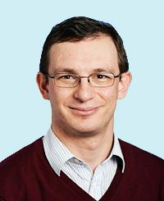
Brief Self Introduction
Onur Mutlu
Full Professor @ ETH Zurich ITET (INFK), since September 2015
Strecker Professor @ Carnegie Mellon University ECE/CS, 2009-2016, 2016-…
PhD from UT-Austin, worked at Google, VMware, Microsoft Research, Intel, AMD
https://people.inf.ethz.ch/omutlu/
omutlu@gmail.com (Best way to reach me)
https://people.inf.ethz.ch/omutlu/projects.htm
Research and Teaching in:
Computer architecture, computer systems, hardware security, bioinformatics
Memory and storage systems
Hardware security, safety, predictability
Fault tolerance
Hardware/software cooperation
Architectures for bioinformatics, health, medicine
…

Slide 3
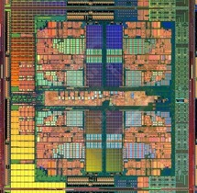
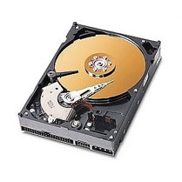
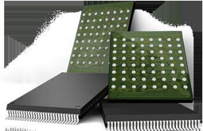
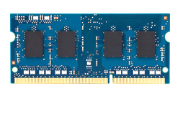
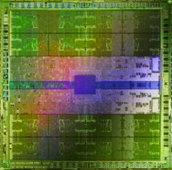
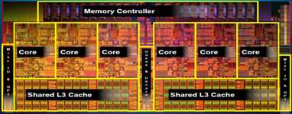
Current Research Mission
Computer architecture, HW/SW, systems, bioinformatics, security
Hybrid Main Memory
Heterogeneous
Processors and
Accelerators
Persistent Memory/Storage
Graphics and Vision Processing
Build fundamentally better architectures
Notes:
Professor Mutlu’s research focus is all aspects of computer architecture, HW/SW interaction and bioinformatics.
He is looking for students to perform research in these areas.
He and his group, SAFARI, solve fundamental problems spanning:
Memory, memory, memory, storage, interconnects
Parallel architectures, heterogeneous architectures, GP-GPUs
System/architecture interaction, new execution models
Energy efficiency, fault tolerance, hardware security
Genome sequence analysis and assembly
His group does broad research spanning systems to logic with architecture at center

Slide 4
The Problem
Computing
is Bottlenecked by Data

Slide 5
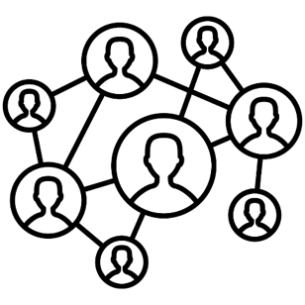
Data is Key for Future Workloads
In-memory Databases
[Mao+, EuroSys’12; Clapp+ (Intel), IISWC’15]
Graph/Tree Processing
[Xu+, IISWC’12; Umuroglu+, FPL’15]
In-Memory Data Analytics
[Clapp+ (Intel), IISWC’15;
Awan+, BDCloud’15]
Datacenter Workloads [Kanev+ (Google), ISCA’15]

Slide 6
Data Overwhelms Modern Machines
In-memory Databases
[Mao+, EuroSys’12; Clapp+ (Intel), IISWC’15]
Graph/Tree Processing
[Xu+, IISWC’12; Umuroglu+, FPL’15]
Data → performance & energy bottleneck
In-Memory Data Analytics
[Clapp+ (Intel), IISWC’15;
Awan+, BDCloud’15]
Datacenter Workloads [Kanev+ (Google), ISCA’15]

Slide 7
Data is Key for Future Workloads
Chrome
TensorFlow Mobile
Google’s web browser
Google’s machine learning framework
Video Playback
Video Capture
Google’s video codec
Google’s video codec
Notes:
In this work, we take a look at widely-used google consumer workloads, to figure out the major sources of energy consumption.
We look at Google Chrome web brower. We take a look at Tensorflow, Google’s machine learning framework, and we also take a look at two important video related workloads, video playback and video capture, both rely on Google’s vp9 codec technology.

Slide 8
Data Overwhelms Modern Machines
Chrome
TensorFlow Mobile
Google’s web browser
Google’s machine learning framework
Data → performance & energy bottleneck
Video Playback
Video Capture
Google’s video codec
Google’s video codec
Notes:
In this work, we take a look at widely-used google consumer workloads, to figure out the major sources of energy consumption.
We look at Google Chrome web brower. We take a look at Tensorflow, Google’s machine learning framework, and we also take a look at two important video related workloads, video playback and video capture, both rely on Google’s vp9 codec technology.

Slide 9
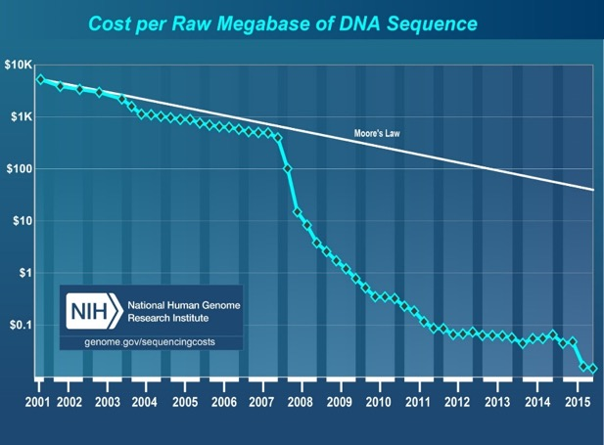
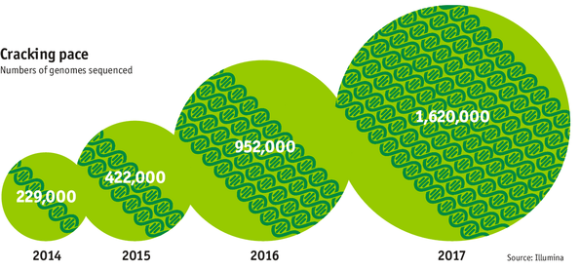
Data is Key for Future Workloads
development of high-throughput sequencing (HTS) technologies
Number of Genomes Sequenced
http://www.economist.com/news/21631808-so-much-genetic-data-so-many-uses-genes-unzipped
Notes:
However, since the development of high throughput sequencing (HTS) technologies, the cost of genome sequencing has fallen off a cliff (<< 1,000$) making it viable for almost everyone's use.

Slide 10
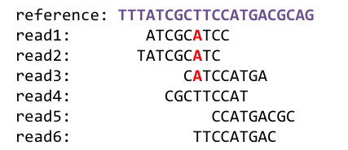
1
Sequencing
Genome Analysis
Read Mapping
2
Data → performance & energy bottleneck
Variant Calling
Scientific Discovery
3
4
Notes:
Genome analysis starts with sequencing random short DNA fragments of copies of the original molecule.
Unfortunately, these reads lack information about their order and which part of genome they are originated from.
Hence the second step is to map these reads to a long reference genome.

Slide 11
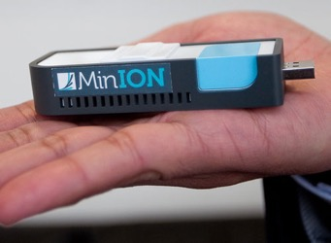
New Genome Sequencing Technologies
Oxford Nanopore MinION
Senol Cali+, “Nanopore Sequencing Technology and Tools for Genome
Assembly: Computational Analysis of the Current State, Bottlenecks
and Future Directions,” Briefings in Bioinformatics, 2018.
[Open arxiv.org version]

Slide 12
New Genome Sequencing Technologies
Oxford Nanopore MinION
Senol Cali+, “Nanopore Sequencing Technology and Tools for Genome
Assembly: Computational Analysis of the Current State, Bottlenecks
and Future Directions,” Briefings in Bioinformatics, 2018.
[Preliminary arxiv.org version]
Data → performance & energy bottleneck

Slide 13
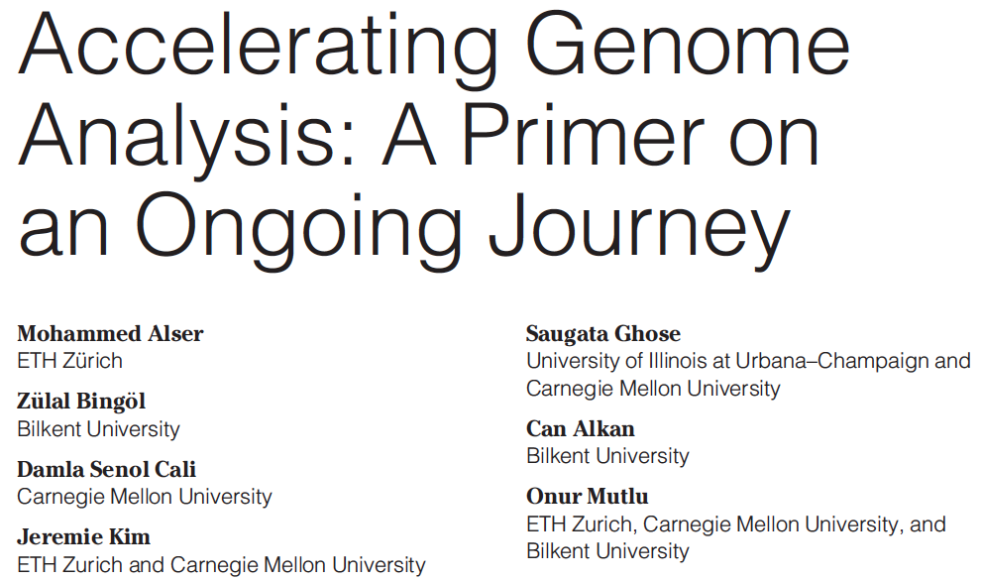
Accelerating Genome Analysis
Mohammed Alser, Zulal Bingol, Damla Senol Cali, Jeremie Kim, Saugata Ghose, Can Alkan, and Onur Mutlu, "Accelerating Genome Analysis: A Primer on an Ongoing Journey" IEEE Micro (IEEE MICRO), Vol. 40, No. 5, pages 65-75, September/October 2020. [Slides (pptx)(pdf)] [Talk Video (1 hour 2 minutes)]

Slide 14
Data Overwhelms Modern Machines …
Storage/memory capability
Communication capability
Computation capability
Greatly impacts robustness, energy, performance, cost

Slide 15
Data Movement Overwhelms Modern Machines
Amirali Boroumand, Saugata Ghose, Youngsok Kim, Rachata Ausavarungnirun, Eric Shiu, Rahul Thakur, Daehyun Kim, Aki Kuusela, Allan Knies, Parthasarathy Ranganathan, and Onur Mutlu, "Google Workloads for Consumer Devices: Mitigating Data Movement Bottlenecks" Proceedings of the 23rd International Conference on Architectural Support for Programming Languages and Operating Systems (ASPLOS), Williamsburg, VA, USA, March 2018.
62.7% of the total system energy
is spent on data movement

Slide 16
Axiom
An Intelligent Architecture
Handles Data Well

Slide 17
Corollaries: Architectures Today …
Architectures are terrible at dealing with data
Designed to mainly store and move data vs. to compute
They are processor-centric as opposed to data-centric
Architectures are terrible at taking advantage of vast amounts of data (and metadata) available to them
Designed to make simple decisions, ignoring lots of data
They make human-driven decisions vs. data-driven decisions
Architectures are terrible at knowing and exploiting different properties of application data
Designed to treat all data as the same
They make component-aware decisions vs. data-aware

Slide 18
Architectures for Intelligent Machines
Data-centric
Data-driven
Data-aware

Slide 19
Data-Centric (Memory-Centric) Architectures

Slide 20
Processing Data Where It Makes Sense

Slide 21
Goal: Processing Inside Memory
Many questions … How do we design the:
compute-capable memory & controllers?
processor chip and in-memory units?
software and hardware interfaces?
system software, compilers, languages?
algorithms and theoretical foundations?
Memory
Processor
Core
Database
Graphs
Media
Cache
Query
Interconnect
Problem
Results
Algorithm
Program/Language
System Software
SW/HW Interface
Micro-architecture
Logic
Devices
Electrons

Slide 22
Processing in Memory: Two Approaches
1. Minimally changing memory chips
2. Exploiting 3D-stacked memory

Slide 23
Challenge and Opportunity for Future
Computing Architectures
with
Minimal Data Movement

Slide 24
Challenge and Opportunity for Future
Self-Optimizing
(Data-Driven)
Computing Architectures

Slide 25
Challenge and Opportunity for Future
Data-Aware
(Expressive)
Computing Architectures

Slide 26
Architectures for Intelligent Machines
Data-centric
Data-driven
Data-aware

Slide 27
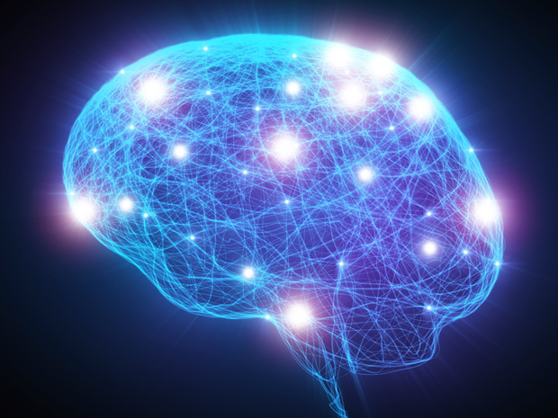
Source: http://spectrum.ieee.org/image/MjYzMzAyMg.jpeg

Slide 28
PIM Review and Open Problems
Onur Mutlu, Saugata Ghose, Juan Gomez-Luna, and Rachata Ausavarungnirun, "A Modern Primer on Processing in Memory" Invited Book Chapter in Emerging Computing: From Devices to Systems - Looking Beyond Moore and Von Neumann, Springer, to be published in 2021.
https://arxiv.org/pdf/1903.03988.pdf

Slide 29
PIM Review and Open Problems (II)
Saugata Ghose, Amirali Boroumand, Jeremie S. Kim, Juan Gomez-Luna, and Onur Mutlu, "Processing-in-Memory: A Workload-Driven Perspective" Invited Article in IBM Journal of Research & Development, Special Issue on Hardware for Artificial Intelligence, to appear in November 2019. [Preliminary arXiv version]
https://arxiv.org/pdf/1907.12947.pdf

Slide 30
Memory-Centric Computing Systems
Onur Mutlu
omutlu@gmail.com
https://people.inf.ethz.ch/omutlu
12 December 2020
IEDM Tutorial Executive Summary

