Slide 1
Processing Data Where It Makes Sense in Modern Computing Systems: Enabling In-Memory Computation
Onur Mutlu
omutlu@gmail.com
https://people.inf.ethz.ch/omutlu
12 May 2019
IMW 2019 In-Memory Computing Tutorial

Slide 2
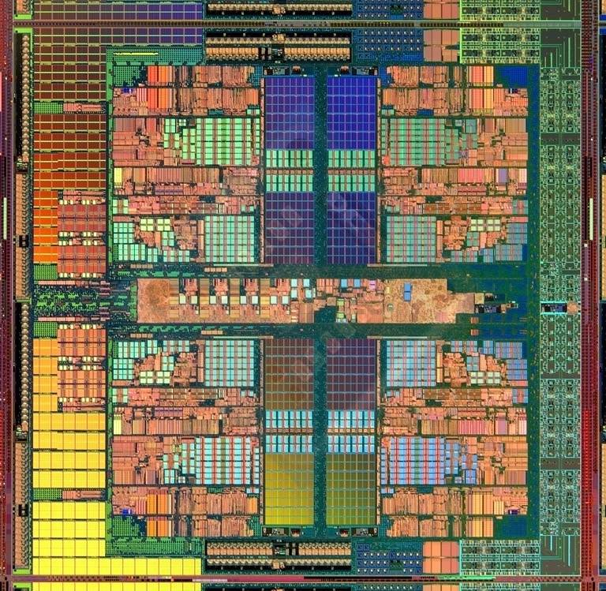
The Main Memory System
Main memory is a critical component of all computing systems: server, mobile, embedded, desktop, sensor
Main memory system must scale (in size, technology, efficiency, cost, and management algorithms) to maintain performance growth and technology scaling benefits
Processors
and caches
Main Memory
Storage (SSD/HDD)

Slide 3
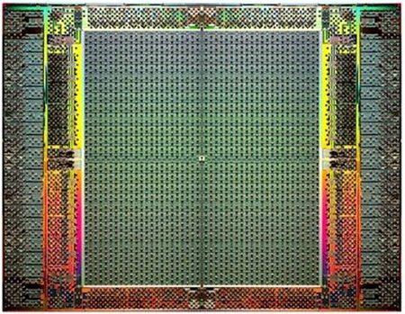
The Main Memory System
Main memory is a critical component of all computing systems: server, mobile, embedded, desktop, sensor
Main memory system must scale (in size, technology, efficiency, cost, and management algorithms) to maintain performance growth and technology scaling benefits
FPGAs
Main Memory
Storage (SSD/HDD)

Slide 4
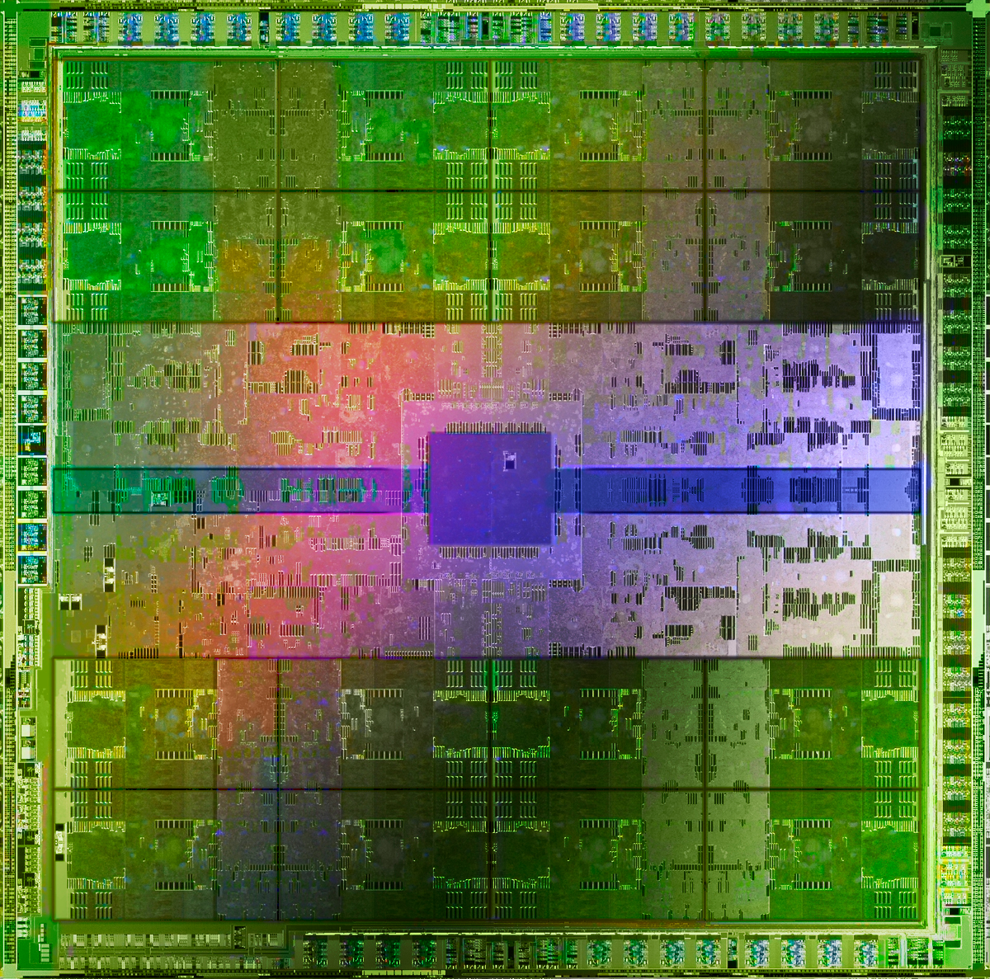
The Main Memory System
Main memory is a critical component of all computing systems: server, mobile, embedded, desktop, sensor
Main memory system must scale (in size, technology, efficiency, cost, and management algorithms) to maintain performance growth and technology scaling benefits
GPUs
Main Memory
Storage (SSD/HDD)

Slide 5
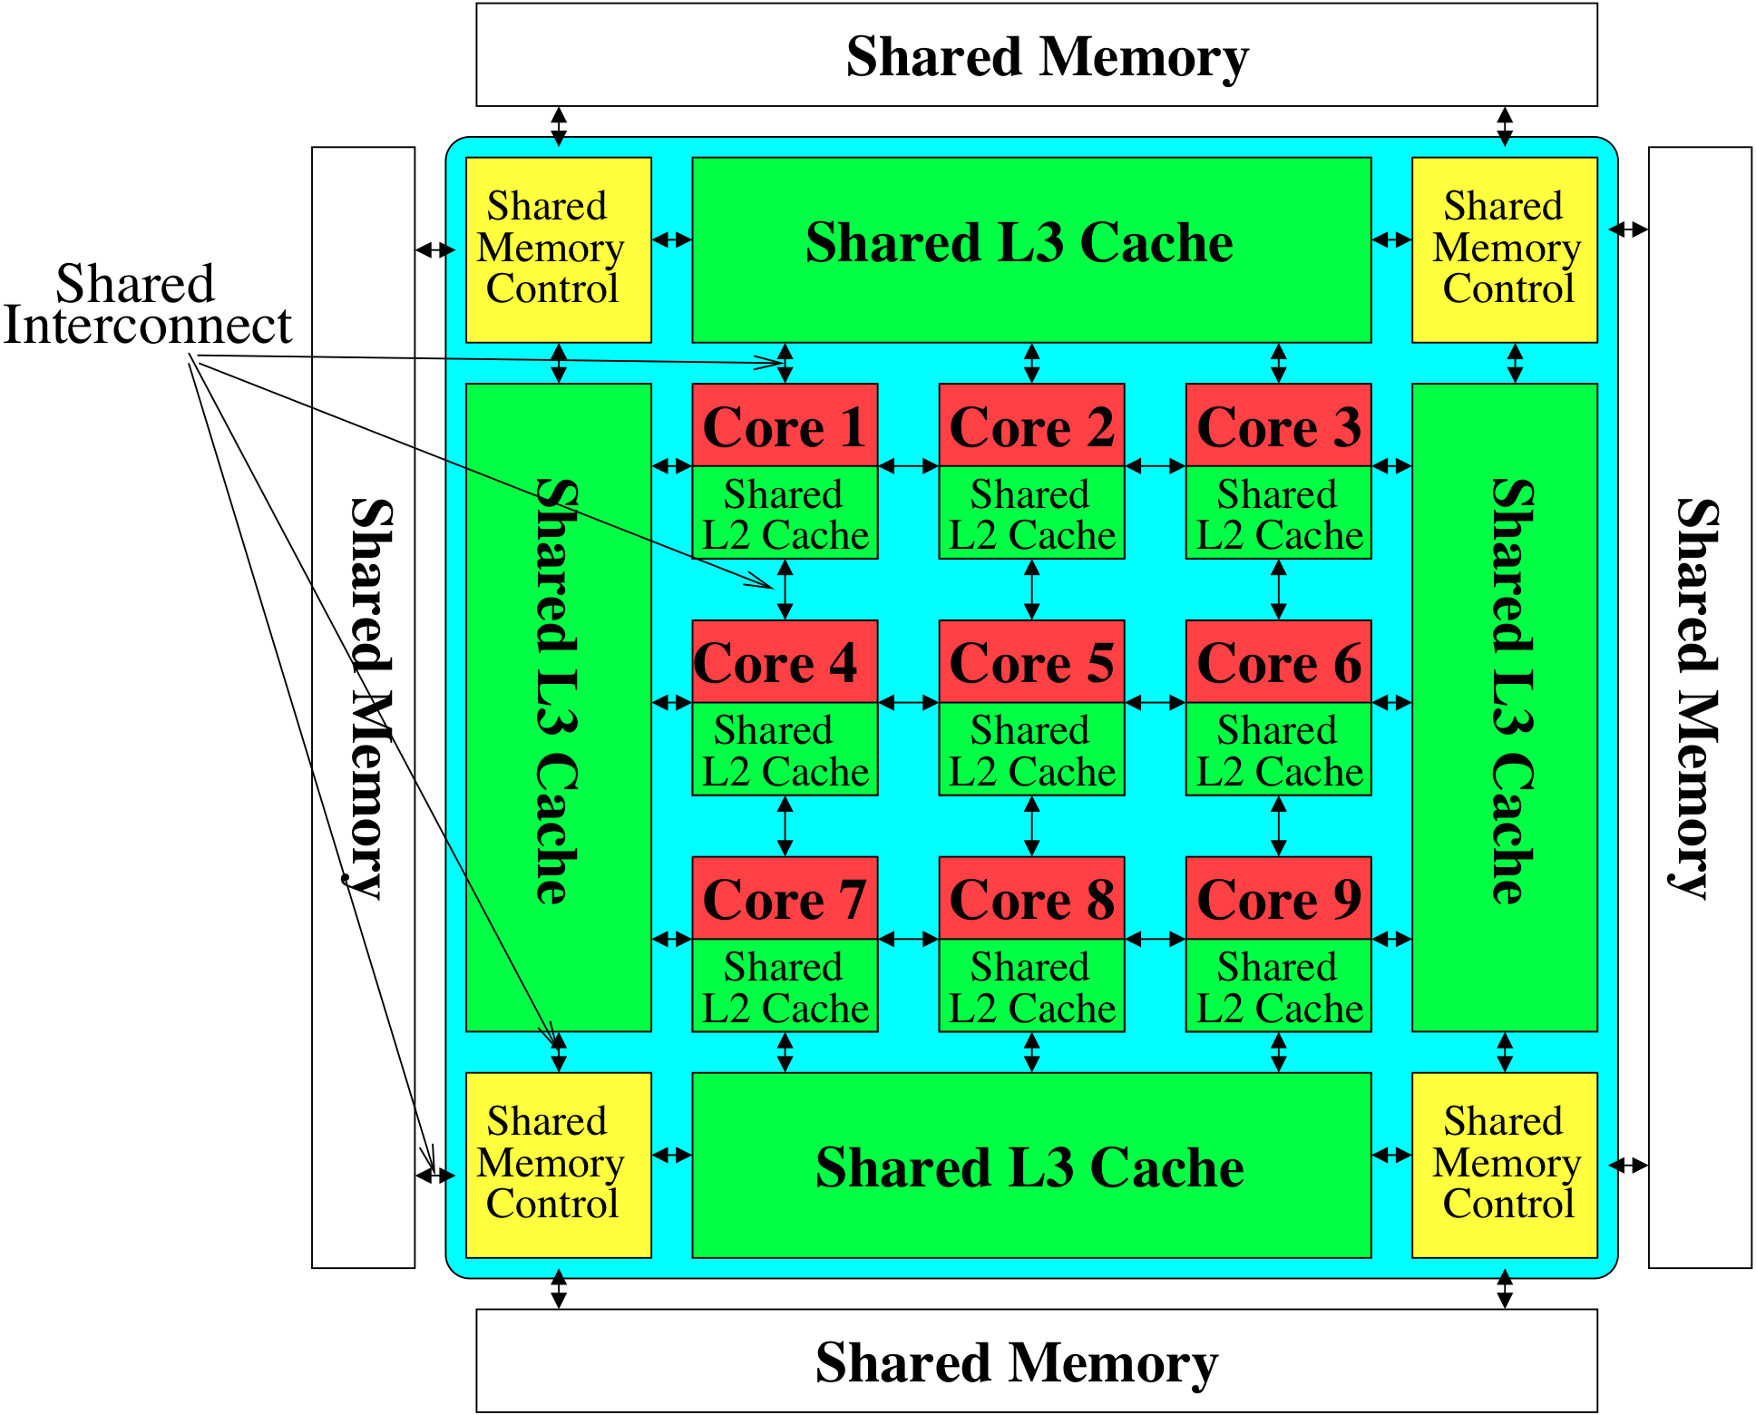
Memory System: A Shared Resource View
Storage
Most of the system is dedicated to storing and moving data

Slide 6
State of the Main Memory System
Recent technology, architecture, and application trends
lead to new requirements
exacerbate old requirements
DRAM and memory controllers, as we know them today, are (will be) unlikely to satisfy all requirements
Some emerging non-volatile memory technologies (e.g., PCM) enable new opportunities: memory+storage merging
We need to rethink the main memory system
to fix DRAM issues and enable emerging technologies
to satisfy all requirements

Slide 7
Major Trends Affecting Main Memory (I)
Need for main memory capacity, bandwidth, QoS increasing
Main memory energy/power is a key system design concern
DRAM technology scaling is ending

Slide 8
Major Trends Affecting Main Memory (II)
Need for main memory capacity, bandwidth, QoS increasing
Multi-core: increasing number of cores/agents
Data-intensive applications: increasing demand/hunger for data
Consolidation: cloud computing, GPUs, mobile, heterogeneity
Main memory energy/power is a key system design concern
DRAM technology scaling is ending

Slide 9
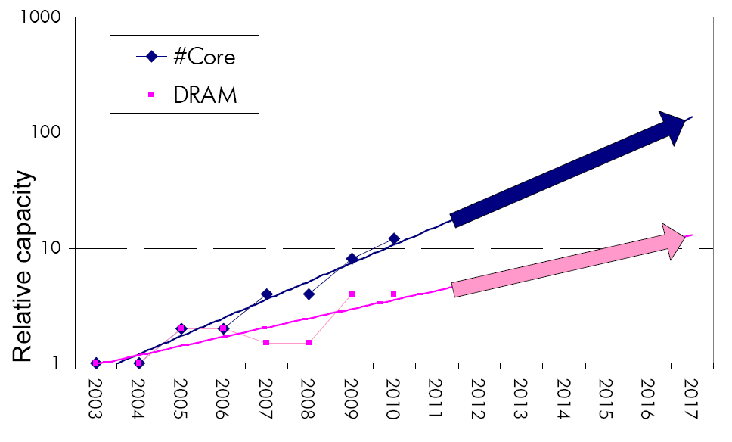
Example: The Memory Capacity Gap
Core count doubling ~ every 2 years
DRAM DIMM capacity doubling ~ every 3 years
Memory capacity per core expected to drop by 30% every two years
Trends worse for memory bandwidth per core!
Lim et al., ISCA 2009

Slide 10
DRAM Capacity, Bandwidth & Latency
128x
20x
1.3x

Slide 11
DRAM Is Critical for Performance
In-memory Databases
[Mao+, EuroSys’12; Clapp+ (Intel), IISWC’15]
Graph/Tree Processing
[Xu+, IISWC’12; Umuroglu+, FPL’15]
In-Memory Data Analytics
[Clapp+ (Intel), IISWC’15;
Awan+, BDCloud’15]
Datacenter Workloads [Kanev+ (Google), ISCA’15]

Slide 12
DRAM Is Critical for Performance
In-memory Databases
[Mao+, EuroSys’12; Clapp+ (Intel), IISWC’15]
Graph/Tree Processing
[Xu+, IISWC’12; Umuroglu+, FPL’15]
Memory → performance bottleneck
In-Memory Data Analytics
[Clapp+ (Intel), IISWC’15;
Awan+, BDCloud’15]
Datacenter Workloads [Kanev+ (Google), ISCA’15]

Slide 13
DRAM Is Critical for Performance
Chrome
TensorFlow Mobile
Google’s web browser
Google’s machine learning framework
Video Playback
Video Capture
Google’s video codec
Google’s video codec
Notes:
In this work, we take a look at widely-used google consumer workloads, to figure out the major sources of energy consumption.
We look at Google Chrome web brower. We take a look at Tensorflow, Google’s machine learning framework, and we also take a look at two important video related workloads, video playback and video capture, both rely on Google’s vp9 codec technology.

Slide 14
DRAM Is Critical for Performance
Chrome
TensorFlow Mobile
Google’s web browser
Google’s machine learning framework
Memory → performance bottleneck
Video Playback
Video Capture
Google’s video codec
Google’s video codec
Notes:
In this work, we take a look at widely-used google consumer workloads, to figure out the major sources of energy consumption.
We look at Google Chrome web brower. We take a look at Tensorflow, Google’s machine learning framework, and we also take a look at two important video related workloads, video playback and video capture, both rely on Google’s vp9 codec technology.

Slide 15
Major Trends Affecting Main Memory (III)
Need for main memory capacity, bandwidth, QoS increasing
Main memory energy/power is a key system design concern
~40-50% energy spent in off-chip memory hierarchy [Lefurgy, IEEE Computer’03] >40% power in DRAM [Ware, HPCA’10][Paul,ISCA’15]
DRAM consumes power even when not used (periodic refresh)
DRAM technology scaling is ending

Slide 16
Energy Waste in Mobile Devices
Amirali Boroumand, Saugata Ghose, Youngsok Kim, Rachata Ausavarungnirun, Eric Shiu, Rahul Thakur, Daehyun Kim, Aki Kuusela, Allan Knies, Parthasarathy Ranganathan, and Onur Mutlu, "Google Workloads for Consumer Devices: Mitigating Data Movement Bottlenecks" Proceedings of the 23rd International Conference on Architectural Support for Programming Languages and Operating Systems (ASPLOS), Williamsburg, VA, USA, March 2018.
62.7% of the total system energy
is spent on data movement

Slide 17
Major Trends Affecting Main Memory (IV)
Need for main memory capacity, bandwidth, QoS increasing
Main memory energy/power is a key system design concern
DRAM technology scaling is ending
ITRS projects DRAM will not scale easily below X nm
Scaling has provided many benefits:
higher capacity (density), lower cost, lower energy

Slide 18
Major Trends Affecting Main Memory (V)
DRAM scaling has already become increasingly difficult
Increasing cell leakage current, reduced cell reliability, increasing manufacturing difficulties [Kim+ ISCA 2014], [Liu+ ISCA 2013], [Mutlu IMW 2013], [Mutlu DATE 2017]
Difficult to significantly improve capacity, energy
Emerging memory technologies are promising
3D-Stacked DRAM | higher bandwidth | smaller capacity
Reduced-Latency DRAM (e.g., RLDRAM, TL-DRAM) | lower latency | higher cost
Low-Power DRAM (e.g., LPDDR3, LPDDR4) | lower power | higher latency higher cost
Non-Volatile Memory (NVM) (e.g., PCM, STTRAM, ReRAM, 3D Xpoint) | larger capacity | higher latency higher dynamic power lower endurance

Slide 19
Major Trends Affecting Main Memory (V)
DRAM scaling has already become increasingly difficult
Increasing cell leakage current, reduced cell reliability, increasing manufacturing difficulties [Kim+ ISCA 2014], [Liu+ ISCA 2013], [Mutlu IMW 2013], [Mutlu DATE 2017]
Difficult to significantly improve capacity, energy
Emerging memory technologies are promising
3D-Stacked DRAM | higher bandwidth | smaller capacity
Reduced-Latency DRAM (e.g., RL/TL-DRAM, FLY-RAM) | lower latency | higher cost
Low-Power DRAM (e.g., LPDDR3, LPDDR4, Voltron) | lower power | higher latency higher cost
Non-Volatile Memory (NVM) (e.g., PCM, STTRAM, ReRAM, 3D Xpoint) | larger capacity | higher latency higher dynamic power lower endurance

Slide 20
Major Trend: Hybrid Main Memory
CPU
Meza+, “Enabling Efficient and Scalable Hybrid Memories,” IEEE Comp. Arch. Letters, 2012.
Yoon+, “Row Buffer Locality Aware Caching Policies for Hybrid Memories,” ICCD 2012 Best Paper Award.
DRAMCtrl
PCM Ctrl
DRAM
Phase Change Memory (or Tech. X)
Fast, durable
Small,
leaky, volatile,
high-cost
Large, non-volatile, low-cost
Slow, wears out, high active energy
Hardware/software manage data allocation and movement
to achieve the best of multiple technologies

Slide 21
Foreshadowing
Main Memory Needs
Intelligent Controllers

Slide 22
Industry Is Writing Papers About It, Too

Slide 23
Call for Intelligent Memory Controllers

Slide 24
Agenda
Major Trends Affecting Main Memory
The Need for Intelligent Memory Controllers
Bottom Up: Push from Circuits and Devices
Top Down: Pull from Systems and Applications
Processing in Memory: Two Directions
Minimally Changing Memory Chips
Exploiting 3D-Stacked Memory
How to Enable Adoption of Processing in Memory
Conclusion

Slide 25
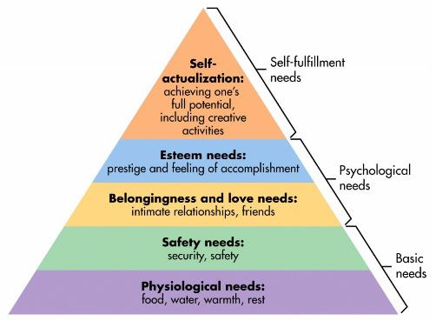
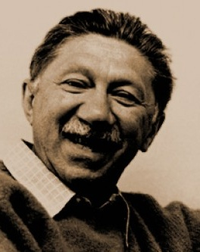
Maslow’s (Human) Hierarchy of Needs
Maslow, “A Theory of Human Motivation,”
Psychological Review, 1943.
Maslow, “A Theory of Human Motivation,”
Psychological Review, 1943.
Maslow, “Motivation and Personality,”
Book, 1954-1970.
We need to start with reliability and security…
Source: https://www.simplypsychology.org/maslow.html
Source: By User:Factoryjoe - Mazlow's Hierarchy of Needs.svg, CC BY-SA 3.0, https://commons.wikimedia.org/w/index.php?curid=7964065

Slide 26
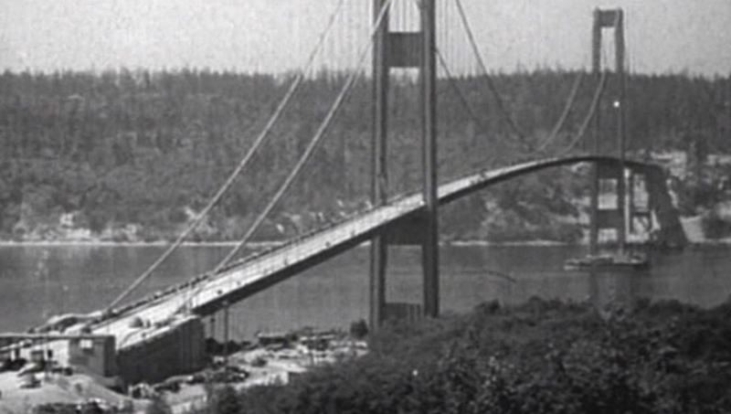
How Reliable/Secure/Safe is This Bridge?
Source: http://www.technologystudent.com/struct1/tacom1.png

Slide 27
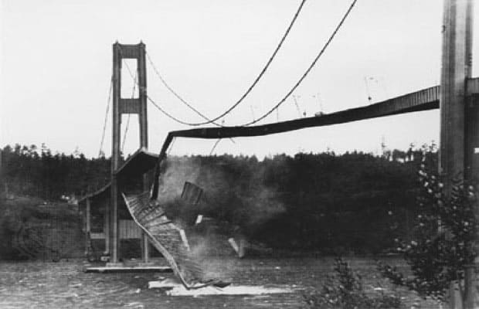
Collapse of the “Galloping Gertie”
Source: AP

Slide 28
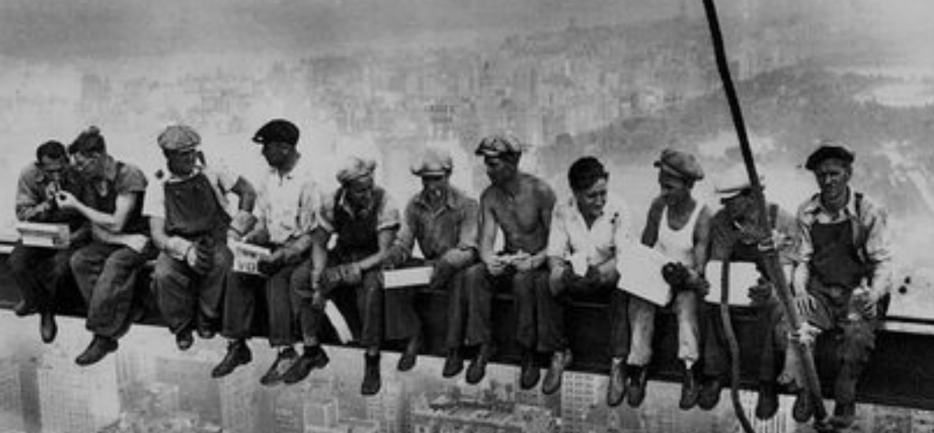
How Secure Are These People?
Security is about preventing unforeseen consequences
Source: https://s-media-cache-ak0.pinimg.com/originals/48/09/54/4809543a9c7700246a0cf8acdae27abf.jpg

Slide 29
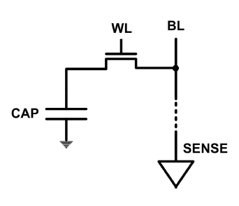
The DRAM Scaling Problem
DRAM stores charge in a capacitor (charge-based memory)
Capacitor must be large enough for reliable sensing
Access transistor should be large enough for low leakage and high retention time
Scaling beyond 40-35nm (2013) is challenging [ITRS, 2009]
DRAM capacity, cost, and energy/power hard to scale

Slide 30
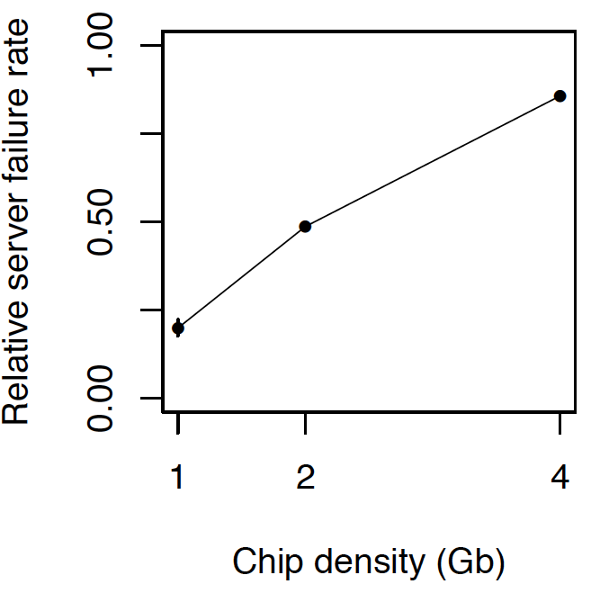
As Memory Scales, It Becomes Unreliable
Data from all of Facebook’s servers worldwide
Meza+, “Revisiting Memory Errors in Large-Scale Production Data Centers,” DSN’15.
Intuition: quadratic increase in capacity

Slide 31
Large-Scale Failure Analysis of DRAM Chips
Analysis and modeling of memory errors found in all of Facebook’s server fleet
Justin Meza, Qiang Wu, Sanjeev Kumar, and Onur Mutlu, "Revisiting Memory Errors in Large-Scale Production Data Centers: Analysis and Modeling of New Trends from the Field" Proceedings of the 45th Annual IEEE/IFIP International Conference on Dependable Systems and Networks (DSN), Rio de Janeiro, Brazil, June 2015. [Slides (pptx) (pdf)] [DRAM Error Model]

Slide 32
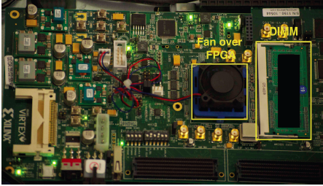
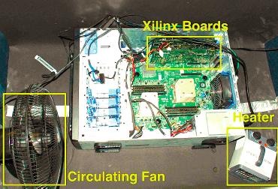
Infrastructures to Understand Such Issues
An Experimental Study of Data Retention Behavior in Modern DRAM Devices: Implications for Retention Time Profiling Mechanisms (Liu et al., ISCA 2013)
The Efficacy of Error Mitigation Techniques for DRAM Retention Failures: A Comparative Experimental Study
(Khan et al., SIGMETRICS 2014)
Flipping Bits in Memory Without Accessing Them: An Experimental Study of DRAM Disturbance Errors (Kim et al., ISCA 2014)
Adaptive-Latency DRAM: Optimizing DRAM Timing for the Common-Case (Lee et al., HPCA 2015)
AVATAR: A Variable-Retention-Time (VRT) Aware Refresh for DRAM Systems (Qureshi et al., DSN 2015)

Slide 33
Infrastructures to Understand Such Issues
Temperature
Controller
FPGAs
Heater
FPGAs
PC
Kim+, “Flipping Bits in Memory Without Accessing Them: An Experimental Study of DRAM Disturbance Errors,” ISCA 2014.

Slide 34
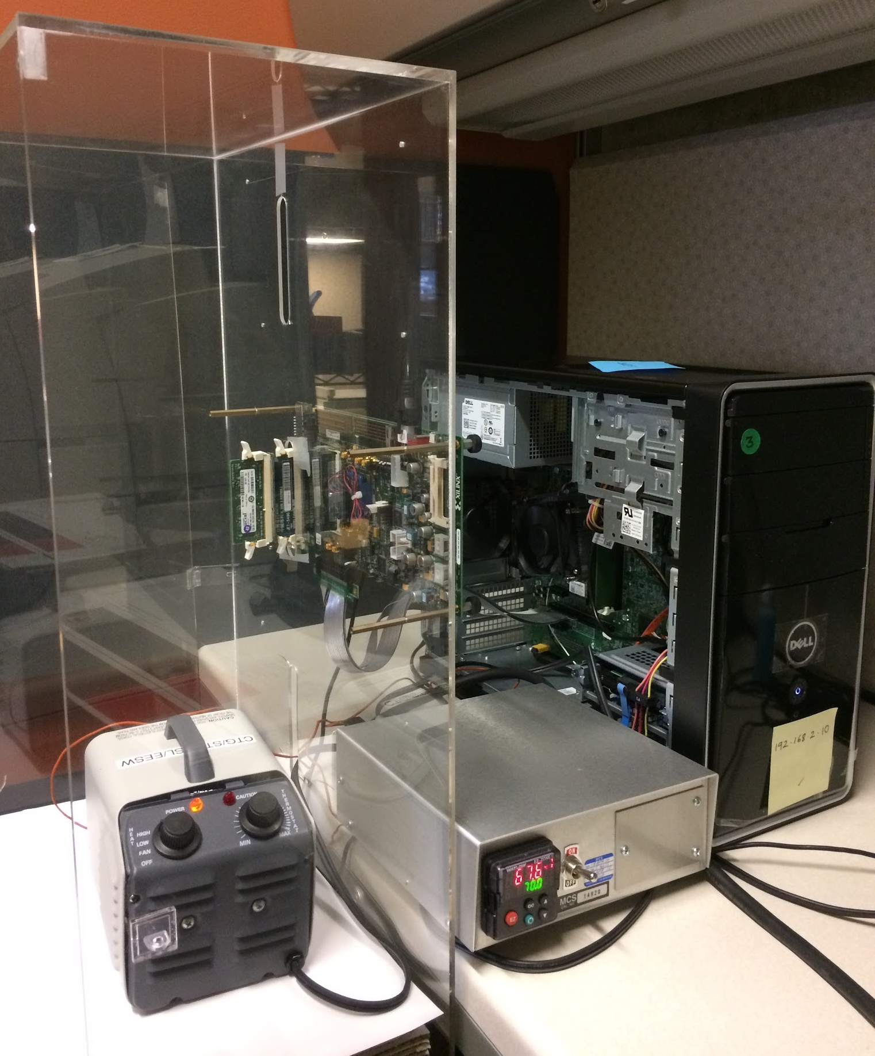
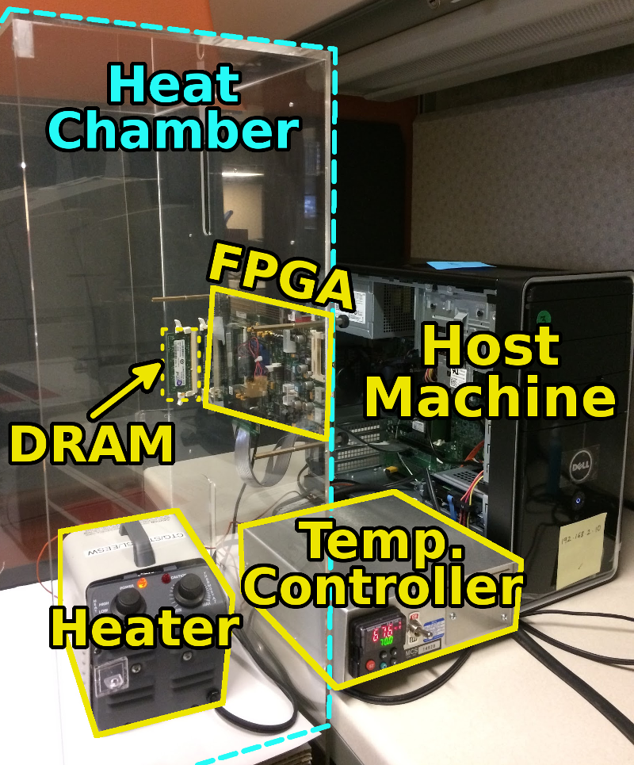
SoftMC: Open Source DRAM Infrastructure
Hasan Hassan et al., “SoftMC: A Flexible and Practical Open-Source Infrastructure for Enabling Experimental DRAM Studies,” HPCA 2017.
Flexible
Easy to Use (C++ API)
Open-source
github.com/CMU-SAFARI/SoftMC

Slide 35
SoftMC
https://github.com/CMU-SAFARI/SoftMC

Slide 36
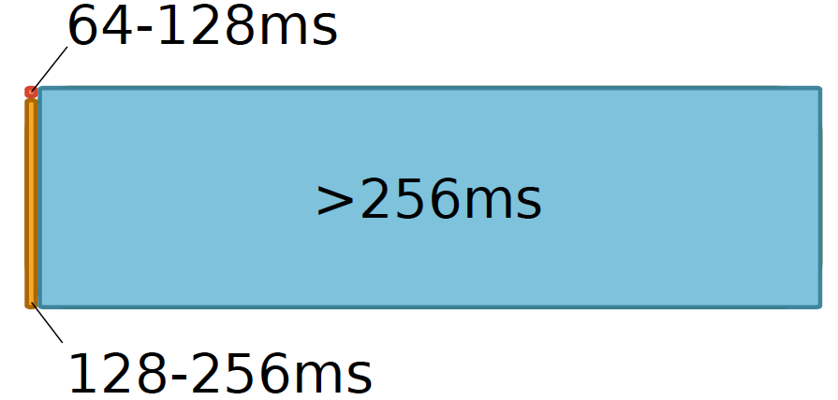
Data Retention in Memory [Liu et al., ISCA 2013]
Retention Time Profile of DRAM looks like this:
Location dependent
Stored value pattern dependent
Time dependent

Slide 37
Takeaway
Main Memory Needs
Intelligent Controllers

Slide 38
A Curious Discovery [Kim et al., ISCA 2014]
One can
predictably induce errors
in most DRAM memory chips

Slide 39
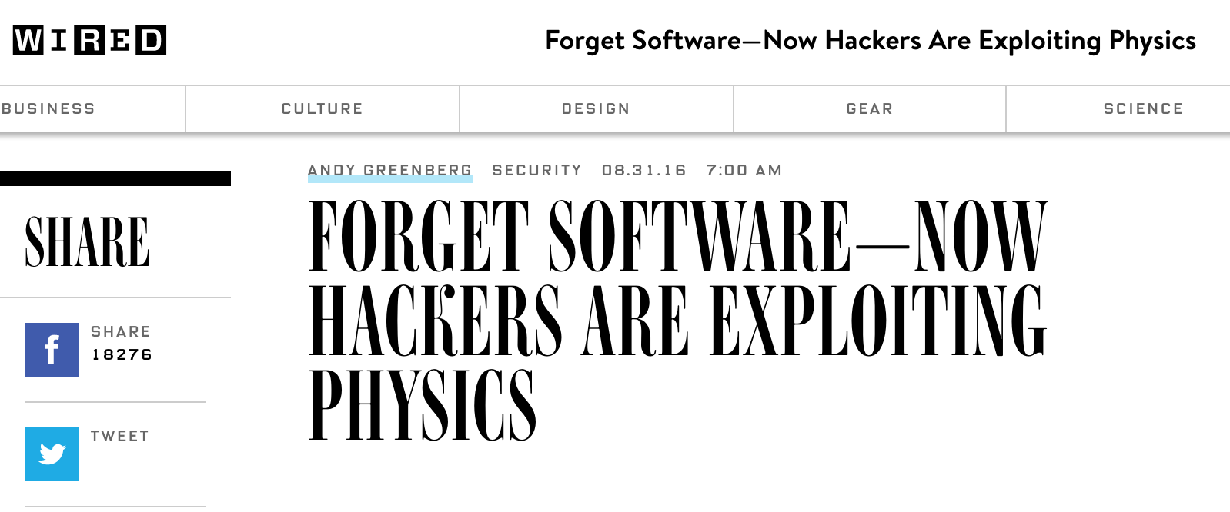
DRAM RowHammer
A simple hardware failure mechanism
can create a widespread
system security vulnerability

Slide 40
Modern DRAM is Prone to Disturbance Errors
Row of Cells
Wordline
Row
Victim Row
Row
Hammered Row
V_{LOW}
Opened
V_{HIGH}
Closed
Row
Victim Row
Row
Repeatedly reading a row enough times (before memory gets refreshed) induces disturbance errors in adjacent rows in most real DRAM chips you can buy today
Flipping Bits in Memory Without Accessing Them: An Experimental Study of DRAM Disturbance Errors, (Kim et al., ISCA 2014)

Slide 41
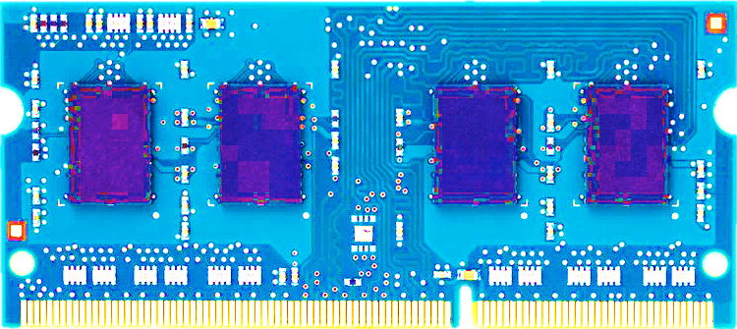
Most DRAM Modules Are Vulnerable
A company
B company
C company
86%
(37/43)
83%
(45/54)
88%
(28/32)
Up to
1.0×10⁷ errors
Up to
2.7×10⁶ errors
Up to
3.3×10⁵ errors
Flipping Bits in Memory Without Accessing Them: An Experimental Study of DRAM Disturbance Errors, (Kim et al., ISCA 2014)

Slide 42
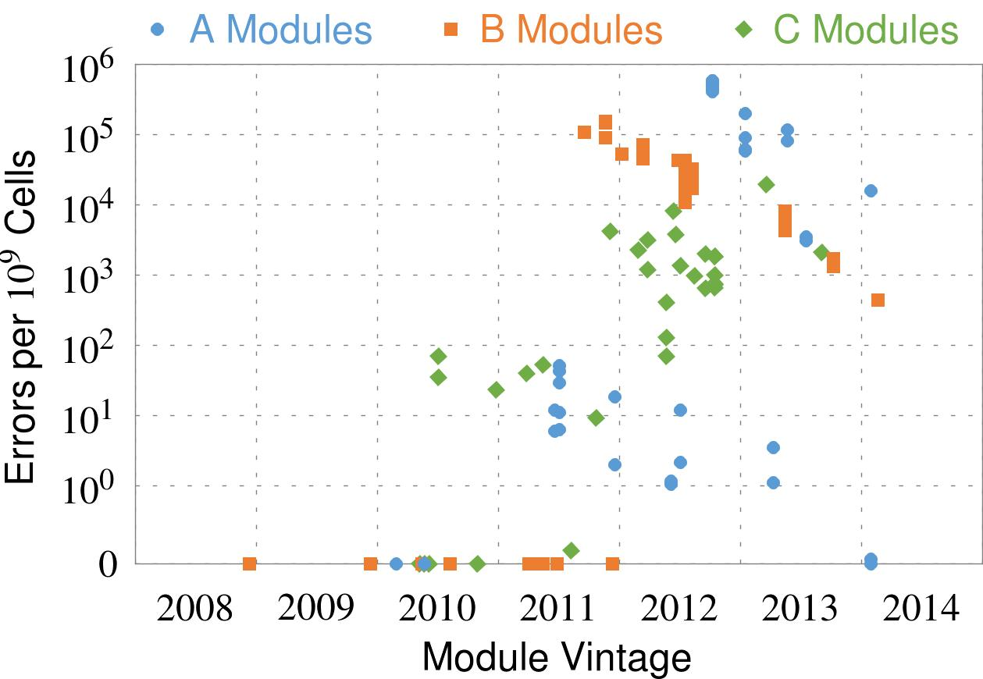
Recent DRAM Is More Vulnerable
Notes:
In this figure, the x-axis is the module manufacture date. And the y-axis is the number of errors in a module, normalized to one billion cells. In 2008 and 2009, there are no errors. But, in 2010, we first start to see errors in C modules. After 2010, the errors start to proliferate. For A and B modules, we first start to see errors in 2011. In particular, all modules from 2012 and 2013 are vulnerable.

Slide 43
Recent DRAM Is More Vulnerable
First
Appearance
Notes:
In this figure, the x-axis is the module manufacture date. And the y-axis is the number of errors in a module, normalized to one billion cells. In 2008 and 2009, there are no errors. But, in 2010, we first start to see errors in C modules. After 2010, the errors start to proliferate. For A and B modules, we first start to see errors in 2011. In particular, all modules from 2012 and 2013 are vulnerable.

Slide 44
Recent DRAM Is More Vulnerable
First
Appearance
All modules from 2012–2013 are vulnerable
Notes:
In this figure, the x-axis is the module manufacture date. And the y-axis is the number of errors in a module, normalized to one billion cells. In 2008 and 2009, there are no errors. But, in 2010, we first start to see errors in C modules. After 2010, the errors start to proliferate. For A and B modules, we first start to see errors in 2011. In particular, all modules from 2012 and 2013 are vulnerable.

Slide 45
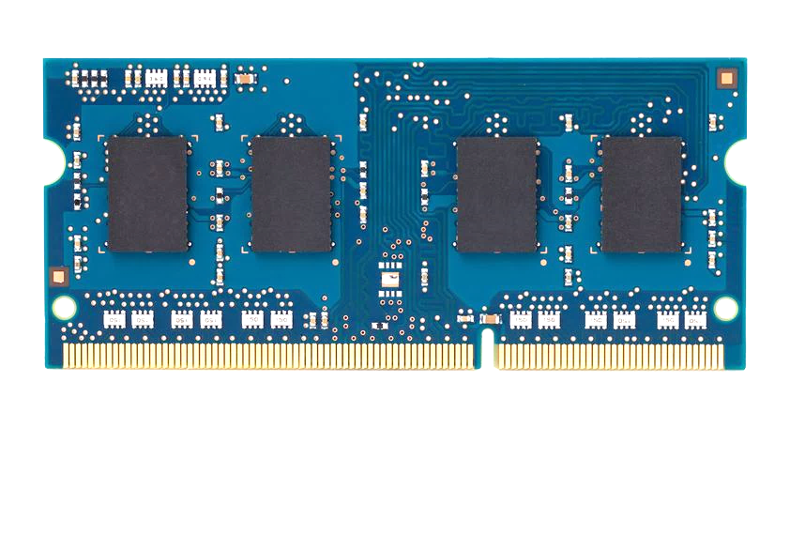
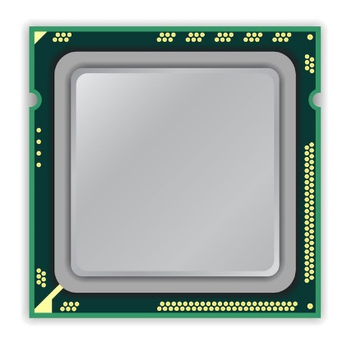
A Simple Program Can Induce Many Errors
CPU
DRAM Module
loop:
mov (X), %eax
mov (Y), %ebx
clflush (X)
clflush (Y)
mfence
jmp loop
X
Y
Download from: https://github.com/CMU-SAFARI/rowhammer
Notes:
We demonstrate the errors on multiple x86 systems. Shown to the bottom-left is a “disturbance kernel”. When executed, it forces two rows to be opened and closed one after the other – over and over again. Consequently, it induces many errors in the module.

Slide 46
A Simple Program Can Induce Many Errors
CPU
DRAM Module
Avoid cache hits
Flush X from cache
Avoid row hits to X
Read Y in another row
X
Y
Download from: https://github.com/CMU-SAFARI/rowhammer
Notes:
We demonstrate the errors on multiple x86 systems. Shown to the bottom-left is a “disturbance kernel”. When executed, it forces two rows to be opened and closed one after the other – over and over again. Consequently, it induces many errors in the module.

Slide 47
A Simple Program Can Induce Many Errors
CPU
DRAM Module
loop:
mov (X), %eax
mov (Y), %ebx
clflush (X)
clflush (Y)
mfence
jmp loop
X
Y
Download from: https://github.com/CMU-SAFARI/rowhammer
Notes:
We demonstrate the errors on multiple x86 systems. Shown to the bottom-left is a “disturbance kernel”. When executed, it forces two rows to be opened and closed one after the other – over and over again. Consequently, it induces many errors in the module.

Slide 48
A Simple Program Can Induce Many Errors
CPU
DRAM Module
loop:
mov (X), %eax
mov (Y), %ebx
clflush (X)
clflush (Y)
mfence
jmp loop
X
Y
Download from: https://github.com/CMU-SAFARI/rowhammer
Notes:
We demonstrate the errors on multiple x86 systems. Shown to the bottom-left is a “disturbance kernel”. When executed, it forces two rows to be opened and closed one after the other – over and over again. Consequently, it induces many errors in the module.

Slide 49
A Simple Program Can Induce Many Errors
CPU
DRAM Module
loop:
mov (X), %eax
mov (Y), %ebx
clflush (X)
clflush (Y)
mfence
jmp loop
X
Y
Download from: https://github.com/CMU-SAFARI/rowhammer
Notes:
We demonstrate the errors on multiple x86 systems. Shown to the bottom-left is a “disturbance kernel”. When executed, it forces two rows to be opened and closed one after the other – over and over again. Consequently, it induces many errors in the module.

Slide 50
Observed Errors in Real Systems
A real reliability & security issue
CPU Architecture | Errors | Access-Rate
Intel Haswell (2013) | 22.9K | 12.3M/sec
Intel Ivy Bridge (2012) | 20.7K | 11.7M/sec
Intel Sandy Bridge (2011) | 16.1K | 11.6M/sec
AMD Piledriver (2012) | 59 | 6.1M/sec
Kim+, “Flipping Bits in Memory Without Accessing Them: An Experimental Study of DRAM Disturbance Errors,” ISCA 2014.
Notes:
When we executed the code on four different processors, all four of them yielded errors. Intel Haswell has the most errors, at 23 thousand, because it has the highest rate of accessing DRAM.
Later on, I’ll show that we can induce as many as ten million disturbance errors in a more controlled environment.
From this, we conclude that disturbance errors are a serious reliability issue.

Slide 51
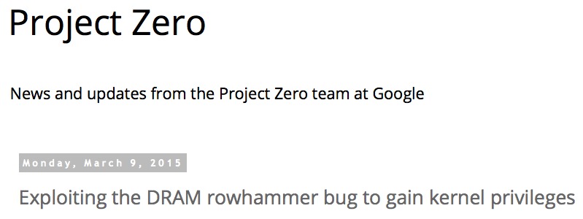
One Can Take Over an Otherwise-Secure System
Flipping Bits in Memory Without Accessing Them: An Experimental Study of DRAM Disturbance Errors (Kim et al., ISCA 2014)
Exploiting the DRAM rowhammer bug to gain kernel privileges (Seaborn, 2015)

Slide 52
RowHammer Security Attack Example
“Rowhammer” is a problem with some recent DRAM devices in which repeatedly accessing a row of memory can cause bit flips in adjacent rows (Kim et al., ISCA 2014).
Flipping Bits in Memory Without Accessing Them: An Experimental Study of DRAM Disturbance Errors (Kim et al., ISCA 2014)
We tested a selection of laptops and found that a subset of them exhibited the problem.
We built two working privilege escalation exploits that use this effect.
Exploiting the DRAM rowhammer bug to gain kernel privileges (Seaborn+, 2015)
One exploit uses rowhammer-induced bit flips to gain kernel privileges on x86-64 Linux when run as an unprivileged userland process.
When run on a machine vulnerable to the rowhammer problem, the process was able to induce bit flips in page table entries (PTEs).
It was able to use this to gain write access to its own page table, and hence gain read-write access to all of physical memory.
Exploiting the DRAM rowhammer bug to gain kernel privileges (Seaborn & Dullien, 2015)

Slide 53
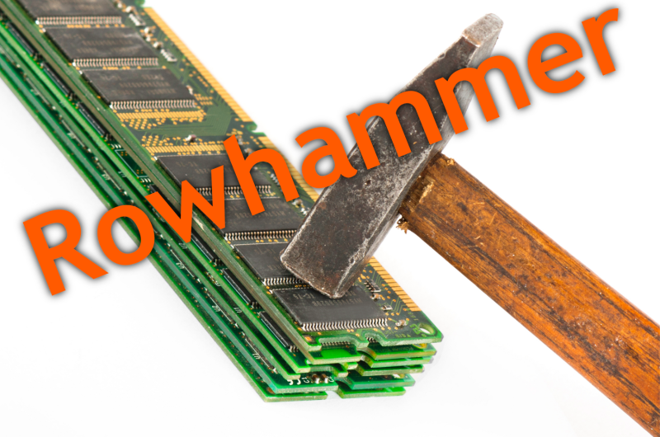
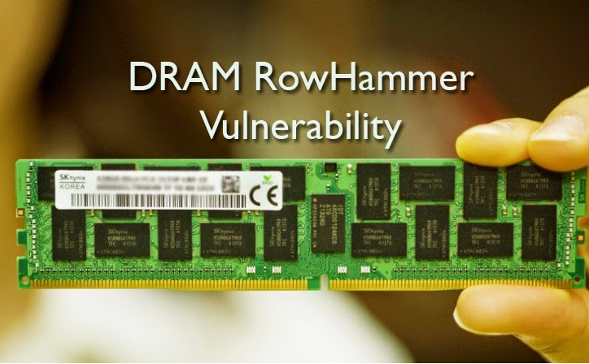
Security Implications
Notes:
Picture from the article:
http://thehackernews.com/2015/03/dram-rowhammer-vulnerability.html

Slide 54
Security Implications
Notes:
Picture from the article:
http://thehackernews.com/2015/03/dram-rowhammer-vulnerability.html

Slide 55
More Security Implications (I)
“We can gain unrestricted access to systems of website visitors.”
Rowhammer.js: A Remote Software-Induced Fault Attack in JavaScript (DIMVA’16)
Source: https://lab.dsst.io/32c3-slides/7197.html

Slide 56
More Security Implications (II)
“Can gain control of a smart phone deterministically”
Drammer: Deterministic Rowhammer Attacks on Mobile Platforms, CCS’16
Source: https://fossbytes.com/drammer-rowhammer-attack-android-root-devices/

Slide 57
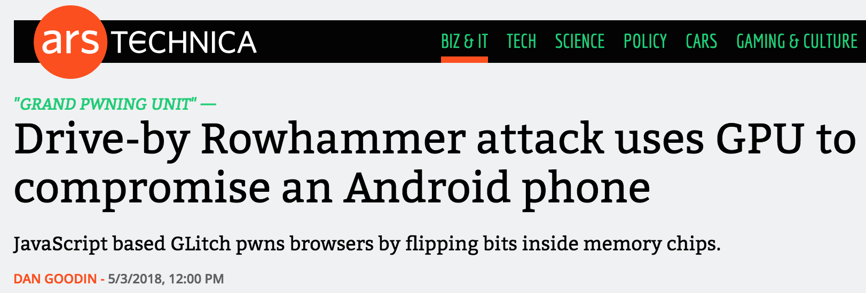
More Security Implications (III)
Using an integrated GPU in a mobile system to remotely escalate privilege via the WebGL interface

Slide 58
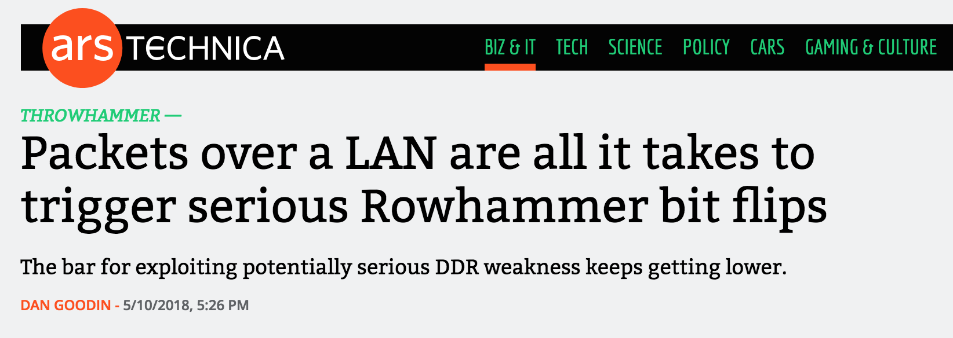
More Security Implications (IV)
Rowhammer over RDMA (I)

Slide 59
More Security Implications (V)
Rowhammer over RDMA (II)

Slide 60
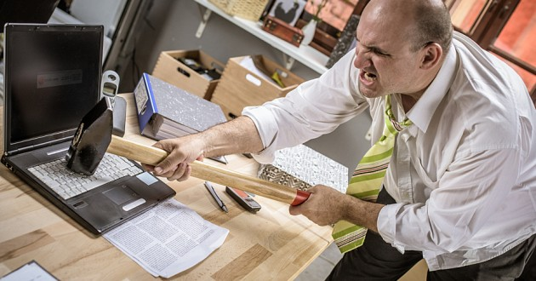
More Security Implications?

Slide 61
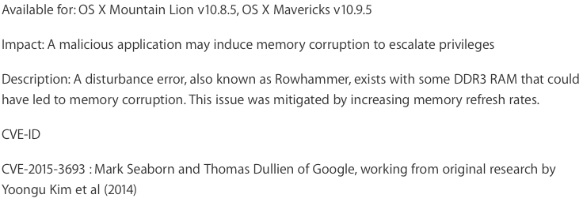
Apple’s Patch for RowHammer
https://support.apple.com/en-gb/HT204934
HP, Lenovo, and other vendors released similar patches

Slide 62
Our Solution to RowHammer
PARA: Probabilistic Adjacent Row Activation
Key Idea
After closing a row, we activate (i.e., refresh) one of its neighbors with a low probability: p = 0.005
Reliability Guarantee
When p=0.005, errors in one year: 9.4×10⁻¹⁴
By adjusting the value of p, we can vary the strength of protection against errors
Notes:
We provide a more efficient solution, called PARA, which stands for probabilistic adjacent row activation.
The key idea is thus: after closing a row, we activate (i.e., refresh) one of its neighbors with a low probability, for example, p equal to 0.005.
PARA provides a strong reliability guarantee even under the worst-case access patterns to DRAM. When we set p to 0.005, the expected number of errors in one year is 9.4 times 10 to the negative 14. This probability is much lower the failure rate of other hardware components, for example, the hard-disk drive.
And by adjusting the value of p, PARA can provide an arbitrarily strong-degree of protection against errors.

Slide 63
Advantages of PARA
PARA refreshes rows infrequently
Low power
Low performance-overhead
Average slowdown: 0.20% (for 29 benchmarks)
Maximum slowdown: 0.75%
PARA is stateless
Low cost
Low complexity
PARA is an effective and low-overhead solution to prevent disturbance errors
Notes:
PARA has many advantages. Since it refreshes row infrequently, it has low power and low performance-overhead. Simulated across 29 benchmarks, we saw an average of only 0.2% slowdown and a maximum of only 0.75% slowdown.
In addition, due to its stateless nature, PARA has low cost and complexity.
Therefore, PARA is an effective and low-overhead solution to prevent disturbance errors.

Slide 64
Requirements for PARA
If implemented in DRAM chip (done today)
Enough slack in timing and refresh parameters
Plenty of slack today:
Lee et al., “Adaptive-Latency DRAM: Optimizing DRAM Timing for the Common Case,” HPCA 2015.
Chang et al., “Understanding Latency Variation in Modern DRAM Chips,” SIGMETRICS 2016.
Lee et al., “Design-Induced Latency Variation in Modern DRAM Chips,” SIGMETRICS 2017.
Chang et al., “Understanding Reduced-Voltage Operation in Modern DRAM Devices,” SIGMETRICS 2017.
Ghose et al., “What Your DRAM Power Models Are Not Telling You: Lessons from a Detailed Experimental Study,” SIGMETRICS 2018.
If implemented in memory controller
Better coordination between memory controller and DRAM
Memory controller should know which rows are physically adjacent

Slide 65
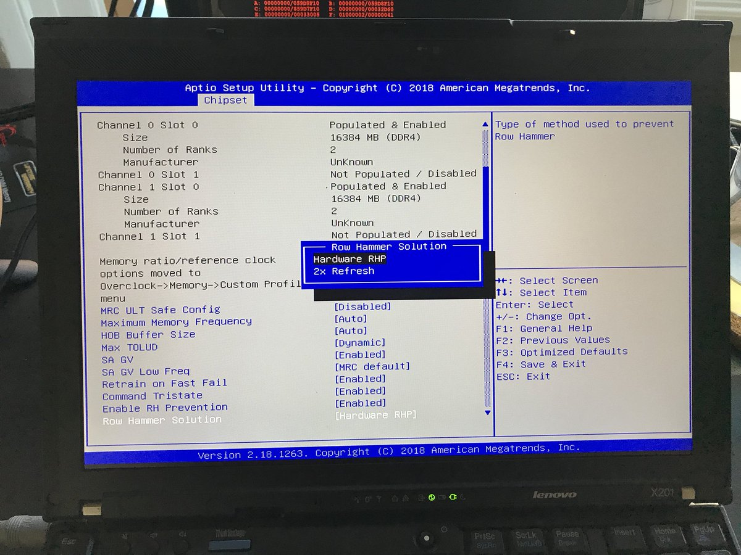
Probabilistic Activation in Real Life (I)
https://twitter.com/isislovecruft/status/1021939922754723841

Slide 66
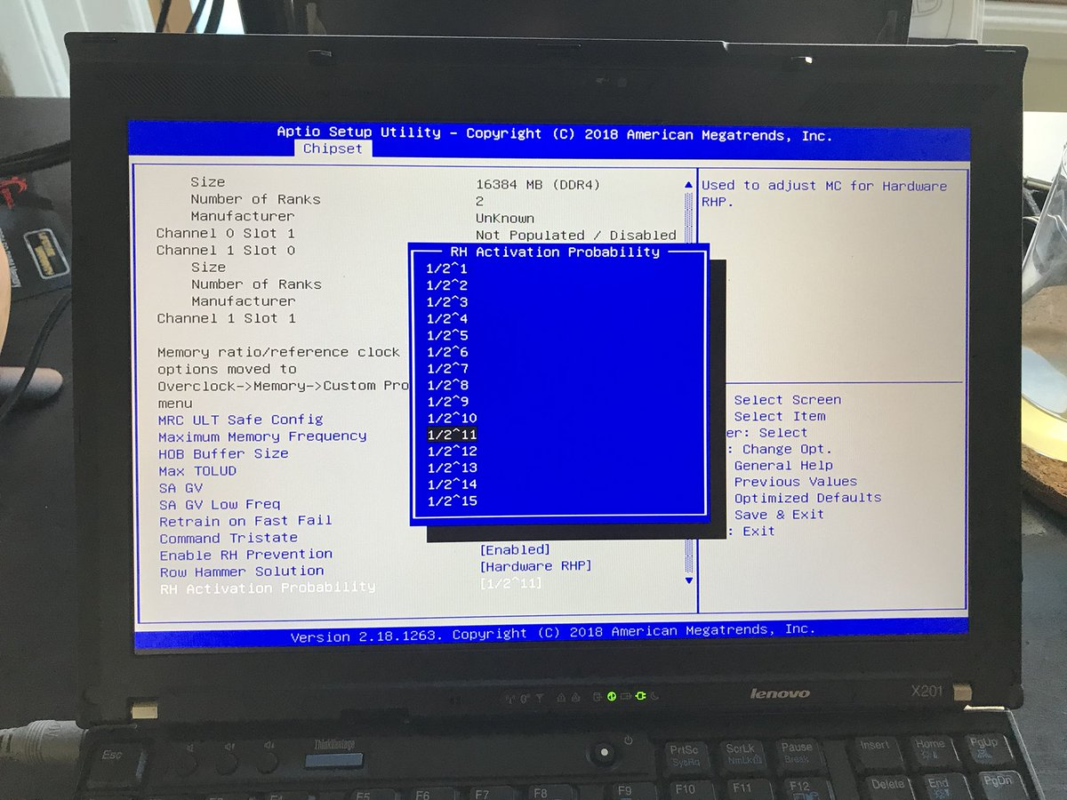
Probabilistic Activation in Real Life (II)
https://twitter.com/isislovecruft/status/1021939922754723841

Slide 67
More on RowHammer Analysis
Yoongu Kim, Ross Daly, Jeremie Kim, Chris Fallin, Ji Hye Lee, Donghyuk Lee, Chris Wilkerson, Konrad Lai, and Onur Mutlu, "Flipping Bits in Memory Without Accessing Them: An Experimental Study of DRAM Disturbance Errors" Proceedings of the 41st International Symposium on Computer Architecture (ISCA), Minneapolis, MN, June 2014. [Slides (pptx) (pdf)] [Lightning Session Slides (pptx) (pdf)] [Source Code and Data]

Slide 68
Future of Memory Reliability
Onur Mutlu, "The RowHammer Problem and Other Issues We May Face as Memory Becomes Denser" Invited Paper in Proceedings of the Design, Automation, and Test in Europe Conference (DATE), Lausanne, Switzerland, March 2017. [Slides (pptx) (pdf)]
https://people.inf.ethz.ch/omutlu/pub/rowhammer-and-other-memory-issues_date17.pdf

Slide 69
For More on RowHammer…
Onur Mutlu and Jeremie Kim, "RowHammer: A Retrospective" IEEE Transactions on Computer-Aided Design of Integrated Circuits and Systems (TCAD) Special Issue on Top Picks in Hardware and Embedded Security, 2019.

Slide 70
Industry Is Writing Papers About It, Too

Slide 71
Call for Intelligent Memory Controllers

Slide 72
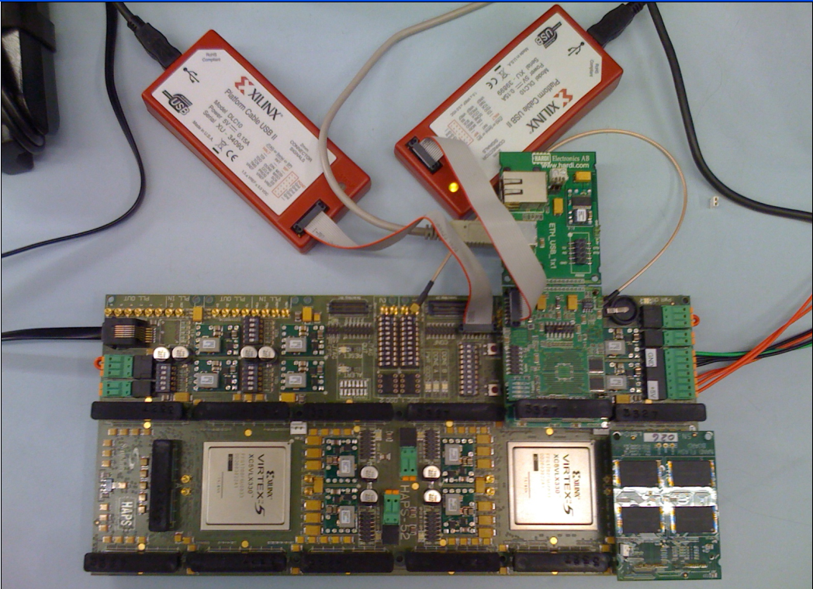
Aside: Intelligent Controller for NAND Flash
USB Daughter Board
USB Jack
HAPS-52 Mother Board
Virtex-II Pro
(USB controller)
1x-nm
NAND Flash
Virtex-V FPGA
(NAND Controller)
[DATE 2012, ICCD 2012, DATE 2013, ITJ 2013, ICCD 2013, SIGMETRICS 2014, HPCA 2015, DSN 2015, MSST 2015, JSAC 2016, HPCA 2017, DFRWS 2017,
PIEEE 2017, HPCA 2018, SIGMETRICS 2018]
NAND Daughter Board
Cai+, “Error Characterization, Mitigation, and Recovery in Flash Memory Based Solid State Drives,” Proc. IEEE 2017.

Slide 73
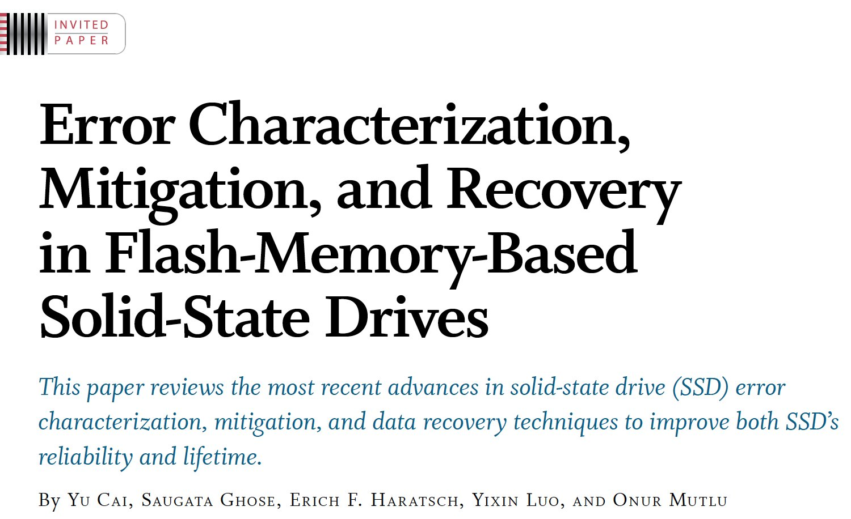
Aside: Intelligent Controller for NAND Flash
Proceedings of the IEEE, Sept. 2017
https://arxiv.org/pdf/1706.08642

Slide 74
Takeaway
Main Memory Needs
Intelligent Controllers

Slide 75
Agenda
Major Trends Affecting Main Memory
The Need for Intelligent Memory Controllers
Bottom Up: Push from Circuits and Devices
Top Down: Pull from Systems and Applications
Processing in Memory: Two Directions
Minimally Changing Memory Chips
Exploiting 3D-Stacked Memory
How to Enable Adoption of Processing in Memory
Conclusion

Slide 76
Three Key Systems Trends
1. Data access is a major bottleneck
Applications are increasingly data hungry
2. Energy consumption is a key limiter
3. Data movement energy dominates compute
Especially true for off-chip to on-chip movement

Slide 77
The Need for More Memory Performance
In-memory Databases
[Mao+, EuroSys’12; Clapp+ (Intel), IISWC’15]
Graph/Tree Processing
[Xu+, IISWC’12; Umuroglu+, FPL’15]
In-Memory Data Analytics
[Clapp+ (Intel), IISWC’15;
Awan+, BDCloud’15]
Datacenter Workloads [Kanev+ (Google), ISCA’15]

Slide 78
The Need for More Memory Performance
Chrome
TensorFlow Mobile
Google’s web browser
Google’s machine learning framework
Video Playback
Video Capture
Google’s video codec
Google’s video codec
Notes:
In this work, we take a look at widely-used google consumer workloads, to figure out the major sources of energy consumption.
We look at Google Chrome web brower. We take a look at Tensorflow, Google’s machine learning framework, and we also take a look at two important video related workloads, video playback and video capture, both rely on Google’s vp9 codec technology.

Slide 79
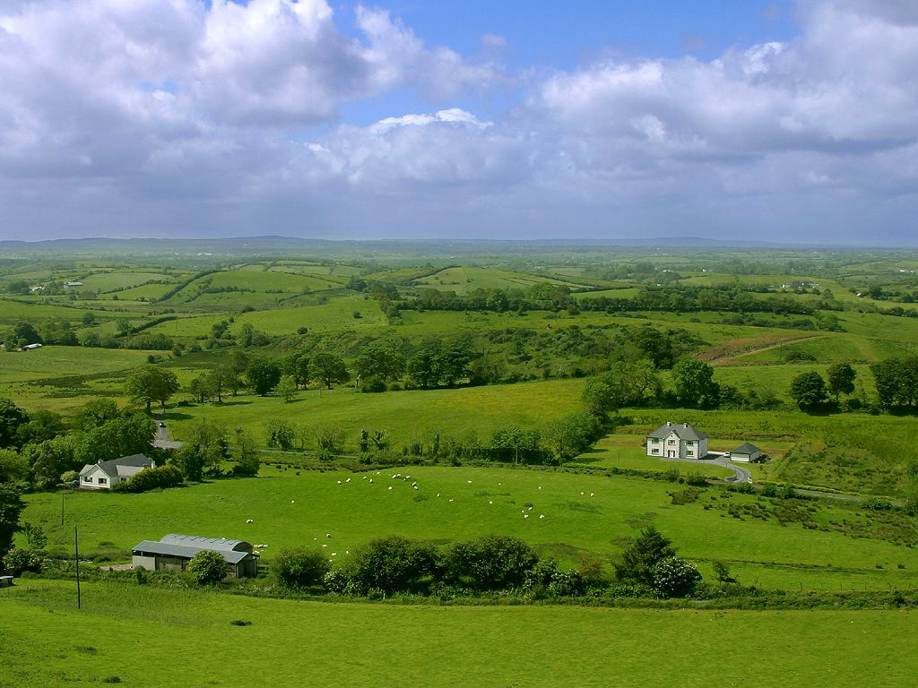
Do We Want This?
Source: V. Milutinovic

Slide 80
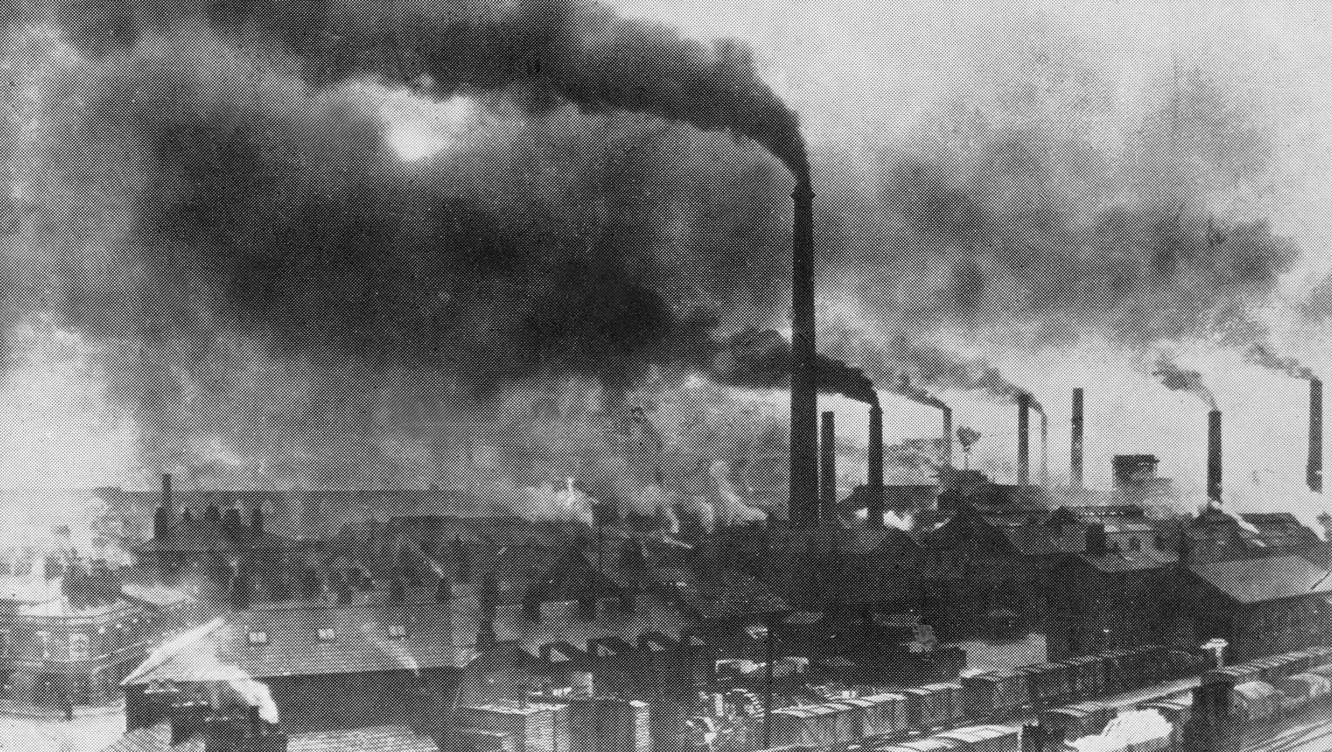
Or This?
Source: V. Milutinovic

Slide 81
Maslow’s (Human) Hierarchy of Needs, Revisited
Maslow, “A Theory of Human Motivation,”
Psychological Review, 1943.
Maslow, “A Theory of Human Motivation,”
Psychological Review, 1943.
Maslow, “Motivation and Personality,”
Book, 1954-1970.
Everlasting energy
Source: https://www.simplypsychology.org/maslow.html

Slide 82
Challenge and Opportunity for Future
High Performance,
Energy Efficient,
Sustainable

Slide 83
The Problem
Data access is the major performance and energy bottleneck
Our current
design principles
cause great energy waste
(and great performance loss)

Slide 84
The Problem
Processing of data
is performed
far away from the data

Slide 85
A Computing System
Three key components
Computation
Communication
Storage/memory
Burks, Goldstein, von Neumann, “Preliminary discussion of the
logical design of an electronic computing instrument,” 1946.
Image source: https://lbsitbytes2010.wordpress.com/2013/03/29/john-von-neumann-roll-no-15/

Slide 86
A Computing System
Three key components
Computation
Communication
Storage/memory
Burks, Goldstein, von Neumann, “Preliminary discussion of the
logical design of an electronic computing instrument,” 1946.
Image source: https://lbsitbytes2010.wordpress.com/2013/03/29/john-von-neumann-roll-no-15/

Slide 87
Today’s Computing Systems
Are overwhelmingly processor centric
All data processed in the processor → at great system cost
Processor is heavily optimized and is considered the master
Data storage units are dumb and are largely unoptimized (except for some that are on the processor die)

Slide 88
Yet …
“It’s the Memory, Stupid!” (Richard Sites, MPR, 1996)
Mutlu+, “Runahead Execution: An Alternative to Very Large Instruction Windows for Out-of-Order Processors,” HPCA 2003.

Slide 89
The Performance Perspective
Onur Mutlu, Jared Stark, Chris Wilkerson, and Yale N. Patt, "Runahead Execution: An Alternative to Very Large Instruction Windows for Out-of-order Processors" Proceedings of the 9th International Symposium on High-Performance Computer Architecture (HPCA), pages 129-140, Anaheim, CA, February 2003. Slides (pdf)

Slide 90
The Performance Perspective (Today)
All of Google’s Data Center Workloads (2015):
Kanev+, “Profiling a Warehouse-Scale Computer,” ISCA 2015.

Slide 91
The Performance Perspective (Today)
All of Google’s Data Center Workloads (2015):
Kanev+, “Profiling a Warehouse-Scale Computer,” ISCA 2015.

Slide 92
Perils of Processor-Centric Design
Grossly-imbalanced systems
Processing done only in one place
Everything else just stores and moves data: data moves a lot
→ Energy inefficient
→ Low performance
→ Complex
Overly complex and bloated processor (and accelerators)
To tolerate data access from memory
Complex hierarchies and mechanisms
→ Energy inefficient
→ Low performance
→ Complex

Slide 93
Perils of Processor-Centric Design
Most of the system is dedicated to storing and moving data

Slide 94
The Energy Perspective
Dally, HiPEAC 2015

Slide 95
Data Movement vs. Computation Energy
Dally, HiPEAC 2015
A memory access consumes ~1000X
the energy of a complex addition

Slide 96
Data Movement vs. Computation Energy
Data movement is a major system energy bottleneck
Comprises 41% of mobile system energy during web browsing [2]
Costs ~115 times as much energy as an ADD operation [1, 2]
[1]: Reducing data Movement Energy via Online Data Clustering and Encoding (MICRO’16)
[2]: Quantifying the energy cost of data movement for emerging smart phone workloads on mobile platforms (IISWC’14)

Slide 97
Energy Waste in Mobile Devices
Amirali Boroumand, Saugata Ghose, Youngsok Kim, Rachata Ausavarungnirun, Eric Shiu, Rahul Thakur, Daehyun Kim, Aki Kuusela, Allan Knies, Parthasarathy Ranganathan, and Onur Mutlu, "Google Workloads for Consumer Devices: Mitigating Data Movement Bottlenecks" Proceedings of the 23rd International Conference on Architectural Support for Programming Languages and Operating Systems (ASPLOS), Williamsburg, VA, USA, March 2018.
62.7% of the total system energy
is spent on data movement

Slide 98
We Do Not Want to Move Data!
Dally, HiPEAC 2015
A memory access consumes ~1000X
the energy of a complex addition

Slide 99
We Need A Paradigm Shift To …
Enable computation with minimal data movement
Compute where it makes sense (where data resides)
Make computing architectures more data-centric

Slide 100
Goal: Processing Inside Memory
Many questions … How do we design the:
compute-capable memory & controllers?
processor chip and in-memory units?
software and hardware interfaces?
system software and languages?
algorithms?
Memory
Processor
Core
Database
Graphs
Media
Cache
Query
Interconnect
Problem
Results
Algorithm
Program/Language
System Software
SW/HW Interface
Micro-architecture
Logic
Devices
Electrons

Slide 101
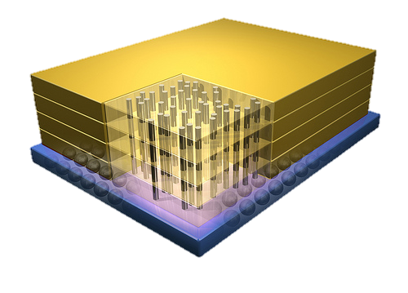
Why In-Memory Computation Today?
Dally, HiPEAC 2015
Push from Technology
DRAM Scaling at jeopardy
→ Controllers close to DRAM
→ Industry open to new memory architectures
Pull from Systems and Applications
Data access is a major system and application bottleneck
Systems are energy limited
Data movement much more energy-hungry than computation

Slide 102
Agenda
Major Trends Affecting Main Memory
The Need for Intelligent Memory Controllers
Bottom Up: Push from Circuits and Devices
Top Down: Pull from Systems and Applications
Processing in Memory: Two Directions
Minimally Changing Memory Chips
Exploiting 3D-Stacked Memory
How to Enable Adoption of Processing in Memory
Conclusion

Slide 103
Processing in Memory: Two Approaches
1. Minimally changing memory chips
2. Exploiting 3D-stacked memory

Slide 104
Approach 1: Minimally Changing DRAM
DRAM has great capability to perform bulk data movement and computation internally with small changes
Can exploit internal connectivity to move data
Can exploit analog computation capability
…
Examples: RowClone, In-DRAM AND/OR, Gather/Scatter DRAM
RowClone: Fast and Efficient In-DRAM Copy and Initialization of Bulk Data (Seshadri et al., MICRO 2013)
Fast Bulk Bitwise AND and OR in DRAM (Seshadri et al., IEEE CAL 2015)
Gather-Scatter DRAM: In-DRAM Address Translation to Improve the Spatial Locality of Non-unit Strided Accesses (Seshadri et al., MICRO 2015)
"Ambit: In-Memory Accelerator for Bulk Bitwise Operations Using Commodity DRAM Technology” (Seshadri et al., MICRO 2017)

Slide 105
Starting Simple: Data Copy and Initialization
memmove & memcpy: 5% cycles in Google’s datacenter [Kanev+ ISCA’15]
000000000000000
Zero initialization
(e.g., security)
Forking
Checkpointing
Many more
VM Cloning
Deduplication
Page Migration

Slide 106
Today’s Systems: Bulk Data Copy
1) High latency
Memory
3) Cache pollution
L3
CPU
L2
L1
MC
2) High bandwidth utilization
4) Unwanted data movement
1046ns, 3.6uJ (for 4KB page copy via DMA)

Slide 107
Future Systems: In-Memory Copy
3) No cache pollution
1) Low latency
Memory
L3
CPU
L2
L1
MC
2) Low bandwidth utilization
4) No unwanted data movement
1046ns, 3.6uJ
→ 90ns, 0.04uJ

Slide 108
RowClone: In-DRAM Row Copy
Idea: Two consecutive ACTivates
4 Kbytes
Negligible HW cost
Step 1: Activate row A
Step 2: Activate row B
Transfer row
DRAM subarray
Transfer
row
Row Buffer (4 Kbytes)
8 bits
Data Bus
Notes:
copy

Slide 109
RowClone: Latency and Energy Savings
11.6x
74x
Seshadri et al., “RowClone: Fast and Efficient In-DRAM Copy and Initialization of Bulk Data,” MICRO 2013.

Slide 110
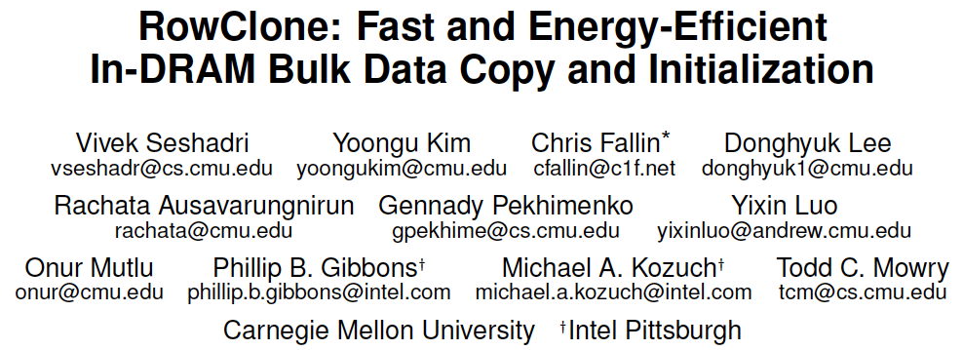
More on RowClone
Vivek Seshadri, Yoongu Kim, Chris Fallin, Donghyuk Lee, Rachata Ausavarungnirun, Gennady Pekhimenko, Yixin Luo, Onur Mutlu, Michael A. Kozuch, Phillip B. Gibbons, and Todd C. Mowry, "RowClone: Fast and Energy-Efficient In-DRAM Bulk Data Copy and Initialization" Proceedings of the 46th International Symposium on Microarchitecture (MICRO), Davis, CA, December 2013. [Slides (pptx) (pdf)] [Lightning Session Slides (pptx) (pdf)] [Poster (pptx) (pdf)]

Slide 111
Déjà vu From IMW 2013
Onur Mutlu, "Memory Scaling: A Systems Architecture Perspective" Proceedings of the 5th International Memory Workshop (IMW), Monterey, CA, May 2013. Slides (pptx) (pdf) EETimes Reprint

Slide 112
Memory as an Accelerator
CPU
core
CPU
core
mini-CPU
core
GPU
(throughput)
core
GPU
(throughput)
core
video
core
GPU
(throughput)
core
GPU
(throughput)
core
CPU
core
CPU
core
Memory
imaging
core
LLC
Specialized
compute-capability
in memory
Memory Controller
Memory Bus
Memory similar to a “conventional” accelerator

Slide 113
In-Memory Bulk Bitwise Operations
We can support in-DRAM COPY, ZERO, AND, OR, NOT, MAJ
At low cost
Using analog computation capability of DRAM
Idea: activating multiple rows performs computation
30-60X performance and energy improvement
Seshadri+, “Ambit: In-Memory Accelerator for Bulk Bitwise Operations Using Commodity DRAM Technology,” MICRO 2017.
New memory technologies enable even more opportunities
Memristors, resistive RAM, phase change mem, STT-MRAM, …
Can operate on data with minimal movement

Slide 114
In-DRAM AND/OR: Triple Row Activation
½V_{DD}
½V_{DD}+δ
V_{DD}
A
Final State
AB + BC + AC
B
C
C(A + B) + ~C(AB)
dis
en
0
½V_{DD}
Seshadri+, “Fast Bulk Bitwise AND and OR in DRAM”, IEEE CAL 2015.

Slide 115
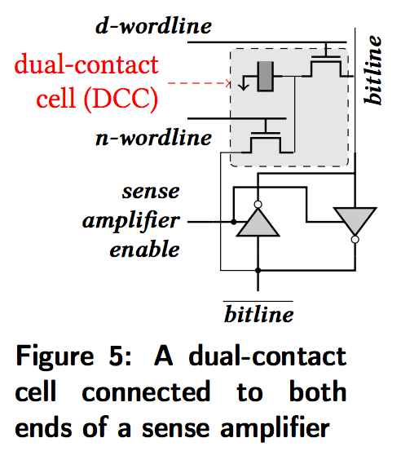
In-DRAM NOT: Dual Contact Cell
Idea:
Feed the
negated value
in the sense amplifier
into a special row
Seshadri+, “Ambit: In-Memory Accelerator for Bulk Bitwise Operations using Commodity DRAM Technology,” MICRO 2017.

Slide 116
Performance: In-DRAM Bitwise Operations
Seshadri+, “Ambit: In-Memory Accelerator for Bulk Bitwise Operations using Commodity DRAM Technology,” MICRO 2017.

Slide 117
Energy of In-DRAM Bitwise Operations
Seshadri+, “Ambit: In-Memory Accelerator for Bulk Bitwise Operations using Commodity DRAM Technology,” MICRO 2017.

Slide 118
Ambit vs. DDR3: Performance and Energy
32X
35X
Seshadri+, “Ambit: In-Memory Accelerator for Bulk Bitwise Operations using Commodity DRAM Technology,” MICRO 2017.

Slide 119
Bulk Bitwise Operations in Workloads
[1] Li and Patel, BitWeaving, SIGMOD 2013
[2] Goodwin+, BitFunnel, SIGIR 2017

Slide 120
Example Data Structure: Bitmap Index
Alternative to B-tree and its variants
Efficient for performing range queries and joins
Many bitwise operations to perform a query
age < 18
18 < age < 25
25 < age < 60
age > 60
Bitmap 1
Bitmap 2
Bitmap 3
Bitmap 4

Slide 121
Performance: Bitmap Index on Ambit
Seshadri+, “Ambit: In-Memory Accelerator for Bulk Bitwise Operations using Commodity DRAM Technology,” MICRO 2017.

Slide 122
Performance: BitWeaving on Ambit
Seshadri+, “Ambit: In-Memory Accelerator for Bulk Bitwise Operations using Commodity DRAM Technology,” MICRO 2017.

Slide 123
More on In-DRAM Bulk AND/OR
Vivek Seshadri, Kevin Hsieh, Amirali Boroumand, Donghyuk Lee, Michael A. Kozuch, Onur Mutlu, Phillip B. Gibbons, and Todd C. Mowry, "Fast Bulk Bitwise AND and OR in DRAM" IEEE Computer Architecture Letters (CAL), April 2015.

Slide 124
More on Ambit
Vivek Seshadri et al., “Ambit: In-Memory Accelerator for Bulk Bitwise Operations Using Commodity DRAM Technology,” MICRO 2017.

Slide 125
Challenge and Opportunity for Future
Computing Architectures
with
Minimal Data Movement

Slide 126
Challenge: Intelligent Memory Device
Does memory
have to be
dumb?

Slide 127
Agenda
Major Trends Affecting Main Memory
The Need for Intelligent Memory Controllers
Bottom Up: Push from Circuits and Devices
Top Down: Pull from Systems and Applications
Processing in Memory: Two Directions
Minimally Changing Memory Chips
Exploiting 3D-Stacked Memory
How to Enable Adoption of Processing in Memory
Conclusion

Slide 128
Processing in Memory: Two Approaches
1. Minimally changing memory chips
2. Exploiting 3D-stacked memory

Slide 129
Opportunity: 3D-Stacked Logic+Memory
Memory
Logic
Other “True 3D” technologies
under development

Slide 130
DRAM Landscape (circa 2015)
Kim+, “Ramulator: A Flexible and Extensible DRAM Simulator”, IEEE CAL 2015.

Slide 131
Two Key Questions in 3D-Stacked PIM
What are the performance and energy benefits of using 3D-stacked memory as a coarse-grained accelerator?
By changing the entire system
By performing simple function offloading
What is the minimal processing-in-memory support we can provide?
With minimal changes to system and programming

Slide 132
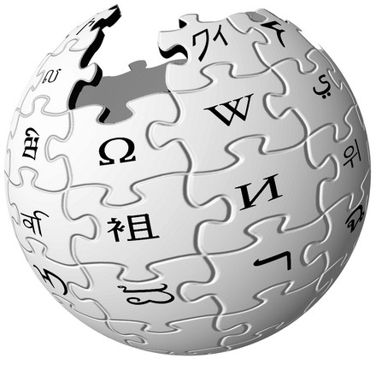
Graph Processing
Large graphs are everywhere (circa 2015)
Scalable large-scale graph processing is challenging
36 Million
Wikipedia Pages
1.4 Billion
Facebook Users
300 Million
Twitter Users
30 Billion
Instagram Photos

Slide 133
Key Bottlenecks in Graph Processing
for (v: graph.vertices) {
for (w: v.successors) {
w.next_rank += weight * v.rank;
}
}
1. Frequent random memory accesses
v
&w
w.rank
w.next_rank
w.edges
weight * v.rank
w
…
2. Little amount of computation

Slide 134
Tesseract System for Graph Processing
Interconnected set of 3D-stacked memory+logic chips with simple cores
Host Processor
Memory
Memory-Mapped
Accelerator Interface
(Noncacheable, Physically Addressed)
Logic
In-Order Core
DRAM Controller
…
…
LP
PF Buffer
Crossbar Network
…
MTP
…
Message Queue
NI
Ahn+, “A Scalable Processing-in-Memory Accelerator for Parallel Graph Processing” ISCA 2015.

Slide 135
Tesseract System for Graph Processing
Host Processor
Memory
Memory-Mapped
Accelerator Interface
(Noncacheable, Physically Addressed)
Logic
In-Order Core
DRAM Controller
…
…
Communications via Remote Function Calls
LP
PF Buffer
Crossbar Network
…
MTP
…
Message Queue
NI

Slide 136
Communications In Tesseract (I)

Slide 137
Communications In Tesseract (II)

Slide 138
Communications In Tesseract (III)

Slide 139
Remote Function Call (Non-Blocking)

Slide 140
Tesseract System for Graph Processing
Host Processor
Memory
Memory-Mapped
Accelerator Interface
(Noncacheable, Physically Addressed)
Logic
Prefetching
In-Order Core
DRAM Controller
…
…
LP
PF Buffer
Crossbar Network
…
MTP
…
Message Queue
NI

Slide 141
Evaluated Systems
DDR3-OoO
HMC-OoO
HMC-MC
Tesseract
32 Tesseract Cores
8 OoO
4GHz
8 OoO
4GHz
8 OoO
4GHz
8 OoO
4GHz
128 In-Order
2GHz
128 In-Order
2GHz
8 OoO
4GHz
8 OoO
4GHz
8 OoO
4GHz
8 OoO
4GHz
128 In-Order
2GHz
128 In-Order
2GHz
102.4GB/s
640GB/s
640GB/s
8TB/s
Ahn+, “A Scalable Processing-in-Memory Accelerator for Parallel Graph Processing” ISCA 2015.

Slide 142
Tesseract Graph Processing Performance
>13X Performance Improvement
On five graph processing algorithms
Ahn+, “A Scalable Processing-in-Memory Accelerator for Parallel Graph Processing” ISCA 2015.

Slide 143
Tesseract Graph Processing Performance

Slide 144
Tesseract Graph Processing System Energy
> 8X Energy Reduction
Ahn+, “A Scalable Processing-in-Memory Accelerator for Parallel Graph Processing” ISCA 2015.

Slide 145
More on Tesseract
Junwhan Ahn, Sungpack Hong, Sungjoo Yoo, Onur Mutlu, and Kiyoung Choi, "A Scalable Processing-in-Memory Accelerator for Parallel Graph Processing" Proceedings of the 42nd International Symposium on Computer Architecture (ISCA), Portland, OR, June 2015. [Slides (pdf)] [Lightning Session Slides (pdf)]

Slide 146
Two Key Questions in 3D-Stacked PIM
What are the performance and energy benefits of using 3D-stacked memory as a coarse-grained accelerator?
By changing the entire system
By performing simple function offloading
What is the minimal processing-in-memory support we can provide?
With minimal changes to system and programming

Slide 147
PIM on Mobile Devices
Amirali Boroumand, Saugata Ghose, Youngsok Kim, Rachata Ausavarungnirun, Eric Shiu, Rahul Thakur, Daehyun Kim, Aki Kuusela, Allan Knies, Parthasarathy Ranganathan, and Onur Mutlu, "Google Workloads for Consumer Devices: Mitigating Data Movement Bottlenecks" Proceedings of the 23rd International Conference on Architectural Support for Programming Languages and Operating Systems (ASPLOS), Williamsburg, VA, USA, March 2018.

Slide 148
Google Workloads for Consumer Devices: Mitigating Data Movement Bottlenecks
Amirali Boroumand
Saugata Ghose, Youngsok Kim, Rachata Ausavarungnirun,
Eric Shiu, Rahul Thakur, Daehyun Kim, Aki Kuusela, Allan Knies, Parthasarathy Ranganathan, Onur Mutlu

Slide 149
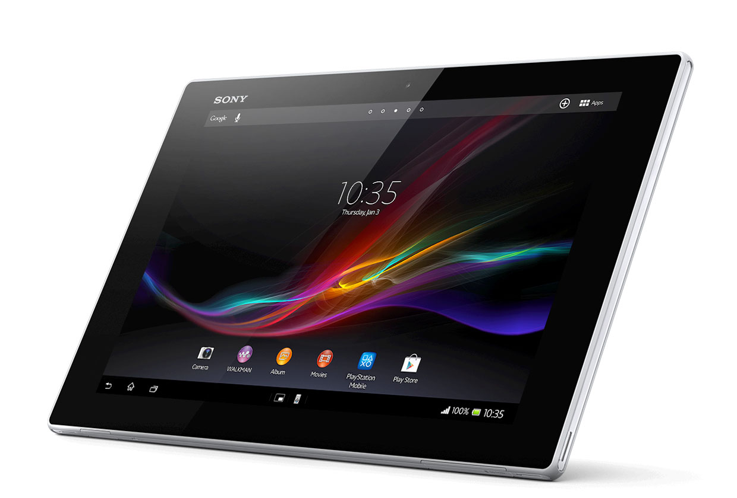
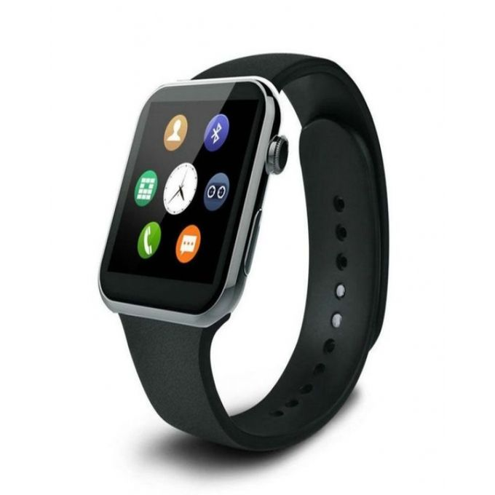
Consumer Devices
Consumer devices are everywhere!
Energy consumption is a first-class concern in consumer devices
Notes:
Consumer devices like tablets smartphone and wearable are now everywhere and used by billions of people.
One of the major challenge in these devices is battery limitation which makes the energy consumption a critical concern …

Slide 150
Popular Google Consumer Workloads
Chrome
TensorFlow Mobile
Google’s web browser
Google’s machine learning framework
Video Playback
Video Capture
Google’s video codec
Google’s video codec
Notes:
In this work, we take a look at widely-used google consumer workloads, to figure out the major sources of energy consumption.
We look at Google Chrome web brower. We take a look at Tensorflow, Google’s machine learning framework, and we also take a look at two important video related workloads, video playback and video capture, both rely on Google’s vp9 codec technology.

Slide 151
Energy Cost of Data Movement
1st key observation: 62.7% of the total system energy is spent on data movement
Data Movement
SoC
DRAM
CPU
L2
CPU
L1
CPU
CPU
Compute Unit
Processing-In-Memory (PIM)
Potential solution: move computation close to data
Challenge: limited area and energy budget
Notes:
Throughout our analysis, we make a key observation that out of all sources of energy consumption, data movement is a major contributor to the total system energy. We find that across all of the workloads, on average around 62.7% of total system energy is spent on data movement.
One way to reduce data movement cost is to move computation close to data, or …
One potential solution to address this cost it do move computation close to data, or in other words, do procesing in memory. However, the challenge is that these devices.
One potential solution to mitigate data movement cost and reduce total system energy is to execute data-movement heavy portions of application close to data, or in other words, do processing in memory. However, consumer devices are extermely limited in terms of area and power budget. So the question is can we move part of the data movement heavy portion given the limited area and energy budget. Our

Slide 152
Using PIM to Reduce Data Movement
2nd key observation: a significant fraction of the data movement often comes from simple functions
We can design lightweight logic to implement these simple functions in memory
Small embedded low-power core
Small fixed-function accelerators
PIM Core
PIM Accelerator
PIM Accelerator
PIM Accelerator
Offloading to PIM logic reduces energy and improves performance, on average, by 55.4% and 54.2%
Notes:
To figure out if we can use processing in memory, we dig deeper into our analysis and we make another key observation that majority of data movement often comes form simple functions and pritmitives. We find that these simple function can be implemented in memory as either a small embedded core, or group of small fixed function accelerators. Our result shows that offloading these function to PIM logic can significantly reduce data movement for each function and reduce energy on average around 55% and improve perforamcne around 54%.
our PIM core can reduce significant portion of data movement, reduce enregy by 49.1% for each function and improve performance up to 2.2X. While using group of fixed function accelerator reduce energy by 55.4% and improve performance by up to 2.5X.
Or use Saugata’s approach : Reduces total system energy by an average of 55.4%
Reduces execution time by an average of 54.2%
Our result show that both of them can significantly reduce the data movement for each function.
Feedback: talk about result more
Don’t talk about specific detail like MemCopy, MemSet stuff like that
Main take away: data movement come from simple functions that are simple enough to implement in PIM
We find that these functions and primitves can be implemented as PIM logic using either (1) a small low-power general-purpose embedded core or (2) a group of small fixed-function accelerators (PIM accelerators). Our Analysis shows that both are cost-feasible to use in consumer devices. We find that they eliminate a significant fraction of dat amovement, and reduce energy consumption for each of these operation on average by 49 and 55%.

Slide 153
Workload Analysis
Chrome
TensorFlow Mobile
Google’s web browser
Google’s machine learning framework
Video Playback
Video Capture
Google’s video codec
Google’s video codec
Notes:
In this work, we take a look at widely-used google consumer workloads, to figure out the major sources of energy consumption.
We look at Google Chrome web brower. We take a look at Tensorflow, Google’s machine learning framework, and we also take a look at two important video related workloads, video playback and video capture, both rely on Google’s vp9 codec technology.

Slide 154
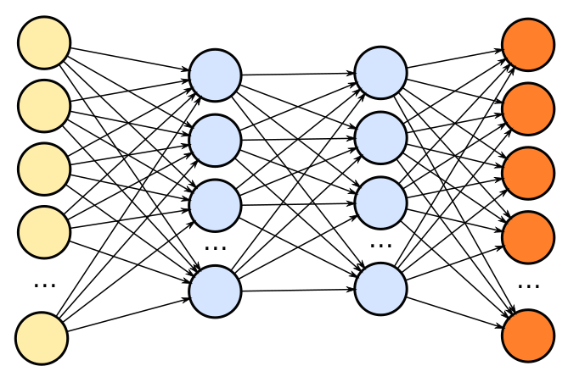
TensorFlow Mobile
Inference
Prediction
57.3% of the inference energy is spent on data movement
54.4% of the data movement energy comes from packing/unpacking and quantization

Slide 155
Packing
Matrix
Packing
Packed Matrix
Reorders elements of matrices to minimize cache misses during matrix multiplication
Up to 40% of the inference energy and 31% of inference execution time
Packing’s data movement accounts for up to 35.3% of the inference energy
A simple data reorganization process that requires simple arithmetic

Slide 156
Quantization
floating point
Quantization
integer
Converts 32-bit floating point to 8-bit integers to improve inference execution time and energy consumption
Up to 16.8% of the inference energy and 16.1% of inference execution time
Majority of quantization energy comes from data movement
A simple data conversion operation that requires shift, addition, and multiplication operations

Slide 157
Quantization
floating point
Quantization
integer
Converts 32-bit floating point to 8-bit integers to improve inference execution time and energy consumption
Based on our analysis, we conclude that:
Both functions are good candidates for PIM execution
It is feasible to implement them in PIM logic
Up to 16.8% of the inference energy and 16.1% of inference execution time
Majority of quantization energy comes from data movement
A simple data conversion operation that requires shift, addition, and multiplication operations

Slide 158
Evaluation Methodology
System Configuration (gem5 Simulator)
SoC: 4 OoO cores, 8-wide issue, 64 kB L1cache, 2MB L2 cache
PIM Core: 1 core per vault, 1-wide issue, 4-wide SIMD, 32kB L1 cache
3D-Stacked Memory: 2GB cube, 16 vaults per cube
Internal Bandwidth: 256GB/S
Off-Chip Channel Bandwidth: 32 GB/s
Baseline Memory: LPDDR3, 2GB, FR-FCFS scheduler
We study each target in isolation and emulate each separately and run them in our simulator
Notes:
and then analyzing the benefit of PIM in our simulator

Slide 159
Normalized Energy
TensorFlow Mobile
Video Playback and Capture
77.7% and 82.6% of energy reduction for texture tiling and packing comes from eliminating data movement
Chrome Browser
PIM core and PIM accelerator reduces energy consumption on average by 49.1% and 55.4%
Notes:
We make another obsrevation that using PIM accelerator provide limited energy reduction over PIM core, for some of these workloads, such as texture tiling. This is becase these kernels are data intensive and have low ocmputational compleity, and as a result, using fixed function accelerator does not provide significant energy reduction over the PIM core.

Slide 160
Normalized Runtime
Chrome Browser
Video Playback and Capture
TensorFlow Mobile
Offloading these kernels to PIM core and PIM accelerator improves performance on average by 44.6% and 54.2%
Notes:
PIM-Core and PIM-Acc significantly outperform CPU-Only across all kernels, improving performance by … This perfomance benefit come from higher bandwidth and lower access latency of 3D-stacked memory, because all of these kernels are data intensive.
Performance improvement of PIM-acc over PIM-core differes across different workloads. In some cases such as Texture Tiling, the performance improvement of PIM-Acc over PIM-Core is limited by the low computational complexity of these two kernels. But there are other cases, such as compression that benefit significantly from using PIM-Acc over PIM-Core in terms of performance, because these kernels are more compute-intensive and less data-intensive compared to texture tiling and.

Slide 161
Google Workloads for Consumer Devices: Mitigating Data Movement Bottlenecks
Amirali Boroumand
Saugata Ghose, Youngsok Kim, Rachata Ausavarungnirun,
Eric Shiu, Rahul Thakur, Daehyun Kim, Aki Kuusela, Allan Knies, Parthasarathy Ranganathan, Onur Mutlu
ASPLOS 2018
Notes:
Please drop by our talk during session 1 if you would like to learn more about data movement in Google workloads.

Slide 162
More on PIM for Mobile Devices
Amirali Boroumand, Saugata Ghose, Youngsok Kim, Rachata Ausavarungnirun, Eric Shiu, Rahul Thakur, Daehyun Kim, Aki Kuusela, Allan Knies, Parthasarathy Ranganathan, and Onur Mutlu, "Google Workloads for Consumer Devices: Mitigating Data Movement Bottlenecks" Proceedings of the 23rd International Conference on Architectural Support for Programming Languages and Operating Systems (ASPLOS), Williamsburg, VA, USA, March 2018.
62.7% of the total system energy
is spent on data movement

Slide 163
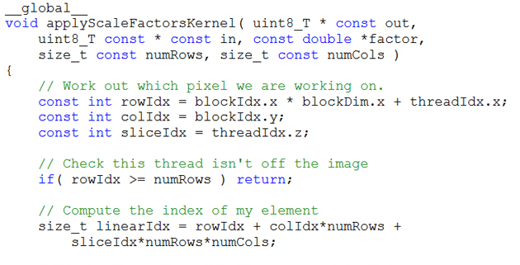
Truly Distributed GPU Processing with PIM?
3D-stacked memory
(memory stack)
SM (Streaming Multiprocessor)
Logic layer
Logic layer SM
Main GPU
Crossbar switch
Vault Ctrl
….
Vault Ctrl

Slide 164
Accelerating GPU Execution with PIM (I)
Kevin Hsieh, Eiman Ebrahimi, Gwangsun Kim, Niladrish Chatterjee, Mike O'Connor, Nandita Vijaykumar, Onur Mutlu, and Stephen W. Keckler, "Transparent Offloading and Mapping (TOM): Enabling Programmer-Transparent Near-Data Processing in GPU Systems" Proceedings of the 43rd International Symposium on Computer Architecture (ISCA), Seoul, South Korea, June 2016. [Slides (pptx) (pdf)] [Lightning Session Slides (pptx) (pdf)]

Slide 165
Accelerating GPU Execution with PIM (II)
Ashutosh Pattnaik, Xulong Tang, Adwait Jog, Onur Kayiran, Asit K. Mishra, Mahmut T. Kandemir, Onur Mutlu, and Chita R. Das, "Scheduling Techniques for GPU Architectures with Processing-In-Memory Capabilities" Proceedings of the 25th International Conference on Parallel Architectures and Compilation Techniques (PACT), Haifa, Israel, September 2016.

Slide 166
Accelerating Linked Data Structures
Kevin Hsieh, Samira Khan, Nandita Vijaykumar, Kevin K. Chang, Amirali Boroumand, Saugata Ghose, and Onur Mutlu, "Accelerating Pointer Chasing in 3D-Stacked Memory: Challenges, Mechanisms, Evaluation" Proceedings of the 34th IEEE International Conference on Computer Design (ICCD), Phoenix, AZ, USA, October 2016.

Slide 167
Accelerating Dependent Cache Misses
Milad Hashemi, Khubaib, Eiman Ebrahimi, Onur Mutlu, and Yale N. Patt, "Accelerating Dependent Cache Misses with an Enhanced Memory Controller" Proceedings of the 43rd International Symposium on Computer Architecture (ISCA), Seoul, South Korea, June 2016. [Slides (pptx) (pdf)] [Lightning Session Slides (pptx) (pdf)]

Slide 168
Two Key Questions in 3D-Stacked PIM
What are the performance and energy benefits of using 3D-stacked memory as a coarse-grained accelerator?
By changing the entire system
By performing simple function offloading
What is the minimal processing-in-memory support we can provide?
With minimal changes to system and programming

Slide 169
PEI: PIM-Enabled Instructions (Ideas)
Goal: Develop mechanisms to get the most out of near-data processing with minimal cost, minimal changes to the system, no changes to the programming model
Key Idea 1: Expose each PIM operation as a cache-coherent, virtually-addressed host processor instruction (called PEI) that operates on only a single cache block
e.g., __pim_add(&w.next_rank, value) → pim.add r1, (r2)
No changes sequential execution/programming model
No changes to virtual memory
Minimal changes to cache coherence
No need for data mapping: Each PEI restricted to a single memory module
Key Idea 2: Dynamically decide where to execute a PEI (i.e., the host processor or PIM accelerator) based on simple locality characteristics and simple hardware predictors
Execute each operation at the location that provides the best performance

Slide 170
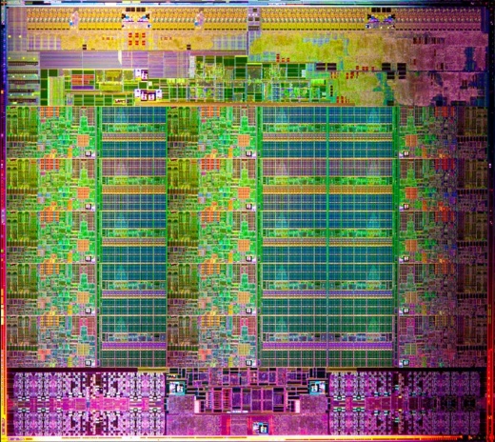
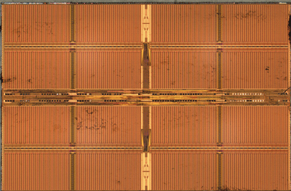
Simple PIM Operations as ISA Extensions (II)
for (v: graph.vertices) {
value = weight * v.rank;
for (w: v.successors) {
w.next_rank += value;
}
}
Host Processor
Main Memory
w.next_rank
w.next_rank
w.next_rank
w.next_rank
64 bytes in
64 bytes out
Conventional Architecture

Slide 171
Simple PIM Operations as ISA Extensions (III)
for (v: graph.vertices) {
value = weight * v.rank;
for (w: v.successors) {
__pim_add(&w.next_rank, value);
}
}
pim.add r1, (r2)
Host Processor
Main Memory
value
w.next_rank
w.next_rank
8 bytes in
0 bytes out
In-Memory Addition

Slide 172
Always Executing in Memory? Not A Good Idea
Increased
Memory Bandwidth Consumption
Caching very effective
Reduced Memory Bandwidth
Consumption due to
In-Memory Computation
More Vertices

Slide 173
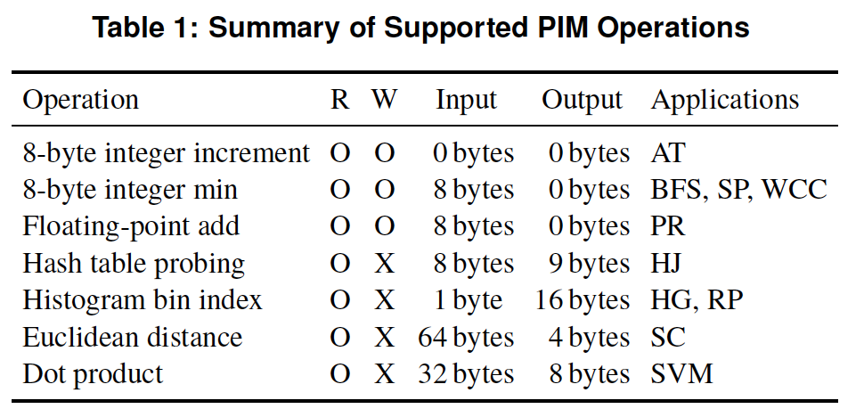
PEI: PIM-Enabled Instructions (Example)
for (v: graph.vertices) {
value = weight * v.rank;
for (w: v.successors) {
__pim_add(&w.next_rank, value);
}
}
pfence();
pim.add r1, (r2)
pfence
Executed either in memory or in the processor: dynamic decision
Low-cost locality monitoring for a single instruction
Cache-coherent, virtually-addressed, single cache block only
Atomic between different PEIs
Not atomic with normal instructions (use pfence for ordering)

Slide 174
Example (Abstract) PEI uArchitecture
Host Processor
3D-stacked Memory
Out-Of-Order Core
Last-Level Cache
DRAM Controller
L1 Cache
PCU
L2 Cache
PCU (PEI Computation Unit)
DRAM Controller
PCU
Network
HMC Controller
PMU (PEI
Mgmt Unit)
…
PIM Directory
Locality Monitor
DRAM Controller
PCU
Example PEI uArchitecture

Slide 175
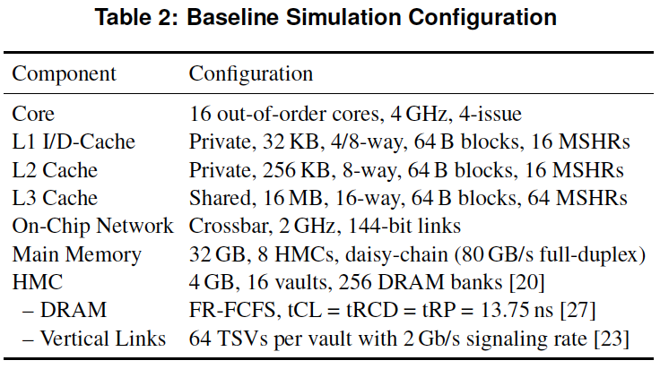
PEI: Initial Evaluation Results
Initial evaluations with 10 emerging data-intensive workloads
Large-scale graph processing
In-memory data analytics
Machine learning and data mining
Three input sets (small, medium, large) for each workload to analyze the impact of data locality
Pin-based cycle-level x86-64 simulation
Performance Improvement and Energy Reduction:
47% average speedup with large input data sets
32% speedup with small input data sets
25% avg. energy reduction in a single node with large input data sets

Slide 176
Evaluated Data-Intensive Applications
Ten emerging data-intensive workloads
Large-scale graph processing
Average teenage follower, BFS, PageRank, single-source shortest path, weakly connected components
In-memory data analytics
Hash join, histogram, radix partitioning
Machine learning and data mining
Streamcluster, SVM-RFE
Three input sets (small, medium, large) for each workload to show the impact of data locality

Slide 177
PEI Performance Delta: Large Data Sets
(Large Inputs, Baseline: Host-Only)

Slide 178
PEI Performance: Large Data Sets
(Large Inputs, Baseline: Host-Only)

Slide 179
PEI Energy Consumption
Host-Only
PIM-Only
Locality-Aware

Slide 180
Simpler PIM: PIM-Enabled Instructions
Junwhan Ahn, Sungjoo Yoo, Onur Mutlu, and Kiyoung Choi, "PIM-Enabled Instructions: A Low-Overhead, Locality-Aware Processing-in-Memory Architecture" Proceedings of the 42nd International Symposium on Computer Architecture (ISCA), Portland, OR, June 2015. [Slides (pdf)] [Lightning Session Slides (pdf)]

Slide 181
Automatic Code and Data Mapping
Kevin Hsieh, Eiman Ebrahimi, Gwangsun Kim, Niladrish Chatterjee, Mike O'Connor, Nandita Vijaykumar, Onur Mutlu, and Stephen W. Keckler, "Transparent Offloading and Mapping (TOM): Enabling Programmer-Transparent Near-Data Processing in GPU Systems" Proceedings of the 43rd International Symposium on Computer Architecture (ISCA), Seoul, South Korea, June 2016. [Slides (pptx) (pdf)] [Lightning Session Slides (pptx) (pdf)]

Slide 182
Automatic Offloading of Critical Code
Milad Hashemi, Khubaib, Eiman Ebrahimi, Onur Mutlu, and Yale N. Patt, "Accelerating Dependent Cache Misses with an Enhanced Memory Controller" Proceedings of the 43rd International Symposium on Computer Architecture (ISCA), Seoul, South Korea, June 2016. [Slides (pptx) (pdf)] [Lightning Session Slides (pptx) (pdf)]

Slide 183
Automatic Offloading of Prefetch Mechanisms
Milad Hashemi, Onur Mutlu, and Yale N. Patt, "Continuous Runahead: Transparent Hardware Acceleration for Memory Intensive Workloads" Proceedings of the 49th International Symposium on Microarchitecture (MICRO), Taipei, Taiwan, October 2016. [Slides (pptx) (pdf)] [Lightning Session Slides (pdf)] [Poster (pptx) (pdf)]

Slide 184
Efficient Automatic Data Coherence Support
Amirali Boroumand, Saugata Ghose, Minesh Patel, Hasan Hassan, Brandon Lucia, Kevin Hsieh, Krishna T. Malladi, Hongzhong Zheng, and Onur Mutlu, "LazyPIM: An Efficient Cache Coherence Mechanism for Processing-in-Memory" IEEE Computer Architecture Letters (CAL), June 2016.

Slide 185
Challenge and Opportunity for Future
Fundamentally
Energy-Efficient
(Data-Centric)
Computing Architectures

Slide 186
Challenge and Opportunity for Future
Fundamentally
High-Performance
(Data-Centric)
Computing Architectures

Slide 187
Challenge and Opportunity for Future
Computing Architectures
with
Minimal Data Movement

Slide 188
Agenda
Major Trends Affecting Main Memory
The Need for Intelligent Memory Controllers
Bottom Up: Push from Circuits and Devices
Top Down: Pull from Systems and Applications
Processing in Memory: Two Directions
Minimally Changing Memory Chips
Exploiting 3D-Stacked Memory
How to Enable Adoption of Processing in Memory
Conclusion

Slide 189
Eliminating the Adoption Barriers
How to Enable Adoption of Processing in Memory

Slide 190
Barriers to Adoption of PIM
1. Functionality of and applications for PIM
2. Ease of programming (interfaces and compiler/HW support)
3. System support: coherence & virtual memory
4. Runtime systems for adaptive scheduling, data mapping, access/sharing control
5. Infrastructures to assess benefits and feasibility

Slide 191
We Need to Revisit the Entire Stack
Problem
Algorithm
Program/Language
System Software
SW/HW Interface
Micro-architecture
Logic
Devices
Electrons

Slide 192
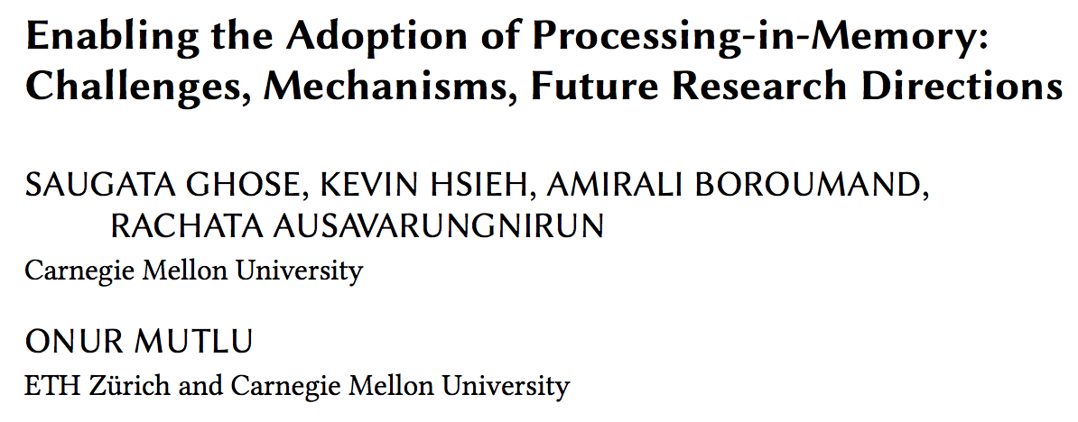
Open Problems: PIM Adoption
Saugata Ghose, Kevin Hsieh, Amirali Boroumand, Rachata Ausavarungnirun, Onur Mutlu, "Enabling the Adoption of Processing-in-Memory: Challenges, Mechanisms, Future Research Directions" Invited Book Chapter, to appear in 2018. [Preliminary arxiv.org version]
https://arxiv.org/pdf/1802.00320.pdf

Slide 193
Open Problems: PIM Adoption
Onur Mutlu, Saugata Ghose, Juan Gomez-Luna, and Rachata Ausavarungnirun, "Processing Data Where It Makes Sense: Enabling In-Memory Computation" Invited paper in Microprocessors and Microsystems (MICPRO), June 2019. [arXiv version]

Slide 194
Key Challenge 1: Code Mapping
Challenge 1: Which operations should be executed in memory vs. in CPU?
?
3D-stacked memory
(memory stack)
SM (Streaming Multiprocessor)
?
Logic layer
Logic layer SM
Main GPU
Crossbar switch
Vault Ctrl
….
Vault Ctrl

Slide 195
Key Challenge 2: Data Mapping
Challenge 2: How should data be mapped to different 3D memory stacks?
3D-stacked memory
(memory stack)
SM (Streaming Multiprocessor)
Logic layer
Logic layer SM
Main GPU
Crossbar switch
Vault Ctrl
….
Vault Ctrl

Slide 196
How to Do the Code and Data Mapping?
Kevin Hsieh, Eiman Ebrahimi, Gwangsun Kim, Niladrish Chatterjee, Mike O'Connor, Nandita Vijaykumar, Onur Mutlu, and Stephen W. Keckler, "Transparent Offloading and Mapping (TOM): Enabling Programmer-Transparent Near-Data Processing in GPU Systems" Proceedings of the 43rd International Symposium on Computer Architecture (ISCA), Seoul, South Korea, June 2016. [Slides (pptx) (pdf)] [Lightning Session Slides (pptx) (pdf)]

Slide 197
How to Schedule Code?
Ashutosh Pattnaik, Xulong Tang, Adwait Jog, Onur Kayiran, Asit K. Mishra, Mahmut T. Kandemir, Onur Mutlu, and Chita R. Das, "Scheduling Techniques for GPU Architectures with Processing-In-Memory Capabilities" Proceedings of the 25th International Conference on Parallel Architectures and Compilation Techniques (PACT), Haifa, Israel, September 2016.

Slide 198
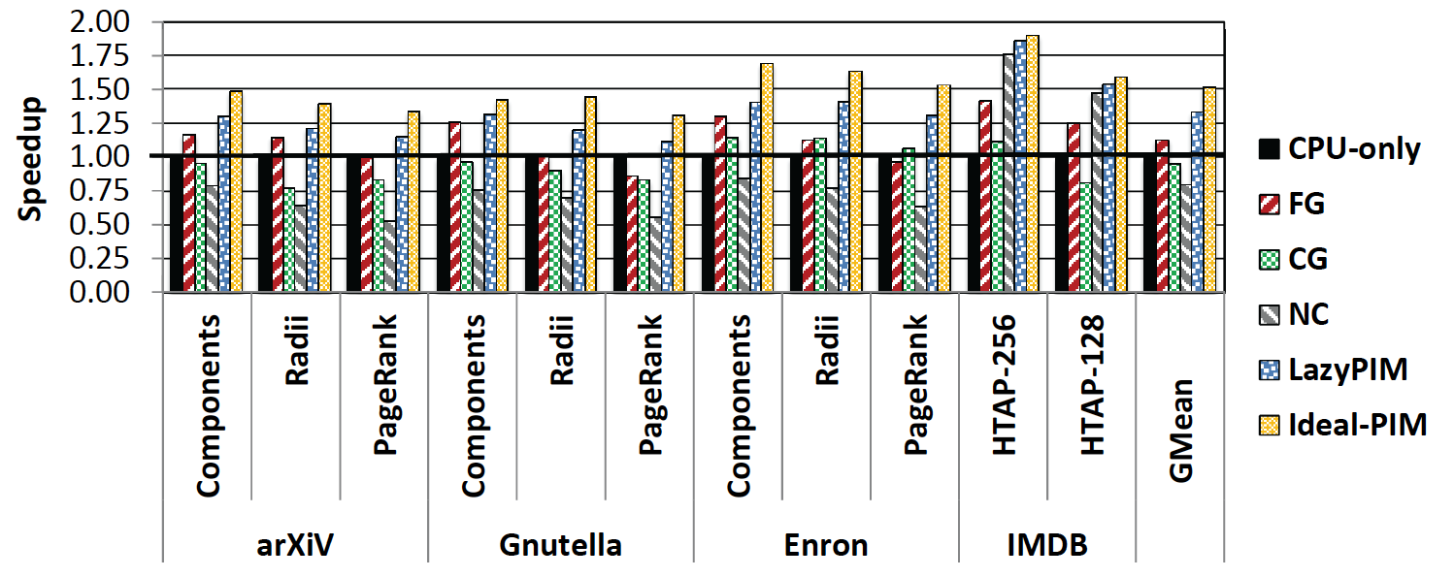
Challenge: Coherence for Hybrid CPU-PIM Apps
Traditional
coherence
No coherence
overhead

Slide 199
How to Maintain Coherence?
Amirali Boroumand, Saugata Ghose, Minesh Patel, Hasan Hassan, Brandon Lucia, Kevin Hsieh, Krishna T. Malladi, Hongzhong Zheng, and Onur Mutlu, "LazyPIM: An Efficient Cache Coherence Mechanism for Processing-in-Memory" IEEE Computer Architecture Letters (CAL), June 2016.

Slide 200
How to Support Virtual Memory?
Kevin Hsieh, Samira Khan, Nandita Vijaykumar, Kevin K. Chang, Amirali Boroumand, Saugata Ghose, and Onur Mutlu, "Accelerating Pointer Chasing in 3D-Stacked Memory: Challenges, Mechanisms, Evaluation" Proceedings of the 34th IEEE International Conference on Computer Design (ICCD), Phoenix, AZ, USA, October 2016.

Slide 201
How to Design Data Structures for PIM?
Zhiyu Liu, Irina Calciu, Maurice Herlihy, and Onur Mutlu, "Concurrent Data Structures for Near-Memory Computing" Proceedings of the 29th ACM Symposium on Parallelism in Algorithms and Architectures (SPAA), Washington, DC, USA, July 2017. [Slides (pptx) (pdf)]

Slide 202
Simulation Infrastructures for PIM
Ramulator extended for PIM
Flexible and extensible DRAM simulator
Can model many different memory standards and proposals
Kim+, “Ramulator: A Flexible and Extensible DRAM Simulator”, IEEE CAL 2015.
https://github.com/CMU-SAFARI/ramulator

Slide 203
An FPGA-based Test-bed for PIM?
Hasan Hassan et al., SoftMC: A Flexible and Practical Open-Source Infrastructure for Enabling Experimental DRAM Studies HPCA 2017.
Flexible
Easy to Use (C++ API)
Open-source
github.com/CMU-SAFARI/SoftMC

Slide 204
Simulation Infrastructures for PIM (in SSDs)
Arash Tavakkol, Juan Gomez-Luna, Mohammad Sadrosadati, Saugata Ghose, and Onur Mutlu, "MQSim: A Framework for Enabling Realistic Studies of Modern Multi-Queue SSD Devices" Proceedings of the 16th USENIX Conference on File and Storage Technologies (FAST), Oakland, CA, USA, February 2018. [Slides (pptx) (pdf)] [Source Code]

Slide 205
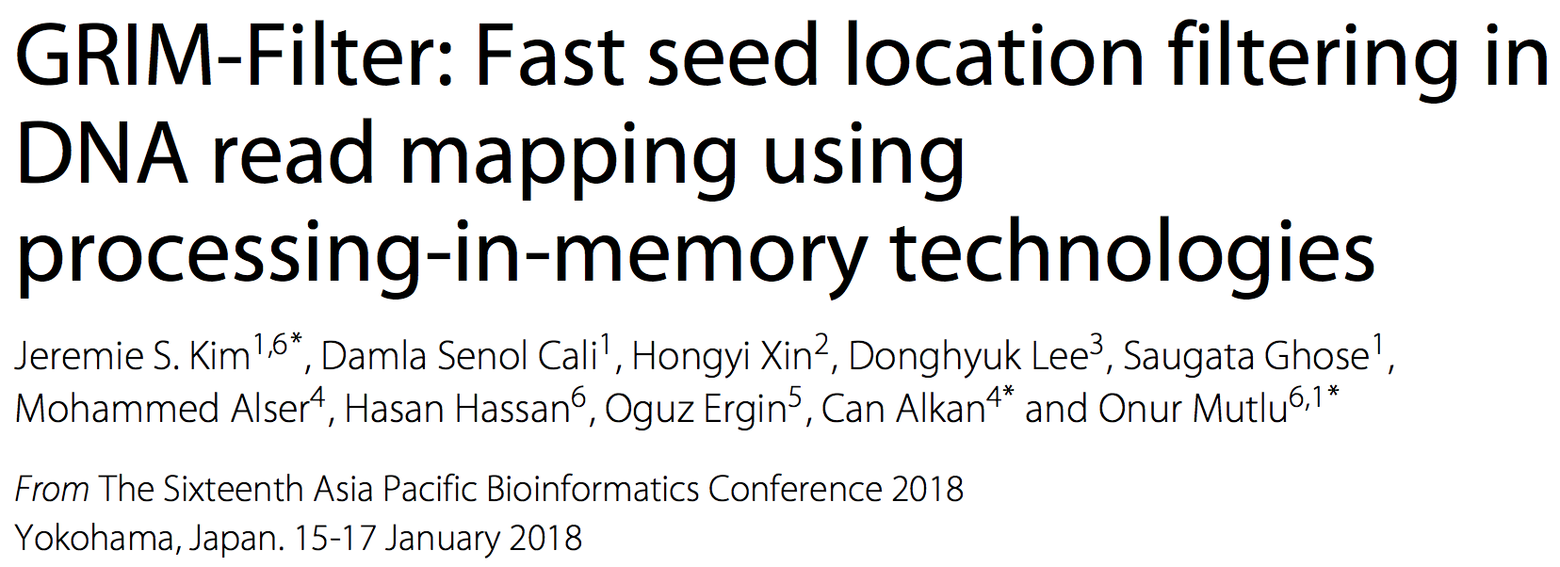
New Applications and Use Cases for PIM
Jeremie S. Kim, Damla Senol Cali, Hongyi Xin, Donghyuk Lee, Saugata Ghose, Mohammed Alser, Hasan Hassan, Oguz Ergin, Can Alkan, and Onur Mutlu, "GRIM-Filter: Fast Seed Location Filtering in DNA Read Mapping Using Processing-in-Memory Technologies" BMC Genomics, 2018. Proceedings of the 16th Asia Pacific Bioinformatics Conference (APBC), Yokohama, Japan, January 2018. arxiv.org Version (pdf)

Slide 206
Genome Read In-Memory (GRIM) Filter: Fast Seed Location Filtering in DNA Read Mapping using Processing-in-Memory Technologies
Jeremie Kim,
Damla Senol, Hongyi Xin, Donghyuk Lee,
Saugata Ghose, Mohammed Alser, Hasan Hassan,
Oguz Ergin, Can Alkan, and Onur Mutlu
Notes:
Hello, my name is Jeremie Kim and I will be presenting Genome Read In-Memory Filter which will also be referred to as GRIM-Filter for short.
[CLICK]

Slide 207
Executive Summary
Genome Read Mapping is a very important problem and is the first step in many types of genomic analysis
Could lead to improved health care, medicine, quality of life
Read mapping is an approximate string matching problem
Find the best fit of 100 character strings into a 3 billion character dictionary
Alignment is currently the best method for determining the similarity between two strings, but is very expensive
We propose an in-memory processing algorithm GRIM-Filter for accelerating read mapping, by reducing the number of required alignments
We implement GRIM-Filter using in-memory processing within 3D-stacked memory and show up to 3.7x speedup.

Slide 208
Google Workloads for Consumer Devices: Mitigating Data Movement Bottlenecks
Amirali Boroumand
Saugata Ghose, Youngsok Kim, Rachata Ausavarungnirun,
Eric Shiu, Rahul Thakur, Daehyun Kim, Aki Kuusela, Allan Knies, Parthasarathy Ranganathan, Onur Mutlu

Slide 209
Open Problems: PIM Adoption
Saugata Ghose, Kevin Hsieh, Amirali Boroumand, Rachata Ausavarungnirun, Onur Mutlu, "Enabling the Adoption of Processing-in-Memory: Challenges, Mechanisms, Future Research Directions" Invited Book Chapter, to appear in 2018. [Preliminary arxiv.org version]
https://arxiv.org/pdf/1802.00320.pdf

Slide 210
Agenda
Major Trends Affecting Main Memory
The Need for Intelligent Memory Controllers
Bottom Up: Push from Circuits and Devices
Top Down: Pull from Systems and Applications
Processing in Memory: Two Directions
Minimally Changing Memory Chips
Exploiting 3D-Stacked Memory
How to Enable Adoption of Processing in Memory
Conclusion

Slide 211
Maslow’s Hierarchy of Needs, A Third Time
Maslow, “A Theory of Human Motivation,”
Psychological Review, 1943.
Maslow, “Motivation and Personality,”
Book, 1954-1970.
Speed
Speed
Speed
Speed
Speed
Source: https://www.simplypsychology.org/maslow.html

Slide 212
Challenge and Opportunity for Future
Fundamentally
Energy-Efficient
(Data-Centric)
Computing Architectures

Slide 213
Challenge and Opportunity for Future
Fundamentally
Low-Latency
(Data-Centric)
Computing Architectures

Slide 214
Challenge and Opportunity for Future
Computing Architectures
with
Minimal Data Movement

Slide 215
One Important Takeaway
Main Memory Needs
Intelligent Controllers

Slide 216
Concluding Remarks

Slide 217
A Quote from A Famous Architect
“architecture […] based upon principle, and not upon precedent”

Slide 218
Precedent-Based Design?
“architecture […] based upon principle, and not upon precedent”

Slide 219
Principled Design
“architecture […] based upon principle, and not upon precedent”

Slide 221
The Overarching Principle

Slide 222
Another Example: Precedent-Based Design
Source: http://cookiemagik.deviantart.com/art/Train-station-207266944

Slide 223
Principled Design
Source: By Toni_V, CC BY-SA 2.0, https://commons.wikimedia.org/w/index.php?curid=4087256

Slide 224
Another Principled Design
Source: By Martín Gómez Tagle - Lisbon, Portugal, CC BY-SA 3.0, https://commons.wikimedia.org/w/index.php?curid=13764903
Source: http://www.arcspace.com/exhibitions/unsorted/santiago-calatrava/

Slide 225
Another Principled Design
Source: De Galván - Puente del Alamillo.jpg on Enciclopedia.us.es, GFDL, https://commons.wikimedia.org/w/index.php?curid=15026095

Slide 226
Another Principled Design
Source: https://www.archdaily.com/245628/how-not-to-host-the-olympics-part-iii/6051758999_5df1511bb5_z-4 Photo via CC Flickr User Vaidas M.

Slide 227
Principle Applied to Another Structure
Source: By 準建築人手札網站 Forgemind ArchiMedia - Flickr: IMG_2489.JPG, CC BY 2.0,
https://commons.wikimedia.org/w/index.php?curid=31493356, https://en.wikipedia.org/wiki/Santiago_Calatrava
Source: https://www.dezeen.com/2016/08/29/santiago-calatrava-oculus-world-trade-center-transportation-hub-new-york-photographs-hufton-crow/

Slide 228
The Overarching Principle

Slide 229
Overarching Principle for Computing?
Source: http://spectrum.ieee.org/image/MjYzMzAyMg.jpeg

Slide 230
Concluding Remarks
It is time to design principled system architectures to solve the memory problem
Design complete systems to be balanced, high-performance, and energy-efficient, i.e., data-centric (or memory-centric)
Enable computation capability inside and close to memory
This can
Lead to orders-of-magnitude improvements
Enable new applications & computing platforms
Enable better understanding of nature
…
Notes:
Perhaps we have taken processor-centric system design a bit too far

Slide 231
The Future of Processing in Memory is Bright
Regardless of challenges
in underlying technology and overlying problems/requirements
Problem
Can enable:
- Orders of magnitude
improvements
- New applications and
computing systems
Yet, we have to
- Think across the stack
- Design enabling systems
Algorithm
Program/Language
System Software
SW/HW Interface
Micro-architecture
Logic
Devices
Electrons

Slide 232
Déjà vu From IMW 2013
Onur Mutlu, "Memory Scaling: A Systems Architecture Perspective" Proceedings of the 5th International Memory Workshop (IMW), Monterey, CA, May 2013. Slides (pptx) (pdf) EETimes Reprint

Slide 233
If In Doubt, See Other Doubtful Technologies
A very “doubtful” emerging technology
for at least two decades
Proceedings of the IEEE, Sept. 2017
https://arxiv.org/pdf/1706.08642

Slide 234
For Some Open Problems, See
Saugata Ghose, Kevin Hsieh, Amirali Boroumand, Rachata Ausavarungnirun, Onur Mutlu, "Enabling the Adoption of Processing-in-Memory: Challenges, Mechanisms, Future Research Directions" Invited Book Chapter, to appear in 2018. [Preliminary arxiv.org version]
https://arxiv.org/pdf/1802.00320.pdf

Slide 235
For Some Open Problems, See (II)
Onur Mutlu, Saugata Ghose, Juan Gomez-Luna, and Rachata Ausavarungnirun, "Processing Data Where It Makes Sense: Enabling In-Memory Computation" Invited paper in Microprocessors and Microsystems (MICPRO), June 2019. [arXiv version]

Slide 236
Accelerated Memory Course (~6.5 hours)
ACACES 2018
Memory Systems and Memory-Centric Computing Systems
Taught by Onur Mutlu July 9-13, 2018
~6.5 hours of lectures
Website for the Course including Videos, Slides, Papers
https://people.inf.ethz.ch/omutlu/acaces2018.html
https://www.youtube.com/playlist?list=PL5Q2soXY2Zi-HXxomthrpDpMJm05P6J9x
All Papers are at:
https://people.inf.ethz.ch/omutlu/projects.htm
Final lecture notes and readings (for all topics)

Slide 237
Processing Data Where It Makes Sense in Modern Computing Systems: Enabling In-Memory Computation
Onur Mutlu
omutlu@gmail.com
https://people.inf.ethz.ch/omutlu
12 May 2019
IMW 2019 In-Memory Computing Tutorial

Slide 238
Slides Not Covered But Could Be Useful

Slide 239
Readings, Videos, Reference Materials

Slide 240
Accelerated Memory Course (~6.5 hours)
ACACES 2018
Memory Systems and Memory-Centric Computing Systems
Taught by Onur Mutlu July 9-13, 2018
~6.5 hours of lectures
Website for the Course including Videos, Slides, Papers
https://people.inf.ethz.ch/omutlu/acaces2018.html
https://www.youtube.com/playlist?list=PL5Q2soXY2Zi-HXxomthrpDpMJm05P6J9x
All Papers are at:
https://people.inf.ethz.ch/omutlu/projects.htm
Final lecture notes and readings (for all topics)

Slide 241
Reference Overview Paper
Onur Mutlu, Saugata Ghose, Juan Gomez-Luna, and Rachata Ausavarungnirun, "Processing Data Where It Makes Sense: Enabling In-Memory Computation" Invited paper in Microprocessors and Microsystems (MICPRO), June 2019. [arXiv version]

Slide 242
Reference Overview Paper I
Saugata Ghose, Kevin Hsieh, Amirali Boroumand, Rachata Ausavarungnirun, Onur Mutlu, "Enabling the Adoption of Processing-in-Memory: Challenges, Mechanisms, Future Research Directions" Invited Book Chapter, to appear in 2018. [Preliminary arxiv.org version]
https://arxiv.org/pdf/1802.00320.pdf

Slide 243
Reference Overview Paper II
Onur Mutlu and Lavanya Subramanian, "Research Problems and Opportunities in Memory Systems" Invited Article in Supercomputing Frontiers and Innovations (SUPERFRI), 2014/2015.
https://people.inf.ethz.ch/omutlu/pub/memory-systems-research_superfri14.pdf

Slide 244
Reference Overview Paper III
Onur Mutlu, "The RowHammer Problem and Other Issues We May Face as Memory Becomes Denser" Invited Paper in Proceedings of the Design, Automation, and Test in Europe Conference (DATE), Lausanne, Switzerland, March 2017. [Slides (pptx) (pdf)]
https://people.inf.ethz.ch/omutlu/pub/rowhammer-and-other-memory-issues_date17.pdf

Slide 245
Reference Overview Paper IV
Onur Mutlu, "Memory Scaling: A Systems Architecture Perspective" Technical talk at MemCon 2013 (MEMCON), Santa Clara, CA, August 2013. [Slides (pptx) (pdf)] [Video] [Coverage on StorageSearch]
https://people.inf.ethz.ch/omutlu/pub/memory-scaling_memcon13.pdf

Slide 246
Reference Overview Paper V
Proceedings of the IEEE, Sept. 2017
https://arxiv.org/pdf/1706.08642

Slide 247
Related Videos and Course Materials (I)
Undergraduate Computer Architecture Course Lecture Videos (2015, 2014, 2013)
Undergraduate Computer Architecture Course Materials (2015, 2014, 2013)
Graduate Computer Architecture Course Lecture Videos (2017, 2015, 2013)
Graduate Computer Architecture Course Materials (2017, 2015, 2013)
Parallel Computer Architecture Course Materials (Lecture Videos)

Slide 248
Related Videos and Course Materials (II)
Freshman Digital Circuits and Computer Architecture Course Lecture Videos (2018, 2017)
Freshman Digital Circuits and Computer Architecture Course Materials (2018)
Memory Systems Short Course Materials
(Lecture Video on Main Memory and DRAM Basics)

Slide 249
Some Open Source Tools (I)
Rowhammer – Program to Induce RowHammer Errors
https://github.com/CMU-SAFARI/rowhammer
Ramulator – Fast and Extensible DRAM Simulator
https://github.com/CMU-SAFARI/ramulator
MemSim – Simple Memory Simulator
https://github.com/CMU-SAFARI/memsim
NOCulator – Flexible Network-on-Chip Simulator
https://github.com/CMU-SAFARI/NOCulator
SoftMC – FPGA-Based DRAM Testing Infrastructure
https://github.com/CMU-SAFARI/SoftMC
Other open-source software from my group
https://github.com/CMU-SAFARI/
http://www.ece.cmu.edu/~safari/tools.html

Slide 250
Some Open Source Tools (II)
MQSim – A Fast Modern SSD Simulator
https://github.com/CMU-SAFARI/MQSim
Mosaic – GPU Simulator Supporting Concurrent Applications
https://github.com/CMU-SAFARI/Mosaic
IMPICA – Processing in 3D-Stacked Memory Simulator
https://github.com/CMU-SAFARI/IMPICA
SMLA – Detailed 3D-Stacked Memory Simulator
https://github.com/CMU-SAFARI/SMLA
HWASim – Simulator for Heterogeneous CPU-HWA Systems
https://github.com/CMU-SAFARI/HWASim
Other open-source software from my group
https://github.com/CMU-SAFARI/
http://www.ece.cmu.edu/~safari/tools.html

Slide 251
More Open Source Tools (III)
A lot more open-source software from my group
https://github.com/CMU-SAFARI/
http://www.ece.cmu.edu/~safari/tools.html

Slide 252
Referenced Papers
All are available at
https://people.inf.ethz.ch/omutlu/projects.htm
http://scholar.google.com/citations?user=7XyGUGkAAAAJ&hl=en
https://people.inf.ethz.ch/omutlu/acaces2018.html

Slide 253
Ramulator: A Fast and Extensible DRAM Simulator [IEEE Comp Arch Letters’15]

Slide 254
Ramulator Motivation
DRAM and Memory Controller landscape is changing
Many new and upcoming standards
Many new controller designs
A fast and easy-to-extend simulator is very much needed

Slide 255
Ramulator
Provides out-of-the box support for many DRAM standards:
DDR3/4, LPDDR3/4, GDDR5, WIO1/2, HBM, plus new proposals (SALP, AL-DRAM, TLDRAM, RowClone, and SARP)
~2.5X faster than fastest open-source simulator
Modular and extensible to different standards

Slide 256
Case Study: Comparison of DRAM Standards
Across 22 workloads, simple CPU model

Slide 257
Ramulator Paper and Source Code
Yoongu Kim, Weikun Yang, and Onur Mutlu, "Ramulator: A Fast and Extensible DRAM Simulator" IEEE Computer Architecture Letters (CAL), March 2015. [Source Code]
Source code is released under the liberal MIT License
https://github.com/CMU-SAFARI/ramulator

Slide 258
FPGA-Based Testing Infrastructures for Memory Scaling Issues

Slide 259
Infrastructures to Understand Such Issues
An Experimental Study of Data Retention Behavior in Modern DRAM Devices: Implications for Retention Time Profiling Mechanisms (Liu et al., ISCA 2013)
The Efficacy of Error Mitigation Techniques for DRAM Retention Failures: A Comparative Experimental Study
(Khan et al., SIGMETRICS 2014)
Flipping Bits in Memory Without Accessing Them: An Experimental Study of DRAM Disturbance Errors (Kim et al., ISCA 2014)
Adaptive-Latency DRAM: Optimizing DRAM Timing for the Common-Case (Lee et al., HPCA 2015)
AVATAR: A Variable-Retention-Time (VRT) Aware Refresh for DRAM Systems (Qureshi et al., DSN 2015)

Slide 260
Infrastructures to Understand Such Issues
Temperature
Controller
FPGAs
Heater
FPGAs
PC
Kim+, “Flipping Bits in Memory Without Accessing Them: An Experimental Study of DRAM Disturbance Errors,” ISCA 2014.

Slide 261
SoftMC: Open Source DRAM Infrastructure
Hasan Hassan et al., “SoftMC: A Flexible and Practical Open-Source Infrastructure for Enabling Experimental DRAM Studies,” HPCA 2017.
Flexible
Easy to Use (C++ API)
Open-source
github.com/CMU-SAFARI/SoftMC

Slide 262
SoftMC
https://github.com/CMU-SAFARI/SoftMC

Slide 263
Tesseract: Extra Slides

Slide 264
Communications In Tesseract (I)

Slide 265
Communications In Tesseract (II)

Slide 266
Communications In Tesseract (III)

Slide 267
Remote Function Call (Non-Blocking)

Slide 268
Effect of Bandwidth & Programming Model
HMC-MC Bandwidth (640GB/s)
Tesseract Bandwidth (8TB/s)
Programming Model
Bandwidth
(No Prefetching)

Slide 269
More on Data Movement in Google Consumer Workloads

Slide 270
Google Workloads for Consumer Devices: Mitigating Data Movement Bottlenecks
Amirali Boroumand
Saugata Ghose, Youngsok Kim, Rachata Ausavarungnirun,
Eric Shiu, Rahul Thakur, Daehyun Kim, Aki Kuusela, Allan Knies, Parthasarathy Ranganathan, Onur Mutlu

Slide 271
Consumer Devices
Consumer devices are everywhere!
Energy consumption is a first-class concern in consumer devices
Notes:
Consumer devices like tablets smartphone and wearable are now everywhere and used by billions of people.
One of the major challenge in these devices is battery limitation which makes the energy consumption a critical concern …

Slide 272
Popular Google Consumer Workloads
Chrome
TensorFlow Mobile
Google’s web browser
Google’s machine learning framework
Video Playback
Video Capture
Google’s video codec
Google’s video codec
Notes:
In this work, we take a look at widely-used google consumer workloads, to figure out the major sources of energy consumption.
We look at Google Chrome web brower. We take a look at Tensorflow, Google’s machine learning framework, and we also take a look at two important video related workloads, video playback and video capture, both rely on Google’s vp9 codec technology.

Slide 273
Energy Cost of Data Movement
1st key observation: 62.7% of the total system energy is spent on data movement
Data Movement
SoC
DRAM
CPU
L2
CPU
L1
CPU
CPU
Compute Unit
Processing-in-Memory (PIM)
Potential solution: move computation close to data
Challenge: limited area and energy budget
Notes:
Throughout our analysis, we make a key observation that out of all sources of energy consumption, data movement is a major contributor to the total system energy. We find that across all of the workloads, on average around 62.7% of total system energy is spent on data movement.
One way to reduce data movement cost is to move computation close to data, or …
One potential solution to address this cost it do move computation close to data, or in other words, do procesing in memory. However, the challenge is that these devices.
One potential solution to mitigate data movement cost and reduce total system energy is to execute data-movement heavy portions of application close to data, or in other words, do processing in memory. However, consumer devices are extermely limited in terms of area and power budget. So the question is can we move part of the data movement heavy portion given the limited area and energy budget. Our

Slide 274
Using PIM to Reduce Data Movement
2nd key observation: a significant fraction of data movement often comes from simple functions
We can design lightweight logic to implement these simple functions in memory
Small embedded low-power core
Small fixed-function accelerators
PIM Core
PIM Accelerator
PIM Accelerator
PIM Accelerator
Offloading to PIM logic reduces energy by 55.4% and improves performance by 54.2% on average
Notes:
To figure out if we can use processing in memory, we dig deeper into our analysis and we make another key observation that majority of data movement often comes form simple functions and pritmitives. We find that these simple function can be implemented in memory as either a small embedded core, or group of small fixed function accelerators. Our result shows that offloading these function to PIM logic can significantly reduce data movement for each function and reduce energy on average around 55% and improve perforamcne around 54%.

Slide 275
Goals
1
Understand the data movement related bottlenecks in modern consumer workloads
2
Analyze opportunities to mitigate data movement by using processing-in-memory (PIM)
3
Design PIM logic that can maximize energy efficiency given the limited area and energy budget in consumer devices

Slide 276
Outline
Introduction
Background
Analysis Methodology
Workload Analysis
Evaluation
Conclusion
Notes:
Before we jump into our analysis, lets talk about …

Slide 277
Potential Solution to Address Data Movement
Processing-in-Memory (PIM)
A potential solution to reduce data movement
Idea: move computation close to data
Enabled by recent advances in 3D-stacked memory
Reduces data movement
Exploits large in-memory bandwidth
Exploits shorter access latency to memory

Slide 278
Outline
Introduction
Background
Analysis Methodology
Workload Analysis
Evaluation
Conclusion

Slide 279
Workload Analysis Methodology
Workload Characterization
Chromebook with an Intel Celeron SoC and 2GB of DRAM
Extensively use performance counters within SoC
Energy Model
Sum of the energy consumption within the CPU, all caches, off-chip interconnects, and DRAM
DRAM
L2
L1
CPU
CPU
Notes:
Feedback: no wifi mention
We did our workload characterization on a Chromebook with an Intel SoC. We use performance counter within Soc to do our analysis.
We model energy as sum of the energy consumption that take place in CPU, caches, interconnet and DRAM. We turn off the wifi and use the lowest brightness for the display to ensure that the majority of the total energy is spent on the SoC and the memory system

Slide 280
PIM Logic Implementation
DRAM
Logic Layer
SoC
PIM Core
PIM Accelerator
PIM Accelerator
PIM Accelerator N
Customized embedded general-purpose core
Small fixed-function accelerators
No aggressive ILP techniques
Multiple copies of customized in-memory logic unit
256-bit SIMD unit
Notes:
During our analysis, for each workload, once we identify a PIM target, we consider two types of PIM logic implementation: (1) a general-purpose PIM core; and (2) a fixed-function PIM accelerator,
For the PIM core, we design a small general purpose core based on the charateristic of PIM candidate we find across the workloads. It’s simple embedded core that doesn’t have any aggressi ILP techniques, and it includes a SIMD unit to benefit from parallelism. For the PIM accelerator, we design a fixed function logic that has an in memory logic unit for each candidates we find. To benefit from paralalliesm, eacch PIM accelerator has multiple. ..
that can run any of the PIM candidates we find. Majortiy of the candidates we find are data instensive and performs simple operations, as a result, our PIM core doesn’t have any aggressive high performance/ILP techniques. It also has a SIMD unit as all of candidates we find benefit from parallelism.
For the PIM accelerator, for each of our PIM targets, we first design a customized in-memory logic unit, To benefit from parallelism, each PIM acceleartor has multiple copies of the in-memory logic unit,

Slide 281
Workload Analysis
Chrome
TensorFlow
Google’s web browser
Google’s machine learning framework
Video Playback
Video Capture
Google’s video codec
Google’s video Codec
Notes:
Now I’m gonna talk about our workload analysis. I will focus on chrome browser for the most of this talk.

Slide 282
Workload Analysis
Chrome
TensorFlow
Google’s web browser
Google’s machine learning framework
Video Playback
Video Capture
Google’s video codec
Google’s video codec

Slide 283
How Chrome Renders a Web Page
Loading and Parsing
Painting
HTML
HTML
HTML Parser
HTML Parser
Render Tree
Render Tree
Layout
Layout
Rasteriza-tion
Rasteriza-tion
Composit-ing
Composi-ting
CSS
CSS
CSS Parser
CSS Parser

Slide 284
How Chrome Renders a Web Page
Loading and Parsing
Layouting
Painting
assembles all layers into a final screen image
HTML
HTML
HTML Parser
HTML Parser
Render Tree
Render Tree
Layout
Layout
Rasteriza-tion
Rasteriza-tion
Composi-ting
Composi-ting
CSS
CSS
CSS Parser
CSS Parser
paints those objects and generates the bitmaps
calculates the visual elements and position of each object
Notes:
Feedback: the first major part just download the source files and parse them.
I just want to give you a brief high-level overview of how chrome renders a webpage. First the browser downloads the HTML and CSS, it starts parsing them to extract the content of the webpage. Then, based on those, at the next two stages, the browser calculate the visual rep and position of each object at the page. So at the end of layout stage, for each object, it knows the visual elements and the location of each object that needs to be drawn.. Then it goes to rasterization which is basically the process of painiting those object and generating the bitmaps. And at the final stages, compositing gets those bitmaps and composite them to gether and gerenate the final screen.
and calculate the visual represenation and postiion of each object in the page. At the end of the layout section,
Everything starts with downloading the HTML and CSS.
The chrome’s rendering engine, starts by parsing HTML files and store the the contents of a web page a tree of Node objects called the DOM tree. It also extracts style rules by parsing the CSS files. DOM tree and style rules together allows them to creates the render tree. The browser combines the DOM and style rules and generates "render tree,”. This tree is the visual representation of the document. The purpose of this tree is to enable painting the contents in their correct order. Up to this point we've calculated which nodes should be visible and their computed styles, but we have not calculated their exact position and size within the viewport of the device---that's the "layout" stage. Layout computes the exact position and size of each object.
Finally, now that we know which nodes are visible, and their computed styles and geometry, we can pass this information to the final stage, which converts each node in the render tree to actual pixels on the screen. This step is often referred to as "painting" or "rasterizing.” Painting is the process of filling in pixels into bitmaps. It involves drawing out text, colors, images, borders, and shadows, essentially every visual part of the elements. Finally, The rasterized bitmap (also known as a texture) is then sent to the GPU through a process called texture upload, after which the GPU performs compositing.
DOM: the contents of a web page are internally stored as a tree of Node objects called the DOM tree.
DOM: content of the webpage
Style rules: describe the style that need to be applies to the document
Render Tree: This tree is of visual elements in the order in which they will be displayed. It is the visual representation of the document. The purpose of this tree is to enable painting the contents in their correct order.
Layout: The calculation of geometric information (where and what size each element has) for every visible element. It’s normally done for the entire
Paint/rasterize: Painting is the process of filling in pixels. It involves drawing out text, colors, images, borders, and shadows, essentially every visual part of the elements. The drawing is typically done onto multiple surfaces, often called layers.
Compositing: Since the parts of the page were drawn into potentially multiple layers they need to be drawn to the screen in the correct order so that the page renders correctly. This is especially important for elements that overlap another, since a mistake could result in one element appearing over the top of another incorrectly.
https://aerotwist.com/blog/the-anatomy-of-a-frame/
The main subsystems are:
Input handling [technically not related to graphics per se, but nevertheless critical for many interactions]
Parsing, which turns a chunk of HTML into DOM nodes
Style, which resolves CSS onto the DOM
Layout, which figures out where DOM elements end up relative to one another
Paint setup, sometimes referred to as recording, which converts styled DOM elements into a display list (SkPicture) of drawing commands to paint later, on a per-layer basis
Painting, which converts the SkPicture of drawing commands into pixels in a bitmap somewhere (either in system memory or on the GPU if using Ganesh)
Compositing, which assembles all layers into a final screen image
and, less obviously, the presentation infrastructure responsible for actually pushing a new frame to the OS (i.e. the browser UI and its compositor, the GPU process which actually communicates with the GL driver, etc).

Slide 285
Browser Analysis
To satisfy user experience, the browser must provide:
Fast loading of webpages
Smooth scrolling of webpages
Quick switching between browser tabs
We focus on two important user interactions: 1) Page Scrolling 2) Tab Switching
Both include page loading
Notes:
So what are the important actions that users do with the browswe in the consumer devices?
The user perception of the browser speed is based on three factors: (1) page load time, (2) smooth web page scrolling, and (3) quick switching between browser tabs. In our study, we focus on two user interactions that impact these three factors, and govern a user’s browsing experience: (1) page scrolling and (2) tab switching. Note that each interaction includes page loading.
We emulate all these actions using Google’s temeletry freamework and focus on two actions:
Link it back to telemtery and probably remove the first bullet

Slide 286
Scrolling
Notes:
Now let me give you a little bit background on how prior works deal with the PIM coherence.

Slide 287
What Does Happen During Scrolling?
rasterization uses color blitters to convert the basic primitives into bitmaps
Rasterization generates the bitmap and sends it to GPU for compositing
Color Blitting
HTML
HTML Parser
Render Tree
Layout
Layout
Rasteriza-tion
Rasteriza-tion
Composi-itng
Composi-ting
CSS
CSS Parser
Texture Tiling
to minimize cache misses during compositing, the graphics driver reorganizes the bitmaps
Notes:
When user scrolls a webpage, it triggers three operations in the browser. It forces the browser to recompute the layout because the position of each object has changed, it forces the browser to do rasterization, because there are some new contents that needs to be rasterized, and the browser need to do compositing because there are new objects that need to be displayed.
In addition to that, I want to briefly talk about two other important functions that play a key role in our analysis. The first one is Texture Tiling, that happens between rasterization and compositing. To minimze cache misses, the graphic drivers invokes texture tiling to reo-rganize the bitmaps before sending them to GPU. Another important function is color blitting. Color blitting is inoked during the rasterization. And it is used to convert the basic primitives like text and line, into bitmaps.

Slide 288
Scrolling Energy Analysis
Google Docs
Gmail
Google Calendar
Word- Press
Twitter
Ani- mation
AVG
41.9% of page scrolling energy is spent on texture tiling and color blitting
Notes:
Here I’m showing the energy breakdown for scrolling on different web pages. This figures shows what functions in browser consume the most of the energy when user do the scrolling. Across all of the pages that we test, 41.9% of page scrolling energy is spent on two data-intensive components: (1) texture tiling, where the graphics driver reorganizes the linear bitmap data into a tiled format for the GPU; and (2) color blitting, which is invoked by the Skia library [51] during rasterization.
The rest of the energy is spent on a variety of other libraries and functions, each of which contributes to less than 1% of the total energy consumption
So now the question is, where exactly the energy is spent in the system?

Slide 289
Scrolling a Google Docs Web Page
77% of total energy consumption goes to data movement
A significant portion of total data movement comes from texture tiling and color blitting
37.7% of total system energy
Notes:
To answer that question, here I’m showing the energy break down, across different hardware components in the consumer devices. The x axis shows how much energy is spent on each components like DRAM, caches or CPU, and the y axis shows the total energy.
A major observation from this figure is that majority of energy is spent on accessing data from DRAM, or on-chip caches, or moving data over interconnects. Our anlaysis shows that 77% of total energy goes to data movement. Our analysis show that almost half of that data movement comes from texture tiling and color blitting. Here I’m showsing that for each of those functions how much of the energy goes to data movement and computation. We find that these two functions are extermely data intensive and the data movement generate by these
To answer this question, we dig deeper into our energy analysis. This figure shows gives more insight into where energy is spent in the system when we scroll through a Google Docs. We find that 77% of the total energy consumption is due to data movement. The data movement energy includes the energy consumed by DRAM, the off-chip interconnect, and the on-chip caches.
We then zoom into each of those function and we find out that these functions are both very data intensive and majority of their energy goes to dat amovment. In fact we find that the data movement generated by texture tiling and color blitting alone accounts for 37.7% of the total system energy
OR
In fact, the data movement generated by these two functions account for 37.7 of total system energy.
When you present the question, you would say: we first need to see whats going on during texture tiling.
To answer this question, we need to first figure what each function does. We start by texture tiling.

Slide 290
Scrolling a Google Docs Web Page
77% of total energy consumption goes to data movement
Can we use PIM to mitigate the data movement cost
for texture tiling and color blitting?
A significant portion of total data movement comes from texture tiling and color blitting
37.7% of total system energy
Notes:
To answer that question, here I’m showing the energy break down, across different hardware components in the consumer devices. The x axis shows how much energy is spent on each components like DRAM, caches or CPU, and the y axis shows the total energy.
A major observation from this figure is that majority of energy is spent on accessing data from DRAM, or on-chip caches, or moving data over interconnects. Our anlaysis shows that 77% of total energy goes to data movement. Our analysis show that almost half of that data movement comes from texture tiling and color blitting. Here I’m showsing that for each of those functions how much of the energy goes to data movement and computation. We find that these two functions are extermely data intensive and the data movement generate by these
To answer this question, we dig deeper into our energy analysis. This figure shows gives more insight into where energy is spent in the system when we scroll through a Google Docs. We find that 77% of the total energy consumption is due to data movement. The data movement energy includes the energy consumed by DRAM, the off-chip interconnect, and the on-chip caches.
We then zoom into each of those function and we find out that these functions are both very data intensive and majority of their energy goes to dat amovment. In fact we find that the data movement generated by texture tiling and color blitting alone accounts for 37.7% of the total system energy
OR
In fact, the data movement generated by these two functions account for 37.7 of total system energy.
When you present the question, you would say: we first need to see whats going on during texture tiling.
To answer this question, we need to first figure what each function does. We start by texture tiling.

Slide 291
Can We Use PIM for Texture Tiling?
CPU-Only
time
CPU + PIM
CPU
Memory
CPU
PIM
Rasterization
Rasterization
Linear
Linear
Bitmap
Read Bitmap
Bitmap
idle
Conversion
Texture Tiling
Conversion
Texture
high
Invoke
Tiles
data movement
Compositing
Write Back
Texture
Invoke
Tiles
Compositing
1) Eliminate a significant portion of data movement
Major sources of data movement: 1) poor data locality 2) large rasterized bitmap size (e.g. 4MB)
Texture tiling is a good candidate for PIM execution
2) Free up CPU to perform
Notes:
Feedback: move stuff from CPU-only to CPU+PIM, not fade
So can we use PIM for texture tiling? To answer that, here I’m showing you a bit more detailed of interactions between CPU and memory during texture tiling. As I said the cpu performs rasterization and store the bitmap in memory. It then needs to invoke Compositing process. Texture Tiling happens in between. The graphic driver read the bitmap, convert it to a more cache friendly format for GPU, and write it back to a location that GPU reads from.. It then invoke compositing. That’s where a lot of data movement happens because there is poor data locality during this processn and the bitmap sizes are so large that in some cases they don’t even fit into last level cache. This process is a good candidate for PIM. Here I’m showing what would happen if we move it to PIM. PIM logic access the bitmaps in memory, do the conversion, and write it to the location gpu access that. This way, it eliminates a significant porition of data movement and it also frees up the cpu to do other important task
So whats texture Tiglin. Here I want to walk you through the major steps during Texture tiling.
Texture tiling happens after rasterization and before compositing. Rasterization generates a rasterized bitmap. Then, that bitmap is sent to GPU for compositing. After rasterization, compositing accesses each texture in both the horizontal and vertical directions. To minimize cache misses during compositing, the graphics driver reads the rasterized bitmap ( 2 ) and converts the bitmap into a tiled texture layout
Because of this high amount of data movement, texture tiling is a good candidate for PIM execution. By moving texture tiling to PIM, we can let the PIM logic read the bitmap, performs the tiling operation in the memory, and the write it to a location that GPU will access. This wa,y we can elimnate a significant portion of data movement as it happens close to data and avoid moving the texture back and forth between memory and CPU . we can free up the CPU ( 5 ) to perform other important compute-intensive tasks in Chrome, such as handling user interaction, executing JavaScript code, or rasterizing other render objects.

Slide 292
Can We Implement Texture Tiling in PIM Logic?
Linear Bitmap
Texture Tiling
Tiled Texture
Requires simple primitives: memcopy, bitwise operations, and simple arithmetic operations
PIM Core
PIM Accelerator
9.4% of the area available for PIM logic
7.1% of the area available for PIM logic
PIM core and PIM accelerator are feasible to implement in-memory Texture Tiling
Notes:
The next question is whether texture tiling is feasible to be implemented using PIM in consumer devices. To answer that, we analyze the texutre tiling in detail and find that
hat texture tiling requires only simple primitives: memcopy, bitwise operations, and simple arithmetic operations (e.g., addition).
These operations can be performed at high performance on our PIM core, and they can easily be implemented as a fixed function PIM accelerator.
Our analysis hsows that each of them takes less than 10% of the area available per vault, and as a result, both are feasible to implement in a consumer device with 3D-stacked memory
As we explained before our PIM core is …
Our PIM accelerator for texture tiling consists of multiple in-memory tiling units.
Each in-memory tiling unit consists of only a simple ALU, and operates on a single 4 kB tile.
We empirically decide to use four in-memory tiling units in each PIM accelerator
We conclude that the area required for texture tiling PIM logic is small, making the PIM logic feasible to implement in a consumer device with 3D-stacked memory

Slide 293
Color Blitting Analysis
Generates a large amount of data movement
Accounts for 19.1% of the total system energy during scrolling
Color blitting is a good candidate
for PIM execution
Requires low-cost operations: Memset, simple arithmetic, and shift operations
It is feasible to implement color blitting in PIM core and PIM accelerator
Notes:
We did the same analysis for Color Blitting. Because of lack of time, I will talk about the key points here.
Majority come from its streaming access pattern and the large sizes of the bitmaps (e.g., 1024x1024 pixels).
The function itself require simple computations

Slide 294
Scrolling Wrap Up
Texture tiling and color blitting account for a significant portion (41.9%) of energy consumption
37.7% of total system energy goes to data movement generated by these functions
Both functions can benefit significantly from PIM execution
1
Both functions are feasible to implement as PIM logic
2
Notes:
So here I just want to wrap up our analysis for page scrolling. We found two data intensive functions that account for a significant portion of energy during scrolling. We find that both function can significantly benfti from PIM execution. We also find that both functions are simple enough that can be impelemented at pim logic

Slide 295
Tab Switching
Notes:
Now let me give you a little bit background on how prior works deal with the PIM coherence.

Slide 296
What Happens During Tab Switching?
Chrome employs a multi-process architecture
Each tab is a separate process
Main operations during tab switching:
Context switch
Load the new page
Chrome Process
…
Tab 1 Process
Tab 2 Process
Tab N Process
Notes:
Chrome uses a multi-process architecture, where each tab has its own application process for rendering the page displayed in the tab to improve reliability and performance.
When a user switches between browser tabs, this triggers two operations: (1) a context switch to the process for the selected tab, and (2) a load operation for the new page.

Slide 297
Memory Consumption
Primary concerns during tab switching:
How fast a new tab loads and becomes interactive
Memory consumption
Chrome uses compression to reduce each tab’s memory footprint
DRAM
CPU
Inactive Tab
Compressed Tab
ZRAM
Decompression
Compression
Notes:
There are two primary concerns during tab switching: (1) how fast a new tab loads and becomes interactive, as this directly affects user satisfaction; and (2) memory consumption.
Memory consumption is a major concern for three reasons. First, the average memory footprint of a web page has increased significantly in recent years because of increased use of images, JavaScript, and video in modern web pages. Second users tend to open multiple tabs at a time with each tab consuming additional memory. Third, consumer devices typically have a much lower memory capacity than server or desktop systems, and without careful memory management, Chrome could run out of memory on these systems over time.

Slide 298
Data Movement Study
To study data movement during tab switching, we emulate a user switching through 50 tabs
We make two key observations:
Compression and decompression contribute to18.1% of the total system energy
1
19.6 GB of data moves between CPU and ZRAM
2
Notes:
Moves between CPU and ZRAM
There are two primary concerns during tab switching: (1) how fast a new tab loads and becomes interactive, as this directly affects user satisfaction; and (2) memory consumption.
Memory consumption is a major concern for three reasons. First, the average memory footprint of a web page has increased significantly in recent years because of increased use of images, JavaScript, and video in modern web pages. Second users tend to open multiple tabs at a time with each tab consuming additional memory. Third, consumer devices typically have a much lower memory capacity than server or desktop systems, and without careful memory management, Chrome could run out of memory on these systems over time.

Slide 299
Can We Use PIM to Mitigate the Cost?
CPU-Only
time
CPU + PIM
CPU
Memory
CPU
PIM
Swap out N pages
Swap out N pages
Uncompressed
Uncompressed
Pages
Pages
Read N Pages
Other tasks
Compress
Compress
high
compression
No off-chip data movement
data movement
ZRAM
Write back
Other tasks
ZRAM
PIM core and PIM accelerator are feasible to implement in-memory compression/decompression
Notes:
Now we want to see if we can mitigate data movement cost with PIM. To answer that, lets again take a look at interaction between CPU and memory when CPU wants to swap out N pages. we need to figure out where the data movement happens. Here shows what happens when CPU wants to swap out N inactive pages. it first read the inactive page data, compress the data ( 2 ), and write the compressed data to ZRAM. This incur a lot of overhead. This operation is a good fit for PIM as (1) it cause a large amount of data movement; and (2) compression can be handled in the background, since none of the active tab processes need the data that is being compressed
Our analysis shows that the compression algorithm used by chrome is simple enough that both pim core and …
To wrap up, we found that a lot of data movement happens during tab switching as chrome tries to compress and decompress tabs. We find that both compression and decompression can significantly benefit from PIM execution and are feasible to be implemented at PIM logic
Now on the right what happens when we offload compression to PIM. In this case, the CPU only informs the PIM logic about the pages that need to be swapped out, and the PIM logic operates on the uncompressed page data that is already in memory. This (1) eliminates the off-chip page data movement that took place during CPU-based compression, and (2) frees up the CPU to perform other tasks while PIM performs compression in the background. We observe a similar behavior during decompression.

Slide 300
Tab Switching Wrap Up
A large amount of data movement happens during tab switching as Chrome attempts to compress and decompress tabs
Both functions can benefit from PIM execution and can be implemented as PIM logic
2
Notes:
To wrap up, we found that a lot of data movement happens during tab switching as chrome tries to compress and decompress tabs. We find that both compression and decompression can significantly benefit from PIM execution and are feasible to be implemented at PIM logic

Slide 301
Workload Analysis
Chrome
TensorFlow
Google’s web browser
Google’s machine learning framework
Video Playback
Video Capture
Google’s video codec
Google’s video codec

Slide 302
Workload Analysis
Chrome
TensorFlow
Google’s web browser
Google’s machine learning framework
Video Playback
Video Capture
Google’s video codec
Google’s video codec

Slide 303
TensorFlow Mobile
Inference
Prediction
57.3% of the inference energy is spent on data movement
54.4% of the data movement energy comes from packing/unpacking and quantization

Slide 304
Packing
Matrix
Packing
Packed Matrix
Reorders elements of matrices to minimize cache misses during matrix multiplication
Up to 40% of the inference energy and 31% of inference execution time
Packing’s data movement accounts for up to 35.3% of the inference energy
A simple data reorganization process that requires simple arithmetic

Slide 305
Quantization
floating point
Quantization
integer
Converts 32-bit floating point to 8-bit integers to improve inference execution time and energy consumption
Up to 16.8% of the inference energy and 16.1% of inference execution time
Majority of quantization energy comes from data movement
A simple data conversion operation that requires shift, addition, and multiplication operations

Slide 306
Quantization
floating point
Quantization
integer
Converts 32-bit floating point to 8-bit integers to improve inference execution time and energy consumption
Based on our analysis, we conclude that:
Both functions are good candidates for PIM execution
It is feasible to implement them in PIM logic
Up to 16.8% of the inference energy and 16.1% of inference execution time
Majority of quantization energy comes from data movement
A simple data conversion operation that requires shift, addition, and multiplication operations

Slide 307
Video Playback and Capture
Compressed video
Captured video
Compressed video
Display
VP9 Decoder
VP9 Encoder
Majority of energy is spent on data movement
Majority of data movement comes from simple functions in decoding and encoding pipelines
Notes:
We also analyze video play back and video capture. We take a look at energy consumption when vp9 decider is yaed to playback a netflix film, and when vp9 wncoder is used to do real-time encoding of ...
We find that for both of these workloads data movemwnt is a major contributor to the total system enery.
When we dog deeper we find that they are simple functions in decoding and encoding pipeline that generate the majority of dara movement.
Please refer to the paper for more detail.

Slide 308
Outline
Introduction
Background
Analysis Methodology
Workload Analysis
Evaluation
Conclusion

Slide 309
Evaluation Methodology
System Configuration (gem5 Simulator)
SoC: 4 OoO cores, 8-wide issue, 64 kB L1cache, 2MB L2 cache
PIM Core: 1 core per vault, 1-wide issue, 4-wide SIMD, 32kB L1 cache
3D-Stacked Memory: 2GB cube, 16 vaults per cube
Internal Bandwidth: 256GB/S
Off-Chip Channel Bandwidth: 32 GB/s
Baseline Memory: LPDDR3, 2GB, FR-FCFS scheduler
We study each target in isolation and emulate each separately and run them in our simulator
Notes:
and then analyzing the benefit of PIM in our simulator

Slide 310
Normalized Energy
TensorFlow Mobile
Video Playback and Capture
77.7% and 82.6% of energy reduction for texture tiling and packing comes from eliminating data movement
Chrome Browser
PIM core and PIM accelerator reduces energy consumption on average by 49.1% and 55.4%
Notes:
We make another obsrevation that using PIM accelerator provide limited energy reduction over PIM core, for some of these workloads, such as texture tiling. This is becase these kernels are data intensive and have low ocmputational compleity, and as a result, using fixed function accelerator does not provide significant energy reduction over the PIM core.

Slide 311
Normalized Runtime
Chrome Browser
Video Playback and Capture
TensorFlow Mobile
Offloading these kernels to PIM core and PIM accelerator improves performance on average by 44.6% and 54.2%
Notes:
PIM-Core and PIM-Acc significantly outperform CPU-Only across all kernels, improving performance by … This perfomance benefit come from higher bandwidth and lower access latency of 3D-stacked memory, because all of these kernels are data intensive.
Performance improvement of PIM-acc over PIM-core differes across different workloads. In some cases such as Texture Tiling, the performance improvement of PIM-Acc over PIM-Core is limited by the low computational complexity of these two kernels. But there are other cases, such as compression that benefit significantly from using PIM-Acc over PIM-Core in terms of performance, because these kernels are more compute-intensive and less data-intensive compared to texture tiling and.

Slide 312
Conclusion
Energy consumption is a major challenge in consumer devices
We conduct an in-depth analysis of popular Google consumer workloads
62.7% of the total system energy is spent on data movement
Most of the data movement comes from simple functions that consist of simple operations
We use PIM to reduce data movement cost
We design lightweight logic to implement simple operations in DRAM
Reduces total energy by 55.4% on average
Reduces execution time by 54.2% on average
PIM Core
PIM Accelerator
PIM Accelerator
PIM Accelerator

Slide 313
Google Workloads for Consumer Devices: Mitigating Data Movement Bottlenecks
Amirali Boroumand
Saugata Ghose, Youngsok Kim, Rachata Ausavarungnirun,
Eric Shiu, Rahul Thakur, Daehyun Kim, Aki Kuusela, Allan Knies, Parthasarathy Ranganathan, Onur Mutlu

