Slide 1


A Fresh Look at DRAM Architecture:
New Techniques to Improve DRAM
Latency, Parallelism, and Energy Efficiency
Onur Mutlu
onur@cmu.edu
July 4, 2013
INRIA

Slide 2
Video Lectures on Same Topics
Videos from a similar series of lectures at Bogazici University (these are longer)
http://www.youtube.com/playlist?list=PLVngZ7BemHHV6N0ejHhwOfLwTr8Q-UKXj
DRAM Basics and DRAM Scaling Lectures
  http://www.youtube.com/watch?v=jX6McDvAIn4&list=PLVngZ7BemHHV6N0ejHhwOfLwTr8Q-UKXj&index=6
  http://www.youtube.com/watch?v=E0GuX12dnVo&list=PLVngZ7BemHHV6N0ejHhwOfLwTr8Q-UKXj&index=7
  http://www.youtube.com/watch?v=ANskLp74Z2k&list=PLVngZ7BemHHV6N0ejHhwOfLwTr8Q-UKXj&index=8
  http://www.youtube.com/watch?v=gzjaNUYxfFo&list=PLVngZ7BemHHV6N0ejHhwOfLwTr8Q-UKXj&index=9

Slide 3



The Main Memory System
Main memory is a critical component of all computing systems: server, mobile, embedded, desktop, sensor
Main memory system must scale (in size, technology, efficiency, cost, and management algorithms) to maintain performance growth and technology scaling benefits
Processor
and caches
Main Memory
Storage (SSD/HDD)

Slide 4
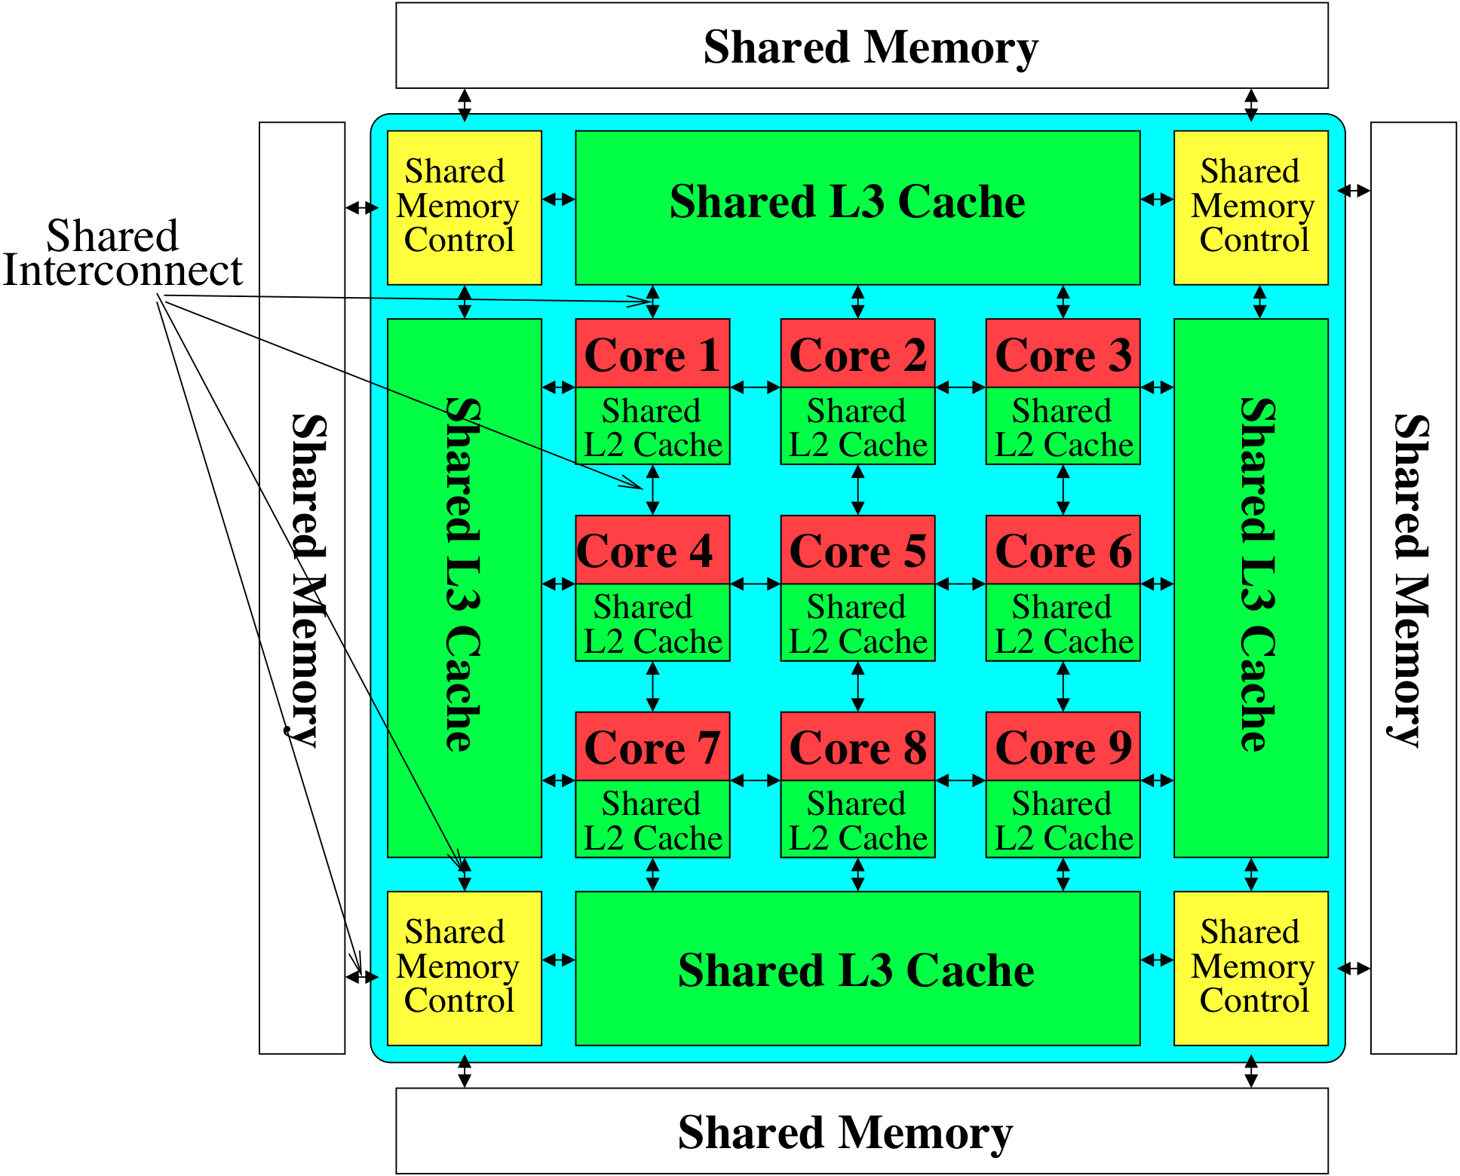
Memory System: A Shared Resource View
Storage

Slide 5
State of the Main Memory System
Recent technology, architecture, and application trends
  lead to new requirements
  exacerbate old requirements
DRAM and memory controllers, as we know them today, are (will be) unlikely to satisfy all requirements
Some emerging non-volatile memory technologies (e.g., PCM) enable new opportunities: memory+storage merging
We need to rethink the main memory system
  to fix DRAM issues and enable emerging technologies
  to satisfy all requirements

Slide 6
Agenda
Major Trends Affecting Main Memory
DRAM Scaling Problem and Solution Directions
Three New Techniques for DRAM
  RAIDR: Reducing Refresh Impact
  TL-DRAM: Reducing DRAM Latency
  SALP: Reducing Bank Conflict Impact
Ongoing Research
Summary

Slide 7
Major Trends Affecting Main Memory (I)
Need for main memory capacity, bandwidth, QoS increasing
Main memory energy/power is a key system design concern
DRAM technology scaling is ending

Slide 8
Major Trends Affecting Main Memory (II)
Need for main memory capacity, bandwidth, QoS increasing
  Multi-core: increasing number of cores
  Data-intensive applications: increasing demand/hunger for data
  Consolidation: cloud computing, GPUs, mobile
Main memory energy/power is a key system design concern
DRAM technology scaling is ending

Slide 9
Major Trends Affecting Main Memory (III)
Need for main memory capacity, bandwidth, QoS increasing
Main memory energy/power is a key system design concern
  ~40-50% energy spent in off-chip memory hierarchy [Lefurgy, IEEE Computer 2003]
  DRAM consumes power even when not used (periodic refresh)
DRAM technology scaling is ending

Slide 10
Major Trends Affecting Main Memory (IV)
Need for main memory capacity, bandwidth, QoS increasing
Main memory energy/power is a key system design concern
DRAM technology scaling is ending
  ITRS projects DRAM will not scale easily below X nm
  Scaling has provided many benefits:
    higher capacity (density), lower cost, lower energy

Slide 11
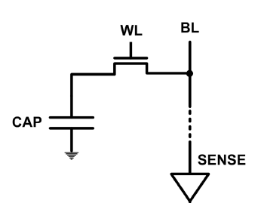
The DRAM Scaling Problem
DRAM stores charge in a capacitor (charge-based memory)
  Capacitor must be large enough for reliable sensing
  Access transistor should be large enough for low leakage and high retention time
  Scaling beyond 40-35nm (2013) is challenging [ITRS, 2009]
DRAM capacity, cost, and energy/power hard to scale

Slide 12
Solutions to the DRAM Scaling Problem
Two potential solutions
  Tolerate DRAM (by taking a fresh look at it)
  Enable emerging memory technologies to eliminate/minimize DRAM
Do both
  Hybrid memory systems

Slide 13
Solution 1: Tolerate DRAM
Overcome DRAM shortcomings with
  System-DRAM co-design
  Novel DRAM architectures, interface, functions
  Better waste management (efficient utilization)
Key issues to tackle
  Reduce refresh energy
  Improve bandwidth and latency
  Reduce waste
  Enable reliability at low cost
Liu, Jaiyen, Veras, Mutlu, “RAIDR: Retention-Aware Intelligent DRAM Refresh,” ISCA 2012.
Kim, Seshadri, Lee+, “A Case for Exploiting Subarray-Level Parallelism in DRAM,” ISCA 2012.
Lee+, “Tiered-Latency DRAM: A Low Latency and Low Cost DRAM Architecture,” HPCA 2013.
Liu+, “An Experimental Study of Data Retention Behavior in Modern DRAM Devices” ISCA’13.
Seshadri+, “RowClone: Fast and Efficient In-DRAM Copy and Initialization of Bulk Data,” 2013.

Slide 14
Solution 2: Emerging Memory Technologies
Some emerging resistive memory technologies seem more scalable than DRAM (and they are non-volatile)
Example: Phase Change Memory
  Expected to scale to 9nm (2022 [ITRS])
  Expected to be denser than DRAM: can store multiple bits/cell
But, emerging technologies have shortcomings as well
  Can they be enabled to replace/augment/surpass DRAM?
Lee, Ipek, Mutlu, Burger, “Architecting Phase Change Memory as a Scalable DRAM Alternative,” ISCA 2009, CACM 2010, Top Picks 2010.
Meza, Chang, Yoon, Mutlu, Ranganathan, “Enabling Efficient and Scalable Hybrid Memories,” IEEE Comp. Arch. Letters 2012.
Yoon, Meza et al., “Row Buffer Locality Aware Caching Policies for Hybrid Memories,” ICCD 2012 Best Paper Award.
Notes:
Even if DRAM continues to scale there could be benefits to examining and enabling these new technologies.

Slide 15
Hybrid Memory Systems
CPU
Meza+, “Enabling Efficient and Scalable Hybrid Memories,” IEEE Comp. Arch. Letters, 2012.
Yoon, Meza et al., “Row Buffer Locality Aware Caching Policies for Hybrid Memories,” ICCD 2012 Best Paper Award.
DRAMCtrl
PCM Ctrl
DRAM
Phase Change Memory (or Tech. X)
Fast, durable
Small,
leaky, volatile,
high-cost
Large, non-volatile, low-cost
Slow, wears out, high active energy
Hardware/software manage data allocation and movement
to achieve the best of multiple technologies

Slide 16
Agenda
Major Trends Affecting Main Memory
DRAM Scaling Problem and Solution Directions
Three New Techniques for DRAM
  RAIDR: Reducing Refresh Impact
  TL-DRAM: Reducing DRAM Latency
  SALP: Reducing Bank Conflict Impact
Ongoing Research
Summary

Slide 17
DRAM Refresh
DRAM capacitor charge leaks over time
The memory controller needs to refresh each row periodically to restore charge
  Activate + precharge each row every N ms
  Typical N = 64 ms
Downsides of refresh
-- Energy consumption: Each refresh consumes energy
  -- Performance degradation: DRAM rank/bank unavailable while refreshed
  -- QoS/predictability impact: (Long) pause times during refresh
  -- Refresh rate limits DRAM density scaling

Slide 18
Refresh Today: Auto Refresh
Columns
BANK 0
BANK 1
BANK 2
BANK 3
Rows
Row Buffer
DRAM Bus
A batch of rows are
periodically refreshed
via the auto-refresh command
DRAM CONTROLLER
Notes:
The DRAM system consists of the DRAM banks, the DRAM bus, and the DRAM memory controller. DRAM banks store the data in physical memory. There are multiple DRAM banks to allow multiple memory requests to proceed in parallel.
Each DRAM bank has a 2-dimensional structure, consisting of rows by columns. Data can only be read from a “row buffer”, which acts as a cache that “caches” the last accessed row. As a result, a request that hits in the row buffer can be serviced much faster than a request that misses in the row buffer.
Existing DRAM controllers take advantage of this fact. To maximize DRAM throughput, these controllers prioritize row-hit requests over other requests in their scheduling. All else being equal, they prioritize older accesses over younger accesses. This policy is called the FR-FCFS policy. Note that this scheduling policy is designed for maximizing DRAM throughput and does not distinguish between different threads’ requests at all.
-----------------------------
Explain bank operation at a high level
- An access that is to the row in the row buffer takes a shorter time than to an access that is to another row.
Multiple banks put together to allow for multiple requests to be serviced in parallel
The DRAM controller treats each bank as an independent entity
In each bank, the DRAM controller optimizes for improving row buffer locality to improve DRAM throughput
- It prioritizes row-hit requests over other requests and all else being equal, older requests over younger requests. It is not aware of the different threads accessing it.
The DRAM controller does not coordinate accesses to different banks.
As a result requests of different threads can be serviced in different banks even though a single thread’s requests might be outstanding to multiple banks

Slide 19
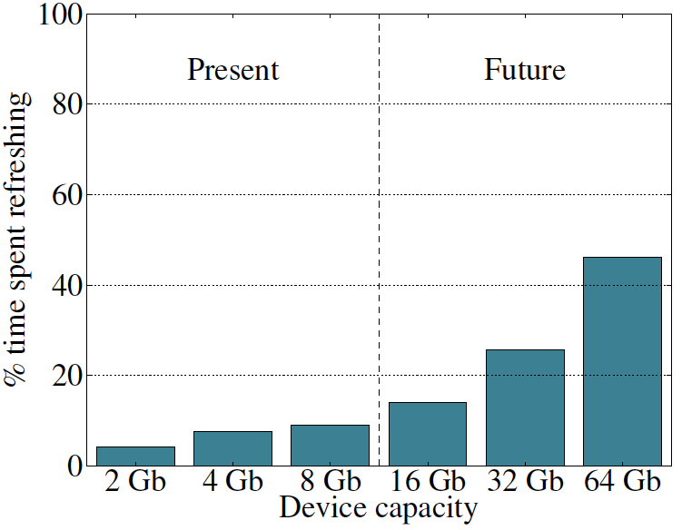
Refresh Overhead: Performance
46%
8%

Slide 20
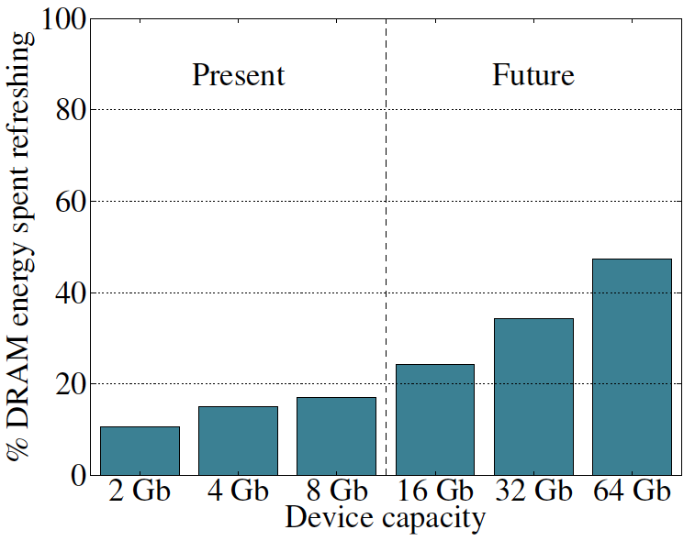
Refresh Overhead: Energy
47%
15%

Slide 21
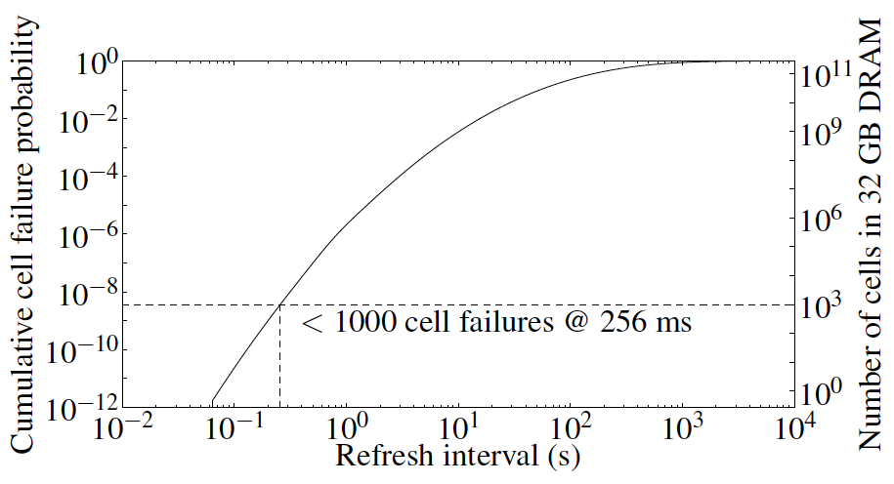
Problem with Conventional Refresh
Today: Every row is refreshed at the same rate
Observation: Most rows can be refreshed much less often without losing data [Kim+, EDL’09]
Problem: No support in DRAM for different refresh rates per row

Slide 22
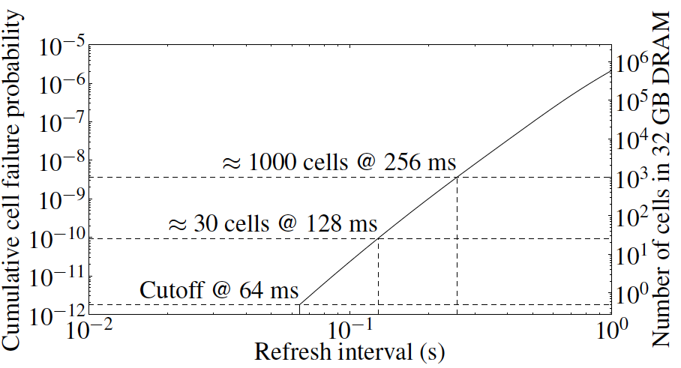
Retention Time of DRAM Rows
Observation: Only very few rows need to be refreshed at the worst-case rate
Can we exploit this to reduce refresh operations at low cost?

Slide 23
Reducing DRAM Refresh Operations
Idea: Identify the retention time of different rows and refresh each row at the frequency it needs to be refreshed
(Cost-conscious) Idea: Bin the rows according to their minimum retention times and refresh rows in each bin at the refresh rate specified for the bin
  e.g., a bin for 64-128ms, another for 128-256ms, …
Observation: Only very few rows need to be refreshed very frequently [64-128ms] → Have only a few bins → Low HW overhead to achieve large reductions in refresh operations
Liu et al., “RAIDR: Retention-Aware Intelligent DRAM Refresh,” ISCA 2012.

Slide 24


RAIDR: Mechanism
1. Profiling: Profile the retention time of all DRAM rows
→ can be done at DRAM design time or dynamically
2. Binning: Store rows into bins by retention time
→ use Bloom Filters for efficient and scalable storage
3. Refreshing: Memory controller refreshes rows in different bins at different rates
→ probe Bloom Filters to determine refresh rate of a row
1.25KB storage in controller for 32GB DRAM memory

Slide 25
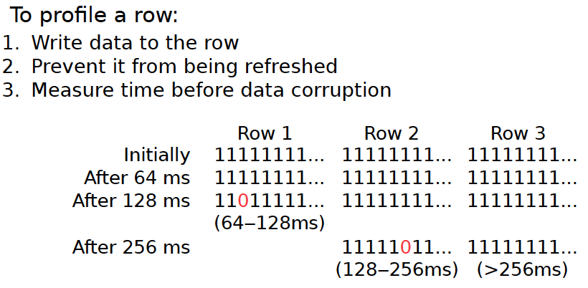
1. Profiling

Slide 26
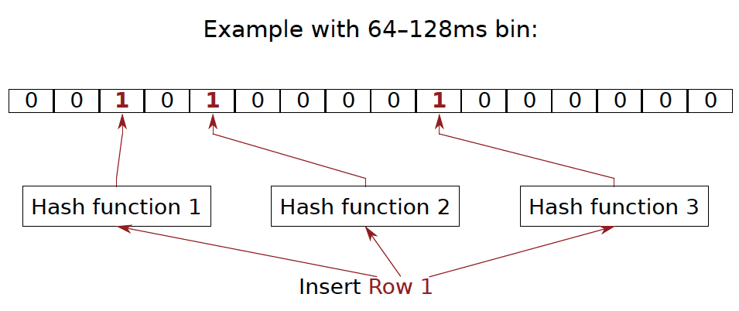
2. Binning
How to efficiently and scalably store rows into retention time bins?
  Use Hardware Bloom Filters [Bloom, CACM 1970]

Slide 27
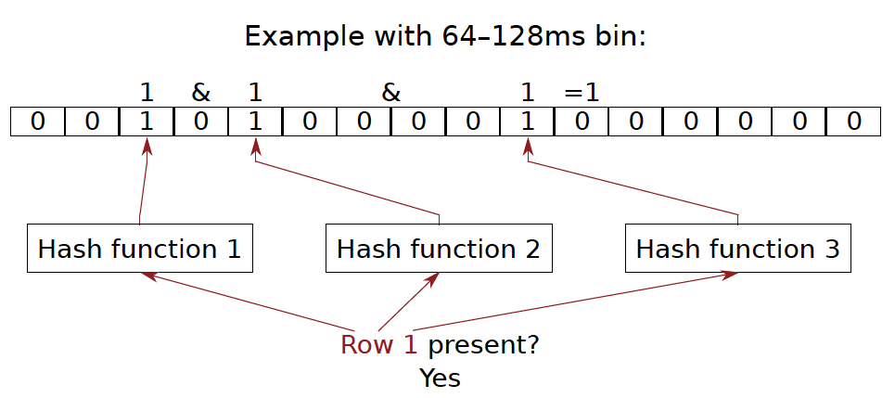
Bloom Filter Operation Example

Slide 28
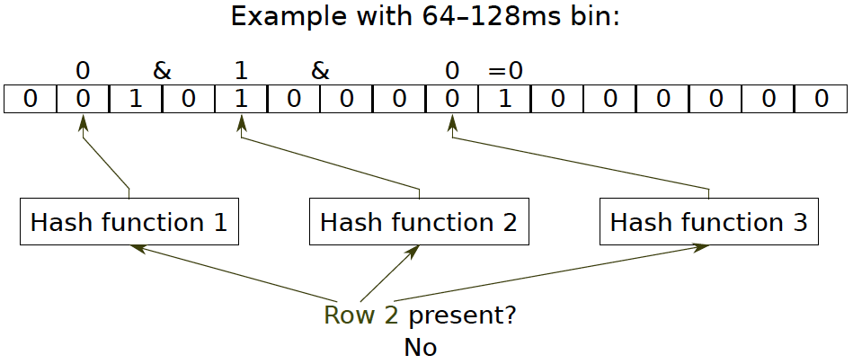
Bloom Filter Operation Example

Slide 29
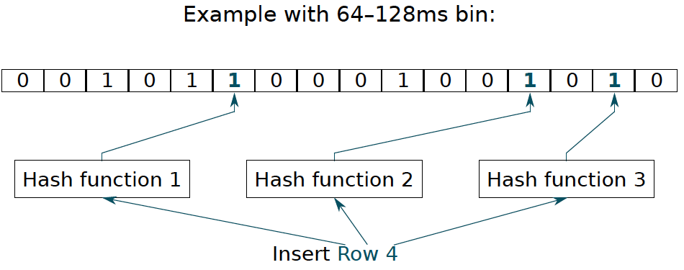
Bloom Filter Operation Example

Slide 30
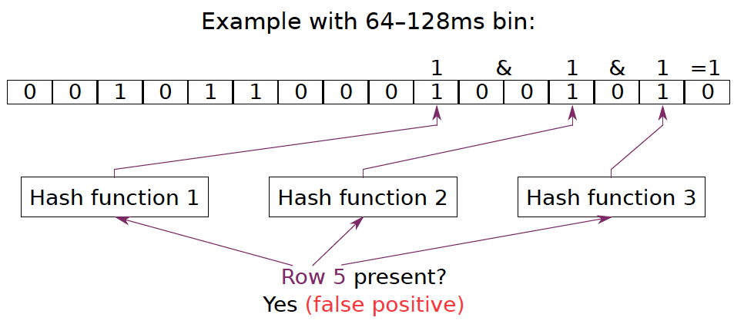
Bloom Filter Operation Example

Slide 31
Benefits of Bloom Filters as Bins
False positives: a row may be declared present in the Bloom filter even if it was never inserted
  Not a problem: Refresh some rows more frequently than needed
No false negatives: rows are never refreshed less frequently than needed (no correctness problems)
Scalable: a Bloom filter never overflows (unlike a fixed-size table)
Efficient: No need to store info on a per-row basis; simple hardware → 1.25 KB for 2 filters for 32 GB DRAM system

Slide 32
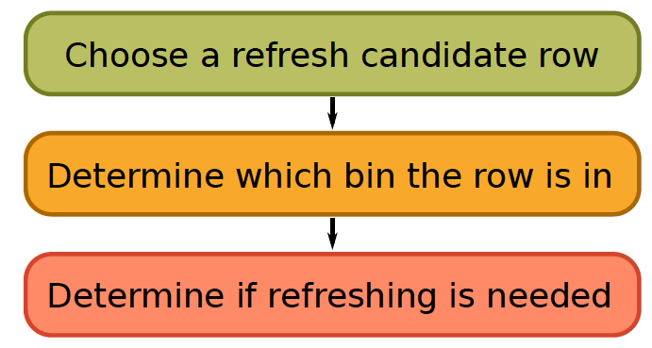
3. Refreshing (RAIDR Refresh Controller)

Slide 33
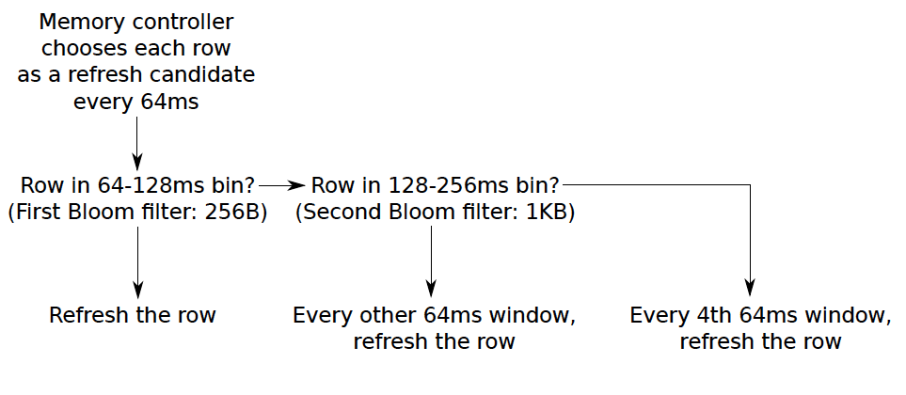
3. Refreshing (RAIDR Refresh Controller)
Liu et al., “RAIDR: Retention-Aware Intelligent DRAM Refresh,” ISCA 2012.

Slide 34
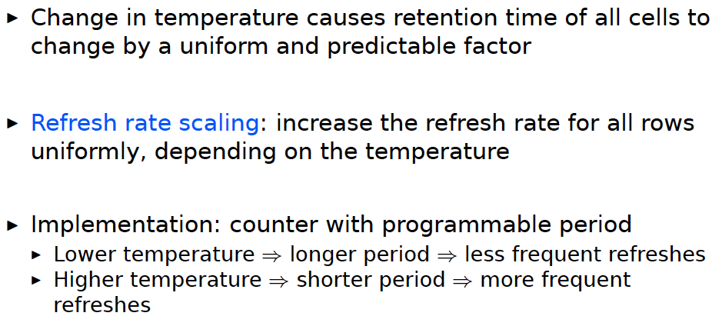
Tolerating Temperature Changes

Slide 35
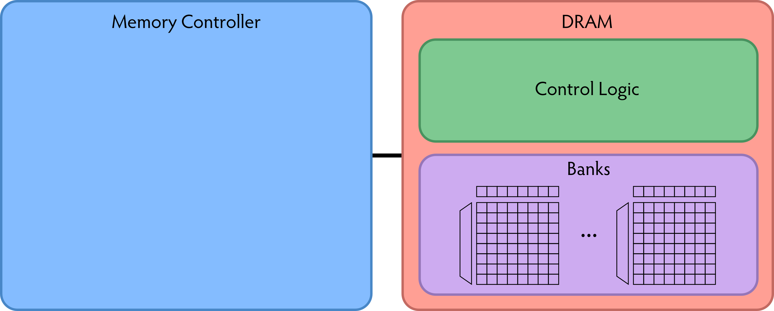
RAIDR: Baseline Design
Refresh control is in DRAM in today’s auto-refresh systems
RAIDR can be implemented in either the controller or DRAM

Slide 36
RAIDR in Memory Controller: Option 1
Overhead of RAIDR in DRAM controller:
1.25 KB Bloom Filters, 3 counters, additional commands issued for per-row refresh (all accounted for in evaluations)

Slide 37
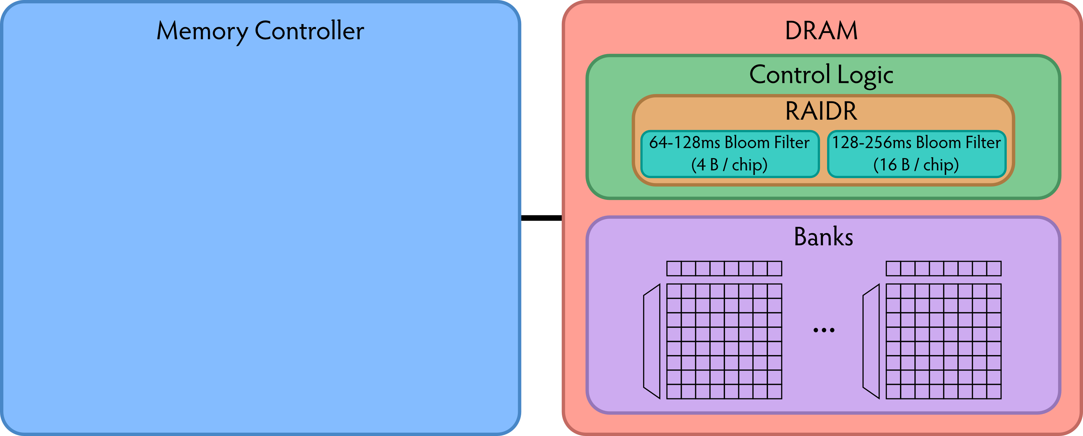
RAIDR in DRAM Chip: Option 2
Overhead of RAIDR in DRAM chip:
Per-chip overhead: 20B Bloom Filters, 1 counter (4 Gbit chip)
Total overhead: 1.25KB Bloom Filters, 64 counters (32 GB DRAM)

Slide 38
RAIDR Results
Baseline:
  32 GB DDR3 DRAM system (8 cores, 512KB cache/core)
  64ms refresh interval for all rows
RAIDR:
  64–128ms retention range: 256 B Bloom filter, 10 hash functions
  128–256ms retention range: 1 KB Bloom filter, 6 hash functions
  Default refresh interval: 256 ms
Results on SPEC CPU2006, TPC-C, TPC-H benchmarks
  74.6% refresh reduction
  ~16%/20% DRAM dynamic/idle power reduction
  ~9% performance improvement

Slide 39
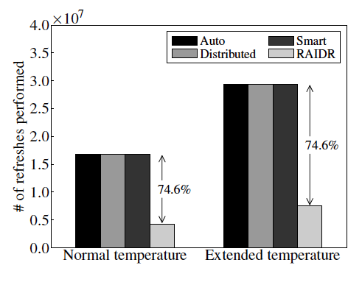
RAIDR Refresh Reduction
32 GB DDR3 DRAM system

Slide 40
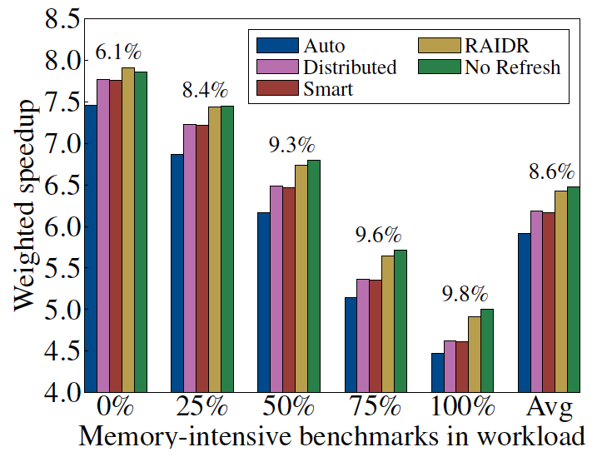
RAIDR: Performance
RAIDR performance benefits increase with workload’s memory intensity

Slide 41
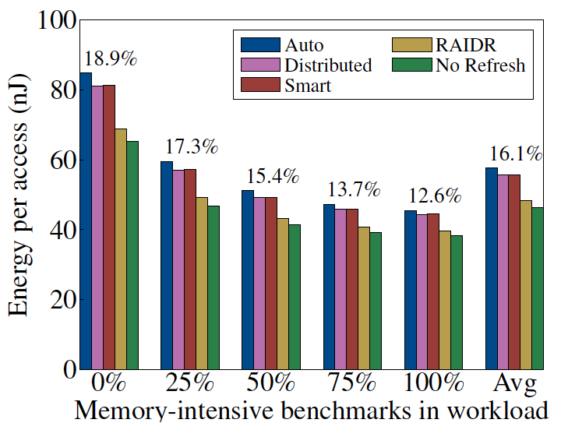
RAIDR: DRAM Energy Efficiency
RAIDR energy benefits increase with memory idleness

Slide 42
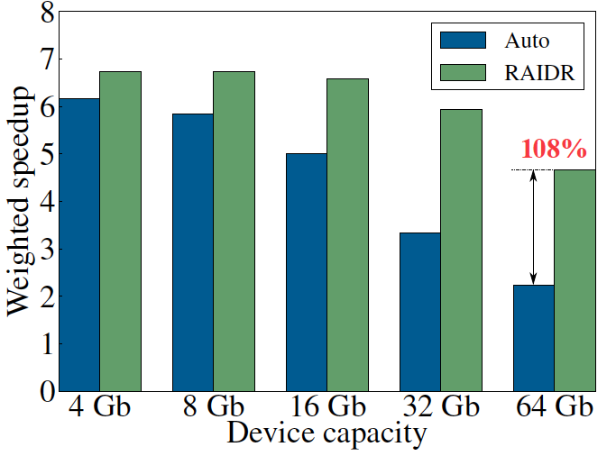
DRAM Device Capacity Scaling: Performance
RAIDR performance benefits increase with DRAM chip capacity

Slide 43
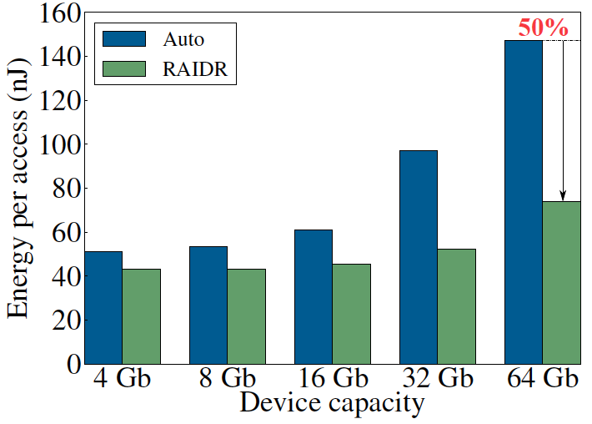
DRAM Device Capacity Scaling: Energy
RAIDR energy benefits increase with DRAM chip capacity
RAIDR slides

Slide 44
Agenda
Major Trends Affecting Main Memory
DRAM Scaling Problem and Solution Directions
Three New Techniques for DRAM
  RAIDR: Reducing Refresh Impact
  TL-DRAM: Reducing DRAM Latency
  SALP: Reducing Bank Conflict Impact
Ongoing Research
Summary

Slide 45
Historical DRAM Latency-Capacity Trend
16X
-20%
DRAM latency continues to be a critical bottleneck
Notes:
The figure shows the historical trends of DRAM during the last 12-years, from 2000 to 2011.
We can see that, during this time, DRAM capacity has increased by 16 times.
On the other hand, during the same period of time, DRAM latency has reduced by only 20%.
As a result, the high DRAM latency continues to be a critical bottleneck for system performance.

Slide 46
What Causes the Long Latency?
DRAM Chip
subarray
banks
cell array
subarray
cell array
cell
I/O
I/O
wordline
channel
channel
row decoder
access
capacitor
transistor
bitline
sense amplifier
Notes:
To understand how to access DRAM, let me take a look at the DRAM organization.
DRAM consists of two components, the cell array and the I/O circuitry.
The cell array consists of multiple banks
and each bank consists of multiple subarray.
Each subarray consists of two dimensional grids of cell
and each cell has one capacitor and one access transistor.
The horizontal cell array is connected to a row decoder by a wire called wordline and
The vertical cell array is connected to sense amplifier by a wire called bitline.

Slide 47
What Causes the Long Latency?
DRAM Chip
row decoder
subarray
banks
cell array
subarray
cell array
sense amplifier
Subarray
row addr.
I/O
I/O
mux
I/O
column
addr.
channel
channel
DRAM Latency = Subarray Latency + I/O Latency
DRAM Latency = Subarray Latency + I/O Latency
Dominant
Notes:
To read from a DRAM chip, the subarray first accesses the data, which consists of two steps.
First, row decoder activate the row which has requested data.
Second, sense amplifiers detect the data of cells.
After these subarray access, IO circuitry transfers the data over channel.
Therefore, the DRAM latency is the sum of the subarray latency and the I/O latency.
We observed that the subarray latency is much higher than the I/O latency.
As a result, subarray is the dominant source of the DRAM latency as we explained in the paper.
--------------------------------------------------------------------------------------------------------------------------------------------
, again.
DRAM consists of two components, the cell array and the I/O circuitry. The cell array consists of multiple subarrays.
To read from a DRAM chip, the data is first accessed from the subarray and then the data is transferred over the channel by the I/O circuitry.

Slide 48
Why is the Subarray So Slow?
Subarray
Cell
cell
wordline
bitline: 512 cells
access
row decoder
row decoder
transistor
capacitor
sense amplifier
bitline
sense amplifier
large sense amplifier
Long bitline
  Amortizes sense amplifier cost → Small area
  Large bitline capacitance → High latency & power
Notes:
The cell’s capacitor is small and can store only a small amount of charge.
That is why a subarray also has sense-amplifiers, which are specialized circuits that can detect the small amount of charge.
Unfortunately, a sense-amplifier size is about *100* times the cell size.
So, to amortize the area of the sense-amplifiers,
hundreds of cells share the same sense-amplifier through a long bitline.
However, a long bitline has a large capacitance that increases latency and power consumption.
Therefore, the long bitline is one of the dominant sources of high latency and high power consumption.
To understand why the subarray is so slow,
let me take a look at the subarray organization.

Slide 49
Trade-Off: Area (Die Size) vs. Latency
Long Bitline
Short Bitline
Faster
Smaller
Trade-Off: Area vs. Latency
Notes:
A naïve way to reduce the DRAM latency is to have short bitlines that have lower latency.
Unfortunately, short bitlines significantly increase the DRAM area.
Therefore, the bitline length exposes an important trade-off between area and latency.

Slide 50
Trade-Off: Area (Die Size) vs. Latency
32
Fancy DRAM
Short Bitline
Commodity DRAM
Long Bitline
64
Cheaper
128
256
512 cells/bitline
GOAL
Faster
Notes:
This figure shows the trade-off between DRAM area and latency as we change the bitline length.
Y-axis is the normalized DRAM area compared to a DRAM using 512 cells/bitline. A lower value is cheaper.
X-axis shows the latency in terms of tRC, an important DRAM timing constraint. A lower value is faster.
Commodity DRAM chips use long bitlines to minimize area cost. On the other hand, shorter bitlines achieve lower latency at higher cost.
Our goal is to achieve the best of both worlds: low latency and low area cost.

Slide 51
Approximating the Best of Both Worlds
Long Bitline
Long Bitline
Our Proposal
Short Bitline
Short Bitline
Small Area
Large Area
Small Area
High Latency
Low Latency
Low Latency
Need Isolation
Add Isolation Transistors
Short Bitline ➔ Fast
Notes:
To sum up, both long and short bitline do not achieve small area and low latency.
Long bitline has small area but has high latency while short bitline has low latency but has large area.
To achieve the best of both worlds, we first start from long bitline, which has small area.
After that, to achieve the low latency of short bitline, we divide the long bitline into two smaller segments.
The bitline length of the segment nearby the sense-amplifier is same as the length of short bitline.
Therefore, the latency of the segment is as low as the latency of the short bitline.
To isolate this fast segment from the other segment, we add isolation transistors that selectively connect the two segments.

Slide 52
Approximating the Best of Both Worlds
Long Bitline
Tiered-Latency DRAM
Our Proposal
Short Bitline
Long Bitline
Short Bitline
Small Area
Small Area
Large Area
High Latency
Low Latency
Low Latency
Small area using long bitline
Low Latency
Notes:
This way, our proposed approach achieves small area and low latency.
We call this new DRAM architecture as Tiered-Latency DRAM

Slide 53
Tiered-Latency DRAM
Divide a bitline into two segments with an isolation transistor
Far Segment
Isolation Transistor
Near Segment
Sense Amplifier
Notes:
Again, the key idea is to divide a subarray into two segments with isolation transistors.
The segment, directly connected to the sense amplifier, is called the near segment.
The other segment is called the far segment.

Slide 54
Near Segment Access
Turn off the isolation transistor
Reduced bitline length
Reduced bitline capacitance
Far Segment
Far Segment
➔ Low latency & low power
Isolation Transistor (off)
Isolation Transistor
Near Segment
Sense Amplifier
Notes:
When accessing the near segment, the isolation transistor is truned off such that the near segment is electrically decoupled from the far segment.
which leads to the reduced bitline length, which leads to reduced bitline capacitance.
Due to these two reasons, the near segment can be accessed with low latency and low power.

Slide 55
Far Segment Access
Turn on the isolation transistor
Long bitline length
Large bitline capacitance
Additional resistance of isolation transistor
Far Segment
➔ High latency & high power
Isolation Transistor (on)
Isolation Transistor
Near Segment
Near Segment
Sense Amplifier
Notes:
When accessing the far segment, the isolation transistor is turned on
such that the far segment is electrically connected to the sense amplifier
and the entire bitline is exposed to sense amplifier,
which leads to long bitline,
which leads to large bitline capacitance.
and also isolation transistors have resistance.
Due to these three reasons, accessing the far segment incurs high latency and high power.

Slide 56
Latency, Power, and Area Evaluation
Commodity DRAM: 512 cells/bitline
TL-DRAM: 512 cells/bitline
  Near segment: 32 cells
  Far segment: 480 cells
Latency Evaluation
  SPICE simulation using circuit-level DRAM model
Power and Area Evaluation
  DRAM area/power simulator from Rambus
  DDR3 energy calculator from Micron
Notes:
We evaluated the latency, power consumption and area cost of TL-DRAM compared to commodity DRAM.
In our evaluations, we modeled a Commodity DRAM that has 512 cells/bitline.
TL-DRAM also has a total of 512 cells/bitline, which is segmented to 32-cell near segment and 480-cell far segment.
We simulated latency using SPICE simulator with circuit-level DRAM model.
We estimated the area and power consumption using Micron DRAM Power calculator and Rambus DRAM Area/Power simulator

Slide 57
Commodity DRAM vs. TL-DRAM
DRAM Latency (tRC)
DRAM Power
  +49%
  +23%
  (52.5ns)
Latency
Power
  –56%
  –51%
  Near Far
  Near Far
  Commodity DRAM
  Commodity DRAM
  TL-DRAM
  TL-DRAM
DRAM Area Overhead
  ~3%: mainly due to the isolation transistors
Notes:
This figure compares the latency.
Y-axis is normalized latency.
Compared to commodity DRAM, TL-DRAM’s near segment has 56% lower latency, while the far segment has 23% higher latency.
The right figure compares the power.
Y-axis is normalized power.
Compared to commodity DRAM, TL-DRAM’s near segment has 51% lower power consumption and the far segment has 49% higher power consumption.
Lastly, mainly due to the isolation transistor, Tiered-latency DRAM increases the die-size by about 3%.

Slide 58
Latency vs. Near Segment Length
Latency (ns)
Longer near segment length leads to
higher near segment latency
Notes:
The figure shows the latency of the near and far segments when varying near segment length.
X-axis is near segment length and Y-axis is Latency in nano seconds.
As the figure shows, a longer near segment length leads to higher near segment latency due to the increased bitline capacitance of the near segment.

Slide 59
Latency vs. Near Segment Length
Latency (ns)
  Far Segment Length = 512 – Near Segment Length
Far segment latency is higher than
commodity DRAM latency
Notes:
For the far segment, a shorter far segment length leads to lower latency. However, the far segment latency is higher than commodity DRAM latency.

Slide 60
Trade-Off: Area (Die-Area) vs. Latency
32
64
Cheaper
128
256
512 cells/bitline
Near Segment
Far Segment
GOAL
Faster
Notes:
Again, the figure shows the trade-off between area and latency in existing DRAM.
Unlike existing DRAM, TL-DRAM achieves low latency using the near segment while increasing the area by only 3%.
Although the far segment has higher latency than commodity DRAM, we show that efficient use of the near segment enables TL-DRAM to achieve high system performance.

Slide 61
Leveraging Tiered-Latency DRAM
TL-DRAM is a substrate that can be leveraged by the hardware and/or software
Many potential uses
  Use near segment as hardware-managed inclusive cache to far segment
  Use near segment as hardware-managed exclusive cache to far segment
  Profile-based page mapping by operating system
  Simply replace DRAM with TL-DRAM
Notes:
There are multiple ways to leverage the TL-DRAM substrate by hardware or software.
In this slide, I describe many such ways.
First, the near segment can be used as a hardware-managed inclusive cache to the far segment.
Second, the near segment can be used as a hardware-managed exclusive cache to the far segment.
Third, the operating system can intelligently allocate frequently-accessed pages to the near segment.
Forth mechanism is to simple replace DRAM with TL-DRAM without any near segment handling
While our paper provides detailed explanations and evaluations of first three mechanism,
in this talk, we will focus on the first approach, which is to use the near segment as a hardware managed cache for the far segment.

Slide 62
Near Segment as Hardware-Managed Cache
TL-DRAM
far segment
subarray
main
memory
near segment
cache
sense amplifier
I/O
channel
Challenge 1: How to efficiently migrate a row between segments?
Challenge 2: How to efficiently manage the cache?
Notes:
This diagram shows TL-DRAM organization.
Each subarray consists of the sense amplifier, near segment and far segment.
In this particular approach, only the far segment capacity is exposed to the operating system and the memory controller caches the frequently accessed rows in each subarray to the corresponding near segment.
This approach has two challenges.
First, how to migrate a row between segments efficiently?
Second, how to manage the near segment cache efficiently?
Let me first address first challenge.

Slide 63
Inter-Segment Migration
Goal: Migrate source row into destination row
Naïve way: Memory controller reads the source row byte by byte and writes to destination row byte by byte
→ High latency
Source
Far Segment
Isolation Transistor
Destination
Near Segment
Sense Amplifier
Notes:
Our goal is to migrate a source row in the far segment to a destination row in the near segment.
The naïve way to achieve this is that memory controller reads all the data from the source row and writes them back to the destination row.
However, this leads to high latency.

Slide 64
Inter-Segment Migration
Our way:
  Source and destination cells share bitlines
  Transfer data from source to destination across shared bitlines concurrently
Source
Far Segment
Isolation Transistor
Destination
Near Segment
Sense Amplifier
Notes:
Our observation is that cells in the source and the destination row share bitlines.
Our idea is to use these shared bitlines to transfer data from the source to the destination concurrently .
We’ll explain the migration procedure step by step.

Slide 65
Inter-Segment Migration
Our way:
  Source and destination cells share bitlines
  Transfer data from source to destination across shared bitlines concurrently
Step 1: Activate source row
Migration is overlapped with source row access
Additional ~4ns over row access latency
Far Segment
Step 2: Activate destination row to connect cell and bitline
Isolation Transistor
Near Segment
Sense Amplifier
Notes:
First, the memory controller accesses the source row in the far segment.
The isolation transistor is turned on and then the cells in the source row are connected to the bitlines.
After that, the sense amplifiers read the data of the source row.
Second, the memory controller accesses the destination row in the near segment.
Now, the cells in the destination row are also connected to the bitline.
Therefore, the data of sense amplifier are migrated to the destination row across the bitlines concurrently.
After these two steps, the all data of the source row are migrated to the destination row with low latency.
In fact, most of the migration latency is overlapped with the source row access latency.
Using SPICE simulation, we estimated that the additional migration latency over the row access latency is about 4ns.

Slide 66
Near Segment as Hardware-Managed Cache
TL-DRAM
far segment
subarray
main
memory
near segment
cache
sense amplifier
I/O
channel
Challenge 1: How to efficiently migrate a row between segments?
Challenge 2: How to efficiently manage the cache?
Notes:
Now, let me address the second challenge

Slide 67
Evaluation Methodology
System simulator
  CPU: Instruction-trace-based x86 simulator
  Memory: Cycle-accurate DDR3 DRAM simulator
Workloads
  32 Benchmarks from TPC, STREAM, SPEC CPU2006
Performance Metrics
  Single-core: Instructions-Per-Cycle
  Multi-core: Weighted speedup
Notes:
We use an x86 CPU simulator and a cycle-accurate DDR3 DRAM simulator for evaluating system performance.
We use TPC, STREAM and SPEC CPU2006 benchmarks.
We use Instructions-Per-Cycle to measure single-core performance and weighted speedup to measure multi-core performance.

Slide 68
Configurations
System configuration
  CPU: 5.3GHz
  LLC: 512kB private per core
  Memory: DDR3-1066
    1-2 channel, 1 rank/channel
    8 banks, 32 subarrays/bank, 512 cells/bitline
    Row-interleaved mapping & closed-row policy
TL-DRAM configuration
  Total bitline length: 512 cells/bitline
  Near segment length: 1-256 cells
  Hardware-managed inclusive cache: near segment
Notes:
For baseline commodity DRAM, We use DDR3-1066 which has 512 cells/bitline.
Our TL-DRAM has the same bitline length as the baseline DRAM.
We vary the near segment length from 1 to 256 cells.

Slide 69
Performance & Power Consumption
12.4%
11.5%
10.7%
–23%
–24%
–26%
Normalized Performance
Normalized Power
Core-Count (Channel)
Core-Count (Channel)
Using near segment as a cache improves performance and reduces power consumption
Notes:
This figure shows the IPC improvement of our three caching mechanisms over commodity DRAM.
All of them improve performance and benefit-based caching shows maximum performance improvement by 12.7%.
The right figure shows the normalized power reduction of our three caching mechanisms over commodity DRAM.
All of them reduce power consumption and benefit-based caching shows maximum power reduction by 23%.
Therefore, using near segment as a cache improves performance and reduces power consumption at the cost of 3% area overhead.

Slide 70
Single-Core: Varying Near Segment Length
Maximum IPC Improvement
Larger cache capacity
Performance Improvement
Higher cache access latency
Near Segment Length (cells)
By adjusting the near segment length, we can trade off cache capacity for cache latency
Notes:
This figure shows the performance improvement over commodity DRAM, when varying the near segment length.
X-axis is the near segment length and Y-axis is the IPC improvement over commodity DRAM.
Increasing the near segment length enables larger cache capacity but the trade-off is increasing the caching latency.
As a result, the peak performance improvement is at 32 cells/bitline.
We observe that by adjusting the near segment length, we can trade off cache capacity for cache latency.

Slide 71
Other Mechanisms & Results
More mechanisms for leveraging TL-DRAM
  Hardware-managed exclusive caching mechanism
  Profile-based page mapping to near segment
  TL-DRAM improves performance and reduces power consumption with other mechanisms
More than two tiers
  Latency evaluation for three-tier TL-DRAM
Detailed circuit evaluation for DRAM latency and power consumption
  Examination of tRC and tRCD
Implementation details and storage cost analysis in memory controller
Notes:
In our paper, we provide more mechanisms and results.
First, we provide detailed explanations and evaluations of two other mechanisms,
a hardware managed exclusive caching and a profile-based OS page mapping.
Second, We provide latency evaluation for three-tier TL-DRAM.
Third, we provide detailed circuit evaluation for DRAM latency and power consumption.
Forth, we provide implementation details and storage cost analysis in memory controller.

Slide 72
Summary of TL-DRAM
Problem: DRAM latency is a critical performance bottleneck
Our Goal: Reduce DRAM latency with low area cost
Observation: Long bitlines in DRAM are the dominant source of DRAM latency
Key Idea: Divide long bitlines into two shorter segments
  Fast and slow segments
Tiered-latency DRAM: Enables latency heterogeneity in DRAM
  Can leverage this in many ways to improve performance and reduce power consumption
Results: When the fast segment is used as a cache to the slow segment → Significant performance improvement (>12%) and power reduction (>23%) at low area cost (3%)
Notes:
Let me conclude.
The problem is that DRAM latency is a critical bottleneck for system performance.
Our goal is to reduce the DRAM latency with low cost.
Our observation is that long bitlines are the dominant source of high DRAM latency.
Our key idea is to divide the long bitlines into two smaller segments: a fast segment and a slow segment
Therefore, Tiered-latency DRAM, enables latency heterogeneity in DRAM.
We show many ways to utilize this latency heterogeneity to improve system performance and power reduction.
Among them, In this talk, we show that a system that uses the fast segment as a cache to the slow segment achieves significant performance improvement and power reduction with low cost for wide variety of both single and multi core workloads.

Slide 73
Agenda
Major Trends Affecting Main Memory
DRAM Scaling Problem and Solution Directions
Three New Techniques for DRAM
  RAIDR: Reducing Refresh Impact
  TL-DRAM: Reducing DRAM Latency
  SALP: Reducing Bank Conflict Impact
Ongoing Research
Summary

Slide 74
The Memory Bank Conflict Problem
Two requests to the same bank are serviced serially
Problem: Costly in terms of performance and power
Goal: We would like to reduce bank conflicts without increasing the number of banks (at low cost)
Idea: Exploit the internal sub-array structure of a DRAM bank to parallelize bank conflicts
  By reducing global sharing of hardware between sub-arrays
Kim, Seshadri, Lee, Liu, Mutlu, “A Case for Exploiting Subarray-Level Parallelism in DRAM,” ISCA 2012.

Slide 75
The Problem with Memory Bank Conflicts
Two Banks
Served in parallel
Bank
Wr
Rd
time
Bank
Wr
Rd
time
One Bank
Wasted
Bank
Wr
Wr
3
Wr
Wr
2
2
Wr
3
Rd
Wr
2
Rd
2
Rd
Rd
Rd
3
Rd
time
3. Thrashing Row-Buffer
1. Serialization
2. Write Penalty

Slide 76
Goal
Goal: Mitigate the detrimental effects of bank conflicts in a cost-effective manner
Naïve solution: Add more banks
  Very expensive
Cost-effective solution: Approximate the benefits of more banks without adding more banks

Slide 77
Key Observation #1
A DRAM bank is divided into subarrays
Logical Bank
Physical Bank
Row
Subarray₆₄
Row
Local Row-Buf
32k rows
Row
Subarray₁
Row
Local Row-Buf
Row-Buffer
Global Row-Buf
A single row-buffer cannot drive all rows
Many local row-buffers, one at each subarray
Notes:
Our key observation is that a DRAM bank is divided into subarrays.
Logically, a DRAM bank is viewed as a monolithic component with a single row-buffer connected to all rows. However, a single row-buffer cannot drive tens of thousands rows.
So, instead, a DRAM bank is physically divided into multiple subarrays, each equipped with a local row-buffer. Although each subarray has a local row-buffer, a single global row-buffer is still required to serve as an interface through which data can be transferred from and to the bank.

Slide 78
Key Observation #2
Each subarray is mostly independent…
  except occasionally sharing global structures
Subarray₆₄
Local Row-Buf
Global Decoder
···
Subarray₁
Local Row-Buf
Bank
Global Row-Buf
Notes:
Based on our observation, we propose two key ideas.
First, we realized that each subarray operates mostly independently of each other, except when occasionally sharing global structures, such as the global row-buffer. Additionally, each subarray has a row-decoder, which in turn is driven by the global row-decoder, another global structure.
Our first key idea is to reduce the sharing of global structures among subarrays to enable subarray-level parallelism.

Slide 79
Key Idea: Reduce Sharing of Globals
1. Parallel access to subarrays
Local Row-Buf
Global Decoder
···
Local Row-Buf
Bank
Global Row-Buf
2. Utilize multiple local row-buffers
Notes:
Based on our observation, we propose two key ideas.
First, we realized that each subarray operates mostly independently of each other, except when occasionally sharing global structures, such as the global row-buffer. Additionally, each subarray has a row-decoder, which in turn is driven by the global row-decoder, another global structure.
Our first key idea is to reduce the sharing of global structures among subarrays to enable subarray-level parallelism.

Slide 80
Overview of Our Mechanism
Subarray₆₄
Local Row-Buf
1. Parallelize
2. Utilize multiple local row-buffers
···
Req
Req
Req
Req
To same bank...
but diff. subarrays
Subarray₁
Local Row-Buf
Global Row-Buf
Notes:
Building on top of our key idea, here is a high-level overview of our mechanism. In existing DRAM, four requests to the same bank are serialized, even when they are to different subarrays within the bank. In contrast, our solution parallelizes requests to different subarrays, and simultaneously utilizes multiple row-buffers across the two subarrays.

Slide 81
Challenges: Global Structures
  1. Global Address Latch
  2. Global Bitlines
Notes:
First, let’s take a look at the problem caused by sharing of the global address latch.

Slide 82
Challenge #1. Global Address Latch
V_{DD}
PRECHARGED
ACTIVATED
Local
row-buffer
addr
addr
Global Decoder
···
Latch
Latch
Latch
V_{DD}
ACTIVATED
Local
row-buffer
Global
row-buffer
Notes:
Since there is only one global address latch, it can store only one row address, preventing multiple rows from being activated at the same time.
For example, if we are activating the blue row, the global address latch would store the address of that row, and subsequently activate it. However, at this point, we cannot immediately activate the yellow row, but we must first precharge the original subarray that contains the blue row, clearing the contents of the global address latch. Only then can the yellow row be activated.

Slide 83

Solution #1. Subarray Address Latch
V_{DD}
ACTIVATED
Local
row-buffer
Global Decoder
···
Latch
Latch
Latch
V_{DD}
ACTIVATED
Local
row-buffer
Global
row-buffer
Global latch → local latches
Notes:
As a solution, we propose to eliminate the global address latch and to push it to individual subarrays. Each of these latches, that we call subarray address latches, can store the row-address for each subarray, allowing multiple rows to be activated across different subarrays..

Slide 84
Challenges: Global Structures
  1. Global Address Latch
    Problem: Only one raised wordline
    Solution: Subarray Address Latch
  2. Global Bitlines
Notes:
We’ve seen how the shared global address latch allows only one raised wordline, or equivalently, only one activated row. As a solution we proposed the subarraay address latch.
Now let’s take a look at the problem caused by the sharing of the global bitlines.

Slide 85
Challenge #2. Global Bitlines
Global bitlines
Local
row-buffer
Switch
Collision
Local
row-buffer
Switch
READ
Global
row-buffer
Notes:
Typically, the global bitlines are routed over the subarrays, using the top metal layer. But for the sake of illustration, let’s assume for now that they are off to the side.
Each subarray’s local row-buffer is connected to the global bitlines, through switches that can be toggled on and off.
The problem is that for an access to either of the rows, both switches are turned on. As a result, both rows attempt to traverse the global bitlines, leading to a collision, or an electrical short-circuit on the global bitlines.

Slide 86
Solution #2. Designated-Bit Latch
Global bitlines
Wire
Local
row-buffer
D
D
Switch
Local
row-buffer
D
D
Switch
READ
READ
Global
row-buffer
Selectively connect local to global
Notes:
As a solution, we propose to selectively connect the local row-buffers to the global bitlines. We do this by augmenting each subarray with a single-bit latch, that we call the designated-bit latch, that controls the subarrays’ switchhes.
Before accessing a row, the DRAM controller ensures that only one subarray’s designated-bit is set, so that only one row traverses the global bitlines. To access a different row, the DRAM controller sets the designated-bit of only that subarray.
It is important to note that the blue row is kept activated, so that if there is another request to the blue row, it can be served quickly.
The designated bits are controlled by a control wire that is added.

Slide 87
Challenges: Global Structures
  1. Global Address Latch
    Problem: Only one raised wordline
    Solution: Subarray Address Latch
  2. Global Bitlines
    Problem: Collision during access
    Solution: Designated-Bit Latch
MASA (Multitude of Activated Subarrays)
Notes:
We’ve seen how the sharing of the global bitlines cause collisions during data access. As a solution, we’ve proposed the designed-bit latch to allow the DRAM controller to selectively connect only one subarray’s local row-buffer to the global bitlines

Slide 88
MASA: Advantages
Baseline (Subarray-Oblivious)
MASA
1. Serialization
Wr
2
3
Wr
2
3
Rd
3
Rd
time
2. Write Penalty
3. Thrashing
Saved
Wr
Rd
time
Wr
Rd
Notes:
Tying it all together, we’ve seen at the beginning of the presentation how a subarray-oblivious baseline suffers from three problems during bank conflicts: serialization, write-penalty, and thrashing of the row-buffer.
On the other hand, MASA, our mechanism, does not suffer from these problems, by parallelizing requests to different requests and utilizing multiple local row-buffers, leading to significant latency savings.

Slide 89
MASA: Overhead
DRAM Die Size: Only 0.15% increase
  Subarray Address Latches
  Designated-Bit Latches & Wire
DRAM Static Energy: Small increase
  0.56mW for each activated subarray
  But saves dynamic energy
Controller: Small additional storage
  Keep track of subarray status (< 256B)
  Keep track of new timing constraints
Notes:
To implement MASA, only a 0.15% increase in die size is required for the latches and the wire.
While MASA increases static energy by a small amount, requiring
Overall, MASA requires only a modest 0.15% increase in DRAM die size, to implement the subarray address latches and the designated bit latches and the wire.
Concerning static energy, MASA requires 0.56mW for each additional activated subarray. However, this comes at large savings in the dynamic energy, due to increased hit-rate in the local row-buffers that allows MASA to avoid energy-hungry activations.
At the DRAM controller, an additional storage of less than 256 bytes is required to keep track of the status of the subarrays, as well as some additional logic to keep track of new timing contraints.

Slide 90
Cheaper Mechanisms
Latches
3. Thrashing
1. Serialization
2. Wr-Penalty
D
MASA
SALP-2
D
SALP-1
Notes:
Although MASA does not require a lot of overhead, we further propose two additional mechanisms that are cheaper than MASA.
MASA, by utilizing the subarray address latch and the designated-bit latch, is able to address all three problems related to bank conflicts.
Starting from here, if we remove the designated-bit latch, we arrive at a mechanism that we call SALP-2, or subarray-level parallelism level-2, which addresses only two of the three problems. If we remove even the subarray address latch, we arrive at a mechanism that we call SALP-1, subarray-level parallelism level-1, which addresses only one of the three problems.

Slide 91
System Configuration
System Configuration
  CPU: 5.3GHz, 128 ROB, 8 MSHR
  LLC: 512kB per-core slice
Memory Configuration
  DDR3-1066
  (default) 1 channel, 1 rank, 8 banks, 8 subarrays-per-bank
  (sensitivity) 1-8 chans, 1-8 ranks, 8-64 banks, 1-128 subarrays
Mapping & Row-Policy
  (default) Line-interleaved & Closed-row
  (sensitivity) Row-interleaved & Open-row
DRAM Controller Configuration
  64-/64-entry read/write queues per-channel
  FR-FCFS, batch scheduling for writes

Slide 92
SALP: Single-core Results
17%
20%
MASA achieves most of the benefit of having more banks (“Ideal”)

Slide 93
SALP: Single-Core Results
20%
17%
13%
7%
DRAM Die Area | < 0.15% | 0.15% | 36.3%
SALP-1, SALP-2, MASA improve performance at low cost

Slide 94
Subarray-Level Parallelism: Results
-19%
+13%
MASA increases energy-efficiency

Slide 95
Agenda
Major Trends Affecting Main Memory
DRAM Scaling Problem and Solution Directions
Three New Techniques for DRAM
  RAIDR: Reducing Refresh Impact
  TL-DRAM: Reducing DRAM Latency
  SALP: Reducing Bank Conflict Impact
Ongoing Research
Summary

Slide 96
Sampling of Ongoing Research
Online retention time profiling
  Preliminary work in ISCA 2013
  Jamie Liu, Ben Jaiyen, Yoongu Kim, Chris Wilkerson, and Onur Mutlu,
  "An Experimental Study of Data Retention Behavior in Modern DRAM Devices: Implications for Retention Time Profiling Mechanisms"
  Proceedings of the 40th International Symposium on Computer Architecture (ISCA), Tel-Aviv, Israel, June 2013. Slides (pptx) Slides (pdf)
Fast bulk data copy and initialization: RowClone
Refresh/demand parallelization

Slide 97
RowClone: Fast Bulk Data
Copy and Initialization
Vivek Seshadri, Yoongu Kim, Chris Fallin, Donghyuk Lee, Rachata Ausavarungnirun,
Gennady Pekhimenko, Yixin Luo, Onur Mutlu, Phillip B. Gibbons, Michael A. Kozuch, Todd C. Mowry,
"RowClone: Fast and Efficient In-DRAM Copy and Initialization of Bulk Data"
CMU Computer Science Technical Report, CMU-CS-13-108, Carnegie Mellon University, April 2013.

Slide 98
Today’s Memory: Bulk Data Copy
1) High latency
Memory
3) Cache pollution
L3
CPU
L2
L1
MC
2) High bandwidth utilization
4) Unwanted data movement

Slide 99
Future: RowClone (In-Memory Copy)
3) No cache pollution
1) Low latency
Memory
L3
CPU
L2
L1
MC
2) Low bandwidth utilization
4) No unwanted data movement
Seshadri et al., “RowClone: Fast and Efficient In-DRAM Copy and Initialization of Bulk Data,” CMU Tech Report 2013.

Slide 100
DRAM operation (load one byte)
4 Kbits
1. Activate row
2. Transfer
row
DRAM array
Row Buffer (4 Kbits)
3. Transfer
byte onto bus
Data pins (8 bits)
Memory Bus
Notes:
say you want a byte

Slide 101
RowClone: in-DRAM Row Copy (and Initialization)
4 Kbits
1. Activate row A
3. Activate row B
2. Transfer
row
DRAM array
4.
Transfer
row
Row Buffer (4 Kbits)
Data pins (8 bits)
Memory Bus
Notes:
copy

Slide 102
Our Approach: Key Idea
DRAM banks contain
  Mutiple rows of DRAM cells – row = 8KB
  A row buffer shared by the DRAM rows
Large scale copy
  Copy data from source row to row buffer
  Copy data from row buffer to destination row

Slide 103
DRAM Subarray Microarchitecture
DRAM Row
(share wordline)
(~8Kb)
Sense Amplifiers
(row buffer)
wordline
DRAM Cell

Slide 104
DRAM Operation
Raise wordline
0
?
1
?
0
?
0
?
1
?
1
?
0
?
0
?
0
?
1
?
1
?
0
?
src
1
1
0
1
0
1
1
1
0
0
1
1
dst
Sense Amplifiers
(row buffer)
0
-
1
+
0
-
0
-
1
+
1
+
0
-
0
-
0
-
1
+
1
+
0
-
Activate (src)
Precharge

Slide 105
RowClone: Intra-subarray Copy
0
1
0
0
1
1
0
0
0
1
1
0
src
1
dst
?
0
1
?
1
0
?
0
1
?
0
0
?
1
1
?
1
1
?
0
1
?
0
0
?
0
0
?
1
1
?
1
1
?
0
Sense Amplifiers
(row buffer)
0
1
0
0
1
1
0
0
0
1
1
0
Deactivate
(our proposal)
Activate (src)
Activate (dst)

Slide 106
RowClone: Inter-bank Copy
dst
src
Read
Write
I/O Bus
Transfer
(our proposal)

Slide 107
RowClone: Inter-subarray Copy
dst
src
temp
I/O Bus
1. Transfer (src to temp)
2. Transfer (temp to dst)

Slide 108
Fast Row Initialization
0
0
0
0
0
0
0
0
0
0
0
0
Fix a row at Zero
(0.5% loss in capacity)

Slide 109
RowClone: Latency and Energy Savings
11.5x
74x
Seshadri et al., “RowClone: Fast and Efficient In-DRAM Copy and Initialization of Bulk Data,” CMU Tech Report 2013.

Slide 110
Agenda
Major Trends Affecting Main Memory
DRAM Scaling Problem and Solution Directions
Three New Techniques for DRAM
  RAIDR: Reducing Refresh Impact
  TL-DRAM: Reducing DRAM Latency
  SALP: Reducing Bank Conflict Impact
Ongoing Research
Summary

Slide 111
Summary
Three major problems with DRAM scaling and design: high refresh rate, high latency, low parallelism
Four new DRAM designs
  RAIDR: Reduces refresh impact
  TL-DRAM: Reduces DRAM latency at low cost
  SALP: Improves DRAM parallelism
  RowClone: Accelerates page copy and initialization
All four designs
  Improve both performance and energy consumption
  Are low cost (low DRAM area overhead)
  Enable new degrees of freedom to software & controllers
Rethinking DRAM interface and design essential for scaling
  Co-design DRAM with the rest of the system

Slide 112
Thank you.

Slide 113
A Fresh Look at DRAM Architecture:
New Techniques to Improve DRAM
Latency, Parallelism, and Energy Efficiency
Onur Mutlu
onur@cmu.edu
July 4, 2013
INRIA

Slide 114
Additional Material

Slide 115
An Experimental Study of
Data Retention Behavior in Modern DRAM Devices
Implications for Retention Time Profiling Mechanisms
Jamie Liu¹ Ben Jaiyen¹ Yoongu Kim¹
Chris Wilkerson² Onur Mutlu¹
¹ Carnegie Mellon University
² Intel Corporation

Slide 116
Summary (I)
DRAM requires periodic refresh to avoid data loss
  Refresh wastes energy, reduces performance, limits DRAM density scaling
Many past works observed that different DRAM cells can retain data for different times without being refreshed; proposed reducing refresh rate for strong DRAM cells
  Problem: These techniques require an accurate profile of the retention time of all DRAM cells
Our goal: To analyze the retention time behavior of DRAM cells in modern DRAM devices to aid the collection of accurate profile information
Our experiments: We characterize 248 modern commodity DDR3 DRAM chips from 5 manufacturers using an FPGA based testing platform
Two Key Issues:
  1. Data Pattern Dependence: A cell’s retention time is heavily dependent on data values stored in itself and nearby cells, which cannot easily be controlled.
  2. Variable Retention Time: Retention time of some cells change unpredictably from high to low at large timescales.

Slide 117
Summary (II)
Key findings on Data Pattern Dependence
  There is no observed single data pattern that elicits the lowest retention times for a DRAM device → very hard to find this pattern
  DPD varies between devices due to variation in DRAM array circuit design between manufacturers
  DPD of retention time gets worse as DRAM scales to smaller feature sizes
Key findings on Variable Retention Time
  VRT is common in modern DRAM cells that are weak
  The timescale at which VRT occurs is very large (e.g., a cell can stay in high retention time state for a day or longer) → finding minimum retention time can take very long
Future work on retention time profiling must address these issues

Slide 118
Talk Agenda
DRAM Refresh: Background and Motivation
Challenges and Our Goal
DRAM Characterization Methodology
Foundational Results
  Temperature Dependence
  Retention Time Distribution
Data Pattern Dependence: Analysis and Implications
Variable Retention Time: Analysis and Implications
Conclusions

Slide 119
A DRAM Cell
A DRAM cell consists of a capacitor and an access transistor
It stores data in terms of charge in the capacitor
A DRAM chip consists of (10s of 1000s of) rows of such cells
wordline
(row enable)
bitline
bitline
bitline
bitline
bitline

Slide 120
DRAM Refresh
DRAM capacitor charge leaks over time
Each DRAM row is periodically refreshed to restore charge
  Activate each row every N ms
  Typical N = 64 ms
Downsides of refresh
-- Energy consumption: Each refresh consumes energy
  -- Performance degradation: DRAM rank/bank unavailable while refreshed
  -- QoS/predictability impact: (Long) pause times during refresh
  -- Refresh rate limits DRAM capacity scaling

Slide 121
Refresh Overhead: Performance
46%
8%
Liu et al., “RAIDR: Retention-Aware Intelligent DRAM Refresh,” ISCA 2012.

Slide 122
Refresh Overhead: Energy
47%
15%
Liu et al., “RAIDR: Retention-Aware Intelligent DRAM Refresh,” ISCA 2012.

Slide 123
Previous Work on Reducing Refreshes
Observed significant variation in data retention times of DRAM cells (due to manufacturing process variation)
  Retention time: maximum time a cell can go without being refreshed while maintaining its stored data
Proposed methods to take advantage of widely varying retention times among DRAM rows
  Reduce refresh rate for rows that can retain data for longer than 64 ms, e.g., [Liu+ ISCA 2012]
  Disable rows that have low retention times, e.g., [Venkatesan+ HPCA 2006]
Showed large benefits in energy and performance

Slide 124
An Example: RAIDR [Liu+, ISCA 2012]
1. Profiling: Profile the retention time of all DRAM rows
2. Binning: Store rows into bins by retention time
→ use Bloom Filters for efficient and scalable storage
3. Refreshing: Memory controller refreshes rows in different bins at different rates
→ probe Bloom Filters to determine refresh rate of a row
1.25KB storage in controller for 32GB DRAM memory
Problem: Requires accurate profiling of DRAM row retention times
Can reduce refreshes by ~75%
→ reduces energy consumption and improves performance
Liu et al., “RAIDR: Retention-Aware Intelligent DRAM Refresh,” ISCA 2012.

Slide 125
Motivation
Past works require accurate and reliable measurement of retention time of each DRAM row
  To maintain data integrity while reducing refreshes
Assumption: worst-case retention time of each row can be determined and stays the same at a given temperature
  Some works propose writing all 1’s and 0’s to a row, and measuring the time before data corruption
Question:
  Can we reliably and accurately determine retention times of all DRAM rows?

Slide 126
Talk Agenda
DRAM Refresh: Background and Motivation
Challenges and Our Goal
DRAM Characterization Methodology
Foundational Results
  Temperature Dependence
  Retention Time Distribution
Data Pattern Dependence: Analysis and Implications
Variable Retention Time: Analysis and Implications
Conclusions

Slide 127
Two Challenges to Retention Time Profiling
Data Pattern Dependence (DPD) of retention time
Variable Retention Time (VRT) phenomenon

Slide 128
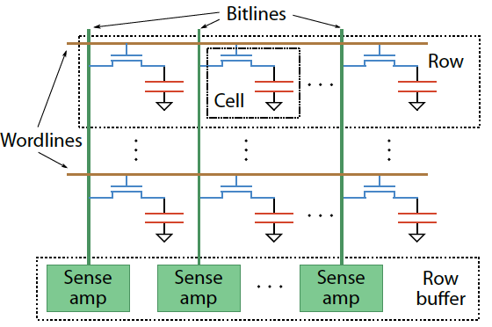
Two Challenges to Retention Time Profiling
Challenge 1: Data Pattern Dependence (DPD)
  Retention time of a DRAM cell depends on its value and the values of cells nearby it
  When a row is activated, all bitlines are perturbed simultaneously

Slide 129
Data Pattern Dependence
Electrical noise on the bitline affects reliable sensing of a DRAM cell
The magnitude of this noise is affected by values of nearby cells via
  Bitline-bitline coupling → electrical coupling between adjacent bitlines
  Bitline-wordline coupling → electrical coupling between each bitline and the activated wordline
Retention time of a cell depends on data patterns stored in nearby cells
→ need to find the worst data pattern to find worst-case retention time
Notes:
If a cell has lost enough charge, this noise can be large enough to cause a failure on a read
(normally, there is enough noise margin to tolerate the coupling noise)

Slide 130
Two Challenges to Retention Time Profiling
Challenge 2: Variable Retention Time (VRT)
  Retention time of a DRAM cell changes randomly over time
    a cell alternates between multiple retention time states
  Leakage current of a cell changes sporadically due to a charge trap in the gate oxide of the DRAM cell access transistor
  When the trap becomes occupied, charge leaks more readily from the transistor’s drain, leading to a short retention time
    Called Trap-Assisted Gate-Induced Drain Leakage
  This process appears to be a random process [Kim+ IEEE TED’11]
  Worst-case retention time depends on a random process
    → need to find the worst case despite this

Slide 131
Our Goal
Analyze the retention time behavior of DRAM cells in modern commodity DRAM devices
  to aid the collection of accurate profile information
Provide a comprehensive empirical investigation of two key challenges to retention time profiling
  Data Pattern Dependence (DPD)
  Variable Retention Time (VRT)

Slide 132
Talk Agenda
DRAM Refresh: Background and Motivation
Challenges and Our Goal
DRAM Characterization Methodology
Foundational Results
  Temperature Dependence
  Retention Time Distribution
Data Pattern Dependence: Analysis and Implications
Variable Retention Time: Analysis and Implications
Conclusions

Slide 133
DRAM Testing Platform and Method
Test platform: Developed a DDR3 DRAM testing platform using the Xilinx ML605 FPGA development board
  Temperature controlled
Tested DRAM chips: 248 commodity DRAM chips from five manufacturers (A,B,C,D,E)
Seven families based on equal capacity per device:
  A 1Gb, A 2Gb
  B 2Gb
  C 2Gb
  D 1Gb, D 2Gb
  E 2Gb
Notes:
Add number of chips

Slide 134
Experiment Design
Each module tested for multiple rounds of tests.
Each test searches for the set of cells with a retention time less than a threshold value for a particular data pattern
High-level structure of a test:
  Write data pattern to rows in a DRAM bank
  Prevent refresh for a period of time tWAIT, leave DRAM idle
  Read stored data pattern, compare to written pattern and record corrupt cells as those with retention time < tWAIT
Test details and important issues to pay attention to are discussed in paper

Slide 135
Experiment Structure
Tests both the data pattern
and its complement
Round
Test
Notes:
Highlight test and round here.
Say each data pattern and its complement is tested to account for true and anti cells

Slide 136
Experiment Parameters
Most tests conducted at 45 degrees Celsius
No cells observed to have a retention time less than 1.5 second at 45ºC
Tested tWAIT in increments of 128ms from 1.5 to 6.1 seconds

Slide 137
Tested Data Patterns
Fixed patterns
All 0s/1s: Value 0/1 is written to all bits
  Previous work suggested this is sufficient
Checkerboard: Consecutive bits alternate between 0 and 1
  Coupling noise increases with voltage difference between the neighboring bitlines → May induce worst case data pattern (if adjacent bits mapped to adjacent cells)
Walk: Attempts to ensure a single cell storing 1 is surrounded by cells storing 0
  This may lead to even worse coupling noise and retention time due to coupling between nearby bitlines [Li+ IEEE TCSI 2011]
  Walk pattern is permuted in each round to exercise different cells
Random: Randomly generated data is written to each row
  A new set of random data is generated for each round

Slide 138
Talk Agenda
DRAM Refresh: Background and Motivation
Challenges and Our Goal
DRAM Characterization Methodology
Foundational Results
  Temperature Dependence
  Retention Time Distribution
Data Pattern Dependence: Analysis and Implications
Variable Retention Time: Analysis and Implications
Conclusions

Slide 139
Temperature Stability
Tested chips at five different stable temperatures

Slide 140
Dependence of Retention Time on Temperature
Fraction of cells that
exhibited retention
time failure
at any tWAIT
for any data pattern
at 50ºC
Normalized retention
times of the same cells
at 55ºC
Best-fit exponential curves
for retention time change
with temperature
Normalized retention
times of the same cells
At 70ºC

Slide 141
Dependence of Retention Time on Temperature
Relationship between retention time and temperature is consistently bounded (predictable) within a device
Every 10ºC temperature increase
46.5% reduction in retention time in the worst case

Slide 142
Retention Time Distribution
NEWER
NEWER
OLDER
OLDER
Newer device families have more weak cells than older ones
Likely a result of technology scaling
Minimum tested retention time ~1.5s at 45C → ~126ms at 85C
Very few cells exhibit the lowest retention times
Shape of the curve consistent with previous works

Slide 143
Talk Agenda
DRAM Refresh: Background and Motivation
Challenges and Our Goal
DRAM Characterization Methodology
Foundational Results
  Temperature Dependence
  Retention Time Distribution
Data Pattern Dependence: Analysis and Implications
Variable Retention Time: Analysis and Implications
Conclusions

Slide 144
Some Terminology
Failure population of cells with Retention Time X: The set of all cells that exhibit retention failure in any test with any data pattern at that retention time (tWAIT)
Retention Failure Coverage of a Data Pattern DP: Fraction of cells with retention time X that exhibit retention failure with that particular data pattern DP
If retention times are not dependent on data pattern stored in cells, we would expect
  Coverage of any data pattern to be 100%
  In other words, if one data pattern causes a retention failure, any other data pattern also would

Slide 145
Recall the Tested Data Patterns
Fixed patterns
All 0s/1s: Value 0/1 is written to all bits
Checkerboard: Consecutive bits alternate between 0 and 1
Walk: Attempts to ensure a single cell storing 1 is surrounded by cells storing 0
Random: Randomly generated data is written to each row

Slide 146
Retention Failure Coverage of Data Patterns
A 2Gb chip family
6.1s retention time
Different data patterns have widely different coverage:
Data pattern dependence exists and is severe
Coverage of fixed patterns is low: ~30% for All 0s/1s
Walk is the most effective data pattern for this device
No data pattern achieves 100% coverage

Slide 147
Retention Failure Coverage of Data Patterns
B 2Gb chip family
6.1s retention time
Random is the most effective data pattern for this device
No data pattern achieves 100% coverage

Slide 148
Retention Failure Coverage of Data Patterns
C 2Gb chip family
6.1s retention time
Random is the most effective data pattern for this device
No data pattern achieves 100% coverage

Slide 149
Data Pattern Dependence: Observations (I)
A cell’s retention time is heavily influenced by data pattern stored in other cells
  Pattern affects the coupling noise, which affects cell leakage
No tested data pattern exercises the worst case retention time for all cells (no pattern has 100% coverage)
  No pattern is able to induce the worst-case coupling noise for every cell
  Problem: Underlying DRAM circuit organization is not known to the memory controller → very hard to construct a pattern that exercises the worst-case cell leakage
  → Opaque mapping of addresses to physical DRAM geometry
  → Internal remapping of addresses within DRAM to tolerate faults
  → Second order coupling effects are very hard to determine

Slide 150
Data Pattern Dependence: Observations (II)
Fixed, simple data patterns have low coverage
  They do not exercise the worst-case coupling noise
The effectiveness of each data pattern varies significantly between DRAM devices (of the same or different vendors)
  Underlying DRAM circuit organization likely differs between different devices → patterns leading to worst coupling are different in different devices
Technology scaling appears to increase the impact of data pattern dependence
  Scaling reduces the physical distance between circuit elements, increasing the magnitude of coupling effects

Slide 151
Effect of Technology Scaling on DPD
A 1Gb chip family
A 2Gb chip family
The lowest-coverage data pattern achieves much lower coverage for the smaller technology node

Slide 152
DPD: Implications on Profiling Mechanisms
Any retention time profiling mechanism must handle data pattern dependence of retention time
Intuitive approach: Identify the data pattern that induces the worst-case retention time for a particular cell or device
Problem 1: Very hard to know at the memory controller which bits actually interfere with each other due to
  Opaque mapping of addresses to physical DRAM geometry → logically consecutive bits may not be physically consecutive
  Remapping of faulty bitlines/wordlines to redundant ones internally within DRAM
Problem 2: Worst-case coupling noise is affected by non-obvious second order bitline coupling effects

Slide 153
DPD: Suggestions (for Future Work)
A mechanism for identifying worst-case data pattern(s) likely requires support from DRAM device
  DRAM manufacturers might be in a better position to do this
  But, the ability of the manufacturer to identify and expose the entire retention time profile is limited due to VRT
An alternative approach: Use random data patterns to increase coverage as much as possible; handle incorrect retention time estimates with ECC
  Need to keep profiling time in check
  Need to keep ECC overhead in check

Slide 154
Talk Agenda
DRAM Refresh: Background and Motivation
Challenges and Our Goal
DRAM Characterization Methodology
Foundational Results
  Temperature Dependence
  Retention Time Distribution
Data Pattern Dependence: Analysis and Implications
Variable Retention Time: Analysis and Implications
Conclusions

Slide 155
Variable Retention Time
Retention time of a cell can vary over time
A cell can randomly switch between multiple leakage current states due to Trap-Assisted Gate-Induced Drain Leakage, which appears to be a random process
[Yaney+ IEDM 1987, Restle+ IEDM 1992]

Slide 156
An Example VRT Cell
A cell from E 2Gb chip family

Slide 157
VRT: Questions and Methodology
Key Questions
  How prevalent is VRT in modern DRAM devices?
  What is the timescale of observation of the lowest retention time state?
  What are the implications on retention time profiling?
Test Methodology
  Each device was tested for at least 1024 rounds over 24 hours
  Temperature fixed at 45ºC
  Data pattern used is the most effective data pattern for each device
  For each cell that fails at any retention time, we record the minimum and the maximum retention time observed

Slide 158
Variable Retention Time
Many failing cells jump from
very high retention time to very low
Most failing cells
exhibit VRT
Min ret time = Max ret time
Expected if no VRT
A 2Gb chip family

Slide 159
Variable Retention Time
B 2Gb chip family

Slide 160
Variable Retention Time
C 2Gb chip family

Slide 161
VRT: Observations So Far
VRT is common among weak cells (i.e., those cells that experience low retention times)
VRT can result in significant retention time changes
  Difference between minimum and maximum retention times of a cell can be more than 4x, and may not be bounded
  Implication: Finding a retention time for a cell and using a guardband to ensure minimum retention time is “covered” requires a large guardband or may not work
Retention time profiling mechanisms must identify lowest retention time in the presence of VRT
  Question: How long to profile a cell to find its lowest retention time state?

Slide 162
Time Between Retention Time State Changes
How much time does a cell spend in a high retention state before switching to the minimum observed retention time state?

Slide 163
Time Spent in High Retention Time State
A 2Gb chip family
~4 hours
~1 day
Time scale at which a cell switches to the low retention time state can be very long (~ 1 day or longer)
Need to profile for a long time to
get to the minimum retention time state

Slide 164
Time Spent in High Retention Time State
B 2Gb chip family

Slide 165
Time Spent in High Retention Time State
C 2Gb chip family

Slide 166
VRT: Implications on Profiling Mechanisms
Problem 1: There does not seem to be a way of determining if a cell exhibits VRT without actually observing a cell exhibiting VRT
  VRT is a memoryless random process [Kim+ JJAP 2010]
Problem 2: VRT complicates retention time profiling by DRAM manufacturers
  Exposure to very high temperatures can induce VRT in cells that were not previously susceptible
  → can happen during soldering of DRAM chips
  → manufacturer’s retention time profile may not be accurate
One option for future work: Use ECC to continuously profile DRAM online while aggressively reducing refresh rate
  Need to keep ECC overhead in check

Slide 167
Talk Agenda
DRAM Refresh: Background and Motivation
Challenges and Our Goal
DRAM Characterization Methodology
Foundational Results
  Temperature Dependence
  Retention Time Distribution
Data Pattern Dependence: Analysis and Implications
Variable Retention Time: Analysis and Implications
Conclusions

Slide 168
Summary and Conclusions
DRAM refresh is a critical challenge in scaling DRAM technology efficiently to higher capacities and smaller feature sizes
Understanding the retention time of modern DRAM devices can enable old or new methods to reduce the impact of refresh
  Many mechanisms require accurate and reliable retention time profiles
We presented the first work that comprehensively examines data retention behavior in modern commodity DRAM devices
  Characterized 248 devices from five manufacturers
Key findings: Retention time of a cell significantly depends on data pattern stored in other cells (data pattern dependence) and changes over time via a random process (variable retention time)
  Discussed the underlying reasons and provided suggestions
Future research on retention time profiling should solve the challenges posed by the DPD and VRT phenomena

Slide 169
An Experimental Study of
Data Retention Behavior in Modern DRAM Devices
Implications for Retention Time Profiling Mechanisms
Jamie Liu¹ Ben Jaiyen¹ Yoongu Kim¹
Chris Wilkerson² Onur Mutlu¹
¹ Carnegie Mellon University
² Intel Corporation

Slide 170
Enabling Emerging Memory Technologies

Slide 171
Aside: Scaling Flash Memory [Cai+, ICCD’12]
NAND flash memory has low endurance: a flash cell dies after 3k P/E cycles vs. 50k desired → Major scaling challenge for flash memory
Flash error rate increases exponentially over flash lifetime
Problem: Stronger error correction codes (ECC) are ineffective and undesirable for improving flash lifetime due to
  diminishing returns on lifetime with increased correction strength
  prohibitively high power, area, latency overheads
Our Goal: Develop techniques to tolerate high error rates w/o strong ECC
Observation: Retention errors are the dominant errors in MLC NAND flash
  flash cell loses charge over time; retention errors increase as cell gets worn out
Solution: Flash Correct-and-Refresh (FCR)
  Periodically read, correct, and reprogram (in place) or remap each flash page before it accumulates more errors than can be corrected by simple ECC
  Adapt “refresh” rate to the severity of retention errors (i.e., # of P/E cycles)
Results: FCR improves flash memory lifetime by 46X with no hardware changes and low energy overhead; outperforms strong ECCs

Slide 172
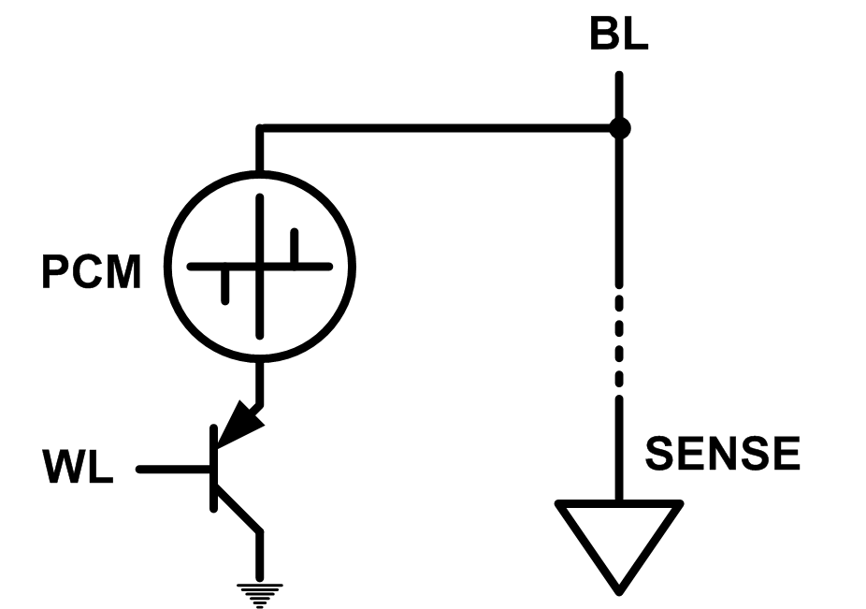
Solution 2: Emerging Memory Technologies
Some emerging resistive memory technologies seem more scalable than DRAM (and they are non-volatile)
Example: Phase Change Memory
  Data stored by changing phase of material
  Data read by detecting material’s resistance
  Expected to scale to 9nm (2022 [ITRS])
  Prototyped at 20nm (Raoux+, IBM JRD 2008)
  Expected to be denser than DRAM: can store multiple bits/cell
But, emerging technologies have (many) shortcomings
  Can they be enabled to replace/augment/surpass DRAM?
Notes:
Even if DRAM continues to scale there could be benefits to examining and enabling these new technologies.

Slide 173
Phase Change Memory: Pros and Cons
Pros over DRAM
  Better technology scaling (capacity and cost)
  Non volatility
  Low idle power (no refresh)
Cons
  Higher latencies: ~4-15x DRAM (especially write)
  Higher active energy: ~2-50x DRAM (especially write)
  Lower endurance (a cell dies after ~10⁸ writes)
Challenges in enabling PCM as DRAM replacement/helper:
  Mitigate PCM shortcomings
  Find the right way to place PCM in the system

Slide 174
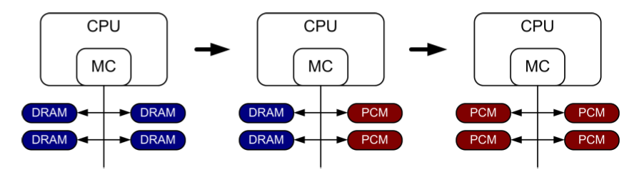
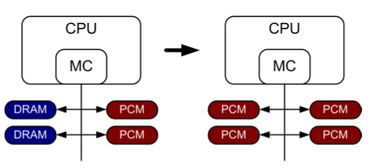
PCM-based Main Memory (I)
How should PCM-based (main) memory be organized?
Hybrid PCM+DRAM [Qureshi+ ISCA’09, Dhiman+ DAC’09]:
  How to partition/migrate data between PCM and DRAM

Slide 175
PCM-based Main Memory (II)
How should PCM-based (main) memory be organized?
Pure PCM main memory [Lee et al., ISCA’09, Top Picks’10]:
  How to redesign entire hierarchy (and cores) to overcome PCM shortcomings

Slide 176
PCM-Based Memory Systems: Research Challenges
Partitioning
  Should DRAM be a cache or main memory, or configurable?
  What fraction? How many controllers?
Data allocation/movement (energy, performance, lifetime)
  Who manages allocation/movement?
  What are good control algorithms?
  How do we prevent degradation of service due to wearout?
Design of cache hierarchy, memory controllers, OS
  Mitigate PCM shortcomings, exploit PCM advantages
Design of PCM/DRAM chips and modules
  Rethink the design of PCM/DRAM with new requirements

Slide 177
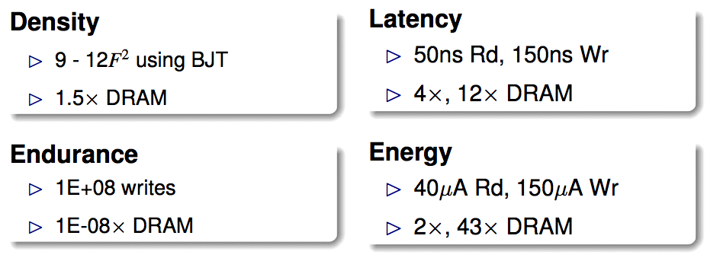
An Initial Study: Replace DRAM with PCM
Lee, Ipek, Mutlu, Burger, “Architecting Phase Change Memory as a Scalable DRAM Alternative,” ISCA 2009.
  Surveyed prototypes from 2003-2008 (e.g. IEDM, VLSI, ISSCC)
  Derived “average” PCM parameters for F=90nm

Slide 178
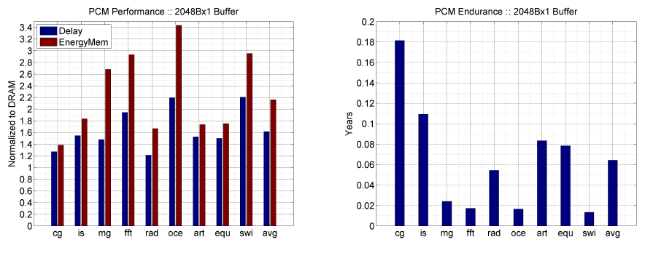
Results: Naïve Replacement of DRAM with PCM
Replace DRAM with PCM in a 4-core, 4MB L2 system
PCM organized the same as DRAM: row buffers, banks, peripherals
1.6x delay, 2.2x energy, 500-hour average lifetime
Lee, Ipek, Mutlu, Burger, “Architecting Phase Change Memory as a Scalable DRAM Alternative,” ISCA 2009.

Slide 179
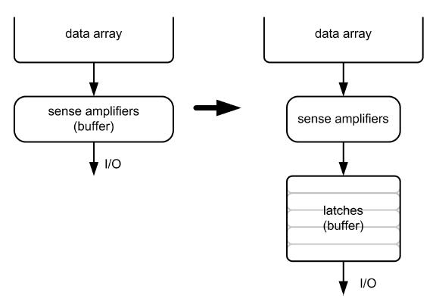
Architecting PCM to Mitigate Shortcomings
Idea 1: Use multiple narrow row buffers in each PCM chip
    → Reduces array reads/writes → better endurance, latency, energy
Idea 2: Write into array at
cache block or word
granularity
→ Reduces unnecessary wear
DRAM
PCM

Slide 180
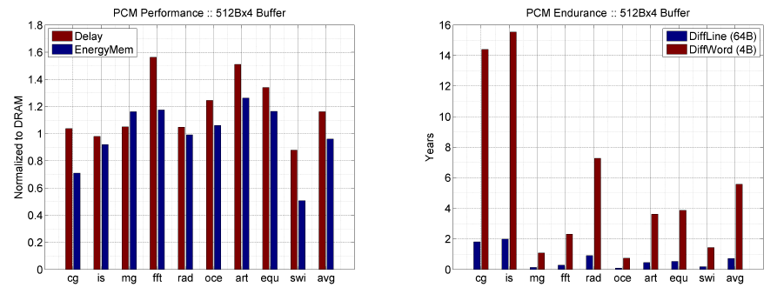
Results: Architected PCM as Main Memory
1.2x delay, 1.0x energy, 5.6-year average lifetime
Scaling improves energy, endurance, density
Caveat 1: Worst-case lifetime is much shorter (no guarantees)
Caveat 2: Intensive applications see large performance and energy hits
Caveat 3: Optimistic PCM parameters?

Slide 181
Hybrid Memory Systems
CPU
Meza, Chang, Yoon, Mutlu, Ranganathan, “Enabling Efficient and Scalable Hybrid Memories,” IEEE Comp. Arch. Letters, 2012.
DRAMCtrl
PCM Ctrl
DRAM
Phase Change Memory (or Tech. X)
Fast, durable
Small,
leaky, volatile,
high-cost
Large, non-volatile, low-cost
Slow, wears out, high active energy
Hardware/software manage data allocation and movement
to achieve the best of multiple technologies
(5-9 years of average lifetime)

Slide 182
One Option: DRAM as a Cache for PCM
PCM is main memory; DRAM caches memory rows/blocks
  Benefits: Reduced latency on DRAM cache hit; write filtering
Memory controller hardware manages the DRAM cache
  Benefit: Eliminates system software overhead
Three issues:
  What data should be placed in DRAM versus kept in PCM?
  What is the granularity of data movement?
  How to design a low-cost hardware-managed DRAM cache?
Two idea directions:
  Locality-aware data placement [Yoon+ , ICCD 2012]
  Cheap tag stores and dynamic granularity [Meza+, IEEE CAL 2012]

Slide 183
DRAM vs. PCM: An Observation
Row buffers are the same in DRAM and PCM
Row buffer hit latency same in DRAM and PCM
Row buffer miss latency small in DRAM, large in PCM
Accessing the row buffer in PCM is fast
What incurs high latency is the PCM array access → avoid this
CPU
Row buffer
DRAMCtrl
PCM Ctrl
DRAM Cache
PCM Main Memory
Bank
Bank
Bank
Bank
N ns row hit
Fast row miss
N ns row hit
Slow row miss

Slide 184
Row-Locality-Aware Data Placement
Idea: Cache in DRAM only those rows that
  Frequently cause row buffer conflicts → because row-conflict latency is smaller in DRAM
  Are reused many times → to reduce cache pollution and bandwidth waste
Simplified rule of thumb:
  Streaming accesses: Better to place in PCM
  Other accesses (with some reuse): Better to place in DRAM
Bridges half of the performance gap between all-DRAM and all-PCM memory on memory-intensive workloads
Yoon et al., “Row Buffer Locality-Aware Caching Policies for Hybrid Memories,” ICCD 2012.

Slide 185
Row-Locality-Aware Data Placement: Mechanism
For a subset of rows in PCM, memory controller:
  Tracks row conflicts as a predictor of future locality
  Tracks accesses as a predictor of future reuse
Cache a row in DRAM if its row conflict and access counts are greater than certain thresholds
Determine thresholds dynamically to adjust to application/workload characteristics
  Simple cost/benefit analysis every fixed interval

Slide 186
Implementation: “Statistics Store”
Goal: To keep count of row buffer misses to recently used rows in PCM
Hardware structure in memory controller
  Operation is similar to a cache
    Input: row address
    Output: row buffer miss count
  128-set 16-way statistics store (9.25KB) achieves system performance within 0.3% of an unlimited-sized statistics store
Notes:
The implementation of our mechanism requires a statistics store, or what we simply call a stats store.
The goal of the stats store is to keep count of the row buffer misses to recently used rows in PCM.
The stats store is a hardware structure in the memory controller, and its operation is similar to a cache.
It is organized into sets and ways, and is indexed using the row address of the row we wish to find the row buffer miss count for.
If the queried row is currently in the stats store, then its row buffer miss count will be output.
We find that a 128-set 16-way stats store, 9.25KB in size, achieves system performance within 0.3% of an unlimited-sized stats store.

Slide 187
Evaluation Methodology
Cycle-level x86 CPU-memory simulator
  CPU: 16 out-of-order cores, 32KB private L1 per core, 512KB shared L2 per core
  Memory: 1GB DRAM (8 banks), 16GB PCM (8 banks), 4KB migration granularity
36 multi-programmed server, cloud workloads
  Server: TPC-C (OLTP), TPC-H (Decision Support)
  Cloud: Apache (Webserv.), H.264 (Video), TPC-C/H
Metrics: Weighted speedup (perf.), perf./Watt (energy eff.), Maximum slowdown (fairness)
Notes:
Here’s our evaluation methodology.
We use a cycle-level x86 simulator to test our hybrid memory caching policies.
We simulate a 16-core system with 1GB of DRAM and 16GB of PCM.
We use 36 multi-programmed server and cloud workloads to test our caching policies.
For server workloads, we use TPC-C, which is an online transaction processing benchmark, and TPC-H, which is a decision support benchmark.
For cloud workloads, we use Apache, which is a webserver application, and H.264, a video processing application, as well as TPC-C and H.
We report multi-core performance in terms of weighted speedup, multi-core fairness in terms of maximum slowdown, and energy efficiency in terms of performance per Watt.

Slide 188
Comparison Points
Conventional LRU Caching
FREQ: Access-frequency-based caching
  Places “hot data” in cache [Jiang+ HPCA’10]
  Cache to DRAM rows with accesses ≥ threshold
  Row buffer locality-unaware
FREQ-Dyn: Adaptive Freq.-based caching
  FREQ + our dynamic threshold adjustment
  Row buffer locality-unaware
RBLA: Row buffer locality-aware caching
RBLA-Dyn: Adaptive RBL-aware caching
Notes:
And here are our comparison points.
The standard conventional LRU caching caches any row from PCM to DRAM when the data is touched. We find this scheme to generate too much data movement between DRAM and PCM and consequently to not perform well. So we’re not going to use it as a comparison point in this talk.
Frek is access frequency based caching. It is inspired by prior work that selectively caches hot data.
The downsides of frek is that it is row buffer locality aware. Hence, it would place a row with high row buffer locality in DRAM, although that row may be accessed as efficiently in PCM.
Frek-Dyn augments frek with the adaptive threshold adjustment technique.
It has the same drawback as frek, in that it is row buffer locality unaware.
Our mechanisms, RBLA and RBLA-Dyn, are specifically designed to be aware of row buffer locality and to exploit it.

Slide 189
System Performance
10%
14%
17%
Benefit 1: Increased row buffer locality (RBL) in PCM by moving low RBL data to DRAM
Benefit 1: Increased row buffer locality (RBL) in PCM by moving low RBL data to DRAM
Benefit 2: Reduced memory bandwidth consumption due to stricter caching criteria
Benefit 2: Reduced memory bandwidth consumption due to stricter caching criteria
Benefit 3: Balanced memory request load between DRAM and PCM
Notes:
Here are the system performance results of the different hybrid memory caching policies.
RBLA-Dyn achieves 17% performance improvement over frek in server workloads, 10% in cloud, and 14% overall.
This is due to a number of reasons.
The first is that RBLA-Dyn increases row buffer locality in PCM by moving low row buffer locality data to DRAM.
The second is that RBLA-Dyn reduces memory bandwidth consumption due its stricter caching criteria.
And RBLA-Dyn also has the effect of balancing the memory request load between DRAM and PCM by letting rows with high row buffer locality remain in PCM, instead of fetching all accessed data to DRAM.

Slide 190
Average Memory Latency
14%
12%
9%
Notes:
These benefits are also reflected in the average memory latency, which RBLA-Dyn reduces by 14% over frek in server workloads, by 9% in cloud, and by 12% overall.

Slide 191
Memory Energy Efficiency
13%
7%
10%
Increased performance & reduced data movement between DRAM and PCM
Notes:
RBLA-Dyn improves memory system energy efficiency by 13% in server workloads, 7% in cloud, and 10% overall.
This is partly due to the increased system performance, and partly due to the reduced data movement between DRAM and PCM because of RBLA-Dyn’s stricter caching criteria.

Slide 192
Thread Fairness
7.6%
6.2%
4.8%
Notes:
And our mechanism also improves multi-core thread fairness by 7.6% in server workloads, by 4.8% in cloud, and by 6.2% overall.

Slide 193
Compared to All-PCM/DRAM
29%
31%
Our mechanism achieves 31% better performance than all PCM, within 29% of all DRAM performance
Notes:
Now let’s compare our mechanism to a homogeneous memory system.
Here the comparison points are a 16GB all-PCM and all-DRAM memory system.
Our mechanism achieves 31% better performance than the all-PCM memory system, and comes within 29% of the all-DRAM performance.
Note that we do not assume any capacity benefits of PCM over DRAM.
And yet, our mechanism bridges the performance gap between the two homogeneous memory systems.
If the capacity benefit of PCM was included, the hybrid memory system will perform even better.

Slide 194
The Problem with Large DRAM Caches
A large DRAM cache requires a large metadata (tag + block-based information) store
How do we design an efficient DRAM cache?
CPU
LOAD X
Metadata:
X → DRAM
Mem
Ctlr
Mem
Ctlr
DRAM
PCM
X
(small, fast cache)
(high capacity)
Access X

Slide 195
Idea 1: Tags in Memory
Store tags in the same row as data in DRAM
  Store metadata in same row as their data
  Data and metadata can be accessed together
Benefit: No on-chip tag storage overhead
Downsides:
  Cache hit determined only after a DRAM access
  Cache hit requires two DRAM accesses
DRAM row
Cache block 0
Cache block 1
Cache block 2
Tag0
Tag1
Tag2

Slide 196
Idea 2: Cache Tags in SRAM
Recall Idea 1: Store all metadata in DRAM
  To reduce metadata storage overhead
Idea 2: Cache in on-chip SRAM frequently-accessed metadata
  Cache only a small amount to keep SRAM size small

Slide 197
Idea 3: Dynamic Data Transfer Granularity
Some applications benefit from caching more data
  They have good spatial locality
Others do not
  Large granularity wastes bandwidth and reduces cache utilization
Idea 3: Simple dynamic caching granularity policy
  Cost-benefit analysis to determine best DRAM cache block size
  Group main memory into sets of rows
  Some row sets follow a fixed caching granularity
  The rest of main memory follows the best granularity
    Cost–benefit analysis: access latency versus number of cachings
    Performed every quantum

Slide 198
TIMBER Tag Management
A Tag-In-Memory BuffER (TIMBER)
  Stores recently-used tags in a small amount of SRAM
Benefits: If tag is cached:
  no need to access DRAM twice
  cache hit determined quickly
DRAM row
Cache block 0
Cache block 1
Cache block 2
Tag0
Tag1
Tag2
Row Tag
Row0
Tag0
Tag1
Tag2
LOAD X
Row27
Tag0
Tag1
Tag2

Slide 199
TIMBER Tag Management Example (I)
Case 1: TIMBER hit
Our proposal
TIMBER: X → DRAM
Row0
Tag0
Tag1
Tag2
Row27
Tag0
Tag1
Tag2
CPU
LOAD X
Mem
Ctlr
Mem
Ctlr
Bank
Bank
Bank
Bank
X
Access X

Slide 200
TIMBER Tag Management Example (II)
Case 2: TIMBER miss
2. Cache M(Y)
Access Metadata(Y)
Y → DRAM
Row0
Tag0
Tag1
Tag2
Row27
Tag0
Tag1
Tag2
CPU
Row143
Miss
LOAD Y
Mem
Ctlr
Mem
Ctlr
Bank
Bank
Bank
Bank
Y
M(Y)
1. Access M(Y)
3. Access Y (row hit)

Slide 201
Methodology
System: 8 out-of-order cores at 4 GHz
Memory: 512 MB direct-mapped DRAM, 8 GB PCM
  128B caching granularity
  DRAM row hit (miss): 200 cycles (400 cycles)
  PCM row hit (clean / dirty miss): 200 cycles (640 / 1840 cycles)
Evaluated metadata storage techniques
  All SRAM system (8MB of SRAM)
  Region metadata storage
  TIM metadata storage (same row as data)
  TIMBER, 64-entry direct-mapped (8KB of SRAM)

Slide 202
TIMBER Performance
-6%
Meza, Chang, Yoon, Mutlu, Ranganathan, “Enabling Efficient and Scalable Hybrid Memories,” IEEE Comp. Arch. Letters, 2012.

Slide 203
TIMBER Energy Efficiency
18%
Meza, Chang, Yoon, Mutlu, Ranganathan, “Enabling Efficient and Scalable Hybrid Memories,” IEEE Comp. Arch. Letters, 2012.

Slide 204
Hybrid Main Memory: Research Topics
Many research ideas from technology layer to algorithms layer
Enabling NVM and hybrid memory
  How to maximize performance?
  How to maximize lifetime?
  How to prevent denial of service?
Exploiting emerging tecnologies
  How to exploit non-volatility?
  How to minimize energy consumption?
  How to minimize cost?
  How to exploit NVM on chip?
Problems
Algorithms
Programs
User
Runtime System
(VM, OS, MM)
ISA
Microarchitecture
Logic
Devices

Slide 205
Security Challenges of Emerging Technologies
1. Limited endurance → Wearout attacks
2. Non-volatility → Data persists in memory after powerdown
→ Easy retrieval of privileged or private information
3. Multiple bits per cell → Information leakage (via side channel)

Slide 206
Securing Emerging Memory Technologies
1. Limited endurance → Wearout attacks
Better architecting of memory chips to absorb writes
Hybrid memory system management
Online wearout attack detection
2. Non-volatility → Data persists in memory after powerdown
→ Easy retrieval of privileged or private information
Efficient encryption/decryption of whole main memory
Hybrid memory system management
3. Multiple bits per cell → Information leakage (via side channel)
System design to hide side channel information

