Slide 1
Processing Data Where It Makes Sense in Modern Computing Systems: Enabling In-Memory Computation Onur Mutlu omutlu@gmail.com https://people.inf.ethz.ch/omutlu Feb. 21st 2019

Slide 2
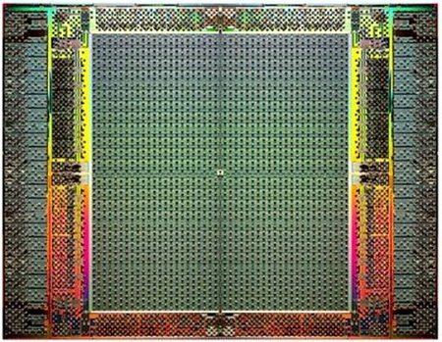
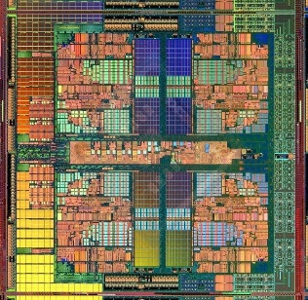
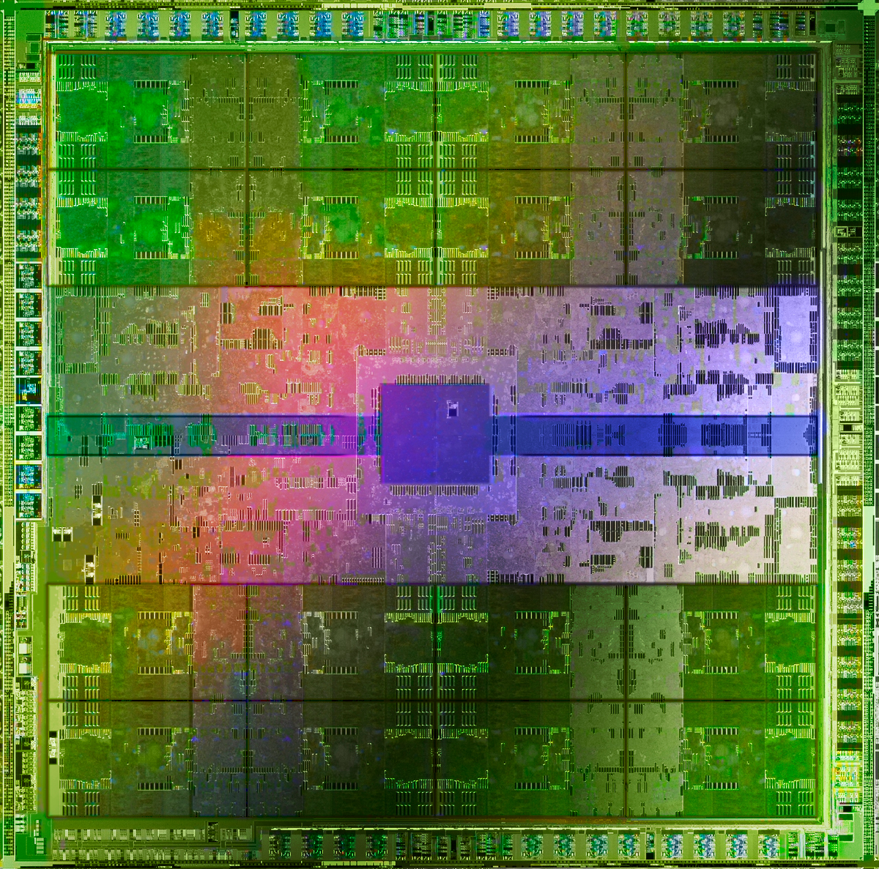
The Main Memory System
Main memory is a critical component of all computing systems: server, mobile, embedded, desktop, sensor
Main memory system must scale (in size, technology, efficiency, cost, and management algorithms) to maintain performance growth and technology scaling benefits
FPGAs
Processors
and caches
Main Memory
Storage (SSD/HDD)
GPUs

Slide 3
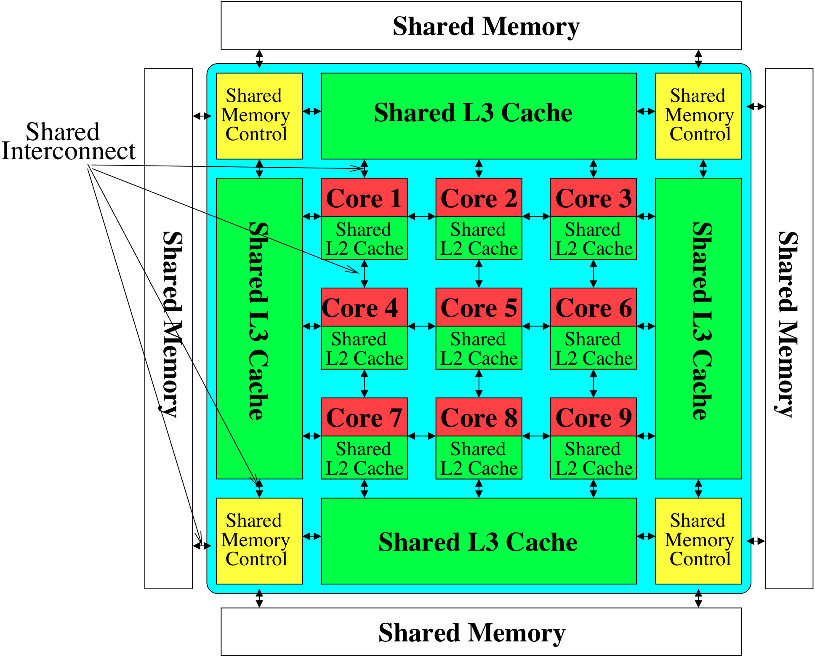
Memory System: A Shared Resource View
Storage
Most of the system is dedicated to storing and moving data

Slide 4
State of the Main Memory System
Recent technology, architecture, and application trends
lead to new requirements
exacerbate old requirements
DRAM and memory controllers, as we know them today, are (will be) unlikely to satisfy all requirements
Some emerging non-volatile memory technologies (e.g., PCM) enable new opportunities: memory+storage merging
We need to rethink the main memory system
to fix DRAM issues and enable emerging technologies
to satisfy all requirements

Slide 5
Major Trends Affecting Main Memory (I)
Need for main memory capacity, bandwidth, QoS increasing
Main memory energy/power is a key system design concern
DRAM technology scaling is ending

Slide 6
Major Trends Affecting Main Memory (II)
Need for main memory capacity, bandwidth, QoS increasing
Multi-core: increasing number of cores/agents
Data-intensive applications: increasing demand/hunger for data
Consolidation: cloud computing, GPUs, mobile, heterogeneity
Main memory energy/power is a key system design concern
DRAM technology scaling is ending

Slide 7
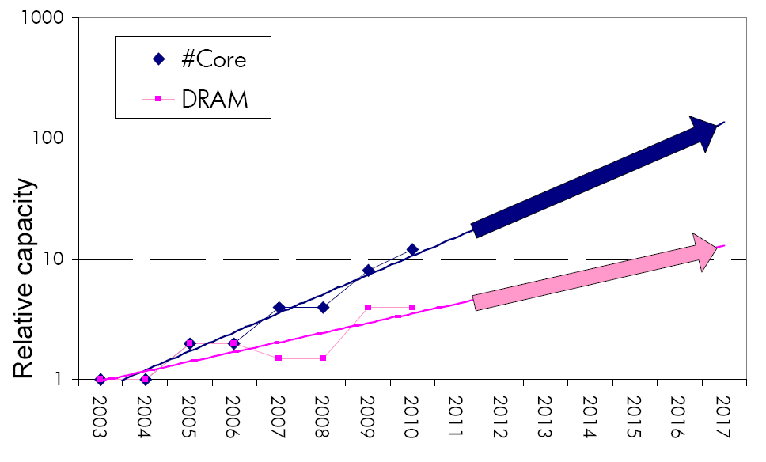
Example: The Memory Capacity Gap
Core count doubling ~ every 2 years
DRAM DIMM capacity doubling ~ every 3 years
Memory capacity per core expected to drop by 30% every two years
Trends worse for memory bandwidth per core!
Lim et al., ISCA 2009

Slide 8
Capacity, Bandwidth & Latency of a DRAM Chip
128x
20x
1.3x
Memory latency remains almost constant

Slide 9
DRAM Is Critical for Performance (Server)
In-memory Databases
[Mao+, EuroSys’12; Clapp+ (Intel), IISWC’15]
Graph/Tree Processing
[Xu+, IISWC’12; Umuroglu+, FPL’15]
Memory → performance bottleneck
In-Memory Data Analytics
[Clapp+ (Intel), IISWC’15;
Awan+, BDCloud’15]
Datacenter Workloads [Kanev+ (Google), ISCA’15]

Slide 10
DRAM Is Critical for Performance (Consumer)
Chrome
TensorFlow Mobile
Google’s web browser
Google’s machine learning framework
Memory → performance bottleneck
Video Playback
Video Capture
Google’s video codec
Google’s video codec

Slide 11
Major Trends Affecting Main Memory (III)
Need for main memory capacity, bandwidth, QoS increasing
Main memory energy/power is a key system design concern
~40-50% energy spent in off-chip memory hierarchy [Lefurgy, IEEE Computer’03] >40% power in DRAM [Ware, HPCA’10][Paul,ISCA’15]
DRAM consumes power even when not used (periodic refresh)
DRAM technology scaling is ending

Slide 12
Energy Waste in Mobile Devices
Amirali Boroumand, Saugata Ghose, Youngsok Kim, Rachata Ausavarungnirun, Eric Shiu, Rahul Thakur, Daehyun Kim, Aki Kuusela, Allan Knies, Parthasarathy Ranganathan, and Onur Mutlu, "Google Workloads for Consumer Devices: Mitigating Data Movement Bottlenecks" Proceedings of the 23rd International Conference on Architectural Support for Programming Languages and Operating Systems (ASPLOS), Williamsburg, VA, USA, March 2018.
62.7% of the total system energy
is spent on data movement

Slide 13
Major Trends Affecting Main Memory (IV)
Need for main memory capacity, bandwidth, QoS increasing
Main memory energy/power is a key system design concern
DRAM technology scaling is ending
ITRS projects DRAM will not scale easily below X nm
Scaling has provided many benefits:
higher capacity (density), lower cost, lower energy

Slide 14
Major Trends Affecting Main Memory (V)
DRAM scaling has already become increasingly difficult
Increasing cell leakage current, reduced cell reliability, increasing manufacturing difficulties [Kim+ ISCA 2014], [Liu+ ISCA 2013], [Mutlu IMW 2013], [Mutlu DATE 2017]
Difficult to significantly improve capacity, energy
Emerging memory technologies are promising
3D-Stacked DRAM | higher bandwidth | smaller capacity
Reduced-Latency DRAM (e.g., RL/TL-DRAM, FLY-RAM) | lower latency | higher cost
Low-Power DRAM (e.g., LPDDR3, LPDDR4, Voltron) | lower power | higher latency higher cost
Non-Volatile Memory (NVM) (e.g., PCM, STTRAM, ReRAM, 3D Xpoint) | larger capacity | higher latency higher dynamic power lower endurance

Slide 15
Major Trend: Hybrid Main Memory
CPU
Meza+, “Enabling Efficient and Scalable Hybrid Memories,” IEEE Comp. Arch. Letters, 2012.
Yoon+, “Row Buffer Locality Aware Caching Policies for Hybrid Memories,” ICCD 2012 Best Paper Award.
DRAMCtrl
PCM Ctrl
DRAM
Phase Change Memory (or Tech. X)
Fast, durable
Small,
leaky, volatile,
high-cost
Large, non-volatile, low-cost
Slow, wears out, high active energy
Hardware/software manage data allocation and movement
to achieve the best of multiple technologies

Slide 16
Foreshadowing
Main Memory Needs
Intelligent Controllers

Slide 17
Call for Intelligent Memory Controllers

Slide 18
Agenda
Major Trends Affecting Main Memory
The Need for Intelligent Memory Controllers
Bottom Up: Push from Circuits and Devices
Top Down: Pull from Systems and Applications
Processing in Memory: Two Directions
Minimally Changing Memory Chips
Exploiting 3D-Stacked Memory
How to Enable Adoption of Processing in Memory
Conclusion

Slide 19
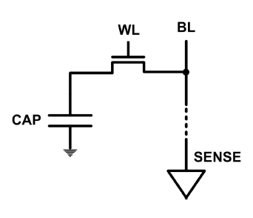
The DRAM Scaling Problem
DRAM stores charge in a capacitor (charge-based memory)
Capacitor must be large enough for reliable sensing
Access transistor should be large enough for low leakage and high retention time
Scaling beyond 40-35nm (2013) is challenging [ITRS, 2009]
DRAM capacity, cost, and energy/power hard to scale

Slide 20
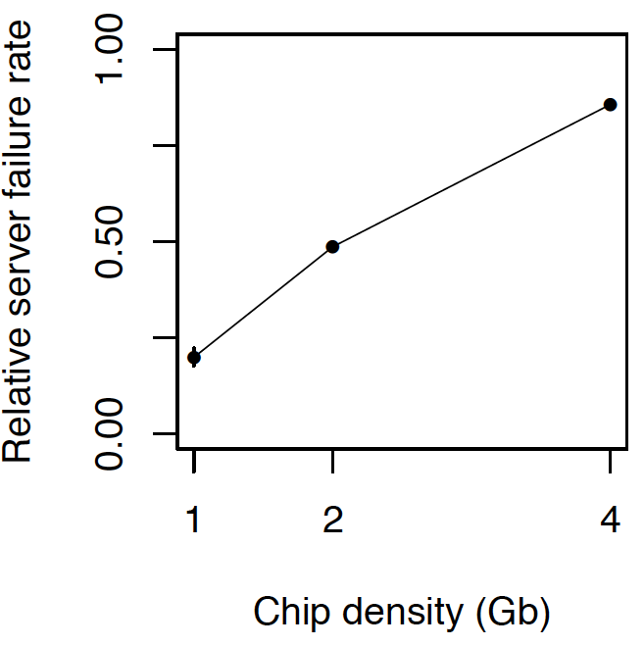
As Memory Scales, It Becomes Unreliable
Data from all of Facebook’s servers worldwide
Meza+, “Revisiting Memory Errors in Large-Scale Production Data Centers,” DSN’15.
Intuition: quadratic increase in capacity

Slide 21
Large-Scale Failure Analysis of DRAM Chips
Analysis and modeling of memory errors found in all of Facebook’s server fleet
Justin Meza, Qiang Wu, Sanjeev Kumar, and Onur Mutlu, "Revisiting Memory Errors in Large-Scale Production Data Centers: Analysis and Modeling of New Trends from the Field" Proceedings of the 45th Annual IEEE/IFIP International Conference on Dependable Systems and Networks (DSN), Rio de Janeiro, Brazil, June 2015. [Slides (pptx) (pdf)] [DRAM Error Model]

Slide 22
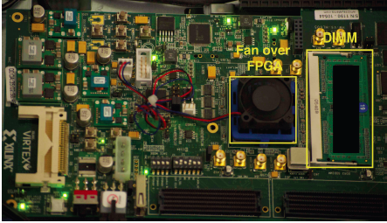
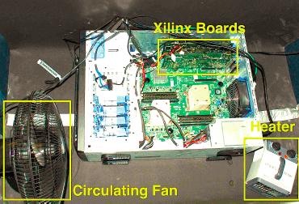
Infrastructures to Understand Such Issues
An Experimental Study of Data Retention Behavior in Modern DRAM Devices: Implications for Retention Time Profiling Mechanisms (Liu et al., ISCA 2013)
The Efficacy of Error Mitigation Techniques for DRAM Retention Failures: A Comparative Experimental Study
(Khan et al., SIGMETRICS 2014)
Flipping Bits in Memory Without Accessing Them: An Experimental Study of DRAM Disturbance Errors (Kim et al., ISCA 2014)
Adaptive-Latency DRAM: Optimizing DRAM Timing for the Common-Case (Lee et al., HPCA 2015)
AVATAR: A Variable-Retention-Time (VRT) Aware Refresh for DRAM Systems (Qureshi et al., DSN 2015)

Slide 23
Infrastructures to Understand Such Issues
Temperature
Controller
FPGAs
Heater
FPGAs
PC
Kim+, “Flipping Bits in Memory Without Accessing Them: An Experimental Study of DRAM Disturbance Errors,” ISCA 2014.

Slide 24
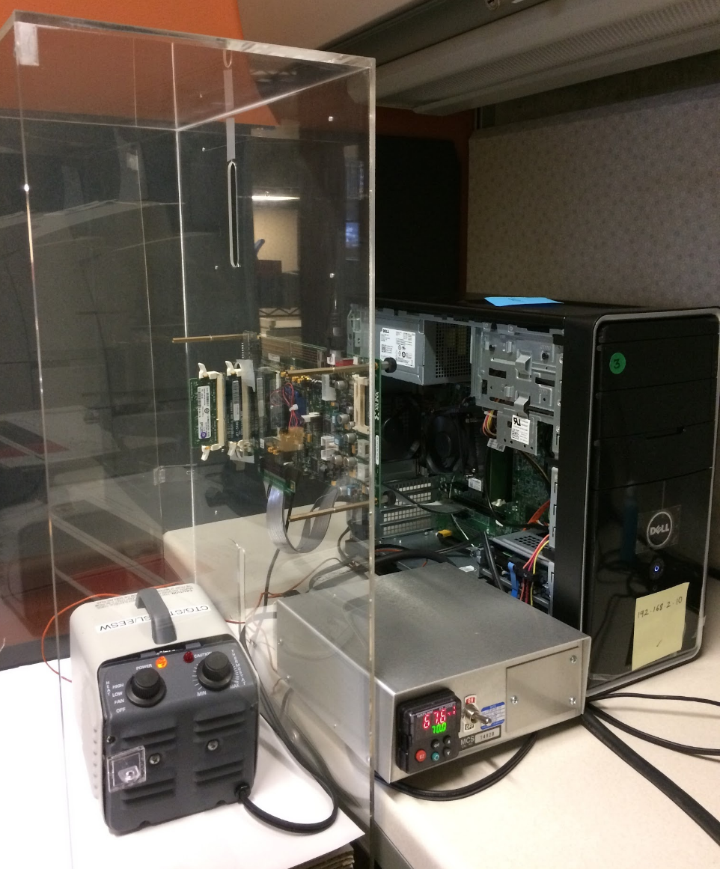
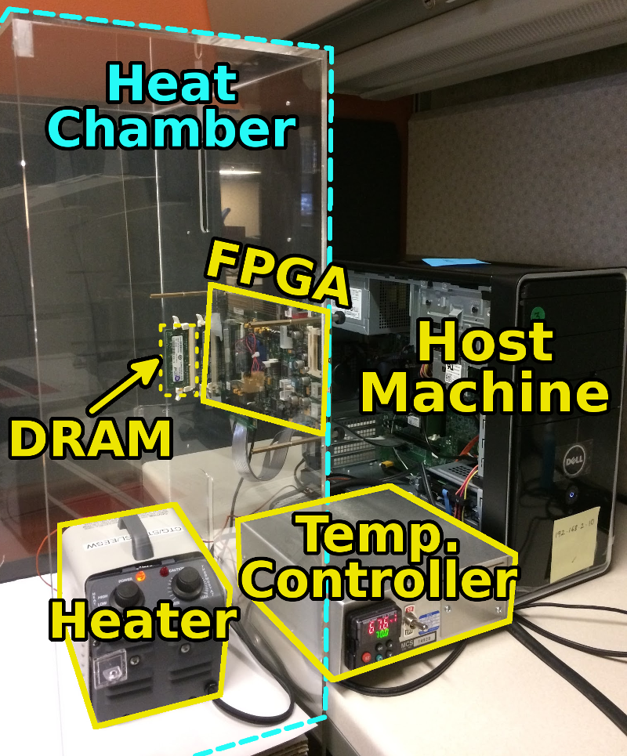
SoftMC: Open Source DRAM Infrastructure
Hasan Hassan et al., “SoftMC: A Flexible and Practical Open-Source Infrastructure for Enabling Experimental DRAM Studies,” HPCA 2017.
Flexible
Easy to Use (C++ API)
Open-source
github.com/CMU-SAFARI/SoftMC

Slide 25
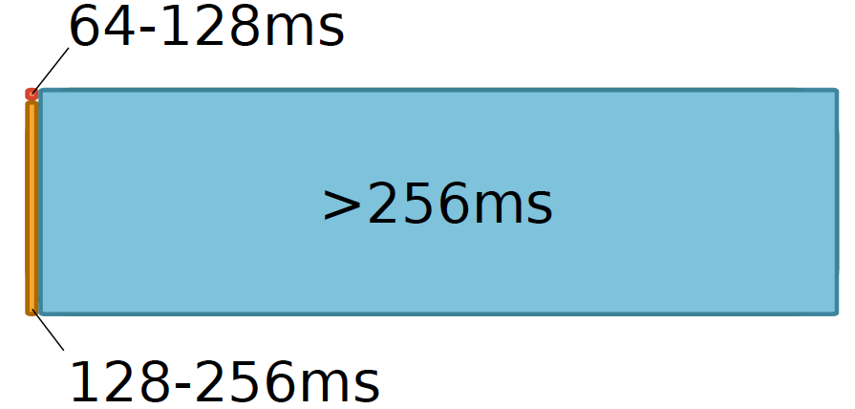
Data Retention in Memory [Liu et al., ISCA 2013]
Retention Time Profile of DRAM looks like this:
Location dependent
Stored value pattern dependent
Time dependent

Slide 26
A Curious Discovery [Kim et al., ISCA 2014]
One can
predictably induce errors
in most DRAM memory chips

Slide 27
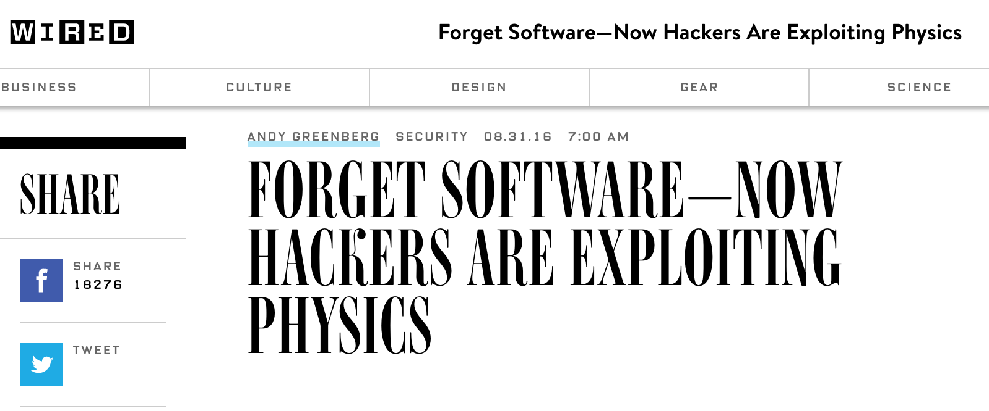
DRAM RowHammer
A simple hardware failure mechanism
can create a widespread
system security vulnerability

Slide 28
Modern DRAM is Prone to Disturbance Errors
Row of Cells
Wordline
Row
Victim Row
Row
Hammered Row
V_{LOW}
Opened
V_{HIGH}
Closed
Row
Victim Row
Row
Repeatedly reading a row enough times (before memory gets refreshed) induces disturbance errors in adjacent rows in most real DRAM chips you can buy today
Flipping Bits in Memory Without Accessing Them: An Experimental Study of DRAM Disturbance Errors, (Kim et al., ISCA 2014)

Slide 29
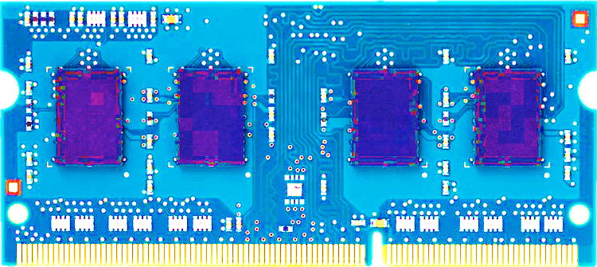
Most DRAM Modules Are Vulnerable
A company
B company
C company
86%
(37/43)
83%
(45/54)
88%
(28/32)
Up to
1.0×10⁷ errors
Up to
2.7×10⁶ errors
Up to
3.3×10⁵ errors
Flipping Bits in Memory Without Accessing Them: An Experimental Study of DRAM Disturbance Errors, (Kim et al., ISCA 2014)

Slide 30
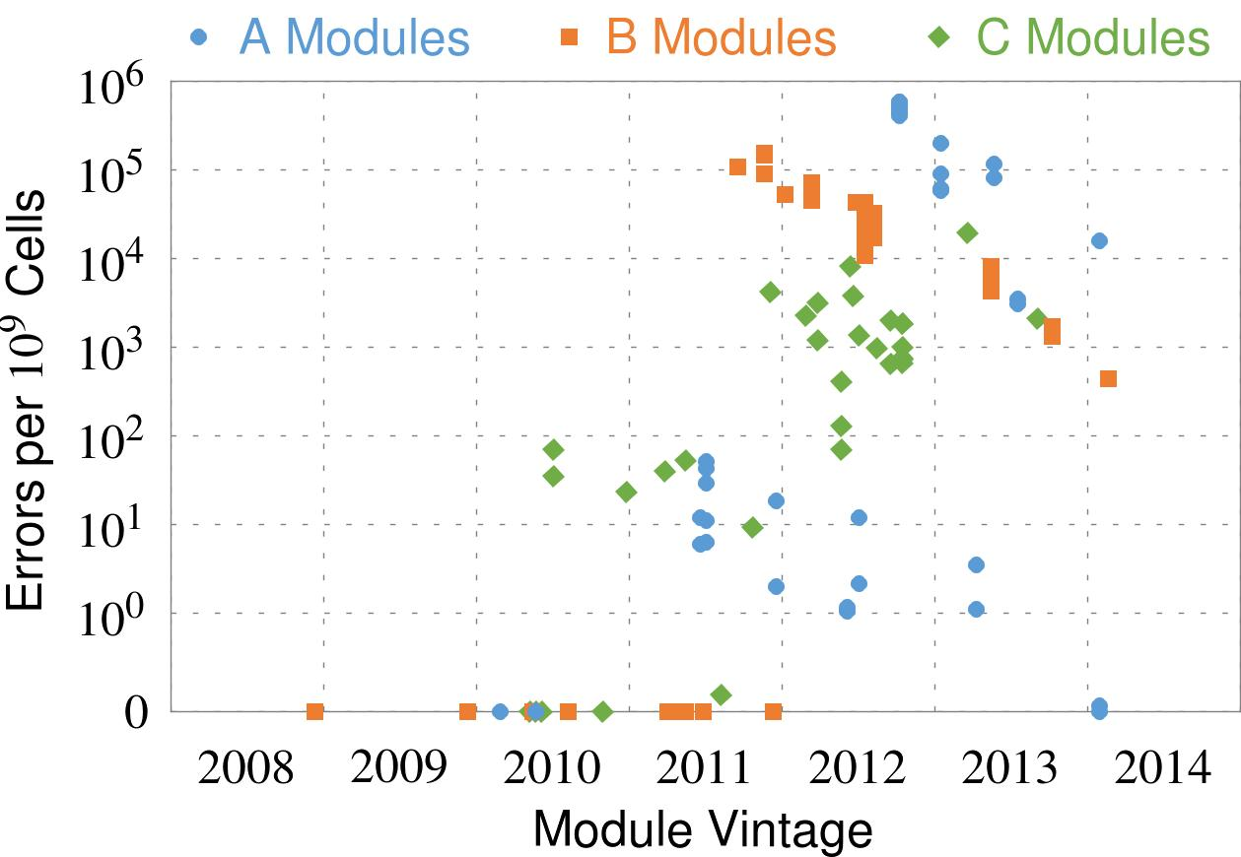
Recent DRAM Is More Vulnerable
First
Appearance
All modules from 2012–2013 are vulnerable

Slide 31
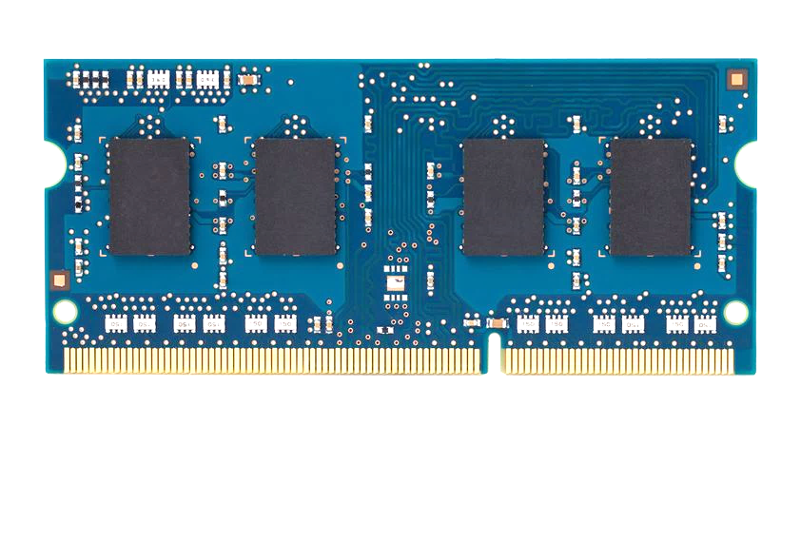
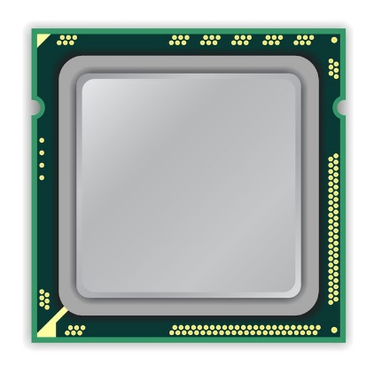
A Simple Program Can Induce Many Errors
CPU
DRAM Module
loop:
mov (X), %eax
mov (Y), %ebx
clflush (X)
clflush (Y)
mfence
jmp loop
X
Y
Download from: https://github.com/CMU-SAFARI/rowhammer

Slide 32
Observed Errors in Real Systems
A real reliability & security issue
CPU Architecture | Errors | Access-Rate
Intel Haswell (2013) | 22.9K | 12.3M/sec
Intel Ivy Bridge (2012) | 20.7K | 11.7M/sec
Intel Sandy Bridge (2011) | 16.1K | 11.6M/sec
AMD Piledriver (2012) | 59 | 6.1M/sec
Kim+, “Flipping Bits in Memory Without Accessing Them: An Experimental Study of DRAM Disturbance Errors,” ISCA 2014.

Slide 33
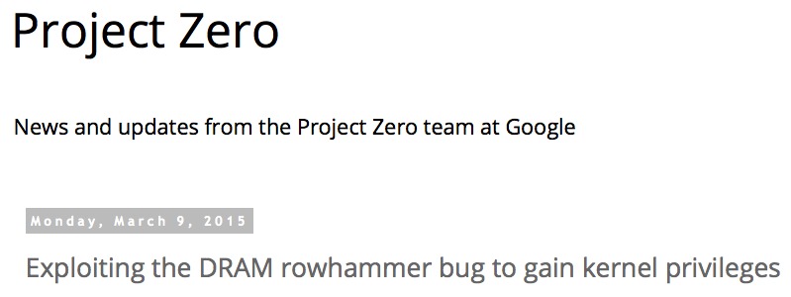
One Can Take Over an Otherwise-Secure System
Flipping Bits in Memory Without Accessing Them: An Experimental Study of DRAM Disturbance Errors (Kim et al., ISCA 2014)
Exploiting the DRAM rowhammer bug to gain kernel privileges (Seaborn, 2015)

Slide 34
RowHammer Security Attack Example
“Rowhammer” is a problem with some recent DRAM devices in which repeatedly accessing a row of memory can cause bit flips in adjacent rows (Kim et al., ISCA 2014).
Flipping Bits in Memory Without Accessing Them: An Experimental Study of DRAM Disturbance Errors (Kim et al., ISCA 2014)
We tested a selection of laptops and found that a subset of them exhibited the problem.
We built two working privilege escalation exploits that use this effect.
Exploiting the DRAM rowhammer bug to gain kernel privileges (Seaborn+, 2015)
One exploit uses rowhammer-induced bit flips to gain kernel privileges on x86-64 Linux when run as an unprivileged userland process.
When run on a machine vulnerable to the rowhammer problem, the process was able to induce bit flips in page table entries (PTEs).
It was able to use this to gain write access to its own page table, and hence gain read-write access to all of physical memory.
Exploiting the DRAM rowhammer bug to gain kernel privileges (Seaborn & Dullien, 2015)

Slide 35
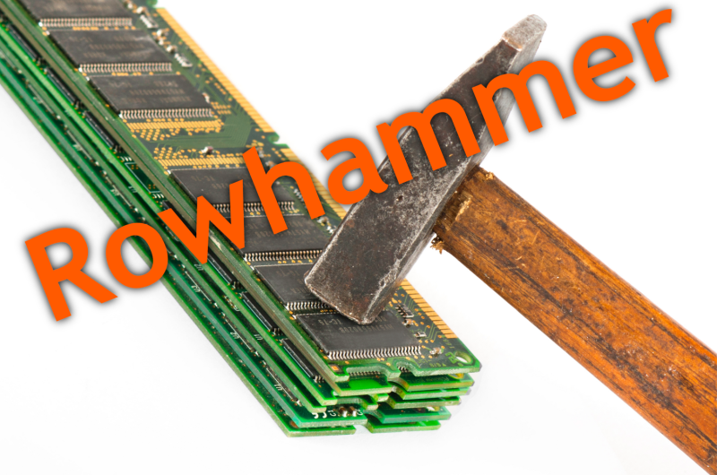
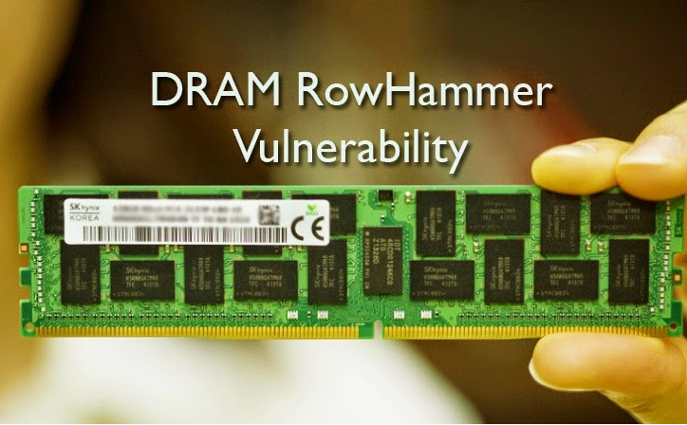
Security Implications

Slide 36
More Security Implications (I)
“We can gain unrestricted access to systems of website visitors.”
Rowhammer.js: A Remote Software-Induced Fault Attack in JavaScript (DIMVA’16)
Source: https://lab.dsst.io/32c3-slides/7197.html

Slide 37
More Security Implications (II)
“Can gain control of a smart phone deterministically”
Drammer: Deterministic Rowhammer Attacks on Mobile Platforms, CCS’16
Source: https://fossbytes.com/drammer-rowhammer-attack-android-root-devices/

Slide 38
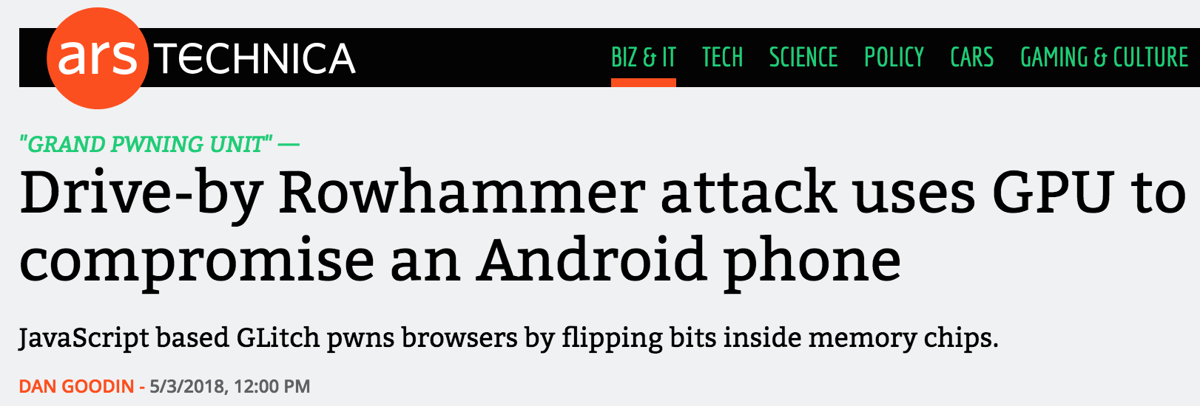
More Security Implications (III)
Using an integrated GPU in a mobile system to remotely escalate privilege via the WebGL interface

Slide 39
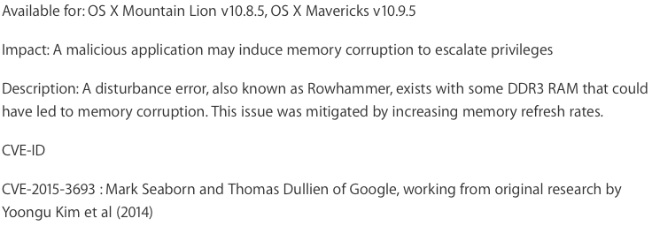
Apple’s Patch for RowHammer
https://support.apple.com/en-gb/HT204934
HP, Lenovo, and other vendors released similar patches

Slide 40
Our Solution to RowHammer
PARA: Probabilistic Adjacent Row Activation
Key Idea
After closing a row, we activate (i.e., refresh) one of its neighbors with a low probability: p = 0.005
Reliability Guarantee
When p=0.005, errors in one year: 9.4×10⁻¹⁴
By adjusting the value of p, we can vary the strength of protection against errors

Slide 41
Advantages of PARA
PARA refreshes rows infrequently
Low power
Low performance-overhead
Average slowdown: 0.20% (for 29 benchmarks)
Maximum slowdown: 0.75%
PARA is stateless
Low cost
Low complexity
PARA is an effective and low-overhead solution to prevent RowHammer disturbance errors

Slide 42
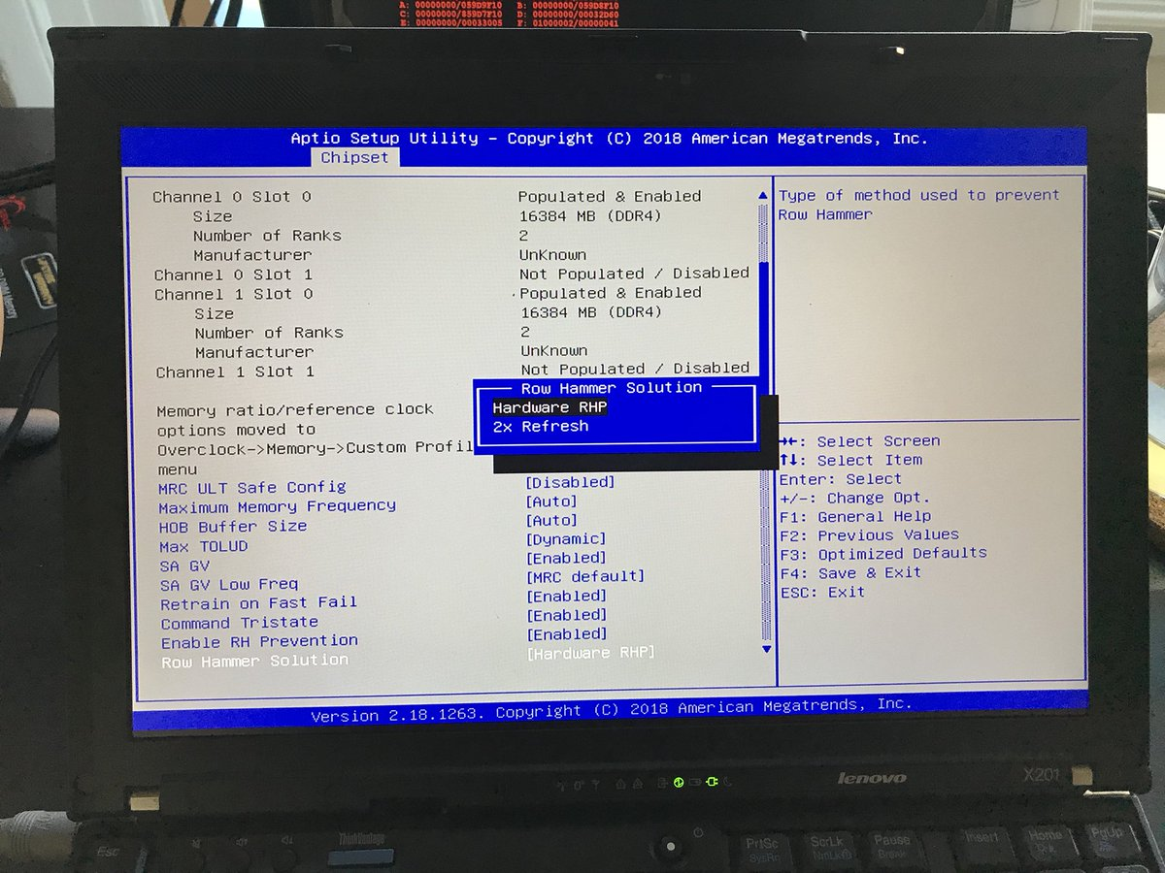
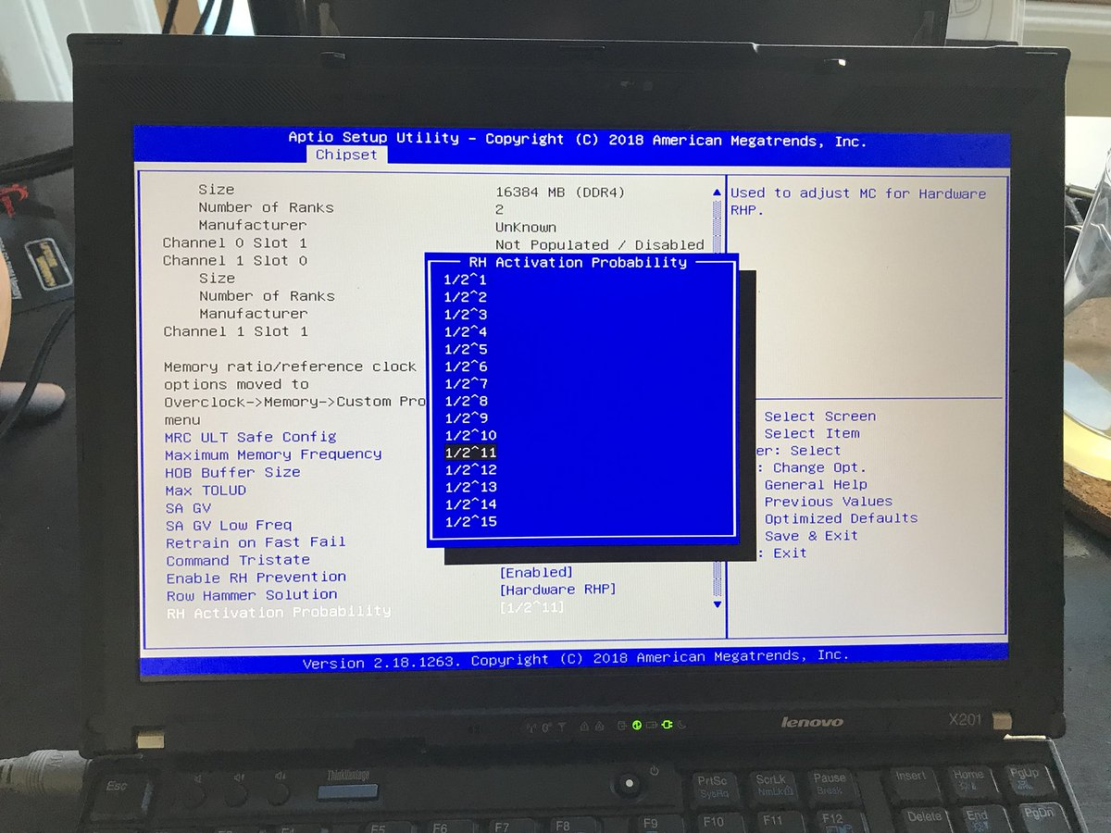
Probabilistic Activation in Real Life

Slide 43
More on RowHammer Analysis
Yoongu Kim, Ross Daly, Jeremie Kim, Chris Fallin, Ji Hye Lee, Donghyuk Lee, Chris Wilkerson, Konrad Lai, and Onur Mutlu, "Flipping Bits in Memory Without Accessing Them: An Experimental Study of DRAM Disturbance Errors" Proceedings of the 41st International Symposium on Computer Architecture (ISCA), Minneapolis, MN, June 2014. [Slides (pptx) (pdf)] [Lightning Session Slides (pptx) (pdf)] [Source Code and Data]

Slide 44
Future of Memory Reliability
Onur Mutlu, "The RowHammer Problem and Other Issues We May Face as Memory Becomes Denser" Invited Paper in Proceedings of the Design, Automation, and Test in Europe Conference (DATE), Lausanne, Switzerland, March 2017. [Slides (pptx) (pdf)]

Slide 45
Call for Intelligent Memory Controllers

Slide 46
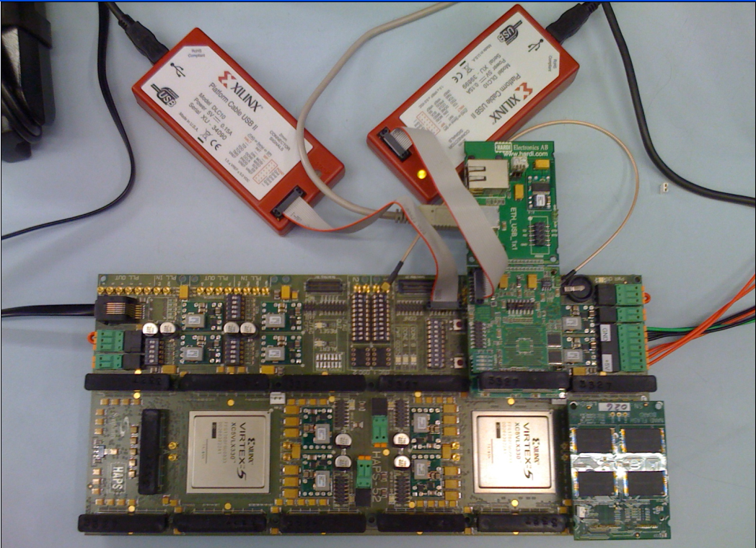
Aside: Intelligent Controller for NAND Flash
USB Daughter Board
USB Jack
HAPS-52 Mother Board
Virtex-II Pro
(USB controller)
1x-nm
NAND Flash
Virtex-V FPGA
(NAND Controller)
[DATE 2012, ICCD 2012, DATE 2013, ITJ 2013, ICCD 2013, SIGMETRICS 2014, HPCA 2015, DSN 2015, MSST 2015, JSAC 2016, HPCA 2017, DFRWS 2017,
PIEEE 2017, HPCA 2018, SIGMETRICS 2018]
NAND Daughter Board
Cai+, “Error Characterization, Mitigation, and Recovery in Flash Memory Based Solid State Drives,” Proc. IEEE 2017.

Slide 47
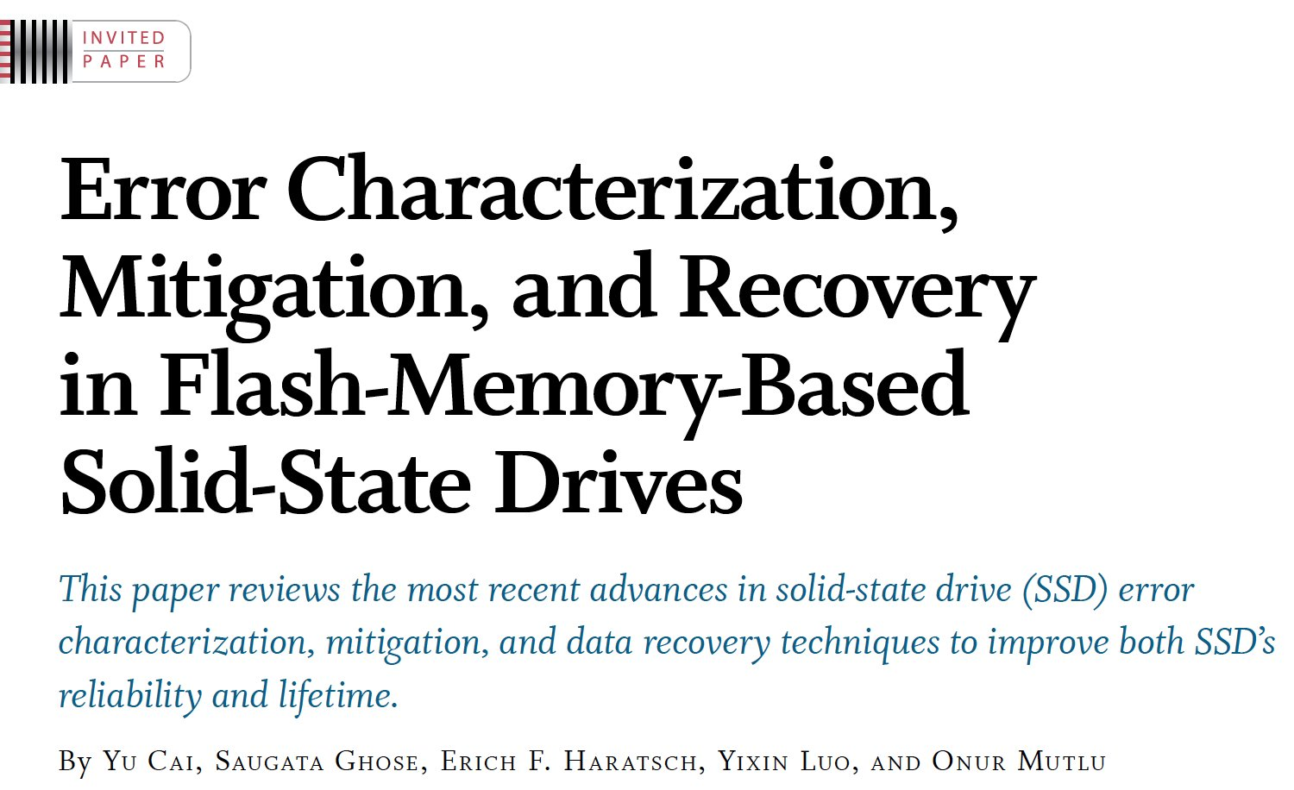
Aside: Intelligent Controller for NAND Flash
Proceedings of the IEEE, Sept. 2017
https://arxiv.org/pdf/1706.08642

Slide 48
Takeaway
Main Memory Needs
Intelligent Controllers

Slide 49
Agenda
Major Trends Affecting Main Memory
The Need for Intelligent Memory Controllers
Bottom Up: Push from Circuits and Devices
Top Down: Pull from Systems and Applications
Processing in Memory: Two Directions
Minimally Changing Memory Chips
Exploiting 3D-Stacked Memory
How to Enable Adoption of Processing in Memory
Conclusion

Slide 50
Three Key Systems Trends
1. Data access is a major performance bottleneck
Applications are increasingly data hungry
2. Energy consumption is a key limiter
3. Data movement energy dominates compute
Especially true for off-chip to on-chip movement
Need high performance, energy efficiency, sustainability

Slide 51
The Problem
Our current design principles
cause great energy waste
(and great performance loss)
Processing of data is performed
far away from the data

Slide 52
A Computing System
Three key components
Computation
Communication
Storage/memory
Image source: https://lbsitbytes2010.wordpress.com/2013/03/29/john-von-neumann-roll-no-15/

Slide 53
Today’s Computing Systems
Are overwhelmingly processor centric
All data processed in the processor → at great system cost
Processor is heavily optimized and is considered the master
Data storage units are dumb and are largely unoptimized (except for some that are on the processor die)

Slide 54
Yet …
“It’s the Memory, Stupid!” (Richard Sites, MPR, 1996)
Mutlu+, “Runahead Execution: An Alternative to Very Large Instruction Windows for Out-of-Order Processors,” HPCA 2003.

Slide 55
The Performance Perspective
Onur Mutlu, Jared Stark, Chris Wilkerson, and Yale N. Patt, "Runahead Execution: An Alternative to Very Large Instruction Windows for Out-of-order Processors" Proceedings of the 9th International Symposium on High-Performance Computer Architecture (HPCA), pages 129-140, Anaheim, CA, February 2003. Slides (pdf)

Slide 56
The Performance Perspective (Today)
All of Google’s Data Center Workloads (2015):
Kanev+, “Profiling a Warehouse-Scale Computer,” ISCA 2015.

Slide 57
Perils of Processor-Centric Design
Grossly-imbalanced systems
Processing done only in one place
Everything else just stores and moves data: data moves a lot
→ Energy inefficient
→ Low performance
→ Complex
Overly complex and bloated processor (and accelerators)
To tolerate data access from memory
Complex hierarchies and mechanisms
→ Energy inefficient
→ Low performance
→ Complex

Slide 58
Perils of Processor-Centric Design
Most of the system is dedicated to storing and moving data

Slide 59
The Energy Perspective
Dally, HiPEAC 2015
A memory access consumes ~1000X
the energy of a complex addition

Slide 60
Data Movement vs. Computation Energy
Data movement is a major system energy bottleneck
Comprises 41% of mobile system energy during web browsing [2]
Costs ~115 times as much energy as an ADD operation [1, 2]
[1]: Reducing data Movement Energy via Online Data Clustering and Encoding (MICRO’16)
[2]: Quantifying the energy cost of data movement for emerging smart phone workloads on mobile platforms (IISWC’14)

Slide 61
Energy Waste in Mobile Devices
Amirali Boroumand, Saugata Ghose, Youngsok Kim, Rachata Ausavarungnirun, Eric Shiu, Rahul Thakur, Daehyun Kim, Aki Kuusela, Allan Knies, Parthasarathy Ranganathan, and Onur Mutlu, "Google Workloads for Consumer Devices: Mitigating Data Movement Bottlenecks" Proceedings of the 23rd International Conference on Architectural Support for Programming Languages and Operating Systems (ASPLOS), Williamsburg, VA, USA, March 2018.
62.7% of the total system energy
is spent on data movement
We do NOT want to move data!

Slide 62
We Need A Paradigm Shift To …
Enable computation with minimal data movement
Compute where it makes sense (where data resides)
Make computing architectures more data-centric

Slide 63
Goal: Processing Inside Memory
Many questions … How do we design the:
compute-capable memory & controllers?
processor chip and in-memory units?
software and hardware interfaces?
system software and languages?
algorithms?
Memory
Processor
Core
Database
Graphs
Media
Cache
Query
Interconnect
Problem
Results
Algorithm
Program/Language
System Software
SW/HW Interface
Micro-architecture
Logic
Devices
Electrons

Slide 64
Processing in Memory: Two Approaches
1. Minimally changing memory chips
2. Exploiting 3D-stacked memory

Slide 65
Approach 1: Minimally Changing DRAM
DRAM has great capability to perform bulk data movement and computation internally with small changes
Can exploit internal connectivity to move data
Can exploit analog computation capability
…
Examples: RowClone, In-DRAM AND/OR, Gather/Scatter DRAM
RowClone: Fast and Efficient In-DRAM Copy and Initialization of Bulk Data (Seshadri et al., MICRO 2013)
Fast Bulk Bitwise AND and OR in DRAM (Seshadri et al., IEEE CAL 2015)
Gather-Scatter DRAM: In-DRAM Address Translation to Improve the Spatial Locality of Non-unit Strided Accesses (Seshadri et al., MICRO 2015)
"Ambit: In-Memory Accelerator for Bulk Bitwise Operations Using Commodity DRAM Technology” (Seshadri et al., MICRO 2017)

Slide 66
Starting Simple: Data Copy and Initialization
000000000000000
Zero initialization
(e.g., security)
Forking
Checkpointing
Many more
VM Cloning
Deduplication
Page Migration

Slide 67
Today’s Systems: Bulk Data Copy
1) High latency
Memory
3) Cache pollution
L3
CPU
L2
L1
MC
2) High bandwidth utilization
4) Unwanted data movement
1046ns, 3.6uJ (for 4KB page copy via DMA)

Slide 68
Future Systems: In-Memory Copy
3) No cache pollution
1) Low latency
Memory
L3
CPU
L2
L1
MC
2) Low bandwidth utilization
4) No unwanted data movement
1046ns, 3.6uJ
→ 90ns, 0.04uJ

Slide 69
RowClone: In-DRAM Row Copy
4 Kbytes
Idea: Two consecutive ACTivates
Negligible HW cost
Step 1: Activate row A
Step 2: Activate row B
Transfer row
DRAM subarray
Transfer
row
Row Buffer (4 Kbytes)
8 bits
Data Bus

Slide 70
RowClone: Latency and Energy Savings
11.6x
74x
Seshadri et al., “RowClone: Fast and Efficient In-DRAM Copy and Initialization of Bulk Data,” MICRO 2013.

Slide 71
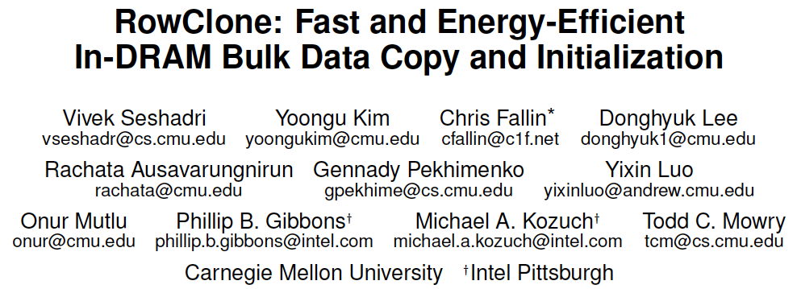
More on RowClone
Vivek Seshadri, Yoongu Kim, Chris Fallin, Donghyuk Lee, Rachata Ausavarungnirun, Gennady Pekhimenko, Yixin Luo, Onur Mutlu, Michael A. Kozuch, Phillip B. Gibbons, and Todd C. Mowry, "RowClone: Fast and Energy-Efficient In-DRAM Bulk Data Copy and Initialization" Proceedings of the 46th International Symposium on Microarchitecture (MICRO), Davis, CA, December 2013. [Slides (pptx) (pdf)] [Lightning Session Slides (pptx) (pdf)] [Poster (pptx) (pdf)]

Slide 72
Memory as an Accelerator
CPU
core
CPU
core
mini-CPU
core
GPU
(throughput)
core
GPU
(throughput)
core
video
core
GPU
(throughput)
core
GPU
(throughput)
core
CPU
core
CPU
core
Memory
imaging
core
LLC
Specialized
compute-capability
in memory
Memory Controller
Memory Bus
Memory similar to a “conventional” accelerator

Slide 73
In-Memory Bulk Bitwise Operations
We can support in-DRAM COPY, ZERO, AND, OR, NOT, MAJ
At low cost
Using analog computation capability of DRAM
Idea: activating multiple rows performs computation
30-60X performance and energy improvement
Seshadri+, “Ambit: In-Memory Accelerator for Bulk Bitwise Operations Using Commodity DRAM Technology,” MICRO 2017.
New memory technologies enable even more opportunities
Memristors, resistive RAM, phase change mem, STT-MRAM, …
Can operate on data with minimal movement

Slide 74
In-DRAM AND/OR: Triple Row Activation
½V_{DD}
½V_{DD}+δ
V_{DD}
A
Final State
AB + BC + AC
B
C
C(A + B) + ~C(AB)
dis
en
0
½V_{DD}
Seshadri+, “Fast Bulk Bitwise AND and OR in DRAM”, IEEE CAL 2015.

Slide 75
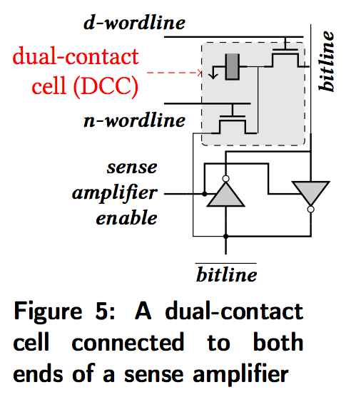
In-DRAM NOT: Dual Contact Cell
Idea:
Feed the
negated value
in the sense amplifier
into a special row
Seshadri+, “Ambit: In-Memory Accelerator for Bulk Bitwise Operations using Commodity DRAM Technology,” MICRO 2017.

Slide 76
Ambit vs. DDR3: Performance and Energy
32X
35X
Seshadri+, “Ambit: In-Memory Accelerator for Bulk Bitwise Operations using Commodity DRAM Technology,” MICRO 2017.

Slide 77
Bulk Bitwise Operations in Workloads
[1] Li and Patel, BitWeaving, SIGMOD 2013
[2] Goodwin+, BitFunnel, SIGIR 2017

Slide 78
Performance: Bitmap Index on Ambit
Seshadri+, “Ambit: In-Memory Accelerator for Bulk Bitwise Operations using Commodity DRAM Technology,” MICRO 2017.

Slide 79
Performance: BitWeaving on Ambit
Seshadri+, “Ambit: In-Memory Accelerator for Bulk Bitwise Operations using Commodity DRAM Technology,” MICRO 2017.

Slide 80
More on Ambit
Vivek Seshadri et al., “Ambit: In-Memory Accelerator for Bulk Bitwise Operations Using Commodity DRAM Technology,” MICRO 2017.

Slide 81
Processing in Memory: Two Approaches
1. Minimally changing memory chips
2. Exploiting 3D-stacked memory

Slide 82
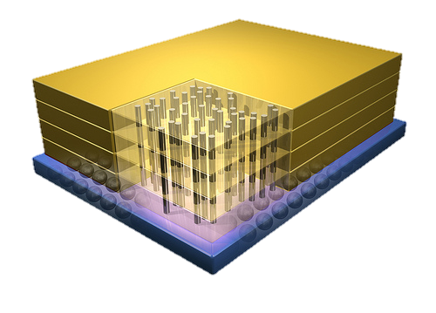
Opportunity: 3D-Stacked Logic+Memory
Memory
Logic
Other “True 3D” technologies
under development

Slide 83
DRAM Landscape (circa 2015)
Kim+, “Ramulator: A Flexible and Extensible DRAM Simulator”, IEEE CAL 2015.

Slide 84
Two Key Questions in 3D-Stacked PIM
How can we accelerate important applications if we use 3D-stacked memory as a coarse-grained accelerator?
what is the architecture and programming model?
what are the mechanisms for acceleration?
What is the minimal processing-in-memory support we can provide?
without changing the system significantly
while achieving significant benefits

Slide 85
Graph Processing
Large graphs are everywhere (circa 2015)
Scalable large-scale graph processing is challenging
36 Million
Wikipedia Pages
1.4 Billion
Facebook Users
300 Million
Twitter Users
30 Billion
Instagram Photos

Slide 86
Key Bottlenecks in Graph Processing
for (v: graph.vertices) {
for (w: v.successors) {
w.next_rank += weight * v.rank;
}
}
1. Frequent random memory accesses
v
&w
w.rank
w.next_rank
w.edges
weight * v.rank
w
…
2. Little amount of computation

Slide 87
Tesseract System for Graph Processing
Interconnected set of 3D-stacked memory+logic chips with simple cores
Communications via Remote Function Calls
Host Processor
Memory
Memory-Mapped
Accelerator Interface
(Noncacheable, Physically Addressed)
Logic
Graph Prefetching
In-Order Core
DRAM Controller
…
…
LP
PF Buffer
Crossbar Network
…
MTP
…
Message Queue
NI
Ahn+, “A Scalable Processing-in-Memory Accelerator for Parallel Graph Processing” ISCA 2015.

Slide 88
Evaluated Systems
DDR3-OoO
HMC-OoO
HMC-MC
Tesseract
32 Tesseract Cores
8 OoO
4GHz
8 OoO
4GHz
8 OoO
4GHz
8 OoO
4GHz
128 In-Order
2GHz
128 In-Order
2GHz
8 OoO
4GHz
8 OoO
4GHz
8 OoO
4GHz
8 OoO
4GHz
128 In-Order
2GHz
128 In-Order
2GHz
102.4GB/s
640GB/s
640GB/s
8TB/s
Ahn+, “A Scalable Processing-in-Memory Accelerator for Parallel Graph Processing” ISCA 2015.

Slide 89
Tesseract Graph Processing Performance
>13X Performance Improvement
On five graph processing algorithms
Ahn+, “A Scalable Processing-in-Memory Accelerator for Parallel Graph Processing” ISCA 2015.

Slide 90
Tesseract Graph Processing Performance

Slide 91
Tesseract Graph Processing System Energy
> 8X Energy Reduction
Ahn+, “A Scalable Processing-in-Memory Accelerator for Parallel Graph Processing” ISCA 2015.

Slide 92
More on Tesseract
Junwhan Ahn, Sungpack Hong, Sungjoo Yoo, Onur Mutlu, and Kiyoung Choi, "A Scalable Processing-in-Memory Accelerator for Parallel Graph Processing" Proceedings of the 42nd International Symposium on Computer Architecture (ISCA), Portland, OR, June 2015. [Slides (pdf)] [Lightning Session Slides (pdf)]

Slide 93
PIM for Mobile Devices: Function Offloading
Amirali Boroumand, Saugata Ghose, Youngsok Kim, Rachata Ausavarungnirun, Eric Shiu, Rahul Thakur, Daehyun Kim, Aki Kuusela, Allan Knies, Parthasarathy Ranganathan, and Onur Mutlu, "Google Workloads for Consumer Devices: Mitigating Data Movement Bottlenecks" Proceedings of the 23rd International Conference on Architectural Support for Programming Languages and Operating Systems (ASPLOS), Williamsburg, VA, USA, March 2018.
62.7% of the total system energy
is spent on data movement

Slide 94
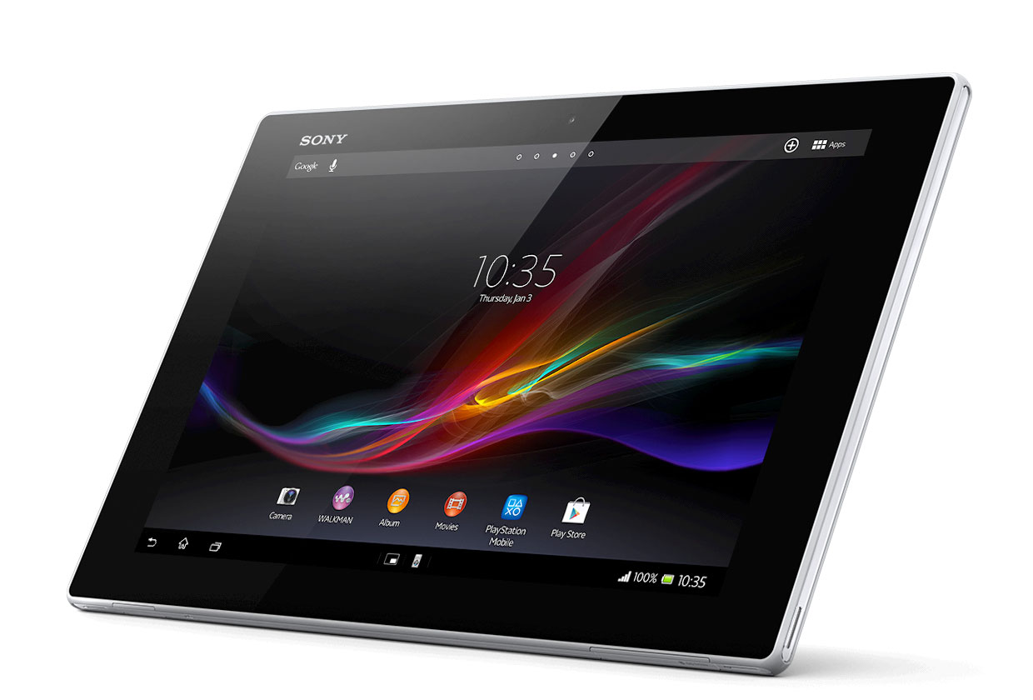
Mobile Devices
Consumer devices are everywhere!
Energy consumption is a first-class concern in consumer devices

Slide 95
Popular Consumer Workloads
Chrome
TensorFlow Mobile
Google’s web browser
Google’s machine learning framework
Video Playback
Video Capture
Google’s video codec
Google’s video codec

Slide 96
Energy Cost of Data Movement
1st key observation: 62.7% of the total system energy is spent on data movement
Data Movement
SoC
DRAM
CPU
L2
CPU
L1
CPU
CPU
Compute Unit
Processing-In-Memory (PIM)
Potential solution: move computation close to data
Challenge: limited area and energy budget

Slide 97
Using PIM to Reduce Data Movement
2nd key observation: a significant fraction of the data movement often comes from simple functions
We can design lightweight logic to implement these simple functions in memory
Small embedded low-power core
Small fixed-function accelerators
PIM Core
PIM Accelerator
PIM Accelerator
PIM Accelerator
Offloading to PIM logic reduces energy and improves performance, on average, by 55.4% and 54.2%

Slide 98
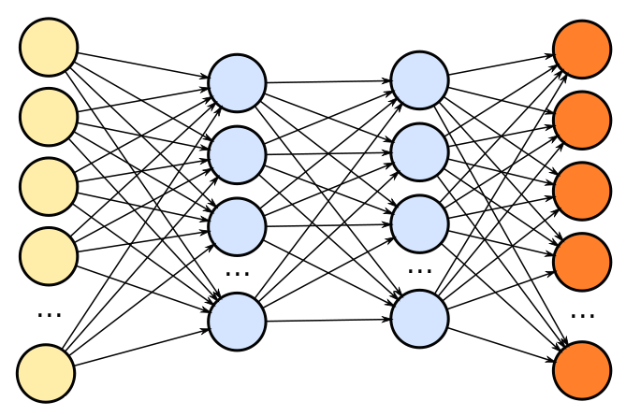
TensorFlow Mobile
Inference
Prediction
57.3% of the inference energy is spent on data movement
54.4% of the data movement energy comes from packing/unpacking and quantization

Slide 99
Packing
Matrix
Packing
Packed Matrix
Reorders elements of matrices to minimize cache misses during matrix multiplication
Up to 40% of the inference energy and 31% of inference execution time
Packing’s data movement accounts for up to 35.3% of the inference energy
A simple data reorganization process that requires simple arithmetic

Slide 100
Quantization
floating point
Quantization
integer
Converts 32-bit floating point to 8-bit integers to improve inference execution time and energy consumption
Up to 16.8% of the inference energy and 16.1% of inference execution time
Majority of quantization energy comes from data movement
A simple data conversion operation that requires shift, addition, and multiplication operations

Slide 101
Normalized Energy
TensorFlow Mobile
Video Playback and Capture
77.7% and 82.6% of energy reduction for texture tiling and packing comes from eliminating data movement
Chrome Browser
PIM core and PIM accelerator reduces energy consumption on average by 49.1% and 55.4%

Slide 102
Normalized Runtime
Chrome Browser
Video Playback and Capture
TensorFlow Mobile
Offloading these kernels to PIM core and PIM accelerator improves performance on average by 44.6% and 54.2%

Slide 103
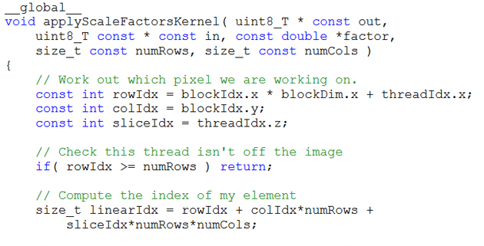
Truly Distributed GPU Processing with PIM?
3D-stacked memory
(memory stack)
SM (Streaming Multiprocessor)
Logic layer
Logic layer SM
Main GPU
Crossbar switch
Vault Ctrl
….
Vault Ctrl

Slide 104
Accelerating GPU Execution with PIM (I)
Kevin Hsieh, Eiman Ebrahimi, Gwangsun Kim, Niladrish Chatterjee, Mike O'Connor, Nandita Vijaykumar, Onur Mutlu, and Stephen W. Keckler, "Transparent Offloading and Mapping (TOM): Enabling Programmer-Transparent Near-Data Processing in GPU Systems" Proceedings of the 43rd International Symposium on Computer Architecture (ISCA), Seoul, South Korea, June 2016. [Slides (pptx) (pdf)] [Lightning Session Slides (pptx) (pdf)]

Slide 105
Accelerating Linked Data Structures
Kevin Hsieh, Samira Khan, Nandita Vijaykumar, Kevin K. Chang, Amirali Boroumand, Saugata Ghose, and Onur Mutlu, "Accelerating Pointer Chasing in 3D-Stacked Memory: Challenges, Mechanisms, Evaluation" Proceedings of the 34th IEEE International Conference on Computer Design (ICCD), Phoenix, AZ, USA, October 2016.

Slide 106
Two Key Questions in 3D-Stacked PIM
How can we accelerate important applications if we use 3D-stacked memory as a coarse-grained accelerator?
what is the architecture and programming model?
what are the mechanisms for acceleration?
What is the minimal processing-in-memory support we can provide?
without changing the system significantly
while achieving significant benefits

Slide 107
PEI: PIM-Enabled Instructions (Ideas)
Goal: Develop mechanisms to get the most out of near-data processing with minimal cost, minimal changes to the system, no changes to the programming model
Key Idea 1: Expose each PIM operation as a cache-coherent, virtually-addressed host processor instruction (called PEI) that operates on only a single cache block
e.g., __pim_add(&w.next_rank, value) → pim.add r1, (r2)
No changes sequential execution/programming model
No changes to virtual memory
Minimal changes to cache coherence
No need for data mapping: Each PEI restricted to a single memory module
Key Idea 2: Dynamically decide where to execute a PEI (i.e., the host processor or PIM accelerator) based on simple locality characteristics and simple hardware predictors
Execute each operation at the location that provides the best performance

Slide 108
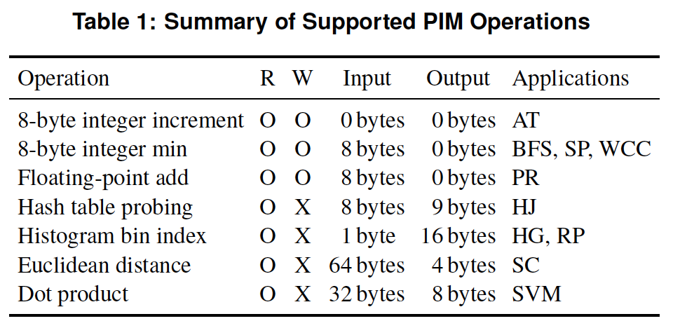
PEI: PIM-Enabled Instructions (Example)
for (v: graph.vertices) {
value = weight * v.rank;
for (w: v.successors) {
__pim_add(&w.next_rank, value);
}
}
pfence();
pim.add r1, (r2)
pfence
Executed either in memory or in the processor: dynamic decision
Low-cost locality monitoring for a single instruction
Cache-coherent, virtually-addressed, single cache block only
Atomic between different PEIs
Not atomic with normal instructions (use pfence for ordering)

Slide 109
Example (Abstract) PEI uArchitecture
Host Processor
3D-stacked Memory
Out-Of-Order Core
Last-Level Cache
DRAM Controller
L1 Cache
PCU
L2 Cache
PCU (PEI Computation Unit)
DRAM Controller
PCU
Network
HMC Controller
PMU (PEI
Mgmt Unit)
…
PIM Directory
Locality Monitor
DRAM Controller
PCU
Example PEI uArchitecture

Slide 110
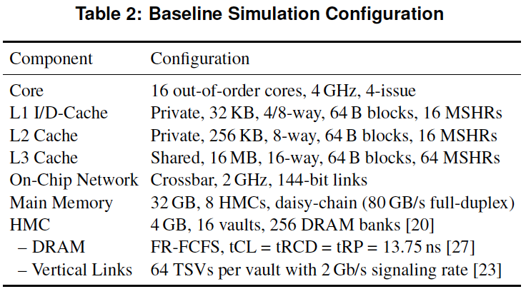
PEI: Initial Evaluation Results
Initial evaluations with 10 emerging data-intensive workloads
Large-scale graph processing
In-memory data analytics
Machine learning and data mining
Three input sets (small, medium, large) for each workload to analyze the impact of data locality
Pin-based cycle-level x86-64 simulation
Performance Improvement and Energy Reduction:
47% average speedup with large input data sets
32% speedup with small input data sets
25% avg. energy reduction in a single node with large input data sets

Slide 111
Simpler PIM: PIM-Enabled Instructions
Junwhan Ahn, Sungjoo Yoo, Onur Mutlu, and Kiyoung Choi, "PIM-Enabled Instructions: A Low-Overhead, Locality-Aware Processing-in-Memory Architecture" Proceedings of the 42nd International Symposium on Computer Architecture (ISCA), Portland, OR, June 2015. [Slides (pdf)] [Lightning Session Slides (pdf)]

Slide 112
Efficient Automatic Data Coherence Support
Amirali Boroumand, Saugata Ghose, Minesh Patel, Hasan Hassan, Brandon Lucia, Kevin Hsieh, Krishna T. Malladi, Hongzhong Zheng, and Onur Mutlu, "LazyPIM: An Efficient Cache Coherence Mechanism for Processing-in-Memory" IEEE Computer Architecture Letters (CAL), June 2016.

Slide 113
Challenge and Opportunity for Future
Computing Architectures
with
Minimal Data Movement

Slide 114
Agenda
Major Trends Affecting Main Memory
The Need for Intelligent Memory Controllers
Bottom Up: Push from Circuits and Devices
Top Down: Pull from Systems and Applications
Processing in Memory: Two Directions
Minimally Changing Memory Chips
Exploiting 3D-Stacked Memory
How to Enable Adoption of Processing in Memory
Conclusion

Slide 115
Barriers to Adoption of PIM
1. Functionality of and applications for PIM
2. Ease of programming (interfaces and compiler/HW support)
3. System support: coherence & virtual memory
4. Runtime systems for adaptive scheduling, data mapping, access/sharing control
5. Infrastructures to assess benefits and feasibility

Slide 116
Concluding Remarks
It is time to design principled system architectures to solve the memory problem
Design complete systems to be balanced, high-performance, and energy-efficient, i.e., data-centric (or memory-centric)
Enable computation capability inside and close to memory
This can
Lead to orders-of-magnitude improvements
Enable new applications & computing platforms
Enable better understanding of nature
…

Slide 117
The Future of Processing in Memory is Bright
Regardless of challenges
in underlying technology and overlying problems/requirements
Problem
Can enable:
- Orders of magnitude
improvements
- New applications and
computing systems
Yet, we have to
- Think across the stack
- Design enabling systems
Algorithm
Program/Language
System Software
SW/HW Interface
Micro-architecture
Logic
Devices
Electrons

Slide 118
If In Doubt, See Other Doubtful Technologies
A very “doubtful” emerging technology
for at least two decades
Proceedings of the IEEE, Sept. 2017
https://arxiv.org/pdf/1706.08642

Slide 119
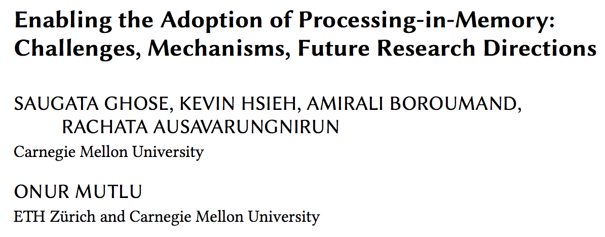
For Some Open Problems, See
Saugata Ghose, Kevin Hsieh, Amirali Boroumand, Rachata Ausavarungnirun, Onur Mutlu, "Enabling the Adoption of Processing-in-Memory: Challenges, Mechanisms, Future Research Directions" Invited Book Chapter, to appear in 2018. [Preliminary arxiv.org version]
https://arxiv.org/pdf/1802.00320.pdf

Slide 120
Accelerated Memory Course (~6.5 hours)
ACACES 2018
Memory Systems and Memory-Centric Computing Systems
Taught by Onur Mutlu on July 9-13, 2018
~6.5 hours of lectures
Website for the Course: including Videos, Slides, Papers
https://people.inf.ethz.ch/omutlu/acaces2018.html
https://www.youtube.com/playlist?list=PL5Q2soXY2Zi-HXxomthrpDpMJm05P6J9x
All Papers are at:
https://people.inf.ethz.ch/omutlu/projects.htm
Final lecture notes and readings (for all topics)

Slide 121
Processing Data Where It Makes Sense in Modern Computing Systems: Enabling In-Memory Computation Onur Mutlu omutlu@gmail.com https://people.inf.ethz.ch/omutlu Feb. 21st 2019

