Slide 1



Processing Data Where It Makes Sense in Modern Computing Systems:
Enabling In-Memory Computation
Onur Mutlu
omutlu@gmail.com
https://people.inf.ethz.ch/omutlu
13 June 2018
MECO 2018 Keynote Talk

Slide 2



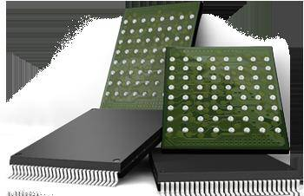

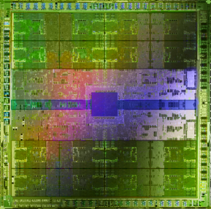
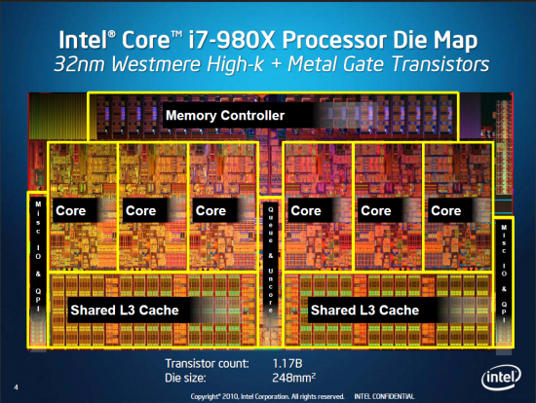
Current Research Focus Areas
Research Focus: Computer architecture, HW/SW, bioinformatics, security
Memory and storage (DRAM, flash, emerging), interconnects
Heterogeneous & parallel systems, GPUs, systems for data analytics
System/architecture interaction, new execution models, new interfaces
Hardware security, energy efficiency, fault tolerance, performance
Genome sequence analysis & assembly algorithms and architectures
Biologically inspired systems & system design for bio/medicine
Hybrid Main Memory
Heterogeneous
Processors and
Accelerators
Persistent Memory/Storage
Broad research
spanning apps, systems, logic
with architecture at the center
Graphics and Vision Processing
Notes:
Professor Mutlu’s research focus is all aspects of computer architecture, HW/SW interaction and bioinformatics.
He is looking for students to perform research in these areas.
He and his group, SAFARI, solve fundamental problems spanning:
Memory, memory, memory, storage, interconnects
Parallel architectures, heterogeneous architectures, GP-GPUs
System/architecture interaction, new execution models
Energy efficiency, fault tolerance, hardware security
Genome sequence analysis and assembly
His group does broad research spanning systems to logic with architecture at center

Slide 3
Four Key Directions
Fundamentally Secure/Reliable/Safe Architectures
Fundamentally Energy-Efficient Architectures
  Memory-centric (Data-centric) Architectures
Fundamentally Low-Latency Architectures
Architectures for Genomics, Medicine, Health

Slide 4
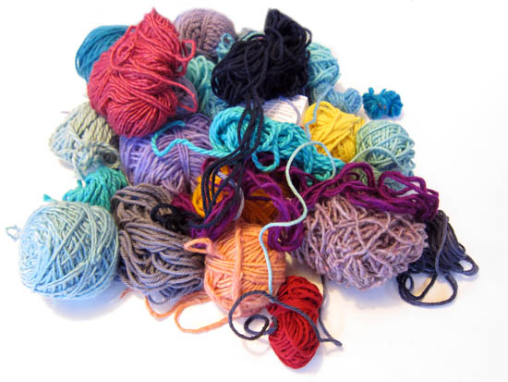
Untangling Yarn Balls & DNA Sequencing
Notes:
untangling yarn ball

Slide 5
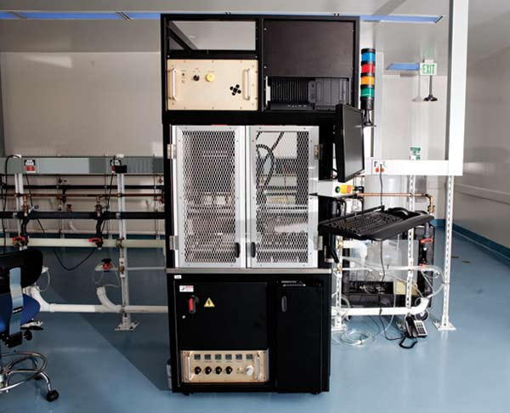
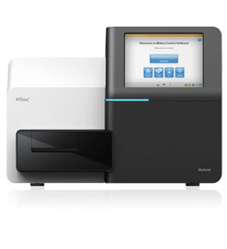
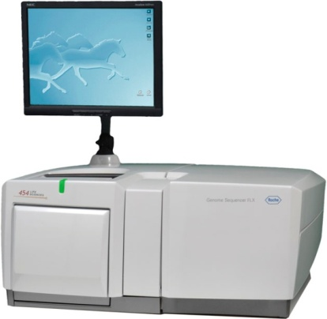
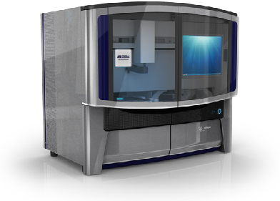
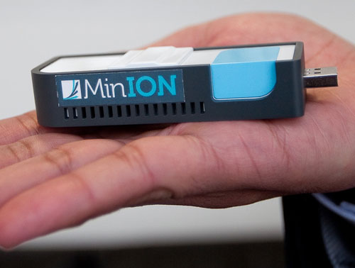
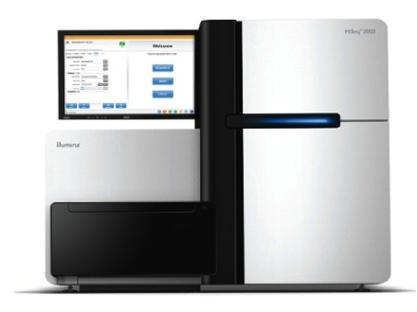
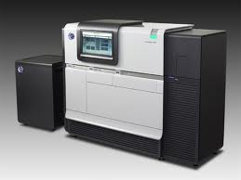
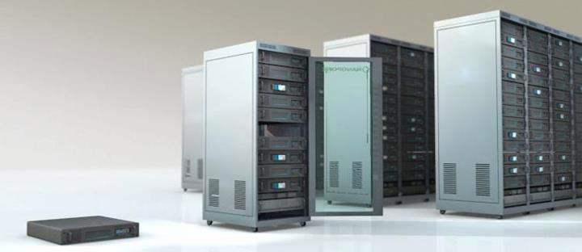
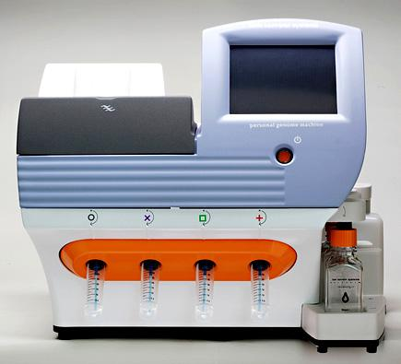
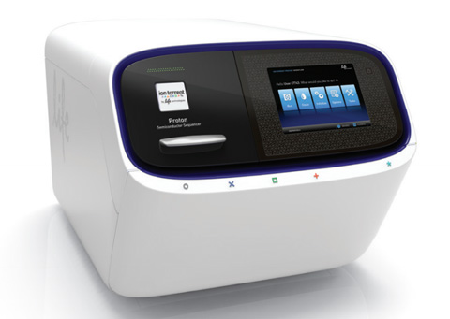
Genome Sequencers
Illumina MiSeq
Complete
Genomics
Roche/454
AB SOLiD
Oxford Nanopore MinION
Illumina
NovaSeq
6000
Illumina HiSeq2000
Pacific Biosciences RS
Oxford Nanopore GridION
Ion Torrent PGM
… and more! All produce data with different properties.
Ion Torrent Proton

Slide 6
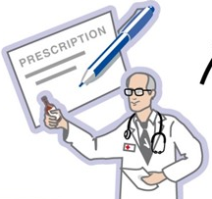
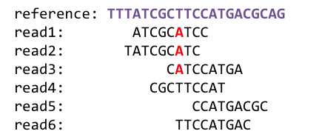
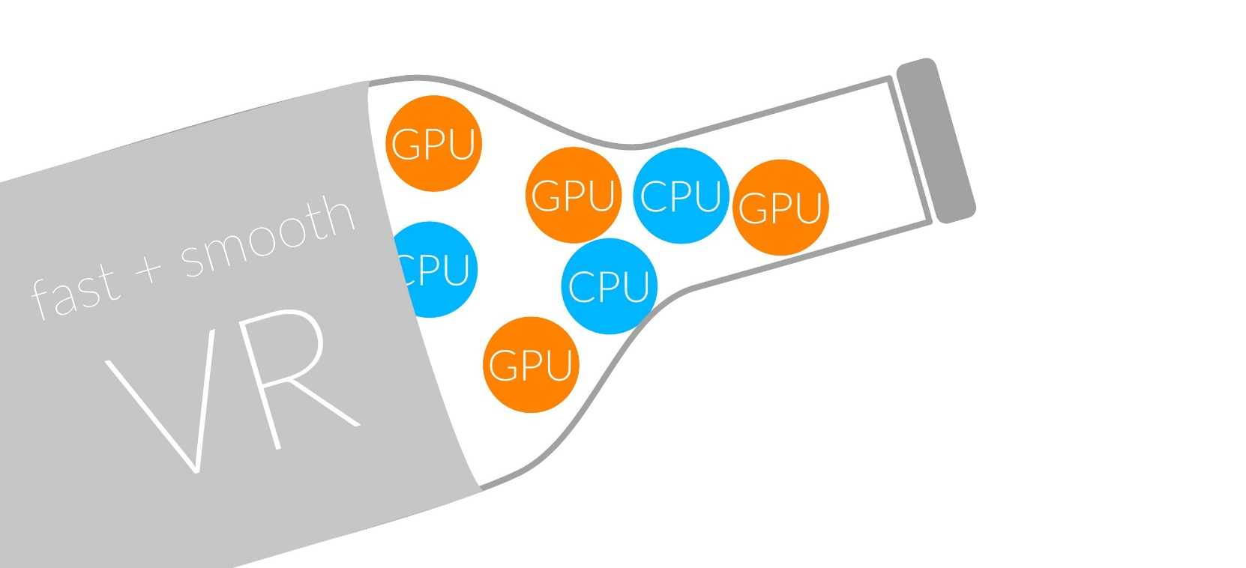
1
Sequencing
Read Mapping
2
Bottlenecked in Mapping!!
Illumina HiSeq4000
on average
GAGTCAGAATTTGAC
2 M
bases/min
300 M
bases/min
GAGTCAGAATTTGAC
GAGTCAGAATTTGAC
GAGTCAGAATTTGAC
GAGTCAGAATTTGAC
GAGTCAGAATTTGAC
GAGTCAGAATTTGAC
GAGTCAGAATTTGAC
GAGTCAGAATTTGAC
GAGTCAGAATTTGAC
GAGTCAGAATTTGAC
GAGTCAGAATTTGAC
GAGTCAGAATTTGAC
GAGTCAGAATTTGAC
GAGTCAGAATTTGAC
(0.6%)
Variant Calling
Scientific Discovery
3
4
Notes:
Typical sequencer machine generates a flood of reads, for example, Illumina HiSeq4000 generates 300 million bases/minute.
However, existing computer alignment algorithms can only process 0.6% of these reads in the same amount of time.
This gap is widening as more advanced sequencers are made available in the market.

Slide 7
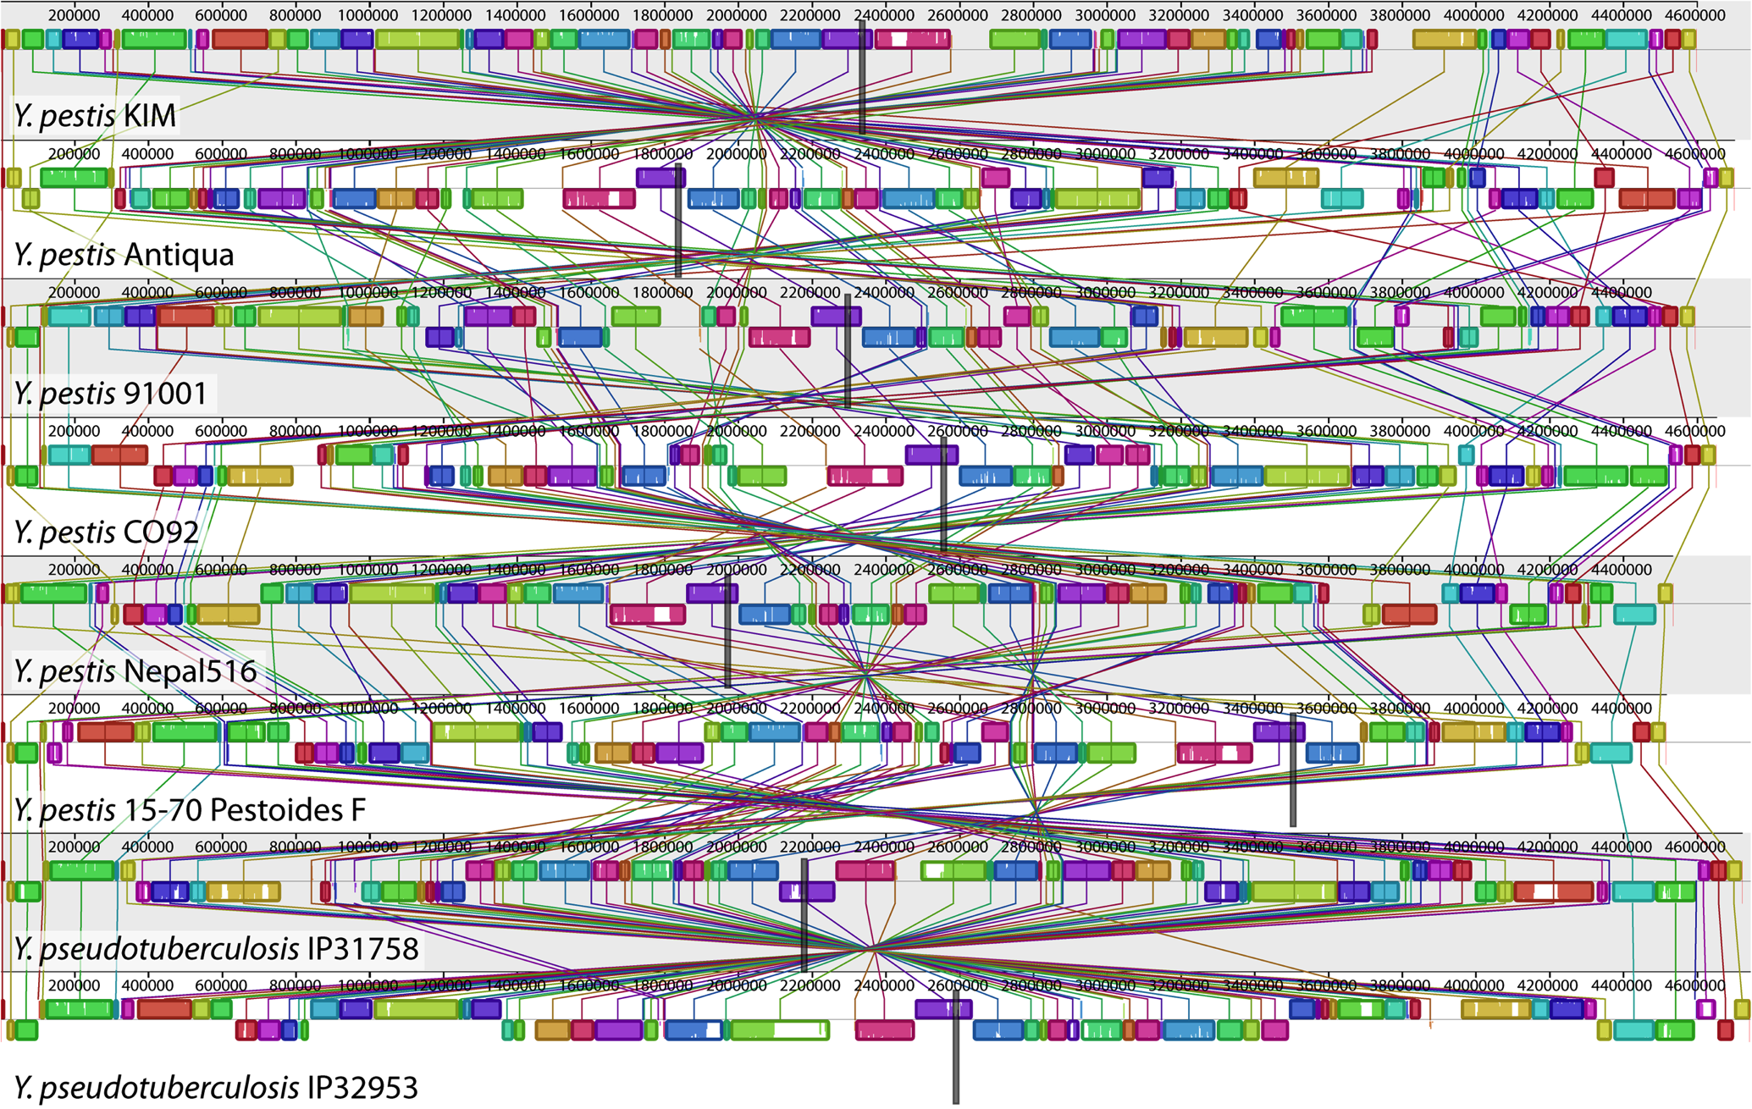
Genome Sequence Alignment: Example
Source: By Aaron E. Darling, István Miklós, Mark A. Ragan - Figure 1 from Darling AE, Miklós I, Ragan MA (2008).
"Dynamics of Genome Rearrangement in Bacterial Populations". PLOS Genetics. DOI:10.1371/journal.pgen.1000128., CC BY 2.5, https://commons.wikimedia.org/w/index.php?curid=30550950

Slide 8
Advantages of Hash Table Based Mappers
+ Guaranteed to find all mappings → sensitive
+ Can tolerate up to e errors
http://mrfast.sourceforge.net/
Alkan+, "Personalized copy number and segmental duplication
maps using next-generation sequencing”, Nature Genetics 2009.
Notes:
It turned out the Hash Table based mappers solve the first 2 challenges pretty well. They guarantee to find all mappings with no more than e errors present.

Slide 9
Read Mapping Execution Time Breakdown
Notes:
An overwhelming majority of the read mapper’s execution time is spent in read alignment.

Slide 10
Idea
Filter fast before you align
Minimize costly
“approximate string comparisons”

Slide 11
Our First Filter: Pure Software Approach
Download source code and try for yourself
  Download link to FastHASH

Slide 12
Shifted Hamming Distance: SIMD Acceleration
Xin+, "Shifted Hamming Distance: A Fast and Accurate SIMD-friendly Filter
to Accelerate Alignment Verification in Read Mapping”, Bioinformatics 2015.

Slide 13
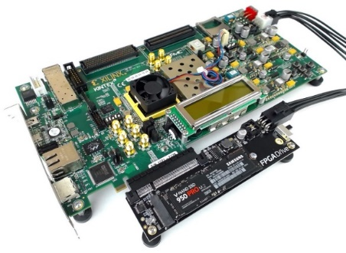
An Example Solution: GateKeeper
1
st
Alignment Filter
FPGA-based Alignment Filter.
Notes:
To bridge the widening gap between the sequencer & the mapper, we propose the concept of pre-alignment filtering. We added a new examination step before the accurate alignment step. The main objective of this step is to detect the incorrect mappings accurately and rapidly. Only the mappings that pass our filter are examined by the alignment step. We also explore exploiting todays’ hardware accelerators to further boost the filtering speed of such filters.

Slide 14
FPGA-Based Alignment Filtering
Mohammed Alser, Hasan Hassan, Hongyi Xin, Oguz Ergin, Onur Mutlu, and Can Alkan
"GateKeeper: A New Hardware Architecture for Accelerating Pre-Alignment in DNA Short Read Mapping"
Bioinformatics, [published online, May 31], 2017.
[Source Code]
[Online link at Bioinformatics Journal]

Slide 15
DNA Read Mapping & Filtering
Problem: Heavily bottlenecked by Data Movement
GateKeeper FPGA performance limited by DRAM bandwidth [Alser+, Bioinformatics 2017]
Ditto for SHD on SIMD [Xin+, Bioinformatics 2015]
Solution: Processing-in-memory can alleviate the bottleneck
However, we need to design mapping & filtering algorithms to fit processing-in-memory

Slide 16
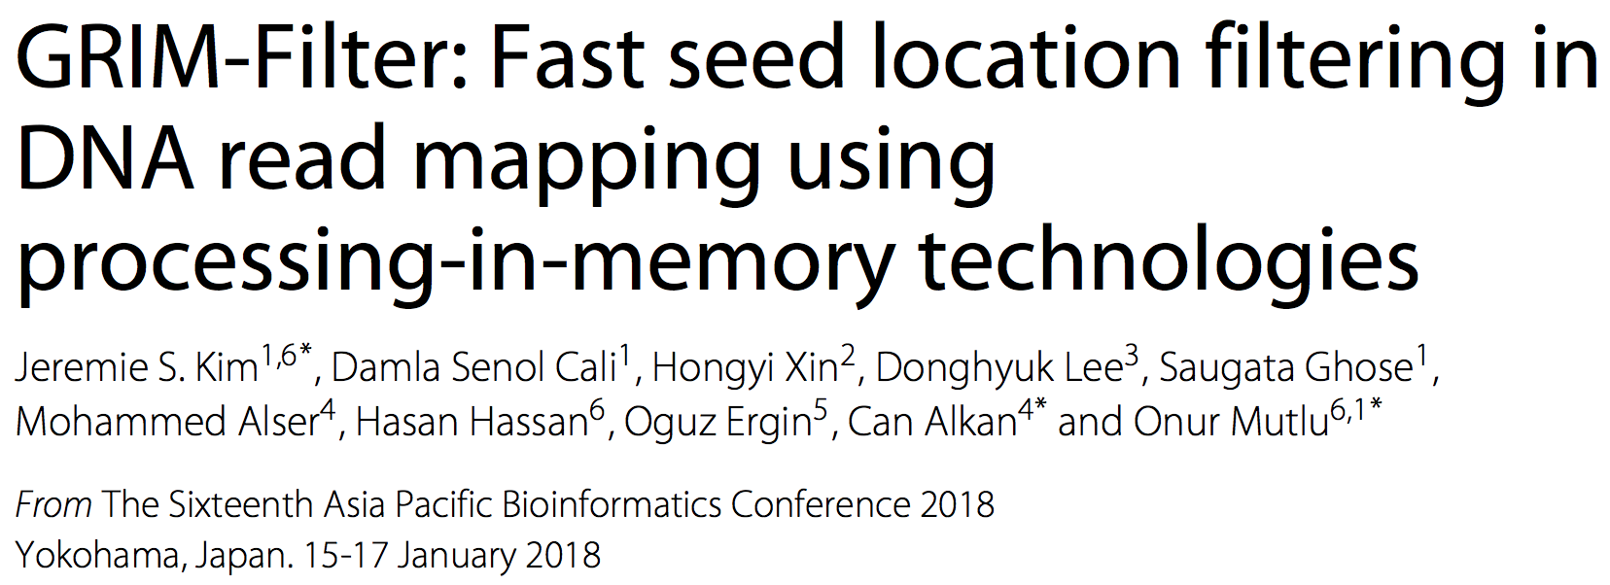
In-Memory DNA Sequence Analysis
Jeremie S. Kim, Damla Senol Cali, Hongyi Xin, Donghyuk Lee, Saugata Ghose, Mohammed Alser, Hasan Hassan, Oguz Ergin, Can Alkan, and Onur Mutlu,
"GRIM-Filter: Fast Seed Location Filtering in DNA Read Mapping Using Processing-in-Memory Technologies"
BMC Genomics, 2018.
Proceedings of the 16th Asia Pacific Bioinformatics Conference (APBC), Yokohama, Japan, January 2018.
arxiv.org Version (pdf)

Slide 17
Key Principles and Results
Two key principles:
  Exploit the structure of the genome to minimize computation
  Morph and exploit the structure of the underlying hardware to maximize performance and efficiency
Algorithm-architecture co-design for DNA read mapping
  Speeds up read mapping by ~200X (sometimes more)
  Improves accuracy of read mapping in the presence of errors
Xin et al., “Accelerating Read Mapping with FastHASH,” BMC Genomics 2013.
Xin et al., “Shifted Hamming Distance: A Fast and Accurate SIMD-friendly Filter to Accelerate
Alignment Verification in Read Mapping,” Bioinformatics 2015.
Alser et al., “GateKeeper: A New Hardware Architecture for Accelerating Pre-Alignment in DNA
Short Read Mapping,” Bioinformatics 2017.
Kim et al., “Genome Read In-Memory (GRIM) Filter,” BMC Genomics 2018.

Slide 18
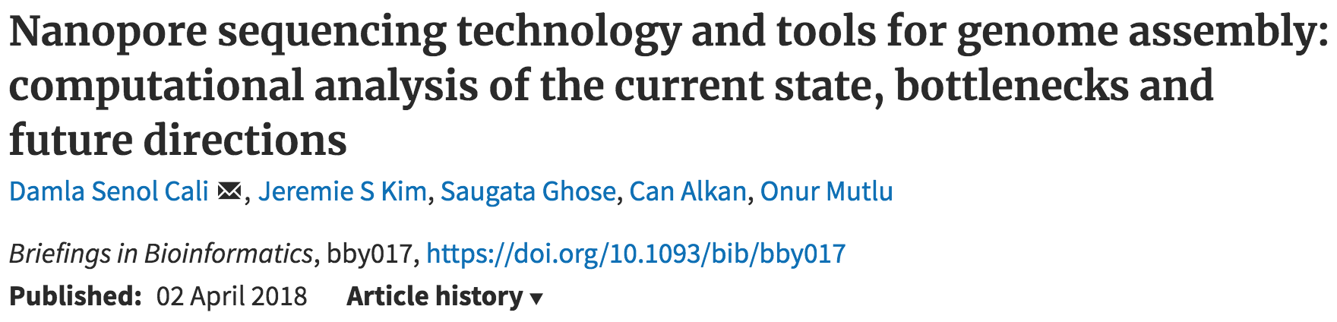
New Genome Sequencing Technologies
Senol Cali+, “Nanopore Sequencing Technology and Tools for Genome
Assembly: Computational Analysis of the Current State, Bottlenecks
and Future Directions,” Briefings in Bioinformatics, 2018.
[Preliminary arxiv.org version]

Slide 19
Nanopore Genome Assembly Pipeline
Senol Cali+, “Nanopore Sequencing Technology and Tools for Genome
Assembly” to appear in Briefings in Bioinformatics, 2018.

Slide 20

More on Genome Analysis: Another Talk

Slide 21
Four Key Directions
Fundamentally Secure/Reliable/Safe Architectures
Fundamentally Energy-Efficient Architectures
  Memory-centric (Data-centric) Architectures
Fundamentally Low-Latency Architectures
Architectures for Genomics, Medicine, Health

Slide 22
Memory & Storage

Slide 23
The Main Memory System
Main memory is a critical component of all computing systems: server, mobile, embedded, desktop, sensor
Main memory system must scale (in size, technology, efficiency, cost, and management algorithms) to maintain performance growth and technology scaling benefits
Processors
and caches
Main Memory
Storage (SSD/HDD)

Slide 24
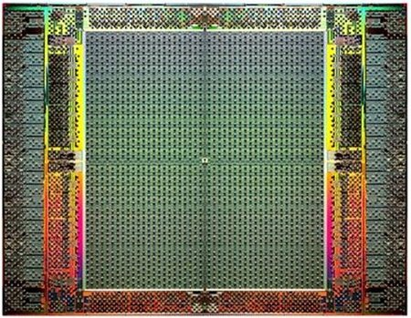
The Main Memory System
Main memory is a critical component of all computing systems: server, mobile, embedded, desktop, sensor
Main memory system must scale (in size, technology, efficiency, cost, and management algorithms) to maintain performance growth and technology scaling benefits
FPGAs
Main Memory
Storage (SSD/HDD)

Slide 25
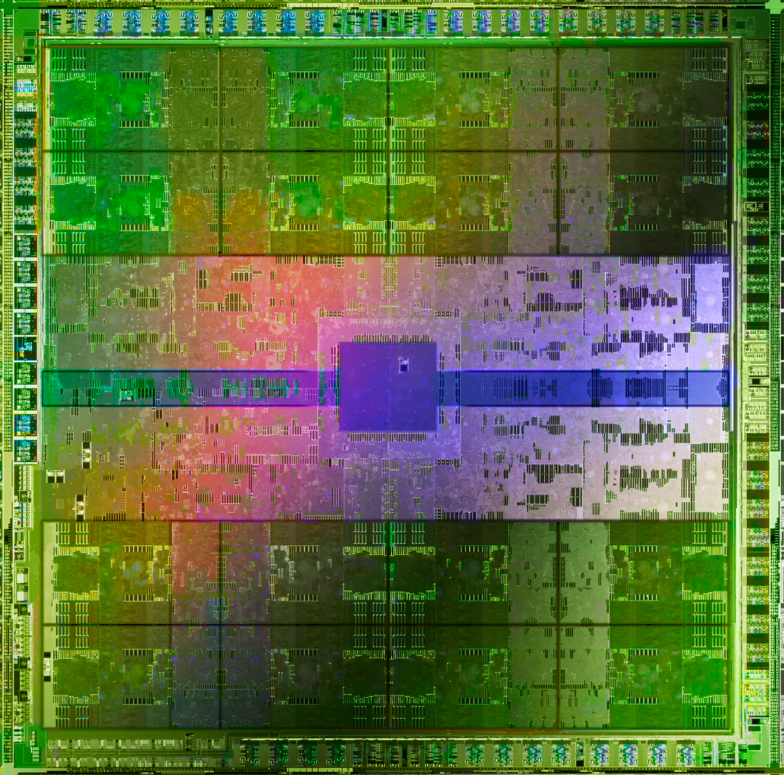
The Main Memory System
Main memory is a critical component of all computing systems: server, mobile, embedded, desktop, sensor
Main memory system must scale (in size, technology, efficiency, cost, and management algorithms) to maintain performance growth and technology scaling benefits
GPUs
Main Memory
Storage (SSD/HDD)

Slide 26
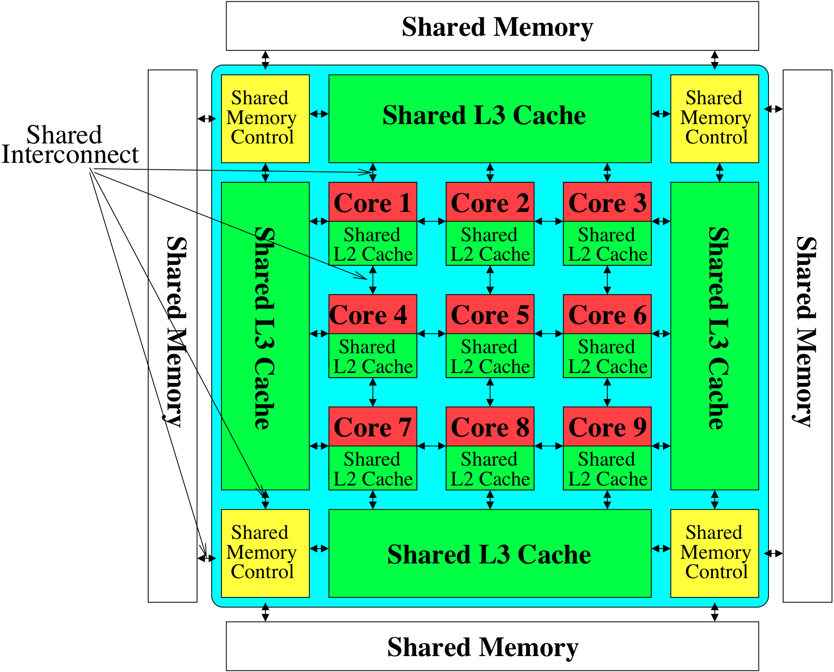
Memory System: A Shared Resource View
Storage
Most of the system is dedicated to storing and moving data

Slide 27
State of the Main Memory System
Recent technology, architecture, and application trends
  lead to new requirements
  exacerbate old requirements
DRAM and memory controllers, as we know them today, are (will be) unlikely to satisfy all requirements
Some emerging non-volatile memory technologies (e.g., PCM) enable new opportunities: memory+storage merging
We need to rethink the main memory system
  to fix DRAM issues and enable emerging technologies
  to satisfy all requirements

Slide 28
Major Trends Affecting Main Memory (I)
Need for main memory capacity, bandwidth, QoS increasing
Main memory energy/power is a key system design concern
DRAM technology scaling is ending

Slide 29
Major Trends Affecting Main Memory (II)
Need for main memory capacity, bandwidth, QoS increasing
  Multi-core: increasing number of cores/agents
  Data-intensive applications: increasing demand/hunger for data
  Consolidation: cloud computing, GPUs, mobile, heterogeneity
Main memory energy/power is a key system design concern
DRAM technology scaling is ending

Slide 30
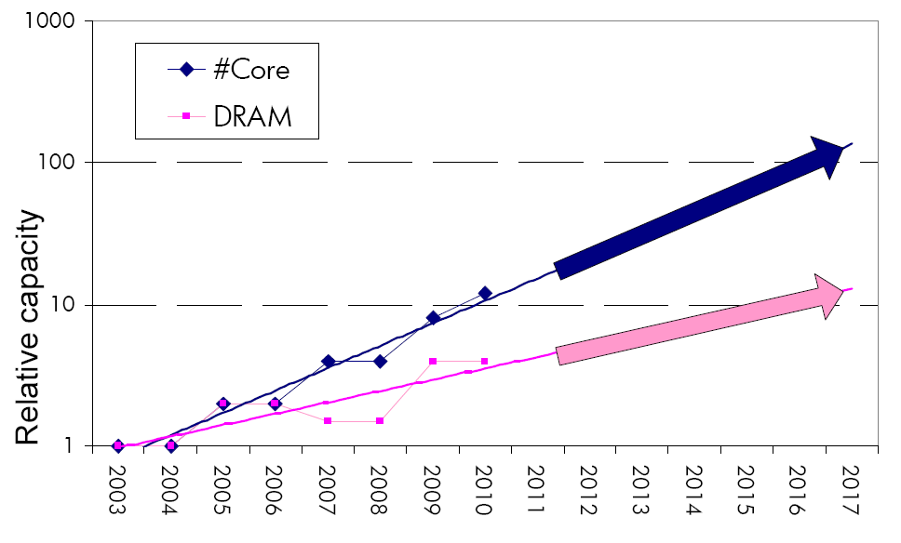
Example: The Memory Capacity Gap
Core count doubling ~ every 2 years
DRAM DIMM capacity doubling ~ every 3 years
Memory capacity per core expected to drop by 30% every two years
Trends worse for memory bandwidth per core!
Lim et al., ISCA 2009

Slide 31
Example: Capacity, Bandwidth & Latency
128x
20x
1.3x
Memory latency remains almost constant

Slide 32
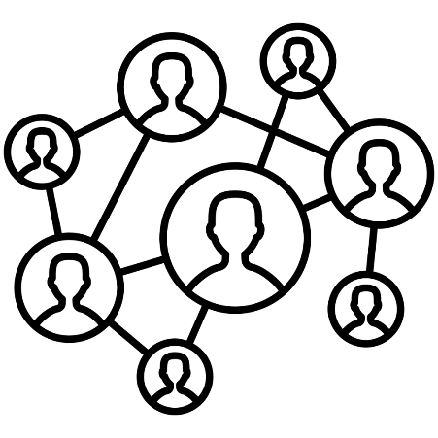

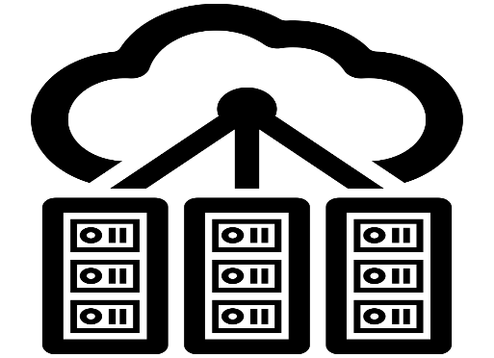

DRAM Latency Is Critical for Performance
In-memory Databases
[Mao+, EuroSys’12;
Clapp+ (Intel), IISWC’15]
Graph/Tree Processing
[Xu+, IISWC’12; Umuroglu+, FPL’15]
In-Memory Data Analytics
[Clapp+ (Intel), IISWC’15;
Awan+, BDCloud’15]
Datacenter Workloads
[Kanev+ (Google), ISCA’15]

Slide 33
DRAM Latency Is Critical for Performance
In-memory Databases
[Mao+, EuroSys’12;
Clapp+ (Intel), IISWC’15]
Graph/Tree Processing
[Xu+, IISWC’12; Umuroglu+, FPL’15]
Long memory latency → performance bottleneck
In-Memory Data Analytics
[Clapp+ (Intel), IISWC’15;
Awan+, BDCloud’15]
Datacenter Workloads
[Kanev+ (Google), ISCA’15]

Slide 34
Major Trends Affecting Main Memory (III)
Need for main memory capacity, bandwidth, QoS increasing
Main memory energy/power is a key system design concern
  ~40-50% energy spent in off-chip memory hierarchy [Lefurgy, IEEE Computer’03] >40% power in DRAM [Ware, HPCA’10][Paul,ISCA’15]
  DRAM consumes power even when not used (periodic refresh)
DRAM technology scaling is ending

Slide 35
Major Trends Affecting Main Memory (IV)
Need for main memory capacity, bandwidth, QoS increasing
Main memory energy/power is a key system design concern
DRAM technology scaling is ending
  ITRS projects DRAM will not scale easily below X nm
  Scaling has provided many benefits:
    higher capacity (density), lower cost, lower energy

Slide 36
Major Trends Affecting Main Memory (V)
DRAM scaling has already become increasingly difficult
  Increasing cell leakage current, reduced cell reliability, increasing manufacturing difficulties [Kim+ ISCA 2014],
  [Liu+ ISCA 2013], [Mutlu IMW 2013], [Mutlu DATE 2017]
  Difficult to significantly improve capacity, energy
Emerging memory technologies are promising
3D-Stacked DRAM | higher bandwidth | smaller capacity
Reduced-Latency DRAM (e.g., RLDRAM, TL-DRAM) | lower latency | higher cost
Low-Power DRAM (e.g., LPDDR3, LPDDR4) | lower power | higher latency higher cost
Non-Volatile Memory (NVM) (e.g., PCM, STTRAM, ReRAM, 3D Xpoint) | larger capacity | higher latency higher dynamic power lower endurance

Slide 37
Major Trends Affecting Main Memory (V)
DRAM scaling has already become increasingly difficult
  Increasing cell leakage current, reduced cell reliability, increasing manufacturing difficulties [Kim+ ISCA 2014],
  [Liu+ ISCA 2013], [Mutlu IMW 2013], [Mutlu DATE 2017]
  Difficult to significantly improve capacity, energy
Emerging memory technologies are promising
3D-Stacked DRAM | higher bandwidth | smaller capacity
Reduced-Latency DRAM (e.g., RL/TL-DRAM, FLY-RAM) | lower latency | higher cost
Low-Power DRAM (e.g., LPDDR3, LPDDR4, Voltron) | lower power | higher latency higher cost
Non-Volatile Memory (NVM) (e.g., PCM, STTRAM, ReRAM, 3D Xpoint) | larger capacity | higher latency higher dynamic power lower endurance

Slide 38
Major Trend: Hybrid Main Memory
CPU
Meza+, “Enabling Efficient and Scalable Hybrid Memories,” IEEE Comp. Arch. Letters, 2012.
Yoon+, “Row Buffer Locality Aware Caching Policies for Hybrid Memories,” ICCD 2012 Best Paper Award.
DRAMCtrl
PCM Ctrl
DRAM
Phase Change Memory (or Tech. X)
Fast, durable
Small,
leaky, volatile,
high-cost
Large, non-volatile, low-cost
Slow, wears out, high active energy
Hardware/software manage data allocation and movement
to achieve the best of multiple technologies

Slide 39
Foreshadowing
Main Memory Needs
Intelligent Controllers

Slide 40
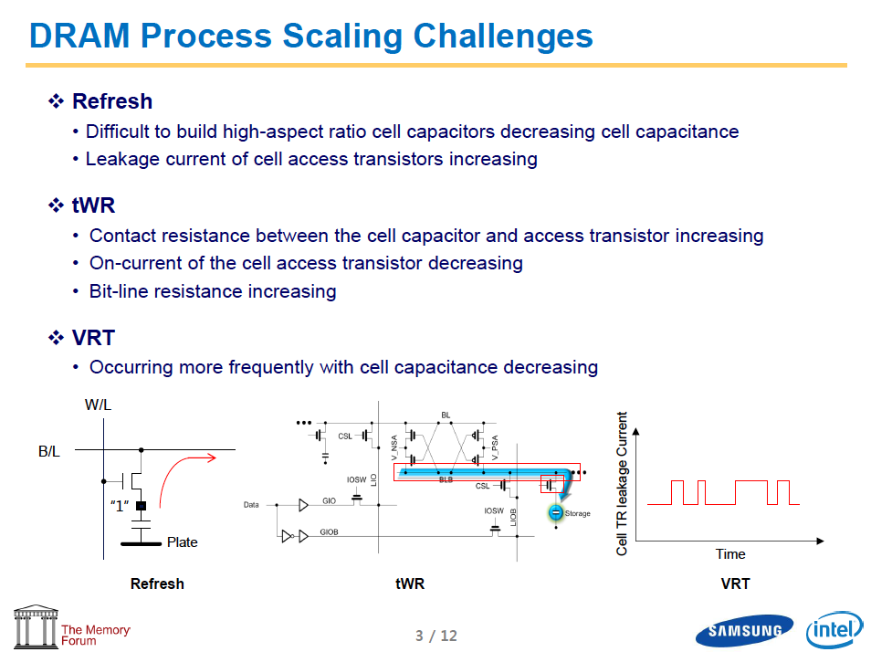
Industry Is Writing Papers About It, Too

Slide 41
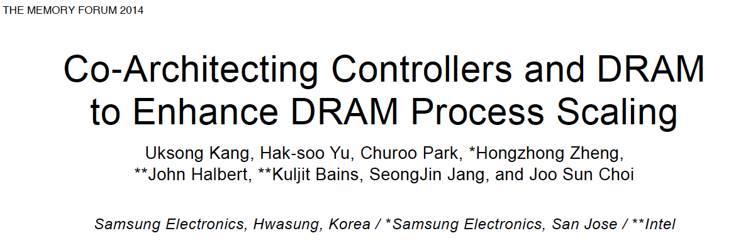
Call for Intelligent Memory Controllers

Slide 42
Agenda
Major Trends Affecting Main Memory
The Need for Intelligent Memory Controllers
  Bottom Up: Push from Circuits and Devices
  Top Down: Pull from Systems and Applications
Processing in Memory: Two Directions
  Minimally Changing Memory Chips
  Exploiting 3D-Stacked Memory
How to Enable Adoption of Processing in Memory
Conclusion

Slide 43
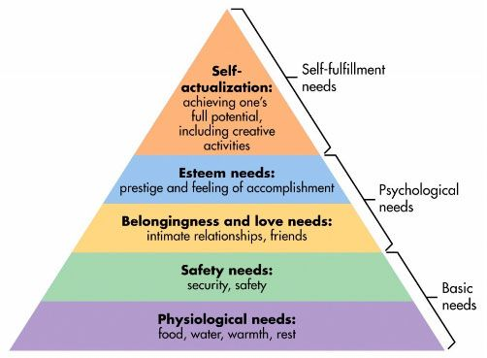
Maslow’s (Human) Hierarchy of Needs
Maslow, “A Theory of Human Motivation,”
Psychological Review, 1943.
Maslow, “A Theory of Human Motivation,”
Psychological Review, 1943.
Maslow, “Motivation and Personality,”
Book, 1954-1970.
We need to start with reliability and security…
Source: https://www.simplypsychology.org/maslow.html

Slide 44
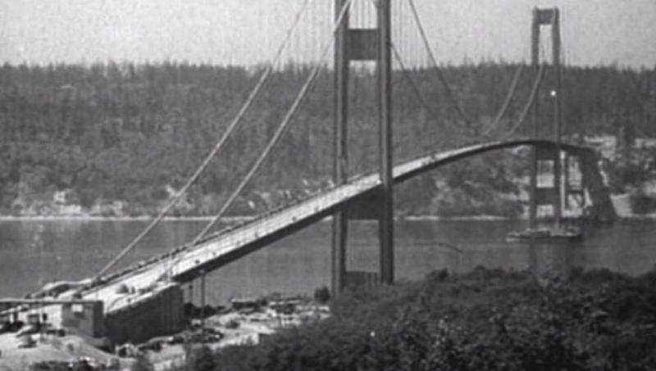
How Reliable/Secure/Safe is This Bridge?
Source: http://www.technologystudent.com/struct1/tacom1.png

Slide 45
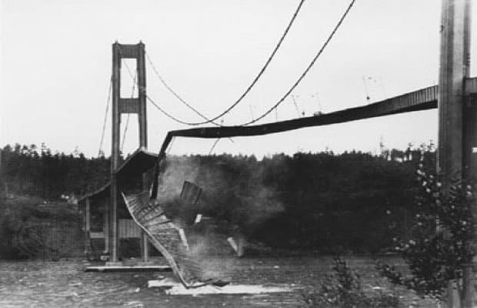
Collapse of the “Galloping Gertie”
Source: AP

Slide 46
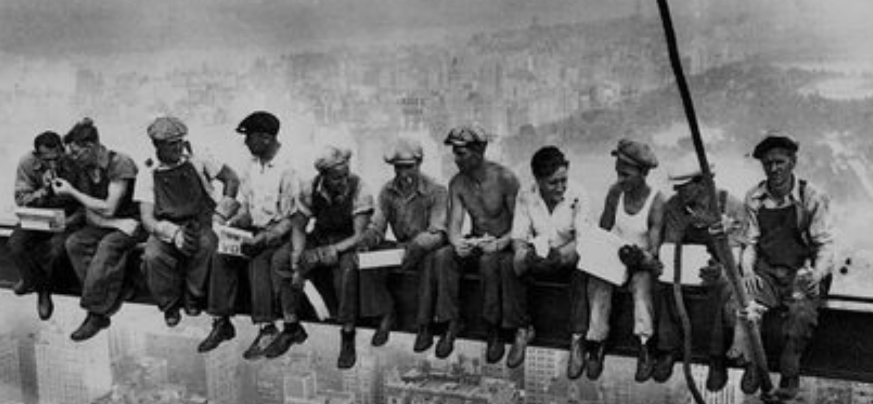
How Secure Are These People?
Security is about preventing unforeseen consequences
Source: https://s-media-cache-ak0.pinimg.com/originals/48/09/54/4809543a9c7700246a0cf8acdae27abf.jpg

Slide 47
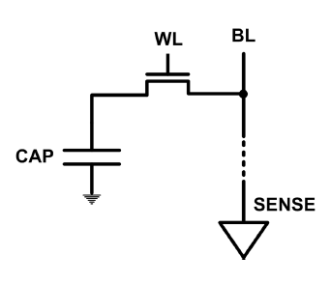
The DRAM Scaling Problem
DRAM stores charge in a capacitor (charge-based memory)
  Capacitor must be large enough for reliable sensing
  Access transistor should be large enough for low leakage and high retention time
  Scaling beyond 40-35nm (2013) is challenging [ITRS, 2009]
DRAM capacity, cost, and energy/power hard to scale

Slide 48
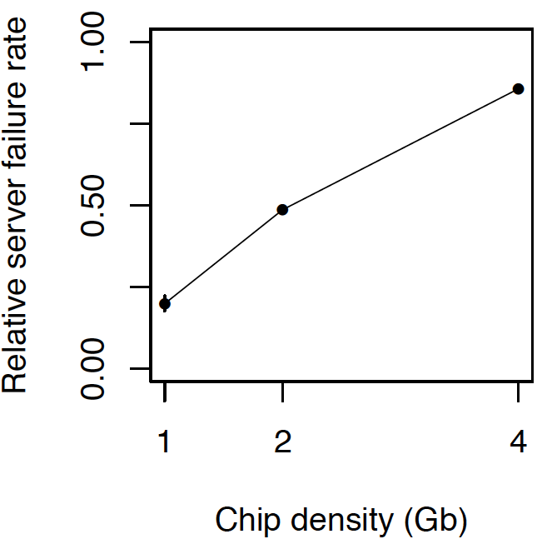
As Memory Scales, It Becomes Unreliable
Data from all of Facebook’s servers worldwide
Meza+, “Revisiting Memory Errors in Large-Scale Production Data Centers,” DSN’15.
Intuition:
quadratic
increase in
capacity

Slide 49
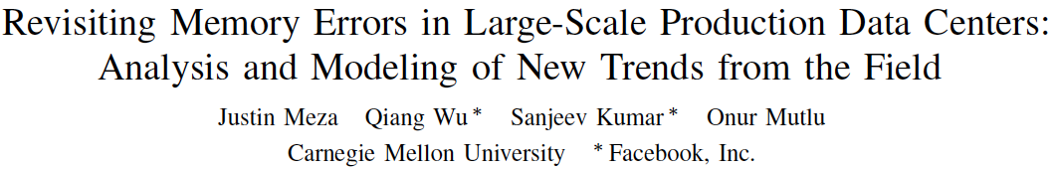
Large-Scale Failure Analysis of DRAM Chips
Analysis and modeling of memory errors found in all of Facebook’s server fleet
Justin Meza, Qiang Wu, Sanjeev Kumar, and Onur Mutlu,
"Revisiting Memory Errors in Large-Scale Production Data Centers: Analysis and Modeling of New Trends from the Field"
Proceedings of the 45th Annual IEEE/IFIP International Conference on Dependable Systems and Networks (DSN), Rio de Janeiro, Brazil, June 2015.
[Slides (pptx) (pdf)] [DRAM Error Model]

Slide 50
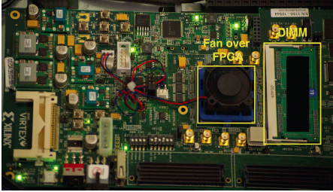
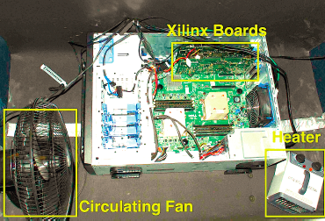
Infrastructures to Understand Such Issues
  An Experimental Study of Data Retention Behavior in Modern DRAM Devices: Implications for Retention Time Profiling Mechanisms (Liu et al., ISCA 2013)
  The Efficacy of Error Mitigation Techniques for DRAM Retention Failures: A Comparative Experimental Study
  (Khan et al., SIGMETRICS 2014)
  Flipping Bits in Memory Without Accessing Them: An Experimental Study of DRAM Disturbance Errors (Kim et al., ISCA 2014)
  Adaptive-Latency DRAM: Optimizing DRAM Timing for the Common-Case (Lee et al., HPCA 2015)
  AVATAR: A Variable-Retention-Time (VRT) Aware Refresh for DRAM Systems (Qureshi et al., DSN 2015)

Slide 51

Infrastructures to Understand Such Issues
Temperature
Controller
FPGAs
Heater
FPGAs
PC
  Kim+, “Flipping Bits in Memory Without Accessing Them: An Experimental Study of DRAM Disturbance Errors,” ISCA 2014.

Slide 52
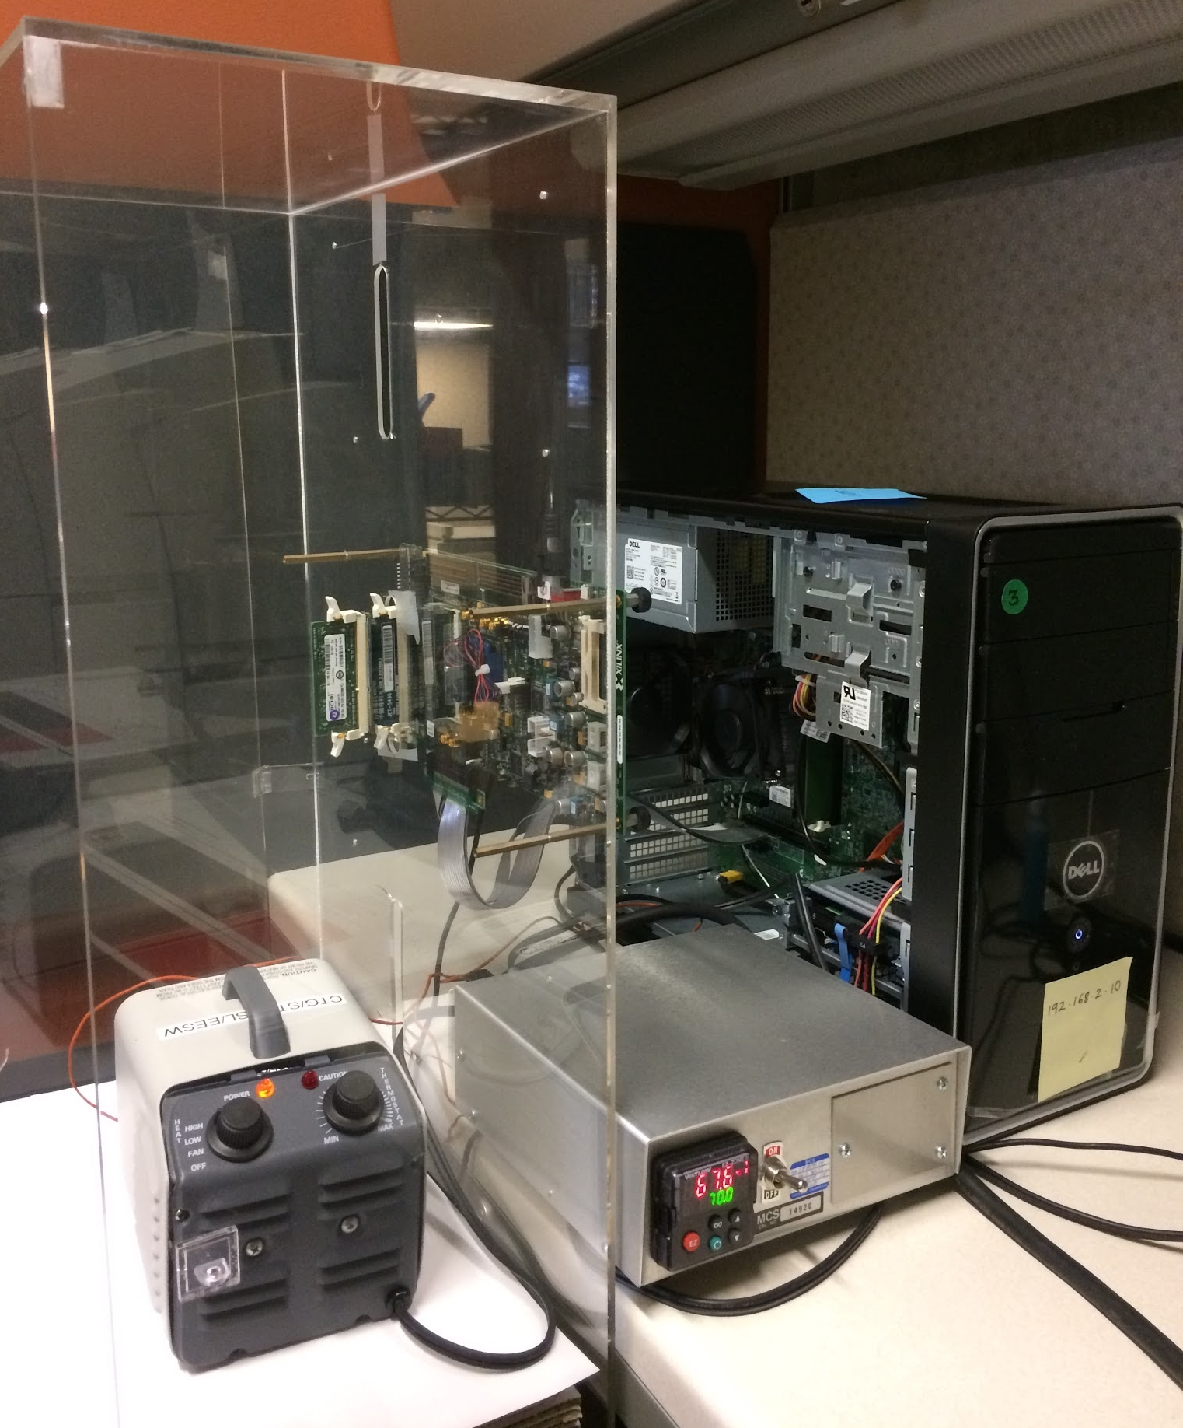
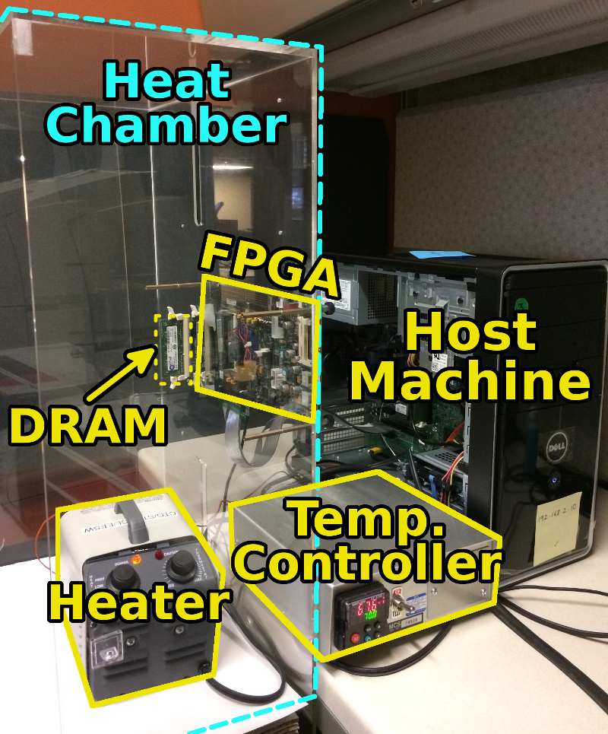
SoftMC: Open Source DRAM Infrastructure
Hasan Hassan et al., “SoftMC: A Flexible and Practical Open-Source Infrastructure for Enabling Experimental DRAM Studies,” HPCA 2017.
Flexible
Easy to Use (C++ API)
Open-source
github.com/CMU-SAFARI/SoftMC

Slide 53
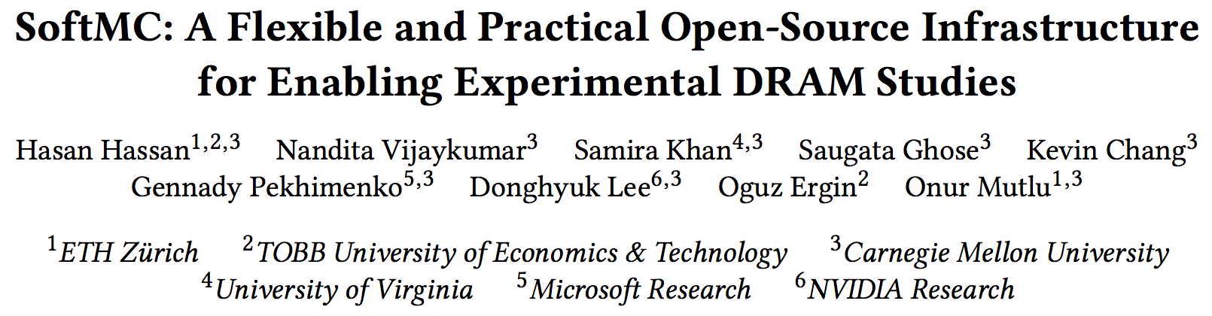
SoftMC
https://github.com/CMU-SAFARI/SoftMC

Slide 54

Data Retention in Memory [Liu et al., ISCA 2013]
Retention Time Profile of DRAM looks like this:
Location dependent
Stored value pattern dependent
Time dependent

Slide 55
A Curious Discovery [Kim et al., ISCA 2014]
One can
predictably induce errors
in most DRAM memory chips

Slide 56
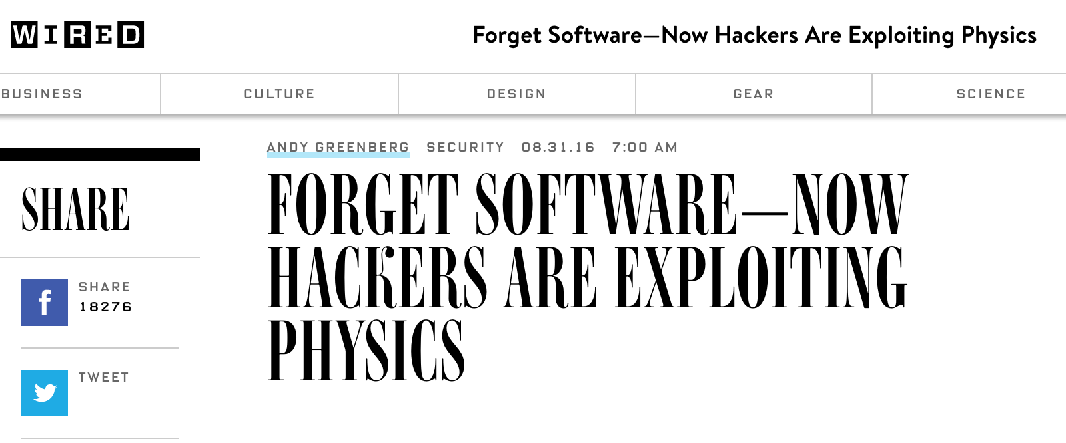
DRAM RowHammer
A simple hardware failure mechanism
can create a widespread
system security vulnerability

Slide 57
Modern DRAM is Prone to Disturbance Errors
Row of Cells
Wordline
Row
Victim Row
Row
Hammered Row
V_{LOW}
Opened
V_{HIGH}
Closed
Row
Victim Row
Row
Repeatedly reading a row enough times (before memory gets refreshed) induces disturbance errors in adjacent rows in most real DRAM chips you can buy today
Flipping Bits in Memory Without Accessing Them: An Experimental Study of DRAM Disturbance Errors, (Kim et al., ISCA 2014)

Slide 58
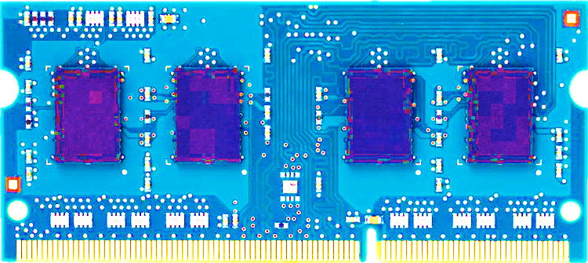
Most DRAM Modules Are Vulnerable
A company
B company
C company
86%
(37/43)
83%
(45/54)
88%
(28/32)
Up to
1.0×10⁷
errors
Up to
2.7×10⁶
errors
Up to
3.3×10⁵
errors
Flipping Bits in Memory Without Accessing Them: An Experimental Study of DRAM Disturbance Errors, (Kim et al., ISCA 2014)

Slide 59
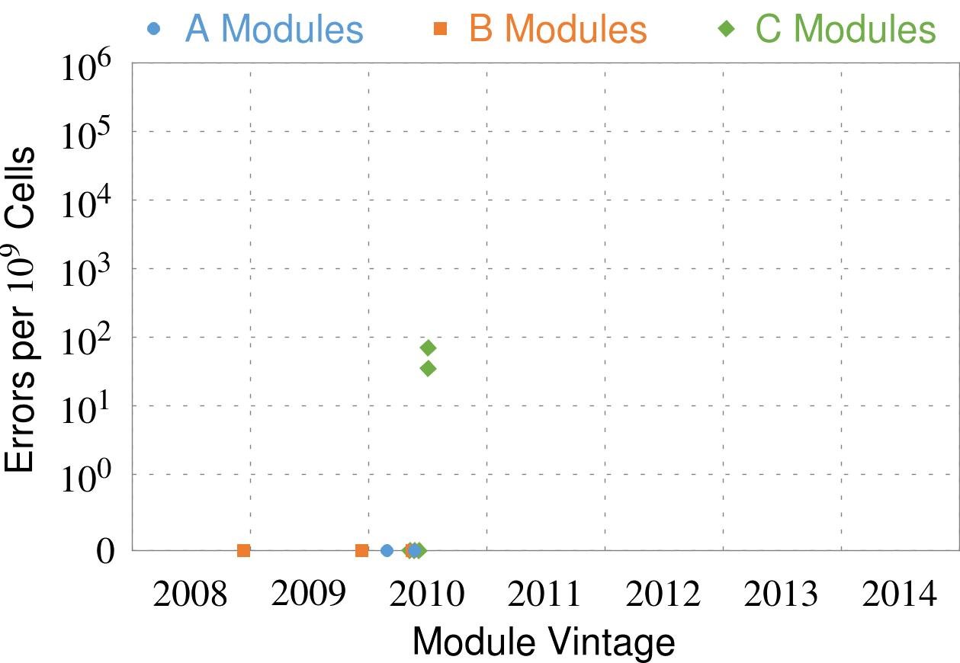
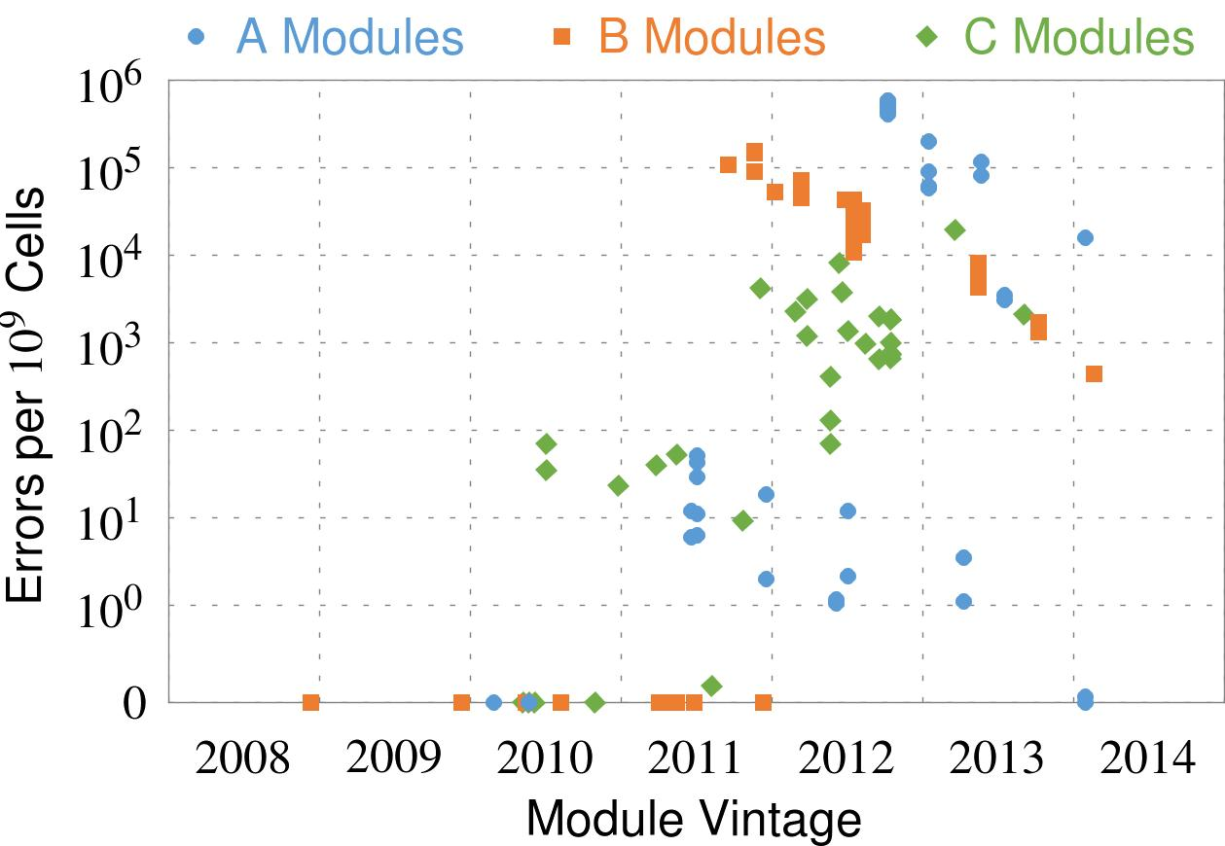
Recent DRAM Is More Vulnerable
Notes:
In this figure, the x-axis is the module manufacture date. And the y-axis is the number of errors in a module, normalized to one billion cells. In 2008 and 2009, there are no errors. But, in 2010, we first start to see errors in C modules. After 2010, the errors start to proliferate. For A and B modules, we first start to see errors in 2011. In particular, all modules from 2012 and 2013 are vulnerable.

Slide 60
Recent DRAM Is More Vulnerable
First
Appearance
Notes:
In this figure, the x-axis is the module manufacture date. And the y-axis is the number of errors in a module, normalized to one billion cells. In 2008 and 2009, there are no errors. But, in 2010, we first start to see errors in C modules. After 2010, the errors start to proliferate. For A and B modules, we first start to see errors in 2011. In particular, all modules from 2012 and 2013 are vulnerable.

Slide 61
Recent DRAM Is More Vulnerable
First
Appearance
All modules from 2012–2013 are vulnerable
Notes:
In this figure, the x-axis is the module manufacture date. And the y-axis is the number of errors in a module, normalized to one billion cells. In 2008 and 2009, there are no errors. But, in 2010, we first start to see errors in C modules. After 2010, the errors start to proliferate. For A and B modules, we first start to see errors in 2011. In particular, all modules from 2012 and 2013 are vulnerable.

Slide 62
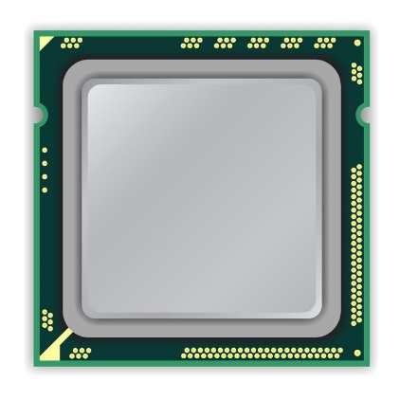
A Simple Program Can Induce Many Errors
CPU
DRAM Module
loop:
mov (X), %eax
mov (Y), %ebx
clflush (X)
clflush (Y)
mfence
jmp loop
X
Y
  Download from: https://github.com/CMU-SAFARI/rowhammer
Notes:
We demonstrate the errors on multiple x86 systems. Shown to the bottom-left is a “disturbance kernel”. When executed, it forces two rows to be opened and closed one after the other – over and over again. Consequently, it induces many errors in the module.

Slide 63
A Simple Program Can Induce Many Errors
CPU
DRAM Module
Avoid cache hits
  Flush X from cache
Avoid row hits to X
  Read Y in another row
X
Y
  Download from: https://github.com/CMU-SAFARI/rowhammer
Notes:
We demonstrate the errors on multiple x86 systems. Shown to the bottom-left is a “disturbance kernel”. When executed, it forces two rows to be opened and closed one after the other – over and over again. Consequently, it induces many errors in the module.

Slide 64
A Simple Program Can Induce Many Errors
CPU
DRAM Module
loop:
mov (X), %eax
mov (Y), %ebx
clflush (X)
clflush (Y)
mfence
jmp loop
X
Y
  Download from: https://github.com/CMU-SAFARI/rowhammer
Notes:
We demonstrate the errors on multiple x86 systems. Shown to the bottom-left is a “disturbance kernel”. When executed, it forces two rows to be opened and closed one after the other – over and over again. Consequently, it induces many errors in the module.

Slide 65
A Simple Program Can Induce Many Errors
CPU
DRAM Module
loop:
mov (X), %eax
mov (Y), %ebx
clflush (X)
clflush (Y)
mfence
jmp loop
X
Y
  Download from: https://github.com/CMU-SAFARI/rowhammer
Notes:
We demonstrate the errors on multiple x86 systems. Shown to the bottom-left is a “disturbance kernel”. When executed, it forces two rows to be opened and closed one after the other – over and over again. Consequently, it induces many errors in the module.

Slide 66
A Simple Program Can Induce Many Errors
CPU
DRAM Module
loop:
mov (X), %eax
mov (Y), %ebx
clflush (X)
clflush (Y)
mfence
jmp loop
X
Y
  Download from: https://github.com/CMU-SAFARI/rowhammer
Notes:
We demonstrate the errors on multiple x86 systems. Shown to the bottom-left is a “disturbance kernel”. When executed, it forces two rows to be opened and closed one after the other – over and over again. Consequently, it induces many errors in the module.

Slide 67
Observed Errors in Real Systems
A real reliability & security issue
CPU Architecture | Errors | Access-Rate
Intel Haswell (2013) | 22.9K | 12.3M/sec
Intel Ivy Bridge (2012) | 20.7K | 11.7M/sec
Intel Sandy Bridge (2011) | 16.1K | 11.6M/sec
AMD Piledriver (2012) | 59 | 6.1M/sec
Kim+, “Flipping Bits in Memory Without Accessing Them: An Experimental Study of DRAM Disturbance Errors,” ISCA 2014.
Notes:
When we executed the code on four different processors, all four of them yielded errors. Intel Haswell has the most errors, at 23 thousand, because it has the highest rate of accessing DRAM.
Later on, I’ll show that we can induce as many as ten million disturbance errors in a more controlled environment.
From this, we conclude that disturbance errors are a serious reliability issue.

Slide 68


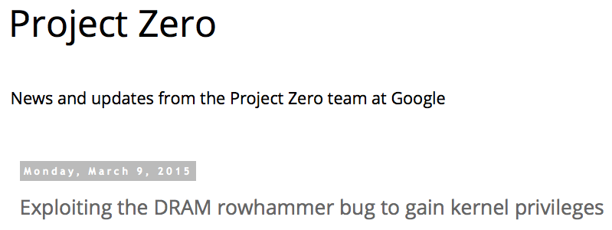
One Can Take Over an Otherwise-Secure System
Flipping Bits in Memory Without Accessing Them: An Experimental Study of DRAM Disturbance Errors (Kim et al., ISCA 2014)
Exploiting the DRAM rowhammer bug to gain kernel privileges (Seaborn, 2015)

Slide 69
RowHammer Security Attack Example
“Rowhammer” is a problem with some recent DRAM devices in which repeatedly accessing a row of memory can cause bit flips in adjacent rows (Kim et al., ISCA 2014).
  Flipping Bits in Memory Without Accessing Them: An Experimental Study of DRAM Disturbance Errors (Kim et al., ISCA 2014)
We tested a selection of laptops and found that a subset of them exhibited the problem.
We built two working privilege escalation exploits that use this effect.
  Exploiting the DRAM rowhammer bug to gain kernel privileges (Seaborn+, 2015)
One exploit uses rowhammer-induced bit flips to gain kernel privileges on x86-64 Linux when run as an unprivileged userland process.
When run on a machine vulnerable to the rowhammer problem, the process was able to induce bit flips in page table entries (PTEs).
It was able to use this to gain write access to its own page table, and hence gain read-write access to all of physical memory.
Exploiting the DRAM rowhammer bug to gain kernel privileges (Seaborn & Dullien, 2015)

Slide 70
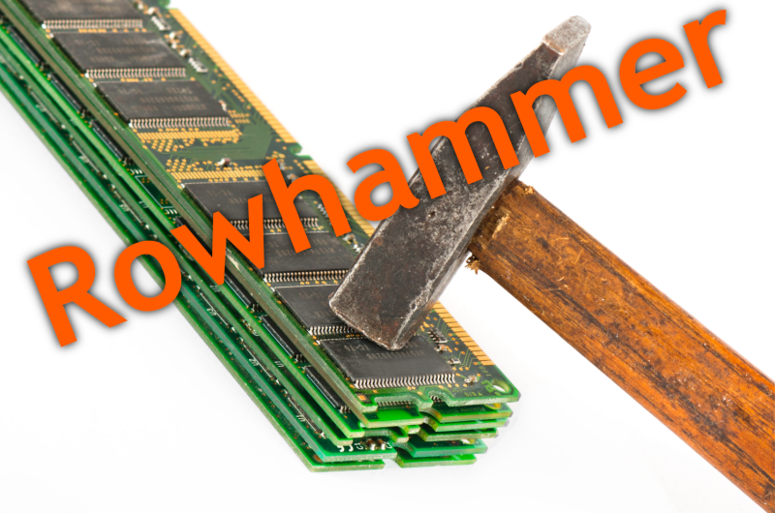
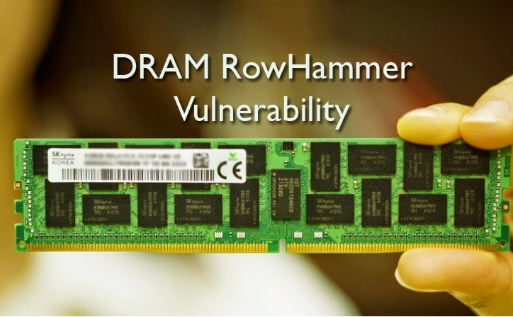
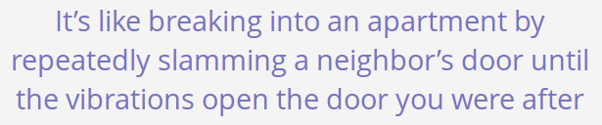
Security Implications
Notes:
Picture from the article:
http://thehackernews.com/2015/03/dram-rowhammer-vulnerability.html

Slide 71

More Security Implications (I)
“We can gain unrestricted access to systems of website visitors.”
Rowhammer.js: A Remote Software-Induced Fault Attack in JavaScript (DIMVA’16)
Source: https://lab.dsst.io/32c3-slides/7197.html

Slide 72

More Security Implications (II)
  “Can gain control of a smart phone deterministically”
Drammer: Deterministic Rowhammer Attacks on Mobile Platforms, CCS’16
Source: https://fossbytes.com/drammer-rowhammer-attack-android-root-devices/

Slide 73


More Security Implications (III)
Using an integrated GPU in a mobile system to remotely escalate privilege via the WebGL interface

Slide 74


More Security Implications (IV)
Rowhammer over RDMA (I)

Slide 75



More Security Implications (V)
Rowhammer over RDMA (II)

Slide 76

More Security Implications?

Slide 77

Apple’s Patch for RowHammer
https://support.apple.com/en-gb/HT204934
HP, Lenovo, and other vendors released similar patches

Slide 78
Our Solution to RowHammer
PARA: Probabilistic Adjacent Row Activation
Key Idea
  After closing a row, we activate (i.e., refresh) one of its neighbors with a low probability: p = 0.005
Reliability Guarantee
  When p=0.005, errors in one year: 9.4×10⁻¹⁴
  By adjusting the value of p, we can vary the strength of protection against errors
Notes:
We provide a more efficient solution, called PARA, which stands for probabilistic adjacent row activation.
The key idea is thus: after closing a row, we activate (i.e., refresh) one of its neighbors with a low probability, for example, p equal to 0.005.
PARA provides a strong reliability guarantee even under the worst-case access patterns to DRAM. When we set p to 0.005, the expected number of errors in one year is 9.4 times 10 to the negative 14. This probability is much lower the failure rate of other hardware components, for example, the hard-disk drive.
And by adjusting the value of p, PARA can provide an arbitrarily strong-degree of protection against errors.

Slide 79

More on RowHammer Analysis
Yoongu Kim, Ross Daly, Jeremie Kim, Chris Fallin, Ji Hye Lee, Donghyuk Lee, Chris Wilkerson, Konrad Lai, and Onur Mutlu,
"Flipping Bits in Memory Without Accessing Them: An Experimental Study of DRAM Disturbance Errors"
Proceedings of the 41st International Symposium on Computer Architecture (ISCA), Minneapolis, MN, June 2014.
[Slides (pptx) (pdf)] [Lightning Session Slides (pptx) (pdf)] [Source Code and Data]

Slide 80

Future of Memory Reliability
Onur Mutlu,
"The RowHammer Problem and Other Issues We May Face as Memory Becomes Denser"
Invited Paper in Proceedings of the Design, Automation, and Test in Europe Conference (DATE), Lausanne, Switzerland, March 2017.
[Slides (pptx) (pdf)]
https://people.inf.ethz.ch/omutlu/pub/rowhammer-and-other-memory-issues_date17.pdf

Slide 81
Industry Is Writing Papers About It, Too

Slide 82
Call for Intelligent Memory Controllers

Slide 83

Aside: Intelligent Controller for NAND Flash
USB Daughter Board
USB Jack
HAPS-52 Mother Board
Virtex-II Pro
(USB controller)
1x-nm
NAND Flash
Virtex-V FPGA
(NAND Controller)
[DATE 2012, ICCD 2012, DATE 2013, ITJ 2013, ICCD 2013, SIGMETRICS 2014, HPCA 2015, DSN 2015, MSST 2015, JSAC 2016, HPCA 2017, DFRWS 2017,
PIEEE 2017, HPCA 2018, SIGMETRICS 2018]
NAND Daughter Board
Cai+, “Error Characterization, Mitigation, and Recovery in Flash Memory Based Solid State Drives,” Proc. IEEE 2017.

Slide 84


Aside: Intelligent Controller for NAND Flash
Proceedings of the IEEE, Sept. 2017
https://arxiv.org/pdf/1706.08642

Slide 85
Takeaway
Main Memory Needs
Intelligent Controllers

Slide 86
Agenda
Major Trends Affecting Main Memory
The Need for Intelligent Memory Controllers
  Bottom Up: Push from Circuits and Devices
  Top Down: Pull from Systems and Applications
Processing in Memory: Two Directions
  Minimally Changing Memory Chips
  Exploiting 3D-Stacked Memory
How to Enable Adoption of Processing in Memory
Conclusion

Slide 87
Three Key Systems Trends
1. Data access is a major bottleneck
  Applications are increasingly data hungry
2. Energy consumption is a key limiter
3. Data movement energy dominates compute
  Especially true for off-chip to on-chip movement

Slide 88
The Need for More Memory Performance
In-memory Databases
[Mao+, EuroSys’12;
Clapp+ (Intel), IISWC’15]
Graph/Tree Processing
[Xu+, IISWC’12; Umuroglu+, FPL’15]
In-Memory Data Analytics
[Clapp+ (Intel), IISWC’15;
Awan+, BDCloud’15]
Datacenter Workloads
[Kanev+ (Google), ISCA’15]

Slide 89
Challenge and Opportunity for Future
High Performance,
Energy Efficient,
Sustainable

Slide 90
Maslow’s (Human) Hierarchy of Needs, Revisited
Maslow, “A Theory of Human Motivation,”
Psychological Review, 1943.
Maslow, “A Theory of Human Motivation,”
Psychological Review, 1943.
Maslow, “Motivation and Personality,”
Book, 1954-1970.
Everlasting energy
Source: https://www.simplypsychology.org/maslow.html

Slide 91
The Problem
Data access is the major performance and energy bottleneck
Our current
design principles
cause great energy waste
(and great performance loss)

Slide 92
The Problem
Processing of data
is performed
far away from the data

Slide 93

A Computing System
Three key components
Computation
Communication
Storage/memory
Burks, Goldstein, von Neumann, “Preliminary discussion of the
logical design of an electronic computing instrument,” 1946.
Image source: https://lbsitbytes2010.wordpress.com/2013/03/29/john-von-neumann-roll-no-15/

Slide 94
A Computing System
Three key components
Computation
Communication
Storage/memory
Burks, Goldstein, von Neumann, “Preliminary discussion of the
logical design of an electronic computing instrument,” 1946.
Image source: https://lbsitbytes2010.wordpress.com/2013/03/29/john-von-neumann-roll-no-15/

Slide 95
Today’s Computing Systems
Are overwhelmingly processor centric
All data processed in the processor → at great system cost
Processor is heavily optimized and is considered the master
Data storage units are dumb and are largely unoptimized (except for some that are on the processor die)

Slide 96

Yet …
“It’s the Memory, Stupid!” (Richard Sites, MPR, 1996)
Mutlu+, “Runahead Execution: An Alternative to Very Large Instruction Windows for Out-of-Order Processors,” HPCA 2003.

Slide 97
The Performance Perspective
Onur Mutlu, Jared Stark, Chris Wilkerson, and Yale N. Patt,
"Runahead Execution: An Alternative to Very Large Instruction Windows for Out-of-order Processors"
Proceedings of the 9th International Symposium on High-Performance Computer Architecture (HPCA), pages 129-140, Anaheim, CA, February 2003. Slides (pdf)

Slide 98
The Performance Perspective (Today)
All of Google’s Data Center Workloads (2015):
Kanev+, “Profiling a Warehouse-Scale Computer,” ISCA 2015.

Slide 99
The Performance Perspective (Today)
All of Google’s Data Center Workloads (2015):
Kanev+, “Profiling a Warehouse-Scale Computer,” ISCA 2015.

Slide 100
Perils of Processor-Centric Design
Grossly-imbalanced systems
  Processing done only in one place
  Everything else just stores and moves data: data moves a lot
  → Energy inefficient
  → Low performance
  → Complex
Overly complex and bloated processor (and accelerators)
  To tolerate data access from memory
  Complex hierarchies and mechanisms
  → Energy inefficient
  → Low performance
  → Complex

Slide 101
Perils of Processor-Centric Design
Most of the system is dedicated to storing and moving data

Slide 102

The Energy Perspective
Dally, HiPEAC 2015

Slide 103
Data Movement vs. Computation Energy
Dally, HiPEAC 2015
A memory access consumes ~1000X
the energy of a complex addition

Slide 104
Data Movement vs. Computation Energy
Data movement is a major system energy bottleneck
  Comprises 41% of mobile system energy during web browsing [2]
  Costs ~115 times as much energy as an ADD operation [1, 2]
[1]: Reducing data Movement Energy via Online Data Clustering and Encoding (MICRO’16)
[2]: Quantifying the energy cost of data movement for emerging smart phone workloads on mobile platforms (IISWC’14)

Slide 105
Energy Waste in Mobile Devices
Amirali Boroumand, Saugata Ghose, Youngsok Kim, Rachata Ausavarungnirun, Eric Shiu, Rahul Thakur, Daehyun Kim, Aki Kuusela, Allan Knies, Parthasarathy Ranganathan, and Onur Mutlu,
"Google Workloads for Consumer Devices: Mitigating Data Movement Bottlenecks"
Proceedings of the 23rd International Conference on Architectural Support for Programming Languages and Operating Systems (ASPLOS), Williamsburg, VA, USA, March 2018.
62.7% of the total system energy
is spent on data movement

Slide 106
We Do Not Want to Move Data!
Dally, HiPEAC 2015
A memory access consumes ~1000X
the energy of a complex addition

Slide 107
We Need A Paradigm Shift To …
Enable computation with minimal data movement
Compute where it makes sense (where data resides)
Make computing architectures more data-centric

Slide 108
Goal: Processing Inside Memory
Many questions … How do we design the:
  compute-capable memory & controllers?
  processor chip and in-memory units?
  software and hardware interfaces?
  system software and languages?
  algorithms?
Memory
Processor
Core
Database
Graphs
Media
Cache
Query
Interconnect
Problem
Results
Algorithm
Program/Language
System Software
SW/HW Interface
Micro-architecture
Logic
Devices
Electrons

Slide 109



Why In-Memory Computation Today?
Dally, HiPEAC 2015
Push from Technology
  DRAM Scaling at jeopardy
  → Controllers close to DRAM
  → Industry open to new memory architectures
Pull from Systems and Applications
  Data access is a major system and application bottleneck
  Systems are energy limited
  Data movement much more energy-hungry than computation

Slide 110
Agenda
Major Trends Affecting Main Memory
The Need for Intelligent Memory Controllers
  Bottom Up: Push from Circuits and Devices
  Top Down: Pull from Systems and Applications
Processing in Memory: Two Directions
  Minimally Changing Memory Chips
  Exploiting 3D-Stacked Memory
How to Enable Adoption of Processing in Memory
Conclusion

Slide 111
Processing in Memory:
Two Approaches
1. Minimally changing memory chips
2. Exploiting 3D-stacked memory

Slide 112
Approach 1: Minimally Changing DRAM
DRAM has great capability to perform bulk data movement and computation internally with small changes
  Can exploit internal connectivity to move data
  Can exploit analog computation capability
  …
Examples: RowClone, In-DRAM AND/OR, Gather/Scatter DRAM
  RowClone: Fast and Efficient In-DRAM Copy and Initialization of Bulk Data (Seshadri et al., MICRO 2013)
  Fast Bulk Bitwise AND and OR in DRAM (Seshadri et al., IEEE CAL 2015)
  Gather-Scatter DRAM: In-DRAM Address Translation to Improve the Spatial Locality of Non-unit Strided Accesses (Seshadri et al., MICRO 2015)
  "Ambit: In-Memory Accelerator for Bulk Bitwise Operations Using Commodity DRAM Technology” (Seshadri et al., MICRO 2017)

Slide 113

Starting Simple: Data Copy and Initialization
  memmove & memcpy: 5% cycles in Google’s datacenter [Kanev+ ISCA’15]
000000000000000
Zero initialization
(e.g., security)
Forking
Checkpointing
Many more
VM Cloning
Deduplication
Page Migration

Slide 114
Today’s Systems: Bulk Data Copy
1) High latency
Memory
3) Cache pollution
L3
CPU
L2
L1
MC
2) High bandwidth utilization
4) Unwanted data movement
1046ns, 3.6uJ (for 4KB page copy via DMA)

Slide 115
Future Systems: In-Memory Copy
3) No cache pollution
1) Low latency
Memory
L3
CPU
L2
L1
MC
2) Low bandwidth utilization
4) No unwanted data movement
1046ns, 3.6uJ
→ 90ns, 0.04uJ

Slide 116
RowClone: In-DRAM Row Copy
Idea: Two consecutive ACTivates
4 Kbytes
Negligible HW cost
Step 1: Activate row A
Step 2: Activate row B
Transfer row
DRAM subarray
Transfer
row
Row Buffer (4 Kbytes)
8 bits
Data Bus
Notes:
copy

Slide 117
RowClone: Latency and Energy Savings
11.6x
74x
Seshadri et al., “RowClone: Fast and Efficient In-DRAM Copy and Initialization of Bulk Data,” MICRO 2013.

Slide 118

More on RowClone
Vivek Seshadri, Yoongu Kim, Chris Fallin, Donghyuk Lee, Rachata Ausavarungnirun, Gennady Pekhimenko, Yixin Luo, Onur Mutlu, Michael A. Kozuch, Phillip B. Gibbons, and Todd C. Mowry,
"RowClone: Fast and Energy-Efficient In-DRAM Bulk Data Copy and Initialization"
Proceedings of the 46th International Symposium on Microarchitecture (MICRO), Davis, CA, December 2013. [Slides (pptx) (pdf)] [Lightning Session Slides (pptx) (pdf)] [Poster (pptx) (pdf)]

Slide 119
Memory as an Accelerator
CPU
core
CPU
core
mini-CPU
core
GPU
(throughput)
core
GPU
(throughput)
core
video
core
GPU
(throughput)
core
GPU
(throughput)
core
CPU
core
CPU
core
Memory
imaging
core
LLC
Specialized
compute-capability
in memory
Memory Controller
Memory Bus
Memory similar to a “conventional” accelerator

Slide 120
In-Memory Bulk Bitwise Operations
We can support in-DRAM COPY, ZERO, AND, OR, NOT, MAJ
At low cost
Using analog computation capability of DRAM
  Idea: activating multiple rows performs computation
30-60X performance and energy improvement
  Seshadri+, “Ambit: In-Memory Accelerator for Bulk Bitwise Operations Using Commodity DRAM Technology,” MICRO 2017.
New memory technologies enable even more opportunities
  Memristors, resistive RAM, phase change mem, STT-MRAM, …
  Can operate on data with minimal movement

Slide 121
In-DRAM AND/OR: Triple Row Activation
½V_{DD}
½V_{DD}+δ
V_{DD}
A
Final State
AB + BC + AC
B
C
C(A + B) + ~C(AB)
dis
en
0
½V_{DD}
Seshadri+, “Fast Bulk Bitwise AND and OR in DRAM”, IEEE CAL 2015.

Slide 122

In-DRAM NOT: Dual Contact Cell
Idea:
Feed the
negated value
in the sense amplifier
into a special row
Seshadri+, “Ambit: In-Memory Accelerator for Bulk Bitwise Operations using Commodity DRAM Technology,” MICRO 2017.

Slide 123
Performance: In-DRAM Bitwise Operations
Seshadri+, “Ambit: In-Memory Accelerator for Bulk Bitwise Operations using Commodity DRAM Technology,” MICRO 2017.

Slide 124
Energy of In-DRAM Bitwise Operations
Seshadri+, “Ambit: In-Memory Accelerator for Bulk Bitwise Operations using Commodity DRAM Technology,” MICRO 2017.

Slide 125
Ambit vs. DDR3: Performance and Energy
32X
35X
Seshadri+, “Ambit: In-Memory Accelerator for Bulk Bitwise Operations using Commodity DRAM Technology,” MICRO 2017.

Slide 126
Bulk Bitwise Operations in Workloads
[1] Li and Patel, BitWeaving, SIGMOD 2013
[2] Goodwin+, BitFunnel, SIGIR 2017

Slide 127
Example Data Structure: Bitmap Index
Alternative to B-tree and its variants
Efficient for performing range queries and joins
Many bitwise operations to perform a query
age < 18
18 < age < 25
25 < age < 60
age > 60
Bitmap 1
Bitmap 2
Bitmap 3
Bitmap 4

Slide 128
Performance: Bitmap Index on Ambit
Seshadri+, “Ambit: In-Memory Accelerator for Bulk Bitwise Operations using Commodity DRAM Technology,” MICRO 2017.

Slide 129
Performance: BitWeaving on Ambit
Seshadri+, “Ambit: In-Memory Accelerator for Bulk Bitwise Operations using Commodity DRAM Technology,” MICRO 2017.

Slide 130

More on In-DRAM Bulk AND/OR
Vivek Seshadri, Kevin Hsieh, Amirali Boroumand, Donghyuk Lee, Michael A. Kozuch, Onur Mutlu, Phillip B. Gibbons, and Todd C. Mowry,
"Fast Bulk Bitwise AND and OR in DRAM"
IEEE Computer Architecture Letters (CAL), April 2015.

Slide 131
More on Ambit
Vivek Seshadri et al., “Ambit: In-Memory Accelerator for Bulk Bitwise Operations Using Commodity DRAM Technology,” MICRO 2017.

Slide 132
Challenge and Opportunity for Future
Computing Architectures
with
Minimal Data Movement

Slide 133
Challenge: Intelligent Memory Device
Does memory
have to be
dumb?

Slide 134
Agenda
Major Trends Affecting Main Memory
The Need for Intelligent Memory Controllers
  Bottom Up: Push from Circuits and Devices
  Top Down: Pull from Systems and Applications
Processing in Memory: Two Directions
  Minimally Changing Memory Chips
  Exploiting 3D-Stacked Memory
How to Enable Adoption of Processing in Memory
Conclusion

Slide 135
Processing in Memory:
Two Approaches
1. Minimally changing memory chips
2. Exploiting 3D-stacked memory

Slide 136
Opportunity: 3D-Stacked Logic+Memory
Memory
Logic
Other “True 3D” technologies
under development

Slide 137
DRAM Landscape (circa 2015)
  Kim+, “Ramulator: A Flexible and Extensible DRAM Simulator”, IEEE CAL 2015.

Slide 138
Two Key Questions in 3D-Stacked PIM
How can we accelerate important applications if we use 3D-stacked memory as a coarse-grained accelerator?
  what is the architecture and programming model?
  what are the mechanisms for acceleration?
What is the minimal processing-in-memory support we can provide?
  without changing the system significantly
  while achieving significant benefits

Slide 139




Graph Processing
Large graphs are everywhere (circa 2015)
Scalable large-scale graph processing is challenging
36 Million
Wikipedia Pages
1.4 Billion
Facebook Users
300 Million
Twitter Users
30 Billion
Instagram Photos

Slide 140
Key Bottlenecks in Graph Processing
for (v: graph.vertices) {
for (w: v.successors) {
w.next_rank += weight * v.rank;
}
}
1. Frequent random memory accesses
v
&w
w.rank
w.next_rank
w.edges
weight * v.rank
w
…
2. Little amount of computation

Slide 141
Tesseract System for Graph Processing
Interconnected set of 3D-stacked memory+logic chips with simple cores
Host Processor
Memory
Memory-Mapped
Accelerator Interface
(Noncacheable, Physically Addressed)
Logic
In-Order Core
DRAM Controller
…
…
LP
PF Buffer
Crossbar Network
…
MTP
…
Message Queue
NI
Ahn+, “A Scalable Processing-in-Memory Accelerator for Parallel Graph Processing” ISCA 2015.

Slide 142
Tesseract System for Graph Processing
Host Processor
Memory
Memory-Mapped
Accelerator Interface
(Noncacheable, Physically Addressed)
Logic
In-Order Core
DRAM Controller
…
…
Communications via
Remote Function Calls
LP
PF Buffer
Crossbar Network
…
MTP
…
Message Queue
NI

Slide 143
Tesseract System for Graph Processing
Host Processor
Memory
Memory-Mapped
Accelerator Interface
(Noncacheable, Physically Addressed)
Logic
Prefetching
In-Order Core
DRAM Controller
…
…
LP
PF Buffer
Crossbar Network
…
MTP
…
Message Queue
NI

Slide 144
Evaluated Systems
DDR3-OoO
HMC-OoO
HMC-MC
Tesseract
32 Tesseract Cores
8 OoO
4GHz
8 OoO
4GHz
8 OoO
4GHz
8 OoO
4GHz
128
In-Order
2GHz
128
In-Order
2GHz
8 OoO
4GHz
8 OoO
4GHz
8 OoO
4GHz
8 OoO
4GHz
128
In-Order
2GHz
128
In-Order
2GHz
102.4GB/s
640GB/s
640GB/s
8TB/s
Ahn+, “A Scalable Processing-in-Memory Accelerator for Parallel Graph Processing” ISCA 2015.

Slide 145
Tesseract Graph Processing Performance
>13X Performance Improvement
On five graph processing algorithms
Ahn+, “A Scalable Processing-in-Memory Accelerator for Parallel Graph Processing” ISCA 2015.

Slide 146
Tesseract Graph Processing Performance

Slide 147
Tesseract Graph Processing System Energy
> 8X Energy Reduction
Ahn+, “A Scalable Processing-in-Memory Accelerator for Parallel Graph Processing” ISCA 2015.

Slide 148

More on Tesseract
Junwhan Ahn, Sungpack Hong, Sungjoo Yoo, Onur Mutlu, and Kiyoung Choi,
"A Scalable Processing-in-Memory Accelerator for Parallel Graph Processing"
Proceedings of the 42nd International Symposium on Computer Architecture (ISCA), Portland, OR, June 2015.
[Slides (pdf)] [Lightning Session Slides (pdf)]

Slide 149
PIM on Mobile Devices
Amirali Boroumand, Saugata Ghose, Youngsok Kim, Rachata Ausavarungnirun, Eric Shiu, Rahul Thakur, Daehyun Kim, Aki Kuusela, Allan Knies, Parthasarathy Ranganathan, and Onur Mutlu,
"Google Workloads for Consumer Devices: Mitigating Data Movement Bottlenecks"
Proceedings of the 23rd International Conference on Architectural Support for Programming Languages and Operating Systems (ASPLOS), Williamsburg, VA, USA, March 2018.

Slide 150





Google Workloads for Consumer Devices:
Mitigating Data Movement Bottlenecks
Amirali Boroumand
Saugata Ghose, Youngsok Kim, Rachata Ausavarungnirun,
Eric Shiu, Rahul Thakur, Daehyun Kim, Aki Kuusela,
Allan Knies, Parthasarathy Ranganathan, Onur Mutlu

Slide 151




Consumer Devices
Consumer devices are everywhere!
Energy consumption is
a first-class concern in consumer devices
Notes:
Consumer devices like tablets smartphone and wearable are now everywhere and used by billions of people.
One of the major challenge in these devices is battery limitation which makes the energy consumption a critical concern …

Slide 152





Popular Google Consumer Workloads
  Chrome
TensorFlow Mobile
    Google’s web browser
Google’s machine learning framework
  Video Playback
  Video Capture
Google’s video codec
Google’s video codec
Notes:
In this work, we take a look at widely-used google consumer workloads, to figure out the major sources of energy consumption.
We look at Google Chrome web brower. We take a look at Tensorflow, Google’s machine learning framework, and we also take a look at two important video related workloads, video playback and video capture, both rely on Google’s vp9 codec technology.

Slide 153
Energy Cost of Data Movement
1st key observation: 62.7% of the total system energy is spent on data movement
Data Movement
SoC
DRAM
CPU
L2
CPU
L1
CPU
CPU
Compute Unit
Processing-In-Memory (PIM)
  Potential solution: move computation close to data
  Challenge: limited area and energy budget
Notes:
Throughout our analysis, we make a key observation that out of all sources of energy consumption, data movement is a major contributor to the total system energy. We find that across all of the workloads, on average around 62.7% of total system energy is spent on data movement.
One way to reduce data movement cost is to move computation close to data, or …
One potential solution to address this cost it do move computation close to data, or in other words, do procesing in memory. However, the challenge is that these devices.
One potential solution to mitigate data movement cost and reduce total system energy is to execute data-movement heavy portions of application close to data, or in other words, do processing in memory. However, consumer devices are extermely limited in terms of area and power budget. So the question is can we move part of the data movement heavy portion given the limited area and energy budget. Our

Slide 154
Using PIM to Reduce Data Movement
  2nd key observation: a significant fraction of the
  data movement often comes from simple functions
We can design lightweight logic to implement
these simple functions in memory
Small embedded
low-power core
Small fixed-function accelerators
PIM Core
PIM Accelerator
PIM Accelerator
PIM Accelerator
  Offloading to PIM logic reduces energy and improves performance, on average, by 55.4% and 54.2%
Notes:
To figure out if we can use processing in memory, we dig deeper into our analysis and we make another key observation that majority of data movement often comes form simple functions and pritmitives. We find that these simple function can be implemented in memory as either a small embedded core, or group of small fixed function accelerators. Our result shows that offloading these function to PIM logic can significantly reduce data movement for each function and reduce energy on average around 55% and improve perforamcne around 54%.
our PIM core can reduce significant portion of data movement, reduce enregy by 49.1% for each function and improve performance up to 2.2X. While using group of fixed function accelerator reduce energy by 55.4% and improve performance by up to 2.5X.
Or use Saugata’s approach : Reduces total system energy by an average of 55.4%
Reduces execution time by an average of 54.2%
Our result show that both of them can significantly reduce the data movement for each function.
Feedback: talk about result more
Don’t talk about specific detail like MemCopy, MemSet stuff like that
Main take away: data movement come from simple functions that are simple enough to implement in PIM
We find that these functions and primitves can be implemented as PIM logic using either (1) a small low-power general-purpose embedded core or (2) a group of small fixed-function accelerators (PIM accelerators). Our Analysis shows that both are cost-feasible to use in consumer devices. We find that they eliminate a significant fraction of dat amovement, and reduce energy consumption for each of these operation on average by 49 and 55%.

Slide 155
Google Workloads for Consumer Devices:
Mitigating Data Movement Bottlenecks
Amirali Boroumand
Saugata Ghose, Youngsok Kim, Rachata Ausavarungnirun,
Eric Shiu, Rahul Thakur, Daehyun Kim, Aki Kuusela,
Allan Knies, Parthasarathy Ranganathan, Onur Mutlu
ASPLOS 2018
Notes:
Please drop by our talk during session 1 if you would like to learn more about data movement in Google workloads.

Slide 156
More on PIM for Mobile Devices
Amirali Boroumand, Saugata Ghose, Youngsok Kim, Rachata Ausavarungnirun, Eric Shiu, Rahul Thakur, Daehyun Kim, Aki Kuusela, Allan Knies, Parthasarathy Ranganathan, and Onur Mutlu,
"Google Workloads for Consumer Devices: Mitigating Data Movement Bottlenecks"
Proceedings of the 23rd International Conference on Architectural Support for Programming Languages and Operating Systems (ASPLOS), Williamsburg, VA, USA, March 2018.
62.7% of the total system energy
is spent on data movement

Slide 157

Truly Distributed GPU Processing with PIM?
3D-stacked memory
(memory stack)
SM (Streaming Multiprocessor)
Logic layer
Logic layer SM
Main GPU
Crossbar switch
Vault Ctrl
….
Vault Ctrl

Slide 158

Accelerating GPU Execution with PIM (I)
Kevin Hsieh, Eiman Ebrahimi, Gwangsun Kim, Niladrish Chatterjee, Mike O'Connor, Nandita Vijaykumar, Onur Mutlu, and Stephen W. Keckler,
"Transparent Offloading and Mapping (TOM): Enabling Programmer-Transparent Near-Data Processing in GPU Systems"
Proceedings of the 43rd International Symposium on Computer Architecture (ISCA), Seoul, South Korea, June 2016.
[Slides (pptx) (pdf)]
[Lightning Session Slides (pptx) (pdf)]

Slide 159

Accelerating GPU Execution with PIM (II)
Ashutosh Pattnaik, Xulong Tang, Adwait Jog, Onur Kayiran, Asit K. Mishra, Mahmut T. Kandemir, Onur Mutlu, and Chita R. Das,
"Scheduling Techniques for GPU Architectures with Processing-In-Memory Capabilities"
Proceedings of the 25th International Conference on Parallel Architectures and Compilation Techniques (PACT), Haifa, Israel, September 2016.

Slide 160

Accelerating Linked Data Structures
Kevin Hsieh, Samira Khan, Nandita Vijaykumar, Kevin K. Chang, Amirali Boroumand, Saugata Ghose, and Onur Mutlu,
"Accelerating Pointer Chasing in 3D-Stacked Memory: Challenges, Mechanisms, Evaluation"
Proceedings of the 34th IEEE International Conference on Computer Design (ICCD), Phoenix, AZ, USA, October 2016.

Slide 161
Two Key Questions in 3D-Stacked PIM
How can we accelerate important applications if we use 3D-stacked memory as a coarse-grained accelerator?
  what is the architecture and programming model?
  what are the mechanisms for acceleration?
What is the minimal processing-in-memory support we can provide?
  without changing the system significantly
  while achieving significant benefits

Slide 162

Simpler PIM: PIM-Enabled Instructions
Junwhan Ahn, Sungjoo Yoo, Onur Mutlu, and Kiyoung Choi,
"PIM-Enabled Instructions: A Low-Overhead, Locality-Aware Processing-in-Memory Architecture"
Proceedings of the 42nd International Symposium on Computer Architecture (ISCA), Portland, OR, June 2015.
[Slides (pdf)] [Lightning Session Slides (pdf)]

Slide 163
Automatic Code and Data Mapping
Kevin Hsieh, Eiman Ebrahimi, Gwangsun Kim, Niladrish Chatterjee, Mike O'Connor, Nandita Vijaykumar, Onur Mutlu, and Stephen W. Keckler,
"Transparent Offloading and Mapping (TOM): Enabling Programmer-Transparent Near-Data Processing in GPU Systems"
Proceedings of the 43rd International Symposium on Computer Architecture (ISCA), Seoul, South Korea, June 2016.
[Slides (pptx) (pdf)]
[Lightning Session Slides (pptx) (pdf)]

Slide 164
Challenge and Opportunity for Future
Fundamentally
Energy-Efficient
(Data-Centric)
Computing Architectures

Slide 165
Challenge and Opportunity for Future
Fundamentally
Low-Latency
(Data-Centric)
Computing Architectures

Slide 166
Challenge and Opportunity for Future
Computing Architectures
with
Minimal Data Movement

Slide 167
Agenda
Major Trends Affecting Main Memory
The Need for Intelligent Memory Controllers
  Bottom Up: Push from Circuits and Devices
  Top Down: Pull from Systems and Applications
Processing in Memory: Two Directions
  Minimally Changing Memory Chips
  Exploiting 3D-Stacked Memory
How to Enable Adoption of Processing in Memory
Conclusion

Slide 168
Eliminating the Adoption Barriers
How to Enable Adoption of Processing in Memory

Slide 169
Barriers to Adoption of PIM
1. Functionality of and applications for PIM
2. Ease of programming (interfaces and compiler/HW support)
3. System support: coherence & virtual memory
4. Runtime systems for adaptive scheduling, data mapping, access/sharing control
5. Infrastructures to assess benefits and feasibility

Slide 170
We Need to Revisit the Entire Stack
Problem
Algorithm
Program/Language
System Software
SW/HW Interface
Micro-architecture
Logic
Devices
Electrons

Slide 171
Key Challenge 1: Code Mapping
Challenge 1: Which operations should be executed in memory vs. in CPU?
?
3D-stacked memory
(memory stack)
SM (Streaming Multiprocessor)
?
Logic layer
Logic layer SM
Main GPU
Crossbar switch
Vault Ctrl
….
Vault Ctrl

Slide 172
Key Challenge 2: Data Mapping
Challenge 2: How should data be mapped to different 3D memory stacks?
3D-stacked memory
(memory stack)
SM (Streaming Multiprocessor)
Logic layer
Logic layer SM
Main GPU
Crossbar switch
Vault Ctrl
….
Vault Ctrl

Slide 173
How to Do the Code and Data Mapping?
Kevin Hsieh, Eiman Ebrahimi, Gwangsun Kim, Niladrish Chatterjee, Mike O'Connor, Nandita Vijaykumar, Onur Mutlu, and Stephen W. Keckler,
"Transparent Offloading and Mapping (TOM): Enabling Programmer-Transparent Near-Data Processing in GPU Systems"
Proceedings of the 43rd International Symposium on Computer Architecture (ISCA), Seoul, South Korea, June 2016.
[Slides (pptx) (pdf)]
[Lightning Session Slides (pptx) (pdf)]

Slide 174
How to Schedule Code?
Ashutosh Pattnaik, Xulong Tang, Adwait Jog, Onur Kayiran, Asit K. Mishra, Mahmut T. Kandemir, Onur Mutlu, and Chita R. Das,
"Scheduling Techniques for GPU Architectures with Processing-In-Memory Capabilities"
Proceedings of the 25th International Conference on Parallel Architectures and Compilation Techniques (PACT), Haifa, Israel, September 2016.

Slide 175

Challenge: Coherence for Hybrid CPU-PIM Apps
Traditional
coherence
No coherence
overhead

Slide 176

How to Maintain Coherence?
Amirali Boroumand, Saugata Ghose, Minesh Patel, Hasan Hassan, Brandon Lucia, Kevin Hsieh, Krishna T. Malladi, Hongzhong Zheng, and Onur Mutlu,
"LazyPIM: An Efficient Cache Coherence Mechanism for Processing-in-Memory"
IEEE Computer Architecture Letters (CAL), June 2016.

Slide 177
How to Support Virtual Memory?
Kevin Hsieh, Samira Khan, Nandita Vijaykumar, Kevin K. Chang, Amirali Boroumand, Saugata Ghose, and Onur Mutlu,
"Accelerating Pointer Chasing in 3D-Stacked Memory: Challenges, Mechanisms, Evaluation"
Proceedings of the 34th IEEE International Conference on Computer Design (ICCD), Phoenix, AZ, USA, October 2016.

Slide 178
How to Design Data Structures for PIM?
Zhiyu Liu, Irina Calciu, Maurice Herlihy, and Onur Mutlu,
"Concurrent Data Structures for Near-Memory Computing"
Proceedings of the 29th ACM Symposium on Parallelism in Algorithms and Architectures (SPAA), Washington, DC, USA, July 2017.
[Slides (pptx) (pdf)]

Slide 179

Simulation Infrastructures for PIM
Ramulator extended for PIM
  Flexible and extensible DRAM simulator
  Can model many different memory standards and proposals
  Kim+, “Ramulator: A Flexible and Extensible DRAM Simulator”, IEEE CAL 2015.
  https://github.com/CMU-SAFARI/ramulator

Slide 180
An FPGA-based Test-bed for PIM?
Hasan Hassan et al., SoftMC: A Flexible and Practical Open-Source Infrastructure for Enabling Experimental DRAM Studies HPCA 2017.
Flexible
Easy to Use (C++ API)
Open-source
github.com/CMU-SAFARI/SoftMC

Slide 181
New Applications and Use Cases for PIM
Jeremie Kim, Damla Senol, Hongyi Xin, Donghyuk Lee, Mohammed Alser, Hasan Hassan, Oguz Ergin, Can Alkan, and Onur Mutlu,
"Genome Read In-Memory (GRIM) Filter: Fast Location Filtering in DNA Read Mapping Using Emerging Memory Technologies"
Pacific Symposium on Biocomputing (PSB) Poster Session, Hawaii, January 2017.
[Poster (pdf) (pptx)] [Abstract (pdf)]
To Appear in APBC 2018 and BMC Genomics 2018.

Slide 182
Agenda
Major Trends Affecting Main Memory
The Need for Intelligent Memory Controllers
  Bottom Up: Push from Circuits and Devices
  Top Down: Pull from Systems and Applications
Processing in Memory: Two Directions
  Minimally Changing Memory Chips
  Exploiting 3D-Stacked Memory
How to Enable Adoption of Processing in Memory
Conclusion

Slide 183
Maslow’s Hierarchy of Needs, A Third Time
Maslow, “A Theory of Human Motivation,”
Psychological Review, 1943.
Maslow, “Motivation and Personality,”
Book, 1954-1970.
Speed
Speed
Speed
Speed
Speed
Source: https://www.simplypsychology.org/maslow.html

Slide 184
Challenge and Opportunity for Future
Fundamentally
Energy-Efficient
(Data-Centric)
Computing Architectures

Slide 185
Challenge and Opportunity for Future
Fundamentally
Low-Latency
(Data-Centric)
Computing Architectures

Slide 186
Challenge and Opportunity for Future
Computing Architectures
with
Minimal Data Movement

Slide 187
Concluding Remarks

Slide 188

A Quote from A Famous Architect
“architecture […] based upon principle, and not upon precedent”

Slide 189

Precedent-Based Design?
“architecture […] based upon principle, and not upon precedent”

Slide 190

Principled Design
“architecture […] based upon principle, and not upon precedent”

Slide 191


Slide 192


The Overarching Principle

Slide 193

Another Example: Precedent-Based Design
Source: http://cookiemagik.deviantart.com/art/Train-station-207266944

Slide 194

Principled Design
Source: By Toni_V, CC BY-SA 2.0, https://commons.wikimedia.org/w/index.php?curid=4087256

Slide 195


Another Principled Design
Source: By Martín Gómez Tagle - Lisbon, Portugal, CC BY-SA 3.0, https://commons.wikimedia.org/w/index.php?curid=13764903
Source: http://www.arcspace.com/exhibitions/unsorted/santiago-calatrava/

Slide 196


Principle Applied to Another Structure
Source: By 準建築人手札網站 Forgemind ArchiMedia - Flickr: IMG_2489.JPG, CC BY 2.0,
https://commons.wikimedia.org/w/index.php?curid=31493356, https://en.wikipedia.org/wiki/Santiago_Calatrava
Source: https://www.dezeen.com/2016/08/29/santiago-calatrava-oculus-world-trade-center-transportation-hub-new-york-photographs-hufton-crow/

Slide 197


The Overarching Principle

Slide 198

Overarching Principle for Computing?
Source: http://spectrum.ieee.org/image/MjYzMzAyMg.jpeg

Slide 199
Concluding Remarks
It is time to design principled system architectures to solve the memory problem
Design complete systems to be balanced, high-performance, and energy-efficient, i.e., data-centric (or memory-centric)
Enable computation capability inside and close to memory
This can
  Lead to orders-of-magnitude improvements
  Enable new applications & computing platforms
  Enable better understanding of nature
  …
Notes:
Perhaps we have taken processor-centric system design a bit too far

Slide 200
The Future of Processing in Memory is Bright
Regardless of challenges
  in underlying technology and overlying problems/requirements
Problem
Can enable:
- Orders of magnitude
improvements
- New applications and
computing systems
Yet, we have to
- Think across the stack
- Design enabling systems
Algorithm
Program/Language
System Software
SW/HW Interface
Micro-architecture
Logic
Devices
Electrons

Slide 201
If In Doubt, See Other Doubtful Technologies
A very “doubtful” emerging technology
  for at least two decades
Proceedings of the IEEE, Sept. 2017
https://arxiv.org/pdf/1706.08642

Slide 202
Processing Data Where It Makes Sense in Modern Computing Systems:
Enabling In-Memory Computation
Onur Mutlu
omutlu@gmail.com
https://people.inf.ethz.ch/omutlu
13 June 2018
MECO 2018 Keynote Talk

Slide 203
Acknowledgments
My current and past students and postdocs
  Rachata Ausavarungnirun, Abhishek Bhowmick, Amirali Boroumand, Rui Cai, Yu Cai, Kevin Chang, Saugata Ghose, Kevin Hsieh, Tyler Huberty, Ben Jaiyen, Samira Khan, Jeremie Kim, Yoongu Kim, Yang Li, Jamie Liu, Lavanya Subramanian, Donghyuk Lee, Yixin Luo, Justin Meza, Gennady Pekhimenko, Vivek Seshadri, Lavanya Subramanian, Nandita Vijaykumar, HanBin Yoon, Jishen Zhao, …
My collaborators
  Can Alkan, Chita Das, Phil Gibbons, Sriram Govindan, Norm Jouppi, Mahmut Kandemir, Mike Kozuch, Konrad Lai, Ken Mai, Todd Mowry, Yale Patt, Moinuddin Qureshi, Partha Ranganathan, Bikash Sharma, Kushagra Vaid, Chris Wilkerson, …

Slide 204
Funding Acknowledgments
NSF
GSRC
SRC
CyLab
Alibaba, AMD, Google, Facebook, HP Labs, Huawei, IBM, Intel, Microsoft, Nvidia, Oracle, Qualcomm, Rambus, Samsung, Seagate, VMware

Slide 205
Some Open Source Tools
Rowhammer
  https://github.com/CMU-SAFARI/rowhammer
Ramulator – Fast and Extensible DRAM Simulator
  https://github.com/CMU-SAFARI/ramulator
MemSim
  https://github.com/CMU-SAFARI/memsim
NOCulator
  https://github.com/CMU-SAFARI/NOCulator
DRAM Error Model
  http://www.ece.cmu.edu/~safari/tools/memerr/index.html
Other open-source software from my group
  https://github.com/CMU-SAFARI/
  http://www.ece.cmu.edu/~safari/tools.html

Slide 206
Tesseract: Extra Slides

Slide 207
Communications In Tesseract (I)

Slide 208
Communications In Tesseract (II)

Slide 209
Communications In Tesseract (III)

Slide 210
Remote Function Call (Non-Blocking)

Slide 211
Effect of Bandwidth & Programming Model
HMC-MC Bandwidth (640GB/s)
Tesseract Bandwidth (8TB/s)
Programming Model
Bandwidth
(No Prefetching)

Slide 212
Reducing Memory Latency

Slide 213
Main Memory Latency Lags Behind
128x
20x
1.3x
Memory latency remains almost constant

Slide 214

A Closer Look …
Chang+, “Understanding Latency Variation in Modern DRAM Chips: Experimental
Characterization, Analysis, and Optimization",” SIGMETRICS 2016.

Slide 215
DRAM Latency Is Critical for Performance
In-memory Databases
[Mao+, EuroSys’12;
Clapp+ (Intel), IISWC’15]
Graph/Tree Processing
[Xu+, IISWC’12; Umuroglu+, FPL’15]
In-Memory Data Analytics
[Clapp+ (Intel), IISWC’15;
Awan+, BDCloud’15]
Datacenter Workloads
[Kanev+ (Google), ISCA’15]

Slide 216
DRAM Latency Is Critical for Performance
In-memory Databases
[Mao+, EuroSys’12;
Clapp+ (Intel), IISWC’15]
Graph/Tree Processing
[Xu+, IISWC’12; Umuroglu+, FPL’15]
Long memory latency → performance bottleneck
In-Memory Data Analytics
[Clapp+ (Intel), IISWC’15;
Awan+, BDCloud’15]
Datacenter Workloads
[Kanev+ (Google), ISCA’15]

Slide 217
Why the Long Latency?
Design of DRAM uArchitecture
  Goal: Maximize capacity/area, not minimize latency
“One size fits all” approach to latency specification
  Same latency parameters for all temperatures
  Same latency parameters for all DRAM chips (e.g., rows)
  Same latency parameters for all parts of a DRAM chip
  Same latency parameters for all supply voltage levels
  Same latency parameters for all application data
  …

Slide 218

Latency Variation in Memory Chips
Heterogeneous manufacturing & operating conditions →
latency variation in timing parameters
DRAM A
DRAM B
DRAM C
Slow cells
Low
High
DRAM Latency

Slide 219
DRAM Characterization Infrastructure
Temperature
Controller
FPGAs
Heater
FPGAs
PC
  Kim+, “Flipping Bits in Memory Without Accessing Them: An Experimental Study of DRAM Disturbance Errors,” ISCA 2014.

Slide 220
DRAM Characterization Infrastructure
Hasan Hassan et al., SoftMC: A Flexible and Practical Open-Source Infrastructure for Enabling Experimental DRAM Studies, HPCA 2017.
Flexible
Easy to Use (C++ API)
Open-source
github.com/CMU-SAFARI/SoftMC

Slide 221
SoftMC: Open Source DRAM Infrastructure
https://github.com/CMU-SAFARI/SoftMC

Slide 222
Tackling the Fixed Latency Mindset
Reliable operation latency is actually very heterogeneous
  Across temperatures, chips, parts of a chip, voltage levels, …
Idea: Dynamically find out and use the lowest latency one can reliably access a memory location with
  Adaptive-Latency DRAM [HPCA 2015]
  Flexible-Latency DRAM [SIGMETRICS 2016]
  Design-Induced Variation-Aware DRAM [SIGMETRICS 2017]
  Voltron [SIGMETRICS 2017]
  ...
We would like to find sources of latency heterogeneity and exploit them to minimize latency

Slide 223
Adaptive-Latency DRAM
Key idea
  Optimize DRAM timing parameters online
Two components
  DRAM manufacturer provides multiple sets of reliable DRAM timing parameters at different temperatures for each DIMM
  System monitors DRAM temperature & uses appropriate DRAM timing parameters
reliable DRAM timing parameters
DRAM temperature
Lee+, “Adaptive-Latency DRAM: Optimizing DRAM Timing for the Common-Case,” HPCA 2015.

Slide 224
Latency Reduction Summary of 115 DIMMs
Latency reduction for read & write (55°C)
  Read Latency: 32.7%
  Write Latency: 55.1%
Latency reduction for each timing parameter (55°C)
  Sensing: 17.3%
  Restore: 37.3% (read), 54.8% (write)
  Precharge: 35.2%
Lee+, “Adaptive-Latency DRAM: Optimizing DRAM Timing for the Common-Case,” HPCA 2015.

Slide 225


AL-DRAM: Real System Evaluation
System
  CPU: AMD 4386 ( 8 Cores, 3.1GHz, 8MB LLC)
  DRAM: 4GByte DDR3-1600 (800Mhz Clock)
  OS: Linux
  Storage: 128GByte SSD
Workload
  35 applications from SPEC, STREAM, Parsec, Memcached, Apache, GUPS

Slide 226
AL-DRAM: Single-Core Evaluation
Average
Improvement
6.7%
Performance Improvement
5.0%
1.4%
all-35-workload
AL-DRAM improves single-core performance
on a real system

Slide 227
AL-DRAM: Multi-Core Evaluation
Average
Improvement
14.0%
10.4%
Performance Improvement
2.9%
all-35-workload
AL-DRAM provides higher performance on
multi-programmed & multi-threaded workloads

Slide 228
Reducing Latency Also Reduces Energy
AL-DRAM reduces DRAM power consumption by 5.8%
Major reason: reduction in row activation time

Slide 229

More on Adaptive-Latency DRAM
Donghyuk Lee, Yoongu Kim, Gennady Pekhimenko, Samira Khan, Vivek Seshadri, Kevin Chang, and Onur Mutlu,
"Adaptive-Latency DRAM: Optimizing DRAM Timing for the Common-Case"
Proceedings of the 21st International Symposium on High-Performance Computer Architecture (HPCA), Bay Area, CA, February 2015.
[Slides (pptx) (pdf)] [Full data sets]

Slide 230
Heterogeneous Latency within A Chip
19.7%
19.5%
17.6%
13.3%
Chang+, “Understanding Latency Variation in Modern DRAM Chips: Experimental
Characterization, Analysis, and Optimization",” SIGMETRICS 2016.

Slide 231

Analysis of Latency Variation in DRAM Chips
Kevin Chang, Abhijith Kashyap, Hasan Hassan, Samira Khan, Kevin Hsieh, Donghyuk Lee, Saugata Ghose, Gennady Pekhimenko, Tianshi Li, and Onur Mutlu,
"Understanding Latency Variation in Modern DRAM Chips: Experimental Characterization, Analysis, and Optimization"
Proceedings of the ACM International Conference on Measurement and Modeling of Computer Systems (SIGMETRICS), Antibes Juan-Les-Pins, France, June 2016.
[Slides (pptx) (pdf)]
[Source Code]

Slide 232
What Is Design-Induced Variation?
fast
slow
across column
inherently slow
distance from wordline driver
slow
across row
wordline drivers
distance from sense amplifier
fast
Inherently fast
sense amplifiers
Systematic variation in cell access times
caused by the physical organization of DRAM
Notes:
As we described, cells in a mat have different distances from peripheral logic.
Cells in different rows have different distance from the sense amplifiers.
Cells in different columns have different distance from the wordline drivers.
Therefore, some regions are inherently faster than other regions,
and some regions are inherently slower than other regions.
We call this architectural variation.

Slide 233
DIVA Online Profiling
Design-Induced-Variation-Aware
inherently slow
wordline driver
sense amplifier
Profile only slow regions to determine min. latency
→ Dynamic & low cost latency optimization
Notes:
We propoe AVA Online profiling.
The key idea is profiling only slow regions to determine latency, leading to low cost online DRAM test.

Slide 234
DIVA Online Profiling
Design-Induced-Variation-Aware
slow cells
inherently slow
process
variation
design-induced
variation
wordline driver
random error
localized error
error-correcting code
online profiling
sense amplifier
Combine error-correcting codes & online profiling
→ Reliably reduce DRAM latency
Notes:
However, due to the process variation, some cells are more vulnerable than other cells, as the figure show.
These cells are randomly distributed while cells in the slow regions cause localized error.
To address both type of cells,
We integrate conventional ECC to correct the process variation induced errors.
Therefore, combining ECC and online profiling leads to reliably reducing DRAM latency.

Slide 235
DIVA-DRAM Reduces Latency
Read
Write
Latency Reduction
DIVA
DIVA
DIVA
DIVA
DIVA-DRAM reduces latency more aggressively
and uses ECC to correct random slow cells
Notes:
The figure compares latency reduction by using AL-DRAM, AVA Profiling, and both AVA Profiling and Shuffling.
As we can, using AVA profiling and shuffling enables more latency reduction compared to AL-DRAM.
This is mainly because ECC corrects the worst cells in a DRAM module, reducing more latency.
Therefore, we conclude that AVA-DRAM reduces latency significantly.

Slide 236

Design-Induced Latency Variation in DRAM
Donghyuk Lee, Samira Khan, Lavanya Subramanian, Saugata Ghose, Rachata Ausavarungnirun, Gennady Pekhimenko, Vivek Seshadri, and Onur Mutlu,
"Design-Induced Latency Variation in Modern DRAM Chips: Characterization, Analysis, and Latency Reduction Mechanisms"
Proceedings of the ACM International Conference on Measurement and Modeling of Computer Systems (SIGMETRICS), Urbana-Champaign, IL, USA, June 2017.

Slide 237
Voltron: Exploiting the
Voltage-Latency-Reliability Relationship

Slide 238
Executive Summary
DRAM (memory) power is significant in today’s systems
  Existing low-voltage DRAM reduces voltage conservatively
Goal: Understand and exploit the reliability and latency behavior of real DRAM chips under aggressive reduced-voltage operation
Key experimental observations:
  Huge voltage margin -- Errors occur beyond some voltage
  Errors exhibit spatial locality
  Higher operation latency mitigates voltage-induced errors
Voltron: A new DRAM energy reduction mechanism
  Reduce DRAM voltage without introducing errors
  Use a regression model to select voltage that does not degrade performance beyond a chosen target → 7.3% system energy reduction

Slide 239

Analysis of Latency-Voltage in DRAM Chips
Kevin Chang, A. Giray Yaglikci, Saugata Ghose, Aditya Agrawal, Niladrish Chatterjee, Abhijith Kashyap, Donghyuk Lee, Mike O'Connor, Hasan Hassan, and Onur Mutlu,
"Understanding Reduced-Voltage Operation in Modern DRAM Devices: Experimental Characterization, Analysis, and Mechanisms"
Proceedings of the ACM International Conference on Measurement and Modeling of Computer Systems (SIGMETRICS), Urbana-Champaign, IL, USA, June 2017.

Slide 240
And, What If …
… we can sacrifice reliability of some data to access it with even lower latency?

Slide 241
Tiered Latency DRAM

Slide 242
What Causes the Long Latency?
DRAM Chip
DRAM Chip
cell array
subarray
Subarray
I/O
I/O
I/O
channel
channel
DRAM Latency = Subarray Latency + I/O Latency
DRAM Latency = Subarray Latency + I/O Latency
Dominant
Notes:
To understand what causes the long latency, let me take a look at the DRAM organization.
DRAM consists of two components, the cell array and the I/O circuitry. The cell array consists of multiple subarrays.
To read from a DRAM chip, the data is first accessed from the subarray and then the data is transferred over the channel by the I/O circuitry.
So, the DRAM latency is the sum of the subarray latency and the I/O latency.
We observed that the subarray latency is much higher than the I/O latency.
As a result, subarray is the dominant source of the DRAM latency as we explained in the paper.

Slide 243
Why is the Subarray So Slow?
Subarray
Cell
cell
wordline
bitline: 512 cells
access
row decoder
row decoder
transistor
capacitor
sense amplifier
bitline
sense amplifier
large sense amplifier
Long bitline
  Amortizes sense amplifier cost → Small area
  Large bitline capacitance → High latency & power
Notes:
The cell’s capacitor is small and can store only a small amount of charge.
That is why a subarray also has sense-amplifiers, which are specialized circuits that can detect the small amount of charge.
Unfortunately, a sense-amplifier size is about *100* times the cell size.
So, to amortize the area of the sense-amplifiers,
hundreds of cells share the same sense-amplifier through a long bitline.
However, a long bitline has a large capacitance that increases latency and power consumption.
Therefore, the long bitline is one of the dominant sources of high latency and high power consumption.
To understand why the subarray is so slow,
let me take a look at the subarray organization.

Slide 244
Trade-Off: Area (Die Size) vs. Latency
Long Bitline
Short Bitline
Faster
Smaller
Trade-Off: Area vs. Latency
Notes:
A naïve way to reduce the DRAM latency is to have short bitlines that have lower latency.
Unfortunately, short bitlines significantly increase the DRAM area.
Therefore, the bitline length exposes an important trade-off between area and latency.

Slide 245
Trade-Off: Area (Die Size) vs. Latency
32
Fancy DRAM
Short Bitline
Commodity DRAM
Long Bitline
64
Cheaper
128
256
512 cells/bitline
GOAL
Faster
Notes:
This figure shows the trade-off between DRAM area and latency as we change the bitline length.
Y-axis is the normalized DRAM area compared to a DRAM using 512 cells/bitline. A lower value is cheaper.
X-axis shows the latency in terms of tRC, an important DRAM timing constraint. A lower value is faster.
Commodity DRAM chips use long bitlines to minimize area cost. On the other hand, shorter bitlines achieve lower latency at higher cost.
Our goal is to achieve the best of both worlds: low latency and low area cost.

Slide 246
Approximating the Best of Both Worlds
Long Bitline
Long Bitline
Our Proposal
Short Bitline
Short Bitline
Small Area
Large Area
Small Area
High Latency
Low Latency
Low Latency
Need Isolation
Add Isolation Transistors
Short Bitline ➔ Fast
Notes:
To sum up, both long and short bitline do not achieve small area and low latency.
Long bitline has small area but has high latency while short bitline has low latency but has large area.
To achieve the best of both worlds, we first start from long bitline, which has small area.
After that, to achieve the low latency of short bitline, we divide the long bitline into two smaller segments.
The bitline length of the segment nearby the sense-amplifier is same as the length of short bitline.
Therefore, the latency of the segment is as low as the latency of the short bitline.
To isolate this fast segment from the other segment, we add isolation transistors that selectively connect the two segments.

Slide 247
Approximating the Best of Both Worlds
Long Bitline
Tiered-Latency DRAM
Our Proposal
Short Bitline
Long Bitline
Short Bitline
Small Area
Small Area
Large Area
High Latency
Low Latency
Low Latency
Small area using long bitline
Low Latency
Notes:
This way, our proposed approach achieves small area and low latency.
We call this new DRAM architecture as Tiered-Latency DRAM

Slide 248
Commodity DRAM vs. TL-DRAM [HPCA 2013]
DRAM Latency (tRC)
DRAM Power
  +49%
  +23%
  (52.5ns)
Latency
Power
  –56%
  –51%
  Near Far
  Near Far
  Commodity DRAM
  Commodity DRAM
  TL-DRAM
  TL-DRAM
DRAM Area Overhead
  ~3%: mainly due to the isolation transistors
Notes:
This figure compares the latency.
Y-axis is normalized latency.
Compared to commodity DRAM, TL-DRAM’s near segment has 56% lower latency, while the far segment has 23% higher latency.
The right figure compares the power.
Y-axis is normalized power.
Compared to commodity DRAM, TL-DRAM’s near segment has 51% lower power consumption and the far segment has 49% higher power consumption.
Lastly, mainly due to the isolation transistor, Tiered-latency DRAM increases the die-size by about 3%.

Slide 249
Trade-Off: Area (Die-Area) vs. Latency
32
64
Cheaper
128
256
512 cells/bitline
Near Segment
Far Segment
GOAL
Faster
Notes:
Again, the figure shows the trade-off between area and latency in existing DRAM.
Unlike existing DRAM, TL-DRAM achieves low latency using the near segment while increasing the area by only 3%.
Although the far segment has higher latency than commodity DRAM, we show that efficient use of the near segment enables TL-DRAM to achieve high system performance.

Slide 250
Leveraging Tiered-Latency DRAM
TL-DRAM is a substrate that can be leveraged by the hardware and/or software
Many potential uses
  Use near segment as hardware-managed inclusive cache to far segment
  Use near segment as hardware-managed exclusive cache to far segment
  Profile-based page mapping by operating system
  Simply replace DRAM with TL-DRAM
Lee+, “Tiered-Latency DRAM: A Low Latency and Low Cost DRAM Architecture,” HPCA 2013.
Notes:
There are multiple ways to leverage the TL-DRAM substrate by hardware or software.
In this slide, I describe many such ways.
First, the near segment can be used as a hardware-managed inclusive cache to the far segment.
Second, the near segment can be used as a hardware-managed exclusive cache to the far segment.
Third, the operating system can intelligently allocate frequently-accessed pages to the near segment.
Forth mechanism is to simple replace DRAM with TL-DRAM without any near segment handling
While our paper provides detailed explanations and evaluations of first three mechanism,
in this talk, we will focus on the first approach, which is to use the near segment as a hardware managed cache for the far segment.

Slide 251
Performance & Power Consumption
12.4%
11.5%
10.7%
–23%
–24%
–26%
Normalized Performance
Normalized Power
Core-Count (Channel)
Core-Count (Channel)
Using near segment as a cache improves performance and reduces power consumption
Lee+, “Tiered-Latency DRAM: A Low Latency and Low Cost DRAM Architecture,” HPCA 2013.
Notes:
This figure shows the IPC improvement of our three caching mechanisms over commodity DRAM.
All of them improve performance and benefit-based caching shows maximum performance improvement by 12.7%.
The right figure shows the normalized power reduction of our three caching mechanisms over commodity DRAM.
All of them reduce power consumption and benefit-based caching shows maximum power reduction by 23%.
Therefore, using near segment as a cache improves performance and reduces power consumption at the cost of 3% area overhead.

Slide 252
Challenge and Opportunity for Future
Fundamentally
Low Latency
Computing Architectures

Slide 253
Ramulator: A Fast and Extensible DRAM Simulator
[IEEE Comp Arch Letters’15]

Slide 254

Ramulator Motivation
DRAM and Memory Controller landscape is changing
Many new and upcoming standards
Many new controller designs
A fast and easy-to-extend simulator is very much needed

Slide 255

Ramulator
Provides out-of-the box support for many DRAM standards:
  DDR3/4, LPDDR3/4, GDDR5, WIO1/2, HBM, plus new proposals (SALP, AL-DRAM, TLDRAM, RowClone, and SARP)
~2.5X faster than fastest open-source simulator
Modular and extensible to different standards

Slide 256


Case Study: Comparison of DRAM Standards
Across 22 workloads, simple CPU model

Slide 257
Ramulator Paper and Source Code
Yoongu Kim, Weikun Yang, and Onur Mutlu,
"Ramulator: A Fast and Extensible DRAM Simulator"
IEEE Computer Architecture Letters (CAL), March 2015.
[Source Code]
Source code is released under the liberal MIT License
  https://github.com/CMU-SAFARI/ramulator

Slide 258
End of Backup Slides

Slide 259

Brief Self Introduction
Onur Mutlu
  Full Professor @ ETH Zurich CS, since September 2015 (officially May 2016)
  Strecker Professor @ Carnegie Mellon University ECE/CS, 2009-2016, 2016-…
  PhD from UT-Austin, worked at Google, VMware, Microsoft Research, Intel, AMD
  https://people.inf.ethz.ch/omutlu/
  omutlu@gmail.com (Best way to reach me)
  https://people.inf.ethz.ch/omutlu/projects.htm
Research and Teaching in:
  Computer architecture, computer systems, hardware security, bioinformatics
  Memory and storage systems
  Hardware security, safety, predictability
  Fault tolerance
  Hardware/software cooperation
  Architectures for bioinformatics, health, medicine
  …

