Slide 1
Microarchitecture Research Panel @ MICRO 2021
Onur Mutlu
omutlu@gmail.com
https://people.inf.ethz.ch/omutlu
20 October 2021
MICRO 2021 Panel

Slide 2
Why Do We Do Computing?

Slide 3
Answer
To Solve Problems

Slide 4
Answer Reworded
To Gain Insight
Hamming, “Numerical Methods for Scientists and Engineers,” 1962.

Slide 5
Answer Extended
To Enable
a Better Life & Future

Slide 6
How Does a Computer Solve Problems?

Slide 7
Answer
Orchestrating Electrons
In today’s dominant technologies

Slide 8
How Do Problems Get Solved by Electrons?

Slide 9
The Transformation Hierarchy
Problem
Algorithm
Program/Language
System Software
Computer Architecture (expanded view)
SW/HW Interface
Computer Architecture (narrow view)
Micro-architecture
Logic
Devices
Electrons

Slide 10
Axiom
To achieve the highest energy efficiency and performance (and also dependability, security, safety):
we must take the expanded view
of computer architecture
Problem
Algorithm
Program/Language
System Software
Co-design across the hierarchy:
Algorithms to devices
SW/HW Interface
Micro-architecture
Logic
Specialize as much as possible
within the design goals
Devices
Electrons

Slide 11
Challenge and Opportunity for Future
Reliable, Secure, Safe

Slide 12
Challenge and Opportunity for Future
Sustainable
and
Energy Efficient

Slide 13
Challenge and Opportunity for Future
High Performance
(to solve
the toughest & all problems)

Slide 14
Challenge and Opportunity for Future
Personalized and Private
(in every aspect of life:
health, medicine,
spaces, devices, robotics, …)

Slide 15
Four Key Current Directions
Fundamentally Secure/Reliable/Safe Architectures
Fundamentally Energy-Efficient Architectures
Memory-centric (Data-centric) Architectures
Fundamentally Low-Latency and Predictable Architectures
Architectures for AI/ML, Genomics, Medicine, Health, …

Slide 16
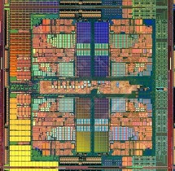
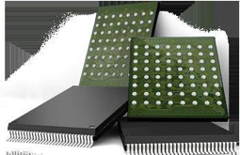
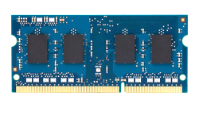
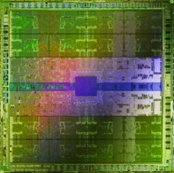
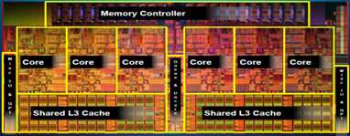
Current Research Mission
Computer architecture, HW/SW, systems, bioinformatics, security
Hybrid Main Memory
Heterogeneous
Processors and
Accelerators
Persistent Memory/Storage
Graphics and Vision Processing
Build fundamentally better architectures
Notes:
Professor Mutlu’s research focus is all aspects of computer architecture, HW/SW interaction and bioinformatics.
He is looking for students to perform research in these areas.
He and his group, SAFARI, solve fundamental problems spanning:
Memory, memory, memory, storage, interconnects
Parallel architectures, heterogeneous architectures, GP-GPUs
System/architecture interaction, new execution models
Energy efficiency, fault tolerance, hardware security
Genome sequence analysis and assembly
His group does broad research spanning systems to logic with architecture at center

Slide 17
Panel Question 1
External or geographic influences on the microarchitecture research environment.
What do you think is different about the environment in which you and your colleagues perform your research, and what do you think is similar across multiple regions of the globe.
For example – academic research funding in different parts of the world is different; so are national or regional priorities which may influence industrial policy and hence the research environment.

Slide 18
Panel Question 1
Globally and ideally, we should be working together freely to solve the huge problems we face, exploring many diverse and big ideas, without borders or external barriers
Unfortunately, funding issues & world+local politics & academic “merit” systems & review systems affect this goal
Collaboration
Immigration
Focus on large advances
Funding
Reviewing biases
Switzerland & ETH: Relatively free, ample funding (so far), yet still affected by global+local politics

Slide 19
Panel Question 2
How do you see the similarities and/or difference influencing the microarchitecture research community?

Slide 20
Panel Question 2
Negative global+local politics is not good for collaboration, funding and progress
Flawed academic merit systems are similarly problematic
Ditto for issues in review systems
All take useful cycles away from fast & large progress

Slide 21
Panel Question 3
What do you think are the most important microarchitecture research areas that researchers in your region should invest in, and why?

Slide 22
Challenge and Opportunity for Future
Reliable, Secure, Safe

Slide 23
Challenge and Opportunity for Future
Sustainable
and
Energy Efficient

Slide 24
Challenge and Opportunity for Future
High Performance
(to solve
the toughest & all problems)

Slide 25
Challenge and Opportunity for Future
Personalized and Private
(in every aspect of life:
health, medicine,
spaces, devices, robotics, …)

Slide 26
Challenge and Opportunity for Future
Hardware systems that
fundamentally guarantee
robustness
(security, safety, reliability)

Slide 27
Challenge and Opportunity for Future
Fundamentally
Energy-Efficient
(Data-Centric)
Computing Architectures

Slide 28
Challenge and Opportunity for Future
Fundamentally
High-Performance
(Data-Centric)
Computing Architectures

Slide 29
Challenge and Opportunity for Future
Computing Architectures
with
Maximal Efficiency

Slide 30
Challenge and Opportunity for Future
Computing systems for
Genomics
Medicine
Health
Climate
…

Slide 31
Challenge and Opportunity for Future
Data-Driven
(Self-Optimizing)
Computing Architectures

Slide 32
Challenge and Opportunity for Future
Data-Aware
(Expressive)
Computing Architectures

Slide 33
Fundamentally Better Architectures
Data-centric
Data-driven
Data-aware

Slide 34
Panel Question 4
What areas you think are less important for researchers to investigate.

Slide 35
Challenge and Opportunity for Future
Diversity is good
Avoid bias against any topic

Slide 36
Suggestions to Reviewers
Be fair; you do not know it all
Be open-minded; you do not know it all
Be accepting of diverse research methods: there is no single way of doing research or writing papers
Be constructive, not destructive
Enable heterogeneity, but do not have double standards…
Do not block or delay scientific progress for non-reasons

Slide 37
Microarchitecture Research Panel @ MICRO 2021
Onur Mutlu
omutlu@gmail.com
https://people.inf.ethz.ch/omutlu
20 October 2021
MICRO 2021 Panel

Slide 38
Current Research Mission & Major Topics
Build fundamentally better architectures
Data-centric arch. for low energy & high perf.
Proc. in Mem/DRAM, NVM, unified mem/storage
Low-latency & predictable architectures
Low-latency, low-energy yet low-cost memory
QoS-aware and predictable memory systems
Fundamentally secure/reliable/safe arch.
Tolerating all bit flips; patchable HW; secure mem
Architectures for ML/AI/Genomics/Health/Med
Algorithm/arch./logic co-design; full heterogeneity
Data-driven and data-aware architectures
ML/AI-driven architectural controllers and design
Expressive memory and expressive systems
Problem
Algorithm
Program/Language
System Software
SW/HW Interface
Micro-architecture
Logic
Devices
Electrons
Broad research
spanning apps, systems, logic
with architecture at the center

Slide 39
The Problem
Computing
is Bottlenecked by Data

Slide 40
Data is Key for AI, ML, Genomics, …
Important workloads are all data intensive
They require rapid and efficient processing of large amounts of data
Data is increasing
We can generate more than we can process

Slide 41
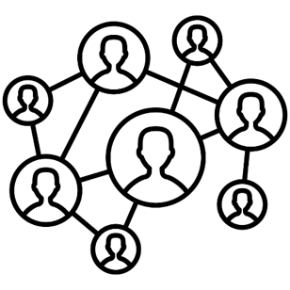
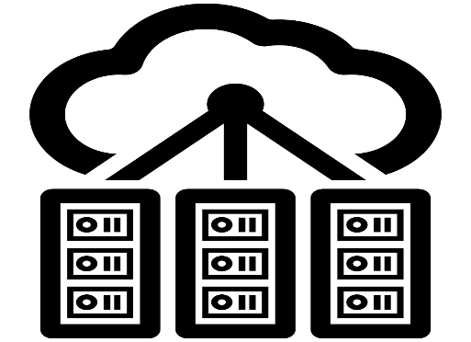
Data is Key for Future Workloads
In-memory Databases
[Mao+, EuroSys’12; Clapp+ (Intel), IISWC’15]
Graph/Tree Processing
[Xu+, IISWC’12; Umuroglu+, FPL’15]
In-Memory Data Analytics
[Clapp+ (Intel), IISWC’15;
Awan+, BDCloud’15]
Datacenter Workloads [Kanev+ (Google), ISCA’15]

Slide 42
Data Overwhelms Modern Machines
In-memory Databases
[Mao+, EuroSys’12; Clapp+ (Intel), IISWC’15]
Graph/Tree Processing
[Xu+, IISWC’12; Umuroglu+, FPL’15]
Data → performance & energy bottleneck
In-Memory Data Analytics
[Clapp+ (Intel), IISWC’15;
Awan+, BDCloud’15]
Datacenter Workloads [Kanev+ (Google), ISCA’15]

Slide 43
Data is Key for Future Workloads
Chrome
TensorFlow Mobile
Google’s web browser
Google’s machine learning framework
Video Playback
Video Capture
Google’s video codec
Google’s video codec
Notes:
In this work, we take a look at widely-used google consumer workloads, to figure out the major sources of energy consumption.
We look at Google Chrome web brower. We take a look at Tensorflow, Google’s machine learning framework, and we also take a look at two important video related workloads, video playback and video capture, both rely on Google’s vp9 codec technology.

Slide 44
Data Overwhelms Modern Machines
Chrome
TensorFlow Mobile
Google’s web browser
Google’s machine learning framework
Data → performance & energy bottleneck
Video Playback
Video Capture
Google’s video codec
Google’s video codec
Notes:
In this work, we take a look at widely-used google consumer workloads, to figure out the major sources of energy consumption.
We look at Google Chrome web brower. We take a look at Tensorflow, Google’s machine learning framework, and we also take a look at two important video related workloads, video playback and video capture, both rely on Google’s vp9 codec technology.

Slide 45
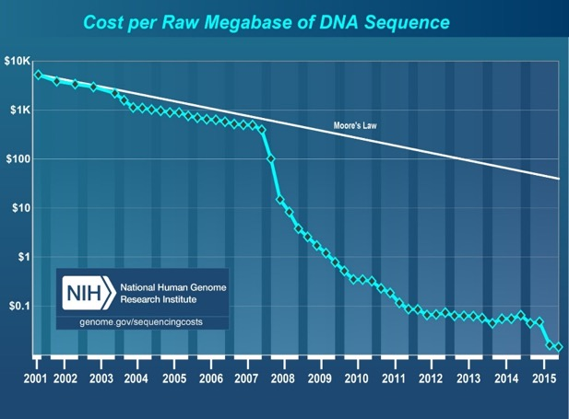
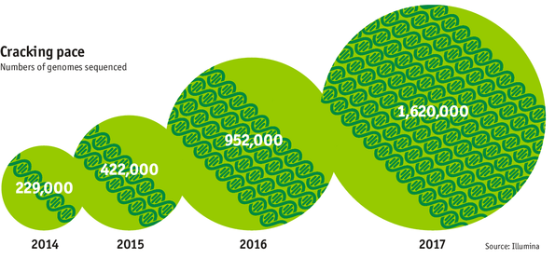
Data is Key for Future Workloads
development of high-throughput sequencing (HTS) technologies
Number of Genomes Sequenced
http://www.economist.com/news/21631808-so-much-genetic-data-so-many-uses-genes-unzipped
Notes:
However, since the development of high throughput sequencing (HTS) technologies, the cost of genome sequencing has fallen off a cliff (<< 1,000$) making it viable for almost everyone's use.

Slide 46
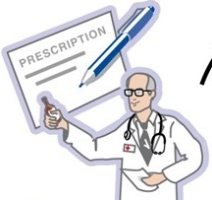
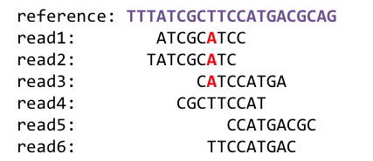
1
Sequencing
Genome Analysis
Read Mapping
2
Variant Calling
Scientific Discovery
3
4
Notes:
Genome analysis starts with sequencing random short DNA fragments of copies of the original molecule.
Unfortunately, these reads lack information about their order and which part of genome they are originated from.
Hence the second step is to map these reads to a long reference genome.

Slide 47
1
Sequencing
Genome Analysis
Read Mapping
2
Data → performance & energy bottleneck
Variant Calling
Scientific Discovery
3
4
Notes:
Genome analysis starts with sequencing random short DNA fragments of copies of the original molecule.
Unfortunately, these reads lack information about their order and which part of genome they are originated from.
Hence the second step is to map these reads to a long reference genome.

Slide 48
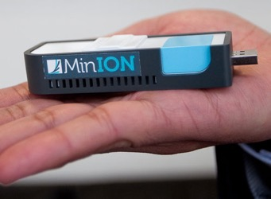
New Genome Sequencing Technologies
Oxford Nanopore MinION
Senol Cali+, “Nanopore Sequencing Technology and Tools for Genome
Assembly: Computational Analysis of the Current State, Bottlenecks
and Future Directions,” Briefings in Bioinformatics, 2018.
[Open arxiv.org version]

Slide 49
New Genome Sequencing Technologies
Oxford Nanopore MinION
Senol Cali+, “Nanopore Sequencing Technology and Tools for Genome
Assembly: Computational Analysis of the Current State, Bottlenecks
and Future Directions,” Briefings in Bioinformatics, 2018.
[Preliminary arxiv.org version]
Data → performance & energy bottleneck

Slide 50
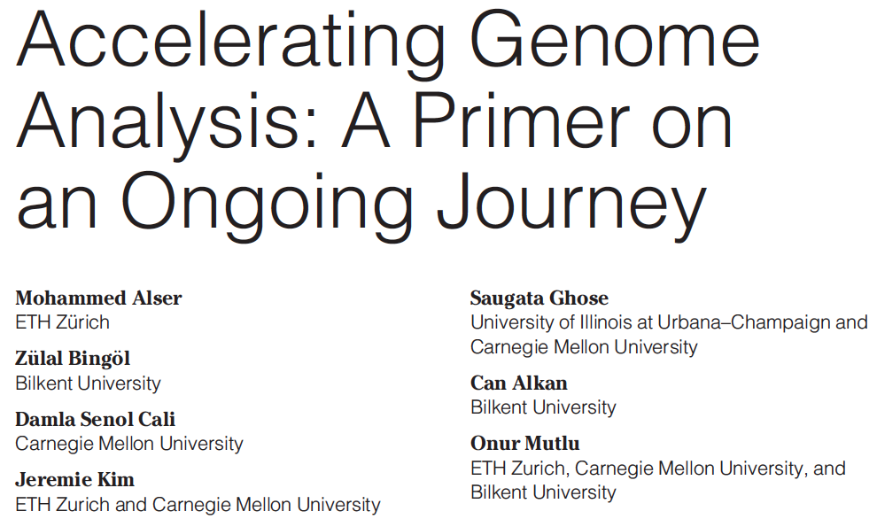
Accelerating Genome Analysis [IEEE MICRO 2020]
Mohammed Alser, Zulal Bingol, Damla Senol Cali, Jeremie Kim, Saugata Ghose, Can Alkan, and Onur Mutlu, "Accelerating Genome Analysis: A Primer on an Ongoing Journey" IEEE Micro (IEEE MICRO), Vol. 40, No. 5, pages 65-75, September/October 2020. [Slides (pptx)(pdf)] [Talk Video (1 hour 2 minutes)]

Slide 51
GenASM Framework [MICRO 2020]
Damla Senol Cali, Gurpreet S. Kalsi, Zulal Bingol, Can Firtina, Lavanya Subramanian, Jeremie S. Kim, Rachata Ausavarungnirun, Mohammed Alser, Juan Gomez-Luna, Amirali Boroumand, Anant Nori, Allison Scibisz, Sreenivas Subramoney, Can Alkan, Saugata Ghose, and Onur Mutlu, "GenASM: A High-Performance, Low-Power Approximate String Matching Acceleration Framework for Genome Sequence Analysis" Proceedings of the 53rd International Symposium on Microarchitecture (MICRO), Virtual, October 2020. [Lighting Talk Video (1.5 minutes)] [Lightning Talk Slides (pptx) (pdf)] [Talk Video (18 minutes)] [Slides (pptx) (pdf)]

Slide 52
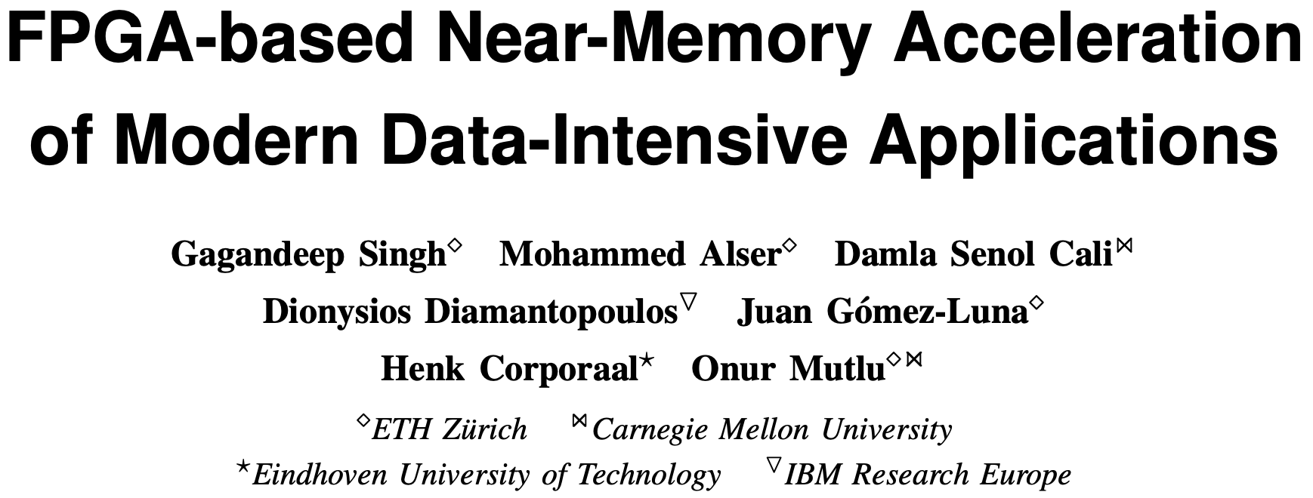
FPGA-based Processing Near Memory
Gagandeep Singh, Mohammed Alser, Damla Senol Cali, Dionysios Diamantopoulos, Juan Gómez-Luna, Henk Corporaal, and Onur Mutlu, "FPGA-based Near-Memory Acceleration of Modern Data-Intensive Applications" IEEE Micro (IEEE MICRO), 2021.

Slide 53
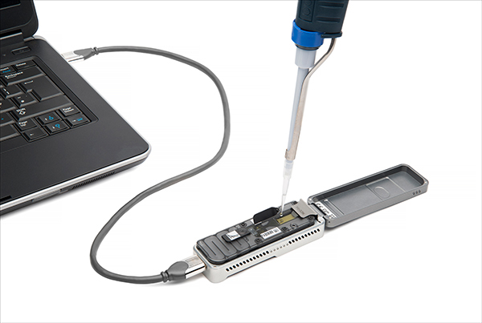
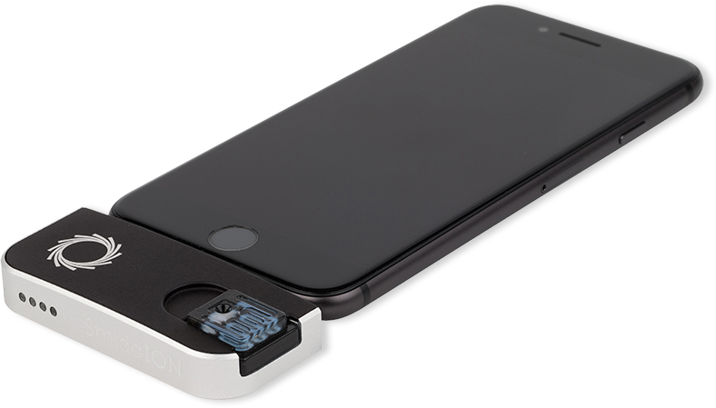
Future of Genome Sequencing & Analysis
MinION from ONT
SmidgION from ONT
Alser+, "Accelerating Genome Analysis: A Primer on an Ongoing Journey”, IEEE Micro 2020.

Slide 54
More on Fast & Efficient Genome Analysis …
Onur Mutlu, "Accelerating Genome Analysis: A Primer on an Ongoing Journey" Invited Lecture at Technion, Virtual, 26 January 2021. [Slides (pptx) (pdf)] [Talk Video (1 hour 37 minutes, including Q&A)] [Related Invited Paper (at IEEE Micro, 2020)]

Slide 55
Detailed Lectures on Genome Analysis
Computer Architecture, Fall 2020, Lecture 3a
Introduction to Genome Sequence Analysis (ETH Zürich, Fall 2020)
https://www.youtube.com/watch?v=CrRb32v7SJc&list=PL5Q2soXY2Zi9xidyIgBxUz7xRPS-wisBN&index=5
Computer Architecture, Fall 2020, Lecture 8
Intelligent Genome Analysis (ETH Zürich, Fall 2020)
https://www.youtube.com/watch?v=ygmQpdDTL7o&list=PL5Q2soXY2Zi9xidyIgBxUz7xRPS-wisBN&index=14
Computer Architecture, Fall 2020, Lecture 9a
GenASM: Approx. String Matching Accelerator (ETH Zürich, Fall 2020)
https://www.youtube.com/watch?v=XoLpzmN-Pas&list=PL5Q2soXY2Zi9xidyIgBxUz7xRPS-wisBN&index=15
Accelerating Genomics Project Course, Fall 2020, Lecture 1
Accelerating Genomics (ETH Zürich, Fall 2020)
https://www.youtube.com/watch?v=rgjl8ZyLsAg&list=PL5Q2soXY2Zi9E2bBVAgCqLgwiDRQDTyId
https://www.youtube.com/onurmutlulectures

Slide 56
Our Goal
Computing systems for
Genomics
Medicine
Health
AI/ML

Slide 57
Data Overwhelms Modern Machines …
Storage/memory capability
Communication capability
Computation capability
Greatly impacts robustness, energy, performance, cost

Slide 58
A Computing System
Three key components
Computation
Communication
Storage/memory
Burks, Goldstein, von Neumann, “Preliminary discussion of the
logical design of an electronic computing instrument,” 1946.
Image source: https://lbsitbytes2010.wordpress.com/2013/03/29/john-von-neumann-roll-no-15/

Slide 59
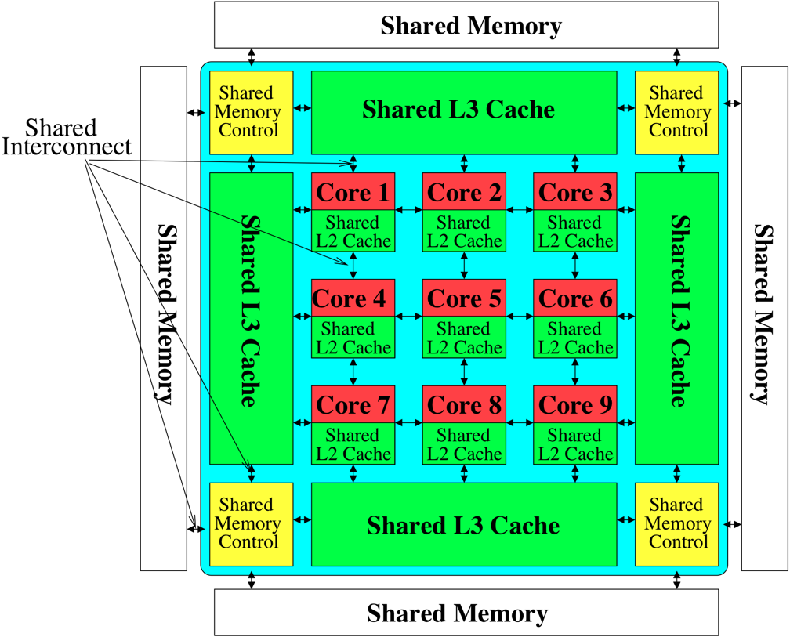
Perils of Processor-Centric Design
Most of the system is dedicated to storing and moving data
Yet, system is still bottlenecked by memory

Slide 60
Data Overwhelms Modern Machines
Chrome
TensorFlow Mobile
Google’s web browser
Google’s machine learning framework
Data → performance & energy bottleneck
Video Playback
Video Capture
Google’s video codec
Google’s video codec
Notes:
In this work, we take a look at widely-used google consumer workloads, to figure out the major sources of energy consumption.
We look at Google Chrome web brower. We take a look at Tensorflow, Google’s machine learning framework, and we also take a look at two important video related workloads, video playback and video capture, both rely on Google’s vp9 codec technology.

Slide 61
Data Movement Overwhelms Modern Machines
Amirali Boroumand, Saugata Ghose, Youngsok Kim, Rachata Ausavarungnirun, Eric Shiu, Rahul Thakur, Daehyun Kim, Aki Kuusela, Allan Knies, Parthasarathy Ranganathan, and Onur Mutlu, "Google Workloads for Consumer Devices: Mitigating Data Movement Bottlenecks" Proceedings of the 23rd International Conference on Architectural Support for Programming Languages and Operating Systems (ASPLOS), Williamsburg, VA, USA, March 2018.
62.7% of the total system energy
is spent on data movement

Slide 62
Data Movement vs. Computation Energy
Dally, HiPEAC 2015
A memory access consumes ~100-1000X
the energy of a complex addition

Slide 63
Axiom
An Intelligent Architecture
Handles Data Well

Slide 64
How to Handle Data Well
Ensure data does not overwhelm the components
via intelligent algorithms
via intelligent architectures
via whole system designs: algorithm-architecture-devices
Take advantage of vast amounts of data and metadata
to improve architectural & system-level decisions
Understand and exploit properties of (different) data
to improve algorithms & architectures in various metrics

Slide 65
Corollaries: Architectures Today …
Architectures are terrible at dealing with data
Designed to mainly store and move data vs. to compute
They are processor-centric as opposed to data-centric
Architectures are terrible at taking advantage of vast amounts of data (and metadata) available to them
Designed to make simple decisions, ignoring lots of data
They make human-driven decisions vs. data-driven
Architectures are terrible at knowing and exploiting different properties of application data
Designed to treat all data as the same
They make component-aware decisions vs. data-aware

Slide 66
Fundamentally Better Architectures
Data-centric
Data-driven
Data-aware

Slide 67
Data-Centric (Memory-Centric) Architectures

Slide 68
Data-Centric Architectures: Properties
Process data where it resides (where it makes sense)
Processing in and near memory structures
Low-latency and low-energy data access
Low latency memory
Low energy memory
Low-cost data storage and processing
High capacity memory at low cost: hybrid memory, compression
Intelligent data management
Intelligent controllers handling robustness, security, cost

Slide 69
Processing Data Where It Makes Sense

Slide 70
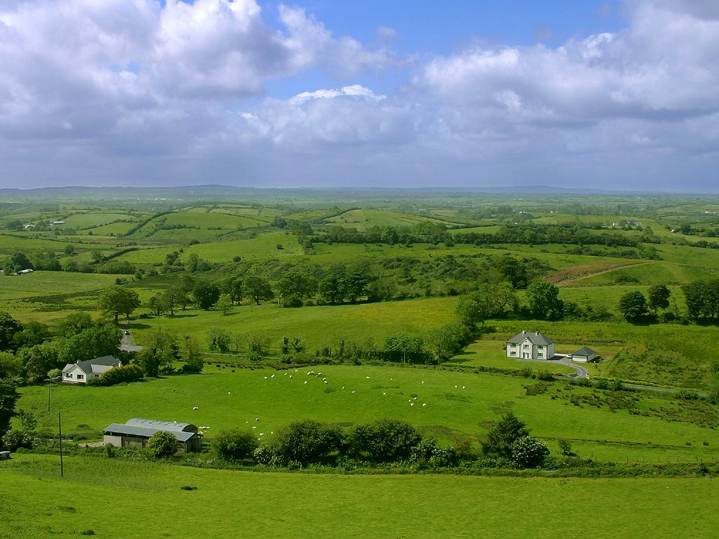
Do We Want This?
Source: V. Milutinovic

Slide 71
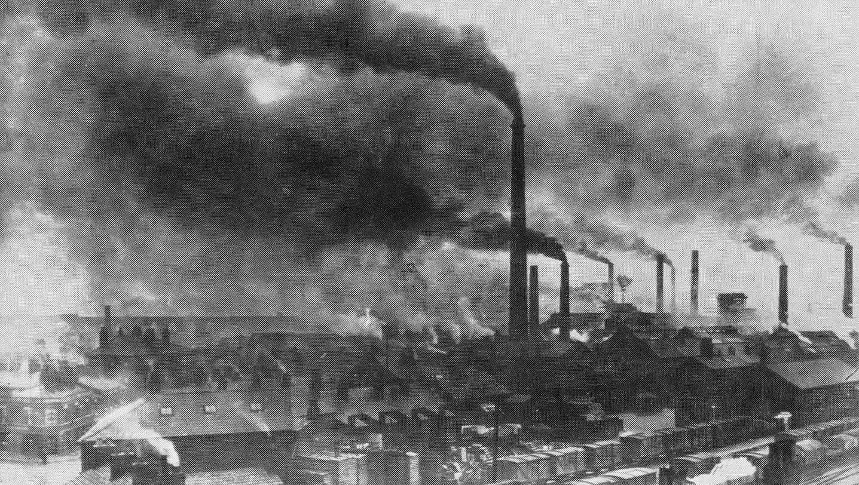
Or This?
Source: V. Milutinovic

Slide 72
Mindset: Memory-Centric Computing
CPU
core
CPU
core
mini-CPU
core
GPU
(throughput)
core
GPU
(throughput)
core
video
core
GPU
(throughput)
core
GPU
(throughput)
core
CPU
core
CPU
core
Memory
imaging
core
LLC
Specialized
compute-capability
in memory
Memory Controller
Memory Bus
Memory similar to a “conventional” accelerator

Slide 73
PIM Review and Open Problems
Onur Mutlu, Saugata Ghose, Juan Gomez-Luna, and Rachata Ausavarungnirun, "A Modern Primer on Processing in Memory" Invited Book Chapter in Emerging Computing: From Devices to Systems - Looking Beyond Moore and Von Neumann, Springer, to be published in 2021.
https://arxiv.org/pdf/1903.03988.pdf

Slide 74
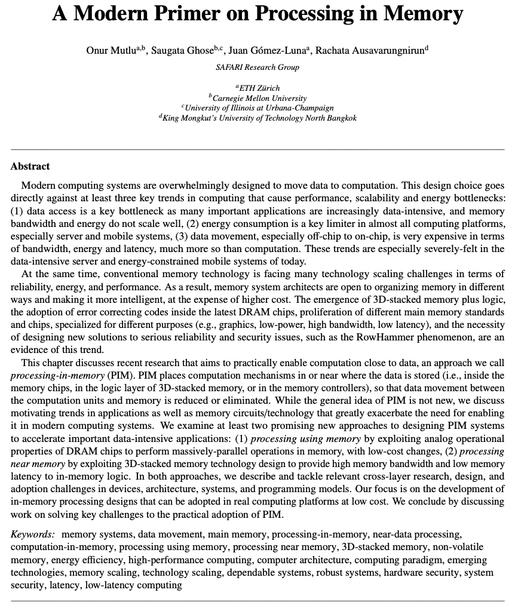

Slide 75
