Slide 1



Processing-in-Memory in Mobile Systems
Changing the Computing Paradigm for High Efficiency
Onur Mutlu
omutlu@gmail.com
https://people.inf.ethz.ch/omutlu
23 November 2018
MST Keynote Talk

Slide 2
A Motivating Detour:
Genome Sequence Analysis

Slide 3
Our Dream
An embedded device that can perform comprehensive genome analysis in real time (within a minute)
  Which of these DNAs does this DNA segment match with?
  What is the likely genetic disposition of this patient to this drug?
  . . .

Slide 4
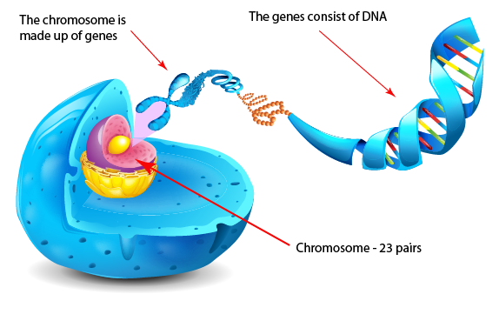
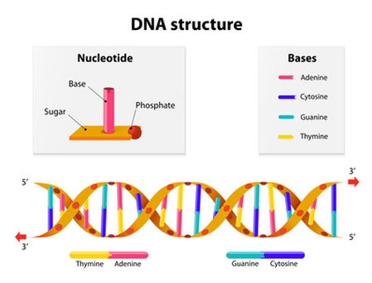
What Is a Genome Made Of?
Cell
Nucleus
The discovery of DNA’s double-helical structure (Watson+, 1953)
Notes:
Unlocking the life’s code requires diving into the nucleus of our body cells, where the double-stranded genome resides. Genome is literally the 'code of life' - it is the set of instructions for making everything from you to zebras, strawberries, and even yeast.
since the discovery of dna’s double-helical structure (watson et al. 1953)

Slide 5
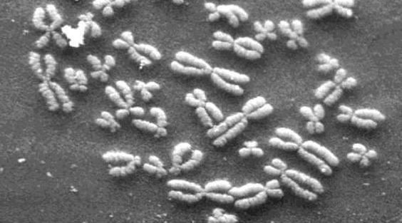
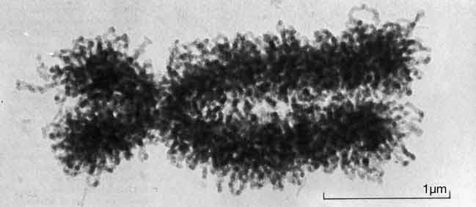
DNA Under Electron Microscope
human chromosome #12
from HeLa’s cell
Notes:
Henrietta Lacks,

Slide 6
DNA Sequencing
Goal:
  Find the complete sequence of A, C, G, T’s in DNA.
Challenge:
  There is no machine that takes long DNA as an input, and gives the complete sequence as output
  All sequencing machines chop DNA into pieces and identify relatively small pieces (but not how they fit together)

Slide 7
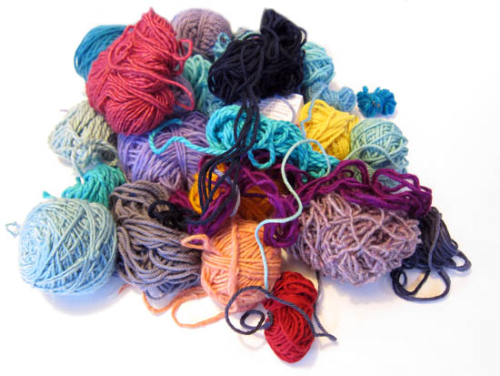
Untangling Yarn Balls & DNA Sequencing
Notes:
untangling yarn ball

Slide 8
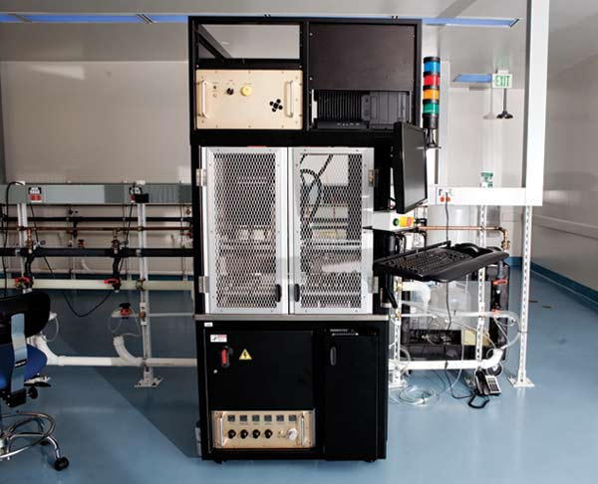
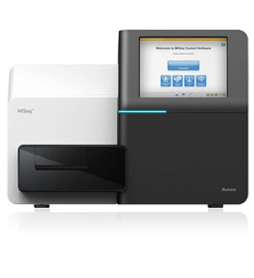
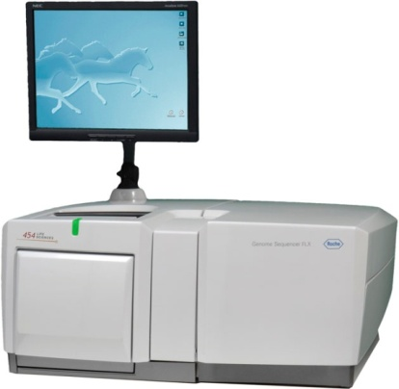
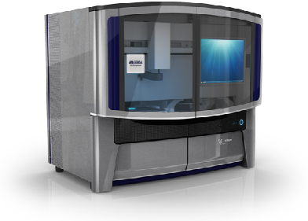
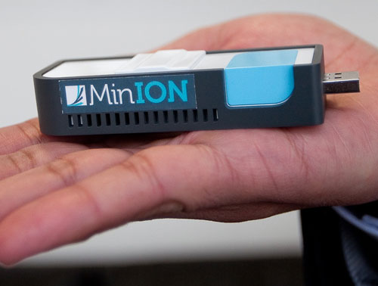
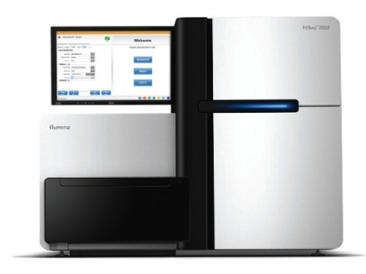
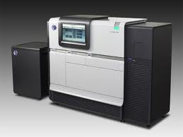
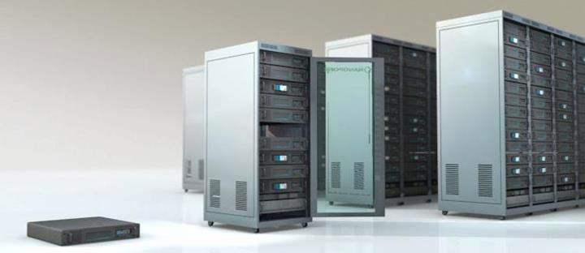
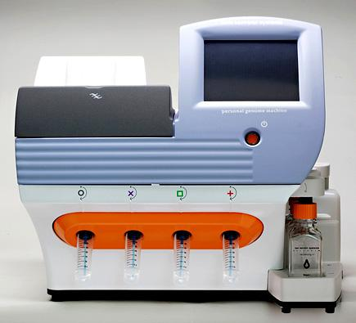
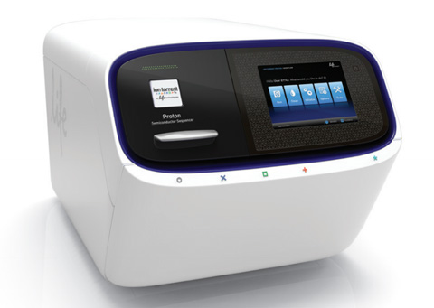
Genome Sequencers
Illumina MiSeq
Complete
Genomics
Roche/454
AB SOLiD
Oxford Nanopore MinION
Illumina
NovaSeq
6000
Illumina HiSeq2000
Pacific Biosciences RS
Oxford Nanopore GridION
Ion Torrent PGM
… and more! All produce data with different properties.
Ion Torrent Proton

Slide 9
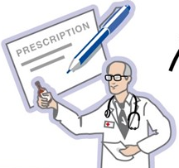
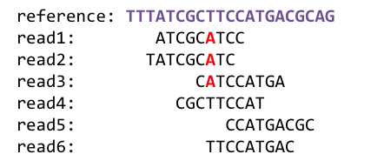
1
Sequencing
Genome Analysis
Read Mapping
2
Variant Calling
Scientific Discovery
3
4
Notes:
Genome analysis starts with sequencing random short DNA fragments of copies of the original molecule.
Unfortunately, these reads lack information about their order and which part of genome they are originated from.
Hence the second step is to map these reads to a long reference genome.

Slide 10
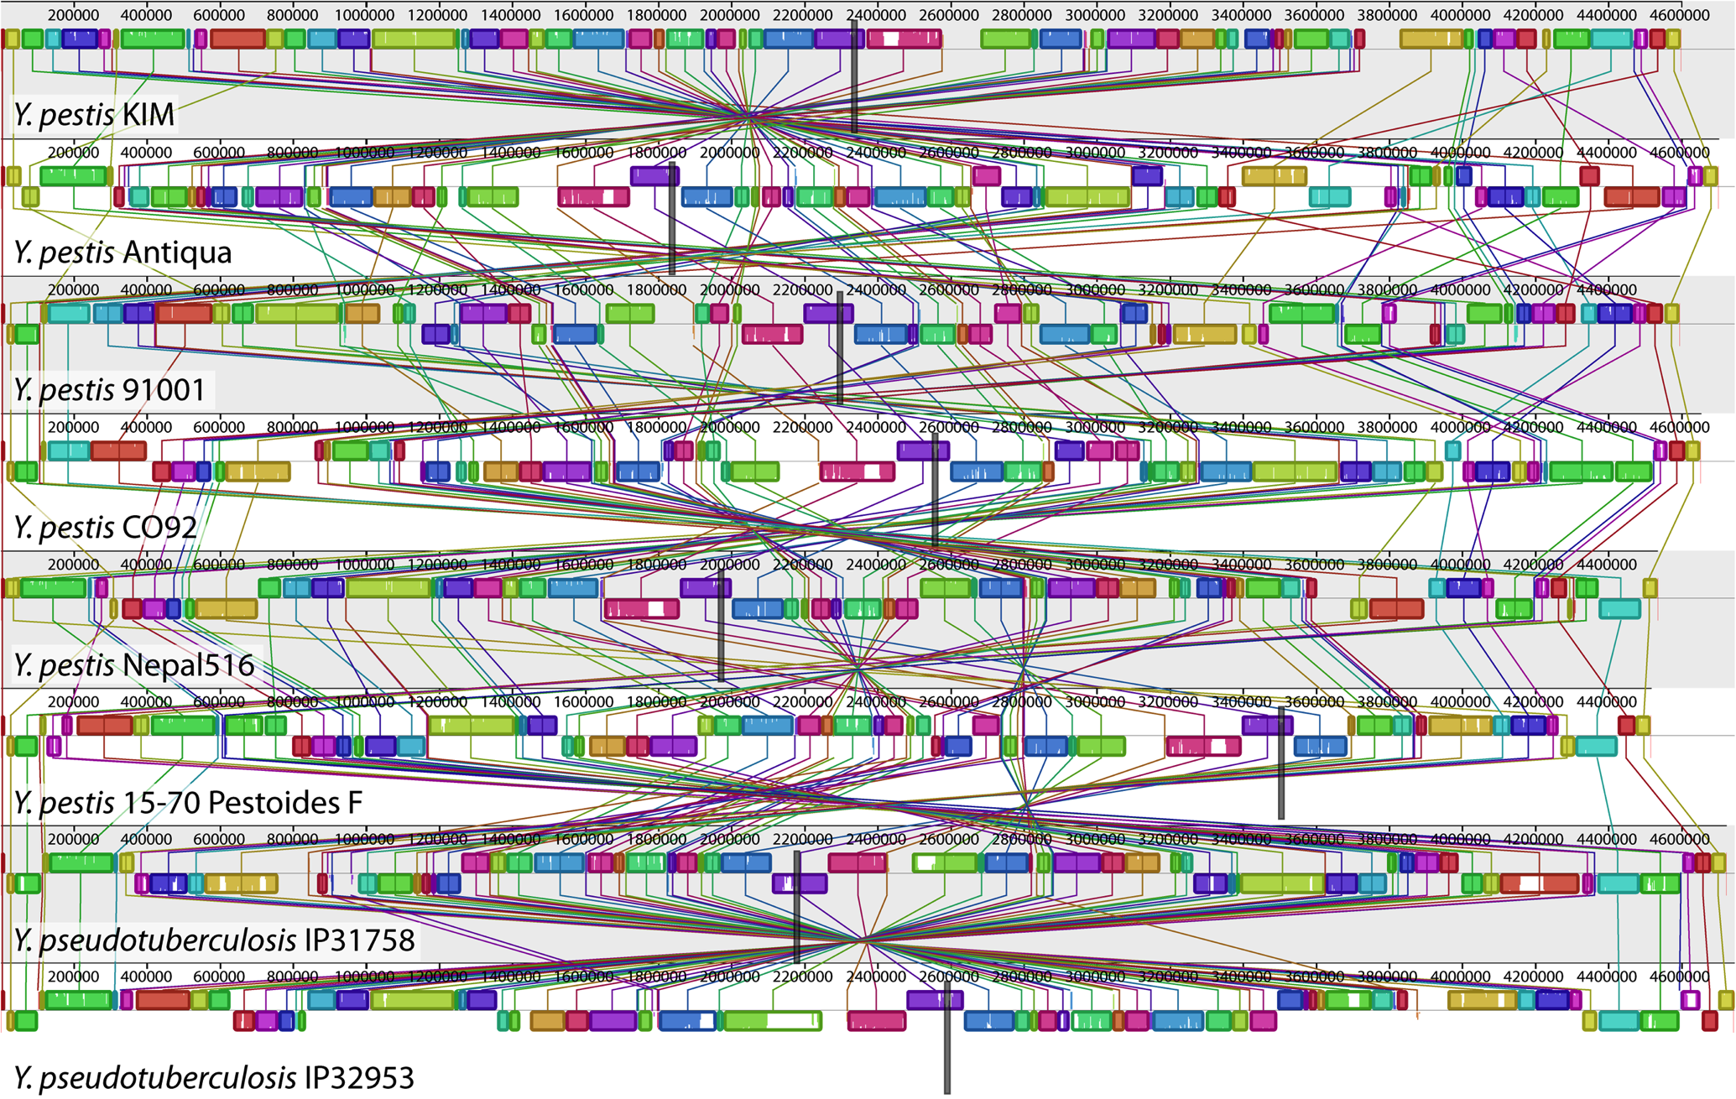
Genome Sequence Alignment: Example
Source: By Aaron E. Darling, István Miklós, Mark A. Ragan - Figure 1 from Darling AE, Miklós I, Ragan MA (2008).
"Dynamics of Genome Rearrangement in Bacterial Populations". PLOS Genetics. DOI:10.1371/journal.pgen.1000128., CC BY 2.5, https://commons.wikimedia.org/w/index.php?curid=30550950

Slide 11
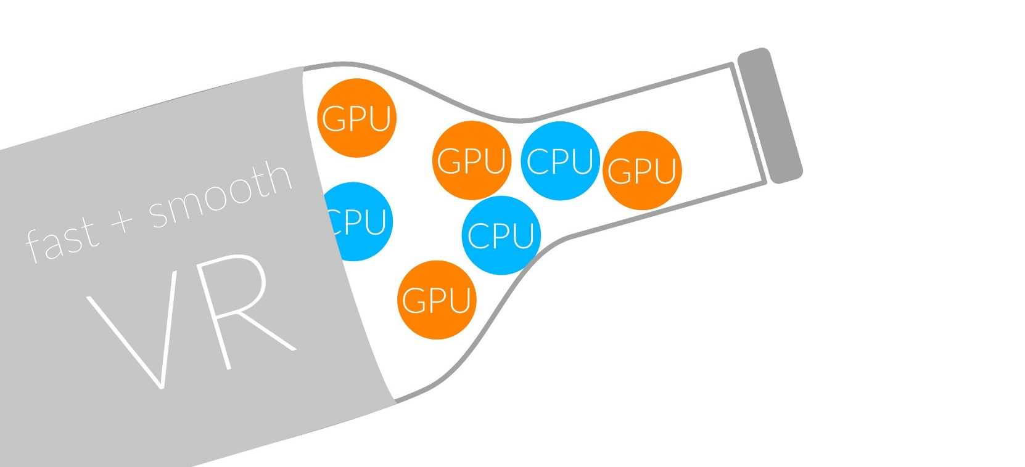
1
Sequencing
Read Mapping
2
Bottlenecked in Mapping!!
Illumina HiSeq4000
on average
GAGTCAGAATTTGAC
2 M
bases/min
300 M
bases/min
GAGTCAGAATTTGAC
GAGTCAGAATTTGAC
GAGTCAGAATTTGAC
GAGTCAGAATTTGAC
GAGTCAGAATTTGAC
GAGTCAGAATTTGAC
GAGTCAGAATTTGAC
GAGTCAGAATTTGAC
GAGTCAGAATTTGAC
GAGTCAGAATTTGAC
GAGTCAGAATTTGAC
GAGTCAGAATTTGAC
GAGTCAGAATTTGAC
GAGTCAGAATTTGAC
(0.6%)
Variant Calling
Scientific Discovery
3
4
Notes:
Typical sequencer machine generates a flood of reads, for example, Illumina HiSeq4000 generates 300 million bases/minute.
However, existing computer alignment algorithms can only process 0.6% of these reads in the same amount of time.
This gap is widening as more advanced sequencers are made available in the market.

Slide 12
Hash Table Based Read Mappers
+ Guaranteed to find all mappings → sensitive
+ Can tolerate up to e errors
http://mrfast.sourceforge.net/
Alkan+, "Personalized copy number and segmental duplication
maps using next-generation sequencing”, Nature Genetics 2009.
Notes:
It turned out the Hash Table based mappers solve the first 2 challenges pretty well. They guarantee to find all mappings with no more than e errors present.

Slide 13
Read Mapping Execution Time Breakdown
Notes:
An overwhelming majority of the read mapper’s execution time is spent in read alignment.

Slide 14
Idea
Filter fast before you align
Minimize costly
“approximate string comparisons”

Slide 15
Our First Filter: Pure Software Approach
Download source code and try for yourself
  Download link to FastHASH

Slide 16
Shifted Hamming Distance: SIMD Acceleration
Xin+, "Shifted Hamming Distance: A Fast and Accurate SIMD-friendly Filter
to Accelerate Alignment Verification in Read Mapping”, Bioinformatics 2015.

Slide 17
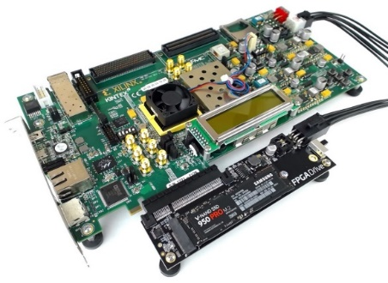
An Example Solution: GateKeeper
1
st
Alignment Filter
FPGA-based Alignment Filter.
Notes:
To bridge the widening gap between the sequencer & the mapper, we propose the concept of pre-alignment filtering. We added a new examination step before the accurate alignment step. The main objective of this step is to detect the incorrect mappings accurately and rapidly. Only the mappings that pass our filter are examined by the alignment step. We also explore exploiting todays’ hardware accelerators to further boost the filtering speed of such filters.

Slide 18
FPGA-Based Alignment Filtering
Mohammed Alser, Hasan Hassan, Hongyi Xin, Oguz Ergin, Onur Mutlu, and Can Alkan
"GateKeeper: A New Hardware Architecture for Accelerating Pre-Alignment in DNA Short Read Mapping"
Bioinformatics, [published online, May 31], 2017.
[Source Code]
[Online link at Bioinformatics Journal]

Slide 19
DNA Read Mapping & Filtering
Problem: Heavily bottlenecked by Data Movement
GateKeeper FPGA performance limited by DRAM bandwidth [Alser+, Bioinformatics 2017]
Ditto for SHD on SIMD [Xin+, Bioinformatics 2015]
Solution: Processing-in-memory can alleviate the bottleneck
However, we need to design mapping & filtering algorithms to fit processing-in-memory

Slide 20
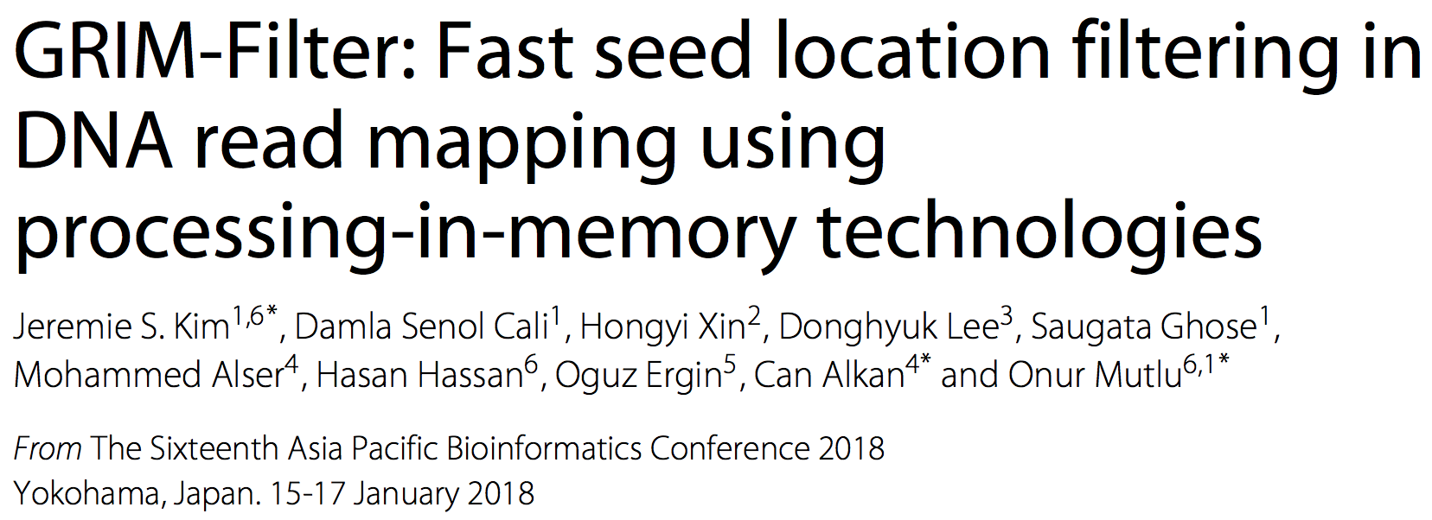
In-Memory DNA Sequence Analysis
Jeremie S. Kim, Damla Senol Cali, Hongyi Xin, Donghyuk Lee, Saugata Ghose, Mohammed Alser, Hasan Hassan, Oguz Ergin, Can Alkan, and Onur Mutlu,
"GRIM-Filter: Fast Seed Location Filtering in DNA Read Mapping Using Processing-in-Memory Technologies"
BMC Genomics, 2018.
Proceedings of the 16th Asia Pacific Bioinformatics Conference (APBC), Yokohama, Japan, January 2018.
arxiv.org Version (pdf)

Slide 21
Quick Note: Key Principles and Results
Two key principles:
  Exploit the structure of the genome to minimize computation
  Morph and exploit the structure of the underlying hardware to maximize performance and efficiency
Algorithm-architecture co-design for DNA read mapping
  Speeds up read mapping by ~200X (sometimes more)
  Improves accuracy of read mapping in the presence of errors
Xin et al., “Accelerating Read Mapping with FastHASH,” BMC Genomics 2013.
Xin et al., “Shifted Hamming Distance: A Fast and Accurate SIMD-friendly Filter to Accelerate
Alignment Verification in Read Mapping,” Bioinformatics 2015.
Alser et al., “GateKeeper: A New Hardware Architecture for Accelerating Pre-Alignment in DNA
Short Read Mapping,” Bioinformatics 2017.
Kim et al., “Genome Read In-Memory (GRIM) Filter,” BMC Genomics 2018.

Slide 22
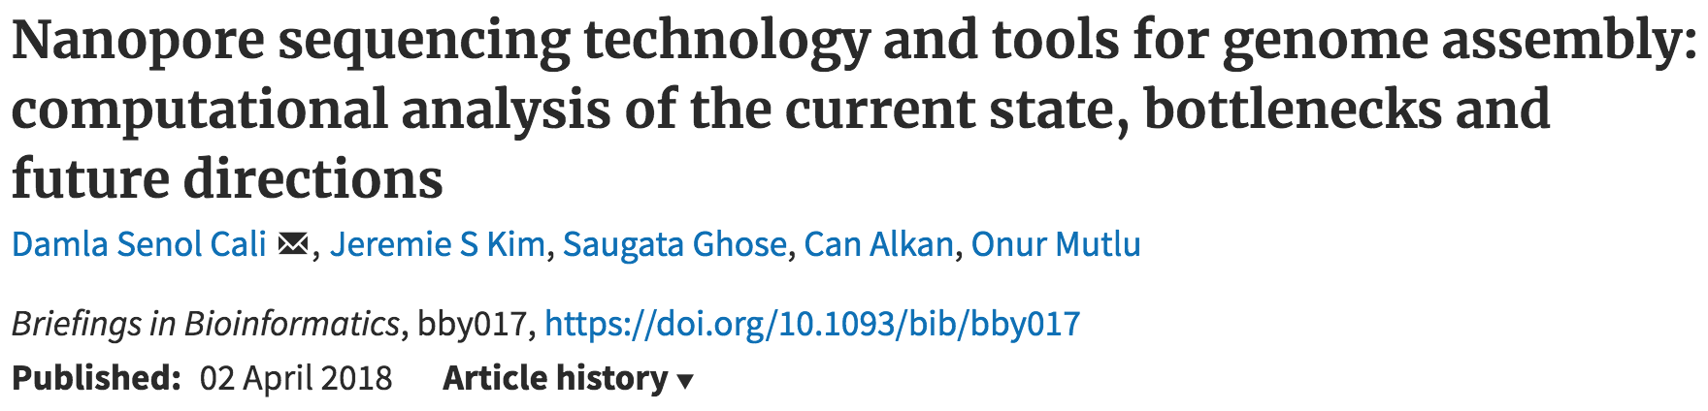
New Genome Sequencing Technologies
Oxford Nanopore MinION
Senol Cali+, “Nanopore Sequencing Technology and Tools for Genome
Assembly: Computational Analysis of the Current State, Bottlenecks
and Future Directions,” Briefings in Bioinformatics, 2018.
[Preliminary arxiv.org version]

Slide 23
Nanopore Genome Assembly Pipeline
Senol Cali+, “Nanopore Sequencing Technology and Tools for Genome
Assembly,” Briefings in Bioinformatics, 2018.

Slide 24

More on Genome Analysis: Another Talk

Slide 25
Recall Our Dream
An embedded device that can perform comprehensive genome analysis in real time (within a minute)
Still a long ways to go
  Energy efficiency
  Performance (latency)
  Security
  Huge memory bottleneck

Slide 26
Memory & Storage

Slide 27



The Main Memory System
Main memory is a critical component of all computing systems: server, mobile, embedded, desktop, sensor
Main memory system must scale (in size, technology, efficiency, cost, and management algorithms) to maintain performance growth and technology scaling benefits
Processors
and caches
Main Memory
Storage (SSD/HDD)

Slide 28
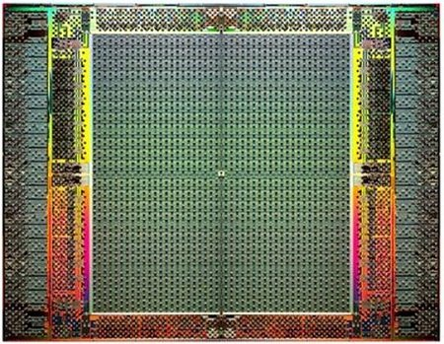
The Main Memory System
Main memory is a critical component of all computing systems: server, mobile, embedded, desktop, sensor
Main memory system must scale (in size, technology, efficiency, cost, and management algorithms) to maintain performance growth and technology scaling benefits
FPGAs
Main Memory
Storage (SSD/HDD)

Slide 29
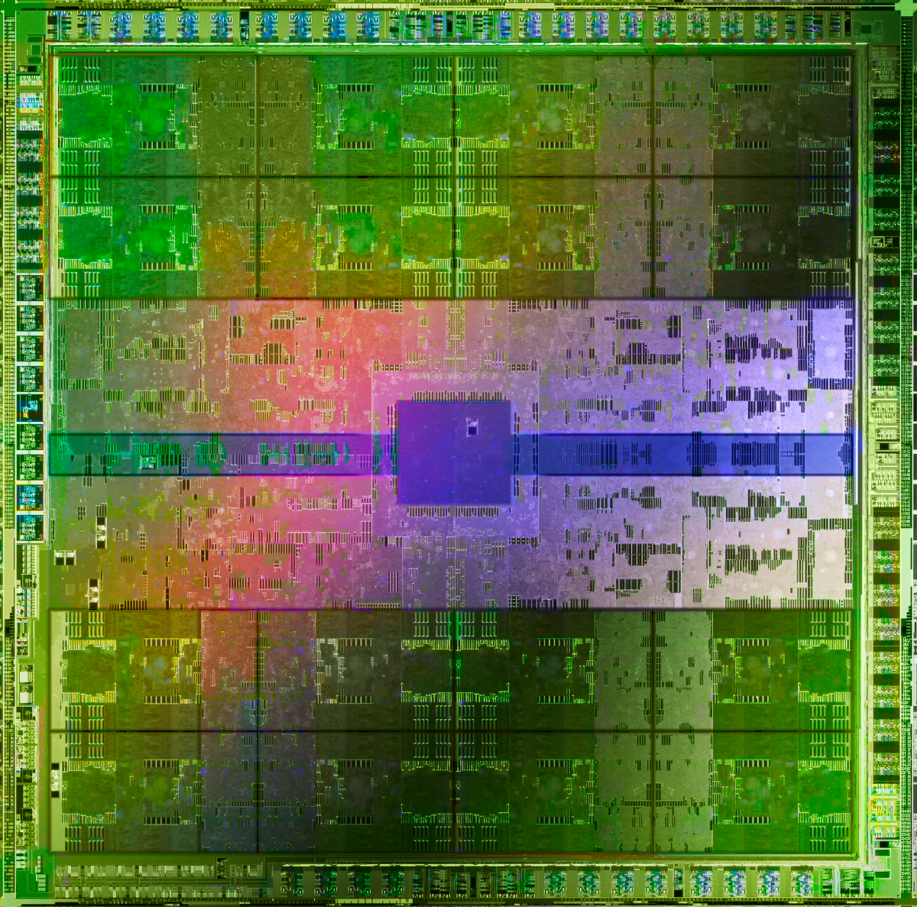
The Main Memory System
Main memory is a critical component of all computing systems: server, mobile, embedded, desktop, sensor
Main memory system must scale (in size, technology, efficiency, cost, and management algorithms) to maintain performance growth and technology scaling benefits
GPUs
Main Memory
Storage (SSD/HDD)

Slide 30
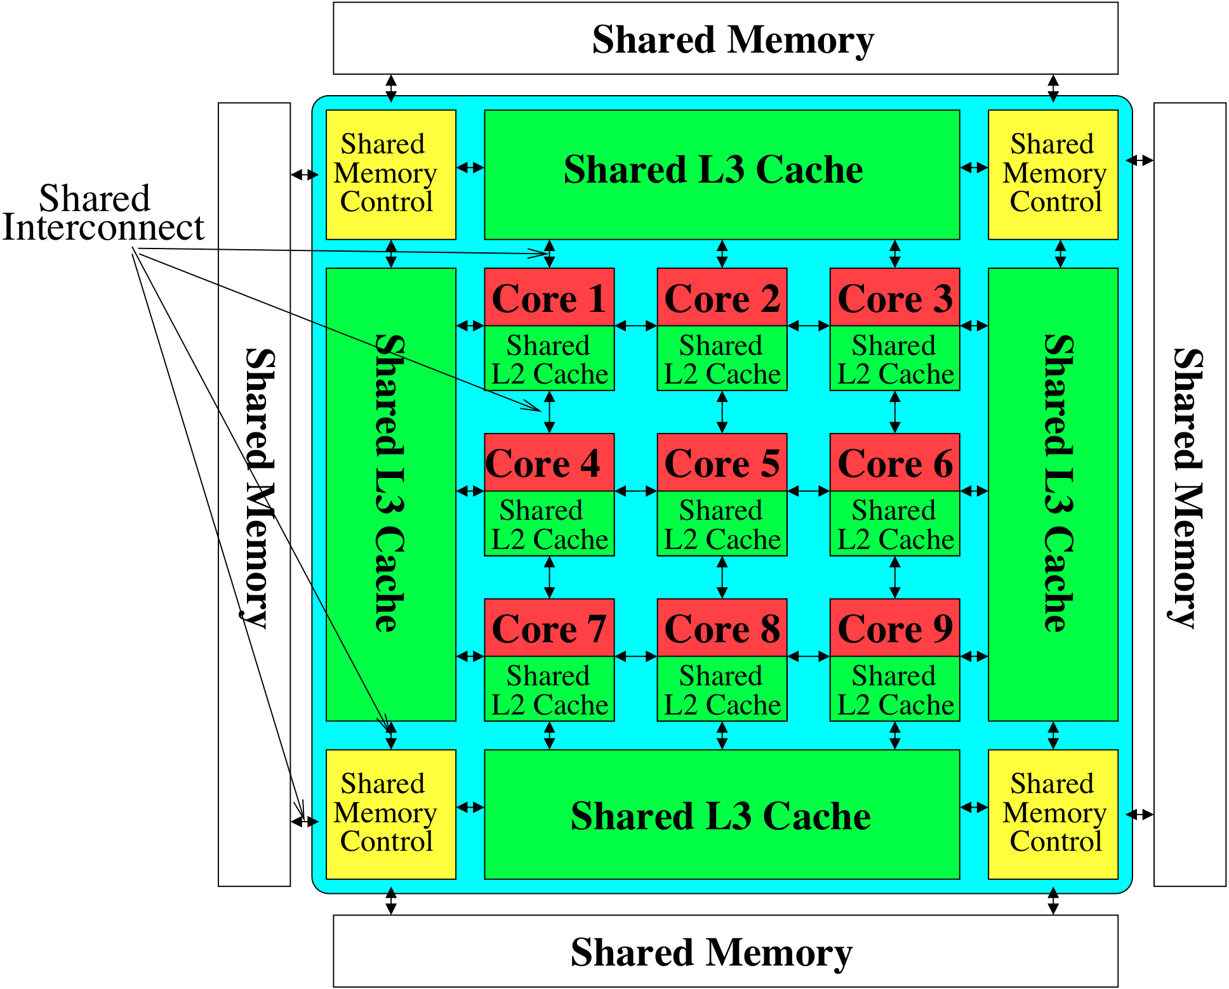
Memory System: A Shared Resource View
Storage
Most of the system is dedicated to storing and moving data

Slide 31
State of the Main Memory System
Recent technology, architecture, and application trends
  lead to new requirements
  exacerbate old requirements
DRAM and memory controllers, as we know them today, are (will be) unlikely to satisfy all requirements
Some emerging non-volatile memory technologies (e.g., PCM) enable new opportunities: memory+storage merging
We need to rethink the main memory system
  to fix DRAM issues and enable emerging technologies
  to satisfy all requirements

Slide 32
Major Trends Affecting Main Memory (I)
Need for main memory capacity, bandwidth, QoS increasing
Main memory energy/power is a key system design concern
DRAM technology scaling is ending

Slide 33
Major Trends Affecting Main Memory (II)
Need for main memory capacity, bandwidth, QoS increasing
  Multi-core: increasing number of cores/agents
  Data-intensive applications: increasing demand/hunger for data
  Consolidation: cloud computing, GPUs, mobile, heterogeneity
Main memory energy/power is a key system design concern
DRAM technology scaling is ending

Slide 34
DRAM Capacity, Bandwidth & Latency
128x
20x
1.3x
Memory latency remains almost constant

Slide 35




DRAM Is Critical for Performance
In-memory Databases
[Mao+, EuroSys’12;
Clapp+ (Intel), IISWC’15]
Graph/Tree Processing
[Xu+, IISWC’12; Umuroglu+, FPL’15]
In-Memory Data Analytics
[Clapp+ (Intel), IISWC’15;
Awan+, BDCloud’15]
Datacenter Workloads
[Kanev+ (Google), ISCA’15]

Slide 36
DRAM Is Critical for Performance
In-memory Databases
[Mao+, EuroSys’12;
Clapp+ (Intel), IISWC’15]
Graph/Tree Processing
[Xu+, IISWC’12; Umuroglu+, FPL’15]
Memory → performance bottleneck
In-Memory Data Analytics
[Clapp+ (Intel), IISWC’15;
Awan+, BDCloud’15]
Datacenter Workloads
[Kanev+ (Google), ISCA’15]

Slide 37





Popular Google Consumer Workloads
  Chrome
TensorFlow Mobile
    Google’s web browser
Google’s machine learning framework
  Video Playback
  Video Capture
Google’s video codec
Google’s video codec
Notes:
In this work, we take a look at widely-used google consumer workloads, to figure out the major sources of energy consumption.
We look at Google Chrome web brower. We take a look at Tensorflow, Google’s machine learning framework, and we also take a look at two important video related workloads, video playback and video capture, both rely on Google’s vp9 codec technology.

Slide 38
Popular Google Consumer Workloads
  Chrome
TensorFlow Mobile
    Google’s web browser
Google’s machine learning framework
Memory → performance bottleneck
  Video Playback
  Video Capture
Google’s video codec
Google’s video codec
Notes:
In this work, we take a look at widely-used google consumer workloads, to figure out the major sources of energy consumption.
We look at Google Chrome web brower. We take a look at Tensorflow, Google’s machine learning framework, and we also take a look at two important video related workloads, video playback and video capture, both rely on Google’s vp9 codec technology.

Slide 39
Major Trends Affecting Main Memory (III)
Need for main memory capacity, bandwidth, QoS increasing
Main memory energy/power is a key system design concern
  ~40-50% energy spent in off-chip memory hierarchy [Lefurgy, IEEE Computer’03] >40% power in DRAM [Ware, HPCA’10][Paul,ISCA’15]
  DRAM consumes power even when not used (periodic refresh)
DRAM technology scaling is ending

Slide 40
Energy Waste in Mobile Devices
Amirali Boroumand, Saugata Ghose, Youngsok Kim, Rachata Ausavarungnirun, Eric Shiu, Rahul Thakur, Daehyun Kim, Aki Kuusela, Allan Knies, Parthasarathy Ranganathan, and Onur Mutlu,
"Google Workloads for Consumer Devices: Mitigating Data Movement Bottlenecks"
Proceedings of the 23rd International Conference on Architectural Support for Programming Languages and Operating Systems (ASPLOS), Williamsburg, VA, USA, March 2018.
62.7% of the total system energy
is spent on data movement

Slide 41
Major Trends Affecting Main Memory (IV)
Need for main memory capacity, bandwidth, QoS increasing
Main memory energy/power is a key system design concern
DRAM technology scaling is ending
  ITRS projects DRAM will not scale easily below X nm
  Scaling has provided many benefits:
    higher capacity (density), lower cost, lower energy

Slide 42
Major Trends Affecting Main Memory (V)
DRAM scaling has already become increasingly difficult
  Increasing cell leakage current, reduced cell reliability, increasing manufacturing difficulties [Kim+ ISCA 2014],
  [Liu+ ISCA 2013], [Mutlu IMW 2013], [Mutlu DATE 2017]
  Difficult to significantly improve capacity, energy
Emerging memory technologies are promising
3D-Stacked DRAM | higher bandwidth | smaller capacity
Reduced-Latency DRAM (e.g., RLDRAM, TL-DRAM) | lower latency | higher cost
Low-Power DRAM (e.g., LPDDR3, LPDDR4) | lower power | higher latency higher cost
Non-Volatile Memory (NVM) (e.g., PCM, STTRAM, ReRAM, 3D Xpoint) | larger capacity | higher latency higher dynamic power lower endurance

Slide 43
Major Trends Affecting Main Memory (V)
DRAM scaling has already become increasingly difficult
  Increasing cell leakage current, reduced cell reliability, increasing manufacturing difficulties [Kim+ ISCA 2014],
  [Liu+ ISCA 2013], [Mutlu IMW 2013], [Mutlu DATE 2017]
  Difficult to significantly improve capacity, energy
Emerging memory technologies are promising
3D-Stacked DRAM | higher bandwidth | smaller capacity
Reduced-Latency DRAM (e.g., RL/TL-DRAM, FLY-RAM) | lower latency | higher cost
Low-Power DRAM (e.g., LPDDR3, LPDDR4, Voltron) | lower power | higher latency higher cost
Non-Volatile Memory (NVM) (e.g., PCM, STTRAM, ReRAM, 3D Xpoint) | larger capacity | higher latency higher dynamic power lower endurance

Slide 44
Major Trend: Hybrid Main Memory
CPU
Meza+, “Enabling Efficient and Scalable Hybrid Memories,” IEEE Comp. Arch. Letters, 2012.
Yoon+, “Row Buffer Locality Aware Caching Policies for Hybrid Memories,” ICCD 2012 Best Paper Award.
DRAMCtrl
PCM Ctrl
DRAM
Phase Change Memory (or Tech. X)
Fast, durable
Small,
leaky, volatile,
high-cost
Large, non-volatile, low-cost
Slow, wears out, high active energy
Hardware/software manage data allocation and movement
to achieve the best of multiple technologies

Slide 45
Foreshadowing
Main Memory Needs
Intelligent Controllers

Slide 46
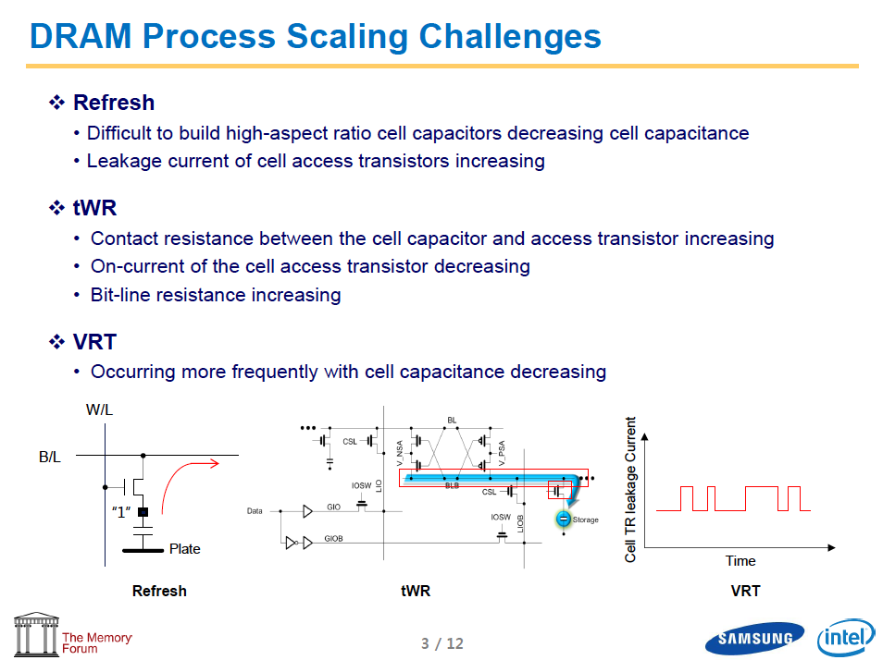
Industry Is Writing Papers About It, Too

Slide 47
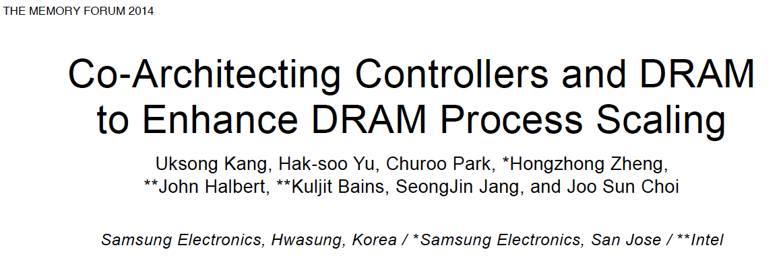
Call for Intelligent Memory Controllers

Slide 48

Data Retention in Memory [Liu et al., ISCA 2013]
Retention Time Profile of DRAM looks like this:
Location dependent
Stored value pattern dependent
Time dependent

Slide 49
Foreshadowing
Main Memory Needs
Intelligent Controllers

Slide 50
Last Time I Was Here …

Slide 51
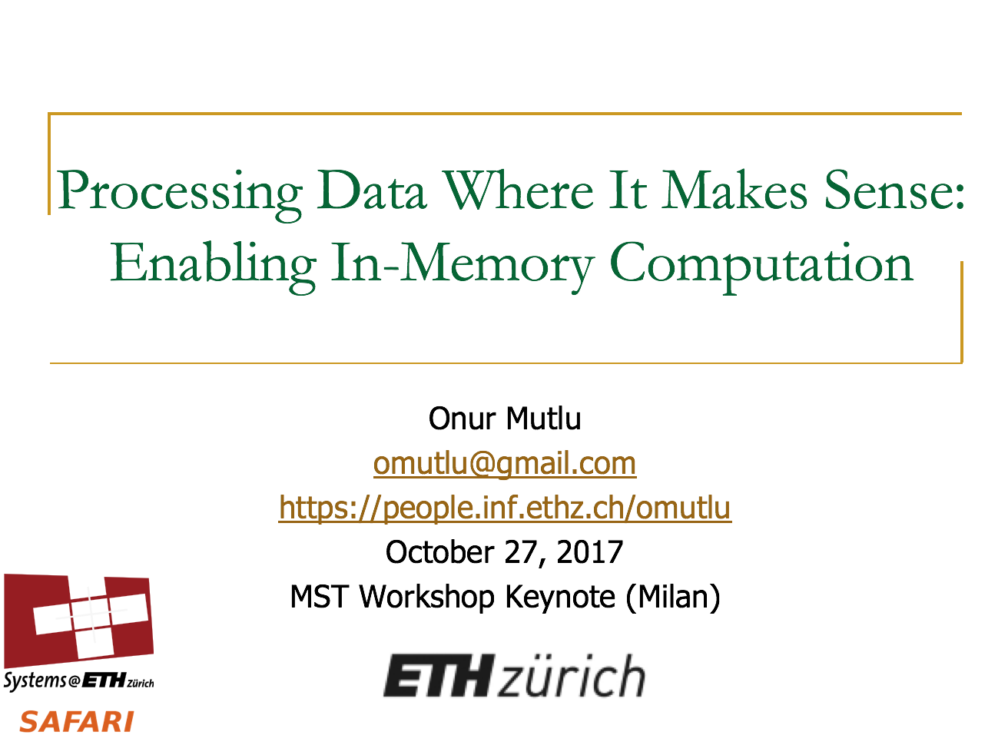
Last Time I Was Here…

Slide 52
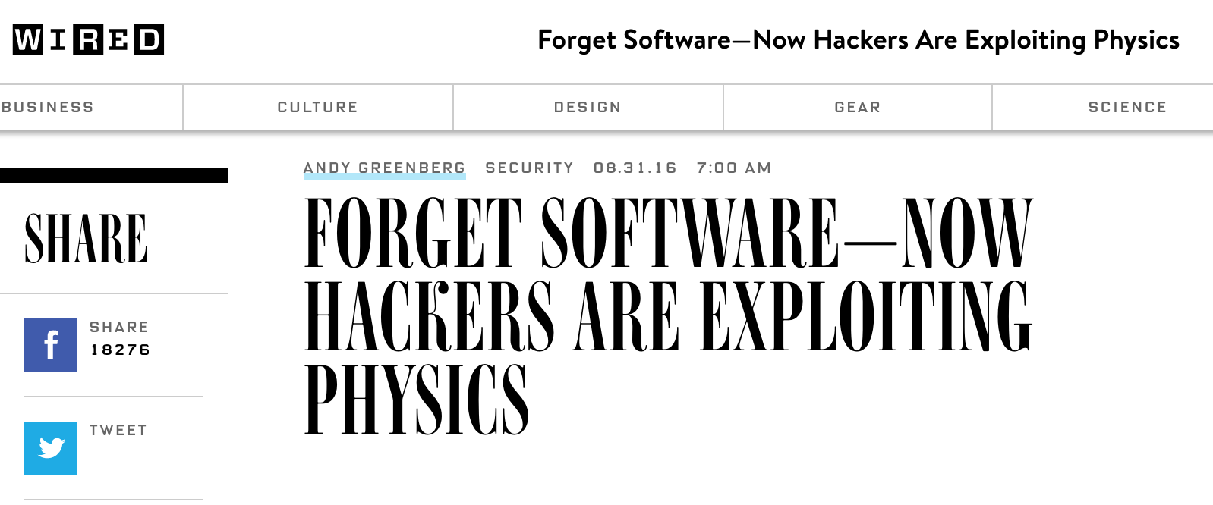
DRAM RowHammer
A simple hardware failure mechanism
can create a widespread
system security vulnerability

Slide 53
Modern DRAM is Prone to Disturbance Errors
Row of Cells
Wordline
Row
Victim Row
Row
Hammered Row
V_{LOW}
Opened
V_{HIGH}
Closed
Row
Victim Row
Row
Repeatedly reading a row enough times (before memory gets refreshed) induces disturbance errors in adjacent rows in most real DRAM chips you can buy today
Flipping Bits in Memory Without Accessing Them: An Experimental Study of DRAM Disturbance Errors, (Kim et al., ISCA 2014)

Slide 54
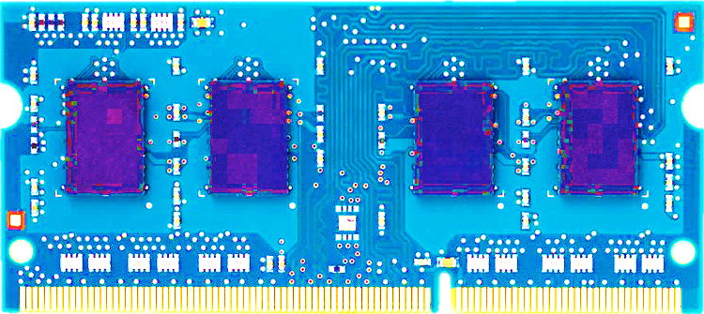
Most DRAM Modules Are Vulnerable
A company
B company
C company
86%
(37/43)
83%
(45/54)
88%
(28/32)
Up to
1.0×10⁷
errors
Up to
2.7×10⁶
errors
Up to
3.3×10⁵
errors
Flipping Bits in Memory Without Accessing Them: An Experimental Study of DRAM Disturbance Errors, (Kim et al., ISCA 2014)

Slide 55


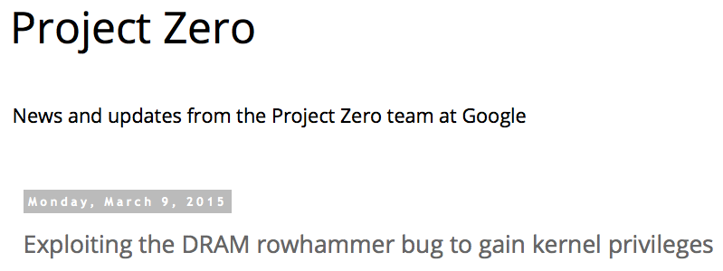
One Can Take Over an Otherwise-Secure System
Flipping Bits in Memory Without Accessing Them: An Experimental Study of DRAM Disturbance Errors (Kim et al., ISCA 2014)
Exploiting the DRAM rowhammer bug to gain kernel privileges (Seaborn, 2015)

Slide 56
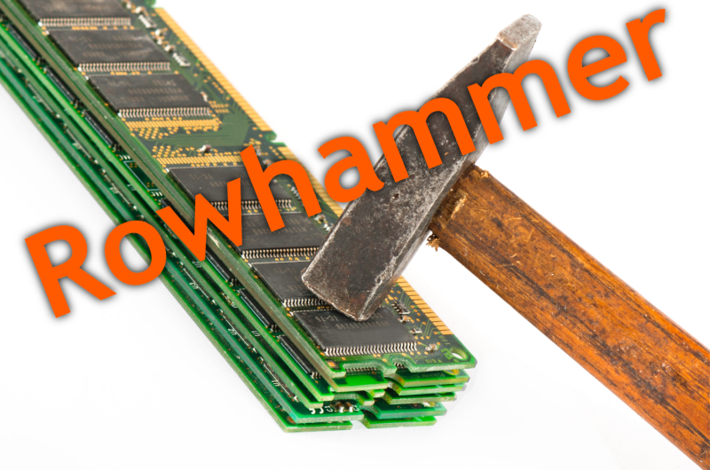
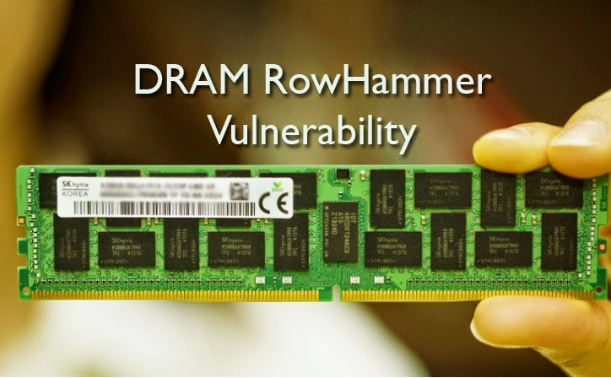
Security Implications
Notes:
Picture from the article:
http://thehackernews.com/2015/03/dram-rowhammer-vulnerability.html

Slide 57

One of the Many Security Implications
  “Can gain control of a smart phone deterministically”
Drammer: Deterministic Rowhammer Attacks on Mobile Platforms, CCS’16
Source: https://fossbytes.com/drammer-rowhammer-attack-android-root-devices/

Slide 58
Our Solution to RowHammer
PARA: Probabilistic Adjacent Row Activation
Key Idea
  After closing a row, we activate (i.e., refresh) one of its neighbors with a low probability: p = 0.005
Reliability Guarantee
  When p=0.005, errors in one year: 9.4×10⁻¹⁴
  By adjusting the value of p, we can vary the strength of protection against errors
Notes:
We provide a more efficient solution, called PARA, which stands for probabilistic adjacent row activation.
The key idea is thus: after closing a row, we activate (i.e., refresh) one of its neighbors with a low probability, for example, p equal to 0.005.
PARA provides a strong reliability guarantee even under the worst-case access patterns to DRAM. When we set p to 0.005, the expected number of errors in one year is 9.4 times 10 to the negative 14. This probability is much lower the failure rate of other hardware components, for example, the hard-disk drive.
And by adjusting the value of p, PARA can provide an arbitrarily strong-degree of protection against errors.

Slide 59
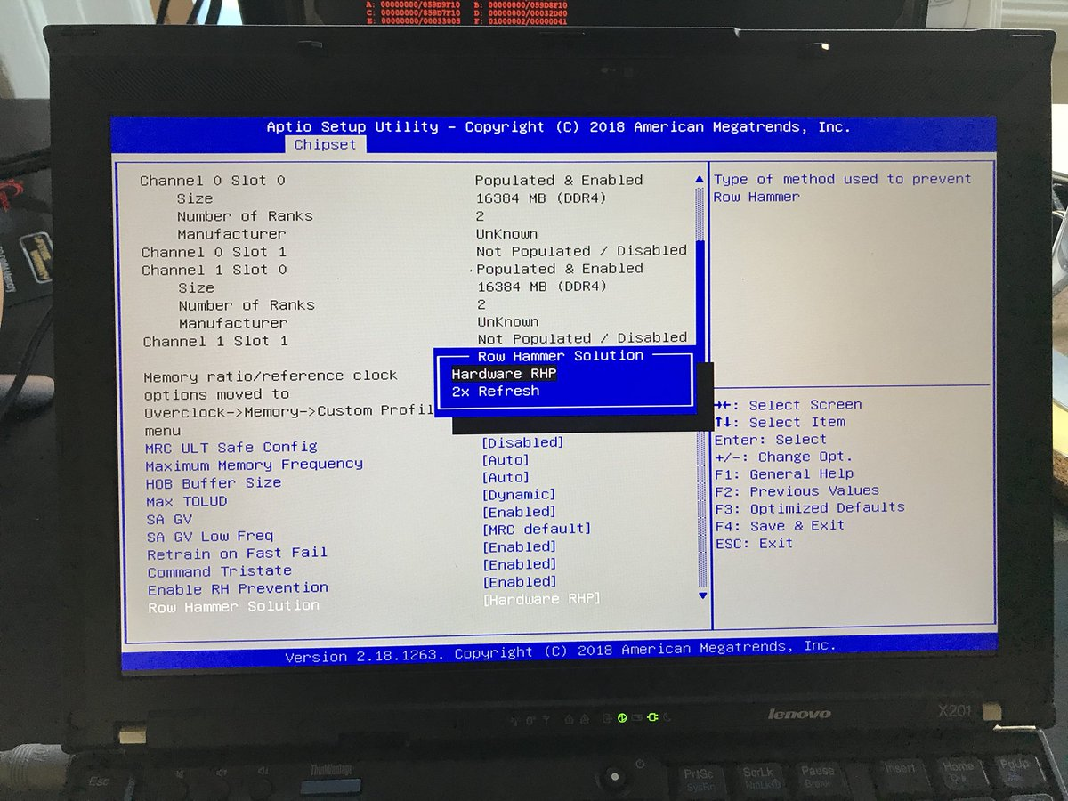
Probabilistic Activation in Real Life (I)
https://twitter.com/isislovecruft/status/1021939922754723841

Slide 60
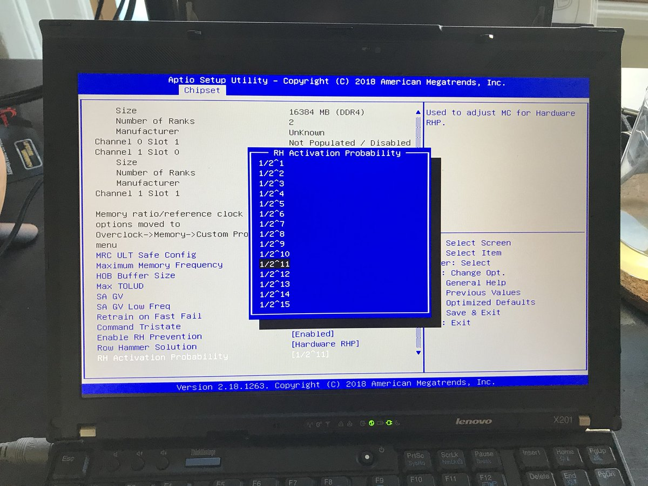
Probabilistic Activation in Real Life (II)
https://twitter.com/isislovecruft/status/1021939922754723841

Slide 61
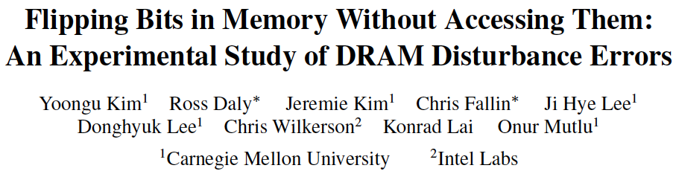
More on RowHammer Analysis
Yoongu Kim, Ross Daly, Jeremie Kim, Chris Fallin, Ji Hye Lee, Donghyuk Lee, Chris Wilkerson, Konrad Lai, and Onur Mutlu,
"Flipping Bits in Memory Without Accessing Them: An Experimental Study of DRAM Disturbance Errors"
Proceedings of the 41st International Symposium on Computer Architecture (ISCA), Minneapolis, MN, June 2014.
[Slides (pptx) (pdf)] [Lightning Session Slides (pptx) (pdf)] [Source Code and Data]

Slide 62
Takeaway
Main Memory Needs
Intelligent Controllers

Slide 63
Agenda
Major Trends Affecting Main Memory
The Need for Intelligent Memory Controllers
  Bottom Up: Push from Circuits and Devices
  Top Down: Pull from Systems and Applications
Processing in Memory in Mobile Systems: Two Directions
  Exploiting 3D-Stacked Memory
  Minimally Changing Memory Chips
How to Enable Adoption of Processing in Memory
Conclusion

Slide 64
Three Key Systems Trends
1. Data access is a major bottleneck
  Applications are increasingly data hungry
2. Energy consumption is a key limiter
3. Data movement energy dominates compute
  Especially true for off-chip to on-chip movement

Slide 65
The Need for More Memory Performance
In-memory Databases
[Mao+, EuroSys’12;
Clapp+ (Intel), IISWC’15]
Graph/Tree Processing
[Xu+, IISWC’12; Umuroglu+, FPL’15]
In-Memory Data Analytics
[Clapp+ (Intel), IISWC’15;
Awan+, BDCloud’15]
Datacenter Workloads
[Kanev+ (Google), ISCA’15]

Slide 66
The Need for More Memory Performance
  Chrome
TensorFlow Mobile
    Google’s web browser
Google’s machine learning framework
  Video Playback
  Video Capture
Google’s video codec
Google’s video codec
Notes:
In this work, we take a look at widely-used google consumer workloads, to figure out the major sources of energy consumption.
We look at Google Chrome web brower. We take a look at Tensorflow, Google’s machine learning framework, and we also take a look at two important video related workloads, video playback and video capture, both rely on Google’s vp9 codec technology.

Slide 67
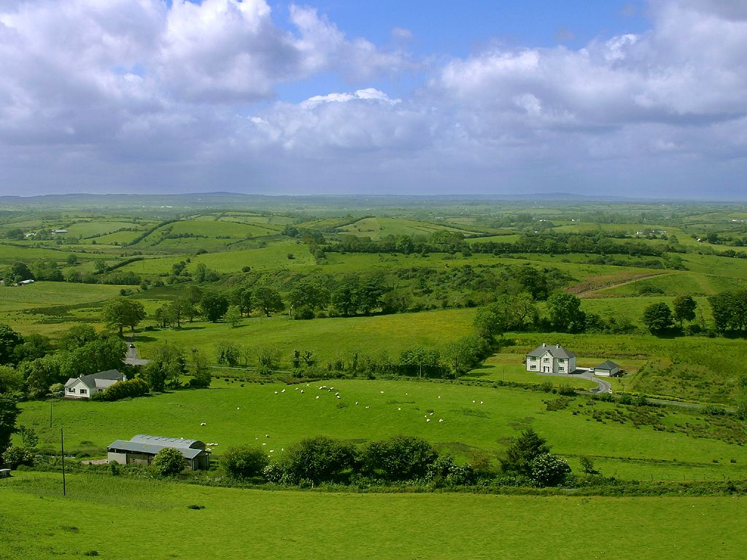
Do We Want This?
Source: V. Milutinovic

Slide 68
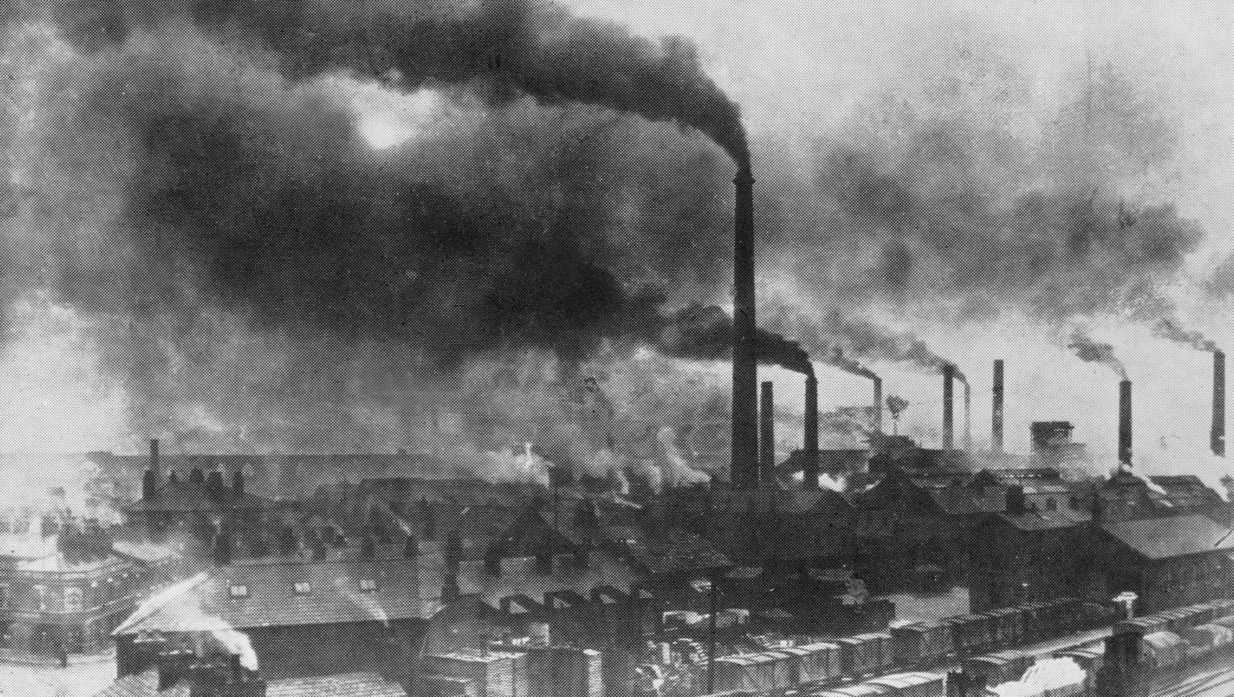
Or This?
Source: V. Milutinovic

Slide 69
Challenge and Opportunity for Future
High Performance,
Energy Efficient,
Sustainable

Slide 70
The Problem
Data access is the major performance and energy bottleneck
Our current
design principles
cause great energy waste
(and great performance loss)

Slide 71
The Problem
Processing of data
is performed
far away from the data

Slide 72
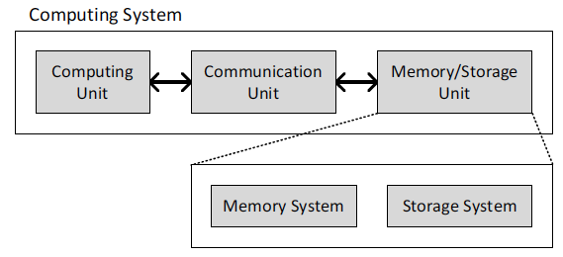
A Computing System
Three key components
Computation
Communication
Storage/memory
Burks, Goldstein, von Neumann, “Preliminary discussion of the
logical design of an electronic computing instrument,” 1946.
Image source: https://lbsitbytes2010.wordpress.com/2013/03/29/john-von-neumann-roll-no-15/

Slide 73
A Computing System
Three key components
Computation
Communication
Storage/memory
Burks, Goldstein, von Neumann, “Preliminary discussion of the
logical design of an electronic computing instrument,” 1946.
Image source: https://lbsitbytes2010.wordpress.com/2013/03/29/john-von-neumann-roll-no-15/

Slide 74
Today’s Computing Systems
Are overwhelmingly processor centric
All data processed in the processor → at great system cost
Processor is heavily optimized and is considered the master
Data storage units are dumb and are largely unoptimized (except for some that are on the processor die)

Slide 75
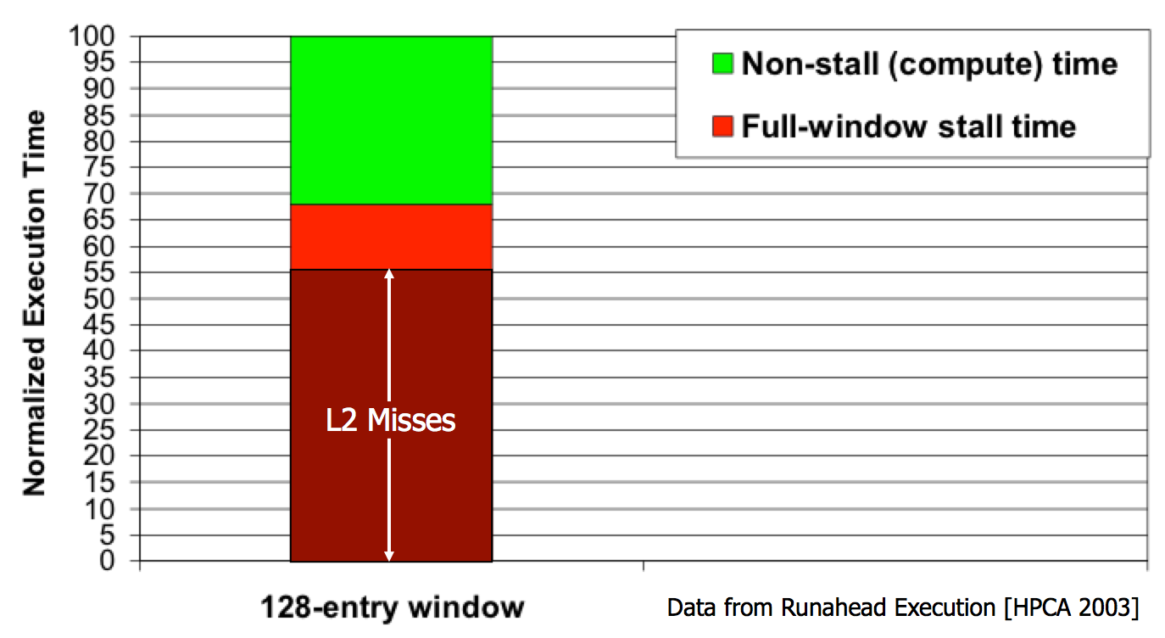
Yet …
“It’s the Memory, Stupid!” (Richard Sites, MPR, 1996)
Mutlu+, “Runahead Execution: An Alternative to Very Large Instruction Windows for Out-of-Order Processors,” HPCA 2003.

Slide 76
The Performance Perspective
Onur Mutlu, Jared Stark, Chris Wilkerson, and Yale N. Patt,
"Runahead Execution: An Alternative to Very Large Instruction Windows for Out-of-order Processors"
Proceedings of the 9th International Symposium on High-Performance Computer Architecture (HPCA), pages 129-140, Anaheim, CA, February 2003. Slides (pdf)

Slide 77
The Performance Perspective (Today)
All of Google’s Data Center Workloads (2015):
Kanev+, “Profiling a Warehouse-Scale Computer,” ISCA 2015.

Slide 78
The Performance Perspective (Today)
All of Google’s Data Center Workloads (2015):
Kanev+, “Profiling a Warehouse-Scale Computer,” ISCA 2015.

Slide 79
Perils of Processor-Centric Design
Grossly-imbalanced systems
  Processing done only in one place
  Everything else just stores and moves data: data moves a lot
  → Energy inefficient
  → Low performance
  → Complex
Overly complex and bloated processor (and accelerators)
  To tolerate data access from memory
  Complex hierarchies and mechanisms
  → Energy inefficient
  → Low performance
  → Complex

Slide 80
Perils of Processor-Centric Design
Most of the system is dedicated to storing and moving data

Slide 81
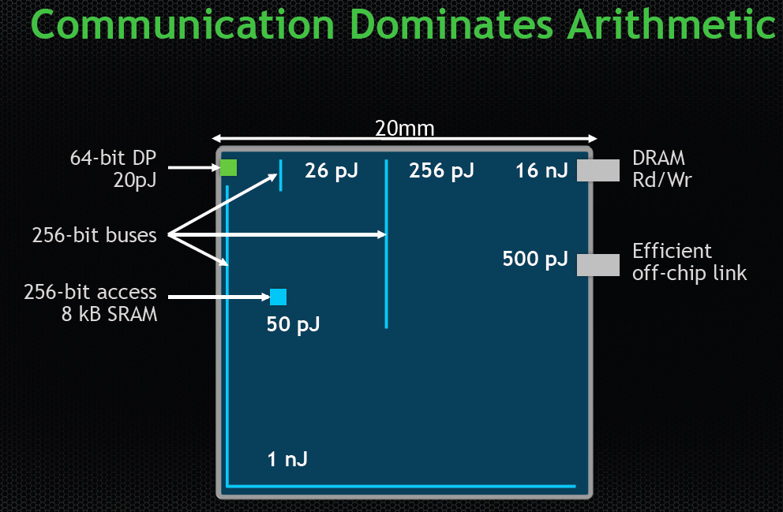
The Energy Perspective
Dally, HiPEAC 2015

Slide 82
Data Movement vs. Computation Energy
Dally, HiPEAC 2015
A memory access consumes ~1000X
the energy of a complex addition

Slide 83
Data Movement vs. Computation Energy
Data movement is a major system energy bottleneck
  Comprises 41% of mobile system energy during web browsing [2]
  Costs ~115 times as much energy as an ADD operation [1, 2]
[1]: Reducing data Movement Energy via Online Data Clustering and Encoding (MICRO’16)
[2]: Quantifying the energy cost of data movement for emerging smart phone workloads on mobile platforms (IISWC’14)

Slide 84
Energy Waste in Mobile Devices
Amirali Boroumand, Saugata Ghose, Youngsok Kim, Rachata Ausavarungnirun, Eric Shiu, Rahul Thakur, Daehyun Kim, Aki Kuusela, Allan Knies, Parthasarathy Ranganathan, and Onur Mutlu,
"Google Workloads for Consumer Devices: Mitigating Data Movement Bottlenecks"
Proceedings of the 23rd International Conference on Architectural Support for Programming Languages and Operating Systems (ASPLOS), Williamsburg, VA, USA, March 2018.
62.7% of the total system energy
is spent on data movement

Slide 85
We Do Not Want to Move Data!
Dally, HiPEAC 2015
A memory access consumes ~1000X
the energy of a complex addition

Slide 86
We Need A Paradigm Shift To …
Enable computation with minimal data movement
Compute where it makes sense (where data resides)
Make computing architectures more data-centric

Slide 87
Goal: Processing Inside Memory
Many questions … How do we design the:
  compute-capable memory & controllers?
  processor chip and in-memory units?
  software and hardware interfaces?
  system software and languages?
  algorithms?
Memory
Processor
Core
Database
Graphs
Media
Cache
Query
Interconnect
Problem
Results
Algorithm
Program/Language
System Software
SW/HW Interface
Micro-architecture
Logic
Devices
Electrons

Slide 88
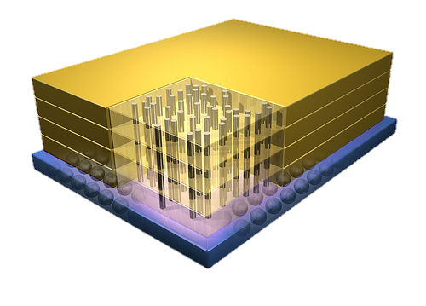


Why In-Memory Computation Today?
Dally, HiPEAC 2015
Push from Technology
  DRAM Scaling at jeopardy
  → Controllers close to DRAM
  → Industry open to new memory architectures
Pull from Systems and Applications
  Data access is a major system and application bottleneck
  Systems are energy limited
  Data movement much more energy-hungry than computation

Slide 89
Agenda
Major Trends Affecting Main Memory
The Need for Intelligent Memory Controllers
  Bottom Up: Push from Circuits and Devices
  Top Down: Pull from Systems and Applications
Processing in Memory in Mobile Systems: Two Directions
  Exploiting 3D-Stacked Memory
  Minimally Changing Memory Chips
How to Enable Adoption of Processing in Memory
Conclusion

Slide 90
Processing in Memory:
Two Approaches
1. Exploiting 3D-stacked memory
2. Minimally changing memory chips

Slide 91
Opportunity: 3D-Stacked Logic+Memory
Memory
Logic
Other “True 3D” technologies
under development

Slide 92
DRAM Landscape (circa 2015)
  Kim+, “Ramulator: A Flexible and Extensible DRAM Simulator”, IEEE CAL 2015.

Slide 93
Several Questions in 3D-Stacked PIM
What are the performance and energy benefits of using 3D-stacked memory as a coarse-grained accelerator?
  By performing simple function offloading
  By changing the entire system completely
What is the minimal processing-in-memory support we can provide?
  With minimal changes to system and programming

Slide 94
PIM on Mobile Devices
Amirali Boroumand, Saugata Ghose, Youngsok Kim, Rachata Ausavarungnirun, Eric Shiu, Rahul Thakur, Daehyun Kim, Aki Kuusela, Allan Knies, Parthasarathy Ranganathan, and Onur Mutlu,
"Google Workloads for Consumer Devices: Mitigating Data Movement Bottlenecks"
Proceedings of the 23rd International Conference on Architectural Support for Programming Languages and Operating Systems (ASPLOS), Williamsburg, VA, USA, March 2018.

Slide 95





Google Workloads for Consumer Devices:
Mitigating Data Movement Bottlenecks
Amirali Boroumand
Saugata Ghose, Youngsok Kim, Rachata Ausavarungnirun,
Eric Shiu, Rahul Thakur, Daehyun Kim, Aki Kuusela,
Allan Knies, Parthasarathy Ranganathan, Onur Mutlu

Slide 96
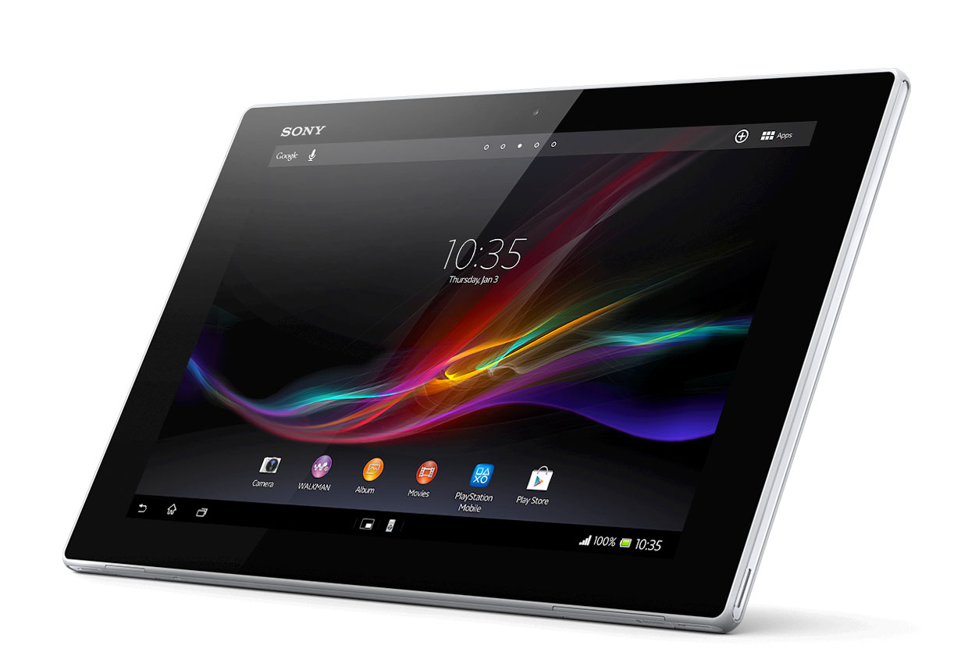

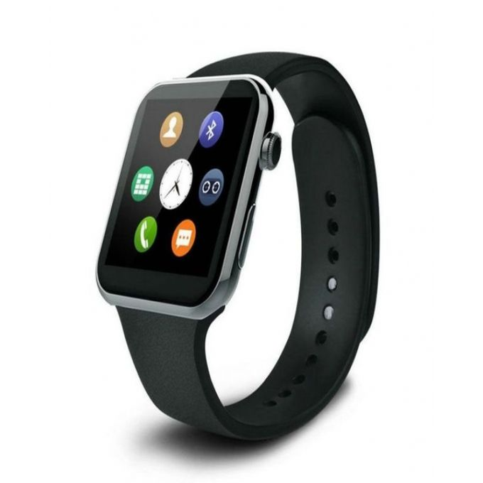

Consumer Devices
Consumer devices are everywhere!
Energy consumption is
a first-class concern in consumer devices
Notes:
Consumer devices like tablets smartphone and wearable are now everywhere and used by billions of people.
One of the major challenge in these devices is battery limitation which makes the energy consumption a critical concern …

Slide 97
Popular Google Consumer Workloads
  Chrome
TensorFlow Mobile
    Google’s web browser
Google’s machine learning framework
  Video Playback
  Video Capture
Google’s video codec
Google’s video codec
Notes:
In this work, we take a look at widely-used google consumer workloads, to figure out the major sources of energy consumption.
We look at Google Chrome web brower. We take a look at Tensorflow, Google’s machine learning framework, and we also take a look at two important video related workloads, video playback and video capture, both rely on Google’s vp9 codec technology.

Slide 98
Energy Cost of Data Movement
1st key observation: 62.7% of the total system energy is spent on data movement
Data Movement
SoC
DRAM
CPU
L2
CPU
L1
CPU
CPU
Compute Unit
Processing-In-Memory (PIM)
  Potential solution: move computation close to data
  Challenge: limited area and energy budget
Notes:
Throughout our analysis, we make a key observation that out of all sources of energy consumption, data movement is a major contributor to the total system energy. We find that across all of the workloads, on average around 62.7% of total system energy is spent on data movement.
One way to reduce data movement cost is to move computation close to data, or …
One potential solution to address this cost it do move computation close to data, or in other words, do procesing in memory. However, the challenge is that these devices.
One potential solution to mitigate data movement cost and reduce total system energy is to execute data-movement heavy portions of application close to data, or in other words, do processing in memory. However, consumer devices are extermely limited in terms of area and power budget. So the question is can we move part of the data movement heavy portion given the limited area and energy budget. Our

Slide 99
Using PIM to Reduce Data Movement
  2nd key observation: a significant fraction of the
  data movement often comes from simple functions
We can design lightweight logic to implement
these simple functions in memory
Small embedded
low-power core
Small fixed-function accelerators
PIM Core
PIM Accelerator
PIM Accelerator
PIM Accelerator
  Offloading to PIM logic reduces energy and improves performance, on average, by 55.4% and 54.2%
Notes:
To figure out if we can use processing in memory, we dig deeper into our analysis and we make another key observation that majority of data movement often comes form simple functions and pritmitives. We find that these simple function can be implemented in memory as either a small embedded core, or group of small fixed function accelerators. Our result shows that offloading these function to PIM logic can significantly reduce data movement for each function and reduce energy on average around 55% and improve perforamcne around 54%.
our PIM core can reduce significant portion of data movement, reduce enregy by 49.1% for each function and improve performance up to 2.2X. While using group of fixed function accelerator reduce energy by 55.4% and improve performance by up to 2.5X.
Or use Saugata’s approach : Reduces total system energy by an average of 55.4%
Reduces execution time by an average of 54.2%
Our result show that both of them can significantly reduce the data movement for each function.
Feedback: talk about result more
Don’t talk about specific detail like MemCopy, MemSet stuff like that
Main take away: data movement come from simple functions that are simple enough to implement in PIM
We find that these functions and primitves can be implemented as PIM logic using either (1) a small low-power general-purpose embedded core or (2) a group of small fixed-function accelerators (PIM accelerators). Our Analysis shows that both are cost-feasible to use in consumer devices. We find that they eliminate a significant fraction of dat amovement, and reduce energy consumption for each of these operation on average by 49 and 55%.

Slide 100
Goals
1
Understand the data movement related bottlenecks in modern consumer workloads
2
Analyze opportunities to mitigate data movement by using processing-in-memory (PIM)
3
    Design PIM logic that can maximize energy efficiency given the limited area and energy budget in consumer devices

Slide 101
Outline
  Introduction
  Background
  Analysis Methodology
  Workload Analysis
  Evaluation
  Conclusion
Notes:
Before we jump into our analysis, lets talk about …

Slide 102

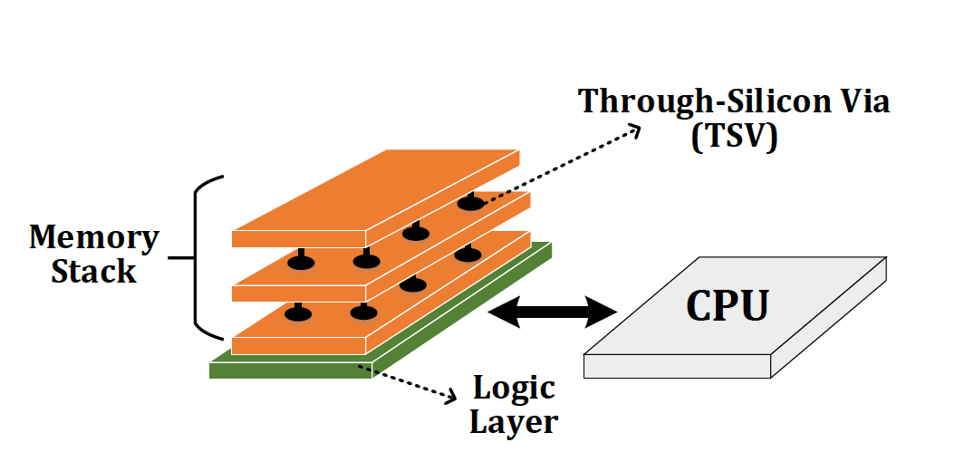
Potential Solution to Address Data Movement
Processing-in-Memory (PIM)
  A potential solution to reduce data movement
  Idea: move computation close to data
Enabled by recent advances in 3D-stacked memory
Reduces data movement
Exploits large in-memory bandwidth
Exploits shorter access latency to memory

Slide 103
Outline
  Introduction
  Background
  Analysis Methodology
  Workload Analysis
  Evaluation
  Conclusion

Slide 104
Workload Analysis Methodology
  Workload Characterization
  Chromebook with an
  Intel Celeron SoC and 2GB of DRAM
  Extensively use performance counters within SoC
Energy Model
  Sum of the energy consumption within the CPU,
  all caches, off-chip interconnects, and DRAM
DRAM
L2
L1
CPU
CPU
Notes:
Feedback: no wifi mention
We did our workload characterization on a Chromebook with an Intel SoC. We use performance counter within Soc to do our analysis.
We model energy as sum of the energy consumption that take place in CPU, caches, interconnet and DRAM. We turn off the wifi and use the lowest brightness for the display to ensure that the majority of the total energy is spent on the SoC and the memory system

Slide 105
PIM Logic Implementation
DRAM
Logic Layer
SoC
PIM Core
PIM Accelerator
PIM Accelerator
PIM Accelerator N
  Customized embedded general-purpose core
  Small fixed-function accelerators
    No aggressive ILP techniques
    Multiple copies of customized
    in-memory logic unit
    256-bit SIMD unit
Notes:
During our analysis, for each workload, once we identify a PIM target, we consider two types of PIM logic implementation: (1) a general-purpose PIM core; and (2) a fixed-function PIM accelerator,
For the PIM core, we design a small general purpose core based on the charateristic of PIM candidate we find across the workloads. It’s simple embedded core that doesn’t have any aggressi ILP techniques, and it includes a SIMD unit to benefit from parallelism. For the PIM accelerator, we design a fixed function logic that has an in memory logic unit for each candidates we find. To benefit from paralalliesm, eacch PIM accelerator has multiple. ..
that can run any of the PIM candidates we find. Majortiy of the candidates we find are data instensive and performs simple operations, as a result, our PIM core doesn’t have any aggressive high performance/ILP techniques. It also has a SIMD unit as all of candidates we find benefit from parallelism.
For the PIM accelerator, for each of our PIM targets, we first design a customized in-memory logic unit, To benefit from parallelism, each PIM acceleartor has multiple copies of the in-memory logic unit,

Slide 106
Workload Analysis
  Chrome
TensorFlow
    Google’s web browser
Google’s machine learning framework
  Video Playback
  Video Capture
Google’s video codec
Google’s video Codec
Notes:
Now I’m gonna talk about our workload analysis. I will focus on chrome browser for the most of this talk.

Slide 107
Workload Analysis
  Chrome
TensorFlow
    Google’s web browser
Google’s machine learning framework
  Video Playback
  Video Capture
Google’s video codec
Google’s video codec

Slide 108

How Chrome Renders a Web Page
Loading and Parsing
Painting
HTML
HTML
HTML Parser
HTML Parser
Render Tree
Render Tree
Layout
Layout
Rasteriza-tion
Rasteriza-tion
Composit-ing
Composi-ting
CSS
CSS
CSS Parser
CSS Parser

Slide 109
How Chrome Renders a Web Page
Loading and Parsing
Layouting
Painting
assembles all layers
into a final screen image
HTML
HTML
HTML Parser
HTML Parser
Render Tree
Render Tree
Layout
Layout
Rasteriza-tion
Rasteriza-tion
Composi-ting
Composi-ting
CSS
CSS
CSS Parser
CSS Parser
paints those objects
and generates the bitmaps
  calculates the
  visual elements and position of each object
Notes:
Feedback: the first major part just download the source files and parse them.
I just want to give you a brief high-level overview of how chrome renders a webpage. First the browser downloads the HTML and CSS, it starts parsing them to extract the content of the webpage. Then, based on those, at the next two stages, the browser calculate the visual rep and position of each object at the page. So at the end of layout stage, for each object, it knows the visual elements and the location of each object that needs to be drawn.. Then it goes to rasterization which is basically the process of painiting those object and generating the bitmaps. And at the final stages, compositing gets those bitmaps and composite them to gether and gerenate the final screen.
and calculate the visual represenation and postiion of each object in the page. At the end of the layout section,
Everything starts with downloading the HTML and CSS.
The chrome’s rendering engine, starts by parsing HTML files and store the the contents of a web page a tree of Node objects called the DOM tree. It also extracts style rules by parsing the CSS files. DOM tree and style rules together allows them to creates the render tree. The browser combines the DOM and style rules and generates "render tree,”. This tree is the visual representation of the document. The purpose of this tree is to enable painting the contents in their correct order. Up to this point we've calculated which nodes should be visible and their computed styles, but we have not calculated their exact position and size within the viewport of the device---that's the "layout" stage. Layout computes the exact position and size of each object.
Finally, now that we know which nodes are visible, and their computed styles and geometry, we can pass this information to the final stage, which converts each node in the render tree to actual pixels on the screen. This step is often referred to as "painting" or "rasterizing.” Painting is the process of filling in pixels into bitmaps. It involves drawing out text, colors, images, borders, and shadows, essentially every visual part of the elements. Finally, The rasterized bitmap (also known as a texture) is then sent to the GPU through a process called texture upload, after which the GPU performs compositing.
DOM: the contents of a web page are internally stored as a tree of Node objects called the DOM tree.
DOM: content of the webpage
Style rules: describe the style that need to be applies to the document
Render Tree: This tree is of visual elements in the order in which they will be displayed. It is the visual representation of the document. The purpose of this tree is to enable painting the contents in their correct order.
Layout: The calculation of geometric information (where and what size each element has) for every visible element. It’s normally done for the entire
Paint/rasterize: Painting is the process of filling in pixels. It involves drawing out text, colors, images, borders, and shadows, essentially every visual part of the elements. The drawing is typically done onto multiple surfaces, often called layers.
Compositing: Since the parts of the page were drawn into potentially multiple layers they need to be drawn to the screen in the correct order so that the page renders correctly. This is especially important for elements that overlap another, since a mistake could result in one element appearing over the top of another incorrectly.
https://aerotwist.com/blog/the-anatomy-of-a-frame/
The main subsystems are:
Input handling [technically not related to graphics per se, but nevertheless critical for many interactions]
Parsing, which turns a chunk of HTML into DOM nodes
Style, which resolves CSS onto the DOM
Layout, which figures out where DOM elements end up relative to one another
Paint setup, sometimes referred to as recording, which converts styled DOM elements into a display list (SkPicture) of drawing commands to paint later, on a per-layer basis
Painting, which converts the SkPicture of drawing commands into pixels in a bitmap somewhere (either in system memory or on the GPU if using Ganesh)
Compositing, which assembles all layers into a final screen image
and, less obviously, the presentation infrastructure responsible for actually pushing a new frame to the OS (i.e. the browser UI and its compositor, the GPU process which actually communicates with the GL driver, etc).

Slide 110
Browser Analysis
To satisfy user experience, the browser must provide:
  Fast loading of webpages
  Smooth scrolling of webpages
  Quick switching between browser tabs
We focus on two important user interactions:
1) Page Scrolling
2) Tab Switching
  Both include page loading
Notes:
So what are the important actions that users do with the browswe in the consumer devices?
The user perception of the browser speed is based on three factors: (1) page load time, (2) smooth web page scrolling, and (3) quick switching between browser tabs. In our study, we focus on two user interactions that impact these three factors, and govern a user’s browsing experience: (1) page scrolling and (2) tab switching. Note that each interaction includes page loading.
We emulate all these actions using Google’s temeletry freamework and focus on two actions:
Link it back to telemtery and probably remove the first bullet

Slide 111
Scrolling
Notes:
Now let me give you a little bit background on how prior works deal with the PIM coherence.

Slide 112
What Does Happen During Scrolling?
rasterization uses color blitters
to convert the basic primitives
into bitmaps
    Rasterization generates the bitmap and sends it to GPU for compositing
Color Blitting
HTML
HTML Parser
Render Tree
Layout
Layout
Rasteriza-tion
Rasteriza-tion
Composi-itng
Composi-ting
CSS
CSS Parser
Texture Tiling
to minimize cache misses
during compositing, the graphics driver reorganizes the bitmaps
Notes:
When user scrolls a webpage, it triggers three operations in the browser. It forces the browser to recompute the layout because the position of each object has changed, it forces the browser to do rasterization, because there are some new contents that needs to be rasterized, and the browser need to do compositing because there are new objects that need to be displayed.
In addition to that, I want to briefly talk about two other important functions that play a key role in our analysis. The first one is Texture Tiling, that happens between rasterization and compositing. To minimze cache misses, the graphic drivers invokes texture tiling to reo-rganize the bitmaps before sending them to GPU. Another important function is color blitting. Color blitting is inoked during the rasterization. And it is used to convert the basic primitives like text and line, into bitmaps.

Slide 113
Scrolling Energy Analysis
Google
Docs
Gmail
Google
Calendar
Word-
Press
Twitter
Ani-
mation
AVG
41.9% of page scrolling energy is spent on
texture tiling and color blitting
Notes:
Here I’m showing the energy breakdown for scrolling on different web pages. This figures shows what functions in browser consume the most of the energy when user do the scrolling. Across all of the pages that we test, 41.9% of page scrolling energy is spent on two data-intensive components: (1) texture tiling, where the graphics driver reorganizes the linear bitmap data into a tiled format for the GPU; and (2) color blitting, which is invoked by the Skia library [51] during rasterization.
The rest of the energy is spent on a variety of other libraries and functions, each of which contributes to less than 1% of the total energy consumption
So now the question is, where exactly the energy is spent in the system?

Slide 114
Scrolling a Google Docs Web Page
77% of total energy consumption goes to data movement
A significant portion of
total data movement comes from
texture tiling and color blitting
37.7% of total system energy
Notes:
To answer that question, here I’m showing the energy break down, across different hardware components in the consumer devices. The x axis shows how much energy is spent on each components like DRAM, caches or CPU, and the y axis shows the total energy.
A major observation from this figure is that majority of energy is spent on accessing data from DRAM, or on-chip caches, or moving data over interconnects. Our anlaysis shows that 77% of total energy goes to data movement. Our analysis show that almost half of that data movement comes from texture tiling and color blitting. Here I’m showsing that for each of those functions how much of the energy goes to data movement and computation. We find that these two functions are extermely data intensive and the data movement generate by these
To answer this question, we dig deeper into our energy analysis. This figure shows gives more insight into where energy is spent in the system when we scroll through a Google Docs.
We find that 77% of the total energy consumption is due to data movement. The data movement energy includes the energy consumed by DRAM, the off-chip interconnect, and the on-chip caches.
We then zoom into each of those function and we find out that these functions are both very data intensive and majority of their energy goes to dat amovment. In fact we find that the data movement generated by texture tiling and color blitting alone accounts for 37.7% of the total system energy
OR
In fact, the data movement generated by these two functions account for 37.7 of total system energy.
When you present the question, you would say: we first need to see whats going on during texture tiling.
To answer this question, we need to first figure what each function does. We start by texture tiling.

Slide 115
Scrolling a Google Docs Web Page
77% of total energy consumption goes to data movement
Can we use PIM to mitigate the data movement cost
for texture tiling and color blitting?
A significant portion of
total data movement comes from
texture tiling and color blitting
37.7% of total system energy
Notes:
To answer that question, here I’m showing the energy break down, across different hardware components in the consumer devices. The x axis shows how much energy is spent on each components like DRAM, caches or CPU, and the y axis shows the total energy.
A major observation from this figure is that majority of energy is spent on accessing data from DRAM, or on-chip caches, or moving data over interconnects. Our anlaysis shows that 77% of total energy goes to data movement. Our analysis show that almost half of that data movement comes from texture tiling and color blitting. Here I’m showsing that for each of those functions how much of the energy goes to data movement and computation. We find that these two functions are extermely data intensive and the data movement generate by these
To answer this question, we dig deeper into our energy analysis. This figure shows gives more insight into where energy is spent in the system when we scroll through a Google Docs.
We find that 77% of the total energy consumption is due to data movement. The data movement energy includes the energy consumed by DRAM, the off-chip interconnect, and the on-chip caches.
We then zoom into each of those function and we find out that these functions are both very data intensive and majority of their energy goes to dat amovment. In fact we find that the data movement generated by texture tiling and color blitting alone accounts for 37.7% of the total system energy
OR
In fact, the data movement generated by these two functions account for 37.7 of total system energy.
When you present the question, you would say: we first need to see whats going on during texture tiling.
To answer this question, we need to first figure what each function does. We start by texture tiling.

Slide 116
Can We Use PIM for Texture Tiling?
CPU-Only
time
CPU + PIM
CPU
Memory
CPU
PIM
Rasterization
Rasterization
Linear
Linear
Bitmap
Read Bitmap
Bitmap
idle
Conversion
Texture Tiling
Conversion
Texture
high
Invoke
Tiles
data movement
Compositing
Write Back
Texture
Invoke
Tiles
Compositing
1) Eliminate a significant portion of data movement
Major sources of data movement:
1) poor data locality
2) large rasterized bitmap size (e.g. 4MB)
  Texture tiling is a good candidate for
  PIM execution
2) Free up CPU to perform
Notes:
Feedback: move stuff from CPU-only to CPU+PIM, not fade
So can we use PIM for texture tiling? To answer that, here I’m showing you a bit more detailed of interactions between CPU and memory during texture tiling. As I said the cpu performs rasterization and store the bitmap in memory. It then needs to invoke Compositing process. Texture Tiling happens in between. The graphic driver read the bitmap, convert it to a more cache friendly format for GPU, and write it back to a location that GPU reads from.. It then invoke compositing. That’s where a lot of data movement happens because there is poor data locality during this processn and the bitmap sizes are so large that in some cases they don’t even fit into last level cache. This process is a good candidate for PIM. Here I’m showing what would happen if we move it to PIM. PIM logic access the bitmaps in memory, do the conversion, and write it to the location gpu access that. This way, it eliminates a significant porition of data movement and it also frees up the cpu to do other important task
So whats texture Tiglin. Here I want to walk you through the major steps during Texture tiling.
Texture tiling happens after rasterization and before compositing. Rasterization generates a rasterized bitmap. Then, that bitmap is sent to GPU for compositing. After rasterization, compositing accesses each texture in both the horizontal and vertical directions. To minimize cache misses during compositing, the graphics driver reads the rasterized bitmap ( 2 ) and converts the bitmap into a tiled texture layout
Because of this high amount of data movement, texture tiling is a good candidate for PIM execution. By moving texture tiling to PIM, we can let the PIM logic read the bitmap, performs the tiling operation in the memory, and the write it to a location that GPU will access. This wa,y we can elimnate a significant portion of data movement as it happens close to data and avoid moving the texture back and forth between memory and CPU . we can free up the CPU ( 5 ) to perform other important compute-intensive tasks in Chrome, such as handling user interaction, executing JavaScript code, or rasterizing other render objects.

Slide 117
Can We Implement Texture Tiling in PIM Logic?
Linear Bitmap
Texture Tiling
Tiled Texture
Requires simple primitives: memcopy, bitwise operations, and simple arithmetic operations
PIM Core
PIM Accelerator
9.4% of the area available for PIM logic
7.1% of the area available for PIM logic
  PIM core and PIM accelerator are feasible to implement in-memory Texture Tiling
Notes:
The next question is whether texture tiling is feasible to be implemented using PIM in consumer devices. To answer that, we analyze the texutre tiling in detail and find that
hat texture tiling requires only simple primitives: memcopy, bitwise operations, and simple arithmetic operations (e.g., addition).
These operations can be performed at high performance on our PIM core, and they can easily be implemented as a fixed function PIM accelerator.
Our analysis hsows that each of them takes less than 10% of the area available per vault, and as a result, both are feasible to implement in a consumer device with 3D-stacked memory
As we explained before our PIM core is …
Our PIM accelerator for texture tiling consists of multiple in-memory tiling units.
Each in-memory tiling unit consists of only a simple ALU, and operates on a single 4 kB tile.
We empirically decide to use four in-memory tiling units in each PIM accelerator
We conclude that the area required for texture tiling PIM logic is small, making the PIM logic feasible to implement in a consumer device with 3D-stacked memory

Slide 118
Color Blitting Analysis
Generates a large amount of data movement
  Accounts for 19.1% of the total system energy during scrolling
Color blitting is a good candidate
for PIM execution
Requires low-cost operations:
Memset, simple arithmetic, and shift operations
It is feasible to implement color blitting
in PIM core and PIM accelerator
Notes:
We did the same analysis for Color Blitting. Because of lack of time, I will talk about the key points here.
Majority come from its streaming access pattern and the large sizes of the bitmaps (e.g., 1024x1024 pixels).
The function itself require simple computations

Slide 119
Scrolling Wrap Up
Texture tiling and color blitting account for
a significant portion (41.9%) of energy consumption
37.7% of total system energy goes to
data movement generated by these functions
  Both functions can benefit significantly
  from PIM execution
1
  Both functions are feasible to implement
  as PIM logic
2
Notes:
So here I just want to wrap up our analysis for page scrolling. We found two data intensive functions that account for a significant portion of energy during scrolling. We find that both function can significantly benfti from PIM execution. We also find that both functions are simple enough that can be impelemented at pim logic

Slide 120
Tab Switching
Notes:
Now let me give you a little bit background on how prior works deal with the PIM coherence.

Slide 121


What Happens During Tab Switching?
Chrome employs a multi-process architecture
  Each tab is a separate process
Main operations during tab switching:
  Context switch
  Load the new page
Chrome Process
…
Tab 1
Process
Tab 2
Process
Tab N
Process
Notes:
Chrome uses a multi-process architecture, where each tab has its own application process for rendering the page displayed in the tab to improve reliability and performance.
When a user switches between browser tabs, this triggers two operations: (1) a context switch to the process for the selected tab, and (2) a load operation for the new page.

Slide 122
Memory Consumption
Primary concerns during tab switching:
  How fast a new tab loads and becomes interactive
  Memory consumption
Chrome uses compression to
reduce each tab’s memory footprint
DRAM
CPU
Inactive Tab
Compressed Tab
ZRAM
Decompression
Compression
Notes:
There are two primary concerns during tab switching: (1) how fast a new tab loads and becomes interactive, as this directly affects user satisfaction; and (2) memory consumption.
Memory consumption is a major concern for three reasons. First, the average memory footprint of a web page has increased significantly in recent years because of increased use of images, JavaScript, and video in modern web pages.
Second users tend to open multiple tabs at a time with each tab consuming additional memory.
Third, consumer devices typically have a much lower memory capacity than server or desktop systems, and without careful memory management, Chrome could run out of memory on these systems over time.

Slide 123
Data Movement Study
To study data movement during tab switching,
we emulate a user switching through 50 tabs
We make two key observations:
Compression and decompression
contribute to18.1% of the total system energy
1
19.6 GB of data moves between
CPU and ZRAM
2
Notes:
Moves between CPU and ZRAM
There are two primary concerns during tab switching: (1) how fast a new tab loads and becomes interactive, as this directly affects user satisfaction; and (2) memory consumption.
Memory consumption is a major concern for three reasons. First, the average memory footprint of a web page has increased significantly in recent years because of increased use of images, JavaScript, and video in modern web pages.
Second users tend to open multiple tabs at a time with each tab consuming additional memory.
Third, consumer devices typically have a much lower memory capacity than server or desktop systems, and without careful memory management, Chrome could run out of memory on these systems over time.

Slide 124
Can We Use PIM to Mitigate the Cost?
CPU-Only
time
CPU + PIM
CPU
Memory
CPU
PIM
Swap out N pages
Swap out N pages
Uncompressed
Uncompressed
Pages
Pages
Read N Pages
Other tasks
Compress
Compress
high
compression
No off-chip data movement
data movement
ZRAM
Write back
Other tasks
ZRAM
  PIM core and PIM accelerator are feasible to implement in-memory compression/decompression
Notes:
Now we want to see if we can mitigate data movement cost with PIM. To answer that, lets again take a look at interaction between CPU and memory when CPU wants to swap out N pages. we need to figure out where the data movement happens. Here shows what happens when CPU wants to swap out N inactive pages. it first read the inactive page data, compress the data ( 2 ), and write the compressed data to ZRAM. This incur a lot of overhead. This operation is a good fit for PIM as (1) it cause a large amount of data movement; and (2) compression can be handled in the background, since none of the active tab processes need the data that is being compressed
Our analysis shows that the compression algorithm used by chrome is simple enough that both pim core and …
To wrap up, we found that a lot of data movement happens during tab switching as chrome tries to compress and decompress tabs. We find that both compression and decompression can significantly benefit from PIM execution and are feasible to be implemented at PIM logic
Now on the right what happens when we offload compression to PIM. In this case, the CPU only informs the PIM logic about the pages that need to be swapped out, and the PIM logic operates on the uncompressed page data that is already in memory. This (1) eliminates the off-chip page data movement that took place during CPU-based compression, and (2) frees up the CPU to perform other tasks while PIM performs compression in the background. We observe a similar behavior during decompression.

Slide 125
Tab Switching Wrap Up
A large amount of data movement happens during tab switching as Chrome attempts to compress and decompress tabs
  Both functions can benefit from PIM execution and can be implemented as PIM logic
2
Notes:
To wrap up, we found that a lot of data movement happens during tab switching as chrome tries to compress and decompress tabs. We find that both compression and decompression can significantly benefit from PIM execution and are feasible to be implemented at PIM logic

Slide 126
Workload Analysis
  Chrome
TensorFlow
    Google’s web browser
Google’s machine learning framework
  Video Playback
  Video Capture
Google’s video codec
Google’s video codec

Slide 127
Workload Analysis
  Chrome
TensorFlow
    Google’s web browser
Google’s machine learning framework
  Video Playback
  Video Capture
Google’s video codec
Google’s video codec

Slide 128
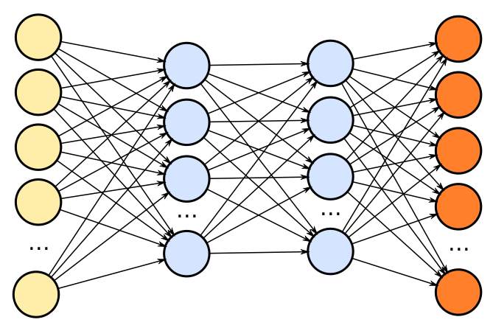
TensorFlow Mobile
Inference
Prediction
57.3% of the inference energy is spent on
data movement
54.4% of the data movement energy comes from
packing/unpacking and quantization

Slide 129
Packing
Matrix
Packing
Packed Matrix
Reorders elements of matrices to minimize
cache misses during matrix multiplication
Up to 40% of the
inference energy and 31% of
inference execution time
Packing’s data movement accounts for up to
35.3% of the inference energy
A simple data reorganization process
that requires simple arithmetic

Slide 130
Quantization
floating point
Quantization
integer
Converts 32-bit floating point to 8-bit integers to improve inference execution time and energy consumption
Up to 16.8% of the inference energy
and 16.1% of
inference execution time
Majority of quantization energy comes from
data movement
A simple data conversion operation that requires shift, addition, and multiplication operations

Slide 131
Quantization
floating point
Quantization
integer
Converts 32-bit floating point to 8-bit integers to improve inference execution time and energy consumption
Based on our analysis, we conclude that:
Both functions are good candidates for PIM execution
It is feasible to implement them in PIM logic
Up to 16.8% of the inference energy
and 16.1% of
inference execution time
Majority of quantization energy comes from
data movement
A simple data conversion operation that requires shift, addition, and multiplication operations

Slide 132
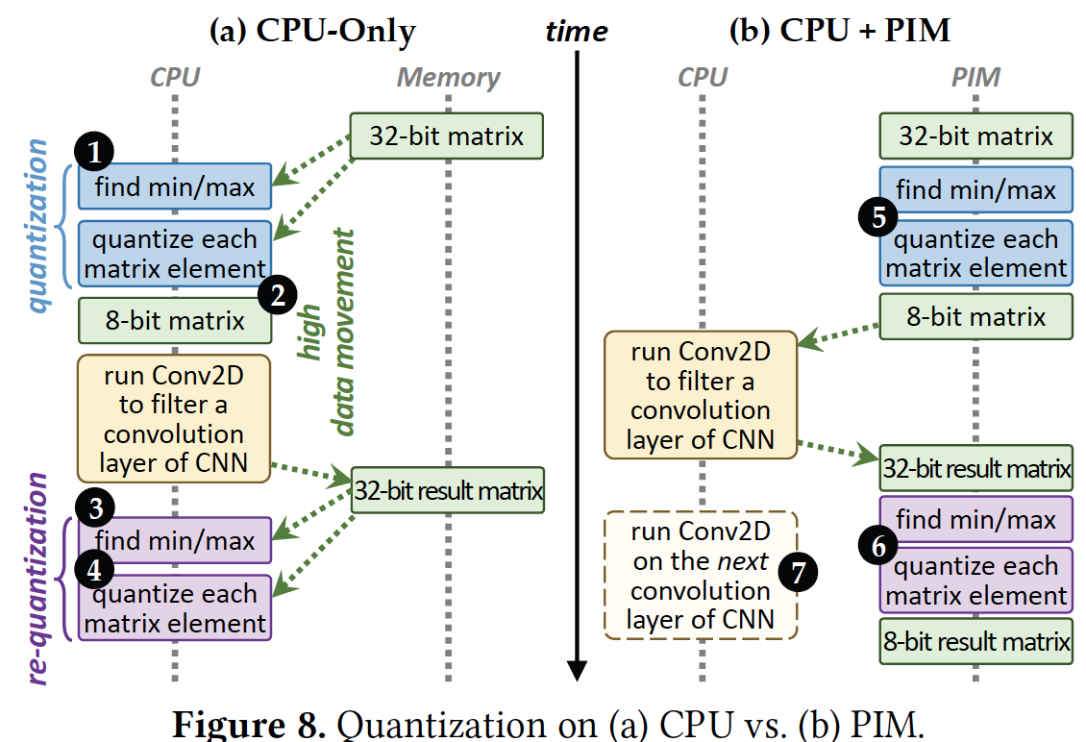
Quantization on PIM

Slide 133

Video Playback and Capture
Compressed video
Captured video
Compressed
video
Display
VP9 Decoder
VP9 Encoder
Majority of energy is spent on data movement
Majority of data movement comes from
simple functions in decoding and encoding pipelines
Notes:
We also analyze video play back and video capture. We take a look at energy consumption when vp9 decider is yaed to playback a netflix film, and when vp9 wncoder is used to do real-time encoding of ...
We find that for both of these workloads data movemwnt is a major contributor to the total system enery.
When we dog deeper we find that they are simple functions in decoding and encoding pipeline that generate the majority of dara movement.
Please refer to the paper for more detail.

Slide 134
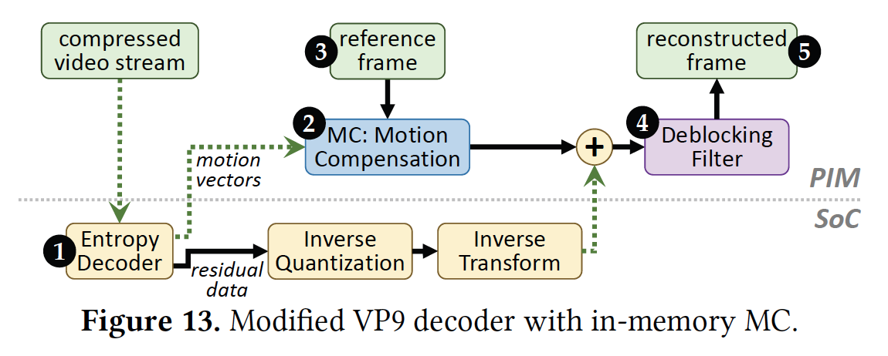
VP9 Video Decoder with PIM

Slide 135
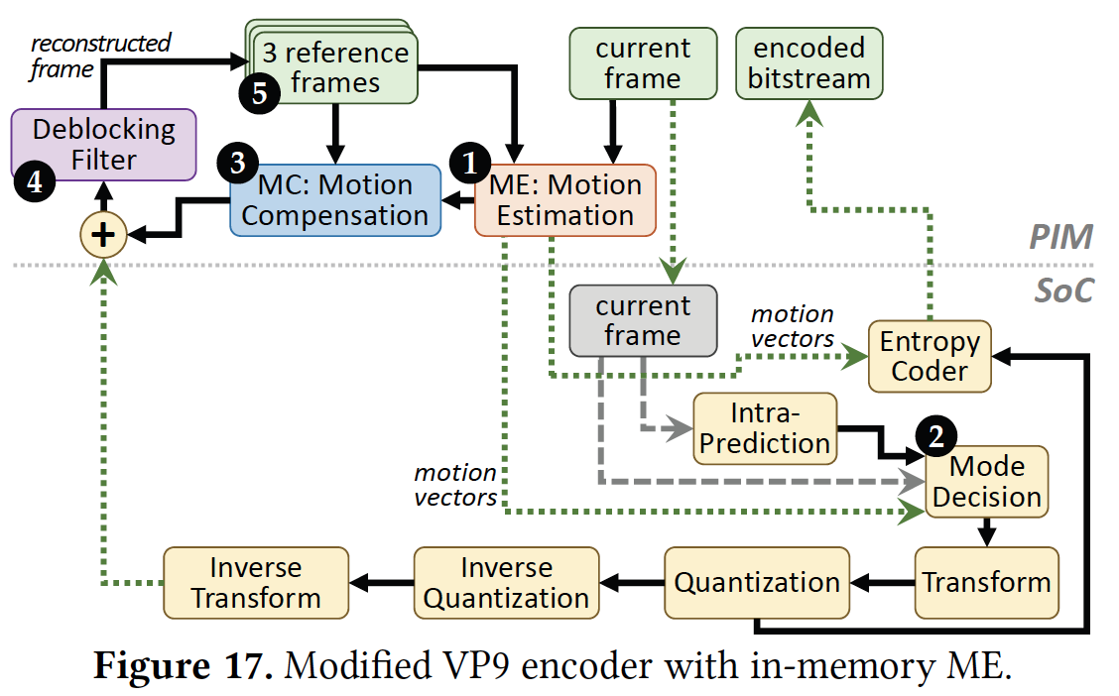
VP9 Video Encoder with PIM

Slide 136
Outline
  Introduction
  Background
  Analysis Methodology
  Workload Analysis
  Evaluation
  Conclusion

Slide 137
Evaluation Methodology
System Configuration (gem5 Simulator)
  SoC: 4 OoO cores, 8-wide issue, 64 kB L1cache,
  2MB L2 cache
  PIM Core: 1 core per vault, 1-wide issue, 4-wide SIMD,
  32kB L1 cache
  3D-Stacked Memory: 2GB cube, 16 vaults per cube
    Internal Bandwidth: 256GB/S
    Off-Chip Channel Bandwidth: 32 GB/s
  Baseline Memory: LPDDR3, 2GB, FR-FCFS scheduler
We study each target in isolation and emulate each separately and run them in our simulator
Notes:
and then analyzing the benefit of PIM in our simulator

Slide 138
Normalized Energy
TensorFlow Mobile
Video Playback and Capture
77.7% and 82.6% of energy reduction for texture tiling and packing comes from eliminating data movement
Chrome Browser
PIM core and PIM accelerator reduces
energy consumption on average by 49.1% and 55.4%
Notes:
We make another obsrevation that using PIM accelerator provide limited energy reduction over PIM core, for some of these workloads, such as texture tiling. This is becase these kernels are data intensive and have low ocmputational compleity, and as a result, using fixed function accelerator does not provide significant energy reduction over the PIM core.

Slide 139
Normalized Runtime
Chrome Browser
Video Playback and Capture
TensorFlow Mobile
Offloading these kernels to PIM core and PIM accelerator improves performance on average by 44.6% and 54.2%
Notes:
PIM-Core and PIM-Acc significantly outperform CPU-Only across all kernels, improving performance by … This perfomance benefit come from higher bandwidth and lower access latency of 3D-stacked memory, because all of these kernels are data intensive.
Performance improvement of PIM-acc over PIM-core differes across different workloads. In some cases such as Texture Tiling, the performance improvement of PIM-Acc over PIM-Core is limited by the low computational complexity of these two kernels. But there are other cases, such as compression that benefit significantly from using PIM-Acc over PIM-Core in terms of performance, because these kernels are more compute-intensive and less data-intensive compared to texture tiling and.

Slide 140
Conclusion
Energy consumption is a major challenge in consumer devices
We conduct an in-depth analysis of popular Google consumer workloads
  62.7% of the total system energy is spent on data movement
  Most of the data movement comes from simple functions that consist of simple operations
We use PIM to reduce data movement cost
  We design lightweight logic to implement
  simple operations in DRAM
  Reduces total energy by 55.4% on average
  Reduces execution time by 54.2% on average
PIM Core
PIM Accelerator
PIM Accelerator
PIM Accelerator

Slide 141
Google Workloads for Consumer Devices:
Mitigating Data Movement Bottlenecks
Amirali Boroumand
Saugata Ghose, Youngsok Kim, Rachata Ausavarungnirun,
Eric Shiu, Rahul Thakur, Daehyun Kim, Aki Kuusela,
Allan Knies, Parthasarathy Ranganathan, Onur Mutlu

Slide 142
More on PIM for Mobile Devices
Amirali Boroumand, Saugata Ghose, Youngsok Kim, Rachata Ausavarungnirun, Eric Shiu, Rahul Thakur, Daehyun Kim, Aki Kuusela, Allan Knies, Parthasarathy Ranganathan, and Onur Mutlu,
"Google Workloads for Consumer Devices: Mitigating Data Movement Bottlenecks"
Proceedings of the 23rd International Conference on Architectural Support for Programming Languages and Operating Systems (ASPLOS), Williamsburg, VA, USA, March 2018.
62.7% of the total system energy
is spent on data movement

Slide 143
Several Questions in 3D-Stacked PIM
What are the performance and energy benefits of using 3D-stacked memory as a coarse-grained accelerator?
  By performing simple function offloading
  By changing the entire system completely
What is the minimal processing-in-memory support we can provide?
  With minimal changes to system and programming

Slide 144
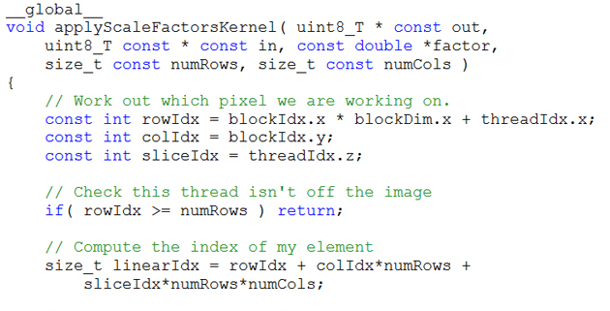
Truly Distributed GPU Processing with PIM?
3D-stacked memory
(memory stack)
SM (Streaming Multiprocessor)
Logic layer
Logic layer SM
Main GPU
Crossbar switch
Vault Ctrl
….
Vault Ctrl

Slide 145

Accelerating GPU Execution with PIM (I)
Kevin Hsieh, Eiman Ebrahimi, Gwangsun Kim, Niladrish Chatterjee, Mike O'Connor, Nandita Vijaykumar, Onur Mutlu, and Stephen W. Keckler,
"Transparent Offloading and Mapping (TOM): Enabling Programmer-Transparent Near-Data Processing in GPU Systems"
Proceedings of the 43rd International Symposium on Computer Architecture (ISCA), Seoul, South Korea, June 2016.
[Slides (pptx) (pdf)]
[Lightning Session Slides (pptx) (pdf)]

Slide 146

Accelerating GPU Execution with PIM (II)
Ashutosh Pattnaik, Xulong Tang, Adwait Jog, Onur Kayiran, Asit K. Mishra, Mahmut T. Kandemir, Onur Mutlu, and Chita R. Das,
"Scheduling Techniques for GPU Architectures with Processing-In-Memory Capabilities"
Proceedings of the 25th International Conference on Parallel Architectures and Compilation Techniques (PACT), Haifa, Israel, September 2016.

Slide 147

Accelerating Linked Data Structures
Kevin Hsieh, Samira Khan, Nandita Vijaykumar, Kevin K. Chang, Amirali Boroumand, Saugata Ghose, and Onur Mutlu,
"Accelerating Pointer Chasing in 3D-Stacked Memory: Challenges, Mechanisms, Evaluation"
Proceedings of the 34th IEEE International Conference on Computer Design (ICCD), Phoenix, AZ, USA, October 2016.

Slide 148
Executive Summary
Our Goal: Accelerating pointer chasing inside main memory
Challenges: Parallelism challenge and Address translation challenge
Our Solution: In-Memory PoInter Chasing Accelerator (IMPICA)
  Address-access decoupling: enabling parallelism in the accelerator with low cost
  IMPICA page table: low cost page table in logic layer
Key Results:
  1.2X – 1.9X speedup for pointer chasing operations, +16% database throughput
  6% - 41% reduction in energy consumption

Slide 149




Linked Data Structures
Linked data structures are widely used in many important applications
Linked data structures are
connected by pointers
Database
Key-value stores
B-Tree
Hash Table

Slide 150

The Problem: Pointer Chasing
Traversing linked data structures requires chasing pointers
Find(A)
H
Addr (A)
Addr (E)
Addr (H)
E
Q
Data (H)
Data (E)
A
F
M
Data (A)
MEM
Serialized and irregular access pattern
6X cycles per instruction in real workloads

Slide 151
Our Goal
Accelerating pointer chasing inside main memory
Find(A)
H
Find
(A)
E
Q
Data (A)
DRAM layers
A
F
M
MEM
Logic layer

Slide 152
Parallelism Challenge
Time
CPU core
Comp
Memory
access
Comp
CPU core
Comp
Memory
access
Comp
In-Memory Accelerator
Comp
Memory access
Comp
Comp
Memory access
Comp
Slower for two operations
Faster for one operation

Slide 153
Parallelism Challenge and Opportunity
A simple in-memory accelerator can still be slower than multiple CPU cores
Opportunity: a pointer-chasing accelerator spends a long time waiting for memory
CPU core
CPU core
CPU core
Accelerator
Comp
Memory access (10-15X of Comp)
Comp

Slide 154
Our Solution:
Address-Access Decoupling
Time
CPU core
Comp
Memory
access
Comp
CPU core
Comp
Memory
access
Comp
Address-access decoupling enables parallelism in both engines with low cost
Address Engine
Comp
Comp
Comp
Comp
Memory access
Access Engine
Memory access

Slide 155
IMPICA Core Architecture
DRAM
DRAM Dies
DRAM Layers
Logic Layer
Memory Controller
IMPICA Cache
Access Queue
Request Queue
Address
Engine
Access
Engine
Traversal 1
Response Queue
Traversal 2
To/From CPU

Slide 156
Address Translation Challenge
The page table walk requires multiple memory accesses
Pointer (VA)
TLB/MMU
Pointer (PA)
PTW
No TLB/MMU on the memory side
Duplicating it is costly and creates compatibility issue
PTW
PTW
PTW
PTW
Page table walk

Slide 157
Our Solution: IMPICA Page Table
Completely decouple the page table of IMPICA from the page table of the CPUs
IMPICA Page Table
CPU Page Table
Map linked data structure into IMPICA regions
IMPICA page table is a partial-to-any mapping
Virtual Page
Physical Page
IMPICA Region
Virtual Page
Physical Page
Virtual Address Space
Physical Address Space

Slide 158
IMPICA Page Table: Mechanism
Virtual Address
Bit [47:41]
Flat page table
saves one memory access
Bit [40:21]
Bit [20:12]
Bit [11:0]
Region Table
+
Tiny region table is almost always in the cache
+
Flat Page Table (2MB)
Small Page Table (4KB)
+
Physical Address

Slide 159
Evaluation Methodology
Simulator: gem5
System Configuration
  CPU
    4 OoO cores, 2GHz
    Cache: 32KB L1, 1MB L2
  IMPICA
    1 core, 500MHz, 32KB Cache
  Memory Bandwidth
    12.8 GB/s for CPU, 51.2 GB/s for IMPICA
Our simulator code is open source
  https://github.com/CMU-SAFARI/IMPICA

Slide 160
Result – Microbenchmark Performance
1.9X
1.3X
1.2X

Slide 161
Result – Database Performance
+16%
+5%
+2%
-0%
-4%
-13%

Slide 162
System Energy Consumption
-6%
-10%
-24%
-41%

Slide 163
Area and Power Overhead
CPU (Cortex-A57) | 5.85 mm² per core
L2 Cache | 5 mm² per MB
Memory Controller | 10 mm²
IMPICA (+32KB cache) | 0.45 mm²
Power overhead: average power increases by 5.6%

Slide 164
Accelerating Linked Data Structures
Kevin Hsieh, Samira Khan, Nandita Vijaykumar, Kevin K. Chang, Amirali Boroumand, Saugata Ghose, and Onur Mutlu,
"Accelerating Pointer Chasing in 3D-Stacked Memory: Challenges, Mechanisms, Evaluation"
Proceedings of the 34th IEEE International Conference on Computer Design (ICCD), Phoenix, AZ, USA, October 2016.

Slide 165
Several Questions in 3D-Stacked PIM
What are the performance and energy benefits of using 3D-stacked memory as a coarse-grained accelerator?
  By performing simple function offloading
  By changing the entire system completely
What is the minimal processing-in-memory support we can provide?
  With minimal changes to system and programming

Slide 166




Graph Processing
Large graphs are everywhere (circa 2015)
Scalable large-scale graph processing is challenging
36 Million
Wikipedia Pages
1.4 Billion
Facebook Users
300 Million
Twitter Users
30 Billion
Instagram Photos

Slide 167
Key Bottlenecks in Graph Processing
for (v: graph.vertices) {
for (w: v.successors) {
w.next_rank += weight * v.rank;
}
}
1. Frequent random memory accesses
v
&w
w.rank
w.next_rank
w.edges
weight * v.rank
w
…
2. Little amount of computation

Slide 168
Tesseract System for Graph Processing
Interconnected set of 3D-stacked memory+logic chips with simple cores
Host Processor
Memory
Memory-Mapped
Accelerator Interface
(Noncacheable, Physically Addressed)
Logic
In-Order Core
DRAM Controller
…
…
LP
PF Buffer
Crossbar Network
…
MTP
…
Message Queue
NI
Ahn+, “A Scalable Processing-in-Memory Accelerator for Parallel Graph Processing” ISCA 2015.

Slide 169
Tesseract System for Graph Processing
Host Processor
Memory
Memory-Mapped
Accelerator Interface
(Noncacheable, Physically Addressed)
Logic
In-Order Core
DRAM Controller
…
…
Communications via
Remote Function Calls
LP
PF Buffer
Crossbar Network
…
MTP
…
Message Queue
NI

Slide 170
Tesseract System for Graph Processing
Host Processor
Memory
Memory-Mapped
Accelerator Interface
(Noncacheable, Physically Addressed)
Logic
Prefetching
In-Order Core
DRAM Controller
…
…
LP
PF Buffer
Crossbar Network
…
MTP
…
Message Queue
NI

Slide 171
Communications In Tesseract (I)

Slide 172
Communications In Tesseract (II)

Slide 173
Communications In Tesseract (III)

Slide 174
Remote Function Call (Non-Blocking)

Slide 175
Evaluated Systems
DDR3-OoO
HMC-OoO
HMC-MC
Tesseract
32 Tesseract Cores
8 OoO
4GHz
8 OoO
4GHz
8 OoO
4GHz
8 OoO
4GHz
128
In-Order
2GHz
128
In-Order
2GHz
8 OoO
4GHz
8 OoO
4GHz
8 OoO
4GHz
8 OoO
4GHz
128
In-Order
2GHz
128
In-Order
2GHz
102.4GB/s
640GB/s
640GB/s
8TB/s
Ahn+, “A Scalable Processing-in-Memory Accelerator for Parallel Graph Processing” ISCA 2015.

Slide 176
Tesseract Graph Processing Performance
>13X Performance Improvement
On five graph processing algorithms
Ahn+, “A Scalable Processing-in-Memory Accelerator for Parallel Graph Processing” ISCA 2015.

Slide 177
Tesseract Graph Processing Performance

Slide 178
Tesseract Graph Processing System Energy
> 8X Energy Reduction
Ahn+, “A Scalable Processing-in-Memory Accelerator for Parallel Graph Processing” ISCA 2015.

Slide 179

More on Tesseract
Junwhan Ahn, Sungpack Hong, Sungjoo Yoo, Onur Mutlu, and Kiyoung Choi,
"A Scalable Processing-in-Memory Accelerator for Parallel Graph Processing"
Proceedings of the 42nd International Symposium on Computer Architecture (ISCA), Portland, OR, June 2015.
[Slides (pdf)] [Lightning Session Slides (pdf)]

Slide 180
Several Questions in 3D-Stacked PIM
What are the performance and energy benefits of using 3D-stacked memory as a coarse-grained accelerator?
  By performing simple function offloading
  By changing the entire system completely
What is the minimal processing-in-memory support we can provide?
  With minimal changes to system and programming

Slide 181
PEI: PIM-Enabled Instructions (Ideas)
Goal: Develop mechanisms to get the most out of near-data processing with minimal cost, minimal changes to the system, no changes to the programming model
Key Idea 1: Expose each PIM operation as a cache-coherent, virtually-addressed host processor instruction (called PEI) that operates on only a single cache block
  e.g., __pim_add(&w.next_rank, value) → pim.add r1, (r2)
  No changes sequential execution/programming model
  No changes to virtual memory
  Minimal changes to cache coherence
  No need for data mapping: Each PEI restricted to a single memory module
Key Idea 2: Dynamically decide where to execute a PEI (i.e., the host processor or PIM accelerator) based on simple locality characteristics and simple hardware predictors
  Execute each operation at the location that provides the best performance

Slide 182


Simple PIM Operations as ISA Extensions (II)
for (v: graph.vertices) {
value = weight * v.rank;
for (w: v.successors) {
w.next_rank += value;
}
}
Host Processor
Main Memory
w.next_rank
w.next_rank
w.next_rank
w.next_rank
64 bytes in
64 bytes out
Conventional Architecture

Slide 183
Simple PIM Operations as ISA Extensions (III)
for (v: graph.vertices) {
value = weight * v.rank;
for (w: v.successors) {
__pim_add(&w.next_rank, value);
}
}
pim.add r1, (r2)
Host Processor
Main Memory
value
w.next_rank
w.next_rank
8 bytes in
0 bytes out
In-Memory Addition

Slide 184

PEI: PIM-Enabled Instructions (Example)
for (v: graph.vertices) {
value = weight * v.rank;
for (w: v.successors) {
__pim_add(&w.next_rank, value);
}
}
pfence();
pim.add r1, (r2)
pfence
Executed either in memory or in the processor: dynamic decision
  Low-cost locality monitoring for a single instruction
Cache-coherent, virtually-addressed, single cache block only
Atomic between different PEIs
Not atomic with normal instructions (use pfence for ordering)

Slide 185
Example (Abstract) PEI uArchitecture
Host Processor
3D-stacked Memory
Out-Of-Order Core
Last-Level Cache
DRAM Controller
L1 Cache
PCU
L2 Cache
PCU (PEI Computation Unit)
DRAM Controller
PCU
Network
HMC Controller
PMU (PEI
Mgmt Unit)
…
PIM Directory
Locality Monitor
DRAM Controller
PCU
Example PEI uArchitecture

Slide 186

PEI: Initial Evaluation Results
Initial evaluations with 10 emerging data-intensive workloads
  Large-scale graph processing
  In-memory data analytics
  Machine learning and data mining
  Three input sets (small, medium, large) for each workload to analyze the impact of data locality
Pin-based cycle-level x86-64 simulation
  Performance Improvement and Energy Reduction:
    47% average speedup with large input data sets
    32% speedup with small input data sets
    25% avg. energy reduction in a single node with large input data sets

Slide 187
PEI Performance Delta: Large Data Sets
(Large Inputs, Baseline: Host-Only)

Slide 188
PEI Energy Consumption
Host-Only
PIM-Only
Locality-Aware

Slide 189

Simpler PIM: PIM-Enabled Instructions
Junwhan Ahn, Sungjoo Yoo, Onur Mutlu, and Kiyoung Choi,
"PIM-Enabled Instructions: A Low-Overhead, Locality-Aware Processing-in-Memory Architecture"
Proceedings of the 42nd International Symposium on Computer Architecture (ISCA), Portland, OR, June 2015.
[Slides (pdf)] [Lightning Session Slides (pdf)]

Slide 190
Automatic Code and Data Mapping
Kevin Hsieh, Eiman Ebrahimi, Gwangsun Kim, Niladrish Chatterjee, Mike O'Connor, Nandita Vijaykumar, Onur Mutlu, and Stephen W. Keckler,
"Transparent Offloading and Mapping (TOM): Enabling Programmer-Transparent Near-Data Processing in GPU Systems"
Proceedings of the 43rd International Symposium on Computer Architecture (ISCA), Seoul, South Korea, June 2016.
[Slides (pptx) (pdf)]
[Lightning Session Slides (pptx) (pdf)]

Slide 191

Automatic Offloading of Critical Code
Milad Hashemi, Khubaib, Eiman Ebrahimi, Onur Mutlu, and Yale N. Patt,
"Accelerating Dependent Cache Misses with an Enhanced Memory Controller"
Proceedings of the 43rd International Symposium on Computer Architecture (ISCA), Seoul, South Korea, June 2016.
[Slides (pptx) (pdf)]
[Lightning Session Slides (pptx) (pdf)]

Slide 192

Automatic Offloading of Prefetch Mechanisms
Milad Hashemi, Onur Mutlu, and Yale N. Patt,
"Continuous Runahead: Transparent Hardware Acceleration for Memory Intensive Workloads"
Proceedings of the 49th International Symposium on Microarchitecture (MICRO), Taipei, Taiwan, October 2016.
[Slides (pptx) (pdf)] [Lightning Session Slides (pdf)] [Poster (pptx) (pdf)]

Slide 193

Efficient Automatic Data Coherence Support
Amirali Boroumand, Saugata Ghose, Minesh Patel, Hasan Hassan, Brandon Lucia, Kevin Hsieh, Krishna T. Malladi, Hongzhong Zheng, and Onur Mutlu,
"LazyPIM: An Efficient Cache Coherence Mechanism for Processing-in-Memory"
IEEE Computer Architecture Letters (CAL), June 2016.

Slide 194
Agenda
Major Trends Affecting Main Memory
The Need for Intelligent Memory Controllers
  Bottom Up: Push from Circuits and Devices
  Top Down: Pull from Systems and Applications
Processing in Memory in Mobile Systems: Two Directions
  Exploiting 3D-Stacked Memory
  Minimally Changing Memory Chips
How to Enable Adoption of Processing in Memory
Conclusion

Slide 195
Processing in Memory:
Two Approaches
1. Exploiting 3D-stacked memory
2. Minimally changing memory chips

Slide 196
Minimally Changing DRAM
DRAM has great capability to perform bulk data movement and computation internally with small changes
  Can exploit internal connectivity to move data
  Can exploit analog computation capability
  …
Examples: RowClone, In-DRAM AND/OR, Gather/Scatter DRAM
  RowClone: Fast and Efficient In-DRAM Copy and Initialization of Bulk Data (Seshadri et al., MICRO 2013)
  Fast Bulk Bitwise AND and OR in DRAM (Seshadri et al., IEEE CAL 2015)
  Gather-Scatter DRAM: In-DRAM Address Translation to Improve the Spatial Locality of Non-unit Strided Accesses (Seshadri et al., MICRO 2015)
  "Ambit: In-Memory Accelerator for Bulk Bitwise Operations Using Commodity DRAM Technology” (Seshadri et al., MICRO 2017)

Slide 197
In-Memory Bulk Bitwise Operations
We can support in-DRAM COPY, ZERO, AND, OR, NOT, MAJ
At low cost
Using analog computation capability of DRAM
  Idea 1: Two consecutive activates copies one row to another
  Idea 2: Activating multiple rows currently performs computation
30-60X performance and energy improvement
  Seshadri et al., “RowClone: Fast and Efficient In-DRAM Copy and Initialization of Bulk Data,” MICRO 2013.
  Seshadri+, “Ambit: In-Memory Accelerator for Bulk Bitwise Operations Using Commodity DRAM Technology,” MICRO 2017.
New memory technologies enable even more opportunities
  Memristors, resistive RAM, phase change mem, STT-MRAM, …
  Can operate on data with minimal movement

Slide 198

Starting Simple: Data Copy and Initialization
  memmove & memcpy: 5% cycles in Google’s datacenter [Kanev+ ISCA’15]
000000000000000
Zero initialization
(e.g., security)
Forking
Checkpointing
Many more
VM Cloning
Deduplication
Page Migration

Slide 199
RowClone: In-DRAM Row Copy
Idea: Two consecutive ACTivates
4 Kbytes
Negligible HW cost
Step 1: Activate row A
Step 2: Activate row B
Transfer row
DRAM subarray
Transfer
row
Row Buffer (4 Kbytes)
8 bits
Data Bus
Notes:
copy

Slide 200
RowClone: Latency & Energy Benefits
74.4x
11.6x
41.5x
6.0x
1.9x
1.0x
3.2x
1.5x
Very low cost: 0.01% increase in die area
Seshadri et al., “RowClone: Fast and Efficient In-DRAM Copy
and Initialization of Bulk Data,” MICRO 2013.

Slide 201
Copy and Initialization in Workloads
Seshadri et al., “RowClone: Fast and Efficient In-DRAM Copy
and Initialization of Bulk Data,” MICRO 2013.

Slide 202
RowClone: Application Performance
Seshadri et al., “RowClone: Fast and Efficient In-DRAM Copy
and Initialization of Bulk Data,” MICRO 2013.

Slide 203

More on RowClone
Vivek Seshadri, Yoongu Kim, Chris Fallin, Donghyuk Lee, Rachata Ausavarungnirun, Gennady Pekhimenko, Yixin Luo, Onur Mutlu, Michael A. Kozuch, Phillip B. Gibbons, and Todd C. Mowry,
"RowClone: Fast and Energy-Efficient In-DRAM Bulk Data Copy and Initialization"
Proceedings of the 46th International Symposium on Microarchitecture (MICRO), Davis, CA, December 2013. [Slides (pptx) (pdf)] [Lightning Session Slides (pptx) (pdf)] [Poster (pptx) (pdf)]

Slide 204
In-DRAM AND/OR: Triple Row Activation
½V_{DD}
½V_{DD}+δ
V_{DD}
A
Final State
AB + BC + AC
B
C
C(A + B) + ~C(AB)
dis
en
0
½V_{DD}
Seshadri+, “Fast Bulk Bitwise AND and OR in DRAM”, IEEE CAL 2015.

Slide 205

In-DRAM NOT: Dual Contact Cell
Idea:
Feed the
negated value
in the sense amplifier
into a special row
Seshadri+, “Ambit: In-Memory Accelerator for Bulk Bitwise Operations using Commodity DRAM Technology,” MICRO 2017.

Slide 206
Performance: In-DRAM Bitwise Operations
Seshadri+, “Ambit: In-Memory Accelerator for Bulk Bitwise Operations using Commodity DRAM Technology,” MICRO 2017.

Slide 207
Energy of In-DRAM Bitwise Operations
Seshadri+, “Ambit: In-Memory Accelerator for Bulk Bitwise Operations using Commodity DRAM Technology,” MICRO 2017.

Slide 208
Ambit vs. DDR3: Performance and Energy
32X
35X
Seshadri+, “Ambit: In-Memory Accelerator for Bulk Bitwise Operations using Commodity DRAM Technology,” MICRO 2017.

Slide 209
Bulk Bitwise Operations in Workloads
[1] Li and Patel, BitWeaving, SIGMOD 2013
[2] Goodwin+, BitFunnel, SIGIR 2017

Slide 210
Example Data Structure: Bitmap Index
Alternative to B-tree and its variants
Efficient for performing range queries and joins
Many bitwise operations to perform a query
age < 18
18 < age < 25
25 < age < 60
age > 60
Bitmap 1
Bitmap 2
Bitmap 3
Bitmap 4

Slide 211
Performance: Bitmap Index on Ambit
Seshadri+, “Ambit: In-Memory Accelerator for Bulk Bitwise Operations using Commodity DRAM Technology,” MICRO 2017.

Slide 212
Performance: BitWeaving on Ambit
Seshadri+, “Ambit: In-Memory Accelerator for Bulk Bitwise Operations using Commodity DRAM Technology,” MICRO 2017.

Slide 213

More on In-DRAM Bulk AND/OR
Vivek Seshadri, Kevin Hsieh, Amirali Boroumand, Donghyuk Lee, Michael A. Kozuch, Onur Mutlu, Phillip B. Gibbons, and Todd C. Mowry,
"Fast Bulk Bitwise AND and OR in DRAM"
IEEE Computer Architecture Letters (CAL), April 2015.

Slide 214
More on Ambit
Vivek Seshadri et al., “Ambit: In-Memory Accelerator for Bulk Bitwise Operations Using Commodity DRAM Technology,” MICRO 2017.

Slide 215
Challenge and Opportunity for Future
Computing Architectures
with
Minimal Data Movement

Slide 216
Challenge: Intelligent Memory Device
Does memory
have to be
dumb?

Slide 217
Agenda
Major Trends Affecting Main Memory
The Need for Intelligent Memory Controllers
  Bottom Up: Push from Circuits and Devices
  Top Down: Pull from Systems and Applications
Processing in Memory in Mobile Systems: Two Directions
  Exploiting 3D-Stacked Memory
  Minimally Changing Memory Chips
How to Enable Adoption of Processing in Memory
Conclusion

Slide 218
Eliminating the Adoption Barriers
How to Enable Adoption of Processing in Memory

Slide 219
Barriers to Adoption of PIM
1. Functionality of and applications for PIM
2. Ease of programming (interfaces and compiler/HW support)
3. System support: coherence & virtual memory
4. Runtime systems for adaptive scheduling, data mapping, access/sharing control
5. Infrastructures to assess benefits and feasibility

Slide 220
We Need to Revisit the Entire Stack
Problem
Algorithm
Program/Language
System Software
SW/HW Interface
Micro-architecture
Logic
Devices
Electrons

Slide 221

Open Problems: PIM Adoption
Saugata Ghose, Kevin Hsieh, Amirali Boroumand, Rachata Ausavarungnirun, Onur Mutlu,
"Enabling the Adoption of Processing-in-Memory: Challenges, Mechanisms, Future Research Directions"
Invited Book Chapter, to appear in 2018.
[Preliminary arxiv.org version]
https://arxiv.org/pdf/1802.00320.pdf

Slide 222
Key Challenge 1: Code Mapping
Challenge 1: Which operations should be executed in memory vs. in CPU?
?
3D-stacked memory
(memory stack)
SM (Streaming Multiprocessor)
?
Logic layer
Logic layer SM
Main GPU
Crossbar switch
Vault Ctrl
….
Vault Ctrl

Slide 223
Key Challenge 2: Data Mapping
Challenge 2: How should data be mapped to different 3D memory stacks?
3D-stacked memory
(memory stack)
SM (Streaming Multiprocessor)
Logic layer
Logic layer SM
Main GPU
Crossbar switch
Vault Ctrl
….
Vault Ctrl

Slide 224
How to Do the Code and Data Mapping?
Kevin Hsieh, Eiman Ebrahimi, Gwangsun Kim, Niladrish Chatterjee, Mike O'Connor, Nandita Vijaykumar, Onur Mutlu, and Stephen W. Keckler,
"Transparent Offloading and Mapping (TOM): Enabling Programmer-Transparent Near-Data Processing in GPU Systems"
Proceedings of the 43rd International Symposium on Computer Architecture (ISCA), Seoul, South Korea, June 2016.
[Slides (pptx) (pdf)]
[Lightning Session Slides (pptx) (pdf)]

Slide 225
How to Schedule Code?
Ashutosh Pattnaik, Xulong Tang, Adwait Jog, Onur Kayiran, Asit K. Mishra, Mahmut T. Kandemir, Onur Mutlu, and Chita R. Das,
"Scheduling Techniques for GPU Architectures with Processing-In-Memory Capabilities"
Proceedings of the 25th International Conference on Parallel Architectures and Compilation Techniques (PACT), Haifa, Israel, September 2016.

Slide 226

Challenge: Coherence for Hybrid CPU-PIM Apps
Traditional
coherence
No coherence
overhead

Slide 227
How to Maintain Coherence?
Amirali Boroumand, Saugata Ghose, Minesh Patel, Hasan Hassan, Brandon Lucia, Kevin Hsieh, Krishna T. Malladi, Hongzhong Zheng, and Onur Mutlu,
"LazyPIM: An Efficient Cache Coherence Mechanism for Processing-in-Memory"
IEEE Computer Architecture Letters (CAL), June 2016.

Slide 228
How to Support Virtual Memory?
Kevin Hsieh, Samira Khan, Nandita Vijaykumar, Kevin K. Chang, Amirali Boroumand, Saugata Ghose, and Onur Mutlu,
"Accelerating Pointer Chasing in 3D-Stacked Memory: Challenges, Mechanisms, Evaluation"
Proceedings of the 34th IEEE International Conference on Computer Design (ICCD), Phoenix, AZ, USA, October 2016.

Slide 229
How to Design Data Structures for PIM?
Zhiyu Liu, Irina Calciu, Maurice Herlihy, and Onur Mutlu,
"Concurrent Data Structures for Near-Memory Computing"
Proceedings of the 29th ACM Symposium on Parallelism in Algorithms and Architectures (SPAA), Washington, DC, USA, July 2017.
[Slides (pptx) (pdf)]

Slide 230

Simulation Infrastructures for PIM
Ramulator extended for PIM
  Flexible and extensible DRAM simulator
  Can model many different memory standards and proposals
  Kim+, “Ramulator: A Flexible and Extensible DRAM Simulator”, IEEE CAL 2015.
  https://github.com/CMU-SAFARI/ramulator

Slide 231


An FPGA-based Test-bed for PIM?
Hasan Hassan et al., SoftMC: A Flexible and Practical Open-Source Infrastructure for Enabling Experimental DRAM Studies HPCA 2017.
Flexible
Easy to Use (C++ API)
Open-source
github.com/CMU-SAFARI/SoftMC

Slide 232

Simulation Infrastructures for PIM (in SSDs)
Arash Tavakkol, Juan Gomez-Luna, Mohammad Sadrosadati, Saugata Ghose, and Onur Mutlu,
"MQSim: A Framework for Enabling Realistic Studies of Modern Multi-Queue SSD Devices"
Proceedings of the 16th USENIX Conference on File and Storage Technologies (FAST), Oakland, CA, USA, February 2018.
[Slides (pptx) (pdf)]
[Source Code]

Slide 233
New Applications and Use Cases for PIM
Jeremie S. Kim, Damla Senol Cali, Hongyi Xin, Donghyuk Lee, Saugata Ghose, Mohammed Alser, Hasan Hassan, Oguz Ergin, Can Alkan, and Onur Mutlu,
"GRIM-Filter: Fast Seed Location Filtering in DNA Read Mapping Using Processing-in-Memory Technologies"
BMC Genomics, 2018.
Proceedings of the 16th Asia Pacific Bioinformatics Conference (APBC), Yokohama, Japan, January 2018.
arxiv.org Version (pdf)

Slide 234

Genome Read In-Memory (GRIM) Filter:
Fast Seed Location Filtering in DNA Read Mapping using Processing-in-Memory Technologies
Jeremie Kim,
Damla Senol, Hongyi Xin, Donghyuk Lee,
Saugata Ghose, Mohammed Alser, Hasan Hassan,
Oguz Ergin, Can Alkan, and Onur Mutlu
Notes:
Hello, my name is Jeremie Kim and I will be presenting Genome Read In-Memory Filter which will also be referred to as GRIM-Filter for short.
[CLICK]

Slide 235
Executive Summary
Genome Read Mapping is a very important problem and is the first step in many types of genomic analysis
  Could lead to improved health care, medicine, quality of life
Read mapping is an approximate string matching problem
  Find the best fit of 100 character strings into a 3 billion character dictionary
  Alignment is currently the best method for determining the similarity between two strings, but is very expensive
We propose an in-memory processing algorithm GRIM-Filter for accelerating read mapping, by reducing the number of required alignments
We implement GRIM-Filter using in-memory processing within 3D-stacked memory and show up to 3.7x speedup.

Slide 236
GRIM-Filter in 3D-stacked DRAM
The layout of bit vectors in a bank enables filtering many bins in parallel
Customized logic for accumulation and comparison per genome segment
  Low area overhead, simple implementation
Notes:
[CLICK]
Each DRAM layer is organized as an array of Banks
[CLICK]
and a bank is an array of cells with a row buffer. The row buffer holds one row at a time and uses this structure to transfer data with high bandwidth into the logic layer via TSVs
[CLICK]
We now show the distribution of bit vectors across the DRAM arrays to enable parallel processing of many bins.
[CLICK]
Each row represents a token's occurrence across many sequential bins. and the row of the appropriate token gets queried to find a vector showing the occurrence of the token across many bins.
These are the vectors are brought down into the logic layer to be operated on.
[CLICK]
[END-CLICK]

Slide 237

GRIM-Filter Performance
Time (x1000 seconds)
Benchmarks and their Execution Times
1.8x-3.7x performance benefit across real data sets
Notes:
We ran 10 separate experiments with real read data sets, consisting of approximately 4 million reads each, and got the following results. Compared to the previous best filter, our filter enjoys a 2x average end-to-end read mapper performance gain across the data sets, and a 6x average lower false positive rate. Again, these are the locations that were not discarded by the filter, but were then later discarded after alignment

Slide 238

GRIM-Filter False Positive Rate
False Positive Rate (%)
Benchmarks and their False Positive Rates
5.6x-6.4x False Positive reduction across real data sets
Notes:
We ran 10 separate experiments with real read data sets, consisting of approximately 4 million reads each, and got the following results. Compared to the previous best filter, our filter enjoys a 2x average end-to-end read mapper performance gain across the data sets, and a 6x average lower false positive rate. Again, these are the locations that were not discarded by the filter, but were then later discarded after alignment

Slide 239
Conclusions
We propose an in memory filter algorithm to accelerate end-to-end genome read mapping by reducing the number of required alignments
Compared to the previous best filter
  We observed 1.8x-3.7x speedup
  We observed 5.6x-6.4x fewer false positives
GRIM-Filter is a universal filter that can be applied to any genome read mapper
Notes:
[CLICK]
We propose an in-memory filter to accelerate read mapping
[CLICK]
Compared to the previous best filter we show up to 3.7x end-to-end speedup on the same mapper and
We also observe on average 6x fewer false positives
[CLICK]
GRIM-Filter is a universal filter that can be applied to any read mapper and we hope these results encourage people to use processing in memory to improve other data intensive algorithms
[END-CLICK]

Slide 240
In-Memory DNA Sequence Analysis
Jeremie S. Kim, Damla Senol Cali, Hongyi Xin, Donghyuk Lee, Saugata Ghose, Mohammed Alser, Hasan Hassan, Oguz Ergin, Can Alkan, and Onur Mutlu,
"GRIM-Filter: Fast Seed Location Filtering in DNA Read Mapping Using Processing-in-Memory Technologies"
BMC Genomics, 2018.
Proceedings of the 16th Asia Pacific Bioinformatics Conference (APBC), Yokohama, Japan, January 2018.
arxiv.org Version (pdf)

Slide 241
Google Workloads for Consumer Devices:
Mitigating Data Movement Bottlenecks
Amirali Boroumand
Saugata Ghose, Youngsok Kim, Rachata Ausavarungnirun,
Eric Shiu, Rahul Thakur, Daehyun Kim, Aki Kuusela,
Allan Knies, Parthasarathy Ranganathan, Onur Mutlu

Slide 242
Open Problems: PIM Adoption
Saugata Ghose, Kevin Hsieh, Amirali Boroumand, Rachata Ausavarungnirun, Onur Mutlu,
"Enabling the Adoption of Processing-in-Memory: Challenges, Mechanisms, Future Research Directions"
Invited Book Chapter, to appear in 2018.
[Preliminary arxiv.org version]
https://arxiv.org/pdf/1802.00320.pdf

Slide 243
Enabling the Paradigm Shift

Slide 244
Computer Architecture Today
You can revolutionize the way computers are built, if you understand both the hardware and the software (and change each accordingly)
You can invent new paradigms for computation, communication, and storage
Recommended book: Thomas Kuhn, “The Structure of Scientific Revolutions” (1962)
  Pre-paradigm science: no clear consensus in the field
  Normal science: dominant theory used to explain/improve things (business as usual); exceptions considered anomalies
  Revolutionary science: underlying assumptions re-examined

Slide 245




Computer Architecture Today
You can revolutionize the way computers are built, if you understand both the hardware and the software (and change each accordingly)
You can invent new paradigms for computation, communication, and storage
Recommended book: Thomas Kuhn, “The Structure of Scientific Revolutions” (1962)
  Pre-paradigm science: no clear consensus in the field
  Normal science: dominant theory used to explain/improve things (business as usual); exceptions considered anomalies
  Revolutionary science: underlying assumptions re-examined

Slide 246
Agenda
Major Trends Affecting Main Memory
The Need for Intelligent Memory Controllers
  Bottom Up: Push from Circuits and Devices
  Top Down: Pull from Systems and Applications
Processing in Memory in Mobile Systems: Two Directions
  Exploiting 3D-Stacked Memory
  Minimally Changing Memory Chips
How to Enable Adoption of Processing in Memory
Conclusion

Slide 247
Concluding Remarks

Slide 248

A Quote from A Famous Architect
“architecture […] based upon principle, and not upon precedent”

Slide 249

Precedent-Based Design?
“architecture […] based upon principle, and not upon precedent”

Slide 250

Principled Design
“architecture […] based upon principle, and not upon precedent”

Slide 251


Slide 252


The Overarching Principle

Slide 253

Another Example: Precedent-Based Design
Source: http://cookiemagik.deviantart.com/art/Train-station-207266944

Slide 254

Principled Design
Source: By Toni_V, CC BY-SA 2.0, https://commons.wikimedia.org/w/index.php?curid=4087256

Slide 255


Another Principled Design
Source: By Martín Gómez Tagle - Lisbon, Portugal, CC BY-SA 3.0, https://commons.wikimedia.org/w/index.php?curid=13764903
Source: http://www.arcspace.com/exhibitions/unsorted/santiago-calatrava/

Slide 256

Another Principled Design
Source: De Galván - Puente del Alamillo.jpg on Enciclopedia.us.es, GFDL, https://commons.wikimedia.org/w/index.php?curid=15026095

Slide 257

Another Principled Design
Source: https://www.archdaily.com/245628/how-not-to-host-the-olympics-part-iii/6051758999_5df1511bb5_z-4 Photo via CC Flickr User Vaidas M.

Slide 258


Principle Applied to Another Structure
Source: By 準建築人手札網站 Forgemind ArchiMedia - Flickr: IMG_2489.JPG, CC BY 2.0,
https://commons.wikimedia.org/w/index.php?curid=31493356, https://en.wikipedia.org/wiki/Santiago_Calatrava
Source: https://www.dezeen.com/2016/08/29/santiago-calatrava-oculus-world-trade-center-transportation-hub-new-york-photographs-hufton-crow/

Slide 259


The Overarching Principle

Slide 260

Overarching Principle for Computing?
Source: http://spectrum.ieee.org/image/MjYzMzAyMg.jpeg

Slide 261
Concluding Remarks
It is time to design principled system architectures to solve the memory problem
Design complete systems to be balanced, high-performance, and energy-efficient, i.e., data-centric (or memory-centric)
Enable computation capability inside and close to memory
This can
  Lead to orders-of-magnitude improvements
  Enable new applications & computing platforms
  Enable better understanding of nature
  …
Notes:
Perhaps we have taken processor-centric system design a bit too far

Slide 262
The Future of Processing in Memory is Bright
Regardless of challenges
  in underlying technology and overlying problems/requirements
Problem
Can enable:
- Orders of magnitude
improvements
- New applications and
computing systems
Yet, we have to
- Think across the stack
- Design enabling systems
Algorithm
Program/Language
System Software
SW/HW Interface
Micro-architecture
Logic
Devices
Electrons

Slide 263

If In Doubt, See Other Doubtful Technologies
A very “doubtful” emerging technology
  for at least two decades
Proceedings of the IEEE, Sept. 2017
https://arxiv.org/pdf/1706.08642

Slide 264
For Some Open Problems, See
Saugata Ghose, Kevin Hsieh, Amirali Boroumand, Rachata Ausavarungnirun, Onur Mutlu,
"Enabling the Adoption of Processing-in-Memory: Challenges, Mechanisms, Future Research Directions"
Invited Book Chapter, to appear in 2018.
[Preliminary arxiv.org version]
https://arxiv.org/pdf/1802.00320.pdf

Slide 265
Accelerated Memory Course (~6.5 hours)
ACACES 2018
  Memory Systems and Memory-Centric Computing Systems
  Taught by Onur Mutlu July 9-13, 2018
  ~6.5 hours of lectures
Website for the Course including Videos, Slides, Papers
  https://people.inf.ethz.ch/omutlu/acaces2018.html
  https://www.youtube.com/playlist?list=PL5Q2soXY2Zi-HXxomthrpDpMJm05P6J9x
All Papers are at:
  https://people.inf.ethz.ch/omutlu/projects.htm
  Final lecture notes and readings (for all topics)

Slide 266
Processing-in-Memory in Mobile Systems
Changing the Computing Paradigm for High Efficiency
Onur Mutlu
omutlu@gmail.com
https://people.inf.ethz.ch/omutlu
23 November 2018
MST Keynote Talk

Slide 267
Slides Not Covered
But Could Be Useful

Slide 268
Readings, Videos, Reference Materials

Slide 269
Accelerated Memory Course (~6.5 hours)
ACACES 2018
  Memory Systems and Memory-Centric Computing Systems
  Taught by Onur Mutlu July 9-13, 2018
  ~6.5 hours of lectures
Website for the Course including Videos, Slides, Papers
  https://people.inf.ethz.ch/omutlu/acaces2018.html
  https://www.youtube.com/playlist?list=PL5Q2soXY2Zi-HXxomthrpDpMJm05P6J9x
All Papers are at:
  https://people.inf.ethz.ch/omutlu/projects.htm
  Final lecture notes and readings (for all topics)

Slide 270
Reference Overview Paper I
Saugata Ghose, Kevin Hsieh, Amirali Boroumand, Rachata Ausavarungnirun, Onur Mutlu,
"Enabling the Adoption of Processing-in-Memory: Challenges, Mechanisms, Future Research Directions"
Invited Book Chapter, to appear in 2018.
[Preliminary arxiv.org version]
https://arxiv.org/pdf/1802.00320.pdf

Slide 271

Reference Overview Paper II
Onur Mutlu and Lavanya Subramanian,
"Research Problems and Opportunities in Memory Systems"
Invited Article in Supercomputing Frontiers and Innovations (SUPERFRI), 2014/2015.
https://people.inf.ethz.ch/omutlu/pub/memory-systems-research_superfri14.pdf

Slide 272

Reference Overview Paper III
Onur Mutlu,
"The RowHammer Problem and Other Issues We May Face as Memory Becomes Denser"
Invited Paper in Proceedings of the Design, Automation, and Test in Europe Conference (DATE), Lausanne, Switzerland, March 2017.
[Slides (pptx) (pdf)]
https://people.inf.ethz.ch/omutlu/pub/rowhammer-and-other-memory-issues_date17.pdf

Slide 273

Reference Overview Paper IV
Onur Mutlu,
"Memory Scaling: A Systems Architecture Perspective"
Technical talk at MemCon 2013 (MEMCON), Santa Clara, CA, August 2013. [Slides (pptx) (pdf)]
[Video] [Coverage on StorageSearch]
https://people.inf.ethz.ch/omutlu/pub/memory-scaling_memcon13.pdf

Slide 274
Reference Overview Paper V
Proceedings of the IEEE, Sept. 2017
https://arxiv.org/pdf/1706.08642

Slide 275
Related Videos and Course Materials (I)
Undergraduate Computer Architecture Course Lecture Videos (2015, 2014, 2013)
Undergraduate Computer Architecture Course Materials (2015, 2014, 2013)
Graduate Computer Architecture Course Lecture Videos (2017, 2015, 2013)
Graduate Computer Architecture Course Materials (2017, 2015, 2013)
Parallel Computer Architecture Course Materials (Lecture Videos)

Slide 276
Related Videos and Course Materials (II)
Freshman Digital Circuits and Computer Architecture Course Lecture Videos (2018, 2017)
Freshman Digital Circuits and Computer Architecture Course Materials (2018)
Memory Systems Short Course Materials
(Lecture Video on Main Memory and DRAM Basics)

Slide 277
Some Open Source Tools (I)
Rowhammer – Program to Induce RowHammer Errors
  https://github.com/CMU-SAFARI/rowhammer
Ramulator – Fast and Extensible DRAM Simulator
  https://github.com/CMU-SAFARI/ramulator
MemSim – Simple Memory Simulator
  https://github.com/CMU-SAFARI/memsim
NOCulator – Flexible Network-on-Chip Simulator
  https://github.com/CMU-SAFARI/NOCulator
SoftMC – FPGA-Based DRAM Testing Infrastructure
  https://github.com/CMU-SAFARI/SoftMC
Other open-source software from my group
  https://github.com/CMU-SAFARI/
  http://www.ece.cmu.edu/~safari/tools.html

Slide 278
Some Open Source Tools (II)
MQSim – A Fast Modern SSD Simulator
  https://github.com/CMU-SAFARI/MQSim
Mosaic – GPU Simulator Supporting Concurrent Applications
  https://github.com/CMU-SAFARI/Mosaic
IMPICA – Processing in 3D-Stacked Memory Simulator
  https://github.com/CMU-SAFARI/IMPICA
SMLA – Detailed 3D-Stacked Memory Simulator
  https://github.com/CMU-SAFARI/SMLA
HWASim – Simulator for Heterogeneous CPU-HWA Systems
  https://github.com/CMU-SAFARI/HWASim
Other open-source software from my group
  https://github.com/CMU-SAFARI/
  http://www.ece.cmu.edu/~safari/tools.html

Slide 279

More Open Source Tools (III)
A lot more open-source software from my group
  https://github.com/CMU-SAFARI/
  http://www.ece.cmu.edu/~safari/tools.html

Slide 280
Referenced Papers
All are available at
  https://people.inf.ethz.ch/omutlu/projects.htm
  http://scholar.google.com/citations?user=7XyGUGkAAAAJ&hl=en
  https://people.inf.ethz.ch/omutlu/acaces2018.html

Slide 281
Ramulator: A Fast and Extensible DRAM Simulator
[IEEE Comp Arch Letters’15]

Slide 282

Ramulator Motivation
DRAM and Memory Controller landscape is changing
Many new and upcoming standards
Many new controller designs
A fast and easy-to-extend simulator is very much needed

Slide 283

Ramulator
Provides out-of-the box support for many DRAM standards:
  DDR3/4, LPDDR3/4, GDDR5, WIO1/2, HBM, plus new proposals (SALP, AL-DRAM, TLDRAM, RowClone, and SARP)
~2.5X faster than fastest open-source simulator
Modular and extensible to different standards

Slide 284


Case Study: Comparison of DRAM Standards
Across 22 workloads, simple CPU model

Slide 285
Ramulator Paper and Source Code
Yoongu Kim, Weikun Yang, and Onur Mutlu,
"Ramulator: A Fast and Extensible DRAM Simulator"
IEEE Computer Architecture Letters (CAL), March 2015.
[Source Code]
Source code is released under the liberal MIT License
  https://github.com/CMU-SAFARI/ramulator

Slide 286
Effect of Bandwidth & Programming Model
HMC-MC Bandwidth (640GB/s)
Tesseract Bandwidth (8TB/s)
Programming Model
Bandwidth
(No Prefetching)

Slide 287




The DRAM Latency PUF:
Quickly Evaluating Physical Unclonable Functions by Exploiting the Latency-Reliability Tradeoff in Modern Commodity DRAM Devices
Jeremie S. Kim Minesh Patel
Hasan Hassan Onur Mutlu
Notes:
Hello, my name is Jeremie Kim and I will be talking about the DRAM Latency PUF.

Slide 288
Motivation
A PUF is function that generates a signature unique to a given device
Used in a Challenge-Response Protocol
  Each device generates a unique PUF response depending the inputs
  A trusted server authenticates a device if it generates the expected PUF response
Notes:
[CLICK] A PUF is a function that generates a signature that is unique to a given device. [CLICK] PUFs are often used in a challenge-response protocol where [CLICK] a trusted server issues a set of input parameters to a device, and the device generates the PUF response depending on the input parameters. [CLICK] The trusted server then receives the PUF response and can authenticate the device.

Slide 289
DRAM Latency Characterization of 223 LPDDR4 DRAM Devices
Latency failures come from accessing DRAM with reduced timing parameters.
Key Observations:
  A cell’s latency failure probability is determined by random process variation
  Latency failure patterns are repeatable and unique to a device
Notes:
In this work, we show results from a detailed experimental characterization of 223 state-of-the-art LPDDR4 DRAM devices. [CLICK] We characterize DRAM latency by observing the effects of accessing DRAM with DRAM timing parameters reduced below manufacturer-recommended values.
[CLICK] We make two key observations. [CLICK] first, a cell’s probability to fail, when accessed with reduced timing parameters, is directly correlated with random variations that arise from process manufacturing. [CLICK] secondly, We note that these error patterns from inducing DRAM latency errors are unique to a device and highly repeatable.

Slide 290
DRAM Latency PUF Key Idea
High % chance to fail with reduced t_{RCD}
Low % chance to fail with reduced t_{RCD}
Row Decoder
SA
SA
SA
SA
SA
SA
SA
Notes:
Here is a cartoon showing the manufacturing variation across a region of DRAM. When accessed with a reduced timing parameter, [CLICK] some cells have a high percentage chance of failing, while others [CLICK] have a low percentage chance of failing.

Slide 291
DRAM Accesses and Failures
wordline
V_{dd}
access
transistor
V_{min}
Ready to Access
Voltage Level
bitline
Process variation during manufacturing leads to cells having unique characteristics
Bitline Voltage
Bitline Charge Sharing
capacitor
SA
0.5 V_{dd}
Time
ACTIVATE
SA Enable
READ
t_{RCD}
Notes:
[CLICK] A DRAM cell holds its charge in a capacitor and gets read out by the sense amplifier via the bitline. [CLICK][CLICK] Initially the bitline is kept at Vdd/2. [CLICK] When the wordline is driven high or activated, [CLICK] the capacitor begins to share charge with the bitline. The sense amplifier is then enabled and [CLICK] the voltage differential on the bitline is amplified to an I/O readable value. [CLICK] In order to ensure correctness of operation, the memory controller can only read data tRCD time after the activation. [CLICK] We could read this data earlier, when it reaches a readable voltage threshold, [CLICK] but other cells, that are weaker due to process variation, might fail. [CLICK]

Slide 292
DRAM Accesses and Failures
wordline
V_{dd}
access
transistor
V_{min}
Ready to Access
Voltage Level
bitline
weaker cells have a higher probability to fail
Bitline Voltage
capacitor
SA
0.5 V_{dd}
Time
ACTIVATE
SA Enable
READ
t_{RCD}
Notes:
Our method of inducing latency errors is to [CLICK] reduce tRCD below manufacturer-recommended values. Cells that are read when their bitline’s voltage is lower than the threshold, have a probability of failure. This probability increases as you read further below the voltage threshold.

Slide 293
The DRAM Latency PUF Evaluation
We generate PUF responses using latency errors in a region of DRAM
The latency error patterns satisfy PUF requirements
The DRAM Latency PUF generates PUF responses in 88.2ms
Notes:
[CLICK] The DRAM latency PUF generates a PUF response by inducing latency errors in a region of DRAM. [CLICK] We find that the error patterns from latency errors in a DRAM region satisfy the requirements for an effective PUF quite well. [CLICK] The DRAM latency PUF can generate a PUF response in 88.2ms.

Slide 294
Results
We are orders of magnitude faster than prior DRAM PUFs!
Notes:
[CLICK] We show by direct comparison that this is orders of magnitudes faster than the previous best DRAM PUF.

Slide 295

The DRAM Latency PUF:
Quickly Evaluating Physical Unclonable Functions by Exploiting the Latency-Reliability Tradeoff in Modern Commodity DRAM Devices
Jeremie S. Kim Minesh Patel
Hasan Hassan Onur Mutlu
HPCA 2018
QR Code for the paper
https://people.inf.ethz.ch/omutlu/pub/dram-latency-puf_hpca18.pdf
Notes:
Please come to my talk at HPCA 2018, if you would like to learn more or have any questions. Thank you very much.

Slide 296

DRAM Latency PUFs
Jeremie S. Kim, Minesh Patel, Hasan Hassan, and Onur Mutlu,
"The DRAM Latency PUF: Quickly Evaluating Physical Unclonable Functions by Exploiting the Latency-Reliability Tradeoff in Modern DRAM Devices"
Proceedings of the 24th International Symposium on High-Performance Computer Architecture (HPCA), Vienna, Austria, February 2018.
[Lightning Talk Video]
[Slides (pptx) (pdf)] [Lightning Session Slides (pptx) (pdf)]

Slide 297
Heterogeneous-Reliability
Memory

Slide 298
There are Two Other Solution Directions
New Technologies: Replace or (more likely) augment DRAM with a different technology
  Non-volatile memories
Embracing Un-reliability:
Design memories with different reliability
and store data intelligently across them
…
Problem
Algorithm
Program/Language
System Software
SW/HW Interface
Micro-architecture
Logic
Devices
Electrons
Fundamental solutions to security require co-design across the hierarchy

Slide 299

Exploiting Memory Error Tolerance with Hybrid Memory Systems
Heterogeneous-Reliability Memory [DSN 2014]
Vulnerable data
Vulnerable data
Tolerant data
Tolerant data
Reliable memory
Low-cost memory
Vulnerable data
  On Microsoft’s Web Search workload
  Reduces server hardware cost by 4.7 %
  Achieves single server availability target of 99.90 %
ECC protected
Well-tested chips
Tolerant data
NoECC or Parity
Less-tested chips
Notes:
As we have shown earlier, either across or within applications, our characterization can identify data that are vulnerable to memory errors and data that are tolerant to memory errors.
To exploit this observation, we would like to map these different data onto different memory modules according to their memory error tolerance.
As an example here, we map vulnerable data to reliable memory to improve reliability, and map tolerant data to low-cost less-reliable memory to exploit its tolerance and lower the cost. We call this mechanism heterogeneous-reliability memory, HRM.
Reliable memory consists of … Low cost memory consists of …
As we will show later, HRM allows us to use weaker error protection in memory, and enables the use of less-tested memory chips to lower the cost of the memory system, while still achieving reasonable single-server reliability target.

Slide 300

More on Heterogeneous-Reliability Memory
Yixin Luo, Sriram Govindan, Bikash Sharma, Mark Santaniello, Justin Meza, Aman Kansal, Jie Liu, Badriddine Khessib, Kushagra Vaid, and Onur Mutlu,
"Characterizing Application Memory Error Vulnerability to Optimize Data Center Cost via Heterogeneous-Reliability Memory"
Proceedings of the 44th Annual IEEE/IFIP International Conference on Dependable Systems and Networks (DSN), Atlanta, GA, June 2014. [Summary] [Slides (pptx) (pdf)] [Coverage on ZDNet]

Slide 301
Other Backup Slides

Slide 302
End of Backup Slides

Slide 303




Current Research Focus Areas
Research Focus: Computer architecture, HW/SW, bioinformatics, security
Memory and storage (DRAM, flash, emerging), interconnects
Heterogeneous & parallel systems, GPUs, systems for data analytics
System/architecture interaction, new execution models, new interfaces
Hardware security, energy efficiency, fault tolerance, performance
Genome sequence analysis & assembly algorithms and architectures
Biologically inspired systems & system design for bio/medicine
Hybrid Main Memory
Heterogeneous
Processors and
Accelerators
Persistent Memory/Storage
Broad research
spanning apps, systems, logic
with architecture at the center
Graphics and Vision Processing
Notes:
Professor Mutlu’s research focus is all aspects of computer architecture, HW/SW interaction and bioinformatics.
He is looking for students to perform research in these areas.
He and his group, SAFARI, solve fundamental problems spanning:
Memory, memory, memory, storage, interconnects
Parallel architectures, heterogeneous architectures, GP-GPUs
System/architecture interaction, new execution models
Energy efficiency, fault tolerance, hardware security
Genome sequence analysis and assembly
His group does broad research spanning systems to logic with architecture at center

Slide 304
Four Key Directions
Fundamentally Secure/Reliable/Safe Architectures
Fundamentally Energy-Efficient Architectures
  Memory-centric (Data-centric) Architectures
Fundamentally Low-Latency Architectures
Architectures for Genomics, Medicine, Health

Slide 305
RowClone: Latency and Energy Savings
11.6x
74x
Seshadri et al., “RowClone: Fast and Efficient In-DRAM Copy and Initialization of Bulk Data,” MICRO 2013.

Slide 306

Brief Self Introduction
Onur Mutlu
  Full Professor @ ETH Zurich CS, since September 2015
  Strecker Professor @ Carnegie Mellon University ECE/CS, 2009-2016, 2016-…
  PhD from UT-Austin, worked at Google, VMware, Microsoft Research, Intel, AMD
  https://people.inf.ethz.ch/omutlu/
  omutlu@gmail.com (Best way to reach me)
  https://people.inf.ethz.ch/omutlu/projects.htm
Research and Teaching in:
  Computer architecture, computer systems, hardware security, bioinformatics
  Memory and storage systems
  Hardware security, safety, predictability
  Fault tolerance
  Hardware/software cooperation
  Architectures for bioinformatics, health, medicine
  …

