Slide 1



Memory-Centric
Computing
Onur Mutlu
omutlu@gmail.com
https://people.inf.ethz.ch/omutlu
2 September 2022
MATEO 2022

Slide 2
The Problem
Computing
is Bottlenecked by Data

Slide 3
Data is Key for AI, ML, Genomics, …
Important workloads are all data intensive
They require rapid and efficient processing of large amounts of data
Data is increasing
  We can generate more than we can process

Slide 4
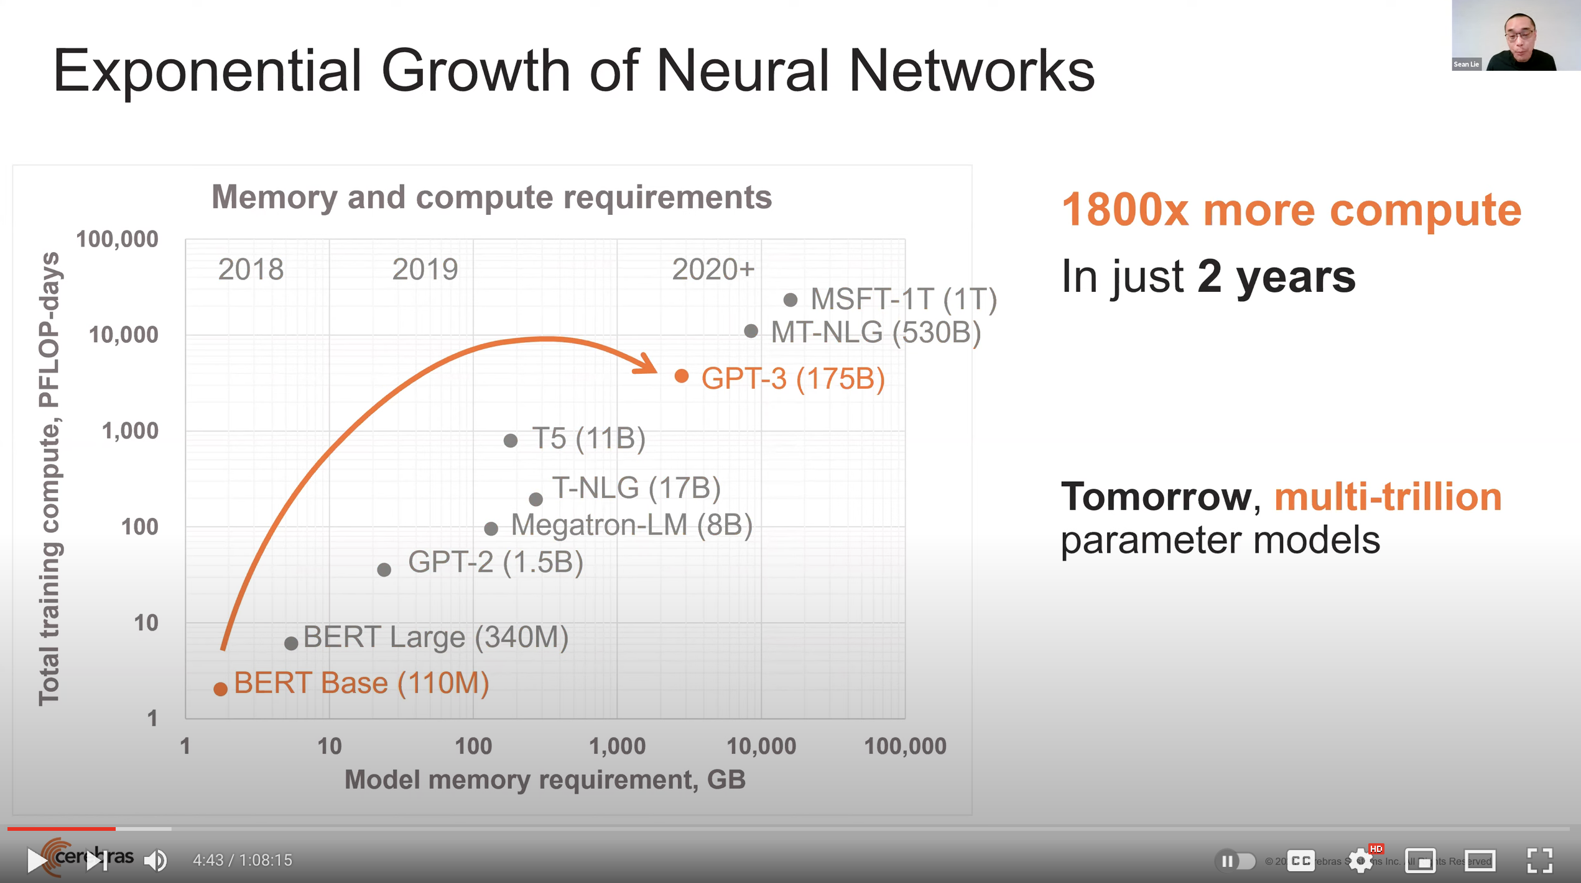
Huge Demand for Performance & Efficiency
https://www.youtube.com/watch?v=x2-qB0J7KHw

Slide 5
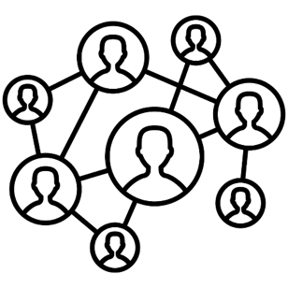



Data is Key for Future Workloads
In-memory Databases
[Mao+, EuroSys’12;
Clapp+ (Intel), IISWC’15]
Graph/Tree Processing
[Xu+, IISWC’12; Umuroglu+, FPL’15]
In-Memory Data Analytics
[Clapp+ (Intel), IISWC’15;
Awan+, BDCloud’15]
Datacenter Workloads
[Kanev+ (Google), ISCA’15]

Slide 6
Data Overwhelms Modern Machines
In-memory Databases
[Mao+, EuroSys’12;
Clapp+ (Intel), IISWC’15]
Graph/Tree Processing
[Xu+, IISWC’12; Umuroglu+, FPL’15]
Data → performance & energy bottleneck
In-Memory Data Analytics
[Clapp+ (Intel), IISWC’15;
Awan+, BDCloud’15]
Datacenter Workloads
[Kanev+ (Google), ISCA’15]

Slide 7








Data is Key for Future Workloads
  Chrome
TensorFlow Mobile
    Google’s web browser
Google’s machine learning framework
  Video Playback
  Video Capture
Google’s video codec
Google’s video codec
Notes:
In this work, we take a look at widely-used google consumer workloads, to figure out the major sources of energy consumption.
We look at Google Chrome web brower. We take a look at Tensorflow, Google’s machine learning framework, and we also take a look at two important video related workloads, video playback and video capture, both rely on Google’s vp9 codec technology.

Slide 8
Data Overwhelms Modern Machines
  Chrome
TensorFlow Mobile
    Google’s web browser
Google’s machine learning framework
Data → performance & energy bottleneck
  Video Playback
  Video Capture
Google’s video codec
Google’s video codec
Notes:
In this work, we take a look at widely-used google consumer workloads, to figure out the major sources of energy consumption.
We look at Google Chrome web brower. We take a look at Tensorflow, Google’s machine learning framework, and we also take a look at two important video related workloads, video playback and video capture, both rely on Google’s vp9 codec technology.

Slide 9
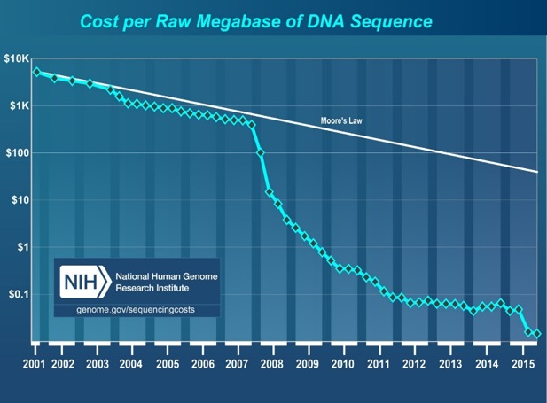
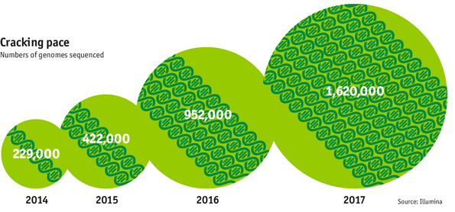

Data is Key for Future Workloads
development of high-throughput sequencing (HTS) technologies
Number of Genomes Sequenced
http://www.economist.com/news/21631808-so-much-genetic-data-so-many-uses-genes-unzipped
Notes:
However, since the development of high throughput sequencing (HTS) technologies, the cost of genome sequencing has fallen off a cliff (<< 1,000$) making it viable for almost everyone's use.

Slide 10

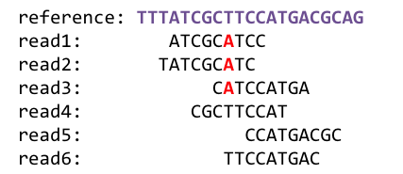
1
Sequencing
Genome Analysis
Read Mapping
2
Data → performance & energy bottleneck
Variant Calling
Scientific Discovery
3
4
Notes:
Genome analysis starts with sequencing random short DNA fragments of copies of the original molecule.
Unfortunately, these reads lack information about their order and which part of genome they are originated from.
Hence the second step is to map these reads to a long reference genome.

Slide 11
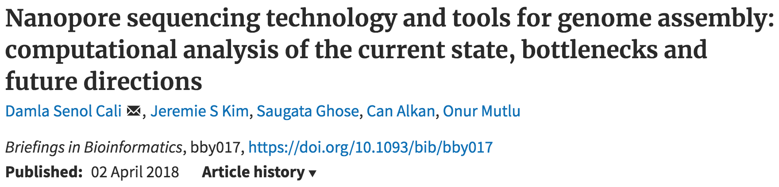
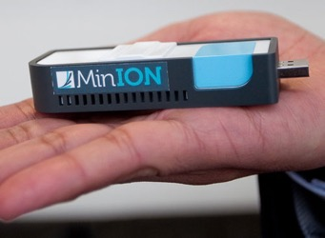
New Genome Sequencing Technologies
Oxford Nanopore MinION
Senol Cali+, “Nanopore Sequencing Technology and Tools for Genome
Assembly: Computational Analysis of the Current State, Bottlenecks
and Future Directions,” Briefings in Bioinformatics, 2018.
[Open arxiv.org version]

Slide 12
New Genome Sequencing Technologies
Oxford Nanopore MinION
Senol Cali+, “Nanopore Sequencing Technology and Tools for Genome
Assembly: Computational Analysis of the Current State, Bottlenecks
and Future Directions,” Briefings in Bioinformatics, 2018.
[Preliminary arxiv.org version]
Data → performance & energy bottleneck

Slide 13

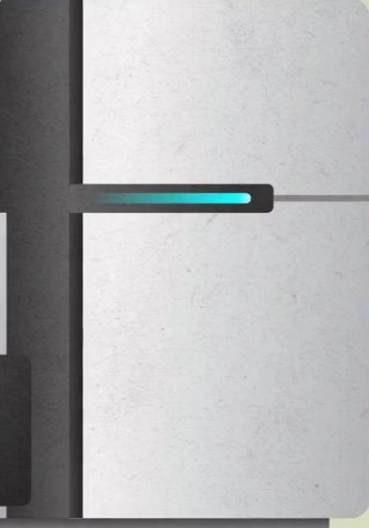

One Problem with (Genome) Analysis Today
Special-Purpose Machine
for Data Generation
General-Purpose Machine
for Data Analysis
FAST SLOW
Slow and inefficient processing capability
This picture is similar for many “data generators & analyzers” today

Slide 14
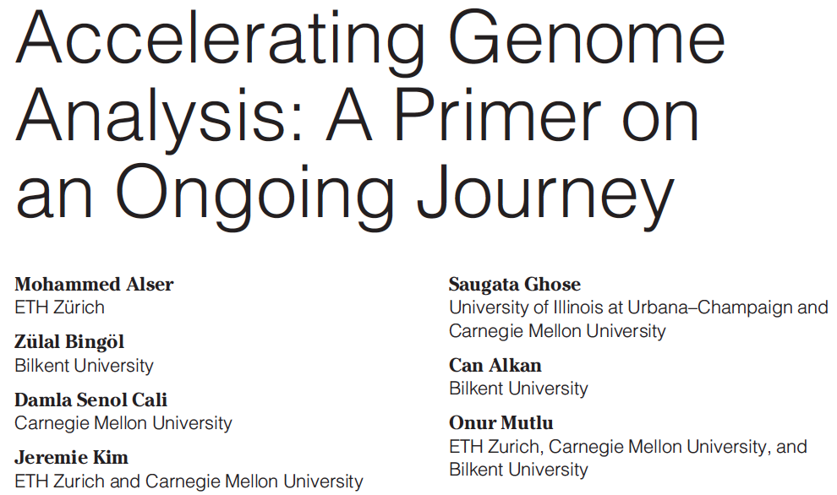
Accelerating Genome Analysis [IEEE MICRO 2020]
Mohammed Alser, Zulal Bingol, Damla Senol Cali, Jeremie Kim, Saugata Ghose, Can Alkan, and Onur Mutlu,
"Accelerating Genome Analysis: A Primer on an Ongoing Journey"
IEEE Micro (IEEE MICRO), Vol. 40, No. 5, pages 65-75, September/October 2020.
[Slides (pptx)(pdf)]
[Talk Video (1 hour 2 minutes)]

Slide 15
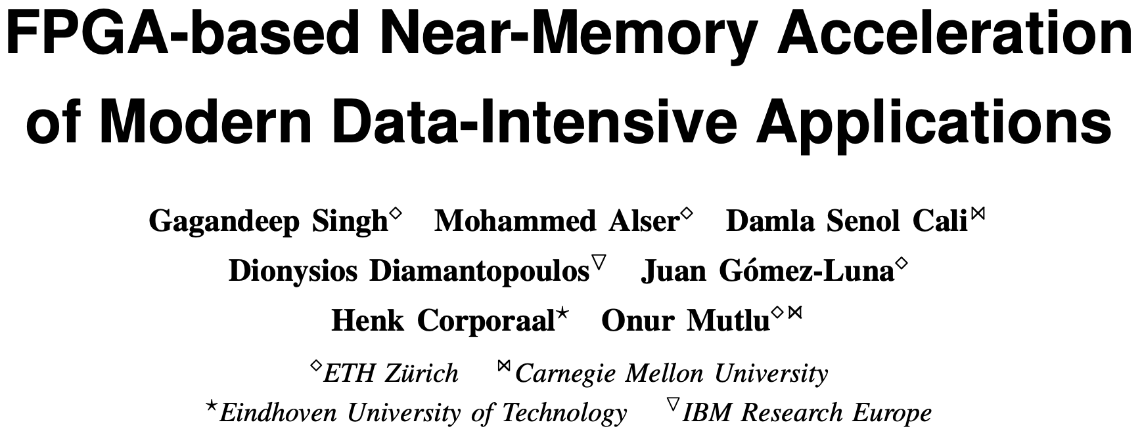
FPGA-based Near-Memory Analytics
Gagandeep Singh, Mohammed Alser, Damla Senol Cali, Dionysios Diamantopoulos, Juan Gómez-Luna, Henk Corporaal, and Onur Mutlu,
"FPGA-based Near-Memory Acceleration of Modern Data-Intensive Applications"
IEEE Micro (IEEE MICRO), 2021.

Slide 16
Data Overwhelms Modern Machines …
Storage/memory capability
Communication capability
Computation capability
Greatly impacts robustness, energy, performance, cost

Slide 17
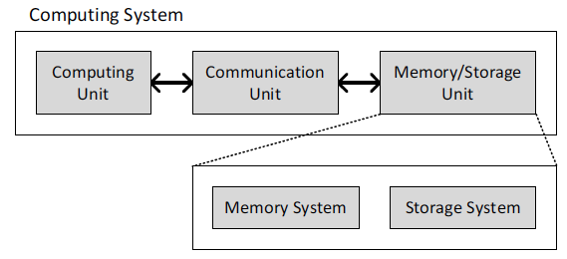
A Computing System
Three key components
Computation
Communication
Storage/memory
Burks, Goldstein, von Neumann, “Preliminary discussion of the
logical design of an electronic computing instrument,” 1946.
Image source: https://lbsitbytes2010.wordpress.com/2013/03/29/john-von-neumann-roll-no-15/

Slide 18
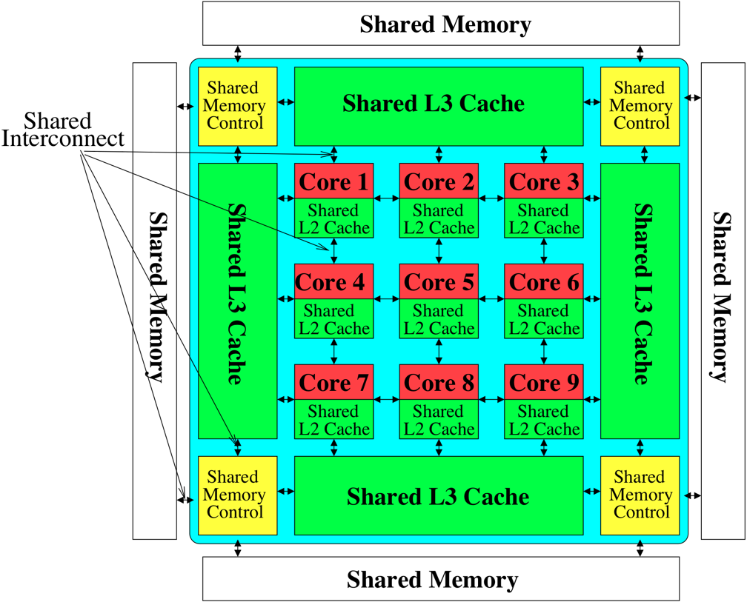

Perils of Processor-Centric Design
Most of the system is dedicated to storing and moving data
Yet, system is still bottlenecked by memory

Slide 19
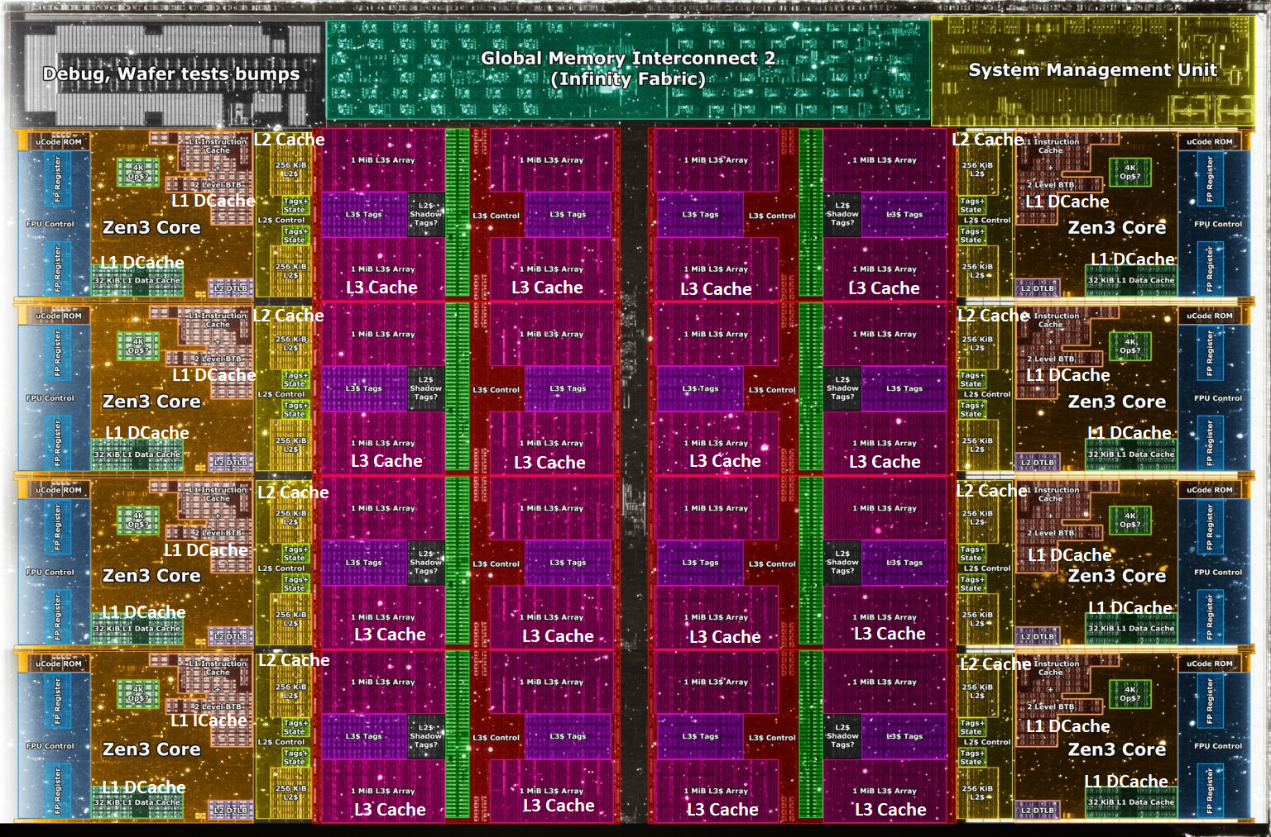
Deeper and Larger Memory Hierarchies
Core Count:
8 cores/16 threads
L1 Caches:
32 KB per core
L2 Caches:
512 KB per core
L3 Cache:
32 MB shared
AMD Ryzen 5000, 2020
https://wccftech.com/amd-ryzen-5000-zen-3-vermeer-undressed-high-res-die-shots-close-ups-pictured-detailed/

Slide 20
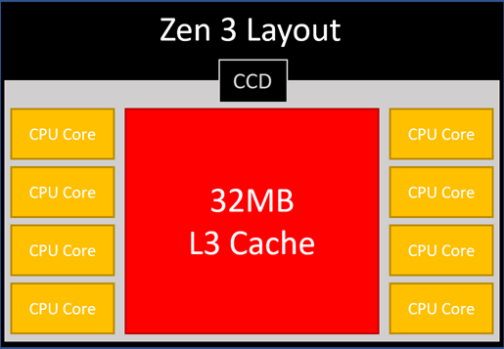
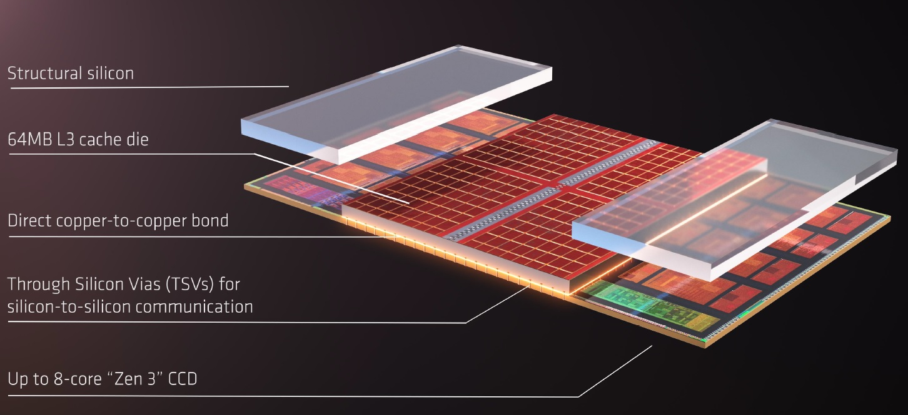
AMD’s 3D Last Level Cache (2021)
AMD increases the L3 size of their 8-core Zen 3 processors from 32 MB to 96 MB
Additional 64 MB L3 cache die stacked on top of the processor die
- Connected using Through Silicon Vias (TSVs)
- Total of 96 MB L3 cache
https://community.microcenter.com/discussion/5134/comparing-zen-3-to-zen-2
https://youtu.be/gqAYMx34euU
https://www.tech-critter.com/amd-keynote-computex-2021/
Notes:
CCD = Core Chiplet Die
Structural silicon is used to equalize the height and facilitate heat dissipation from the cores.

Slide 21
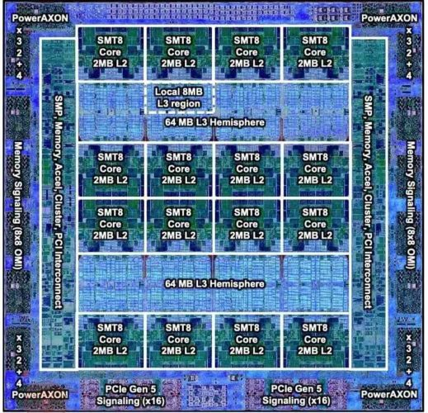
Deeper and Larger Memory Hierarchies
IBM POWER10,
2020
Cores:
15-16 cores,
8 threads/core
L2 Caches:
2 MB per core
L3 Cache:
120 MB shared
https://www.it-techblog.de/ibm-power10-prozessor-mehr-speicher-mehr-tempo-mehr-sicherheit/09/2020/

Slide 22
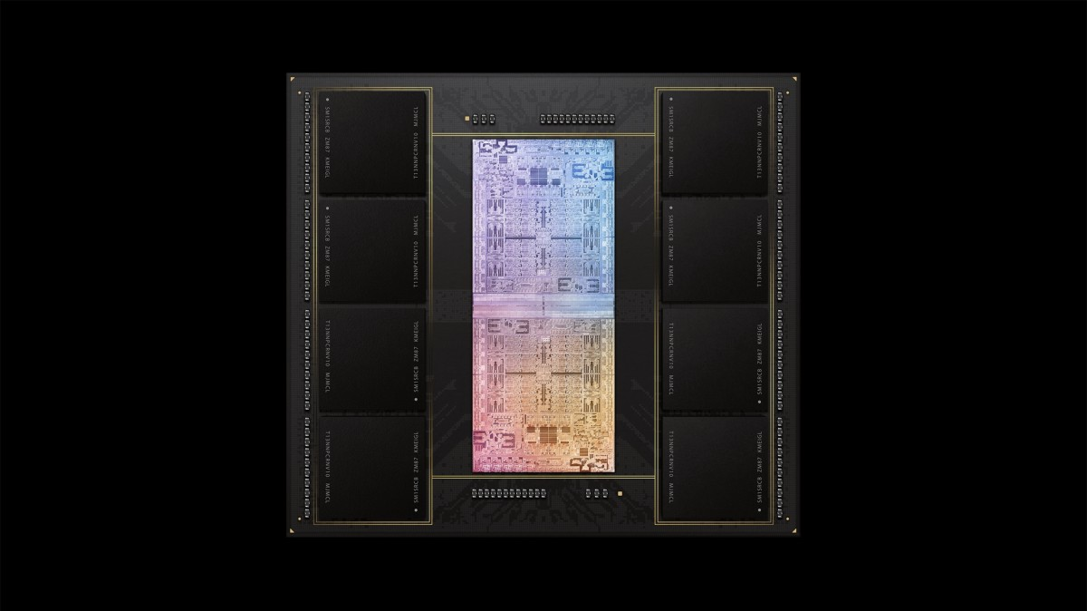
Deeper and Larger Memory Hierarchies
A lot of
SRAM
Storage
DRAM
DRAM
Storage
Apple M1 Ultra System (2022)
https://www.gsmarena.com/apple_announces_m1_ultra_with_20core_cpu_and_64core_gpu-news-53481.php

Slide 23
Data Overwhelms Modern Machines
  Chrome
TensorFlow Mobile
    Google’s web browser
Google’s machine learning framework
Data → performance & energy bottleneck
  Video Playback
  Video Capture
Google’s video codec
Google’s video codec
Notes:
In this work, we take a look at widely-used google consumer workloads, to figure out the major sources of energy consumption.
We look at Google Chrome web brower. We take a look at Tensorflow, Google’s machine learning framework, and we also take a look at two important video related workloads, video playback and video capture, both rely on Google’s vp9 codec technology.

Slide 24
Data Movement Overwhelms Modern Machines
Amirali Boroumand, Saugata Ghose, Youngsok Kim, Rachata Ausavarungnirun, Eric Shiu, Rahul Thakur, Daehyun Kim, Aki Kuusela, Allan Knies, Parthasarathy Ranganathan, and Onur Mutlu,
"Google Workloads for Consumer Devices: Mitigating Data Movement Bottlenecks"
Proceedings of the 23rd International Conference on Architectural Support for Programming Languages and Operating Systems (ASPLOS), Williamsburg, VA, USA, March 2018.
62.7% of the total system energy
is spent on data movement

Slide 25
Axiom
An Intelligent Architecture
Handles Data Well

Slide 26
How to Handle Data Well
Ensure data does not overwhelm the components
  via intelligent algorithms
  via intelligent architectures
  via whole system designs: algorithm-architecture-devices
Take advantage of vast amounts of data and metadata
  to improve architectural & system-level decisions
Understand and exploit properties of (different) data
  to improve algorithms & architectures in various metrics

Slide 27
Corollaries: Computing Systems Today …
Are processor-centric vs. data-centric
Make designer-dictated decisions vs. data-driven
Make component-based myopic decisions vs. data-aware

Slide 28
Architectures for Intelligent Machines
Data-centric
Data-driven
Data-aware

Slide 29
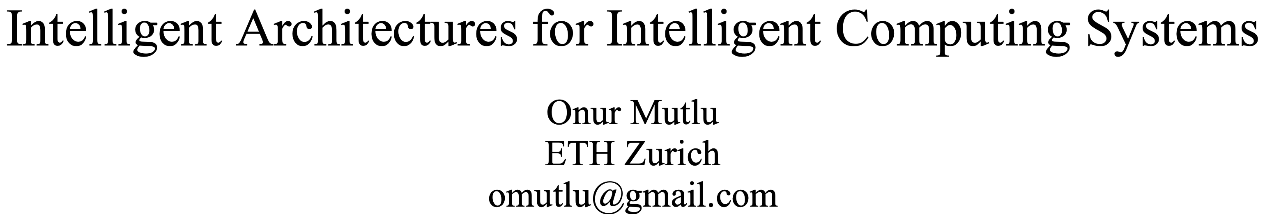
A Blueprint for Fundamentally Better Architectures
Onur Mutlu,
"Intelligent Architectures for Intelligent Computing Systems"
Invited Paper in Proceedings of the Design, Automation, and Test in Europe Conference (DATE), Virtual, February 2021.
[Slides (pptx) (pdf)]
[IEDM Tutorial Slides (pptx) (pdf)]
[Short DATE Talk Video (11 minutes)]
[Longer IEDM Tutorial Video (1 hr 51 minutes)]

Slide 30
We Need to Revisit the Entire Stack
Problem
Algorithm
Program/Language
System Software
SW/HW Interface
Micro-architecture
Logic
Devices
Electrons
We can get there step by step

Slide 31
Data-Centric (Memory-Centric) Architectures

Slide 32
Data-Centric Architectures: Properties
Process data where it resides (where it makes sense)
  Processing in and near memory structures
Low-latency and low-energy data access
  Low latency memory
  Low energy memory
Low-cost data storage and processing
  High capacity memory at low cost: hybrid memory, compression
Intelligent data management
  Intelligent controllers handling robustness, security, cost, perf.

Slide 33
Processing Data
Where It Makes Sense

Slide 34
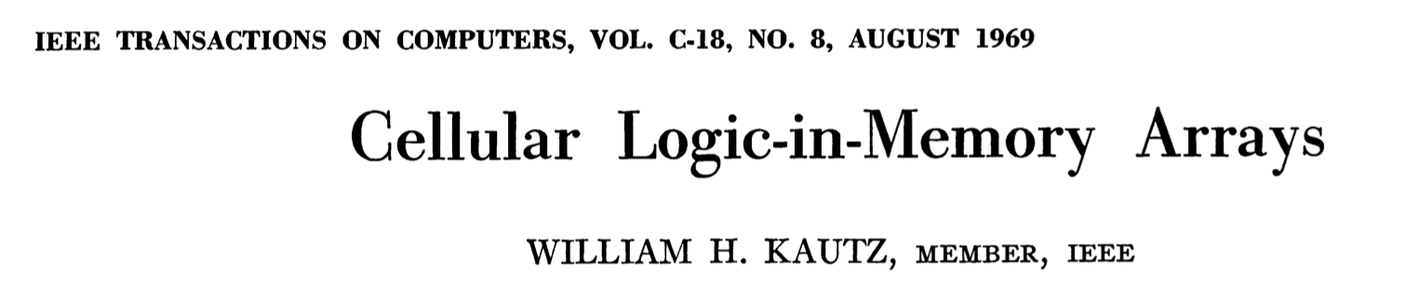
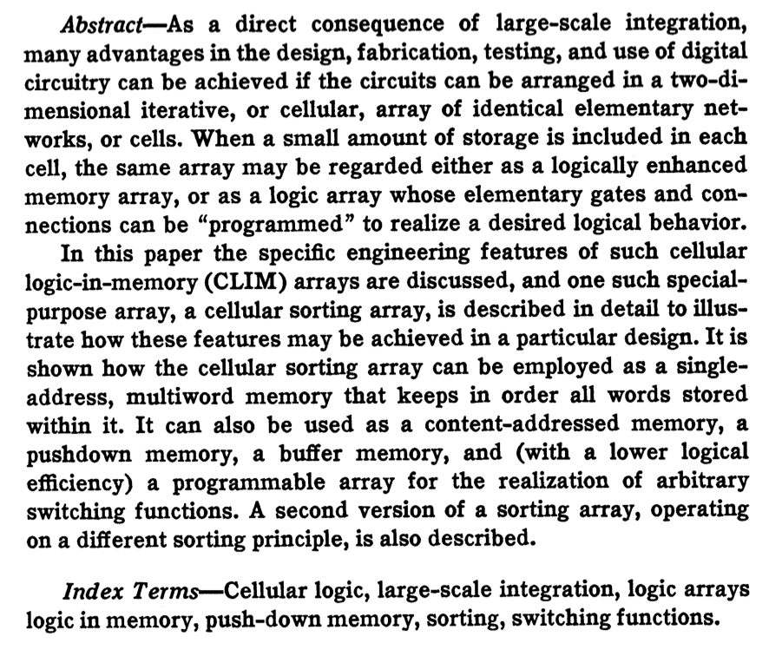
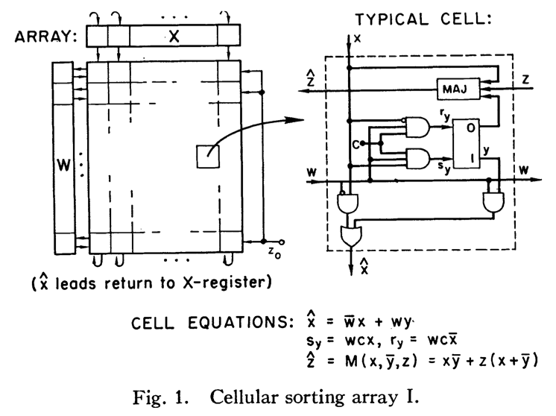
Processing in/near Memory: An Old Idea
Kautz, “Cellular Logic-in-Memory Arrays”, IEEE TC 1969.
https://doi.org/10.1109/T-C.1969.222754

Slide 35
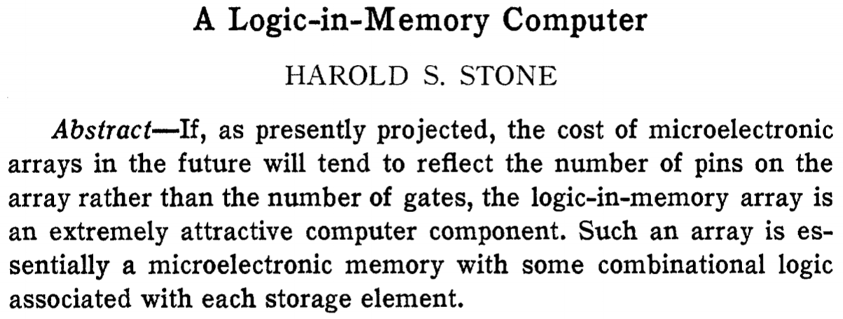
Processing in/near Memory: An Old Idea
Stone, “A Logic-in-Memory Computer,” IEEE TC 1970.
https://safari.ethz.ch/architecture/fall2020/lib/exe/fetch.php?media=stone_logic_in_memory_1970.pdf

Slide 36
Why In-Memory Computation Today?
Push from Technology
  Memory technology scaling is not going well (e.g., RowHammer)
  Many scaling issues demand intelligence in memory
Pull from Applications & Systems
  Data access is the major bottleneck
  Systems are energy & power limited
  Data movement much more energy-hungry than computation
  Need all at the same time: performance, energy, sustainability
  We can improve all metrics by minimizing data movement
Designs are squeezed in the middle

Slide 37
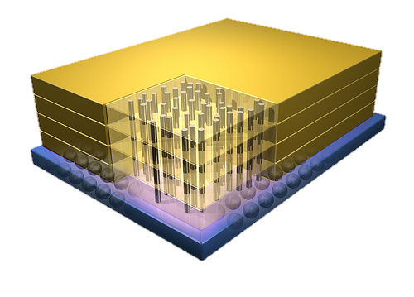


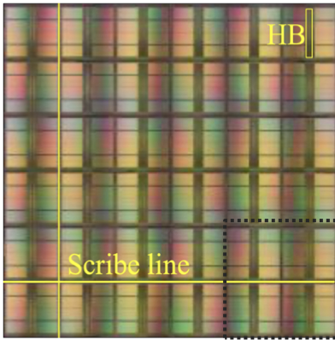
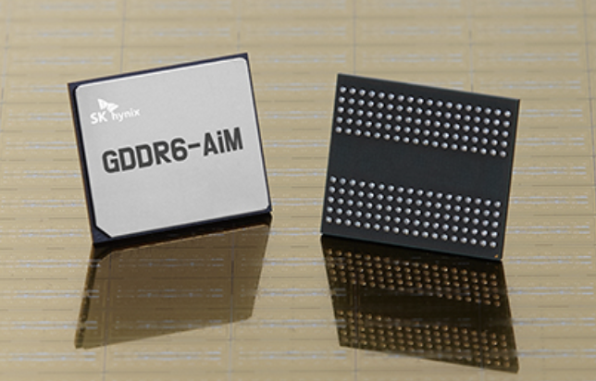
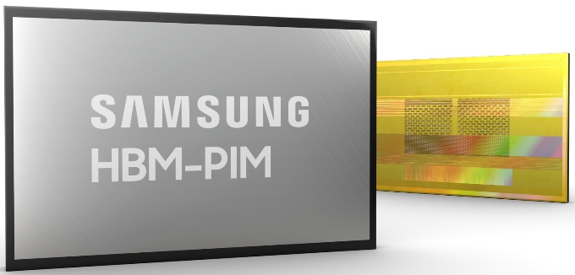
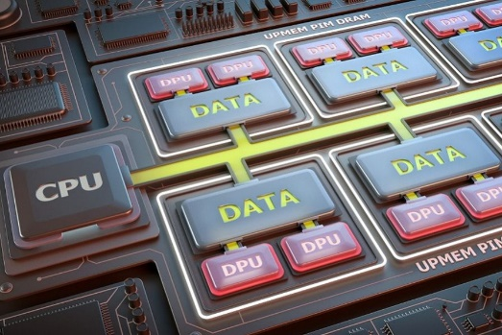
Processing-in-Memory Landscape Today
[Samsung 2021]
[Alibaba 2022]
[SK Hynix 2022]
[Samsung 2021]
[UPMEM 2019]
And, many other experimental chips and startups

Slide 38
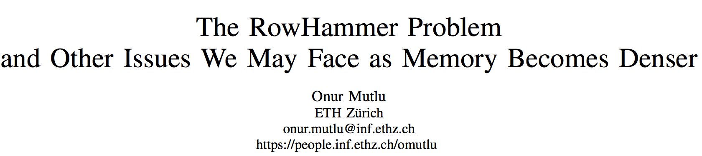
Memory Scaling Issues Are Real
Onur Mutlu,
"The RowHammer Problem and Other Issues We May Face as Memory Becomes Denser"
Invited Paper in Proceedings of the Design, Automation, and Test in Europe Conference (DATE), Lausanne, Switzerland, March 2017.
[Slides (pptx) (pdf)]
https://people.inf.ethz.ch/omutlu/pub/rowhammer-and-other-memory-issues_date17.pdf

Slide 39
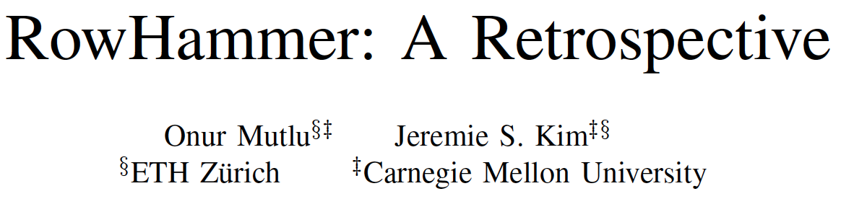
Memory Scaling Issues Are Real
Onur Mutlu and Jeremie Kim,
"RowHammer: A Retrospective"
IEEE Transactions on Computer-Aided Design of Integrated Circuits and Systems (TCAD) Special Issue on Top Picks in Hardware and Embedded Security, 2019.
[Preliminary arXiv version]
[Slides from COSADE 2019 (pptx)]
[Slides from VLSI-SOC 2020 (pptx) (pdf)]
[Talk Video (1 hr 15 minutes, with Q&A)]

Slide 40
The Push from Circuits and Devices
Main Memory Needs
Intelligent Controllers

Slide 41
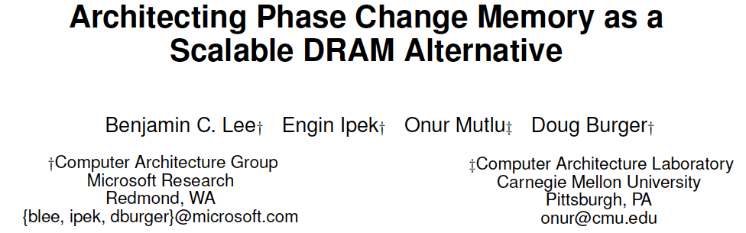
Emerging Memories Also Need Intelligent Controllers
Benjamin C. Lee, Engin Ipek, Onur Mutlu, and Doug Burger,
"Architecting Phase Change Memory as a Scalable DRAM Alternative"
Proceedings of the 36th International Symposium on Computer Architecture (ISCA), pages 2-13, Austin, TX, June 2009. Slides (pdf)
One of the 13 computer architecture papers of 2009 selected as Top Picks by IEEE Micro. Selected as a CACM Research Highlight. 2022 Persistent Impact Prize.

Slide 42
The Takeaway
Intelligent
Memory Controllers
Can Avoid Many Failures
& Enable Better Scaling

Slide 43
Three Key Systems & Application Trends
1. Data access is the major bottleneck
  Applications are increasingly data hungry
2. Energy consumption is a key limiter
3. Data movement energy dominates compute
  Especially true for off-chip to on-chip movement

Slide 44
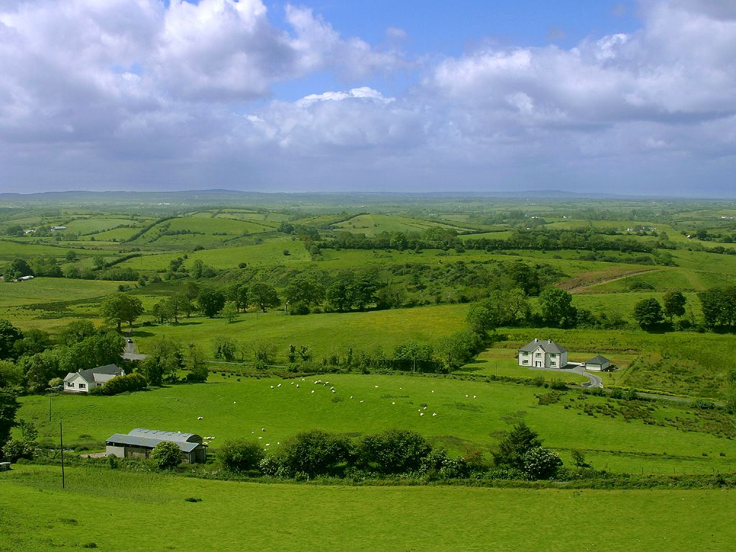
Do We Want This?
Source: V. Milutinovic

Slide 45
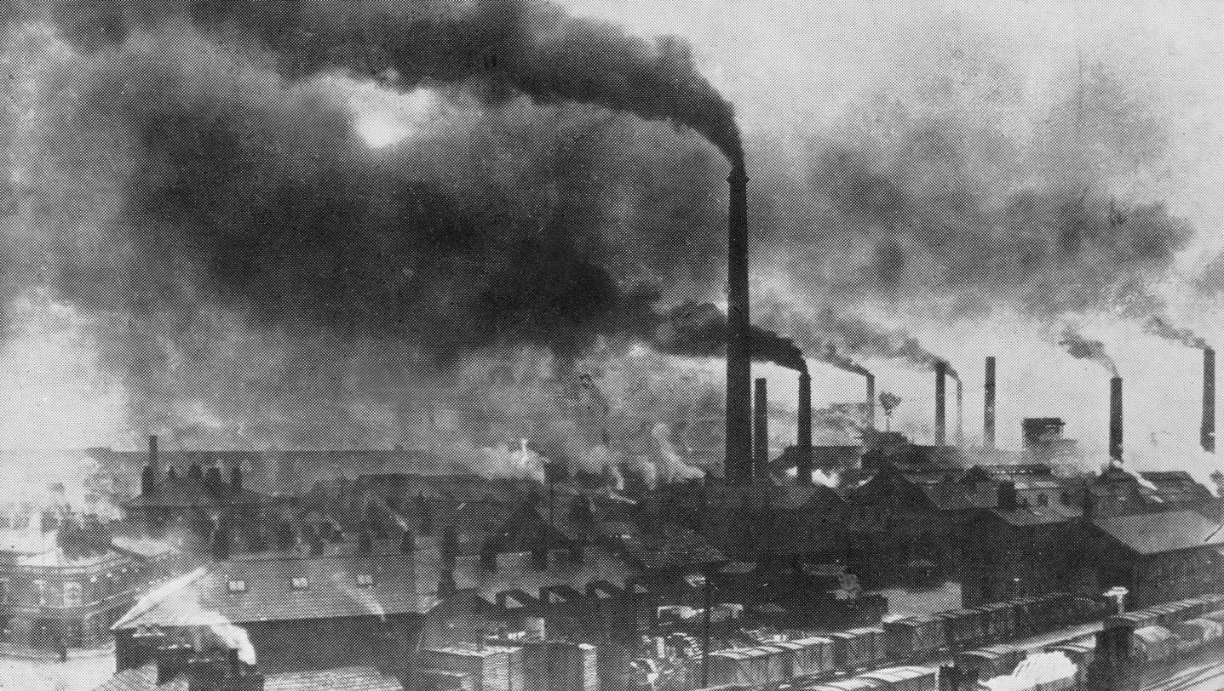
Or This?
Source: V. Milutinovic

Slide 46
Challenge and Opportunity for Future
High Performance,
Energy Efficient,
Sustainable
(All at the Same Time)

Slide 47
The Problem
Data access is the major performance and energy bottleneck
Our current
design principles
cause great energy waste
(and great performance loss)

Slide 48
The Problem
Processing of data
is performed
far away from the data

Slide 49
A Computing System
Three key components
Computation
Communication
Storage/memory
Burks, Goldstein, von Neumann, “Preliminary discussion of the
logical design of an electronic computing instrument,” 1946.
Image source: https://lbsitbytes2010.wordpress.com/2013/03/29/john-von-neumann-roll-no-15/

Slide 50


A Computing System
Three key components
Computation
Communication
Storage/memory
Burks, Goldstein, von Neumann, “Preliminary discussion of the
logical design of an electronic computing instrument,” 1946.
Image source: https://lbsitbytes2010.wordpress.com/2013/03/29/john-von-neumann-roll-no-15/

Slide 51
Today’s Computing Systems
Are overwhelmingly processor centric
All data processed in the processor → at great system cost
Processor is heavily optimized and is considered the master
Data storage units are dumb and are largely unoptimized

Slide 52
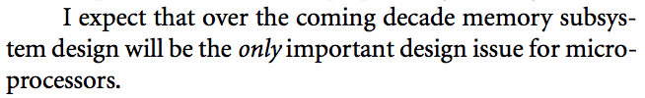
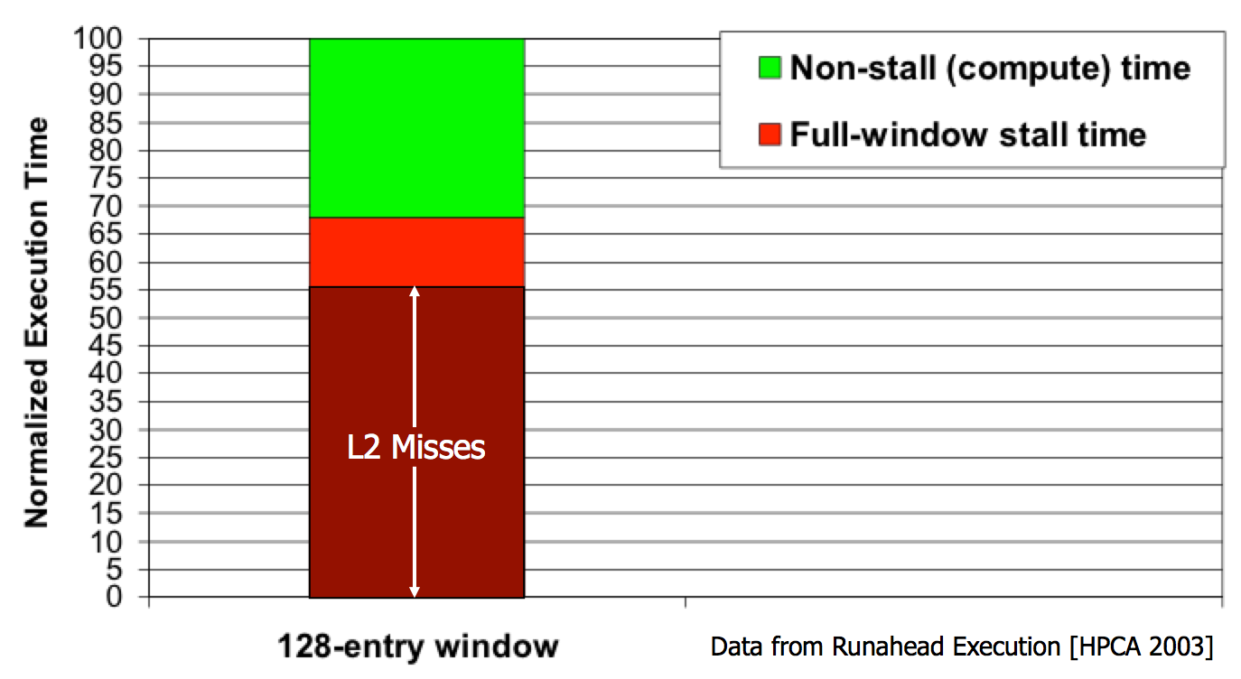
Yet …
“It’s the Memory, Stupid!” (Richard Sites, MPR, 1996)
Mutlu+, “Runahead Execution: An Alternative to Very Large Instruction Windows for Out-of-Order Processors,” HPCA 2003.

Slide 53
The Performance Perspective
Onur Mutlu, Jared Stark, Chris Wilkerson, and Yale N. Patt,
"Runahead Execution: An Alternative to Very Large Instruction Windows for Out-of-order Processors"
Proceedings of the 9th International Symposium on High-Performance Computer Architecture (HPCA), pages 129-140, Anaheim, CA, February 2003. Slides (pdf)
  One of the 15 computer arch. papers of 2003 selected as Top Picks by IEEE Micro.
  HPCA Test of Time Award (awarded in 2021).

Slide 54
The Performance Perspective (Today)
All of Google’s Data Center Workloads (2015):
Kanev+, “Profiling a Warehouse-Scale Computer,” ISCA 2015.

Slide 55
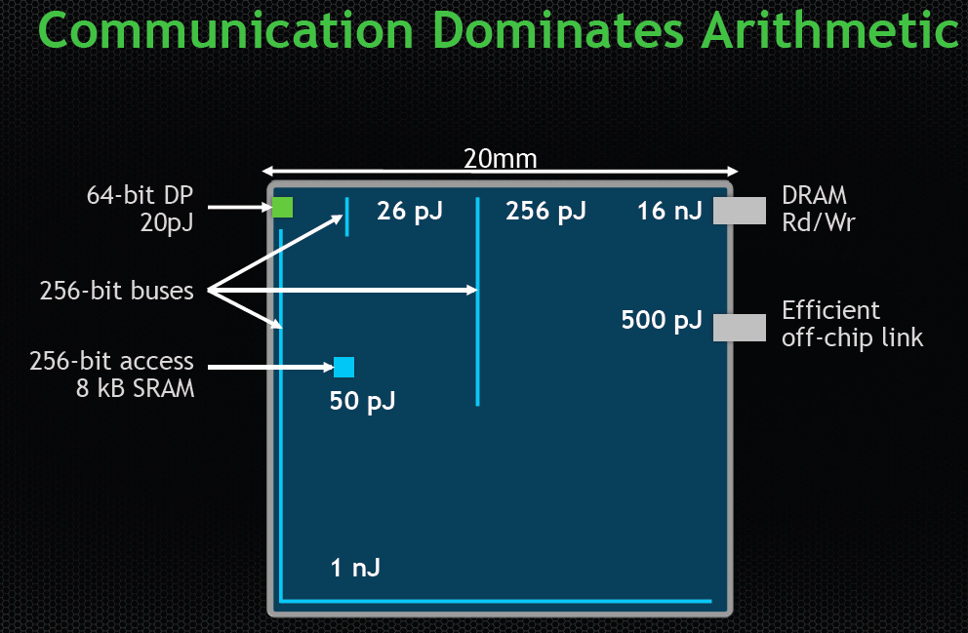
The Energy Perspective
Dally, HiPEAC 2015

Slide 56
Data Movement vs. Computation Energy
Dally, HiPEAC 2015
A memory access consumes ~100-1000X
the energy of a complex addition

Slide 57
Data Movement vs. Computation Energy
Han+, “EIE: Efficient Inference Engine on Compressed Deep Neural Network,” ISCA 2016.

Slide 58
Data Movement vs. Computation Energy
6400X
A memory access consumes 6400X
the energy of a simple integer addition
Han+, “EIE: Efficient Inference Engine on Compressed Deep Neural Network,” ISCA 2016.

Slide 59
Energy Waste in Mobile Devices
Amirali Boroumand, Saugata Ghose, Youngsok Kim, Rachata Ausavarungnirun, Eric Shiu, Rahul Thakur, Daehyun Kim, Aki Kuusela, Allan Knies, Parthasarathy Ranganathan, and Onur Mutlu,
"Google Workloads for Consumer Devices: Mitigating Data Movement Bottlenecks"
Proceedings of the 23rd International Conference on Architectural Support for Programming Languages and Operating Systems (ASPLOS), Williamsburg, VA, USA, March 2018.
62.7% of the total system energy
is spent on data movement

Slide 60
We Do Not Want to Move Data!
Dally, HiPEAC 2015
A memory access consumes ~100-1000X
the energy of a complex addition

Slide 61
We Need A Paradigm Shift To …
Enable computation with minimal data movement
Compute where it makes sense (where data resides)
Make computing architectures more data-centric

Slide 62
Goal: Processing Inside Memory
Many questions … How do we design the:
  compute-capable memory & controllers?
  processors & communication units?
  software & hardware interfaces?
  system software, compilers, languages?
  algorithms & theoretical foundations?
Memory
Processor
Core
Database
Graphs
Media
Cache
Query
Interconnect
Problem
Results
Algorithm
Program/Language
System Software
SW/HW Interface
Micro-architecture
Logic
Devices
Electrons

Slide 63
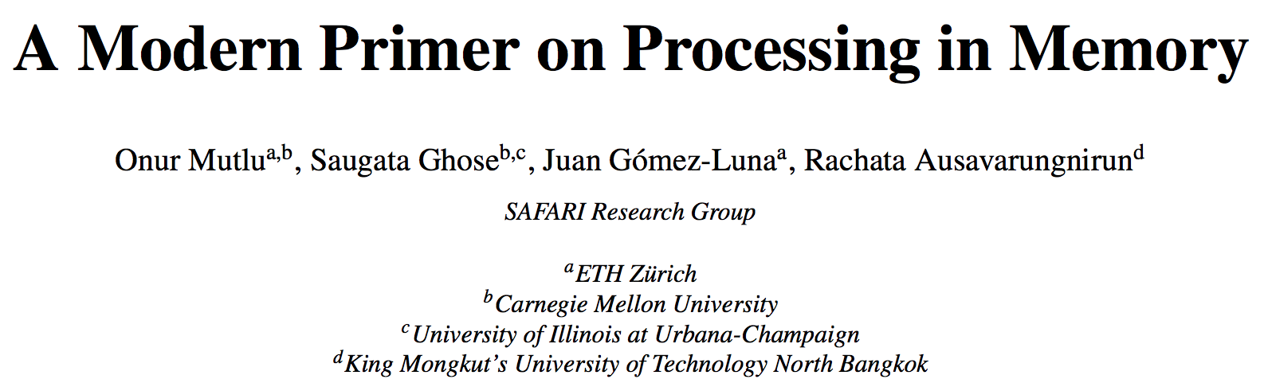
PIM Review and Open Problems
Onur Mutlu, Saugata Ghose, Juan Gomez-Luna, and Rachata Ausavarungnirun,
"A Modern Primer on Processing in Memory"
Invited Book Chapter in Emerging Computing: From Devices to Systems - Looking Beyond Moore and Von Neumann, Springer, to be published in 2021.
https://arxiv.org/pdf/1903.03988.pdf

Slide 64
We Need to Think Differently from the Past Approaches

Slide 65
Processing in Memory:
Two Approaches
1. Processing near Memory
2. Processing using Memory

Slide 66
Mindset: Memory as an Accelerator
CPU
core
CPU
core
mini-CPU
core
GPU
(throughput)
core
GPU
(throughput)
core
video
core
GPU
(throughput)
core
GPU
(throughput)
core
CPU
core
CPU
core
Memory
imaging
core
LLC
Specialized
compute-capability
in memory
Memory Controller
Memory Bus
Memory similar to a “conventional” accelerator

Slide 67
Eliminating the Adoption Barriers
Processing-in-Memory
in the Real World

Slide 68
Processing-in-Memory Landscape Today
[Samsung 2021]
[Alibaba 2022]
[SK Hynix 2022]
[Samsung 2021]
[UPMEM 2019]
This does not include many experimental chips and startups

Slide 69
UPMEM Processing-in-DRAM Engine (2019)
Processing in DRAM Engine
Includes standard DIMM modules, with a large number of DPU processors combined with DRAM chips.
Replaces standard DIMMs
  DDR4 R-DIMM modules
    8GB+128 DPUs (16 PIM chips)
    Standard 2x-nm DRAM process
  Large amounts of compute & memory bandwidth
https://www.anandtech.com/show/14750/hot-chips-31-analysis-inmemory-processing-by-upmem
https://www.upmem.com/video-upmem-presenting-its-true-processing-in-memory-solution-hot-chips-2019/

Slide 70
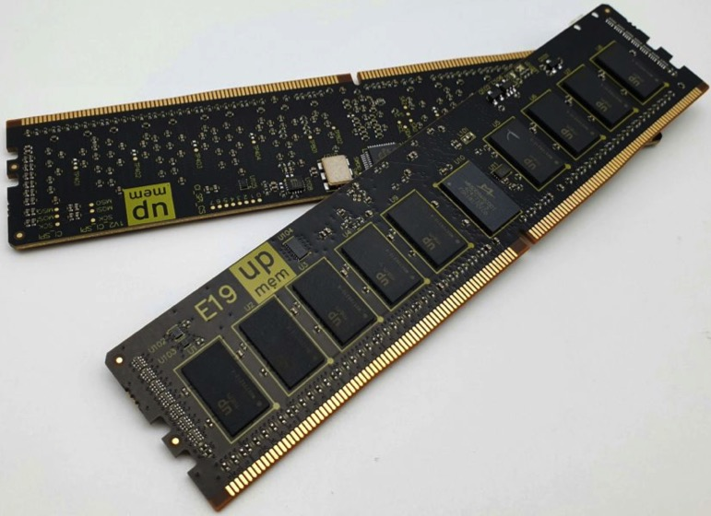
UPMEM Memory Modules
E19: 8 chips DIMM (1 rank). DPUs @ 267 MHz
P21: 16 chips DIMM (2 ranks). DPUs @ 350 MHz
www.upmem.com

Slide 71
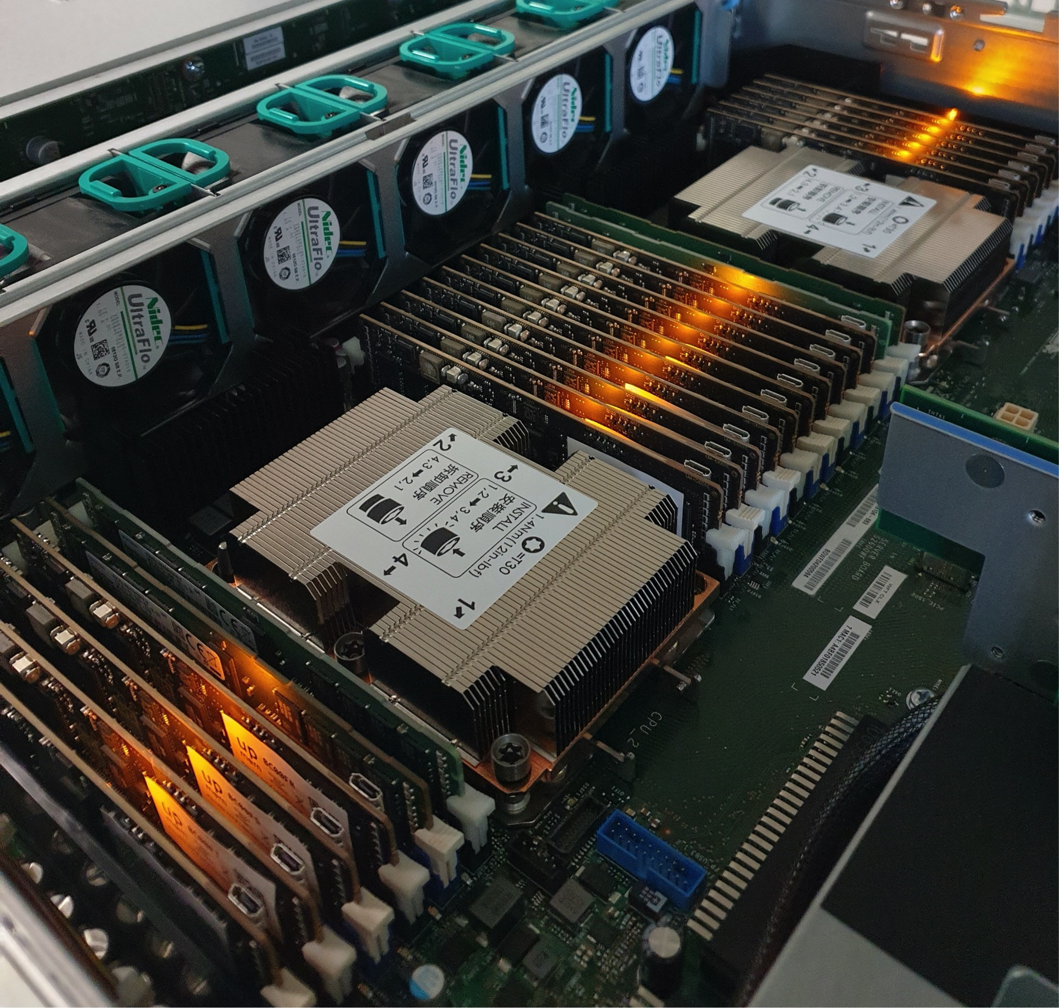
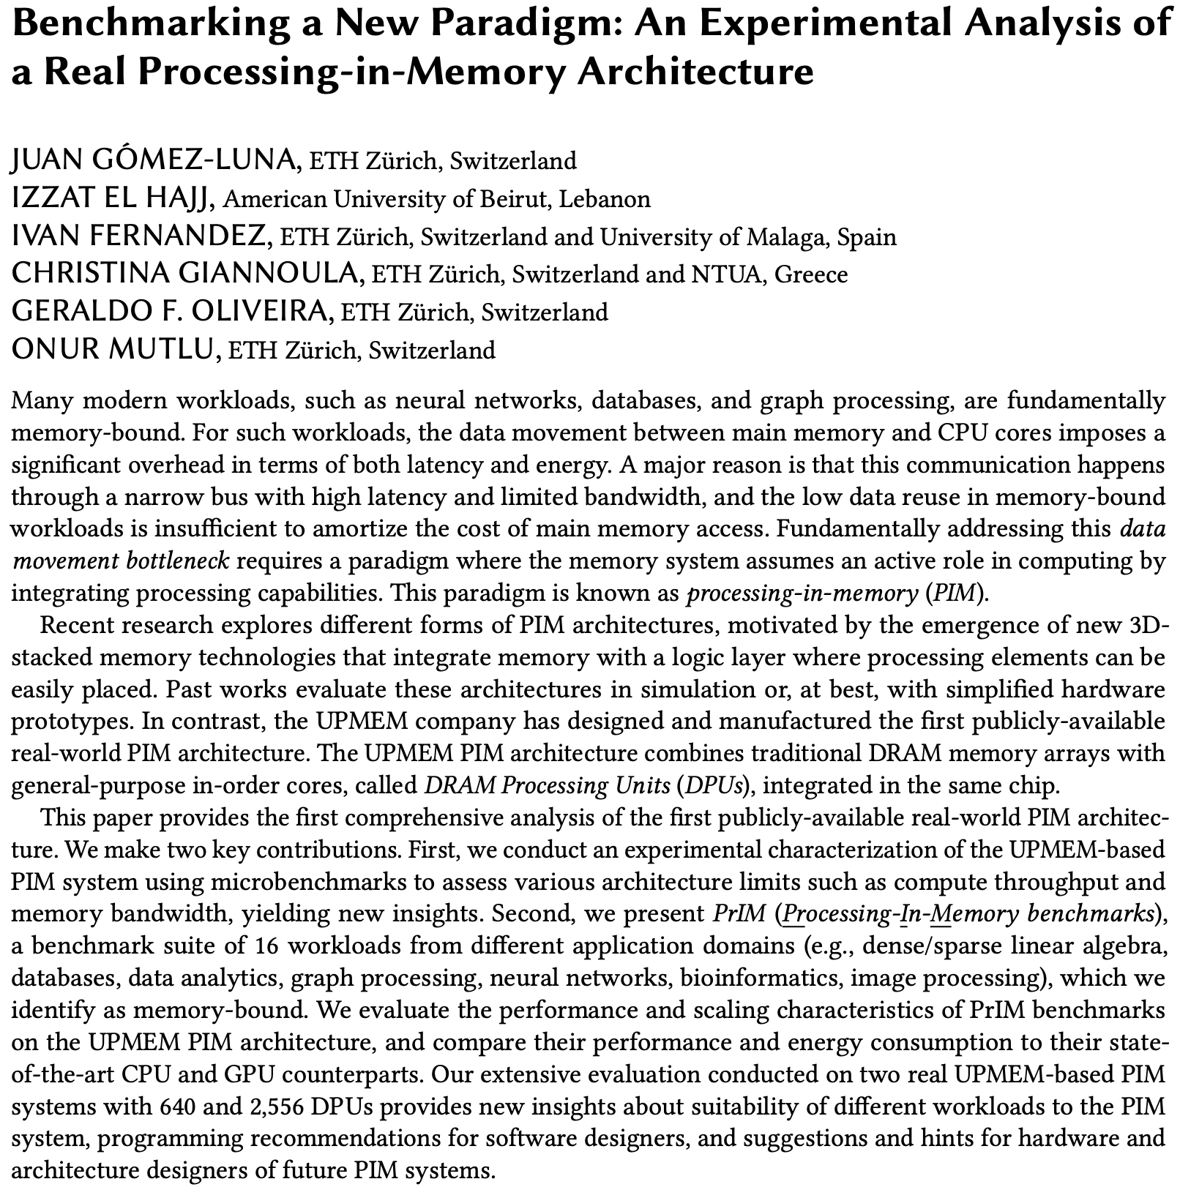
2,560-DPU Processing-in-Memory System
https://arxiv.org/pdf/2105.03814.pdf

Slide 72
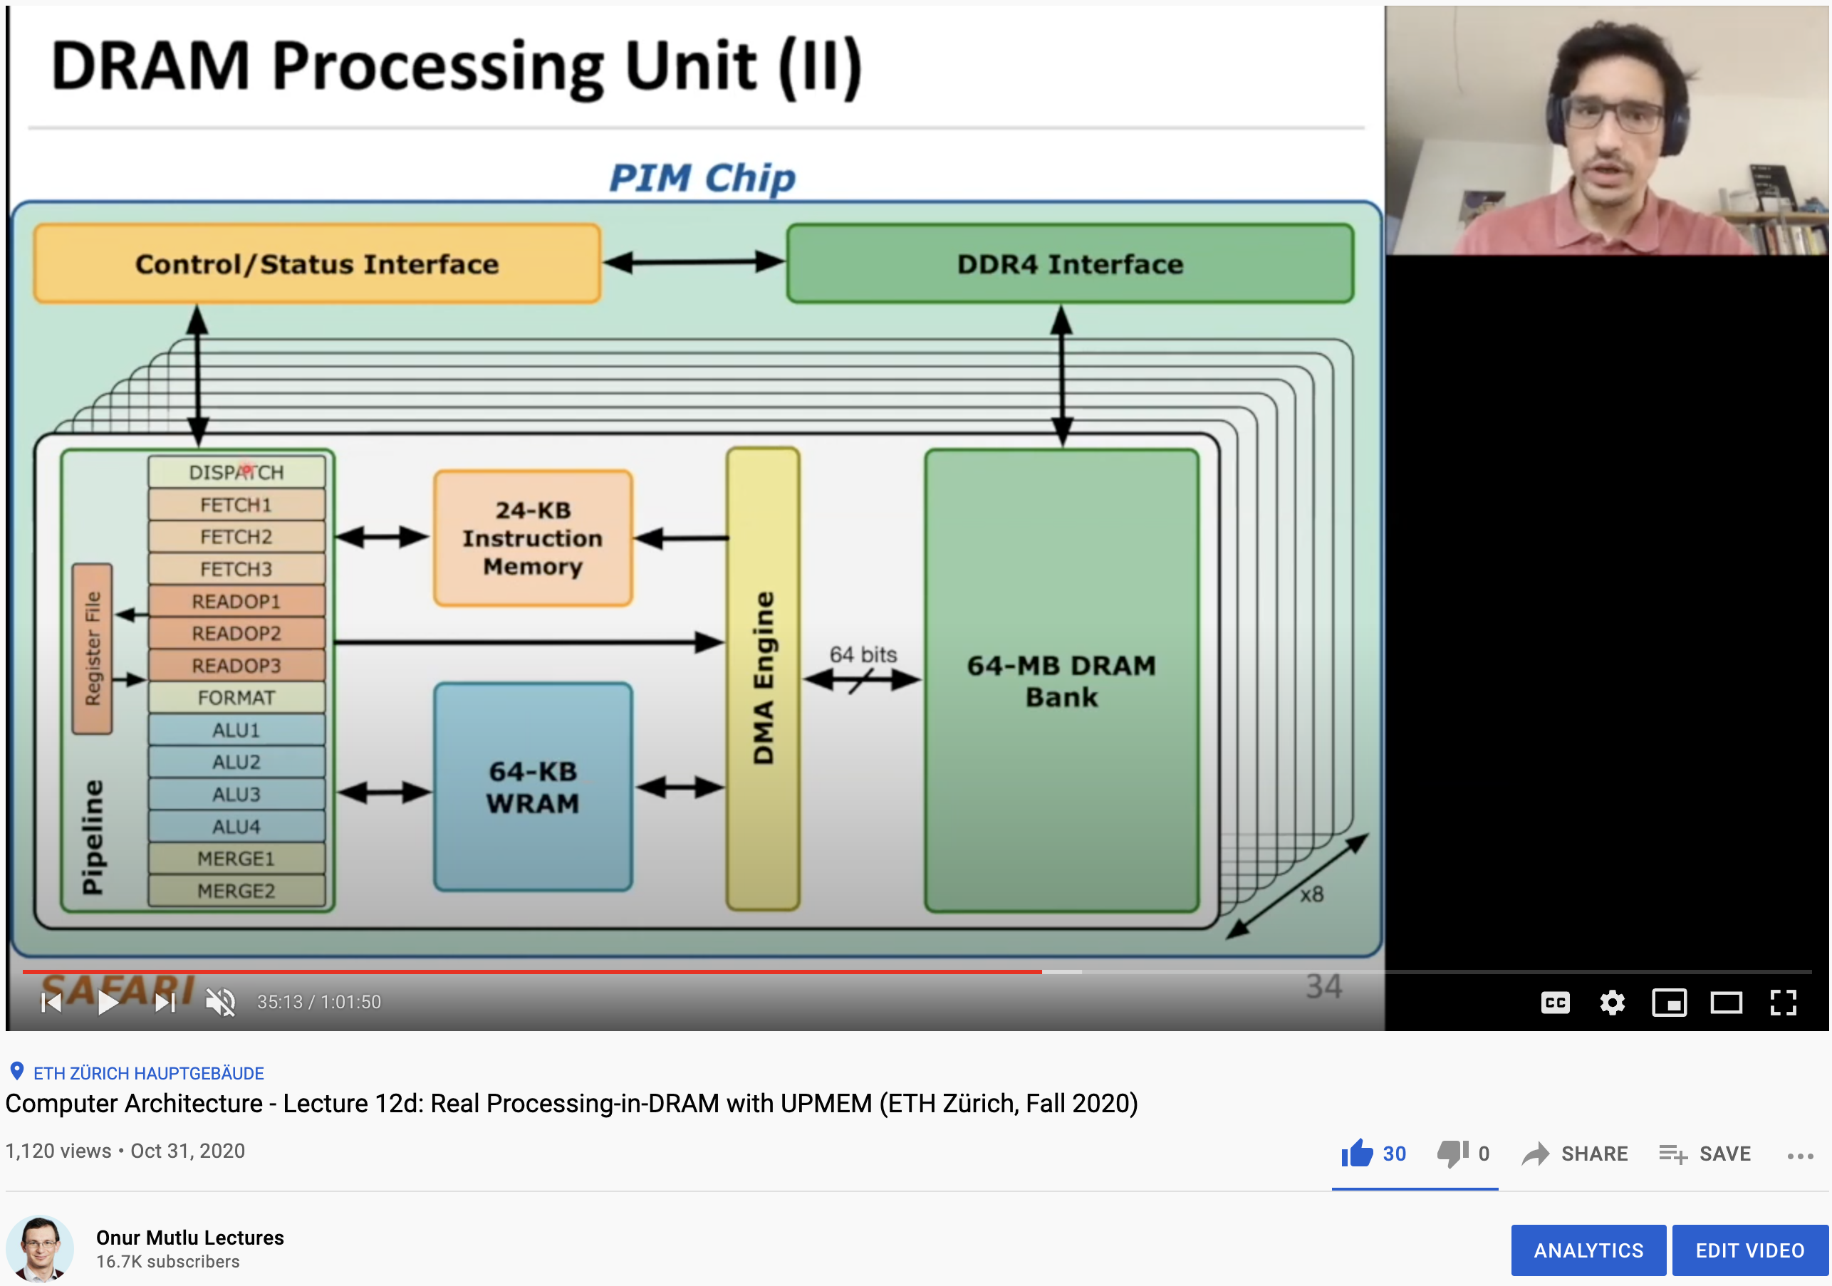
More on the UPMEM PIM System
https://www.youtube.com/watch?v=Sscy1Wrr22A&list=PL5Q2soXY2Zi9xidyIgBxUz7xRPS-wisBN&index=26

Slide 73
Experimental Analysis of the UPMEM PIM Engine
https://arxiv.org/pdf/2105.03814.pdf

Slide 74
Understanding a Modern Processing-in-Memory Architecture:
Benchmarking and Experimental Characterization
Juan Gómez Luna, Izzat El Hajj,
Ivan Fernandez, Christina Giannoula,
Geraldo F. Oliveira, Onur Mutlu
https://arxiv.org/pdf/2105.03814.pdf
https://github.com/CMU-SAFARI/prim-benchmarks

Slide 75
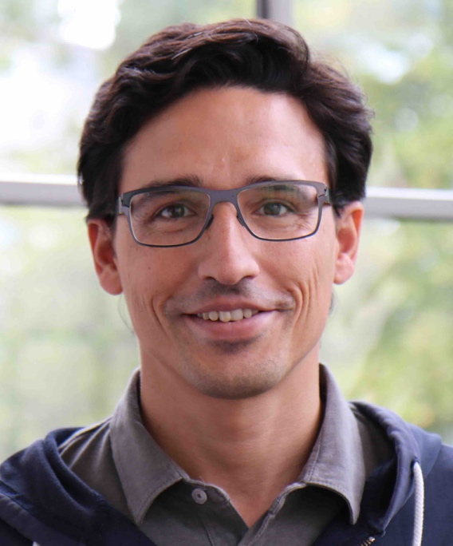
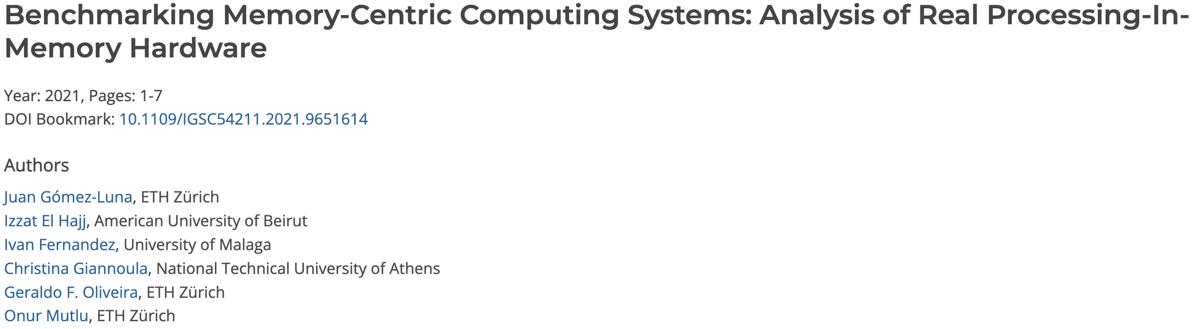
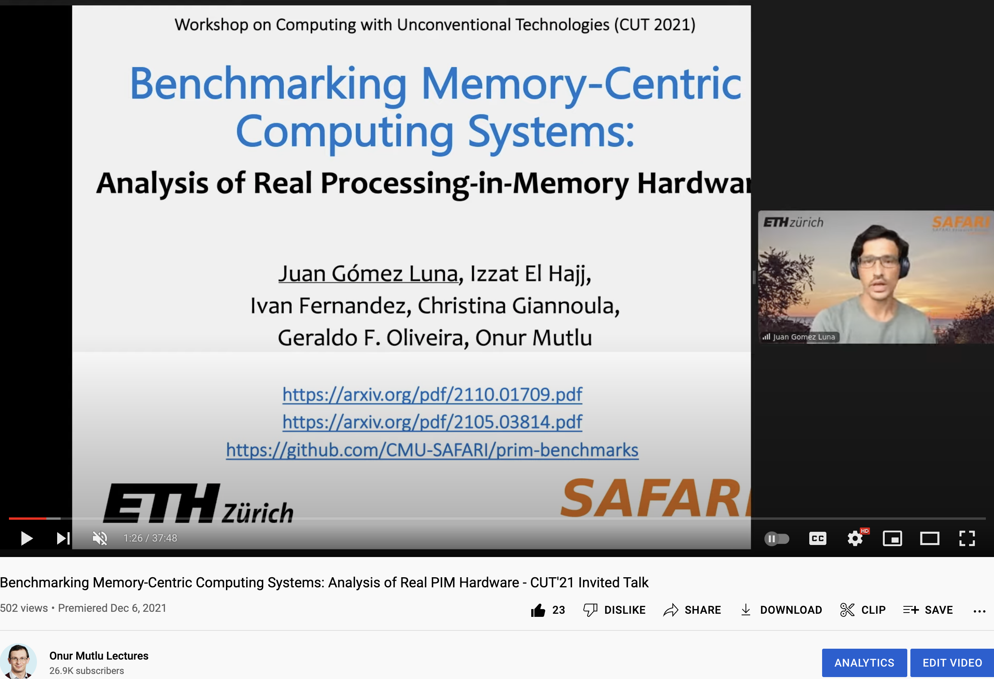
Upcoming TECHCON Presentation
Dr. Juan Gomez-Luna
  Benchmarking Memory-Centric Computing Systems: Analysis of Real Processing-in-Memory Hardware
  Based on two major works
    https://arxiv.org/pdf/2105.03814.pdf
    https://arxiv.org/pdf/2207.07886.pdf
https://www.youtube.com/watch?v=nphV36SrysA

Slide 76
Key Takeaway 1
The throughput saturation point is as low as ¼ OP/B,
i.e., 1 integer addition per every 32-bit element fetched
Memory-bound region
Compute-bound region
KEY TAKEAWAY 1
The UPMEM PIM architecture is fundamentally compute bound.
As a result, the most suitable workloads are memory-bound.

Slide 77
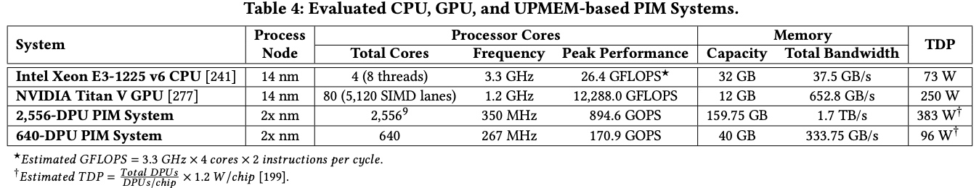
Key Takeaway 2
KEY TAKEAWAY 2
The most well-suited workloads for the UPMEM PIM architecture use no arithmetic operations or use only simple operations (e.g., bitwise operations and integer addition/subtraction).

Slide 78
Key Takeaway 3
KEY TAKEAWAY 3
The most well-suited workloads for the UPMEM PIM architecture require little or no communication across DPUs (inter-DPU communication).

Slide 79
Understanding a Modern Processing-in-Memory Architecture:
Benchmarking and Experimental Characterization
Juan Gómez Luna, Izzat El Hajj,
Ivan Fernandez, Christina Giannoula,
Geraldo F. Oliveira, Onur Mutlu
el1goluj@gmail.com
https://arxiv.org/pdf/2105.03814.pdf
https://github.com/CMU-SAFARI/prim-benchmarks

Slide 80
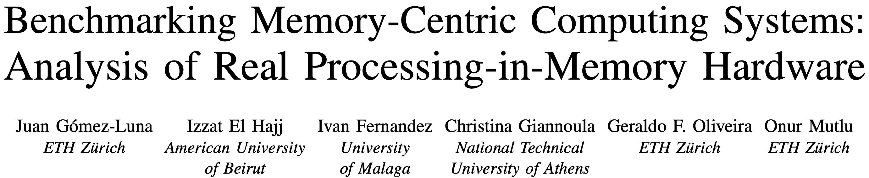
UPMEM PIM System Summary & Analysis
Juan Gomez-Luna, Izzat El Hajj, Ivan Fernandez, Christina Giannoula, Geraldo F. Oliveira, and Onur Mutlu,
"Benchmarking Memory-Centric Computing Systems: Analysis of Real Processing-in-Memory Hardware"
Invited Paper at Workshop on Computing with Unconventional Technologies (CUT), Virtual, October 2021.
[arXiv version]
[PrIM Benchmarks Source Code]
[Slides (pptx) (pdf)]
[Talk Video (37 minutes)]
[Lightning Talk Video (3 minutes)]

Slide 81
PrIM Benchmarks: Application Domains
Domain | Benchmark | Short name
Dense linear algebra | Vector Addition | VA
 | Matrix-Vector Multiply | GEMV
Sparse linear algebra | Sparse Matrix-Vector Multiply | SpMV
Databases | Select | SEL
 | Unique | UNI
Data analytics | Binary Search | BS
 | Time Series Analysis | TS
Graph processing | Breadth-First Search | BFS
Neural networks | Multilayer Perceptron | MLP
Bioinformatics | Needleman-Wunsch | NW
Image processing | Image histogram (short) | HST-S
 | Image histogram (large) | HST-L
Parallel primitives | Reduction | RED
 | Prefix sum (scan-scan-add) | SCAN-SSA
 | Prefix sum (reduce-scan-scan) | SCAN-RSS
 | Matrix transposition | TRNS

Slide 82
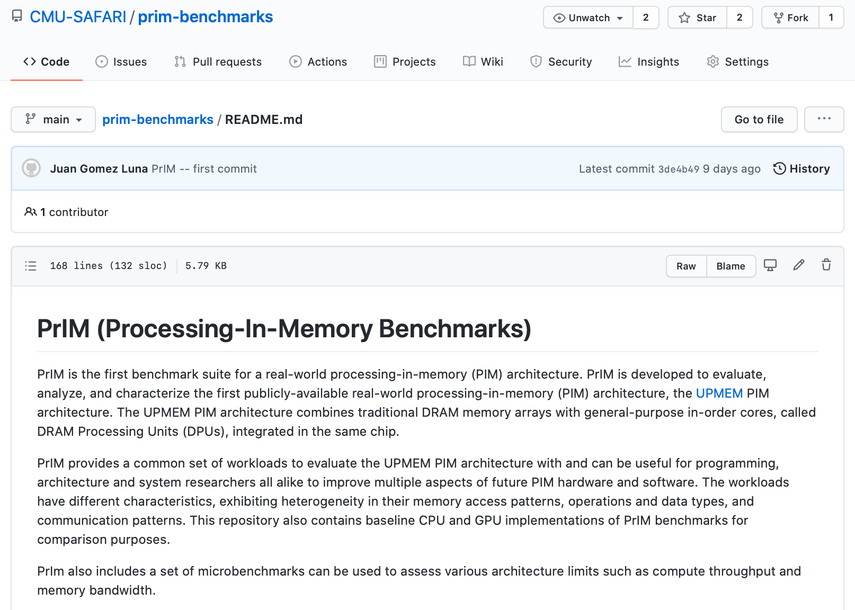
PrIM Benchmarks are Open Source
All microbenchmarks, benchmarks, and scripts
https://github.com/CMU-SAFARI/prim-benchmarks

Slide 83
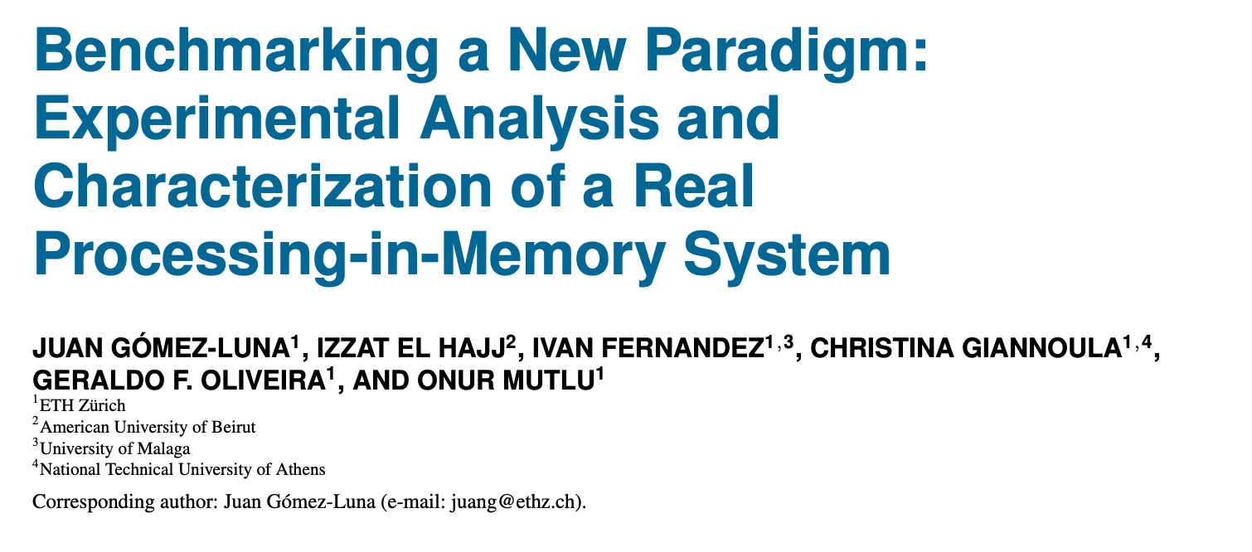
Understanding a Modern PIM Architecture
https://arxiv.org/pdf/2105.03814.pdf
https://github.com/CMU-SAFARI/prim-benchmarks

Slide 84
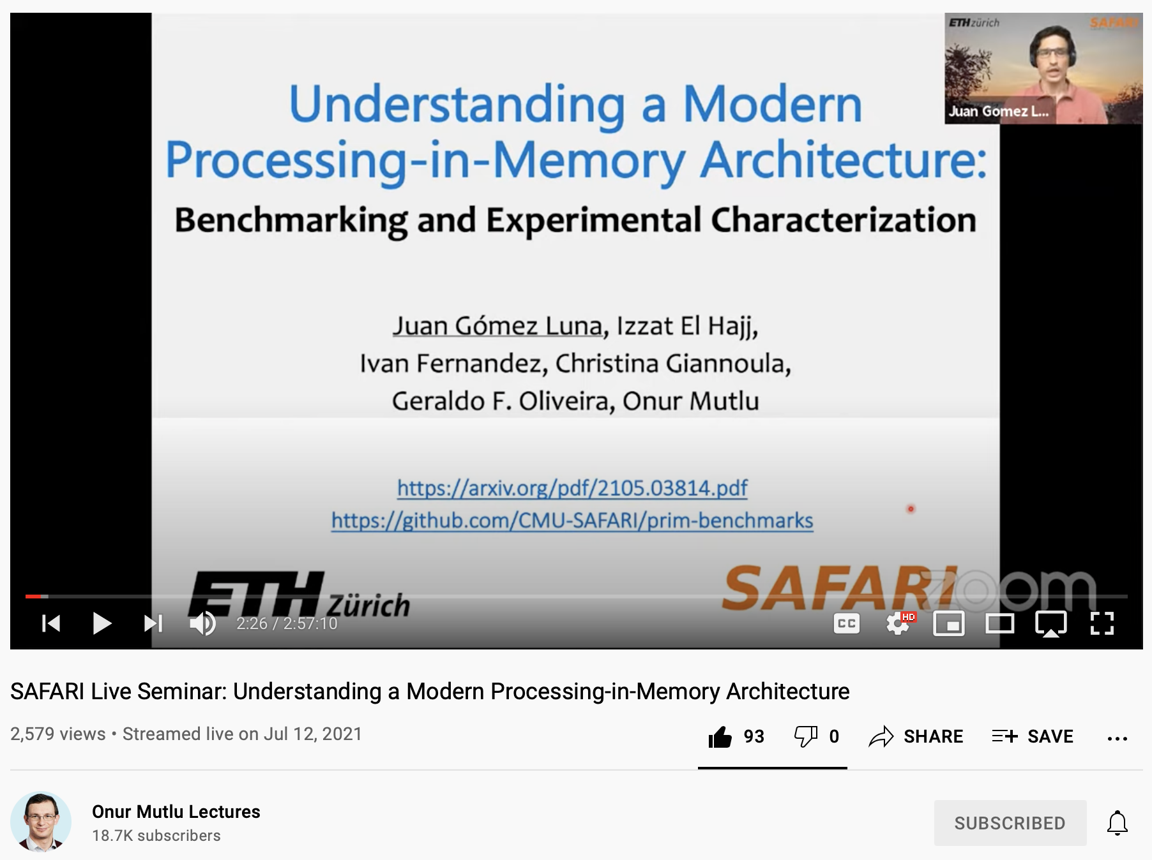
Understanding a Modern PIM Architecture
https://www.youtube.com/watch?v=D8Hjy2iU9l4&list=PL5Q2soXY2Zi_tOTAYm--dYByNPL7JhwR9

Slide 85
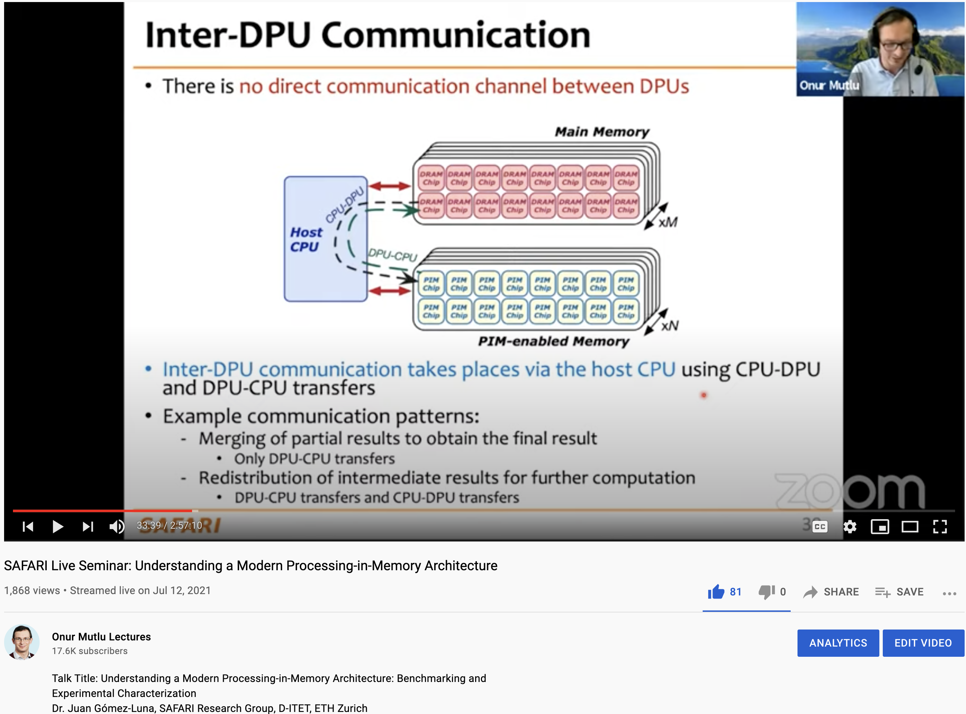
More on Analysis of the UPMEM PIM Engine
https://www.youtube.com/watch?v=D8Hjy2iU9l4&list=PL5Q2soXY2Zi_tOTAYm--dYByNPL7JhwR9

Slide 86
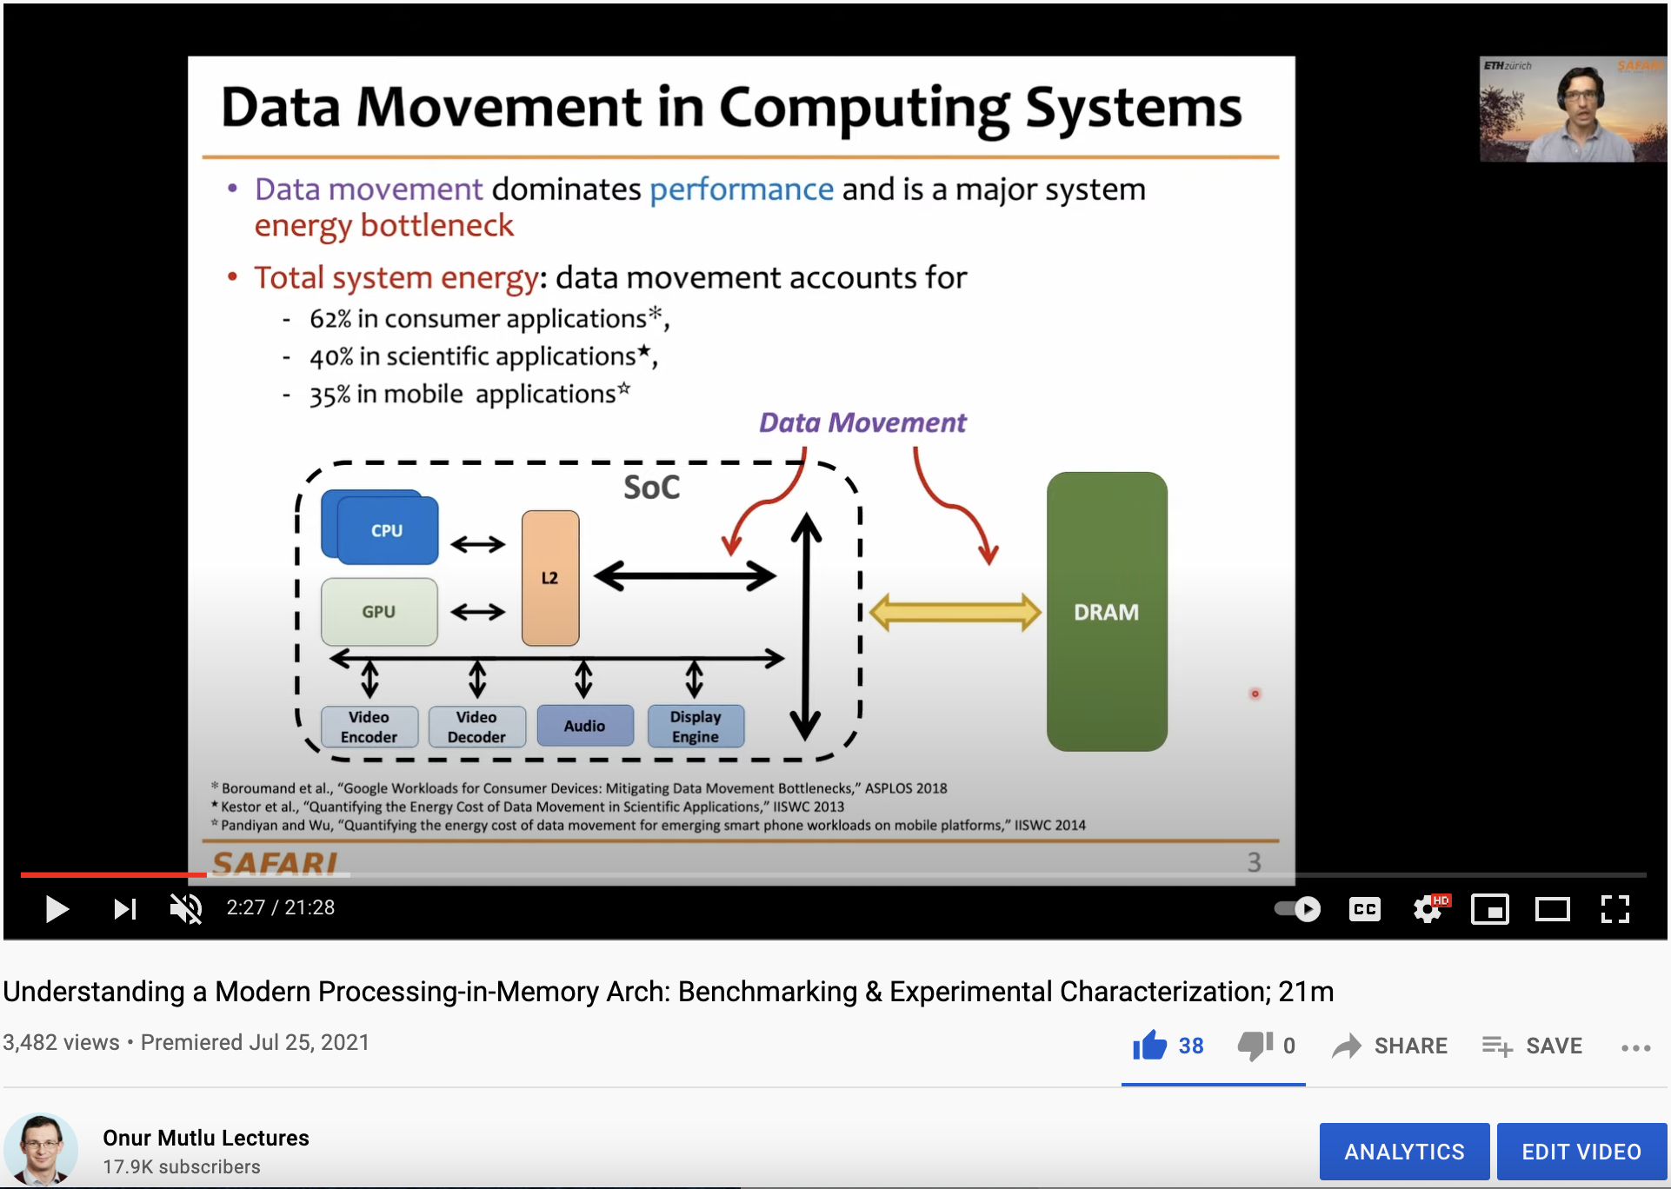
More on Analysis of the UPMEM PIM Engine
https://www.youtube.com/watch?v=Pp9jSU2b9oM&list=PL5Q2soXY2Zi8_VVChACnON4sfh2bJ5IrD&index=159

Slide 87


ML Training on a Real PIM System
Short version: https://arxiv.org/pdf/2206.06022.pdf
Long version: https://arxiv.org/pdf/2207.07886.pdf
https://www.youtube.com/watch?v=qeukNs5XI3g&t=11226s

Slide 88
ML Training on a Real PIM System
Need to optimize data representation
  (1) fixed-point
  (2) quantization
  (3) hybrid precision
Use lookup tables (LUTs) to implement complex functions (e.g., sigmoid)
Optimize data placement & layout for streaming
Large speedups: 2.8X/27X vs. CPU, 1.3x/3.2x vs. GPU

Slide 89

ML Training on Real PIM Talk Video
https://www.youtube.com/watch?v=qeukNs5XI3g&t=11226s

Slide 90

SpMV Multiplication on Real PIM Systems
Appears in SIGMETRICS 2022
https://arxiv.org/pdf/2201.05072.pdf
https://github.com/CMU-SAFARI/SparseP
https://www.youtube.com/watch?v=5kaOsJKlGrE

Slide 91





SparseP
Towards Efficient Sparse Matrix Vector Multiplication
on Real Processing-In-Memory Architectures
Christina Giannoula
Ivan Fernandez, Juan Gomez-Luna,
Nectarios Koziris, Georgios Goumas, Onur Mutlu

Slide 92
SparseP Summary
Efficient Algorithmic Designs
The first open-source Sparse Matrix Vector Multiplication (SpMV) software package, SparseP, for real Processing-In-Memory (PIM) systems
Extensive Characterization
The first comprehensive analysis of SpMV on the first real commercial PIM architecture
SparseP is Open-Source
SparseP: https://github.com/CMU-SAFARI/SparseP
Recommendations for Architects and Programmers
Full Paper: https://arxiv.org/pdf/2201.05072.pdf

Slide 93

SparseP: SpMV Library for Real PIMs
Our Contributions:
Design efficient SpMV kernels for current and future PIM systems
  25 SpMV kernels
    4 compressed matrix formats (CSR, COO, BCSR, BCOO)
    6 data types
    4 data partitioning techniques
    Various load balancing schemes among PIM cores/threads
    3 synchronization approaches
Provide a comprehensive analysis of SpMV on the first commercially-available real PIM system
  26 sparse matrices
  Comparisons to state-of-the-art CPU and GPU systems
  Recommendations for software, system and hardware designers

Slide 94

SparseP Talk Video
https://www.youtube.com/watch?v=5kaOsJKlGrE

Slide 95

Samsung Function-in-Memory DRAM (2021)
https://news.samsung.com/global/samsung-develops-industrys-first-high-bandwidth-memory-with-ai-processing-power

Slide 96


Samsung Function-in-Memory DRAM (2021)

Slide 97

Samsung Function-in-Memory DRAM (2021)

Slide 98

Samsung Function-in-Memory DRAM (2021)

Slide 99

Samsung Function-in-Memory DRAM (2021)

Slide 100



Samsung AxDIMM (2021)
DDRx-PIM
  DLRM recommendation system
Baseline System
AxDIMM System
Ke et al. "Near-Memory Processing in Action: Accelerating Personalized Recommendation with AxDIMM", IEEE Micro (2021)

Slide 101


SK Hynix Accelerator-in-Memory (2022)
https://news.skhynix.com/sk-hynix-develops-pim-next-generation-ai-accelerator/

Slide 102



AliBaba PIM Recommendation System (2022)

Slide 103
Eliminating the Adoption Barriers
Processing-in-Memory
in the Real World

Slide 104
Processing in Memory:
Two Approaches
1. Processing near Memory
2. Processing using Memory

Slide 105
Mindset: Memory as an Accelerator
CPU
core
CPU
core
mini-CPU
core
GPU
(throughput)
core
GPU
(throughput)
core
video
core
GPU
(throughput)
core
GPU
(throughput)
core
CPU
core
CPU
core
Memory
imaging
core
LLC
Specialized
compute-capability
in memory
Memory Controller
Memory Bus
Memory similar to a “conventional” accelerator

Slide 106

Starting Simple: Data Copy and Initialization
  memmove & memcpy: 5% cycles in Google’s datacenter [Kanev+ ISCA’15]
000000000000000
Zero initialization
(e.g., security)
Forking
Checkpointing
Many more
VM Cloning
Deduplication
Page Migration

Slide 107
Future Systems: In-Memory Copy
3) No cache pollution
1) Low latency
Memory
L3
CPU
L2
L1
MC
2) Low bandwidth utilization
4) No unwanted data movement
1046ns, 3.6uJ
→ 90ns, 0.04uJ

Slide 108
RowClone: In-DRAM Row Copy
Idea: Two consecutive ACTivates
4 Kbytes
Negligible HW cost
Step 1: Activate row A
Step 2: Activate row B
Transfer row
DRAM subarray
Transfer
row
Row Buffer (4 Kbytes)
8 bits
Data Bus
Notes:
copy

Slide 109
RowClone: Latency and Energy Savings
11.6x
74x
Seshadri et al., “RowClone: Fast and Efficient In-DRAM Copy and Initialization of Bulk Data,” MICRO 2013.

Slide 110

More on RowClone
Vivek Seshadri, Yoongu Kim, Chris Fallin, Donghyuk Lee, Rachata Ausavarungnirun, Gennady Pekhimenko, Yixin Luo, Onur Mutlu, Michael A. Kozuch, Phillip B. Gibbons, and Todd C. Mowry,
"RowClone: Fast and Energy-Efficient In-DRAM Bulk Data Copy and Initialization"
Proceedings of the 46th International Symposium on Microarchitecture (MICRO), Davis, CA, December 2013. [Slides (pptx) (pdf)] [Lightning Session Slides (pptx) (pdf)] [Poster (pptx) (pdf)]

Slide 111

RowClone in Off-the-Shelf DRAM Chips
Idea: Violate DRAM timing parameters to mimic RowClone
https://parallel.princeton.edu/papers/micro19-gao.pdf

Slide 112

Real Processing Using Memory Prototype
End-to-end RowClone & TRNG using off-the-shelf DRAM chips
Idea: Violate DRAM timing parameters to mimic RowClone
https://arxiv.org/pdf/2111.00082.pdf
https://github.com/cmu-safari/pidram
https://www.youtube.com/watch?v=qeukNs5XI3g&t=4192s

Slide 113

Real Processing-using-Memory Prototype
https://arxiv.org/pdf/2111.00082.pdf
https://github.com/cmu-safari/pidram
https://www.youtube.com/watch?v=qeukNs5XI3g&t=4192s
Host Machine
FPGA Board
RISC-V System
PiM-Enabled DIMM

Slide 114

Real Processing-using-Memory Prototype
https://arxiv.org/pdf/2111.00082.pdf
https://github.com/cmu-safari/pidram
https://www.youtube.com/watch?v=qeukNs5XI3g&t=4192s

Slide 115

Microbenchmark Copy/Initialization
Throughput Improvement
In-DRAM Copy and Initialization
improve throughput by 119x and 89x, respectively
Notes:
This plot shows the throughput improvement provided by in-DRAM copy operations for bulk data initialization and copy over CPU-based copy and initialization using LOAD and STORE instructions. We do not execute any CLFLUSH instructions and assume that the data is up to date in DRAM and there are no cached copies.
The x-axis shows the size of the arrays that we copy or initialize. The dark gray bar shows the improvement for initialization operations, and the bright gray bar shows the improvement for copy operations.
[CLICK] We observe that in-DRAM copy and initialization operations improve copy and initialization throughput by 119x and 89x including the overheads of system support required for RowClone operations

Slide 116

PiDRAM is Open Source
https://github.com/CMU-SAFARI/PiDRAM
Notes:
PiDRAM is openly and freely available on Github. If you are interested in PiDRAM, please use it and feel free to contribute to it.

Slide 117

Extended Version on ArXiv
https://arxiv.org/abs/2111.00082
Notes:
An extended version of our conference paper is available on arXiv on this link where we discuss our framework in more detail.

Slide 118

Long Talk + Tutorial on Youtube
https://youtu.be/s_z_S6FYpC8
Notes:
I also describe PiDRAM in more detail and give a tutorial on how to use our framework in this SAFARI live seminar talk.

Slide 119
(Truly) In-Memory Computation
We can support in-DRAM AND, OR, NOT, MAJ
At low cost
Using analog computation capability of DRAM
  Idea: activating multiple rows performs computation
30-60X performance and energy improvement
  Seshadri+, “Ambit: In-Memory Accelerator for Bulk Bitwise Operations Using Commodity DRAM Technology,” MICRO 2017.
New memory technologies enable even more opportunities
  Memristors, resistive RAM, phase change mem, STT-MRAM, …
  Can operate on data with minimal movement

Slide 120
In-DRAM AND/OR: Triple Row Activation
½V_{DD}
½V_{DD}+δ
V_{DD}
A
Final State
AB + BC + AC
B
C
C(A + B) + ~C(AB)
dis
en
0
½V_{DD}
Seshadri+, “Fast Bulk Bitwise AND and OR in DRAM”, IEEE CAL 2015.

Slide 121
Bulk Bitwise Operations in Workloads
[1] Li and Patel, BitWeaving, SIGMOD 2013
[2] Goodwin+, BitFunnel, SIGIR 2017

Slide 122
In-DRAM Acceleration of Database Queries
>4-12X Performance Improvement
Seshadri+, “Ambit: In-Memory Accelerator for Bulk Bitwise Operations using Commodity DRAM Technology,” MICRO 2017.

Slide 123
More on Ambit
Vivek Seshadri, Donghyuk Lee, Thomas Mullins, Hasan Hassan, Amirali Boroumand, Jeremie Kim, Michael A. Kozuch, Onur Mutlu, Phillip B. Gibbons, and Todd C. Mowry,
"Ambit: In-Memory Accelerator for Bulk Bitwise Operations Using Commodity DRAM Technology"
Proceedings of the 50th International Symposium on Microarchitecture (MICRO), Boston, MA, USA, October 2017.
[Slides (pptx) (pdf)] [Lightning Session Slides (pptx) (pdf)] [Poster (pptx) (pdf)]

Slide 124

In-DRAM Bulk Bitwise Execution
Vivek Seshadri and Onur Mutlu,
"In-DRAM Bulk Bitwise Execution Engine"
Invited Book Chapter in Advances in Computers, to appear in 2020.
[Preliminary arXiv version]

Slide 125

SIMDRAM Framework
Nastaran Hajinazar, Geraldo F. Oliveira, Sven Gregorio, Joao Dinis Ferreira, Nika Mansouri Ghiasi, Minesh Patel, Mohammed Alser, Saugata Ghose, Juan Gomez-Luna, and Onur Mutlu,
"SIMDRAM: An End-to-End Framework for Bit-Serial SIMD Computing in DRAM"
Proceedings of the 26th International Conference on Architectural Support for Programming Languages and Operating Systems (ASPLOS), Virtual, March-April 2021.
[2-page Extended Abstract]
[Short Talk Slides (pptx) (pdf)]
[Talk Slides (pptx) (pdf)]
[Short Talk Video (5 mins)]
[Full Talk Video (27 mins)]

Slide 126





SIMDRAM Framework: Overview
User Input
Step 1: Generate
MAJ logic
Step 2: Generate
sequence of
DRAM commands
SIMDRAM Output
Desired operation
New SIMDRAM $μ$Program
ACT/PRE
ACT/PRE
ACT/PRE
ACT/ACT/PRE
done
$$μProgram$$
$$μProgram$$
MAJ
Main memory
AND/OR/NOT logic
MAJ/NOT logic
bbop_new
New SIMDRAM
instruction
ISA
$μ$Program
User Input
Step 3: Execution according to $μ$Program
SIMDRAM Output
SIMDRAM-enabled application
Instruction result
in memory
foo () {
bbop_new
}
ACT/PRE
ACT/PRE
ACT/PRE
ACT/PRE/PRE
done
ACT/PRE
Control Unit
$μ$Program
Memory Controller

Slide 127
SIMDRAM Key Results
Evaluated on:
  16 complex in-DRAM operations
  7 commonly-used real-world applications
SIMDRAM provides:
88× and 5.8× the throughput of a CPU and a high-end GPU, respectively, over 16 operations
257× and 31× the energy efficiency of a CPU and a high-end GPU, respectively, over 16 operations
21× and 2.1× the performance of a CPU an a high-end GPU, over seven real-world applications

Slide 128
More on SIMDRAM
Nastaran Hajinazar, Geraldo F. Oliveira, Sven Gregorio, Joao Dinis Ferreira, Nika Mansouri Ghiasi, Minesh Patel, Mohammed Alser, Saugata Ghose, Juan Gomez-Luna, and Onur Mutlu,
"SIMDRAM: An End-to-End Framework for Bit-Serial SIMD Computing in DRAM"
Proceedings of the 26th International Conference on Architectural Support for Programming Languages and Operating Systems (ASPLOS), Virtual, March-April 2021.
[2-page Extended Abstract]
[Short Talk Slides (pptx) (pdf)]
[Talk Slides (pptx) (pdf)]
[Short Talk Video (5 mins)]
[Full Talk Video (27 mins)]

Slide 129

In-DRAM Physical Unclonable Functions
Jeremie S. Kim, Minesh Patel, Hasan Hassan, and Onur Mutlu,
"The DRAM Latency PUF: Quickly Evaluating Physical Unclonable Functions by Exploiting the Latency-Reliability Tradeoff in Modern DRAM Devices"
Proceedings of the 24th International Symposium on High-Performance Computer Architecture (HPCA), Vienna, Austria, February 2018.
[Lightning Talk Video]
[Slides (pptx) (pdf)] [Lightning Session Slides (pptx) (pdf)]
[Full Talk Lecture Video (28 minutes)]

Slide 130

In-DRAM True Random Number Generation
Jeremie S. Kim, Minesh Patel, Hasan Hassan, Lois Orosa, and Onur Mutlu,
"D-RaNGe: Using Commodity DRAM Devices to Generate True Random Numbers with Low Latency and High Throughput"
Proceedings of the 25th International Symposium on High-Performance Computer Architecture (HPCA), Washington, DC, USA, February 2019.
[Slides (pptx) (pdf)]
[Full Talk Video (21 minutes)]
[Full Talk Lecture Video (27 minutes)]
Top Picks Honorable Mention by IEEE Micro.

Slide 131

In-DRAM True Random Number Generation
Ataberk Olgun, Minesh Patel, A. Giray Yaglikci, Haocong Luo, Jeremie S. Kim, F. Nisa Bostanci, Nandita Vijaykumar, Oguz Ergin, and Onur Mutlu,
"QUAC-TRNG: High-Throughput True Random Number Generation Using Quadruple Row Activation in Commodity DRAM Chips"
Proceedings of the 48th International Symposium on Computer Architecture (ISCA), Virtual, June 2021.
[Slides (pptx) (pdf)]
[Short Talk Slides (pptx) (pdf)]
[Talk Video (25 minutes)]
[SAFARI Live Seminar Video (1 hr 26 mins)]

Slide 132

In-DRAM True Random Number Generation
F. Nisa Bostanci, Ataberk Olgun, Lois Orosa, A. Giray Yaglikci, Jeremie S. Kim, Hasan Hassan, Oguz Ergin, and Onur Mutlu,
"DR-STRaNGe: End-to-End System Design for DRAM-based True Random Number Generators"
Proceedings of the 28th International Symposium on High-Performance Computer Architecture (HPCA), Virtual, April 2022.
[Slides (pptx) (pdf)]
[Short Talk Slides (pptx) (pdf)]
https://arxiv.org/pdf/2201.01385.pdf

Slide 133
Processing in Memory:
Adoption Challenges
1. Processing using Memory
2. Processing near Memory

Slide 134
Eliminating the Adoption Barriers
How to Enable Adoption of Processing in Memory

Slide 135
Potential Barriers to Adoption of PIM
1. Applications & software for PIM
2. Ease of programming (interfaces and compiler/HW support)
3. System and security support: coherence, synchronization, virtual memory, isolation, communication interfaces, …
4. Runtime and compilation systems for adaptive scheduling, data mapping, access/sharing control, …
5. Infrastructures to assess benefits and feasibility
All can be solved with change of mindset

Slide 136
We Need to Revisit the Entire Stack
Problem
Algorithm
Program/Language
System Software
SW/HW Interface
Micro-architecture
Logic
Devices
Electrons
We can get there step by step

Slide 137
Challenge and Opportunity for Future
Fundamentally
Energy-Efficient
(Data-Centric)
Computing Architectures

Slide 138
Challenge and Opportunity for Future
Fundamentally
High-Performance
(Data-Centric)
Computing Architectures

Slide 139
Challenge and Opportunity for Future
Computing Architectures
with
Minimal Data Movement

Slide 140
Concluding Remarks
We must design systems to be balanced, high-performance, energy-efficient (all at the same time) → intelligent systems
  Data-centric, data-driven, data-aware
Enable computation capability inside and close to memory
This can
  Lead to orders-of-magnitude improvements
  Enable new applications & computing platforms
  Enable better understanding of nature
  …
Future of truly memory-centric computing is bright
  We need to do research & design across the computing stack
Notes:
Perhaps we have taken processor-centric system design a bit too far

Slide 141
Fundamentally Better Architectures
Data-centric
Data-driven
Data-aware

Slide 142

Source: http://spectrum.ieee.org/image/MjYzMzAyMg.jpeg

Slide 143
We Need to Revisit the Entire Stack
Problem
Algorithm
Program/Language
System Software
SW/HW Interface
Micro-architecture
Logic
Devices
Electrons
We can get there step by step

Slide 144
Funding Acknowledgments
Alibaba, AMD, ASML, Google, Facebook, Hi-Silicon, HP Labs, Huawei, IBM, Intel, Microsoft, Nvidia, Oracle, Qualcomm, Rambus, Samsung, Seagate, VMware, Xilinx
NSF
NIH
GSRC
SRC
CyLab
EFCL

Slide 145

Acknowledgments
Think BIG, Aim HIGH!
https://safari.ethz.ch

Slide 146

SAFARI Newsletter December 2021 Edition
https://safari.ethz.ch/safari-newsletter-december-2021/

Slide 147
Referenced Papers, Talks, Artifacts
All are available at
  https://people.inf.ethz.ch/omutlu/projects.htm
  https://www.youtube.com/onurmutlulectures
  https://github.com/CMU-SAFARI/

Slide 148


Open Source Tools: SAFARI GitHub
https://github.com/CMU-SAFARI/

Slide 149

Special Research Sessions & Courses
Special Session at ISVLSI 2022: 9 cutting-edge talks
https://www.youtube.com/watch?v=qeukNs5XI3g

Slide 150

Comp Arch (Fall’21)
Fall 2021 Edition:
  https://safari.ethz.ch/architecture/fall2021/doku.php?id=schedule
Fall 2020 Edition:
  https://safari.ethz.ch/architecture/fall2020/doku.php?id=schedule
Youtube Livestream (2021):
  https://www.youtube.com/watch?v=4yfkM_5EFgo&list=PL5Q2soXY2Zi-Mnk1PxjEIG32HAGILkTOF
Youtube Livestream (2020):
  https://www.youtube.com/watch?v=c3mPdZA-Fmc&list=PL5Q2soXY2Zi9xidyIgBxUz7xRPS-wisBN
Master’s level course
  Taken by Bachelor’s/Masters/PhD students
  Cutting-edge research topics + fundamentals in Computer Architecture
  5 Simulator-based Lab Assignments
  Potential research exploration
  Many research readings
https://www.youtube.com/onurmutlulectures

Slide 151

PIM Course (Spring 2022)
Spring 2022 Edition:
  https://safari.ethz.ch/projects_and_seminars/spring2022/doku.php?id=processing_in_memory
Youtube Livestream:
  https://www.youtube.com/watch?v=9e4Chnwdovo&list=PL5Q2soXY2Zi-841fUYYUK9EsXKhQKRPyX
Project course
  Taken by Bachelor’s/Master’s students
  Processing-in-Memory lectures
  Hands-on research exploration
  Many research readings

Slide 152

Genomics (Spring 2022)
Spring 2022 Edition:
  https://safari.ethz.ch/projects_and_seminars/spring2022/doku.php?id=bioinformatics
Youtube Livestream:
  https://www.youtube.com/watch?v=DEL_5A_Y3TI&list=PL5Q2soXY2Zi8NrPDgOR1yRU_Cxxjw-u18
Project course
  Taken by Bachelor’s/Master’s students
  Genomics lectures
  Hands-on research exploration
  Many research readings

Slide 153

Hetero. Systems (Spring’22)
Spring 2022 Edition:
  https://safari.ethz.ch/projects_and_seminars/spring2022/doku.php?id=heterogeneous_systems
Youtube Livestream:
  https://www.youtube.com/watch?v=oFO5fTrgFIY&list=PL5Q2soXY2Zi9XrgXR38IM_FTjmY6h7Gzm
Project course
  Taken by Bachelor’s/Master’s students
  GPU and Parallelism lectures
  Hands-on research exploration
  Many research readings

Slide 154


HW/SW Co-Design (Spring 2022)
Spring 2022 Edition:
  https://safari.ethz.ch/projects_and_seminars/spring2022/doku.php?id=hw_sw_codesign
Youtube Livestream:
  https://youtube.com/playlist?list=PL5Q2soXY2Zi8nH7un3ghD2nutKWWDk-NK
Project course
  Taken by Bachelor’s/Master’s students
  HW/SW co-design lectures
  Hands-on research exploration
  Many research readings

Slide 155


SSD Course (Spring 2022)
Spring 2022 Edition:
  https://safari.ethz.ch/projects_and_seminars/spring2022/doku.php?id=modern_ssds
Youtube Livestream:
  https://www.youtube.com/watch?v=_q4rm71DsY4&list=PL5Q2soXY2Zi8vabcse1kL22DEcgMl2RAq
Project course
  Taken by Bachelor’s/Master’s students
  SSD Basics and Advanced Topics
  Hands-on research exploration
  Many research readings

Slide 156
Memory-Centric
Computing
Onur Mutlu
omutlu@gmail.com
https://people.inf.ethz.ch/omutlu
2 September 2022
MATEO 2022

Slide 157
Backup Slides

Slide 158

In-Storage Genomic Data Filtering [ASPLOS 2022]
Nika Mansouri Ghiasi, Jisung Park, Harun Mustafa, Jeremie Kim, Ataberk Olgun, Arvid Gollwitzer, Damla Senol Cali, Can Firtina, Haiyu Mao, Nour Almadhoun Alserr, Rachata Ausavarungnirun, Nandita Vijaykumar, Mohammed Alser, and Onur Mutlu,
"GenStore: A High-Performance and Energy-Efficient In-Storage Computing System for Genome Sequence Analysis"
Proceedings of the 27th International Conference on Architectural Support for Programming Languages and Operating Systems (ASPLOS), Virtual, February-March 2022.
[Lightning Talk Slides (pptx) (pdf)]
[Lightning Talk Video (90 seconds)]

Slide 159

Genome Sequence Analysis
Data Movement from Storage
Alignment
Storage
System
Main
Memory
Cache
Computation
Unit
(CPU or Accelerator)
AAGCTTCCATGG
CGTTCCTTGGCA
GGGCCAGAATG
CCTTTGGGTCCA
AAAATTCCATGG
GAATGGGGCCA
TTTTTTCCAAAA
TCCCCGGGGCCA
GCTTCCAGAATG
Computation overhead
Data movement overhead
Notes:
Read mapping performs alignment on large genomic datasets, containing millions of reads. [CLICK]
Therefore, read mapping is both computationally expensive [CLICK]
And incurs high data movement overhead [CLICK]

Slide 160



Accelerating Genome Sequence Analysis
Heuristics
Accelerators
Filters
Storage
System
Main
Memory
Cache
Computation
Unit
(CPU or Accelerator)
AAGCTTCCATGG
CGTTCCTTGGCA
GGGCCAGAATG
CCTTTGGGTCCA
AAAATTCCATGG
GAATGGGGCCA
TTTTTTCCAAAA
TCCCCGGGGCCA
GCTTCCAGAATG
✓
Computation overhead
Data movement overhead
Notes:
There has been significant effort into improving read mapping performance [CLICK]
Through efficient heuristics [CLICK]
hardware accelerators [CLICK]
and various filters that prune reads that do not require expensive computation [CLICK].
While these approaches address the computation overhead in read mapping [CLICK]
[While Reads Move] None of them alleviate the data movement overhead from storage, whose impact becomes even larger when the computation overhead gets alleviated [CLICK]

Slide 161

Key Idea
Filter reads that do not require alignment
inside the storage system
Storage
System
Main
Memory
Cache
Computation
Unit
(CPU or Accelerator)
AAGCTTCCATGG
CGTTCCTTGGCA
GGGCCAGAATG
CCTTTGGGTCCA
AAAATTCCATGG
GAATGGGGCCA
TTTTTTCCAAAA
TCCCCGGGGCCA
GCTTCCAGAATG
Filtered Reads
Exactly-matching reads
Do not need expensive approximate string matching during alignment
Non-matching reads
Do not have potential matching locations and can skip alignment
Notes:
Our key idea is to filter reads that do not require the expensive alignment computation in the storage system [CLICK] …
[While Reads Move] To fundamentally reduce the data movement overhead of read mapping
Examples of the reads that not require the costlt alignment step
Exactly-matching reads to the reference genome that do not need approximate string matching performed during alignment
Non-matching reads that have no potential matching locations in the reference genome hence skip the alignemt step

Slide 162
GenStore
Filter reads that do not require alignment
inside the storage system
GenStore-Enabled
Storage
System
Main
Memory
Cache
Computation
Unit
(CPU or Accelerator)
✓
Computation overhead
✓
Data movement overhead
  GenStore provides significant speedup (1.4x - 33.6x) and
  energy reduction (3.9x – 29.2x) at low cost
Notes:
We propose GenStore, the first in-storage processing system designed for genome sequence analysis. [CLICK]
To reduce both the computation [CLICK]
And the data movement overhead [CLICK]
GenStore provides high-performance and energy benefits compared to state-of-the-art HW and SW baselines [CLICK]

Slide 163

GenStore Talk Video
https://www.youtube.com/watch?v=kIU44FxjbFk

Slide 164
In-Storage Genomic Data Filtering [ASPLOS 2022]
Nika Mansouri Ghiasi, Jisung Park, Harun Mustafa, Jeremie Kim, Ataberk Olgun, Arvid Gollwitzer, Damla Senol Cali, Can Firtina, Haiyu Mao, Nour Almadhoun Alserr, Rachata Ausavarungnirun, Nandita Vijaykumar, Mohammed Alser, and Onur Mutlu,
"GenStore: A High-Performance and Energy-Efficient In-Storage Computing System for Genome Sequence Analysis"
Proceedings of the 27th International Conference on Architectural Support for Programming Languages and Operating Systems (ASPLOS), Virtual, February-March 2022.
[Lightning Talk Slides (pptx) (pdf)]
[Lightning Talk Video (90 seconds)]

