Slide 1
Some Reflections (on DRAM)
Onur Mutlu
omutlu@gmail.com
https://people.inf.ethz.ch/omutlu
25 June 2019
Maurice Wilkes Award @ ISCA 2019

Slide 2
Agenda
On Maurice Wilkes
Thanks
A Sketch of Our DRAM Work
Looking to the Future

Slide 3
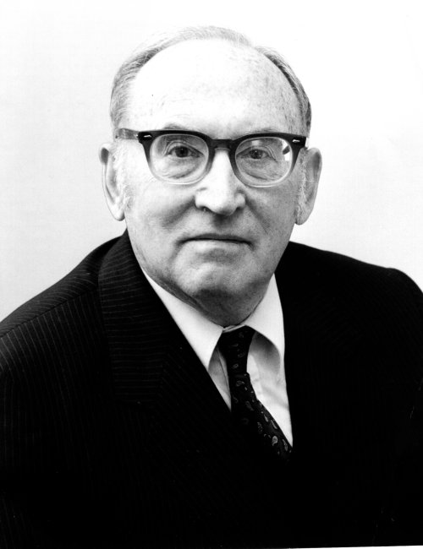
On Maurice Wilkes (I)
Maurice Wilkes, “The Best Way to Design an Automatic Calculating Machine,” Manchester Univ. Computer Inaugural Conf., 1951.
The concept of microcoded/microprogrammed machines

Slide 4
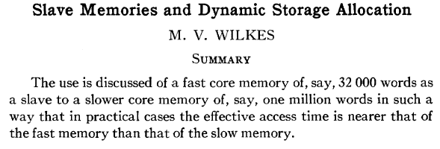
On Maurice Wilkes (II)
Wilkes, “Slave Memories and Dynamic Storage Allocation,” IEEE Trans. On Electronic Computers, 1965.
The concept of hardware cache

Slide 5
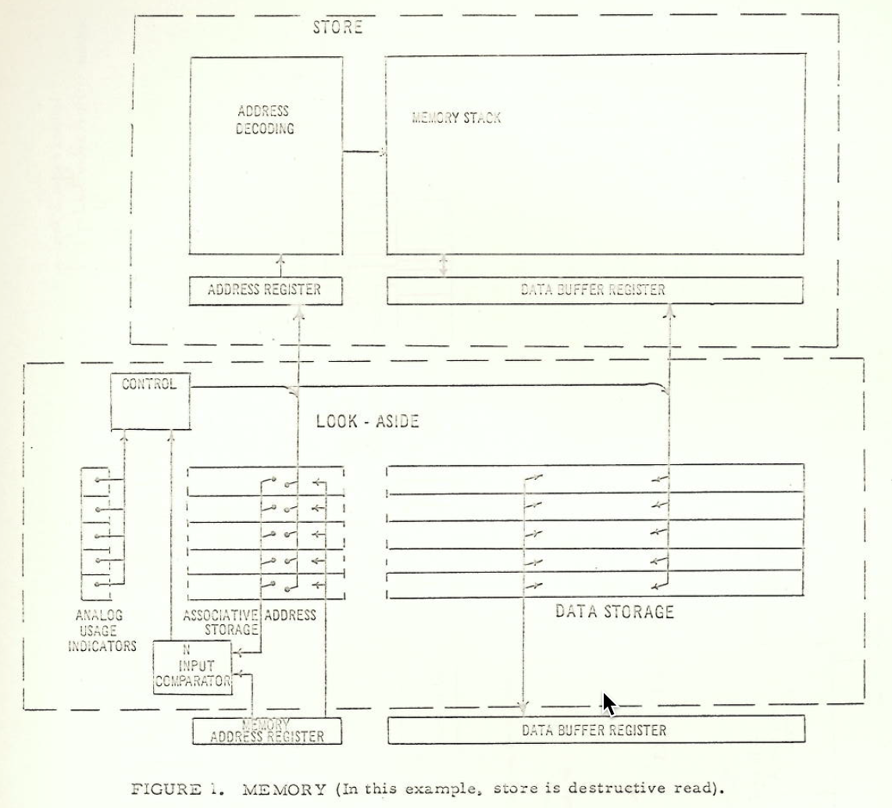
Cache in 1962 (Bloom, Cohen, Porter)
Bloom, Cohen, Porter, “Considerations in the Design of a Computer with High Logic-to-Memory Speed Ratio,” AIEE Gigacycle Computing Systems Winter Meeting, Jan. 1962.

Slide 6
Thank You
It is humbling to receive an award named after a true researcher and pioneer

Slide 7
Special Thanks to…
My PhD advisor, Yale Patt
All my past and current teachers and family
My students and trainees
Lavanya Subramanian, Gennady Pekhimenko, Yixin Luo
Samira Khan, Saugata Ghose
Tyler Huberty
Hasan Hassan, Amirali Boroumand
My collaborators and past research groups
Funding agencies and many industrial partners

Slide 8
SAFARI Research Group
Think BIG, Aim HIGH!
https://safari.ethz.ch

Slide 9
Agenda
On Maurice Wilkes
Thanks
A Sketch of Our DRAM Work
Looking to the Future

Slide 10
DRAM Controllers

Slide 11
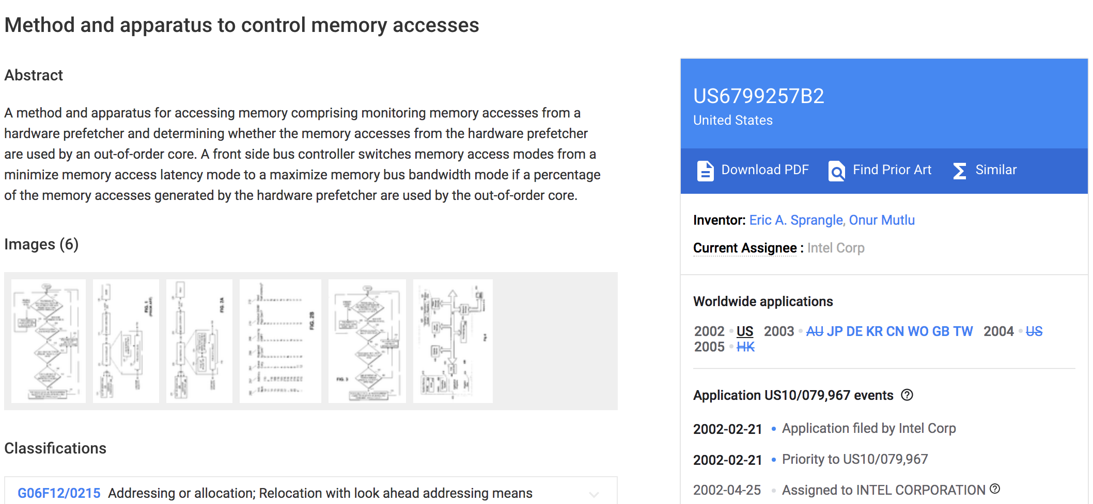
It All Started with FSB Controllers (2001)

Slide 12
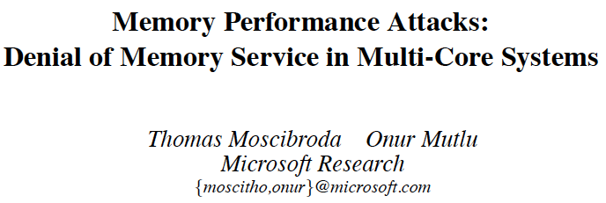
Memory Performance Attacks [USENIX SEC’07]
Thomas Moscibroda and Onur Mutlu, "Memory Performance Attacks: Denial of Memory Service in Multi-Core Systems" Proceedings of the 16th USENIX Security Symposium (USENIX SECURITY), pages 257-274, Boston, MA, August 2007. Slides (ppt)

Slide 13
STFM [MICRO’07]
Onur Mutlu and Thomas Moscibroda, "Stall-Time Fair Memory Access Scheduling for Chip Multiprocessors" Proceedings of the 40th International Symposium on Microarchitecture (MICRO), pages 146-158, Chicago, IL, December 2007. [Summary] [Slides (ppt)]

Slide 14
PAR-BS [ISCA’08]
Onur Mutlu and Thomas Moscibroda, "Parallelism-Aware Batch Scheduling: Enhancing both Performance and Fairness of Shared DRAM Systems" Proceedings of the 35th International Symposium on Computer Architecture (ISCA), pages 63-74, Beijing, China, June 2008. [Summary] [Slides (ppt)]

Slide 15
On PAR-BS
Variants implemented in Samsung SoC memory controllers
Review from ISCA 2008

Slide 16
ATLAS Memory Scheduler [HPCA’10]
Yoongu Kim, Dongsu Han, Onur Mutlu, and Mor Harchol-Balter, "ATLAS: A Scalable and High-Performance Scheduling Algorithm for Multiple Memory Controllers" Proceedings of the 16th International Symposium on High-Performance Computer Architecture (HPCA), Bangalore, India, January 2010. Slides (pptx)

Slide 17
Thread Cluster Memory Scheduling [MICRO’10]
Yoongu Kim, Michael Papamichael, Onur Mutlu, and Mor Harchol-Balter, "Thread Cluster Memory Scheduling: Exploiting Differences in Memory Access Behavior" Proceedings of the 43rd International Symposium on Microarchitecture (MICRO), pages 65-76, Atlanta, GA, December 2010. Slides (pptx) (pdf)

Slide 18
BLISS [ICCD’14, TPDS’16]
Lavanya Subramanian, Donghyuk Lee, Vivek Seshadri, Harsha Rastogi, and Onur Mutlu, "The Blacklisting Memory Scheduler: Achieving High Performance and Fairness at Low Cost" Proceedings of the 32nd IEEE International Conference on Computer Design (ICCD), Seoul, South Korea, October 2014. [Slides (pptx) (pdf)]

Slide 19
Staged Memory Scheduling: CPU-GPU [ISCA’12]
Rachata Ausavarungnirun, Kevin Chang, Lavanya Subramanian, Gabriel Loh, and Onur Mutlu, "Staged Memory Scheduling: Achieving High Performance and Scalability in Heterogeneous Systems" Proceedings of the 39th International Symposium on Computer Architecture (ISCA), Portland, OR, June 2012. Slides (pptx)

Slide 20
DASH: Heterogeneous Systems [TACO’16]
Hiroyuki Usui, Lavanya Subramanian, Kevin Kai-Wei Chang, and Onur Mutlu, "DASH: Deadline-Aware High-Performance Memory Scheduler for Heterogeneous Systems with Hardware Accelerators" ACM Transactions on Architecture and Code Optimization (TACO), Vol. 12, January 2016. Presented at the 11th HiPEAC Conference, Prague, Czech Republic, January 2016. [Slides (pptx) (pdf)] [Source Code]

Slide 21
MISE: Predictable Performance [HPCA’13]
Lavanya Subramanian, Vivek Seshadri, Yoongu Kim, Ben Jaiyen, and Onur Mutlu, "MISE: Providing Performance Predictability and Improving Fairness in Shared Main Memory Systems" Proceedings of the 19th International Symposium on High-Performance Computer Architecture (HPCA), Shenzhen, China, February 2013. Slides (pptx)

Slide 22
ASM: Predictable Performance [MICRO’15]
Lavanya Subramanian, Vivek Seshadri, Arnab Ghosh, Samira Khan, and Onur Mutlu, "The Application Slowdown Model: Quantifying and Controlling the Impact of Inter-Application Interference at Shared Caches and Main Memory" Proceedings of the 48th International Symposium on Microarchitecture (MICRO), Waikiki, Hawaii, USA, December 2015. [Slides (pptx) (pdf)] [Lightning Session Slides (pptx) (pdf)] [Poster (pptx) (pdf)] [Source Code]

Slide 23
The Future
Memory Controllers
are critical to research
They will become
even more important

Slide 24
Memory Control is Getting More Complex
CPU
CPU
CPU
CPU
GPU
HWA
HWA
Shared Cache
DRAM and Hybrid Memory Controllers
DRAM and Hybrid Memories
Heterogeneous agents: CPUs, GPUs, and HWAs
Main memory interference between CPUs, GPUs, HWAs
Many goals, many constraints, many metrics …

Slide 25
Memory Control w/ Machine Learning [ISCA’08]
Engin Ipek, Onur Mutlu, José F. Martínez, and Rich Caruana, "Self Optimizing Memory Controllers: A Reinforcement Learning Approach" Proceedings of the 35th International Symposium on Computer Architecture (ISCA), pages 39-50, Beijing, China, June 2008. Slides (pptx)

Slide 26
The Future
Memory Controllers:
Many New Problems

Slide 27
Takeaway
Main Memory Needs
Intelligent Controllers

Slide 28
DRAM Scaling Issues

Slide 29
An “Early” Position Paper [IMW’13]
Onur Mutlu, "Memory Scaling: A Systems Architecture Perspective" Proceedings of the 5th International Memory Workshop (IMW), Monterey, CA, May 2013. Slides (pptx) (pdf) EETimes Reprint
https://people.inf.ethz.ch/omutlu/pub/memory-scaling_memcon13.pdf

Slide 30
Challenges in DRAM Scaling
Refresh
Latency
Bank conflicts/parallelism
Reliability and vulnerabilities
Energy & power
Memory’s inability to do more than store data

Slide 31
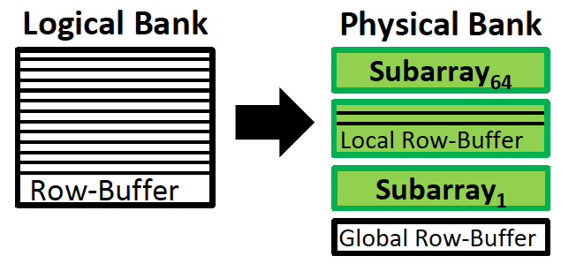
SALP: Subarray-Level Parallelism [ISCA’12]
Problem: Bank conflicts are costly for performance and energy
Goal: Reduce bank conflicts without adding more banks (low cost)
Observation: A DRAM bank is divided into subarrays
Idea: Enable mostly-parallel access to different subarrays

Slide 32
SALP: Subarray-Level Parallelism [ISCA’12]
Yoongu Kim, Vivek Seshadri, Donghyuk Lee, Jamie Liu, and Onur Mutlu, "A Case for Exploiting Subarray-Level Parallelism (SALP) in DRAM" Proceedings of the 39th International Symposium on Computer Architecture (ISCA), Portland, OR, June 2012. Slides (pptx)

Slide 33
More on SALP [Memory Forum’14]

Slide 34
More on SALP [Memory Forum’14]
http://www.cs.utah.edu/thememoryforum/kang_slides.pdf

Slide 35
More on SALP [Memory Forum’14]
http://www.cs.utah.edu/thememoryforum/kang_slides.pdf

Slide 36
Takeaway
Low-Cost DRAM Changes Enable Large Parallelism

Slide 37
Most Recent Example: CROW [ISCA’19]
Hasan Hassan, Minesh Patel, Jeremie S. Kim, A. Giray Yaglikci, Nandita Vijaykumar, Nika Mansourighiasi, Saugata Ghose, and Onur Mutlu, "CROW: A Low-Cost Substrate for Improving DRAM Performance, Energy Efficiency, and Reliability" Proceedings of the 46th International Symposium on Computer Architecture (ISCA), Phoenix, AZ, USA, June 2019.

Slide 38
DRAM Refresh Problem

Slide 39
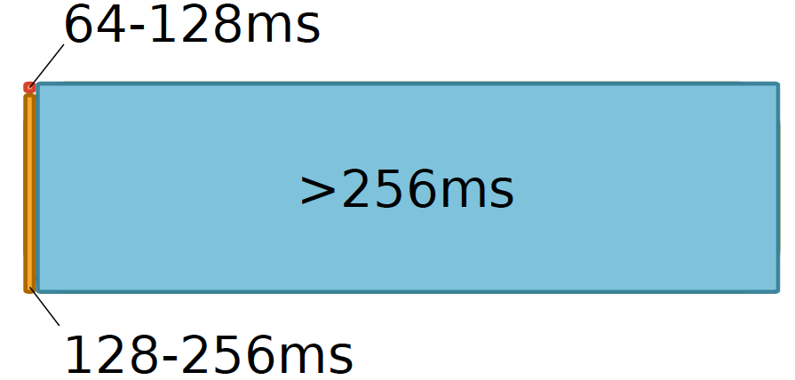
Most Refreshes Are Unnecessary
Retention Time Profile of DRAM looks like this:
Location dependent
Stored value pattern dependent
Time dependent

Slide 40
RAIDR [ISCA’12]
Jamie Liu, Ben Jaiyen, Richard Veras, and Onur Mutlu, "RAIDR: Retention-Aware Intelligent DRAM Refresh" Proceedings of the 39th International Symposium on Computer Architecture (ISCA), Portland, OR, June 2012. Slides (pdf)

Slide 41
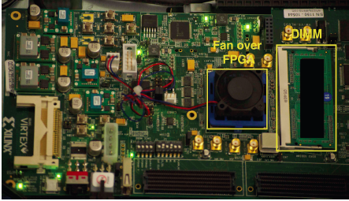
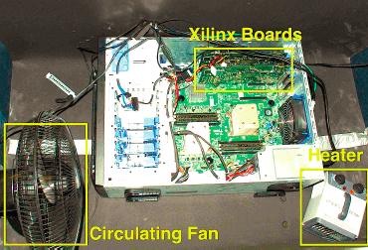
Infrastructures to Understand and Model DRAM Issues
An Experimental Study of Data Retention Behavior in Modern DRAM Devices: Implications for Retention Time Profiling Mechanisms (Liu et al., ISCA 2013)
The Efficacy of Error Mitigation Techniques for DRAM Retention Failures: A Comparative Experimental Study
(Khan et al., SIGMETRICS 2014)
Flipping Bits in Memory Without Accessing Them: An Experimental Study of DRAM Disturbance Errors (Kim et al., ISCA 2014)
Adaptive-Latency DRAM: Optimizing DRAM Timing for the Common-Case (Lee et al., HPCA 2015)
AVATAR: A Variable-Retention-Time (VRT) Aware Refresh for DRAM Systems (Qureshi et al., DSN 2015)

Slide 42
Infrastructures to Understand and Model DRAM Issues
Temperature
Controller
FPGAs
Heater
FPGAs
PC
Kim+, “Flipping Bits in Memory Without Accessing Them: An Experimental Study of DRAM Disturbance Errors,” ISCA 2014.

Slide 43
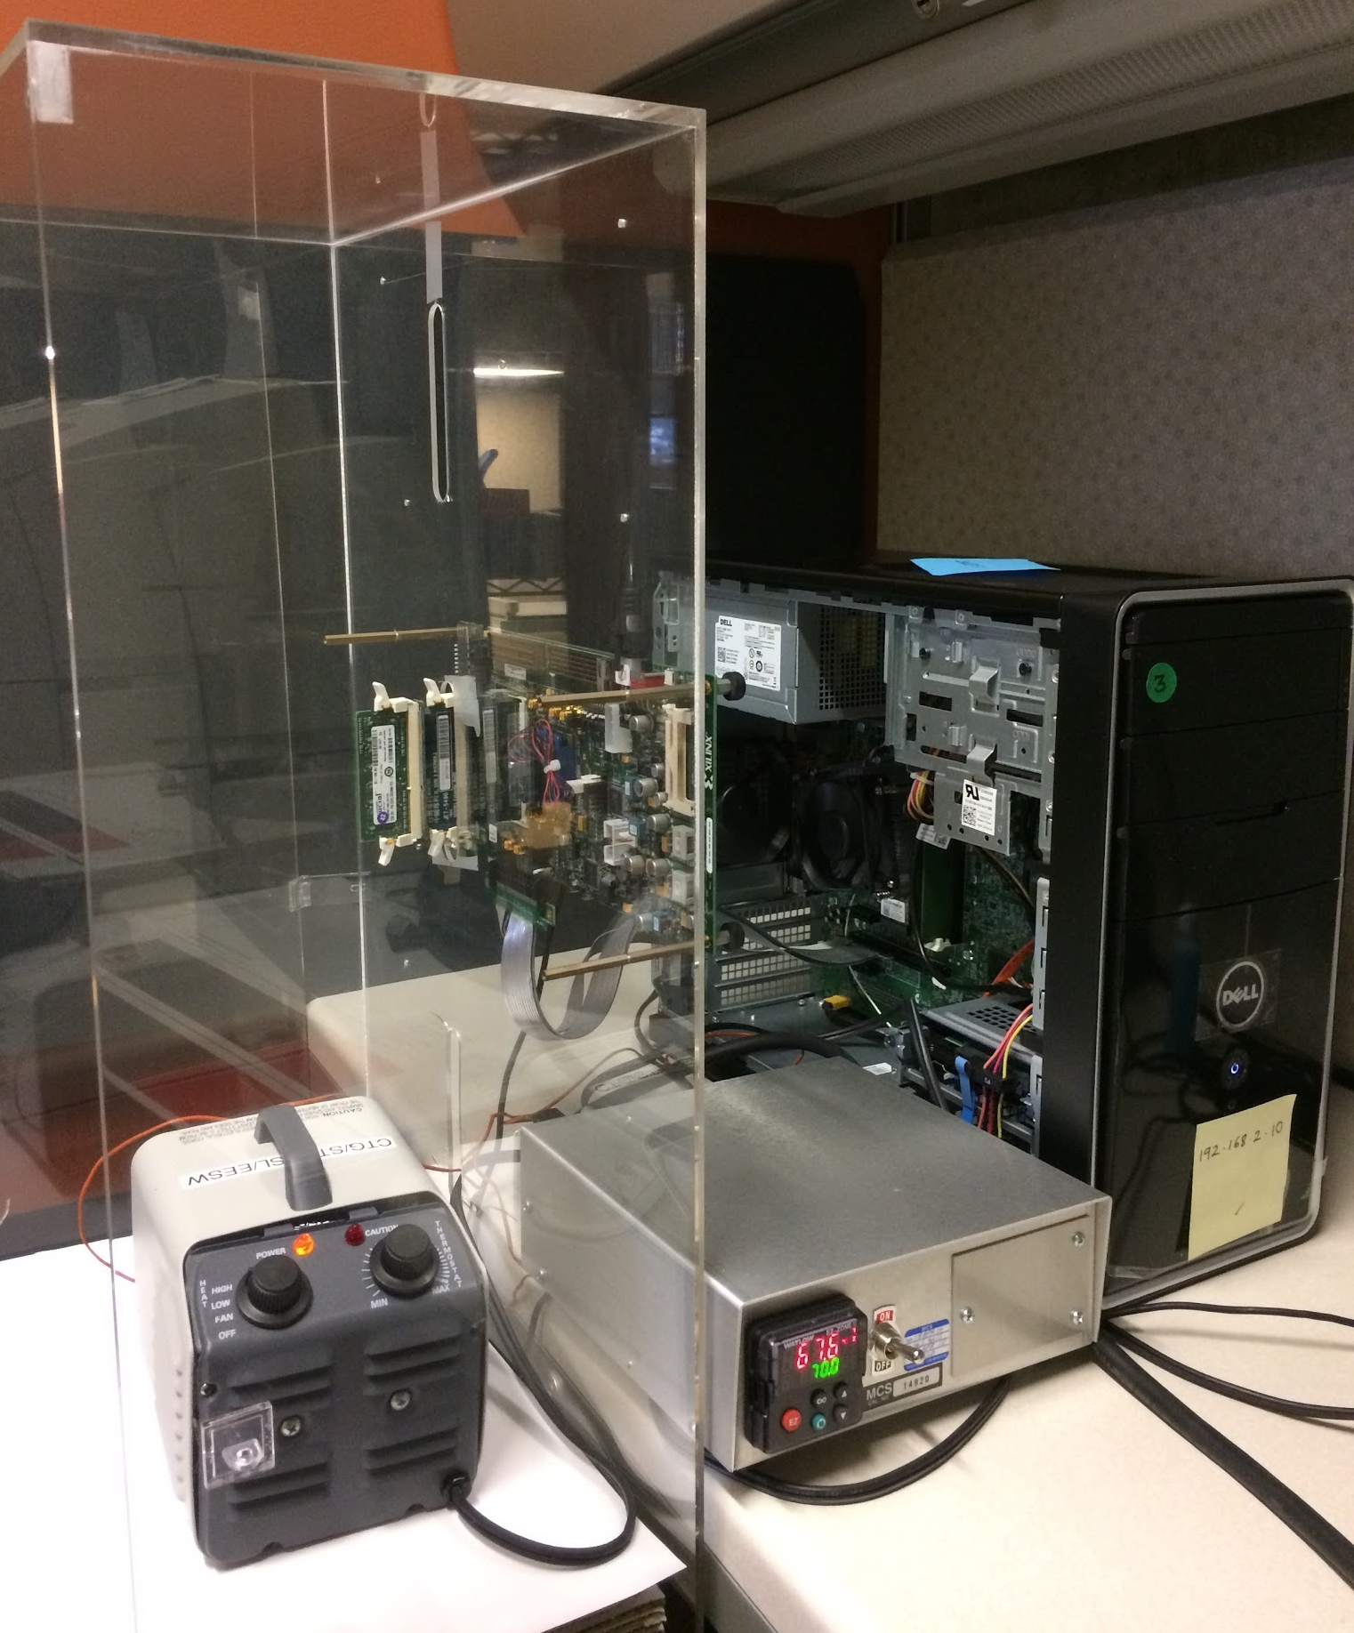
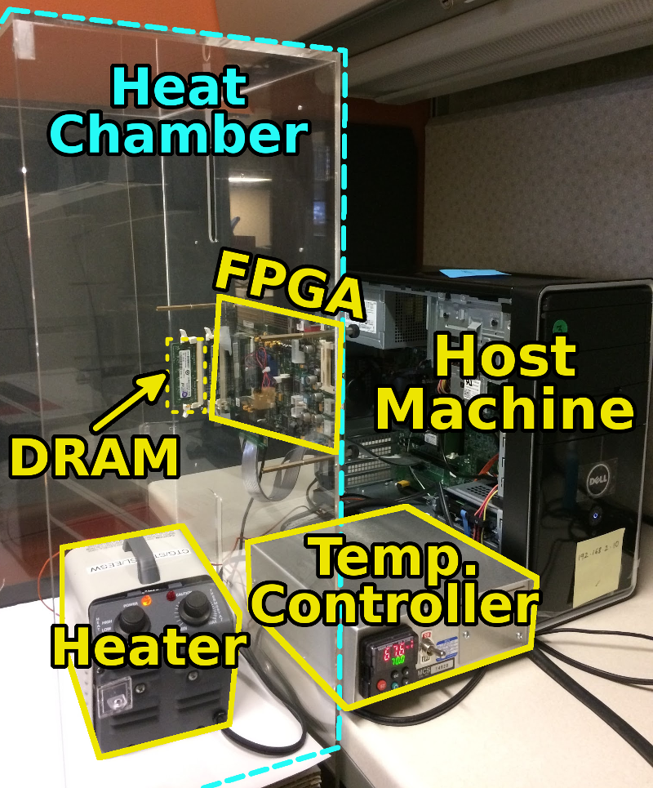
SoftMC: Open Source DRAM Infrastructure
Hasan Hassan et al., “SoftMC: A Flexible and Practical Open-Source Infrastructure for Enabling Experimental DRAM Studies,” HPCA 2017.
Flexible
Easy to Use (C++ API)
Open-source
github.com/CMU-SAFARI/SoftMC

Slide 44
SoftMC [ISCA’12]
https://github.com/CMU-SAFARI/SoftMC

Slide 45
Mitigating Refresh Issues

Slide 46
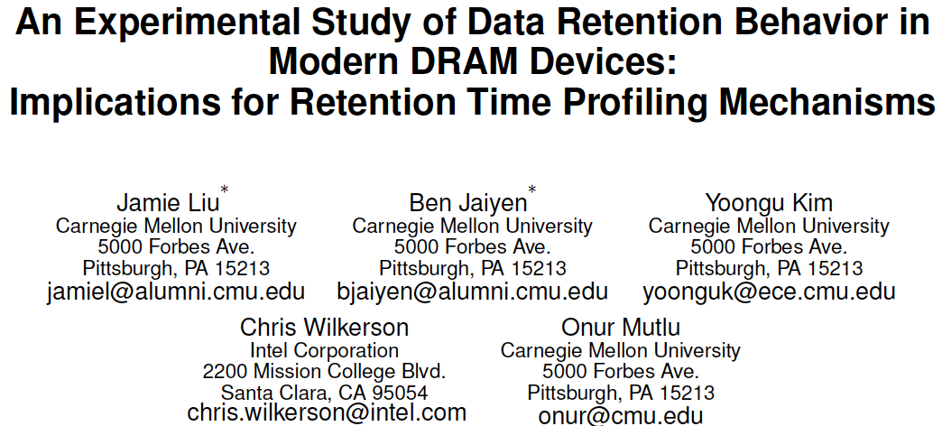
Analysis of Data Retention Failures [ISCA’13]
Jamie Liu, Ben Jaiyen, Yoongu Kim, Chris Wilkerson, and Onur Mutlu, "An Experimental Study of Data Retention Behavior in Modern DRAM Devices: Implications for Retention Time Profiling Mechanisms" Proceedings of the 40th International Symposium on Computer Architecture (ISCA), Tel-Aviv, Israel, June 2013. Slides (ppt) Slides (pdf)

Slide 47
Mitigation of Retention Issues [SIGMETRICS’14]
Samira Khan, Donghyuk Lee, Yoongu Kim, Alaa Alameldeen, Chris Wilkerson, and Onur Mutlu, "The Efficacy of Error Mitigation Techniques for DRAM Retention Failures: A Comparative Experimental Study" Proceedings of the ACM International Conference on Measurement and Modeling of Computer Systems (SIGMETRICS), Austin, TX, June 2014. [Slides (pptx) (pdf)] [Poster (pptx) (pdf)] [Full data sets]

Slide 48
Handling Variable Retention Time [DSN’15]
Moinuddin Qureshi, Dae Hyun Kim, Samira Khan, Prashant Nair, and Onur Mutlu, "AVATAR: A Variable-Retention-Time (VRT) Aware Refresh for DRAM Systems" Proceedings of the 45th Annual IEEE/IFIP International Conference on Dependable Systems and Networks (DSN), Rio de Janeiro, Brazil, June 2015. [Slides (pptx) (pdf)]

Slide 49
Handling Data-Dependent Failures [DSN’16]
Samira Khan, Donghyuk Lee, and Onur Mutlu, "PARBOR: An Efficient System-Level Technique to Detect Data-Dependent Failures in DRAM" Proceedings of the 45th Annual IEEE/IFIP International Conference on Dependable Systems and Networks (DSN), Toulouse, France, June 2016. [Slides (pptx) (pdf)]

Slide 50
Handling Data-Dependent Failures [MICRO’17]
Samira Khan, Chris Wilkerson, Zhe Wang, Alaa R. Alameldeen, Donghyuk Lee, and Onur Mutlu, "Detecting and Mitigating Data-Dependent DRAM Failures by Exploiting Current Memory Content" Proceedings of the 50th International Symposium on Microarchitecture (MICRO), Boston, MA, USA, October 2017. [Slides (pptx) (pdf)] [Lightning Session Slides (pptx) (pdf)] [Poster (pptx) (pdf)]

Slide 51
Handling Both DPD and VRT [ISCA’17]
Minesh Patel, Jeremie S. Kim, and Onur Mutlu, "The Reach Profiler (REAPER): Enabling the Mitigation of DRAM Retention Failures via Profiling at Aggressive Conditions" Proceedings of the 44th International Symposium on Computer Architecture (ISCA), Toronto, Canada, June 2017. [Slides (pptx) (pdf)] [Lightning Session Slides (pptx) (pdf)]
First experimental analysis of (mobile) LPDDR4 chips
Analyzes the complex tradeoff space of retention time profiling
Idea: enable fast and robust profiling at higher refresh intervals & temperatures

Slide 52
Understanding In-DRAM ECC [DSN’19]
Minesh Patel, Jeremie S. Kim, Hasan Hassan, and Onur Mutlu, "Understanding and Modeling On-Die Error Correction in Modern DRAM: An Experimental Study Using Real Devices" Proceedings of the 49th Annual IEEE/IFIP International Conference on Dependable Systems and Networks (DSN), Portland, OR, USA, June 2019. [Source Code for EINSim, the Error Inference Simulator] Best paper session.

Slide 53
Takeaway
Most Refreshes
Can Be Eliminated

Slide 54
Takeaway
Main Memory Needs
Intelligent Controllers

Slide 55
Principle: Build Infrastructure
Build Infrastructure to Enable Your Passion

Slide 56
Ramulator [IEEE CAL’15]
Yoongu Kim, Weikun Yang, and Onur Mutlu, "Ramulator: A Fast and Extensible DRAM Simulator" IEEE Computer Architecture Letters (CAL), March 2015. [Source Code]
Source code is released under the liberal MIT License
https://github.com/CMU-SAFARI/ramulator

Slide 57
RowHammer

Slide 58
Infrastructures Enable Scientific Inquiry
Temperature
Controller
FPGAs
Heater
FPGAs
PC
Kim+, “Flipping Bits in Memory Without Accessing Them: An Experimental Study of DRAM Disturbance Errors,” ISCA 2014.

Slide 59
A Curious Observation [Kim et al., ISCA 2014]
One can
predictably induce errors
in most DRAM memory chips

Slide 60
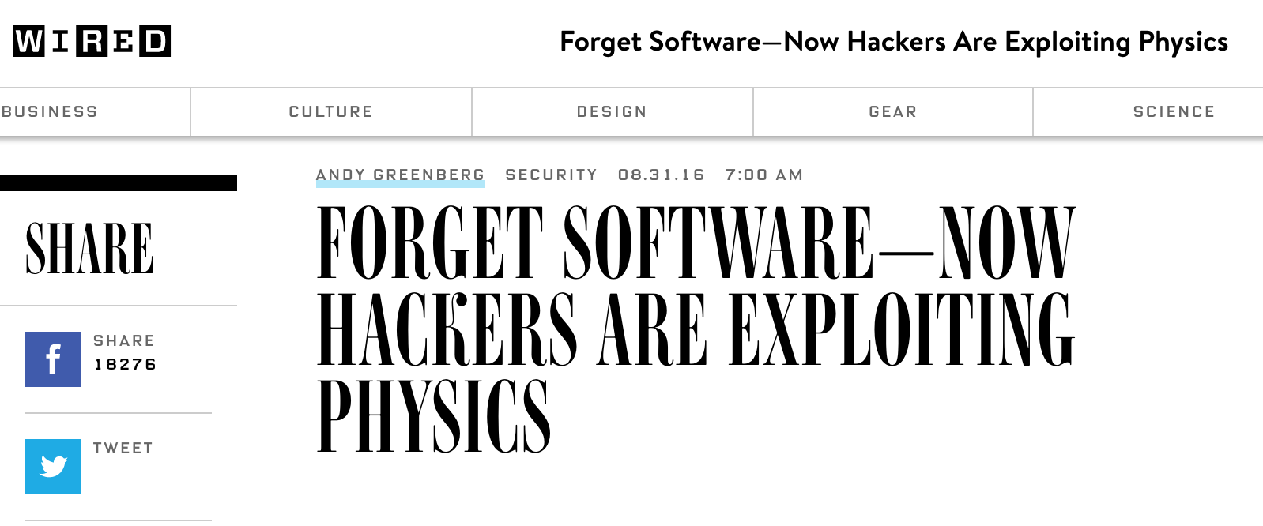
RowHammer
One can predictably induce bit flips in commodity DRAM chips
>80% of the tested DRAM chips are vulnerable
First example of how a simple hardware failure mechanism can create a widespread system security vulnerability

Slide 61
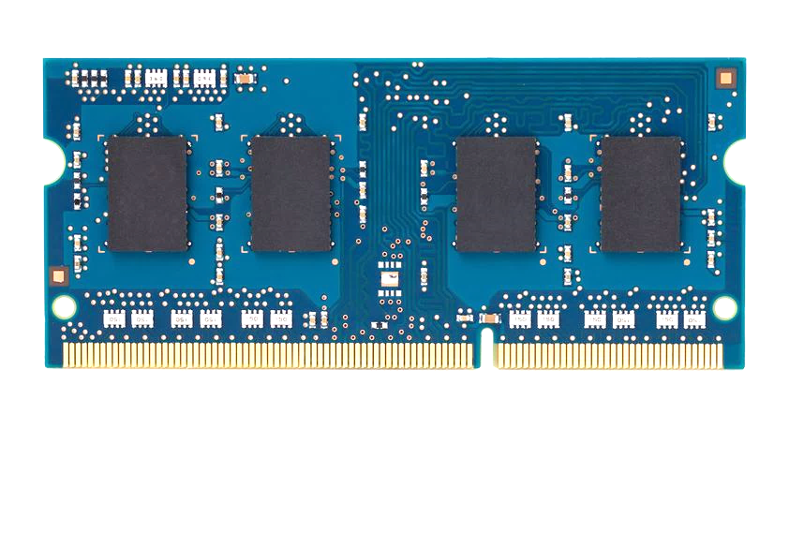
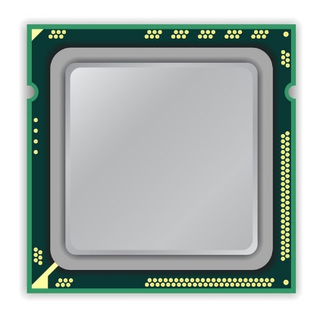
A Simple Program Can Induce Many Errors
CPU
DRAM Module
loop:
mov (X), %eax
mov (Y), %ebx
clflush (X)
clflush (Y)
mfence
jmp loop
X
Y
Download from: https://github.com/CMU-SAFARI/rowhammer
Notes:
We demonstrate the errors on multiple x86 systems. Shown to the bottom-left is a “disturbance kernel”. When executed, it forces two rows to be opened and closed one after the other – over and over again. Consequently, it induces many errors in the module.

Slide 62
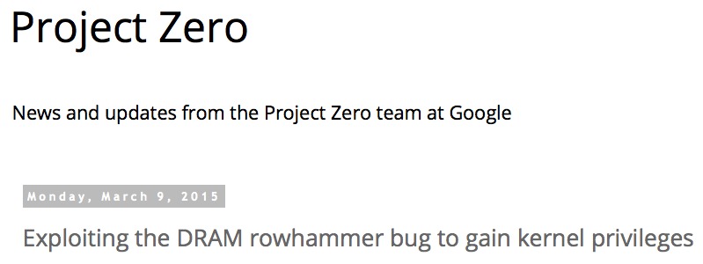
One Can Take Over an Otherwise-Secure System
Flipping Bits in Memory Without Accessing Them: An Experimental Study of DRAM Disturbance Errors (Kim et al., ISCA 2014)
Exploiting the DRAM rowhammer bug to gain kernel privileges (Seaborn, 2015)

Slide 63
More Security Implications (I)
“We can gain unrestricted access to systems of website visitors.”
Rowhammer.js: A Remote Software-Induced Fault Attack in JavaScript (DIMVA’16)
Source: https://lab.dsst.io/32c3-slides/7197.html

Slide 64
More Security Implications (II)
“Can gain control of a smart phone deterministically”
Drammer: Deterministic Rowhammer Attacks on Mobile Platforms, CCS’16
Source: https://fossbytes.com/drammer-rowhammer-attack-android-root-devices/

Slide 65
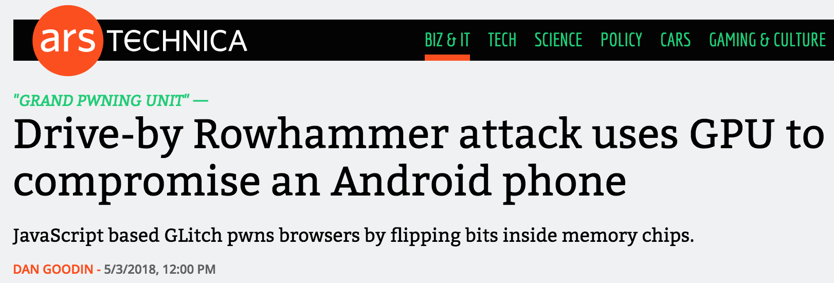
More Security Implications (III)
Using an integrated GPU in a mobile system to remotely escalate privilege via the WebGL interface

Slide 66
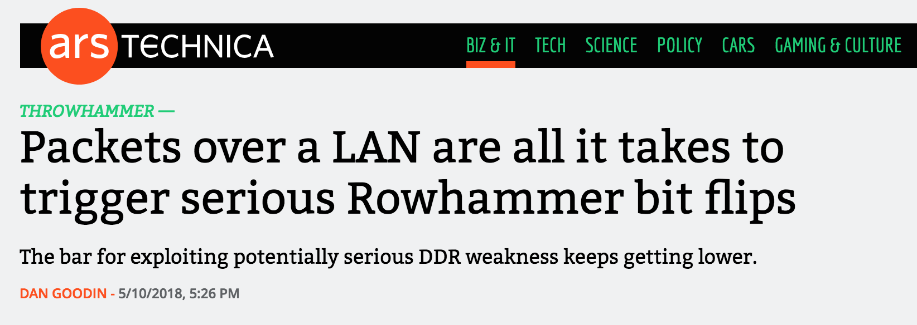
More Security Implications (IV)
Rowhammer over RDMA (I)

Slide 67
More Security Implications (V)
Rowhammer over RDMA (II)

Slide 68
More Security Implications (VI)
IEEE S&P 2020

Slide 69
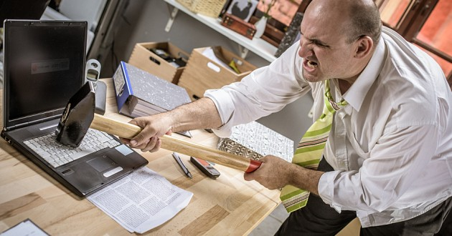
More Security Implications?

Slide 70
Seven RowHammer Solutions
Yoongu Kim, Ross Daly, Jeremie Kim, Chris Fallin, Ji Hye Lee, Donghyuk Lee, Chris Wilkerson, Konrad Lai, and Onur Mutlu, "Flipping Bits in Memory Without Accessing Them: An Experimental Study of DRAM Disturbance Errors" Proceedings of the 41st International Symposium on Computer Architecture (ISCA), Minneapolis, MN, June 2014. [Slides (pptx) (pdf)] [Lightning Session Slides (pptx) (pdf)] [Source Code and Data]

Slide 71
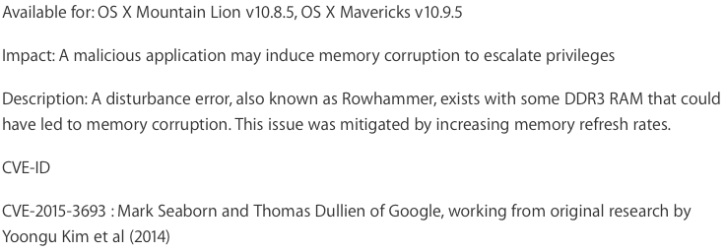
Apple’s Patch for RowHammer
https://support.apple.com/en-gb/HT204934
HP, Lenovo, and other vendors released similar patches

Slide 72
Our Solution to RowHammer
PARA: Probabilistic Adjacent Row Activation
Key Idea
After closing a row, we activate (i.e., refresh) one of its neighbors with a low probability: p = 0.005
Reliability Guarantee
When p=0.005, errors in one year: 9.4×10⁻¹⁴
By adjusting the value of p, we can vary the strength of protection against errors
Notes:
We provide a more efficient solution, called PARA, which stands for probabilistic adjacent row activation.
The key idea is thus: after closing a row, we activate (i.e., refresh) one of its neighbors with a low probability, for example, p equal to 0.005.
PARA provides a strong reliability guarantee even under the worst-case access patterns to DRAM. When we set p to 0.005, the expected number of errors in one year is 9.4 times 10 to the negative 14. This probability is much lower the failure rate of other hardware components, for example, the hard-disk drive.
And by adjusting the value of p, PARA can provide an arbitrarily strong-degree of protection against errors.

Slide 73
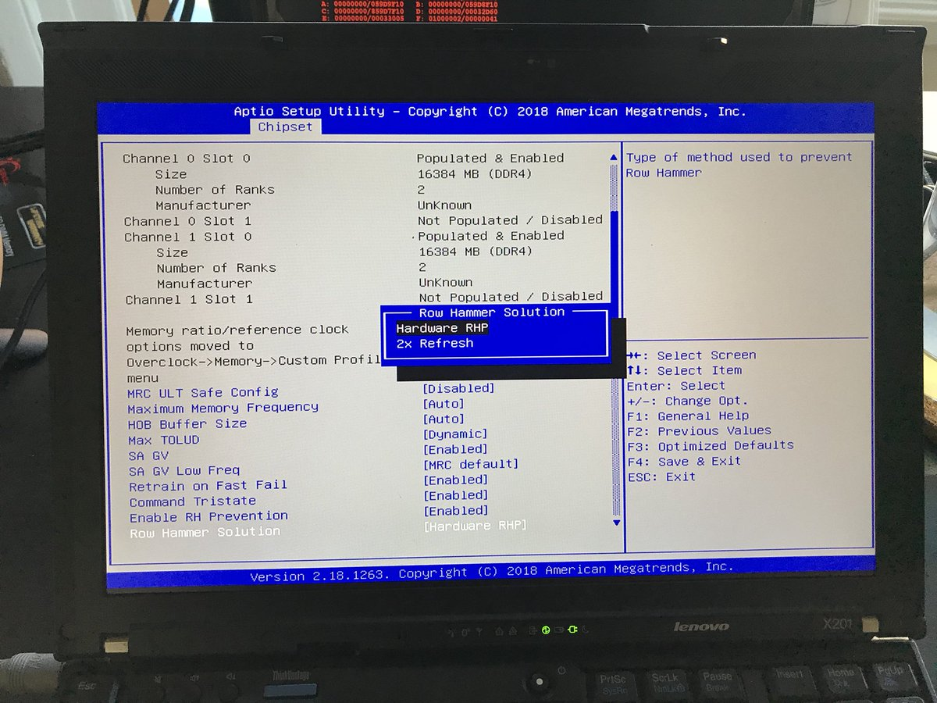
Probabilistic Activation in Real Life (I)
https://twitter.com/isislovecruft/status/1021939922754723841

Slide 74
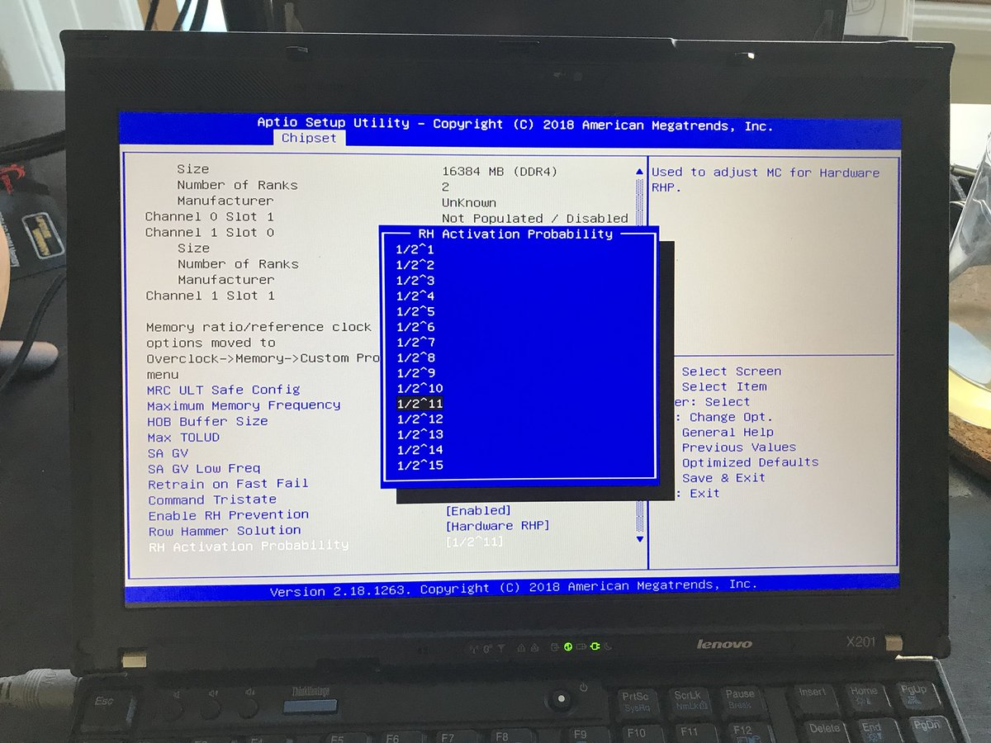
Probabilistic Activation in Real Life (II)
https://twitter.com/isislovecruft/status/1021939922754723841

Slide 75
The Original RowHammer Analysis
Yoongu Kim, Ross Daly, Jeremie Kim, Chris Fallin, Ji Hye Lee, Donghyuk Lee, Chris Wilkerson, Konrad Lai, and Onur Mutlu, "Flipping Bits in Memory Without Accessing Them: An Experimental Study of DRAM Disturbance Errors" Proceedings of the 41st International Symposium on Computer Architecture (ISCA), Minneapolis, MN, June 2014. [Slides (pptx) (pdf)] [Lightning Session Slides (pptx) (pdf)] [Source Code and Data]

Slide 76
RowHammer: 5 Years Later
Onur Mutlu and Jeremie Kim, "RowHammer: A Retrospective" IEEE Transactions on Computer-Aided Design of Integrated Circuits and Systems (TCAD) Special Issue on Top Picks in Hardware and Embedded Security, 2019.

Slide 77
RowHammer Takeaway
First example of how a
simple hardware failure mechanism
can create a
widespread security vulnerability

Slide 78
A Takeaway
Main Memory Needs
Intelligent Controllers
for Security

Slide 79
RowHammer: Retrospective
New mindset that has enabled a renewed interest in HW security attack research:
Real (memory) chips are vulnerable, in a simple and widespread manner → this causes real security problems
Hardware reliability → security connection is now mainstream discourse
Many new RowHammer attacks…
Tens of papers in top security venues
More to come as RowHammer is getting worse (DDR4 & beyond)
Many new RowHammer solutions…
Apple security release; Memtest86 updated
Many solution proposals in top venues (latest in ISCA 2019)
Principled system-DRAM co-design (in original RowHammer paper)
More to come…

Slide 80
Perhaps Most Importantly…
RowHammer enabled a shift of mindset in mainstream security researchers
General-purpose hardware is fallible, in a widespread manner
Its problems are exploitable
This mindset has enabled many systems security researchers to examine hardware in more depth
And understand HW’s inner workings and vulnerabilities
It is no coincidence that two of the groups that discovered Meltdown and Spectre heavily worked on RowHammer attacks before
More to come…

Slide 81
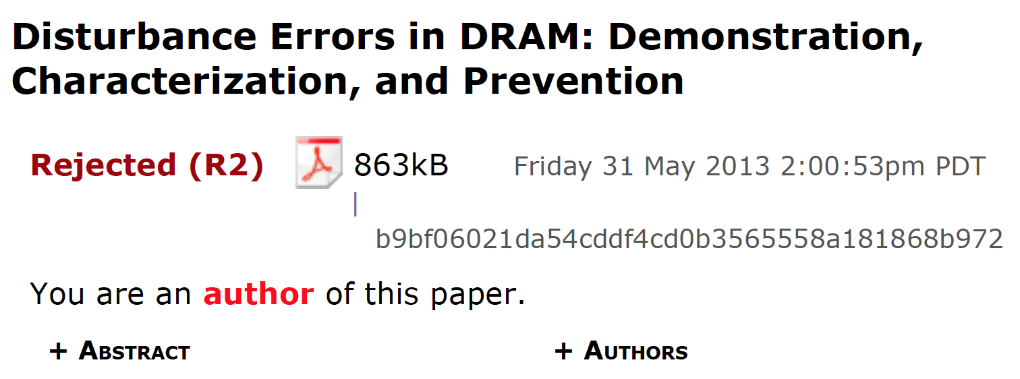
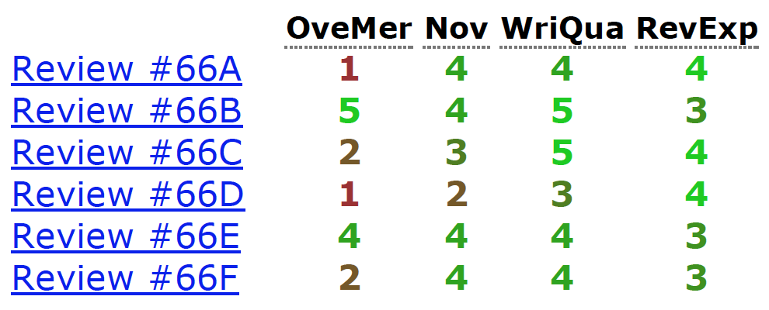
Initial RowHammer Reviews

Slide 82
Missing the Point
Reviews from Micro 2013

Slide 83
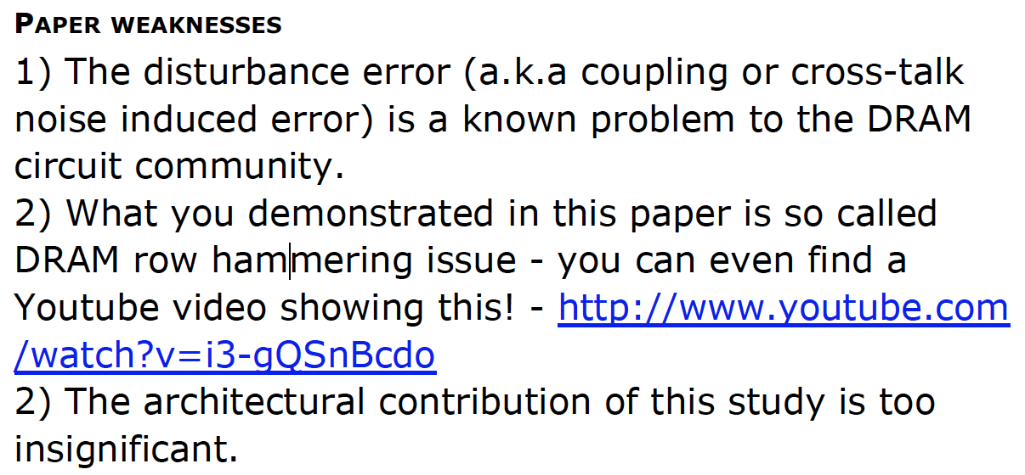
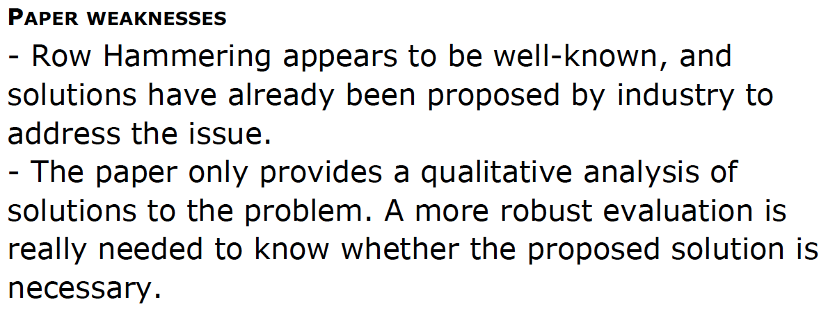
More …
Reviews from ISCA 2014

Slide 84
Suggestions to Reviewers
Be fair; you do not know it all
Be open-minded; you do not know it all
Be accepting of diverse research methods: there is no single way of doing research
Be constructive, not destructive
Do not have double standards…
Do not block or delay scientific progress for non-reasons

Slide 85
Suggestion to Community
We Need to Fix the Reviewer Accountability Problem

Slide 86
Suggestion to Community
Eliminate
Double Standards

Slide 87
Suggestion to Researchers: Principle: Passion
Follow Your Passion
(Do not get derailed
by naysayers)

Slide 88
Suggestion to Researchers: Principle: Resilience
Be Resilient

Slide 89
Principle: Learning and Scholarship
Focus on
learning and scholarship

Slide 90
Principle: Learning and Scholarship
The quality of your work defines your impact

Slide 91
Reducing DRAM Latency

Slide 92
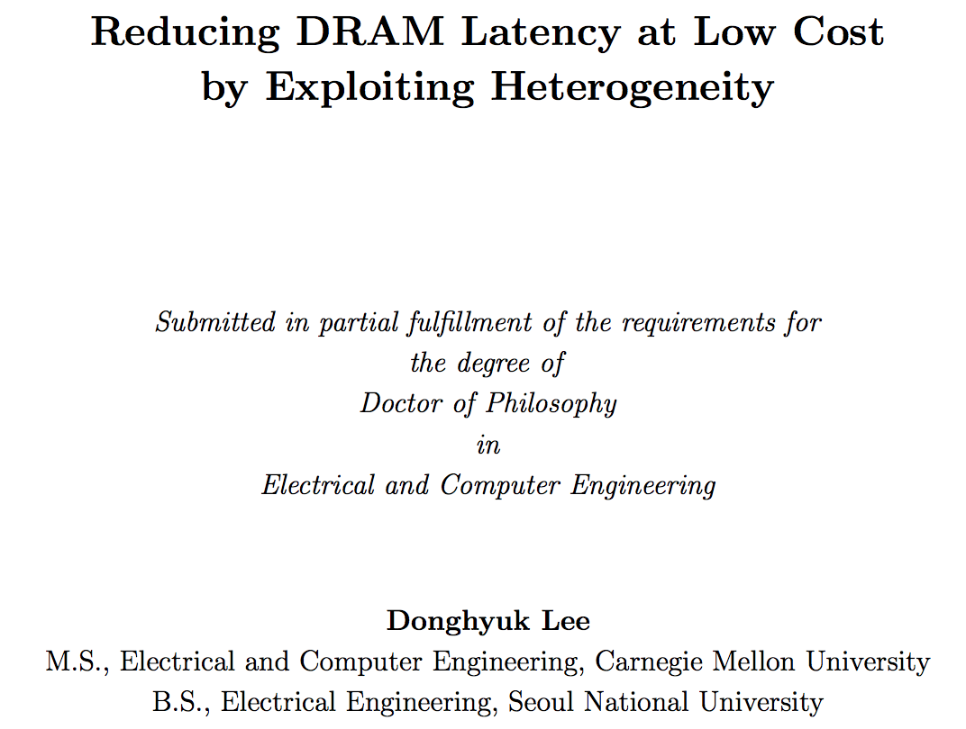
Donghyuk Lee’s PhD Thesis [CMU 2015]

Slide 93
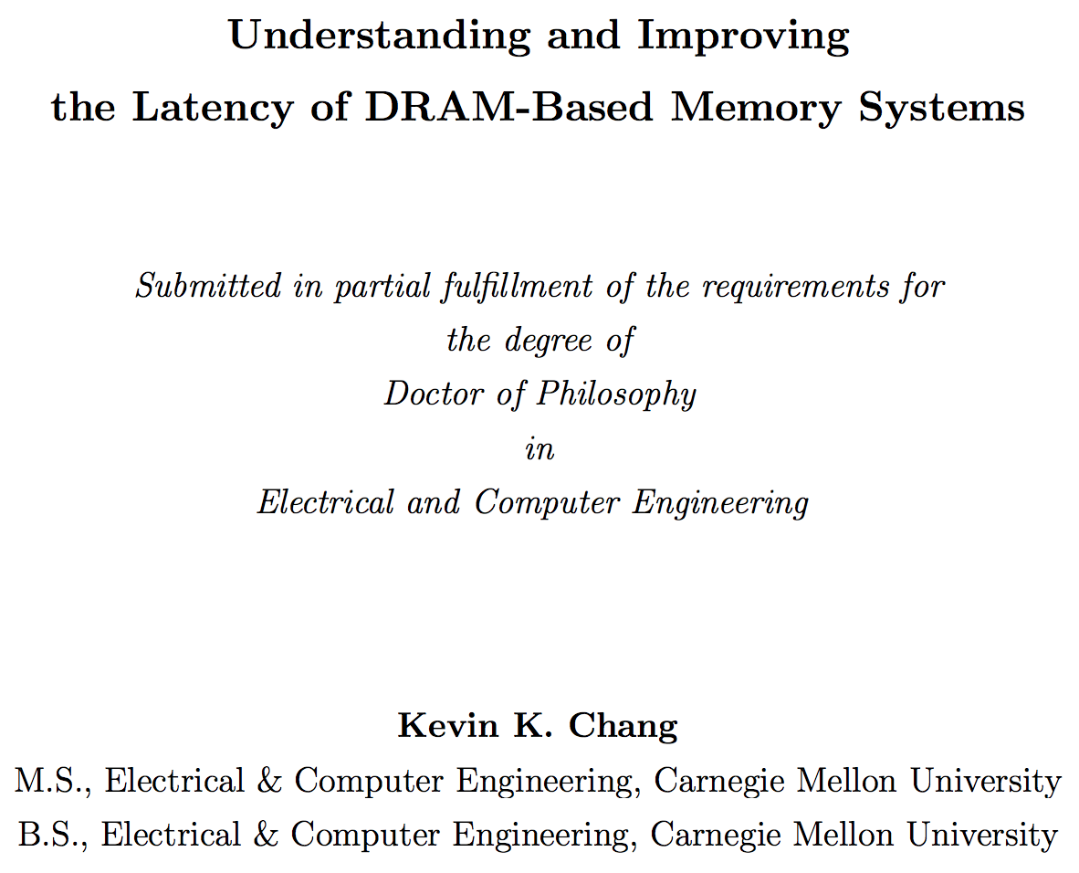
Kevin Chang’s PhD Thesis [CMU 2017]

Slide 94
Reducing DRAM Energy

Slide 95
Enabling DRAM to Compute at Low Cost

Slide 96
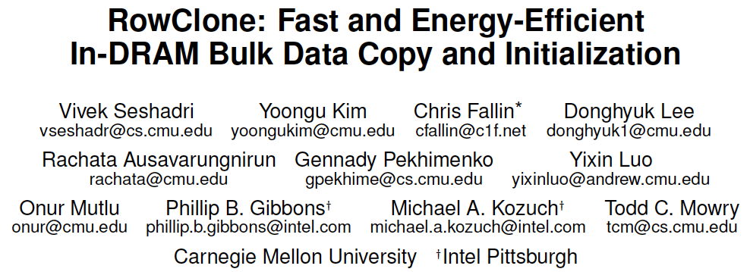
RowClone [MICRO’13]
Vivek Seshadri, Yoongu Kim, Chris Fallin, Donghyuk Lee, Rachata Ausavarungnirun, Gennady Pekhimenko, Yixin Luo, Onur Mutlu, Michael A. Kozuch, Phillip B. Gibbons, and Todd C. Mowry, "RowClone: Fast and Energy-Efficient In-DRAM Bulk Data Copy and Initialization" Proceedings of the 46th International Symposium on Microarchitecture (MICRO), Davis, CA, December 2013. [Slides (pptx) (pdf)] [Lightning Session Slides (pptx) (pdf)] [Poster (pptx) (pdf)]

Slide 97
Ambit [MICRO’17]
Vivek Seshadri et al., “Ambit: In-Memory Accelerator for Bulk Bitwise Operations Using Commodity DRAM Technology,” MICRO 2017.

Slide 98
Ambit
Vivek Seshadri and Onur Mutlu, "In-DRAM Bulk Bitwise Execution Engine" Invited Book Chapter in Advances in Computers, to appear in 2020. [Preliminary arXiv version]

Slide 99
In-Memory Bulk Bitwise Operations
We can support in-DRAM COPY, ZERO, AND, OR, NOT, MAJ
At low cost
Using analog computation capability of DRAM
Idea: activating multiple rows performs computation
30-74X performance and energy improvement
Seshadri+, “Ambit: In-Memory Accelerator for Bulk Bitwise Operations Using Commodity DRAM Technology,” MICRO 2017.
New memory technologies enable even more opportunities

Slide 100
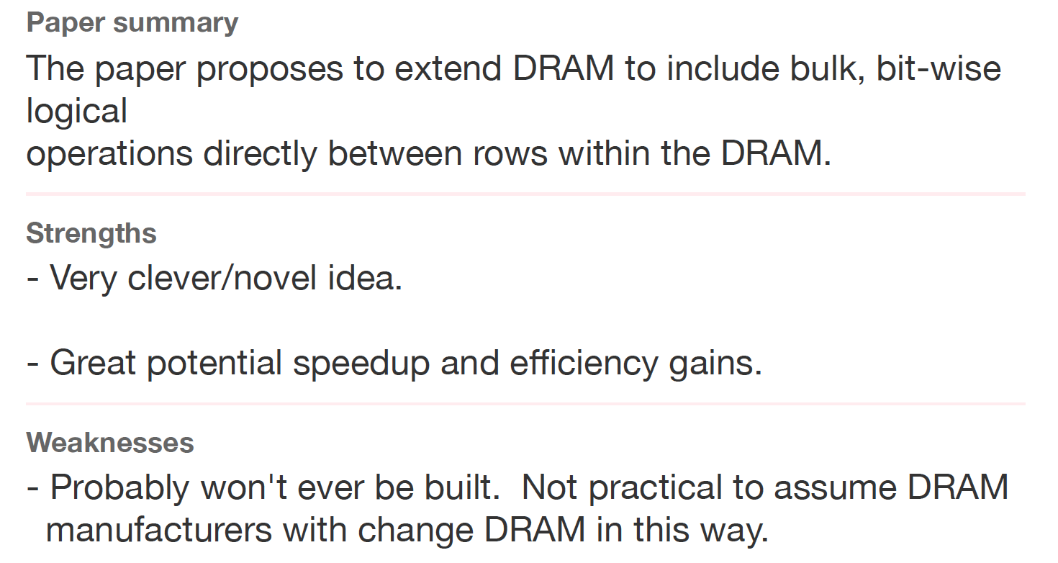
Sounds Good, No?
Review from ISCA 2016

Slide 101
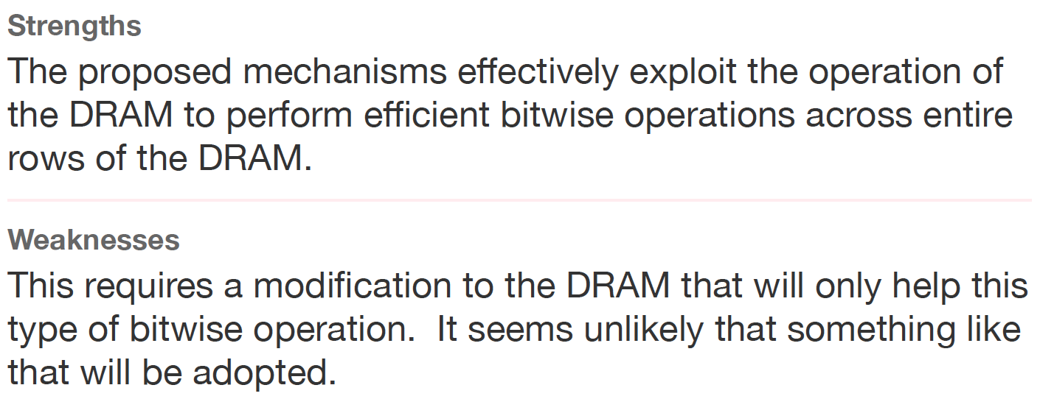
Another Review
Another Review from ISCA 2016

Slide 102
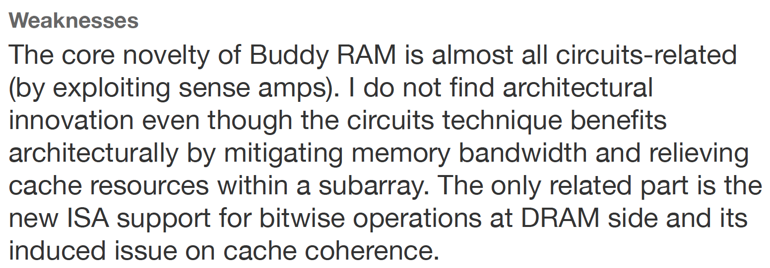
Yet Another Review
Yet Another Review from ISCA 2016

Slide 103
Aside: A Recommended Book
Raj Jain, “The Art of
Computer Systems
Performance Analysis,”
Wiley, 1991.

Slide 104
Raj Jain, “The Art of
Computer Systems
Performance Analysis,”
Wiley, 1991.

Slide 105
Raj Jain, “The Art of
Computer Systems
Performance Analysis,”
Wiley, 1991.

Slide 106
Into the Future

Slide 107
The Problem
Computing
is Bottlenecked by Data

Slide 108
Prediction
Future Innovations
Will Be Even More
Bottlenecked by Memory

Slide 109
We Need Architectures That Handle Data Well
Data-centric
Data-driven
Data-aware

Slide 110
Challenge and Opportunity for Future
Computing Architectures
with
Minimal Data Movement

Slide 111
We Need to Revisit the Entire Stack
Problem
Algorithm
Program/Language
System Software
SW/HW Interface
Micro-architecture
Logic
Devices
Electrons
We can get there step by step

Slide 112
Overview of PIM Challenges
Onur Mutlu, Saugata Ghose, Juan Gomez-Luna, and Rachata Ausavarungnirun, "Processing Data Where It Makes Sense: Enabling In-Memory Computation" Invited paper in Microprocessors and Microsystems (MICPRO), June 2019. [arXiv version]
https://arxiv.org/pdf/1903.03988.pdf

Slide 113
Source: http://spectrum.ieee.org/image/MjYzMzAyMg.jpeg

Slide 114
Food for Thought: Two Quotes
Progress is impossible without change,
and those who cannot change their minds
cannot change anything.
George Bernard Shaw
My heart is in the work.
Andrew Carnegie
Image: By Alvin Langdon Coburn - Illustrated London News, p. 575 (subscription required), PD-US, https://en.wikipedia.org/w/index.php?curid=49887931

Slide 115
Some Reflections (on DRAM)
Onur Mutlu
omutlu@gmail.com
https://people.inf.ethz.ch/omutlu
25 June 2019
Maurice Wilkes Award @ ISCA 2019

