Slide 1


Memory Scaling:
A Systems Architecture Perspective
Onur Mutlu
onur@cmu.edu
August 6, 2013
MemCon 2013

Slide 2



The Main Memory System
Main memory is a critical component of all computing systems: server, mobile, embedded, desktop, sensor
Main memory system must scale (in size, technology, efficiency, cost, and management algorithms) to maintain performance growth and technology scaling benefits
Processor
and caches
Main Memory
Storage (SSD/HDD)

Slide 3
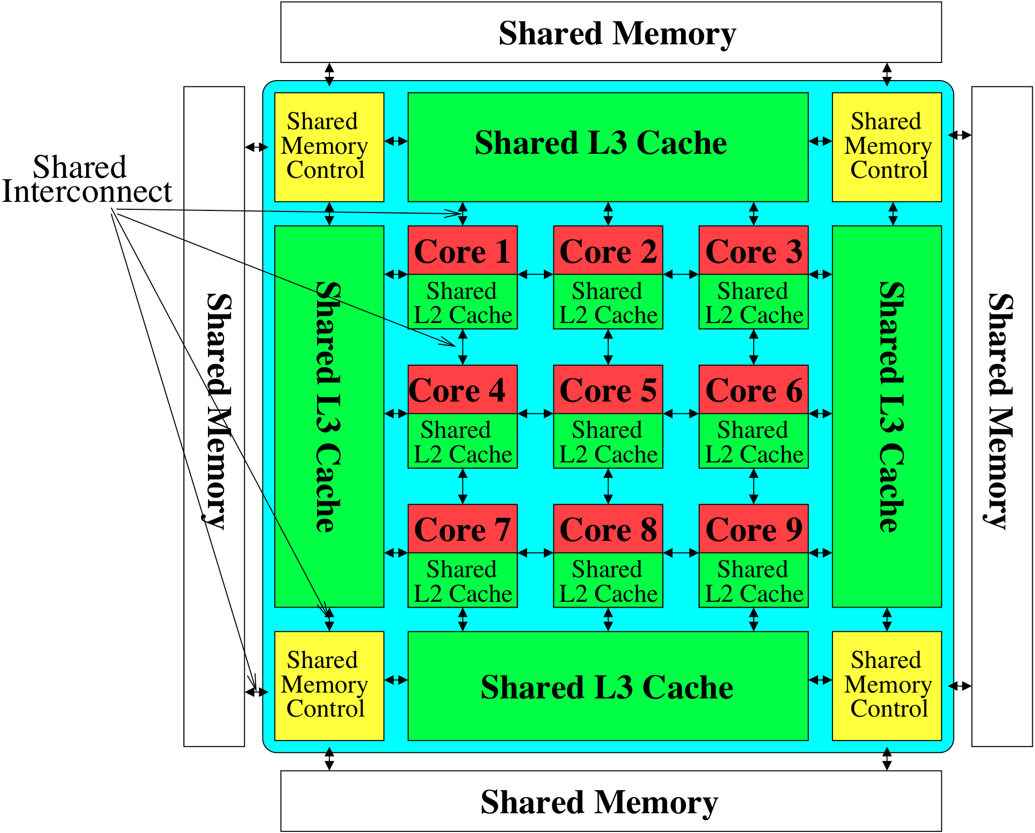
Memory System: A Shared Resource View
Storage

Slide 4
State of the Main Memory System
Recent technology, architecture, and application trends
  lead to new requirements
  exacerbate old requirements
DRAM and memory controllers, as we know them today, are (will be) unlikely to satisfy all requirements
Some emerging non-volatile memory technologies (e.g., PCM) enable new opportunities: memory+storage merging
We need to rethink the main memory system
  to fix DRAM issues and enable emerging technologies
  to satisfy all requirements

Slide 5
Agenda
Major Trends Affecting Main Memory
The DRAM Scaling Problem and Solution Directions
  Tolerating DRAM: New DRAM Architectures
  Enabling Emerging Technologies: Hybrid Memory Systems
How Can We Do Better?
Summary

Slide 6
Major Trends Affecting Main Memory (I)
Need for main memory capacity, bandwidth, QoS increasing
Main memory energy/power is a key system design concern
DRAM technology scaling is ending

Slide 7
Major Trends Affecting Main Memory (II)
Need for main memory capacity, bandwidth, QoS increasing
  Multi-core: increasing number of cores/agents
  Data-intensive applications: increasing demand/hunger for data
  Consolidation: cloud computing, GPUs, mobile, heterogeneity
Main memory energy/power is a key system design concern
DRAM technology scaling is ending

Slide 8
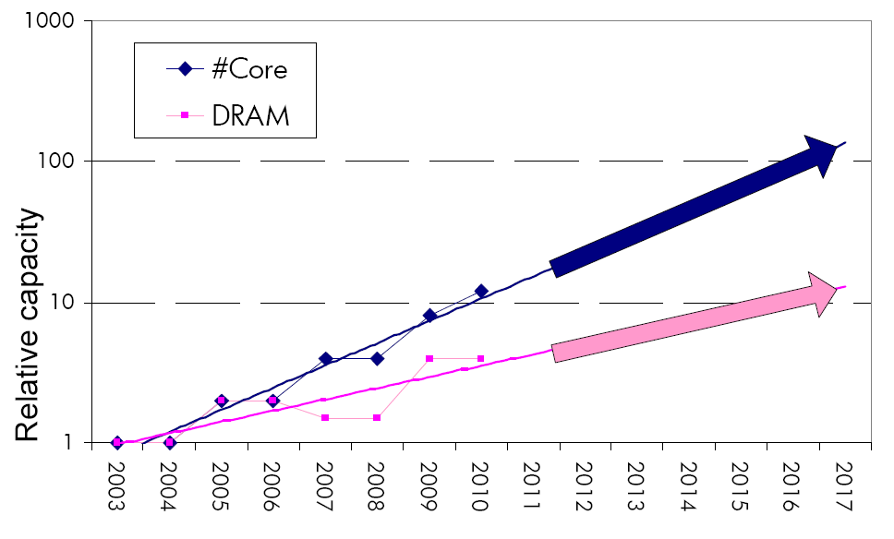
Example: The Memory Capacity Gap
Core count doubling ~ every 2 years
DRAM DIMM capacity doubling ~ every 3 years
Memory capacity per core expected to drop by 30% every two years
Trends worse for memory bandwidth per core!

Slide 9
Major Trends Affecting Main Memory (III)
Need for main memory capacity, bandwidth, QoS increasing
Main memory energy/power is a key system design concern
  ~40-50% energy spent in off-chip memory hierarchy [Lefurgy, IEEE Computer 2003]
  DRAM consumes power even when not used (periodic refresh)
DRAM technology scaling is ending

Slide 10
Major Trends Affecting Main Memory (IV)
Need for main memory capacity, bandwidth, QoS increasing
Main memory energy/power is a key system design concern
DRAM technology scaling is ending
  ITRS projects DRAM will not scale easily below X nm
  Scaling has provided many benefits:
    higher capacity (density), lower cost, lower energy

Slide 11
Agenda
Major Trends Affecting Main Memory
The DRAM Scaling Problem and Solution Directions
  Tolerating DRAM: New DRAM Architectures
  Enabling Emerging Technologies: Hybrid Memory Systems
How Can We Do Better?
Summary

Slide 12
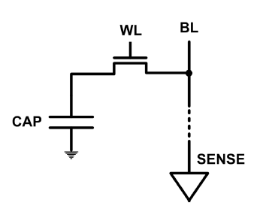
The DRAM Scaling Problem
DRAM stores charge in a capacitor (charge-based memory)
  Capacitor must be large enough for reliable sensing
  Access transistor should be large enough for low leakage and high retention time
  Scaling beyond 40-35nm (2013) is challenging [ITRS, 2009]
DRAM capacity, cost, and energy/power hard to scale

Slide 13
Solutions to the DRAM Scaling Problem
Two potential solutions
  Tolerate DRAM (by taking a fresh look at it)
  Enable emerging memory technologies to eliminate/minimize DRAM
Do both
  Hybrid memory systems

Slide 14
Solution 1: Tolerate DRAM
Overcome DRAM shortcomings with
  System-DRAM co-design
  Novel DRAM architectures, interface, functions
  Better waste management (efficient utilization)
Key issues to tackle
  Reduce refresh energy
  Improve bandwidth and latency
  Reduce waste
  Enable reliability at low cost
Liu, Jaiyen, Veras, Mutlu, “RAIDR: Retention-Aware Intelligent DRAM Refresh,” ISCA 2012.
Kim, Seshadri, Lee+, “A Case for Exploiting Subarray-Level Parallelism in DRAM,” ISCA 2012.
Lee+, “Tiered-Latency DRAM: A Low Latency and Low Cost DRAM Architecture,” HPCA 2013.
Liu+, “An Experimental Study of Data Retention Behavior in Modern DRAM Devices” ISCA’13.
Seshadri+, “RowClone: Fast and Efficient In-DRAM Copy and Initialization of Bulk Data,” 2013.

Slide 15
Solution 2: Emerging Memory Technologies
Some emerging resistive memory technologies seem more scalable than DRAM (and they are non-volatile)
Example: Phase Change Memory
  Expected to scale to 9nm (2022 [ITRS])
  Expected to be denser than DRAM: can store multiple bits/cell
But, emerging technologies have shortcomings as well
  Can they be enabled to replace/augment/surpass DRAM?
Lee, Ipek, Mutlu, Burger, “Architecting Phase Change Memory as a Scalable DRAM Alternative,” ISCA 2009, CACM 2010, Top Picks 2010.
Meza, Chang, Yoon, Mutlu, Ranganathan, “Enabling Efficient and Scalable Hybrid Memories,” IEEE Comp. Arch. Letters 2012.
Yoon, Meza et al., “Row Buffer Locality Aware Caching Policies for Hybrid Memories,” ICCD 2012.
Kultursay+, “Evaluating STT-RAM as an Energy-Efficient Main Memory Alternative,” ISPASS 2013.
Notes:
Even if DRAM continues to scale there could be benefits to examining and enabling these new technologies.

Slide 16
Hybrid Memory Systems
CPU
Meza+, “Enabling Efficient and Scalable Hybrid Memories,” IEEE Comp. Arch. Letters, 2012.
Yoon, Meza et al., “Row Buffer Locality Aware Caching Policies for Hybrid Memories,” ICCD 2012 Best Paper Award.
DRAMCtrl
PCM Ctrl
DRAM
Phase Change Memory (or Tech. X)
Fast, durable
Small,
leaky, volatile,
high-cost
Large, non-volatile, low-cost
Slow, wears out, high active energy
Hardware/software manage data allocation and movement
to achieve the best of multiple technologies

Slide 17
An Orthogonal Issue: Memory Interference
Main
Memory
Core
Core
Core
Core
Cores’ interfere with each other when accessing shared main memory
Notes:
In a multicore system, multiple applications running on the different cores share the main memory.
These applications interfere at the main memory. The result of this interference is unpredictable application slowdowns.

Slide 18
An Orthogonal Issue: Memory Interference
Problem: Memory interference between cores is uncontrolled
  → unfairness, starvation, low performance
  → uncontrollable, unpredictable, vulnerable system
Solution: QoS-Aware Memory Systems
  Hardware designed to provide a configurable fairness substrate
    Application-aware memory scheduling, partitioning, throttling
  Software designed to configure the resources to satisfy different QoS goals
QoS-aware memory controllers and interconnects can provide predictable performance and higher efficiency

Slide 19
Agenda
Major Trends Affecting Main Memory
The DRAM Scaling Problem and Solution Directions
  Tolerating DRAM: New DRAM Architectures
  Enabling Emerging Technologies: Hybrid Memory Systems
How Can We Do Better?
Summary

Slide 20
Tolerating DRAM: Example Techniques
Retention-Aware DRAM Refresh: Reducing Refresh Impact
Tiered-Latency DRAM: Reducing DRAM Latency
RowClone: Accelerating Page Copy and Initialization
Subarray-Level Parallelism: Reducing Bank Conflict Impact

Slide 21
DRAM Refresh
DRAM capacitor charge leaks over time
The memory controller needs to refresh each row periodically to restore charge
  Activate each row every N ms
  Typical N = 64 ms
Downsides of refresh
-- Energy consumption: Each refresh consumes energy
  -- Performance degradation: DRAM rank/bank unavailable while refreshed
  -- QoS/predictability impact: (Long) pause times during refresh
  -- Refresh rate limits DRAM capacity scaling

Slide 22
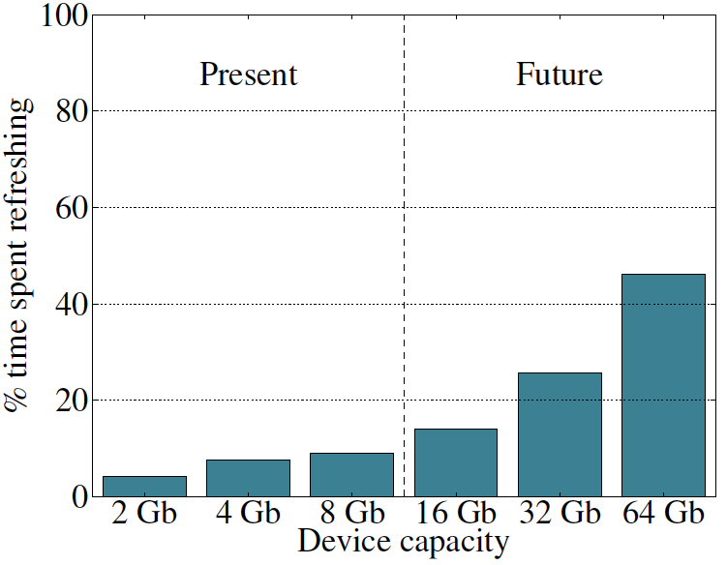
Refresh Overhead: Performance
46%
8%

Slide 23
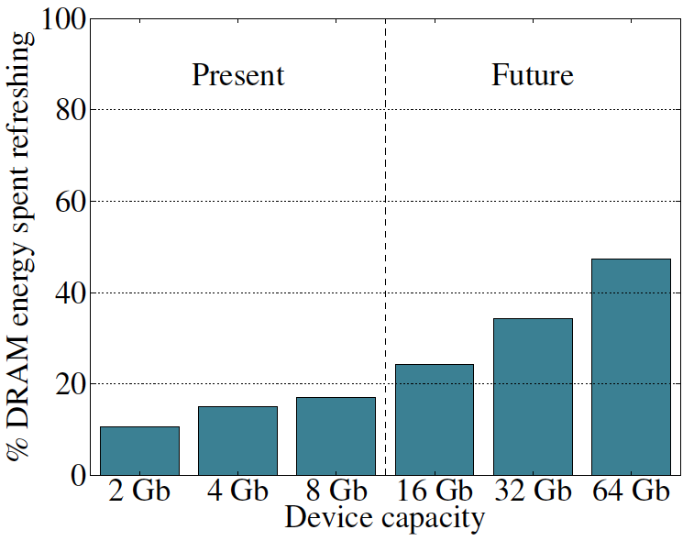
Refresh Overhead: Energy
47%
15%

Slide 24

Retention Time Profile of DRAM

Slide 25
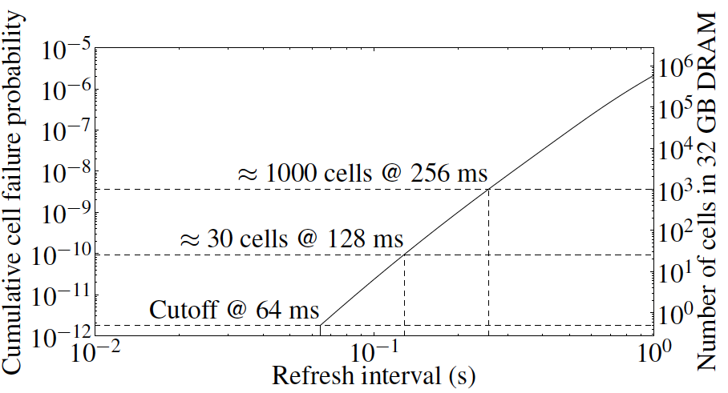
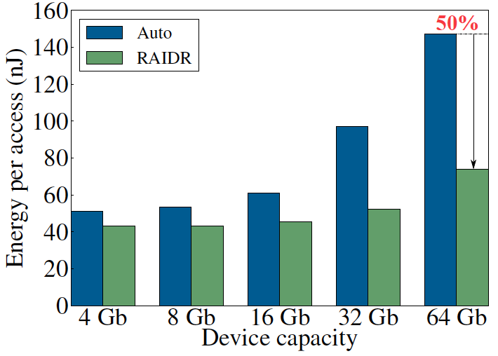
RAIDR: Eliminating Unnecessary Refreshes
Observation: Most DRAM rows can be refreshed much less often without losing data [Kim+, EDL’09][Liu+ ISCA’13]
Key idea: Refresh rows containing weak cells
more frequently, other rows less frequently
  1. Profiling: Profile retention time of all rows
  2. Binning: Store rows into bins by retention time in memory controller
  Efficient storage with Bloom Filters (only 1.25KB for 32GB memory)
  3. Refreshing: Memory controller refreshes rows in different bins at different rates
Results: 8-core, 32GB, SPEC, TPC-C, TPC-H
  74.6% refresh reduction @ 1.25KB storage
  ~16%/20% DRAM dynamic/idle power reduction
  ~9% performance improvement
  Benefits increase with DRAM capacity
Liu et al., “RAIDR: Retention-Aware Intelligent DRAM Refresh,” ISCA 2012.

Slide 26
Going Forward
How to find out and expose weak memory cells/rows
  Early analysis of modern DRAM chips:
    Liu+, “An Experimental Study of Data Retention Behavior in Modern DRAM Devices: Implications for Retention Time Profiling Mechanisms”, ISCA 2013.
Low-cost system-level tolerance of DRAM errors
Tolerating cell-to-cell interference at the system level
  For both DRAM and Flash. Early analysis of Flash chips:
    Cai+, “Program Interference in MLC NAND Flash Memory: Characterization, Modeling, and Mitigation,” ICCD 2013.

Slide 27
Tolerating DRAM: Example Techniques
Retention-Aware DRAM Refresh: Reducing Refresh Impact
Tiered-Latency DRAM: Reducing DRAM Latency
RowClone: Accelerating Page Copy and Initialization
Subarray-Level Parallelism: Reducing Bank Conflict Impact

Slide 28
DRAM Latency-Capacity Trend
16X
-20%
DRAM latency continues to be a critical bottleneck
Notes:
The figure shows the historical trends of DRAM during the last 12-years, from 2000 to 2011.
We can see that, during this time, DRAM capacity has increased by 16 times.
On the other hand, during the same period of time, DRAM latency has reduced by only 20%.
As a result, the high DRAM latency continues to be a critical bottleneck for system performance.

Slide 29
What Causes the Long Latency?
DRAM Chip
DRAM Chip
cell array
subarray
Subarray
I/O
I/O
I/O
channel
channel
DRAM Latency = Subarray Latency + I/O Latency
DRAM Latency = Subarray Latency + I/O Latency
Dominant
Notes:
To understand what causes the long latency, let me take a look at the DRAM organization.
DRAM consists of two components, the cell array and the I/O circuitry. The cell array consists of multiple subarrays.
To read from a DRAM chip, the data is first accessed from the subarray and then the data is transferred over the channel by the I/O circuitry.
So, the DRAM latency is the sum of the subarray latency and the I/O latency.
We observed that the subarray latency is much higher than the I/O latency.
As a result, subarray is the dominant source of the DRAM latency as we explained in the paper.

Slide 30
Why is the Subarray So Slow?
Subarray
Cell
cell
wordline
bitline: 512 cells
access
row decoder
row decoder
transistor
capacitor
sense amplifier
bitline
sense amplifier
large sense amplifier
Long bitline
  Amortizes sense amplifier cost → Small area
  Large bitline capacitance → High latency & power
Notes:
The cell’s capacitor is small and can store only a small amount of charge.
That is why a subarray also has sense-amplifiers, which are specialized circuits that can detect the small amount of charge.
Unfortunately, a sense-amplifier size is about *100* times the cell size.
So, to amortize the area of the sense-amplifiers,
hundreds of cells share the same sense-amplifier through a long bitline.
However, a long bitline has a large capacitance that increases latency and power consumption.
Therefore, the long bitline is one of the dominant sources of high latency and high power consumption.
To understand why the subarray is so slow,
let me take a look at the subarray organization.

Slide 31
Trade-Off: Area (Die Size) vs. Latency
Long Bitline
Short Bitline
Faster
Smaller
Trade-Off: Area vs. Latency
Notes:
A naïve way to reduce the DRAM latency is to have short bitlines that have lower latency.
Unfortunately, short bitlines significantly increase the DRAM area.
Therefore, the bitline length exposes an important trade-off between area and latency.

Slide 32
Trade-Off: Area (Die Size) vs. Latency
32
Fancy DRAM
Short Bitline
Commodity DRAM
Long Bitline
64
Cheaper
128
256
512 cells/bitline
GOAL
Faster
Notes:
This figure shows the trade-off between DRAM area and latency as we change the bitline length.
Y-axis is the normalized DRAM area compared to a DRAM using 512 cells/bitline. A lower value is cheaper.
X-axis shows the latency in terms of tRC, an important DRAM timing constraint. A lower value is faster.
Commodity DRAM chips use long bitlines to minimize area cost. On the other hand, shorter bitlines achieve lower latency at higher cost.
Our goal is to achieve the best of both worlds: low latency and low area cost.

Slide 33
Approximating the Best of Both Worlds
Long Bitline
Long Bitline
Our Proposal
Short Bitline
Short Bitline
Small Area
Large Area
Small Area
High Latency
Low Latency
Low Latency
Need Isolation
Add Isolation Transistors
Short Bitline ➔ Fast
Notes:
To sum up, both long and short bitline do not achieve small area and low latency.
Long bitline has small area but has high latency while short bitline has low latency but has large area.
To achieve the best of both worlds, we first start from long bitline, which has small area.
After that, to achieve the low latency of short bitline, we divide the long bitline into two smaller segments.
The bitline length of the segment nearby the sense-amplifier is same as the length of short bitline.
Therefore, the latency of the segment is as low as the latency of the short bitline.
To isolate this fast segment from the other segment, we add isolation transistors that selectively connect the two segments.

Slide 34
Approximating the Best of Both Worlds
Long Bitline
Tiered-Latency DRAM
Our Proposal
Short Bitline
Long Bitline
Short Bitline
Small Area
Small Area
Large Area
High Latency
Low Latency
Low Latency
Small area using long bitline
Low Latency
Notes:
This way, our proposed approach achieves small area and low latency.
We call this new DRAM architecture as Tiered-Latency DRAM

Slide 35
Tiered-Latency DRAM
Divide a bitline into two segments with an isolation transistor
Far Segment
Isolation Transistor
Near Segment
Sense Amplifier
Lee+, “Tiered-Latency DRAM: A Low Latency and Low Cost DRAM Architecture,” HPCA 2013.
Notes:
Again, the key idea is to divide a subarray into two segments with isolation transistors.
The segment, directly connected to the sense amplifier, is called the near segment.
The other segment is called the far segment.

Slide 36
Commodity DRAM vs. TL-DRAM
DRAM Latency (tRC)
DRAM Power
  +49%
  +23%
  (52.5ns)
Latency
Power
  –56%
  –51%
  Near Far
  Near Far
  Commodity DRAM
  Commodity DRAM
  TL-DRAM
  TL-DRAM
DRAM Area Overhead
  ~3%: mainly due to the isolation transistors
Notes:
This figure compares the latency.
Y-axis is normalized latency.
Compared to commodity DRAM, TL-DRAM’s near segment has 56% lower latency, while the far segment has 23% higher latency.
The right figure compares the power.
Y-axis is normalized power.
Compared to commodity DRAM, TL-DRAM’s near segment has 51% lower power consumption and the far segment has 49% higher power consumption.
Lastly, mainly due to the isolation transistor, Tiered-latency DRAM increases the die-size by about 3%.

Slide 37
Trade-Off: Area (Die-Area) vs. Latency
32
64
Cheaper
128
256
512 cells/bitline
Near Segment
Far Segment
GOAL
Faster
Notes:
Again, the figure shows the trade-off between area and latency in existing DRAM.
Unlike existing DRAM, TL-DRAM achieves low latency using the near segment while increasing the area by only 3%.
Although the far segment has higher latency than commodity DRAM, we show that efficient use of the near segment enables TL-DRAM to achieve high system performance.

Slide 38
Leveraging Tiered-Latency DRAM
TL-DRAM is a substrate that can be leveraged by the hardware and/or software
Many potential uses
  Use near segment as hardware-managed inclusive cache to far segment
  Use near segment as hardware-managed exclusive cache to far segment
  Profile-based page mapping by operating system
  Simply replace DRAM with TL-DRAM
Notes:
There are multiple ways to leverage the TL-DRAM substrate by hardware or software.
In this slide, I describe many such ways.
First, the near segment can be used as a hardware-managed inclusive cache to the far segment.
Second, the near segment can be used as a hardware-managed exclusive cache to the far segment.
Third, the operating system can intelligently allocate frequently-accessed pages to the near segment.
Forth mechanism is to simple replace DRAM with TL-DRAM without any near segment handling
While our paper provides detailed explanations and evaluations of first three mechanism,
in this talk, we will focus on the first approach, which is to use the near segment as a hardware managed cache for the far segment.

Slide 39
Performance & Power Consumption
12.4%
11.5%
10.7%
–23%
–24%
–26%
Normalized Performance
Normalized Power
Core-Count (Channel)
Core-Count (Channel)
Using near segment as a cache improves performance and reduces power consumption
Notes:
This figure shows the IPC improvement of our three caching mechanisms over commodity DRAM.
All of them improve performance and benefit-based caching shows maximum performance improvement by 12.7%.
The right figure shows the normalized power reduction of our three caching mechanisms over commodity DRAM.
All of them reduce power consumption and benefit-based caching shows maximum power reduction by 23%.
Therefore, using near segment as a cache improves performance and reduces power consumption at the cost of 3% area overhead.

Slide 40
Tolerating DRAM: Example Techniques
Retention-Aware DRAM Refresh: Reducing Refresh Impact
Tiered-Latency DRAM: Reducing DRAM Latency
RowClone: Accelerating Page Copy and Initialization
Subarray-Level Parallelism: Reducing Bank Conflict Impact

Slide 41
Today’s Memory: Bulk Data Copy
1) High latency
Memory
3) Cache pollution
L3
CPU
L2
L1
MC
2) High bandwidth utilization
4) Unwanted data movement

Slide 42
Future: RowClone (In-Memory Copy)
3) No cache pollution
1) Low latency
Memory
L3
CPU
L2
L1
MC
2) Low bandwidth utilization
4) No unwanted data movement

Slide 43
DRAM operation (load one byte)
4 Kbits
Step 1: Activate row
Transfer row
DRAM array
Row Buffer (4 Kbits)
Step 2: Read
Transfer byte onto bus
Data pins (8 bits)
Memory Bus
Notes:
say you want a byte

Slide 44
RowClone: in-DRAM Row Copy (and Initialization)
4 Kbits
Step 1: Activate row A
Step 2: Activate row B
Transfer row
DRAM array
Transfer
row
Row Buffer (4 Kbits)
Data pins (8 bits)
Memory Bus
Notes:
copy

Slide 45
RowClone: Latency and Energy Savings
11.6x
74x
Seshadri et al., “RowClone: Fast and Efficient In-DRAM Copy and Initialization of Bulk Data,” CMU Tech Report 2013.

Slide 46
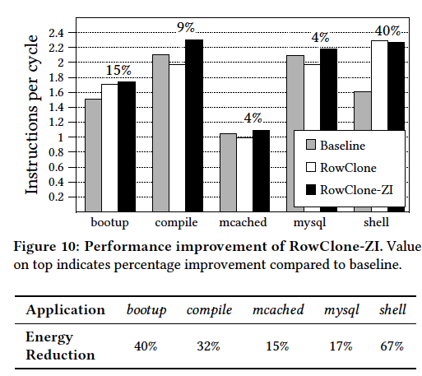
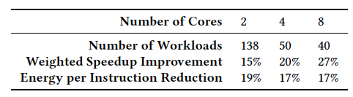
RowClone: Overall Performance

Slide 47
Goal: Ultra-efficient heterogeneous architectures
CPU
core
CPU
core
mini-CPU
core
GPU
(throughput)
core
GPU
(throughput)
core
video
core
GPU
(throughput)
core
GPU
(throughput)
core
CPU
core
CPU
core
Memory
imaging
core
LLC
Specialized
compute-capability
in memory
Memory Controller
Memory Bus
Slide credit: Prof. Kayvon Fatahalian, CMU

Slide 48
Enabling Ultra-efficient (Visual) Search
What is the right partitioning of computation capability?
What is the right low-cost memory substrate?
What memory technologies are the best enablers?
How do we rethink/ease (visual) search algorithms/applications?
Main Memory
Processor
Core
Database (of images)
Cache
Query vector
Memory Bus
Results
Picture credit: Prof. Kayvon Fatahalian, CMU

Slide 49
Tolerating DRAM: Example Techniques
Retention-Aware DRAM Refresh: Reducing Refresh Impact
Tiered-Latency DRAM: Reducing DRAM Latency
RowClone: In-Memory Page Copy and Initialization
Subarray-Level Parallelism: Reducing Bank Conflict Impact

Slide 50
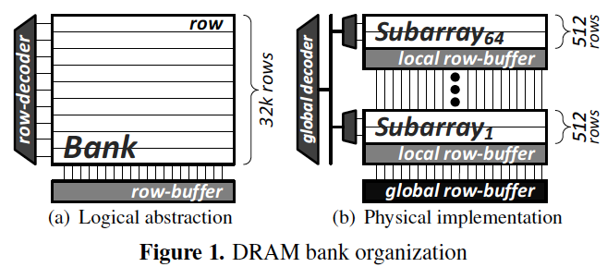
SALP: Reducing DRAM Bank Conflicts
Problem: Bank conflicts are costly for performance and energy
  serialized requests, wasted energy (thrashing of row buffer, busy wait)
Goal: Reduce bank conflicts without adding more banks (low cost)
Key idea: Exploit the internal subarray structure of a DRAM bank to parallelize bank conflicts to different subarrays
  Slightly modify DRAM bank to reduce subarray-level hardware sharing
Results on Server, Stream/Random, SPEC
  19% reduction in dynamic DRAM energy
  13% improvement in row hit rate
  17% performance improvement
  0.15% DRAM area overhead
-19%
+13%
Kim, Seshadri+ “A Case for Exploiting Subarray-Level
Parallelism in DRAM,” ISCA 2012.

Slide 51
Agenda
Major Trends Affecting Main Memory
The DRAM Scaling Problem and Solution Directions
  Tolerating DRAM: New DRAM Architectures
  Enabling Emerging Technologies: Hybrid Memory Systems
How Can We Do Better?
Summary

Slide 52
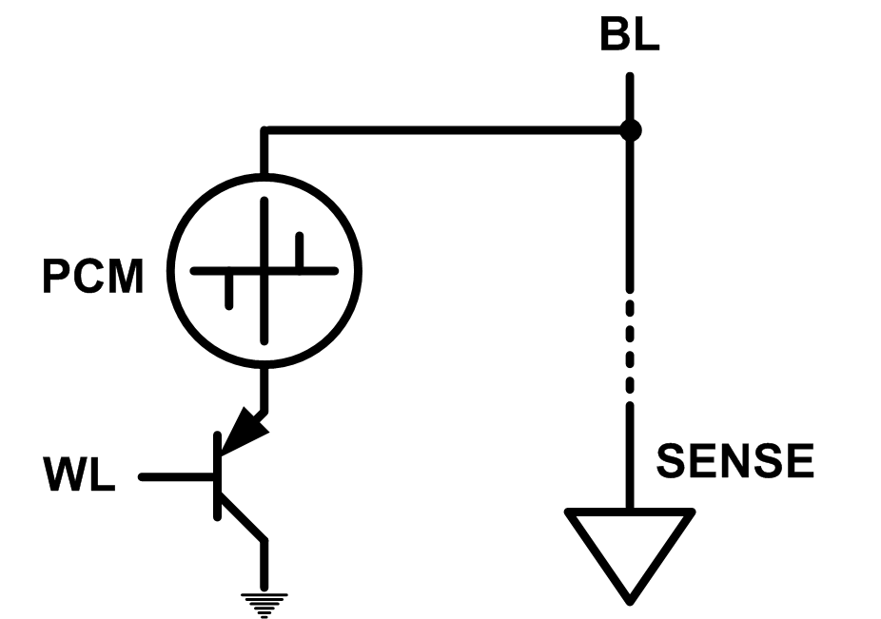
Solution 2: Emerging Memory Technologies
Some emerging resistive memory technologies seem more scalable than DRAM (and they are non-volatile)
Example: Phase Change Memory
  Data stored by changing phase of material
  Data read by detecting material’s resistance
  Expected to scale to 9nm (2022 [ITRS])
  Prototyped at 20nm (Raoux+, IBM JRD 2008)
  Expected to be denser than DRAM: can store multiple bits/cell
But, emerging technologies have (many) shortcomings
  Can they be enabled to replace/augment/surpass DRAM?
Notes:
Even if DRAM continues to scale there could be benefits to examining and enabling these new technologies.

Slide 53
Phase Change Memory: Pros and Cons
Pros over DRAM
  Better technology scaling (capacity and cost)
  Non volatility
  Low idle power (no refresh)
Cons
  Higher latencies: ~4-15x DRAM (especially write)
  Higher active energy: ~2-50x DRAM (especially write)
  Lower endurance (a cell dies after ~10⁸ writes)
Challenges in enabling PCM as DRAM replacement/helper:
  Mitigate PCM shortcomings
  Find the right way to place PCM in the system

Slide 54
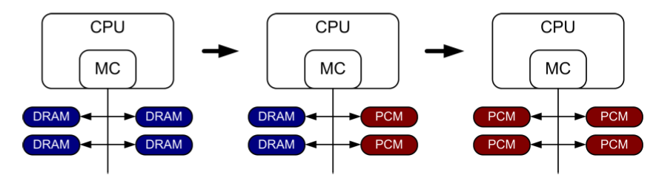
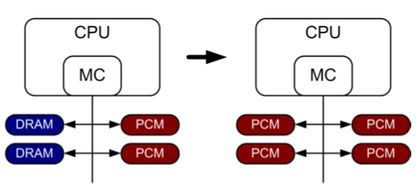
PCM-based Main Memory (I)
How should PCM-based (main) memory be organized?
Hybrid PCM+DRAM [Qureshi+ ISCA’09, Dhiman+ DAC’09]:
  How to partition/migrate data between PCM and DRAM

Slide 55
PCM-based Main Memory (II)
How should PCM-based (main) memory be organized?
Pure PCM main memory [Lee et al., ISCA’09, Top Picks’10]:
  How to redesign entire hierarchy (and cores) to overcome PCM shortcomings

Slide 56
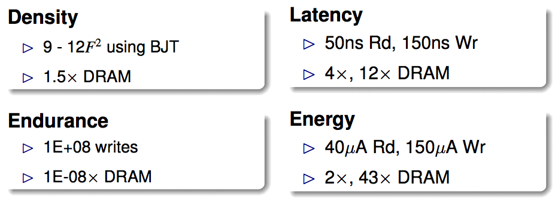
An Initial Study: Replace DRAM with PCM
Lee, Ipek, Mutlu, Burger, “Architecting Phase Change Memory as a Scalable DRAM Alternative,” ISCA 2009.
  Surveyed prototypes from 2003-2008 (e.g. IEDM, VLSI, ISSCC)
  Derived “average” PCM parameters for F=90nm

Slide 57
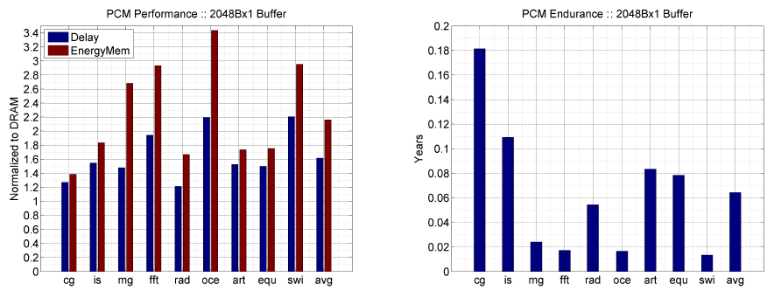
Results: Naïve Replacement of DRAM with PCM
Replace DRAM with PCM in a 4-core, 4MB L2 system
PCM organized the same as DRAM: row buffers, banks, peripherals
1.6x delay, 2.2x energy, 500-hour average lifetime
Lee, Ipek, Mutlu, Burger, “Architecting Phase Change Memory as a Scalable DRAM Alternative,” ISCA 2009.

Slide 58
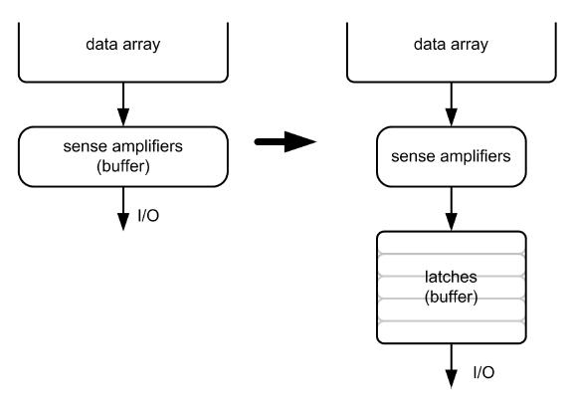
Architecting PCM to Mitigate Shortcomings
Idea 1: Use multiple narrow row buffers in each PCM chip
    → Reduces array reads/writes → better endurance, latency, energy
Idea 2: Write into array at
cache block or word
granularity
→ Reduces unnecessary wear
DRAM
PCM

Slide 59
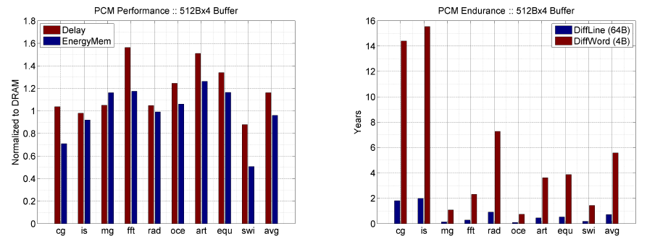
Results: Architected PCM as Main Memory
1.2x delay, 1.0x energy, 5.6-year average lifetime
Scaling improves energy, endurance, density
Caveat 1: Worst-case lifetime is much shorter (no guarantees)
Caveat 2: Intensive applications see large performance and energy hits
Caveat 3: Optimistic PCM parameters?

Slide 60
Hybrid Memory Systems
CPU
Meza+, “Enabling Efficient and Scalable Hybrid Memories,” IEEE Comp. Arch. Letters, 2012.
Yoon, Meza et al., “Row Buffer Locality Aware Caching Policies for Hybrid Memories,” ICCD 2012 Best Paper Award.
DRAMCtrl
PCM Ctrl
DRAM
Phase Change Memory (or Tech. X)
Fast, durable
Small,
leaky, volatile,
high-cost
Large, non-volatile, low-cost
Slow, wears out, high active energy
Hardware/software manage data allocation and movement
to achieve the best of multiple technologies

Slide 61
One Option: DRAM as a Cache for PCM
PCM is main memory; DRAM caches memory rows/blocks
  Benefits: Reduced latency on DRAM cache hit; write filtering
Memory controller hardware manages the DRAM cache
  Benefit: Eliminates system software overhead
Three issues:
  What data should be placed in DRAM versus kept in PCM?
  What is the granularity of data movement?
  How to design a low-cost hardware-managed DRAM cache?
Two solutions:
  Locality-aware data placement [Yoon+ , ICCD 2012]
  Cheap tag stores and dynamic granularity [Meza+, IEEE CAL 2012]

Slide 62
DRAM vs. PCM: An Observation
Row buffers are the same in DRAM and PCM
Row buffer hit latency same in DRAM and PCM
Row buffer miss latency small in DRAM, large in PCM
Accessing the row buffer in PCM is fast
What incurs high latency is the PCM array access → avoid this
CPU
Row buffer
DRAMCtrl
PCM Ctrl
DRAM Cache
PCM Main Memory
Bank
Bank
Bank
Bank
N ns row hit
Fast row miss
N ns row hit
Slow row miss

Slide 63
Row-Locality-Aware Data Placement
Idea: Cache in DRAM only those rows that
  Frequently cause row buffer conflicts → because row-conflict latency is smaller in DRAM
  Are reused many times → to reduce cache pollution and bandwidth waste
Simplified rule of thumb:
  Streaming accesses: Better to place in PCM
  Other accesses (with some reuse): Better to place in DRAM
Yoon et al., “Row Buffer Locality-Aware Data Placement in Hybrid Memories,” ICCD 2012 Best Paper Award.

Slide 64
Row-Locality-Aware Data Placement: Results
10%
14%
17%
Memory energy-efficiency and fairness also improve correspondingly

Slide 65
Hybrid vs. All-PCM/DRAM
29%
31%
31% better performance than all PCM,
within 29% of all DRAM performance
Notes:
Now let’s compare our mechanism to a homogeneous memory system.
Here the comparison points are a 16GB all-PCM and all-DRAM memory system.
Our mechanism achieves 31% better performance than the all-PCM memory system, and comes within 29% of the all-DRAM performance.
Note that we do not assume any capacity benefits of PCM over DRAM.
And yet, our mechanism bridges the performance gap between the two homogeneous memory systems.
If the capacity benefit of PCM was included, the hybrid memory system will perform even better.

Slide 66
Agenda
Major Trends Affecting Main Memory
The DRAM Scaling Problem and Solution Directions
  Tolerating DRAM: New DRAM Architectures
  Enabling Emerging Technologies: Hybrid Memory Systems
How Can We Do Better?
Summary

Slide 67
Principles (So Far)
Better cooperation between devices and the system
  Expose more information about devices to upper layers
  More flexible interfaces
Better-than-worst-case design
  Do not optimize for the worst case
  Worst case should not determine the common case
Heterogeneity in design
  Enables a more efficient design (No one size fits all)

Slide 68
Other Opportunities with Emerging Technologies
Merging of memory and storage
  e.g., a single interface to manage all data
New applications
  e.g., ultra-fast checkpoint and restore
More robust system design
  e.g., reducing data loss
Processing tightly-coupled with memory
  e.g., enabling efficient search and filtering

Slide 69
Coordinated Memory and Storage with NVM (I)
The traditional two-level storage model is a bottleneck with NVM
  Volatile data in memory → a load/store interface
  Persistent data in storage → a file system interface
  Problem: Operating system (OS) and file system (FS) code to locate, translate, buffer data become performance and energy bottlenecks with fast NVM stores
Two-Level Store
Load/Store
fopen, fread, fwrite, …
Virtual memory
Operating system
and file system
Processor
and caches
Address translation
Main Memory
Storage (SSD/HDD)

Slide 70
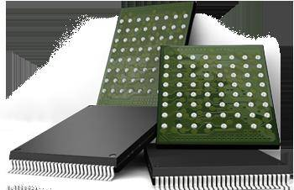
Coordinated Memory and Storage with NVM (II)
Goal: Unify memory and storage management in a single unit to eliminate wasted work to locate, transfer, and translate data
  Improves both energy and performance
  Simplifies programming model as well
Unified Memory/Storage
Persistent Memory
Manager
Processor
and caches
Load/Store
Feedback
Persistent (e.g., Phase-Change) Memory
Meza+, “A Case for Efficient Hardware-Software Cooperative Management of Storage and Memory,” WEED 2013.

Slide 71
Performance Benefits of a Single-Level Store
~5X
Results for PostMark

Slide 72
Energy Benefits of a Single-Level Store
~5X
Results for PostMark

Slide 73
Agenda
Major Trends Affecting Main Memory
The DRAM Scaling Problem and Solution Directions
  Tolerating DRAM: New DRAM Architectures
  Enabling Emerging Technologies: Hybrid Memory Systems
How Can We Do Better?
Summary

Slide 74
Summary: Main Memory Scaling
Main memory scaling problems are a critical bottleneck for system performance, efficiency, and usability
Solution 1: Tolerate DRAM with novel architectures
  RAIDR: Retention-aware refresh
  TL-DRAM: Tiered-Latency DRAM
  RowClone: Fast page copy and initialization
  SALP: Subarray-level parallelism
Solution 2: Enable emerging memory technologies
  Replace DRAM with NVM by architecting NVM chips well
  Hybrid memory systems with automatic data management
  Coordinated management of memory and storage
Software/hardware/device cooperation essential for effective scaling of main memory

Slide 75
More Material: Slides, Papers, Videos
These slides are a very short version of the Scalable Memory Systems course at ACACES 2013
Website for Course Slides, Papers, and Videos
  http://users.ece.cmu.edu/~omutlu/acaces2013-memory.html
  http://users.ece.cmu.edu/~omutlu/projects.htm
  Includes extended lecture notes and readings
Overview Reading
  Onur Mutlu,
  "Memory Scaling: A Systems Architecture Perspective"
  Proceedings of the 5th International Memory Workshop (IMW), Monterey, CA, May 2013. Slides (pptx) (pdf)

Slide 76
Thank you.
Feel free to email me with any feedback
onur@cmu.edu

Slide 77
Memory Scaling:
A Systems Architecture Perspective
Onur Mutlu
onur@cmu.edu
August 6, 2013
MemCon 2013

Slide 78
Backup Slides

Slide 79
Backup Slides Agenda
Building Large DRAM Caches for Hybrid Memories
Memory QoS and Predictable Performance
Subarray-Level Parallelism (SALP) in DRAM
Coordinated Memory and Storage with NVM

Slide 80
Building Large Caches for Hybrid Memories

Slide 81
One Option: DRAM as a Cache for PCM
PCM is main memory; DRAM caches memory rows/blocks
  Benefits: Reduced latency on DRAM cache hit; write filtering
Memory controller hardware manages the DRAM cache
  Benefit: Eliminates system software overhead
Three issues:
  What data should be placed in DRAM versus kept in PCM?
  What is the granularity of data movement?
  How to design a low-cost hardware-managed DRAM cache?
Two ideas:
  Locality-aware data placement [Yoon+ , ICCD 2012]
  Cheap tag stores and dynamic granularity [Meza+, IEEE CAL 2012]

Slide 82
The Problem with Large DRAM Caches
A large DRAM cache requires a large metadata (tag + block-based information) store
How do we design an efficient DRAM cache?
CPU
LOAD X
Metadata:
X → DRAM
Mem
Ctlr
Mem
Ctlr
DRAM
PCM
X
(small, fast cache)
(high capacity)
Access X

Slide 83
Idea 1: Store Tags in Main Memory
Store tags in the same row as data in DRAM
  Data and metadata can be accessed together
Benefit: No on-chip tag storage overhead
Downsides:
  Cache hit determined only after a DRAM access
  Cache hit requires two DRAM accesses
DRAM row
Cache block 0
Cache block 1
Cache block 2
Tag0
Tag1
Tag2

Slide 84
Idea 2: Cache Tags in On-Chip SRAM
Recall Idea 1: Store all metadata in DRAM
  To reduce metadata storage overhead
Idea 2: Cache in on-chip SRAM frequently-accessed metadata
  Cache only a small amount to keep SRAM size small

Slide 85
Idea 3: Dynamic Data Transfer Granularity
Some applications benefit from caching more data
  They have good spatial locality
Others do not
  Large granularity wastes bandwidth and reduces cache utilization
Idea 3: Simple dynamic caching granularity policy
  Cost-benefit analysis to determine best DRAM cache block size
Meza, Chang, Yoon, Mutlu, Ranganathan, “Enabling Efficient and Scalable Hybrid Memories,” IEEE Comp. Arch. Letters, 2012.

Slide 86
TIMBER Performance
-6%
Meza, Chang, Yoon, Mutlu, Ranganathan, “Enabling Efficient and Scalable Hybrid Memories,” IEEE Comp. Arch. Letters, 2012.

Slide 87
TIMBER Energy Efficiency
18%
Meza, Chang, Yoon, Mutlu, Ranganathan, “Enabling Efficient and Scalable Hybrid Memories,” IEEE Comp. Arch. Letters, 2012.

Slide 88
Hybrid Main Memory: Research Topics
Many research topics from technology layer to algorithms layer
Enabling NVM and hybrid memory
  How to maximize performance?
  How to maximize lifetime?
  How to prevent denial of service?
Exploiting emerging tecnologies
  How to exploit non-volatility?
  How to minimize energy consumption?
  How to minimize cost?
  How to exploit NVM on chip?
Problems
Algorithms
Programs
User
Runtime System
(VM, OS, MM)
ISA
Microarchitecture
Logic
Devices

Slide 89
Security Challenges of Emerging Technologies
1. Limited endurance → Wearout attacks
2. Non-volatility → Data persists in memory after powerdown
→ Easy retrieval of privileged or private information
3. Multiple bits per cell → Information leakage (via side channel)

Slide 90
Memory QoS

Slide 91
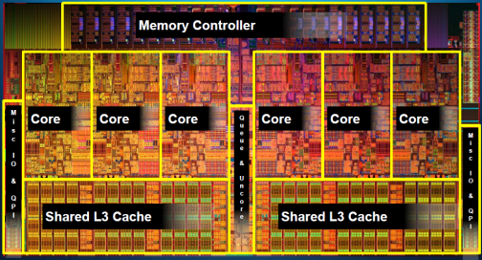
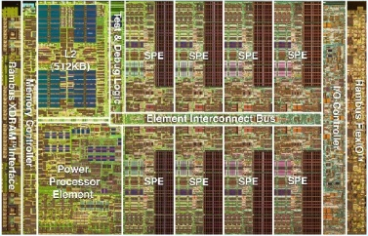
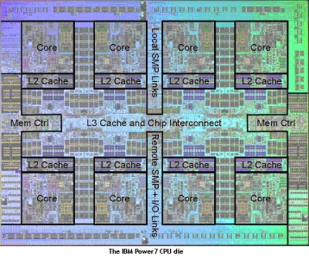
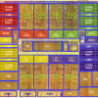
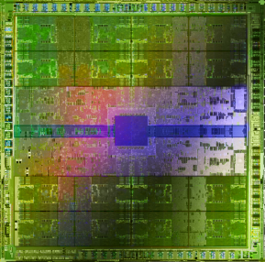
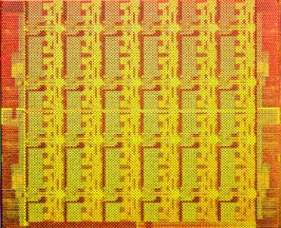
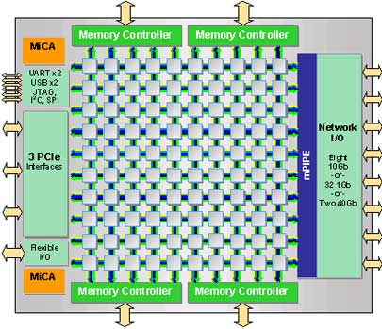
Trend: Many Cores on Chip
Simpler and lower power than a single large core
Large scale parallelism on chip
Intel Core i7
8 cores
IBM Cell BE
8+1 cores
IBM POWER7
8 cores
AMD Barcelona
4 cores
Nvidia Fermi
448 “cores”
Intel SCC
48 cores, networked
Tilera TILE Gx
100 cores, networked
Sun Niagara II
8 cores

Slide 92
Many Cores on Chip
What we want:
  N times the system performance with N times the cores
What do we get today?

Slide 93
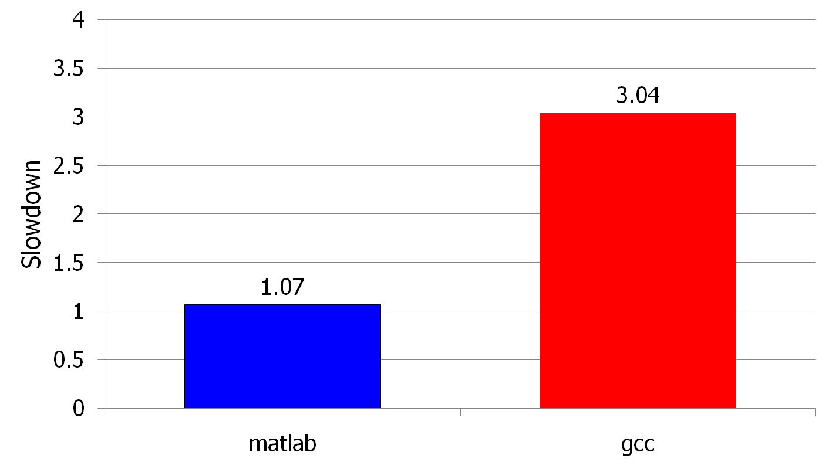
Unfair Slowdowns due to Interference
High priority
Memory Performance Hog
Low priority
matlab
(Core 1)
gcc
(Core 2)
(Core 0)
(Core 1)
Moscibroda and Mutlu, “Memory performance attacks: Denial of memory service
in multi-core systems,” USENIX Security 2007.
Notes:
What kind of performance do we expect when we run two applications on a multi-core system? To answer this question, we performed an experiment. We took two applications we cared about, ran them together on different cores in a dual-core system, and measured their slowdown compared to when each is run alone on the same system. This graph shows the slowdown each app experienced. (DATA explanation…)
Why do we get such a large disparity in the slowdowns?
Is it the priorities? No. We went back and gave high priority to gcc and low priority to matlab. The slowdowns did not change at all. Neither the software or the hardware enforced the priorities.
Is it the contention in the disk? We checked for this possibility, but found that these applications did not have any disk accesses in the steady state. They both fit in the physical memory and therefore did not interfere in the disk.
What is it then? Why do we get such large disparity in slowdowns in a dual core system?
I will call such an application a “memory performance hog”
Now, let me tell you why this disparity in slowdowns happens.
Is it that there are other applications or the OS interfering with gcc, stealing its time quantums? No.

Slide 94
Uncontrolled Interference: An Example
CORE 1
gcc
Multi-Core
Chip
matlab
CORE 2
L2
CACHE
L2
CACHE
unfairness
INTERCONNECT
Shared DRAM
Memory System
DRAM MEMORY CONTROLLER
DRAM
Bank 0
DRAM
Bank 1
DRAM
Bank 2
DRAM
Bank 3
Notes:
-In a multi-core chip, different cores share some hardware resources. In particular, they share the DRAM memory system. The shared memory system consists of this and that.
When we run matlab on one core, and gcc on another core, both cores generate memory requests to access the DRAM banks. When these requests arrive at the DRAM controller, the controller favors matlab’s requests over gcc’s requests. As a result, matlab can make progress and continues generating memory requests. These requests are again favored by the DRAM controller over gcc’s requests. Therefore, gcc starves waiting for its requests to be serviced in DRAM whereas matlab makes very quick progress as if it were running alone.
Why does this happen? This is because the algorithms employed by the DRAM controller are unfair.
But, why are these algorithms unfair? Why do they unfairly prioritize matlab accesses?
To understand this, we need to understand how a DRAM bank operates.
Almost all systems today contain multi-core chips
Multi-core systems consist of multiple on-chip cores and caches
Cores share the DRAM memory system
DRAM memory system consists of
DRAM banks that store data (multiple banks to allow parallel accesses)
DRAM memory controller that mediates between cores and DRAM memory
It schedules memory operations generated by cores to DRAM
This talk is about exploiting the unfair algorithms in the memory controllers to perform denial of service to running threads
To understand how this happens, we need to know about how each DRAM bank operates

Slide 95
A Memory Performance Hog
// initialize large arrays A, B
for (j=0; j<N; j++) {
index = j*linesize;
A[index] = B[index];
…
}
// initialize large arrays A, B
for (j=0; j<N; j++) {
index = rand();
A[index] = B[index];
…
}
streaming
random
STREAM
RANDOM
Sequential memory access
Very high row buffer locality (96% hit rate)
Memory intensive
Random memory access
Very low row buffer locality (3% hit rate)
Similarly memory intensive
Moscibroda and Mutlu, “Memory Performance Attacks,” USENIX Security 2007.
Notes:
Streaming through memory by performing operations on two 1D arrays.
Sequential memory access
Each access is a cache miss (elements of array larger than a cache line size) → hence, very memory intensive
Link to the real code…

Slide 96
What Does the Memory Hog Do?
Row decoder
T0: Row 0
T0: Row 0
T0: Row 0
T0: Row 0
T0: Row 0
T0: Row 0
T0: Row 0
T1: Row 5
T1: Row 111
T0: Row 0
T1: Row 16
T0: Row 0
Memory Request Buffer
Row 0
Row Buffer
Row 0
Column mux
Row size: 8KB, cache block size: 64B
128 (8KB/64B) requests of T0 serviced before T1
T0: STREAM
T1: RANDOM
Data
Moscibroda and Mutlu, “Memory Performance Attacks,” USENIX Security 2007.
Notes:
Pictorially demonstrate how stream denies memory service to rdarray
Stream continuously accesses columns in row 0 in a streaming manner (streams through a row after opening it)
In other words almost all its requests are row-hits
RDarray’s requests are row-conflicts (no locality)
The DRAM controller reorders streams requests to the open row over other requests (even older ones) to maximize DRAM throughput
Hence, rdarray’s requests do not get serviced as long as stream is issuing requests at a fast-enough rate
In this example, the red thread’s request to another row will not get serviced until stream stops issuing a request to row 0
With those parameters, 128 requests of stream would be serviced before 1 from rdarray
As row-buffer size increases, which is the industry trend, this problem will become more severe
This is not the worst case, but it is easy to construct and understand
Stream falls off the row buffer at some point
I leave it to the listeners to construct a case worse than this (it is possible)

Slide 97
Effect of the Memory Performance Hog
2.82X slowdown
Slowdown
1.18X slowdown
Results on Intel Pentium D running Windows XP
(Similar results for Intel Core Duo and AMD Turion, and on Fedora Linux)
Moscibroda and Mutlu, “Memory Performance Attacks,” USENIX Security 2007.
Notes:
RANDOM was given higher OS priority in the experiments

Slide 98
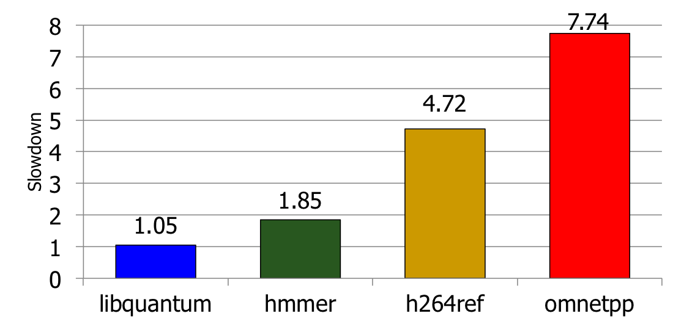
Greater Problem with More Cores
Vulnerable to denial of service (DoS)
Unable to enforce priorities or SLAs
Low system performance
Uncontrollable, unpredictable system

Slide 99
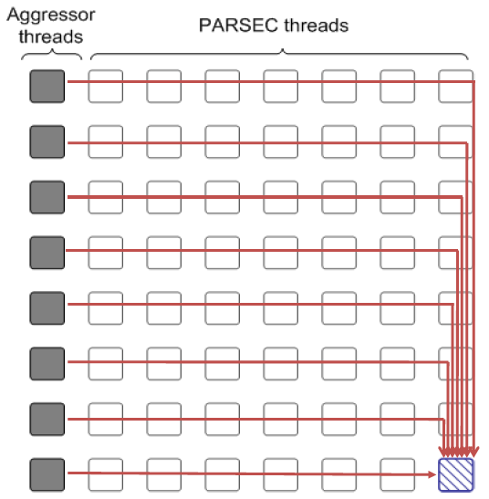
Distributed DoS in Networked Multi-Core Systems
Attackers
(Cores 1-8)
Stock option pricing application
(Cores 9-64)
Cores connected via
packet-switched
routers on chip
~5000X slowdown
Grot, Hestness, Keckler, Mutlu,
“Preemptive virtual clock: A Flexible,
Efficient, and Cost-effective QOS
Scheme for Networks-on-Chip,“
MICRO 2009.

Slide 100
How Do We Solve The Problem?
Inter-thread interference is uncontrolled in all memory resources
  Memory controller
  Interconnect
  Caches
We need to control it
  i.e., design an interference-aware (QoS-aware) memory system

Slide 101
QoS-Aware Memory Systems: Challenges
How do we reduce inter-thread interference?
  Improve system performance and core utilization
  Reduce request serialization and core starvation
How do we control inter-thread interference?
  Provide mechanisms to enable system software to enforce QoS policies
  While providing high system performance
How do we make the memory system configurable/flexible?
  Enable flexible mechanisms that can achieve many goals
    Provide fairness or throughput when needed
    Satisfy performance guarantees when needed

Slide 102
Designing QoS-Aware Memory Systems: Approaches
Smart resources: Design each shared resource to have a configurable interference control/reduction mechanism
  QoS-aware memory controllers [Mutlu+ MICRO’07] [Moscibroda+, Usenix Security’07] [Mutlu+ ISCA’08, Top Picks’09] [Kim+ HPCA’10] [Kim+ MICRO’10, Top Picks’11] [Ebrahimi+ ISCA’11, MICRO’11] [Ausavarungnirun+, ISCA’12]
  QoS-aware interconnects [Das+ MICRO’09, ISCA’10, Top Picks ’11] [Grot+ MICRO’09, ISCA’11, Top Picks ’12]
  QoS-aware caches
Dumb resources: Keep each resource free-for-all, but reduce/control interference by injection control or data mapping
  Source throttling to control access to memory system [Ebrahimi+ ASPLOS’10, ISCA’11, TOCS’12] [Ebrahimi+ MICRO’09] [Nychis+ HotNets’10]
  QoS-aware data mapping to memory controllers [Muralidhara+ MICRO’11]
  QoS-aware thread scheduling to cores

Slide 103
A Mechanism to Reduce Memory Interference
Memory Channel Partitioning
  Idea: System software maps badly-interfering applications’ pages to different channels [Muralidhara+, MICRO’11]
Separate data of low/high intensity and low/high row-locality applications
Especially effective in reducing interference of threads with “medium” and “heavy” memory intensity
  11% higher performance over existing systems (200 workloads)
Time Units
Time Units
Channel 0
Channel 0
5
4
3
2
1
5
4
3
2
1
Bank 0
Bank 0
Core 0
App A
Core 0
App A
Bank 1
Bank 1
Bank 0
Core 1
App B
Bank 0
Core 1
App B
Bank 1
Bank 1
Channel 1
Channel 1
Conventional Page Mapping
Channel Partitioning

Slide 104
Designing QoS-Aware Memory Systems: Approaches
Smart resources: Design each shared resource to have a configurable interference control/reduction mechanism
  QoS-aware memory controllers [Mutlu+ MICRO’07] [Moscibroda+, Usenix Security’07] [Mutlu+ ISCA’08, Top Picks’09] [Kim+ HPCA’10] [Kim+ MICRO’10, Top Picks’11] [Ebrahimi+ ISCA’11, MICRO’11] [Ausavarungnirun+, ISCA’12][Subramanian+, HPCA’13]
  QoS-aware interconnects [Das+ MICRO’09, ISCA’10, Top Picks ’11] [Grot+ MICRO’09, ISCA’11, Top Picks ’12]
  QoS-aware caches
Dumb resources: Keep each resource free-for-all, but reduce/control interference by injection control or data mapping
  Source throttling to control access to memory system [Ebrahimi+ ASPLOS’10, ISCA’11, TOCS’12] [Ebrahimi+ MICRO’09] [Nychis+ HotNets’10] [Nychis+ SIGCOMM’12]
  QoS-aware data mapping to memory controllers [Muralidhara+ MICRO’11]
  QoS-aware thread scheduling to cores [Das+ HPCA’13]

Slide 105
QoS-Aware Memory Scheduling
Resolves memory contention by scheduling requests
How to schedule requests to provide
  High system performance
  High fairness to applications
  Configurability to system software
Memory controller needs to be aware of threads
Core
Core
Memory Controller
Memory
Core
Core

Slide 106
QoS-Aware Memory Scheduling: Evolution
Stall-time fair memory scheduling [Mutlu+ MICRO’07]
  Idea: Estimate and balance thread slowdowns
  Takeaway: Proportional thread progress improves performance, especially when threads are “heavy” (memory intensive)
Parallelism-aware batch scheduling [Mutlu+ ISCA’08, Top Picks’09]
  Idea: Rank threads and service in rank order (to preserve bank parallelism); batch requests to prevent starvation
  Takeaway: Preserving within-thread bank-parallelism improves performance; request batching improves fairness
ATLAS memory scheduler [Kim+ HPCA’10]
  Idea: Prioritize threads that have attained the least service from the memory scheduler
  Takeaway: Prioritizing “light” threads improves performance

Slide 107
Throughput vs. Fairness
Throughput biased approach
Fairness biased approach
  Prioritize less memory-intensive threads
  Take turns accessing memory
  Good for throughput
  Does not starve
thread A
less memory
intensive
thread B
higher
priority
thread C
thread A
thread B
thread C
not prioritized ➔
reduced throughput
starvation ➔ unfairness
Single policy for all threads is insufficient
Notes:
So why do previous algorithms fail?
On the one hand there is the throughput biased approach that prioritizes less memory-intensive threads.
Servicing memory requests from such threads allow them to make progress in the processor, increasing throughput.
However, the most memory-intensive thread, thread C, remains persistently deprioritized and and becomes prone to starvation causing large slowdowns and, ultimately, unfairness.
On the other hand there is the fairness biased approach where threads take turns accessing the memory.
In this case, the most memory-intensive thread does not starve.
However, the least memory-intensive thread, thread A, is not prioritized, leading to reduced throughput.
As you can see, a single policy applied to all threads is insufficient since different threads have different memory access needs.

Slide 108

Achieving the Best of Both Worlds
higher
priority
For Throughput
  Prioritize memory-non-intensive threads
thread
thread
thread
For Fairness
thread
  Unfairness caused by memory-intensive being prioritized over each other
    Shuffle thread ranking
  Memory-intensive threads have
  different vulnerability to interference
    Shuffle asymmetrically
thread
thread
thread
thread
thread
thread
thread
thread
Notes:
So how do we achieve the best of both worlds? Our algorithm is based on the following insights:
First, we would like to prioritize the memory-non-intensive threads to increase system throughput.
Doing so does not degrade unfairness, since memory-non-intensive threads are inherently “light” and rarely cause interference for the memory-intensive threads.
For fairness, we discovered that unfairness is usually caused when one memory-intensive thread is prioritized over another.
As we’ve seen, the most deprioritized thread can starve.
To address this problem, we would like to shuffle their priority so that no single thread is persistently prioritized over another thread.
However, memory-intensive threads are not created equal.
They have different vulnerability to memory interference.
To address their differences, shuffling should be performed in an asymmetric manner.

Slide 109
Thread Cluster Memory Scheduling [Kim+ MICRO’10]
Group threads into two clusters
Prioritize non-intensive cluster
Different policies for each cluster
higher
priority
Memory-non-intensive
Non-intensive
cluster
thread
Throughput
thread
thread
thread
thread
thread
Prioritized
higher
priority
thread
thread
thread
thread
Threads in the system
Memory-intensive
Intensive cluster
Fairness
Kim+, “Thread Cluster Memory Scheduling,” MICRO 2010.
Notes:
Our algorithm, Thread Cluster Memory Scheduling, first groups threads into two clusters.
Among the threads executing in the system, some are memory-non-intensive whereas some are memory-intensive.
We isolate the memory-non-intensive threads into the non-intensive cluster and the memory-intensive threads into the intensive cluster.
This is so that we can apply different policies for different threads.
Subsequently, we prioritize the non-intensive cluster over the intensive cluster since the non-intensive threads have greater potential for making progress IN THEIR CORES [ONUR].
Finally, we apply different policies within each cluster, one optimized for throughput and the other for fairness.

Slide 110
TCM: Quantum-Based Operation
Previous quantum (~1M cycles)
Current quantum
(~1M cycles)
Time
Shuffle interval
(~1K cycles)
During quantum:
Monitor thread behavior
Memory intensity
Bank-level parallelism
Row-buffer locality
Beginning of quantum:
Perform clustering
Compute niceness of intensive threads
Kim+, “Thread Cluster Memory Scheduling,” MICRO 2010.
Notes:
Clustering is performed at regular time intervals called quanta.
THIS IS DONE [ONUR] to account for phase changes in threads’ memory access behavior.
During A [ONUR] quantum, TCM monitors each thread’s memory access behavior:
memory intensity, bank-level parallelism, and row-buffer locality.
At the beginning of the next quantum, TCM is invoked to perform clustering and calculate niceness for the intensive threads.
Throughout the quantum, shuffling of the intensive threads is performed periodically.

Slide 111
TCM: Throughput and Fairness
24 cores, 4 memory controllers, 96 workloads
Better fairness
Better system throughput
TCM, a heterogeneous scheduling policy,
provides best fairness and system throughput
Notes:
This figure shows the performance of the four previous scheduling algorithms in addition to TCM, averaged over 96 workloads.
FRFCFS has low system throughput and fairness.
STFM and PAR-BS is biased towards fairness, while ATLAS is biased towards system throughput.
TCM lies towards the lower right part of the figure and provides the best fairness and system throughput.
Compared to ATLAS, TCM provides approx 5% better throughput and 39% better fairness.
Compared to PAR-BS, TCM provides approx 5% better fairness and 8% better throughput.

Slide 112
TCM: Fairness-Throughput Tradeoff
When configuration parameter is varied…
Better fairness
FRFCFS
STFM
Better system throughput
ATLAS
PAR-BS
TCM
Adjusting ClusterThreshold
TCM allows robust fairness-throughput tradeoff

Slide 113
More on TCM
Yoongu Kim, Michael Papamichael, Onur Mutlu, and Mor Harchol-Balter,
"Thread Cluster Memory Scheduling: Exploiting Differences in Memory Access Behavior"
Proceedings of the 43rd International Symposium on Microarchitecture (MICRO), pages 65-76, Atlanta, GA, December 2010. Slides (pptx) (pdf)

Slide 114
Memory Control in CPU-GPU Systems
Observation: Heterogeneous CPU-GPU systems require memory schedulers with large request buffers
Problem: Existing monolithic application-aware memory scheduler designs are hard to scale to large request buffer sizes
Solution: Staged Memory Scheduling (SMS)
  decomposes the memory controller into three simple stages:
  1) Batch formation: maintains row buffer locality
  2) Batch scheduler: reduces interference between applications
  3) DRAM command scheduler: issues requests to DRAM
Compared to state-of-the-art memory schedulers:
  SMS is significantly simpler and more scalable
  SMS provides higher performance and fairness
Ausavarungnirun+, “Staged Memory Scheduling,” ISCA 2012.
Notes:
We observe that Heterogeneous CPU-GPU systems require memory schedulers with large request buffers and this becomes a problem for existing monolithic application-aware memory scheduler designs because they are hard to scale to large request buffer size
Our Solution, staged memory scheduling, decomposes MC into three simpler stages:
1) Batch formation: maintains row buffer locality by forming batches of row-hitting requests.
2) Batch scheduler: reduces interference between applications by picking the next batch to prioritize.
3) DRAM command scheduler: issues requests to DRAM
Compared to state-of-the-art memory schedulers:
SMS is significantly simpler and more scalable
SMS provides higher performance and fairness, especially in heterogeneous CPU-GPU systems.

Slide 115
Key Idea: Decouple Tasks into Stages
Idea: Decouple the functional tasks of the memory controller
  Partition tasks across several simpler HW structures (stages)
1) Maximize row buffer hits
  Stage 1: Batch formation
  Within each application, groups requests to the same row into batches
2) Manage contention between applications
  Stage 2: Batch scheduler
  Schedules batches from different applications
3) Satisfy DRAM timing constraints
  Stage 3: DRAM command scheduler
  Issues requests from the already-scheduled order to each bank
Notes:
Our key idea is to decouple these functional tasks <click> into different stages.
<click>
We partition these three <click> tasks across several simpler hardware structures, which we call stages.
<click>
Stage 1 is the batch formation. This stage maximizes row buffer hits by grouping requests that access the same row within each application into batches
<click>
Stage 2 is the batch scheduler. This stage manages contention by scheduling batches from different applications
<click>
And stage 3 is the DRAM command scheduler. This stage issues requests from an already scheduled order and make sure that it satisfy DRAM timing constraints
<click … transition>
With these key observations, we will show how we can decouple a monolithic schedulers into a simpler design through …

Slide 116
SMS: Staged Memory Scheduling
Core 1
Core 2
Core 3
Core 4
GPU
Stage 1
Req
Req
Req
Req
Req
Req
Req
Req
Batch Formation
Req
Req
Req
Req
Req
Req
Req
Req
Req
Req
Req
Req
Req
Req
Req
Req
Req
Req
Req
Req
Req
Req
Req
Req
Stage 2
Batch Scheduler
Monolithic Scheduler
Req
Req
Req
Req
Req
Req
Req
Req
Req
Req
Req
Memory Scheduler
Stage 3
DRAM Command Scheduler
Bank 1
Bank 2
Bank 3
Bank 4
To DRAM
Notes:
With these key observations, we will show how we can decouple a monolithic schedulers into a simpler design through <click> stage 1, the batch formation, <click> stage 2, the batch scheduler, <click> stage 3, the DRAM command scheduler

Slide 117
SMS: Staged Memory Scheduling
Core 1
Core 2
Core 3
Core 4
GPU
Stage 1
Batch Formation
Stage 2
Batch Scheduler
Req
Req
Stage 3
DRAM Command Scheduler
Bank 1
Bank 2
Bank 3
Bank 4
To DRAM
Notes:
Now, let me explain how the batch formation works …

Slide 118
  SMS: Staged Memory Scheduling
Core 1
Core 2
Core 3
Core 4
GPU
Stage 1:
Batch
Formation
Stage 2:
Batch Scheduler
Current Batch Scheduling Policy
RR
Current Batch Scheduling Policy
SJF
Stage 3: DRAM Command Scheduler
Bank 1
Bank 2
Bank 3
Bank 4
Ausavarungnirun+, “Staged Memory Scheduling,” ISCA 2012.
Notes:
In this example, the system consist of 4 CPU cores and a GPU, and the color represent a row the request wants to access. Similar color means these requests want to access the same row.
In the batch formation stage, memory requests that access the same row will be batched.
<click>
One criteria that a batch becomes ready to be scheduled is when the next request is going to a different row, as illustrated in this example at core 2 and core 3. <click click>
Another criteria is when the timeout for the batch formation expires.
This batching process will happen across all cores including the GPU
<click>
<click> and how the batch scheduler will select one of these front batch to send to <click> the DRAM command scheduler.
The scheduler can either use a shortest job poilcy
<click> which will pick this purple request because it is from an application with the fewest number of requests.
Or a round-robin policy
<click>
Whenever the bank is ready to schedule a next request. DRAM command scheduler will schedule the requests in an in-order manner.
<click>
Now that I told you about how SMS works, let me tell you about the complexity of SMS
<click … transition>

Slide 119
SMS Complexity
Compared to a row hit first scheduler, SMS consumes*
  66% less area
  46% less static power
Reduction comes from:
  Monolithic scheduler → stages of simpler schedulers
  Each stage has a simpler scheduler (considers fewer properties at a time to make the scheduling decision)
  Each stage has simpler buffers (FIFO instead of out-of-order)
  Each stage has a portion of the total buffer size (buffering is distributed across stages)
* Based on a Verilog model using 180nm library
Notes:
<transition from the previous slide>
Now that I told you about how SMS works, let me tell you about the complexity of SMS.
Compared to a row hit first scheduler, which is the one of the simplest memory scheduling algorithm that has been proposed, SMS consumes 66% less area and 46% less static power
The reduction in area and static power comes from:
Decoupling the monolithic scheduler into stages of simpler schedulers
Each stage has simpler scheduler, which considers fewer properties at a time to make the scheduling decision
Each stage has simpler buffers, which is a FIFO instead of out-of-order buffers
Each stage has a portion of the total buffer size and buffering is distributed across stages

Slide 120
SMS Performance
Best Previous
Scheduler
ATLAS
TCM
FR-FCFS
Notes:
In this plot, we show the performance of SMS, compared to the best performing scheduler. Note that the best previous algorithm is different for different weights. We vary the GPU weight of 0.001 to 1000. The Y-Axis shows the system performance measured by dividing the CPU-GPU weighted speedup by the total weight to make sure it is bound between 0 and 1.

Slide 121
SMS Performance
At every GPU weight, SMS outperforms the best previous scheduling algorithm for that weight
Best Previous
Scheduler
SMS
Notes:
We found that at every GPU weight, we can configure the probablity of using shortest job first batch scheduling policy such that SMS outperforms the best previous mechanism for that weight

Slide 122
CPU-GPU Performance Tradeoff
Notes:
CPU performs better with high SJF probability
GPU performs better with low SJF probability
[Say: summarize the other key results in the paper]

Slide 123
More on SMS
Rachata Ausavarungnirun, Kevin Chang, Lavanya Subramanian, Gabriel Loh, and Onur Mutlu,
"Staged Memory Scheduling: Achieving High Performance and Scalability in Heterogeneous Systems"
Proceedings of the 39th International Symposium on Computer Architecture (ISCA), Portland, OR, June 2012. Slides (pptx)

Slide 124
Stronger Memory Service Guarantees [HPCA’13]
Uncontrolled memory interference slows down applications unpredictably
Goal: Estimate and control slowdowns
MISE: An accurate slowdown estimation model
  Request Service Rate is a good proxy for performance
    Slowdown = Request Service Rate _{Alone} / Request Service Rate _{Shared}
  Request Service Rate _{Alone} estimated by giving an application highest priority in accessing memory
  Average slowdown estimation error of MISE: 8.2% (3000 data pts)
Memory controller leverages MISE to control slowdowns
  To provide soft slowdown guarantees
  To minimize maximum slowdown
Subramanian+, “MISE,” HPCA 2013.

Slide 125
More on MISE
Lavanya Subramanian, Vivek Seshadri, Yoongu Kim, Ben Jaiyen, and Onur Mutlu,
"MISE: Providing Performance Predictability and Improving Fairness in Shared Main Memory Systems"
Proceedings of the 19th International Symposium on High-Performance Computer Architecture (HPCA), Shenzhen, China, February 2013. Slides (pptx)

Slide 126
Memory QoS in a Parallel Application
Threads in a multithreaded application are inter-dependent
Some threads can be on the critical path of execution due to synchronization; some threads are not
How do we schedule requests of inter-dependent threads to maximize multithreaded application performance?
  Idea: Estimate limiter threads likely to be on the critical path and prioritize their requests; shuffle priorities of non-limiter threads to reduce memory interference among them [Ebrahimi+, MICRO’11]
  Hardware/software cooperative limiter thread estimation:
    Thread executing the most contended critical section
    Thread that is falling behind the most in a parallel for loop
Ebrahimi+, “Parallel Application Memory Scheduling,” MICRO 2011.

Slide 127
More on PAMS
Eiman Ebrahimi, Rustam Miftakhutdinov, Chris Fallin, Chang Joo Lee, Onur Mutlu, and Yale N. Patt,
"Parallel Application Memory Scheduling"
Proceedings of the 44th International Symposium on Microarchitecture (MICRO), Porto Alegre, Brazil, December 2011. Slides (pptx)

Slide 128
Summary: Memory QoS Approaches and Techniques
Approaches: Smart vs. dumb resources
  Smart resources: QoS-aware memory scheduling
  Dumb resources: Source throttling; channel partitioning
  Both approaches are effective in reducing interference
  No single best approach for all workloads
Techniques: Request scheduling, source throttling, memory partitioning
  All approaches are effective in reducing interference
  Can be applied at different levels: hardware vs. software
  No single best technique for all workloads
Combined approaches and techniques are the most powerful
  Integrated Memory Channel Partitioning and Scheduling [MICRO’11]

Slide 129
SALP: Reducing DRAM Bank Conflict Impact
Kim, Seshadri, Lee, Liu, Mutlu
A Case for Exploiting Subarray-Level Parallelism (SALP) in DRAM
ISCA 2012.

Slide 130
SALP: Reducing DRAM Bank Conflicts
Problem: Bank conflicts are costly for performance and energy
  serialized requests, wasted energy (thrashing of row buffer, busy wait)
Goal: Reduce bank conflicts without adding more banks (low cost)
Key idea: Exploit the internal subarray structure of a DRAM bank to parallelize bank conflicts to different subarrays
  Slightly modify DRAM bank to reduce subarray-level hardware sharing
-19%
+13%
Kim, Seshadri+ “A Case for Exploiting Subarray-Level
Parallelism in DRAM,” ISCA 2012.

Slide 131
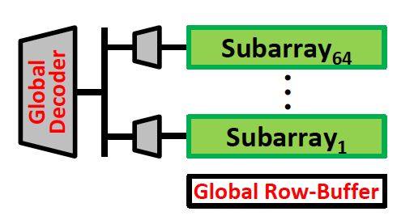
SALP: Key Ideas
A DRAM bank consists of mostly-independent subarrays
  Subarrays share some global structures to reduce cost
Key Idea of SALP: Minimally reduce sharing of global structures
Reduce the sharing of …
Global decoder → Enables pipelined access to subarrays
Global row buffer → Utilizes multiple local row buffers

Slide 132
SALP: Reduce Sharing of Global Decoder
Instead of a global latch, have per-subarray latches
Local
row-buffer
Global Decoder
···
Latch
Latch
Latch
Local
row-buffer
Global
row-buffer

Slide 133
SALP: Reduce Sharing of Global Row-Buffer
Selectively connect local row-buffers to global row-buffer using a Designated single-bit latch
Global bitlines
Local
row-buffer
D
D
Switch
Wire
Local
row-buffer
D
D
Switch
READ
READ
Global
row-buffer

Slide 134
SALP: Baseline Bank Organization
Global
bitlines
Local
row-buffer
Global Decoder
Latch
Local
row-buffer
Global
row-buffer

Slide 135
SALP: Proposed Bank Organization
Global
bitlines
Latch
Local
row-buffer
D
Global Decoder
Latch
Local
row-buffer
D
Overhead of SALP in DRAM chip: 0.15%
1. Global latch → per-subarray local latches
2. Designated bit latches and wire to selectively enable a subarray
Global
row-buffer

Slide 136
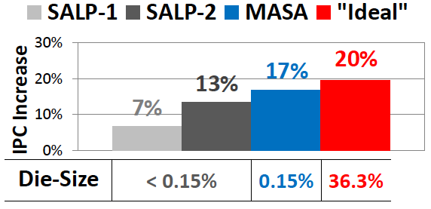
SALP: Results
Wide variety of systems with different #channels, banks, ranks, subarrays
Server, streaming, random-access, SPEC workloads
Dynamic DRAM energy reduction: 19%
  DRAM row hit rate improvement: 13%
System performance improvement: 17%
  Within 3% of ideal (all independent banks)
DRAM die area overhead: 0.15%
  vs. 36% overhead of independent banks

Slide 137
More on SALP
Yoongu Kim, Vivek Seshadri, Donghyuk Lee, Jamie Liu, and Onur Mutlu,
"A Case for Exploiting Subarray-Level Parallelism (SALP) in DRAM"
Proceedings of the 39th International Symposium on Computer Architecture (ISCA), Portland, OR, June 2012. Slides (pptx)

Slide 138
Coordinated Memory and Storage with NVM
Meza, Luo, Khan, Zhao, Xie, and Mutlu,
"A Case for Efficient Hardware-Software Cooperative Management of Storage and Memory”
WEED 2013.

Slide 139
Overview
Traditional systems have a two-level storage model
  Access volatile data in memory with a load/store interface
  Access persistent data in storage with a file system interface
  Problem: Operating system (OS) and file system (FS) code and buffering for storage lead to energy and performance inefficiencies
Opportunity: New non-volatile memory (NVM) technologies can help provide fast (similar to DRAM), persistent storage (similar to Flash)
  Unfortunately, OS and FS code can easily become energy efficiency and performance bottlenecks if we keep the traditional storage model
This work: makes a case for hardware/software cooperative management of storage and memory within a single-level
  We describe the idea of a Persistent Memory Manager (PMM) for efficiently coordinating storage and memory, and quantify its benefit
  And, examine questions and challenges to address to realize PMM

Slide 140
A Tale of Two Storage Levels
Two-level storage arose in systems due to the widely different access latencies and methods of the commodity storage devices
  Fast, low capacity, volatile DRAM → working storage
  Slow, high capacity, non-volatile hard disk drives → persistent storage
Data from slow storage media is buffered in fast DRAM
  After that it can be manipulated by programs → programs cannot directly access persistent storage
  It is the programmer’s job to translate this data between the two formats of the two-level storage (files and data structures)
Locating, transferring, and translating data and formats between the two levels of storage can waste significant energy and performance

Slide 141
Opportunity: New Non-Volatile Memories
Emerging memory technologies provide the potential for unifying storage and memory (e.g., Phase-Change, STT-RAM, RRAM)
  Byte-addressable (can be accessed like DRAM)
  Low latency (comparable to DRAM)
  Low power (idle power better than DRAM)
  High capacity (closer to Flash)
  Non-volatile (can enable persistent storage)
  May have limited endurance (but, better than Flash)
Can provide fast access to both volatile data and persistent storage
Question: if such devices are used, is it efficient to keep a two-level storage model?

Slide 142
Eliminating Traditional Storage Bottlenecks
Today (DRAM + HDD) and two-level storage model
Replace HDD with NVM (PCM-like), keep two-level storage model
Replace HDD and DRAM with NVM (PCM-like), eliminate all OS+FS overhead
Results for PostMark
Notes:
On the x axis are three system designs that we will look at throughout this talk.
The system on the left is a traditional HDD Baseline system that uses DRAM for volatile memory and an HDD for storage and all of the levels of operating system and file system code and buffering required to access persistent data.
The system in the middle is an NVM Baseline system that simply replaces the HDD for NVM – and doesn’t change anything else.
The system on the right is equipped with a Persistent Memory composed entirely of NVM. It manages the placement and location of data using hardware and software and does not execute any OS or FS code to access persistent data.
On the y axis is the fraction of total energy consumed by these systems normalized to the HDD baseline and averaged across the workloads we will later evaluate. As we can see, simply switching the HDD for NVM can greatly reduce total system energy consumption, as is expected from future systems employing such technology. But what is less obvious is how much energy can be reduced by switching from the traditional two-level storage model of the NVM Baseline to the single-level storage model of the Persistent Memory. As we can see, the energy savings can be quite drastic: reducing energy by around 80% on average.
Let’s take a look at where these energy savings come from.

Slide 143
Where is Energy Spent in Each Model?
HDD access
wastes energy
No FS/OS overhead
No additional buffering overhead in DRAM
Additional DRAM energy due to buffering overhead of two-level model
FS/OS overhead becomes important
Results for PostMark
Notes:
This figure shows the same systems as before, but breaks down how the they consume energy among several different categories:
User CPU – on the bottom – is the amount of energy consumed by the process executing code on the CPU.
Syscall CPU is the amount of energy consumed to execute the operating system and file system on the program’s behalf on the CPU. Notice that the Persistent Memory system does not consume energy in this category because it does away with OS and FS code for persistent data.
DRAM, NVM, and HDD are the amounts of energy consumed to access and operate each of those devices.
What we can see from this graph is that while the energy spent handling persistent data in the traditional HDD Baseline system is dwarfed by the energy of accessing its devices, in the NVM Baseline system – by just switching the HDD with NVM – the energy consumed to manage persistent data in the traditional way begins to emerge as a significant bottleneck. By eliminating this source of inefficiency in the Persistent Memory system, however, we can improve energy (and as we will later see, performance as well).

Slide 144
Our Proposal: Coordinated HW/SW Memory and Storage Management
Goal: Unify memory and storage to eliminate wasted work to locate, transfer, and translate data
  Improve both energy and performance
  Simplify programming model as well

Slide 145
Our Proposal: Coordinated HW/SW Memory and Storage Management
Goal: Unify memory and storage to eliminate wasted work to locate, transfer, and translate data
  Improve both energy and performance
  Simplify programming model as well
Before: Traditional Two-Level Store
Load/Store
fopen, fread, fwrite, …
Virtual memory
Operating system
and file system
Processor
and caches
Address translation
Main Memory
Storage (SSD/HDD)

Slide 146
Our Proposal: Coordinated HW/SW Memory and Storage Management
Goal: Unify memory and storage to eliminate wasted work to locate, transfer, and translate data
  Improve both energy and performance
  Simplify programming model as well
After: Coordinated HW/SW Management
Persistent Memory
Manager
Processor
and caches
Load/Store
Feedback
Persistent (e.g., Phase-Change) Memory

Slide 147
The Persistent Memory Manager (PMM)
Exposes a load/store interface to access persistent data
  Applications can directly access persistent memory → no conversion, translation, location overhead for persistent data
Manages data placement, location, persistence, security
  To get the best of multiple forms of storage
Manages metadata storage and retrieval
  This can lead to overheads that need to be managed
Exposes hooks and interfaces for system software
  To enable better data placement and management decisions
Notes:
Let’s take a closer look at the high-level design goals for a Persistent Memory Manager, or PMM.
[click] The most noticeable feature of the PMM – from the system software perspective – is the fact that it exposes a load/store interface to access all persistent data in the system. This means that applications can allocate portions of persistent memory, just as they would allocate portions of volatile DRAM memory in today’s systems.
[click] Of course, with a diverse array of devices managed by a persistent memory, it will be important for the PMM to leverage each of their strengths – and mitigate each of their weaknesses – as much as possible. To this end, the PMM is responsible for managing how volatile and persistent are placed among devices, to ensure data can be efficiently located, persistence guarantees met, and any security rules enforced.
[click] The PMM is also responsible for managing metadata storage and retrieval. We will later evaluate how such overheads affect system performance.
[click] In addition, to achieve the best performance and energy efficiency for the applications running on a system, it will be necessary for the system software to provide hints to the hardware to be used to make more efficient data placement decisions.

Slide 148
The Persistent Memory Manager
Persistent Memory Manager
  Exposes a load/store interface to access persistent data
  Manages data placement, location, persistence, security
  Manages metadata storage and retrieval
  Exposes hooks and interfaces for system software
Example program manipulating a persistent object:
Create persistent object and its handle
Allocate a persistent array and assign
Load/store interface
Notes:
Here is an example of what a program might look like if written for a system equipped with a persistent memory.
The main function creates a new persistent object called “myData” with the handle “file.dat”. You can see that we use a similar notation to C’s FILE structure. The contents of myData is then set to a newly-allocated *persistent* array of 64 integers.
Later (perhaps after reboots of the machine), the data for the handle “file.dat” is retrieved and the contents of myData is modified and will remain persistent.

Slide 149
Putting Everything Together
PMM uses access and hint information to allocate, locate, migrate and access data in the heterogeneous array of devices
Notes:
And to tie everything together, here is how a persistent memory would operate. Code allocates persistent objects and accesses them using loads and stores – no different than persistent memory in today’s machines. Optionally, the software can provide hints as to the types of access patterns or requirements of the software.
Then, a Persistent Memory Manager uses this access information and software hints to allocate, locate, migrate, and access data among the heterogeneous array of devices present on the system, attempting to strike a balance between application-level guarantees, like persistence and security, and performance and energy efficiency.

Slide 150
Opportunities and Benefits
We’ve identified at least five opportunities and benefits of a unified storage/memory system that gets rid of the two-level model:
  Eliminating system calls for file operations
  Eliminating file system operations
  Efficient data mapping/location among heterogeneous devices
  Providing security and reliability in persistent memories
  Hardware/software cooperative data management

Slide 151
Evaluation Methodology
Hybrid real system / simulation-based approach
  System calls are executed on host machine (functional correctness) and timed to accurately model their latency in the simulator
  Rest of execution is simulated in Multi2Sim (enables hardware-level exploration)
Power evaluated using McPAT and memory power models
16 cores, 4-wide issue, 128-entry instruction window, 1.6 GHz
Volatile memory: 4GB DRAM, 4KB page size, 100-cycle latency
Persistent memory
  HDD (measured): 4ms seek latency, 6Gbps bus rate
  NVM: (modeled after PCM) 4KB page size, 160-/480-cycle (read/write) latency

Slide 152
Evaluated Systems
HDD Baseline (HB)
  Traditional system with volatile DRAM memory and persistent HDD storage
  Overheads of operating system and file system code and buffering
HDD without OS/FS (HW)
  Same as HDD Baseline, but with the ideal elimination of all OS/FS overheads
  System calls take 0 cycles (but HDD access takes normal latency)
NVM Baseline (NB)
  Same as HDD Baseline, but HDD is replaced with NVM
  Still has OS/FS overheads of the two-level storage model
Persistent Memory (PM)
  Uses only NVM (no DRAM) to ensure full-system persistence
  All data accessed using loads and stores
  Does not waste energy on system calls
  Data is manipulated directly on the NVM device

Slide 153
Evaluated Workloads
Unix utilities that manipulate files
  cp: copy a large file from one location to another
  cp –r: copy files in a directory tree from one location to another
  grep: search for a string in a large file
  grep –r: search for a string recursively in a directory tree
PostMark: an I/O-intensive benchmark from NetApp
  Emulates typical access patterns for email, news, web commerce
MySQL Server: a popular database management system
  OLTP-style queries generated by Sysbench
  MySQL (simple): single, random read to an entry
  MySQL (complex): reads/writes 1 to 100 entries per transaction

Slide 154
Performance Results
The workloads that see the greatest improvement from using a Persistent Memory are those that spend a large portion of their time executing system call code due to the two-level storage model

Slide 155
Energy Results: NVM to PMM
Between systems with and without OS/FS code, energy improvements come from:
1. reduced code footprint, 2. reduced data movement
Large energy reductions with a PMM over the NVM based system
Notes:
Reduced code footprint lowers *both* static and dynamic energy consumption by reducing number of instructions required to perform the same amount of work
Reduced data movement lowers static energy consumption

Slide 156
Scalability Analysis: Effect of PMM Latency
Even if each PMM access takes a non-overlapped 50 cycles (conservative),
PMM still provides an overall improvement compared to the NVM baseline
Future research should target keeping PMM latencies in check
Notes:
Up until this point, we have assumed that the PMM requires no additional overhead in order to explore the potential of systems with persistent memory. This figure shows how execution time varies as the latency *per memory access* to the PMM is varied from 1 to 100 cycles. Note that this estimate is conservative in the sense that it does not consider the potential for overlapping multiple access latencies in the PMM.
For each benchmark, the categories are normalized to the performance of the NVM Baseline system, shown on the left.

Slide 157
New Questions and Challenges
We identify and discuss several open research questions
Q1. How to tailor applications for systems with persistent memory?
Q2. How can hardware and software cooperate to support a scalable, persistent single-level address space?
Q3. How to provide efficient backward compatibility (for two-level stores) on persistent memory systems?
Q4. How to mitigate potential hardware performance and energy overheads?
Notes:
(Say *in words* some of the talking points from the paper):
Q1. How should data be intelligently partitioned among devices?
How can data be efficiently transmitted between devices?
How can software be designed for improved fault tolerance?
How does persistent memory change models for availability?
Q2. What is the right interface between persistent memory and software?
What types of hooks and access data should be exposed to the software?
How can software signal to hardware that applications have particular access patterns?
How can software help provide consistency, reliability, and protection among heterogeneous devices?
Q3. How to efficiently support legacy system functionality (e.g., run HDD Baseline code on Persistent Memory and have it run nearly as fast as code designed for the Persistent Memory system)
How can devices in a persistent memory efficiently manage legacy interface (e.g., filesystem, page table) metadata?
Q4. A key challenge will be to keep accesses to a persistent memory fast, how this can be done efficiently (e.g., in between 10 to 50 cycles per access) is an important open area for future research.

Slide 158
Single-Level Stores: Summary and Conclusions
Traditional two-level storage model is inefficient in terms of performance and energy
  Due to OS/FS code and buffering needed to manage two models
  Especially so in future devices with NVM technologies, as we show
New non-volatile memory based persistent memory designs that use a single-level storage model to unify memory and storage can alleviate this problem
We quantified the performance and energy benefits of such a single-level persistent memory/storage design
  Showed significant benefits from reduced code footprint, data movement, and system software overhead on a variety of workloads
Such a design requires more research to answer the questions we have posed and enable efficient persistent memory managers
  → can lead to a fundamentally more efficient storage system

Slide 159
End of Backup Slides

