Slide 1


Memory Scaling:
A Systems Architecture Perspective
Onur Mutlu
onur@cmu.edu
August 6, 2013
MemCon 2013

Slide 2



The Main Memory System
Main memory is a critical component of all computing systems: server, mobile, embedded, desktop, sensor
Main memory system must scale (in size, technology, efficiency, cost, and management algorithms) to maintain performance growth and technology scaling benefits
Processor
and caches
Main Memory
Storage (SSD/HDD)

Slide 3
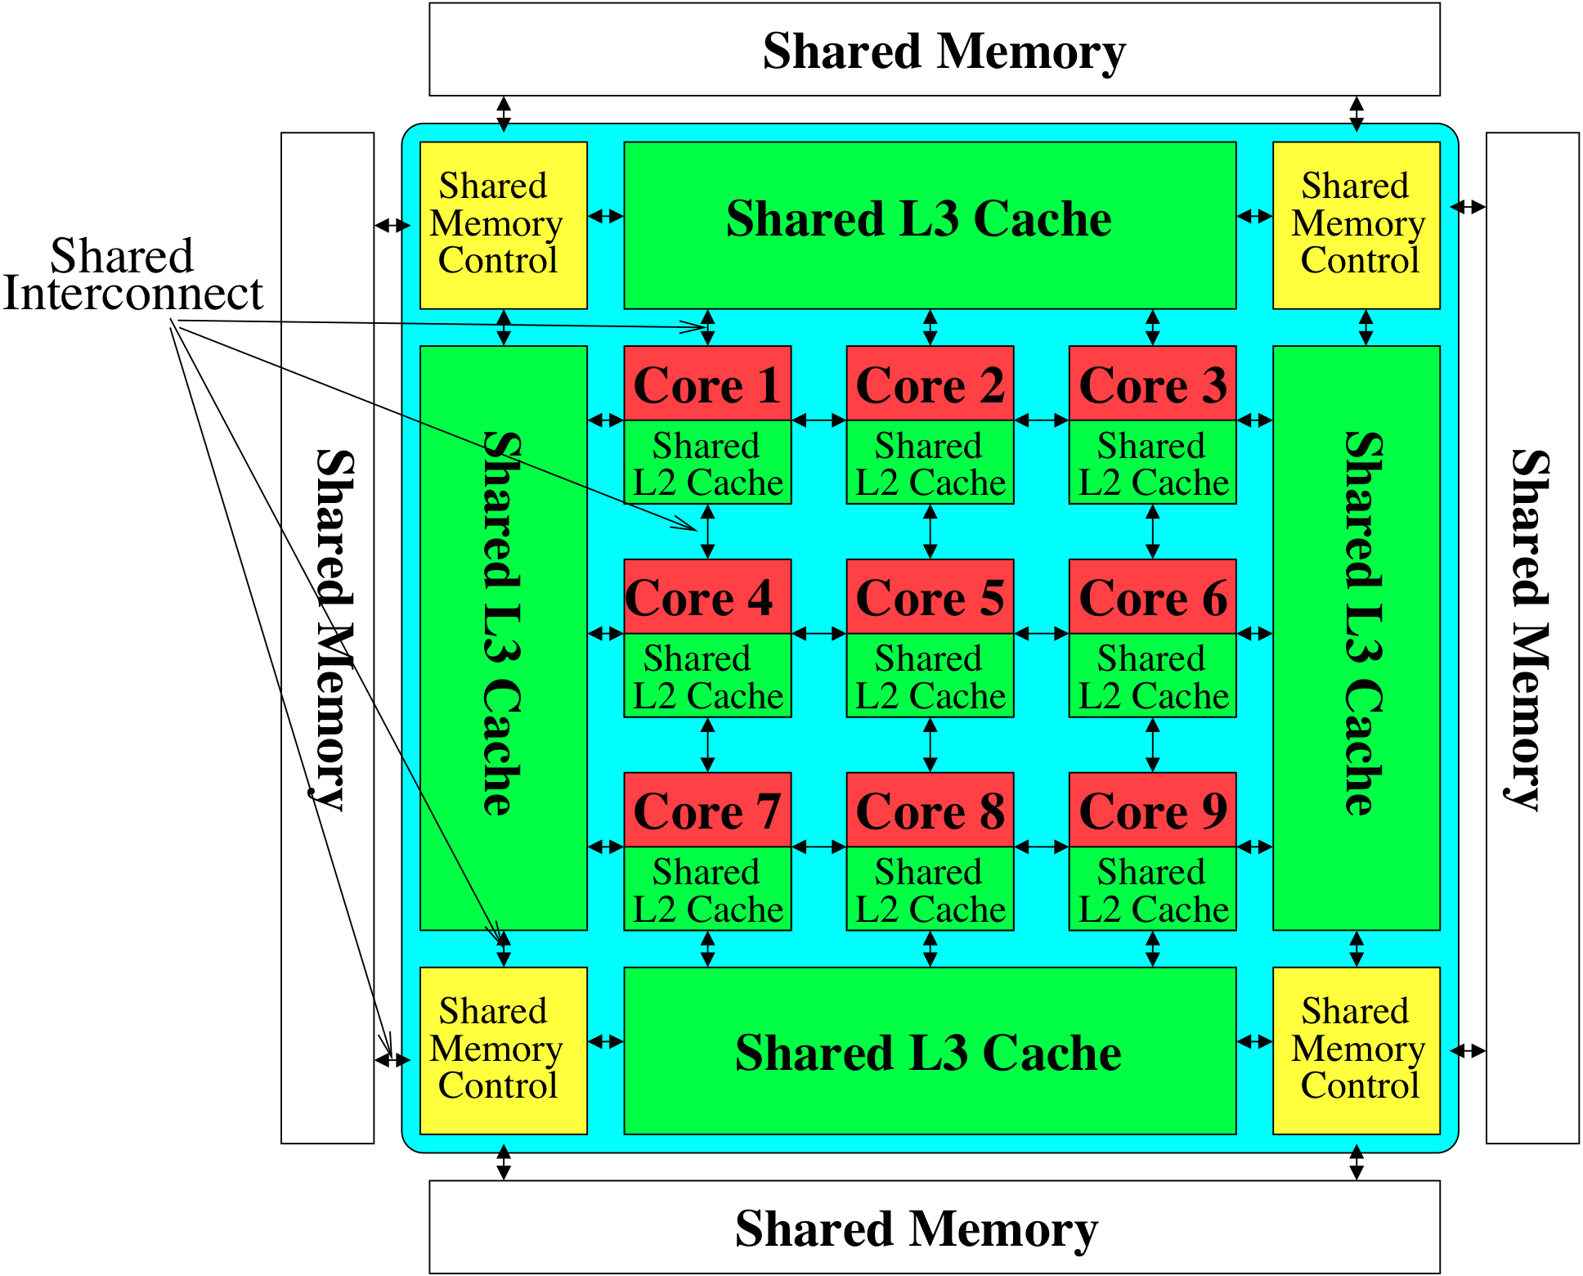
Memory System: A Shared Resource View
Storage

Slide 4
State of the Main Memory System
Recent technology, architecture, and application trends
  lead to new requirements
  exacerbate old requirements
DRAM and memory controllers, as we know them today, are (will be) unlikely to satisfy all requirements
Some emerging non-volatile memory technologies (e.g., PCM) enable new opportunities: memory+storage merging
We need to rethink the main memory system
  to fix DRAM issues and enable emerging technologies
  to satisfy all requirements

Slide 5
Agenda
Major Trends Affecting Main Memory
The DRAM Scaling Problem and Solution Directions
  Tolerating DRAM: New DRAM Architectures
  Enabling Emerging Technologies: Hybrid Memory Systems
How Can We Do Better?
Summary

Slide 6
Major Trends Affecting Main Memory (I)
Need for main memory capacity, bandwidth, QoS increasing
Main memory energy/power is a key system design concern
DRAM technology scaling is ending

Slide 7
Major Trends Affecting Main Memory (II)
Need for main memory capacity, bandwidth, QoS increasing
  Multi-core: increasing number of cores/agents
  Data-intensive applications: increasing demand/hunger for data
  Consolidation: cloud computing, GPUs, mobile, heterogeneity
Main memory energy/power is a key system design concern
DRAM technology scaling is ending

Slide 8
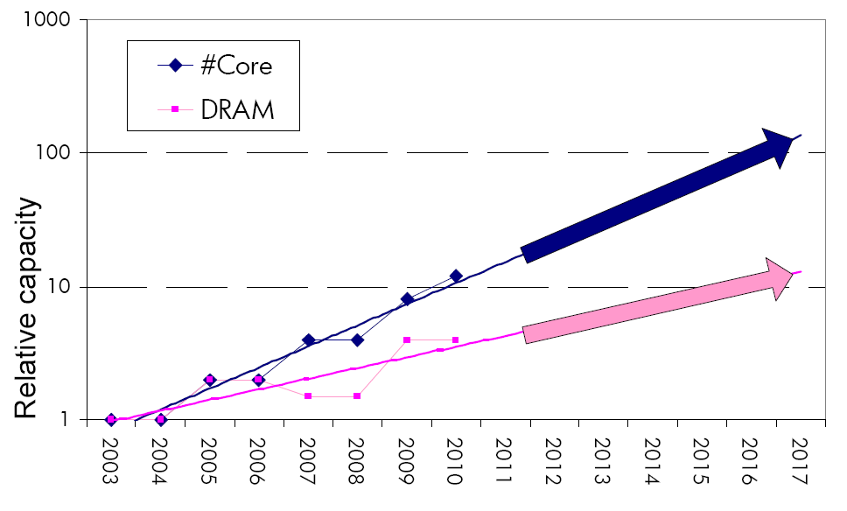
Example: The Memory Capacity Gap
Core count doubling ~ every 2 years
DRAM DIMM capacity doubling ~ every 3 years
Memory capacity per core expected to drop by 30% every two years
Trends worse for memory bandwidth per core!

Slide 9
Major Trends Affecting Main Memory (III)
Need for main memory capacity, bandwidth, QoS increasing
Main memory energy/power is a key system design concern
  ~40-50% energy spent in off-chip memory hierarchy [Lefurgy, IEEE Computer 2003]
  DRAM consumes power even when not used (periodic refresh)
DRAM technology scaling is ending

Slide 10
Major Trends Affecting Main Memory (IV)
Need for main memory capacity, bandwidth, QoS increasing
Main memory energy/power is a key system design concern
DRAM technology scaling is ending
  ITRS projects DRAM will not scale easily below X nm
  Scaling has provided many benefits:
    higher capacity (density), lower cost, lower energy

Slide 11
Agenda
Major Trends Affecting Main Memory
The DRAM Scaling Problem and Solution Directions
  Tolerating DRAM: New DRAM Architectures
  Enabling Emerging Technologies: Hybrid Memory Systems
How Can We Do Better?
Summary

Slide 12
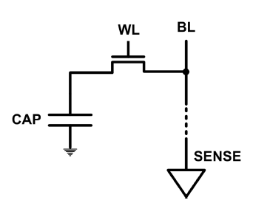
The DRAM Scaling Problem
DRAM stores charge in a capacitor (charge-based memory)
  Capacitor must be large enough for reliable sensing
  Access transistor should be large enough for low leakage and high retention time
  Scaling beyond 40-35nm (2013) is challenging [ITRS, 2009]
DRAM capacity, cost, and energy/power hard to scale

Slide 13
Solutions to the DRAM Scaling Problem
Two potential solutions
  Tolerate DRAM (by taking a fresh look at it)
  Enable emerging memory technologies to eliminate/minimize DRAM
Do both
  Hybrid memory systems

Slide 14
Solution 1: Tolerate DRAM
Overcome DRAM shortcomings with
  System-DRAM co-design
  Novel DRAM architectures, interface, functions
  Better waste management (efficient utilization)
Key issues to tackle
  Reduce refresh energy
  Improve bandwidth and latency
  Reduce waste
  Enable reliability at low cost
Liu, Jaiyen, Veras, Mutlu, “RAIDR: Retention-Aware Intelligent DRAM Refresh,” ISCA 2012.
Kim, Seshadri, Lee+, “A Case for Exploiting Subarray-Level Parallelism in DRAM,” ISCA 2012.
Lee+, “Tiered-Latency DRAM: A Low Latency and Low Cost DRAM Architecture,” HPCA 2013.
Liu+, “An Experimental Study of Data Retention Behavior in Modern DRAM Devices” ISCA’13.
Seshadri+, “RowClone: Fast and Efficient In-DRAM Copy and Initialization of Bulk Data,” 2013.

Slide 15
Solution 2: Emerging Memory Technologies
Some emerging resistive memory technologies seem more scalable than DRAM (and they are non-volatile)
Example: Phase Change Memory
  Expected to scale to 9nm (2022 [ITRS])
  Expected to be denser than DRAM: can store multiple bits/cell
But, emerging technologies have shortcomings as well
  Can they be enabled to replace/augment/surpass DRAM?
Lee, Ipek, Mutlu, Burger, “Architecting Phase Change Memory as a Scalable DRAM Alternative,” ISCA 2009, CACM 2010, Top Picks 2010.
Meza, Chang, Yoon, Mutlu, Ranganathan, “Enabling Efficient and Scalable Hybrid Memories,” IEEE Comp. Arch. Letters 2012.
Yoon, Meza et al., “Row Buffer Locality Aware Caching Policies for Hybrid Memories,” ICCD 2012.
Kultursay+, “Evaluating STT-RAM as an Energy-Efficient Main Memory Alternative,” ISPASS 2013.
Notes:
Even if DRAM continues to scale there could be benefits to examining and enabling these new technologies.

Slide 16
Hybrid Memory Systems
CPU
Meza+, “Enabling Efficient and Scalable Hybrid Memories,” IEEE Comp. Arch. Letters, 2012.
Yoon, Meza et al., “Row Buffer Locality Aware Caching Policies for Hybrid Memories,” ICCD 2012 Best Paper Award.
DRAMCtrl
PCM Ctrl
DRAM
Phase Change Memory (or Tech. X)
Fast, durable
Small,
leaky, volatile,
high-cost
Large, non-volatile, low-cost
Slow, wears out, high active energy
Hardware/software manage data allocation and movement
to achieve the best of multiple technologies

Slide 17
An Orthogonal Issue: Memory Interference
Main
Memory
Core
Core
Core
Core
Cores’ interfere with each other when accessing shared main memory
Notes:
In a multicore system, multiple applications running on the different cores share the main memory.
These applications interfere at the main memory. The result of this interference is unpredictable application slowdowns.

Slide 18
An Orthogonal Issue: Memory Interference
Problem: Memory interference between cores is uncontrolled
  → unfairness, starvation, low performance
  → uncontrollable, unpredictable, vulnerable system
Solution: QoS-Aware Memory Systems
  Hardware designed to provide a configurable fairness substrate
    Application-aware memory scheduling, partitioning, throttling
  Software designed to configure the resources to satisfy different QoS goals
QoS-aware memory controllers and interconnects can provide predictable performance and higher efficiency

Slide 19
Agenda
Major Trends Affecting Main Memory
The DRAM Scaling Problem and Solution Directions
  Tolerating DRAM: New DRAM Architectures
  Enabling Emerging Technologies: Hybrid Memory Systems
How Can We Do Better?
Summary

Slide 20
Tolerating DRAM: Example Techniques
Retention-Aware DRAM Refresh: Reducing Refresh Impact
Tiered-Latency DRAM: Reducing DRAM Latency
RowClone: Accelerating Page Copy and Initialization
Subarray-Level Parallelism: Reducing Bank Conflict Impact

Slide 21
DRAM Refresh
DRAM capacitor charge leaks over time
The memory controller needs to refresh each row periodically to restore charge
  Activate each row every N ms
  Typical N = 64 ms
Downsides of refresh
-- Energy consumption: Each refresh consumes energy
  -- Performance degradation: DRAM rank/bank unavailable while refreshed
  -- QoS/predictability impact: (Long) pause times during refresh
  -- Refresh rate limits DRAM capacity scaling

Slide 22
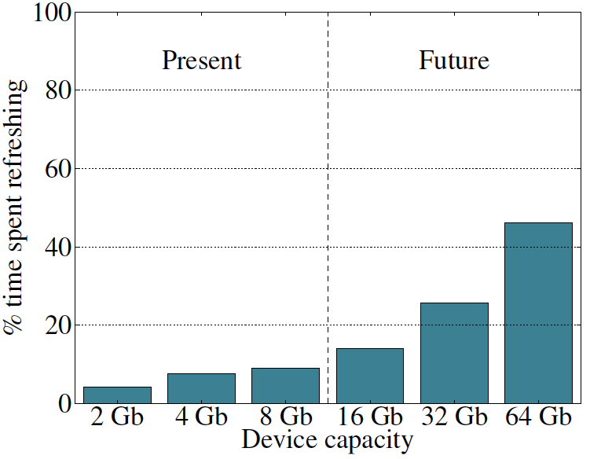
Refresh Overhead: Performance
46%
8%

Slide 23
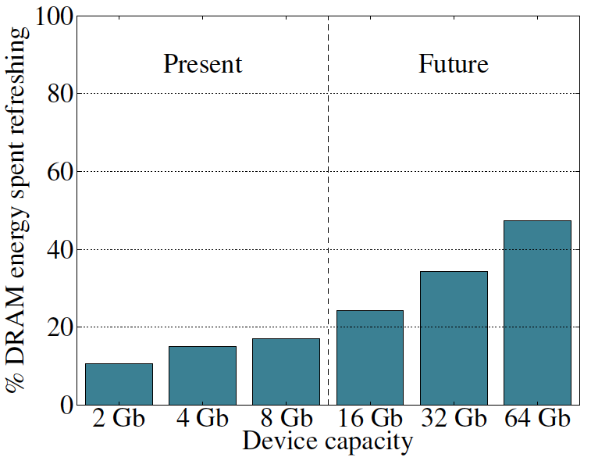
Refresh Overhead: Energy
47%
15%

Slide 24

Retention Time Profile of DRAM

Slide 25
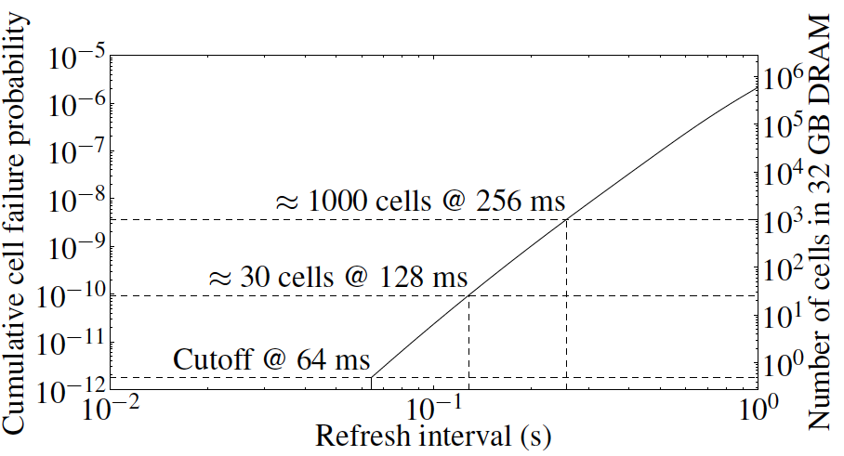
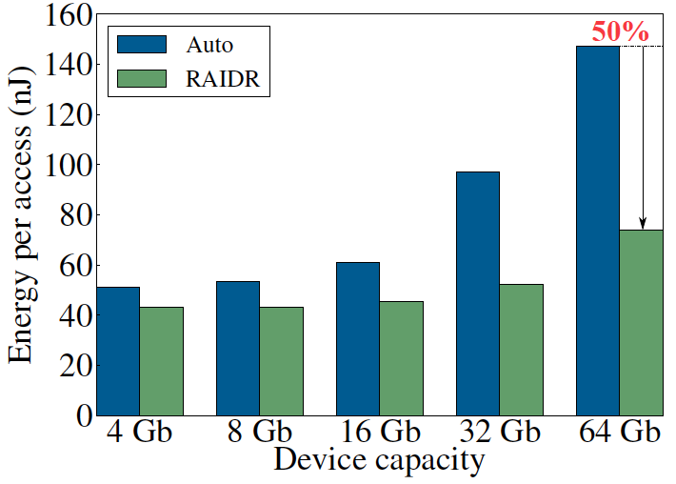
RAIDR: Eliminating Unnecessary Refreshes
Observation: Most DRAM rows can be refreshed much less often without losing data [Kim+, EDL’09][Liu+ ISCA’13]
Key idea: Refresh rows containing weak cells
more frequently, other rows less frequently
  1. Profiling: Profile retention time of all rows
  2. Binning: Store rows into bins by retention time in memory controller
  Efficient storage with Bloom Filters (only 1.25KB for 32GB memory)
  3. Refreshing: Memory controller refreshes rows in different bins at different rates
Results: 8-core, 32GB, SPEC, TPC-C, TPC-H
  74.6% refresh reduction @ 1.25KB storage
  ~16%/20% DRAM dynamic/idle power reduction
  ~9% performance improvement
  Benefits increase with DRAM capacity
Liu et al., “RAIDR: Retention-Aware Intelligent DRAM Refresh,” ISCA 2012.

Slide 26
Going Forward
How to find out and expose weak memory cells/rows
  Early analysis of modern DRAM chips:
    Liu+, “An Experimental Study of Data Retention Behavior in Modern DRAM Devices: Implications for Retention Time Profiling Mechanisms”, ISCA 2013.
Low-cost system-level tolerance of DRAM errors
Tolerating cell-to-cell interference at the system level
  For both DRAM and Flash. Early analysis of Flash chips:
    Cai+, “Program Interference in MLC NAND Flash Memory: Characterization, Modeling, and Mitigation,” ICCD 2013.

Slide 27
Tolerating DRAM: Example Techniques
Retention-Aware DRAM Refresh: Reducing Refresh Impact
Tiered-Latency DRAM: Reducing DRAM Latency
RowClone: Accelerating Page Copy and Initialization
Subarray-Level Parallelism: Reducing Bank Conflict Impact

Slide 28
DRAM Latency-Capacity Trend
16X
-20%
DRAM latency continues to be a critical bottleneck
Notes:
The figure shows the historical trends of DRAM during the last 12-years, from 2000 to 2011.
We can see that, during this time, DRAM capacity has increased by 16 times.
On the other hand, during the same period of time, DRAM latency has reduced by only 20%.
As a result, the high DRAM latency continues to be a critical bottleneck for system performance.

Slide 29
What Causes the Long Latency?
DRAM Chip
DRAM Chip
cell array
subarray
Subarray
I/O
I/O
I/O
channel
channel
DRAM Latency = Subarray Latency + I/O Latency
DRAM Latency = Subarray Latency + I/O Latency
Dominant
Notes:
To understand what causes the long latency, let me take a look at the DRAM organization.
DRAM consists of two components, the cell array and the I/O circuitry. The cell array consists of multiple subarrays.
To read from a DRAM chip, the data is first accessed from the subarray and then the data is transferred over the channel by the I/O circuitry.
So, the DRAM latency is the sum of the subarray latency and the I/O latency.
We observed that the subarray latency is much higher than the I/O latency.
As a result, subarray is the dominant source of the DRAM latency as we explained in the paper.

Slide 30
Why is the Subarray So Slow?
Subarray
Cell
cell
wordline
bitline: 512 cells
access
row decoder
row decoder
transistor
capacitor
sense amplifier
bitline
sense amplifier
large sense amplifier
Long bitline
  Amortizes sense amplifier cost → Small area
  Large bitline capacitance → High latency & power
Notes:
The cell’s capacitor is small and can store only a small amount of charge.
That is why a subarray also has sense-amplifiers, which are specialized circuits that can detect the small amount of charge.
Unfortunately, a sense-amplifier size is about *100* times the cell size.
So, to amortize the area of the sense-amplifiers,
hundreds of cells share the same sense-amplifier through a long bitline.
However, a long bitline has a large capacitance that increases latency and power consumption.
Therefore, the long bitline is one of the dominant sources of high latency and high power consumption.
To understand why the subarray is so slow,
let me take a look at the subarray organization.

Slide 31
Trade-Off: Area (Die Size) vs. Latency
Long Bitline
Short Bitline
Faster
Smaller
Trade-Off: Area vs. Latency
Notes:
A naïve way to reduce the DRAM latency is to have short bitlines that have lower latency.
Unfortunately, short bitlines significantly increase the DRAM area.
Therefore, the bitline length exposes an important trade-off between area and latency.

Slide 32
Trade-Off: Area (Die Size) vs. Latency
32
Fancy DRAM
Short Bitline
Commodity DRAM
Long Bitline
64
Cheaper
128
256
512 cells/bitline
GOAL
Faster
Notes:
This figure shows the trade-off between DRAM area and latency as we change the bitline length.
Y-axis is the normalized DRAM area compared to a DRAM using 512 cells/bitline. A lower value is cheaper.
X-axis shows the latency in terms of tRC, an important DRAM timing constraint. A lower value is faster.
Commodity DRAM chips use long bitlines to minimize area cost. On the other hand, shorter bitlines achieve lower latency at higher cost.
Our goal is to achieve the best of both worlds: low latency and low area cost.

Slide 33
Approximating the Best of Both Worlds
Long Bitline
Long Bitline
Our Proposal
Short Bitline
Short Bitline
Small Area
Large Area
Small Area
High Latency
Low Latency
Low Latency
Need Isolation
Add Isolation Transistors
Short Bitline ➔ Fast
Notes:
To sum up, both long and short bitline do not achieve small area and low latency.
Long bitline has small area but has high latency while short bitline has low latency but has large area.
To achieve the best of both worlds, we first start from long bitline, which has small area.
After that, to achieve the low latency of short bitline, we divide the long bitline into two smaller segments.
The bitline length of the segment nearby the sense-amplifier is same as the length of short bitline.
Therefore, the latency of the segment is as low as the latency of the short bitline.
To isolate this fast segment from the other segment, we add isolation transistors that selectively connect the two segments.

Slide 34
Approximating the Best of Both Worlds
Long Bitline
Tiered-Latency DRAM
Our Proposal
Short Bitline
Long Bitline
Short Bitline
Small Area
Small Area
Large Area
High Latency
Low Latency
Low Latency
Small area using long bitline
Low Latency
Notes:
This way, our proposed approach achieves small area and low latency.
We call this new DRAM architecture as Tiered-Latency DRAM

Slide 35
Tiered-Latency DRAM
Divide a bitline into two segments with an isolation transistor
Far Segment
Isolation Transistor
Near Segment
Sense Amplifier
Lee+, “Tiered-Latency DRAM: A Low Latency and Low Cost DRAM Architecture,” HPCA 2013.
Notes:
Again, the key idea is to divide a subarray into two segments with isolation transistors.
The segment, directly connected to the sense amplifier, is called the near segment.
The other segment is called the far segment.

Slide 36
Commodity DRAM vs. TL-DRAM
DRAM Latency (tRC)
DRAM Power
  +49%
  +23%
  (52.5ns)
Latency
Power
  –56%
  –51%
  Near Far
  Near Far
  Commodity DRAM
  Commodity DRAM
  TL-DRAM
  TL-DRAM
DRAM Area Overhead
  ~3%: mainly due to the isolation transistors
Notes:
This figure compares the latency.
Y-axis is normalized latency.
Compared to commodity DRAM, TL-DRAM’s near segment has 56% lower latency, while the far segment has 23% higher latency.
The right figure compares the power.
Y-axis is normalized power.
Compared to commodity DRAM, TL-DRAM’s near segment has 51% lower power consumption and the far segment has 49% higher power consumption.
Lastly, mainly due to the isolation transistor, Tiered-latency DRAM increases the die-size by about 3%.

Slide 37
Trade-Off: Area (Die-Area) vs. Latency
32
64
Cheaper
128
256
512 cells/bitline
Near Segment
Far Segment
GOAL
Faster
Notes:
Again, the figure shows the trade-off between area and latency in existing DRAM.
Unlike existing DRAM, TL-DRAM achieves low latency using the near segment while increasing the area by only 3%.
Although the far segment has higher latency than commodity DRAM, we show that efficient use of the near segment enables TL-DRAM to achieve high system performance.

Slide 38
Leveraging Tiered-Latency DRAM
TL-DRAM is a substrate that can be leveraged by the hardware and/or software
Many potential uses
  Use near segment as hardware-managed inclusive cache to far segment
  Use near segment as hardware-managed exclusive cache to far segment
  Profile-based page mapping by operating system
  Simply replace DRAM with TL-DRAM
Notes:
There are multiple ways to leverage the TL-DRAM substrate by hardware or software.
In this slide, I describe many such ways.
First, the near segment can be used as a hardware-managed inclusive cache to the far segment.
Second, the near segment can be used as a hardware-managed exclusive cache to the far segment.
Third, the operating system can intelligently allocate frequently-accessed pages to the near segment.
Forth mechanism is to simple replace DRAM with TL-DRAM without any near segment handling
While our paper provides detailed explanations and evaluations of first three mechanism,
in this talk, we will focus on the first approach, which is to use the near segment as a hardware managed cache for the far segment.

Slide 39
Performance & Power Consumption
12.4%
11.5%
10.7%
–23%
–24%
–26%
Normalized Performance
Normalized Power
Core-Count (Channel)
Core-Count (Channel)
Using near segment as a cache improves performance and reduces power consumption
Notes:
This figure shows the IPC improvement of our three caching mechanisms over commodity DRAM.
All of them improve performance and benefit-based caching shows maximum performance improvement by 12.7%.
The right figure shows the normalized power reduction of our three caching mechanisms over commodity DRAM.
All of them reduce power consumption and benefit-based caching shows maximum power reduction by 23%.
Therefore, using near segment as a cache improves performance and reduces power consumption at the cost of 3% area overhead.

Slide 40
Tolerating DRAM: Example Techniques
Retention-Aware DRAM Refresh: Reducing Refresh Impact
Tiered-Latency DRAM: Reducing DRAM Latency
RowClone: Accelerating Page Copy and Initialization
Subarray-Level Parallelism: Reducing Bank Conflict Impact

Slide 41
Today’s Memory: Bulk Data Copy
1) High latency
Memory
3) Cache pollution
L3
CPU
L2
L1
MC
2) High bandwidth utilization
4) Unwanted data movement

Slide 42
Future: RowClone (In-Memory Copy)
3) No cache pollution
1) Low latency
Memory
L3
CPU
L2
L1
MC
2) Low bandwidth utilization
4) No unwanted data movement

Slide 43
DRAM operation (load one byte)
4 Kbits
Step 1: Activate row
Transfer row
DRAM array
Row Buffer (4 Kbits)
Step 2: Read
Transfer byte onto bus
Data pins (8 bits)
Memory Bus
Notes:
say you want a byte

Slide 44
RowClone: in-DRAM Row Copy (and Initialization)
4 Kbits
Step 1: Activate row A
Step 2: Activate row B
Transfer row
DRAM array
Transfer
row
Row Buffer (4 Kbits)
Data pins (8 bits)
Memory Bus
Notes:
copy

Slide 45
RowClone: Latency and Energy Savings
11.6x
74x
Seshadri et al., “RowClone: Fast and Efficient In-DRAM Copy and Initialization of Bulk Data,” CMU Tech Report 2013.

Slide 46
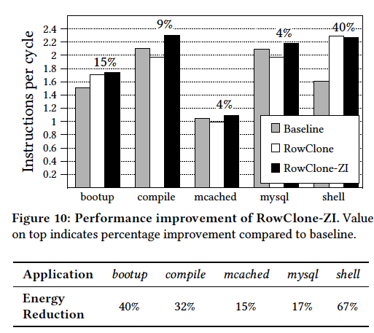
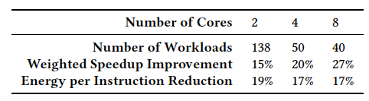
RowClone: Overall Performance

Slide 47
Goal: Ultra-efficient heterogeneous architectures
CPU
core
CPU
core
mini-CPU
core
GPU
(throughput)
core
GPU
(throughput)
core
video
core
GPU
(throughput)
core
GPU
(throughput)
core
CPU
core
CPU
core
Memory
imaging
core
LLC
Specialized
compute-capability
in memory
Memory Controller
Memory Bus
Slide credit: Prof. Kayvon Fatahalian, CMU

Slide 48
Enabling Ultra-efficient (Visual) Search
What is the right partitioning of computation capability?
What is the right low-cost memory substrate?
What memory technologies are the best enablers?
How do we rethink/ease (visual) search algorithms/applications?
Main Memory
Processor
Core
Database (of images)
Cache
Query vector
Memory Bus
Results
Picture credit: Prof. Kayvon Fatahalian, CMU

Slide 49
Tolerating DRAM: Example Techniques
Retention-Aware DRAM Refresh: Reducing Refresh Impact
Tiered-Latency DRAM: Reducing DRAM Latency
RowClone: In-Memory Page Copy and Initialization
Subarray-Level Parallelism: Reducing Bank Conflict Impact

Slide 50
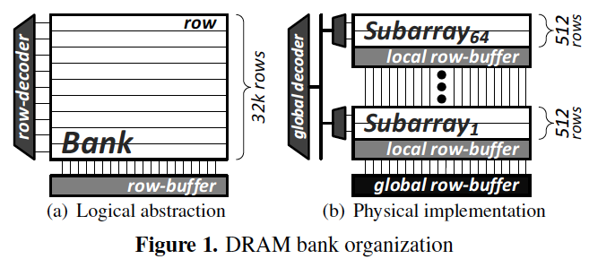
SALP: Reducing DRAM Bank Conflicts
Problem: Bank conflicts are costly for performance and energy
  serialized requests, wasted energy (thrashing of row buffer, busy wait)
Goal: Reduce bank conflicts without adding more banks (low cost)
Key idea: Exploit the internal subarray structure of a DRAM bank to parallelize bank conflicts to different subarrays
  Slightly modify DRAM bank to reduce subarray-level hardware sharing
Results on Server, Stream/Random, SPEC
  19% reduction in dynamic DRAM energy
  13% improvement in row hit rate
  17% performance improvement
  0.15% DRAM area overhead
-19%
+13%
Kim, Seshadri+ “A Case for Exploiting Subarray-Level
Parallelism in DRAM,” ISCA 2012.

Slide 51
Agenda
Major Trends Affecting Main Memory
The DRAM Scaling Problem and Solution Directions
  Tolerating DRAM: New DRAM Architectures
  Enabling Emerging Technologies: Hybrid Memory Systems
How Can We Do Better?
Summary

Slide 52
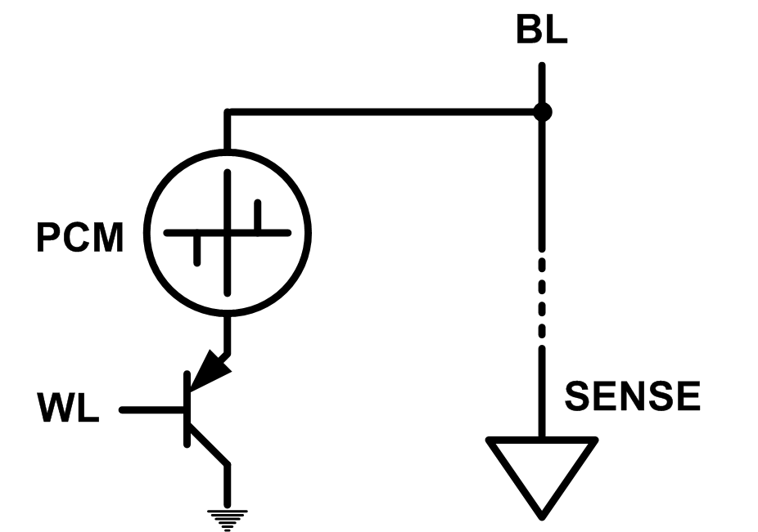
Solution 2: Emerging Memory Technologies
Some emerging resistive memory technologies seem more scalable than DRAM (and they are non-volatile)
Example: Phase Change Memory
  Data stored by changing phase of material
  Data read by detecting material’s resistance
  Expected to scale to 9nm (2022 [ITRS])
  Prototyped at 20nm (Raoux+, IBM JRD 2008)
  Expected to be denser than DRAM: can store multiple bits/cell
But, emerging technologies have (many) shortcomings
  Can they be enabled to replace/augment/surpass DRAM?
Notes:
Even if DRAM continues to scale there could be benefits to examining and enabling these new technologies.

Slide 53
Phase Change Memory: Pros and Cons
Pros over DRAM
  Better technology scaling (capacity and cost)
  Non volatility
  Low idle power (no refresh)
Cons
  Higher latencies: ~4-15x DRAM (especially write)
  Higher active energy: ~2-50x DRAM (especially write)
  Lower endurance (a cell dies after ~10⁸ writes)
Challenges in enabling PCM as DRAM replacement/helper:
  Mitigate PCM shortcomings
  Find the right way to place PCM in the system

Slide 54
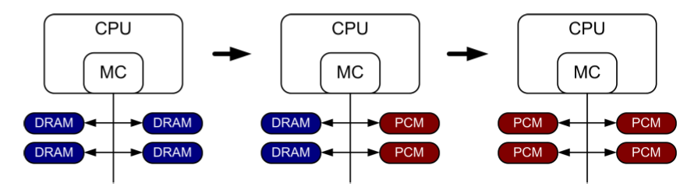
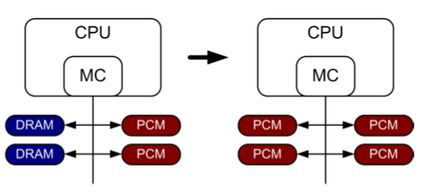
PCM-based Main Memory (I)
How should PCM-based (main) memory be organized?
Hybrid PCM+DRAM [Qureshi+ ISCA’09, Dhiman+ DAC’09]:
  How to partition/migrate data between PCM and DRAM

Slide 55
PCM-based Main Memory (II)
How should PCM-based (main) memory be organized?
Pure PCM main memory [Lee et al., ISCA’09, Top Picks’10]:
  How to redesign entire hierarchy (and cores) to overcome PCM shortcomings

Slide 56
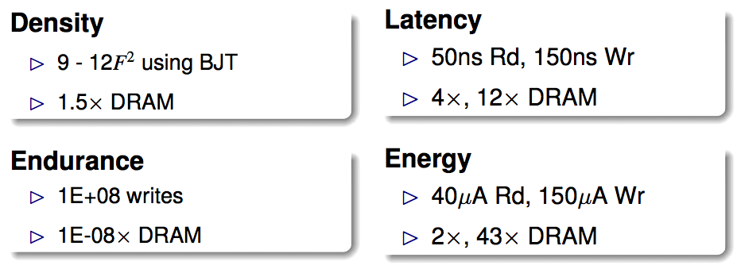
An Initial Study: Replace DRAM with PCM
Lee, Ipek, Mutlu, Burger, “Architecting Phase Change Memory as a Scalable DRAM Alternative,” ISCA 2009.
  Surveyed prototypes from 2003-2008 (e.g. IEDM, VLSI, ISSCC)
  Derived “average” PCM parameters for F=90nm

Slide 57
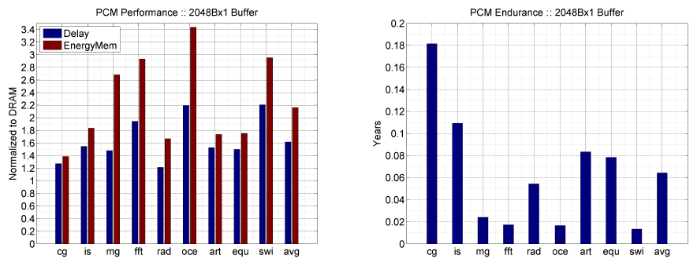
Results: Naïve Replacement of DRAM with PCM
Replace DRAM with PCM in a 4-core, 4MB L2 system
PCM organized the same as DRAM: row buffers, banks, peripherals
1.6x delay, 2.2x energy, 500-hour average lifetime
Lee, Ipek, Mutlu, Burger, “Architecting Phase Change Memory as a Scalable DRAM Alternative,” ISCA 2009.

Slide 58
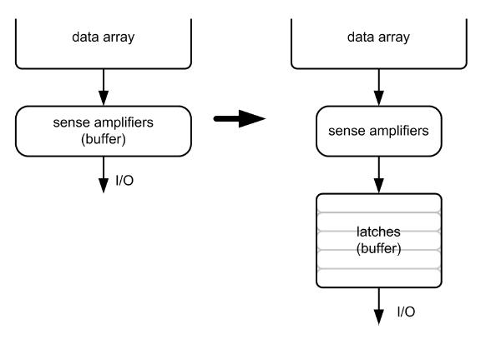
Architecting PCM to Mitigate Shortcomings
Idea 1: Use multiple narrow row buffers in each PCM chip
    → Reduces array reads/writes → better endurance, latency, energy
Idea 2: Write into array at
cache block or word
granularity
→ Reduces unnecessary wear
DRAM
PCM

Slide 59
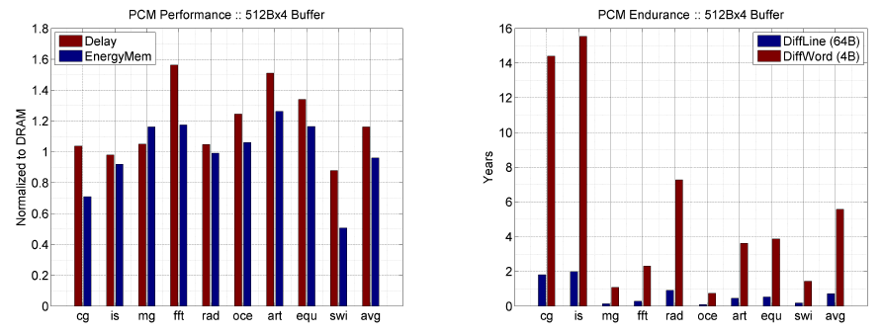
Results: Architected PCM as Main Memory
1.2x delay, 1.0x energy, 5.6-year average lifetime
Scaling improves energy, endurance, density
Caveat 1: Worst-case lifetime is much shorter (no guarantees)
Caveat 2: Intensive applications see large performance and energy hits
Caveat 3: Optimistic PCM parameters?

Slide 60
Hybrid Memory Systems
CPU
Meza+, “Enabling Efficient and Scalable Hybrid Memories,” IEEE Comp. Arch. Letters, 2012.
Yoon, Meza et al., “Row Buffer Locality Aware Caching Policies for Hybrid Memories,” ICCD 2012 Best Paper Award.
DRAMCtrl
PCM Ctrl
DRAM
Phase Change Memory (or Tech. X)
Fast, durable
Small,
leaky, volatile,
high-cost
Large, non-volatile, low-cost
Slow, wears out, high active energy
Hardware/software manage data allocation and movement
to achieve the best of multiple technologies

Slide 61
One Option: DRAM as a Cache for PCM
PCM is main memory; DRAM caches memory rows/blocks
  Benefits: Reduced latency on DRAM cache hit; write filtering
Memory controller hardware manages the DRAM cache
  Benefit: Eliminates system software overhead
Three issues:
  What data should be placed in DRAM versus kept in PCM?
  What is the granularity of data movement?
  How to design a low-cost hardware-managed DRAM cache?
Two solutions:
  Locality-aware data placement [Yoon+ , ICCD 2012]
  Cheap tag stores and dynamic granularity [Meza+, IEEE CAL 2012]

Slide 62
DRAM vs. PCM: An Observation
Row buffers are the same in DRAM and PCM
Row buffer hit latency same in DRAM and PCM
Row buffer miss latency small in DRAM, large in PCM
Accessing the row buffer in PCM is fast
What incurs high latency is the PCM array access → avoid this
CPU
Row buffer
DRAMCtrl
PCM Ctrl
DRAM Cache
PCM Main Memory
Bank
Bank
Bank
Bank
N ns row hit
Fast row miss
N ns row hit
Slow row miss

Slide 63
Row-Locality-Aware Data Placement
Idea: Cache in DRAM only those rows that
  Frequently cause row buffer conflicts → because row-conflict latency is smaller in DRAM
  Are reused many times → to reduce cache pollution and bandwidth waste
Simplified rule of thumb:
  Streaming accesses: Better to place in PCM
  Other accesses (with some reuse): Better to place in DRAM
Yoon et al., “Row Buffer Locality-Aware Data Placement in Hybrid Memories,” ICCD 2012 Best Paper Award.

Slide 64
Row-Locality-Aware Data Placement: Results
10%
14%
17%
Memory energy-efficiency and fairness also improve correspondingly

Slide 65
Hybrid vs. All-PCM/DRAM
29%
31%
31% better performance than all PCM,
within 29% of all DRAM performance
Notes:
Now let’s compare our mechanism to a homogeneous memory system.
Here the comparison points are a 16GB all-PCM and all-DRAM memory system.
Our mechanism achieves 31% better performance than the all-PCM memory system, and comes within 29% of the all-DRAM performance.
Note that we do not assume any capacity benefits of PCM over DRAM.
And yet, our mechanism bridges the performance gap between the two homogeneous memory systems.
If the capacity benefit of PCM was included, the hybrid memory system will perform even better.

Slide 66
Agenda
Major Trends Affecting Main Memory
The DRAM Scaling Problem and Solution Directions
  Tolerating DRAM: New DRAM Architectures
  Enabling Emerging Technologies: Hybrid Memory Systems
How Can We Do Better?
Summary

Slide 67
Principles (So Far)
Better cooperation between devices and the system
  Expose more information about devices to upper layers
  More flexible interfaces
Better-than-worst-case design
  Do not optimize for the worst case
  Worst case should not determine the common case
Heterogeneity in design
  Enables a more efficient design (No one size fits all)

Slide 68
Other Opportunities with Emerging Technologies
Merging of memory and storage
  e.g., a single interface to manage all data
New applications
  e.g., ultra-fast checkpoint and restore
More robust system design
  e.g., reducing data loss
Processing tightly-coupled with memory
  e.g., enabling efficient search and filtering

Slide 69
Coordinated Memory and Storage with NVM (I)
The traditional two-level storage model is a bottleneck with NVM
  Volatile data in memory → a load/store interface
  Persistent data in storage → a file system interface
  Problem: Operating system (OS) and file system (FS) code to locate, translate, buffer data become performance and energy bottlenecks with fast NVM stores
Two-Level Store
Load/Store
fopen, fread, fwrite, …
Virtual memory
Operating system
and file system
Processor
and caches
Address translation
Main Memory
Storage (SSD/HDD)

Slide 70
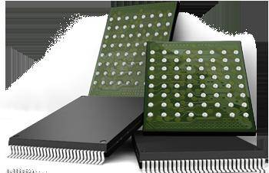
Coordinated Memory and Storage with NVM (II)
Goal: Unify memory and storage management in a single unit to eliminate wasted work to locate, transfer, and translate data
  Improves both energy and performance
  Simplifies programming model as well
Unified Memory/Storage
Persistent Memory
Manager
Processor
and caches
Load/Store
Feedback
Persistent (e.g., Phase-Change) Memory
Meza+, “A Case for Efficient Hardware-Software Cooperative Management of Storage and Memory,” WEED 2013.

Slide 71
Performance Benefits of a Single-Level Store
~5X
Results for PostMark

Slide 72
Energy Benefits of a Single-Level Store
~5X
Results for PostMark

Slide 73
Agenda
Major Trends Affecting Main Memory
The DRAM Scaling Problem and Solution Directions
  Tolerating DRAM: New DRAM Architectures
  Enabling Emerging Technologies: Hybrid Memory Systems
How Can We Do Better?
Summary

Slide 74
Summary: Main Memory Scaling
Main memory scaling problems are a critical bottleneck for system performance, efficiency, and usability
Solution 1: Tolerate DRAM with novel architectures
  RAIDR: Retention-aware refresh
  TL-DRAM: Tiered-Latency DRAM
  RowClone: Fast page copy and initialization
  SALP: Subarray-level parallelism
Solution 2: Enable emerging memory technologies
  Replace DRAM with NVM by architecting NVM chips well
  Hybrid memory systems with automatic data management
  Coordinated management of memory and storage
Software/hardware/device cooperation essential for effective scaling of main memory

Slide 75
More Material: Slides, Papers, Videos
These slides are a very short version of the Scalable Memory Systems course at ACACES 2013
Website for Course Slides, Papers, and Videos
  http://users.ece.cmu.edu/~omutlu/acaces2013-memory.html
  http://users.ece.cmu.edu/~omutlu/projects.htm
  Includes extended lecture notes and readings
Overview Reading
  Onur Mutlu,
  "Memory Scaling: A Systems Architecture Perspective"
  Proceedings of the 5th International Memory Workshop (IMW), Monterey, CA, May 2013. Slides (pptx) (pdf)

Slide 76
Thank you.
Feel free to email me with any feedback
onur@cmu.edu

Slide 77
Memory Scaling:
A Systems Architecture Perspective
Onur Mutlu
onur@cmu.edu
August 6, 2013
MemCon 2013

