Slide 1



Memory Systems and Memory-Centric Computing Systems
Lecture 1: Trends & Reliability/Security
Onur Mutlu
omutlu@gmail.com
https://people.inf.ethz.ch/omutlu
29 January 2019
UT Austin ECE Endowed Lecture Series

Slide 2



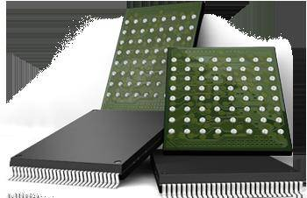

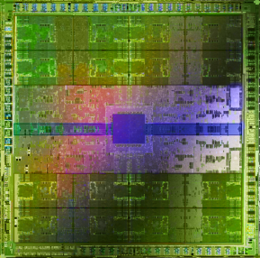
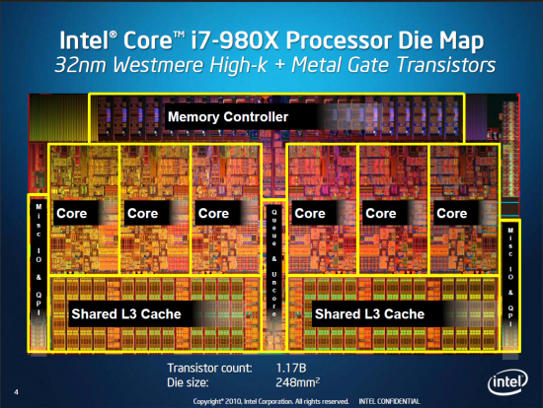
Current Research Focus Areas
Research Focus: Computer architecture, HW/SW, bioinformatics, security
Memory and storage (DRAM, flash, emerging), interconnects
Heterogeneous & parallel systems, GPUs, systems for data analytics
System/architecture interaction, new execution models, new interfaces
Hardware security, energy efficiency, fault tolerance, performance
Genome sequence analysis & assembly algorithms and architectures
Biologically inspired systems & system design for bio/medicine
Hybrid Main Memory
Heterogeneous
Processors and
Accelerators
Persistent Memory/Storage
Broad research
spanning apps, systems, logic
with architecture at the center
Graphics and Vision Processing
Notes:
Professor Mutlu’s research focus is all aspects of computer architecture, HW/SW interaction and bioinformatics.
He is looking for students to perform research in these areas.
He and his group, SAFARI, solve fundamental problems spanning:
Memory, memory, memory, storage, interconnects
Parallel architectures, heterogeneous architectures, GP-GPUs
System/architecture interaction, new execution models
Energy efficiency, fault tolerance, hardware security
Genome sequence analysis and assembly
His group does broad research spanning systems to logic with architecture at center

Slide 3
Four Key Directions
Fundamentally Secure/Reliable/Safe Architectures
Fundamentally Energy-Efficient Architectures
  Memory-centric (Data-centric) Architectures
Fundamentally Low-Latency Architectures
Architectures for Genomics, Medicine, Health

Slide 4
Four Key Directions
Fundamentally Secure/Reliable/Safe Architectures
Fundamentally Energy-Efficient Architectures
  Memory-centric (Data-centric) Architectures
Fundamentally Low-Latency Architectures
Architectures for Genomics, Medicine, Health

Slide 5
A Motivating Detour:
Genome Sequence Analysis

Slide 6
Our Dream
An embedded device that can perform comprehensive genome analysis in real time (within a minute)
  Which of these DNAs does this DNA segment match with?
  What is the likely genetic disposition of this patient to this drug?
  . . .

Slide 7
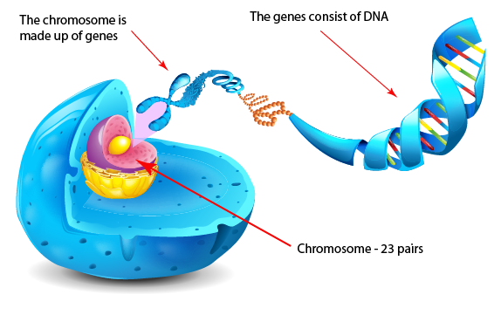
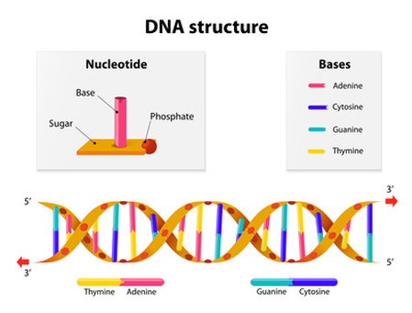
What Is a Genome Made Of?
Cell
Nucleus
The discovery of DNA’s double-helical structure (Watson+, 1953)
Notes:
Unlocking the life’s code requires diving into the nucleus of our body cells, where the double-stranded genome resides. Genome is literally the 'code of life' - it is the set of instructions for making everything from you to zebras, strawberries, and even yeast.
since the discovery of dna’s double-helical structure (watson et al. 1953)

Slide 8
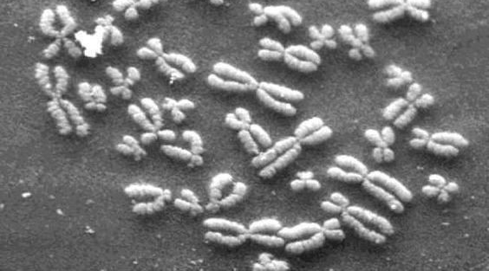
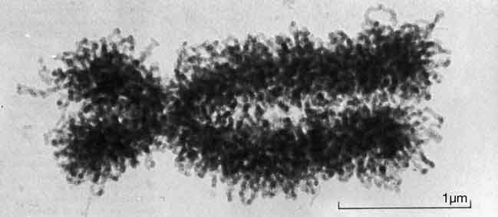
DNA Under Electron Microscope
human chromosome #12
from HeLa’s cell
Notes:
Henrietta Lacks,

Slide 9
DNA Sequencing
Goal:
  Find the complete sequence of A, C, G, T’s in DNA.
Challenge:
  There is no machine that takes long DNA as an input, and gives the complete sequence as output
  All sequencing machines chop DNA into pieces and identify relatively small pieces (but not how they fit together)

Slide 10
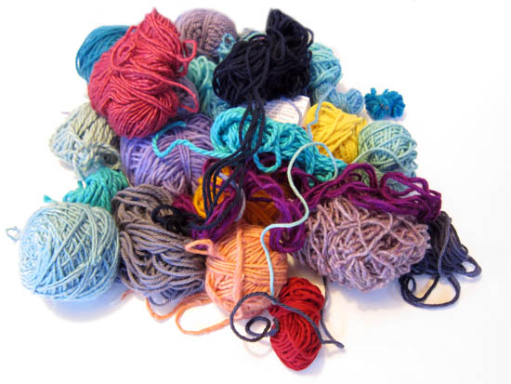
Untangling Yarn Balls & DNA Sequencing
Notes:
untangling yarn ball

Slide 11
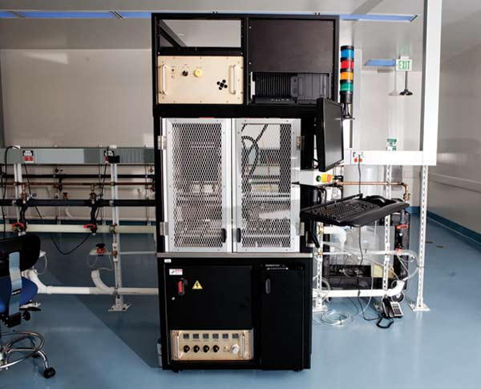
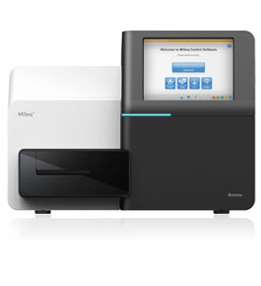
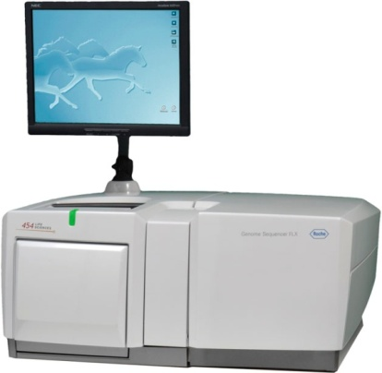
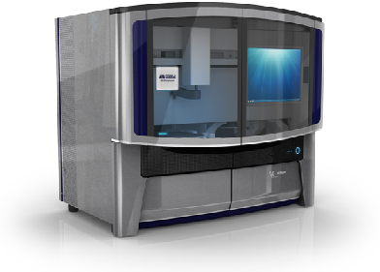
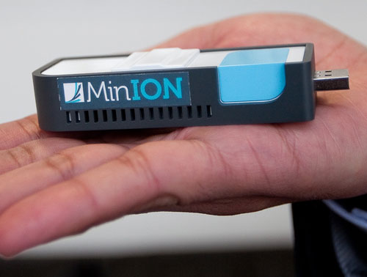
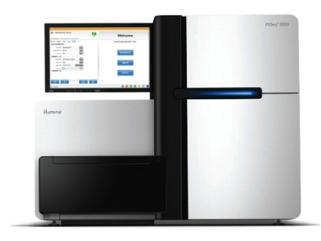
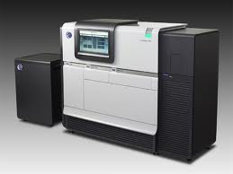
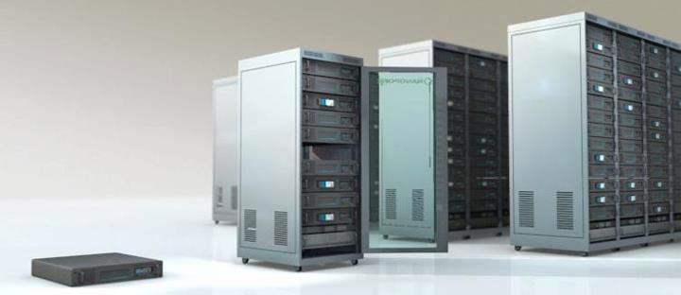
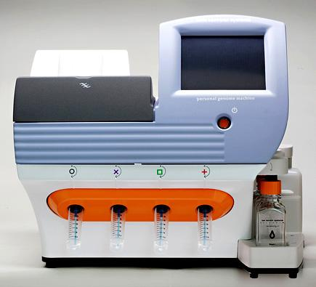
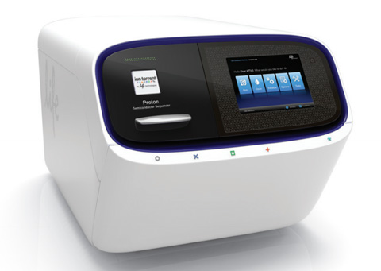
Genome Sequencers
Illumina MiSeq
Complete
Genomics
Roche/454
AB SOLiD
Oxford Nanopore MinION
Illumina
NovaSeq
6000
Illumina HiSeq2000
Pacific Biosciences RS
Oxford Nanopore GridION
Ion Torrent PGM
… and more! All produce data with different properties.
Ion Torrent Proton

Slide 12
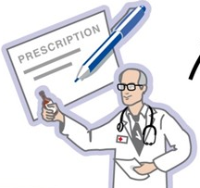
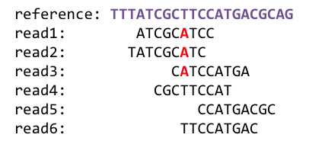
1
Sequencing
Genome Analysis
Read Mapping
2
Variant Calling
Scientific Discovery
3
4
Notes:
Genome analysis starts with sequencing random short DNA fragments of copies of the original molecule.
Unfortunately, these reads lack information about their order and which part of genome they are originated from.
Hence the second step is to map these reads to a long reference genome.

Slide 13
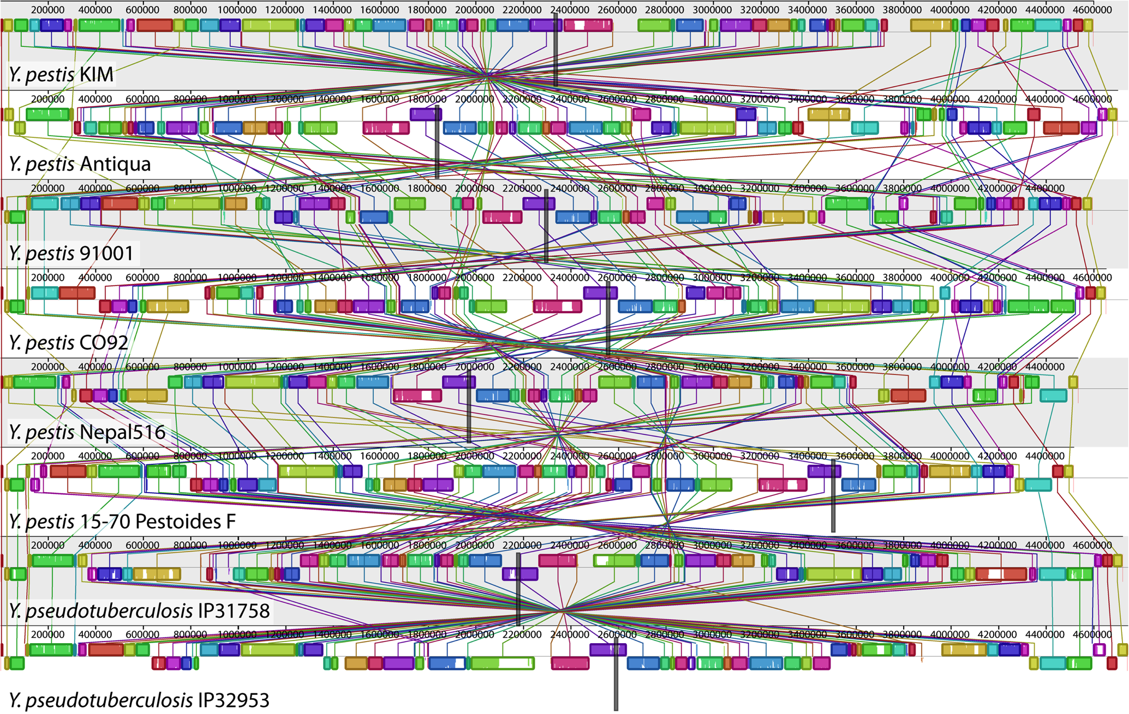
Genome Sequence Alignment: Example
Source: By Aaron E. Darling, István Miklós, Mark A. Ragan - Figure 1 from Darling AE, Miklós I, Ragan MA (2008).
"Dynamics of Genome Rearrangement in Bacterial Populations". PLOS Genetics. DOI:10.1371/journal.pgen.1000128., CC BY 2.5, https://commons.wikimedia.org/w/index.php?curid=30550950

Slide 14
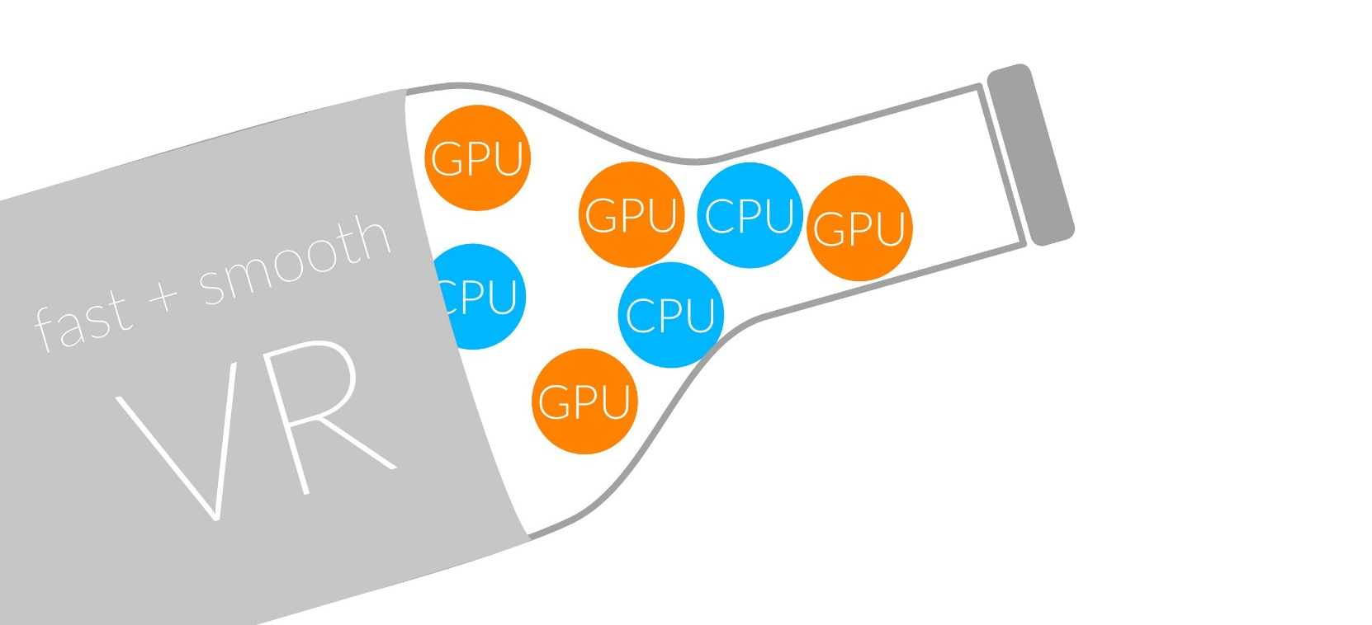
1
Sequencing
Read Mapping
2
Bottlenecked in Mapping!!
Illumina HiSeq4000
on average
GAGTCAGAATTTGAC
2 M
bases/min
300 M
bases/min
GAGTCAGAATTTGAC
GAGTCAGAATTTGAC
GAGTCAGAATTTGAC
GAGTCAGAATTTGAC
GAGTCAGAATTTGAC
GAGTCAGAATTTGAC
GAGTCAGAATTTGAC
GAGTCAGAATTTGAC
GAGTCAGAATTTGAC
GAGTCAGAATTTGAC
GAGTCAGAATTTGAC
GAGTCAGAATTTGAC
GAGTCAGAATTTGAC
GAGTCAGAATTTGAC
(0.6%)
Variant Calling
Scientific Discovery
3
4
Notes:
Typical sequencer machine generates a flood of reads, for example, Illumina HiSeq4000 generates 300 million bases/minute.
However, existing computer alignment algorithms can only process 0.6% of these reads in the same amount of time.
This gap is widening as more advanced sequencers are made available in the market.

Slide 15
Hash Table Based Read Mappers
+ Guaranteed to find all mappings → sensitive
+ Can tolerate up to e errors
http://mrfast.sourceforge.net/
Alkan+, "Personalized copy number and segmental duplication
maps using next-generation sequencing”, Nature Genetics 2009.
Notes:
It turned out the Hash Table based mappers solve the first 2 challenges pretty well. They guarantee to find all mappings with no more than e errors present.

Slide 16
Read Mapping Execution Time Breakdown
Notes:
An overwhelming majority of the read mapper’s execution time is spent in read alignment.

Slide 17
Idea
Filter fast before you align
Minimize costly
“approximate string comparisons”

Slide 18
Our First Filter: Pure Software Approach
Download the source code and try for yourself
  Download link to FastHASH

Slide 19
Shifted Hamming Distance: SIMD Acceleration
https://github.com/CMU-SAFARI/Shifted-Hamming-Distance
Xin+, "Shifted Hamming Distance: A Fast and Accurate SIMD-friendly Filter
to Accelerate Alignment Verification in Read Mapping”, Bioinformatics 2015.

Slide 20
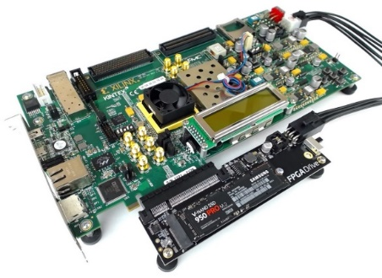
GateKeeper: FPGA-Based Alignment Filtering
1
st
Alignment Filter
FPGA-based Alignment Filter.
Notes:
To bridge the widening gap between the sequencer & the mapper, we propose the concept of pre-alignment filtering. We added a new examination step before the accurate alignment step. The main objective of this step is to detect the incorrect mappings accurately and rapidly. Only the mappings that pass our filter are examined by the alignment step. We also explore exploiting todays’ hardware accelerators to further boost the filtering speed of such filters.

Slide 21
GateKeeper: FPGA-Based Alignment Filtering
Mohammed Alser, Hasan Hassan, Hongyi Xin, Oguz Ergin, Onur Mutlu, and Can Alkan
"GateKeeper: A New Hardware Architecture for Accelerating Pre-Alignment in DNA Short Read Mapping"
Bioinformatics, [published online, May 31], 2017.
[Source Code]
[Online link at Bioinformatics Journal]

Slide 22
DNA Read Mapping & Filtering
Problem: Heavily bottlenecked by Data Movement
GateKeeper FPGA performance limited by DRAM bandwidth [Alser+, Bioinformatics 2017]
Ditto for SHD on SIMD [Xin+, Bioinformatics 2015]
Solution: Processing-in-memory can alleviate the bottleneck
However, we need to design mapping & filtering algorithms to fit processing-in-memory

Slide 23
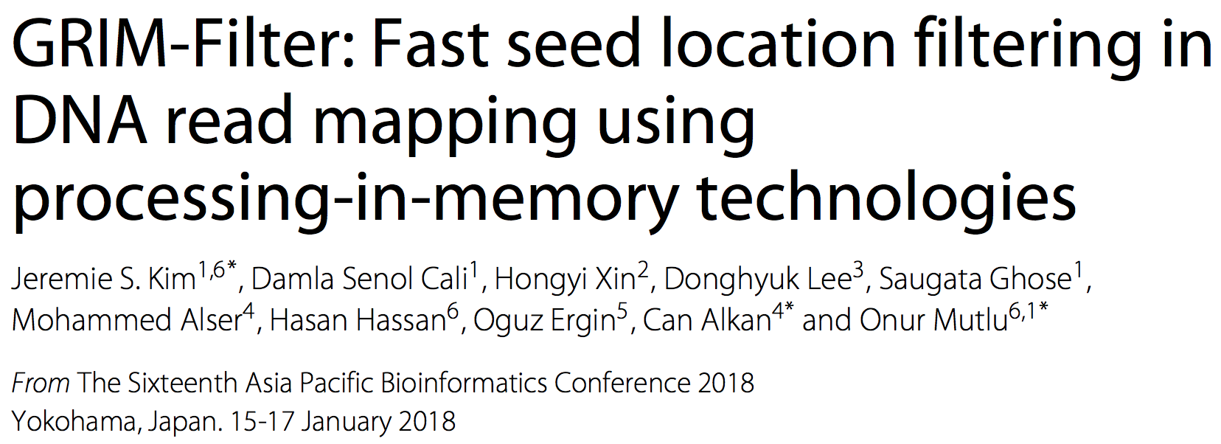
In-Memory DNA Sequence Analysis
Jeremie S. Kim, Damla Senol Cali, Hongyi Xin, Donghyuk Lee, Saugata Ghose, Mohammed Alser, Hasan Hassan, Oguz Ergin, Can Alkan, and Onur Mutlu,
"GRIM-Filter: Fast Seed Location Filtering in DNA Read Mapping Using Processing-in-Memory Technologies"
BMC Genomics, 2018.
Proceedings of the 16th Asia Pacific Bioinformatics Conference (APBC), Yokohama, Japan, January 2018.
arxiv.org Version (pdf)

Slide 24
Quick Note: Key Principles and Results
Two key principles:
  Exploit the structure of the genome to minimize computation
  Morph and exploit the structure of the underlying hardware to maximize performance and efficiency
Algorithm-architecture co-design for DNA read mapping
  Speeds up read mapping by ~200X (sometimes more)
  Improves accuracy of read mapping in the presence of errors
Xin et al., “Accelerating Read Mapping with FastHASH,” BMC Genomics 2013.
Xin et al., “Shifted Hamming Distance: A Fast and Accurate SIMD-friendly Filter to Accelerate
Alignment Verification in Read Mapping,” Bioinformatics 2015.
Alser et al., “GateKeeper: A New Hardware Architecture for Accelerating Pre-Alignment in DNA
Short Read Mapping,” Bioinformatics 2017.
Kim et al., “Genome Read In-Memory (GRIM) Filter,” BMC Genomics 2018.

Slide 25
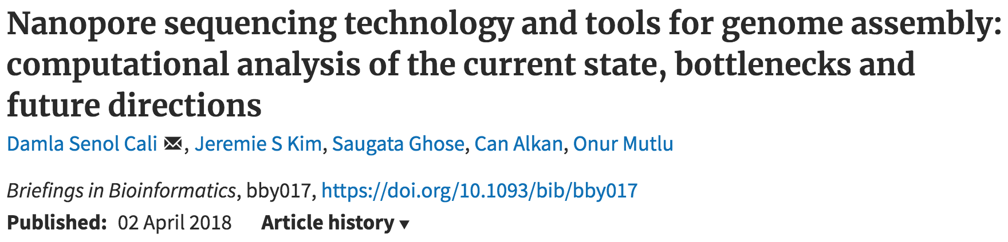
New Genome Sequencing Technologies
Oxford Nanopore MinION
Senol Cali+, “Nanopore Sequencing Technology and Tools for Genome
Assembly: Computational Analysis of the Current State, Bottlenecks
and Future Directions,” Briefings in Bioinformatics, 2018.
[Preliminary arxiv.org version]

Slide 26
Nanopore Genome Assembly Pipeline
Senol Cali+, “Nanopore Sequencing Technology and Tools for Genome
Assembly,” Briefings in Bioinformatics, 2018.

Slide 27

More on Genome Analysis: Another Talk

Slide 28
Recall Our Dream
An embedded device that can perform comprehensive genome analysis in real time (within a minute)
Still a long ways to go
  Energy efficiency
  Performance (latency)
  Security
  Huge memory bottleneck

Slide 29
Four Key Directions
Fundamentally Secure/Reliable/Safe Architectures
Fundamentally Energy-Efficient Architectures
  Memory-centric (Data-centric) Architectures
Fundamentally Low-Latency Architectures
Architectures for Genomics, Medicine, Health

Slide 30
Memory & Storage

Slide 31
The Main Memory System
Main memory is a critical component of all computing systems: server, mobile, embedded, desktop, sensor
Main memory system must scale (in size, technology, efficiency, cost, and management algorithms) to maintain performance growth and technology scaling benefits
Processors
and caches
Main Memory
Storage (SSD/HDD)

Slide 32
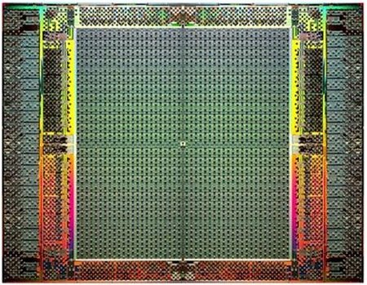
The Main Memory System
Main memory is a critical component of all computing systems: server, mobile, embedded, desktop, sensor
Main memory system must scale (in size, technology, efficiency, cost, and management algorithms) to maintain performance growth and technology scaling benefits
FPGAs
Main Memory
Storage (SSD/HDD)

Slide 33
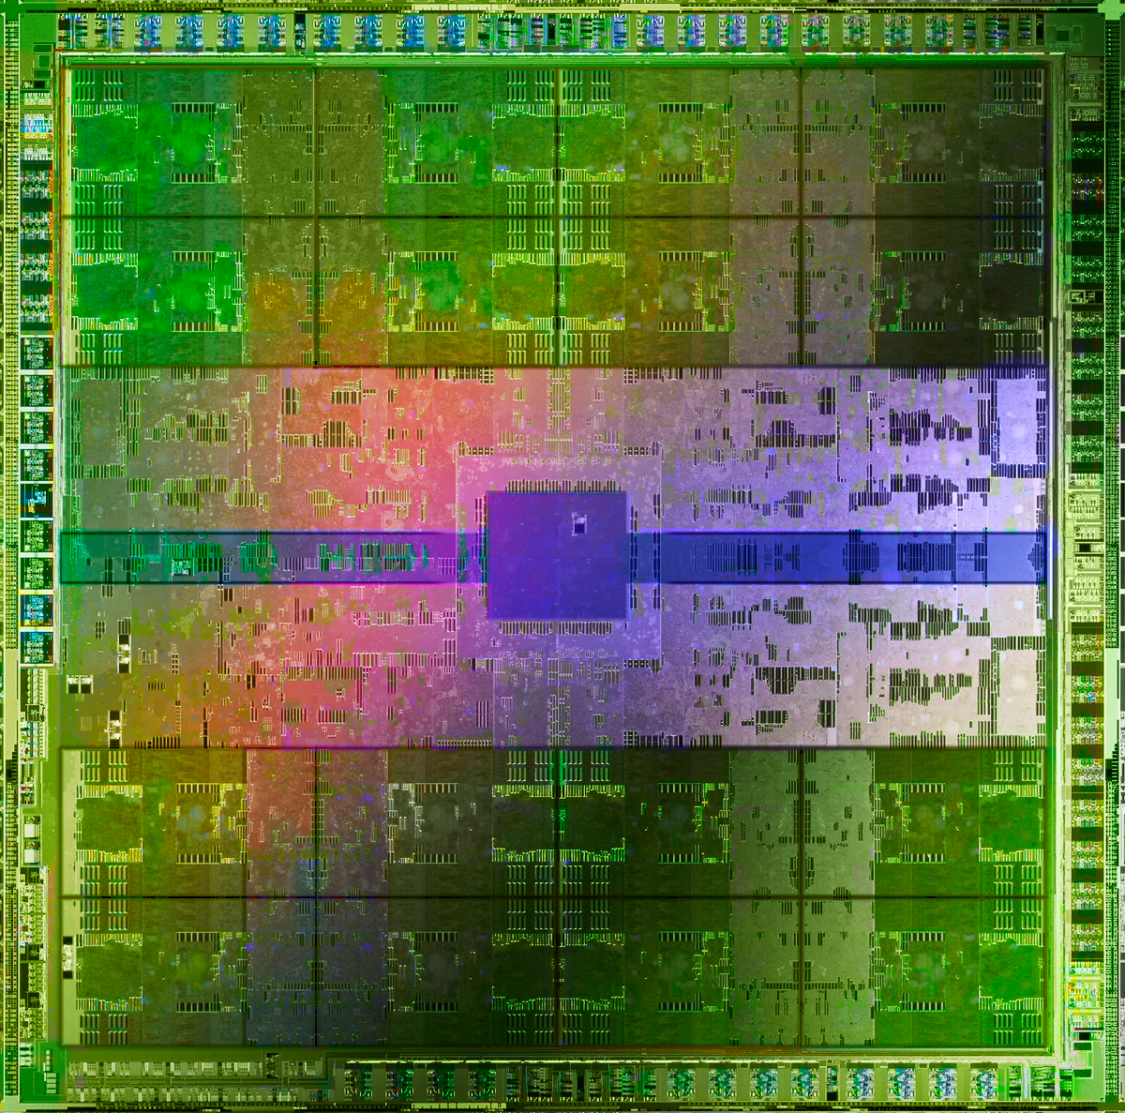
The Main Memory System
Main memory is a critical component of all computing systems: server, mobile, embedded, desktop, sensor
Main memory system must scale (in size, technology, efficiency, cost, and management algorithms) to maintain performance growth and technology scaling benefits
GPUs
Main Memory
Storage (SSD/HDD)

Slide 34
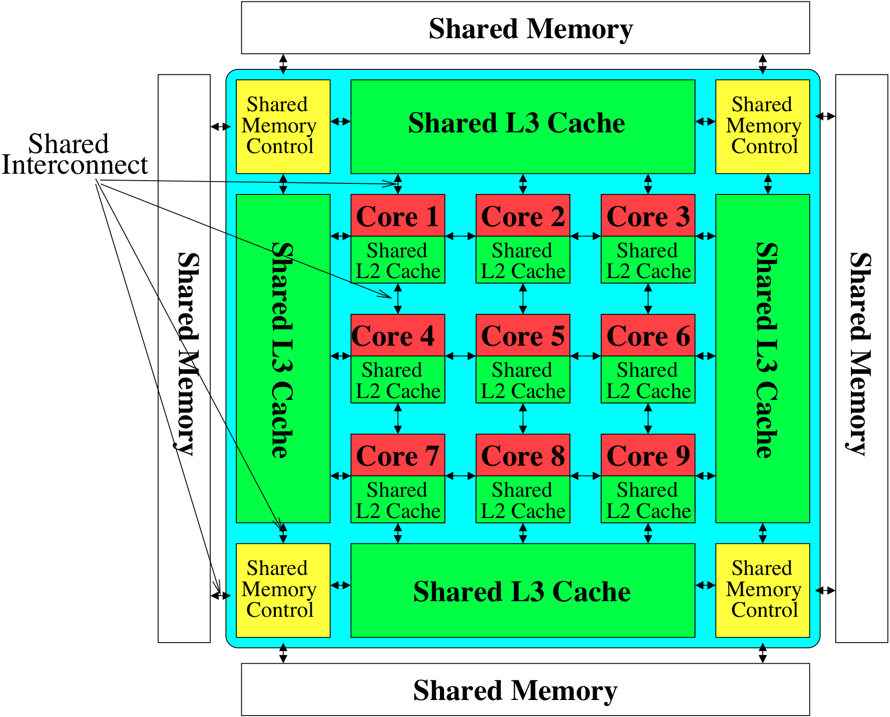
Memory System: A Shared Resource View
Storage
Most of the system is dedicated to storing and moving data

Slide 35
State of the Main Memory System
Recent technology, architecture, and application trends
  lead to new requirements
  exacerbate old requirements
DRAM and memory controllers, as we know them today, are (will be) unlikely to satisfy all requirements
Some emerging non-volatile memory technologies (e.g., PCM) enable new opportunities: memory+storage merging
We need to rethink the main memory system
  to fix DRAM issues and enable emerging technologies
  to satisfy all requirements

Slide 36
Agenda
Major Trends Affecting Main Memory
Key Challenges and Solution Directions
  Robustness: Reliability and Security
  Energy and Performance: In-Memory Computation
  Low Latency/Energy and Latency/Energy/Reliability Tradeoffs
  Scalability and More: Enabling Emerging Technologies
Solution Principles
Concluding Remarks

Slide 37
Major Trends Affecting Main Memory (I)
Need for main memory capacity, bandwidth, QoS increasing
Main memory energy/power is a key system design concern
DRAM technology scaling is ending

Slide 38
Major Trends Affecting Main Memory (II)
Need for main memory capacity, bandwidth, QoS increasing
  Multi-core: increasing number of cores/agents
  Data-intensive applications: increasing demand/hunger for data
  Consolidation: cloud computing, GPUs, mobile, heterogeneity
Main memory energy/power is a key system design concern
DRAM technology scaling is ending

Slide 39
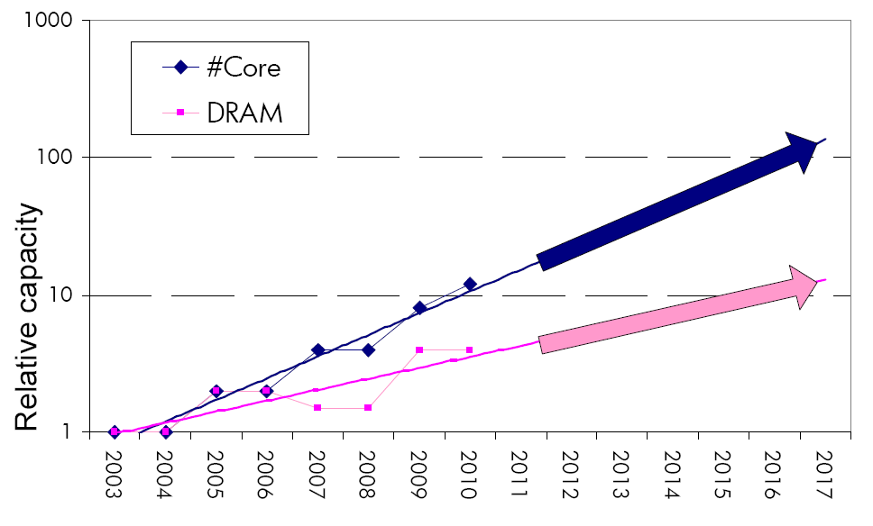
Example: The Memory Capacity Gap
Core count doubling ~ every 2 years
DRAM DIMM capacity doubling ~ every 3 years
Memory capacity per core expected to drop by 30% every two years
Trends worse for memory bandwidth per core!
Lim et al., ISCA 2009

Slide 40
DRAM Capacity, Bandwidth, Latency Trends
128x
20x
1.3x
Memory latency remains almost constant

Slide 41
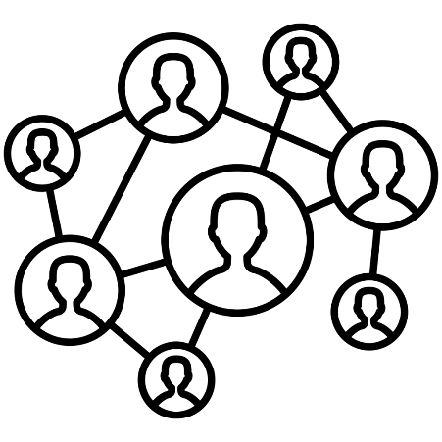

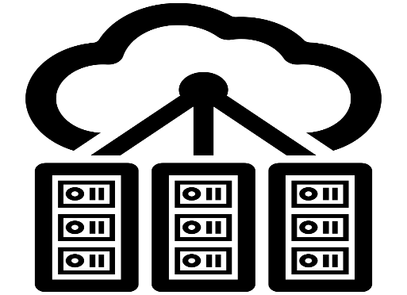

DRAM Is Critical for Performance
In-memory Databases
[Mao+, EuroSys’12;
Clapp+ (Intel), IISWC’15]
Graph/Tree Processing
[Xu+, IISWC’12; Umuroglu+, FPL’15]
In-Memory Data Analytics
[Clapp+ (Intel), IISWC’15;
Awan+, BDCloud’15]
Datacenter Workloads
[Kanev+ (Google), ISCA’15]

Slide 42
DRAM Is Critical for Performance
In-memory Databases
[Mao+, EuroSys’12;
Clapp+ (Intel), IISWC’15]
Graph/Tree Processing
[Xu+, IISWC’12; Umuroglu+, FPL’15]
Memory → performance bottleneck
In-Memory Data Analytics
[Clapp+ (Intel), IISWC’15;
Awan+, BDCloud’15]
Datacenter Workloads
[Kanev+ (Google), ISCA’15]

Slide 43





Popular Consumer Workloads
  Chrome
TensorFlow Mobile
    Google’s web browser
Google’s machine learning framework
  Video Playback
  Video Capture
Google’s video codec
Google’s video codec
Notes:
In this work, we take a look at widely-used google consumer workloads, to figure out the major sources of energy consumption.
We look at Google Chrome web brower. We take a look at Tensorflow, Google’s machine learning framework, and we also take a look at two important video related workloads, video playback and video capture, both rely on Google’s vp9 codec technology.

Slide 44
Popular Consumer Workloads
  Chrome
TensorFlow Mobile
    Google’s web browser
Google’s machine learning framework
Memory → performance bottleneck
  Video Playback
  Video Capture
Google’s video codec
Google’s video codec
Notes:
In this work, we take a look at widely-used google consumer workloads, to figure out the major sources of energy consumption.
We look at Google Chrome web brower. We take a look at Tensorflow, Google’s machine learning framework, and we also take a look at two important video related workloads, video playback and video capture, both rely on Google’s vp9 codec technology.

Slide 45
Major Trends Affecting Main Memory (III)
Need for main memory capacity, bandwidth, QoS increasing
Main memory energy/power is a key system design concern
  ~40-50% energy spent in off-chip memory hierarchy [Lefurgy, IEEE Computer’03] >40% power in DRAM [Ware, HPCA’10][Paul,ISCA’15]
  DRAM consumes power even when not used (periodic refresh)
DRAM technology scaling is ending

Slide 46
Energy Waste in Mobile Devices
Amirali Boroumand, Saugata Ghose, Youngsok Kim, Rachata Ausavarungnirun, Eric Shiu, Rahul Thakur, Daehyun Kim, Aki Kuusela, Allan Knies, Parthasarathy Ranganathan, and Onur Mutlu,
"Google Workloads for Consumer Devices: Mitigating Data Movement Bottlenecks"
Proceedings of the 23rd International Conference on Architectural Support for Programming Languages and Operating Systems (ASPLOS), Williamsburg, VA, USA, March 2018.
62.7% of the total system energy
is spent on data movement

Slide 47
Major Trends Affecting Main Memory (IV)
Need for main memory capacity, bandwidth, QoS increasing
Main memory energy/power is a key system design concern
DRAM technology scaling is ending
  ITRS projects DRAM will not scale easily below X nm
  Scaling has provided many benefits:
    higher capacity (density), lower cost, lower energy

Slide 48
Major Trends Affecting Main Memory (V)
DRAM scaling has already become increasingly difficult
  Increasing cell leakage current, reduced cell reliability, increasing manufacturing difficulties [Kim+ ISCA 2014],
  [Liu+ ISCA 2013], [Mutlu IMW 2013], [Mutlu DATE 2017]
  Difficult to significantly improve capacity, energy
Emerging memory technologies are promising
3D-Stacked DRAM | higher bandwidth | smaller capacity
Reduced-Latency DRAM (e.g., RLDRAM, TL-DRAM) | lower latency | higher cost
Low-Power DRAM (e.g., LPDDR3, LPDDR4) | lower power | higher latency higher cost
Non-Volatile Memory (NVM) (e.g., PCM, STTRAM, ReRAM, 3D Xpoint) | larger capacity | higher latency higher dynamic power lower endurance

Slide 49
Major Trends Affecting Main Memory (V)
DRAM scaling has already become increasingly difficult
  Increasing cell leakage current, reduced cell reliability, increasing manufacturing difficulties [Kim+ ISCA 2014],
  [Liu+ ISCA 2013], [Mutlu IMW 2013], [Mutlu DATE 2017]
  Difficult to significantly improve capacity, energy
Emerging memory technologies are promising
3D-Stacked DRAM | higher bandwidth | smaller capacity
Reduced-Latency DRAM (e.g., RL/TL-DRAM, FLY-RAM) | lower latency | higher cost
Low-Power DRAM (e.g., LPDDR3, LPDDR4, Voltron) | lower power | higher latency higher cost
Non-Volatile Memory (NVM) (e.g., PCM, STTRAM, ReRAM, 3D Xpoint) | larger capacity | higher latency higher dynamic power lower endurance

Slide 50
Major Trend: Hybrid Main Memory
CPU
Meza+, “Enabling Efficient and Scalable Hybrid Memories,” IEEE Comp. Arch. Letters, 2012.
Yoon+, “Row Buffer Locality Aware Caching Policies for Hybrid Memories,” ICCD 2012 Best Paper Award.
DRAMCtrl
PCM Ctrl
DRAM
Phase Change Memory (or Tech. X)
Fast, durable
Small,
leaky, volatile,
high-cost
Large, non-volatile, low-cost
Slow, wears out, high active energy
Hardware/software manage data allocation and movement
to achieve the best of multiple technologies

Slide 51
One Foreshadowing
Main Memory Needs
Intelligent Controllers

Slide 52
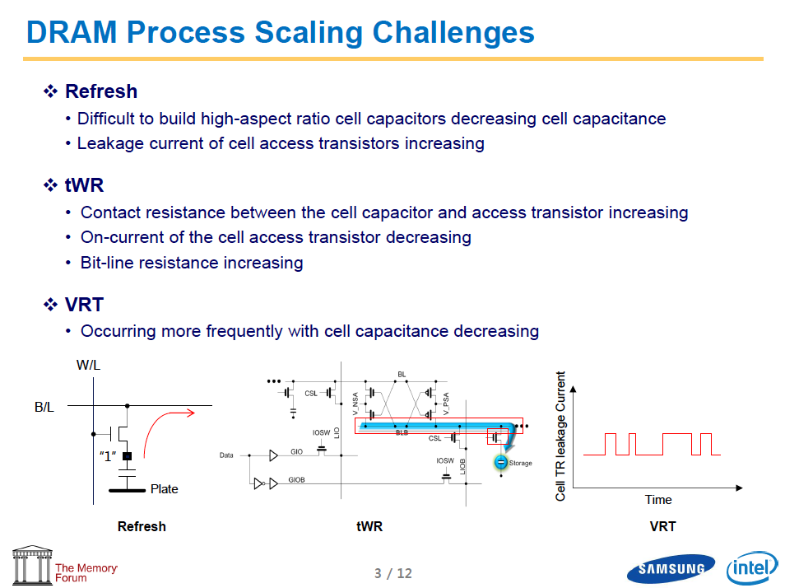
Industry Is Writing Papers About It, Too

Slide 53
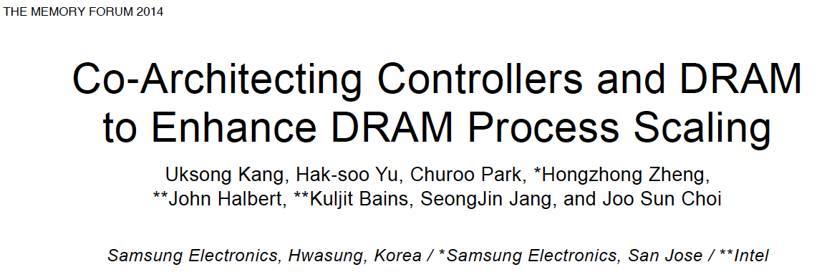
Call for Intelligent Memory Controllers

Slide 54
Agenda
Major Trends Affecting Main Memory
Key Challenges and Solution Directions
  Robustness: Reliability and Security
  Energy and Performance: In-Memory Computation
  Low Latency/Energy and Latency/Energy/Reliability Tradeoffs
  Scalability and More: Enabling Emerging Technologies
Solution Principles
Concluding Remarks

Slide 55
Four Key Issues in Future Platforms
Fundamentally Secure/Reliable/Safe Architectures
Fundamentally Energy-Efficient Architectures
  Memory-centric (Data-centric) Architectures
Fundamentally Low-Latency Architectures
Architectures for Genomics, Medicine, Health

Slide 56
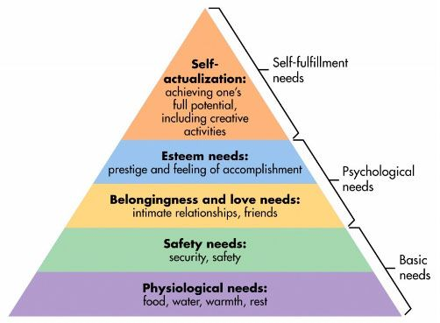
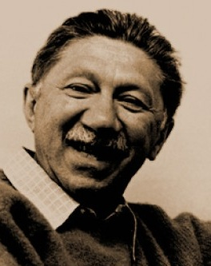
Maslow’s (Human) Hierarchy of Needs
Maslow, “A Theory of Human Motivation,”
Psychological Review, 1943.
Maslow, “A Theory of Human Motivation,”
Psychological Review, 1943.
Maslow, “Motivation and Personality,”
Book, 1954-1970.
We need to start with reliability and security…
Source: https://www.simplypsychology.org/maslow.html
Source: By User:Factoryjoe - Mazlow's Hierarchy of Needs.svg, CC BY-SA 3.0, https://commons.wikimedia.org/w/index.php?curid=7964065

Slide 57
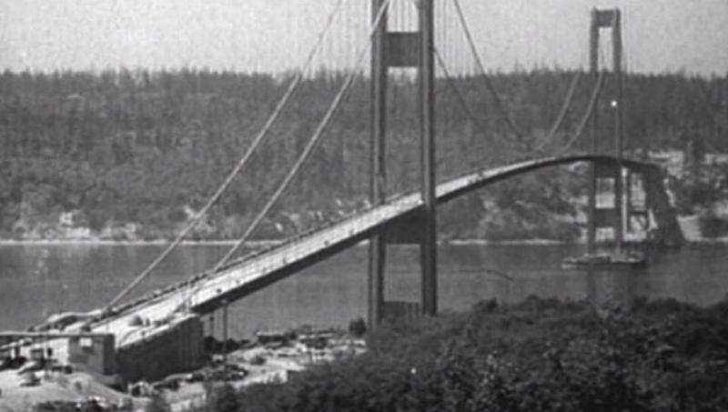
How Reliable/Secure/Safe is This Bridge?
Source: http://www.technologystudent.com/struct1/tacom1.png

Slide 58
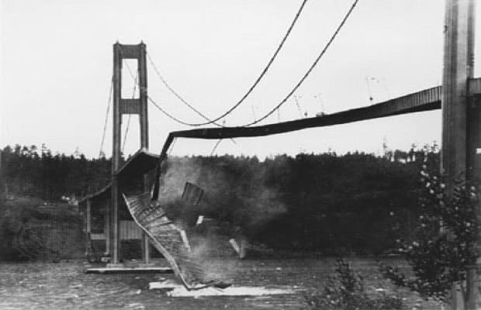
Collapse of the “Galloping Gertie”
Source: AP
http://www.wsdot.wa.gov/tnbhistory/connections/connections3.htm

Slide 59
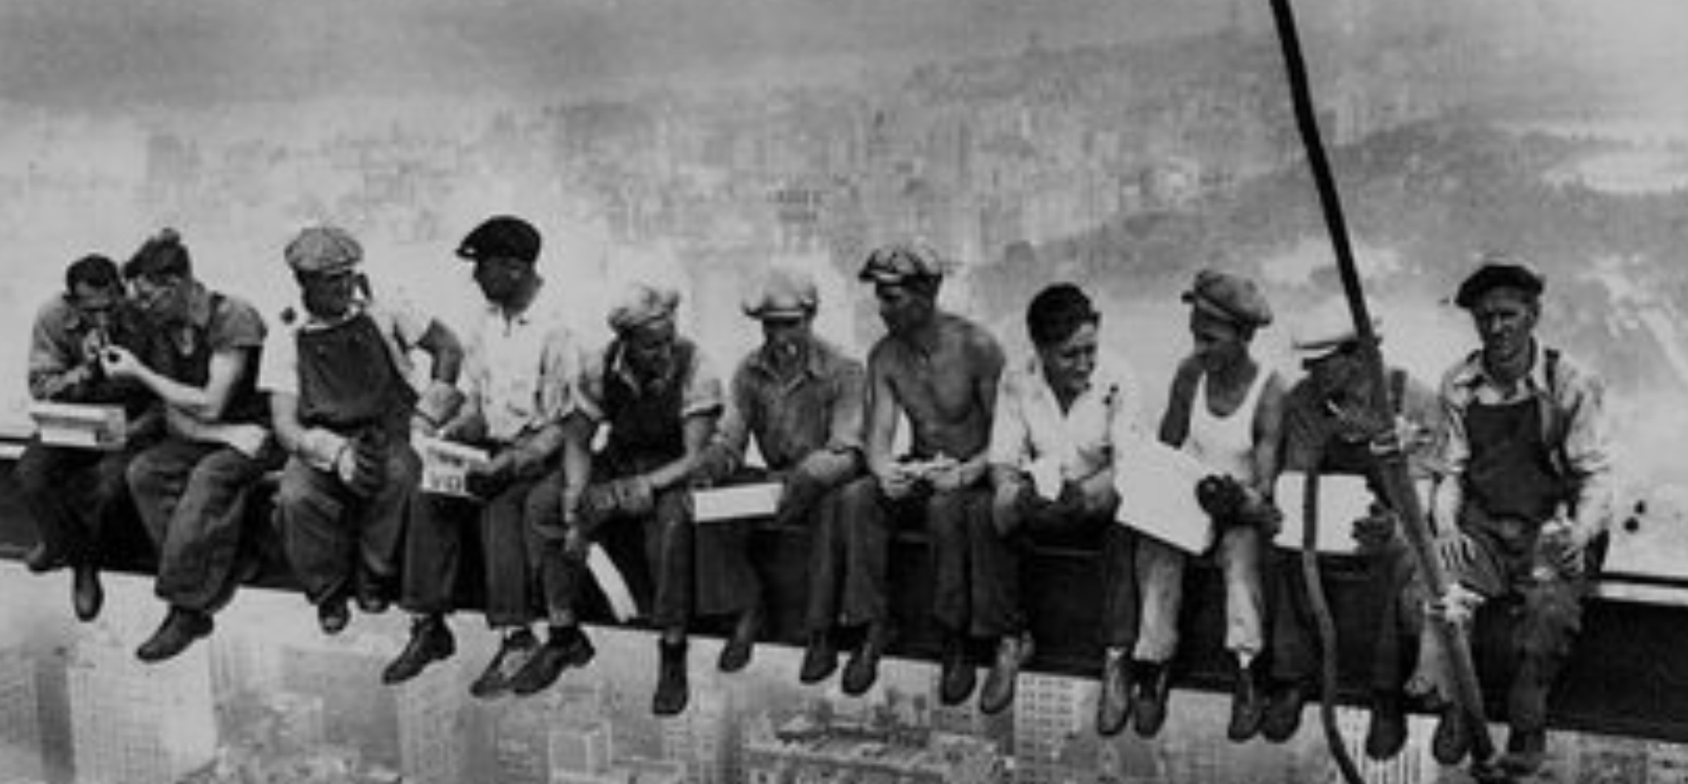
How Secure Are These People?
Security is about preventing unforeseen consequences
Source: https://s-media-cache-ak0.pinimg.com/originals/48/09/54/4809543a9c7700246a0cf8acdae27abf.jpg

Slide 60
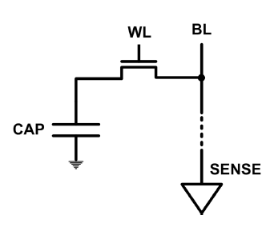
The DRAM Scaling Problem
DRAM stores charge in a capacitor (charge-based memory)
  Capacitor must be large enough for reliable sensing
  Access transistor should be large enough for low leakage and high retention time
  Scaling beyond 40-35nm (2013) is challenging [ITRS, 2009]
DRAM capacity, cost, and energy/power hard to scale

Slide 61
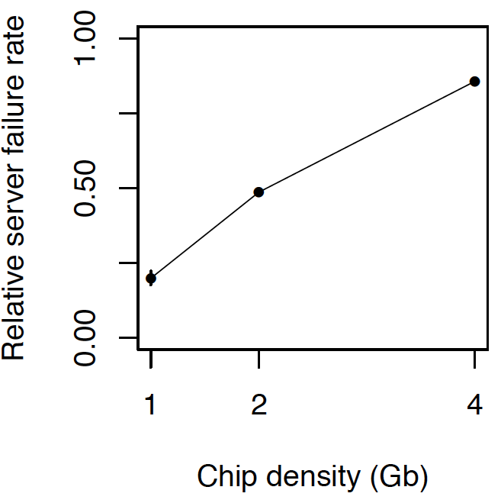
As Memory Scales, It Becomes Unreliable
Data from all of Facebook’s servers worldwide
Meza+, “Revisiting Memory Errors in Large-Scale Production Data Centers,” DSN’15.
Intuition:
quadratic
increase in
capacity

Slide 62
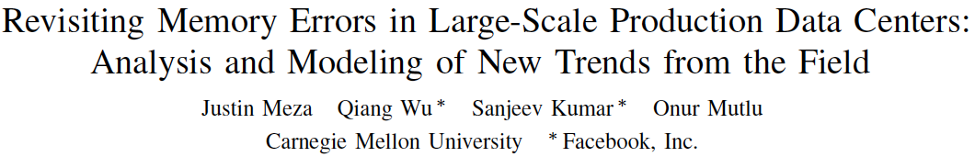
Large-Scale Failure Analysis of DRAM Chips
Analysis and modeling of memory errors found in all of Facebook’s server fleet
Justin Meza, Qiang Wu, Sanjeev Kumar, and Onur Mutlu,
"Revisiting Memory Errors in Large-Scale Production Data Centers: Analysis and Modeling of New Trends from the Field"
Proceedings of the 45th Annual IEEE/IFIP International Conference on Dependable Systems and Networks (DSN), Rio de Janeiro, Brazil, June 2015.
[Slides (pptx) (pdf)] [DRAM Error Model]

Slide 63
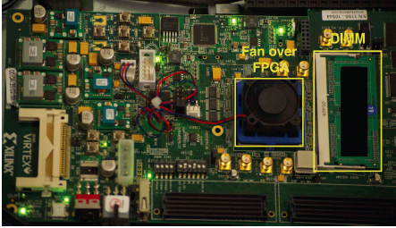
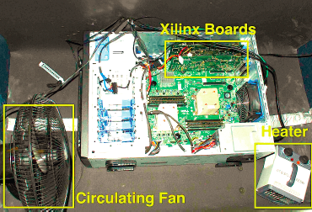
Infrastructures to Understand Such Issues
  An Experimental Study of Data Retention Behavior in Modern DRAM Devices: Implications for Retention Time Profiling Mechanisms (Liu et al., ISCA 2013)
  The Efficacy of Error Mitigation Techniques for DRAM Retention Failures: A Comparative Experimental Study
  (Khan et al., SIGMETRICS 2014)
  Flipping Bits in Memory Without Accessing Them: An Experimental Study of DRAM Disturbance Errors (Kim et al., ISCA 2014)
  Adaptive-Latency DRAM: Optimizing DRAM Timing for the Common-Case (Lee et al., HPCA 2015)
  AVATAR: A Variable-Retention-Time (VRT) Aware Refresh for DRAM Systems (Qureshi et al., DSN 2015)

Slide 64

Infrastructures to Understand Such Issues
Temperature
Controller
FPGAs
Heater
FPGAs
PC
  Kim+, “Flipping Bits in Memory Without Accessing Them: An Experimental Study of DRAM Disturbance Errors,” ISCA 2014.

Slide 65
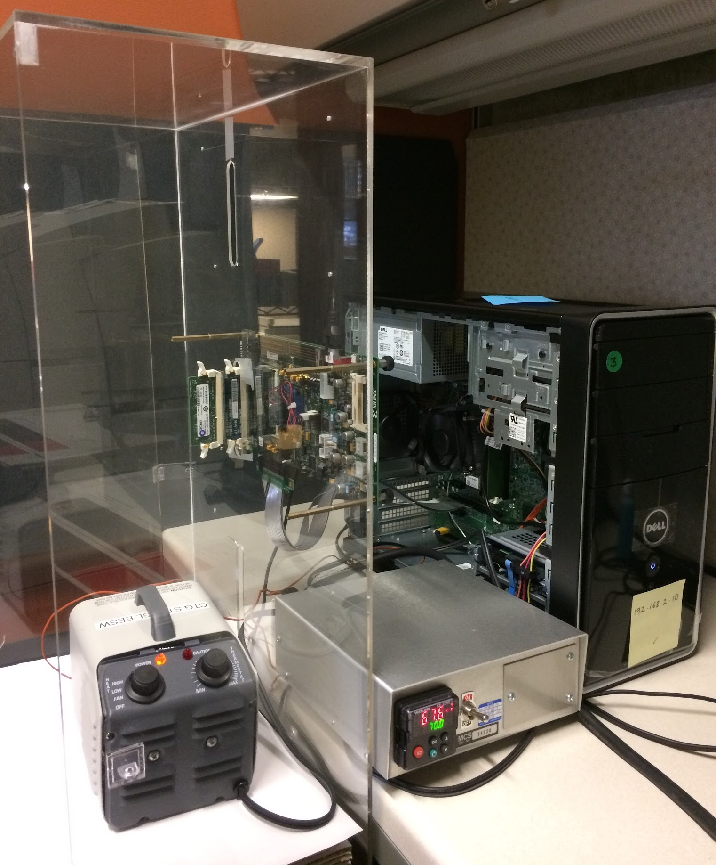
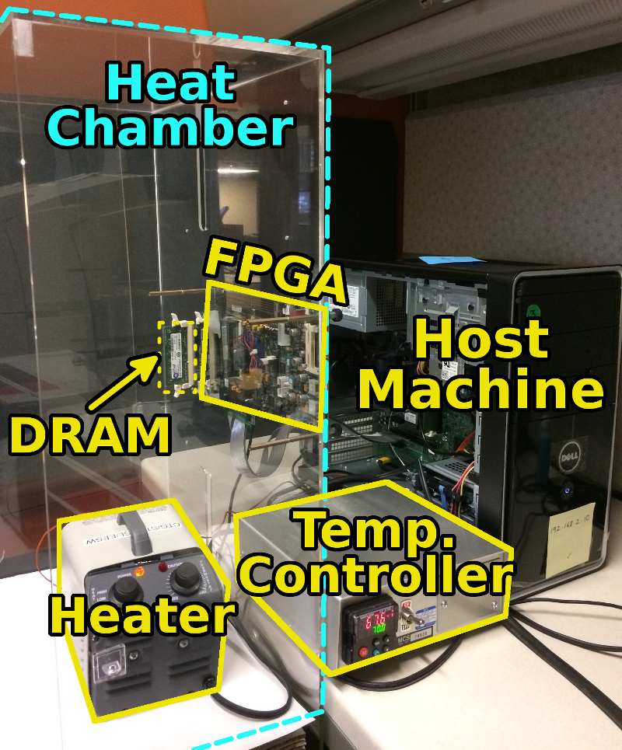
SoftMC: Open Source DRAM Infrastructure
Hasan Hassan et al., “SoftMC: A Flexible and Practical Open-Source Infrastructure for Enabling Experimental DRAM Studies,” HPCA 2017.
Flexible
Easy to Use (C++ API)
Open-source
github.com/CMU-SAFARI/SoftMC

Slide 66
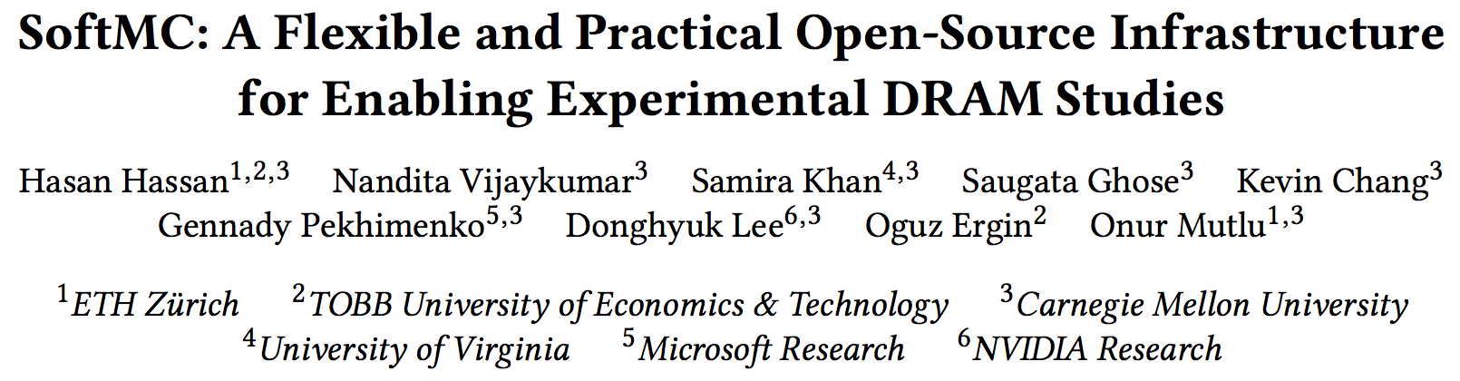
SoftMC
https://github.com/CMU-SAFARI/SoftMC

Slide 67

Data Retention in Memory [Liu et al., ISCA 2013]
Retention Time Profile of DRAM looks like this:
Location dependent
Stored value pattern dependent
Time dependent
Liu+, “RAIDR: Retention-Aware Intelligent DRAM Refresh,” ISCA 2012.

Slide 68
Takeaway
Main Memory Needs
Intelligent Controllers

Slide 69
A Curious Discovery [Kim et al., ISCA 2014]
One can
predictably induce errors
in most DRAM memory chips

Slide 70
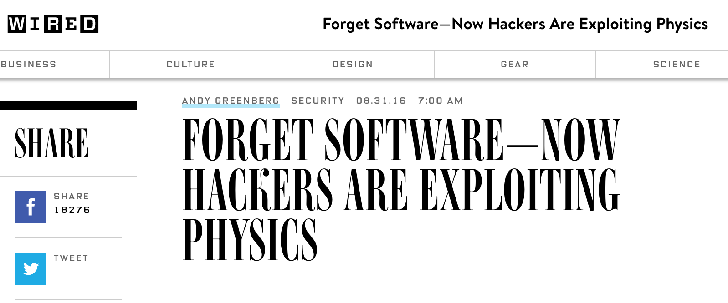
DRAM RowHammer
A simple hardware failure mechanism
can create a widespread
system security vulnerability

Slide 71
Modern DRAM is Prone to Disturbance Errors
Row of Cells
Wordline
Row
Victim Row
Row
Hammered Row
V_{LOW}
Opened
V_{HIGH}
Closed
Row
Victim Row
Row
Repeatedly reading a row enough times (before memory gets refreshed) induces disturbance errors in adjacent rows in most real DRAM chips you can buy today
Flipping Bits in Memory Without Accessing Them: An Experimental Study of DRAM Disturbance Errors, (Kim et al., ISCA 2014)

Slide 72
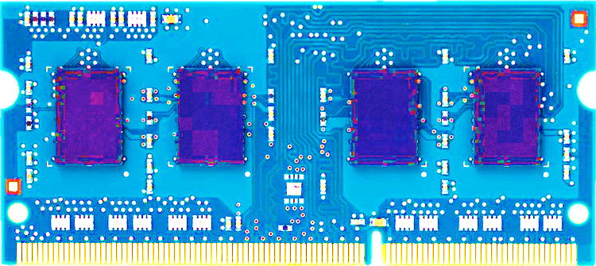
Most DRAM Modules Are Vulnerable
A company
B company
C company
86%
(37/43)
83%
(45/54)
88%
(28/32)
Up to
1.0×10⁷
errors
Up to
2.7×10⁶
errors
Up to
3.3×10⁵
errors
Flipping Bits in Memory Without Accessing Them: An Experimental Study of DRAM Disturbance Errors, (Kim et al., ISCA 2014)

Slide 73
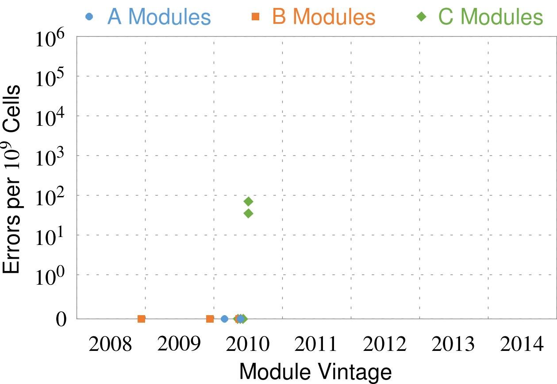
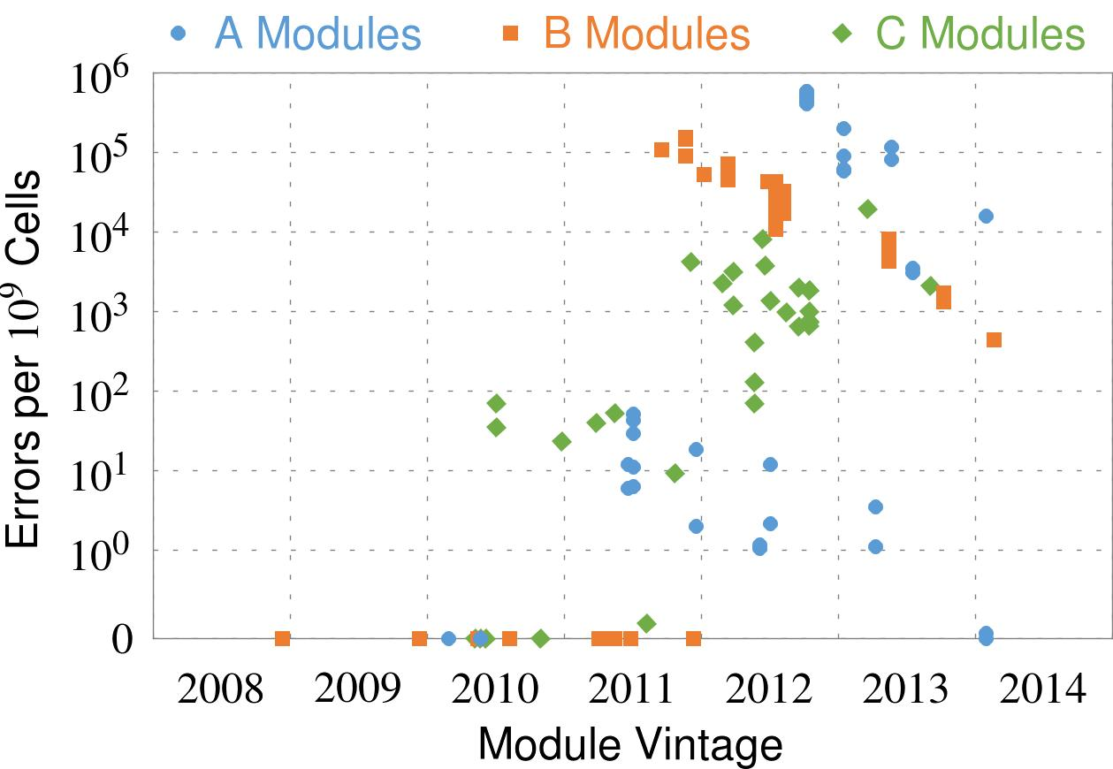
Recent DRAM Is More Vulnerable
Notes:
In this figure, the x-axis is the module manufacture date. And the y-axis is the number of errors in a module, normalized to one billion cells. In 2008 and 2009, there are no errors. But, in 2010, we first start to see errors in C modules. After 2010, the errors start to proliferate. For A and B modules, we first start to see errors in 2011. In particular, all modules from 2012 and 2013 are vulnerable.

Slide 74
Recent DRAM Is More Vulnerable
First
Appearance
Notes:
In this figure, the x-axis is the module manufacture date. And the y-axis is the number of errors in a module, normalized to one billion cells. In 2008 and 2009, there are no errors. But, in 2010, we first start to see errors in C modules. After 2010, the errors start to proliferate. For A and B modules, we first start to see errors in 2011. In particular, all modules from 2012 and 2013 are vulnerable.

Slide 75
Recent DRAM Is More Vulnerable
First
Appearance
All modules from 2012–2013 are vulnerable
Notes:
In this figure, the x-axis is the module manufacture date. And the y-axis is the number of errors in a module, normalized to one billion cells. In 2008 and 2009, there are no errors. But, in 2010, we first start to see errors in C modules. After 2010, the errors start to proliferate. For A and B modules, we first start to see errors in 2011. In particular, all modules from 2012 and 2013 are vulnerable.

Slide 76

A Simple Program Can Induce Many Errors
CPU
DRAM Module
loop:
mov (X), %eax
mov (Y), %ebx
clflush (X)
clflush (Y)
mfence
jmp loop
X
Y
  Download from: https://github.com/CMU-SAFARI/rowhammer
Notes:
We demonstrate the errors on multiple x86 systems. Shown to the bottom-left is a “disturbance kernel”. When executed, it forces two rows to be opened and closed one after the other – over and over again. Consequently, it induces many errors in the module.

Slide 77
A Simple Program Can Induce Many Errors
CPU
DRAM Module
Avoid cache hits
  Flush X from cache
Avoid row hits to X
  Read Y in another row
X
Y
  Download from: https://github.com/CMU-SAFARI/rowhammer
Notes:
We demonstrate the errors on multiple x86 systems. Shown to the bottom-left is a “disturbance kernel”. When executed, it forces two rows to be opened and closed one after the other – over and over again. Consequently, it induces many errors in the module.

Slide 78
A Simple Program Can Induce Many Errors
CPU
DRAM Module
loop:
mov (X), %eax
mov (Y), %ebx
clflush (X)
clflush (Y)
mfence
jmp loop
X
Y
  Download from: https://github.com/CMU-SAFARI/rowhammer
Notes:
We demonstrate the errors on multiple x86 systems. Shown to the bottom-left is a “disturbance kernel”. When executed, it forces two rows to be opened and closed one after the other – over and over again. Consequently, it induces many errors in the module.

Slide 79
A Simple Program Can Induce Many Errors
CPU
DRAM Module
loop:
mov (X), %eax
mov (Y), %ebx
clflush (X)
clflush (Y)
mfence
jmp loop
X
Y
  Download from: https://github.com/CMU-SAFARI/rowhammer
Notes:
We demonstrate the errors on multiple x86 systems. Shown to the bottom-left is a “disturbance kernel”. When executed, it forces two rows to be opened and closed one after the other – over and over again. Consequently, it induces many errors in the module.

Slide 80
A Simple Program Can Induce Many Errors
CPU
DRAM Module
loop:
mov (X), %eax
mov (Y), %ebx
clflush (X)
clflush (Y)
mfence
jmp loop
X
Y
  Download from: https://github.com/CMU-SAFARI/rowhammer
Notes:
We demonstrate the errors on multiple x86 systems. Shown to the bottom-left is a “disturbance kernel”. When executed, it forces two rows to be opened and closed one after the other – over and over again. Consequently, it induces many errors in the module.

Slide 81
Observed Errors in Real Systems
A real reliability & security issue
CPU Architecture | Errors | Access-Rate
Intel Haswell (2013) | 22.9K | 12.3M/sec
Intel Ivy Bridge (2012) | 20.7K | 11.7M/sec
Intel Sandy Bridge (2011) | 16.1K | 11.6M/sec
AMD Piledriver (2012) | 59 | 6.1M/sec
Kim+, “Flipping Bits in Memory Without Accessing Them: An Experimental Study of DRAM Disturbance Errors,” ISCA 2014.
Notes:
When we executed the code on four different processors, all four of them yielded errors. Intel Haswell has the most errors, at 23 thousand, because it has the highest rate of accessing DRAM.
Later on, I’ll show that we can induce as many as ten million disturbance errors in a more controlled environment.
From this, we conclude that disturbance errors are a serious reliability issue.

Slide 82



One Can Take Over an Otherwise-Secure System
Flipping Bits in Memory Without Accessing Them: An Experimental Study of DRAM Disturbance Errors (Kim et al., ISCA 2014)
Exploiting the DRAM rowhammer bug to gain kernel privileges (Seaborn, 2015)

Slide 83
RowHammer Security Attack Example
“Rowhammer” is a problem with some recent DRAM devices in which repeatedly accessing a row of memory can cause bit flips in adjacent rows (Kim et al., ISCA 2014).
  Flipping Bits in Memory Without Accessing Them: An Experimental Study of DRAM Disturbance Errors (Kim et al., ISCA 2014)
We tested a selection of laptops and found that a subset of them exhibited the problem.
We built two working privilege escalation exploits that use this effect.
  Exploiting the DRAM rowhammer bug to gain kernel privileges (Seaborn+, 2015)
One exploit uses rowhammer-induced bit flips to gain kernel privileges on x86-64 Linux when run as an unprivileged userland process.
When run on a machine vulnerable to the rowhammer problem, the process was able to induce bit flips in page table entries (PTEs).
It was able to use this to gain write access to its own page table, and hence gain read-write access to all of physical memory.
Exploiting the DRAM rowhammer bug to gain kernel privileges (Seaborn & Dullien, 2015)

Slide 84


Security Implications
Notes:
Picture from the article:
http://thehackernews.com/2015/03/dram-rowhammer-vulnerability.html

Slide 85

Security Implications
Notes:
Picture from the article:
http://thehackernews.com/2015/03/dram-rowhammer-vulnerability.html

Slide 86
Selected Readings on RowHammer (I)
Our first detailed study: Rowhammer analysis and solutions (June 2014)
  Yoongu Kim, Ross Daly, Jeremie Kim, Chris Fallin, Ji Hye Lee, Donghyuk Lee, Chris Wilkerson, Konrad Lai, and Onur Mutlu,
  "Flipping Bits in Memory Without Accessing Them: An Experimental Study of DRAM Disturbance Errors"
  Proceedings of the 41st International Symposium on Computer Architecture (ISCA), Minneapolis, MN, June 2014. [Slides (pptx) (pdf)] [Lightning Session Slides (pptx) (pdf)] [Source Code and Data]
Our Source Code to Induce Errors in Modern DRAM Chips (June 2014)
  https://github.com/CMU-SAFARI/rowhammer
Google Project Zero’s Attack to Take Over a System (March 2015)
  Exploiting the DRAM rowhammer bug to gain kernel privileges (Seaborn+, 2015)
  https://github.com/google/rowhammer-test
  Double-sided Rowhammer

Slide 87
Selected Readings on RowHammer (II)
Remote RowHammer Attacks via JavaScript (July 2015)
  http://arxiv.org/abs/1507.06955
  https://github.com/IAIK/rowhammerjs
  Gruss et al., DIMVA 2016.
  CLFLUSH-free Rowhammer
  “A fully automated attack that requires nothing but a website with JavaScript to trigger faults on remote hardware.”
  “We can gain unrestricted access to systems of website visitors.”
ANVIL: Software-Based Protection Against Next-Generation Rowhammer Attacks (March 2016)
  http://dl.acm.org/citation.cfm?doid=2872362.2872390
  Aweke et al., ASPLOS 2016
  CLFLUSH-free Rowhammer
  Software based monitoring for rowhammer detection

Slide 88
Selected Readings on RowHammer (III)
Dedup Est Machina: Memory Deduplication as an Advanced Exploitation Vector (May 2016)
  https://www.ieee-security.org/TC/SP2016/papers/0824a987.pdf
  Bosman et al., IEEE S&P 2016.
  Exploits Rowhammer and Memory Deduplication to overtake a browser
  “We report on the first reliable remote exploit for the Rowhammer vulnerability running entirely in Microsoft Edge.”
  “[an attacker] … can reliably “own” a system with all defenses up, even if the software is entirely free of bugs.”

Slide 89
Selected Readings on RowHammer (IV)
Flip Feng Shui: Hammering a Needle in the Software Stack (August 2016)
  https://www.usenix.org/system/files/conference/usenixsecurity16/sec16_paper_razavi.pdf
  Razavi et al., USENIX Security 2016.
  Combines memory deduplication and RowHammer
  “A malicious VM can gain unauthorized access to a co-hosted VM running OpenSSH.”
  Breaks OpenSSH public key authentication
Drammer: Deterministic Rowhammer Attacks on Mobile Platforms (October 2016)
  http://dl.acm.org/citation.cfm?id=2976749.2978406
  Van Der Veen et al., CCS 2016
  Can take over an ARM-based Android system deterministically
  Exploits predictable physical memory allocator behavior
    Can deterministically place security-sensitive data (e.g., page table) in an attacker-chosen, vulnerable location in memory

Slide 90
Selected Readings on RowHammer (V)
Grand Pwning Unit: Accelerating Microarchitectural Attacks with the GPU (May 2018)
  https://www.vusec.net/wp-content/uploads/2018/05/glitch.pdf
  Frigo et al., IEEE S&P 2018.
  The first end-to-end remote Rowhammer exploit on mobile platforms that use our GPU-based primitives in orchestration to compromise browsers on mobile devices in under two minutes.
Throwhammer: Rowhammer Attacks over the Network and Defenses (July 2018)
  https://www.cs.vu.nl/~herbertb/download/papers/throwhammer_atc18.pdf
  Tatar et al., USENIX ATC 2018.
  “[We] show that an attacker can trigger and exploit Rowhammer bit flips directly from a remote machine by only sending network packets.”

Slide 91
Selected Readings on RowHammer (VI)
Nethammer: Inducing Rowhammer Faults through Network Requests (July 2018)
  https://arxiv.org/pdf/1805.04956.pdf
  Lipp et al., arxiv.org 2018.
  “Nethammer is the first truly remote Rowhammer attack, without a single attacker-controlled line of code on the targeted system.”

Slide 92

More Security Implications (I)
“We can gain unrestricted access to systems of website visitors.”
Rowhammer.js: A Remote Software-Induced Fault Attack in JavaScript (DIMVA’16)
Source: https://lab.dsst.io/32c3-slides/7197.html

Slide 93

More Security Implications (II)
  “Can gain control of a smart phone deterministically”
Drammer: Deterministic Rowhammer Attacks on Mobile Platforms, CCS’16
Source: https://fossbytes.com/drammer-rowhammer-attack-android-root-devices/

Slide 94


More Security Implications (III)
Using an integrated GPU in a mobile system to remotely escalate privilege via the WebGL interface

Slide 95


More Security Implications (IV)
Rowhammer over RDMA (I)

Slide 96



More Security Implications (V)
Rowhammer over RDMA (II)

Slide 97

More Security Implications?

Slide 98
Some Potential Solutions
Cost
Make better DRAM chips
Power, Performance
Refresh frequently
Cost, Power
Sophisticated ECC
Cost, Power, Complexity
Access counters
Notes:
Here is a list of four potential solutions to disturbance errors: making better DRAM chips, refreshing more frequently, employing sophisticated ECC schemes, and using hardware counters to track the number of accesses to different rows.
However, all of these solutions incur a large overhead in terms cost, power, performance, and/or complexity.

Slide 99

Apple’s Patch for RowHammer
https://support.apple.com/en-gb/HT204934
HP, Lenovo, and other vendors released similar patches

Slide 100
Our Solution to RowHammer
PARA: Probabilistic Adjacent Row Activation
Key Idea
  After closing a row, we activate (i.e., refresh) one of its neighbors with a low probability: p = 0.005
Reliability Guarantee
  When p=0.005, errors in one year: 9.4×10⁻¹⁴
  By adjusting the value of p, we can vary the strength of protection against errors
Notes:
We provide a more efficient solution, called PARA, which stands for probabilistic adjacent row activation.
The key idea is thus: after closing a row, we activate (i.e., refresh) one of its neighbors with a low probability, for example, p equal to 0.005.
PARA provides a strong reliability guarantee even under the worst-case access patterns to DRAM. When we set p to 0.005, the expected number of errors in one year is 9.4 times 10 to the negative 14. This probability is much lower the failure rate of other hardware components, for example, the hard-disk drive.
And by adjusting the value of p, PARA can provide an arbitrarily strong-degree of protection against errors.

Slide 101
Advantages of PARA
PARA refreshes rows infrequently
  Low power
  Low performance-overhead
    Average slowdown: 0.20% (for 29 benchmarks)
    Maximum slowdown: 0.75%
PARA is stateless
  Low cost
  Low complexity
PARA is an effective and low-overhead solution to prevent disturbance errors
Notes:
PARA has many advantages. Since it refreshes row infrequently, it has low power and low performance-overhead. Simulated across 29 benchmarks, we saw an average of only 0.2% slowdown and a maximum of only 0.75% slowdown.
In addition, due to its stateless nature, PARA has low cost and complexity.
Therefore, PARA is an effective and low-overhead solution to prevent disturbance errors.

Slide 102
Requirements for PARA
If implemented in DRAM chip (done today)
  Enough slack in timing parameters
  Plenty of slack today:
    Lee et al., “Adaptive-Latency DRAM: Optimizing DRAM Timing for the Common Case,” HPCA 2015.
    Chang et al., “Understanding Latency Variation in Modern DRAM Chips,” SIGMETRICS 2016.
    Lee et al., “Design-Induced Latency Variation in Modern DRAM Chips,” SIGMETRICS 2017.
    Chang et al., “Understanding Reduced-Voltage Operation in Modern DRAM Devices,” SIGMETRICS 2017.
    Ghose et al., “What Your DRAM Power Models Are Not Telling You: Lessons from a Detailed Experimental Study,” SIGMETRICS 2018.
If implemented in memory controller
  Better coordination between memory controller and DRAM
  Memory controller should know which rows are physically adjacent

Slide 103

Probabilistic Activation in Real Life (I)
https://twitter.com/isislovecruft/status/1021939922754723841

Slide 104

Probabilistic Activation in Real Life (II)
https://twitter.com/isislovecruft/status/1021939922754723841

Slide 105

More on RowHammer Analysis
Yoongu Kim, Ross Daly, Jeremie Kim, Chris Fallin, Ji Hye Lee, Donghyuk Lee, Chris Wilkerson, Konrad Lai, and Onur Mutlu,
"Flipping Bits in Memory Without Accessing Them: An Experimental Study of DRAM Disturbance Errors"
Proceedings of the 41st International Symposium on Computer Architecture (ISCA), Minneapolis, MN, June 2014.
[Slides (pptx) (pdf)] [Lightning Session Slides (pptx) (pdf)] [Source Code and Data]

Slide 106

Future of Memory Reliability/Security
Onur Mutlu,
"The RowHammer Problem and Other Issues We May Face as Memory Becomes Denser"
Invited Paper in Proceedings of the Design, Automation, and Test in Europe Conference (DATE), Lausanne, Switzerland, March 2017.
[Slides (pptx) (pdf)]
https://people.inf.ethz.ch/omutlu/pub/rowhammer-and-other-memory-issues_date17.pdf

Slide 107
Industry Is Writing Papers About It, Too

Slide 108
Call for Intelligent Memory Controllers

Slide 109

Aside: Intelligent Controller for NAND Flash
USB Daughter Board
USB Jack
HAPS-52 Mother Board
Virtex-II Pro
(USB controller)
1x-nm
NAND Flash
Virtex-V FPGA
(NAND Controller)
[DATE 2012, ICCD 2012, DATE 2013, ITJ 2013, ICCD 2013, SIGMETRICS 2014, HPCA 2015, DSN 2015, MSST 2015, JSAC 2016, HPCA 2017, DFRWS 2017,
PIEEE 2017, HPCA 2018, SIGMETRICS 2018]
NAND Daughter Board
Cai+, “Error Characterization, Mitigation, and Recovery in Flash Memory Based Solid State Drives,” Proc. IEEE 2017.

Slide 110


Aside: Intelligent Controller for NAND Flash
Proceedings of the IEEE, Sept. 2017
https://arxiv.org/pdf/1706.08642

Slide 111
A Key Takeaway
Main Memory Needs
Intelligent Controllers

Slide 112
Challenge and Opportunity for Future
Fundamentally
Secure, Reliable, Safe
Computing Architectures

Slide 113
Future Memory Reliability/Security Challenges

Slide 114
Future of Main Memory
DRAM is becoming less reliable → more vulnerable

Slide 115
Large-Scale Failure Analysis of DRAM Chips
Analysis and modeling of memory errors found in all of Facebook’s server fleet
Justin Meza, Qiang Wu, Sanjeev Kumar, and Onur Mutlu,
"Revisiting Memory Errors in Large-Scale Production Data Centers: Analysis and Modeling of New Trends from the Field"
Proceedings of the 45th Annual IEEE/IFIP International Conference on Dependable Systems and Networks (DSN), Rio de Janeiro, Brazil, June 2015.
[Slides (pptx) (pdf)] [DRAM Error Model]

Slide 116
DRAM Reliability Reducing
Intuition:
quadratic
increase in
capacity
Meza+, “Revisiting Memory Errors in Large-Scale Production Data Centers,” DSN’15.

Slide 117

Aside: SSD Error Analysis in the Field
First large-scale field study of flash memory errors
Justin Meza, Qiang Wu, Sanjeev Kumar, and Onur Mutlu,
"A Large-Scale Study of Flash Memory Errors in the Field"
Proceedings of the ACM International Conference on Measurement and Modeling of Computer Systems (SIGMETRICS), Portland, OR, June 2015.
[Slides (pptx) (pdf)] [Coverage at ZDNet]

Slide 118
Future of Main Memory
DRAM is becoming less reliable → more vulnerable
Due to difficulties in DRAM scaling, other problems may also appear (or they may be going unnoticed)
Some errors may already be slipping into the field
  Read disturb errors (Rowhammer)
  Retention errors
  Read errors, write errors
  …
These errors can also pose security vulnerabilities

Slide 119
DRAM Data Retention Time Failures
Determining the data retention time of a cell/row is getting more difficult
Retention failures may already be slipping into the field

Slide 120

Analysis of Data Retention Failures [ISCA’13]
Jamie Liu, Ben Jaiyen, Yoongu Kim, Chris Wilkerson, and Onur Mutlu,
"An Experimental Study of Data Retention Behavior in Modern DRAM Devices: Implications for Retention Time Profiling Mechanisms"
Proceedings of the 40th International Symposium on Computer Architecture (ISCA), Tel-Aviv, Israel, June 2013. Slides (ppt) Slides (pdf)

Slide 121
Two Challenges to Retention Time Profiling
Data Pattern Dependence (DPD) of retention time
Variable Retention Time (VRT) phenomenon

Slide 122

Two Challenges to Retention Time Profiling
Challenge 1: Data Pattern Dependence (DPD)
  Retention time of a DRAM cell depends on its value and the values of cells nearby it
  When a row is activated, all bitlines are perturbed simultaneously

Slide 123
Data Pattern Dependence
Electrical noise on the bitline affects reliable sensing of a DRAM cell
The magnitude of this noise is affected by values of nearby cells via
  Bitline-bitline coupling → electrical coupling between adjacent bitlines
  Bitline-wordline coupling → electrical coupling between each bitline and the activated wordline
Notes:
If a cell has lost enough charge, this noise can be large enough to cause a failure on a read
(normally, there is enough noise margin to tolerate the coupling noise)

Slide 124
Data Pattern Dependence
Electrical noise on the bitline affects reliable sensing of a DRAM cell
The magnitude of this noise is affected by values of nearby cells via
  Bitline-bitline coupling → electrical coupling between adjacent bitlines
  Bitline-wordline coupling → electrical coupling between each bitline and the activated wordline
Retention time of a cell depends on data patterns stored in nearby cells
→ need to find the worst data pattern to find worst-case retention time
→ this pattern is location dependent
Notes:
If a cell has lost enough charge, this noise can be large enough to cause a failure on a read
(normally, there is enough noise margin to tolerate the coupling noise)

Slide 125
Two Challenges to Retention Time Profiling
Challenge 2: Variable Retention Time (VRT)
  Retention time of a DRAM cell changes randomly over time
    a cell alternates between multiple retention time states
  Leakage current of a cell changes sporadically due to a charge trap in the gate oxide of the DRAM cell access transistor
  When the trap becomes occupied, charge leaks more readily from the transistor’s drain, leading to a short retention time
    Called Trap-Assisted Gate-Induced Drain Leakage
  This process appears to be a random process [Kim+ IEEE TED’11]
  Worst-case retention time depends on a random process
    → need to find the worst case despite this

Slide 126
Modern DRAM Retention Time Distribution
NEWER
NEWER
OLDER
OLDER
Newer device families have more weak cells than older ones
Likely a result of technology scaling

Slide 127
An Example VRT Cell
A cell from E 2Gb chip family

Slide 128
Variable Retention Time
Many failing cells jump from
very high retention time to very low
Most failing cells
exhibit VRT
Min ret time = Max ret time
Expected if no VRT
A 2Gb chip family

Slide 129
More on Data Retention Failures [ISCA’13]
Jamie Liu, Ben Jaiyen, Yoongu Kim, Chris Wilkerson, and Onur Mutlu,
"An Experimental Study of Data Retention Behavior in Modern DRAM Devices: Implications for Retention Time Profiling Mechanisms"
Proceedings of the 40th International Symposium on Computer Architecture (ISCA), Tel-Aviv, Israel, June 2013. Slides (ppt) Slides (pdf)

Slide 130
Industry Is Writing Papers About It, Too

Slide 131
Industry Is Writing Papers About It, Too

Slide 132

Mitigation of Retention Issues [SIGMETRICS’14]
Samira Khan, Donghyuk Lee, Yoongu Kim, Alaa Alameldeen, Chris Wilkerson, and Onur Mutlu,
"The Efficacy of Error Mitigation Techniques for DRAM Retention Failures: A Comparative Experimental Study"
Proceedings of the ACM International Conference on Measurement and Modeling of Computer Systems (SIGMETRICS), Austin, TX, June 2014. [Slides (pptx) (pdf)] [Poster (pptx) (pdf)] [Full data sets]

Slide 133
Towards an Online Profiling System
Key Observations:
Testing alone cannot detect all possible failures
Combination of ECC and other mitigation techniques is much more effective
  But degrades performance
Testing can help to reduce the ECC strength
  Even when starting with a higher strength ECC
Khan+, “The Efficacy of Error Mitigation Techniques for DRAM Retention Failures: A Comparative Experimental Study,” SIGMETRICS 2014.
Notes:
Our high-level design for online profiling system is based to thee key observations:

Slide 134


Towards an Online Profiling System
Initially Protect DRAM
with Strong ECC
Periodically Test
Parts of DRAM
1
2
Test
ECC
Test
Test
Mitigate errors and
reduce ECC
3
Run tests periodically after a short interval
at smaller regions of memory
Notes:
Based on these observations, we propose that in an online profiling system,

Slide 135

Handling Variable Retention Time [DSN’15]
Moinuddin Qureshi, Dae Hyun Kim, Samira Khan, Prashant Nair, and Onur Mutlu,
"AVATAR: A Variable-Retention-Time (VRT) Aware Refresh for DRAM Systems"
Proceedings of the 45th Annual IEEE/IFIP International Conference on Dependable Systems and Networks (DSN), Rio de Janeiro, Brazil, June 2015.
[Slides (pptx) (pdf)]

Slide 136

Handling Data-Dependent Failures [DSN’16]
Samira Khan, Donghyuk Lee, and Onur Mutlu,
"PARBOR: An Efficient System-Level Technique to Detect Data-Dependent Failures in DRAM"
Proceedings of the 45th Annual IEEE/IFIP International Conference on Dependable Systems and Networks (DSN), Toulouse, France, June 2016.
[Slides (pptx) (pdf)]

Slide 137
Handling Data-Dependent Failures [MICRO’17]
Samira Khan, Chris Wilkerson, Zhe Wang, Alaa R. Alameldeen, Donghyuk Lee, and Onur Mutlu,
"Detecting and Mitigating Data-Dependent DRAM Failures by Exploiting Current Memory Content"
Proceedings of the 50th International Symposium on Microarchitecture (MICRO), Boston, MA, USA, October 2017.
[Slides (pptx) (pdf)] [Lightning Session Slides (pptx) (pdf)] [Poster (pptx) (pdf)]

Slide 138

Handling Both DPD and VRT [ISCA’17]
Minesh Patel, Jeremie S. Kim, and Onur Mutlu,
"The Reach Profiler (REAPER): Enabling the Mitigation of DRAM Retention Failures via Profiling at Aggressive Conditions"
Proceedings of the 44th International Symposium on Computer Architecture (ISCA), Toronto, Canada, June 2017.
[Slides (pptx) (pdf)]
[Lightning Session Slides (pptx) (pdf)]
First experimental analysis of (mobile) LPDDR4 chips
Analyzes the complex tradeoff space of retention time profiling
Idea: enable fast and robust profiling at higher refresh intervals & temperatures

Slide 139





The DRAM Latency PUF:
Quickly Evaluating Physical Unclonable Functions by Exploiting the Latency-Reliability Tradeoff in Modern Commodity DRAM Devices
Jeremie S. Kim Minesh Patel
Hasan Hassan Onur Mutlu
HPCA 2018
QR Code for the paper
https://people.inf.ethz.ch/omutlu/pub/dram-latency-puf_hpca18.pdf
Notes:
Please come to my talk at HPCA 2018, if you would like to learn more or have any questions. Thank you very much.

Slide 140
Keeping Future Memory Secure

Slide 141
How Do We Keep Memory Secure?
DRAM
Flash memory
Emerging Technologies
  Phase Change Memory
  STT-MRAM
  RRAM, memristors
  …

Slide 142
Solution Direction: Principled Designs
Design fundamentally secure
computing architectures
Predict and prevent
such safety issues

Slide 143
Recall: Collapse of the “Galloping Gertie”
Source: AP
http://www.wsdot.wa.gov/tnbhistory/connections/connections3.htm

Slide 144

Another Example (1994)
Source: By 최광모 - Own work, CC BY-SA 4.0, https://commons.wikimedia.org/w/index.php?curid=35197984

Slide 145

Yet Another Example (2007)
Source: Morry Gash/AP,
https://www.npr.org/2017/08/01/540669701/10-years-after-bridge-collapse-america-is-still-crumbling?t=1535427165809

Slide 146

A More Recent Example (2018)
Source: AFP / Valery HACHE, https://www.capitalfm.co.ke/news/2018/08/genoa-bridge-collapse-what-we-know/

Slide 147
Architecting for Security
Understand: Methods for vulnerability modeling & discovery
  Modeling and prediction based on real (device) data and analysis
  Understanding vulnerabilities
  Developing reliable metrics
Architect: Principled architectures with security as key concern
  Good partitioning of duties across the stack
  Cannot give up performance and efficiency
  Patch-ability in the field
Design & Test: Principled design, automation, (online) testing
  Design for security
  High coverage and good interaction with system reliability methods

Slide 148
Understand and Model with Experiments (DRAM)
Temperature
Controller
FPGAs
Heater
FPGAs
PC
  Kim+, “Flipping Bits in Memory Without Accessing Them: An Experimental Study of DRAM Disturbance Errors,” ISCA 2014.

Slide 149
Understand and Model with Experiments (Flash)
USB Daughter Board
USB Jack
HAPS-52 Mother Board
Virtex-II Pro
(USB controller)
1x-nm
NAND Flash
Virtex-V FPGA
(NAND Controller)
[DATE 2012, ICCD 2012, DATE 2013, ITJ 2013, ICCD 2013, SIGMETRICS 2014, HPCA 2015, DSN 2015, MSST 2015, JSAC 2016, HPCA 2017, DFRWS 2017,
PIEEE 2017, HPCA 2018, SIGMETRICS 2018]
NAND Daughter Board
Cai+, “Error Characterization, Mitigation, and Recovery in Flash Memory Based Solid State Drives,” Proc. IEEE 2017.

Slide 150
Understanding Flash Memory Reliability
Proceedings of the IEEE, Sept. 2017
https://arxiv.org/pdf/1706.08642

Slide 151

Understanding Flash Memory Reliability
Justin Meza, Qiang Wu, Sanjeev Kumar, and Onur Mutlu,
"A Large-Scale Study of Flash Memory Errors in the Field"
Proceedings of the ACM International Conference on Measurement and Modeling of Computer Systems (SIGMETRICS), Portland, OR, June 2015.
[Slides (pptx) (pdf)] [Coverage at ZDNet] [Coverage on The Register] [Coverage on TechSpot] [Coverage on The Tech Report]

Slide 152
NAND Flash Vulnerabilities [HPCA’17]
HPCA, Feb. 2017
https://people.inf.ethz.ch/omutlu/pub/flash-memory-programming-vulnerabilities_hpca17.pdf

Slide 153

3D NAND Flash Reliability I [HPCA’18]
Yixin Luo, Saugata Ghose, Yu Cai, Erich F. Haratsch, and Onur Mutlu,
"HeatWatch: Improving 3D NAND Flash Memory Device Reliability by Exploiting Self-Recovery and Temperature-Awareness"
Proceedings of the 24th International Symposium on High-Performance Computer Architecture (HPCA), Vienna, Austria, February 2018.
[Lightning Talk Video]
[Slides (pptx) (pdf)] [Lightning Session Slides (pptx) (pdf)]

Slide 154

3D NAND Flash Reliability II [SIGMETRICS’18]
Yixin Luo, Saugata Ghose, Yu Cai, Erich F. Haratsch, and Onur Mutlu,
"Improving 3D NAND Flash Memory Lifetime by Tolerating Early Retention Loss and Process Variation"
Proceedings of the ACM International Conference on Measurement and Modeling of Computer Systems (SIGMETRICS), Irvine, CA, USA, June 2018.
[Abstract]
[POMACS Journal Version (same content, different format)]
[Slides (pptx) (pdf)]

Slide 155
Another Talk: NAND Flash Memory Robustness
Yu Cai, Saugata Ghose, Erich F. Haratsch, Yixin Luo, and Onur Mutlu,
"Error Characterization, Mitigation, and Recovery in Flash Memory Based Solid State Drives"
to appear in Proceedings of the IEEE, 2017.
Cai+, “Error Patterns in MLC NAND Flash Memory: Measurement, Characterization, and Analysis,” DATE 2012.
Cai+, “Flash Correct-and-Refresh: Retention-Aware Error Management for Increased Flash Memory Lifetime,” ICCD 2012.
Cai+, “Threshold Voltage Distribution in MLC NAND Flash Memory: Characterization, Analysis and Modeling,” DATE 2013.
Cai+, “Error Analysis and Retention-Aware Error Management for NAND Flash Memory,” Intel Technology Journal 2013.
Cai+, “Program Interference in MLC NAND Flash Memory: Characterization, Modeling, and Mitigation,” ICCD 2013.
Cai+, “Neighbor-Cell Assisted Error Correction for MLC NAND Flash Memories,” SIGMETRICS 2014.
Cai+,”Data Retention in MLC NAND Flash Memory: Characterization, Optimization and Recovery,” HPCA 2015.
Cai+, “Read Disturb Errors in MLC NAND Flash Memory: Characterization and Mitigation,” DSN 2015.
Luo+, “WARM: Improving NAND Flash Memory Lifetime with Write-hotness Aware Retention Management,” MSST 2015.
Meza+, “A Large-Scale Study of Flash Memory Errors in the Field,” SIGMETRICS 2015.
Luo+, “Enabling Accurate and Practical Online Flash Channel Modeling for Modern MLC NAND Flash Memory,” IEEE JSAC 2016.
Cai+, “Vulnerabilities in MLC NAND Flash Memory Programming: Experimental Analysis, Exploits, and Mitigation Techniques,” HPCA 2017.
Fukami+, “Improving the Reliability of Chip-Off Forensic Analysis of NAND Flash Memory Devices,” DFRWS EU 2017.
Luo+, “HeatWatch: Improving 3D NAND Flash Memory Device Reliability by Exploiting Self-Recovery and Temperature-Awareness," HPCA 2018.
Luo+, “Improving 3D NAND Flash Memory Lifetime by Tolerating Early Retention Loss and Process Variation," SIGMETRICS 2018.
Cai+, “Error Characterization, Mitigation, and Recovery in Flash Memory Based Solid State Drives,” Proc. IEEE 2017.

Slide 156
There are Two Other Solution Directions
New Technologies: Replace or (more likely) augment DRAM with a different technology
  Non-volatile memories
Embracing Un-reliability:
Design memories with different reliability
and store data intelligently across them
[Luo+ DSN 2014]
…
Problem
Algorithm
Program/Language
System Software
SW/HW Interface
Micro-architecture
Logic
Devices
Electrons
Fundamental solutions to security require co-design across the hierarchy

Slide 157

Exploiting Memory Error Tolerance with Hybrid Memory Systems
Heterogeneous-Reliability Memory [DSN 2014]
Vulnerable data
Vulnerable data
Tolerant data
Tolerant data
Reliable memory
Low-cost memory
Vulnerable data
  On Microsoft’s Web Search workload
  Reduces server hardware cost by 4.7 %
  Achieves single server availability target of 99.90 %
ECC protected
Well-tested chips
Tolerant data
NoECC or Parity
Less-tested chips
Notes:
As we have shown earlier, either across or within applications, our characterization can identify data that are vulnerable to memory errors and data that are tolerant to memory errors.
To exploit this observation, we would like to map these different data onto different memory modules according to their memory error tolerance.
As an example here, we map vulnerable data to reliable memory to improve reliability, and map tolerant data to low-cost less-reliable memory to exploit its tolerance and lower the cost. We call this mechanism heterogeneous-reliability memory, HRM.
Reliable memory consists of … Low cost memory consists of …
As we will show later, HRM allows us to use weaker error protection in memory, and enables the use of less-tested memory chips to lower the cost of the memory system, while still achieving reasonable single-server reliability target.

Slide 158

More on Heterogeneous-Reliability Memory
Yixin Luo, Sriram Govindan, Bikash Sharma, Mark Santaniello, Justin Meza, Aman Kansal, Jie Liu, Badriddine Khessib, Kushagra Vaid, and Onur Mutlu,
"Characterizing Application Memory Error Vulnerability to Optimize Data Center Cost via Heterogeneous-Reliability Memory"
Proceedings of the 44th Annual IEEE/IFIP International Conference on Dependable Systems and Networks (DSN), Atlanta, GA, June 2014. [Summary] [Slides (pptx) (pdf)] [Coverage on ZDNet]

Slide 159
Conclusion

Slide 160
Summary: Memory Reliability and Security
Memory reliability is reducing
Reliability issues open up security vulnerabilities
  Very hard to defend against
Rowhammer is an example
  Its implications on system security research are tremendous & exciting
Good news: We have a lot more to do.
Understand: Solid methodologies for failure modeling and discovery
  Modeling based on real device data – small scale and large scale
Architect: Principled co-architecting of system and memory
  Good partitioning of duties across the stack
Design & Test: Principled electronic design, automation, testing
  High coverage and good interaction with system reliability methods

Slide 161
Challenge and Opportunity for Future
Fundamentally
Secure, Reliable, Safe
Computing Architectures

Slide 162
One Important Takeaway
Main Memory Needs
Intelligent Controllers

Slide 163
Memory Systems and Memory-Centric Computing Systems
Lecture 1: Trends & Reliability/Security
Onur Mutlu
omutlu@gmail.com
https://people.inf.ethz.ch/omutlu
29 January 2019
UT Austin ECE Endowed Lecture Series

