Slide 1



Memory Systems and Memory-Centric Computing Systems
Lecture 2: Computation in Memory
Onur Mutlu
omutlu@gmail.com
https://people.inf.ethz.ch/omutlu
31 January 2019
UT Austin ECE Endowed Lecture Series

Slide 2
Agenda
Major Trends Affecting Main Memory
Key Challenges and Solution Directions
  Robustness: Reliability and Security
  Energy and Performance: In-Memory Computation
  Low Latency/Energy and Latency/Energy/Reliability Tradeoffs
  Scalability and More: Enabling Emerging Technologies
Solution Principles
Concluding Remarks

Slide 3
Sub-Agenda: In-Memory Computation
Major Trends Affecting Main Memory
The Need for Intelligent Memory Controllers
  Bottom Up: Push from Circuits and Devices
  Top Down: Pull from Systems and Applications
Processing in Memory: Two Directions
  Minimally Changing Memory Chips
  Exploiting 3D-Stacked Memory
How to Enable Adoption of Processing in Memory
Conclusion

Slide 4
Three Key Systems Trends
1. Data access is a major bottleneck
  Applications are increasingly data hungry
2. Energy consumption is a key limiter
3. Data movement energy dominates compute
  Especially true for off-chip to on-chip movement

Slide 5
Observation and Opportunity
High latency and high energy caused by data movement
  Long, energy-hungry interconnects
  Energy-hungry electrical interfaces
  Movement of large amounts of data
Opportunity: Minimize data movement by performing computation directly (near) where the data resides
  Processing in memory (PIM)
  In-memory computation/processing
  Near-data processing (NDP)
  General concept applicable to any data storage & movement unit (caches, SSDs, main memory, network, controllers)

Slide 6
Four Key Issues in Future Platforms
Fundamentally Secure/Reliable/Safe Architectures
Fundamentally Energy-Efficient Architectures
  Memory-centric (Data-centric) Architectures
Fundamentally Low-Latency Architectures
Architectures for Genomics, Medicine, Health

Slide 7
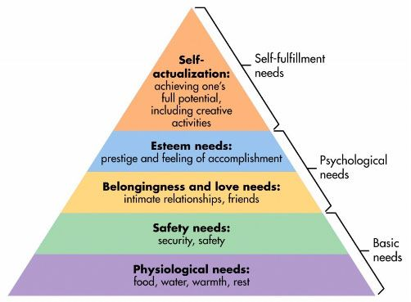
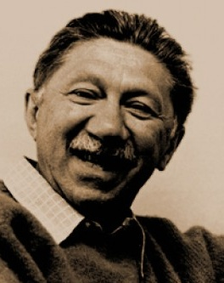
Maslow’s (Human) Hierarchy of Needs, Revisited
Maslow, “A Theory of Human Motivation,”
Psychological Review, 1943.
Maslow, “A Theory of Human Motivation,”
Psychological Review, 1943.
Maslow, “Motivation and Personality,”
Book, 1954-1970.
Everlasting energy
Source: https://www.simplypsychology.org/maslow.html

Slide 8

Do We Want This?
Source: V. Milutinovic

Slide 9
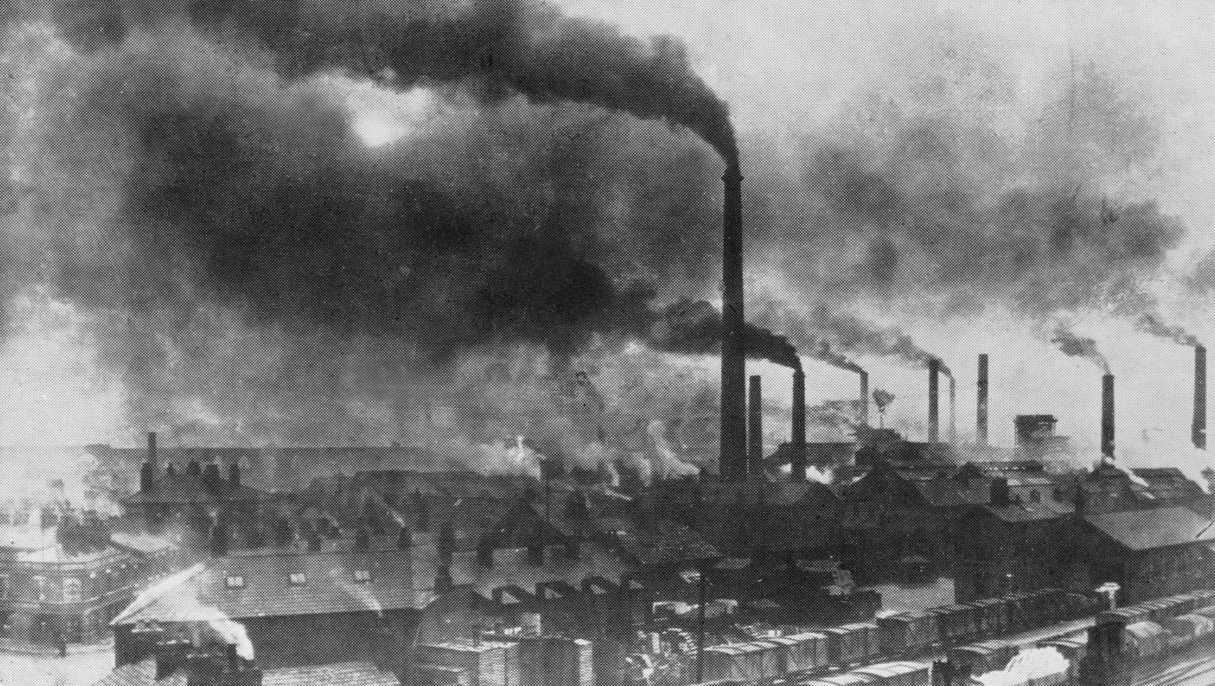
Or This?
Source: V. Milutinovic

Slide 10
Challenge and Opportunity for Future
Sustainable
and
Energy Efficient

Slide 11
The Problem
Data access is the major performance and energy bottleneck
Our current
design principles
cause great energy waste
(and great performance loss)

Slide 12
The Problem
Processing of data
is performed
far away from the data

Slide 13
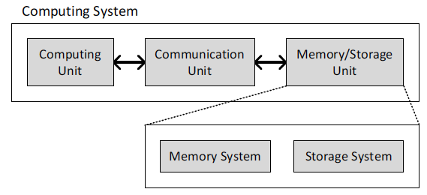
A Computing System
Three key components
Computation
Communication
Storage/memory
Burks, Goldstein, von Neumann, “Preliminary discussion of the
logical design of an electronic computing instrument,” 1946.
Image source: https://lbsitbytes2010.wordpress.com/2013/03/29/john-von-neumann-roll-no-15/

Slide 14



A Computing System
Three key components
Computation
Communication
Storage/memory
Burks, Goldstein, von Neumann, “Preliminary discussion of the
logical design of an electronic computing instrument,” 1946.
Image source: https://lbsitbytes2010.wordpress.com/2013/03/29/john-von-neumann-roll-no-15/

Slide 15
Today’s Computing Systems
Are overwhelmingly processor centric
All data processed in the processor → at great system cost
Processor is heavily optimized and is considered the master
Data storage units are dumb and are largely unoptimized (except for some that are on the processor die)

Slide 16
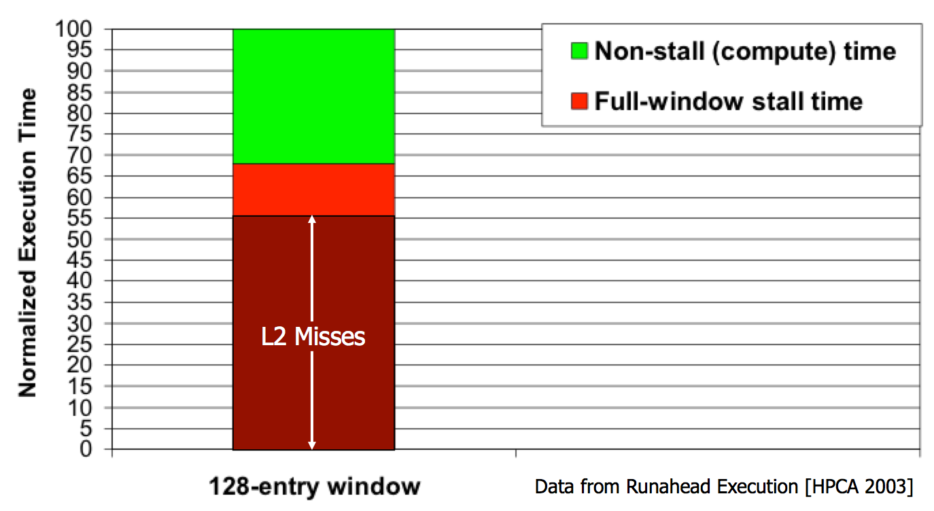
Yet …
“It’s the Memory, Stupid!” (Richard Sites, MPR, 1996)
Mutlu+, “Runahead Execution: An Alternative to Very Large Instruction Windows for Out-of-Order Processors,” HPCA 2003.

Slide 17
The Performance Perspective
Onur Mutlu, Jared Stark, Chris Wilkerson, and Yale N. Patt,
"Runahead Execution: An Alternative to Very Large Instruction Windows for Out-of-order Processors"
Proceedings of the 9th International Symposium on High-Performance Computer Architecture (HPCA), pages 129-140, Anaheim, CA, February 2003. Slides (pdf)

Slide 18
The Performance Perspective (Today)
All of Google’s Data Center Workloads (2015):
Kanev+, “Profiling a Warehouse-Scale Computer,” ISCA 2015.

Slide 19
The Performance Perspective (Today)
All of Google’s Data Center Workloads (2015):
Kanev+, “Profiling a Warehouse-Scale Computer,” ISCA 2015.

Slide 20
Perils of Processor-Centric Design
Grossly-imbalanced systems
  Processing done only in one place
  Everything else just stores and moves data: data moves a lot
  → Energy inefficient
  → Low performance
  → Complex
Overly complex and bloated processor (and accelerators)
  To tolerate data access from memory
  Complex hierarchies and mechanisms
  → Energy inefficient
  → Low performance
  → Complex

Slide 21
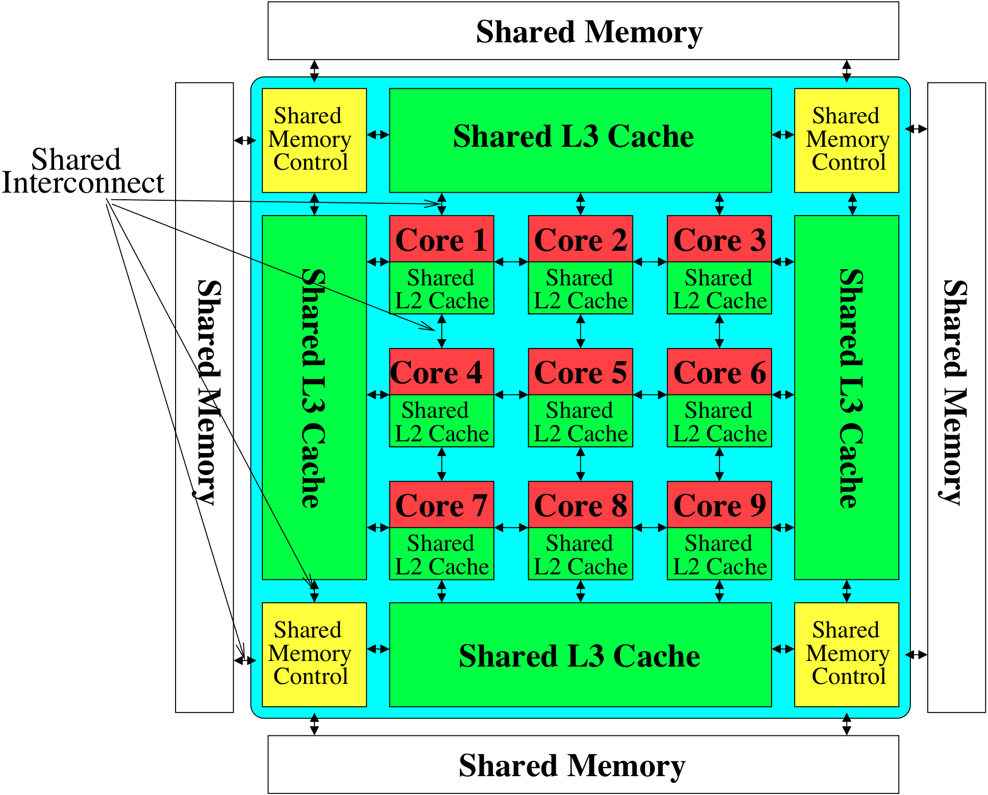
Perils of Processor-Centric Design
Most of the system is dedicated to storing and moving data

Slide 22
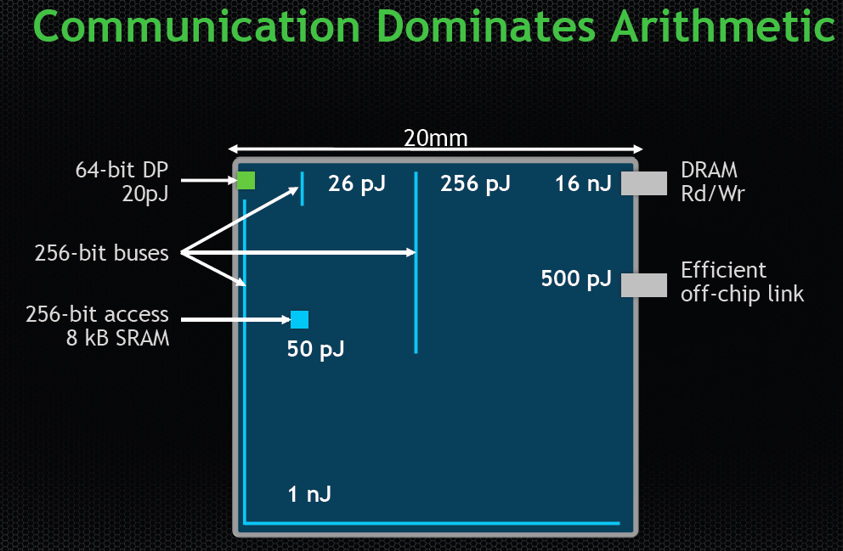
The Energy Perspective
Dally, HiPEAC 2015

Slide 23
Data Movement vs. Computation Energy
Dally, HiPEAC 2015
A memory access consumes ~1000X
the energy of a complex addition

Slide 24
Data Movement vs. Computation Energy
Data movement is a major system energy bottleneck
  Comprises 41% of mobile system energy during web browsing [2]
  Costs ~115 times as much energy as an ADD operation [1, 2]
[1]: Reducing data Movement Energy via Online Data Clustering and Encoding (MICRO’16)
[2]: Quantifying the energy cost of data movement for emerging smart phone workloads on mobile platforms (IISWC’14)

Slide 25
Energy Waste in Mobile Devices
Amirali Boroumand, Saugata Ghose, Youngsok Kim, Rachata Ausavarungnirun, Eric Shiu, Rahul Thakur, Daehyun Kim, Aki Kuusela, Allan Knies, Parthasarathy Ranganathan, and Onur Mutlu,
"Google Workloads for Consumer Devices: Mitigating Data Movement Bottlenecks"
Proceedings of the 23rd International Conference on Architectural Support for Programming Languages and Operating Systems (ASPLOS), Williamsburg, VA, USA, March 2018.
62.7% of the total system energy
is spent on data movement

Slide 26
We Do Not Want to Move Data!
Dally, HiPEAC 2015
A memory access consumes ~1000X
the energy of a complex addition

Slide 27
We Need A Paradigm Shift To …
Enable computation with minimal data movement
Compute where it makes sense (where data resides)
Make computing architectures more data-centric

Slide 28
Goal: Processing Inside Memory
Many questions … How do we design the:
  compute-capable memory & controllers?
  processor chip and in-memory units?
  software and hardware interfaces?
  system software and languages?
  algorithms?
Memory
Processor
Core
Database
Graphs
Media
Cache
Query
Interconnect
Problem
Results
Algorithm
Program/Language
System Software
SW/HW Interface
Micro-architecture
Logic
Devices
Electrons

Slide 29
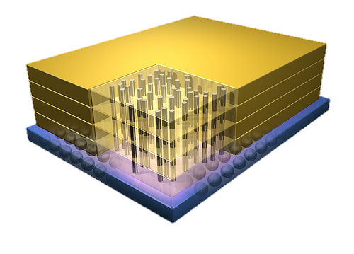


Why In-Memory Computation Today?
Dally, HiPEAC 2015
Push from Technology
  DRAM Scaling at jeopardy
  → Controllers close to DRAM
  → Industry open to new memory architectures
Pull from Systems and Applications
  Data access is a major system and application bottleneck
  Systems are energy limited
  Data movement much more energy-hungry than computation

Slide 30
Sub-Agenda: In-Memory Computation
Major Trends Affecting Main Memory
The Need for Intelligent Memory Controllers
  Bottom Up: Push from Circuits and Devices
  Top Down: Pull from Systems and Applications
Processing in Memory: Two Directions
  Minimally Changing Memory Chips
  Exploiting 3D-Stacked Memory
How to Enable Adoption of Processing in Memory
Conclusion

Slide 31
Processing in Memory:
Two Approaches
1. Minimally changing memory chips
2. Exploiting 3D-stacked memory

Slide 32
Approach 1: Minimally Changing DRAM
DRAM has great capability to perform bulk data movement and computation internally with small changes
  Can exploit internal connectivity to move data
  Can exploit analog computation capability
  …
Examples: RowClone, In-DRAM AND/OR, Gather/Scatter DRAM
  RowClone: Fast and Efficient In-DRAM Copy and Initialization of Bulk Data (Seshadri et al., MICRO 2013)
  Fast Bulk Bitwise AND and OR in DRAM (Seshadri et al., IEEE CAL 2015)
  Gather-Scatter DRAM: In-DRAM Address Translation to Improve the Spatial Locality of Non-unit Strided Accesses (Seshadri et al., MICRO 2015)
  "Ambit: In-Memory Accelerator for Bulk Bitwise Operations Using Commodity DRAM Technology” (Seshadri et al., MICRO 2017)

Slide 33
Starting Simple: Data Copy and Initialization
Bulk Data Copy
src
dst
Bulk Data Initialization
dst
val

Slide 34

Starting Simple: Data Copy and Initialization
  memmove & memcpy: 5% cycles in Google’s datacenter [Kanev+ ISCA’15]
000000000000000
Zero initialization
(e.g., security)
Forking
Checkpointing
Many more
VM Cloning
Deduplication
Page Migration

Slide 35
Today’s Systems: Bulk Data Copy
1) High latency
Memory
3) Cache pollution
L3
CPU
L2
L1
MC
2) High bandwidth utilization
4) Unwanted data movement
1046ns, 3.6uJ (for 4KB page copy via DMA)

Slide 36
Future Systems: In-Memory Copy
3) No cache pollution
1) Low latency
Memory
L3
CPU
L2
L1
MC
2) Low bandwidth utilization
4) No unwanted data movement
1046ns, 3.6uJ
→ 90ns, 0.04uJ

Slide 37
RowClone: In-DRAM Row Copy
Idea: Two consecutive ACTivates
4 Kbytes
Negligible HW cost
Step 1: Activate row A
Step 2: Activate row B
Transfer row
DRAM subarray
Transfer
row
Row Buffer (4 Kbytes)
8 bits
11.6X latency reduction, 74X energy reduction
Data Bus
Notes:
copy

Slide 38
RowClone: Inter-Bank
Chip I/O
Bank
Shared internal bus
Memory Channel
Overlap the latency of the read and the write
1.9X latency reduction, 3.2X energy reduction

Slide 39
Generalized RowClone
0.01% area cost
Inter Subarray Copy
(Use Inter-Bank Copy Twice)
Subarray
Chip I/O
Bank
Bank I/O
Memory Channel
Inter Bank Copy
(Pipelined
Internal RD/WR)
Intra Subarray
Copy (2 ACTs)

Slide 40
RowClone: Latency and Energy Savings
11.6x
74x
Seshadri et al., “RowClone: Fast and Efficient In-DRAM Copy and Initialization of Bulk Data,” MICRO 2013.

Slide 41
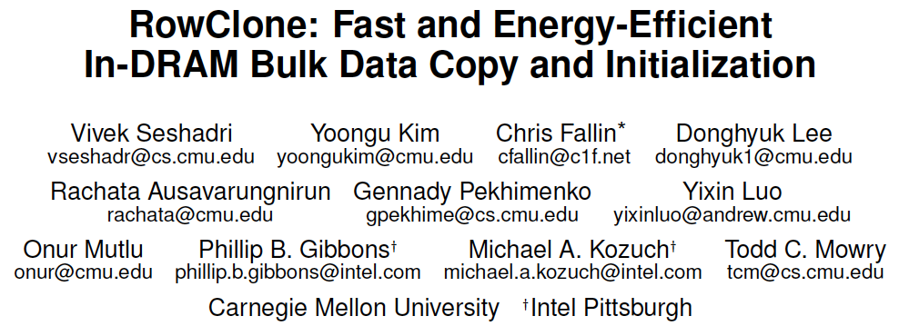
More on RowClone
Vivek Seshadri, Yoongu Kim, Chris Fallin, Donghyuk Lee, Rachata Ausavarungnirun, Gennady Pekhimenko, Yixin Luo, Onur Mutlu, Michael A. Kozuch, Phillip B. Gibbons, and Todd C. Mowry,
"RowClone: Fast and Energy-Efficient In-DRAM Bulk Data Copy and Initialization"
Proceedings of the 46th International Symposium on Microarchitecture (MICRO), Davis, CA, December 2013. [Slides (pptx) (pdf)] [Lightning Session Slides (pptx) (pdf)] [Poster (pptx) (pdf)]

Slide 42
In-Memory Bulk Bitwise Operations
We can support in-DRAM COPY, ZERO, AND, OR, NOT, MAJ
At low cost
Using analog computation capability of DRAM
  Idea: activating multiple rows performs computation
30-60X performance and energy improvement
  Seshadri+, “Ambit: In-Memory Accelerator for Bulk Bitwise Operations Using Commodity DRAM Technology,” MICRO 2017.
New memory technologies enable even more opportunities
  Memristors, resistive RAM, phase change mem, STT-MRAM, …
  Can operate on data with minimal movement

Slide 43
In-DRAM AND/OR: Triple Row Activation
½V_{DD}
½V_{DD}+δ
V_{DD}
A
Final State
AB + BC + AC
B
C
C(A + B) + ~C(AB)
dis
en
0
½V_{DD}
Seshadri+, “Fast Bulk Bitwise AND and OR in DRAM”, IEEE CAL 2015.

Slide 44
In-DRAM Bulk Bitwise AND/OR Operation
BULKAND A, B → C
Semantics: Perform a bitwise AND of two rows A and B and store the result in row C
R0 – reserved zero row, R1 – reserved one row
D1, D2, D3 – Designated rows for triple activation
1. RowClone A into D1
2. RowClone B into D2
3. RowClone R0 into D3
4. ACTIVATE D1,D2,D3
5. RowClone Result into C

Slide 45
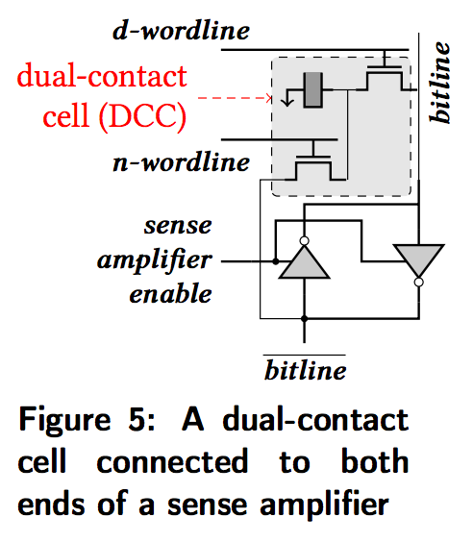
In-DRAM NOT: Dual Contact Cell
Idea:
Feed the
negated value
in the sense amplifier
into a special row
Seshadri+, “Ambit: In-Memory Accelerator for Bulk Bitwise Operations using Commodity DRAM Technology,” MICRO 2017.

Slide 46
Performance: In-DRAM Bitwise Operations

Slide 47
Energy of In-DRAM Bitwise Operations
Seshadri+, “Ambit: In-Memory Accelerator for Bulk Bitwise Operations using Commodity DRAM Technology,” MICRO 2017.

Slide 48
Ambit vs. DDR3: Performance and Energy
32X
35X
Seshadri+, “Ambit: In-Memory Accelerator for Bulk Bitwise Operations using Commodity DRAM Technology,” MICRO 2017.

Slide 49
Bulk Bitwise Operations in Workloads
[1] Li and Patel, BitWeaving, SIGMOD 2013
[2] Goodwin+, BitFunnel, SIGIR 2017

Slide 50
Example Data Structure: Bitmap Index
Alternative to B-tree and its variants
Efficient for performing range queries and joins
Many bitwise operations to perform a query
age < 18
18 < age < 25
25 < age < 60
age > 60
Bitmap 1
Bitmap 2
Bitmap 3
Bitmap 4

Slide 51
Performance: Bitmap Index on Ambit
Seshadri+, “Ambit: In-Memory Accelerator for Bulk Bitwise Operations using Commodity DRAM Technology,” MICRO 2017.

Slide 52
Performance: BitWeaving on Ambit
>4-12X Performance Improvement
Seshadri+, “Ambit: In-Memory Accelerator for Bulk Bitwise Operations using Commodity DRAM Technology,” MICRO 2017.

Slide 53
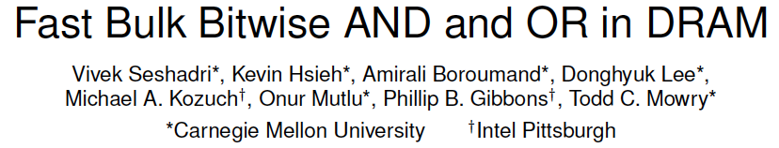
More on In-DRAM Bulk AND/OR
Vivek Seshadri, Kevin Hsieh, Amirali Boroumand, Donghyuk Lee, Michael A. Kozuch, Onur Mutlu, Phillip B. Gibbons, and Todd C. Mowry,
"Fast Bulk Bitwise AND and OR in DRAM"
IEEE Computer Architecture Letters (CAL), April 2015.

Slide 54
More on In-DRAM Bitwise Operations
Vivek Seshadri et al., “Ambit: In-Memory Accelerator for Bulk Bitwise Operations Using Commodity DRAM Technology,” MICRO 2017.

Slide 55
Challenge: Intelligent Memory Device
Does memory
have to be
dumb?

Slide 56
Challenge and Opportunity for Future
Computing Architectures
with
Minimal Data Movement

Slide 57
Sub-Agenda: In-Memory Computation
Major Trends Affecting Main Memory
The Need for Intelligent Memory Controllers
  Bottom Up: Push from Circuits and Devices
  Top Down: Pull from Systems and Applications
Processing in Memory: Two Directions
  Minimally Changing Memory Chips
  Exploiting 3D-Stacked Memory
How to Enable Adoption of Processing in Memory
Conclusion

Slide 58
Processing in Memory:
Two Approaches
1. Minimally changing memory chips
2. Exploiting 3D-stacked memory

Slide 59
Opportunity: 3D-Stacked Logic+Memory
Memory
Logic
Other “True 3D” technologies
under development

Slide 60
DRAM Landscape (circa 2015)
  Kim+, “Ramulator: A Flexible and Extensible DRAM Simulator”, IEEE CAL 2015.

Slide 61
Several Questions in 3D-Stacked PIM
What are the performance and energy benefits of using 3D-stacked memory as a coarse-grained accelerator?
  By changing the entire system
  By performing simple function offloading
What is the minimal processing-in-memory support we can provide?
  With minimal changes to system and programming

Slide 62




Another Example: In-Memory Graph Processing
Large graphs are everywhere (circa 2015)
Scalable large-scale graph processing is challenging
36 Million
Wikipedia Pages
1.4 Billion
Facebook Users
300 Million
Twitter Users
30 Billion
Instagram Photos

Slide 63
Key Bottlenecks in Graph Processing
for (v: graph.vertices) {
for (w: v.successors) {
w.next_rank += weight * v.rank;
}
}
1. Frequent random memory accesses
v
&w
w.rank
w.next_rank
w.edges
weight * v.rank
w
…
2. Little amount of computation

Slide 64
Tesseract System for Graph Processing
Interconnected set of 3D-stacked memory+logic chips with simple cores
Host Processor
Memory
Memory-Mapped
Accelerator Interface
(Noncacheable, Physically Addressed)
Logic
In-Order Core
DRAM Controller
…
…
LP
PF Buffer
Crossbar Network
…
MTP
…
Message Queue
NI
Ahn+, “A Scalable Processing-in-Memory Accelerator for Parallel Graph Processing” ISCA 2015.

Slide 65
Tesseract System for Graph Processing
Host Processor
Memory
Memory-Mapped
Accelerator Interface
(Noncacheable, Physically Addressed)
Logic
In-Order Core
DRAM Controller
…
…
Communications via
Remote Function Calls
LP
PF Buffer
Crossbar Network
…
MTP
…
Message Queue
NI

Slide 66
Communications In Tesseract (I)

Slide 67
Communications In Tesseract (II)

Slide 68
Communications In Tesseract (III)

Slide 69
Remote Function Call (Non-Blocking)

Slide 70
Tesseract System for Graph Processing
Host Processor
Memory
Memory-Mapped
Accelerator Interface
(Noncacheable, Physically Addressed)
Logic
Prefetching
In-Order Core
DRAM Controller
…
…
LP
PF Buffer
Crossbar Network
…
MTP
…
Message Queue
NI

Slide 71
Evaluated Systems
DDR3-OoO
HMC-OoO
HMC-MC
Tesseract
32 Tesseract Cores
8 OoO
4GHz
8 OoO
4GHz
8 OoO
4GHz
8 OoO
4GHz
128
In-Order
2GHz
128
In-Order
2GHz
8 OoO
4GHz
8 OoO
4GHz
8 OoO
4GHz
8 OoO
4GHz
128
In-Order
2GHz
128
In-Order
2GHz
102.4GB/s
640GB/s
640GB/s
8TB/s
Ahn+, “A Scalable Processing-in-Memory Accelerator for Parallel Graph Processing” ISCA 2015.

Slide 72
Tesseract Graph Processing Performance
>13X Performance Improvement
On five graph processing algorithms
Ahn+, “A Scalable Processing-in-Memory Accelerator for Parallel Graph Processing” ISCA 2015.

Slide 73
Tesseract Graph Processing Performance

Slide 74
Effect of Bandwidth & Programming Model
HMC-MC Bandwidth (640GB/s)
Tesseract Bandwidth (8TB/s)
Programming Model
Bandwidth
(No Prefetching)

Slide 75
Tesseract Graph Processing System Energy
> 8X Energy Reduction
Ahn+, “A Scalable Processing-in-Memory Accelerator for Parallel Graph Processing” ISCA 2015.

Slide 76
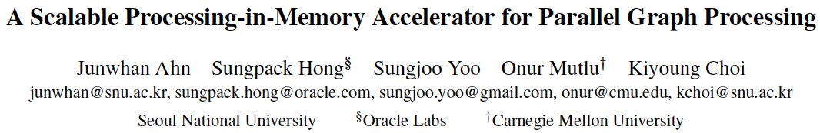
More on Tesseract
Junwhan Ahn, Sungpack Hong, Sungjoo Yoo, Onur Mutlu, and Kiyoung Choi,
"A Scalable Processing-in-Memory Accelerator for Parallel Graph Processing"
Proceedings of the 42nd International Symposium on Computer Architecture (ISCA), Portland, OR, June 2015.
[Slides (pdf)] [Lightning Session Slides (pdf)]

Slide 77
Several Questions in 3D-Stacked PIM
What are the performance and energy benefits of using 3D-stacked memory as a coarse-grained accelerator?
  By changing the entire system
  By performing simple function offloading
What is the minimal processing-in-memory support we can provide?
  With minimal changes to system and programming

Slide 78
3D-Stacked PIM on Mobile Devices
Amirali Boroumand, Saugata Ghose, Youngsok Kim, Rachata Ausavarungnirun, Eric Shiu, Rahul Thakur, Daehyun Kim, Aki Kuusela, Allan Knies, Parthasarathy Ranganathan, and Onur Mutlu,
"Google Workloads for Consumer Devices: Mitigating Data Movement Bottlenecks"
Proceedings of the 23rd International Conference on Architectural Support for Programming Languages and Operating Systems (ASPLOS), Williamsburg, VA, USA, March 2018.

Slide 79





Google Workloads for Consumer Devices:
Mitigating Data Movement Bottlenecks
Amirali Boroumand
Saugata Ghose, Youngsok Kim, Rachata Ausavarungnirun,
Eric Shiu, Rahul Thakur, Daehyun Kim, Aki Kuusela,
Allan Knies, Parthasarathy Ranganathan, Onur Mutlu

Slide 80
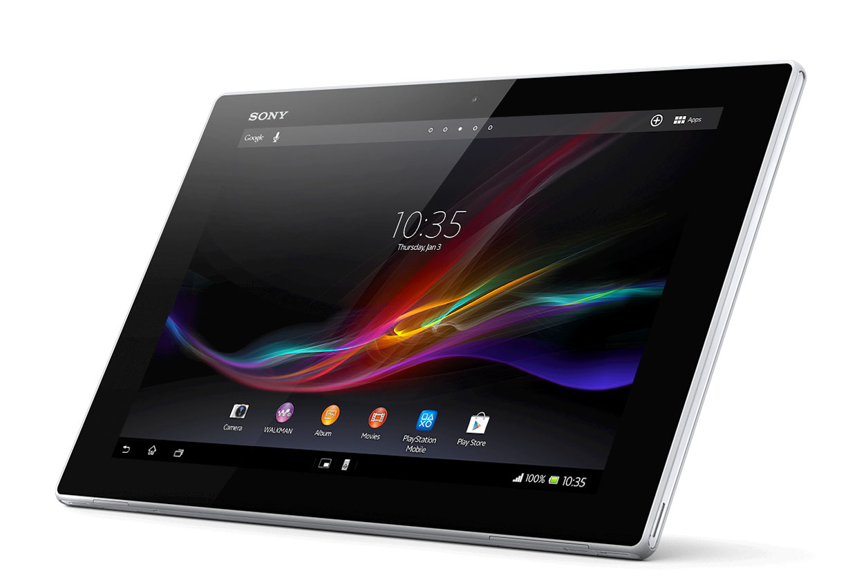



Consumer Devices
Consumer devices are everywhere!
Energy consumption is
a first-class concern in consumer devices
Notes:
Consumer devices like tablets smartphone and wearable are now everywhere and used by billions of people.
One of the major challenge in these devices is battery limitation which makes the energy consumption a critical concern …

Slide 81





Popular Google Consumer Workloads
  Chrome
TensorFlow Mobile
    Google’s web browser
Google’s machine learning framework
  Video Playback
  Video Capture
Google’s video codec
Google’s video codec
Notes:
In this work, we take a look at widely-used google consumer workloads, to figure out the major sources of energy consumption.
We look at Google Chrome web brower. We take a look at Tensorflow, Google’s machine learning framework, and we also take a look at two important video related workloads, video playback and video capture, both rely on Google’s vp9 codec technology.

Slide 82
Energy Cost of Data Movement
1st key observation: 62.7% of the total system energy is spent on data movement
Data Movement
SoC
DRAM
CPU
L2
CPU
L1
CPU
CPU
Compute Unit
Processing-In-Memory (PIM)
  Potential solution: move computation close to data
  Challenge: limited area and energy budget
Notes:
Throughout our analysis, we make a key observation that out of all sources of energy consumption, data movement is a major contributor to the total system energy. We find that across all of the workloads, on average around 62.7% of total system energy is spent on data movement.
One way to reduce data movement cost is to move computation close to data, or …
One potential solution to address this cost it do move computation close to data, or in other words, do procesing in memory. However, the challenge is that these devices.
One potential solution to mitigate data movement cost and reduce total system energy is to execute data-movement heavy portions of application close to data, or in other words, do processing in memory. However, consumer devices are extermely limited in terms of area and power budget. So the question is can we move part of the data movement heavy portion given the limited area and energy budget. Our

Slide 83
Using PIM to Reduce Data Movement
  2nd key observation: a significant fraction of the
  data movement often comes from simple functions
We can design lightweight logic to implement
these simple functions in memory
Small embedded
low-power core
Small fixed-function accelerators
PIM Core
PIM Accelerator
PIM Accelerator
PIM Accelerator
  Offloading to PIM logic reduces energy and improves performance, on average, by 55.4% and 54.2%
Notes:
To figure out if we can use processing in memory, we dig deeper into our analysis and we make another key observation that majority of data movement often comes form simple functions and pritmitives. We find that these simple function can be implemented in memory as either a small embedded core, or group of small fixed function accelerators. Our result shows that offloading these function to PIM logic can significantly reduce data movement for each function and reduce energy on average around 55% and improve perforamcne around 54%.
our PIM core can reduce significant portion of data movement, reduce enregy by 49.1% for each function and improve performance up to 2.2X. While using group of fixed function accelerator reduce energy by 55.4% and improve performance by up to 2.5X.
Or use Saugata’s approach : Reduces total system energy by an average of 55.4%
Reduces execution time by an average of 54.2%
Our result show that both of them can significantly reduce the data movement for each function.
Feedback: talk about result more
Don’t talk about specific detail like MemCopy, MemSet stuff like that
Main take away: data movement come from simple functions that are simple enough to implement in PIM
We find that these functions and primitves can be implemented as PIM logic using either (1) a small low-power general-purpose embedded core or (2) a group of small fixed-function accelerators (PIM accelerators). Our Analysis shows that both are cost-feasible to use in consumer devices. We find that they eliminate a significant fraction of dat amovement, and reduce energy consumption for each of these operation on average by 49 and 55%.

Slide 84
Goals
1
Understand the data movement related bottlenecks in modern consumer workloads
2
Analyze opportunities to mitigate data movement by using processing-in-memory (PIM)
3
    Design PIM logic that can maximize energy efficiency given the limited area and energy budget in consumer devices

Slide 85
Workload Analysis
  Chrome
TensorFlow Mobile
    Google’s web browser
Google’s machine learning framework
  Video Playback
  Video Capture
Google’s video codec
Google’s video codec
Notes:
In this work, we take a look at widely-used google consumer workloads, to figure out the major sources of energy consumption.
We look at Google Chrome web brower. We take a look at Tensorflow, Google’s machine learning framework, and we also take a look at two important video related workloads, video playback and video capture, both rely on Google’s vp9 codec technology.

Slide 86
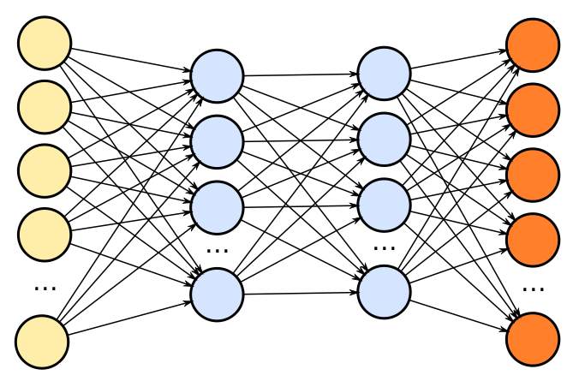
TensorFlow Mobile
Inference
Prediction
57.3% of the inference energy is spent on
data movement
54.4% of the data movement energy comes from
packing/unpacking and quantization

Slide 87
Packing
Matrix
Packing
Packed Matrix
Reorders elements of matrices to minimize
cache misses during matrix multiplication
Up to 40% of the
inference energy and 31% of
inference execution time
Packing’s data movement accounts for up to
35.3% of the inference energy
A simple data reorganization process
that requires simple arithmetic

Slide 88
Quantization
floating point
Quantization
integer
Converts 32-bit floating point to 8-bit integers to improve inference execution time and energy consumption
Up to 16.8% of the inference energy
and 16.1% of
inference execution time
Majority of quantization energy comes from
data movement
A simple data conversion operation that requires shift, addition, and multiplication operations

Slide 89
Quantization
floating point
Quantization
integer
Converts 32-bit floating point to 8-bit integers to improve inference execution time and energy consumption
Based on our analysis, we conclude that:
Both functions are good candidates for PIM execution
It is feasible to implement them in PIM logic
Up to 16.8% of the inference energy
and 16.1% of
inference execution time
Majority of quantization energy comes from
data movement
A simple data conversion operation that requires shift, addition, and multiplication operations

Slide 90
Evaluation Methodology
System Configuration (gem5 Simulator)
  SoC: 4 OoO cores, 8-wide issue, 64 kB L1cache,
  2MB L2 cache
  PIM Core: 1 core per vault, 1-wide issue, 4-wide SIMD,
  32kB L1 cache
  3D-Stacked Memory: 2GB cube, 16 vaults per cube
    Internal Bandwidth: 256GB/S
    Off-Chip Channel Bandwidth: 32 GB/s
  Baseline Memory: LPDDR3, 2GB, FR-FCFS scheduler
We study each target in isolation and emulate each separately and run them in our simulator
Notes:
and then analyzing the benefit of PIM in our simulator

Slide 91
Normalized Energy
TensorFlow Mobile
Video Playback and Capture
77.7% and 82.6% of energy reduction for texture tiling and packing comes from eliminating data movement
Chrome Browser
PIM core and PIM accelerator reduces
energy consumption on average by 49.1% and 55.4%
Notes:
We make another obsrevation that using PIM accelerator provide limited energy reduction over PIM core, for some of these workloads, such as texture tiling. This is becase these kernels are data intensive and have low ocmputational compleity, and as a result, using fixed function accelerator does not provide significant energy reduction over the PIM core.

Slide 92
Normalized Runtime
Chrome Browser
Video Playback and Capture
TensorFlow Mobile
Offloading these kernels to PIM core and PIM accelerator improves performance on average by 44.6% and 54.2%
Notes:
PIM-Core and PIM-Acc significantly outperform CPU-Only across all kernels, improving performance by … This perfomance benefit come from higher bandwidth and lower access latency of 3D-stacked memory, because all of these kernels are data intensive.
Performance improvement of PIM-acc over PIM-core differes across different workloads. In some cases such as Texture Tiling, the performance improvement of PIM-Acc over PIM-Core is limited by the low computational complexity of these two kernels. But there are other cases, such as compression that benefit significantly from using PIM-Acc over PIM-Core in terms of performance, because these kernels are more compute-intensive and less data-intensive compared to texture tiling and.

Slide 93
Google Workloads for Consumer Devices:
Mitigating Data Movement Bottlenecks
Amirali Boroumand
Saugata Ghose, Youngsok Kim, Rachata Ausavarungnirun,
Eric Shiu, Rahul Thakur, Daehyun Kim, Aki Kuusela,
Allan Knies, Parthasarathy Ranganathan, Onur Mutlu
ASPLOS 2018
Notes:
Please drop by our talk during session 1 if you would like to learn more about data movement in Google workloads.

Slide 94
More on PIM for Mobile Devices
Amirali Boroumand, Saugata Ghose, Youngsok Kim, Rachata Ausavarungnirun, Eric Shiu, Rahul Thakur, Daehyun Kim, Aki Kuusela, Allan Knies, Parthasarathy Ranganathan, and Onur Mutlu,
"Google Workloads for Consumer Devices: Mitigating Data Movement Bottlenecks"
Proceedings of the 23rd International Conference on Architectural Support for Programming Languages and Operating Systems (ASPLOS), Williamsburg, VA, USA, March 2018.
62.7% of the total system energy
is spent on data movement

Slide 95
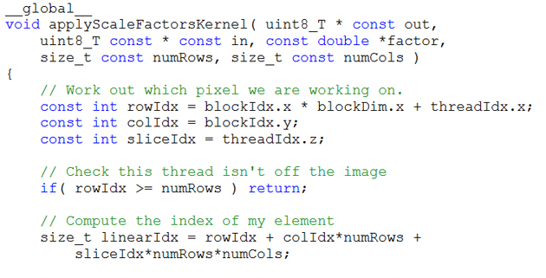
Truly Distributed GPU Processing with PIM?
3D-stacked memory
(memory stack)
SM (Streaming Multiprocessor)
Logic layer
Logic layer SM
Main GPU
Crossbar switch
Vault Ctrl
….
Vault Ctrl

Slide 96
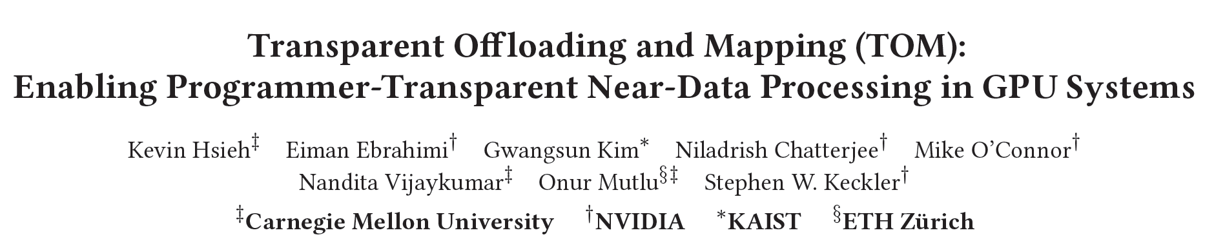
Accelerating GPU Execution with PIM (I)
Kevin Hsieh, Eiman Ebrahimi, Gwangsun Kim, Niladrish Chatterjee, Mike O'Connor, Nandita Vijaykumar, Onur Mutlu, and Stephen W. Keckler,
"Transparent Offloading and Mapping (TOM): Enabling Programmer-Transparent Near-Data Processing in GPU Systems"
Proceedings of the 43rd International Symposium on Computer Architecture (ISCA), Seoul, South Korea, June 2016.
[Slides (pptx) (pdf)]
[Lightning Session Slides (pptx) (pdf)]

Slide 97
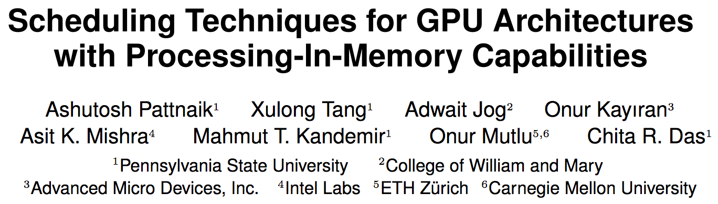
Accelerating GPU Execution with PIM (II)
Ashutosh Pattnaik, Xulong Tang, Adwait Jog, Onur Kayiran, Asit K. Mishra, Mahmut T. Kandemir, Onur Mutlu, and Chita R. Das,
"Scheduling Techniques for GPU Architectures with Processing-In-Memory Capabilities"
Proceedings of the 25th International Conference on Parallel Architectures and Compilation Techniques (PACT), Haifa, Israel, September 2016.

Slide 98
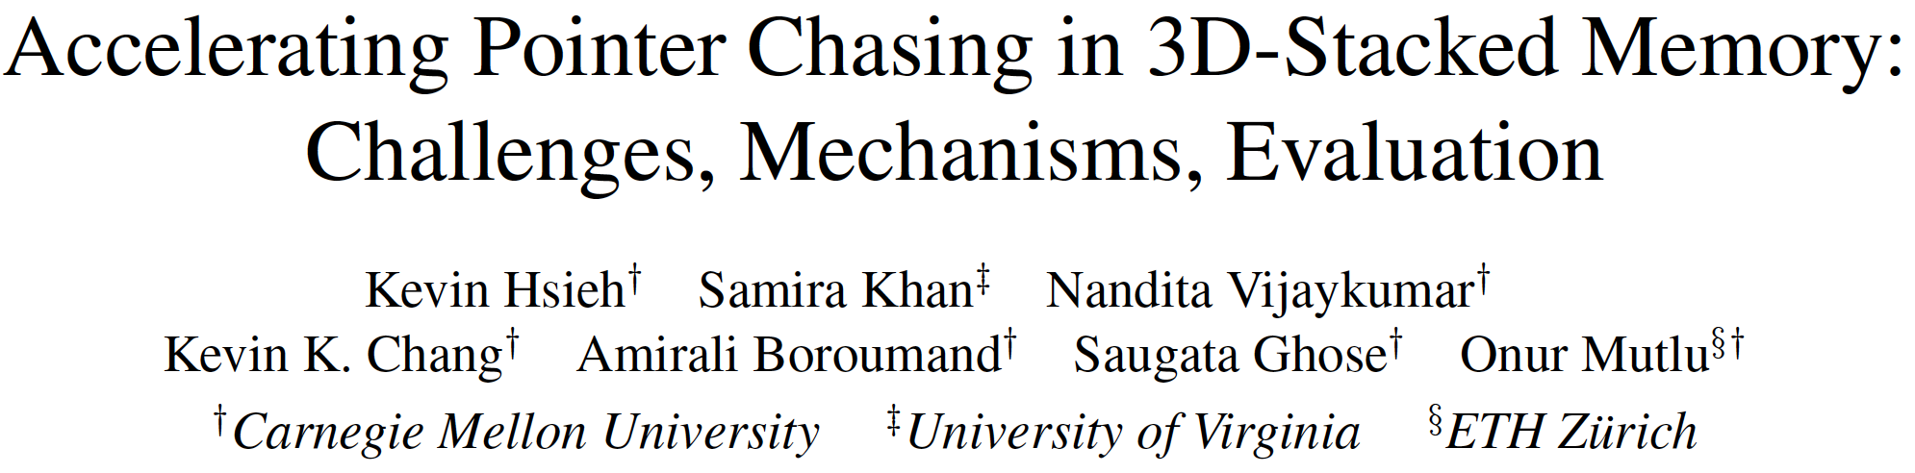
Accelerating Linked Data Structures
Kevin Hsieh, Samira Khan, Nandita Vijaykumar, Kevin K. Chang, Amirali Boroumand, Saugata Ghose, and Onur Mutlu,
"Accelerating Pointer Chasing in 3D-Stacked Memory: Challenges, Mechanisms, Evaluation"
Proceedings of the 34th IEEE International Conference on Computer Design (ICCD), Phoenix, AZ, USA, October 2016.

Slide 99
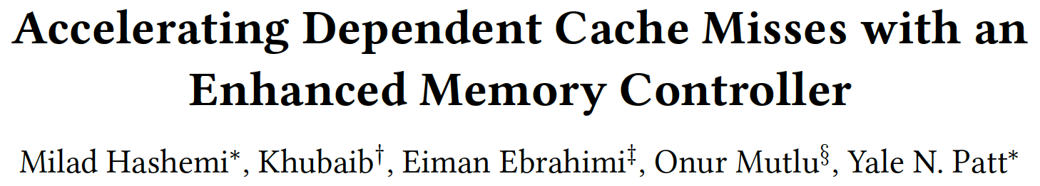
Accelerating Dependent Cache Misses
Milad Hashemi, Khubaib, Eiman Ebrahimi, Onur Mutlu, and Yale N. Patt,
"Accelerating Dependent Cache Misses with an Enhanced Memory Controller"
Proceedings of the 43rd International Symposium on Computer Architecture (ISCA), Seoul, South Korea, June 2016.
[Slides (pptx) (pdf)]
[Lightning Session Slides (pptx) (pdf)]

Slide 100
Several Questions in 3D-Stacked PIM
What are the performance and energy benefits of using 3D-stacked memory as a coarse-grained accelerator?
  By changing the entire system
  By performing simple function offloading
What is the minimal processing-in-memory support we can provide?
  With minimal changes to system and programming

Slide 101
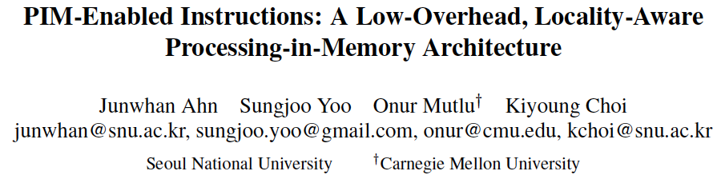
PIM-Enabled Instructions
Junwhan Ahn, Sungjoo Yoo, Onur Mutlu, and Kiyoung Choi,
"PIM-Enabled Instructions: A Low-Overhead, Locality-Aware Processing-in-Memory Architecture"
Proceedings of the 42nd International Symposium on Computer Architecture (ISCA), Portland, OR, June 2015.
[Slides (pdf)] [Lightning Session Slides (pdf)]

Slide 102
PEI: PIM-Enabled Instructions (Ideas)
Goal: Develop mechanisms to get the most out of near-data processing with minimal cost, minimal changes to the system, no changes to the programming model
Key Idea 1: Expose each PIM operation as a cache-coherent, virtually-addressed host processor instruction (called PEI) that operates on only a single cache block
  e.g., __pim_add(&w.next_rank, value) → pim.add r1, (r2)
  No changes sequential execution/programming model
  No changes to virtual memory
  Minimal changes to cache coherence
  No need for data mapping: Each PEI restricted to a single memory module
Key Idea 2: Dynamically decide where to execute a PEI (i.e., the host processor or PIM accelerator) based on simple locality characteristics and simple hardware predictors
  Execute each operation at the location that provides the best performance

Slide 103
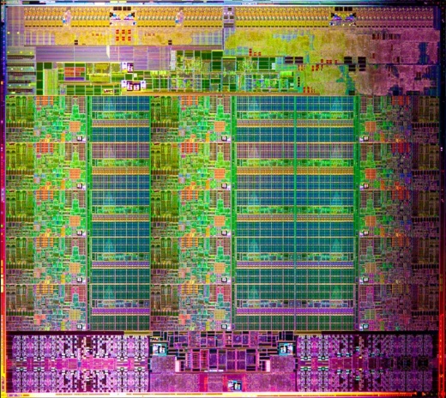
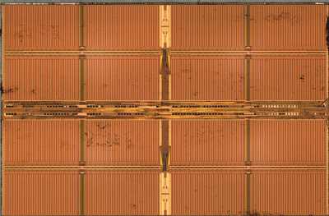
Simple PIM Operations as ISA Extensions (II)
for (v: graph.vertices) {
value = weight * v.rank;
for (w: v.successors) {
w.next_rank += value;
}
}
Host Processor
Main Memory
w.next_rank
w.next_rank
w.next_rank
w.next_rank
64 bytes in
64 bytes out
Conventional Architecture

Slide 104
Simple PIM Operations as ISA Extensions (III)
for (v: graph.vertices) {
value = weight * v.rank;
for (w: v.successors) {
__pim_add(&w.next_rank, value);
}
}
pim.add r1, (r2)
Host Processor
Main Memory
value
w.next_rank
w.next_rank
8 bytes in
0 bytes out
In-Memory Addition

Slide 105
Always Executing in Memory? Not A Good Idea
Increased
Memory Bandwidth Consumption
Caching very effective
Reduced Memory Bandwidth
Consumption due to
In-Memory Computation
More Vertices

Slide 106
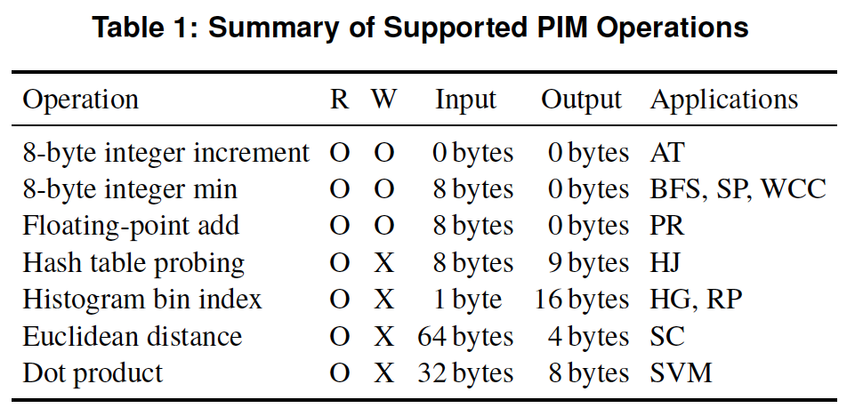
PEI: PIM-Enabled Instructions (Example)
for (v: graph.vertices) {
value = weight * v.rank;
for (w: v.successors) {
__pim_add(&w.next_rank, value);
}
}
pfence();
pim.add r1, (r2)
pfence
Executed either in memory or in the processor: dynamic decision
  Low-cost locality monitoring for a single instruction
Cache-coherent, virtually-addressed, single cache block only
Atomic between different PEIs
Not atomic with normal instructions (use pfence for ordering)

Slide 107
PIM-Enabled Instructions
Key to practicality: single-cache-block restriction
  Each PEI can access at most one last-level cache block
  Similar restrictions exist in atomic instructions
Benefits
  Localization: each PEI is bounded to one memory module
  Interoperability: easier support for cache coherence and virtual memory
  Simplified locality monitoring: data locality of PEIs can be identified simply by the cache control logic

Slide 108
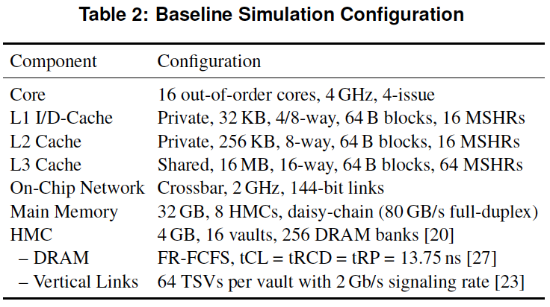
PEI: Initial Evaluation Results
Initial evaluations with 10 emerging data-intensive workloads
  Large-scale graph processing
  In-memory data analytics
  Machine learning and data mining
  Three input sets (small, medium, large) for each workload to analyze the impact of data locality
Pin-based cycle-level x86-64 simulation
  Performance Improvement and Energy Reduction:
    47% average speedup with large input data sets
    32% speedup with small input data sets
    25% avg. energy reduction in a single node with large input data sets

Slide 109
Evaluated Data-Intensive Applications
Ten emerging data-intensive workloads
  Large-scale graph processing
    Average teenage follower, BFS, PageRank, single-source shortest path, weakly connected components
  In-memory data analytics
    Hash join, histogram, radix partitioning
  Machine learning and data mining
    Streamcluster, SVM-RFE
Three input sets (small, medium, large) for each workload to show the impact of data locality

Slide 110
PEI Performance Delta: Large Data Sets
(Large Inputs, Baseline: Host-Only)

Slide 111
PEI Performance: Large Data Sets
(Large Inputs, Baseline: Host-Only)

Slide 112
PEI Performance Delta: Small Data Sets
(Small Inputs, Baseline: Host-Only)

Slide 113
PEI Performance: Small Data Sets
(Small Inputs, Baseline: Host-Only)

Slide 114
PEI Performance Delta: Medium Data Sets
(Medium Inputs, Baseline: Host-Only)

Slide 115
PEI Energy Consumption
Host-Only
PIM-Only
Locality-Aware

Slide 116
PEI: Advantages & Disadvantages
Advantages
+ Simple and low cost approach to PIM
+ No changes to programming model, virtual memory
+ Dynamically decides where to execute an instruction
Disadvantages
- Does not take full advantage of PIM potential
- Single cache block restriction is limiting

Slide 117
Simpler PIM: PIM-Enabled Instructions
Junwhan Ahn, Sungjoo Yoo, Onur Mutlu, and Kiyoung Choi,
"PIM-Enabled Instructions: A Low-Overhead, Locality-Aware Processing-in-Memory Architecture"
Proceedings of the 42nd International Symposium on Computer Architecture (ISCA), Portland, OR, June 2015.
[Slides (pdf)] [Lightning Session Slides (pdf)]

Slide 118
Automatic Code and Data Mapping
Kevin Hsieh, Eiman Ebrahimi, Gwangsun Kim, Niladrish Chatterjee, Mike O'Connor, Nandita Vijaykumar, Onur Mutlu, and Stephen W. Keckler,
"Transparent Offloading and Mapping (TOM): Enabling Programmer-Transparent Near-Data Processing in GPU Systems"
Proceedings of the 43rd International Symposium on Computer Architecture (ISCA), Seoul, South Korea, June 2016.
[Slides (pptx) (pdf)]
[Lightning Session Slides (pptx) (pdf)]

Slide 119
Automatic Offloading of Critical Code
Milad Hashemi, Khubaib, Eiman Ebrahimi, Onur Mutlu, and Yale N. Patt,
"Accelerating Dependent Cache Misses with an Enhanced Memory Controller"
Proceedings of the 43rd International Symposium on Computer Architecture (ISCA), Seoul, South Korea, June 2016.
[Slides (pptx) (pdf)]
[Lightning Session Slides (pptx) (pdf)]

Slide 120
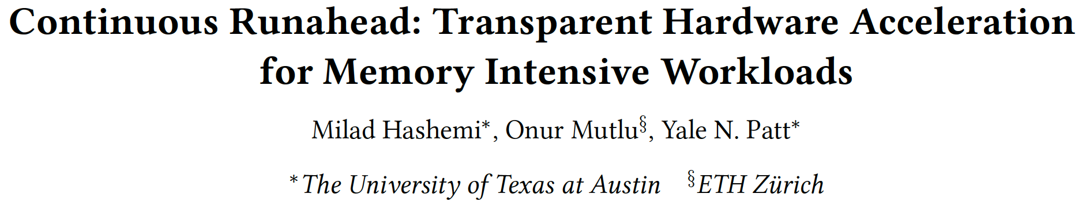
Automatic Offloading of Prefetch Mechanisms
Milad Hashemi, Onur Mutlu, and Yale N. Patt,
"Continuous Runahead: Transparent Hardware Acceleration for Memory Intensive Workloads"
Proceedings of the 49th International Symposium on Microarchitecture (MICRO), Taipei, Taiwan, October 2016.
[Slides (pptx) (pdf)] [Lightning Session Slides (pdf)] [Poster (pptx) (pdf)]

Slide 121

Efficient Automatic Data Coherence Support
Amirali Boroumand, Saugata Ghose, Minesh Patel, Hasan Hassan, Brandon Lucia, Kevin Hsieh, Krishna T. Malladi, Hongzhong Zheng, and Onur Mutlu,
"LazyPIM: An Efficient Cache Coherence Mechanism for Processing-in-Memory"
IEEE Computer Architecture Letters (CAL), June 2016.

Slide 122
Challenge and Opportunity for Future
Fundamentally
Energy-Efficient
(Data-Centric)
Computing Architectures

Slide 123
Challenge and Opportunity for Future
Fundamentally
High-Performance
(Data-Centric)
Computing Architectures

Slide 124
Challenge and Opportunity for Future
Computing Architectures
with
Minimal Data Movement

Slide 125
Sub-Agenda: In-Memory Computation
Major Trends Affecting Main Memory
The Need for Intelligent Memory Controllers
  Bottom Up: Push from Circuits and Devices
  Top Down: Pull from Systems and Applications
Processing in Memory: Two Directions
  Minimally Changing Memory Chips
  Exploiting 3D-Stacked Memory
How to Enable Adoption of Processing in Memory
Conclusion

Slide 126
Eliminating the Adoption Barriers
How to Enable Adoption of Processing in Memory

Slide 127
Barriers to Adoption of PIM
1. Functionality of and applications for PIM
2. Ease of programming (interfaces and compiler/HW support)
3. System support: coherence & virtual memory
4. Runtime systems for adaptive scheduling, data mapping, access/sharing control
5. Infrastructures to assess benefits and feasibility

Slide 128
We Need to Revisit the Entire Stack
Problem
Algorithm
Program/Language
System Software
SW/HW Interface
Micro-architecture
Logic
Devices
Electrons

Slide 129
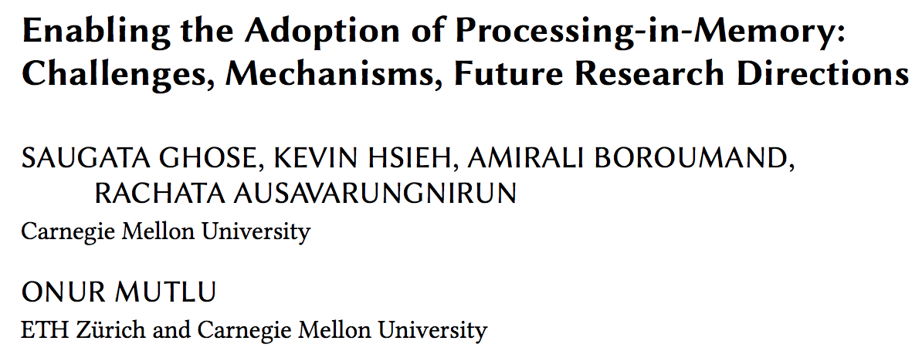
Open Problems: PIM Adoption
Saugata Ghose, Kevin Hsieh, Amirali Boroumand, Rachata Ausavarungnirun, Onur Mutlu,
"Enabling the Adoption of Processing-in-Memory: Challenges, Mechanisms, Future Research Directions"
Invited Book Chapter, to appear in 2018.
[Preliminary arxiv.org version]
https://arxiv.org/pdf/1802.00320.pdf

Slide 130
Key Challenge 1: Code Mapping
Challenge 1: Which operations should be executed in memory vs. in CPU?
?
3D-stacked memory
(memory stack)
SM (Streaming Multiprocessor)
?
Logic layer
Logic layer SM
Main GPU
Crossbar switch
Vault Ctrl
….
Vault Ctrl

Slide 131
Key Challenge 2: Data Mapping
Challenge 2: How should data be mapped to different 3D memory stacks?
3D-stacked memory
(memory stack)
SM (Streaming Multiprocessor)
Logic layer
Logic layer SM
Main GPU
Crossbar switch
Vault Ctrl
….
Vault Ctrl

Slide 132
How to Do the Code and Data Mapping?
Kevin Hsieh, Eiman Ebrahimi, Gwangsun Kim, Niladrish Chatterjee, Mike O'Connor, Nandita Vijaykumar, Onur Mutlu, and Stephen W. Keckler,
"Transparent Offloading and Mapping (TOM): Enabling Programmer-Transparent Near-Data Processing in GPU Systems"
Proceedings of the 43rd International Symposium on Computer Architecture (ISCA), Seoul, South Korea, June 2016.
[Slides (pptx) (pdf)]
[Lightning Session Slides (pptx) (pdf)]

Slide 133
How to Schedule Code?
Ashutosh Pattnaik, Xulong Tang, Adwait Jog, Onur Kayiran, Asit K. Mishra, Mahmut T. Kandemir, Onur Mutlu, and Chita R. Das,
"Scheduling Techniques for GPU Architectures with Processing-In-Memory Capabilities"
Proceedings of the 25th International Conference on Parallel Architectures and Compilation Techniques (PACT), Haifa, Israel, September 2016.

Slide 134
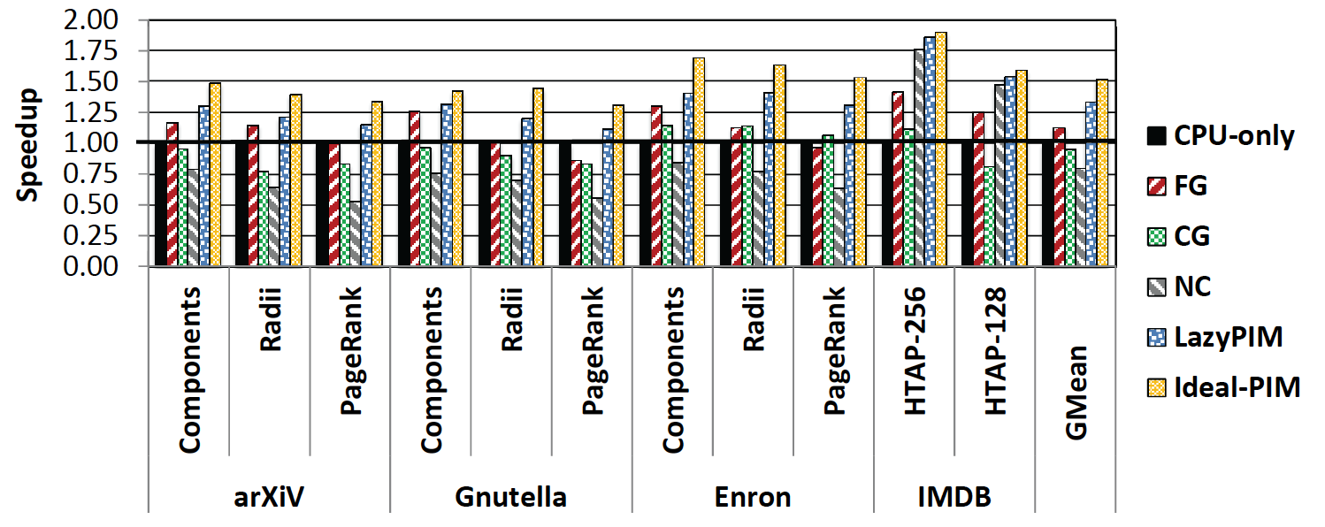
Challenge: Coherence for Hybrid CPU-PIM Apps
Traditional
coherence
No coherence
overhead

Slide 135
How to Maintain Coherence?
Amirali Boroumand, Saugata Ghose, Minesh Patel, Hasan Hassan, Brandon Lucia, Kevin Hsieh, Krishna T. Malladi, Hongzhong Zheng, and Onur Mutlu,
"LazyPIM: An Efficient Cache Coherence Mechanism for Processing-in-Memory"
IEEE Computer Architecture Letters (CAL), June 2016.

Slide 136
How to Support Virtual Memory?
Kevin Hsieh, Samira Khan, Nandita Vijaykumar, Kevin K. Chang, Amirali Boroumand, Saugata Ghose, and Onur Mutlu,
"Accelerating Pointer Chasing in 3D-Stacked Memory: Challenges, Mechanisms, Evaluation"
Proceedings of the 34th IEEE International Conference on Computer Design (ICCD), Phoenix, AZ, USA, October 2016.

Slide 137
How to Design Data Structures for PIM?
Zhiyu Liu, Irina Calciu, Maurice Herlihy, and Onur Mutlu,
"Concurrent Data Structures for Near-Memory Computing"
Proceedings of the 29th ACM Symposium on Parallelism in Algorithms and Architectures (SPAA), Washington, DC, USA, July 2017.
[Slides (pptx) (pdf)]

Slide 138
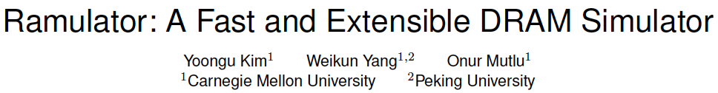
Simulation Infrastructures for PIM
Ramulator extended for PIM
  Flexible and extensible DRAM simulator
  Can model many different memory standards and proposals
  Kim+, “Ramulator: A Flexible and Extensible DRAM Simulator”, IEEE CAL 2015.
  https://github.com/CMU-SAFARI/ramulator

Slide 139
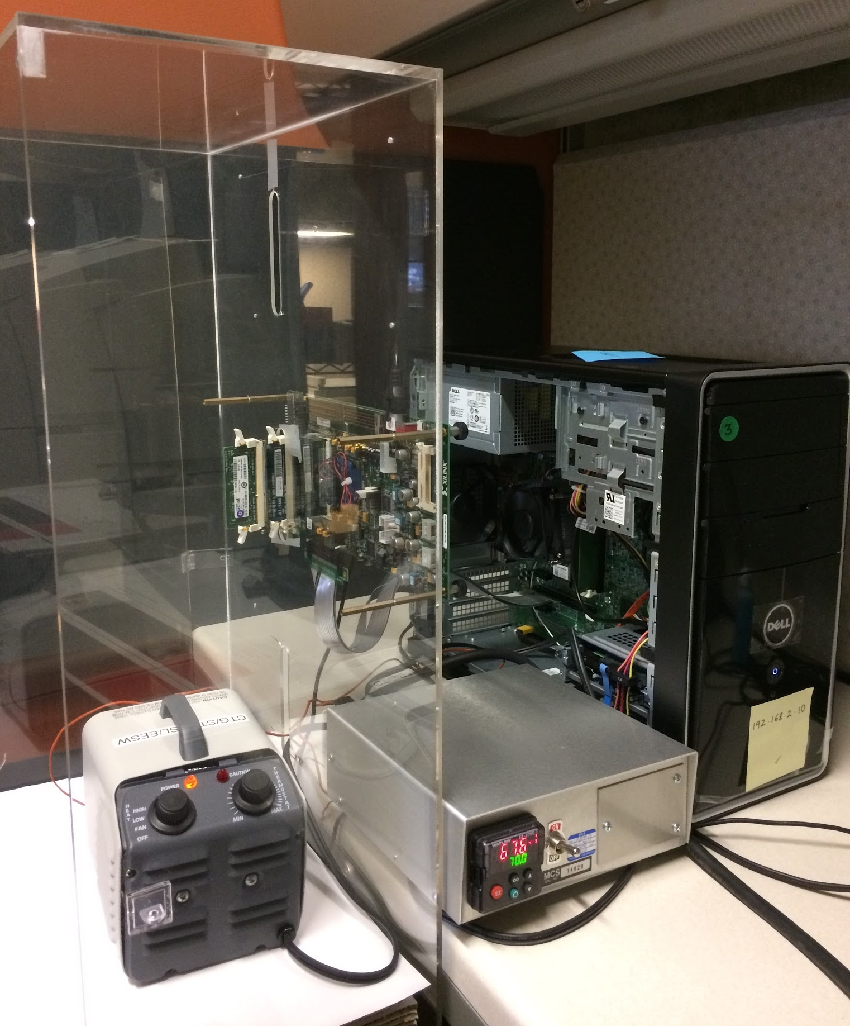
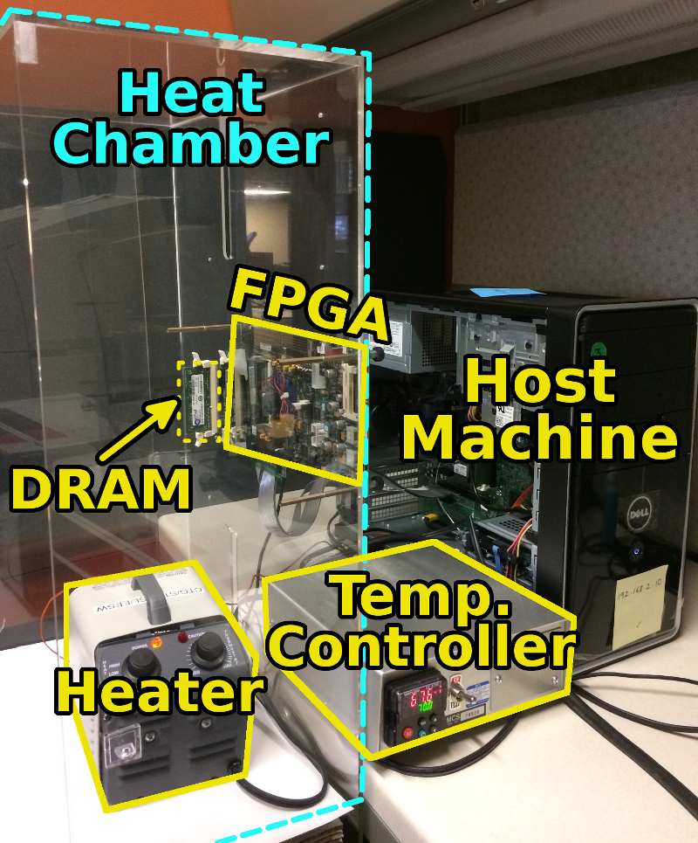
An FPGA-based Test-bed for PIM?
Hasan Hassan et al., SoftMC: A Flexible and Practical Open-Source Infrastructure for Enabling Experimental DRAM Studies HPCA 2017.
Flexible
Easy to Use (C++ API)
Open-source
github.com/CMU-SAFARI/SoftMC

Slide 140
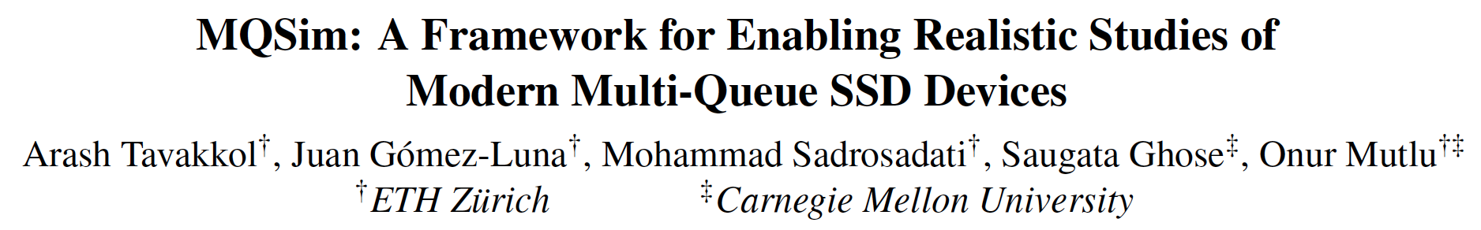
Simulation Infrastructures for PIM (in SSDs)
Arash Tavakkol, Juan Gomez-Luna, Mohammad Sadrosadati, Saugata Ghose, and Onur Mutlu,
"MQSim: A Framework for Enabling Realistic Studies of Modern Multi-Queue SSD Devices"
Proceedings of the 16th USENIX Conference on File and Storage Technologies (FAST), Oakland, CA, USA, February 2018.
[Slides (pptx) (pdf)]
[Source Code]

Slide 141
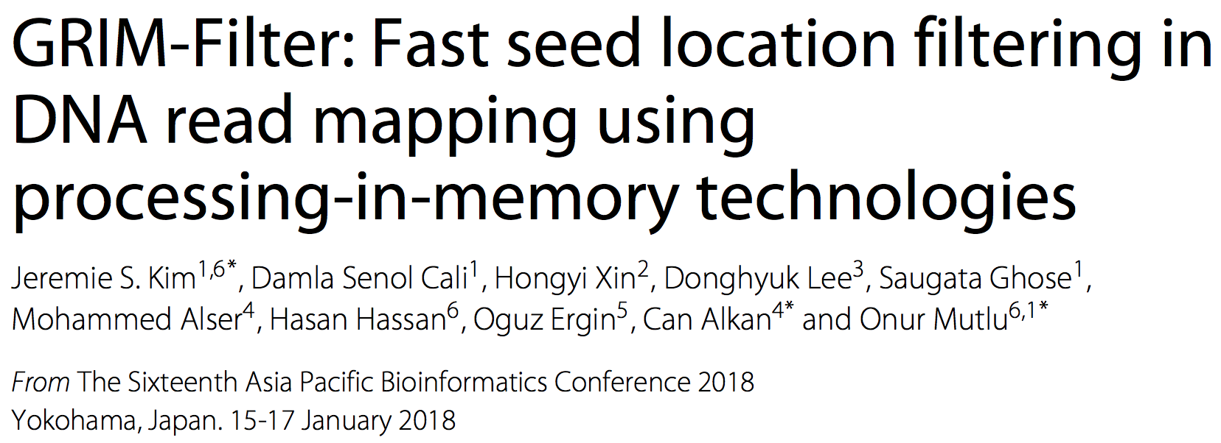
New Applications and Use Cases for PIM
Jeremie S. Kim, Damla Senol Cali, Hongyi Xin, Donghyuk Lee, Saugata Ghose, Mohammed Alser, Hasan Hassan, Oguz Ergin, Can Alkan, and Onur Mutlu,
"GRIM-Filter: Fast Seed Location Filtering in DNA Read Mapping Using Processing-in-Memory Technologies"
BMC Genomics, 2018.
Proceedings of the 16th Asia Pacific Bioinformatics Conference (APBC), Yokohama, Japan, January 2018.
arxiv.org Version (pdf)

Slide 142

Genome Read In-Memory (GRIM) Filter:
Fast Seed Location Filtering in DNA Read Mapping using Processing-in-Memory Technologies
Jeremie Kim,
Damla Senol, Hongyi Xin, Donghyuk Lee,
Saugata Ghose, Mohammed Alser, Hasan Hassan,
Oguz Ergin, Can Alkan, and Onur Mutlu
Notes:
Hello, my name is Jeremie Kim and I will be presenting Genome Read In-Memory Filter which will also be referred to as GRIM-Filter for short.
[CLICK]

Slide 143
Executive Summary
Genome Read Mapping is a very important problem and is the first step in many types of genomic analysis
  Could lead to improved health care, medicine, quality of life
Read mapping is an approximate string matching problem
  Find the best fit of 100 character strings into a 3 billion character dictionary
  Alignment is currently the best method for determining the similarity between two strings, but is very expensive
We propose an in-memory processing algorithm GRIM-Filter for accelerating read mapping, by reducing the number of required alignments
We implement GRIM-Filter using in-memory processing within 3D-stacked memory and show up to 3.7x speedup.

Slide 144
Google Workloads for Consumer Devices:
Mitigating Data Movement Bottlenecks
Amirali Boroumand
Saugata Ghose, Youngsok Kim, Rachata Ausavarungnirun,
Eric Shiu, Rahul Thakur, Daehyun Kim, Aki Kuusela,
Allan Knies, Parthasarathy Ranganathan, Onur Mutlu

Slide 145
Open Problems: PIM Adoption
https://arxiv.org/pdf/1802.00320.pdf

Slide 146
Challenge and Opportunity for Future
Fundamentally
Energy-Efficient
(Data-Centric)
Computing Architectures

Slide 147
Challenge and Opportunity for Future
Fundamentally
High-Performance
(Data-Centric)
Computing Architectures

Slide 148
Challenge and Opportunity for Future
Computing Architectures
with
Minimal Data Movement

Slide 149
One Important Takeaway
Main Memory Needs
Intelligent Controllers

Slide 150
Sub-Agenda: In-Memory Computation
Major Trends Affecting Main Memory
The Need for Intelligent Memory Controllers
  Bottom Up: Push from Circuits and Devices
  Top Down: Pull from Systems and Applications
Processing in Memory: Two Directions
  Minimally Changing Memory Chips
  Exploiting 3D-Stacked Memory
How to Enable Adoption of Processing in Memory
Conclusion

Slide 151
Concluding Remarks
It is time to design principled system architectures to solve the memory problem
Design complete systems to be balanced, high-performance, and energy-efficient, i.e., data-centric (or memory-centric)
Enable computation capability inside and close to memory
This can
  Lead to orders-of-magnitude improvements
  Enable new applications & computing platforms
  Enable better understanding of nature
  …
Notes:
Perhaps we have taken processor-centric system design a bit too far

Slide 152
The Future of Processing in Memory is Bright
Regardless of challenges
  in underlying technology and overlying problems/requirements
Problem
Can enable:
- Orders of magnitude
improvements
- New applications and
computing systems
Yet, we have to
- Think across the stack
- Design enabling systems
Algorithm
Program/Language
System Software
SW/HW Interface
Micro-architecture
Logic
Devices
Electrons

Slide 153
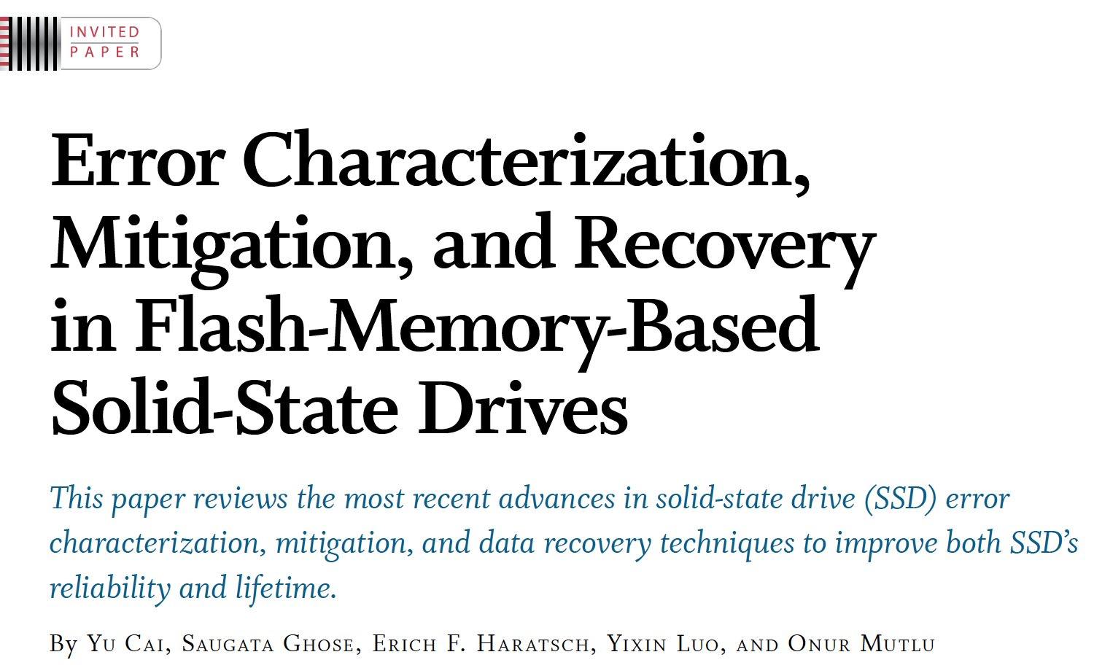
If In Doubt, See Other Doubtful Technologies
A very “doubtful” emerging technology
  for at least two decades
Proceedings of the IEEE, Sept. 2017
https://arxiv.org/pdf/1706.08642

Slide 154
For Some Open Problems, See
Saugata Ghose, Kevin Hsieh, Amirali Boroumand, Rachata Ausavarungnirun, Onur Mutlu,
"Enabling the Adoption of Processing-in-Memory: Challenges, Mechanisms, Future Research Directions"
Invited Book Chapter, to appear in 2018.
[Preliminary arxiv.org version]
https://arxiv.org/pdf/1802.00320.pdf

Slide 155
Memory Systems and Memory-Centric Computing Systems
Lecture 2: Computation in Memory
Onur Mutlu
omutlu@gmail.com
https://people.inf.ethz.ch/omutlu
31 January 2019
UT Austin ECE Endowed Lecture Series

