Slide 1



Memory Systems and Memory-Centric Computing Systems
Lecture 3: Low-Latency Memory
Onur Mutlu
omutlu@gmail.com
https://people.inf.ethz.ch/omutlu
1 February 2019
UT Austin ECE Endowed Lecture Series

Slide 2
Agenda
Major Trends Affecting Main Memory
Key Challenges and Solution Directions
  Robustness: Reliability and Security
  Energy and Performance: In-Memory Computation
  Low Latency/Energy and Latency/Energy/Reliability Tradeoffs
  Scalability and More: Enabling Emerging Technologies
Solution Principles
Concluding Remarks

Slide 3
Four Key Issues in Future Platforms
Fundamentally Secure/Reliable/Safe Architectures
Fundamentally Energy-Efficient Architectures
  Memory-centric (Data-centric) Architectures
Fundamentally Low-Latency Architectures
Architectures for Genomics, Medicine, Health

Slide 4

Solving the Hardest Problems
Source: http://spectrum.ieee.org/image/MjYzMzAyMg.jpeg

Slide 5
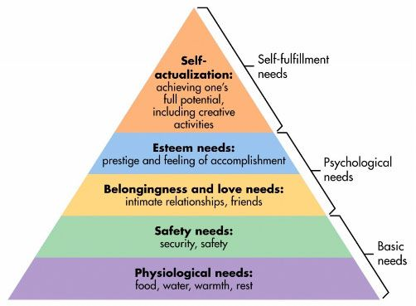
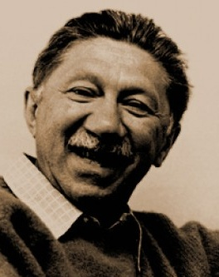
Maslow’s Hierarchy of Needs, A Third Time
Maslow, “A Theory of Human Motivation,”
Psychological Review, 1943.
Maslow, “Motivation and Personality,”
Book, 1954-1970.
Speed
Speed
Speed
Speed
Speed
Source: https://www.simplypsychology.org/maslow.html

Slide 6
Challenge and Opportunity for Future
Fundamentally
Low-Latency
Computing Architectures

Slide 7
Main Memory Latency Lags Behind
128x
20x
1.3x
Memory latency remains almost constant

Slide 8
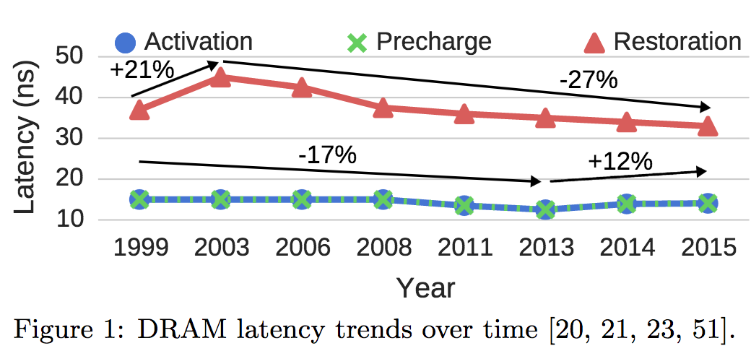
A Closer Look …
Chang+, “Understanding Latency Variation in Modern DRAM Chips: Experimental
Characterization, Analysis, and Optimization",” SIGMETRICS 2016.

Slide 9
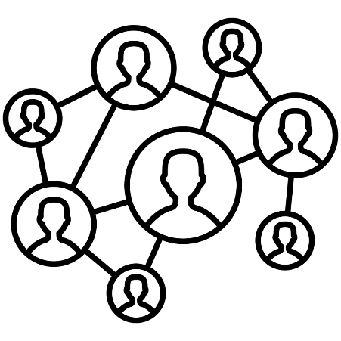



DRAM Latency Is Critical for Performance
In-memory Databases
[Mao+, EuroSys’12;
Clapp+ (Intel), IISWC’15]
Graph/Tree Processing
[Xu+, IISWC’12; Umuroglu+, FPL’15]
In-Memory Data Analytics
[Clapp+ (Intel), IISWC’15;
Awan+, BDCloud’15]
Datacenter Workloads
[Kanev+ (Google), ISCA’15]

Slide 10
DRAM Latency Is Critical for Performance
In-memory Databases
[Mao+, EuroSys’12;
Clapp+ (Intel), IISWC’15]
Graph/Tree Processing
[Xu+, IISWC’12; Umuroglu+, FPL’15]
Long memory latency → performance bottleneck
In-Memory Data Analytics
[Clapp+ (Intel), IISWC’15;
Awan+, BDCloud’15]
Datacenter Workloads
[Kanev+ (Google), ISCA’15]

Slide 11
The Memory Latency Problem
High memory latency is a significant limiter of system performance and energy-efficiency
It is becoming increasingly so with higher memory contention in multi-core and heterogeneous architectures
  Exacerbating the bandwidth need
  Exacerbating the QoS problem
It increases processor design complexity due to the mechanisms incorporated to tolerate memory latency

Slide 12
Retrospective: Conventional Latency Tolerance Techniques
Caching [initially by Wilkes, 1965]
  Widely used, simple, effective, but inefficient, passive
  Not all applications/phases exhibit temporal or spatial locality
Prefetching [initially in IBM 360/91, 1967]
  Works well for regular memory access patterns
  Prefetching irregular access patterns is difficult, inaccurate, and hardware-intensive
Multithreading [initially in CDC 6600, 1964]
  Works well if there are multiple threads
  Improving single thread performance using multithreading hardware is an ongoing research effort
Out-of-order execution [initially by Tomasulo, 1967]
  Tolerates cache misses that cannot be prefetched
  Requires extensive hardware resources for tolerating long latencies
None of These
Fundamentally Reduce
Memory Latency

Slide 13
Truly Reducing Memory Latency

Slide 14
Two Major Sources of Latency Inefficiency
Modern DRAM is not designed for low latency
  Main focus is cost-per-bit (capacity)
Modern DRAM latency is determined by worst case conditions and worst case devices
  Much of memory latency is unnecessary
Our Goal: Reduce Memory Latency at the Source of the Problem

Slide 15
Why the Long Memory Latency?
Reason 1: Design of DRAM Micro-architecture
  Goal: Maximize capacity/area, not minimize latency
Reason 2: “One size fits all” approach to latency specification
  Same latency parameters for all temperatures
  Same latency parameters for all DRAM chips (e.g., rows)
  Same latency parameters for all parts of a DRAM chip
  Same latency parameters for all supply voltage levels
  Same latency parameters for all application data
  …

Slide 16
Tackling the Fixed Latency Mindset
Reliable operation latency is actually very heterogeneous
  Across temperatures, chips, parts of a chip, voltage levels, …
Idea: Dynamically find out and use the lowest latency one can reliably access a memory location with
  Adaptive-Latency DRAM [HPCA 2015]
  Flexible-Latency DRAM [SIGMETRICS 2016]
  Design-Induced Variation-Aware DRAM [SIGMETRICS 2017]
  Voltron [SIGMETRICS 2017]
  DRAM Latency PUF [HPCA 2018]
  DRAM Latency True Random Number Generator [HPCA 2019]
  ...
We would like to find sources of latency heterogeneity and exploit them to minimize latency (or create other benefits)

Slide 17

Latency Variation in Memory Chips
Heterogeneous manufacturing & operating conditions →
latency variation in timing parameters
DRAM A
DRAM B
DRAM C
Slow cells
Low
High
DRAM Latency

Slide 18
Why is Latency High?
DRAM latency: Delay as specified in DRAM standards
  Doesn’t reflect true DRAM device latency
Imperfect manufacturing process → latency variation
High standard latency chosen to increase yield
DRAM A
DRAM B
DRAM C
Standard
Latency
Manufacturing
Variation
Low
High
DRAM Latency
Notes:
To understand the latency problem, we need to go into what defines latency.
DRAM latency is the total amnt of time that the underlying hw operations need <> to retrieve data.
The DRAM standards define a single fixed time for how long these ops should take in every DRAM chip.
However, this defined delay doesn’t actually reflect the latency of the individual DRAMs.
<Timeline illustration>
Because the manufacturing process is imperfect, it introduces variation in the production chips, resulting in latency variation across different chips.
This simple illustartion shows the difference b/w the average latency across 3 different dram chips, to convey the point of latency variation.
It’s important to note that not only does latency variation exists <across> chips, but also <inside> each dram chip itself.
<Blue standard>
Since we don’t want to throw away the chips with high variation, we tolerate them.
The simple way is to <slow> down the acceptable latency so that the majority of chips can all work reliably under this high standard latency.
as we can see, the high standard latency is a result of a trade-off made for higher DRAM production yield.
---
<> Operative word

Slide 19
What Causes the Long Memory Latency?
Conservative timing margins!
DRAM timing parameters are set to cover the worst case
Worst-case temperatures
  85 degrees vs. common-case
  to enable a wide range of operating conditions
Worst-case devices
  DRAM cell with smallest charge across any acceptable device
  to tolerate process variation at acceptable yield
This leads to large timing margins for the common case

Slide 20
Understanding and Exploiting
Variation in DRAM Latency

Slide 21

DRAM Characterization Infrastructure
Temperature
Controller
FPGAs
Heater
FPGAs
PC
  Kim+, “Flipping Bits in Memory Without Accessing Them: An Experimental Study of DRAM Disturbance Errors,” ISCA 2014.

Slide 22
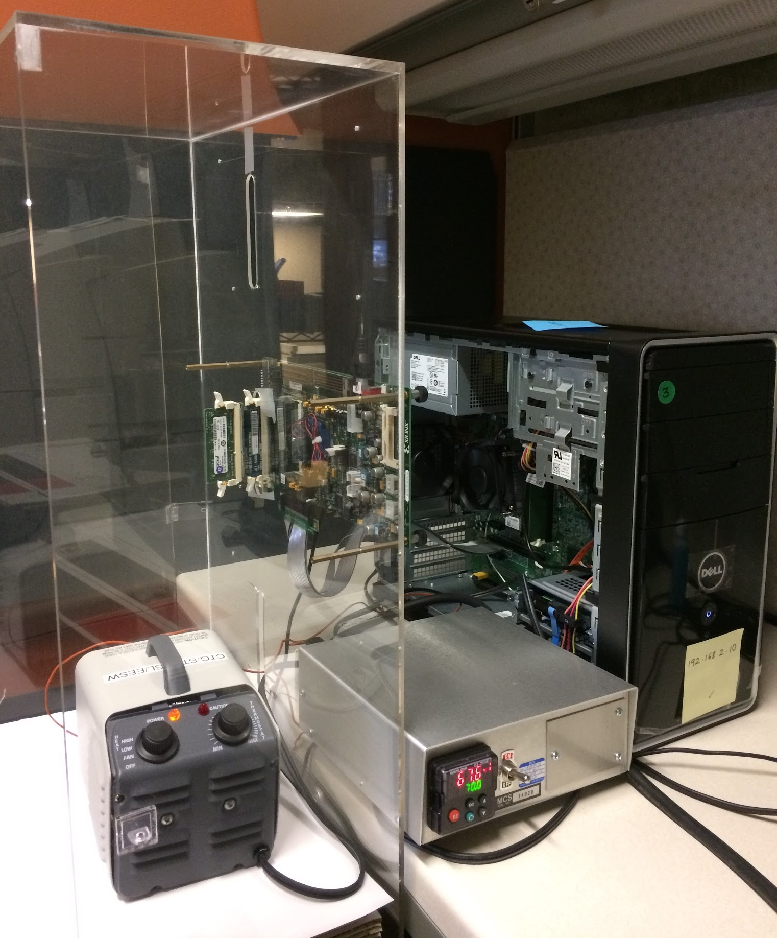
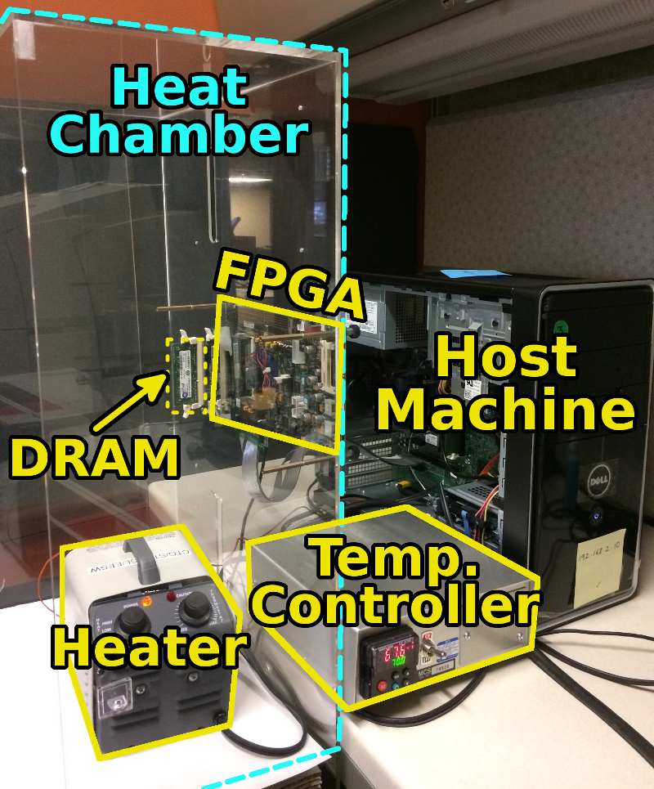
DRAM Characterization Infrastructure
Hasan Hassan et al., SoftMC: A Flexible and Practical Open-Source Infrastructure for Enabling Experimental DRAM Studies, HPCA 2017.
Flexible
Easy to Use (C++ API)
Open-source
github.com/CMU-SAFARI/SoftMC

Slide 23
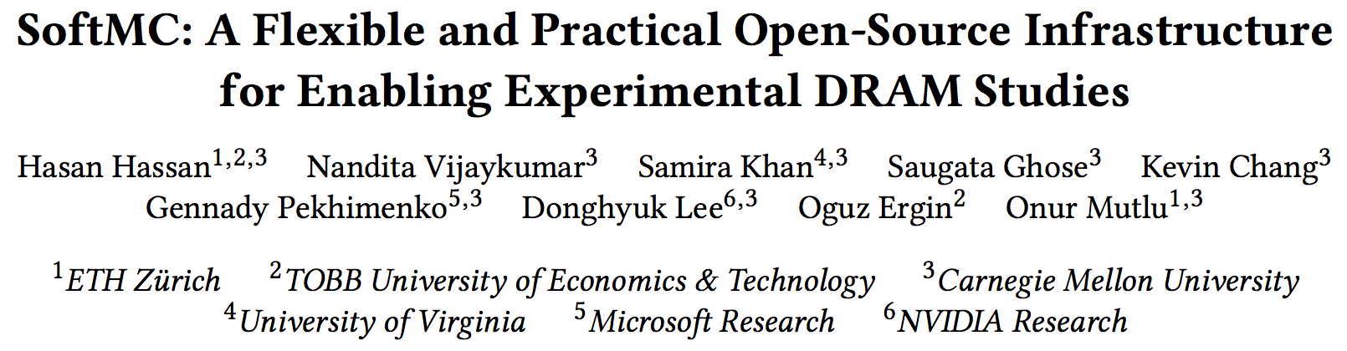
SoftMC: Open Source DRAM Infrastructure
https://github.com/CMU-SAFARI/SoftMC

Slide 24
Adaptive-Latency DRAM
Key idea
  Optimize DRAM timing parameters online
Two components
  DRAM manufacturer provides multiple sets of reliable DRAM timing parameters at different temperatures for each DIMM
  System monitors DRAM temperature & uses appropriate DRAM timing parameters
reliable DRAM timing parameters
DRAM temperature
Lee+, “Adaptive-Latency DRAM: Optimizing DRAM Timing for the Common-Case,” HPCA 2015.

Slide 25
Latency Reduction Summary of 115 DIMMs
Latency reduction for read & write (55°C)
  Read Latency: 32.7%
  Write Latency: 55.1%
Latency reduction for each timing parameter (55°C)
  Sensing: 17.3%
  Restore: 37.3% (read), 54.8% (write)
  Precharge: 35.2%
Lee+, “Adaptive-Latency DRAM: Optimizing DRAM Timing for the Common-Case,” HPCA 2015.

Slide 26
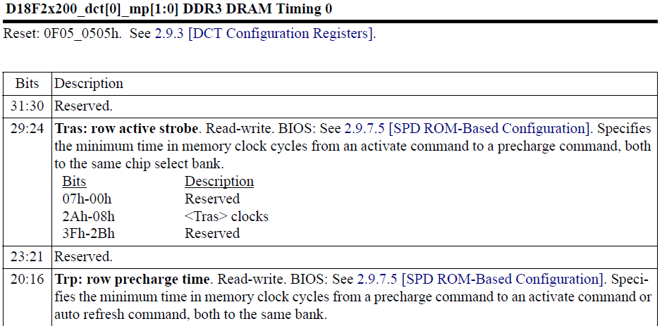
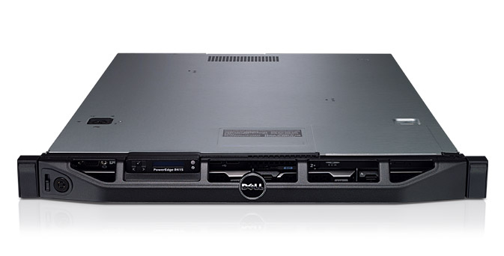
AL-DRAM: Real System Evaluation
System
  CPU: AMD 4386 ( 8 Cores, 3.1GHz, 8MB LLC)
  DRAM: 4GByte DDR3-1600 (800Mhz Clock)
  OS: Linux
  Storage: 128GByte SSD
Workload
  35 applications from SPEC, STREAM, Parsec, Memcached, Apache, GUPS

Slide 27
AL-DRAM: Single-Core Evaluation
Average
Improvement
6.7%
Performance Improvement
5.0%
1.4%
all-35-workload
AL-DRAM improves single-core performance
on a real system

Slide 28
AL-DRAM: Multi-Core Evaluation
Average
Improvement
14.0%
10.4%
Performance Improvement
2.9%
all-35-workload
AL-DRAM provides higher performance on
multi-programmed & multi-threaded workloads

Slide 29
Reducing Latency Also Reduces Energy
AL-DRAM reduces DRAM power consumption by 5.8%
Major reason: reduction in row activation time

Slide 30
AL-DRAM: Advantages & Disadvantages
Advantages
+ Simple mechanism to reduce latency
+ Significant system performance and energy benefits
+ Benefits higher at low temperature
+ Low cost, low complexity
Disadvantages
- Need to determine reliable operating latencies for different temperatures and different DIMMs → higher testing cost
(might not be that difficult for low temperatures)

Slide 31
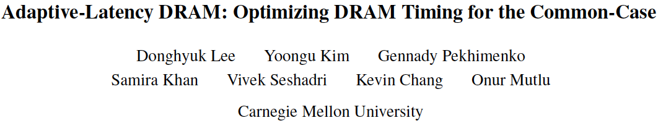
More on Adaptive-Latency DRAM
Donghyuk Lee, Yoongu Kim, Gennady Pekhimenko, Samira Khan, Vivek Seshadri, Kevin Chang, and Onur Mutlu,
"Adaptive-Latency DRAM: Optimizing DRAM Timing for the Common-Case"
Proceedings of the 21st International Symposium on High-Performance Computer Architecture (HPCA), Bay Area, CA, February 2015.
[Slides (pptx) (pdf)] [Full data sets]

Slide 32
Different Types of Latency Variation
AL-DRAM exploits latency variation
  Across time (different temperatures)
  Across chips
Is there also latency variation within a chip?
  Across different parts of a chip

Slide 33
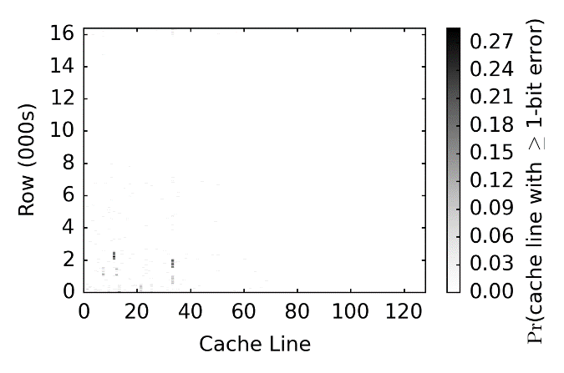
Spatial Locality of Activation Errors
One DIMM @ tRCD=7.5ns
Activation errors are concentrated
at certain columns of cells
Notes:
This fig is showing the prob. of seeing at least 1 bit error in each cache line from one DIMM under trcd = 7.5ns. The y-axis is the row # (in 000s) and the x-axis is the cl #.
The main observation is that errors exhibit spatial locality. In this DIMM, errors tend to cluster at certain columns of cache lines without errors in the majority of the remaining cl.
This is an imperative observation for our proposed mechanism, which I’ll discuss later.
Next, we investigate the impact of reading different data patterns stored in these cells.

Slide 34
Heterogeneous Latency within A Chip
Observation: DRAM timing errors (slow DRAM cells) are concentrated on certain regions
Flexible-LatencY (FLY) DRAM
  A software-transparent design that reduces latency
Key idea:
  1) Divide memory into regions of different latencies
  2) Memory controller: Use lower latency for regions without slow cells; higher latency for other regions
Chang+, “Understanding Latency Variation in Modern DRAM Chips: Experimental
Characterization, Analysis, and Optimization",” SIGMETRICS 2016.
Notes:
To summarize the observations so far, we find that dram timing errors due to shortened act and pre don’t occur in all cells and they are concentrated at certain regions.
So let’s go back to our second main goal which is on improving latency.
TO achieve this, we propose a software… design, called flex.. Dram or FLY for short, to reduce dram latency.
The key idea is the following:
We divide the dram up into different regions based on a latency variation profile.
Then We enable the mc to use different latency for diff regions.
For regions without slow cells, we are going to run it faster at a much lower latency.
For any region that has slow cells, we are going to operate at a higher latency.

Slide 35
FLY-DRAM Configurations
tRCD
99%
93%
12%
Profiles of 3 real DIMMs
tRP
99%
74%
13%
Chang+, “Understanding Latency Variation in Modern DRAM Chips: Experimental
Characterization, Analysis, and Optimization",” SIGMETRICS 2016.
Notes:
We evaluate FLY-DRAM with various configurations.
These 2 figures show the fraction of cells with different latencies for act and pre.
X-axis shows you the configurations that we have.
First, we evaluate a baseline dram system with the standardized latency at 13ns.
Then we use latency profiles that were collected from 3 real DIMMs. The percentage numbers show you the fraction of fast cells in each DIMM.
Note that Darker color means faster latency.
We also evalaute an upperbound configuration that has 100% fast cells under 7.5ns.

Slide 36
Heterogeneous Latency within A Chip
19.7%
19.5%
17.6%
13.3%
Chang+, “Understanding Latency Variation in Modern DRAM Chips: Experimental
Characterization, Analysis, and Optimization",” SIGMETRICS 2016.

Slide 37
FLY-DRAM: Advantages & Disadvantages
Advantages
+ Reduces latency significantly
+ Exploits significant within-chip latency variation
Disadvantages
- Need to determine reliable operating latencies for different parts of a chip → higher testing cost
- Slightly more complicated controller

Slide 38
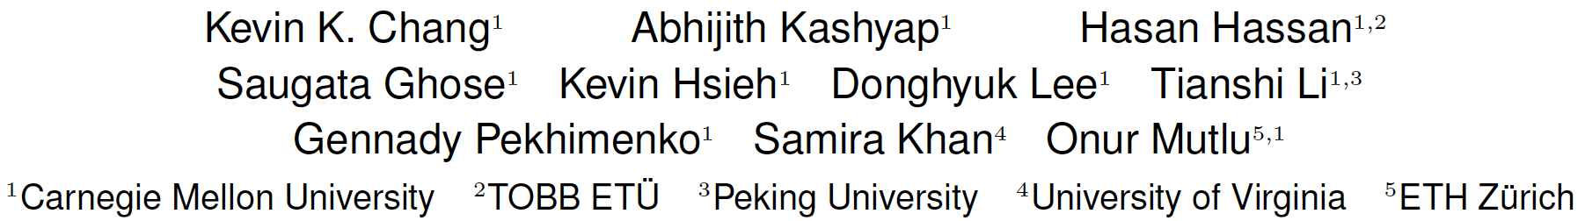
Analysis of Latency Variation in DRAM Chips
Kevin Chang, Abhijith Kashyap, Hasan Hassan, Samira Khan, Kevin Hsieh, Donghyuk Lee, Saugata Ghose, Gennady Pekhimenko, Tianshi Li, and Onur Mutlu,
"Understanding Latency Variation in Modern DRAM Chips: Experimental Characterization, Analysis, and Optimization"
Proceedings of the ACM International Conference on Measurement and Modeling of Computer Systems (SIGMETRICS), Antibes Juan-Les-Pins, France, June 2016.
[Slides (pptx) (pdf)]
[Source Code]

Slide 39
Why Is There
Spatial Latency Variation
Within a Chip?

Slide 40
What Is Design-Induced Variation?
fast
slow
across column
inherently slow
distance from wordline driver
slow
across row
wordline drivers
distance from sense amplifier
fast
Inherently fast
sense amplifiers
Systematic variation in cell access times
caused by the physical organization of DRAM
Notes:
As we described, cells in a mat have different distances from peripheral logic.
Cells in different rows have different distance from the sense amplifiers.
Cells in different columns have different distance from the wordline drivers.
Therefore, some regions are inherently faster than other regions,
and some regions are inherently slower than other regions.
We call this architectural variation.

Slide 41
DIVA Online Profiling
Design-Induced-Variation-Aware
inherently slow
wordline driver
sense amplifier
Profile only slow regions to determine min. latency
→ Dynamic & low cost latency optimization
Notes:
We propoe AVA Online profiling.
The key idea is profiling only slow regions to determine latency, leading to low cost online DRAM test.

Slide 42
DIVA Online Profiling
Design-Induced-Variation-Aware
slow cells
inherently slow
process
variation
design-induced
variation
wordline driver
random error
localized error
error-correcting code
online profiling
sense amplifier
Combine error-correcting codes & online profiling
→ Reliably reduce DRAM latency
Notes:
However, due to the process variation, some cells are more vulnerable than other cells, as the figure show.
These cells are randomly distributed while cells in the slow regions cause localized error.
To address both type of cells,
We integrate conventional ECC to correct the process variation induced errors.
Therefore, combining ECC and online profiling leads to reliably reducing DRAM latency.

Slide 43
DIVA-DRAM Reduces Latency
Read
Write
Latency Reduction
DIVA
DIVA
DIVA
DIVA
DIVA-DRAM reduces latency more aggressively
and uses ECC to correct random slow cells
Notes:
The figure compares latency reduction by using AL-DRAM, AVA Profiling, and both AVA Profiling and Shuffling.
As we can, using AVA profiling and shuffling enables more latency reduction compared to AL-DRAM.
This is mainly because ECC corrects the worst cells in a DRAM module, reducing more latency.
Therefore, we conclude that AVA-DRAM reduces latency significantly.

Slide 44
DIVA-DRAM: Advantages & Disadvantages
Advantages
++ Automatically finds the lowest reliable operating latency at system runtime (lower production-time testing cost)
+ Reduces latency more than prior methods (w/ ECC)
+ Reduces latency at high temperatures as well
Disadvantages
- Requires knowledge of inherently-slow regions
- Requires ECC (Error Correcting Codes)
- Imposes overhead during runtime profiling

Slide 45
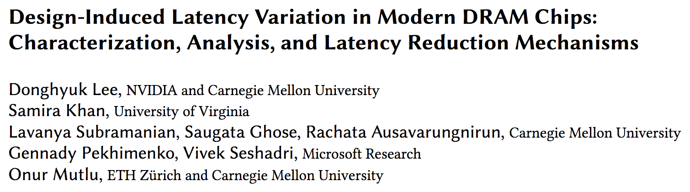
Design-Induced Latency Variation in DRAM
Donghyuk Lee, Samira Khan, Lavanya Subramanian, Saugata Ghose, Rachata Ausavarungnirun, Gennady Pekhimenko, Vivek Seshadri, and Onur Mutlu,
"Design-Induced Latency Variation in Modern DRAM Chips: Characterization, Analysis, and Latency Reduction Mechanisms"
Proceedings of the ACM International Conference on Measurement and Modeling of Computer Systems (SIGMETRICS), Urbana-Champaign, IL, USA, June 2017.

Slide 46
Understanding & Exploiting the
Voltage-Latency-Reliability Relationship

Slide 47
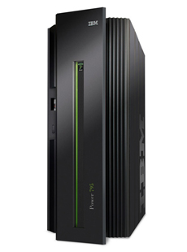
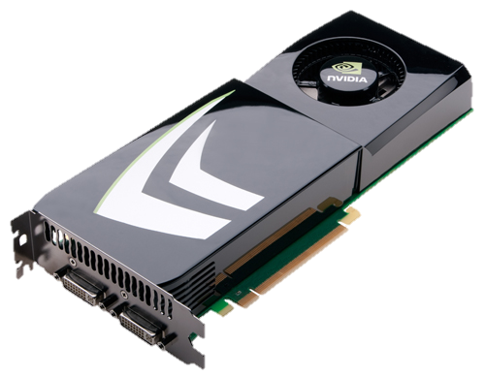
High DRAM Power Consumption
Problem: High DRAM (memory) power in today’s systems
>40% in POWER7 (Ware+, HPCA’10)
  >40% in GPU (Paul+, ISCA’15)

Slide 48
Executive Summary
DRAM (memory) power is significant in today’s systems
  Existing low-voltage DRAM reduces voltage conservatively
Goal: Understand and exploit the reliability and latency behavior of real DRAM chips under aggressive reduced-voltage operation
Key experimental observations:
  Huge voltage margin -- Errors occur beyond some voltage
  Errors exhibit spatial locality
  Higher operation latency mitigates voltage-induced errors
Voltron: A new DRAM energy reduction mechanism
  Reduce DRAM voltage without introducing errors
  Use a regression model to select voltage that does not degrade performance beyond a chosen target → 7.3% system energy reduction

Slide 49
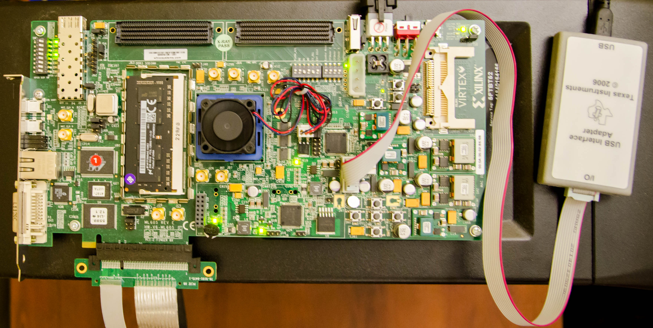
Custom Testing Platform
SoftMC [Hassan+, HPCA’17]: FPGA testing platform to
1) Adjust supply voltage to DRAM modules
2) Schedule DRAM commands to DRAM modules
  Existing systems: DRAM commands not exposed to users
DRAM
module
Voltage
controller
FPGA
https://github.com/CMU-SAFARI/DRAM-Voltage-Study

Slide 50
Reliability Worsens with Lower Voltage
Errors induced by
reduced-voltage operation
Min. voltage (V_{min}) without errors
Nominal
Voltage
Reducing voltage below V_{min} causes
an increasing number of errors

Slide 51
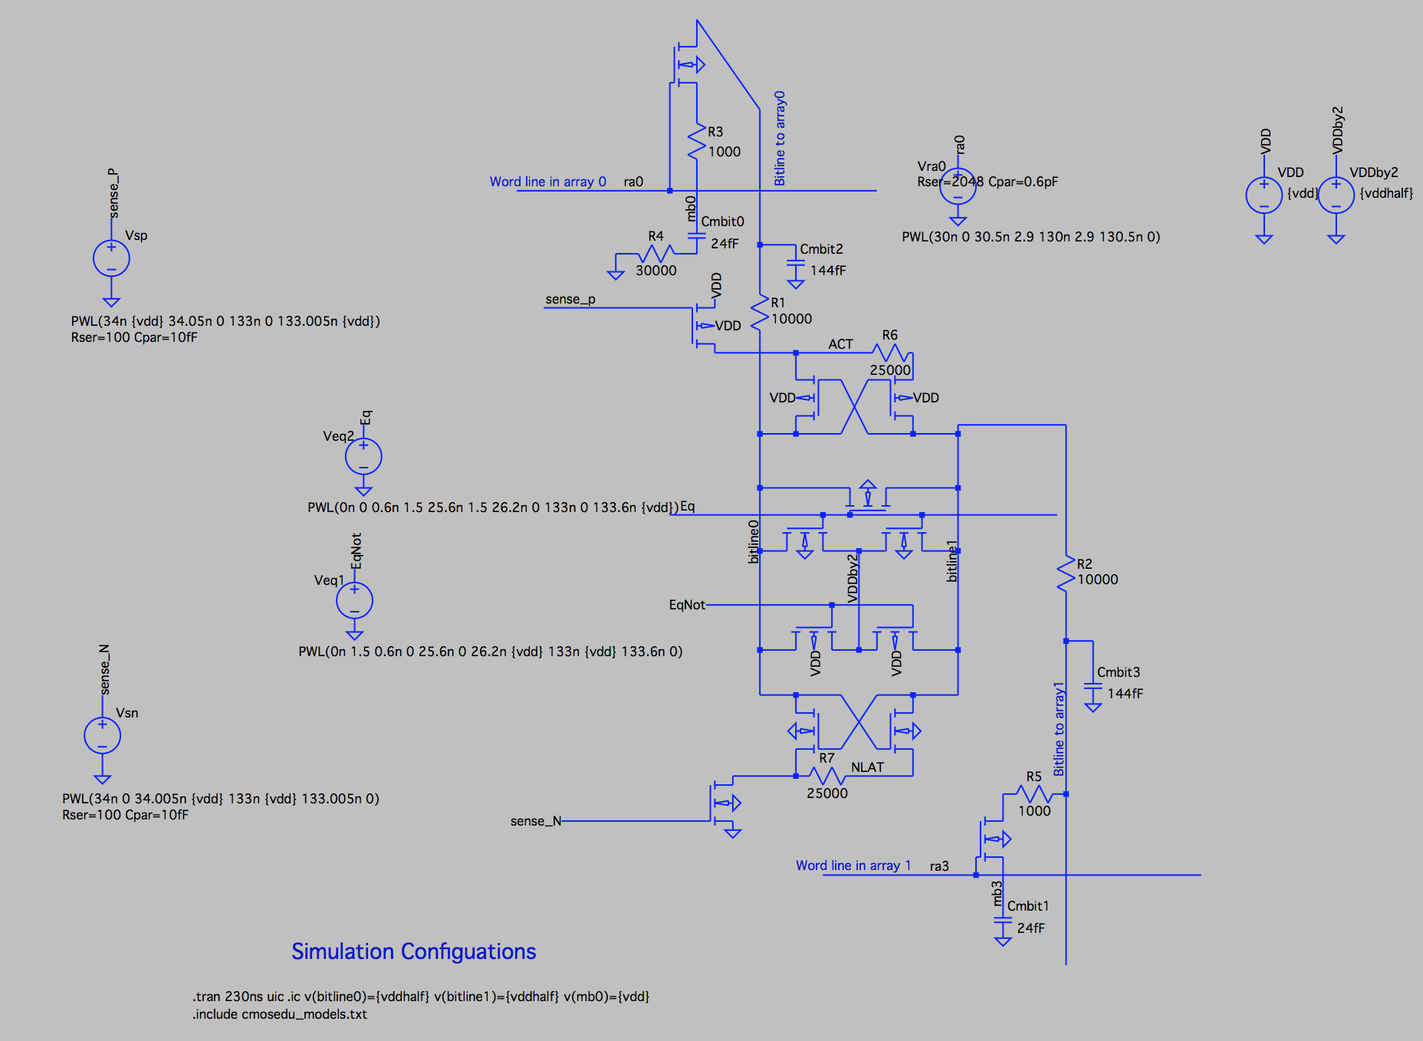
Source of Errors
Detailed circuit simulations (SPICE) of a DRAM cell array to model the behavior of DRAM operations
https://github.com/CMU-SAFARI/DRAM-Voltage-Study
Nominal
Voltage
Circuit model
Reliable low-voltage operation requires higher latency

Slide 52
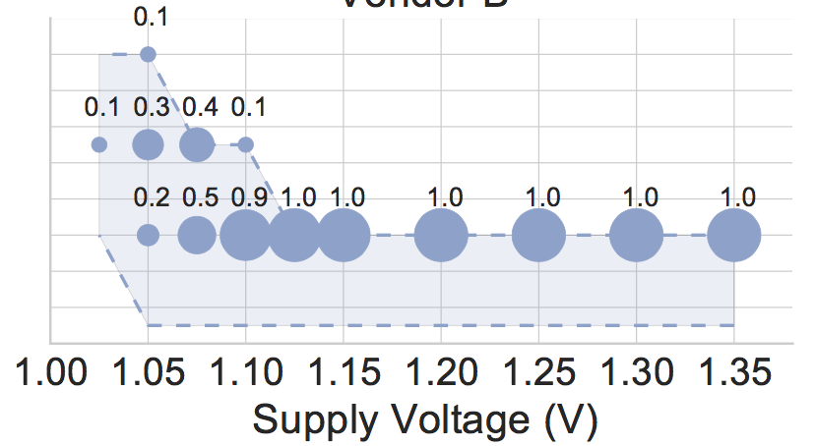
Higher Access Latency → Fewer Errors
Measured minimum latency that does not cause errors in DRAM modules
40% of modules
14
Distribution of latency in the total population
100% of modules
Measured Minimum
Activate Latency (ns)
12
10
8
DRAM requires longer latency to access data without errors at lower voltage
Lower bound of latency as our latency adjustment granularity is 2.5ns

Slide 53
Spatial Locality of Errors
A module under 1.175V (12% voltage reduction)
Errors concentrate in certain regions

Slide 54



Voltron Overview
Voltron
User specifies the performance loss target
Select the minimum DRAM voltage without violating the target
How do we predict performance loss due to increased latency under low DRAM voltage?

Slide 55

Linear Model to Predict Performance
Voltron
User specifies the performance loss target
Select the minimum DRAM voltage without violating the target
Application’s characteristics
Min.
Voltage
Final
Voltage
[-1%, -3%, …]
Predicted performance loss
[1.3V, 1.25V, …]
Target
DRAM Voltage
Linear regression model

Slide 56
Energy Savings with Bounded Performance
[David+, ICAC’11]
Meets performance target
7.3%
More savings for
high bandwidth applications
-1.6%
-1.8%
3.2%
Performance Target

Slide 57
Voltron: Advantages & Disadvantages
Advantages
+ Can trade-off between voltage and latency to improve energy or performance
+ Can exploit the high voltage margin present in DRAM
Disadvantages
- Requires finding the reliable operating voltage for each chip → higher testing cost

Slide 58
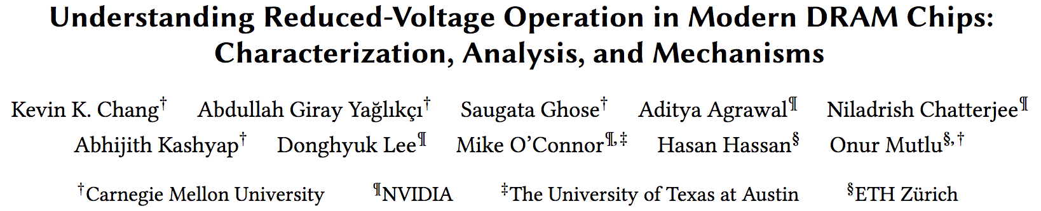
Analysis of Latency-Voltage in DRAM Chips
Kevin Chang, A. Giray Yaglikci, Saugata Ghose, Aditya Agrawal, Niladrish Chatterjee, Abhijith Kashyap, Donghyuk Lee, Mike O'Connor, Hasan Hassan, and Onur Mutlu,
"Understanding Reduced-Voltage Operation in Modern DRAM Devices: Experimental Characterization, Analysis, and Mechanisms"
Proceedings of the ACM International Conference on Measurement and Modeling of Computer Systems (SIGMETRICS), Urbana-Champaign, IL, USA, June 2017.

Slide 59
And, What If …
… we can sacrifice reliability of some data to access it with even lower latency?

Slide 60




The DRAM Latency PUF:
Quickly Evaluating Physical Unclonable Functions by Exploiting the Latency-Reliability Tradeoff in Modern Commodity DRAM Devices
Jeremie S. Kim Minesh Patel
Hasan Hassan Onur Mutlu
Notes:
Hello, my name is Jeremie Kim and I will be talking about the DRAM Latency PUF.

Slide 61
Motivation
A PUF is function that generates a signature unique to a given device
Used in a Challenge-Response Protocol
  Each device generates a unique PUF response depending the inputs
  A trusted server authenticates a device if it generates the expected PUF response
Notes:
[CLICK] A PUF is a function that generates a signature that is unique to a given device. [CLICK] PUFs are often used in a challenge-response protocol where [CLICK] a trusted server issues a set of input parameters to a device, and the device generates the PUF response depending on the input parameters. [CLICK] The trusted server then receives the PUF response and can authenticate the device.

Slide 62
DRAM Latency Characterization of 223 LPDDR4 DRAM Devices
Latency failures come from accessing DRAM with reduced timing parameters.
Key Observations:
  A cell’s latency failure probability is determined by random process variation
  Latency failure patterns are repeatable and unique to a device
Notes:
In this work, we show results from a detailed experimental characterization of 223 state-of-the-art LPDDR4 DRAM devices. [CLICK] We characterize DRAM latency by observing the effects of accessing DRAM with DRAM timing parameters reduced below manufacturer-recommended values.
[CLICK] We make two key observations. [CLICK] first, a cell’s probability to fail, when accessed with reduced timing parameters, is directly correlated with random variations that arise from process manufacturing. [CLICK] secondly, We note that these error patterns from inducing DRAM latency errors are unique to a device and highly repeatable.

Slide 63
DRAM Latency PUF Key Idea
High % chance to fail with reduced t_{RCD}
Low % chance to fail with reduced t_{RCD}
Row Decoder
SA
SA
SA
SA
SA
SA
SA
Notes:
Here is a cartoon showing the manufacturing variation across a region of DRAM. When accessed with a reduced timing parameter, [CLICK] some cells have a high percentage chance of failing, while others [CLICK] have a low percentage chance of failing.

Slide 64
DRAM Accesses and Failures
wordline
V_{dd}
access
transistor
V_{min}
Ready to Access
Voltage Level
bitline
Process variation during manufacturing leads to cells having unique characteristics
Bitline Voltage
Bitline Charge Sharing
capacitor
SA
0.5 V_{dd}
Time
ACTIVATE
SA Enable
READ
t_{RCD}
Notes:
[CLICK] A DRAM cell holds its charge in a capacitor and gets read out by the sense amplifier via the bitline. [CLICK][CLICK] Initially the bitline is kept at Vdd/2. [CLICK] When the wordline is driven high or activated, [CLICK] the capacitor begins to share charge with the bitline. The sense amplifier is then enabled and [CLICK] the voltage differential on the bitline is amplified to an I/O readable value. [CLICK] In order to ensure correctness of operation, the memory controller can only read data tRCD time after the activation. [CLICK] We could read this data earlier, when it reaches a readable voltage threshold, [CLICK] but other cells, that are weaker due to process variation, might fail. [CLICK]

Slide 65
DRAM Accesses and Failures
wordline
V_{dd}
access
transistor
V_{min}
Ready to Access
Voltage Level
bitline
weaker cells have a higher probability to fail
Bitline Voltage
capacitor
SA
0.5 V_{dd}
Time
ACTIVATE
SA Enable
READ
t_{RCD}
Notes:
Our method of inducing latency errors is to [CLICK] reduce tRCD below manufacturer-recommended values. Cells that are read when their bitline’s voltage is lower than the threshold, have a probability of failure. This probability increases as you read further below the voltage threshold.

Slide 66
The DRAM Latency PUF Evaluation
We generate PUF responses using latency errors in a region of DRAM
The latency error patterns satisfy PUF requirements
The DRAM Latency PUF generates PUF responses in 88.2ms
Notes:
[CLICK] The DRAM latency PUF generates a PUF response by inducing latency errors in a region of DRAM. [CLICK] We find that the error patterns from latency errors in a DRAM region satisfy the requirements for an effective PUF quite well. [CLICK] The DRAM latency PUF can generate a PUF response in 88.2ms.

Slide 67
Results
DL-PUF is orders of magnitude faster than prior DRAM PUFs & temperature independent
Notes:
[CLICK] We show by direct comparison that this is orders of magnitudes faster than the previous best DRAM PUF.

Slide 68

The DRAM Latency PUF:
Quickly Evaluating Physical Unclonable Functions by Exploiting the Latency-Reliability Tradeoff in Modern Commodity DRAM Devices
Jeremie S. Kim Minesh Patel
Hasan Hassan Onur Mutlu
QR Code for the paper
https://people.inf.ethz.ch/omutlu/pub/dram-latency-puf_hpca18.pdf
Notes:
Please come to my talk at HPCA 2018, if you would like to learn more or have any questions. Thank you very much.

Slide 69
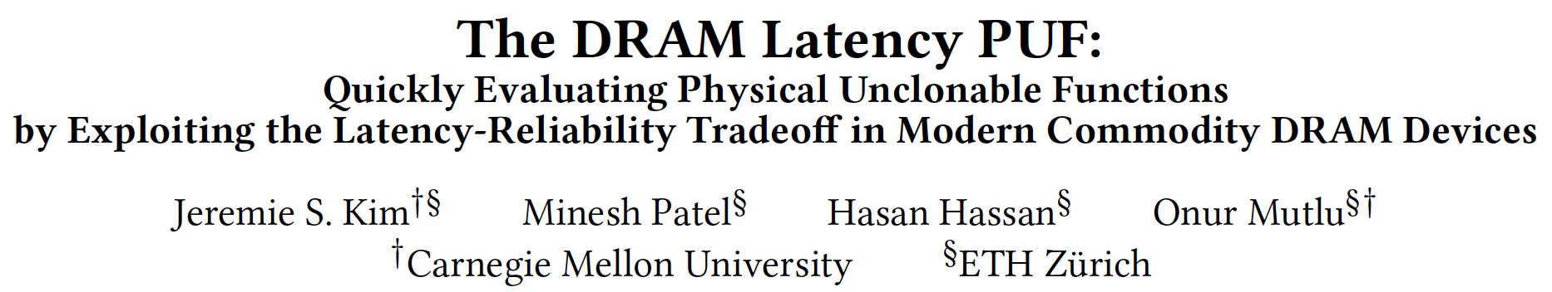
DRAM Latency PUFs
Jeremie S. Kim, Minesh Patel, Hasan Hassan, and Onur Mutlu,
"The DRAM Latency PUF: Quickly Evaluating Physical Unclonable Functions by Exploiting the Latency-Reliability Tradeoff in Modern DRAM Devices"
Proceedings of the 24th International Symposium on High-Performance Computer Architecture (HPCA), Vienna, Austria, February 2018.
[Lightning Talk Video]
[Slides (pptx) (pdf)] [Lightning Session Slides (pptx) (pdf)]

Slide 70
D-RaNGe: Using Commodity DRAM Devices to Generate True Random Numbers with Low Latency and High Throughput
Jeremie S. Kim Minesh Patel
Hasan Hassan Lois Orosa Onur Mutlu
HPCA 2019

Slide 71
DRAM Latency Characterization of 282 LPDDR4 DRAM Devices
Latency failures come from accessing DRAM with reduced timing parameters.
Key Observations:
  A cell’s latency failure probability is determined by random process variation
  Some cells fail randomly
Notes:
In this work, we show results from a detailed experimental characterization of 282 state-of-the-art LPDDR4 DRAM devices. [CLICK] We characterize DRAM latency by observing the effects of accessing DRAM with DRAM timing parameters reduced below manufacturer-recommended values.
[CLICK] We make two key observations. [CLICK] first, a cell’s probability to fail, when accessed with reduced timing parameters, is directly correlated with random variations that arise from process manufacturing. [CLICK] secondly, We note that some cells fail randomly when accessed with a reduced tRCD.

Slide 72
D-RaNGe Key Idea
Low % chance to fail with reduced t_{RCD}
High % chance to fail with reduced t_{RCD}
Row Decoder
SA
SA
SA
SA
SA
SA
SA
Fails randomly
with reduced t_{RCD}
Notes:
Here is a cartoon showing the manufacturing variation across a region of DRAM. When accessed with a reduced timing parameter, [CLICK] some cells have a high percentage chance of failing, while others [CLICK] have a low percentage chance of failing. [CLICK} Some cells fail randomly when accessed with a reduced tRCD.

Slide 73
D-RaNGe Key Idea
Low % chance to fail with reduced t_{RCD}
High % chance to fail with reduced t_{RCD}
We refer to cells that fail randomly
when accessed with a reduced t_{RCD}
as RNG cells
Row Decoder
SA
SA
SA
SA
SA
SA
SA
Fails randomly
with reduced t_{RCD}
Notes:
We refer to cells that fail randomly when accessed with a reduced tRCD as RNG cells

Slide 74
Our D-RaNGe Evaluation
We generate random values by repeatedly accessing RNG cells and aggregating the data read
The random data satisfies the NIST statistical test suite for randomness
The D-RaNGE generates random numbers
  Throughput: 717.4 Mb/s
  Latency: 64 bits in <1us
  Power: 4.4 nJ/bit

Slide 75
D-RaNGe: Using Commodity DRAM Devices to Generate True Random Numbers with Low Latency and High Throughput
Jeremie S. Kim Minesh Patel
Hasan Hassan Lois Orosa Onur Mutlu
HPCA 2019

Slide 76
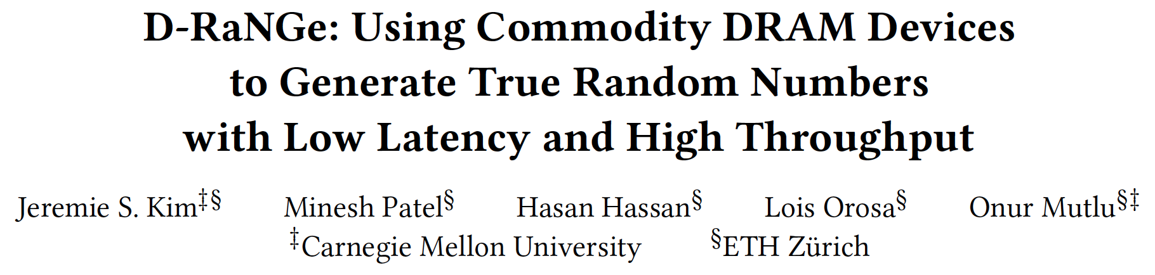
DRAM Latency True Random Number Generator
Jeremie S. Kim, Minesh Patel, Hasan Hassan, Lois Orosa, and Onur Mutlu,
"D-RaNGe: Using Commodity DRAM Devices to Generate True Random Numbers with Low Latency and High Throughput"
Proceedings of the 25th International Symposium on High-Performance Computer Architecture (HPCA), Washington, DC, USA, February 2019.

Slide 77
Other Ideas on
Reducing DRAM Latency

Slide 78
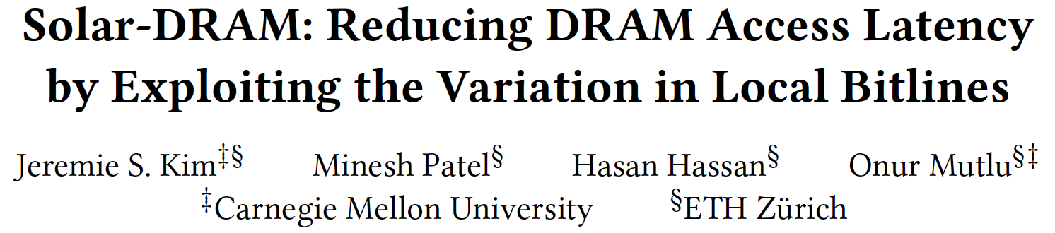
Solar-DRAM: Exploiting Spatial Variation
Jeremie S. Kim, Minesh Patel, Hasan Hassan, and Onur Mutlu,
"Solar-DRAM: Reducing DRAM Access Latency by Exploiting the Variation in Local Bitlines"
Proceedings of the 36th IEEE International Conference on Computer Design (ICCD), Orlando, FL, USA, October 2018.

Slide 79
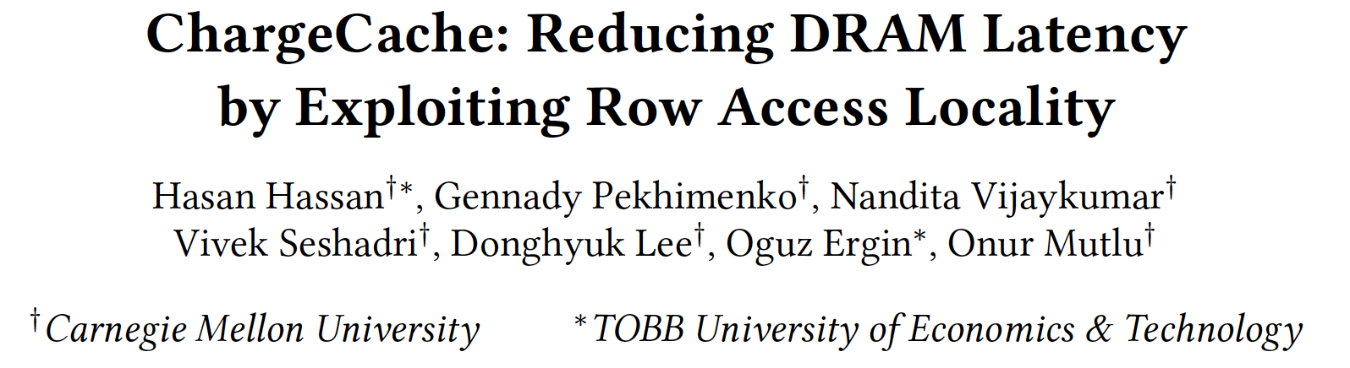
ChargeCache: Exploiting Access Patterns
Hasan Hassan, Gennady Pekhimenko, Nandita Vijaykumar, Vivek Seshadri, Donghyuk Lee, Oguz Ergin, and Onur Mutlu,
"ChargeCache: Reducing DRAM Latency by Exploiting Row Access Locality"
Proceedings of the 22nd International Symposium on High-Performance Computer Architecture (HPCA), Barcelona, Spain, March 2016.
[Slides (pptx) (pdf)]
[Source Code]

Slide 80
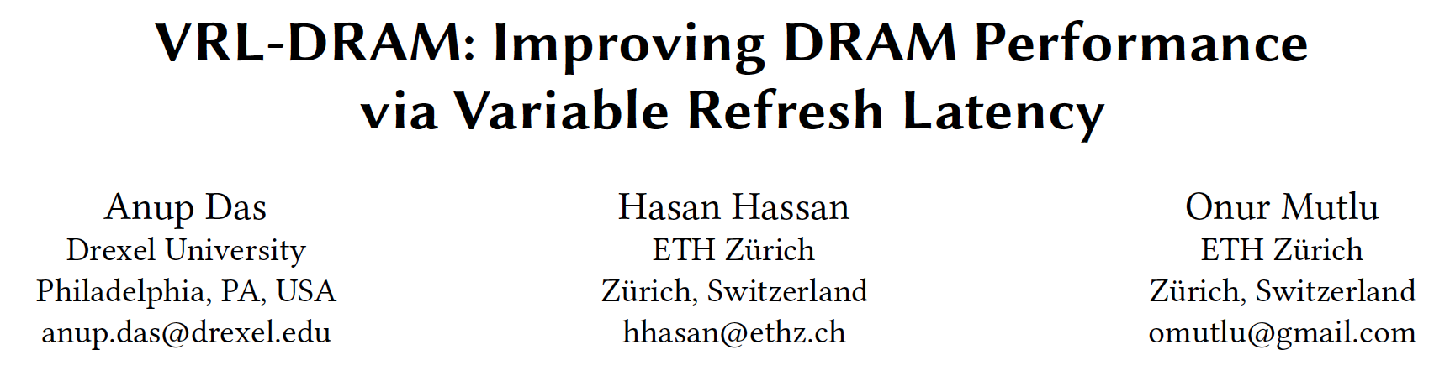
Reducing Refresh Latency
Anup Das, Hasan Hassan, and Onur Mutlu,
"VRL-DRAM: Improving DRAM Performance via Variable Refresh Latency"
Proceedings of the 55th Design Automation Conference (DAC), San Francisco, CA, USA, June 2018.

Slide 81
Why the Long Memory Latency?
Reason 1: Design of DRAM Micro-architecture
  Goal: Maximize capacity/area, not minimize latency
Reason 2: “One size fits all” approach to latency specification
  Same latency parameters for all temperatures
  Same latency parameters for all DRAM chips (e.g., rows)
  Same latency parameters for all parts of a DRAM chip
  Same latency parameters for all supply voltage levels
  Same latency parameters for all application data
  …

Slide 82
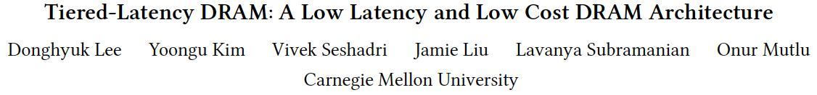
Tiered-Latency DRAM
Donghyuk Lee, Yoongu Kim, Vivek Seshadri, Jamie Liu, Lavanya Subramanian, and Onur Mutlu,
"Tiered-Latency DRAM: A Low Latency and Low Cost DRAM Architecture"
Proceedings of the 19th International Symposium on High-Performance Computer Architecture (HPCA), Shenzhen, China, February 2013. Slides (pptx)

Slide 83
LISA: Low-cost Inter-linked Subarrays
Kevin K. Chang, Prashant J. Nair, Saugata Ghose, Donghyuk Lee, Moinuddin K. Qureshi, and Onur Mutlu,
"Low-Cost Inter-Linked Subarrays (LISA): Enabling Fast Inter-Subarray Data Movement in DRAM"
Proceedings of the 22nd International Symposium on High-Performance Computer Architecture (HPCA), Barcelona, Spain, March 2016.
[Slides (pptx) (pdf)]
[Source Code]

Slide 84
Tiered Latency DRAM

Slide 85
What Causes the Long Latency?
DRAM Chip
DRAM Chip
cell array
subarray
Subarray
I/O
I/O
I/O
channel
channel
DRAM Latency = Subarray Latency + I/O Latency
DRAM Latency = Subarray Latency + I/O Latency
Dominant
Notes:
To understand what causes the long latency, let me take a look at the DRAM organization.
DRAM consists of two components, the cell array and the I/O circuitry. The cell array consists of multiple subarrays.
To read from a DRAM chip, the data is first accessed from the subarray and then the data is transferred over the channel by the I/O circuitry.
So, the DRAM latency is the sum of the subarray latency and the I/O latency.
We observed that the subarray latency is much higher than the I/O latency.
As a result, subarray is the dominant source of the DRAM latency as we explained in the paper.

Slide 86
Why is the Subarray So Slow?
Subarray
Cell
cell
wordline
bitline: 512 cells
access
row decoder
row decoder
transistor
capacitor
sense amplifier
bitline
sense amplifier
large sense amplifier
Long bitline
  Amortizes sense amplifier cost → Small area
  Large bitline capacitance → High latency & power
Notes:
The cell’s capacitor is small and can store only a small amount of charge.
That is why a subarray also has sense-amplifiers, which are specialized circuits that can detect the small amount of charge.
Unfortunately, a sense-amplifier size is about *100* times the cell size.
So, to amortize the area of the sense-amplifiers,
hundreds of cells share the same sense-amplifier through a long bitline.
However, a long bitline has a large capacitance that increases latency and power consumption.
Therefore, the long bitline is one of the dominant sources of high latency and high power consumption.
To understand why the subarray is so slow,
let me take a look at the subarray organization.

Slide 87
Trade-Off: Area (Die Size) vs. Latency
Long Bitline
Short Bitline
Faster
Smaller
Trade-Off: Area vs. Latency
Notes:
A naïve way to reduce the DRAM latency is to have short bitlines that have lower latency.
Unfortunately, short bitlines significantly increase the DRAM area.
Therefore, the bitline length exposes an important trade-off between area and latency.

Slide 88
Trade-Off: Area (Die Size) vs. Latency
32
Fancy DRAM
Short Bitline
Commodity DRAM
Long Bitline
64
Cheaper
128
256
512 cells/bitline
GOAL
Faster
Notes:
This figure shows the trade-off between DRAM area and latency as we change the bitline length.
Y-axis is the normalized DRAM area compared to a DRAM using 512 cells/bitline. A lower value is cheaper.
X-axis shows the latency in terms of tRC, an important DRAM timing constraint. A lower value is faster.
Commodity DRAM chips use long bitlines to minimize area cost. On the other hand, shorter bitlines achieve lower latency at higher cost.
Our goal is to achieve the best of both worlds: low latency and low area cost.

Slide 89
Approximating the Best of Both Worlds
Long Bitline
Long Bitline
Our Proposal
Short Bitline
Short Bitline
Small Area
Large Area
Small Area
High Latency
Low Latency
Low Latency
Need Isolation
Add Isolation Transistors
Short Bitline ➔ Fast
Notes:
To sum up, both long and short bitline do not achieve small area and low latency.
Long bitline has small area but has high latency while short bitline has low latency but has large area.
To achieve the best of both worlds, we first start from long bitline, which has small area.
After that, to achieve the low latency of short bitline, we divide the long bitline into two smaller segments.
The bitline length of the segment nearby the sense-amplifier is same as the length of short bitline.
Therefore, the latency of the segment is as low as the latency of the short bitline.
To isolate this fast segment from the other segment, we add isolation transistors that selectively connect the two segments.

Slide 90
Approximating the Best of Both Worlds
Long Bitline
Tiered-Latency DRAM
Our Proposal
Short Bitline
Long Bitline
Short Bitline
Small Area
Small Area
Large Area
High Latency
Low Latency
Low Latency
Small area using long bitline
Low Latency
Notes:
This way, our proposed approach achieves small area and low latency.
We call this new DRAM architecture as Tiered-Latency DRAM

Slide 91
Commodity DRAM vs. TL-DRAM [HPCA 2013]
DRAM Latency (tRC)
DRAM Power
  +49%
  +23%
  (52.5ns)
Latency
Power
  –56%
  –51%
  Near Far
  Near Far
  Commodity DRAM
  Commodity DRAM
  TL-DRAM
  TL-DRAM
DRAM Area Overhead
  ~3%: mainly due to the isolation transistors
Notes:
This figure compares the latency.
Y-axis is normalized latency.
Compared to commodity DRAM, TL-DRAM’s near segment has 56% lower latency, while the far segment has 23% higher latency.
The right figure compares the power.
Y-axis is normalized power.
Compared to commodity DRAM, TL-DRAM’s near segment has 51% lower power consumption and the far segment has 49% higher power consumption.
Lastly, mainly due to the isolation transistor, Tiered-latency DRAM increases the die-size by about 3%.

Slide 92
Trade-Off: Area (Die-Area) vs. Latency
32
64
Cheaper
128
256
512 cells/bitline
Near Segment
Far Segment
GOAL
Faster
Notes:
Again, the figure shows the trade-off between area and latency in existing DRAM.
Unlike existing DRAM, TL-DRAM achieves low latency using the near segment while increasing the area by only 3%.
Although the far segment has higher latency than commodity DRAM, we show that efficient use of the near segment enables TL-DRAM to achieve high system performance.

Slide 93
Leveraging Tiered-Latency DRAM
TL-DRAM is a substrate that can be leveraged by the hardware and/or software
Many potential uses
  Use near segment as hardware-managed inclusive cache to far segment
  Use near segment as hardware-managed exclusive cache to far segment
  Profile-based page mapping by operating system
  Simply replace DRAM with TL-DRAM
Lee+, “Tiered-Latency DRAM: A Low Latency and Low Cost DRAM Architecture,” HPCA 2013.
Notes:
There are multiple ways to leverage the TL-DRAM substrate by hardware or software.
In this slide, I describe many such ways.
First, the near segment can be used as a hardware-managed inclusive cache to the far segment.
Second, the near segment can be used as a hardware-managed exclusive cache to the far segment.
Third, the operating system can intelligently allocate frequently-accessed pages to the near segment.
Forth mechanism is to simple replace DRAM with TL-DRAM without any near segment handling
While our paper provides detailed explanations and evaluations of first three mechanism,
in this talk, we will focus on the first approach, which is to use the near segment as a hardware managed cache for the far segment.

Slide 94
Near Segment as Hardware-Managed Cache
TL-DRAM
far segment
subarray
main
memory
near segment
cache
sense amplifier
I/O
channel
Challenge 1: How to efficiently migrate a row between segments?
Challenge 2: How to efficiently manage the cache?
Notes:
This diagram shows TL-DRAM organization.
Each subarray consists of the sense amplifier, near segment and far segment.
In this particular approach, only the far segment capacity is exposed to the operating system and the memory controller caches the frequently accessed rows in each subarray to the corresponding near segment.
This approach has two challenges.
First, how to migrate a row between segments efficiently?
Second, how to manage the near segment cache efficiently?
Let me first address first challenge.

Slide 95
Performance & Power Consumption
12.4%
11.5%
10.7%
–23%
–24%
–26%
Normalized Performance
Normalized Power
Core-Count (Channel)
Core-Count (Channel)
Using near segment as a cache improves performance and reduces power consumption
Lee+, “Tiered-Latency DRAM: A Low Latency and Low Cost DRAM Architecture,” HPCA 2013.
Notes:
This figure shows the IPC improvement of our three caching mechanisms over commodity DRAM.
All of them improve performance and benefit-based caching shows maximum performance improvement by 12.7%.
The right figure shows the normalized power reduction of our three caching mechanisms over commodity DRAM.
All of them reduce power consumption and benefit-based caching shows maximum power reduction by 23%.
Therefore, using near segment as a cache improves performance and reduces power consumption at the cost of 3% area overhead.

Slide 96
More on TL-DRAM
Donghyuk Lee, Yoongu Kim, Vivek Seshadri, Jamie Liu, Lavanya Subramanian, and Onur Mutlu,
"Tiered-Latency DRAM: A Low Latency and Low Cost DRAM Architecture"
Proceedings of the 19th International Symposium on High-Performance Computer Architecture (HPCA), Shenzhen, China, February 2013. Slides (pptx)

Slide 97
LISA: Low-Cost Inter-Linked Subarrays
[HPCA 2016]

Slide 98
Problem: Inefficient Bulk Data Movement
Bulk data movement is a key operation in many applications
  memmove & memcpy: 5% cycles in Google’s datacenter [Kanev+ ISCA’15]
Core
Core
LLC
Memory Controller
src
Channel
Core
Core
64 bits
dst
CPU
Memory
Long latency and high energy

Slide 99
Moving Data Inside DRAM?
8Kb
Bank
512
rows
Subarray 1
Bank
DRAM
cell
Subarray 2
Bank
Subarray 3
…
…
Bank
Subarray N
DRAM
Internal
Data Bus (64b)
Low connectivity in DRAM is the fundamental bottleneck for bulk data movement
Goal: Provide a new substrate to enable
wide connectivity between subarrays

Slide 100

Key Idea and Applications
Low-cost Inter-linked subarrays (LISA)
  Fast bulk data movement between subarrays
  Wide datapath via isolation transistors: 0.8% DRAM chip area
LISA is a versatile substrate → new applications
Subarray 1
…
Subarray 2
  Fast bulk data copy: Copy latency 1.363ms→0.148ms (9.2x)
  → 66% speedup, -55% DRAM energy
  In-DRAM caching: Hot data access latency 48.7ns→21.5ns (2.2x)
  → 5% speedup
  Fast precharge: Precharge latency 13.1ns→5.0ns (2.6x)
  → 8% speedup

Slide 101
3. Linked Precharge (LIP)
Problem: The precharge time is limited by the strength of one precharge unit
Linked Precharge (LIP): LISA precharges a subarray using multiple precharge units
S
S
S
S
S
S
S
S
on
P
P
P
P
P
P
P
P
Activated row
Reduces precharge latency by 2.6x
(43% guardband)
Precharging
Linked
Precharging
S
S
S
S
on
S
S
S
S
on
P
P
P
P
P
P
P
P
Conventional DRAM
LISA DRAM

Slide 102
More on LISA
Kevin K. Chang, Prashant J. Nair, Saugata Ghose, Donghyuk Lee, Moinuddin K. Qureshi, and Onur Mutlu,
"Low-Cost Inter-Linked Subarrays (LISA): Enabling Fast Inter-Subarray Data Movement in DRAM"
Proceedings of the 22nd International Symposium on High-Performance Computer Architecture (HPCA), Barcelona, Spain, March 2016.
[Slides (pptx) (pdf)]
[Source Code]

Slide 103
Summary: Low-Latency Memory

Slide 104
Summary: Tackling Long Memory Latency
Reason 1: Design of DRAM Micro-architecture
  Goal: Maximize capacity/area, not minimize latency
Reason 2: “One size fits all” approach to latency specification
  Same latency parameters for all temperatures
  Same latency parameters for all DRAM chips (e.g., rows)
  Same latency parameters for all parts of a DRAM chip
  Same latency parameters for all supply voltage levels
  Same latency parameters for all application data
  …

Slide 105
Challenge and Opportunity for Future
Fundamentally
Low-Latency
Computing Architectures

Slide 106
One Important Takeaway
Main Memory Needs
Intelligent Controllers

Slide 107
On DRAM Power Consumption

Slide 108
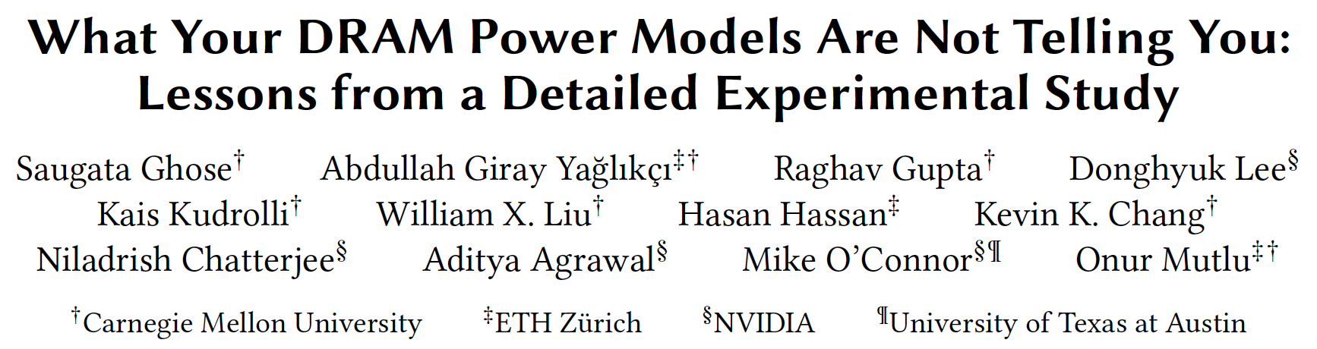
VAMPIRE DRAM Power Model
Saugata Ghose, A. Giray Yaglikci, Raghav Gupta, Donghyuk Lee, Kais Kudrolli, William X. Liu, Hasan Hassan, Kevin K. Chang, Niladrish Chatterjee, Aditya Agrawal, Mike O'Connor, and Onur Mutlu,
"What Your DRAM Power Models Are Not Telling You: Lessons from a Detailed Experimental Study"
Proceedings of the ACM International Conference on Measurement and Modeling of Computer Systems (SIGMETRICS), Irvine, CA, USA, June 2018.
[Abstract]

Slide 109
Memory Systems and Memory-Centric Computing Systems
Lecture 3: Low-Latency Memory
Onur Mutlu
omutlu@gmail.com
https://people.inf.ethz.ch/omutlu
1 February 2019
UT Austin ECE Endowed Lecture Series

Slide 110
Memory Systems and Memory-Centric Computing Systems
Lecture 3: Principles and Conclusion
Onur Mutlu
omutlu@gmail.com
https://people.inf.ethz.ch/omutlu
1 February 2019
UT Austin ECE Endowed Lecture Series

Slide 111
Agenda
Major Trends Affecting Main Memory
Key Challenges and Solution Directions
  Robustness: Reliability and Security
  Energy and Performance: In-Memory Computation
  Low Latency/Energy and Latency/Energy/Reliability Tradeoffs
  Scalability and More: Enabling Emerging Technologies
Solution Principles
Concluding Remarks

Slide 112
Some Solution Principles (So Far)
Data-centric system design & intelligence spread around
  Do not center everything around traditional computation units
Better cooperation across layers of the system
  Careful co-design of components and layers: system/arch/device
  Better, richer, more expressive and flexible interfaces
Better-than-worst-case design
  Do not optimize for the worst case
  Worst case should not determine the common case
Heterogeneity in design (specialization, asymmetry)
  Enables a more efficient design (No one size fits all)

Slide 113
Some Solution Principles (More Compact)
Data-centric design
All components intelligent
Better cross-layer communication, better interfaces
Better-than-worst-case design
Heterogeneity
Flexibility, adaptability
Open minds

Slide 114
Agenda
Major Trends Affecting Main Memory
Key Challenges and Solution Directions
  Robustness: Reliability and Security
  Energy and Performance: In-Memory Computation
  Low Latency/Energy and Latency/Energy/Reliability Tradeoffs
  Scalability and More: Enabling Emerging Technologies
Solution Principles
Concluding Remarks

Slide 115
Concluding Remarks

Slide 116
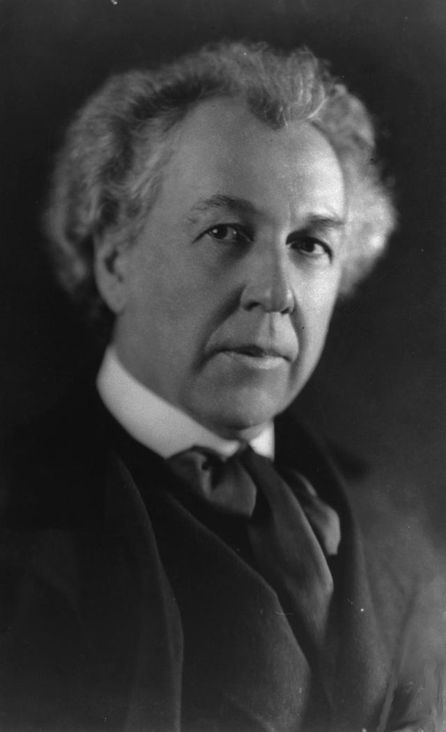
A Quote from A Famous Architect
“architecture […] based upon principle, and not upon precedent”

Slide 117
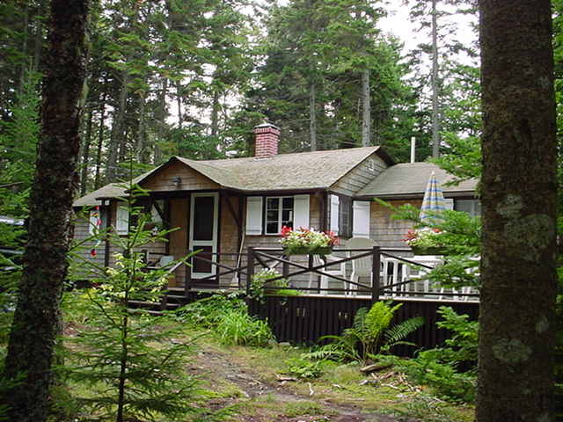
Precedent-Based Design?
“architecture […] based upon principle, and not upon precedent”

Slide 118

Principled Design
“architecture […] based upon principle, and not upon precedent”

Slide 119


Slide 120
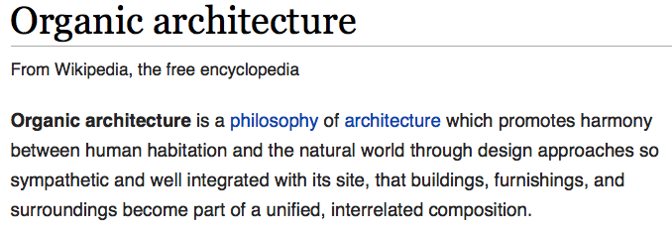
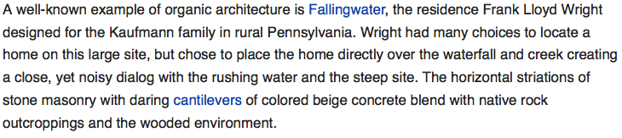
The Overarching Principle

Slide 121
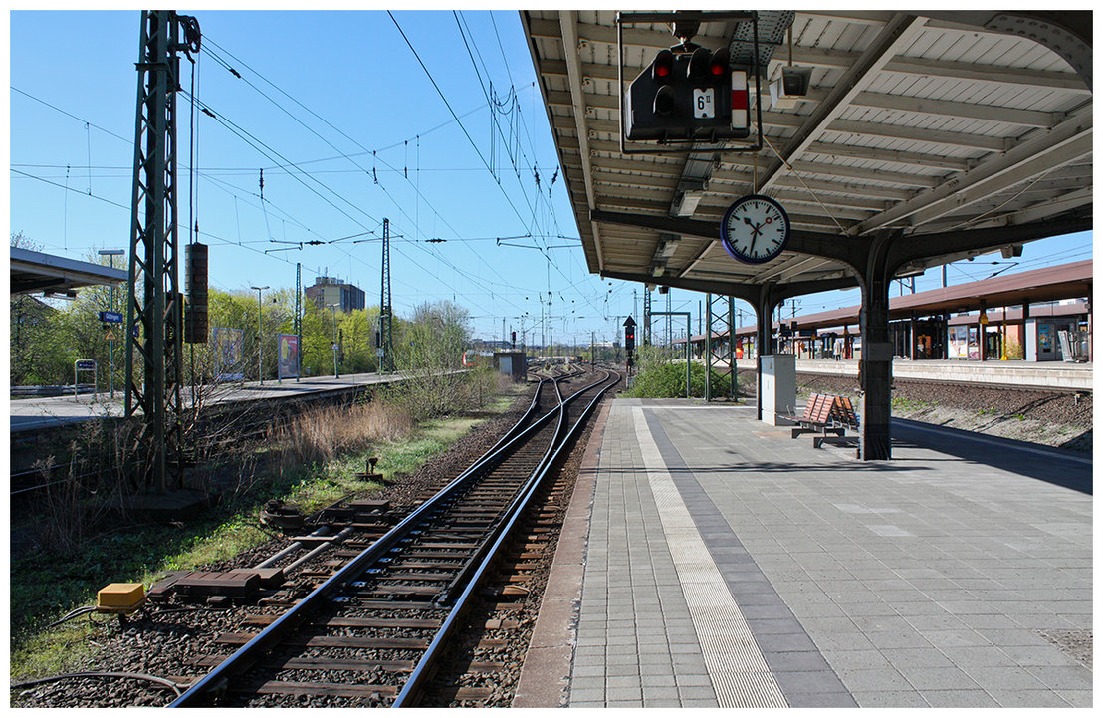
Another Example: Precedent-Based Design
Source: http://cookiemagik.deviantart.com/art/Train-station-207266944

Slide 122
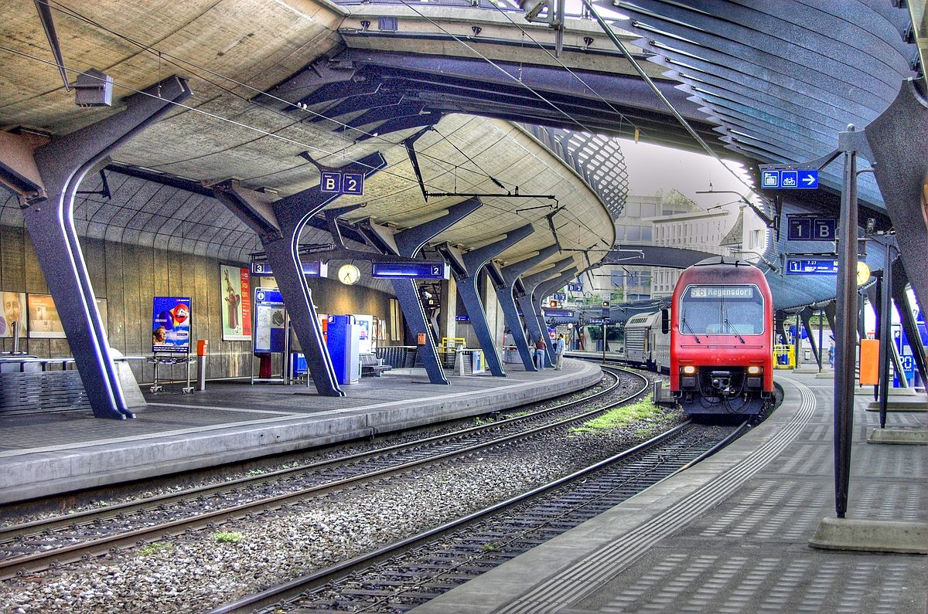
Principled Design
Source: By Toni_V, CC BY-SA 2.0, https://commons.wikimedia.org/w/index.php?curid=4087256

Slide 123
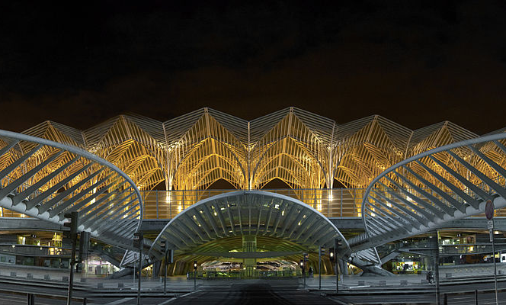
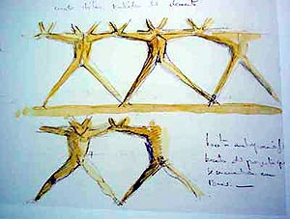
Another Principled Design
Source: By Martín Gómez Tagle - Lisbon, Portugal, CC BY-SA 3.0, https://commons.wikimedia.org/w/index.php?curid=13764903
Source: http://www.arcspace.com/exhibitions/unsorted/santiago-calatrava/

Slide 124
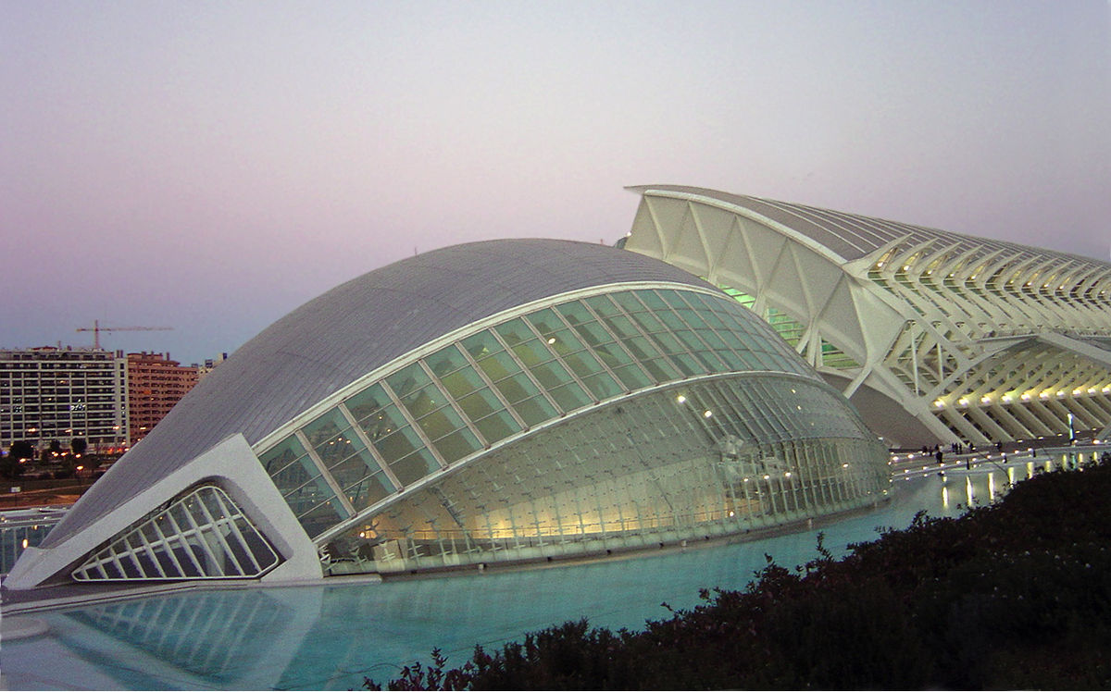
Another Principled Design
Source: CC BY-SA 3.0, https://commons.wikimedia.org/w/index.php?curid=172107

Slide 125
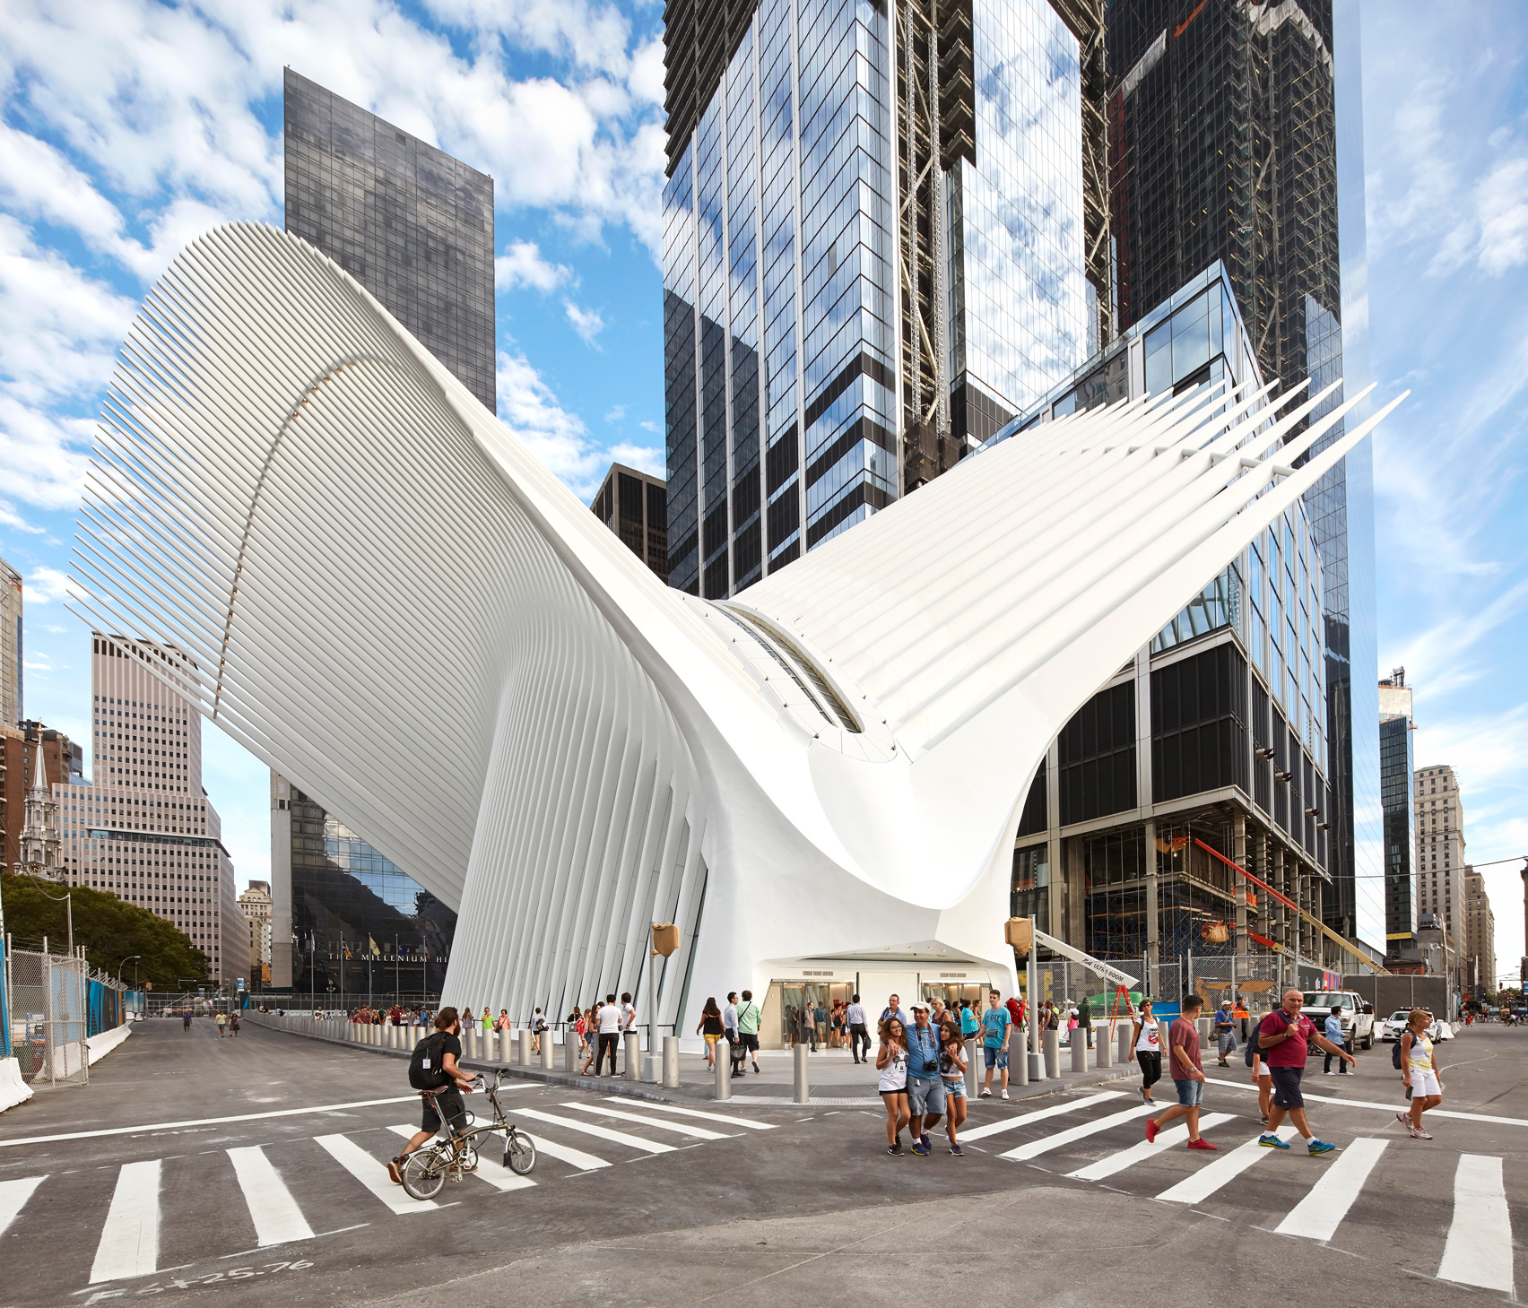
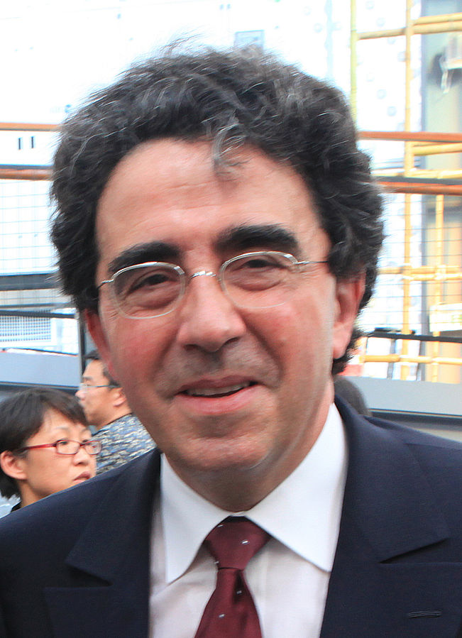
Principle Applied to Another Structure
Source: By 準建築人手札網站 Forgemind ArchiMedia - Flickr: IMG_2489.JPG, CC BY 2.0,
https://commons.wikimedia.org/w/index.php?curid=31493356, https://en.wikipedia.org/wiki/Santiago_Calatrava
Source: https://www.dezeen.com/2016/08/29/santiago-calatrava-oculus-world-trade-center-transportation-hub-new-york-photographs-hufton-crow/

Slide 126
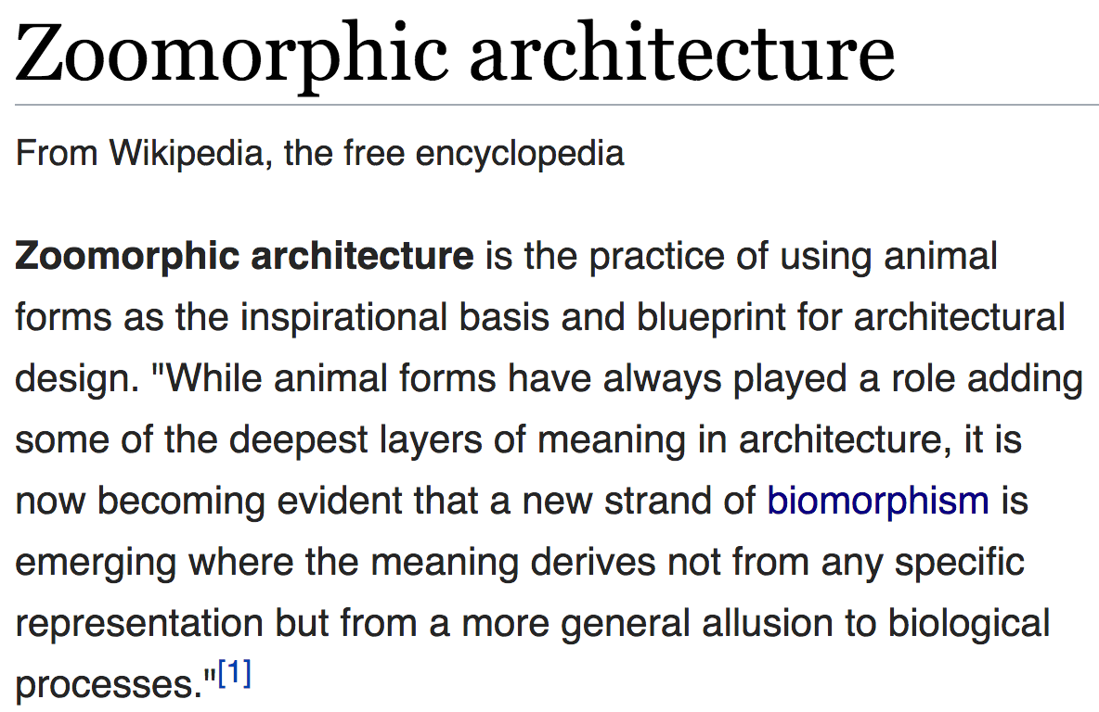
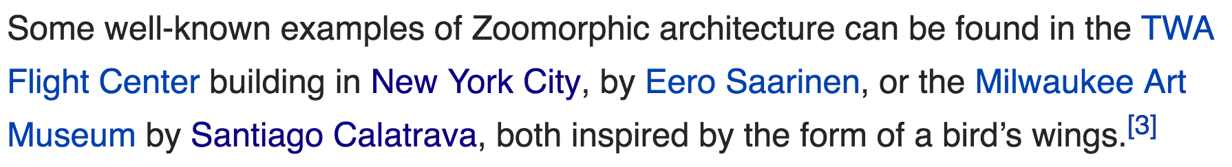
The Overarching Principle

Slide 127
Overarching Principle for Computing?
Source: http://spectrum.ieee.org/image/MjYzMzAyMg.jpeg

Slide 128
Concluding Remarks
It is time to design principled system architectures to solve the memory problem
Discover design principles for fundamentally secure and reliable computer architectures
Design complete systems to be balanced and energy-efficient, i.e., low latency and data-centric (or memory-centric)
Enable new and emerging memory architectures
This can
  Lead to orders-of-magnitude improvements
  Enable new applications & computing platforms
  Enable better understanding of nature
  …
Notes:
Perhaps we have taken processor-centric system design a bit too far

Slide 129
We Need to Think Across the Stack
Problem
Algorithm
Program/Language
System Software
SW/HW Interface
Micro-architecture
Logic
Devices
Electrons

Slide 130
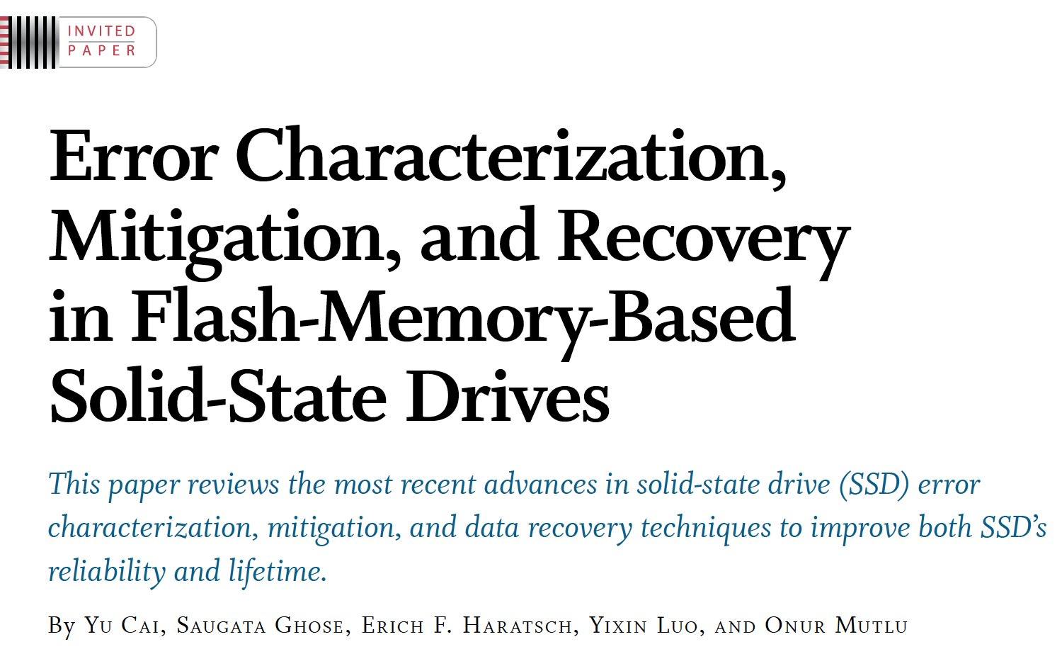
If In Doubt, See Other Doubtful Technologies
A very “doubtful” emerging technology
  for at least two decades
Proceedings of the IEEE, Sept. 2017
https://arxiv.org/pdf/1706.08642

Slide 131
Accelerated Memory Course (~6.5 hours)
ACACES 2018
  Memory Systems and Memory-Centric Computing Systems
  Taught by Onur Mutlu July 9-13, 2018
  ~6.5 hours of lectures
Website for the Course including Videos, Slides, Papers
  https://people.inf.ethz.ch/omutlu/acaces2018.html
  https://www.youtube.com/playlist?list=PL5Q2soXY2Zi-HXxomthrpDpMJm05P6J9x
All Papers are at:
  https://people.inf.ethz.ch/omutlu/projects.htm
  Final lecture notes and readings (for all topics)

Slide 132
Memory Systems and Memory-Centric Computing Systems
Lecture 3: Principles and Conclusion
Onur Mutlu
omutlu@gmail.com
https://people.inf.ethz.ch/omutlu
1 February 2019
UT Austin ECE Endowed Lecture Series

Slide 133
Acknowledgments
My current and past students and postdocs
  Rachata Ausavarungnirun, Abhishek Bhowmick, Amirali Boroumand, Rui Cai, Yu Cai, Kevin Chang, Saugata Ghose, Kevin Hsieh, Tyler Huberty, Ben Jaiyen, Samira Khan, Jeremie Kim, Yoongu Kim, Yang Li, Jamie Liu, Lavanya Subramanian, Donghyuk Lee, Yixin Luo, Justin Meza, Gennady Pekhimenko, Vivek Seshadri, Lavanya Subramanian, Nandita Vijaykumar, HanBin Yoon, Jishen Zhao, …
My collaborators
  Can Alkan, Chita Das, Phil Gibbons, Sriram Govindan, Norm Jouppi, Mahmut Kandemir, Mike Kozuch, Konrad Lai, Ken Mai, Todd Mowry, Yale Patt, Moinuddin Qureshi, Partha Ranganathan, Bikash Sharma, Kushagra Vaid, Chris Wilkerson, …

Slide 134
Funding Acknowledgments
NSF
GSRC
SRC
CyLab
Alibaba, AMD, Google, Facebook, HP Labs, Huawei, IBM, Intel, Microsoft, Nvidia, Oracle, Qualcomm, Rambus, Samsung, Seagate, VMware

Slide 135
Slides Not Covered
But Could Be Useful

Slide 136
Readings, Videos, Reference Materials

Slide 137
Accelerated Memory Course (~6.5 hours)
ACACES 2018
  Memory Systems and Memory-Centric Computing Systems
  Taught by Onur Mutlu July 9-13, 2018
  ~6.5 hours of lectures
Website for the Course including Videos, Slides, Papers
  https://people.inf.ethz.ch/omutlu/acaces2018.html
  https://www.youtube.com/playlist?list=PL5Q2soXY2Zi-HXxomthrpDpMJm05P6J9x
All Papers are at:
  https://people.inf.ethz.ch/omutlu/projects.htm
  Final lecture notes and readings (for all topics)

Slide 138
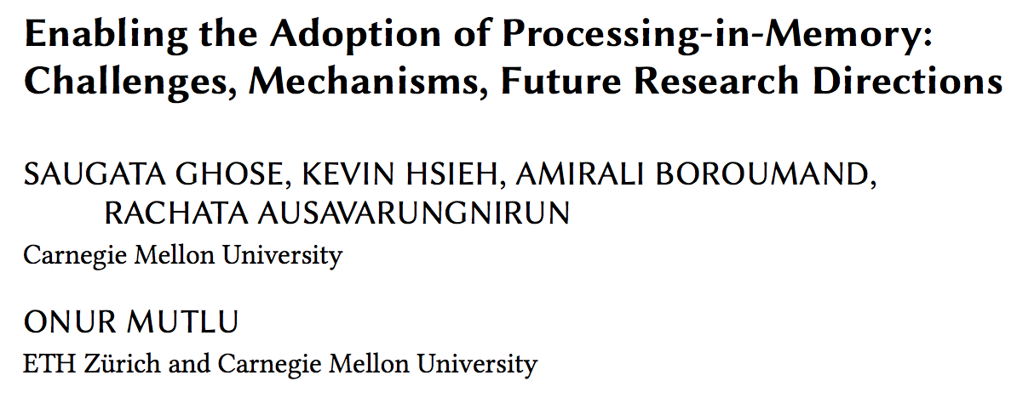
Reference Overview Paper I
Saugata Ghose, Kevin Hsieh, Amirali Boroumand, Rachata Ausavarungnirun, Onur Mutlu,
"Enabling the Adoption of Processing-in-Memory: Challenges, Mechanisms, Future Research Directions"
Invited Book Chapter, to appear in 2018.
[Preliminary arxiv.org version]
https://arxiv.org/pdf/1802.00320.pdf

Slide 139
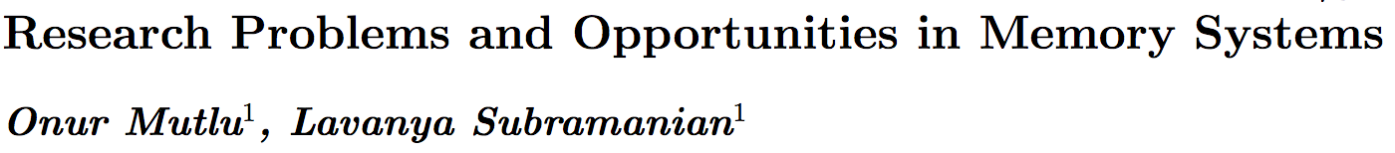
Reference Overview Paper II
Onur Mutlu and Lavanya Subramanian,
"Research Problems and Opportunities in Memory Systems"
Invited Article in Supercomputing Frontiers and Innovations (SUPERFRI), 2014/2015.
https://people.inf.ethz.ch/omutlu/pub/memory-systems-research_superfri14.pdf

Slide 140
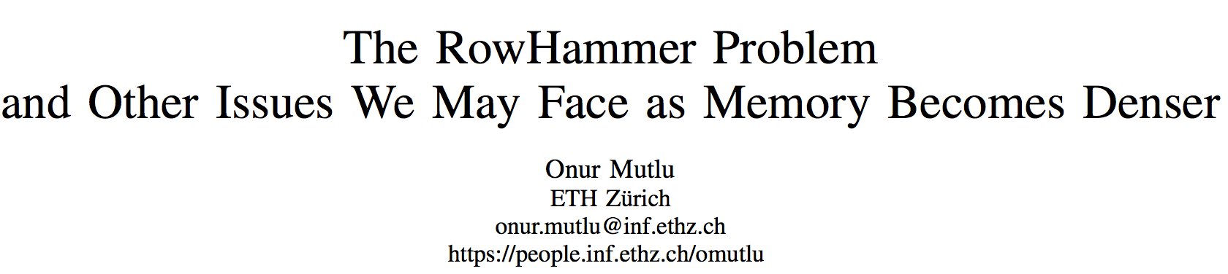
Reference Overview Paper III
Onur Mutlu,
"The RowHammer Problem and Other Issues We May Face as Memory Becomes Denser"
Invited Paper in Proceedings of the Design, Automation, and Test in Europe Conference (DATE), Lausanne, Switzerland, March 2017.
[Slides (pptx) (pdf)]
https://people.inf.ethz.ch/omutlu/pub/rowhammer-and-other-memory-issues_date17.pdf

Slide 141
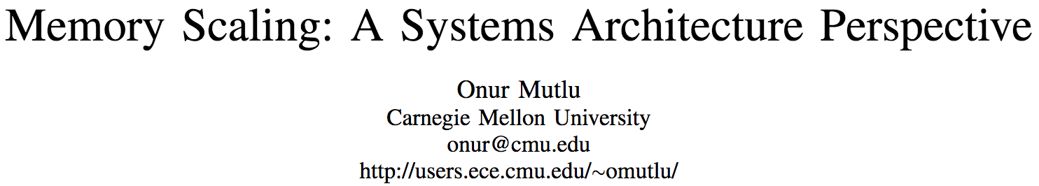
Reference Overview Paper IV
Onur Mutlu,
"Memory Scaling: A Systems Architecture Perspective"
Technical talk at MemCon 2013 (MEMCON), Santa Clara, CA, August 2013. [Slides (pptx) (pdf)]
[Video] [Coverage on StorageSearch]
https://people.inf.ethz.ch/omutlu/pub/memory-scaling_memcon13.pdf

Slide 142
Reference Overview Paper V
Proceedings of the IEEE, Sept. 2017
https://arxiv.org/pdf/1706.08642

Slide 143
Related Videos and Course Materials (I)
Undergraduate Computer Architecture Course Lecture Videos (2015, 2014, 2013)
Undergraduate Computer Architecture Course Materials (2015, 2014, 2013)
Graduate Computer Architecture Course Lecture Videos (2017, 2015, 2013)
Graduate Computer Architecture Course Materials (2017, 2015, 2013)
Parallel Computer Architecture Course Materials (Lecture Videos)

Slide 144
Related Videos and Course Materials (II)
Freshman Digital Circuits and Computer Architecture Course Lecture Videos (2018, 2017)
Freshman Digital Circuits and Computer Architecture Course Materials (2018)
Memory Systems Short Course Materials
(Lecture Video on Main Memory and DRAM Basics)

Slide 145
Some Open Source Tools (I)
Rowhammer – Program to Induce RowHammer Errors
  https://github.com/CMU-SAFARI/rowhammer
Ramulator – Fast and Extensible DRAM Simulator
  https://github.com/CMU-SAFARI/ramulator
MemSim – Simple Memory Simulator
  https://github.com/CMU-SAFARI/memsim
NOCulator – Flexible Network-on-Chip Simulator
  https://github.com/CMU-SAFARI/NOCulator
SoftMC – FPGA-Based DRAM Testing Infrastructure
  https://github.com/CMU-SAFARI/SoftMC
Other open-source software from my group
  https://github.com/CMU-SAFARI/
  http://www.ece.cmu.edu/~safari/tools.html

Slide 146
Some Open Source Tools (II)
MQSim – A Fast Modern SSD Simulator
  https://github.com/CMU-SAFARI/MQSim
Mosaic – GPU Simulator Supporting Concurrent Applications
  https://github.com/CMU-SAFARI/Mosaic
IMPICA – Processing in 3D-Stacked Memory Simulator
  https://github.com/CMU-SAFARI/IMPICA
SMLA – Detailed 3D-Stacked Memory Simulator
  https://github.com/CMU-SAFARI/SMLA
HWASim – Simulator for Heterogeneous CPU-HWA Systems
  https://github.com/CMU-SAFARI/HWASim
Other open-source software from my group
  https://github.com/CMU-SAFARI/
  http://www.ece.cmu.edu/~safari/tools.html

Slide 147
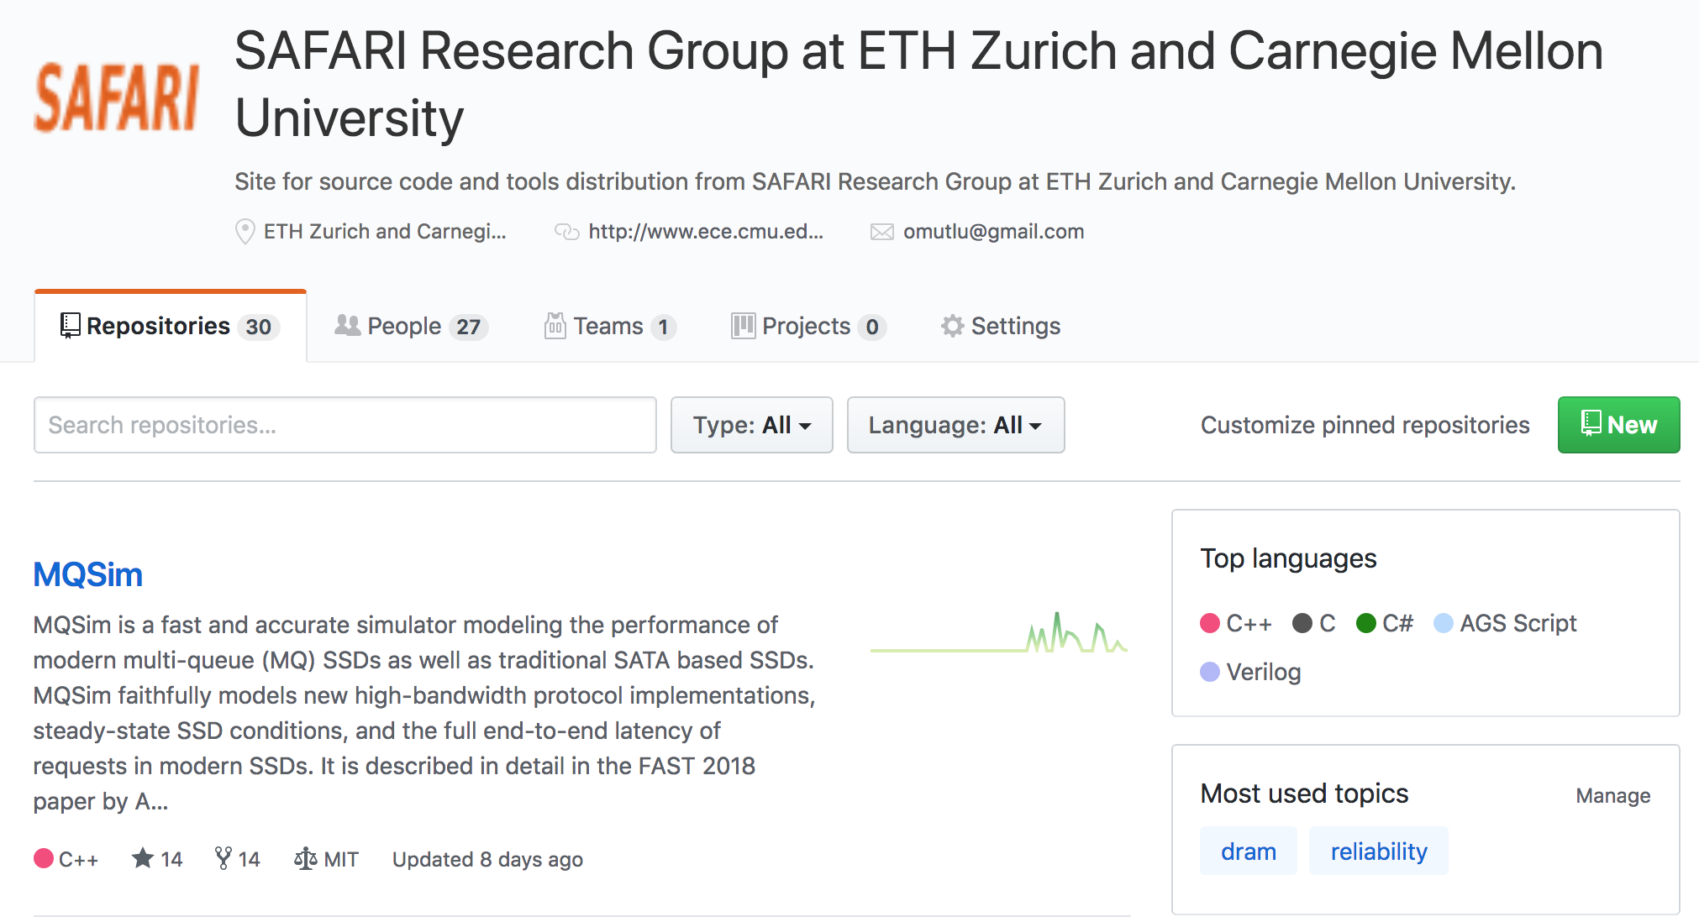
More Open Source Tools (III)
A lot more open-source software from my group
  https://github.com/CMU-SAFARI/
  http://www.ece.cmu.edu/~safari/tools.html

Slide 148
Referenced Papers
All are available at
  https://people.inf.ethz.ch/omutlu/projects.htm
  http://scholar.google.com/citations?user=7XyGUGkAAAAJ&hl=en
  https://people.inf.ethz.ch/omutlu/acaces2018.html

Slide 149
Ramulator: A Fast and Extensible DRAM Simulator
[IEEE Comp Arch Letters’15]

Slide 150
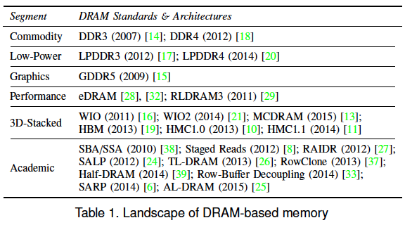
Ramulator Motivation
DRAM and Memory Controller landscape is changing
Many new and upcoming standards
Many new controller designs
A fast and easy-to-extend simulator is very much needed

Slide 151
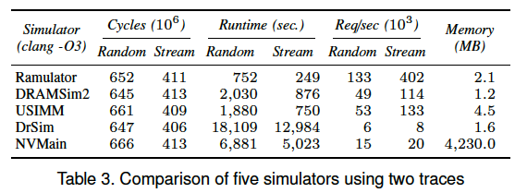
Ramulator
Provides out-of-the box support for many DRAM standards:
  DDR3/4, LPDDR3/4, GDDR5, WIO1/2, HBM, plus new proposals (SALP, AL-DRAM, TLDRAM, RowClone, and SARP)
~2.5X faster than fastest open-source simulator
Modular and extensible to different standards

Slide 152
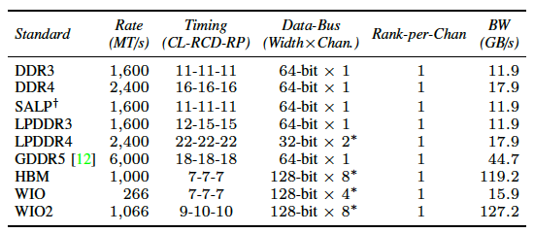
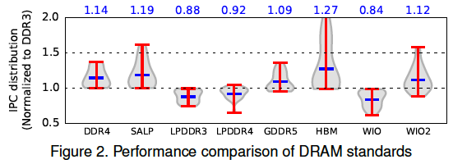
Case Study: Comparison of DRAM Standards
Across 22 workloads, simple CPU model

Slide 153
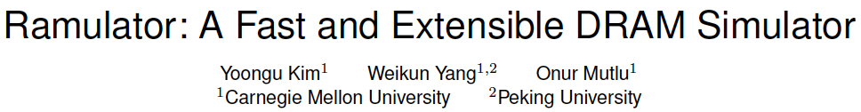
Ramulator Paper and Source Code
Yoongu Kim, Weikun Yang, and Onur Mutlu,
"Ramulator: A Fast and Extensible DRAM Simulator"
IEEE Computer Architecture Letters (CAL), March 2015.
[Source Code]
Source code is released under the liberal MIT License
  https://github.com/CMU-SAFARI/ramulator

Slide 154
End of Backup Slides

Slide 155

Brief Self Introduction
Onur Mutlu
  Full Professor @ ETH Zurich CS, since September 2015 (officially May 2016)
  Strecker Professor @ Carnegie Mellon University ECE/CS, 2009-2016, 2016-…
  PhD from UT-Austin, worked at Google, VMware, Microsoft Research, Intel, AMD
  https://people.inf.ethz.ch/omutlu/
  omutlu@gmail.com (Best way to reach me)
  https://people.inf.ethz.ch/omutlu/projects.htm
Research and Teaching in:
  Computer architecture, computer systems, hardware security, bioinformatics
  Memory and storage systems
  Hardware security, safety, predictability
  Fault tolerance
  Hardware/software cooperation
  Architectures for bioinformatics, health, medicine
  …

