Slide 1



Storage-Centric Computing for Modern Data-Intensive Workloads
Onur Mutlu
omutlu@gmail.com
https://people.inf.ethz.ch/omutlu
15 May 2023
Huawei Next Generation Data Storage Architecture Innovation Forum Keynote

Slide 2
The Problem
Computing
is Bottlenecked by Data

Slide 3
Data is Key for AI, ML, Genomics, …
Important workloads are all data intensive
They require rapid and efficient processing of large amounts of data
Data is increasing
  We can generate more than we can process
  We need to perform more sophisticated analyses on more data

Slide 4
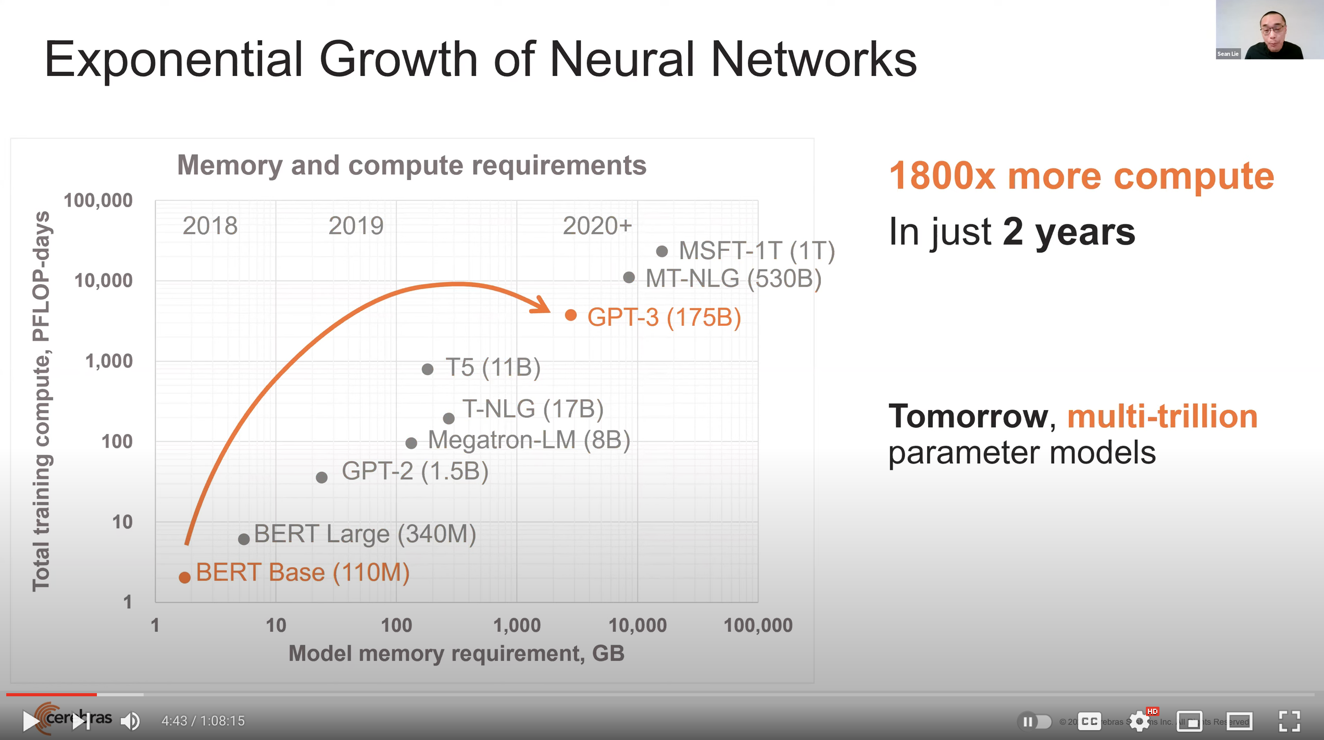
Huge Demand for Performance & Efficiency
Source: https://youtu.be/Bh13Idwcb0Q?t=283

Slide 5
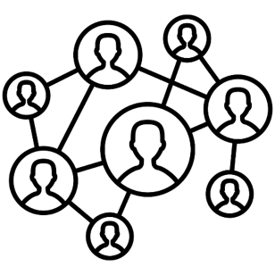



Data is Key for Future Workloads
In-memory Databases
[Mao+, EuroSys’12;
Clapp+ (Intel), IISWC’15]
Graph/Tree Processing
[Xu+, IISWC’12; Umuroglu+, FPL’15]
In-Memory Data Analytics
[Clapp+ (Intel), IISWC’15;
Awan+, BDCloud’15]
Datacenter Workloads
[Kanev+ (Google), ISCA’15]

Slide 6
Data Overwhelms Modern Machines
In-memory Databases
[Mao+, EuroSys’12;
Clapp+ (Intel), IISWC’15]
Graph/Tree Processing
[Xu+, IISWC’12; Umuroglu+, FPL’15]
Data → performance & energy bottleneck
In-Memory Data Analytics
[Clapp+ (Intel), IISWC’15;
Awan+, BDCloud’15]
Datacenter Workloads
[Kanev+ (Google), ISCA’15]

Slide 7








Data is Key for Future Workloads
  Chrome
TensorFlow Mobile
    Google’s web browser
Google’s machine learning framework
  Video Playback
  Video Capture
Google’s video codec
Google’s video codec
Notes:
In this work, we take a look at widely-used google consumer workloads, to figure out the major sources of energy consumption.
We look at Google Chrome web brower. We take a look at Tensorflow, Google’s machine learning framework, and we also take a look at two important video related workloads, video playback and video capture, both rely on Google’s vp9 codec technology.

Slide 8
Data Overwhelms Modern Machines
  Chrome
TensorFlow Mobile
    Google’s web browser
Google’s machine learning framework
Data → performance & energy bottleneck
  Video Playback
  Video Capture
Google’s video codec
Google’s video codec
Notes:
In this work, we take a look at widely-used google consumer workloads, to figure out the major sources of energy consumption.
We look at Google Chrome web brower. We take a look at Tensorflow, Google’s machine learning framework, and we also take a look at two important video related workloads, video playback and video capture, both rely on Google’s vp9 codec technology.

Slide 9
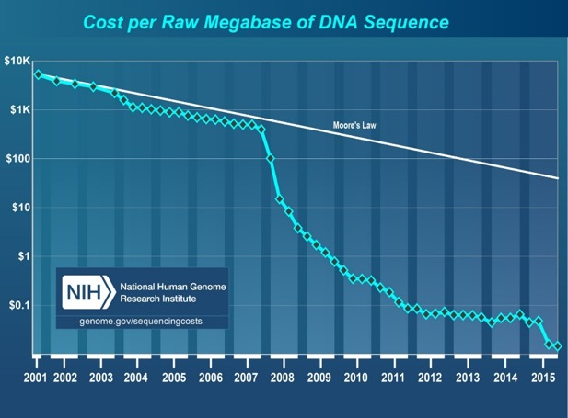
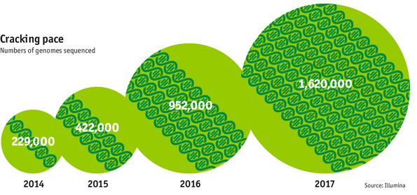

Data is Key for Future Workloads
development of high-throughput sequencing (HTS) technologies
Number of Genomes Sequenced
http://www.economist.com/news/21631808-so-much-genetic-data-so-many-uses-genes-unzipped
Notes:
However, since the development of high throughput sequencing (HTS) technologies, the cost of genome sequencing has fallen off a cliff (<< 1,000$) making it viable for almost everyone's use.

Slide 10

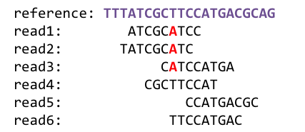
1
Sequencing
Genome Analysis
Read Mapping
2
Data → performance & energy bottleneck
Variant Calling
Scientific Discovery
3
4
Notes:
Genome analysis starts with sequencing random short DNA fragments of copies of the original molecule.
Unfortunately, these reads lack information about their order and which part of genome they are originated from.
Hence the second step is to map these reads to a long reference genome.

Slide 11




We Need Faster & Scalable Genome Analysis
Understanding genetic variations, species, evolution, …
Predicting the presence and relative abundance of microbes in a sample
Rapid surveillance of disease outbreaks
Developing personalized medicine
And, many, many other applications …
Notes:
Knowing what organisms are present in a given environmental sample and how abundant are they

Slide 12
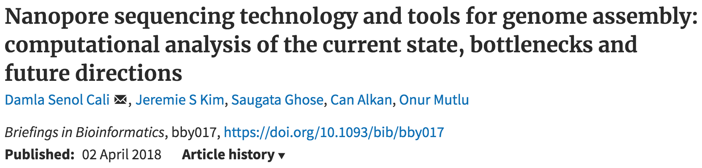
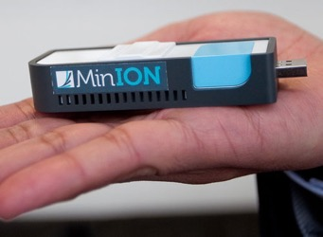
New Genome Sequencing Technologies
Oxford Nanopore MinION
Senol Cali+, “Nanopore Sequencing Technology and Tools for Genome
Assembly: Computational Analysis of the Current State, Bottlenecks
and Future Directions,” Briefings in Bioinformatics, 2018.
[Open arxiv.org version]

Slide 13
New Genome Sequencing Technologies
Oxford Nanopore MinION
Senol Cali+, “Nanopore Sequencing Technology and Tools for Genome
Assembly: Computational Analysis of the Current State, Bottlenecks
and Future Directions,” Briefings in Bioinformatics, 2018.
[Preliminary arxiv.org version]
Data → performance & energy bottleneck

Slide 14



Problems with (Genome) Analysis Today
Special-Purpose Machine
for Data Generation
General-Purpose Machine
for Data Analysis
FAST SLOW
Slow and inefficient processing capability
Large amounts of data movement
This picture is similar for many “data generators & analyzers” today

Slide 15
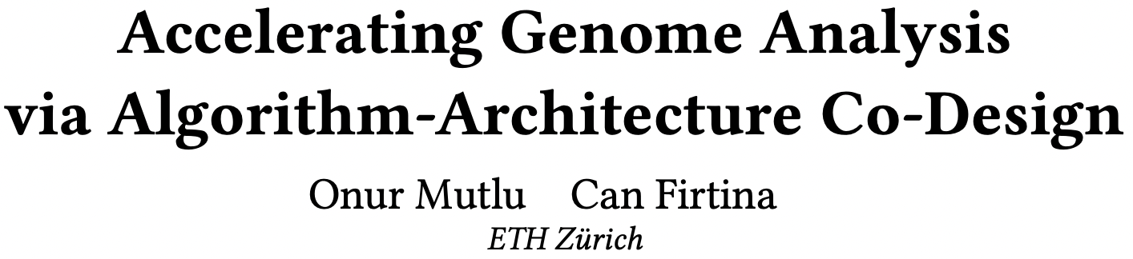
Accelerating Genome Analysis [DAC 2023]
To appear at DAC 2023
https://arxiv.org/pdf/2305.00492.pdf

Slide 16
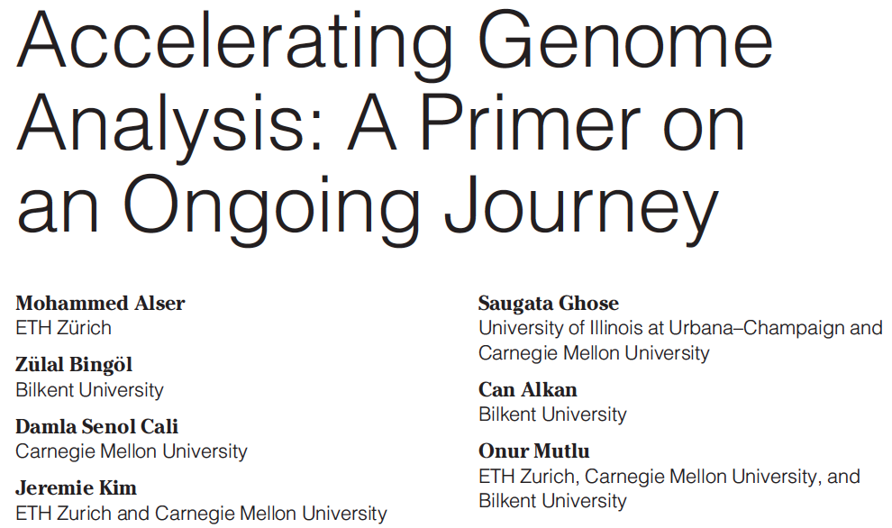
Accelerating Genome Analysis [IEEE MICRO 2020]
Mohammed Alser, Zulal Bingol, Damla Senol Cali, Jeremie Kim, Saugata Ghose, Can Alkan, and Onur Mutlu,
"Accelerating Genome Analysis: A Primer on an Ongoing Journey"
IEEE Micro (IEEE MICRO), Vol. 40, No. 5, pages 65-75, September/October 2020.
[Slides (pptx)(pdf)]
[Talk Video (1 hour 2 minutes)]

Slide 17
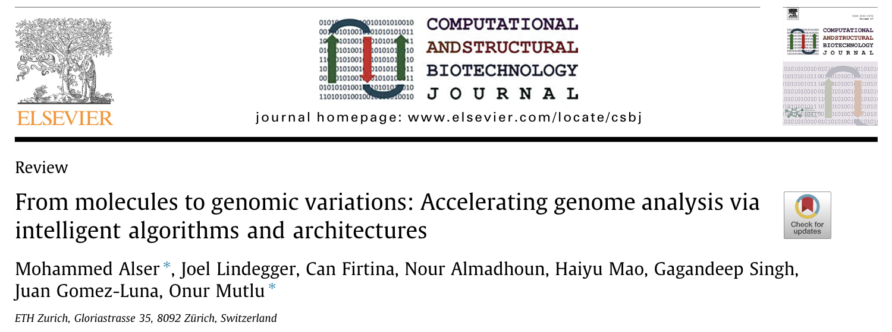
Beginner Reading on Genome Analysis
Mohammed Alser, Joel Lindegger, Can Firtina, Nour Almadhoun, Haiyu Mao, Gagandeep Singh, Juan Gomez-Luna, Onur Mutlu
“From Molecules to Genomic Variations to Scientific Discovery: Intelligent Algorithms and Architectures for Intelligent Genome Analysis”
Computational and Structural Biotechnology Journal, 2022
[Source code]
https://arxiv.org/pdf/2205.07957.pdf

Slide 18
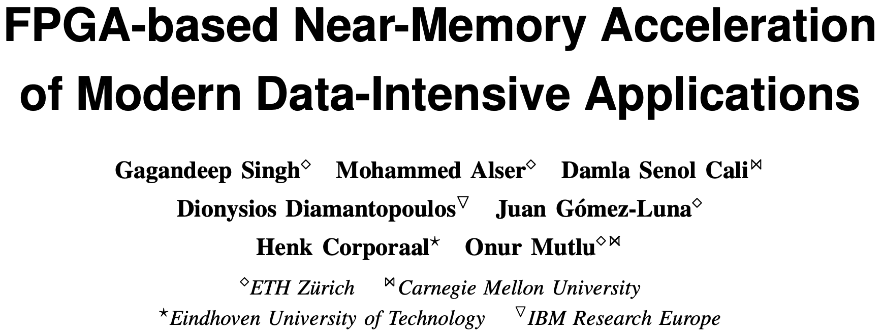
FPGA-based Near-Memory Analytics
Gagandeep Singh, Mohammed Alser, Damla Senol Cali, Dionysios Diamantopoulos, Juan Gómez-Luna, Henk Corporaal, and Onur Mutlu,
"FPGA-based Near-Memory Acceleration of Modern Data-Intensive Applications"
IEEE Micro (IEEE MICRO), 2021.

Slide 19
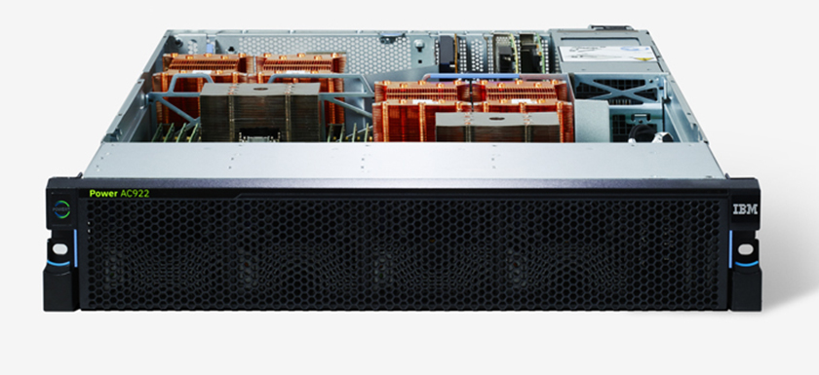
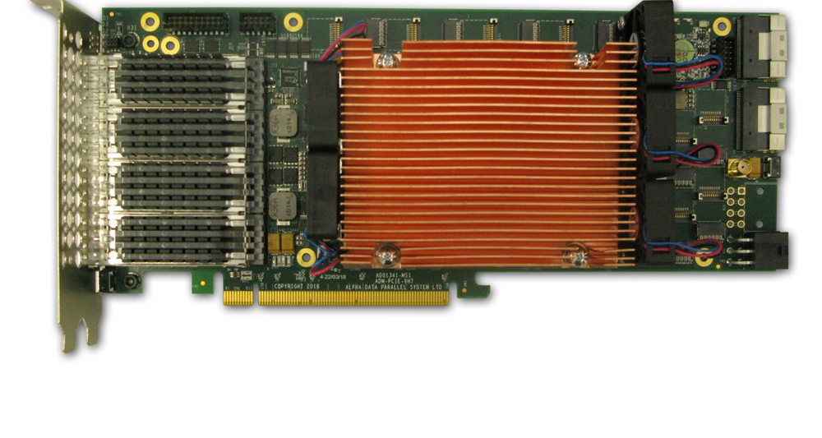
Near-Memory Acceleration using FPGAs
OCAPI
Source: IBM
Source: AlphaData
IBM POWER9 CPU
HBM-based FPGA board
Near-HBM FPGA-based accelerator
Two communication technologies: CAPI2 and OCAPI
Two memory technologies: DDR4 and HBM
Two workloads: Weather Modeling and Genome Analysis
Notes:
To this end we build a [CLICK] near-HBM FPGA based accelerator which is connected to a server-grade IBM POWER9-based CPU system

Slide 20
Performance & Energy Greatly Improve
5-27× performance vs. a 16-core (64-thread) IBM POWER9 CPU
12-133× energy efficiency vs. a 16-core (64-thread) IBM POWER9 CPU
HBM alleviates memory bandwidth contention vs. DDR4
Notes:
[CLICK]

Slide 21
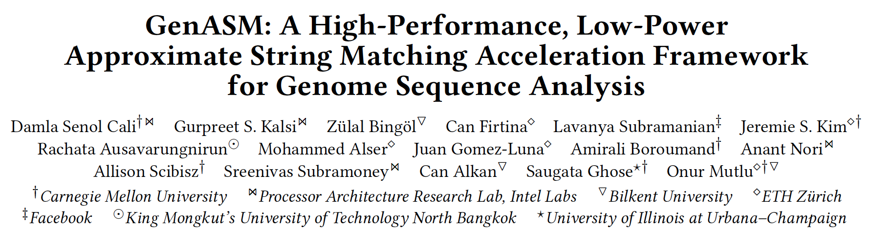
GenASM Framework [MICRO 2020]
Damla Senol Cali, Gurpreet S. Kalsi, Zulal Bingol, Can Firtina, Lavanya Subramanian, Jeremie S. Kim, Rachata Ausavarungnirun, Mohammed Alser, Juan Gomez-Luna, Amirali Boroumand, Anant Nori, Allison Scibisz, Sreenivas Subramoney, Can Alkan, Saugata Ghose, and Onur Mutlu,
"GenASM: A High-Performance, Low-Power Approximate String Matching Acceleration Framework for Genome Sequence Analysis"
Proceedings of the 53rd International Symposium on Microarchitecture (MICRO), Virtual, October 2020.
[Lighting Talk Video (1.5 minutes)]
[Lightning Talk Slides (pptx) (pdf)]
[Talk Video (18 minutes)]
[Slides (pptx) (pdf)]

Slide 22
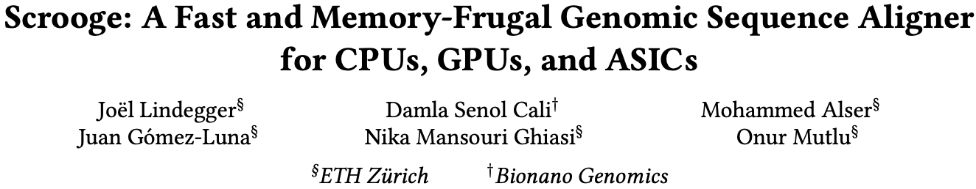
Scrooge: Overcoming GenASM Limitations
Joël Lindegger, Damla Senol Cali, Mohammed Alser, Juan Gómez-Luna, Nika Mansouri Ghiasi, and Onur Mutlu,
"Scrooge: A Fast and Memory-Frugal Genomic Sequence Aligner for CPUs, GPUs, and ASICs"
Bioinformatics, [published online on] 24 March 2023.
[Online link at Bioinformatics Journal]
[arXiv preprint]
[Scrooge Source Code]
https://arxiv.org/pdf/2208.09985.pdf

Slide 23
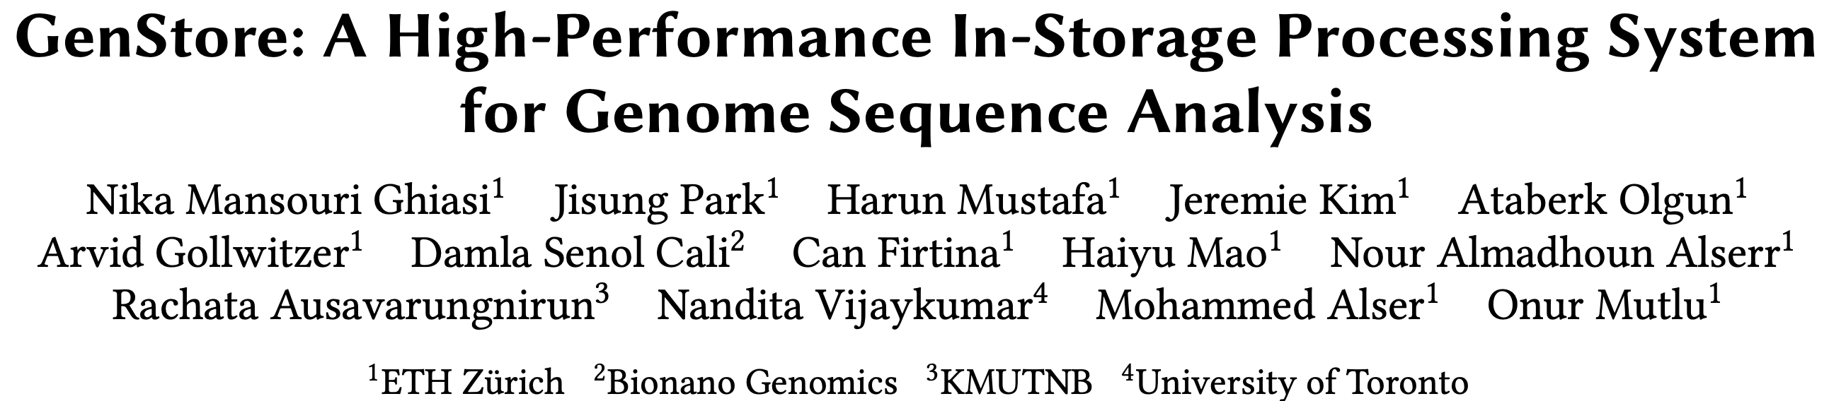
In-Storage Genome Filtering [ASPLOS 2022]
Nika Mansouri Ghiasi, Jisung Park, Harun Mustafa, Jeremie Kim, Ataberk Olgun, Arvid Gollwitzer, Damla Senol Cali, Can Firtina, Haiyu Mao, Nour Almadhoun Alserr, Rachata Ausavarungnirun, Nandita Vijaykumar, Mohammed Alser, and Onur Mutlu,
"GenStore: A High-Performance and Energy-Efficient In-Storage Computing System for Genome Sequence Analysis"
Proceedings of the 27th International Conference on Architectural Support for Programming Languages and Operating Systems (ASPLOS), Virtual, February-March 2022.
[Talk Slides (pptx) (pdf)]
[Lightning Talk Slides (pptx) (pdf)]
[Lightning Talk Video (90 seconds)]
[Talk Video (17 minutes)]

Slide 24
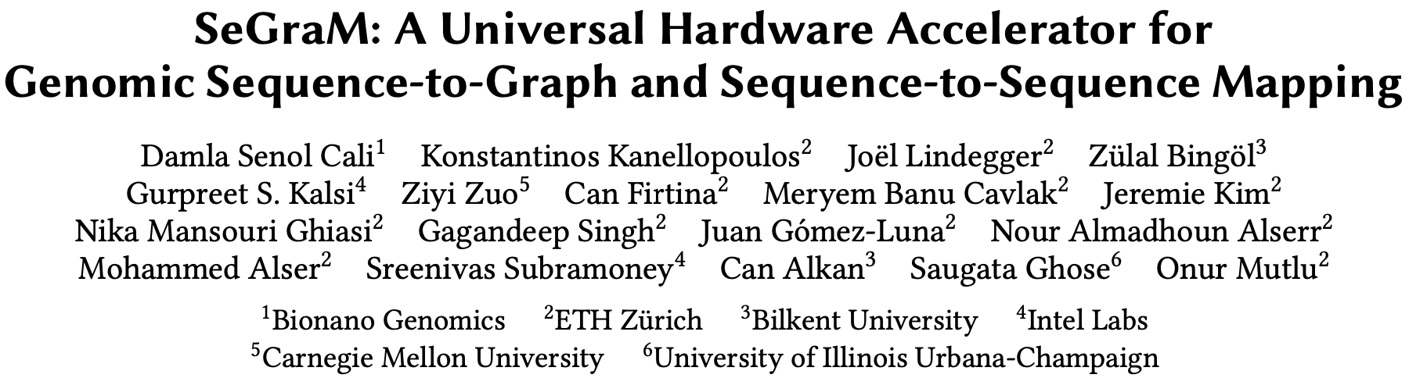
Accelerating Sequence-to-Graph Mapping
Damla Senol Cali, Konstantinos Kanellopoulos, Joel Lindegger, Zulal Bingol, Gurpreet S. Kalsi, Ziyi Zuo, Can Firtina, Meryem Banu Cavlak, Jeremie Kim, Nika MansouriGhiasi, Gagandeep Singh, Juan Gomez-Luna, Nour Almadhoun Alserr, Mohammed Alser, Sreenivas Subramoney, Can Alkan, Saugata Ghose, and Onur Mutlu,
"SeGraM: A Universal Hardware Accelerator for Genomic Sequence-to-Graph and Sequence-to-Sequence Mapping"
Proceedings of the 49th International Symposium on Computer Architecture (ISCA), New York, June 2022.
[arXiv version]
https://arxiv.org/pdf/2205.05883.pdf

Slide 25
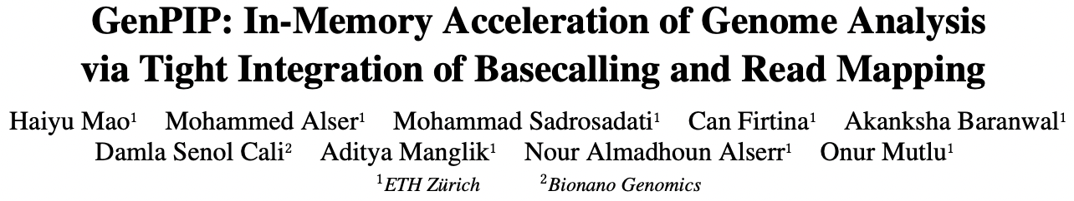
Accelerating Basecalling + Read Mapping
Haiyu Mao, Mohammed Alser, Mohammad Sadrosadati, Can Firtina, Akanksha Baranwal, Damla Senol Cali, Aditya Manglik, Nour Almadhoun Alserr, and Onur Mutlu,
"GenPIP: In-Memory Acceleration of Genome Analysis via Tight Integration of Basecalling and Read Mapping"
Proceedings of the 55th International Symposium on Microarchitecture (MICRO), Chicago, IL, USA, October 2022.
[Slides (pptx) (pdf)]
[Longer Lecture Slides (pptx) (pdf)]
[Lecture Video (25 minutes)]
[arXiv version]
https://arxiv.org/pdf/2209.08600.pdf

Slide 26
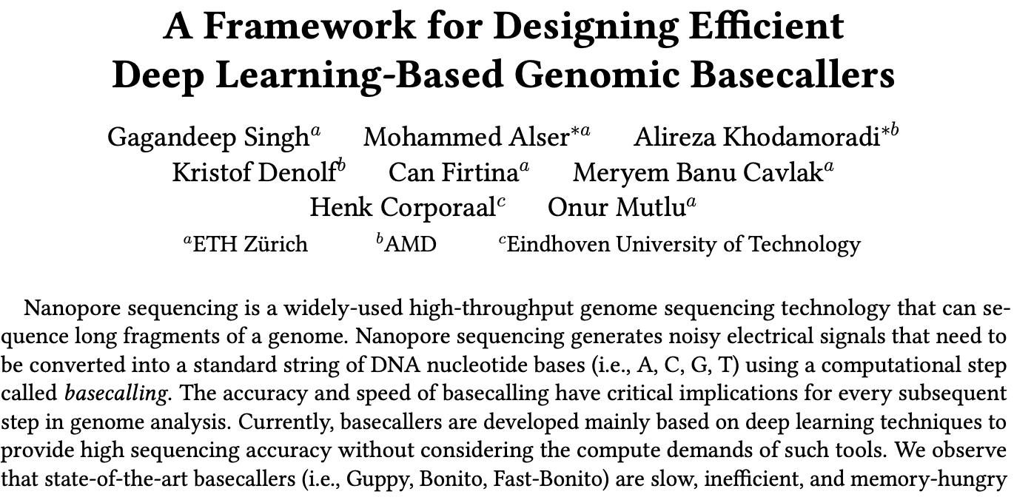
Designing & Accelerating Basecallers
https://arxiv.org/pdf/2211.03079.pdf

Slide 27
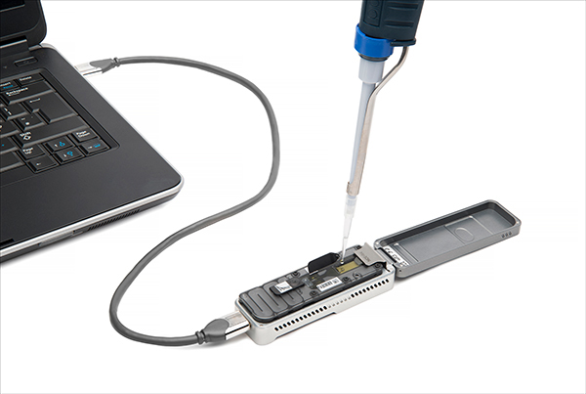

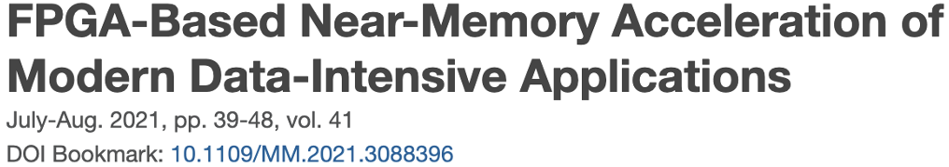
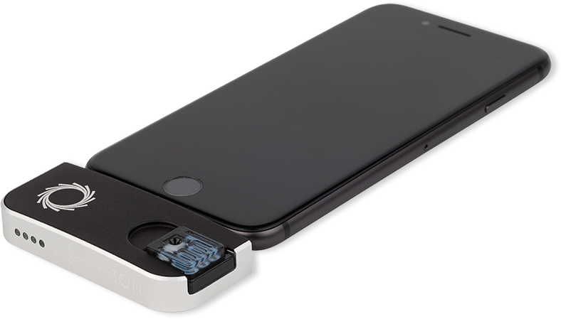
Future of Genome Sequencing & Analysis
Mohammed Alser, Zülal Bingöl, Damla Senol Cali, Jeremie Kim, Saugata Ghose, Can Alkan, Onur Mutlu
“Accelerating Genome Analysis: A Primer on an Ongoing Journey” IEEE Micro, August 2020.
MinION from ONT
SmidgION from ONT

Slide 28
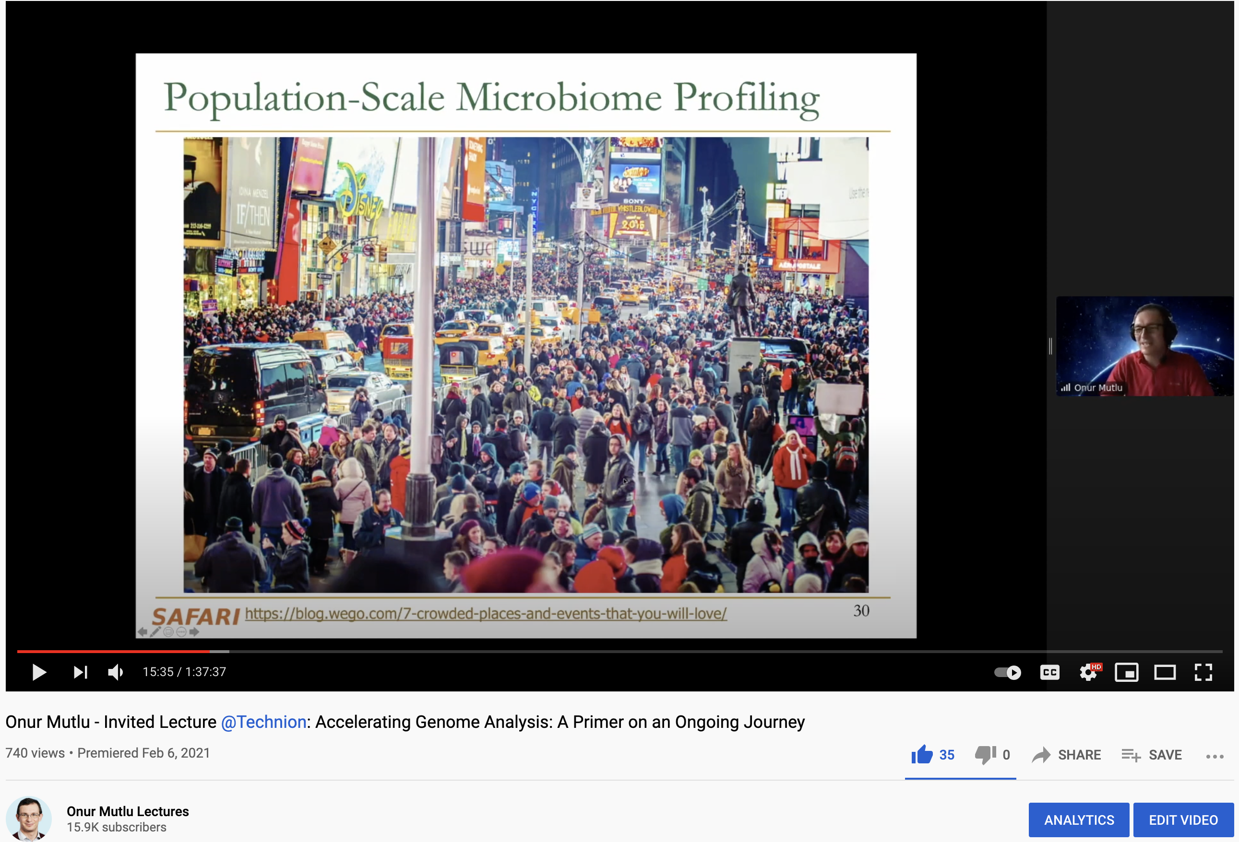
More on Fast & Efficient Genome Analysis …
Onur Mutlu,
"Accelerating Genome Analysis: A Primer on an Ongoing Journey"
Invited Lecture at Technion, Virtual, 26 January 2021.
[Slides (pptx) (pdf)]
[Talk Video (1 hour 37 minutes, including Q&A)]
[Related Invited Paper (at IEEE Micro, 2020)]
https://www.youtube.com/watch?v=r7sn41lH-4A

Slide 29
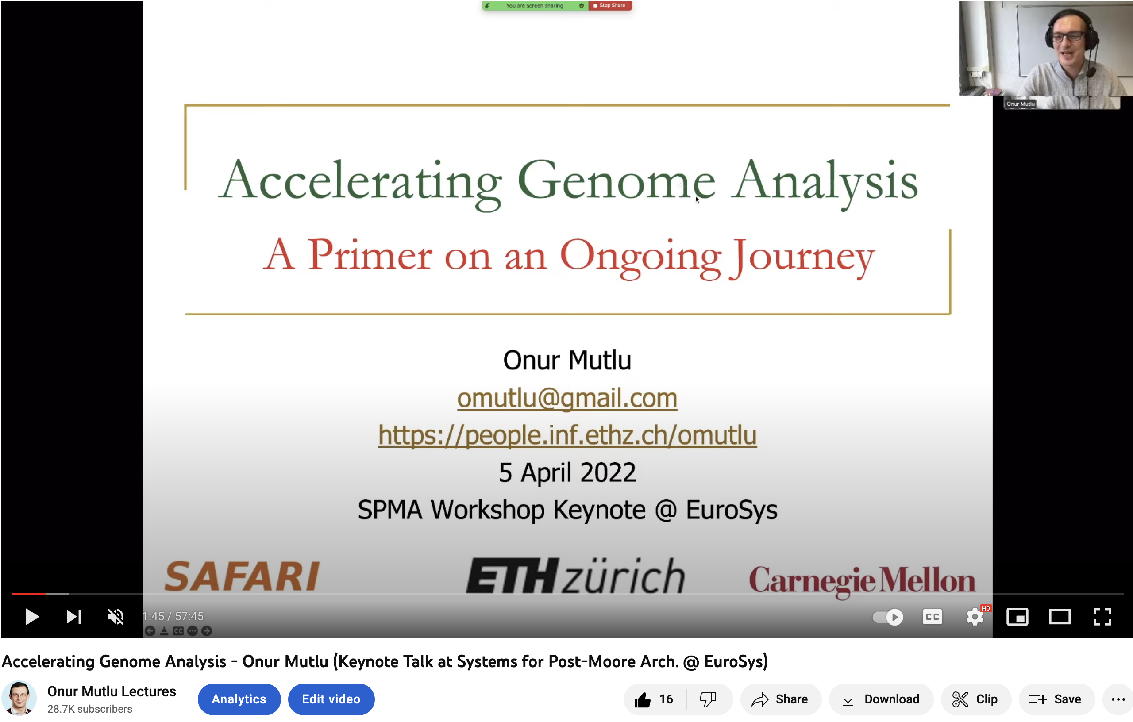
More on Fast & Efficient Genome Analysis …
https://www.youtube.com/watch?v=NCagwf0ivT0

Slide 30
Detailed Lectures on Genome Analysis
Computer Architecture, Fall 2020, Lecture 3a
  Introduction to Genome Sequence Analysis (ETH Zürich, Fall 2020)
  https://www.youtube.com/watch?v=CrRb32v7SJc&list=PL5Q2soXY2Zi9xidyIgBxUz7xRPS-wisBN&index=5
Computer Architecture, Fall 2020, Lecture 8
  Intelligent Genome Analysis (ETH Zürich, Fall 2020)
  https://www.youtube.com/watch?v=ygmQpdDTL7o&list=PL5Q2soXY2Zi9xidyIgBxUz7xRPS-wisBN&index=14
Computer Architecture, Fall 2020, Lecture 9a
  GenASM: Approx. String Matching Accelerator (ETH Zürich, Fall 2020)
  https://www.youtube.com/watch?v=XoLpzmN-Pas&list=PL5Q2soXY2Zi9xidyIgBxUz7xRPS-wisBN&index=15
Accelerating Genomics Project Course, Fall 2020, Lecture 1
  Accelerating Genomics (ETH Zürich, Fall 2020)
  https://www.youtube.com/watch?v=rgjl8ZyLsAg&list=PL5Q2soXY2Zi9E2bBVAgCqLgwiDRQDTyId
https://www.youtube.com/onurmutlulectures

Slide 31
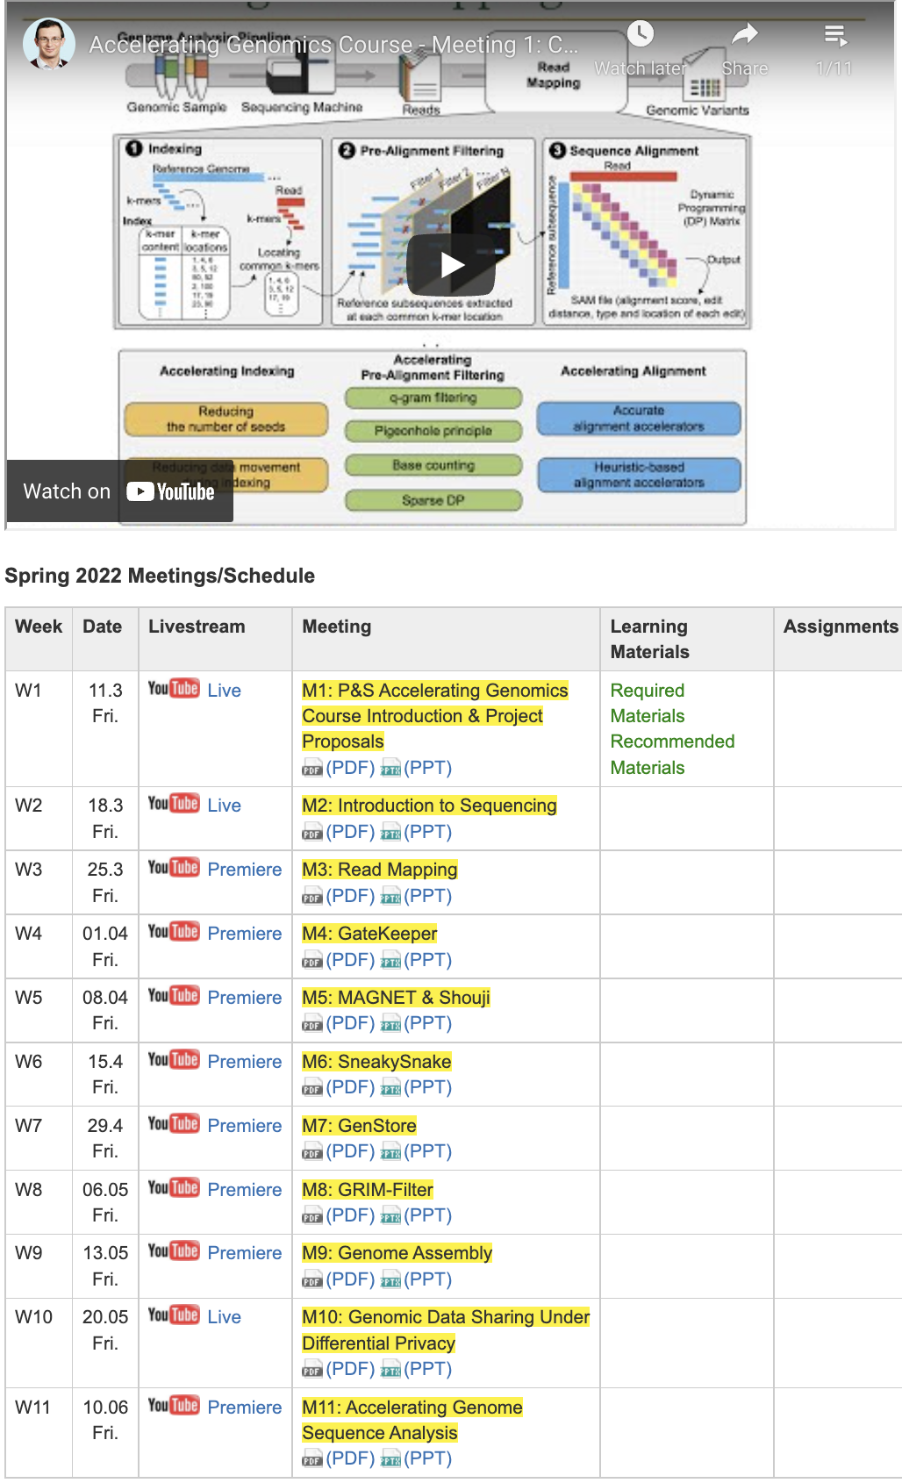
Genomics Course (Fall 2022)
Fall 2022 Edition:
  https://safari.ethz.ch/projects_and_seminars/fall2022/doku.php?id=bioinformatics
Spring 2022 Edition:
  https://safari.ethz.ch/projects_and_seminars/spring2022/doku.php?id=bioinformatics
Youtube Livestream (Fall 2022):
  https://www.youtube.com/watch?v=nA41964-9r8&list=PL5Q2soXY2Zi8tFlQvdxOdizD_EhVAMVQV
Youtube Livestream (Spring 2022):
  https://www.youtube.com/watch?v=DEL_5A_Y3TI&list=PL5Q2soXY2Zi8NrPDgOR1yRU_Cxxjw-u18
Project course
  Taken by Bachelor’s/Master’s students
  Genomics lectures
  Hands-on research exploration
  Many research readings
https://www.youtube.com/onurmutlulectures

Slide 32
Data Overwhelms Modern Machines …
Storage/memory capability
Communication capability
Computation capability
Greatly impacts robustness, energy, performance, cost

Slide 33
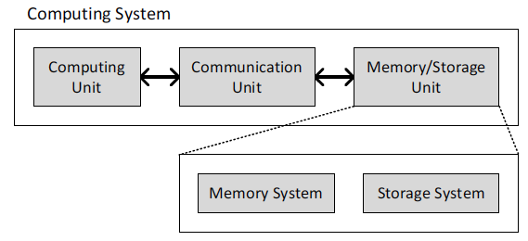
A Computing System
Three key components
Computation
Communication
Storage/memory
Burks, Goldstein, von Neumann, “Preliminary discussion of the
logical design of an electronic computing instrument,” 1946.
Image source: https://lbsitbytes2010.wordpress.com/2013/03/29/john-von-neumann-roll-no-15/

Slide 34
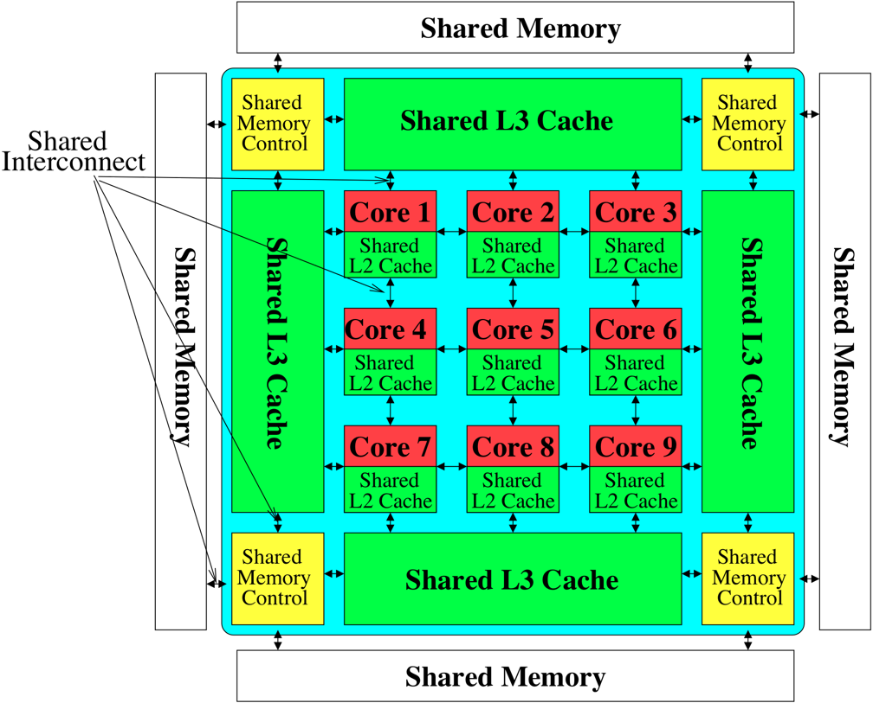

Perils of Processor-Centric Design
Most of the system is dedicated to storing and moving data
Yet, system is still bottlenecked by memory & storage

Slide 35
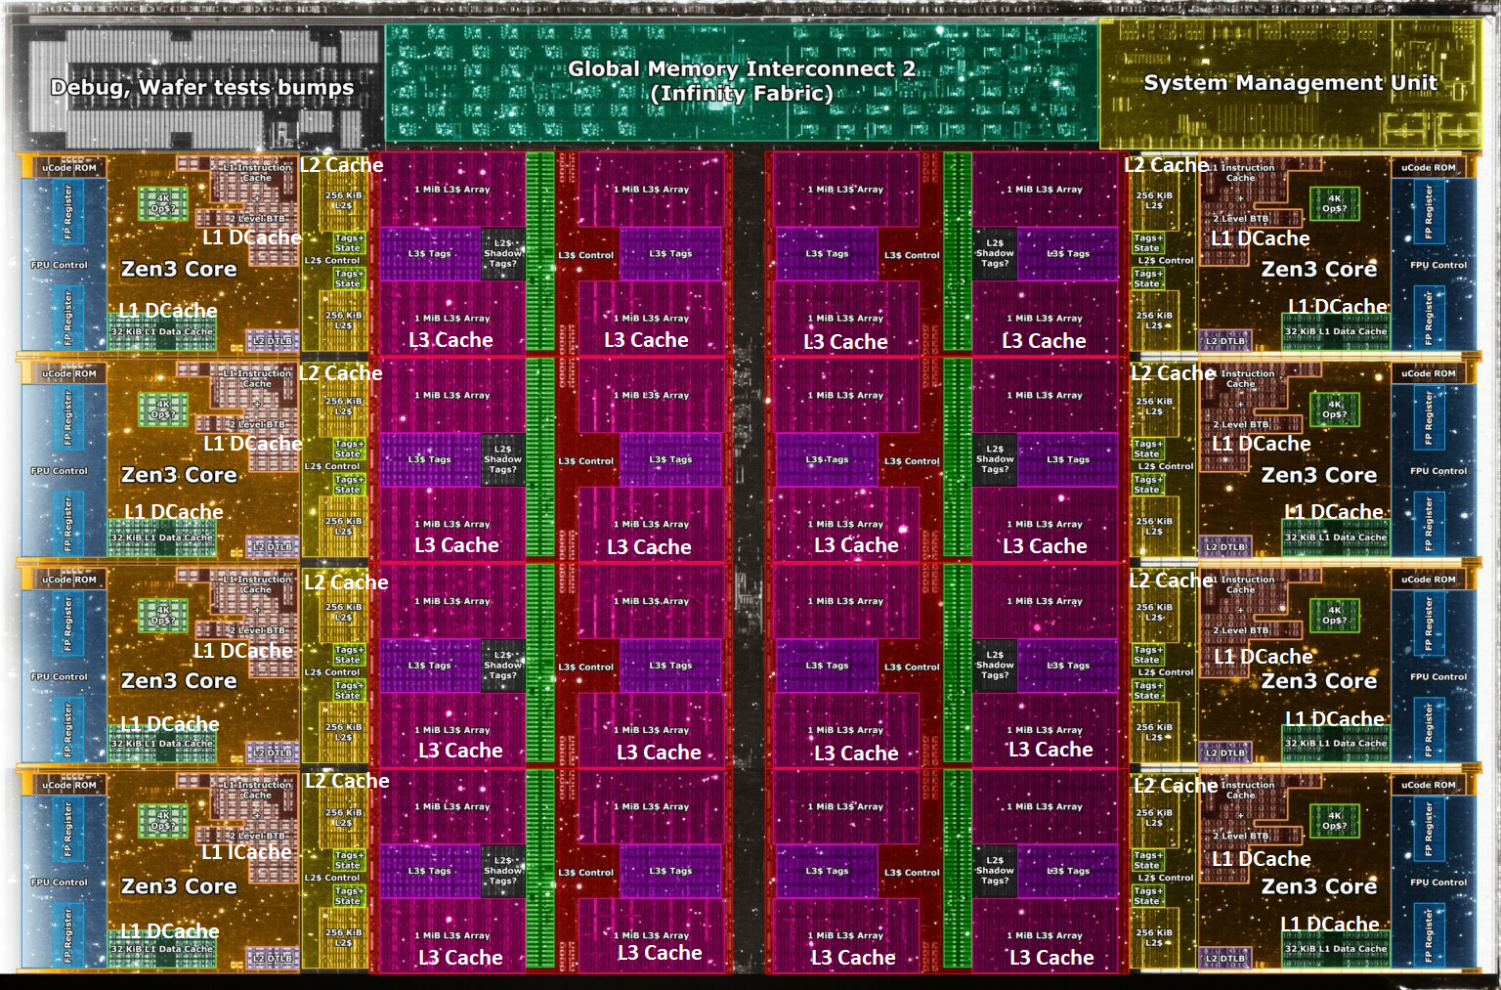
Deeper and Larger Memory Hierarchies
Core Count:
8 cores/16 threads
L1 Caches:
32 KB per core
L2 Caches:
512 KB per core
L3 Cache:
32 MB shared
AMD Ryzen 5000, 2020
https://wccftech.com/amd-ryzen-5000-zen-3-vermeer-undressed-high-res-die-shots-close-ups-pictured-detailed/

Slide 36
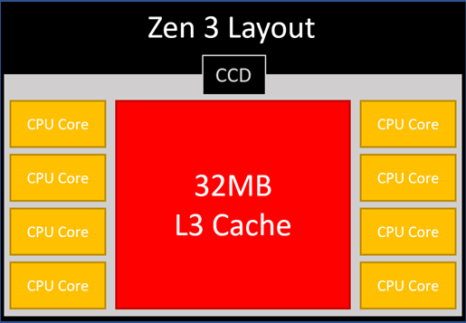
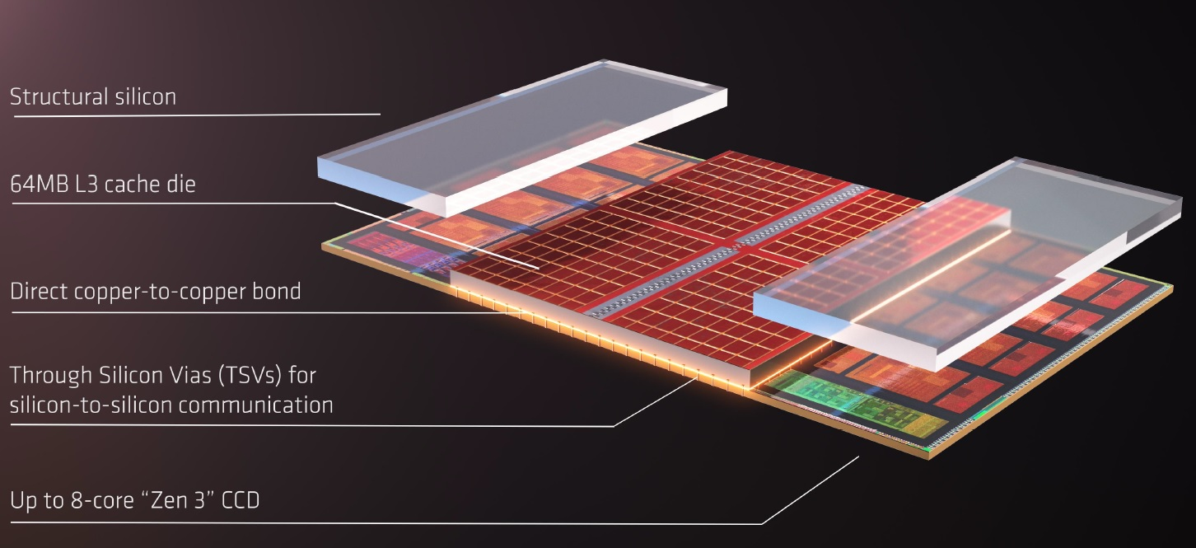
AMD’s 3D Last Level Cache (2021)
AMD increases the L3 size of their 8-core Zen 3 processors from 32 MB to 96 MB
Additional 64 MB L3 cache die stacked on top of the processor die
- Connected using Through Silicon Vias (TSVs)
- Total of 96 MB L3 cache
https://community.microcenter.com/discussion/5134/comparing-zen-3-to-zen-2
https://youtu.be/gqAYMx34euU
https://www.tech-critter.com/amd-keynote-computex-2021/
Notes:
CCD = Core Chiplet Die
Structural silicon is used to equalize the height and facilitate heat dissipation from the cores.

Slide 37
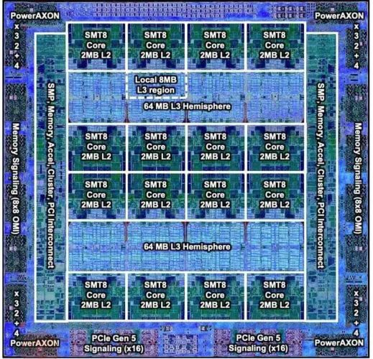
Deeper and Larger Memory Hierarchies
IBM POWER10,
2020
Cores:
15-16 cores,
8 threads/core
L2 Caches:
2 MB per core
L3 Cache:
120 MB shared
https://www.it-techblog.de/ibm-power10-prozessor-mehr-speicher-mehr-tempo-mehr-sicherheit/09/2020/

Slide 38
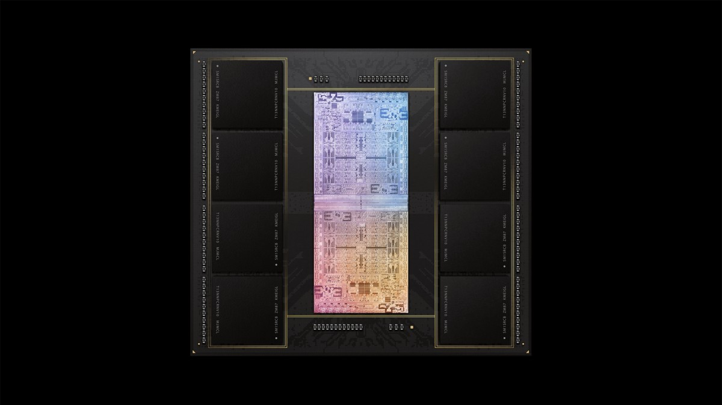
Deeper and Larger Memory Hierarchies
A lot of
SRAM
Storage
DRAM
DRAM
Storage
Apple M1 Ultra System (2022)
https://www.gsmarena.com/apple_announces_m1_ultra_with_20core_cpu_and_64core_gpu-news-53481.php

Slide 39
Data Overwhelms Modern Machines
  Chrome
TensorFlow Mobile
    Google’s web browser
Google’s machine learning framework
Data → performance & energy bottleneck
  Video Playback
  Video Capture
Google’s video codec
Google’s video codec
Notes:
In this work, we take a look at widely-used google consumer workloads, to figure out the major sources of energy consumption.
We look at Google Chrome web brower. We take a look at Tensorflow, Google’s machine learning framework, and we also take a look at two important video related workloads, video playback and video capture, both rely on Google’s vp9 codec technology.

Slide 40
Data Movement Overwhelms Modern Machines
Amirali Boroumand, Saugata Ghose, Youngsok Kim, Rachata Ausavarungnirun, Eric Shiu, Rahul Thakur, Daehyun Kim, Aki Kuusela, Allan Knies, Parthasarathy Ranganathan, and Onur Mutlu,
"Google Workloads for Consumer Devices: Mitigating Data Movement Bottlenecks"
Proceedings of the 23rd International Conference on Architectural Support for Programming Languages and Operating Systems (ASPLOS), Williamsburg, VA, USA, March 2018.
62.7% of the total system energy
is spent on data movement

Slide 41
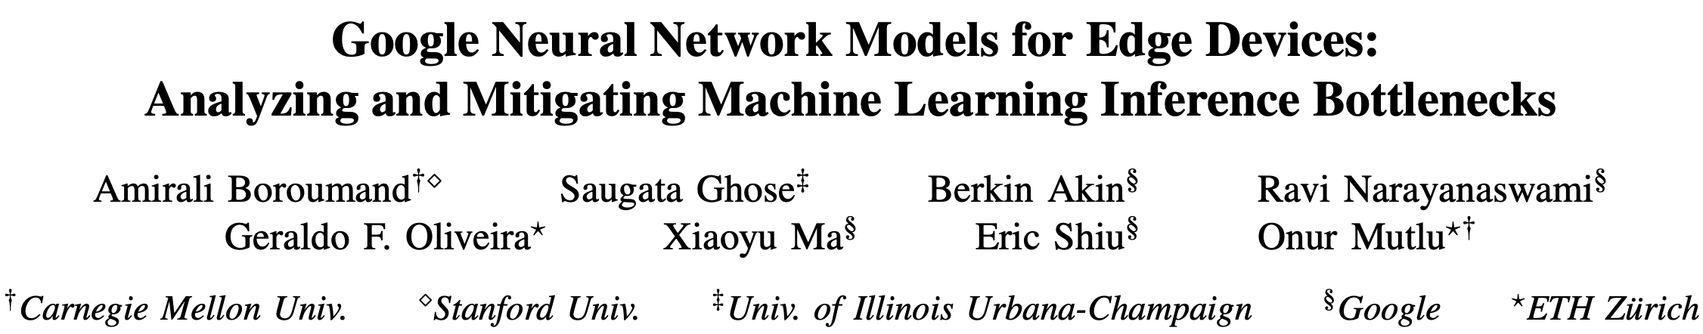
Data Movement Overwhelms Accelerators
Amirali Boroumand, Saugata Ghose, Berkin Akin, Ravi Narayanaswami, Geraldo F. Oliveira, Xiaoyu Ma, Eric Shiu, and Onur Mutlu,
"Google Neural Network Models for Edge Devices: Analyzing and Mitigating Machine Learning Inference Bottlenecks"
Proceedings of the 30th International Conference on Parallel Architectures and Compilation Techniques (PACT), Virtual, September 2021.
[Slides (pptx) (pdf)]
[Talk Video (14 minutes)]
> 90% of the total system energy
is spent on memory in large ML models

Slide 42
Axiom
An Intelligent Architecture
Handles Data Well

Slide 43
How to Handle Data Well
Ensure data does not overwhelm the components
  via intelligent algorithms, architectures & system designs: algorithm-architecture-devices
Take advantage of vast amounts of data and metadata
  to improve architectural & system-level decisions
Understand and exploit properties of (different) data
  to improve algorithms & architectures in various metrics

Slide 44
Corollaries: Computing Systems Today …
Are processor-centric vs. data-centric
Make designer-dictated decisions vs. data-driven
Make component-based myopic decisions vs. data-aware

Slide 45
Fundamentally Better Architectures
Data-centric
Data-driven
Data-aware

Slide 46
We Need to Revisit the Entire Stack
Problem
Algorithm
Program/Language
System Software
SW/HW Interface
Micro-architecture
Logic
Devices
Electrons
We can get there step by step

Slide 47
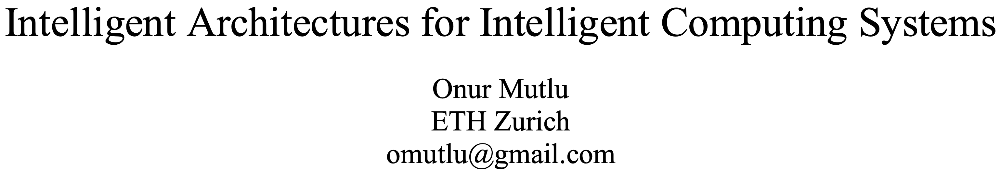
A Blueprint for Fundamentally Better Architectures
Onur Mutlu,
"Intelligent Architectures for Intelligent Computing Systems"
Invited Paper in Proceedings of the Design, Automation, and Test in Europe Conference (DATE), Virtual, February 2021.
[Slides (pptx) (pdf)]
[IEDM Tutorial Slides (pptx) (pdf)]
[Short DATE Talk Video (11 minutes)]
[Longer IEDM Tutorial Video (1 hr 51 minutes)]

Slide 48
Data-Centric (Memory-Centric) Architectures

Slide 49
Data-Centric Architectures: Properties
Process data where it resides (where it makes sense)
  Processing in and near memory & sensor structures
Low-latency & low-energy data access
Low-cost data storage & processing
  High capacity memory at low cost: hybrid memory, compression
Intelligent data management
  Intelligent controllers handling robustness, security, cost, perf.

Slide 50
Processing Data
Where It Makes Sense

Slide 51
Process Data Where It Makes Sense
Sensors
A lot of
SRAM
Storage
DRAM
DRAM
Storage
Apple M1 Ultra System (2022)
https://www.gsmarena.com/apple_announces_m1_ultra_with_20core_cpu_and_64core_gpu-news-53481.php

Slide 52
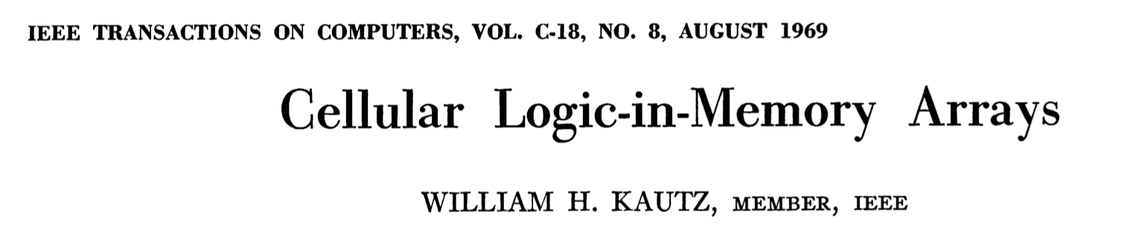
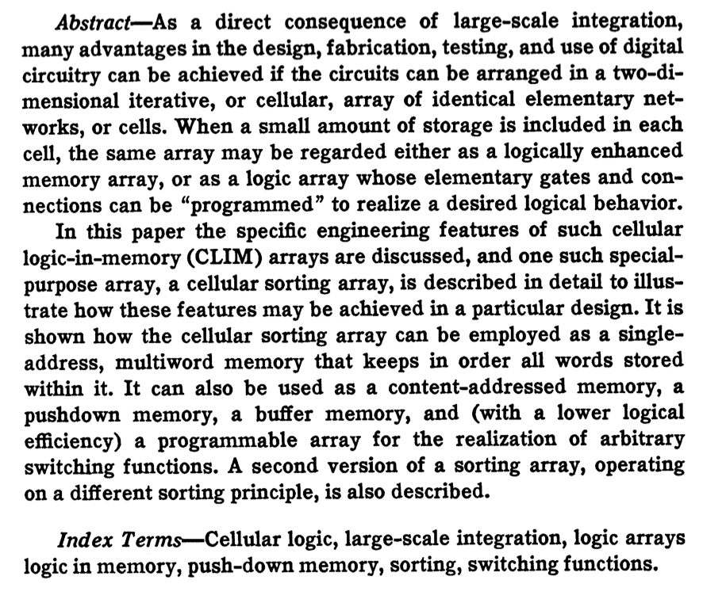
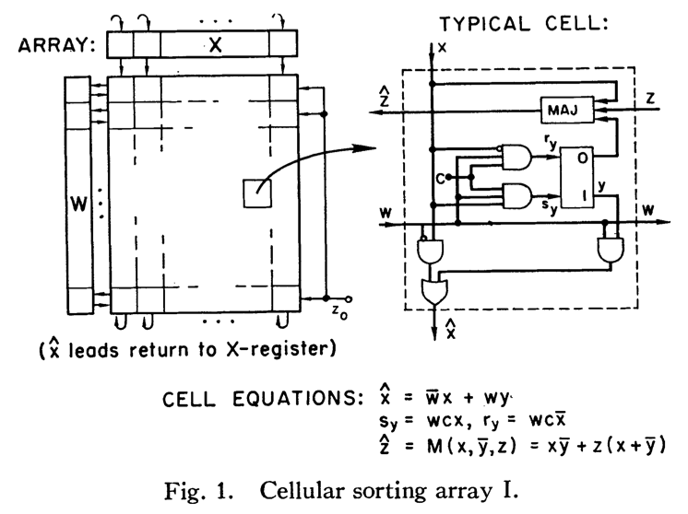
Processing in/near Memory: An Old Idea
Kautz, “Cellular Logic-in-Memory Arrays”, IEEE TC 1969.
https://doi.org/10.1109/T-C.1969.222754

Slide 53
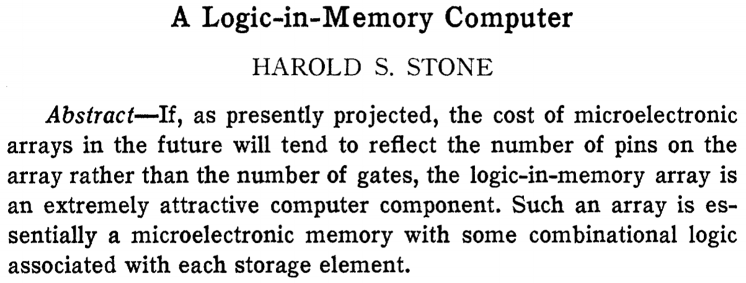
Processing in/near Memory: An Old Idea
Stone, “A Logic-in-Memory Computer,” IEEE TC 1970.
https://safari.ethz.ch/architecture/fall2020/lib/exe/fetch.php?media=stone_logic_in_memory_1970.pdf

Slide 54
Why In-Memory Computation Today?
Huge problems with Memory Technology
  Memory technology scaling is not going well (e.g., RowHammer)
  Many scaling issues demand intelligence in memory
Huge demand from Applications & Systems
  Data access bottleneck
  Energy & power bottlenecks
  Data movement energy dominates computation energy
  Need all at the same time: performance, energy, sustainability
  We can improve all metrics by minimizing data movement
Designs are squeezed in the middle

Slide 55
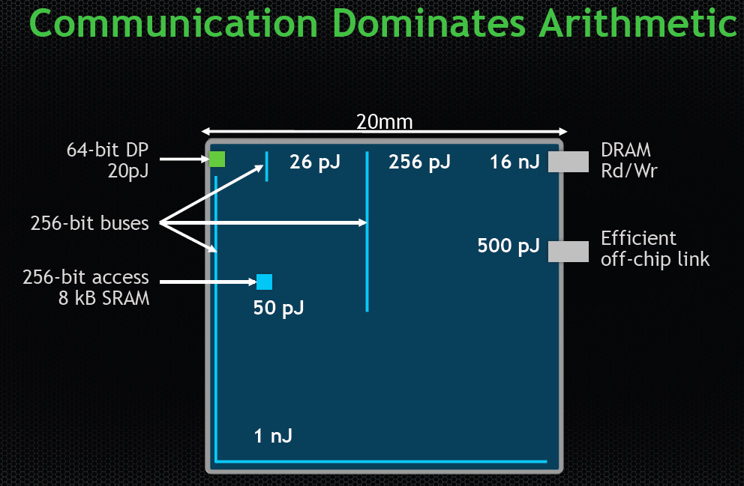
We Do Not Want to Move Data!
Dally, HiPEAC 2015
A memory access consumes ~100-1000X
the energy of a complex addition

Slide 56
We Need A Paradigm Shift To …
Enable computation with minimal data movement
Compute where it makes sense (where data resides)
Make computing architectures more data-centric

Slide 57
Goal: Processing Inside Memory/Storage
Many questions … How do we design the:
  compute-capable memory & controllers?
  processors & communication units?
  software & hardware interfaces?
  system software, compilers, languages?
  algorithms & theoretical foundations?
Memory/Storage
Database
Graphs
Media
Processor
Core
Cache
Query
Interconnect
Problem
Results
Algorithm
Program/Language
System Software
SW/HW Interface
Micro-architecture
Logic
Devices
Electrons

Slide 58
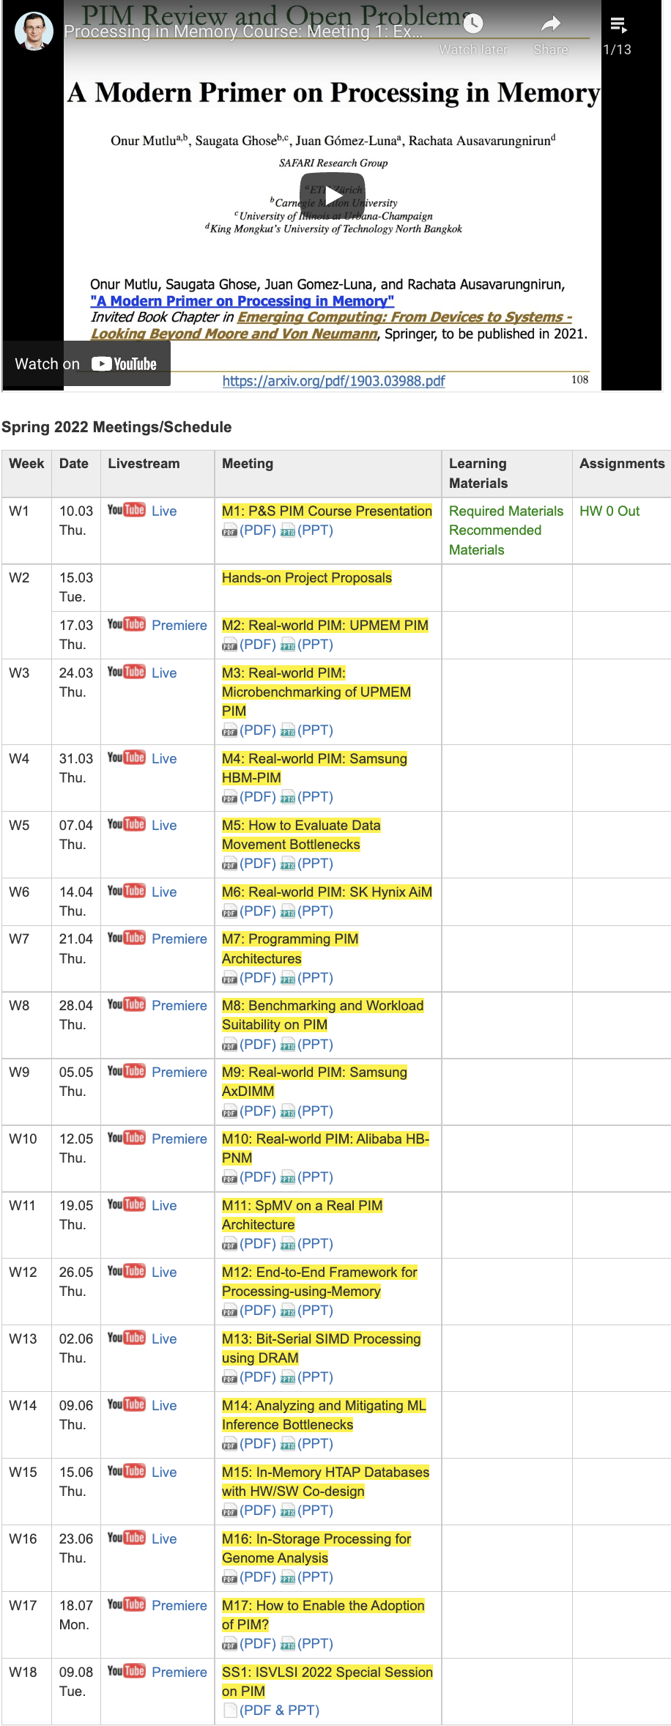
PIM Course (Fall 2022)
Fall 2022 Edition:
  https://safari.ethz.ch/projects_and_seminars/fall2022/doku.php?id=processing_in_memory
Spring 2022 Edition:
  https://safari.ethz.ch/projects_and_seminars/spring2022/doku.php?id=processing_in_memory
Youtube Livestream (Fall 2022):
  https://www.youtube.com/watch?v=QLL0wQ9I4Dw&list=PL5Q2soXY2Zi8KzG2CQYRNQOVD0GOBrnKy
Youtube Livestream (Spring 2022):
  https://www.youtube.com/watch?v=9e4Chnwdovo&list=PL5Q2soXY2Zi-841fUYYUK9EsXKhQKRPyX
Project course
  Taken by Bachelor’s/Master’s students
  Processing-in-Memory lectures
  Hands-on research exploration
  Many research readings
https://www.youtube.com/onurmutlulectures

Slide 59
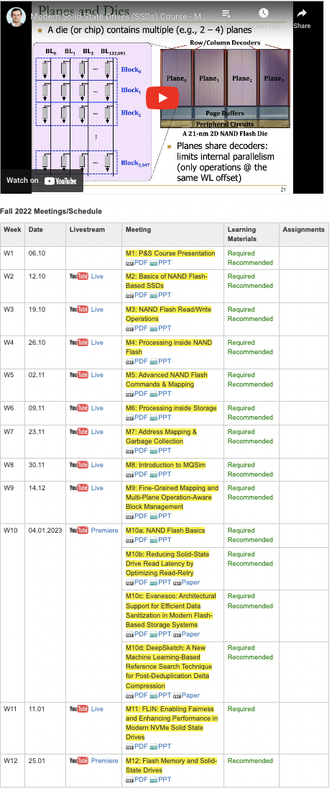
SSD Course (Spring 2023)
Spring 2023 Edition:
  https://safari.ethz.ch/projects_and_seminars/spring2023/doku.php?id=modern_ssds
Fall 2022 Edition:
  https://safari.ethz.ch/projects_and_seminars/fall2022/doku.php?id=modern_ssds
Youtube Livestream (Spring 2023):
  https://www.youtube.com/watch?v=4VTwOMmsnJY&list=PL5Q2soXY2Zi_8qOM5Icpp8hB2SHtm4z57&pp=iAQB
Youtube Livestream (Fall 2022):
  https://www.youtube.com/watch?v=hqLrd-Uj0aU&list=PL5Q2soXY2Zi9BJhenUq4JI5bwhAMpAp13&pp=iAQB
Project course
  Taken by Bachelor’s/Master’s students
  SSD Basics and Advanced Topics
  Hands-on research exploration
  Many research readings
https://www.youtube.com/onurmutlulectures

Slide 60
Genomics Course (Fall 2022)
Fall 2022 Edition:
  https://safari.ethz.ch/projects_and_seminars/fall2022/doku.php?id=bioinformatics
Spring 2022 Edition:
  https://safari.ethz.ch/projects_and_seminars/spring2022/doku.php?id=bioinformatics
Youtube Livestream (Fall 2022):
  https://www.youtube.com/watch?v=nA41964-9r8&list=PL5Q2soXY2Zi8tFlQvdxOdizD_EhVAMVQV
Youtube Livestream (Spring 2022):
  https://www.youtube.com/watch?v=DEL_5A_Y3TI&list=PL5Q2soXY2Zi8NrPDgOR1yRU_Cxxjw-u18
Project course
  Taken by Bachelor’s/Master’s students
  Genomics lectures
  Hands-on research exploration
  Many research readings
https://www.youtube.com/onurmutlulectures

Slide 61
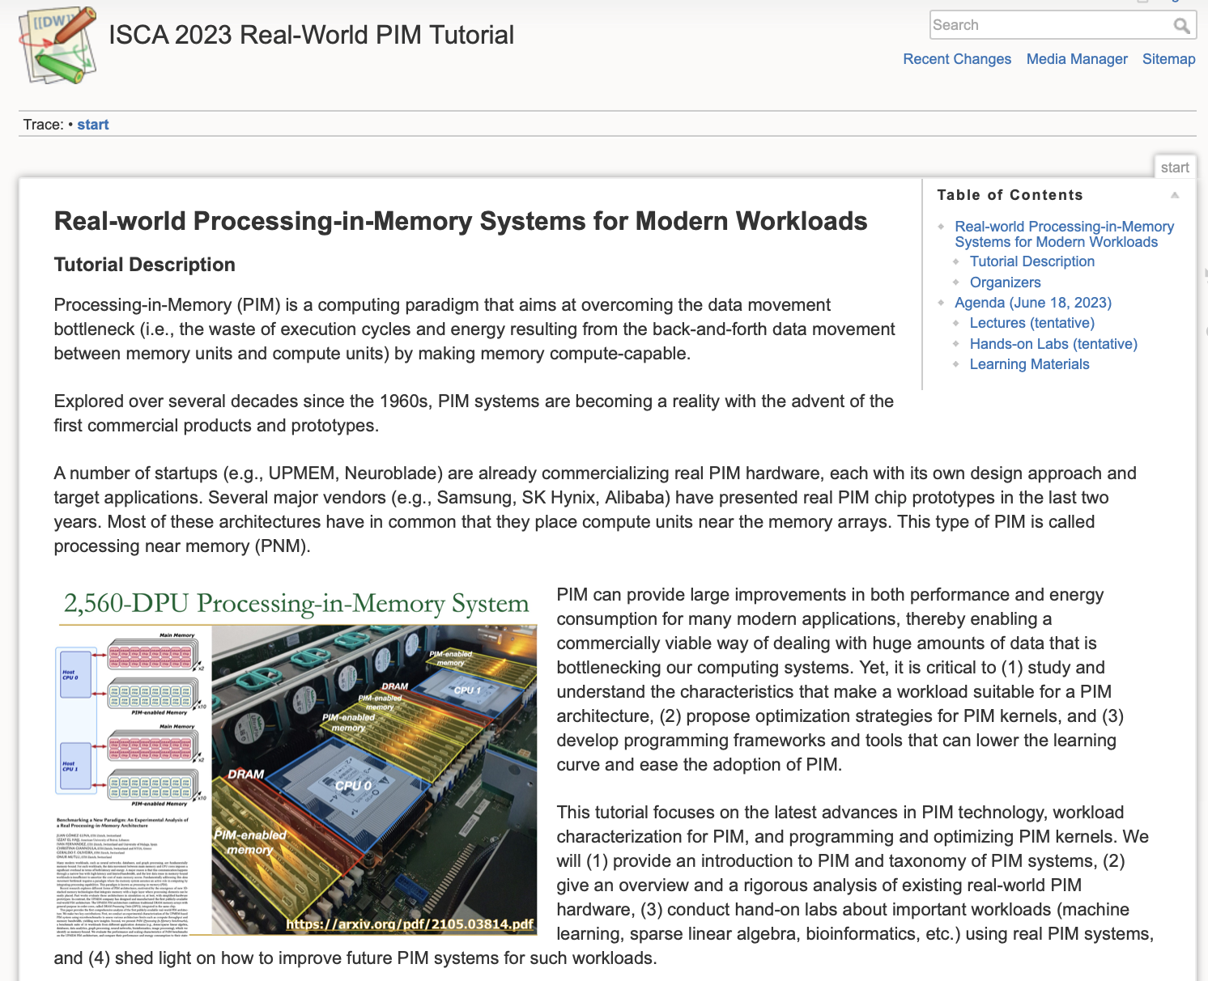
Upcoming Real PIM Tutorial (ISCA 2023)
June 18: Lectures + Hands-on labs + Invited talks
https://events.safari.ethz.ch/isca-pim-tutorial/

Slide 62
We Need to Think Differently from the Past Approaches

Slide 63
Storage-Centric Computing (I)
Storage system is a heterogeneous computing device with hybrid memory
Storage system enables data-centric design of systems & workloads
Application-driven customization enables a powerful data-centric engine
Cai+, “Error Characterization, Mitigation, and Recovery in Flash Memory Based Solid State Drives,” Proc. IEEE 2017.
https://arxiv.org/pdf/1711.11427.pdf

Slide 64


Storage-Centric Computing (II)
Workload-customized storage-centric computing

Slide 65
Workload-Customized Storage-Centric Computing
Software and hardware customized for major workloads
  Genomics
  Video analytics
  Data & graph analytics
  Machine learning
  …
Data-centric (processing capability in all memories)
Data-driven (design & decision making)
Data-aware (optimization & design)
Unified interfaces for efficient & fast communication

Slide 66
Processing in Storage:
Two Approaches
1. Processing using Storage
2. Processing near Storage

Slide 67
In-Storage Genomic Data Filtering [ASPLOS 2022]
Nika Mansouri Ghiasi, Jisung Park, Harun Mustafa, Jeremie Kim, Ataberk Olgun, Arvid Gollwitzer, Damla Senol Cali, Can Firtina, Haiyu Mao, Nour Almadhoun Alserr, Rachata Ausavarungnirun, Nandita Vijaykumar, Mohammed Alser, and Onur Mutlu,
"GenStore: A High-Performance and Energy-Efficient In-Storage Computing System for Genome Sequence Analysis"
Proceedings of the 27th International Conference on Architectural Support for Programming Languages and Operating Systems (ASPLOS), Virtual, February-March 2022.
[Lightning Talk Slides (pptx) (pdf)]
[Lightning Talk Video (90 seconds)]

Slide 68
Genome Sequence Analysis
Read mapping: first key step in genome sequence analysis
  Aligns reads to potential matching locations in the reference genome
  For each matching location, the alignment step finds the degree of similarity (alignment score)
Reference Genome
…GCCCATATGGTTAAGCTTCCATGGAAATGGGCTTTCGCTTCCACAATG…
Differences
Differences
GCTTCCAGAATG
Calculating the alignment score requires computationally-expensive approximate string matching (ASM) to account for differences between reads and the reference genome due to:
AAGCTTCCATGG
AAATGGGCTTTC
GCCCAAATGGTT
  Sequencing errors
  Genetic variation
Notes:
Read mapping is the first key step in genome sequence analysis [CLICK]
That Aligns reads to potential matching locations within the reference genome [CLICK]
For each matching location, the alignment step finds the degree of similarity between read and reference by calculating the alignment score
Calculating the alignment score requires computationally-expensive approximate string matching (ASM) to account for differences between reads and the reference genome. [CLICK]

Slide 69

Genome Sequence Analysis
Data Movement from Storage
Alignment
Storage
System
Main
Memory
Cache
Computation
Unit
(CPU or Accelerator)
AAGCTTCCATGG
CGTTCCTTGGCA
GGGCCAGAATG
CCTTTGGGTCCA
AAAATTCCATGG
GAATGGGGCCA
TTTTTTCCAAAA
TCCCCGGGGCCA
GCTTCCAGAATG
Computation overhead
Data movement overhead
Notes:
Read mapping performs alignment on large genomic datasets, containing millions of reads. [CLICK]
Therefore, read mapping is both computationally expensive [CLICK]
And incurs high data movement overhead [CLICK]

Slide 70



Compute-Centric Accelerators
Heuristics
Accelerators
Filters
Storage
System
Main
Memory
Cache
Computation
Unit
(CPU or Accelerator)
AAGCTTCCATGG
CGTTCCTTGGCA
GGGCCAGAATG
CCTTTGGGTCCA
AAAATTCCATGG
GAATGGGGCCA
TTTTTTCCAAAA
TCCCCGGGGCCA
GCTTCCAGAATG
✓
Computation overhead
Data movement overhead
Notes:
There has been significant effort into improving read mapping performance [CLICK]
Through efficient heuristics [CLICK]
hardware accelerators [CLICK]
and various filters that prune reads that do not require expensive computation [CLICK].
While these approaches address the computation overhead in read mapping [CLICK]
[While Reads Move] None of them alleviate the data movement overhead from storage, whose impact becomes even larger when the computation overhead gets alleviated [CLICK]

Slide 71

Key Idea: In-Storage Filtering
Filter reads that do not require alignment
inside the storage system
Storage
System
Main
Memory
Cache
Computation
Unit
(CPU or Accelerator)
AAGCTTCCATGG
CGTTCCTTGGCA
GGGCCAGAATG
CCTTTGGGTCCA
AAAATTCCATGG
GAATGGGGCCA
TTTTTTCCAAAA
TCCCCGGGGCCA
GCTTCCAGAATG
Filtered Reads
Exactly-matching reads
Do not need expensive approximate string matching during alignment
Non-matching reads
Do not have potential matching locations and can skip alignment
Notes:
Our key idea is to filter reads that do not require the expensive alignment computation in the storage system [CLICK] …
[While Reads Move] To fundamentally reduce the data movement overhead of read mapping
Examples of the reads that not require the costlt alignment step
Exactly-matching reads to the reference genome that do not need approximate string matching performed during alignment
Non-matching reads that have no potential matching locations in the reference genome hence skip the alignemt step

Slide 72
GenStore
Key idea: Filter reads that do not require alignment inside the storage system
Challenges
  Different behavior across read mapping workloads
  Limited hardware resources in the SSD
Host System
Reads that need
substantial processing
SSD Controller
In-SSD DRAM
Flash
Ctrl.#1
ACC
GenStore
FTL
FTL
NAND
Die#1
NAND
Die#4
Core
L2P
Mappings
Core
⋯
Core
⋯
Flash
Ctrl.#N
ACC
ACC
GenStore
Metadata
NAND
Die#1
NAND
Die#4
⋯
Notes:
Which is the first in-storage processing system designed for genome sequence analysis
Our key idea is to Filter reads that do not require alignment inside the storage system and send the unfiltered data to the host system for further processing
However, filtering reads in a modern SSD can be challenging [CLICK]
Due to different behavior across read mapping workloads. [CLICK]
And the limited hardware resources in the SSD.

Slide 73
Filtering Opportunities
Sequencing machines produce one of two kinds of reads
  Short reads: highly accurate and short
  Long reads: less accurate and long
Reads that do not require the expensive alignment step:
Exactly-matching reads
Do not need expensive approximate string matching during alignment
Low sequencing error rates (short reads) combined with
Low genetic variation
Non-matching reads
Do not have potential matching locations, so they skip alignment
High sequencing error rates (long reads) or
High genetic variation (short or long reads)
Notes:
Let’s take a look at filtering opportunities based on the input reads.
Sequencing machines produce one of two kinds of reads
Short reads: highly accurate (99.9%) and short (e.g., up to a few hundreds of DNA characters)
Long reads: less accurate (85-90%) and long (e.g., from hundreds to millions of DNA characters)
Based on these, We leverage two filtering opportunities
First, we can filter exactly matching reads, which are reads that match exactly to one or more subsequences of the reference genome and do not require approximate string matching during alignment. Exact matches can frequently occur in short read sets with low sequencing errors and low genetic variations
Second, we can filter non-matching reads. Such reads do not have any potential matching locations in the reference genome can skip the expensive alignment step. Non-matching reads can frequently occur in long read sets with high sequencing errors and short or long read sets with high genetic variations

Slide 74
GenStore
GenStore-EM for Exactly-Matching Reads
GenStore-NM for Non-Matching Reads
Notes:
by thorough analysis of mapping processes of reads with different properties and different degrees of genetic variation, we design two low-cost in-storage filters
[CLICK] 1) GenStore-EM for filtering exactly-matching reads
[CLICK] and 2) GenStore-NM for filtering most of the non-matching reads

Slide 75
GenStore
Filter reads that do not require alignment
inside the storage system
GenStore-Enabled
Storage
System
Main
Memory
Cache
Computation
Unit
(CPU or Accelerator)
✓
Computation overhead
✓
Data movement overhead
  GenStore provides significant speedup (1.4x - 33.6x) and
  energy reduction (3.9x – 29.2x) at low cost
Notes:
We propose GenStore, the first in-storage processing system designed for genome sequence analysis. [CLICK]
To reduce both the computation [CLICK]
And the data movement overhead [CLICK]
GenStore provides high-performance and energy benefits compared to state-of-the-art HW and SW baselines [CLICK]

Slide 76
Performance – GenStore-EM
With the Software Mapper
With the Hardware Mapper
3.3x
2.1x
2.1x
29
2.5x
2.5x
1.5x
Exec. time [sec]
2.1× - 2.5× speedup compared to the software Base
1.5× – 3.3× speedup compared to the hardware Base
On average 3.92× energy reduction
Notes:
We analyze the benefits of GenStore-EM for a 22-GB short read set where 80% of reads exactly match some subsequence in the reference genome and can be filtered.
We show the benefit of GS on software and hardware read mappers.
GS provides 2.1× - 2.5× speedup compared to the software Base
GS provides 1.5× – 3.3× speedup compared to the hardware Base
GS provides on average 3.92× energy reduction

Slide 77
Performance – GenStore-NM
With the Software Mapper
With the Hardware Mapper
Exec. time [sec]
Log scale
22.4
27.9x
19.2x
29x
6.8x
6.8x
22.4× – 27.9× speedup compared to the software Base
6.8× – 19.2× speedup compared to the hardware Base
On average 27.2× energy reduction
Notes:
We analyze the benefits of GenStore-NM for a 12-GB long read set with very high genetic variation compared the the reference genome where 99.7% of reads do not match any subsequence in the reference genome.
We show the benefit of GS on software and hardware read mappers.
GS provides 22.4× – 27.9× speedup compared to the software Base
GS provides 6.8× – 19.2× speedup compared to the hardware Base
GS provides on average 27.2× energy reduction

Slide 78
Area and Power Consumption
Based on Synthesis of GenStore accelerators using the Synopsys Design Compiler @ 65nm technology node
Logic unit | # of instances | Area [mm²] | Power [mW]
Comparator | 1 per SSD | 0.0007 | 0.14
K -mer Window | 2 per channel | 0.0018 | 0.27
Hash Accelerator | 2 per SSD | 0.008 | 1.8
Location Buffer | 1 per channel | 0.00725 | 0.37375
Chaining Buffer | 1 per channel | 0.008 | 0.95
Chaining PE | 1 per channel | 0.004 | 0.98
Control | 1 per SSD | 0.0002 | 0.11
Total for an 8-channel SSD | - | 0.2 | 26.6
Only 0.006% of a 14nm Intel Processor, less than 9.5% of the three ARM processors in a SATA SSD controller
Notes:
We find area and power values of GenStore by synthesizing GenStore-EM and NM using 65nm technology node,
And find that for an 8-channel SSD, the area of GS is 0.2 mm square and the power is 26.6 watts
BY scaling the area to lower technology nodes, we observe that the area overhead of GS is 0.006% of an Intel processor and less than 9.5% of the of the three ARM processors in a SATA SSD controller.

Slide 79
In-Storage Genomic Data Filtering [ASPLOS 2022]
Nika Mansouri Ghiasi, Jisung Park, Harun Mustafa, Jeremie Kim, Ataberk Olgun, Arvid Gollwitzer, Damla Senol Cali, Can Firtina, Haiyu Mao, Nour Almadhoun Alserr, Rachata Ausavarungnirun, Nandita Vijaykumar, Mohammed Alser, and Onur Mutlu,
"GenStore: A High-Performance and Energy-Efficient In-Storage Computing System for Genome Sequence Analysis"
Proceedings of the 27th International Conference on Architectural Support for Programming Languages and Operating Systems (ASPLOS), Virtual, February-March 2022.
[Lightning Talk Slides (pptx) (pdf)]
[Lightning Talk Video (90 seconds)]

Slide 80
Tight Integration of Genome Analysis Tasks
Haiyu Mao, Mohammed Alser, Mohammad Sadrosadati, Can Firtina, Akanksha Baranwal, Damla Senol Cali, Aditya Manglik, Nour Almadhoun Alserr, and Onur Mutlu,
"GenPIP: In-Memory Acceleration of Genome Analysis via Tight Integration of Basecalling and Read Mapping"
Proceedings of the 55th International Symposium on Microarchitecture (MICRO), Chicago, IL, USA, October 2022.
[Slides (pptx) (pdf)]
[Longer Lecture Slides (pptx) (pdf)]
[Lecture Video (25 minutes)]
[arXiv version]
https://arxiv.org/pdf/2209.08600.pdf

Slide 81
Accelerating Sequence-to-Graph Mapping
Damla Senol Cali, Konstantinos Kanellopoulos, Joel Lindegger, Zulal Bingol, Gurpreet S. Kalsi, Ziyi Zuo, Can Firtina, Meryem Banu Cavlak, Jeremie Kim, Nika MansouriGhiasi, Gagandeep Singh, Juan Gomez-Luna, Nour Almadhoun Alserr, Mohammed Alser, Sreenivas Subramoney, Can Alkan, Saugata Ghose, and Onur Mutlu,
"SeGraM: A Universal Hardware Accelerator for Genomic Sequence-to-Graph and Sequence-to-Sequence Mapping"
Proceedings of the 49th International Symposium on Computer Architecture (ISCA), New York, June 2022.
[arXiv version]
https://arxiv.org/pdf/2205.05883.pdf

Slide 82
Processing in Storage:
Two Approaches
1. Processing using Storage
2. Processing near Storage

Slide 83
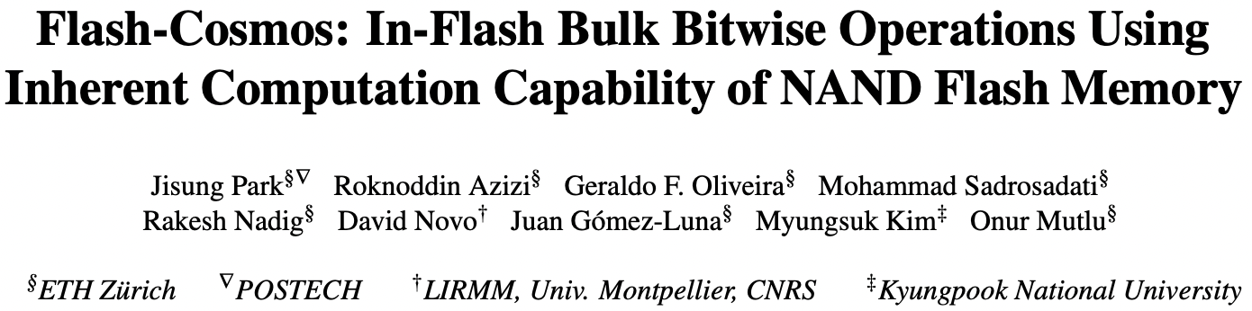
In-Flash Bulk Bitwise Execution
Jisung Park, Roknoddin Azizi, Geraldo F. Oliveira, Mohammad Sadrosadati, Rakesh Nadig, David Novo, Juan Gómez-Luna, Myungsuk Kim, and Onur Mutlu,
"Flash-Cosmos: In-Flash Bulk Bitwise Operations Using Inherent Computation Capability of NAND Flash Memory"
Proceedings of the 55th International Symposium on Microarchitecture (MICRO), Chicago, IL, USA, October 2022.
[Slides (pptx) (pdf)]
[Longer Lecture Slides (pptx) (pdf)]
[Lecture Video (44 minutes)]
[arXiv version]
https://arxiv.org/pdf/2209.05566.pdf

Slide 84



Summary: Flash-Cosmos
The first work that enables
in-flash multi-operand bulk bitwise operations
with a single sensing operation and high reliability
Improves performance
by 32x/25x/3.5x over OSP/ISP/ParaBit
Improves energy efficiency
by 95x/13.4x/3.3x over OSP/ISP/ParaBit
Low-cost & requires no changes to flash cell arrays
$

Slide 85
Data-Movement Bottleneck
Conventional systems: Outside-storage processing (OSP) that must move the entire data to CPUs/GPUs through the memory hierarchy
Memory bandwidth:
~ 40 GB/s
Storage
(NAND Flash-Based SSD)
CPU/GPU
Main
Memory
(DRAM)
$ (SRAM)
Storage I/O bandwidth:
~ 8 GB/s
External I/O bandwidth of storage systems
is the main bottleneck in conventional systems (OSP)
Notes:
This is a very high-level overview of computing systems that consist of three main components, compute units, main memory, and storage devices. [Click]
To perform just simple bitwise operations, conventional systems must first read the massive entire data to the compute units throughout the memory hierarch. [Click]
If the target data resides in the storgage device, [Click] the relatively slow storage bandwidth becomes the main bottleneck in conventional systems. [Click]

Slide 86
In-Storage Processing (ISP)
Uses in-storage compute units (embedded cores or FPGA) to send only the computation results
Memory bandwidth:
~ 40 GB/s
Storage
(NAND Flash-Based SSD)
CPU/GPU
Main
Memory
(DRAM)
$ (SRAM)
Storage I/O bandwidth:
~ 8 GB/s
Notes:
In-storage processing leverages cute units inside the storage devices, [Clompick] such as …

Slide 87
In-Storage Processing (ISP)
Uses in-storage compute units (embedded cores or FPGA) to send only the computation results
Memory bandwidth:
~ 40 GB/s
Storage
(NAND Flash-Based SSD)
CPU/GPU
Main
Memory
(DRAM)
In-Storage
Compute
Units
NAND
Chip#1
…
NAND
Chip#4
$ (SRAM)
…
In-storage
processing
NAND
Chip#31
…
NAND
Chip#32
Storage I/O bandwidth:
~ 8 GB/s
Notes:
Such as embedded core or FPGA to perform computation inside the storage [Click] and sends …

Slide 88
In-Storage Processing (ISP)
Uses in-storage compute units (embedded cores or FPGA) to send only the computation results
Memory bandwidth:
~ 40 GB/s
Storage
(NAND Flash-Based SSD)
Results only
CPU/GPU
Main
Memory
(DRAM)
In-Storage
Compute
Units
NAND
Chip#1
…
NAND
Chip#4
$ (SRAM)
…
In-storage
processing
NAND
Chip#31
…
NAND
Chip#32
Storage I/O bandwidth:
~ 8 GB/s
ISP can mitigate data movement overhead
by reducing SSD-external data movement
Notes:
Sends only the computation results. [Click]
This way, in-storage processing can significatnly mitigate the data movement by reducing external I/Os between the host and the storage device. [Click]

Slide 89
In-Storage Processing (ISP)
Uses in-storage compute units (embedded cores or FPGA) to send only the computation results
Memory bandwidth:
~ 40 GB/s
Storage
(NAND Flash-Based SSD)
Results only
CPU/GPU
Main
Memory
(DRAM)
In-Storage
Compute
Units
NAND
Chip#1
…
NAND
Chip#4
$ (SRAM)
…
In-storage
processing
NAND
Chip#31
…
NAND
Chip#32
Storage I/O bandwidth:
~ 8 GB/s
SSD-internal bandwidth
becomes the new bottleneck in ISP
SSD internal I/O bandwidth: ~ 10 GB/s
Notes:
However, in-storage processing also needs to read the massive data from underlying NAND flash chips, [Click] and SSD internal bandwidth is not that higher than the external bandwidth even in high-end NAND flash-based SSDs. [Click]
As a result, SSD internal I/Os become the new bottlenck in in-storage processing. [Click]

Slide 90
In-Flash Processing (IFP)
Performs computation inside NAND flash chips
Memory bandwidth:
~ 40 GB/s
Storage
(NAND Flash-Based SSD)
Results only
CPU/GPU
Main
Memory
(DRAM)
In-Storage
Compute
Units
NAND
Chip#1
…
NAND
Chip#4
$ (SRAM)
…
NAND
Chip#31
…
NAND
Chip#32
Storage I/O bandwidth:
~ 8 GB/s
In-flash processing
SSD internal I/O bandwidth: ~ 10 GB/s
Notes:
If we can perform computation inside NAND flash chips, [Click] it can reduce …

Slide 91
In-Flash Processing (IFP)
Performs computation inside NAND flash chips
Memory bandwidth:
~ 40 GB/s
Storage
(NAND Flash-Based SSD)
Results only
Results only
CPU/GPU
Main
Memory
(DRAM)
In-Storage
Compute
Units
NAND
Chip#1
…
NAND
Chip#4
$ (SRAM)
…
NAND
Chip#31
…
NAND
Chip#32
Storage I/O bandwidth:
~ 8 GB/s
In-flash processing
SSD internal I/O bandwidth: ~ 10 GB/s
IFP fundamentally mitigates data movement
Notes:
It can reduce the internal data movement within the SSD by sending only the results to the flash controller and the host, [Click] thereby fundamentally mitigating the data movement from the storage device. [Click]

Slide 92
Our Proposal: Flash-Cosmos
Flash-Cosmos enables
  Computation on multiple operands with a single sensing operation
  Accurate computation results by eliminating raw bit errors in stored data
NAND Flash Chip
Operand O₁
Operand O₁
Operand O₂
Operand O₂
Operand O₃
Operand O₃
…
…
Simultaneous sensing
Operand O₃₂
Operand O₃₂
Bitlines (BLs)
Page Buffer
O₁ & O₂ & O₃ & … & O₃₂
Notes:
At a very high level, Flash-Cosmos enables [Click] computation while sensing multiple operands at once and accurate computation results by zeroing raw bit errors in stored data. [Click]

Slide 93

Key Ideas of Flash-Cosmos
Multi-Wordline Sensing (MWS)
to enable in-flash bulk bitwise operations
via a single sensing operation
Enhanced SLC-Mode Programming (ESP)
to eliminate raw bit errors in stored data
(and thus in computation results)
Notes:
We introduce two techniques, Multi-Wordline Sensing, or MWS in short, that enables in-flash bulk bitwise operations via a single sensing operation, [Click] and Enhanced SLC-Mode Programming, or ESP in short, to achieve zero raw bit errors in stored data and thus no errors in computation results. [Click]

Slide 94
Multi-Wordline Sensing (MWS): Bitwise AND
Intra-Block MWS:
Simultaneously activates multiple WLs in the same block
→ Bitwise AND of the stored data in the WLs
BL₁
BL₂
BL₃
BL₄
WL₁
0
0
1
1
…
WL₂
0
1
0
1
…
WL₃
1
0
1
1
…
WL₄
0
0
1
0
…
…
…
…
…
Block_{i}
Notes:
The key observation is that, if we simultaneously activate multiple wordlines within a block, which we call intra-block MWS, it results in the bitwise AND of stored data in the wordlines. [Click]

Slide 95
Multi-Wordline Sensing (MWS): Bitwise AND
Intra-Block MWS:
Simultaneously activates multiple WLs in the same block
→ Bitwise AND of the stored data in the WLs
BL₁
BL₂
BL₃
BL₄
WL₁
0
0
1
1
…
WL₂
0
1
0
1
…
WL₃
1
0
1
1
…
Non-Target Cells:
Operate
as resistors
0
0
1
0
…
WL₄
…
…
…
…
Block_{i}
Notes:
As explained all the non-target cell would operate as a resistance, [Click] while …

Slide 96
Multi-Wordline Sensing (MWS): Bitwise AND
Intra-Block MWS:
Simultaneously activates multiple WLs in the same block
→ Bitwise AND of the stored data in the WLs
BL₁
BL₂
BL₃
BL₄
Target Cells:
Operate
as resistors (1)
or open switches (0)
WL₁
0
0
1
1
…
WL₂
0
1
0
1
…
WL₃
1
0
1
1
…
Non-Target Cells:
Operate
as resistors
0
0
1
0
…
WL₄
…
…
…
…
Result:
0
0
0
1
Notes:
Target cells operate as either a resistance or an open switch depending the stored data. [Click]
In this example, only Bitline 4 can conduct flow, as the other bitlines have at least one cell that operates as an open switch. [Click]

Slide 97
Multi-Wordline Sensing (MWS): Bitwise AND
Intra-Block MWS:
Simultaneously activates multiple WLs in the same block
→ Bitwise AND of the stored data in the WLs
BL₁
BL₂
BL₃
BL₄
Target Cell:
Operate
as a resistance (1)
or an open switch (0)
WL₁
0
0
1
1
…
A bitline reads as ‘1’ only when all the target cells store ‘1’
→ Equivalent to the bitwise AND of all the target cells
WL₂
0
1
0
1
…
WL₃
1
0
1
1
…
Non-Target Cell:
Operate
as a resistance
0
0
1
0
…
WL₄
…
…
…
…
Result:
0
0
0
1
Notes:
So, the sensing result would be ‘1’ only when all the target cells store bit data ‘1’, which is equivalent to the bitwise AND of all the target cells. [Click]

Slide 98
Multi-Wordline Sensing (MWS): Bitwise AND
Intra-Block MWS:
Simultaneously activates multiple WLs in the same block
→ Bitwise AND of the stored data in the WLs
BL₁
BL₂
BL₃
BL₄
WL₁
0
0
1
1
…
Target Cells:
Operate
as resistors (1)
or open switches (0)
WL₂
0
1
0
1
…
WL₃
1
0
1
1
…
WL₄
0
0
1
0
…
…
…
…
…
Result:
0
0
0
0
Notes:
This property also holds [Click] when we activate more than two wordlines at the same time, [Click], for example, …

Slide 99
Multi-Wordline Sensing (MWS): Bitwise AND
Intra-Block MWS:
Simultaneously activates multiple WLs in the same block
→ Bitwise AND of the stored data in the WLs
BL₁
BL₂
BL₃
BL₄
A bitline reads as ‘1’ only when all the target cells store ‘1’
→ Equivalent to the bitwise AND of all the target cells
WL₁
0
0
1
1
…
Target Cell:
Operate
as a resistance (1)
or an open switch (0)
WL₂
0
1
0
1
…
WL₃
1
0
1
1
…
WL₄
0
0
1
0
…
…
…
…
…
Result:
0
0
0
0
Notes:
The bitline current cannot flow through Bitline 4 any longer, as it has a cell that stores ‘0’ and blocks the bitline current. [Click]

Slide 100
Multi-Wordline Sensing (MWS): Bitwise AND
Intra-Block MWS:
Simultaneously activates multiple WLs in the same block
→ Bitwise AND of the stored data in the WLs
BL₁
BL₂
BL₃
BL₄
Flash-Cosmos (Intra-Block MWS) enables
bitwise AND of multiple pages in the same block
via a single sensing operation
WL₁
0
0
1
1
…
A bitline reads as ‘1’ only when all the target cells store ‘1’
→ Equivalent to the bitwise AND of all the target cells
Target Cell:
Operate
as a resistance (1)
or an open switch (0)
WL₂
0
1
0
1
…
WL₃
1
0
1
1
…
WL₄
0
0
1
1
…
…
…
…
…
Result:
0
0
0
1
Notes:
This way, intra-block MWS enables bitwise AND operation on any pages in the same block via a single sensing operation. [Click]

Slide 101
Multi-Wordline Sensing (MWS): Bitwise OR
Inter-Block MWS:
Simultaneously activates multiple WLs in different blocks
→ Bitwise OR of the stored data in the WLs
BL₁
BL₂
BL₃
BL₄
WL_{x} in Block₁
1
0
1
0
…
…
…
…
…
WL_{y} in Block_{i}
1
1
0
0
…
…
…
…
…
Notes:
Flash-Cosmos also enables bitwise OR operations by simultaneously activating multiple wordlines in different blocks, which we call inter-block MWS. [Click]

Slide 102
Multi-Wordline Sensing (MWS): Bitwise OR
Inter-Block MWS:
Simultaneously activates multiple WLs in different blocks
→ Bitwise OR of the stored data in the WLs
BL₁
BL₂
BL₃
BL₄
WL_{x} in Block₁
1
0
1
0
…
…
…
…
…
WL_{y} in Block_{i}
1
1
0
0
…
…
…
…
…
Result:
1
1
1
0
Notes:
In this example, only Bitline 4 cannot conduct current, as both the target NAND string have a cell that operates as an open switch. [Click]

Slide 103
Multi-Wordline Sensing (MWS): Bitwise OR
Inter-Block MWS:
Simultaneously activates multiple WLs in different blocks
→ Bitwise OR of the stored data in the WLs
BL₁
BL₂
BL₃
BL₄
WL_{x} in Block₁
1
0
1
0
…
A bitline reads as ‘0’ only when all the target cells store ‘0’
→ Equivalent to the bitwise OR of all the target cells
…
…
…
…
WL_{y} in Block_{i}
1
1
0
0
…
…
…
…
…
Result:
1
1
1
0
Notes:
It means that the sensing result would read as ‘0’ only when all the target cells store bit data ‘0’, which is equivalent to the bitwise OR of all the target cells. [Click]

Slide 104
Multi-Wordline Sensing (MWS): Bitwise OR
Inter-Block MWS:
Simultaneously activates multiple WLs in different blocks
→ Bitwise OR of the stored data in the WLs
BL₁
BL₂
BL₃
BL₄
WL_{x} in Block₁
1
0
1
0
…
…
…
…
…
WL_{y} in Block_{i}
1
1
0
0
…
…
…
…
…
WL_{z} in Block_{j}
1
0
0
1
…
Result:
1
1
1
1
Notes:
Like intra-block MWS, [Click] this property holds when we activate more than two wordlines in different blocks at the same time, [Click], as we can see …

Slide 105
Multi-Wordline Sensing (MWS): Bitwise OR
Inter-Block MWS:
Simultaneously activates multiple WLs in different blocks
→ Bitwise OR of the stored data in the WLs
BL₁
BL₂
BL₃
BL₄
A bitline reads as ‘0’ only when all the target cells store ‘0’
→ Equivalent to the bitwise OR of all the target cells
WL_{x} in Block₁
1
0
1
0
…
…
…
…
…
WL_{y} in Block_{i}
1
1
0
0
…
…
…
…
…
WL_{z} in Block_{j}
1
0
0
1
…
Result:
1
1
1
1
Notes:
As we can see the current can flow through Bitline 4 as well, since there is a cell that operates as a resistance. [Click]

Slide 106
Multi-Wordline Sensing (MWS): Bitwise OR
Inter-Block MWS:
Simultaneously activates multiple WLs in different blocks
→ Bitwise OR of the stored data in the WLs
BL₁
BL₂
BL₃
BL₄
1
0
1
0
…
Flash-Cosmos (Inter-Block MWS) enables
bitwise OR of multiple pages in different blocks
via a single sensing operation
WL_{x} in Block₁
…
…
…
…
WL_{y} in Block_{i}
1
1
0
0
…
…
…
…
…
WL_{z} in Block_{j}
1
0
0
1
…
Result:
1
1
1
1
Notes:
This way, inter-block MWS enables bitwise OR operations on any pages in different blocks via only a single sensing operation. [Click]

Slide 107
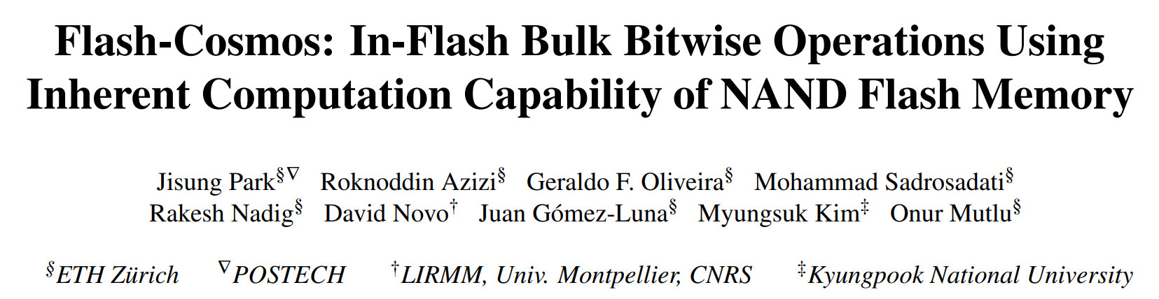

Other Types of Bitwise Operations
Flash-Cosmos also enables
other types of bitwise operations (NOT/NAND/NOR/XOR/XNOR)
leveraging existing features of NAND flash memory
https://arxiv.org/abs/2209.05566.pdf

Slide 108
Key Ideas
Multi-Wordline Sensing (MWS)
to enable in-flash bulk bitwise operations
via a single sensing operation
Enhanced SLC-Mode Programming (ESP)
to eliminate raw bit errors in stored data
(and thus in computation results)
Notes:
Now let’s dive into the key ideas of Enhanced SLC-Mode Programming [Click] that elminiates …

Slide 109
Enhanced SLC-Mode Programming (ESP)
Goal: eliminate raw bit errors in stored data (and computation results)
Key ideas
  Programs only a single bit per cell (SLC-mode programming)
    Trades storage density for reliable computation
  Performs more precise programming of the cells
    Trades programming latency for reliable computaion
Maximizes the reliability margin
between the different states of flash cells
Notes:
Eliminates raw bit errors in stored data. [Click]
The key idea is to program only a single bit per cell for the target data of computation, meaning that ESP trades storage density, [Click] and use more precise program-voltage control, meaning that it also trades program latency, [Click] to maximize the reliability margin between the program and erased states of flash cells. [Click]

Slide 110
Enhanced SLC-Mode Programming (ESP)
To eliminate raw bit errors in stored data (and computation results)
Key ideas
  Programs only a single bit per cell (SLC-mode programming)
    Trades storage density for reliable computation
  More precise program-voltage control
    Trades programming latency for reliable computaion
Flash-Cosmos (ESP) enables
reliable in-flash computation
by trading storage density & programming latency
Storage & latency overheads affect
only data used in in-flash computation
Maximizes the reliability margin
between the different states of flash cells
Notes:
So, ESP enables reliable in-flash computation by trading storage density and program performance, [Click] but the overheads occur only for the target data of computation. [Click]

Slide 111
Evaluation Methodology
Real-device characterization
  To validate the feasibility and reliability of Flash-Cosmos
  Using 160 48-WL-layer 3D Triple-Level Cell NAND flash chips
    3,686,400 tested wordlines
  Under worst-case operating conditions
    Under a 1-year retention time at 10K P/E cycles
    Worst-case data patterns
System-level evaluation
  Using the state-of-the-art SSD simulator (MQSim [Tavakkol+, FAST’18])
  Three real-world applications
    Bitmap Indices (BMI): Bitwise AND of up to ~1,000 operands
    Image Segmentation (IMS): Bitwise AND of 3 operands
    K-clique Star Listing (KCS): Bitwise OR of up to 32 operands
  Baselines
    Outside-Storage Processing (OSP): A multi-core CPU (Intel i7-11700K)
    In-Storage Processing (ISP): An in-storage hardware accelerator
    ParaBit [Gao+, MICRO’21]: State-of-the-art in-flash processing mechanism
Notes:
First, we conducted rigorous real-device characterization to validate the feasibility and reliability of Flash-Cosmos, [Click] using 160 3D NAND flash chips, [Click] considering the worst-case operation conditions. [Click]
We also performed system-level evaluation using the state-of-the-art SSD simulator, [Click] for three real-world applications that perform bulk bitwise operations on different numbers of operands. [Click]
We compared Flash-Cosmos against three baselines, a conventional system that uses a multi-core CPU, an in-storage processing system with an in-storage hardware accelerator, and a system that adopts the state-of-the-art in-flash processing mechanism to perform bulk bitwise operations. [Click]

Slide 112
Results: Real-Device Characterization
No changes to the cell array
of commodity NAND flash chips
Can have many operands
(AND: up to 48, OR: up to 4)
with small increase in sensing latency (< 10%)
ESP significantly improves
the reliability of computation results
(no observed bit error in the tested flash cells)
Notes:
Through our real-device characterization, we demnostrated that both MWS operations are possible without requiring any change ot the cell array of commodity NAND flash chips, [Click] and they can reliably activate multiple wordlines at the same time without significant increase in sensing latency. [Click]
We also observed no errors in the tested cells when we program data using ESP, which shows that Flash-Cosmos enables reliable in-flash bulk bitwise operations. [Click]

Slide 113
Results: Performance & Energy
ISP
ParaBit
Flash-Cosmos
150×
70×
Speedup over OSP
Energy benefit over OSP
14×
2×
25×
3.5×
12×
2×
13.4×
3.3×
1.6×
10×
2.5×
20×
Flash-Cosmos provides significant performance & energy benefits over all the baselines
The larger the number of operands,
the higher the performance & energy benefits
Notes:
As system-level evaluation, [Click] we evaluate the speedup and [Click] energy benefit over the conventional system. [Click]
We observe that Flash-Cosmos provides significant performance and energy benefits over all the baselines, including the state-of-the-art in-flash bulk bitwise operation technique, [Click] and the larger the number of operands for bulk bitwise operations, the higher the performance and energy benefits that Flash-Cosmos can achieve over other computing platforms. [Click]

Slide 114
In-Flash Bulk Bitwise Execution
Jisung Park, Roknoddin Azizi, Geraldo F. Oliveira, Mohammad Sadrosadati, Rakesh Nadig, David Novo, Juan Gómez-Luna, Myungsuk Kim, and Onur Mutlu,
"Flash-Cosmos: In-Flash Bulk Bitwise Operations Using Inherent Computation Capability of NAND Flash Memory"
Proceedings of the 55th International Symposium on Microarchitecture (MICRO), Chicago, IL, USA, October 2022.
[Slides (pptx) (pdf)]
[Longer Lecture Slides (pptx) (pdf)]
[Lecture Video (44 minutes)]
[arXiv version]
https://arxiv.org/pdf/2209.05566.pdf

Slide 115
Processing in Storage:
Two Approaches
1. Processing using Storage
2. Processing near Storage

Slide 116
Challenge and Opportunity for Future
Fundamentally
Energy-Efficient
(Data-Centric)
Computing Architectures

Slide 117
Challenge and Opportunity for Future
Fundamentally
High-Performance
(Data-Centric)
Computing Architectures

Slide 118
Challenge and Opportunity for Future
Computing Architectures
with
Minimal Data Movement

Slide 119
Concluding Remarks

Slide 120
Concluding Remarks
We must design systems to be balanced, high-performance, energy-efficient (all at the same time) → intelligent systems
  Data-centric, data-driven, data-aware
Enable computation capability inside and close to storage
This can
  Lead to orders-of-magnitude improvements
  Enable new applications & computing platforms
  Enable better understanding of nature
  …
Future of truly storage-centric computing is bright
  We need to do research & design across the computing stack
Notes:
Perhaps we have taken processor-centric system design a bit too far

Slide 121
Fundamentally Better Architectures
Data-centric
Data-driven
Data-aware

Slide 122
Source: http://spectrum.ieee.org/image/MjYzMzAyMg.jpeg

Slide 123
We Need to Revisit the Entire Stack
Problem
Algorithm
Program/Language
System Software
SW/HW Interface
Micro-architecture
Logic
Devices
Electrons
We can get there step by step

Slide 124
A Blueprint for Fundamentally Better Architectures
Onur Mutlu,
"Intelligent Architectures for Intelligent Computing Systems"
Invited Paper in Proceedings of the Design, Automation, and Test in Europe Conference (DATE), Virtual, February 2021.
[Slides (pptx) (pdf)]
[IEDM Tutorial Slides (pptx) (pdf)]
[Short DATE Talk Video (11 minutes)]
[Longer IEDM Tutorial Video (1 hr 51 minutes)]

Slide 125

Acknowledgments
Think BIG, Aim HIGH!
https://safari.ethz.ch

Slide 126
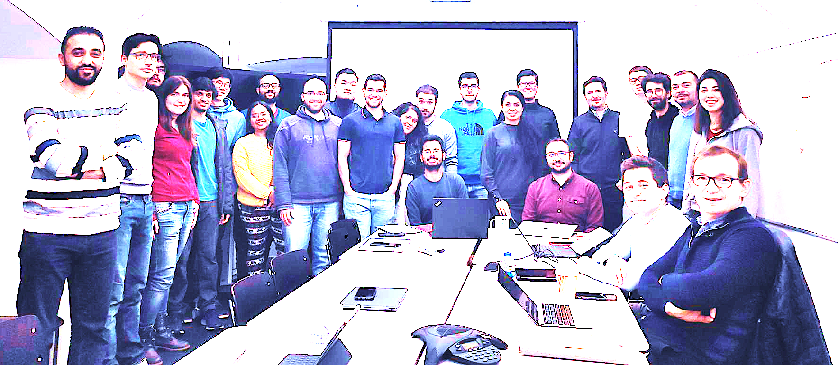

Onur Mutlu’s SAFARI Research Group
Computer architecture, HW/SW, systems, bioinformatics, security, memory
https://safari.ethz.ch/safari-newsletter-january-2021/
40+ Researchers
Think BIG, Aim HIGH!
https://safari.ethz.ch

Slide 127
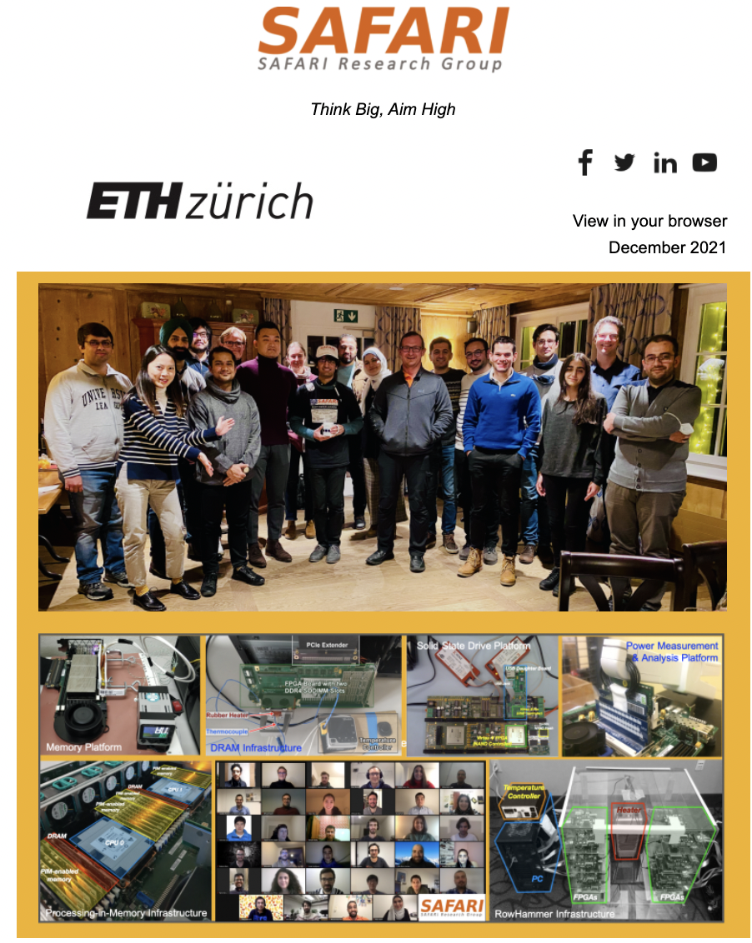
SAFARI Newsletter December 2021 Edition
https://safari.ethz.ch/safari-newsletter-december-2021/

Slide 128
Referenced Papers, Talks, Artifacts
All are available at
  https://people.inf.ethz.ch/omutlu/projects.htm
  https://www.youtube.com/onurmutlulectures
  https://github.com/CMU-SAFARI/

Slide 129






Open Source Tools: SAFARI GitHub
https://github.com/CMU-SAFARI/

Slide 130
Storage-Centric Computing for Modern Data-Intensive Workloads
Onur Mutlu
omutlu@gmail.com
https://people.inf.ethz.ch/omutlu
15 May 2023
Huawei Next Generation Data Storage Architecture Innovation Forum Keynote

Slide 131
Backup Slides

Slide 132




GenStore:
A High-Performance In-Storage Processing System for Genome Sequence Analysis
Session 6A: Thursday 3 March, 3:00 PM CEST
Nika Mansouri Ghiasi, Jisung Park, Harun Mustafa, Jeremie Kim, Ataberk Olgun,
Arvid Gollwitzer, Damla Senol Cali, Can Firtina, Haiyu Mao, Nour Almadhoun Alserr,
Rachata Ausavarungnirun, Nandita Vijaykumar, Mohammed Alser, and Onur Mutlu
Notes:
Hi, I’m Nika, and today I will introduce GenStore: A High-Performance In-Storage Processing System
for Genome Sequence Analysis

Slide 133
Genome Sequence Analysis
Genome sequence analysis is critical for many applications
  Personalized medicine
  Outbreak tracing
  Evolutionary studies
Genome sequencing machines extract smaller fragments of the original DNA sequence, known as reads
AAGCTTCCATGG
AAATGGGCTTTC
GCTTCCAGAATG
GCCCAAATGGTT
Notes:
Genome sequence analysis (GSA) is critical for many applications [CLICK]
Genome sequencing machines extract smaller fragments of the original DNA sequence, known as reads. [CLICK]

Slide 134
Genome Sequence Analysis
Read mapping: first key step in genome sequence analysis
  Aligns reads to potential matching locations in the reference genome
  For each matching location, the alignment step finds the degree of similarity (alignment score)
Reference Genome
…GCCCATATGGTTAAGCTTCCATGGAAATGGGCTTTCGCTTCCACAATG…
Differences
Differences
GCTTCCAGAATG
Calculating the alignment score requires computationally-expensive approximate string matching (ASM) to account for differences between reads and the reference genome due to:
AAGCTTCCATGG
AAATGGGCTTTC
GCCCAAATGGTT
  Sequencing errors
  Genetic variation
Notes:
Read mapping is the first key step in genome sequence analysis [CLICK]
That Aligns reads to potential matching locations within the reference genome [CLICK]
For each matching location, the alignment step finds the degree of similarity between read and reference by calculating the alignment score
Calculating the alignment score requires computationally-expensive approximate string matching (ASM) to account for differences between reads and the reference genome. [CLICK]

Slide 135
Genome Sequence Analysis
Data Movement from Storage
Alignment
Storage
System
Main
Memory
Cache
Computation
Unit
(CPU or Accelerator)
AAGCTTCCATGG
CGTTCCTTGGCA
GGGCCAGAATG
CCTTTGGGTCCA
AAAATTCCATGG
GAATGGGGCCA
TTTTTTCCAAAA
TCCCCGGGGCCA
GCTTCCAGAATG
Computation overhead
Data movement overhead
Notes:
Read mapping performs alignment on large genomic datasets, containing millions of reads. [CLICK]
Therefore, read mapping is both computationally expensive [CLICK]
And incurs high data movement overhead [CLICK]

Slide 136
Accelerating Genome Sequence Analysis
Heuristics
Accelerators
Filters
Storage
System
Main
Memory
Cache
Computation
Unit
(CPU or Accelerator)
AAGCTTCCATGG
CGTTCCTTGGCA
GGGCCAGAATG
CCTTTGGGTCCA
AAAATTCCATGG
GAATGGGGCCA
TTTTTTCCAAAA
TCCCCGGGGCCA
GCTTCCAGAATG
✓
Computation overhead
Data movement overhead
Notes:
There has been significant effort into improving read mapping performance [CLICK]
Through efficient heuristics [CLICK]
hardware accelerators [CLICK]
and various filters that prune reads that do not require expensive computation [CLICK].
While these approaches address the computation overhead in read mapping [CLICK]
[While Reads Move] None of them alleviate the data movement overhead from storage, whose impact becomes even larger when the computation overhead gets alleviated [CLICK]

Slide 137
Key Idea
Filter reads that do not require alignment
inside the storage system
Storage
System
Main
Memory
Cache
Computation
Unit
(CPU or Accelerator)
AAGCTTCCATGG
CGTTCCTTGGCA
GGGCCAGAATG
CCTTTGGGTCCA
AAAATTCCATGG
GAATGGGGCCA
TTTTTTCCAAAA
TCCCCGGGGCCA
GCTTCCAGAATG
Filtered Reads
Exactly-matching reads
Do not need expensive approximate string matching during alignment
Non-matching reads
Do not have potential matching locations and can skip alignment
Notes:
Our key idea is to filter reads that do not require the expensive alignment computation in the storage system [CLICK] …
[While Reads Move] To fundamentally reduce the data movement overhead of read mapping
Examples of the reads that not require the costlt alignment step
Exactly-matching reads to the reference genome that do not need approximate string matching performed during alignment
Non-matching reads that have no potential matching locations in the reference genome hence skip the alignemt step

Slide 138
Challenges
Filter reads that do not require alignment
inside the storage system
Storage
System
Main
Memory
Cache
Computation
Unit
(CPU or Accelerator)
AAGCTTCCATGG
CGTTCCTTGGCA
GGGCCAGAATG
CCTTTGGGTCCA
AAAATTCCATGG
GAATGGGGCCA
TTTTTTCCAAAA
TCCCCGGGGCCA
GCTTCCAGAATG
Filtered Reads
Read mapping workloads can exhibit different behavior
There are limited hardware resources
in the storage system
Notes:
However, filtering reads in a modern SSD can be challenging [CLICK]
Due to different behavior across read mapping workloads. [CLICK]
And the limited hardware resources in the SSD. By addressing these challenges [CLICK]

Slide 139
GenStore
Filter reads that do not require alignment
inside the storage system
GenStore-Enabled
Storage
System
Main
Memory
Cache
Computation
Unit
(CPU or Accelerator)
✓
Computation overhead
✓
Data movement overhead
  GenStore provides significant speedup (1.4x - 33.6x) and
  energy reduction (3.9x – 29.2x) at low cost
Notes:
We propose GenStore, the first in-storage processing system designed for genome sequence analysis. [CLICK]
To reduce both the computation [CLICK]
And the data movement overhead [CLICK]
GenStore provides high-performance and energy benefits compared to state-of-the-art HW and SW baselines [CLICK]

Slide 140
Outline
Background
Motivation and Goal
Experimental Methodology
Temperature Analysis
Aggressor Row Active Time Analysis
Spatial Variation Analysis
Implications on Attacks and Defenses
Conclusions
Motivation and Goal
GenStore
Evaluation
Conclusions
Notes:
That was a summary of my talk. So let’s start with the background on read mapping so we can dive into the talk in more detail.

Slide 141
Read Mapping Process
> 3 billion characters
Seeds
Reference
…CAATTTGCCCATATGGTTAAGCTTCCATGGAAATGGGCTTTCGCTTTG…
…
K-mer
Locations
Read
GCCCAAATGGTT
GCC | 7
CCC | 8
CAA | 1
AAA | 31 | 101
CCA | 25 | 230 | 400
… | … | … | …
K-mers
GCC
CCC
…
Index
Seeding
Determine potential matching locations (seeds) in the reference genome
Seed Filtering
(e.g., Chaining)
Prune some seeds in the reference genome
Alignment
Determine the exact differences between the read and the reference genome
Notes:
Mapping reads to reference genome requires expensive computation on large datasets.
[CLICK] The search space in the Reference genome can be very large (for example the human reference genome contains more than three billion characters).
[CLICK] Therefore, read mappers typically use an index of the reference genome to reduce the search space. This index contains unique 𝑘-length subsequences ([CLICK] called 𝑘-mers) extracted from the reference genome, [CLICK] and locations of these 𝑘-mers in the reference genome.
Read mapping is a three step process. State-of-the-art read mappers involve several heuristics to reduce the cost of expensive alignment computation.
[CLICK] In the first step (seeding), the mapper determines the potential matching locations (seeds) in the large reference genome where the read could map.
[CLICK] To do so, the read mapper extracts k-mers from the read [CLICK] and looks up the k-mer fetched from a read in the reference index. [CLICK] For all the k-mers that hit in the index, the read mapper marks the locations of them in the reference genome as the read’s potential matching locations (or seeds).
To further reduce the cost of the computationally-expensive alignment, the read mapper performs a second step [CLICK] , called chaining or seed filtering, in which the mapper [CLICK] prunes the seeds in the reference to which the read would not align using a simple approximation of the alignment score.
At the end of this step, the reads that have all their locations filtered, skip the third step.
[CLICK] For the remaining reads, the thitd step, which is the costly alignment, determines the exact differences between a read and the reference genome [CLICK] via approximate string matching.

Slide 142
Outline
Background
Motivation and Goal
Experimental Methodology
Temperature Analysis
Aggressor Row Active Time Analysis
Spatial Variation Analysis
Implications on Attacks and Defenses
Conclusions
Motivation and Goal
GenStore
Evaluation
Conclusions
Notes:
We perform experimental studies to understand the potential of efficient in-storage filters for improving read mapping performance.

Slide 143
Motivation
Case study on a real-world genomic read dataset
  Various read mapping systems
  Various state-of-the-art SSD configurations
The ideal in-storage filter significantly improves performance by
reducing the computation overhead
reducing the data movement overhead
Notes:
We perform a case study on a real world genomic read dataset, on various read mapping systems and state-of-the-art SSD configirations.

Slide 144
Motivation
Case study on a real-world genomic read dataset
  Various read mapping systems
  Various state-of-the-art SSD configurations
Filtering outside SSD provides lower performance benefit since it
does not reduce the data movement overhead
2) must compete with read mapping for system resources
A HW accelerator reduces the computation bottleneck,
which makes I/O a larger bottleneck in the system
Notes:
We perform a case study on a real world genomic read dataset, on various read mapping systems and state-of-the-art SSD configirations.

Slide 145
Our Goal
Design an in-storage filter for genome sequence analysis in a cost-effective manner
Design Objectives:
Performance
Provide high in-storage filtering performance to overlap the filtering with the read mapping of unfiltered data
Applicability
Support reads with 1) different properties and 2) different degrees of genetic variation in the compared genomes
Low-cost
Do not require significant hardware overhead
Notes:
Motivated by these observations, Our goal is to design an in-storage filter for genome sequence analysis in a cost-effective manner. [CLICK]
We have three key objectives in designing our new system. [CLICK]
First, the system should Provide high in-storage filtering performance to overlap the filtering with the read mapping of unfiltered data
Second, the design should Support reads with 1) different properties and 2) different degrees of genetic variation
Third, it should not require significant additional hardware overhead

Slide 146
Outline
Background
Motivation and Goal
Experimental Methodology
Temperature Analysis
Aggressor Row Active Time Analysis
Spatial Variation Analysis
Implications on Attacks and Defenses
Conclusions
Motivation and Goal
GenStore
Evaluation
Conclusions
Notes:
To this end, we propose GenStore…

Slide 147
GenStore
Key idea: Filter reads that do not require alignment inside the storage system
Challenges
  Different behavior across read mapping workloads
  Limited hardware resources in the SSD
Host System
Reads that need
substantial processing
SSD Controller
In-SSD DRAM
Flash
Ctrl.#1
ACC
GenStore
FTL
FTL
NAND
Die#1
NAND
Die#4
Core
L2P
Mappings
Core
⋯
Core
⋯
Flash
Ctrl.#N
ACC
ACC
GenStore
Metadata
NAND
Die#1
NAND
Die#4
⋯
Notes:
Which is the first in-storage processing system designed for genome sequence analysis
Our key idea is to Filter reads that do not require alignment inside the storage system and send the unfiltered data to the host system for further processing
However, filtering reads in a modern SSD can be challenging [CLICK]
Due to different behavior across read mapping workloads. [CLICK]
And the limited hardware resources in the SSD.

Slide 148
Filtering Opportunities
Sequencing machines produce one of two kinds of reads
  Short reads: highly accurate and short
  Long reads: less accurate and long
Reads that do not require the expensive alignment step:
Exactly-matching reads
Do not need expensive approximate string matching during alignment
Low sequencing error rates (short reads) combined with
Low genetic variation
Non-matching reads
Do not have potential matching locations, so they skip alignment
High sequencing error rates (long reads) or
High genetic variation (short or long reads)
Notes:
Let’s take a look at filtering opportunities based on the input reads.
Sequencing machines produce one of two kinds of reads
Short reads: highly accurate (99.9%) and short (e.g., up to a few hundreds of DNA characters)
Long reads: less accurate (85-90%) and long (e.g., from hundreds to millions of DNA characters)
Based on these, We leverage two filtering opportunities
First, we can filter exactly matching reads, which are reads that match exactly to one or more subsequences of the reference genome and do not require approximate string matching during alignment. Exact matches can frequently occur in short read sets with low sequencing errors and low genetic variations
Second, we can filter non-matching reads. Such reads do not have any potential matching locations in the reference genome can skip the expensive alignment step. Non-matching reads can frequently occur in long read sets with high sequencing errors and short or long read sets with high genetic variations

Slide 149
GenStore
GenStore-EM for Exactly-Matching Reads
GenStore-NM for Non-Matching Reads
Notes:
by thorough analysis of mapping processes of reads with different properties and different degrees of genetic variation, we design two low-cost in-storage filters
[CLICK] 1) GenStore-EM for filtering exactly-matching reads
[CLICK] and 2) GenStore-NM for filtering most of the non-matching reads

Slide 150
GenStore
GenStore-EM for Exactly-Matching Reads
GenStore-NM for Non-Matching Reads
Notes:
Let's take a closer look at GenStore-EM

Slide 151
GenStore-EM
Efficient in-storage filter for reads with at least one exact match in the reference genome
Uses simple operations, without requiring alignment
Challenge: large number of random accesses per read to the reference genome and its index
Expensive random accesses to flash chips
Limited DRAM capacity inside the SSD
Notes:
[CLICK] GenStore-EM accelerates read mapping by using an efficient in-storage filter to filter reads that have at least one exactly matching location in the reference genome
[CLICK] via simple operations, without requiring alignment.
The key challenge in designing GenStore-EM is the large number of random accesses to large data structures inside the SSD.
This is challenging because. [CLICK]
NAND flash memory exhibits poor performance for random access reads. [CLICK]
there is limited DRAM capacity available in SSD which is relatively small compared to the size of the data structures that need to be accessed.

Slide 152
GenStore-EM: Data Structures
Read-sized k-mers: to reduce the number of accesses per each read
K-mer
Read
GCCCAAATGGTT
✓
K-mers
GCC
CCC
…
Only one index lookup per read
Sorted read-sized k-mers: to avoid random accesses to the index
✓
Sequential scan of the read set and the index
Notes:
To reduce the **number** of accesses per each read, we introduce read-sized k-mers.
Therefore, instead of extracting several k-mers per read and performing index lookup for each of them, [CLICK] we can use the whole read as one k-mer
[CLICK] And have only one index lookup per read
[CLICK] To avoid **random** accesses to the index, we introduce the **sorted** index of read-sized k-mers.
[CLICK] This sorted index allows finding exact matches via sequential scanning of the read sets and the index

Slide 153
GenStore-EM: Data Structures
Sorted Read Table
Sorted K-mer Index
Read
ID | Read
873 | AAAAAAAAAA
232 | AAAAAAAAAG
17 | AAAAAAAACT
… | …
Sorted
K-mer | Loc.
AAAAAAAAAA | 1, 8, …
AAAAAAAAAC | 51
AAAAAAAAAT | 23, 37
… | …
AAAAAAAAAA
Read-sized
K-mers
Notes:
I show the key idea of GenStore-EM with a simplified example in which each short read consists of 10 characters.
Suppose that we have two data structures:
[CLICK] 1) a sorted read table, each entry of which stores a read [CLICK] and its unique ID, and
[CLICK] 2) a sorted k-mer index, which contains all unique read sized k-mers of the reference genome,
[CLICK] along with each k-mer’s corresponding locations in the reference genome.
[CLICK] Each data structure is sorted by read/k-mer in alphabetical order.

Slide 154
GenStore-EM: Finding a Match
Sorted Read Table
Sorted K-mer Index
ID | Read
873 | AAAAAAAAAA
232 | AAAAAAAAAG
17 | AAAAAAAACT
… | …
K-mer | Loc.
AAAAAAAAAA | 1, 8, …
AAAAAAAAAC | 51
AAAAAAAAAT | 23, 37
… | …
Next
Next
Comparator
Read = K-mer
Exact match → Filter the read
Notes:
We sequentially scan through these data structures in three different ways based on the [CLICK] comparison result of the current read and k-mer.
[CLICK] First, when the current read and k-mer are identical,
[CLICK] we record the read as an exactly-matching read that can be filtered from further read mapping process
[CLICK] Then, we move to the next element in both arrays. [CLICK]

Slide 155
GenStore-EM: Not Finding a Match
Sorted Read Table
Sorted K-mer Index
ID | Read
873 | AAAAAAAAAA
232 | AAAAAAAAAG
17 | AAAAAAAACT
… | …
K-mer | Loc.
AAAAAAAAAA | 1, 8, …
AAAAAAAAAC | 51
AAAAAAAAAT | 23, 37
… | …
Next
Comparator
Read > K-mer
Notes:
if the read is alphabetically larger than the k-mer,
we conclude that the k-mer does not match any read
and go to the next element in the index (so that we can examine if the next k-mer).

Slide 156
GenStore-EM: Not Finding a Match
Sorted Read Table
Sorted K-mer Index
ID | Read
873 | AAAAAAAAAA
232 | AAAAAAAAAG
17 | AAAAAAAACT
… | …
K-mer | Loc.
AAAAAAAAAA | 1, 8, …
AAAAAAAAAC | 51
AAAAAAAAAT | 23, 37
… | …
Next
Comparator
Read < K-mer
Not an exact match → Send to read mapper
Notes:
if the k-mer is alphabeticall larger than the read,
we conclude that the read does not match any k-mer in index, and needs to be sent for the full read mapping process
Then, we go to the next element in the sorted read table (so that we can examine the next read).
Using this technique, GenStore-EM avoids random accesses and performs filtering using only simple low-cost logic

Slide 157
GenStore-EM: Not Finding a Match
Sorted Read Table
Sorted K-mer Index
ID | Read
873 | AAAAAAAAAA
232 | AAAAAAAAAG
17 | AAAAAAAACT
… | …
K-mer | Loc.
AAAAAAAAAA | 1, 8, …
AAAAAAAAAC | 51
AAAAAAAAAT | 23, 37
… | …
✓
Avoids random accesses
Simple low-cost logic
✓
Next
Comparator
Read < K-mer
Not an exact match → Send to read mapper
Notes:
if the k-mer is alphabeticall larger than the read,
we conclude that the read does not match any k-mer in index, and needs to be sent for the full read mapping process
Then, we go to the next element in the sorted read table (so that we can examine the next read).
Using this technique, GenStore-EM avoids random accesses and performs filtering using only simple low-cost logic

Slide 158
GenStore-EM: Optimization
Read-sized k-mer index takes up a large amount of space (126 GB for human index) due to the larger number of unique k-mers
Sorted K-mer Index
K-mer | Loc.
AAAAAAAAAA | 1, 8, …
AAAAAAAAAC | 51
AAAAAAAAAT | 23, 37
… | …
Strong Hash Value
1
4
7
16
Using strong hash values instead of read-sized k-mers
reduces the size of the index by 3.9x
Notes:
Despite the key benefits of the sorted read-sized k-mer index, this index takes up a large space (126 GB for human index) due to the large number of unique read-sized k-mers.
We further reduce the overheads of GenStore-EM, by replacing read-sized k-mers with a strong hash of each read that act as
Sorting criterion
Fingerprint of each entry
Using strong hash values instead of read-sized k-mers reduces the size of the index by 3.9x
While this index is still larger than the baseline k-mer index used in the conventional read mappers, our proposal is feasible for in-storage processing due to the large capacity and high internal bandwidth of modern NAND flash-based SSDs.

Slide 159
GenStore-EM: Design
Host System
❷ Exact-match filtering
GenStore-Enabled SSD
NAND Flash Array
SSD Controller
DRAM
SRTable
Comparator
Batch#i-1
SRTable Buffer
Batch#i
SKIndex
❶ Sequential Reads
Batch#j-1
SKIndex Buffer
Batch#j
Steps 1 and 2 are pipelined.
During filtering, GenStore-EM sends the unfiltered reads
to the host system.
Channel#1
Channel#2
Channel#N
Die#1
Die#4
Die#1
Die#4
Die#1
Die#4
Plane#1
Plane#2
P#1
P#2
P#1
P#2
P#1
P#2
P#1
P#2
P#1
P#2
⋯
⋯
⋯
⋯
Data is evenly distributed between channels, dies, and planes
to leverage the full internal bandwidth of the SSD
Notes:
Now I show the overall operational flow of GenStore-EM, [CLICK]
with SRTable and SKIndex in the NAND flash memory, [CLICK]
distributed across all channels and dies. [CLICK]
And the comparator logic located on the SSD controller.
GenStore-EM consists of two steps: [CLICK]
Step 1 reads the two data structures from NAND flash chips to the SSD’s internal DRAM [CLICK] in a batched manner
Step 2 performs exact-match filtering within each read batch, using simple comparator logic.
Steps 1 and 2 are performed in a pipelined manner. During filtering, GenStore-EM sends the unfiltered reads to the host system for full read mapping.

Slide 160
GenStore
GenStore-EM for Exactly-Matching Reads
GenStore-NM for Non-Matching Reads
Notes:
Now, let’s take a closer look at GenStore-NM

Slide 161
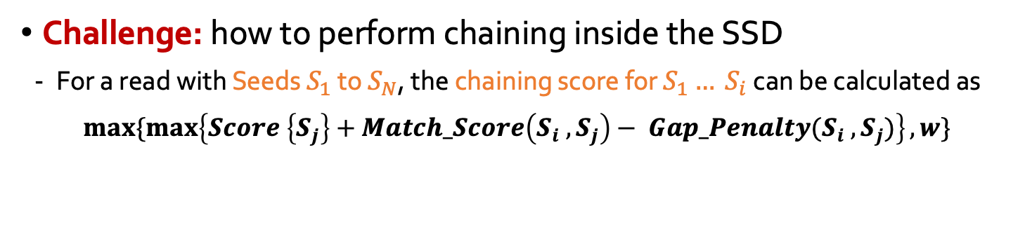
GenStore-NM
Efficient chaining-based in-storage filter to prune most of the non-matching reads
Seeding
Determine potential matching locations (seeds) in the reference genome
Seed Filtering
(e.g., Chaining)
Prune some seeds in the reference genome
Alignment
Determine the exact differences between the read and the reference genome
Challenge: how to perform chaining inside the SSD
  For a read with Seeds $S_{1}$ to $S_{N}$, the chaining score for $S_{1}{… S}_{i}$ can be calculated as
$$\max{\{\max\left\{Score \left\{S_{j}\right\}+Match_Score\left(S_{i} , S_{j}\right)− Gap_Penalty(S_{i} , S_{j})\right\}, w\}}$$
Costly dynamic programming on many seeds in each read
Particularly challenging for long reads with many seeds
i > j > 1
Notes:
Using chaing, GenStore-NM filters most of the nonmatching reads, i.e., reads that would not align to any subsequence in the reference genome. Recall that chaining filter calculates a similarity score for each read (called chaining score) and filters read with no high-scoring potential matching locations.
Calculating a chaining score in the SSD is challenging
because finding the best chaining score requires performing [CLICK] many iterations of a dynamic programming algorithm for all seeds within a read,
This is particularly challenging for long reads since they have a large number of k-mers per read

Slide 162
GenStore-NM: Mechanism
GenStore-NM uses a light-weight chaining filter
  Selectively performs chaining only on reads with a small number of seeds
  Directly sends reads that require more complex chaining to the host system
High Alignment
Probability
Alignment
Probability
Number of seeds per read
Reads with a sufficiently large number of seeds
are very likely to align to the reference genome
✓
  Filters many non-aligning reads without costly hardware resources in the SSD
Notes:
[CLICK] To reduce the cost of chaining, GenStore-NM GenStore-NM uses a light-weight chaining filter
[CLICK] Selectively performs chaining only on reads with a small number of seeds
[CLICK] And Directly send reads that require more complex chaining to the host system
This idea is based on our observation from analyzing a wide range of real world genomic read sets.
[CLICK] This figure shows alignment probability of a read in a long read dataset to subsequences in the reference genome, as a function of the number of seeds per read.
[CLICK] We observe that reads with a sufficiently large number of seeds are very likely to align to subsequences in the reference
genome. Such reads can be directly sent to the CPU for full read mapping (bypassing the in-storage filter).
[CLICK] We conclude that the selective light-weight chaining approach can filter many non-aligning reads without costly hardware resources in the SSD

Slide 163

GenStore-NM: Mechanism
GenStore-NM uses a light-weight chaining filter
  Selectively performs chaining only on reads with a small number of seeds
  Directly sends reads that require more complex chaining to the host system
High Alignment
Probability
Alignment
Probability
Number of seeds per read
Reads with a sufficiently large number of seeds
are very likely to align to the reference genome
Details on GenStore-NM’s design are in the paper
  Can filter many non-aligning reads without costly hardware resources in the SSD
Notes:
[CLICK] To reduce the cost of chaining, GenStore-NM GenStore-NM uses a light-weight chaining filter
[CLICK] Selectively performs chaining only on reads with a small number of seeds
[CLICK] And Directly send reads that require more complex chaining to the host system
This idea is based on our observation from analyzing a wide range of real world genomic read sets.
[CLICK] This figure shows alignment probability of a read in a long read dataset to subsequences in the reference genome, as a function of the number of seeds per read.
[CLICK] We observe that reads with a sufficiently large number of seeds are very likely to align to subsequences in the reference
genome. Such reads can be directly sent to the CPU for full read mapping (bypassing the in-storage filter).
[CLICK] We conclude that the selective light-weight chaining approach can filter many non-aligning reads without costly hardware resources in the SSD

Slide 164
Outline
Background
Motivation and Goal
Experimental Methodology
Temperature Analysis
Aggressor Row Active Time Analysis
Spatial Variation Analysis
Implications on Attacks and Defenses
Conclusions
Motivation and Goal
GenStore
Evaluation
Conclusions
Notes:
I will now go into our results

Slide 165
Evaluation Methodology
Read Mappers
Base: state-of-the-art software or hardware read mappers
  Minimap2 [Bioinformatics’18]: software mapper for short and long reads
  GenCache [MICRO’19]: hardware mapper for short reads
  Darwin [ASPLOS’18]: hardware mapper for long reads
GS: Base integrated with GenStore
SSD Configurations
SSD-L: with SATA3 interface (0.5 GB/s sequential read bandwidth)
SSD-M: with PCIe Gen3 interface (3.5 GB/s sequential read bandwidth)
SSD-H: with PCIe Gen4 interface (7 GB/s sequential read bandwidth)
Notes:
We valuate the following systems:
[CLICK] Base: state-of-the-art software or hardware read mappers for both short and long reads
[CLICK] GS: Base integrated with the GenStore inside the SSD
We evaluate these mappers on systems with various SSD configurations, a low-end, medium-end, and high-end SSD
For other details about our methodology, please refer to the paper.

Slide 166
Performance – GenStore-EM
For a read set with 80% exactly-matching reads
With the Software Mapper
With the Hardware Mapper
3.3x
2.1x
2.1x
29
2.5x
2.5x
1.5x
Exec. time [sec]
2.1× - 2.5× speedup compared to the software Base
1.5× – 3.3× speedup compared to the hardware Base
On average 3.92× energy reduction
Notes:
We analyze the benefits of GenStore-EM for a 22-GB short read set where 80% of reads exactly match some subsequence in the reference genome and can be filtered.
We show the benefit of GS on software and hardware read mappers.
GS provides 2.1× - 2.5× speedup compared to the software Base
GS provides 1.5× – 3.3× speedup compared to the hardware Base
GS provides on average 3.92× energy reduction

Slide 167
Performance – GenStore-NM
For a read set with 99.7% non-matching reads
With the Software Mapper
With the Hardware Mapper
Exec. time [sec]
Log scale
22.4
27.9x
19.2x
29x
6.8x
6.8x
22.4× – 27.9× speedup compared to the software Base
6.8× – 19.2× speedup compared to the hardware Base
On average 27.2× energy reduction
Notes:
We analyze the benefits of GenStore-NM for a 12-GB long read set with very high genetic variation compared the the reference genome where 99.7% of reads do not match any subsequence in the reference genome.
We show the benefit of GS on software and hardware read mappers.
GS provides 22.4× – 27.9× speedup compared to the software Base
GS provides 6.8× – 19.2× speedup compared to the hardware Base
GS provides on average 27.2× energy reduction

Slide 168
Area and Power
Based on Synthesis of GenStore accelerators using the Synopsys Design Compiler @ 65nm technology node
Logic unit | # of instances | Area [mm²] | Power [mW]
Comparator | 1 per SSD | 0.0007 | 0.14
K -mer Window | 2 per channel | 0.0018 | 0.27
Hash Accelerator | 2 per SSD | 0.008 | 1.8
Location Buffer | 1 per channel | 0.00725 | 0.37375
Chaining Buffer | 1 per channel | 0.008 | 0.95
Chaining PE | 1 per channel | 0.004 | 0.98
Control | 1 per SSD | 0.0002 | 0.11
Total for an 8-channel SSD | - | 0.2 | 26.6
Only 0.006% of a 14nm Intel Processor, less than 9.5% of the three ARM processors in a SATA SSD controller
Notes:
We find area and power values of GenStore by synthesizing GenStore-EM and NM using 65nm technology node,
And find that for an 8-channel SSD, the area of GS is 0.2 mm square and the power is 26.6 watts
BY scaling the area to lower technology nodes, we observe that the area overhead of GS is 0.006% of an Intel processor and less than 9.5% of the of the three ARM processors in a SATA SSD controller.

Slide 169
Other Results in the Paper
Effect of read set features on performance
  Data size (up to 440 GB)
  Filter ratio
Performance benefit of an implementation of GenStore outside the SSD
  In some cases, it provides performance benefits due more efficient streaming accesses
  Provides significantly lower benefit compared to GenStore
More detailed characterization of non-matching reads across different read mapping use cases and species
Notes:
Let me briefly talk about other results that are included in the paper before concluding this talk. These include the following:

Slide 170
Outline
Background
Motivation and Goal
Experimental Methodology
Temperature Analysis
Aggressor Row Active Time Analysis
Spatial Variation Analysis
Implications on Attacks and Defenses
Conclusions
Motivation and Goal
GenStore
Evaluation
Conclusions
Notes:
Now, let me conclude by giving the summary.

Slide 171
Conclusion
There has been significant effort into improving read mapping performance through efficient heuristics, hardware acceleration, accurate filters
Problem: while these approaches address the computation overhead, none of them alleviate the data movement overhead from storage
Goal: improve the performance of genome sequence analysis by effectively reducing unnecessary data movement from the storage system
Idea: filter reads that do not require the expensive alignment computation in the storage system to fundamentally reduce the data movement overhead
Challenges:
  Read mapping workloads can exhibit different behavior
  There are limited available hardware resources in the storage system
GenStore: the first in-storage processing system designed for genome sequence analysis to reduce both the computation and data movement overhead
Key Results: GenStore provides significant speedup (1.4x - 33.6x) and energy reduction (3.9x – 29.2x) at low cost
Notes:
[CLICK] There has been significant effort into improving read mapping performance through efficient heuristics, hardware accelerators, and various filters that prune reads that do not require expensive computation.
[CLICK] While these approaches address the computation overhead in read mapping, None of them alleviate the data movement overhead from storage, whose impact becomes even larger when the computation overhead gets alleviated
[CLICK] Our goal is to Improve the performance of genome sequence analysis by effectively reducing unnecessary data movement from the storage system
[CLICK] The key idea is to Filter reads that do not require the expensive ASM computation in the storage system to fundamentally reduce the data movement overhead
CLICK] however, filtering reads inside SSD is challebging 1) Read mapping workloads can exhibit different behavior, and 2) There are limited available hardware resources in the storage system
[CLICK] To this end, we propose GenStore, The first in-storage processing system designed for genome sequence analysis to reduce both the computation/data movement overhead
[CLICK] GenStore provides high-performance and energy benefits compared to state-of-the-art HW and SW baselines

Slide 172
GenStore:
A High-Performance In-Storage Processing System
for Genome Sequence Analysis
Session 6A: Thursday 3 March, 3:00 PM CEST
Nika Mansouri Ghiasi (mnika@ethz.ch)
Jisung Park, Harun Mustafa, Jeremie Kim, Ataberk Olgun,
Arvid Gollwitzer, Damla Senol Cali, Can Firtina, Haiyu Mao, Nour Almadhoun Alserr,
Rachata Ausavarungnirun, Nandita Vijaykumar, Mohammed Alser, and Onur Mutlu
Notes:
That concludes my talk. Thank you very much for listening.

Slide 173
Backup Slides

Slide 174
End-to-End Workflow of Genome Sequence Analysis
There are three key initial steps in a standard genome sequencing and analysis workflow
  Collection, preparation, and sequencing of a DNA sample in the laboratory
  Basecalling
  Read mapping
Genomic read sets can be obtained by
  Sequencing a DNA sample and storing the generated read set into the SSD of a sequencing machine
  Downloading read sets from publicly available repositories and storing them into an SSD
We focus on optimizing the performance of read mapping because sequencing and basecalling are performed only once per read set, whereas read mapping can be performed many times
  Analyzing the differences between a reads from an individual and many reference genomes of other individuals
  Repeating the read mapping step many times to improve the outcome of read mapping
Improving read mapping performance is critical in almost all genomic analyses that use sequencing
  45% of the execution time when discovering sequence variants in cancer genomics studies
  60% of the execution time when profiling the species composition of a multi-species (i.e., metagenomic) read

Slide 175
Motivation
SSD-L
SSD-M
SSD-H
DRAM
2.01
3.54
1.64
1.44
24.8
10.1
0.72
N/A
Execution time [sec]
N/A
SW-filter
ACC

Slide 176
Motivation
Execution time [sec]
N/A
State-of-the-art software read mapper, Minimap2
Base integrated with an
ideal in-storage filter
Base integrated with a software filter
that prunes 80% of exactly-matching reads
Notes:
This plot shows the execution time of three read mapping systems.
Base refers to a State-of-the-art software read mapper, Minimap2
SW-filter refers to Base integrated with a software filter that prunes 80% of exactly-matching reads
Ideal-ISF refers to base integrated with an ideal in-storage filter than prunes 80% exactly matching reads inside the SSD

Slide 177
Motivation
High-end SSD with PCIe Gen4 interface (7 GB/s)
Low-end SSD with SATA3 interface (0.5 GB/s)
Data preloaded in DRAM,
with no I/O overhead
Execution time [sec]
N/A
Notes:
To assess the impact of the storage subsystem, we evaluate each of the three mappers with different configurations
A low-end SSD, a high-end SSD, and DRAM which refers to an idealized scenario where all needed data is preloaded in DRAM with no I/O overhead

Slide 178
Benefits of Ideal In-Storage Filter
Execution time [sec]
N/A
The ideal in-storage filter significantly improves performance by
Reducing computation overhead
Reducing data movement overhead
Notes:
Based on this plot, we make several observations, First…

Slide 179
Overheads of Software Mappers
Execution time [sec]
N/A
I/O has a significant impact on application performance
which can be alleviated at the cost of
expensive storage devices and interfaces
Notes:
By comparing the high-end SSD, low-end SSD, and DRAM with no I/O overhead, we observe that
[CLICK] I/O has a significant impact on application performance
[CLICK] which can be alleviated at the cost of expensive storage devices and interfaces
However, it is challenging to scale a storage system’s capacity using only the high-end SSDs due to
[CLICK] the relatively smaller number of the PCIe slots in a server
[CLICK] And their significantly-higher prices

Slide 180
Overheads of Software Mappers
Execution time [sec]
N/A
SW-filter provides limited benefits compared to Base
The filtering process outside the SSD must compete
with the read mapping process for the resources in the system
Notes:
Third, by comparing Base and SW-filter, we observe that despite a large number of needs that can be filtered, SW-filter does not provide significant benefits compared to base.
The limited speedup is mainly due to large number of accesses to the index structure for several k-mers per each read.
[CLICK] This shows that as opposed to the instorage filter, the filtering process outside the SSD must compete with the read mapping process for the resources in the system

Slide 181
Overheads of Hardware Mappers
24.8
23%
10.1
Execution time [sec]
N/A
Even the high-end SSD does not fully alleviate the storage bottleneck
The ideal in-storage filter significantly improves performance
Notes:
This figures shows similar analysis but with a state-of-the-art hardware read mapper, gencache, and its integration with the ideal in-storage filter.
We observe that Even the high-end SSD does not fully alleviate the storage bottleneck in this case
This is because by addressing computation overhead using the accelerator, I/O turns into a more serious bottleneck.
However, we observe that the ideal n-storage filter significantly improves performance since it addresses both the computation and data movement overheads.

Slide 182

Ideal-OSF
Execution time of an ideal in-storage filter:
Execution time of an ideal outside-storage filter:
  60% slower than Ideal-ISF in our analysis

Slide 183
Comparison to PIM
Even though read mapping applications could also benefit from other near-data, in-storage processing can fundamentally address the data movement problem by filtering large, low-reuse data where the data initially resides.
Even if an ideal accelerator achieved a zero execution time, there would still exist the need to bring the data from storage to the accelerator.
  2.15x slower than the execution time that Ideal-ISF+ACC provides in our motivational analysis
In-storage filter can be integrated with any read mapping accelerator, including PIM accelerators, to alleviate their data movement overhead.

Slide 184
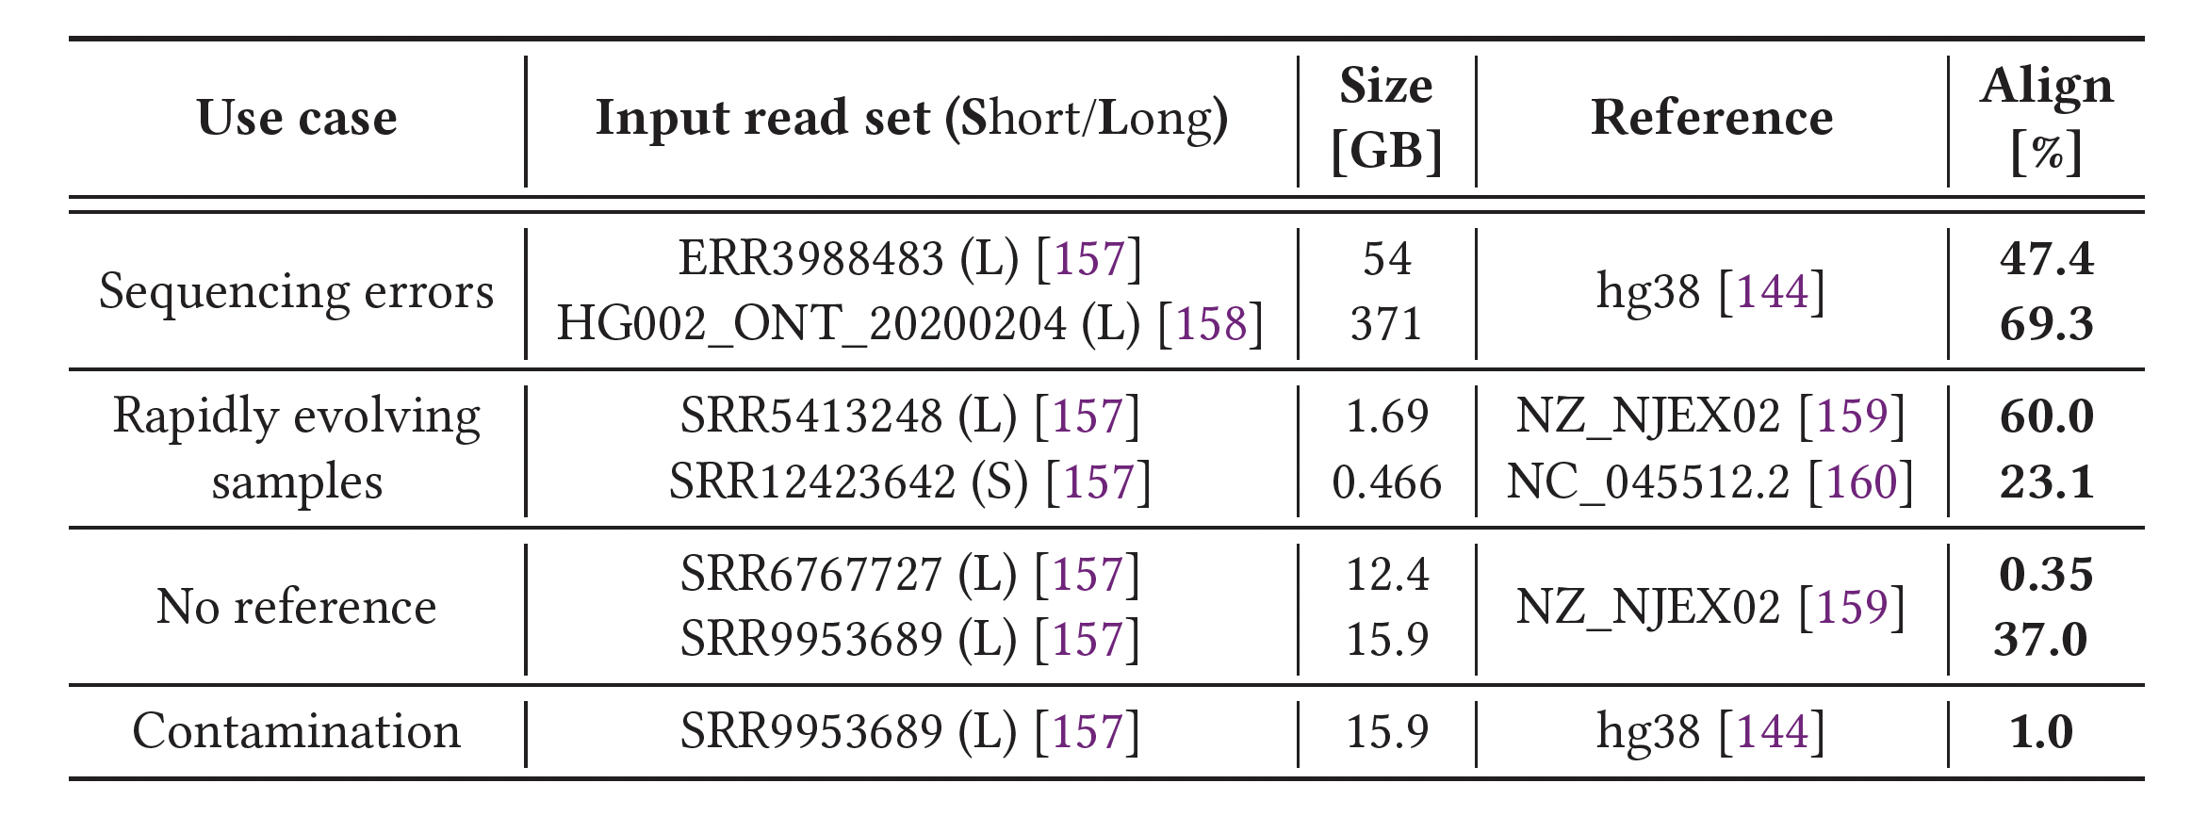
Long Read Use Cases

Slide 185
FTL
Host System
① Start analysis
⑤ Unfiltered data
GenStore-Enabled SSD
❷
❸
GenStore SSD Controller
DRAM
Flash
Ctrl.#1
CH-LV
ACC#1
GenStore
FTL
NAND
Die#1
NAND
Die#4
Core
L2P
Mappings
Core
⋯
Core
Flush
⋯
④ Filtering
③ Full-bandwidth read
⋯
② Preparation
❶
Flash
Ctrl.#N
CH-LV
ACC#N
SSD-LV
ACC
GenStore
Metadata
NAND
Die#1
NAND
Die#4
Load
⋯

Slide 186
FTL: Metadata
GenStore metadata includes the mapping information of the data structures necessary for read mapping acceleration
In accelerator mode, GenStore also keeps in internal DRAM other metadata structures of the regular FTL
  Examples include the page status table and block read counts which need to be updated during the filtering process
We carefully design GenStore to only sequentially access the underlying NAND flash chips while operating as an accelerator
  Requires only a small amount of metadata to access the stored data

Slide 187
FTL: Data Placement
GenStore needs to properly place its data structures to enable the full utilization of the internal SSD bandwidth
When each data structure is initially written to the SSD, GenStore sequentially and evenly distributes it across NAND flash chips
GenStore can specify the physical location of a 30-GB data structure by maintaining only the list of 1,250 (30 GB/24 MB) physical block addresses
It significantly reduces the size of the necessary mapping information from 300 MB (with conventional 4-KiB page mapping) to only 5 KB (1,250 4 bytes)

Slide 188
FTL: SSD Management Tasks
In accelerator mode, GenStore only reads data structures to perform filtering, and does not write any new data
  GenStore does not require any write-related SSD-management tasks such as garbage collection and wear-leveling
The other tasks necessary for ensuring data reliability can be done before or after the filtering process
  GenStore significantly limits the amount of data whose retention age would exceed the manufacturer-specified threshold since GenStore’s filtering process takes a short time.
  GenStore-FTL can easily avoid read disturbance errors for data with high read counts since GenStore sequentially reads NAND flash blocks only once during filtering

Slide 189
Data Sizes
Conventional k-mer index in Minimap2 + reference genome: 7 GB (k = 15)
Read-sized k-mer index before optimization: 126 GB (k= 150)
Read-sized k-mer index after optimization: 32 GB (k = 150)

Slide 190
SSD Specs
SSD-L: SATA3 interface (0.5 GB/s sequential read)
  1.2 GB/s per channel bandwidth
  8 channels
SSD-L: PCIe Gen3 M.2 interface (3.5 GB/s sequential read)
  1.2 GB/s per channel bandwidth
  16 channels
SSD-L: PCIe Gen4 interface (7 GB/s sequential read)
  1.2 GB/s per channel bandwidth
  16 channels

Slide 191
Evaluation Methodology
Performance modeling
  Ramulator for DRAM timing
  MQSim for SSD timing
  We model the end-to-end throughput of GenStore based on the throughput of each GenStore pipeline stage
    Accessing NAND flash chips
    Accessing internal DRAM
    Accelerator computation
    Transferring unfiltered data to the host
Real system results
  AMD EPYC 7742 CPU
  1TB DDR4 DRAM
  AMD μProf
Notes:
I won’t go into details, but you can refer to our paper for more details about our evaluation methdology.

Slide 192
GenStore-NM
Host System
GenStore-Enabled SSD
# of Seeds ≥ N
High chaining score
Flash Array
SSD Controller
Input
Read Set
Seed Finder
❸
❶
Chaining-Based Filter
(Filters low-score reads)
① Reads
K-mer Window
②
K-mers
M ≤ # of Seeds < N
③ Query
❷
DRAM
Hash Acc.
Seed Count-Based Filter
(Filters if # of Seeds < M)
KmerIndex
④ Seeds
Location Buffer

Slide 193
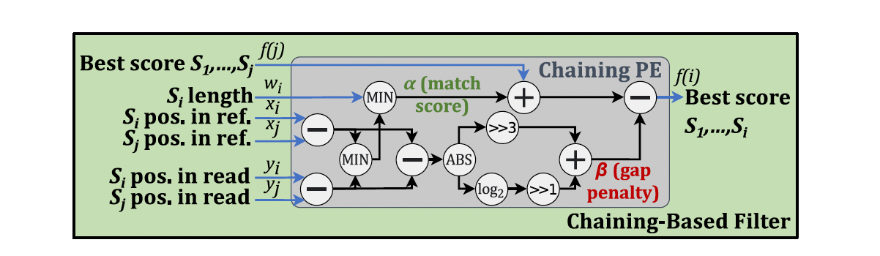
Chaining Processing Element

Slide 194
GenStore-EM
44
108
15
Exec. time [sec]
GS-Ext provides significant performance improvements
over both Base and SIMD in SSD-M and SSD-H.
GS-Ext provides limited benefits over SIMD in SSD-L
due to low external I/O bandwidth.
Notes:
GS-Ext provides significant performance
improvements over both Base and SIMD in SSD-M and SSD-H. However,
GS-Ext provides limited benefits over SIMD in SSD-L since
its performance is bottlenecked by the low external I/O bandwidth.

Slide 195
GenStore-NM
GS-Ext performs significantly slower than Base (2.28x - 1.91x)
on all systems.
Notes:
GS-Ext performs significantly slower than Base (2.28x - 1.91x) on all systems.

Slide 196
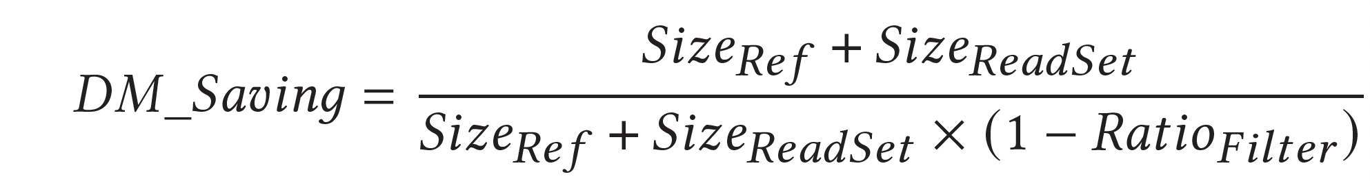
Effect of Inputs on GenStore-EM
Normalized
exec. time
Exact match:
Read set size:

Slide 197
Effect of Inputs on GenStore-NM
0.69
Normalized
exec. time
0.67
0.66
Align. rate:
Read set size:

Slide 198
Relevant Courses & Training

Slide 199

Special Research Sessions & Courses
Special Session at ISVLSI 2022: 9 cutting-edge talks
https://www.youtube.com/watch?v=qeukNs5XI3g

Slide 200

Special Research Sessions & Courses (II)
Special Session at ISVLSI 2022: 9 cutting-edge talks
https://www.youtube.com/playlist?list=PL5Q2soXY2Zi8KzG2CQYRNQOVD0GOBrnKy

Slide 201

Comp Arch (Fall 2021)
Fall 2021 Edition:
  https://safari.ethz.ch/architecture/fall2021/doku.php?id=schedule
Fall 2020 Edition:
  https://safari.ethz.ch/architecture/fall2020/doku.php?id=schedule
Youtube Livestream (2021):
  https://www.youtube.com/watch?v=4yfkM_5EFgo&list=PL5Q2soXY2Zi-Mnk1PxjEIG32HAGILkTOF
Youtube Livestream (2020):
  https://www.youtube.com/watch?v=c3mPdZA-Fmc&list=PL5Q2soXY2Zi9xidyIgBxUz7xRPS-wisBN
Master’s level course
  Taken by Bachelor’s/Masters/PhD students
  Cutting-edge research topics + fundamentals in Computer Architecture
  5 Simulator-based Lab Assignments
  Potential research exploration
  Many research readings
https://www.youtube.com/onurmutlulectures

Slide 202

DDCA (Spring 2022)
Spring 2022 Edition:
  https://safari.ethz.ch/digitaltechnik/spring2022/doku.php?id=schedule
Spring 2021 Edition:
  https://safari.ethz.ch/digitaltechnik/spring2021/doku.php?id=schedule
Youtube Livestream (Spring 2022):
  https://www.youtube.com/watch?v=cpXdE3HwvK0&list=PL5Q2soXY2Zi97Ya5DEUpMpO2bbAoaG7c6
Youtube Livestream (Spring 2021):
  https://www.youtube.com/watch?v=LbC0EZY8yw4&list=PL5Q2soXY2Zi_uej3aY39YB5pfW4SJ7LlN
Bachelor’s course
  2nd semester at ETH Zurich
  Rigorous introduction into “How Computers Work”
  Digital Design/Logic
  Computer Architecture
  10 FPGA Lab Assignments
https://www.youtube.com/onurmutlulectures

Slide 203


Processing-in-Memory Course (Fall 2022)
Short weekly lectures
Hands-on projects
https://safari.ethz.ch/projects_and_seminars/fall2022/doku.php?id=processing_in_memory
https://youtube.com/playlist?list=PL5Q2soXY2Zi8KzG2CQYRNQOVD0GOBrnKy

Slide 204
PIM Course (Fall 2022)
Fall 2022 Edition:
  https://safari.ethz.ch/projects_and_seminars/fall2022/doku.php?id=processing_in_memory
Spring 2022 Edition:
  https://safari.ethz.ch/projects_and_seminars/spring2022/doku.php?id=processing_in_memory
Youtube Livestream (Fall 2022):
  https://www.youtube.com/watch?v=QLL0wQ9I4Dw&list=PL5Q2soXY2Zi8KzG2CQYRNQOVD0GOBrnKy
Youtube Livestream (Spring 2022):
  https://www.youtube.com/watch?v=9e4Chnwdovo&list=PL5Q2soXY2Zi-841fUYYUK9EsXKhQKRPyX
Project course
  Taken by Bachelor’s/Master’s students
  Processing-in-Memory lectures
  Hands-on research exploration
  Many research readings
https://www.youtube.com/onurmutlulectures

Slide 205



Real PIM Tutorial (HPCA 2023)
February 26: Lectures + Hands-on labs + Invited Talks
https://www.youtube.com/watch?v=f5-nT1tbz5w
https://events.safari.ethz.ch/real-pim-tutorial/

Slide 206



Real PIM Tutorial (ASPLOS 2023)
March 26: Lectures + Hands-on labs + Invited talks
https://www.youtube.com/watch?v=oYCaLcT0Kmo
https://events.safari.ethz.ch/asplos-pim-tutorial/

Slide 207
Upcoming Real PIM Tutorial (ISCA 2023)
June 18: Lectures + Hands-on labs + Invited talks
https://events.safari.ethz.ch/isca-pim-tutorial/

Slide 208
SSD Course (Spring 2023)
Spring 2023 Edition:
  https://safari.ethz.ch/projects_and_seminars/spring2023/doku.php?id=modern_ssds
Fall 2022 Edition:
  https://safari.ethz.ch/projects_and_seminars/fall2022/doku.php?id=modern_ssds
Youtube Livestream (Spring 2023):
  https://www.youtube.com/watch?v=4VTwOMmsnJY&list=PL5Q2soXY2Zi_8qOM5Icpp8hB2SHtm4z57&pp=iAQB
Youtube Livestream (Fall 2022):
  https://www.youtube.com/watch?v=hqLrd-Uj0aU&list=PL5Q2soXY2Zi9BJhenUq4JI5bwhAMpAp13&pp=iAQB
Project course
  Taken by Bachelor’s/Master’s students
  SSD Basics and Advanced Topics
  Hands-on research exploration
  Many research readings
https://www.youtube.com/onurmutlulectures

Slide 209
Genomics Course (Fall 2022)
Fall 2022 Edition:
  https://safari.ethz.ch/projects_and_seminars/fall2022/doku.php?id=bioinformatics
Spring 2022 Edition:
  https://safari.ethz.ch/projects_and_seminars/spring2022/doku.php?id=bioinformatics
Youtube Livestream (Fall 2022):
  https://www.youtube.com/watch?v=nA41964-9r8&list=PL5Q2soXY2Zi8tFlQvdxOdizD_EhVAMVQV
Youtube Livestream (Spring 2022):
  https://www.youtube.com/watch?v=DEL_5A_Y3TI&list=PL5Q2soXY2Zi8NrPDgOR1yRU_Cxxjw-u18
Project course
  Taken by Bachelor’s/Master’s students
  Genomics lectures
  Hands-on research exploration
  Many research readings
https://www.youtube.com/onurmutlulectures

Slide 210

Hetero. Systems (Spring’22)
Spring 2022 Edition:
  https://safari.ethz.ch/projects_and_seminars/spring2022/doku.php?id=heterogeneous_systems
Youtube Livestream:
  https://www.youtube.com/watch?v=oFO5fTrgFIY&list=PL5Q2soXY2Zi9XrgXR38IM_FTjmY6h7Gzm
Project course
  Taken by Bachelor’s/Master’s students
  GPU and Parallelism lectures
  Hands-on research exploration
  Many research readings
https://www.youtube.com/onurmutlulectures

Slide 211


HW/SW Co-Design (Spring 2022)
Spring 2022 Edition:
  https://safari.ethz.ch/projects_and_seminars/spring2022/doku.php?id=hw_sw_codesign
Youtube Livestream:
  https://youtube.com/playlist?list=PL5Q2soXY2Zi8nH7un3ghD2nutKWWDk-NK
Project course
  Taken by Bachelor’s/Master’s students
  HW/SW co-design lectures
  Hands-on research exploration
  Many research readings
https://www.youtube.com/onurmutlulectures

Slide 212

RowHammer & DRAM Exploration (Fall 2022)
Fall 2022 Edition:
  https://safari.ethz.ch/projects_and_seminars/fall2022/doku.php?id=softmc
Spring 2022 Edition:
  https://safari.ethz.ch/projects_and_seminars/spring2022/doku.php?id=softmc
Youtube Livestream (Spring 2022):
  https://www.youtube.com/watch?v=r5QxuoJWttg&list=PL5Q2soXY2Zi_1trfCckr6PTN8WR72icUO
Bachelor’s course
  Elective at ETH Zurich
  Introduction to DRAM organization & operation
  Tutorial on using FPGA-based infrastructure
  Verilog & C++
  Potential research exploration
https://www.youtube.com/onurmutlulectures

Slide 213

Exploration of Emerging Memory Systems (Fall 2022)
Fall 2022 Edition:
  https://safari.ethz.ch/projects_and_seminars/fall2022/doku.php?id=ramulator
Spring 2022 Edition:
  https://safari.ethz.ch/projects_and_seminars/spring2022/doku.php?id=ramulator
Youtube Livestream (Spring 2022):
  https://www.youtube.com/watch?v=aM-llXRQd3s&list=PL5Q2soXY2Zi_TlmLGw_Z8hBo2925ZApqV
Bachelor’s course
  Elective at ETH Zurich
  Introduction to memory system simulation
  Tutorial on using Ramulator
  C++
  Potential research exploration
https://www.youtube.com/onurmutlulectures

