Slide 1


Opportunities and Challenges of Emerging Memory Technologies
Onur Mutlu
omutlu@gmail.com
https://people.inf.ethz.ch/omutlu
September 11, 2017
ARM Research Summit

Slide 2



The Main Memory System
Main memory is a critical component of all computing systems: server, mobile, embedded, desktop, sensor
Main memory system must scale (in size, technology, efficiency, cost, and management algorithms) to maintain performance growth and technology scaling benefits
Processors
and caches
Main Memory
Storage (SSD/HDD)

Slide 3
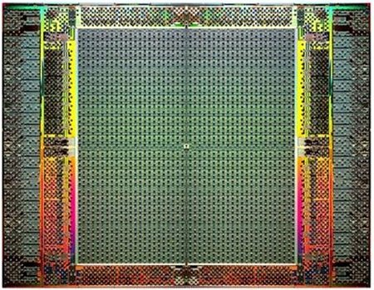
The Main Memory System
Main memory is a critical component of all computing systems: server, mobile, embedded, desktop, sensor
Main memory system must scale (in size, technology, efficiency, cost, and management algorithms) to maintain performance growth and technology scaling benefits
FPGAs
Main Memory
Storage (SSD/HDD)

Slide 4
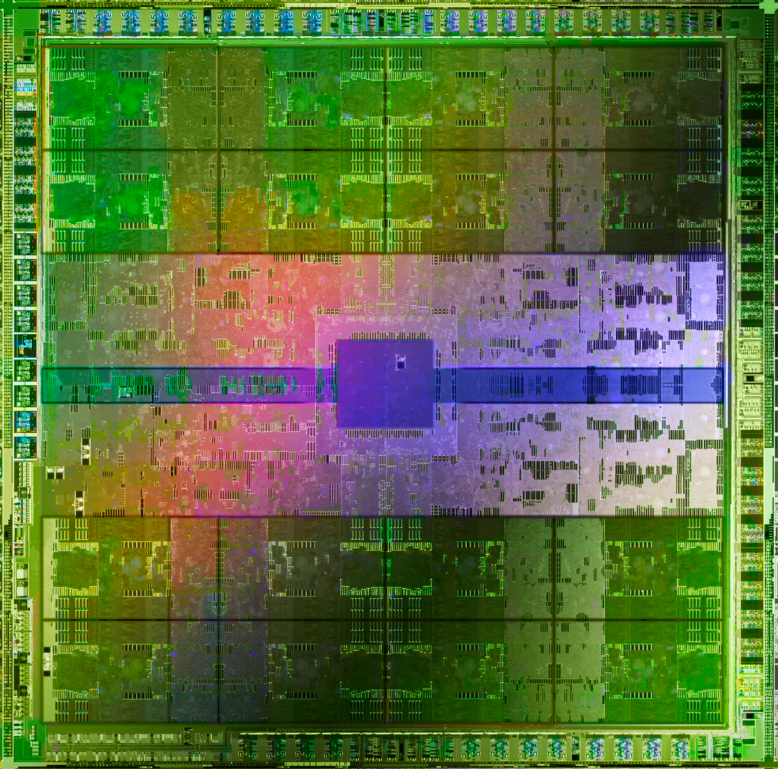
The Main Memory System
Main memory is a critical component of all computing systems: server, mobile, embedded, desktop, sensor
Main memory system must scale (in size, technology, efficiency, cost, and management algorithms) to maintain performance growth and technology scaling benefits
GPUs
Main Memory
Storage (SSD/HDD)

Slide 5
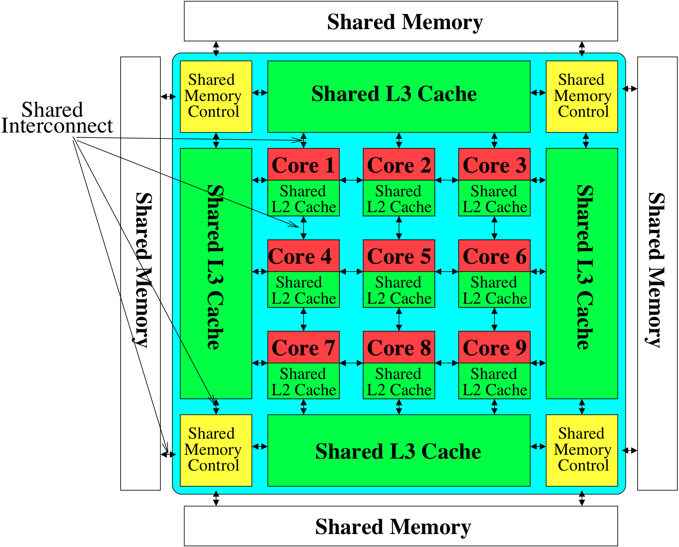
Memory System: A Shared Resource View
Storage
Most of the system is dedicated to storing and moving data

Slide 6
State of the Main Memory System
Recent technology, architecture, and application trends
  lead to new requirements
  exacerbate old requirements
DRAM and memory controllers, as we know them today, are (will be) unlikely to satisfy all requirements
Some emerging non-volatile memory technologies (e.g., PCM) enable new opportunities: memory+storage merging
We need to rethink the main memory system
  to fix DRAM issues and enable emerging technologies
  to satisfy all requirements

Slide 7
Major Trends Affecting Main Memory (I)
Need for main memory capacity, bandwidth, QoS increasing
Main memory energy/power is a key system design concern
DRAM technology scaling is ending

Slide 8
Major Trends Affecting Main Memory (II)
Need for main memory capacity, bandwidth, QoS increasing
  Multi-core: increasing number of cores/agents
  Data-intensive applications: increasing demand/hunger for data
  Consolidation: cloud computing, GPUs, mobile, heterogeneity
Main memory energy/power is a key system design concern
DRAM technology scaling is ending

Slide 9
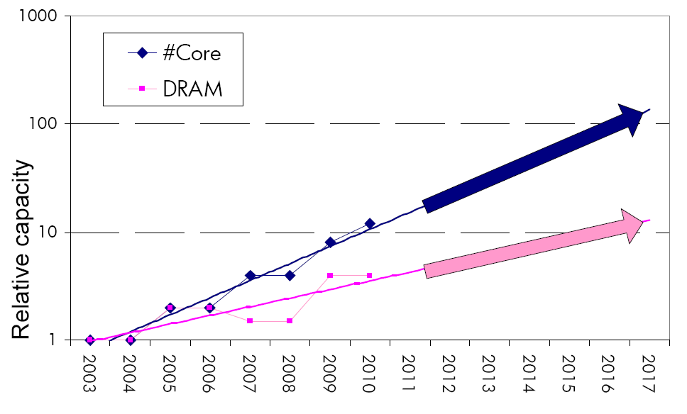
Example: The Memory Capacity Gap
Core count doubling ~ every 2 years
DRAM DIMM capacity doubling ~ every 3 years
Memory capacity per core expected to drop by 30% every two years
Trends worse for memory bandwidth per core!
Lim et al., ISCA 2009

Slide 10
Major Trends Affecting Main Memory (III)
Need for main memory capacity, bandwidth, QoS increasing
Main memory energy/power is a key system design concern
  ~40-50% energy spent in off-chip memory hierarchy [Lefurgy, IEEE Computer’03] >40% power in DRAM [Ware, HPCA’10][Paul,ISCA’15]
  DRAM consumes power even when not used (periodic refresh)
DRAM technology scaling is ending

Slide 11
Major Trends Affecting Main Memory (IV)
Need for main memory capacity, bandwidth, QoS increasing
Main memory energy/power is a key system design concern
DRAM technology scaling is ending
  ITRS projects DRAM will not scale easily below X nm
  Scaling has provided many benefits:
    higher capacity (density), lower cost, lower energy

Slide 12
Major Trends Affecting Main Memory (V)
DRAM scaling has already become increasingly difficult
  Increasing cell leakage current, reduced cell reliability, increasing manufacturing difficulties [Kim+ ISCA 2014],
  [Liu+ ISCA 2013], [Mutlu IMW 2013], [Mutlu DATE 2017]
  Difficult to significantly improve capacity, energy
Emerging memory technologies are promising
3D-Stacked DRAM | higher bandwidth | smaller capacity
Reduced-Latency DRAM (e.g., RLDRAM, TL-DRAM) | lower latency | higher cost
Low-Power DRAM (e.g., LPDDR3, LPDDR4) | lower power | higher latency higher cost
Non-Volatile Memory (NVM) (e.g., PCM, STTRAM, ReRAM, 3D Xpoint) | larger capacity | higher latency higher dynamic power lower endurance

Slide 13
Major Trends Affecting Main Memory (V)
DRAM scaling has already become increasingly difficult
  Increasing cell leakage current, reduced cell reliability, increasing manufacturing difficulties [Kim+ ISCA 2014],
  [Liu+ ISCA 2013], [Mutlu IMW 2013], [Mutlu DATE 2017]
  Difficult to significantly improve capacity, energy
Emerging memory technologies are promising
3D-Stacked DRAM | higher bandwidth | smaller capacity
Reduced-Latency DRAM (e.g., RLDRAM, TL-DRAM) | lower latency | higher cost
Low-Power DRAM (e.g., LPDDR3, LPDDR4) | lower power | higher latency higher cost
Non-Volatile Memory (NVM) (e.g., PCM, STTRAM, ReRAM, 3D Xpoint) | larger capacity | higher latency higher dynamic power lower endurance

Slide 14
Agenda
Major Trends Affecting Main Memory
The Memory Scaling Problem
Two Complementary Solution Directions
  New Memory (DRAM) Architectures
  Enabling Emerging (NVM) Technologies
Conclusion

Slide 15
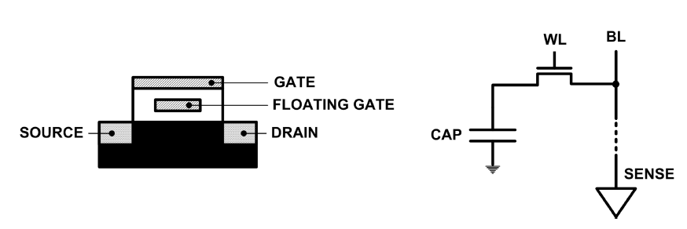
Limits of Charge Memory
Difficult charge placement and control
  Flash: floating gate charge
  DRAM: capacitor charge, transistor leakage
Reliable sensing becomes difficult as charge storage unit size reduces

Slide 16
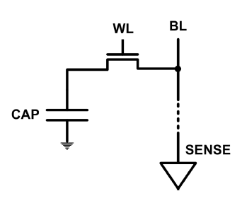
The DRAM Scaling Problem
DRAM stores charge in a capacitor (charge-based memory)
  Capacitor must be large enough for reliable sensing
  Access transistor should be large enough for low leakage and high retention time
  Scaling beyond 40-35nm (2013) is challenging [ITRS, 2009]
DRAM capacity, cost, and energy/power hard to scale

Slide 17
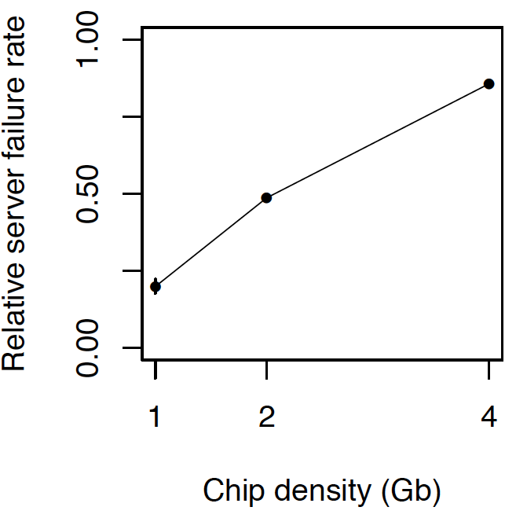
As Memory Scales, It Becomes Unreliable
Data from all of Facebook’s servers worldwide
Meza+, “Revisiting Memory Errors in Large-Scale Production Data Centers,” DSN’15.
Intuition:
quadratic
increase in
capacity

Slide 18
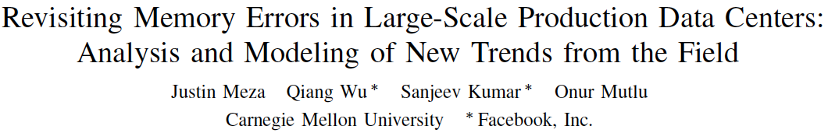
Large-Scale Failure Analysis of DRAM Chips
Analysis and modeling of memory errors found in all of Facebook’s server fleet
Justin Meza, Qiang Wu, Sanjeev Kumar, and Onur Mutlu,
"Revisiting Memory Errors in Large-Scale Production Data Centers: Analysis and Modeling of New Trends from the Field"
Proceedings of the 45th Annual IEEE/IFIP International Conference on Dependable Systems and Networks (DSN), Rio de Janeiro, Brazil, June 2015.
[Slides (pptx) (pdf)] [DRAM Error Model]

Slide 19

Infrastructures to Understand Such Issues
Temperature
Controller
FPGAs
Heater
FPGAs
PC
  Kim+, “Flipping Bits in Memory Without Accessing Them: An Experimental Study of DRAM Disturbance Errors,” ISCA 2014.

Slide 20
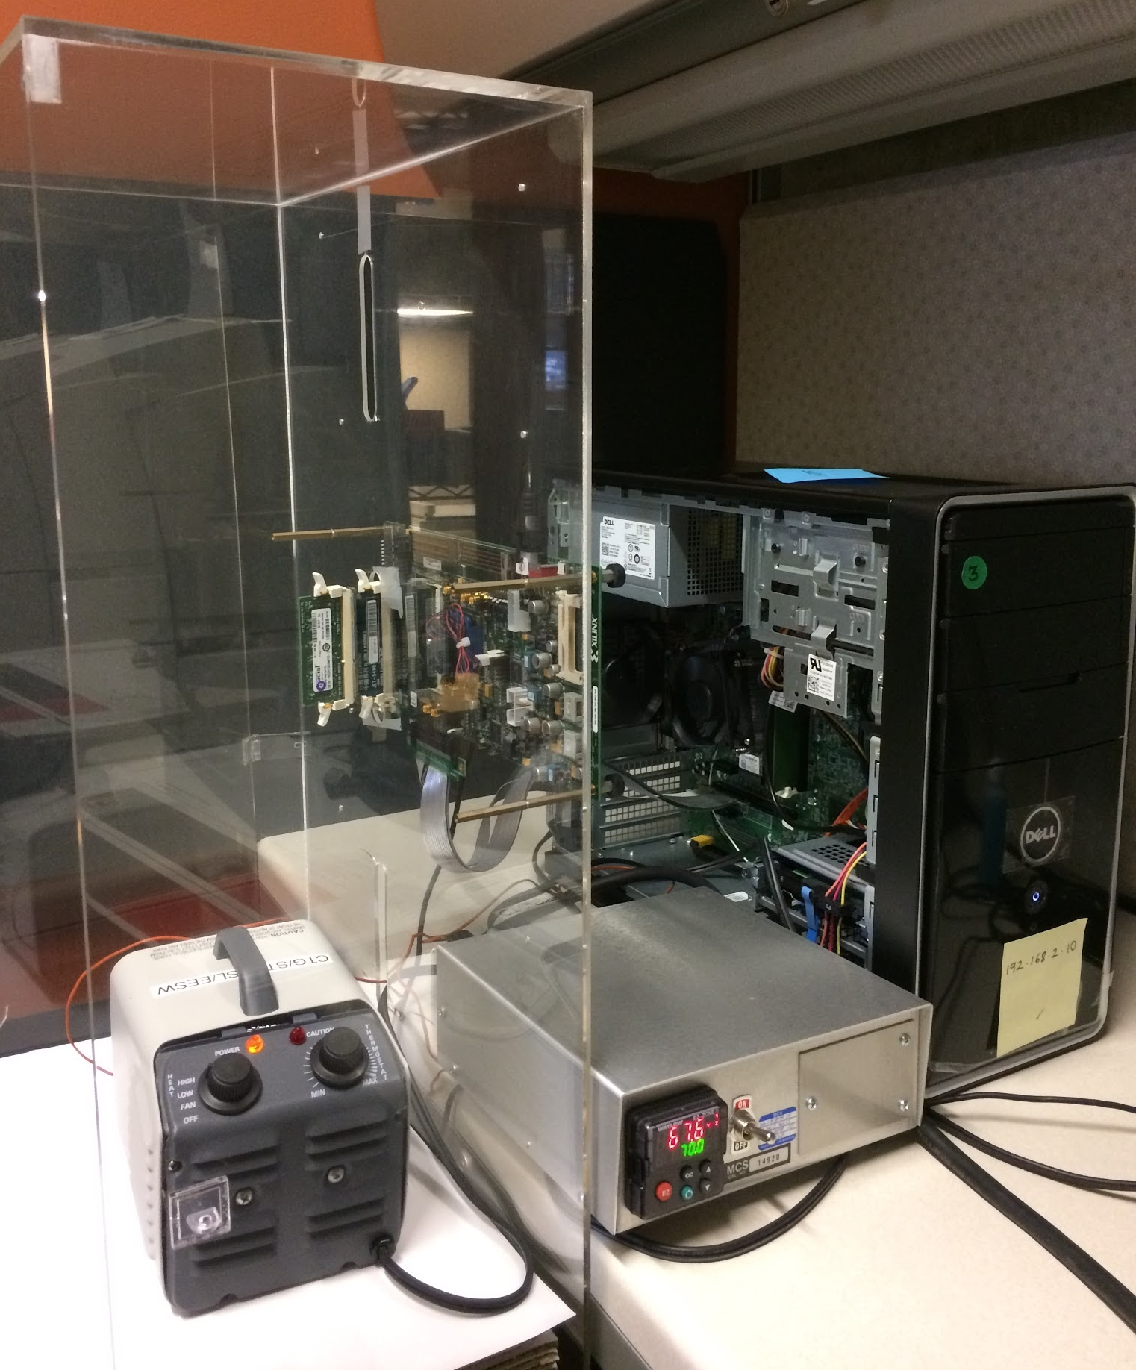
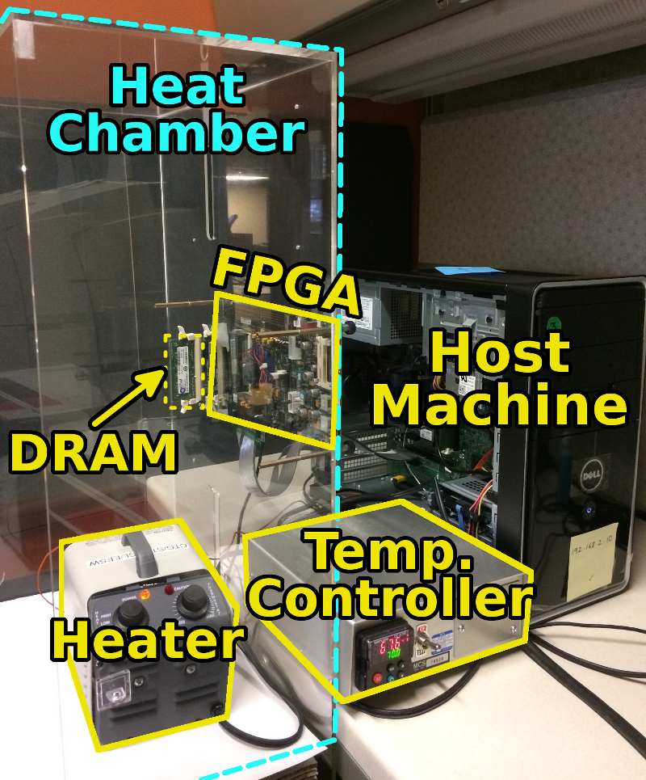
SoftMC: Open Source DRAM Infrastructure
Hasan Hassan et al., “SoftMC: A Flexible and Practical Open-Source Infrastructure for Enabling Experimental DRAM Studies,” HPCA 2017.
Flexible
Easy to Use (C++ API)
Open-source
github.com/CMU-SAFARI/SoftMC

Slide 21
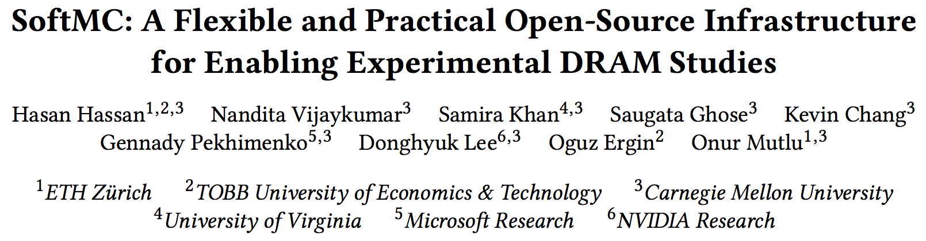
SoftMC
https://github.com/CMU-SAFARI/SoftMC

Slide 22
A Curious Discovery [Kim et al., ISCA 2014]
One can
predictably induce errors
in most DRAM memory chips

Slide 23
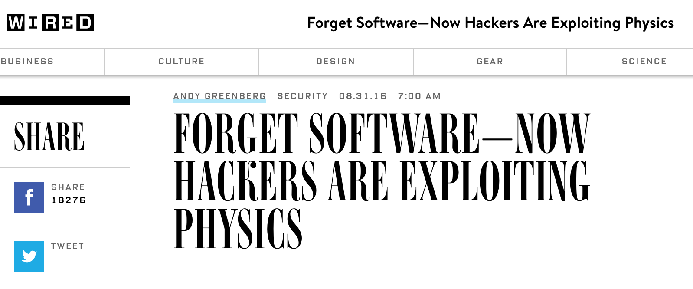
DRAM RowHammer
A simple hardware failure mechanism
can create a widespread
system security vulnerability

Slide 24
Modern DRAM is Prone to Disturbance Errors
Row of Cells
Wordline
Row
Victim Row
Row
Hammered Row
V_{LOW}
Opened
V_{HIGH}
Closed
Row
Victim Row
Row
Repeatedly reading a row enough times (before memory gets refreshed) induces disturbance errors in adjacent rows in most real DRAM chips you can buy today
Flipping Bits in Memory Without Accessing Them: An Experimental Study of DRAM Disturbance Errors, (Kim et al., ISCA 2014)

Slide 25
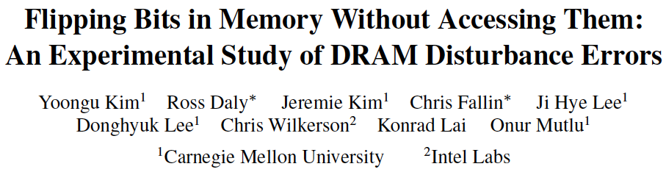
More on RowHammer Analysis
Yoongu Kim, Ross Daly, Jeremie Kim, Chris Fallin, Ji Hye Lee, Donghyuk Lee, Chris Wilkerson, Konrad Lai, and Onur Mutlu,
"Flipping Bits in Memory Without Accessing Them: An Experimental Study of DRAM Disturbance Errors"
Proceedings of the 41st International Symposium on Computer Architecture (ISCA), Minneapolis, MN, June 2014.
[Slides (pptx) (pdf)] [Lightning Session Slides (pptx) (pdf)] [Source Code and Data]

Slide 26
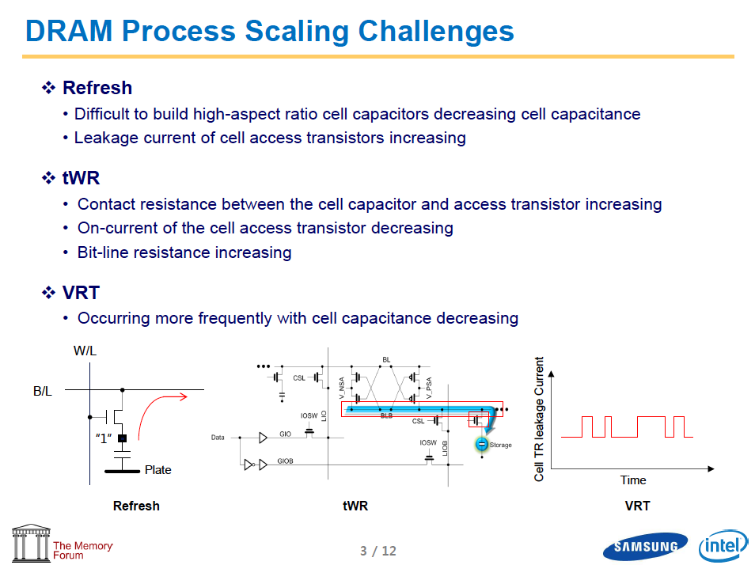
Industry Is Writing Papers About It, Too

Slide 27
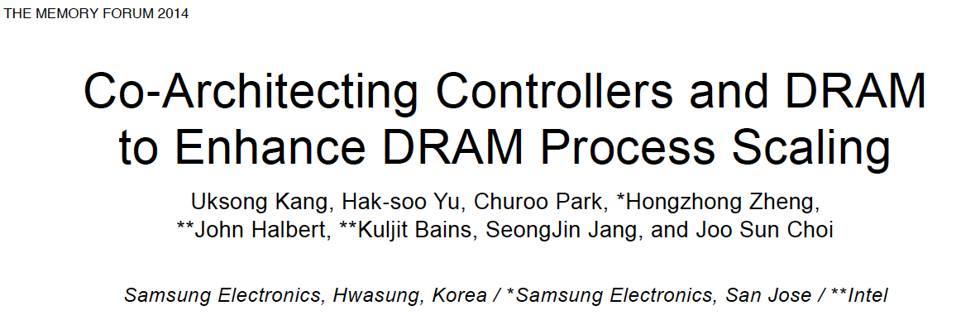
Industry Is Writing Papers About It, Too

Slide 28
How Do We Solve The Memory Problem?
Fix it: Make memory and controllers more intelligent
  New interfaces, functions, architectures: system-mem codesign
Eliminate or minimize it: Replace or (more likely) augment DRAM with a different technology
  New technologies and system-wide rethinking of memory & storage
Embrace it: Design heterogeneous memories (none of which are perfect) and map data intelligently across them
  New models for data management and maybe usage
…
Problems
Algorithms
Programs
User
Runtime System
(VM, OS, MM)
ISA
Microarchitecture
Logic
Devices
Solutions (to memory scaling) require
software/hardware/device cooperation

Slide 29
Agenda
Major Trends Affecting Main Memory
The Memory Scaling Problem
Two Complementary Solution Directions
  New Memory (DRAM) Architectures
  Enabling Emerging (NVM) Technologies
Conclusion

Slide 30
Solution 1: New Memory Architectures
Overcome memory shortcomings with
  Memory-centric system design
  Novel memory architectures, interfaces, functions
  Better waste management (efficient utilization)
Key issues to tackle
  Enable reliability at low cost → high capacity
  Reduce energy
  Improve latency and bandwidth
  Reduce waste (capacity, bandwidth, latency)
  Enable computation close to data

Slide 31
Solution 1: New Memory Architectures
Liu+, “RAIDR: Retention-Aware Intelligent DRAM Refresh,” ISCA 2012.
Kim+, “A Case for Exploiting Subarray-Level Parallelism in DRAM,” ISCA 2012.
Lee+, “Tiered-Latency DRAM: A Low Latency and Low Cost DRAM Architecture,” HPCA 2013.
Liu+, “An Experimental Study of Data Retention Behavior in Modern DRAM Devices,” ISCA 2013.
Seshadri+, “RowClone: Fast and Efficient In-DRAM Copy and Initialization of Bulk Data,” MICRO 2013.
Pekhimenko+, “Linearly Compressed Pages: A Main Memory Compression Framework,” MICRO 2013.
Chang+, “Improving DRAM Performance by Parallelizing Refreshes with Accesses,” HPCA 2014.
Khan+, “The Efficacy of Error Mitigation Techniques for DRAM Retention Failures: A Comparative Experimental Study,” SIGMETRICS 2014.
Luo+, “Characterizing Application Memory Error Vulnerability to Optimize Data Center Cost,” DSN 2014.
Kim+, “Flipping Bits in Memory Without Accessing Them: An Experimental Study of DRAM Disturbance Errors,” ISCA 2014.
Lee+, “Adaptive-Latency DRAM: Optimizing DRAM Timing for the Common-Case,” HPCA 2015.
Qureshi+, “AVATAR: A Variable-Retention-Time (VRT) Aware Refresh for DRAM Systems,” DSN 2015.
Meza+, “Revisiting Memory Errors in Large-Scale Production Data Centers: Analysis and Modeling of New Trends from the Field,” DSN 2015.
Kim+, “Ramulator: A Fast and Extensible DRAM Simulator,” IEEE CAL 2015.
Seshadri+, “Fast Bulk Bitwise AND and OR in DRAM,” IEEE CAL 2015.
Ahn+, “A Scalable Processing-in-Memory Accelerator for Parallel Graph Processing,” ISCA 2015.
Ahn+, “PIM-Enabled Instructions: A Low-Overhead, Locality-Aware Processing-in-Memory Architecture,” ISCA 2015.
Lee+, “Decoupled Direct Memory Access: Isolating CPU and IO Traffic by Leveraging a Dual-Data-Port DRAM,” PACT 2015.
Seshadri+, “Gather-Scatter DRAM: In-DRAM Address Translation to Improve the Spatial Locality of Non-unit Strided Accesses,” MICRO 2015.
Lee+, “Simultaneous Multi-Layer Access: Improving 3D-Stacked Memory Bandwidth at Low Cost,” TACO 2016.
Hassan+, “ChargeCache: Reducing DRAM Latency by Exploiting Row Access Locality,” HPCA 2016.
Chang+, “Low-Cost Inter-Linked Subarrays (LISA): Enabling Fast Inter-Subarray Data Migration in DRAM,” HPCA 2016.
Chang+, “Understanding Latency Variation in Modern DRAM Chips Experimental Characterization, Analysis, and Optimization,” SIGMETRICS 2016.
Khan+, “PARBOR: An Efficient System-Level Technique to Detect Data Dependent Failures in DRAM,” DSN 2016.
Hsieh+, “Transparent Offloading and Mapping (TOM): Enabling Programmer-Transparent Near-Data Processing in GPU Systems,” ISCA 2016.
Hashemi+, “Accelerating Dependent Cache Misses with an Enhanced Memory Controller,” ISCA 2016.
Boroumand+, “LazyPIM: An Efficient Cache Coherence Mechanism for Processing-in-Memory,” IEEE CAL 2016.
Pattnaik+, “Scheduling Techniques for GPU Architectures with Processing-In-Memory Capabilities,” PACT 2016.
Hsieh+, “Accelerating Pointer Chasing in 3D-Stacked Memory: Challenges, Mechanisms, Evaluation,” ICCD 2016.
Hashemi+, “Continuous Runahead: Transparent Hardware Acceleration for Memory Intensive Workloads,” MICRO 2016.
Khan+, “A Case for Memory Content-Based Detection and Mitigation of Data-Dependent Failures in DRAM",” IEEE CAL 2016.
Hassan+, “SoftMC: A Flexible and Practical Open-Source Infrastructure for Enabling Experimental DRAM Studies,” HPCA 2017.
Mutlu, “The RowHammer Problem and Other Issues We May Face as Memory Becomes Denser,” DATE 2017.
Lee+, “Design-Induced Latency Variation in Modern DRAM Chips: Characterization, Analysis, and Latency Reduction Mechanisms,” SIGMETRICS 2017.
Chang+, “Understanding Reduced-Voltage Operation in Modern DRAM Devices: Experimental Characterization, Analysis, and Mechanisms,” SIGMETRICS 2017.
Patel+, “The Reach Profiler (REAPER): Enabling the Mitigation of DRAM Retention Failures via Profiling at Aggressive Conditions,” ISCA 2017.
Seshadri and Mutlu, “Simple Operations in Memory to Reduce Data Movement,” ADCOM 2017.
Liu+, “Concurrent Data Structures for Near-Memory Computing,” SPAA 2017.
Khan+, “Detecting and Mitigating Data-Dependent DRAM Failures by Exploiting Current Memory Content,” MICRO 2017.
Seshadri+, “Ambit: In-Memory Accelerator for Bulk Bitwise Operations Using Commodity DRAM Technology,” MICRO 2017.
Avoid DRAM:
  Seshadri+, “The Evicted-Address Filter: A Unified Mechanism to Address Both Cache Pollution and Thrashing,” PACT 2012.
  Pekhimenko+, “Base-Delta-Immediate Compression: Practical Data Compression for On-Chip Caches,” PACT 2012.
  Seshadri+, “The Dirty-Block Index,” ISCA 2014.
  Pekhimenko+, “Exploiting Compressed Block Size as an Indicator of Future Reuse,” HPCA 2015.
  Vijaykumar+, “A Case for Core-Assisted Bottleneck Acceleration in GPUs: Enabling Flexible Data Compression with Assist Warps,” ISCA 2015.
  Pekhimenko+, “Toggle-Aware Bandwidth Compression for GPUs,” HPCA 2016.

Slide 32
Example: (Truly) In-Memory Computation
We can support in-DRAM COPY, ZERO, AND, OR, NOT, MAJ
At low cost
Using analog computation capability of DRAM
  Idea: activating multiple rows performs computation
30-60X performance and energy improvement
  Seshadri+, “Ambit: In-Memory Accelerator for Bulk Bitwise Operations Using Commodity DRAM Technology,” MICRO 2017.
New memory technologies enable even more opportunities
  Memristors, resistive RAM, phase change mem, STT-MRAM, …
  Can operate on data with minimal movement

Slide 33
Performance: In-DRAM Bitwise Operations

Slide 34
Energy of In-DRAM Bitwise Operations
Seshadri+, “Ambit: In-Memory Accelerator for Bulk Bitwise Operations using Commodity DRAM Technology,” MICRO 2017.

Slide 35
More on Ambit
Vivek Seshadri et al., “Ambit: In-Memory Accelerator for Bulk Bitwise Operations Using Commodity DRAM Technology,” MICRO 2017.

Slide 36
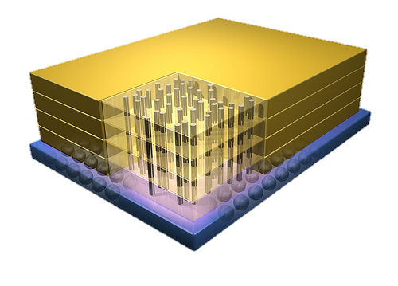
Tesseract System for Graph Processing
Interconnected set of 3D-stacked memory+logic chips with simple cores
Host Processor
Memory
Memory-Mapped
Accelerator Interface
(Noncacheable, Physically Addressed)
Logic
In-Order Core
DRAM Controller
…
…
LP
PF Buffer
Crossbar Network
…
MTP
…
Message Queue
NI
Ahn+, “A Scalable Processing-in-Memory Accelerator for Parallel Graph Processing” ISCA 2015.

Slide 37
Tesseract Graph Processing Performance
>13X Performance Improvement
On five graph processing algorithms
Ahn+, “A Scalable Processing-in-Memory Accelerator for Parallel Graph Processing” ISCA 2015.

Slide 38
Tesseract Graph Processing System Energy
> 8X Energy Reduction
Ahn+, “A Scalable Processing-in-Memory Accelerator for Parallel Graph Processing” ISCA 2015.

Slide 39
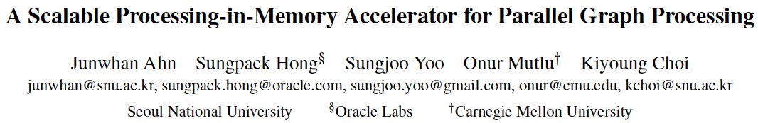
More on Tesseract
Junwhan Ahn, Sungpack Hong, Sungjoo Yoo, Onur Mutlu, and Kiyoung Choi,
"A Scalable Processing-in-Memory Accelerator for Parallel Graph Processing"
Proceedings of the 42nd International Symposium on Computer Architecture (ISCA), Portland, OR, June 2015.
[Slides (pdf)] [Lightning Session Slides (pdf)]

Slide 40
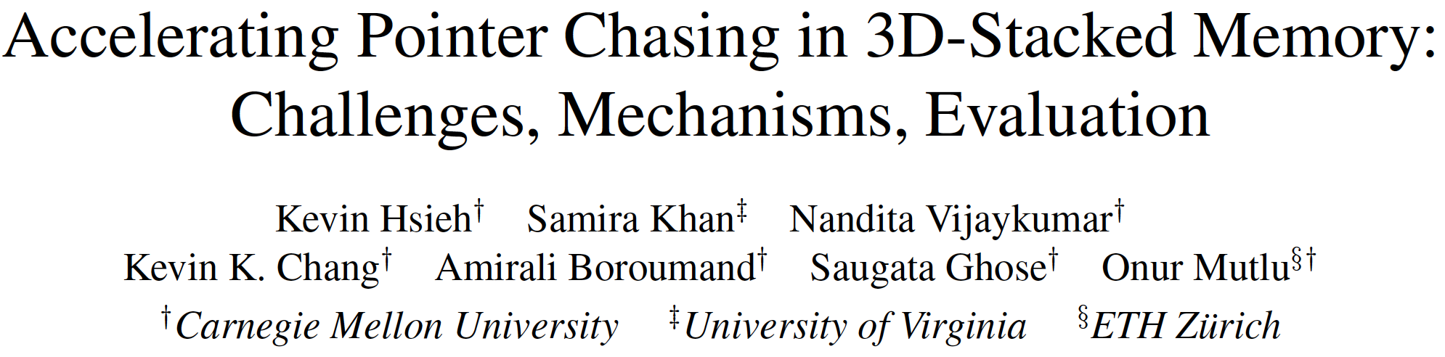
Accelerating Pointer Chasing with PIM
Kevin Hsieh, Samira Khan, Nandita Vijaykumar, Kevin K. Chang, Amirali Boroumand, Saugata Ghose, and Onur Mutlu,
"Accelerating Pointer Chasing in 3D-Stacked Memory: Challenges, Mechanisms, Evaluation"
Proceedings of the 34th IEEE International Conference on Computer Design (ICCD), Phoenix, AZ, USA, October 2016.

Slide 41
Agenda
Major Trends Affecting Main Memory
The Memory Scaling Problem
Two Complementary Solution Directions
  New Memory (DRAM) Architectures
  Enabling Emerging (NVM) Technologies
Conclusion

Slide 42
Limits of Charge Memory
Difficult charge placement and control
  Flash: floating gate charge
  DRAM: capacitor charge, transistor leakage
Reliable sensing becomes difficult as charge storage unit size reduces

Slide 43
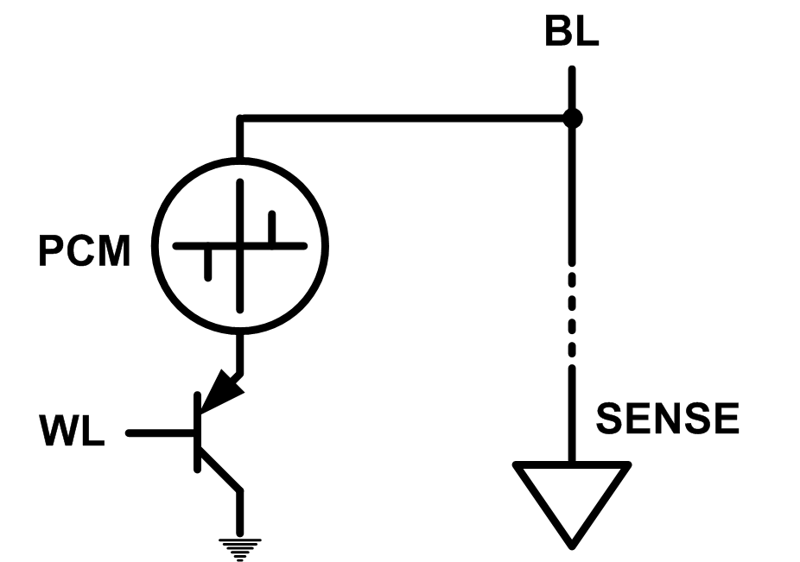
Solution 2: Emerging Memory Technologies
Some emerging resistive memory technologies seem more scalable than DRAM (and they are non-volatile)
Example: Phase Change Memory
  Data stored by changing phase of material
  Data read by detecting material’s resistance
  Expected to scale to 9nm (2022 [ITRS 2009])
  Prototyped at 20nm (Raoux+, IBM JRD 2008)
  Expected to be denser than DRAM: can store multiple bits/cell
But, emerging technologies have (many) shortcomings
  Can they be enabled to replace/augment/surpass DRAM?
Notes:
Even if DRAM continues to scale there could be benefits to examining and enabling these new technologies.

Slide 44
Solution 2: Emerging Memory Technologies
Lee+, “Architecting Phase Change Memory as a Scalable DRAM Alternative,” ISCA’09, CACM’10, IEEE Micro’10.
Meza+, “Enabling Efficient and Scalable Hybrid Memories,” IEEE Comp. Arch. Letters 2012.
Yoon, Meza+, “Row Buffer Locality Aware Caching Policies for Hybrid Memories,” ICCD 2012.
Kultursay+, “Evaluating STT-RAM as an Energy-Efficient Main Memory Alternative,” ISPASS 2013.
Meza+, “A Case for Efficient Hardware-Software Cooperative Management of Storage and Memory,” WEED 2013.
Lu+, “Loose Ordering Consistency for Persistent Memory,” ICCD 2014.
Zhao+, “FIRM: Fair and High-Performance Memory Control for Persistent Memory Systems,” MICRO 2014.
Yoon, Meza+, “Efficient Data Mapping and Buffering Techniques for Multi-Level Cell Phase-Change Memories,” TACO 2014.
Ren+, “ThyNVM: Enabling Software-Transparent Crash Consistency in Persistent Memory Systems,” MICRO 2015.
Chauhan+, “NVMove: Helping Programmers Move to Byte-Based Persistence,” INFLOW 2016.
Li+, “Utility-Based Hybrid Memory Management,” CLUSTER 2017.
Yu+, “Banshee: Bandwidth-Efficient DRAM Caching via Software/Hardware Cooperation,” MICRO 2017.
Notes:
Even if DRAM continues to scale there could be benefits to examining and enabling these new technologies.

Slide 45
Promising Resistive Memory Technologies
PCM
  Inject current to change material phase
  Resistance determined by phase
STT-MRAM
  Inject current to change magnet polarity
  Resistance determined by polarity
Memristors/RRAM/ReRAM
  Inject current to change atomic structure
  Resistance determined by atom distance

Slide 46
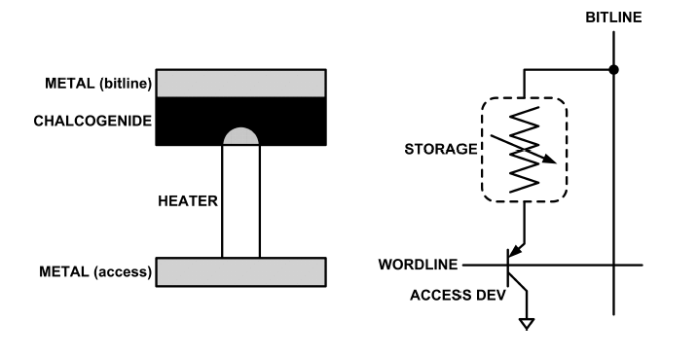
What is Phase Change Memory?
Phase change material (chalcogenide glass) exists in two states:
  Amorphous: Low optical reflexivity and high electrical resistivity
  Crystalline: High optical reflexivity and low electrical resistivity
PCM is resistive memory: High resistance (0), Low resistance (1)
PCM cell can be switched between states reliably and quickly

Slide 47
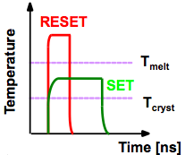
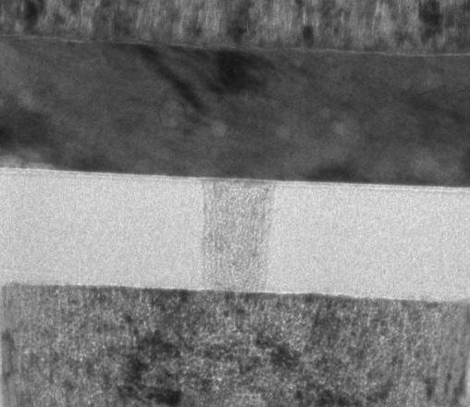
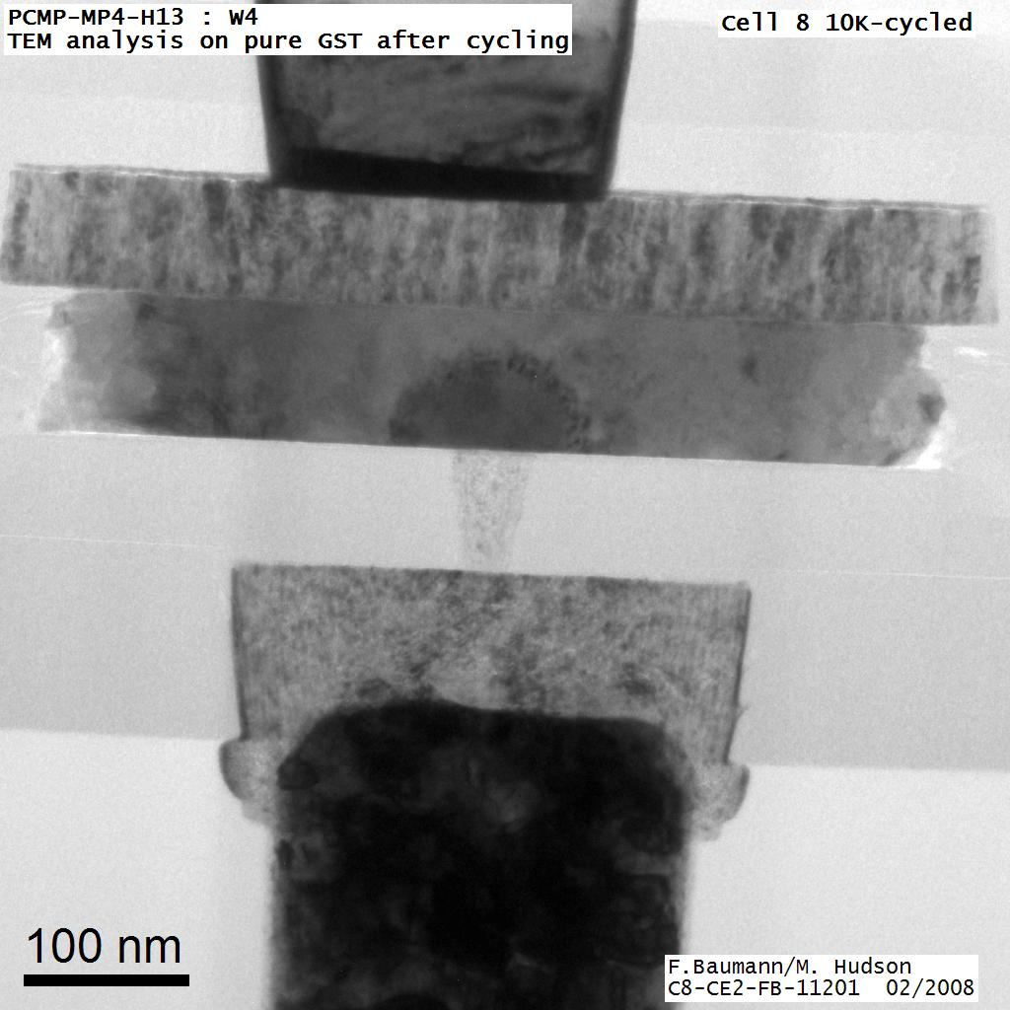
How Does PCM Work?
Write: change phase via current injection
  SET: sustained current to heat cell above Tcryst
  RESET: cell heated above Tmelt and quenched
Read: detect phase via material resistance
  amorphous/crystalline
Large
Current
Small
Current
Memory
Element
SET (cryst)
Low resistance
Access
Device
RESET (amorph)
High resistance
10³-10⁴ Ω
10⁶-10⁷ Ω
Photo Courtesy: Bipin Rajendran, IBM
Slide Courtesy: Moinuddin Qureshi, IBM

Slide 48
Opportunity: PCM Advantages
Scales better than DRAM, Flash
  Requires current pulses, which scale linearly with feature size
  Expected to scale to 9nm (2022 [ITRS])
  Prototyped at 20nm (Raoux+, IBM JRD 2008)
Can be denser than DRAM
  Can store multiple bits per cell due to large resistance range
  Prototypes with 2 bits/cell in ISSCC’08, 4 bits/cell by 2012
Non-volatile
  Retain data for >10 years at 85C
No refresh needed, low idle power

Slide 49
Phase Change Memory Properties
Surveyed prototypes from 2003-2008 (ITRS, IEDM, VLSI, ISSCC)
Derived PCM parameters for F=90nm
Lee, Ipek, Mutlu, Burger, “Architecting Phase Change Memory as a Scalable DRAM Alternative,” ISCA 2009.
Lee et al., “Phase Change Technology and the Future of Main Memory,” IEEE Micro Top Picks 2010.

Slide 50
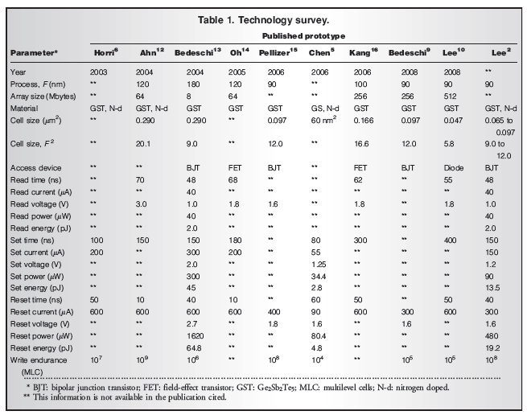

Slide 51
Phase Change Memory: Pros and Cons
Pros over DRAM
  Better technology scaling (capacity and cost)
  Non volatile → Persistent
  Low idle power (no refresh)
Cons
  Higher latencies: ~4-15x DRAM (especially write)
  Higher active energy: ~2-50x DRAM (especially write)
  Lower endurance (a cell dies after ~10⁸ writes)
  Reliability issues (resistance drift)
Challenges in enabling PCM as DRAM replacement/helper:
  Mitigate PCM shortcomings
  Find the right way to place PCM in the system

Slide 52
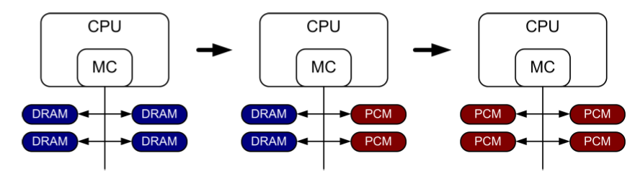
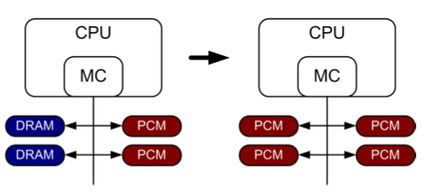
PCM-based Main Memory (I)
How should PCM-based (main) memory be organized?
Hybrid PCM+DRAM [Qureshi+ ISCA’09, Dhiman+ DAC’09]:
  How to partition/migrate data between PCM and DRAM

Slide 53
PCM-based Main Memory (II)
How should PCM-based (main) memory be organized?
Pure PCM main memory [Lee et al., ISCA’09, Top Picks’10]:
  How to redesign entire hierarchy (and cores) to overcome PCM shortcomings

Slide 54
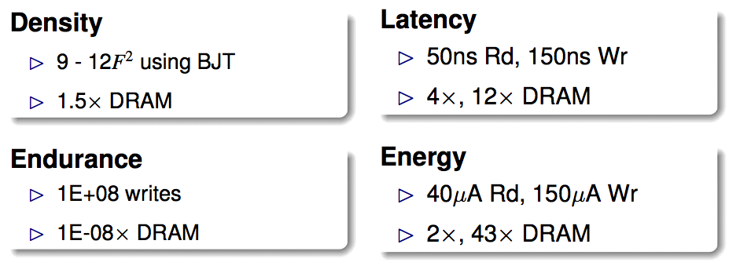
An Initial Study: Replace DRAM with PCM
Lee, Ipek, Mutlu, Burger, “Architecting Phase Change Memory as a Scalable DRAM Alternative,” ISCA 2009.
  Surveyed prototypes from 2003-2008 (e.g. IEDM, VLSI, ISSCC)
  Derived “average” PCM parameters for F=90nm

Slide 55
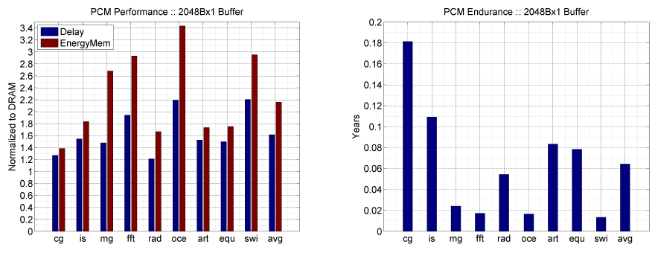
Results: Naïve Replacement of DRAM with PCM
Replace DRAM with PCM in a 4-core, 4MB L2 system
PCM organized the same as DRAM: row buffers, banks, peripherals
1.6x delay, 2.2x energy, 500-hour average lifetime
Lee, Ipek, Mutlu, Burger, “Architecting Phase Change Memory as a Scalable DRAM Alternative,” ISCA 2009.

Slide 56
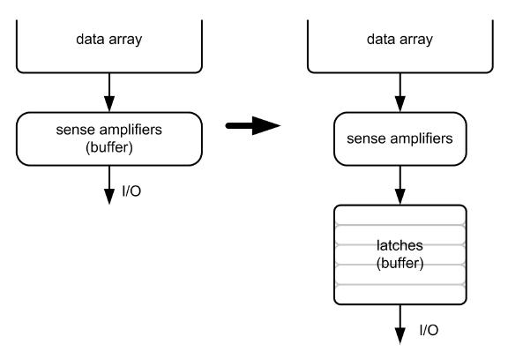
Architecting PCM to Mitigate Shortcomings
Idea 1: Use multiple narrow row buffers in each PCM chip
    → Reduces array reads/writes → better endurance, latency, energy
Idea 2: Write into array at
cache block or word
granularity
→ Reduces unnecessary wear
DRAM
PCM

Slide 57
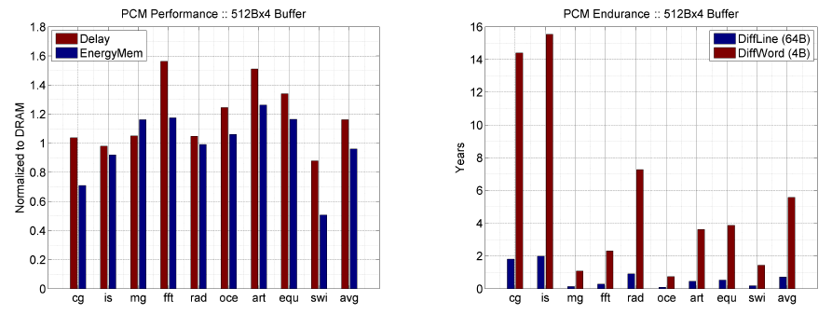
Results: Architected PCM as Main Memory
1.2x delay, 1.0x energy, 5.6-year average lifetime
Scaling improves energy, endurance, density
Caveat 1: Worst-case lifetime is much shorter (no guarantees)
Caveat 2: Intensive applications see large performance and energy hits
Caveat 3: Optimistic PCM parameters?

Slide 58
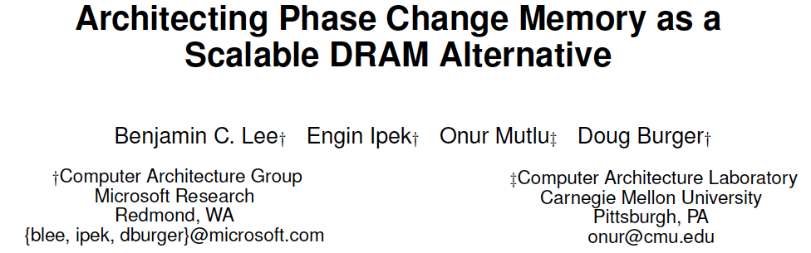
More on PCM As Main Memory
Benjamin C. Lee, Engin Ipek, Onur Mutlu, and Doug Burger,
"Architecting Phase Change Memory as a Scalable DRAM Alternative"
Proceedings of the 36th International Symposium on Computer Architecture (ISCA), pages 2-13, Austin, TX, June 2009. Slides (pdf)

Slide 59
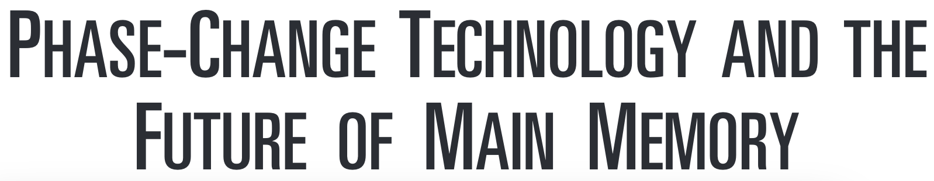
More on PCM As Main Memory (II)
Benjamin C. Lee, Ping Zhou, Jun Yang, Youtao Zhang, Bo Zhao, Engin Ipek, Onur Mutlu, and Doug Burger,
"Phase Change Technology and the Future of Main Memory"
IEEE Micro, Special Issue: Micro's Top Picks from 2009 Computer Architecture Conferences (MICRO TOP PICKS), Vol. 30, No. 1, pages 60-70, January/February 2010.

Slide 60
STT-MRAM as Main Memory
Magnetic Tunnel Junction (MTJ) device
  Reference layer: Fixed magnetic orientation
  Free layer: Parallel or anti-parallel
Magnetic orientation of the free layer determines logical state of device
  High vs. low resistance
Write: Push large current through MTJ to change orientation of free layer
Read: Sense current flow
Kultursay et al., “Evaluating STT-RAM as an Energy-Efficient Main Memory Alternative,” ISPASS 2013.
Logical 0
Reference Layer
Barrier
Free Layer
Logical 1
Reference Layer
Barrier
Free Layer
Word Line
MTJ
Access
Transistor
Bit Line
Sense Line
Notes:
Moving from DRAM to STT-RAM, instead of a capacitor that stores charge, now we have a magnetic tunnel junction that has one reference layer with a fixed magnetic orientation, and a free layer that can be parallel or anti parallel to the reference layer; which determines the resistance, and in turn, the data stored in the MTJ. In addition to the MTJ, the cell, again, has an access transistor.
Reading requires a small voltage to be applied across the bitline and sense line; and the current is sensed. This current varies depending on the resistance of MTJ. To write data, we push a large current into the MTJ, which re-aligns the free layer. The direction of the current determines whether it becomes parallel or anti-parallel; i.e. logical 0 or 1.

Slide 61
STT-MRAM: Pros and Cons
Pros over DRAM
  Better technology scaling (capacity and cost)
  Non volatile → Persistent
  Low idle power (no refresh)
Cons
  Higher write latency
  Higher write energy
  Poor density (currently)
  Reliability?
Another level of freedom
  Can trade off non-volatility for lower write latency/energy (by reducing the size of the MTJ)

Slide 62
Architected STT-MRAM as Main Memory
4-core, 4GB main memory, multiprogrammed workloads
~6% performance loss, ~60% energy savings vs. DRAM
Kultursay+, “Evaluating STT-RAM as an Energy-Efficient Main Memory Alternative,” ISPASS 2013.

Slide 63

More on STT-MRAM as Main Memory
Emre Kultursay, Mahmut Kandemir, Anand Sivasubramaniam, and Onur Mutlu,
"Evaluating STT-RAM as an Energy-Efficient Main Memory Alternative"
Proceedings of the 2013 IEEE International Symposium on Performance Analysis of Systems and Software (ISPASS), Austin, TX, April 2013. Slides (pptx) (pdf)

Slide 64
A More Viable Approach: Hybrid Memory Systems
CPU
Meza+, “Enabling Efficient and Scalable Hybrid Memories,” IEEE Comp. Arch. Letters, 2012.
Yoon+, “Row Buffer Locality Aware Caching Policies for Hybrid Memories,” ICCD 2012 Best Paper Award.
DRAMCtrl
PCM Ctrl
DRAM
Phase Change Memory (or Tech. X)
Fast, durable
Small,
leaky, volatile,
high-cost
Large, non-volatile, low-cost
Slow, wears out, high active energy
Hardware/software manage data allocation and movement
to achieve the best of multiple technologies

Slide 65
Challenge and Opportunity
Providing the Best of
Multiple Metrics
with
Multiple Memory Technologies

Slide 66
Challenge and Opportunity
Heterogeneous,
Configurable,
Programmable
Memory Systems

Slide 67
Hybrid Memory Systems: Issues
Cache vs. Main Memory
Granularity of Data Move/Manage-ment: Fine or Coarse
Hardware vs. Software vs. HW/SW Cooperative
When to migrate data?
How to design a scalable and efficient large cache?
…

Slide 68
Data Placement in Hybrid Memory
Cores/Caches
Memory Controllers
Channel A
IDLE
Channel B
Memory A
Memory B
(Fast, Small)
(Large, Slow)
Page 1
Page 2
Which memory do we place each page in,
to maximize system performance?
Memory A is fast, but small
Load should be balanced on both channels
Page migrations have performance and energy overhead

Slide 69
Data Placement Between DRAM and PCM
Idea: Characterize data access patterns and guide data placement in hybrid memory
Streaming accesses: As fast in PCM as in DRAM
Random accesses: Much faster in DRAM
Idea: Place random access data with some reuse in DRAM; streaming data in PCM
Yoon+, “Row Buffer Locality-Aware Data Placement in Hybrid Memories,” ICCD 2012 Best Paper Award.

Slide 70
Hybrid vs. All-PCM/DRAM [ICCD’12]
29%
31%
31% better performance than all PCM,
within 29% of all DRAM performance
Yoon+, “Row Buffer Locality-Aware Data Placement in Hybrid Memories,” ICCD 2012 Best Paper Award.
Notes:
Now let’s compare our mechanism to a homogeneous memory system.
Here the comparison points are a 16GB all-PCM and all-DRAM memory system.
Our mechanism achieves 31% better performance than the all-PCM memory system, and comes within 29% of the all-DRAM performance.
Note that we do not assume any capacity benefits of PCM over DRAM.
And yet, our mechanism bridges the performance gap between the two homogeneous memory systems.
If the capacity benefit of PCM was included, the hybrid memory system will perform even better.

Slide 71
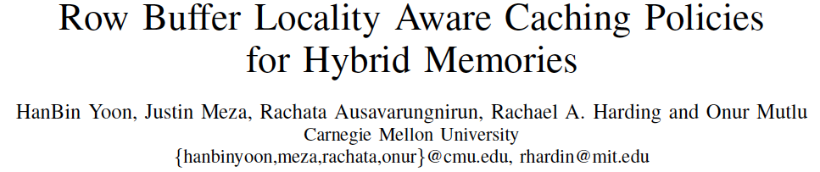
More on Hybrid Memory Data Placement
HanBin Yoon, Justin Meza, Rachata Ausavarungnirun, Rachael Harding, and Onur Mutlu,
"Row Buffer Locality Aware Caching Policies for Hybrid Memories"
Proceedings of the 30th IEEE International Conference on Computer Design (ICCD), Montreal, Quebec, Canada, September 2012. Slides (pptx) (pdf)

Slide 72
Weaknesses of Existing Solutions
They are all heuristics that consider only a limited part of memory access behavior
Do not directly capture the overall system performance impact of data placement decisions
Example: None capture memory-level parallelism (MLP)
  Number of concurrent memory requests from the same application when a page is accessed
  Affects how much page migration helps performance
Notes:
These proposals consider only a limited number of characteristics, using these few data points to construct a placement heuristic that is specific to the memory types being used in the system.
These heuristic-based approaches do not directly capture the overall system performance benefits of data placement decisions.
Therefore, they can only indirectly optimize system performance, which sometimes leads to sub-optimal data placement decisions.

Slide 73
Importance of Memory-Level Parallelism
Before migration:
Before migration:
requests to Page 1
Mem. B
requests to Page 2
Mem. B
requests to Page 3
Mem. B
After migration:
After migration:
requests to Page 1
Mem. A
requests to Page 2
Mem. A
T
requests to Page 3
T
Mem. B
Mem. A
time
Migrating one page
reduces stall time by T
time
Must migrate two pages
to reduce stall time by T:
migrating one page alone
does not help
Page migration decisions need to consider MLP
Notes:
Should say: On the left, The page has much more utility because it directly affects performance if it is migrated to the fast memory;
On the right. Each page has less utility because migrated alone, neither would affect performance significantly. They both need to be migrated together.
Let’s look at two pages with access latency overlapped with each other
Change animation later

Slide 74
Our Goal [CLUSTER 2017]
A generalized mechanism that
1. Directly estimates the performance benefit
of migrating a page between
any two types of memory
2. Places only the performance-critical data
in the fast memory

Slide 75
Utility-Based Hybrid Memory Management
A memory manager that works for any hybrid memory
  e.g., DRAM-NVM, DRAM-RLDRAM
Key Idea
  For each page, use comprehensive characteristics to calculate estimated utility (i.e., performance impact)
  of migrating page from one memory to the other in the system
  Migrate only pages with the highest utility
  (i.e., pages that improve system performance the most when migrated)
Li+, “Utility-Based Hybrid Memory Management”, CLUSTER 2017.

Slide 76
Key Mechanisms of UH-MEM
For each page, estimate utility using a performance model
  Application stall time reduction
    How much would migrating a page benefit the performance of the application that the page belongs to?
  Application performance sensitivity
    How much does the improvement of a single application’s performance increase the overall system performance?
Migrate only pages whose utility exceed the migration threshold from slow memory to fast memory
Periodically adjust migration threshold
  $$Utility= {∆StallTime}_{i}×{Sensitivity}_{i}$$

Slide 77
Results: System Performance
14%
9%
3%
5%
UH-MEM improves system performance
over the best state-of-the-art hybrid memory manager

Slide 78
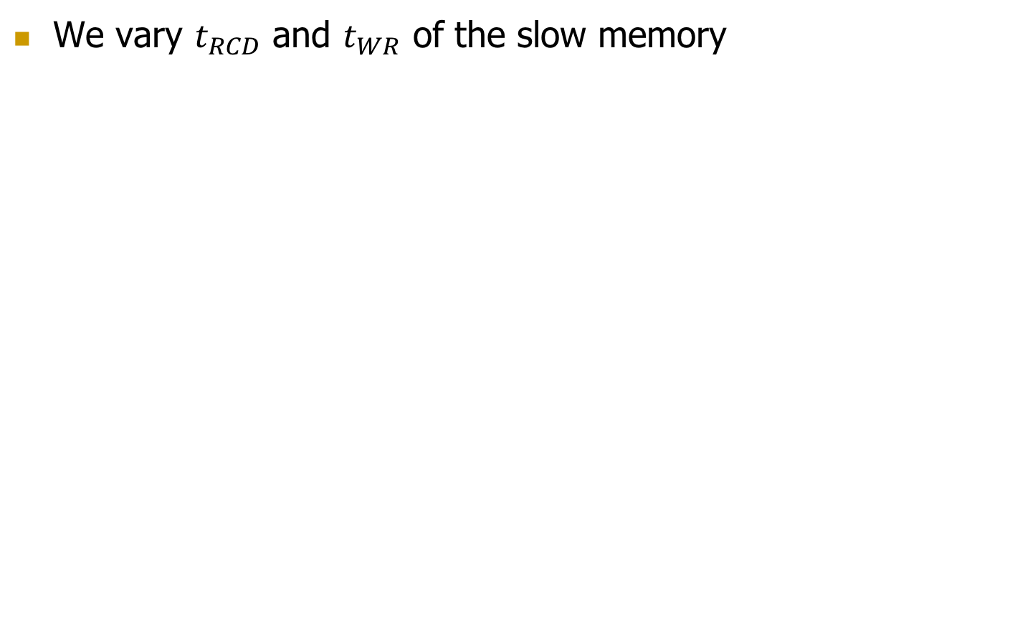
Results: Sensitivity to Slow Memory Latency
We vary $t_{RCD}$ and $t_{WR}$ of the slow memory
8%
6%
14%
13%
13%
$$t_{RCD}:$$
$$t_{WR}:$$
UH-MEM improves system performance
for a wide variety of hybrid memory systems

Slide 79
More on UH-MEM
Yang Li, Saugata Ghose, Jongmoo Choi, Jin Sun, Hui Wang, and Onur Mutlu,
"Utility-Based Hybrid Memory Management"
Proceedings of the 19th IEEE Cluster Conference (CLUSTER), Honolulu, Hawaii, USA, September 2017.
[Slides (pptx) (pdf)]

Slide 80
Challenge and Opportunity
Enabling
an Emerging Technology
to Augment DRAM
Managing Hybrid Memories

Slide 81
Another Challenge
Designing Effective
Large (DRAM) Caches

Slide 82
One Problem with Large DRAM Caches
A large DRAM cache requires a large metadata (tag + block-based information) store
How do we design an efficient DRAM cache?
CPU
LOAD X
Metadata:
X → DRAM
Mem
Ctlr
Mem
Ctlr
DRAM
PCM
X
(small, fast cache)
(high capacity)
Access X

Slide 83
Idea 1: Tags in Memory
Store tags in the same row as data in DRAM
  Store metadata in same row as their data
  Data and metadata can be accessed together
Benefit: No on-chip tag storage overhead
Downsides:
  Cache hit determined only after a DRAM access
  Cache hit requires two DRAM accesses
DRAM row
Cache block 0
Cache block 1
Cache block 2
Tag0
Tag1
Tag2

Slide 84
Idea 2: Cache Tags in SRAM
Recall Idea 1: Store all metadata in DRAM
  To reduce metadata storage overhead
Idea 2: Cache in on-chip SRAM frequently-accessed metadata
  Cache only a small amount to keep SRAM size small

Slide 85
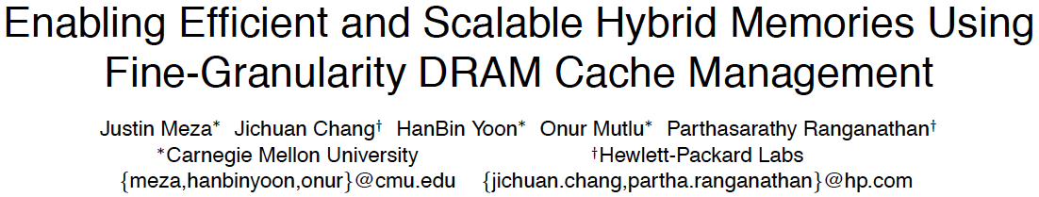
On Large DRAM Cache Design
Justin Meza, Jichuan Chang, HanBin Yoon, Onur Mutlu, and Parthasarathy Ranganathan,
"Enabling Efficient and Scalable Hybrid Memories Using Fine-Granularity DRAM Cache Management"
IEEE Computer Architecture Letters (CAL), February 2012.

Slide 86
DRAM Caches: Many Recent Options
Yu+, “Banshee: Bandwidth-Efficient DRAM Caching via Software/Hardware Cooperation,” MICRO 2017.

Slide 87
Banshee [MICRO 2017]
Tracks presence in cache using TLB and Page Table
  No tag store needed for DRAM cache
  Enabled by a new lightweight lazy TLB coherence protocol
New bandwidth-aware frequency-based replacement policy

Slide 88
More on Banshee
Xiangyao Yu, Christopher J. Hughes, Nadathur Satish, Onur Mutlu, and Srinivas Devadas,
"Banshee: Bandwidth-Efficient DRAM Caching via Software/Hardware Cooperation"
Proceedings of the 50th International Symposium on Microarchitecture (MICRO), Boston, MA, USA, October 2017.

Slide 89
Other Opportunities with Emerging Technologies
Merging of memory and storage
  e.g., a single interface to manage all data
New applications
  e.g., ultra-fast checkpoint and restore
More robust system design
  e.g., reducing data loss
Processing tightly-coupled with memory
  e.g., enabling efficient search and filtering

Slide 90

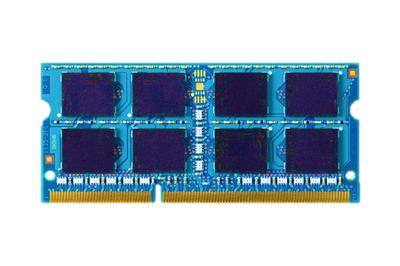
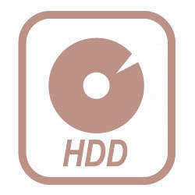
TWO-LEVEL STORAGE MODEL
CPU
Ld/St
VOLATILE
MEMORY
FAST
DRAM
BYTE ADDR
FILE
I/O
STORAGE
NONVOLATILE
SLOW
BLOCK ADDR
Notes:
If we look at our system’s today, we have a two-level storage model where memory is directly accessed by ld/st instructions, but storage is accesses by system calls. Disk stores the persistent data, but is slow and can only be accessed as a block. So we transfer data to DRAM, which is fast and byte addressable.

Slide 91
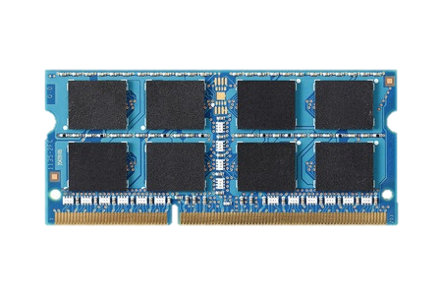
TWO-LEVEL STORAGE MODEL
CPU
Ld/St
VOLATILE
MEMORY
FAST
DRAM
BYTE ADDR
FILE
I/O
NVM
STORAGE
PCM, STT-RAM
NONVOLATILE
SLOW
BLOCK ADDR
Non-volatile memories combine characteristics of memory and storage
Notes:
However, now we have these emerging non-volatile memories which actually combine the characteristics of both memory and storage. They are fast and byte addressable like DRAM, but also can persist data as storage

Slide 92
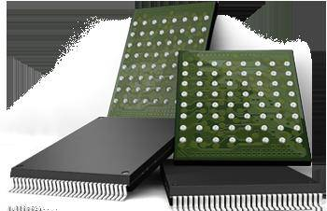
Two-Level Memory/Storage Model
The traditional two-level storage model is a bottleneck with NVM
  Volatile data in memory → a load/store interface
  Persistent data in storage → a file system interface
  Problem: Operating system (OS) and file system (FS) code to locate, translate, buffer data become performance and energy bottlenecks with fast NVM stores
Two-Level Store
Load/Store
fopen, fread, fwrite, …
Virtual memory
Operating system
and file system
Processor
and caches
Address translation
Persistent (e.g., Phase-Change)
Memory
Main Memory
Storage (SSD/HDD)

Slide 93
Unified Memory and Storage with NVM
Goal: Unify memory and storage management in a single unit to eliminate wasted work to locate, transfer, and translate data
  Improves both energy and performance
  Simplifies programming model as well
Unified Memory/Storage
Persistent Memory
Manager
Processor
and caches
Load/Store
Feedback
Persistent (e.g., Phase-Change) Memory
Meza+, “A Case for Efficient Hardware-Software Cooperative Management of Storage and Memory,” WEED 2013.

Slide 94
The Persistent Memory Manager (PMM)
Persistent objects
PMM uses access and hint information to allocate, locate, migrate and access data in the heterogeneous array of devices
Notes:
And to tie everything together, here is how a persistent memory would operate. Code allocates persistent objects and accesses them using loads and stores – no different than persistent memory in today’s machines. Optionally, the software can provide hints as to the types of access patterns or requirements of the software.
Then, a Persistent Memory Manager uses this access information and software hints to allocate, locate, migrate, and access data among the heterogeneous array of devices present on the system, attempting to strike a balance between application-level guarantees, like persistence and security, and performance and energy efficiency.

Slide 95
Performance Benefits of a Single-Level Store
~24X
~5X
Meza+, “A Case for Efficient Hardware-Software Cooperative Management of Storage and Memory,” WEED 2013.

Slide 96
Energy Benefits of a Single-Level Store
~16X
~5X
Meza+, “A Case for Efficient Hardware-Software Cooperative Management of Storage and Memory,” WEED 2013.

Slide 97

On Persistent Memory Benefits & Challenges
Justin Meza, Yixin Luo, Samira Khan, Jishen Zhao, Yuan Xie, and Onur Mutlu,
"A Case for Efficient Hardware-Software Cooperative Management of Storage and Memory"
Proceedings of the 5th Workshop on Energy-Efficient Design (WEED), Tel-Aviv, Israel, June 2013. Slides (pptx) Slides (pdf)

Slide 98
Challenge and Opportunity
Combined
Memory & Storage

Slide 99
Challenge and Opportunity
A Unified Interface to All Data

Slide 100
One Key Challenge in Persistent Memory
How to ensure consistency of system/data if all memory is persistent?
Two extremes
  Programmer transparent: Let the system handle it
  Programmer only: Let the programmer handle it
Many alternatives in-between…

Slide 101


CHALLENGE: CRASH CONSISTENCY
Persistent Memory System
System crash can result in
permanent data corruption in NVM

Slide 102
CRASH CONSISTENCY PROBLEM
Example: Add a node to a linked list
2. Link to prev
1. Link to next
System crash can result in
inconsistent memory state
Notes:
Let’s see an example of crash consistency problem in persistent memory systems. When we add a node in the linked list, there are two operations, first, we need to link the new node to next node and then link the previous node to the new node. Unfortunately due to the write ordering, we cannot guarantee which write will reach the memory first. If there is a power failure, depending on which write persisted, we might have a broken linked list. As a result, after a crash we can have an inconsistent memory state.

Slide 103
CURRENT SOLUTIONS
Explicit interfaces to manage consistency
  NV-Heaps [ASPLOS’11], BPFS [SOSP’09], Mnemosyne [ASPLOS’11]
AtomicBegin {
Insert a new node;
} AtomicEnd;
Limits adoption of NVM
Have to rewrite code with clear partition
between volatile and non-volatile data
Burden on the programmers

Slide 104
OUR APPROACH: ThyNVM
Goal:
Software transparent consistency in
persistent memory systems

Slide 105
ThyNVM: Summary
A new hardware-based
checkpointing mechanism
Checkpoints at multiple granularities to reduce both checkpointing latency and metadata overhead
Overlaps checkpointing and execution to reduce checkpointing latency
Adapts to DRAM and NVM characteristics
Performs within 4.9% of an idealized DRAM with zero cost consistency

Slide 106
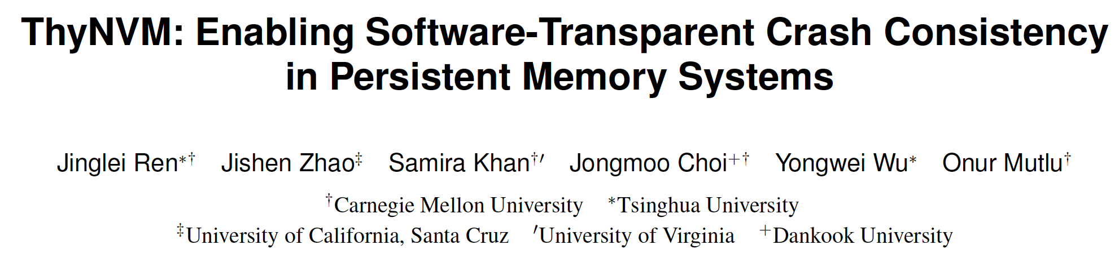
More About ThyNVM
Jinglei Ren, Jishen Zhao, Samira Khan, Jongmoo Choi, Yongwei Wu, and Onur Mutlu,
"ThyNVM: Enabling Software-Transparent Crash Consistency in Persistent Memory Systems"
Proceedings of the 48th International Symposium on Microarchitecture (MICRO), Waikiki, Hawaii, USA, December 2015.
[Slides (pptx) (pdf)] [Lightning Session Slides (pptx) (pdf)] [Poster (pptx) (pdf)]
[Source Code]

Slide 107
Another Key Challenge in Persistent Memory
Programming Ease
to Exploit Persistence

Slide 108
Tools/Libraries to Help Programmers
Himanshu Chauhan, Irina Calciu, Vijay Chidambaram, Eric Schkufza, Onur Mutlu, and Pratap Subrahmanyam,
"NVMove: Helping Programmers Move to Byte-Based Persistence"
Proceedings of the 4th Workshop on Interactions of NVM/Flash with Operating Systems and Workloads (INFLOW), Savannah, GA, USA, November 2016.
[Slides (pptx) (pdf)]

Slide 109
Agenda
Major Trends Affecting Main Memory
The Memory Scaling Problem
Two Complementary Solution Directions
  New Memory (DRAM) Architectures
  Enabling Emerging (NVM) Technologies
Conclusion

Slide 110
The Future of Emerging Technologies is Bright
Regardless of challenges
  in underlying technology and overlying problems/requirements
Problem
Can enable:
- Orders of magnitude
improvements
- New applications and
computing systems
Yet, we have to
- Think across the stack
- Design enabling systems
Algorithm
Program/Language
System Software
SW/HW Interface
Micro-architecture
Logic
Devices
Electrons

Slide 111
If In Doubt, Refer to Flash Memory
A very “doubtful” emerging technology
  for at least two decades
Proceedings of the IEEE, Sept. 2017
https://arxiv.org/pdf/1706.08642

Slide 112
Opportunities and Challenges of Emerging Memory Technologies
Onur Mutlu
omutlu@gmail.com
https://people.inf.ethz.ch/omutlu
September 11, 2017
ARM Research Summit

Slide 113

Overview Paper on Flash Reliability
Yu Cai, Saugata Ghose, Erich F. Haratsch, Yixin Luo, and Onur Mutlu,
"Error Characterization, Mitigation, and Recovery in Flash Memory Based Solid State Drives"
to appear in Proceedings of the IEEE, 2017.

Slide 114
Solution 2: Emerging Memory Technologies
Some emerging resistive memory technologies seem more scalable than DRAM (and they are non-volatile)
Example: Phase Change Memory
  Expected to scale to 9nm (2022 [ITRS])
  Expected to be denser than DRAM: can store multiple bits/cell
But, emerging technologies have shortcomings as well
  Can they be enabled to replace/augment/surpass DRAM?
Lee+, “Architecting Phase Change Memory as a Scalable DRAM Alternative,” ISCA’09, CACM’10, IEEE Micro’10.
Meza+, “Enabling Efficient and Scalable Hybrid Memories,” IEEE Comp. Arch. Letters 2012.
Yoon, Meza+, “Row Buffer Locality Aware Caching Policies for Hybrid Memories,” ICCD 2012.
Kultursay+, “Evaluating STT-RAM as an Energy-Efficient Main Memory Alternative,” ISPASS 2013.
Meza+, “A Case for Efficient Hardware-Software Cooperative Management of Storage and Memory,” WEED 2013.
Lu+, “Loose Ordering Consistency for Persistent Memory,” ICCD 2014.
Zhao+, “FIRM: Fair and High-Performance Memory Control for Persistent Memory Systems,” MICRO 2014.
Yoon, Meza+, “Efficient Data Mapping and Buffering Techniques for Multi-Level Cell Phase-Change Memories,” TACO 2014.
Ren+, “ThyNVM: Enabling Software-Transparent Crash Consistency in Persistent Memory Systems,” MICRO 2015.
Chauhan+, “NVMove: Helping Programmers Move to Byte-Based Persistence,” INFLOW 2016.
Li+, “Utility-Based Hybrid Memory Management,” CLUSTER 2017.
Yu+, “Banshee: Bandwidth-Efficient DRAM Caching via Software/Hardware Cooperation,” MICRO 2017.
Notes:
Even if DRAM continues to scale there could be benefits to examining and enabling these new technologies.

Slide 115
Combination: Hybrid Memory Systems
CPU
Meza+, “Enabling Efficient and Scalable Hybrid Memories,” IEEE Comp. Arch. Letters, 2012.
Yoon, Meza et al., “Row Buffer Locality Aware Caching Policies for Hybrid Memories,” ICCD 2012 Best Paper Award.
DRAMCtrl
PCM Ctrl
DRAM
Technology X (e.g., PCM)
Fast, durable
Small,
leaky, volatile,
high-cost
Large, non-volatile, low-cost
Slow, wears out, high active energy
Hardware/software manage data allocation and movement
to achieve the best of multiple technologies

Slide 116
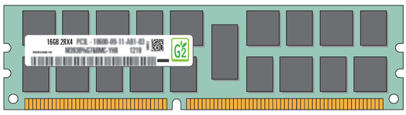
Exploiting Memory Error Tolerance with Hybrid Memory Systems
Heterogeneous-Reliability Memory [DSN 2014]
Vulnerable data
Vulnerable data
Tolerant data
Tolerant data
Reliable memory
Low-cost memory
Vulnerable data
  On Microsoft’s Web Search workload
  Reduces server hardware cost by 4.7 %
  Achieves single server availability target of 99.90 %
ECC protected
Well-tested chips
Tolerant data
NoECC or Parity
Less-tested chips
Notes:
As we have shown earlier, either across or within applications, our characterization can identify data that are vulnerable to memory errors and data that are tolerant to memory errors.
To exploit this observation, we would like to map these different data onto different memory modules according to their memory error tolerance.
As an example here, we map vulnerable data to reliable memory to improve reliability, and map tolerant data to low-cost less-reliable memory to exploit its tolerance and lower the cost. We call this mechanism heterogeneous-reliability memory, HRM.
Reliable memory consists of … Low cost memory consists of …
As we will show later, HRM allows us to use weaker error protection in memory, and enables the use of less-tested memory chips to lower the cost of the memory system, while still achieving reasonable single-server reliability target.

Slide 117
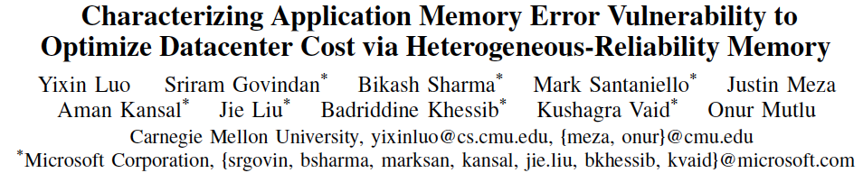
More on Heterogeneous Reliability Memory
Yixin Luo, Sriram Govindan, Bikash Sharma, Mark Santaniello, Justin Meza, Aman Kansal, Jie Liu, Badriddine Khessib, Kushagra Vaid, and Onur Mutlu,
"Characterizing Application Memory Error Vulnerability to Optimize Data Center Cost via Heterogeneous-Reliability Memory"
Proceedings of the 44th Annual IEEE/IFIP International Conference on Dependable Systems and Networks (DSN), Atlanta, GA, June 2014. [Summary] [Slides (pptx) (pdf)] [Coverage on ZDNet]

Slide 118
Challenge and Opportunity
Providing the Best of
Multiple Metrics
with
Multiple Memory Technologies

Slide 119
Challenge and Opportunity
Heterogeneous,
Configurable,
Programmable
Memory Systems

