Slide 1


Rethinking Memory System Design
(and the Platforms We Design Around It)
Onur Mutlu
onur.mutlu@inf.ethz.ch
https://people.inf.ethz.ch/omutlu
June 5, 2017
Technion Seiden Workshop: Beyond CMOS

Slide 2



The Main Memory System
Main memory is a critical component of all computing systems: server, mobile, embedded, desktop, sensor
Main memory system must scale (in size, technology, efficiency, cost, and management algorithms) to maintain performance growth and technology scaling benefits
Processors
and caches
Main Memory
Storage (SSD/HDD)

Slide 3
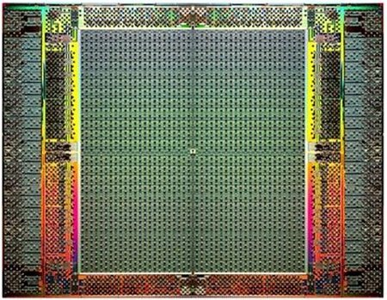
The Main Memory System
Main memory is a critical component of all computing systems: server, mobile, embedded, desktop, sensor
Main memory system must scale (in size, technology, efficiency, cost, and management algorithms) to maintain performance growth and technology scaling benefits
FPGAs
Main Memory
Storage (SSD/HDD)

Slide 4
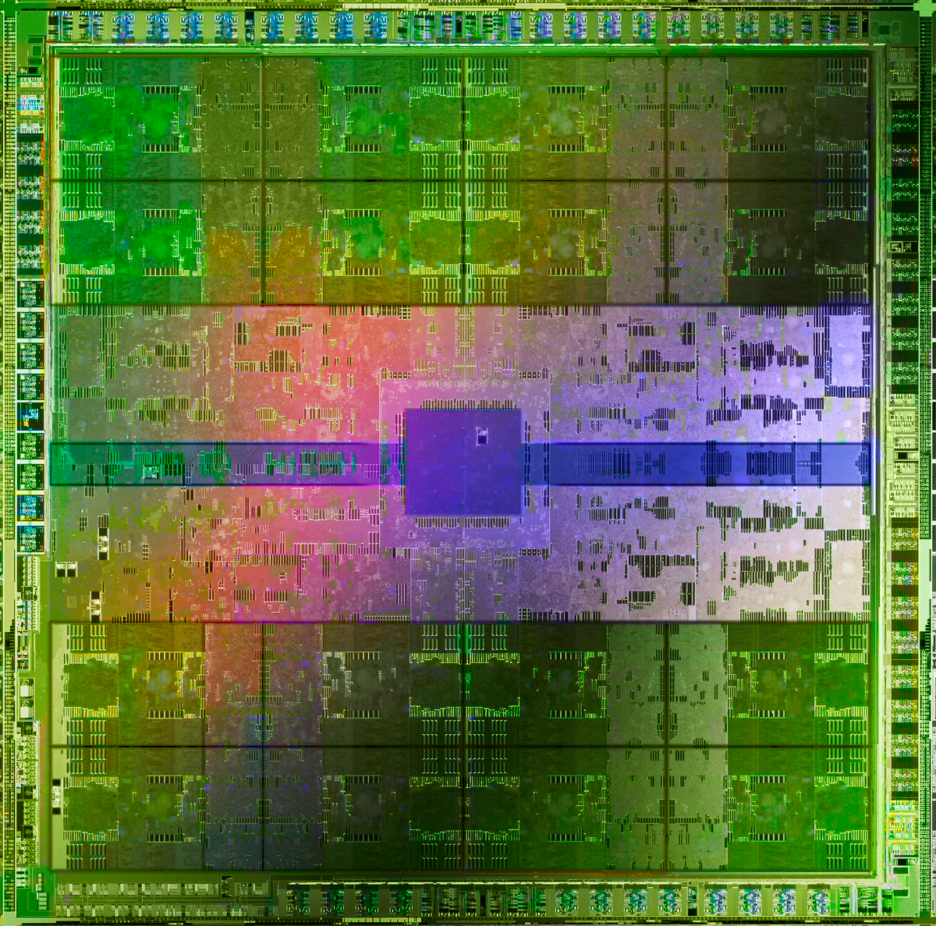
The Main Memory System
Main memory is a critical component of all computing systems: server, mobile, embedded, desktop, sensor
Main memory system must scale (in size, technology, efficiency, cost, and management algorithms) to maintain performance growth and technology scaling benefits
GPUs
Main Memory
Storage (SSD/HDD)

Slide 5
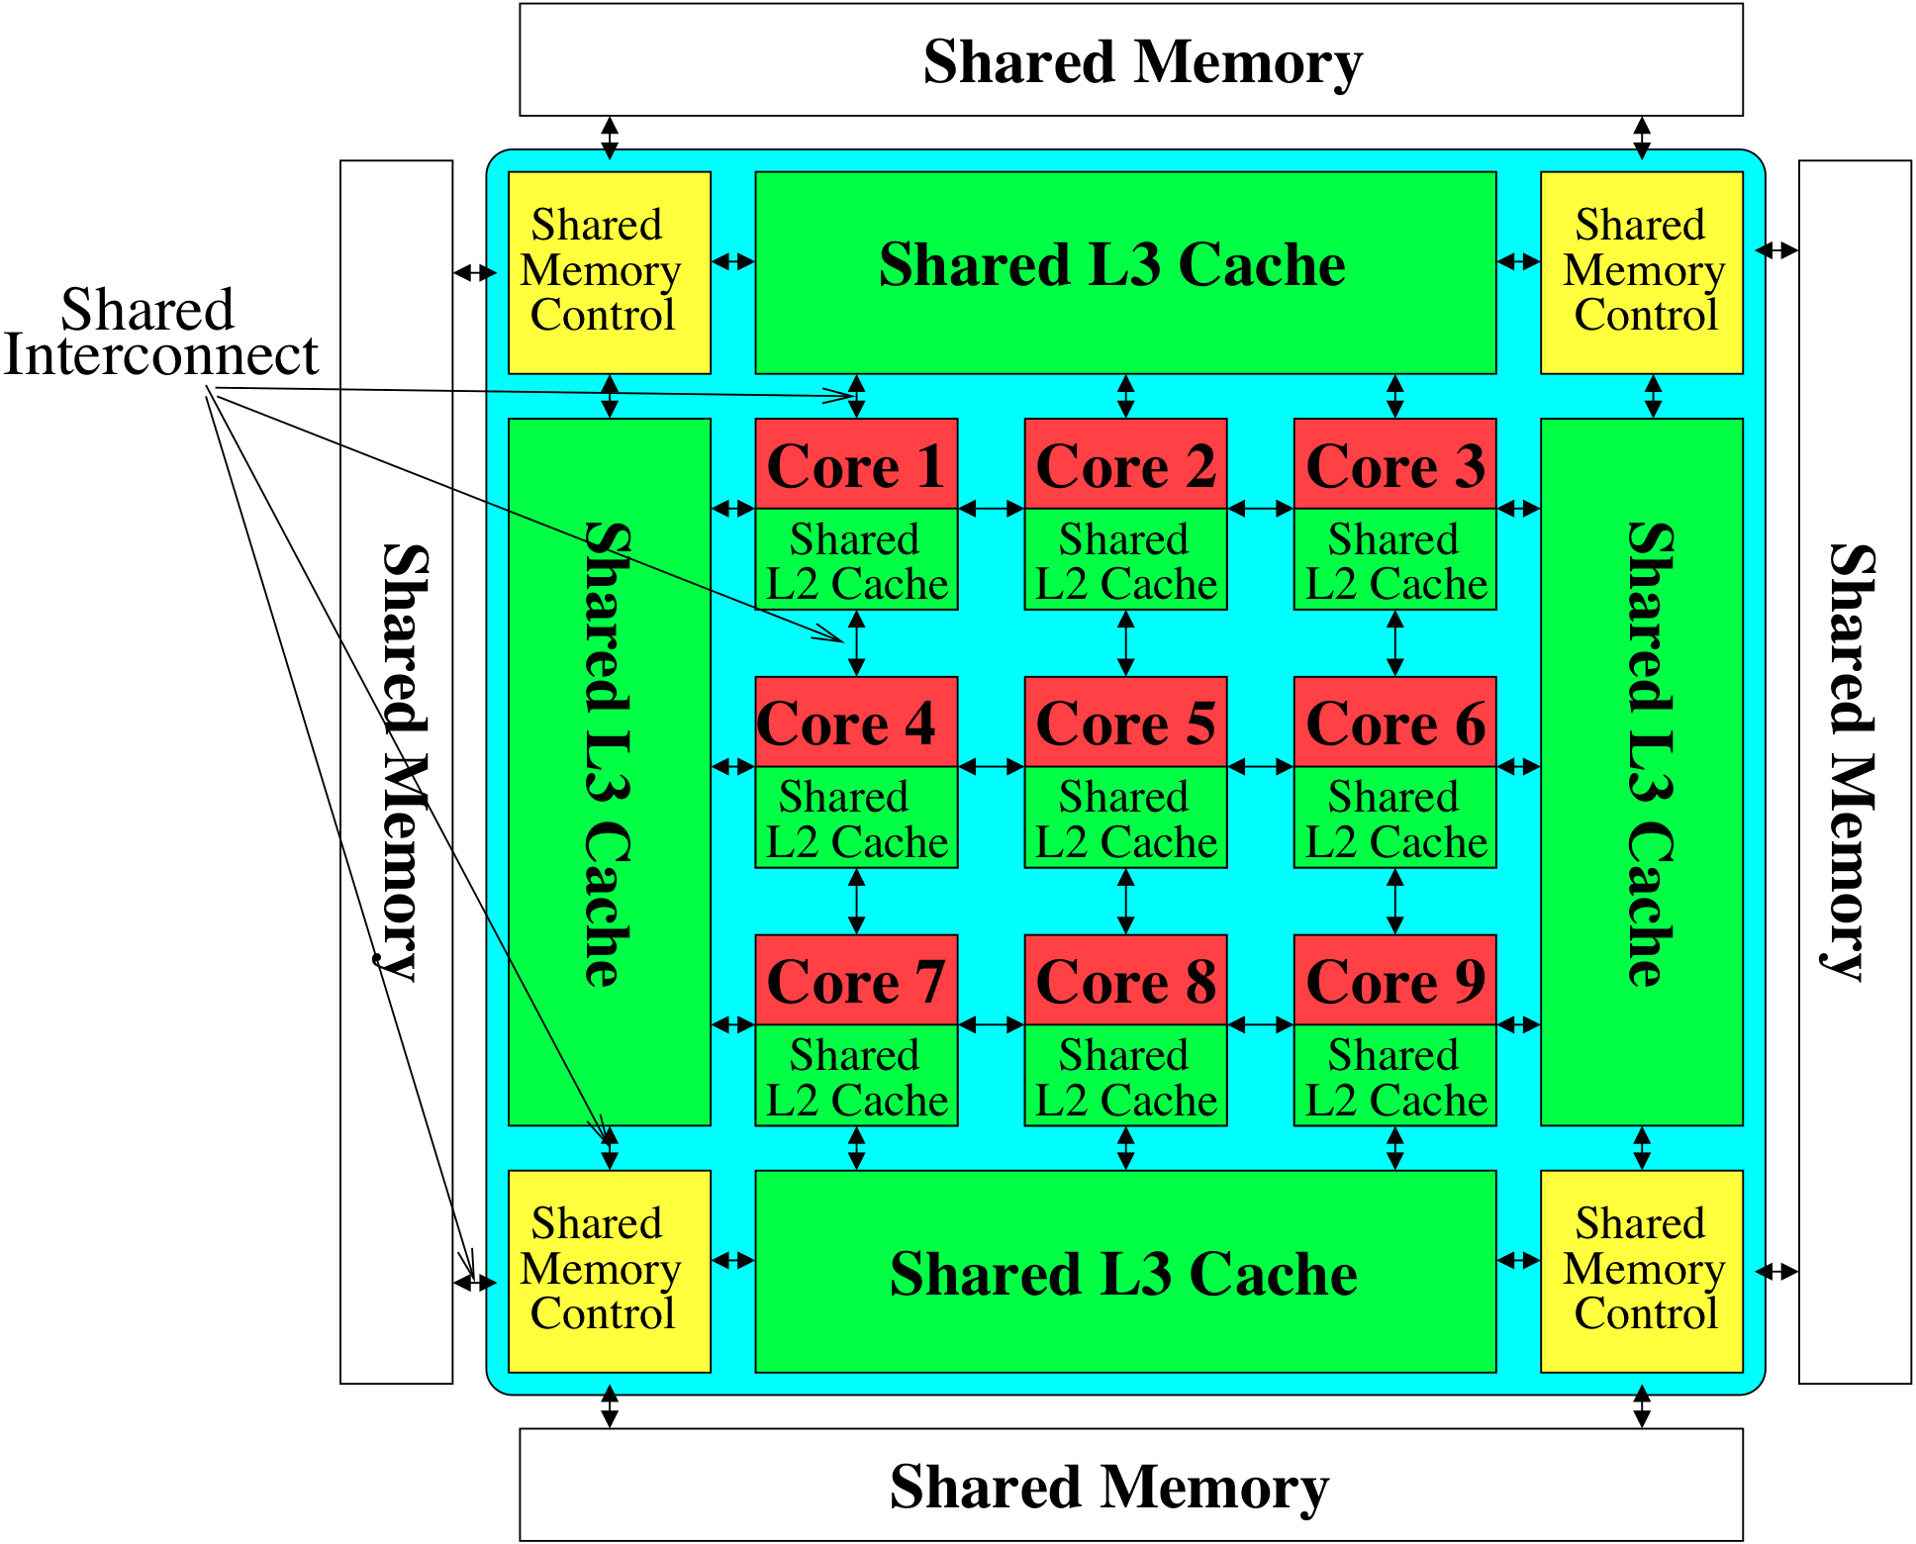
Memory System: A Shared Resource View
Storage
Most of the system is dedicated to storing and moving data

Slide 6
State of the Main Memory System
Recent technology, architecture, and application trends
  lead to new requirements
  exacerbate old requirements
DRAM and memory controllers, as we know them today, are (will be) unlikely to satisfy all requirements
Some emerging non-volatile memory technologies (e.g., PCM) enable new opportunities: memory+storage merging
We need to rethink the main memory system
  to fix DRAM issues and enable emerging technologies
  to satisfy all requirements

Slide 7
Agenda
Major Trends Affecting Main Memory
The Memory Scaling Problem and Solution Directions
  New Memory Architectures
  Enabling Emerging Technologies
Cross-Cutting Principles
Summary

Slide 8
Major Trends Affecting Main Memory (I)
Need for main memory capacity, bandwidth, QoS increasing
Main memory energy/power is a key system design concern
DRAM technology scaling is ending

Slide 9
Major Trends Affecting Main Memory (II)
Need for main memory capacity, bandwidth, QoS increasing
  Multi-core: increasing number of cores/agents
  Data-intensive applications: increasing demand/hunger for data
  Consolidation: cloud computing, GPUs, mobile, heterogeneity
Main memory energy/power is a key system design concern
DRAM technology scaling is ending

Slide 10
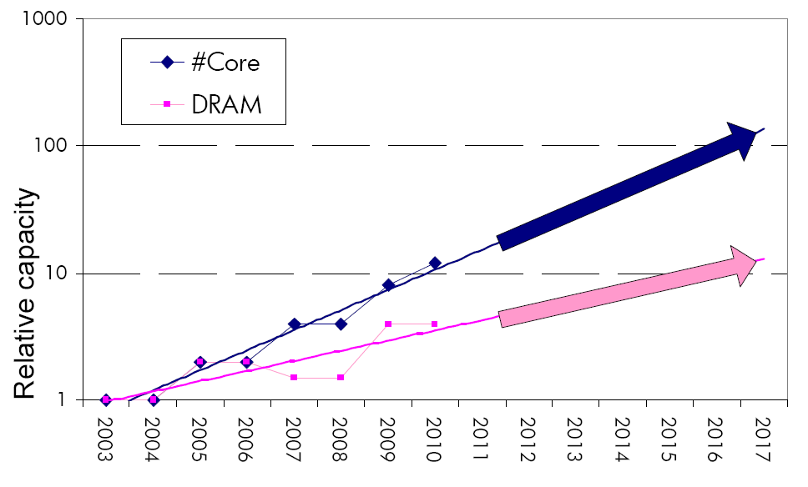
Example: The Memory Capacity Gap
Core count doubling ~ every 2 years
DRAM DIMM capacity doubling ~ every 3 years
Memory capacity per core expected to drop by 30% every two years
Trends worse for memory bandwidth per core!
Lim et al., ISCA 2009

Slide 11
Major Trends Affecting Main Memory (III)
Need for main memory capacity, bandwidth, QoS increasing
Main memory energy/power is a key system design concern
  ~40-50% energy spent in off-chip memory hierarchy [Lefurgy, IEEE Computer 2003]
  DRAM consumes power even when not used (periodic refresh)
DRAM technology scaling is ending

Slide 12
Major Trends Affecting Main Memory (IV)
Need for main memory capacity, bandwidth, QoS increasing
Main memory energy/power is a key system design concern
DRAM technology scaling is ending
  ITRS projects DRAM will not scale easily below X nm
  Scaling has provided many benefits:
    higher capacity (density), lower cost, lower energy

Slide 13
Agenda
Major Trends Affecting Main Memory
The Memory Scaling Problem and Solution Directions
  New Memory Architectures
  Enabling Emerging Technologies
Cross-Cutting Principles
Summary

Slide 14
Two Key Issues in Future Platforms
Fundamentally Secure/Reliable/Safe Architectures
Fundamentally Energy-Efficient Architectures
  Memory-centric (Data-centric) Architectures

Slide 15
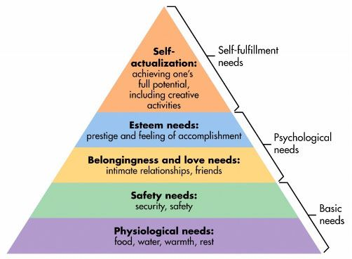
Maslow’s (Human) Hierarchy of Needs
Maslow, “A Theory of Human Motivation,”
Psychological Review, 1943.
We need to start with reliability and security…
Source: https://www.simplypsychology.org/maslow.html

Slide 16
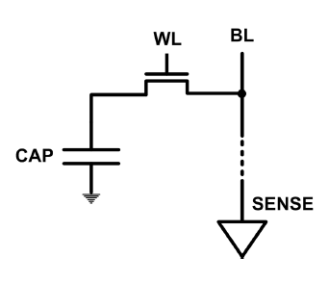
The DRAM Scaling Problem
DRAM stores charge in a capacitor (charge-based memory)
  Capacitor must be large enough for reliable sensing
  Access transistor should be large enough for low leakage and high retention time
  Scaling beyond 40-35nm (2013) is challenging [ITRS, 2009]
DRAM capacity, cost, and energy/power hard to scale

Slide 17
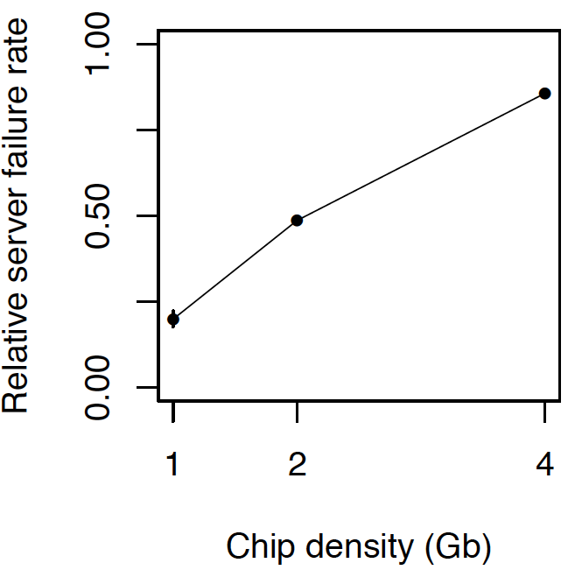
As Memory Scales, It Becomes Unreliable
Data from all of Facebook’s servers worldwide
Meza+, “Revisiting Memory Errors in Large-Scale Production Data Centers,” DSN’15.
Intuition:
quadratic
increase in
capacity

Slide 18
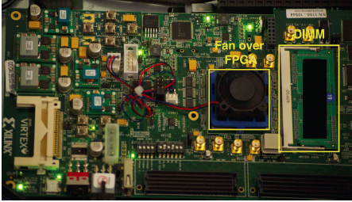
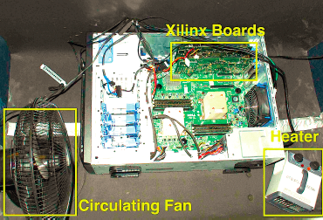
Infrastructures to Understand Such Issues
  An Experimental Study of Data Retention Behavior in Modern DRAM Devices: Implications for Retention Time Profiling Mechanisms (Liu et al., ISCA 2013)
  The Efficacy of Error Mitigation Techniques for DRAM Retention Failures: A Comparative Experimental Study
  (Khan et al., SIGMETRICS 2014)
  Flipping Bits in Memory Without Accessing Them: An Experimental Study of DRAM Disturbance Errors (Kim et al., ISCA 2014)
  Adaptive-Latency DRAM: Optimizing DRAM Timing for the Common-Case (Lee et al., HPCA 2015)
  AVATAR: A Variable-Retention-Time (VRT) Aware Refresh for DRAM Systems (Qureshi et al., DSN 2015)

Slide 19

Infrastructures to Understand Such Issues
Temperature
Controller
FPGAs
Heater
FPGAs
PC
  Kim+, “Flipping Bits in Memory Without Accessing Them: An Experimental Study of DRAM Disturbance Errors,” ISCA 2014.

Slide 20
A Curious Discovery [Kim et al., ISCA 2014]
One can
predictably induce errors
in most DRAM memory chips

Slide 21
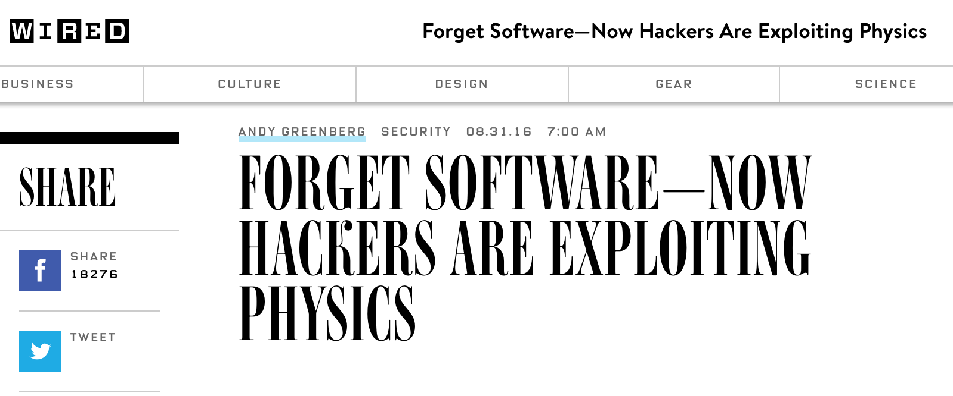
DRAM RowHammer
A simple hardware failure mechanism
can create a widespread
system security vulnerability

Slide 22
Modern DRAM is Prone to Disturbance Errors
Row of Cells
Wordline
Row
Victim Row
Row
Hammered Row
V_{LOW}
Opened
V_{HIGH}
Closed
Row
Victim Row
Row
Repeatedly reading a row enough times (before memory gets refreshed) induces disturbance errors in adjacent rows in most real DRAM chips you can buy today
Flipping Bits in Memory Without Accessing Them: An Experimental Study of DRAM Disturbance Errors, (Kim et al., ISCA 2014)

Slide 23
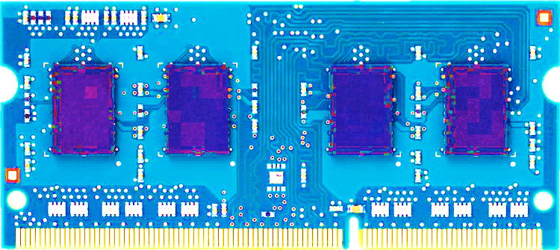
Most DRAM Modules Are at Risk
A company
B company
C company
86%
(37/43)
83%
(45/54)
88%
(28/32)
Up to
1.0×10⁷
errors
Up to
2.7×10⁶
errors
Up to
3.3×10⁵
errors
Flipping Bits in Memory Without Accessing Them: An Experimental Study of DRAM Disturbance Errors, (Kim et al., ISCA 2014)

Slide 24
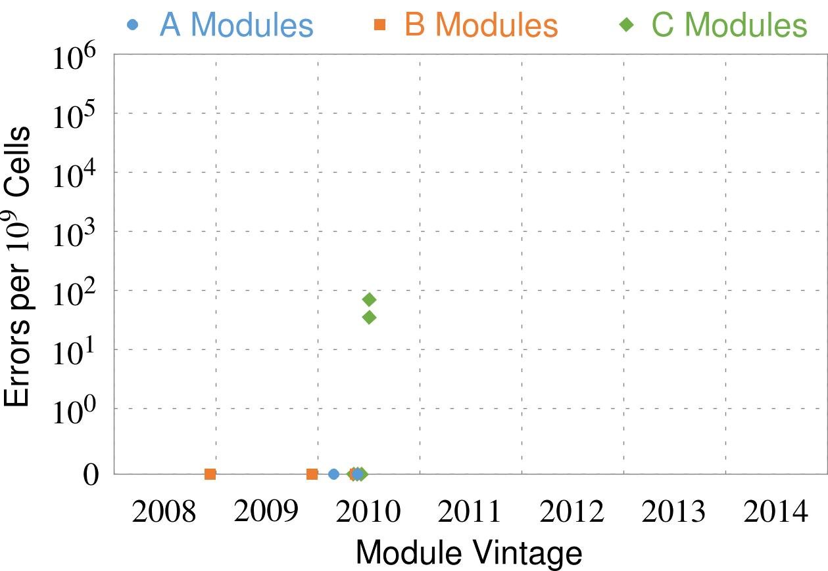
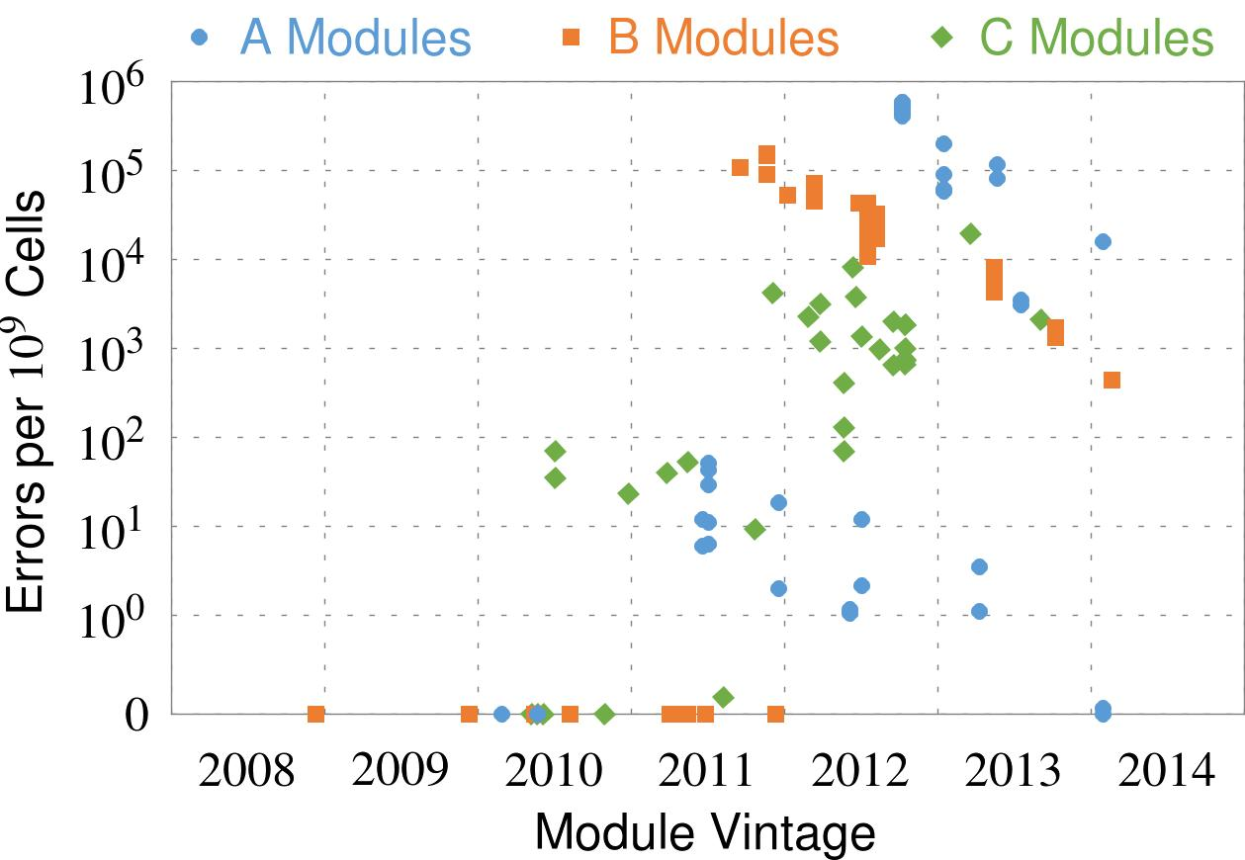
Recent DRAM Is More Vulnerable
First
Appearance
All modules from 2012–2013 are vulnerable
Notes:
In this figure, the x-axis is the module manufacture date. And the y-axis is the number of errors in a module, normalized to one billion cells. In 2008 and 2009, there are no errors. But, in 2010, we first start to see errors in C modules. After 2010, the errors start to proliferate. For A and B modules, we first start to see errors in 2011. In particular, all modules from 2012 and 2013 are vulnerable.

Slide 25

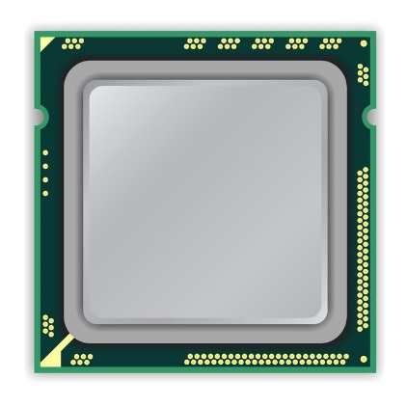
A Simple Program Can Induce Many Errors
CPU
DRAM Module
loop:
mov (X), %eax
mov (Y), %ebx
clflush (X)
clflush (Y)
mfence
jmp loop
X
Y
  Download from: https://github.com/CMU-SAFARI/rowhammer
Notes:
We demonstrate the errors on multiple x86 systems. Shown to the bottom-left is a “disturbance kernel”. When executed, it forces two rows to be opened and closed one after the other – over and over again. Consequently, it induces many errors in the module.

Slide 26
A Simple Program Can Induce Many Errors
CPU
DRAM Module
loop:
mov (X), %eax
mov (Y), %ebx
clflush (X)
clflush (Y)
mfence
jmp loop
X
Y
  Download from: https://github.com/CMU-SAFARI/rowhammer
Notes:
We demonstrate the errors on multiple x86 systems. Shown to the bottom-left is a “disturbance kernel”. When executed, it forces two rows to be opened and closed one after the other – over and over again. Consequently, it induces many errors in the module.

Slide 27
A Simple Program Can Induce Many Errors
CPU
DRAM Module
loop:
mov (X), %eax
mov (Y), %ebx
clflush (X)
clflush (Y)
mfence
jmp loop
X
Y
  Download from: https://github.com/CMU-SAFARI/rowhammer
Notes:
We demonstrate the errors on multiple x86 systems. Shown to the bottom-left is a “disturbance kernel”. When executed, it forces two rows to be opened and closed one after the other – over and over again. Consequently, it induces many errors in the module.

Slide 28
A Simple Program Can Induce Many Errors
CPU
DRAM Module
loop:
mov (X), %eax
mov (Y), %ebx
clflush (X)
clflush (Y)
mfence
jmp loop
X
Y
  Download from: https://github.com/CMU-SAFARI/rowhammer
Notes:
We demonstrate the errors on multiple x86 systems. Shown to the bottom-left is a “disturbance kernel”. When executed, it forces two rows to be opened and closed one after the other – over and over again. Consequently, it induces many errors in the module.

Slide 29
Observed Errors in Real Systems
A real reliability & security issue
CPU Architecture | Errors | Access-Rate
Intel Haswell (2013) | 22.9K | 12.3M/sec
Intel Ivy Bridge (2012) | 20.7K | 11.7M/sec
Intel Sandy Bridge (2011) | 16.1K | 11.6M/sec
AMD Piledriver (2012) | 59 | 6.1M/sec
Kim+, “Flipping Bits in Memory Without Accessing Them: An Experimental Study of DRAM Disturbance Errors,” ISCA 2014.
Notes:
When we executed the code on four different processors, all four of them yielded errors. Intel Haswell has the most errors, at 23 thousand, because it has the highest rate of accessing DRAM.
Later on, I’ll show that we can induce as many as ten million disturbance errors in a more controlled environment.
From this, we conclude that disturbance errors are a serious reliability issue.

Slide 30


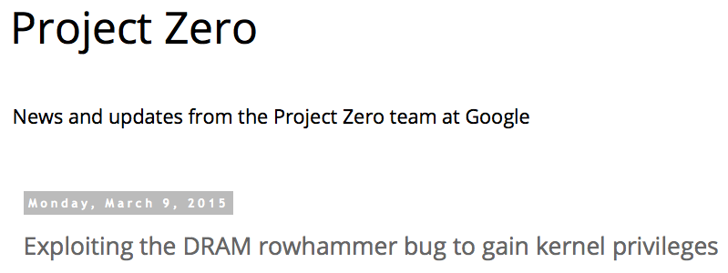
One Can Take Over an Otherwise-Secure System
Flipping Bits in Memory Without Accessing Them: An Experimental Study of DRAM Disturbance Errors (Kim et al., ISCA 2014)
Exploiting the DRAM rowhammer bug to gain kernel privileges (Seaborn, 2015)

Slide 31
RowHammer Security Attack Example
“Rowhammer” is a problem with some recent DRAM devices in which repeatedly accessing a row of memory can cause bit flips in adjacent rows (Kim et al., ISCA 2014).
  Flipping Bits in Memory Without Accessing Them: An Experimental Study of DRAM Disturbance Errors (Kim et al., ISCA 2014)
We tested a selection of laptops and found that a subset of them exhibited the problem.
We built two working privilege escalation exploits that use this effect.
  Exploiting the DRAM rowhammer bug to gain kernel privileges (Seaborn, 2015)
One exploit uses rowhammer-induced bit flips to gain kernel privileges on x86-64 Linux when run as an unprivileged userland process.
When run on a machine vulnerable to the rowhammer problem, the process was able to induce bit flips in page table entries (PTEs).
It was able to use this to gain write access to its own page table, and hence gain read-write access to all of physical memory.
Exploiting the DRAM rowhammer bug to gain kernel privileges (Seaborn, 2015)

Slide 32
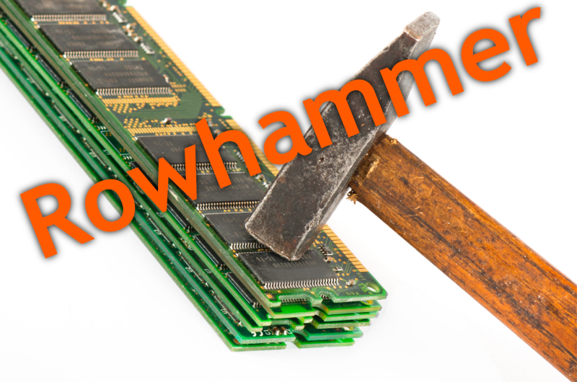

Security Implications
Notes:
Picture from the article:
http://thehackernews.com/2015/03/dram-rowhammer-vulnerability.html

Slide 33
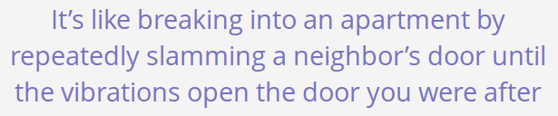
Security Implications
Notes:
Picture from the article:
http://thehackernews.com/2015/03/dram-rowhammer-vulnerability.html

Slide 34
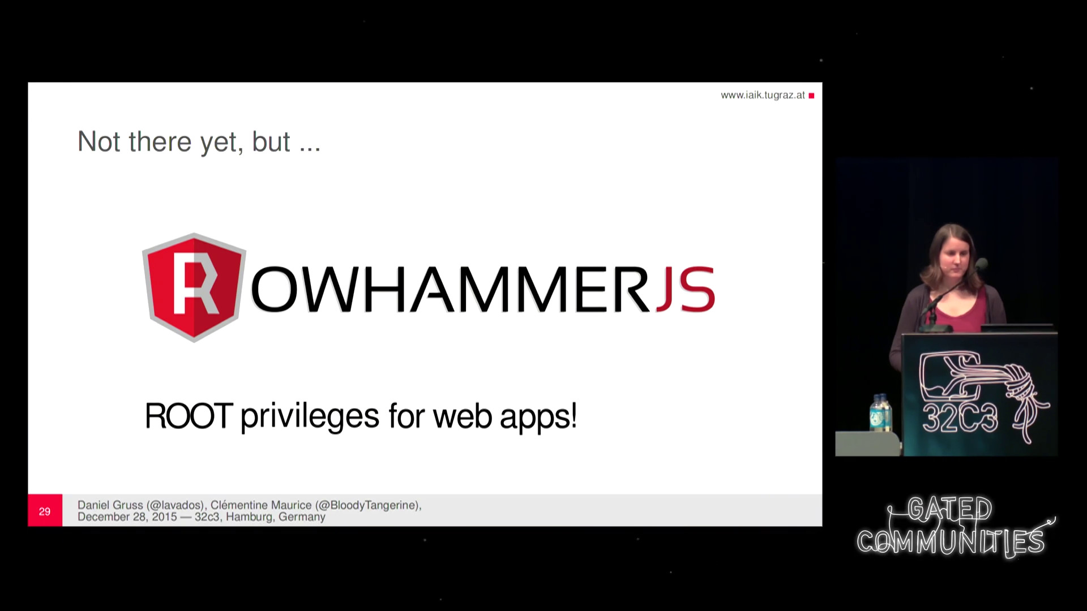
More Security Implications
“We can gain unrestricted access to systems of website visitors.”
Rowhammer.js: A Remote Software-Induced Fault Attack in JavaScript (DIMVA’16)
Source: https://lab.dsst.io/32c3-slides/7197.html

Slide 35

More Security Implications
  “Can gain control of a smart phone deterministically”
Drammer: Deterministic Rowhammer Attacks on Mobile Platforms, CCS’16
Source: https://fossbytes.com/drammer-rowhammer-attack-android-root-devices/

Slide 36
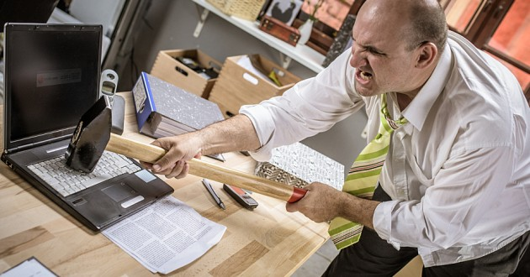
More Security Implications?

Slide 37
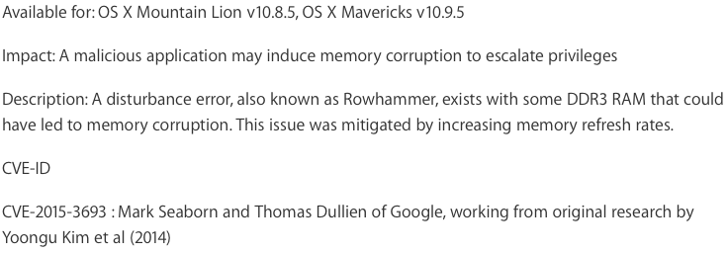
Apple’s Patch for RowHammer
https://support.apple.com/en-gb/HT204934
HP, Lenovo, and other vendors released similar patches

Slide 38
Better Solution Directions: Principled Designs
Design fundamentally secure
computing architectures
Predict and prevent such safety issues

Slide 39
How Do We Keep Memory Secure?
Understand: Methodologies for failure modeling and discovery
  Modeling and prediction based on real (device) data
Architect: Principled co-architecting of system and memory
  Good partitioning of duties across the stack
Design & Test: Principled design, automation, testing
  High coverage and good interaction with system reliability methods

Slide 40
Understand and Model with Experiments (DRAM)
Temperature
Controller
FPGAs
Heater
FPGAs
PC
  Kim+, “Flipping Bits in Memory Without Accessing Them: An Experimental Study of DRAM Disturbance Errors,” ISCA 2014.

Slide 41
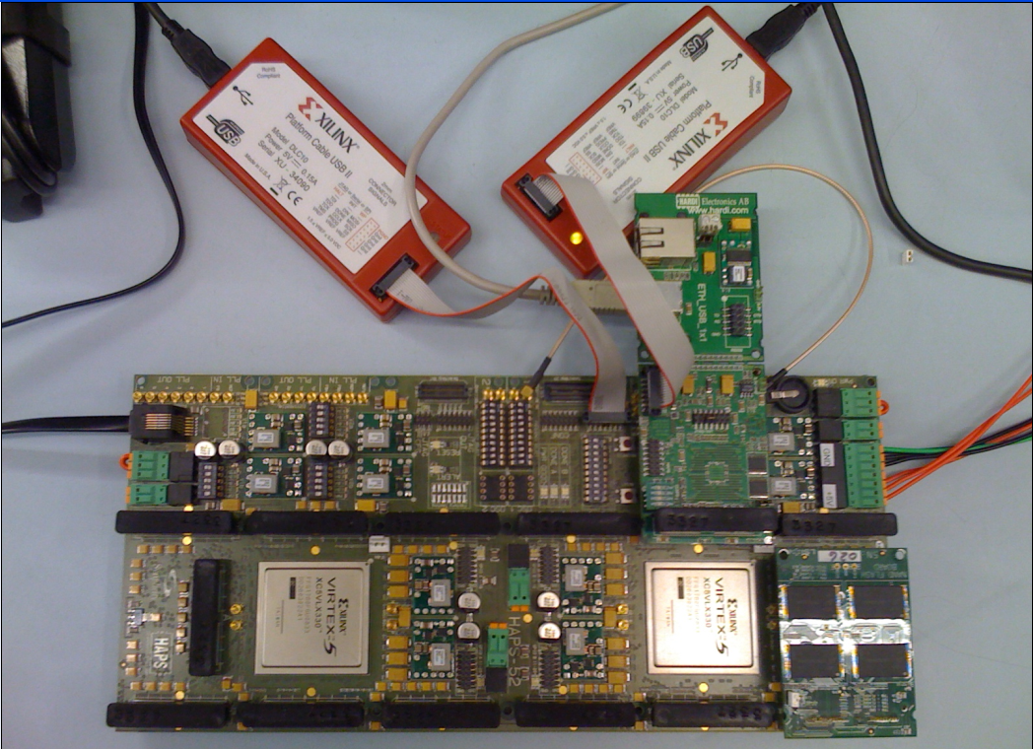
Understand and Model with Experiments (Flash)
USB Daughter Board
USB Jack
HAPS-52 Mother Board
Virtex-II Pro
(USB controller)
1x-nm
NAND Flash
Virtex-V FPGA
(NAND Controller)
[DATE 2012, ICCD 2012, DATE 2013, ITJ 2013, ICCD 2013, SIGMETRICS 2014, HPCA 2015, DSN 2015, MSST 2015, JSAC 2016, HPCA 2017, DFRWS 2017]
NAND Daughter Board
Cai+, “Error Characterization, Mitigation, and Recovery in Flash Memory Based Solid State Drives,” Proc. IEEE 2017.

Slide 42
There are Two Other Solutions
New Technologies: Replace or (more likely) augment DRAM with a different technology
  Non-volatile memories
Embracing Un-reliability:
Design memories with different reliability
and store data intelligently across them
…
Problem
Algorithm
Program/Language
System Software
SW/HW Interface
Micro-architecture
Logic
Devices
Electrons
Fundamental solutions to security require co-design across the hierarchy

Slide 43
Challenge and Opportunity for Future
Fundamentally
Secure, Reliable, Safe
Computing Architectures

Slide 44
Solving the Memory Scaling Problem
Fix it: Make memory and controllers more intelligent
  New interfaces, functions, architectures: system-mem codesign
Eliminate or minimize it: Replace or (more likely) augment DRAM with a different technology
  New technologies and system-wide rethinking of memory & storage
Embrace it: Design heterogeneous memories (none of which are perfect) and map data intelligently across them
  New models for data management and maybe usage
…

Slide 45
Solving the Memory Scaling Problem
Fix it: Make memory and controllers more intelligent
  New interfaces, functions, architectures: system-mem codesign
Eliminate or minimize it: Replace or (more likely) augment DRAM with a different technology
  New technologies and system-wide rethinking of memory & storage
Embrace it: Design heterogeneous memories (none of which are perfect) and map data intelligently across them
  New models for data management and maybe usage
…
Problems
Algorithms
Programs
User
Runtime System
(VM, OS, MM)
ISA
Microarchitecture
Logic
Devices
Solutions (to memory scaling) require
software/hardware/device cooperation

Slide 46
Two Key Issues in Future Platforms
Fundamentally Secure/Reliable/Safe Architectures
Fundamentally Energy-Efficient Architectures
  Memory-centric (Data-centric) Architectures

Slide 47
Maslow’s (Human) Hierarchy of Needs, Revisited
Maslow, “A Theory of Human Motivation,”
Psychological Review, 1943.
Everlasting battery life

Slide 48
Challenge and Opportunity for Future
Sustainable
and
Energy Efficient

Slide 49
The Problem
Data access is the major performance and energy bottleneck
Our current
design principles
cause great energy waste

Slide 50
The Problem
Processing of data
is performed
far away from the data

Slide 51
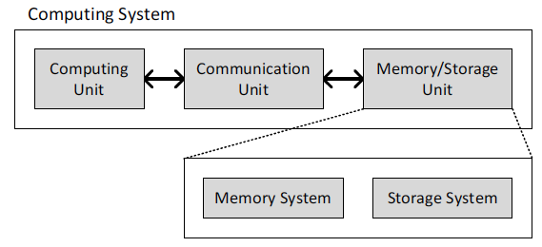
A Computing System
Three key components
Computation
Communication
Storage/memory
Burks, Goldstein, von Neumann, “Preliminary discussion of the
logical design of an electronic computing instrument,” 1946.

Slide 52
A Computing System
Three key components
Computation
Communication
Storage/memory
Burks, Goldstein, von Neumann, “Preliminary discussion of the
logical design of an electronic computing instrument,” 1946.

Slide 53
Today’s Computing Systems
Are overwhelmingly processor centric
All data processed in the processor → at great system cost
Processor is heavily optimized and is considered the master
Data storage units are dumb slaves and are largely unoptimized (except for some that are on the processor die)

Slide 54
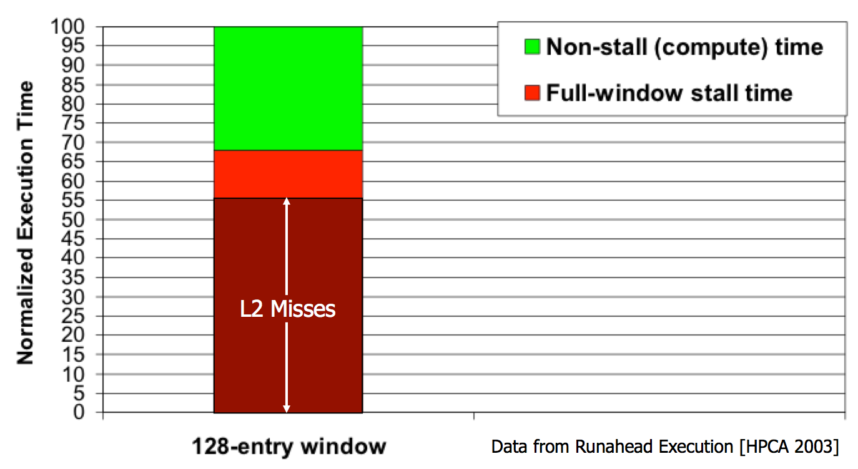
Yet …
“It’s the Memory, Stupid!” (Richard Sites, MPR, 1996)
Mutlu+, “Runahead Execution: An Alternative to Very Large Instruction Windows for Out-of-Order Processors,” HPCA 2003.

Slide 55
Perils of Processor-Centric Design
Grossly-imbalanced systems
  Processing done only in one place
  Everything else just stores and moves data: data moves a lot
  → Energy inefficient
  → Low performance
  → Complex
Overly complex and bloated processor (and accelerators)
  To tolerate data access from memory
  Complex hierarchies and mechanisms
  → Energy inefficient
  → Low performance
  → Complex

Slide 56
Perils of Processor-Centric Design
Most of the system is dedicated to storing and moving data

Slide 57
Three Key Systems Trends
1. Data access is a major bottleneck
  Applications are increasingly data hungry
2. Energy consumption is a key limiter
3. Data movement energy dominates compute
  Especially true for off-chip to on-chip movement

Slide 58
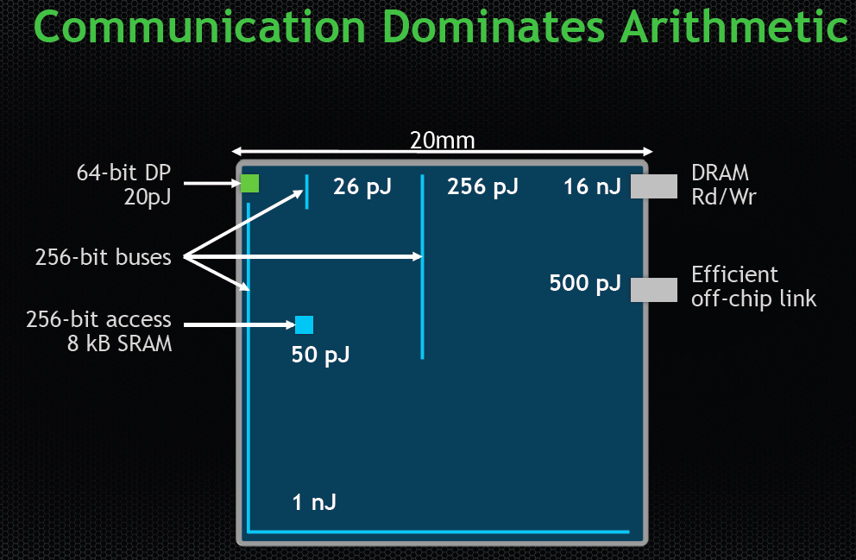
Data Movement vs. Computation Energy
Dally, HiPEAC 2015

Slide 59
Data Movement vs. Computation Energy
Dally, HiPEAC 2015
A memory access consumes ~1000X
the energy of a complex addition

Slide 60
We Need A Paradigm Shift To …
Enable computation with minimal data movement
Compute where it makes sense (where data resides)
Make computing architectures more data-centric

Slide 61
Goal: In-Memory Computation Engine
Many questions … How do we design the:
  compute-capable memory?
  processor chip?
  software interface?
  system software and languages?
  algorithms?
Memory
Processor
Core
Database
Graphs
Media
Cache
Query
Interconnect
Problem
Results
Algorithm
Program/Language
System Software
SW/HW Interface
Micro-architecture
Logic
Devices
Electrons

Slide 62

Starting Simple: Data Copy and Initialization
  memmove & memcpy: 5% cycles in Google’s datacenter [Kanev+ ISCA’15]
000000000000000
Zero initialization
(e.g., security)
Forking
Checkpointing
Many more
VM Cloning
Deduplication
Page Migration

Slide 63
Today’s Systems: Bulk Data Copy
1) High latency
Memory
3) Cache pollution
L3
CPU
L2
L1
MC
2) High bandwidth utilization
4) Unwanted data movement
1046ns, 3.6uJ (for 4KB page copy via DMA)

Slide 64
Future Systems: In-Memory Copy
3) No cache pollution
1) Low latency
Memory
L3
CPU
L2
L1
MC
2) Low bandwidth utilization
4) No unwanted data movement
1046ns, 3.6uJ
90ns, 0.04uJ

Slide 65
RowClone: In-DRAM Row Copy
Idea: Two consecutive ACTivates
4 Kbytes
Negligible HW cost
Step 1: Activate row A
Step 2: Activate row B
Transfer row
DRAM subarray
Transfer
row
Row Buffer (4 Kbytes)
8 bits
Data Bus
Notes:
copy

Slide 66
RowClone: Latency and Energy Savings
11.6x
74x
Seshadri et al., “RowClone: Fast and Efficient In-DRAM Copy and Initialization of Bulk Data,” MICRO 2013.

Slide 67
(Truly) In-Memory Computation
Similarly, we can support in-DRAM AND, OR, NOT, MAJ
At low cost
Using analog behavior of memory
30-60X performance and energy improvement
  Seshadri+, “In-DRAM Bulk Bitwise AND and OR,” CAL 2016.
  Seshadri+, “Buddy-RAM: Improving the Performance and Efficiency of Bulk Bitwise Operations Using DRAM,” arxiv 2016.
New memory technologies enable even more opportunities
  Memristors, resistive RAM, phase change mem, STT-MRAM, …
  Can operate on data with minimal movement

Slide 68




Another Example: In-Memory Graph Processing
Large graphs are everywhere (circa 2015)
Scalable large-scale graph processing is challenging
36 Million
Wikipedia Pages
1.4 Billion
Facebook Users
300 Million
Twitter Users
30 Billion
Instagram Photos

Slide 69
Key Bottlenecks in Graph Processing
for (v: graph.vertices) {
for (w: v.successors) {
w.next_rank += weight * v.rank;
}
}
1. Frequent random memory accesses
v
&w
w.rank
w.next_rank
w.edges
weight * v.rank
w
…
2. Little amount of computation

Slide 70
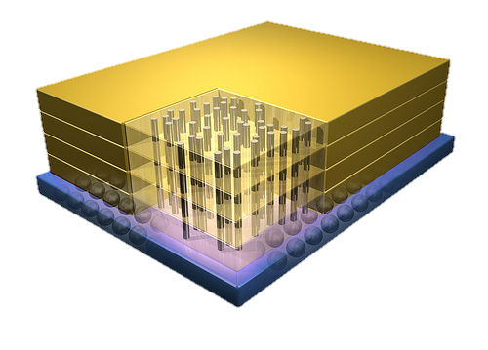
Tesseract System for Graph Processing
Interconnected set of 3D-stacked memory+logic chips with simple cores
Host Processor
Memory
Memory-Mapped
Accelerator Interface
(Noncacheable, Physically Addressed)
Logic
In-Order Core
DRAM Controller
…
…
LP
PF Buffer
Crossbar Network
…
MTP
…
Message Queue
NI
Ahn+, “A Scalable Processing-in-Memory Accelerator for Parallel Graph Processing” ISCA 2015.

Slide 71
Tesseract System for Graph Processing
Host Processor
Memory
Memory-Mapped
Accelerator Interface
(Noncacheable, Physically Addressed)
Logic
In-Order Core
DRAM Controller
…
…
Communications via
Remote Function Calls
LP
PF Buffer
Crossbar Network
…
MTP
…
Message Queue
NI

Slide 72
Tesseract System for Graph Processing
Host Processor
Memory
Memory-Mapped
Accelerator Interface
(Noncacheable, Physically Addressed)
Logic
Prefetching
In-Order Core
DRAM Controller
…
…
LP
PF Buffer
Crossbar Network
…
MTP
…
Message Queue
NI

Slide 73
Evaluated Systems
DDR3-OoO
HMC-OoO
HMC-MC
Tesseract
32 Tesseract Cores
8 OoO
4GHz
8 OoO
4GHz
8 OoO
4GHz
8 OoO
4GHz
128
In-Order
2GHz
128
In-Order
2GHz
8 OoO
4GHz
8 OoO
4GHz
8 OoO
4GHz
8 OoO
4GHz
128
In-Order
2GHz
128
In-Order
2GHz
102.4GB/s
640GB/s
640GB/s
8TB/s
Ahn+, “A Scalable Processing-in-Memory Accelerator for Parallel Graph Processing” ISCA 2015.

Slide 74
Tesseract Graph Processing Performance
>13X Performance Improvement
On five graph processing algorithms
Ahn+, “A Scalable Processing-in-Memory Accelerator for Parallel Graph Processing” ISCA 2015.

Slide 75
Tesseract Graph Processing Performance

Slide 76
Tesseract Graph Processing Energy
> 8X Energy Reduction
Ahn+, “A Scalable Processing-in-Memory Accelerator for Parallel Graph Processing” ISCA 2015.

Slide 77
Challenge and Opportunity for Future
Fundamentally
Energy-Efficient
(Data-Centric)
Computing Architectures

Slide 78
Concluding Remarks

Slide 79
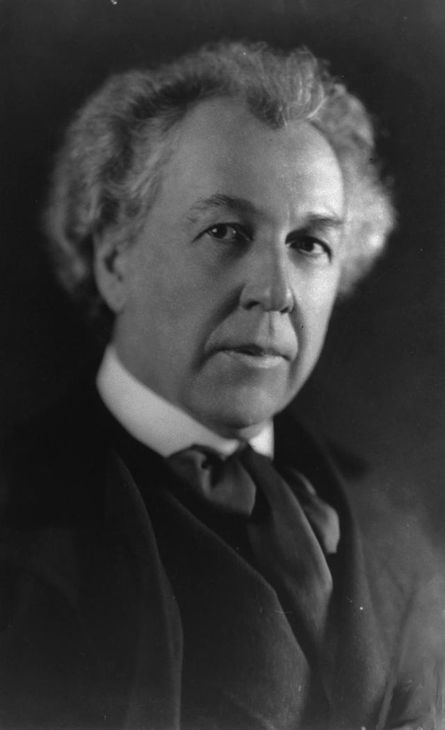
A Quote from A Famous Architect
“architecture […] based upon principle, and not upon precedent”

Slide 80
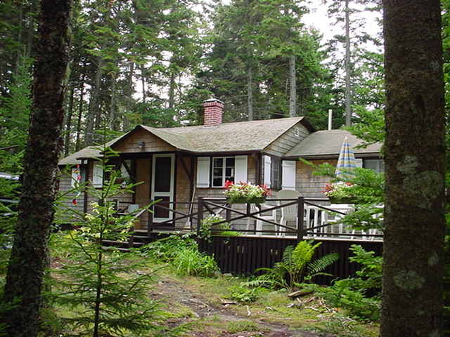
Precedent-Based Design?
“architecture […] based upon principle, and not upon precedent”

Slide 81

Principled Design
“architecture […] based upon principle, and not upon precedent”

Slide 82
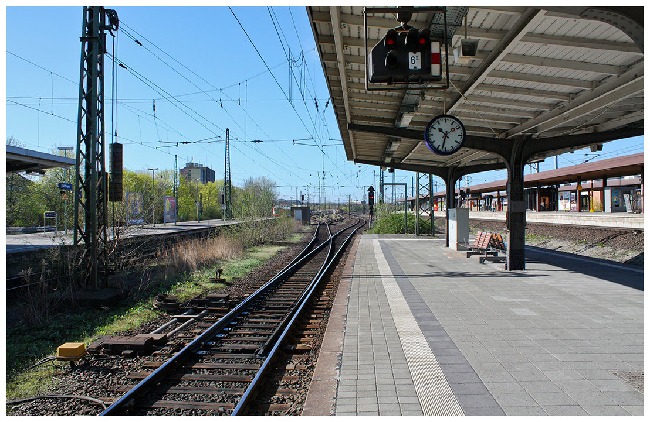
Another Example: Precedent-Based Design
Source: http://cookiemagik.deviantart.com/art/Train-station-207266944

Slide 83
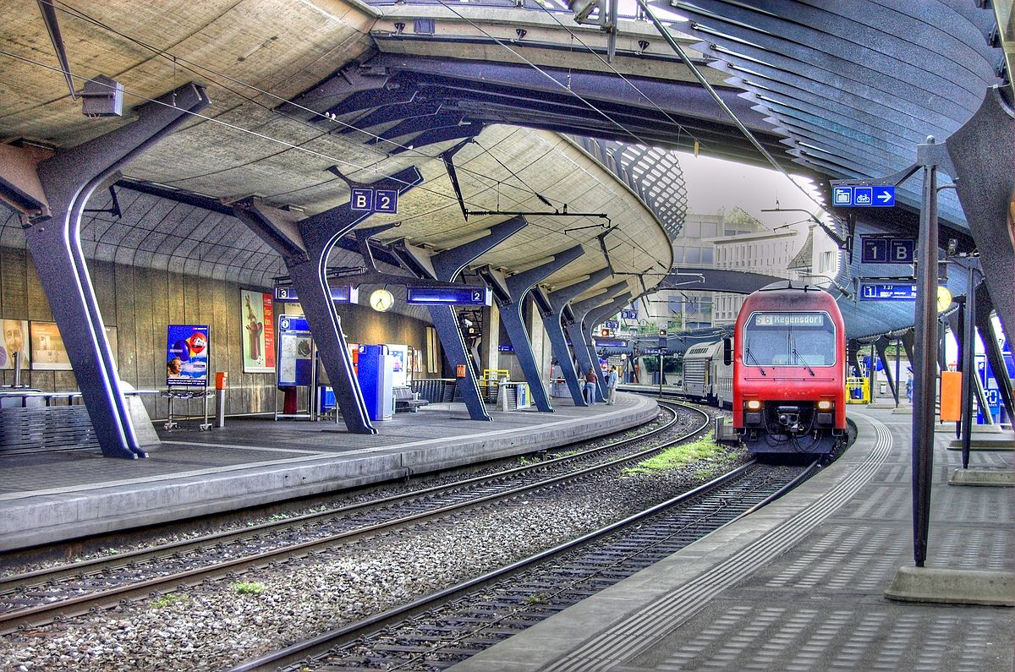
Principled Design
Source: By Toni_V, CC BY-SA 2.0, https://commons.wikimedia.org/w/index.php?curid=4087256

Slide 84
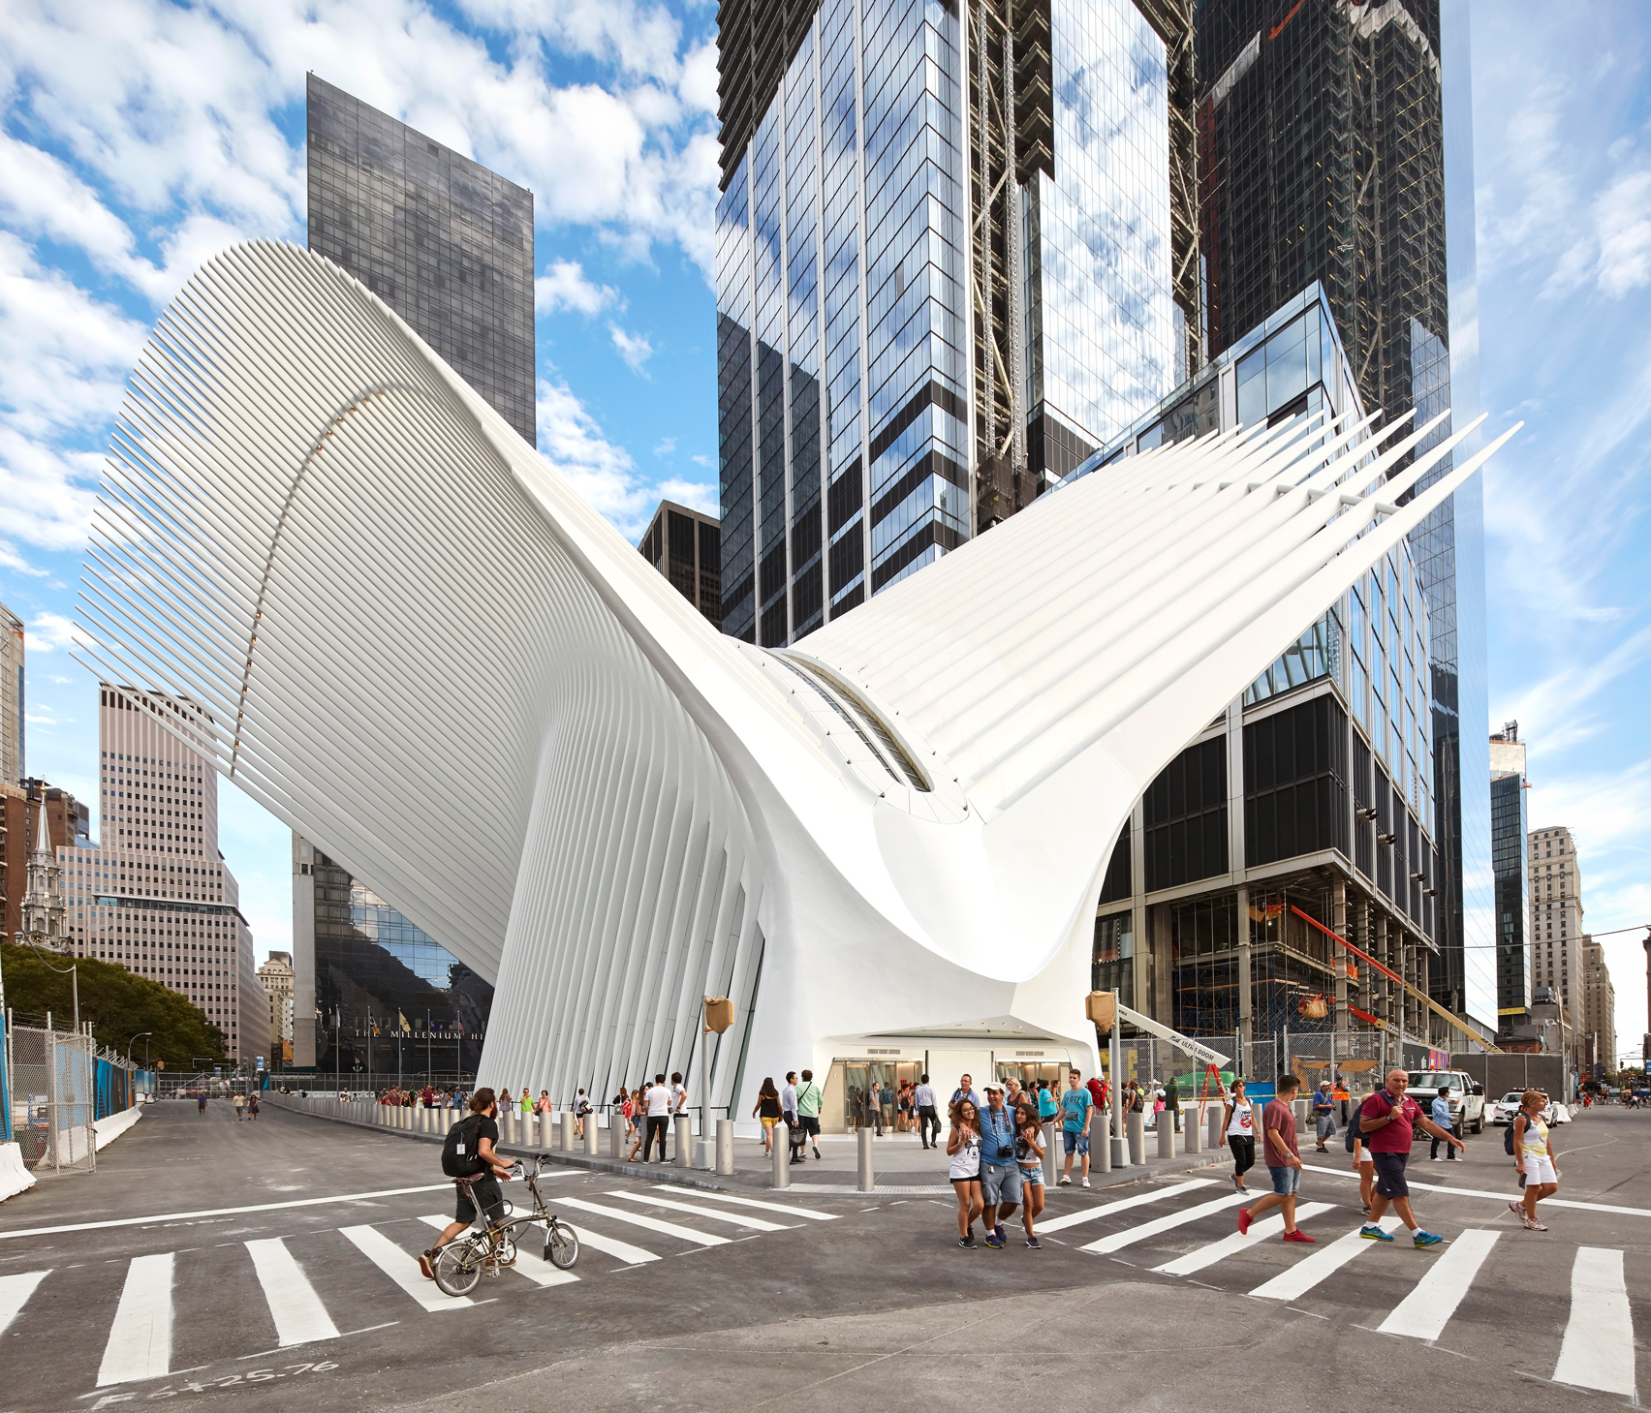
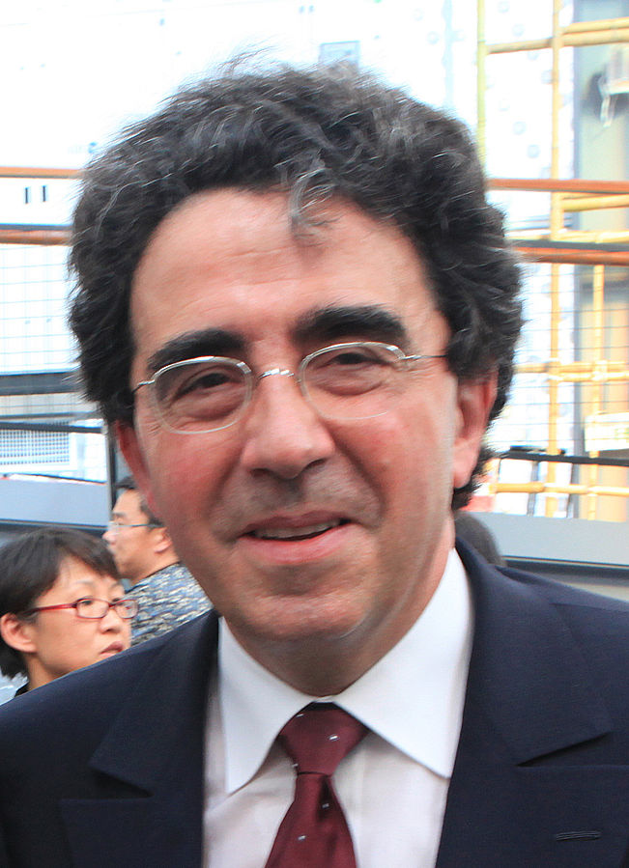
Principle Applied to Another Structure
Source: By 準建築人手札網站 Forgemind ArchiMedia - Flickr: IMG_2489.JPG, CC BY 2.0,
https://commons.wikimedia.org/w/index.php?curid=31493356, https://en.wikipedia.org/wiki/Santiago_Calatrava
Source: https://www.dezeen.com/2016/08/29/santiago-calatrava-oculus-world-trade-center-transportation-hub-new-york-photographs-hufton-crow/

Slide 85
Concluding Remarks
It is time to design principled system architectures to solve the memory scaling problem
Discover design principles for fundamentally secure and reliable computer architectures
Design complete systems to be balanced and energy-efficient, i.e., data-centric (or memory-centric)
Enable new and emerging memory architectures
This can
  Lead to orders-of-magnitude improvements
  Enable new applications & computing platforms
  …
Notes:
Perhaps we have taken processor-centric system design a bit too far

Slide 86
Concluding Remarks
Problem
Algorithm
Program/Language
System Software
SW/HW Interface
Micro-architecture
Logic
Devices
Electrons

Slide 87
Rethinking Memory System Design
(and the Platforms We Design Around It)
Onur Mutlu
onur.mutlu@inf.ethz.ch
https://people.inf.ethz.ch/omutlu
June 5, 2017
Technion Seiden Workshop: Beyond CMOS

Slide 88
Acknowledgments
My current and past students and postdocs
  Rachata Ausavarungnirun, Abhishek Bhowmick, Amirali Boroumand, Rui Cai, Yu Cai, Kevin Chang, Saugata Ghose, Kevin Hsieh, Tyler Huberty, Ben Jaiyen, Samira Khan, Jeremie Kim, Yoongu Kim, Yang Li, Jamie Liu, Lavanya Subramanian, Donghyuk Lee, Yixin Luo, Justin Meza, Gennady Pekhimenko, Vivek Seshadri, Lavanya Subramanian, Nandita Vijaykumar, HanBin Yoon, Jishen Zhao, …
My collaborators
  Can Alkan, Chita Das, Phil Gibbons, Sriram Govindan, Norm Jouppi, Mahmut Kandemir, Mike Kozuch, Konrad Lai, Ken Mai, Todd Mowry, Yale Patt, Moinuddin Qureshi, Partha Ranganathan, Bikash Sharma, Kushagra Vaid, Chris Wilkerson, …

Slide 89
Funding Acknowledgments
NSF
GSRC
SRC
CyLab
AMD, Google, Facebook, HP Labs, Huawei, IBM, Intel, Microsoft, Nvidia, Oracle, Qualcomm, Rambus, Samsung, Seagate, VMware

Slide 90
Slides Not Covered
But Could Be Useful

Slide 91
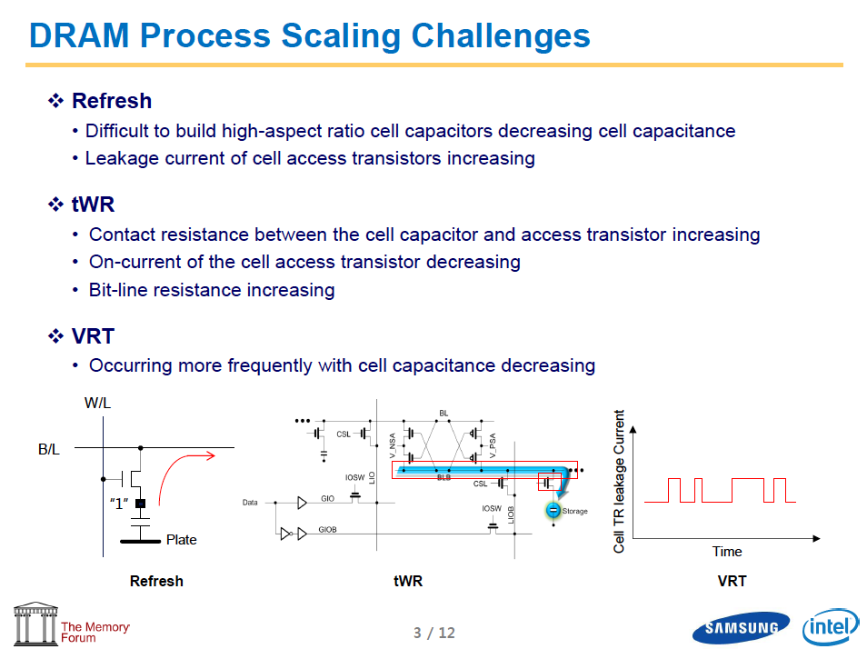
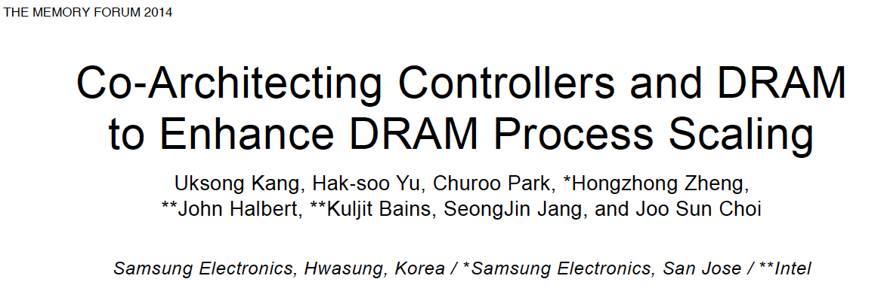
Recap: The DRAM Scaling Problem

Slide 92
Solution 1: New Memory Architectures
Overcome memory shortcomings with
  Memory-centric system design
  Novel memory architectures, interfaces, functions
  Better waste management (efficient utilization)
Key issues to tackle
  Enable reliability at low cost
  Reduce energy
  Improve latency and bandwidth
  Reduce waste (capacity, bandwidth, latency)
  Enable computation close to data

Slide 93
Solution 1: New Memory Architectures
Liu+, “RAIDR: Retention-Aware Intelligent DRAM Refresh,” ISCA 2012.
Kim+, “A Case for Exploiting Subarray-Level Parallelism in DRAM,” ISCA 2012.
Lee+, “Tiered-Latency DRAM: A Low Latency and Low Cost DRAM Architecture,” HPCA 2013.
Liu+, “An Experimental Study of Data Retention Behavior in Modern DRAM Devices,” ISCA 2013.
Seshadri+, “RowClone: Fast and Efficient In-DRAM Copy and Initialization of Bulk Data,” MICRO 2013.
Pekhimenko+, “Linearly Compressed Pages: A Main Memory Compression Framework,” MICRO 2013.
Chang+, “Improving DRAM Performance by Parallelizing Refreshes with Accesses,” HPCA 2014.
Khan+, “The Efficacy of Error Mitigation Techniques for DRAM Retention Failures: A Comparative Experimental Study,” SIGMETRICS 2014.
Luo+, “Characterizing Application Memory Error Vulnerability to Optimize Data Center Cost,” DSN 2014.
Kim+, “Flipping Bits in Memory Without Accessing Them: An Experimental Study of DRAM Disturbance Errors,” ISCA 2014.
Lee+, “Adaptive-Latency DRAM: Optimizing DRAM Timing for the Common-Case,” HPCA 2015.
Qureshi+, “AVATAR: A Variable-Retention-Time (VRT) Aware Refresh for DRAM Systems,” DSN 2015.
Meza+, “Revisiting Memory Errors in Large-Scale Production Data Centers: Analysis and Modeling of New Trends from the Field,” DSN 2015.
Kim+, “Ramulator: A Fast and Extensible DRAM Simulator,” IEEE CAL 2015.
Seshadri+, “Fast Bulk Bitwise AND and OR in DRAM,” IEEE CAL 2015.
Ahn+, “A Scalable Processing-in-Memory Accelerator for Parallel Graph Processing,” ISCA 2015.
Ahn+, “PIM-Enabled Instructions: A Low-Overhead, Locality-Aware Processing-in-Memory Architecture,” ISCA 2015.
Lee+, “Decoupled Direct Memory Access: Isolating CPU and IO Traffic by Leveraging a Dual-Data-Port DRAM,” PACT 2015.
Seshadri+, “Gather-Scatter DRAM: In-DRAM Address Translation to Improve the Spatial Locality of Non-unit Strided Accesses,” MICRO 2015.
Lee+, “Simultaneous Multi-Layer Access: Improving 3D-Stacked Memory Bandwidth at Low Cost,” TACO 2016.
Hassan+, “ChargeCache: Reducing DRAM Latency by Exploiting Row Access Locality,” HPCA 2016.
Chang+, “Low-Cost Inter-Linked Subarrays (LISA): Enabling Fast Inter-Subarray Data Migration in DRAM,” HPCA 2016.
Chang+, “Understanding Latency Variation in Modern DRAM Chips Experimental Characterization, Analysis, and Optimization,” SIGMETRICS 2016.
Khan+, “PARBOR: An Efficient System-Level Technique to Detect Data Dependent Failures in DRAM,” DSN 2016.
Hsieh+, “Transparent Offloading and Mapping (TOM): Enabling Programmer-Transparent Near-Data Processing in GPU Systems,” ISCA 2016.
Hashemi+, “Accelerating Dependent Cache Misses with an Enhanced Memory Controller,” ISCA 2016.
Boroumand+, “LazyPIM: An Efficient Cache Coherence Mechanism for Processing-in-Memory,” IEEE CAL 2016.
Pattnaik+, “Scheduling Techniques for GPU Architectures with Processing-In-Memory Capabilities,” PACT 2016.
Hsieh+, “Accelerating Pointer Chasing in 3D-Stacked Memory: Challenges, Mechanisms, Evaluation,” ICCD 2016.
Hashemi+, “Continuous Runahead: Transparent Hardware Acceleration for Memory Intensive Workloads,” MICRO 2016.
Khan+, “A Case for Memory Content-Based Detection and Mitigation of Data-Dependent Failures in DRAM",” IEEE CAL 2016.
Hassan+, “SoftMC: A Flexible and Practical Open-Source Infrastructure for Enabling Experimental DRAM Studies,” HPCA 2017.
Avoid DRAM:
  Seshadri+, “The Evicted-Address Filter: A Unified Mechanism to Address Both Cache Pollution and Thrashing,” PACT 2012.
  Pekhimenko+, “Base-Delta-Immediate Compression: Practical Data Compression for On-Chip Caches,” PACT 2012.
  Seshadri+, “The Dirty-Block Index,” ISCA 2014.
  Pekhimenko+, “Exploiting Compressed Block Size as an Indicator of Future Reuse,” HPCA 2015.
  Vijaykumar+, “A Case for Core-Assisted Bottleneck Acceleration in GPUs: Enabling Flexible Data Compression with Assist Warps,” ISCA 2015.
  Pekhimenko+, “Toggle-Aware Bandwidth Compression for GPUs,” HPCA 2016.

Slide 94
Solution 2: Emerging Memory Technologies
Some emerging resistive memory technologies seem more scalable than DRAM (and they are non-volatile)
Example: Phase Change Memory
  Expected to scale to 9nm (2022 [ITRS])
  Expected to be denser than DRAM: can store multiple bits/cell
But, emerging technologies have shortcomings as well
  Can they be enabled to replace/augment/surpass DRAM?
Lee+, “Architecting Phase Change Memory as a Scalable DRAM Alternative,” ISCA’09, CACM’10, IEEE Micro’10.
Meza+, “Enabling Efficient and Scalable Hybrid Memories,” IEEE Comp. Arch. Letters 2012.
Yoon, Meza+, “Row Buffer Locality Aware Caching Policies for Hybrid Memories,” ICCD 2012.
Kultursay+, “Evaluating STT-RAM as an Energy-Efficient Main Memory Alternative,” ISPASS 2013.
Meza+, “A Case for Efficient Hardware-Software Cooperative Management of Storage and Memory,” WEED 2013.
Lu+, “Loose Ordering Consistency for Persistent Memory,” ICCD 2014.
Zhao+, “FIRM: Fair and High-Performance Memory Control for Persistent Memory Systems,” MICRO 2014.
Yoon, Meza+, “Efficient Data Mapping and Buffering Techniques for Multi-Level Cell Phase-Change Memories,” TACO 2014.
Ren+, “ThyNVM: Enabling Software-Transparent Crash Consistency in Persistent Memory Systems,” MICRO 2015.
Chauhan+, “NVMove: Helping Programmers Move to Byte-Based Persistence,” INFLOW 2016.
Notes:
Even if DRAM continues to scale there could be benefits to examining and enabling these new technologies.

Slide 95
Solution 3: Hybrid Memory Systems
CPU
Meza+, “Enabling Efficient and Scalable Hybrid Memories,” IEEE Comp. Arch. Letters, 2012.
Yoon, Meza et al., “Row Buffer Locality Aware Caching Policies for Hybrid Memories,” ICCD 2012 Best Paper Award.
DRAMCtrl
PCM Ctrl
DRAM
Technology X (e.g., PCM)
Fast, durable
Small,
leaky, volatile,
high-cost
Large, non-volatile, low-cost
Slow, wears out, high active energy
Hardware/software manage data allocation and movement
to achieve the best of multiple technologies

Slide 96
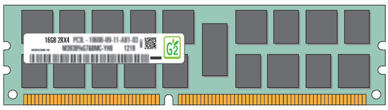
Exploiting Memory Error Tolerance with Hybrid Memory Systems
Heterogeneous-Reliability Memory [DSN 2014]
Vulnerable data
Vulnerable data
Tolerant data
Tolerant data
Reliable memory
Low-cost memory
Vulnerable data
  On Microsoft’s Web Search workload
  Reduces server hardware cost by 4.7 %
  Achieves single server availability target of 99.90 %
ECC protected
Well-tested chips
Tolerant data
NoECC or Parity
Less-tested chips
Notes:
As we have shown earlier, either across or within applications, our characterization can identify data that are vulnerable to memory errors and data that are tolerant to memory errors.
To exploit this observation, we would like to map these different data onto different memory modules according to their memory error tolerance.
As an example here, we map vulnerable data to reliable memory to improve reliability, and map tolerant data to low-cost less-reliable memory to exploit its tolerance and lower the cost. We call this mechanism heterogeneous-reliability memory, HRM.
Reliable memory consists of … Low cost memory consists of …
As we will show later, HRM allows us to use weaker error protection in memory, and enables the use of less-tested memory chips to lower the cost of the memory system, while still achieving reasonable single-server reliability target.

Slide 97
Challenge and Opportunity
Providing the Best of
Multiple Metrics

Slide 98
Departing From “Business as Usual”
Heterogeneous Memory Systems
Configurable Memory Systems

Slide 99
An Orthogonal Issue: Memory Interference
Main
Memory
Core
Core
Core
Core
Cores’ interfere with each other when accessing shared main memory
This is uncontrolled today → Unpredictable, uncontrollable system
Notes:
In a multicore system, multiple applications running on the different cores share the main memory.
These applications interfere at the main memory. The result of this interference is unpredictable application slowdowns.

Slide 100
Goal: Predictable Performance in Complex Systems
CPU
CPU
CPU
CPU
GPU
HWA
HWA
Shared Cache
DRAM and Hybrid Memory Controllers
DRAM and Hybrid Memories
Heterogeneous agents: CPUs, GPUs, and HWAs
Main memory interference between CPUs, GPUs, HWAs
How to allocate resources to heterogeneous agents
to mitigate interference and provide predictable performance?

Slide 101
QoS-Aware Memory Systems
Solution: QoS-Aware Memory Systems
Hardware provides a configurable QoS substrate
  Application-aware memory scheduling, partitioning, throttling
Software configures the substrate to satisfy various QoS goals
QoS-aware memory systems provide predictable performance and higher efficiency
Subramanian et al., “MISE: Providing Performance Predictability and Improving Fairness in Shared Main Memory Systems,” HPCA 2013.
Subramanian et al., “The Application Slowdown Model,” MICRO 2015.

Slide 102
Challenge and Opportunity
Strong
Memory Service
Guarantees

Slide 103
Departing From “Business as Usual”
Predictable Memory Management
Programmable Memory Systems

Slide 104
Some Promising Directions
New memory architectures
  Memory-centric system design
Enabling and exploiting emerging NVM technologies
  Hybrid memory systems
  Unified interface to all data
System-level QoS and predictability
  Predictable systems with configurable QoS

Slide 105
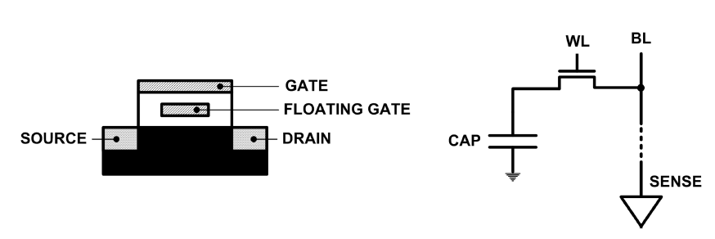
Limits of Charge Memory
Difficult charge placement and control
  Flash: floating gate charge
  DRAM: capacitor charge, transistor leakage
Reliable sensing becomes difficult as charge storage unit size reduces

Slide 106
Promising Resistive Memory Technologies
PCM
  Inject current to change material phase
  Resistance determined by phase
STT-MRAM
  Inject current to change magnet polarity
  Resistance determined by polarity
Memristors/RRAM/ReRAM
  Inject current to change atomic structure
  Resistance determined by atom distance

Slide 107
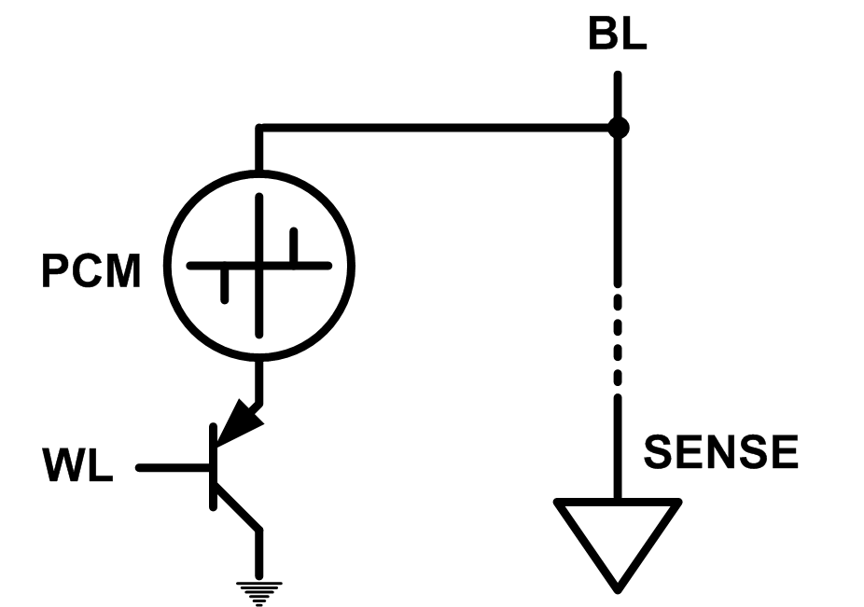
Emerging Memory Technologies
Some emerging resistive memory technologies seem more scalable than DRAM (and they are non-volatile)
Example: Phase Change Memory
  Data stored by changing phase of material
  Data read by detecting material’s resistance
  Expected to scale to 9nm (2022 [ITRS])
  Prototyped at 20nm (Raoux+, IBM JRD 2008)
  Expected to be denser than DRAM: can store multiple bits/cell
But, emerging technologies have (many) shortcomings
  Can they be enabled to replace/augment/surpass DRAM?
Notes:
Even if DRAM continues to scale there could be benefits to examining and enabling these new technologies.

Slide 108
Phase Change Memory: Pros and Cons
Pros over DRAM
  Better technology scaling (capacity and cost)
  Non volatile → Persistent
  Low idle power (no refresh)
Cons
  Higher latencies: ~4-15x DRAM (especially write)
  Higher active energy: ~2-50x DRAM (especially write)
  Lower endurance (a cell dies after ~10⁸ writes)
  Reliability issues (resistance drift)
Challenges in enabling PCM as DRAM replacement/helper:
  Mitigate PCM shortcomings
  Find the right way to place PCM in the system

Slide 109
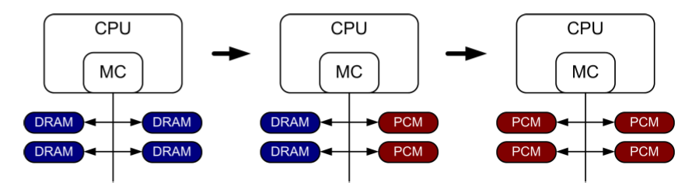
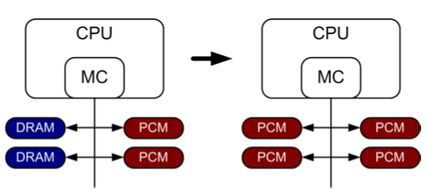
PCM-based Main Memory (I)
How should PCM-based (main) memory be organized?
Hybrid PCM+DRAM [Qureshi+ ISCA’09, Dhiman+ DAC’09]:
  How to partition/migrate data between PCM and DRAM

Slide 110
PCM-based Main Memory (II)
How should PCM-based (main) memory be organized?
Pure PCM main memory [Lee et al., ISCA’09, Top Picks’10]:
  How to redesign entire hierarchy (and cores) to overcome PCM shortcomings

Slide 111
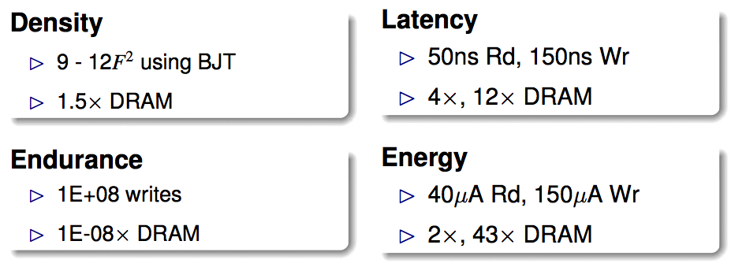
An Initial Study: Replace DRAM with PCM
Lee, Ipek, Mutlu, Burger, “Architecting Phase Change Memory as a Scalable DRAM Alternative,” ISCA 2009.
  Surveyed prototypes from 2003-2008 (e.g. IEDM, VLSI, ISSCC)
  Derived “average” PCM parameters for F=90nm

Slide 112
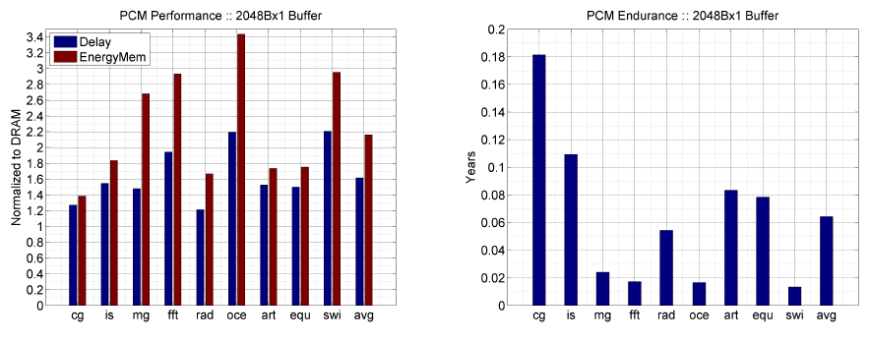
Results: Naïve Replacement of DRAM with PCM
Replace DRAM with PCM in a 4-core, 4MB L2 system
PCM organized the same as DRAM: row buffers, banks, peripherals
1.6x delay, 2.2x energy, 500-hour average lifetime
Lee, Ipek, Mutlu, Burger, “Architecting Phase Change Memory as a Scalable DRAM Alternative,” ISCA 2009.

Slide 113
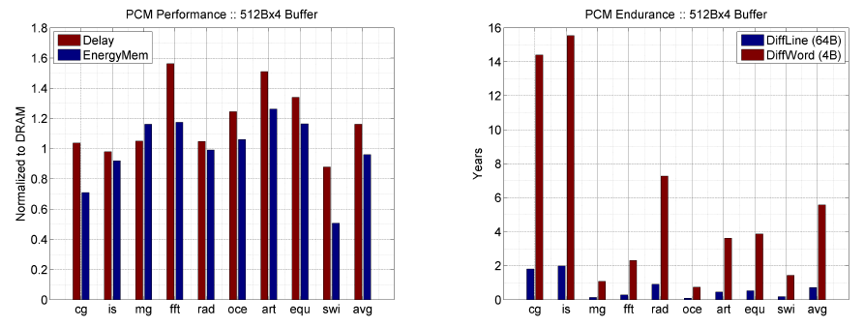
Results: Architected PCM as Main Memory
1.2x delay, 1.0x energy, 5.6-year average lifetime
Scaling improves energy, endurance, density
Caveat 1: Worst-case lifetime is much shorter (no guarantees)
Caveat 2: Intensive applications see large performance and energy hits
Caveat 3: Optimistic PCM parameters?

Slide 114
A More Viable Approach: Hybrid Memory Systems
CPU
Meza+, “Enabling Efficient and Scalable Hybrid Memories,” IEEE Comp. Arch. Letters, 2012.
Yoon+, “Row Buffer Locality Aware Caching Policies for Hybrid Memories,” ICCD 2012 Best Paper Award.
DRAMCtrl
PCM Ctrl
DRAM
Phase Change Memory (or Tech. X)
Fast, durable
Small,
leaky, volatile,
high-cost
Large, non-volatile, low-cost
Slow, wears out, high active energy
Hardware/software manage data allocation and movement
to achieve the best of multiple technologies

Slide 115
Data Placement Between DRAM and PCM
Idea: Characterize data access patterns and guide data placement in hybrid memory
Streaming accesses: As fast in PCM as in DRAM
Random accesses: Much faster in DRAM
Idea: Place random access data with some reuse in DRAM; streaming data in PCM
Yoon+, “Row Buffer Locality-Aware Data Placement in Hybrid Memories,” ICCD 2012 Best Paper Award.

Slide 116
Hybrid vs. All-PCM/DRAM [ICCD’12]
29%
31%
31% better performance than all PCM,
within 29% of all DRAM performance
Yoon+, “Row Buffer Locality-Aware Data Placement in Hybrid Memories,” ICCD 2012 Best Paper Award.
Notes:
Now let’s compare our mechanism to a homogeneous memory system.
Here the comparison points are a 16GB all-PCM and all-DRAM memory system.
Our mechanism achieves 31% better performance than the all-PCM memory system, and comes within 29% of the all-DRAM performance.
Note that we do not assume any capacity benefits of PCM over DRAM.
And yet, our mechanism bridges the performance gap between the two homogeneous memory systems.
If the capacity benefit of PCM was included, the hybrid memory system will perform even better.

Slide 117
STT-MRAM as Main Memory
Magnetic Tunnel Junction (MTJ) device
  Reference layer: Fixed magnetic orientation
  Free layer: Parallel or anti-parallel
Magnetic orientation of the free layer determines logical state of device
  High vs. low resistance
Write: Push large current through MTJ to change orientation of free layer
Read: Sense current flow
Kultursay et al., “Evaluating STT-RAM as an Energy-Efficient Main Memory Alternative,” ISPASS 2013.
Logical 0
Reference Layer
Barrier
Free Layer
Logical 1
Reference Layer
Barrier
Free Layer
Word Line
MTJ
Access
Transistor
Bit Line
Sense Line
Notes:
Moving from DRAM to STT-RAM, instead of a capacitor that stores charge, now we have a magnetic tunnel junction that has one reference layer with a fixed magnetic orientation, and a free layer that can be parallel or anti parallel to the reference layer; which determines the resistance, and in turn, the data stored in the MTJ. In addition to the MTJ, the cell, again, has an access transistor.
Reading requires a small voltage to be applied across the bitline and sense line; and the current is sensed. This current varies depending on the resistance of MTJ. To write data, we push a large current into the MTJ, which re-aligns the free layer. The direction of the current determines whether it becomes parallel or anti-parallel; i.e. logical 0 or 1.

Slide 118
STT-MRAM: Pros and Cons
Pros over DRAM
  Better technology scaling
  Non volatility
  Low idle power (no refresh)
Cons
  Higher write latency
  Higher write energy
  Reliability?
Another level of freedom
  Can trade off non-volatility for lower write latency/energy (by reducing the size of the MTJ)

Slide 119
Architected STT-MRAM as Main Memory
4-core, 4GB main memory, multiprogrammed workloads
~6% performance loss, ~60% energy savings vs. DRAM
Kultursay+, “Evaluating STT-RAM as an Energy-Efficient Main Memory Alternative,” ISPASS 2013.

Slide 120
Challenge and Opportunity
Enabling an Emerging Technology
to Replace DRAM

Slide 121
Departing From Business As Usual
Hybrid Memory
Persistent Memory

Slide 122
Other Opportunities with Emerging Technologies
Merging of memory and storage
  e.g., a single interface to manage all data
New applications
  e.g., ultra-fast checkpoint and restore
More robust system design
  e.g., reducing data loss
Processing tightly-coupled with memory
  e.g., enabling efficient search and filtering

Slide 123
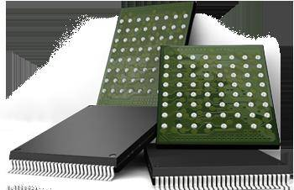
Coordinated Memory and Storage with NVM (I)
The traditional two-level storage model is a bottleneck with NVM
  Volatile data in memory → a load/store interface
  Persistent data in storage → a file system interface
  Problem: Operating system (OS) and file system (FS) code to locate, translate, buffer data become performance and energy bottlenecks with fast NVM stores
Two-Level Store
Load/Store
fopen, fread, fwrite, …
Virtual memory
Operating system
and file system
Processor
and caches
Address translation
Persistent (e.g., Phase-Change)
Memory
Main Memory
Storage (SSD/HDD)

Slide 124
Coordinated Memory and Storage with NVM (II)
Goal: Unify memory and storage management in a single unit to eliminate wasted work to locate, transfer, and translate data
  Improves both energy and performance
  Simplifies programming model as well
Unified Memory/Storage
Persistent Memory
Manager
Processor
and caches
Load/Store
Feedback
Persistent (e.g., Phase-Change) Memory
Meza+, “A Case for Efficient Hardware-Software Cooperative Management of Storage and Memory,” WEED 2013.

Slide 125
The Persistent Memory Manager (PMM)
Persistent objects
PMM uses access and hint information to allocate, locate, migrate and access data in the heterogeneous array of devices
Notes:
And to tie everything together, here is how a persistent memory would operate. Code allocates persistent objects and accesses them using loads and stores – no different than persistent memory in today’s machines. Optionally, the software can provide hints as to the types of access patterns or requirements of the software.
Then, a Persistent Memory Manager uses this access information and software hints to allocate, locate, migrate, and access data among the heterogeneous array of devices present on the system, attempting to strike a balance between application-level guarantees, like persistence and security, and performance and energy efficiency.

Slide 126
The Persistent Memory Manager (PMM)
Exposes a load/store interface to access persistent data
  Applications can directly access persistent memory → no conversion, translation, location overhead for persistent data
Manages data placement, location, persistence, security
  To get the best of multiple forms of storage
Manages metadata storage and retrieval
  This can lead to overheads that need to be managed
Exposes hooks and interfaces for system software
  To enable better data placement and management decisions
Meza+, “A Case for Efficient Hardware-Software Cooperative Management of Storage and Memory,” WEED 2013.
Notes:
Let’s take a closer look at the high-level design goals for a Persistent Memory Manager, or PMM.
[click] The most noticeable feature of the PMM – from the system software perspective – is the fact that it exposes a load/store interface to access all persistent data in the system. This means that applications can allocate portions of persistent memory, just as they would allocate portions of volatile DRAM memory in today’s systems.
[click] Of course, with a diverse array of devices managed by a persistent memory, it will be important for the PMM to leverage each of their strengths – and mitigate each of their weaknesses – as much as possible. To this end, the PMM is responsible for managing how volatile and persistent are placed among devices, to ensure data can be efficiently located, persistence guarantees met, and any security rules enforced.
[click] The PMM is also responsible for managing metadata storage and retrieval. We will later evaluate how such overheads affect system performance.
[click] In addition, to achieve the best performance and energy efficiency for the applications running on a system, it will be necessary for the system software to provide hints to the hardware to be used to make more efficient data placement decisions.

Slide 127
Performance Benefits of a Single-Level Store
~24X
~5X
Meza+, “A Case for Efficient Hardware-Software Cooperative Management of Storage and Memory,” WEED 2013.

Slide 128
Energy Benefits of a Single-Level Store
~16X
~5X
Meza+, “A Case for Efficient Hardware-Software Cooperative Management of Storage and Memory,” WEED 2013.

Slide 129
Challenge and Opportunity
Combined
Memory & Storage

Slide 130
Departing From “Business as Usual”
A Unified Interface to All Data

Slide 131
Agenda
Major Trends Affecting Main Memory
The Memory Scaling Problem and Solution Directions
  New Memory Architectures
  Enabling Emerging Technologies
Cross-Cutting Principles
Summary

Slide 132
Principles (So Far)
Better interfaces between layers of the system stack
  Expose more information judiciously across the system stack
  Design more flexible and efficient interfaces
Better-than-worst-case design
  Do not optimize for the worst case
  Worst case should not determine the common case
Heterogeneity in design (specialization, asymmetry)
  Enables a more efficient design (No one size fits all)
These principles are coupled (and require broad thinking)

Slide 133
Principles (So Far)
Better interfaces between layers of the system stack
  Expose more information judiciously across the system stack
  Design more flexible and efficient interfaces
Better-than-worst-case design
  Do not optimize for the worst case
  Worst case should not determine the common case
Heterogeneity in design (specialization, asymmetry)
  Enables a more efficient design (No one size fits all)
These principles are coupled (and require broad thinking)
Problems
Algorithms
Programs
User
Runtime System
(VM, OS, MM)
ISA
Microarchitecture
Logic
Devices

Slide 134
Agenda
Major Trends Affecting Main Memory
The Memory Scaling Problem and Solution Directions
  New Memory Architectures
  Enabling Emerging Technologies
Cross-Cutting Principles
Summary

Slide 135
Summary
Business as Usual | Opportunity
RowHammer | Memory controller anticipates and fixes errors
Fixed, frequent refreshes | Heterogeneous refresh rate across memory
Fixed, high latency | Heterogeneous latency in time and space
Slow page copy & initialization | Exploit internal connectivity in memory to move data
Fixed reliability mechanisms | Heterogeneous reliability across time and space
Memory as a dumb device | Memory as an accelerator and autonomous agent
DRAM-only main memory | Emerging memory technologies and hybrid memories
Two-level data storage model | Unified interface to all data
Large timing and error margins | Online adaptation of timing and error margins
Poor performance guarantees | Strong service guarantees and configurable QoS
Fixed policies in controllers | Configurable and programmable memory controllers
… | …

Slide 136
Summary
Memory problems are a critical bottleneck for system performance, efficiency, and usability
New memory architectures
  Compute capable and autonomous memory
Enabling emerging NVM technologies
  Persistent and hybrid memory
System-level memory/storage QoS
  Predictable systems with configurable QoS
Many opportunities and challenges that will change the systems and software we design

Slide 137
Some Open Source Tools
Rowhammer
  https://github.com/CMU-SAFARI/rowhammer
Ramulator – Fast and Extensible DRAM Simulator
  https://github.com/CMU-SAFARI/ramulator
MemSim
  https://github.com/CMU-SAFARI/memsim
NOCulator
  https://github.com/CMU-SAFARI/NOCulator
DRAM Error Model
  http://www.ece.cmu.edu/~safari/tools/memerr/index.html
Other open-source software from my group
  https://github.com/CMU-SAFARI/
  http://www.ece.cmu.edu/~safari/tools.html

Slide 138
Referenced Papers
All are available at
  http://users.ece.cmu.edu/~omutlu/projects.htm
  http://scholar.google.com/citations?user=7XyGUGkAAAAJ&hl=en
A detailed accompanying overview paper
  Onur Mutlu and Lavanya Subramanian,
  "Research Problems and Opportunities in Memory Systems"
  Invited Article in Supercomputing Frontiers and Innovations (SUPERFRI), 2015.

Slide 139
Related Videos and Course Materials
Undergraduate Computer Architecture Course Lecture Videos (2013, 2014, 2015)
Undergraduate Computer Architecture Course Materials (2013, 2014, 2015)
Graduate Computer Architecture Lecture Videos (2013, 2015)
Graduate Computer Architecture Course Materials (2013, 2015)
Parallel Computer Architecture Course Materials (Lecture Videos)
Memory Systems Short Course Materials
(Lecture Video on Main Memory and DRAM Basics)

Slide 140
Ramulator: A Fast and Extensible DRAM Simulator
[IEEE Comp Arch Letters’15]

Slide 141
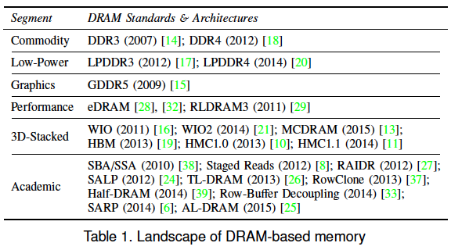
Ramulator Motivation
DRAM and Memory Controller landscape is changing
Many new and upcoming standards
Many new controller designs
A fast and easy-to-extend simulator is very much needed

Slide 142
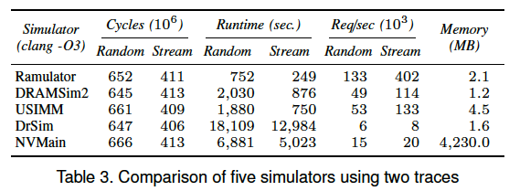
Ramulator
Provides out-of-the box support for many DRAM standards:
  DDR3/4, LPDDR3/4, GDDR5, WIO1/2, HBM, plus new proposals (SALP, AL-DRAM, TLDRAM, RowClone, and SARP)
~2.5X faster than fastest open-source simulator
Modular and extensible to different standards

Slide 143
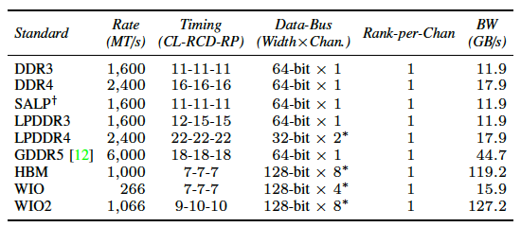
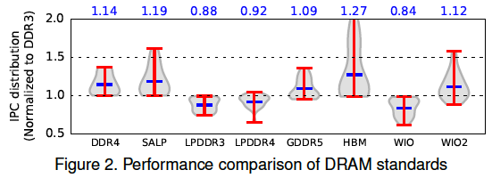
Case Study: Comparison of DRAM Standards
Across 22 workloads, simple CPU model

Slide 144
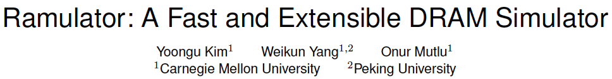
Ramulator Paper and Source Code
Yoongu Kim, Weikun Yang, and Onur Mutlu,
"Ramulator: A Fast and Extensible DRAM Simulator"
IEEE Computer Architecture Letters (CAL), March 2015.
[Source Code]
Source code is released under the liberal MIT License
  https://github.com/CMU-SAFARI/ramulator

Slide 145
DRAM Infrastructure

Slide 146
Experimental DRAM Testing Infrastructure
  An Experimental Study of Data Retention Behavior in Modern DRAM Devices: Implications for Retention Time Profiling Mechanisms (Liu et al., ISCA 2013)
  The Efficacy of Error Mitigation Techniques for DRAM Retention Failures: A Comparative Experimental Study
  (Khan et al., SIGMETRICS 2014)
  Flipping Bits in Memory Without Accessing Them: An Experimental Study of DRAM Disturbance Errors (Kim et al., ISCA 2014)
  Adaptive-Latency DRAM: Optimizing DRAM Timing for the Common-Case (Lee et al., HPCA 2015)
  AVATAR: A Variable-Retention-Time (VRT) Aware Refresh for DRAM Systems (Qureshi et al., DSN 2015)

Slide 147
Experimental DRAM Testing Infrastructure
Temperature
Controller
FPGAs
Heater
FPGAs
PC
  Kim+, “Flipping Bits in Memory Without Accessing Them: An Experimental Study of DRAM Disturbance Errors,” ISCA 2014.

Slide 148
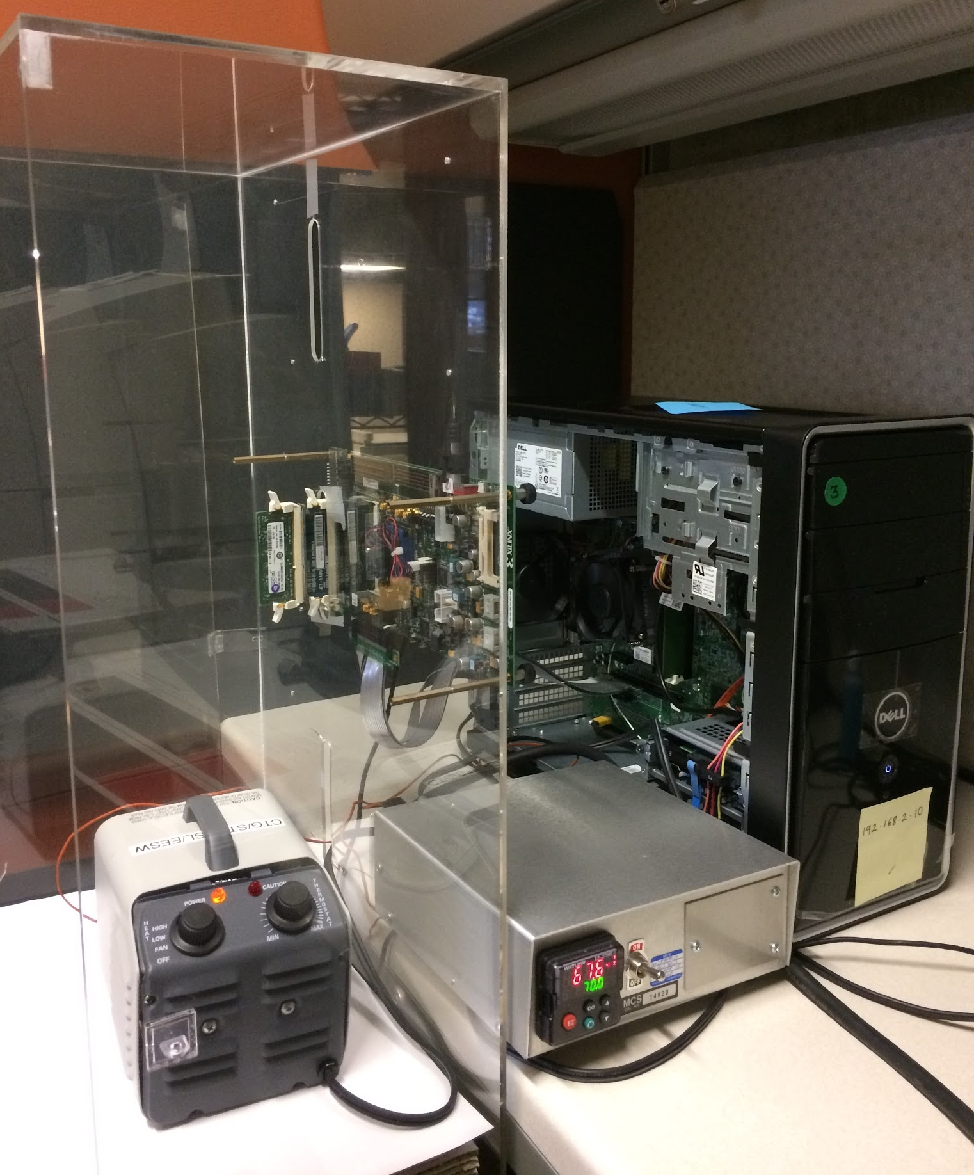
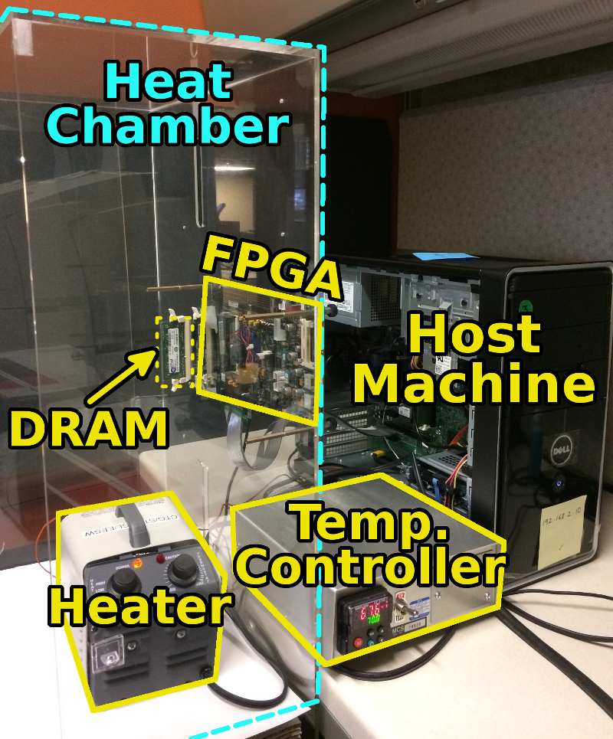
SoftMC: Open Source DRAM Infrastructure
Hasan Hassan et al., “SoftMC: A Flexible and Practical Open-Source Infrastructure for Enabling Experimental DRAM Studies,” HPCA 2017.
Flexible
Easy to Use (C++ API)
Open-source
github.com/CMU-SAFARI/SoftMC

Slide 149
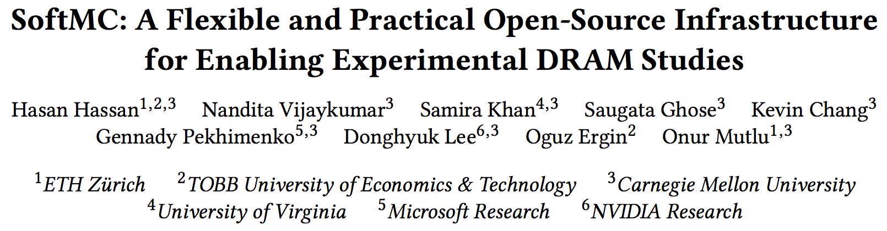
SoftMC: Open Source DRAM Infrastructure
https://github.com/CMU-SAFARI/SoftMC

