Slide 1



Revisiting RowHammer
Onur Mutlu
omutlu@gmail.com
https://people.inf.ethz.ch/omutlu
9 October 2020
VLSI-SoC

Slide 2
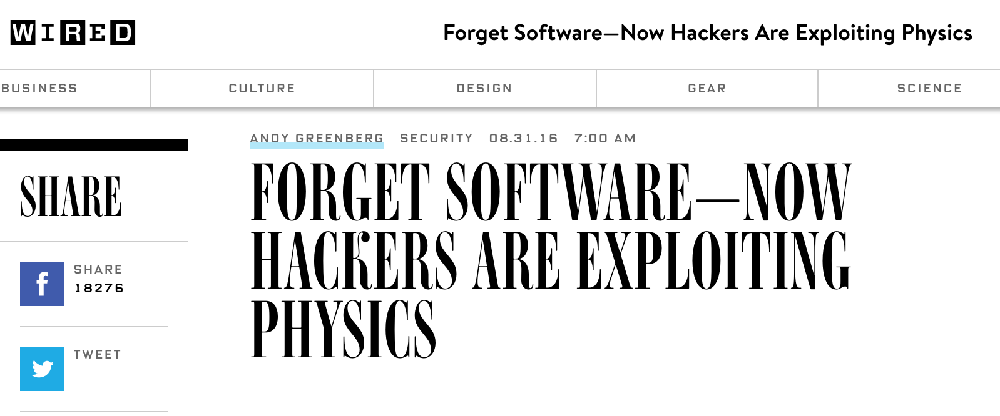
The Story of RowHammer
One can predictably induce bit flips in commodity DRAM chips
  >80% of the tested DRAM chips are vulnerable
First example of how a simple hardware failure mechanism can create a widespread system security vulnerability

Slide 3
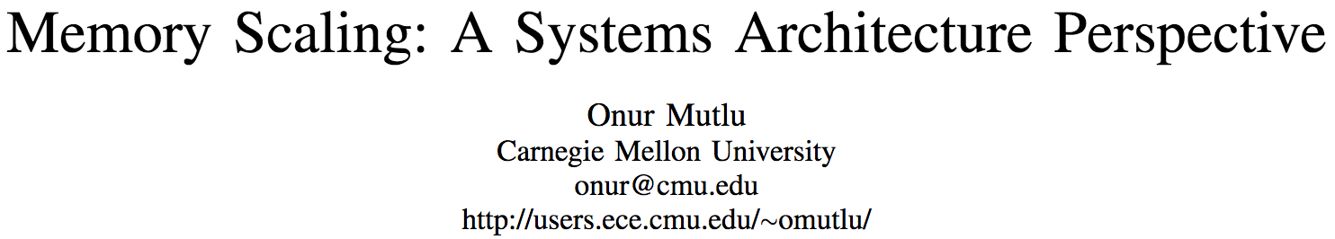
An “Early” Position Paper [IMW’13]
Onur Mutlu,
"Memory Scaling: A Systems Architecture Perspective"
Proceedings of the 5th International Memory Workshop (IMW), Monterey, CA, May 2013. Slides (pptx) (pdf)
EETimes Reprint
https://people.inf.ethz.ch/omutlu/pub/memory-scaling_memcon13.pdf

Slide 4
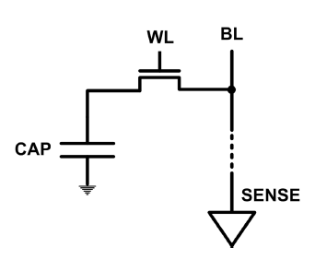
The DRAM Scaling Problem
DRAM stores charge in a capacitor (charge-based memory)
  Capacitor must be large enough for reliable sensing
  Access transistor should be large enough for low leakage and high retention time
  Scaling beyond 40-35nm (2013) is challenging [ITRS, 2009]
DRAM capacity, cost, and energy/power hard to scale

Slide 5
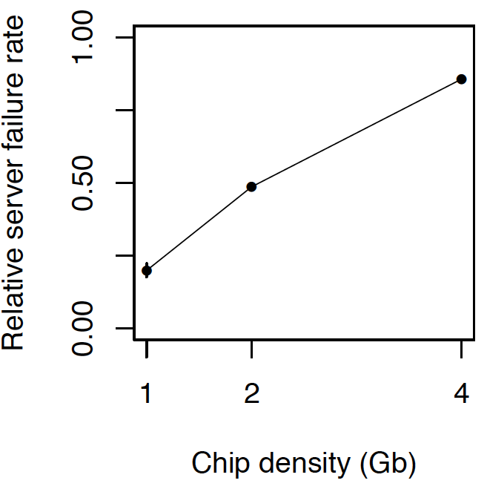
As Memory Scales, It Becomes Unreliable
Data from all of Facebook’s servers worldwide
Meza+, “Revisiting Memory Errors in Large-Scale Production Data Centers,” DSN’15.
Intuition:
quadratic
increase in
capacity

Slide 6
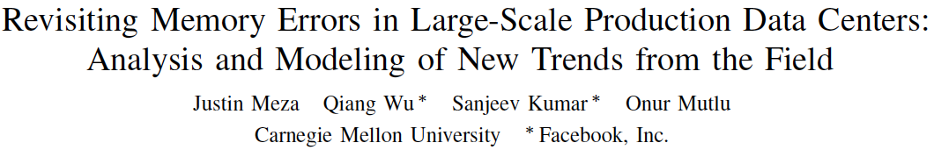
Large-Scale Failure Analysis of DRAM Chips
Analysis and modeling of memory errors found in all of Facebook’s server fleet
Justin Meza, Qiang Wu, Sanjeev Kumar, and Onur Mutlu,
"Revisiting Memory Errors in Large-Scale Production Data Centers: Analysis and Modeling of New Trends from the Field"
Proceedings of the 45th Annual IEEE/IFIP International Conference on Dependable Systems and Networks (DSN), Rio de Janeiro, Brazil, June 2015.
[Slides (pptx) (pdf)] [DRAM Error Model]

Slide 7
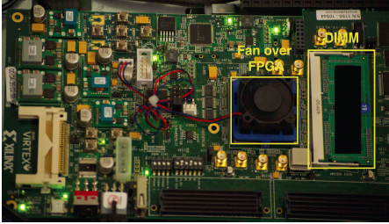
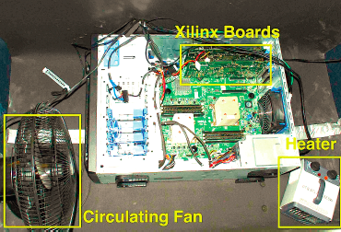
Infrastructures to Understand Such Issues
  An Experimental Study of Data Retention Behavior in Modern DRAM Devices: Implications for Retention Time Profiling Mechanisms (Liu et al., ISCA 2013)
  The Efficacy of Error Mitigation Techniques for DRAM Retention Failures: A Comparative Experimental Study
  (Khan et al., SIGMETRICS 2014)
  Flipping Bits in Memory Without Accessing Them: An Experimental Study of DRAM Disturbance Errors (Kim et al., ISCA 2014)
  Adaptive-Latency DRAM: Optimizing DRAM Timing for the Common-Case (Lee et al., HPCA 2015)
  AVATAR: A Variable-Retention-Time (VRT) Aware Refresh for DRAM Systems (Qureshi et al., DSN 2015)

Slide 8

Infrastructures to Understand Such Issues
Temperature
Controller
FPGAs
Heater
FPGAs
PC
  Kim+, “Flipping Bits in Memory Without Accessing Them: An Experimental Study of DRAM Disturbance Errors,” ISCA 2014.

Slide 9
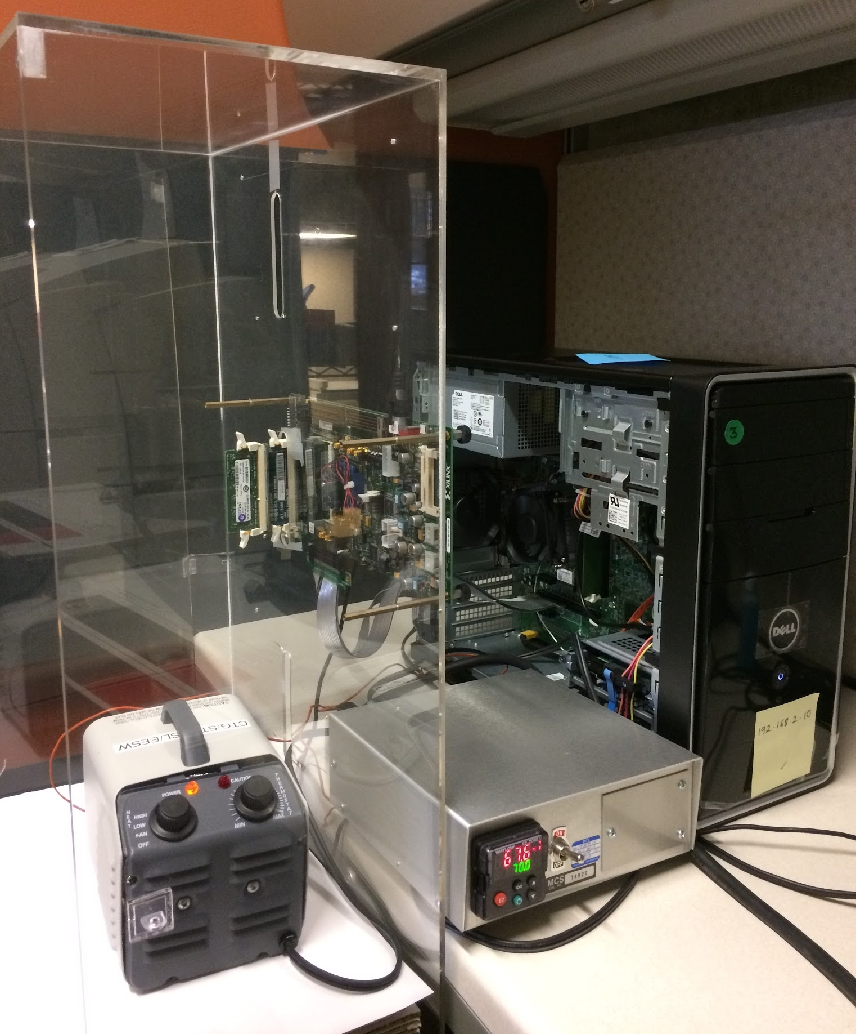
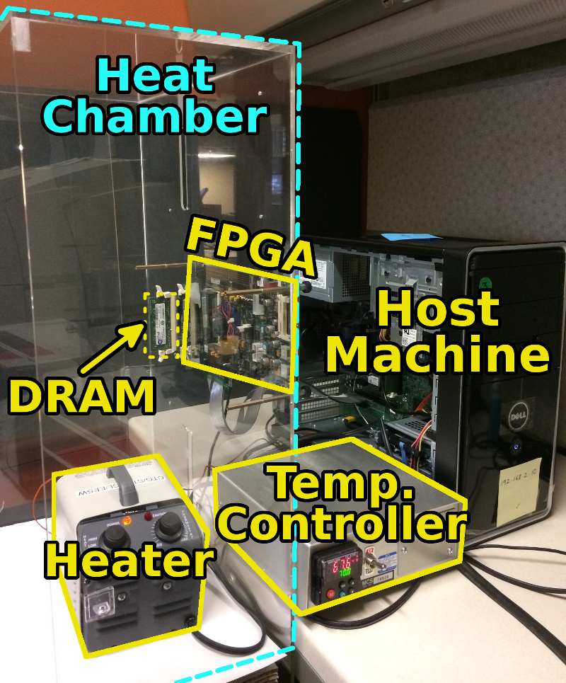
SoftMC: Open Source DRAM Infrastructure
Hasan Hassan et al., “SoftMC: A Flexible and Practical Open-Source Infrastructure for Enabling Experimental DRAM Studies,” HPCA 2017.
Flexible
Easy to Use (C++ API)
Open-source
github.com/CMU-SAFARI/SoftMC

Slide 10
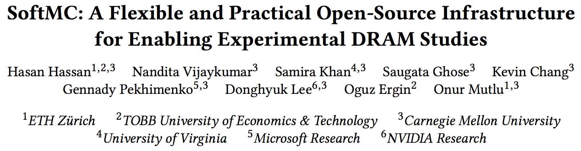
SoftMC: Open Source DRAM Infrastructure
https://github.com/CMU-SAFARI/SoftMC

Slide 11

Data Retention in Memory [Liu et al., ISCA 2013]
Retention Time Profile of DRAM looks like this:
Location dependent
Stored value pattern dependent
Time dependent
Liu+, “RAIDR: Retention-Aware Intelligent DRAM Refresh,” ISCA 2012.

Slide 12
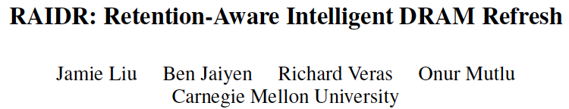
RAIDR: Heterogeneous Refresh [ISCA’12]
Jamie Liu, Ben Jaiyen, Richard Veras, and Onur Mutlu,
"RAIDR: Retention-Aware Intelligent DRAM Refresh"
Proceedings of the 39th International Symposium on Computer Architecture (ISCA), Portland, OR, June 2012. Slides (pdf)

Slide 13
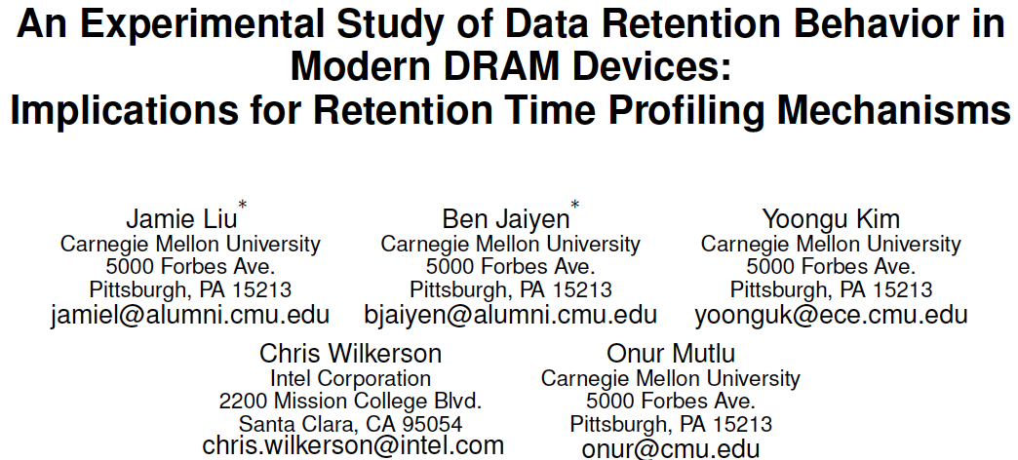
Analysis of Data Retention Failures [ISCA’13]
Jamie Liu, Ben Jaiyen, Yoongu Kim, Chris Wilkerson, and Onur Mutlu,
"An Experimental Study of Data Retention Behavior in Modern DRAM Devices: Implications for Retention Time Profiling Mechanisms"
Proceedings of the 40th International Symposium on Computer Architecture (ISCA), Tel-Aviv, Israel, June 2013. Slides (ppt) Slides (pdf)

Slide 14
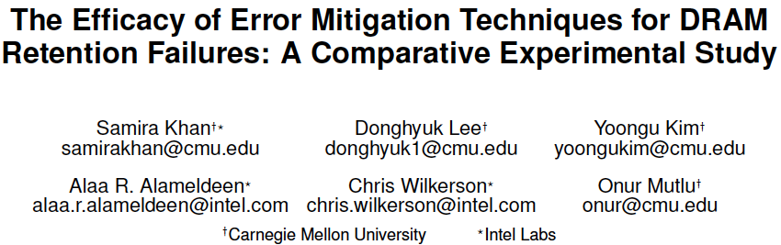
Mitigation of Retention Issues [SIGMETRICS’14]
Samira Khan, Donghyuk Lee, Yoongu Kim, Alaa Alameldeen, Chris Wilkerson, and Onur Mutlu,
"The Efficacy of Error Mitigation Techniques for DRAM Retention Failures: A Comparative Experimental Study"
Proceedings of the ACM International Conference on Measurement and Modeling of Computer Systems (SIGMETRICS), Austin, TX, June 2014. [Slides (pptx) (pdf)] [Poster (pptx) (pdf)] [Full data sets]

Slide 15
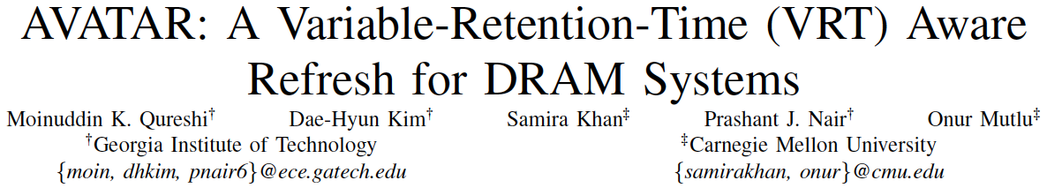
Mitigation of Retention Issues [DSN’15]
Moinuddin Qureshi, Dae Hyun Kim, Samira Khan, Prashant Nair, and Onur Mutlu,
"AVATAR: A Variable-Retention-Time (VRT) Aware Refresh for DRAM Systems"
Proceedings of the 45th Annual IEEE/IFIP International Conference on Dependable Systems and Networks (DSN), Rio de Janeiro, Brazil, June 2015.
[Slides (pptx) (pdf)]

Slide 16
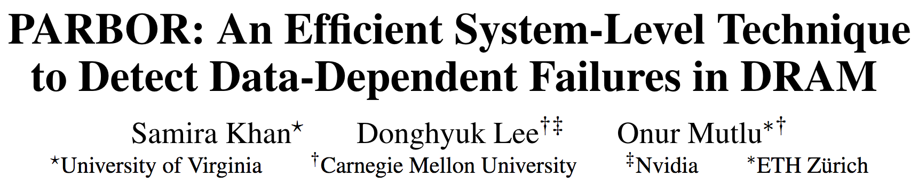
Mitigation of Retention Issues [DSN’16]
Samira Khan, Donghyuk Lee, and Onur Mutlu,
"PARBOR: An Efficient System-Level Technique to Detect Data-Dependent Failures in DRAM"
Proceedings of the 45th Annual IEEE/IFIP International Conference on Dependable Systems and Networks (DSN), Toulouse, France, June 2016.
[Slides (pptx) (pdf)]

Slide 17
Mitigation of Retention Issues [MICRO’17]
Samira Khan, Chris Wilkerson, Zhe Wang, Alaa R. Alameldeen, Donghyuk Lee, and Onur Mutlu,
"Detecting and Mitigating Data-Dependent DRAM Failures by Exploiting Current Memory Content"
Proceedings of the 50th International Symposium on Microarchitecture (MICRO), Boston, MA, USA, October 2017.
[Slides (pptx) (pdf)] [Lightning Session Slides (pptx) (pdf)] [Poster (pptx) (pdf)]

Slide 18
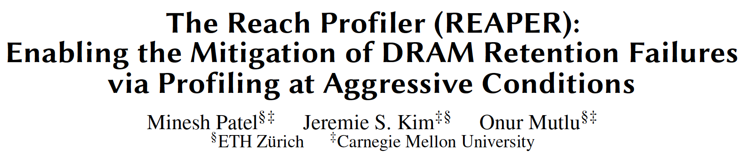
Mitigation of Retention Issues [ISCA’17]
Minesh Patel, Jeremie S. Kim, and Onur Mutlu,
"The Reach Profiler (REAPER): Enabling the Mitigation of DRAM Retention Failures via Profiling at Aggressive Conditions"
Proceedings of the 44th International Symposium on Computer Architecture (ISCA), Toronto, Canada, June 2017.
[Slides (pptx) (pdf)]
[Lightning Session Slides (pptx) (pdf)]
First experimental analysis of (mobile) LPDDR4 chips
Analyzes the complex tradeoff space of retention time profiling
Idea: enable fast and robust profiling at higher refresh intervals & temperatures

Slide 19
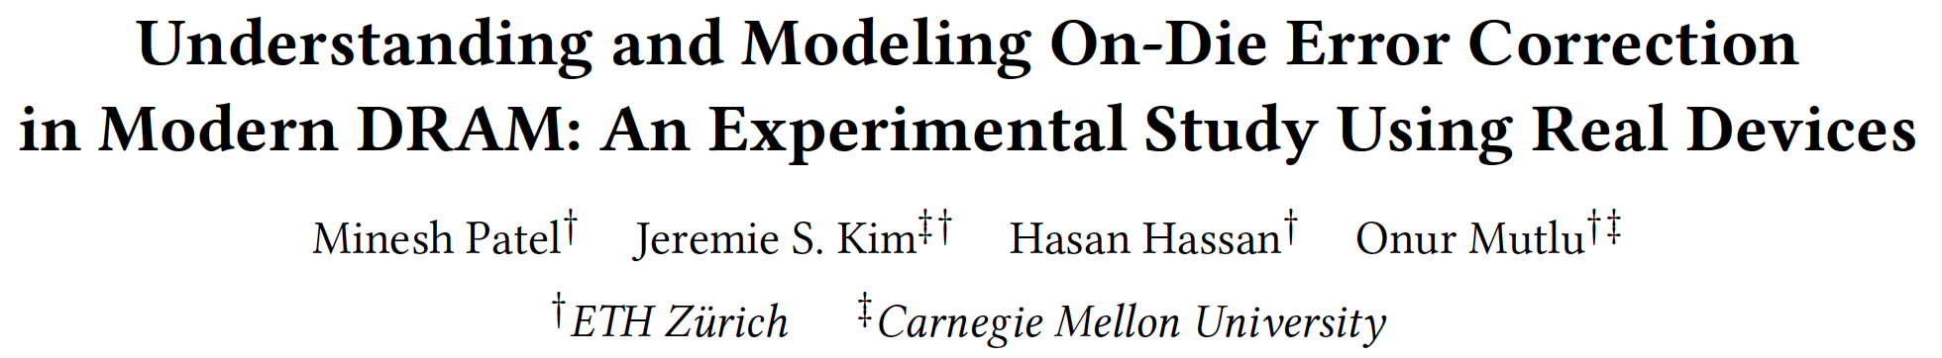
Mitigation of Retention Issues [DSN’19]
Minesh Patel, Jeremie S. Kim, Hasan Hassan, and Onur Mutlu,
"Understanding and Modeling On-Die Error Correction in Modern DRAM: An Experimental Study Using Real Devices"
Proceedings of the 49th Annual IEEE/IFIP International Conference on Dependable Systems and Networks (DSN), Portland, OR, USA, June 2019.
[Source Code for EINSim, the Error Inference Simulator]
Best paper award.

Slide 20
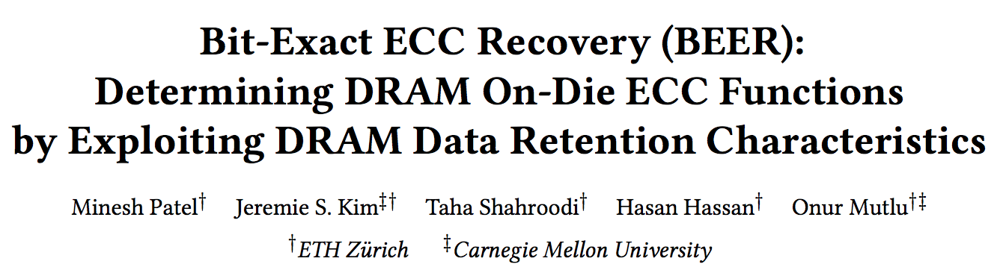
Mitigation of Retention Issues [MICRO’20]
Minesh Patel, Jeremie S. Kim, Taha Shahroodi, Hasan Hassan, and Onur Mutlu,
"Bit-Exact ECC Recovery (BEER): Determining DRAM On-Die ECC Functions by Exploiting DRAM Data Retention Characteristics"
Proceedings of the 53rd International Symposium on Microarchitecture (MICRO), Virtual, October 2020.
[Slides (pptx) (pdf)]
[Lightning Talk Slides (pptx) (pdf)]
[Talk Video (15 minutes)]
[Lightning Talk Video (1.5 minutes)]

Slide 21
A Curious Phenomenon

Slide 22
A Curious Discovery [Kim et al., ISCA 2014]
One can
predictably induce errors
in most DRAM memory chips

Slide 23
DRAM RowHammer
A simple hardware failure mechanism
can create a widespread
system security vulnerability

Slide 24
Modern DRAM is Prone to Disturbance Errors
Row of Cells
Wordline
Row
Victim Row
Row
Hammered Row
V_{LOW}
Opened
V_{HIGH}
Closed
Row
Victim Row
Row
Repeatedly reading a row enough times (before memory gets refreshed) induces disturbance errors in adjacent rows in most real DRAM chips you can buy today
Flipping Bits in Memory Without Accessing Them: An Experimental Study of DRAM Disturbance Errors, (Kim et al., ISCA 2014)

Slide 25
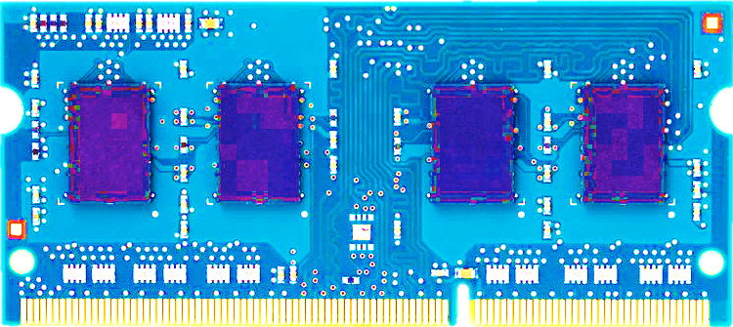
Most DRAM Modules Are Vulnerable
A company
B company
C company
86%
(37/43)
83%
(45/54)
88%
(28/32)
Up to
1.0×10⁷
errors
Up to
2.7×10⁶
errors
Up to
3.3×10⁵
errors
Flipping Bits in Memory Without Accessing Them: An Experimental Study of DRAM Disturbance Errors, (Kim et al., ISCA 2014)

Slide 26
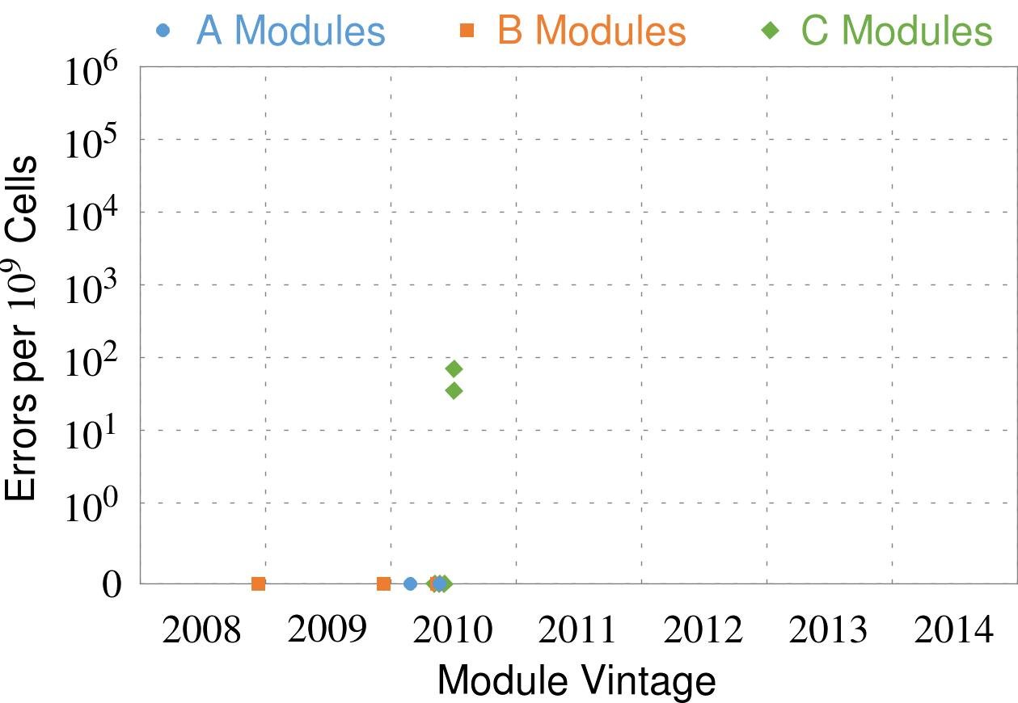
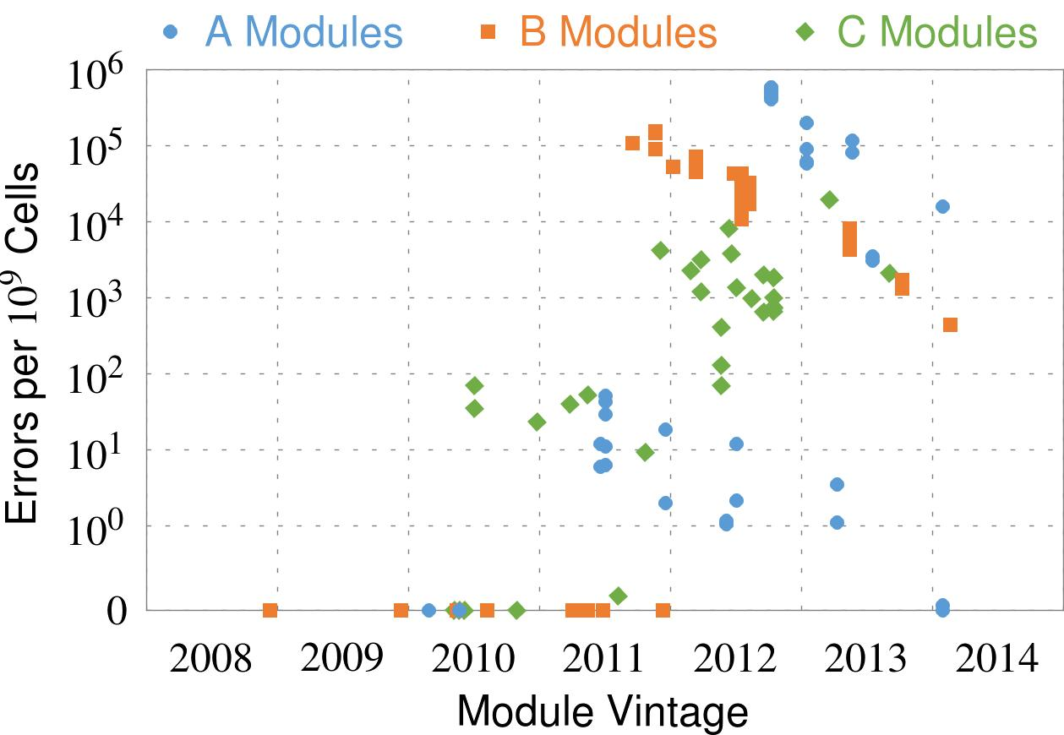
Recent DRAM Is More Vulnerable
Notes:
In this figure, the x-axis is the module manufacture date. And the y-axis is the number of errors in a module, normalized to one billion cells. In 2008 and 2009, there are no errors. But, in 2010, we first start to see errors in C modules. After 2010, the errors start to proliferate. For A and B modules, we first start to see errors in 2011. In particular, all modules from 2012 and 2013 are vulnerable.

Slide 27
Recent DRAM Is More Vulnerable
First
Appearance
Notes:
In this figure, the x-axis is the module manufacture date. And the y-axis is the number of errors in a module, normalized to one billion cells. In 2008 and 2009, there are no errors. But, in 2010, we first start to see errors in C modules. After 2010, the errors start to proliferate. For A and B modules, we first start to see errors in 2011. In particular, all modules from 2012 and 2013 are vulnerable.

Slide 28
Recent DRAM Is More Vulnerable
First
Appearance
All modules from 2012–2013 are vulnerable
Notes:
In this figure, the x-axis is the module manufacture date. And the y-axis is the number of errors in a module, normalized to one billion cells. In 2008 and 2009, there are no errors. But, in 2010, we first start to see errors in C modules. After 2010, the errors start to proliferate. For A and B modules, we first start to see errors in 2011. In particular, all modules from 2012 and 2013 are vulnerable.

Slide 29

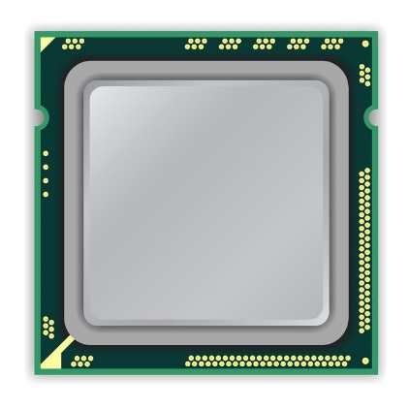
A Simple Program Can Induce Many Errors
CPU
DRAM Module
loop:
mov (X), %eax
mov (Y), %ebx
clflush (X)
clflush (Y)
mfence
jmp loop
X
Y
  Download from: https://github.com/CMU-SAFARI/rowhammer
Notes:
We demonstrate the errors on multiple x86 systems. Shown to the bottom-left is a “disturbance kernel”. When executed, it forces two rows to be opened and closed one after the other – over and over again. Consequently, it induces many errors in the module.

Slide 30
A Simple Program Can Induce Many Errors
CPU
DRAM Module
Avoid cache hits
  Flush X from cache
Avoid row hits to X
  Read Y in another row
X
Y
  Download from: https://github.com/CMU-SAFARI/rowhammer
Notes:
We demonstrate the errors on multiple x86 systems. Shown to the bottom-left is a “disturbance kernel”. When executed, it forces two rows to be opened and closed one after the other – over and over again. Consequently, it induces many errors in the module.

Slide 31
A Simple Program Can Induce Many Errors
CPU
DRAM Module
loop:
mov (X), %eax
mov (Y), %ebx
clflush (X)
clflush (Y)
mfence
jmp loop
X
Y
  Download from: https://github.com/CMU-SAFARI/rowhammer
Notes:
We demonstrate the errors on multiple x86 systems. Shown to the bottom-left is a “disturbance kernel”. When executed, it forces two rows to be opened and closed one after the other – over and over again. Consequently, it induces many errors in the module.

Slide 32
A Simple Program Can Induce Many Errors
CPU
DRAM Module
loop:
mov (X), %eax
mov (Y), %ebx
clflush (X)
clflush (Y)
mfence
jmp loop
X
Y
  Download from: https://github.com/CMU-SAFARI/rowhammer
Notes:
We demonstrate the errors on multiple x86 systems. Shown to the bottom-left is a “disturbance kernel”. When executed, it forces two rows to be opened and closed one after the other – over and over again. Consequently, it induces many errors in the module.

Slide 33
A Simple Program Can Induce Many Errors
CPU
DRAM Module
loop:
mov (X), %eax
mov (Y), %ebx
clflush (X)
clflush (Y)
mfence
jmp loop
X
Y
  Download from: https://github.com/CMU-SAFARI/rowhammer
Notes:
We demonstrate the errors on multiple x86 systems. Shown to the bottom-left is a “disturbance kernel”. When executed, it forces two rows to be opened and closed one after the other – over and over again. Consequently, it induces many errors in the module.

Slide 34
Observed Errors in Real Systems
A real reliability & security issue
CPU Architecture | Errors | Access-Rate
Intel Haswell (2013) | 22.9K | 12.3M/sec
Intel Ivy Bridge (2012) | 20.7K | 11.7M/sec
Intel Sandy Bridge (2011) | 16.1K | 11.6M/sec
AMD Piledriver (2012) | 59 | 6.1M/sec
Kim+, “Flipping Bits in Memory Without Accessing Them: An Experimental Study of DRAM Disturbance Errors,” ISCA 2014.
Notes:
When we executed the code on four different processors, all four of them yielded errors. Intel Haswell has the most errors, at 23 thousand, because it has the highest rate of accessing DRAM.
Later on, I’ll show that we can induce as many as ten million disturbance errors in a more controlled environment.
From this, we conclude that disturbance errors are a serious reliability issue.

Slide 35


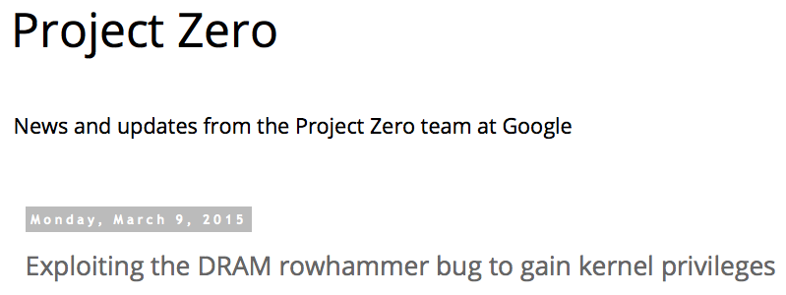
One Can Take Over an Otherwise-Secure System
Flipping Bits in Memory Without Accessing Them: An Experimental Study of DRAM Disturbance Errors (Kim et al., ISCA 2014)
Exploiting the DRAM rowhammer bug to gain kernel privileges (Seaborn, 2015)

Slide 36
RowHammer Security Attack Example
“Rowhammer” is a problem with some recent DRAM devices in which repeatedly accessing a row of memory can cause bit flips in adjacent rows (Kim et al., ISCA 2014).
  Flipping Bits in Memory Without Accessing Them: An Experimental Study of DRAM Disturbance Errors (Kim et al., ISCA 2014)
We tested a selection of laptops and found that a subset of them exhibited the problem.
We built two working privilege escalation exploits that use this effect.
  Exploiting the DRAM rowhammer bug to gain kernel privileges (Seaborn+, 2015)
One exploit uses rowhammer-induced bit flips to gain kernel privileges on x86-64 Linux when run as an unprivileged userland process.
When run on a machine vulnerable to the rowhammer problem, the process was able to induce bit flips in page table entries (PTEs).
It was able to use this to gain write access to its own page table, and hence gain read-write access to all of physical memory.
Exploiting the DRAM rowhammer bug to gain kernel privileges (Seaborn & Dullien, 2015)

Slide 37
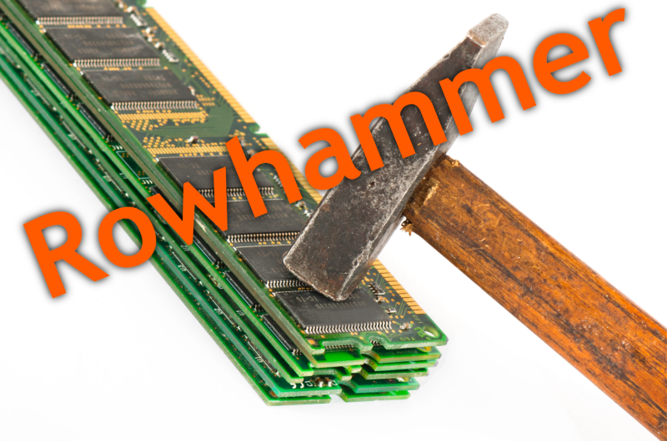
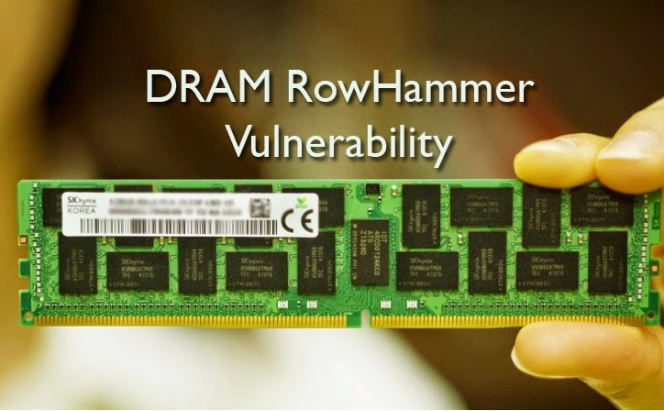
Security Implications
Notes:
Picture from the article:
http://thehackernews.com/2015/03/dram-rowhammer-vulnerability.html

Slide 38
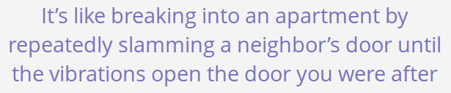
Security Implications
Notes:
Picture from the article:
http://thehackernews.com/2015/03/dram-rowhammer-vulnerability.html

Slide 39
Selected Readings on RowHammer (I)
Our first detailed study: Rowhammer analysis and solutions (June 2014)
  Yoongu Kim, Ross Daly, Jeremie Kim, Chris Fallin, Ji Hye Lee, Donghyuk Lee, Chris Wilkerson, Konrad Lai, and Onur Mutlu,
  "Flipping Bits in Memory Without Accessing Them: An Experimental Study of DRAM Disturbance Errors"
  Proceedings of the 41st International Symposium on Computer Architecture (ISCA), Minneapolis, MN, June 2014. [Slides (pptx) (pdf)] [Lightning Session Slides (pptx) (pdf)] [Source Code and Data]
Our Source Code to Induce Errors in Modern DRAM Chips (June 2014)
  https://github.com/CMU-SAFARI/rowhammer
Google Project Zero’s Attack to Take Over a System (March 2015)
  Exploiting the DRAM rowhammer bug to gain kernel privileges (Seaborn+, 2015)
  https://github.com/google/rowhammer-test
  Double-sided Rowhammer

Slide 40
Selected Readings on RowHammer (II)
Remote RowHammer Attacks via JavaScript (July 2015)
  http://arxiv.org/abs/1507.06955
  https://github.com/IAIK/rowhammerjs
  Gruss et al., DIMVA 2016.
  CLFLUSH-free Rowhammer
  “A fully automated attack that requires nothing but a website with JavaScript to trigger faults on remote hardware.”
  “We can gain unrestricted access to systems of website visitors.”
ANVIL: Software-Based Protection Against Next-Generation Rowhammer Attacks (March 2016)
  http://dl.acm.org/citation.cfm?doid=2872362.2872390
  Aweke et al., ASPLOS 2016
  CLFLUSH-free Rowhammer
  Software based monitoring for rowhammer detection

Slide 41
Selected Readings on RowHammer (III)
Dedup Est Machina: Memory Deduplication as an Advanced Exploitation Vector (May 2016)
  https://www.ieee-security.org/TC/SP2016/papers/0824a987.pdf
  Bosman et al., IEEE S&P 2016.
  Exploits Rowhammer and Memory Deduplication to overtake a browser
  “We report on the first reliable remote exploit for the Rowhammer vulnerability running entirely in Microsoft Edge.”
  “[an attacker] … can reliably “own” a system with all defenses up, even if the software is entirely free of bugs.”
CAn’t Touch This: Software-only Mitigation against Rowhammer Attacks targeting Kernel Memory (August 2017)
  https://www.usenix.org/system/files/conference/usenixsecurity17/sec17-brasser.pdf
  Brasser et al., USENIX Security 2017.
  Partitions physical memory into security domains, user vs. kernel; limits rowhammer-induced bit flips to the user domain.

Slide 42
Selected Readings on RowHammer (IV)
A New Approach for Rowhammer Attacks (May 2016)
  https://ieeexplore.ieee.org/document/7495576
  Qiao et al., HOST 2016
  CLFLUSH-free RowHammer
  “Libc functions memset and memcpy are found capable of rowhammer.”
  Triggers RowHammer with malicious inputs but benign code
One Bit Flips, One Cloud Flops: Cross-VM Row Hammer Attacks and Privilege Escalation (August 2016)
  https://www.usenix.org/system/files/conference/usenixsecurity16/sec16_paper_xiao.pdf
  Xiao et al., USENIX Security 2016.
  “Technique that allows a malicious guest VM to have read and write accesses to arbitrary physical pages on a shared machine.”
  Graph-based algorithm to reverse engineer mapping of physical addresses in DRAM

Slide 43
Selected Readings on RowHammer (V)
Curious Case of RowHammer: Flipping Secret Exponent Bits using Timing Analysis (August 2016)
  https://link.springer.com/content/pdf/10.1007%2F978-3-662-53140-2_29.pdf
  Bhattacharya et al., CHES 2016
  Combines timing analysis to perform rowhammer on cryptographic keys stored in memory
DRAMA: Exploiting DRAM Addressing for Cross-CPU Attacks (August 2016)
  https://www.usenix.org/system/files/conference/usenixsecurity16/sec16_paper_pessl.pdf
  Pessl et al., USENIX Security 2016
  Shows RowHammer failures on DDR4 devices despite TRR solution
  Reverse engineers address mapping functions to improve existing RowHammer attacks

Slide 44
Selected Readings on RowHammer (VI)
Flip Feng Shui: Hammering a Needle in the Software Stack (August 2016)
  https://www.usenix.org/system/files/conference/usenixsecurity16/sec16_paper_razavi.pdf
  Razavi et al., USENIX Security 2016.
  Combines memory deduplication and RowHammer
  “A malicious VM can gain unauthorized access to a co-hosted VM running OpenSSH.”
  Breaks OpenSSH public key authentication
Drammer: Deterministic Rowhammer Attacks on Mobile Platforms (October 2016)
  http://dl.acm.org/citation.cfm?id=2976749.2978406
  Van Der Veen et al., ACM CCS 2016
  Can take over an ARM-based Android system deterministically
  Exploits predictable physical memory allocator behavior
    Can deterministically place security-sensitive data (e.g., page table) in an attacker-chosen, vulnerable location in memory

Slide 45
Selected Readings on RowHammer (VII)
When Good Protections go Bad: Exploiting anti-DoS Measures to Accelerate Rowhammer Attacks (May 2017)
  https://web.eecs.umich.edu/~misiker/resources/HOST-2017-Misiker.pdf
  Aga et al., HOST 2017
  “A virtual-memory based cache-flush free attack that is sufficiently fast to rowhammer with double rate refresh.”
  Enabled by Cache Allocation Technology
SGX-Bomb: Locking Down the Processor via Rowhammer Attack (October 2017)
  https://dl.acm.org/citation.cfm?id=3152709
  Jang et al., SysTEX 2017
  “Launches the Rowhammer attack against enclave memory to trigger the processor lockdown.”
  Running unknown enclave programs on the cloud can shut down servers shared with other clients.

Slide 46
Selected Readings on RowHammer (VIII)
Another Flip in the Wall of Rowhammer Defenses (May 2018)
  https://arxiv.org/pdf/1710.00551.pdf
  Gruss et al., IEEE S&P 2018
  A new type of Rowhammer attack which only hammers one single address, which can be done without knowledge of physical addresses and DRAM mappings
  Defeats static analysis and performance counter analysis defenses by running inside an SGX enclave
GuardION: Practical Mitigation of DMA-Based Rowhammer Attacks on ARM (June 2018)
  https://link.springer.com/chapter/10.1007/978-3-319-93411-2_5
  Van Der Veen et al., DIMVA 2018
  Presents RAMPAGE, a DMA-based RowHammer attack against the latest Android OS

Slide 47
Selected Readings on RowHammer (IX)
Grand Pwning Unit: Accelerating Microarchitectural Attacks with the GPU (May 2018)
  https://www.vusec.net/wp-content/uploads/2018/05/glitch.pdf
  Frigo et al., IEEE S&P 2018.
  The first end-to-end remote Rowhammer exploit on mobile platforms that use our GPU-based primitives in orchestration to compromise browsers on mobile devices in under two minutes.
Throwhammer: Rowhammer Attacks over the Network and Defenses (July 2018)
  https://www.cs.vu.nl/~herbertb/download/papers/throwhammer_atc18.pdf
  Tatar et al., USENIX ATC 2018.
  “[We] show that an attacker can trigger and exploit Rowhammer bit flips directly from a remote machine by only sending network packets.”

Slide 48
Selected Readings on RowHammer (X)
Nethammer: Inducing Rowhammer Faults through Network Requests (July 2018)
  https://arxiv.org/pdf/1805.04956.pdf
  Lipp et al., arxiv.org 2018.
  “Nethammer is the first truly remote Rowhammer attack, without a single attacker-controlled line of code on the targeted system.”
ZebRAM: Comprehensive and Compatible Software Protection Against Rowhammer Attacks (October 2018)
  https://www.usenix.org/system/files/osdi18-konoth.pdf
  Konoth et al., OSDI 2018
  A new pure-software protection mechanism against RowHammer.

Slide 49
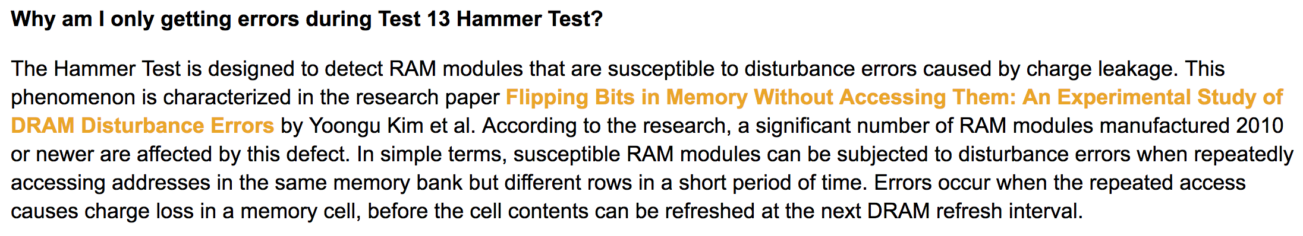
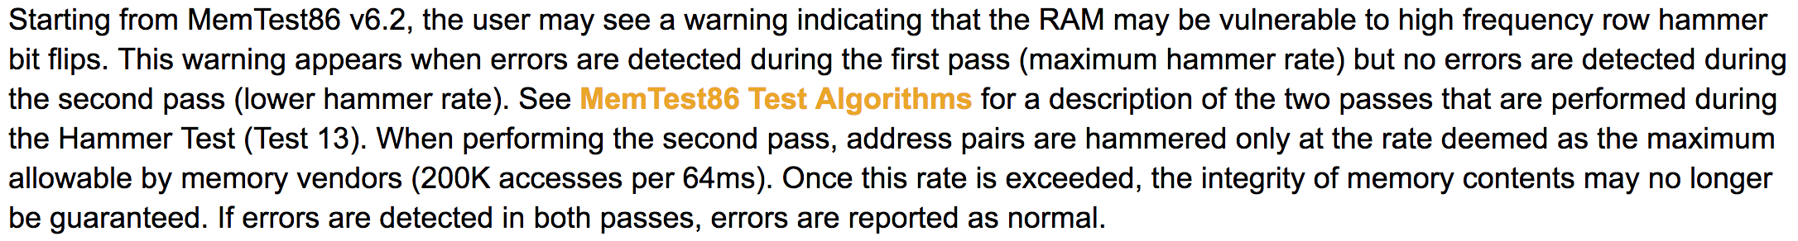
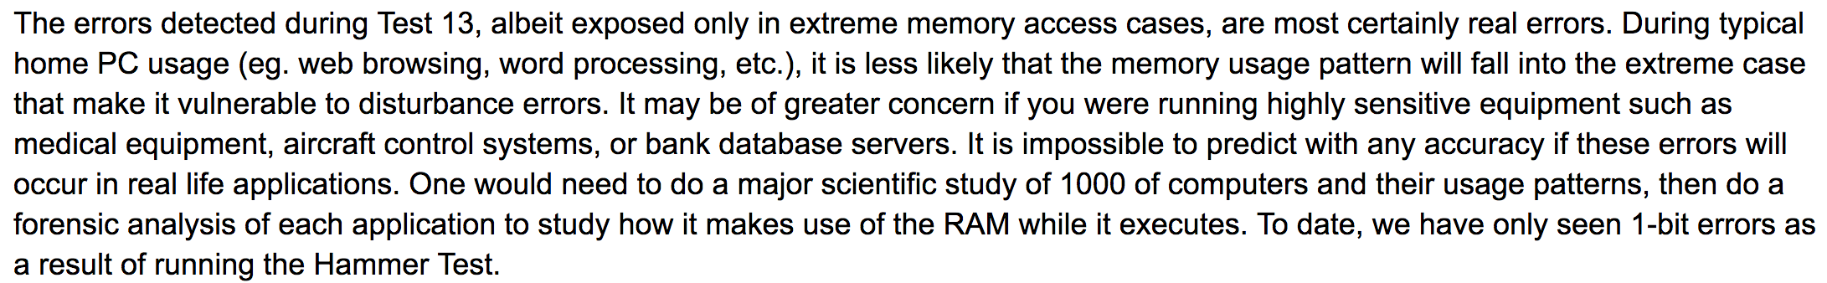
Selected Readings on RowHammer (XI.A)
PassMark Software, memtest86, since 2014
  https://www.memtest86.com/troubleshooting.htm#hammer

Slide 50
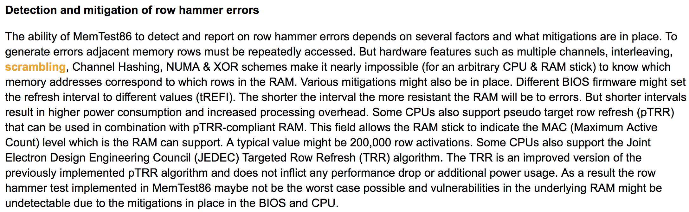

Selected Readings on RowHammer (XI.B)
PassMark Software, memtest86, since 2014
  https://www.memtest86.com/troubleshooting.htm#hammer

Slide 51
Security Implications (ISCA 2014)
Breach of memory protection
  OS page (4KB) fits inside DRAM row (8KB)
  Adjacent DRAM row → Different OS page
Vulnerability: disturbance attack
  By accessing its own page, a program could
  corrupt pages belonging to another program
We constructed a proof-of-concept
  Using only user-level instructions
Notes:
In addition, they have serious implications for security
When disturbance errors occur, they could breach memory protection. This is because an OS page fits inside a DRAM row. So an error in a different DRAM row means an error in a different OS page.
This opens up a vulnerability to disturbance attacks. Just by accessing its own page, a malicious program could corrupt pages belonging to another program.
And, as shown previously, we constructed a proof-of-concept using only user-level instructions.

Slide 52
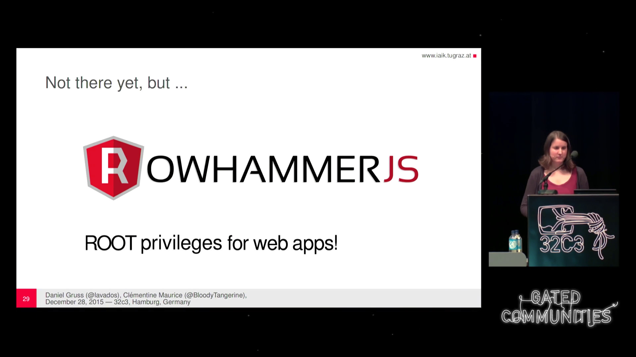
More Security Implications (I)
“We can gain unrestricted access to systems of website visitors.”
Rowhammer.js: A Remote Software-Induced Fault Attack in JavaScript (DIMVA’16)
Source: https://lab.dsst.io/32c3-slides/7197.html

Slide 53

More Security Implications (II)
  “Can gain control of a smart phone deterministically”
Drammer: Deterministic Rowhammer Attacks on Mobile Platforms, CCS’16
Source: https://fossbytes.com/drammer-rowhammer-attack-android-root-devices/

Slide 54
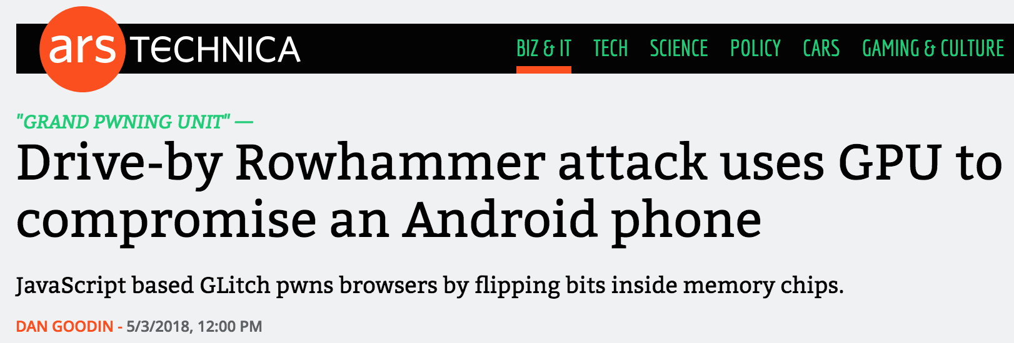

More Security Implications (III)
Using an integrated GPU in a mobile system to remotely escalate privilege via the WebGL interface

Slide 55
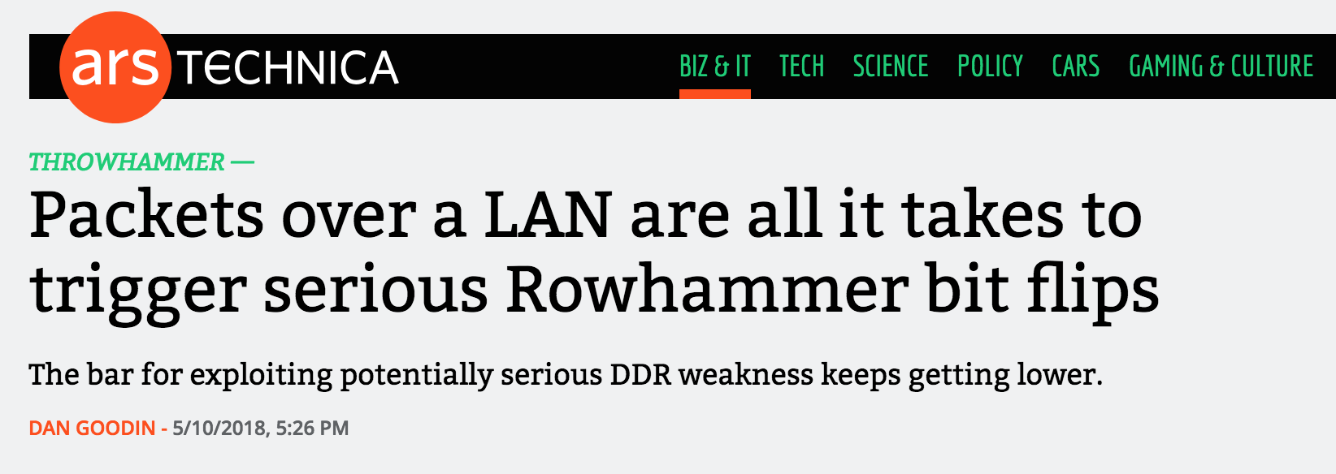
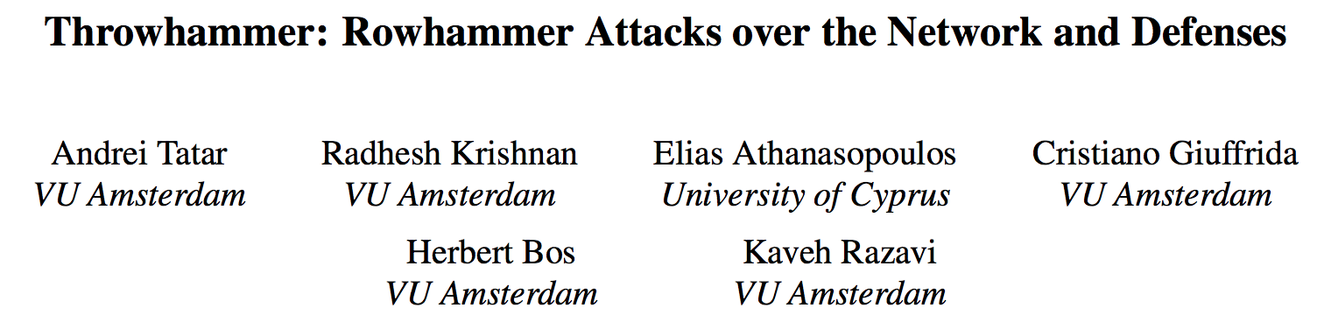
More Security Implications (IV)
Rowhammer over RDMA (I)

Slide 56
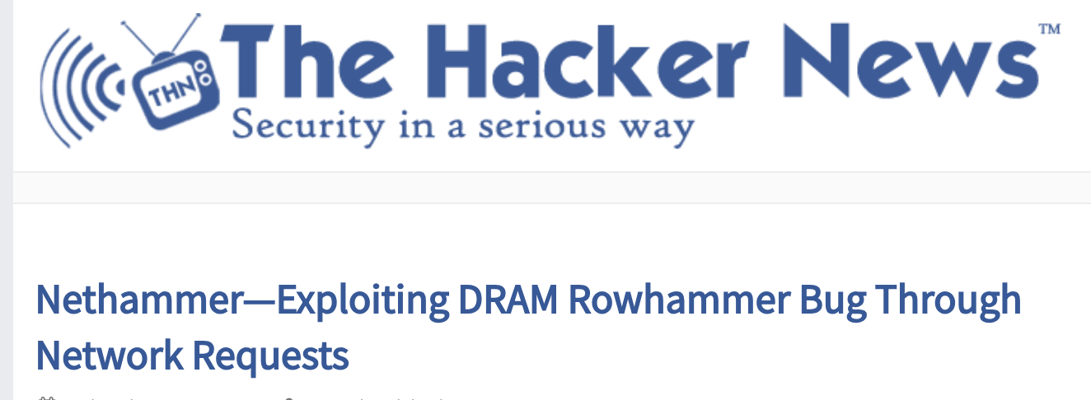

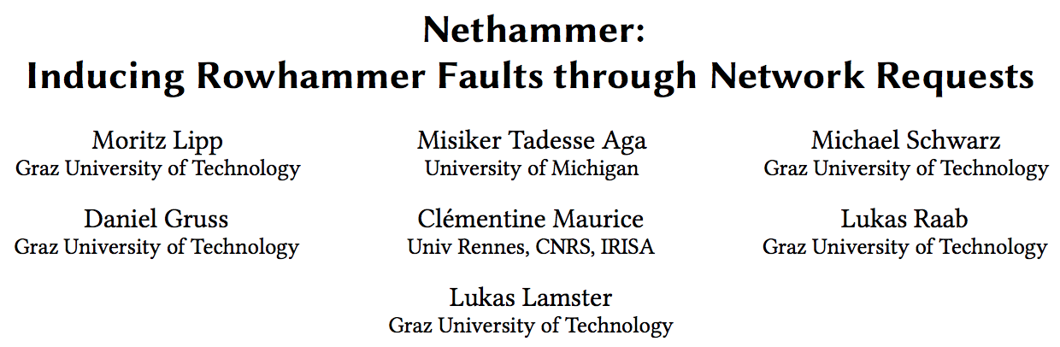
More Security Implications (V)
Rowhammer over RDMA (II)

Slide 57
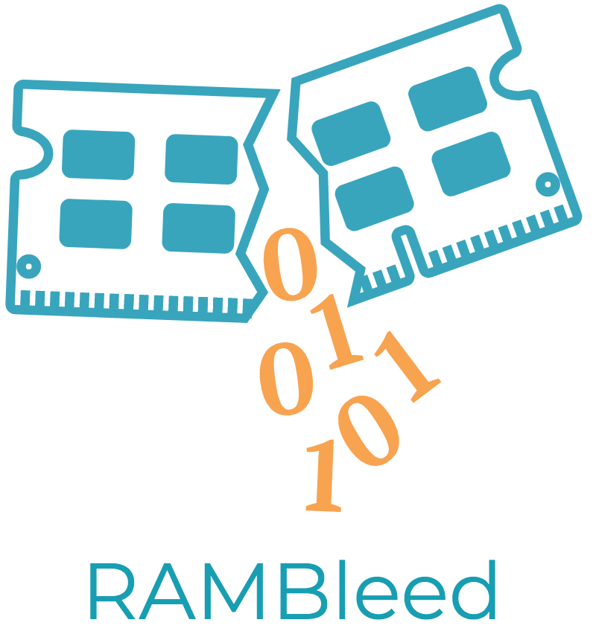
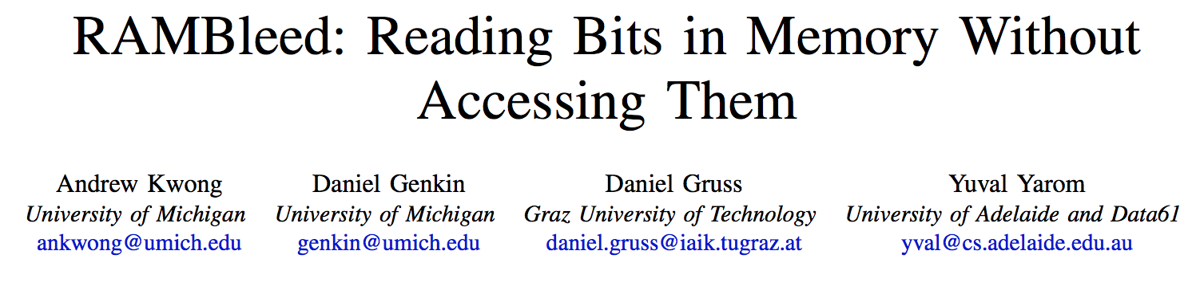
More Security Implications (VI)
IEEE S&P 2020

Slide 58

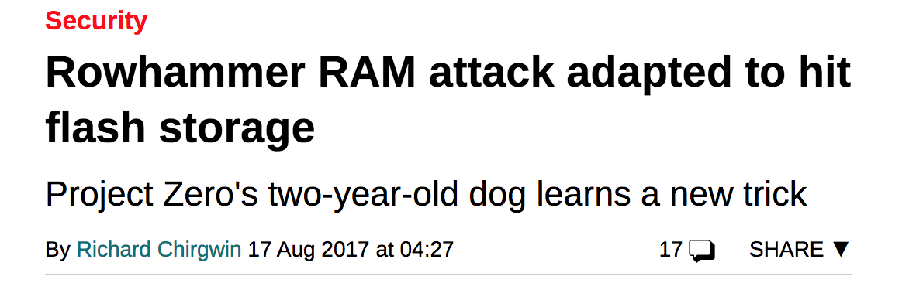
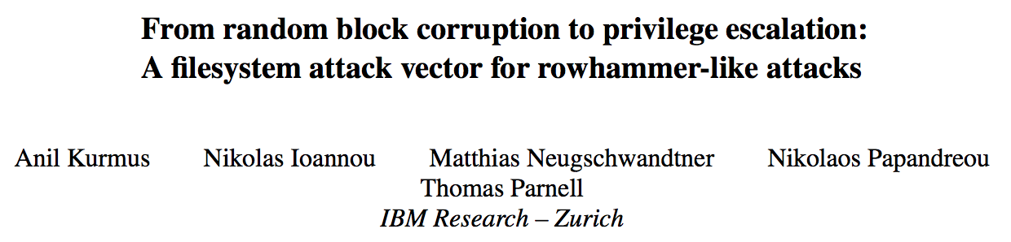
More Security Implications (VII)
Rowhammer on MLC NAND Flash (based on [Cai+, HPCA 2017])

Slide 59
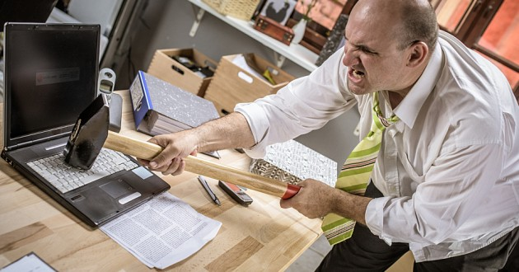
More Security Implications?

Slide 60
RowHammer Solutions

Slide 61
Two Types of RowHammer Solutions
Immediate
  To protect the vulnerable DRAM chips in the field
  Limited possibilities
Longer-term
  To protect future DRAM chips
  Wider range of protection mechanisms
Our ISCA 2014 paper proposes both types of solutions
  Seven solutions in total
  PARA proposed as best solution → already employed in the field

Slide 62
Some Potential Solutions (ISCA 2014)
Cost
Make better DRAM chips
Power, Performance
Refresh frequently
Cost, Power
Sophisticated ECC
Cost, Power, Complexity
Access counters
Notes:
Here is a list of four potential solutions to disturbance errors: making better DRAM chips, refreshing more frequently, employing sophisticated ECC schemes, and using hardware counters to track the number of accesses to different rows.
However, all of these solutions incur a large overhead in terms cost, power, performance, and/or complexity.

Slide 63
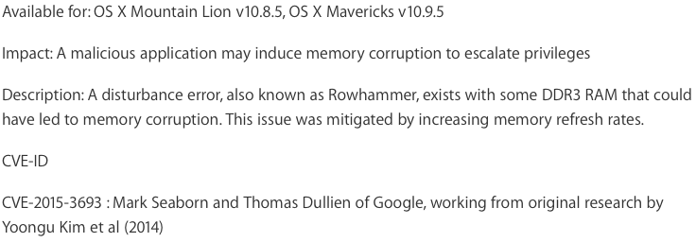
Apple’s Patch for RowHammer
https://support.apple.com/en-gb/HT204934
HP, Lenovo, and other vendors released similar patches

Slide 64
Our Best Solution to RowHammer
PARA: Probabilistic Adjacent Row Activation
Key Idea
  After closing a row, we activate (i.e., refresh) one of its neighbors with a low probability: p = 0.005
Reliability Guarantee
  When p=0.005, errors in one year: 9.4×10⁻¹⁴
  By adjusting the value of p, we can vary the strength of protection against errors
Notes:
We provide a more efficient solution, called PARA, which stands for probabilistic adjacent row activation.
The key idea is thus: after closing a row, we activate (i.e., refresh) one of its neighbors with a low probability, for example, p equal to 0.005.
PARA provides a strong reliability guarantee even under the worst-case access patterns to DRAM. When we set p to 0.005, the expected number of errors in one year is 9.4 times 10 to the negative 14. This probability is much lower the failure rate of other hardware components, for example, the hard-disk drive.
And by adjusting the value of p, PARA can provide an arbitrarily strong-degree of protection against errors.

Slide 65
Advantages of PARA
PARA refreshes rows infrequently
  Low power
  Low performance-overhead
    Average slowdown: 0.20% (for 29 benchmarks)
    Maximum slowdown: 0.75%
PARA is stateless
  Low cost
  Low complexity
PARA is an effective and low-overhead solution to prevent disturbance errors
Notes:
PARA has many advantages. Since it refreshes row infrequently, it has low power and low performance-overhead. Simulated across 29 benchmarks, we saw an average of only 0.2% slowdown and a maximum of only 0.75% slowdown.
In addition, due to its stateless nature, PARA has low cost and complexity.
Therefore, PARA is an effective and low-overhead solution to prevent disturbance errors.

Slide 66
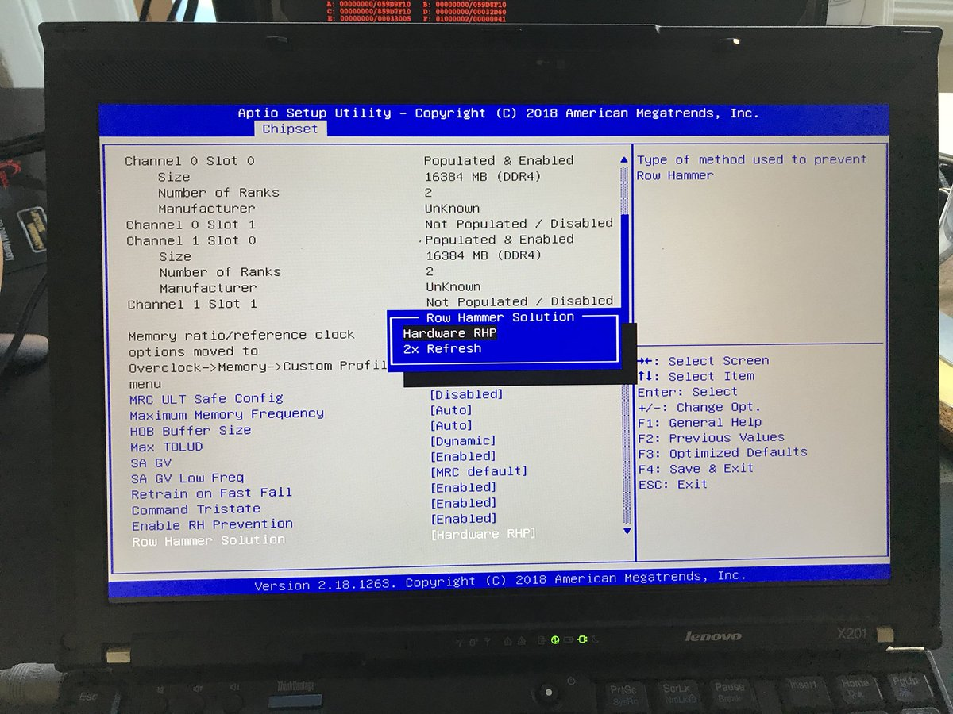
Probabilistic Activation in Real Life (I)
https://twitter.com/isislovecruft/status/1021939922754723841

Slide 67
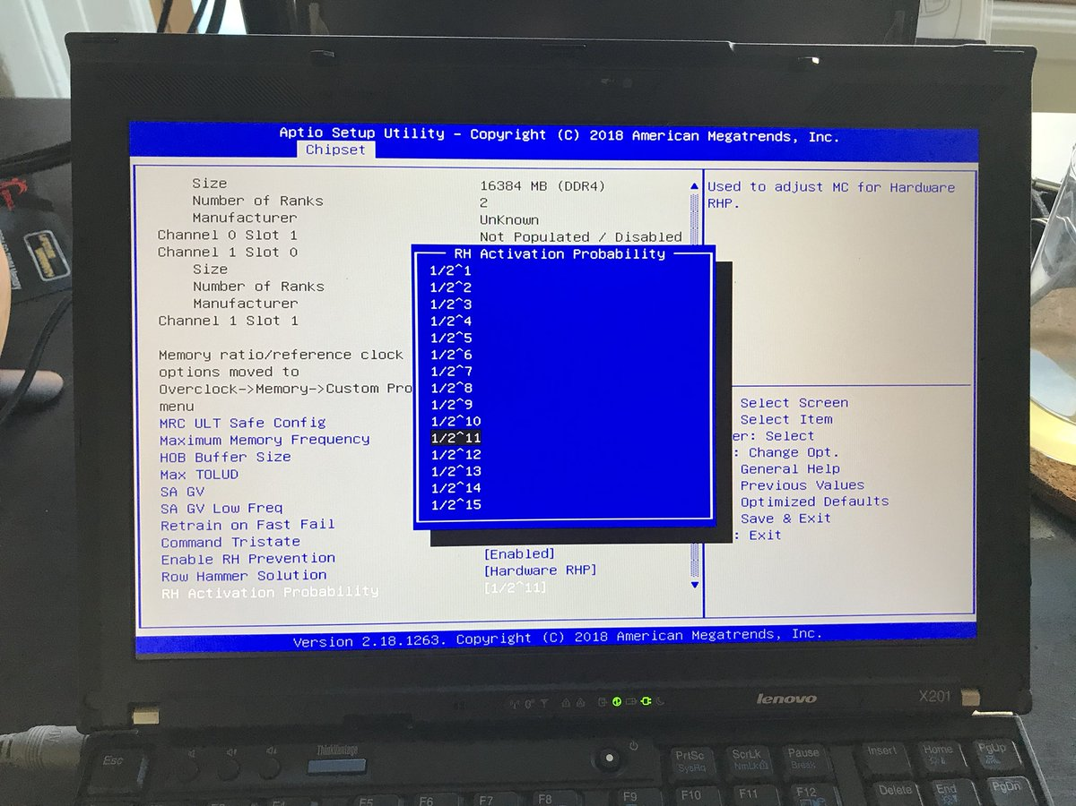
Probabilistic Activation in Real Life (II)
https://twitter.com/isislovecruft/status/1021939922754723841

Slide 68
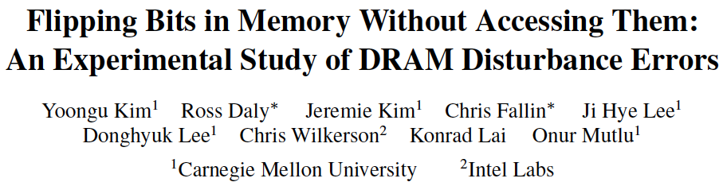
Seven RowHammer Solutions Proposed
Yoongu Kim, Ross Daly, Jeremie Kim, Chris Fallin, Ji Hye Lee, Donghyuk Lee, Chris Wilkerson, Konrad Lai, and Onur Mutlu,
"Flipping Bits in Memory Without Accessing Them: An Experimental Study of DRAM Disturbance Errors"
Proceedings of the 41st International Symposium on Computer Architecture (ISCA), Minneapolis, MN, June 2014.
[Slides (pptx) (pdf)] [Lightning Session Slides (pptx) (pdf)] [Source Code and Data]

Slide 69
A Takeaway
Main Memory Needs
Intelligent Controllers
for Security

Slide 70
First RowHammer Analysis
Yoongu Kim, Ross Daly, Jeremie Kim, Chris Fallin, Ji Hye Lee, Donghyuk Lee, Chris Wilkerson, Konrad Lai, and Onur Mutlu,
"Flipping Bits in Memory Without Accessing Them: An Experimental Study of DRAM Disturbance Errors"
Proceedings of the 41st International Symposium on Computer Architecture (ISCA), Minneapolis, MN, June 2014.
[Slides (pptx) (pdf)] [Lightning Session Slides (pptx) (pdf)] [Source Code and Data]

Slide 71
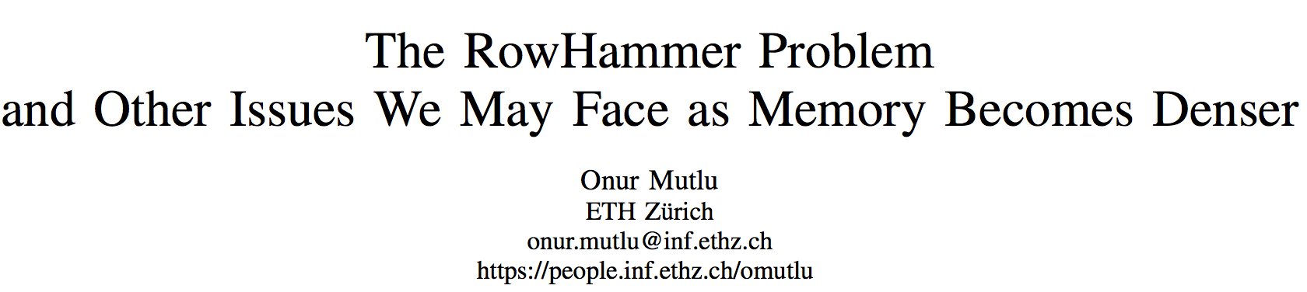
Retrospective on RowHammer & Future
Onur Mutlu,
"The RowHammer Problem and Other Issues We May Face as Memory Becomes Denser"
Invited Paper in Proceedings of the Design, Automation, and Test in Europe Conference (DATE), Lausanne, Switzerland, March 2017.
[Slides (pptx) (pdf)]
https://people.inf.ethz.ch/omutlu/pub/rowhammer-and-other-memory-issues_date17.pdf

Slide 72
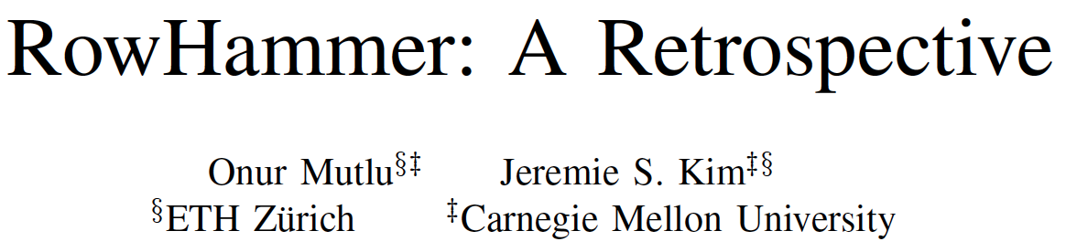
A More Recent RowHammer Retrospective
Onur Mutlu and Jeremie Kim,
"RowHammer: A Retrospective"
IEEE Transactions on Computer-Aided Design of Integrated Circuits and Systems (TCAD) Special Issue on Top Picks in Hardware and Embedded Security, 2019.
[Preliminary arXiv version]

Slide 73
RowHammer in 2020

Slide 74
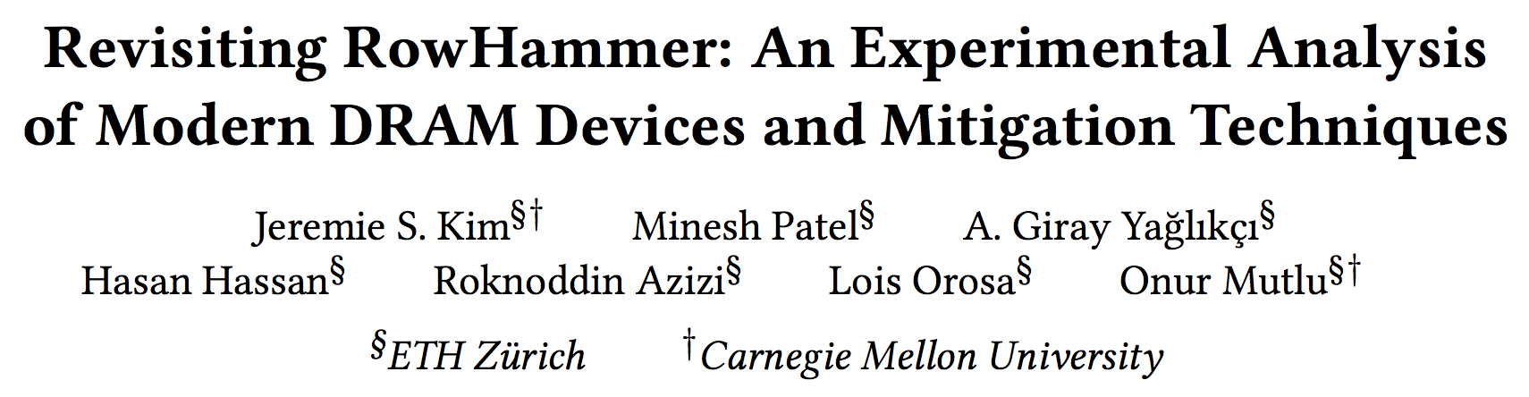
RowHammer in 2020 (I)
Jeremie S. Kim, Minesh Patel, A. Giray Yaglikci, Hasan Hassan, Roknoddin Azizi, Lois Orosa, and Onur Mutlu,
"Revisiting RowHammer: An Experimental Analysis of Modern Devices and Mitigation Techniques"
Proceedings of the 47th International Symposium on Computer Architecture (ISCA), Valencia, Spain, June 2020.
[Slides (pptx) (pdf)]
[Lightning Talk Slides (pptx) (pdf)]
[Talk Video (20 minutes)]
[Lightning Talk Video (3 minutes)]

Slide 75
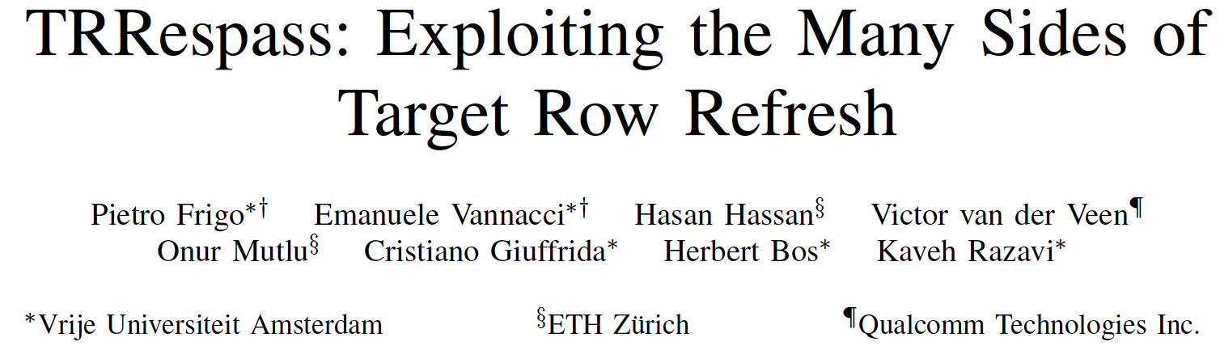
RowHammer in 2020 (II)
Pietro Frigo, Emanuele Vannacci, Hasan Hassan, Victor van der Veen, Onur Mutlu, Cristiano Giuffrida, Herbert Bos, and Kaveh Razavi,
"TRRespass: Exploiting the Many Sides of Target Row Refresh"
Proceedings of the 41st IEEE Symposium on Security and Privacy (S&P), San Francisco, CA, USA, May 2020.
[Slides (pptx) (pdf)]
[Talk Video (17 minutes)]
[Source Code]
[Web Article]
Best paper award.

Slide 76
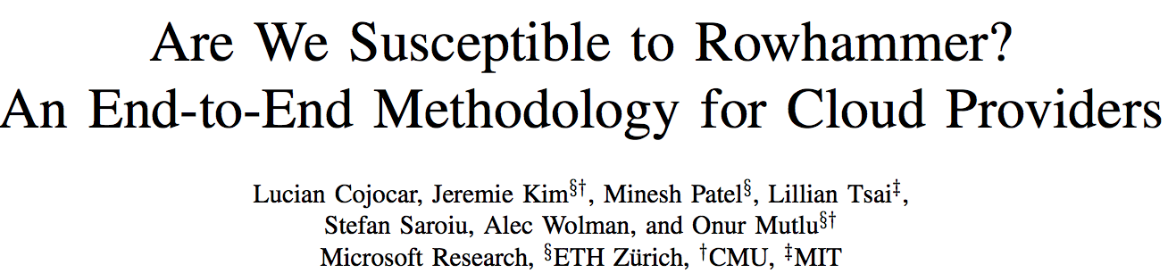
RowHammer in 2020 (III)
Lucian Cojocar, Jeremie Kim, Minesh Patel, Lillian Tsai, Stefan Saroiu, Alec Wolman, and Onur Mutlu,
"Are We Susceptible to Rowhammer? An End-to-End Methodology for Cloud Providers"
Proceedings of the 41st IEEE Symposium on Security and Privacy (S&P), San Francisco, CA, USA, May 2020.
[Slides (pptx) (pdf)]
[Talk Video (17 minutes)]

Slide 77
TRRespass

Slide 78
RowHammer in 2020 (II)
Pietro Frigo, Emanuele Vannacci, Hasan Hassan, Victor van der Veen, Onur Mutlu, Cristiano Giuffrida, Herbert Bos, and Kaveh Razavi,
"TRRespass: Exploiting the Many Sides of Target Row Refresh"
Proceedings of the 41st IEEE Symposium on Security and Privacy (S&P), San Francisco, CA, USA, May 2020.
[Slides (pptx) (pdf)]
[Talk Video (17 minutes)]
[Source Code]
[Web Article]
Best paper award.

Slide 79
TRRespass
First work that shows that TRR-protected DRAM chips are vulnerable to RowHammer in the field
  Mitigations advertised as secure are not secure
Introduces the Many-sided RowHammer attack
  Idea: Hammer many rows to bypass TRR mitigations (e.g., by overflowing proprietary TRR tables that detect aggressor rows)
(Partially) reverse-engineers the TRR and pTRR mitigation mechanisms implemented in DRAM chips and memory controllers
Provides an automatic tool that can effectively create many-sided RowHammer attacks in DDR4 and LPDDR4(X) chips

Slide 80



BitFlips vs. Number of Aggressor Rows

Slide 81
TRRespass Key Results
13 out of 42 tested DDR4 DRAM modules are vulnerable
  From all 3 major manufacturers
  3-, 9-, 10-, 14-, 19-sided hammer attacks needed
5 out of 13 mobile phones tested vulnerable
  From 4 major manufacturers
  With LPDDR4(X) DRAM chips
These results are scratching the surface
  TRRespass tool is not exhaustive
  There is a lot of room for uncovering more vulnerable chips and phones

Slide 82
TRRespass Key Takeaways
RowHammer is still
an open problem
Security by obscurity
is likely not a good solution

Slide 83
More on TRRespass
Pietro Frigo, Emanuele Vannacci, Hasan Hassan, Victor van der Veen, Onur Mutlu, Cristiano Giuffrida, Herbert Bos, and Kaveh Razavi,
"TRRespass: Exploiting the Many Sides of Target Row Refresh"
Proceedings of the 41st IEEE Symposium on Security and Privacy (S&P), San Francisco, CA, USA, May 2020.
[Slides (pptx) (pdf)]
[Talk Video (17 minutes)]
[Source Code]
[Web Article]
Best paper award.

Slide 84
Revisiting RowHammer

Slide 85



Revisiting RowHammer
An Experimental Analysis of Modern Devices and Mitigation Techniques
Jeremie S. Kim Minesh Patel
A. Giray Yağlıkçı Hasan Hassan
Roknoddin Azizi Lois Orosa Onur Mutlu
Notes:
Hello, my name is Jeremie Kim and I will be presenting our work revisiting rowhammer: an experimental analysis of modern devices and mitigation techniques

Slide 86
Key Conclusions
We characterized 1580 DRAM chips of different DRAM types, technology nodes, and manufacturers.
We studied five state-of-the-art RowHammer mitigation mechanisms and an ideal refresh-based mechanism
We made two key observations
  RowHammer is getting much worse. It takes much fewer hammers to induce RowHammer bit flips in newer chips
    e.g., DDR3: 69.2k to 22.4k, DDR4: 17.5k to 10k, LPDDR4: 16.8k to 4.8k
  Existing mitigation mechanisms do not scale to DRAM chips that are more vulnerable to RowHammer
    e.g., 80% performance loss when the hammer count to induce the first bit flip is 128
We conclude that it is critical to do more research on RowHammer and develop scalable mitigation mechanisms to prevent RowHammer in future systems
Notes:
We characterized over 1500 DRAM chips of different DRAM types, technology nodes and manufacturers
[CLICK] we studied five state-of-the-art RowHammer mitigation mechanisms and an ideal refresh-based mechanism
[CLICK] and we made two key observations.
[CLICK] First, RowHAmmer is getting much worse. It takes much fewer hammers to induce RowHAmmer bit flips in newer chips
[CLICK] Second, existing mitigation mechanisms do not scale to DRAM chips that are more vulnerable to RowHammer
[CLICK] we conclude that it is critical to do more research on RowHammer and develop scalable mitigation mechanisms to prevent RowHammer in future systems
=====

Slide 87

DRAM Testing Infrastructures
Three separate testing infrastructures
  DDR3: FPGA-based SoftMC [Hassan+, HPCA’17]
    (Xilinx ML605)
  DDR4: FPGA-based SoftMC [Hassan+, HPCA’17]
    (Xilinx Virtex UltraScale 95)
  LPDDR4: In-house testing hardware for LPDDR4 chips
All provide fine-grained control over DRAM commands, timing parameters and temperature
DDR4 DRAM testing infrastructure
Notes:
We use three separate testing infrastructures for each DRAM standard or type that we characterize in this work.
We use one FPGA-based SoftMC infrastructure for DDR3 chips and another for DDR4 chips.
We also use an in-house testing hardware infrastructure to examine LPDDR4 chips
Across our infrastructures, we have fine-grained control over DRAM commands, timing parameters, and temperatures
Below is an example of our FPGA-based DDR4 testing infrastructure.
=======

Slide 88
DRAM Chips Tested
1580 total DRAM chips tested from 300 DRAM modules
Three major DRAM manufacturers {A, B, C}
Three DRAM types or standards {DDR3, DDR4, LPDDR4}
  LPDDR4 chips we test implement on-die ECC
Two technology nodes per DRAM type {old/new, 1x/1y}
  Categorized based on manufacturing date, datasheet publication date, purchase date, and characterization results
Type-node: configuration describing a chip’s type and technology node generation: DDR3-old/new, DDR4-old/new, LPDDR4-1x/1y
Notes:
Here we show a table that lists all the DRAM chips that we test
[CLICK] We characterize over 1500 DRAM chips from 300 DRAM modules
[CLICK] spanning the three major DRAM manufacturers which we anonymize as A, B, and C
[CLICK] of three DRAM types or standards DDR3, DDR4, and LPDDR4. We note that LPDDR4 chips that we test implement on-die ECC.
[CLICK] We identify two technology nodes per DRAM type (old/new, 1x and 1y) , which we categorize based on manufacturing date, datasheet publication date, purchase date, and characterization results
[CLICK] we define the term type-node which refers to the configuration describing a chip’s type and technology node generation. Across the chips we characterize, we identify the 6 DRAM type-node configurations listed

Slide 89
3. Hammer Count (HC) Effects
RowHammer bit flip rates increase
when going from old to new DDR4 technology node generations
RowHammer bit flip rates (i.e., RowHammer vulnerability)
increase with technology node generation
Notes:
We plot each of these curves across our DRAM type-node configurations per manufacturer
[CLICK] We find that newer DDR4 DRAM technology nodes show a clear trend of increasing RowHammer bit flip rates.
the same Hammer count value causes an increased RowHammer bit flip rate from DDR4-old to DDR4-new DRAM chips of all DRAM manufacturers
[CLICK] This indicates that RowHammer bit flip rates are increasing with newer technology node generations.
=======
spend more time.
Stronger second conclusion. Clear from this that rh bit flips increase with technology node generation. and we show DDR4 as an example.
rowhammer bit flip rates are increasing when going from old to new DDR4 technology nodes.

Slide 90
5. First RowHammer Bit Flips per Chip
What is the minimum Hammer Count required to cause bit flips (HC_{first})?
We note the different DRAM types on the x-axis: DDR3, DDR4, LPDDR4.
We focus on trends across chips of the same DRAM type to draw conclusions
Notes:
We note the different DRAM types on the x-axis: DDR3, DDR4, and LPDDR4, and subdivide the plots with vertical lines.
We focus on trends across chips of the same DRAM type but different technology node generations to draw conclusions.

Slide 91
5. First RowHammer Bit Flips per Chip
Newer chips from a given DRAM manufacturer
more vulnerable to RowHammer
Notes:
We plot these distributions across each DRAM manufacturer.
[CLICK] We find that newer chips from a given DRAM manufacturer are more vulnerable to RowHammer, which is demonstrated by the clear reduction in HCfirst values from older to newer DRAM generations across most DRAM types
===============

Slide 92
5. First RowHammer Bit Flips per Chip
In a DRAM type, HC_{first} reduces significantly from old to new chips, i.e., DDR3: 69.2k to 22.4k,
DDR4: 17.5k to 10k, LPDDR4: 16.8k to 4.8k
There are chips whose weakest cells fail
after only 4800 hammers
Newer chips from a given DRAM manufacturer
more vulnerable to RowHammer
Notes:
We plot these distributions across each DRAM manufacturer.
[CLICK] We find that newer chips from a given DRAM manufacturer are more vulnerable to RowHammer, which is demonstrated by the clear reduction in HCfirst values from older to newer DRAM generations across most DRAM types
===============

Slide 93
Key Takeaways from 1580 Chips
Chips of newer DRAM technology nodes are more vulnerable to RowHammer
There are chips today whose weakest cells fail after only 4800 hammers
Chips of newer DRAM technology nodes can exhibit RowHammer bit flips 1) in more rows and 2) farther away from the victim row.
Notes:
To reiterate our three key takeaways from our experimental characterization, we find that
[CLICK] First, chips of newer DRAM technology nodes are more vulnerable to RowHammer
[CLICK] Second, there are chips today whose weakest cells fail after only 4800 hammers
[CLICK] Third, chips of newer DRAM technology nodes can exhibit RowHammer bit flips in more rows and farther away from the victim row
================

Slide 94
Mitigation Mechanism Evaluation
10⁵
10⁴
10³
10²
Ideal
TWiCe-ideal
PARA
LPDDR4-1x
LPDDR4-1y
DDR3-old
DDR3-new
DDR4-new
DDR4-old
10⁵
10⁴
10³
10²
HC_{first} (number of hammers required to induce first RowHammer bit flip)
PARA, ProHIT, and MRLoc mitigate RowHammer bit flips
in worst chips today with reasonable system performance (92%, 100%, 100%)
Notes:
[CLICK] We next overlay the lowest HCfirst values observed across all chips of a given DRAM type-node configuration, to show exactly how each mechanism would affect a system's performance when used on a system using a particular DRAM type-node configuration
[CLICK] We find that PARA, ProHIT and MRLoc are viable options for mitigating RowHammer bit flips in the worst chips that we tested today with reasonable system performance

Slide 95
Mitigation Mechanism Evaluation
10⁵
10⁴
10³
10²
Ideal
TWiCe-ideal
PARA
LPDDR4-1x
LPDDR4-1y
DDR3-old
DDR3-new
DDR4-new
DDR4-old
10⁵
10⁴
10³
10²
HC_{first} (number of hammers required to induce first RowHammer bit flip)
Only PARA’s design scales to low HC_{first} values
but has very low normalized system performance
Notes:
However, only PARA’s design scales to low HCfirst values that we are likely to see in future DRAM chips but has very low normalized system performance

Slide 96
Mitigation Mechanism Evaluation
10⁵
10⁴
10³
10²
Ideal
TWiCe-ideal
PARA
LPDDR4-1x
LPDDR4-1y
DDR3-old
DDR3-new
DDR4-new
DDR4-old
10⁵
10⁴
10³
10²
HC_{first} (number of hammers required to induce first RowHammer bit flip)
Ideal mechanism is significantly better
than any existing mechanism for HC_{first} < 1024
Significant opportunity for developing a RowHammer solution
with low performance overhead that supports low HC_{first}
Notes:
We find that the ideal refresh-based mitigation mechanism is significantly better than any existing mechanism as HCFirst reduces below 1024 .
[CLICK] And this indicates significant opportunity for developing a RowHammer solution with low performance overhead that also scales to low HCFirst values

Slide 97
Key Takeaways from Mitigation Mechanisms
Existing RowHammer mitigation mechanisms can prevent RowHammer attacks with reasonable system performance overhead in DRAM chips today
Existing RowHammer mitigation mechanisms do not scale well to DRAM chips more vulnerable to RowHammer
There is still significant opportunity for developing a mechanism that is scalable with low overhead
Notes:
From our evaluation of mitigation mechanisms
[CLICK] we find that existing RowHammer mitigation mechanisms can prevent RowHammer attacks with reasonable system performance overhead in DRAM chips today
[CLICK] However, existing mitigation mechanisms do not scale well to DRAM chips that are more vulnerable to RowHammer
[CLICK] and there is still significant opportunity for developing a mechanism that is scalable with low overhead
===========

Slide 98
RowHammer Solutions Going Forward
Two promising directions for new RowHammer solutions:
DRAM-system cooperation
  We believe the DRAM and system should cooperate more to provide a holistic solution can prevent RowHammer at low cost
Profile-guided
  Accurate profile of RowHammer-susceptible cells in DRAM provides a powerful substrate for building targeted RowHammer solutions, e.g.:
    Only increase the refresh rate for rows containing RowHammer-susceptible cells
  A fast and accurate profiling mechanism is a key research challenge for developing low-overhead and scalable RowHammer solutions
Notes:
We identify two promising directions for new RowHammer solutions
[CLICK] First, we believe that the [CLICK] DRAM and system should cooperate more to provide a holistic approach that can prevent RowHammer at low cost
[CLICK] Second, we believe that a profile-guided approach can provide significant benefits.
[CLICK] Accurately profiling RowHammer-susceptible cells in DRAM provides a powerful substrate for building target RowHammer solutions. For Example:
[CLICK] in the Increasing refresh rate mechanism, the DRAM bandwidth overhead could be reduced by only increasing the refresh rate for rows containing RowHammer-susceptible cells
[CLICK] We believe that a fast and accurate profiling mechanism is a key research challenge for developing low-overhead and scalable RowHammer solutions
=============
[CLICK] In mechanisms that use DRAM access counters, we could lower the area overhead by only counting accesses to rows containing RowHammer-susceptible cells.
beautify. Maybe reduce and save time. DRAM system should cooperate more. Details in the paper

Slide 99
Revisiting RowHammer
An Experimental Analysis of Modern Devices and Mitigation Techniques
Jeremie S. Kim Minesh Patel
A. Giray Yağlıkçı Hasan Hassan
Roknoddin Azizi Lois Orosa Onur Mutlu
Notes:
This concludes my talk . Thank you for your time and attention. For many more details, I invite you to read our ISCA 2020 paper.

Slide 100
Revisiting RowHammer in 2020 (I)
Jeremie S. Kim, Minesh Patel, A. Giray Yaglikci, Hasan Hassan, Roknoddin Azizi, Lois Orosa, and Onur Mutlu,
"Revisiting RowHammer: An Experimental Analysis of Modern Devices and Mitigation Techniques"
Proceedings of the 47th International Symposium on Computer Architecture (ISCA), Valencia, Spain, June 2020.
[Slides (pptx) (pdf)]
[Lightning Talk Slides (pptx) (pdf)]
[Talk Video (20 minutes)]
[Lightning Talk Video (3 minutes)]

Slide 101

RowHammer in 2020 (IV)

Slide 102

RowHammer in 2020 (V)

Slide 103

RowHammer in 2020 (VI)

Slide 104
More to Come…

Slide 105
Future Memory Reliability/Security Challenges

Slide 106
Future of Main Memory Security
DRAM is becoming less reliable → more vulnerable
Due to difficulties in DRAM scaling, other problems may also appear (or they may be going unnoticed)
Some errors may already be slipping into the field
  Read disturb errors (Rowhammer)
  Retention errors
  Read errors, write errors
  …
These errors can also pose security vulnerabilities

Slide 107
The Takeaway, Reinforced
Main Memory Needs
Intelligent Controllers
for Security

Slide 108
Keeping Future Memory Secure

Slide 109
How Do We Keep Memory Secure?
DRAM
Flash memory
Emerging Technologies
  Phase Change Memory
  STT-MRAM
  RRAM, memristors
  …

Slide 110
Solution Direction: Principled Designs
Design fundamentally secure
computing architectures
Predict and prevent
such safety issues

Slide 111
Architecting Future Memory for Security
Understand: Methods for vulnerability modeling & discovery
  Modeling and prediction based on real (device) data and analysis
  Understanding vulnerabilities
  Developing reliable metrics
Architect: Principled architectures with security as key concern
  Good partitioning of duties across the stack
  Cannot give up performance and efficiency
  Patch-ability in the field
Design & Test: Principled design, automation, (online) testing
  Design for security
  High coverage and good interaction with system reliability methods

Slide 112
Understand and Model with Experiments (DRAM)
Temperature
Controller
FPGAs
Heater
FPGAs
PC
  Kim+, “Flipping Bits in Memory Without Accessing Them: An Experimental Study of DRAM Disturbance Errors,” ISCA 2014.

Slide 113

Understand and Model with Experiments (Flash)
USB Daughter Board
USB Jack
HAPS-52 Mother Board
Virtex-II Pro
(USB controller)
1x-nm
NAND Flash
Virtex-V FPGA
(NAND Controller)
[DATE 2012, ICCD 2012, DATE 2013, ITJ 2013, ICCD 2013, SIGMETRICS 2014, HPCA 2015, DSN 2015, MSST 2015, JSAC 2016, HPCA 2017, DFRWS 2017,
PIEEE 2017, HPCA 2018, SIGMETRICS 2018]
NAND Daughter Board
Cai+, “Error Characterization, Mitigation, and Recovery in Flash Memory Based Solid State Drives,” Proc. IEEE 2017.

Slide 114

Collapse of the “Galloping Gertie” (1940)
Source: AP
http://www.wsdot.wa.gov/tnbhistory/connections/connections3.htm

Slide 115

Another Example (1994)
Source: By 최광모 - Own work, CC BY-SA 4.0, https://commons.wikimedia.org/w/index.php?curid=35197984

Slide 116

Yet Another Example (2007)
Source: Morry Gash/AP,
https://www.npr.org/2017/08/01/540669701/10-years-after-bridge-collapse-america-is-still-crumbling?t=1535427165809

Slide 117

A More Recent Example (2018)
Source: AFP / Valery HACHE, https://www.capitalfm.co.ke/news/2018/08/genoa-bridge-collapse-what-we-know/

Slide 118
The Takeaway, Again
In-Field Patch-ability
(Intelligent Memory)
Can Avoid Such Failures

Slide 119
Conclusion

Slide 120
Summary: RowHammer
Memory reliability is reducing
Reliability issues open up security vulnerabilities
  Very hard to defend against
Rowhammer is a prime example
  First example of how a simple hardware failure mechanism can create a widespread system security vulnerability
  Its implications on system security research are tremendous & exciting
Bad news: RowHammer is getting worse.
Good news: We have a lot more to do.
  We are now fully aware hardware is easily fallible.
  We are developing both attacks and solutions.
  We are developing principled models, methodologies, solutions.

Slide 121
For More on RowHammer…
Onur Mutlu and Jeremie Kim,
"RowHammer: A Retrospective"
IEEE Transactions on Computer-Aided Design of Integrated Circuits and Systems (TCAD) Special Issue on Top Picks in Hardware and Embedded Security, 2019.
[Preliminary arXiv version]

Slide 122
RowHammer in 2020 (I)
Jeremie S. Kim, Minesh Patel, A. Giray Yaglikci, Hasan Hassan, Roknoddin Azizi, Lois Orosa, and Onur Mutlu,
"Revisiting RowHammer: An Experimental Analysis of Modern Devices and Mitigation Techniques"
Proceedings of the 47th International Symposium on Computer Architecture (ISCA), Valencia, Spain, June 2020.
[Slides (pptx) (pdf)]
[Lightning Talk Slides (pptx) (pdf)]
[Talk Video (20 minutes)]
[Lightning Talk Video (3 minutes)]

Slide 123
RowHammer in 2020 (II)
Pietro Frigo, Emanuele Vannacci, Hasan Hassan, Victor van der Veen, Onur Mutlu, Cristiano Giuffrida, Herbert Bos, and Kaveh Razavi,
"TRRespass: Exploiting the Many Sides of Target Row Refresh"
Proceedings of the 41st IEEE Symposium on Security and Privacy (S&P), San Francisco, CA, USA, May 2020.
[Slides (pptx) (pdf)]
[Talk Video (17 minutes)]
[Source Code]
[Web Article]
Best paper award.

Slide 124
RowHammer in 2020 (III)
Lucian Cojocar, Jeremie Kim, Minesh Patel, Lillian Tsai, Stefan Saroiu, Alec Wolman, and Onur Mutlu,
"Are We Susceptible to Rowhammer? An End-to-End Methodology for Cloud Providers"
Proceedings of the 41st IEEE Symposium on Security and Privacy (S&P), San Francisco, CA, USA, May 2020.
[Slides (pptx) (pdf)]
[Talk Video (17 minutes)]

Slide 125
Notes:
Picture from the article:
http://thehackernews.com/2015/03/dram-rowhammer-vulnerability.html

Slide 126
Funding Acknowledgments
Alibaba, AMD, ASML, Google, Facebook, Hi-Silicon, HP Labs, Huawei, IBM, Intel, Microsoft, Nvidia, Oracle, Qualcomm, Rambus, Samsung, Seagate, VMware
NSF
NIH
GSRC
SRC
CyLab

Slide 127
Acknowledgments
My current and past students and postdocs
  Rachata Ausavarungnirun, Abhishek Bhowmick, Amirali Boroumand, Rui Cai, Yu Cai, Kevin Chang, Saugata Ghose, Kevin Hsieh, Tyler Huberty, Ben Jaiyen, Samira Khan, Jeremie Kim, Yoongu Kim, Yang Li, Jamie Liu, Lavanya Subramanian, Donghyuk Lee, Yixin Luo, Justin Meza, Gennady Pekhimenko, Vivek Seshadri, Lavanya Subramanian, Nandita Vijaykumar, HanBin Yoon, Jishen Zhao, …
My collaborators
  Can Alkan, Chita Das, Phil Gibbons, Sriram Govindan, Norm Jouppi, Mahmut Kandemir, Mike Kozuch, Konrad Lai, Ken Mai, Todd Mowry, Yale Patt, Moinuddin Qureshi, Partha Ranganathan, Bikash Sharma, Kushagra Vaid, Chris Wilkerson, …

Slide 128

Acknowledgments
Think BIG, Aim HIGH!
https://safari.ethz.ch

Slide 129


Onur Mutlu’s SAFARI Research Group
Computer architecture, HW/SW, systems, bioinformatics, security, memory
https://safari.ethz.ch/safari-newsletter-april-2020/
38+ Researchers
Think BIG, Aim HIGH!
https://safari.ethz.ch

Slide 130

SAFARI Newsletter April 2020 Edition
https://safari.ethz.ch/safari-newsletter-april-2020/

Slide 131
Revisiting RowHammer
Onur Mutlu
omutlu@gmail.com
https://people.inf.ethz.ch/omutlu
9 October 2020
VLSI-SoC

Slide 132
Backup Slides for Further Info

Slide 133
Research & Teaching: Some Overview Talks
https://www.youtube.com/onurmutlulectures
Future Computing Architectures
  https://www.youtube.com/watch?v=kgiZlSOcGFM&list=PL5Q2soXY2Zi8D_5MGV6EnXEJHnV2YFBJl&index=1
Enabling In-Memory Computation
  https://www.youtube.com/watch?v=njX_14584Jw&list=PL5Q2soXY2Zi8D_5MGV6EnXEJHnV2YFBJl&index=16
Accelerating Genome Analysis
  https://www.youtube.com/watch?v=hPnSmfwu2-A&list=PL5Q2soXY2Zi8D_5MGV6EnXEJHnV2YFBJl&index=9
Rethinking Memory System Design
  https://www.youtube.com/watch?v=F7xZLNMIY1E&list=PL5Q2soXY2Zi8D_5MGV6EnXEJHnV2YFBJl&index=3
Intelligent Architectures for Intelligent Machines
  https://www.youtube.com/watch?v=n8Aj_A0WSg8&list=PL5Q2soXY2Zi8D_5MGV6EnXEJHnV2YFBJl&index=22

Slide 134
An Interview on Research and Education
Computing Research and Education (@ ISCA 2019)
  https://www.youtube.com/watch?v=8ffSEKZhmvo&list=PL5Q2soXY2Zi_4oP9LdL3cc8G6NIjD2Ydz
Maurice Wilkes Award Speech (10 minutes)
  https://www.youtube.com/watch?v=tcQ3zZ3JpuA&list=PL5Q2soXY2Zi8D_5MGV6EnXEJHnV2YFBJl&index=15

Slide 135
More Thoughts and Suggestions
Onur Mutlu,
"Some Reflections (on DRAM)"
Award Speech for ACM SIGARCH Maurice Wilkes Award, at the ISCA Awards Ceremony, Phoenix, AZ, USA, 25 June 2019.
[Slides (pptx) (pdf)]
[Video of Award Acceptance Speech (Youtube; 10 minutes) (Youku; 13 minutes)]
[Video of Interview after Award Acceptance (Youtube; 1 hour 6 minutes) (Youku; 1 hour 6 minutes)]
[News Article on "ACM SIGARCH Maurice Wilkes Award goes to Prof. Onur Mutlu"]
Onur Mutlu,
"How to Build an Impactful Research Group"
57th Design Automation Conference Early Career Workshop (DAC), Virtual, 19 July 2020.
[Slides (pptx) (pdf)]

Slide 136
Understanding RowHammer

Slide 137
Why Is This Happening?
DRAM cells are too close to each other!
  They are not electrically isolated from each other
Access to one cell affects the value in nearby cells
  due to electrical interference between
    the cells
    wires used for accessing the cells
  Also called cell-to-cell coupling/interference
Example: When we activate (apply high voltage) to a row, an adjacent row gets slightly activated as well
  Vulnerable cells in that slightly-activated row lose a little bit of charge
  If row hammer happens enough times, charge in such cells gets drained

Slide 138
Higher-Level Implications
This simple circuit level failure mechanism has enormous implications on upper layers of the transformation hierarchy
Problem
Problem
Algorithm
Algorithm
Program/Language
User
Program/Language
Runtime System
(VM, OS, MM)
Runtime System
(VM, OS, MM)
ISA (Architecture)
ISA
Microarchitecture
Microarchitecture
Logic
Logic
Devices
Devices
Electrons
Electrons

Slide 139
Root Causes of Disturbance Errors
Cause 1: Electromagnetic coupling
  Toggling the wordline voltage briefly increases the voltage of adjacent wordlines
  Slightly opens adjacent rows → Charge leakage
Cause 2: Conductive bridges
Cause 3: Hot-carrier injection
Confirmed by at least one manufacturer
Notes:
Why do the errors occur? We see three possible causes.
First, there could electromagnetic coupling between adjacent wordlines. When the voltage of one is toggled, it could briefly increase the voltage of the other and facilitate the leakage of charge.
Two other possibilities are conductive bridges and hot-carrier injection.
At least one manufacturer confirmed that these three could play a role in the disturbance errors we see them today.

Slide 140
Experimental DRAM Testing Infrastructure
  An Experimental Study of Data Retention Behavior in Modern DRAM Devices: Implications for Retention Time Profiling Mechanisms (Liu et al., ISCA 2013)
  The Efficacy of Error Mitigation Techniques for DRAM Retention Failures: A Comparative Experimental Study
  (Khan et al., SIGMETRICS 2014)
  Flipping Bits in Memory Without Accessing Them: An Experimental Study of DRAM Disturbance Errors (Kim et al., ISCA 2014)
  Adaptive-Latency DRAM: Optimizing DRAM Timing for the Common-Case (Lee et al., HPCA 2015)
  AVATAR: A Variable-Retention-Time (VRT) Aware Refresh for DRAM Systems (Qureshi et al., DSN 2015)

Slide 141
Where RowHammer Was Discovered
Temperature
Controller
FPGAs
Heater
FPGAs
PC
  Kim+, “Flipping Bits in Memory Without Accessing Them: An Experimental Study of DRAM Disturbance Errors,” ISCA 2014.

Slide 142

Tested
DRAM
Modules
(129 total)

Slide 143
RowHammer Characterization Results
Most Modules Are at Risk
Errors vs. Vintage
Error = Charge Loss
Adjacency: Aggressor & Victim
Sensitivity Studies
Other Results in Paper
Solution Space
Flipping Bits in Memory Without Accessing Them: An Experimental Study of DRAM Disturbance Errors, (Kim et al., ISCA 2014)
Notes:
Now I will present the characterization results, one-by-one.
First, I show that most modules are at risk. Second, I show the number of errors in a module as a function of the manufacture date. Third, I show that the errors are symptomatic of charge loss. Fourth, I show that an aggressor induces errors in adjacent rows. Fifth, I show several sensitivity studies. And, finally, I briefly describe other results in the paper.

Slide 144


4. Adjacency: Aggressor & Victim
Adjacent
Adjacent
Adjacent
Non-Adjacent
Non-Adjacent
Note: For three modules with the most errors (only first bank)
Most aggressors & victims are adjacent
Notes:
In this figure, the x-axis is the row-address difference between an aggressor and its victims. And the y-axis is the number of victim-aggressor pairs that correspond to the row-address difference. For all three modules, we see strong peaks at plus/minus 1. This implies that aggressors and victims have consecutive row-addresses, in other words, they are adjacent.
However, the figure also shows some victims that are not adjacent to the aggressor. We believe this could be caused by two reasons. First, depending on the mapping, two rows that are physically adjacent within the DRAM chip may not have consecutive row-addresses. Second, fault rows are often re-mapped to spare rows that may reside on a different portion of the DRAM chip.
Nevertheless, we conclude that the vast majority of aggressors & victims are adjacent.

Slide 145


❶ Access Interval (Aggressor)
Not Allowed
500ns
55ns
Note: For three modules with the most errors (only first bank)
Less frequent accesses → Fewer errors
Notes:
In this figure, the x-axis is the interval at which we access the aggressor. And the y-axis is the number of errors. To comply with the DRAM standard, we employ a default value of 55ns in our experiments. However, as we increase the access-interval, we see that the number of errors decreases. In particular, at 500ns, there are no errors for all three modules.
From this, we conclude that less frequent accesses induce fewer errors.

Slide 146


❷ Refresh Interval
~7x frequent
64ms
Note: Using three modules with the most errors (only first bank)
More frequent refreshes → Fewer errors
Notes:
In this figure, the x-axis is the refresh-interval. And the y-axis is the number of errors. To comply with the DRAM standard, we employ a default value of 64ms in our experiments. However, as we decrease the refresh-interval, we see that the number of errors decreases. In particular, when the refresh is shortened by 7x, there are no errors for all three modules.
From this, we conclude that more frequent accesses induce fewer errors.

Slide 147
❸ Data Pattern
Solid
RowStripe
111111
111111
111111
000000
111111
111111
10x Errors
111111
000000
~Solid
~RowStripe
000000
000000
000000
111111
000000
000000
000000
111111
Errors affected by data stored in other cells
Notes:
We tested the modules with four different data-patterns: Solid, inverse Solid, RowStripe, and inverse RowStripe. Solid and inverse Solid give us full coverage since each cell is tested with both 1s and 0s. And the same applies to RowStripe and its inverse.
However, we found that the rowstripe pattern had 10 times as more errors than the solid pattern. We also tested many other data-patterns, including random, but found RowStripe to induce the most errors.
Therefore, we conclude that errors are affected by data stored in other cells due to differences in coupling effects between the cells.

Slide 148
6. Other Results (in Paper)
Victim Cells ≠ Weak Cells (i.e., leaky cells)
  Almost no overlap between them
Errors not strongly affected by temperature
  Default temperature: 50°C
  At 30°C and 70°C, number of errors changes <15%
Errors are repeatable
  Across ten iterations of testing, >70% of victim cells had errors in every iteration
Notes:
First, we show that victim cells are not weak cells, which are cells that are inherently leaky. According to our experiments, we saw almost no overlap between them.
Second, we show that errors are not strongly affected by temperature. In all of the tests so far, we set the temperature to 50 degrees Celsius. But even when we changed the temperature by 20 degrees, the number of errors changed by less than 15 percent.
Third, we show that errors are repeatable. Across ten iterations of testing, more than 70% of victim cells had errors in every iteration.

Slide 149
6. Other Results (in Paper) cont’d
As many as 4 errors per cache-line
  Simple ECC (e.g., SECDED) cannot prevent all errors
Number of cells & rows affected by aggressor
  Victims cells per aggressor: ≤110
  Victims rows per aggressor: ≤9
Cells affected by two aggressors on either side
  Very small fraction of victim cells (<100) have an error when either one of the aggressors is toggled
Notes:
Fourth, we show that there are as many as four errors per cacheline. From this, we conclude that simple ECC schemes (for example, SECDED) cannot prevent all errors.
Fifth, we show that the number of cells & rows affected by an aggressor can be as high as 110 or 9, respectively.
Lastly, we show that a very small fraction of victim cells experience an error when either one of the aggressors is toggled.

Slide 150
First RowHammer Analysis
Yoongu Kim, Ross Daly, Jeremie Kim, Chris Fallin, Ji Hye Lee, Donghyuk Lee, Chris Wilkerson, Konrad Lai, and Onur Mutlu,
"Flipping Bits in Memory Without Accessing Them: An Experimental Study of DRAM Disturbance Errors"
Proceedings of the 41st International Symposium on Computer Architecture (ISCA), Minneapolis, MN, June 2014.
[Slides (pptx) (pdf)] [Lightning Session Slides (pptx) (pdf)] [Source Code and Data]

Slide 151
RowHammer Solutions

Slide 152
Naive Solutions
❶ Throttle accesses to same row
  Limit access-interval: ≥500ns
  Limit number of accesses: ≤128K (=64ms/500ns)
❷ Refresh more frequently
  Shorten refresh-interval by ~7x
Both naive solutions introduce significant overhead in performance and power
Notes:
Based on what we learned from the sensitivity studies, there are two naive solutions that immediately present themselves.
First, we can throttle accesses to the same row. If the access-interval is greater than 500ns, I showed how errors are not induced. We can achieve the same effect by limiting the maximum number of accesses to the same row to be less than 128K, within a refresh interval.
Second, we can refresh the module more frequently. If the refresh-interval is shortened by 7x, I showed how errors can be prevented.
However, both naive solutions introduce significant overhead in both performance and power. Later on, I will propose a much more efficient solution.

Slide 153
Requirements for PARA
If implemented in DRAM chip (done today)
  Enough slack in timing and refresh parameters
  Plenty of slack today:
    Lee et al., “Adaptive-Latency DRAM: Optimizing DRAM Timing for the Common Case,” HPCA 2015.
    Chang et al., “Understanding Latency Variation in Modern DRAM Chips,” SIGMETRICS 2016.
    Lee et al., “Design-Induced Latency Variation in Modern DRAM Chips,” SIGMETRICS 2017.
    Chang et al., “Understanding Reduced-Voltage Operation in Modern DRAM Devices,” SIGMETRICS 2017.
    Ghose et al., “What Your DRAM Power Models Are Not Telling You: Lessons from a Detailed Experimental Study,” SIGMETRICS 2018.
    Kim et al., “Solar-DRAM: Reducing DRAM Access Latency by Exploiting the Variation in Local Bitlines,” ICCD 2018.
If implemented in memory controller
  Better coordination between memory controller and DRAM
  Memory controller should know which rows are physically adjacent

Slide 154

Industry Is Writing Papers About It, Too

Slide 155

Industry Is Writing Papers About It, Too

Slide 156
Aside: Intelligent Controller for NAND Flash
USB Daughter Board
USB Jack
HAPS-52 Mother Board
Virtex-II Pro
(USB controller)
1x-nm
NAND Flash
Virtex-V FPGA
(NAND Controller)
[DATE 2012, ICCD 2012, DATE 2013, ITJ 2013, ICCD 2013, SIGMETRICS 2014, HPCA 2015, DSN 2015, MSST 2015, JSAC 2016, HPCA 2017, DFRWS 2017,
PIEEE 2017, HPCA 2018, SIGMETRICS 2018]
NAND Daughter Board
Cai+, “Error Characterization, Mitigation, and Recovery in Flash Memory Based Solid State Drives,” Proc. IEEE 2017.

Slide 157
Revisiting RowHammer in 2020

Slide 158
Executive Summary
Motivation: Denser DRAM chips are more vulnerable to RowHammer but no characterization-based study demonstrates how vulnerability scales
Problem: Unclear if existing mitigation mechanisms will remain viable for future DRAM chips that are likely to be more vulnerable to RowHammer
Goal:
  Experimentally demonstrate how vulnerable modern DRAM chips are to RowHammer and study how this vulnerability will scale going forward
  Study viability of existing mitigation mechanisms on more vulnerable chips
Experimental Study: First rigorous RowHammer characterization study across a broad range of DRAM chips
  1580 chips of different DRAM {types, technology node generations, manufacturers}
  We find that RowHammer vulnerability worsens in newer chips
RowHammer Mitigation Mechanism Study: How five state-of-the-art mechanisms are affected by worsening RowHammer vulnerability
  Reasonable performance loss (8% on average) on modern DRAM chips
  Scale poorly to more vulnerable DRAM chips (e.g., 80% performance loss)
Conclusion: it is critical to research more effective solutions to RowHammer for future DRAM chips that will likely be even more vulnerable to RowHammer
Notes:
I will first begin with an executive summary
[CLICK] Denser DRAM chips are more vulnerable to RowHammer but there is no characterization-based study that demonstrates how exactly the vulnerability scales
[CLICK] The problem is that it is unclear whether current mitigation mechanisms will remain viable for future DRAM chips that are likely to be more vulnerable to RowHammer
[CLICK] The goal of this work is to [CLICK] first experimentally demonstrate how vulnerable modern DRAM chips are to RowHammer and study how this vulnerability will scale going forward
[CLICK] Secondly, we want to study the viability of current mitigation mechanisms on more vulnerable chips
[CLICK] We are the first experimental study to present a rigorous RowHammer failure characterization study across a broad range of DRAM chips
[CLICK] We characterize 1580 DRAM chips across different DRAM types and technology node generations, across the three major DRAM manufacturers
[CLICK] And we demonstrate that the RowHammer vulnerability worsens in newer chips
[CLICK] We also study RowHammer mitigation mechanisms in simulation and show how 5 state-of-the-art mechanisms are affected by a worsening RowHammer vulnerability
[CLICK] We find that these mitigation mechanisms have reasonable performance loss on modern DRAM chips, but [CLICK] scale poorly to more vulnerable DRAM chips
[CLICK] We conclude that it is critical to research more effective solutions to RowHammer for future DRAM chips that will likely be even more vulnerable to RowHammer
=============
reduce text on this slide.

Slide 159
Motivation
  Denser DRAM chips are more vulnerable to RowHammer
  Three prior works [Kim+, ISCA’14], [Park+, MR’16], [Park+, MR’16], over the last six years provide RowHammer characterization data on real DRAM
  However, there is no comprehensive experimental study that demonstrates how vulnerability scales across DRAM types and technology node generations
  It is unclear whether current mitigation mechanisms will remain viable for future DRAM chips that are likely to be more vulnerable to RowHammer
Notes:
The motivation for this study is that
[CLICK] denser DRAM chips are more vulnerable to RowHammer
[CLICK] Three prior works provide RowHammer characterization data on real DRAM chips.
[CLICK] However, there is no comprehensive experimental study that demonstrates how the RowHammer vulnerability scales across DRAM types and technology node generations and as DRAM chips become more dense
[CLICK] Therefore it is hard to identify whether current mitigation mechanisms will remain viable for future DRAM chips that are likely to be more vulnerable to RowHammer

Slide 160
Goal
  Experimentally demonstrate how vulnerable modern DRAM chips are to RowHammer and predict how this vulnerability will scale going forward
  Examine the viability of current mitigation mechanisms on more vulnerable chips
Notes:
The goal of this work is to
[CLICK] First, experimentally demonstrate how vulnerable modern DRAM chips are to RowHammer and predict how this vulnerability will scale going forward and
[CLICK] Second, we want to study the viability of current mitigation mechanisms on more vulnerable chips.

Slide 161
Effective RowHammer Characterization
To characterize our DRAM chips at worst-case conditions, we:
Prevent sources of interference during core test loop
  We disable:
    DRAM refresh: to avoid refreshing victim row
    DRAM calibration events: to minimize variation in test timing
    RowHammer mitigation mechanisms: to observe circuit-level effects
  Test for less than refresh window (32ms) to avoid retention failures
Worst-case access sequence
- We use worst-case access sequence based on prior works’ observations
- For each row, repeatedly access the two directly physically-adjacent rows as fast as possible
[More details in the paper]
Notes:
[CLICK] To characterize our DRAM chips at worst-case conditions we take two measures:
[CLICK] First, we prevent external sources of interference such that the core loop of testing (or the code sequence that repeatedly activates rows) can run consistently as desired and without interruptions
[CLICK] During the core loop of testing, we disable
[CLICK] DRAM refresh so the victim rows are not refreshed during a RowHammer test,
[CLICK] DRAM calibration events to minimize variation in test timings
[CLICK] and RowHammer mitigation mechanisms to ensure that we can directly observe circuit-level bit flips such that we can make conclusions about DRAM vulnerability to RowHammer at the circuit technology level rather than the system level.
[CLICK] we also ensure that the core loop of our test runs for shorter than the refresh window to prevent retention failures from interfering with our results
[CLICK] Second, we try to issue the worst-case access sequence for inducing RowHammer bit flips
[CLICK] we construct the worst-case access sequence based on observations from prior work
[CLICK] Using these observations, we test each row’s worst-case vulnerability to RowHammer by repeatedly accessing the two directly physically-adjacent rows as fast as possible
[CLICK] We refer to our paper for more details on the worst-case access sequence
=========

Slide 162
Testing Methodology
Row 0
Row 0
Aggressor Row
Row
REFRESH
Row 1
Row 1
Row
Victim Row
Victim Row
Row 2
Row 2
Aggressor Row
Aggressor Row
Row
Row 3
Row 3
Row
Row 4
Row 4
Row
Row 5
Row
Row
Disable refresh to prevent interruptions in the core loop of our test from refresh operations
Induce RowHammer bit flips on a fully charged row
Notes:
We describe our RowHammer characterization test using a DRAM diagram and a snippet of pseudocode.
To test each row in DRAM, we run the following sequence
[CLICK] first we set that row as the victim row in which we will induce RowHammer bit flips
[CLICK] we then select the two physically-adjacent rows as aggressor rows which we will repeatedly access
[CLICK] we then disable refresh to prevent interruptions in the core loop of our test from refresh operations
[CLICK] We then refresh the victim row so that we are inducing RowHammer bit flips on a fully charged row and minimizing interference from charge variation in the cells
[CLICK]
=======
HC defined more clearly somewhere

Slide 163
Testing Methodology
open
closed
Row 0
Row 0
Row 0
Aggressor Row
Aggressor Row
Row
Row 1
Row 1
Row 1
Aggressor Row
Row
Victim Row
Victim Row
open
closed
Row 2
Row 2
Row 2
Row 2
Row 2
Row 2
Aggressor Row
Aggressor Row
Aggressor Row
Row
Aggressor Row
Row
Victim Row
Row 3
Row 3
Row 3
Row 3
Row 3
Aggressor Row
Aggressor Row
Row
Victim Row
Row 4
Row 4
Row 4
Row 4
Aggressor Row
Row
Victim Row
Row 5
Row 5
Aggressor Row
Row
Row
Disable refresh to prevent interruptions in the core loop of our test from refresh operations
Induce RowHammer bit flips on a fully charged row
Core test loop where we alternate accesses to adjacent rows
1 Hammer (HC) = two accesses
Prevent further retention failures
Record bit flips for analysis
Notes:
We [FORTH&BACK] then induce RowHammer bit flips in our core test loop by alternating accesses to the aggressor rows
[CLICK] note that 1 hammer, which we call HC, refers to two accesses. One to each of the aggressors
[CLICK] After hammering a prescribed number of times. We then enable DRAM refresh to prevent further retention failures
[CLICK] and record the resulting RowHammer bit flips for analysis
[CLICK] Finally, we restore the bit flips to their original values
[CLICK]
[CLICK] We repeat this sequence for all rows in the DRAM chip
[CLICK]

Slide 164
1. RowHammer Vulnerability
Q. Can we induce RowHammer bit flips in all of our DRAM chips?
All chips are vulnerable, except many DDR3 chips
A total of 1320 out of all 1580 chips (84%) are vulnerable
Within DDR3-old chips, only 12% of chips (24/204) are vulnerable
Within DDR3-new chips, 65% of chips (148/228) are vulnerable
Newer DRAM chips are more vulnerable to RowHammer
27%
0%
0%
11%
85%
92%
Notes:
The first question we want to answer is "Can we induce RowHammer bit flips in all of our DRAM chips?"
[CLICK] We find that we are able to induce RowHammer bit flips in all chips we test except many DDR3 DRAM chips
[CLICK] We find that of the total set of chips, 84% are vulnerable. The remaining 16% are of DDR3 DRAM types.
[CLICK] Wtihin DDR3-old chips, we find only 12% of chips to be vulnerable
[CLICK] Within DDR3-new chips, we find 65% of chips to be vulnerable
[CLICK] we conclude that Newer DRAM chips are more vulnerable to RowHammer based on the increasing percentage from DDR3-old to DDR3-new, the fact that all other newer chips are vulnerable, and also as we will show later.
In the remaining characterization results, we only show results for chips that we can induce enough RowHammer bit flips in
====================
Potentially describe the outlier mfr a.

Slide 165
2. Data Pattern Dependence
Q. Are some data patterns more effective in inducing RowHammer bit flips?
We test several data patterns typically examined in prior work to identify the worst-case data pattern
The worst-case data pattern is consistent across chips of the same manufacturer and DRAM type-node configuration
We use the worst-case data pattern per DRAM chip to characterize each chip at worst-case conditions and minimize the extensive testing time
[More detail and figures in paper]
Notes:
The second question we want to answer is "Are some data patterns more effective in inducing RowHammer bit flips than others?"
[CLICK] We test several data patterns that are typically examined in prior work to identify the worst-case data pattern for inducing RowHammer bit flips
[CLICK] We find that the worst-case data pattern is consistent across chips of the same manufacturer and DRAM type-node configuration
[CLICK] and we use the worst-case data pattern per DRAM chip to characterize each chip at worst-case conditions and minimize the extensive testing time
[CLICK] We refer to our paper for more detail

Slide 166
3. Hammer Count (HC) Effects
Q. How does the Hammer Count affect the number of bit flips induced?
Mfr. A DDR4-new
Hammer Count = 2 Accesses,
one to each adjacent row of victim
Notes:
The third question we want to answer is "How does the Hammer Count affect the number of bit flips induced?"
[CLICK] We plot the RowHammer bit flip rate (or the number of observed RowHammer bit flips to the total number of bits in the tested DRAM rows) on the y-axis as a function of the hammer count on the x-axis for DDR4-new chips of Mfr A as an example.
[CLICK] Remember that Hammer Count is defined as two accesses. One access to each of the two adjacent rows.

Slide 167
4. Spatial Effects: Row Distance
Q. Where do RowHammer bit flips occur relative to aggressor rows?
Mfr. A DDR4-old
Aggressor Row
Aggressor Row
The number of RowHammer bit flips that occur in a given row decreases as the distance from the victim row (row 0) increases.
Notes:
The next question we want to answer is "Where do RowHammer bit flips occur relative to aggressor rows?"
[CLICK] We plot the fraction of RowHammer bit flips that occur in a given row offset from the victim row out of all observed RowHammer bit flips for DDR4-old chips of Mfr A as an example.
[CLICK] The aggressor rows at offsets 1 and -1 are marked and the error bars show the standard deviation of the distribution across our tested chips.
[CLICK] We find that the number of RowHammer bit flips that occur in a given row decreases as the distance from the victim row (or row 0) increases. This is because row 0 is being hammered from both sides with a double-sided hammer, while rows 2 and -2 are only being "hammered" from a single side each.

Slide 168
4. Spatial Effects: Row Distance
We normalize data by inducing a bit flip rate of 10⁻⁶ in each chip
Chips of newer DRAM technology nodes can exhibit RowHammer
bit flips 1) in more rows and 2) farther away from the victim row.
Notes:
We first normalize the data we get across our different chips by inducing a RowHammer bit flip rate of 10-6 in each chip and studying the resulting bit flips
[CLICK] And plot representative distributions for different DRAM type-node configurations ordered from top to bottom
[CLICK] we find that DRAM chips of newer DRAM technology nodes can exhibit RowHammer bit flips in more rows and also farther away from the victim rows.

Slide 169
4. Spatial Effects: Row Distance
We plot this data for each DRAM type-node configuration per manufacturer
[More analysis in the paper]
Notes:
We plot results for each group of chips from each DRAM type-node configuration per manufacturer in the paper
And we provide more analysis on these results in the paper
====

Slide 170
4. Spatial Distribution of Bit Flips
Q. How are RowHammer bit flips spatially distributed across a chip?
We normalize data by inducing a bit flip rate of 10⁻⁶ in each chip
Representative of DDR3/DDR4 chip
Representative of LPDDR4 chip
The distribution of RowHammer bit flip density per word
changes significantly in LPDDR4 chips from other DRAM types
At a bit flip rate of 10⁻⁶, a 64-bit word can contain up to 4 bit flips.
Even at this very low bit flip rate, a very strong ECC is required
Notes:
The next question we want to answer is ”How are RowHammer bit flips spatially distributed across a chip?"
[CLICK] we first normalize the data we get across our different chips by inducing a RowHammer bit flip rate of 10-6 in each chip and studying the resulting bit flips
[CLICK] We plot the distribution of 64-bit words containing x RowHammer bit flips across our tested DRAM chips. We find the proportion of 64-bit words containing x RowHammer bit flips out of all 64-bit words in each chip containing any RowHammer bit flip and plot the distribution as a bar chart with error bars for each x value
[CLICK] we find that this plot is representative of the results from our DDR3 and DDR4 chips.
[CLICK] we next plot data that is representative of our LPDDR4 chips.
[CLICK] We find that the distribution of RowHammer bit flip density per word changes significantly in LPDDR4 chips compared to other DRAM types.
We believe this is due to the interaction of RowHammer bit flips and the on-die ECC that is implemented in the LPDDR4 chips we test.
[CLICK] We find that at a bit flip rate of 10^-6, a 64-bit word can contain up to 4 bit flips. This indicates that even at this relatively low bit flip rate, a DRAM chip can only be protected from RowHammer bit flips with a very strong ECC code
======

Slide 171
4. Spatial Distribution of Bit Flips
We plot this data for each DRAM type-node configuration per manufacturer
[More analysis in the paper]
Notes:
We show the results for each DRAM type-node configuration per manufacturer as is in the paper.
And we provide more analysis on these plots in the paper

Slide 172
5. First RowHammer Bit Flips per Chip
What is the minimum Hammer Count required to cause bit flips (HC_{first})?
Whisker
Q3: 75% point
Median: 50%
Q1: 25% point
Whisker
Notes:
We next want to answer the question "What is the minimum hammer count required to cause RowHammer bit flips in a chip?" We refer to this value as HC first
[CLICK] For each DRAM chip we find the lowest number of hammers required to induce a RowHammer bit flip in that chip, and we plot the distribution of those values across each chip in a given DRAM type-node configuration (on the x-axis). We use results from Manufacturer C as an example.
We plot these distribution as box-and-whisker plots, where
[CLICK] the center line indicates the median,
[CLICK] the box edges represent the Q1 and Q3 points,
[CLICK] the whiskers extend 1.5 times the difference between Q3 and Q1 beyond Q3 and Q1 and
[CLICK] Any point outside of the whiskers are outliers and are shown with plus signs.
=======

Slide 173
Evaluation Methodology
Cycle-level simulator: Ramulator [Kim+, CAL’15]
https://github.com/CMU-SAFARI/ramulator
  4GHz, 4-wide, 128 entry instruction window
  48 8-core workload mixes randomly drawn from SPEC CPU2006 (10 < MPKI < 740)
Metrics to evaluate mitigation mechanisms
  DRAM Bandwidth Overhead: fraction of total system DRAM bandwidth consumption from mitigation mechanism
  Normalized System Performance: normalized weighted speedup to a 100% baseline
Notes:
[CLICK] We use ramulator, a cycle-level DRAM simulator with a simple core model to examine 48 8-core workload mixes drawn from SPEC CPU2006 with last level cache misses per kilo-instruction or MPKI values ranging between 10 and 740. We note that there could be other workloads with which mitigation mechanisms exhibit higher performance overheads, but we did not try to maximize the overhead experienced by workloads by biasing the workload construction in any way.
[CLICK] We use two metrics to evaluate our mechanisms
[CLICK] First, we use DRAM Bandwidth overhead, which is the fraction of the total system DRAM bandwidth consumption coming from the RowHammer mitigation mechanism
[CLICK] Second, we use Normalized System Performance, which is the weighted speedup metric normalized to the baseline value, which we denote as 100%. We find that when using RowHammer mitigation mechanisms, most values appear below the baseline. Therefore, for clarity, we refer to normalized weighted speedup as normalized system performance in our evaluations
[CLICK] While we present the results of both metrics in the paper, we focus on our Normalized system performance results in this talk as they are highly correlated
==================

Slide 174
Evaluation Methodology
We evaluate five state-of-the-art mitigation mechanisms:
  Increased Refresh Rate [Kim+, ISCA’14]
  PARA [Kim+, ISCA’14]
  ProHIT [Son+, DAC’17]
  MRLoc [You+, DAC’19]
  TWiCe [Lee+, ISCA’19]
and one ideal refresh-based mitigation mechanism:
  Ideal
More detailed descriptions in the paper on:
  Descriptions of mechanisms in our paper and the original publications
  How we scale each mechanism to more vulnerable DRAM chips (lower HC_{first})
Notes:
[CLICK] We evaluate five state-of-the-art mitigation mechanisms
[CLICK] and one ideal refresh-based mitigation mechanism
[CLICK] Please refer to our paper and the respective original publications for more detailed descriptions of each mechanism, and how we scale each mechanism to DRAM chips that are more vulnerable to RowHammer or that require a lower hammer count to induce the first RowHammer bit flip in the chip. As a reminder, we refer to this value as HCfirst
===========

Slide 175
Mitigation Mech. Eval. (Increased Refresh)
10⁵
10⁴
10³
10²
Increased Refresh Rate
10⁵
10⁴
10³
10²
HC_{first} (number of hammers required to induce first RowHammer bit flip)
Substantial overhead for high HC_{first} values.
This mechanism does not support HC_{first} < 32k
due to the prohibitively high refresh rates required
Notes:
We plot normalized system performance as a function of HCfirst, or the number of hammers required to induce the first RowHammer bit flip in a chip. A Lower y value corresponds to worse system performance and we sweep HCfirst between 200k and 64.
[CLICK] We first plot the results for the increased refresh rate mechanism.
[CLICK] we note that there is substantial overhead even at high HCfirst values and that it does not scale under HCfirst values of 32k due to prohibitively high refresh rates required for mitigating RowHammer bit flips.
========
Title mention the mechanism evaluated

Slide 176
Mitigation Mechanism Evaluation (PARA)
10⁵
10⁴
10³
10²
80% performance loss
PARA
Low Performance Overhead
High Performance Overhead
10⁵
10⁴
10³
10²
HC_{first} (number of hammers required to induce first RowHammer bit flip)
Notes:
We next plot the results for PARA and find that it [CLICK] results in reasonable normalized system performance until around the point where HCfirst is 4000, at which point the system performance quickly reduces.
[CLICK] When HCfirst is 128, the system suffers 80% performance loss

Slide 177
Mitigation Mechanism Evaluation (ProHIT)
10⁵
10⁴
10³
10²
ProHIT
PARA
10⁵
10⁴
10³
10²
HC_{first} (number of hammers required to induce first RowHammer bit flip)
Notes:
We next plot ProHIT

Slide 178
Mitigation Mechanism Evaluation (MRLoc)
10⁵
10⁴
10³
10²
MRLoc
PARA
Supported
Not supported
10⁵
10⁴
10³
10²
HC_{first} (number of hammers required to induce first RowHammer bit flip)
Models for scaling ProHIT and MRLoc for HC_{first} < 2k
are not provided and how to do so is not intuitive
Notes:
and MRLoc for a single data point of HCfirst = 2000.[CLICK] We only plot a single data point, since both of these works do not provide models for scaling their mechanisms to lower HCfirst values and how to do so is not intuitive.

Slide 179
Mitigation Mechanism Evaluation (TWiCe)
10⁵
10⁴
10³
10²
TWiCe
TWiCe-ideal
PARA
Supported
Not supported
10⁵
10⁴
10³
10²
HC_{first} (number of hammers required to induce first RowHammer bit flip)
TWiCe does not support HC_{first} < 32k.
We evaluate an ideal scalable version (TWiCe-ideal)
assuming it solves two critical design issues
Notes:
We next plot the results for TWiCe with a solid line, which has high normalized system performance for HCfirst values that it supports.
[CLICK] In its current form, TWiCe does not support HCfirst values under 32k, but we evaluate an ideal version that we refer to as TWiCe-ideal assuming that it solves two critical design issues in scaling. TWiCe-ideal is drawn with a dashed line. We note that TWiCe-ideal has the potential to provide a higher normalized system performance compared to PARA for all HCfirst values, but only if it is able to overcome the critical design issues. We discuss these issues in more detail in the paper
==========

Slide 180
Mitigation Mechanism Evaluation (Ideal)
10⁵
10⁴
10³
10²
Ideal
TWiCe-ideal
PARA
6% performance loss
10⁵
10⁴
10³
10²
HC_{first} (number of hammers required to induce first RowHammer bit flip)
Ideal mechanism issues a refresh command
to a row only right before the row
can potentially experience a RowHammer bit flip
Notes:
We next plot the ideal refresh-based mitigation mechanism in green.
[CLICK] The ideal mechanism works by tracking every single activation and issuing a refresh command to a row only right before it can potentially experience a RowHammer bit flip.
We find that the ideal mechanism provides reasonably high normalized system performance across all tested HCfirst values. However, there is still opportunity for exceeding the scalability of the ideal refresh-based mechanism, which [CLICK] results in 6% performance loss when HCfirst is 128.
====

Slide 181
Additional Details in the Paper
Single-cell RowHammer bit flip probability
More details on our data pattern dependence study
Analysis of Error Correcting Codes (ECC) in mitigating RowHammer bit flips
Additional observations on our data
Methodology details for characterizing DRAM
Further discussion on comparing data across different infrastructures
Discussion on scaling each mitigation mechanism
Notes:
There are additional details in the paper including:
[CLICK] a study on the single-cell RowHammer bit flip probability
[CLICK] more details on our data pattern dependence study
[CLICK] an analysis of Error Correcting Codes (ECC) in mitigating RowHammer bit flips
[CLICK] additional observations on our data
[CLICK] methodology details for characterizing DRAM
[CLICK] further discussion on comparing data across different infrastructures and a
[CLICK] discussion on scaling each mitigation mechanism
=======

Slide 182
RowHammer Reviews

Slide 183


Initial RowHammer Reviews

Slide 184



Missing the Point
Reviews from Micro 2013

Slide 185


More …
Reviews from ISCA 2014

Slide 186


Final RowHammer Reviews

Slide 187



Before RowHammer (I)
https://www.cs.princeton.edu/~appel/papers/memerr.pdf

Slide 188

Before RowHammer (II)
https://www.cs.princeton.edu/~appel/papers/memerr.pdf

Slide 189
Aside: Byzantine Failures
This class of failures is known as Byzantine failures
Characterized by
  Undetected erroneous computation
  Opposite of “fail fast (with an error or no result)”
“erroneous” can be “malicious” (intent is the only distinction)
Very difficult to detect and confine Byzantine failures
Do all you can to avoid them
Lamport et al., “The Byzantine Generals Problem,” ACM TOPLAS 1982.
Slide credit: Mahadev Satyanarayanan, CMU, 15-440, Spring 2015

Slide 190

Aside: Byzantine Generals Problem
https://dl.acm.org/citation.cfm?id=357176

Slide 191
RowHammer, Revisited
One can predictably induce bit flips in commodity DRAM chips
  >80% of the tested DRAM chips are vulnerable
First example of how a simple hardware failure mechanism can create a widespread system security vulnerability

