Slide 1



RowHammer
Onur Mutlu
omutlu@gmail.com
https://people.inf.ethz.ch/omutlu
November 8, 2018
Top Picks in Hardware and Embedded Security

Slide 2
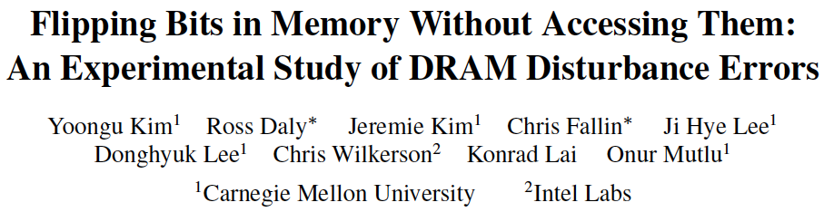
The RowHammer Paper (ISCA 2014)
Yoongu Kim, Ross Daly, Jeremie Kim, Chris Fallin, Ji Hye Lee, Donghyuk Lee, Chris Wilkerson, Konrad Lai, and Onur Mutlu,
"Flipping Bits in Memory Without Accessing Them: An Experimental Study of DRAM Disturbance Errors"
Proceedings of the 41st International Symposium on Computer Architecture (ISCA), Minneapolis, MN, June 2014.
[Slides (pptx) (pdf)] [Lightning Session Slides (pptx) (pdf)] [Source Code and Data]

Slide 3
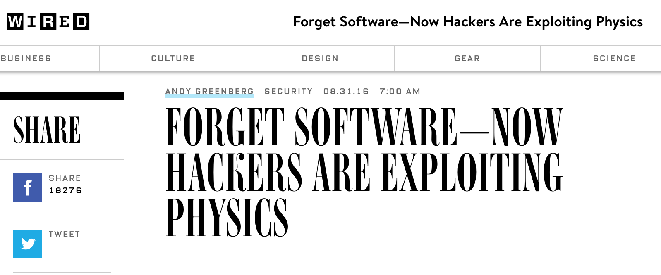
The Story of RowHammer
One can predictably induce bit flips in commodity DRAM chips
  >80% of the tested DRAM chips are vulnerable
First example of how a simple hardware failure mechanism can create a widespread system security vulnerability

Slide 4
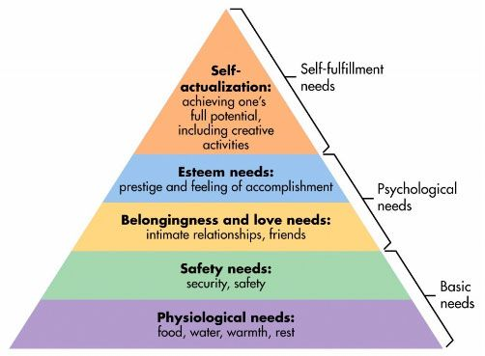
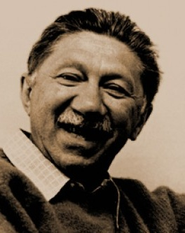
Maslow’s (Human) Hierarchy of Needs
Maslow, “A Theory of Human Motivation,”
Psychological Review, 1943.
Maslow, “A Theory of Human Motivation,”
Psychological Review, 1943.
Maslow, “Motivation and Personality,”
Book, 1954-1970.
We need to start with reliability and security…
Source: https://www.simplypsychology.org/maslow.html
Source: By User:Factoryjoe - Mazlow's Hierarchy of Needs.svg, CC BY-SA 3.0, https://commons.wikimedia.org/w/index.php?curid=7964065

Slide 5
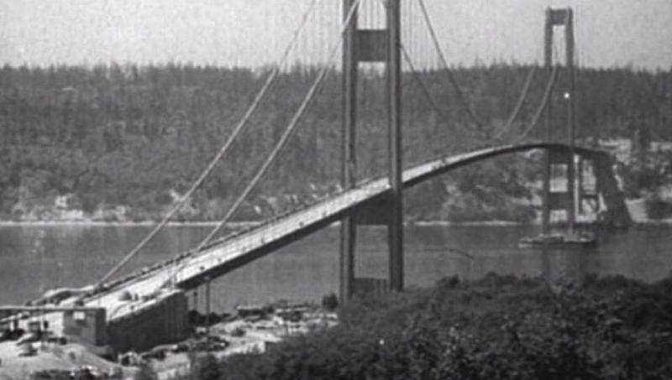
How Reliable/Secure/Safe is This Bridge?
Source: http://www.technologystudent.com/struct1/tacom1.png

Slide 6
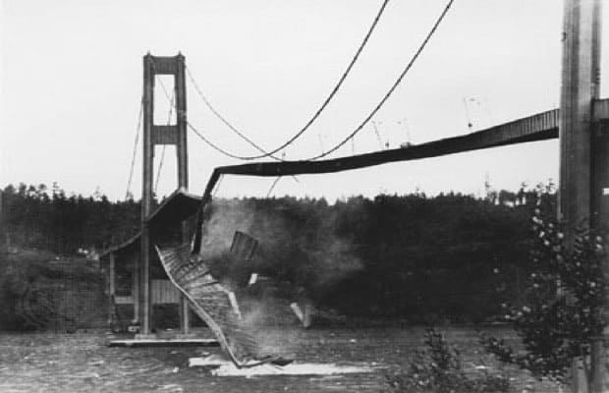
Collapse of the “Galloping Gertie”
Source: AP
http://www.wsdot.wa.gov/tnbhistory/connections/connections3.htm

Slide 7
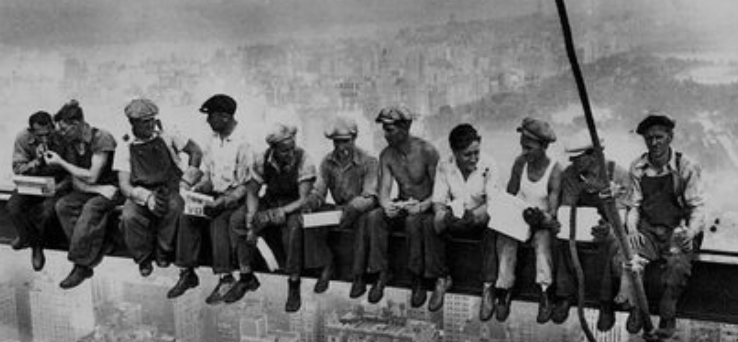
How Secure Are These People?
Security is about preventing unforeseen consequences
Source: https://s-media-cache-ak0.pinimg.com/originals/48/09/54/4809543a9c7700246a0cf8acdae27abf.jpg

Slide 8



The Main Memory System
Main memory is a critical component of all computing systems: server, mobile, embedded, desktop, sensor
Main memory system must scale (in size, technology, efficiency, cost, and management algorithms) to maintain performance growth and technology scaling benefits
Processors
and caches
Main Memory
Storage (SSD/HDD)

Slide 9
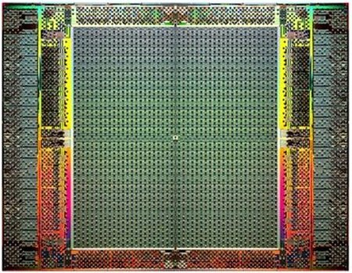
The Main Memory System
Main memory is a critical component of all computing systems: server, mobile, embedded, desktop, sensor
Main memory system must scale (in size, technology, efficiency, cost, and management algorithms) to maintain performance growth and technology scaling benefits
FPGAs
Main Memory
Storage (SSD/HDD)

Slide 10
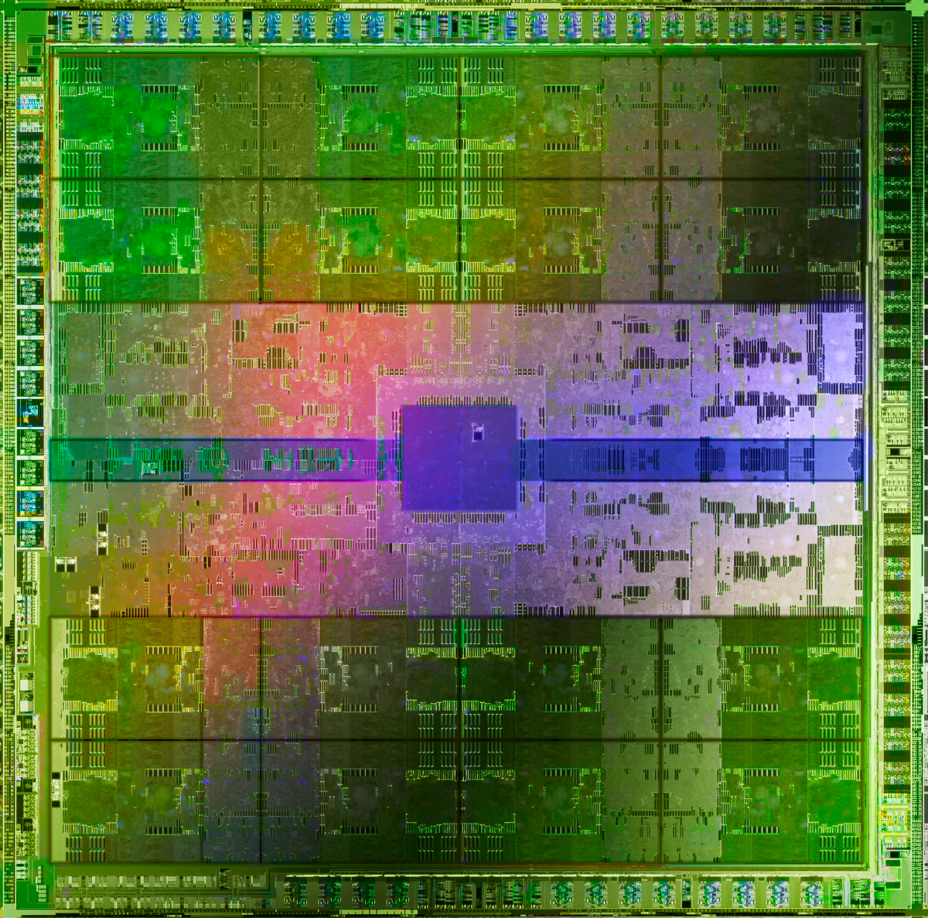
The Main Memory System
Main memory is a critical component of all computing systems: server, mobile, embedded, desktop, sensor
Main memory system must scale (in size, technology, efficiency, cost, and management algorithms) to maintain performance growth and technology scaling benefits
GPUs
Main Memory
Storage (SSD/HDD)

Slide 11
Major Trends Affecting Main Memory (I)
Need for main memory capacity, bandwidth, QoS increasing
Main memory energy/power is a key system design concern
DRAM technology scaling is ending

Slide 12
Major Trends Affecting Main Memory (II)
Need for main memory capacity, bandwidth, QoS increasing
  Multi-core: increasing number of cores/agents
  Data-intensive applications: increasing demand/hunger for data
  Consolidation: cloud computing, GPUs, mobile, heterogeneity
Main memory energy/power is a key system design concern
DRAM technology scaling is ending

Slide 13
Major Trends Affecting Main Memory (III)
Need for main memory capacity, bandwidth, QoS increasing
Main memory energy/power is a key system design concern
  ~40-50% energy spent in off-chip memory hierarchy [Lefurgy, IEEE Computer’03] >40% power in DRAM [Ware, HPCA’10][Paul,ISCA’15]
  DRAM consumes power even when not used (periodic refresh)
DRAM technology scaling is ending

Slide 14
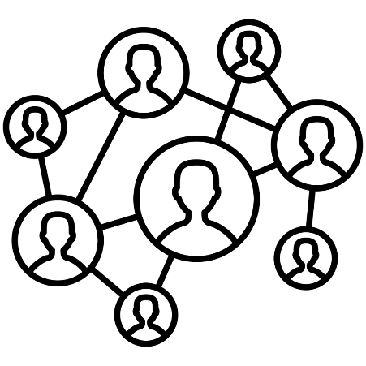
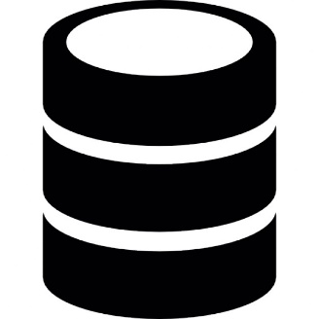
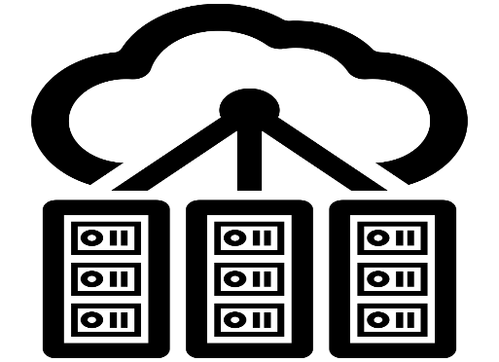

DRAM Is Critical for Performance & Energy
In-memory Databases
[Mao+, EuroSys’12;
Clapp+ (Intel), IISWC’15]
Graph/Tree Processing
[Xu+, IISWC’12; Umuroglu+, FPL’15]
In-Memory Data Analytics
[Clapp+ (Intel), IISWC’15;
Awan+, BDCloud’15]
Datacenter Workloads
[Kanev+ (Google), ISCA’15]

Slide 15
DRAM Is Critical for Performance & Energy
In-memory Databases
[Mao+, EuroSys’12;
Clapp+ (Intel), IISWC’15]
Graph/Tree Processing
[Xu+, IISWC’12; Umuroglu+, FPL’15]
Memory → performance & energy bottleneck
In-Memory Data Analytics
[Clapp+ (Intel), IISWC’15;
Awan+, BDCloud’15]
Datacenter Workloads
[Kanev+ (Google), ISCA’15]

Slide 16
Major Trends Affecting Main Memory (IV)
Need for main memory capacity, bandwidth, QoS increasing
Main memory energy/power is a key system design concern
DRAM technology scaling is ending
  ITRS projects DRAM will not scale easily below X nm
  Scaling has provided many benefits:
    higher capacity (density), lower cost, lower energy

Slide 17
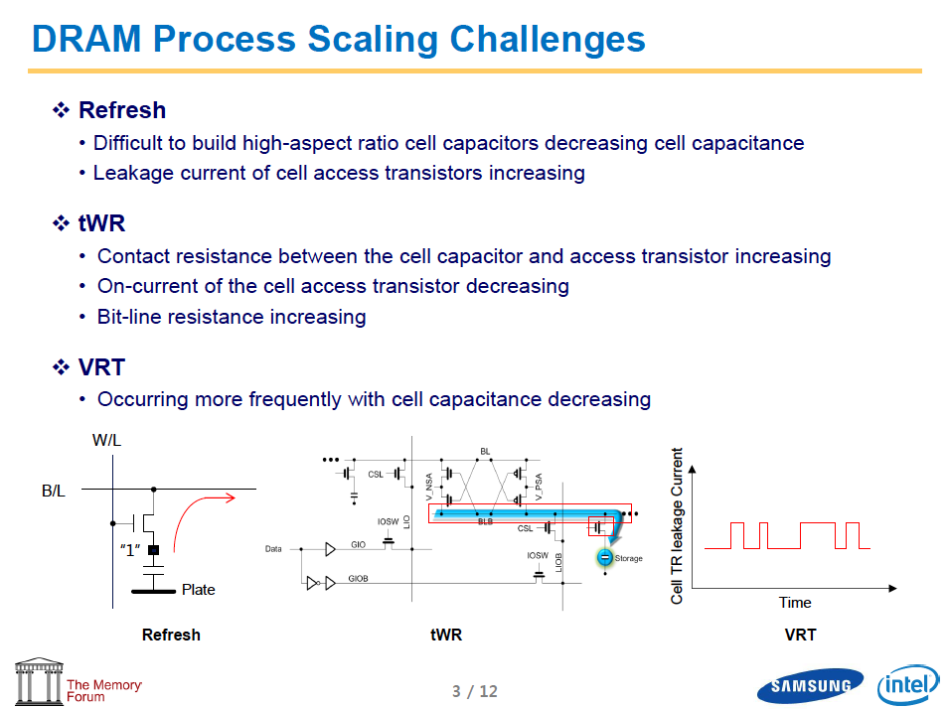
Industry Is Writing Papers About It, Too

Slide 18
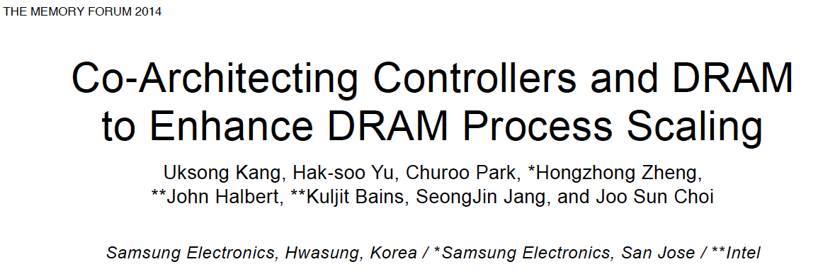
Industry Is Writing Papers About It, Too

Slide 19
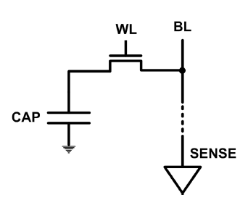
The DRAM Scaling Problem
DRAM stores charge in a capacitor (charge-based memory)
  Capacitor must be large enough for reliable sensing
  Access transistor should be large enough for low leakage and high retention time
  Scaling beyond 40-35nm (2013) is challenging [ITRS, 2009]
DRAM capacity, cost, and energy/power hard to scale

Slide 20
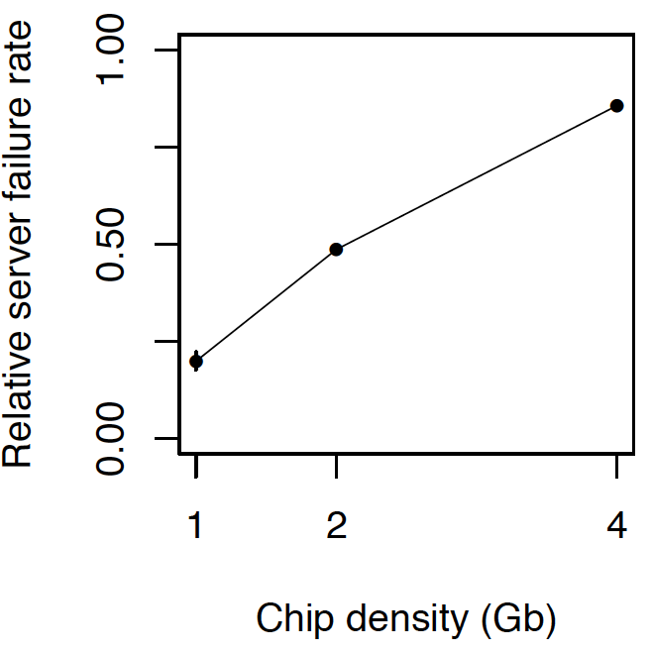
As Memory Scales, It Becomes Unreliable
Data from all of Facebook’s servers worldwide
Meza+, “Revisiting Memory Errors in Large-Scale Production Data Centers,” DSN’15.
Intuition:
quadratic
increase in
capacity

Slide 21
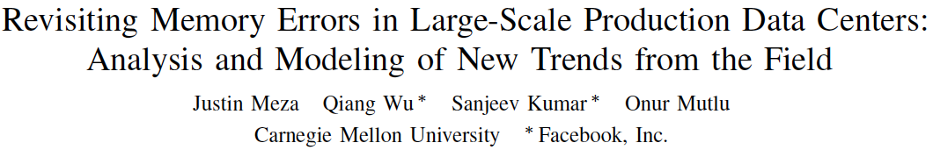
Large-Scale Failure Analysis of DRAM Chips
Analysis and modeling of memory errors found in all of Facebook’s server fleet
Justin Meza, Qiang Wu, Sanjeev Kumar, and Onur Mutlu,
"Revisiting Memory Errors in Large-Scale Production Data Centers: Analysis and Modeling of New Trends from the Field"
Proceedings of the 45th Annual IEEE/IFIP International Conference on Dependable Systems and Networks (DSN), Rio de Janeiro, Brazil, June 2015.
[Slides (pptx) (pdf)] [DRAM Error Model]

Slide 22
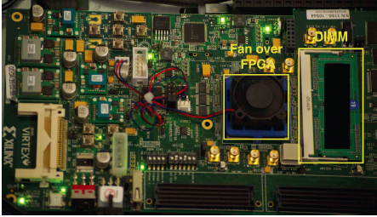
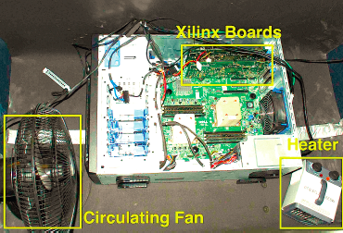
Infrastructures to Understand Such Issues
  An Experimental Study of Data Retention Behavior in Modern DRAM Devices: Implications for Retention Time Profiling Mechanisms (Liu et al., ISCA 2013)
  The Efficacy of Error Mitigation Techniques for DRAM Retention Failures: A Comparative Experimental Study
  (Khan et al., SIGMETRICS 2014)
  Flipping Bits in Memory Without Accessing Them: An Experimental Study of DRAM Disturbance Errors (Kim et al., ISCA 2014)
  Adaptive-Latency DRAM: Optimizing DRAM Timing for the Common-Case (Lee et al., HPCA 2015)
  AVATAR: A Variable-Retention-Time (VRT) Aware Refresh for DRAM Systems (Qureshi et al., DSN 2015)

Slide 23

Infrastructures to Understand Such Issues
Temperature
Controller
FPGAs
Heater
FPGAs
PC
  Kim+, “Flipping Bits in Memory Without Accessing Them: An Experimental Study of DRAM Disturbance Errors,” ISCA 2014.

Slide 24
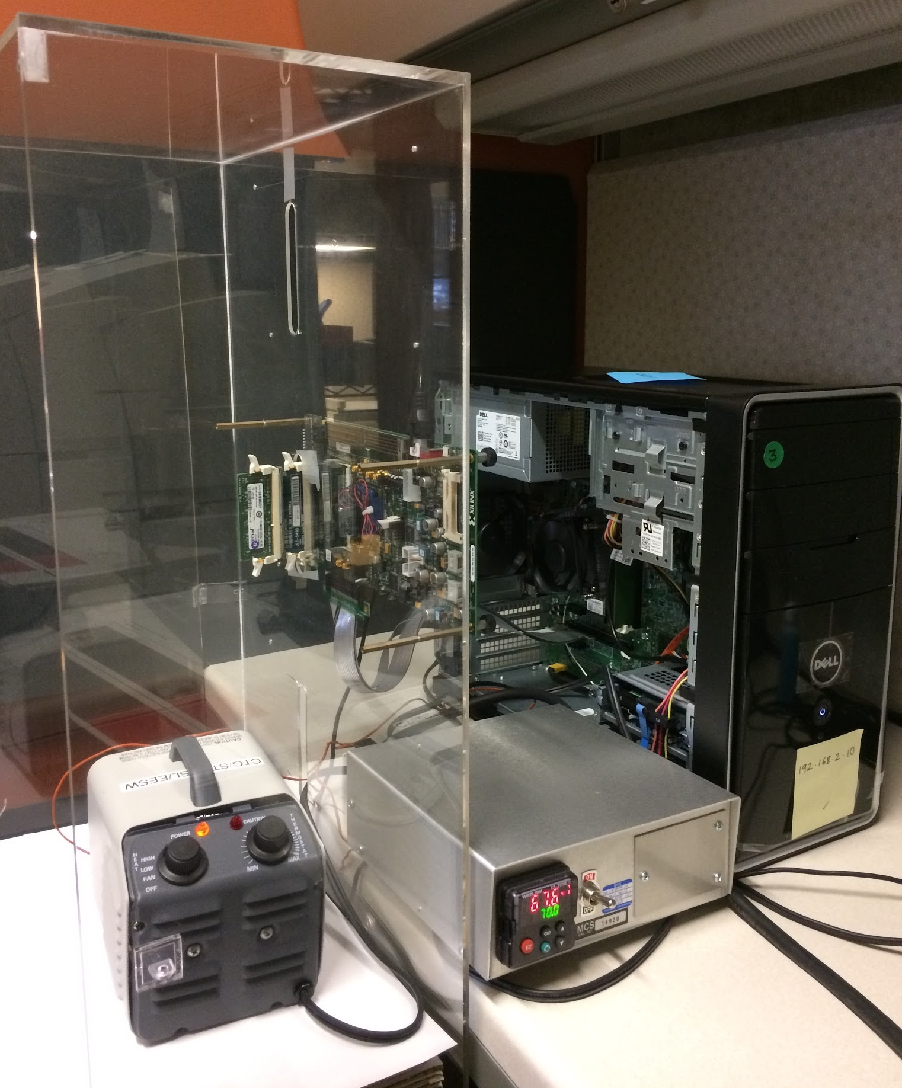
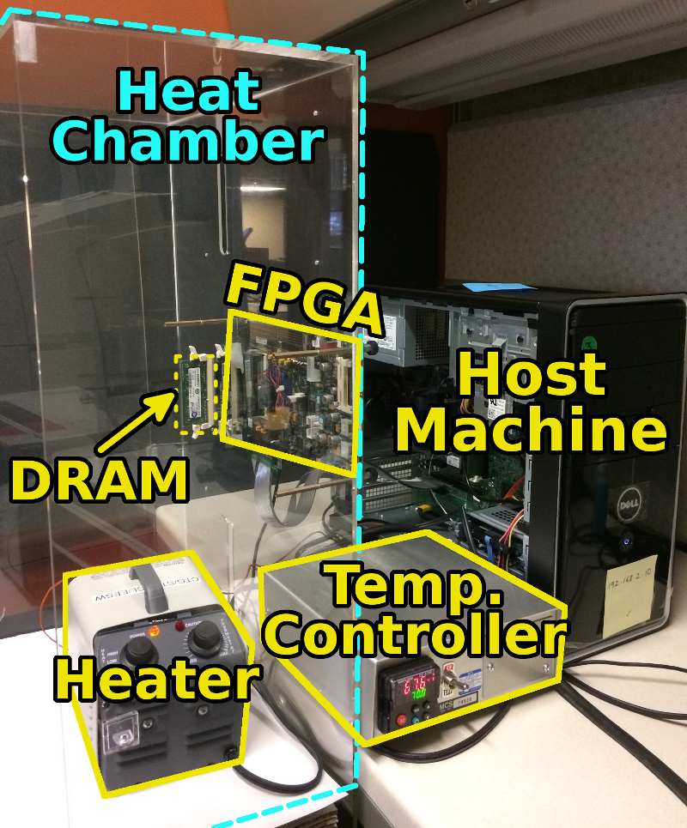
SoftMC: Open Source DRAM Infrastructure
Hasan Hassan et al., “SoftMC: A Flexible and Practical Open-Source Infrastructure for Enabling Experimental DRAM Studies,” HPCA 2017.
Flexible
Easy to Use (C++ API)
Open-source
github.com/CMU-SAFARI/SoftMC

Slide 25
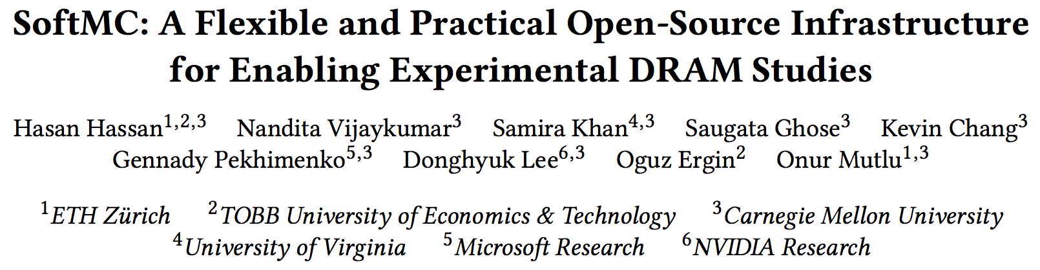
SoftMC: Open Source DRAM Infrastructure
https://github.com/CMU-SAFARI/SoftMC

Slide 26

Data Retention in Memory [Liu et al., ISCA 2013]
Retention Time Profile of DRAM looks like this:
Location dependent
Stored value pattern dependent
Time dependent

Slide 27
A Curious Discovery [Kim et al., ISCA 2014]
One can
predictably induce errors
in most DRAM memory chips

Slide 28
DRAM RowHammer
A simple hardware failure mechanism
can create a widespread
system security vulnerability

Slide 29
Modern DRAM is Prone to Disturbance Errors
Row of Cells
Wordline
Row
Victim Row
Row
Hammered Row
V_{LOW}
Opened
V_{HIGH}
Closed
Row
Victim Row
Row
Repeatedly reading a row enough times (before memory gets refreshed) induces disturbance errors in adjacent rows in most real DRAM chips you can buy today
Flipping Bits in Memory Without Accessing Them: An Experimental Study of DRAM Disturbance Errors, (Kim et al., ISCA 2014)

Slide 30
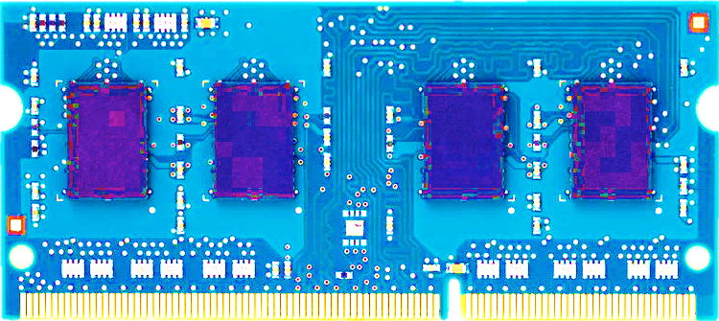
Most DRAM Modules Are Vulnerable
A company
B company
C company
86%
(37/43)
83%
(45/54)
88%
(28/32)
Up to
1.0×10⁷
errors
Up to
2.7×10⁶
errors
Up to
3.3×10⁵
errors
Flipping Bits in Memory Without Accessing Them: An Experimental Study of DRAM Disturbance Errors, (Kim et al., ISCA 2014)

Slide 31
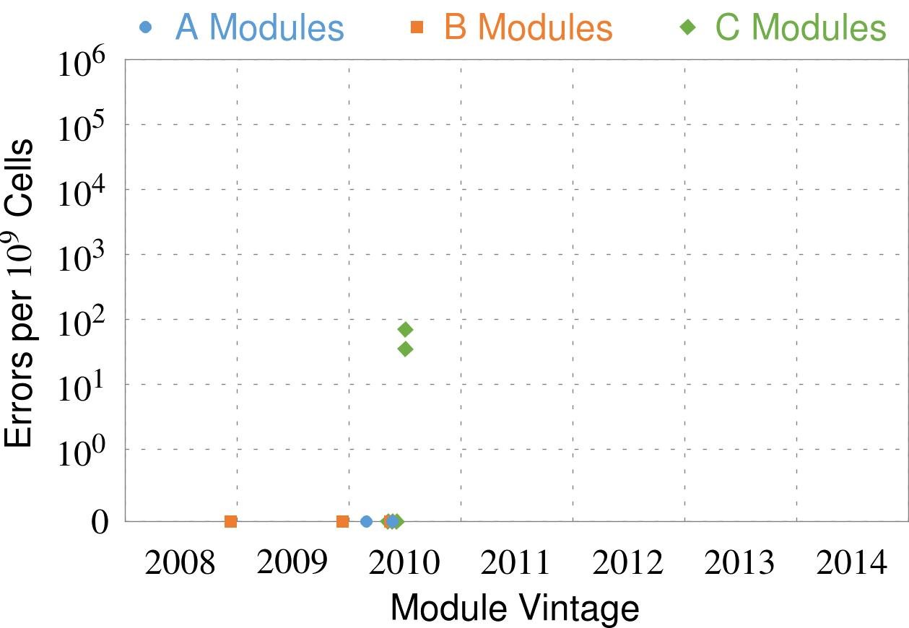
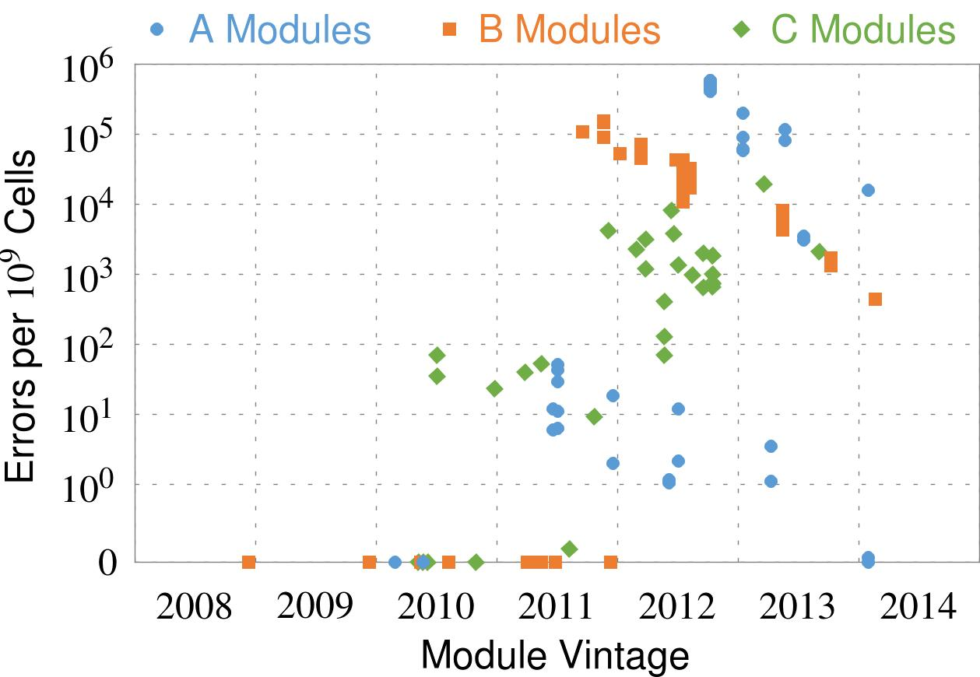
Recent DRAM Is More Vulnerable
Notes:
In this figure, the x-axis is the module manufacture date. And the y-axis is the number of errors in a module, normalized to one billion cells. In 2008 and 2009, there are no errors. But, in 2010, we first start to see errors in C modules. After 2010, the errors start to proliferate. For A and B modules, we first start to see errors in 2011. In particular, all modules from 2012 and 2013 are vulnerable.

Slide 32
Recent DRAM Is More Vulnerable
First
Appearance
Notes:
In this figure, the x-axis is the module manufacture date. And the y-axis is the number of errors in a module, normalized to one billion cells. In 2008 and 2009, there are no errors. But, in 2010, we first start to see errors in C modules. After 2010, the errors start to proliferate. For A and B modules, we first start to see errors in 2011. In particular, all modules from 2012 and 2013 are vulnerable.

Slide 33
Recent DRAM Is More Vulnerable
First
Appearance
All modules from 2012–2013 are vulnerable
Notes:
In this figure, the x-axis is the module manufacture date. And the y-axis is the number of errors in a module, normalized to one billion cells. In 2008 and 2009, there are no errors. But, in 2010, we first start to see errors in C modules. After 2010, the errors start to proliferate. For A and B modules, we first start to see errors in 2011. In particular, all modules from 2012 and 2013 are vulnerable.

Slide 34
Why Is This Happening?
DRAM cells are too close to each other!
  They are not electrically isolated from each other
Access to one cell affects the value in nearby cells
  due to electrical interference between
    the cells
    wires used for accessing the cells
  Also called cell-to-cell coupling/interference
Example: When we activate (apply high voltage) to a row, an adjacent row gets slightly activated as well
  Vulnerable cells in that slightly-activated row lose a little bit of charge
  If row hammer happens enough times, charge in such cells gets drained

Slide 35
Higher-Level Implications
This simple circuit level failure mechanism has enormous implications on upper layers of the transformation hierarchy
Problem
Problem
Algorithm
Algorithm
Program/Language
User
Program/Language
Runtime System
(VM, OS, MM)
Runtime System
(VM, OS, MM)
ISA (Architecture)
ISA
Microarchitecture
Microarchitecture
Logic
Logic
Devices
Devices
Electrons
Electrons

Slide 36

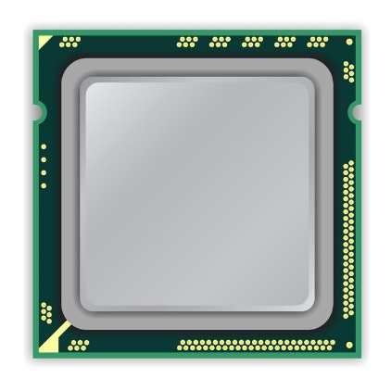
A Simple Program Can Induce Many Errors
CPU
DRAM Module
loop:
mov (X), %eax
mov (Y), %ebx
clflush (X)
clflush (Y)
mfence
jmp loop
X
Y
  Download from: https://github.com/CMU-SAFARI/rowhammer
Notes:
We demonstrate the errors on multiple x86 systems. Shown to the bottom-left is a “disturbance kernel”. When executed, it forces two rows to be opened and closed one after the other – over and over again. Consequently, it induces many errors in the module.

Slide 37
A Simple Program Can Induce Many Errors
CPU
DRAM Module
Avoid cache hits
  Flush X from cache
Avoid row hits to X
  Read Y in another row
X
Y
  Download from: https://github.com/CMU-SAFARI/rowhammer
Notes:
We demonstrate the errors on multiple x86 systems. Shown to the bottom-left is a “disturbance kernel”. When executed, it forces two rows to be opened and closed one after the other – over and over again. Consequently, it induces many errors in the module.

Slide 38
A Simple Program Can Induce Many Errors
CPU
DRAM Module
loop:
mov (X), %eax
mov (Y), %ebx
clflush (X)
clflush (Y)
mfence
jmp loop
X
Y
  Download from: https://github.com/CMU-SAFARI/rowhammer
Notes:
We demonstrate the errors on multiple x86 systems. Shown to the bottom-left is a “disturbance kernel”. When executed, it forces two rows to be opened and closed one after the other – over and over again. Consequently, it induces many errors in the module.

Slide 39
A Simple Program Can Induce Many Errors
CPU
DRAM Module
loop:
mov (X), %eax
mov (Y), %ebx
clflush (X)
clflush (Y)
mfence
jmp loop
X
Y
  Download from: https://github.com/CMU-SAFARI/rowhammer
Notes:
We demonstrate the errors on multiple x86 systems. Shown to the bottom-left is a “disturbance kernel”. When executed, it forces two rows to be opened and closed one after the other – over and over again. Consequently, it induces many errors in the module.

Slide 40
A Simple Program Can Induce Many Errors
CPU
DRAM Module
loop:
mov (X), %eax
mov (Y), %ebx
clflush (X)
clflush (Y)
mfence
jmp loop
X
Y
  Download from: https://github.com/CMU-SAFARI/rowhammer
Notes:
We demonstrate the errors on multiple x86 systems. Shown to the bottom-left is a “disturbance kernel”. When executed, it forces two rows to be opened and closed one after the other – over and over again. Consequently, it induces many errors in the module.

Slide 41
Observed Errors in Real Systems
A real reliability & security issue
CPU Architecture | Errors | Access-Rate
Intel Haswell (2013) | 22.9K | 12.3M/sec
Intel Ivy Bridge (2012) | 20.7K | 11.7M/sec
Intel Sandy Bridge (2011) | 16.1K | 11.6M/sec
AMD Piledriver (2012) | 59 | 6.1M/sec
Kim+, “Flipping Bits in Memory Without Accessing Them: An Experimental Study of DRAM Disturbance Errors,” ISCA 2014.
Notes:
When we executed the code on four different processors, all four of them yielded errors. Intel Haswell has the most errors, at 23 thousand, because it has the highest rate of accessing DRAM.
Later on, I’ll show that we can induce as many as ten million disturbance errors in a more controlled environment.
From this, we conclude that disturbance errors are a serious reliability issue.

Slide 42


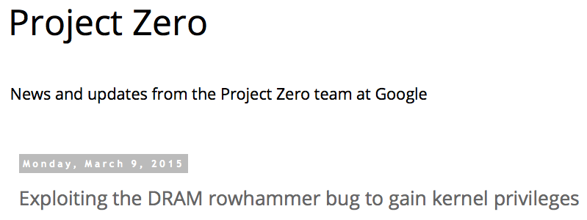
One Can Take Over an Otherwise-Secure System
Flipping Bits in Memory Without Accessing Them: An Experimental Study of DRAM Disturbance Errors (Kim et al., ISCA 2014)
Exploiting the DRAM rowhammer bug to gain kernel privileges (Seaborn, 2015)

Slide 43
RowHammer Security Attack Example
“Rowhammer” is a problem with some recent DRAM devices in which repeatedly accessing a row of memory can cause bit flips in adjacent rows (Kim et al., ISCA 2014).
  Flipping Bits in Memory Without Accessing Them: An Experimental Study of DRAM Disturbance Errors (Kim et al., ISCA 2014)
We tested a selection of laptops and found that a subset of them exhibited the problem.
We built two working privilege escalation exploits that use this effect.
  Exploiting the DRAM rowhammer bug to gain kernel privileges (Seaborn+, 2015)
One exploit uses rowhammer-induced bit flips to gain kernel privileges on x86-64 Linux when run as an unprivileged userland process.
When run on a machine vulnerable to the rowhammer problem, the process was able to induce bit flips in page table entries (PTEs).
It was able to use this to gain write access to its own page table, and hence gain read-write access to all of physical memory.
Exploiting the DRAM rowhammer bug to gain kernel privileges (Seaborn & Dullien, 2015)

Slide 44
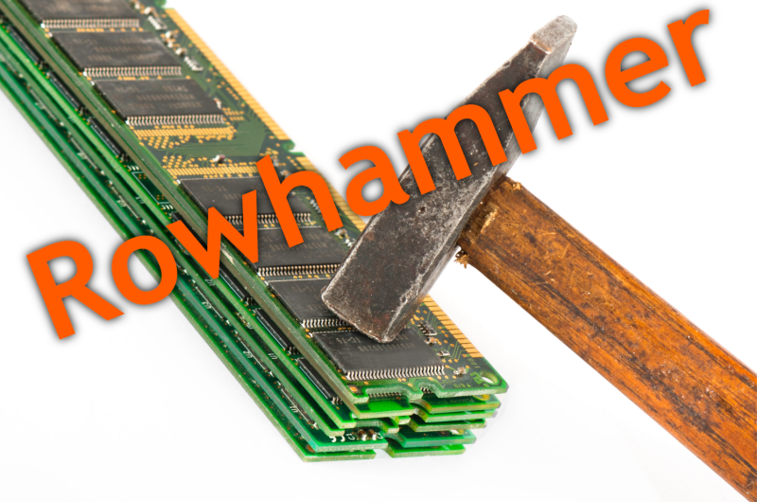
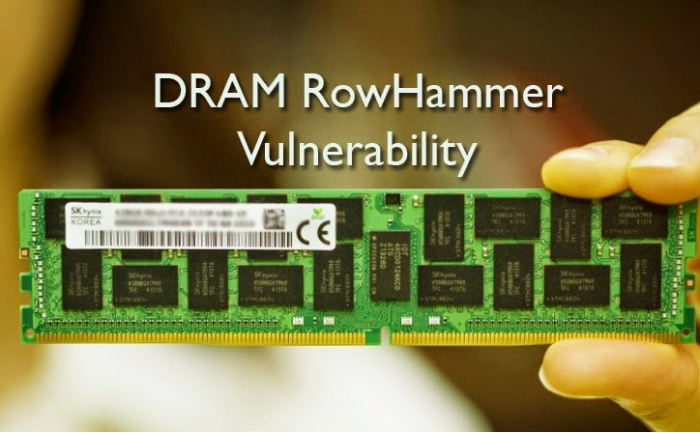
Security Implications
Notes:
Picture from the article:
http://thehackernews.com/2015/03/dram-rowhammer-vulnerability.html

Slide 45
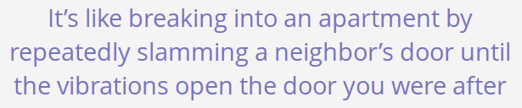
Security Implications
Notes:
Picture from the article:
http://thehackernews.com/2015/03/dram-rowhammer-vulnerability.html

Slide 46
Selected Readings on RowHammer (I)
Our first detailed study: Rowhammer analysis and solutions (June 2014)
  Yoongu Kim, Ross Daly, Jeremie Kim, Chris Fallin, Ji Hye Lee, Donghyuk Lee, Chris Wilkerson, Konrad Lai, and Onur Mutlu,
  "Flipping Bits in Memory Without Accessing Them: An Experimental Study of DRAM Disturbance Errors"
  Proceedings of the 41st International Symposium on Computer Architecture (ISCA), Minneapolis, MN, June 2014. [Slides (pptx) (pdf)] [Lightning Session Slides (pptx) (pdf)] [Source Code and Data]
Our Source Code to Induce Errors in Modern DRAM Chips (June 2014)
  https://github.com/CMU-SAFARI/rowhammer
Google Project Zero’s Attack to Take Over a System (March 2015)
  Exploiting the DRAM rowhammer bug to gain kernel privileges (Seaborn+, 2015)
  https://github.com/google/rowhammer-test
  Double-sided Rowhammer

Slide 47
Selected Readings on RowHammer (II)
Remote RowHammer Attacks via JavaScript (July 2015)
  http://arxiv.org/abs/1507.06955
  https://github.com/IAIK/rowhammerjs
  Gruss et al., DIMVA 2016.
  CLFLUSH-free Rowhammer
  “A fully automated attack that requires nothing but a website with JavaScript to trigger faults on remote hardware.”
  “We can gain unrestricted access to systems of website visitors.”
ANVIL: Software-Based Protection Against Next-Generation Rowhammer Attacks (March 2016)
  http://dl.acm.org/citation.cfm?doid=2872362.2872390
  Aweke et al., ASPLOS 2016
  CLFLUSH-free Rowhammer
  Software based monitoring for rowhammer detection

Slide 48
Selected Readings on RowHammer (III)
Dedup Est Machina: Memory Deduplication as an Advanced Exploitation Vector (May 2016)
  https://www.ieee-security.org/TC/SP2016/papers/0824a987.pdf
  Bosman et al., IEEE S&P 2016.
  Exploits Rowhammer and Memory Deduplication to overtake a browser
  “We report on the first reliable remote exploit for the Rowhammer vulnerability running entirely in Microsoft Edge.”
  “[an attacker] … can reliably “own” a system with all defenses up, even if the software is entirely free of bugs.”
CAn’t Touch This: Software-only Mitigation against Rowhammer Attacks targeting Kernel Memory (August 2017)
  https://www.usenix.org/system/files/conference/usenixsecurity17/sec17-brasser.pdf
  Brasser et al., USENIX Security 2017.
  Partitions physical memory into security domains, user vs. kernel; limits rowhammer-induced bit flips to the user domain.

Slide 49
Selected Readings on RowHammer (IV)
A New Approach for Rowhammer Attacks (May 2016)
  https://ieeexplore.ieee.org/document/7495576
  Qiao et al., HOST 2016
  CLFLUSH-free RowHammer
  “Libc functions memset and memcpy are found capable of rowhammer.”
  Triggers RowHammer with malicious inputs but benign code
One Bit Flips, One Cloud Flops: Cross-VM Row Hammer Attacks and Privilege Escalation (August 2016)
  https://www.usenix.org/system/files/conference/usenixsecurity16/sec16_paper_xiao.pdf
  Xiao et al., USENIX Security 2016.
  “Technique that allows a malicious guest VM to have read and write accesses to arbitrary physical pages on a shared machine.”
  Graph-based algorithm to reverse engineer mapping of physical addresses in DRAM

Slide 50
Selected Readings on RowHammer (V)
Curious Case of RowHammer: Flipping Secret Exponent Bits using Timing Analysis (August 2016)
  https://link.springer.com/content/pdf/10.1007%2F978-3-662-53140-2_29.pdf
  Bhattacharya et al., CHES 2016
  Combines timing analysis to perform rowhammer on cryptographic keys stored in memory
DRAMA: Exploiting DRAM Addressing for Cross-CPU Attacks (August 2016)
  https://www.usenix.org/system/files/conference/usenixsecurity16/sec16_paper_pessl.pdf
  Pessl et al., USENIX Security 2016
  Shows RowHammer failures on DDR4 devices despite TRR solution
  Reverse engineers address mapping functions to improve existing RowHammer attacks

Slide 51
Selected Readings on RowHammer (VI)
Flip Feng Shui: Hammering a Needle in the Software Stack (August 2016)
  https://www.usenix.org/system/files/conference/usenixsecurity16/sec16_paper_razavi.pdf
  Razavi et al., USENIX Security 2016.
  Combines memory deduplication and RowHammer
  “A malicious VM can gain unauthorized access to a co-hosted VM running OpenSSH.”
  Breaks OpenSSH public key authentication
Drammer: Deterministic Rowhammer Attacks on Mobile Platforms (October 2016)
  http://dl.acm.org/citation.cfm?id=2976749.2978406
  Van Der Veen et al., ACM CCS 2016
  Can take over an ARM-based Android system deterministically
  Exploits predictable physical memory allocator behavior
    Can deterministically place security-sensitive data (e.g., page table) in an attacker-chosen, vulnerable location in memory

Slide 52
Selected Readings on RowHammer (VII)
When Good Protections go Bad: Exploiting anti-DoS Measures to Accelerate Rowhammer Attacks (May 2017)
  https://web.eecs.umich.edu/~misiker/resources/HOST-2017-Misiker.pdf
  Aga et al., HOST 2017
  “A virtual-memory based cache-flush free attack that is sufficiently fast to rowhammer with double rate refresh.”
  Enabled by Cache Allocation Technology
SGX-Bomb: Locking Down the Processor via Rowhammer Attack (October 2017)
  https://dl.acm.org/citation.cfm?id=3152709
  Jang et al., SysTEX 2017
  “Launches the Rowhammer attack against enclave memory to trigger the processor lockdown.”
  Running unknown enclave programs on the cloud can shut down servers shared with other clients.

Slide 53
Selected Readings on RowHammer (VIII)
Another Flip in the Wall of Rowhammer Defenses (May 2018)
  https://arxiv.org/pdf/1710.00551.pdf
  Gruss et al., IEEE S&P 2018
  A new type of Rowhammer attack which only hammers one single address, which can be done without knowledge of physical addresses and DRAM mappings
  Defeats static analysis and performance counter analysis defenses by running inside an SGX enclave
GuardION: Practical Mitigation of DMA-Based Rowhammer Attacks on ARM (June 2018)
  https://link.springer.com/chapter/10.1007/978-3-319-93411-2_5
  Van Der Veen et al., DIMVA 2018
  Presents RAMPAGE, a DMA-based RowHammer attack against the latest Android OS

Slide 54
Selected Readings on RowHammer (IX)
Grand Pwning Unit: Accelerating Microarchitectural Attacks with the GPU (May 2018)
  https://www.vusec.net/wp-content/uploads/2018/05/glitch.pdf
  Frigo et al., IEEE S&P 2018.
  The first end-to-end remote Rowhammer exploit on mobile platforms that use our GPU-based primitives in orchestration to compromise browsers on mobile devices in under two minutes.
Throwhammer: Rowhammer Attacks over the Network and Defenses (July 2018)
  https://www.cs.vu.nl/~herbertb/download/papers/throwhammer_atc18.pdf
  Tatar et al., USENIX ATC 2018.
  “[We] show that an attacker can trigger and exploit Rowhammer bit flips directly from a remote machine by only sending network packets.”

Slide 55
Selected Readings on RowHammer (X)
Nethammer: Inducing Rowhammer Faults through Network Requests (July 2018)
  https://arxiv.org/pdf/1805.04956.pdf
  Lipp et al., arxiv.org 2018.
  “Nethammer is the first truly remote Rowhammer attack, without a single attacker-controlled line of code on the targeted system.”
ZebRAM: Comprehensive and Compatible Software Protection Against Rowhammer Attacks (October 2018)
  https://www.usenix.org/system/files/osdi18-konoth.pdf
  Konoth et al., OSDI 2018
  A new pure-software protection mechanism against RowHammer.

Slide 56
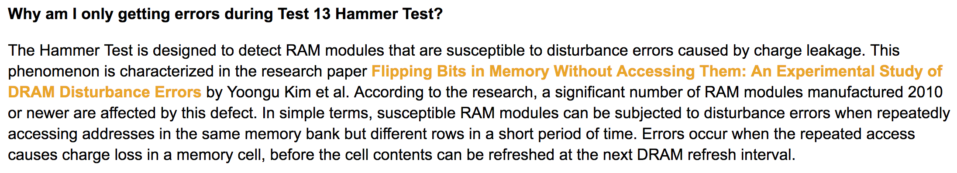
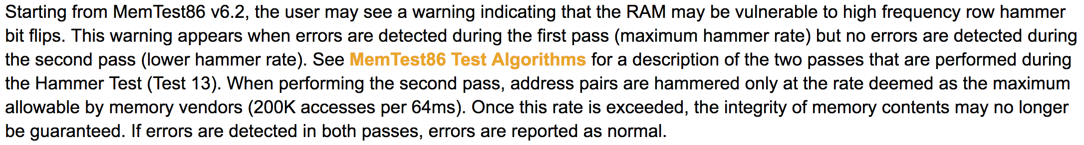
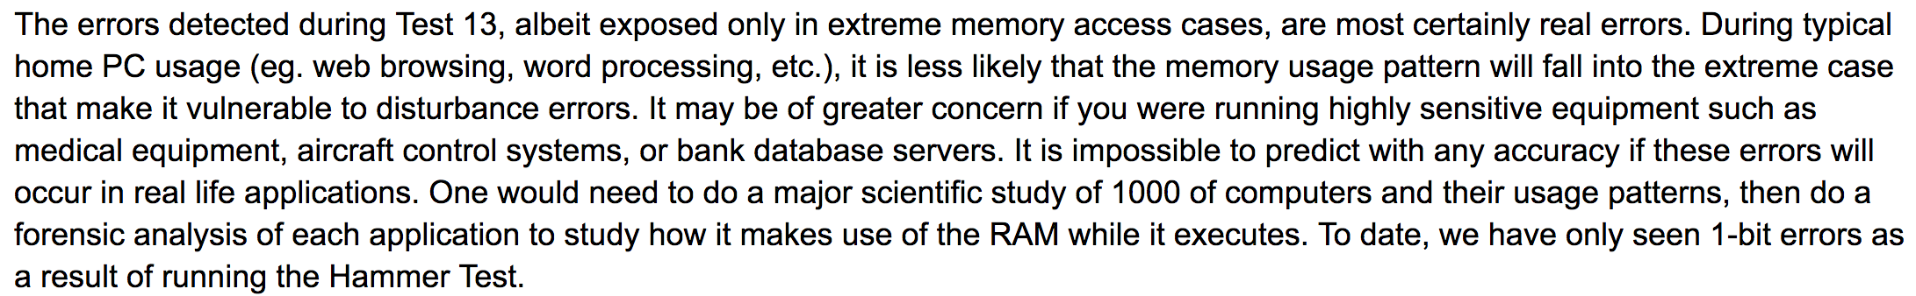
Selected Readings on RowHammer (XI.A)
PassMark Software, memtest86, since 2014
  https://www.memtest86.com/troubleshooting.htm#hammer

Slide 57
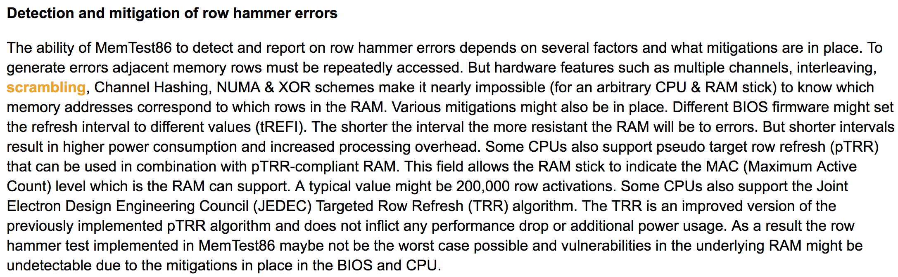

Selected Readings on RowHammer (XI.B)
PassMark Software, memtest86, since 2014
  https://www.memtest86.com/troubleshooting.htm#hammer

Slide 58
Security Implications (ISCA 2014)
Breach of memory protection
  OS page (4KB) fits inside DRAM row (8KB)
  Adjacent DRAM row → Different OS page
Vulnerability: disturbance attack
  By accessing its own page, a program could
  corrupt pages belonging to another program
We constructed a proof-of-concept
  Using only user-level instructions
Notes:
In addition, they have serious implications for security
When disturbance errors occur, they could breach memory protection. This is because an OS page fits inside a DRAM row. So an error in a different DRAM row means an error in a different OS page.
This opens up a vulnerability to disturbance attacks. Just by accessing its own page, a malicious program could corrupt pages belonging to another program.
And, as shown previously, we constructed a proof-of-concept using only user-level instructions.

Slide 59
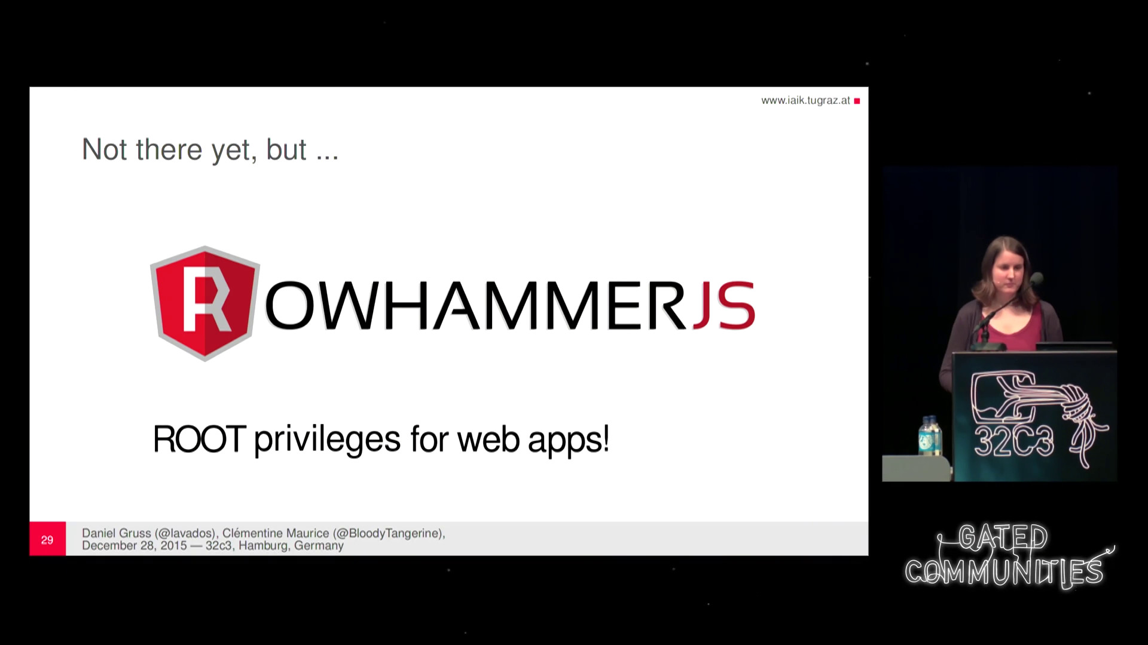
More Security Implications (I)
“We can gain unrestricted access to systems of website visitors.”
Rowhammer.js: A Remote Software-Induced Fault Attack in JavaScript (DIMVA’16)
Source: https://lab.dsst.io/32c3-slides/7197.html

Slide 60

More Security Implications (II)
  “Can gain control of a smart phone deterministically”
Drammer: Deterministic Rowhammer Attacks on Mobile Platforms, CCS’16
Source: https://fossbytes.com/drammer-rowhammer-attack-android-root-devices/

Slide 61
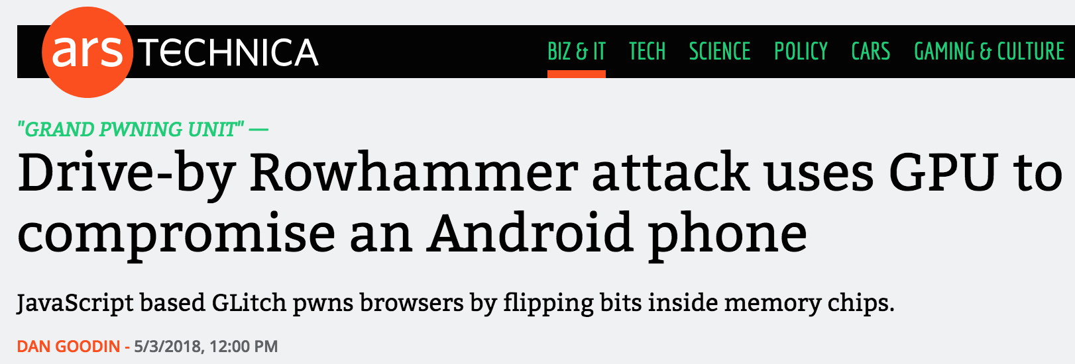

More Security Implications (III)
Using an integrated GPU in a mobile system to remotely escalate privilege via the WebGL interface

Slide 62
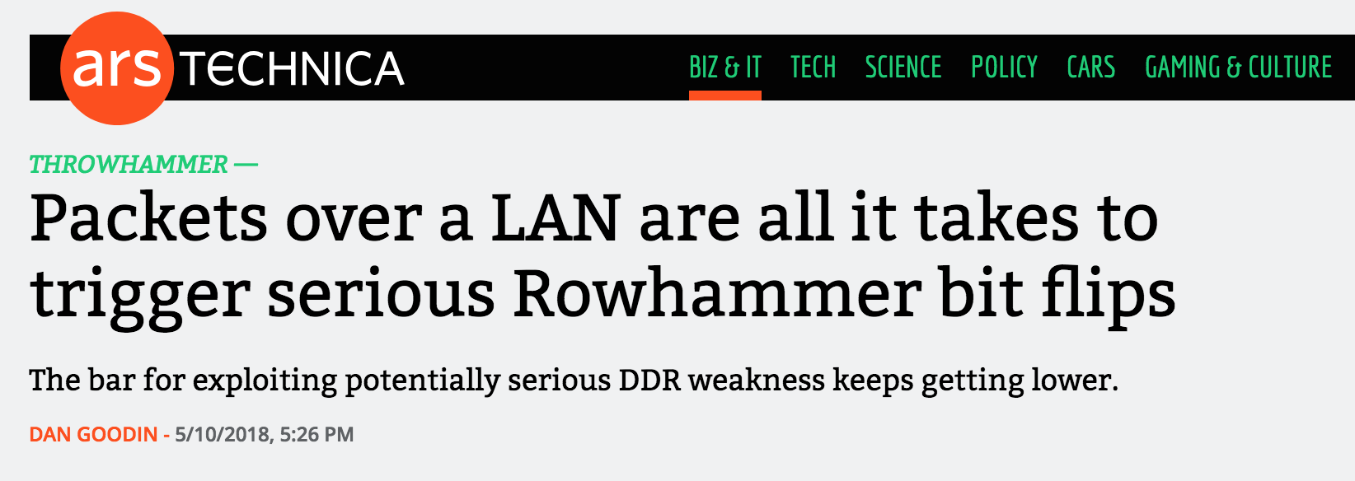
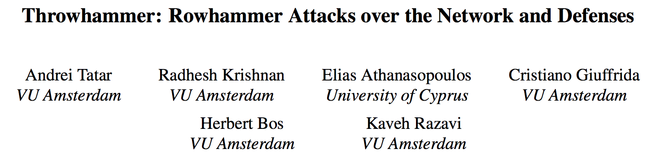
More Security Implications (IV)
Rowhammer over RDMA (I)

Slide 63
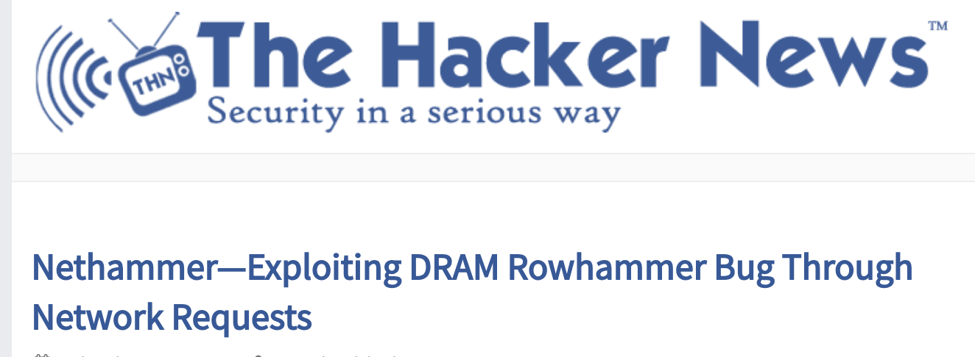

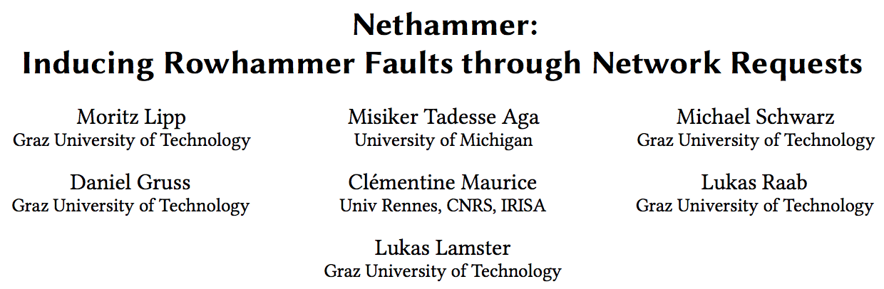
More Security Implications (V)
Rowhammer over RDMA (II)

Slide 64

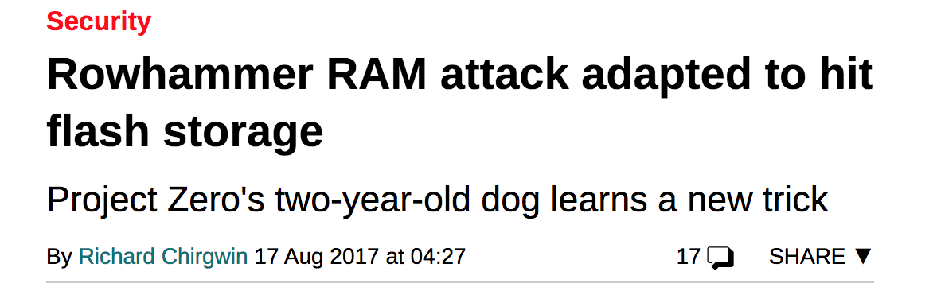
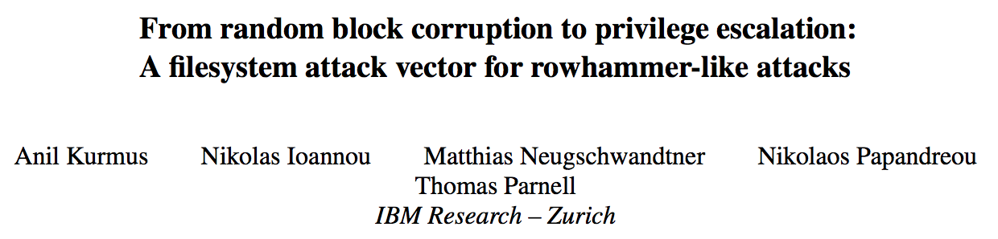
More Security Implications (VI)
Rowhammer on MLC NAND Flash (based on [Cai+, HPCA 2017])

Slide 65
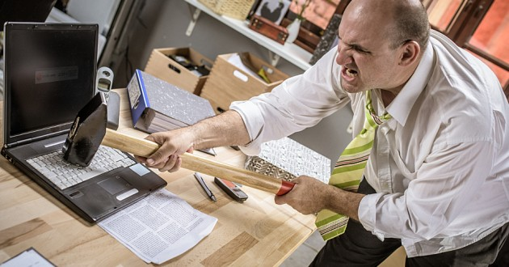
More Security Implications?

Slide 66
Understanding RowHammer

Slide 67
Root Causes of Disturbance Errors
Cause 1: Electromagnetic coupling
  Toggling the wordline voltage briefly increases the voltage of adjacent wordlines
  Slightly opens adjacent rows → Charge leakage
Cause 2: Conductive bridges
Cause 3: Hot-carrier injection
Confirmed by at least one manufacturer
Notes:
Why do the errors occur? We see three possible causes.
First, there could electromagnetic coupling between adjacent wordlines. When the voltage of one is toggled, it could briefly increase the voltage of the other and facilitate the leakage of charge.
Two other possibilities are conductive bridges and hot-carrier injection.
At least one manufacturer confirmed that these three could play a role in the disturbance errors we see them today.

Slide 68
Experimental DRAM Testing Infrastructure
  An Experimental Study of Data Retention Behavior in Modern DRAM Devices: Implications for Retention Time Profiling Mechanisms (Liu et al., ISCA 2013)
  The Efficacy of Error Mitigation Techniques for DRAM Retention Failures: A Comparative Experimental Study
  (Khan et al., SIGMETRICS 2014)
  Flipping Bits in Memory Without Accessing Them: An Experimental Study of DRAM Disturbance Errors (Kim et al., ISCA 2014)
  Adaptive-Latency DRAM: Optimizing DRAM Timing for the Common-Case (Lee et al., HPCA 2015)
  AVATAR: A Variable-Retention-Time (VRT) Aware Refresh for DRAM Systems (Qureshi et al., DSN 2015)

Slide 69
Where RowHammer Was Discovered
Temperature
Controller
FPGAs
Heater
FPGAs
PC
  Kim+, “Flipping Bits in Memory Without Accessing Them: An Experimental Study of DRAM Disturbance Errors,” ISCA 2014.

Slide 70
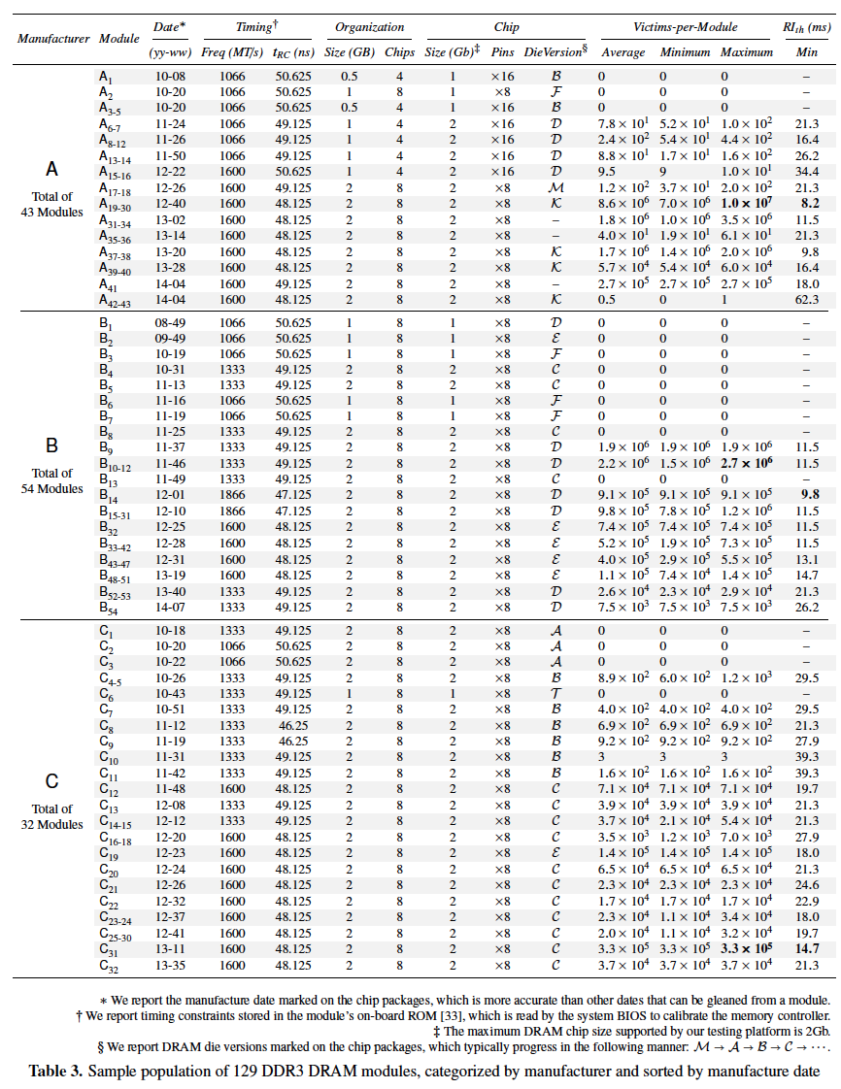
Tested
DRAM
Modules
(129 total)

Slide 71
RowHammer Characterization Results
Most Modules Are at Risk
Errors vs. Vintage
Error = Charge Loss
Adjacency: Aggressor & Victim
Sensitivity Studies
Other Results in Paper
Solution Space
Flipping Bits in Memory Without Accessing Them: An Experimental Study of DRAM Disturbance Errors, (Kim et al., ISCA 2014)
Notes:
Now I will present the characterization results, one-by-one.
First, I show that most modules are at risk. Second, I show the number of errors in a module as a function of the manufacture date. Third, I show that the errors are symptomatic of charge loss. Fourth, I show that an aggressor induces errors in adjacent rows. Fifth, I show several sensitivity studies. And, finally, I briefly describe other results in the paper.

Slide 72
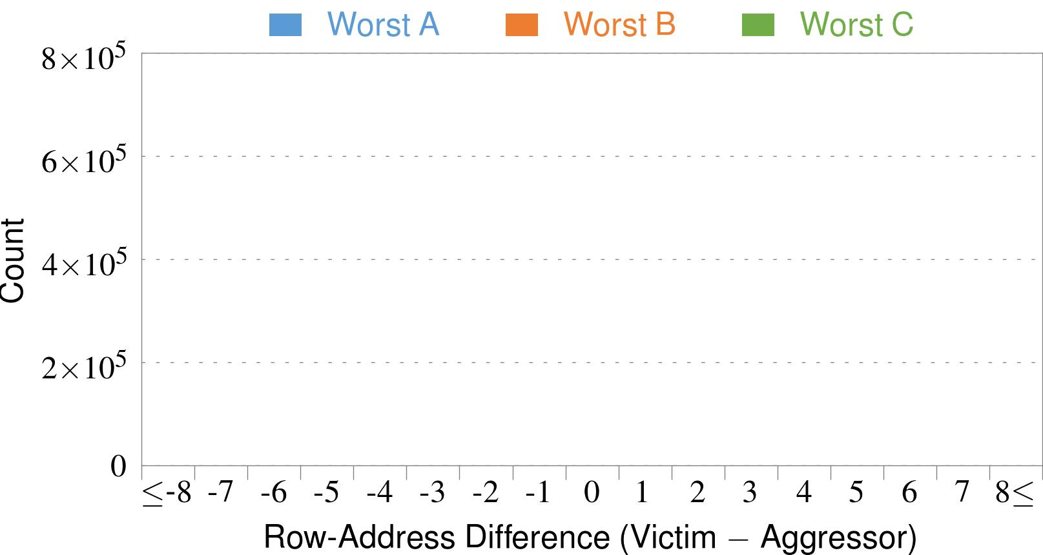
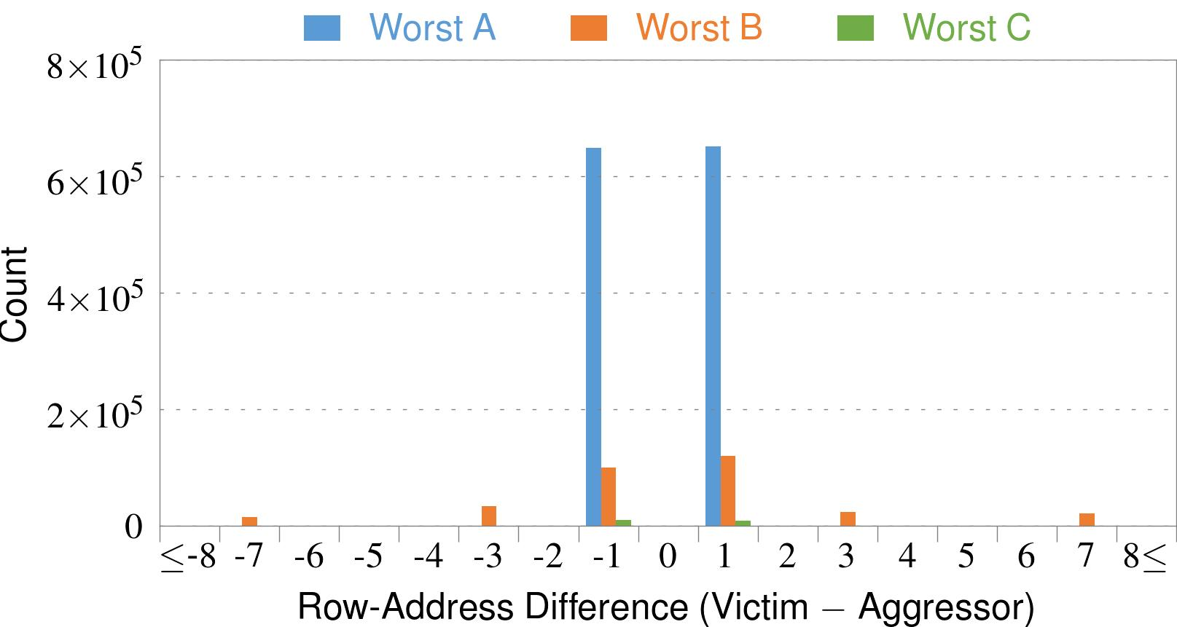
4. Adjacency: Aggressor & Victim
Adjacent
Adjacent
Adjacent
Non-Adjacent
Non-Adjacent
Note: For three modules with the most errors (only first bank)
Most aggressors & victims are adjacent
Notes:
In this figure, the x-axis is the row-address difference between an aggressor and its victims. And the y-axis is the number of victim-aggressor pairs that correspond to the row-address difference. For all three modules, we see strong peaks at plus/minus 1. This implies that aggressors and victims have consecutive row-addresses, in other words, they are adjacent.
However, the figure also shows some victims that are not adjacent to the aggressor. We believe this could be caused by two reasons. First, depending on the mapping, two rows that are physically adjacent within the DRAM chip may not have consecutive row-addresses. Second, fault rows are often re-mapped to spare rows that may reside on a different portion of the DRAM chip.
Nevertheless, we conclude that the vast majority of aggressors & victims are adjacent.

Slide 73
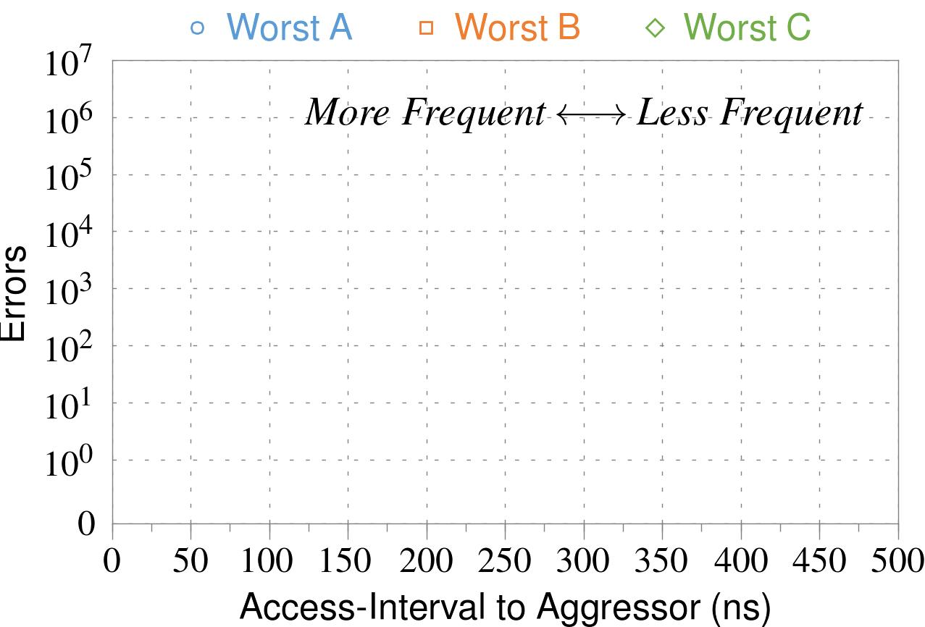
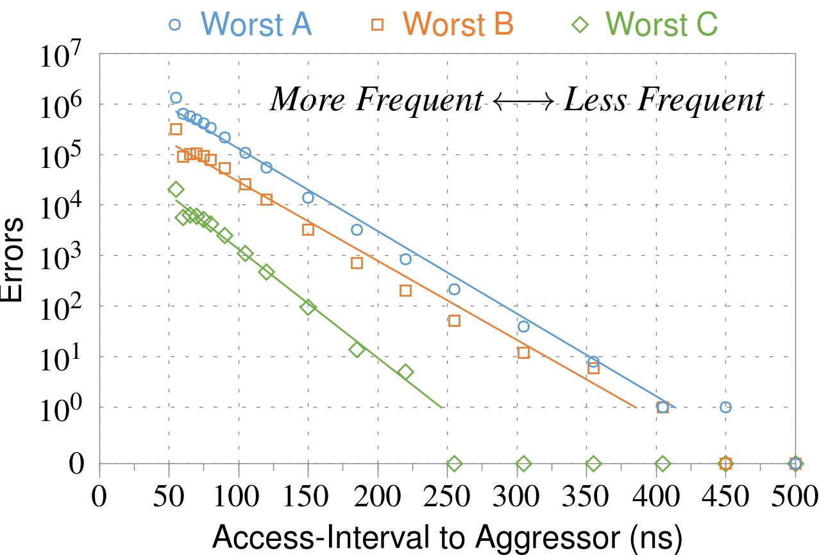
❶ Access Interval (Aggressor)
Not Allowed
500ns
55ns
Note: For three modules with the most errors (only first bank)
Less frequent accesses → Fewer errors
Notes:
In this figure, the x-axis is the interval at which we access the aggressor. And the y-axis is the number of errors. To comply with the DRAM standard, we employ a default value of 55ns in our experiments. However, as we increase the access-interval, we see that the number of errors decreases. In particular, at 500ns, there are no errors for all three modules.
From this, we conclude that less frequent accesses induce fewer errors.

Slide 74
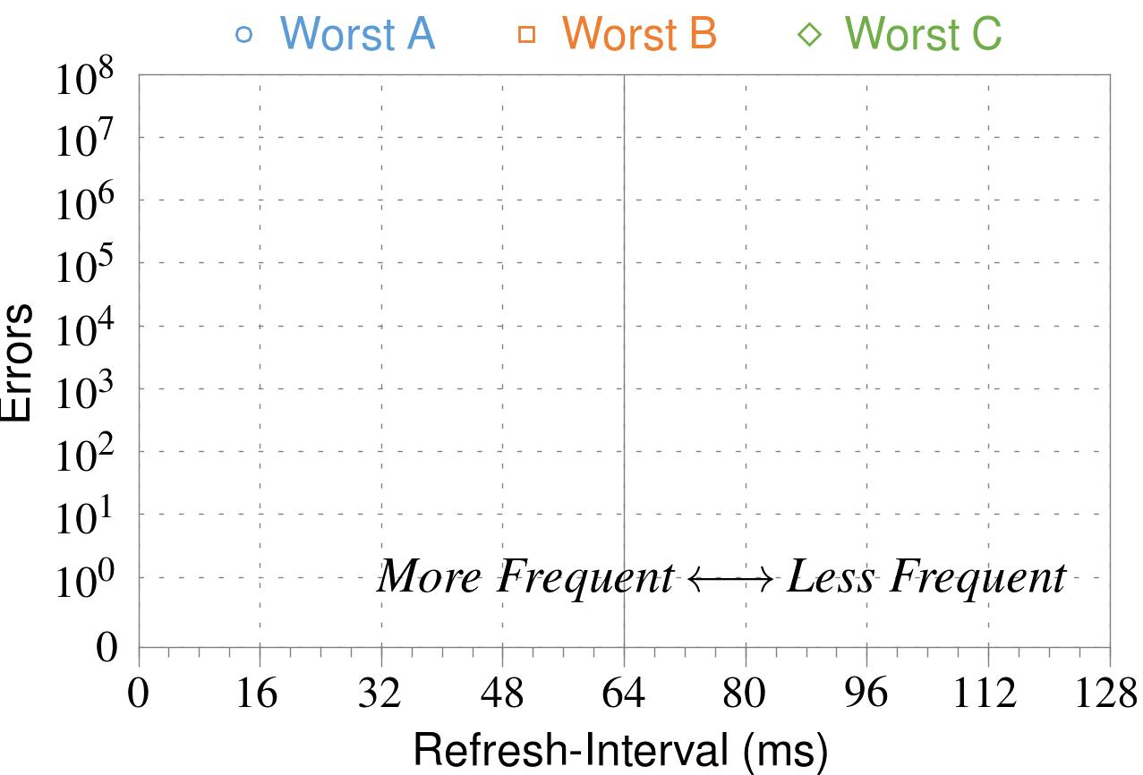
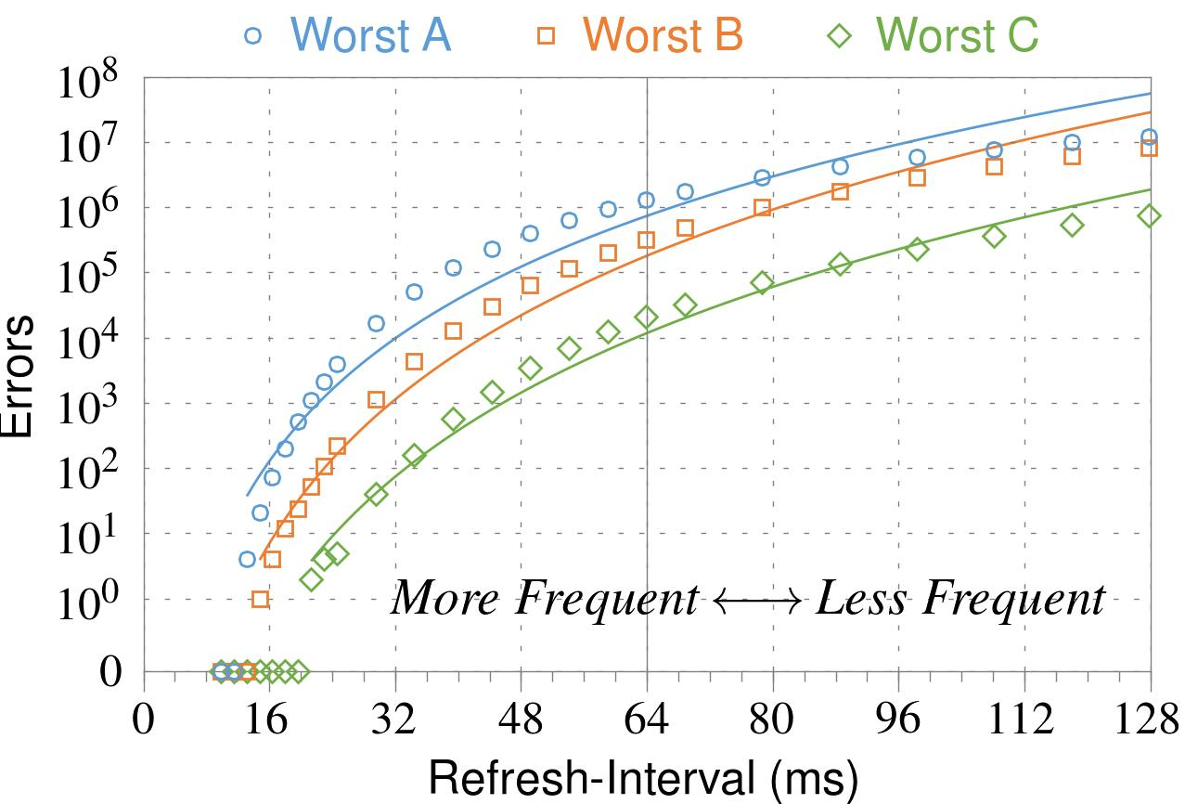
❷ Refresh Interval
~7x frequent
64ms
Note: Using three modules with the most errors (only first bank)
More frequent refreshes → Fewer errors
Notes:
In this figure, the x-axis is the refresh-interval. And the y-axis is the number of errors. To comply with the DRAM standard, we employ a default value of 64ms in our experiments. However, as we decrease the refresh-interval, we see that the number of errors decreases. In particular, when the refresh is shortened by 7x, there are no errors for all three modules.
From this, we conclude that more frequent accesses induce fewer errors.

Slide 75
❸ Data Pattern
Solid
RowStripe
111111
111111
111111
000000
111111
111111
10x Errors
111111
000000
~Solid
~RowStripe
000000
000000
000000
111111
000000
000000
000000
111111
Errors affected by data stored in other cells
Notes:
We tested the modules with four different data-patterns: Solid, inverse Solid, RowStripe, and inverse RowStripe. Solid and inverse Solid give us full coverage since each cell is tested with both 1s and 0s. And the same applies to RowStripe and its inverse.
However, we found that the rowstripe pattern had 10 times as more errors than the solid pattern. We also tested many other data-patterns, including random, but found RowStripe to induce the most errors.
Therefore, we conclude that errors are affected by data stored in other cells due to differences in coupling effects between the cells.

Slide 76
6. Other Results (in Paper)
Victim Cells ≠ Weak Cells (i.e., leaky cells)
  Almost no overlap between them
Errors not strongly affected by temperature
  Default temperature: 50°C
  At 30°C and 70°C, number of errors changes <15%
Errors are repeatable
  Across ten iterations of testing, >70% of victim cells had errors in every iteration
Notes:
First, we show that victim cells are not weak cells, which are cells that are inherently leaky. According to our experiments, we saw almost no overlap between them.
Second, we show that errors are not strongly affected by temperature. In all of the tests so far, we set the temperature to 50 degrees Celsius. But even when we changed the temperature by 20 degrees, the number of errors changed by less than 15 percent.
Third, we show that errors are repeatable. Across ten iterations of testing, more than 70% of victim cells had errors in every iteration.

Slide 77
6. Other Results (in Paper) cont’d
As many as 4 errors per cache-line
  Simple ECC (e.g., SECDED) cannot prevent all errors
Number of cells & rows affected by aggressor
  Victims cells per aggressor: ≤110
  Victims rows per aggressor: ≤9
Cells affected by two aggressors on either side
  Very small fraction of victim cells (<100) have an error when either one of the aggressors is toggled
Notes:
Fourth, we show that there are as many as four errors per cacheline. From this, we conclude that simple ECC schemes (for example, SECDED) cannot prevent all errors.
Fifth, we show that the number of cells & rows affected by an aggressor can be as high as 110 or 9, respectively.
Lastly, we show that a very small fraction of victim cells experience an error when either one of the aggressors is toggled.

Slide 78
First RowHammer Analysis
Yoongu Kim, Ross Daly, Jeremie Kim, Chris Fallin, Ji Hye Lee, Donghyuk Lee, Chris Wilkerson, Konrad Lai, and Onur Mutlu,
"Flipping Bits in Memory Without Accessing Them: An Experimental Study of DRAM Disturbance Errors"
Proceedings of the 41st International Symposium on Computer Architecture (ISCA), Minneapolis, MN, June 2014.
[Slides (pptx) (pdf)] [Lightning Session Slides (pptx) (pdf)] [Source Code and Data]

Slide 79

Retrospective on RowHammer & Future
Onur Mutlu,
"The RowHammer Problem and Other Issues We May Face as Memory Becomes Denser"
Invited Paper in Proceedings of the Design, Automation, and Test in Europe Conference (DATE), Lausanne, Switzerland, March 2017.
[Slides (pptx) (pdf)]
https://people.inf.ethz.ch/omutlu/pub/rowhammer-and-other-memory-issues_date17.pdf

Slide 80
RowHammer Solutions

Slide 81
Two Types of RowHammer Solutions
Immediate
  To protect the vulnerable DRAM chips in the field
  Limited possibilities
Longer-term
  To protect future DRAM chips
  Wider range of protection mechanisms
Our ISCA 2014 paper proposes both types of solutions
  Seven solutions in total
  PARA proposed as best solution → already employed in the field

Slide 82
Some Potential Solutions (ISCA 2014)
Cost
Make better DRAM chips
Power, Performance
Refresh frequently
Cost, Power
Sophisticated ECC
Cost, Power, Complexity
Access counters
Notes:
Here is a list of four potential solutions to disturbance errors: making better DRAM chips, refreshing more frequently, employing sophisticated ECC schemes, and using hardware counters to track the number of accesses to different rows.
However, all of these solutions incur a large overhead in terms cost, power, performance, and/or complexity.

Slide 83
Naive Solutions
❶ Throttle accesses to same row
  Limit access-interval: ≥500ns
  Limit number of accesses: ≤128K (=64ms/500ns)
❷ Refresh more frequently
  Shorten refresh-interval by ~7x
Both naive solutions introduce significant overhead in performance and power
Notes:
Based on what we learned from the sensitivity studies, there are two naive solutions that immediately present themselves.
First, we can throttle accesses to the same row. If the access-interval is greater than 500ns, I showed how errors are not induced. We can achieve the same effect by limiting the maximum number of accesses to the same row to be less than 128K, within a refresh interval.
Second, we can refresh the module more frequently. If the refresh-interval is shortened by 7x, I showed how errors can be prevented.
However, both naive solutions introduce significant overhead in both performance and power. Later on, I will propose a much more efficient solution.

Slide 84

Apple’s Patch for RowHammer
https://support.apple.com/en-gb/HT204934
HP, Lenovo, and other vendors released similar patches

Slide 85
Our Best Solution to RowHammer
PARA: Probabilistic Adjacent Row Activation
Key Idea
  After closing a row, we activate (i.e., refresh) one of its neighbors with a low probability: p = 0.005
Reliability Guarantee
  When p=0.005, errors in one year: 9.4×10⁻¹⁴
  By adjusting the value of p, we can vary the strength of protection against errors
Notes:
We provide a more efficient solution, called PARA, which stands for probabilistic adjacent row activation.
The key idea is thus: after closing a row, we activate (i.e., refresh) one of its neighbors with a low probability, for example, p equal to 0.005.
PARA provides a strong reliability guarantee even under the worst-case access patterns to DRAM. When we set p to 0.005, the expected number of errors in one year is 9.4 times 10 to the negative 14. This probability is much lower the failure rate of other hardware components, for example, the hard-disk drive.
And by adjusting the value of p, PARA can provide an arbitrarily strong-degree of protection against errors.

Slide 86
Advantages of PARA
PARA refreshes rows infrequently
  Low power
  Low performance-overhead
    Average slowdown: 0.20% (for 29 benchmarks)
    Maximum slowdown: 0.75%
PARA is stateless
  Low cost
  Low complexity
PARA is an effective and low-overhead solution to prevent disturbance errors
Notes:
PARA has many advantages. Since it refreshes row infrequently, it has low power and low performance-overhead. Simulated across 29 benchmarks, we saw an average of only 0.2% slowdown and a maximum of only 0.75% slowdown.
In addition, due to its stateless nature, PARA has low cost and complexity.
Therefore, PARA is an effective and low-overhead solution to prevent disturbance errors.

Slide 87
Requirements for PARA
If implemented in DRAM chip (done today)
  Enough slack in timing and refresh parameters
  Plenty of slack today:
    Lee et al., “Adaptive-Latency DRAM: Optimizing DRAM Timing for the Common Case,” HPCA 2015.
    Chang et al., “Understanding Latency Variation in Modern DRAM Chips,” SIGMETRICS 2016.
    Lee et al., “Design-Induced Latency Variation in Modern DRAM Chips,” SIGMETRICS 2017.
    Chang et al., “Understanding Reduced-Voltage Operation in Modern DRAM Devices,” SIGMETRICS 2017.
    Ghose et al., “What Your DRAM Power Models Are Not Telling You: Lessons from a Detailed Experimental Study,” SIGMETRICS 2018.
If implemented in memory controller
  Better coordination between memory controller and DRAM
  Memory controller should know which rows are physically adjacent

Slide 88

Probabilistic Activation in Real Life (I)
https://twitter.com/isislovecruft/status/1021939922754723841

Slide 89

Probabilistic Activation in Real Life (II)
https://twitter.com/isislovecruft/status/1021939922754723841

Slide 90
Seven RowHammer Solutions Proposed
Yoongu Kim, Ross Daly, Jeremie Kim, Chris Fallin, Ji Hye Lee, Donghyuk Lee, Chris Wilkerson, Konrad Lai, and Onur Mutlu,
"Flipping Bits in Memory Without Accessing Them: An Experimental Study of DRAM Disturbance Errors"
Proceedings of the 41st International Symposium on Computer Architecture (ISCA), Minneapolis, MN, June 2014.
[Slides (pptx) (pdf)] [Lightning Session Slides (pptx) (pdf)] [Source Code and Data]

Slide 91
Future Memory Reliability/Security Challenges

Slide 92
Future of RowHammer & Memory Reliability
Onur Mutlu,
"The RowHammer Problem and Other Issues We May Face as Memory Becomes Denser"
Invited Paper in Proceedings of the Design, Automation, and Test in Europe Conference (DATE), Lausanne, Switzerland, March 2017.
[Slides (pptx) (pdf)]
https://people.inf.ethz.ch/omutlu/pub/rowhammer-and-other-memory-issues_date17.pdf

Slide 93
Future of Main Memory
DRAM is becoming less reliable → more vulnerable

Slide 94
Large-Scale Failure Analysis of DRAM Chips
Analysis and modeling of memory errors found in all of Facebook’s server fleet
Justin Meza, Qiang Wu, Sanjeev Kumar, and Onur Mutlu,
"Revisiting Memory Errors in Large-Scale Production Data Centers: Analysis and Modeling of New Trends from the Field"
Proceedings of the 45th Annual IEEE/IFIP International Conference on Dependable Systems and Networks (DSN), Rio de Janeiro, Brazil, June 2015.
[Slides (pptx) (pdf)] [DRAM Error Model]

Slide 95
DRAM Reliability Reducing
Intuition:
quadratic
increase in
capacity
Meza+, “Revisiting Memory Errors in Large-Scale Production Data Centers,” DSN’15.

Slide 96
Future of Main Memory Security
DRAM is becoming less reliable → more vulnerable
Due to difficulties in DRAM scaling, other problems may also appear (or they may be going unnoticed)
Some errors may already be slipping into the field
  Read disturb errors (Rowhammer)
  Retention errors
  Read errors, write errors
  …
These errors can also pose security vulnerabilities

Slide 97
How Do We Keep Memory Secure?
DRAM
Flash memory
Emerging Technologies
  Phase Change Memory
  STT-MRAM
  RRAM, memristors
  …

Slide 98
Solution Direction: Principled Designs
Design fundamentally secure
computing architectures
Predict and prevent
such safety issues

Slide 99
Architecting Future Memory for Security
Understand: Methods for vulnerability modeling & discovery
  Modeling and prediction based on real (device) data and analysis
  Understanding vulnerabilities
  Developing reliable metrics
Architect: Principled architectures with security as key concern
  Good partitioning of duties across the stack
  Cannot give up performance and efficiency
  Patch-ability in the field
Design & Test: Principled design, automation, (online) testing
  Design for security
  High coverage and good interaction with system reliability methods

Slide 100
Understand and Model with Experiments (DRAM)
Temperature
Controller
FPGAs
Heater
FPGAs
PC
  Kim+, “Flipping Bits in Memory Without Accessing Them: An Experimental Study of DRAM Disturbance Errors,” ISCA 2014.

Slide 101
Key Contributions and Impact

Slide 102
Recall: Collapse of the “Galloping Gertie”
Source: AP
http://www.wsdot.wa.gov/tnbhistory/connections/connections3.htm

Slide 103

Another Example (1994)
Source: By 최광모 - Own work, CC BY-SA 4.0, https://commons.wikimedia.org/w/index.php?curid=35197984

Slide 104

Yet Another Example (2007)
Source: Morry Gash/AP,
https://www.npr.org/2017/08/01/540669701/10-years-after-bridge-collapse-america-is-still-crumbling?t=1535427165809

Slide 105

A More Recent Example (2018)
Source: AFP / Valery HACHE, https://www.capitalfm.co.ke/news/2018/08/genoa-bridge-collapse-what-we-know/

Slide 106
Key Discovery (ISCA 2014)
One can predictably induce bit flips in commodity DRAM chips
  >80% of the tested DRAM chips are vulnerable
First example of how a simple hardware failure mechanism can create a widespread system security vulnerability

Slide 107
Key Contributions & Impact (ISCA 2014)
New mindset that has enabled a renewed interest in HW security attack research:
  Real (memory) chips are vulnerable, in a simple and widespread manner → this causes real security problems
  Hardware (memory) security is now part of the mainstream discourse
Many new RowHammer attacks build on our work
  Tens of papers in top security venues
  More to come as RowHammer is getting worse (DDR4 & beyond)
Many new RowHammer solutions inspired by our work
  Apple security release; Memtest86 updated
  Many solution proposals in top venues (latest in OSDI 2018)
  Principled system-DRAM co-design (first proposed by our paper)
  More to come

Slide 108
Perhaps Most Importantly…
RowHammer enabled a shift of mindset in mainstream security researchers
  General-purpose hardware is fallible, in a widespread manner
  Its problems are exploitable
This mindset has enabled many systems security researchers to examine hardware in more depth
  And understand HW’s inner workings and vulnerabilities
It is no coincidence that two of the groups that discovered Meltdown and Spectre heavily worked on RowHammer attacks before
  More to come…

Slide 109
Conclusion

Slide 110
Summary: RowHammer
DRAM reliability is reducing
Reliability issues open up security vulnerabilities
  Very hard to defend against
Rowhammer is a prime example
  First example of how a simple hardware failure mechanism can create a widespread system security vulnerability
  Its implications on system security research are tremendous & exciting
Bad news: RowHammer is getting worse.
Good news: We have a lot more to do.
  We are now fully aware hardware is easily fallible.
  We are developing both attacks and solutions.
  We are developing principled models, methodologies, solutions.

Slide 111
RowHammer
Onur Mutlu
omutlu@gmail.com
https://people.inf.ethz.ch/omutlu
November 8, 2018
Top Picks in Hardware and Embedded Security

Slide 112
Backup Slides

Slide 113
Keeping Future Memory Secure

Slide 114
Architecting for Security
Understand: Methods for vulnerability modeling & discovery
  Modeling and prediction based on real (device) data and analysis
  Understanding vulnerabilities
  Developing reliable metrics
Architect: Principled architectures with security as key concern
  Good partitioning of duties across the stack
  Cannot give up performance and efficiency
  Patch-ability in the field
Design & Test: Principled design, automation, (online) testing
  Design for security
  High coverage and good interaction with system reliability methods

Slide 115
Understand and Model with Experiments (DRAM)
Temperature
Controller
FPGAs
Heater
FPGAs
PC
  Kim+, “Flipping Bits in Memory Without Accessing Them: An Experimental Study of DRAM Disturbance Errors,” ISCA 2014.

Slide 116

Understand and Model with Experiments (Flash)
USB Daughter Board
USB Jack
HAPS-52 Mother Board
Virtex-II Pro
(USB controller)
1x-nm
NAND Flash
Virtex-V FPGA
(NAND Controller)
[DATE 2012, ICCD 2012, DATE 2013, ITJ 2013, ICCD 2013, SIGMETRICS 2014, HPCA 2015, DSN 2015, MSST 2015, JSAC 2016, HPCA 2017, DFRWS 2017,
PIEEE 2017, HPCA 2018, SIGMETRICS 2018]
NAND Daughter Board
Cai+, “Error Characterization, Mitigation, and Recovery in Flash Memory Based Solid State Drives,” Proc. IEEE 2017.

Slide 117

Understanding Flash Memory Reliability
Proceedings of the IEEE, Sept. 2017
https://arxiv.org/pdf/1706.08642

Slide 118

Understanding Flash Memory Reliability
Justin Meza, Qiang Wu, Sanjeev Kumar, and Onur Mutlu,
"A Large-Scale Study of Flash Memory Errors in the Field"
Proceedings of the ACM International Conference on Measurement and Modeling of Computer Systems (SIGMETRICS), Portland, OR, June 2015.
[Slides (pptx) (pdf)] [Coverage at ZDNet] [Coverage on The Register] [Coverage on TechSpot] [Coverage on The Tech Report]

Slide 119
NAND Flash Vulnerabilities [HPCA’17]
HPCA, Feb. 2017
https://people.inf.ethz.ch/omutlu/pub/flash-memory-programming-vulnerabilities_hpca17.pdf

Slide 120
Original RowHammer Talk (ISCA 2014)

Slide 121


Flipping Bits in Memory Without Accessing Them
DRAM Disturbance Errors
Yoongu Kim
Ross Daly, Jeremie Kim, Chris Fallin, Ji Hye Lee,
Donghyuk Lee, Chris Wilkerson, Konrad Lai, Onur Mutlu
Notes:
Hi, my name is Yoongu Kim. And today, I am presenting "Flipping Bits in Memory Without Accessing Them: An Experimental Study of DRAM Disturbance Errors." This is a work done in collaboration with my co-authors from Carnegie Mellon and Intel.

Slide 122
DRAM Chip
Row of Cells
Wordline
Row
Victim Row
Row
Aggressor Row
V_{LOW}
Closed
V_{HIGH}
Opened
Row
Victim Row
Row
Repeatedly opening and closing a row induces disturbance errors in adjacent rows
Notes:
A DRAM chip consists of multiple rows of cells, where each row is associated with a wire called the wordline. To access a row, the wordline voltage must be increased, thereby opening the row. After accessing the row, the wordline voltage is decreased, thereby closing the row. But if we repeat this procedure, on the same row, over, and over again, we observed that some cells in adjacent rows lose their data. We refer to the row being accessed as the aggressor, and the rows having errors as its victims. In other words, repeatedly opening and closing a row induces disturbance errors in adjacent rows.

Slide 123
Quick Summary of Paper
We expose the existence and prevalence of disturbance errors in DRAM chips of today
  110 of 129 modules are vulnerable
  Affects modules of 2010 vintage or later
We characterize the cause and symptoms
  Toggling a row accelerates charge leakage in adjacent rows: row-to-row coupling
We prevent errors using a system-level approach
  Each time a row is closed, we refresh the charge stored in its adjacent rows with a low probability
Notes:
Here is a quick summary of our paper.
First, we expose the existence, and the prevalence, of disturbance errors in DRAM chips of today. Among 129 DRAM modules that we tested, we were able to induce errors in 110 modules, all of which were manufactured in 2010 or later.
Second, we characterize the cause and symptoms of disturbance errors. When a row is repeatedly toggled, we show that it accelerates the leakage of charge in adjacent rows, through a coupling effect between the rows.
Third, we prevent errors using a system-level approach. Each time a row is opened and closed, our idea is to refresh the charge stored in the adjacent rows with a low probability, thereby offsetting the leakage effect of disturbance.

Slide 124
1. Historical Context
2. Demonstration (Real System)
3. Characterization (FPGA-Based)
4. Solutions
Notes:
This is the outline of my talk.
First, I’ll provide the historical context behind DRAM disturbance errors. Second, I’ll demonstrate the errors on real systems. Third, I’ll characterize the errors using an FPGA-based testing platform. And finally, I’ll discuss several potential solutions to prevent the errors.
But, first, let us take a trip down memory lane.

Slide 125
A Trip Down Memory Lane
IBM’s patent on DRAM
1968
Intel commercializes DRAM (Intel 1103)
1971
Suffered bitline-to-cell coupling
Bitline
Bitline
“... this big fat metal line with full level signals running right over the storage node (of cell).”
– Joel Karp (1103 Designer)
Interview: Comp. History Museum
Cell
2013
8um
6um
2014
Notes:
In 1968, IBM was granted the original patent on DRAM.
And in 1971, Intel commercialized the first DRAM chip, the Intel 1103, which suffered from bitline-to-cell coupling. According to Joel Karp, who was one of its designers, the 1103 had “this big fat metal line with full signals running right over the storage node of the cell.” As a solution, Joel told me that they reduced the width of the bitline and nudged it slightly off to the side.
As you can see, coupling in DRAM has been with us ever since the very first DRAM chips.

Slide 126
A Trip Down Memory Lane
IBM’s patent on DRAM
1968
Intel commercializes DRAM (Intel 1103)
1971
Suffered bitline-to-cell coupling
Earliest DRAM with row-to-row coupling
2010
We observe row-to-row coupling
2013
Intel’s patents mention “Row Hammer”
2014
Notes:
Forty-two years later, in 2013, we observed row-to-row coupling in off-the-shelf DRAM chips. According to our experiments, the earliest DRAM chips that suffer from this effect date back to 2010. And just this year, in 2014, several Intel patents were published that mention a problem that they say is widely referred to as “Row Hammer” in the industry.

Slide 127
Lessons from History
Coupling in DRAM is not new
  Leads to disturbance errors if not addressed
  Remains a major hurdle in DRAM scaling
Traditional efforts to contain errors
  Design-Time: Improve circuit-level isolation
  Production-Time: Test for disturbance errors
Despite such efforts, disturbance errors have been slipping into the field since 2010
Notes:
So what lessons can we draw from history?
First of all, we learned that coupling in DRAM is not new at all. And if not properly addressed, it could lead to disturbance errors. In fact, coupling in DRAM has been, and continues to be, a major hurdle in DRAM scaling.
Historically, DRAM manufacturers have been employing a two-pronged approach to contain disturbance errors. During design-time, they try to improve circuit-level isolation. And during production-time, they try to test for errors.
Despite their efforts, however, we show that disturbance errors have been slipping into the field since as early as 2010.

Slide 128
1. Historical Context
2. Demonstration (Real System)
3. Characterization (FPGA-Based)
4. Solutions
Notes:
Now I’ll talk about how disturbance errors can be induced on real systems.

Slide 129

How to Induce Errors
x86 CPU
DRAM Module
DDR3
Avoid cache hits
  Flush X from cache
Avoid row hits to X
  Read Y in another row
111111111
X
111111111
111111111
111111111
Y
111111111
111111111
Notes:
This is the setup of the system where we induce disturbance errors. It has an x86 processor connected to a DRAM module, which is initially populated with a known data-pattern – in this case, all ‘1’s. Our goal, is to construct a program that repeatedly toggles the row at address X.
However, this cannot be achieved just by issuing many loads to address X. This is because of two reasons. First, cache hits in the processor prevent the load from reaching DRAM. But we can avoid this by flushing X from the cache. Second, when there are consecutive accesses to the same row, the processor keeps the row open without closing it. But we can avoid this by interleaving accesses to two different rows: X and Y.

Slide 130
How to Induce Errors
x86 CPU
DRAM Module
DDR3
loop:
mov (X), %eax
mov (Y), %ebx
clflush (X)
clflush (Y)
mfence
jmp loop
001110111
111111111
X
111111111
1111
111111111
101111101
110001011
111111111
Y
1111
111111111
011011110
111111111
Notes:
This is the assembly code that behaves precisely in the manner that I just described. It first opens row X and fetches a cacheline into the processor. But since the next access is to a different row, the processor is forced to close row X before opening row Y. And from row Y, another cacheline is fetched. Subsequently, the two flush instructions evict the cachelines from the processor. Each iteration of the code toggles the two rows X and Y, and after many iterations, many errors appear in adjacent rows.

Slide 131
Number of Disturbance Errors
In a more controlled environment, we can induce as many as ten million disturbance errors
Disturbance errors are a serious reliability issue
CPU Architecture | Errors | Access-Rate
Intel Haswell (2013) | 22.9K | 12.3M/sec
Intel Ivy Bridge (2012) | 20.7K | 11.7M/sec
Intel Sandy Bridge (2011) | 16.1K | 11.6M/sec
AMD Piledriver (2012) | 59 | 6.1M/sec
Notes:
When we executed the code on four different processors, all four of them yielded errors. Intel Haswell has the most errors, at 23 thousand, because it has the highest rate of accessing DRAM.
Later on, I’ll show that we can induce as many as ten million disturbance errors in a more controlled environment.
From this, we conclude that disturbance errors are a serious reliability issue.

Slide 132
Security Implications
Breach of memory protection
  OS page (4KB) fits inside DRAM row (8KB)
  Adjacent DRAM row → Different OS page
Vulnerability: disturbance attack
  By accessing its own page, a program could
  corrupt pages belonging to another program
We constructed a proof-of-concept
  Using only user-level instructions
Notes:
In addition, they have serious implications for security
When disturbance errors occur, they could breach memory protection. This is because an OS page fits inside a DRAM row. So an error in a different DRAM row means an error in a different OS page.
This opens up a vulnerability to disturbance attacks. Just by accessing its own page, a malicious program could corrupt pages belonging to another program.
And, as shown previously, we constructed a proof-of-concept using only user-level instructions.

Slide 133
Mechanics of Disturbance Errors
Cause 1: Electromagnetic coupling
  Toggling the wordline voltage briefly increases the voltage of adjacent wordlines
  Slightly opens adjacent rows → Charge leakage
Cause 2: Conductive bridges
Cause 3: Hot-carrier injection
Confirmed by at least one manufacturer
Notes:
Why do the errors occur? We see three possible causes.
First, there could electromagnetic coupling between adjacent wordlines. When the voltage of one is toggled, it could briefly increase the voltage of the other and facilitate the leakage of charge.
Two other possibilities are conductive bridges and hot-carrier injection.
At least one manufacturer confirmed that these three could play a role in the disturbance errors we see them today.

Slide 134
1. Historical Context
2. Demonstration (Real System)
3. Characterization (FPGA-Based)
4. Solutions
Notes:
Now I will characterize the errors.

Slide 135

Infrastructure
PC
FPGA Board
Test Engine
PCIe
DRAM Ctrl
Notes:
This is the high-level block diagram of our testing infrastructure.
We programmed an FPGA board with a PCIe module, a DRAM controller module, and a custom test engine. The FPGA is connected to a computer, from which we control the FPGAs using a custom software library.

Slide 136

Temperature
Controller
FPGAs
Heater
FPGAs
PC
Notes:
This is the photo of our infrastructure, that we built mostly from scratch.
For higher throughput, we employ eight FPGAs, all of which are enclosed in thermally-regulated environment.

Slide 137
Tested DDR3 DRAM Modules
Company A
Company B
Company C
43
54
32
Total: 129
Vintage: 2008 – 2014
Capacity: 512MB – 2GB
Notes:
We tested 129 DRAM modules from thee manufacturers: company A, B, and C.
Their manufacture date ranges from 2008 to 2014. And their capacity ranges from half a gigabyte to two gigabytes.

Slide 138
Characterization Results
Most Modules Are at Risk
Errors vs. Vintage
Error = Charge Loss
Adjacency: Aggressor & Victim
Sensitivity Studies
Other Results in Paper
Notes:
Now I will present the characterization results, one-by-one.
First, I show that most modules are at risk. Second, I show the number of errors in a module as a function of the manufacture date. Third, I show that the errors are symptomatic of charge loss. Fourth, I show that an aggressor induces errors in adjacent rows. Fifth, I show several sensitivity studies. And, finally, I briefly describe other results in the paper.

Slide 139
1. Most Modules Are at Risk
A company
B company
C company
86%
(37/43)
83%
(45/54)
88%
(28/32)
Up to
1.0×10⁷
errors
Up to
2.7×10⁶
errors
Up to
3.3×10⁵
errors
Notes:
For all three manufacturers, we were able to induce errors in more than 80% of their modules. And, for some modules, we were able to induce as many as ten million errors. From this, we conclude that most modules are at risk.

Slide 140
2. Errors vs. Vintage
First
Appearance
All modules from 2012–2013 are vulnerable
Notes:
In this figure, the x-axis is the module manufacture date. And the y-axis is the number of errors in a module, normalized to one billion cells. In 2008 and 2009, there are no errors. But, in 2010, we first start to see errors in C modules. After 2010, the errors start to proliferate. For A and B modules, we first start to see errors in 2011. In particular, all modules from 2012 and 2013 are vulnerable.

Slide 141
3. Error = Charge Loss
Two types of errors
  ‘1’ → ‘0’
  ‘0’ → ‘1’
A given cell suffers only one type
Two types of cells
  True: Charged (‘1’)
  Anti: Charged (‘0’)
Manufacturer’s design choice
True-cells have only ‘1’ → ‘0’ errors
Anti-cells have only ‘0’ → ‘1’ errors
Errors are manifestations of charge loss
Notes:
Depending on which way a bit flips, there are two types of errors: one to zero and zero to one. However, we observed that a given cell suffers from only type of error.
This is closely related to an intrinsic property of DRAM cells called orientation. There are two types of DRAM cells. True cells use the charged state to represent a data of ‘1’, whereas anti cells use the charged state to represent a data of ‘0’. And it is entirely up to the manufacturers to decide which types of cells they implement.
We found that true-cells have only one to zero errors, and that anti-cells have only zero to one errors. From this, we conclude that the errors are manifestations of charge loss.

Slide 142
4. Adjacency: Aggressor & Victim
Adjacent
Adjacent
Adjacent
Non-Adjacent
Non-Adjacent
Note: For three modules with the most errors (only first bank)
Most aggressors & victims are adjacent
Notes:
In this figure, the x-axis is the row-address difference between an aggressor and its victims. And the y-axis is the number of victim-aggressor pairs that correspond to the row-address difference. For all three modules, we see strong peaks at plus/minus 1. This implies that aggressors and victims have consecutive row-addresses, in other words, they are adjacent.
However, the figure also shows some victims that are not adjacent to the aggressor. We believe this could be caused by two reasons. First, depending on the mapping, two rows that are physically adjacent within the DRAM chip may not have consecutive row-addresses. Second, fault rows are often re-mapped to spare rows that may reside on a different portion of the DRAM chip.
Nevertheless, we conclude that the vast majority of aggressors & victims are adjacent.

Slide 143
5. Sensitivity Studies
time
Test Row 0
Test Row 1
Test Row 2
···
Fill Module
with Data
Open
Open
···
Find Errors
in Module
Refresh Periodically
❶
Access-Interval: 55–500ns
❷
Refresh-Interval: 8–128ms
❸
Data-Pattern: all ‘1’s, all ‘0’s, etc.
Notes:
Now let’s take a look at the sensitivity of the errors to different test parameters. For each module, we tested their rows one-by-one. And for each row, we first initialize the module with a data-pattern. Then, we opened and closed the row repeatedly, while also refreshing the module periodically. In the end, we read out the module to find the errors.
In this context, there are three different test parameters. First, the access-interval determines how quickly the row is opened and closed. Second, the refresh-interval determines how long the access-pattern is sustained for. Third, the data-pattern determines the initial state of the module.
Now let’s take a look at the effect of varying the first test parameter: the access-interval.

Slide 144
❶ Access-Interval (Aggressor)
Not Allowed
500ns
55ns
Note: For three modules with the most errors (only first bank)
Less frequent accesses → Fewer errors
Notes:
In this figure, the x-axis is the interval at which we access the aggressor. And the y-axis is the number of errors. To comply with the DRAM standard, we employ a default value of 55ns in our experiments. However, as we increase the access-interval, we see that the number of errors decreases. In particular, at 500ns, there are no errors for all three modules.
From this, we conclude that less frequent accesses induce fewer errors.

Slide 145
5. Sensitivity Studies
time
Test Row 0
Test Row 1
Test Row 2
···
Fill Module
with Data
Open
Open
···
Find Errors
in Module
Refresh Periodically
❶
Access-Interval: 55–500ns
❷
Refresh-Interval: 8–128ms
❸
Data-Pattern: all ‘1’s, all ‘0’s, etc.
Notes:
Now let’s take a look at the effect of varying the second test parameter: the refresh-interval.

Slide 146
❷ Refresh-Interval
~7x frequent
64ms
Note: Using three modules with the most errors (only first bank)
More frequent refreshes → Fewer errors
Notes:
In this figure, the x-axis is the refresh-interval. And the y-axis is the number of errors. To comply with the DRAM standard, we employ a default value of 64ms in our experiments. However, as we decrease the refresh-interval, we see that the number of errors decreases. In particular, when the refresh is shortened by 7x, there are no errors for all three modules.
From this, we conclude that more frequent accesses induce fewer errors.

Slide 147
5. Sensitivity Studies
time
Test Row 0
Test Row 1
Test Row 2
···
Fill Module
with Data
Open
Open
···
Find Errors
in Module
Refresh Periodically
❶
Access-Interval: 55–500ns
❷
Refresh-Interval: 8–128ms
❸
Data-Pattern: all ‘1’s, all ‘0’s, etc.
Notes:
Now let’s take a look at the effect of varying the third test parameter: the data-pattern.

Slide 148
❸ Data-Pattern
Solid
RowStripe
111111
111111
111111
000000
111111
111111
10x Errors
111111
000000
~Solid
~RowStripe
000000
000000
000000
111111
000000
000000
000000
111111
Errors affected by data stored in other cells
Notes:
We tested the modules with four different data-patterns: Solid, inverse Solid, RowStripe, and inverse RowStripe. Solid and inverse Solid give us full coverage since each cell is tested with both 1s and 0s. And the same applies to RowStripe and its inverse.
However, we found that the rowstripe pattern had 10 times as more errors than the solid pattern. We also tested many other data-patterns, including random, but found RowStripe to induce the most errors.
Therefore, we conclude that errors are affected by data stored in other cells due to differences in coupling effects between the cells.

Slide 149
Naive Solutions
❶ Throttle accesses to same row
  Limit access-interval: ≥500ns
  Limit number of accesses: ≤128K (=64ms/500ns)
❷ Refresh more frequently
  Shorten refresh-interval by ~7x
Both naive solutions introduce significant overhead in performance and power
Notes:
Based on what we learned from the sensitivity studies, there are two naive solutions that immediately present themselves.
First, we can throttle accesses to the same row. If the access-interval is greater than 500ns, I showed how errors are not induced. We can achieve the same effect by limiting the maximum number of accesses to the same row to be less than 128K, within a refresh interval.
Second, we can refresh the module more frequently. If the refresh-interval is shortened by 7x, I showed how errors can be prevented.
However, both naive solutions introduce significant overhead in both performance and power. Later on, I will propose a much more efficient solution.

Slide 150
Characterization Results
Most Modules Are at Risk
Errors vs. Vintage
Error = Charge Loss
Adjacency: Aggressor & Victim
Sensitivity Studies
Other Results in Paper
Notes:
Now that I have presented the five major characterization results, I will go on to describe briefly several other results we have in the paper.

Slide 151
6. Other Results in Paper
Victim Cells ≠ Weak Cells (i.e., leaky cells)
  Almost no overlap between them
Errors not strongly affected by temperature
  Default temperature: 50°C
  At 30°C and 70°C, number of errors changes <15%
Errors are repeatable
  Across ten iterations of testing, >70% of victim cells had errors in every iteration
Notes:
First, we show that victim cells are not weak cells, which are cells that are inherently leaky. According to our experiments, we saw almost no overlap between them.
Second, we show that errors are not strongly affected by temperature. In all of the tests so far, we set the temperature to 50 degrees Celsius. But even when we changed the temperature by 20 degrees, the number of errors changed by less than 15 percent.
Third, we show that errors are repeatable. Across ten iterations of testing, more than 70% of victim cells had errors in every iteration.

Slide 152
6. Other Results in Paper (cont’d)
As many as 4 errors per cache-line
  Simple ECC (e.g., SECDED) cannot prevent all errors
Number of cells & rows affected by aggressor
  Victims cells per aggressor: ≤110
  Victims rows per aggressor: ≤9
Cells affected by two aggressors on either side
  Very small fraction of victim cells (<100) have an error when either one of the aggressors is toggled
Notes:
Fourth, we show that there are as many as four errors per cacheline. From this, we conclude that simple ECC schemes (for example, SECDED) cannot prevent all errors.
Fifth, we show that the number of cells & rows affected by an aggressor can be as high as 110 or 9, respectively.
Lastly, we show that a very small fraction of victim cells experience an error when either one of the aggressors is toggled.

Slide 153
1. Historical Context
2. Demonstration (Real System)
3. Characterization (FPGA-Based)
4. Solutions
Notes:
Now I present solutions.

Slide 154
Several Potential Solutions
Cost
Make better DRAM chips
Power, Performance
Refresh frequently
Cost, Power
Sophisticated ECC
Cost, Power, Complexity
Access counters
Notes:
Here is a list of four potential solutions to disturbance errors: making better DRAM chips, refreshing more frequently, employing sophisticated ECC schemes, and using hardware counters to track the number of accesses to different rows.
However, all of these solutions incur a large overhead in terms cost, power, performance, and/or complexity.

Slide 155
Our Solution
PARA: Probabilistic Adjacent Row Activation
Key Idea
  After closing a row, we activate (i.e., refresh) one of its neighbors with a low probability: p = 0.005
Reliability Guarantee
  When p=0.005, errors in one year: 9.4×10⁻¹⁴
  By adjusting the value of p, we can provide an arbitrarily strong protection against errors
Notes:
We provide a more efficient solution, called PARA, which stands for probabilistic adjacent row activation.
The key idea is thus: after closing a row, we activate (i.e., refresh) one of its neighbors with a low probability, for example, p equal to 0.005.
PARA provides a strong reliability guarantee even under the worst-case access patterns to DRAM. When we set p to 0.005, the expected number of errors in one year is 9.4 times 10 to the negative 14. This probability is much lower the failure rate of other hardware components, for example, the hard-disk drive.
And by adjusting the value of p, PARA can provide an arbitrarily strong-degree of protection against errors.

Slide 156
Advantages of PARA
PARA refreshes rows infrequently
  Low power
  Low performance-overhead
    Average slowdown: 0.20% (for 29 benchmarks)
    Maximum slowdown: 0.75%
PARA is stateless
  Low cost
  Low complexity
PARA is an effective and low-overhead solution to prevent disturbance errors
Notes:
PARA has many advantages. Since it refreshes row infrequently, it has low power and low performance-overhead. Simulated across 29 benchmarks, we saw an average of only 0.2% slowdown and a maximum of only 0.75% slowdown.
In addition, due to its stateless nature, PARA has low cost and complexity.
Therefore, PARA is an effective and low-overhead solution to prevent disturbance errors.

Slide 157
Conclusion
Disturbance errors are widespread in DRAM chips sold and used today
When a row is opened repeatedly, adjacent rows leak charge at an accelerated rate
We propose a stateless solution that prevents disturbance errors with low overhead
Due to difficulties in DRAM scaling, new and unexpected types of failures may appear
Notes:
Now I conclude the talk. We demonstrated that disturbance errors widespread in DRAM chips sold and used today.
We showed that when a row is opened repeatedly, adjacent rows leak charge at an accelerated rate.
We proposed a stateless solution, PARA, that prevents disturbance errors with low overhead.
We have exposed a real manifestation of the difficulties in DRAM scaling. And as these effects are exacerbated, new and unforeseen types of failures may appear in the future. And we believe that exposing these issues to the computer architecture community is the first step toward enabling better solutions.

Slide 158
Flipping Bits in Memory Without Accessing Them
DRAM Disturbance Errors
Yoongu Kim
Ross Daly, Jeremie Kim, Chris Fallin, Ji Hye Lee,
Donghyuk Lee, Chris Wilkerson, Konrad Lai, Onur Mutlu
Notes:
Thank you, I’ll take questions.

Slide 159
Example: Capacity, Bandwidth & Latency
128x
20x
1.3x

