Slide 1
Memory Systems and Memory-Centric Computing Systems Part 1: Memory Importance and Trends
Prof. Onur Mutlu
omutlu@gmail.com
https://people.inf.ethz.ch/omutlu
7 July 2019
SAMOS Tutorial

Slide 2
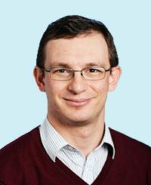
Brief Self Introduction
Onur Mutlu
Full Professor @ ETH Zurich CS (EE), since September 2015
Strecker Professor @ Carnegie Mellon University ECE/CS, 2009-2016, 2016-…
PhD from UT-Austin, worked at Google, VMware, Microsoft Research, Intel, AMD
https://people.inf.ethz.ch/omutlu/
omutlu@gmail.com (Best way to reach me)
https://people.inf.ethz.ch/omutlu/projects.htm
Research and Teaching in:
Computer architecture, computer systems, hardware security, bioinformatics
Memory and storage systems
Hardware security, safety, predictability
Fault tolerance
Hardware/software cooperation
Architectures for bioinformatics, health, medicine
…

Slide 3
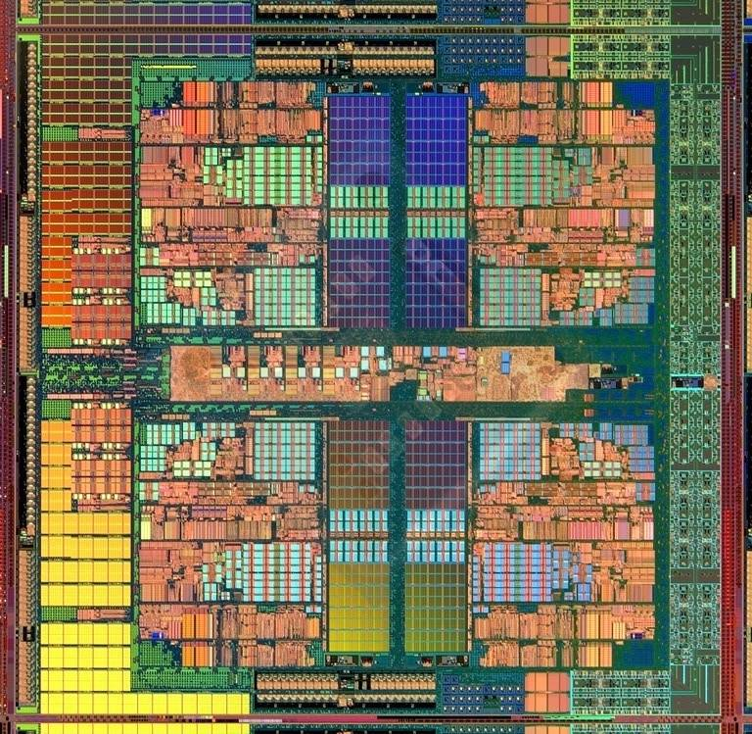
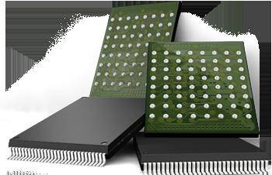
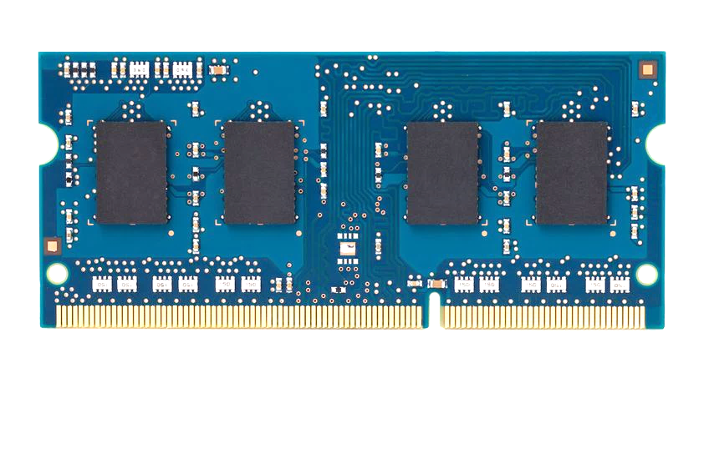
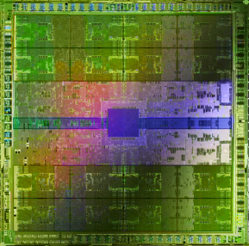
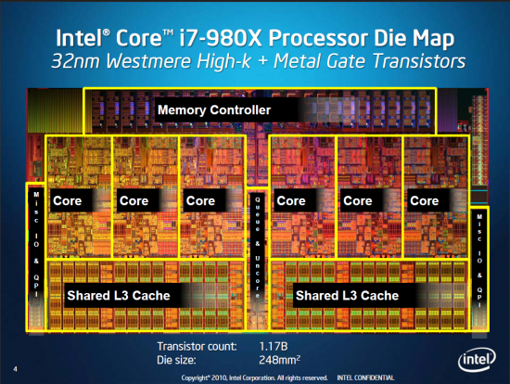
Current Research Focus Areas
Research Focus: Computer architecture, HW/SW, bioinformatics, security
Memory and storage (DRAM, flash, emerging), interconnects
Heterogeneous & parallel systems, GPUs, systems for data analytics
System/architecture interaction, new execution models, new interfaces
Hardware security, energy efficiency, fault tolerance, performance
Genome sequence analysis & assembly algorithms and architectures
Biologically inspired systems & system design for bio/medicine
Hybrid Main Memory
Heterogeneous
Processors and
Accelerators
Persistent Memory/Storage
Broad research
spanning apps, systems, logic
with architecture at the center
Graphics and Vision Processing
Notes:
Professor Mutlu’s research focus is all aspects of computer architecture, HW/SW interaction and bioinformatics.
He is looking for students to perform research in these areas.
He and his group, SAFARI, solve fundamental problems spanning:
Memory, memory, memory, storage, interconnects
Parallel architectures, heterogeneous architectures, GP-GPUs
System/architecture interaction, new execution models
Energy efficiency, fault tolerance, hardware security
Genome sequence analysis and assembly
His group does broad research spanning systems to logic with architecture at center

Slide 4
Four Key Directions
Fundamentally Secure/Reliable/Safe Architectures
Fundamentally Energy-Efficient Architectures
Memory-centric (Data-centric) Architectures
Fundamentally Low-Latency Architectures
Architectures for Genomics, Medicine, Health

Slide 5
A Motivating Detour: Genome Sequence Analysis

Slide 6
Our Dream (circa 2007)
An embedded device that can perform comprehensive genome analysis in real time (within a minute)
Which of these DNAs does this DNA segment match with?
What is the likely genetic disposition of this patient to this drug?
. . .

Slide 7
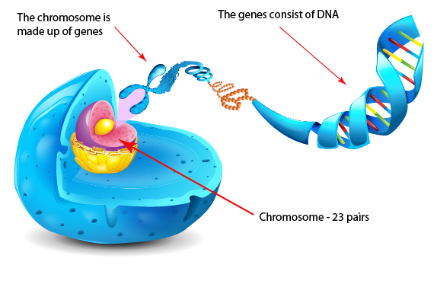
What Is a Genome Made Of?
Cell
Nucleus
The discovery of DNA’s double-helical structure (Watson+, 1953)
Notes:
Unlocking the life’s code requires diving into the nucleus of our body cells, where the double-stranded genome resides. Genome is literally the 'code of life' - it is the set of instructions for making everything from you to zebras, strawberries, and even yeast.
since the discovery of dna’s double-helical structure (watson et al. 1953)

Slide 8
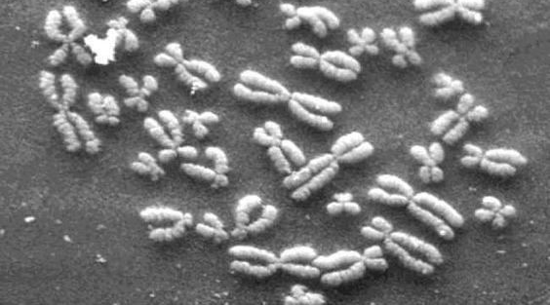
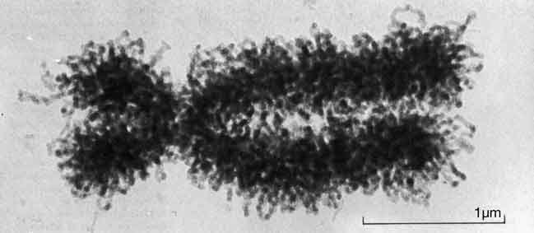
DNA Under Electron Microscope
human chromosome #12
from HeLa’s cell
Notes:
Henrietta Lacks,

Slide 9
DNA Sequencing
Goal:
Find the complete sequence of A, C, G, T’s in DNA.
Challenge:
There is no machine that takes long DNA as an input, and gives the complete sequence as output
All sequencing machines chop DNA into pieces and identify relatively small pieces (but not how they fit together)

Slide 10
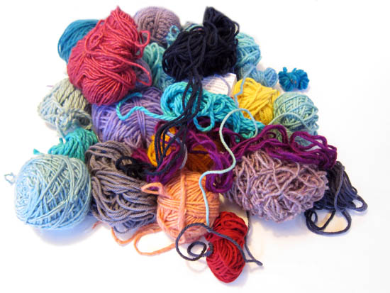
Untangling Yarn Balls & DNA Sequencing
Notes:
untangling yarn ball

Slide 11
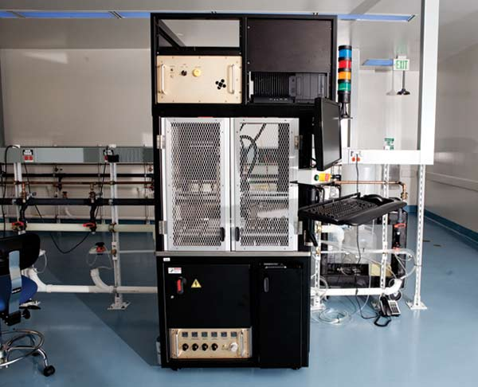
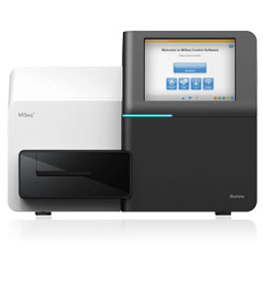
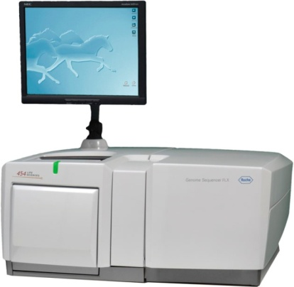
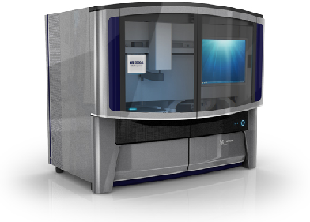
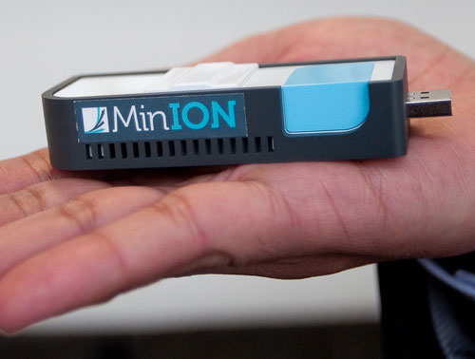
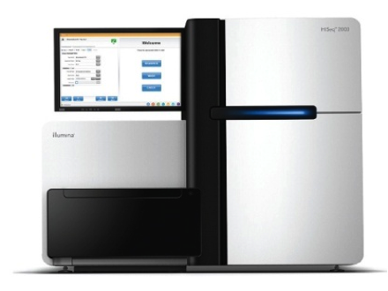
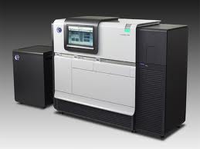
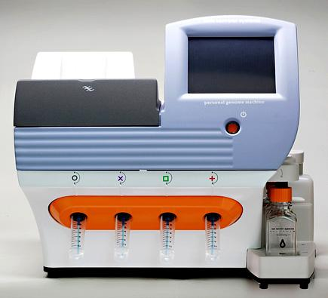
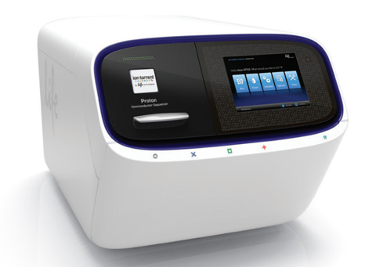
Genome Sequencers
Illumina MiSeq
Complete
Genomics
Roche/454
AB SOLiD
Oxford Nanopore MinION
Illumina
NovaSeq
6000
Illumina HiSeq2000
Pacific Biosciences RS
Oxford Nanopore GridION
Ion Torrent PGM
… and more! All produce data with different properties.
Ion Torrent Proton

Slide 12
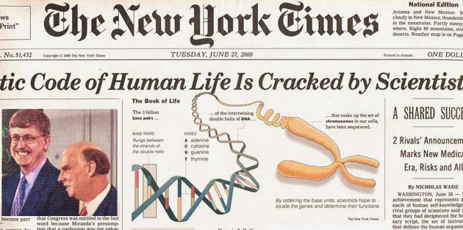
The Genomic Era
1990-2003: The Human Genome Project (HGP) provides a complete and accurate sequence of all DNA base pairs that make up the human genome and finds 20,000 to 25,000 human genes.
13 year-long
$3,000,000,000
Notes:
The 13-year long human project is the starting of the genomic era! It opened the door to remarkable biomedical discoveries by providing the first complete human genome sequence. It cost 3 billion dollars to read the entire sequence.

Slide 13
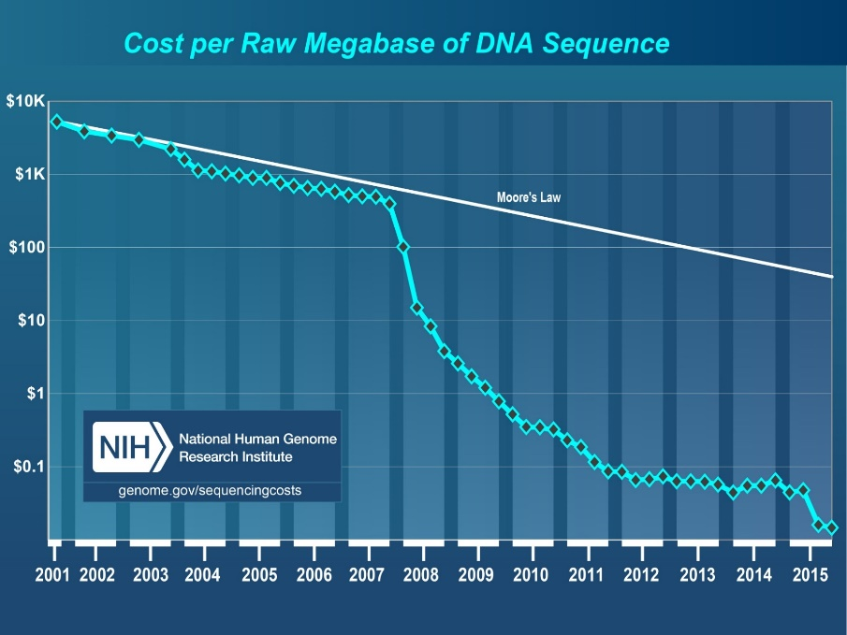
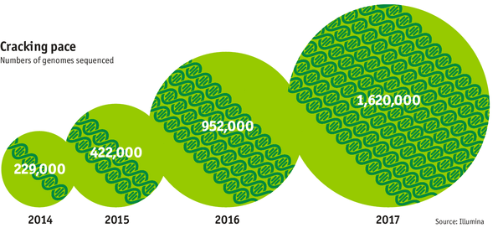
The Genomic Era (continued)
development of high-throughput sequencing (HTS) technologies
Number of Genomes Sequenced
http://www.economist.com/news/21631808-so-much-genetic-data-so-many-uses-genes-unzipped
Notes:
However, since the development of high throughput sequencing (HTS) technologies, the cost of genome sequencing has fallen off a cliff (<< 1,000$) making it viable for almost everyone's use.

Slide 14
1
Sequencing
Genome Analysis
Read Mapping
2
Variant Calling
Scientific Discovery
3
4
Notes:
Genome analysis starts with sequencing random short DNA fragments of copies of the original molecule.
Unfortunately, these reads lack information about their order and which part of genome they are originated from.
Hence the second step is to map these reads to a long reference genome.

Slide 15
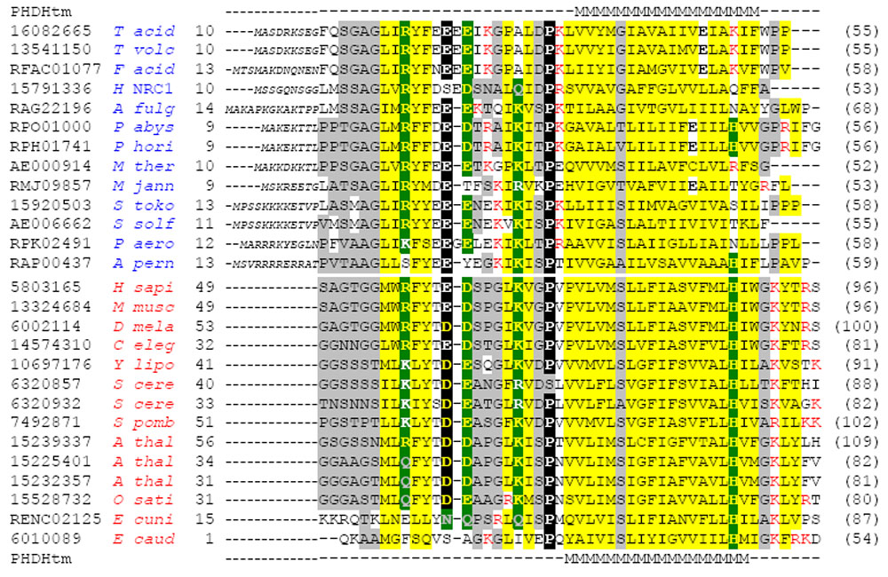
Multiple sequence alignment
Example Question: If I give you a bunch of sequences, tell me where they are the same and where they are different.

Slide 16
Genome Sequence Alignment: Example
Source: By Aaron E. Darling, István Miklós, Mark A. Ragan - Figure 1 from Darling AE, Miklós I, Ragan MA (2008).
"Dynamics of Genome Rearrangement in Bacterial Populations". PLOS Genetics. DOI:10.1371/journal.pgen.1000128., CC BY 2.5, https://commons.wikimedia.org/w/index.php?curid=30550950

Slide 17
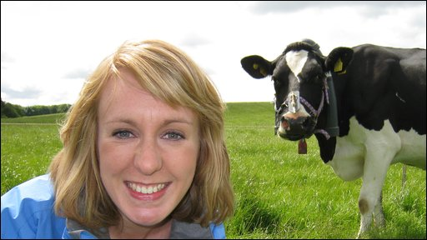
The Genetic Similarity Between Species
Human ~ Chimpanzee
96%
Human ~ Cat
90%
Human ~ Human
Human ~ Cow
99.9%
80%
Human ~ Banana
50-60%

Slide 18
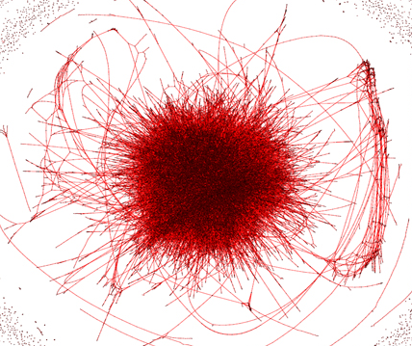
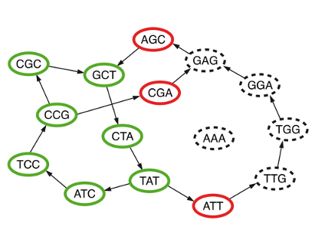
Metagenomics, genome assembly, de novo sequencing
Question 2: Given a bunch of short sequences, Can you identify the approximate species cluster for genomically unknown organisms?
uncleaned de Bruijn graph
http://math.oregonstate.edu/~koslickd
Notes:
organism detection in metagenomes

Slide 19
1
Sequencing
Read Mapping
2
Bottlenecked in Mapping!!
Illumina HiSeq4000
on average
GAGTCAGAATTTGAC
2 M
bases/min
300 M
bases/min
GAGTCAGAATTTGAC
GAGTCAGAATTTGAC
GAGTCAGAATTTGAC
GAGTCAGAATTTGAC
GAGTCAGAATTTGAC
GAGTCAGAATTTGAC
GAGTCAGAATTTGAC
GAGTCAGAATTTGAC
GAGTCAGAATTTGAC
GAGTCAGAATTTGAC
GAGTCAGAATTTGAC
GAGTCAGAATTTGAC
GAGTCAGAATTTGAC
GAGTCAGAATTTGAC
(0.6%)
Variant Calling
Scientific Discovery
3
4
Notes:
Typical sequencer machine generates a flood of reads, for example, Illumina HiSeq4000 generates 300 million bases/minute.
However, existing computer alignment algorithms can only process 0.6% of these reads in the same amount of time.
This gap is widening as more advanced sequencers are made available in the market.

Slide 20
Problem
Need to construct
the entire genome
from many reads

Slide 21
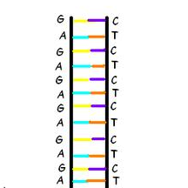
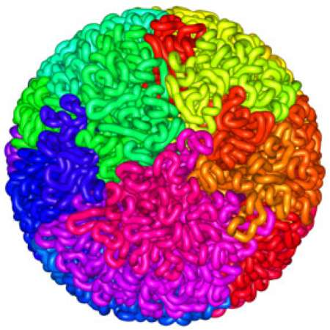
Read Mapping
Map many short DNA fragments (reads) to a known reference genome with some differences allowed
Reference genome
Reads
DNA, physically
DNA, logically
Mapping short reads to reference genome is challenging (billions of 50-300 base pair reads)
Notes:
Read mapping is a post processing procedure after DNA sequencing. It maps the data output from a DNA sequencer, which are many short DNA fragments, to a known reference genome, with some minor differences allowed.
To illustrate the problem better, let us take a closer look at the DNA itself. Logically, the DNA is a double stranded long string. In reality, within a cell they folded into a sphere in the nucleus like a ball of wool. Since it is very hard to disentangle the DNA at molecular level, to extract the information out, a sequencer cuts the mass into many short DNA pieces which are called reads.
A mapper’s job is to find where these DNA short reads are most likely to be originally placed so that later we can assemble them in the correct order to restore the original DNA.
Mapping these short reads, up to billions of them, with each one being 50 to 300 base-pairs long, to the reference genome is challenging.

Slide 22
Read Alignment/Verification
Edit distance is defined as the minimum number of edits (i.e. insertions, deletions, or substitutions) needed to make the read exactly match the reference segment.
NETHERLANDS x SWITZERLAND
N | E | - | T | H | E | R | L | A | N | D | S
S | W | I | T | Z | E | R | L | A | N | D | -
match
deletion
insertion
mismatch
Notes:
http://www.let.rug.nl/kleiweg/lev/

Slide 23
Challenges in Read Mapping
Need to find many mappings of each read
How can we find all mappings efficiently?
Need to tolerate small variances/errors in each read
Each individual is different: Subject’s DNA may slightly differ from the reference (Mismatches, insertions, deletions)
How can we efficiently map each read with up to e errors present?
Need to map each read very fast (i.e., performance is important)
Human DNA is 3.2 billion base pairs long → Millions to billions of reads (State-of-the-art mappers take weeks to map a human’s DNA)
How can we design a much higher performance read mapper?
Notes:
There are three main challenges.
First. The mapper needs to find many mappings for each read. Because the read is so short, they can map to multiple locations in the reference genome. How can we efficiently find all mappings of a read?
Second. The mapper needs to tolerate small variance or errors in each read. Since individuals are different, the subject’s DNA might slightly differs from the reference DNA, which can be mismatches, insertions or deletions of base pairs. How can we efficiently map each read with up to a number of e errors present?
Third. The mapper needs to map each read very fast. In another word, performance is important. Because the human DNA is 3.2 billion base-pairs long and each read is only hundreds of base-pairs long, there can be billions of reads subjected to mapping for an individual human. Current state of the art mappers take weeks to map a human’s DNA. So the question is, how can we design a much higher performance read mapper?

Slide 24
Our First Step: Comprehensive Mapping
+ Guaranteed to find all mappings → sensitive
+ Can tolerate up to e errors
http://mrfast.sourceforge.net/
Alkan+, "Personalized copy number and segmental duplication
maps using next-generation sequencing”, Nature Genetics 2009.
Notes:
It turned out the Hash Table based mappers solve the first 2 challenges pretty well. They guarantee to find all mappings with no more than e errors present.

Slide 25
Read Mapping Execution Time Breakdown
Notes:
An overwhelming majority of the read mapper’s execution time is spent in read alignment.

Slide 26
The Read Mapping Bottleneck
ACGTACGTACGTACGT
CCCCCCTATATATACGTACTAGTACGT
ACGACTTTAGTACGTACGT
TATATATACGTACTAGTACGT
ACGTACGCCCCTACGTA
TATATATACGTACTAGTACGT
ACGACTTTAGTACGTACGT
TATATATACGTACTAAAGTACGT
TATATATACGTACTAGTACGT
ACGTTTTTAAAACGTA
TATATATACGTACTAGTACGT
ACGACGGGGAGTACGTACGT
TATATATACGTACTAAAGTACGT
Illumina HiSeq4000
300
Million
bases/minute
2
Million
bases/minute
150X slower

Slide 27
Idea
Filter fast before you align
Minimize costly
“approximate string comparisons”

Slide 28
Our First Filter: Pure Software Approach
Download the source code and try for yourself
Download link to FastHASH

Slide 29
Shifted Hamming Distance: SIMD Acceleration
https://github.com/CMU-SAFARI/Shifted-Hamming-Distance
Xin+, "Shifted Hamming Distance: A Fast and Accurate SIMD-friendly Filter
to Accelerate Alignment Verification in Read Mapping”, Bioinformatics 2015.

Slide 30
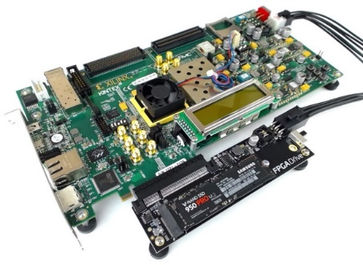
GateKeeper: FPGA-Based Alignment Filtering
1
st
Alignment Filter
FPGA-based Alignment Filter.
Notes:
To bridge the widening gap between the sequencer & the mapper, we propose the concept of pre-alignment filtering. We added a new examination step before the accurate alignment step. The main objective of this step is to detect the incorrect mappings accurately and rapidly. Only the mappings that pass our filter are examined by the alignment step. We also explore exploiting todays’ hardware accelerators to further boost the filtering speed of such filters.

Slide 31
GateKeeper: FPGA-Based Alignment Filtering
Mohammed Alser, Hasan Hassan, Hongyi Xin, Oguz Ergin, Onur Mutlu, and Can Alkan "GateKeeper: A New Hardware Architecture for Accelerating Pre-Alignment in DNA Short Read Mapping" Bioinformatics, [published online, May 31], 2017. [Source Code] [Online link at Bioinformatics Journal]

Slide 32
MAGNET Accelerator [Alser+, TIR 2017]
Notes:
We implement our algorithm in Verilog and design a hardware accelerator for it. Each processing core is able to examine a single mapping. We integrate many hardware processing cores in the architecture of MAGNET for examining many mappings in a parallel fashion.

Slide 33
Newest Work: Shouji [Alser+, Bioinformatics 2019]
Mohammed Alser, Hasan Hassan, Akash Kumar, Onur Mutlu, and Can Alkan, "Shouji: A Fast and Efficient Pre-Alignment Filter for Sequence Alignment" Bioinformatics, [published online, March 28], 2019. [Source Code] [Online link at Bioinformatics Journal]

Slide 34
DNA Read Mapping & Filtering
Problem: Heavily bottlenecked by Data Movement
GateKeeper FPGA performance limited by DRAM bandwidth [Alser+, Bioinformatics 2017]
Ditto for SHD on SIMD [Xin+, Bioinformatics 2015]
Solution: Processing-in-memory can alleviate the bottleneck
However, we need to design mapping & filtering algorithms to fit processing-in-memory

Slide 35
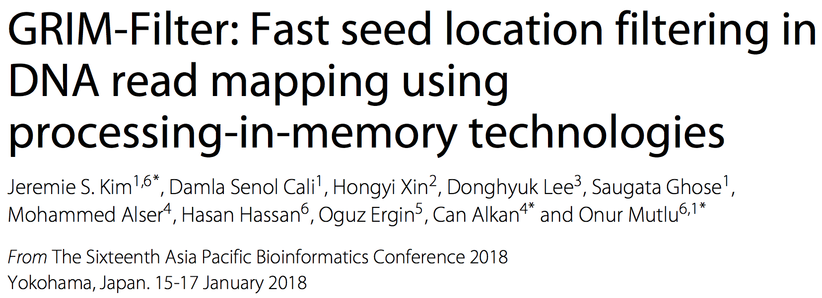
In-Memory DNA Sequence Analysis
Jeremie S. Kim, Damla Senol Cali, Hongyi Xin, Donghyuk Lee, Saugata Ghose, Mohammed Alser, Hasan Hassan, Oguz Ergin, Can Alkan, and Onur Mutlu, "GRIM-Filter: Fast Seed Location Filtering in DNA Read Mapping Using Processing-in-Memory Technologies" BMC Genomics, 2018. Proceedings of the 16th Asia Pacific Bioinformatics Conference (APBC), Yokohama, Japan, January 2018. arxiv.org Version (pdf)

Slide 36
Quick Note: Key Principles and Results
Two key principles:
Exploit the structure of the genome to minimize computation
Morph and exploit the structure of the underlying hardware to maximize performance and efficiency
Algorithm-architecture co-design for DNA read mapping
Speeds up read mapping by ~300X (sometimes more)
Improves accuracy of read mapping in the presence of errors
Xin et al., “Accelerating Read Mapping with FastHASH,” BMC Genomics 2013.
Xin et al., “Shifted Hamming Distance: A Fast and Accurate SIMD-friendly Filter to Accelerate
Alignment Verification in Read Mapping,” Bioinformatics 2015.
Alser et al., “GateKeeper: A New Hardware Architecture for Accelerating Pre-Alignment in DNA
Short Read Mapping,” Bioinformatics 2017.
Kim et al., “Genome Read In-Memory (GRIM) Filter,” BMC Genomics 2018.

Slide 37
New Genome Sequencing Technologies
Oxford Nanopore MinION
Senol Cali+, “Nanopore Sequencing Technology and Tools for Genome
Assembly: Computational Analysis of the Current State, Bottlenecks
and Future Directions,” Briefings in Bioinformatics, 2018.
[Preliminary arxiv.org version]

Slide 38
Nanopore Genome Assembly Pipeline
Senol Cali+, “Nanopore Sequencing Technology and Tools for Genome
Assembly,” Briefings in Bioinformatics, 2018.

Slide 39
Recall Our Dream
An embedded device that can perform comprehensive genome analysis in real time (within a minute)
Still a long ways to go
Energy efficiency
Performance (latency)
Security
Huge memory bottleneck

Slide 40
More on Genome Analysis: Another Talk
Onur Mutlu, "Accelerating Genome Analysis: A Primer on an Ongoing Journey" Keynote talk at 2nd Workshop on Accelerator Architecture in Computational Biology and Bioinformatics (AACBB), Washington, DC, USA, February 2019. [Slides (pptx)(pdf)] [Video]
https://www.youtube.com/watch?v=hPnSmfwu2-A

Slide 41
Four Key Directions
Fundamentally Secure/Reliable/Safe Architectures
Fundamentally Energy-Efficient Architectures
Memory-centric (Data-centric) Architectures
Fundamentally Low-Latency Architectures
Architectures for Genomics, Medicine, Health

Slide 42
Memory & Storage

Slide 43
Why Is Memory So Important? (Especially Today)

Slide 44
Importance of Main Memory
The Performance Perspective
The Energy Perspective
The Scaling/Reliability/Security Perspective
Trends/Challenges/Opportunities in Main Memory

Slide 45
The Main Memory System
Main memory is a critical component of all computing systems: server, mobile, embedded, desktop, sensor
Main memory system must scale (in size, technology, efficiency, cost, and management algorithms) to maintain performance growth and technology scaling benefits
Processors
and caches
Main Memory
Storage (SSD/HDD)

Slide 46
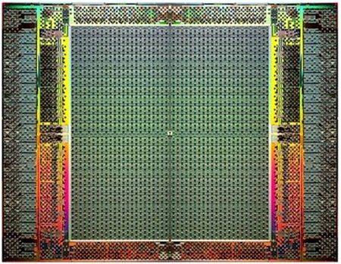
The Main Memory System
Main memory is a critical component of all computing systems: server, mobile, embedded, desktop, sensor
Main memory system must scale (in size, technology, efficiency, cost, and management algorithms) to maintain performance growth and technology scaling benefits
FPGAs
Main Memory
Storage (SSD/HDD)

Slide 47
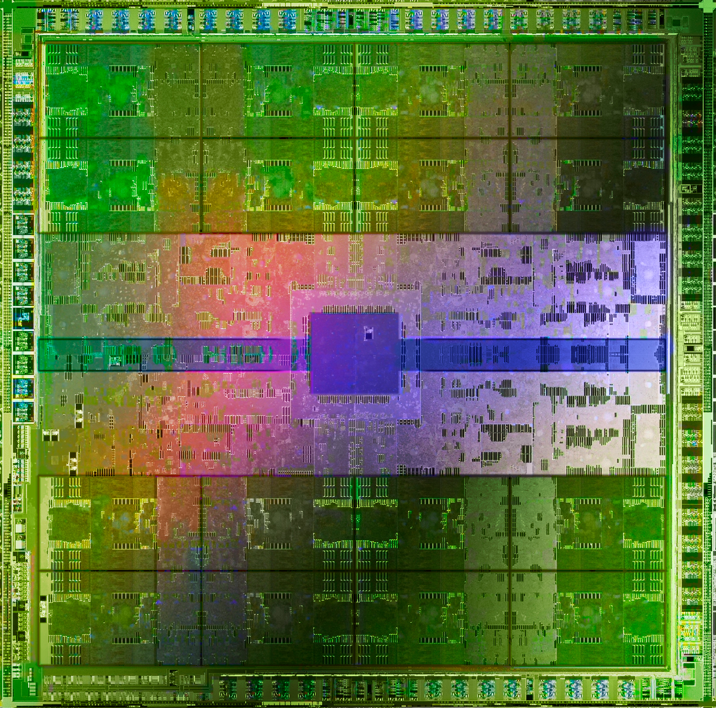
The Main Memory System
Main memory is a critical component of all computing systems: server, mobile, embedded, desktop, sensor
Main memory system must scale (in size, technology, efficiency, cost, and management algorithms) to maintain performance growth and technology scaling benefits
GPUs
Main Memory
Storage (SSD/HDD)

Slide 48
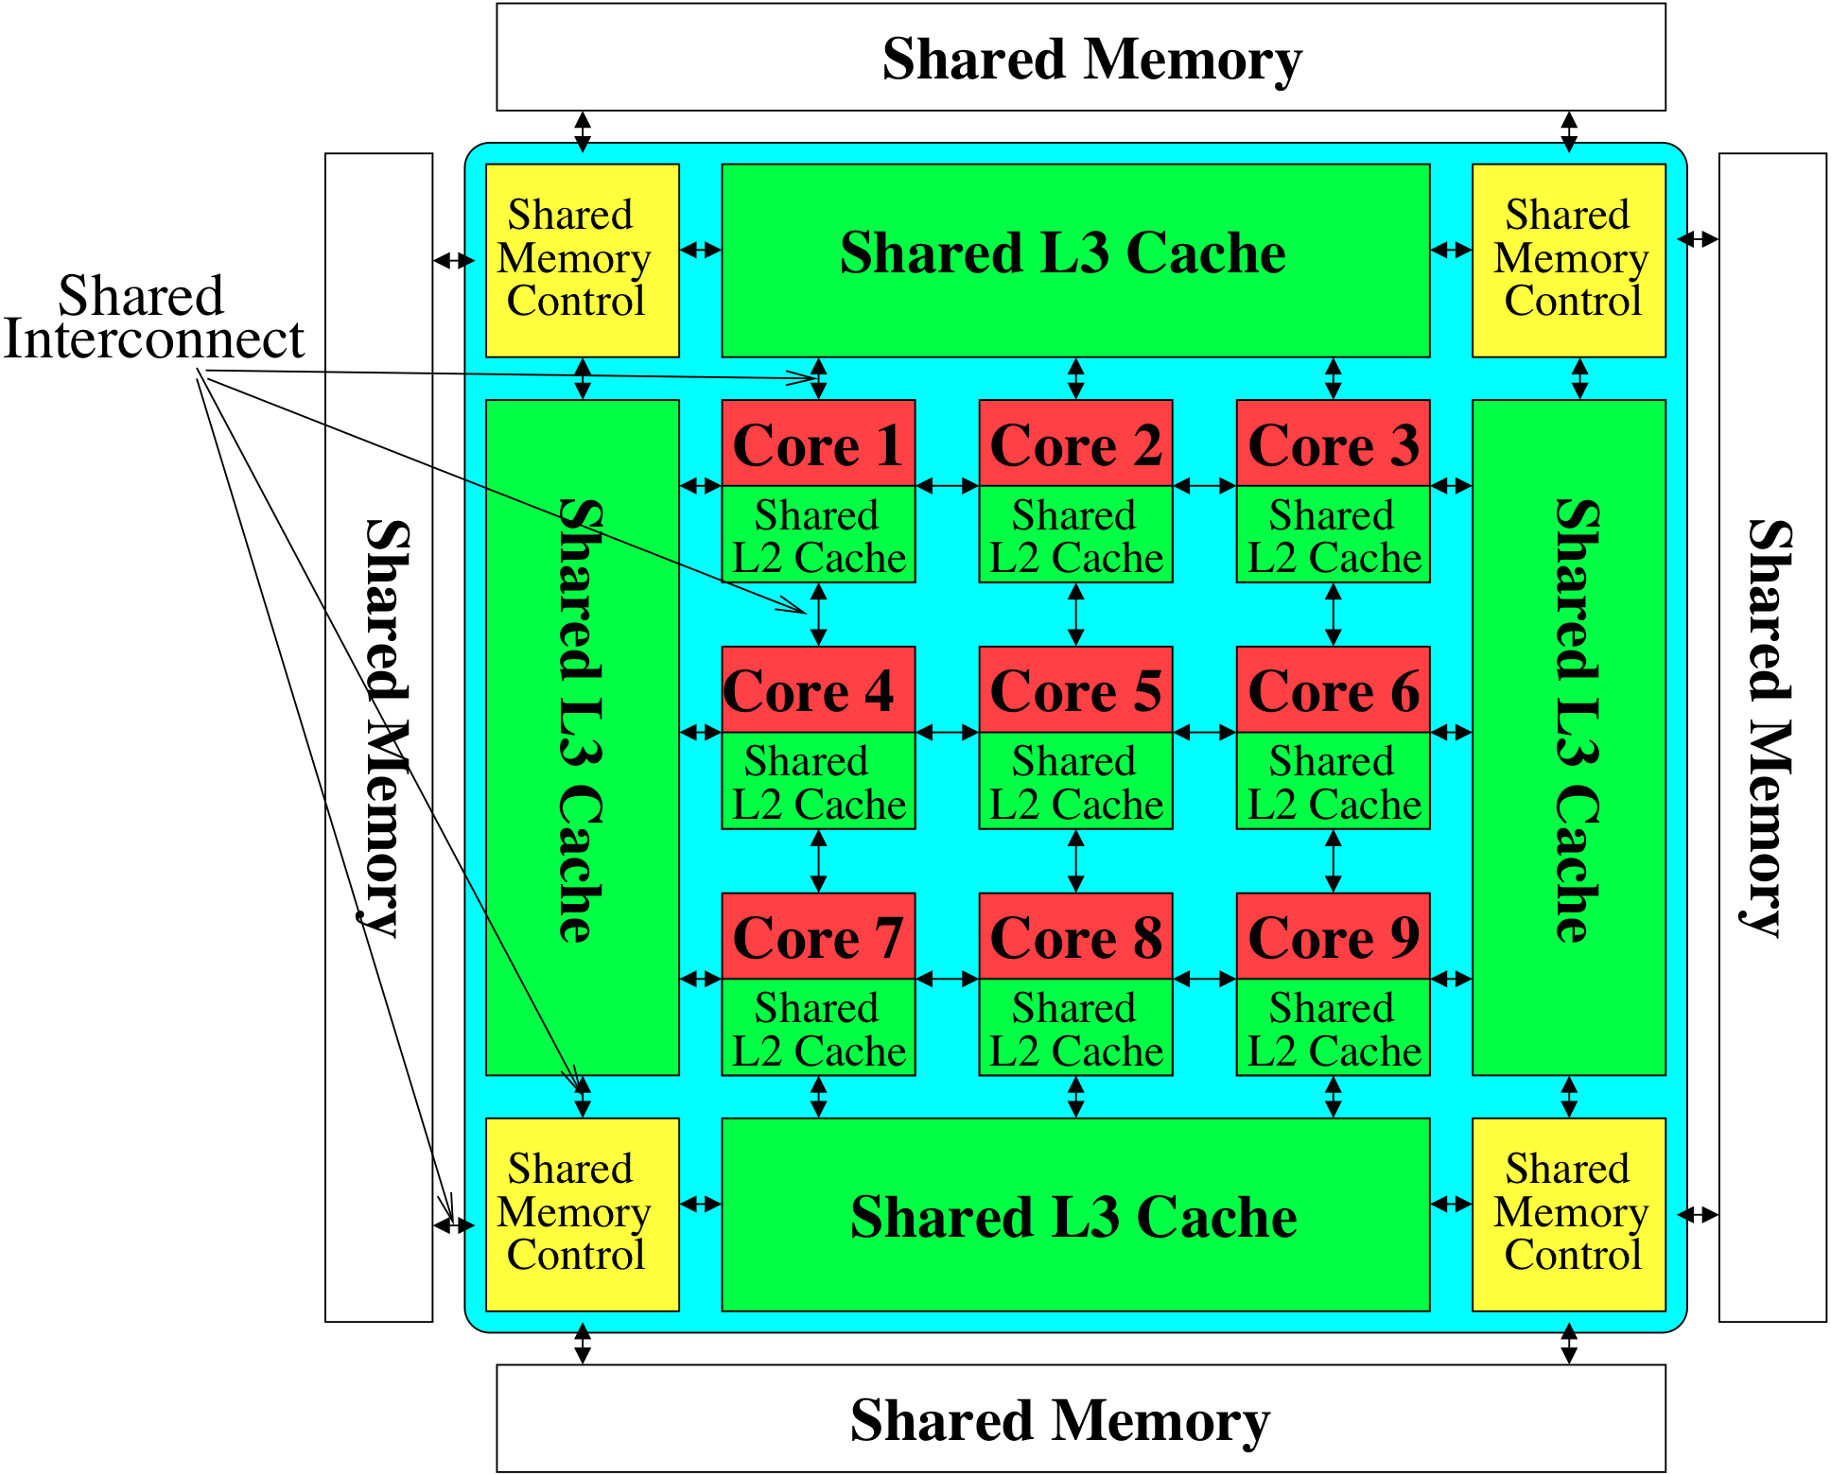
Memory System: A Shared Resource View
Storage
Most of the system is dedicated to storing and moving data

Slide 49
State of the Main Memory System
Recent technology, architecture, and application trends
lead to new requirements
exacerbate old requirements
DRAM and memory controllers, as we know them today, are (will be) unlikely to satisfy all requirements
Some emerging non-volatile memory technologies (e.g., PCM) enable new opportunities: memory+storage merging
We need to rethink the main memory system
to fix DRAM issues and enable emerging technologies
to satisfy all requirements

Slide 50
Major Trends Affecting Main Memory (I)
Need for main memory capacity, bandwidth, QoS increasing
Main memory energy/power is a key system design concern
DRAM technology scaling is ending

Slide 51
Major Trends Affecting Main Memory (II)
Need for main memory capacity, bandwidth, QoS increasing
Multi-core: increasing number of cores/agents
Data-intensive applications: increasing demand/hunger for data
Consolidation: cloud computing, GPUs, mobile, heterogeneity
Main memory energy/power is a key system design concern
DRAM technology scaling is ending

Slide 52
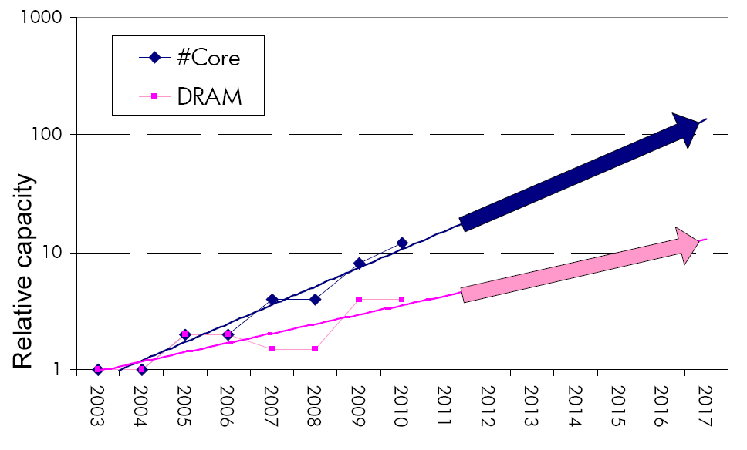
Consequence: The Memory Capacity Gap
Core count doubling ~ every 2 years
DRAM DIMM capacity doubling ~ every 3 years
Memory capacity per core expected to drop by 30% every two years
Trends worse for memory bandwidth per core!
Lim et al., ISCA 2009

Slide 53
DRAM Capacity, Bandwidth & Latency
128x
20x
1.3x

Slide 54
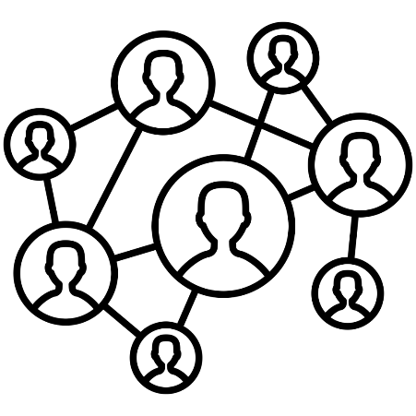
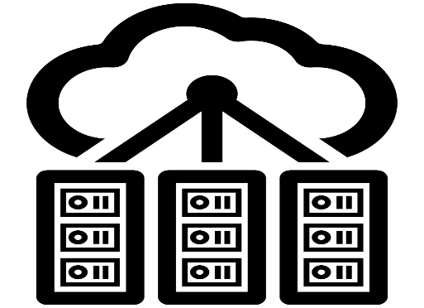
DRAM Is Critical for Performance
In-memory Databases
[Mao+, EuroSys’12; Clapp+ (Intel), IISWC’15]
Graph/Tree Processing
[Xu+, IISWC’12; Umuroglu+, FPL’15]
In-Memory Data Analytics
[Clapp+ (Intel), IISWC’15;
Awan+, BDCloud’15]
Datacenter Workloads [Kanev+ (Google), ISCA’15]

Slide 55
DRAM Is Critical for Performance
In-memory Databases
[Mao+, EuroSys’12; Clapp+ (Intel), IISWC’15]
Graph/Tree Processing
[Xu+, IISWC’12; Umuroglu+, FPL’15]
Memory → performance bottleneck
In-Memory Data Analytics
[Clapp+ (Intel), IISWC’15;
Awan+, BDCloud’15]
Datacenter Workloads [Kanev+ (Google), ISCA’15]

Slide 56
DRAM Is Critical for Performance
Chrome
TensorFlow Mobile
Google’s web browser
Google’s machine learning framework
Video Playback
Video Capture
Google’s video codec
Google’s video codec
Notes:
In this work, we take a look at widely-used google consumer workloads, to figure out the major sources of energy consumption.
We look at Google Chrome web brower. We take a look at Tensorflow, Google’s machine learning framework, and we also take a look at two important video related workloads, video playback and video capture, both rely on Google’s vp9 codec technology.

Slide 57
DRAM Is Critical for Performance
Chrome
TensorFlow Mobile
Google’s web browser
Google’s machine learning framework
Memory → performance bottleneck
Video Playback
Video Capture
Google’s video codec
Google’s video codec
Notes:
In this work, we take a look at widely-used google consumer workloads, to figure out the major sources of energy consumption.
We look at Google Chrome web brower. We take a look at Tensorflow, Google’s machine learning framework, and we also take a look at two important video related workloads, video playback and video capture, both rely on Google’s vp9 codec technology.

Slide 58
Performance Cost of Data Movement
“It’s the Memory, Stupid!” (Richard Sites, MPR, 1996)
Mutlu+, “Runahead Execution: An Alternative to Very Large Instruction Windows for Out-of-Order Processors,” HPCA 2003.

Slide 59
Major Trends Affecting Main Memory (III)
Need for main memory capacity, bandwidth, QoS increasing
Main memory energy/power is a key system design concern
~40-50% energy spent in off-chip memory hierarchy [Lefurgy, IEEE Computer’03] >40% power in DRAM [Ware, HPCA’10][Paul,ISCA’15]
DRAM consumes power even when not used (periodic refresh)
DRAM technology scaling is ending

Slide 60
Energy Cost of Data Movement
Dally, HiPEAC 2015
A memory access consumes ~1000X
the energy of a complex addition

Slide 61
Energy Waste in Mobile Devices
Amirali Boroumand, Saugata Ghose, Youngsok Kim, Rachata Ausavarungnirun, Eric Shiu, Rahul Thakur, Daehyun Kim, Aki Kuusela, Allan Knies, Parthasarathy Ranganathan, and Onur Mutlu, "Google Workloads for Consumer Devices: Mitigating Data Movement Bottlenecks" Proceedings of the 23rd International Conference on Architectural Support for Programming Languages and Operating Systems (ASPLOS), Williamsburg, VA, USA, March 2018.
62.7% of the total system energy
is spent on data movement

Slide 62
Major Trends Affecting Main Memory (IV)
Need for main memory capacity, bandwidth, QoS increasing
Main memory energy/power is a key system design concern
DRAM technology scaling is ending
ITRS projects DRAM will not scale easily below X nm
Scaling has provided many benefits:
higher capacity (density), lower cost, lower energy

Slide 63
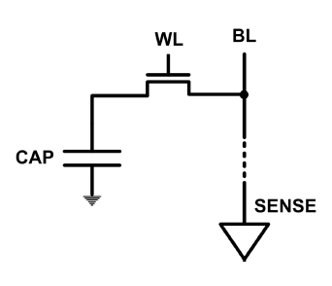
The DRAM Scaling Problem
DRAM stores charge in a capacitor (charge-based memory)
Capacitor must be large enough for reliable sensing
Access transistor should be large enough for low leakage and high retention time
Scaling beyond 40-35nm (2013) is challenging [ITRS, 2009]
DRAM capacity, cost, and energy/power hard to scale

Slide 64
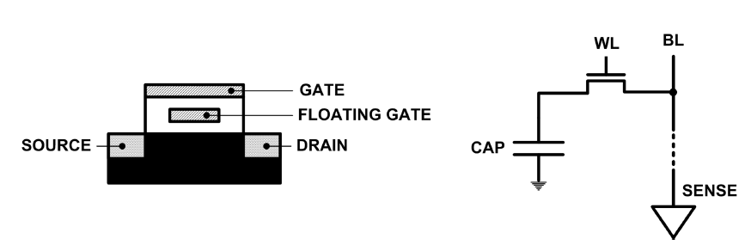
Limits of Charge Memory
Difficult charge placement and control
Flash: floating gate charge
DRAM: capacitor charge, transistor leakage
Reliable sensing becomes difficult as charge storage unit size reduces

Slide 65
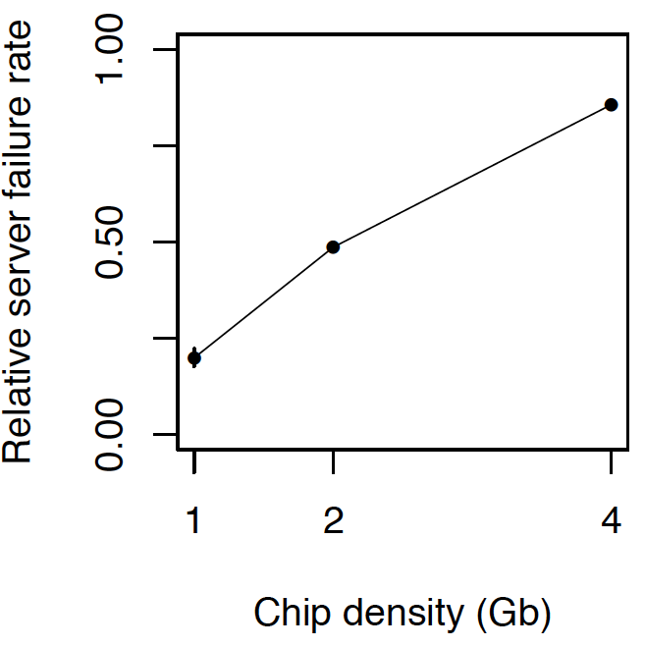
As Memory Scales, It Becomes Unreliable
Data from all of Facebook’s servers worldwide
Meza+, “Revisiting Memory Errors in Large-Scale Production Data Centers,” DSN’15.
Intuition: quadratic increase in capacity

Slide 66
Large-Scale Failure Analysis of DRAM Chips
Analysis and modeling of memory errors found in all of Facebook’s server fleet
Justin Meza, Qiang Wu, Sanjeev Kumar, and Onur Mutlu, "Revisiting Memory Errors in Large-Scale Production Data Centers: Analysis and Modeling of New Trends from the Field" Proceedings of the 45th Annual IEEE/IFIP International Conference on Dependable Systems and Networks (DSN), Rio de Janeiro, Brazil, June 2015. [Slides (pptx) (pdf)] [DRAM Error Model]

Slide 67
Infrastructures to Understand Such Issues
Temperature
Controller
FPGAs
Heater
FPGAs
PC
Kim+, “Flipping Bits in Memory Without Accessing Them: An Experimental Study of DRAM Disturbance Errors,” ISCA 2014.

Slide 68
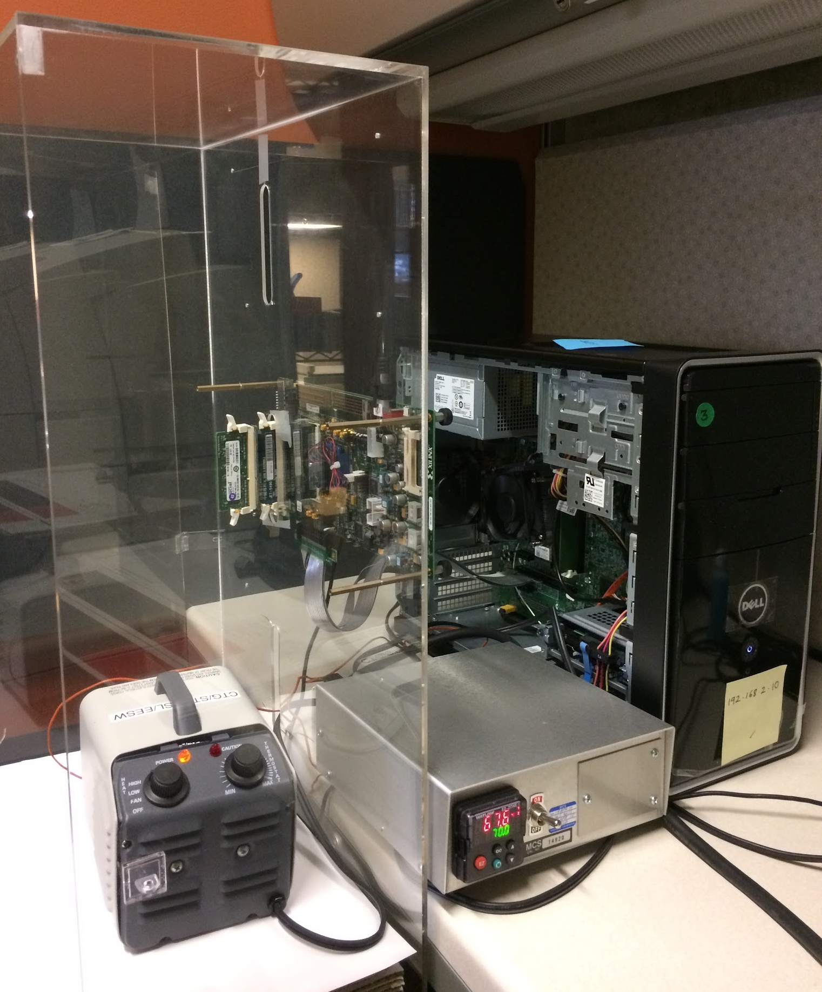
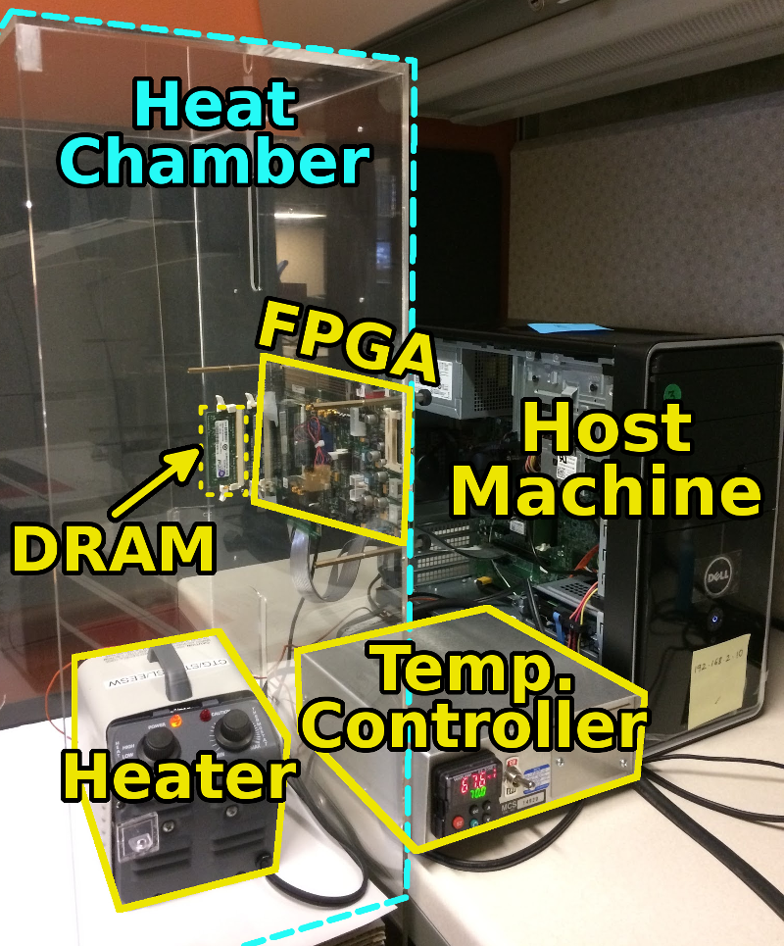
SoftMC: Open Source DRAM Infrastructure
Hasan Hassan et al., “SoftMC: A Flexible and Practical Open-Source Infrastructure for Enabling Experimental DRAM Studies,” HPCA 2017.
Flexible
Easy to Use (C++ API)
Open-source
github.com/CMU-SAFARI/SoftMC

Slide 69
SoftMC
https://github.com/CMU-SAFARI/SoftMC

Slide 70
A Curious Discovery [Kim et al., ISCA 2014]
One can
predictably induce errors
in most DRAM memory chips

Slide 71
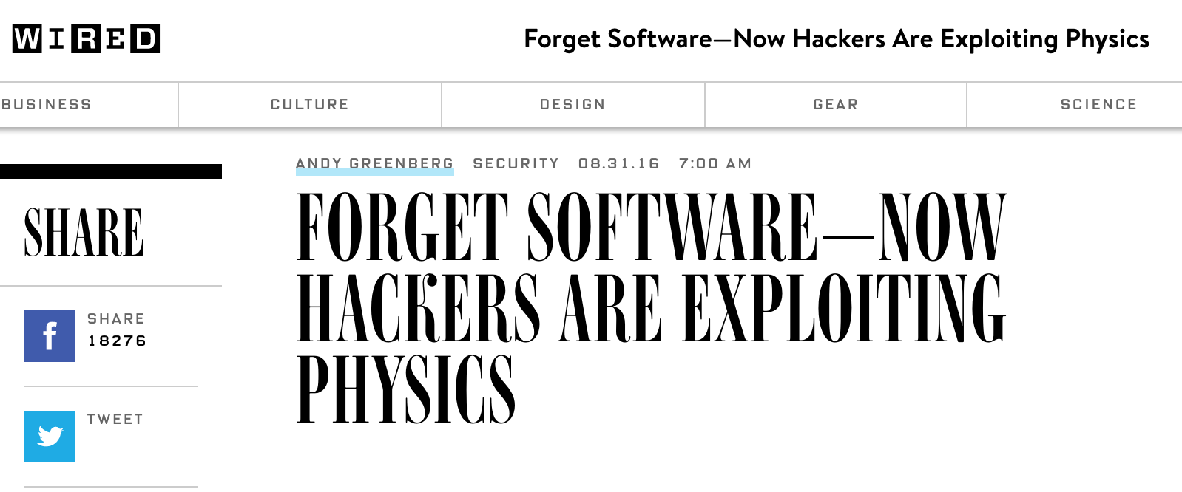
DRAM RowHammer
A simple hardware failure mechanism
can create a widespread
system security vulnerability

Slide 72
The Reliability & Security Perspectives
Onur Mutlu, "The RowHammer Problem and Other Issues We May Face as Memory Becomes Denser" Invited Paper in Proceedings of the Design, Automation, and Test in Europe Conference (DATE), Lausanne, Switzerland, March 2017. [Slides (pptx) (pdf)]
https://people.inf.ethz.ch/omutlu/pub/rowhammer-and-other-memory-issues_date17.pdf

Slide 73
A RowHammer Retrospective
Onur Mutlu and Jeremie Kim, "RowHammer: A Retrospective" IEEE Transactions on Computer-Aided Design of Integrated Circuits and Systems (TCAD) Special Issue on Top Picks in Hardware and Embedded Security, 2019. [Preliminary arXiv version]

Slide 74
Major Trends Affecting Main Memory (V)
DRAM scaling has already become increasingly difficult
Increasing cell leakage current, reduced cell reliability, increasing manufacturing difficulties [Kim+ ISCA 2014], [Liu+ ISCA 2013], [Mutlu IMW 2013], [Mutlu DATE 2017]
Difficult to significantly improve capacity, energy
Emerging memory technologies are promising
3D-Stacked DRAM | higher bandwidth | smaller capacity
Reduced-Latency DRAM (e.g., RLDRAM, TL-DRAM) | lower latency | higher cost
Low-Power DRAM (e.g., LPDDR3, LPDDR4) | lower power | higher latency higher cost
Non-Volatile Memory (NVM) (e.g., PCM, STTRAM, ReRAM, 3D Xpoint) | larger capacity | higher latency higher dynamic power lower endurance

Slide 75
Major Trends Affecting Main Memory (V)
DRAM scaling has already become increasingly difficult
Increasing cell leakage current, reduced cell reliability, increasing manufacturing difficulties [Kim+ ISCA 2014], [Liu+ ISCA 2013], [Mutlu IMW 2013], [Mutlu DATE 2017]
Difficult to significantly improve capacity, energy
Emerging memory technologies are promising
3D-Stacked DRAM | higher bandwidth | smaller capacity
Reduced-Latency DRAM (e.g., RL/TL-DRAM, FLY-RAM) | lower latency | higher cost
Low-Power DRAM (e.g., LPDDR3, LPDDR4, Voltron) | lower power | higher latency higher cost
Non-Volatile Memory (NVM) (e.g., PCM, STTRAM, ReRAM, 3D Xpoint) | larger capacity | higher latency higher dynamic power lower endurance

Slide 76
Major Trend: Hybrid Main Memory
CPU
Meza+, “Enabling Efficient and Scalable Hybrid Memories,” IEEE Comp. Arch. Letters, 2012.
Yoon+, “Row Buffer Locality Aware Caching Policies for Hybrid Memories,” ICCD 2012 Best Paper Award.
DRAMCtrl
PCM Ctrl
DRAM
Phase Change Memory (or Tech. X)
Fast, durable
Small,
leaky, volatile,
high-cost
Large, non-volatile, low-cost
Slow, wears out, high active energy
Hardware/software manage data allocation and movement
to achieve the best of multiple technologies

Slide 77
One Foreshadowing
Main Memory Needs
Intelligent Controllers

Slide 78
Industry Is Writing Papers About It, Too

Slide 79
Call for Intelligent Memory Controllers

Slide 80
An Orthogonal Issue: Memory Interference
Main
Memory
Core
Core
Core
Core
Cores’ interfere with each other when accessing shared main memory
Uncontrolled interference leads to many problems (QoS, performance)
Notes:
In a multicore system, multiple applications running on the different cores share the main memory.
These applications interfere at the main memory. The result of this interference is unpredictable application slowdowns.

Slide 81
Goal: Predictable Performance in Complex Systems
CPU
CPU
CPU
CPU
GPU
HWA
HWA
Shared Cache
DRAM and Hybrid Memory Controllers
DRAM and Hybrid Memories
Heterogeneous agents: CPUs, GPUs, and HWAs
Main memory interference between CPUs, GPUs, HWAs
How to allocate resources to heterogeneous agents
to mitigate interference and provide predictable performance?

Slide 82
One Foreshadowing
Main Memory Needs
Intelligent Controllers

Slide 83
Trends, Challenges, and Opportunities in Main Memory

Slide 84
How Do We Solve The Memory Problem?
Fix it: Make memory and controllers more intelligent
New interfaces, functions, architectures: system-mem codesign
Eliminate or minimize it: Replace or (more likely) augment DRAM with a different technology
New technologies and system-wide rethinking of memory & storage
Embrace it: Design heterogeneous memories (none of which are perfect) and map data intelligently across them
New models for data management and maybe usage
…

Slide 85
How Do We Solve The Memory Problem?
Fix it: Make memory and controllers more intelligent
New interfaces, functions, architectures: system-mem codesign
Eliminate or minimize it: Replace or (more likely) augment DRAM with a different technology
New technologies and system-wide rethinking of memory & storage
Embrace it: Design heterogeneous memories (none of which are perfect) and map data intelligently across them
New models for data management and maybe usage
…
Solutions (to memory scaling) require
software/hardware/device cooperation

Slide 86
How Do We Solve The Memory Problem?
Fix it: Make memory and controllers more intelligent
New interfaces, functions, architectures: system-mem codesign
Eliminate or minimize it: Replace or (more likely) augment DRAM with a different technology
New technologies and system-wide rethinking of memory & storage
Embrace it: Design heterogeneous memories (none of which are perfect) and map data intelligently across them
New models for data management and maybe usage
…
Problems
Algorithms
Programs
User
Runtime System
(VM, OS, MM)
ISA
Microarchitecture
Logic
Devices
Solutions (to memory scaling) require
software/hardware/device cooperation

Slide 87
Solution 1: New Memory Architectures
Overcome memory shortcomings with
Memory-centric system design
Novel memory architectures, interfaces, functions
Better waste management (efficient utilization)
Key issues to tackle
Enable reliability at low cost → high capacity
Reduce energy
Reduce latency
Improve bandwidth
Reduce waste (capacity, bandwidth, latency)
Enable computation close to data

Slide 88
Solution 1: New Memory Architectures
Liu+, “RAIDR: Retention-Aware Intelligent DRAM Refresh,” ISCA 2012.
Kim+, “A Case for Exploiting Subarray-Level Parallelism in DRAM,” ISCA 2012.
Lee+, “Tiered-Latency DRAM: A Low Latency and Low Cost DRAM Architecture,” HPCA 2013.
Liu+, “An Experimental Study of Data Retention Behavior in Modern DRAM Devices,” ISCA 2013.
Seshadri+, “RowClone: Fast and Efficient In-DRAM Copy and Initialization of Bulk Data,” MICRO 2013.
Pekhimenko+, “Linearly Compressed Pages: A Main Memory Compression Framework,” MICRO 2013.
Chang+, “Improving DRAM Performance by Parallelizing Refreshes with Accesses,” HPCA 2014.
Khan+, “The Efficacy of Error Mitigation Techniques for DRAM Retention Failures: A Comparative Experimental Study,” SIGMETRICS 2014.
Luo+, “Characterizing Application Memory Error Vulnerability to Optimize Data Center Cost,” DSN 2014.
Kim+, “Flipping Bits in Memory Without Accessing Them: An Experimental Study of DRAM Disturbance Errors,” ISCA 2014.
Lee+, “Adaptive-Latency DRAM: Optimizing DRAM Timing for the Common-Case,” HPCA 2015.
Qureshi+, “AVATAR: A Variable-Retention-Time (VRT) Aware Refresh for DRAM Systems,” DSN 2015.
Meza+, “Revisiting Memory Errors in Large-Scale Production Data Centers: Analysis and Modeling of New Trends from the Field,” DSN 2015.
Kim+, “Ramulator: A Fast and Extensible DRAM Simulator,” IEEE CAL 2015.
Seshadri+, “Fast Bulk Bitwise AND and OR in DRAM,” IEEE CAL 2015.
Ahn+, “A Scalable Processing-in-Memory Accelerator for Parallel Graph Processing,” ISCA 2015.
Ahn+, “PIM-Enabled Instructions: A Low-Overhead, Locality-Aware Processing-in-Memory Architecture,” ISCA 2015.
Lee+, “Decoupled Direct Memory Access: Isolating CPU and IO Traffic by Leveraging a Dual-Data-Port DRAM,” PACT 2015.
Seshadri+, “Gather-Scatter DRAM: In-DRAM Address Translation to Improve the Spatial Locality of Non-unit Strided Accesses,” MICRO 2015.
Lee+, “Simultaneous Multi-Layer Access: Improving 3D-Stacked Memory Bandwidth at Low Cost,” TACO 2016.
Hassan+, “ChargeCache: Reducing DRAM Latency by Exploiting Row Access Locality,” HPCA 2016.
Chang+, “Low-Cost Inter-Linked Subarrays (LISA): Enabling Fast Inter-Subarray Data Migration in DRAM,” HPCA 2016.
Chang+, “Understanding Latency Variation in Modern DRAM Chips Experimental Characterization, Analysis, and Optimization,” SIGMETRICS 2016.
Khan+, “PARBOR: An Efficient System-Level Technique to Detect Data Dependent Failures in DRAM,” DSN 2016.
Hsieh+, “Transparent Offloading and Mapping (TOM): Enabling Programmer-Transparent Near-Data Processing in GPU Systems,” ISCA 2016.
Hashemi+, “Accelerating Dependent Cache Misses with an Enhanced Memory Controller,” ISCA 2016.
Boroumand+, “LazyPIM: An Efficient Cache Coherence Mechanism for Processing-in-Memory,” IEEE CAL 2016.
Pattnaik+, “Scheduling Techniques for GPU Architectures with Processing-In-Memory Capabilities,” PACT 2016.
Hsieh+, “Accelerating Pointer Chasing in 3D-Stacked Memory: Challenges, Mechanisms, Evaluation,” ICCD 2016.
Hashemi+, “Continuous Runahead: Transparent Hardware Acceleration for Memory Intensive Workloads,” MICRO 2016.
Khan+, “A Case for Memory Content-Based Detection and Mitigation of Data-Dependent Failures in DRAM",” IEEE CAL 2016.
Hassan+, “SoftMC: A Flexible and Practical Open-Source Infrastructure for Enabling Experimental DRAM Studies,” HPCA 2017.
Mutlu, “The RowHammer Problem and Other Issues We May Face as Memory Becomes Denser,” DATE 2017.
Lee+, “Design-Induced Latency Variation in Modern DRAM Chips: Characterization, Analysis, and Latency Reduction Mechanisms,” SIGMETRICS 2017.
Chang+, “Understanding Reduced-Voltage Operation in Modern DRAM Devices: Experimental Characterization, Analysis, and Mechanisms,” SIGMETRICS 2017.
Patel+, “The Reach Profiler (REAPER): Enabling the Mitigation of DRAM Retention Failures via Profiling at Aggressive Conditions,” ISCA 2017.
Seshadri and Mutlu, “Simple Operations in Memory to Reduce Data Movement,” ADCOM 2017.
Liu+, “Concurrent Data Structures for Near-Memory Computing,” SPAA 2017.
Khan+, “Detecting and Mitigating Data-Dependent DRAM Failures by Exploiting Current Memory Content,” MICRO 2017.
Seshadri+, “Ambit: In-Memory Accelerator for Bulk Bitwise Operations Using Commodity DRAM Technology,” MICRO 2017.
Kim+, “GRIM-Filter: Fast Seed Location Filtering in DNA Read Mapping Using Processing-in-Memory Technologies,” BMC Genomics 2018.
Kim+, “The DRAM Latency PUF: Quickly Evaluating Physical Unclonable Functions by Exploiting the Latency-Reliability Tradeoff in Modern DRAM Devices,” HPCA 2018.
Boroumand+, “Google Workloads for Consumer Devices: Mitigating Data Movement Bottlenecks,” ASPLOS 2018.
Das+, “VRL-DRAM: Improving DRAM Performance via Variable Refresh Latency,” DAC 2018.
Ghose+, “What Your DRAM Power Models Are Not Telling You: Lessons from a Detailed Experimental Study,” SIGMETRICS 2018.
Kim+, “Solar-DRAM: Reducing DRAM Access Latency by Exploiting the Variation in Local Bitlines,” ICCD 2018.
Wang+, “Reducing DRAM Latency via Charge-Level-Aware Look-Ahead Partial Restoration,” MICRO 2018.
Kim+, “D-RaNGe: Using Commodity DRAM Devices to Generate True Random Numbers with Low Latency and High Throughput,” HPCA 2019.
Singh+, “NAPEL: Near-Memory Computing Application Performance Prediction via Ensemble Learning,” DAC 2019.
Ghose+, “Demystifying Workload–DRAM Interactions: An Experimental Study,” SIGMETRICS 2019.
Patel+, “Understanding and Modeling On-Die Error Correction in Modern DRAM: An Experimental Study Using Real Devices,” DSN 2019.
Boroumand+, “CoNDA: Efficient Cache Coherence Support for Near-Data Accelerators,” ISCA 2019.
Hassan+, “CROW: A Low-Cost Substrate for Improving DRAM Performance, Energy Efficiency, and Reliability,” ISCA 2019.
Mutlu and Kim, “RowHammer: A Retrospective,” TCAD 2019.
Mutlu+, “Processing Data Where It Makes Sense: Enabling In-Memory Computation,” MICPRO 2019.
Seshadri and Mutlu, “In-DRAM Bulk Bitwise Execution Engine,” ADCOM 2020.
Avoid DRAM:
Seshadri+, “The Evicted-Address Filter: A Unified Mechanism to Address Both Cache Pollution and Thrashing,” PACT 2012.
Pekhimenko+, “Base-Delta-Immediate Compression: Practical Data Compression for On-Chip Caches,” PACT 2012.
Seshadri+, “The Dirty-Block Index,” ISCA 2014.
Pekhimenko+, “Exploiting Compressed Block Size as an Indicator of Future Reuse,” HPCA 2015.
Vijaykumar+, “A Case for Core-Assisted Bottleneck Acceleration in GPUs: Enabling Flexible Data Compression with Assist Warps,” ISCA 2015.
Pekhimenko+, “Toggle-Aware Bandwidth Compression for GPUs,” HPCA 2016.

Slide 89
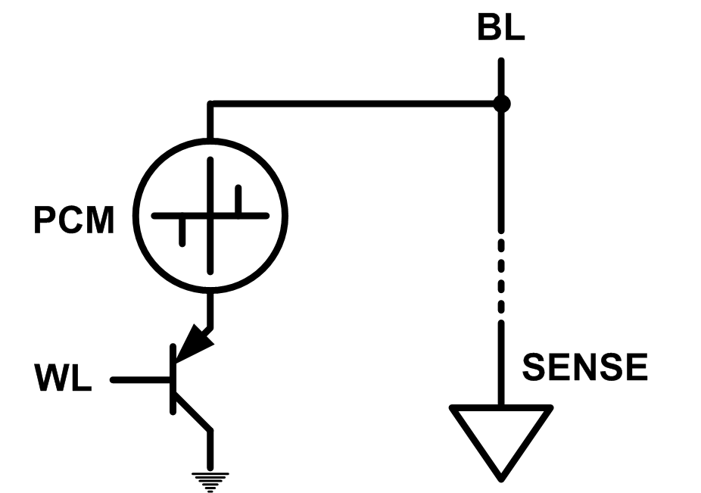
Solution 2: Emerging Memory Technologies
Some emerging resistive memory technologies seem more scalable than DRAM (and they are non-volatile)
Example: Phase Change Memory
Data stored by changing phase of material
Data read by detecting material’s resistance
Expected to scale to 9nm (2022 [ITRS 2009])
Prototyped at 20nm (Raoux+, IBM JRD 2008)
Expected to be denser than DRAM: can store multiple bits/cell
But, emerging technologies have (many) shortcomings
Can they be enabled to replace/augment/surpass DRAM?
Notes:
Even if DRAM continues to scale there could be benefits to examining and enabling these new technologies.

Slide 90
Solution 2: Emerging Memory Technologies
Lee+, “Architecting Phase Change Memory as a Scalable DRAM Alternative,” ISCA’09, CACM’10, IEEE Micro’10.
Meza+, “Enabling Efficient and Scalable Hybrid Memories,” IEEE Comp. Arch. Letters 2012.
Yoon, Meza+, “Row Buffer Locality Aware Caching Policies for Hybrid Memories,” ICCD 2012.
Kultursay+, “Evaluating STT-RAM as an Energy-Efficient Main Memory Alternative,” ISPASS 2013.
Meza+, “A Case for Efficient Hardware-Software Cooperative Management of Storage and Memory,” WEED 2013.
Lu+, “Loose Ordering Consistency for Persistent Memory,” ICCD 2014.
Zhao+, “FIRM: Fair and High-Performance Memory Control for Persistent Memory Systems,” MICRO 2014.
Yoon, Meza+, “Efficient Data Mapping and Buffering Techniques for Multi-Level Cell Phase-Change Memories,” TACO 2014.
Ren+, “ThyNVM: Enabling Software-Transparent Crash Consistency in Persistent Memory Systems,” MICRO 2015.
Chauhan+, “NVMove: Helping Programmers Move to Byte-Based Persistence,” INFLOW 2016.
Li+, “Utility-Based Hybrid Memory Management,” CLUSTER 2017.
Yu+, “Banshee: Bandwidth-Efficient DRAM Caching via Software/Hardware Cooperation,” MICRO 2017.
Tavakkol+, “MQSim: A Framework for Enabling Realistic Studies of Modern Multi-Queue SSD Devices,” FAST 2018.
Tavakkol+, “FLIN: Enabling Fairness and Enhancing Performance in Modern NVMe Solid State Drives,” ISCA 2018.
Sadrosadati+. “LTRF: Enabling High-Capacity Register Files for GPUs via Hardware/Software Cooperative Register Prefetching,” ASPLOS 2018.
Salkhordeh+, “An Analytical Model for Performance and Lifetime Estimation of Hybrid DRAM-NVM Main Memories,” TC 2019.
Wang+, “Panthera: Holistic Memory Management for Big Data Processing over Hybrid Memories,” PLDI 2019.
Notes:
Even if DRAM continues to scale there could be benefits to examining and enabling these new technologies.

Slide 91
Combination: Hybrid Memory Systems
CPU
Meza+, “Enabling Efficient and Scalable Hybrid Memories,” IEEE Comp. Arch. Letters, 2012.
Yoon, Meza et al., “Row Buffer Locality Aware Caching Policies for Hybrid Memories,” ICCD 2012 Best Paper Award.
DRAMCtrl
PCM Ctrl
DRAM
Technology X (e.g., PCM)
Fast, durable
Small,
leaky, volatile,
high-cost
Large, non-volatile, low-cost
Slow, wears out, high active energy
Hardware/software manage data allocation and movement
to achieve the best of multiple technologies

Slide 92
Exploiting Memory Error Tolerance with Hybrid Memory Systems
Heterogeneous-Reliability Memory [DSN 2014]
Vulnerable data
Vulnerable data
Tolerant data
Tolerant data
Reliable memory
Low-cost memory
Vulnerable data
On Microsoft’s Web Search workload
Reduces server hardware cost by 4.7 %
Achieves single server availability target of 99.90 %
ECC protected
Well-tested chips
Tolerant data
NoECC or Parity
Less-tested chips
Notes:
As we have shown earlier, either across or within applications, our characterization can identify data that are vulnerable to memory errors and data that are tolerant to memory errors.
To exploit this observation, we would like to map these different data onto different memory modules according to their memory error tolerance.
As an example here, we map vulnerable data to reliable memory to improve reliability, and map tolerant data to low-cost less-reliable memory to exploit its tolerance and lower the cost. We call this mechanism heterogeneous-reliability memory, HRM.
Reliable memory consists of … Low cost memory consists of …
As we will show later, HRM allows us to use weaker error protection in memory, and enables the use of less-tested memory chips to lower the cost of the memory system, while still achieving reasonable single-server reliability target.

Slide 93
More on Heterogeneous Reliability Memory
Yixin Luo, Sriram Govindan, Bikash Sharma, Mark Santaniello, Justin Meza, Aman Kansal, Jie Liu, Badriddine Khessib, Kushagra Vaid, and Onur Mutlu, "Characterizing Application Memory Error Vulnerability to Optimize Data Center Cost via Heterogeneous-Reliability Memory" Proceedings of the 44th Annual IEEE/IFIP International Conference on Dependable Systems and Networks (DSN), Atlanta, GA, June 2014. [Summary] [Slides (pptx) (pdf)] [Coverage on ZDNet]

Slide 94
An Orthogonal Issue: Memory Interference
Problem: Memory interference between cores is uncontrolled
→ unfairness, starvation, low performance
→ uncontrollable, unpredictable, vulnerable system
Solution: QoS-Aware Memory Systems
Hardware designed to provide a configurable fairness substrate
Application-aware memory scheduling, partitioning, throttling
Software designed to configure the resources to satisfy different QoS goals
QoS-aware memory systems can provide predictable performance and higher efficiency

Slide 95
Strong Memory Service Guarantees
Goal: Satisfy performance/SLA requirements in the presence of shared main memory, heterogeneous agents, and hybrid memory/storage
Approach:
Develop techniques/models to accurately estimate the performance loss of an application/agent in the presence of resource sharing
Develop mechanisms (hardware and software) to enable the resource partitioning/prioritization needed to achieve the required performance levels for all applications
All the while providing high system performance
Subramanian et al., “MISE: Providing Performance Predictability and Improving Fairness in Shared Main Memory Systems,” HPCA 2013.
Subramanian et al., “The Application Slowdown Model,” MICRO 2015.

Slide 96
Agenda for Today
Memory Importance and Trends
RowHammer: Memory Reliability and Security
In-Memory Computation
Low-Latency Memory
Guiding Principles
Conclusion

Slide 97
Memory Systems and Memory-Centric Computing Systems Part 1: Memory Importance and Trends
Prof. Onur Mutlu
omutlu@gmail.com
https://people.inf.ethz.ch/omutlu
7 July 2019
SAMOS Tutorial

Slide 98
Backup Slides

Slide 99
Readings, Videos, Reference Materials

Slide 100
Accelerated Memory Course (~6.5 hours)
ACACES 2018
Memory Systems and Memory-Centric Computing Systems
Taught by Onur Mutlu July 9-13, 2018
~6.5 hours of lectures
Website for the Course including Videos, Slides, Papers
https://safari.ethz.ch/memory_systems/ACACES2018/
https://www.youtube.com/playlist?list=PL5Q2soXY2Zi-HXxomthrpDpMJm05P6J9x
All Papers are at:
https://people.inf.ethz.ch/omutlu/projects.htm
Final lecture notes and readings (for all topics)

Slide 101
Required: Reference Overview Paper I
Onur Mutlu, Saugata Ghose, Juan Gomez-Luna, and Rachata Ausavarungnirun, "Processing Data Where It Makes Sense: Enabling In-Memory Computation" Invited paper in Microprocessors and Microsystems (MICPRO), June 2019. [arXiv version]

Slide 102
Required: Reference Overview Paper II
Onur Mutlu and Jeremie Kim, "RowHammer: A Retrospective" IEEE Transactions on Computer-Aided Design of Integrated Circuits and Systems (TCAD) Special Issue on Top Picks in Hardware and Embedded Security, 2019. [Preliminary arXiv version]

Slide 103
Required: Reference Overview Paper III
Onur Mutlu and Lavanya Subramanian, "Research Problems and Opportunities in Memory Systems" Invited Article in Supercomputing Frontiers and Innovations (SUPERFRI), 2014/2015.
https://people.inf.ethz.ch/omutlu/pub/memory-systems-research_superfri14.pdf

Slide 104
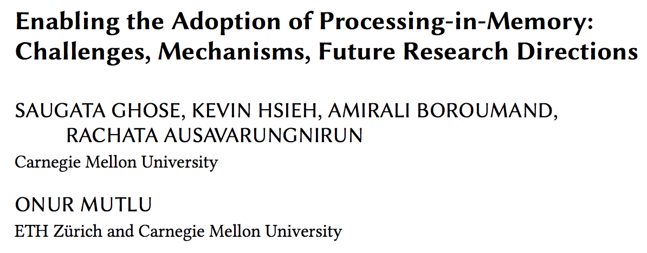
Reference Overview Paper IV
Saugata Ghose, Kevin Hsieh, Amirali Boroumand, Rachata Ausavarungnirun, Onur Mutlu, "Enabling the Adoption of Processing-in-Memory: Challenges, Mechanisms, Future Research Directions" Invited Book Chapter, to appear in 2018. [Preliminary arxiv.org version]
https://arxiv.org/pdf/1802.00320.pdf

Slide 105
Reference Overview Paper V
Onur Mutlu, "The RowHammer Problem and Other Issues We May Face as Memory Becomes Denser" Invited Paper in Proceedings of the Design, Automation, and Test in Europe Conference (DATE), Lausanne, Switzerland, March 2017. [Slides (pptx) (pdf)]
https://people.inf.ethz.ch/omutlu/pub/rowhammer-and-other-memory-issues_date17.pdf

Slide 106
Reference Overview Paper VI
Onur Mutlu, "Memory Scaling: A Systems Architecture Perspective" Technical talk at MemCon 2013 (MEMCON), Santa Clara, CA, August 2013. [Slides (pptx) (pdf)] [Video] [Coverage on StorageSearch]
https://people.inf.ethz.ch/omutlu/pub/memory-scaling_memcon13.pdf

Slide 107
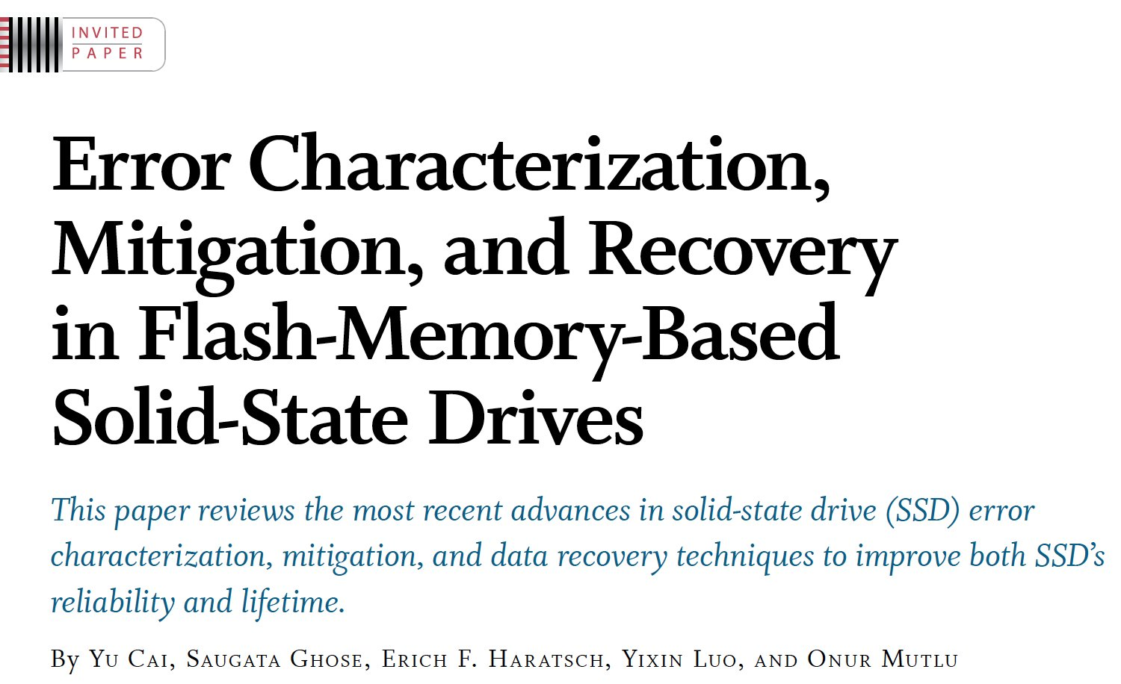
Reference Overview Paper VII
Proceedings of the IEEE, Sept. 2017
https://arxiv.org/pdf/1706.08642

Slide 108
Related Videos and Course Materials (I)
Undergraduate Computer Architecture Course Lecture Videos (2015, 2014, 2013)
Undergraduate Computer Architecture Course Materials (2015, 2014, 2013)
Graduate Computer Architecture Course Lecture Videos (2017, 2015, 2013)
Graduate Computer Architecture Course Materials (2017, 2015, 2013)
Parallel Computer Architecture Course Materials (Lecture Videos)

Slide 109
Related Videos and Course Materials (II)
Freshman Digital Circuits and Computer Architecture Course Lecture Videos (2018, 2017)
Freshman Digital Circuits and Computer Architecture Course Materials (2018)
Memory Systems Short Course Materials
(Lecture Video on Main Memory and DRAM Basics)

Slide 110
Some Open Source Tools (I)
Rowhammer – Program to Induce RowHammer Errors
https://github.com/CMU-SAFARI/rowhammer
Ramulator – Fast and Extensible DRAM Simulator
https://github.com/CMU-SAFARI/ramulator
MemSim – Simple Memory Simulator
https://github.com/CMU-SAFARI/memsim
NOCulator – Flexible Network-on-Chip Simulator
https://github.com/CMU-SAFARI/NOCulator
SoftMC – FPGA-Based DRAM Testing Infrastructure
https://github.com/CMU-SAFARI/SoftMC
Other open-source software from my group
https://github.com/CMU-SAFARI/
http://www.ece.cmu.edu/~safari/tools.html

Slide 111
Some Open Source Tools (II)
MQSim – A Fast Modern SSD Simulator
https://github.com/CMU-SAFARI/MQSim
Mosaic – GPU Simulator Supporting Concurrent Applications
https://github.com/CMU-SAFARI/Mosaic
IMPICA – Processing in 3D-Stacked Memory Simulator
https://github.com/CMU-SAFARI/IMPICA
SMLA – Detailed 3D-Stacked Memory Simulator
https://github.com/CMU-SAFARI/SMLA
HWASim – Simulator for Heterogeneous CPU-HWA Systems
https://github.com/CMU-SAFARI/HWASim
Other open-source software from my group
https://github.com/CMU-SAFARI/
http://www.ece.cmu.edu/~safari/tools.html

Slide 112
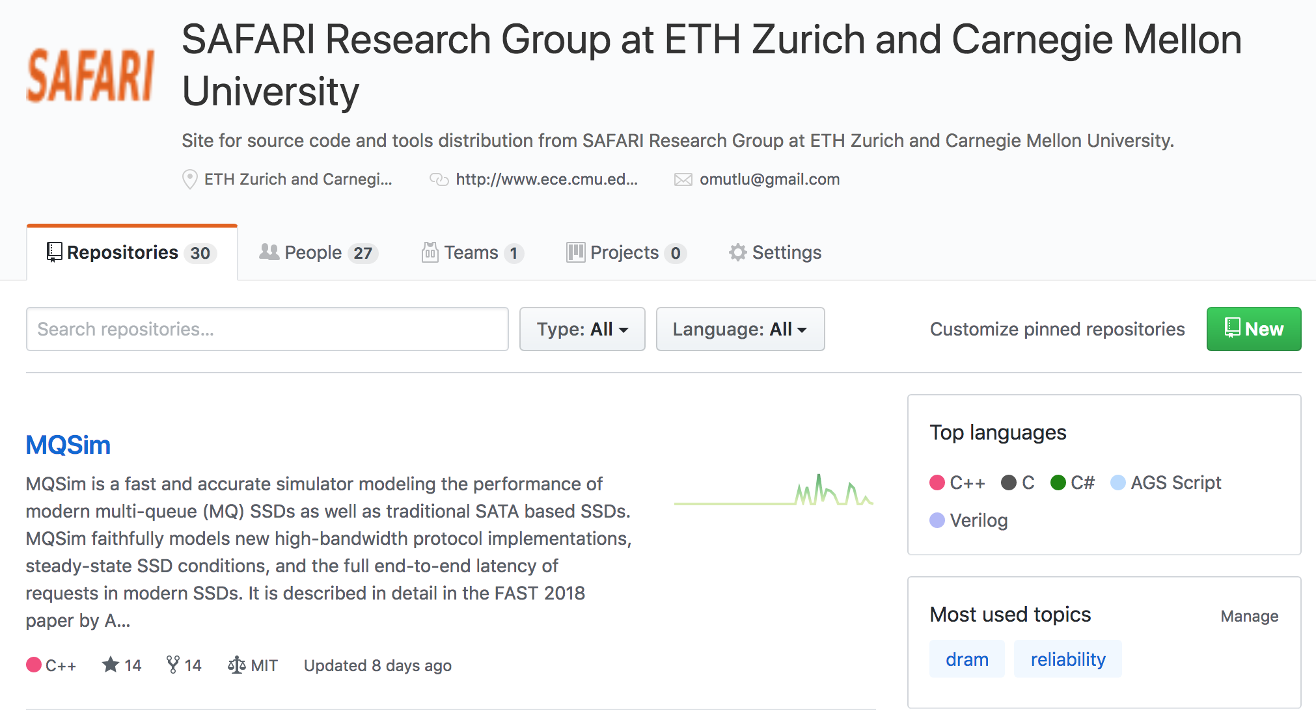
More Open Source Tools (III)
A lot more open-source software from my group
https://github.com/CMU-SAFARI/
http://www.ece.cmu.edu/~safari/tools.html

Slide 113
Referenced Papers
All are available at
https://people.inf.ethz.ch/omutlu/projects.htm
http://scholar.google.com/citations?user=7XyGUGkAAAAJ&hl=en
https://people.inf.ethz.ch/omutlu/acaces2018.html

Slide 114
Ramulator: A Fast and Extensible DRAM Simulator [IEEE Comp Arch Letters’15]

Slide 115
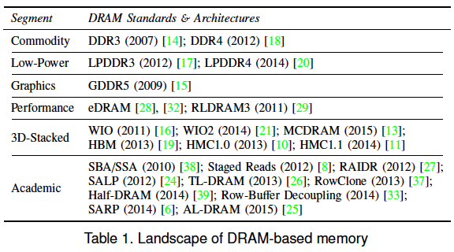
Ramulator Motivation
DRAM and Memory Controller landscape is changing
Many new and upcoming standards
Many new controller designs
A fast and easy-to-extend simulator is very much needed

Slide 116
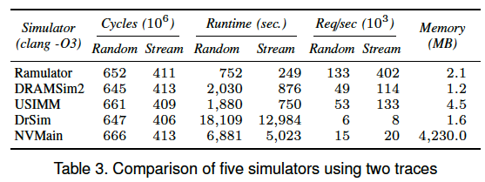
Ramulator
Provides out-of-the box support for many DRAM standards:
DDR3/4, LPDDR3/4, GDDR5, WIO1/2, HBM, plus new proposals (SALP, AL-DRAM, TLDRAM, RowClone, and SARP)
~2.5X faster than fastest open-source simulator
Modular and extensible to different standards

Slide 117
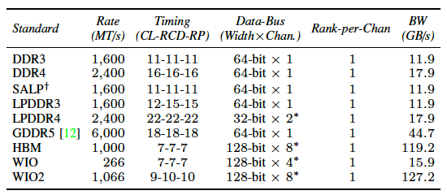
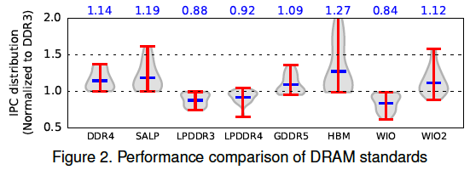
Case Study: Comparison of DRAM Standards
Across 22 workloads, simple CPU model

Slide 118
Ramulator Paper and Source Code
Yoongu Kim, Weikun Yang, and Onur Mutlu, "Ramulator: A Fast and Extensible DRAM Simulator" IEEE Computer Architecture Letters (CAL), March 2015. [Source Code]
Source code is released under the liberal MIT License
https://github.com/CMU-SAFARI/ramulator

Slide 119
Optional Assignment
Review the Ramulator paper
Email me your review (omutlu@gmail.com)
Download and run Ramulator
Compare DDR3, DDR4, SALP, HBM for the libquantum benchmark (provided in Ramulator repository)
Email me your report (omutlu@gmail.com)
This will help you get into memory systems research

Slide 120
Some More Suggested Readings

Slide 121
Some Key Readings on DRAM (I)
DRAM Organization and Operation
Lee et al., “Tiered-Latency DRAM: A Low Latency and Low Cost DRAM Architecture,” HPCA 2013.
https://people.inf.ethz.ch/omutlu/pub/tldram_hpca13.pdf
Kim et al., “A Case for Subarray-Level Parallelism (SALP) in DRAM,” ISCA 2012.
https://people.inf.ethz.ch/omutlu/pub/salp-dram_isca12.pdf
Lee et al., “Simultaneous Multi-Layer Access: Improving 3D-Stacked Memory Bandwidth at Low Cost,” ACM TACO 2016.
https://people.inf.ethz.ch/omutlu/pub/smla_high-bandwidth-3d-stacked-memory_taco16.pdf

Slide 122
Some Key Readings on DRAM (II)
DRAM Refresh
Liu et al., “RAIDR: Retention-Aware Intelligent DRAM Refresh,” ISCA 2012. https://people.inf.ethz.ch/omutlu/pub/raidr-dram-refresh_isca12.pdf
Chang et al., “Improving DRAM Performance by Parallelizing Refreshes with Accesses,” HPCA 2014.
https://people.inf.ethz.ch/omutlu/pub/dram-access-refresh-parallelization_hpca14.pdf
Patel et al., “The Reach Profiler (REAPER): Enabling the Mitigation of DRAM Retention Failures via Profiling at Aggressive Conditions,” ISCA 2017.
https://people.inf.ethz.ch/omutlu/pub/reaper-dram-retention-profiling-lpddr4_isca17.pdf

Slide 123
Reading on Simulating Main Memory
How to evaluate future main memory systems?
An open-source simulator and its brief description
Yoongu Kim, Weikun Yang, and Onur Mutlu, "Ramulator: A Fast and Extensible DRAM Simulator" IEEE Computer Architecture Letters (CAL), March 2015. [Source Code]

Slide 124
Some Key Readings on Memory Control 1
Mutlu+, “Parallelism-Aware Batch Scheduling: Enhancing both Performance and Fairness of Shared DRAM Systems,” ISCA 2008.
https://people.inf.ethz.ch/omutlu/pub/parbs_isca08.pdf
Kim et al., “Thread Cluster Memory Scheduling: Exploiting Differences in Memory Access Behavior,” MICRO 2010.
https://people.inf.ethz.ch/omutlu/pub/tcm_micro10.pdf
Subramanian et al., “BLISS: Balancing Performance, Fairness and Complexity in Memory Access Scheduling,” TPDS 2016.
https://people.inf.ethz.ch/omutlu/pub/bliss-memory-scheduler_ieee-tpds16.pdf
Usui et al., “DASH: Deadline-Aware High-Performance Memory Scheduler for Heterogeneous Systems with Hardware Accelerators,” TACO 2016.
https://people.inf.ethz.ch/omutlu/pub/dash_deadline-aware-heterogeneous-memory-scheduler_taco16.pdf

Slide 125
Some Key Readings on Memory Control 2
Ipek+, “Self Optimizing Memory Controllers: A Reinforcement Learning Approach,” ISCA 2008.
https://people.inf.ethz.ch/omutlu/pub/rlmc_isca08.pdf
Ebrahimi et al., “Fairness via Source Throttling: A Configurable and High-Performance Fairness Substrate for Multi-Core Memory Systems,” ASPLOS 2010.
https://people.inf.ethz.ch/omutlu/pub/fst_asplos10.pdf
Subramanian et al., “The Application Slowdown Model: Quantifying and Controlling the Impact of Inter-Application Interference at Shared Caches and Main Memory,” MICRO 2015.
https://people.inf.ethz.ch/omutlu/pub/application-slowdown-model_micro15.pdf
Lee et al., “Decoupled Direct Memory Access: Isolating CPU and IO Traffic by Leveraging a Dual-Data-Port DRAM,” PACT 2015.
https://people.inf.ethz.ch/omutlu/pub/decoupled-dma_pact15.pdf

Slide 126
More Readings
To come as we cover the future topics
Search for “DRAM” or “Memory” in:
https://people.inf.ethz.ch/omutlu/projects.htm

Slide 127
Inside A DRAM Chip

Slide 128
DRAM Module and Chip

Slide 129
Goals
Cost
Latency
Bandwidth
Parallelism
Power
Energy
Reliability
…

Slide 130
DRAM Chip
Row Decoder
Cell Array
Array of Sense Amplifiers
Cell Array
Row Decoder
Cell Array
Array of Sense Amplifiers
Cell Array
Bank I/O

Slide 131
Sense Amplifier
top
enable
Inverter
bottom

Slide 132
Sense Amplifier – Two Stable States
V_{DD}
0
1
1
0
V_{DD}
Logical “1”
Logical “0”

Slide 133
Sense Amplifier Operation
V_{T}
V_{DD}
0
V_{T} > V_{B}
1
V_{B}
0

Slide 134
DRAM Cell – Capacitor
Empty State
Fully Charged State
Logical “0”
Logical “1”
1
Small – Cannot drive circuits
2
Reading destroys the state

Slide 135
Capacitor to Sense Amplifier
0
V_{DD}
1
1
V_{DD}
0

Slide 136
DRAM Cell Operation
½V_{DD}
½V_{DD}+δ
V_{DD}
0
1
0
½V_{DD}

Slide 137
DRAM Subarray – Building Block for DRAM Chip
Row Decoder
Cell Array
Array of Sense Amplifiers (Row Buffer) 8Kb
Cell Array

Slide 138
DRAM Bank
Row Decoder
Cell Array
Array of Sense Amplifiers (8Kb)
Cell Array
Address
Row Decoder
Cell Array
Array of Sense Amplifiers
Cell Array
Bank I/O (64b)
Data
Address

Slide 139
DRAM Chip
Shared internal bus
Row Decoder
Cell Array
Row Decoder
Cell Array
Array of Sense Amplifiers
Array of Sense Amplifiers
Cell Array
Cell Array
Row Decoder
Cell Array
Row Decoder
Cell Array
Array of Sense Amplifiers
Array of Sense Amplifiers
Row Decoder
Cell Array
Row Decoder
Cell Array
Cell Array
Cell Array
Array of Sense Amplifiers
Array of Sense Amplifiers
Bank I/O
Bank I/O
Cell Array
Cell Array
Row Decoder
Cell Array
Row Decoder
Cell Array
Array of Sense Amplifiers
Array of Sense Amplifiers
Row Decoder
Cell Array
Row Decoder
Cell Array
Cell Array
Cell Array
Array of Sense Amplifiers
Array of Sense Amplifiers
Bank I/O
Bank I/O
Cell Array
Cell Array
Row Decoder
Cell Array
Row Decoder
Cell Array
Array of Sense Amplifiers
Array of Sense Amplifiers
Row Decoder
Cell Array
Row Decoder
Cell Array
Cell Array
Cell Array
Array of Sense Amplifiers
Array of Sense Amplifiers
Bank I/O
Bank I/O
Cell Array
Cell Array
Row Decoder
Cell Array
Row Decoder
Cell Array
Array of Sense Amplifiers
Array of Sense Amplifiers
Cell Array
Cell Array
Bank I/O
Bank I/O
Memory channel - 8bits

Slide 140
DRAM Operation
Row Decoder
ACTIVATE Row
1
Row Address
2
READ/WRITE Column
Row Decoder
Cell Array
Array of Sense Amplifiers
Cell Array
3
PRECHARGE
Bank I/O
Data
Column Address

Slide 141
End of Backup Slides

