Slide 1



Memory Systems and Memory-Centric Computing Systems
Part 2: RowHammer
Prof. Onur Mutlu
omutlu@gmail.com
https://people.inf.ethz.ch/omutlu
7 July 2019
SAMOS Tutorial

Slide 2
Four Key Directions
Fundamentally Secure/Reliable/Safe Architectures
Fundamentally Energy-Efficient Architectures
  Memory-centric (Data-centric) Architectures
Fundamentally Low-Latency Architectures
Architectures for Genomics, Medicine, Health

Slide 3
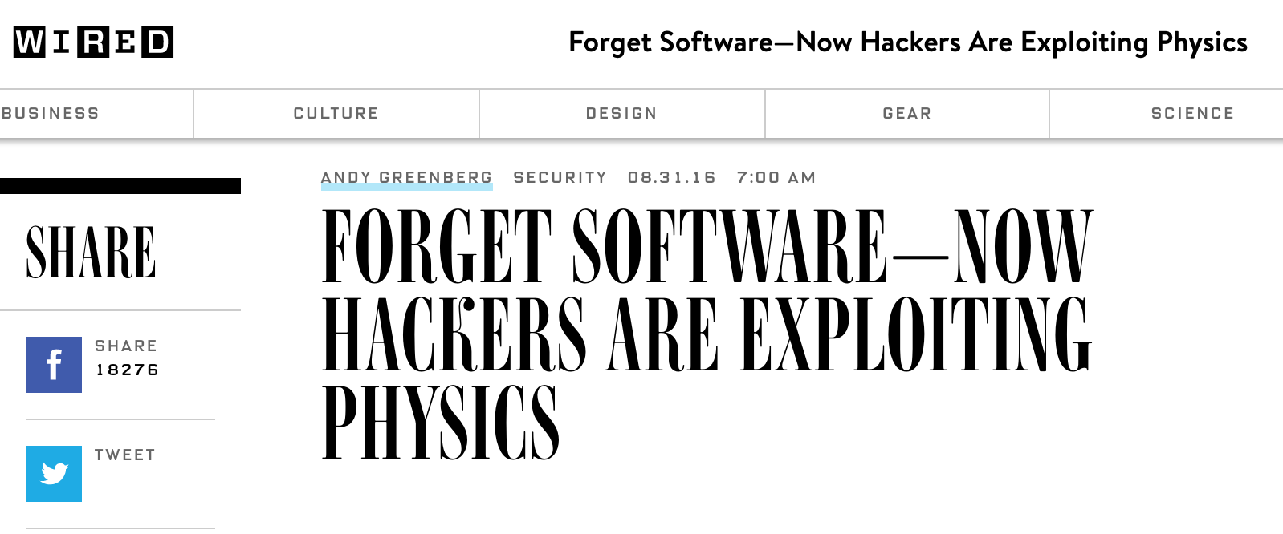
The Story of RowHammer
One can predictably induce bit flips in commodity DRAM chips
  >80% of the tested DRAM chips are vulnerable
First example of how a simple hardware failure mechanism can create a widespread system security vulnerability

Slide 4
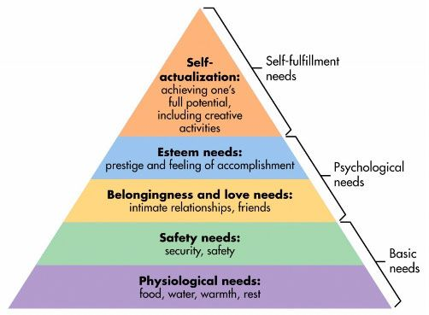
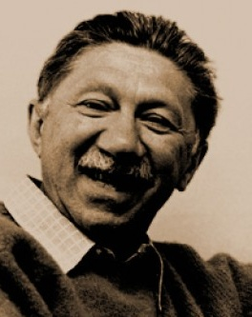
Maslow’s (Human) Hierarchy of Needs
Maslow, “A Theory of Human Motivation,”
Psychological Review, 1943.
Maslow, “A Theory of Human Motivation,”
Psychological Review, 1943.
Maslow, “Motivation and Personality,”
Book, 1954-1970.
We need to start with reliability and security…
Source: https://www.simplypsychology.org/maslow.html
Source: By User:Factoryjoe - Mazlow's Hierarchy of Needs.svg, CC BY-SA 3.0, https://commons.wikimedia.org/w/index.php?curid=7964065

Slide 5
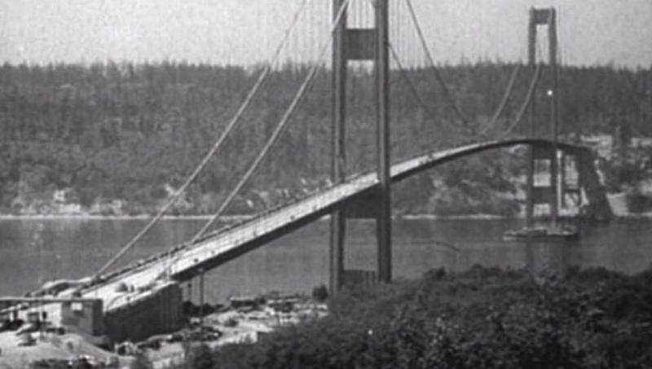
How Reliable/Secure/Safe is This Bridge?
Source: http://www.technologystudent.com/struct1/tacom1.png

Slide 6
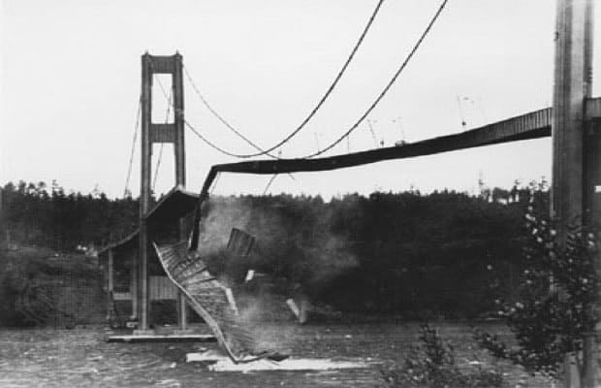
Collapse of the “Galloping Gertie”
Source: AP
http://www.wsdot.wa.gov/tnbhistory/connections/connections3.htm

Slide 7

How Secure Are These People?
Security is about preventing unforeseen consequences
Source: https://s-media-cache-ak0.pinimg.com/originals/48/09/54/4809543a9c7700246a0cf8acdae27abf.jpg

Slide 8
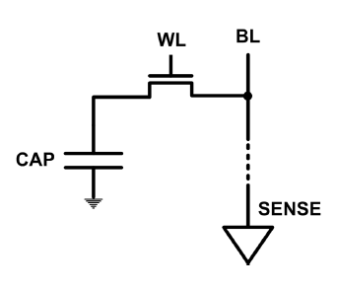
The DRAM Scaling Problem
DRAM stores charge in a capacitor (charge-based memory)
  Capacitor must be large enough for reliable sensing
  Access transistor should be large enough for low leakage and high retention time
  Scaling beyond 40-35nm (2013) is challenging [ITRS, 2009]
DRAM capacity, cost, and energy/power hard to scale

Slide 9
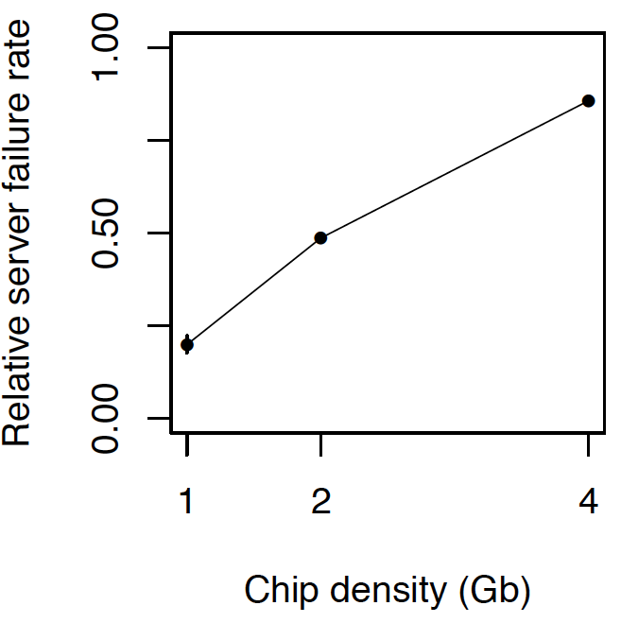
As Memory Scales, It Becomes Unreliable
Data from all of Facebook’s servers worldwide
Meza+, “Revisiting Memory Errors in Large-Scale Production Data Centers,” DSN’15.
Intuition:
quadratic
increase in
capacity

Slide 10
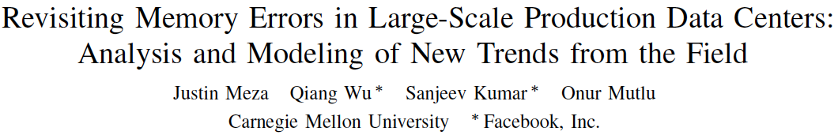
Large-Scale Failure Analysis of DRAM Chips
Analysis and modeling of memory errors found in all of Facebook’s server fleet
Justin Meza, Qiang Wu, Sanjeev Kumar, and Onur Mutlu,
"Revisiting Memory Errors in Large-Scale Production Data Centers: Analysis and Modeling of New Trends from the Field"
Proceedings of the 45th Annual IEEE/IFIP International Conference on Dependable Systems and Networks (DSN), Rio de Janeiro, Brazil, June 2015.
[Slides (pptx) (pdf)] [DRAM Error Model]

Slide 11
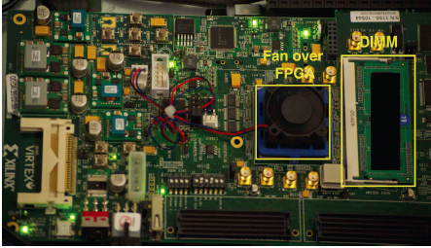
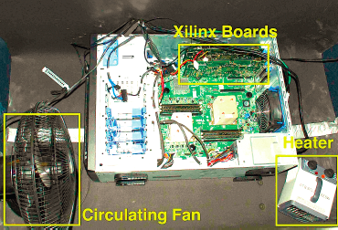
Infrastructures to Understand Such Issues
  An Experimental Study of Data Retention Behavior in Modern DRAM Devices: Implications for Retention Time Profiling Mechanisms (Liu et al., ISCA 2013)
  The Efficacy of Error Mitigation Techniques for DRAM Retention Failures: A Comparative Experimental Study
  (Khan et al., SIGMETRICS 2014)
  Flipping Bits in Memory Without Accessing Them: An Experimental Study of DRAM Disturbance Errors (Kim et al., ISCA 2014)
  Adaptive-Latency DRAM: Optimizing DRAM Timing for the Common-Case (Lee et al., HPCA 2015)
  AVATAR: A Variable-Retention-Time (VRT) Aware Refresh for DRAM Systems (Qureshi et al., DSN 2015)

Slide 12

Infrastructures to Understand Such Issues
Temperature
Controller
FPGAs
Heater
FPGAs
PC
  Kim+, “Flipping Bits in Memory Without Accessing Them: An Experimental Study of DRAM Disturbance Errors,” ISCA 2014.

Slide 13
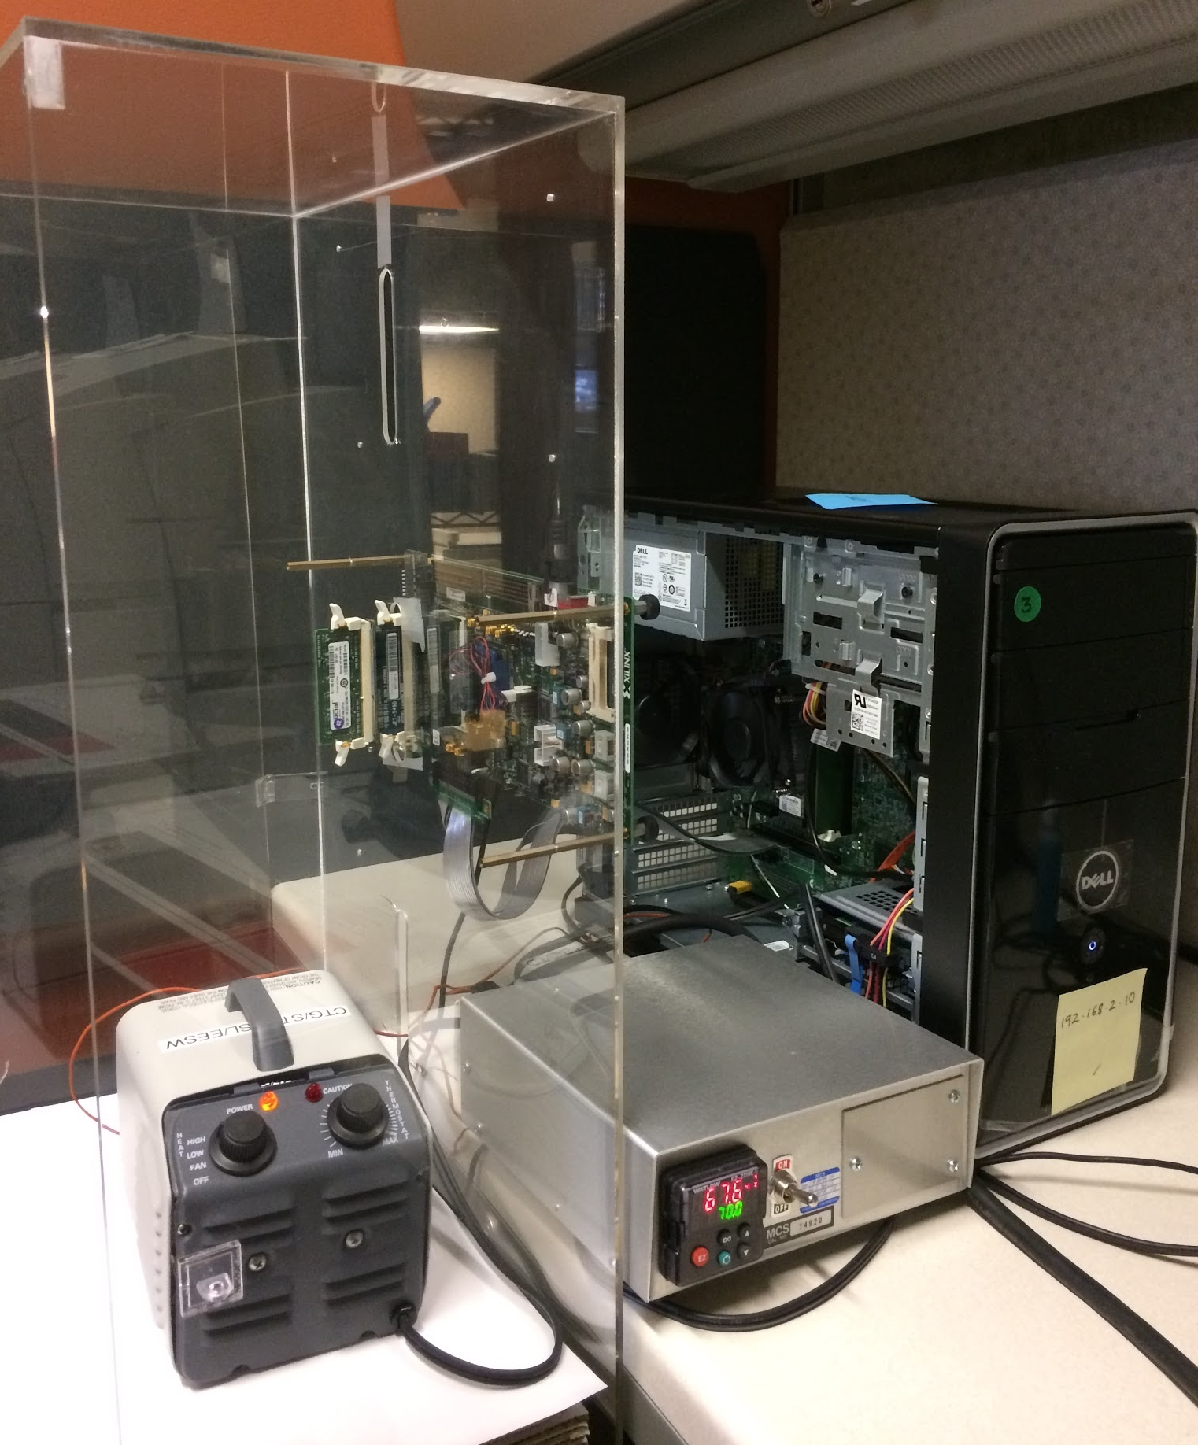
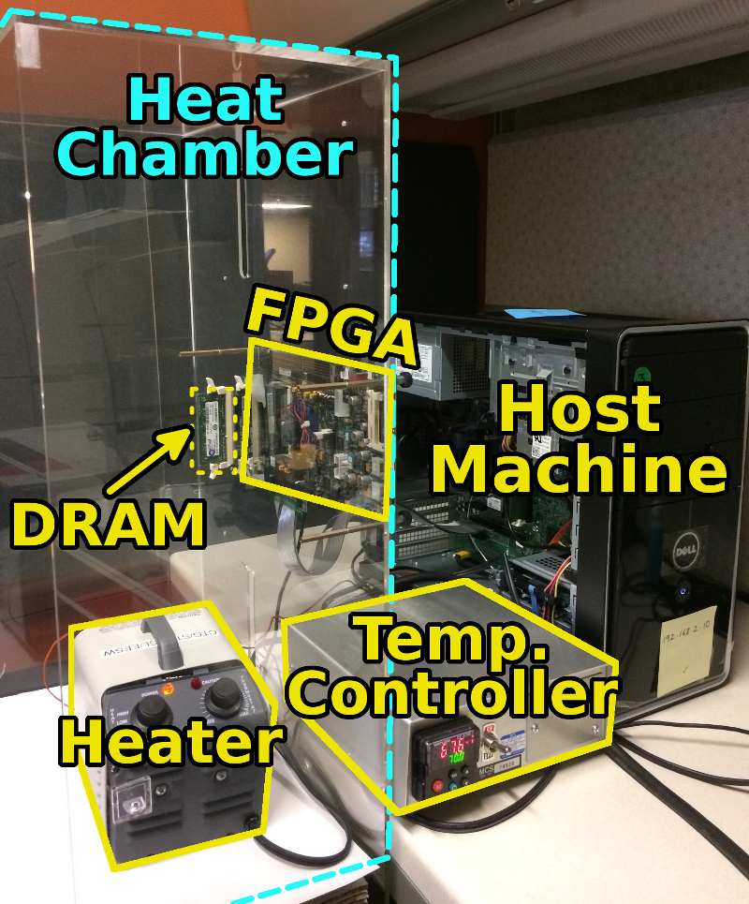
SoftMC: Open Source DRAM Infrastructure
Hasan Hassan et al., “SoftMC: A Flexible and Practical Open-Source Infrastructure for Enabling Experimental DRAM Studies,” HPCA 2017.
Flexible
Easy to Use (C++ API)
Open-source
github.com/CMU-SAFARI/SoftMC

Slide 14
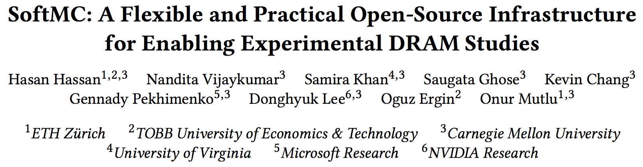
SoftMC
https://github.com/CMU-SAFARI/SoftMC

Slide 15

Data Retention in Memory [Liu et al., ISCA 2013]
Retention Time Profile of DRAM looks like this:
Location dependent
Stored value pattern dependent
Time dependent

Slide 16
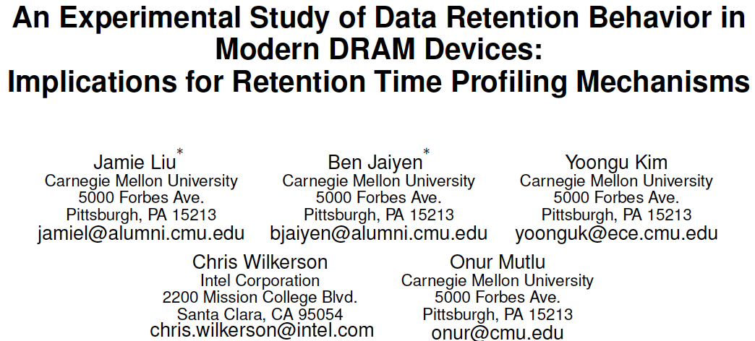
Analysis of Data Retention Failures [ISCA’13]
Jamie Liu, Ben Jaiyen, Yoongu Kim, Chris Wilkerson, and Onur Mutlu,
"An Experimental Study of Data Retention Behavior in Modern DRAM Devices: Implications for Retention Time Profiling Mechanisms"
Proceedings of the 40th International Symposium on Computer Architecture (ISCA), Tel-Aviv, Israel, June 2013. Slides (ppt) Slides (pdf)

Slide 17
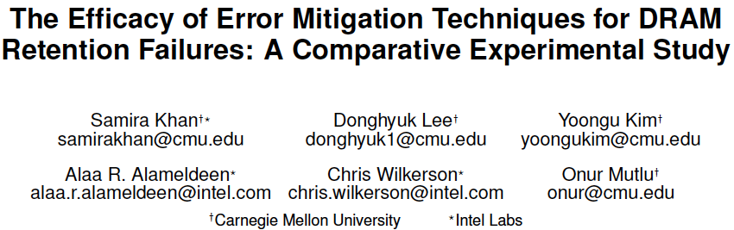
Mitigation of Retention Issues [SIGMETRICS’14]
Samira Khan, Donghyuk Lee, Yoongu Kim, Alaa Alameldeen, Chris Wilkerson, and Onur Mutlu,
"The Efficacy of Error Mitigation Techniques for DRAM Retention Failures: A Comparative Experimental Study"
Proceedings of the ACM International Conference on Measurement and Modeling of Computer Systems (SIGMETRICS), Austin, TX, June 2014. [Slides (pptx) (pdf)] [Poster (pptx) (pdf)] [Full data sets]

Slide 18
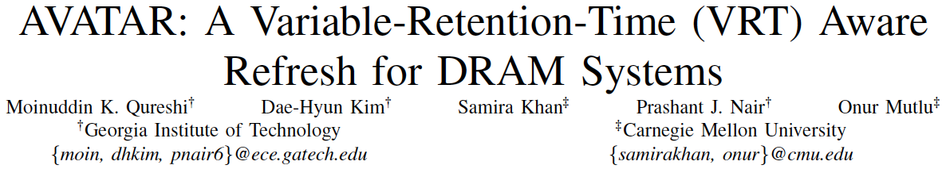
Mitigation of Retention Issues [DSN’15]
Moinuddin Qureshi, Dae Hyun Kim, Samira Khan, Prashant Nair, and Onur Mutlu,
"AVATAR: A Variable-Retention-Time (VRT) Aware Refresh for DRAM Systems"
Proceedings of the 45th Annual IEEE/IFIP International Conference on Dependable Systems and Networks (DSN), Rio de Janeiro, Brazil, June 2015.
[Slides (pptx) (pdf)]

Slide 19
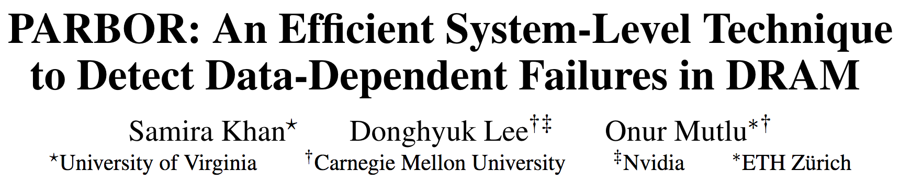
Mitigation of Retention Issues [DSN’16]
Samira Khan, Donghyuk Lee, and Onur Mutlu,
"PARBOR: An Efficient System-Level Technique to Detect Data-Dependent Failures in DRAM"
Proceedings of the 45th Annual IEEE/IFIP International Conference on Dependable Systems and Networks (DSN), Toulouse, France, June 2016.
[Slides (pptx) (pdf)]

Slide 20
Mitigation of Retention Issues [MICRO’17]
Samira Khan, Chris Wilkerson, Zhe Wang, Alaa R. Alameldeen, Donghyuk Lee, and Onur Mutlu,
"Detecting and Mitigating Data-Dependent DRAM Failures by Exploiting Current Memory Content"
Proceedings of the 50th International Symposium on Microarchitecture (MICRO), Boston, MA, USA, October 2017.
[Slides (pptx) (pdf)] [Lightning Session Slides (pptx) (pdf)] [Poster (pptx) (pdf)]

Slide 21
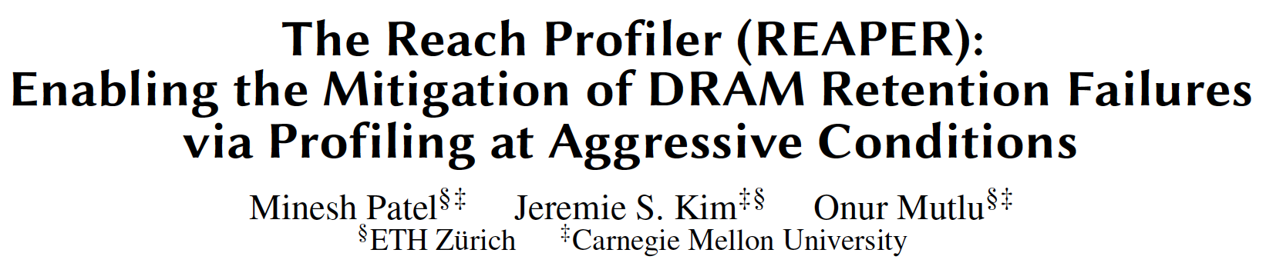
Mitigation of Retention Issues [ISCA’17]
Minesh Patel, Jeremie S. Kim, and Onur Mutlu,
"The Reach Profiler (REAPER): Enabling the Mitigation of DRAM Retention Failures via Profiling at Aggressive Conditions"
Proceedings of the 44th International Symposium on Computer Architecture (ISCA), Toronto, Canada, June 2017.
[Slides (pptx) (pdf)]
[Lightning Session Slides (pptx) (pdf)]
First experimental analysis of (mobile) LPDDR4 chips
Analyzes the complex tradeoff space of retention time profiling
Idea: enable fast and robust profiling at higher refresh intervals & temperatures

Slide 22
A Curious Discovery [Kim et al., ISCA 2014]
One can
predictably induce errors
in most DRAM memory chips

Slide 23
DRAM RowHammer
A simple hardware failure mechanism
can create a widespread
system security vulnerability

Slide 24
Modern DRAM is Prone to Disturbance Errors
Row of Cells
Wordline
Row
Victim Row
Row
Hammered Row
V_{LOW}
Opened
V_{HIGH}
Closed
Row
Victim Row
Row
Repeatedly reading a row enough times (before memory gets refreshed) induces disturbance errors in adjacent rows in most real DRAM chips you can buy today
Flipping Bits in Memory Without Accessing Them: An Experimental Study of DRAM Disturbance Errors, (Kim et al., ISCA 2014)

Slide 25
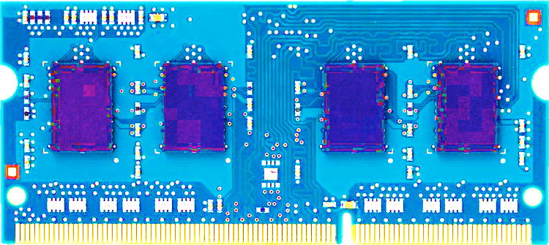
Most DRAM Modules Are Vulnerable
A company
B company
C company
86%
(37/43)
83%
(45/54)
88%
(28/32)
Up to
1.0×10⁷
errors
Up to
2.7×10⁶
errors
Up to
3.3×10⁵
errors
Flipping Bits in Memory Without Accessing Them: An Experimental Study of DRAM Disturbance Errors, (Kim et al., ISCA 2014)

Slide 26
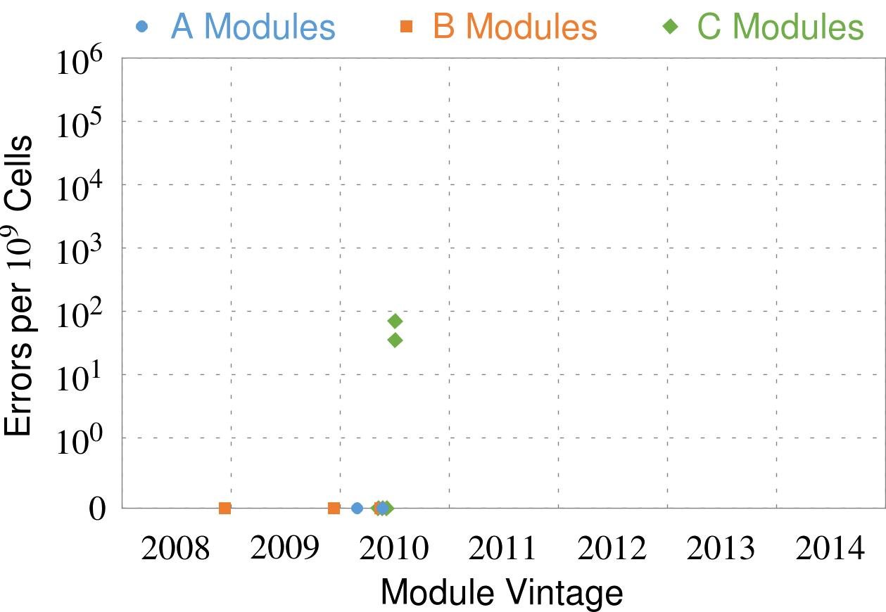
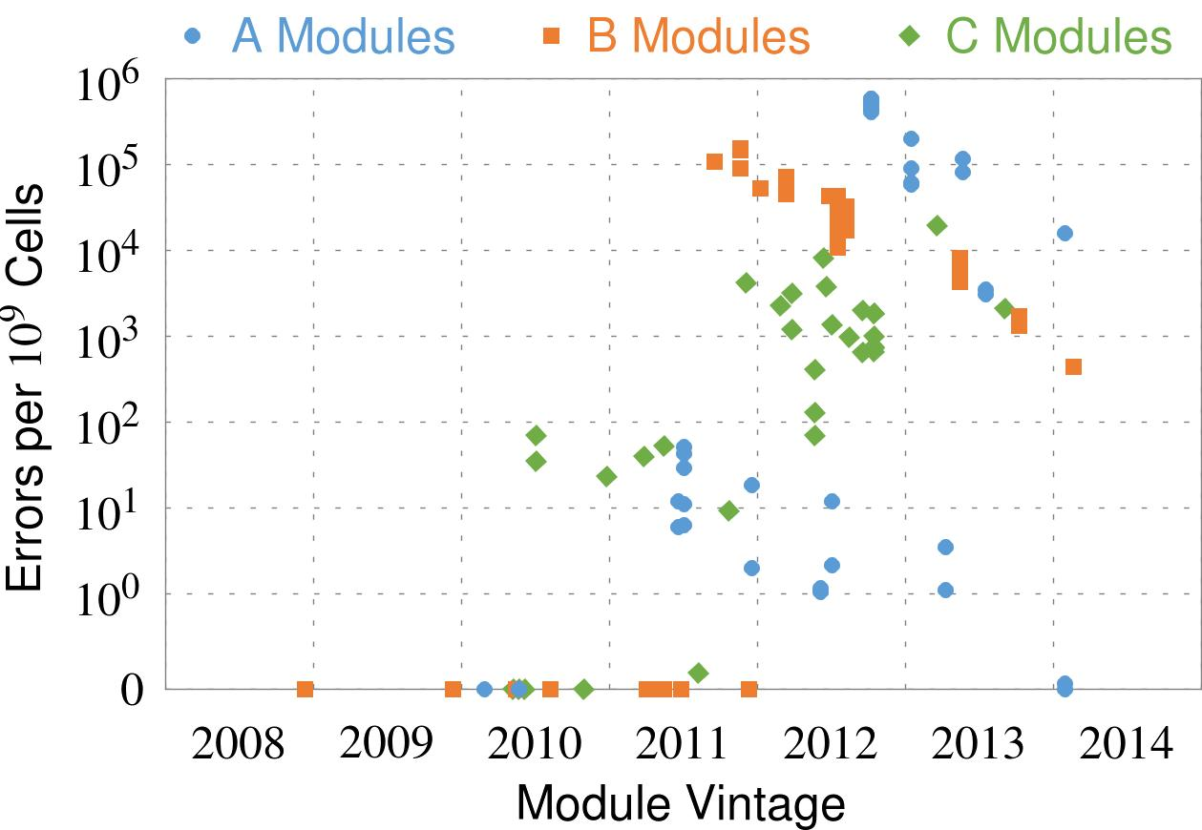
Recent DRAM Is More Vulnerable
Notes:
In this figure, the x-axis is the module manufacture date. And the y-axis is the number of errors in a module, normalized to one billion cells. In 2008 and 2009, there are no errors. But, in 2010, we first start to see errors in C modules. After 2010, the errors start to proliferate. For A and B modules, we first start to see errors in 2011. In particular, all modules from 2012 and 2013 are vulnerable.

Slide 27
Recent DRAM Is More Vulnerable
First
Appearance
Notes:
In this figure, the x-axis is the module manufacture date. And the y-axis is the number of errors in a module, normalized to one billion cells. In 2008 and 2009, there are no errors. But, in 2010, we first start to see errors in C modules. After 2010, the errors start to proliferate. For A and B modules, we first start to see errors in 2011. In particular, all modules from 2012 and 2013 are vulnerable.

Slide 28
Recent DRAM Is More Vulnerable
First
Appearance
All modules from 2012–2013 are vulnerable
Notes:
In this figure, the x-axis is the module manufacture date. And the y-axis is the number of errors in a module, normalized to one billion cells. In 2008 and 2009, there are no errors. But, in 2010, we first start to see errors in C modules. After 2010, the errors start to proliferate. For A and B modules, we first start to see errors in 2011. In particular, all modules from 2012 and 2013 are vulnerable.

Slide 29
Why Is This Happening?
DRAM cells are too close to each other!
  They are not electrically isolated from each other
Access to one cell affects the value in nearby cells
  due to electrical interference between
    the cells
    wires used for accessing the cells
  Also called cell-to-cell coupling/interference
Example: When we activate (apply high voltage) to a row, an adjacent row gets slightly activated as well
  Vulnerable cells in that slightly-activated row lose a little bit of charge
  If row hammer happens enough times, charge in such cells gets drained

Slide 30
Higher-Level Implications
This simple circuit level failure mechanism has enormous implications on upper layers of the transformation hierarchy
Problem
Problem
Algorithm
Algorithm
Program/Language
User
Program/Language
Runtime System
(VM, OS, MM)
Runtime System
(VM, OS, MM)
ISA (Architecture)
ISA
Microarchitecture
Microarchitecture
Logic
Logic
Devices
Devices
Electrons
Electrons

Slide 31

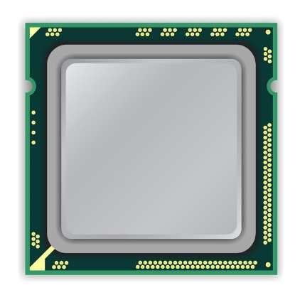
A Simple Program Can Induce Many Errors
CPU
DRAM Module
loop:
mov (X), %eax
mov (Y), %ebx
clflush (X)
clflush (Y)
mfence
jmp loop
X
Y
  Download from: https://github.com/CMU-SAFARI/rowhammer
Notes:
We demonstrate the errors on multiple x86 systems. Shown to the bottom-left is a “disturbance kernel”. When executed, it forces two rows to be opened and closed one after the other – over and over again. Consequently, it induces many errors in the module.

Slide 32
A Simple Program Can Induce Many Errors
CPU
DRAM Module
Avoid cache hits
  Flush X from cache
Avoid row hits to X
  Read Y in another row
X
Y
  Download from: https://github.com/CMU-SAFARI/rowhammer
Notes:
We demonstrate the errors on multiple x86 systems. Shown to the bottom-left is a “disturbance kernel”. When executed, it forces two rows to be opened and closed one after the other – over and over again. Consequently, it induces many errors in the module.

Slide 33
A Simple Program Can Induce Many Errors
CPU
DRAM Module
loop:
mov (X), %eax
mov (Y), %ebx
clflush (X)
clflush (Y)
mfence
jmp loop
X
Y
  Download from: https://github.com/CMU-SAFARI/rowhammer
Notes:
We demonstrate the errors on multiple x86 systems. Shown to the bottom-left is a “disturbance kernel”. When executed, it forces two rows to be opened and closed one after the other – over and over again. Consequently, it induces many errors in the module.

Slide 34
A Simple Program Can Induce Many Errors
CPU
DRAM Module
loop:
mov (X), %eax
mov (Y), %ebx
clflush (X)
clflush (Y)
mfence
jmp loop
X
Y
  Download from: https://github.com/CMU-SAFARI/rowhammer
Notes:
We demonstrate the errors on multiple x86 systems. Shown to the bottom-left is a “disturbance kernel”. When executed, it forces two rows to be opened and closed one after the other – over and over again. Consequently, it induces many errors in the module.

Slide 35
A Simple Program Can Induce Many Errors
CPU
DRAM Module
loop:
mov (X), %eax
mov (Y), %ebx
clflush (X)
clflush (Y)
mfence
jmp loop
X
Y
  Download from: https://github.com/CMU-SAFARI/rowhammer
Notes:
We demonstrate the errors on multiple x86 systems. Shown to the bottom-left is a “disturbance kernel”. When executed, it forces two rows to be opened and closed one after the other – over and over again. Consequently, it induces many errors in the module.

Slide 36
Observed Errors in Real Systems
A real reliability & security issue
CPU Architecture | Errors | Access-Rate
Intel Haswell (2013) | 22.9K | 12.3M/sec
Intel Ivy Bridge (2012) | 20.7K | 11.7M/sec
Intel Sandy Bridge (2011) | 16.1K | 11.6M/sec
AMD Piledriver (2012) | 59 | 6.1M/sec
Kim+, “Flipping Bits in Memory Without Accessing Them: An Experimental Study of DRAM Disturbance Errors,” ISCA 2014.
Notes:
When we executed the code on four different processors, all four of them yielded errors. Intel Haswell has the most errors, at 23 thousand, because it has the highest rate of accessing DRAM.
Later on, I’ll show that we can induce as many as ten million disturbance errors in a more controlled environment.
From this, we conclude that disturbance errors are a serious reliability issue.

Slide 37


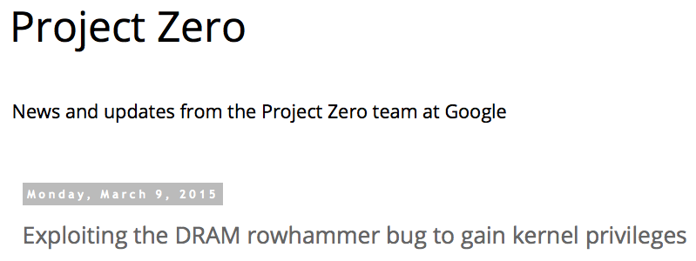
One Can Take Over an Otherwise-Secure System
Flipping Bits in Memory Without Accessing Them: An Experimental Study of DRAM Disturbance Errors (Kim et al., ISCA 2014)
Exploiting the DRAM rowhammer bug to gain kernel privileges (Seaborn, 2015)

Slide 38
RowHammer Security Attack Example
“Rowhammer” is a problem with some recent DRAM devices in which repeatedly accessing a row of memory can cause bit flips in adjacent rows (Kim et al., ISCA 2014).
  Flipping Bits in Memory Without Accessing Them: An Experimental Study of DRAM Disturbance Errors (Kim et al., ISCA 2014)
We tested a selection of laptops and found that a subset of them exhibited the problem.
We built two working privilege escalation exploits that use this effect.
  Exploiting the DRAM rowhammer bug to gain kernel privileges (Seaborn+, 2015)
One exploit uses rowhammer-induced bit flips to gain kernel privileges on x86-64 Linux when run as an unprivileged userland process.
When run on a machine vulnerable to the rowhammer problem, the process was able to induce bit flips in page table entries (PTEs).
It was able to use this to gain write access to its own page table, and hence gain read-write access to all of physical memory.
Exploiting the DRAM rowhammer bug to gain kernel privileges (Seaborn & Dullien, 2015)

Slide 39
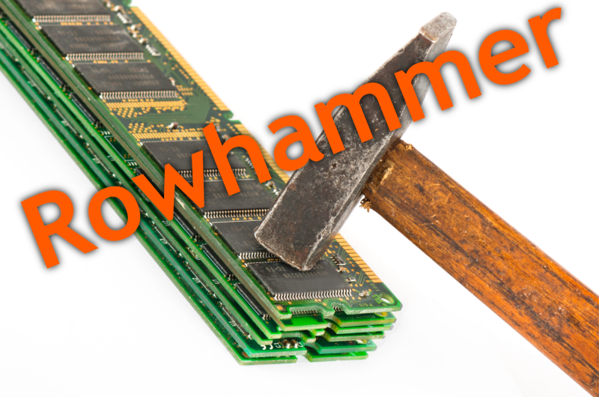
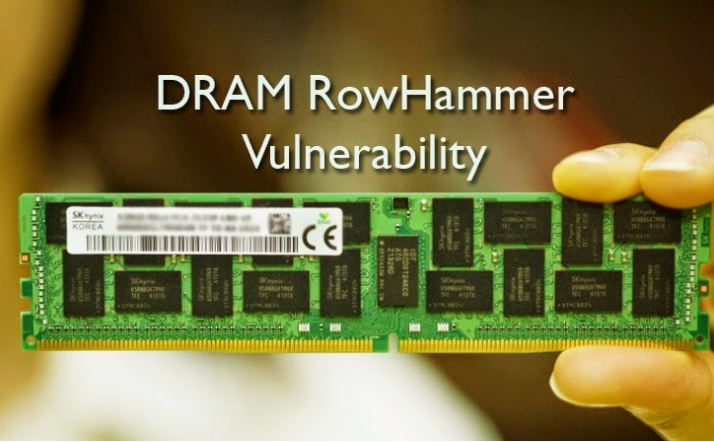
Security Implications
Notes:
Picture from the article:
http://thehackernews.com/2015/03/dram-rowhammer-vulnerability.html

Slide 40
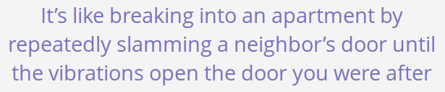
Security Implications
Notes:
Picture from the article:
http://thehackernews.com/2015/03/dram-rowhammer-vulnerability.html

Slide 41
Selected Readings on RowHammer (I)
Our first detailed study: Rowhammer analysis and solutions (June 2014)
  Yoongu Kim, Ross Daly, Jeremie Kim, Chris Fallin, Ji Hye Lee, Donghyuk Lee, Chris Wilkerson, Konrad Lai, and Onur Mutlu,
  "Flipping Bits in Memory Without Accessing Them: An Experimental Study of DRAM Disturbance Errors"
  Proceedings of the 41st International Symposium on Computer Architecture (ISCA), Minneapolis, MN, June 2014. [Slides (pptx) (pdf)] [Lightning Session Slides (pptx) (pdf)] [Source Code and Data]
Our Source Code to Induce Errors in Modern DRAM Chips (June 2014)
  https://github.com/CMU-SAFARI/rowhammer
Google Project Zero’s Attack to Take Over a System (March 2015)
  Exploiting the DRAM rowhammer bug to gain kernel privileges (Seaborn+, 2015)
  https://github.com/google/rowhammer-test
  Double-sided Rowhammer

Slide 42
Selected Readings on RowHammer (II)
Remote RowHammer Attacks via JavaScript (July 2015)
  http://arxiv.org/abs/1507.06955
  https://github.com/IAIK/rowhammerjs
  Gruss et al., DIMVA 2016.
  CLFLUSH-free Rowhammer
  “A fully automated attack that requires nothing but a website with JavaScript to trigger faults on remote hardware.”
  “We can gain unrestricted access to systems of website visitors.”
ANVIL: Software-Based Protection Against Next-Generation Rowhammer Attacks (March 2016)
  http://dl.acm.org/citation.cfm?doid=2872362.2872390
  Aweke et al., ASPLOS 2016
  CLFLUSH-free Rowhammer
  Software based monitoring for rowhammer detection

Slide 43
Selected Readings on RowHammer (III)
Dedup Est Machina: Memory Deduplication as an Advanced Exploitation Vector (May 2016)
  https://www.ieee-security.org/TC/SP2016/papers/0824a987.pdf
  Bosman et al., IEEE S&P 2016.
  Exploits Rowhammer and Memory Deduplication to overtake a browser
  “We report on the first reliable remote exploit for the Rowhammer vulnerability running entirely in Microsoft Edge.”
  “[an attacker] … can reliably “own” a system with all defenses up, even if the software is entirely free of bugs.”
CAn’t Touch This: Software-only Mitigation against Rowhammer Attacks targeting Kernel Memory (August 2017)
  https://www.usenix.org/system/files/conference/usenixsecurity17/sec17-brasser.pdf
  Brasser et al., USENIX Security 2017.
  Partitions physical memory into security domains, user vs. kernel; limits rowhammer-induced bit flips to the user domain.

Slide 44
Selected Readings on RowHammer (IV)
A New Approach for Rowhammer Attacks (May 2016)
  https://ieeexplore.ieee.org/document/7495576
  Qiao et al., HOST 2016
  CLFLUSH-free RowHammer
  “Libc functions memset and memcpy are found capable of rowhammer.”
  Triggers RowHammer with malicious inputs but benign code
One Bit Flips, One Cloud Flops: Cross-VM Row Hammer Attacks and Privilege Escalation (August 2016)
  https://www.usenix.org/system/files/conference/usenixsecurity16/sec16_paper_xiao.pdf
  Xiao et al., USENIX Security 2016.
  “Technique that allows a malicious guest VM to have read and write accesses to arbitrary physical pages on a shared machine.”
  Graph-based algorithm to reverse engineer mapping of physical addresses in DRAM

Slide 45
Selected Readings on RowHammer (V)
Curious Case of RowHammer: Flipping Secret Exponent Bits using Timing Analysis (August 2016)
  https://link.springer.com/content/pdf/10.1007%2F978-3-662-53140-2_29.pdf
  Bhattacharya et al., CHES 2016
  Combines timing analysis to perform rowhammer on cryptographic keys stored in memory
DRAMA: Exploiting DRAM Addressing for Cross-CPU Attacks (August 2016)
  https://www.usenix.org/system/files/conference/usenixsecurity16/sec16_paper_pessl.pdf
  Pessl et al., USENIX Security 2016
  Shows RowHammer failures on DDR4 devices despite TRR solution
  Reverse engineers address mapping functions to improve existing RowHammer attacks

Slide 46
Selected Readings on RowHammer (VI)
Flip Feng Shui: Hammering a Needle in the Software Stack (August 2016)
  https://www.usenix.org/system/files/conference/usenixsecurity16/sec16_paper_razavi.pdf
  Razavi et al., USENIX Security 2016.
  Combines memory deduplication and RowHammer
  “A malicious VM can gain unauthorized access to a co-hosted VM running OpenSSH.”
  Breaks OpenSSH public key authentication
Drammer: Deterministic Rowhammer Attacks on Mobile Platforms (October 2016)
  http://dl.acm.org/citation.cfm?id=2976749.2978406
  Van Der Veen et al., ACM CCS 2016
  Can take over an ARM-based Android system deterministically
  Exploits predictable physical memory allocator behavior
    Can deterministically place security-sensitive data (e.g., page table) in an attacker-chosen, vulnerable location in memory

Slide 47
Selected Readings on RowHammer (VII)
When Good Protections go Bad: Exploiting anti-DoS Measures to Accelerate Rowhammer Attacks (May 2017)
  https://web.eecs.umich.edu/~misiker/resources/HOST-2017-Misiker.pdf
  Aga et al., HOST 2017
  “A virtual-memory based cache-flush free attack that is sufficiently fast to rowhammer with double rate refresh.”
  Enabled by Cache Allocation Technology
SGX-Bomb: Locking Down the Processor via Rowhammer Attack (October 2017)
  https://dl.acm.org/citation.cfm?id=3152709
  Jang et al., SysTEX 2017
  “Launches the Rowhammer attack against enclave memory to trigger the processor lockdown.”
  Running unknown enclave programs on the cloud can shut down servers shared with other clients.

Slide 48
Selected Readings on RowHammer (VIII)
Another Flip in the Wall of Rowhammer Defenses (May 2018)
  https://arxiv.org/pdf/1710.00551.pdf
  Gruss et al., IEEE S&P 2018
  A new type of Rowhammer attack which only hammers one single address, which can be done without knowledge of physical addresses and DRAM mappings
  Defeats static analysis and performance counter analysis defenses by running inside an SGX enclave
GuardION: Practical Mitigation of DMA-Based Rowhammer Attacks on ARM (June 2018)
  https://link.springer.com/chapter/10.1007/978-3-319-93411-2_5
  Van Der Veen et al., DIMVA 2018
  Presents RAMPAGE, a DMA-based RowHammer attack against the latest Android OS

Slide 49
Selected Readings on RowHammer (IX)
Grand Pwning Unit: Accelerating Microarchitectural Attacks with the GPU (May 2018)
  https://www.vusec.net/wp-content/uploads/2018/05/glitch.pdf
  Frigo et al., IEEE S&P 2018.
  The first end-to-end remote Rowhammer exploit on mobile platforms that use our GPU-based primitives in orchestration to compromise browsers on mobile devices in under two minutes.
Throwhammer: Rowhammer Attacks over the Network and Defenses (July 2018)
  https://www.cs.vu.nl/~herbertb/download/papers/throwhammer_atc18.pdf
  Tatar et al., USENIX ATC 2018.
  “[We] show that an attacker can trigger and exploit Rowhammer bit flips directly from a remote machine by only sending network packets.”

Slide 50
Selected Readings on RowHammer (X)
Nethammer: Inducing Rowhammer Faults through Network Requests (July 2018)
  https://arxiv.org/pdf/1805.04956.pdf
  Lipp et al., arxiv.org 2018.
  “Nethammer is the first truly remote Rowhammer attack, without a single attacker-controlled line of code on the targeted system.”
ZebRAM: Comprehensive and Compatible Software Protection Against Rowhammer Attacks (October 2018)
  https://www.usenix.org/system/files/osdi18-konoth.pdf
  Konoth et al., OSDI 2018
  A new pure-software protection mechanism against RowHammer.

Slide 51
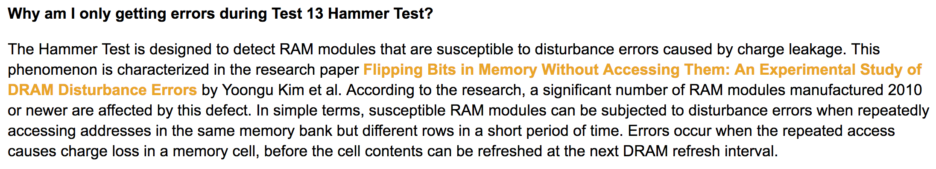
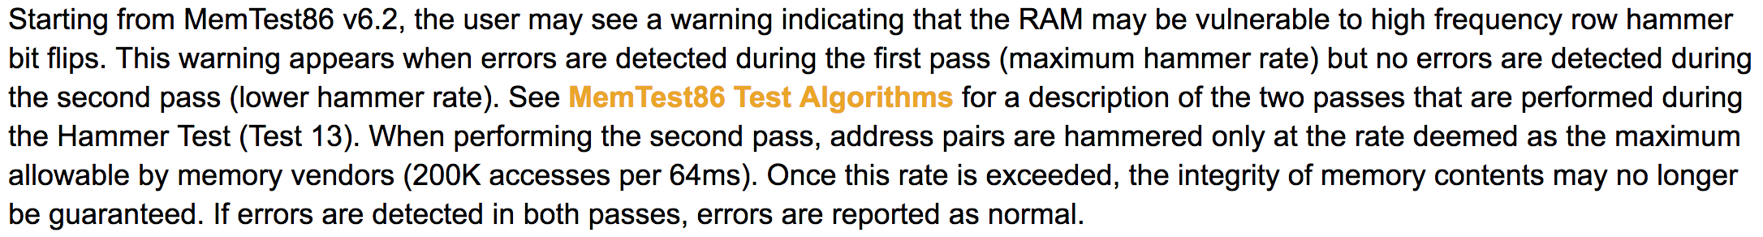
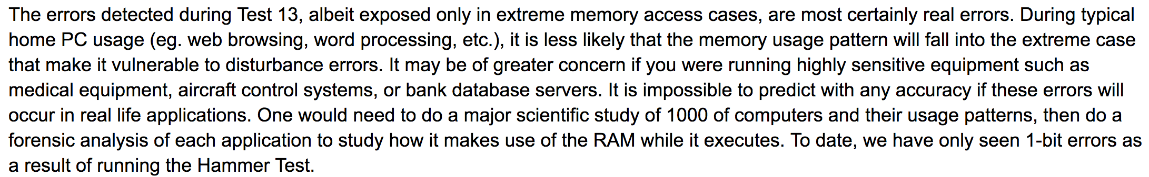
Selected Readings on RowHammer (XI.A)
PassMark Software, memtest86, since 2014
  https://www.memtest86.com/troubleshooting.htm#hammer

Slide 52
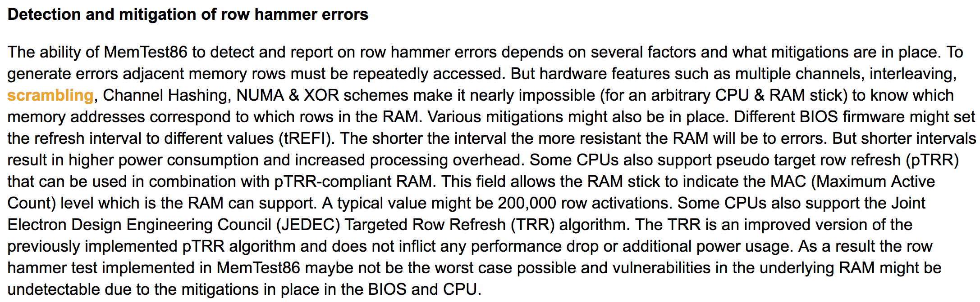

Selected Readings on RowHammer (XI.B)
PassMark Software, memtest86, since 2014
  https://www.memtest86.com/troubleshooting.htm#hammer

Slide 53
Security Implications (ISCA 2014)
Breach of memory protection
  OS page (4KB) fits inside DRAM row (8KB)
  Adjacent DRAM row → Different OS page
Vulnerability: disturbance attack
  By accessing its own page, a program could
  corrupt pages belonging to another program
We constructed a proof-of-concept
  Using only user-level instructions
Notes:
In addition, they have serious implications for security
When disturbance errors occur, they could breach memory protection. This is because an OS page fits inside a DRAM row. So an error in a different DRAM row means an error in a different OS page.
This opens up a vulnerability to disturbance attacks. Just by accessing its own page, a malicious program could corrupt pages belonging to another program.
And, as shown previously, we constructed a proof-of-concept using only user-level instructions.

Slide 54
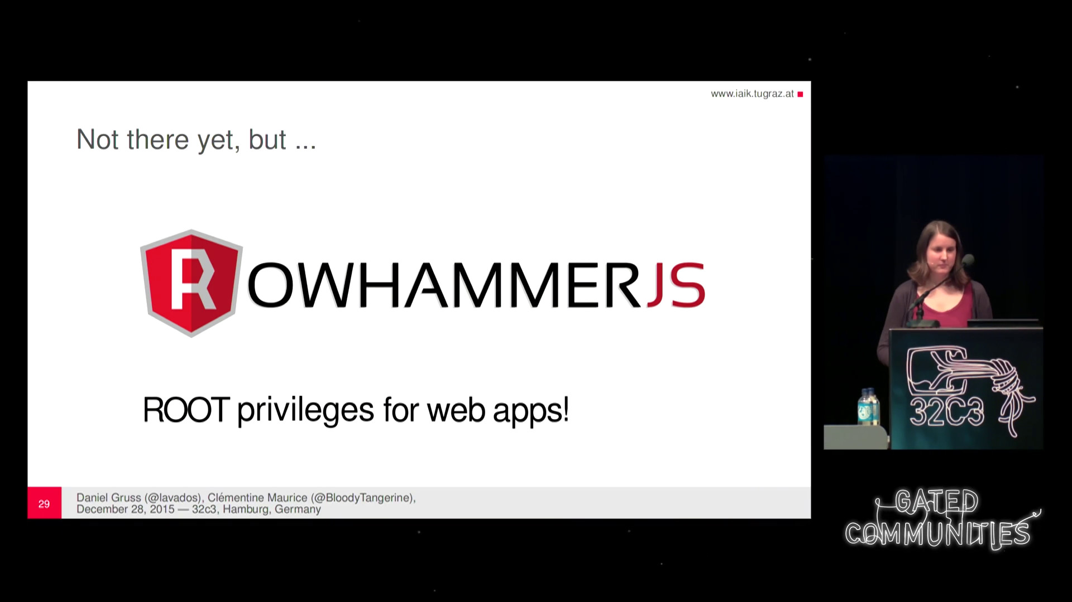
More Security Implications (I)
“We can gain unrestricted access to systems of website visitors.”
Rowhammer.js: A Remote Software-Induced Fault Attack in JavaScript (DIMVA’16)
Source: https://lab.dsst.io/32c3-slides/7197.html

Slide 55

More Security Implications (II)
  “Can gain control of a smart phone deterministically”
Drammer: Deterministic Rowhammer Attacks on Mobile Platforms, CCS’16
Source: https://fossbytes.com/drammer-rowhammer-attack-android-root-devices/

Slide 56
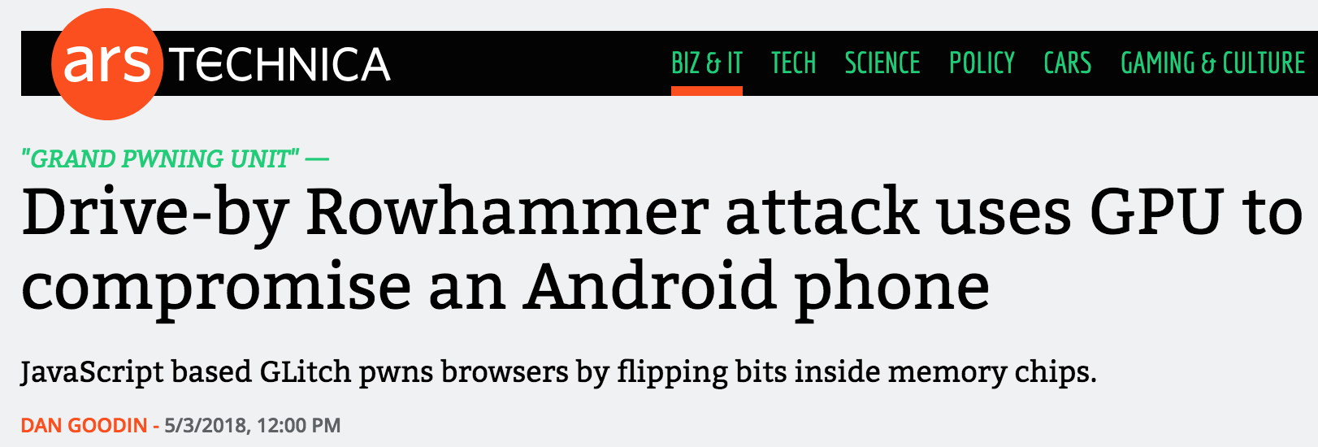

More Security Implications (III)
Using an integrated GPU in a mobile system to remotely escalate privilege via the WebGL interface

Slide 57
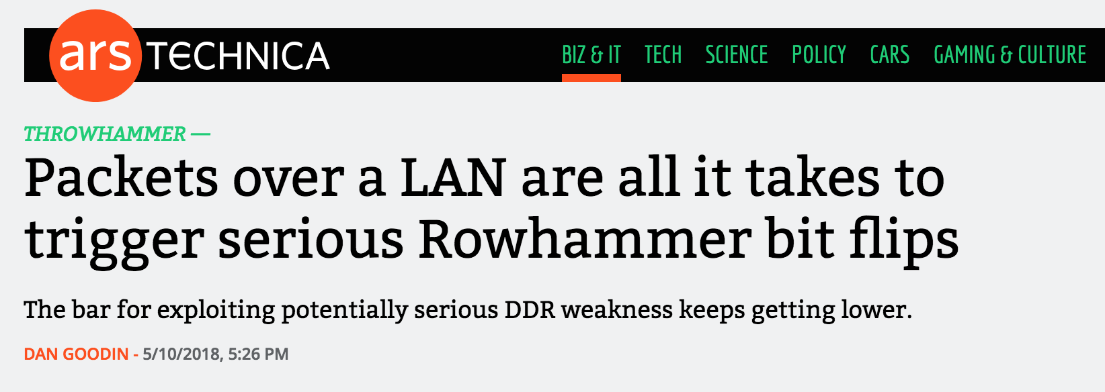
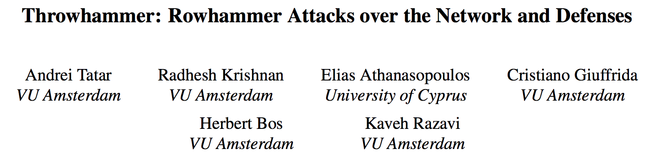
More Security Implications (IV)
Rowhammer over RDMA (I)

Slide 58

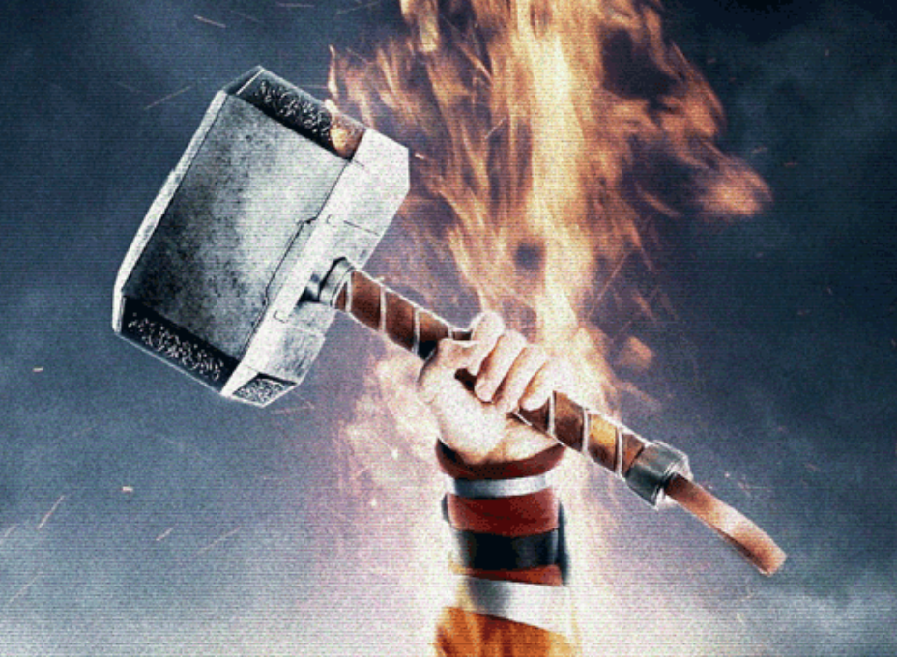
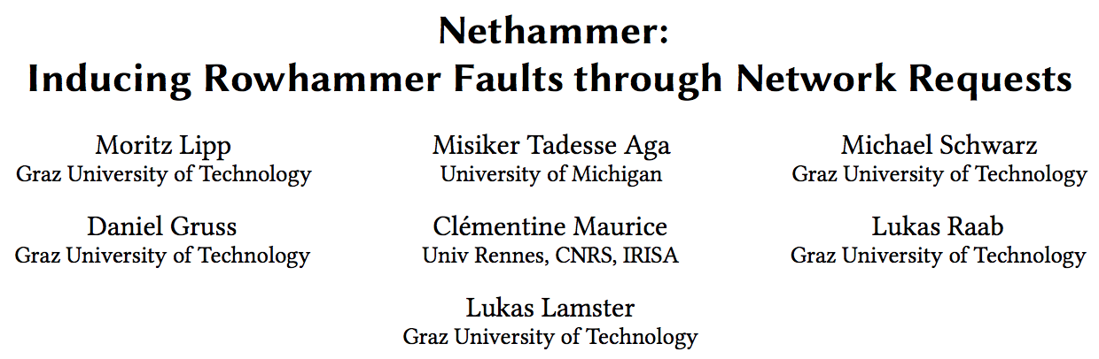
More Security Implications (V)
Rowhammer over RDMA (II)

Slide 59

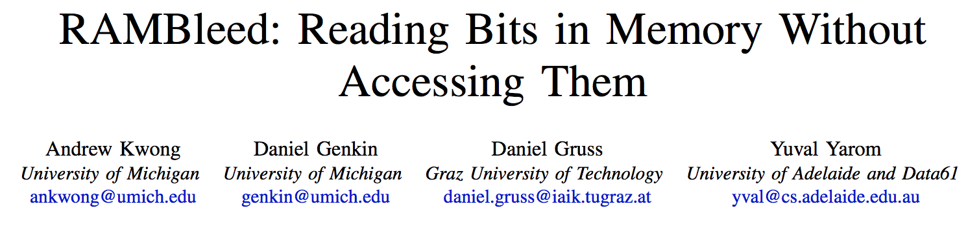
More Security Implications (VI)
IEEE S&P 2020

Slide 60

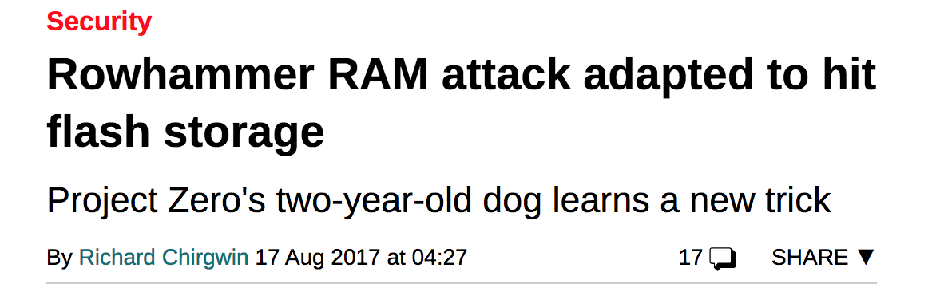
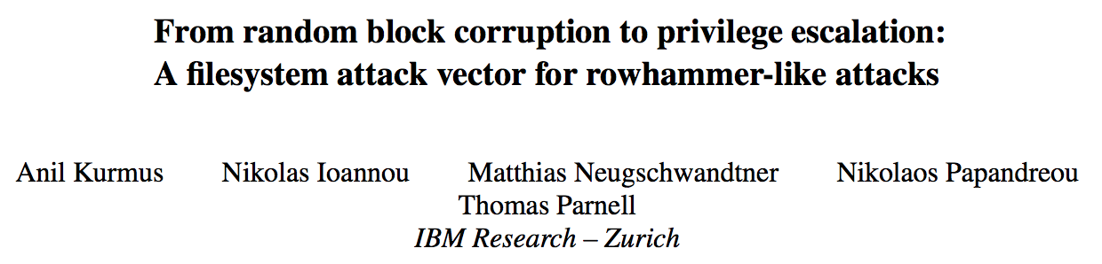
More Security Implications (VII)
Rowhammer on MLC NAND Flash (based on [Cai+, HPCA 2017])

Slide 61
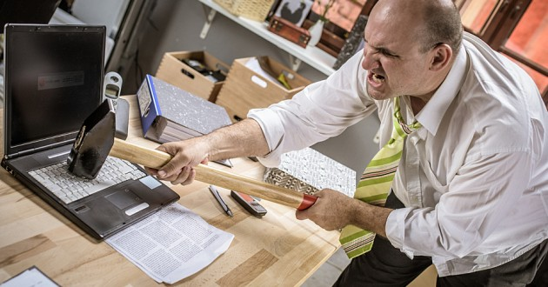
More Security Implications?

Slide 62
Understanding RowHammer

Slide 63
Root Causes of Disturbance Errors
Cause 1: Electromagnetic coupling
  Toggling the wordline voltage briefly increases the voltage of adjacent wordlines
  Slightly opens adjacent rows → Charge leakage
Cause 2: Conductive bridges
Cause 3: Hot-carrier injection
Confirmed by at least one manufacturer
Notes:
Why do the errors occur? We see three possible causes.
First, there could electromagnetic coupling between adjacent wordlines. When the voltage of one is toggled, it could briefly increase the voltage of the other and facilitate the leakage of charge.
Two other possibilities are conductive bridges and hot-carrier injection.
At least one manufacturer confirmed that these three could play a role in the disturbance errors we see them today.

Slide 64
Experimental DRAM Testing Infrastructure
  An Experimental Study of Data Retention Behavior in Modern DRAM Devices: Implications for Retention Time Profiling Mechanisms (Liu et al., ISCA 2013)
  The Efficacy of Error Mitigation Techniques for DRAM Retention Failures: A Comparative Experimental Study
  (Khan et al., SIGMETRICS 2014)
  Flipping Bits in Memory Without Accessing Them: An Experimental Study of DRAM Disturbance Errors (Kim et al., ISCA 2014)
  Adaptive-Latency DRAM: Optimizing DRAM Timing for the Common-Case (Lee et al., HPCA 2015)
  AVATAR: A Variable-Retention-Time (VRT) Aware Refresh for DRAM Systems (Qureshi et al., DSN 2015)

Slide 65
Experimental DRAM Testing Infrastructure
Temperature
Controller
FPGAs
Heater
FPGAs
PC
  Kim+, “Flipping Bits in Memory Without Accessing Them: An Experimental Study of DRAM Disturbance Errors,” ISCA 2014.

Slide 66
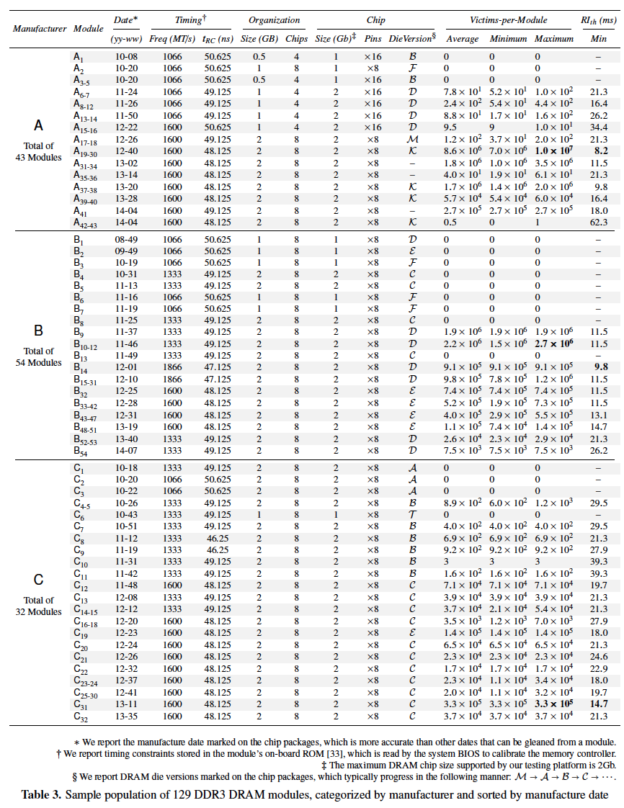
Tested
DRAM
Modules
(129 total)

Slide 67
RowHammer Characterization Results
Most Modules Are at Risk
Errors vs. Vintage
Error = Charge Loss
Adjacency: Aggressor & Victim
Sensitivity Studies
Other Results in Paper
Solution Space
Flipping Bits in Memory Without Accessing Them: An Experimental Study of DRAM Disturbance Errors, (Kim et al., ISCA 2014)
Notes:
Now I will present the characterization results, one-by-one.
First, I show that most modules are at risk. Second, I show the number of errors in a module as a function of the manufacture date. Third, I show that the errors are symptomatic of charge loss. Fourth, I show that an aggressor induces errors in adjacent rows. Fifth, I show several sensitivity studies. And, finally, I briefly describe other results in the paper.

Slide 68
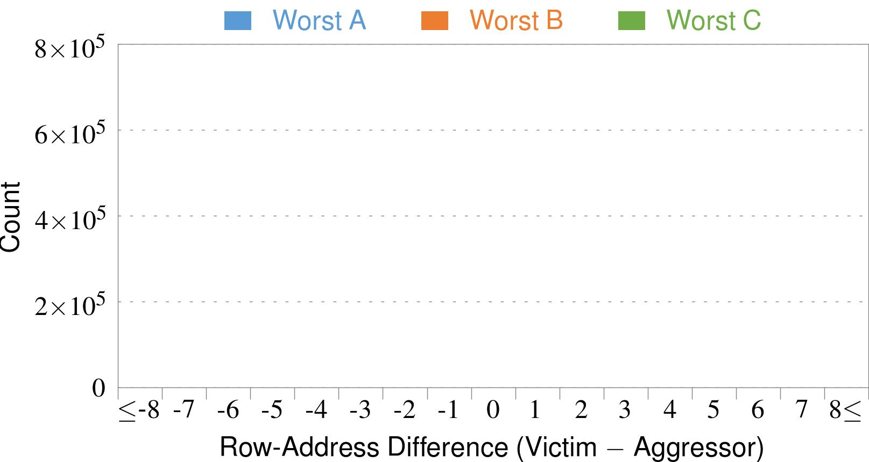
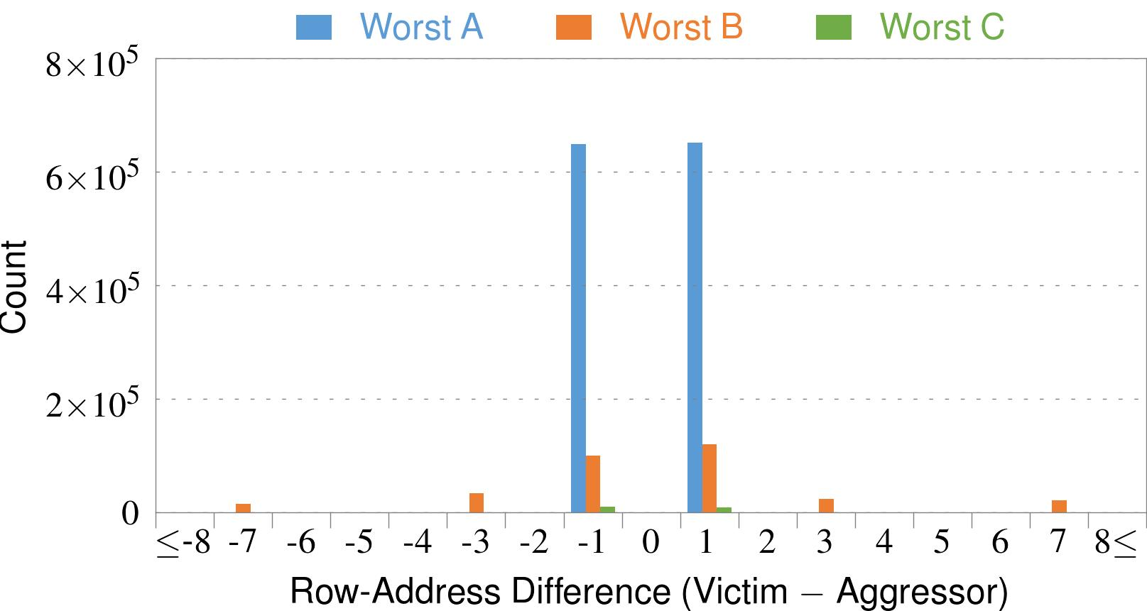
4. Adjacency: Aggressor & Victim
Adjacent
Adjacent
Adjacent
Non-Adjacent
Non-Adjacent
Note: For three modules with the most errors (only first bank)
Most aggressors & victims are adjacent
Notes:
In this figure, the x-axis is the row-address difference between an aggressor and its victims. And the y-axis is the number of victim-aggressor pairs that correspond to the row-address difference. For all three modules, we see strong peaks at plus/minus 1. This implies that aggressors and victims have consecutive row-addresses, in other words, they are adjacent.
However, the figure also shows some victims that are not adjacent to the aggressor. We believe this could be caused by two reasons. First, depending on the mapping, two rows that are physically adjacent within the DRAM chip may not have consecutive row-addresses. Second, fault rows are often re-mapped to spare rows that may reside on a different portion of the DRAM chip.
Nevertheless, we conclude that the vast majority of aggressors & victims are adjacent.

Slide 69
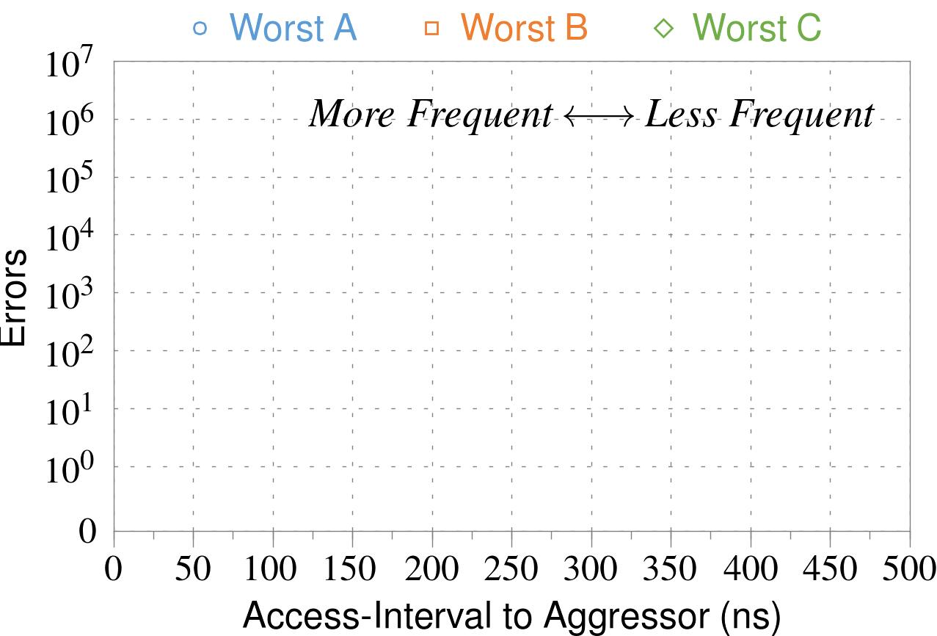
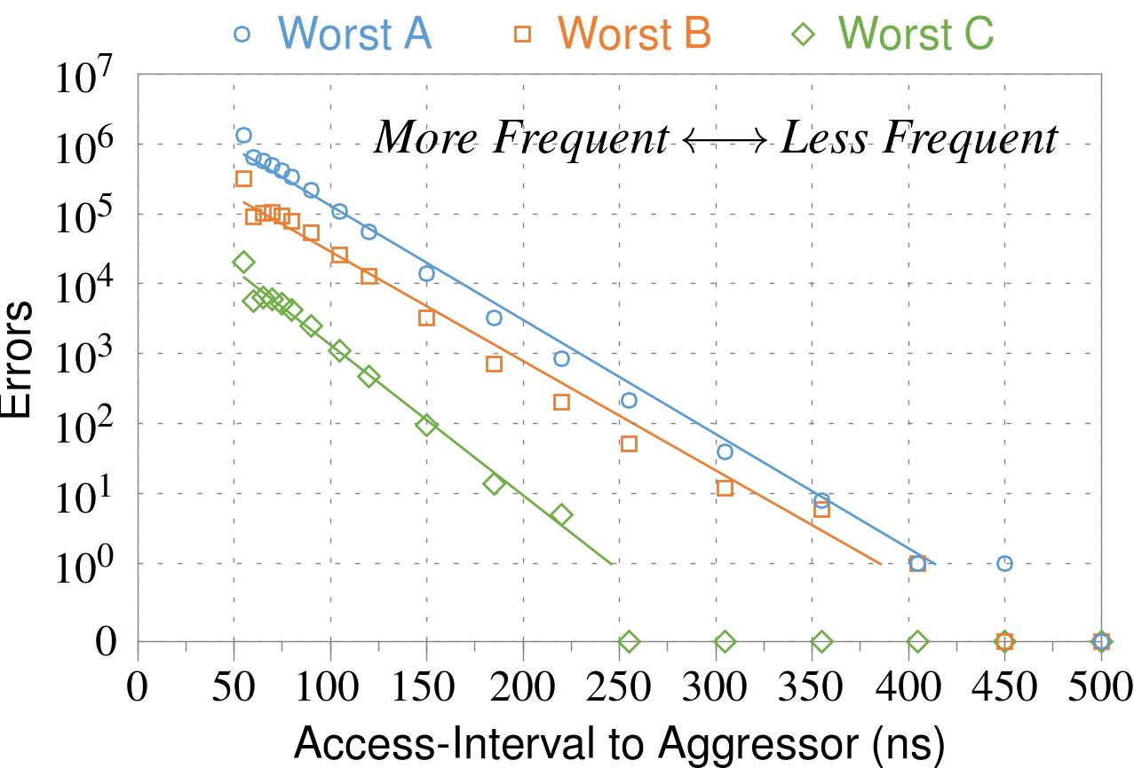
❶ Access Interval (Aggressor)
Not Allowed
500ns
55ns
Note: For three modules with the most errors (only first bank)
Less frequent accesses → Fewer errors
Notes:
In this figure, the x-axis is the interval at which we access the aggressor. And the y-axis is the number of errors. To comply with the DRAM standard, we employ a default value of 55ns in our experiments. However, as we increase the access-interval, we see that the number of errors decreases. In particular, at 500ns, there are no errors for all three modules.
From this, we conclude that less frequent accesses induce fewer errors.

Slide 70
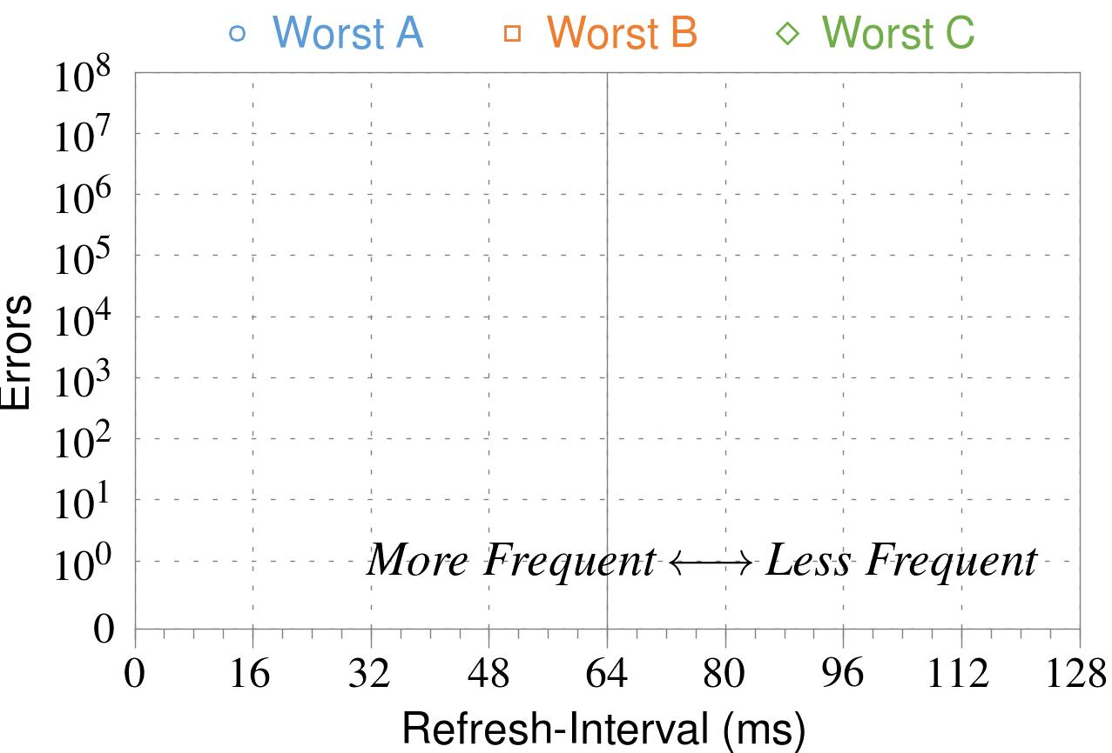
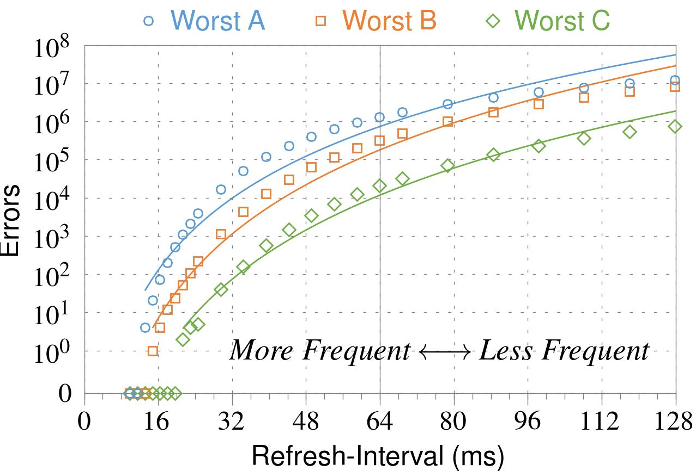
❷ Refresh Interval
~7x frequent
64ms
Note: Using three modules with the most errors (only first bank)
More frequent refreshes → Fewer errors
Notes:
In this figure, the x-axis is the refresh-interval. And the y-axis is the number of errors. To comply with the DRAM standard, we employ a default value of 64ms in our experiments. However, as we decrease the refresh-interval, we see that the number of errors decreases. In particular, when the refresh is shortened by 7x, there are no errors for all three modules.
From this, we conclude that more frequent accesses induce fewer errors.

Slide 71
❸ Data Pattern
Solid
RowStripe
111111
111111
111111
000000
111111
111111
10x Errors
111111
000000
~Solid
~RowStripe
000000
000000
000000
111111
000000
000000
000000
111111
Errors affected by data stored in other cells
Notes:
We tested the modules with four different data-patterns: Solid, inverse Solid, RowStripe, and inverse RowStripe. Solid and inverse Solid give us full coverage since each cell is tested with both 1s and 0s. And the same applies to RowStripe and its inverse.
However, we found that the rowstripe pattern had 10 times as more errors than the solid pattern. We also tested many other data-patterns, including random, but found RowStripe to induce the most errors.
Therefore, we conclude that errors are affected by data stored in other cells due to differences in coupling effects between the cells.

Slide 72
6. Other Results (in Paper)
Victim Cells ≠ Weak Cells (i.e., leaky cells)
  Almost no overlap between them
Errors not strongly affected by temperature
  Default temperature: 50°C
  At 30°C and 70°C, number of errors changes <15%
Errors are repeatable
  Across ten iterations of testing, >70% of victim cells had errors in every iteration
Notes:
First, we show that victim cells are not weak cells, which are cells that are inherently leaky. According to our experiments, we saw almost no overlap between them.
Second, we show that errors are not strongly affected by temperature. In all of the tests so far, we set the temperature to 50 degrees Celsius. But even when we changed the temperature by 20 degrees, the number of errors changed by less than 15 percent.
Third, we show that errors are repeatable. Across ten iterations of testing, more than 70% of victim cells had errors in every iteration.

Slide 73
6. Other Results (in Paper) cont’d
As many as 4 errors per cache-line
  Simple ECC (e.g., SECDED) cannot prevent all errors
Number of cells & rows affected by aggressor
  Victims cells per aggressor: ≤110
  Victims rows per aggressor: ≤9
Cells affected by two aggressors on either side
  Very small fraction of victim cells (<100) have an error when either one of the aggressors is toggled
Notes:
Fourth, we show that there are as many as four errors per cacheline. From this, we conclude that simple ECC schemes (for example, SECDED) cannot prevent all errors.
Fifth, we show that the number of cells & rows affected by an aggressor can be as high as 110 or 9, respectively.
Lastly, we show that a very small fraction of victim cells experience an error when either one of the aggressors is toggled.

Slide 74
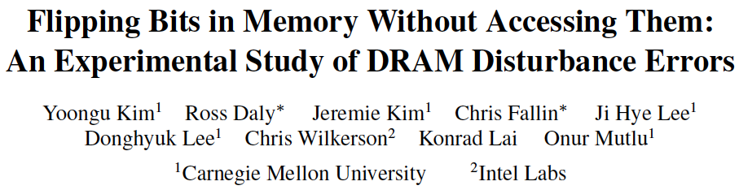
More on RowHammer Analysis
Yoongu Kim, Ross Daly, Jeremie Kim, Chris Fallin, Ji Hye Lee, Donghyuk Lee, Chris Wilkerson, Konrad Lai, and Onur Mutlu,
"Flipping Bits in Memory Without Accessing Them: An Experimental Study of DRAM Disturbance Errors"
Proceedings of the 41st International Symposium on Computer Architecture (ISCA), Minneapolis, MN, June 2014.
[Slides (pptx) (pdf)] [Lightning Session Slides (pptx) (pdf)] [Source Code and Data]

Slide 75
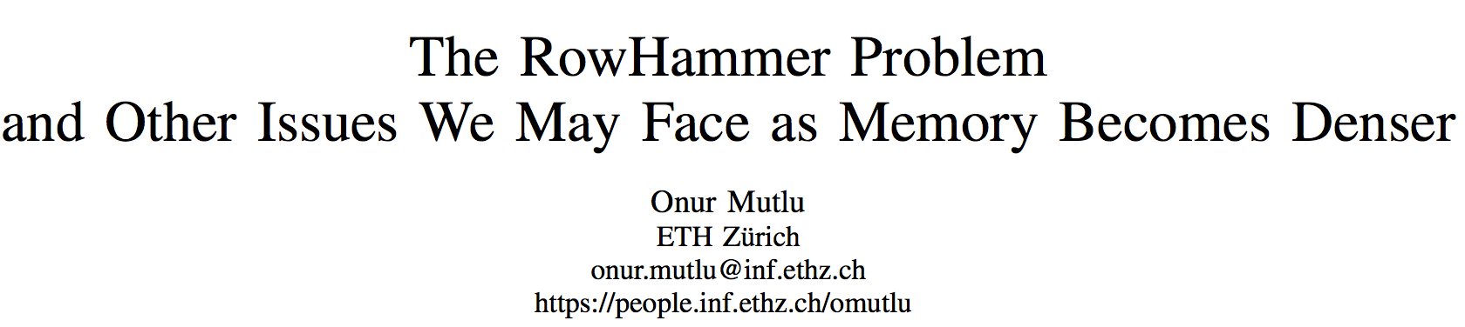
Retrospective on RowHammer & Future
Onur Mutlu,
"The RowHammer Problem and Other Issues We May Face as Memory Becomes Denser"
Invited Paper in Proceedings of the Design, Automation, and Test in Europe Conference (DATE), Lausanne, Switzerland, March 2017.
[Slides (pptx) (pdf)]
https://people.inf.ethz.ch/omutlu/pub/rowhammer-and-other-memory-issues_date17.pdf

Slide 76
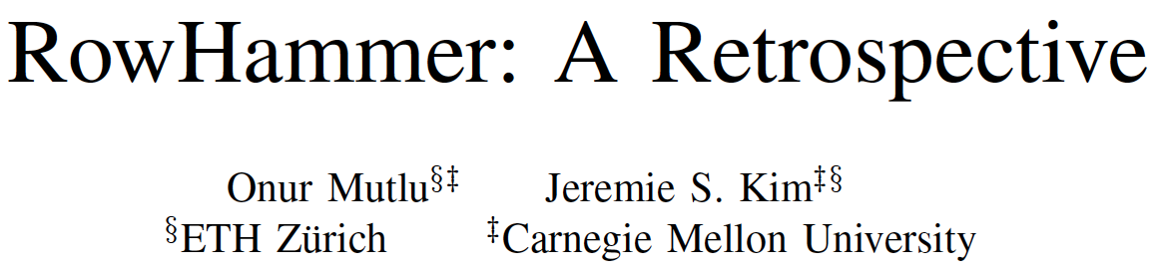
A More Recent RowHammer Retrospective
Onur Mutlu and Jeremie Kim,
"RowHammer: A Retrospective"
IEEE Transactions on Computer-Aided Design of Integrated Circuits and Systems (TCAD) Special Issue on Top Picks in Hardware and Embedded Security, 2019.
[Preliminary arXiv version]

Slide 77
RowHammer Solutions

Slide 78
Two Types of RowHammer Solutions
Immediate
  To protect the vulnerable DRAM chips in the field
  Limited possibilities
Longer-term
  To protect future DRAM chips
  Wider range of protection mechanisms
Our ISCA 2014 paper proposes both types of solutions
  Seven solutions in total
  PARA proposed as best solution → already employed in the field

Slide 79
Some Potential Solutions
Cost
Make better DRAM chips
Power, Performance
Refresh frequently
Cost, Power
Sophisticated ECC
Cost, Power, Complexity
Access counters
Notes:
Here is a list of four potential solutions to disturbance errors: making better DRAM chips, refreshing more frequently, employing sophisticated ECC schemes, and using hardware counters to track the number of accesses to different rows.
However, all of these solutions incur a large overhead in terms cost, power, performance, and/or complexity.

Slide 80
Naive Solutions
❶ Throttle accesses to same row
  Limit access-interval: ≥500ns
  Limit number of accesses: ≤128K (=64ms/500ns)
❷ Refresh more frequently
  Shorten refresh-interval by ~7x
Both naive solutions introduce significant overhead in performance and power
Notes:
Based on what we learned from the sensitivity studies, there are two naive solutions that immediately present themselves.
First, we can throttle accesses to the same row. If the access-interval is greater than 500ns, I showed how errors are not induced. We can achieve the same effect by limiting the maximum number of accesses to the same row to be less than 128K, within a refresh interval.
Second, we can refresh the module more frequently. If the refresh-interval is shortened by 7x, I showed how errors can be prevented.
However, both naive solutions introduce significant overhead in both performance and power. Later on, I will propose a much more efficient solution.

Slide 81

Apple’s Patch for RowHammer
https://support.apple.com/en-gb/HT204934
HP, Lenovo, and other vendors released similar patches

Slide 82
Our Solution to RowHammer
PARA: Probabilistic Adjacent Row Activation
Key Idea
  After closing a row, we activate (i.e., refresh) one of its neighbors with a low probability: p = 0.005
Reliability Guarantee
  When p=0.005, errors in one year: 9.4×10⁻¹⁴
  By adjusting the value of p, we can vary the strength of protection against errors
Notes:
We provide a more efficient solution, called PARA, which stands for probabilistic adjacent row activation.
The key idea is thus: after closing a row, we activate (i.e., refresh) one of its neighbors with a low probability, for example, p equal to 0.005.
PARA provides a strong reliability guarantee even under the worst-case access patterns to DRAM. When we set p to 0.005, the expected number of errors in one year is 9.4 times 10 to the negative 14. This probability is much lower the failure rate of other hardware components, for example, the hard-disk drive.
And by adjusting the value of p, PARA can provide an arbitrarily strong-degree of protection against errors.

Slide 83
Advantages of PARA
PARA refreshes rows infrequently
  Low power
  Low performance-overhead
    Average slowdown: 0.20% (for 29 benchmarks)
    Maximum slowdown: 0.75%
PARA is stateless
  Low cost
  Low complexity
PARA is an effective and low-overhead solution to prevent disturbance errors
Notes:
PARA has many advantages. Since it refreshes row infrequently, it has low power and low performance-overhead. Simulated across 29 benchmarks, we saw an average of only 0.2% slowdown and a maximum of only 0.75% slowdown.
In addition, due to its stateless nature, PARA has low cost and complexity.
Therefore, PARA is an effective and low-overhead solution to prevent disturbance errors.

Slide 84
Requirements for PARA
If implemented in DRAM chip
  Enough slack in timing parameters
  Plenty of slack today:
    Lee et al., “Adaptive-Latency DRAM: Optimizing DRAM Timing for the Common Case,” HPCA 2015.
    Chang et al., “Understanding Latency Variation in Modern DRAM Chips,” SIGMETRICS 2016.
    Lee et al., “Design-Induced Latency Variation in Modern DRAM Chips,” SIGMETRICS 2017.
    Chang et al., “Understanding Reduced-Voltage Operation in Modern DRAM Devices,” SIGMETRICS 2017.
    Ghose et al., “What Your DRAM Power Models Are Not Telling You: Lessons from a Detailed Experimental Study,” SIGMETRICS 2018.
If implemented in memory controller
  Better coordination between memory controller and DRAM
  Memory controller should know which rows are physically adjacent

Slide 85

Probabilistic Activation in Real Life (I)
https://twitter.com/isislovecruft/status/1021939922754723841

Slide 86

Probabilistic Activation in Real Life (II)
https://twitter.com/isislovecruft/status/1021939922754723841

Slide 87
Seven RowHammer Solutions Proposed
Yoongu Kim, Ross Daly, Jeremie Kim, Chris Fallin, Ji Hye Lee, Donghyuk Lee, Chris Wilkerson, Konrad Lai, and Onur Mutlu,
"Flipping Bits in Memory Without Accessing Them: An Experimental Study of DRAM Disturbance Errors"
Proceedings of the 41st International Symposium on Computer Architecture (ISCA), Minneapolis, MN, June 2014.
[Slides (pptx) (pdf)] [Lightning Session Slides (pptx) (pdf)] [Source Code and Data]

Slide 88
A Takeaway
Main Memory Needs
Intelligent Controllers
for Security

Slide 89

Industry Is Writing Papers About It, Too

Slide 90

Call for Intelligent Memory Controllers

Slide 91

Aside: Intelligent Controller for NAND Flash
USB Daughter Board
USB Jack
HAPS-52 Mother Board
Virtex-II Pro
(USB controller)
1x-nm
NAND Flash
Virtex-V FPGA
(NAND Controller)
[DATE 2012, ICCD 2012, DATE 2013, ITJ 2013, ICCD 2013, SIGMETRICS 2014, HPCA 2015, DSN 2015, MSST 2015, JSAC 2016, HPCA 2017, DFRWS 2017,
PIEEE 2017, HPCA 2018, SIGMETRICS 2018]
NAND Daughter Board
Cai+, “Error Characterization, Mitigation, and Recovery in Flash Memory Based Solid State Drives,” Proc. IEEE 2017.

Slide 92


Aside: Intelligent Controller for NAND Flash
Proceedings of the IEEE, Sept. 2017
https://arxiv.org/pdf/1706.08642

Slide 93
A Key Takeaway
Main Memory Needs
Intelligent Controllers

Slide 94
Future Memory Reliability/Security Challenges

Slide 95
Future of Main Memory
DRAM is becoming less reliable → more vulnerable

Slide 96
Large-Scale Failure Analysis of DRAM Chips
Analysis and modeling of memory errors found in all of Facebook’s server fleet
Justin Meza, Qiang Wu, Sanjeev Kumar, and Onur Mutlu,
"Revisiting Memory Errors in Large-Scale Production Data Centers: Analysis and Modeling of New Trends from the Field"
Proceedings of the 45th Annual IEEE/IFIP International Conference on Dependable Systems and Networks (DSN), Rio de Janeiro, Brazil, June 2015.
[Slides (pptx) (pdf)] [DRAM Error Model]

Slide 97
DRAM Reliability Reducing
Intuition:
quadratic
increase in
capacity
Meza+, “Revisiting Memory Errors in Large-Scale Production Data Centers,” DSN’15.

Slide 98

Aside: SSD Error Analysis in the Field
First large-scale field study of flash memory errors
Justin Meza, Qiang Wu, Sanjeev Kumar, and Onur Mutlu,
"A Large-Scale Study of Flash Memory Errors in the Field"
Proceedings of the ACM International Conference on Measurement and Modeling of Computer Systems (SIGMETRICS), Portland, OR, June 2015.
[Slides (pptx) (pdf)] [Coverage at ZDNet]

Slide 99
Future of Main Memory
DRAM is becoming less reliable → more vulnerable
Due to difficulties in DRAM scaling, other problems may also appear (or they may be going unnoticed)
Some errors may already be slipping into the field
  Read disturb errors (Rowhammer)
  Retention errors
  Read errors, write errors
  …
These errors can also pose security vulnerabilities

Slide 100
DRAM Data Retention Time Failures
Determining the data retention time of a cell/row is getting more difficult
Retention failures may already be slipping into the field

Slide 101
Keeping Future Memory Secure

Slide 102
How Do We Keep Memory Secure?
DRAM
Flash memory
Emerging Technologies
  Phase Change Memory
  STT-MRAM
  RRAM, memristors
  …

Slide 103
Challenge and Opportunity for Future
Fundamentally
Secure, Reliable, Safe
Computing Architectures

Slide 104
Solution Direction: Principled Designs
Design fundamentally secure
computing architectures
Predict and prevent
such safety issues

Slide 105
Architecting for Security
Understand: Methods for vulnerability modeling & discovery
  Modeling and prediction based on real (device) data and analysis
  Understanding vulnerabilities
  Developing reliable metrics
Architect: Principled architectures with security as key concern
  Good partitioning of duties across the stack
  Cannot give up performance and efficiency
  Patch-ability in the field
Design & Test: Principled design, automation, (online) testing
  Design for security
  High coverage and good interaction with system reliability methods

Slide 106
Understand and Model with Experiments (DRAM)
Temperature
Controller
FPGAs
Heater
FPGAs
PC
  Kim+, “Flipping Bits in Memory Without Accessing Them: An Experimental Study of DRAM Disturbance Errors,” ISCA 2014.

Slide 107
Understand and Model with Experiments (Flash)
USB Daughter Board
USB Jack
HAPS-52 Mother Board
Virtex-II Pro
(USB controller)
1x-nm
NAND Flash
Virtex-V FPGA
(NAND Controller)
[DATE 2012, ICCD 2012, DATE 2013, ITJ 2013, ICCD 2013, SIGMETRICS 2014, HPCA 2015, DSN 2015, MSST 2015, JSAC 2016, HPCA 2017, DFRWS 2017,
PIEEE 2017, HPCA 2018, SIGMETRICS 2018]
NAND Daughter Board
Cai+, “Error Characterization, Mitigation, and Recovery in Flash Memory Based Solid State Drives,” Proc. IEEE 2017.

Slide 108
Recall: Collapse of the “Galloping Gertie”
Source: AP
http://www.wsdot.wa.gov/tnbhistory/connections/connections3.htm

Slide 109

Another Example (1994)
Source: By 최광모 - Own work, CC BY-SA 4.0, https://commons.wikimedia.org/w/index.php?curid=35197984

Slide 110

Yet Another Example (2007)
Source: Morry Gash/AP,
https://www.npr.org/2017/08/01/540669701/10-years-after-bridge-collapse-america-is-still-crumbling?t=1535427165809

Slide 111

A More Recent Example (2018)
Source: AFP / Valery HACHE, https://www.capitalfm.co.ke/news/2018/08/genoa-bridge-collapse-what-we-know/

Slide 112
The Takeaway, Again
In-Field Patch-ability
(Intelligent Memory)
Can Avoid Such Failures

Slide 113
Final Thoughts on RowHammer

Slide 114
Some Thoughts on RowHammer
A simple hardware failure mechanism can create a widespread system security vulnerability
How to exploit and fix the vulnerability requires a strong understanding across the transformation layers
  And, a strong understanding of tools available to you
Fixing needs to happen for two types of chips
  Existing chips (already in the field)
  Future chips
Mechanisms for fixing are different between the two types

Slide 115
Aside: Byzantine Failures
This class of failures is known as Byzantine failures
Characterized by
  Undetected erroneous computation
  Opposite of “fail fast (with an error or no result)”
“erroneous” can be “malicious” (intent is the only distinction)
Very difficult to detect and confine Byzantine failures
Do all you can to avoid them
Lamport et al., “The Byzantine Generals Problem,” ACM TOPLAS 1982.
Slide credit: Mahadev Satyanarayanan, CMU, 15-440, Spring 2015

Slide 116
RowHammer, Revisited
One can predictably induce bit flips in commodity DRAM chips
  >80% of the tested DRAM chips are vulnerable
First example of how a simple hardware failure mechanism can create a widespread system security vulnerability

Slide 117
RowHammer: Retrospective
New mindset that has enabled a renewed interest in HW security attack research:
  Real (memory) chips are vulnerable, in a simple and widespread manner → this causes real security problems
  Hardware reliability → security connection is now mainstream discourse
Many new RowHammer attacks…
  Tens of papers in top security venues
  More to come as RowHammer is getting worse (DDR4 & beyond)
Many new RowHammer solutions…
  Apple security release; Memtest86 updated
  Many solution proposals in top venues (latest in ISCA 2019)
  Principled system-DRAM co-design (in original RowHammer paper)
  More to come…

Slide 118
Perhaps Most Importantly…
RowHammer enabled a shift of mindset in mainstream security researchers
  General-purpose hardware is fallible, in a widespread manner
  Its problems are exploitable
This mindset has enabled many systems security researchers to examine hardware in more depth
  And understand HW’s inner workings and vulnerabilities
It is no coincidence that two of the groups that discovered Meltdown and Spectre heavily worked on RowHammer attacks before
  More to come…

Slide 119
Summary: RowHammer
DRAM reliability is reducing
Reliability issues open up security vulnerabilities
  Very hard to defend against
Rowhammer is a prime example
  First example of how a simple hardware failure mechanism can create a widespread system security vulnerability
  Its implications on system security research are tremendous & exciting
Bad news: RowHammer is getting worse.
Good news: We have a lot more to do.
  We are now fully aware hardware is easily fallible.
  We are developing both attacks and solutions.
  We are developing principled models, methodologies, solutions.

Slide 120
For More on RowHammer…
Onur Mutlu and Jeremie Kim,
"RowHammer: A Retrospective"
IEEE Transactions on Computer-Aided Design of Integrated Circuits and Systems (TCAD) Special Issue on Top Picks in Hardware and Embedded Security, 2019.
[Preliminary arXiv version]

Slide 121
Notes:
Picture from the article:
http://thehackernews.com/2015/03/dram-rowhammer-vulnerability.html

Slide 122
Memory Systems and Memory-Centric Computing Systems
Part 2: RowHammer
Prof. Onur Mutlu
omutlu@gmail.com
https://people.inf.ethz.ch/omutlu
7 July 2019
SAMOS Tutorial

Slide 123
Future Memory Reliability/Security Challenges

Slide 124
Future of Main Memory
DRAM is becoming less reliable → more vulnerable

Slide 125
Large-Scale Failure Analysis of DRAM Chips
Analysis and modeling of memory errors found in all of Facebook’s server fleet
Justin Meza, Qiang Wu, Sanjeev Kumar, and Onur Mutlu,
"Revisiting Memory Errors in Large-Scale Production Data Centers: Analysis and Modeling of New Trends from the Field"
Proceedings of the 45th Annual IEEE/IFIP International Conference on Dependable Systems and Networks (DSN), Rio de Janeiro, Brazil, June 2015.
[Slides (pptx) (pdf)] [DRAM Error Model]

Slide 126
DRAM Reliability Reducing
Intuition:
quadratic
increase in
capacity
Meza+, “Revisiting Memory Errors in Large-Scale Production Data Centers,” DSN’15.

Slide 127
Aside: SSD Error Analysis in the Field
First large-scale field study of flash memory errors
Justin Meza, Qiang Wu, Sanjeev Kumar, and Onur Mutlu,
"A Large-Scale Study of Flash Memory Errors in the Field"
Proceedings of the ACM International Conference on Measurement and Modeling of Computer Systems (SIGMETRICS), Portland, OR, June 2015.
[Slides (pptx) (pdf)] [Coverage at ZDNet]

Slide 128
Future of Main Memory
DRAM is becoming less reliable → more vulnerable
Due to difficulties in DRAM scaling, other problems may also appear (or they may be going unnoticed)
Some errors may already be slipping into the field
  Read disturb errors (Rowhammer)
  Retention errors
  Read errors, write errors
  …
These errors can also pose security vulnerabilities

Slide 129
DRAM Data Retention Time Failures
Determining the data retention time of a cell/row is getting more difficult
Retention failures may already be slipping into the field

Slide 130
Analysis of Data Retention Failures [ISCA’13]
Jamie Liu, Ben Jaiyen, Yoongu Kim, Chris Wilkerson, and Onur Mutlu,
"An Experimental Study of Data Retention Behavior in Modern DRAM Devices: Implications for Retention Time Profiling Mechanisms"
Proceedings of the 40th International Symposium on Computer Architecture (ISCA), Tel-Aviv, Israel, June 2013. Slides (ppt) Slides (pdf)

Slide 131
Two Challenges to Retention Time Profiling
Data Pattern Dependence (DPD) of retention time
Variable Retention Time (VRT) phenomenon

Slide 132

Two Challenges to Retention Time Profiling
Challenge 1: Data Pattern Dependence (DPD)
  Retention time of a DRAM cell depends on its value and the values of cells nearby it
  When a row is activated, all bitlines are perturbed simultaneously

Slide 133
Data Pattern Dependence
Electrical noise on the bitline affects reliable sensing of a DRAM cell
The magnitude of this noise is affected by values of nearby cells via
  Bitline-bitline coupling → electrical coupling between adjacent bitlines
  Bitline-wordline coupling → electrical coupling between each bitline and the activated wordline
Notes:
If a cell has lost enough charge, this noise can be large enough to cause a failure on a read
(normally, there is enough noise margin to tolerate the coupling noise)

Slide 134
Data Pattern Dependence
Electrical noise on the bitline affects reliable sensing of a DRAM cell
The magnitude of this noise is affected by values of nearby cells via
  Bitline-bitline coupling → electrical coupling between adjacent bitlines
  Bitline-wordline coupling → electrical coupling between each bitline and the activated wordline
Retention time of a cell depends on data patterns stored in nearby cells
→ need to find the worst data pattern to find worst-case retention time
→ this pattern is location dependent
Notes:
If a cell has lost enough charge, this noise can be large enough to cause a failure on a read
(normally, there is enough noise margin to tolerate the coupling noise)

Slide 135
Two Challenges to Retention Time Profiling
Challenge 2: Variable Retention Time (VRT)
  Retention time of a DRAM cell changes randomly over time
    a cell alternates between multiple retention time states
  Leakage current of a cell changes sporadically due to a charge trap in the gate oxide of the DRAM cell access transistor
  When the trap becomes occupied, charge leaks more readily from the transistor’s drain, leading to a short retention time
    Called Trap-Assisted Gate-Induced Drain Leakage
  This process appears to be a random process [Kim+ IEEE TED’11]
  Worst-case retention time depends on a random process
    → need to find the worst case despite this

Slide 136
Modern DRAM Retention Time Distribution
NEWER
NEWER
OLDER
OLDER
Newer device families have more weak cells than older ones
Likely a result of technology scaling

Slide 137
An Example VRT Cell
A cell from E 2Gb chip family

Slide 138
Variable Retention Time
Many failing cells jump from
very high retention time to very low
Most failing cells
exhibit VRT
Min ret time = Max ret time
Expected if no VRT
A 2Gb chip family

Slide 139
More on Data Retention Failures [ISCA’13]
Jamie Liu, Ben Jaiyen, Yoongu Kim, Chris Wilkerson, and Onur Mutlu,
"An Experimental Study of Data Retention Behavior in Modern DRAM Devices: Implications for Retention Time Profiling Mechanisms"
Proceedings of the 40th International Symposium on Computer Architecture (ISCA), Tel-Aviv, Israel, June 2013. Slides (ppt) Slides (pdf)

Slide 140
Industry Is Writing Papers About It, Too

Slide 141
Industry Is Writing Papers About It, Too

Slide 142

Refresh Overhead: Performance
46%
8%
Liu et al., “RAIDR: Retention-Aware Intelligent DRAM Refresh,” ISCA 2012.

Slide 143

Refresh Overhead: Energy
47%
15%
Liu et al., “RAIDR: Retention-Aware Intelligent DRAM Refresh,” ISCA 2012.

Slide 144
Most Refreshes Are Unnecessary
Retention Time Profile of DRAM looks like this:

Slide 145

RAIDR: Eliminating Unnecessary Refreshes
1. Profiling: Profile the retention time of all DRAM rows
2. Binning: Store rows into bins by retention time
→ use Bloom Filters for efficient and scalable storage
3. Refreshing: Memory controller refreshes rows in different bins at different rates
→ probe Bloom Filters to determine refresh rate of a row
1.25KB storage in controller for 32GB DRAM memory
Can reduce refreshes by ~75%
→ reduces energy consumption and improves performance
Liu et al., “RAIDR: Retention-Aware Intelligent DRAM Refresh,” ISCA 2012.

Slide 146

RAIDR: Baseline Design
Refresh control is in DRAM in today’s auto-refresh systems
RAIDR can be implemented in either the controller or DRAM

Slide 147
RAIDR in Memory Controller: Option 1
Overhead of RAIDR in DRAM controller:
1.25 KB Bloom Filters, 3 counters, additional commands issued for per-row refresh (all accounted for in evaluations)

Slide 148

RAIDR in DRAM Chip: Option 2
Overhead of RAIDR in DRAM chip:
Per-chip overhead: 20B Bloom Filters, 1 counter (4 Gbit chip)
Total overhead: 1.25KB Bloom Filters, 64 counters (32 GB DRAM)

Slide 149


RAIDR: Results and Takeaways
System: 32GB DRAM, 8-core; SPEC, TPC-C, TPC-H workloads
RAIDR hardware cost: 1.25 kB (2 Bloom filters)
Refresh reduction: 74.6%
Dynamic DRAM energy reduction: 16%
Idle DRAM power reduction: 20%
Performance improvement: 9%
Benefits increase as DRAM scales in density

Slide 150

DRAM Device Capacity Scaling: Performance
RAIDR performance benefits increase with DRAM chip capacity
Liu et al., “RAIDR: Retention-Aware Intelligent DRAM Refresh,” ISCA 2012.

Slide 151

DRAM Device Capacity Scaling: Energy
RAIDR energy benefits increase with DRAM chip capacity
Liu et al., “RAIDR: Retention-Aware Intelligent DRAM Refresh,” ISCA 2012.

Slide 152

RAIDR: Eliminating Unnecessary Refreshes
Observation: Most DRAM rows can be refreshed much less often without losing data [Kim+, EDL’09][Liu+ ISCA’13]
Key idea: Refresh rows containing weak cells
more frequently, other rows less frequently
  1. Profiling: Profile retention time of all rows
  2. Binning: Store rows into bins by retention time in memory controller
  Efficient storage with Bloom Filters (only 1.25KB for 32GB memory)
  3. Refreshing: Memory controller refreshes rows in different bins at different rates
Results: 8-core, 32GB, SPEC, TPC-C, TPC-H
  74.6% refresh reduction @ 1.25KB storage
  ~16%/20% DRAM dynamic/idle power reduction
  ~9% performance improvement
  Benefits increase with DRAM capacity
Liu et al., “RAIDR: Retention-Aware Intelligent DRAM Refresh,” ISCA 2012.

Slide 153

More on RAIDR: Perf+Energy Perspective
Jamie Liu, Ben Jaiyen, Richard Veras, and Onur Mutlu,
"RAIDR: Retention-Aware Intelligent DRAM Refresh"
Proceedings of the 39th International Symposium on Computer Architecture (ISCA), Portland, OR, June 2012. Slides (pdf)

Slide 154
Finding DRAM Retention Failures
How can we reliably find the retention time of all DRAM cells?
Goals: so that we can
  Make DRAM reliable and secure
  Make techniques like RAIDR work
  → improve performance and energy

Slide 155
Mitigation of Retention Issues [SIGMETRICS’14]
Samira Khan, Donghyuk Lee, Yoongu Kim, Alaa Alameldeen, Chris Wilkerson, and Onur Mutlu,
"The Efficacy of Error Mitigation Techniques for DRAM Retention Failures: A Comparative Experimental Study"
Proceedings of the ACM International Conference on Measurement and Modeling of Computer Systems (SIGMETRICS), Austin, TX, June 2014. [Slides (pptx) (pdf)] [Poster (pptx) (pdf)] [Full data sets]

Slide 156
Towards an Online Profiling System
Key Observations:
Testing alone cannot detect all possible failures
Combination of ECC and other mitigation techniques is much more effective
  But degrades performance
Testing can help to reduce the ECC strength
  Even when starting with a higher strength ECC
Khan+, “The Efficacy of Error Mitigation Techniques for DRAM Retention Failures: A Comparative Experimental Study,” SIGMETRICS 2014.
Notes:
Our high-level design for online profiling system is based to thee key observations:

Slide 157


Towards an Online Profiling System
Initially Protect DRAM
with Strong ECC
Periodically Test
Parts of DRAM
1
2
Test
ECC
Test
Test
Mitigate errors and
reduce ECC
3
Run tests periodically after a short interval
at smaller regions of memory
Notes:
Based on these observations, we propose that in an online profiling system,

Slide 158
Handling Variable Retention Time [DSN’15]
Moinuddin Qureshi, Dae Hyun Kim, Samira Khan, Prashant Nair, and Onur Mutlu,
"AVATAR: A Variable-Retention-Time (VRT) Aware Refresh for DRAM Systems"
Proceedings of the 45th Annual IEEE/IFIP International Conference on Dependable Systems and Networks (DSN), Rio de Janeiro, Brazil, June 2015.
[Slides (pptx) (pdf)]

Slide 159
AVATAR
Insight: Avoid retention failures ➔ Upgrade row on ECC error
Observation: Rate of VRT >> Rate of soft error (50x-2500x)
Scrub
(15 min)
DRAM Rows
Ref. Rate Table
ECC
A
0
ECC
B
Weak Cell
0
ECC
C
1
ECC
D
RETENTION
PROFILING
0
Row protected from future
retention failures
ECC
E
0
ECC
F
0
ECC
G
1
1
ECC
H
0
AVATAR mitigates VRT by increasing refresh rate on error

Slide 160

RESULTS: REFRESH SAVINGS
Retention Testing Once a Year can revert refresh saving from 60% to 70%
No VRT
AVATAR
AVATAR reduces refresh by 60%-70%, similar to multi rate refresh but with VRT tolerance

Slide 161
SPEEDUP
Speedup
AVATAR gets 2/3rd the performance of NoRefresh. More gains at higher capacity nodes

Slide 162
ENERGY DELAY PRODUCT
Energy Delay Product
AVATAR reduces EDP,
Significant reduction at higher capacity nodes

Slide 163
Handling Data-Dependent Failures [DSN’16]
Samira Khan, Donghyuk Lee, and Onur Mutlu,
"PARBOR: An Efficient System-Level Technique to Detect Data-Dependent Failures in DRAM"
Proceedings of the 45th Annual IEEE/IFIP International Conference on Dependable Systems and Networks (DSN), Toulouse, France, June 2016.
[Slides (pptx) (pdf)]

Slide 164
Handling Data-Dependent Failures [MICRO’17]
Samira Khan, Chris Wilkerson, Zhe Wang, Alaa R. Alameldeen, Donghyuk Lee, and Onur Mutlu,
"Detecting and Mitigating Data-Dependent DRAM Failures by Exploiting Current Memory Content"
Proceedings of the 50th International Symposium on Microarchitecture (MICRO), Boston, MA, USA, October 2017.
[Slides (pptx) (pdf)] [Lightning Session Slides (pptx) (pdf)] [Poster (pptx) (pdf)]

Slide 165
Handling Both DPD and VRT [ISCA’17]
Minesh Patel, Jeremie S. Kim, and Onur Mutlu,
"The Reach Profiler (REAPER): Enabling the Mitigation of DRAM Retention Failures via Profiling at Aggressive Conditions"
Proceedings of the 44th International Symposium on Computer Architecture (ISCA), Toronto, Canada, June 2017.
[Slides (pptx) (pdf)]
[Lightning Session Slides (pptx) (pdf)]
First experimental analysis of (mobile) LPDDR4 chips
Analyzes the complex tradeoff space of retention time profiling
Idea: enable fast and robust profiling at higher refresh intervals & temperatures

Slide 166
Goal: find all retention failures for
a refresh interval T > default (64ms)
Row Decoder
SA
SA
SA
SA
SA
Notes:
Ideally, we would like to identify all the cells that fail at a given refresh interval so that we can extend the default refresh interval past 64ms and mitigate DRAM refresh overhead

Slide 167
Process, voltage, temperature
Variable retention time
Data pattern dependence
Notes:
However, there are a number of unwanted effects that complicate profiling, which I will go into in detail in my talk later this afternoon

Slide 168
Characterization of
368 LPDDR4 DRAM Chips
1
Cells are more likely to fail at an
increased (refresh interval | temperature)
2
Complex tradeoff space between profiling
(speed & coverage & false positives)
Notes:
In order to better understand these effects in modern DRAM, we perform the first extensive characterization of 368 LPDDR4 DRAM chips
We make two major observations
First, we find that cells are more likely to fail at an increased refresh interval or temperature
Second, we identify a complex tradeoff space surrounding profiling, and characterize it in terms of profiling speed, failure coverage, and false positive rate

Slide 169
temperature
operate
here
refresh interval
Notes:
We leverage these observations to develop the reach profiler, which searches for failures NOT at the operating conditions,

Slide 170
REACH
PROFILING
profile
here
temperature
operate
here
refresh interval
Notes:
But rather at reach conditions, where cells are more likely to fail

Slide 171
Reach Profiling
A new DRAM retention failure profiling methodology
+ Faster and more reliable
than current approaches
+ Enables longer refresh intervals
Notes:
We find that this not only increases profiling speed and reliability beyond prior approaches to profiling,
But also enables longer refresh intervals that were previously unreasonable due to profiling overhead

Slide 172
LPDDR4 Studies
Temperature
Data Pattern Dependence
Retention Time Distributions
Variable Retention Time
Individual Cell Characterization
20/36
Notes:
Here are the studies that we did using our infrastructure.
We find that the first three, temperature, data pattern dependence, and retention time distributions, show results similar to those in prior work using DDR3 DRAM.
[CLICK]
Therefore, in this talk I’m going to focus on 4 and 5, variable retention time, and individual cell characterization, which show new results that help motivate our mechanism.
[END]

Slide 173

Long-term Continuous Profiling
Representative chip from Vendor B, 2048ms, 45°C
# New Failing Cells
Time (days)
New failing cells continue to appear over time
  Attributed to variable retention time (VRT)
The set of failing cells changes over time
21/36
Notes:
Here is some data we collected from a representative chip at a fixed refresh interval of 2048ms.
We show the number of new failing cells discovered by continuously profiling over 6 days.
[CLICK]
We see that new failing cells continue to appear over time.
We attribute these to variable retention time effects, which mean that cells can randomly change retention times at any point.
[CLICK]
This shows that the set of failing cells we find at 2048ms changes over time
[CLICK]
This means that error correction codes and online profiling are necessary to manage new failing cells that continue to appear
[END]

Slide 174
Long-term Continuous Profiling
Representative chip from Vendor B, 2048ms, 45°C
# New Failing Cells
Error correction codes (ECC)
and online profiling are necessary
to manage new failing cells
Time (days)
New failing cells continue to appear over time
  Attributed to variable retention time (VRT)
The set of failing cells changes over time
21/36
Notes:
Here is some data we collected from a representative chip at a fixed refresh interval of 2048ms.
We show the number of new failing cells discovered by continuously profiling over 6 days.
[CLICK]
We see that new failing cells continue to appear over time.
We attribute these to variable retention time effects, which mean that cells can randomly change retention times at any point.
[CLICK]
This shows that the set of failing cells we find at 2048ms changes over time
[CLICK]
This means that error correction codes and online profiling are necessary to manage new failing cells that continue to appear
[END]

Slide 175
Single-cell Failure Probability (Cartoon)
idealized cell
(retention time = 3s)
22/36
Notes:
In another study, we analyzed the failure probability of individual cells.
Here we show the probability of read failure for a single cell over different refresh intervals
We show an idealized cell, with never fails below 3.5 seconds, but always fails above 3.5s
We can say that this cell has a retention time of 3.5s.
[CLICK]
However, we find that real cells look more like the blue cartoon, which follows a normal distribution with a mean at 3.5s.
Note that even below 3.5s, there is a nonzero probability of the cell failing.
[END]

Slide 176
Single-cell Failure Probability (Cartoon)
idealized cell
(retention time = 3s)
actual cell
N(μ, σ) | μ = 3s
22/36
Notes:
In another study, we analyzed the failure probability of individual cells.
Here we show the probability of read failure for a single cell over different refresh intervals
We show an idealized cell, with never fails below 3.5 seconds, but always fails above 3.5s
We can say that this cell has a retention time of 3.5s.
[CLICK]
However, we find that real cells look more like the blue cartoon, which follows a normal distribution with a mean at 3.5s.
Note that even below 3.5s, there is a nonzero probability of the cell failing.
[END]

Slide 177
Single-cell Failure Probability (Real)
22/36
Notes:
TEMPERATURE TEMPERATURE TEMPERATURE TEMPERATURE TEMPERATURE TEMPERATURE TEMPERATURE
Here we show real data from a real chip, [CLICK] which we collected by testing how often the cell failed out of 16 trials for different refresh intervals.
[CLICK]
We now show 8 different cells from the same chip.
[CLICK]
Suppose we are interested in operating at a refresh interval of 1.7 seconds.
[CLICK]
We will find 6 cells with a non-negligible probability of failing
[CLICK]
However, the bottom two cells will be hard to find since they have a low probability of failure at this refresh interval
[CLICK]
Instead, if we profile at an increased refresh interval, [CLICK] the same cells will be much easier to find since they will have a high probability of failure.
[CLICK]
However, we will also identify some additional cells as failing, which can end up being false positives.
[CLICK]
We repeat the same analysis for temperature variation and find that cells behave similarly. We show details of this analysis in the paper.
[CLICK]
The takeaway here is that any given cell is more likely to fail at a longer refresh interval or a higher temperature.
[END]

Slide 178
Single-cell Failure Probability (Real)
failed 9 times out of 16 trials
22/36
Notes:
TEMPERATURE TEMPERATURE TEMPERATURE TEMPERATURE TEMPERATURE TEMPERATURE TEMPERATURE
Here we show real data from a real chip, [CLICK] which we collected by testing how often the cell failed out of 16 trials for different refresh intervals.
[CLICK]
We now show 8 different cells from the same chip.
[CLICK]
Suppose we are interested in operating at a refresh interval of 1.7 seconds.
[CLICK]
We will find 6 cells with a non-negligible probability of failing
[CLICK]
However, the bottom two cells will be hard to find since they have a low probability of failure at this refresh interval
[CLICK]
Instead, if we profile at an increased refresh interval, [CLICK] the same cells will be much easier to find since they will have a high probability of failure.
[CLICK]
However, we will also identify some additional cells as failing, which can end up being false positives.
[CLICK]
We repeat the same analysis for temperature variation and find that cells behave similarly. We show details of this analysis in the paper.
[CLICK]
The takeaway here is that any given cell is more likely to fail at a longer refresh interval or a higher temperature.
[END]

Slide 179
Single-cell Failure Probability (Real)
22/36
Notes:
TEMPERATURE TEMPERATURE TEMPERATURE TEMPERATURE TEMPERATURE TEMPERATURE TEMPERATURE
Here we show real data from a real chip, [CLICK] which we collected by testing how often the cell failed out of 16 trials for different refresh intervals.
[CLICK]
We now show 8 different cells from the same chip.
[CLICK]
Suppose we are interested in operating at a refresh interval of 1.7 seconds.
[CLICK]
We will find 6 cells with a non-negligible probability of failing
[CLICK]
However, the bottom two cells will be hard to find since they have a low probability of failure at this refresh interval
[CLICK]
Instead, if we profile at an increased refresh interval, [CLICK] the same cells will be much easier to find since they will have a high probability of failure.
[CLICK]
However, we will also identify some additional cells as failing, which can end up being false positives.
[CLICK]
We repeat the same analysis for temperature variation and find that cells behave similarly. We show details of this analysis in the paper.
[CLICK]
The takeaway here is that any given cell is more likely to fail at a longer refresh interval or a higher temperature.
[END]

Slide 180
Single-cell Failure Probability (Real)
22/36
Notes:
TEMPERATURE TEMPERATURE TEMPERATURE TEMPERATURE TEMPERATURE TEMPERATURE TEMPERATURE
Here we show real data from a real chip, [CLICK] which we collected by testing how often the cell failed out of 16 trials for different refresh intervals.
[CLICK]
We now show 8 different cells from the same chip.
[CLICK]
Suppose we are interested in operating at a refresh interval of 1.7 seconds.
[CLICK]
We will find 6 cells with a non-negligible probability of failing
[CLICK]
However, the bottom two cells will be hard to find since they have a low probability of failure at this refresh interval
[CLICK]
Instead, if we profile at an increased refresh interval, [CLICK] the same cells will be much easier to find since they will have a high probability of failure.
[CLICK]
However, we will also identify some additional cells as failing, which can end up being false positives.
[CLICK]
We repeat the same analysis for temperature variation and find that cells behave similarly. We show details of this analysis in the paper.
[CLICK]
The takeaway here is that any given cell is more likely to fail at a longer refresh interval or a higher temperature.
[END]

Slide 181
Single-cell Failure Probability (Real)
operate here
22/36
Notes:
TEMPERATURE TEMPERATURE TEMPERATURE TEMPERATURE TEMPERATURE TEMPERATURE TEMPERATURE
Here we show real data from a real chip, [CLICK] which we collected by testing how often the cell failed out of 16 trials for different refresh intervals.
[CLICK]
We now show 8 different cells from the same chip.
[CLICK]
Suppose we are interested in operating at a refresh interval of 1.7 seconds.
[CLICK]
We will find 6 cells with a non-negligible probability of failing
[CLICK]
However, the bottom two cells will be hard to find since they have a low probability of failure at this refresh interval
[CLICK]
Instead, if we profile at an increased refresh interval, [CLICK] the same cells will be much easier to find since they will have a high probability of failure.
[CLICK]
However, we will also identify some additional cells as failing, which can end up being false positives.
[CLICK]
We repeat the same analysis for temperature variation and find that cells behave similarly. We show details of this analysis in the paper.
[CLICK]
The takeaway here is that any given cell is more likely to fail at a longer refresh interval or a higher temperature.
[END]

Slide 182
Single-cell Failure Probability (Real)
operate here
22/36
Notes:
TEMPERATURE TEMPERATURE TEMPERATURE TEMPERATURE TEMPERATURE TEMPERATURE TEMPERATURE
Here we show real data from a real chip, [CLICK] which we collected by testing how often the cell failed out of 16 trials for different refresh intervals.
[CLICK]
We now show 8 different cells from the same chip.
[CLICK]
Suppose we are interested in operating at a refresh interval of 1.7 seconds.
[CLICK]
We will find 6 cells with a non-negligible probability of failing
[CLICK]
However, the bottom two cells will be hard to find since they have a low probability of failure at this refresh interval
[CLICK]
Instead, if we profile at an increased refresh interval, [CLICK] the same cells will be much easier to find since they will have a high probability of failure.
[CLICK]
However, we will also identify some additional cells as failing, which can end up being false positives.
[CLICK]
We repeat the same analysis for temperature variation and find that cells behave similarly. We show details of this analysis in the paper.
[CLICK]
The takeaway here is that any given cell is more likely to fail at a longer refresh interval or a higher temperature.
[END]

Slide 183
Single-cell Failure Probability (Real)
operate here
hard
to find
22/36
Notes:
TEMPERATURE TEMPERATURE TEMPERATURE TEMPERATURE TEMPERATURE TEMPERATURE TEMPERATURE
Here we show real data from a real chip, [CLICK] which we collected by testing how often the cell failed out of 16 trials for different refresh intervals.
[CLICK]
We now show 8 different cells from the same chip.
[CLICK]
Suppose we are interested in operating at a refresh interval of 1.7 seconds.
[CLICK]
We will find 6 cells with a non-negligible probability of failing
[CLICK]
However, the bottom two cells will be hard to find since they have a low probability of failure at this refresh interval
[CLICK]
Instead, if we profile at an increased refresh interval, [CLICK] the same cells will be much easier to find since they will have a high probability of failure.
[CLICK]
However, we will also identify some additional cells as failing, which can end up being false positives.
[CLICK]
We repeat the same analysis for temperature variation and find that cells behave similarly. We show details of this analysis in the paper.
[CLICK]
The takeaway here is that any given cell is more likely to fail at a longer refresh interval or a higher temperature.
[END]

Slide 184
Single-cell Failure Probability (Real)
operate here
profile here
hard
to find
22/36
Notes:
TEMPERATURE TEMPERATURE TEMPERATURE TEMPERATURE TEMPERATURE TEMPERATURE TEMPERATURE
Here we show real data from a real chip, [CLICK] which we collected by testing how often the cell failed out of 16 trials for different refresh intervals.
[CLICK]
We now show 8 different cells from the same chip.
[CLICK]
Suppose we are interested in operating at a refresh interval of 1.7 seconds.
[CLICK]
We will find 6 cells with a non-negligible probability of failing
[CLICK]
However, the bottom two cells will be hard to find since they have a low probability of failure at this refresh interval
[CLICK]
Instead, if we profile at an increased refresh interval, [CLICK] the same cells will be much easier to find since they will have a high probability of failure.
[CLICK]
However, we will also identify some additional cells as failing, which can end up being false positives.
[CLICK]
We repeat the same analysis for temperature variation and find that cells behave similarly. We show details of this analysis in the paper.
[CLICK]
The takeaway here is that any given cell is more likely to fail at a longer refresh interval or a higher temperature.
[END]

Slide 185
Single-cell Failure Probability (Real)
operate here
profile here
easy
to find
hard
to find
22/36
Notes:
TEMPERATURE TEMPERATURE TEMPERATURE TEMPERATURE TEMPERATURE TEMPERATURE TEMPERATURE
Here we show real data from a real chip, [CLICK] which we collected by testing how often the cell failed out of 16 trials for different refresh intervals.
[CLICK]
We now show 8 different cells from the same chip.
[CLICK]
Suppose we are interested in operating at a refresh interval of 1.7 seconds.
[CLICK]
We will find 6 cells with a non-negligible probability of failing
[CLICK]
However, the bottom two cells will be hard to find since they have a low probability of failure at this refresh interval
[CLICK]
Instead, if we profile at an increased refresh interval, [CLICK] the same cells will be much easier to find since they will have a high probability of failure.
[CLICK]
However, we will also identify some additional cells as failing, which can end up being false positives.
[CLICK]
We repeat the same analysis for temperature variation and find that cells behave similarly. We show details of this analysis in the paper.
[CLICK]
The takeaway here is that any given cell is more likely to fail at a longer refresh interval or a higher temperature.
[END]

Slide 186
Single-cell Failure Probability (Real)
operate here
profile here
easy
to find
hard
false
to find
positives
22/36
Notes:
TEMPERATURE TEMPERATURE TEMPERATURE TEMPERATURE TEMPERATURE TEMPERATURE TEMPERATURE
Here we show real data from a real chip, [CLICK] which we collected by testing how often the cell failed out of 16 trials for different refresh intervals.
[CLICK]
We now show 8 different cells from the same chip.
[CLICK]
Suppose we are interested in operating at a refresh interval of 1.7 seconds.
[CLICK]
We will find 6 cells with a non-negligible probability of failing
[CLICK]
However, the bottom two cells will be hard to find since they have a low probability of failure at this refresh interval
[CLICK]
Instead, if we profile at an increased refresh interval, [CLICK] the same cells will be much easier to find since they will have a high probability of failure.
[CLICK]
However, we will also identify some additional cells as failing, which can end up being false positives.
[CLICK]
We repeat the same analysis for temperature variation and find that cells behave similarly. We show details of this analysis in the paper.
[CLICK]
The takeaway here is that any given cell is more likely to fail at a longer refresh interval or a higher temperature.
[END]

Slide 187
Single-cell Failure Probability (Real)
operate here
profile here
easy
Any cell is more likely to fail
at a longer refresh interval
OR a higher temperature
to find
hard
false
to find
positives
22/36
Notes:
TEMPERATURE TEMPERATURE TEMPERATURE TEMPERATURE TEMPERATURE TEMPERATURE TEMPERATURE
Here we show real data from a real chip, [CLICK] which we collected by testing how often the cell failed out of 16 trials for different refresh intervals.
[CLICK]
We now show 8 different cells from the same chip.
[CLICK]
Suppose we are interested in operating at a refresh interval of 1.7 seconds.
[CLICK]
We will find 6 cells with a non-negligible probability of failing
[CLICK]
However, the bottom two cells will be hard to find since they have a low probability of failure at this refresh interval
[CLICK]
Instead, if we profile at an increased refresh interval, [CLICK] the same cells will be much easier to find since they will have a high probability of failure.
[CLICK]
However, we will also identify some additional cells as failing, which can end up being false positives.
[CLICK]
We repeat the same analysis for temperature variation and find that cells behave similarly. We show details of this analysis in the paper.
[CLICK]
The takeaway here is that any given cell is more likely to fail at a longer refresh interval or a higher temperature.
[END]

Slide 188
Reach Profiling
Key idea: profile at a longer refresh interval and/or a higher temperature
Pros
  Fast + Reliable: reach profiling searches for cells where they are most likely to fail
Cons
  False Positives: profiler may identify cells that fail under profiling conditions, but not under operating conditions
25/36
Notes:
…which is to profile NOT at the desired operating conditions, but rather at a longer refresh interval and/or a higher tempereature
[CLICK]
The pros of this approach are that it’s faster and more reliable since we are profiling for failures where they are most likely to occur
[CLICK]
However, we may also identify false positives, which fail under profiling conditions but not under operating conditions
[END]

Slide 189
Towards an Implementation
Reach profiling is a general methodology
3 key questions for an implementation:
What are desirable profiling conditions?
How often should the system profile?
What information does the profiler need?
26/36
Notes:
Reach profiling as shown is a general methodology.
[CLICK]
In order to turn it into a concrete implementation, we need to answer three key questions
[CLICK]
First, what are the desirable profiling conditions?
[CLICK]
Second, how often must we reprofile?
[CLICK]
Third, what information does the profiler need in order to figure all of this out?
[END]

Slide 190
Three Key Profiling Metrics
  Runtime: how long profiling takes
  Coverage: portion of all possible failures discovered by profiling
  False positives: number of cells observed to fail during profiling but never during actual operation
27/36
Notes:
To this end, we identify three key metrics we can use to characterize any retention failure profiling mechanism.
[CLICK]
Runtime represents how long profiling actually takes
[CLICK]
Coverage represents the portion of all possible failures that are discovered by the profiling mechanism
[CLICK]
False positives represent the number of cells that are observed to fail during profiling, but never during actual operation
[CLICK]
We then perform a detailed exploration of how these three metrics change under many different profiling conditions.
[END]

Slide 191
Three Key Profiling Metrics
  Runtime: how long profiling takes
  Coverage: portion of all possible failures discovered by profiling
  False positives: number of cells observed to fail during profiling but never during actual operation
We explore how these three metrics
change under many different
profiling conditions
27/36
Notes:
To this end, we identify three key metrics we can use to characterize any retention failure profiling mechanism.
[CLICK]
Runtime represents how long profiling actually takes
[CLICK]
Coverage represents the portion of all possible failures that are discovered by the profiling mechanism
[CLICK]
False positives represent the number of cells that are observed to fail during profiling, but never during actual operation
[CLICK]
We then perform a detailed exploration of how these three metrics change under many different profiling conditions.
[END]

Slide 192



Simulated End-to-end Performance
On average, REAPER enables:
16.3% system performance improvement
36.4% DRAM power reduction
REAPER enables longer refresh intervals, which are unreasonable
using brute-force profiling
refresh interval (ms)
Reprofile rarely
Reprofile often
34/36
Notes:
Here is a plot of our simulated end-to-end performance gain for operating at different refresh intervals.
The boxplots show the distribution of benchmark performance for brute-force profiling, REAPER, and the ideal profiling mechanism with no overhead.
[CLICK]
We see that for short refresh intervals, where we reprofile rarely, profiling overhead is not significant and both profiling mechanisms come close to ideal.
[CLICK]
However, for long refresh intervals where we reprofile often, profiling overhead is highly significant and actually begins to cause system performance degradation.
[CLICK]
We see that at 1024 and 1280 milliseconds, visibly REAPER outperforms brute-force profiling, maintaining more of the ideal profiler’s benefit than brute-force profiling is able to.
[CLICK]
Overall, we find that REAPER enables a best-case 16.3% system performance improvement and a 36.4% DRAM power reduction, which is shown in the paper.
[CLICK]
Furthermore, REAPER enables the 1280ms refresh interval, which is unreasonable with brute-force profiling due to profiling overhead.
[END]

Slide 193
REAPER Summary
Problem:
DRAM refresh performance and energy overhead is high
Current approaches to retention failure profiling are slow or unreliable
Goals:
Thoroughly analyze profiling tradeoffs
Develop a fast and reliable profiling mechanism
Key Contributions:
First detailed characterization of 368 LPDDR4 DRAM chips
Reach profiling: Profile at a longer refresh interval or higher temperature than target conditions, where cells are more likely to fail
Evaluation:
2.5x faster profiling with 99% coverage and 50% false positives
REAPER enables 16.3% system performance improvement and 36.4% DRAM power reduction
Enables longer refresh intervals that were previously unreasonable
36/36
Notes:
To conclude, I’ll go over a summary of the talk.
The high level motivation for this work is that DRAM refresh is a major impediment to scaling, especially in terms of energy.
The specific problem that we focus on is that DRAM retention failure profiling is hard.
Our goals in this work are twofold. First, we would like to thoroughly analyze retention failure profiling tradeoffs
Second, we would like to use what we learn to develop a fast, reliable profiling mechanism.
We make two key contributions in this work.
First, we perform the first detailed retention failure characterization of 368 LPDDR4 DRAM chips
Second, we use what we learn to introduce the reach profiler, which profiles for failures at a longer refresh interval and/or a higher temperature, where cells are more likely to fail.
Through our evaluations, we find that reach profiling increases profiling performance by an average of 2.5x while maintaining high coverage and a moderate false positive rate.
Our implementation of reach profiling, called REAPER, enables significant system performance improvement and DRAM power reduction.
Finally, reach profiling enables longer refresh intervals that were previously unreasonable due to profiling overhead.
[END]

Slide 194
The Takeaway, Reinforced
Main Memory Needs
Intelligent Controllers
for Reliability & Security

Slide 195

Understanding In-DRAM ECC
Minesh Patel, Jeremie S. Kim, Hasan Hassan, and Onur Mutlu,
"Understanding and Modeling On-Die Error Correction in Modern DRAM: An Experimental Study Using Real Devices"
Proceedings of the 49th Annual IEEE/IFIP International Conference on Dependable Systems and Networks (DSN), Portland, OR, USA, June 2019.
[Source Code for EINSim, the Error Inference Simulator]
Best paper session.

Slide 196
Understanding Flash Memory Vulnerabilities

Slide 197
Understand and Model with Experiments (Flash)
USB Daughter Board
USB Jack
HAPS-52 Mother Board
Virtex-II Pro
(USB controller)
1x-nm
NAND Flash
Virtex-V FPGA
(NAND Controller)
[DATE 2012, ICCD 2012, DATE 2013, ITJ 2013, ICCD 2013, SIGMETRICS 2014, HPCA 2015, DSN 2015, MSST 2015, JSAC 2016, HPCA 2017, DFRWS 2017,
PIEEE 2017, HPCA 2018, SIGMETRICS 2018]
NAND Daughter Board
Cai+, “Error Characterization, Mitigation, and Recovery in Flash Memory Based Solid State Drives,” Proc. IEEE 2017.

Slide 198
Understanding Flash Memory Reliability
Proceedings of the IEEE, Sept. 2017
https://arxiv.org/pdf/1706.08642

Slide 199

Understanding Flash Memory Reliability
Justin Meza, Qiang Wu, Sanjeev Kumar, and Onur Mutlu,
"A Large-Scale Study of Flash Memory Errors in the Field"
Proceedings of the ACM International Conference on Measurement and Modeling of Computer Systems (SIGMETRICS), Portland, OR, June 2015.
[Slides (pptx) (pdf)] [Coverage at ZDNet] [Coverage on The Register] [Coverage on TechSpot] [Coverage on The Tech Report]

Slide 200
NAND Flash Vulnerabilities [HPCA’17]
HPCA, Feb. 2017
https://people.inf.ethz.ch/omutlu/pub/flash-memory-programming-vulnerabilities_hpca17.pdf

Slide 201

3D NAND Flash Reliability I [HPCA’18]
Yixin Luo, Saugata Ghose, Yu Cai, Erich F. Haratsch, and Onur Mutlu,
"HeatWatch: Improving 3D NAND Flash Memory Device Reliability by Exploiting Self-Recovery and Temperature-Awareness"
Proceedings of the 24th International Symposium on High-Performance Computer Architecture (HPCA), Vienna, Austria, February 2018.
[Lightning Talk Video]
[Slides (pptx) (pdf)] [Lightning Session Slides (pptx) (pdf)]

Slide 202

3D NAND Flash Reliability II [SIGMETRICS’18]
Yixin Luo, Saugata Ghose, Yu Cai, Erich F. Haratsch, and Onur Mutlu,
"Improving 3D NAND Flash Memory Lifetime by Tolerating Early Retention Loss and Process Variation"
Proceedings of the ACM International Conference on Measurement and Modeling of Computer Systems (SIGMETRICS), Irvine, CA, USA, June 2018.
[Abstract]
[POMACS Journal Version (same content, different format)]
[Slides (pptx) (pdf)]

Slide 203
Another Talk: NAND Flash Memory Robustness
Yu Cai, Saugata Ghose, Erich F. Haratsch, Yixin Luo, and Onur Mutlu,
"Error Characterization, Mitigation, and Recovery in Flash Memory Based Solid State Drives"
to appear in Proceedings of the IEEE, 2017.
Cai+, “Error Patterns in MLC NAND Flash Memory: Measurement, Characterization, and Analysis,” DATE 2012.
Cai+, “Flash Correct-and-Refresh: Retention-Aware Error Management for Increased Flash Memory Lifetime,” ICCD 2012.
Cai+, “Threshold Voltage Distribution in MLC NAND Flash Memory: Characterization, Analysis and Modeling,” DATE 2013.
Cai+, “Error Analysis and Retention-Aware Error Management for NAND Flash Memory,” Intel Technology Journal 2013.
Cai+, “Program Interference in MLC NAND Flash Memory: Characterization, Modeling, and Mitigation,” ICCD 2013.
Cai+, “Neighbor-Cell Assisted Error Correction for MLC NAND Flash Memories,” SIGMETRICS 2014.
Cai+,”Data Retention in MLC NAND Flash Memory: Characterization, Optimization and Recovery,” HPCA 2015.
Cai+, “Read Disturb Errors in MLC NAND Flash Memory: Characterization and Mitigation,” DSN 2015.
Luo+, “WARM: Improving NAND Flash Memory Lifetime with Write-hotness Aware Retention Management,” MSST 2015.
Meza+, “A Large-Scale Study of Flash Memory Errors in the Field,” SIGMETRICS 2015.
Luo+, “Enabling Accurate and Practical Online Flash Channel Modeling for Modern MLC NAND Flash Memory,” IEEE JSAC 2016.
Cai+, “Vulnerabilities in MLC NAND Flash Memory Programming: Experimental Analysis, Exploits, and Mitigation Techniques,” HPCA 2017.
Fukami+, “Improving the Reliability of Chip-Off Forensic Analysis of NAND Flash Memory Devices,” DFRWS EU 2017.
Luo+, “HeatWatch: Improving 3D NAND Flash Memory Device Reliability by Exploiting Self-Recovery and Temperature-Awareness," HPCA 2018.
Luo+, “Improving 3D NAND Flash Memory Lifetime by Tolerating Early Retention Loss and Process Variation," SIGMETRICS 2018.
Cai+, “Error Characterization, Mitigation, and Recovery in Flash Memory Based Solid State Drives,” Proc. IEEE 2017.

Slide 204
Two Other Solution Directions

Slide 205
There are Two Other Solution Directions
New Technologies: Replace or (more likely) augment DRAM with a different technology
  Non-volatile memories
Embracing Un-reliability:
Design memories with different reliability
and store data intelligently across them
[Luo+ DSN 2014]
…
Problem
Algorithm
Program/Language
System Software
SW/HW Interface
Micro-architecture
Logic
Devices
Electrons
Fundamental solutions to security require co-design across the hierarchy

Slide 206

Exploiting Memory Error Tolerance with Hybrid Memory Systems
Heterogeneous-Reliability Memory [DSN 2014]
Vulnerable data
Vulnerable data
Tolerant data
Tolerant data
Reliable memory
Low-cost memory
Vulnerable data
  On Microsoft’s Web Search workload
  Reduces server hardware cost by 4.7 %
  Achieves single server availability target of 99.90 %
ECC protected
Well-tested chips
Tolerant data
NoECC or Parity
Less-tested chips
Notes:
As we have shown earlier, either across or within applications, our characterization can identify data that are vulnerable to memory errors and data that are tolerant to memory errors.
To exploit this observation, we would like to map these different data onto different memory modules according to their memory error tolerance.
As an example here, we map vulnerable data to reliable memory to improve reliability, and map tolerant data to low-cost less-reliable memory to exploit its tolerance and lower the cost. We call this mechanism heterogeneous-reliability memory, HRM.
Reliable memory consists of … Low cost memory consists of …
As we will show later, HRM allows us to use weaker error protection in memory, and enables the use of less-tested memory chips to lower the cost of the memory system, while still achieving reasonable single-server reliability target.

Slide 207
Heterogeneous-Reliability Memory
App 1 data A
App 1 data B
App 2 data A
App 2 data B
App 3 data A
App 3 data B
Step 1: Characterize and classify application memory error tolerance
App 1 data A
App 2 data A
App 2 data B
App 1 data B
App 3 data A
App 3 data B
Vulnerable
Tolerant
Step 2: Map application data to the HRM system enabled by SW/HW cooperative solutions
Reliable
Unreliable
Reliable memory
Parity memory
+ software recovery (Par+R)
Low-cost memory
Notes:
Now we have described the key idea of HRM and Par+R, let’s look at our mechanism to put them together.
First, we characterize and classify application data in terms of their memory error tolerance, rank them from vulnerable to tolerant.
Then, we map application data to HRM according to their error tolerance. As an example here, vulnerable data is mapped to reliable memory, tolerable data is mapped to low-cost memory, and recoverable data is mapped to parity memory with Par+R.

Slide 208

Evaluation Results
Typical Server
Consumer PC
HRM
Less-Tested (L)
HRM/L
Inner is worse
Outer is better
Bigger area means better tradeoff
Notes:
Here is a radar graph for all 5 metrics and systems.
Each axis represents one of the metrics, each closed curve represents the results of the system its color stands for.
We show crashes and incorrect query rates in negative numbers so that, for all of the axes, outer is better.
We conclude that our HRM systems have the largest areas.

Slide 209

More on Heterogeneous-Reliability Memory
Yixin Luo, Sriram Govindan, Bikash Sharma, Mark Santaniello, Justin Meza, Aman Kansal, Jie Liu, Badriddine Khessib, Kushagra Vaid, and Onur Mutlu,
"Characterizing Application Memory Error Vulnerability to Optimize Data Center Cost via Heterogeneous-Reliability Memory"
Proceedings of the 44th Annual IEEE/IFIP International Conference on Dependable Systems and Networks (DSN), Atlanta, GA, June 2014. [Summary] [Slides (pptx) (pdf)] [Coverage on ZDNet]

