Slide 1



Memory Systems and Memory-Centric Computing Systems
Part 4: Low-Latency Memory
Prof. Onur Mutlu
omutlu@gmail.com
https://people.inf.ethz.ch/omutlu
7 July 2019
SAMOS Tutorial

Slide 2
Four Key Issues in Future Platforms
Fundamentally Secure/Reliable/Safe Architectures
Fundamentally Energy-Efficient Architectures
  Memory-centric (Data-centric) Architectures
Fundamentally Low-Latency Architectures
Architectures for Genomics, Medicine, Health

Slide 3

Solving the Hardest Problems
Source: http://spectrum.ieee.org/image/MjYzMzAyMg.jpeg

Slide 4
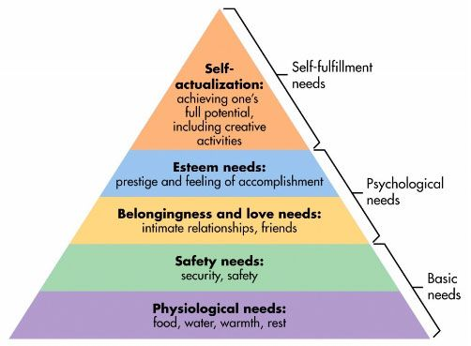
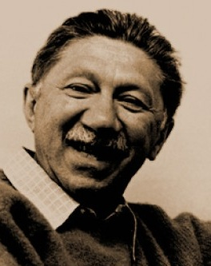
Maslow’s Hierarchy of Needs, A Third Time
Maslow, “A Theory of Human Motivation,”
Psychological Review, 1943.
Maslow, “Motivation and Personality,”
Book, 1954-1970.
Speed
Speed
Speed
Speed
Speed
Source: https://www.simplypsychology.org/maslow.html

Slide 5
Challenge and Opportunity for Future
Fundamentally
Low-Latency
Computing Architectures

Slide 6
Main Memory Latency Lags Behind
128x
20x
1.3x
Memory latency remains almost constant

Slide 7
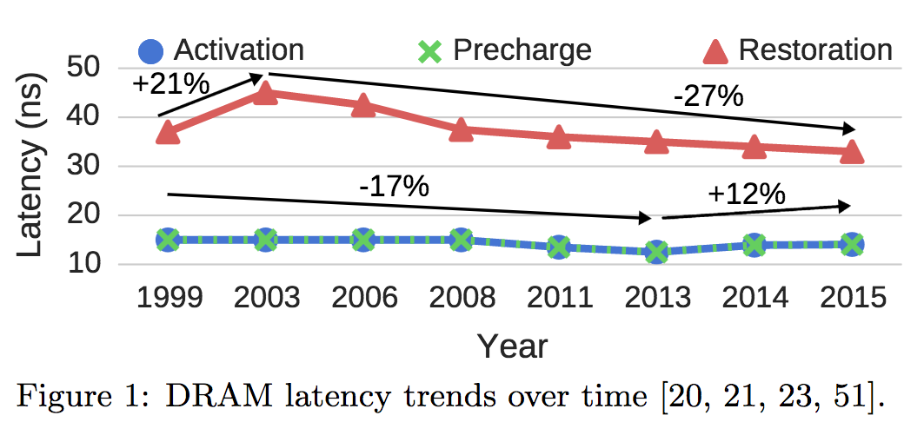
A Closer Look …
Chang+, “Understanding Latency Variation in Modern DRAM Chips: Experimental
Characterization, Analysis, and Optimization",” SIGMETRICS 2016.

Slide 8




DRAM Latency Is Critical for Performance
In-memory Databases
[Mao+, EuroSys’12;
Clapp+ (Intel), IISWC’15]
Graph/Tree Processing
[Xu+, IISWC’12; Umuroglu+, FPL’15]
In-Memory Data Analytics
[Clapp+ (Intel), IISWC’15;
Awan+, BDCloud’15]
Datacenter Workloads
[Kanev+ (Google), ISCA’15]

Slide 9
DRAM Latency Is Critical for Performance
In-memory Databases
[Mao+, EuroSys’12;
Clapp+ (Intel), IISWC’15]
Graph/Tree Processing
[Xu+, IISWC’12; Umuroglu+, FPL’15]
Long memory latency → performance bottleneck
In-Memory Data Analytics
[Clapp+ (Intel), IISWC’15;
Awan+, BDCloud’15]
Datacenter Workloads
[Kanev+ (Google), ISCA’15]

Slide 10
The Memory Latency Problem
High memory latency is a significant limiter of system performance and energy-efficiency
It is becoming increasingly so with higher memory contention in multi-core and heterogeneous architectures
  Exacerbating the bandwidth need
  Exacerbating the QoS problem
It increases processor design complexity due to the mechanisms incorporated to tolerate memory latency

Slide 11
Retrospective: Conventional Latency Tolerance Techniques
Caching [initially by Wilkes, 1965]
  Widely used, simple, effective, but inefficient, passive
  Not all applications/phases exhibit temporal or spatial locality
Prefetching [initially in IBM 360/91, 1967]
  Works well for regular memory access patterns
  Prefetching irregular access patterns is difficult, inaccurate, and hardware-intensive
Multithreading [initially in CDC 6600, 1964]
  Works well if there are multiple threads
  Improving single thread performance using multithreading hardware is an ongoing research effort
Out-of-order execution [initially by Tomasulo, 1967]
  Tolerates cache misses that cannot be prefetched
  Requires extensive hardware resources for tolerating long latencies
None of These
Fundamentally Reduce
Memory Latency

Slide 12
Runahead Execution

Slide 13
Runahead Execution Example
Perfect Caches:
Load 1 Hit
Load 2 Hit
Compute
Compute
Small OoO Instruction Window:
Load 1 Miss
Load 2 Miss
Compute
Stall
Compute
Stall
Miss 1
Miss 2
Runahead:
Load 1 Miss
Load 2 Miss
Load 1 Hit
Load 2 Hit
Compute
Runahead
Compute
Saved Cycles
Miss 1
Miss 2

Slide 14
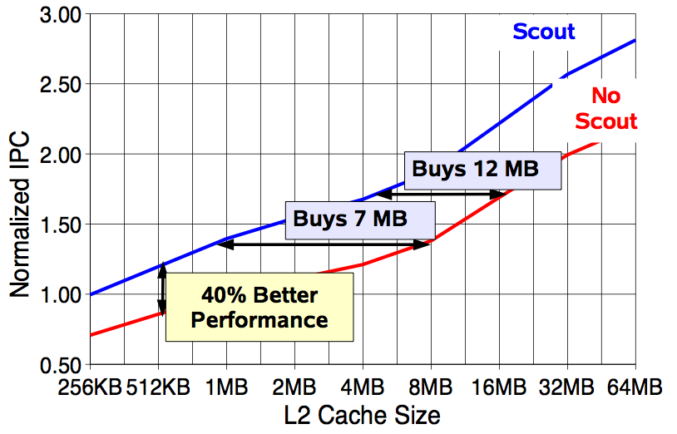
Effect of Runahead in Sun ROCK
Shailender Chaudhry talk, Aug 2008.

Slide 15
More on Runahead Execution
Onur Mutlu, Jared Stark, Chris Wilkerson, and Yale N. Patt,
"Runahead Execution: An Alternative to Very Large Instruction Windows for Out-of-order Processors"
Proceedings of the 9th International Symposium on High-Performance Computer Architecture (HPCA), pages 129-140, Anaheim, CA, February 2003. Slides (pdf)

Slide 16
More on Runahead Execution (Short)
Onur Mutlu, Jared Stark, Chris Wilkerson, and Yale N. Patt,
"Runahead Execution: An Effective Alternative to Large Instruction Windows"
IEEE Micro, Special Issue: Micro's Top Picks from Microarchitecture Conferences (MICRO TOP PICKS), Vol. 23, No. 6, pages 20-25, November/December 2003.

Slide 17
Runahead Readings
Required
  Mutlu et al., “Runahead Execution”, HPCA 2003, Top Picks 2003.
Recommended
  Mutlu et al., “Efficient Runahead Execution: Power-Efficient Memory Latency Tolerance,” ISCA 2005, IEEE Micro Top Picks 2006.
  Mutlu et al., “Address-Value Delta (AVD) Prediction,” MICRO 2005.
  Armstrong et al., “Wrong Path Events,” MICRO 2004.

Slide 18
Retrospective: Conventional Latency Tolerance Techniques
Caching [initially by Wilkes, 1965]
  Widely used, simple, effective, but inefficient, passive
  Not all applications/phases exhibit temporal or spatial locality
Prefetching [initially in IBM 360/91, 1967]
  Works well for regular memory access patterns
  Prefetching irregular access patterns is difficult, inaccurate, and hardware-intensive
Multithreading [initially in CDC 6600, 1964]
  Works well if there are multiple threads
  Improving single thread performance using multithreading hardware is an ongoing research effort
Out-of-order execution [initially by Tomasulo, 1967]
  Tolerates cache misses that cannot be prefetched
  Requires extensive hardware resources for tolerating long latencies
None of These
Fundamentally Reduce
Memory Latency

Slide 19
Two Major Sources of Latency Inefficiency
Modern DRAM is not designed for low latency
  Main focus is cost-per-bit (capacity)
Modern DRAM latency is determined by worst case conditions and worst case devices
  Much of memory latency is unnecessary
Our Goal: Reduce Memory Latency at the Source of the Problem

Slide 20
Truly Reducing Memory Latency

Slide 21
Two Major Sources of Latency Inefficiency
Modern DRAM is not designed for low latency
  Main focus is cost-per-bit (capacity)
Modern DRAM latency is determined by worst case conditions and worst case devices
  Much of memory latency is unnecessary
Our Goal: Reduce Memory Latency at the Source of the Problem

Slide 22
Why the Long Memory Latency?
Reason 1: Design of DRAM Micro-architecture
  Goal: Maximize capacity/area, not minimize latency
Reason 2: “One size fits all” approach to latency specification
  Same latency parameters for all temperatures
  Same latency parameters for all DRAM chips
  Same latency parameters for all parts of a DRAM chip
  Same latency parameters for all supply voltage levels
  Same latency parameters for all application data
  …

Slide 23
Tackling the Fixed Latency Mindset
Reliable operation latency is actually very heterogeneous
  Across temperatures, chips, parts of a chip, voltage levels, …
Idea: Dynamically find out and use the lowest latency one can reliably access a memory location with
  Adaptive-Latency DRAM [HPCA 2015]
  Flexible-Latency DRAM [SIGMETRICS 2016]
  Design-Induced Variation-Aware DRAM [SIGMETRICS 2017]
  Voltron [SIGMETRICS 2017]
  DRAM Latency PUF [HPCA 2018]
  DRAM Latency True Random Number Generator [HPCA 2019]
  ...
We would like to find sources of latency heterogeneity and exploit them to minimize latency (or create other benefits)

Slide 24

Latency Variation in Memory Chips
Heterogeneous manufacturing & operating conditions →
latency variation in timing parameters
DRAM A
DRAM B
DRAM C
Slow cells
Low
High
DRAM Latency

Slide 25
Why is Latency High?
DRAM latency: Delay as specified in DRAM standards
  Doesn’t reflect true DRAM device latency
Imperfect manufacturing process → latency variation
High standard latency chosen to increase yield
DRAM A
DRAM B
DRAM C
Standard
Latency
Manufacturing
Variation
Low
High
DRAM Latency
Notes:
To understand the latency problem, we need to go into what defines latency.
DRAM latency is the total amnt of time that the underlying hw operations need <> to retrieve data.
The DRAM standards define a single fixed time for how long these ops should take in every DRAM chip.
However, this defined delay doesn’t actually reflect the latency of the individual DRAMs.
<Timeline illustration>
Because the manufacturing process is imperfect, it introduces variation in the production chips, resulting in latency variation across different chips.
This simple illustartion shows the difference b/w the average latency across 3 different dram chips, to convey the point of latency variation.
It’s important to note that not only does latency variation exists <across> chips, but also <inside> each dram chip itself.
<Blue standard>
Since we don’t want to throw away the chips with high variation, we tolerate them.
The simple way is to <slow> down the acceptable latency so that the majority of chips can all work reliably under this high standard latency.
as we can see, the high standard latency is a result of a trade-off made for higher DRAM production yield.
---
<> Operative word

Slide 26
What Causes the Long Memory Latency?
Conservative timing margins!
DRAM timing parameters are set to cover the worst case
Worst-case temperatures
  85 degrees vs. common-case
  to enable a wide range of operating conditions
Worst-case devices
  DRAM cell with smallest charge across any acceptable device
  to tolerate process variation at acceptable yield
This leads to large timing margins for the common case

Slide 27
Understanding and Exploiting
Variation in DRAM Latency

Slide 28

DRAM Characterization Infrastructure
Temperature
Controller
FPGAs
Heater
FPGAs
PC
  Kim+, “Flipping Bits in Memory Without Accessing Them: An Experimental Study of DRAM Disturbance Errors,” ISCA 2014.

Slide 29
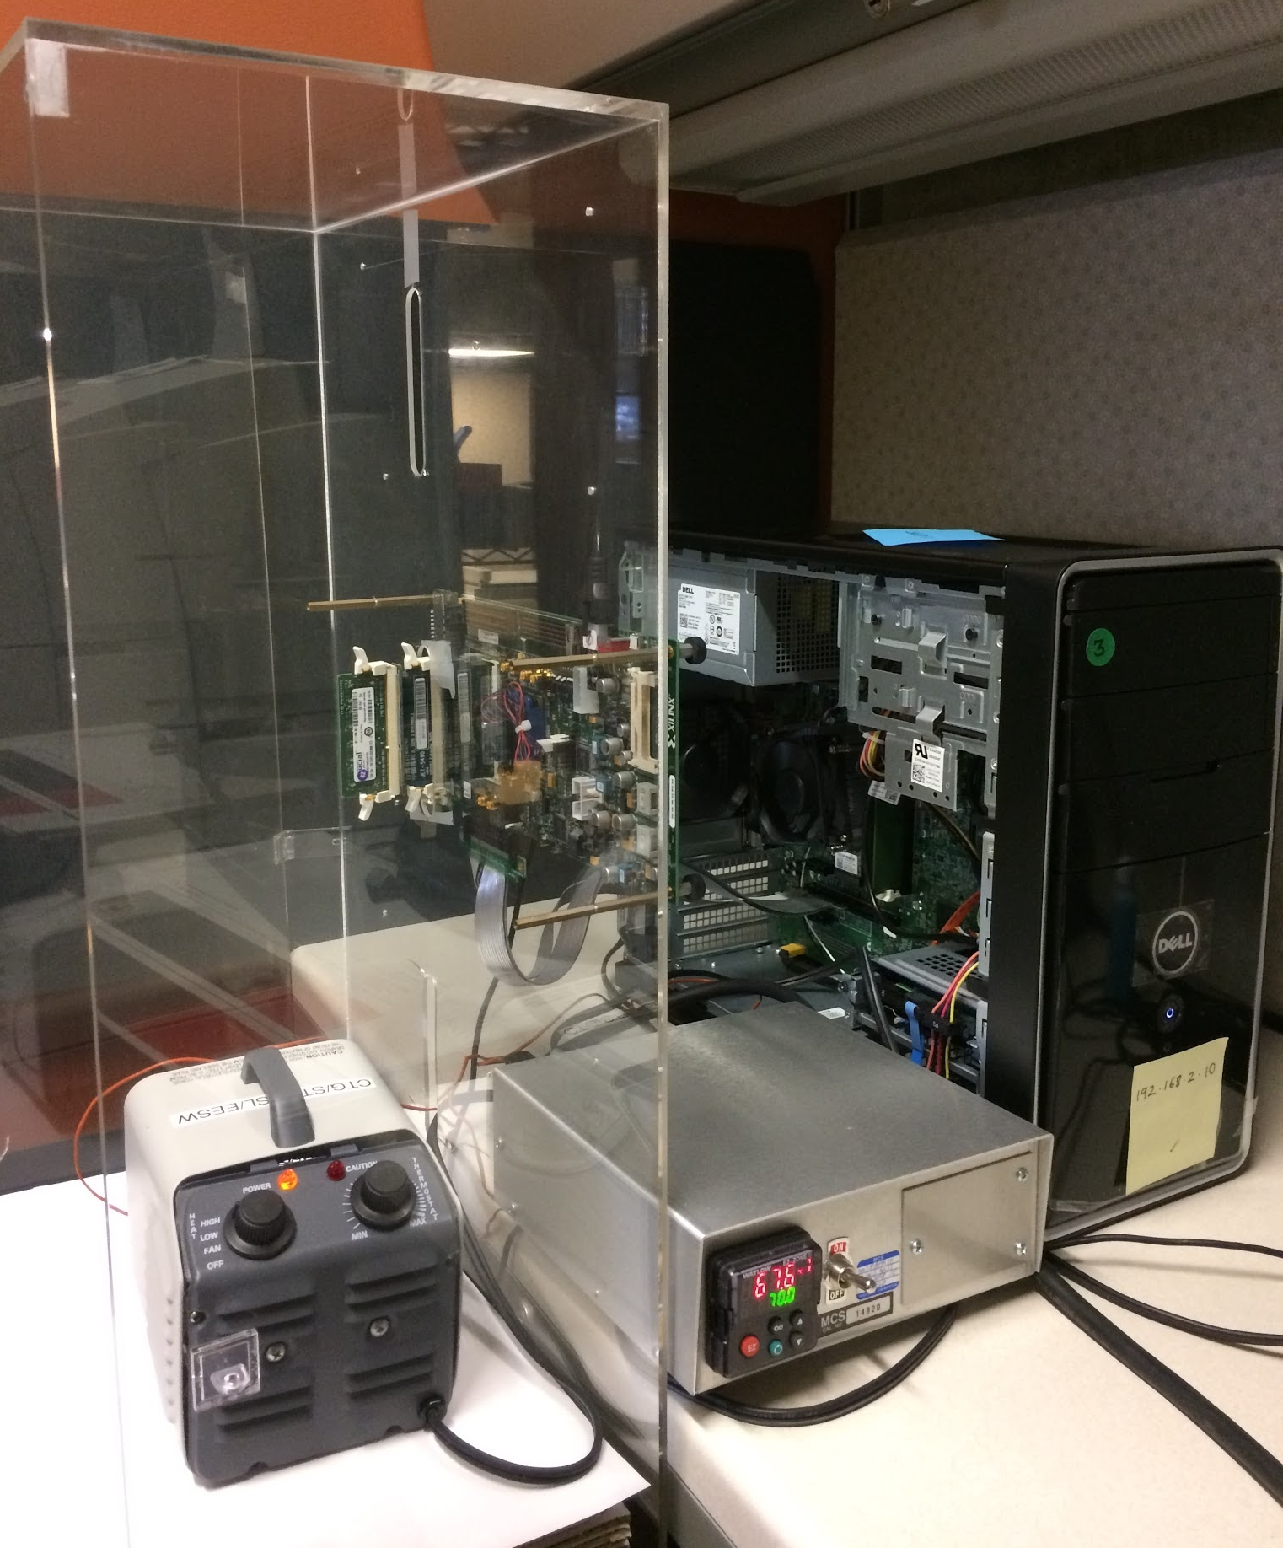
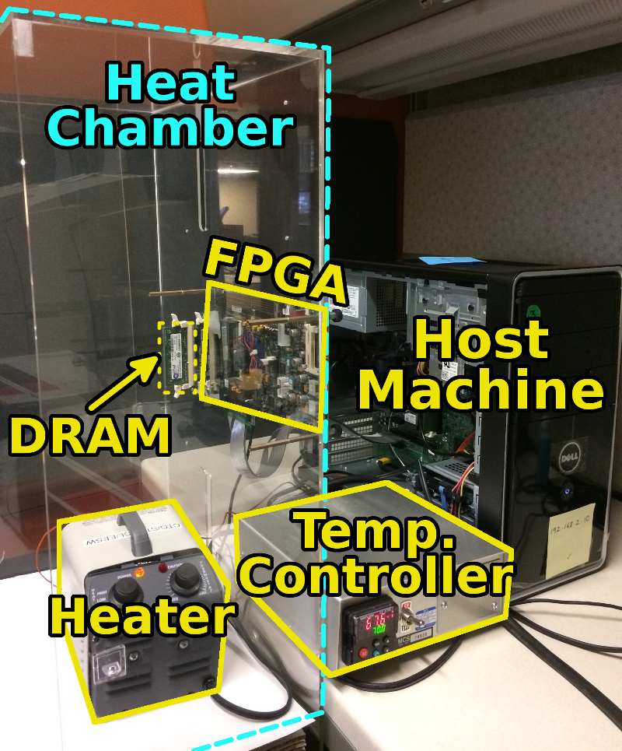
DRAM Characterization Infrastructure
Hasan Hassan et al., SoftMC: A Flexible and Practical Open-Source Infrastructure for Enabling Experimental DRAM Studies, HPCA 2017.
Flexible
Easy to Use (C++ API)
Open-source
github.com/CMU-SAFARI/SoftMC

Slide 30
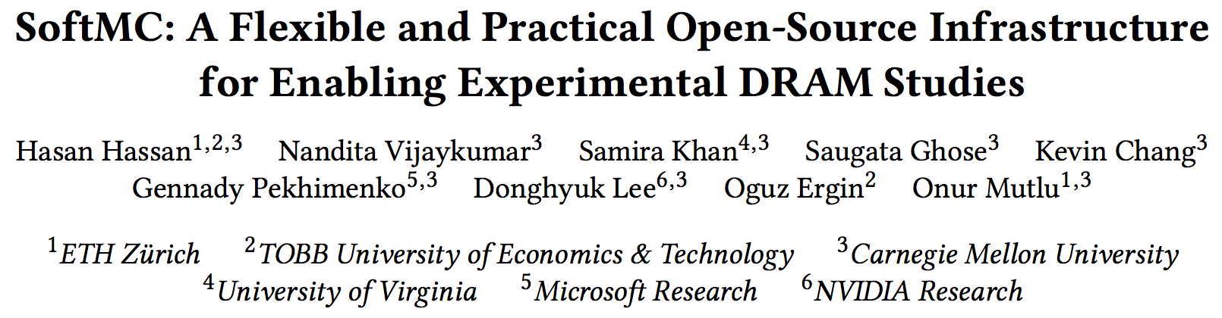
SoftMC: Open Source DRAM Infrastructure
https://github.com/CMU-SAFARI/SoftMC

Slide 31
Adaptive-Latency DRAM
Key idea
  Optimize DRAM timing parameters online
Two components
  DRAM manufacturer provides multiple sets of reliable DRAM timing parameters at different temperatures for each DIMM
  System monitors DRAM temperature & uses appropriate DRAM timing parameters
reliable DRAM timing parameters
DRAM temperature
Lee+, “Adaptive-Latency DRAM: Optimizing DRAM Timing for the Common-Case,” HPCA 2015.

Slide 32
Latency Reduction Summary of 115 DIMMs
Latency reduction for read & write (55°C)
  Read Latency: 32.7%
  Write Latency: 55.1%
Latency reduction for each timing parameter (55°C)
  Sensing: 17.3%
  Restore: 37.3% (read), 54.8% (write)
  Precharge: 35.2%
Lee+, “Adaptive-Latency DRAM: Optimizing DRAM Timing for the Common-Case,” HPCA 2015.

Slide 33
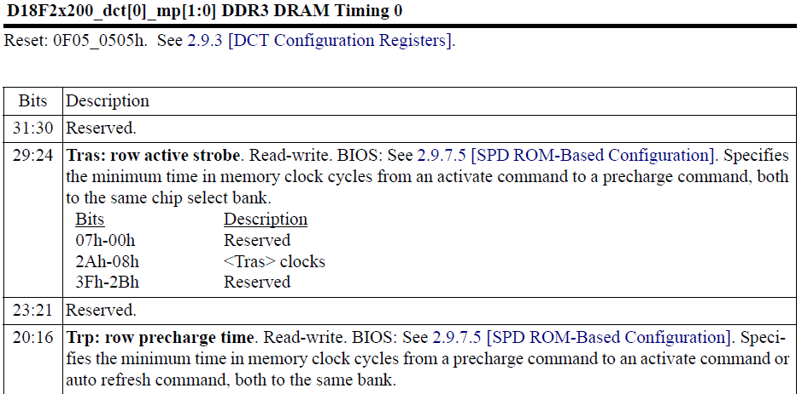
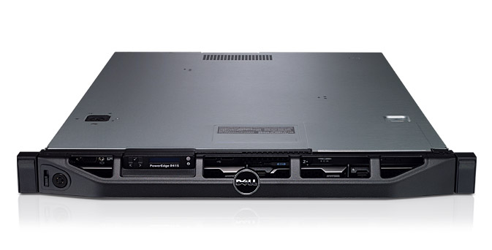
AL-DRAM: Real System Evaluation
System
  CPU: AMD 4386 ( 8 Cores, 3.1GHz, 8MB LLC)
  DRAM: 4GByte DDR3-1600 (800Mhz Clock)
  OS: Linux
  Storage: 128GByte SSD
Workload
  35 applications from SPEC, STREAM, Parsec, Memcached, Apache, GUPS

Slide 34
AL-DRAM: Single-Core Evaluation
Average
Improvement
6.7%
Performance Improvement
5.0%
1.4%
all-35-workload
AL-DRAM improves single-core performance
on a real system

Slide 35
AL-DRAM: Multi-Core Evaluation
Average
Improvement
14.0%
10.4%
Performance Improvement
2.9%
all-35-workload
AL-DRAM provides higher performance on
multi-programmed & multi-threaded workloads

Slide 36
Reducing Latency Also Reduces Energy
AL-DRAM reduces DRAM power consumption by 5.8%
Major reason: reduction in row activation time

Slide 37
AL-DRAM: Advantages & Disadvantages
Advantages
+ Simple mechanism to reduce latency
+ Significant system performance and energy benefits
+ Benefits higher at low temperature
+ Low cost, low complexity
Disadvantages
- Need to determine reliable operating latencies for different temperatures and different DIMMs → higher testing cost
(might not be that difficult for low temperatures)

Slide 38
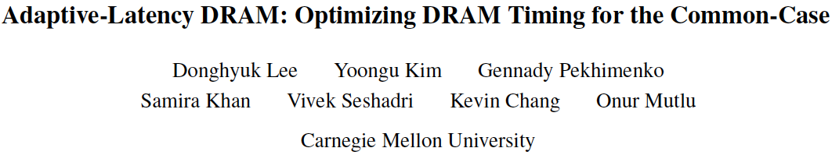
More on Adaptive-Latency DRAM
Donghyuk Lee, Yoongu Kim, Gennady Pekhimenko, Samira Khan, Vivek Seshadri, Kevin Chang, and Onur Mutlu,
"Adaptive-Latency DRAM: Optimizing DRAM Timing for the Common-Case"
Proceedings of the 21st International Symposium on High-Performance Computer Architecture (HPCA), Bay Area, CA, February 2015.
[Slides (pptx) (pdf)] [Full data sets]

Slide 39
Different Types of Latency Variation
AL-DRAM exploits latency variation
  Across time (different temperatures)
  Across chips
Is there also latency variation within a chip?
  Across different parts of a chip

Slide 40
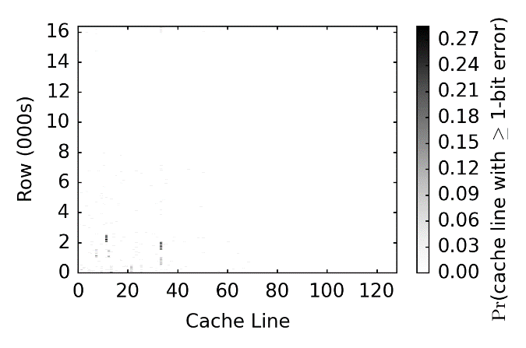
Spatial Locality of Activation Errors
One DIMM @ tRCD=7.5ns
Activation errors are concentrated
at certain columns of cells
Notes:
This fig is showing the prob. of seeing at least 1 bit error in each cache line from one DIMM under trcd = 7.5ns. The y-axis is the row # (in 000s) and the x-axis is the cl #.
The main observation is that errors exhibit spatial locality. In this DIMM, errors tend to cluster at certain columns of cache lines without errors in the majority of the remaining cl.
This is an imperative observation for our proposed mechanism, which I’ll discuss later.
Next, we investigate the impact of reading different data patterns stored in these cells.

Slide 41
Heterogeneous Latency within A Chip
Observation: DRAM timing errors (slow DRAM cells) are concentrated on certain regions
Flexible-LatencY (FLY) DRAM
  A software-transparent design that reduces latency
Key idea:
  1) Divide memory into regions of different latencies
  2) Memory controller: Use lower latency for regions without slow cells; higher latency for other regions
Chang+, “Understanding Latency Variation in Modern DRAM Chips: Experimental
Characterization, Analysis, and Optimization",” SIGMETRICS 2016.
Notes:
To summarize the observations so far, we find that dram timing errors due to shortened act and pre don’t occur in all cells and they are concentrated at certain regions.
So let’s go back to our second main goal which is on improving latency.
TO achieve this, we propose a software… design, called flex.. Dram or FLY for short, to reduce dram latency.
The key idea is the following:
We divide the dram up into different regions based on a latency variation profile.
Then We enable the mc to use different latency for diff regions.
For regions without slow cells, we are going to run it faster at a much lower latency.
For any region that has slow cells, we are going to operate at a higher latency.

Slide 42
FLY-DRAM Configurations
tRCD
99%
93%
12%
Profiles of 3 real DIMMs
tRP
99%
74%
13%
Chang+, “Understanding Latency Variation in Modern DRAM Chips: Experimental
Characterization, Analysis, and Optimization",” SIGMETRICS 2016.
Notes:
We evaluate FLY-DRAM with various configurations.
These 2 figures show the fraction of cells with different latencies for act and pre.
X-axis shows you the configurations that we have.
First, we evaluate a baseline dram system with the standardized latency at 13ns.
Then we use latency profiles that were collected from 3 real DIMMs. The percentage numbers show you the fraction of fast cells in each DIMM.
Note that Darker color means faster latency.
We also evalaute an upperbound configuration that has 100% fast cells under 7.5ns.

Slide 43
Heterogeneous Latency within A Chip
19.7%
19.5%
17.6%
13.3%
Chang+, “Understanding Latency Variation in Modern DRAM Chips: Experimental
Characterization, Analysis, and Optimization",” SIGMETRICS 2016.

Slide 44
FLY-DRAM: Advantages & Disadvantages
Advantages
+ Reduces latency significantly
+ Exploits significant within-chip latency variation
Disadvantages
- Need to determine reliable operating latencies for different parts of a chip → higher testing cost
- Slightly more complicated controller

Slide 45
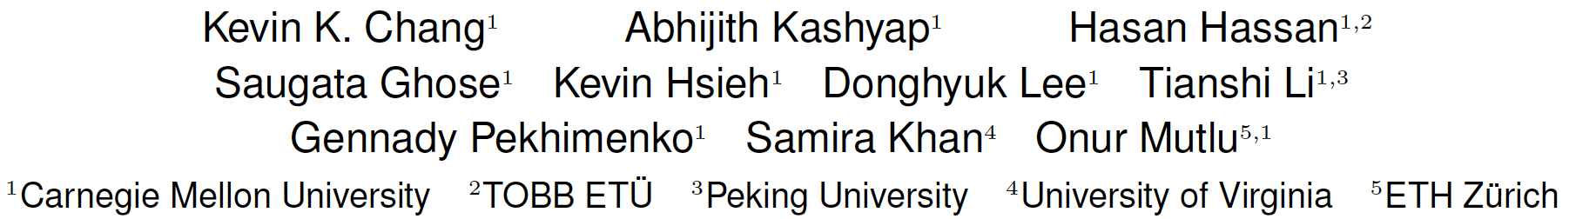
Analysis of Latency Variation in DRAM Chips
Kevin Chang, Abhijith Kashyap, Hasan Hassan, Samira Khan, Kevin Hsieh, Donghyuk Lee, Saugata Ghose, Gennady Pekhimenko, Tianshi Li, and Onur Mutlu,
"Understanding Latency Variation in Modern DRAM Chips: Experimental Characterization, Analysis, and Optimization"
Proceedings of the ACM International Conference on Measurement and Modeling of Computer Systems (SIGMETRICS), Antibes Juan-Les-Pins, France, June 2016.
[Slides (pptx) (pdf)]
[Source Code]

Slide 46
Why Is There
Spatial Latency Variation
Within a Chip?

Slide 47
What Is Design-Induced Variation?
fast
slow
across column
inherently slow
distance from wordline driver
slow
across row
wordline drivers
distance from sense amplifier
fast
Inherently fast
sense amplifiers
Systematic variation in cell access times
caused by the physical organization of DRAM
Notes:
As we described, cells in a mat have different distances from peripheral logic.
Cells in different rows have different distance from the sense amplifiers.
Cells in different columns have different distance from the wordline drivers.
Therefore, some regions are inherently faster than other regions,
and some regions are inherently slower than other regions.
We call this architectural variation.

Slide 48
DIVA Online Profiling
Design-Induced-Variation-Aware
inherently slow
wordline driver
sense amplifier
Profile only slow regions to determine min. latency
→ Dynamic & low cost latency optimization
Notes:
We propoe AVA Online profiling.
The key idea is profiling only slow regions to determine latency, leading to low cost online DRAM test.

Slide 49
DIVA Online Profiling
Design-Induced-Variation-Aware
slow cells
inherently slow
process
variation
design-induced
variation
wordline driver
random error
localized error
error-correcting code
online profiling
sense amplifier
Combine error-correcting codes & online profiling
→ Reliably reduce DRAM latency
Notes:
However, due to the process variation, some cells are more vulnerable than other cells, as the figure show.
These cells are randomly distributed while cells in the slow regions cause localized error.
To address both type of cells,
We integrate conventional ECC to correct the process variation induced errors.
Therefore, combining ECC and online profiling leads to reliably reducing DRAM latency.

Slide 50
DIVA-DRAM Reduces Latency
Read
Write
Latency Reduction
DIVA
DIVA
DIVA
DIVA
DIVA-DRAM reduces latency more aggressively
and uses ECC to correct random slow cells
Notes:
The figure compares latency reduction by using AL-DRAM, AVA Profiling, and both AVA Profiling and Shuffling.
As we can, using AVA profiling and shuffling enables more latency reduction compared to AL-DRAM.
This is mainly because ECC corrects the worst cells in a DRAM module, reducing more latency.
Therefore, we conclude that AVA-DRAM reduces latency significantly.

Slide 51
DIVA-DRAM: Advantages & Disadvantages
Advantages
++ Automatically finds the lowest reliable operating latency at system runtime (lower production-time testing cost)
+ Reduces latency more than prior methods (w/ ECC)
+ Reduces latency at high temperatures as well
Disadvantages
- Requires knowledge of inherently-slow regions
- Requires ECC (Error Correcting Codes)
- Imposes overhead during runtime profiling

Slide 52
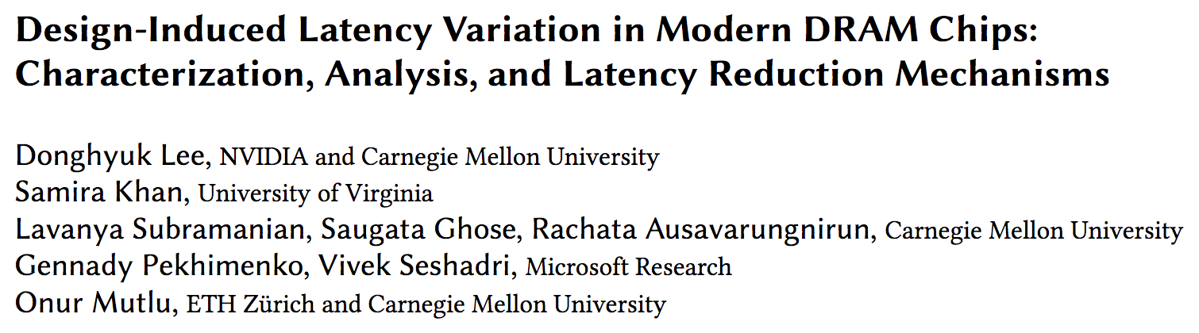
Design-Induced Latency Variation in DRAM
Donghyuk Lee, Samira Khan, Lavanya Subramanian, Saugata Ghose, Rachata Ausavarungnirun, Gennady Pekhimenko, Vivek Seshadri, and Onur Mutlu,
"Design-Induced Latency Variation in Modern DRAM Chips: Characterization, Analysis, and Latency Reduction Mechanisms"
Proceedings of the ACM International Conference on Measurement and Modeling of Computer Systems (SIGMETRICS), Urbana-Champaign, IL, USA, June 2017.

Slide 53
Understanding & Exploiting the
Voltage-Latency-Reliability Relationship

Slide 54

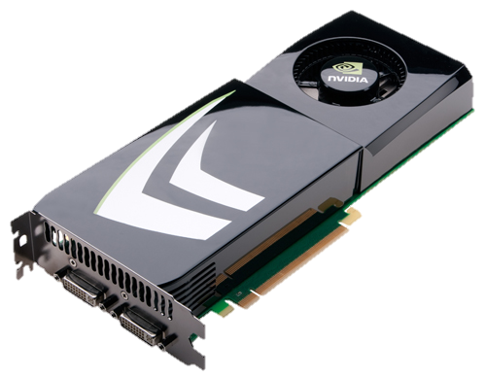
High DRAM Power Consumption
Problem: High DRAM (memory) power in today’s systems
>40% in POWER7 (Ware+, HPCA’10)
  >40% in GPU (Paul+, ISCA’15)

Slide 55
Executive Summary
DRAM (memory) power is significant in today’s systems
  Existing low-voltage DRAM reduces voltage conservatively
Goal: Understand and exploit the reliability and latency behavior of real DRAM chips under aggressive reduced-voltage operation
Key experimental observations:
  Huge voltage margin -- Errors occur beyond some voltage
  Errors exhibit spatial locality
  Higher operation latency mitigates voltage-induced errors
Voltron: A new DRAM energy reduction mechanism
  Reduce DRAM voltage without introducing errors
  Use a regression model to select voltage that does not degrade performance beyond a chosen target → 7.3% system energy reduction

Slide 56
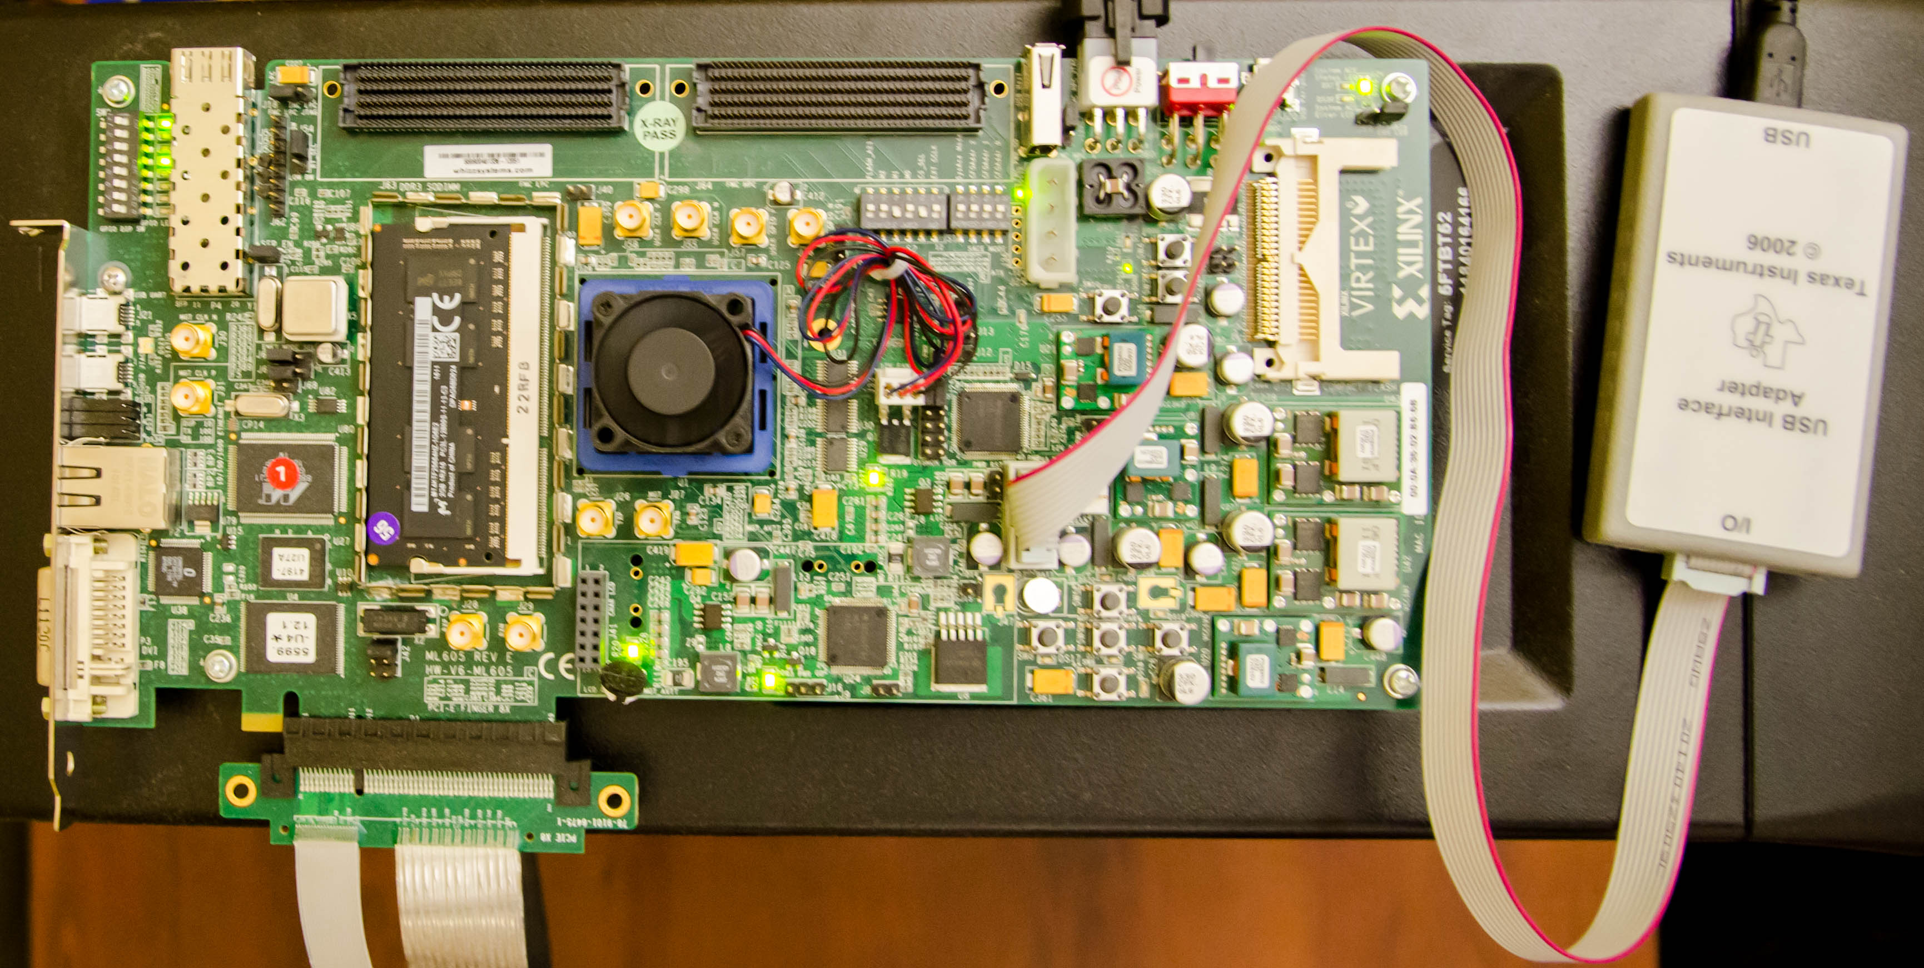
Custom Testing Platform
SoftMC [Hassan+, HPCA’17]: FPGA testing platform to
1) Adjust supply voltage to DRAM modules
2) Schedule DRAM commands to DRAM modules
  Existing systems: DRAM commands not exposed to users
DRAM
module
Voltage
controller
FPGA
https://github.com/CMU-SAFARI/DRAM-Voltage-Study

Slide 57
Reliability Worsens with Lower Voltage
Errors induced by
reduced-voltage operation
Min. voltage (V_{min}) without errors
Nominal
Voltage
Reducing voltage below V_{min} causes
an increasing number of errors

Slide 58
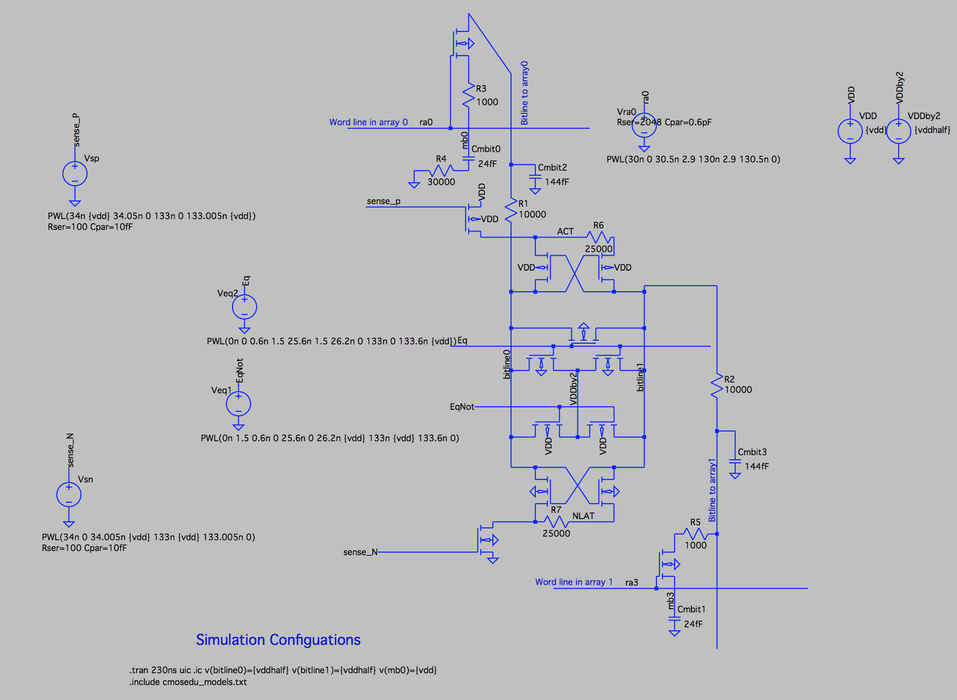
Source of Errors
Detailed circuit simulations (SPICE) of a DRAM cell array to model the behavior of DRAM operations
https://github.com/CMU-SAFARI/DRAM-Voltage-Study
Nominal
Voltage
Circuit model
Reliable low-voltage operation requires higher latency

Slide 59
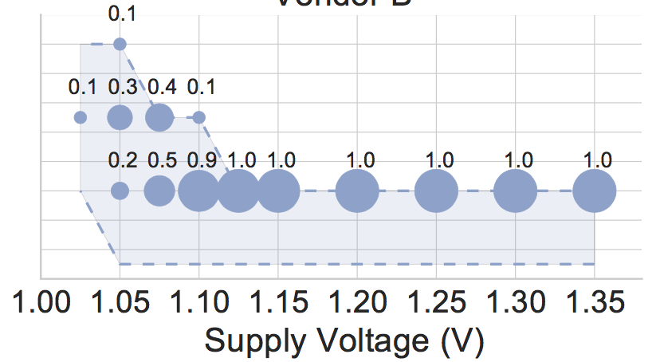
Higher Access Latency → Fewer Errors
Measured minimum latency that does not cause errors in DRAM modules
40% of modules
14
Distribution of latency in the total population
100% of modules
Measured Minimum
Activate Latency (ns)
12
10
8
DRAM requires longer latency to access data without errors at lower voltage
Lower bound of latency as our latency adjustment granularity is 2.5ns

Slide 60
Spatial Locality of Errors
A module under 1.175V (12% voltage reduction)
Errors concentrate in certain regions

Slide 61



Voltron Overview
Voltron
User specifies the performance loss target
Select the minimum DRAM voltage without violating the target
How do we predict performance loss due to increased latency under low DRAM voltage?

Slide 62

Linear Model to Predict Performance
Voltron
User specifies the performance loss target
Select the minimum DRAM voltage without violating the target
Application’s characteristics
Min.
Voltage
Final
Voltage
[-1%, -3%, …]
Predicted performance loss
[1.3V, 1.25V, …]
Target
DRAM Voltage
Linear regression model

Slide 63
Energy Savings with Bounded Performance
[David+, ICAC’11]
Meets performance target
7.3%
More savings for
high bandwidth applications
-1.6%
-1.8%
3.2%
Performance Target

Slide 64
Voltron: Advantages & Disadvantages
Advantages
+ Can trade-off between voltage and latency to improve energy or performance
+ Can exploit the high voltage margin present in DRAM
Disadvantages
- Requires finding the reliable operating voltage for each chip → higher testing cost

Slide 65
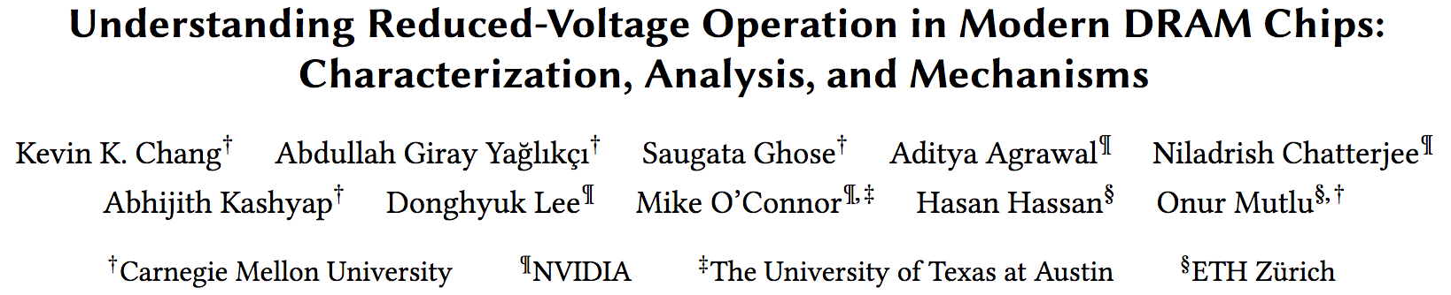
Analysis of Latency-Voltage in DRAM Chips
Kevin Chang, A. Giray Yaglikci, Saugata Ghose, Aditya Agrawal, Niladrish Chatterjee, Abhijith Kashyap, Donghyuk Lee, Mike O'Connor, Hasan Hassan, and Onur Mutlu,
"Understanding Reduced-Voltage Operation in Modern DRAM Devices: Experimental Characterization, Analysis, and Mechanisms"
Proceedings of the ACM International Conference on Measurement and Modeling of Computer Systems (SIGMETRICS), Urbana-Champaign, IL, USA, June 2017.

Slide 66
And, What If …
… we can sacrifice reliability of some data to access it with even lower latency?

Slide 67




The DRAM Latency PUF:
Quickly Evaluating Physical Unclonable Functions by Exploiting the Latency-Reliability Tradeoff in Modern Commodity DRAM Devices
Jeremie S. Kim Minesh Patel
Hasan Hassan Onur Mutlu
Notes:
Hello, my name is Jeremie Kim and I will be talking about the DRAM Latency PUF.

Slide 68
Motivation
A PUF is function that generates a signature unique to a given device
Used in a Challenge-Response Protocol
  Each device generates a unique PUF response depending the inputs
  A trusted server authenticates a device if it generates the expected PUF response
Notes:
[CLICK] A PUF is a function that generates a signature that is unique to a given device. [CLICK] PUFs are often used in a challenge-response protocol where [CLICK] a trusted server issues a set of input parameters to a device, and the device generates the PUF response depending on the input parameters. [CLICK] The trusted server then receives the PUF response and can authenticate the device.

Slide 69
DRAM Latency Characterization of 223 LPDDR4 DRAM Devices
Latency failures come from accessing DRAM with reduced timing parameters.
Key Observations:
  A cell’s latency failure probability is determined by random process variation
  Latency failure patterns are repeatable and unique to a device
Notes:
In this work, we show results from a detailed experimental characterization of 223 state-of-the-art LPDDR4 DRAM devices. [CLICK] We characterize DRAM latency by observing the effects of accessing DRAM with DRAM timing parameters reduced below manufacturer-recommended values.
[CLICK] We make two key observations. [CLICK] first, a cell’s probability to fail, when accessed with reduced timing parameters, is directly correlated with random variations that arise from process manufacturing. [CLICK] secondly, We note that these error patterns from inducing DRAM latency errors are unique to a device and highly repeatable.

Slide 70
DRAM Latency PUF Key Idea
High % chance to fail with reduced t_{RCD}
Low % chance to fail with reduced t_{RCD}
Row Decoder
SA
SA
SA
SA
SA
SA
SA
Notes:
Here is a cartoon showing the manufacturing variation across a region of DRAM. When accessed with a reduced timing parameter, [CLICK] some cells have a high percentage chance of failing, while others [CLICK] have a low percentage chance of failing.

Slide 71
DRAM Accesses and Failures
wordline
V_{dd}
access
transistor
V_{min}
Ready to Access
Voltage Level
bitline
Process variation during manufacturing leads to cells having unique characteristics
Bitline Voltage
Bitline Charge Sharing
capacitor
SA
0.5 V_{dd}
Time
ACTIVATE
SA Enable
READ
t_{RCD}
Notes:
[CLICK] A DRAM cell holds its charge in a capacitor and gets read out by the sense amplifier via the bitline. [CLICK][CLICK] Initially the bitline is kept at Vdd/2. [CLICK] When the wordline is driven high or activated, [CLICK] the capacitor begins to share charge with the bitline. The sense amplifier is then enabled and [CLICK] the voltage differential on the bitline is amplified to an I/O readable value. [CLICK] In order to ensure correctness of operation, the memory controller can only read data tRCD time after the activation. [CLICK] We could read this data earlier, when it reaches a readable voltage threshold, [CLICK] but other cells, that are weaker due to process variation, might fail. [CLICK]

Slide 72
DRAM Accesses and Failures
wordline
V_{dd}
access
transistor
V_{min}
Ready to Access
Voltage Level
bitline
weaker cells have a higher probability to fail
Bitline Voltage
capacitor
SA
0.5 V_{dd}
Time
ACTIVATE
SA Enable
READ
t_{RCD}
Notes:
Our method of inducing latency errors is to [CLICK] reduce tRCD below manufacturer-recommended values. Cells that are read when their bitline’s voltage is lower than the threshold, have a probability of failure. This probability increases as you read further below the voltage threshold.

Slide 73
The DRAM Latency PUF Evaluation
We generate PUF responses using latency errors in a region of DRAM
The latency error patterns satisfy PUF requirements
The DRAM Latency PUF generates PUF responses in 88.2ms
Notes:
[CLICK] The DRAM latency PUF generates a PUF response by inducing latency errors in a region of DRAM. [CLICK] We find that the error patterns from latency errors in a DRAM region satisfy the requirements for an effective PUF quite well. [CLICK] The DRAM latency PUF can generate a PUF response in 88.2ms.

Slide 74
Results
DL-PUF is orders of magnitude faster than prior DRAM PUFs & temperature independent
Notes:
[CLICK] We show by direct comparison that this is orders of magnitudes faster than the previous best DRAM PUF.

Slide 75

The DRAM Latency PUF:
Quickly Evaluating Physical Unclonable Functions by Exploiting the Latency-Reliability Tradeoff in Modern Commodity DRAM Devices
Jeremie S. Kim Minesh Patel
Hasan Hassan Onur Mutlu
QR Code for the paper
https://people.inf.ethz.ch/omutlu/pub/dram-latency-puf_hpca18.pdf
Notes:
Please come to my talk at HPCA 2018, if you would like to learn more or have any questions. Thank you very much.

Slide 76
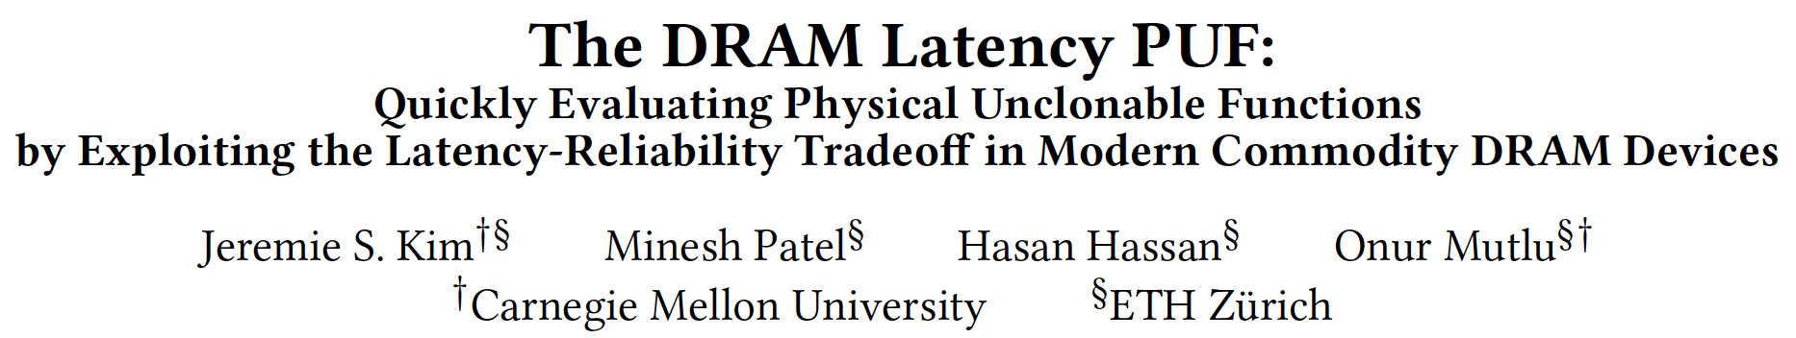
DRAM Latency PUFs
Jeremie S. Kim, Minesh Patel, Hasan Hassan, and Onur Mutlu,
"The DRAM Latency PUF: Quickly Evaluating Physical Unclonable Functions by Exploiting the Latency-Reliability Tradeoff in Modern DRAM Devices"
Proceedings of the 24th International Symposium on High-Performance Computer Architecture (HPCA), Vienna, Austria, February 2018.
[Lightning Talk Video]
[Slides (pptx) (pdf)] [Lightning Session Slides (pptx) (pdf)]

Slide 77
D-RaNGe: Using Commodity DRAM Devices to Generate True Random Numbers with Low Latency and High Throughput
Jeremie S. Kim Minesh Patel
Hasan Hassan Lois Orosa Onur Mutlu
HPCA 2019

Slide 78
DRAM Latency Characterization of 282 LPDDR4 DRAM Devices
Latency failures come from accessing DRAM with reduced timing parameters.
Key Observations:
  A cell’s latency failure probability is determined by random process variation
  Some cells fail randomly
Notes:
In this work, we show results from a detailed experimental characterization of 282 state-of-the-art LPDDR4 DRAM devices. [CLICK] We characterize DRAM latency by observing the effects of accessing DRAM with DRAM timing parameters reduced below manufacturer-recommended values.
[CLICK] We make two key observations. [CLICK] first, a cell’s probability to fail, when accessed with reduced timing parameters, is directly correlated with random variations that arise from process manufacturing. [CLICK] secondly, We note that some cells fail randomly when accessed with a reduced tRCD.

Slide 79
D-RaNGe Key Idea
Low % chance to fail with reduced t_{RCD}
High % chance to fail with reduced t_{RCD}
Row Decoder
SA
SA
SA
SA
SA
SA
SA
Fails randomly
with reduced t_{RCD}
Notes:
Here is a cartoon showing the manufacturing variation across a region of DRAM. When accessed with a reduced timing parameter, [CLICK] some cells have a high percentage chance of failing, while others [CLICK] have a low percentage chance of failing. [CLICK} Some cells fail randomly when accessed with a reduced tRCD.

Slide 80
D-RaNGe Key Idea
Low % chance to fail with reduced t_{RCD}
High % chance to fail with reduced t_{RCD}
We refer to cells that fail randomly
when accessed with a reduced t_{RCD}
as RNG cells
Row Decoder
SA
SA
SA
SA
SA
SA
SA
Fails randomly
with reduced t_{RCD}
Notes:
We refer to cells that fail randomly when accessed with a reduced tRCD as RNG cells

Slide 81
Our D-RaNGe Evaluation
We generate random values by repeatedly accessing RNG cells and aggregating the data read
The random data satisfies the NIST statistical test suite for randomness
The D-RaNGE generates random numbers
  Throughput: 717.4 Mb/s
  Latency: 64 bits in <1us
  Power: 4.4 nJ/bit

Slide 82
D-RaNGe: Using Commodity DRAM Devices to Generate True Random Numbers with Low Latency and High Throughput
Jeremie S. Kim Minesh Patel
Hasan Hassan Lois Orosa Onur Mutlu
HPCA 2019

Slide 83
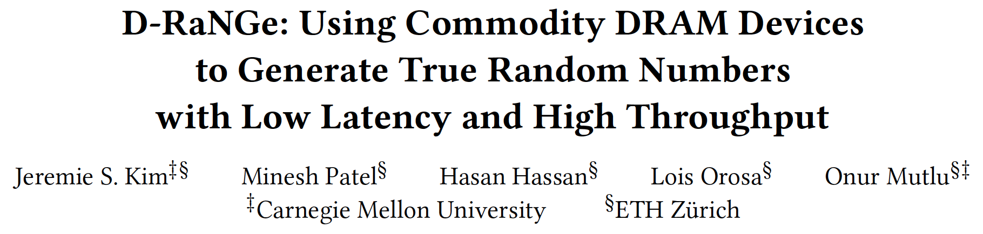
DRAM Latency True Random Number Generator
Jeremie S. Kim, Minesh Patel, Hasan Hassan, Lois Orosa, and Onur Mutlu,
"D-RaNGe: Using Commodity DRAM Devices to Generate True Random Numbers with Low Latency and High Throughput"
Proceedings of the 25th International Symposium on High-Performance Computer Architecture (HPCA), Washington, DC, USA, February 2019.

Slide 84
Other Ideas on
Reducing DRAM Latency

Slide 85
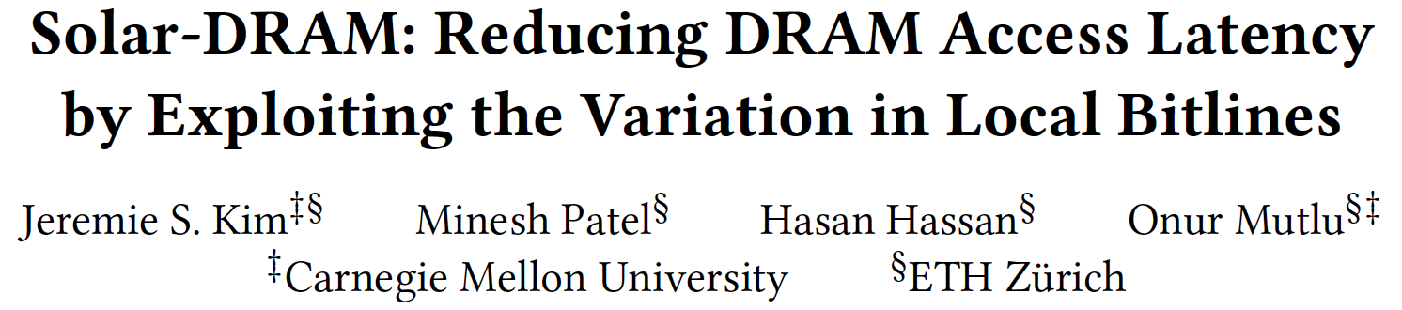
Solar-DRAM: Exploiting Spatial Variation
Jeremie S. Kim, Minesh Patel, Hasan Hassan, and Onur Mutlu,
"Solar-DRAM: Reducing DRAM Access Latency by Exploiting the Variation in Local Bitlines"
Proceedings of the 36th IEEE International Conference on Computer Design (ICCD), Orlando, FL, USA, October 2018.

Slide 86
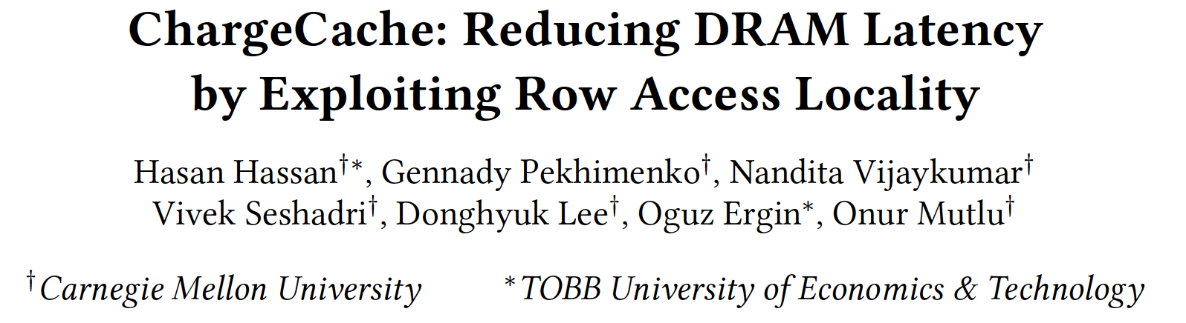
ChargeCache: Exploiting Access Patterns
Hasan Hassan, Gennady Pekhimenko, Nandita Vijaykumar, Vivek Seshadri, Donghyuk Lee, Oguz Ergin, and Onur Mutlu,
"ChargeCache: Reducing DRAM Latency by Exploiting Row Access Locality"
Proceedings of the 22nd International Symposium on High-Performance Computer Architecture (HPCA), Barcelona, Spain, March 2016.
[Slides (pptx) (pdf)]
[Source Code]

Slide 87
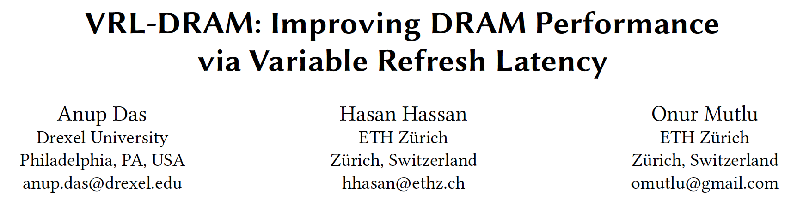
Reducing Refresh Latency
Anup Das, Hasan Hassan, and Onur Mutlu,
"VRL-DRAM: Improving DRAM Performance via Variable Refresh Latency"
Proceedings of the 55th Design Automation Conference (DAC), San Francisco, CA, USA, June 2018.

Slide 88
Why the Long Memory Latency?
Reason 1: Design of DRAM Micro-architecture
  Goal: Maximize capacity/area, not minimize latency
Reason 2: “One size fits all” approach to latency specification
  Same latency parameters for all temperatures
  Same latency parameters for all DRAM chips
  Same latency parameters for all parts of a DRAM chip
  Same latency parameters for all supply voltage levels
  Same latency parameters for all application data
  …

Slide 89
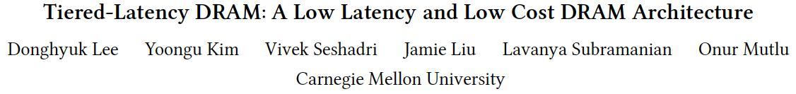
Tiered-Latency DRAM
Donghyuk Lee, Yoongu Kim, Vivek Seshadri, Jamie Liu, Lavanya Subramanian, and Onur Mutlu,
"Tiered-Latency DRAM: A Low Latency and Low Cost DRAM Architecture"
Proceedings of the 19th International Symposium on High-Performance Computer Architecture (HPCA), Shenzhen, China, February 2013. Slides (pptx)

Slide 90
LISA: Low-cost Inter-linked Subarrays
Kevin K. Chang, Prashant J. Nair, Saugata Ghose, Donghyuk Lee, Moinuddin K. Qureshi, and Onur Mutlu,
"Low-Cost Inter-Linked Subarrays (LISA): Enabling Fast Inter-Subarray Data Movement in DRAM"
Proceedings of the 22nd International Symposium on High-Performance Computer Architecture (HPCA), Barcelona, Spain, March 2016.
[Slides (pptx) (pdf)]
[Source Code]

Slide 91
Tiered Latency DRAM

Slide 92
What Causes the Long Latency?
DRAM Chip
DRAM Chip
cell array
subarray
Subarray
I/O
I/O
I/O
channel
channel
DRAM Latency = Subarray Latency + I/O Latency
DRAM Latency = Subarray Latency + I/O Latency
Dominant
Notes:
To understand what causes the long latency, let me take a look at the DRAM organization.
DRAM consists of two components, the cell array and the I/O circuitry. The cell array consists of multiple subarrays.
To read from a DRAM chip, the data is first accessed from the subarray and then the data is transferred over the channel by the I/O circuitry.
So, the DRAM latency is the sum of the subarray latency and the I/O latency.
We observed that the subarray latency is much higher than the I/O latency.
As a result, subarray is the dominant source of the DRAM latency as we explained in the paper.

Slide 93
Why is the Subarray So Slow?
Subarray
Cell
cell
wordline
bitline: 512 cells
access
row decoder
row decoder
transistor
capacitor
sense amplifier
bitline
sense amplifier
large sense amplifier
Long bitline
  Amortizes sense amplifier cost → Small area
  Large bitline capacitance → High latency & power
Notes:
The cell’s capacitor is small and can store only a small amount of charge.
That is why a subarray also has sense-amplifiers, which are specialized circuits that can detect the small amount of charge.
Unfortunately, a sense-amplifier size is about *100* times the cell size.
So, to amortize the area of the sense-amplifiers,
hundreds of cells share the same sense-amplifier through a long bitline.
However, a long bitline has a large capacitance that increases latency and power consumption.
Therefore, the long bitline is one of the dominant sources of high latency and high power consumption.
To understand why the subarray is so slow,
let me take a look at the subarray organization.

Slide 94
Trade-Off: Area (Die Size) vs. Latency
Long Bitline
Short Bitline
Faster
Smaller
Trade-Off: Area vs. Latency
Notes:
A naïve way to reduce the DRAM latency is to have short bitlines that have lower latency.
Unfortunately, short bitlines significantly increase the DRAM area.
Therefore, the bitline length exposes an important trade-off between area and latency.

Slide 95
Trade-Off: Area (Die Size) vs. Latency
32
Fancy DRAM
Short Bitline
Commodity DRAM
Long Bitline
64
Cheaper
128
256
512 cells/bitline
GOAL
Faster
Notes:
This figure shows the trade-off between DRAM area and latency as we change the bitline length.
Y-axis is the normalized DRAM area compared to a DRAM using 512 cells/bitline. A lower value is cheaper.
X-axis shows the latency in terms of tRC, an important DRAM timing constraint. A lower value is faster.
Commodity DRAM chips use long bitlines to minimize area cost. On the other hand, shorter bitlines achieve lower latency at higher cost.
Our goal is to achieve the best of both worlds: low latency and low area cost.

Slide 96
Approximating the Best of Both Worlds
Long Bitline
Long Bitline
Our Proposal
Short Bitline
Short Bitline
Small Area
Large Area
Small Area
High Latency
Low Latency
Low Latency
Need Isolation
Add Isolation Transistors
Short Bitline ➔ Fast
Notes:
To sum up, both long and short bitline do not achieve small area and low latency.
Long bitline has small area but has high latency while short bitline has low latency but has large area.
To achieve the best of both worlds, we first start from long bitline, which has small area.
After that, to achieve the low latency of short bitline, we divide the long bitline into two smaller segments.
The bitline length of the segment nearby the sense-amplifier is same as the length of short bitline.
Therefore, the latency of the segment is as low as the latency of the short bitline.
To isolate this fast segment from the other segment, we add isolation transistors that selectively connect the two segments.

Slide 97
Approximating the Best of Both Worlds
Long Bitline
Tiered-Latency DRAM
Our Proposal
Short Bitline
Long Bitline
Short Bitline
Small Area
Small Area
Large Area
High Latency
Low Latency
Low Latency
Small area using long bitline
Low Latency
Notes:
This way, our proposed approach achieves small area and low latency.
We call this new DRAM architecture as Tiered-Latency DRAM

Slide 98
Commodity DRAM vs. TL-DRAM [HPCA 2013]
DRAM Latency (tRC)
DRAM Power
  +49%
  +23%
  (52.5ns)
Latency
Power
  –56%
  –51%
  Near Far
  Near Far
  Commodity DRAM
  Commodity DRAM
  TL-DRAM
  TL-DRAM
DRAM Area Overhead
  ~3%: mainly due to the isolation transistors
Notes:
This figure compares the latency.
Y-axis is normalized latency.
Compared to commodity DRAM, TL-DRAM’s near segment has 56% lower latency, while the far segment has 23% higher latency.
The right figure compares the power.
Y-axis is normalized power.
Compared to commodity DRAM, TL-DRAM’s near segment has 51% lower power consumption and the far segment has 49% higher power consumption.
Lastly, mainly due to the isolation transistor, Tiered-latency DRAM increases the die-size by about 3%.

Slide 99
Trade-Off: Area (Die-Area) vs. Latency
32
64
Cheaper
128
256
512 cells/bitline
Near Segment
Far Segment
GOAL
Faster
Notes:
Again, the figure shows the trade-off between area and latency in existing DRAM.
Unlike existing DRAM, TL-DRAM achieves low latency using the near segment while increasing the area by only 3%.
Although the far segment has higher latency than commodity DRAM, we show that efficient use of the near segment enables TL-DRAM to achieve high system performance.

Slide 100
Leveraging Tiered-Latency DRAM
TL-DRAM is a substrate that can be leveraged by the hardware and/or software
Many potential uses
  Use near segment as hardware-managed inclusive cache to far segment
  Use near segment as hardware-managed exclusive cache to far segment
  Profile-based page mapping by operating system
  Simply replace DRAM with TL-DRAM
Lee+, “Tiered-Latency DRAM: A Low Latency and Low Cost DRAM Architecture,” HPCA 2013.
Notes:
There are multiple ways to leverage the TL-DRAM substrate by hardware or software.
In this slide, I describe many such ways.
First, the near segment can be used as a hardware-managed inclusive cache to the far segment.
Second, the near segment can be used as a hardware-managed exclusive cache to the far segment.
Third, the operating system can intelligently allocate frequently-accessed pages to the near segment.
Forth mechanism is to simple replace DRAM with TL-DRAM without any near segment handling
While our paper provides detailed explanations and evaluations of first three mechanism,
in this talk, we will focus on the first approach, which is to use the near segment as a hardware managed cache for the far segment.

Slide 101
Near Segment as Hardware-Managed Cache
TL-DRAM
far segment
subarray
main
memory
near segment
cache
sense amplifier
I/O
channel
Challenge 1: How to efficiently migrate a row between segments?
Challenge 2: How to efficiently manage the cache?
Notes:
This diagram shows TL-DRAM organization.
Each subarray consists of the sense amplifier, near segment and far segment.
In this particular approach, only the far segment capacity is exposed to the operating system and the memory controller caches the frequently accessed rows in each subarray to the corresponding near segment.
This approach has two challenges.
First, how to migrate a row between segments efficiently?
Second, how to manage the near segment cache efficiently?
Let me first address first challenge.

Slide 102
Performance & Power Consumption
12.4%
11.5%
10.7%
–23%
–24%
–26%
Normalized Performance
Normalized Power
Core-Count (Channel)
Core-Count (Channel)
Using near segment as a cache improves performance and reduces power consumption
Lee+, “Tiered-Latency DRAM: A Low Latency and Low Cost DRAM Architecture,” HPCA 2013.
Notes:
This figure shows the IPC improvement of our three caching mechanisms over commodity DRAM.
All of them improve performance and benefit-based caching shows maximum performance improvement by 12.7%.
The right figure shows the normalized power reduction of our three caching mechanisms over commodity DRAM.
All of them reduce power consumption and benefit-based caching shows maximum power reduction by 23%.
Therefore, using near segment as a cache improves performance and reduces power consumption at the cost of 3% area overhead.

Slide 103
More on TL-DRAM
Donghyuk Lee, Yoongu Kim, Vivek Seshadri, Jamie Liu, Lavanya Subramanian, and Onur Mutlu,
"Tiered-Latency DRAM: A Low Latency and Low Cost DRAM Architecture"
Proceedings of the 19th International Symposium on High-Performance Computer Architecture (HPCA), Shenzhen, China, February 2013. Slides (pptx)

Slide 104
LISA: Low-Cost Inter-Linked Subarrays
[HPCA 2016]

Slide 105
Problem: Inefficient Bulk Data Movement
Bulk data movement is a key operation in many applications
  memmove & memcpy: 5% cycles in Google’s datacenter [Kanev+ ISCA’15]
Core
Core
LLC
Memory Controller
src
Channel
Core
Core
64 bits
dst
CPU
Memory
Long latency and high energy

Slide 106
Moving Data Inside DRAM?
8Kb
Bank
512
rows
Subarray 1
Bank
DRAM
cell
Subarray 2
Bank
Subarray 3
…
…
Bank
Subarray N
DRAM
Internal
Data Bus (64b)
Low connectivity in DRAM is the fundamental bottleneck for bulk data movement
Goal: Provide a new substrate to enable
wide connectivity between subarrays

Slide 107
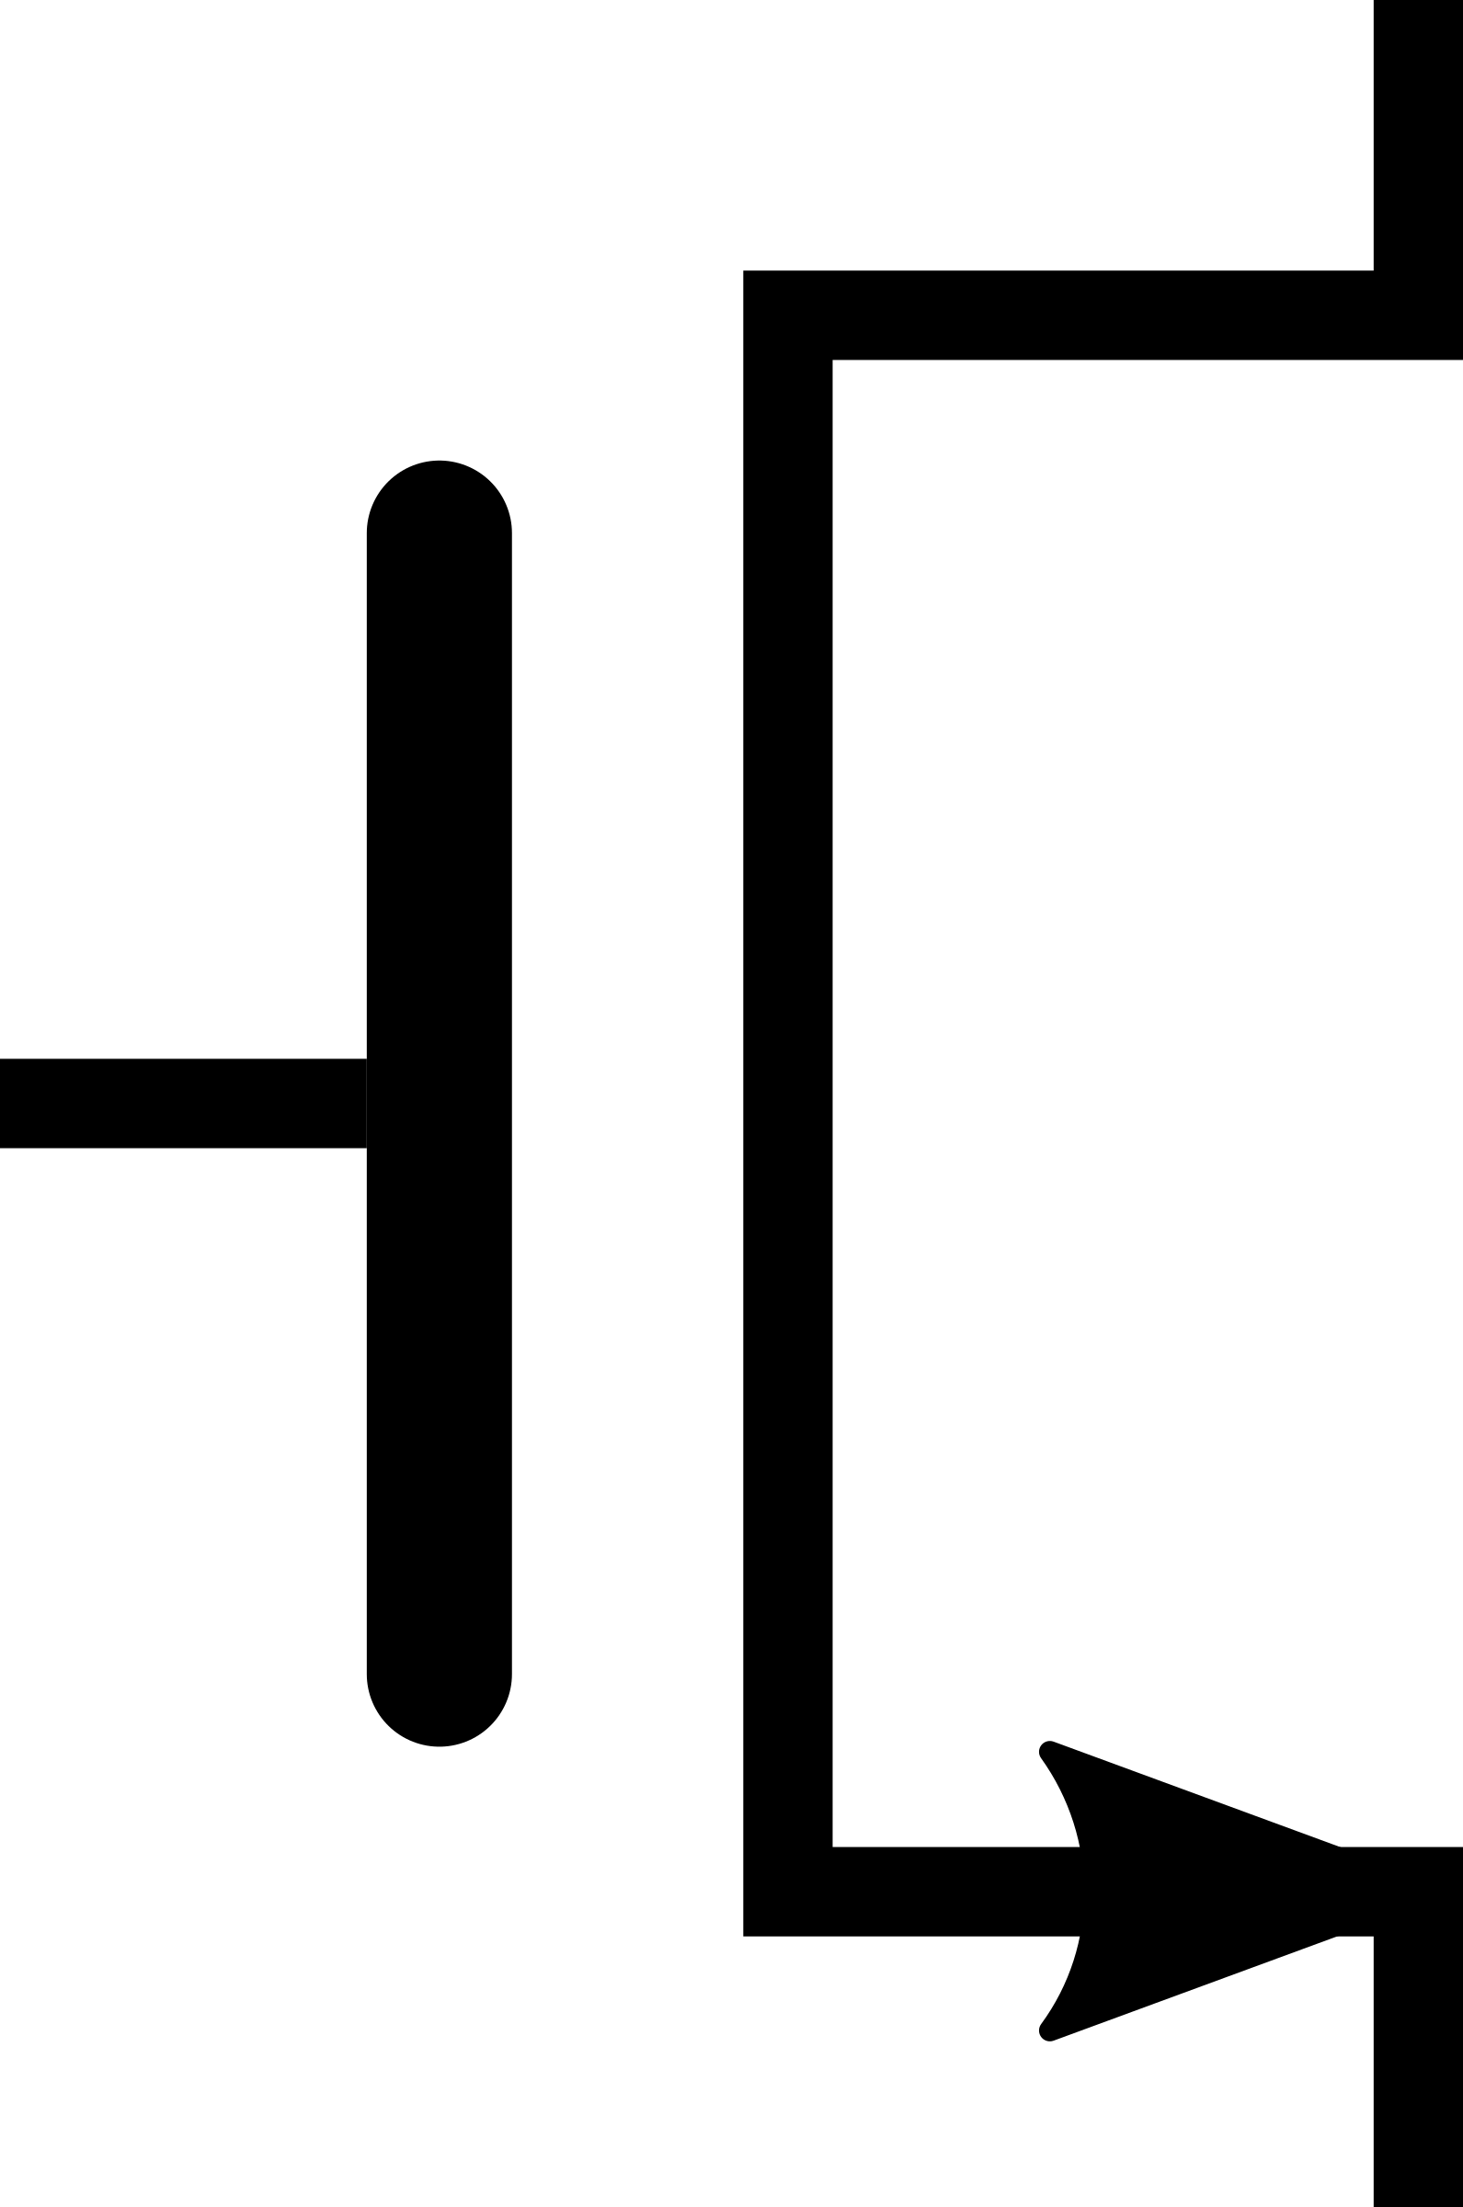
Key Idea and Applications
Low-cost Inter-linked subarrays (LISA)
  Fast bulk data movement between subarrays
  Wide datapath via isolation transistors: 0.8% DRAM chip area
LISA is a versatile substrate → new applications
Subarray 1
…
Subarray 2
  Fast bulk data copy: Copy latency 1.363ms→0.148ms (9.2x)
  → 66% speedup, -55% DRAM energy
  In-DRAM caching: Hot data access latency 48.7ns→21.5ns (2.2x)
  → 5% speedup
  Fast precharge: Precharge latency 13.1ns→5.0ns (2.6x)
  → 8% speedup

Slide 108
3. Linked Precharge (LIP)
Problem: The precharge time is limited by the strength of one precharge unit
Linked Precharge (LIP): LISA precharges a subarray using multiple precharge units
S
S
S
S
S
S
S
S
on
P
P
P
P
P
P
P
P
Activated row
Reduces precharge latency by 2.6x
(43% guardband)
Precharging
Linked
Precharging
S
S
S
S
on
S
S
S
S
on
P
P
P
P
P
P
P
P
Conventional DRAM
LISA DRAM

Slide 109
More on LISA
Kevin K. Chang, Prashant J. Nair, Saugata Ghose, Donghyuk Lee, Moinuddin K. Qureshi, and Onur Mutlu,
"Low-Cost Inter-Linked Subarrays (LISA): Enabling Fast Inter-Subarray Data Movement in DRAM"
Proceedings of the 22nd International Symposium on High-Performance Computer Architecture (HPCA), Barcelona, Spain, March 2016.
[Slides (pptx) (pdf)]
[Source Code]

Slide 110
CROW: The Copy Row Substrate
[ISCA 2019]

Slide 111

Challenges of DRAM Scaling
1
access latency
2
refresh overhead
3
exposure to vulnerabilities
Notes:
DRAM offers high memory capacity at low cost.
However, process technology scaling introduces three key challenges to DRAM [CLICK]
First, high DRAM access latency is a bottleneck for improving system performance and energy efficiency. [CLICK]
Second, as the number of cells in a DRAM chip increase, DRAM refresh overheads incur more performance and energy overheads. [CLICK]
Third, as process technology shrinks, DRAM cells become smaller and get closer to each other. The increasing interference between cells exposes DRAM to vulnerabilities such as RowHammer, which reduce DRAM reliability.

Slide 112
Conventional DRAM
DRAM Subarray
sense amplifier
Notes:
Conventional DRAM chip is composed of multiple subarrays. DRAM cells in a subarray are organized as two-dimensional array.
To access a cell, a DRAM row has to be activated. [CLICK] A row activation results in loading the row’s data into the sense amplifiers, where read and write operations can be performed.

Slide 113
Copy Row DRAM (CROW)
DRAM Subarray
Row copy
Multiple row activation
sense amplifier
Notes:
To address the scaling challenges of conventional DRAM, we propose a flexible substrate which we call CROW.
CROW slightly modifies the DRAM subarray by introducing copy rows in addition to the regular rows in conventional DRAM. The copy rows have their own address decoders and they can be activated independently from the regular rows.
The CROW substrate enables two key operations. [CLICK]
First, it enables duplicating an entire regular row to a copy row within the subarray. This operation is simply performed by following a regular row activation with a copy row activation. [CLICK]
Second, CROW enables simultaneously activating a regular row and a copy row. If the two rows contain the same data, this operation results in low latency activation. This is because two rows share more charge with the sense amplifiers and as a result the sense amplifiers operate faster.

Slide 114
Use Cases of CROW
CROW-cache
  reduces access latency
CROW-ref
  reduces DRAM refresh overhead
A mechanism for protecting against RowHammer
weak
strong
Notes:
The CROW substrate is flexible and can be used to enable a variety of mechanisms.
In this work, we discuss and evaluate two mechanisms. First, [CLICK] CROW-cache enables low-latency access to the most recently activated regular rows in every subarray. To do so, [CLICK] CROW-cache
makes a copy of the activated regular row into an available copy row. During a subsequent access to the same regular row, [CLICK] CROW-cache simultaneously activates both the regular and copy row to reduce activation latency.
[CLICK]
Second, CROW-ref mitigates DRAM refresh overhead by avoiding storing any data in retention-weak rows such that the entire DRAM chip can use a longer refresh interval. [CLICK] CROW-ref simply remaps weak regular DRAM rows to strong copy rows and the memory controller activates the corresponding copy row instead of the weak regular row.
Please come to my talk to learn more about these mechanisms.
[CLICK]
In the talk, we will also briefly discuss a third mechanism for mitigating RowHammer errors.
We hope future work exploits CROW to devise more use cases.

Slide 115
Key Results
  CROW-cache + CROW-ref
    20% speedup
    22% less DRAM energy
  Hardware Overhead
    0.5% DRAM chip area
    1.6% DRAM capacity
    11.3 KiB memory controller storage
Notes:
CROW-cache and CROW-ref are complementary to each other. Averaged across 20 four-core memory intensive workloads, the combination of CROW-cache and CROW-ref improves performance by 20.0% and reduces DRAM energy by 22%.
[CLICK]
CROW provides such performance and energy benefits with a small hardware overhead in the DRAM chip and the memory controller.

Slide 116
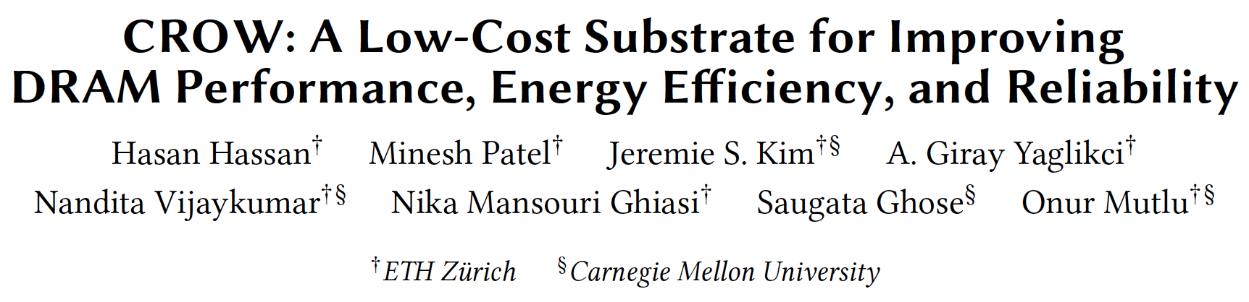
More on CROW
Hasan Hassan, Minesh Patel, Jeremie S. Kim, A. Giray Yaglikci, Nandita Vijaykumar, Nika Mansourighiasi, Saugata Ghose, and Onur Mutlu,
"CROW: A Low-Cost Substrate for Improving DRAM Performance, Energy Efficiency, and Reliability"
Proceedings of the 46th International Symposium on Computer Architecture (ISCA), Phoenix, AZ, USA, June 2019.

Slide 117
SALP: Reducing DRAM Bank Conflict Impact
Kim, Seshadri, Lee, Liu, Mutlu
A Case for Exploiting Subarray-Level Parallelism (SALP) in DRAM
ISCA 2012.

Slide 118
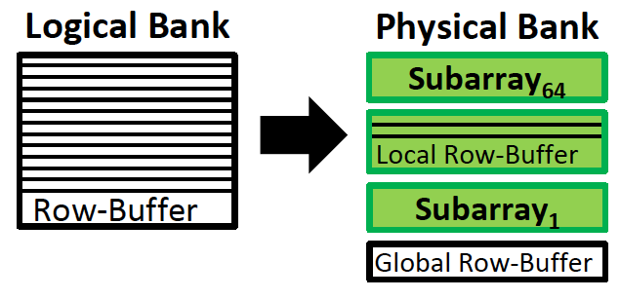
SALP: Problem, Goal, Observations
Problem: Bank conflicts are costly for performance and energy
  serialized requests, wasted energy (thrashing of row buffer, busy wait)
Goal: Reduce bank conflicts without adding more banks (low cost)
Observation 1: A DRAM bank is divided into subarrays and each subarray has its own local row buffer

Slide 119
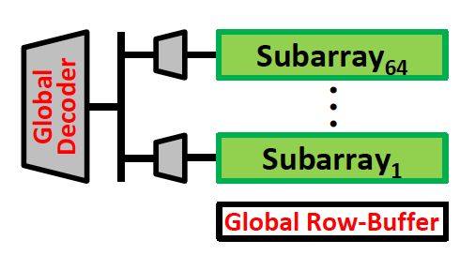
SALP: Key Ideas
Observation 2: Subarrays are mostly independent
  Except when sharing global structures to reduce cost
Key Idea of SALP: Minimally reduce sharing of global structures
Reduce the sharing of …
Global decoder → Enables almost parallel access to subarrays
Global row buffer → Utilizes multiple local row buffers

Slide 120
SALP: Reduce Sharing of Global Decoder
Instead of a global latch, have per-subarray latches
Local
row-buffer
Global Decoder
···
Latch
Latch
Latch
Local
row-buffer
Global
row-buffer

Slide 121
SALP: Reduce Sharing of Global Row-Buffer
Selectively connect local row-buffers to global row-buffer using a Designated single-bit latch
Global bitlines
Local
row-buffer
D
D
Switch
Wire
Local
row-buffer
D
D
Switch
READ
READ
Global
row-buffer

Slide 122
SALP: Baseline Bank Organization
Global
bitlines
Local
row-buffer
Global Decoder
Latch
Local
row-buffer
Global
row-buffer

Slide 123
SALP: Proposed Bank Organization
Global
bitlines
Latch
Local
row-buffer
D
Global Decoder
Latch
Local
row-buffer
D
Overhead of SALP in DRAM chip: 0.15%
1. Global latch → per-subarray local latches
2. Designated bit latches and wire to selectively enable a subarray
Global
row-buffer

Slide 124
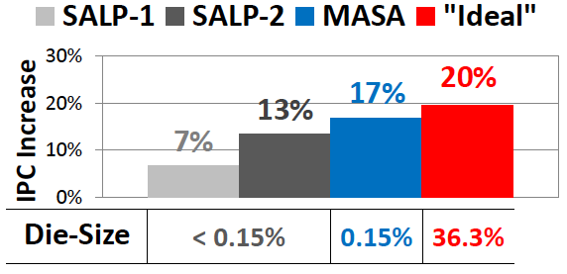
SALP: Results
Wide variety of systems with different #channels, banks, ranks, subarrays
Server, streaming, random-access, SPEC workloads
Dynamic DRAM energy reduction: 19%
  DRAM row hit rate improvement: 13%
System performance improvement: 17%
  Within 3% of ideal (all independent banks)
DRAM die area overhead: 0.15%
  vs. 36% overhead of independent banks

Slide 125
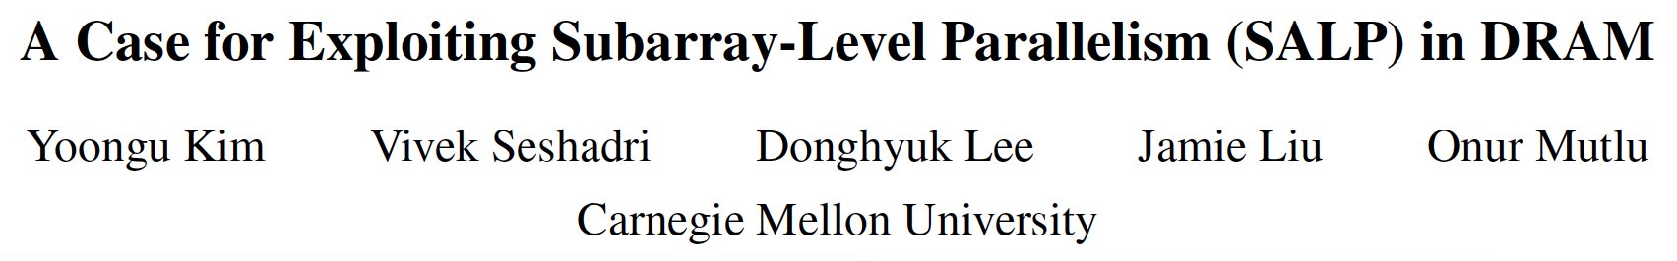
More on SALP
Yoongu Kim, Vivek Seshadri, Donghyuk Lee, Jamie Liu, and Onur Mutlu,
"A Case for Exploiting Subarray-Level Parallelism (SALP) in DRAM"
Proceedings of the 39th International Symposium on Computer Architecture (ISCA), Portland, OR, June 2012. Slides (pptx)

Slide 126
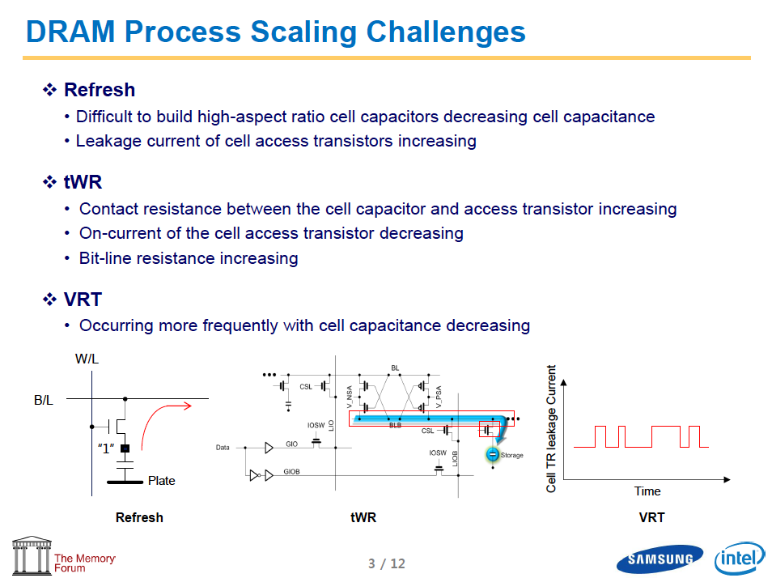
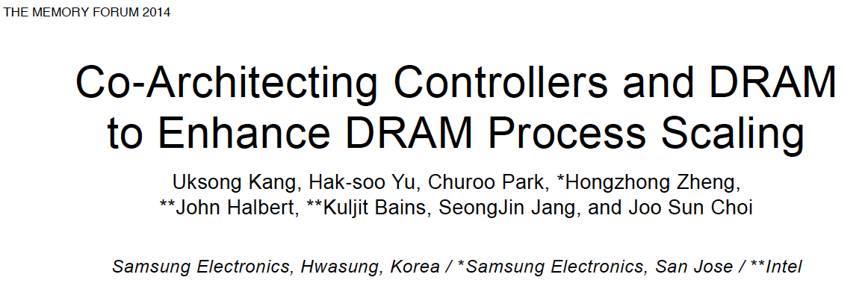
More on SALP

Slide 127
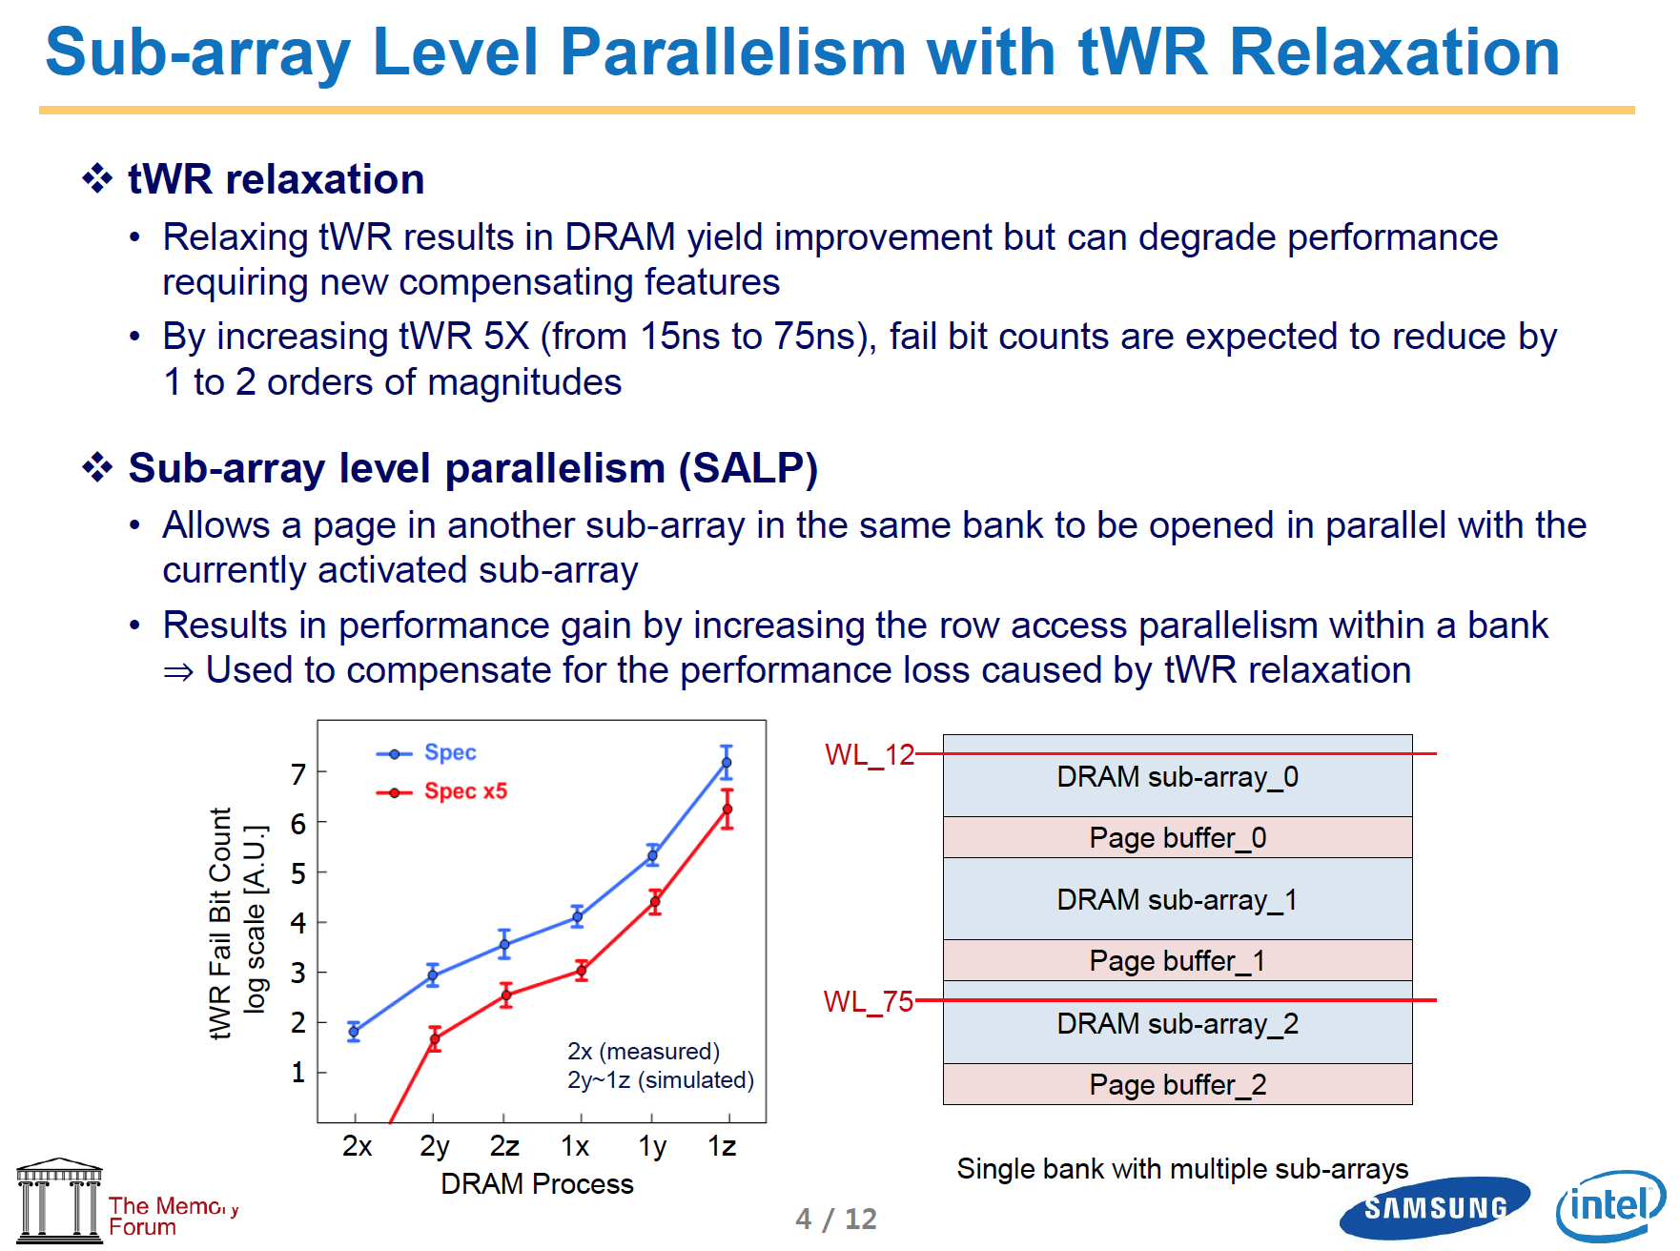
More on SALP
http://www.cs.utah.edu/thememoryforum/kang_slides.pdf

Slide 128
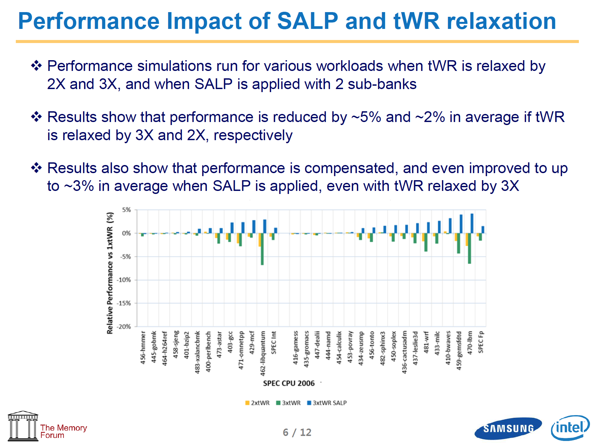
More on SALP
http://www.cs.utah.edu/thememoryforum/kang_slides.pdf

Slide 129
Summary: Low-Latency Memory

Slide 130
Summary: Tackling Long Memory Latency
Reason 1: Design of DRAM Micro-architecture
  Goal: Maximize capacity/area, not minimize latency
Reason 2: “One size fits all” approach to latency specification
  Same latency parameters for all temperatures
  Same latency parameters for all DRAM chips
  Same latency parameters for all parts of a DRAM chip
  Same latency parameters for all supply voltage levels
  Same latency parameters for all application data
  …

Slide 131
Challenge and Opportunity for Future
Fundamentally
Low-Latency
Computing Architectures

Slide 132
One Important Takeaway
Main Memory Needs
Intelligent Controllers

Slide 133
On DRAM Power Consumption

Slide 134
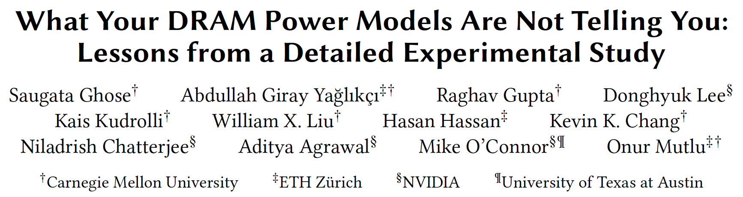
VAMPIRE DRAM Power Model
Saugata Ghose, A. Giray Yaglikci, Raghav Gupta, Donghyuk Lee, Kais Kudrolli, William X. Liu, Hasan Hassan, Kevin K. Chang, Niladrish Chatterjee, Aditya Agrawal, Mike O'Connor, and Onur Mutlu,
"What Your DRAM Power Models Are Not Telling You: Lessons from a Detailed Experimental Study"
Proceedings of the ACM International Conference on Measurement and Modeling of Computer Systems (SIGMETRICS), Irvine, CA, USA, June 2018.
[Abstract]

Slide 135
More Motivation to Reduce Memory Latency

Slide 136
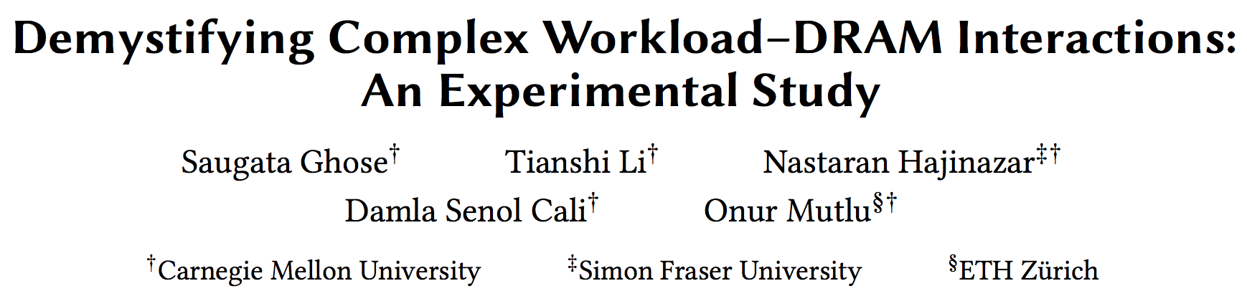
Workload-DRAM Interaction Analysis
Saugata Ghose, Tianshi Li, Nastaran Hajinazar, Damla Senol Cali, and Onur Mutlu,
"Demystifying Workload–DRAM Interactions: An Experimental Study"
Proceedings of the ACM International Conference on Measurement and Modeling of Computer Systems (SIGMETRICS), Phoenix, AZ, USA, June 2019.
[Preliminary arXiv Version]
[Abstract]
[Slides (pptx) (pdf)]

Slide 137
Memory Systems and Memory-Centric Computing Systems
Part 4: Low-Latency Memory
Prof. Onur Mutlu
omutlu@gmail.com
https://people.inf.ethz.ch/omutlu
7 July 2019
SAMOS Tutorial

