Slide 1
Memory Systems and Memory-Centric Computing Systems Part 5: Principles and Conclusion
Prof. Onur Mutlu
omutlu@gmail.com
https://people.inf.ethz.ch/omutlu
7 July 2019
SAMOS Tutorial

Slide 2
Four Key Directions
Fundamentally Secure/Reliable/Safe Architectures
Fundamentally Energy-Efficient Architectures
Memory-centric (Data-centric) Architectures
Fundamentally Low-Latency Architectures
Architectures for Genomics, Medicine, Health

Slide 3
Guiding Principles

Slide 4
Some Solution Principles (So Far)
Data-centric system design & intelligence spread around
Do not center everything around traditional computation units
Better cooperation across layers of the system
Careful co-design of components and layers: system/arch/device
Better, richer, more expressive and flexible interfaces
Better-than-worst-case design
Do not optimize for the worst case
Worst case should not determine the common case
Heterogeneity in design (specialization, asymmetry)
Enables a more efficient design (No one size fits all)

Slide 5
Some Solution Principles (More Compact)
Data-centric design
All components intelligent
Better cross-layer communication, better interfaces
Better-than-worst-case design
Heterogeneity
Flexibility, adaptability
Open minds

Slide 6
Data-Aware Architectures
A data-aware architecture understands what it can do with and to each piece of data
It makes use of different properties of data to improve performance, efficiency and other metrics
Compressibility
Approximability
Locality
Sparsity
Criticality for Computation X
Access Semantics
…

Slide 7
One Problem: Limited Interfaces

Slide 8
A Solution: More Expressive Interfaces

Slide 9
Expressive (Memory) Interfaces
Nandita Vijaykumar, Abhilasha Jain, Diptesh Majumdar, Kevin Hsieh, Gennady Pekhimenko, Eiman Ebrahimi, Nastaran Hajinazar, Phillip B. Gibbons and Onur Mutlu, "A Case for Richer Cross-layer Abstractions: Bridging the Semantic Gap with Expressive Memory" Proceedings of the 45th International Symposium on Computer Architecture (ISCA), Los Angeles, CA, USA, June 2018. [Slides (pptx) (pdf)] [Lightning Talk Slides (pptx) (pdf)] [Lightning Talk Video]

Slide 10
Expressive (Memory) Interfaces for GPUs
Nandita Vijaykumar, Eiman Ebrahimi, Kevin Hsieh, Phillip B. Gibbons and Onur Mutlu, "The Locality Descriptor: A Holistic Cross-Layer Abstraction to Express Data Locality in GPUs" Proceedings of the 45th International Symposium on Computer Architecture (ISCA), Los Angeles, CA, USA, June 2018. [Slides (pptx) (pdf)] [Lightning Talk Slides (pptx) (pdf)] [Lightning Talk Video]

Slide 11
Architectures for Intelligent Machines
Data-centric
Data-driven
Data-aware

Slide 12
Concluding Remarks

Slide 13
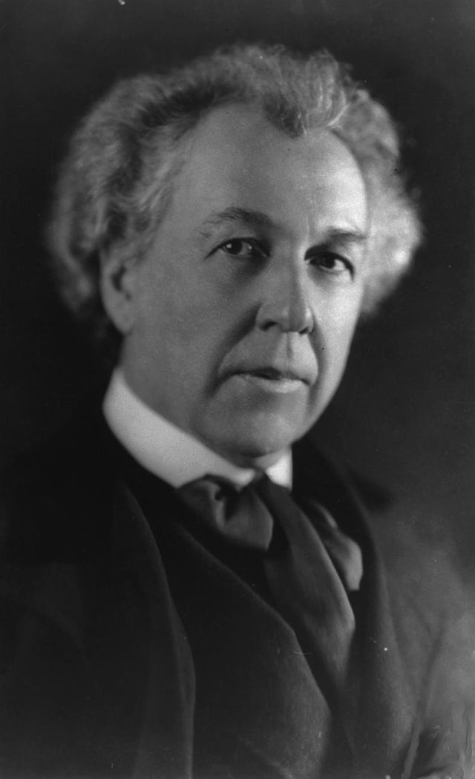
A Quote from A Famous Architect
“architecture […] based upon principle, and not upon precedent”

Slide 14
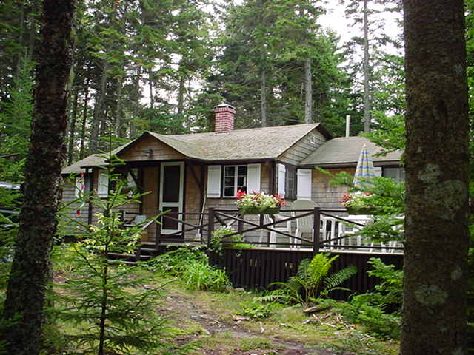
Precedent-Based Design?
“architecture […] based upon principle, and not upon precedent”

Slide 15
Principled Design
“architecture […] based upon principle, and not upon precedent”

Slide 17
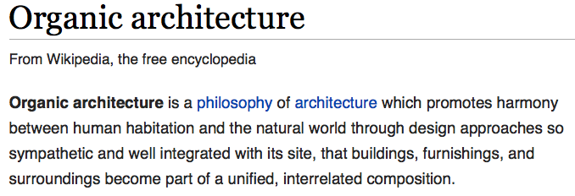
The Overarching Principle

Slide 18
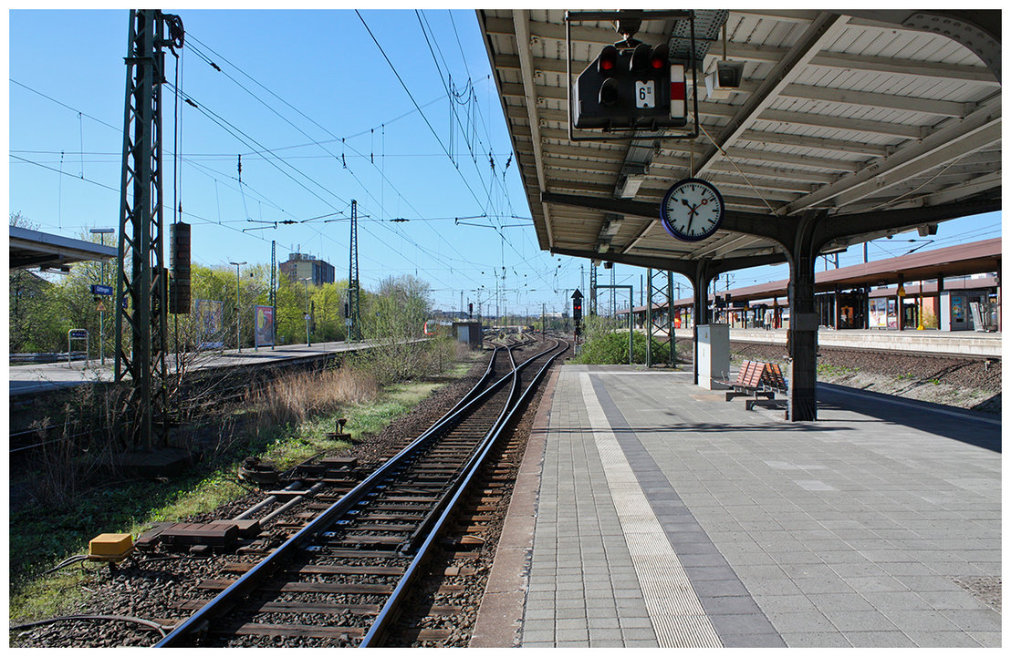
Another Example: Precedent-Based Design
Source: http://cookiemagik.deviantart.com/art/Train-station-207266944

Slide 19
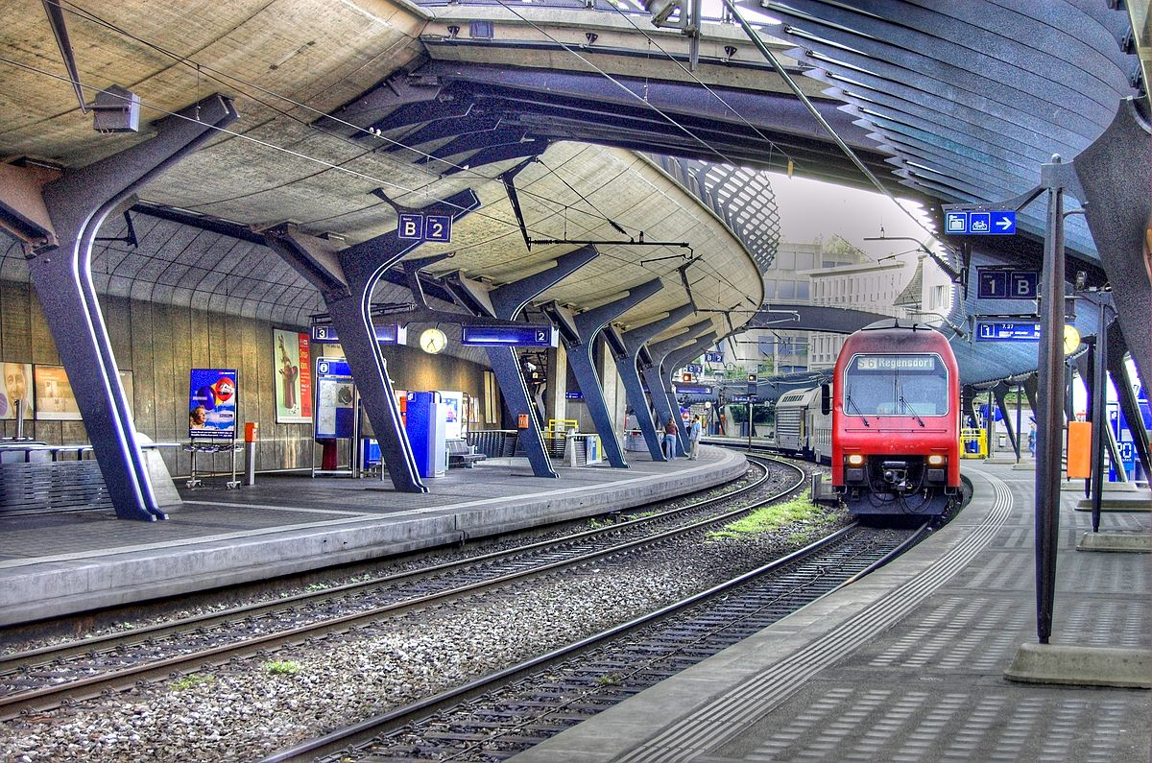
Principled Design
Source: By Toni_V, CC BY-SA 2.0, https://commons.wikimedia.org/w/index.php?curid=4087256

Slide 20
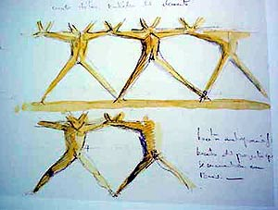
Another Principled Design
Source: By Martín Gómez Tagle - Lisbon, Portugal, CC BY-SA 3.0, https://commons.wikimedia.org/w/index.php?curid=13764903
Source: http://www.arcspace.com/exhibitions/unsorted/santiago-calatrava/

Slide 21
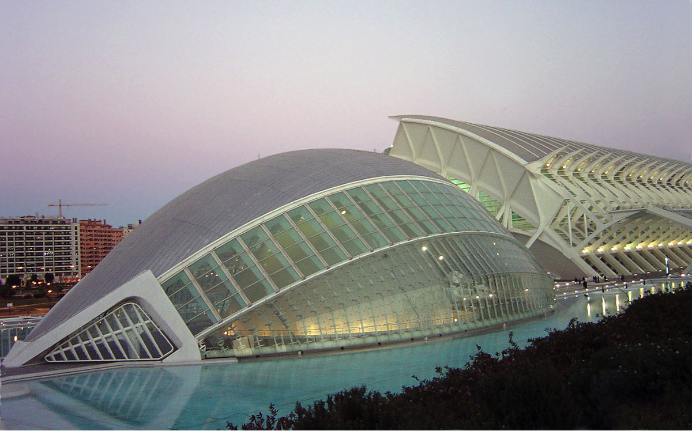
Another Principled Design
Source: CC BY-SA 3.0, https://commons.wikimedia.org/w/index.php?curid=172107

Slide 22
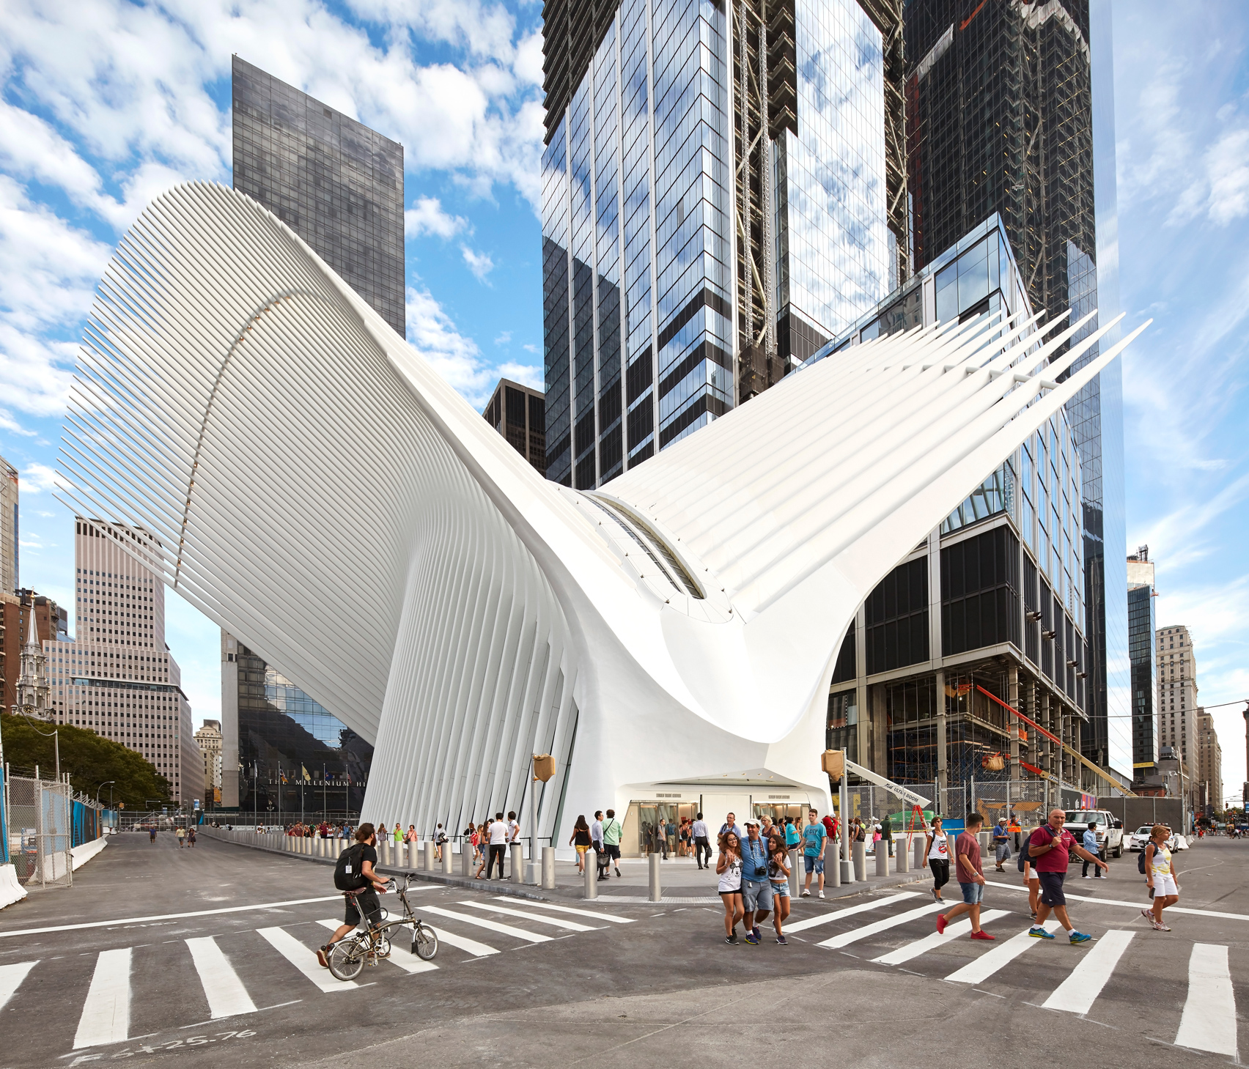
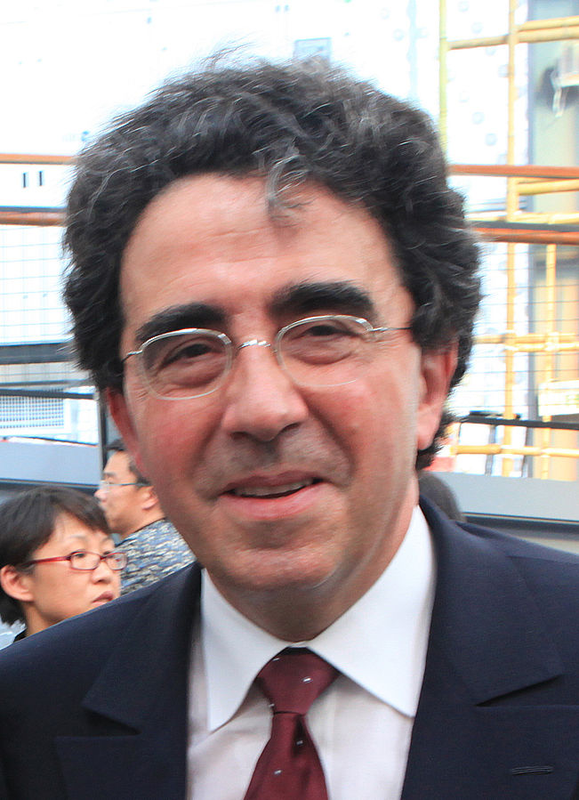
Principle Applied to Another Structure
Source: By 準建築人手札網站 Forgemind ArchiMedia - Flickr: IMG_2489.JPG, CC BY 2.0,
https://commons.wikimedia.org/w/index.php?curid=31493356, https://en.wikipedia.org/wiki/Santiago_Calatrava
Source: https://www.dezeen.com/2016/08/29/santiago-calatrava-oculus-world-trade-center-transportation-hub-new-york-photographs-hufton-crow/

Slide 23
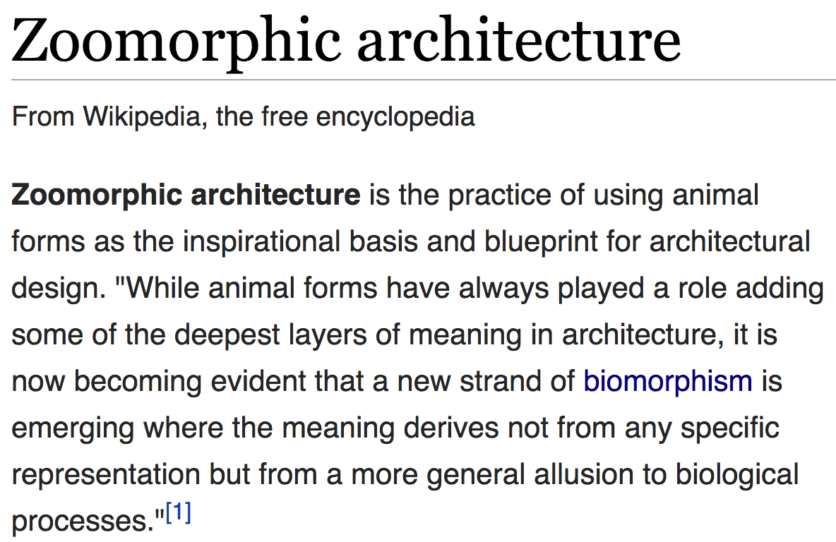
The Overarching Principle

Slide 24
Overarching Principle for Computing?
Source: http://spectrum.ieee.org/image/MjYzMzAyMg.jpeg

Slide 25
Concluding Remarks
It is time to design principled system architectures to solve the memory problem
Discover design principles for fundamentally secure and reliable computer architectures
Design complete systems to be balanced and energy-efficient, i.e., low latency and data-centric (or memory-centric)
Enable new and emerging memory architectures
This can
Lead to orders-of-magnitude improvements
Enable new applications & computing platforms
Enable better understanding of nature
…
Notes:
Perhaps we have taken processor-centric system design a bit too far

Slide 26
We Need to Think Across the Stack
Problem
Algorithm
Program/Language
System Software
SW/HW Interface
Micro-architecture
Logic
Devices
Electrons
We can get there step by step

Slide 27
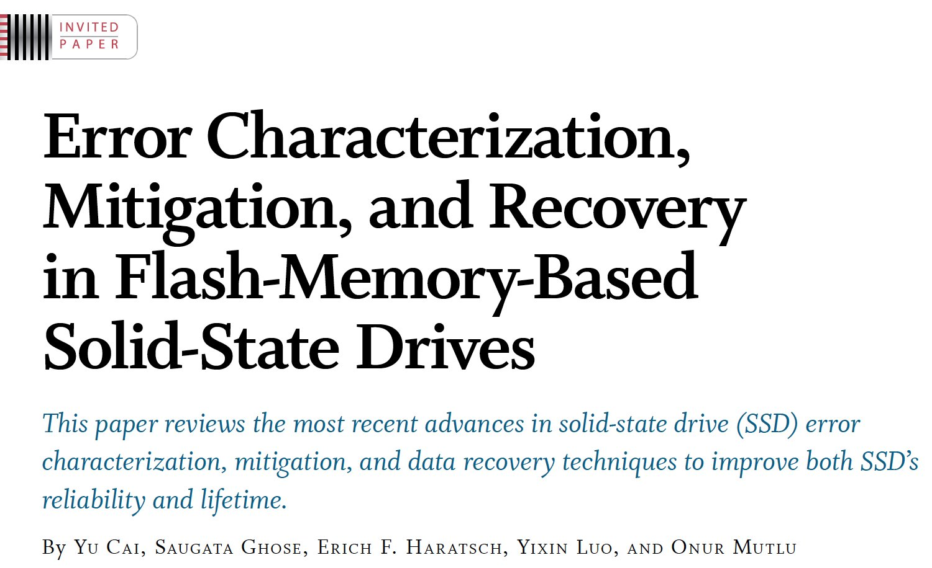
If In Doubt, See Other Doubtful Technologies
A very “doubtful” emerging technology
for at least two decades
Proceedings of the IEEE, Sept. 2017
https://arxiv.org/pdf/1706.08642

Slide 28
Accelerated Memory Course (~6.5 hours)
ACACES 2018
Memory Systems and Memory-Centric Computing Systems
Taught by Onur Mutlu July 9-13, 2018
~6.5 hours of lectures
Website for the Course including Videos, Slides, Papers
https://people.inf.ethz.ch/omutlu/acaces2018.html
https://www.youtube.com/playlist?list=PL5Q2soXY2Zi-HXxomthrpDpMJm05P6J9x
All Papers are at:
https://people.inf.ethz.ch/omutlu/projects.htm
Final lecture notes and readings (for all topics)

Slide 29
A Final Detour

Slide 30
In-Memory Bulk Bitwise Operations
We can support in-DRAM COPY, ZERO, AND, OR, NOT, MAJ
At low cost
Using analog computation capability of DRAM
Idea: activating multiple rows performs computation
30-60X performance and energy improvement
Seshadri+, “Ambit: In-Memory Accelerator for Bulk Bitwise Operations Using Commodity DRAM Technology,” MICRO 2017.
New memory technologies enable even more opportunities
Memristors, resistive RAM, phase change mem, STT-MRAM, …
Can operate on data with minimal movement

Slide 31
More on Ambit
Vivek Seshadri et al., “Ambit: In-Memory Accelerator for Bulk Bitwise Operations Using Commodity DRAM Technology,” MICRO 2017.

Slide 32
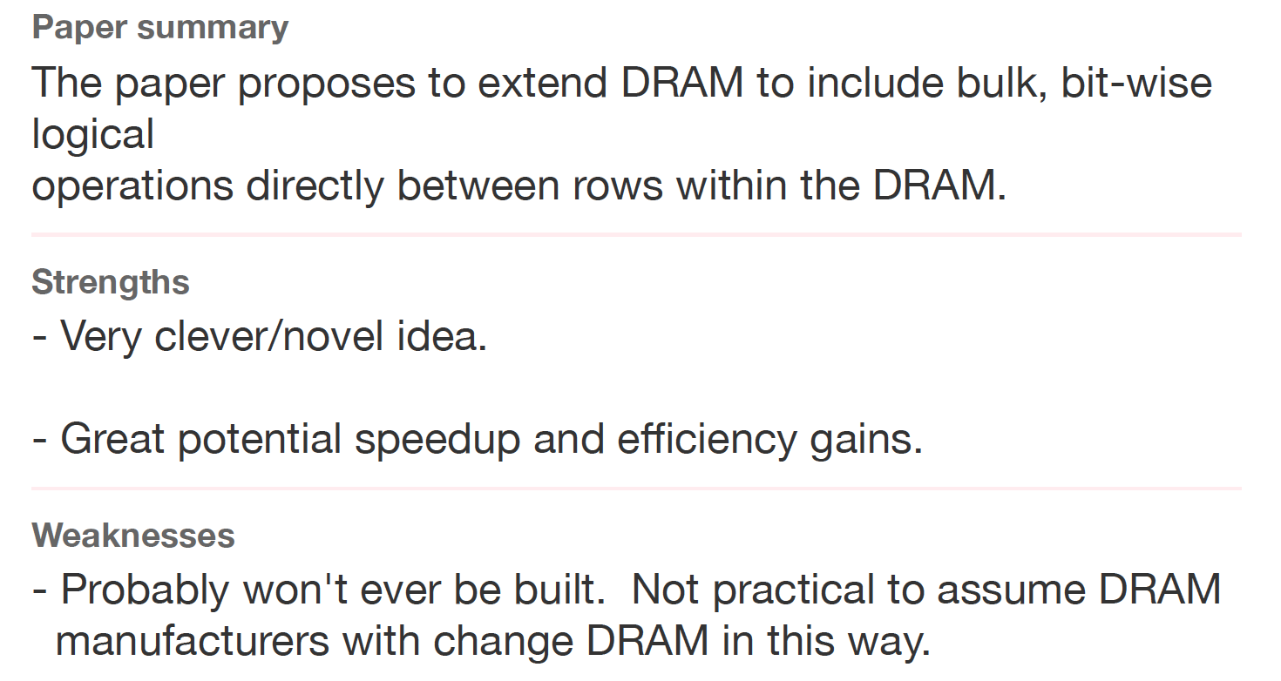
Ambit Sounds Good, No?
Review from ISCA 2016

Slide 33
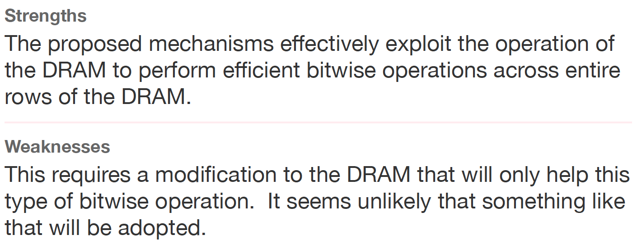
Another Review
Another Review from ISCA 2016

Slide 34
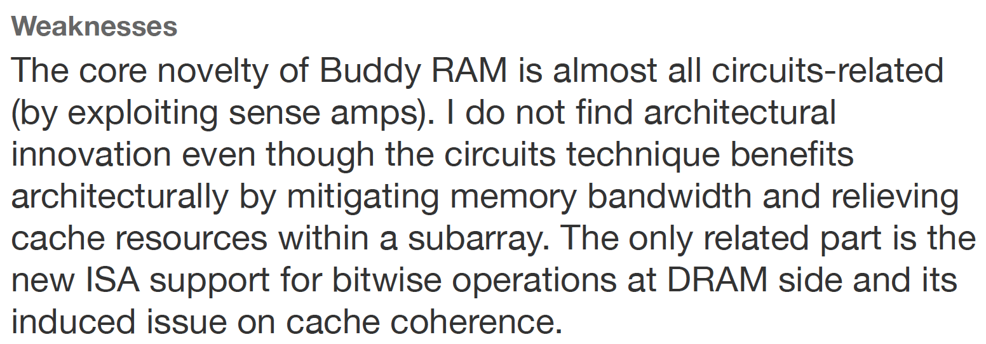
Yet Another Review
Yet Another Review from ISCA 2016

Slide 35
We Have a Mindset Issue…
There are many other similar examples from reviews…
For many other papers…
And, we are not even talking about JEDEC yet…
How do we fix the mindset problem?
By doing more research, education, implementation in alternative processing paradigms
We need to work on enabling the better future…

Slide 36
Aside: A Recommended Book
Raj Jain, “The Art of
Computer Systems
Performance Analysis,”
Wiley, 1991.

Slide 37
Raj Jain, “The Art of
Computer Systems
Performance Analysis,”
Wiley, 1991.

Slide 38
Raj Jain, “The Art of
Computer Systems
Performance Analysis,”
Wiley, 1991.

Slide 39
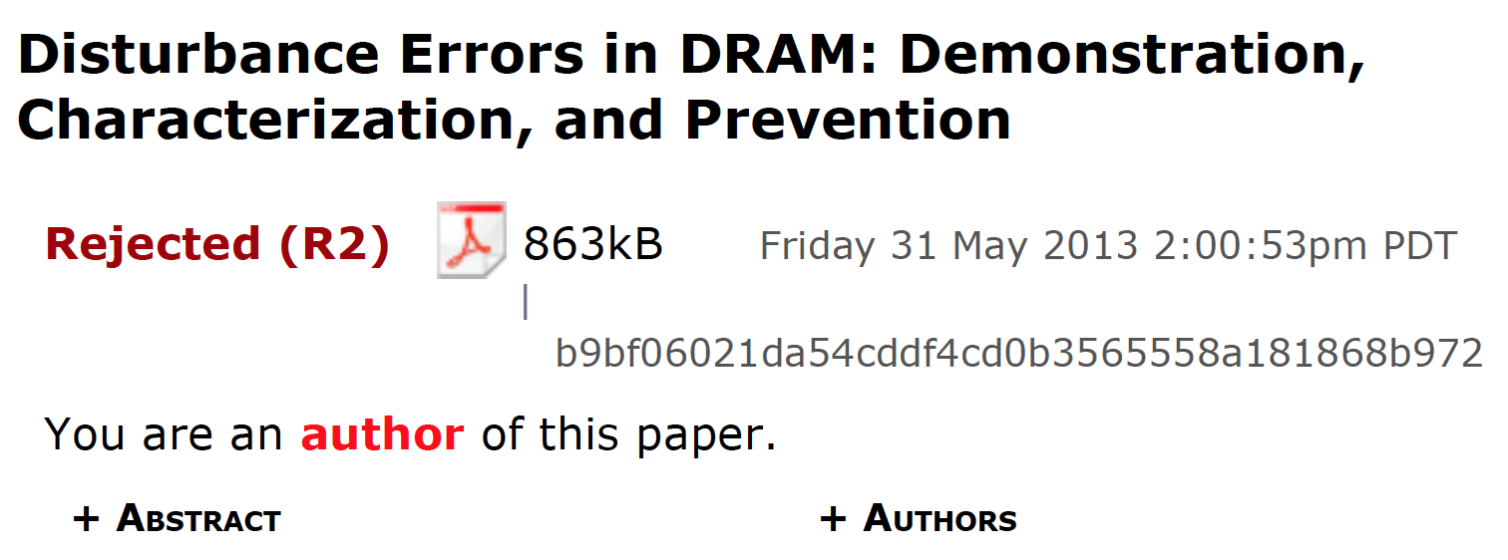
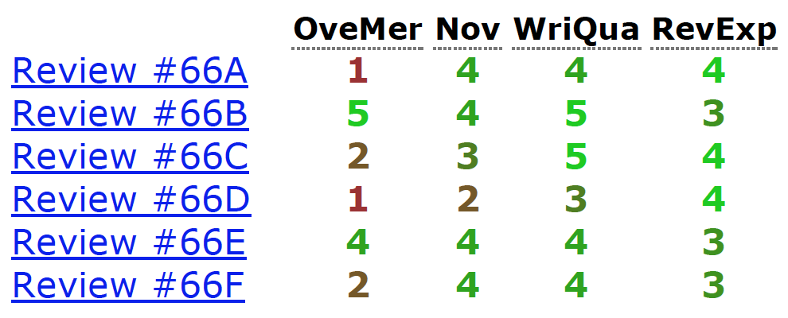
Initial RowHammer Reviews

Slide 40
Missing the Point
Reviews from Micro 2013

Slide 41
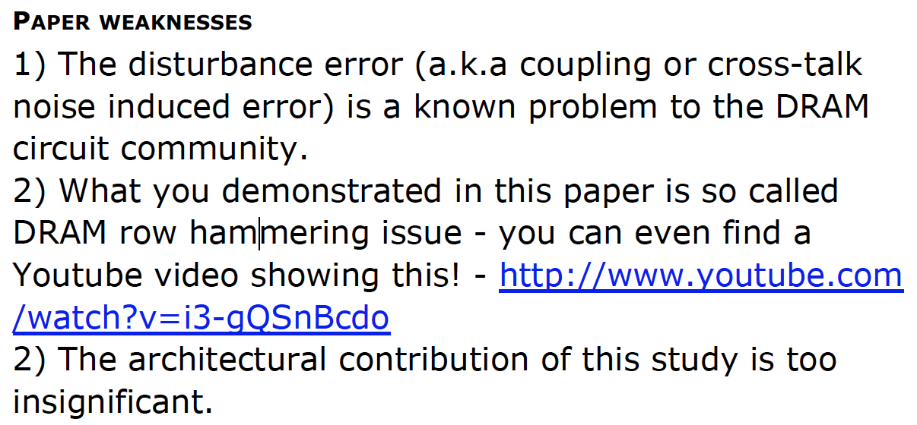
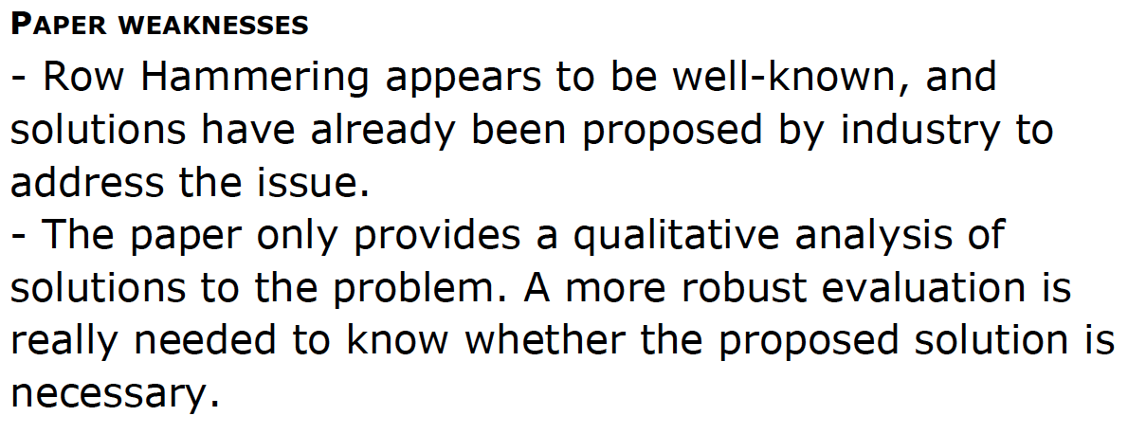
More …
Reviews from ISCA 2014

Slide 42
Suggestions to Reviewers
Be fair; you do not know it all
Be open-minded; you do not know it all
Be accepting of diverse research methods: there is no single way of doing research
Be constructive, not destructive
Do not have double standards…
Do not block or delay scientific progress for non-reasons

Slide 43
Suggestion to Community
We Need to Fix the Reviewer Accountability Problem

Slide 44
Suggestion to Community
Eliminate
Double Standards

Slide 45
Suggestion to Researchers: Principle: Passion
Follow Your Passion
(Do not get derailed
by naysayers)

Slide 46
Suggestion to Researchers: Principle: Resilience
Be Resilient

Slide 47
Principle: Learning and Scholarship
Focus on
learning and scholarship

Slide 48
Principle: Learning and Scholarship
The quality of your work defines your impact

Slide 49
Memory Systems and Memory-Centric Computing Systems Part 5: Principles and Conclusion
Prof. Onur Mutlu
omutlu@gmail.com
https://people.inf.ethz.ch/omutlu
7 July 2019
SAMOS Tutorial

Slide 50
Acknowledgments
My current and past students and postdocs
Rachata Ausavarungnirun, Abhishek Bhowmick, Amirali Boroumand, Rui Cai, Yu Cai, Kevin Chang, Saugata Ghose, Kevin Hsieh, Tyler Huberty, Ben Jaiyen, Samira Khan, Jeremie Kim, Yoongu Kim, Yang Li, Jamie Liu, Lavanya Subramanian, Donghyuk Lee, Yixin Luo, Justin Meza, Gennady Pekhimenko, Vivek Seshadri, Lavanya Subramanian, Nandita Vijaykumar, HanBin Yoon, Jishen Zhao, …
My collaborators
Can Alkan, Chita Das, Phil Gibbons, Sriram Govindan, Norm Jouppi, Mahmut Kandemir, Mike Kozuch, Konrad Lai, Ken Mai, Todd Mowry, Yale Patt, Moinuddin Qureshi, Partha Ranganathan, Bikash Sharma, Kushagra Vaid, Chris Wilkerson, …

Slide 51
Funding Acknowledgments
NSF
GSRC
SRC
CyLab
Alibaba, AMD, Google, Facebook, HP Labs, Huawei, IBM, Intel, Microsoft, Nvidia, Oracle, Qualcomm, Rambus, Samsung, Seagate, VMware

Slide 52
Slides Not Covered But Could Be Useful

Slide 53
End of Backup Slides

Slide 54
Readings, Videos, Reference Materials

Slide 55
Accelerated Memory Course (~6.5 hours)
ACACES 2018
Memory Systems and Memory-Centric Computing Systems
Taught by Onur Mutlu July 9-13, 2018
~6.5 hours of lectures
Website for the Course including Videos, Slides, Papers
https://safari.ethz.ch/memory_systems/ACACES2018/
https://www.youtube.com/playlist?list=PL5Q2soXY2Zi-HXxomthrpDpMJm05P6J9x
All Papers are at:
https://people.inf.ethz.ch/omutlu/projects.htm
Final lecture notes and readings (for all topics)

Slide 56
Required: Reference Overview Paper I
Onur Mutlu, Saugata Ghose, Juan Gomez-Luna, and Rachata Ausavarungnirun, "Processing Data Where It Makes Sense: Enabling In-Memory Computation" Invited paper in Microprocessors and Microsystems (MICPRO), June 2019. [arXiv version]

Slide 57
Required: Reference Overview Paper II
Onur Mutlu and Jeremie Kim, "RowHammer: A Retrospective" IEEE Transactions on Computer-Aided Design of Integrated Circuits and Systems (TCAD) Special Issue on Top Picks in Hardware and Embedded Security, 2019. [Preliminary arXiv version]

Slide 58
Required: Reference Overview Paper III
Onur Mutlu and Lavanya Subramanian, "Research Problems and Opportunities in Memory Systems" Invited Article in Supercomputing Frontiers and Innovations (SUPERFRI), 2014/2015.
https://people.inf.ethz.ch/omutlu/pub/memory-systems-research_superfri14.pdf

Slide 59
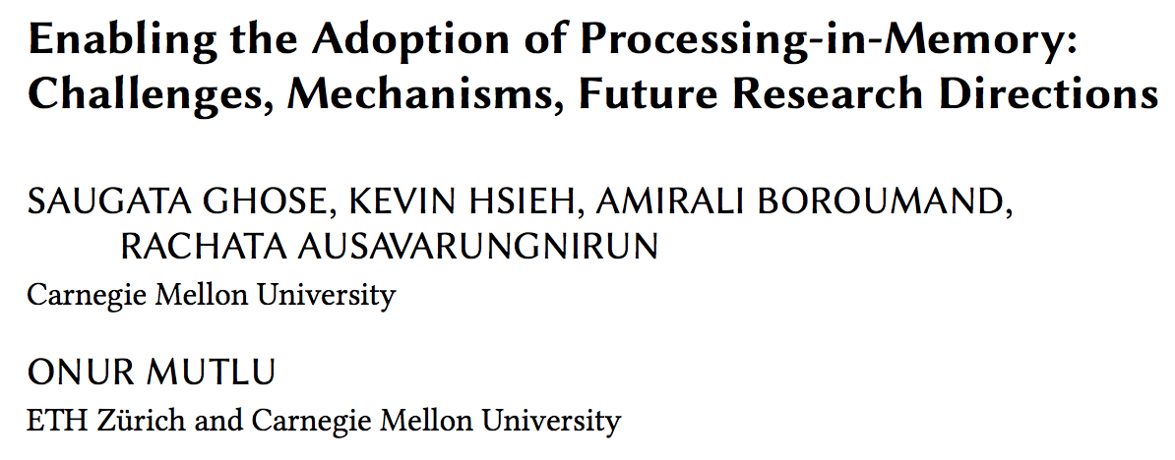
Reference Overview Paper IV
Saugata Ghose, Kevin Hsieh, Amirali Boroumand, Rachata Ausavarungnirun, Onur Mutlu, "Enabling the Adoption of Processing-in-Memory: Challenges, Mechanisms, Future Research Directions" Invited Book Chapter, to appear in 2018. [Preliminary arxiv.org version]
https://arxiv.org/pdf/1802.00320.pdf

Slide 60
Reference Overview Paper V
Onur Mutlu, "The RowHammer Problem and Other Issues We May Face as Memory Becomes Denser" Invited Paper in Proceedings of the Design, Automation, and Test in Europe Conference (DATE), Lausanne, Switzerland, March 2017. [Slides (pptx) (pdf)]
https://people.inf.ethz.ch/omutlu/pub/rowhammer-and-other-memory-issues_date17.pdf

Slide 61
Reference Overview Paper VI
Onur Mutlu, "Memory Scaling: A Systems Architecture Perspective" Technical talk at MemCon 2013 (MEMCON), Santa Clara, CA, August 2013. [Slides (pptx) (pdf)] [Video] [Coverage on StorageSearch]
https://people.inf.ethz.ch/omutlu/pub/memory-scaling_memcon13.pdf

Slide 62
Reference Overview Paper VII
Proceedings of the IEEE, Sept. 2017
https://arxiv.org/pdf/1706.08642

Slide 63
Related Videos and Course Materials (I)
Undergraduate Computer Architecture Course Lecture Videos (2015, 2014, 2013)
Undergraduate Computer Architecture Course Materials (2015, 2014, 2013)
Graduate Computer Architecture Course Lecture Videos (2017, 2015, 2013)
Graduate Computer Architecture Course Materials (2017, 2015, 2013)
Parallel Computer Architecture Course Materials (Lecture Videos)

Slide 64
Related Videos and Course Materials (II)
Freshman Digital Circuits and Computer Architecture Course Lecture Videos (2018, 2017)
Freshman Digital Circuits and Computer Architecture Course Materials (2018)
Memory Systems Short Course Materials
(Lecture Video on Main Memory and DRAM Basics)

Slide 65
Some Open Source Tools (I)
Rowhammer – Program to Induce RowHammer Errors
https://github.com/CMU-SAFARI/rowhammer
Ramulator – Fast and Extensible DRAM Simulator
https://github.com/CMU-SAFARI/ramulator
MemSim – Simple Memory Simulator
https://github.com/CMU-SAFARI/memsim
NOCulator – Flexible Network-on-Chip Simulator
https://github.com/CMU-SAFARI/NOCulator
SoftMC – FPGA-Based DRAM Testing Infrastructure
https://github.com/CMU-SAFARI/SoftMC
Other open-source software from my group
https://github.com/CMU-SAFARI/
http://www.ece.cmu.edu/~safari/tools.html

Slide 66
Some Open Source Tools (II)
MQSim – A Fast Modern SSD Simulator
https://github.com/CMU-SAFARI/MQSim
Mosaic – GPU Simulator Supporting Concurrent Applications
https://github.com/CMU-SAFARI/Mosaic
IMPICA – Processing in 3D-Stacked Memory Simulator
https://github.com/CMU-SAFARI/IMPICA
SMLA – Detailed 3D-Stacked Memory Simulator
https://github.com/CMU-SAFARI/SMLA
HWASim – Simulator for Heterogeneous CPU-HWA Systems
https://github.com/CMU-SAFARI/HWASim
Other open-source software from my group
https://github.com/CMU-SAFARI/
http://www.ece.cmu.edu/~safari/tools.html

Slide 67
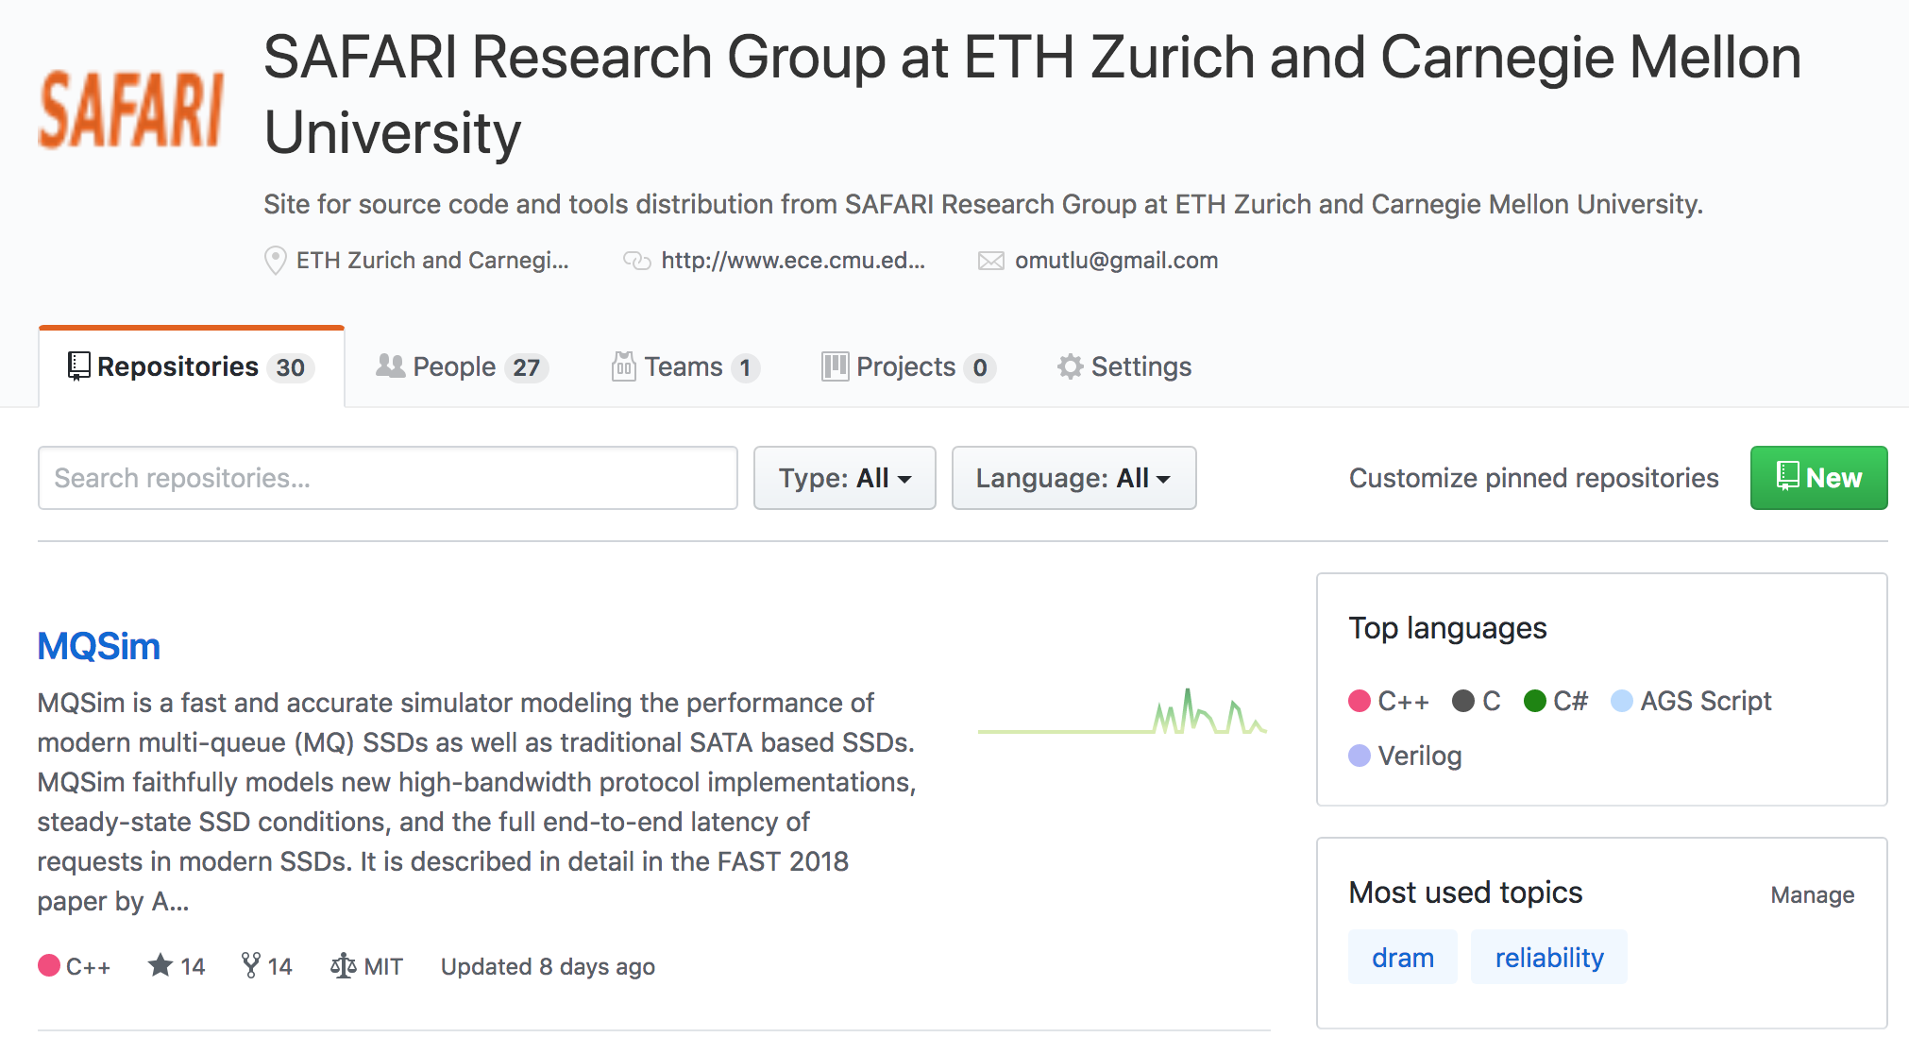
More Open Source Tools (III)
A lot more open-source software from my group
https://github.com/CMU-SAFARI/
http://www.ece.cmu.edu/~safari/tools.html

Slide 68
Referenced Papers
All are available at
https://people.inf.ethz.ch/omutlu/projects.htm
http://scholar.google.com/citations?user=7XyGUGkAAAAJ&hl=en
https://people.inf.ethz.ch/omutlu/acaces2018.html

Slide 69
Ramulator: A Fast and Extensible DRAM Simulator [IEEE Comp Arch Letters’15]

Slide 70
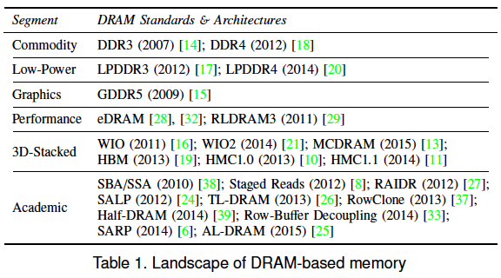
Ramulator Motivation
DRAM and Memory Controller landscape is changing
Many new and upcoming standards
Many new controller designs
A fast and easy-to-extend simulator is very much needed

Slide 71
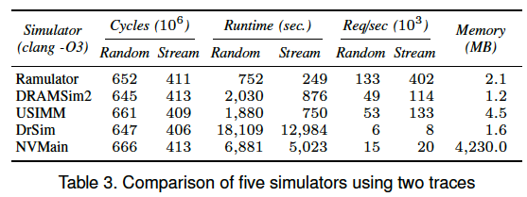
Ramulator
Provides out-of-the box support for many DRAM standards:
DDR3/4, LPDDR3/4, GDDR5, WIO1/2, HBM, plus new proposals (SALP, AL-DRAM, TLDRAM, RowClone, and SARP)
~2.5X faster than fastest open-source simulator
Modular and extensible to different standards

Slide 72
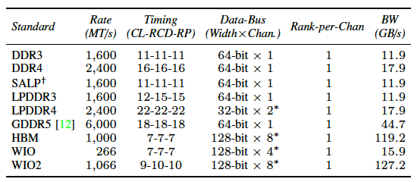
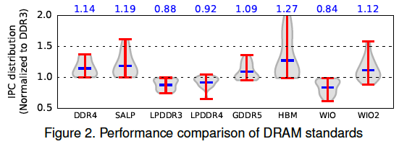
Case Study: Comparison of DRAM Standards
Across 22 workloads, simple CPU model

Slide 73
Ramulator Paper and Source Code
Yoongu Kim, Weikun Yang, and Onur Mutlu, "Ramulator: A Fast and Extensible DRAM Simulator" IEEE Computer Architecture Letters (CAL), March 2015. [Source Code]
Source code is released under the liberal MIT License
https://github.com/CMU-SAFARI/ramulator

Slide 74
Optional Assignment
Review the Ramulator paper
Email me your review (omutlu@gmail.com)
Download and run Ramulator
Compare DDR3, DDR4, SALP, HBM for the libquantum benchmark (provided in Ramulator repository)
Email me your report (omutlu@gmail.com)
This will help you get into memory systems research

Slide 75
Some More Suggested Readings

Slide 76
Some Key Readings on DRAM (I)
DRAM Organization and Operation
Lee et al., “Tiered-Latency DRAM: A Low Latency and Low Cost DRAM Architecture,” HPCA 2013.
https://people.inf.ethz.ch/omutlu/pub/tldram_hpca13.pdf
Kim et al., “A Case for Subarray-Level Parallelism (SALP) in DRAM,” ISCA 2012.
https://people.inf.ethz.ch/omutlu/pub/salp-dram_isca12.pdf
Lee et al., “Simultaneous Multi-Layer Access: Improving 3D-Stacked Memory Bandwidth at Low Cost,” ACM TACO 2016.
https://people.inf.ethz.ch/omutlu/pub/smla_high-bandwidth-3d-stacked-memory_taco16.pdf

Slide 77
Some Key Readings on DRAM (II)
DRAM Refresh
Liu et al., “RAIDR: Retention-Aware Intelligent DRAM Refresh,” ISCA 2012. https://people.inf.ethz.ch/omutlu/pub/raidr-dram-refresh_isca12.pdf
Chang et al., “Improving DRAM Performance by Parallelizing Refreshes with Accesses,” HPCA 2014.
https://people.inf.ethz.ch/omutlu/pub/dram-access-refresh-parallelization_hpca14.pdf
Patel et al., “The Reach Profiler (REAPER): Enabling the Mitigation of DRAM Retention Failures via Profiling at Aggressive Conditions,” ISCA 2017.
https://people.inf.ethz.ch/omutlu/pub/reaper-dram-retention-profiling-lpddr4_isca17.pdf

Slide 78
Reading on Simulating Main Memory
How to evaluate future main memory systems?
An open-source simulator and its brief description
Yoongu Kim, Weikun Yang, and Onur Mutlu, "Ramulator: A Fast and Extensible DRAM Simulator" IEEE Computer Architecture Letters (CAL), March 2015. [Source Code]

Slide 79
Some Key Readings on Memory Control 1
Mutlu+, “Parallelism-Aware Batch Scheduling: Enhancing both Performance and Fairness of Shared DRAM Systems,” ISCA 2008.
https://people.inf.ethz.ch/omutlu/pub/parbs_isca08.pdf
Kim et al., “Thread Cluster Memory Scheduling: Exploiting Differences in Memory Access Behavior,” MICRO 2010.
https://people.inf.ethz.ch/omutlu/pub/tcm_micro10.pdf
Subramanian et al., “BLISS: Balancing Performance, Fairness and Complexity in Memory Access Scheduling,” TPDS 2016.
https://people.inf.ethz.ch/omutlu/pub/bliss-memory-scheduler_ieee-tpds16.pdf
Usui et al., “DASH: Deadline-Aware High-Performance Memory Scheduler for Heterogeneous Systems with Hardware Accelerators,” TACO 2016.
https://people.inf.ethz.ch/omutlu/pub/dash_deadline-aware-heterogeneous-memory-scheduler_taco16.pdf

Slide 80
Some Key Readings on Memory Control 2
Ipek+, “Self Optimizing Memory Controllers: A Reinforcement Learning Approach,” ISCA 2008.
https://people.inf.ethz.ch/omutlu/pub/rlmc_isca08.pdf
Ebrahimi et al., “Fairness via Source Throttling: A Configurable and High-Performance Fairness Substrate for Multi-Core Memory Systems,” ASPLOS 2010.
https://people.inf.ethz.ch/omutlu/pub/fst_asplos10.pdf
Subramanian et al., “The Application Slowdown Model: Quantifying and Controlling the Impact of Inter-Application Interference at Shared Caches and Main Memory,” MICRO 2015.
https://people.inf.ethz.ch/omutlu/pub/application-slowdown-model_micro15.pdf
Lee et al., “Decoupled Direct Memory Access: Isolating CPU and IO Traffic by Leveraging a Dual-Data-Port DRAM,” PACT 2015.
https://people.inf.ethz.ch/omutlu/pub/decoupled-dma_pact15.pdf

Slide 81
More Readings
To come as we cover the future topics
Search for “DRAM” or “Memory” in:
https://people.inf.ethz.ch/omutlu/projects.htm

