Slide 1



Hermes & Sibyl:
ML-Driven Memory & Storage Management
Onur Mutlu
omutlu@gmail.com
https://people.inf.ethz.ch/omutlu
27 September 2023
VMware

Slide 2
Data-Driven (Self-Optimizing) Architectures

Slide 3
System Architecture Design Today
Human-driven
  Humans design the policies (how to do things)
Many (too) simple, short-sighted policies all over the system
No automatic data-driven policy learning
(Almost) no learning: cannot take lessons from past actions
Can we design
fundamentally intelligent architectures?

Slide 4
An Intelligent Architecture
Data-driven
  Machine learns the “best” policies (how to do things)
Sophisticated, workload-driven, changing, far-sighted policies
Automatic data-driven policy learning
All controllers are intelligent data-driven agents
We need to rethink design
(of all controllers)

Slide 5
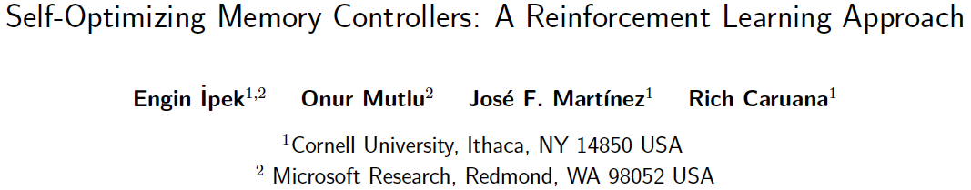
Self-Optimizing Memory Controllers
Engin Ipek, Onur Mutlu, José F. Martínez, and Rich Caruana,
"Self Optimizing Memory Controllers: A Reinforcement Learning Approach"
Proceedings of the 35th International Symposium on Computer Architecture (ISCA), pages 39-50, Beijing, China, June 2008. Selected to the ISCA-50 25-Year Retrospective Issue covering 1996-2020 in 2023 (Retrospective (pdf) Full Issue).

Slide 6
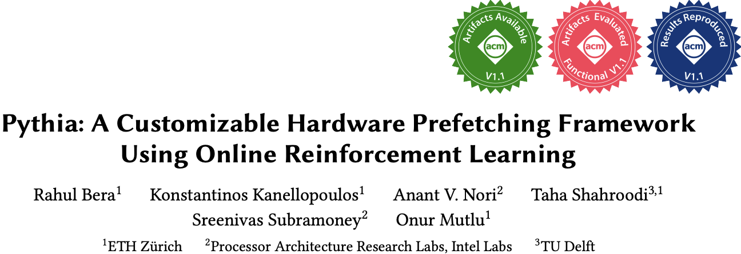
Self-Optimizing Memory Prefetchers
Rahul Bera, Konstantinos Kanellopoulos, Anant Nori, Taha Shahroodi, Sreenivas Subramoney, and Onur Mutlu,
"Pythia: A Customizable Hardware Prefetching Framework Using Online Reinforcement Learning"
Proceedings of the 54th International Symposium on Microarchitecture (MICRO), Virtual, October 2021.
[Slides (pptx) (pdf)]
[Short Talk Slides (pptx) (pdf)]
[Lightning Talk Slides (pptx) (pdf)]
[Talk Video (20 minutes)]
[Lightning Talk Video (1.5 minutes)]
[Pythia Source Code (Officially Artifact Evaluated with All Badges)]
[arXiv version]
Officially artifact evaluated as available, reusable and reproducible.
https://arxiv.org/pdf/2109.12021.pdf

Slide 7

Learning-Based Off-Chip Load Predictors
Rahul Bera, Konstantinos Kanellopoulos, Shankar Balachandran, David Novo, Ataberk Olgun, Mohammad Sadrosadati, and Onur Mutlu,
"Hermes: Accelerating Long-Latency Load Requests via Perceptron-Based Off-Chip Load Prediction"
Proceedings of the 55th International Symposium on Microarchitecture (MICRO), Chicago, IL, USA, October 2022.
[Slides (pptx) (pdf)]
[Longer Lecture Slides (pptx) (pdf)]
[Talk Video (12 minutes)]
[Lecture Video (25 minutes)]
[arXiv version]
[Source Code (Officially Artifact Evaluated with All Badges)]
Officially artifact evaluated as available, reusable and reproducible.
Best paper award at MICRO 2022.
https://arxiv.org/pdf/2209.00188.pdf

Slide 8
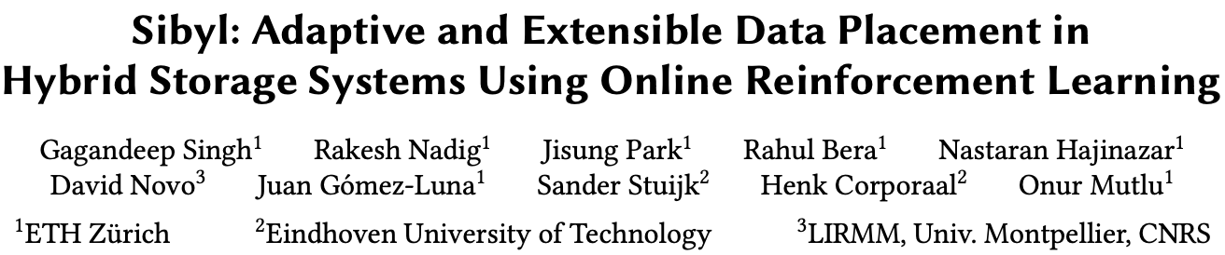
Self-Optimizing Hybrid SSD Controllers
Gagandeep Singh, Rakesh Nadig, Jisung Park, Rahul Bera, Nastaran Hajinazar, David Novo, Juan Gomez-Luna, Sander Stuijk, Henk Corporaal, and Onur Mutlu,
"Sibyl: Adaptive and Extensible Data Placement in Hybrid Storage Systems Using Online Reinforcement Learning"
Proceedings of the 49th International Symposium on Computer Architecture (ISCA), New York, June 2022.
[Slides (pptx) (pdf)]
[arXiv version]
[Sibyl Source Code]
[Talk Video (16 minutes)]
https://arxiv.org/pdf/2205.07394.pdf

Slide 9
Hermes: Perceptron-Based
Off-Chip Load Prediction

Slide 10
Learning-Based Off-Chip Load Predictors
Rahul Bera, Konstantinos Kanellopoulos, Shankar Balachandran, David Novo, Ataberk Olgun, Mohammad Sadrosadati, and Onur Mutlu,
"Hermes: Accelerating Long-Latency Load Requests via Perceptron-Based Off-Chip Load Prediction"
Proceedings of the 55th International Symposium on Microarchitecture (MICRO), Chicago, IL, USA, October 2022.
[Slides (pptx) (pdf)]
[Longer Lecture Slides (pptx) (pdf)]
[Talk Video (12 minutes)]
[Lecture Video (25 minutes)]
[arXiv version]
[Source Code (Officially Artifact Evaluated with All Badges)]
Officially artifact evaluated as available, reusable and reproducible.
Best paper award at MICRO 2022.
https://arxiv.org/pdf/2209.00188.pdf

Slide 11
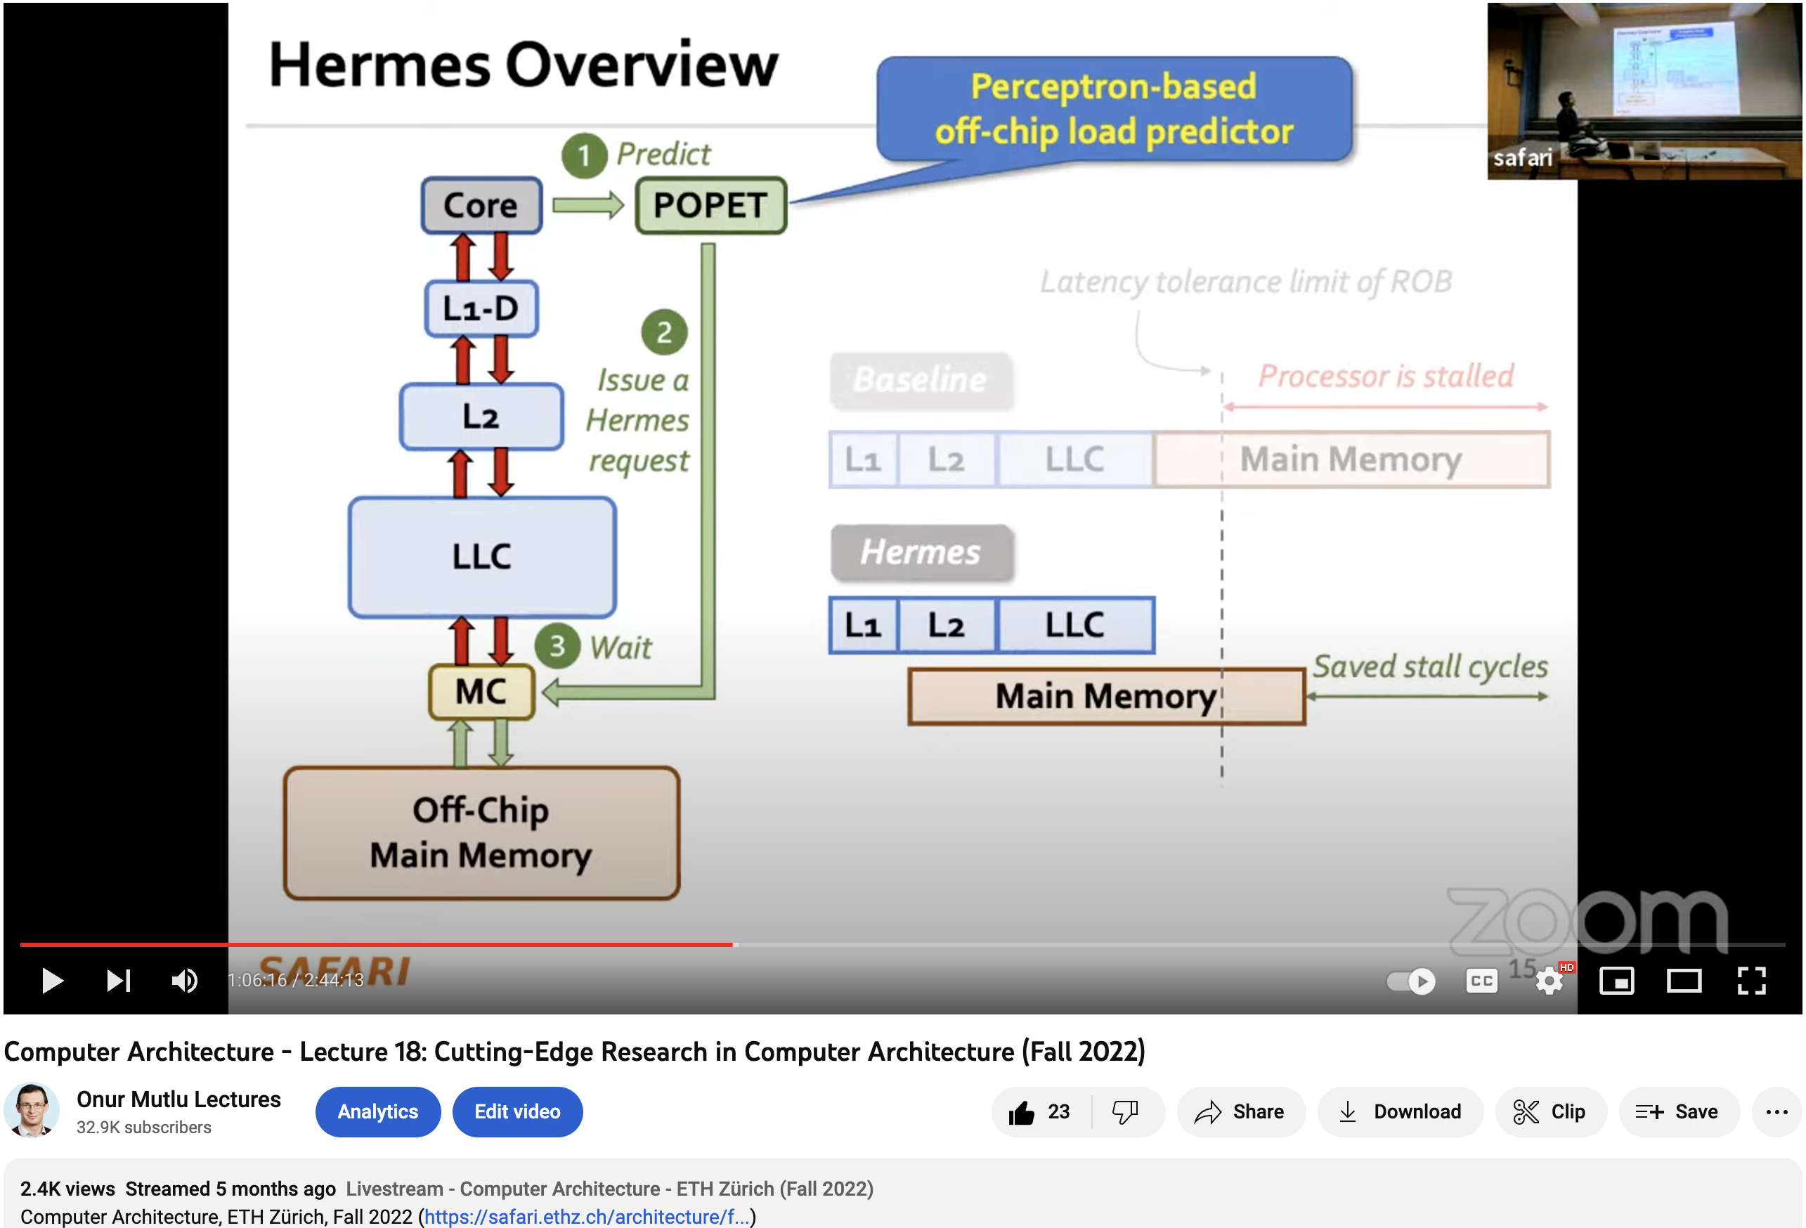
Hermes Talk Video
https://www.youtube.com/watch?v=PWWBtrL60dQ&t=3609s

Slide 12







Accelerating Long-Latency Load Requests
via Perceptron-Based Off-Chip Load Prediction
Rahul Bera, Konstantinos Kanellopoulos, Shankar Balachandran,
David Novo, Ataberk Olgun, Mohammad Sadrosadati, Onur Mutlu
https://github.com/CMU-SAFARI/Hermes
https://arxiv.org/pdf/2209.00188.pdf

Slide 13
The Key Problem
Long-latency off-chip load requests
Often stall processor by
blocking instruction retirement from
Reorder Buffer (ROB)
Limit performance
Notes:
The key problem that we are trying to address in this work is stemming from Off-chip load request
[CLICK] As we know, these off-chip load requests often stall…,
[CLICK] which severely limits the performance of a core.

Slide 14

Traditional Solutions
1
Employ sophisticated prefetchers
2
Increase size of on-chip caches
Notes:
Architects have primarily relied on two key techniques to reduce latency of such loads:
[CLICK] By employing sophisticated data prefetchers
[CLICK] And Increasing size of the on-chip cache hierarchy

Slide 15
Key Observation 1
Many loads still go off-chip
50%
still go off-chip even with
a state-of-the-art prefetcher
50%
successfully prefetched
70% of the off-chip loads
block the ROB
# off-chip loads without any prefetcher
Notes:
In this work, we show that prior prefetchers successfully prefetch a significant fraction of the off-chip load requests.
[CLICK] However, nearly 50% of the off-chip loads in a system without any prefetcher are still going off-chip even in presence of a state-of-the-art prefetcher
[CLICK] And 70% of these off-chip loads even block the ROB.

Slide 16
Key Observation 2
50% still go off-chip
On-chip cache access latency
significantly contributes to off-chip load latency
L1
L2
LLC
Main Memory
L1
L2
LLC
Main Memory
Saved cycles
40% of the stalls can be eliminated by removing
on-chip cache access latency from critical path
Notes:
Now, if we focus on the off-chip loads that are still going to the main memory even in presence of a state-of-the-art prefetcher,
We observe that the on-chip cache access latency…
[CLICK] We show that nearly 40% of …

Slide 17
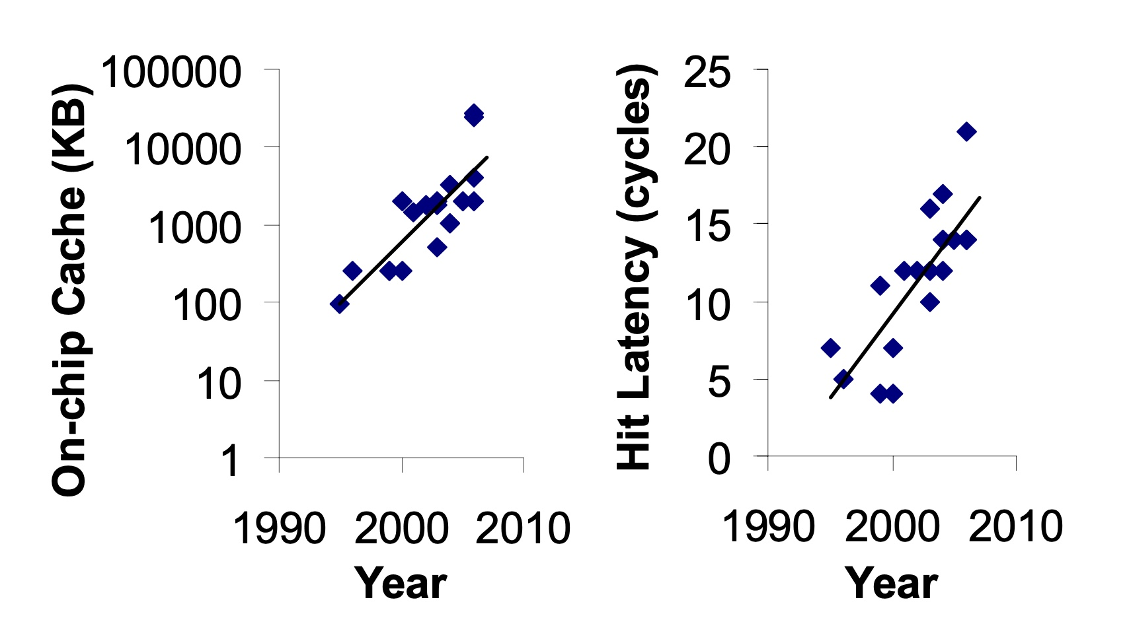
Caches are Getting Bigger and Slower…
On-chip Cache Size (KB)
Hardavellas+, “Database Servers on Chip Multiprocessors: Limitations and Opportunities”, CIDR, 2007
Notes:
As the cache hierarchy continue to grow in size and complexity, as noted by previous works,
As well as a trend that we see in recent processors,
This problem is only going to get exacerbated even more in future generation processors

Slide 18
Our Goal
Improve processor performance
by removing on-chip cache access latency
from the critical path of off-chip loads
Notes:
Thus to alleviate this problem, the goal of our work is to improve…

Slide 19

Predicts which load requests
are likely to go off-chip
Starts fetching data directly from main memory while concurrently accessing the cache hierarchy
Notes:
Towards this we propose Hermes, which is based on two key ideas.
[CLICK] Hermes predicts which…
[CLICK] Hermes starts fetching …

Slide 20




Key Contribution
Hermes employs the first
perceptron-based off-chip load predictor
That predicts which loads are likely to go off-chip
By learning from
multiple program context information
Notes:
To enable accurate off-chip prediction,
Hermes employs the first perceptron-based off-chip load predictor
[CLICK] that identifies loads …
[CLICK] by only learning from multiple…

Slide 21
Hermes Overview
Core
Latency tolerance limit of ROB
L1-D
Baseline
Processor is stalled
L2
L1
L2
LLC
Main Memory
LLC
MC
Off-Chip
Main Memory
Notes:
Now let me give you a brief overview of Hermes.
This is how a traditional cache hierarchy looks like in today’s processor.
[CLICK] And this is how the memory latency timeline looks like for an off-chip load in the baseline system
[CLICK] If the ROB has a latency tolerance limit up till here, the processor stalls for the remaining cycles

Slide 22




Hermes Overview
Perceptron-based
off-chip load predictor
Predict
Core
POPET
Train
Latency tolerance limit of ROB
L1-D
Issue a Hermes request
Baseline
Processor is stalled
L2
L1
L2
LLC
Main Memory
LLC
Hermes
L1
L2
LLC
Wait
Saved stall cycles
MC
Main Memory
Off-Chip
Main Memory
Notes:
Now Hermes employs an off-chip predictor named POPET.
[CLICK] For every load generated in the core, Hermes consults POPET to predict whether this load would go off-chip or not
[CLICK] If the load is predicted to go off-chip, Hermes waits for the address translation to finish, which happens in parallel with L1 cache access
[CLICK] And then issues a speculative memory request, which we call a Hermes request,
directly to the main memory controller to start fetching the data from the main memory,
While also concurrently accessing the cache hierarchy for such a load.
[CLICK] If the off-chip prediction is correct, the load would eventually miss the LLC and arrive at the memory controller
Where it will simply wait for the ongoing Hermes request to finish, thus hiding the entire cache access latency from its critical path.
Once the data returns from the main memory, Hermes returns the data to the core [CLICK],
Thus, saving the precious stall cycles induced by the off-chip load [CLICK], which in turn provides performance benefit.
[CLICK] Hermes trains POPET when the data finally returns to the core, closing the feedback loop.

Slide 23

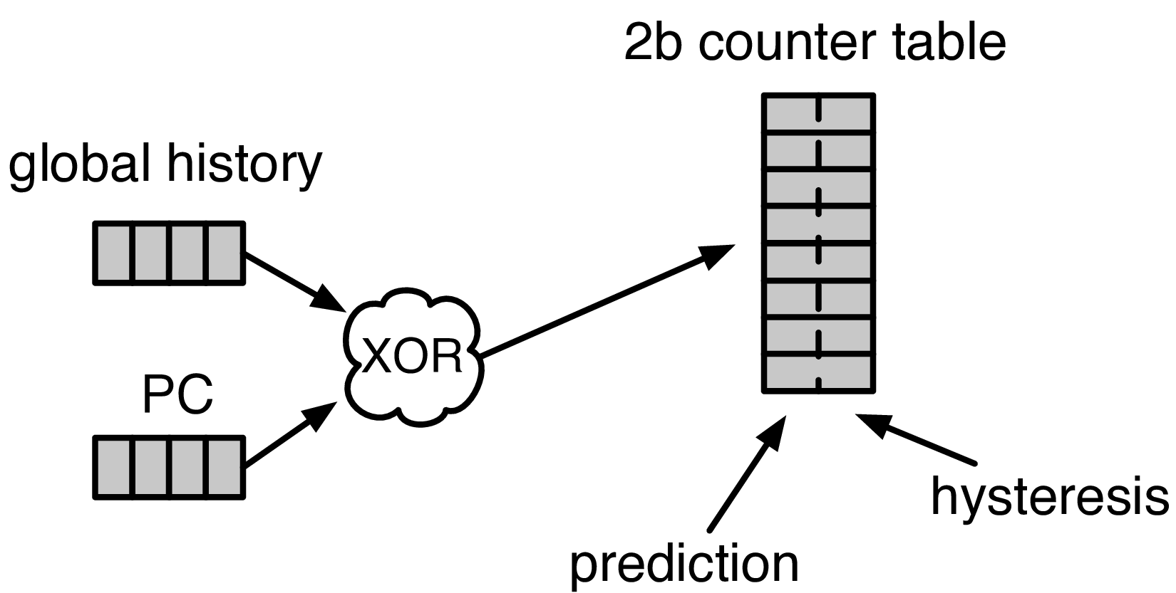


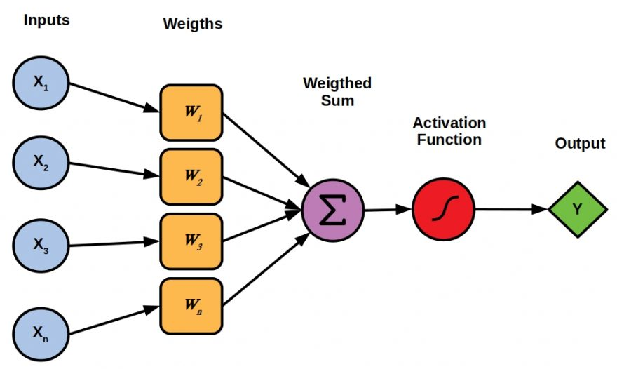

Designing the Off-Chip Load Predictor
History-based prediction
HMP [Yoaz+, ISCA’99] for the L1-D cache
Using branch-predictor-like hybrid predictor:
Global, Gshare, and GSkew
POPET provides
both higher accuracy and higher performance
than predictors inspired from these previous works
Tracking cache contents
MissMap [Loh+, MICRO’11] for the DRAM cache,
D2D [Sembrant+, ISCA’14], D2M [Sembrant+, HPCA’17], LP [Jalili+, HPCA’22] for the cache hierarchy
  Large metadata
  Metadata size increases with cache hierarchy size
  May need to track all cache operations
  Gets complex depending on the cache hierarchy configuration (e.g., inclusivity, bypassing,…)
Learning from program behavior
  Correlate different program features with off-chip loads
Low storage overhead
Low design complexity
Notes:
Now let’s discuss how to design this off-chip predictor.
So, there are multiple prior works that can be used either directly or with small modifications for off-chip load prediction.
These works can be broadly categorized into two classes.
[CLICK] History-based predictor introduced by HMP, uses a branch-predictor like hybrid predictor design
to identify which requests are going to miss L1 cache.
We can easily extend HMP’s design to predict loads that are going to miss the entire cache hierarchy.
[CLICK] Tracking-based methods, on the other hand, explicitly track cache contents
to predict which load requests are going to miss the cache hierarchy.
[CLICK] These tracking-based methods poses two key challenges…
[CLICK] First,…
[CLICK] Second,…
[CLICK] POPET takes a completely different approach to predict off-chip load requests by learning from program behavior.
[CLICK] It aims to correlate multiple different types of program features with off-chip load requests
to provide accurate predictions with much lower storage overhead and design complexity.
[CLICK] In our paper, we compare POPET against predictors inspired from these prior works and show that
[CLICK] POPET provides both higher accuracy and performance than them.

Slide 24

POPET: Perceptron-Based Off-Chip Predictor
Multi-feature hashed perceptron model^{[1]}
  Each feature has its own weight table
    Stores correlation between feature value and off-chip prediction
[1] D. Tarjan and K. Skadron, “Merging Path and Gshare Indexing in Perceptron Branch Prediction,” TACO, 2005
Notes:
Now let’s deep dive into our off-chip predictor design.
Our predictor, named as POPET, is designed using hashed-perceptron model.
[CLICK] where each feature has its own weight table
That stores the correlation between feature value and the off-chip prediction

Slide 25

Predicting using POPET
Uses simple table lookups, addition, and comparison
42
-4
0x7ffe0+12
3
3 >= -2
Predict that the load would go off-chip
Extract features from the load request
12
-5
Notes:
Hermes predicts using POPET using simple operations like table lookup, addition, and comparison.
Let me give you an example on how POPET’s prediction works.
POPET’s prediction works in three stages.
[CLICK] In the first stage, POPET extracts the features from the load request
[CLICK] In the second stage, each feature value is hashed and used as an index to retrieve the weights from each individual weight tables
[CLICK] In the third stage, the retrieved weights are accumulated and the cumulative weight is used to compute the activation function.
[CLICK] If the cumulative weight is higher than the activation threshold, POPET predicts that the load would go off-chip.

Slide 26
Training POPET
Uses simple increment or decrement of feature weights
42
-1
-4
0x7ffe0+12
3
3 >= -2
Predict that the load would go off-chip
-1
12
Shouldn’t be activated
-5
Cumulative weight < 𝜏_{act}
-1
Notes:
Now let’s understand how to train POPET.
For this let’s assume the previous example where the load is predicted to go off-chip.
[CLICK] But in reality, the load didn’t go off-chip
[CLICK] this means the activation which have triggered before, shouldn’t have triggered
Which means, the cumulative weight should be lower than the activation threshold
[CLICK] Now to adjust the feature weights, POPET again indexes each weight table using the hashed feature values
[CLICK] And simply decrement each weight from the individual weight tables.
Thus, by using simple increment and decrement operations, POPET continuously learns from program behavior to accurately predict off-chip loads.

Slide 27
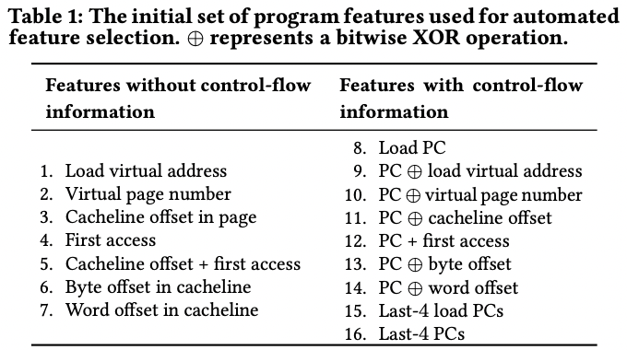
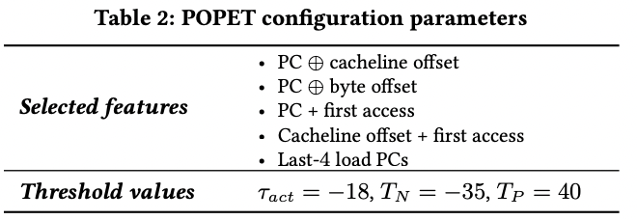
Features Used in Hermes

Slide 28
Evaluation
Notes:
Now let’s evaluate Hermes.

Slide 29
Simulation Methodology
ChampSim trace driven simulator
110 single-core memory-intensive traces
  SPEC CPU 2006 and 2017
  PARSEC 2.1
  Ligra
  Real-world applications
220 eight-core memory-intensive trace mixes
LLC Prefetchers
Off-Chip Predictors
Pythia [Bera+, MICRO’21]
Bingo [Bakshalipour+, HPCA’19]
MLOP [Shakerinava+, 3rd Prefetching Championship’19]
SPP + Perceptron filter [Bhatia+, ISCA’20]
SMS [Somogyi+, ISCA’06]
History-based: HMP [Yoaz+, ISCA’99]
Tracking-based: Address Tag-Tracking based Predictor (TTP)
Ideal Off-chip Predictor
Notes:
We evaluate Hermes using ChampSim simulator,
[CLICK] using a wide range of memory-intensive traces spanning across SPEC CPU, PARSEC, Ligra, and real-world applications
[CLICK] We compare Hermes with five LLC prefetchers
[CLICK] and two off-chip predictors extended from prior works

Slide 30

Latency Configuration
Cache round-trip latency
  L1-D: 5 cycles
  L2: 15 cycles
  LLC: 55 cycles
Hermes request issue latency (incurred after address translation)
Depends on
  Interconnect between POPET and MC
0 cycles
24 cycles
6 cycles
Notes:
For our evaluation, we consider
[CLICK] a 5 cycle L1-D
[CLICK] 15 cycle L2
[CLICK] and 55 cycle LLC round-trip latency.
[CLICK] The latency for Hermes to issue a request directly to the main memory controller (after the address translation) depends on …
[CLICK] For this reason we sweep this latency from 0-cycles to 24-cycles in our paper.
[CLICK] But in this presentation, I am going to show you results considering a 6-cycle latency.

Slide 31
Single-Core Performance Improvement
5.4%
20.3%
11.5%
Hermes alone provides nearly
50% performance benefits of Pythia
with only 1/5th storage overhead
Hermes provides nearly 90% performance benefit of Ideal Hermes that has an ideal off-chip load predictor
Hermes on top of Pythia
outperforms Pythia alone in every workload category
Notes:
Let’s first analyze the single-core performance improvement.
[CLICK] This is how Hermes and a state-of-the-art prefetcher Pythia improves performance on top of a no-prefetching system.
[CLICK] The first takeaway is that Hermes alone provides nearly 50%...
[CLICK] Now if we combine Hermes with Pythia, that provides an additional 5.4% performance improvement on top of a strong baseline that has Pythia.
[CLICK] And finally, if we compare Hermes’s performance benefit with the Ideal Hermes that has an ideal off-chip predictor,
We see that Hermes provides nearly 90% performance benefit of the Ideal Hermes

Slide 32
Increase in Main Memory Requests
20.3%
5.4%
11.5%
For every 1% performance benefit,
increase in main memory requests
Pythia
2%
5.9%
Hermes on top of Pythia
1%
38.5%
Hermes alone
0.5%
5.5%
Hermes is more bandwidth-efficient
than even an efficient prefetcher like Pythia
Notes:
This performance improvement comes at a cost of increase in main memory requests.
This graph shows the increase in the main memory request over the no-prefetching system provided by the three configurations.
[CLICK] As we can see, Hermes increases the main memory requests by 5.5% on average on top of the no-prefetching system..
Whereas Pythia increases …
If we combine two together, then it increases the main memory request by an additional 5.9%.
[CLICK] Now, if we compare this increase in the main memory request with the performance improvement each of these configurations are providing,
We see that
[CLICK] For every 1% performance benefit, Pythia …
[CLICK] This basically shows that Hermes is much more bandwidth efficient than a traditional data prefetcher like Pythia.
And for this reason [NEXT]

Slide 33
Performance with Varying Memory Bandwidth
Pythia+Hermes
Pythia
Hermes
Baseline
~Intel Xeon 6258R
(Cascade Lake, 28C/6ch, 2020)
~AMD EPYC Rome 7702P (Zen 2, 64C/8ch, 2019)
~AMD Threadripper 3990x (Zen 2, 64C/4ch, 2020)
In bandwidth-constrained configurations,
Hermes alone outperforms Pythia
Hermes+Pythia outperforms Pythia
across all bandwidth configurations
Notes:
If we evaluate Pythia and Hermes over a wide range of memory bandwidth configurations, we see that,
[CLICK] In these extremely-bandwidth constrained configurations, which are in fact roughly modeling per-core main memory bandwidth of commercial processors,
Hermes even outperforms Pythia.
[CLICK] And if we combine both of them, the combination of Hermes and Pythia outperforms Pythia in every bandwidth configurations.

Slide 34
Performance with Varying Baseline Prefetcher
5.4%
6.2%
7.6%
5.1%
Hermes consistently improves performance
on top of a wide range of baseline prefetchers
7.7%
Notes:
And these observations are not only true for Pythia.
We evaluate Hermes combined with multiple prior baseline state-of-the-art prefetchers and find that
Hermes consistently improves performance on top of a wide range of baseline prefetchers.

Slide 35

Overhead of Hermes
4 KB storage overhead
1.5% power overhead*
*On top of an Intel Alder Lake-like performance-core ^{[2]} configuration
[2] https://www.anandtech.com/show/16881/a-deep-dive-into-intels-alder-lake-microarchitectures/3
Notes:
All of these performance benefit comes at a
[CLICK] modest 4KB storage overhead per core and
[CLICK] 1.5% power overhead on top an Intel Alder Lake-like performance-core configuration

Slide 36
More in the Paper
Performance sensitivity to:
  Cache hierarchy access latency
  Hermes request issue latency
  Activation threshold
  ROB size (in extended version on arXiv)
  LLC size (in extended version on arXiv)
Accuracy, coverage, and performance analysis against HMP and TTP
Understanding usefulness of each program feature
Effect on stall cycle reduction
Performance analysis on an eight-core system
Notes:
We have many more evaluation results:
For example, a wide range of performance sensitivity study by varying…in the paper.

Slide 37
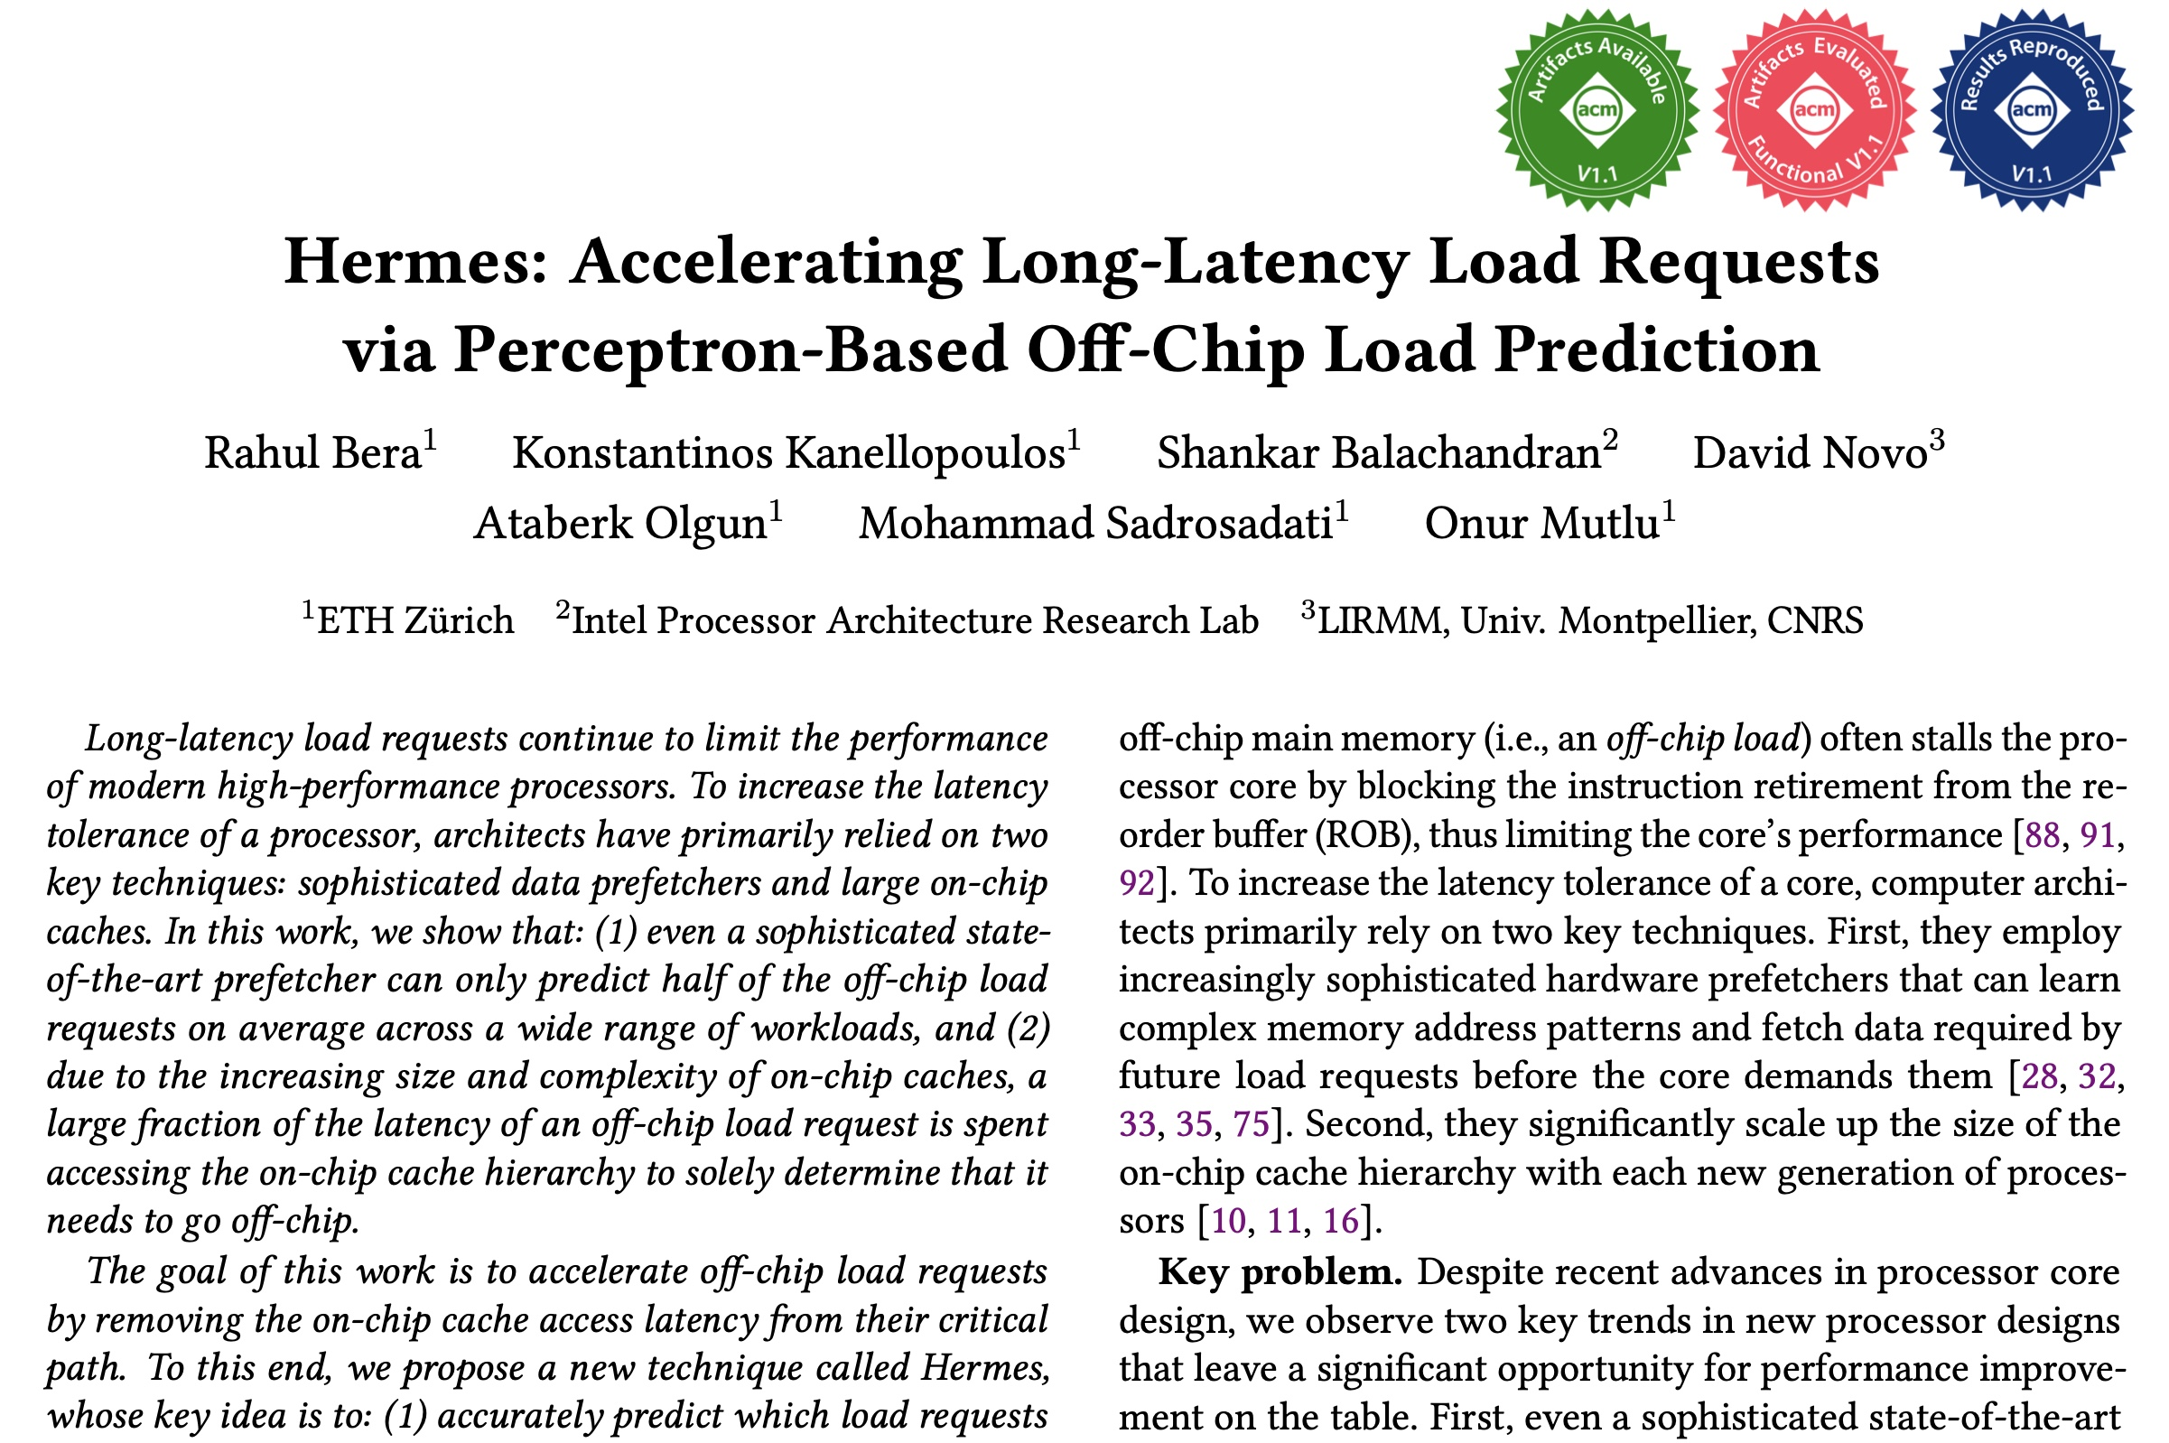
More in the Paper
Performance sensitivity to:
  Cache hierarchy access latency
  Hermes request issue latency
  Activation threshold
  ROB size (in extended version at arXiv)
  LLC size (in extended version at arXiv)
Accuracy, coverage, and performance analysis against HMP and TTP
Understanding usefulness of each program feature
Effect on stall cycle reduction
Performance analysis in eight-core system
https://arxiv.org/pdf/2209.00188.pdf
Notes:
We have many more evaluation results:
For example, a wide range of performance sensitivity study by varying…in the paper.

Slide 38
To Summarize…
Notes:
Thus to summarize…

Slide 39
Summary
Hermes advocates for off-chip load prediction,
a different form of speculation than
load address prediction employed by prefetchers
Off-chip load prediction can be applied by itself
or combined with load address prediction
to provide performance improvement
Notes:
Hermes advocates …
[CLICK] We show that off-chip load prediction…

Slide 40





Summary
Hermes employs the first
perceptron-based off-chip load predictor
High accuracy
(77%)
High coverage
(74%)
Low storage overhead
(4KB/core)
High performance improvement over best prior baseline
(5.4%)
High performance
per bandwidth

Slide 41
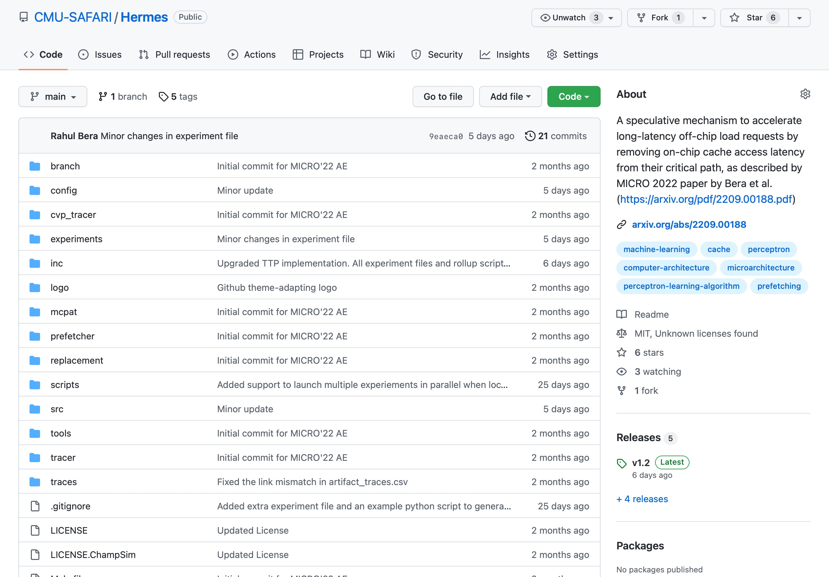
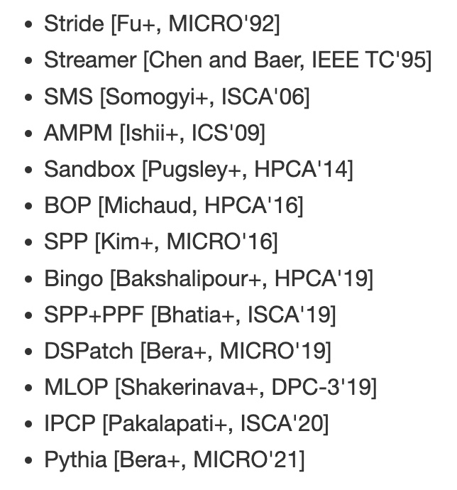
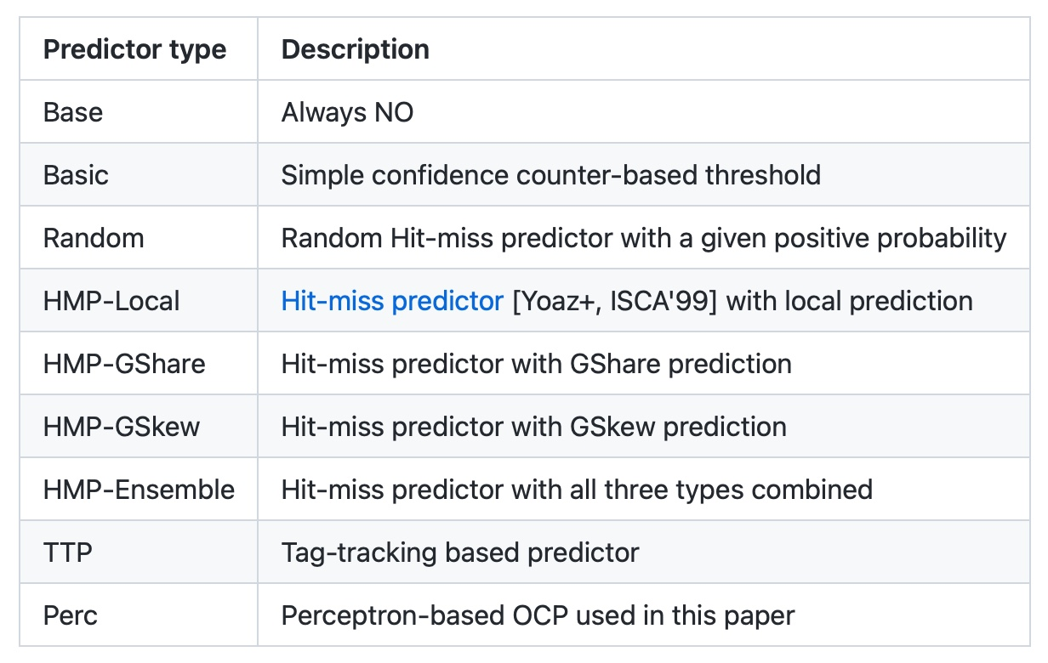
Hermes is Open Sourced
All workload traces
13 prefetchers
9 off-chip predictors
https://github.com/CMU-SAFARI/Hermes
Notes:
That’s why we open-source our artifact.
It can be freely downloaded from our GitHub repository.
In this artifact, [CLICK] you will get all the workload traces we have used to evaluate Hermes,
[CLICK] 13 types of data prefetchers proposed in the past and
[CLICK] 9 types of off-chip predictors out of the box

Slide 42
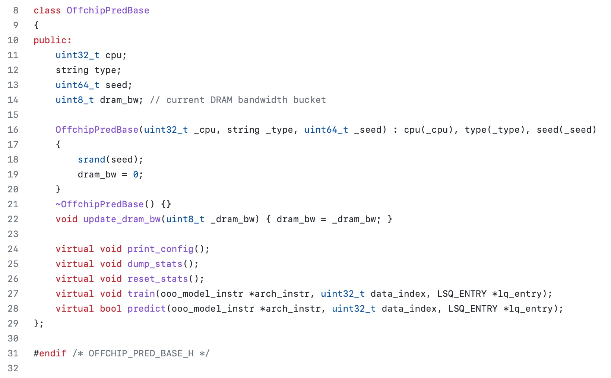
Easy To Define Your Own Off-Chip Predictor
Just extend the OffchipPredBase class
Notes:
But if you want to impalement your own off-chip predictor, that’s also very easy.
All you have to do is to extend the OffchipPred base class…

Slide 43
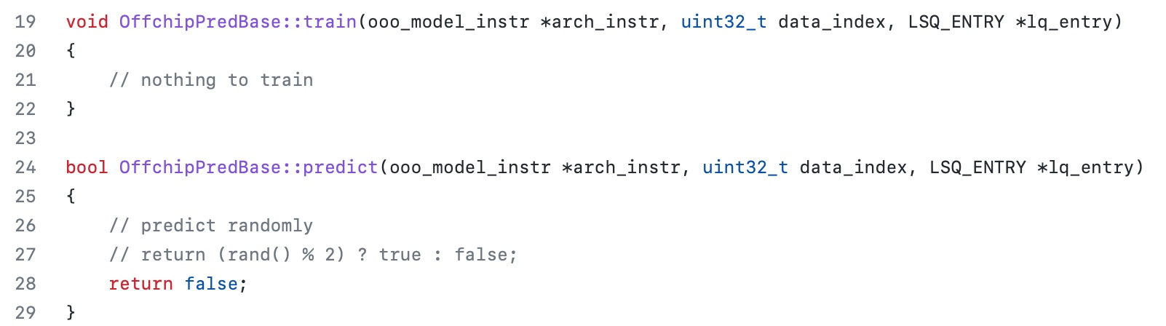
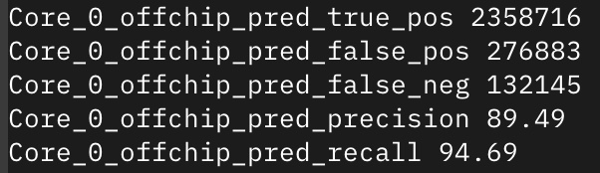
Easy To Define Your Own Off-Chip Predictor
Define your own train() and predict() functions
Get statistics like accuracy (stat name precision) and coverage (stat name recall) out of the box
Notes:
And define your own train() and predict() functions
[CLICK] the infrastructure will automatically provide statistics like precision and recall out of the box

Slide 44
Off-Chip Prediction Can Further Enable…
Prioritizing loads that are likely go off-chip
in cache queues and on-chip network routing
Better instruction scheduling
of data-dependent instructions
Other ideas to improve performance and fairness in multi-core system design...
Notes:
We hope that high-accuracy off-chip prediction can further enable a multitude of optimization possibilities, for example:
[CLICK] prioritizing loads … to improve performance and fairness in extreme core processors
[CLICK] better instruction scheduling for data dependent loads
[CLICK] and many more…

Slide 45
Accelerating Long-Latency Load Requests
via Perceptron-Based Off-Chip Load Prediction
Rahul Bera, Konstantinos Kanellopoulos, Shankar Balachandran,
David Novo, Ataberk Olgun, Mohammad Sadrosadati, Onur Mutlu
https://github.com/CMU-SAFARI/Hermes
https://arxiv.org/pdf/2209.00188.pdf
Notes:
With that hope, I will conclude my talk.
I will be very happy to take any question from the audience.

Slide 46
Hermes Discussion
FAQs
  What are the selected set of program features?
  Can you provide some intuition on why these features work?
  What happens in case of a misprediction?
  What’s the performance headroom for off-chip prediction?
  Do you see a variance of different features in final prediction accuracy?
Simulation Methodology
  System parameters
  Evaluated workloads
More Results
  Percentage of off-chip requests
  Reduction in stall cycles by reducing the critical path
  Fraction of off-chip load requests
  Accuracy and coverage of POPET
  Effect of different features
  Are all features required?
  1C performance
  1C performance line graph
  1C performance against prior predictors
  Effect on stall cycles
  8C performance
  Sensitivity:
    Hermes request issue latency
    Cache hierarchy access latency
    Activation threshold
    ROB size
    LLC size
  Power overhead
  Accuracy without prefetcher
  Main memory request overhead with different prefetchers

Slide 47
Hermes Paper [MICRO 2022]
Rahul Bera, Konstantinos Kanellopoulos, Shankar Balachandran, David Novo, Ataberk Olgun, Mohammad Sadrosadati, and Onur Mutlu,
"Hermes: Accelerating Long-Latency Load Requests via Perceptron-Based Off-Chip Load Prediction"
Proceedings of the 55th International Symposium on Microarchitecture (MICRO), Chicago, IL, USA, October 2022.
[Slides (pptx) (pdf)]
[Longer Lecture Slides (pptx) (pdf)]
[Talk Video (12 minutes)]
[Lecture Video (25 minutes)]
[arXiv version]
[Source Code (Officially Artifact Evaluated with All Badges)]
Officially artifact evaluated as available, reusable and reproducible.
Best paper award at MICRO 2022.
https://arxiv.org/pdf/2209.00188.pdf

Slide 48
Sibyl: Reinforcement Learning based
Data Placement in Hybrid SSDs

Slide 49
Self-Optimizing Hybrid SSD Controllers
Gagandeep Singh, Rakesh Nadig, Jisung Park, Rahul Bera, Nastaran Hajinazar, David Novo, Juan Gomez-Luna, Sander Stuijk, Henk Corporaal, and Onur Mutlu,
"Sibyl: Adaptive and Extensible Data Placement in Hybrid Storage Systems Using Online Reinforcement Learning"
Proceedings of the 49th International Symposium on Computer Architecture (ISCA), New York, June 2022.
[Slides (pptx) (pdf)]
[arXiv version]
[Sibyl Source Code]
[Talk Video (16 minutes)]
https://arxiv.org/pdf/2205.07394.pdf

Slide 50

Sibyl
Adaptive and Extensible Data Placement in Hybrid Storage Systems
Using Online Reinforcement Learning
Gagandeep Singh, Rakesh Nadig, Jisung Park,
Rahul Bera, Nastaran Hajinazar, David Novo,
Juan Gómez Luna, Sander Stuijk, Henk Corporaal,
Onur Mutlu
50
Notes:
Hi First of all. Thank you very much for staying until this long.
I’m going to present our work “…”

Slide 51
Executive Summary
Background: A hybrid storage system (HSS) uses multiple different storage devices to provide high and scalable storage capacity at high performance
Problem: Two key shortcomings of prior data placement policies:
  Lack of adaptivity to:
    Workload changes
    Changes in device types and configurations
  Lack of extensibility to more devices
Goal: Design a data placement technique that provides:
  Adaptivity, by continuously learning and adapting to the application and underlying device characteristics
  Easy extensibility to incorporate a wide range of hybrid storage configurations
Contribution: Sibyl, the first reinforcement learning-based data placement technique in hybrid storage systems that:
  Provides adaptivity to changing workload demands and underlying device characteristics
  Can easily extend to any number of storage devices
  Provides ease of design and implementation that requires only a small computation overhead
Key Results: Evaluate on real systems using a wide range of workloads
  Sibyl improves performance by 21.6% compared to the best previous data placement technique in dual-HSS configuration
  In a tri-HSS configuration, Sibyl outperforms the state-of-the-art-policy policy by 48.2%
  Sibyl achieves 80% of the performance of an oracle policy with storage overhead of only 124.4 KiB
https://github.com/CMU-SAFARI/Sibyl
Notes:
First, I am going to start with an executive summary.
[CLICK] Hybrid storage systems use multiple different storage devices to provide high and scalable storage capacity at high performance
[CLICK] We observe two key shortcomings in prior data placement techniques:
First, lack of adaptivity to workload changes and changes in device types and configurations
Second, they also lack extensibility to to more devices.
[CLICK] Our goal in this work is to design a data placement technique that provides
Adaptivity, by continuously learning and adapting to the application and underlying device characteristics
Easy extensibility to incorporate a wide range of hybrid storage configurations
[CLICK] to this end we propose Sibyl, an online reinforcement learning-based data placement in Hybrid storage systems that:
Provides both adaptivity
and easy extensiblity
and also Provides ease of design and implementation that requires only a small computation overhead
[CLICK] We extensively evaluate Sibyl on real systems using a wide range of workloads
We show that Sibyl outperforms prior state-of-the-art data placement policeis by 21.6% in dual-hybrid storage system and upto 48.2% on trihybrid system
Sibyl achieves 80% of the performance of an oracle policy that has a complete knowledge of future access patterns while incurring a very modest storage overhead of only 124.4 KiB
The code will be opensourced on our GitHub repository.
https://github.com/CMU-SAFARI/Sibyl

Slide 52
Talk Outline
Key Shortcomings of Prior Data Placement Techniques
Formulating Data Placement as Reinforcement Learning
Sibyl: Overview
Evaluation of Sibyl and Key Results
Conclusion
Notes:
This is the outline of my talk.
First, I am going to start by discussing key shortcomings of prior data placement techniques.

Slide 53
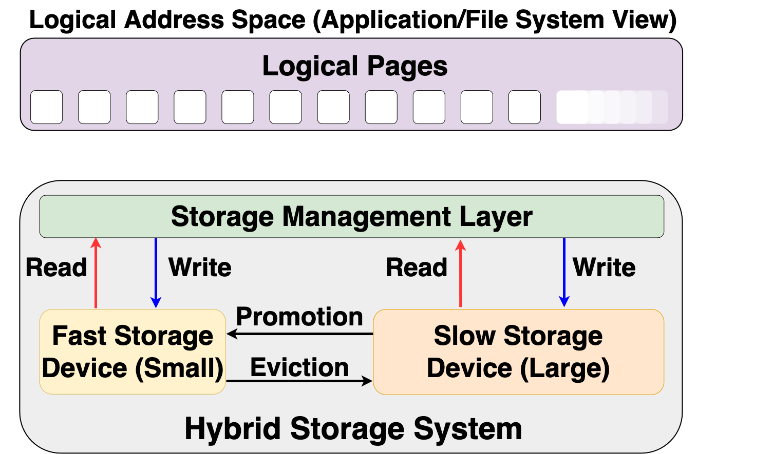
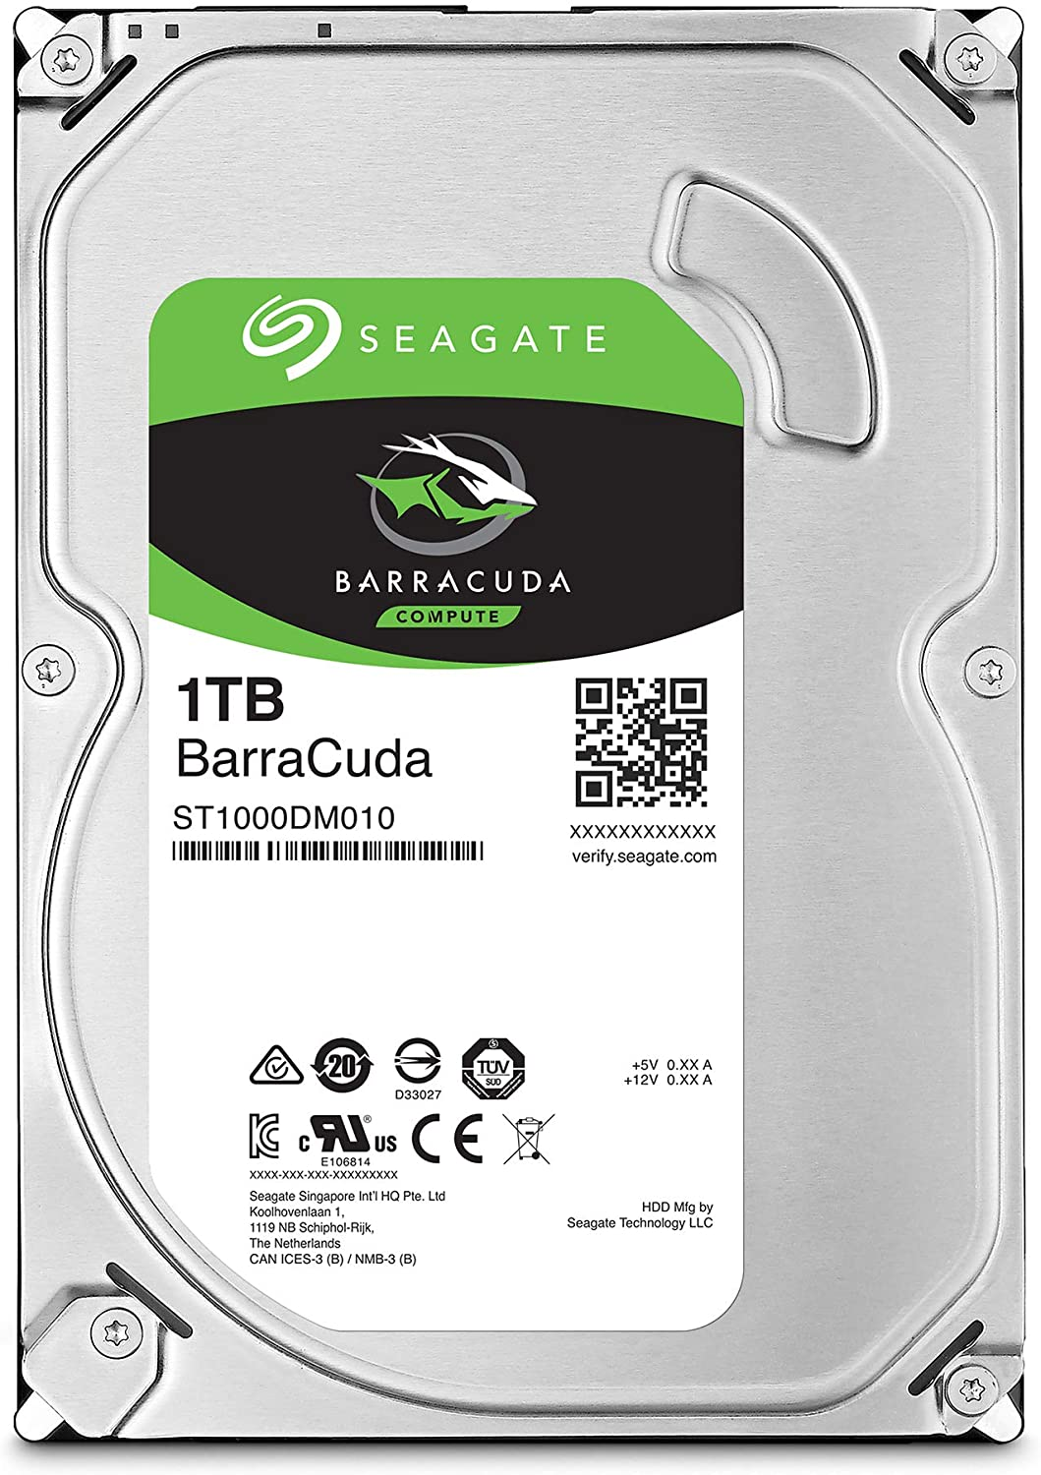

Hybrid Storage System Basics
Address Space (Application/File System View)
Read
Write
Storage Management Layer
Read
Write
Read
Write
Promotion
Eviction
Fast Device
Slow Device
Hybrid Storage System
Notes:
Let's look at some basics on hybrid storage systems. [CLICK] OVER here we show a typical HSS consisting of a fast-yet-small storage device and a slow-yet-large storage device
[CLICK]The address space is divided into a number of logical pages (e.g. 4kib), which are assigned to an application.
[CLICK] The storage management layer in the OS orchestrates host I/O requests across heterogeneous devices,
[CLICK] the storage management layer also manages data migration between the storage devices in an Hybrid storage systems . Eviction usually moves infrequently access data fom the fast storage to the slow storage or when the fast storage device is full.
When data currently stored in the slow storage device is moved to the fast storage device, it is called promotion. Promotion is usually performed when a page in the slow storage device is accessed frequently.
[CLICK] A desirable policy has to effectively utilize the low latency characteristics of the fast device while making optimal use of its small capacity and should provide easy extensibility to a wide range of workloads and Hybrid storage systems configurations

Slide 54
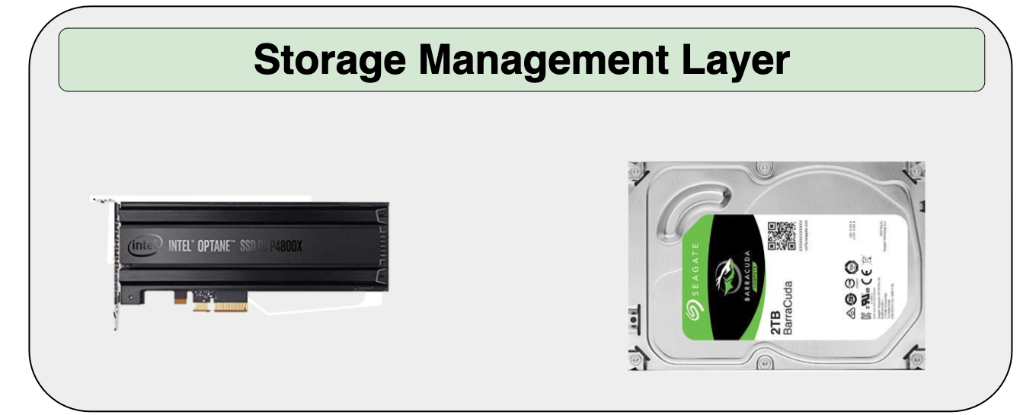
Hybrid Storage System Basics
Read
Write
Performance of a hybrid storage system
highly depends on the ability of the
storage management layer
Read
Write
Read
Write
Promotion
Eviction
Hybrid Storage System
Notes:
[CLICK] Therefore the performance of a hybrid storage system highly depends on the ability of the storage management layer to effectively manage diverse deviaces and workloads

Slide 55
Key Shortcomings in Prior Techniques
We observe two key shortcomings that significantly limit the performance benefits of prior techniques
Lack of adaptivity to:
  Workload changes
  Changes in device types and configuration
Lack of extensibility to more devices
Notes:
We observe two key shortcomings in prior data placement techniques that significantly limits their performance improvement
[CLICK] First, lack of adaptivity to both workload changes and
CLICK] changes in device types and configurations
[CLICK] Second, Lack of extensibility: to more devices
Let’s take a closer look at each of these shortcomings.
[NEXT]

Slide 56
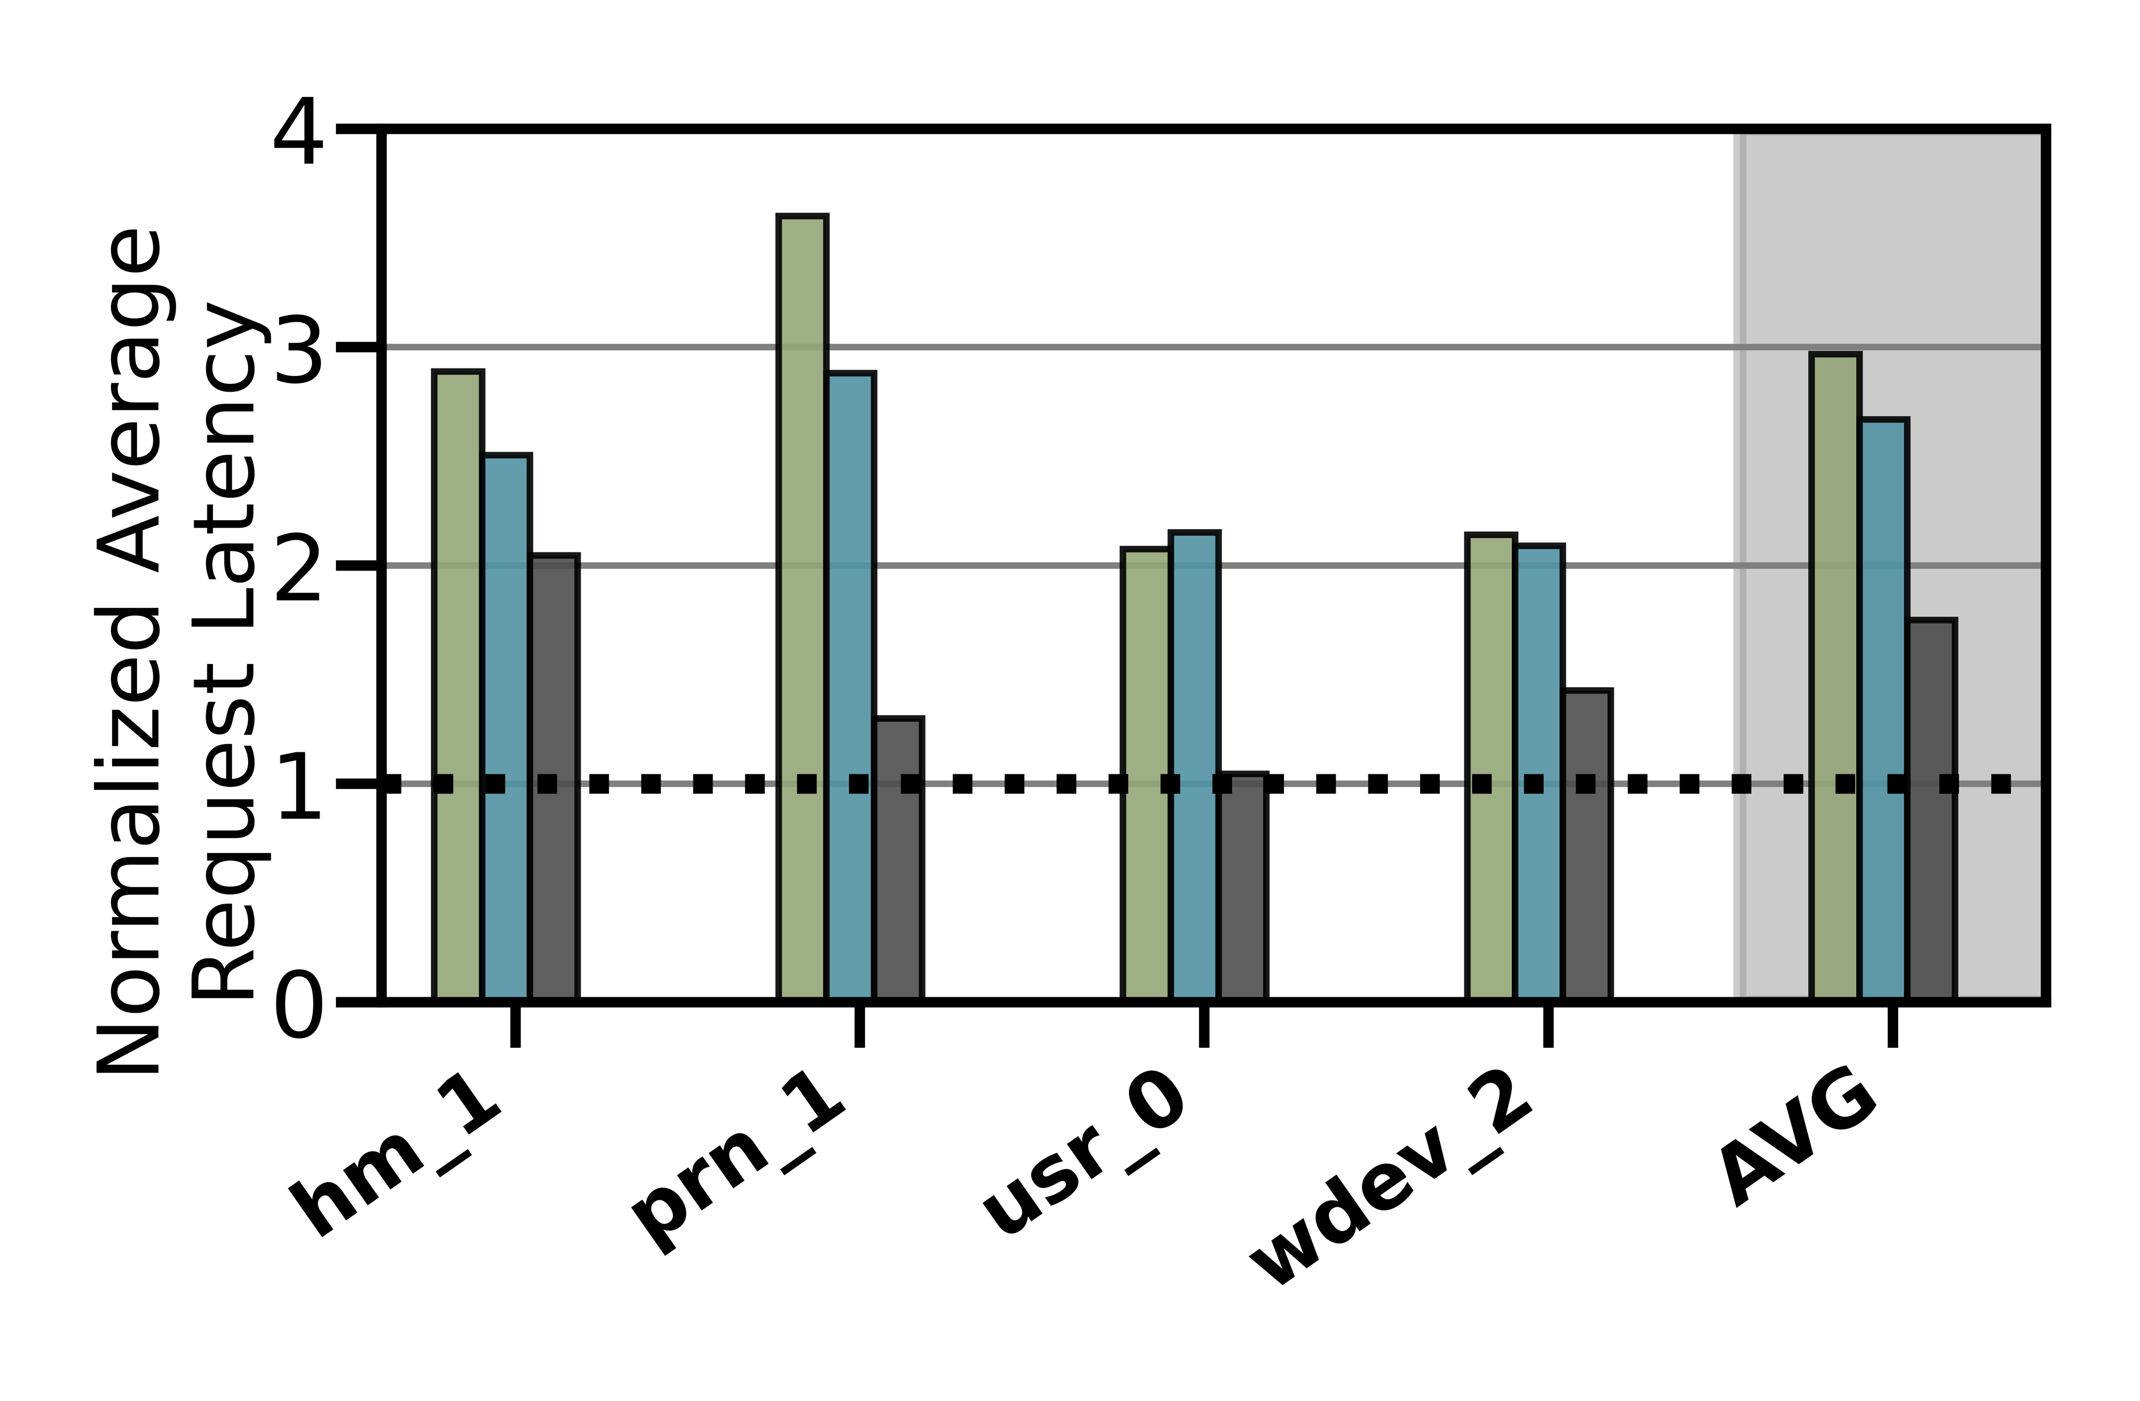
Lack of Adaptivity (1/2)
Workload Changes
Prior data placement techniques consider only a few workload characteristics that are statically tuned
CDE
RNN-HSS
Oracle
41.1%
Notes:
The lower the request latency the better
We observe that all baselines provide reasonable performance under specific workloads [CLICK] while for other they show way lower performance than oracle. [CLICK]
[CLICK] on avg we observe a performance loss for some policies by 41.1% compared to oracle
We conclude, considering only a limited number of workload characteristics leads to
a significant performance gap

Slide 57
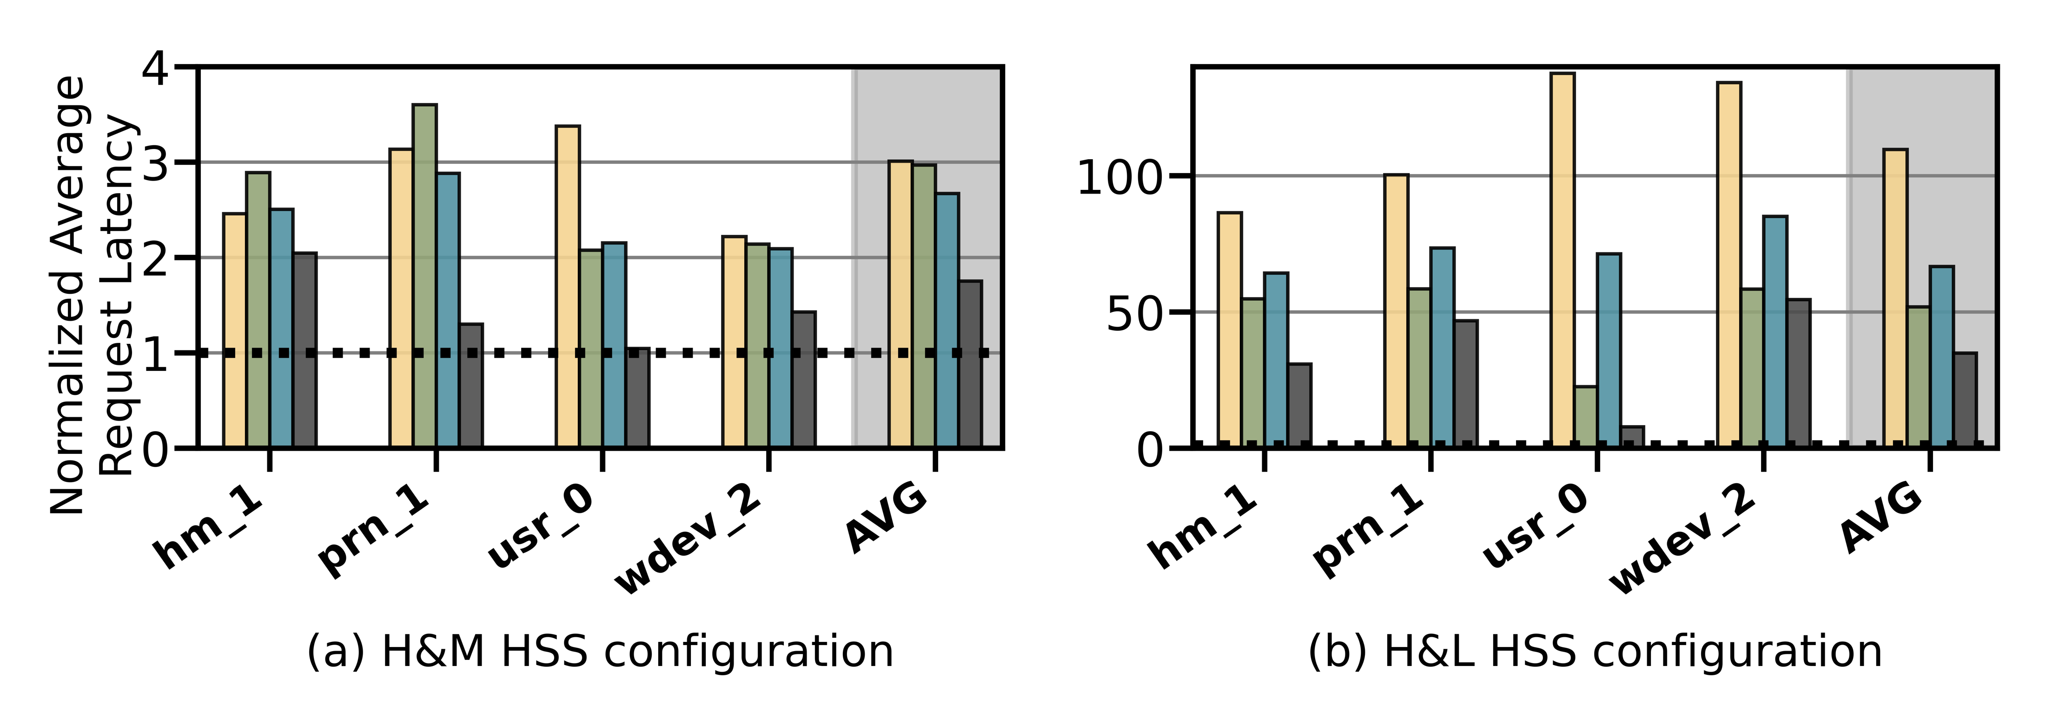
Lack of Adaptivity (2/2)
Changes in Device Types and Configurations
Do not consider underlying storage device characteristics (e.g., changes in the level asymmetry in read/write latencies, garbage collection)
Slow-Only
CDE
RNN-HSS
Oracle
Slow-Only
CDE
RNN-HSS
Oracle
HSS Configuration 1
HSS Configuration 2
Notes:
We obseve that performance of some workloads is even worse than slow-only policy that places everything in the slow storage [CLICK] while in another hybrid storage configuration these workloads perform better than slow only[CLICK] [CLICK]
Therefore, we conclude that the high diversity in device characteristics makes it very difficult for a system architect to design a generic data-placement technique that is suitable for all Hybrid storage systems configurations

Slide 58


Lack of Extensibility (1/2)
Rigid techniques that require significant effort to accommodate more than two devices
Change in storage configuration
Dual-HSS
Notes:
The second key shortcoming is that, most of the prior techniques are
[CLICK] rigid that require significant effort to accommodate more than two devices
if we extend from dual hybrid stroage configuration from dual hyrbid to a tri-hybrid configuration

Slide 59

Lack of Extensibility (2/2)
Rigid techniques that require significant effort to accommodate more than two devices
Change in storage configuration
Design a new policy
Tri-HSS
Notes:
[click] design a new data policy to exploit the new device to eviction and promotino from the new storage and update heuristic values as wel. [CLICK]
Therefore system architects need to put significant effort into extending prior data placement techniques to accommodate more than two devices [CLICK] This wastes precious design time and human resource.

Slide 60
Our Goal
A data-placement mechanism
that can provide:
Adaptivity, by continuously learning and adapting to the application and underlying device characteristics
Easy extensibility to incorporate a wide range of hybrid storage configurations
Notes:
So our goal in this work is to design a data-placement mechanism that can provide
[CLICK]
Adaptivity, by continuously learning and adapting to the application and underlying device characteristics
[CLICK]
Easy extensibility to incorporate a wide range of hybrid storage configurations.

Slide 61

Our Proposal
Sibyl
Formulates data placement in hybrid storage systems as a reinforcement learning problem
Sibyl is an oracle that makes accurate prophecies
https://en.wikipedia.org/wiki/Sibyl
Notes:
To this end, we propose Sibyl
Which formulates data placement in hybrid…

Slide 62
Talk Outline
Key Shortcomings of Prior Data Placement Techniques
Formulating Data Placement as Reinforcement Learning
Sibyl: Overview
Evaluation of Sibyl and Key Results
Conclusion
Notes:
Lets go into the formulation of dataplacement as a reinforcement learning problem

Slide 63
Basics of Reinforcement Learning (RL)
Agent learns to take an action in a given state
to maximize a numerical reward
Notes:
First, let me briefly describe the basics of reinforcement learning.
A RL system contains two components: [CLICK] the agent and the environment.
The agent observes the state of the environment in every timestep [CLICK], takes an action based on the state [CLICK], and receives a reward for that action [CLICK].
[CLICK] Agent’s goal is to find a policy where agent’s action in a given state leads to maximum reward

Slide 64
Formulating Data Placement as RL
Agent
State (S_{t})
Reward (R_{t+1})
Action (A_{t})
Environment
Sibyl
Features of the current request and system
Request latency
(of last served request)
Select storage device to place the current page
Hybrid Storage System
Notes:
In Sibyl, we formulate data-placement as a reinforcement learning problem.
[CLICK] Sibyl acts as the agent, while [CLICK] the hybrid storage subsystem acts as the environment.
[CLICK] Sibyl observes workload and system features from every storage request and use it as a state information to take a data placement action [CLICK]
[CLICK] For every data placement action, Sibyl receives a numerical reward that evaluates the effectiveness of the data placement decision
Now we will concretely define the state, action, and the reward for Sibyl.

Slide 65
What is State?
Sibyl
Features of the current request and system
Request latency
(of last served request)
Select storage device to place
the current page
Limited number of state features:
  Reduce the implementation overhead
  RL agent is more sensitive to reward
6-dimensional vector of state features
We quantize the state representation into bins to reduce storage overhead
Hybrid Storage System
Notes:
[CLICK] For the state, we use limited number of state features after performing feature selection to:
reduce implementation overhead
[CLICK] and we observe RL agent's perfromance is more sensitive to the reward than state features. So adding many feature does not help
[CLICK] We define the state as a 6-dimensional vector of program features.
[CLICK] Some examples are the size of the incoming request the type of request etc
[click] we also quantize the state representation into bins to reduce the storage overhead

Slide 66
What is Reward?
Sibyl
Features of the current request and system
Request latency
(of last served request)
Select storage device to place
the current page
Defines the objective of Sibyl
We formulate the reward as a function of the request latency
Encapsulates three key aspects:
  Internal state of the device (e.g., read/write latencies, the latency of garbage collection, queuing delays, …)
  Throughput
  Evictions
More details in the paper
Hybrid Storage System
Notes:
The reward defines the objective of Sibyl
[CLICK] Though Sibyl can learn from any …, in this paper we formulate the reward as a function of the request latency
[CLICK] A reward encapsulates three metrics: …

Slide 67
What is Action?
Sibyl
Features of the current request and system
Request latency
(of last served request)
Select storage device to place
the current page
At every new page request, the action is to select a storage device
Action can be easily extended to any number of storage devices
Sibyl learns to proactively evict or promote a page
Hybrid Storage System
Notes:
We define the action as the selection of a storage device to place the current page.
[CLICK] Such an action allows easy extensiblity to any number of storage devices
[CLICK] it makes SIbyl learn to proactively evit or promote a page from the storage device

Slide 68
Talk Outline
Key Shortcomings of Prior Data Placement Techniques
Formulating Data Placement as Reinforcement Learning
Sibyl: Overview
Evaluation of Sibyl and Key Results
Conclusion
Notes:
We now provide a brief overview and design of Sibyl.

Slide 69
Sibyl Execution
RL Training Thread
Asynchronous
Execution
State, Reward, and Action Information
Periodic Policy
Weight Update
Storage
Request
(from OS)
RL Decision Thread
Data Placement Decision
Sibyl
Notes:
FIRST we discuss the execution model for Sibyl. We implement sibyl in the the host OS. [CLICK] Where for every storage request Sibyl uses an RL decision thread to make [CLICK] data placemnet decisions.
Sibyl uses another thread, [CLICK] called the RL training thread that works in the background. It keeps collecting information about Sibyl's state, action and reward, which uses this information to train a data placement policy. [CLICK] periodically we replace the RL decision thread policy with RL training thread policy.
[CLICK] Our two-threaded implementation runs ASYNCHROUNOUS AND avoids that the training in RL training thread interrupts or delays data placement decisions for incoming requests.

Slide 70
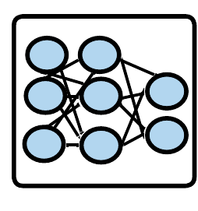
Sibyl Design: Overview
RL Training Thread
Training
Network
Training Dataset
Batch
Periodic Policy
Weight Update
Periodic Weights update
10
RL Decision Thread
Experience Buffer (in host DRAM)
State
Max
Action
Storage
Request
(from OS)
Inference
Network
Sibyl Policy
Observation
Vector
HSS
Reward
Collect
Experiences
State
Notes:
Now we will go into the implementation of each thread

Slide 71
RL Decision Thread
RL Training Thread
Training
Network
Training Dataset
Batch
Periodic Policy
Weight Update
RL Decision Thread
Experience Buffer (in host DRAM)
State
Max
Action
Storage
Request
(from OS)
Inference
Network
Sibyl Policy
Observation
Vector
HSS
Reward
Collect
Experiences
State
Notes:
First we discuss the RL decision thread, where Sibyl decides the data placement of the current storage request while collecting information about its decisions

Slide 72
RL Decision Thread
RL Training Thread
Training
Network
Training Dataset
Batch
Periodic Policy
Weight Update
RL Decision Thread
Experience Buffer (in host DRAM)
State
Max
Action
Storage
Request
(from OS)
Inference
Network
Sibyl Policy
Observation
Vector
HSS
Reward
Collect
Experiences
State
Notes:
For every new storage request to the Hybrid storage systems , Sibyl uses the state information to make a data placement action.

Slide 73
RL Decision Thread
RL Training Thread
Training
Network
Training Dataset
Batch
Periodic Policy
Weight Update
RL Decision Thread
Experience Buffer (in host DRAM)
State
Max
Action
Storage
Request
(from OS)
Inference
Network
Sibyl Policy
Observation
Vector
HSS
Reward
Collect
Experiences
State
Notes:
The inference network predicts the expected benefits of each action for a given state.
Sibyl policy selects the action with the highest expected benefit
or, a random action for exploration of the Hybrid storage systems

Slide 74
RL Decision Thread
RL Training Thread
Training
Network
Training Dataset
Batch
Periodic Policy
Weight Update
RL Decision Thread
Experience Buffer (in host DRAM)
State
Max
Action
Storage
Request
(from OS)
Inference
Network
Sibyl Policy
Observation
Vector
HSS
Reward
Collect
Experiences
State
Notes:
While making data placement decision, Sibyl collects information about the state, action, and reward

Slide 75
RL Decision Thread
RL Training Thread
Training
Network
Training Dataset
Batch
Periodic Policy
Weight Update
RL Decision Thread
Experience Buffer (in host DRAM)
State
Max
Action
Storage
Request
(from OS)
Inference
Network
Sibyl Policy
Observation
Vector
HSS
Reward
Collect
Experiences
State
Notes:
in an experience buffer, which in used in RL Training thread

Slide 76
RL Training Thread
RL Training Thread
Training
Network
Training Dataset
Batch
Periodic Policy
Weight Update
Periodic Weights update
10
RL Decision Thread
Experience Buffer (in host DRAM)
State
Max
Action
Storage
Request
(from OS)
Inference
Network
Sibyl Policy
Observation
Vector
HSS
Reward
Collect
Experiences
State
Notes:
In the RL training thread, Sibyl uses the collected experiences to update its decision making policy online by training a neural network.
Sibyl continuously learns from its past decisions and their impact.

Slide 77
Periodic Weight Transfer
RL Training Thread
Training
Network
Training Dataset
Batch
Periodic Policy
Weight Update
Periodic Weights update
10
RL Decision Thread
Experience Buffer (in host DRAM)
State
Max
Action
Storage
Request
(from OS)
Inference
Network
Sibyl Policy
Observation
Vector
HSS
Reward
Collect
Experiences
State
Notes:
To enable the parallel execution of the two threads, we duplicate the neural network that is used to make data placement decisions, so the inference network does not have a separate training steps and only uses the weights of the training network, which we periodically update.

Slide 78
Talk Outline
Key Shortcomings of Prior Data Placement Techniques
Formulating Data Placement as Reinforcement Learning
Sibyl: Overview
Evaluation of Sibyl and Key Results
Conclusion
Notes:
We now present our key results

Slide 79
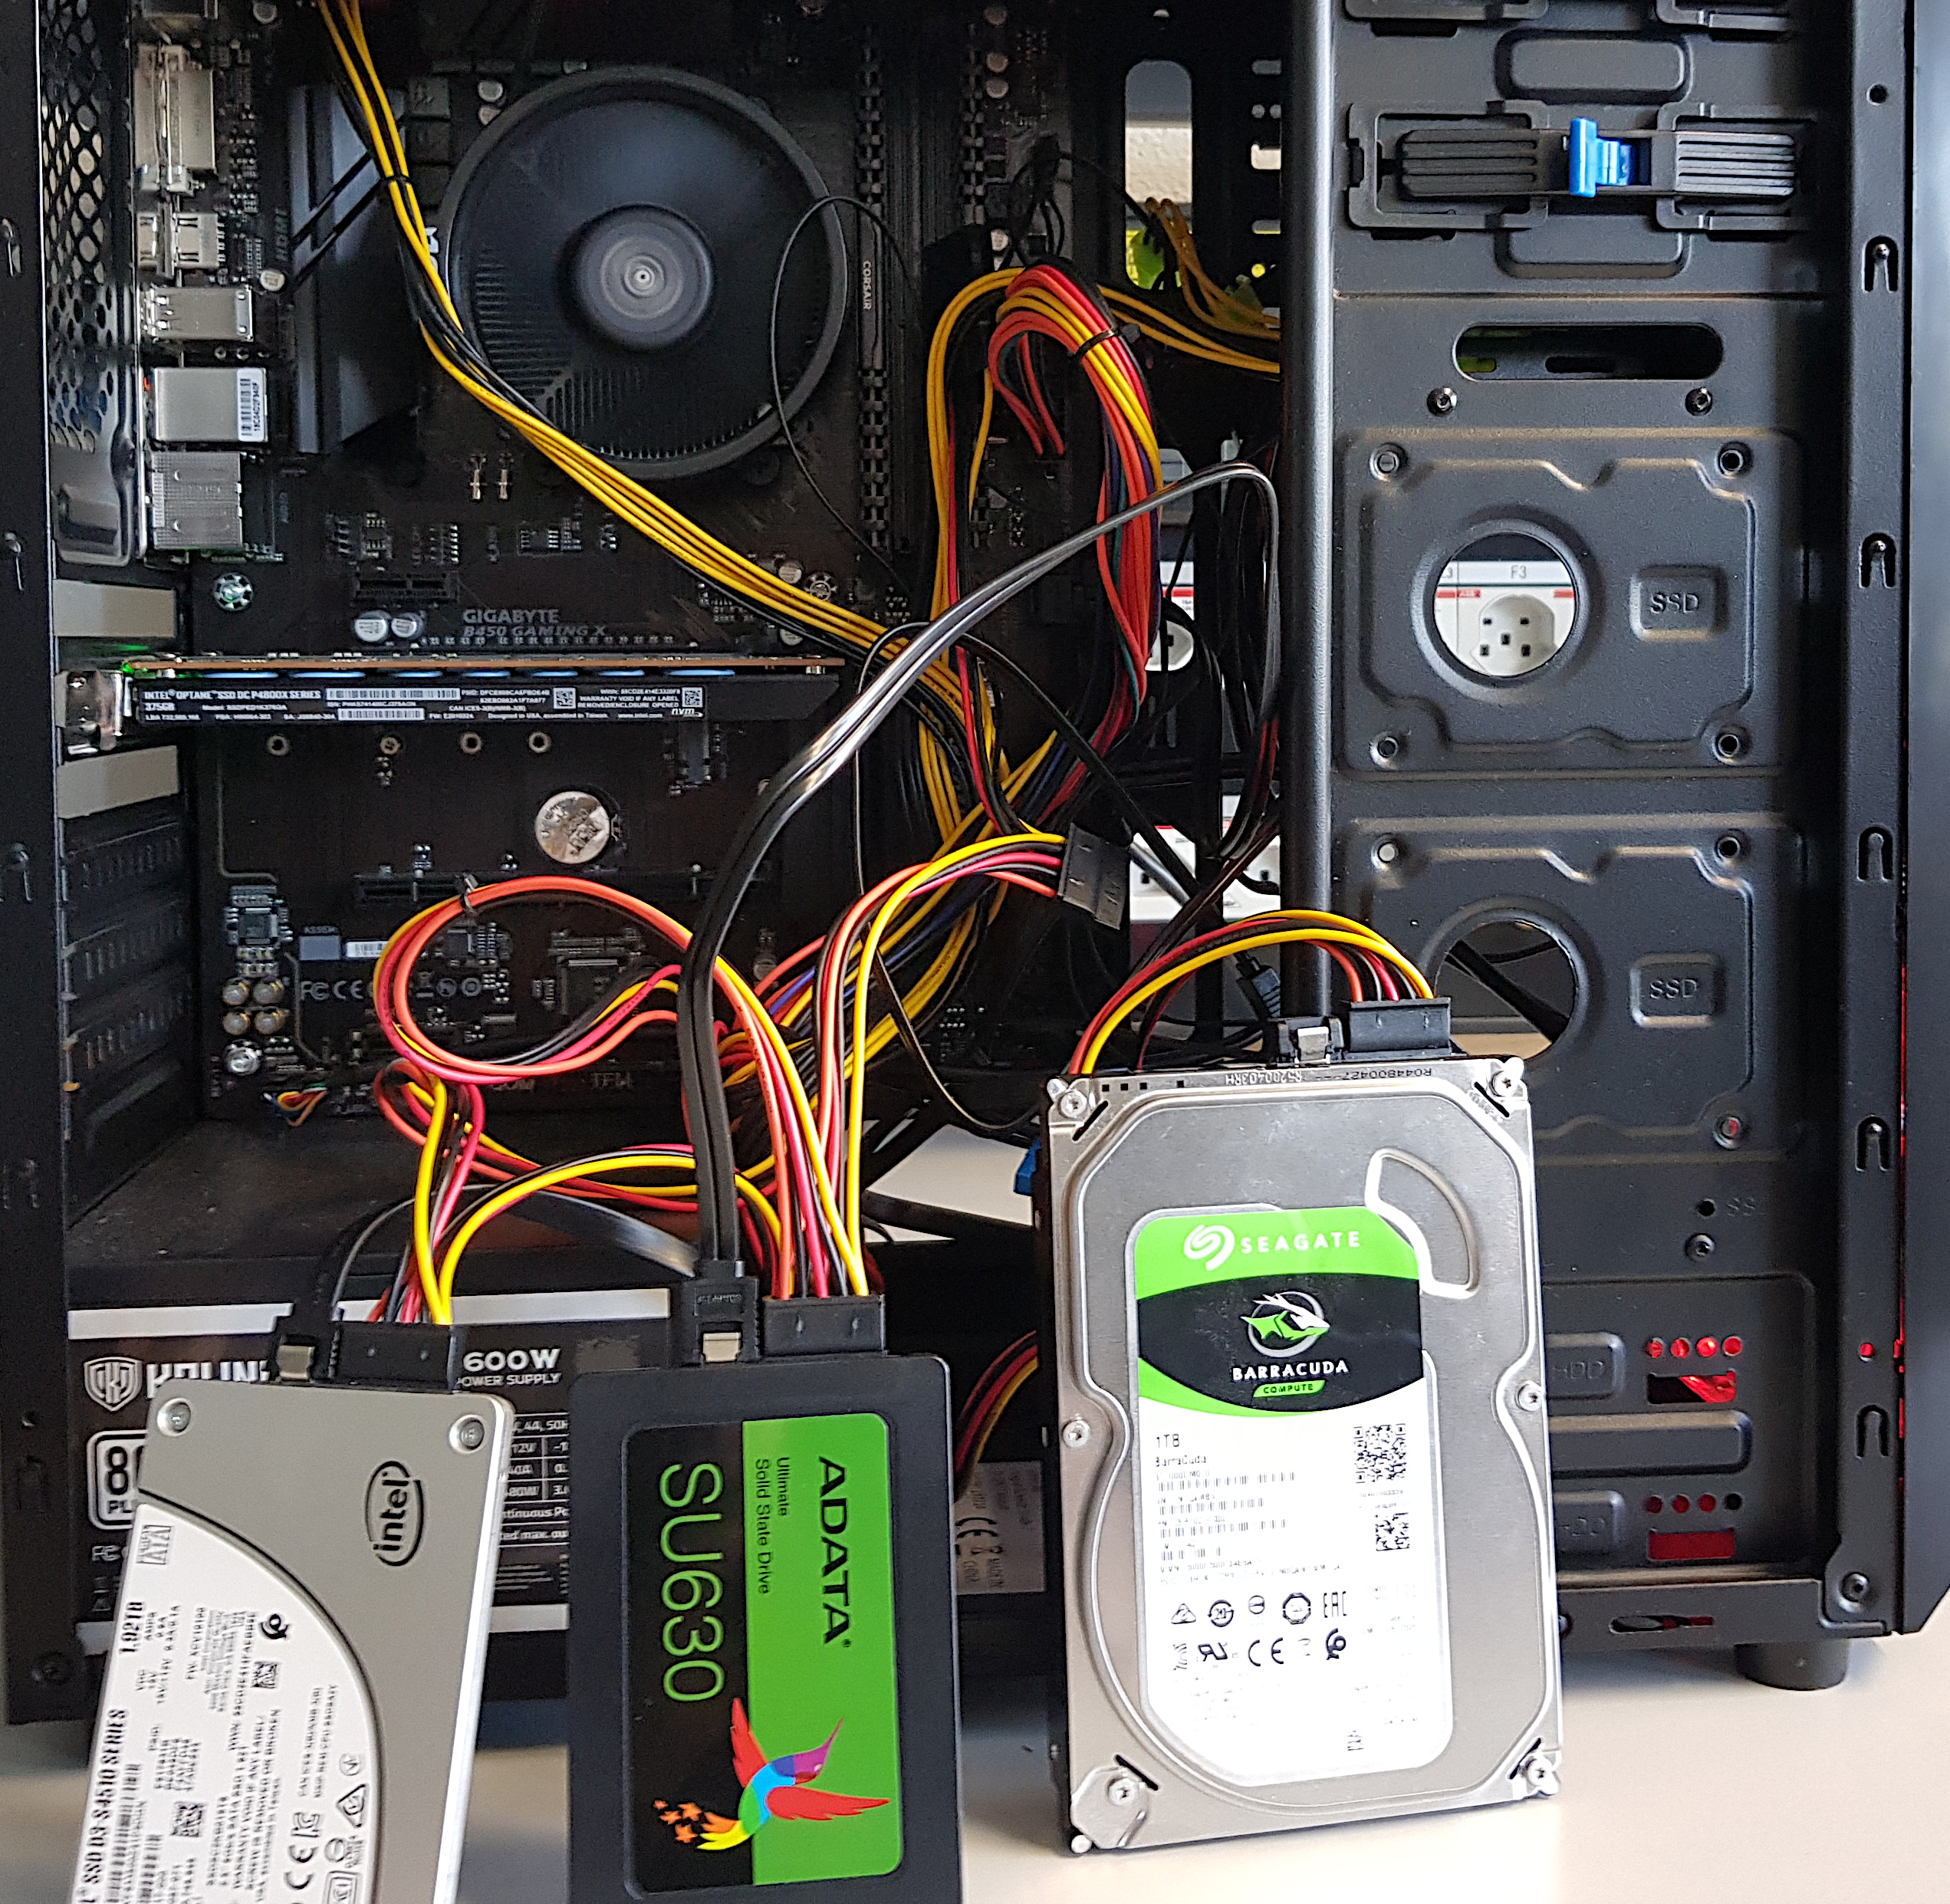

Evaluation Methodology (1/3)
Real system with various HSS configurations
  Dual-hybrid and tri-hybrid systems
AMD Ryzen7 2700G CPU
Intel Optane SSD P4800X
Seagate HDD
ST1000DM010
Intel SSD D3-S4510
ADATA
SU630 SSD
Notes:
[CLICK] We perfrom real system evaluation for both dual-hybrid and tri-hybrid systems
[CLICK] over here we show our evaluation setup that consists of multi different devices
[CLICK] We implement sibyl in the storage management layer of AMD Ryzen 7 2700G CPU

Slide 80
Evaluation Methodology (2/3)
Cost-Oriented HSS Configuration
High-end SSD
Low-end HDD
Performance-Oriented HSS Configuration
High-end SSD
Middle-end SSD
Notes:
First we evalutate a cost-oriented hybrid storage configuration in which we use
[CLICK]a high end ssd with a low-end hard disk drive where the latency difference between the two devices is quite large
[CLICK] Performance oriented hybrid storage configuration we
[CLICK]use a high end ssd with a middle end ssd
where two devices have similar latencies

Slide 81
Evaluation Methodology (3/3)
18 different workloads from:
  MSR Cambridge and Filebench Suites
Four state-of-the-art data placement baselines:
  CDE [Matsui+, Proc. IEEE’17]
  HPS [Meswani+, HPCA’15]
  Archivist [Ren+, ICCD’19]
  RNN-HSS [Doudali+, HPDC’19]
Heuristic-based
Learning-based
Notes:
[CLICK] We use 18 different workloads from MSR CAMBRIDGE and Filebench Suite
[CLICK] and compare Sibyl against four state of heuristic and supervised—learning based data placmenet policies

Slide 82
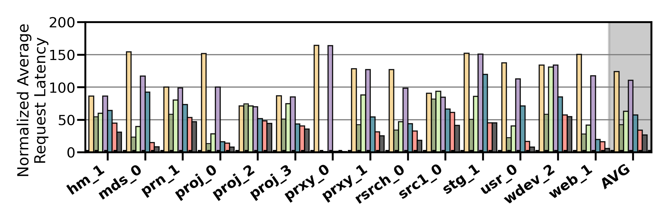
Performance Analysis
High-end SSD
Low-end HDD
Cost-Oriented HSS Configuration
Slow-Only
CDE
HPS
Archivist
RNN-HSS
Sibyl
Oracle
Notes:
[CLICK]Over here we show the performance results in terms of average request latency for MSR CAMBRIDGE workloads for all the workloads and policies

Slide 83
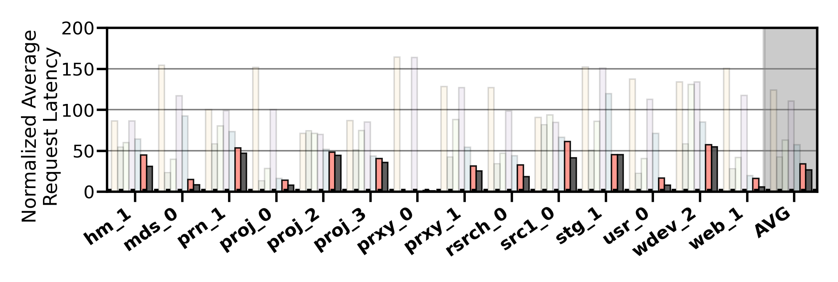
Performance Analysis
High-end SSD
Low-end HDD
Cost-Oriented HSS Configuration
Slow-Only
CDE
HPS
Archivist
RNN-HSS
Sibyl
Oracle
Sibyl consistently outperforms all the baselines
for all the workloads
Notes:
We observe that Sibyl consistently outperforms all the baselines for all the workloads

Slide 84
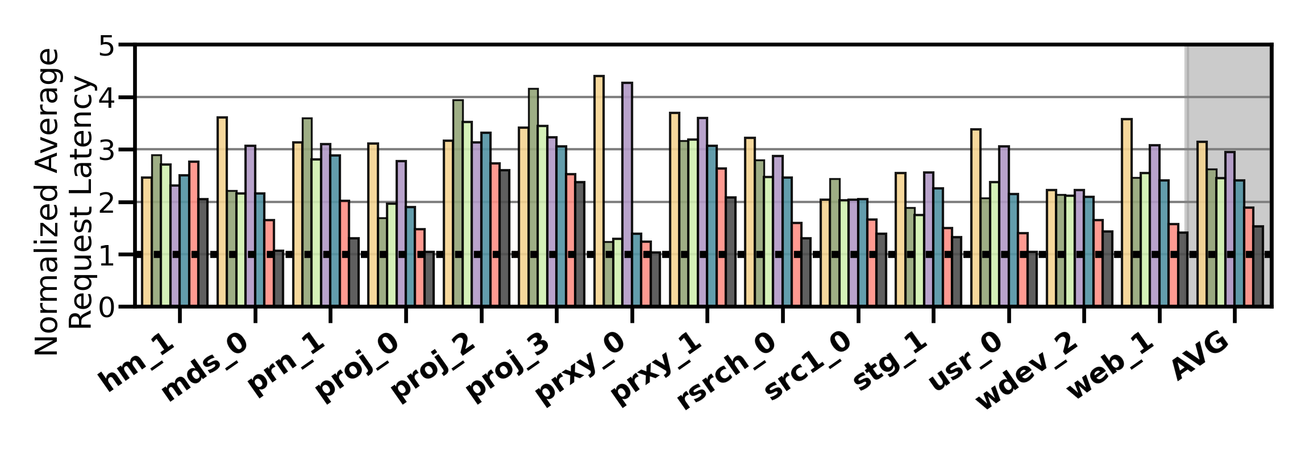
Performance Analysis
High-end SSD
Mid-end SSD
Performance-Oriented HSS Configuration
Slow-Only
CDE
HPS
Archivist
RNN-HSS
Sibyl
Oracle
Notes:
In a performance oriented Hybrid storage systems configuration, where two devices have similar latencies [CLICK]
[CLICK]

Slide 85
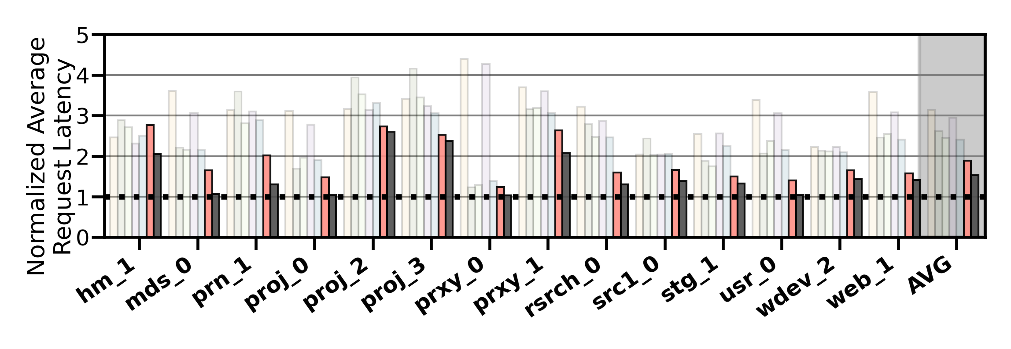
Performance Analysis
High-end SSD
Mid-end SSD
Performance-Oriented HSS Configuration
Slow-Only
CDE
HPS
Archivist
RNN-HSS
Sibyl
Oracle
Sibyl provides 21.6% performance improvement by dynamically adapting its data placement policy
Notes:
Sibyl provides 21.6% performance improvement by dynamically adapting its data placement policy

Slide 86
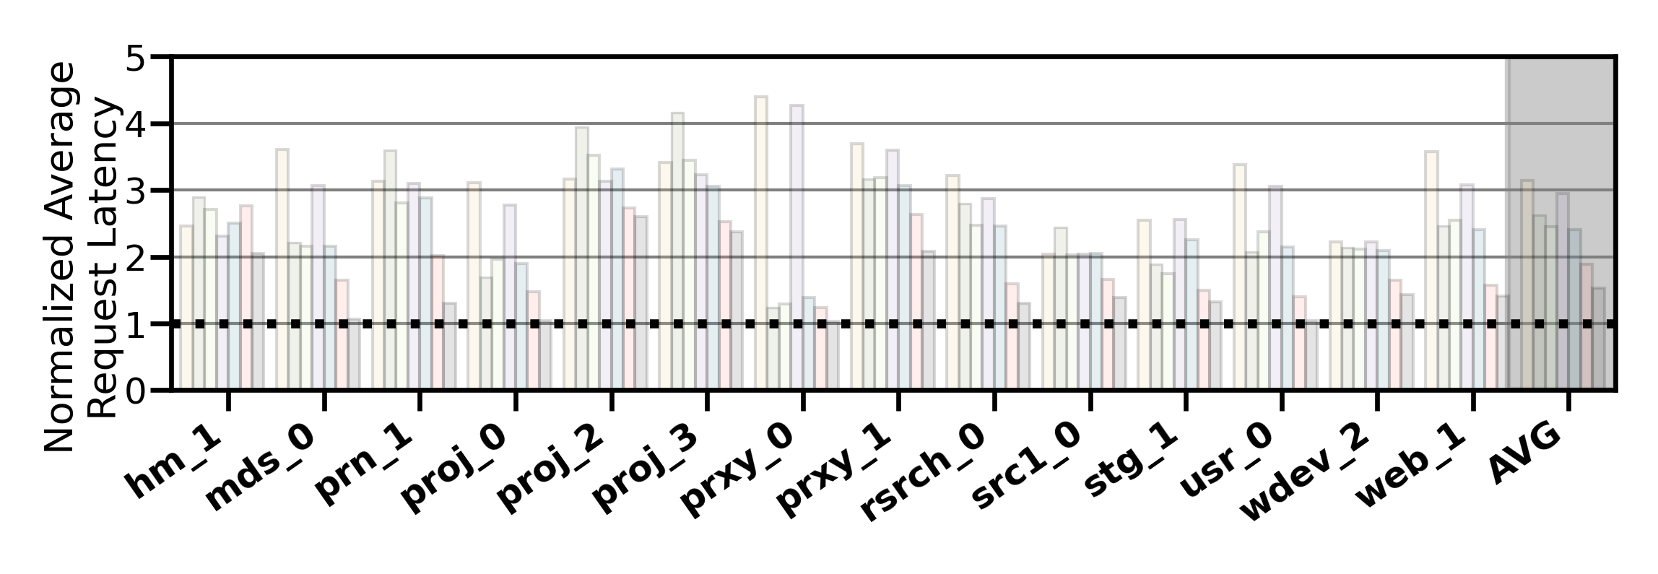
Performance Analysis
High-end SSD
Mid-end SSD
Performance-Oriented HSS Configuration
Slow-Only
CDE
HPS
Archivist
RNN-HSS
Sibyl
Oracle
Notes:
Sibyl provides slightly lower performance than other baselines in only two workloads for this configuration.
We observe that such workloads are write-intensive and have many random requests (in terms of both access pattern and request size).
Therefore, in the paper we show that for such workloads we need to perform frequent retraining

Slide 87
Performance Analysis
High-end SSD
Mid-end SSD
Performance-Oriented HSS Configuration
Slow-Only
CDE
HPS
Archivist
RNN-HSS
Sibyl
Oracle
Sibyl achieves 80% of the performance
of an oracle policy that has
complete knowledge of future access patterns
Notes:
on average Sibyl achieves 80% performance of an oracle policy that has complete knowledge of
future access patterns

Slide 88
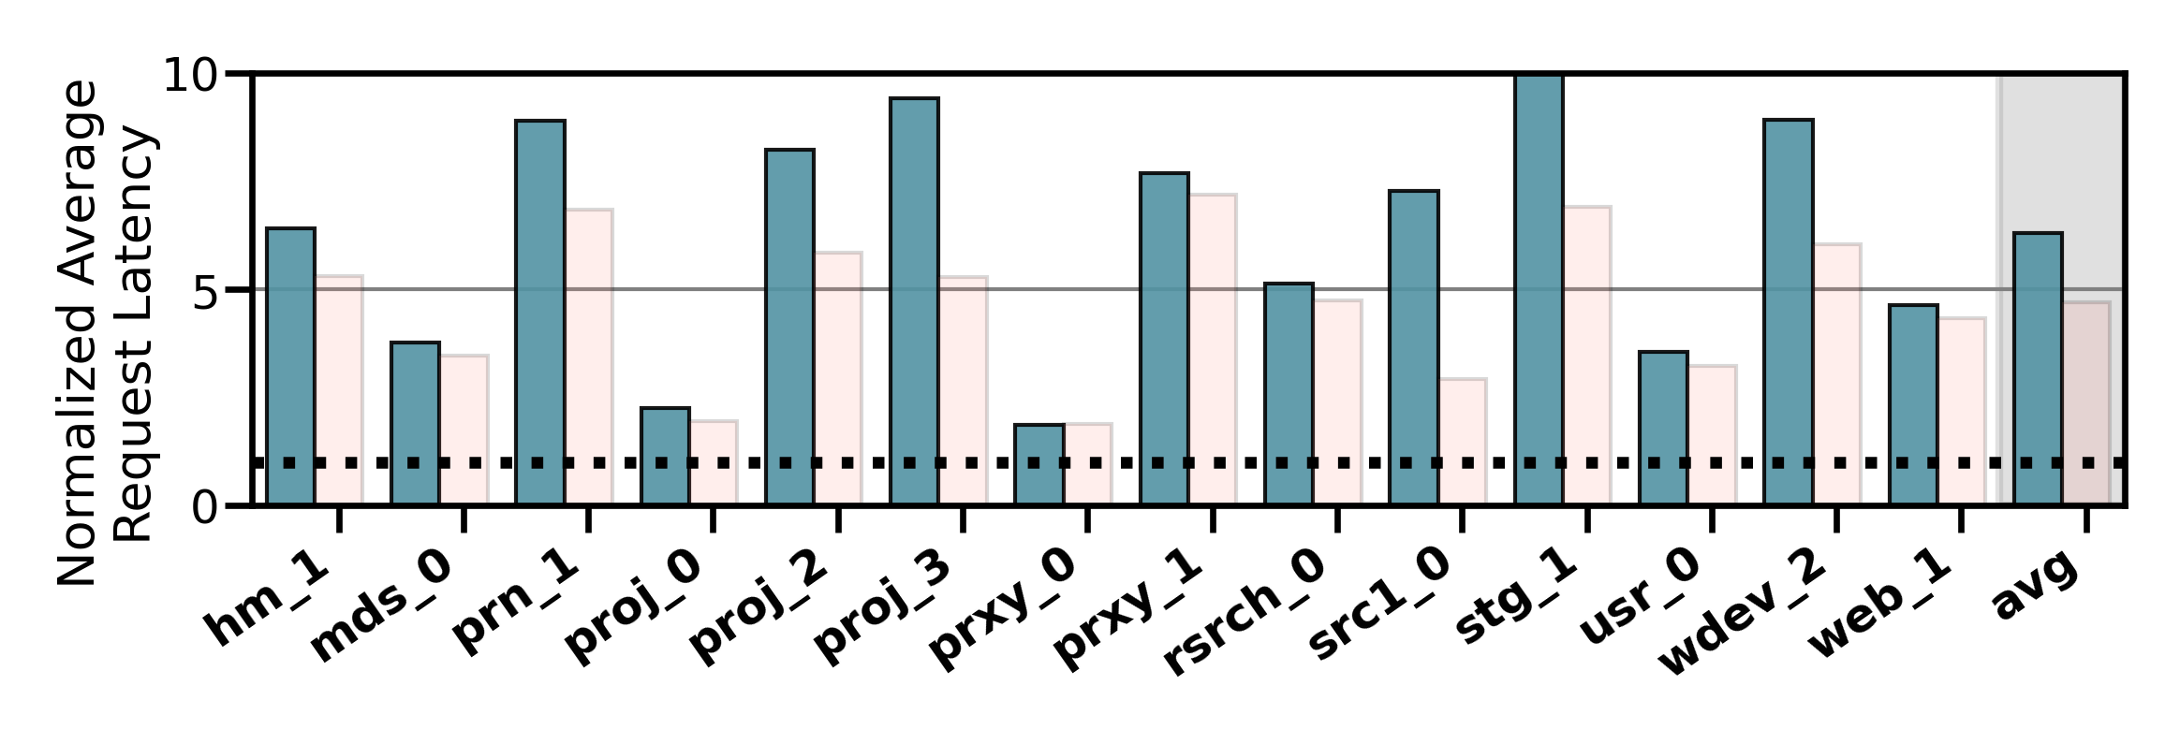
Performance on Tri-HSS
High-end SSD
Mid-end SSD
Low-end HDD
Extending Sibyl for more devices:
Extending Sibyl for more devices:
  Add a new action
  Add the remaining capacity of the new device as a state feature
Heuristic_{Tri-hybrid}
Sibyl_{Tri-hybrid}
Notes:
We also evaluate the EXTENSIBILITY of sibyl to more devices
To extend sibyl for more storage devices we have to only:
1. Add a new action in sibyl’s action space
2. Add the remaining capacity of the new device as a state feature
and sibyl automatically figures out the best policy
Here we show the performanc results for a state of the art heuristic based policy. This heuristic policy is an extended version of CDE policy which requires significant implementation effort for handling all the dataplacement cases because of the new device like eviction and promotion from the new device and where to send that data, set threshold values etc.

Slide 89
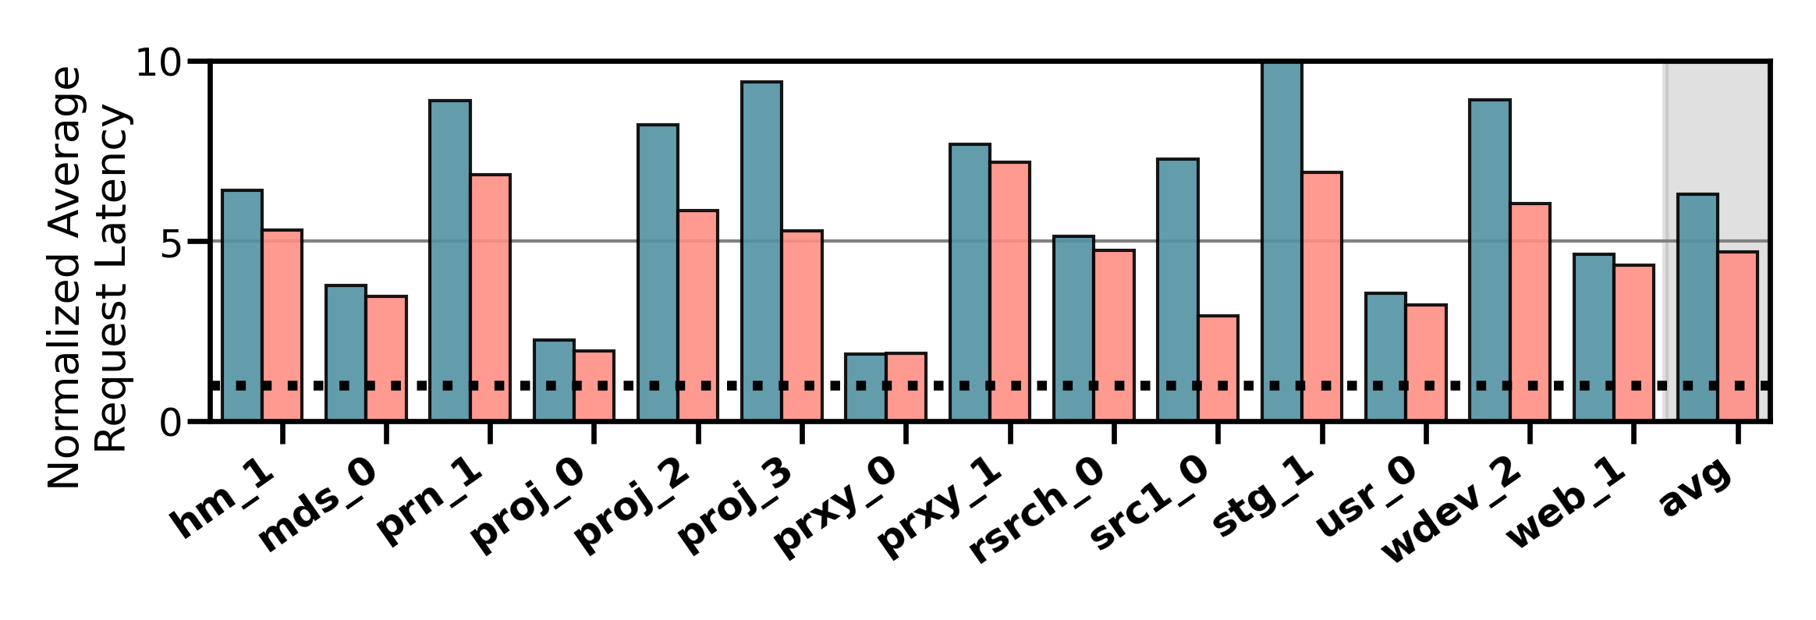
Performance on Tri-HSS
High-end SSD
Mid-end SSD
Low-end HDD
Extending Sibyl for more devices:
  Add a new action
  Add the remaining capacity of the new device as a state feature
Heuristic_{Tri-hybrid}
Sibyl_{Tri-hybrid}
Notes:
and compare to sibyl for trihybrid system

Slide 90
Performance on Tri-HSS
High-end SSD
Mid-end SSD
Low-end HDD
Extending Sibyl for more devices:
  Add a new action
  Add the remaining capacity of the new device as a state feature
Sibyl outperforms the state-of-the-art
data placement policy by
48.2% in a real tri-hybrid system
Heuristic_{Tri-hybrid}
Sibyl_{Tri-hybrid}
Sibyl reduces the system architect's burden
by providing ease of extensibility
Notes:
Sibyl outperforms the state-of-the-art-policy policy by upto 48.2%
[click]
We conclude that Sibyl provides ease of extensibility to new storage system configurations, which reduces the system architect’s burden in designing sophisticated data placement mechanisms.

Slide 91
Sibyl’s Overhead
124.4 KiB of total storage cost
  Experience buffer, inference and training network
40-bit metadata overhead per page for state features
Inference latency of ~10ns
Training latency of ~2us
Small area overhead
Small inference overhead
Satisfies prediction latency
Notes:
All of Sibyl performance benefits comes at a modest cost of 124.4KB storage cost to implement experience buffer, inference and training network
[CLICK] and 40-bit metadata overhead per page
[CLICK] We have inference latency of 10nanos, which are orders of magnitude smaller than the I/O read latency of a even a high end SSD (around 3micro seconds for Samsung ZNAND SSD)
[CLICK] with training latency of 2mico sec
So sibyl provides:
[CLICK]small area and
[CLICK]inference overhead [CLICK] which satisfied the prediction latency for making a data placement decision

Slide 92
More in the Paper (1/3)
Throughput (IOPS) evaluation
  Sibyl provides high IOPS compared to baseline policies because it indirectly captures throughput (size/latency)
Evaluation on unseen workloads
  Sibyl can effectively adapt its policy to highly dynamic workloads
Evaluation on mixed workloads
  Sibyl provides equally-high performance benefits as in single workloads
Notes:
We have many more exciting results in the paper including throughput comparison, evaluation on unseen workloads and mixed workloads

Slide 93
More in the Paper (2/3)
Evaluation on different features
  Sibyl autonomously decides which features are important to maximize the performance
Evaluation with different hyperparameter values
Sensitivity to fast storage capacity
  Sibyl provides scalability by dynamically adapting its policy to available storage size
Explainability analysis of Sibyl's decision making
  Explain Sibyl’s actions for different workload characteristics and device configurations
Notes:
And many more.
For more details we encourage you to read our paper

Slide 94
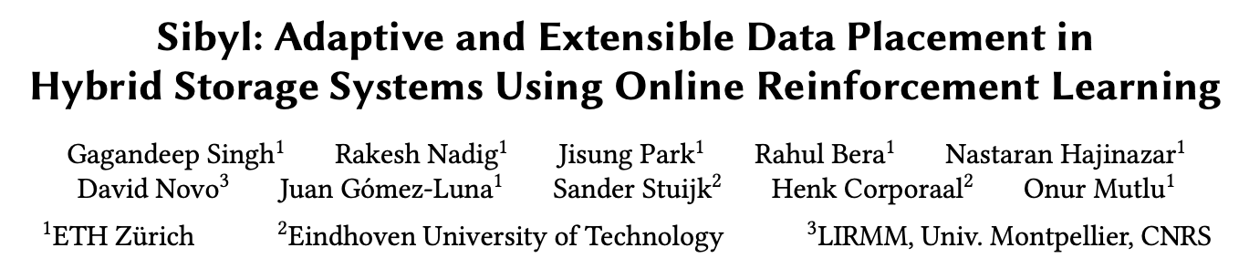
More in the Paper (3/3)
https://arxiv.org/pdf/2205.07394.pdf
https://github.com/CMU-SAFARI/Sibyl

Slide 95
Talk Outline
Key Shortcomings of Prior Data Placement Techniques
Formulating Data Placement as Reinforcement Learning
Sibyl: Overview
Evaluation of Sibyl and Key Results
Conclusion
Notes:
Now I will conclude my talk

Slide 96
Conclusion
We introduced Sibyl, the first reinforcement learning-based data placement technique in hybrid storage systems that provides
  Adaptivity
  Easily extensibility
  Ease of design and implementation
We evaluated Sibyl on real systems using many different workloads
  Sibyl improves performance by 21.6% compared to the best prior data placement policy in a dual-HSS configuration
  In a tri-HSS configuration, Sibyl outperforms the state-of-the-art-data placement policy by 48.2%
  Sibyl achieves 80% of the performance of an oracle policy with a storage overhead of only 124.4 KiB
https://github.com/CMU-SAFARI/Sibyl
Notes:
We introduced Sibyl, the first reinforcement learning-based data placement in HSS that provides
Adaptivity
Easily extensibility
Ease of design and implementation
We evaluated Sibyl on real systems using many different workloads
Sibyl improves performance by 21.6% compared to the best previous data placement technique in dual-HSS configuration
In a tri-HSS configuration, Sibyl outperforms the state-of-the-art-policy policy by 48.2%
Sibyl achieves 80% performance of an oracle policy with storage overhead of only 124.4 KiB

Slide 97
Sibyl
Adaptive and Extensible Data Placement in Hybrid Storage Systems
Using Online Reinforcement Learning
Gagandeep Singh, Rakesh Nadig, Jisung Park,
Rahul Bera, Nastaran Hajinazar, David Novo,
Juan Gómez Luna, Sander Stuijk, Henk Corporaal,
Onur Mutlu
97
Notes:
Hi First of all. Thank you very much for staying until this long.
I’m going to present our work “…”

Slide 98
ISCA 2022 Paper, Slides, Videos
Gagandeep Singh, Rakesh Nadig, Jisung Park, Rahul Bera, Nastaran Hajinazar, David Novo, Juan Gomez-Luna, Sander Stuijk, Henk Corporaal, and Onur Mutlu,
"Sibyl: Adaptive and Extensible Data Placement in Hybrid Storage Systems Using Online Reinforcement Learning"
Proceedings of the 49th International Symposium on Computer Architecture (ISCA), New York, June 2022.
[Slides (pptx) (pdf)]
[arXiv version]
[Sibyl Source Code]
[Talk Video (16 minutes)]
https://arxiv.org/pdf/2205.07394.pdf

Slide 99
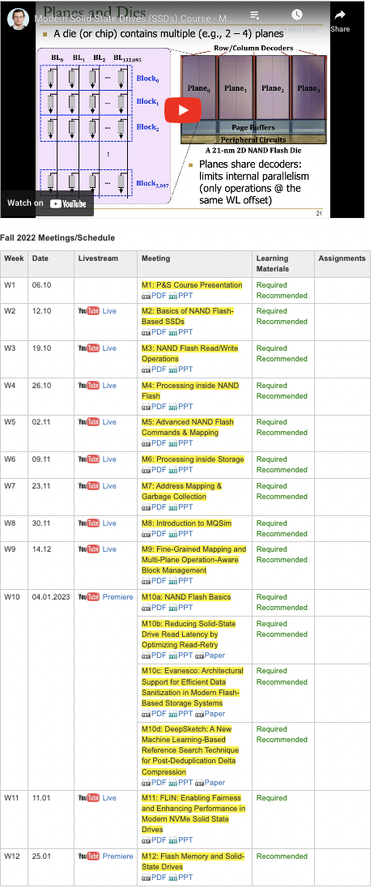
SSD Course (Spring 2023)
Spring 2023 Edition:
  https://safari.ethz.ch/projects_and_seminars/spring2023/doku.php?id=modern_ssds
Fall 2022 Edition:
  https://safari.ethz.ch/projects_and_seminars/fall2022/doku.php?id=modern_ssds
Youtube Livestream (Spring 2023):
  https://www.youtube.com/watch?v=4VTwOMmsnJY&list=PL5Q2soXY2Zi_8qOM5Icpp8hB2SHtm4z57&pp=iAQB
Youtube Livestream (Fall 2022):
  https://www.youtube.com/watch?v=hqLrd-Uj0aU&list=PL5Q2soXY2Zi9BJhenUq4JI5bwhAMpAp13&pp=iAQB
Project course
  Taken by Bachelor’s/Master’s students
  SSD Basics and Advanced Topics
  Hands-on research exploration
  Many research readings
https://www.youtube.com/onurmutlulectures

Slide 100

Comp Arch (Fall 2021)
Fall 2021 Edition:
  https://safari.ethz.ch/architecture/fall2021/doku.php?id=schedule
Fall 2020 Edition:
  https://safari.ethz.ch/architecture/fall2020/doku.php?id=schedule
Youtube Livestream (2021):
  https://www.youtube.com/watch?v=4yfkM_5EFgo&list=PL5Q2soXY2Zi-Mnk1PxjEIG32HAGILkTOF
Youtube Livestream (2020):
  https://www.youtube.com/watch?v=c3mPdZA-Fmc&list=PL5Q2soXY2Zi9xidyIgBxUz7xRPS-wisBN
Master’s level course
  Taken by Bachelor’s/Masters/PhD students
  Cutting-edge research topics + fundamentals in Computer Architecture
  5 Simulator-based Lab Assignments
  Potential research exploration
  Many research readings
https://www.youtube.com/onurmutlulectures

Slide 101
Hermes & Sibyl:
ML-Driven Memory & Storage Management
Onur Mutlu
omutlu@gmail.com
https://people.inf.ethz.ch/omutlu
27 September 2023
VMware

Slide 102
Hermes Discussion
FAQs
  What are the selected set of program features?
  Can you provide some intuition on why these features work?
  What happens in case of a misprediction?
  What’s the performance headroom for off-chip prediction?
  Do you see a variance of different features in final prediction accuracy?
Simulation Methodology
  System parameters
  Evaluated workloads
More Results
  Percentage of off-chip requests
  Reduction in stall cycles by reducing the critical path
  Fraction of off-chip load requests
  Accuracy and coverage of POPET
  Effect of different features
  Are all features required?
  1C performance
  1C performance line graph
  1C performance against prior predictors
  Effect on stall cycles
  8C performance
  Sensitivity:
    Hermes request issue latency
    Cache hierarchy access latency
    Activation threshold
    ROB size
    LLC size
  Power overhead
  Accuracy without prefetcher
  Main memory request overhead with different prefetchers

Slide 103
HERMES BACKUP

Slide 104
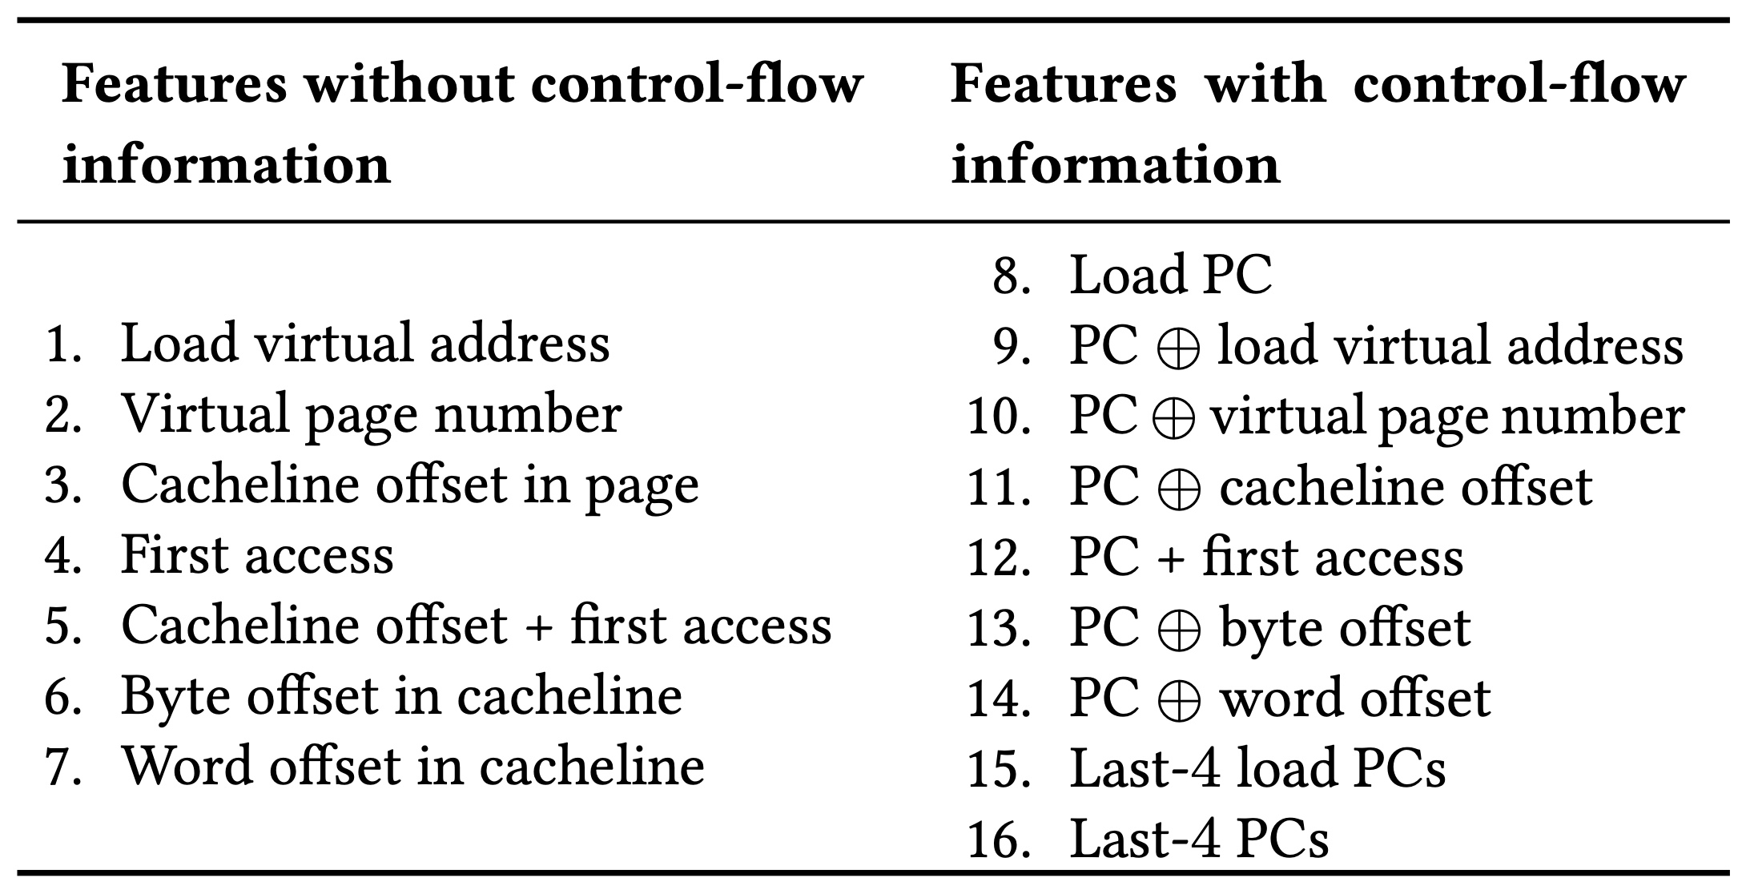
Initial Set of Program Features

Slide 105
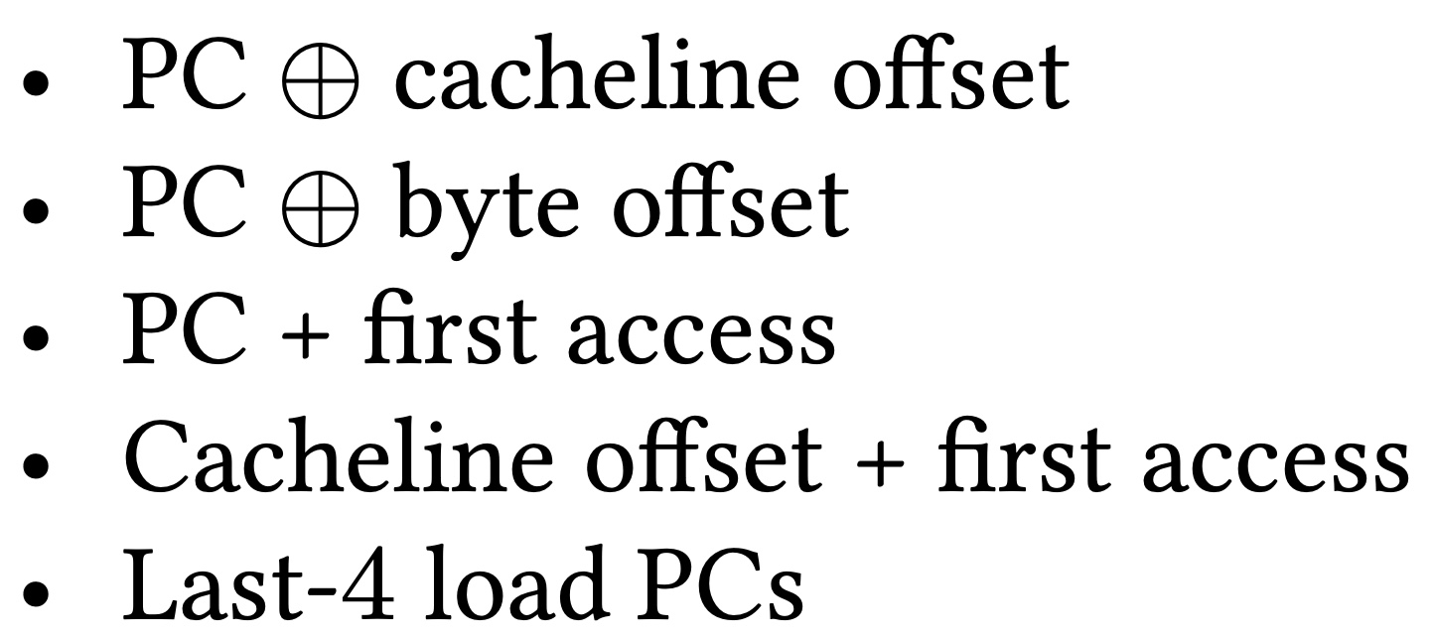

Selected Set of Program Features
A binary hint that represents whether or not a cacheblock has been recently touched
Five features

Slide 106
When A Feature Works/Does Not Work?
Trace: 462.libquantum-1343B
PC: 0x401442
…
Cacheline #42
Cacheline #43
…
Without prefetcher
With a simple stride prefetcher
PC + first access
Cacheline offset + first access
Cacheline offset + first access

Slide 107
What Happens in case of a Misprediction?
Two cases of mispredictions:
Predicted on-chip but actually goes off-chip
  Loss of performance improvement opportunity
Predicted off-chip but actually is on-chip
  Memory controller forwards the data to LLC if and only if a load to the same address have already missed LLC and arrived at the memory controller
No need for misprediction detection and recovery
No need for misprediction detection and recovery

Slide 108
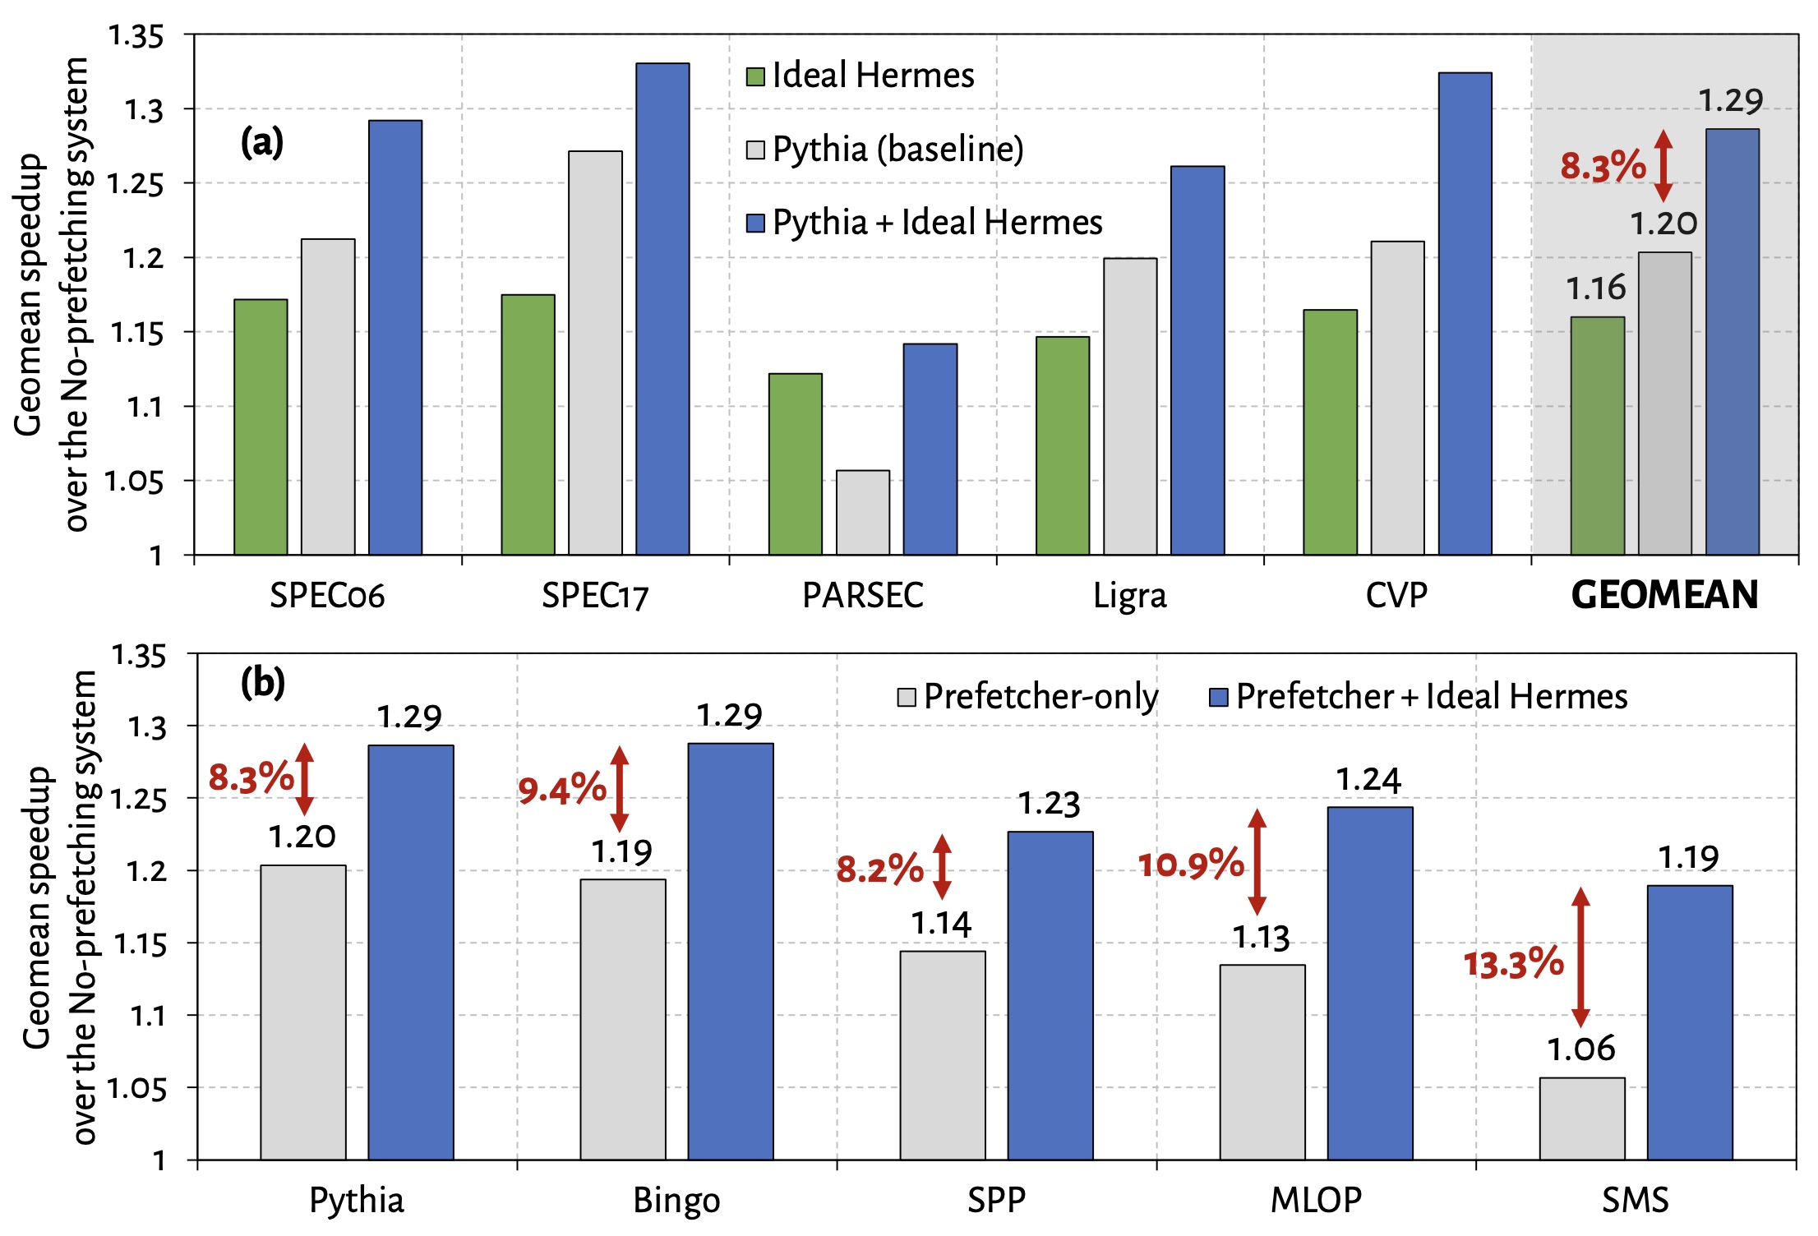
Performance Headroom of Off-Chip Prediction

Slide 109
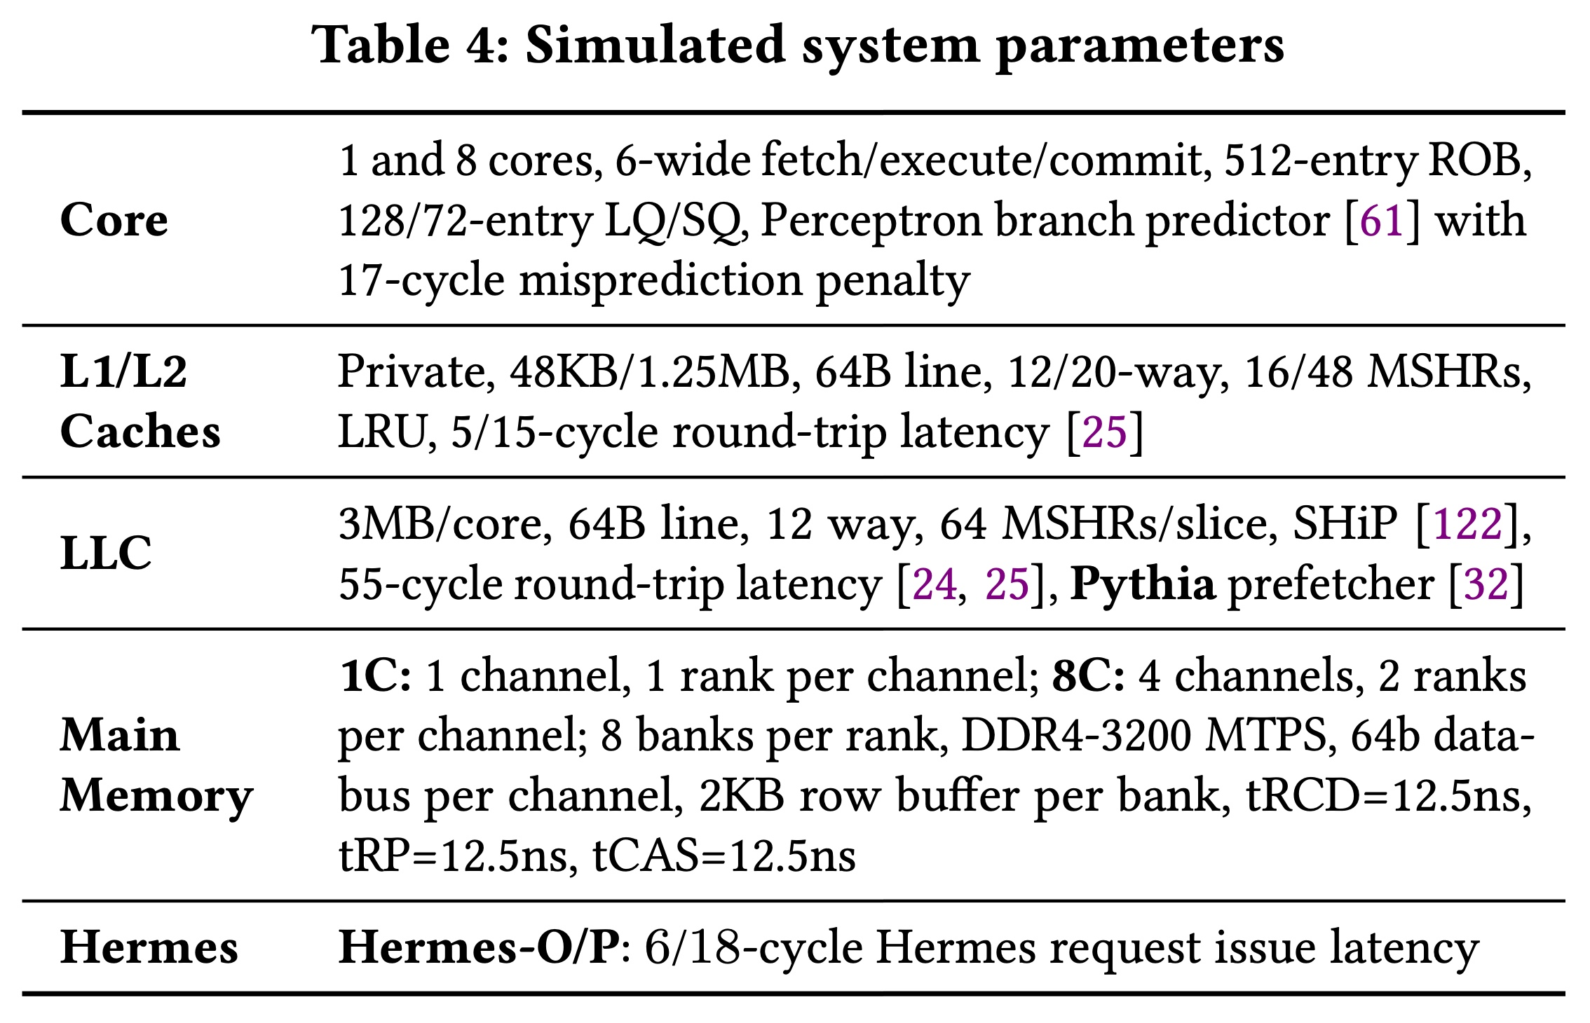
System Parameters

Slide 110
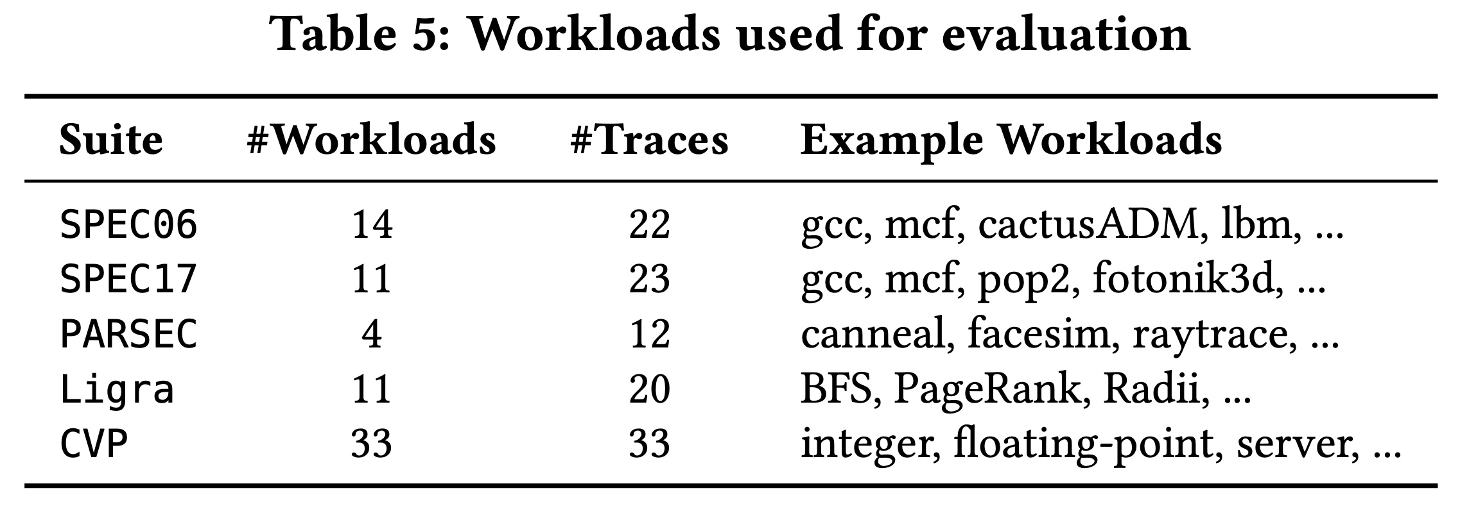
Evaluated Workloads

Slide 111
Observation: Not All Off-Chip Loads are Prefetched
50%
1
Nearly 50% of the loads are still not prefetched

Slide 112
Observation: Not All Off-Chip Loads are Prefetched
2
70% of these off-chip loads blocks ROB

Slide 113
Observation: With Large Cache Comes Longer Latency
On-chip cache access latency significantly contributes to the latency of an off-chip load
On-chip cache hierarchy access latency
58

Slide 114
Observation: With Large Cache Comes Longer Latency
On-chip cache access latency significantly contributes to the latency of an off-chip load
On-chip cache hierarchy access latency
40% of stall cycles caused by an off-chip load can be eliminated
by removing on-chip cache access latency from its critical path
58

Slide 115
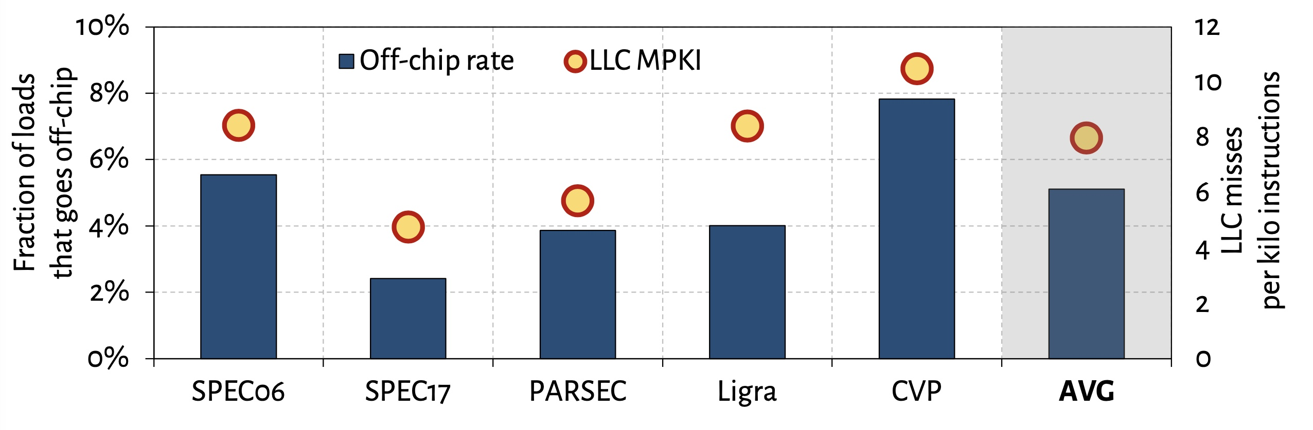
What Fraction of Load Requests Goes Off-Chip?

Slide 116
Off-Chip Prediction Quality: Defining Metrics
Accuracy
Coverage
Predicted off-chip
Actual off-chip
Predicted and actual off-chip

Slide 117
Off-Chip Prediction Quality: Analysis
Accuracy
77%
47%
16%
Coverage
95%
74%
22%

Slide 118
Off-Chip Prediction Quality: Analysis
Accuracy
77%
47%
16%
POPET provides off-chip predictions with high-accuracy and high-coverage
Coverage
95%
74%
22%

Slide 119
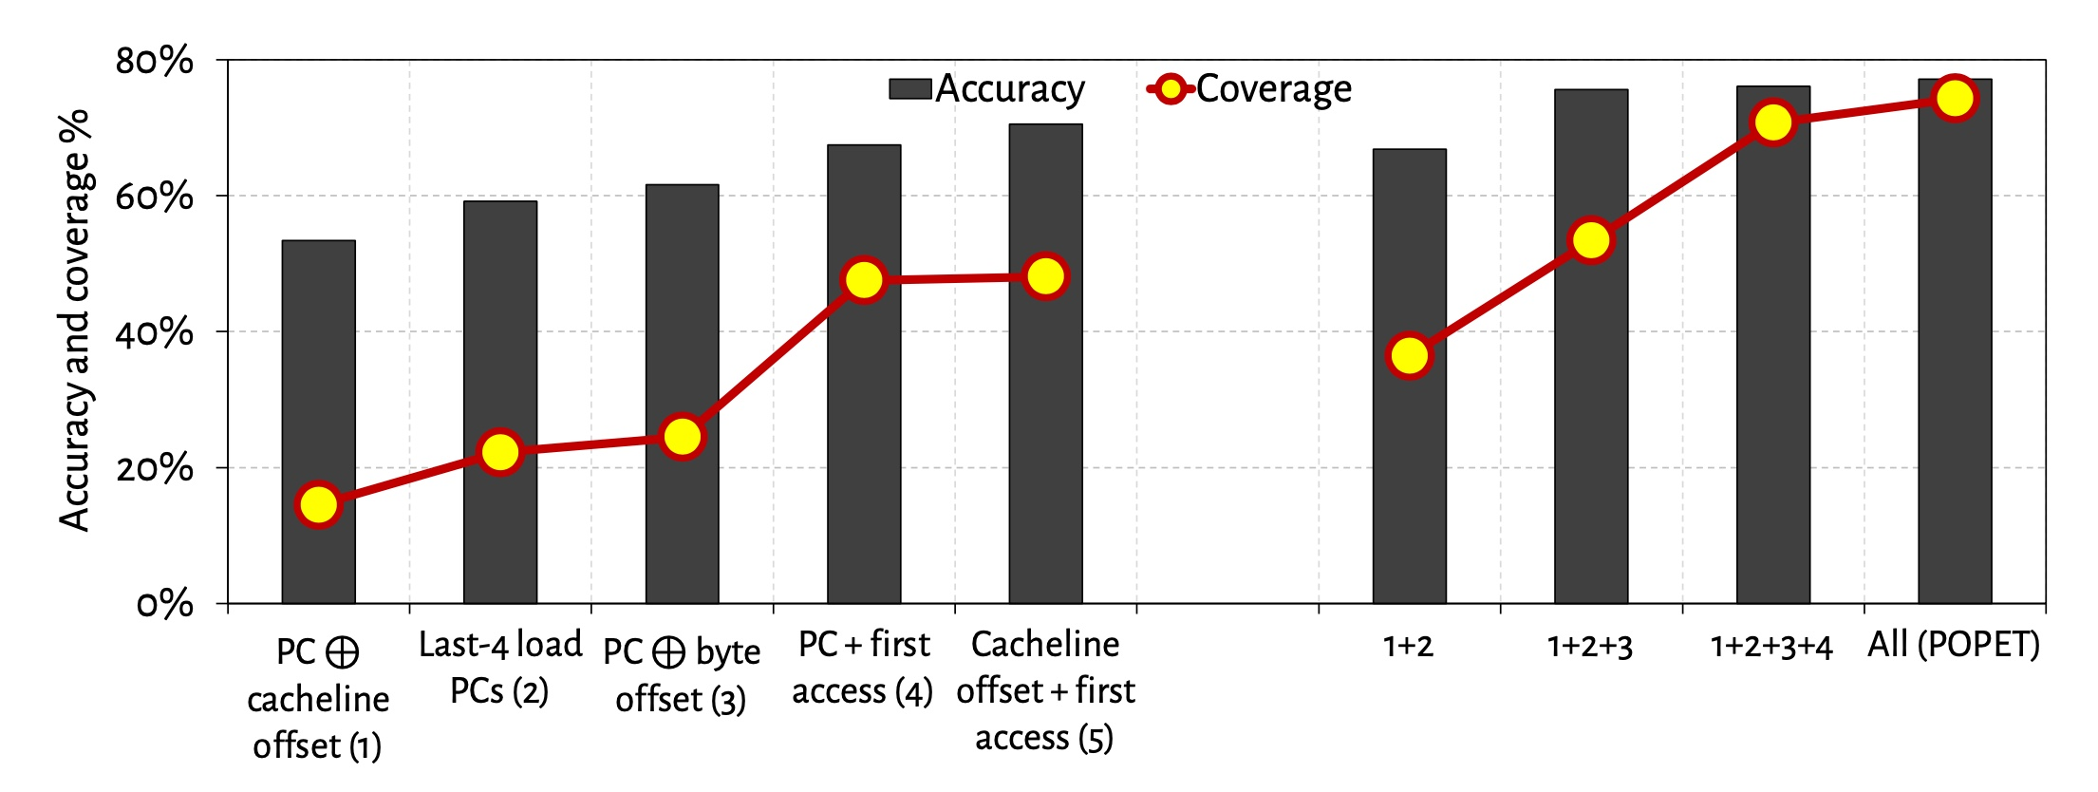
Effect of Different Features
Combination of features provides both higher accuracy and higher coverage than any individual feature

Slide 120
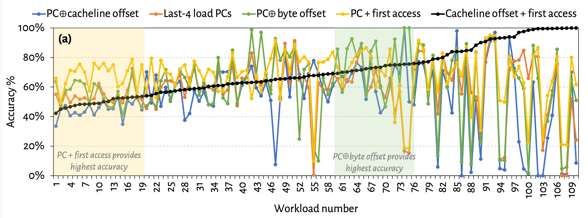
Are All Features Required? (1)
No single feature individually provides
highest prediction accuracy across all workloads

Slide 121
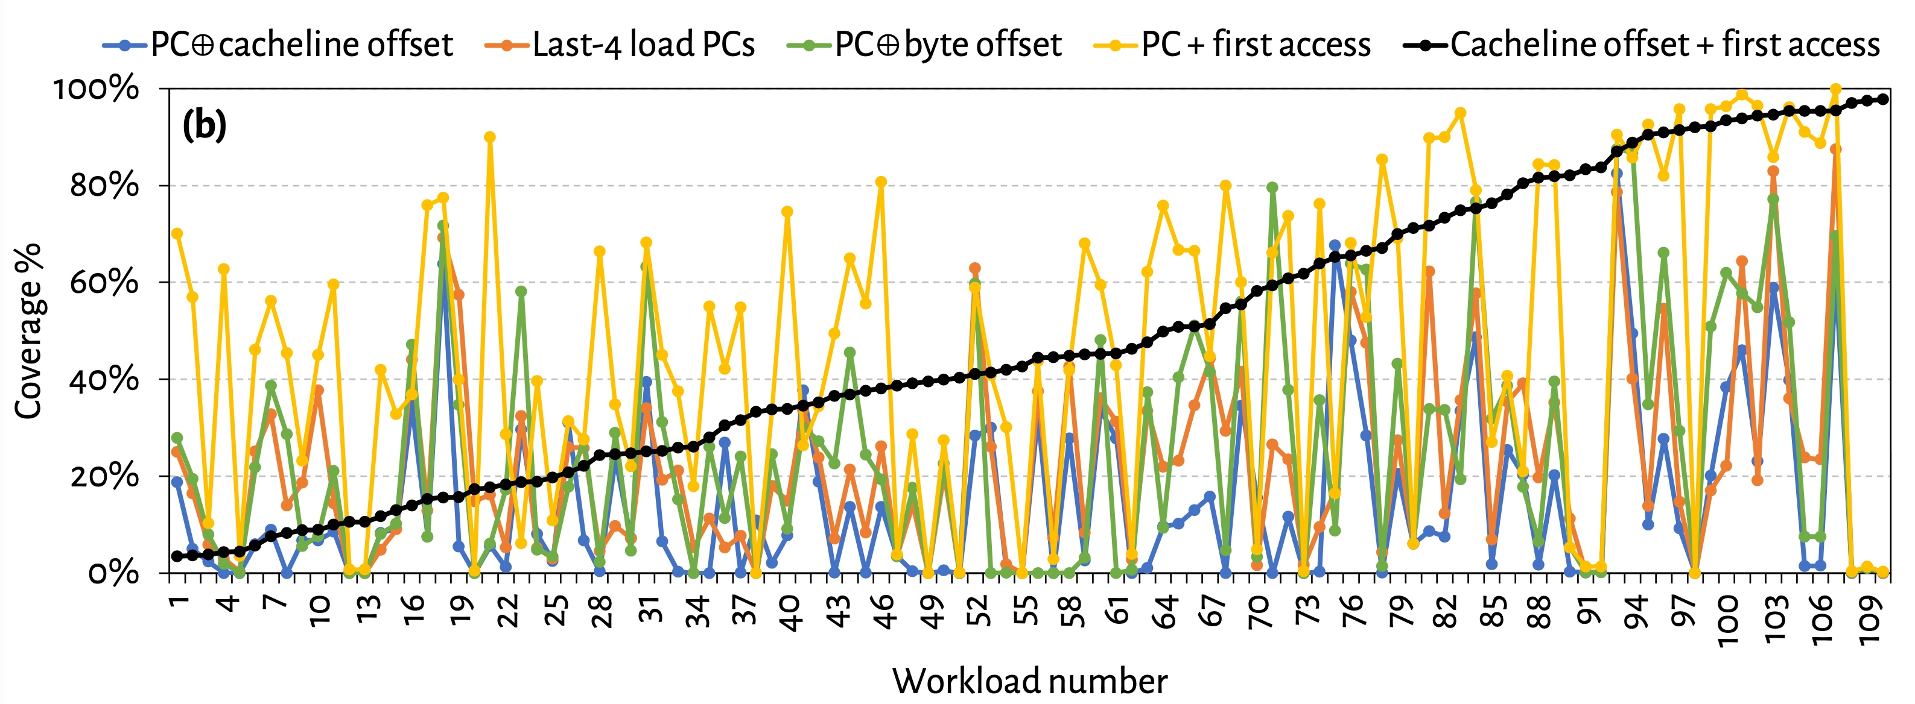
Are All Features Required? (2)
No single feature individually provides
highest prediction coverage also across all workloads

Slide 122
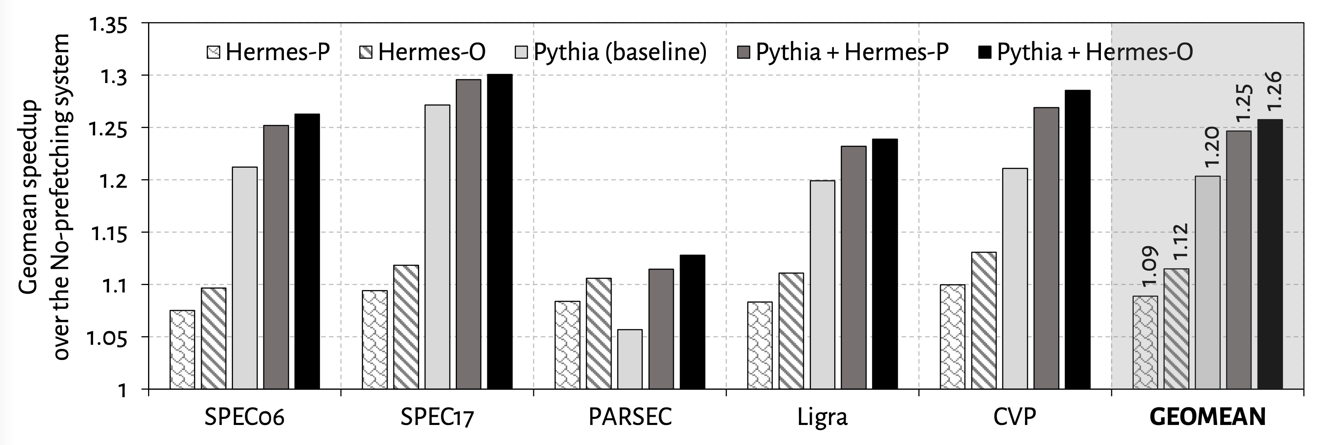
Single-Core Performance
Hermes in combination with Pythia
outperforms Pythia alone in every workload category

Slide 123
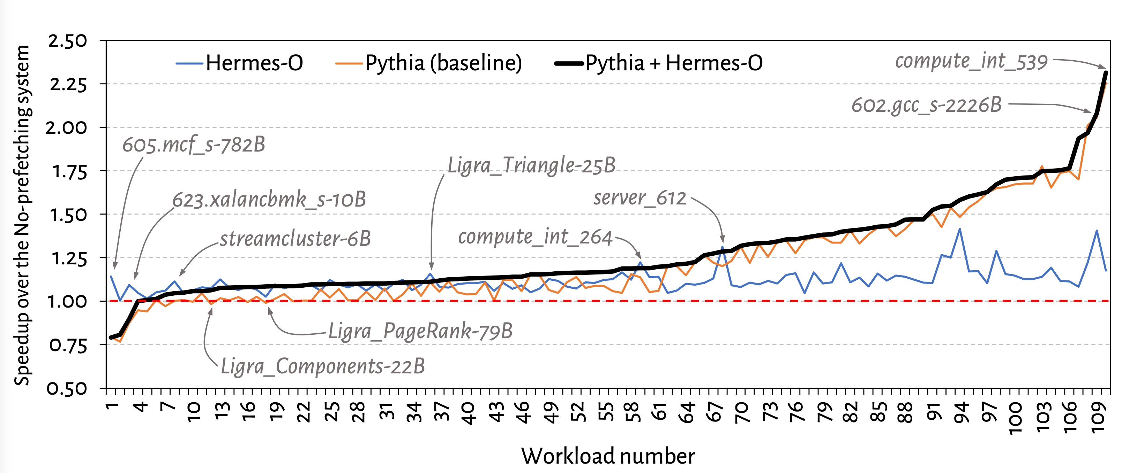
Single-Core Performance Line Graph

Slide 124
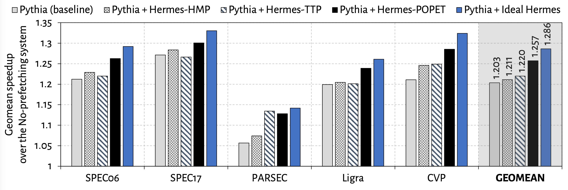
Single-Core Performance Against Prior Predictors
POPET provides higher performance benefit
than prior predictors
Hermes with POPET achieves nearly 90% performance improvement of the Ideal Hermes

Slide 125
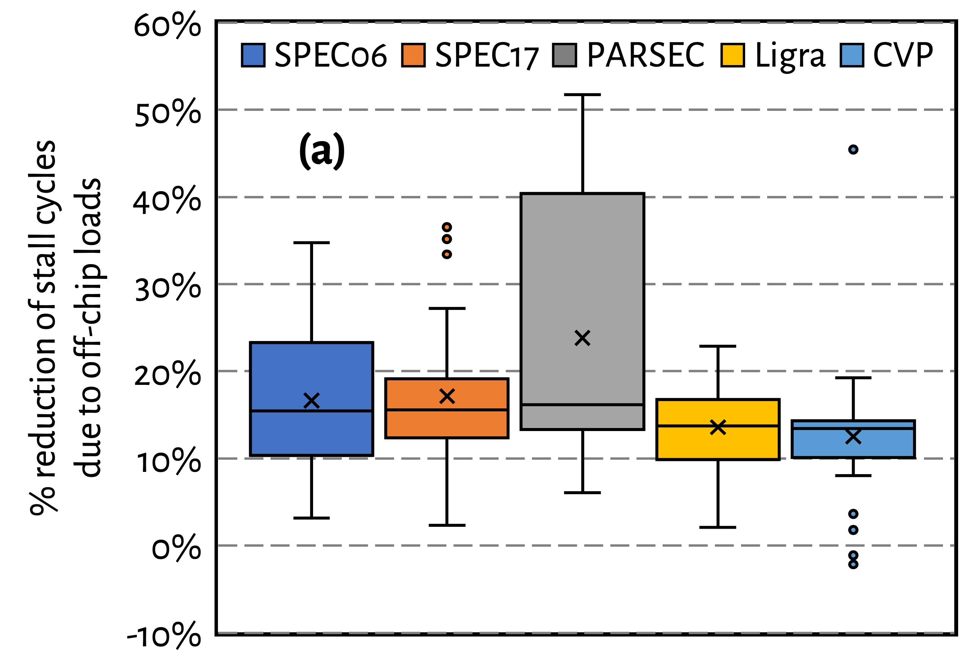
Effect on Stall Cycles
Hermes reduces off-chip load induced stall cycles
on average by 16.2% (up-to 51.8%)

Slide 126
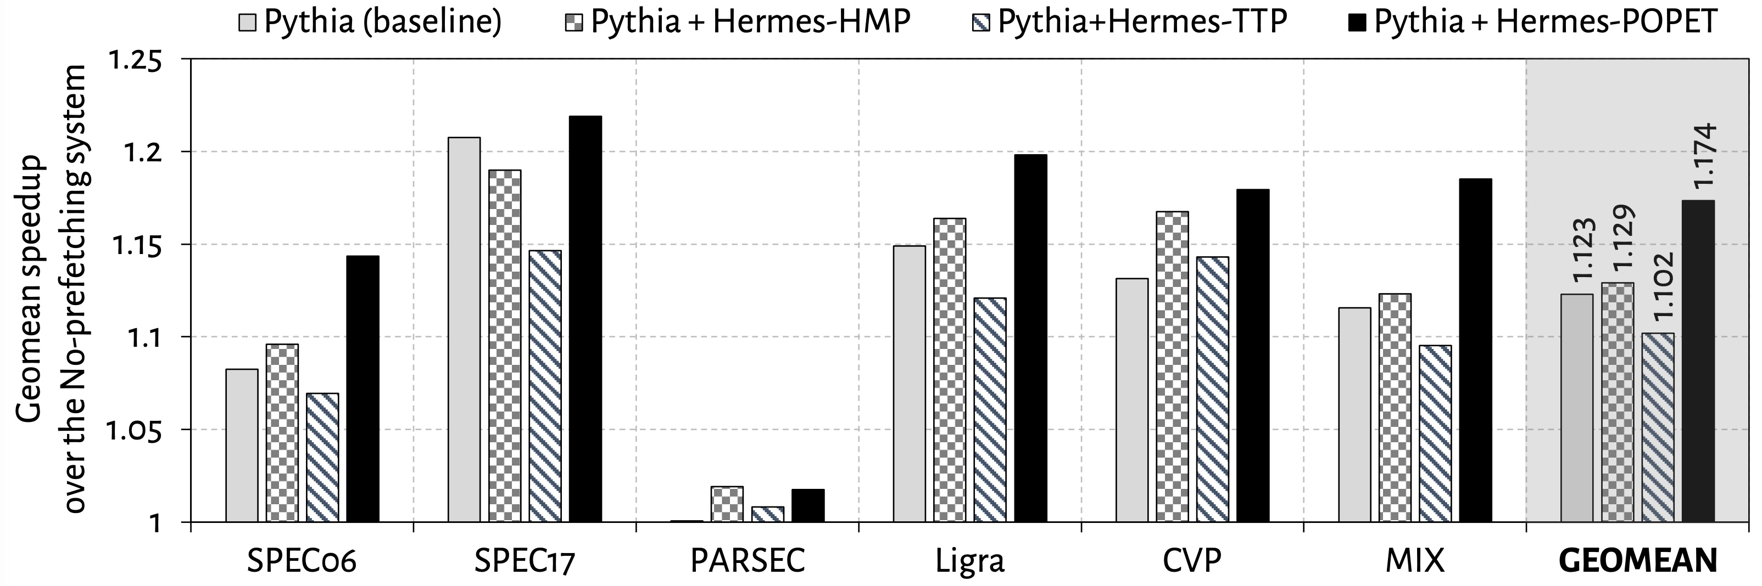
Eight-Core Performance
Hermes in combination with Pythia
outperforms Pythia alone by 5.1% on average

Slide 127
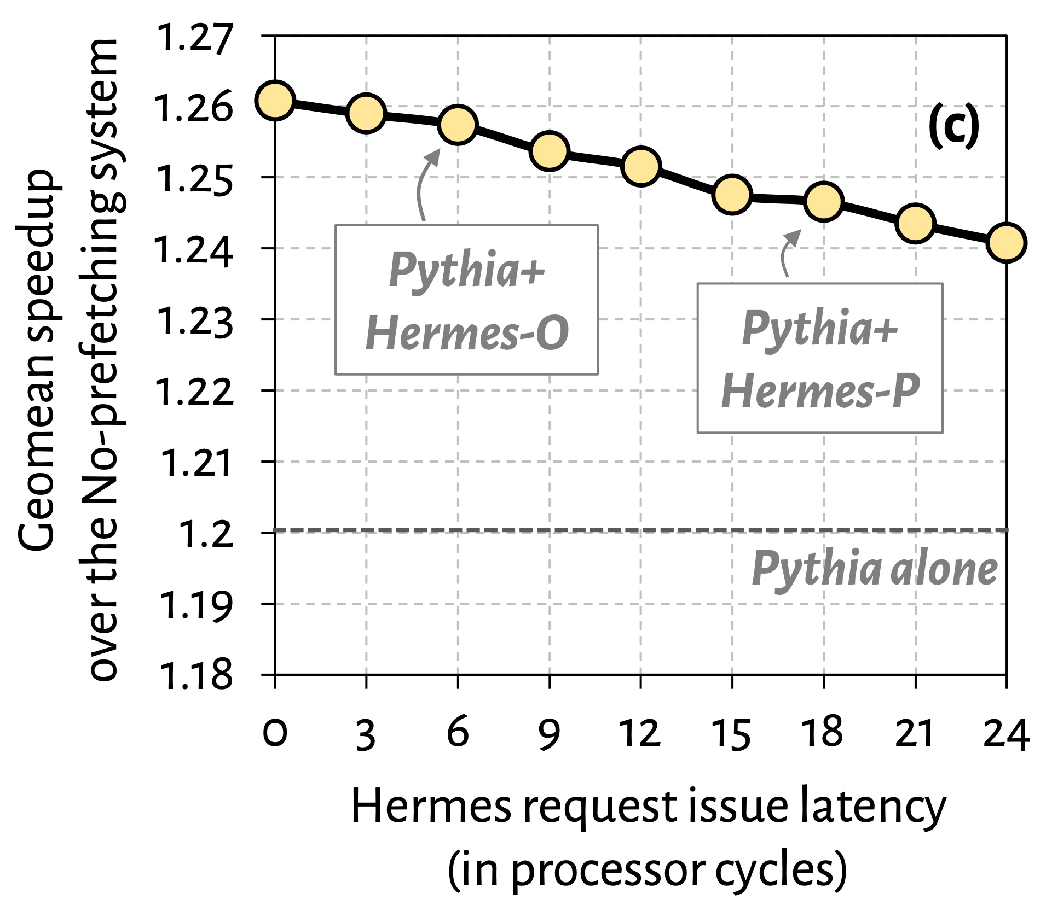

Effect of Hermes Request Issue Latency
3.6%
5.7%
Hermes in combination with Pythia outperforms Pythia alone even with a 24-cycle Hermes request issue latency

Slide 128
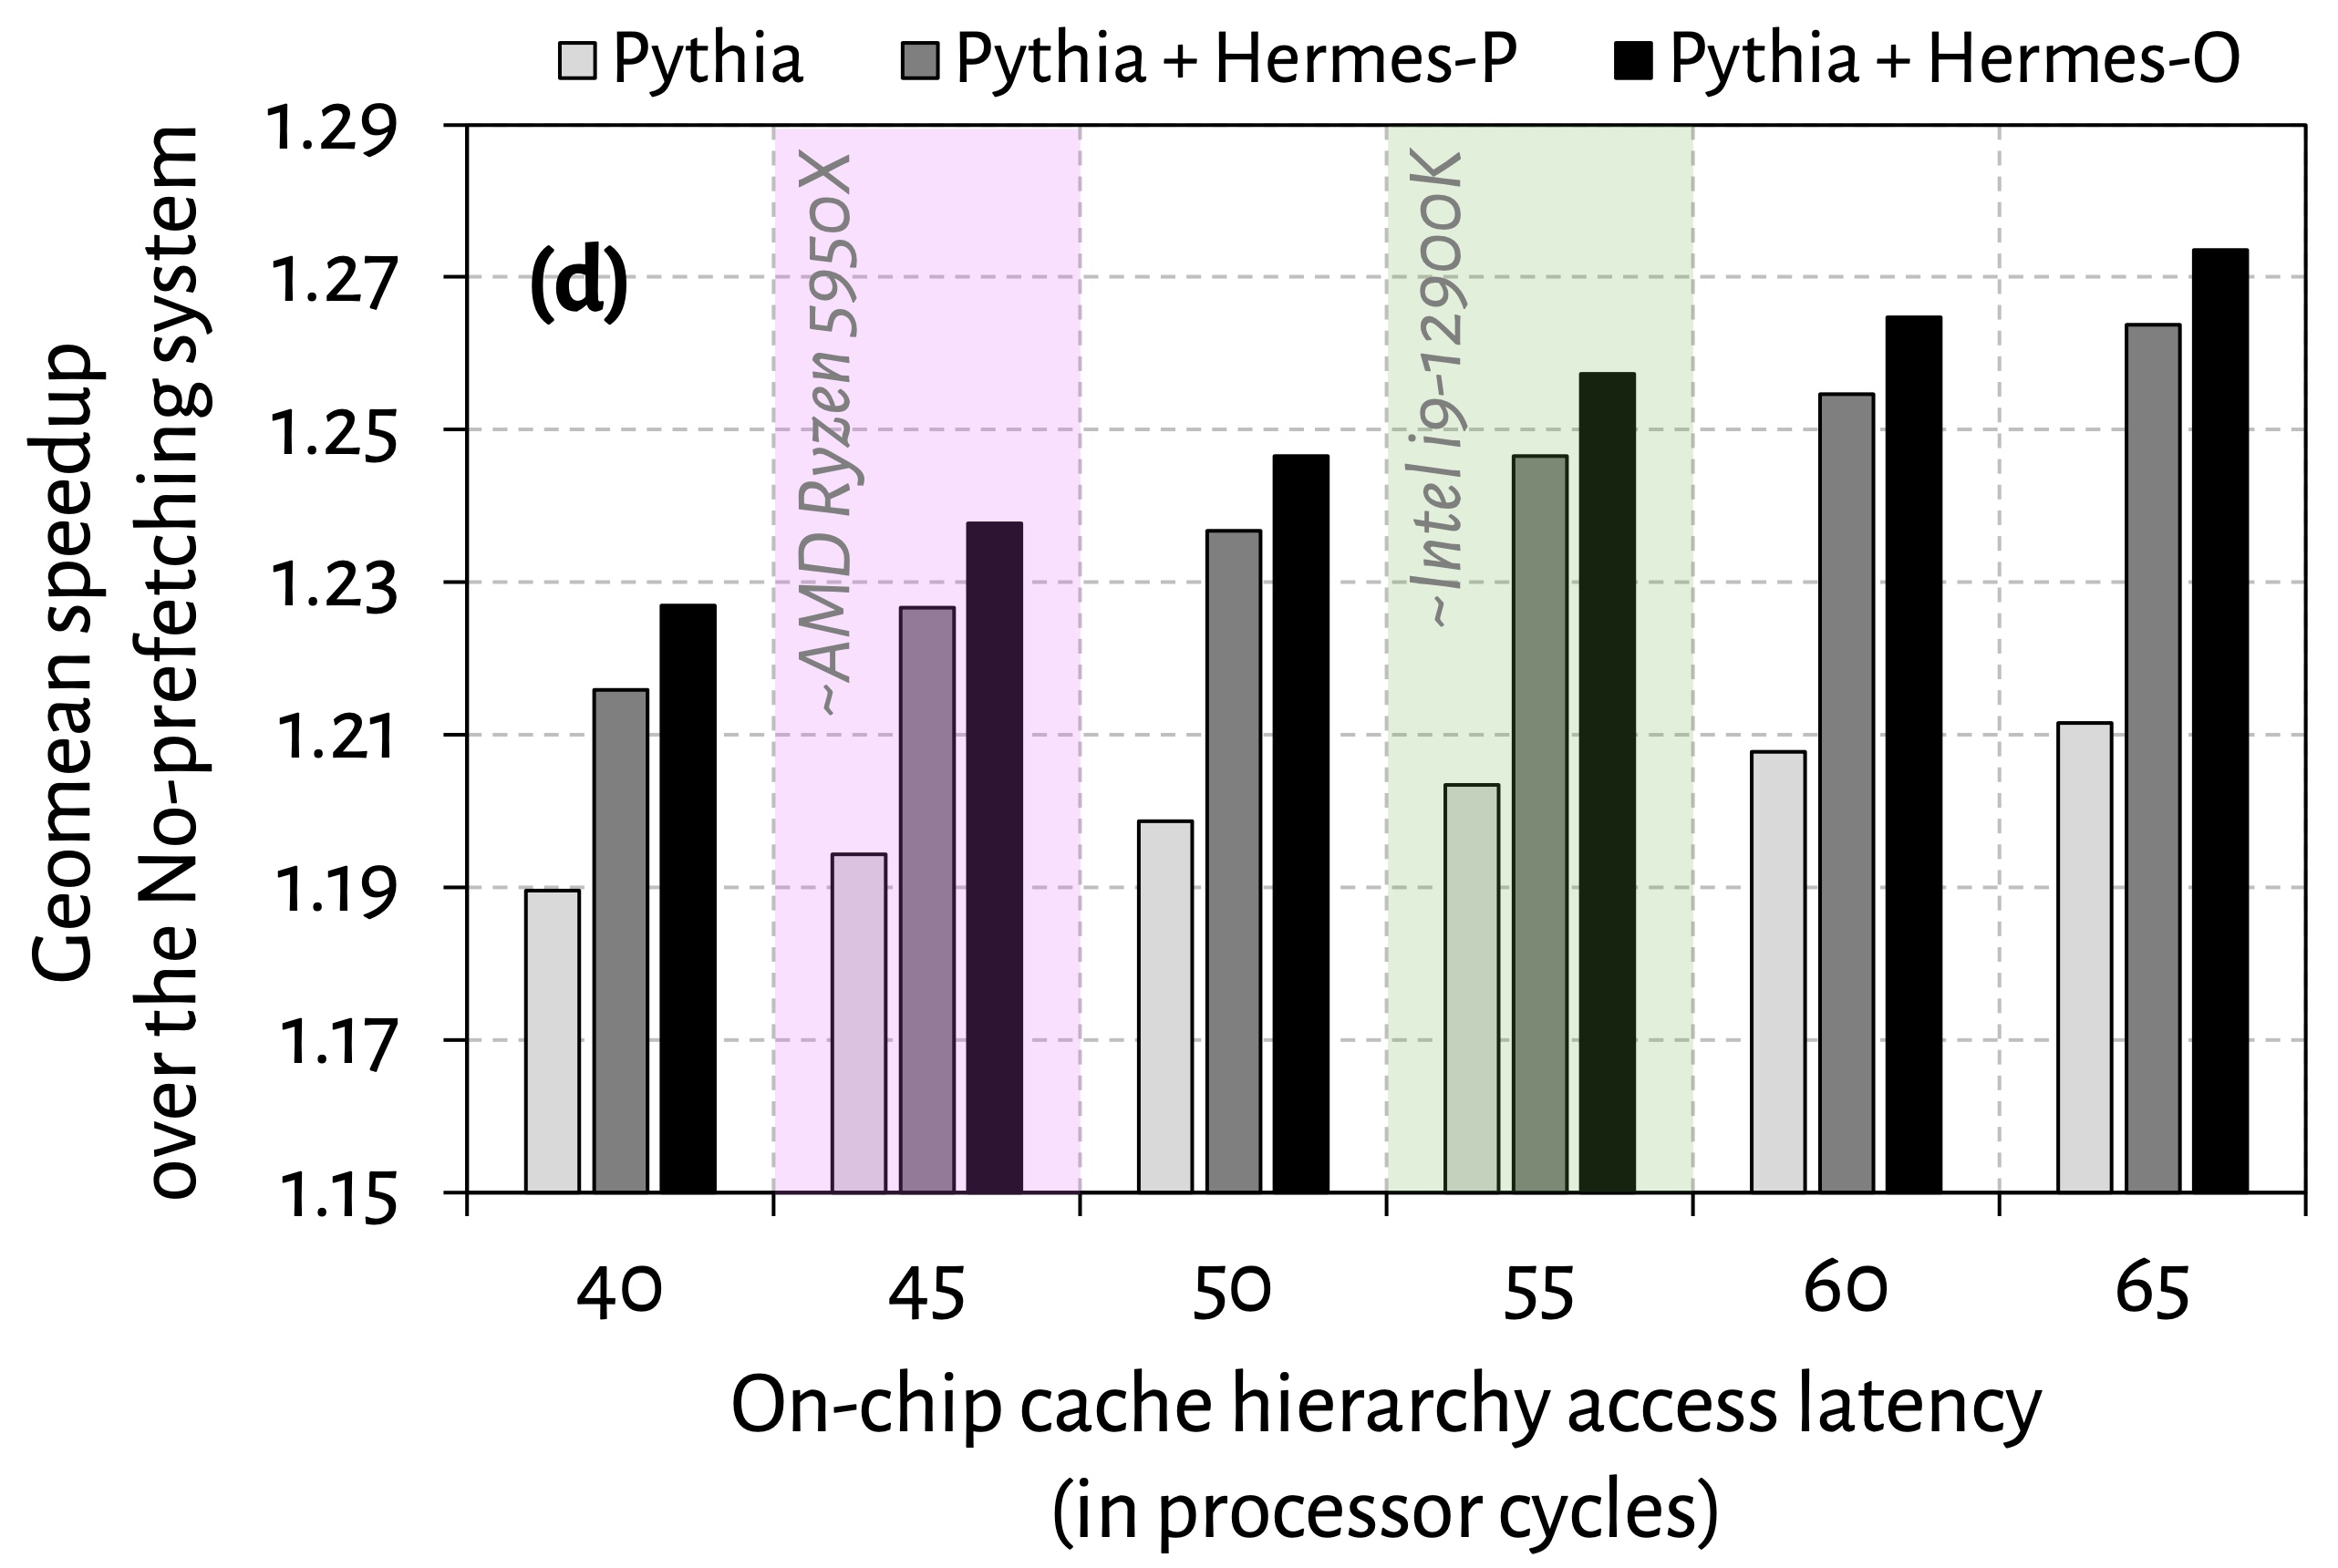
Effect of Cache Hierarchy Access Latency
6.2%
3.6%
Hermes can provide even higher performance benefit in
future processors with bigger and slower on-chip caches

Slide 129
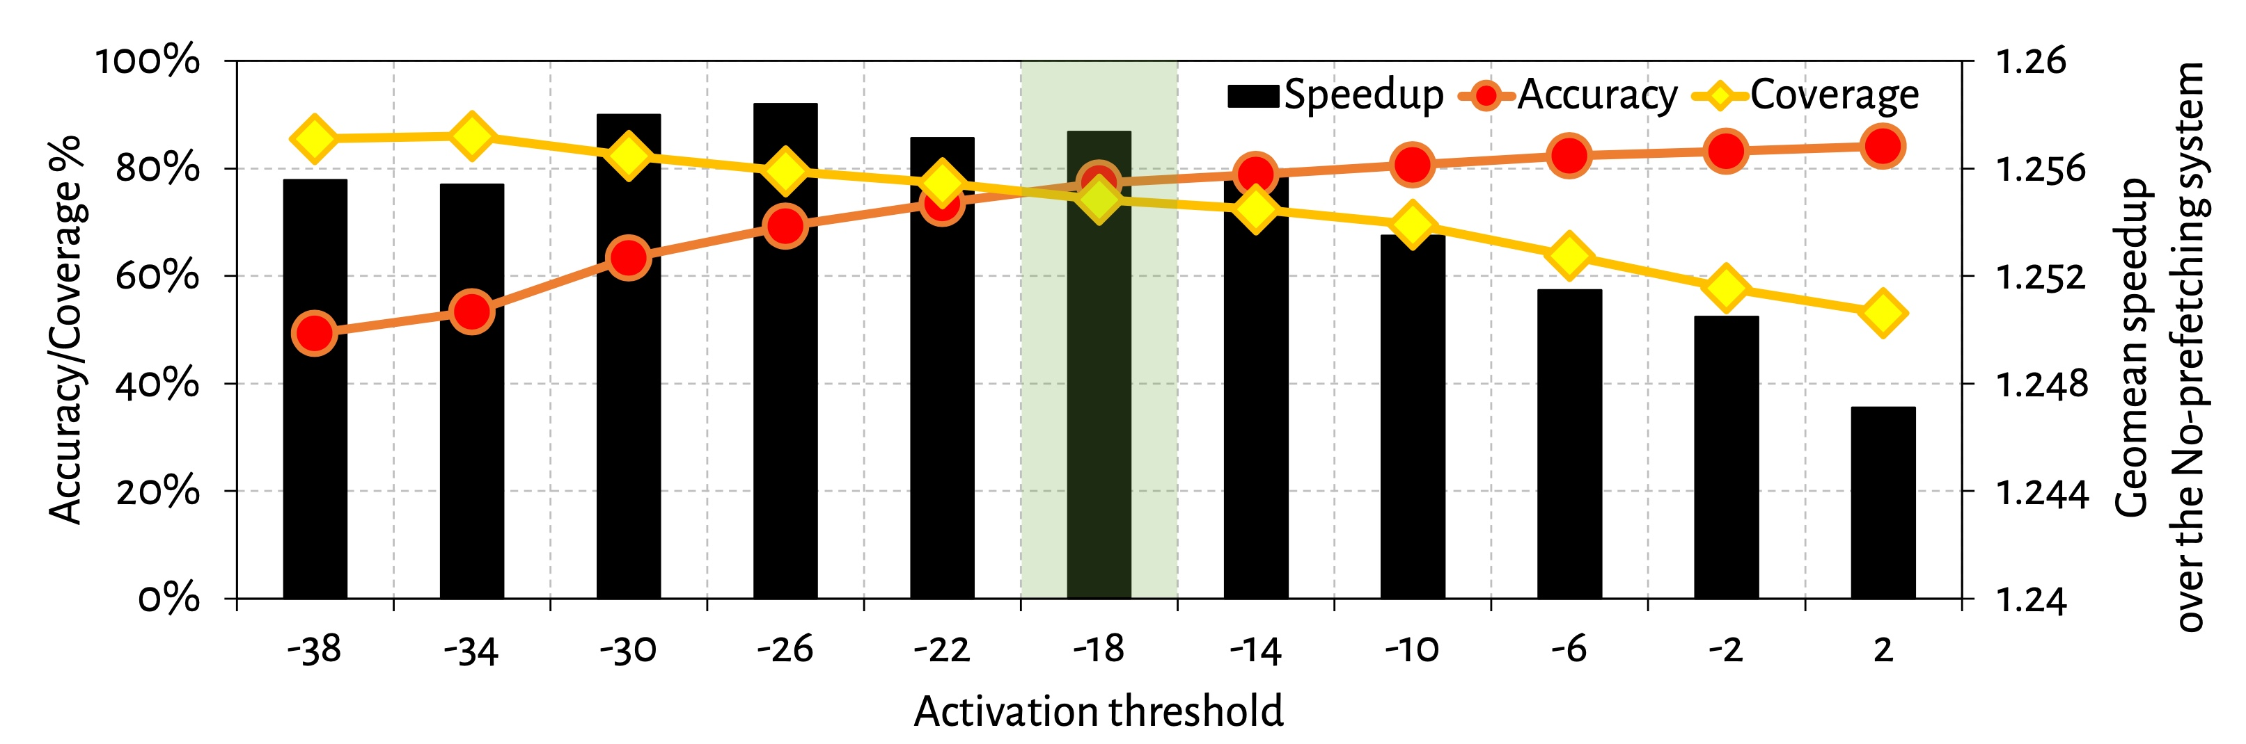
Effect of Activation Threshold
With increase in activation threshold
Accuracy increases
Coverage decreases

Slide 130
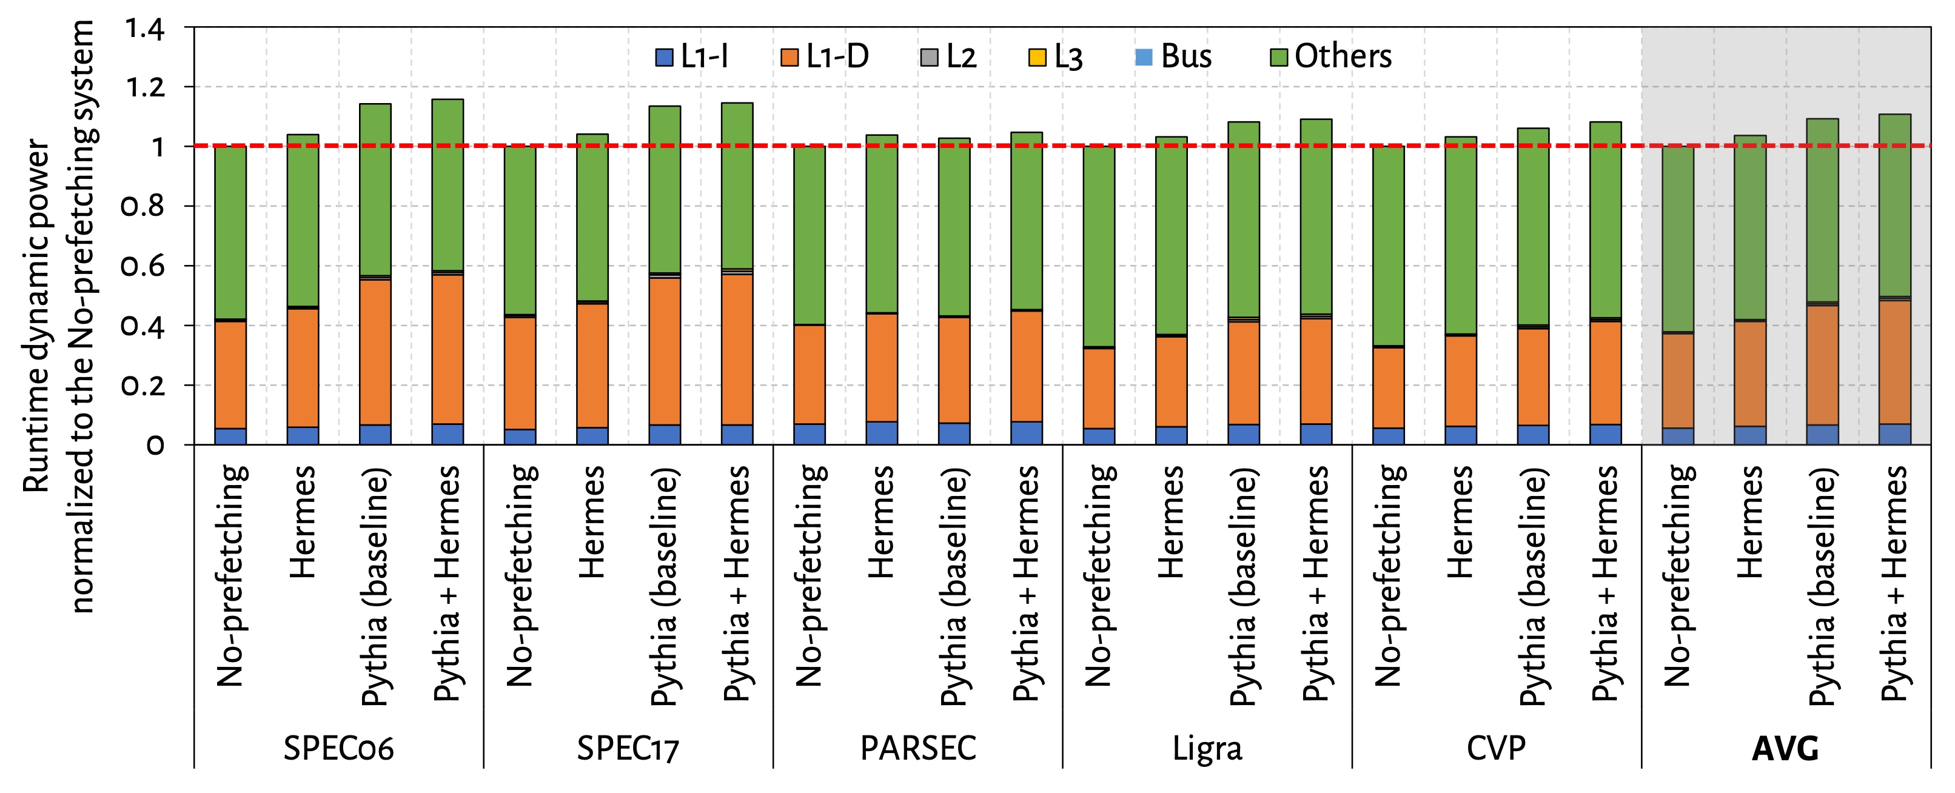
Power Overhead

Slide 131

Effect of ROB Size
6.7%
5.3%

Slide 132

Effect of LLC Size
2.5%
1.3%

Slide 133

Accuracy and Coverage with Different Prefetchers
POPET’s accuracy and coverage increases significantly
in absence of a data prefetcher

Slide 134

Increase in Main Memory Requests

Slide 135
SIBYL BACKUP
135

Slide 136

Performance on Unseen Workloads
H&M (H&L) HSS configuration, Sibyl outperforms RNN-HSS and Archivist by 46.1% (54.6%) and 8.5% (44.1%), respectively

Slide 137
Performance Analysis
Performance-Oriented HSS Configuration
Slow-Only
CDE
HPS
Archivist
RNN-HSS
Sibyl
Oracle
Baseline policies are ineffective for many workloads even when compared to Slow-Only
Notes:
For workloads like prn_1, proj_2, etch baseline policies are ineffeciteve even when compared to slow only policy does places everything in the slow storage

Slide 138

Performance on Mixed Workloads
Slow-Only
CDE
HPS
Archivist
RNN-HSS
Sibyl_{Def}
Sibyl_{Opt}
Oracle
Performance-Oriented
Cost-Oriented
Notes:
We evaluate mixing two or more workloads at the same time while randomly varying their relative start times.
Such a scenario
leads to unpredictable execution where requests arrive at dif- ferent, unpredictable timesteps,
mimics distributed workloads,
(3) further tests the ability of Sibyl to dynamically adapt its decision-making policy.
shows average request latency for mixed workloads in two different storage configuration.[click] We use two different settings for Sibyl: (a) Sibyl𝐷𝑒 𝑓 , where we use our default hyper-parameters and (b) Sibyl𝑂𝑝𝑡, where we optimize the hyper-parameters for these mixed workloads

Slide 139

Performance on Mixed Workloads
Slow-Only
CDE
HPS
Archivist
RNN-HSS
Sibyl_{Def}
Sibyl_{Opt}
Oracle
Performance-Oriented
Cost-Oriented
Sibyl_{Def} outperforms baseline data placement techniques by up to 27.9%
Notes:
Sibyl𝐷𝑒 𝑓 provides upto 27.9% higher performance than baseline policies

Slide 140

Performance on Mixed Workloads
Slow-Only
CDE
HPS
Archivist
RNN-HSS
Sibyl_{Def}
Sibyl_{Opt}
Oracle
Performance-Oriented
Cost-Oriented
Sibyl_{Def} outperforms baseline data placement techniques by up to 27.9%
Sibyl_{Opt} provides 7.2% higher average performance than Sibyl_{Def}
Notes:
With optimized hyper-parameters, Sibyl𝑂𝑝𝑡 provides 5.2% (9.3%) higher average performance for H&M (H&L) HSS configuration than Sibyl𝐷𝑒 𝑓 .
We conclude that Sibyl can effectively adapt its data placement policy online to highly dynamic workloads.

Slide 141

Performance With Different Features
Sibyl autonomously decides which features are important to maximize the performance of the running workload

Slide 142

Sensitivity to Fast Storage Capacity

Slide 143

Explainability Analysis

Slide 144

Training and Inference Network
Training and inference network allow parallel execution
Observation vector as the input
Produces probability distribution of Q-values
Notes:
A deep neural network can be prohibitive due to the long time it requires for training and convergence, preventing Sibyl to adapt to new state-action pairs in a timely manner.
Based on experiments, we find that a simple feed-forward network [135] with only two hidden layers [136] provides good performance for Sibyl’s data placement task.
The network takes the observation vector 𝑂𝑡 as its input and produces a probability distribution of Q-values as its output

