Slide 1



Pythia & Hermes:
ML-Driven Prefetching
Onur Mutlu
omutlu@gmail.com
https://people.inf.ethz.ch/omutlu
20 September 2023
VMware

Slide 2
Data-Driven (Self-Optimizing) Architectures

Slide 3
System Architecture Design Today
Human-driven
  Humans design the policies (how to do things)
Many (too) simple, short-sighted policies all over the system
No automatic data-driven policy learning
(Almost) no learning: cannot take lessons from past actions
Can we design
fundamentally intelligent architectures?

Slide 4
An Intelligent Architecture
Data-driven
  Machine learns the “best” policies (how to do things)
Sophisticated, workload-driven, changing, far-sighted policies
Automatic data-driven policy learning
All controllers are intelligent data-driven agents
We need to rethink design
(of all controllers)

Slide 5
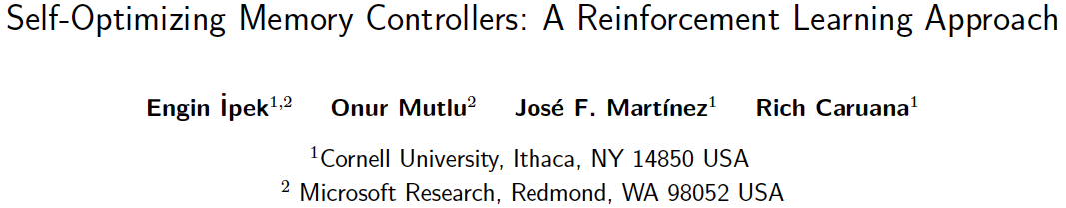
Self-Optimizing Memory Controllers
Engin Ipek, Onur Mutlu, José F. Martínez, and Rich Caruana,
"Self Optimizing Memory Controllers: A Reinforcement Learning Approach"
Proceedings of the 35th International Symposium on Computer Architecture (ISCA), pages 39-50, Beijing, China, June 2008. Selected to the ISCA-50 25-Year Retrospective Issue covering 1996-2020 in 2023 (Retrospective (pdf) Full Issue).

Slide 6
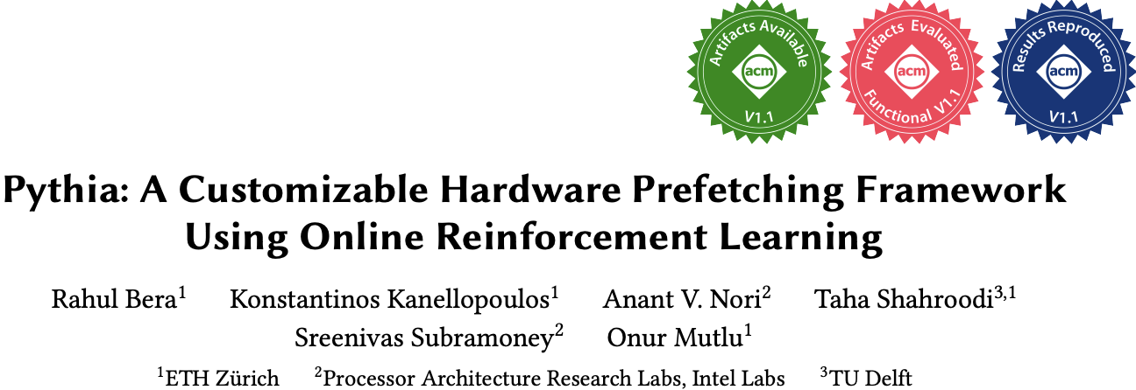
Self-Optimizing Memory Prefetchers
Rahul Bera, Konstantinos Kanellopoulos, Anant Nori, Taha Shahroodi, Sreenivas Subramoney, and Onur Mutlu,
"Pythia: A Customizable Hardware Prefetching Framework Using Online Reinforcement Learning"
Proceedings of the 54th International Symposium on Microarchitecture (MICRO), Virtual, October 2021.
[Slides (pptx) (pdf)]
[Short Talk Slides (pptx) (pdf)]
[Lightning Talk Slides (pptx) (pdf)]
[Talk Video (20 minutes)]
[Lightning Talk Video (1.5 minutes)]
[Pythia Source Code (Officially Artifact Evaluated with All Badges)]
[arXiv version]
Officially artifact evaluated as available, reusable and reproducible.
https://arxiv.org/pdf/2109.12021.pdf

Slide 7
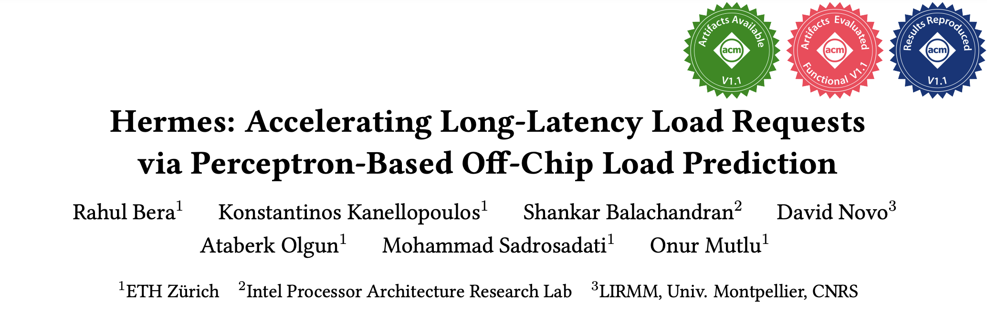
Learning-Based Off-Chip Load Predictors
Rahul Bera, Konstantinos Kanellopoulos, Shankar Balachandran, David Novo, Ataberk Olgun, Mohammad Sadrosadati, and Onur Mutlu,
"Hermes: Accelerating Long-Latency Load Requests via Perceptron-Based Off-Chip Load Prediction"
Proceedings of the 55th International Symposium on Microarchitecture (MICRO), Chicago, IL, USA, October 2022.
[Slides (pptx) (pdf)]
[Longer Lecture Slides (pptx) (pdf)]
[Talk Video (12 minutes)]
[Lecture Video (25 minutes)]
[arXiv version]
[Source Code (Officially Artifact Evaluated with All Badges)]
Officially artifact evaluated as available, reusable and reproducible.
Best paper award at MICRO 2022.
https://arxiv.org/pdf/2209.00188.pdf

Slide 8
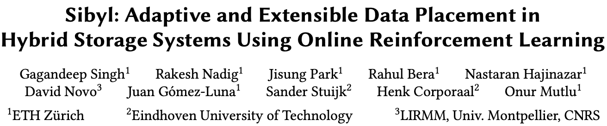
Self-Optimizing Hybrid SSD Controllers
Gagandeep Singh, Rakesh Nadig, Jisung Park, Rahul Bera, Nastaran Hajinazar, David Novo, Juan Gomez-Luna, Sander Stuijk, Henk Corporaal, and Onur Mutlu,
"Sibyl: Adaptive and Extensible Data Placement in Hybrid Storage Systems Using Online Reinforcement Learning"
Proceedings of the 49th International Symposium on Computer Architecture (ISCA), New York, June 2022.
[Slides (pptx) (pdf)]
[arXiv version]
[Sibyl Source Code]
[Talk Video (16 minutes)]
https://arxiv.org/pdf/2205.07394.pdf

Slide 9
Pythia: Prefetching using
Reinforcement Learning

Slide 10
Self-Optimizing Memory Prefetchers
Rahul Bera, Konstantinos Kanellopoulos, Anant Nori, Taha Shahroodi, Sreenivas Subramoney, and Onur Mutlu,
"Pythia: A Customizable Hardware Prefetching Framework Using Online Reinforcement Learning"
Proceedings of the 54th International Symposium on Microarchitecture (MICRO), Virtual, October 2021.
[Slides (pptx) (pdf)]
[Short Talk Slides (pptx) (pdf)]
[Lightning Talk Slides (pptx) (pdf)]
[Talk Video (20 minutes)]
[Lightning Talk Video (1.5 minutes)]
[Pythia Source Code (Officially Artifact Evaluated with All Badges)]
[arXiv version]
Officially artifact evaluated as available, reusable and reproducible.
https://arxiv.org/pdf/2109.12021.pdf

Slide 11






Pythia
A Customizable Hardware Prefetching Framework Using Online Reinforcement Learning
Rahul Bera, Konstantinos Kanellopoulos, Anant V. Nori,
Taha Shahroodi, Sreenivas Subramoney, Onur Mutlu
https://github.com/CMU-SAFARI/Pythia
https://arxiv.org/pdf/2109.12021.pdf
Notes:
Hi I am Rahul. Today, I’m going to present our work “…”
This work is done by researchers from SAFARI research group at ETH Zurich, in collaboration with Intel Labs and TU Delft.

Slide 12
Executive Summary
Background: Prefetchers predict addresses of future memory requests by associating memory access patterns with program context (called feature)
Problem: Three key shortcomings of prior prefetchers:
  Predict mainly using a single program feature
  Lack inherent system awareness (e.g., memory bandwidth usage)
  Lack in-silicon customizability
Goal: Design a prefetching framework that:
  Learns from multiple features and inherent system-level feedback
  Can be customized in silicon to use different features and/or prefetching objectives
Contribution: Pythia, which formulates prefetching as reinforcement learning problem
  Takes adaptive prefetch decisions using multiple features and system-level feedback
  Can be customized in silicon for target workloads via simple configuration registers
  Proposes a realistic and practical implementation of RL algorithm in hardware
Key Results:
  Evaluated using a wide range of workloads from SPEC CPU, PARSEC, Ligra, Cloudsuite
  Outperforms best prefetcher (in 1-core config.) by 3.4%, 7.7% and 17% in 1/4/bw-constrained cores
  Up to 7.8% more performance over basic Pythia across Ligra workloads via simple customization
https://github.com/CMU-SAFARI/Pythia
Notes:
First, I am going to start with an executive summary.
[CLICK] Prefetching is a speculative technique that predicts address of future memory requests by associating patterns in memory addresses with some program context. We call this context a feature.
[CLICK] We observe three key shortcomings in prior prefetchers:
First, they mainly use a single program feature for prediction.
Second, they lack inherent system awareness
Third, they also lack any customizability in silicon
[CLICK] Our goal in this work is to design a prefetching framework that
– can learn from multiple program features and inherent system-level feedback
-- and can be customized in silicon to change the features or the objective of the prefetcher
[CLICK] Towards this we propose Pythia, that formulates …
Pythia makes adaptive and autonomous …
Pythia also proposes a realistic and practical …
[CLICK] We extensively evaluate Pythia using …
We show that Pythia outperforms prior state-of-the-art …
Pythia is freely available in our GitHub repository.

Slide 13
Talk Outline
Key Shortcomings of Prior Prefetchers
Formulating Prefetching as Reinforcement Learning
Pythia: Overview
Evaluation of Pythia and Key Results
Conclusion
Notes:
This is the outline of my talk.
First, I am going to start by discussing key shortcomings of prior prefetchers.

Slide 14
Prefetching Basics
Predicts addresses of long-latency memory requests and fetches data before the program demands it
Associates access patterns from past memory requests with program context information
Example program features
  Program counter (PC)
  Page number
  Page offset
  Cacheline delta
  …
  Or a combination of these attributes
Program Feature
Program context → Access Pattern
Notes:
Prefetching is a speculative technique that predicts …
[CLICK] To predict addresses, a prefetcher typically associates …
[CLICK] We call these context information as program feature.
[CLICK] Some examples of program features are … or any combination of these information

Slide 15
Key Shortcomings in Prior Prefetchers
We observe three key shortcomings that significantly limit performance benefits of prior prefetchers
Predict mainly using a single program feature
1
Lack inherent system awareness
2
Lack in-silicon customizability
3
Notes:
We observe three key shortcomings in prior prefetchers that significantly limits their performance improvement
[CLICK] First, they predict mainly …
[CLICK] Second, they lack any inherent …
[CLICK] Third, the also lack any online in-silicon customizability
Let’s take a closer look at each of these shortcomings.
[NEXT]

Slide 16
(1) Single-Feature Prefetch Prediction
Provides good performance gains mainly on workloads where the feature-to-pattern correlation exists
15.4%
4.6%
5.5%
3.5%
Bingo [1] performs better
SPP [2] performs better
[1] Bakshalipour et al., HPCA’19
[2] Kim et al., MICRO’16
Notes:
Due to the use of a single program feature for prefetch prediction, a prefetcher typically provides performance benefits …
In other types of workloads, the same prefetcher fails to provide performance gains.
To illustrate this [CLICK], we show the coverage, overprediction, and performance improvement of two prior prefetchers SPP and Bingo for six sample workloads.
The top figure shows …
The bottom figure shows …
As we can see, for workloads like [CLICK], … Bingo performs better than SPP, as the program feature exploited by Bingo has stronger correlation with the access pattern than SPP.
On the other hand, for workloads like … [CLICK], SPP’s program feature provides better correlation, and thus performs better than Bingo.

Slide 17
(1) Single-Feature Prefetch Prediction
Provides good performance gains mainly on workloads where the feature-to-pattern correlation exists
Relying on a single feature for prediction leaves significant performance improvement on table
15.4%
4.6%
5.5%
3.5%
Bingo [1] performs better
SPP [2] performs better
[1] Bakshalipour et al., HPCA’19
[2] Kim et al., MICRO’16
Notes:
Due to the use of a single program feature for prefetch prediction, a prefetcher typically provides performance benefits …
In other types of workloads, the same prefetcher fails to provide performance gains.
To illustrate this [CLICK], we show the coverage, overprediction, and performance improvement of two prior prefetchers SPP and Bingo for six sample workloads.
The top figure shows …
The bottom figure shows …
As we can see, for workloads like [CLICK], … Bingo performs better than SPP, as the program feature exploited by Bingo has stronger correlation with the access pattern than SPP.
On the other hand, for workloads like … [CLICK], SPP’s program feature provides better correlation, and thus performs better than Bingo.

Slide 18
(2) Lack of Inherent System Awareness
Little understanding of undesirable effects (e.g., memory bandwidth usage, cache pollution, …)
  Performance loss in resource-constrained configurations
368%
574%
Similar coverage
Lower overpredictions
Yet, lower performance
Notes:
The second shortcoming is that, all prior prefetchers have …, which often leads to …
To illustrate this, let revisit the previous figure and focus on Bingo’s performance in PARSEC-Canneal and Ligra-CC.
Bingo in Ligra-CC has similar coverage to PARSEC-Canneal with significantly …
The reason is that, in baseline without prefetching, Ligra-CC consumes much higher main memory …
As a result, even a smaller amount of overprediction hurts more performance in Ligra-CC than in PARSEC-Canneal.
This is only happening as Bingo does not take its undesirable effects into account while prefetching.
Thus the key takeaway is that, [CLICK] …

Slide 19
(2) Lack of Inherent System Awareness
Little understanding of undesirable effects (e.g., memory bandwidth usage, cache pollution, …)
  Performance loss in resource-constrained configurations
368%
574%
Prefetchers often lose performance due to lack of inherent system awareness
Similar coverage
Lower overpredictions
Yet, lower performance
Notes:
The second shortcoming is that, all prior prefetchers have …, which often leads to …
To illustrate this, let revisit the previous figure and focus on Bingo’s performance in PARSEC-Canneal and Ligra-CC.
Bingo in Ligra-CC has similar coverage to PARSEC-Canneal with significantly …
The reason is that, in baseline without prefetching, Ligra-CC consumes much higher main memory …
As a result, even a smaller amount of overprediction hurts more performance in Ligra-CC than in PARSEC-Canneal.
This is only happening as Bingo does not take its undesirable effects into account while prefetching.
Thus the key takeaway is that, [CLICK] …

Slide 20


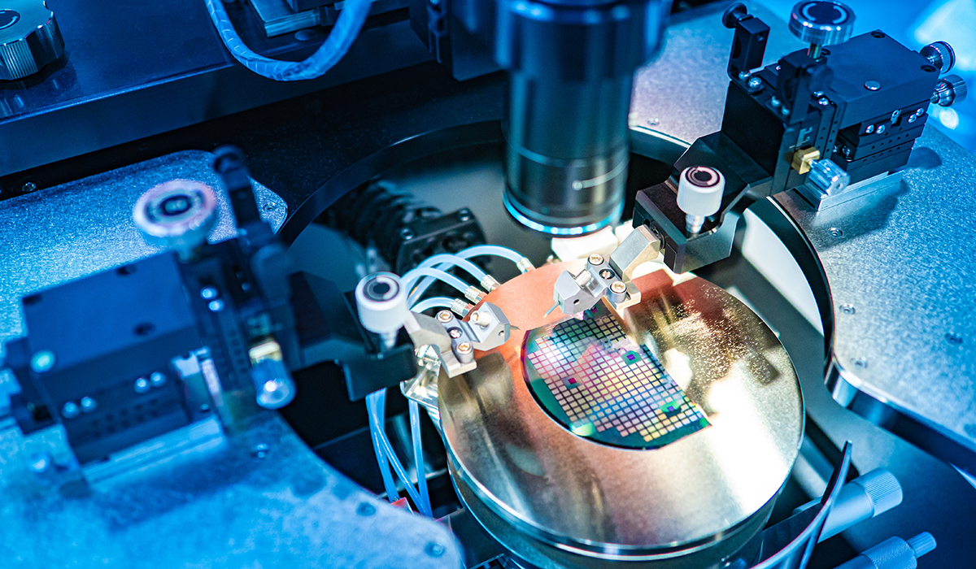
(3) Lack of In-silicon Customizability
Feature statically selected at design time
  Rigid hardware designed specifically to exploit that feature
No way to change program feature and/or change prefetcher’s objective in silicon
  Cannot adapt to a wide range of workload demands
Design from scratch
Verify
Fabricate
Notes:
The third key shortcoming is that, all prior prefetcher lack in-silicon customizability.
These prefetchers statically selects the feature to exploit at design time and design a rigid hardware to specifically …
[CLICK] There is no way …
In order to exploit a new program feature, architects need to design a prefetcher from scratch …
[CLICK] and this cycle goes on for every new prefetcher. This wastes precious design time and human resource.

Slide 21
Our Goal
A prefetching framework that can:
Learn to prefetch using multiple features and inherent system-level feedback information
Be easily customized in silicon to use different features and/or change prefetcher’s objectives
Notes:
So our goal in this work is to … that
[CLICK] …
[CLICK] …

Slide 22

Our Proposal
Pythia
Formulates prefetching as a reinforcement learning problem
Pythia is named after the oracle of Delphi, who is known for her accurate prophecies
https://en.wikipedia.org/wiki/Pythia

Slide 23
Talk Outline
Key Shortcomings of Prior Prefetchers
Formulating Prefetching as Reinforcement Learning
Pythia: Overview
Evaluation of Pythia and Key Results
Conclusion
Notes:
To this end, we propose Pythia, which formulates …

Slide 24
Basics of Reinforcement Learning (RL)
Algorithmic approach to learn to take an action in a given situation to maximize a numerical reward
Agent stores Q-values for every state-action pair
  Expected return for taking an action in a state
  Given a state, selects action that provides highest Q-value
Notes:
First, let me briefly describe the basics of reinforcement learning.
Reinforcement learning, in its simplest form, is the ...
A RL system contains two components: [CLICK] the agent and the environment.
The agent observes the state of the environment in every timestep [CLICK], takes an action based on the state [CLICK], and receives a reward for that action [CLICK].
[CLICK] The agent stores …
Given a state, the agent …

Slide 25
Formulating Prefetching as RL
Notes:
In Pythia, we formulate prefetching as a reinforcement learning problem.
[CLICK] The prefetcher acts as the agent, while [CLICK] the processor and memory subsystem acts as the environment.
[CLICK] Pythia extracts the program features from every demand request and use it as a state information to take a prefetch action [CLICK]
[CLICK] For every prefetch action, Pythia receives a numerical reward that evaluates the usefulness of the prefetch request, while considering various system-level feedbacks.
Not let’s concretely define the state, action, and the reward for Pythia.

Slide 26

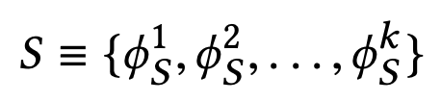
What is State?
k-dimensional vector of features
Feature = control-flow + data-flow
Control-flow examples
  PC
  Branch PC
  Last-3 PCs, …
Data-flow examples
  Cacheline address
  Physical page number
  Delta between two cacheline addresses
  Last 4 deltas, …
Notes:
We define the state as a k-dimensional vector of program features.
[CLICK] Each feature is composed of …
[CLICK] Some examples of control-flow information are …
[CLICK] Some examples of data-flow information are …
Though Pythia can theoretically learn from any number of such program features, we limit the size k as per storage budget.

Slide 27
What is State?
Example of a state information
S = {PC+Delta, Sequence of last-4 deltas}
Feature-1 (ɸ₁)
Feature-2 (ɸ₂)
PC
(Control-flow info.)
Cacheline Delta
(Data-flow info.)
Seq. of last-4 deltas
(Data-flow info.)
Notes:
We define the state as a k-dimensional vector of program features.
[CLICK] Each feature is composed of …
[CLICK] Some examples of control-flow information are …
[CLICK] Some examples of data-flow information are …
Though Pythia can theoretically learn from any number of such program features, we limit the size k as per storage budget.

Slide 28
What is Action?
Given a demand access to address A
the action is to select prefetch offset “O”
Action-space: 127 actions in the range [-63, +63]
  For a machine with 4KB page and 64B cacheline
Upper and lower limits ensure prefetches do not cross physical page boundary
A zero offset means no prefetch is generated
We further prune action-space by design-space exploration
Notes:
We define the action as the selection of a prefetch offset. Pythia adds this offset to the demanded cacheline to get the prefetched cacheline address.
[CLICK] Note that a zero offset is also a valid action for Pythia, which means no prefetch is generated.
[CLICK] As every post-L1 prefetcher …, the list of actions are limited to the range from -63 to +63 for a traditionally-sized …
[CLICK] However, we can prune the action list by automatic design-space exploration, as we show in the paper.

Slide 29
What is Reward?
Defines the objective of Pythia
Encapsulates two metrics:
  Prefetch usefulness (e.g., accurate, late, out-of-page, …)
  System-level feedback (e.g., mem. b/w usage, cache pollution, energy, …)
We demonstrate Pythia with memory bandwidth usage as the system-level feedback in the paper
Notes:
The reward defines the objective of Pythia
[CLICK] A reward encapsulates two metrics: …
[CLICK] Though Pythia can learn from any …, in this paper we demonstrate Pythia using a major system-level feedback: mem b/w usage

Slide 30
What is Reward?
Seven distinct reward levels
  Accurate and timely (R_{AT})
  Accurate but late (R_{AL})
  Loss of coverage (R_{CL})
  Inaccurate
    With low memory b/w usage (R_{IN}-L)
    With high memory b/w usage (R_{IN}-H)
  No-prefetch
    With low memory b/w usage (R_{NP}-L)
    With high memory b/w usage(R_{NP}-H)
Values are set at design time via automatic design-space exploration
  Can be customized further in silicon for higher performance
Notes:
We define reward in five distinct levels mentioned as follows [CLICK].
Each reward level corresponds to various usefulness of a prefetch request. The inaccurate and no-prefetch reward levels are further categorized based on the system memory bandwidth usage.
[CLICK] The values of each of these reward levels are set at design time via automatic design-space exploration.
[CLICK] However, one can customize the rewards in silicon via simple configuration registers to specify a dfferent objective for Pythia for extracting higher performance benefits in target workload suites.

Slide 31
Steering Pythia’s Objective via Reward Values
Example reward configuration for
  Generating accurate prefetches
  Making bandwidth-aware prefetch decisions
-14
-8
-4
-2
+12
+20
R_{IN}-H
R_{IN}-L
R_{NP}-L
R_{NP}-H
R_{AL}
R_{AT}
AT = Accurate & timely; AL = Accurate & late; NP = No-prefetching; IN = Inaccurate;
H = High mem. b/w; L = Low mem. b/w
1
Highly prefers to generate accurate prefetches
2
Prefers not to prefetch if memory bandwidth usage is low
3
Strongly prefers not to prefetch if memory bandwidth usage is high
Notes:
Now, let’s take a concrete example of reward values and how they specify the objectives for Pythia.
[CLICK] These are the reward level values in basic Pythia configuration.
Pythia sets three key objectives for prefetching by this reward configuration.
[CLICK] First, we provide much higher perks to Pythia for prefetching accurately, either timely or untimely. Thus, Pythia prefers to generate accurate prefetches.
[CLICK] Second, in case of low memory bandwidth usage, Pythia has higher perks in no prefetching, rather that prefetching inaccurately.
Thus, if the memory bandwidth usage is low, Pythia prefers not to prefetch, rather than prefetching inaccurately.
[CLICK] Third, in case of high memory bandwidth usage, Pythia has much higher perks in no prefetching than prefetching accurately.
Thus, if the memory bandwidth usage is low, Pythia strongly prefers not to prefetch, rather than prefetching inaccurately.
[] Let’s take a look at a reward values to steer Pythia to generate accurate prefetches and make fine-tuned decisions based on b/w usage.

Slide 32
Steering Pythia’s Objective via Reward Values
Customizing reward values to make Pythia conservative towards prefetching
-22
-20
+1
+2
+12
+20
R_{IN}-H
R_{IN}-L
R_{NP}-L
R_{NP}-H
R_{AL}
R_{AT}
AT = Accurate & timely; AL = Accurate & late; NP = No-prefetching; IN = Inaccurate;
H = High mem. b/w; L = Low mem. b/w
1
Highly prefers to generate accurate prefetches
2
Otherwise prefers not to prefetch
Notes:
Now, if we increase the reward for no prefetching while significantly decreasing the rewards for inaccurate prefetching, we set a different prefetching objective for Pythia.
[CLICK] We still provide much higher perks for prefetching accurately. Thus Pythia strives to generate accurate prefetches.
[CLICK] Otherwise, we provide much higher perks for no prefetching as compared to inaccurate prefetching, irrespective of the memory bandwidth usage. Thus, Pythia becomes conservative and simply do not prefetch at all.
This is particularly useful if we are repurposing Pythia for server-class processors which have modest per-core memory bandwidth
or workloads like Ligra whose performance improvement is sensitive to memory bandwidth usage.

Slide 33

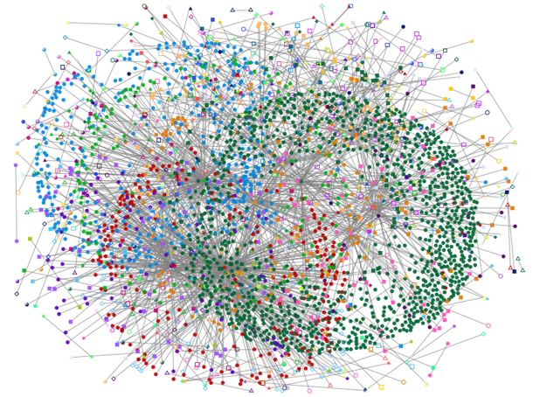
Steering Pythia’s Objective via Reward Values
Customizing reward values to make Pythia conservative towards prefetching
Strict Pythia configuration
-22
-20
+2
+4
+12
+20
R_{IN}-H
R_{IN}-L
R_{NP}-L
R_{NP}-H
R_{AL}
R_{AT}
AT = Accurate & timely; AL = Accurate & late; NP = No-prefetching; IN = Inaccurate;
H = High mem. b/w; L = Low mem. b/w
1
Highly prefers to generate accurate prefetches
2
Bandwidth-sensitive workloads
Otherwise prefers not to prefetch
Server-class processors
Notes:
Now, if we increase the reward for no prefetching while significantly decreasing the rewards for inaccurate prefetching, we set a different prefetching objective for Pythia.
[CLICK] We still provide much higher perks for prefetching accurately. Thus Pythia strives to generate accurate prefetches.
[CLICK] Otherwise, we provide much higher perks for no prefetching as compared to inaccurate prefetching, irrespective of the memory bandwidth usage. Thus, Pythia becomes conservative and simply do not prefetch at all.
This is particularly useful if we are repurposing Pythia for server-class processors which have modest per-core memory bandwidth
or workloads like Ligra whose performance improvement is sensitive to memory bandwidth usage.

Slide 34
Talk Outline
Key Shortcomings of Prior Prefetchers
Formulating Prefetching as Reinforcement Learning
Pythia: Overview
Evaluation of Pythia and Key Results
Conclusion
Notes:
We now provide a brief overview and design of Pythia.

Slide 35
Pythia Overview
Q-Value Store: Records Q-values for all state-action pairs
Evaluation Queue: A FIFO queue of recently-taken actions
Find the Action with max Q-Value
A1
A2
A3
4
2
Look up
QVStore
Generate
prefetch
Demand Request
State
Vector
Memory
Hierarchy
S1
3
S2
Max
S3
S4
Q-Value Store
(QVStore)
6
Evict EQ entry and update QVStore
5
Evaluation Queue (EQ)
Insert prefetch action &
State-Action pair in EQ
1
7
Set filled bit
Assign reward to
corresponding EQ entry
Prefetch Fill
Notes:
Pythia consists of two key components:
[CLICK] Q-value store, which is responsible for …
[CLICK] Evaluation queue, which is a first-in-first-out queue that stores the recently taken action.
As Pythia cannot always immediately assign a reward to a taken action
because the usefulness of the corresponding prefetch request is known, Pythia stores the action
in evaluation queue to properly assign rewards to them.
[CLICK] For every demand request, Pythia first checks EQ with deamdned address. If a matching entry is found in EQ, it means the corresponding action in EQ entry has generated a useful prefetch, and Pythia assigns a reward accordingly.
[CLICK] Then Pythia extracts features from the attributes of the demand request to create the state-vector and uses the state-vector to lookup QVStore [CLICK]
[CLICK] For the given state-vector, Pythia finds the action that has the highest Q-value and generates prefetch request accordingly to the memory hierarchy [CLICK]
[CLICK] Next, Pythia inserts the action in the EQ along with the state-action pair.
[CLICK] Pythia uses the reward stored in the evicted EQ entry to update the QVStore.

Slide 36
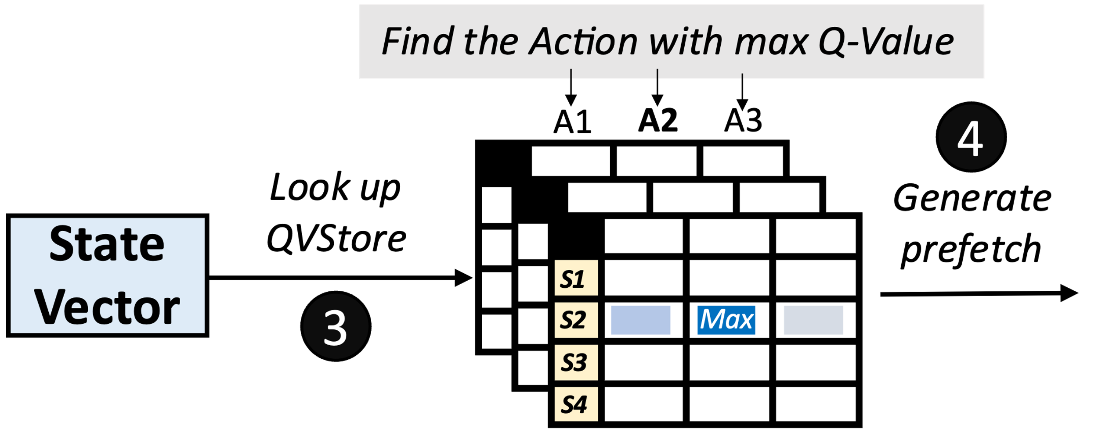
Architecting QVStore
+1
+2
+3
…
S = {PC+Delta,
Sequence of last-4 deltas}
Q-Value Store
(QVStore)
Notes:
Now let’s take a closer look at how Pythia makes a prefetch prediction.
For every prefetch prediction, Pythia has to look up the QVStore using the state vector, [CLICK] for example, a vector of features: PC+Delta, and seq. of last-4 deltas.
For the given state-vector, Pythia has to retrieve the Q-value for each prefetch action, e.g., [CLICK] prefetch offsets +1, +2, +3 and so on, to find the action that has the maximum Q-value.
Thus, it is necessary to store all state-action Q-values in an efficient way for a fast Q-value retrieval.

Slide 37
Architecting the QVStore
Fast prefetch prediction
+1
+2
+3
…
Fast retrieval of Q-values from QVStore
S = {PC+Delta,
Sequence of last-4 deltas}
Q-Value Store
(QVStore)
Efficient storage organization of Q-values in QVStore
Notes:
Now let’s see an example of how QVStore works.
For every prefetch decision, Pythia looks up the QVStore using the state vector, which in this case …
For the state-vector, Pythia retrieves the Q-value for each prefetch action, e.g., +1, +2, +3 ... to find the action that has the maximum Q-value.
Thus, it is necessary to store all state-action Q-values in an efficient way for a fast Q-value retrieval.

Slide 38

Organization of QVStore
A monolithic two-dimensional table?
  Indexed by state and action values
State-space increases exponentially with #bits
S = {PC+Delta, Sequence of last-4 deltas}
32b
+
7b
+
4x7b
= 67 bits
127 actions
 | A1 | A2 | A3 | A4 | A5 | A6 | A7 | A8 | A9
S1
S2
S3
S4
S5
S6
S7
2⁶⁷ states
Design complexity
Access latency
Notes:
[CLICK] Now, a naïve choice for designing the QVStore is to organize as a monolithic two-dimensional table, which is indexed by the state and the action values
[CLICK] However, the state-space increases exponentially with the number of bits used to represent the state.
[CLICK] As you can see, the state information considered in our example requires 67 bits to represent
[CLICK] Which requires an impractically-sized monolithic table to store Q-values for every state-action pairs.
[CLICK] but also significantly increases the access latency.

Slide 39
Organization of QVStore
We partition QVStore into k vaults [k = number of features in state]
  Each vault corresponds to one feature and stores the Q-values of feature-action pairs
To retrieve Q(S,A) for each action
Query each vault in parallel with feature and action
Retrieve feature-action Q-value from each vault
Compute MAX of all feature-action Q-values
MAX ensures the Q(S,A) is driven by the constituent feature that has highest Q(ɸ,A)
Notes:
[CLICK] Thus, we partition the QVStore into k vaults, where k is the number of features in a state information
[CLICK] Each vault corresponds to …
[CLICK] To retrieve the Q-value of a state-action pair …
[CLICK] We do this…
[CLICK] Then we do this …
[CLICK] Then we do this …
[CLICK] The maximum operation ensures that …

Slide 40
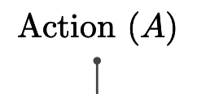
Organization of QVStore
We further partition each vault into multiple planes
  Each plane stores a partial Q-value of a feature-action pair
To retrieve Q(ɸ,A) for each action
Query each plane in parallel with hashed feature and action
Retrieve partial feature-action Q-value from each plane
Compute SUM of all partial feature-action Q-values
Notes:
[CLICK] We further partition …
[CLICK] Where each plane stores …
[CLICK] To retrieve the feature-action Q-value,
[CLICK] We query each plane …
[CLICK] We retrieve the partial Q-value from each plane
[CLICK] and finally compute a sum …

Slide 41
Organization of QVStore
We further partition each vault into multiple planes
  Each plane stores a partial Q-value of a feature-action pair
To retrieve Q(ɸ,A) for each action
1. Enables sharing of partial Q-values between similar feature values, shortens prefetcher training time
Query each plane in parallel with hashed feature and action
Retrieve partial feature-action Q-value from each plane
Compute SUM of all parital feature-action Q-values
2. Reduces chances of sharing partial Q-values
across widely different feature values
Notes:
[CLICK] We further partition …
[CLICK] Where each plane stores …
[CLICK] To retrieve the feature-action Q-value,
[CLICK] We query each plane …
[CLICK] We retrieve the partial Q-value from each plane
[CLICK] and finally compute a sum …

Slide 42
More in the Paper
Pipelined search operation for QVStore
Reward assignment and QVStore update
Automatic design-space exploration
  Feature types
  Actions
  Reward and Hyperparameter values
Notes:
We have much more detailed description of Pythia’s design in our paper including …

Slide 43
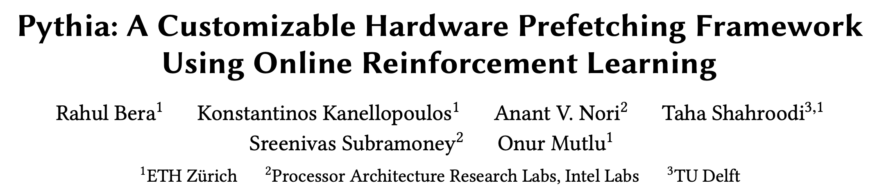
More in the Paper
Pipelined search operation for QVStore
Reward assignment and QVStore update
Automatic design-space exploration
  Feature types
  Action
  Reward and Hyperparameter values
https://arxiv.org/pdf/2109.12021.pdf
Notes:
We have much more detailed description of Pythia’s design in our paper including …

Slide 44
Talk Outline
Key Shortcomings of Prior Prefetchers
Formulating Prefetching as Reinforcement Learning
Pythia: Overview
Evaluation of Pythia and Key Results
Conclusion

Slide 45
Simulation Methodology
Champsim [3] trace-driven simulator
150 single-core memory-intensive workload traces
  SPEC CPU2006 and CPU2017
  PARSEC 2.1
  Ligra
  Cloudsuite
Homogeneous and heterogeneous multi-core mixes
Five state-of-the-art prefetchers
  SPP [Kim+, MICRO’16]
  Bingo [Bakhshalipour+, HPCA’19]
  MLOP [Shakerinava+, 3rd Prefetching Championship, 2019]
  SPP+DSPatch [Bera+, MICRO’19]
  SPP+PPF [Bhatia+, ISCA’20]
[3] https://github.com/ChampSim/ChampSim

Slide 46
Basic Pythia Configuration
Derived from automatic design-space exploration
State: 2 features
  PC+Delta
  Sequence of last-4 deltas
Actions: 16 prefetch offsets
  Ranging between -6 to +32. Including 0.
Rewards:
  R_{AT} = +20; R_{AL} = +12; R_{NP}-H=-2; R_{NP}-L=-4;
  R_{IN}-H=-14; R_{IN}-L=-8; R_{CL}=-12
Notes:
This is the basic Pythia configuration that we are going to evaluate, which is derived from the automatic design-space exploration.

Slide 47
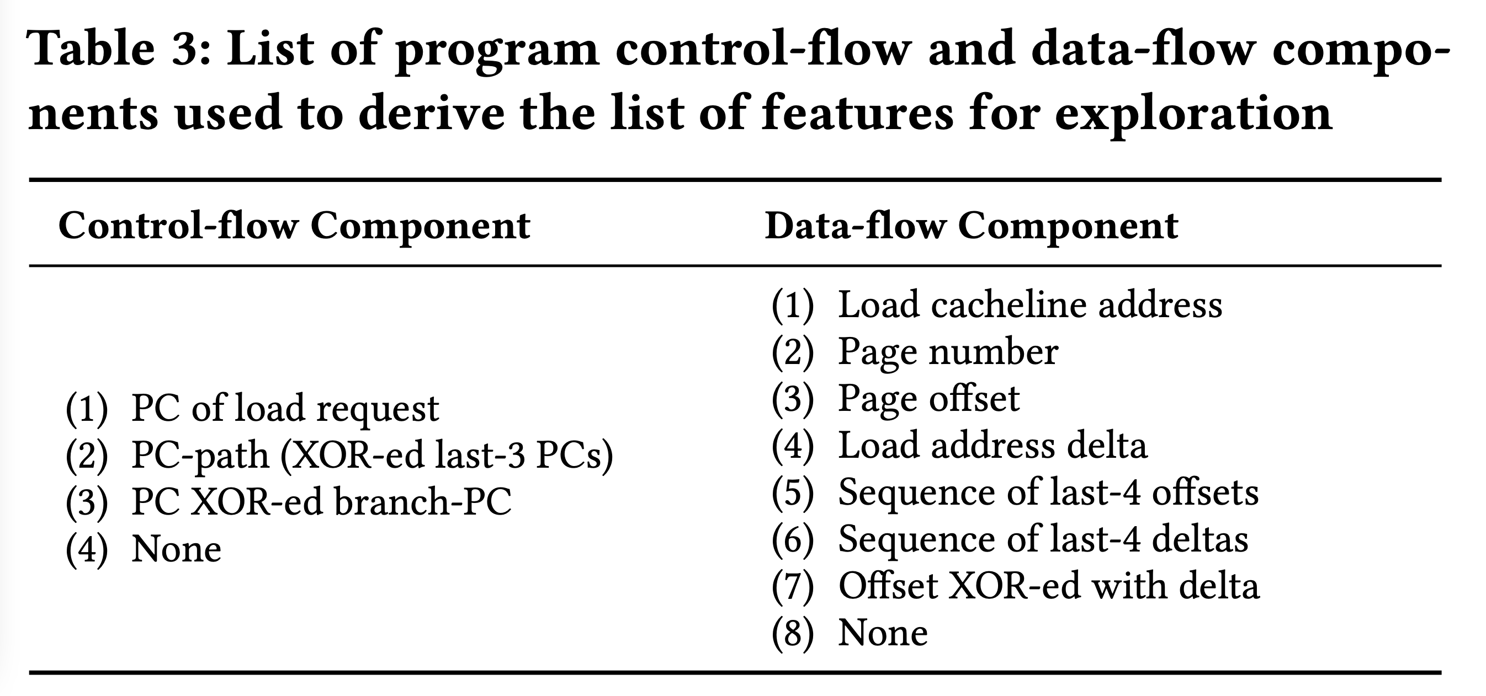

List of Evaluated Features

Slide 48
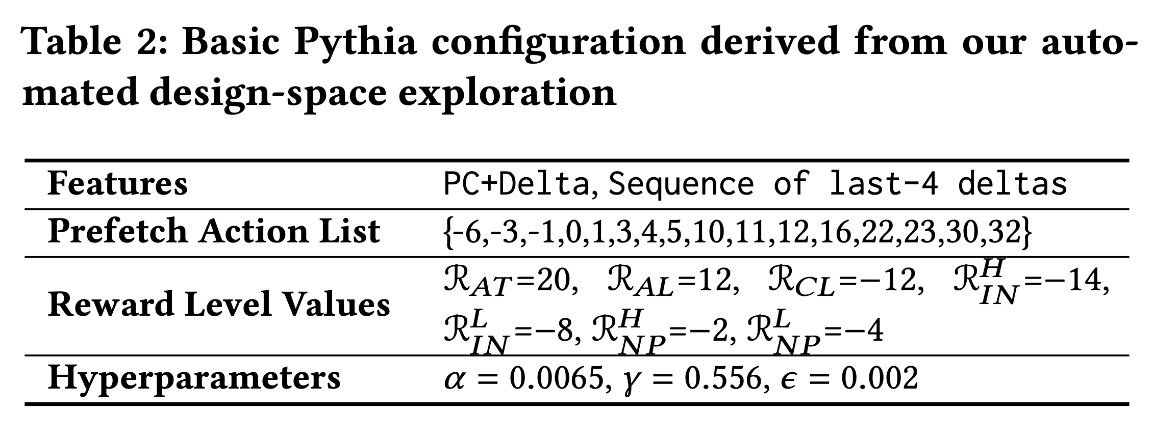
Basic Pythia Configuration

Slide 49
Performance with Varying Core Count
Pythia
3.4%
7.7%
SPP
MLOP
Bingo

Slide 50
Performance with Varying Core Count
1. Pythia consistently provides the highest performance in all core configurations
Pythia
7.7%
3.4%
SPP
2. Pythia’s gain increases with core count
MLOP
Bingo

Slide 51
Performance with Varying DRAM Bandwidth
3%
Pythia
Bingo
MLOP
Baseline
SPP
~Intel Xeon 6258R
~AMD EPYC Rome 7702P
17%
~AMD Threadripper 3990x

Slide 52
Performance with Varying DRAM Bandwidth
3%
Pythia
Bingo
MLOP
Baseline
SPP
~Intel Xeon 6258R
Pythia outperforms prior best prefetchers for
a wide range of DRAM bandwidth configurations
~AMD EPYC Rome 7702P
17%
~AMD Threadripper 3990x

Slide 53
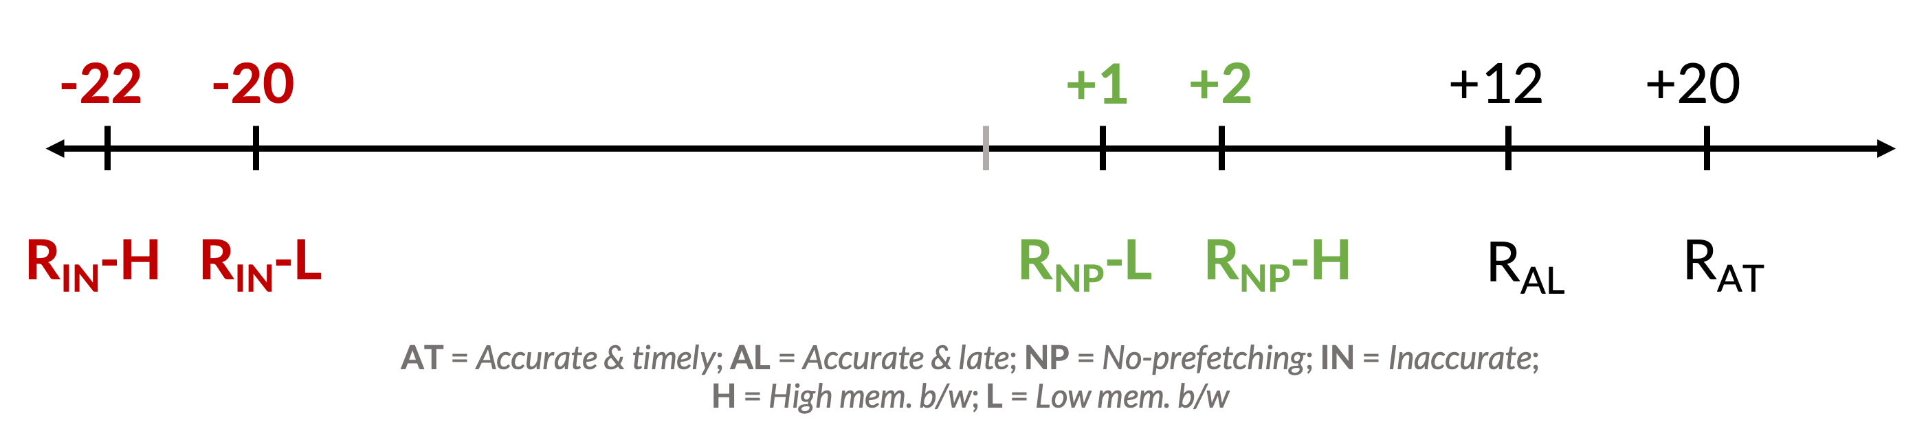
Performance Improvement via Customization
Reward value customization
Strict Pythia configuration
  Increasing the rewards for no prefetching
  Decreasing the rewards for inaccurate prefetching
Strict Pythia is more conservative in generating prefetch requests than the basic Pythia
Evaluate on all Ligra graph processing workloads
Notes:
Next, we analyze performance improvement of Pythia via customization.
[CLICK] We show an example of reward value customization, where,
[CLICK] We devise a strict Pythia configuration by increasing the reward level values for no prefetching, while decreasing the rewards values for inaccurate prefetching.
In short, strict Pythia is more conservative than the basic Pythia and strongly prefers not to prefetch, rather than prefetching inaccurately.
We evaluate both basic Pythia and strict Pythia on Ligra workload suite.

Slide 54
Performance Improvement via Customization
5.2%
7.8%
2%
2.8%
3.4%
3.1%
Notes:
[CLICK] As you can see, strict Pythia outperforms the basic Pythia configuration as much as 7.8% and
[CLICK] 2% on average over the entire Ligra workload suite.

Slide 55
Performance Improvement via Customization
5.2%
7.8%
Pythia can extract even higher performance via customization without changing hardware
2%
2.8%
3.4%
3.1%
Notes:
[CLICK] As you can see, strict Pythia outperforms the basic Pythia configuration as much as 7.8% and
[CLICK] 2% on average over the entire Ligra workload suite.

Slide 56

Pythia’s Overhead
25.5 KB of total metadata storage per core
  Only simple tables
We also model functionally-accurate Pythia with full complexity in Chisel [4] HDL
1.03% area overhead
0.4% power overhead
Satisfies prediction latency
of a desktop-class 4-core Skylake processor (Xeon D2132IT, 60W)
[4] https://www.chisel-lang.org
Notes:
All of Pythia’s performance benefits comes at a modest cost of 25.5KB of metadata storge, which is invested only in simple storage, without any need to complex structures.
[CLICK] We also model a fully-functionally-accurate Pythia with its full complexity in Chisel and show that, Pythia incurs
[CLICK] a modest area overhead of 1.03%
[CLICK] a power overhead of half-a-percent
[CLICK] while simultaneously satisfying the prediction latency at L2 cache frequency
Of a desktop-class …

Slide 57
More in the Paper
Performance comparison with unseen traces
  Pythia provides equally high performance benefits
Comparison against multi-level prefetchers
  Pythia outperforms prior best multi-level prefetchers
Understanding Pythia’s learning with a case study
  We reason towards the correctness of Pythia’s decision
Performance sensitivity towards different features and hyperparameter values
Detailed single-core and four-core performance
Notes:
We have many more exciting results including, ….
We encourage everyone to read it.

Slide 58
Performance on Previously-Unseen Workloads
Evaluated with 500 traces from value prediction championship
  No prefetcher has been trained on these traces
Pythia outperforms MLOP and Bingo by
8.3% and 3.5% in single-core
And 9.7% and 5.4% in four-core

Slide 59
More in the Paper
Performance comparison with unseen traces
  Pythia provides equally high performance benefits
Comparison against multi-level prefetchers
  Pythia outperforms prior best multi-level prefetchers
Understanding Pythia’s learning with a case study
  We reason towards the correctness of Pythia’s decision
Performance sensitivity towards different features and hyperparameter values
Detailed single-core and four-core performance
https://arxiv.org/pdf/2109.12021.pdf
Notes:
We have many more exciting results including, ….
We encourage everyone to read it.

Slide 60
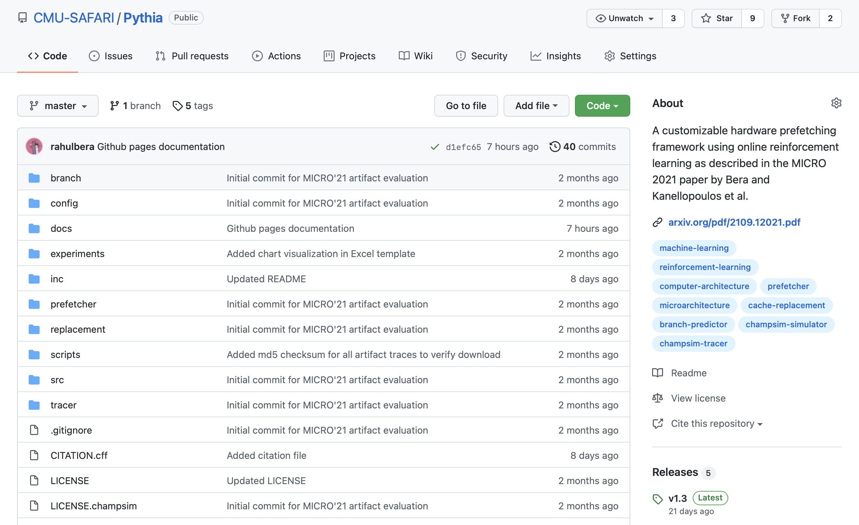
Pythia is Open Source
https://github.com/CMU-SAFARI/Pythia
MICRO’21 artifact evaluated
Champsim source code + Chisel modeling code
All traces used for evaluation

Slide 61
Talk Outline
Key Shortcomings of Prior Prefetchers
Formulating Prefetching as Reinforcement Learning
Pythia: Overview
Evaluation of Pythia and Key Results
Conclusion

Slide 62
Executive Summary
Background: Prefetchers predict addresses of future memory requests by associating memory access patterns with program context (called feature)
Problem: Three key shortcomings of prior prefetchers:
  Predict mainly using a single program feature
  Lack inherent system awareness (e.g., memory bandwidth usage)
  Lack in-silicon customizability
Goal: Design a prefetching framework that:
  Learns from multiple features and inherent system-level feedback
  Can be customized in silicon to use different features and/or prefetching objectives
Contribution: Pythia, which formulates prefetching as reinforcement learning problem
  Takes adaptive prefetch decisions using multiple features and system-level feedback
  Can be customized in silicon for target workloads via simple configuration registers
  Proposes a realistic and practical implementation of RL algorithm in hardware
Key Results:
  Evaluated using a wide range of workloads from SPEC CPU, PARSEC, Ligra, Cloudsuite
  Outperforms best prefetcher (in 1-core config.) by 3.4%, 7.7% and 17% in 1/4/bw-constrained cores
  Up to 7.8% more performance over basic Pythia across Ligra workloads via simple customization
https://github.com/CMU-SAFARI/Pythia
Notes:
First, I am going to start with an executive summary.
[CLICK] Prefetching is a speculative technique that predicts address of future memory requests by associating patterns in memory addresses with some program context. We call this context a feature.
[CLICK] We observe three key shortcomings in prior prefetchers:
First, they mainly use a single program feature for prediction.
Second, they lack inherent system awareness
Third, they also lack any customizability in silicon
[CLICK] Our goal in this work is to design a prefetching framework that
– can learn from multiple program features and inherent system-level feedback
-- and can be customized in silicon to change the features or the objective of the prefetcher
[CLICK] Towards this we propose Pythia, that formulates …
Pythia makes adaptive and autonomous …
Pythia also proposes a realistic and practical …
[CLICK] We extensively evaluate Pythia using …
We show that Pythia outperforms prior state-of-the-art …
Pythia is freely available in our GitHub repository.

Slide 63
Pythia
A Customizable Hardware Prefetching Framework Using Online Reinforcement Learning
Rahul Bera, Konstantinos Kanellopoulos, Anant V. Nori,
Taha Shahroodi, Sreenivas Subramoney, Onur Mutlu
https://github.com/CMU-SAFARI/Pythia
https://arxiv.org/pdf/2109.12021.pdf
Notes:
Hi I am Rahul. Today, I’m going to present our work “…”
This work is done by researchers from SAFARI research group at ETH Zurich, in collaboration with Intel Labs and TU Delft.

Slide 64
Pythia Discussion
FAQs
  Why RL?
  What about large page?
  What’s the prefetch degree?
  Can customization happen during workload execution?
  Can runtime mixing create problem?
Simulation and Methodology
  Basic Pythia configuration
  System parameters
  Configuration of prefetchers
  Evaluated workloads
  Feature selection
Detailed Design
  Reward structure
  Design overview
  QVStore Organization
More Results
  Comparison against other adaptive prefetchers
  Comparison against Context prefetcher
  Feature combination sensitivity
  Hyperparameter sensitivity
  Comparison with multi-level prefetchers
  Performance in unseen workloads
  Single-core s-curve
  Four-core s-curve
  Detailed performance analysis
  Benefit of bandwidth awareness
  Case study
  Customizing rewards
  Customizing features

Slide 65
Self-Optimizing Memory Prefetchers
Rahul Bera, Konstantinos Kanellopoulos, Anant Nori, Taha Shahroodi, Sreenivas Subramoney, and Onur Mutlu,
"Pythia: A Customizable Hardware Prefetching Framework Using Online Reinforcement Learning"
Proceedings of the 54th International Symposium on Microarchitecture (MICRO), Virtual, October 2021.
[Slides (pptx) (pdf)]
[Short Talk Slides (pptx) (pdf)]
[Lightning Talk Slides (pptx) (pdf)]
[Talk Video (20 minutes)]
[Lightning Talk Video (1.5 minutes)]
[Pythia Source Code (Officially Artifact Evaluated with All Badges)]
[arXiv version]
Officially artifact evaluated as available, reusable and reproducible.
https://arxiv.org/pdf/2109.12021.pdf

Slide 66
Hermes: Perceptron-Based
Off-Chip Load Prediction

Slide 67
Learning-Based Off-Chip Load Predictors
Rahul Bera, Konstantinos Kanellopoulos, Shankar Balachandran, David Novo, Ataberk Olgun, Mohammad Sadrosadati, and Onur Mutlu,
"Hermes: Accelerating Long-Latency Load Requests via Perceptron-Based Off-Chip Load Prediction"
Proceedings of the 55th International Symposium on Microarchitecture (MICRO), Chicago, IL, USA, October 2022.
[Slides (pptx) (pdf)]
[Longer Lecture Slides (pptx) (pdf)]
[Talk Video (12 minutes)]
[Lecture Video (25 minutes)]
[arXiv version]
[Source Code (Officially Artifact Evaluated with All Badges)]
Officially artifact evaluated as available, reusable and reproducible.
Best paper award at MICRO 2022.
https://arxiv.org/pdf/2209.00188.pdf

Slide 68
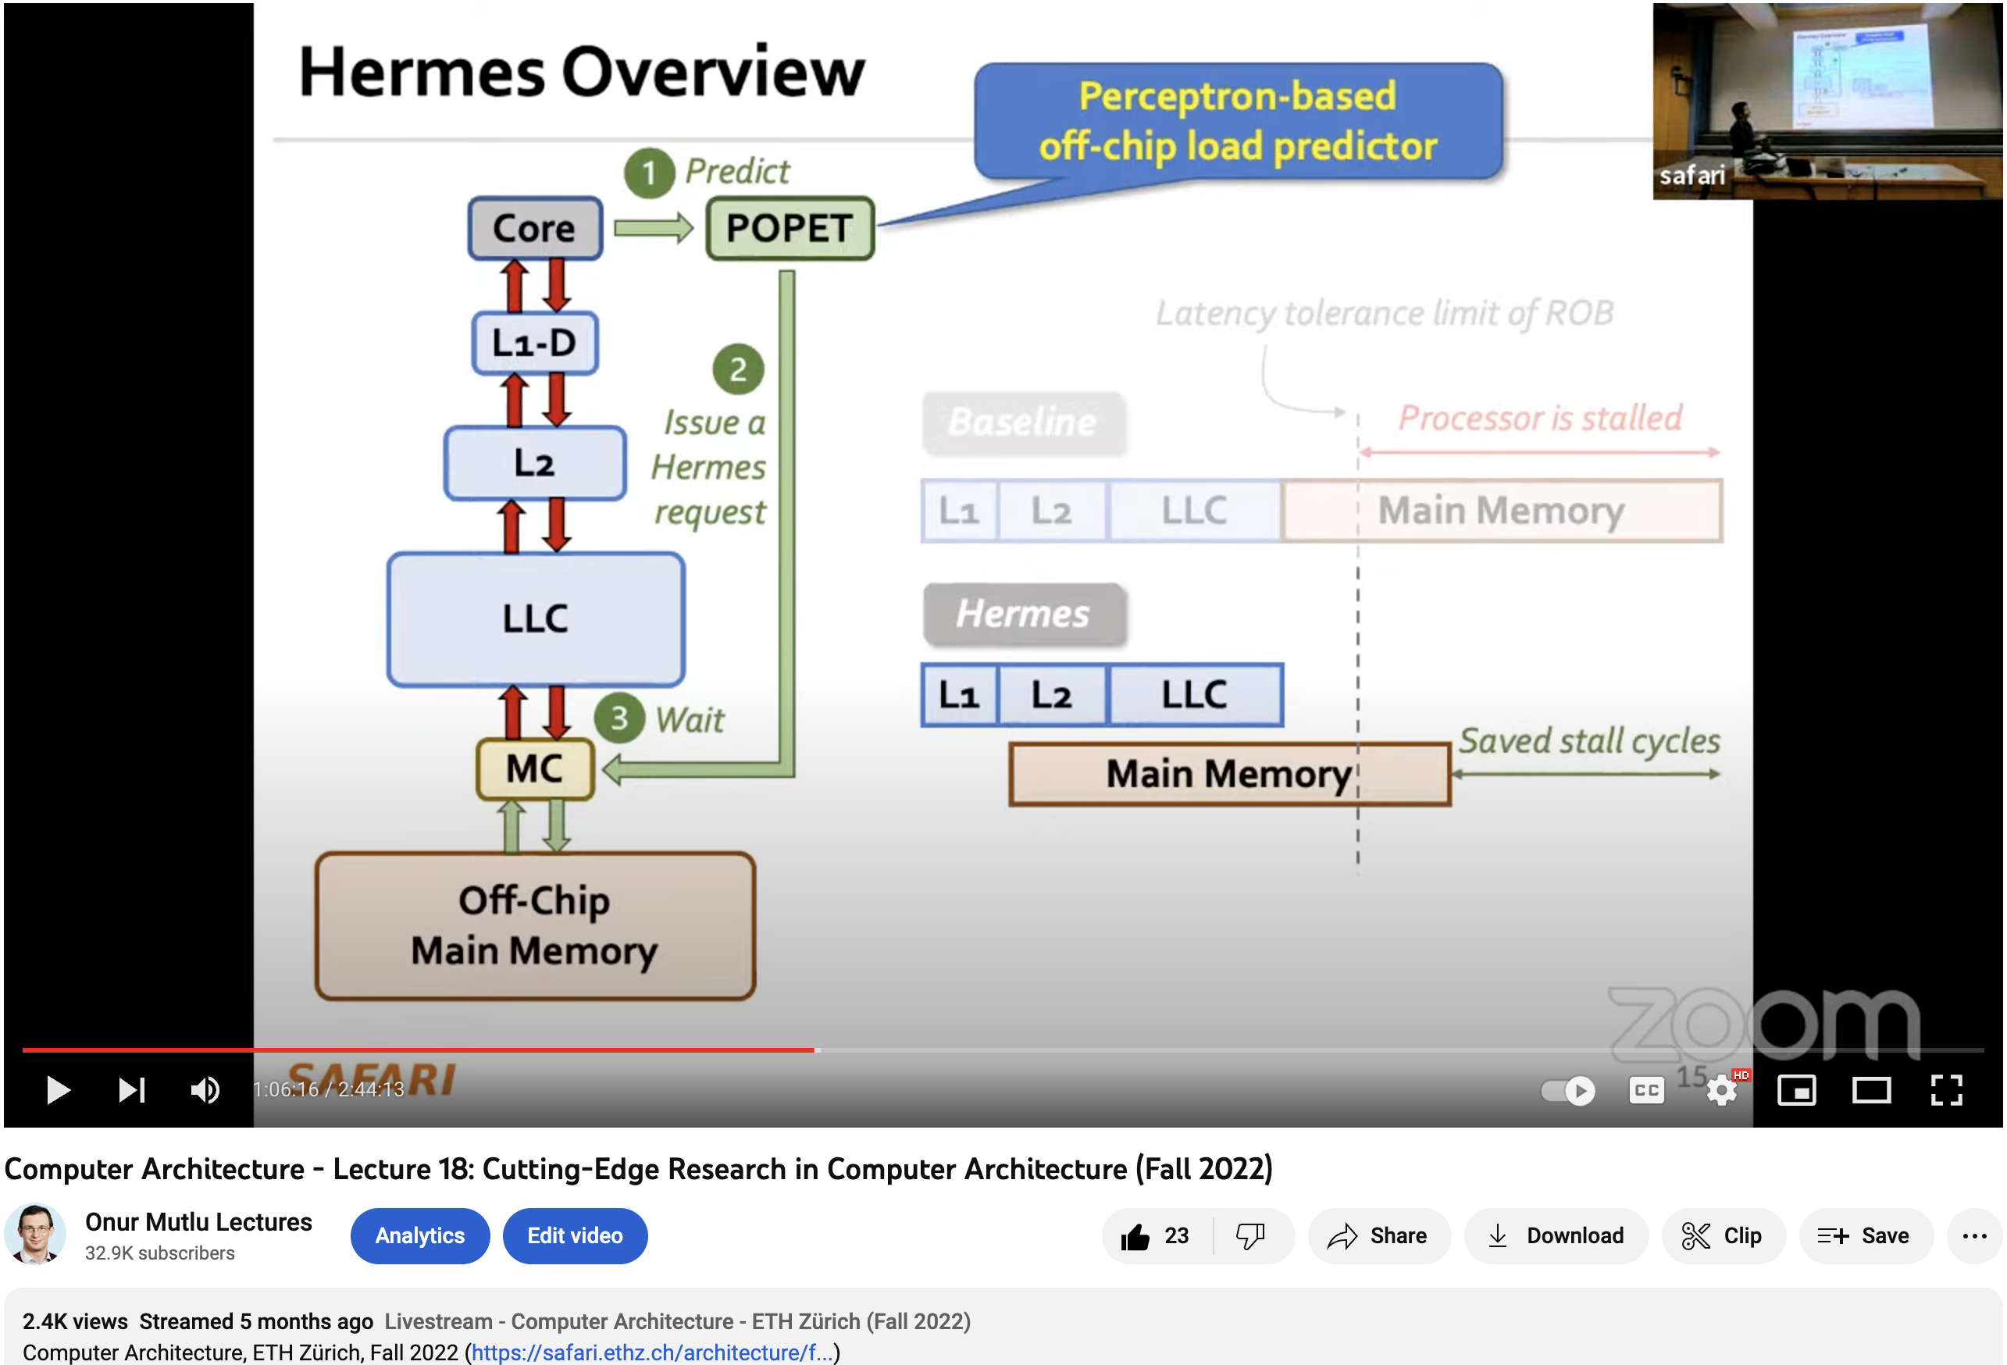
Hermes Talk Video
https://www.youtube.com/watch?v=PWWBtrL60dQ&t=3609s

Slide 69


Accelerating Long-Latency Load Requests
via Perceptron-Based Off-Chip Load Prediction
Rahul Bera, Konstantinos Kanellopoulos, Shankar Balachandran,
David Novo, Ataberk Olgun, Mohammad Sadrosadati, Onur Mutlu
https://github.com/CMU-SAFARI/Hermes
https://arxiv.org/pdf/2209.00188.pdf

Slide 70
The Key Problem
Long-latency off-chip load requests
Often stall processor by
blocking instruction retirement from
Reorder Buffer (ROB)
Limit performance
Notes:
The key problem that we are trying to address in this work is stemming from Off-chip load request
[CLICK] As we know, these off-chip load requests often stall…,
[CLICK] which severely limits the performance of a core.

Slide 71

Traditional Solutions
1
Employ sophisticated prefetchers
2
Increase size of on-chip caches
Notes:
Architects have primarily relied on two key techniques to reduce latency of such loads:
[CLICK] By employing sophisticated data prefetchers
[CLICK] And Increasing size of the on-chip cache hierarchy

Slide 72
Key Observation 1
Many loads still go off-chip
50%
still go off-chip even with
a state-of-the-art prefetcher
50%
successfully prefetched
70% of the off-chip loads
block the ROB
# off-chip loads without any prefetcher
Notes:
In this work, we show that prior prefetchers successfully prefetch a significant fraction of the off-chip load requests.
[CLICK] However, nearly 50% of the off-chip loads in a system without any prefetcher are still going off-chip even in presence of a state-of-the-art prefetcher
[CLICK] And 70% of these off-chip loads even block the ROB.

Slide 73
Key Observation 2
50% still go off-chip
On-chip cache access latency
significantly contributes to off-chip load latency
L1
L2
LLC
Main Memory
L1
L2
LLC
Main Memory
Saved cycles
40% of the stalls can be eliminated by removing
on-chip cache access latency from critical path
Notes:
Now, if we focus on the off-chip loads that are still going to the main memory even in presence of a state-of-the-art prefetcher,
We observe that the on-chip cache access latency…
[CLICK] We show that nearly 40% of …

Slide 74
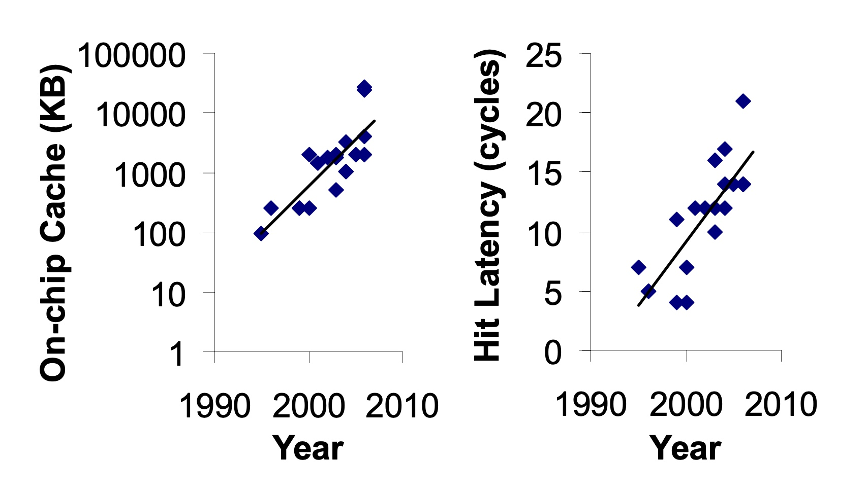
Caches are Getting Bigger and Slower…
On-chip Cache Size (KB)
Hardavellas+, “Database Servers on Chip Multiprocessors: Limitations and Opportunities”, CIDR, 2007
Notes:
As the cache hierarchy continue to grow in size and complexity, as noted by previous works,
As well as a trend that we see in recent processors,
This problem is only going to get exacerbated even more in future generation processors

Slide 75
Our Goal
Improve processor performance
by removing on-chip cache access latency
from the critical path of off-chip loads
Notes:
Thus to alleviate this problem, the goal of our work is to improve…

Slide 76

Predicts which load requests
are likely to go off-chip
Starts fetching data directly from main memory while concurrently accessing the cache hierarchy
Notes:
Towards this we propose Hermes, which is based on two key ideas.
[CLICK] Hermes predicts which…
[CLICK] Hermes starts fetching …

Slide 77




Key Contribution
Hermes employs the first
perceptron-based off-chip load predictor
That predicts which loads are likely to go off-chip
By learning from
multiple program context information
Notes:
To enable accurate off-chip prediction,
Hermes employs the first perceptron-based off-chip load predictor
[CLICK] that identifies loads …
[CLICK] by only learning from multiple…

Slide 78
Hermes Overview
Core
Latency tolerance limit of ROB
L1-D
Baseline
Processor is stalled
L2
L1
L2
LLC
Main Memory
LLC
MC
Off-Chip
Main Memory
Notes:
Now let me give you a brief overview of Hermes.
This is how a traditional cache hierarchy looks like in today’s processor.
[CLICK] And this is how the memory latency timeline looks like for an off-chip load in the baseline system
[CLICK] If the ROB has a latency tolerance limit up till here, the processor stalls for the remaining cycles

Slide 79




Hermes Overview
Perceptron-based
off-chip load predictor
Predict
Core
POPET
Train
Latency tolerance limit of ROB
L1-D
Issue a Hermes request
Baseline
Processor is stalled
L2
L1
L2
LLC
Main Memory
LLC
Hermes
L1
L2
LLC
Wait
Saved stall cycles
MC
Main Memory
Off-Chip
Main Memory
Notes:
Now Hermes employs an off-chip predictor named POPET.
[CLICK] For every load generated in the core, Hermes consults POPET to predict whether this load would go off-chip or not
[CLICK] If the load is predicted to go off-chip, Hermes waits for the address translation to finish, which happens in parallel with L1 cache access
[CLICK] And then issues a speculative memory request, which we call a Hermes request,
directly to the main memory controller to start fetching the data from the main memory,
While also concurrently accessing the cache hierarchy for such a load.
[CLICK] If the off-chip prediction is correct, the load would eventually miss the LLC and arrive at the memory controller
Where it will simply wait for the ongoing Hermes request to finish, thus hiding the entire cache access latency from its critical path.
Once the data returns from the main memory, Hermes returns the data to the core [CLICK],
Thus, saving the precious stall cycles induced by the off-chip load [CLICK], which in turn provides performance benefit.
[CLICK] Hermes trains POPET when the data finally returns to the core, closing the feedback loop.

Slide 80

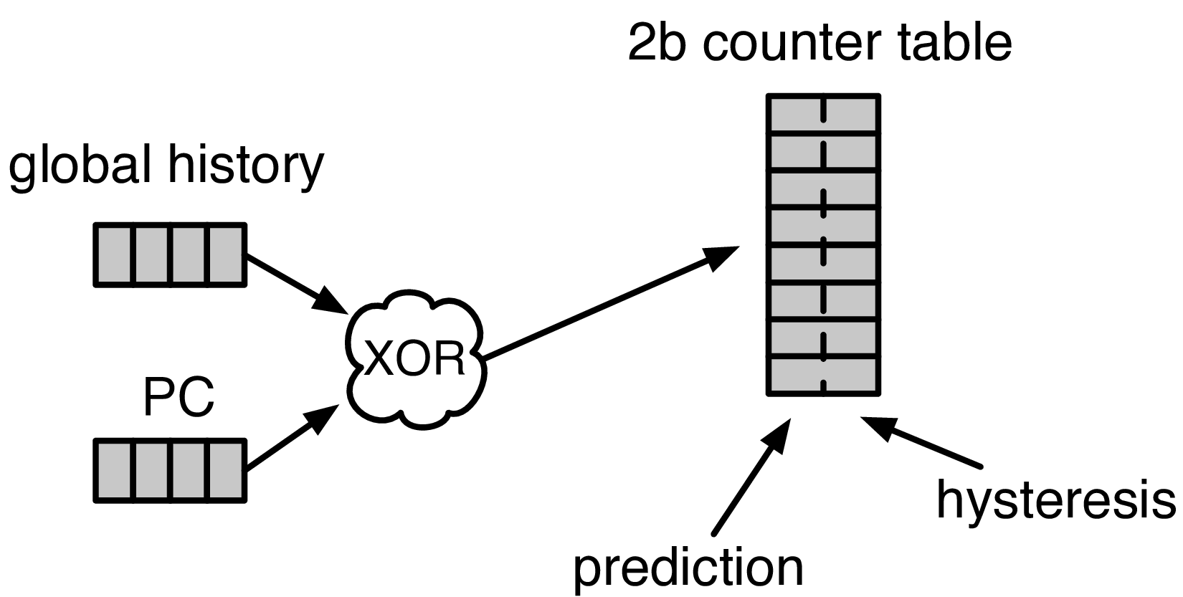


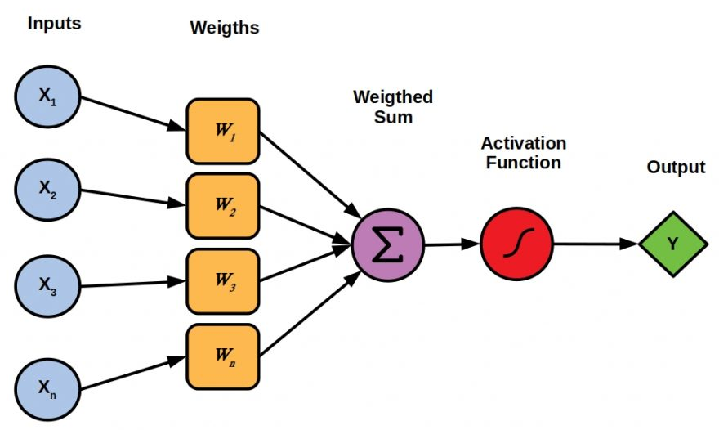

Designing the Off-Chip Load Predictor
History-based prediction
HMP [Yoaz+, ISCA’99] for the L1-D cache
Using branch-predictor-like hybrid predictor:
Global, Gshare, and GSkew
POPET provides
both higher accuracy and higher performance
than predictors inspired from these previous works
Tracking cache contents
MissMap [Loh+, MICRO’11] for the DRAM cache,
D2D [Sembrant+, ISCA’14], D2M [Sembrant+, HPCA’17], LP [Jalili+, HPCA’22] for the cache hierarchy
  Large metadata
  Metadata size increases with cache hierarchy size
  May need to track all cache operations
  Gets complex depending on the cache hierarchy configuration (e.g., inclusivity, bypassing,…)
Learning from program behavior
  Correlate different program features with off-chip loads
Low storage overhead
Low design complexity
Notes:
Now let’s discuss how to design this off-chip predictor.
So, there are multiple prior works that can be used either directly or with small modifications for off-chip load prediction.
These works can be broadly categorized into two classes.
[CLICK] History-based predictor introduced by HMP, uses a branch-predictor like hybrid predictor design
to identify which requests are going to miss L1 cache.
We can easily extend HMP’s design to predict loads that are going to miss the entire cache hierarchy.
[CLICK] Tracking-based methods, on the other hand, explicitly track cache contents
to predict which load requests are going to miss the cache hierarchy.
[CLICK] These tracking-based methods poses two key challenges…
[CLICK] First,…
[CLICK] Second,…
[CLICK] POPET takes a completely different approach to predict off-chip load requests by learning from program behavior.
[CLICK] It aims to correlate multiple different types of program features with off-chip load requests
to provide accurate predictions with much lower storage overhead and design complexity.
[CLICK] In our paper, we compare POPET against predictors inspired from these prior works and show that
[CLICK] POPET provides both higher accuracy and performance than them.

Slide 81
POPET: Perceptron-Based Off-Chip Predictor
Multi-feature hashed perceptron model^{[1]}
  Each feature has its own weight table
    Stores correlation between feature value and off-chip prediction
[1] D. Tarjan and K. Skadron, “Merging Path and Gshare Indexing in Perceptron Branch Prediction,” TACO, 2005
Notes:
Now let’s deep dive into our off-chip predictor design.
Our predictor, named as POPET, is designed using hashed-perceptron model.
[CLICK] where each feature has its own weight table
That stores the correlation between feature value and the off-chip prediction

Slide 82

Predicting using POPET
Uses simple table lookups, addition, and comparison
42
-4
0x7ffe0+12
3
3 >= -2
Predict that the load would go off-chip
Extract features from the load request
12
-5
Notes:
Hermes predicts using POPET using simple operations like table lookup, addition, and comparison.
Let me give you an example on how POPET’s prediction works.
POPET’s prediction works in three stages.
[CLICK] In the first stage, POPET extracts the features from the load request
[CLICK] In the second stage, each feature value is hashed and used as an index to retrieve the weights from each individual weight tables
[CLICK] In the third stage, the retrieved weights are accumulated and the cumulative weight is used to compute the activation function.
[CLICK] If the cumulative weight is higher than the activation threshold, POPET predicts that the load would go off-chip.

Slide 83
Training POPET
Uses simple increment or decrement of feature weights
42
-1
-4
0x7ffe0+12
3
3 >= -2
Predict that the load would go off-chip
-1
12
Shouldn’t be activated
-5
Cumulative weight < 𝜏_{act}
-1
Notes:
Now let’s understand how to train POPET.
For this let’s assume the previous example where the load is predicted to go off-chip.
[CLICK] But in reality, the load didn’t go off-chip
[CLICK] this means the activation which have triggered before, shouldn’t have triggered
Which means, the cumulative weight should be lower than the activation threshold
[CLICK] Now to adjust the feature weights, POPET again indexes each weight table using the hashed feature values
[CLICK] And simply decrement each weight from the individual weight tables.
Thus, by using simple increment and decrement operations, POPET continuously learns from program behavior to accurately predict off-chip loads.

Slide 84
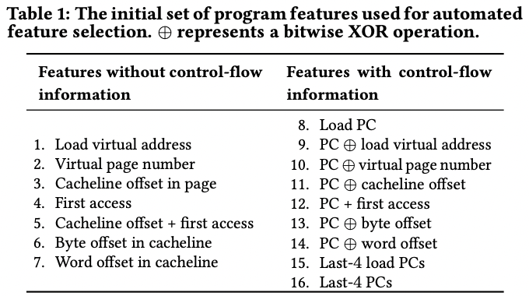
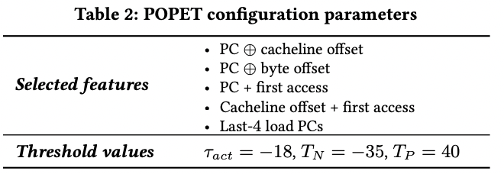
Features Used in Hermes

Slide 85
Evaluation
Notes:
Now let’s evaluate Hermes.

Slide 86
Simulation Methodology
ChampSim trace driven simulator
110 single-core memory-intensive traces
  SPEC CPU 2006 and 2017
  PARSEC 2.1
  Ligra
  Real-world applications
220 eight-core memory-intensive trace mixes
LLC Prefetchers
Off-Chip Predictors
Pythia [Bera+, MICRO’21]
Bingo [Bakshalipour+, HPCA’19]
MLOP [Shakerinava+, 3rd Prefetching Championship’19]
SPP + Perceptron filter [Bhatia+, ISCA’20]
SMS [Somogyi+, ISCA’06]
History-based: HMP [Yoaz+, ISCA’99]
Tracking-based: Address Tag-Tracking based Predictor (TTP)
Ideal Off-chip Predictor
Notes:
We evaluate Hermes using ChampSim simulator,
[CLICK] using a wide range of memory-intensive traces spanning across SPEC CPU, PARSEC, Ligra, and real-world applications
[CLICK] We compare Hermes with five LLC prefetchers
[CLICK] and two off-chip predictors extended from prior works

Slide 87

Latency Configuration
Cache round-trip latency
  L1-D: 5 cycles
  L2: 15 cycles
  LLC: 55 cycles
Hermes request issue latency (incurred after address translation)
Depends on
  Interconnect between POPET and MC
0 cycles
24 cycles
6 cycles
Notes:
For our evaluation, we consider
[CLICK] a 5 cycle L1-D
[CLICK] 15 cycle L2
[CLICK] and 55 cycle LLC round-trip latency.
[CLICK] The latency for Hermes to issue a request directly to the main memory controller (after the address translation) depends on …
[CLICK] For this reason we sweep this latency from 0-cycles to 24-cycles in our paper.
[CLICK] But in this presentation, I am going to show you results considering a 6-cycle latency.

Slide 88
Single-Core Performance Improvement
5.4%
20.3%
11.5%
Hermes alone provides nearly
50% performance benefits of Pythia
with only 1/5th storage overhead
Hermes provides nearly 90% performance benefit of Ideal Hermes that has an ideal off-chip load predictor
Hermes on top of Pythia
outperforms Pythia alone in every workload category
Notes:
Let’s first analyze the single-core performance improvement.
[CLICK] This is how Hermes and a state-of-the-art prefetcher Pythia improves performance on top of a no-prefetching system.
[CLICK] The first takeaway is that Hermes alone provides nearly 50%...
[CLICK] Now if we combine Hermes with Pythia, that provides an additional 5.4% performance improvement on top of a strong baseline that has Pythia.
[CLICK] And finally, if we compare Hermes’s performance benefit with the Ideal Hermes that has an ideal off-chip predictor,
We see that Hermes provides nearly 90% performance benefit of the Ideal Hermes

Slide 89
Increase in Main Memory Requests
20.3%
5.4%
11.5%
For every 1% performance benefit,
increase in main memory requests
Pythia
2%
5.9%
Hermes on top of Pythia
1%
38.5%
Hermes alone
0.5%
5.5%
Hermes is more bandwidth-efficient
than even an efficient prefetcher like Pythia
Notes:
This performance improvement comes at a cost of increase in main memory requests.
This graph shows the increase in the main memory request over the no-prefetching system provided by the three configurations.
[CLICK] As we can see, Hermes increases the main memory requests by 5.5% on average on top of the no-prefetching system..
Whereas Pythia increases …
If we combine two together, then it increases the main memory request by an additional 5.9%.
[CLICK] Now, if we compare this increase in the main memory request with the performance improvement each of these configurations are providing,
We see that
[CLICK] For every 1% performance benefit, Pythia …
[CLICK] This basically shows that Hermes is much more bandwidth efficient than a traditional data prefetcher like Pythia.
And for this reason [NEXT]

Slide 90
Performance with Varying Memory Bandwidth
Pythia+Hermes
Pythia
Hermes
Baseline
~Intel Xeon 6258R
(Cascade Lake, 28C/6ch, 2020)
~AMD EPYC Rome 7702P (Zen 2, 64C/8ch, 2019)
~AMD Threadripper 3990x (Zen 2, 64C/4ch, 2020)
In bandwidth-constrained configurations,
Hermes alone outperforms Pythia
Hermes+Pythia outperforms Pythia
across all bandwidth configurations
Notes:
If we evaluate Pythia and Hermes over a wide range of memory bandwidth configurations, we see that,
[CLICK] In these extremely-bandwidth constrained configurations, which are in fact roughly modeling per-core main memory bandwidth of commercial processors,
Hermes even outperforms Pythia.
[CLICK] And if we combine both of them, the combination of Hermes and Pythia outperforms Pythia in every bandwidth configurations.

Slide 91
Performance with Varying Baseline Prefetcher
5.4%
6.2%
7.6%
5.1%
Hermes consistently improves performance
on top of a wide range of baseline prefetchers
7.7%
Notes:
And these observations are not only true for Pythia.
We evaluate Hermes combined with multiple prior baseline state-of-the-art prefetchers and find that
Hermes consistently improves performance on top of a wide range of baseline prefetchers.

Slide 92
Overhead of Hermes
4 KB storage overhead
1.5% power overhead*
*On top of an Intel Alder Lake-like performance-core ^{[2]} configuration
[2] https://www.anandtech.com/show/16881/a-deep-dive-into-intels-alder-lake-microarchitectures/3
Notes:
All of these performance benefit comes at a
[CLICK] modest 4KB storage overhead per core and
[CLICK] 1.5% power overhead on top an Intel Alder Lake-like performance-core configuration

Slide 93
More in the Paper
Performance sensitivity to:
  Cache hierarchy access latency
  Hermes request issue latency
  Activation threshold
  ROB size (in extended version on arXiv)
  LLC size (in extended version on arXiv)
Accuracy, coverage, and performance analysis against HMP and TTP
Understanding usefulness of each program feature
Effect on stall cycle reduction
Performance analysis on an eight-core system
Notes:
We have many more evaluation results:
For example, a wide range of performance sensitivity study by varying…in the paper.

Slide 94
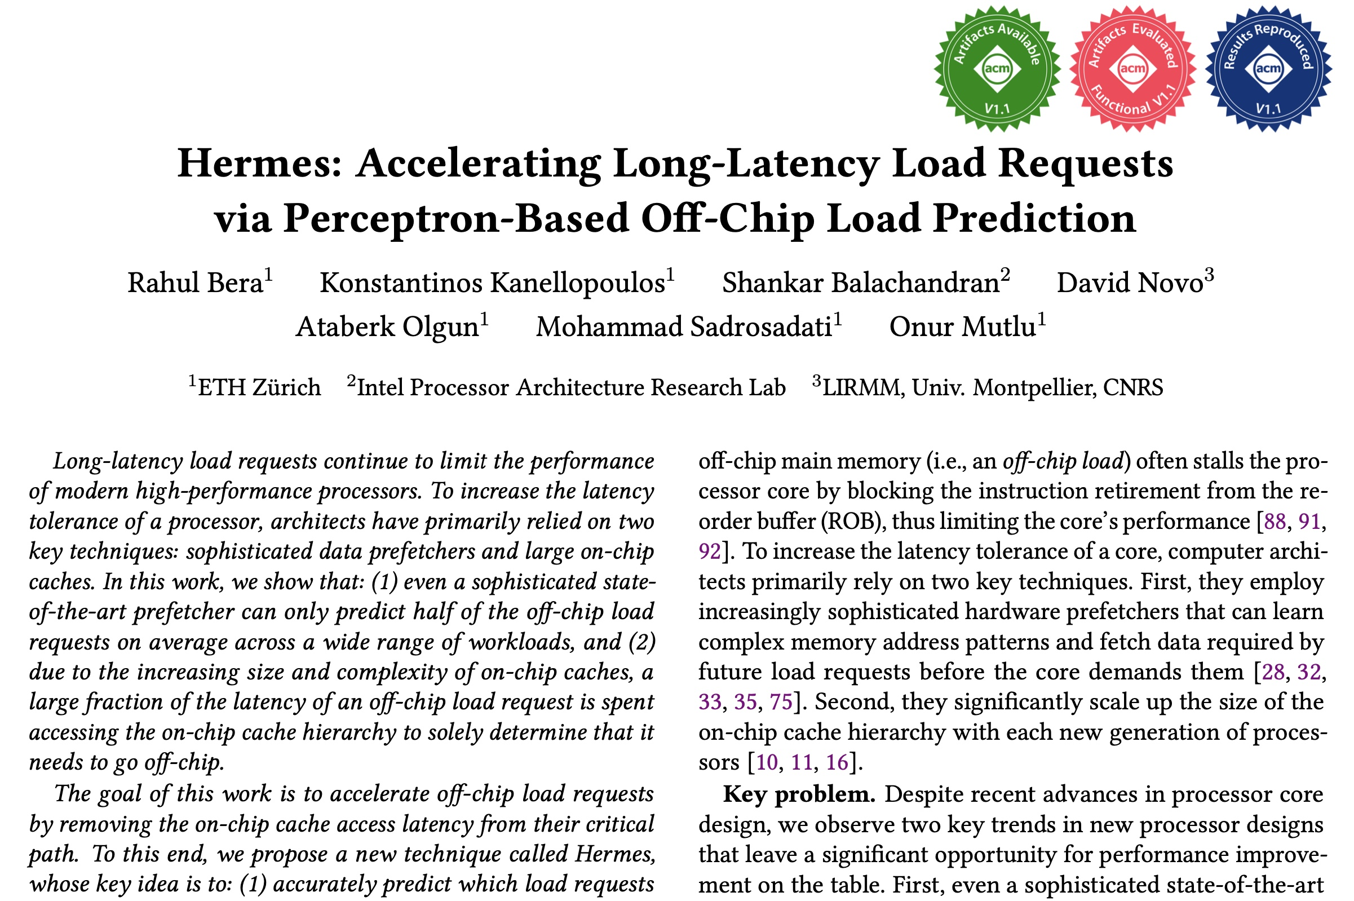
More in the Paper
Performance sensitivity to:
  Cache hierarchy access latency
  Hermes request issue latency
  Activation threshold
  ROB size (in extended version at arXiv)
  LLC size (in extended version at arXiv)
Accuracy, coverage, and performance analysis against HMP and TTP
Understanding usefulness of each program feature
Effect on stall cycle reduction
Performance analysis in eight-core system
https://arxiv.org/pdf/2209.00188.pdf
Notes:
We have many more evaluation results:
For example, a wide range of performance sensitivity study by varying…in the paper.

Slide 95
To Summarize…
Notes:
Thus to summarize…

Slide 96
Summary
Hermes advocates for off-chip load prediction,
a different form of speculation than
load address prediction employed by prefetchers
Off-chip load prediction can be applied by itself
or combined with load address prediction
to provide performance improvement
Notes:
Hermes advocates …
[CLICK] We show that off-chip load prediction…

Slide 97





Summary
Hermes employs the first
perceptron-based off-chip load predictor
High accuracy
(77%)
High coverage
(74%)
Low storage overhead
(4KB/core)
High performance improvement over best prior baseline
(5.4%)
High performance
per bandwidth

Slide 98
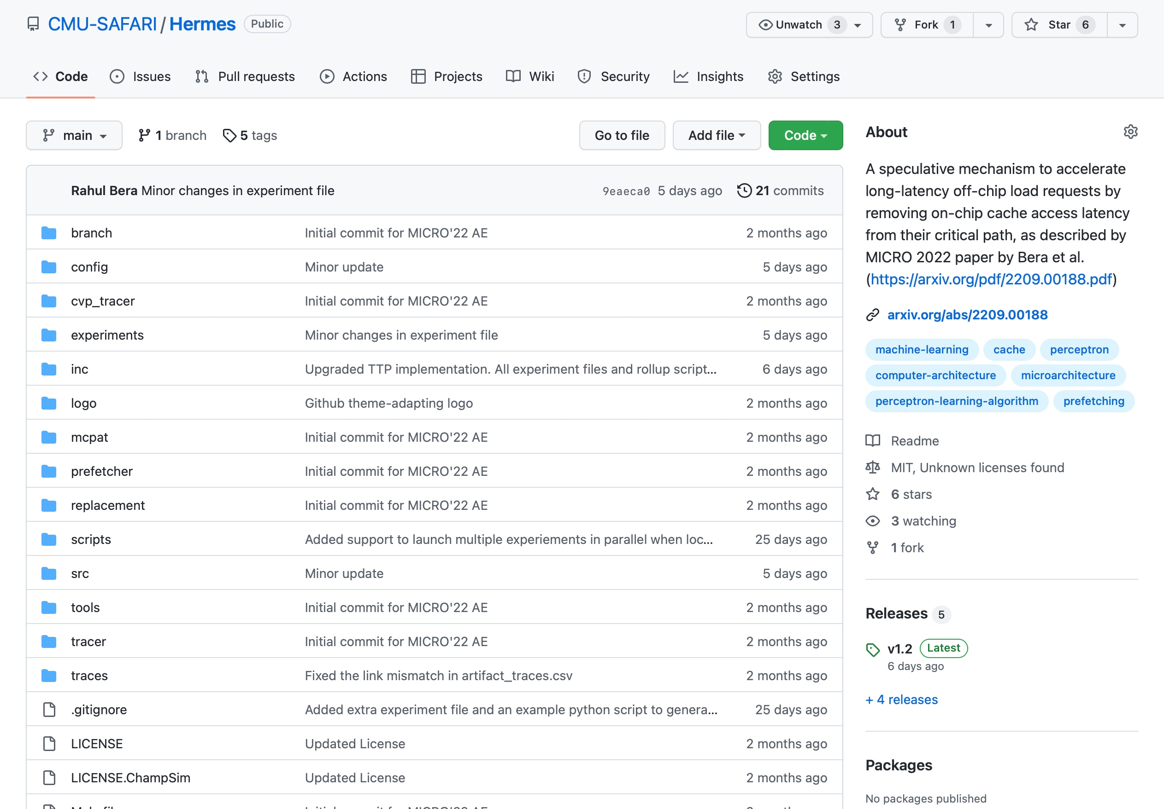
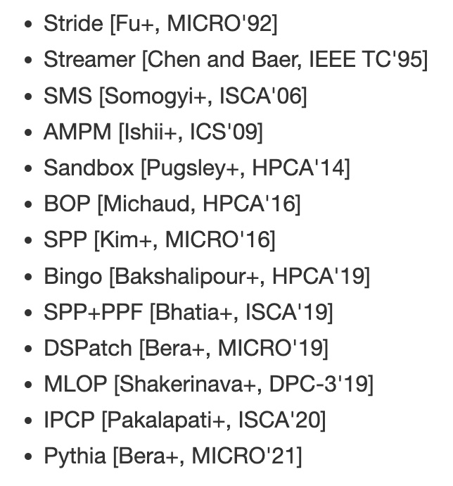
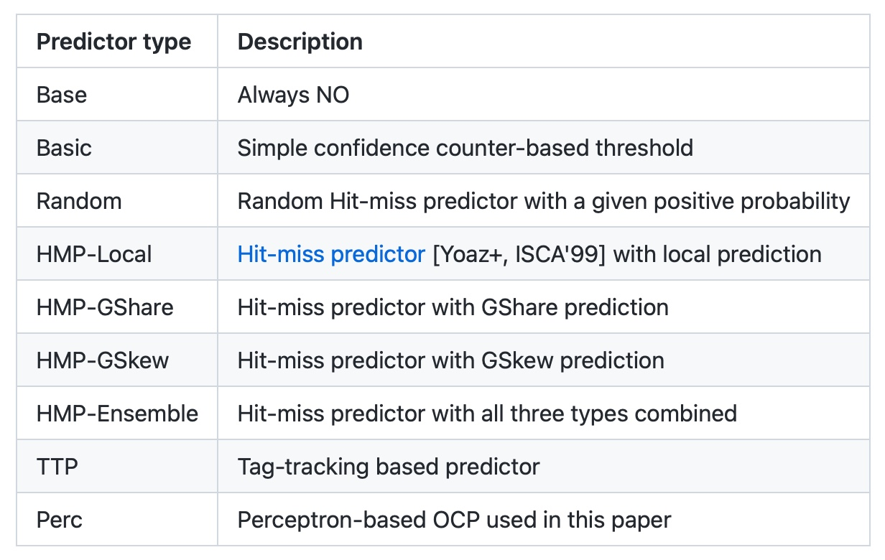
Hermes is Open Sourced
All workload traces
13 prefetchers
9 off-chip predictors
https://github.com/CMU-SAFARI/Hermes
Notes:
That’s why we open-source our artifact.
It can be freely downloaded from our GitHub repository.
In this artifact, [CLICK] you will get all the workload traces we have used to evaluate Hermes,
[CLICK] 13 types of data prefetchers proposed in the past and
[CLICK] 9 types of off-chip predictors out of the box

Slide 99
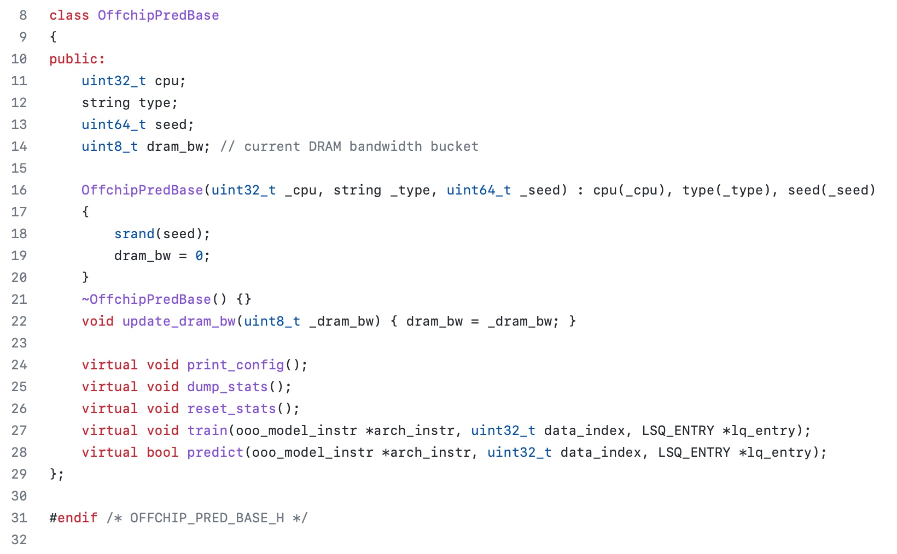
Easy To Define Your Own Off-Chip Predictor
Just extend the OffchipPredBase class
Notes:
But if you want to impalement your own off-chip predictor, that’s also very easy.
All you have to do is to extend the OffchipPred base class…

Slide 100
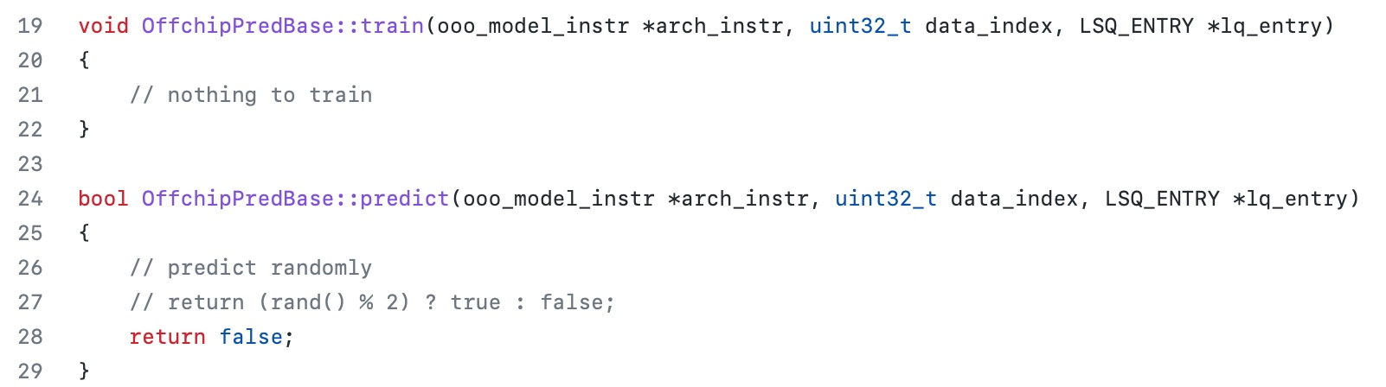
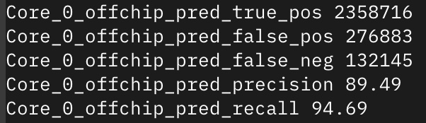
Easy To Define Your Own Off-Chip Predictor
Define your own train() and predict() functions
Get statistics like accuracy (stat name precision) and coverage (stat name recall) out of the box
Notes:
And define your own train() and predict() functions
[CLICK] the infrastructure will automatically provide statistics like precision and recall out of the box

Slide 101
Off-Chip Prediction Can Further Enable…
Prioritizing loads that are likely go off-chip
in cache queues and on-chip network routing
Better instruction scheduling
of data-dependent instructions
Other ideas to improve performance and fairness in multi-core system design...
Notes:
We hope that high-accuracy off-chip prediction can further enable a multitude of optimization possibilities, for example:
[CLICK] prioritizing loads … to improve performance and fairness in extreme core processors
[CLICK] better instruction scheduling for data dependent loads
[CLICK] and many more…

Slide 102
Accelerating Long-Latency Load Requests
via Perceptron-Based Off-Chip Load Prediction
Rahul Bera, Konstantinos Kanellopoulos, Shankar Balachandran,
David Novo, Ataberk Olgun, Mohammad Sadrosadati, Onur Mutlu
https://github.com/CMU-SAFARI/Hermes
https://arxiv.org/pdf/2209.00188.pdf
Notes:
With that hope, I will conclude my talk.
I will be very happy to take any question from the audience.

Slide 103
Hermes Discussion
FAQs
  What are the selected set of program features?
  Can you provide some intuition on why these features work?
  What happens in case of a misprediction?
  What’s the performance headroom for off-chip prediction?
  Do you see a variance of different features in final prediction accuracy?
Simulation Methodology
  System parameters
  Evaluated workloads
More Results
  Percentage of off-chip requests
  Reduction in stall cycles by reducing the critical path
  Fraction of off-chip load requests
  Accuracy and coverage of POPET
  Effect of different features
  Are all features required?
  1C performance
  1C performance line graph
  1C performance against prior predictors
  Effect on stall cycles
  8C performance
  Sensitivity:
    Hermes request issue latency
    Cache hierarchy access latency
    Activation threshold
    ROB size
    LLC size
  Power overhead
  Accuracy without prefetcher
  Main memory request overhead with different prefetchers

Slide 104
Hermes Paper [MICRO 2022]
Rahul Bera, Konstantinos Kanellopoulos, Shankar Balachandran, David Novo, Ataberk Olgun, Mohammad Sadrosadati, and Onur Mutlu,
"Hermes: Accelerating Long-Latency Load Requests via Perceptron-Based Off-Chip Load Prediction"
Proceedings of the 55th International Symposium on Microarchitecture (MICRO), Chicago, IL, USA, October 2022.
[Slides (pptx) (pdf)]
[Longer Lecture Slides (pptx) (pdf)]
[Talk Video (12 minutes)]
[Lecture Video (25 minutes)]
[arXiv version]
[Source Code (Officially Artifact Evaluated with All Badges)]
Officially artifact evaluated as available, reusable and reproducible.
Best paper award at MICRO 2022.
https://arxiv.org/pdf/2209.00188.pdf

Slide 105
Pythia & Hermes:
ML-Driven Prefetching
Onur Mutlu
omutlu@gmail.com
https://people.inf.ethz.ch/omutlu
20 September 2023
VMware

Slide 106
PYTHIA BACKUP

Slide 107
Reward Assignment to EQ Entry
Every action gets inserted into EQ
Reward is assigned to each EQ entry before or during the eviction
During EQ insertion: for actions
  Not to prefetch
  Out-of-page prefetch

Slide 108
Reward Assignment to EQ Entry
Every action gets inserted into EQ
Reward is assigned to each EQ entry before or during the eviction
During EQ insertion: for actions
  Not to prefetch
  Out-of-page prefetch
During EQ residency:
  In case address of a demand matches with address in EQ (signifies accurate prefetch)

Slide 109
Reward Assignment to EQ Entry
Every action gets inserted into EQ
Reward is assigned to each EQ entry before or during the eviction
During EQ insertion: for actions
  Not to prefetch
  Out-of-page prefetch
During EQ residency:
  In case address of a demand matches with address in EQ (signifies accurate prefetch)
During EQ eviction:
  In case no reward is assigned till eviction (signifies inaccurate prefetch)

Slide 110
Performance S-curve: Single-core
603.bwaves_s-2931B
462.libquantum
streamcluster
fluidanimate-9500M
623.xalancbmk_s-592B
BFSCC-22B
pagerank-51B
429.mcf

Slide 111
Performance S-curve: Four-core
437.leslie3d-271B
462.libquantum-1343B
raytrace-23.75B
429.mcf-184B
Mix-59
pagerank
Mix-240

Slide 112
FAQs

Slide 113
Pythia Discussion
FAQs
  Why RL?
  What about large page?
  What’s the prefetch degree?
  Can customization happen during workload execution?
  Can runtime mixing create problem?
Simulation and Methodology
  Basic Pythia configuration
  System parameters
  Configuration of prefetchers
  Evaluated workloads
  Feature selection
Detailed Design
  Reward structure
  Design overview
  QVStore Organization
More Results
  Comparison against other adaptive prefetchers
  Comparison against Context prefetcher
  Feature combination sensitivity
  Hyperparameter sensitivity
  Comparison with multi-level prefetchers
  Performance in unseen workloads
  Single-core s-curve
  Four-core s-curve
  Detailed performance analysis
  Benefit of bandwidth awareness
  Case study
  Customizing rewards
  Customizing features

Slide 114
Why RL? Why Not Supervised Learning?
Determining the benefits of prefetching (i.e., whether a decision was good for performance or not) is not easy
  Depends on a complex set of metrics
    Coverage, accuracy, timeliness
    Effects on system: b/w usage, pollution, cross-application interference, …
  Dynamically-changing environmental conditions change the benefit
  Delayed feedback due to long latency (might not receive feedback at all for inaccurate prefetches!)
Differs from classification tasks (e.g., branch prediction)
  Performance strongly correlates mainly to accuracy
  Does not depend on environment
  Bounded feedback delay

Slide 115
What About Large Pages?
Pythia’s framework can be easily extended to incorporate additional prefetch actions (i.e., possible prefetch offsets for the page size)
To decrease the storage overhead
  Prune action space via automatic design-space exploration
  Hash action values to retrieve Q-values

Slide 116
What is the Prefetch Degree? Is It Managed by the RL Agent?
Pythia employs a simple degree selector, separate from the RL agent
  If the agent has selected the same prefetch action (O) multiple times in a row, Pythia increases the degree (A+2O, A+3O, …)
  At most degree 4
Future works on managing degree by the RL agent

Slide 117
Can the Customization Be Done While the Workload is Running?
Certainly.
Pythia, being an online learning technique, will autonomously adapt (and optimize) its policy to use the new program features or the modified reward values

Slide 118
Can Runtime Workload Mix Create an Issue?
We implement the bandwidth usage feedback using a counter in the memory controller. Thus Pythia already has a global view of the memory bandwidth usage that incorporates all workloads running on a multi-core system
We evaluate a diverse set (300 of each category) of four-core, eight-core, twelve-core random workload mixes
Based on our evaluation, we observe that Pythia dynamically adapts itself to varying workload demands

Slide 119
How does Pythia Compare Against Other Adaptive Prefetching Solutions?
We compare Pythia against IBM POWER7[5] prefetcher
  Adaptively selects prefetcher degree/configuration by monitoring program IPC
4.5%
(a) single-core
6.4%
(b) four-core
[5] Jimenez et al., TOPC’14

Slide 120
How Does Pythia Compare Against the Context Prefetcher?
Pythia widely differs from the Context Prefetcher (CP)[6] in all three aspects: state, action, and reward. The key differences are:
  CP does not consider system-level feedback
  CP models the agent as a contextual bandit which takes myopic prefetch decisions as compared to Pythia
  CP requires compiler support to extract software-level features
Pythia outperforms CP-HW by 5.3% in single-core and 7.6% in four-core system
[6] Leeor et al., ISCA’15

Slide 121
How Pythia’s Performance Changes With Various State Definitions You Have Swept?
In total we evaluate state defined as any-one, any-two, and any-three combinations of 32 features
Performance gain ranges from 20.7% to 22.4%
Coverage ranges from 66.2% to 71.5%
Overprediction ranges from 26.7% to 32.2%

Slide 122
Is Pythia Sensitive to Hyperparameters?
Not setting hyperparameters can significantly impact the overall performance improvement
Changing 𝜀 from 0.002 to 1.0 drops perf. by 16%
Changing 𝛼 from 0.0065 to 1.0 drops perf. by 5.4%

Slide 123
How Does Pythia Compare Against Commercial Multi-level Prefetchers?
Pythia outperforms IPCP [7] by 14.2% on average in 150-MTPS
[6] Prakalapati et al., ISCA’20

Slide 124
Does Pythia Perform Equally Well for Unseen Workloads?
Evaluated with 500 traces from value prediction championship
  No prefetcher has been trained on these traces
Pythia outperforms MLOP and Bingo by
8.3% and 3.5% in single-core
And 9.7% and 5.4% in four-core

Slide 125
Basic Pythia Configuration

Slide 126
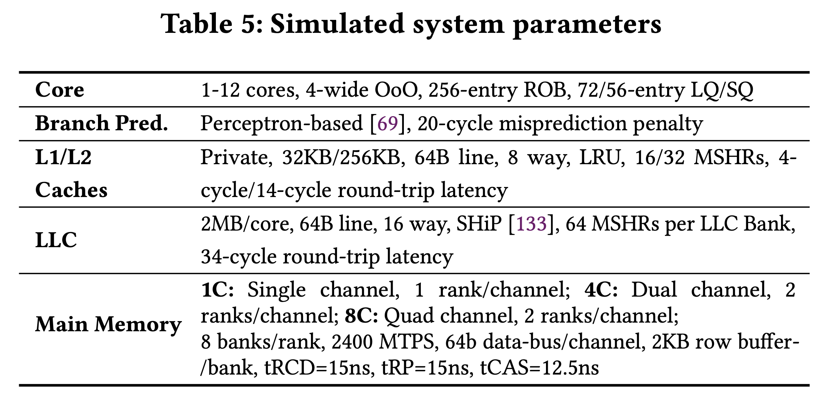
System Parameters

Slide 127
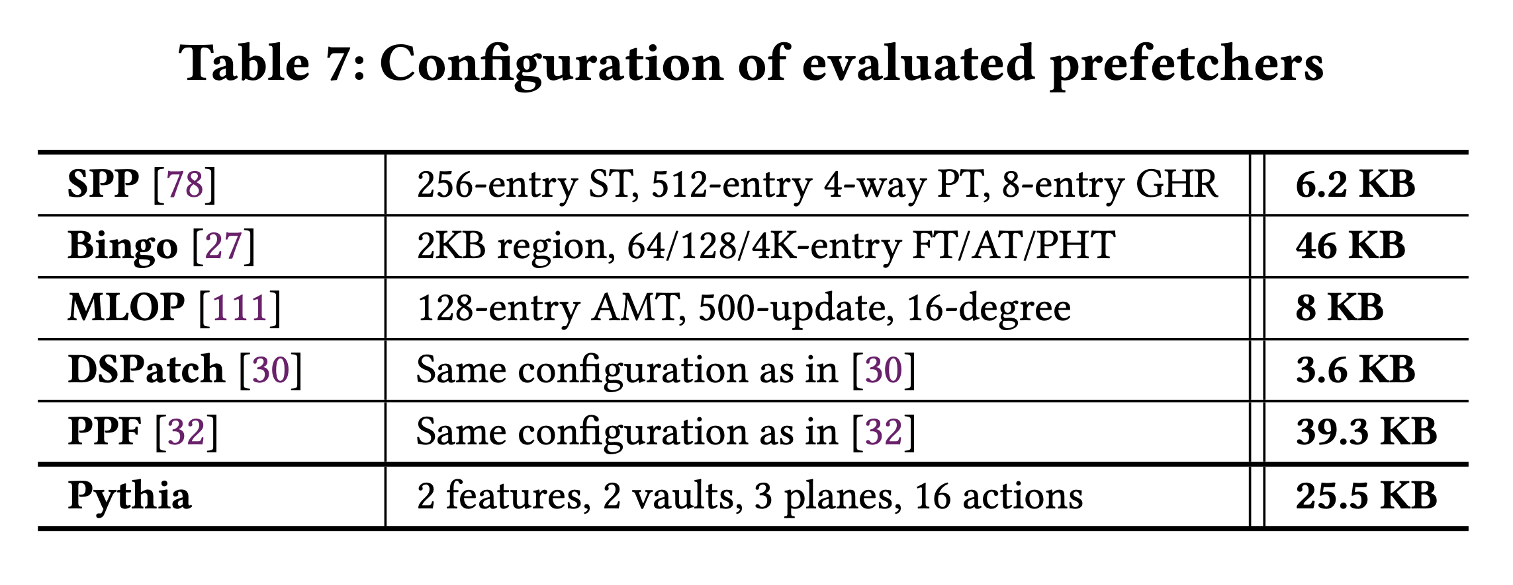
Configuration of Prefetchers

Slide 128
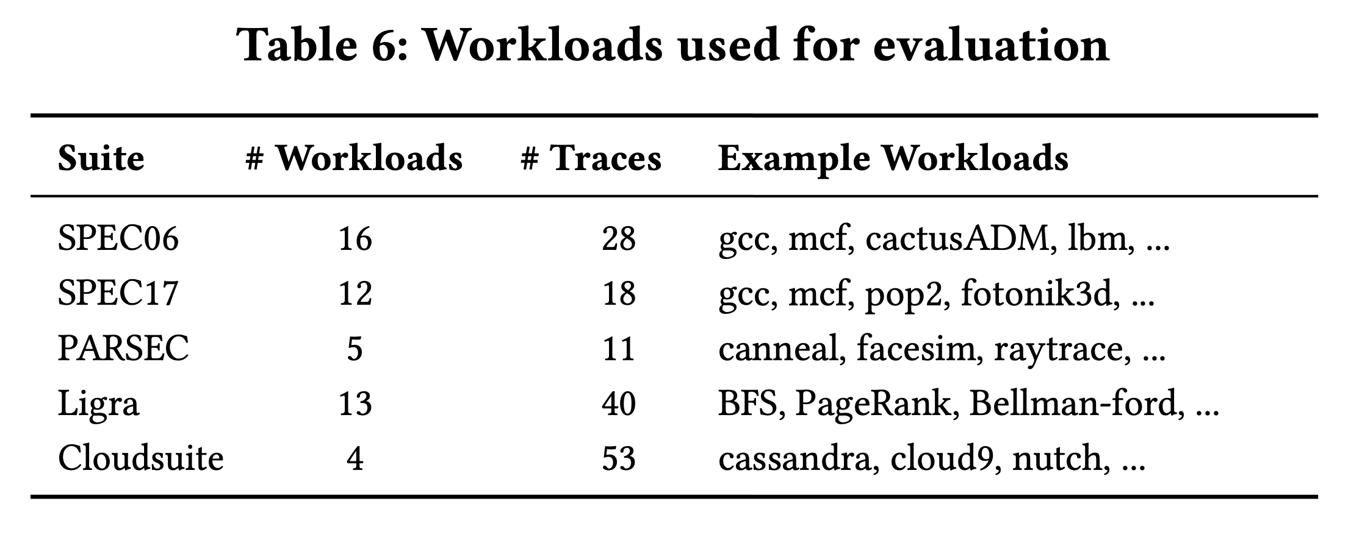
Evaluated Workloads

Slide 129
List of Evaluated Features

Slide 130
MORE RESULTS

Slide 131
Performance S-curve: Single-core
603.bwaves_s-2931B
462.libquantum
streamcluster
fluidanimate-9500M
623.xalancbmk_s-592B
BFSCC-22B
pagerank-51B
429.mcf

Slide 132
Performance S-curve: Four-core
437.leslie3d-271B
462.libquantum-1343B
raytrace-23.75B
429.mcf-184B
Mix-59
pagerank
Mix-240

Slide 133
Single-core Coverage & Overprediction

Slide 134
Detailed Performance

Slide 135
Benefit of Bandwidth Awareness

Slide 136
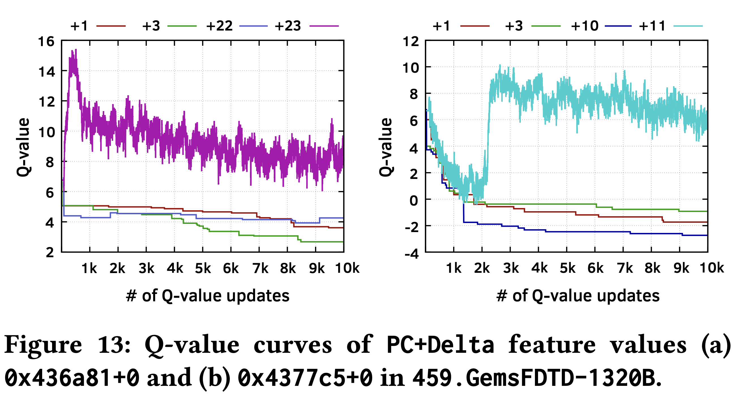
Case Study

Slide 137
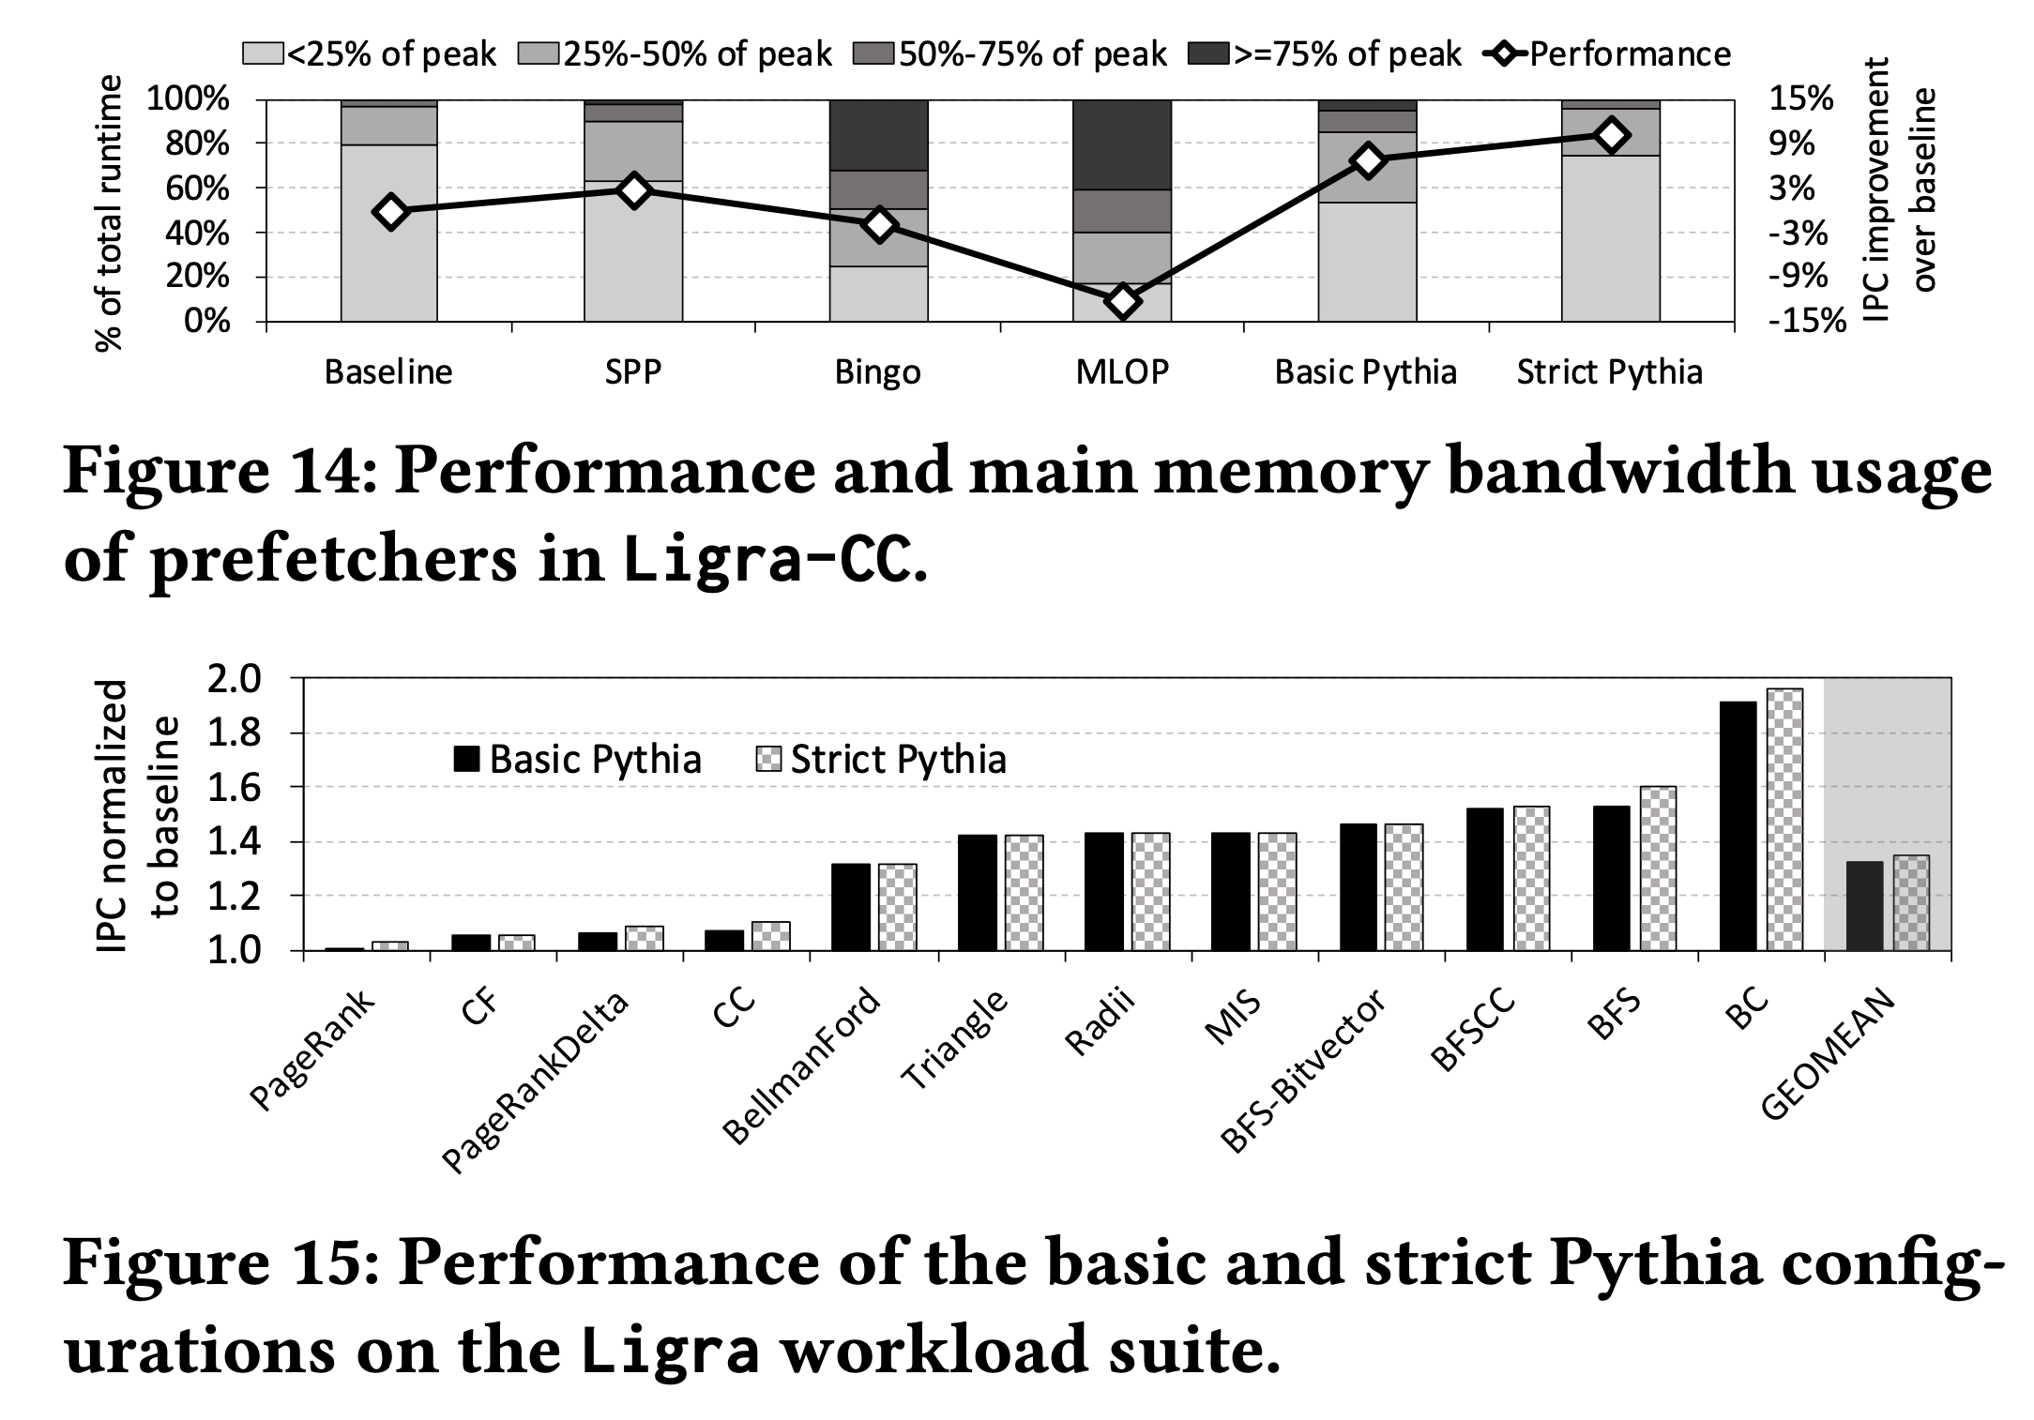
Customizing Rewards

Slide 138
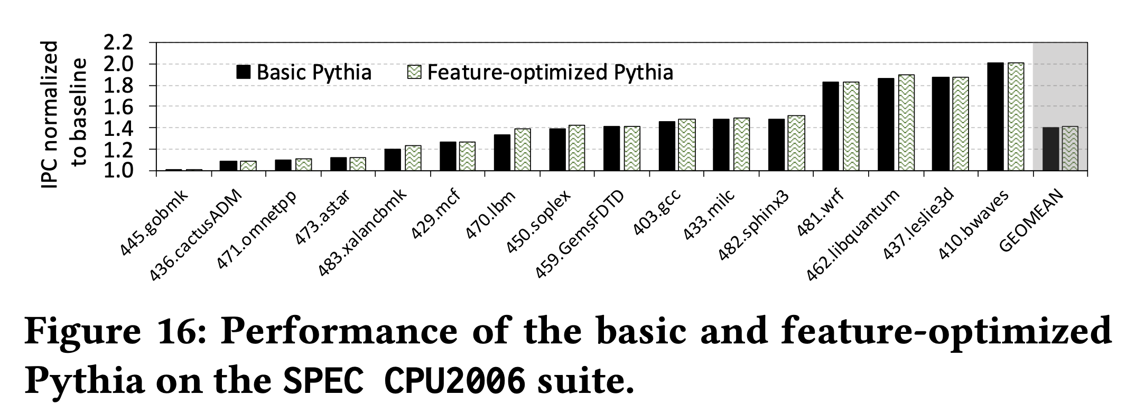
Customizing Features

Slide 139
Hermes Discussion
FAQs
  What are the selected set of program features?
  Can you provide some intuition on why these features work?
  What happens in case of a misprediction?
  What’s the performance headroom for off-chip prediction?
  Do you see a variance of different features in final prediction accuracy?
Simulation Methodology
  System parameters
  Evaluated workloads
More Results
  Percentage of off-chip requests
  Reduction in stall cycles by reducing the critical path
  Fraction of off-chip load requests
  Accuracy and coverage of POPET
  Effect of different features
  Are all features required?
  1C performance
  1C performance line graph
  1C performance against prior predictors
  Effect on stall cycles
  8C performance
  Sensitivity:
    Hermes request issue latency
    Cache hierarchy access latency
    Activation threshold
    ROB size
    LLC size
  Power overhead
  Accuracy without prefetcher
  Main memory request overhead with different prefetchers

Slide 140
HERMES BACKUP

Slide 141
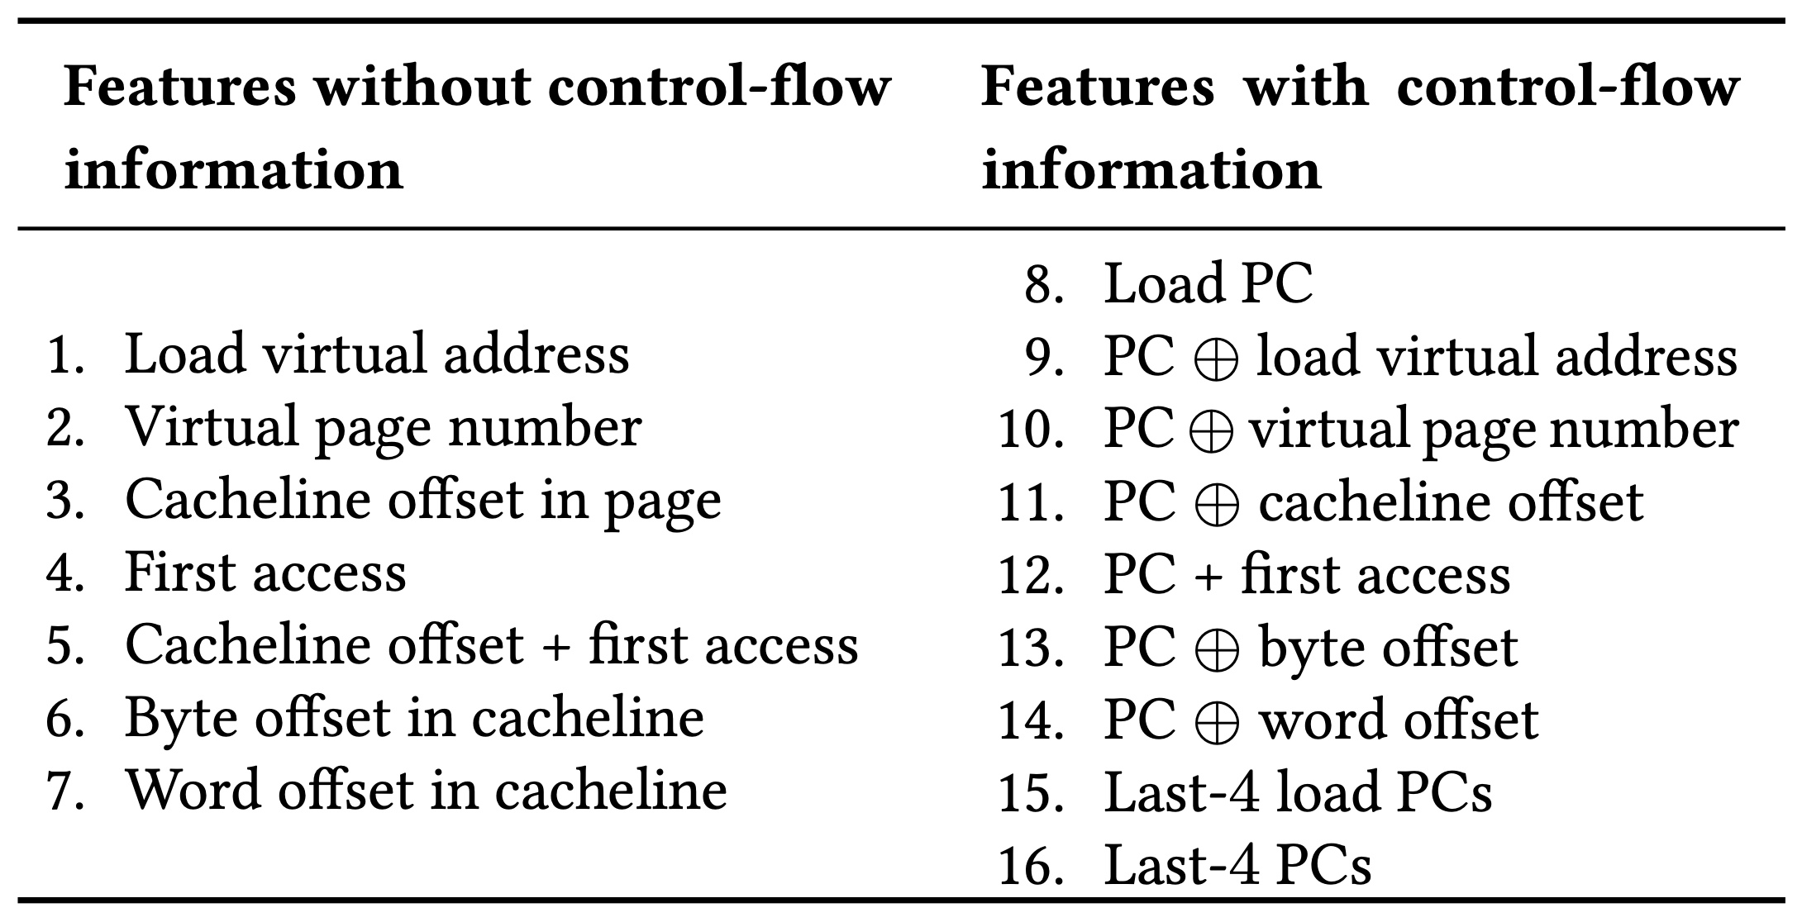
Initial Set of Program Features

Slide 142
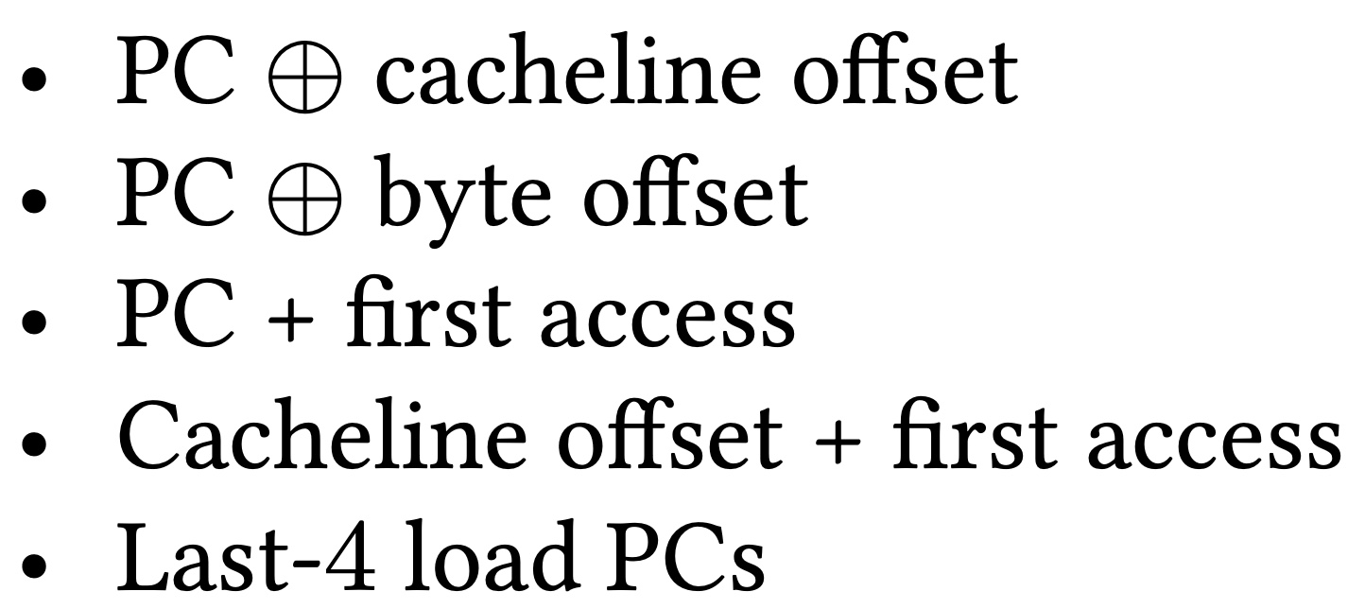
Selected Set of Program Features
A binary hint that represents whether or not a cacheblock has been recently touched
Five features

Slide 143
When A Feature Works/Does Not Work?
Trace: 462.libquantum-1343B
PC: 0x401442
…
Cacheline #42
Cacheline #43
…
Without prefetcher
With a simple stride prefetcher
PC + first access
Cacheline offset + first access
Cacheline offset + first access

Slide 144
What Happens in case of a Misprediction?
Two cases of mispredictions:
Predicted on-chip but actually goes off-chip
  Loss of performance improvement opportunity
Predicted off-chip but actually is on-chip
  Memory controller forwards the data to LLC if and only if a load to the same address have already missed LLC and arrived at the memory controller
No need for misprediction detection and recovery
No need for misprediction detection and recovery

Slide 145
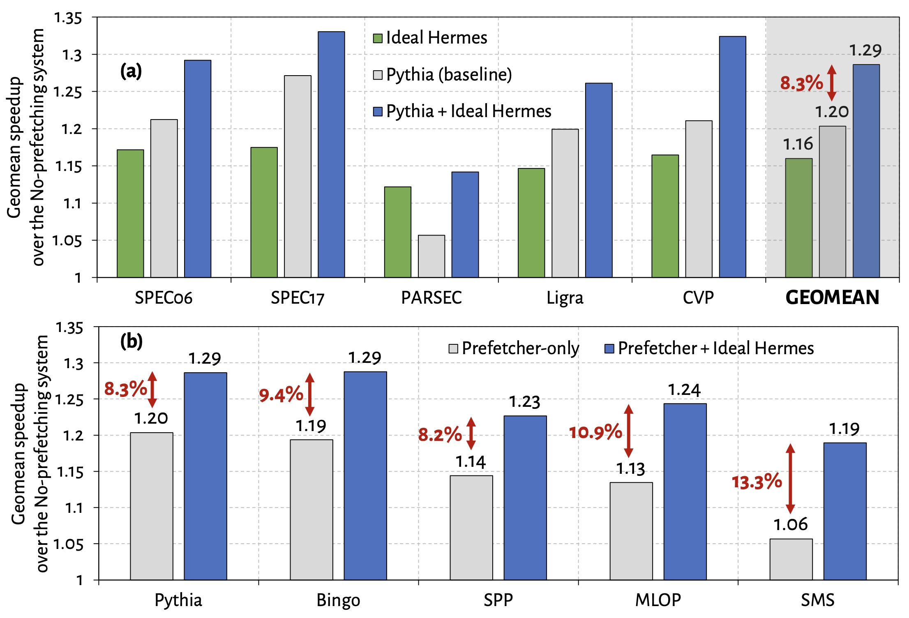
Performance Headroom of Off-Chip Prediction

Slide 146
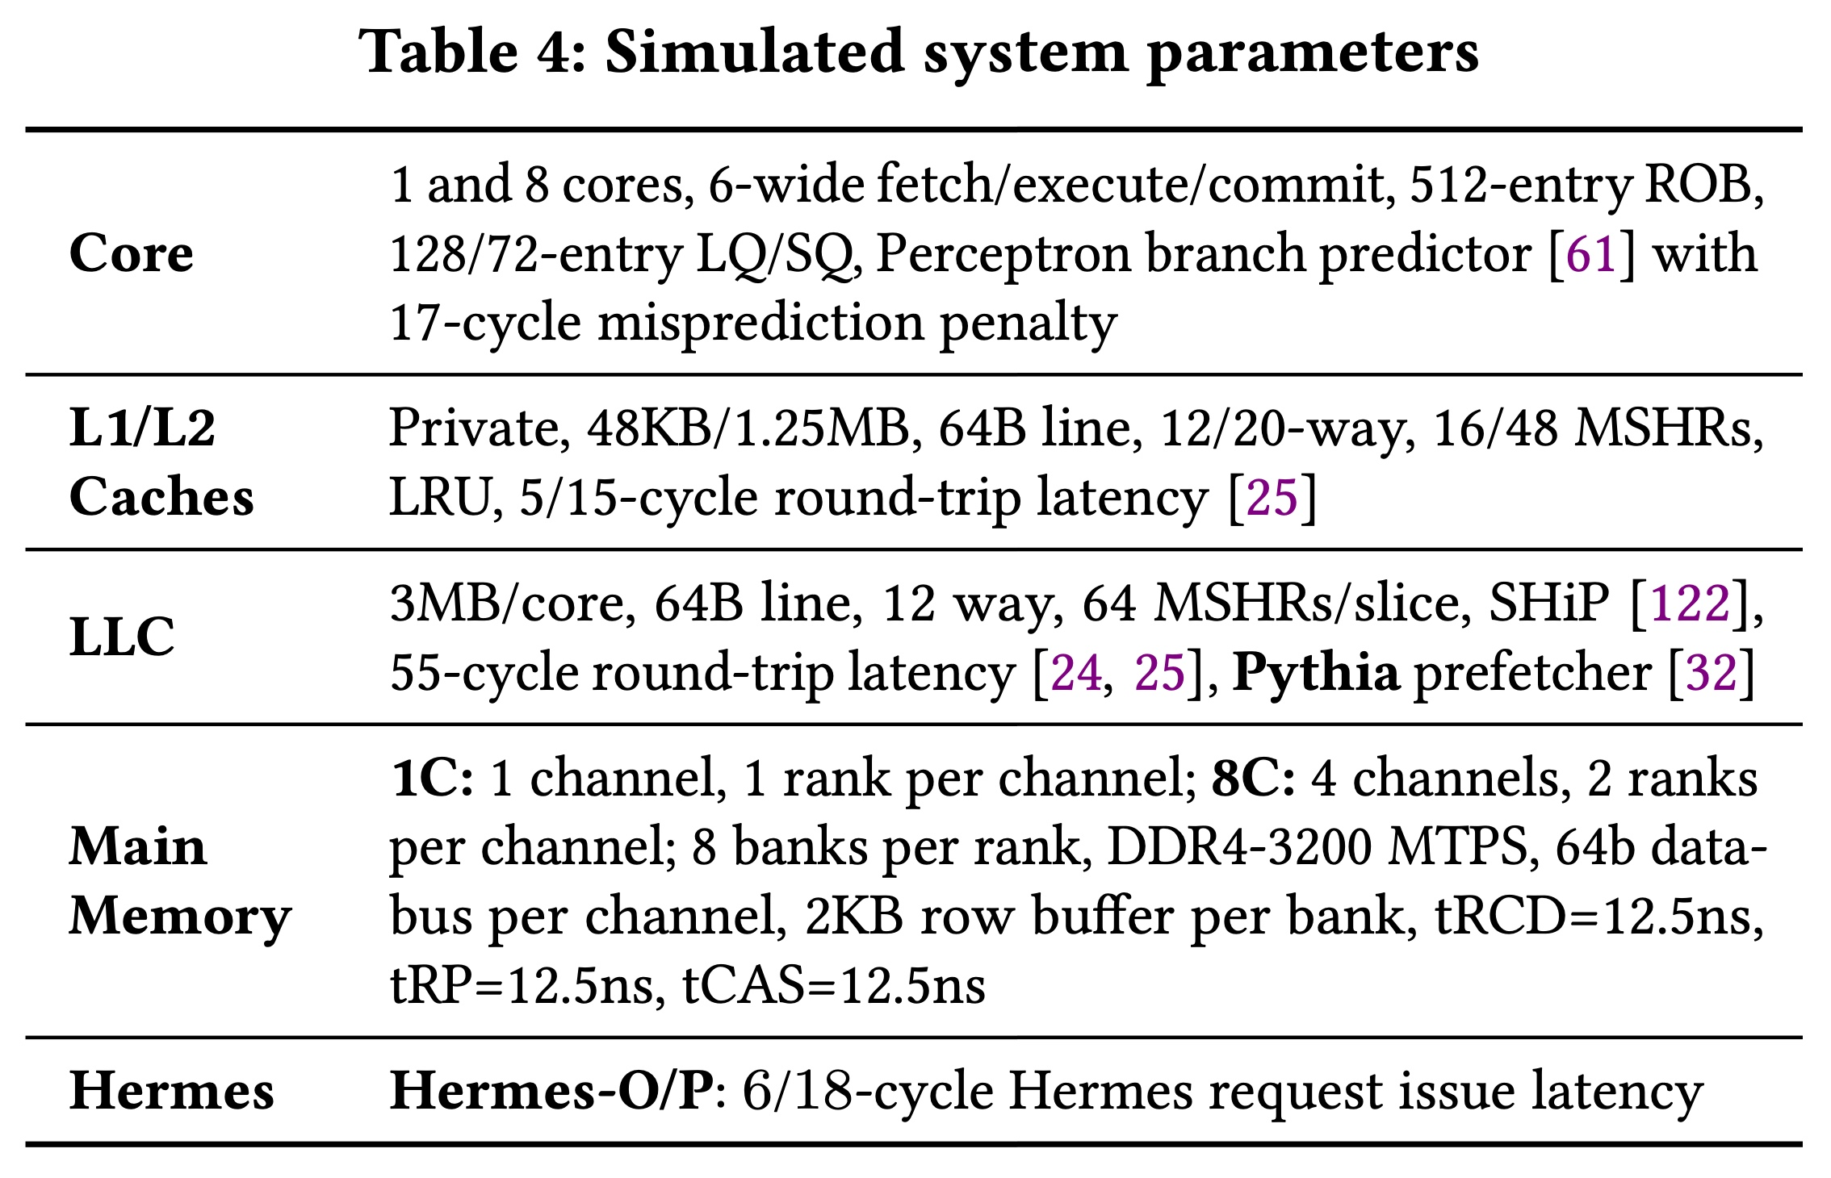
System Parameters

Slide 147
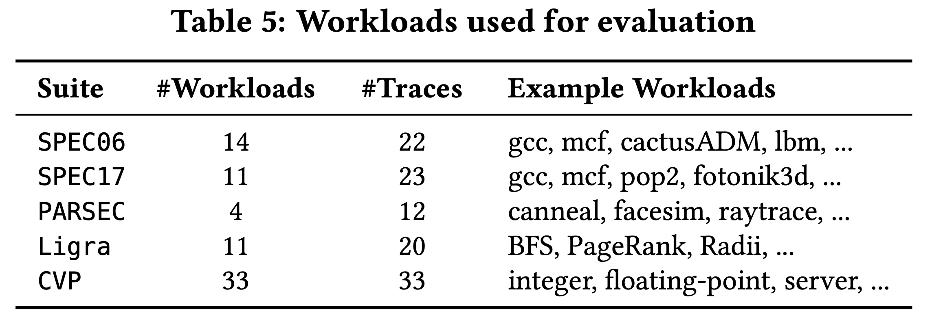
Evaluated Workloads

Slide 148
Observation: Not All Off-Chip Loads are Prefetched
50%
1
Nearly 50% of the loads are still not prefetched

Slide 149
Observation: Not All Off-Chip Loads are Prefetched
2
70% of these off-chip loads blocks ROB

Slide 150
Observation: With Large Cache Comes Longer Latency
On-chip cache access latency significantly contributes to the latency of an off-chip load
On-chip cache hierarchy access latency
58

Slide 151
Observation: With Large Cache Comes Longer Latency
On-chip cache access latency significantly contributes to the latency of an off-chip load
On-chip cache hierarchy access latency
40% of stall cycles caused by an off-chip load can be eliminated
by removing on-chip cache access latency from its critical path
58

Slide 152
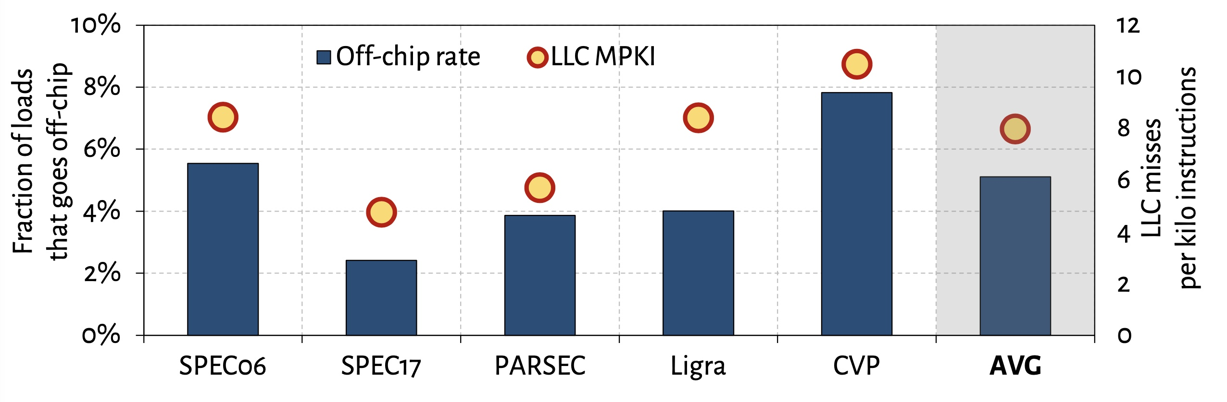
What Fraction of Load Requests Goes Off-Chip?

Slide 153
Off-Chip Prediction Quality: Defining Metrics
Accuracy
Coverage
Predicted off-chip
Actual off-chip
Predicted and actual off-chip

Slide 154
Off-Chip Prediction Quality: Analysis
Accuracy
77%
47%
16%
Coverage
95%
74%
22%

Slide 155
Off-Chip Prediction Quality: Analysis
Accuracy
77%
47%
16%
POPET provides off-chip predictions with high-accuracy and high-coverage
Coverage
95%
74%
22%

Slide 156
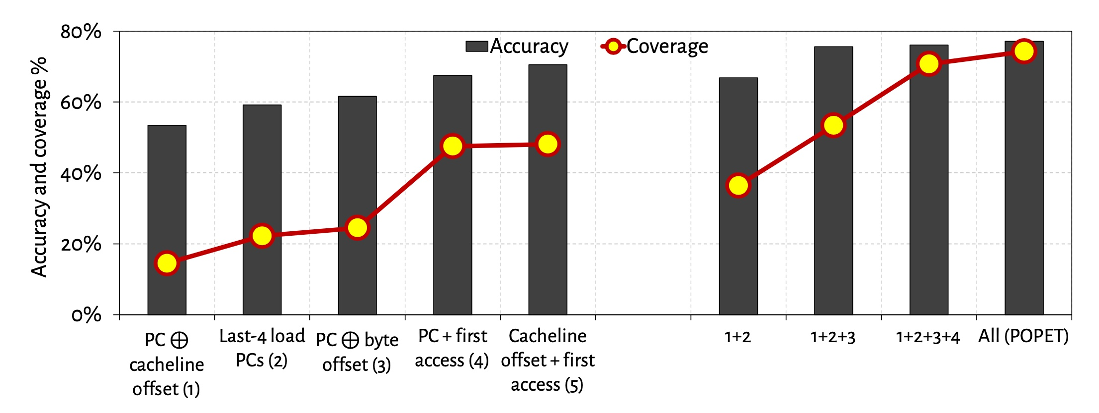
Effect of Different Features
Combination of features provides both higher accuracy and higher coverage than any individual feature

Slide 157
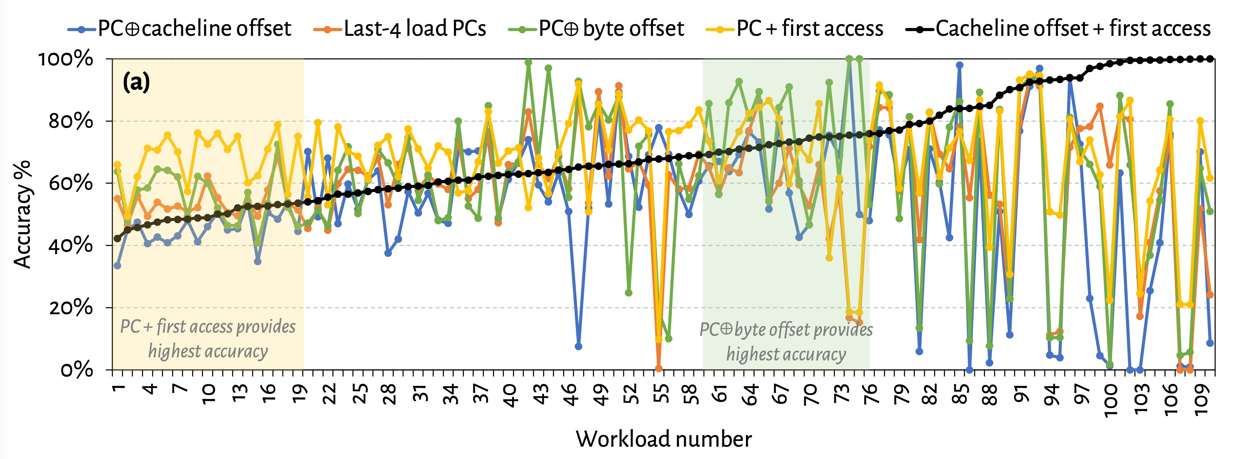
Are All Features Required? (1)
No single feature individually provides
highest prediction accuracy across all workloads

Slide 158
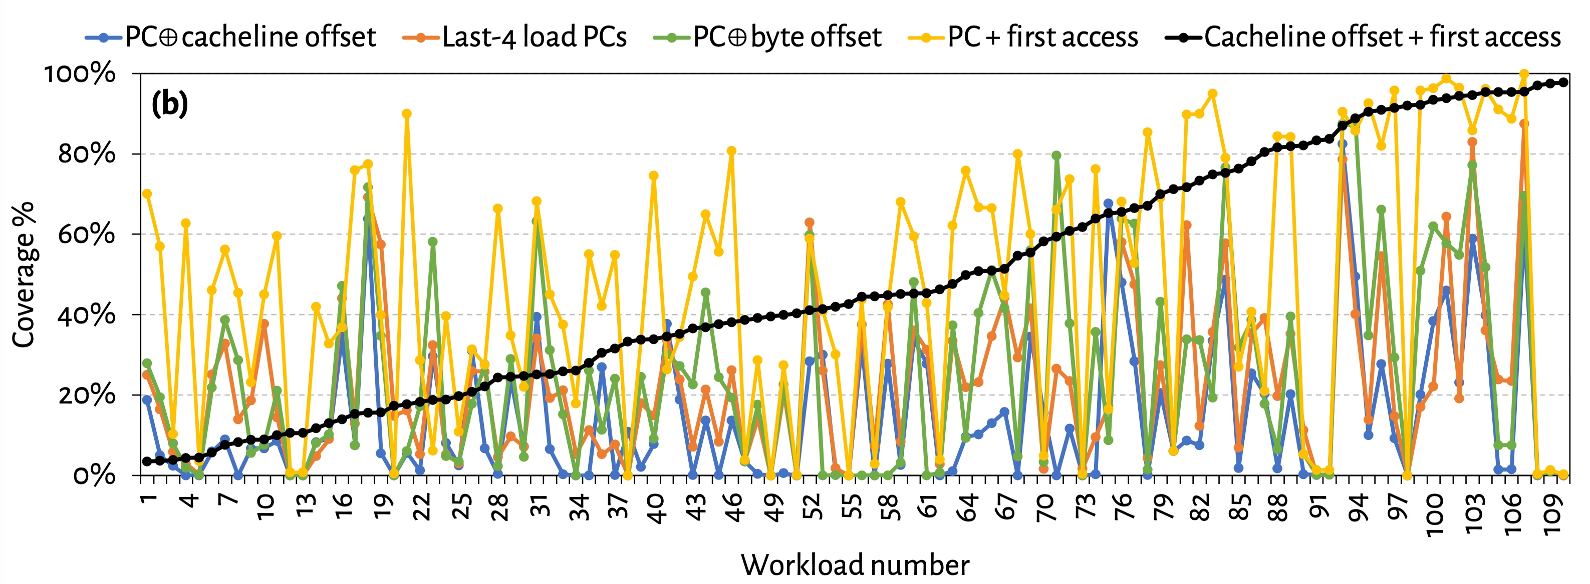
Are All Features Required? (2)
No single feature individually provides
highest prediction coverage also across all workloads

Slide 159
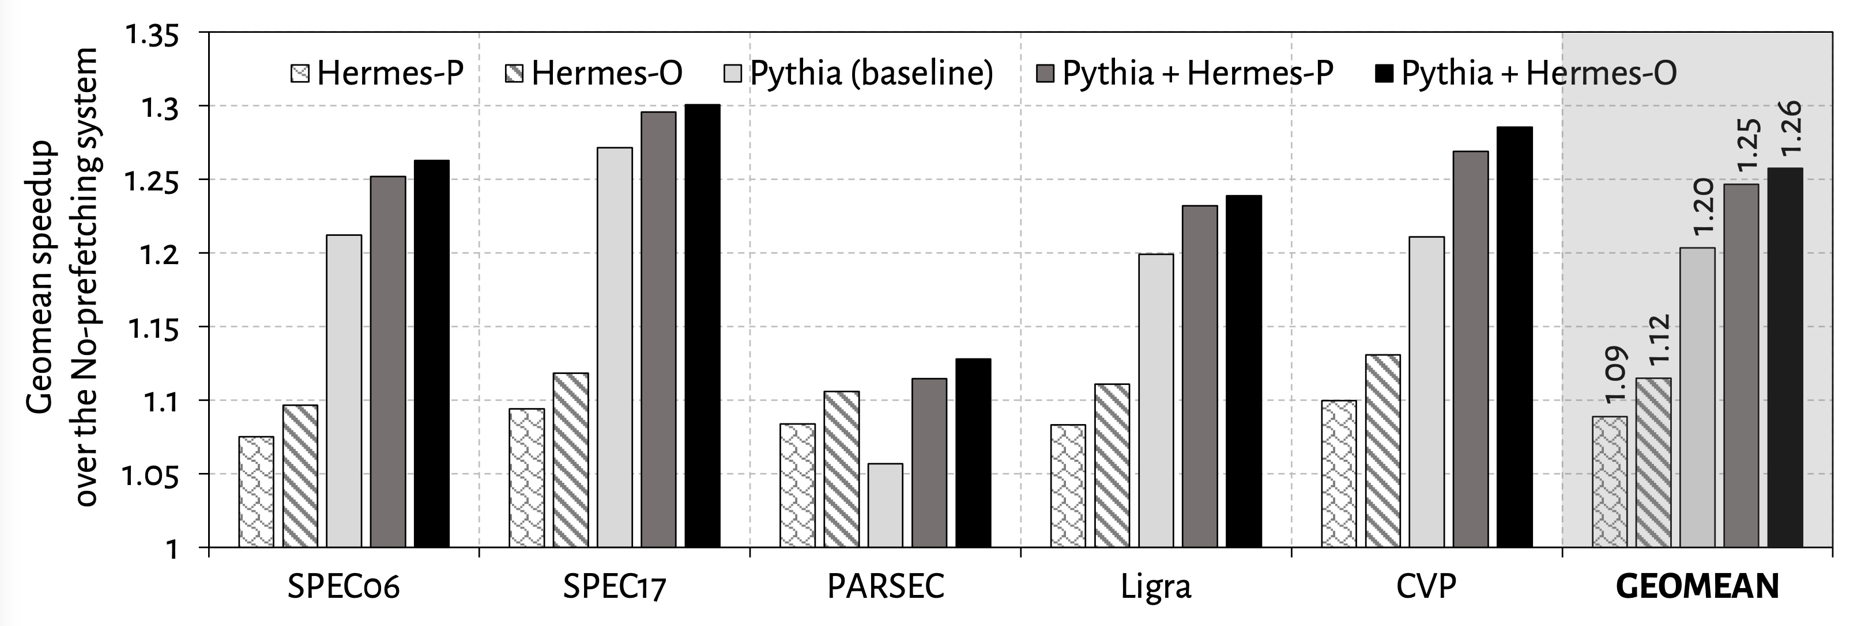
Single-Core Performance
Hermes in combination with Pythia
outperforms Pythia alone in every workload category

Slide 160
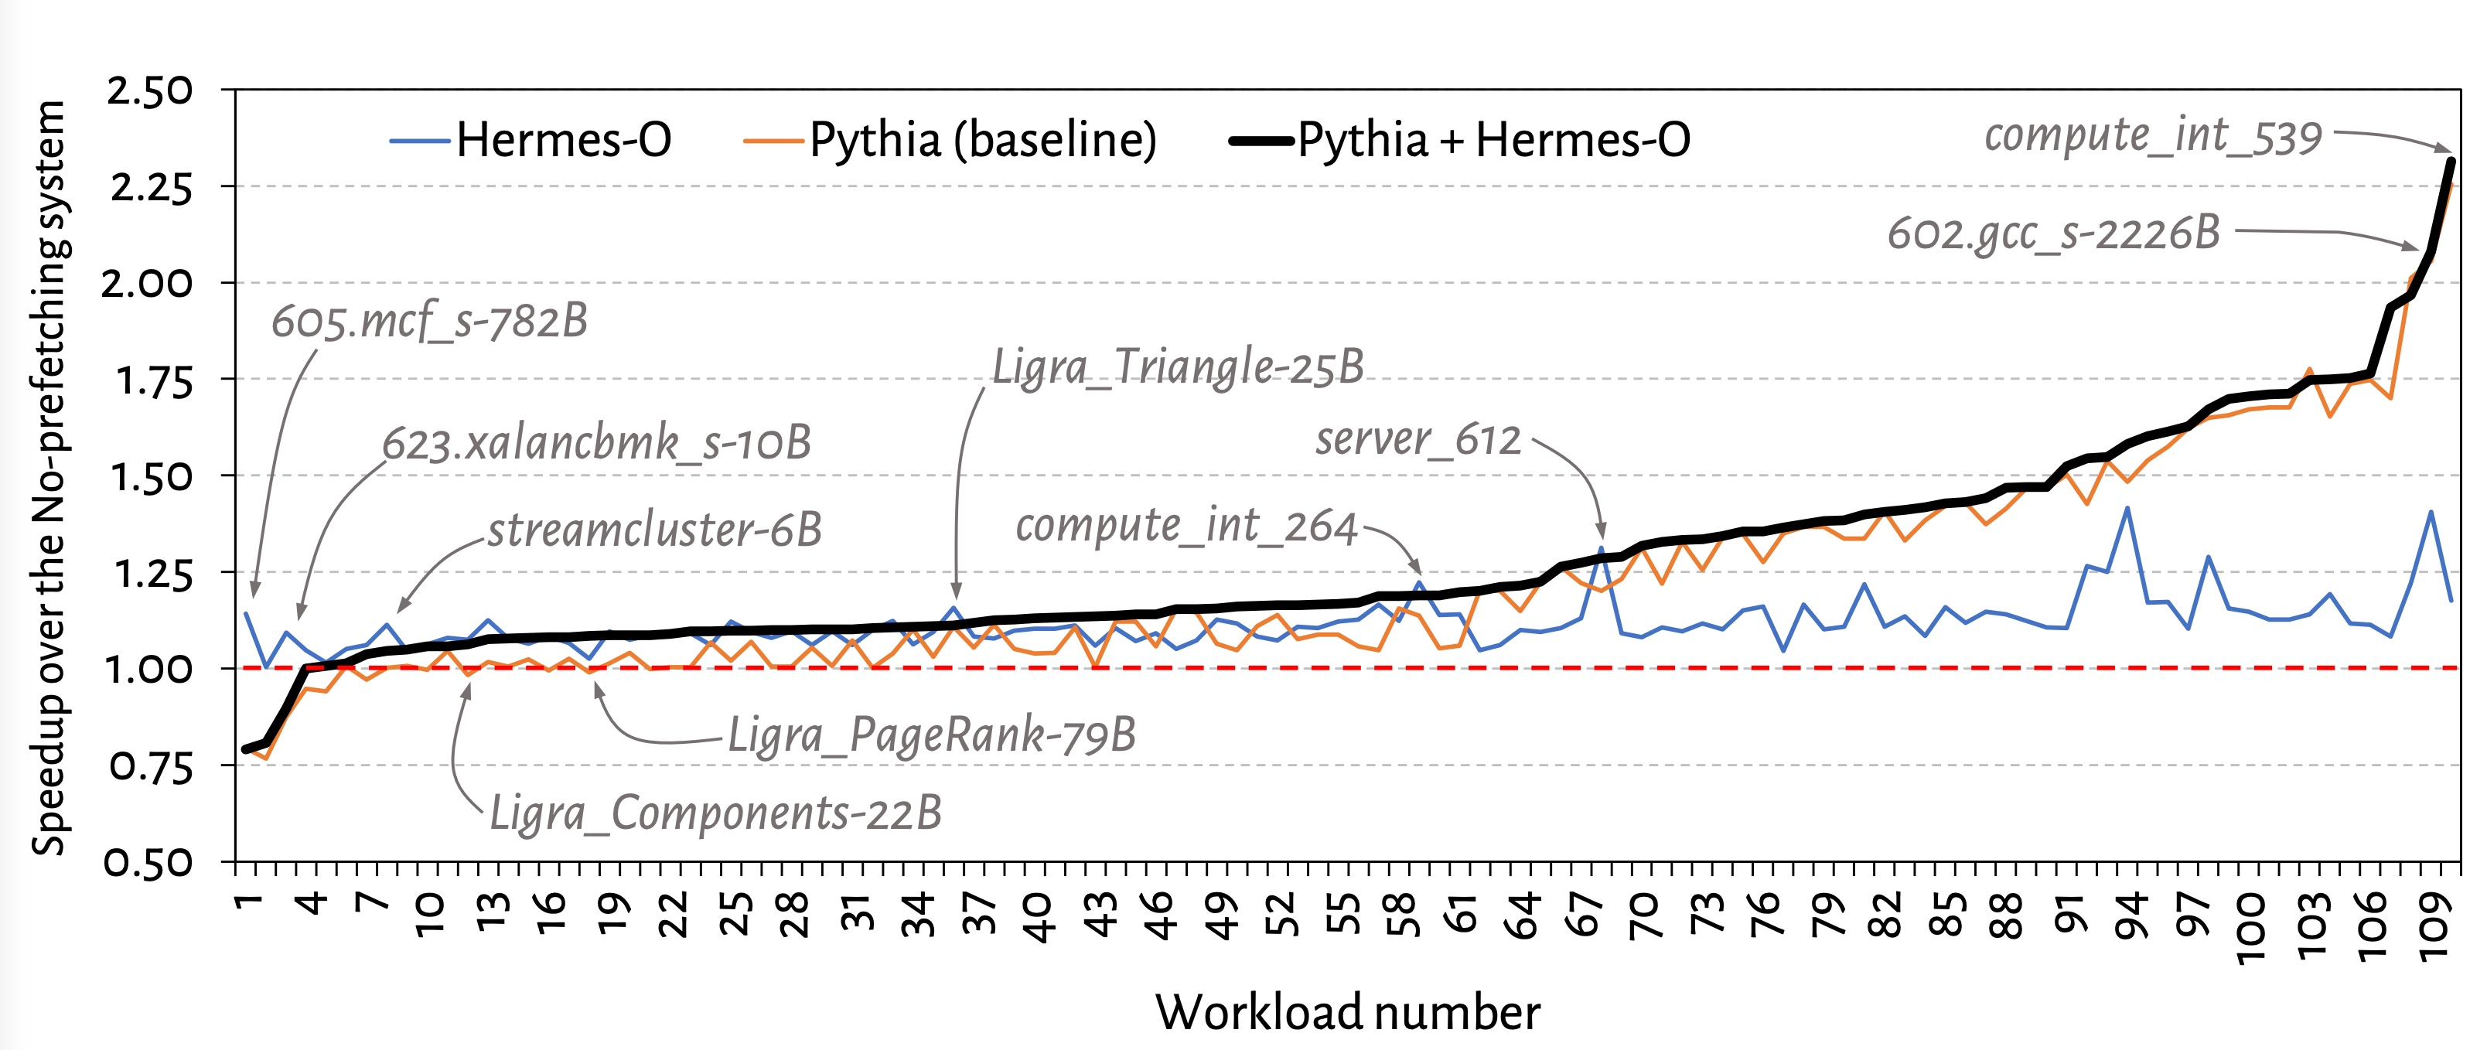
Single-Core Performance Line Graph

Slide 161
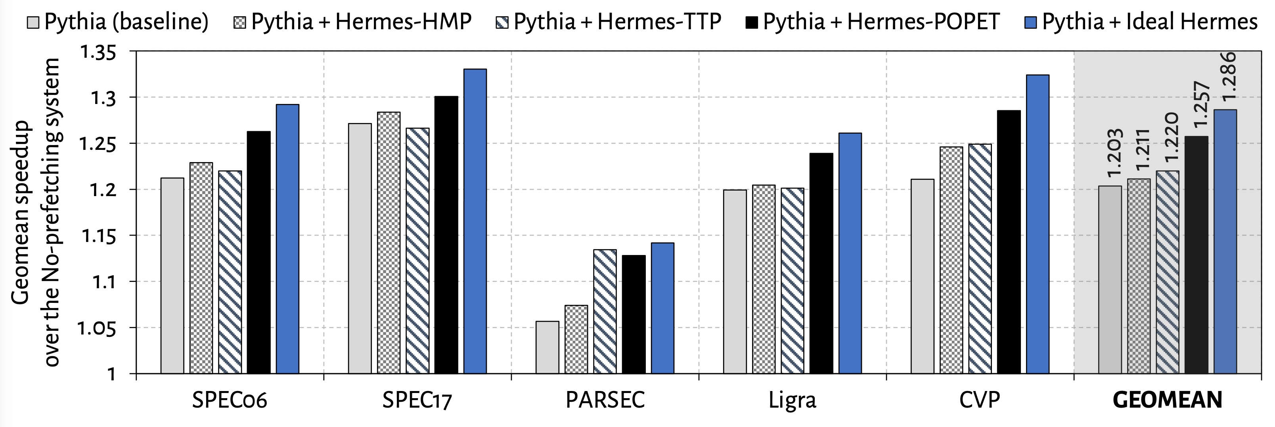
Single-Core Performance Against Prior Predictors
POPET provides higher performance benefit
than prior predictors
Hermes with POPET achieves nearly 90% performance improvement of the Ideal Hermes

Slide 162
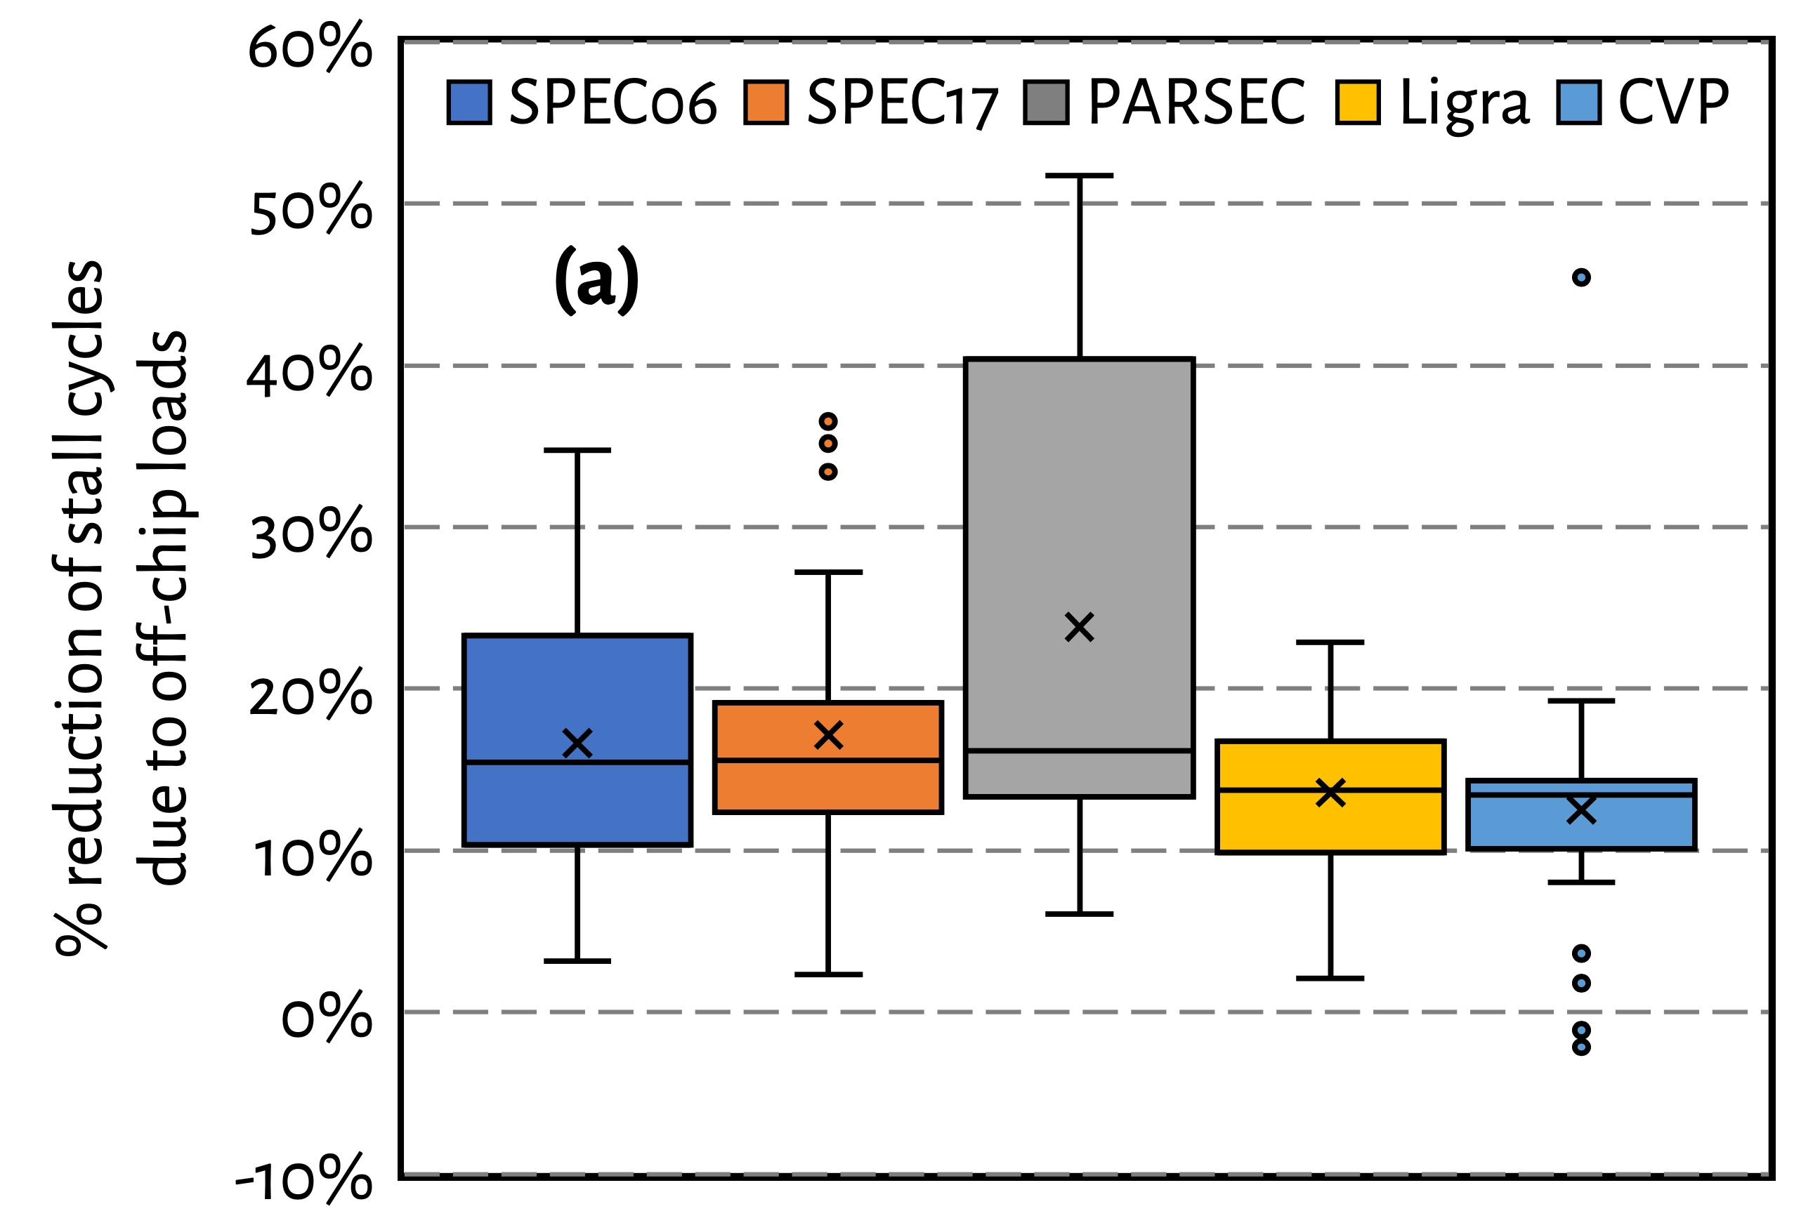
Effect on Stall Cycles
Hermes reduces off-chip load induced stall cycles
on average by 16.2% (up-to 51.8%)

Slide 163
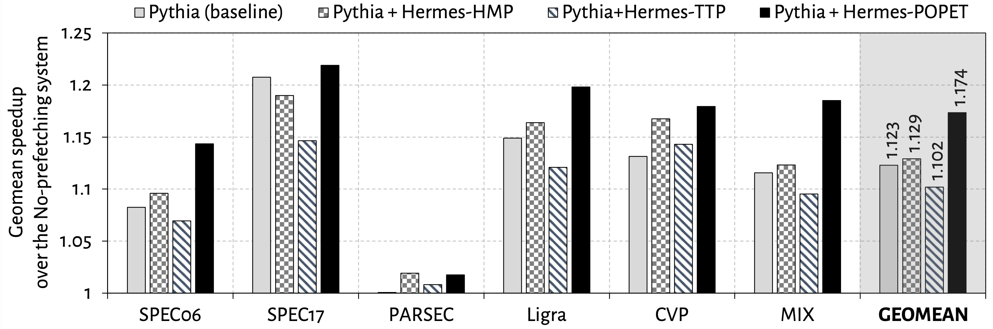
Eight-Core Performance
Hermes in combination with Pythia
outperforms Pythia alone by 5.1% on average

Slide 164
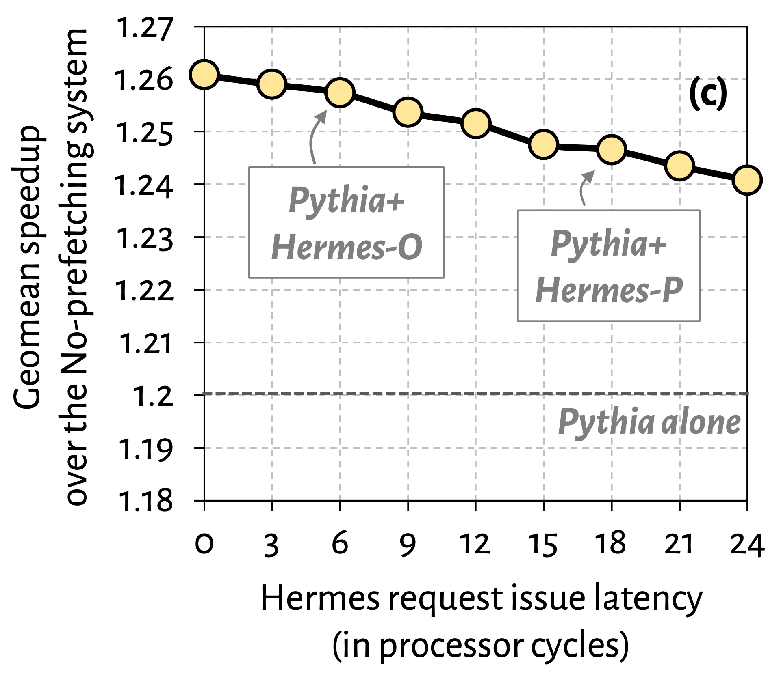

Effect of Hermes Request Issue Latency
3.6%
5.7%
Hermes in combination with Pythia outperforms Pythia alone even with a 24-cycle Hermes request issue latency

Slide 165
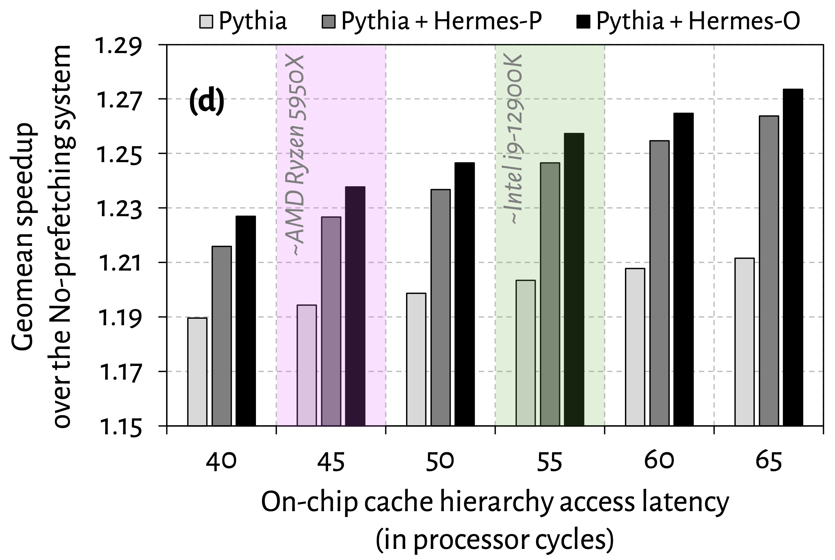
Effect of Cache Hierarchy Access Latency
6.2%
3.6%
Hermes can provide even higher performance benefit in
future processors with bigger and slower on-chip caches

Slide 166
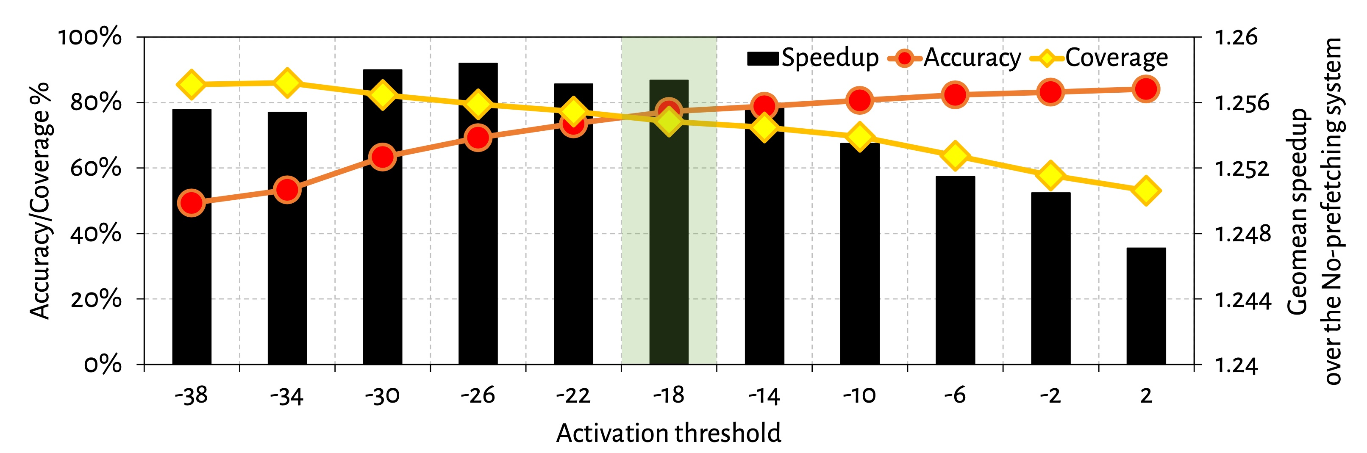
Effect of Activation Threshold
With increase in activation threshold
Accuracy increases
Coverage decreases

Slide 167

Power Overhead

Slide 168

Effect of ROB Size
6.7%
5.3%

Slide 169

Effect of LLC Size
2.5%
1.3%

Slide 170

Accuracy and Coverage with Different Prefetchers
POPET’s accuracy and coverage increases significantly
in absence of a data prefetcher

Slide 171

Increase in Main Memory Requests

