Slide 1



Intelligent Architectures for
Intelligent Machines
Onur Mutlu
omutlu@gmail.com
https://people.inf.ethz.ch/omutlu
1 July 2019
Yale @ 80

Slide 2
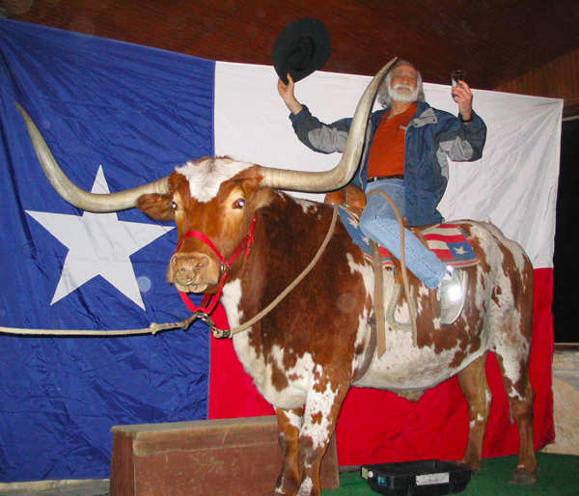

Slide 3
Design Principles
Critical path design
Bread and Butter design
Balanced design
from Yale Patt’s EE 382N lecture notes
Notes:
ADD a banner on: slide that has not changed for decades.
Spring 2001
To
Spring 2014

Slide 4
(Micro)architecture Design Principles
Bread and butter design
  Spend time and resources on where it matters (i.e. improving what the machine is designed to do)
  Common case vs. uncommon case
Balanced design
  Balance instruction/data flow through uarch components
  Design to eliminate bottlenecks
Critical path design
  Find the maximum speed path and decrease it
    Break a path into multiple cycles?
from my ECE 740 lecture notes

Slide 5
This Talk
Design Principles
How We Violate Those Principles Today
Principled Intelligent Architectures
Concluding Remarks

Slide 6
The Problem
Computing
is Bottlenecked by Data

Slide 7
Data is Key for AI, ML, Genomics, …
Important workloads are all data intensive
They require rapid and efficient processing of large amounts of data
Data is increasing
  We can generate more than we can process

Slide 8
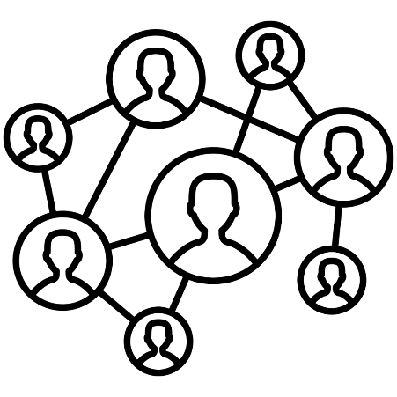

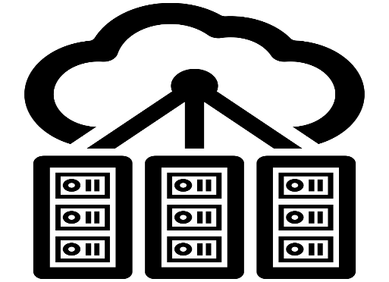

Data is Key for Future Workloads
In-memory Databases
[Mao+, EuroSys’12;
Clapp+ (Intel), IISWC’15]
Graph/Tree Processing
[Xu+, IISWC’12; Umuroglu+, FPL’15]
In-Memory Data Analytics
[Clapp+ (Intel), IISWC’15;
Awan+, BDCloud’15]
Datacenter Workloads
[Kanev+ (Google), ISCA’15]

Slide 9
Data Overwhelms Modern Machines
In-memory Databases
[Mao+, EuroSys’12;
Clapp+ (Intel), IISWC’15]
Graph/Tree Processing
[Xu+, IISWC’12; Umuroglu+, FPL’15]
Data → performance & energy bottleneck
In-Memory Data Analytics
[Clapp+ (Intel), IISWC’15;
Awan+, BDCloud’15]
Datacenter Workloads
[Kanev+ (Google), ISCA’15]

Slide 10





Data is Key for Future Workloads
  Chrome
TensorFlow Mobile
    Google’s web browser
Google’s machine learning framework
  Video Playback
  Video Capture
Google’s video codec
Google’s video codec
Notes:
In this work, we take a look at widely-used google consumer workloads, to figure out the major sources of energy consumption.
We look at Google Chrome web brower. We take a look at Tensorflow, Google’s machine learning framework, and we also take a look at two important video related workloads, video playback and video capture, both rely on Google’s vp9 codec technology.

Slide 11
Data Overwhelms Modern Machines
  Chrome
TensorFlow Mobile
    Google’s web browser
Google’s machine learning framework
Data → performance & energy bottleneck
  Video Playback
  Video Capture
Google’s video codec
Google’s video codec
Notes:
In this work, we take a look at widely-used google consumer workloads, to figure out the major sources of energy consumption.
We look at Google Chrome web brower. We take a look at Tensorflow, Google’s machine learning framework, and we also take a look at two important video related workloads, video playback and video capture, both rely on Google’s vp9 codec technology.

Slide 12
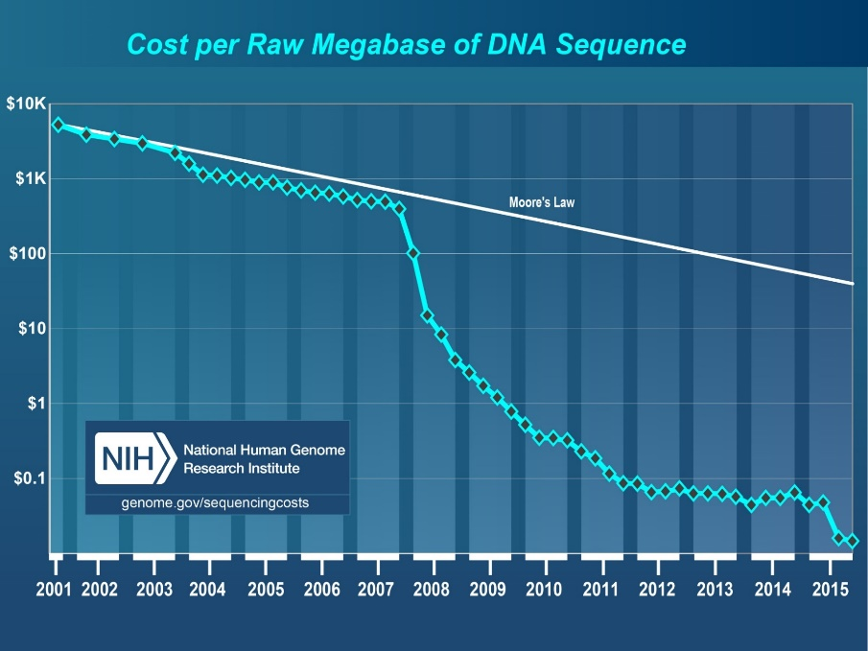
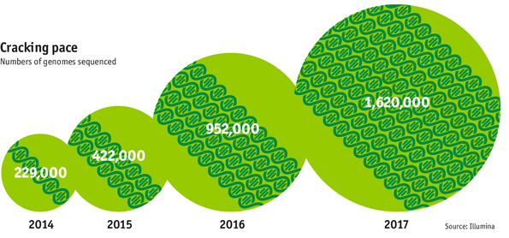

Data is Key for Future Workloads
development of high-throughput sequencing (HTS) technologies
Number of Genomes Sequenced
http://www.economist.com/news/21631808-so-much-genetic-data-so-many-uses-genes-unzipped
Notes:
However, since the development of high throughput sequencing (HTS) technologies, the cost of genome sequencing has fallen off a cliff (<< 1,000$) making it viable for almost everyone's use.

Slide 13
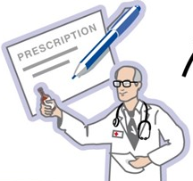
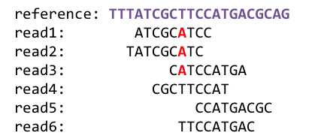
1
Sequencing
Genome Analysis
Read Mapping
2
Data → performance & energy bottleneck
Variant Calling
Scientific Discovery
3
4
Notes:
Genome analysis starts with sequencing random short DNA fragments of copies of the original molecule.
Unfortunately, these reads lack information about their order and which part of genome they are originated from.
Hence the second step is to map these reads to a long reference genome.

Slide 14
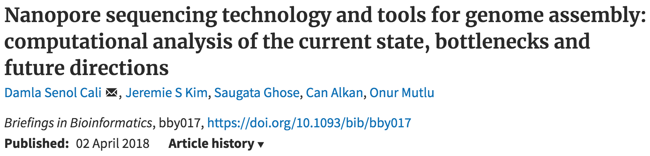

New Genome Sequencing Technologies
Oxford Nanopore MinION
Senol Cali+, “Nanopore Sequencing Technology and Tools for Genome
Assembly: Computational Analysis of the Current State, Bottlenecks
and Future Directions,” Briefings in Bioinformatics, 2018.
[Preliminary arxiv.org version]
Data → performance & energy bottleneck

Slide 15
Data Overwhelms Modern Machines …
Storage/memory capability
Communication capability
Computation capability
Greatly impacts robustness, energy, performance, cost

Slide 16
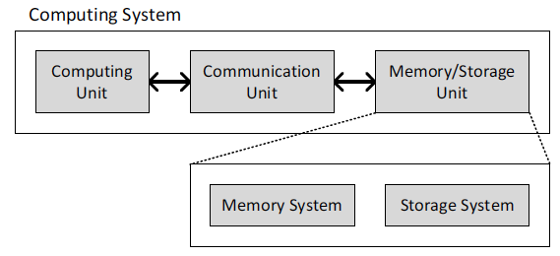
A Computing System
Three key components
Computation
Communication
Storage/memory
Burks, Goldstein, von Neumann, “Preliminary discussion of the
logical design of an electronic computing instrument,” 1946.
Image source: https://lbsitbytes2010.wordpress.com/2013/03/29/john-von-neumann-roll-no-15/

Slide 17
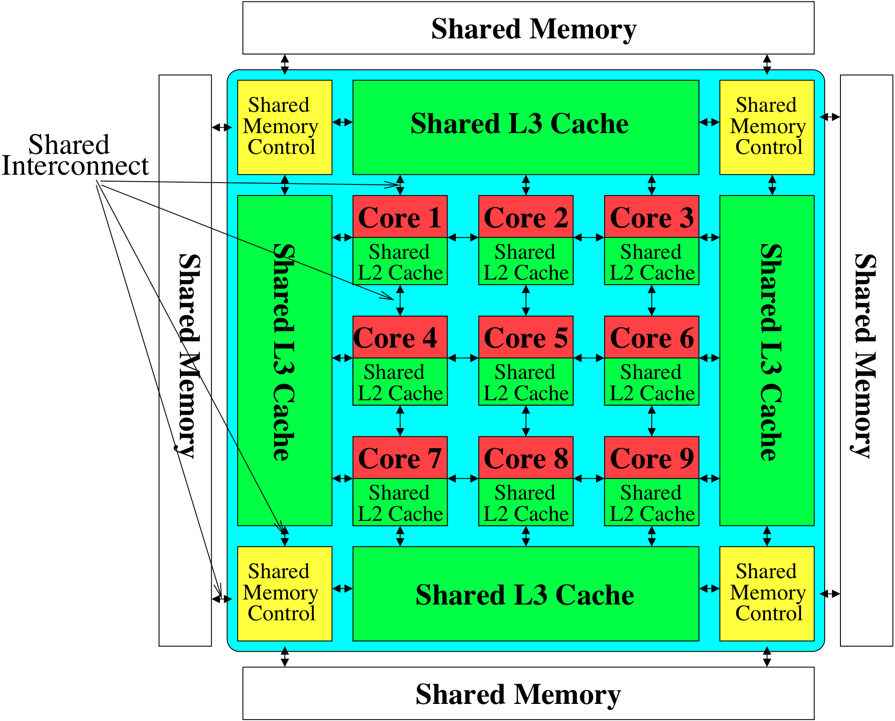

Perils of Processor-Centric Design
Most of the system is dedicated to storing and moving data

Slide 18
Data Overwhelms Modern Machines
  Chrome
TensorFlow Mobile
    Google’s web browser
Google’s machine learning framework
Data → performance & energy bottleneck
  Video Playback
  Video Capture
Google’s video codec
Google’s video codec
Notes:
In this work, we take a look at widely-used google consumer workloads, to figure out the major sources of energy consumption.
We look at Google Chrome web brower. We take a look at Tensorflow, Google’s machine learning framework, and we also take a look at two important video related workloads, video playback and video capture, both rely on Google’s vp9 codec technology.

Slide 19
Data Movement Overwhelms Modern Machines
Amirali Boroumand, Saugata Ghose, Youngsok Kim, Rachata Ausavarungnirun, Eric Shiu, Rahul Thakur, Daehyun Kim, Aki Kuusela, Allan Knies, Parthasarathy Ranganathan, and Onur Mutlu,
"Google Workloads for Consumer Devices: Mitigating Data Movement Bottlenecks"
Proceedings of the 23rd International Conference on Architectural Support for Programming Languages and Operating Systems (ASPLOS), Williamsburg, VA, USA, March 2018.
62.7% of the total system energy
is spent on data movement

Slide 20
Axiom
An Intelligent Architecture
Handles Data Well

Slide 21
How to Handle Data Well
Ensure data does not overwhelm the components
  via intelligent algorithms
  via intelligent architectures
  via whole system designs: algorithm-architecture-devices
Take advantage of vast amounts of data and metadata
  to improve architectural & system-level decisions
Understand and exploit properties of (different) data
  to improve algorithms & architectures in various metrics

Slide 22
Corollaries: Architectures Today …
Architectures are terrible at dealing with data
  Designed to mainly store and move data vs. to compute
  They are processor-centric as opposed to data-centric
Architectures are terrible at taking advantage of vast amounts of data (and metadata) available to them
  Designed to make simple decisions, ignoring lots of data
  They make human-driven decisions vs. data-driven decisions
Architectures are terrible at knowing and exploiting different properties of application data
  Designed to treat all data as the same
  They make component-aware decisions vs. data-aware

Slide 23
Data-Centric (Memory-Centric) Architectures

Slide 24
Data-Centric Architectures: Properties
Process data where it resides (where it makes sense)
  Processing in and near memory structures
Low-latency and low-energy data access
  Low latency memory
  Low energy memory
Low-cost data storage and processing
  High capacity memory at low cost: hybrid memory, compression
Intelligent data management
  Intelligent controllers handling robustness, security, cost

Slide 25
Processing Data
Where It Makes Sense

Slide 26
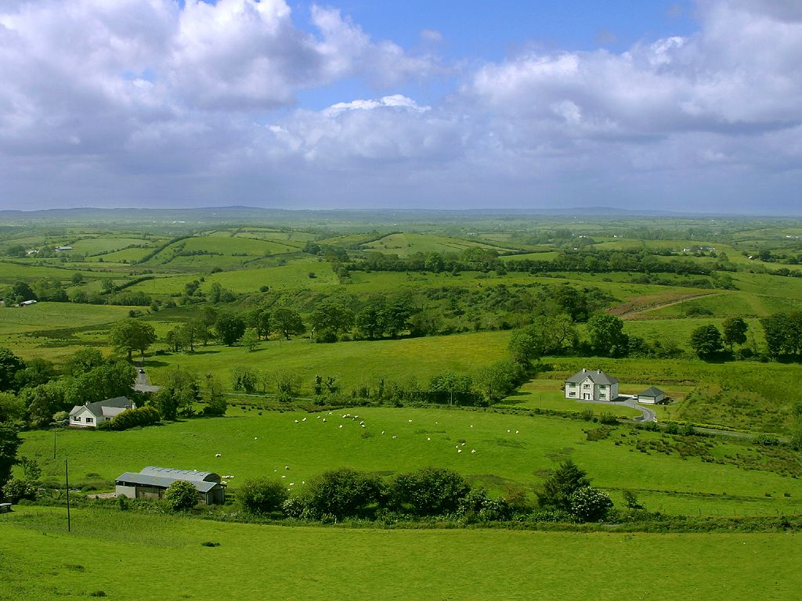
Do We Want This?
Source: V. Milutinovic

Slide 27
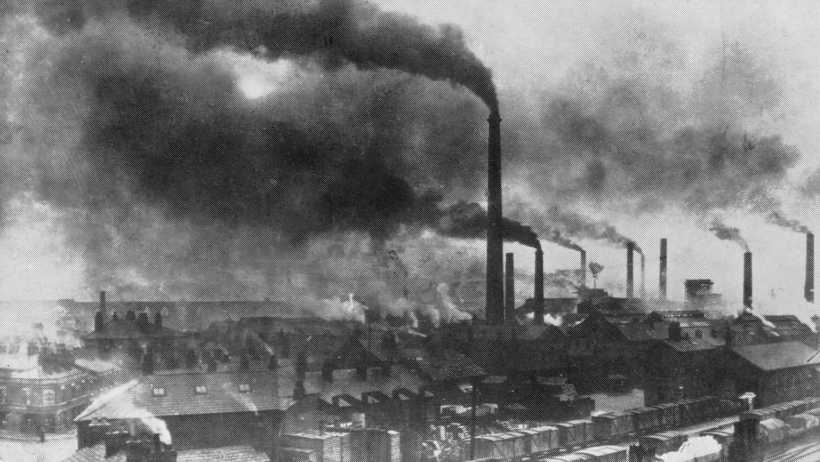
Or This?
Source: V. Milutinovic

Slide 28
Challenge and Opportunity for Future
High Performance,
Energy Efficient,
Sustainable

Slide 29
The Problem
Data access is the major performance and energy bottleneck
Our current
design principles
cause great energy waste
(and great performance loss)

Slide 30
The Problem
Processing of data
is performed
far away from the data

Slide 31
A Computing System
Three key components
Computation
Communication
Storage/memory
Burks, Goldstein, von Neumann, “Preliminary discussion of the
logical design of an electronic computing instrument,” 1946.
Image source: https://lbsitbytes2010.wordpress.com/2013/03/29/john-von-neumann-roll-no-15/

Slide 32
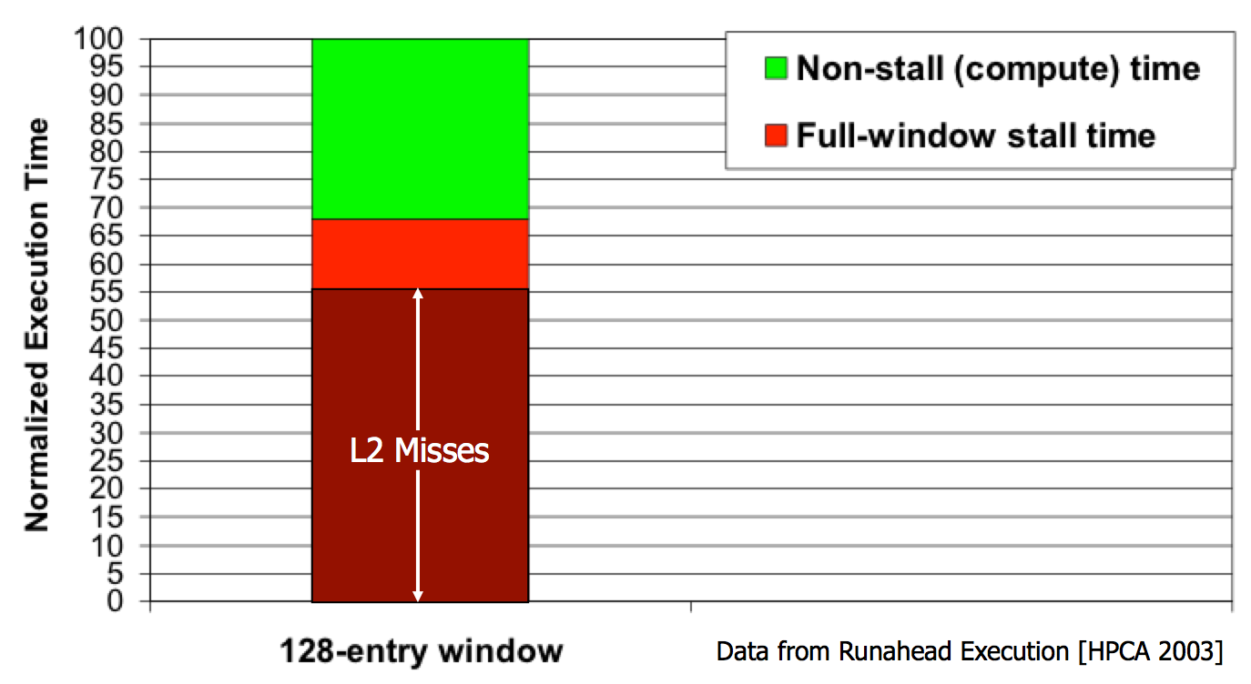
Yet …
“It’s the Memory, Stupid!” (Richard Sites, MPR, 1996)
Mutlu+, “Runahead Execution: An Alternative to Very Large Instruction Windows for Out-of-Order Processors,” HPCA 2003.

Slide 33
The Performance Perspective (Today)
All of Google’s Data Center Workloads (2015):
Kanev+, “Profiling a Warehouse-Scale Computer,” ISCA 2015.

Slide 34
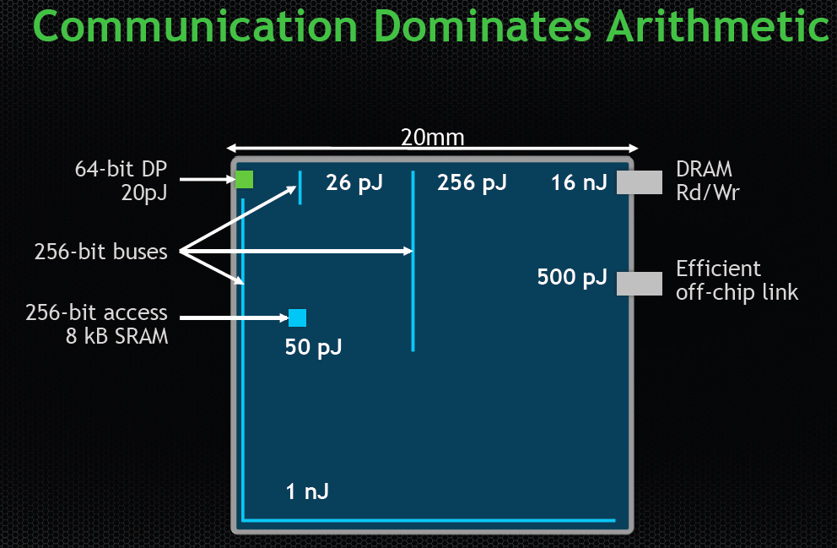
Data Movement vs. Computation Energy
Dally, HiPEAC 2015
A memory access consumes ~100-1000X
the energy of a complex addition

Slide 35
Energy Waste in Mobile Devices
Amirali Boroumand, Saugata Ghose, Youngsok Kim, Rachata Ausavarungnirun, Eric Shiu, Rahul Thakur, Daehyun Kim, Aki Kuusela, Allan Knies, Parthasarathy Ranganathan, and Onur Mutlu,
"Google Workloads for Consumer Devices: Mitigating Data Movement Bottlenecks"
Proceedings of the 23rd International Conference on Architectural Support for Programming Languages and Operating Systems (ASPLOS), Williamsburg, VA, USA, March 2018.
62.7% of the total system energy
is spent on data movement

Slide 36
We Do Not Want to Move Data!
Dally, HiPEAC 2015
A memory access consumes ~1000X
the energy of a complex addition

Slide 37
We Need A Paradigm Shift To …
Enable computation with minimal data movement
Compute where it makes sense (where data resides)
Make computing architectures more data-centric

Slide 38
Goal: Processing Inside Memory
Many questions … How do we design the:
  compute-capable memory & controllers?
  processor chip and in-memory units?
  software and hardware interfaces?
  system software and languages?
  algorithms?
Memory
Processor
Core
Database
Graphs
Media
Cache
Query
Interconnect
Problem
Results
Algorithm
Program/Language
System Software
SW/HW Interface
Micro-architecture
Logic
Devices
Electrons

Slide 39
Processing in Memory:
Two Approaches
1. Minimally changing memory chips
2. Exploiting 3D-stacked memory

Slide 40

Starting Simple: Data Copy and Initialization
  memmove & memcpy: 5% cycles in Google’s datacenter [Kanev+ ISCA’15]
000000000000000
Zero initialization
(e.g., security)
Forking
Checkpointing
Many more
VM Cloning
Deduplication
Page Migration

Slide 41
Today’s Systems: Bulk Data Copy
1) High latency
Memory
3) Cache pollution
L3
CPU
L2
L1
MC
2) High bandwidth utilization
4) Unwanted data movement
1046ns, 3.6uJ (for 4KB page copy via DMA)

Slide 42
Future Systems: In-Memory Copy
3) No cache pollution
1) Low latency
Memory
L3
CPU
L2
L1
MC
2) Low bandwidth utilization
4) No unwanted data movement
1046ns, 3.6uJ
→ 90ns, 0.04uJ

Slide 43
RowClone: In-DRAM Row Copy
Idea: Two consecutive ACTivates
4 Kbytes
Negligible HW cost
Step 1: Activate row A
Step 2: Activate row B
Transfer row
DRAM subarray
Transfer
row
Row Buffer (4 Kbytes)
8 bits
Data Bus
Notes:
copy

Slide 44
RowClone: Latency and Energy Savings
11.6x
74x
Seshadri et al., “RowClone: Fast and Efficient In-DRAM Copy and Initialization of Bulk Data,” MICRO 2013.

Slide 45
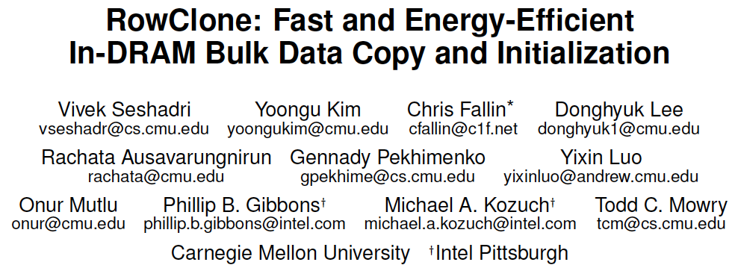
More on RowClone
Vivek Seshadri, Yoongu Kim, Chris Fallin, Donghyuk Lee, Rachata Ausavarungnirun, Gennady Pekhimenko, Yixin Luo, Onur Mutlu, Michael A. Kozuch, Phillip B. Gibbons, and Todd C. Mowry,
"RowClone: Fast and Energy-Efficient In-DRAM Bulk Data Copy and Initialization"
Proceedings of the 46th International Symposium on Microarchitecture (MICRO), Davis, CA, December 2013. [Slides (pptx) (pdf)] [Lightning Session Slides (pptx) (pdf)] [Poster (pptx) (pdf)]

Slide 46
Memory as an Accelerator
CPU
core
CPU
core
mini-CPU
core
GPU
(throughput)
core
GPU
(throughput)
core
video
core
GPU
(throughput)
core
GPU
(throughput)
core
CPU
core
CPU
core
Memory
imaging
core
LLC
Specialized
compute-capability
in memory
Memory Controller
Memory Bus
Memory similar to a “conventional” accelerator

Slide 47
In-Memory Bulk Bitwise Operations
We can support in-DRAM COPY, ZERO, AND, OR, NOT, MAJ
At low cost
Using analog computation capability of DRAM
  Idea: activating multiple rows performs computation
30-60X performance and energy improvement
  Seshadri+, “Ambit: In-Memory Accelerator for Bulk Bitwise Operations Using Commodity DRAM Technology,” MICRO 2017.
New memory technologies enable even more opportunities
  Memristors, resistive RAM, phase change mem, STT-MRAM, …
  Can operate on data with minimal movement

Slide 48
In-DRAM AND/OR: Triple Row Activation
½V_{DD}
½V_{DD}+δ
V_{DD}
A
Final State
AB + BC + AC
B
C
C(A + B) + ~C(AB)
dis
en
0
½V_{DD}
Seshadri+, “Fast Bulk Bitwise AND and OR in DRAM”, IEEE CAL 2015.

Slide 49
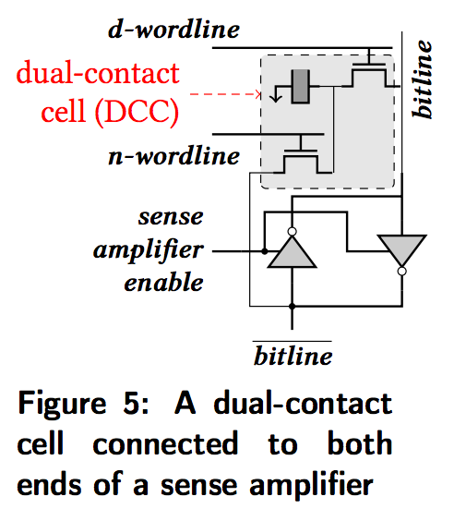
In-DRAM NOT: Dual Contact Cell
Idea:
Feed the
negated value
in the sense amplifier
into a special row
Seshadri+, “Ambit: In-Memory Accelerator for Bulk Bitwise Operations using Commodity DRAM Technology,” MICRO 2017.

Slide 50
Bulk Bitwise Operations in Workloads
[1] Li and Patel, BitWeaving, SIGMOD 2013
[2] Goodwin+, BitFunnel, SIGIR 2017

Slide 51
Performance: Bitmap Index on Ambit
>5.4-6.6X Performance Improvement
Seshadri+, “Ambit: In-Memory Accelerator for Bulk Bitwise Operations using Commodity DRAM Technology,” MICRO 2017.

Slide 52
Performance: BitWeaving on Ambit
>4-12X Performance Improvement
Seshadri+, “Ambit: In-Memory Accelerator for Bulk Bitwise Operations using Commodity DRAM Technology,” MICRO 2017.

Slide 53
More on Ambit
Vivek Seshadri et al., “Ambit: In-Memory Accelerator for Bulk Bitwise Operations Using Commodity DRAM Technology,” MICRO 2017.

Slide 54
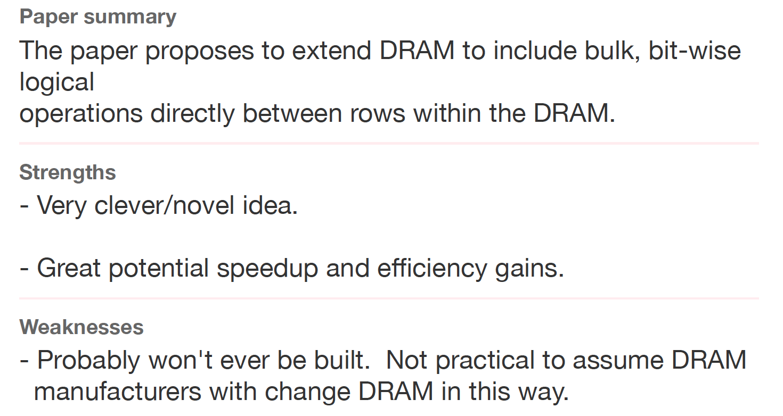
Sounds Good, No?
Review from ISCA 2016

Slide 55
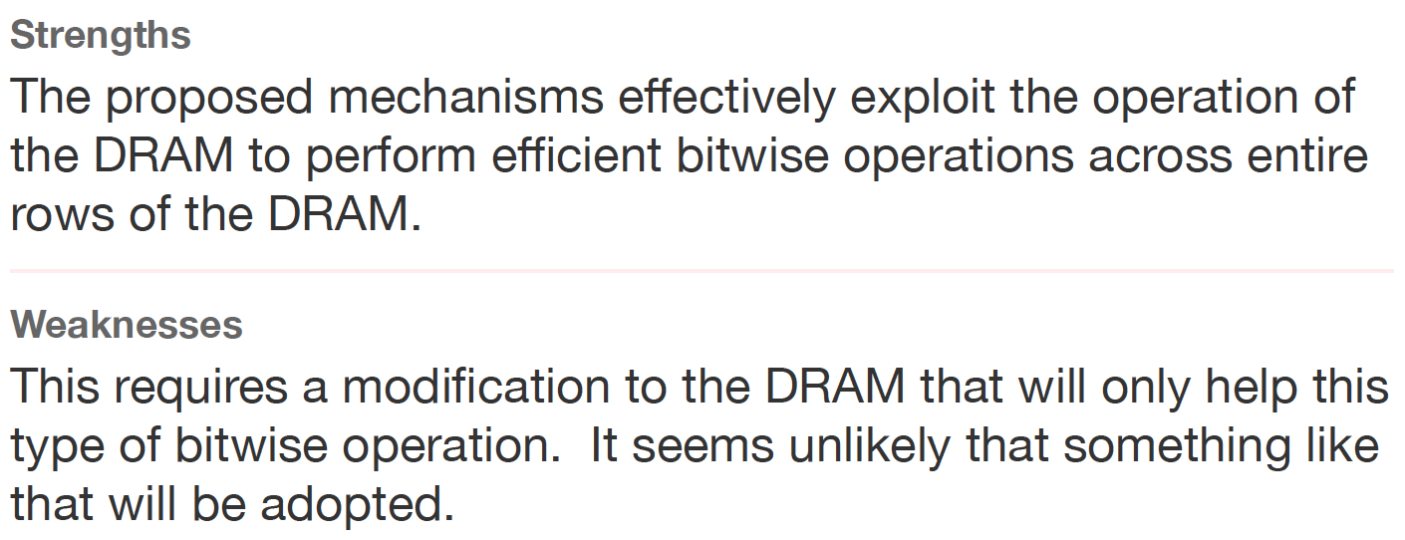
Another Review
Another Review from ISCA 2016

Slide 56
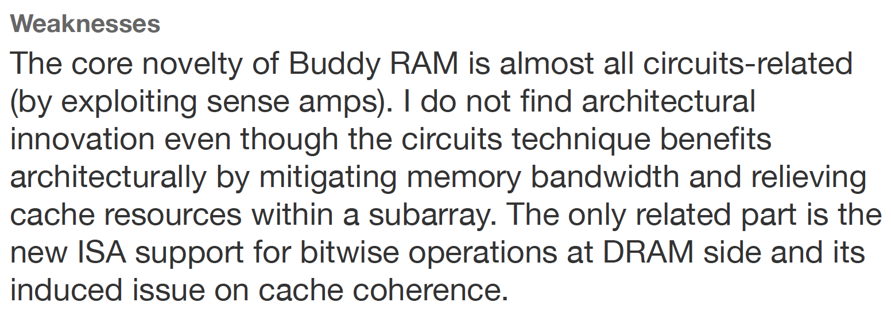
Yet Another Review
Yet Another Review from ISCA 2016

Slide 57
We Have a Mindset Issue…
There are many other similar examples from reviews…
  For many other papers…
And, we are not even talking about JEDEC yet…
How do we fix the mindset problem?
By doing more research, education, implementation in alternative processing paradigms
We need to work on enabling the better future…

Slide 58
Processing in Memory:
Two Approaches
1. Minimally changing memory chips
2. Exploiting 3D-stacked memory

Slide 59

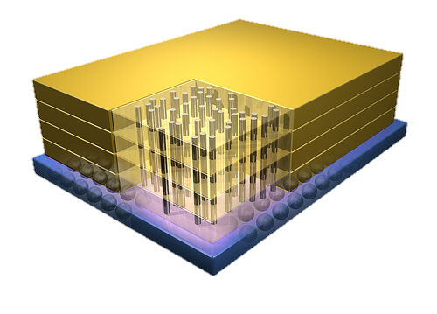
Opportunity: 3D-Stacked Logic+Memory
Memory
Logic
Other “True 3D” technologies
under development

Slide 60
Tesseract System for Graph Processing
Interconnected set of 3D-stacked memory+logic chips with simple cores
Memory
>8X Energy
Reduction
Host Processor
Memory-Mapped
Accelerator Interface
(Noncacheable, Physically Addressed)
Logic
>13X Speedup
In-Order Core
DRAM Controller
…
…
LP
PF Buffer
Crossbar Network
…
MTP
…
Message Queue
NI
Ahn+, “A Scalable Processing-in-Memory Accelerator for Parallel Graph Processing” ISCA 2015.

Slide 61
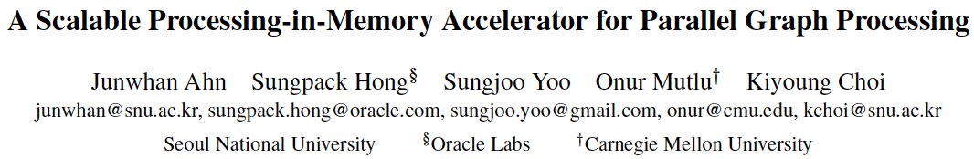
More on Tesseract
Junwhan Ahn, Sungpack Hong, Sungjoo Yoo, Onur Mutlu, and Kiyoung Choi,
"A Scalable Processing-in-Memory Accelerator for Parallel Graph Processing"
Proceedings of the 42nd International Symposium on Computer Architecture (ISCA), Portland, OR, June 2015.
[Slides (pdf)] [Lightning Session Slides (pdf)]

Slide 62
Another Example: PIM on Mobile Devices
Amirali Boroumand, Saugata Ghose, Youngsok Kim, Rachata Ausavarungnirun, Eric Shiu, Rahul Thakur, Daehyun Kim, Aki Kuusela, Allan Knies, Parthasarathy Ranganathan, and Onur Mutlu,
"Google Workloads for Consumer Devices: Mitigating Data Movement Bottlenecks"
Proceedings of the 23rd International Conference on Architectural Support for Programming Languages and Operating Systems (ASPLOS), Williamsburg, VA, USA, March 2018.

Slide 63
Four Important Workloads
  Chrome
TensorFlow Mobile
    Google’s web browser
Google’s machine learning framework
  Video Playback
  Video Capture
Google’s video codec
Google’s video codec
Notes:
In this work, we take a look at widely-used google consumer workloads, to figure out the major sources of energy consumption.
We look at Google Chrome web brower. We take a look at Tensorflow, Google’s machine learning framework, and we also take a look at two important video related workloads, video playback and video capture, both rely on Google’s vp9 codec technology.

Slide 64
Simple PIM on Mobile Workloads
  2nd key observation: a significant fraction of the
  data movement often comes from simple functions
We can design lightweight logic to implement
these simple functions in memory
Small embedded
low-power core
Small fixed-function accelerators
PIM Core
PIM Accelerator
PIM Accelerator
PIM Accelerator
  Offloading to PIM logic reduces energy and
  execution time, on average, by 55.4% and 54.2%
Notes:
To figure out if we can use processing in memory, we dig deeper into our analysis and we make another key observation that majority of data movement often comes form simple functions and pritmitives. We find that these simple function can be implemented in memory as either a small embedded core, or group of small fixed function accelerators. Our result shows that offloading these function to PIM logic can significantly reduce data movement for each function and reduce energy on average around 55% and improve perforamcne around 54%.
our PIM core can reduce significant portion of data movement, reduce enregy by 49.1% for each function and improve performance up to 2.2X. While using group of fixed function accelerator reduce energy by 55.4% and improve performance by up to 2.5X.
Or use Saugata’s approach : Reduces total system energy by an average of 55.4%
Reduces execution time by an average of 54.2%
Our result show that both of them can significantly reduce the data movement for each function.
Feedback: talk about result more
Don’t talk about specific detail like MemCopy, MemSet stuff like that
Main take away: data movement come from simple functions that are simple enough to implement in PIM
We find that these functions and primitves can be implemented as PIM logic using either (1) a small low-power general-purpose embedded core or (2) a group of small fixed-function accelerators (PIM accelerators). Our Analysis shows that both are cost-feasible to use in consumer devices. We find that they eliminate a significant fraction of dat amovement, and reduce energy consumption for each of these operation on average by 49 and 55%.

Slide 65
Eliminating the Adoption Barriers
How to Enable Adoption of Processing in Memory

Slide 66
Barriers to Adoption of PIM
1. Functionality of and applications & software for PIM
2. Ease of programming (interfaces and compiler/HW support)
3. System support: coherence & virtual memory
4. Runtime and compilation systems for adaptive scheduling, data mapping, access/sharing control
5. Infrastructures to assess benefits and feasibility
All can be solved with change of mindset

Slide 67
We Need to Revisit the Entire Stack
Problem
Algorithm
Program/Language
System Software
SW/HW Interface
Micro-architecture
Logic
Devices
Electrons
We can get there step by step

Slide 68
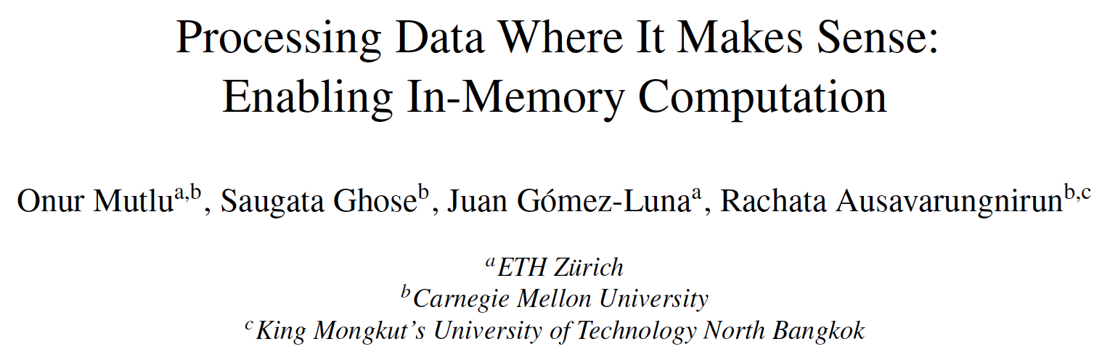
PIM Review and Open Problems
Onur Mutlu, Saugata Ghose, Juan Gomez-Luna, and Rachata Ausavarungnirun,
"Processing Data Where It Makes Sense: Enabling In-Memory Computation"
Invited paper in Microprocessors and Microsystems (MICPRO), June 2019.
[arXiv version]
https://arxiv.org/pdf/1903.03988.pdf

Slide 69
Challenge and Opportunity for Future
Computing Architectures
with
Minimal Data Movement

Slide 70
Corollaries: Architectures Today …
Architectures are terrible at dealing with data
  Designed to mainly store and move data vs. to compute
  They are processor-centric as opposed to data-centric
Architectures are terrible at taking advantage of vast amounts of data (and metadata) available to them
  Designed to make simple decisions, ignoring lots of data
  They make human-driven decisions vs. data-driven decisions
Architectures are terrible at knowing and exploiting different properties of application data
  Designed to treat all data as the same
  They make component-aware decisions vs. data-aware

Slide 71
Exploiting Data to Design Intelligent Architectures

Slide 72
System Architecture Design Today
Human-driven
  Humans design the policies (how to do things)
Many (too) simple, short-sighted policies all over the system
No automatic data-driven policy learning
(Almost) no learning: cannot take lessons from past actions
Can we design
fundamentally intelligent architectures?

Slide 73
An Intelligent Architecture
Data-driven
  Machine learns the “best” policies (how to do things)
Sophisticated, workload-driven, changing, far-sighted policies
Automatic data-driven policy learning
All controllers are intelligent data-driven agents
How do we start?

Slide 74
Self-Optimizing
Memory Controllers

Slide 75
Memory Controller
How to schedule requests to maximize system performance?
Resolves memory contention by scheduling requests
Core
Core
Memory Controller
Memory
Core
Core

Slide 76
Why are Memory Controllers Difficult to Design?
Need to obey DRAM timing constraints for correctness
  There are many (50+) timing constraints in DRAM
  tWTR: Minimum number of cycles to wait before issuing a read command after a write command is issued
  tRC: Minimum number of cycles between the issuing of two consecutive activate commands to the same bank
  …
Need to keep track of many resources to prevent conflicts
  Channels, banks, ranks, data bus, address bus, row buffers, …
Need to handle DRAM refresh
Need to manage power consumption
Need to optimize performance & QoS (in the presence of constraints)
  Reordering is not simple
  Fairness and QoS needs complicates the scheduling problem
…

Slide 77
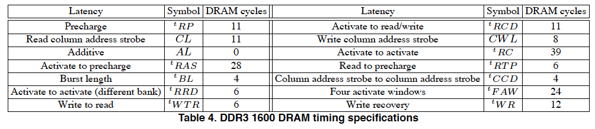
Many Memory Timing Constraints
From Lee et al., “DRAM-Aware Last-Level Cache Writeback: Reducing Write-Caused Interference in Memory Systems,” HPS Technical Report, April 2010.

Slide 78
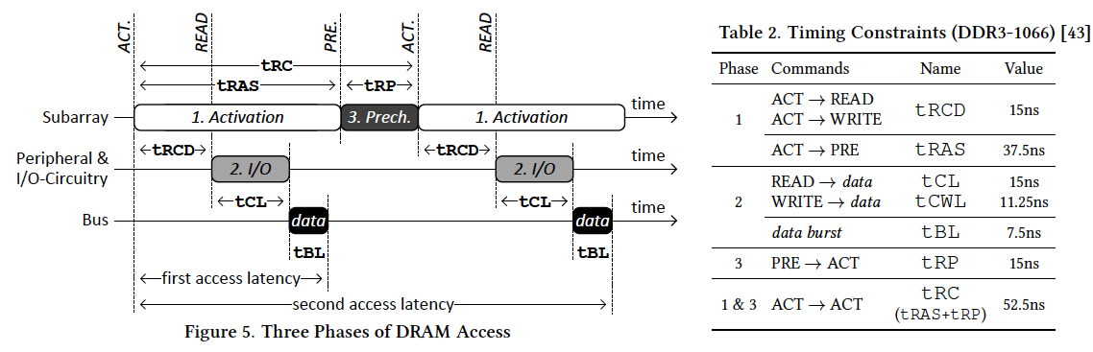
Many Memory Timing Constraints
Kim et al., “A Case for Exploiting Subarray-Level Parallelism (SALP) in DRAM,” ISCA 2012.
Lee et al., “Tiered-Latency DRAM: A Low Latency and Low Cost DRAM Architecture,” HPCA 2013.

Slide 79
Memory Controller Design Is Becoming More Difficult
CPU
CPU
CPU
CPU
GPU
HWA
HWA
Shared Cache
DRAM and Hybrid Memory Controllers
DRAM and Hybrid Memories
Heterogeneous agents: CPUs, GPUs, and HWAs
Main memory interference between CPUs, GPUs, HWAs
Many timing constraints for various memory types
Many goals at the same time: performance, fairness, QoS, energy efficiency, …

Slide 80
Reality and Dream
Reality: It difficult to design a policy that maximizes performance, QoS, energy-efficiency, …
  Too many things to think about
  Continuously changing workload and system behavior
Dream: Wouldn’t it be nice if the DRAM controller automatically found a good scheduling policy on its own?

Slide 81
Self-Optimizing DRAM Controllers
Problem: DRAM controllers are difficult to design
  It is difficult for human designers to design a policy that can adapt itself very well to different workloads and different system conditions
Idea: A memory controller that adapts its scheduling policy to workload behavior and system conditions using machine learning.
Observation: Reinforcement learning maps nicely to memory control.
Design: Memory controller is a reinforcement learning agent
  It dynamically and continuously learns and employs the best scheduling policy to maximize long-term performance.
Ipek+, “Self Optimizing Memory Controllers: A Reinforcement Learning Approach,” ISCA 2008.

Slide 82
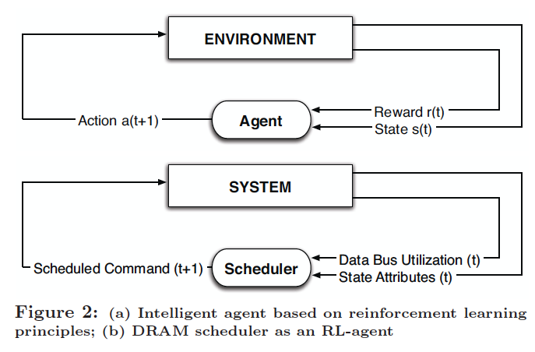
Self-Optimizing DRAM Controllers
Engin Ipek, Onur Mutlu, José F. Martínez, and Rich Caruana,
"Self Optimizing Memory Controllers: A Reinforcement Learning Approach"
Proceedings of the 35th International Symposium on Computer Architecture (ISCA), pages 39-50, Beijing, China, June 2008.
Goal: Learn to choose actions to maximize r₀ + γr₁ + γ²r₂ + … ( 0 ≤ γ < 1)

Slide 83
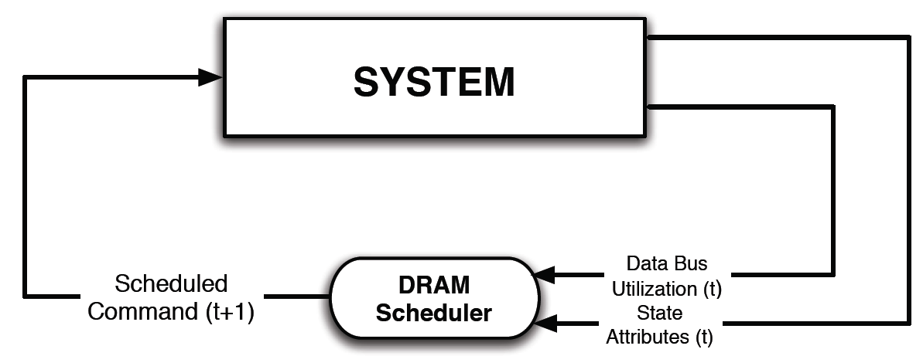
Self-Optimizing DRAM Controllers
Dynamically adapt the memory scheduling policy via interaction with the system at runtime
  Associate system states and actions (commands) with long term reward values: each action at a given state leads to a learned reward
  Schedule command with highest estimated long-term reward value in each state
  Continuously update reward values for <state, action> pairs based on feedback from system

Slide 84
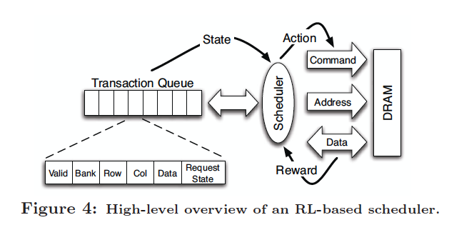
Self-Optimizing DRAM Controllers
Engin Ipek, Onur Mutlu, José F. Martínez, and Rich Caruana,
"Self Optimizing Memory Controllers: A Reinforcement Learning Approach"
Proceedings of the 35th International Symposium on Computer Architecture (ISCA), pages 39-50, Beijing, China, June 2008.

Slide 85
States, Actions, Rewards
Reward function
  +1 for scheduling Read and Write commands
  0 at all other times
  Goal is to maximize long-term data bus utilization
State attributes
  Number of reads, writes, and load misses in transaction queue
  Number of pending writes and ROB heads waiting for referenced row
  Request’s relative ROB order
Actions
  Activate
  Write
  Read - load miss
  Read - store miss
  Precharge - pending
  Precharge - preemptive
  NOP

Slide 86
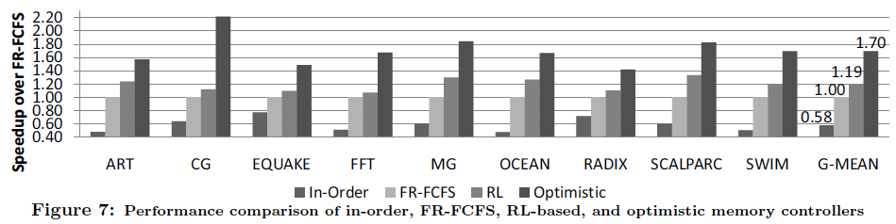
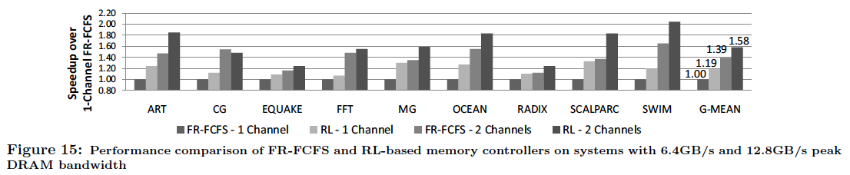
Performance Results
Large, robust performance improvements
over many human-designed policies

Slide 87
Self Optimizing DRAM Controllers
+ Continuous learning in the presence of changing environment
+ Reduced designer burden in finding a good scheduling policy. Designer specifies:
1) What system variables might be useful
2) What target to optimize, but not how to optimize it
-- How to specify different objectives? (e.g., fairness, QoS, …)
-- Hardware complexity?
-- Design mindset and flow

Slide 88
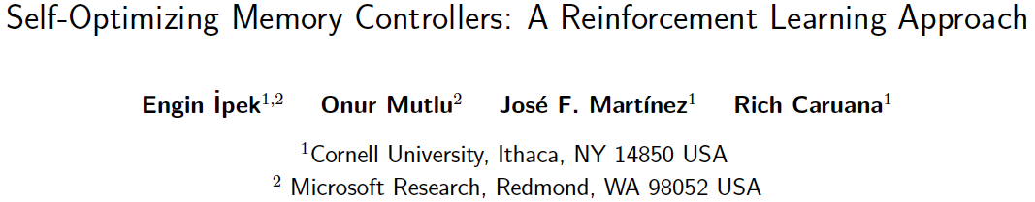
More on Self-Optimizing DRAM Controllers
Engin Ipek, Onur Mutlu, José F. Martínez, and Rich Caruana,
"Self Optimizing Memory Controllers: A Reinforcement Learning Approach"
Proceedings of the 35th International Symposium on Computer Architecture (ISCA), pages 39-50, Beijing, China, June 2008.

Slide 89
An Intelligent Architecture
Data-driven
  Machine learns the “best” policies (how to do things)
Sophisticated, workload-driven, changing, far-sighted policies
Automatic data-driven policy learning
All controllers are intelligent data-driven agents
We need to rethink design
(of all controllers)

Slide 90
Challenge and Opportunity for Future
Self-Optimizing
(Data-Driven)
Computing Architectures

Slide 91
Corollaries: Architectures Today …
Architectures are terrible at dealing with data
  Designed to mainly store and move data vs. to compute
  They are processor-centric as opposed to data-centric
Architectures are terrible at taking advantage of vast amounts of data (and metadata) available to them
  Designed to make simple decisions, ignoring lots of data
  They make human-driven decisions vs. data-driven decisions
Architectures are terrible at knowing and exploiting different properties of application data
  Designed to treat all data as the same
  They make component-aware decisions vs. data-aware

Slide 92
Data-Aware Architectures
A data-aware architecture understands what it can do with and to each piece of data
It makes use of different properties of data to improve performance, efficiency and other metrics
  Compressibility
  Approximability
  Locality
  Sparsity
  Criticality for Computation X
  Access Semantics
  …

Slide 93
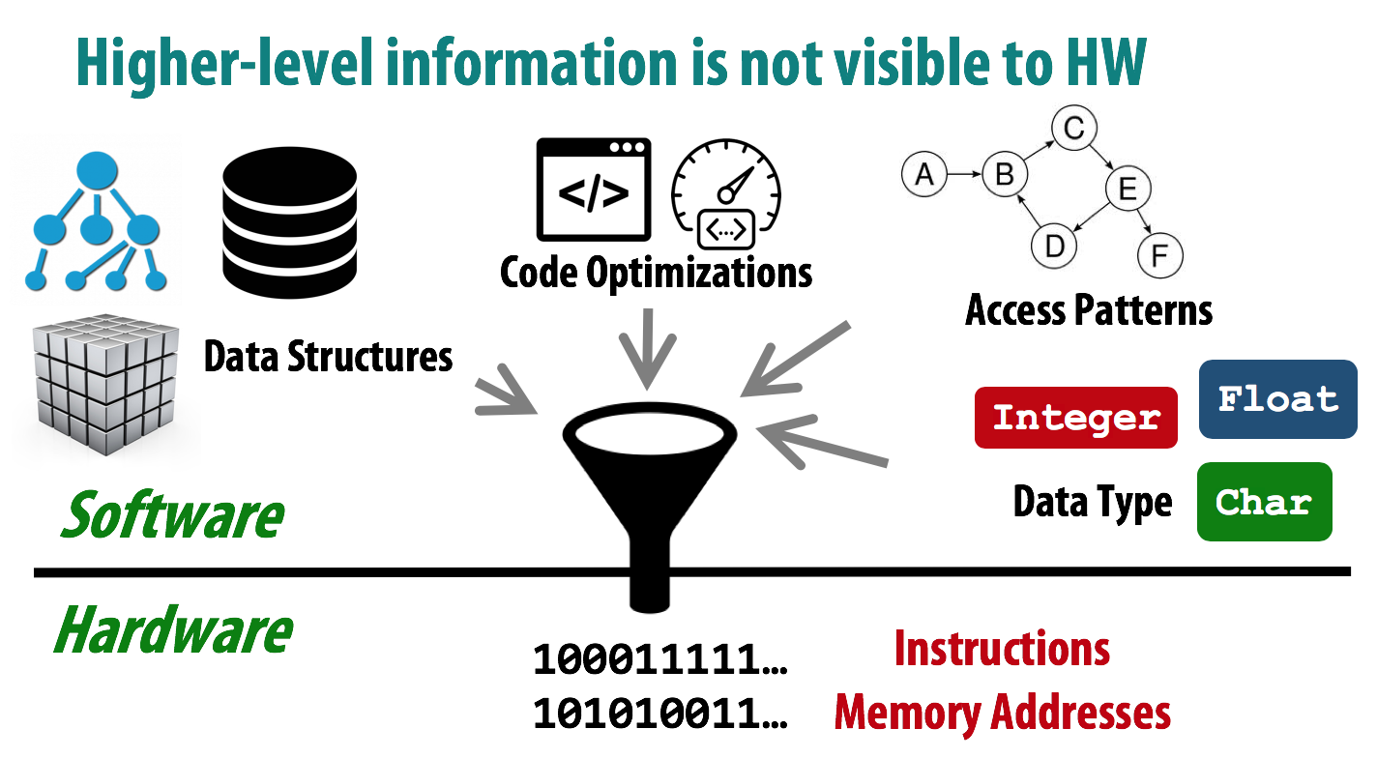
One Problem: Limited Interfaces

Slide 94
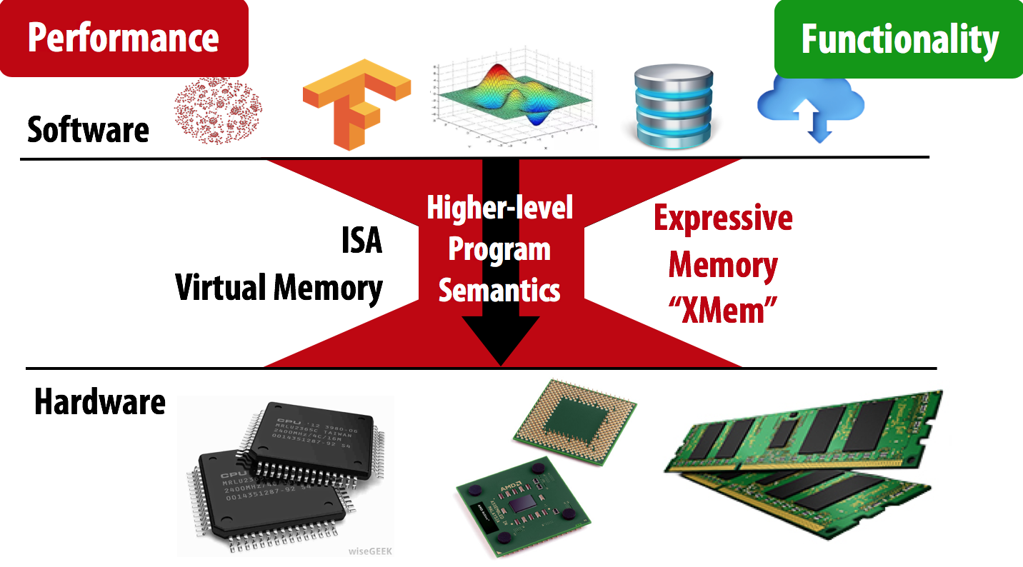
A Solution: More Expressive Interfaces

Slide 95
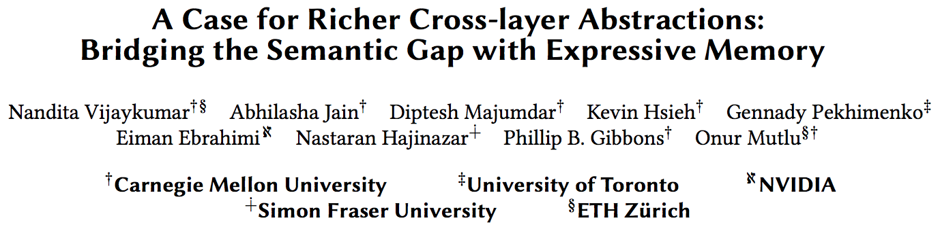
Expressive (Memory) Interfaces
Nandita Vijaykumar, Abhilasha Jain, Diptesh Majumdar, Kevin Hsieh, Gennady Pekhimenko, Eiman Ebrahimi, Nastaran Hajinazar, Phillip B. Gibbons and Onur Mutlu,
"A Case for Richer Cross-layer Abstractions: Bridging the Semantic Gap with Expressive Memory"
Proceedings of the 45th International Symposium on Computer Architecture (ISCA), Los Angeles, CA, USA, June 2018.
[Slides (pptx) (pdf)] [Lightning Talk Slides (pptx) (pdf)]
[Lightning Talk Video]

Slide 96
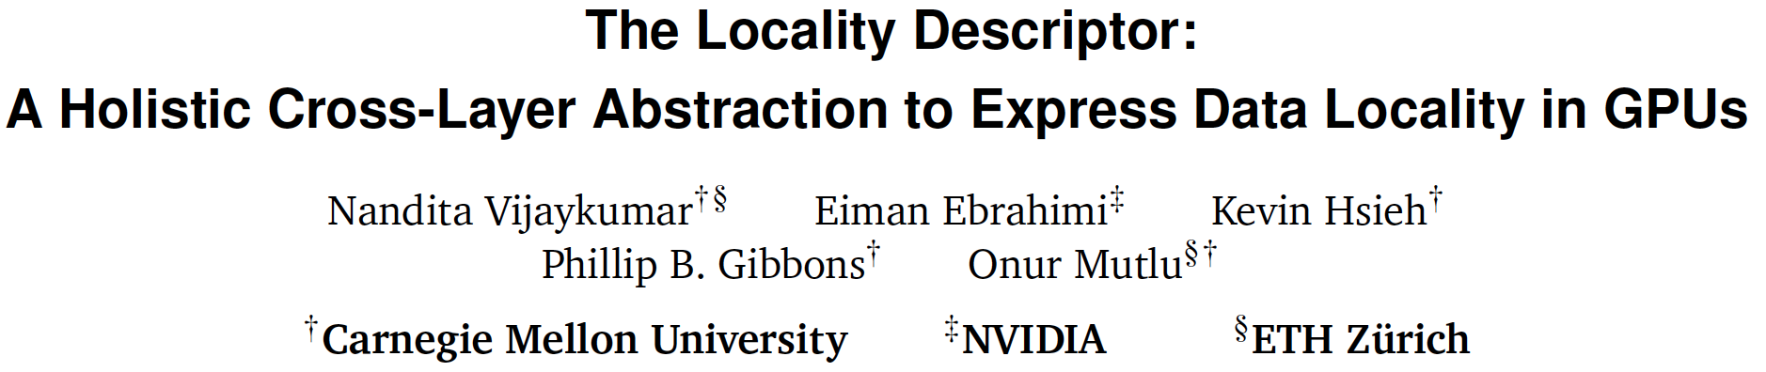
Expressive (Memory) Interfaces for GPUs
Nandita Vijaykumar, Eiman Ebrahimi, Kevin Hsieh, Phillip B. Gibbons and Onur Mutlu,
"The Locality Descriptor: A Holistic Cross-Layer Abstraction to Express Data Locality in GPUs"
Proceedings of the 45th International Symposium on Computer Architecture (ISCA), Los Angeles, CA, USA, June 2018.
[Slides (pptx) (pdf)] [Lightning Talk Slides (pptx) (pdf)]
[Lightning Talk Video]

Slide 97
An Example: Hybrid Memory Management
SoC
Meza+, “Enabling Efficient and Scalable Hybrid Memories,” IEEE Comp. Arch. Letters, 2012.
Yoon+, “Row Buffer Locality Aware Caching Policies for Hybrid Memories,” ICCD 2012 Best Paper Award.
DRAMCtrl
PCM Ctrl
DRAM
Phase Change Memory (or Tech. X)
Fast, durable
Small,
leaky, volatile,
high-cost
Large, non-volatile, low-cost
Slow, wears out, high active energy
Hardware/software manage data allocation and movement
to achieve the best of multiple technologies

Slide 98
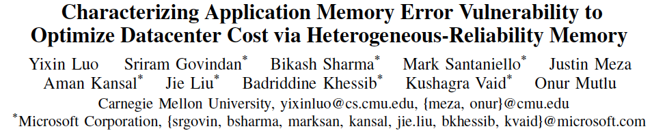
An Example: Heterogeneous-Reliability Memory
Yixin Luo, Sriram Govindan, Bikash Sharma, Mark Santaniello, Justin Meza, Aman Kansal, Jie Liu, Badriddine Khessib, Kushagra Vaid, and Onur Mutlu,
"Characterizing Application Memory Error Vulnerability to Optimize Data Center Cost via Heterogeneous-Reliability Memory"
Proceedings of the 44th Annual IEEE/IFIP International Conference on Dependable Systems and Networks (DSN), Atlanta, GA, June 2014. [Summary] [Slides (pptx) (pdf)] [Coverage on ZDNet]

Slide 99
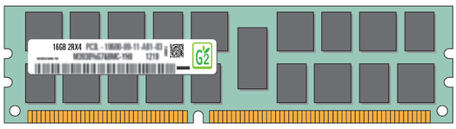
Exploiting Memory Error Tolerance with Hybrid Memory Systems
Heterogeneous-Reliability Memory [DSN 2014]
Vulnerable data
Vulnerable data
Tolerant data
Tolerant data
Reliable memory
Low-cost memory
Vulnerable data
  On Microsoft’s Web Search workload
  Reduces server hardware cost by 4.7 %
  Achieves single server availability target of 99.90 %
ECC protected
Well-tested chips
Tolerant data
NoECC or Parity
Less-tested chips
Notes:
As we have shown earlier, either across or within applications, our characterization can identify data that are vulnerable to memory errors and data that are tolerant to memory errors.
To exploit this observation, we would like to map these different data onto different memory modules according to their memory error tolerance.
As an example here, we map vulnerable data to reliable memory to improve reliability, and map tolerant data to low-cost less-reliable memory to exploit its tolerance and lower the cost. We call this mechanism heterogeneous-reliability memory, HRM.
Reliable memory consists of … Low cost memory consists of …
As we will show later, HRM allows us to use weaker error protection in memory, and enables the use of less-tested memory chips to lower the cost of the memory system, while still achieving reasonable single-server reliability target.

Slide 100
Another Example: EDEN
Deep Neural Network evaluation is very DRAM-intensive (especially for large networks)
1. Some data and layers in DNNs are very tolerant to errors
2. We can reduce DRAM latency and voltage on such data and layers (intermediate feature maps and weights)
3. While still achieving a user-specified DNN accuracy target by making training DRAM-error-aware
Data-aware management of DRAM latency and voltage

Slide 101
Challenge and Opportunity for Future
Data-Aware
(Expressive)
Computing Architectures

Slide 102
Recap: Corollaries: Architectures Today …
Architectures are terrible at dealing with data
  Designed to mainly store and move data vs. to compute
  They are processor-centric as opposed to data-centric
Architectures are terrible at taking advantage of vast amounts of data (and metadata) available to them
  Designed to make simple decisions, ignoring lots of data
  They make human-driven decisions vs. data-driven decisions
Architectures are terrible at knowing and exploiting different properties of application data
  Designed to treat all data as the same
  They make component-aware decisions vs. data-aware

Slide 103
Concluding Remarks
It is time to design principled system architectures to solve the data handling (i.e., memory/storage) problem
Design complete systems to be truly balanced, high-performance, and energy-efficient → intelligent architectures
Data-centric, data-driven, data-aware
This can
  Lead to orders-of-magnitude improvements
  Enable new applications & computing platforms
  Enable better understanding of nature
  …
Notes:
Perhaps we have taken processor-centric system design a bit too far

Slide 104
Architectures for Intelligent Machines
Data-centric
Data-driven
Data-aware

Slide 105

Source: http://spectrum.ieee.org/image/MjYzMzAyMg.jpeg

Slide 106
We Need to Revisit the Entire Stack
Problem
Algorithm
Program/Language
System Software
SW/HW Interface
Micro-architecture
Logic
Devices
Electrons
We can get there step by step

Slide 107
Finally, people are always telling you:
Think outside the box
from Yale Patt’s EE 382N lecture notes

Slide 108
I prefer: Expand the box
from Yale Patt’s EE 382N lecture notes

Slide 110
Principled Architectures for
Intelligent Machines
Onur Mutlu
omutlu@gmail.com
https://people.inf.ethz.ch/omutlu
1 July 2019
Yale @ 80

Slide 111
Aside: A Recommended Book
Raj Jain, “The Art of
Computer Systems
Performance Analysis,”
Wiley, 1991.

Slide 112
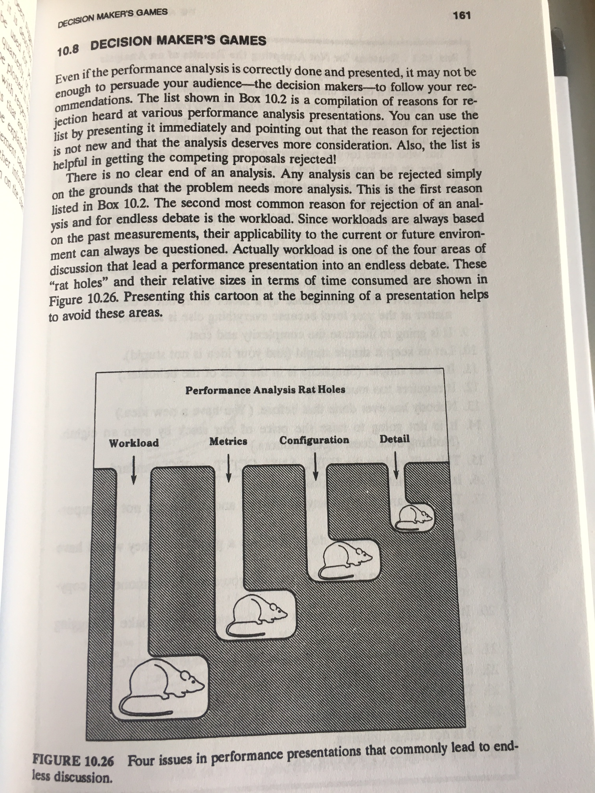
Raj Jain, “The Art of
Computer Systems
Performance Analysis,”
Wiley, 1991.

Slide 113
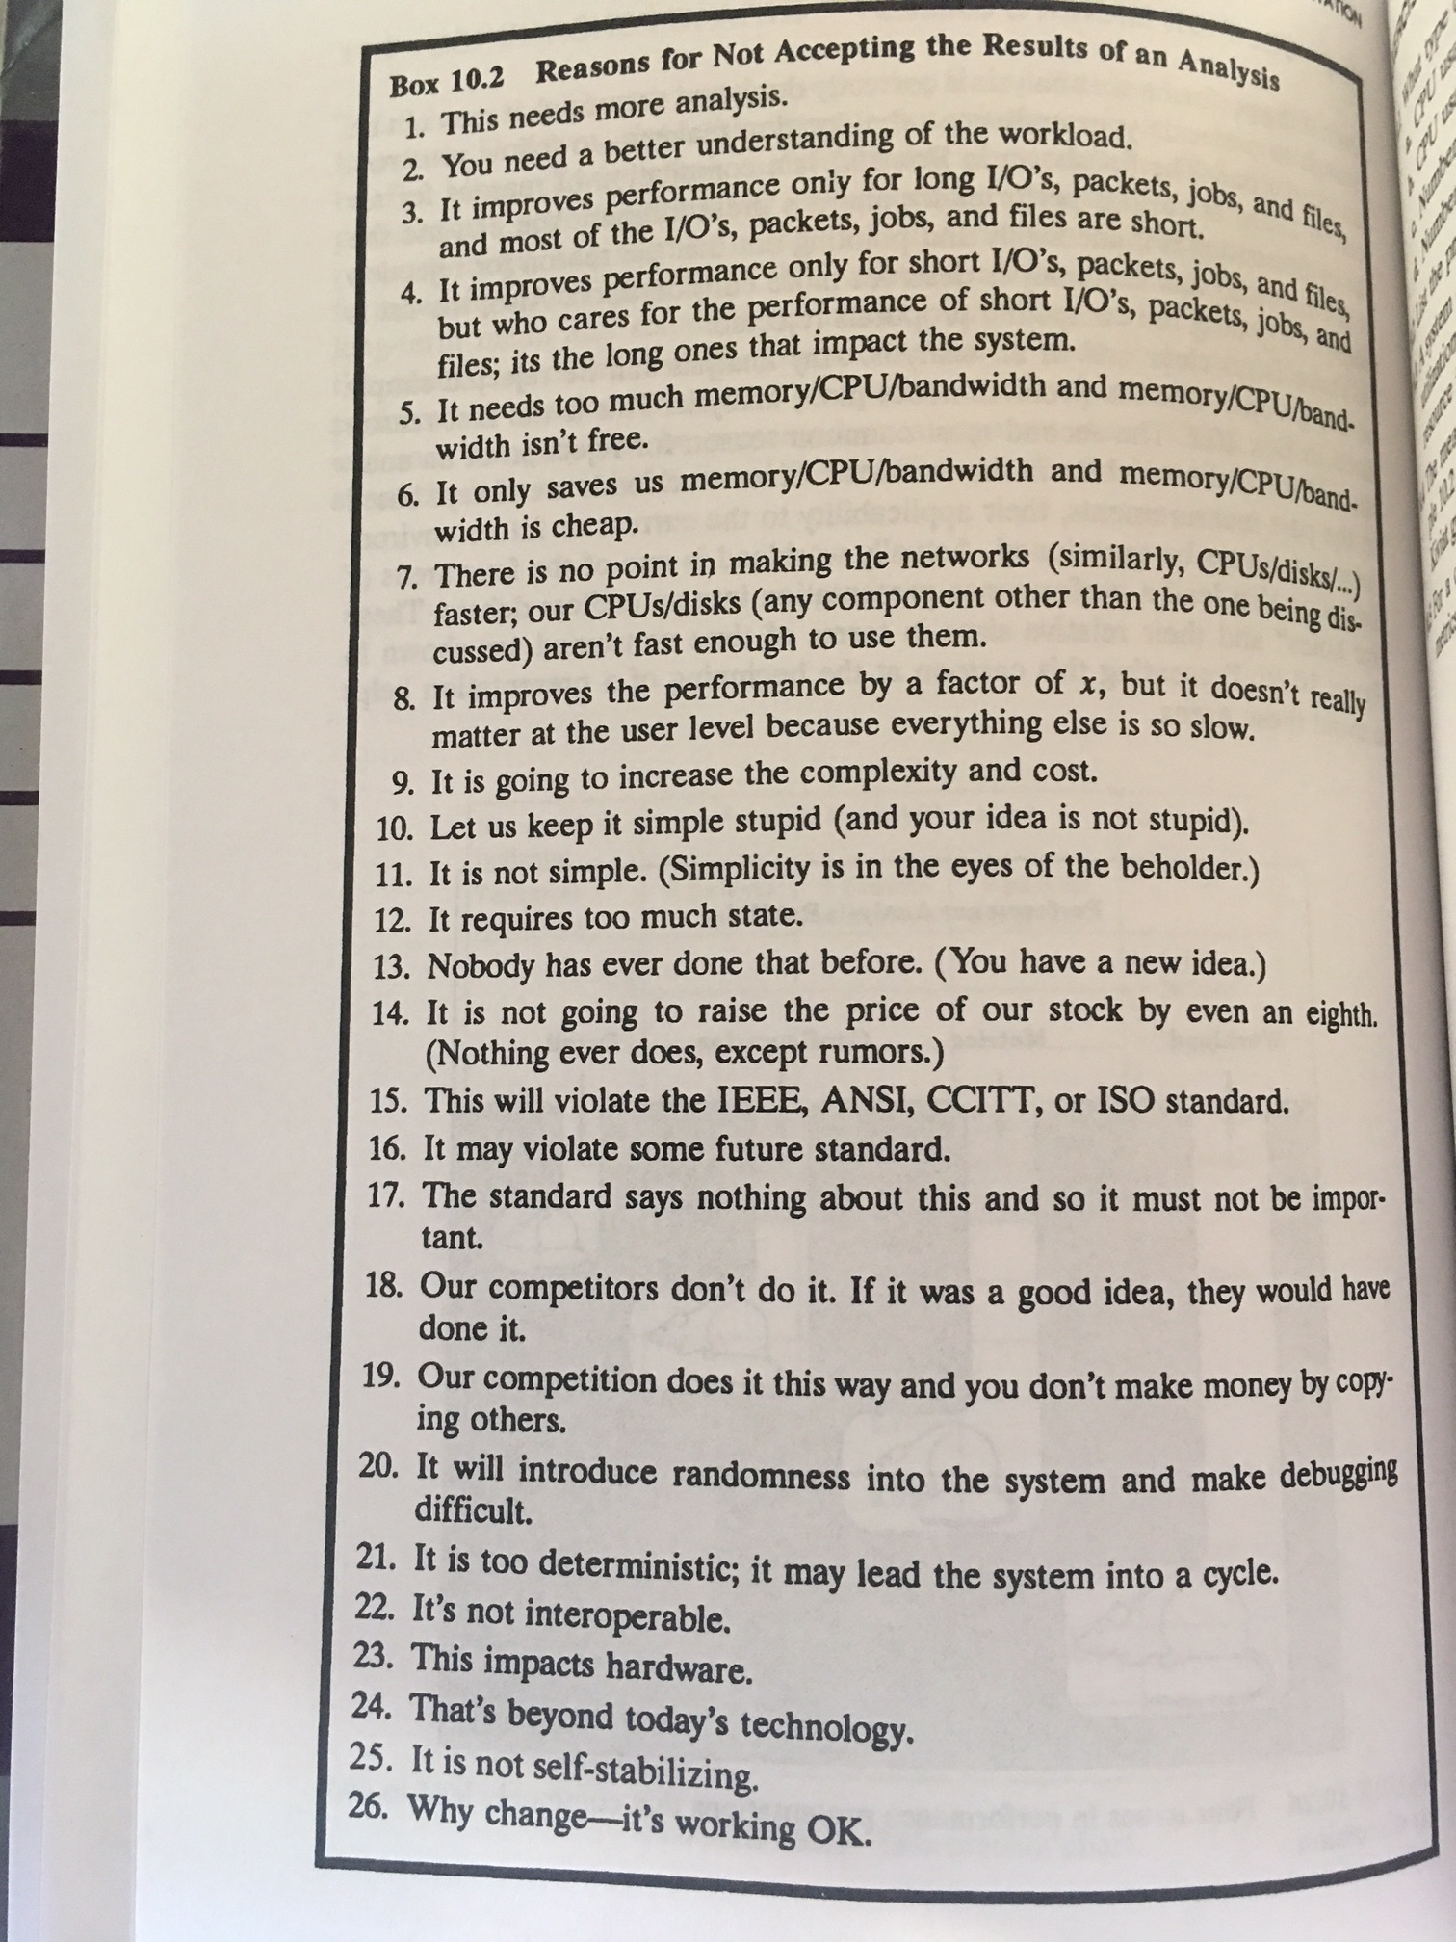
Raj Jain, “The Art of
Computer Systems
Performance Analysis,”
Wiley, 1991.

Slide 114
Low Latency Data Access

Slide 115
Data-Centric Architectures: Properties
Process data where it resides (where it makes sense)
  Processing in and near memory structures
Low-latency & low-energy data access
  Low latency memory
  Low energy memory
Low-cost data storage & processing
  High capacity memory at low cost: hybrid memory, compression
Intelligent data management
  Intelligent controllers handling robustness, security, cost, scaling

Slide 116
Low-Latency & Low-Energy
Data Access

Slide 117
Retrospective: Conventional Latency Tolerance Techniques
Caching [initially by Wilkes, 1965]
  Widely used, simple, effective, but inefficient, passive
  Not all applications/phases exhibit temporal or spatial locality
Prefetching [initially in IBM 360/91, 1967]
  Works well for regular memory access patterns
  Prefetching irregular access patterns is difficult, inaccurate, and hardware-intensive
Multithreading [initially in CDC 6600, 1964]
  Works well if there are multiple threads
  Improving single thread performance using multithreading hardware is an ongoing research effort
Out-of-order execution [initially by Tomasulo, 1967]
  Tolerates cache misses that cannot be prefetched
  Requires extensive hardware resources for tolerating long latencies
None of These
Fundamentally Reduce
Memory Latency

Slide 118
Two Major Sources of Latency Inefficiency
Modern DRAM is not designed for low latency
  Main focus is cost-per-bit (capacity)
Modern DRAM latency is determined by worst case conditions and worst case devices
  Much of memory latency is unnecessary
Our Goal: Reduce Memory Latency at the Source of the Problem

Slide 119

Why is Latency High?
DRAM latency: Delay as specified in DRAM standards
  Doesn’t reflect true DRAM device latency
Imperfect manufacturing process → latency variation
High standard latency chosen to increase yield
DRAM A
DRAM B
DRAM C
Standard
Latency
Manufacturing
Variation
Low
High
DRAM Latency
Notes:
To understand the latency problem, we need to go into what defines latency.
DRAM latency is the total amnt of time that the underlying hw operations need <> to retrieve data.
The DRAM standards define a single fixed time for how long these ops should take in every DRAM chip.
However, this defined delay doesn’t actually reflect the latency of the individual DRAMs.
<Timeline illustration>
Because the manufacturing process is imperfect, it introduces variation in the production chips, resulting in latency variation across different chips.
This simple illustartion shows the difference b/w the average latency across 3 different dram chips, to convey the point of latency variation.
It’s important to note that not only does latency variation exists <across> chips, but also <inside> each dram chip itself.
<Blue standard>
Since we don’t want to throw away the chips with high variation, we tolerate them.
The simple way is to <slow> down the acceptable latency so that the majority of chips can all work reliably under this high standard latency.
as we can see, the high standard latency is a result of a trade-off made for higher DRAM production yield.
---
<> Operative word

Slide 120
Adaptive-Latency DRAM
Key idea
  Optimize DRAM timing parameters online
Two components
  DRAM manufacturer provides multiple sets of reliable DRAM timing parameters at different temperatures for each DIMM
  System monitors DRAM temperature & uses appropriate DRAM timing parameters
reliable DRAM timing parameters
DRAM temperature
Lee+, “Adaptive-Latency DRAM: Optimizing DRAM Timing for the Common-Case,” HPCA 2015.

Slide 121
Latency Reduction Summary of 115 DIMMs
Latency reduction for read & write (55°C)
  Read Latency: 32.7%
  Write Latency: 55.1%
Latency reduction for each timing parameter (55°C)
  Sensing: 17.3%
  Restore: 37.3% (read), 54.8% (write)
  Precharge: 35.2%
Lee+, “Adaptive-Latency DRAM: Optimizing DRAM Timing for the Common-Case,” HPCA 2015.

Slide 122
AL-DRAM: Real-System Performance
Average
Improvement
14.0%
10.4%
Performance Improvement
2.9%
all-35-workload
AL-DRAM provides high performance on
memory-intensive workloads

Slide 123
Reducing Latency Also Reduces Energy
AL-DRAM reduces DRAM power consumption
Major reason: reduction in row activation time

Slide 124
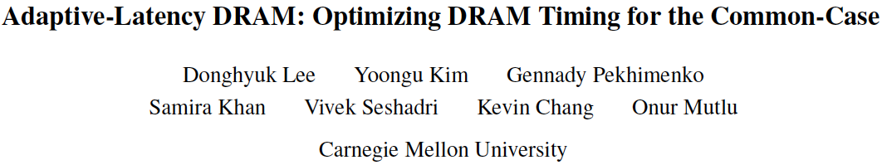
More on Adaptive-Latency DRAM
Donghyuk Lee, Yoongu Kim, Gennady Pekhimenko, Samira Khan, Vivek Seshadri, Kevin Chang, and Onur Mutlu,
"Adaptive-Latency DRAM: Optimizing DRAM Timing for the Common-Case"
Proceedings of the 21st International Symposium on High-Performance Computer Architecture (HPCA), Bay Area, CA, February 2015.
[Slides (pptx) (pdf)] [Full data sets]

Slide 125
Tackling the Fixed Latency Mindset
Reliable operation latency is actually very heterogeneous
  Across temperatures, chips, parts of a chip, voltage levels, …
Idea: Dynamically find out and use the lowest latency one can reliably access a memory location with
  Adaptive-Latency DRAM [HPCA 2015]
  Flexible-Latency DRAM [SIGMETRICS 2016]
  Design-Induced Variation-Aware DRAM [SIGMETRICS 2017]
  Voltron [SIGMETRICS 2017]
  DRAM Latency PUF [HPCA 2018]
  Solar DRAM [ICCD 2018]
  DRAM Latency True Random Number Generator [HPCA 2019]
  ...
We would like to find sources of latency heterogeneity and exploit them to minimize latency (or create other benefits)

Slide 126
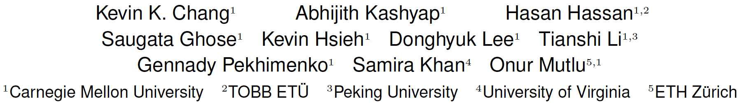
Analysis of Latency Variation in DRAM Chips
Kevin Chang, Abhijith Kashyap, Hasan Hassan, Samira Khan, Kevin Hsieh, Donghyuk Lee, Saugata Ghose, Gennady Pekhimenko, Tianshi Li, and Onur Mutlu,
"Understanding Latency Variation in Modern DRAM Chips: Experimental Characterization, Analysis, and Optimization"
Proceedings of the ACM International Conference on Measurement and Modeling of Computer Systems (SIGMETRICS), Antibes Juan-Les-Pins, France, June 2016.
[Slides (pptx) (pdf)]
[Source Code]

Slide 127
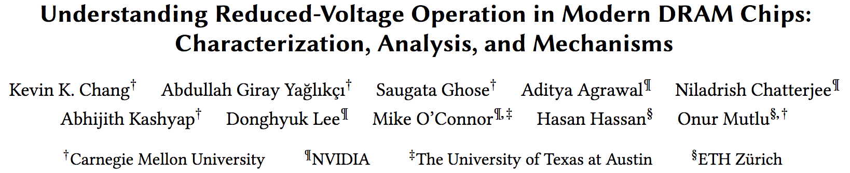
Analysis of Latency-Voltage in DRAM Chips
Kevin Chang, A. Giray Yaglikci, Saugata Ghose, Aditya Agrawal, Niladrish Chatterjee, Abhijith Kashyap, Donghyuk Lee, Mike O'Connor, Hasan Hassan, and Onur Mutlu,
"Understanding Reduced-Voltage Operation in Modern DRAM Devices: Experimental Characterization, Analysis, and Mechanisms"
Proceedings of the ACM International Conference on Measurement and Modeling of Computer Systems (SIGMETRICS), Urbana-Champaign, IL, USA, June 2017.

Slide 128
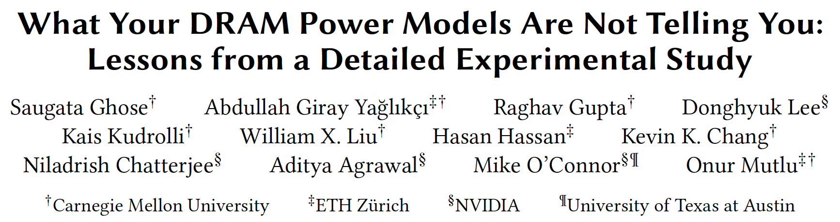
VAMPIRE DRAM Power Model
Saugata Ghose, A. Giray Yaglikci, Raghav Gupta, Donghyuk Lee, Kais Kudrolli, William X. Liu, Hasan Hassan, Kevin K. Chang, Niladrish Chatterjee, Aditya Agrawal, Mike O'Connor, and Onur Mutlu,
"What Your DRAM Power Models Are Not Telling You: Lessons from a Detailed Experimental Study"
Proceedings of the ACM International Conference on Measurement and Modeling of Computer Systems (SIGMETRICS), Irvine, CA, USA, June 2018.
[Abstract]

Slide 129
EDEN

Slide 130
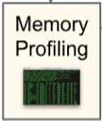
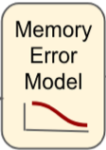
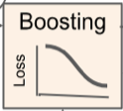
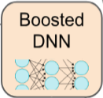
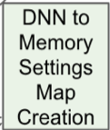
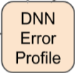

EDEN Flow
Goal: reduce energy consumption and improve performance of DNNs by reducing voltage and timing parameters in DRAM
Key Ideas:
  Build an error model by profiling the target DRAM module with reduced voltage and timing
  Boost DNN accuracy by introducing the error model in training
  Profile the boosted DNN to understand the network’s error tolerance
  Map DNN components to DRAM partitions and DRAM settings

Slide 131
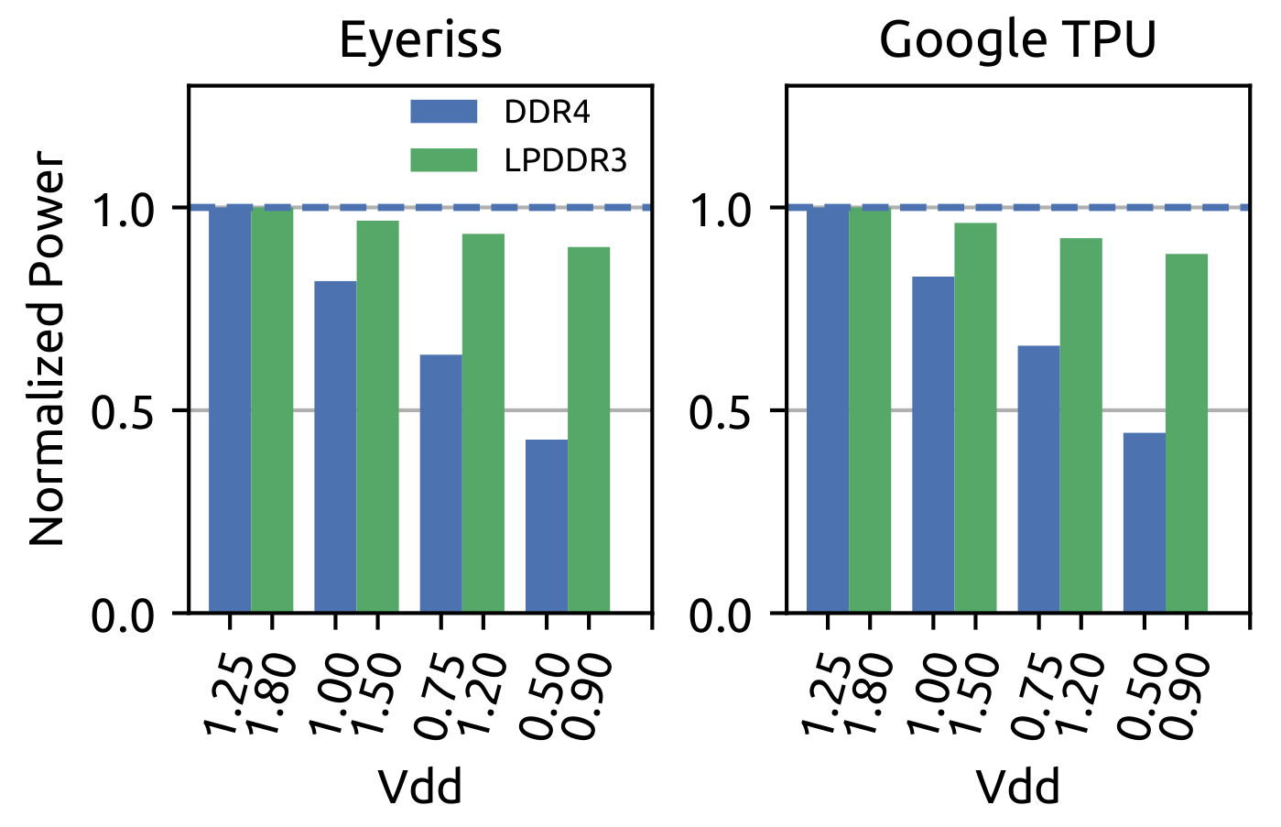
EDEN Power, Performance, Accuracy
~15-20% power savings, 8% perf improvement, <1% accuracy loss

Slide 132
Other Backup Slides

Slide 133
Readings, Videos, Reference Materials

Slide 134
Accelerated Memory Course (~6.5 hours)
ACACES 2018
  Memory Systems and Memory-Centric Computing Systems
  Taught by Onur Mutlu July 9-13, 2018
  ~6.5 hours of lectures
Website for the Course including Videos, Slides, Papers
  https://people.inf.ethz.ch/omutlu/acaces2018.html
  https://www.youtube.com/playlist?list=PL5Q2soXY2Zi-HXxomthrpDpMJm05P6J9x
All Papers are at:
  https://people.inf.ethz.ch/omutlu/projects.htm
  Final lecture notes and readings (for all topics)

Slide 135
Reference Overview Paper I
Onur Mutlu, Saugata Ghose, Juan Gomez-Luna, and Rachata Ausavarungnirun,
"Processing Data Where It Makes Sense: Enabling In-Memory Computation"
Invited paper in Microprocessors and Microsystems (MICPRO), June 2019.
[arXiv version]
https://arxiv.org/pdf/1903.03988.pdf

Slide 136
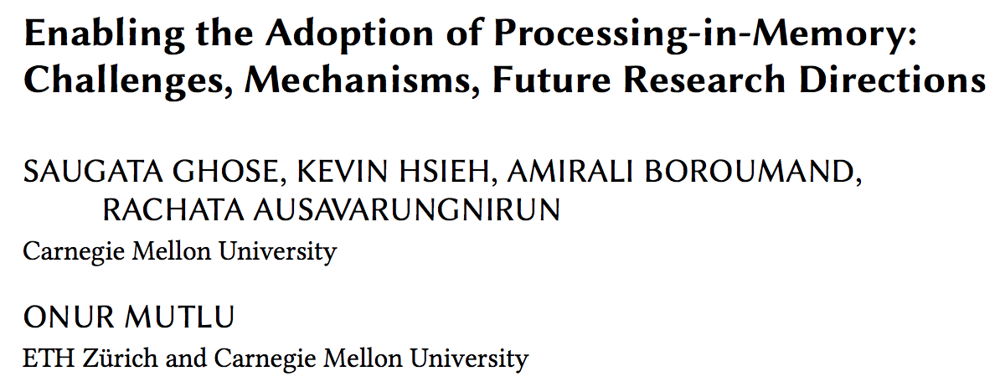
Reference Overview Paper II
Saugata Ghose, Kevin Hsieh, Amirali Boroumand, Rachata Ausavarungnirun, Onur Mutlu,
"Enabling the Adoption of Processing-in-Memory: Challenges, Mechanisms, Future Research Directions"
Invited Book Chapter, to appear in 2018.
[Preliminary arxiv.org version]
https://arxiv.org/pdf/1802.00320.pdf

Slide 137

Reference Overview Paper III
Onur Mutlu and Lavanya Subramanian,
"Research Problems and Opportunities in Memory Systems"
Invited Article in Supercomputing Frontiers and Innovations (SUPERFRI), 2014/2015.
https://people.inf.ethz.ch/omutlu/pub/memory-systems-research_superfri14.pdf

Slide 138

Reference Overview Paper IV
Onur Mutlu,
"The RowHammer Problem and Other Issues We May Face as Memory Becomes Denser"
Invited Paper in Proceedings of the Design, Automation, and Test in Europe Conference (DATE), Lausanne, Switzerland, March 2017.
[Slides (pptx) (pdf)]
https://people.inf.ethz.ch/omutlu/pub/rowhammer-and-other-memory-issues_date17.pdf

Slide 139

Reference Overview Paper V
Onur Mutlu,
"Memory Scaling: A Systems Architecture Perspective"
Technical talk at MemCon 2013 (MEMCON), Santa Clara, CA, August 2013. [Slides (pptx) (pdf)]
[Video] [Coverage on StorageSearch]
https://people.inf.ethz.ch/omutlu/pub/memory-scaling_memcon13.pdf

Slide 140

Reference Overview Paper VI
Proceedings of the IEEE, Sept. 2017
https://arxiv.org/pdf/1706.08642

Slide 141
Related Videos and Course Materials (I)
Undergraduate Computer Architecture Course Lecture Videos (2015, 2014, 2013)
Undergraduate Computer Architecture Course Materials (2015, 2014, 2013)
Graduate Computer Architecture Course Lecture Videos (2018, 2017, 2015, 2013)
Graduate Computer Architecture Course Materials (2018, 2017, 2015, 2013)
Parallel Computer Architecture Course Materials (Lecture Videos)

Slide 142
Related Videos and Course Materials (II)
Freshman Digital Circuits and Computer Architecture Course Lecture Videos (2018, 2017)
Freshman Digital Circuits and Computer Architecture Course Materials (2018)
Memory Systems Short Course Materials
(Lecture Video on Main Memory and DRAM Basics)

Slide 143
Some Open Source Tools (I)
Rowhammer – Program to Induce RowHammer Errors
  https://github.com/CMU-SAFARI/rowhammer
Ramulator – Fast and Extensible DRAM Simulator
  https://github.com/CMU-SAFARI/ramulator
MemSim – Simple Memory Simulator
  https://github.com/CMU-SAFARI/memsim
NOCulator – Flexible Network-on-Chip Simulator
  https://github.com/CMU-SAFARI/NOCulator
SoftMC – FPGA-Based DRAM Testing Infrastructure
  https://github.com/CMU-SAFARI/SoftMC
Other open-source software from my group
  https://github.com/CMU-SAFARI/
  http://www.ece.cmu.edu/~safari/tools.html

Slide 144
Some Open Source Tools (II)
MQSim – A Fast Modern SSD Simulator
  https://github.com/CMU-SAFARI/MQSim
Mosaic – GPU Simulator Supporting Concurrent Applications
  https://github.com/CMU-SAFARI/Mosaic
IMPICA – Processing in 3D-Stacked Memory Simulator
  https://github.com/CMU-SAFARI/IMPICA
SMLA – Detailed 3D-Stacked Memory Simulator
  https://github.com/CMU-SAFARI/SMLA
HWASim – Simulator for Heterogeneous CPU-HWA Systems
  https://github.com/CMU-SAFARI/HWASim
Other open-source software from my group
  https://github.com/CMU-SAFARI/
  http://www.ece.cmu.edu/~safari/tools.html

Slide 145

More Open Source Tools (III)
A lot more open-source software from my group
  https://github.com/CMU-SAFARI/
  http://www.ece.cmu.edu/~safari/tools.html

Slide 146
Referenced Papers
All are available at
  https://people.inf.ethz.ch/omutlu/projects.htm
  http://scholar.google.com/citations?user=7XyGUGkAAAAJ&hl=en
  https://people.inf.ethz.ch/omutlu/acaces2018.html

