Slide 1
Computer Architecture Lecture 19: Cache Coherence
Prof. Onur Mutlu
ETH Zürich
Fall 2022
1 December 2022

Slide 2
Recall: Weak Memory Ordering

Slide 3
Recall: Issues with Sequential Consistency?
Performance enhancement techniques that could make SC implementation difficult
Out-of-order execution
Loads happen out-of-order with respect to each other and with respect to independent stores → makes it difficult for all processors to see the same global order of all memory operations
Caching
A memory location is now present in multiple places
Prevents the effect of a store to be seen by other processors → makes it difficult for all processors to see the same global order of all memory operations

Slide 4
Recall: Weaker Memory Consistency
The ordering of operations is important when the order affects operations on shared data → i.e., when processors need to synchronize to execute a “program region”
Weak consistency
Idea: Programmer specifies regions in which memory operations do not need to be ordered
“Memory fence” instructions delineate those regions
All memory operations before a fence must complete before fence is executed
All memory operations after the fence must wait for the fence to complete
Fences complete in program order
All synchronization operations act like a fence

Slide 5
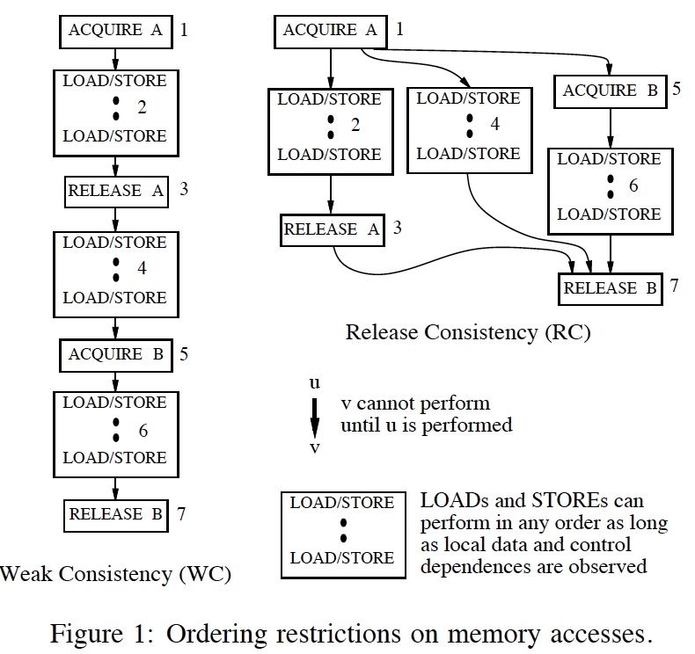
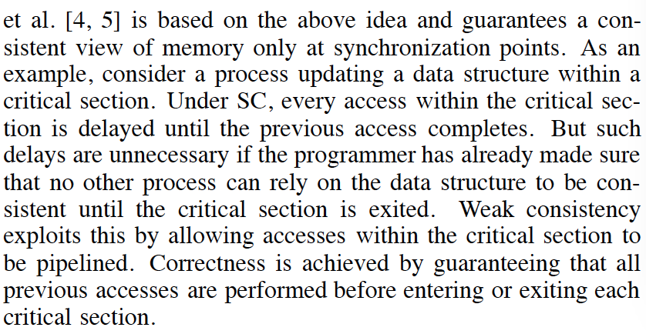
Examples of Weak Consistency Models
Gharachorloo et al., “Two Techniques to Enhance the Performance of Memory Consistency Models,” ICPP 1991.

Slide 6
More on Weak Consistency
Dubois et al., “Memory Access Buffering in Multiprocessors,” ISCA 1986.
Dubois et al., “Memory Access Dependencies in Shared-Memory Multiprocessors,” IEEE TSE 1990.

Slide 7
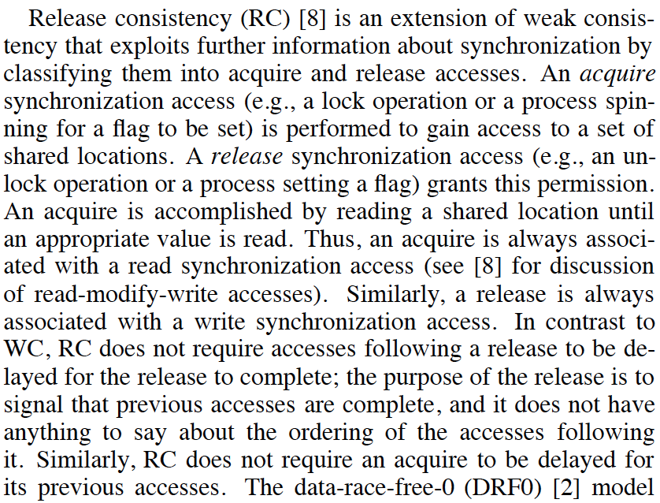
Examples of Weak Consistency Models
Gharachorloo et al., “Two Techniques to Enhance the Performance of Memory Consistency Models,” ICPP 1991.

Slide 8
More on Release Consistency
Gharachorloo et al., “Memory Consistency and Event Ordering in Scalable Shared-Memory Multiprocessors,” ISCA 1990.

Slide 9
Tradeoffs: Weaker Consistency
Advantage
No need to guarantee a (very) strict order of memory operations
→ Enables the hardware implementation of performance enhancement techniques to be simpler
→ Can be higher performance than stricter ordering
Disadvantage
More burden on the programmer or software (need to get the “fences” and labeling of synchronization operations correct)
Debugging is harder → harder to reason about what went wrong
Another example of the programmer-microarchitect tradeoff

Slide 10
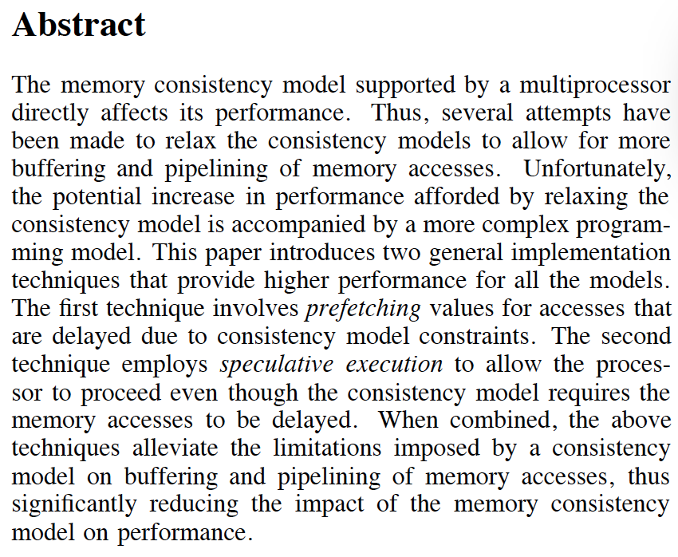
More on Weak Consistency Models
Gharachorloo et al., “Two Techniques to Enhance the Performance of Memory Consistency Models,” ICPP 1991.

Slide 11
Cache Coherence

Slide 12
Caching in Multiprocessors
Caching not only complicates ordering of all operations…
A memory location can be present in multiple caches
Prevents the effect of a store or load to be seen by other processors → makes it difficult for all processors to see the same global order of (all) memory operations
… but it also complicates ordering of operations on a single memory location
A single memory location can be present in multiple caches
Makes it difficult for processors that have cached the same location to have the correct value of that location (in the presence of updates to that location)

Slide 13
Memory Consistency vs. Cache Coherence
Consistency is about ordering of all memory operations from different processors (i.e., to different memory locations)
Global ordering of accesses to all memory locations
Coherence is about ordering of operations from different processors to the same memory location
Local ordering of accesses to each cache block

Slide 14
Readings: Cache Coherence
Required
Culler and Singh, Parallel Computer Architecture
Chapter 5.1 (pp 269 – 283), Chapter 5.3 (pp 291 – 305)
P&H, Computer Organization and Design
Chapter 5.8 (pp 534 – 538 in 4th and 4th revised eds.)
Papamarcos and Patel, “A low-overhead coherence solution for multiprocessors with private cache memories,” ISCA 1984.
Recommended
Censier and Feautrier, “A new solution to coherence problems in multicache systems,” IEEE Trans. Computers, 1978.
Goodman, “Using cache memory to reduce processor-memory traffic,” ISCA 1983.
Laudon and Lenoski, “The SGI Origin: a ccNUMA highly scalable server,” ISCA 1997.
Martin et al, “Token coherence: decoupling performance and correctness,” ISCA 2003.
Baer and Wang, “On the inclusion properties for multi-level cache hierarchies,” ISCA 1988.

Slide 15
Shared Memory Model
Many parallel programs communicate through shared memory
Proc 0 writes to an address, followed by Proc 1 reading
This implies communication between the two
Each read should receive the value last written by anyone
This requires synchronization (what does last written mean?)
What if Mem[A] is cached (at either end)?
Proc 0
Mem[A] = 1
Proc 1
…
Print Mem[A]

Slide 16
Cache Coherence
Basic question: If multiple processors cache the same block, how do they ensure they all see a consistent state?
P1
P2
Interconnection Network
1000
x
Main Memory

Slide 17
The Cache Coherence Problem
P1
P2
ld r2, x
1000
Interconnection Network
1000
x
Main Memory

Slide 18
The Cache Coherence Problem
P1
P2
ld r2, x
ld r2, x
1000
1000
Interconnection Network
x
1000
Main Memory

Slide 19
The Cache Coherence Problem
P1
P2
ld r2, x
ld r2, x
add r1, r2, r4
st x, r1
2000
1000
Interconnection Network
1000
x
Main Memory

Slide 20
The Cache Coherence Problem
P1
P2
ld r2, x
ld r2, x
add r1, r2, r4
st x, r1
2000
1000
Should NOT load 1000
ld r5, x
Interconnection Network
1000
x
Main Memory

Slide 21
Cache Coherence: Whose Responsibility?
Software
Can programmer ensure coherence if caches invisible to software?
Coarse-grained: Page-level coherence has overheads
Non-solution: Make shared locks/data non-cacheable
A combination of non-cacheable and coarse-grained is doable
Fine-grained: What if the ISA provided a cache flush instruction?
FLUSH-LOCAL A: Flushes/invalidates the cache block containing address A from a processor’s local cache.
FLUSH-GLOBAL A: Flushes/invalidates the cache block containing address A from all other processors’ caches.
FLUSH-CACHE X: Flushes/invalidates all blocks in cache X.
Hardware
Greatly simplifies software’s job
One idea: Invalidate all other copies of block A when a core writes to A

Slide 22
A Very Simple Coherence Scheme (VI)
Caches “snoop” (observe) each other’s write/read operations. If a processor writes to a block, all others invalidate the block.
A simple protocol:
PrRd/--
PrWr / BusWr
Write-through, no-write-allocate cache
Actions of the local processor on the cache block: PrRd, PrWr,
Actions that are broadcast on the bus for the block: BusRd, BusWr
Valid
BusWr
PrRd / BusRd
Invalid
PrWr / BusWr

Slide 23
(Non-)Solutions to Cache Coherence
No hardware based coherence
Keeping caches coherent is software’s responsibility
+ Makes microarchitect’s life easier
-- Makes average programmer’s life much harder
need to worry about hardware caches to maintain program correctness?
-- Overhead in ensuring coherence in software (e.g., page protection, page-based software coherence, non-cacheable)
All caches are shared between all processors
+ No need for coherence
-- Shared cache becomes the bottleneck
-- Very hard to design a scalable system with low-latency cache access this way

Slide 24
Maintaining Coherence
Need to guarantee that all processors see a consistent value (i.e., consistent updates) for the same memory location
Writes to location A by P0 should be seen by P1 (eventually), and all writes to A should appear in some order
Coherence needs to provide:
Write propagation: guarantee that updates will propagate
Write serialization: provide a consistent order seen by all processors for the same memory location
Need a global point of serialization for this write ordering

Slide 25
Hardware Cache Coherence
Basic idea:
A processor/cache broadcasts its write/update to a memory location to all other processors
Another cache that has the location either updates or invalidates its local copy

Slide 26
Coherence: Update vs. Invalidate
How can we safely update replicated data?
Option 1 (Update protocol): push an update to all copies
Option 2 (Invalidate protocol): ensure there is only one copy (local), update it
On a Read:
If local copy is Invalid, put out request
(If another node has a copy, it returns it, otherwise memory does)

Slide 27
Coherence: Update vs. Invalidate (II)
On a Write:
Read block into cache as before
Update Protocol:
Write to block, and simultaneously broadcast written data and address to sharers
(Other nodes update the data in their caches if block is present)
Invalidate Protocol:
Write to block, and simultaneously broadcast invalidation of address to sharers
(Other nodes invalidate block in their caches if block is present)

Slide 28
Update vs. Invalidate Tradeoffs
Which one is better? Update or invalidate?
Write frequency and sharing behavior are critical
Update
+ If sharer set is constant and updates are infrequent, avoids the cost of invalidate-reacquire (broadcast update pattern)
- If data is rewritten without intervening reads by other cores, updates would be useless
- Write-through cache policy ➔ bus can become a bottleneck
Invalidate
+ After invalidation, core has exclusive access rights
+ Only cores that keep reading after each write retain a copy
- If write contention is high, leads to ping-ponging (rapid invalidation-reacquire traffic from different processors)

Slide 29
Two Cache Coherence Methods
How do we ensure that the proper caches are updated?
Snoopy Bus [Goodman ISCA 1983, Papamarcos+ ISCA 1984]
Bus-based, single point of serialization for all memory requests
Processors observe other processors’ actions
E.g.: P1 makes “read-exclusive” request for A on bus, P0 sees this and invalidates its own copy of A
Directory [Censier and Feautrier, IEEE ToC 1978]
Single point of serialization per block, distributed among nodes
Processors make explicit requests for blocks
Directory tracks which caches have each block
Directory coordinates invalidations and updates
E.g.: P1 asks directory for exclusive copy, directory asks P0 to invalidate, waits for ACK, then responds to P1

Slide 30
Directory Based Cache Coherence

Slide 31
Directory Based Coherence
Idea: A logically-central directory keeps track of where the copies of each cache block reside. Caches consult this directory to ensure coherence.
An example mechanism:
For each cache block in memory, store P+1 bits in directory
One bit for each cache, indicating whether the block is in cache
Exclusive bit: indicates that a cache has the only copy of the block and can update it without notifying others
On a read: set the cache’s bit and arrange the supply of data
On a write: invalidate all caches that have the block and reset their bits
Have an “exclusive bit” associated with each block in each cache (so that the cache can update the exclusive block silently)

Slide 32
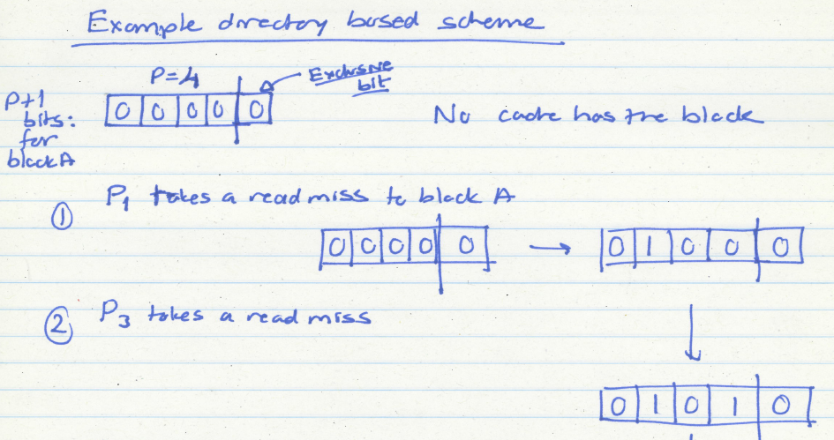
Directory Based Coherence Example (I)

Slide 33
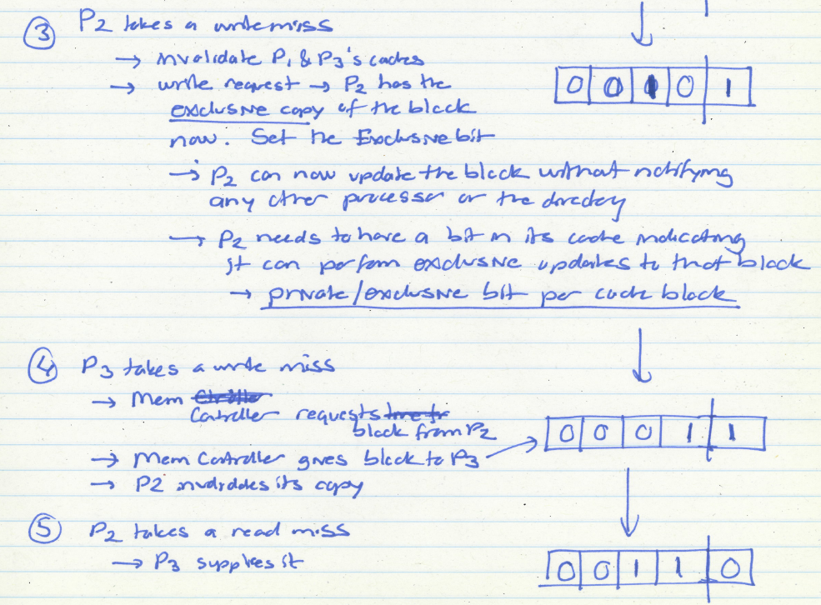
Directory Based Coherence Example (I)

Slide 34
Directory Optimizations
Directory is the coordinator for all actions to be performed on a given block by any processor
Guarantees correctness, ordering
Yet, there are many opportunities for optimization
Enabled by bypassing the directory and directly communicating between caches
We will see examples of these optimizations later

Slide 35
Snoopy Cache Coherence

Slide 36
Snoopy Cache Coherence
Idea:
All caches “snoop” all other caches’ read/write requests and keep the cache block coherent
Each cache block has “coherence metadata” associated with it in the tag store of each cache
Easy to implement if all caches share a common bus
Each cache broadcasts its read/write operations on the bus
Good for small-scale multiprocessors
What if you would like to have a 10,000-node multiprocessor?

Slide 37
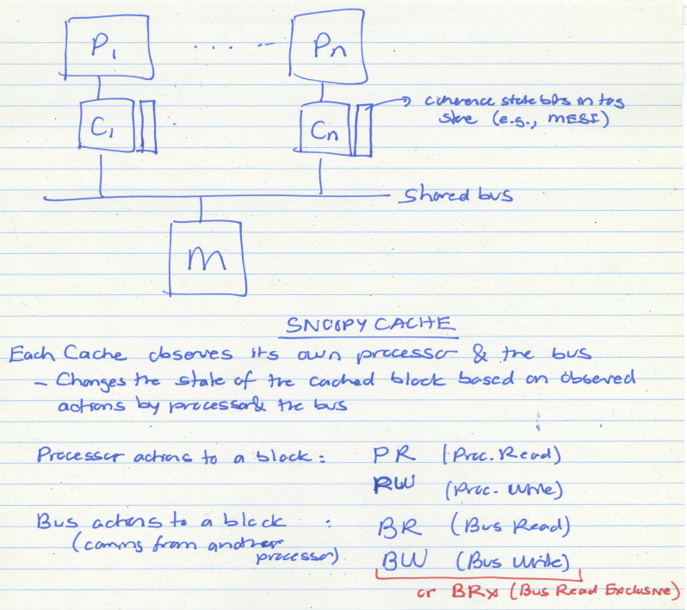

Slide 38
A Simple Snoopy Cache Coherence Protocol
Caches “snoop” (observe) each others’ write/read operations
A simple protocol (VI protocol):
PrRd/--
PrWr / BusWr
Write-through, no-write-allocate cache
Actions of the local processor on the cache block: PrRd, PrWr,
Actions that are broadcast on the bus for the block: BusRd, BusWr
Valid
BusWr
PrRd / BusRd
Invalid
PrWr / BusWr

Slide 39
Extending the Protocol
What if you want write-back caches?
We want a “modified” state

Slide 40
A More Sophisticated Protocol: MSI
Extend metadata per block to encode three states:
M(odified): cache line is the only cached copy and is dirty
S(hared): cache line is one of potentially several cached copies and it is clean (i.e., at least one clean cached copy)
I(nvalid): cache line is not present in this cache
Read miss makes a Read request on bus, transitions to S
Write miss makes a ReadEx request, transitions to M state
When a processor snoops ReadEx from another writer, it must invalidate its own copy (if any)
S→M upgrade can be made without accessing memory (via Invalidations)

Slide 41
MSI State Machine
M
BusRd/Flush
PrWr/BusRdX
PrWr/BusRdX
PrRd/--
PrWr/--
BusRdX/Flush
PrRd/BusRd
S
I
PrRd/--
BusRd/--
BusRdX/--
ObservedEvent/Action
[Culler/Singh96]

Slide 42
The Problem with MSI
A block is in no cache to begin with
Problem: On a read, the block immediately goes to “Shared” state although it may be the only copy to be cached (i.e., no other processor will cache it)
Why is this a problem?
Suppose the cache that reads the block wants to write to it at some point
It needs to broadcast “invalidate” even though it has the only cached copy!
If the cache knew it had the only cached copy in the system, it could have written to the block without notifying any other cache → saves unnecessary broadcasts of invalidations

Slide 43
The Problem with MSI
M
BusRd/Flush
PrWr/BusRdX
PrWr/BusRdX
PrRd/--
PrWr/--
BusRdX/Flush
PrRd/BusRd
S
I
PrRd/--
BusRd/--
BusRdX/--
ObservedEvent/Action
[Culler/Singh96]

Slide 44
The Solution: MESI
Idea: Add another state indicating that this is the only cached copy and it is clean.
Exclusive state
Block is placed into the exclusive state if, during BusRd, no other cache had it
Wired-OR “shared” signal on bus can determine this: snooping caches assert the signal if they also have a copy
Silent transition Exclusive→Modified is possible on write!
MESI is also called the Illinois protocol
Papamarcos and Patel, “A low-overhead coherence solution for multiprocessors with private cache memories,” ISCA 1984.

Slide 45
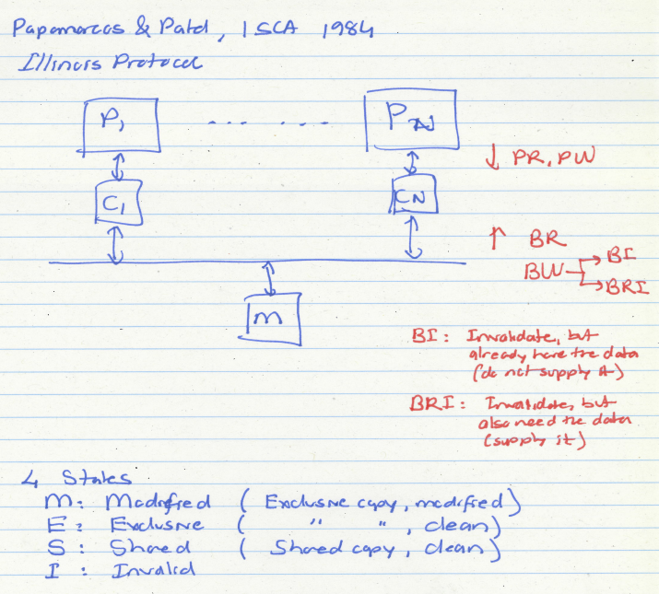

Slide 46
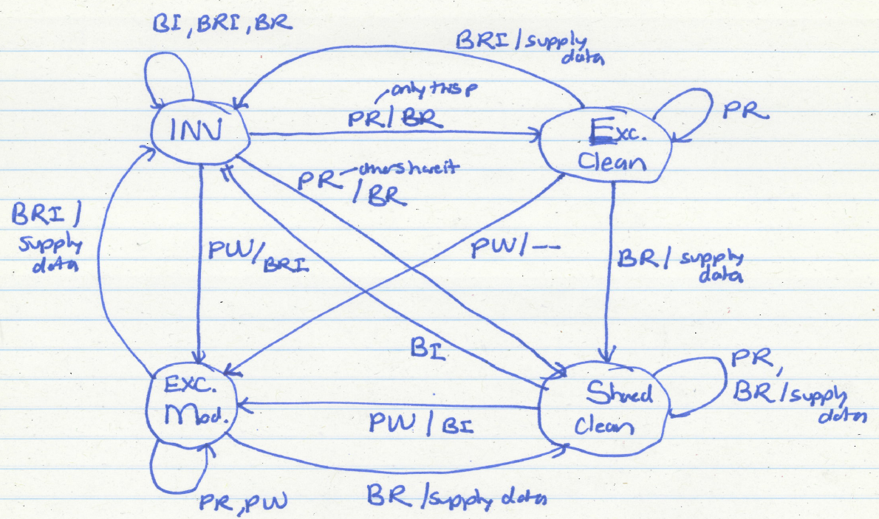
MESI State Machine

Slide 47
MESI State Machine
M
PrWr/--
BusRd/Flush
PrWr/BusRdX
E
BusRd/ $ Transfer
PrWr/BusRdX
S
PrRd (S’)/BusRd
PrRd (S)/BusRd
I
BusRdX/Flush (all incoming)
[Culler/Singh96]

Slide 48
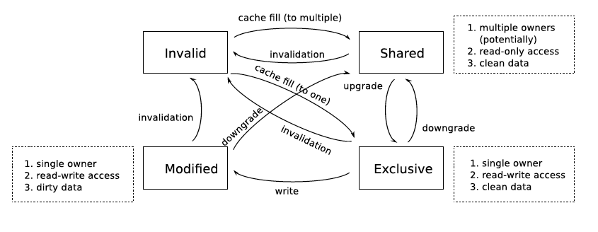
MESI State Machine from Bonus Lab 6
A transition from a single-owner state (Exclusive or Modified) to Shared is called a downgrade, because the transition takes away the owner's right to modify the data
A transition from Shared to a single-owner state (Exclusive or Modified) is called an upgrade, because the transition grants the ability to the owner (the cache which contains the respective block) to write to the block.

Slide 49
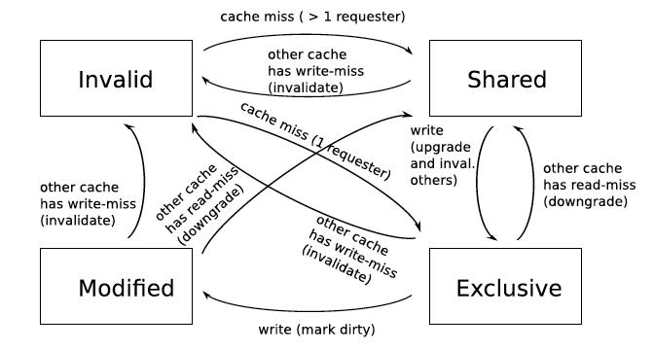
MESI State Machine from Bonus Lab 6

Slide 50
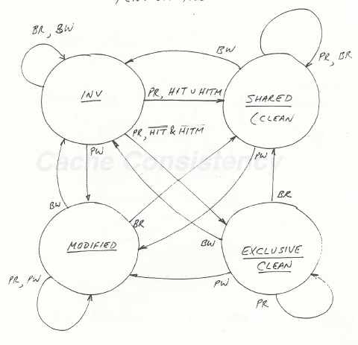
Intel Pentium Pro Coherence Protocol
Slide credit: Yale Patt

Slide 51
Snoopy Invalidation Tradeoffs
Should a downgrade from M go to S or I?
S: if data is likely to be reused (before it is written to by another processor)
I: if data is likely to be not reused (before it is written to by another)
Cache-to-cache transfers?
On a BusRd, should data come from another cache or memory?
Another cache
May be faster, if memory is slow or highly contended
Memory
Simpler: no need to wait to see if another cache has the data first
Less contention at the other caches
Requires writeback on M downgrade
Writeback on Modified->Shared needed since Shared state is Clean
Can we avoid this writeback to memory?
One possibility: Owner (O) state (MOESI protocol)
One cache owns the latest data (memory is not updated)
Memory writeback happens when all caches evict copies

Slide 52
The Problem with MESI
Observation: Shared state requires the data to be clean
i.e., all caches that have the block have the up-to-date copy and so does the memory
Problem: Need to write the block to memory when BusRd happens when the block is in Modified state
Why is this a problem?
Memory can be updated unnecessarily → some other processor may want to write to the block again

Slide 53
Improving on MESI
Idea 1: Do not transition from M→S on a BusRd. Invalidate the copy and supply the modified block to the requesting processor directly without updating memory
Idea 2: Transition from M→S, but designate one cache as the owner (O), who will write the block back when it is evicted
Now “Shared” means “Shared and potentially dirty”
This is a version of the MOESI protocol

Slide 54
Tradeoffs in Sophisticated Cache Coherence Protocols
The protocol can be optimized with more states and prediction mechanisms to
+ Reduce unnecessary invalidates and transfers of blocks
However, more states and optimizations
-- Are more difficult to design and verify (lead to more cases to take care of, race conditions)
-- Provide diminishing returns

Slide 55
Revisiting Two Cache Coherence Methods
How do we ensure that the proper caches are updated?
Snoopy Bus [Goodman ISCA 1983, Papamarcos+ ISCA 1984]
Bus-based, single point of serialization for all memory requests
Processors observe other processors’ actions
E.g.: P1 makes “read-exclusive” request for A on bus, P0 sees this and invalidates its own copy of A
Directory [Censier and Feautrier, IEEE ToC 1978]
Single point of serialization per block, distributed among nodes
Processors make explicit requests for blocks
Directory tracks which caches have each block
Directory coordinates invalidation and updates
E.g.: P1 asks directory for exclusive copy, directory asks P0 to invalidate, waits for ACK, then responds to P1

Slide 56
Snoopy Cache vs. Directory Coherence
Snoopy Cache
+ Miss latency (critical path) is short: request → bus transaction to mem.
+ Global serialization is easy: bus provides this already (arbitration)
+ Simple: can adapt bus-based uniprocessors easily
- Relies on broadcast messages to be seen by all caches (in same order):
→ single point of serialization (bus): not scalable
→ need a virtual bus (or a totally-ordered interconnect)
Directory
- Adds indirection to miss latency (critical path): request → dir. → mem.
- Requires extra storage space to track sharer sets
Can be approximate (false positives are OK for correctness)
- Protocols and race conditions are more complex (for high-performance)
+ Does not require broadcast to all caches
+ Exactly as scalable as interconnect and directory storage (much more scalable than bus)
Notes:
Make reference to SGI Origin paper

Slide 57
Revisiting Directory-Based Cache Coherence

Slide 58
Remember: Directory Based Coherence
Idea: A logically-central directory keeps track of where the copies of each cache block reside. Caches consult this directory to ensure coherence.
An example mechanism:
For each cache block in memory, store P+1 bits in directory
One bit for each cache, indicating whether the block is in cache
Exclusive bit: indicates that the cache that has the only copy of the block and can update it without notifying others
On a read: set the cache’s bit and arrange the supply of data
On a write: invalidate all caches that have the block and reset their bits
Have an “exclusive bit” associated with each block in each cache

Slide 59
Remember: Directory Based Coherence Example

Slide 60
Directory-Based Protocols
Required when scaling past the capacity of a single bus
Distributed:
Coherence still requires single point of serialization for a give block (for write serialization)
Serialization location can be different for different blocks (striped across nodes/memory-controllers)
We can reason about the protocol for a single block: one server (directory node), many clients (private caches)
Directory receives Read and ReadEx requests, and sends Invl requests: invalidation is explicit (as opposed to snoopy bus)

Slide 61
Directory: Data Structures
0x00
0x04
0x08
0x0C
…
Shared: {P0, P1, P2}
---
Exclusive: P2
---
---
Required to support invalidation and cache block requests
Key operation to support is set inclusion test
False positives are OK: want to know which caches may contain a copy of a block, and spurious invalidations are ignored
False positive rate determines performance
Most accurate (and expensive): full bit-vector
Compressed representation, linked list, Bloom filters are all possible

Slide 62
Directory: Basic Operations
Follow semantics of a snoop-based system
but with explicit request, reply messages
Directory:
Receives Read, ReadEx, Upgrade requests from nodes
Sends Inval/Downgrade messages to sharers if needed
Forwards request to memory if needed
Replies to requestor and updates sharing state
Protocol design is flexible
Exact forwarding paths depend on implementation
For example, do cache-to-cache transfer?

Slide 63
MESI Directory Transaction: Read
P0 acquires an address for reading:
1. Read
P0
Home
2. DatEx (DatShr)
P1
Culler/Singh Fig. 8.16

Slide 64
RdEx with Former Owner
1. RdEx
2. Invl
P0
Home
3a. Rev
Owner
3b. DatEx
Notes:
Why speculative reply? Allows silent eviction of E (clean exclusive) block. Otherwise, have to make another roundtrip to home node to get data for requestor.

Slide 65
Contention Resolution (for Write)
1a. RdEx
1b. RdEx
4. Invl
3. RdEx
☺
P0
Home
P1
☹
5a. Rev
2a. DatEx
2b. NACK
☺
5b. DatEx

Slide 66
Issues with Contention Resolution
Need to escape race conditions by:
NACKing requests to busy (pending invalidate) entries
Original requestor retries
OR, queuing requests and granting in sequence
(Or some combination thereof)
Fairness
Which requestor should be preferred in a conflict?
Interconnect delivery order, and distance, both matter
Ping-ponging can be reduced w/ protocol optimizations OR better higher-level synchronization
With solutions like combining trees (for locks/barriers) and better shared-data-structure design

Slide 67
Scaling the Directory: Some Questions
How large is the directory?
How can we reduce the access latency to the directory?
How can we scale the system to thousands of nodes?
Can we get the best of snooping and directory protocols?
Heterogeneity
E.g., token coherence [Martin+, ISCA 2003]

Slide 68
An Example Question (I)

Slide 69
An Example Answer
Blocks per node
(32GB address space / 128 bytes per block) / 32 nodes
2^(35-7-5) = 2^23
Directory storage per node
200 MB = 25 * 2^23 bytes = 25 * 2^26 bits
Directory storage per block
25 * 2^26 bits / 2^23 blocks = 200 bits per block
Each directory entry has P+1 bits
P+1 = 200 => P = 199

Slide 70
Cache Coherence & RowHammer

Slide 71
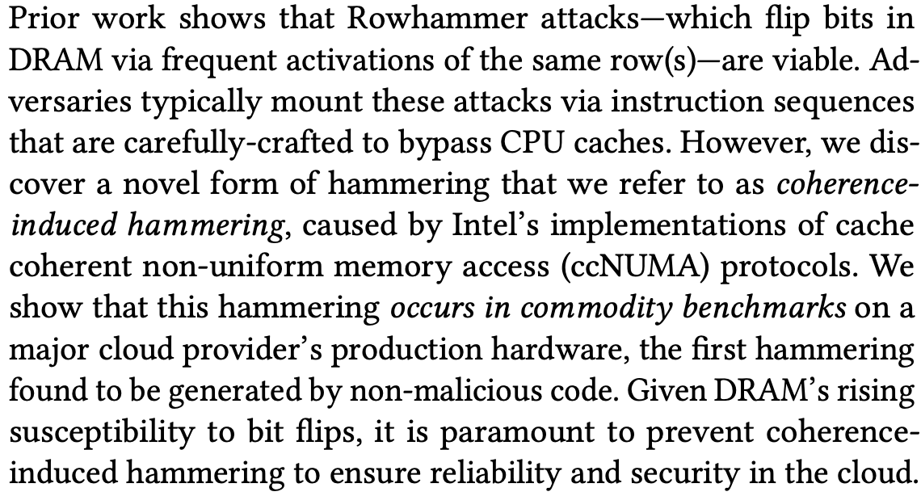
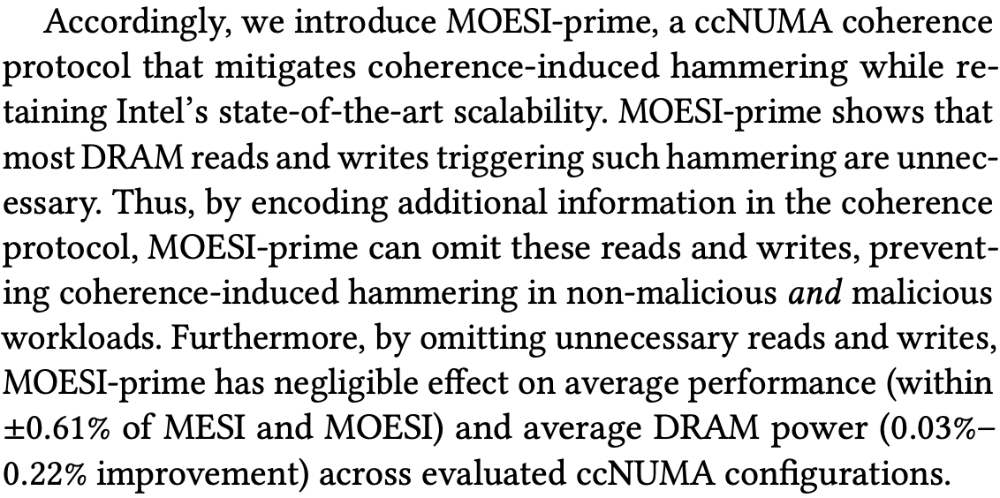
Coherence Traffic Exacerbates RowHammer
Appears at ISCA 2022
https://www.kevinloughlin.org/moesi-prime.pdf

Slide 72
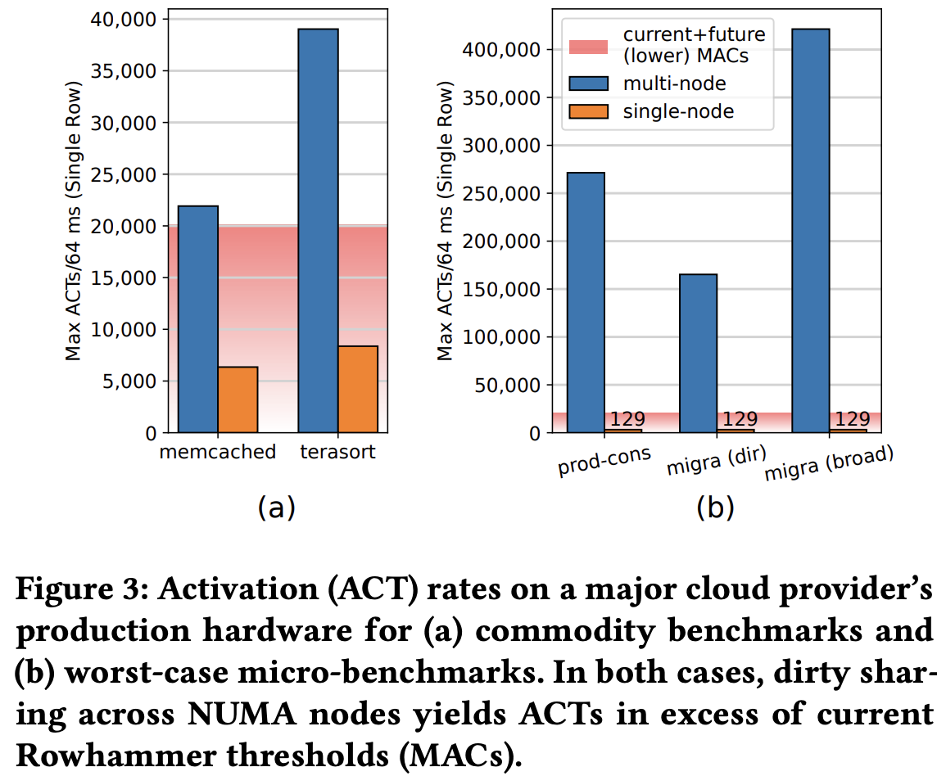
Coherence Traffic Exacerbates RowHammer
https://www.kevinloughlin.org/moesi-prime.pdf

Slide 73
Cache Coherence: A Recent Example

Slide 74
Eliminating the Adoption Barriers to PIM
How to Enable Adoption of Processing in Memory

Slide 75
Potential Barriers to Adoption of PIM
1. Applications & software for PIM
2. Ease of programming (interfaces and compiler/HW support)
3. System and security support: coherence, synchronization, virtual memory, isolation, communication interfaces, …
4. Runtime and compilation systems for adaptive scheduling, data mapping, access/sharing control, …
5. Infrastructures to assess benefits and feasibility
All can be solved with change of mindset

Slide 76
Automatic Data Coherence Support for PIM
Amirali Boroumand, Saugata Ghose, Minesh Patel, Hasan Hassan, Brandon Lucia, Kevin Hsieh, Krishna T. Malladi, Hongzhong Zheng, and Onur Mutlu, "LazyPIM: An Efficient Cache Coherence Mechanism for Processing-in-Memory" IEEE Computer Architecture Letters (CAL), June 2016.

Slide 77
Automatic Data Coherence Support for PIM
Amirali Boroumand, Saugata Ghose, Minesh Patel, Hasan Hassan, Brandon Lucia, Rachata Ausavarungnirun, Kevin Hsieh, Nastaran Hajinazar, Krishna T. Malladi, Hongzhong Zheng, and Onur Mutlu, "CoNDA: Efficient Cache Coherence Support for Near-Data Accelerators" Proceedings of the 46th International Symposium on Computer Architecture (ISCA), Phoenix, AZ, USA, June 2019. [Slides (pptx) (pdf)] [Lightning Talk Slides (pptx) (pdf)] [Poster (pptx) (pdf)] [Lightning Talk Video (4 minutes)]

Slide 78
CoNDA: Efficient Cache Coherence Support for Near-Data Accelerators
Amirali Boroumand
Saugata Ghose, Minesh Patel, Hasan Hassan, Brandon Lucia, Rachata Ausavarungnirun, Kevin Hsieh, Nastaran Hajinazar, Krishna Malladi, Hongzhong Zheng, Onur Mutlu

Slide 79
Specialized Accelerators
Specialized accelerators are now everywhere!
ASIC
NDA
GPU
FPGA
ASIC
Recent advances in DRAM technology enabled Near-Data Accelerators (NDA)
DRAM
CPU
NDA
ASIC
Notes:
Specialized accelerators are now every where, and they are widely used to improve the performance and energy efficiency of computing systems.
At the same time, recent advancement in 3D-stacked technology enabled near data acceleartors. These accelerators can further boost the benefits of specialized accelerator by moving computation close to data and getting rid of data movement.

Slide 80
Coherence For NDAs
Challenge: Coherence between NDAs and CPUs
(1) Large cost of off-chip communication
DRAM
CPU
L2
CPU
L1
CPU
CPU
Compute Unit
(2) NDA applications generate a large amount of off-chip data movement
NDA
ASIC
It is impractical to use traditional coherence protocols
Notes:
However, one of the major system challenges for adopting near data accelartors into computing system is coherence. Maintainig coherence between NDAs and CPUs is very challenging because of two reasons: First, the cost of off-chip communication between NDAs and CPUs is very high. Second, NDA applications typically have poor locality, and generate a large amount of off-chip data movement which leads to a large number of coherence misses. Because of these challenges, it is
Impractical use traditional coherence protocols for coherence, because that leads to a large amount of off-chip coherence messages, which can eliminate a significant portion of NDA benefits

Slide 81
Existing Coherence Mechanisms
We extensively study existing NDA coherence mechanisms and make three key observations:
These mechanisms eliminate a significant portion of NDA’s benefits
1
The majority of off-chip coherence traffic generated by these mechanisms is unnecessary
2
Much of the off-chip traffic can be eliminated if the coherence mechanism has insight into the memory accesses
3
ASIC
Notes:
In this work, We extensively study existing NDA coherence mechanisms and make three key observations:
First, these mechanisms eliminate a significant portion of NDA’s benefits as they generate a large amount of off-chip coherence traffic, Second, … Finally, we find that a significant portion of off-chip traffic can be eliminated if the coherence mechanism has insight into
which memory accesses actually require a coherence operation (what part of the shared data is actually accessed)

Slide 82
An Optimistic Approach
We find that an optimistic approach to coherence can address the challenges related to NDA coherence
1
Gain insights before any coherence checks happen
2
Perform only the necessary coherence requests
We propose CoNDA, a coherence mechanism that lets an NDA optimistically execute an NDA kernel
Optimistic execution enables CoNDA to identify and avoid unnecessary coherence requests
CoNDA comes within 10.4% and 4.4% of performance and energy of an ideal NDA coherence mechanism
ASIC
Notes:
Based on these observations, we find that an optimistic approach to coherence can address the challenges of NDA coherence. We find that an optimistic execution model for NDA enables us to gain insight into the memory accesses before any coherence permissions are
checked, and as a result, enforce coherence with only the necessary data movement/coherence requests.
We propose CoNDA, a new coherence mechanism that optimistically executes code on an NDA to gather information on memory
accesses. Optimistic execution enables CoNDA to identify and avoid performing unnecessary coherence requests
Our evaluation shows that CoNDA consistency retain the benefit of NDA across all of the workloads and …

Slide 83
Outline
Introduction
Background
Motivation
CoNDA
Architecture Support
Evaluation
Conclusion
Notes:
Before we jump into our analysis, lets talk about …

Slide 84
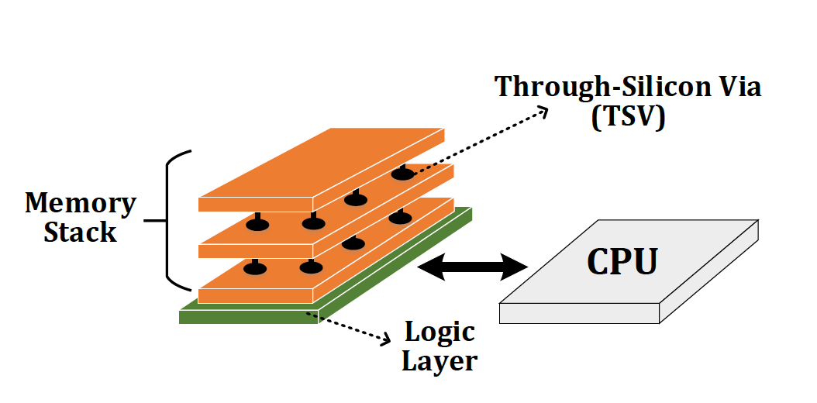
Background
Near-Data Processing (NDP)
A potential solution to reduce data movement
Idea: move computation close to data
Enabled by recent advances in 3D-stacked memory
Reduces data movement
Exploits large in-memory bandwidth
Exploits shorter access latency to memory
Notes:
Before we jump into our analysis, lets talk about …

Slide 85
Outline
Introduction
Background
Motivation
CoNDA
Architecture Support
Evaluation
Conclusion
Notes:
Before we jump into our analysis, lets talk about …

Slide 86
Application Analysis
Notes:
Let me first

Slide 87
Sharing Data between NDAs and CPUs
Hybrid Databases (HTAP)
Graph Processing
We find not all portions of applications benefit from NDA
1
Memory-intensive portions benefit from NDA
2
Compute-intensive or cache friendly portions should remain on the CPU
1st key observation: CPU threads often concurrently access the same region of data that NDA kernels access which leads to significant data sharing
ASIC
Notes:
In this work we extensively analyzed two important class of applications: graph processing framworks and hybrid in memory data bases
We find that not all portions of applications benefit from NDA. While the memory intensive parts can significantly benefit from NDA, compute-intensive parts or those parts that are cache friendly should stay on CPU to maximize performance. We then make a key observation that those portions that run on CPU …
In fact, an application benefit from NDA when the memory intensive parts are offloaded there, those parts that geenrate a lot of data movement and … parts of the application that are compute intensive should …

Slide 88
Shared Data Access Patterns
2nd key observation: CPU threads and NDA kernels typically do not concurrently access the same cache lines
For Connected Components application, only 5.1% of the CPU accesses collide with NDA accesses
CPU threads rarely update the same data that an NDA is actively working on
ASIC
Notes:
To understand data sharing more, we dig deeper and analyze the memory access patterns of the CPU threads and NDA kernels.
We make a second key observation: while CPU threads and NDA kernels share data structures, they often do not concurrently access the same elements
For example, when we analyze one of our graph applications, the Connected Components, we find that only 5.1% of the CPU accesses collide with accesses from the
NDA. In fact, we observe that CPU threads rarely update the same data that an NDA is actively working on

Slide 89
Analysis of NDA Coherence Mechanisms
Notes:
Now I’m gonna tlak about our analysus of existing coherence mechanisms
After we did the application analysis, we start looking at existing coherence mechanism

Slide 90
Analysis of Existing Coherence Mechanism
We analyze three existing coherence mechanisms:
1
Non-cacheable (NC)
Mark the NDA data as non-cacheable
2
Coarse-Grained Coherence (CG)
Get coherence permission for the entire NDA region
3
Fine-Grained Coherence (FG)
Traditional coherence protocols
ASIC
Notes:
One approach to address the coherence problem is to mark the NDA data as non-cacheable. In such a case, we don’t need to worry about coherence as any CPU writes are immediately visible to the NDA.
While this approach works well if there is a limited number of accesses from CPU threads to NDA data, it performs very bad when CPU accesses NDA region frequently. For example, in the hybrid database example, transaction thread operates within the same database with anaylitical threads, and if you mark NDA data as non-cacheable, you end up having a large number of off-chip accesses to DRAM, which eliminate a significant portion of NDA benefit. . It also hurt cpu thread performance, because they no longer can benefit form their large caches
Our analysis shows that Non-cacheable approach fails to …
Conclusion at the end of the slides (either as a banner, or just say it) → while NC works well for
applications where the CPU rarely accesses the NDA data region, it performs poorly for many applications where the CPU accesses
the region often.

Slide 91
Non-Cacheable (NC) Approach
Mark the NDA data as non-cacheable
Transactions
Analytics
(1) Generates a large number of off-chip accesses
Hybrid Database (HTAP)
(2) Significantly hurts CPU threads performance
Transactions
Analytics
Data Sharing
CPU
NDA
CPU
NC fails to provide any energy saving and perform 6.0% worse than CPU-only
ASIC
Notes:
One approach to address the coherence problem is to mark the NDA data as non-cacheable. In such a case, we don’t need to worry about coherence as any CPU writes are immediately visible to the NDA.
While this approach works well if there is a limited number of accesses from CPU threads to NDA data, it performs very bad when CPU accesses NDA region frequently. For example, in the hybrid database example, transaction thread operates within the same database with anaylitical threads, and if you mark NDA data as non-cacheable, you end up having a large number of off-chip accesses to DRAM, which eliminate a significant portion of NDA benefit. . It also hurt cpu thread performance, because they no longer can benefit form their large caches
Our analysis shows that Non-cacheable approach fails to …
Conclusion at the end of the slides (either as a banner, or just say it) → while NC works well for
applications where the CPU rarely accesses the NDA data region, it performs poorly for many applications where the CPU accesses
the region often.

Slide 92
Coarse-Grained (CG) Coherence
Get coherence permission for the entire NDA region
Unnecessarily flushes a large amount of dirty data, especially in pointer-chasing applications
Flush dirty data
CPU
NDA
CPU
Use coarse-grained locks to provide exclusive access
CPU
NDA
Time
Access to NDA data
Blocks CPU threads when they access NDA data regions
STALL
ASIC
CG fails to provide any performance benefit of NDA and performs 0.4% worse than CPU-only
Notes:
Another potential approach is the CG approach. Instead of getting coherence permission per each cacheline, we can get it for an entire region. The coarse-grained appraoch helps to reduce off-chip coherence traffic. However, the issue with this approach is that, every time an NDA wants to get coherence permissions for the region, the CPU must flush all dirty cache lines in the NDA data region even if the NDA does not access most of the data in the region. And where is high amount of sharing, this results in a significant amount of unnecessary data movement, especially in pointer chasing application thatwe don’t know what part of shared data will be accessed by NDA.
Another issues with CG is that some instances of coarse-grained coherence use coarse-grained locks to provide the CPU or NDA with exclusive access to a coarse- grained
region. And that actually keepCPU and NDA to concurrently access a region of data. Again, this works well when there is limited amount of sharing but when there is a significant amount of sharing, each time cpu wants to access any of cache line in that region, it get blocked, basically it keeps NDA and CPU from concurrently executing.
these works don’t allow concurrent access from CPU to PIM, basically they lock that region while PIM is working. (becuae of that could lead to ping-ponging the coherence permission between cpu and pim if cpu wants to access a cacheline in that region.) because they assume there is zero or limited sharing between CPU and PIM. But we showed that there is actually a significant amount of sharing in many data intensive applications, and as a result each time cpu wants to access any of cache line in that region, it get blocked. And effectively, it doesn’t allow concurrent execution between CPU and PIM, even if they don’t access the same piece of data. This gets even worse considering pointer-intensive data structure that pim lock the entire data structure, like graph. Stalling CPUs and flushing a large number of cache lines makes CG to perform even worse than CPU baseline and eliminate all PIM benefit.
this only works well when there is only limited amount of data sharing between the CPU threads and
the NDA kernel and the application can be well-partitioned between them. When there is a high amount of data sharing and there is no easy way to find what part
of the data will be accessed by the NDA, it generate a large amount of unnecessary data movement.
In fact, every time an NDA wants to get coherence permissions for the region, the CPU must flush all dirty cache lines in the NDA data region even if the NDA does not access most of the data in the region. This results in a significant amount of unnecessary data movement.
Some instances of coarse-grained coherence use coarse-grained locks to provide the CPU or NDA with exclusive access to a coarse- grained
region. Without exclusive access, coherence permission can ping-pong between the CPU and the NDA when they concurrently access the
NDA data region. Coarse-grained locks avoid ping-ponging by having the NDA acquire exclusive access to
a region for the duration of the NDA kernel
Our analysis shows that coarse-grained locks significantly limit performance when there is data sharing between them, as it blocks CPU thread when they want to access NDA data region.
We conclude that while CG works well in some cases, it is not suitable for many important NDA applications

Slide 93
Fine-Grained (FG) Coherence
Using fine-grained coherence has two benefits:
1
Simplifies NDA programming model
2
Allows us to get permissions for only the pieces of data that are actually accessed
(1) Memory-intensive
(2) Poor locality
High amount of off-chip coherence Traffic
CPU
NDA
CPU
FG eliminates 71.8% of the energy benefits of an ideal NDA mechanism
Large amount of these coherence messages are unnecessary
Notes:
The final mechanism we analyzed was FG approach. Using FG has two benefits: First, it simplifies … because using FG the entire system behaves like a multithreaded programs.
(the system behave similar to what we expect from multithreaded programming)
Since NDA kernel has a high number of cache misses, FG generates many off-chip coherence
requests;
Since NDA kernels are memory-intensive and exhibit poor temporal
locality, this fine-grained message exchange generates large
amounts of off-chip data movement. A large amount of those coherence
messages are unnecessary, as our analysis from Section 3.1
shows that the vast majority of NDA accesses do not collide with
CPU writes and, thus, do not need coherence.
Conclusion → while FG acquires permissions for only cache lines that are actually accessed, it still causes a lot of unnecessary
off-chip data movement.

Slide 94
Analysis of Existing Coherence Mechanisms
GMEAN
Loses a significant portion of the performance and energy benefits
Increases energy over CPU-only by 64.4% and performs 6.0% worse than CPU-only
Performs 0.4% worse than CPU-only
Poor handling of coherence eliminates much of an NDA’s performance and energy benefits
FG suffers from high amount of unnecessary off-chip coherence traffic
NC suffers from a large number of off-chip accesses from CPU threads
CG unnecessarily flushes a large amount of dirty data
Notes:
So here, on the left, I’m showing you the speedup for different coherence mechanism across a subset of our applications, the average number I’m showing here is across all of our applications. Also I’m showing the result for the ideal-nda which we assume it has zero cost for coherence. And on the right, I’m showing you the average normalized energy across all of the applications
As you can see, all of the coherence mchanisms eliminate a signifcant portion of ..
So now lets take a look at each inidividualy.
In case of non-acheable, we can see that if fails to provide any energy saving and even performs worse than CPU-only baseline. This is because when there is high amount of sharing, it suffers from large number of accesses to DRAM from CPU threads.
For the coarse-grained approach, we find that it eliminate a signifcant portion of energy benefit, and it performs .4% worse than CPU-only. The reason is that, everytime NDA wants to get coherence permission, the cpu has to flush every dirty data in the region back to DRAM, eventhough NDA might not access all of them. And That leads to a large amount of unnecessary coherence traffic. The other problem with CG is that, it uses coarse-grained locks to provide exclusive access to NDA and CPU. Those coarse grained keep CPU and NDA from concurrently executing because when there is high amount of sharing, every time CPU access NDA region, it gets blocked For the FG, even though it performs better than the tow other approaches, it still loses a significant portion of energy and performance benefits. The reason is thatthese application generate a large number of coherence misses, everytime a coherence miss happens, FG genreates an off-chip coherence message. And we already showed that most of them are unnecessary.

Slide 95
Motivation and Goal
Poor handling of coherence eliminates much of an NDA’s benefits
1
1
The majority of off-chip coherence traffic is unnecessary
2
2
Our goal is to design a coherence mechanism that:
3
1
Retains benefits of Ideal NDA
2
Enforces coherence with only the necessary data movement

Slide 96
Outline
Introduction
Background
Motivation
CoNDA
Architecture Support
Evaluation
Conclusion
Notes:
Before we jump into our analysis, lets talk about …

Slide 97
Optimistic NDA Execution
We leverage two key observations:
1
Having insight enables us to eliminate much of unnecessary coherence traffic
2
Low rate of collision for CPU threads and NDA kernels
We propose to use optimistic execution for NDAs
NDA executes the kernel:
1
Assumes it has coherence permissions
2
Gains insights into memory accesses
ASIC
When execution is done:
Performs only the necessary coherence requests
Notes:
We levergae to key observations:
lets the NDA optimistically
start execution assuming that it has coherence permissions, without
issuing any coherence messages off-chip.
Majority is unnecessary since they don’t collide in the same cache line
With insight ahead of time, we can eliminate that
Based on our observations from our anaysis, we propose to use optimistic
execution for NDAs. Bascially, we assume that NDA executes in optimistic mode and during that mode
it gains insight into its memory accesses by tracking the
accesses without issuing any coherence requests.
When optimistic
execution is done, the NDA uses the tracking information to perform
necessary coherence requests for only the parts of the shared
data that were actually accessed during execution, which minimizes
coherence-related data movement.
This behavior leads to a very low
re-execution rate of NDA kernels, which is one of our key motivations
behind adopting an optimistic execution model for NDA
coherence

Slide 98
High-Level Overview of Optimistic Execution Model
CPU
NDA
Time
Fits well within the context of NDA coherence:
1
CPU Thread Execution
Allows us to identify the necessary coherence traffic
Starts optimistic execution
2
Most of the time optimistic execution works → low re-execution rate
Concurrent CPU + NDA Execution
Optimistic Execution
No Coherence Request
Coherence Resolution
Commit or Re-execute
Notes:
Here is a high-level overview of our optimistic execution model.
An application is running on the CPU and then it can issue a call to start executing the kernel on an NDA. When the NDA starts executing, the CPU
continue execution in parallel. The NDA executes in optimistic mode, which means that it assumes that it always has coherence permissions on the cache lines that it uses, without checking the CPU coherence directory. This means that there is no off-chip coherence request during execution.
When optimistic execution stops, we use the insight to check if any coherence violation happened and perform the necessary coherence request.
we check if any coherence requests should have been issued to guarantee correctness, using the insight we gathered duriong optimistic mode.
If find out that there is no violation of coherence, the NDA data updates are committed and become visible to the rest of the system. Otherwise, the NDA must resolve any violations by performing only the necessary coherence operations, and re-execute the optimistically-executed code.
Because CPU threads and NDA kernels rarely access the same cache lines during concurrent execution (see Section 3.1), re-execution happens rarely, as we show in Section 7.2, making optimistic execution efficient.

Slide 99
High-Level Overview of CoNDA
We propose CoNDA, a mechanism that uses optimistic NDA execution to avoid unnecessary coherence traffic
CPU
NDA
Time
CPU Thread Execution
Offload NDA kernel
Concurrent CPU + NDA Execution
No Coherence Request
Optimistic Execution
Signature
Signature
Send signatures
Coherence Resolution
Commit or Re-execute
Notes:
So, based on the execution model I just explained, we propose a coherence mechanism, which uses that execution model to avoid unnecessary coherence traffic.
Basically, in Conda, CPU offload the kernel to NDA. NDA starts executing in optimistic mode. During optimistic execution
CoNDA efficiently tracks the addresses of all NDA reads, NDA writes, and CPU write using compressed signatures. When optimistic mode is done, NDA send these signaturs to CPU and CoNDA use these signatures to resolve coherence violations.
If CoNDA detects any coherence violation (1) the NDA invalidates all
Of updates; (2) the CPU resolves the coherence
requests, performing only the necessary coherence operations (including
any cache line updates); and (3) the NDA re-executes the
uncommitted portion of the kernel.
Otherwise, CoNDA performs the necessary coherence operations, clears the uncommitted flag
for all data updates in the NDA L1 cache, and resumes optimistic execution if
the NDA kernel is not finished.

Slide 100
How do we identify coherence violations?
Notes:
So now lets how we actually identify the necessary coherence request during coherence resolution

Slide 101
Necessary Coherence Requests
Coherence requests are only necessary if:
Both NDA and CPU access a cache line
At least one of them updates it
We discuss three possible interleaving of accesses to the same cache line:
1
NDA Read and CPU Write (coherence violation)
2
NDA Write and CPU Read (no violation)
3
NDA Write and CPU Write (no violation)
ASIC
Notes:
A coherecne request is necessary of both NDA and CPU access a cache line and at least one of them, updates it.
A coherence violation happens if we don’t do a necessary coherence request. So to explain coherence violations, here I discuss three ... And show that only one of the interleavings leads to a violation
and requires NDA re-execution to ensure correct execution

Slide 102
Identifying Coherence Violations
CPU
NDA
Time
C1. Wr Z
N1. Rd X
No coherence checks during NDA execution
C2. Rd A
N2. Wr Y
C3. Wr B
N3. Rd Z
1) NDA Read and CPU Write: violation
2) NDA Write and CPU Read : no violation
3) NDA Write and CPU Write: no violation
NDA reads old value of Z
Any Coherence Violation?
Yes. Flush Z to DRAM
Coherence checks happen at the end of NDA kernel
C4. Wr Y
N4. Rd X
C5. Rd Y
N5. Wr Y
N6. Rd Z
“C4” and “C5” are ordered before “N5”
Any Coherence Violation?
No. Commit NDA operations
C6. Wr X
Notes:
Here I’m showing you an example where CPU is executing a bunch of instructions. And we also have NDA kernel that is running concurrently. Here we are considering a case where CPU is updating a cache line and NDA is reading the same cacheline. In this case, CPU updates cache line Z and NDA kernel reads from cacheline z.
Because we don’t do any coherence lookup or update during NDA kernel execution, NDA ends up reading old values of Z from DRAM. That’s a coherence violation, because CPU write has happened before NDA read, and we need to guarantee writes bcome visible right away. and In that case, we need to flush Z to DRAM and re-execute the NDA kernel. So the next time NDA kernel see the updated value. the effective ordering becomes like this.
Now lets consider another case. This time, while NDA is writing to cache line Y, cpu also write and read to same cache line. Neither of these cause coherence violation. The reason is that NDA makes its update visibile to the system at the end of optimistic mode execution. All of the updates are happen at the end of NDA kernel when we ensure there is no coherence violation. As a result, any write and read from CPU during NDA kernel execution, effectively order before the NDA write.
Some one might ask, what if we want this cpu to read the value PIM is updating. In that case, like any normal multi-threaded environemnt, we need to use synchroniztion primitves like semaphore or memory barrier, to make sure CPU read order before PIM write.
So as we said, when we send the signature back, no conflict will be detected, and pim core commit its update. So to summarize, if there is a write from CPU to a cacheline that PIM is reading that is a conflict. If there is a read from CPU to a cacheline PIM is writing to, that read orders before that write, and as a result, it doesn’t create any conflict.
Basically there are three possible conflicts: 1) processor update, pim read, 2) pim update something processor read, and both processor and pim update.

Slide 103
Outline
Introduction
Background
Motivation
CoNDA
Architecture Support
Evaluation
Conclusion
Notes:
Before we jump into our analysis, lets talk about …

Slide 104
CoNDA: Architecture Support
DRAM
CPU
CPU
L1
NDA Core
L1
Shared LLC
NDAReadSet
NDAReadSet
Coherence Resolution
Coherence Resolution
NDAWriteSet
CPUWriteSet
NDAWriteSet
CPUWriteSet
ASIC
Notes:
Here we have the overal architecture of CoNDA. The parts I highlited with blue, are the components we add to baseline architecture to support our mechanism.
I wanna discuss about the hardware support we provide to support optimistic execution , and coherence resolution. Basically I’d like to answer these three questions
When you talk about blue components you added, you can briefly introduce each one

Slide 105
Optimistic Mode Execution
The CPU records all writes to the NDA data region in the CPUWriteSet
CPU
L1
L1
NDA Core
L1
NDA Core
NDAReadSet
Shared LLC
NDAReadSet
NDAWriteSet
Coherence Resolution
NDAWriteSet
CPUWriteSet
CPUWriteSet
Per-word dirty bit mask to mark all uncommitted data updates
ASIC
The NDAReadSet and NDAWriteSet are used to track memory accesses from NDA
Notes:
So we start with Optimistic mode execution. On the left, we have the CPU-side, and on the right, we have the NDAside. As I said before, NDA executes the NDA kernel in optimistic mode assuming it has the required coherence permission. It first makes a checkpoint at starting pc in case a rollback is required later and then start executing the NDA kernel. We add a per-word dirty bit mask to each cache line, to mark all
uncommitted data updates.
The CPUWriteSet records the addresses of all cache lines in the NDA data region that (1) a CPU thread writes to during optimistic execution, or (2) have dirty copies in a CPU cache before an NDA kernel starts.
CoNDA use signatures to track the memory addresses during the optimistic execution to identify necessary coherence requests.
. We use three sets of signatures. A NDAreadsets, which tracks all of the reads by NDA, a NDAwrite set, which records all of the writes by the NDA, and CPUwriteset, which has all of the writes from CPU to NDA data. We also record all dirty cache lines in NDA data region that are still in CPU cache into CPUWriteSet. When NDA kernel execution finished, we use these three to identify necessary coherecne requests

Slide 106
Signatures
Address
h₀
h₁
…
h_{k-1}
CPU
L1
NDA Core
L1
…
0
1
1
0
1
0
1
1
1
0
0
0
NDAReadSet
Shared LLC
NDAReadSet
NDAWriteSet
Coherence Resolution
NDAWriteSet
CPUWriteSet
CPUWriteSet
Bloom filter based signature has two major benefits:
Allows us to easily perform coherence resolution
Allows for a large number of addresses to be stored within a fixed-length register
ASIC
Notes:
To implement compressed signatures, we use fixed-length parallel Bloom filter. The signatures store data by partitioning each signature into multiple fixed-size segments. Each time we want to add an address into the signature, we use a unique hash function that maps the address to a single bit for each segment.
Using parallel Bloom filters we can easily figure out if any coherence violation happened. We can quickly generate the intersection of two signatures by taking the bitwise AND of the two signatures. If we find that any of the M segments in the intersection are empty, no conflicts exist between the two signatures. Otherwise, the intersection contains the hashed values of all ad- dresses that might exist in both signatures (including potential false positives).

Slide 107
Coherence Resolution
CPUWriteSet
NDAReadSet
Conflict
CPU
L1
NDA Core
L1
NDAReadSet
Shared LLC
NDAReadSet
Coherence Resolution
NDAWriteSet
Coherence Resolution
CPUWriteSet
CPUWriteSet
If conflicts happens:
The CPU flushes the dirty cache lines that match addresses in the NDAReadSet
If no conflicts:
Any clean cache lines in the CPU that match an address in the NDAWriteSet are invalidated
NDA invalidates all uncommitted cache lines
ASIC
Signatures are erased and NDA restarts execution
NDA commits data updates
Notes:
Here we explain how we do coherence resolution and identify necessary coherence requests. As I explained before, when optimistic execution is done, both the NDAReadSet and NDAWriteset are sent back to the coherence resolution logic on CPU side. We then compute the intersection of the NDAReadSet and CPUWriteSet to determine if any addresses exist in both signatures.
No conflict: if no match, means that there is no coherence violation. In that case, we invalidate any clean cache line … . NDA also …
Conflict: If there is a match, this means that a coherence violation may have happened. In that case, CoNDA has to perform the necessary coherence and re-execute the NDA kernel. To do so, the CPU flushes any dirty cache lines that match addresses in the NDAReadSet to DRAM

Slide 108
Outline
Introduction
Background
Motivation
CoNDA
Architecture Support
Evaluation
Conclusion
Notes:
Before we jump into our analysis, lets talk about …

Slide 109
Evaluation Methodology
Simulator
Gem5 full system simulator
System Configuration:
CPU
16 cores, 8-wide, 2GHz frequency
L1 I/D cache: 64 kB private, 4-way associative, 64 B block
L2 cache: 2 MB shared, 8-way associative, 64 B blocks
Cache Coherence Protocol: MESI
NDA
16 cores, 1-wide, 2GHz frequency
L1 I/D cache: 64 kB private, 4-way associative, 64 B Block
Cache coherence protocol: MESI
3D-stacked Memory
One 4GB Cube, 16 Vaults per cube

Slide 110
Applications
Ligra
Lightweight multithreaded graph processing
We used three Ligra graph applications
PageRank (PR)
Radii
Connected Components (CC)
Real-world Input graphs:
Enron
arXiV
Gnutella25
Hybrid Database (HTAP)
In-house prototype of an in-memory database
Capable of running both transactional and analytical queries on the same database (HTAP workload)
32K transactions, 128/256 analytical queries
Notes:
We study two classes of applications that are wellsuited for NDA
We evaluate three graph applications from Ligra which is multhreaded graph processing …
We also evaluate an in-house prototype of an in-memory database
(IMDB) that supports HTAP workload

Slide 111
Speedup
66.0%
GMEAN
FG loses a significant portion of Ideal-NDA’s improvement
NDA-only eliminates 82.2% of Ideal-NDA’s improvement
CG and NC eliminate the entire performance benefit of Ideal-NDA execution
CoNDA consistently retains most of Ideal-NDA’s benefits, coming within 10.4% of the Ideal-NDA performance
Notes:
Can be a banner at the end of last slide

Slide 112
Memory System Energy
GMEAN
FG loses a significant portion of benefits because of a large number of off-chip coherence messages
CoNDA significantly reduces energy consumption and comes within 4.4% of Ideal-NDA
Notes:
Can be a banner at the end of last slide

Slide 113
Effect of Multiple Memory Stacks
ASIC
Notes:
Points:
Poor handling of coherence eliminate …
Specifically, CG generates a large number of unnecessary flushes, and it also keeps them from working concurrently
FG generate a large number of unnecessary messages

Slide 114
Other Results in the Paper
Results for larger data sets
8.4x over CPU-only
7.7x over NDA-only
38.3% over the best prior coherence mechanism
Sensitivity analysis
Multiple memory stacks
Effect of optimistic execution duration
Effect of signature size
Effect of data sharing characteristics
Hardware overhead analysis
512 B NDA signature, 2 kB CPU signature, 1 bit per page table, 1 bit per TLB entry, 1.6% increase in NDA L1 cache
Notes:
We have more result in the paper. We have result for larger data sets. We also have serveral sensityivty analysis as well as hardware overhead analysis. Please refer to paper for more details.

Slide 115
Outline
Introduction
Background
Motivation
CoNDA
Architecture Support
Evaluation
Conclusion
Notes:
Before we jump into our analysis, lets talk about …

Slide 116
Conclusion
Coherence is a major system challenge for NDA
Efficient handling of coherence is critical to retain NDA benefits
We extensively analyze NDA applications and existing coherence mechanisms. Major Observations:
There is a significant amount of data sharing between CPU threads and NDAs
A majority of off-chip coherence traffic is unnecessary
A significant portion of off-chip traffic can be eliminated if the mechanism has insight into NDA memory accesses
We propose CoNDA, a mechanism that uses optimistic NDA execution to avoid unnecessary coherence traffic
CoNDA comes within 10.4% and 4.4% of performance and energy of an ideal NDA coherence mechanism
Notes:
Before we jump into our analysis, lets talk about …

Slide 117
CoNDA: Efficient Cache Coherence Support for Near-Data Accelerators
Amirali Boroumand
Saugata Ghose, Minesh Patel, Hasan Hassan, Brandon Lucia, Rachata Ausavarungnirun, Kevin Hsieh, Nastaran Hajinazar, Krishna Malladi, Hongzhong Zheng, Onur Mutlu

Slide 118
More on CoNDA…
Amirali Boroumand, Saugata Ghose, Minesh Patel, Hasan Hassan, Brandon Lucia, Rachata Ausavarungnirun, Kevin Hsieh, Nastaran Hajinazar, Krishna T. Malladi, Hongzhong Zheng, and Onur Mutlu, "CoNDA: Efficient Cache Coherence Support for Near-Data Accelerators" Proceedings of the 46th International Symposium on Computer Architecture (ISCA), Phoenix, AZ, USA, June 2019. [Slides (pptx) (pdf)] [Lightning Talk Slides (pptx) (pdf)] [Poster (pptx) (pdf)] [Lightning Talk Video (4 minutes)]

Slide 119
Readings on Optimistic Concurrency: TM
Herlihy & Moss, “Transactional memory: architectural support for lock-free data structures,” ISCA 1993.

Slide 120
Transactional Memory
Idea: Programmer specifies code to be executed atomically as transactions. Hardware/software guarantees atomicity for transactions.
Motivated by difficulty of lock-based programming
Motivated by lack of concurrency (performance issues) in blocking synchronization (or “pessimistic concurrency”)

Slide 121
Locks vs. Transactions
Locks → pessimistic concurrency
Transactions → optimistic concurrency
Lock issues:
Under-locking → data races
Deadlock due to lock ordering
Blocking synchronization
Conservative serialization
How transactions help:
Simpler interface/reasoning
No ordering
Nonblocking (Abort on conflict)
Serialization only on conflicts

Slide 122
Transactional Memory
Transactional Memory (TM) allows arbitrary multiple memory locations to be updated atomically (all or none)
Basic Mechanisms:
Isolation and conflict management: Track read/writes per transaction, detect when a conflict occurs between transactions
Version management: Record new/old values (where?)
Atomicity: Commit new values or abort back to old values → all or none semantics of a transaction
Issues the same as other speculative parallelization schemes
Logging/buffering
Conflict detection
Abort/rollback or commit

Slide 123
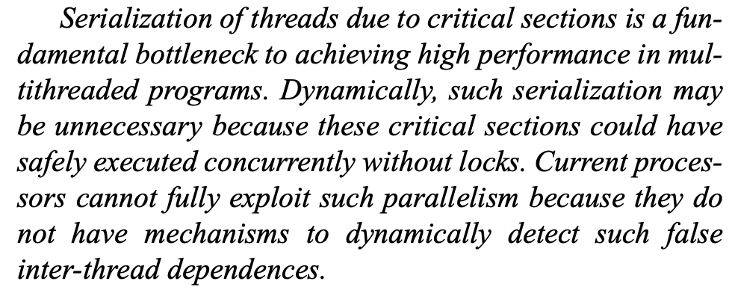
Readings on Optimistic Concurrency: SLE
Rajwar & Goodman, “Speculative Lock Elision: Enabling Highly Concurrent Multithreaded Execution,” MICRO 2001.

Slide 124
Lecture Video on Transactional Memory
https://www.youtube.com/watch?v=McMyefc8CCE

Slide 125
Speculative Lock Elision
Many programs use locks for synchronization
Many locks are not necessary
Stores occur infrequently during execution
Updates can occur to disjoint parts of the data structure
Idea:
Speculatively assume lock is not necessary and execute critical section without acquiring the lock
Check for conflicts within the critical section
Roll back if assumption is incorrect
Rajwar and Goodman, “Speculative Lock Elision: Enabling Highly Concurrent Multithreaded Execution,” MICRO 2001.

Slide 126
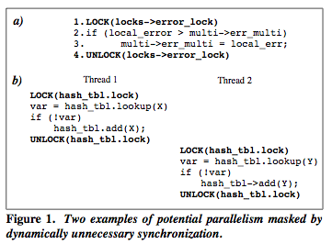
Dynamically Unnecessary Synchronization

Slide 127
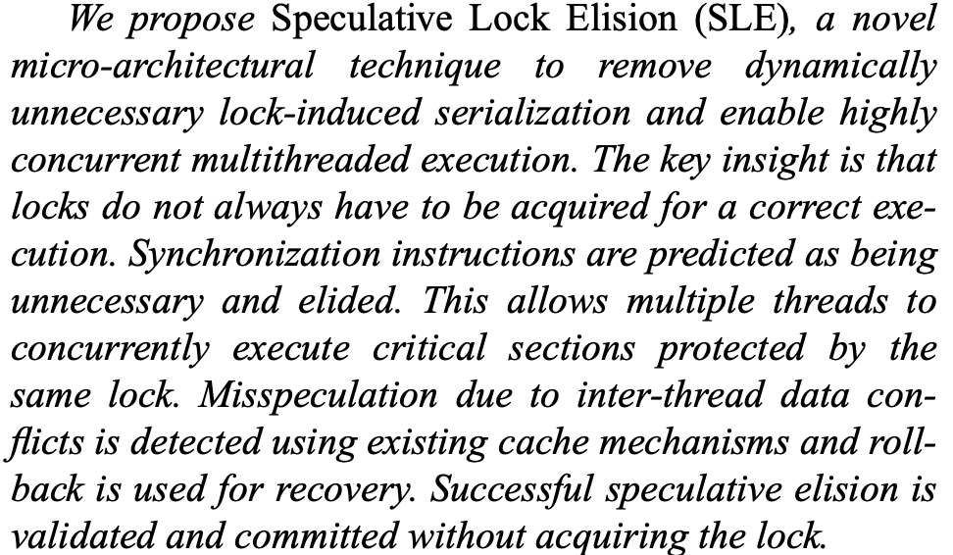
Readings on Optimistic Concurrency: SLE
Rajwar & Goodman, “Speculative Lock Elision: Enabling Highly Concurrent Multithreaded Execution,” MICRO 2001.

Slide 128
Readings on Optimistic Concurrency: SLE
Rajwar & Goodman, “Speculative Lock Elision: Enabling Highly Concurrent Multithreaded Execution,” MICRO 2001.

Slide 129
Speculative Parallelization Concepts
Idea: Execute threads unsafely in parallel
Threads can be from a sequential or parallel application
Hardware or software monitors for data dependence violations
If data dependence ordering is violated
Offending thread is squashed and restarted
If data dependences are not violated
Thread commits
If threads are from a sequential order, the sequential order needs to be preserved → threads commit one by one and in order

Slide 130
Lecture Video on Speculative Parallelization
https://www.youtube.com/watch?v=McMyefc8CCE

Slide 131
Lecture Video on Speculation in Parallel Machines
https://www.youtube.com/watch?v=g3IF8DTtr8c

Slide 132
Computer Architecture Lecture 19: Cache Coherence
Prof. Onur Mutlu
ETH Zürich
Fall 2022
1 December 2022

Slide 133
An Example Parallel Problem: Task Assignment to Processors

Slide 134
Static versus Dynamic Scheduling
Static: Done at compile time or parallel task creation time
Schedule does not change based on runtime information
Dynamic: Done at run time (e.g., after tasks are created)
Schedule changes based on runtime information
Example: Instruction scheduling
Why would you like to do dynamic scheduling?
What pieces of information are not available to the static scheduler?

Slide 135
Parallel Task Assignment: Tradeoffs
Problem: N tasks, P processors, N>P. Do we assign tasks to processors statically (fixed) or dynamically (adaptive)?
Static assignment
+ Simpler: No movement of tasks.
- Inefficient: Underutilizes resources when load is not balanced
When can load not be balanced?
Dynamic assignment
+ Efficient: Better utilizes processors when load is not balanced
- More complex: Need to move tasks to balance processor load
- Higher overhead: Task movement takes time, can disrupt locality

Slide 136
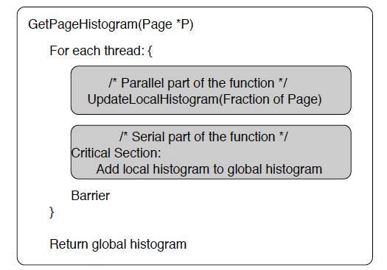
Parallel Task Assignment: Example
Compute histogram of a large set of values
Parallelization:
Divide the values across T tasks
Each task computes a local histogram for its value set
Local histograms merged with global histograms in the end

Slide 137
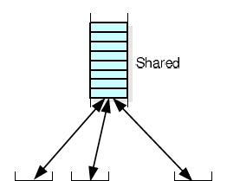
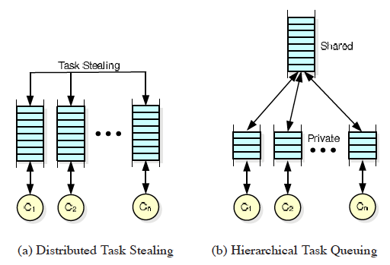
Parallel Task Assignment: Example (II)
How to schedule tasks updating local histograms?
Static: Assign equal number of tasks to each processor
Dynamic: Assign tasks to a processor that is available
When does static work as well as dynamic?
Implementation of Dynamic Assignment with Task Queues

Slide 138
Software Task Queues
What are the advantages and disadvantages of each?
Centralized
Distributed
Hierarchical

Slide 139
Task Stealing
Idea: When a processor’s task queue is empty it steals a task from another processor’s task queue
Whom to steal from? (Randomized stealing works well)
How many tasks to steal?
+ Dynamic balancing of computation load
- Additional communication/synchronization overhead between processors
- Need to stop stealing if no tasks to steal

Slide 140
Parallel Task Assignment: Tradeoffs
Who does the assignment? Hardware versus software?
Software
+ Better scope
- More time overhead
- Slow to adapt to dynamic events (e.g., a processor becoming idle)
Hardware
+ Low time overhead
+ Can adjust to dynamic events faster
- Requires hardware changes (area and possibly energy overhead)

Slide 141
How Can the Hardware Help?
Managing task queues in software has overhead
Especially high when task sizes are small
An idea: Hardware Task Queues
Each processor has a dedicated task queue
Software fills the task queues (on demand)
Hardware manages movement of tasks from queue to queue
There can be a global task queue as well → hierarchical tasking in hardware
Kumar et al., “Carbon: Architectural Support for Fine-Grained Parallelism on Chip Multiprocessors,” ISCA 2007.
Optional reading

Slide 142
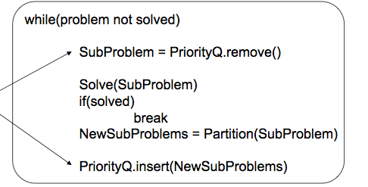
Dynamic Task Generation
Does static task assignment work in this case?
Problem: Searching the exit of a maze

Slide 143
Programming Model vs. Hardware Execution Model

Slide 144
Programming Models vs. Architectures
Five major models
(Sequential)
Shared memory
Message passing
Data parallel (SIMD)
Dataflow
Systolic
Hybrid models?

Slide 145
Shared Memory vs. Message Passing
Are these programming models or execution models supported by the hardware architecture?
Does a multiprocessor that is programmed by “shared memory programming model” have to support a shared address space between processors?
Does a multiprocessor that is programmed by “message passing programming model” have to have no shared address space between processors?

Slide 146
Programming Models: Message Passing vs. Shared Memory
Difference: how communication is achieved between tasks
Message passing programming model
Explicit communication via messages
Loose coupling of program components
Analogy: telephone call or letter, no shared location accessible to all
Shared memory programming model
Implicit communication via memory operations (load/store)
Tight coupling of program components
Analogy: bulletin board, post information at a shared space
Suitability of the programming model depends on the problem to be solved. Issues affected by the model include:
Overhead, scalability, ease of programming, bugs, match to underlying hardware, …

Slide 147
Message Passing vs. Shared Memory Hardware
Difference: how task communication is supported in hardware
Shared memory hardware (or machine model)
All processors see a global shared address space
Ability to access all memory from each processor
A write to a location is visible to the reads of other processors
Message passing hardware (machine model)
No global shared address space
Send and receive variants are the only method of communication between processors (much like networks of workstations today, i.e. clusters)
Suitability of the hardware depends on the problem to be solved as well as the programming model.

Slide 148
Programming Model vs. Hardware
Most of parallel computing history, there was no separation between programming model and hardware
Message passing: Caltech Cosmic Cube, Intel Hypercube, Intel Paragon
Shared memory: CMU C.mmp, Sequent Balance, SGI Origin.
SIMD: ILLIAC IV, CM-1
However, any hardware can really support any programming model
Why?
Application → compiler/library → OS services → hardware

Slide 149
Backup Slides

Slide 150
Breakdown of Performance Overhead
CoNDA’s execution time consist of three major parts:
(1) NDA kernel execution
(2) Coherence resolution overhead (3.3% of execution time)
(3) Re-execution overhead (8.4% of execution time)
Coherence resolution overhead is low
CPU-threads do not stall during resolution
NDAWriteSet contains only a small number of addresses (6)
Resolution mainly involves sending signatures and checking necessary coherence
Overhead of re-execution is low
The collision rate is low for our applications → 13.4%
Re-execution is significantly faster than original execution
Notes:
We have more result in the paper. We have result for larger data sets. We also have serveral sensityivty analysis as well as hardware overhead analysis. Please refer to paper for more details.

Slide 151
Memory System Energy
NC suffers greatly from the large number of accesses to DRAM
Interconnect and DRAM energy increase by 3.1x and 4.5x
CG and FG loses a significant portion of benefits because of large number of writebacks and off-chip coherence messages
GMEAN
CoNDA significantly reduces energy consumption and comes within 4.4% of Ideal-NDA
Notes:
We model the sum of the energy consumption that takes place within the DRAM, off-chip interconnects, and all caches. We model DRAM energy as the energy consumed per bit, lever- aging estimates from prior work
-The energy consumption of NC suffers greatly from the large number of memory operations that are redirected from the processor caches to DRAM.
-CG has a large number of writebacks, which leads to increased L1 and L2 cache lookups and a large amount of traffic sending dirty data back to DRAM preemptively
-The main energy improvement for LazyPIM over CPU-only comes from a reduction in interconnect and memory utilization, as LazyPIM successfully reduces data movement across the off-chip channel.
, and significantly reduces energy consumption, by an average of 35.5% over FG, 18.0% over CG, 62.2% over NC, and 43.7% over CPU-only.

Slide 152
Speedup
FG loses a significant portion of Ideal-NDA’s improvement
GMEAN
CoNDA consistently retains most of Ideal-NDA’s benefits, coming within 10.4% of the Ideal-NDA performance
NDA-only eliminates 82.2% of Ideal-NDA’s improvement
CG and NC eliminate the entire benefit of Ideal-NDA execution
Notes:
Here we show normalized speedup for different coherence mechanism (fine-grained, coarse-grained, non-cacheable, etc) across all of the workloads. The result is normalized to CPU-only baseline. We also show the performance of an ideal mechanism where there is no performance penalty for coherence. It basically shows if coherence is magically solved and there is no penalty for that, how much upper bound improvement we can get.
Without any coherence overhead, the ideal NDA mechanism significantly outperforms CPU-only across all applications, showing the potential of PIM execution on these workloads. On the other hand, poor handling of coherence by CG and NC leads to drastic performance losses compared to Ideal-PIM. With NC, the processor threads incur a large penalty for going to DRAM frequently to access the PIM data region. CG suffers greatly due to (1) flushing dirty cache lines, and (2) blocking all processor threads that access PIM data during execution. In fact, pro- cessor threads are blocked for up to 73.1% of the total exe- cution time with CG. In fact, on average, they perform worse than CPU-only execution. FG also performs worse than CPU-only. Mostly because many off-chip messages This shows an efficient coherence mechanism is essential for PIM performance.
In contrast, LazyPIM consistently retains most of Ideal-PIM’s benefits for all applications, coming within 11.4% of the Ideal-PIM performance, on average. It also significantly improve performance compare to other approaches.
The reason is that the NDA cannot afford to incorporate
complicated logic and large caches due to power and area
constraints [13, 21, 27], which, for NDA-only, significantly slows
down the parts of the application that are better suited for CPU
execution.

Slide 153
Effect of Multiple Memory Stacks
ASIC
Notes:
Points:
Poor handling of coherence eliminate …
Specifically, CG generates a large number of unnecessary flushes, and it also keeps them from working concurrently
FG generate a large number of unnecessary messages

Slide 154
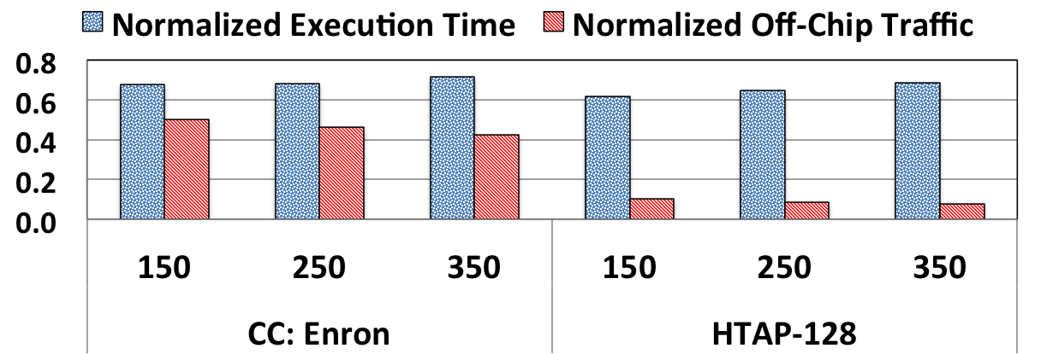
Effect of Optimistic Execution Duration
ASIC
Notes:
Points:
Poor handling of coherence eliminate …
Specifically, CG generates a large number of unnecessary flushes, and it also keeps them from working concurrently
FG generate a large number of unnecessary messages

Slide 155
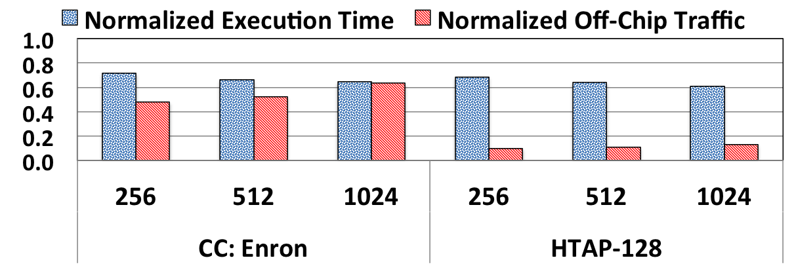
Effect of Signature Size
ASIC
Notes:
Points:
Poor handling of coherence eliminate …
Specifically, CG generates a large number of unnecessary flushes, and it also keeps them from working concurrently
FG generate a large number of unnecessary messages

Slide 156
Identifying Coherence Violations
CPU
NDA
Effective Ordering
Time
C1. Wr Z
C1. Wr Z
N1. Rd X
C2. Rd A
1) NDA Read and CPU Write: violation
2) NDA Write and CPU Read : no violation
3) NDA Write and CPU Write: no violation
C2. Rd A
N2. Wr Y
C3. Wr B
N3. Rd Z
C3. Wr B
Any Coherence Violation?
Yes. Flush Z to DRAM
C4. Wr Y
C4. Wr Y
N4. Rd X
C5. Rd Y
C5. Rd Y
N5. Wr Y
N4. Rd X
N6. Rd Z
N5. Wr Y
Any Coherence Violation?
N6. Rd Z
No. commit NDA operations
C6. Wr X
C6. Wr X
Notes:
Here I’m showing you an example where CPU is executing a bunch of instructions. And we also have NDA kernel that is running concurrently. Here we are considering a case where CPU is updating a cache line and NDA is reading the same cacheline. In this case, CPU updates cache line Z and NDA kernel reads from cacheline z.
Because we don’t do any coherence lookup or update during NDA kernel execution, NDA ends up reading old values of Z from DRAM. That’s a coherence violation, because CPU write has happened before NDA read, and we need to guarantee writes bcome visible right away. and In that case, we need to flush Z to DRAM and re-execute the NDA kernel. So the next time NDA kernel see the updated value. the effective ordering becomes like this.
Now lets consider another case. This time, while NDA is writing to cache line Y, cpu also write and read to same cache line. Neither of these cause coherence violation. The reason is that NDA makes its update visibile to the system at the end of optimistic mode execution. All of the updates are happen at the end of NDA kernel when we ensure there is no coherence violation. As a result, any write and read from CPU during NDA kernel execution, effectively order before the NDA write.
Some one might ask, what if we want this cpu to read the value PIM is updating. In that case, like any normal multi-threaded environemnt, we need to use synchroniztion primitves like semaphore or memory barrier, to make sure CPU read order before PIM write.
So as we said, when we send the signature back, no conflict will be detected, and pim core commit its update. So to summarize, if there is a write from CPU to a cacheline that PIM is reading that is a conflict. If there is a read from CPU to a cacheline PIM is writing to, that read orders before that write, and as a result, it doesn’t create any conflict.
Basically there are three possible conflicts: 1) processor update, pim read, 2) pim update something processor read, and both processor and pim update.

Slide 157
Example: Hybrid Database (HTAP)
Transactions
Analytics
Hybrid Database (HTAP)
Transactions
Analytics
Data Sharing
ASIC
CPU
NDA
CPU
Notes:
So now lets look at one of the applications we analyzed as an example.
Our first case study is a hybrid in-memory databases. Today, because we need to perform real-time analytical processing, many industrial and academic databases, combine the transactional and analytical behavior into one single hybrid database, and because of that, you can perform both transactions and analytical queries on the same database (these two used to be separate). When we analyzed this application, we observe that , analytical queries are a good fit for NDA as they generate a large amount of random memory accesses and data movement
In contrast, even though transactional queries access the same data, they perform better if they stay on the CPU, as they have short execution times, are
latency-sensitive, and have cache-friendly access patterns.
And then In such workloads, when we offload analytical threads to NDA, because they are both operating within the same database and share many data structures. data sharing and concurrent accesses from both NDA kernels and CPU threads can not be avoided.

