Slide 1


Reliability (and Security) Issues of DRAM and NAND Flash Scaling
Onur Mutlu
omutlu@gmail.com
http://users.ece.cmu.edu/~omutlu/
HPCA Memory Reliability Workshop
March 13, 2016

Slide 2
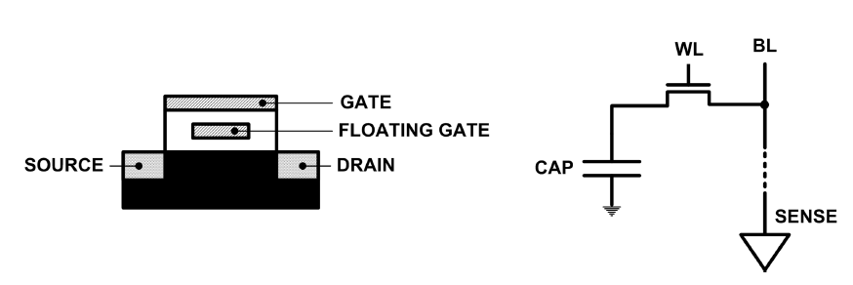
Limits of Charge Memory
Difficult charge placement and control
  Flash: floating gate charge
  DRAM: capacitor charge, transistor leakage
Reliable sensing, data retention, and charge control become more difficult as charge storage unit size reduces

Slide 3
Agenda
DRAM Scaling Issues
  DRAM RowHammer Problem
  Some Other DRAM Reliability Studies
NAND Flash Scaling Issues
  Some NAND Flash Reliability Studies
  Read Disturb Errors in NAND Flash Memory
Summary and Discussion

Slide 4
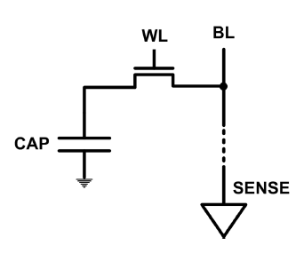
The DRAM Scaling Problem
DRAM stores charge in a capacitor (charge-based memory)
  Capacitor must be large enough for reliable sensing
  Access transistor should be large enough for low leakage and high retention time
  Scaling beyond 40-35nm (2013) is challenging [ITRS, 2009]
As DRAM cell becomes smaller, it becomes more vulnerable

Slide 5
An Example of the DRAM Scaling Problem
Row of Cells
Wordline
Row
Victim Row
Row
Hammered Row
V_{LOW}
Opened
V_{HIGH}
Closed
Row
Victim Row
Row
Repeatedly opening and closing a row enough times within a refresh interval induces disturbance errors in adjacent rows in most real DRAM chips you can buy today
Flipping Bits in Memory Without Accessing Them: An Experimental Study of DRAM Disturbance Errors, (Kim et al., ISCA 2014)

Slide 6
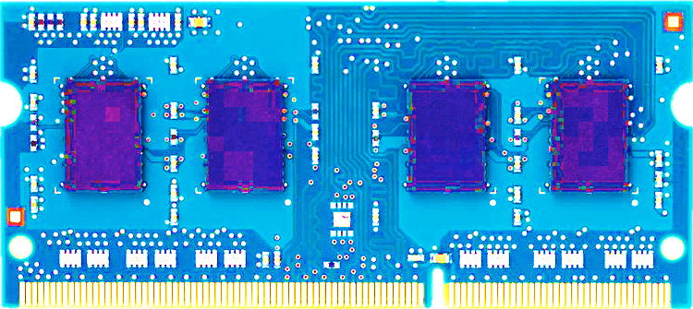
Most DRAM Modules Are Vulnerable
A company
B company
C company
86%
(37/43)
83%
(45/54)
88%
(28/32)
Up to
1.0×10⁷
errors
Up to
2.7×10⁶
errors
Up to
3.3×10⁵
errors
Flipping Bits in Memory Without Accessing Them: An Experimental Study of DRAM Disturbance Errors, (Kim et al., ISCA 2014)

Slide 7
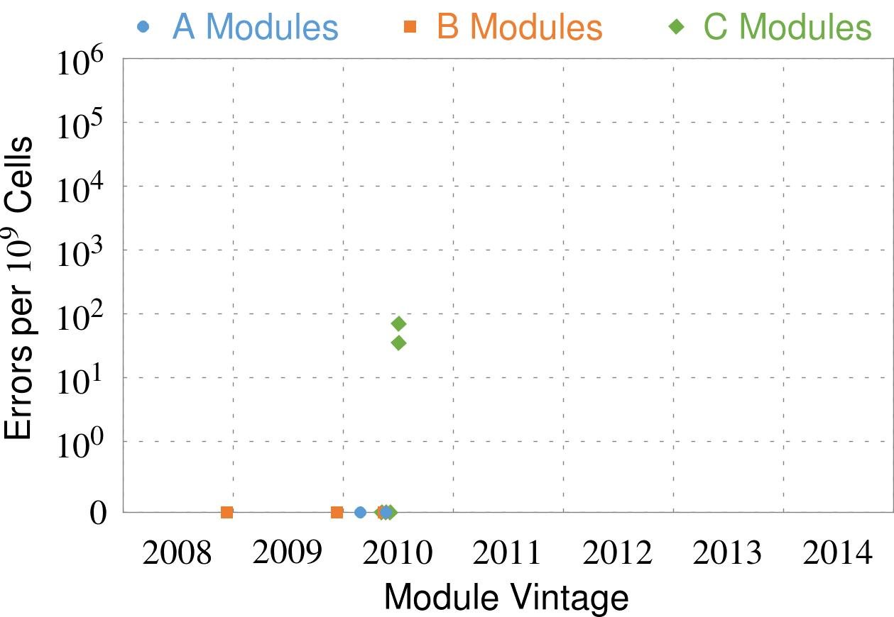
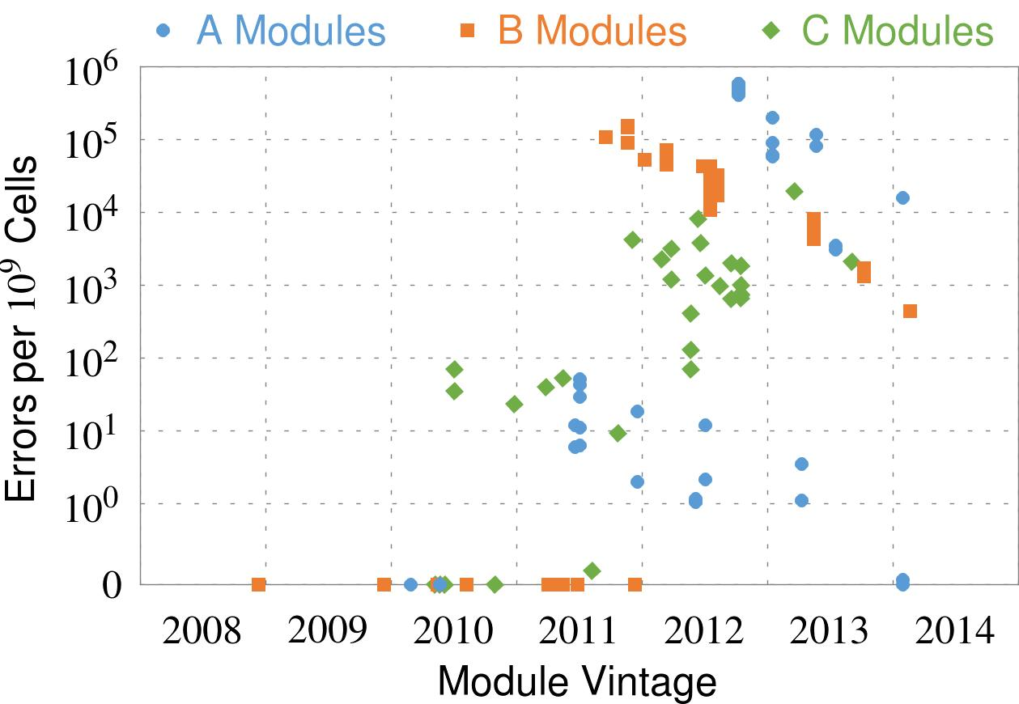
Recent DRAM Is More Vulnerable
First
Appearance
All modules from 2012–2013 are vulnerable
Notes:
In this figure, the x-axis is the module manufacture date. And the y-axis is the number of errors in a module, normalized to one billion cells. In 2008 and 2009, there are no errors. But, in 2010, we first start to see errors in C modules. After 2010, the errors start to proliferate. For A and B modules, we first start to see errors in 2011. In particular, all modules from 2012 and 2013 are vulnerable.

Slide 8

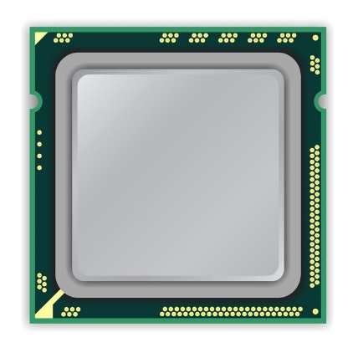
A Simple Program Can Induce Many Errors
CPU
DRAM Module
loop:
mov (X), %eax
mov (Y), %ebx
clflush (X)
clflush (Y)
mfence
jmp loop
X
Y
  Download from: https://github.com/CMU-SAFARI/rowhammer
Notes:
We demonstrate the errors on multiple x86 systems. Shown to the bottom-left is a “disturbance kernel”. When executed, it forces two rows to be opened and closed one after the other – over and over again. Consequently, it induces many errors in the module.

Slide 9
Observed Errors in Real Systems
A real reliability & security issue
In a more controlled environment, we can induce as many as ten million disturbance errors
CPU Architecture | Errors | Access-Rate
Intel Haswell (2013) | 22.9K | 12.3M/sec
Intel Ivy Bridge (2012) | 20.7K | 11.7M/sec
Intel Sandy Bridge (2011) | 16.1K | 11.6M/sec
AMD Piledriver (2012) | 59 | 6.1M/sec
Kim+, “Flipping Bits in Memory Without Accessing Them: An Experimental Study of DRAM Disturbance Errors,” ISCA 2014.
Notes:
When we executed the code on four different processors, all four of them yielded errors. Intel Haswell has the most errors, at 23 thousand, because it has the highest rate of accessing DRAM.
Later on, I’ll show that we can induce as many as ten million disturbance errors in a more controlled environment.
From this, we conclude that disturbance errors are a serious reliability issue.

Slide 10


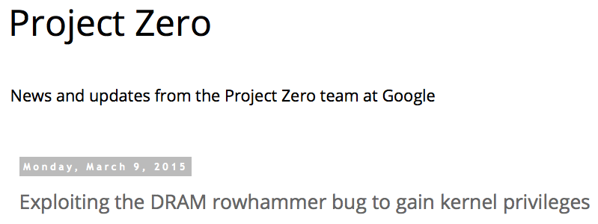
One Can Take Over an Otherwise-Secure System
Flipping Bits in Memory Without Accessing Them: An Experimental Study of DRAM Disturbance Errors (Kim et al., ISCA 2014)
Exploiting the DRAM rowhammer bug to gain kernel privileges (Seaborn, 2015)

Slide 11
RowHammer Security Attack Example
“Rowhammer” is a problem with some recent DRAM devices in which repeatedly accessing a row of memory can cause bit flips in adjacent rows (Kim et al., ISCA 2014).
  Flipping Bits in Memory Without Accessing Them: An Experimental Study of DRAM Disturbance Errors (Kim et al., ISCA 2014)
We tested a selection of laptops and found that a subset of them exhibited the problem.
We built two working privilege escalation exploits that use this effect.
  Exploiting the DRAM rowhammer bug to gain kernel privileges (Seaborn, 2015)
One exploit uses rowhammer-induced bit flips to gain kernel privileges on x86-64 Linux when run as an unprivileged userland process.
When run on a machine vulnerable to the rowhammer problem, the process was able to induce bit flips in page table entries (PTEs).
It was able to use this to gain write access to its own page table, and hence gain read-write access to all of physical memory.
Exploiting the DRAM rowhammer bug to gain kernel privileges (Seaborn, 2015)

Slide 12


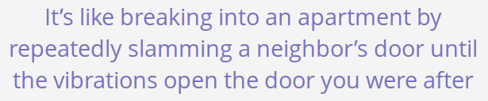
Security Implications
Notes:
Picture from the article:
http://thehackernews.com/2015/03/dram-rowhammer-vulnerability.html

Slide 13
Selected Readings on RowHammer
Our first detailed study: Rowhammer analysis and solutions
  Yoongu Kim, Ross Daly, Jeremie Kim, Chris Fallin, Ji Hye Lee, Donghyuk Lee, Chris Wilkerson, Konrad Lai, and Onur Mutlu,
  "Flipping Bits in Memory Without Accessing Them: An Experimental Study of DRAM Disturbance Errors"
  Proceedings of the 41st International Symposium on Computer Architecture (ISCA), Minneapolis, MN, June 2014. [Slides (pptx) (pdf)] [Lightning Session Slides (pptx) (pdf)] [Source Code and Data]
Our Source Code to Induce Errors in Modern DRAM Chips
  https://github.com/CMU-SAFARI/rowhammer
Google Project Zero’s Attack to Take Over a System (March 2015)
  Exploiting the DRAM rowhammer bug to gain kernel privileges (Seaborn, 2015)
  https://github.com/google/rowhammer-test
Remote RowHammer Attacks via JavaScript (July 2015)
  http://arxiv.org/abs/1507.06955
  https://github.com/IAIK/rowhammerjs

Slide 14
Root Causes of Disturbance Errors
Cause 1: Electromagnetic coupling
  Toggling the wordline voltage briefly increases the voltage of adjacent wordlines
  Slightly opens adjacent rows → Charge leakage
Cause 2: Conductive bridges
Cause 3: Hot-carrier injection
Confirmed by at least one manufacturer
Notes:
Why do the errors occur? We see three possible causes.
First, there could electromagnetic coupling between adjacent wordlines. When the voltage of one is toggled, it could briefly increase the voltage of the other and facilitate the leakage of charge.
Two other possibilities are conductive bridges and hot-carrier injection.
At least one manufacturer confirmed that these three could play a role in the disturbance errors we see them today.

Slide 15
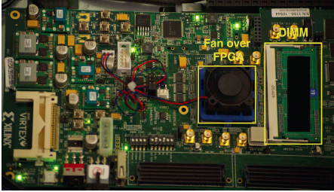
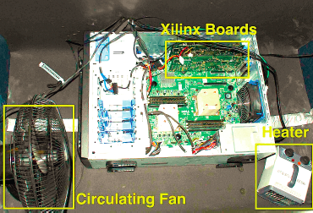
Experimental DRAM Testing Infrastructure
  An Experimental Study of Data Retention Behavior in Modern DRAM Devices: Implications for Retention Time Profiling Mechanisms (Liu et al., ISCA 2013)
  The Efficacy of Error Mitigation Techniques for DRAM Retention Failures: A Comparative Experimental Study
  (Khan et al., SIGMETRICS 2014)
  Flipping Bits in Memory Without Accessing Them: An Experimental Study of DRAM Disturbance Errors (Kim et al., ISCA 2014)
  Adaptive-Latency DRAM: Optimizing DRAM Timing for the Common-Case (Lee et al., HPCA 2015)
  AVATAR: A Variable-Retention-Time (VRT) Aware Refresh for DRAM Systems (Qureshi et al., DSN 2015)

Slide 16

Experimental Infrastructure (DRAM)
Temperature
Controller
FPGAs
Heater
FPGAs
PC
  Kim+, “Flipping Bits in Memory Without Accessing Them: An Experimental Study of DRAM Disturbance Errors,” ISCA 2014.

Slide 17
RowHammer Characterization Results
Most Modules Are at Risk
Errors vs. Vintage
Error = Charge Loss
Adjacency: Aggressor & Victim
Sensitivity Studies
Other Results in Paper
Solution Space
Flipping Bits in Memory Without Accessing Them: An Experimental Study of DRAM Disturbance Errors, (Kim et al., ISCA 2014)
Notes:
Now I will present the characterization results, one-by-one.
First, I show that most modules are at risk. Second, I show the number of errors in a module as a function of the manufacture date. Third, I show that the errors are symptomatic of charge loss. Fourth, I show that an aggressor induces errors in adjacent rows. Fifth, I show several sensitivity studies. And, finally, I briefly describe other results in the paper.

Slide 18
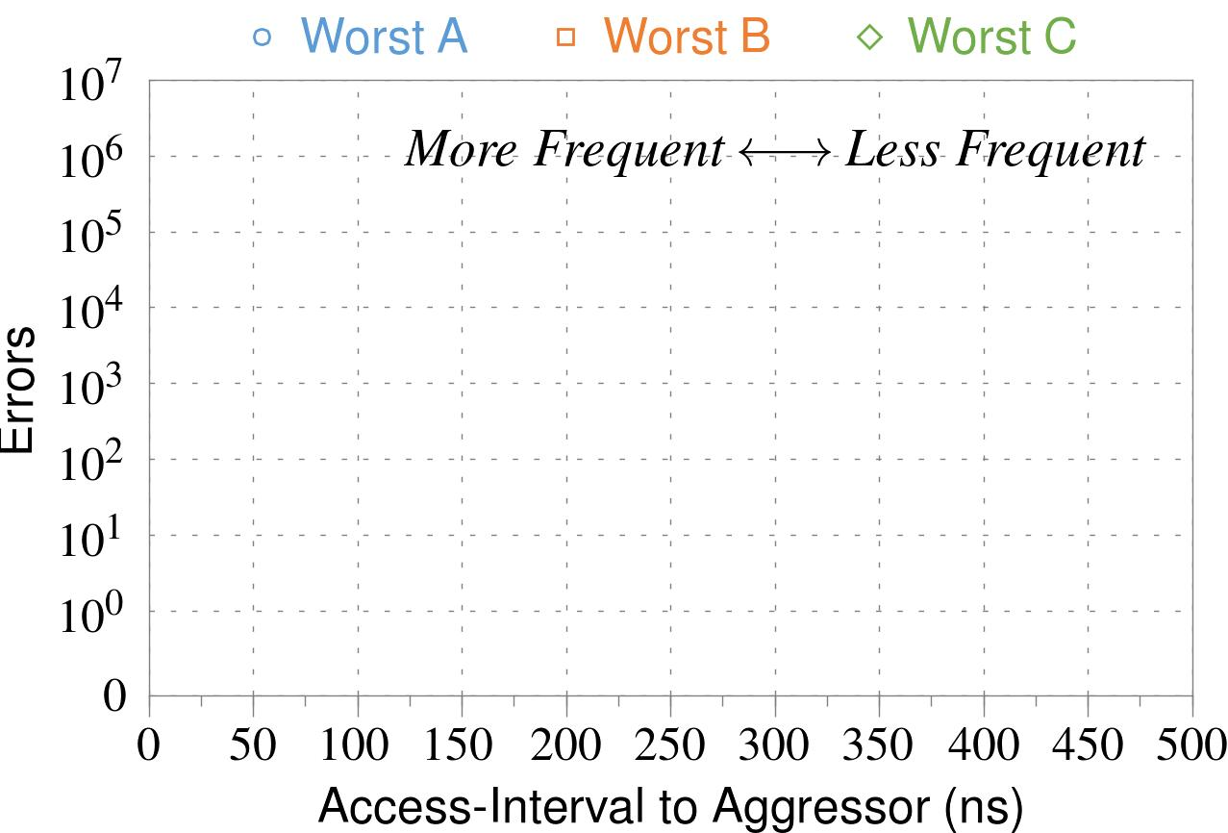
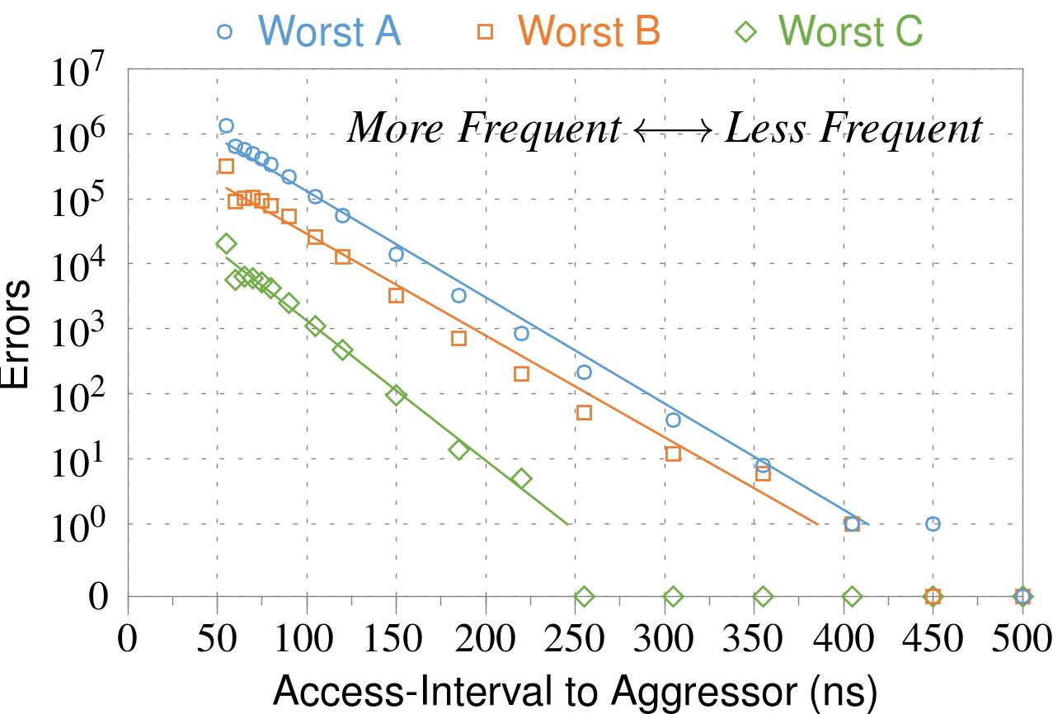
❶ Access Interval (Aggressor)
Not Allowed
500ns
55ns
Note: For three modules with the most errors (only first bank)
Less frequent accesses → Fewer errors
Notes:
In this figure, the x-axis is the interval at which we access the aggressor. And the y-axis is the number of errors. To comply with the DRAM standard, we employ a default value of 55ns in our experiments. However, as we increase the access-interval, we see that the number of errors decreases. In particular, at 500ns, there are no errors for all three modules.
From this, we conclude that less frequent accesses induce fewer errors.

Slide 19
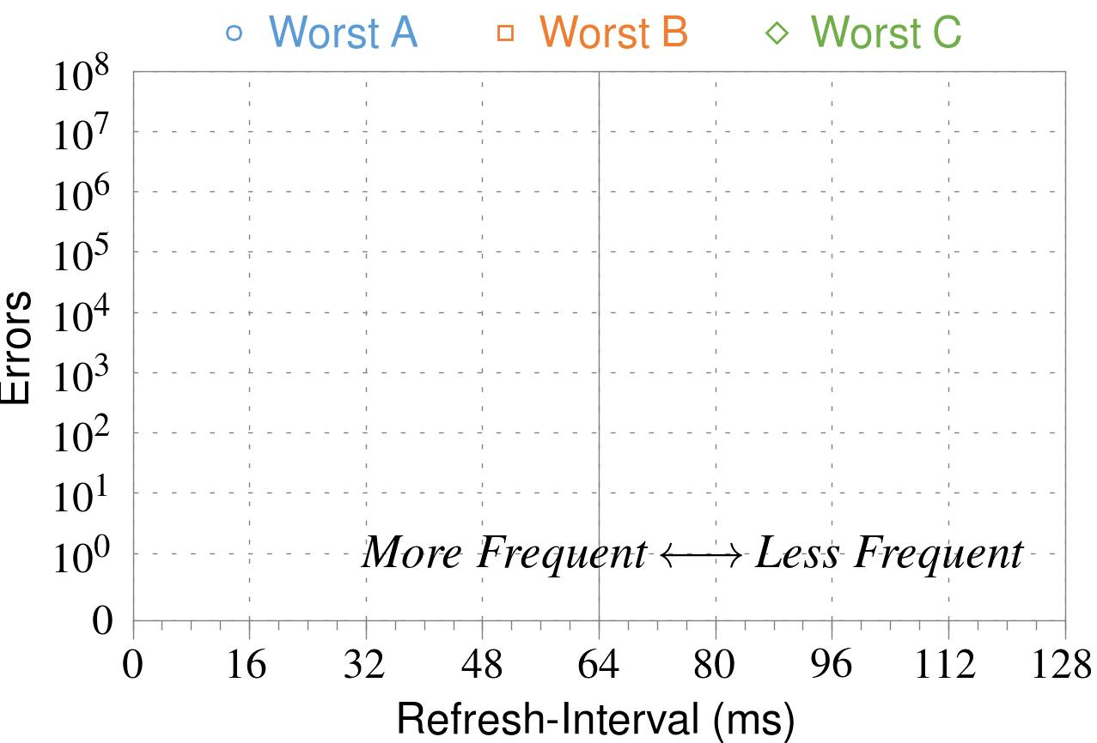
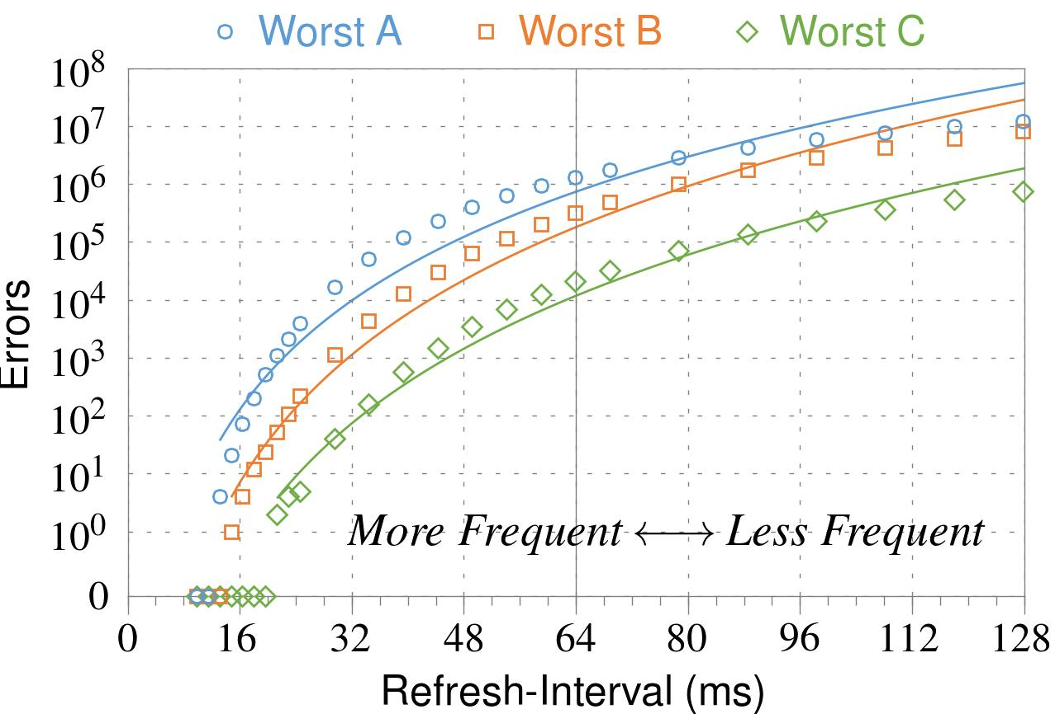
❷ Refresh Interval
~7x frequent
64ms
Note: Using three modules with the most errors (only first bank)
More frequent refreshes → Fewer errors
Notes:
In this figure, the x-axis is the refresh-interval. And the y-axis is the number of errors. To comply with the DRAM standard, we employ a default value of 64ms in our experiments. However, as we decrease the refresh-interval, we see that the number of errors decreases. In particular, when the refresh is shortened by 7x, there are no errors for all three modules.
From this, we conclude that more frequent accesses induce fewer errors.

Slide 20
❸ Data Pattern
Solid
RowStripe
111111
111111
111111
000000
111111
111111
10x Errors
111111
000000
~Solid
~RowStripe
000000
000000
000000
111111
000000
000000
000000
111111
Errors affected by data stored in other cells
Notes:
We tested the modules with four different data-patterns: Solid, inverse Solid, RowStripe, and inverse RowStripe. Solid and inverse Solid give us full coverage since each cell is tested with both 1s and 0s. And the same applies to RowStripe and its inverse.
However, we found that the rowstripe pattern had 10 times as more errors than the solid pattern. We also tested many other data-patterns, including random, but found RowStripe to induce the most errors.
Therefore, we conclude that errors are affected by data stored in other cells due to differences in coupling effects between the cells.

Slide 21
Naive Solutions
❶ Throttle accesses to same row
  Limit access-interval: ≥500ns
  Limit number of accesses: ≤128K (=64ms/500ns)
❷ Refresh more frequently
  Shorten refresh-interval by ~7x
Both naive solutions introduce significant overhead in performance and power
Notes:
Based on what we learned from the sensitivity studies, there are two naive solutions that immediately present themselves.
First, we can throttle accesses to the same row. If the access-interval is greater than 500ns, I showed how errors are not induced. We can achieve the same effect by limiting the maximum number of accesses to the same row to be less than 128K, within a refresh interval.
Second, we can refresh the module more frequently. If the refresh-interval is shortened by 7x, I showed how errors can be prevented.
However, both naive solutions introduce significant overhead in both performance and power. Later on, I will propose a much more efficient solution.

Slide 22
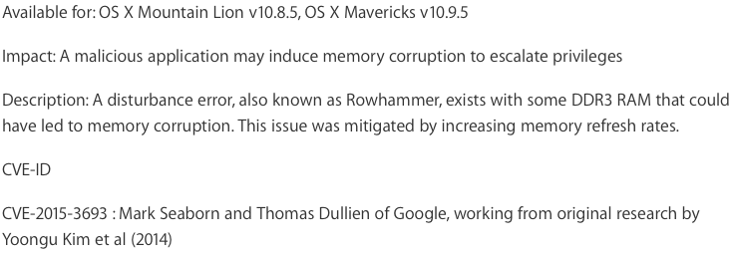
Apple’s Patch for RowHammer
https://support.apple.com/en-gb/HT204934
HP and Lenovo released similar patches

Slide 23
Our Solution
PARA: Probabilistic Adjacent Row Activation
Key Idea
  After closing a row, we activate (i.e., refresh) one of its neighbors with a low probability: p = 0.005
Reliability Guarantee
  When p=0.005, errors in one year: 9.4×10⁻¹⁴
  By adjusting the value of p, we can provide an arbitrarily strong protection against errors
Notes:
We provide a more efficient solution, called PARA, which stands for probabilistic adjacent row activation.
The key idea is thus: after closing a row, we activate (i.e., refresh) one of its neighbors with a low probability, for example, p equal to 0.005.
PARA provides a strong reliability guarantee even under the worst-case access patterns to DRAM. When we set p to 0.005, the expected number of errors in one year is 9.4 times 10 to the negative 14. This probability is much lower the failure rate of other hardware components, for example, the hard-disk drive.
And by adjusting the value of p, PARA can provide an arbitrarily strong-degree of protection against errors.

Slide 24
Advantages of PARA
PARA refreshes rows infrequently
  Low power
  Low performance-overhead
    Average slowdown: 0.20% (for 29 benchmarks)
    Maximum slowdown: 0.75%
PARA is stateless
  Low cost
  Low complexity
PARA is an effective and low-overhead solution to prevent disturbance errors
Notes:
PARA has many advantages. Since it refreshes row infrequently, it has low power and low performance-overhead. Simulated across 29 benchmarks, we saw an average of only 0.2% slowdown and a maximum of only 0.75% slowdown.
In addition, due to its stateless nature, PARA has low cost and complexity.
Therefore, PARA is an effective and low-overhead solution to prevent disturbance errors.

Slide 25
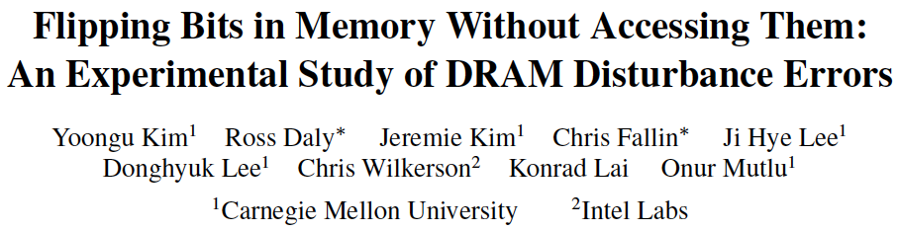
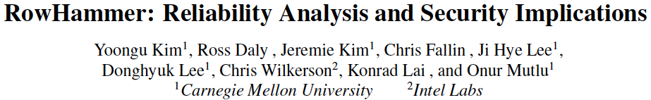
More on RowHammer Analysis

Slide 26
Future of Main Memory
DRAM is becoming less reliable → more vulnerable
Due to difficulties in DRAM scaling, unexpected types of failures may appear
And, they may already be slipping into the field
  Read disturb errors (Rowhammer)
  Retention errors
  Read errors, write errors
  …
These failures can also pose security vulnerabilities

Slide 27
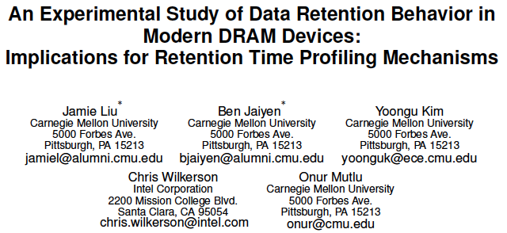
Analysis of Retention Failures [ISCA’13]

Slide 28

Can We Exploit the DRAM Retention Time Profile?

Slide 29
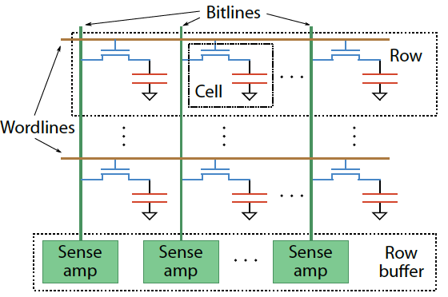
Two Challenges to Retention Time Profiling
Challenge 1: Data Pattern Dependence (DPD)
  Retention time of a DRAM cell depends on its value and the values of cells nearby it
  When a row is activated, all bitlines are perturbed simultaneously

Slide 30
Two Challenges to Retention Time Profiling
Challenge 2: Variable Retention Time (VRT)
  Retention time of a DRAM cell changes randomly over time
    a cell alternates between multiple retention time states
  Leakage current of a cell changes sporadically due to a charge trap in the gate oxide of the DRAM cell access transistor
  When the trap becomes occupied, charge leaks more readily from the transistor’s drain, leading to a short retention time
    Called Trap-Assisted Gate-Induced Drain Leakage
  This process appears to be a random process [Kim+ IEEE TED’11]
  Worst-case retention time depends on a random process
    → need to find the worst case despite this

Slide 31
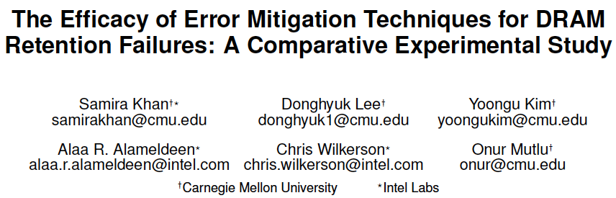
Mitigation of Retention Issues [SIGMETRICS’14]

Slide 32

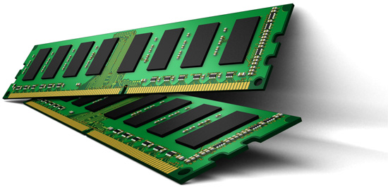
Online Profiling of DRAM In the Field
Initially protect DRAM
with ECC
Periodically test
parts of DRAM
1
2
Test
ECC
Test
Test
Adjust refresh rate and
reduce ECC
3
Optimize DRAM and mitigate errors online
without disturbing the system and applications
Notes:
Based on these observations, we propose that in an online profiling system,

Slide 33
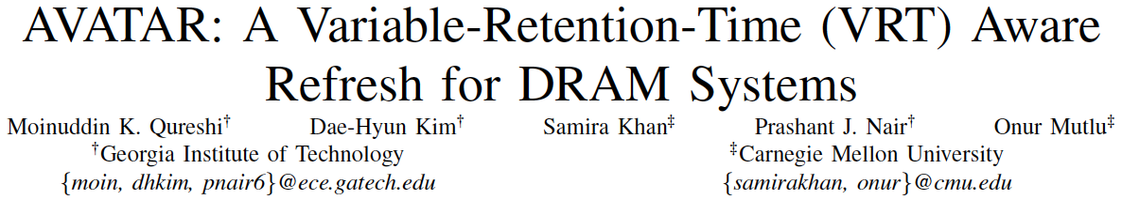
Multi-Rate Refresh with Online Profiling & ECC
Moinuddin Qureshi, Dae Hyun Kim, Samira Khan, Prashant Nair, and Onur Mutlu,
"AVATAR: A Variable-Retention-Time (VRT) Aware Refresh for DRAM Systems"
Proceedings of the 45th Annual IEEE/IFIP International Conference on Dependable Systems and Networks (DSN), Rio de Janeiro, Brazil, June 2015.
[Slides (pptx) (pdf)]

Slide 34
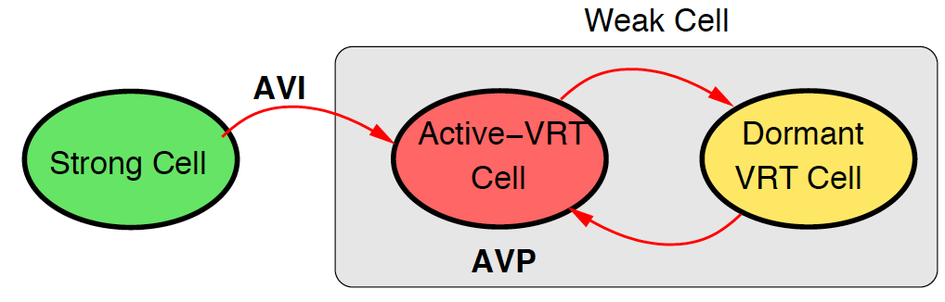
ARCHITECTURE MODEL FOR CELL UNDER VRT
Two key parameters:
Active-VRT Pool (AVP): How many VRT cells in this period?
Active-VRT Injection (AVI): How many new (previously
undiscovered) cells became weak in this period?
Model has two parameters: AVP and AVI
Notes:
However, lowering refresh rate comes with a cost.
it introduces some bit errors, since charges in some cells are not restored timely.
And we call those errors refresh errors.
In the figure, we show the function of bit error rate to the refresh rate.
The y-axis is the bit error rate corresponding to the refresh rate in the x-axis.
All axis are in log scale.
#@ When refresh rate is 64ms, the bit error rate is 10^-9, which means one of the billion bits will have refresh errors.
These errors are fixed at the testing phase by using spare rows and columns.
If we keep lowering refresh rate, the bit error rate increases pretty fast.
#@ When refresh rate is 1s, the bit error rate is in the range between 10^-4 and 10^-5.
At this scale, the refresh errors cannot be mitigated by the spare rows, due to the expensive cost of spare rows.
#@ Thus, lowering refresh rate saves energy, but introduces bit errors.
What can we do about it?
Is there anyway we can tolerate those errors?

Slide 35
AVATAR
Insight: Avoid forming Active VRT Pool ➔ Upgrade on ECC error
Observation: Rate of VRT >> Rate of soft error (50x-2500x)
Scrub
(15 min)
DRAM Rows
Ref. Rate Table
ECC
A
0
ECC
B
Weak Cell
0
ECC
C
1
ECC
D
RETENTION
PROFILING
0
Row protected from future
retention failures
ECC
E
0
ECC
F
0
ECC
G
1
1
ECC
H
0
AVATAR mitigates VRT by breaking AVP Pool

Slide 36
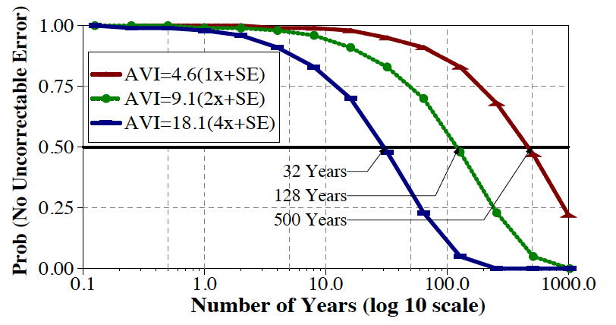
AVATAR: TIME TO FAILURE
System: Four channels, each with 8GB DIMM
AVI = 1x
AVI = 2x
2x
AVI = 4x
4x
32 Years
128 Years
500 Years
AVATAR increases time to failure to 10s of years
* We include the effect of soft error in the above lifetime analysis (details in the paper)

Slide 37
ENERGY DELAY PRODUCT
Energy Delay Product
AVATAR reduces EDP,
Significant reduction at higher capacity nodes

Slide 38
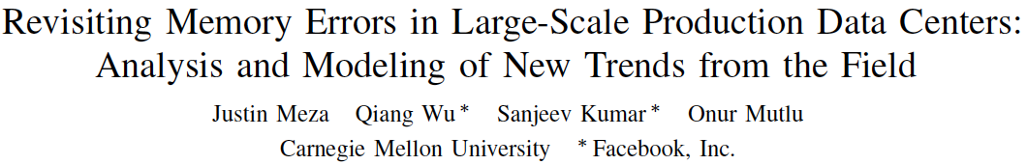
Large-Scale Failure Analysis of DRAM Chips
Analysis and modeling of memory errors found in all of Facebook’s server fleet
Justin Meza, Qiang Wu, Sanjeev Kumar, and Onur Mutlu,
"Revisiting Memory Errors in Large-Scale Production Data Centers: Analysis and Modeling of New Trends from the Field"
Proceedings of the 45th Annual IEEE/IFIP International Conference on Dependable Systems and Networks (DSN), Rio de Janeiro, Brazil, June 2015.
[Slides (pptx) (pdf)] [DRAM Error Model]

Slide 39
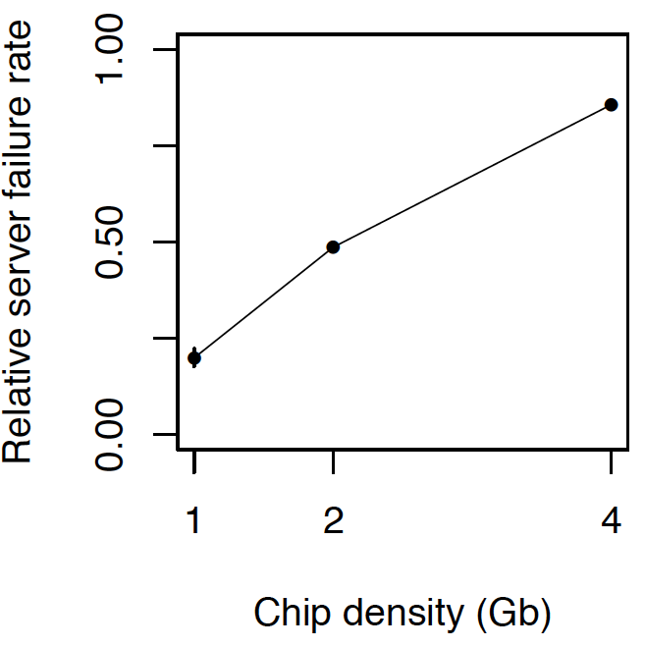
DRAM Reliability Reducing
Intuition:
quadratic
increase in
capacity

Slide 40
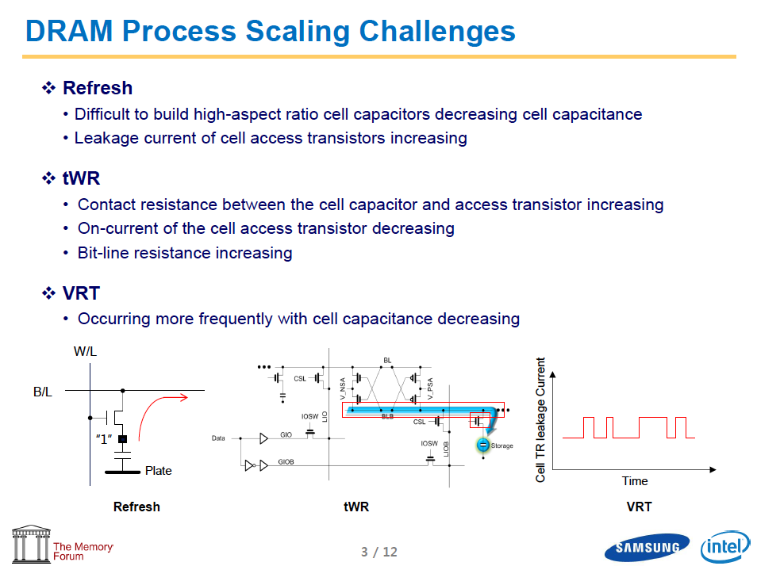
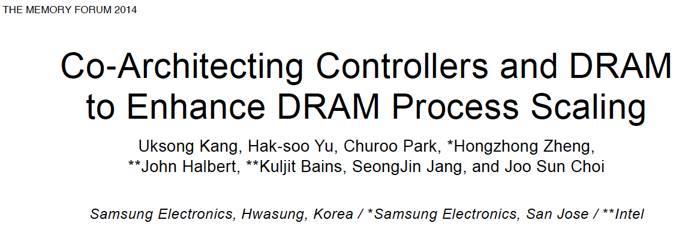
Recap: The DRAM Scaling Problem

Slide 41
How Do We Solve The Problem?
Fix it: Make DRAM and controllers more intelligent
  New interfaces, functions, architectures: system-DRAM codesign
Eliminate or minimize it: Replace or (more likely) augment DRAM with a different technology
  New technologies and system-wide rethinking of memory & storage
Embrace it: Design heterogeneous memories (none of which are perfect) and map data intelligently across them
  New models for data management and maybe usage
…
Problems
Algorithms
Programs
User
Runtime System
(VM, OS, MM)
ISA
Microarchitecture
Logic
Devices
Solutions (to memory scaling) require
software/hardware/device cooperation

Slide 42
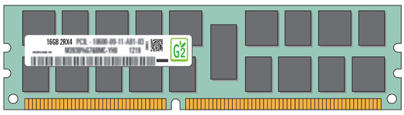
Exploiting Memory Error Tolerance with Hybrid Memory Systems
Heterogeneous-Reliability Memory [DSN 2014]
Vulnerable data
Vulnerable data
Tolerant data
Tolerant data
Reliable memory
Low-cost memory
Vulnerable data
  On Microsoft’s Web Search workload
  Reduces server hardware cost by 4.7 %
  Achieves single server availability target of 99.90 %
ECC protected
Well-tested chips
Tolerant data
NoECC or Parity
Less-tested chips
Notes:
As we have shown earlier, either across or within applications, our characterization can identify data that are vulnerable to memory errors and data that are tolerant to memory errors.
To exploit this observation, we would like to map these different data onto different memory modules according to their memory error tolerance.
As an example here, we map vulnerable data to reliable memory to improve reliability, and map tolerant data to low-cost less-reliable memory to exploit its tolerance and lower the cost. We call this mechanism heterogeneous-reliability memory, HRM.
Reliable memory consists of … Low cost memory consists of …
As we will show later, HRM allows us to use weaker error protection in memory, and enables the use of less-tested memory chips to lower the cost of the memory system, while still achieving reasonable single-server reliability target.

Slide 43
Agenda
DRAM Scaling Issues
  DRAM RowHammer Problem
  Some Other DRAM Reliability Studies
NAND Flash Scaling Issues
  Some NAND Flash Reliability Studies
  Read Disturb Errors in NAND Flash Memory
Summary and Discussion

Slide 44

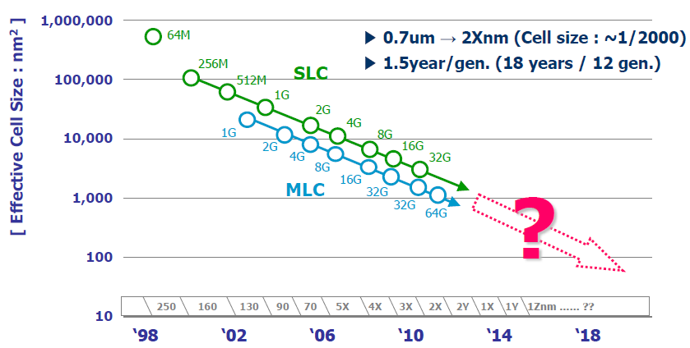
Evolution of NAND Flash Memory
CMOS scaling
More bits per Cell
Seaung Suk Lee, “Emerging Challenges in NAND Flash Technology”, Flash Summit 2011 (Hynix)
Flash memory is widening its range of applications
  Portable consumer devices, laptop PCs and enterprise servers

Slide 45
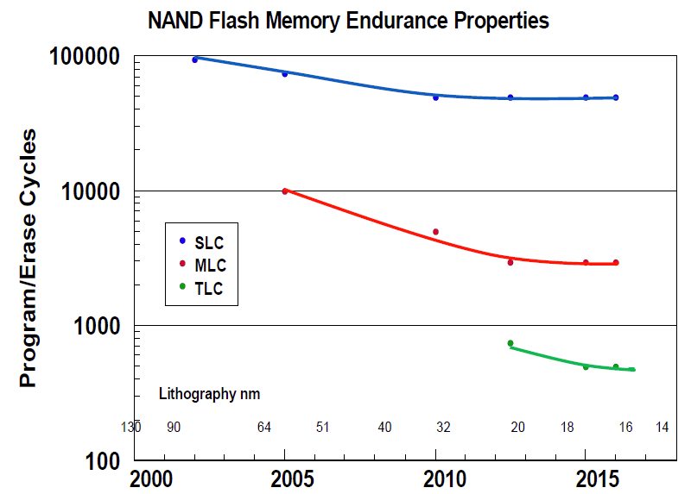
Flash Challenges: Reliability and Endurance
P/E cycles (provided)
A few thousand
P/E cycles (required)
Writing
the full capacity
of the drive
10 times per day
for 5 years
(STEC)
> 50k P/E cycles
E. Grochowski et al., “Future technology challenges for NAND flash and HDD products”, Flash Memory Summit 2012

Slide 46
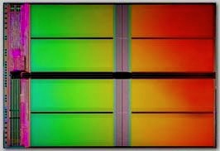
NAND Flash Memory is Increasingly Noisy
Write
Noisy NAND
Read

Slide 47
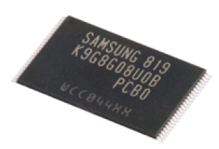
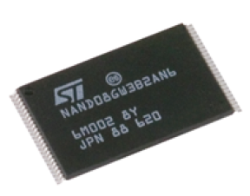
Future NAND Flash-based Storage Architecture
Memory
Signal
Processing
Raw Bit
Error Rate
Uncorrectable
BER < 10⁻¹⁵
Noisy
Error
Correction
Lower
High
Better
Our Goals:
Build reliable error models for NAND flash memory
Design efficient reliability mechanisms based on the model

Slide 48
NAND Flash Error Model
Write
Noisy NAND
Read
Experimentally characterize and model dominant errors
Cai et al., “Error Patterns in MLC NAND Flash Memory: Measurement, Characterization, and Analysis””, DATE 2012
Write
Erase block
Program page
Neighbor page program (c-to-c interference)
Read
Retention
Cai et al., “Program Interference in MLC NAND Flash Memory: Characterization, Modeling, and Mitigation”, ICCD 2013
Cai et al., “Neighbor-Cell Assisted Error Correction in MLC NAND Flash Memories”, SIGMETRICS 2014
Cai et al., “Read Disturb Errors in MLC NAND Flash Memory: Characterization and Mitigation”, DSN 2015
Cai et al., “Flash Correct-and-Refresh: Retention-aware error management for increased flash memory lifetime”, ICCD 2012
Cai et al., “Threshold voltage distribution in MLC NAND Flash Memory: Characterization, Analysis, and Modeling”, DATE 2013
Cai et al., “Error Analysis and Retention-Aware Error Management for NAND Flash Memory, ITJ 2013
Cai et al., “Data Retention in MLC NAND Flash Memory: Characterization, Optimization and Recovery" , HPCA 2015

Slide 49
Our Goals and Approach
Goals:
  Understand error mechanisms and develop reliable predictive models for MLC NAND flash memory errors
  Develop efficient error management techniques to mitigate errors and improve flash reliability and endurance
Approach:
  Solid experimental analyses of errors in real MLC NAND flash memory → drive the understanding and models
  Understanding, models and creativity → drive the new techniques

Slide 50
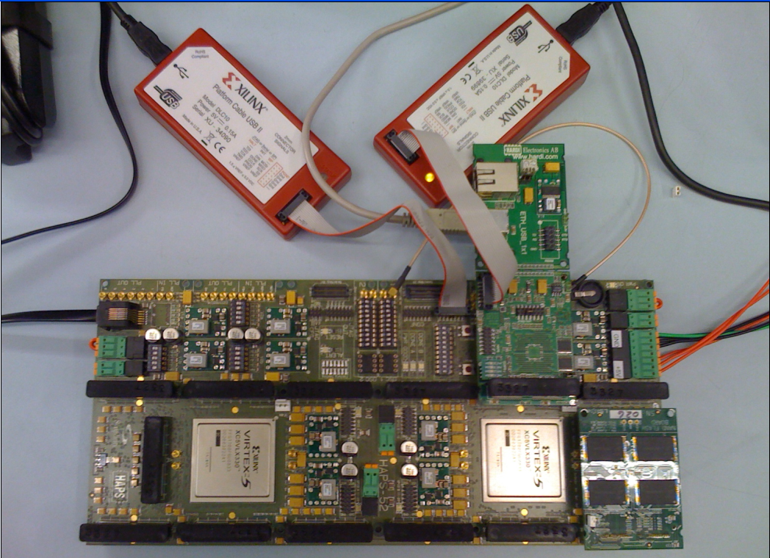
Experimental Testing Platform
USB Daughter Board
USB Jack
HAPS-52 Mother Board
Virtex-II Pro
(USB controller)
3x-nm
NAND Flash
Virtex-V FPGA
(NAND Controller)
[Cai+, FCCM 2011, DATE 2012, ICCD 2012, DATE 2013, ITJ 2013, ICCD 2013, SIGMETRICS 2014, HPCA 2015, DSN 2015]
NAND Daughter Board
Cai et al., FPGA-based Solid-State Drive prototyping platform, FCCM 2011.

Slide 51
NAND Flash Usage and Error Model
Erase Errors
Program Errors
Start
Erase
Block
Program
Page
P/E cycle 0
(Page0 - Page128)
…
Retention Errors
Read Errors
Retention1
(t₁ days)
Read
Page
P/E cycle i
…
Retention Errors
…
Read Errors
P/E cycle n
Retention j
(t_{j} days)
Read
Page
End of life
Notes:
13
lots of diagrams of boxes and text, need to find a way to differentiate them

Slide 52
Methodology: Error and ECC Analysis
Characterized errors and error rates of 3x and 2y-nm MLC NAND flash using an experimental FPGA-based platform
  [Cai+, DATE’12, ICCD’12, DATE’13, ITJ’13, ICCD’13, SIGMETRICS’14]
Quantified Raw Bit Error Rate (RBER) at a given P/E cycle
  Raw Bit Error Rate: Fraction of erroneous bits without any correction
Quantified error correction capability (and area and power consumption) of various BCH-code implementations
  Identified how much RBER each code can tolerate
  → how many P/E cycles (flash lifetime) each code can sustain

Slide 53
NAND Flash Error Types
Four types of errors [Cai+, DATE 2012]
Caused by common flash operations
  Read errors
  Erase errors
  Program (interference) errors
Caused by flash cell losing charge over time
  Retention errors
    Whether an error happens depends on required retention time
    Especially problematic in MLC flash because threshold voltage window to determine stored value is smaller

Slide 54
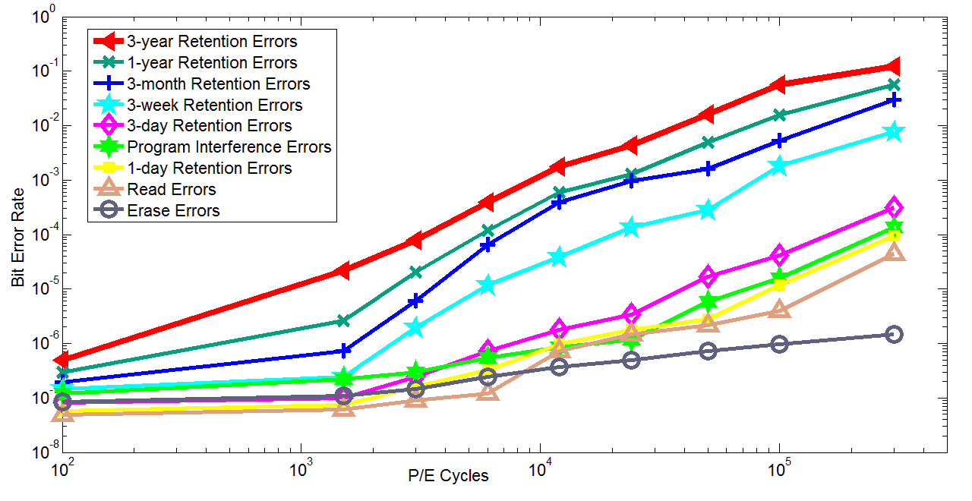
Observations: Flash Error Analysis
retention errors
Raw Bit Error Rate
P/E Cycles
Raw bit error rate increases exponentially with P/E cycles
Retention errors are dominant (>99% for 1-year ret. time)
Retention errors increase with retention time requirement
Cai et al., Error Patterns in MLC NAND Flash Memory, DATE 2012.

Slide 55
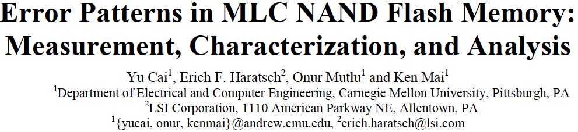
More on Flash Error Analysis
Yu Cai, Erich F. Haratsch, Onur Mutlu, and Ken Mai,
"Error Patterns in MLC NAND Flash Memory: Measurement, Characterization, and Analysis"
Proceedings of the Design, Automation, and Test in Europe Conference (DATE), Dresden, Germany, March 2012. Slides (ppt)

Slide 56
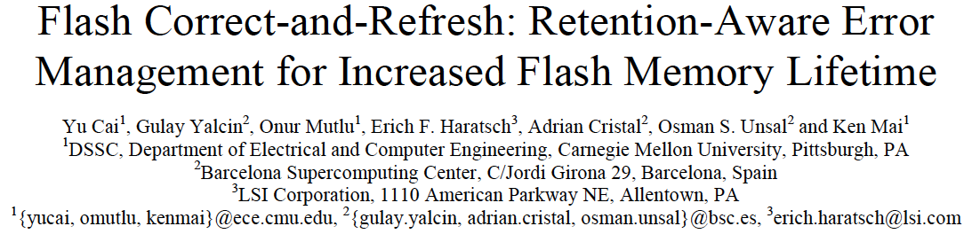
Flash Correct and Refresh
Yu Cai, Gulay Yalcin, Onur Mutlu, Erich F. Haratsch, Adrian Cristal, Osman Unsal, and Ken Mai,
"Flash Correct-and-Refresh: Retention-Aware Error Management for Increased Flash Memory Lifetime"
Proceedings of the 30th IEEE International Conference on Computer Design (ICCD), Montreal, Quebec, Canada, September 2012. Slides (ppt) (pdf)

Slide 57
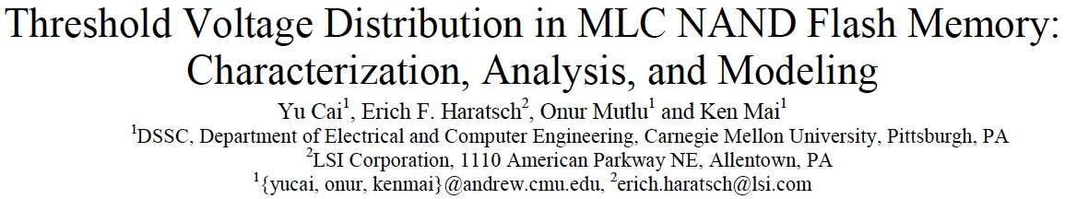
Threshold Voltage Modeling
Yu Cai, Erich F. Haratsch, Onur Mutlu, and Ken Mai,
"Threshold Voltage Distribution in MLC NAND Flash Memory: Characterization, Analysis and Modeling"
Proceedings of the Design, Automation, and Test in Europe Conference (DATE), Grenoble, France, March 2013. Slides (ppt)

Slide 58
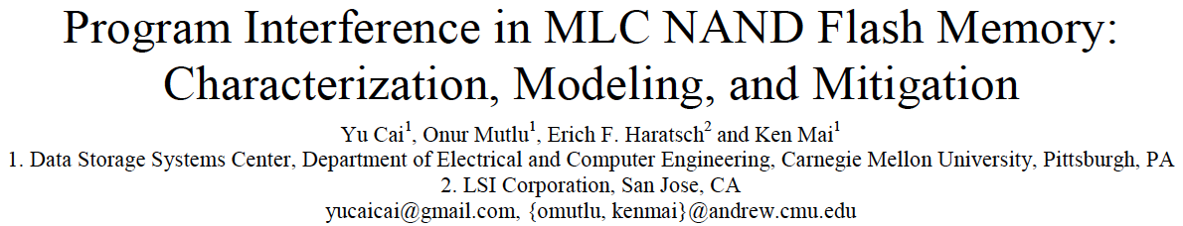
Program Interference Modeling
Yu Cai, Onur Mutlu, Erich F. Haratsch, and Ken Mai,
"Program Interference in MLC NAND Flash Memory: Characterization, Modeling, and Mitigation"
Proceedings of the 31st IEEE International Conference on Computer Design (ICCD), Asheville, NC, October 2013. Slides (pptx) (pdf) Lightning Session Slides (pdf)

Slide 59

Neighbor-Assisted Error Correction
Yu Cai, Gulay Yalcin, Onur Mutlu, Eric Haratsch, Osman Unsal, Adrian Cristal, and Ken Mai,
"Neighbor-Cell Assisted Error Correction for MLC NAND Flash Memories"
Proceedings of the ACM International Conference on Measurement and Modeling of Computer Systems (SIGMETRICS), Austin, TX, June 2014. Slides (ppt) (pdf)

Slide 60
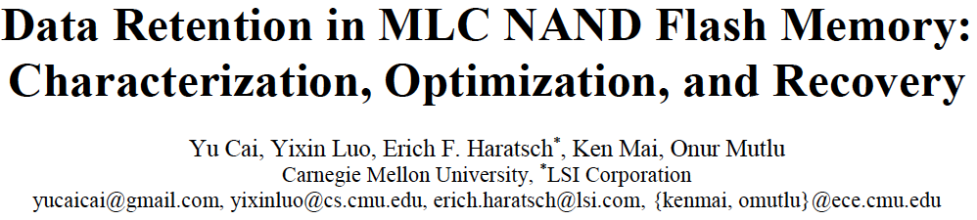
Data Retention Analysis & Recovery
Yu Cai, Yixin Luo, Erich F. Haratsch, Ken Mai, and Onur Mutlu,
"Data Retention in MLC NAND Flash Memory: Characterization, Optimization and Recovery"
Proceedings of the 21st International Symposium on High-Performance Computer Architecture (HPCA), Bay Area, CA, February 2015.
[Slides (pptx) (pdf)]

Slide 61
Agenda
DRAM Scaling Issues
  DRAM RowHammer Problem
  Some Other DRAM Reliability Studies
NAND Flash Scaling Issues
  Some NAND Flash Reliability Studies
  Read Disturb Errors in NAND Flash Memory
Summary and Discussion

Slide 62
Read Disturb Errors in Flash Memory

Slide 63
Paper
Presented at IEEE/IFIP DSN 2015 Conference in June 2015.
Full paper for details:
  Yu Cai, Yixin Luo, Saugata Ghose, Erich F. Haratsch, Ken Mai, and Onur Mutlu,
  "Read Disturb Errors in MLC NAND Flash Memory: Characterization and Mitigation"
  Proceedings of the 45th Annual IEEE/IFIP International Conference on Dependable Systems and Networks (DSN), Rio de Janeiro, Brazil, June 2015.
  http://users.ece.cmu.edu/~omutlu/pub/flash-read-disturb-errors_dsn15.pdf

Slide 64
Executive Summary
Read disturb errors limit flash memory lifetime today
  Apply a high pass-through voltage (V_{pass}) to multiple pages on a read
  Repeated application of V_{pass} can alter stored values in unread pages
We characterize read disturb on real NAND flash chips
  Slightly lowering V_{pass} greatly reduces read disturb errors
  Some flash cells are more prone to read disturb
Technique 1: Mitigate read disturb errors online
  V_{pass} Tuning dynamically finds and applies a lowered V_{pass} per block
  Flash memory lifetime improves by 21%
Technique 2: Recover after failure to prevent data loss
  Read Disturb Oriented Error Recovery (RDR) selectively corrects cells more susceptible to read disturb errors
  Reduces raw bit error rate (RBER) by up to 36%
Notes:
When we read data from one page, we have to apply a high voltage to multiple other flash pages that are connected to this page, and we call this high pass-through voltage.
Over time this high pass-through voltage can alter the values stored in unread flash pages. We call this a read disturb error.
For the first time in open literature, we characterize read disturb on real NAND flash chips, and show that read disturb errors exist in today’s flash chips and is expected to increase in the future.
We make two key observations from the characterization.
Using our characterization, we develop two techniques that can help flash memory tolerate such read disturb errors.

Slide 65
Outline
Background (Problem and Goal)
Key Experimental Observations
Mitigation: V_{pass} Tuning
Recovery: Read Disturb Oriented Error Recovery
Conclusion

Slide 66
Outline
Background (Problem and Goal)
Key Experimental Observations
Mitigation: V_{pass} Tuning
Recovery: Read Disturb Oriented Error Recovery
Conclusion

Slide 67

NAND Flash Memory Background
Flash Memory
Page 0
Read
Block 0
Page 256
……
Page M
Block 1
Block N
Page 1
Page 257
Page M+1
Pass
Page 2
Page 258
Page M+2
Pass
……
……
……
…
Page 255
Pass
Page 511
Page M+255
Flash Controller
Notes:
When we read from one page in a block, we apply a high voltage to all the other pages in the same block. We will explain why later

Slide 68
Flash Cell Array
Row
Block X
Page Y
Column
Sense Amplifiers
Sense Amplifiers
Notes:
Now, let’s zoom in to a single block of flash memory, which consists of an array of flash pages.
Each flash page is written to flash cells located in the same row.
Each row of cells are controlled by the same horizontal wire.
Each column of cells are connected in series with a sense amplifier at the bottom.

Slide 69
Flash Cell
Drain
Floating Gate
Gate
V_{th} = 2.5 V
Source
Floating Gate Transistor
(Flash Cell)
Notes:
Now let’s zoom in again to look at a single flash cell, or, it can also be called, a floating gate transistor.

Slide 70
Flash Read
V_{read} = 2.5 V
V_{th} = 2 V
V_{read} = 2.5 V
V_{th} = 3 V
Gate
1
0
Notes:
Now, if we have two flash cells programmed to different threshold voltages, 2V and 3V, we can distinguish them with a read voltage of 2.5V.
When we apply 2.5V to the gate, since the read voltage is higher than the threshold voltage, …
Now if we look back at this example, we can see that the threshold voltage of each flash cell actually represents the value being stored.

Slide 71
Flash Pass-Through
V_{pass} = 5 V
V_{th} = 2 V
V_{pass} = 5 V
V_{th} = 3 V
Gate
1
1
Notes:
But, for the same cells, when we apply a high voltage to them, regardless of the threshold voltage, any cell will be passed-through.
So we call this voltage pass-through voltage or Vpass

Slide 72
Read from Flash Cell Array
V_{pass} = 5.0 V
Pass (5V)
3.0V
3.8V
3.9V
4.8V
Page 1
V_{read} = 2.5 V
Read (2.5V)
3.5V
2.9V
2.4V
2.1V
Page 2
V_{pass} = 5.0 V
Pass (5V)
2.2V
4.3V
4.6V
1.8V
Page 3
V_{pass} = 5.0 V
Pass (5V)
3.5V
2.3V
1.9V
4.3V
Page 4
Correct values for page 2:
0
0
1
1
Notes:
Now, let’s look at an example array of flash cells.
In this example, we make up threshold voltage numbers for each cell.
Let’s say we want to read from the second page in this array.
So we apply a read voltage of 2.5 V to the second page
And since all the other pages are connected in series, we apply a high pass-through voltage of 5 V to the other pages.
As we can see, the high pass through voltage switches on all the flash pages being passed-through, allowing the sense amplifier to read the values stored in the second page.
In this case, the correct values …

Slide 73
Read Disturb Problem: “Weak Programming” Effect
Pass (5V)
3.0V
3.8V
3.9V
4.8V
Page 1
Pass (5V)
3.5V
2.9V
2.4V
2.1V
Page 2
Read (2.5V)
2.2V
4.3V
4.6V
1.8V
Page 3
Pass (5V)
3.5V
2.3V
1.9V
4.3V
Page 4
Repeatedly read page 3 (or any page other than page 2)
Notes:
However, the high pass through voltage can generate read disturb problem, which we will introduce now.
When we want to read page 3, instead of page 2, this high pass through voltage now needs to be applied on the 2nd page.
When we repeatedly read page 3, the pass through voltage induces a weak programming effect on the second page.

Slide 74
Read Disturb Problem: “Weak Programming” Effect
V_{pass} = 5.0 V
3.0V
3.8V
3.9V
4.8V
Page 1
V_{read} = 2.5 V
3.5V
2.9V
2.4V
2.6V
2.1V
Page 2
V_{pass} = 5.0 V
2.2V
4.3V
4.6V
1.8V
Page 3
V_{pass} = 5.0 V
3.5V
2.3V
1.9V
4.3V
Page 4
Incorrect values from page 2:
0
0
0
1
High pass-through voltage induces “weak-programming” effect
Notes:
As the weak programming effect accumulates, the threshold voltage of each flash cell increases, and the threshold voltage state of a cell can be altered.
In this case, when we read page 2 again, we will read incorrect values from page 2, 0001
Flash vendors conservatively set this pass-through voltage to a high voltage.
However, we find in the paper that it is unnecessary to set to this high, and that reducing this voltage by just a bit will reduce read disturb errors significantly in the future.

Slide 75
Goal: Mitigate and Recover Read Disturb Errors
Read disturb errors: Reading from one page can alter the values stored in other unread pages
Notes:
To this point, we have identified the problem that …
So we set our goal to mitigate and recover these read disturb errors.
Vpass is set conservatively

Slide 76
Outline
Background (Problem and Goal)
Key Experimental Observations
Mitigation: V_{pass} Tuning
Recovery: Read Disturb Oriented Error Recovery
Conclusion
Notes:
To understand read disturb errors, we perform the first experimental study on read disturb errors.

Slide 77
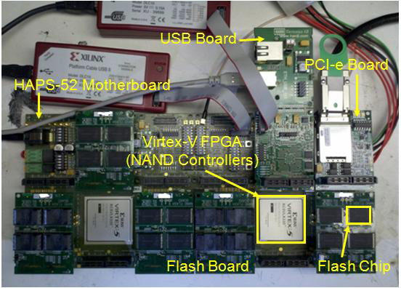
Methodology
FPGA-based flash memory testing platform [Cai+, FCCM ‘11]
Real 20- to 24-nm MLC NAND flash chips
0 to 1M read disturbs
0 to 15K Program/Erase Cycles (PEC)

Slide 78
Experimental Infrastructure
USB Daughter Board
USB Jack
HAPS-52 Mother Board
Virtex-II Pro
(USB controller)
3x-nm
NAND Flash
Virtex-V FPGA
(NAND Controller)
[Cai+, DATE 2012, ICCD 2012, DATE 2013, ITJ 2013, ICCD 2013, SIGMETRICS 2014, HPCA 2015, DSN 2015, MSST 2015]
NAND Daughter Board

Slide 79
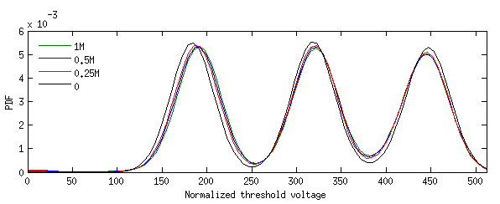
Read Disturb Effect on V_{th} Distribution
× 10⁻³
6
0 (No Read Disturbs)
V_{th} gradually increases with read disturb count
5
0.25M Read Disturbs
4
0.5M Read Disturbs
PDF
3
1M Read Disturbs
P1 state
P2 state
P3 state
2
1
ER state
0
0
50
100
150
200
250
300
350
400
450
500
Normalized Threshold Voltage
Notes:
In our paper, we characterize the threshold voltage distribution of flash cells before and after read disturb.
The x-axis is normalized threshold voltage, the y-axis is probability density function.
Overall, we can see roughly 3.1 states of threshold voltages, and we call them the ER, P1, P2, and P3 states.
This shows our MLC device has 4 states, and each flash cell can store 2 bits.
Note that only a small fraction of the erased state is visible because the erased state can have negative threshold voltages.
In this figure, we plot 4 lines, each represents the threshold voltage distribution with no read disturbs, after .25M read disturbs, …
The threshold voltage shifts are not very dramatic, so let’s zoom in and take a look.
Now we can see that Vth gradually…
In the paper, we have lots of other results derived from this characterization that we will not cover in this presentation.

Slide 80
Other Experimental Observations
Lower threshold voltage states are affected more by read disturb
Wear-out increases read disturb effect
Notes:
But here we list our key conclusions from these results.
These new observations help us to understand the read disturb effects better.

Slide 81
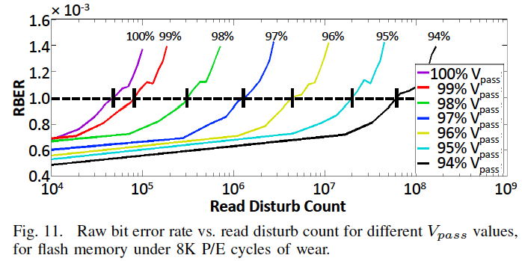
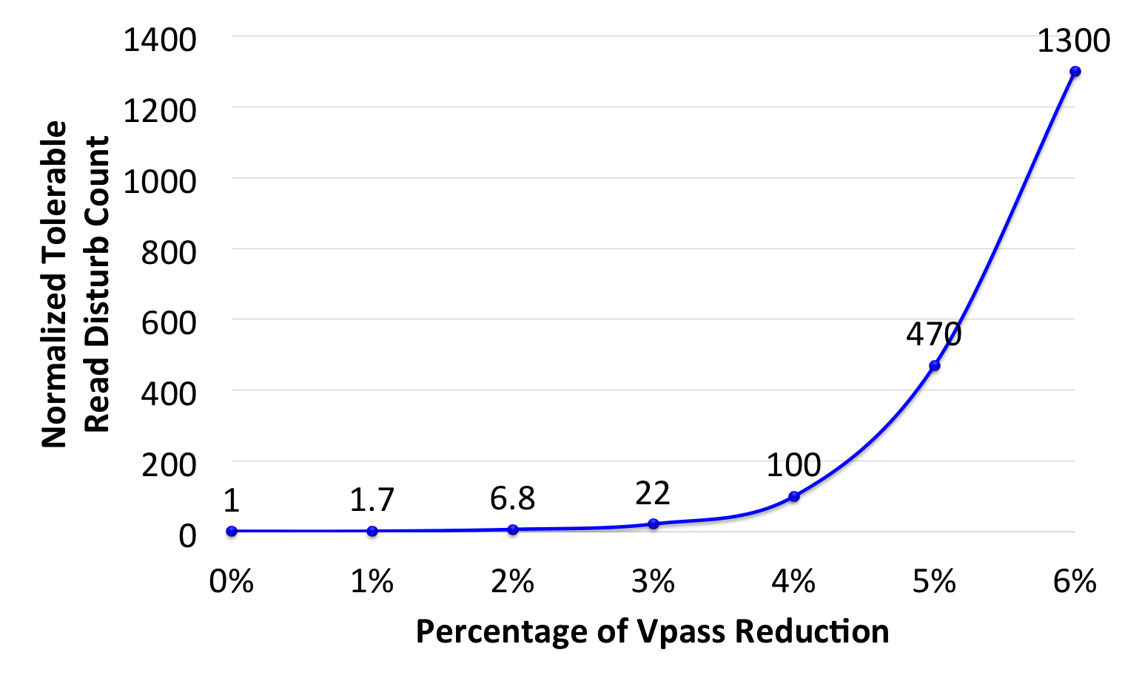
Reducing The Pass-Through Voltage
  Key Observation 1: Slightly lowering V_{pass} greatly reduces read disturb errors
Notes:
Now let’s look at the effect of reducing pass-through voltage, because, as we have introduced earlier, high pass-through voltage is the main reason for read disturb errors.
We set up an experiment that emulates a reduced the pass through voltage.
We assume an acceptable raw bit error rate of 10^-3, which is typical amount for a flash memory.
And we record the tolerable read disturb count before the raw bit error rate exceeds this amount.
In this figure, the x axis is … y axis is …
We normalize tolerable read disturb count to that of the default pass through voltage, which is 0% on this figure.
As we can see, as we continue to reduce the pass through voltage by 6%, the tolerable read disturb count increases significantly up to 1300x.

Slide 82
Outline
Background (Problem and Goal)
Key Experimental Observations
Mitigation: V_{pass} Tuning
Recovery: Read Disturb Oriented Error Recovery
Conclusion
Notes:
Now that we have developed an understanding of the read disturb phenomenon in flash memory.
Let’s look at how we exploit these observations to mitigate read disturb errors.

Slide 83
Read Disturb Mitigation: V_{pass} Tuning
Key Idea: Dynamically find and apply a lowered V_{pass}
Trade-off for lowering V_{pass}
  Allows more read disturbs
  Induces more read errors
Notes:
To mitigate read disturb errors, we propose Vpass Tuning, whose key idea is to dynamically find and apply a lowered pass-through voltage.
However, lowering the pass through voltage presents a trade off.
First, as we have just described, lowering pass through voltage by a little significantly reduces the read disturb effect.
However, lowering Vpass also induces more read errors, which we will introduce next.

Slide 84
Read Errors Induced by V_{pass} Reduction
Reducing V_{pass} to 4.9V
V_{pass} = 4.9 V
3.0V
3.8V
3.9V
4.8V
Page 1
V_{read} = 2.5 V
3.5V
2.9V
2.4V
2.1V
Page 2
V_{pass} = 4.9 V
2.2V
4.3V
4.6V
1.8V
Page 3
V_{pass} = 4.9 V
3.5V
2.3V
1.9V
4.3V
Page 4
0
0
1
1
Notes:
If we only reduce the pass-through voltage by a little, very few read errors will be generated.
In this example, we reduce Vpass to 4.9V, which is higher than the threshold voltage of any cell that we want to pass through.

Slide 85
Read Errors Induced by V_{pass} Reduction
Reducing V_{pass} to 4.7V
V_{pass} = 4.7 V
3.0V
3.8V
3.9V
4.8V
Page 1
V_{read} = 2.5 V
3.5V
2.9V
2.4V
2.1V
Page 2
V_{pass} = 4.7 V
2.2V
4.3V
4.6V
1.8V
Page 3
V_{pass} = 4.7 V
3.5V
2.3V
1.9V
4.3V
Page 4
Incorrect values from page 2:
0
0
1
0
Notes:
However, as we further reduce the pass through voltage to 4.7V, some cell with higher threshold voltage cannot be correctly passed through, and thus will generate a read error.
In this case, incorrect values are being read from page 2.

Slide 86
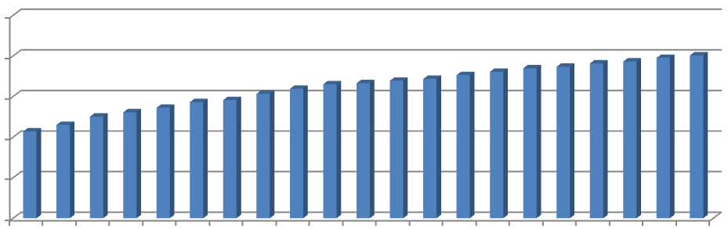
Utilizing the Unused ECC Capability
× 10⁻³
ECC Correction Capability
1.0
Unused ECC capability
RBER
0.8
0.6
0.4
0.2
0
01 02 03 04 05 06 07 08 09 10 11 12 13 14 15 16 17 18 19 20 21
N-day Retention
ECC provisioned for high retention “age”
2. Unused ECC capability can be used to fix read errors
3. Unused ECC capability decreases over retention age
Dynamically adjust V_{pass} so that read errors fully utilize the unused ECC capability
Notes:
However, these read errors can be tolerated by the unused ECC capability when the error rate is low, allowing us to reduce read disturb errors when the error rate is high.
In this figure, we plot how raw bit error rate increases over retention age, the time since the data is last programmed.
The x-axis is … y-axis is …
Over time, flash retention errors and read disturb errors are accumulated, so the error rate keeps increasing.
The red line shows …
As we can see, in early retention age, there is huge unused ECC correction capability that can be used to tolerate read errors.
Then over time, the unused ECC capability decreases so we need to readjust Vpass reduction to reduce read errors.
This leads to our Vpass tuning technique that …

Slide 87
V_{pass} Reduction Trade-Off Summary
Today: Conservatively set V_{pass} to a high voltage
  Accumulates more read disturb errors at the end of each refresh interval
  No read errors
Idea: Dynamically adjust V_{pass} to unused ECC capability
  Minimize read disturb errors
  Control read errors to be tolerable by ECC
  If read errors exceed ECC capability, read again with a higher V_{pass} to correct read errors
Notes:
Now, let’s summarize and compare the trade-offs for Vpass Reduction.
If we conservatively …, which is what flash vendors do today, we will accumulate lots of read disturb errors at the end of each refresh interval, but we don’t trade-off read errors.
If we dynamically …, we can minimize read disturb errors, and in the mean time control the number of read errors to be tolerable by ECC.
Even if we tune the Vpass too aggressively that the read errors …

Slide 88
V_{pass} Tuning Steps
Perform once for each block every day:
  Estimate unused ECC capability (using retention age)
  Aggressively reduce V_{pass} until read errors exceed ECC capability
  Gradually increase V_{pass} until read errors become just less than ECC capability
Notes:
Here, we listed the detailed steps for pass-through voltage tuning.
These steps are performed once for each block every day.
Using these steps, we can maximize the utilization of the unused ECC capability such that read disturb errors are minimized when the error rate is high.

Slide 89
Evaluation of V_{pass} Tuning
19 real workload I/O traces
Assume 7-day refresh period
Similar methodology as before to determine acceptable V_{pass} reduction
Overhead for a 512 GB flash drive:
  128 KB storage overhead for per-block V_{pass} setting and worst-case page
  24.34 sec/day average V_{pass} Tuning overhead
Notes:
… which can be hidden by performing in the background.

Slide 90
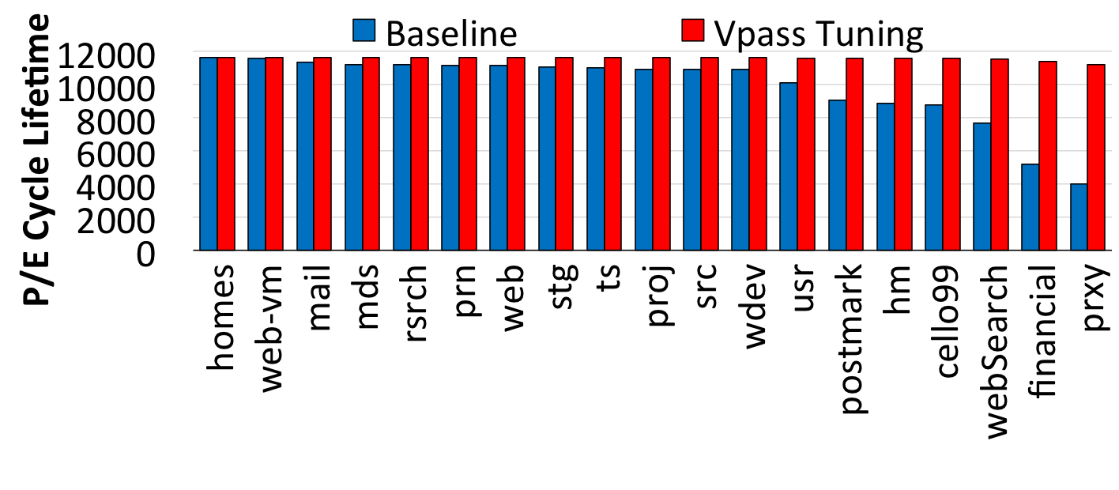
V_{pass} Tuning Lifetime Improvements
V_{pass} Tuning
Average lifetime improvement: 21.0%
Notes:
This figure shows the Vpass tuning lifetime improvements.
The length of each bar shows the PE cycle lifetime for each configuration.
The blue bars show our baseline system without Vpass tuning.
The red bars show the lifetime after applying Vpass tuning for each workload.
On average, Vpass tuning improves lifetime by 21%.

Slide 91
Outline
Background (Problem and Goal)
Key Experimental Observations
Mitigation: V_{pass} Tuning
Recovery: Read Disturb Oriented Error Recovery
Conclusion
Notes:
Read disturb errors not only affects flash lifetime, but also increases the risk for data loss.
To recover from read disturb errors, we propose a mechanism call RDR.

Slide 92
Read Disturb Resistance
PDF
N read disturbs
Disturb-Resistant
R
R
N read disturbs
Disturb-Prone
P
P
Normalized V_{th}
Notes:
RDR exploits each cell’s read disturb resistance.
Because of process variation, each cell can be classified as either disturb resistant or disturb prone.
After the same amount of read disturbs, the threshold voltage of a disturb-resistant cell does not change much, but the threshold voltage change of a disturb-prone cell is high.

Slide 93
Observation 2: Some Flash Cells Are
More Prone to Read Disturb
After 250K read disturb:
PDF
Disturb-prone cells have higher threshold voltages
Disturb-resistant cells have lower threshold voltages
ER
P1
R
R
P
P
P
P
Disturb-resistant
→P1 state
Disturb-prone
→ER state
P
P
P
P
R
R
Normalized V_{th}
Notes:
As our fourth observation, we find some flash cells are more prone to read disturb.
Now lets look at an example of the erased and P1 state.
With no read disturb, the threshold voltage of disturb prone and resistant cells are randomly distributed.
After a significant amount of read disturb, the cells redistribute because of read disturb.
At this point, we can see that disturb-prone cells have higher threshold voltages within each state,
And disturb-resistant cells have lower threshold voltages.
Now, if we look at the cells susceptible to errors, which are cells with threshold voltage closer to the boundary.
The disturb-prone cells are from the erased state, and the disturb-resistant cells are from the P1 state.

Slide 94
Read Disturb Oriented Error Recovery (RDR)
Triggered by an uncorrectable flash error
  Back up all valid data in the faulty block
  Disturb the faulty page 100K times (more)
  Compare V_{th}’s before and after read disturb
  Select cells susceptible to flash errors (V_{ref}−σ<V_{th}<V_{ref}−σ)
  Predict among these susceptible cells
    Cells with more V_{th} shifts are disturb-prone → Lower V_{th} state
    Cells with less V_{th} shifts are disturb-resistant → Higher V_{th} state
Notes:
Based on this finding, we propose read disturb oriented error recovery to identify disturb-prone and resistant cells after a failure has happened to recover from read disturb errors.
After an uncorrectable flash error, the following steps are triggered.

Slide 95
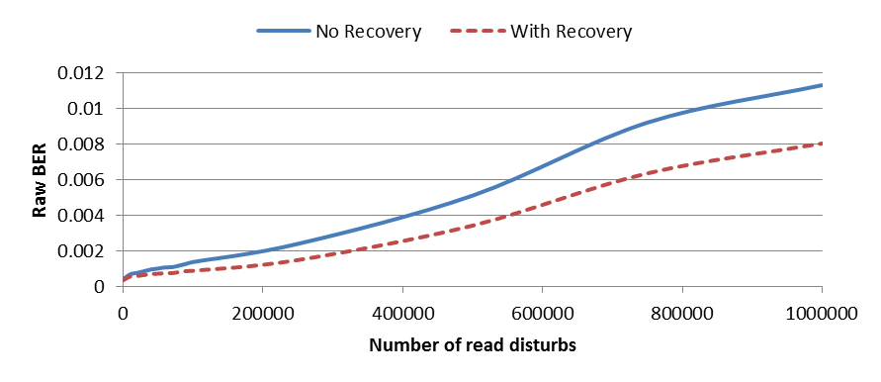
RDR Evaluation
× 10⁻³
12
No Recovery
RDR
10
8
RBER
6
4
2
0
0
0.2M
0.4M
0.6M
0.8M
1M
Read Disturb Count
Reduces total error counts by up to 36% @ 1M read disturbs
ECC can be used to correct the remaining errors
Notes:
Finally, we evaluate RDR from 0 to 1M read disturbs.
The x-axis shows the read disturb count, The y-axis shows the raw bit error rate.
The blue curve shows the RBER without RDR, the dotted red curve shows the RBER with RDR.
On average, RDR reduces RBER by 36% and the ECC can be used to correct the remaining errors.

Slide 96
Outline
Background (Problem and Goal)
Key Experimental Observations
Mitigation: V_{pass} Tuning
Recovery: Read Disturb Oriented Error Recovery
Conclusion

Slide 97
Executive Summary
Read disturb errors limit flash memory lifetime today
  Apply a high pass-through voltage (V_{pass}) to multiple pages on a read
  Repeated application of V_{pass} can alter stored values in unread pages
We characterize read disturb on real NAND flash chips
  Slightly lowering V_{pass} greatly reduces read disturb errors
  Some flash cells are more prone to read disturb
Technique 1: Mitigate read disturb errors online
  V_{pass} Tuning dynamically finds and applies a lowered V_{pass} per block
  Flash memory lifetime improves by 21%
Technique 2: Recover after failure to prevent data loss
  Read Disturb Oriented Error Recovery (RDR) selectively corrects cells more susceptible to read disturb errors
  Reduces raw bit error rate (RBER) by up to 36%
Notes:
When we read data from one page, we have to apply a high voltage to multiple other flash pages that are connected to this page, and we call this high pass-through voltage.
Over time this high pass-through voltage can alter the values stored in unread flash pages. We call this a read disturb error.
For the first time in open literature, we characterize read disturb on real NAND flash chips, and show that read disturb errors exist in today’s flash chips and is expected to increase in the future.
We make two key observations from the characterization.
Using our characterization, we develop two techniques that can help flash memory tolerate such read disturb errors.

Slide 98
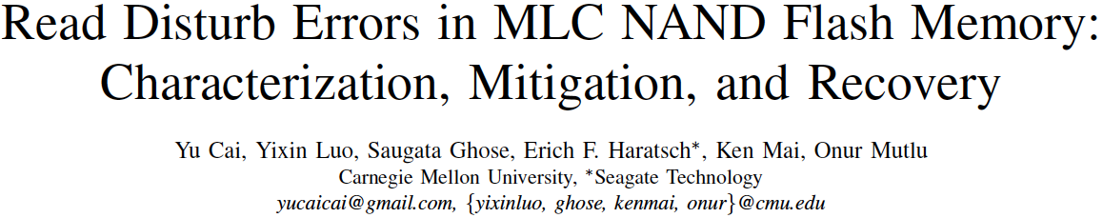
More on Flash Read Disturb Errors
Yu Cai, Yixin Luo, Saugata Ghose, Erich F. Haratsch, Ken Mai, and Onur Mutlu,
"Read Disturb Errors in MLC NAND Flash Memory: Characterization and Mitigation"
Proceedings of the 45th Annual IEEE/IFIP International Conference on Dependable Systems and Networks (DSN), Rio de Janeiro, Brazil, June 2015.

Slide 99
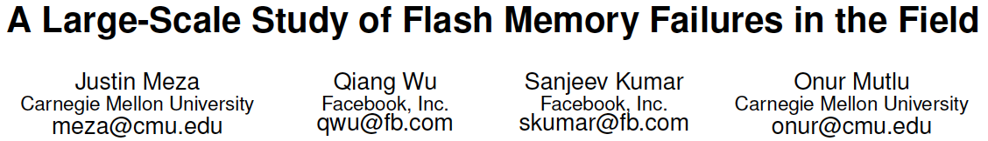
Large-Scale Flash SSD Error Analysis
First large-scale field study of flash memory errors
Justin Meza, Qiang Wu, Sanjeev Kumar, and Onur Mutlu,
"A Large-Scale Study of Flash Memory Errors in the Field"
Proceedings of the ACM International Conference on Measurement and Modeling of Computer Systems (SIGMETRICS), Portland, OR, June 2015.
[Slides (pptx) (pdf)] [Coverage at ZDNet] [Coverage on The Register] [Coverage on TechSpot] [Coverage on The Tech Report]

Slide 100

A few SSDs cause most errors

Slide 101
Summary
SSD lifecycle
New reliability trends
Access pattern
dependence
Read
disturbance
Temperature

Slide 102
Agenda
DRAM Scaling Issues
  DRAM RowHammer Problem
  Some Other DRAM Reliability Studies
NAND Flash Scaling Issues
  Some NAND Flash Reliability Studies
  Read Disturb Errors in NAND Flash Memory
Summary and Discussion

Slide 103
Summary
DRAM and Flash Scaling Challenges are real and critical
  They lead to many reliability (and security) challenges
We need to understand various reliability issues with both
  Small-scale experimental studies (FPGA-based testing platforms)
  Large-scale experimental studies (data centers and clusters)
We need to innovate at all levels
  DRAM and Flash architecture and controllers
  Hardware, software, devices
There are many problems to solve
  Industry-academia cooperation is much needed and welcome

Slide 104
Reliability (and Security) Issues of DRAM and NAND Flash Scaling
Onur Mutlu
omutlu@gmail.com
http://users.ece.cmu.edu/~omutlu/
HPCA Memory Reliability Workshop
March 13, 2016

Slide 105
Ramulator: A Fast and Extensible DRAM Simulator
[IEEE Comp Arch Letters’15]

Slide 106

Ramulator Motivation
DRAM and Memory Controller landscape is changing
Many new and upcoming standards
Many new controller designs
A fast and easy-to-extend simulator is very much needed

Slide 107

Ramulator
Provides out-of-the box support for many DRAM standards:
  DDR3/4, LPDDR3/4, GDDR5, WIO1/2, HBM, plus new proposals (SALP, AL-DRAM, TLDRAM, RowClone, and SARP)
~2.5X faster than fastest open-source simulator
Modular and extensible to different standards

Slide 108


Case Study: Comparison of DRAM Standards
Across 22 workloads, simple CPU model

Slide 109
Ramulator Paper and Source Code
Yoongu Kim, Weikun Yang, and Onur Mutlu,
"Ramulator: A Fast and Extensible DRAM Simulator"
IEEE Computer Architecture Letters (CAL), March 2015.
[Source Code]
Source code is released under the liberal MIT License
  https://github.com/CMU-SAFARI/ramulator

Slide 110
More Detail on DRAM Errors

Slide 111
Memory Errors in Facebook Fleet
Analysis and modeling of memory errors found in all of Facebook’s server fleet
Justin Meza, Qiang Wu, Sanjeev Kumar, and Onur Mutlu,
"Revisiting Memory Errors in Large-Scale Production Data Centers: Analysis and Modeling of New Trends from the Field"
Proceedings of the 45th Annual IEEE/IFIP International Conference on Dependable Systems and Networks (DSN), Rio de Janeiro, Brazil, June 2015.
[Slides (pptx) (pdf)] [DRAM Error Model]

Slide 112
Findings
Error/failure occurrence
New
reliability
trends
Page offlining
at scale
Technology
scaling
Modeling errors
Architecture &
workload

Slide 113

Findings
Error/failure occurrence
New
reliability
trends
Page offlining
at scale
Technology
scaling
Errors follow a power-law distribution and a large number of errors occur due to sockets/channels
Modeling errors
Architecture &
workload
Notes:
Unlike popularly believed, memory errors are not isolated events and can bombard a server, creating a kind of denial of service attack.

Slide 114

Findings
Error/failure occurrence
New
reliability
trends
We find that newer cell fabrication technologies have higher failure rates
Page offlining
at scale
Technology
scaling
Modeling errors
Architecture &
workload

Slide 115
Findings
Error/failure occurrence
New
reliability
trends
Chips per DIMM, transfer width, and workload type (not necessarily CPU/memory utilization) affect reliability
Page offlining
at scale
Technology
scaling
Modeling errors
Architecture &
workload

Slide 116
Findings
Error/failure occurrence
New
reliability
trends
Page offlining
at scale
Technology
scaling
We have made publicly available a statistical model for assessing server memory reliability
Modeling errors
Architecture &
workload

Slide 117
Findings
Error/failure occurrence
New
reliability
trends
First large-scale study of page offlining; real-world limitations of technique
Page offlining
at scale
Technology
scaling
Modeling errors
Architecture &
workload

Slide 118

Server error rate
Notes:
- Correctable errors occur relatively commonly and affect around 2% of servers each month.

Slide 119

Memory error distribution

Slide 120

Memory error distribution
Decreasing
hazard
rate

Slide 121
Large Scale Field Analysis of
Flash Memory Errors

Slide 122
SSD Error Analysis of Facebook Systems
First large-scale field study of flash memory errors
Justin Meza, Qiang Wu, Sanjeev Kumar, and Onur Mutlu,
"A Large-Scale Study of Flash Memory Errors in the Field"
Proceedings of the ACM International Conference on Measurement and Modeling of Computer Systems (SIGMETRICS), Portland, OR, June 2015.
[Slides (pptx) (pdf)] [Coverage at ZDNet] [Coverage on The Register] [Coverage on TechSpot] [Coverage on The Tech Report]

Slide 123

A few SSDs cause most errors

Slide 124
A few SSDs cause most errors

Slide 125
Summary
SSD lifecycle
New reliability trends
Access pattern
dependence
Read
disturbance
Temperature

Slide 126

Summary
SSD lifecycle
New reliability trends
Early detection lifecycle period distinct from hard disk drive lifecycle.
Access pattern
dependence
Read
disturbance
Temperature

Slide 127
SSD lifecycle
New reliability trends
Access pattern
dependence
Read
disturbance
Temperature

Slide 128
Storage lifecycle background:
the
bathtub curve
for disk drives
Failure
rate
Usage
[Schroeder+,FAST'07]

Slide 129
Storage lifecycle background:
the
bathtub curve
for disk drives
Early
failure
period
Wearout
period
Failure
rate
Useful life
period
Usage
[Schroeder+,FAST'07]

Slide 130

Storage lifecycle background:
the
bathtub curve
for disk drives
Early
failure
period
Wearout
period
Do SSDs display similar lifecycle periods?
Failure
rate
Useful life
period
Usage
[Schroeder+,FAST'07]

Slide 131
data written to flash
Use
to examine SSD lifecycle
(time-independent utilization metric)
Notes:
We use data written to flash to examine SSD lifecycle trends.
This is because data written to flash is a time-independent metric for SSD utilization.

Slide 132

720GB, 1 SSD
720GB, 2 SSDs
0
40
80
Data written (TB)

Slide 133



720GB, 1 SSD
720GB, 2 SSDs
Wearout period
Useful life period
Early failure period
0
40
80
Data written (TB)

Slide 134

720GB, 1 SSD
720GB, 2 SSDs
Wearout period
Early
detection
period
Useful life period
Early failure period
0
40
80
Data written (TB)

Slide 135
SSD lifecycle
New reliability trends
Early detection lifecycle period distinct from hard disk drive lifecycle.
Access pattern
dependence
Read
disturbance
Temperature

Slide 136
SSD lifecycle
New reliability trends
Access pattern
dependence
Read
disturbance
Temperature

Slide 137


Slide 138
Temperature
sensor

Slide 139

720GB, 1 SSD
720GB, 2 SSDs

Slide 140
High temperature:
may throttle or
shut down

Slide 141

1.2TB, 1 SSD
3.2TB, 1 SSD
Throttling

Slide 142
SSD lifecycle
New reliability trends
Throttling SSD usage helps mitigate temperature-induced errors.
Access pattern
dependence
Read
disturbance
Temperature

Slide 143
Summary
SSD lifecycle
New reliability trends
We do not observe the effects of read disturbance errors in the field.
Access pattern
dependence
Read
disturbance
Temperature

Slide 144
Summary
SSD lifecycle
New reliability trends
Throttling SSD usage helps mitigate temperature-induced errors.
Access pattern
dependence
Read
disturbance
Temperature

Slide 145
Summary
SSD lifecycle
New reliability trends
We quantify the effects of the page cache and write amplification in the field.
Access pattern
dependence
Read
disturbance
Temperature

Slide 146
More on SSD Error Analysis in the Field
First large-scale field study of flash memory errors
Justin Meza, Qiang Wu, Sanjeev Kumar, and Onur Mutlu,
"A Large-Scale Study of Flash Memory Errors in the Field"
Proceedings of the ACM International Conference on Measurement and Modeling of Computer Systems (SIGMETRICS), Portland, OR, June 2015.
[Slides (pptx) (pdf)] [Coverage at ZDNet] [Coverage on The Register] [Coverage on TechSpot] [Coverage on The Tech Report]

Slide 147
NAND Flash Memory Readings

Slide 148
Errors in Flash Memory (I)
Retention noise study and management
  Yu Cai, Gulay Yalcin, Onur Mutlu, Erich F. Haratsch, Adrian Cristal, Osman Unsal, and Ken Mai, Flash Correct-and-Refresh: Retention-Aware Error Management for Increased Flash Memory Lifetime, ICCD 2012.
  Yu Cai, Yixin Luo, Erich F. Haratsch, Ken Mai, and Onur Mutlu, Data Retention in MLC NAND Flash Memory: Characterization, Optimization and Recovery, HPCA 2015.
  Yixin Luo, Yu Cai, Saugata Ghose, Jongmoo Choi, and Onur Mutlu, WARM: Improving NAND Flash Memory Lifetime with Write-hotness Aware Retention Management, MSST 2015.
Flash-based SSD prototyping and testing platform
  Yu Cai, Erich F. Haratsh, Mark McCartney, Ken Mai, FPGA-based solid-state drive prototyping platform, FCCM 2011.

Slide 149
Errors in Flash Memory (II)
Overall flash error analysis
  Yu Cai, Erich F. Haratsch, Onur Mutlu, and Ken Mai, Error Patterns in MLC NAND Flash Memory: Measurement, Characterization, and Analysis, DATE 2012.
  Yu Cai, Gulay Yalcin, Onur Mutlu, Erich F. Haratsch, Adrian Cristal, Osman Unsal, and Ken Mai, Error Analysis and Retention-Aware Error Management for NAND Flash Memory, ITJ 2013.
Program and erase noise study
  Yu Cai, Erich F. Haratsch, Onur Mutlu, and Ken Mai, Threshold Voltage Distribution in MLC NAND Flash Memory: Characterization, Analysis and Modeling, DATE 2013.

Slide 150
Errors in Flash Memory (III)
5. Cell-to-cell interference characterization and tolerance
  Yu Cai, Onur Mutlu, Erich F. Haratsch, and Ken Mai, Program Interference in MLC NAND Flash Memory: Characterization, Modeling, and Mitigation, ICCD 2013.
  Yu Cai, Gulay Yalcin, Onur Mutlu, Erich F. Haratsch, Osman Unsal, Adrian Cristal, and Ken Mai, Neighbor-Cell Assisted Error Correction for MLC NAND Flash Memories, SIGMETRICS 2014.
  6. Read disturb noise study
  Yu Cai, Yixin Luo, Saugata Ghose, Erich F. Haratsch, Ken Mai, and Onur Mutlu,
  Read Disturb Errors in MLC NAND Flash Memory: Characterization and Mitigation, DSN 2015.
7. Flash errors in the field
  Justin Meza, Qiang Wu, Sanjeev Kumar, and Onur Mutlu, A Large-Scale Study of Flash Memory Errors in the Field, SIGMETRICS 2015.

Slide 151

More Detail on Flash Error Analysis
Yu Cai, Gulay Yalcin, Onur Mutlu, Erich F. Haratsch, Adrian Cristal, Osman Unsal, and Ken Mai,
"Error Analysis and Retention-Aware Error Management for NAND Flash Memory"
Intel Technology Journal (ITJ) Special Issue on Memory Resiliency, Vol. 17, No. 1, May 2013.

Slide 152

Error Analysis and Management for MLC NAND Flash Memory
Onur Mutlu
onur@cmu.edu
(joint work with Yu Cai, Gulay Yalcin, Erich Haratsch, Ken Mai, Adrian Cristal, Osman Unsal)
August 7, 2014
Flash Memory Summit 2014, Santa Clara, CA

Slide 153
Executive Summary
Problem: MLC NAND flash memory reliability/endurance is a key challenge for satisfying future storage systems’ requirements
Our Goals: (1) Build reliable error models for NAND flash memory via experimental characterization, (2) Develop efficient techniques to improve reliability and endurance
This talk provides a “flash” summary of our recent results published in the past 3 years:
  Experimental error and threshold voltage characterization [DATE’12&13]
  Retention-aware error management [ICCD’12]
  Program interference analysis and read reference V prediction [ICCD’13]
  Neighbor-assisted error correction [SIGMETRICS’14]

Slide 154
Agenda
Background, Motivation and Approach
Experimental Characterization Methodology
Error Analysis and Management
  Characterization Results
  Retention-Aware Error Management
  Threshold Voltage and Program Interference Analysis
  Read Reference Voltage Prediction
  Neighbor-Assisted Error Correction
Summary

Slide 155
Evolution of NAND Flash Memory
CMOS scaling
More bits per Cell
Seaung Suk Lee, “Emerging Challenges in NAND Flash Technology”, Flash Summit 2011 (Hynix)
Flash memory is widening its range of applications
  Portable consumer devices, laptop PCs and enterprise servers

Slide 156
Flash Challenges: Reliability and Endurance
P/E cycles (provided)
A few thousand
P/E cycles (required)
Writing
the full capacity
of the drive
10 times per day
for 5 years
(STEC)
> 50k P/E cycles
E. Grochowski et al., “Future technology challenges for NAND flash and HDD products”, Flash Memory Summit 2012

Slide 157
NAND Flash Memory is Increasingly Noisy
Write
Noisy NAND
Read

Slide 158
Future NAND Flash-based Storage Architecture
Memory
Signal
Processing
Raw Bit
Error Rate
Uncorrectable
BER < 10⁻¹⁵
Noisy
Error
Correction
Lower
High
Better
Our Goals:
Build reliable error models for NAND flash memory
Design efficient reliability mechanisms based on the model

Slide 159
NAND Flash Error Model
Write
Noisy NAND
Read
Experimentally characterize and model dominant errors
Cai et al., “Error Patterns in MLC NAND Flash Memory: Measurement, Characterization, and Analysis””, DATE 2012
Write
Erase block
Program page
Neighbor page program (c-to-c interference)
Read
Retention
Cai et al., “Threshold voltage distribution in MLC NAND Flash Memory: Characterization, Analysis, and Modeling”, DATE 2013
Cai et al., “Program Interference in MLC NAND Flash Memory: Characterization, Modeling, and Mitigation”, ICCD 2013
Cai et al., “Neighbor-Cell Assisted Error Correction in MLC NAND Flash Memories”, SIGMETRICS 2014
Cai et al., “Flash Correct-and-Refresh: Retention-aware error management for increased flash memory lifetime”, ICCD 2012
Cai et al., “Error Analysis and Retention-Aware Error Management for NAND Flash Memory, ITJ 2013

Slide 160
Our Goals and Approach
Goals:
  Understand error mechanisms and develop reliable predictive models for MLC NAND flash memory errors
  Develop efficient error management techniques to mitigate errors and improve flash reliability and endurance
Approach:
  Solid experimental analyses of errors in real MLC NAND flash memory → drive the understanding and models
  Understanding, models and creativity → drive the new techniques

Slide 161
Agenda
Background, Motivation and Approach
Experimental Characterization Methodology
Error Analysis and Management
  Main Characterization Results
  Retention-Aware Error Management
  Threshold Voltage and Program Interference Analysis
  Read Reference Voltage Prediction
  Neighbor-Assisted Error Correction
Summary

Slide 162
Experimental Testing Platform
USB Daughter Board
USB Jack
HAPS-52 Mother Board
Virtex-II Pro
(USB controller)
3x-nm
NAND Flash
Virtex-V FPGA
(NAND Controller)
[Cai+, FCCM 2011, DATE 2012, ICCD 2012, DATE 2013, ITJ 2013, ICCD 2013, SIGMETRICS 2014]
NAND Daughter Board
Cai et al., FPGA-based Solid-State Drive prototyping platform, FCCM 2011.

Slide 163
NAND Flash Usage and Error Model
Erase Errors
Program Errors
Start
Erase
Block
Program
Page
P/E cycle 0
(Page0 - Page128)
…
Retention Errors
Read Errors
Retention1
(t₁ days)
Read
Page
P/E cycle i
…
Retention Errors
…
Read Errors
P/E cycle n
Retention j
(t_{j} days)
Read
Page
End of life
Notes:
13
lots of diagrams of boxes and text, need to find a way to differentiate them

Slide 164
Methodology: Error and ECC Analysis
Characterized errors and error rates of 3x and 2y-nm MLC NAND flash using an experimental FPGA-based platform
  [Cai+, DATE’12, ICCD’12, DATE’13, ITJ’13, ICCD’13, SIGMETRICS’14]
Quantified Raw Bit Error Rate (RBER) at a given P/E cycle
  Raw Bit Error Rate: Fraction of erroneous bits without any correction
Quantified error correction capability (and area and power consumption) of various BCH-code implementations
  Identified how much RBER each code can tolerate
  → how many P/E cycles (flash lifetime) each code can sustain

Slide 165
NAND Flash Error Types
Four types of errors [Cai+, DATE 2012]
Caused by common flash operations
  Read errors
  Erase errors
  Program (interference) errors
Caused by flash cell losing charge over time
  Retention errors
    Whether an error happens depends on required retention time
    Especially problematic in MLC flash because threshold voltage window to determine stored value is smaller

Slide 166
Agenda
Background, Motivation and Approach
Experimental Characterization Methodology
Error Analysis and Management
  Main Characterization Results
  Retention-Aware Error Management
  Threshold Voltage and Program Interference Analysis
  Read Reference Voltage Prediction
  Neighbor-Assisted Error Correction
Summary

Slide 167
Observations: Flash Error Analysis
retention errors
Raw Bit Error Rate
P/E Cycles
Raw bit error rate increases exponentially with P/E cycles
Retention errors are dominant (>99% for 1-year ret. time)
Retention errors increase with retention time requirement
Cai et al., Error Patterns in MLC NAND Flash Memory, DATE 2012.

Slide 168

Retention Error Mechanism
LSB/MSB
Stress Induced Leakage Current (SILC)
Floating
Gate
REF1
REF2
REF3
11
10
01
00
V_{th}
Erased
Fully programmed
Electron loss from the floating gate causes retention errors
  Cells with more programmed electrons suffer more from retention errors
  Threshold voltage is more likely to shift by one window than by multiple
Notes:
16
explain what the diagram is showing
animate in distribution spread

Slide 169


Retention Error Value Dependency
01 →10
00 →01
Cells with more programmed electrons tend to suffer more from retention noise (i.e. 00 and 01)

Slide 170
More on Flash Error Analysis
Yu Cai, Erich F. Haratsch, Onur Mutlu, and Ken Mai,
"Error Patterns in MLC NAND Flash Memory: Measurement, Characterization, and Analysis"
Proceedings of the Design, Automation, and Test in Europe Conference (DATE), Dresden, Germany, March 2012. Slides (ppt)

Slide 171
Agenda
Background, Motivation and Approach
Experimental Characterization Methodology
Error Analysis and Management
  Main Characterization Results
  Retention-Aware Error Management
  Threshold Voltage and Program Interference Analysis
  Read Reference Voltage Prediction
  Neighbor-Assisted Error Correction
Summary

Slide 172
Flash Correct-and-Refresh (FCR)
Key Observations:
  Retention errors are the dominant source of errors in flash memory [Cai+ DATE 2012][Tanakamaru+ ISSCC 2011]
  → limit flash lifetime as they increase over time
  Retention errors can be corrected by “refreshing” each flash page periodically
Key Idea:
  Periodically read each flash page,
  Correct its errors using “weak” ECC, and
  Either remap it to a new physical page or reprogram it in-place,
  Before the page accumulates more errors than ECC-correctable
  Optimization: Adapt refresh rate to endured P/E cycles
Cai et al., Flash Correct and Refresh, ICCD 2012.

Slide 173
FCR: Two Key Questions
How to refresh?
  Remap a page to another one
  Reprogram a page (in-place)
  Hybrid of remap and reprogram
When to refresh?
  Fixed period
  Adapt the period to retention error severity

Slide 174



In-Place Reprogramming of Flash Cells
Floating Gate
Pro: No remapping needed → no additional erase operations
Con: Increases the occurrence of program errors
Floating Gate
Voltage Distribution
for each Stored Value
Retention errors are caused by cell voltage shifting to the left
ISPP moves cell voltage to the right; fixes retention errors

Slide 175
Normalized Flash Memory Lifetime
46x
4x
Lifetime of FCR much higher than lifetime of stronger ECC
Adaptive-rate FCR provides the highest lifetime

Slide 176
Energy Overhead
Adaptive-rate refresh: <1.8% energy increase until daily refresh is triggered
7.8%
5.5%
2.6%
1.8%
0.4%
0.3%
Refresh Interval

Slide 177
More Detail and Analysis on FCR
Yu Cai, Gulay Yalcin, Onur Mutlu, Erich F. Haratsch, Adrian Cristal, Osman Unsal, and Ken Mai,
"Flash Correct-and-Refresh: Retention-Aware Error Management for Increased Flash Memory Lifetime"
Proceedings of the 30th IEEE International Conference on Computer Design (ICCD), Montreal, Quebec, Canada, September 2012. Slides (ppt) (pdf)

Slide 178
Agenda
Background, Motivation and Approach
Experimental Characterization Methodology
Error Analysis and Management
  Main Characterization Results
  Retention-Aware Error Management
  Threshold Voltage and Program Interference Analysis
  Read Reference Voltage Prediction
  Neighbor-Assisted Error Correction
Summary

Slide 179
Key Questions
How does threshold voltage (Vth) distribution of different programmed states change over flash lifetime?
Can we model it accurately and predict the Vth changes?
Can we build mechanisms that can correct for Vth changes? (thereby reducing read error rates)

Slide 180
Threshold Voltage Distribution Model
Characterized on 2Y-nm chips using the read-retry feature
Gaussian distribution with additive white noise
As P/E cycles increase ...
Distribution shifts to the right
Distribution becomes wider
Cai et al., Threshold Voltage Distribution in MLC NAND Flash Memory, DATE 2013.
Notes:
Why right shift? As P/E cycles increase, more defects
accumulate on the tunnel oxide of the flash memory cell and thus the
properties of the oxide change. More electrons can be programmed
into the floating gates at higher P/E cycles due to trap-assisted
tunneling [16], given the same program pulse voltage. Threshold
voltage control of ISPP at high P/E cycles is therefore not as accurate
as that at low P/E cycles. The flash cells tend to be over-programmed
at high P/E cycles, and we can see that the threshold voltage
distribution shifts to the right (i.e., toward higher threshold voltages)
systematically as P/E cycles increase.
Why widen?
Second, the threshold voltage distributions disperse and become
wider as P/E cycles increase. This can be due to two potential reasons.
First, due to process variation effects, different flash cells’ properties,
e.g., tunnel oxide characteristics, are different. These properties can
also get affected differently for different cells as the P/E cycles
increase. As a result, each cell’s tolerance to defects that are caused by
increased P/E cycles is different, leading to increased variation in
threshold voltage across cells with increasing P/E cycles. Second,
different flash cells are programmed with different data patterns
(because we program random data to different flash cells in these
experiments), which could cause different cells’ properties to get
affected differently as P/E cycles increase, leading to increased
variance in threshold voltage levels.
This plot shows the probability density function of the cell threshold voltage as the number of program/erase cycles increases.
As the wear on the cells increase, we can see the distributions broadening and shifting to the right (higher voltages).
As around 30k cycles, the distributions in adjacent states begin to overlap, meaning that a read error is possible.
However, we note that the manufacturer cell lifetime is typically only around 5k cycles, so errors due to wear would not be evident at those wear levels.

Slide 181
Threshold Voltage Distribution Model
Vth distribution can be modeled with ~95% accuracy as a Gaussian distribution with additive white noise
Distortion in Vth over P/E cycles can be modeled and predicted as an exponential function of P/E cycles
  With more than 95% accuracy
Notes:
Ideally, when flash memory cells are programmed to the same
target data value (ideally, the same target threshold voltage), the cells’
observed threshold voltages should be the same. However, the
observed threshold voltage signal is actually the signal to be
programmed mixed with noise. In fact, the flash cell can be thought
of as a communication channel that takes an input program signal (i.e.,
a target threshold voltage) and outputs an observed signal (i.e.,
observed threshold voltage). We can decouple the Vth of the flash
memory cell into two parts: signal and additive noise:

Slide 182
More Detail on Threshold Voltage Model
Yu Cai, Erich F. Haratsch, Onur Mutlu, and Ken Mai,
"Threshold Voltage Distribution in MLC NAND Flash Memory: Characterization, Analysis and Modeling"
Proceedings of the Design, Automation, and Test in Europe Conference (DATE), Grenoble, France, March 2013. Slides (ppt)

Slide 183
Program Interference Errors
When a cell is being programmed, voltage level of a neighboring cell changes (unintentionally) due to parasitic capacitance coupling
→ can change the data value stored
Also called program interference error
Causes neighboring cell voltage to increase (shift right)
Once retention errors are minimized, these errors can become dominant

Slide 184
How Current Flash Cells are Programmed
Programming 2-bit MLC NAND flash memory in two steps
ER
(11)
1
0
V_{th}
LSB
Program
ER
(11)
Temp
(0x)
V_{th}
1
0
0
1
MSB
Program
ER
(11)
P1
(10)
P2
(00)
P3
(01)
V_{th}

Slide 185
Basics of Program Interference
(n+1,j-1)
(n+1,j)
(n+1,j+1)
∆V_{xy}
∆V_{y}
∆V_{xy}
MSB:6
WL<2>
LSB:3
∆V_{x}
Victim
Cell
∆V_{x}
MSB:4
WL<1>
LSB:1
(n,j)
∆V_{xy}
∆V_{y}
∆V_{xy}
MSB:2
WL<0>
LSB:0
(n-1,j-1)
(n-1,j)
(n-1,j+1)

Slide 186
Traditional Model for Vth Change
(n+1,j-1)
(n+1,j)
(n+1,j+1)
∆V_{xy}
∆V_{y}
∆V_{xy}
MSB:6
WL<2>
LSB:3
∆V_{x}
Victim
Cell
∆V_{x}
MSB:4
WL<1>
LSB:1
(n,j)
MSB:2
WL<0>
LSB:0
(n-1,j-1)
(n-1,j)
(n-1,j+1)
Traditional model for victim cell threshold voltage change
Not accurate and requires knowledge of coupling caps!

Slide 187
Our Goal and Idea
Develop a new, more accurate and easier to implement model for program interference
Idea:
  Empirically characterize and model the effect of neighbor cell Vth changes on the Vth of the victim cell
  Fit neighbor Vth change to a linear regression model and find the coefficients of the model via empirical measurement
Can be measured

Slide 188
Developing a New Model via Empirical Measurement
Feature extraction for V_{th} changes based on characterization
  Threshold voltage changes on aggressor cell
  Original state of victim cell
Enhanced linear regression model
Maximum likelihood estimation of the model coefficients
(vector expression)

Slide 189

Effect of Neighbor Voltages on the Victim
Immediately-above cell interference is dominant
Immediately-diagonal neighbor is the second dominant
Far neighbor cell interference exists
Victim cell’s Vth has negative effect on interference
Cai et al., Program Interference in MLC NAND Flash Memory, ICCD 2013

Slide 190
New Model for Program Interference
(n+1,j-1)
(n+1,j)
(n+1,j+1)
∆V_{xy}
∆V_{y}
∆V_{xy}
MSB:6
WL<2>
LSB:3
∆V_{x}
Victim
Cell
∆V_{x}
MSB:4
WL<1>
LSB:1
(n,j)
∆V_{xy}
∆V_{y}
∆V_{xy}
MSB:2
WL<0>
LSB:0
(n-1,j-1)
(n-1,j)
(n-1,j+1)
Cai et al., Program Interference in MLC NAND Flash Memory, ICCD 2013

Slide 191


Model Accuracy
Characterized on 2Y-nm chips using the read-retry feature
(x,y)=(measured before interference, measured after interference)
Ideal if no interference
Interference causes systematic Vth shift
(x,y)=(measured before interference, predicted with model)
Ideal if prediction is 100% accurate
Model corrects for the Vth shift: 96.8% acc.
Notes:
The predicted threshold
voltage is obtained by subtracting the predicted threshold voltage
change (estimated by our model) from the measured threshold voltage
after program interference.

Slide 192
Many Other Results in the Paper
Yu Cai, Onur Mutlu, Erich F. Haratsch, and Ken Mai,
"Program Interference in MLC NAND Flash Memory: Characterization, Modeling, and Mitigation"
Proceedings of the 31st IEEE International Conference on Computer Design (ICCD), Asheville, NC, October 2013. Slides (pptx) (pdf) Lightning Session Slides (pdf)

Slide 193
Agenda
Background, Motivation and Approach
Experimental Characterization Methodology
Error Analysis and Management
  Main Characterization Results
  Retention-Aware Error Management
  Threshold Voltage and Program Interference Analysis
  Read Reference Voltage Prediction
  Neighbor-Assisted Error Correction
Summary

Slide 194
Mitigation: Applying the Model
So, what can we do with the model?
Goal: Mitigate the effects of program interference caused voltage shifts

Slide 195


Optimum Read Reference for Flash Memory
Read reference voltage affects the raw bit error rate
There exists an optimal read reference voltage
  Predictable if the statistics (i.e. mean, variance) of threshold voltage distributions are characterized and modeled
f(x)
g(x)
f(x)
g(x)
State-A
State-B
State-A
State-B
V_{th}
V_{th}
v₀
v_{ref}
v₁
v₀
v’_{ref}
v₁
Notes:
We introduce a new error tolerance mechanism that can adjust
the read reference voltage dynamically based on the predictive
threshold voltage model. The key observation is that the threshold
voltage distribution of a cell shifts to the right and widens with
program interference in a manner that is predictable via online
learning of the distribution. As a result, the optimum read reference
voltage between different threshold voltage ranges (i.e., logical values)
can be predicted. Our evaluations show that doing so with our online
mechanism reduces the raw bit error rate (BER) by 64% and improves
the P/E cycle lifetime of NAND flash memory by 30% compared to a
baseline that uses state-of-the-art error-correcting codes (ECC).

Slide 196


Optimum Read Reference Voltage Prediction
Vth shift
After program
interference
Vth shift learning (done every ~1k P/E cycles)
  Program sample cells with known data pattern and test Vth
  Program aggressor neighbor cells and test victim Vth after interference
  Characterize the mean shift in Vth (i.e., program interference noise)
Optimum read reference voltage prediction
  Default read reference voltage + Predicted mean Vth shift by model

Slide 197

Effect of Read Reference Voltage Prediction
Raw bit error rate
30% lifetime improvement
32k-bit BCH Code
(acceptable BER = 2x10⁻³)
No read reference voltage prediction
With read reference voltage prediction
Read reference voltage prediction reduces raw BER (by 64%) and increases the P/E cycle lifetime (by 30%)

Slide 198
More on Read Reference Voltage Prediction
Yu Cai, Onur Mutlu, Erich F. Haratsch, and Ken Mai,
"Program Interference in MLC NAND Flash Memory: Characterization, Modeling, and Mitigation"
Proceedings of the 31st IEEE International Conference on Computer Design (ICCD), Asheville, NC, October 2013. Slides (pptx) (pdf) Lightning Session Slides (pdf)

Slide 199
Agenda
Background, Motivation and Approach
Experimental Characterization Methodology
Error Analysis and Management
  Main Characterization Results
  Retention-Aware Error Management
  Threshold Voltage and Program Interference Analysis
  Read Reference Voltage Prediction
  Neighbor-Assisted Error Correction
Summary

Slide 200
Goal
Develop a better error correction mechanism for cases where ECC fails to correct a page

Slide 201
Observations So Far
Immediate neighbor cell has the most effect on the victim cell when programmed
A single set of read reference voltages is used to determine the value of the (victim) cell
The set of read reference voltages is determined based on the overall threshold voltage distribution of all cells in flash memory

Slide 202
New Observations [Cai+ SIGMETRICS’14]
Vth distributions of cells with different-valued immediate-neighbor cells are significantly different
  Because neighbor value affects the amount of Vth shift
Corollary: If we know the value of the immediate-neighbor, we can find a more accurate set of read reference voltages based on the “conditional” threshold voltage distribution
Cai et al., Neighbor-Cell Assisted Error Correction for MLC NAND Flash Memories, SIGMETRICS 2014.

Slide 203
Secrets of Threshold Voltage Distributions
Aggressor WL
11
10
01
00
01
10
11
00
……
……
Victim WL
Victim WL before MSB page of aggressor WL are programmed
State P_{(i)}
State P_{(i+1)}
N11
N00
N10
N01
N11
N00
N10
N01
Victim WL after MSB page of aggressor WL are programmed
State P’_{(i)}
State P’_{(i+1)}

Slide 204
If We Knew the Immediate Neighbor …
Then, we could choose a different read reference voltage to more accurately read the “victim” cell

Slide 205
Overall vs Conditional Reading
N11
N00
N10
N01
REF_{x}
N11
N00
N10
N01
State P’_{(i)}
State P’_{(i+1)}
V_{th}
Using the optimum read reference voltage based on the overall distribution leads to more errors
Better to use the optimum read reference voltage based on the conditional distribution (i.e., value of the neighbor)
  Conditional distributions of two states are farther apart from each other

Slide 206


Measurement Results
P1 State
P2 State
P3 State
Small margin
Large margin
Raw BER of conditional reading is much smaller than overall reading

Slide 207
Idea: Neighbor Assisted Correction (NAC)
Read a page with the read reference voltages based on overall Vth distribution (same as today) and buffer it
If ECC fails:
  Read the immediate-neighbor page
  Re-read the page using the read reference voltages corresponding to the voltage distribution assuming a particular immediate-neighbor value
  Replace the buffered values of the cells with that particular immediate-neighbor cell value
  Apply ECC again

Slide 208

Neighbor Assisted Correction Flow
How to select next local optimum read reference voltage?
Trigger neighbor-assisted reading only when ECC fails
Read neighbor values and use corresponding read reference voltages in a prioritized order until ECC passes

Slide 209

Lifetime Extension with NAC
Stage-0
Stage-1
Stage-2
Stage-3
ECC needs to correct
40 bits per 1k-Byte
22%
33%
39%
33% lifetime improvement at no performance loss

Slide 210

Performance Analysis of NAC
No performance loss within nominal lifetime
and with reasonable (1%) ECC fail rates

Slide 211
More on Neighbor-Assisted Correction
Yu Cai, Gulay Yalcin, Onur Mutlu, Eric Haratsch, Osman Unsal, Adrian Cristal, and Ken Mai,
"Neighbor-Cell Assisted Error Correction for MLC NAND Flash Memories"
Proceedings of the ACM International Conference on Measurement and Modeling of Computer Systems (SIGMETRICS), Austin, TX, June 2014. Slides (ppt) (pdf)

Slide 212
Agenda
Background, Motivation and Approach
Experimental Characterization Methodology
Error Analysis and Management
  Main Characterization Results
  Retention-Aware Error Management
  Threshold Voltage and Program Interference Analysis
  Read Reference Voltage Prediction
  Neighbor-Assisted Error Correction
Summary

Slide 213
Executive Summary
Problem: MLC NAND flash memory reliability/endurance is a key challenge for satisfying future storage systems’ requirements
We are: (1) Building reliable error models for NAND flash memory via experimental characterization, (2) Developing efficient techniques to improve reliability and endurance
This talk provided a “flash” summary of our recent results published in the past 3 years:
  Experimental error and threshold voltage characterization [DATE’12&13]
  Retention-aware error management [ICCD’12]
  Program interference analysis and read reference V prediction [ICCD’13]
  Neighbor-assisted error correction [SIGMETRICS’14]

Slide 214
Readings (I)
Yu Cai, Erich F. Haratsch, Onur Mutlu, and Ken Mai,
"Error Patterns in MLC NAND Flash Memory: Measurement, Characterization, and Analysis"
Proceedings of the Design, Automation, and Test in Europe Conference (DATE), Dresden, Germany, March 2012. Slides (ppt)
Yu Cai, Gulay Yalcin, Onur Mutlu, Erich F. Haratsch, Adrian Cristal, Osman Unsal, and Ken Mai,
"Flash Correct-and-Refresh: Retention-Aware Error Management for Increased Flash Memory Lifetime"
Proceedings of the 30th IEEE International Conference on Computer Design (ICCD), Montreal, Quebec, Canada, September 2012. Slides (ppt) (pdf)
Yu Cai, Erich F. Haratsch, Onur Mutlu, and Ken Mai,
"Threshold Voltage Distribution in MLC NAND Flash Memory: Characterization, Analysis and Modeling"
Proceedings of the Design, Automation, and Test in Europe Conference (DATE), Grenoble, France, March 2013. Slides (ppt)

Slide 215
Readings (II)
Yu Cai, Gulay Yalcin, Onur Mutlu, Erich F. Haratsch, Adrian Cristal, Osman Unsal, and Ken Mai,
"Error Analysis and Retention-Aware Error Management for NAND Flash Memory"
Intel Technology Journal (ITJ) Special Issue on Memory Resiliency, Vol. 17, No. 1, May 2013.
Yu Cai, Onur Mutlu, Erich F. Haratsch, and Ken Mai,
"Program Interference in MLC NAND Flash Memory: Characterization, Modeling, and Mitigation"
Proceedings of the 31st IEEE International Conference on Computer Design (ICCD), Asheville, NC, October 2013. Slides (pptx) (pdf) Lightning Session Slides (pdf)
Yu Cai, Gulay Yalcin, Onur Mutlu, Eric Haratsch, Osman Unsal, Adrian Cristal, and Ken Mai,
"Neighbor-Cell Assisted Error Correction for MLC NAND Flash Memories"
Proceedings of the ACM International Conference on Measurement and Modeling of Computer Systems (SIGMETRICS), Austin, TX, June 2014. Slides (ppt) (pdf)

Slide 216
Referenced Papers
All are available at
  http://users.ece.cmu.edu/~omutlu/projects.htm

Slide 217
Related Videos and Course Materials
Computer Architecture Lecture Videos on Youtube
  https://www.youtube.com/playlist?list=PL5PHm2jkkXmidJOd59REog9jDnPDTG6IJ
Computer Architecture Course Materials
  http://www.ece.cmu.edu/~ece447/s13/doku.php?id=schedule
Advanced Computer Architecture Course Materials
  http://www.ece.cmu.edu/~ece740/f13/doku.php?id=schedule
Advanced Computer Architecture Lecture Videos on Youtube
  https://www.youtube.com/playlist?list=PL5PHm2jkkXmgDN1PLwOY_tGtUlynnyV6D

Slide 218
Thank you.
Feel free to email me with any questions & feedback
onur@cmu.edu
http://users.ece.cmu.edu/~omutlu/

Slide 219
Error Analysis and Management for MLC NAND Flash Memory
Onur Mutlu
onur@cmu.edu
(joint work with Yu Cai, Gulay Yalcin, Eric Haratsch, Ken Mai, Adrian Cristal, Osman Unsal)
August 7, 2014
Flash Memory Summit 2014, Santa Clara, CA

