Slide 1
Computer Systems in ECE @CMU
as told by
Onur Mutlu
(on behalf of many)
ECE Open House 2012

Slide 2
An Exciting and Collaborative Place to Fundamentally Change the Way Future Computers are Designed

Slide 3
Tons of Great People
Doing a Great Breadth of Great Work

Slide 4
Many High-Impact Projects

Slide 5


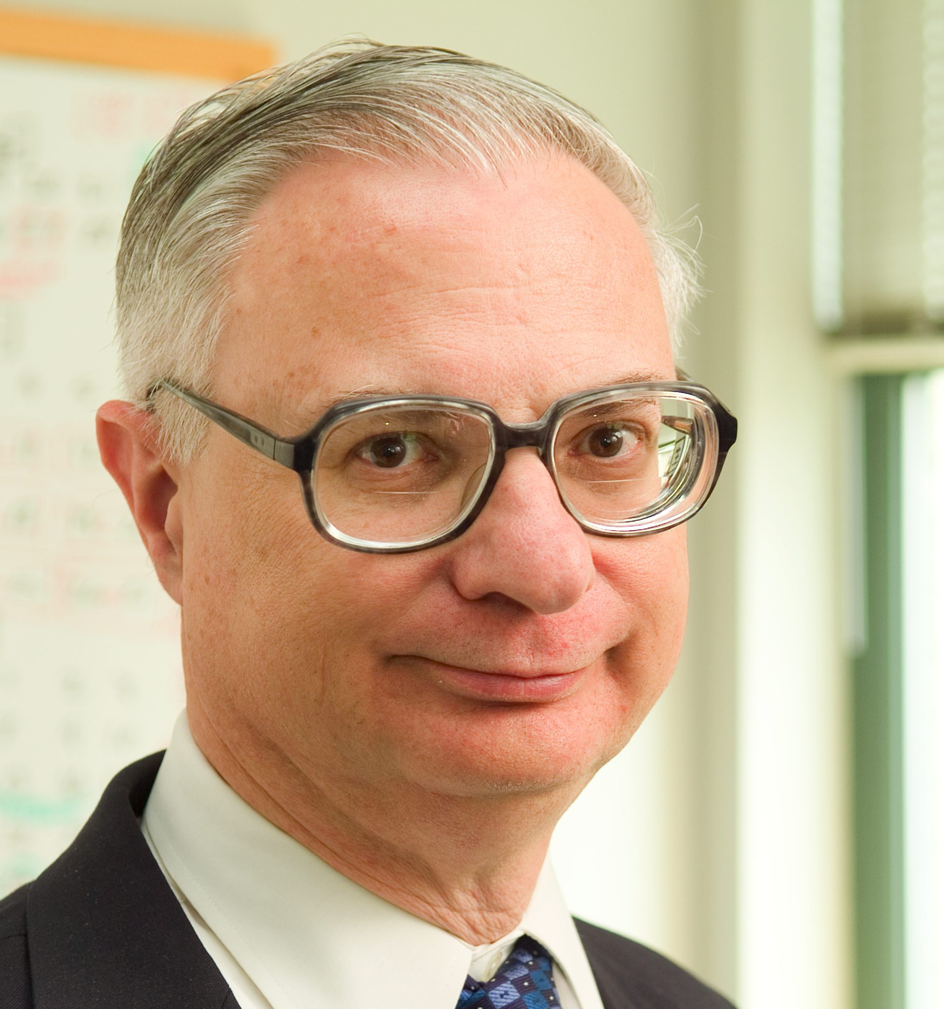
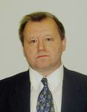


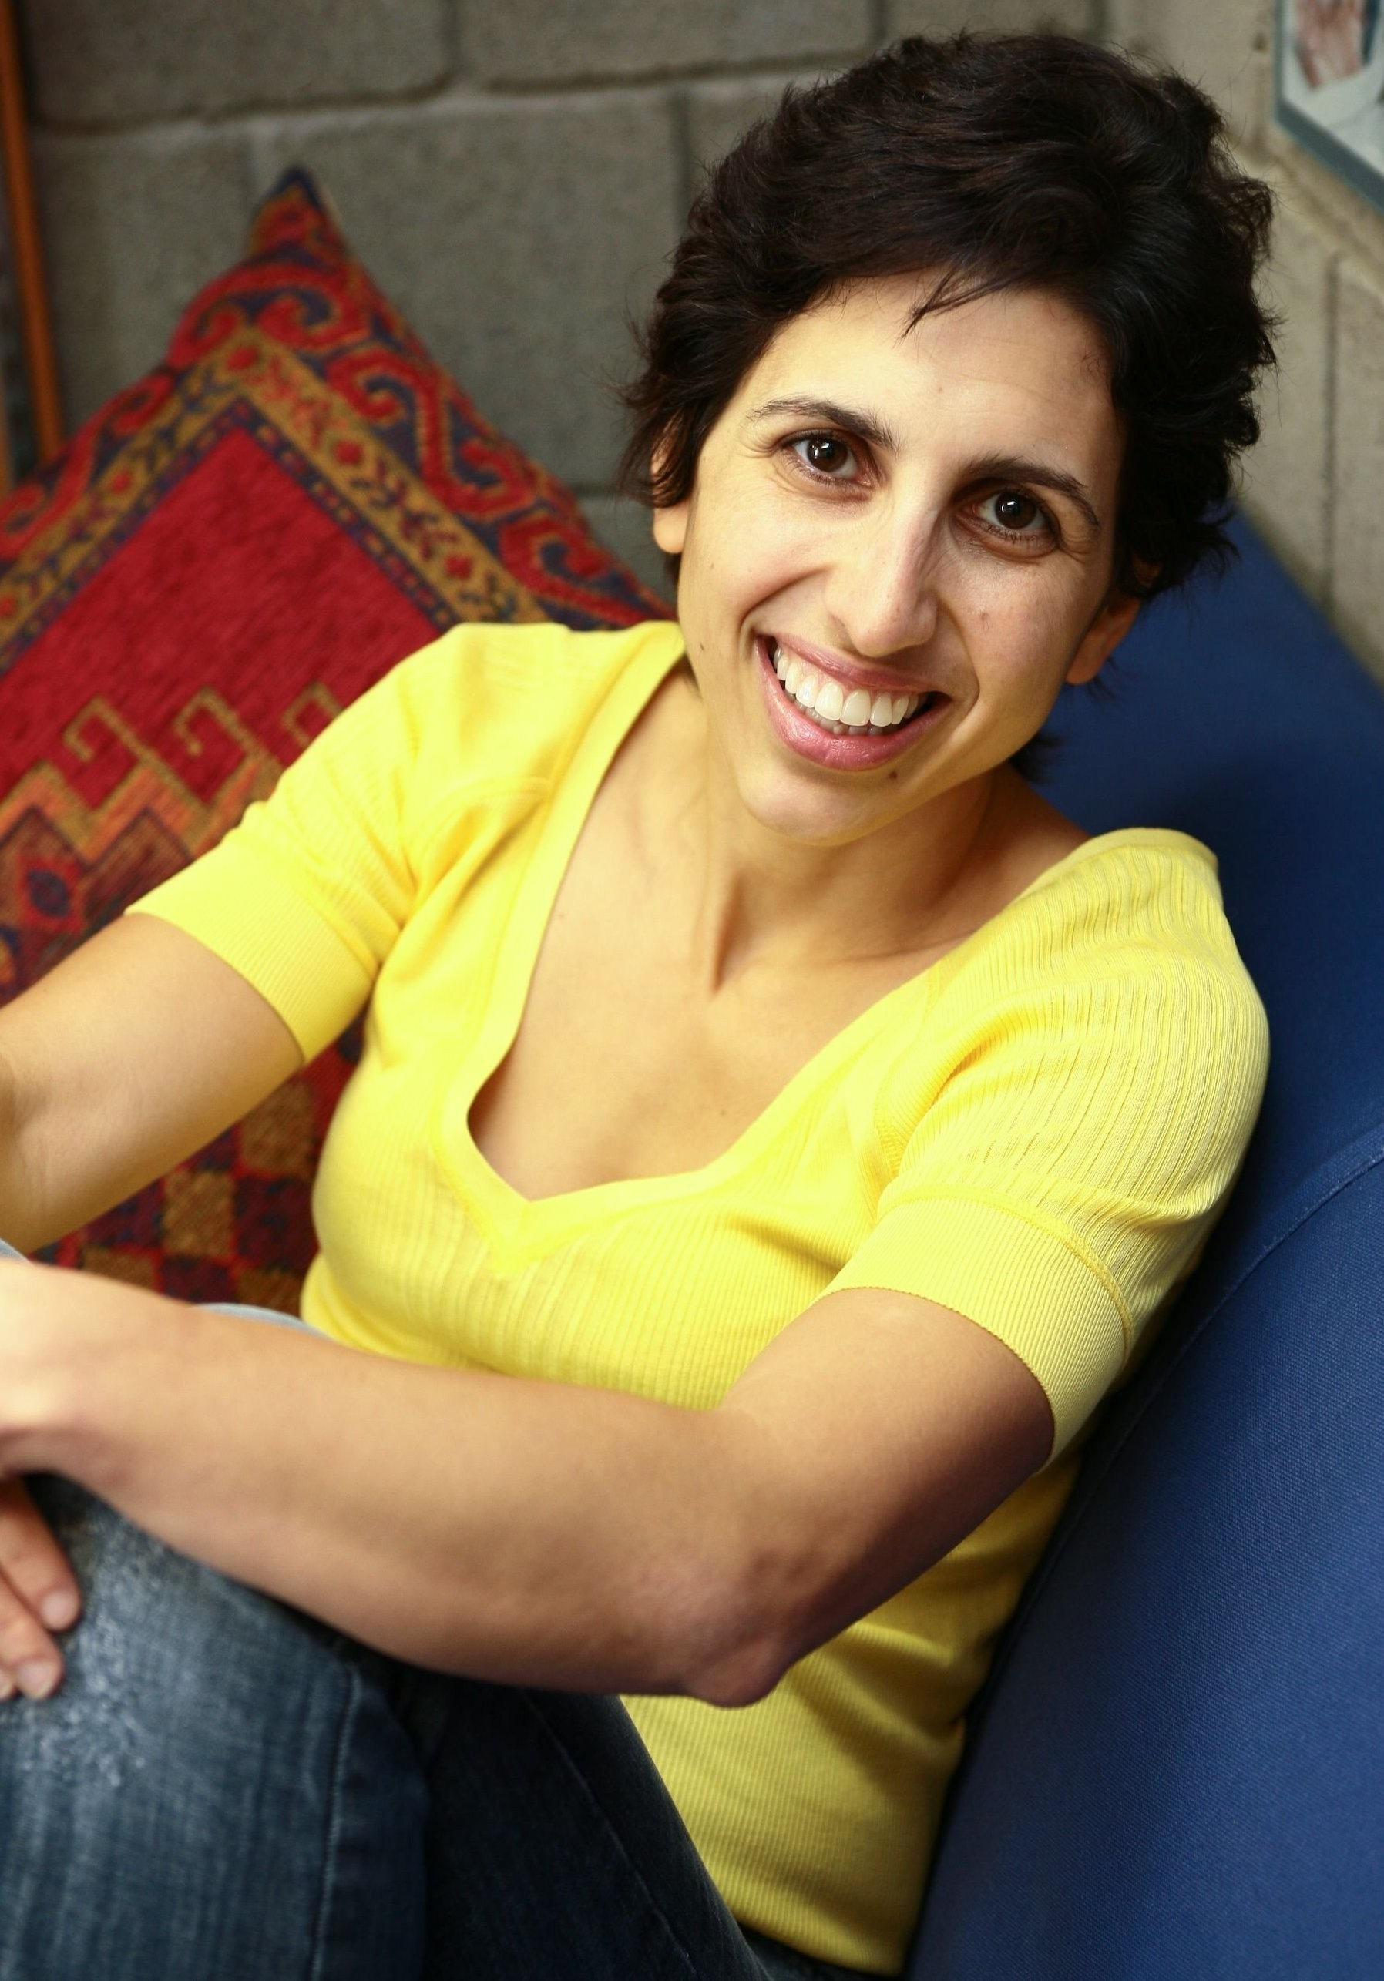
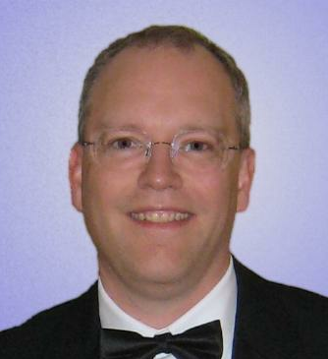
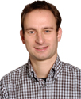
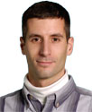


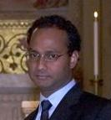

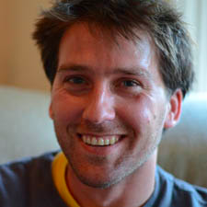
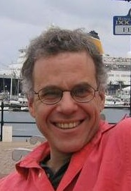
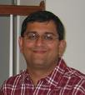
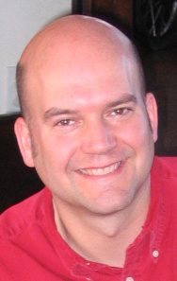

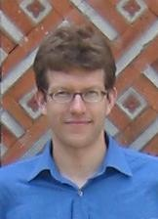
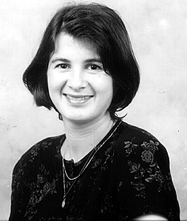

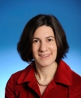
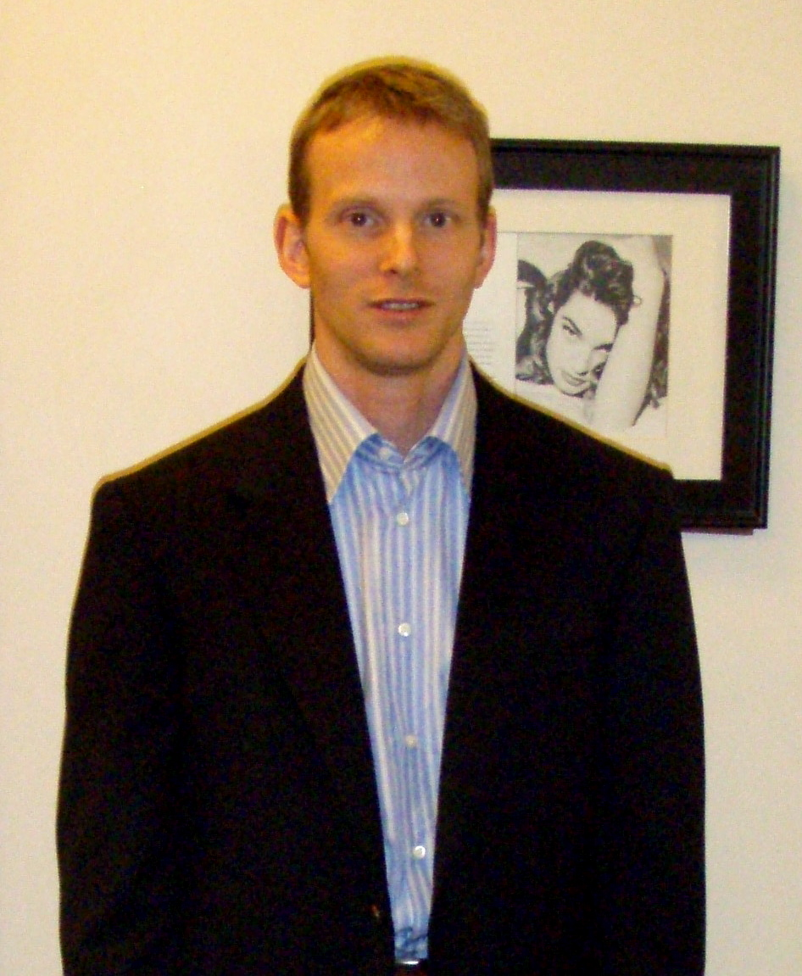

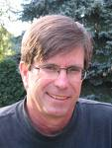

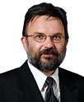
Notes:
Impossible to cover all research in this talk. You should talk with the faculty members you are interested in!

Slide 6




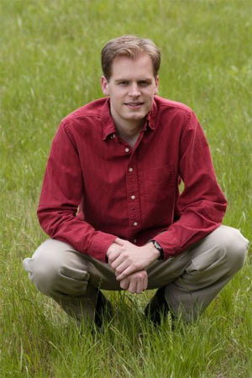
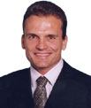

Computer Systems
Computer Architecture
  Seth Goldstein, James Hoe, Diana Marculescu, Todd Mowry, Onur Mutlu, David O’Hallaron
Security
  Lujo Bauer, David Brumley, Lorrie Cranor, Anupam Datta, Adrian Perrig, Virgil Gligor
Networks
  Hyong Kim, Srinivasan Seshan, Peter Steenkiste, Hui Zhang, Rohit Negi
Data Storage
  Greg Ganger, Garth Gibson
Embedded Systems
  Priya Narasimhan, Phil Koopman, Raj Rajkumar, Dan Siewiorek, Asim Smailagic
Fast Computing
  Franz Franchetti, Markus Püschel
Silicon Valley
  Martin Griss, Jason Lohn, Joy Zhang, Pei Zhang, Collin Jackson,
  Patrick Tague
And Others

Slide 7
Collaboration is Natural at CMU
Within the Systems Area
Across Areas: Systems, Circuits, Theory
Across Departments: ECE, CSD, RI, EPP, …
With Many Partners in Computing Industry

Slide 8
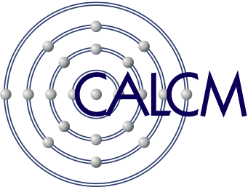

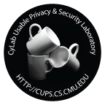
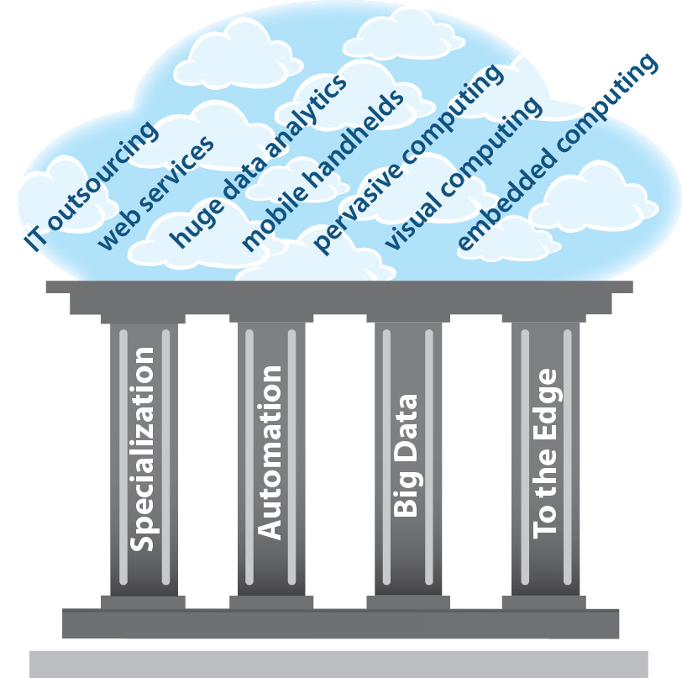
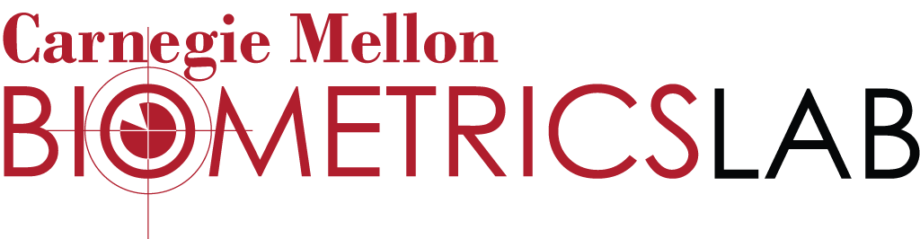
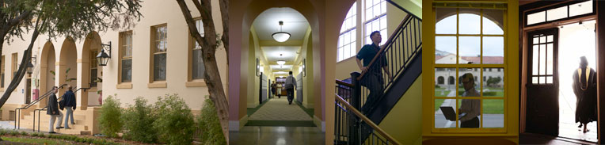

CMU Silicon Valley

Slide 9
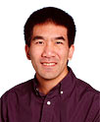

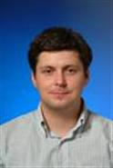
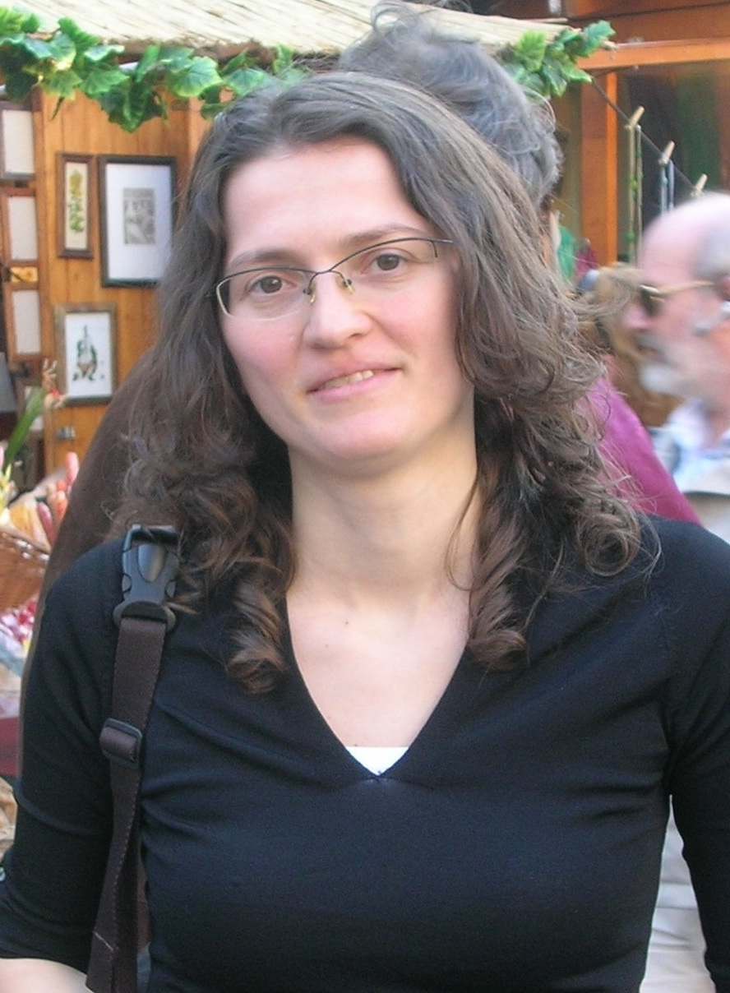
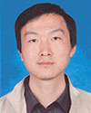
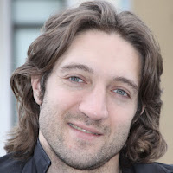
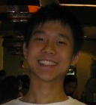
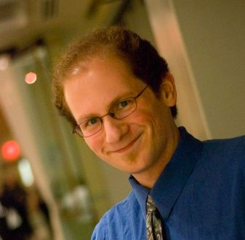
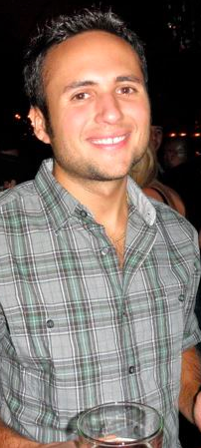
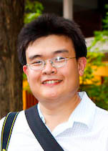
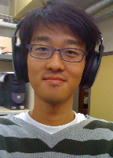

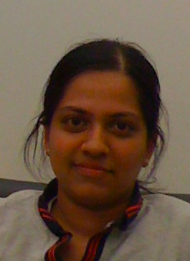
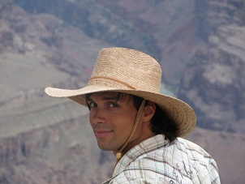
A Personal Example
Students Drive Research

Slide 10
An Exciting and Collaborative Place to Fundamentally Change the Way Future Computers are Designed
Cloud Computing Research
Embedded Computing Research

Slide 11
Cloud Computing
Cloud computing: use someone else’s computers instead of buying/maintaining your own
Promises huge benefits in…
  resource efficiency: consolidation
  agility and productivity of application development
  system and service robustness
  data sharing and end user access
But, hype far ahead of capability & knowledge
  huge need for fundamental research and understanding at many levels
Notes:
Huge potential efficiency benefits
Consolidation
Higher server utilization (7-25% -> 70+%)
Economies of scale
E.g., HP went from 80+ data centers to 6
and saved $1B/year… over 60% of total annual expense
Aggregation
One set of experts doing it for many
Instead of each for themselves
Huge productivity benefits (Rapid deployment)
Rent when ready and scale as need
Rather than specify, buy, deploy, setup, then start

Slide 12
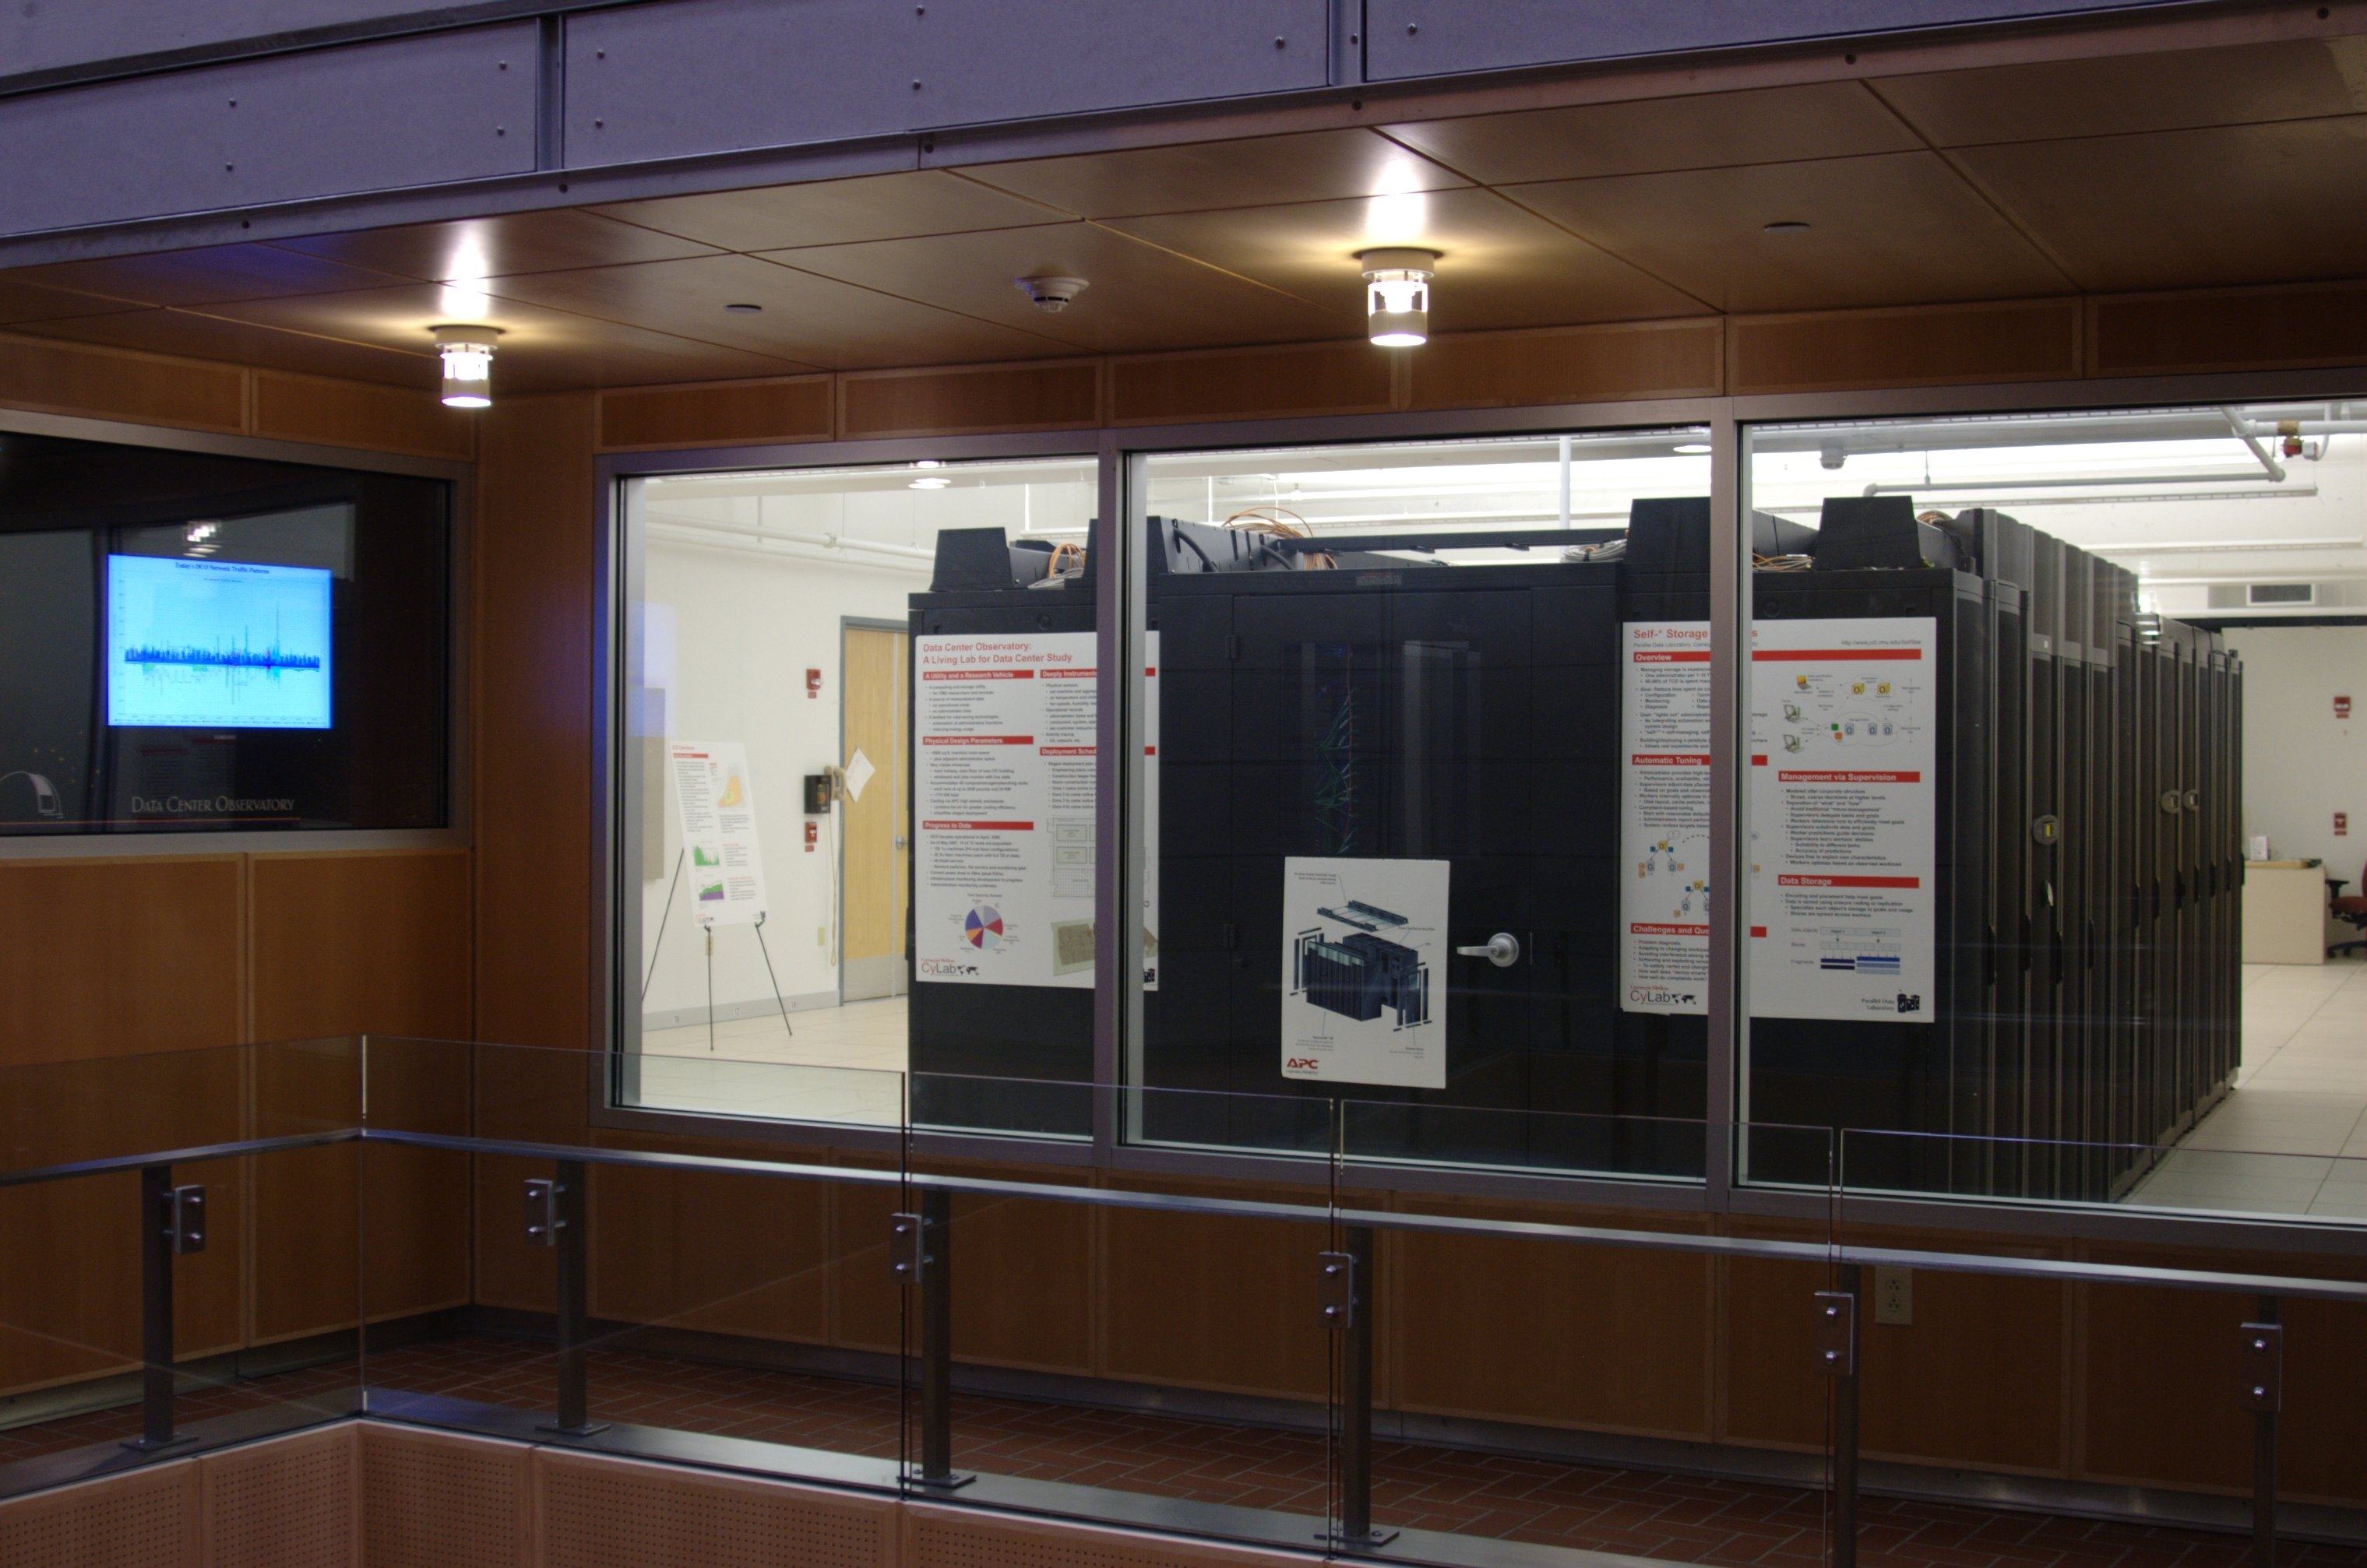
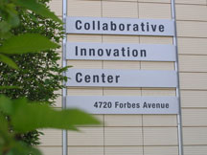
The Beginnings: PDL’s Data Center Observatory
PDL Consortium: $7M over last decade
APC, EMC, Facebook, Google, HP, Hitachi, Intel, Microsoft, NEC, NetApp, Oracle, Panasas, Riverbed, Samsung, Seagate, STEC, Symantec, VMware

Slide 13
The Parallel Data Lab
Academia’s Premier Storage Systems Lab!
Selected Research Topics
(Too many to list here!)
Very Successful History
Founded in 1992
Numerous best paper awards
Excellent partnership with industry
Successful public code deployments
New storage architectures
Distributed storage systems
File & database systems
Storage management
Secure storage systems
Home media systems
Data organization & search
Virtual machines
Applying new technologies
Significant Industry Involvement
17 member companies!
Two annual on-campus events
Access to the industry leaders
Check out www.pdl.cmu.edu for the whole story!

Slide 14
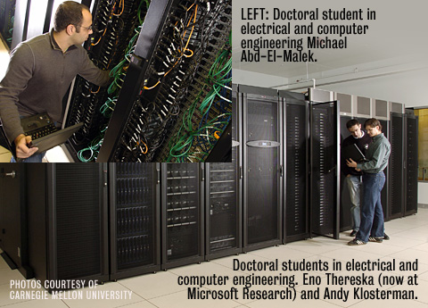
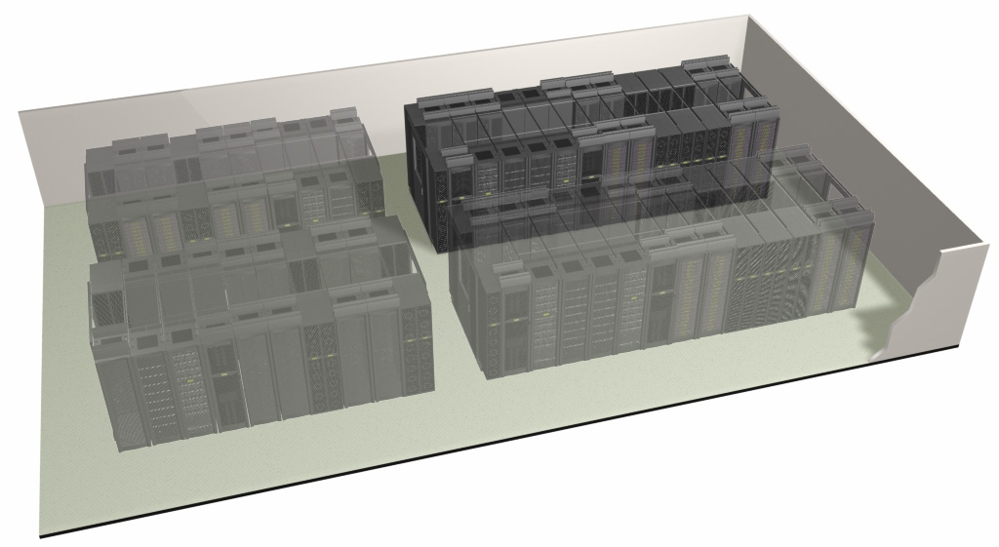
The Parallel Data Lab
Academia’s Premier Storage Systems Lab!
Data Center Observatory
Showcase lab and computing resource
OpenCirrus and OpenCloud clusters
10 gbit network, PVFS storage, state of the art cooling, …
“Top 10 Cool University Lab” –NetworkWorld
A true systems research group
exploring a wide range of systems topics.

Slide 15
PDL Facts
Established: 1992
Faculty involved: 25
  Career pubs >1,800, citations ~30,000
PhD+MS graduated: 57+53
  Faculty at Berkeley, Stanford, MIT, Toronto, ...
  Key technical leaders at EMC, Seagate, Intel, …
Papers published: >200
  FAST 2011, 2010, 2009, 2008, 2007, 2005, 2004, 2003, 2002
  SOSP 2011, 2009, 2007, 2005; HotOS 2010, 2009, 2003
  NSDI 2011, 2007, 2006; SIGCOMM 2009
  ATC 2010, 2007, 2006, 2005, 2003, 2002
  SIGMETRICS 2008, 2007, 2006, 2004, 2002
  ICDE 2007, 2004, 2002; VLDB 2010, 2007, 2004, 2003, 2002; SIGMOD 2005, 2003
  SC 2011, 2009, 2005, 2004; HPDC 2010; SciDAC 2007; PDSW 2009, 2008, 2007
  ISCA 2011; HPCA 2010; MICRO 2010; ISCA 2009; ASPLOS 2004; Computer 2010, 2006, DSN 2010, 2006, 2004; HotDep 2009, 2006
Awards: Last 5 years: 54; Prior 5 years: 32
  2011 SOSP Hall of Fame
  2011 IEEE Young Computer Architect
  2011 ACM Graduate Student Research
  …
Notes:
Stats from ACM DL
Stanford (Jure Leskovec), Berkeley (Ion Stoica, Dawn Song), MIT (Stavros Harizopoulos)
Toronto (Bianca Schroeder, Angela Demke Brown), Michigan (Shuheng Zhou), Tsinghua (Likun Liu), Northwestern (Nikos Hardavellas), Amherst (Kinman Au)

Slide 16
Storage/Cloud Systems Themes
Scalability
  Performance demand drives ever more devices
Manageability
  Human costs cannot grow with scale
Models of Computation: Data-Intensive Computing
  BigData needs simple tools for processing massive data
Anticipating & Exploiting New Technology
  Non-volatile memory devices & non-overwrite disks
  New hardware/software stacks, new failure modes, new efficiencies

Slide 17
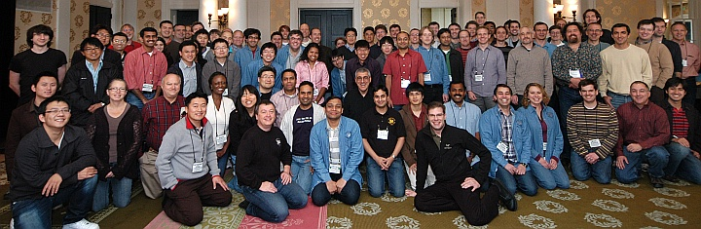
PDL Retreat 2011
Strong Industry Following, Collaboration, Feedback

Slide 18
Intel Science & Technology Center for Cloud Computing (ISTC-CC)
5-institution community enabling the promise
  led by Carnegie Mellon and Intel
  including Georgia Tech, Princeton, and UC-Berkeley
  homed at Carnegie Mellon; 4 Intel researchers onsite
Focus on critical enabling technologies
  foundations on which future clouds will be built
    complementing evolution of early cloud building blocks
  work with researchers exploring new cloud apps
    e.g., ISTCs on visual, pervasive, and embedded
Broad, aggressive 5-year research agenda

Slide 19
ISTC-CC Research Pillars Build Foundation

Slide 20
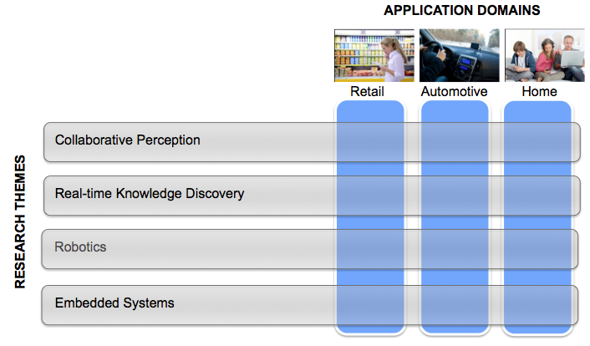
Intel Science & Technology Center for Embedded Computing (ISTC-EC)

Slide 21
Cross-cutting Centers and Research
Problem
Algorithm
CMU is a great place to do cross-cutting, cross-layer research across the computing stack
Program/Language
User
Runtime System
(VM, OS, MM)
ISA
Microarchitecture
Logic
Circuits
Electrons

Slide 22
An Exciting and Collaborative Place to Fundamentally Change the Way Future Computers are Designed
Computer Architecture Research

Slide 23
Computer Architecture Lab at Carnegie Mellon
10-20 years from now
  What is the hardware like?
  What are the hardware/software interfaces?
  What is the software like?

Slide 24

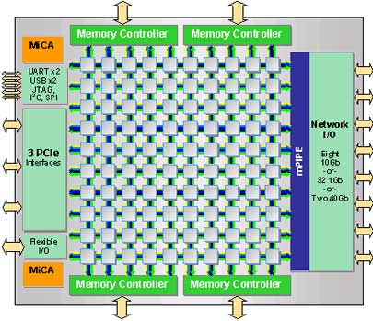
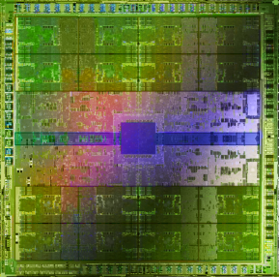
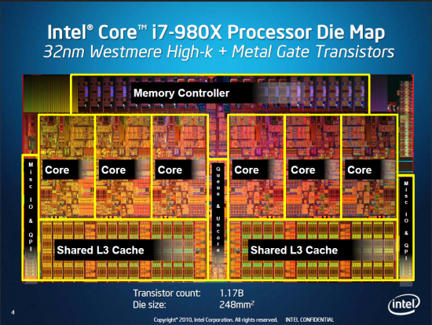
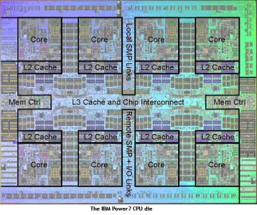

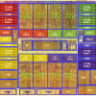
Onur Mutlu
Computer Architecture
and Systems
Research Focus: Computer architecture, HW/SW, bioinformatics
many-core systems, scalable parallelism, bottleneck acceleration
memory systems, interconnects
hardware/software interaction, alternative models
energy efficiency, fault tolerance, hardware security
Some Big Questions:
How do we design very efficient 1000-core systems?
Can we put the entire data center on a single chip?
Can we find alternatives to multi-core?
What is the HW/SW interface and chip of 2030 AD?
Intel Core i7
8 cores
Tilera TILE Gx
100 cores
Nvidia Fermi
448 “cores”
IBM POWER7
8 cores
AMD Barcelona
4 cores
Sun Niagara II
8 cores
Notes:
Professor Mutlu’s research focus is all aspects of computer hardware architecture. Current projects are in many-core systems, memory systems, HW/SW interaction, fault tolerance, and hardware security.
The main theme of his research group is to devise scalable, efficient, high-performance hardware architectures that are 10-20 years out into the future.
Some big questions his research group is trying to answer are:
How do we design very efficient 1000-core systems?
Can we put the entire data center on a single chip?
Can we find alternatives to multi-core?
What is the HW/SW interface and chip of 2030 AD?
Mutlu is looking for bright students interested in the general area of computer architecture. Here is a sampling of some of the topic areas his group is currently investigating.

Slide 25
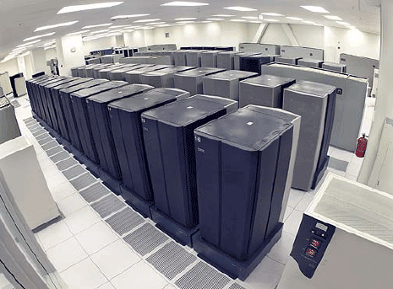
Example: Cloud Computers on a Chip
Can we put the entire cloud computer (data center) on a single chip?
QoS and security: How to ensure every app gets the performance it needs?
Energy-efficiency: How to customize hardware to application on the fly?
Asymmetry: How to design and exploit it in many-core systems?
Interconnects: What are efficient communication algorithms?
???

Slide 26
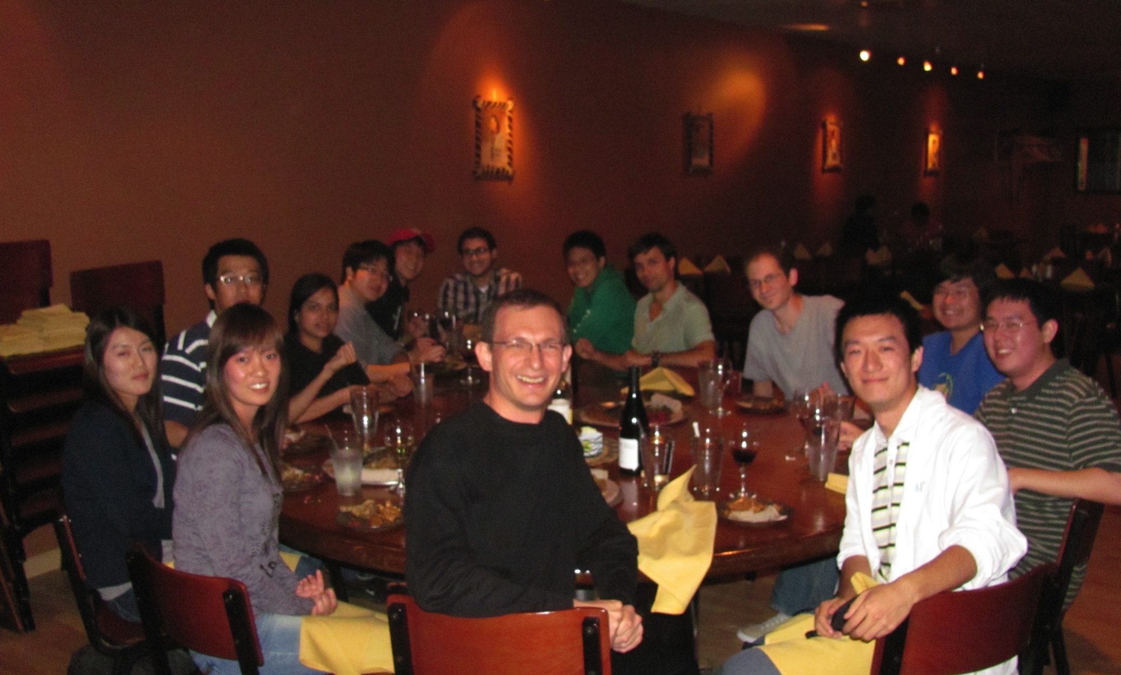

Slide 27
Impact
Intel, AMD, IBM and Oracle processor designs
  POWER6, Sun ROCK
Memory controller designs in multi-core chip companies
  New OS/hardware interfaces
Novel (emerging) scalable memory designs now being investigated widely by industry
  New software/hardware interfaces; data management

Slide 28
Many Faculty Members Have Multiple Research Interests
Talk with them to find out their style and future topics

Slide 29
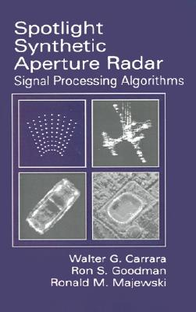




Spiral: Computers Programming Computers
Programming
Synthesis
COTS
Intel
Special hardware
Cell blade
Result
Same performance, 1/10th human effort, non-expert user
Key ideas
restrict domain, use mathematics, performance portability
Franz
Franchetti
D. McFarlin, F. Franchetti, M. Püschel, and J. M. F. Moura: High Performance Synthetic Aperture Radar Image Formation On Commodity Multicore Architectures. in Proceedings SPIE, 2009.
Notes:
Spiral is an example of high-level domain-specific code generation or code synthesis. We input into Spiral algorithm knowledge and architecture knowledge as well as program transformations/optimizations. Once Spiral “knows” these things, it behaves like a human expert programmer talking to an expert algorithm designer, who jointly produce highly optimized software for a given functionality and platform.
One demonstration was to compare our tool against industry-written RADAR image formation code.
A defense contractor implemented a polar formatting SAR image formation algorithm (taking a photo with RADAR)0 for the Cell processor. The work is documented in a paper that won the best paper award (Rudin:2007). We then worked with them to formalize their algorithm in Spiral and had Spiral generate the SAR image formation algorithm instances according to the specification in their paper.
A non-expert then was using our tool to generate a SAR implementation according to the paper specs that was outperforming the expert implementation on a much weaker machine (Intel Quadcore vs. Cell blade).
This is an example of successfully converting a high-level algorithm description into extremely competitive code. The Spiral produced scary 13MB code from the algorithm specification, pulling all the tricks no human programmer would dare to try (but dream to do if only possible).

Slide 30







Hyong S. Kim
Drew D. Perkins Professor
Department of ECE
kim@ece.cmu.edu
Scalable Switching System
Network Control & Management
Cloud Computing Control & Management
Control theoretic approach to VM management
Dynamic resource allocation of VM
Analytical framework for VM
Fault-tolerant control plane
Self-healing network operation
Wireless control & management
Scalable and dependable systems
Notes:
Major focus of our work is in management of complex systems.
How to manage effectively and efficiently as the operational costs
are becoming dominant compared to capital costs.

Slide 31


CoRAM Memory Architecture
Can we make reconfigurable fabric a first-class computing device?
Memory and I/O is Hard on FPGA
Proposed Solution [Chung, FPGA’11]
  extend capability of FPGA SRAMs to act as universal portals to memory and I/O
  built-in NoC provides data transport
  replace rigid platform interfaces with
  portable software control threads
Channels
Software
Control Threads
Core Logic
CoRAM
Memory
User-Level Abstraction
Multiple Target Platforms
FPGA
Platform
(e.g., Altera)
James Hoe
Notes:
So let’s begin with a brief review of CoRAM. With today’s practices, FPGAs are known to have a lot of pain points, one of the major ones is how an application interacts with memory and I/O.
When an application needs to talk to memory, the user is often responsible for building a custom memory hierarchy from scratch. The application must conform to rigid, platform- and device-specific interfaces and gateware, some of which even the user designs himself. Furthermore, the user is responsible for efficiently distributing this data from the interfaces to the application, which often entails building an application-specific network-on-chip.
Last year, we presented a solution called the CoRAM memory architecture. The idea behind CoRAM is to present an abstracted view of the FPGA’s memory resources, that in itself can be re-targeted automatically to different devices, and platforms.
The CoRAM memory architecture restricts all communication between the application and DRAM and I/O using the FPGA’s built-in SRAMs. The distributed SRAMs are backed and interconnected by a built-in network-on-chip that automatically facilitates the on-chip data distribution required by the application.
Last but not least, a key feature of CoRAM is the idea of replacing the conventional, platform-specific control logic with a high-level, software control thread abstraction that can be made portable and easy-to-use for general-purpose applications.

Slide 32




Prototype Release
Online Tool Live Now
  users can generate “soft” CoRAM designs automatically
  ML605 target, more coming
  video tutorials
  www.ece.cmu.edu/~coram
Source Release (Limited)
  Compiler, soft macro blocks
  Verilog design examples, tutorials

Slide 33

Designing “Human” Embedded Systems
Radu Marculescu
Off-line DSE
traits 2
traits 1
Modeling user behavior and interaction w/ the system; Develop efficient techniques for run-time application mapping and resource management
On-line
optimization
Notes:
In this project, we bring together machine learning and embedded systems design techniques, while taking into consideration both application characteristics and users behavior. More precisely, we envision a combination of an off-line design space exploration (DSE) and an on-line optimization technique that incorporate the user’s behavior over time into the design process. Towards this end, we first cluster the user traces into k distinct classes such that all users belonging to the same cluster have a similar behavior while interacting with the target system. (see the top part and the lower left hand side part of this of this figure). The parameter k is a given design parameter which can be determined by the market survey or from previous design experience. Then, we define two metrics, namely the inter-application similarity and the application usage similarity, and apply the k-mean clustering method for this process.
During the second step of this approach, for each cluster of traces, our goal is to generate a suitable multiprocessor platform where communication is based on network-on-chip (NoC), while meeting the design constraints (see the lower part of this figure). This automation process includes two critical steps: Step 1 is to select the computational resources, that is to decide the number and the type of resources needed to build the platform. The second step is to allocate the resource to 2-D NoC tiles. Finally, we generate k platforms at design time and each platform is suitable for this class of users. Therefore, most likely users will be satisfied with the platform, and we can further apply light-weight run-time strategies to make the best use of the available resources.
Overall, this project is fits well ECE and CS type of backgrounds.

Slide 34
An Exciting and Collaborative Place to Fundamentally Change the Way Future Computers are Designed
Security Research

Slide 35
What is CyLab?
World’s Premier Academic Research Center for Cyber Security
  One of largest U.S. university-based research & education programs for cyber security, dependability & privacy
  Nationally Recognized
    National Science Foundation (NSF) CyberTrust Center
    National Security Agency (NSA)
    Center of Academic Excellence in Information Assurance Education
  Many awards
    ACM Best Doctoral Dissertation Award 2011
  Cross-disciplinary, university-wide program
    Faculty and researchers from six colleges of Carnegie Mellon
    50+ faculty/researchers and
    130+ graduate students
  Funded by both private & public sectors
    Gov’t like NSA, DARPA, NSF
    Companies like Lockheed Martin, Booz Allen, Northrop Grumman, and others.

Slide 36

What Does CyLab Do?
Cross-Cutting CyLab Research Thrusts

Slide 37





CyLab Researchers & Collaboration
Access Control
Availability
Lujo
Bauer
Network Security
Jon
McCune
David
Brumley
Crypto
Adrian
Perrig
Trusted Computing
Anupam
Datta
Marios Savvides
Usability & Privacy
Lorrie
Cranor
Bruno Sinopoli
Threat Analysis & Response
Virgil
Gligor
Software Security
Patrick
Tague
Collin
Jackson
Pei
Zhang
Philip Koopman
Average In Degree: > 2

Slide 38
One Example
Trusted computing:
Can I make sure critical functionality works even if hacked?

Slide 39
TrustVisor
Faculty: Anupam Datta, Virgil Gligor, Adrian Perrig
Goals
  Secure execution of security-sensitive code S
  No need to trust OS, applications, local hardware devices
  TrustVisor ensures code integrity, data secrecy and integrity
Legend:
App
App
Untrusted
S
OS
Trusted
V
Verified
TrustVisor
HW

Slide 40
CMU is a Great Environment

Slide 41










Collaborative (and Social)

Slide 42

Collaborative (and Social)

Slide 43
Collaboration → High Impact → More Collaboration

Slide 44
An Exciting and Collaborative Place to Fundamentally Change the Way Future Computers are Designed

Slide 45
Summary
Great people
Doing a great breadth of great research
With great synergy, collaboration and friendship
Focus on fundamentals and key future problems → High industry impact
Great environment
Thank you
onur@cmu.edu

Slide 46
Computer Systems in ECE @CMU
as told by
Onur Mutlu
(on behalf of many)
ECE Open House 2012

