Slide 1
Memory Systems in the Many-Core Era: Some Challenges and Solution Directions
Onur Mutlu
onur@cmu.edu
June 5, 2011
ISMM/MSPC

Slide 2
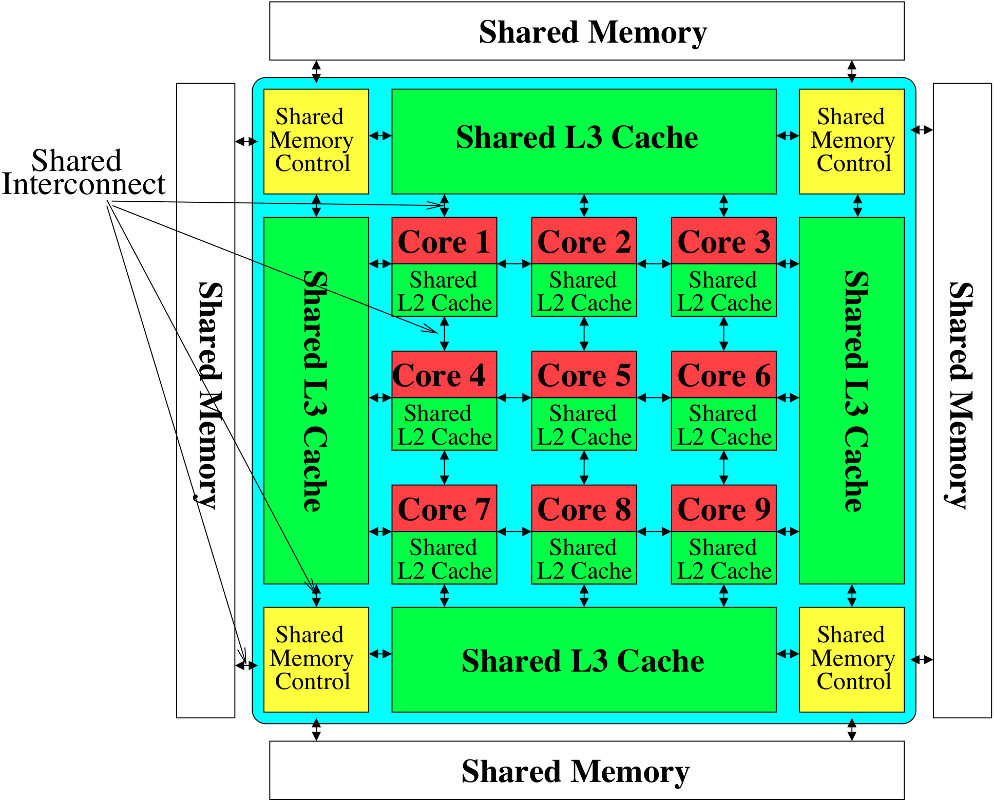
Modern Memory System: A Shared Resource

Slide 3
The Memory System
The memory system is a fundamental performance and power bottleneck in almost all computing systems: server, mobile, embedded, desktop, sensor
The memory system must scale (in size, performance, efficiency, cost) to maintain performance and technology scaling
Recent technology, architecture, and application trends lead to new requirements from the memory system:
Scalability (technology and algorithm)
Fairness and QoS-awareness
Energy/power efficiency

Slide 4
Agenda
Technology, Application, Architecture Trends
Requirements from the Memory Hierarchy
Research Challenges and Solution Directions
Main Memory Scalability
QoS support: Inter-thread/application interference
Summary

Slide 5
Technology Trends
DRAM does not scale well beyond N nm [ITRS 2009, 2010]
Memory scaling benefits: density, capacity, cost
Energy/power already key design limiters
Memory hierarchy responsible for a large fraction of power
IBM servers: ~50% energy spent in off-chip memory hierarchy [Lefurgy+, IEEE Computer 2003]
DRAM consumes power when idle and needs periodic refresh
More transistors (cores) on chip
Pin bandwidth not increasing as fast as number of transistors
Memory is the major shared resource among cores
More pressure on the memory hierarchy

Slide 6
Application Trends
Many different threads/applications/virtual-machines (will) concurrently share the memory system
Cloud computing/servers: Many workloads consolidated on-chip to improve efficiency
GP-GPU, CPU+GPU, accelerators: Many threads from multiple applications
Mobile: Interactive + non-interactive consolidation
Different applications with different requirements (SLAs)
Some applications/threads require performance guarantees
Modern hierarchies do not distinguish between applications
Applications are increasingly data intensive
More demand for memory capacity and bandwidth

Slide 7
Architecture/System Trends
Sharing of memory hierarchy
More cores and components
More pressure on the memory hierarchy
Asymmetric cores: Performance asymmetry, CPU+GPUs, accelerators, …
Motivated by energy efficiency and Amdahl’s Law
Different cores have different performance requirements
Memory hierarchies do not distinguish between cores
Different goals for different systems/users
System throughput, fairness, per-application performance
Modern hierarchies are not flexible/configurable

Slide 8
Summary: Major Trends Affecting Memory
Need for main memory capacity and bandwidth increasing
New need for handling inter-application interference; providing fairness, QoS
Need for memory system flexibility increasing
Main memory energy/power is a key system design concern
DRAM is not scaling well

Slide 9
Agenda
Technology, Application, Architecture Trends
Requirements from the Memory Hierarchy
Research Challenges and Solution Directions
Main Memory Scalability
QoS support: Inter-thread/application interference
Summary

Slide 10
Requirements from an Ideal Memory System
Traditional
High system performance
Enough capacity
Low cost
New
Technology scalability
QoS support and configurability
Energy (and power, bandwidth) efficiency

Slide 11
Requirements from an Ideal Memory System
Traditional
High system performance: Need to reduce inter-thread interference
Enough capacity: Emerging tech. and waste management can help
Low cost: Other memory technologies can help
New
Technology scalability
Emerging memory technologies (e.g., PCM) can help
QoS support and configurability
Need HW mechanisms to control interference and build QoS policies
Energy (and power, bandwidth) efficiency
One-size-fits-all design wastes energy; emerging tech. can help?

Slide 12
Agenda
Technology, Application, Architecture Trends
Requirements from the Memory Hierarchy
Research Challenges and Solution Directions
Main Memory Scalability
QoS support: Inter-thread/application interference
Summary

Slide 13
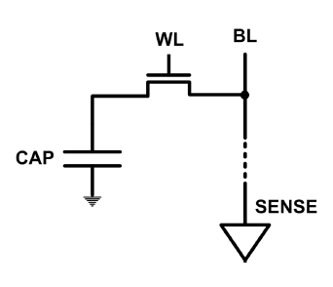
The DRAM Scaling Problem
DRAM stores charge in a capacitor (charge-based memory)
Capacitor must be large enough for reliable sensing
Access transistor should be large enough for low leakage and high retention time
Scaling beyond 40-35nm (2013) is challenging [ITRS, 2009]
DRAM capacity, cost, and energy/power hard to scale

Slide 14
Concerns with DRAM as Main Memory
Need for main memory capacity and bandwidth increasing
DRAM capacity hard to scale
Main memory energy/power is a key system design concern
DRAM consumes high power due to leakage and refresh
DRAM technology scaling is becoming difficult
DRAM capacity and cost may not continue to scale

Slide 15
Possible Solution 1: Tolerate DRAM
Overcome DRAM shortcomings with
System-level solutions
Changes to DRAM microarchitecture, interface, and functions

Slide 16
Possible Solution 2: Emerging Technologies
Some emerging resistive memory technologies are more scalable than DRAM (and they are non-volatile)
Example: Phase Change Memory
Data stored by changing phase of special material
Data read by detecting material’s resistance
Expected to scale to 9nm (2022 [ITRS])
Prototyped at 20nm (Raoux+, IBM JRD 2008)
Expected to be denser than DRAM: can store multiple bits/cell
But, emerging technologies have shortcomings as well
Can they be enabled to replace/augment/surpass DRAM?

Slide 17
Phase Change Memory: Pros and Cons
Pros over DRAM
Better technology scaling (capacity and cost)
Non volatility
Low idle power (no refresh)
Cons
Higher latencies: ~4-15x DRAM (especially write)
Higher active energy: ~2-50x DRAM (especially write)
Lower endurance (a cell dies after ~10⁸ writes)
Challenges in enabling PCM as DRAM replacement/helper:
Mitigate PCM shortcomings
Find the right way to place PCM in the system
Ensure secure and fault-tolerant PCM operation

Slide 18
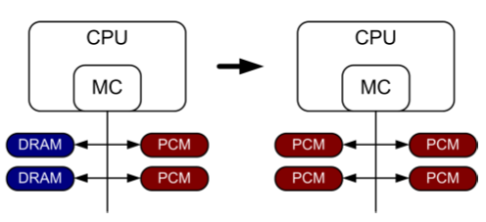
PCM-based Main Memory (I)
How should PCM-based (main) memory be organized?
Hybrid PCM+DRAM [Qureshi+ ISCA’09, Dhiman+ DAC’09]:
How to partition/migrate data between PCM and DRAM
Energy, performance, endurance
Is DRAM a cache for PCM or part of main memory?
How to design the hardware and software
Exploit advantages, minimize disadvantages of each technology

Slide 19
PCM-based Main Memory (II)
How should PCM-based (main) memory be organized?
Pure PCM main memory [Lee et al., ISCA’09, Top Picks’10]:
How to redesign entire hierarchy (and cores) to overcome PCM shortcomings
Energy, performance, endurance

Slide 20
PCM-Based Memory Systems: Research Challenges
Partitioning
Should DRAM be a cache or main memory, or configurable?
What fraction? How many controllers?
Data allocation/movement (energy, performance, lifetime)
Who manages allocation/movement?
What are good control algorithms?
Latency-critical, heavily modified → DRAM, otherwise PCM?
Preventing denial/degradation of service
Design of cache hierarchy, memory controllers, OS
Mitigate PCM shortcomings, exploit PCM advantages
Design of PCM/DRAM chips and modules
Rethink the design of PCM/DRAM with new requirements

Slide 21
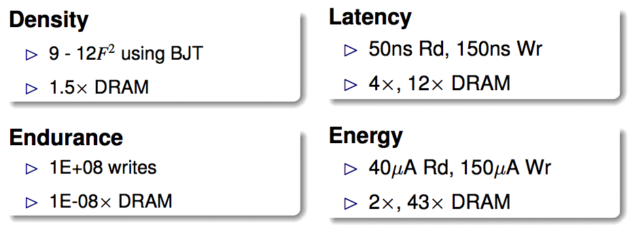
An Initial Study: Replace DRAM with PCM
Lee, Ipek, Mutlu, Burger, “Architecting Phase Change Memory as a Scalable DRAM Alternative,” ISCA 2009.
Surveyed prototypes from 2003-2008 (e.g. IEDM, VLSI, ISSCC)
Derived “average” PCM parameters for F=90nm

Slide 22
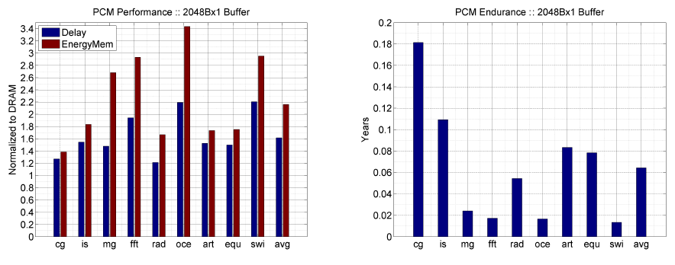
Results: Naïve Replacement of DRAM with PCM
Replace DRAM with PCM in a 4-core, 4MB L2 system
PCM organized the same as DRAM: row buffers, banks, peripherals
1.6x delay, 2.2x energy, 500-hour average lifetime
Lee, Ipek, Mutlu, Burger, “Architecting Phase Change Memory as a Scalable DRAM Alternative,” ISCA 2009.

Slide 23
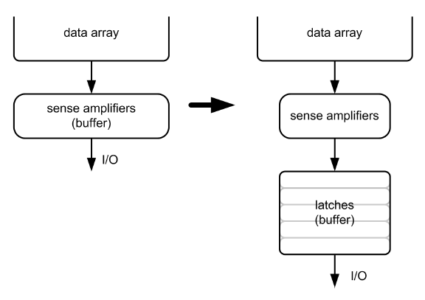
Architecting PCM to Mitigate Shortcomings
Idea 1: Use narrow row buffers in each PCM chip
→ Reduces write energy, peripheral circuitry
Idea 2: Use multiple row buffers in each PCM chip
→ Reduces array reads/writes → better endurance, latency, energy
Idea 3: Write into array at
cache block or word
granularity
→ Reduces unnecessary wear
DRAM
PCM

Slide 24
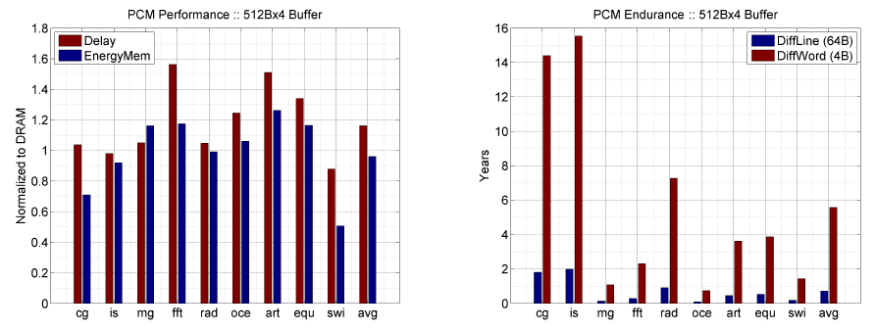
Results: Architected PCM as Main Memory
1.2x delay, 1.0x energy, 5.6-year average lifetime
Scaling improves energy, endurance, density
Caveat 1: Worst-case lifetime is much shorter (no guarantees)
Caveat 2: Intensive applications see large performance and energy hits
Caveat 3: Optimistic PCM parameters?

Slide 25
PCM as Main Memory: Research Challenges
Many research opportunities from technology layer to algorithms layer
Enabling PCM/NVM
How to maximize performance?
How to maximize lifetime?
How to prevent denial of service?
Exploiting PCM/NVM
How to exploit non-volatility?
How to minimize energy consumption?
How to minimize cost?
How to exploit NVM on chip?
Problems
Algorithms
Programs
User
Runtime System
(VM, OS, MM)
ISA
Microarchitecture
Logic
Devices

Slide 26
Agenda
Technology, Application, Architecture Trends
Requirements from the Memory Hierarchy
Research Challenges and Solution Directions
Main Memory Scalability
QoS support: Inter-thread/application interference
Summary

Slide 27
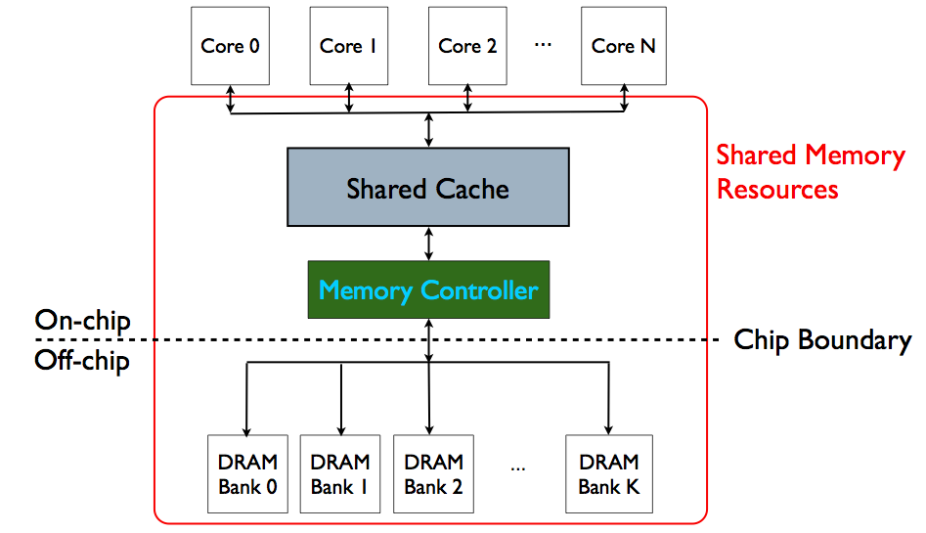
Memory System is the Major Shared Resource
threads’ requests
interfere

Slide 28
Inter-Thread/Application Interference
Problem: Threads share the memory system, but memory system does not distinguish between threads’ requests
Existing memory systems
Free-for-all, shared based on demand
Control algorithms thread-unaware and thread-unfair
Aggressive threads can deny service to others
Do not try to reduce or control inter-thread interference

Slide 29
Uncontrolled Interference: An Example
CORE 1
random
Multi-Core
Chip
stream
CORE 2
L2
CACHE
L2
CACHE
unfairness
INTERCONNECT
Shared DRAM
Memory System
DRAM MEMORY CONTROLLER
DRAM
Bank 0
DRAM
Bank 1
DRAM
Bank 2
DRAM
Bank 3

Slide 30
A Memory Performance Hog
// initialize large arrays A, B
for (j=0; j<N; j++) {
index = j*linesize;
A[index] = B[index];
…
}
// initialize large arrays A, B
for (j=0; j<N; j++) {
index = rand();
A[index] = B[index];
…
}
streaming
random
STREAM
RANDOM
Sequential memory access
Very high row buffer locality (96% hit rate)
Memory intensive
Random memory access
Very low row buffer locality (3% hit rate)
Similarly memory intensive
Moscibroda and Mutlu, “Memory Performance Attacks,” USENIX Security 2007.

Slide 31
What Does the Memory Hog Do?
Row decoder
T0: Row 0
T0: Row 0
T0: Row 0
T0: Row 0
T0: Row 0
T0: Row 0
T0: Row 0
T1: Row 5
T1: Row 111
T0: Row 0
T1: Row 16
T0: Row 0
Memory Request Buffer
Row 0
Row Buffer
Row 0
Column mux
Row size: 8KB, cache block size: 64B
128 (8KB/64B) requests of T0 serviced before T1
T0: STREAM
T1: RANDOM
Data
Moscibroda and Mutlu, “Memory Performance Attacks,” USENIX Security 2007.

Slide 32
Effect of the Memory Performance Hog
2.82X slowdown
Slowdown
1.18X slowdown
Results on Intel Pentium D running Windows XP
(Similar results for Intel Core Duo and AMD Turion, and on Fedora Linux)
Moscibroda and Mutlu, “Memory Performance Attacks,” USENIX Security 2007.

Slide 33
Problems due to Uncontrolled Interference
Main memory is the only shared resource
High priority
Memory performance hog
Low priority
Slowdown
Cores make
very slow
progress
Unfair slowdown of different threads [MICRO’07, ISCA’08, ASPLOS’10]
Low system performance [MICRO’07, ISCA’08, HPCA’10, MICRO’10]
Vulnerability to denial of service [USENIX Security’07]
Priority inversion: unable to enforce priorities/SLAs [MICRO’07]
Poor performance predictability (no performance isolation)

Slide 34
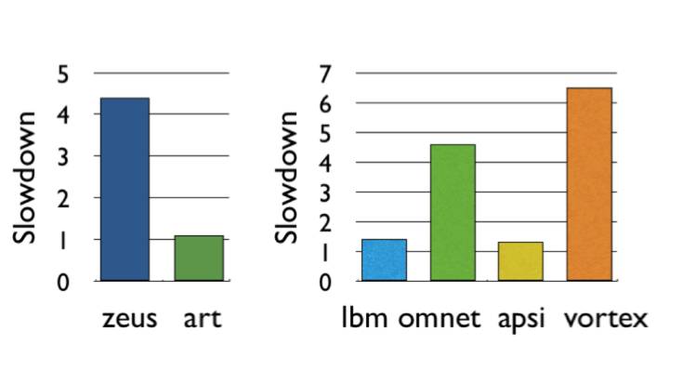
Problems due to Uncontrolled Interference
Unfair slowdown of different threads [MICRO’07, ISCA’08, ASPLOS’10]
Low system performance [MICRO’07, ISCA’08, HPCA’10, MICRO’10]
Vulnerability to denial of service [USENIX Security’07]
Priority inversion: unable to enforce priorities/SLAs [MICRO’07]
Poor performance predictability (no performance isolation)

Slide 35
How Do We Solve The Problem?
Inter-thread interference is uncontrolled in all memory resources
Memory controller
Interconnect
Caches
We need to control it
i.e., design an interference-aware (QoS-aware) memory system

Slide 36
QoS-Aware Memory Systems: Challenges
How do we reduce inter-thread interference?
Improve system performance and core utilization
Reduce request serialization and core starvation
How do we control inter-thread interference?
Provide mechanisms to enable system software to enforce QoS policies
While providing high system performance
How do we make the memory system configurable/flexible?
Enable flexible mechanisms that can achieve many goals
Provide fairness or throughput when needed
Satisfy performance guarantees when needed

Slide 37
Designing QoS-Aware Memory Systems: Approaches
Smart resources: Design each shared resource to have a configurable interference control/reduction mechanism
QoS-aware memory controllers [Mutlu+ MICRO’07] [Moscibroda+, Usenix Security’07] [Mutlu+ ISCA’08, Top Picks’09] [Kim+ HPCA’10] [Kim+ MICRO’10, Top Picks’11]
QoS-aware interconnects [Das+ MICRO’09, ISCA’10, Top Picks ’11] [Grot+ MICRO’09, ISCA’11]
QoS-aware caches
Dumb resources: Keep each resource free-for-all, but reduce/control interference by injection control or data mapping
Source throttling to control access to memory system [Ebrahimi+ ASPLOS’10, ISCA’11] [Ebrahimi+ MICRO’09] [Nychis+ HotNets’10]
QoS-aware data mapping to memory controllers [Muralidhara+ CMU TR’11]
QoS-aware thread scheduling to cores

Slide 38
Agenda
Technology, Application, Architecture Trends
Requirements from the Memory Hierarchy
Research Challenges and Solution Directions
Main Memory Scalability
QoS support: Inter-thread/application interference
Smart Resources: Thread Cluster Memory Scheduling
Dumb Resources: Fairness via Source Throttling
Summary

Slide 39
QoS-Aware Memory Scheduling
Resolves memory contention by scheduling requests
How to schedule requests to provide
High system performance
High fairness to applications
Configurability to system software
Memory controller needs to be aware of threads
Core
Core
Memory Controller
Memory
Core
Core

Slide 40
QoS-Aware Memory Scheduling: Evolution
Stall-time fair memory scheduling [Mutlu+ MICRO’07]
Idea: Estimate and balance thread slowdowns
Takeaway: Proportional thread progress improves performance, especially when threads are “heavy” (memory intensive)
Parallelism-aware batch scheduling [Mutlu+ ISCA’08, Top Picks’09]
Idea: Rank threads and service in rank order (to preserve bank parallelism); batch requests to prevent starvation
ATLAS memory scheduler [Kim+ HPCA’10]

Slide 41
Within-Thread Bank Parallelism
thread A
Key Idea:
rank
thread B
thread B
req
req
Bank 1
req
req
Bank 1
thread A
req
req
Bank 0
req
req
Bank 0
memory service timeline
memory service timeline
SAVED CYCLES
thread A
WAIT
thread A
WAIT
thread B
WAIT
thread B
WAIT
thread execution timeline
thread execution timeline
Notes:
A memory scheduler can actively exploit bank-level parallelism to reduce the effective memory access latency. Here’s how.
Let us assume a case where two threads send two memory requests to two different banks.
A naïve memory scheduler that doesn’t exploit bank-level parallelism would schedule the requests in the order they arrived.
As shown in their thread execution timeline, both threads must wait for two bank latencies before all their requests are serviced.
In contrast, a memory scheduler that is aware of bank-level parallelism was proposed by Mutlu and Moscibroda.
Their key idea was to rank the threads so that thread’s memory requests are prioritized in the same order across all the banks.
In this case, let us assume that the blue thread’s request are the most prioritized.
The scheduler would then reorder the requests at bank 1’s request buffer…
so that the blue requests are serviced concurrently, after which the red requests can be serviced concurrently.
The memory service timeline shows how the access latencies for requests from the same thread are overlapped.
And, as a result, thread A has to wait less for its requests to be serviced.

Slide 42
QoS-Aware Memory Scheduling: Evolution
Stall-time fair memory scheduling [Mutlu+ MICRO’07]
Idea: Estimate and balance thread slowdowns
Takeaway: Proportional thread progress improves performance, especially when threads are “heavy” (memory intensive)
Parallelism-aware batch scheduling [Mutlu+ ISCA’08, Top Picks’09]
Idea: Rank threads and service in rank order (to preserve bank parallelism); batch requests to prevent starvation
Takeaway: Preserving within-thread bank-parallelism improves performance; request batching improves fairness
ATLAS memory scheduler [Kim+ HPCA’10]
Idea: Prioritize threads that have attained the least service from the memory scheduler
Takeaway: Prioritizing “light” threads improves performance

Slide 43
Previous Scheduling Algorithms are Biased
24 cores, 4 memory controllers, 96 workloads
Better fairness
System throughput bias
Better system throughput
Ideal
Fairness bias
No previous memory scheduling algorithm provides both the best fairness and system throughput

Slide 44
Throughput vs. Fairness
Throughput biased approach
Fairness biased approach
Prioritize less memory-intensive threads
Take turns accessing memory
Good for throughput
Does not starve
thread A
less memory intensive
thread B
higher
priority
thread C
thread A
thread B
thread C
not prioritized ➔
reduced throughput
starvation ➔ unfairness
Single policy for all threads is insufficient

Slide 45
Achieving the Best of Both Worlds
higher
priority
For Throughput
Prioritize memory-non-intensive threads
thread
thread
thread
For Fairness
thread
Unfairness caused by memory-intensive being prioritized over each other
Shuffle thread ranking
Memory-intensive threads have different vulnerability to interference
Shuffle asymmetrically
thread
thread
thread
thread
thread
thread
thread
thread

Slide 46
Thread Cluster Memory Scheduling [Kim+ MICRO’10]
Group threads into two clusters
Prioritize non-intensive cluster
Different policies for each cluster
higher
priority
Memory-non-intensive
Non-intensive
cluster
thread
Throughput
thread
thread
thread
thread
thread
Prioritized
higher
priority
thread
thread
thread
thread
Threads in the system
Memory-intensive
Intensive cluster
Fairness

Slide 47
TCM: Throughput and Fairness
24 cores, 4 memory controllers, 96 workloads
Better fairness
Better system throughput
TCM, a heterogeneous scheduling policy,
provides best fairness and system throughput

Slide 48
TCM: Fairness-Throughput Tradeoff
When configuration parameter is varied…
Better fairness
FRFCFS
STFM
Better system throughput
ATLAS
PAR-BS
TCM
Adjusting ClusterThreshold
TCM allows robust fairness-throughput tradeoff

Slide 49
Agenda
Technology, Application, Architecture Trends
Requirements from the Memory Hierarchy
Research Challenges and Solution Directions
Main Memory Scalability
QoS support: Inter-thread/application interference
Smart Resources: Thread Cluster Memory Scheduling
Dumb Resources: Fairness via Source Throttling
Summary

Slide 50
Designing QoS-Aware Memory Systems: Approaches
Smart resources: Design each shared resource to have a configurable interference control/reduction mechanism
QoS-aware memory controllers [Mutlu+ MICRO’07] [Moscibroda+, Usenix Security’07] [Mutlu+ ISCA’08, Top Picks’09] [Kim+ HPCA’10] [Kim+ MICRO’10, Top Picks’11]
QoS-aware interconnects [Das+ MICRO’09, ISCA’10, Top Picks ’11] [Grot+ MICRO’09, ISCA’11]
QoS-aware caches
Dumb resources: Keep each resource free-for-all, but reduce/control interference by injection control or data mapping
Source throttling to control access to memory system [Ebrahimi+ ASPLOS’10, ISCA’11] [Ebrahimi+ MICRO’09] [Nychis+ HotNets’10]
QoS-aware data mapping to memory controllers [Muralidhara+ CMU TR’11]
QoS-aware thread scheduling to cores

Slide 51
Many Shared Resources
Core 0
Core 1
Core 2
...
Core N
Shared Memory
Resources
Shared Cache
Memory Controller
On-chip
Chip Boundary
Off-chip
DRAM
Bank 0
DRAM
Bank 1
DRAM Bank 2
...
DRAM Bank K
51

Slide 52
The Problem with “Smart Resources”
Independent interference control mechanisms in caches, interconnect, and memory can contradict each other
Explicitly coordinating mechanisms for different resources requires complex implementation
How do we enable fair sharing of the entire memory system by controlling interference in a coordinated manner?

Slide 53
An Alternative Approach: Source Throttling
Manage inter-thread interference at the cores, not at the shared resources
Dynamically estimate unfairness in the memory system
Feed back this information into a controller
Throttle cores’ memory access rates accordingly
Whom to throttle and by how much depends on performance target (throughput, fairness, per-thread QoS, etc)
E.g., if unfairness > system-software-specified target then throttle down core causing unfairness & throttle up core that was unfairly treated
Ebrahimi et al., “Fairness via Source Throttling,” ASPLOS’10.

Slide 54
Fairness via Source Throttling (FST) [ASPLOS’10]
Interval 1
Interval 2
Interval 3
Time
⎩
⎪
⎨
⎪
⎧
Slowdown Estimation
FST
Unfairness Estimate
Runtime Unfairness
Evaluation
Runtime Unfairness
Evaluation
Dynamic
Request Throttling
Dynamic
Request Throttling
App-slowest
App-interfering
1- Estimating system unfairness
2- Find app. with the highest slowdown (App-slowest)
3- Find app. causing most interference for App-slowest (App-interfering)
if (Unfairness Estimate >Target)
{
1-Throttle down App-interfering
(limit injection rate and parallelism)
2-Throttle up App-slowest
}
54

Slide 55
System Software Support
Different fairness objectives can be configured by system software
Keep maximum slowdown in check
Estimated Max Slowdown < Target Max Slowdown
Keep slowdown of particular applications in check to achieve a particular performance target
Estimated Slowdown(i) < Target Slowdown(i)
Support for thread priorities
Weighted Slowdown(i) = Estimated Slowdown(i) x Weight(i)

Slide 56
Source Throttling Results: Takeaways
Source throttling alone provides better performance than a combination of “smart” memory scheduling and fair caching
Decisions made at the memory scheduler and the cache sometimes contradict each other
Neither source throttling alone nor “smart resources” alone provides the best performance
Combined approaches are even more powerful
Source throttling and resource-based interference control

Slide 57
Designing QoS-Aware Memory Systems: Approaches
Smart resources: Design each shared resource to have a configurable interference control/reduction mechanism
QoS-aware memory controllers [Mutlu+ MICRO’07] [Moscibroda+, Usenix Security’07] [Mutlu+ ISCA’08, Top Picks’09] [Kim+ HPCA’10] [Kim+ MICRO’10, Top Picks’11]
QoS-aware interconnects [Das+ MICRO’09, ISCA’10, Top Picks ’11] [Grot+ MICRO’09, ISCA’11]
QoS-aware caches
Dumb resources: Keep each resource free-for-all, but reduce/control interference by injection control or data mapping
Source throttling to control access to memory system [Ebrahimi+ ASPLOS’10, ISCA’11] [Ebrahimi+ MICRO’09] [Nychis+ HotNets’10]
QoS-aware data mapping to memory controllers [Muralidhara+ CMU TR’11]
QoS-aware thread scheduling to cores

Slide 58
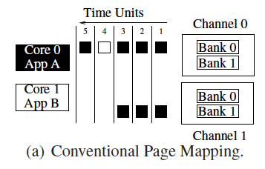
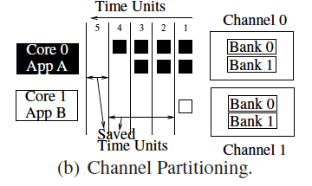
Another Way of Reducing Interference
Memory Channel Partitioning
Idea: Map badly-interfering applications’ pages to different channels [Muralidhara+ CMU TR’11]
Separate data of low/high intensity and low/high row-locality applications
Especially effective in reducing interference of threads with “medium” and “heavy” memory intensity

Slide 59
Summary: Memory QoS Approaches and Techniques
Approaches: Smart vs. dumb resources
Smart resources: QoS-aware memory scheduling
Dumb resources: Source throttling; channel partitioning
Both approaches are effective in reducing interference
No single best approach for all workloads
Techniques: Request scheduling, source throttling, memory partitioning
All approaches are effective in reducing interference
Can be applied at different levels: hardware vs. software
No single best technique for all workloads
Combined approaches and techniques are the most powerful
Integrated Memory Channel Partitioning and Scheduling

Slide 60
Two Related Talks at ISCA
How to design QoS-aware memory systems (memory scheduling and source throttling) in the presence of prefetching
Ebrahimi et al., “Prefetch-Aware Shared Resource Management for Multi-Core Systems,” ISCA’11.
Monday afternoon (Session 3B)
How to design scalable QoS mechanisms in on-chip interconnects
Idea: Isolate shared resources in a region, provide QoS support only within the region, ensure interference-free access to the region
Grot et al., “Kilo-NOC: A Heterogeneous Network-on-Chip Architecture for Scalability and Service Guarantees,” ISCA’11.
Wednesday morning (Session 8B)

Slide 61
Agenda
Technology, Application, Architecture Trends
Requirements from the Memory Hierarchy
Research Challenges and Solution Directions
Main Memory Scalability
QoS support: Inter-thread/application interference
Smart Resources: Thread Cluster Memory Scheduling
Dumb Resources: Fairness via Source Throttling
Conclusions

Slide 62
Conclusions
Technology, application, architecture trends dictate new needs from memory system
A fresh look at (re-designing) the memory hierarchy
Scalability: Enabling new memory technologies
QoS, fairness & performance: Reducing and controlling inter-application interference: QoS-aware memory system design
Efficiency: Customizability, minimal waste, new technologies
Many exciting research topics in fundamental areas across the system stack
Hardware/software/device cooperation essential

Slide 63
Thank you.

Slide 64
Memory Systems in the Many-Core Era: Some Challenges and Solution Directions
Onur Mutlu
onur@cmu.edu
June 5, 2011
ISMM/MSPC

